Slide 2
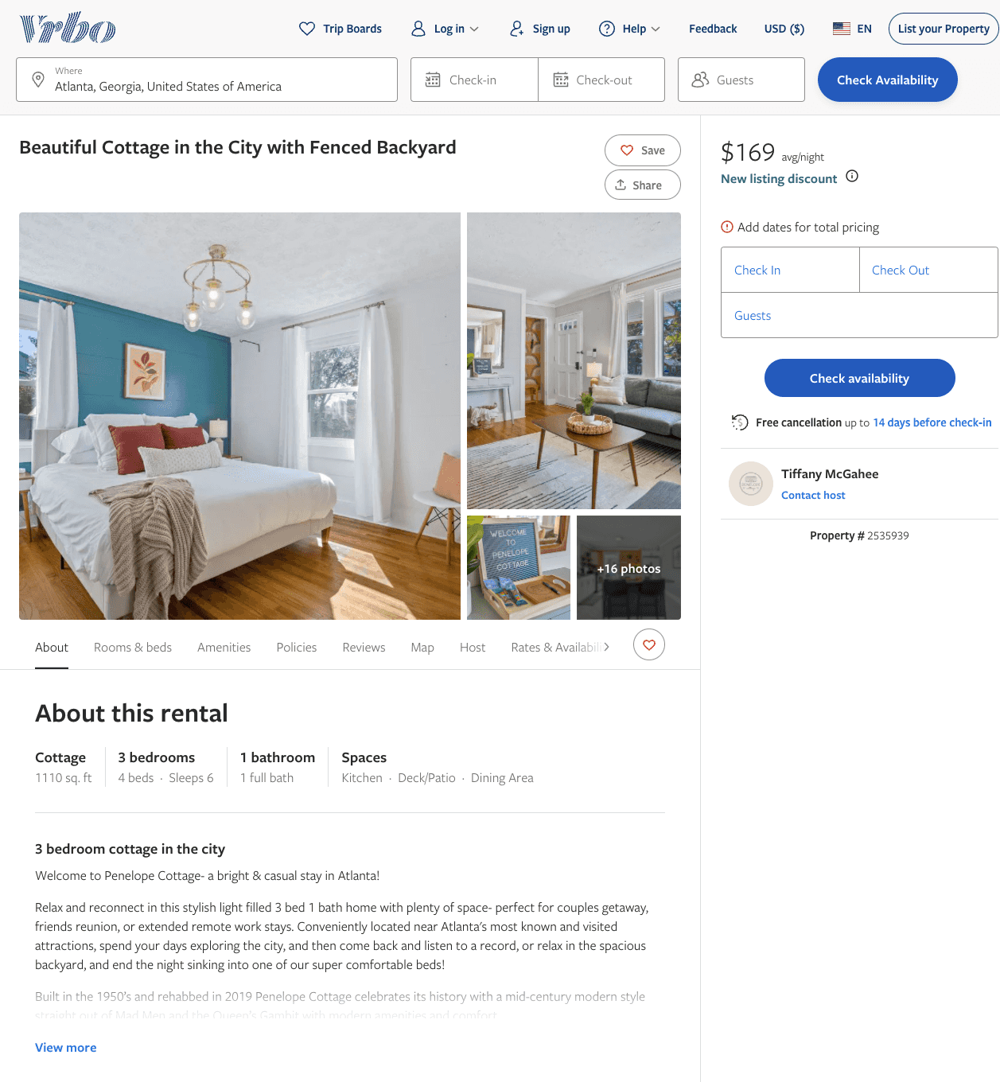
Listing 2535939
3
6
$160 - $169
4.8
2
Tiffany McGahee
https://www.vrbo.com/2535939
Aug 2022

Slide 3
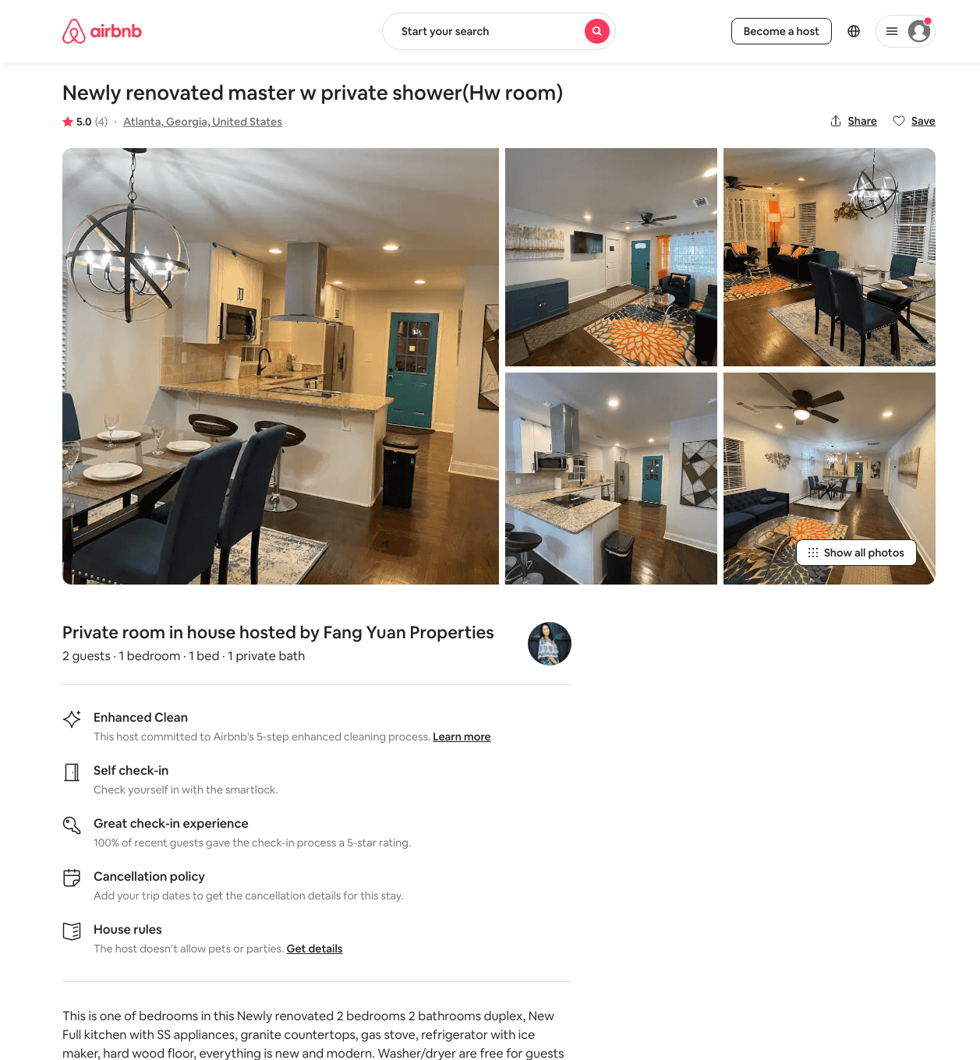
Listing 48508453
1
2
$45 - $72
4.53
1
Fang Yuan Properties
126122495
21
https://www.airbnb.com/rooms/48508453
Aug 2022

Slide 4
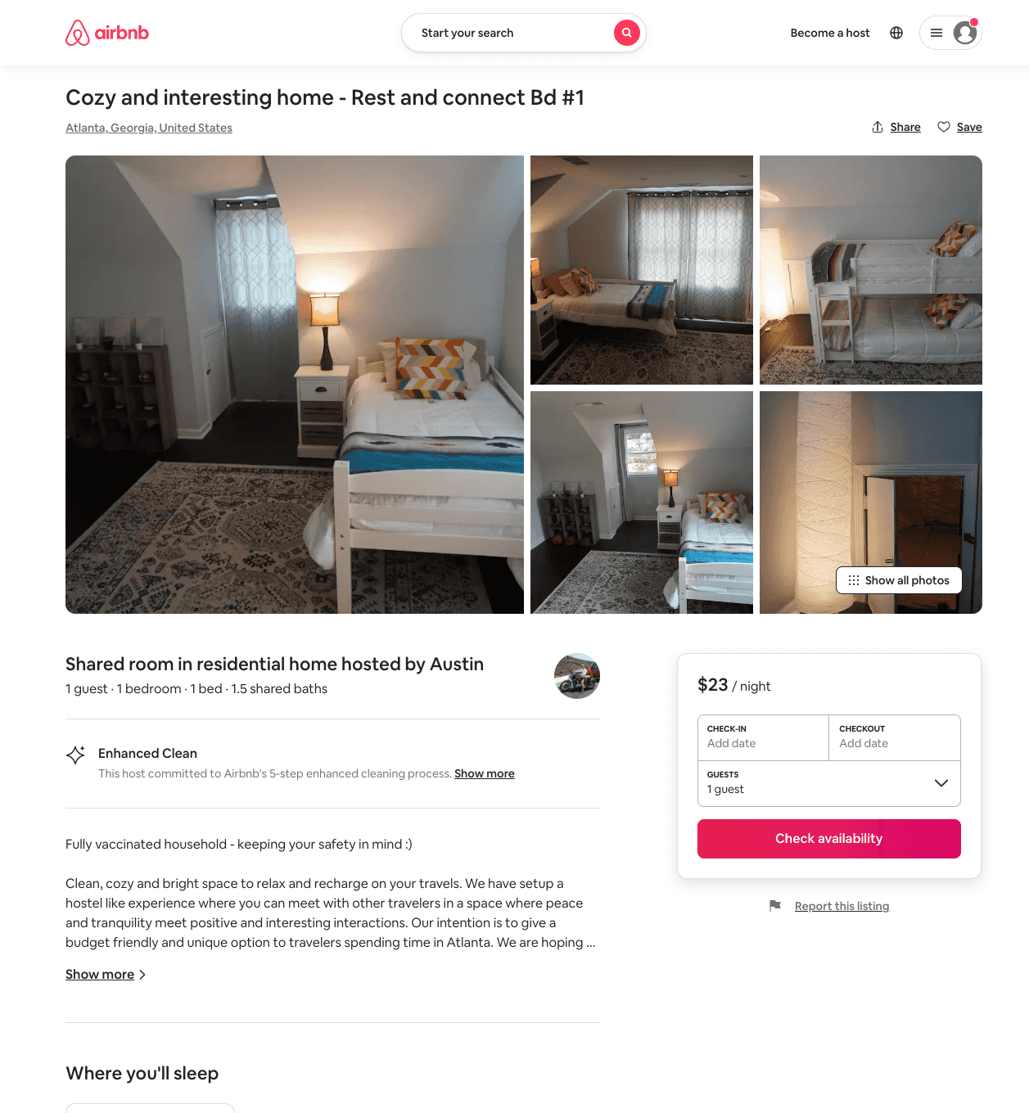
Listing 51225043
1
1
$23 - $35
4.83
1
Austin
18755915
3
https://www.airbnb.com/rooms/51225043
Aug 2022

Slide 5
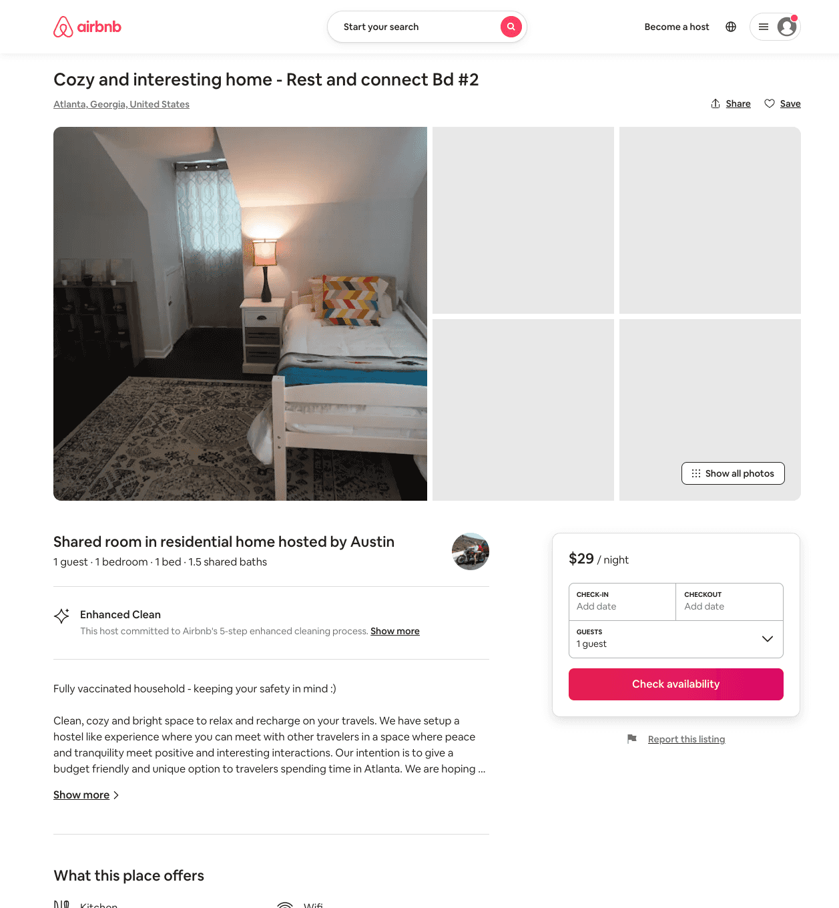
Listing 51278268
1
1
$24 - $33
4.82
1
Austin
18755915
3
https://www.airbnb.com/rooms/51278268
Aug 2022

Slide 6
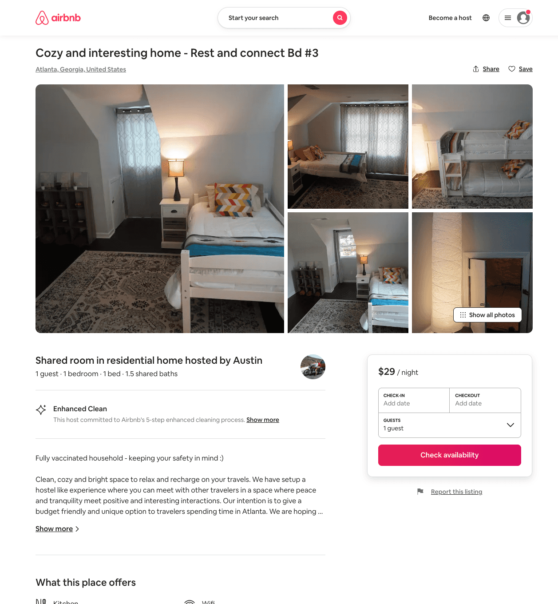
Listing 51278596
1
1
$24 - $33
4.68
1
Austin
18755915
3
https://www.airbnb.com/rooms/51278596
Aug 2022

Slide 7
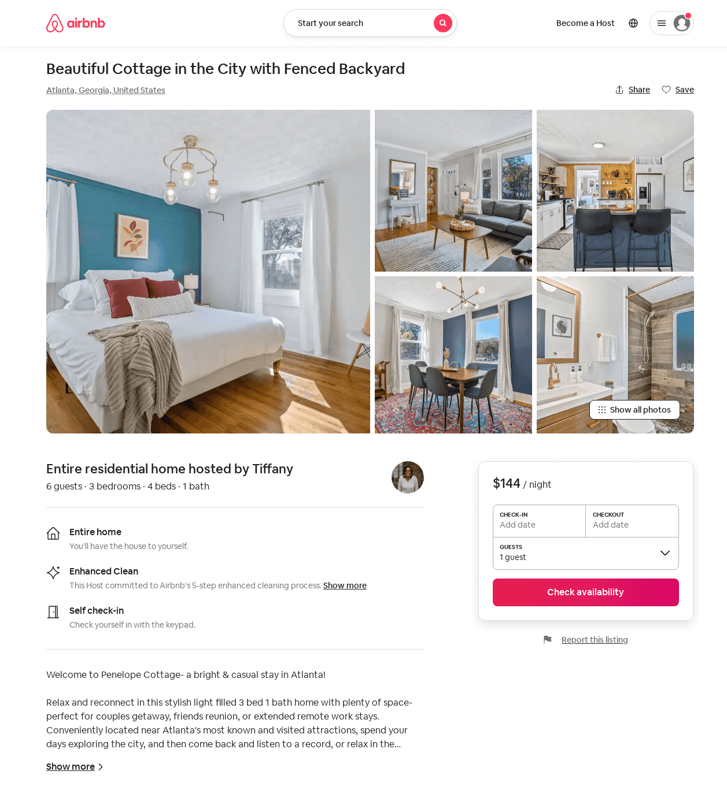
Listing 51843502
3
6
$116 - $169
4.89
1
Tiffany
99138506
1
https://www.airbnb.com/rooms/51843502
Aug 2022

Slide 8
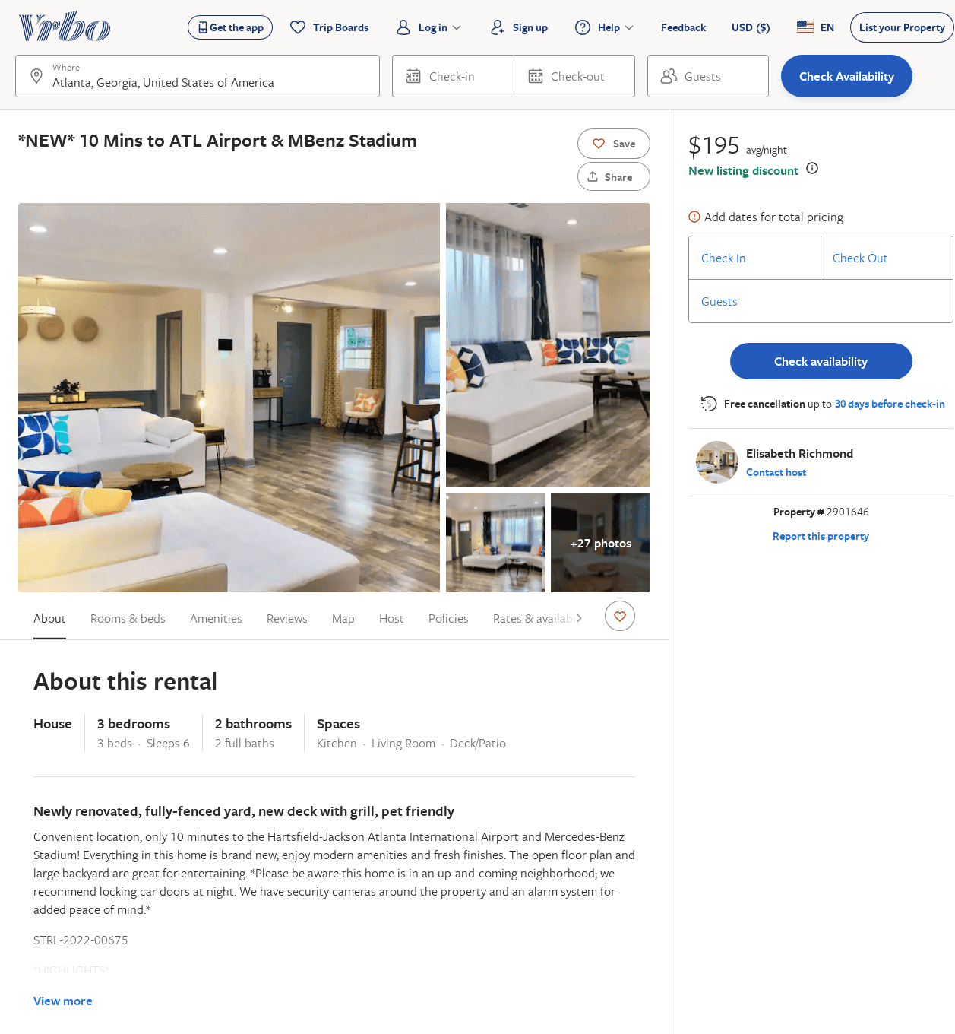
Listing 2901646
3
6
$178
5
1
Elisabeth Richmond
https://www.vrbo.com/2901646
Aug 2022

Slide 9
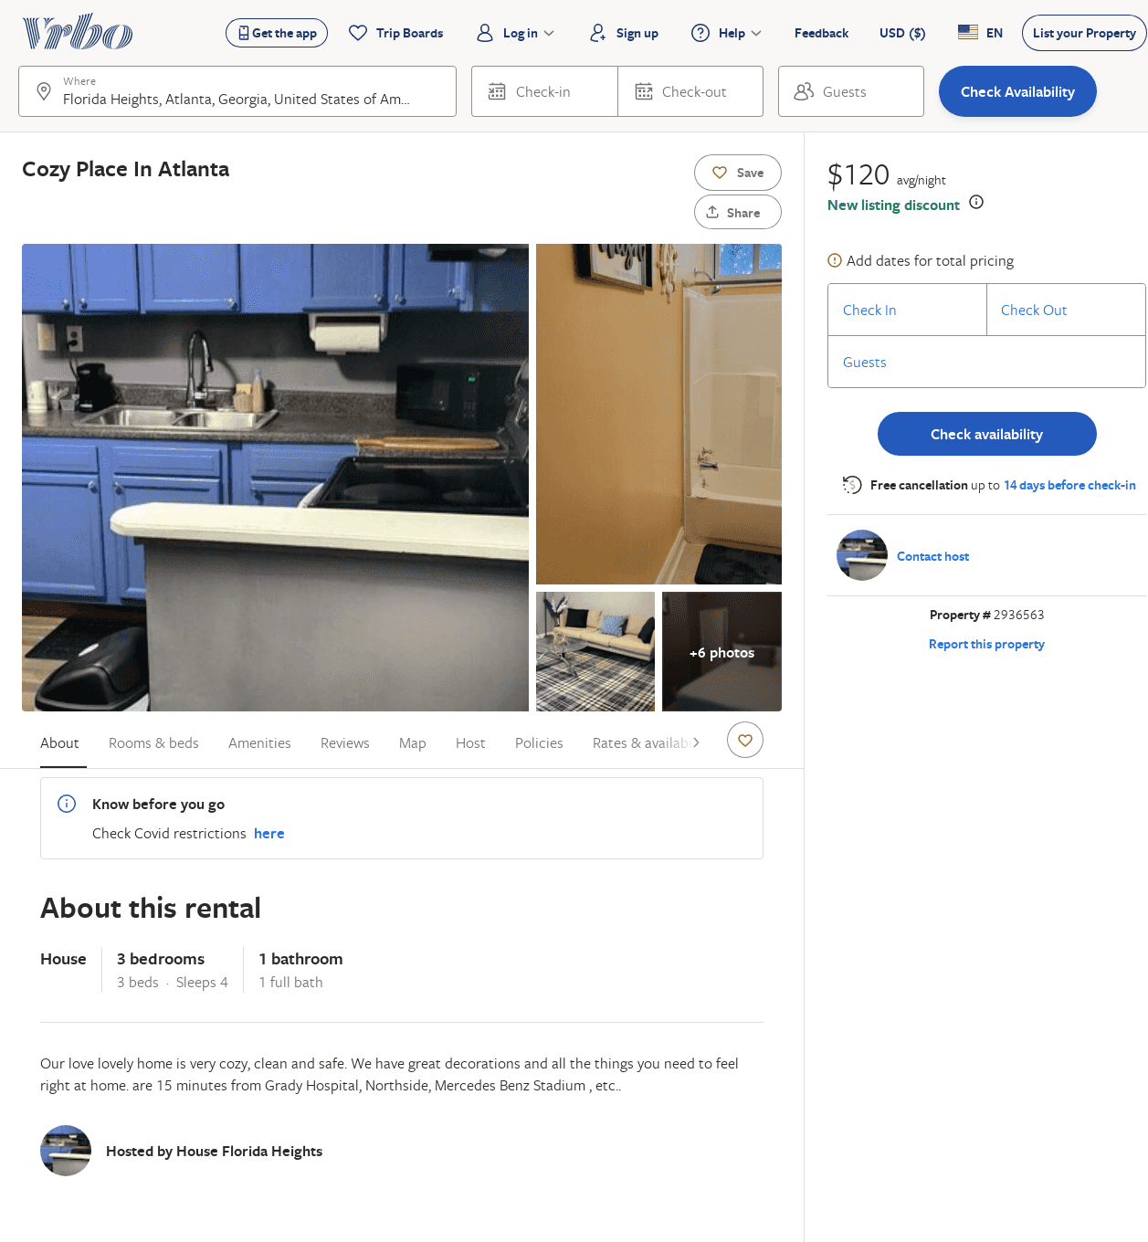
Listing 2936563
3
4
$116
2
https://www.vrbo.com/2936563
Aug 2022

