Slide 2
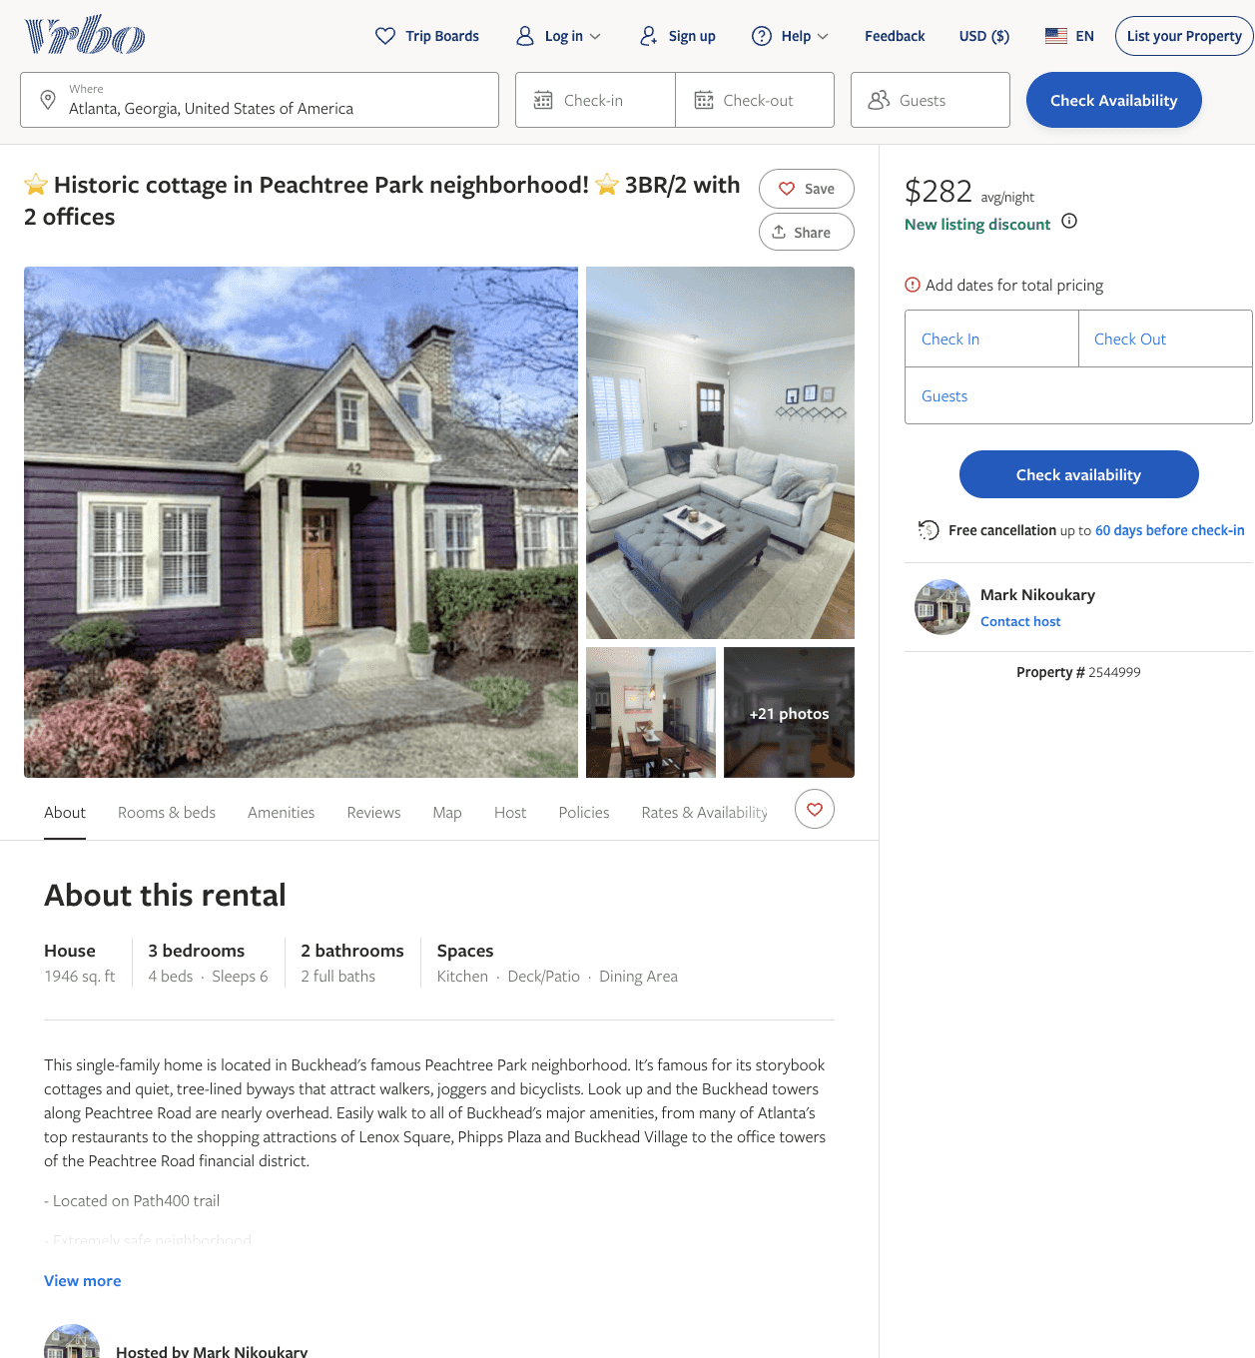
Listing 2544999
3
6
$282 - $327
3
Mark Nikoukary
https://www.vrbo.com/2544999
Aug 2022

Slide 3
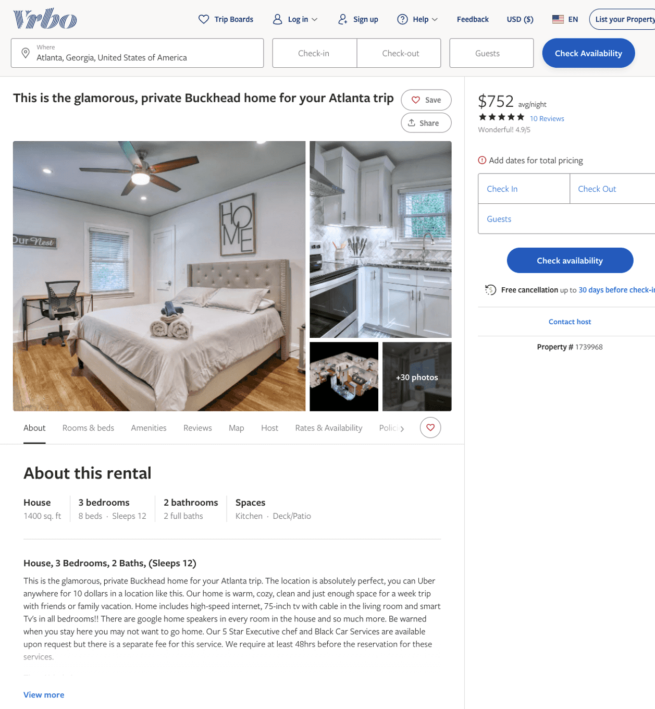
Listing 1739968
3
12
$168 - $774
4.647059
1
anthony williams
https://www.vrbo.com/1739968
Aug 2022

Slide 4
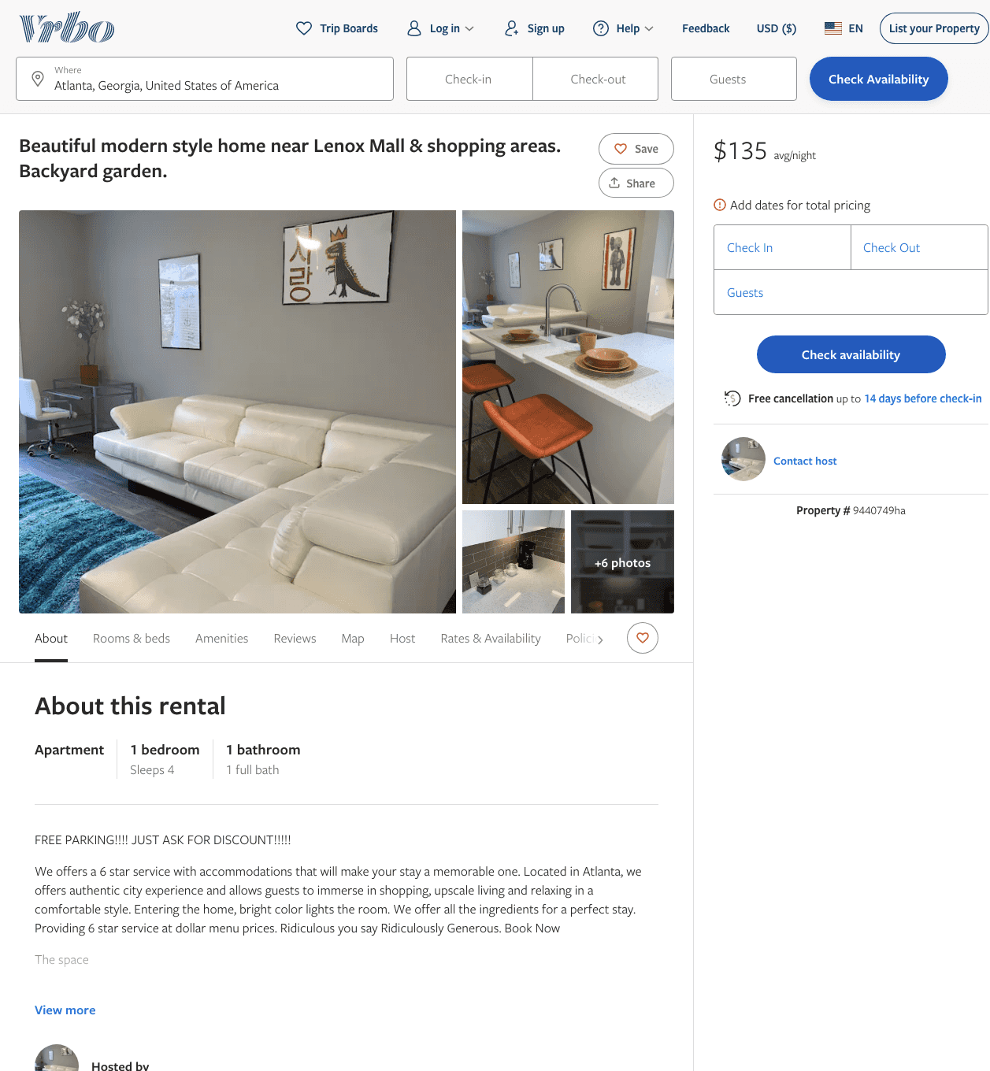
Listing 9440749
1
4
$135
3
https://www.vrbo.com/9440749ha
Aug 2022

Slide 5
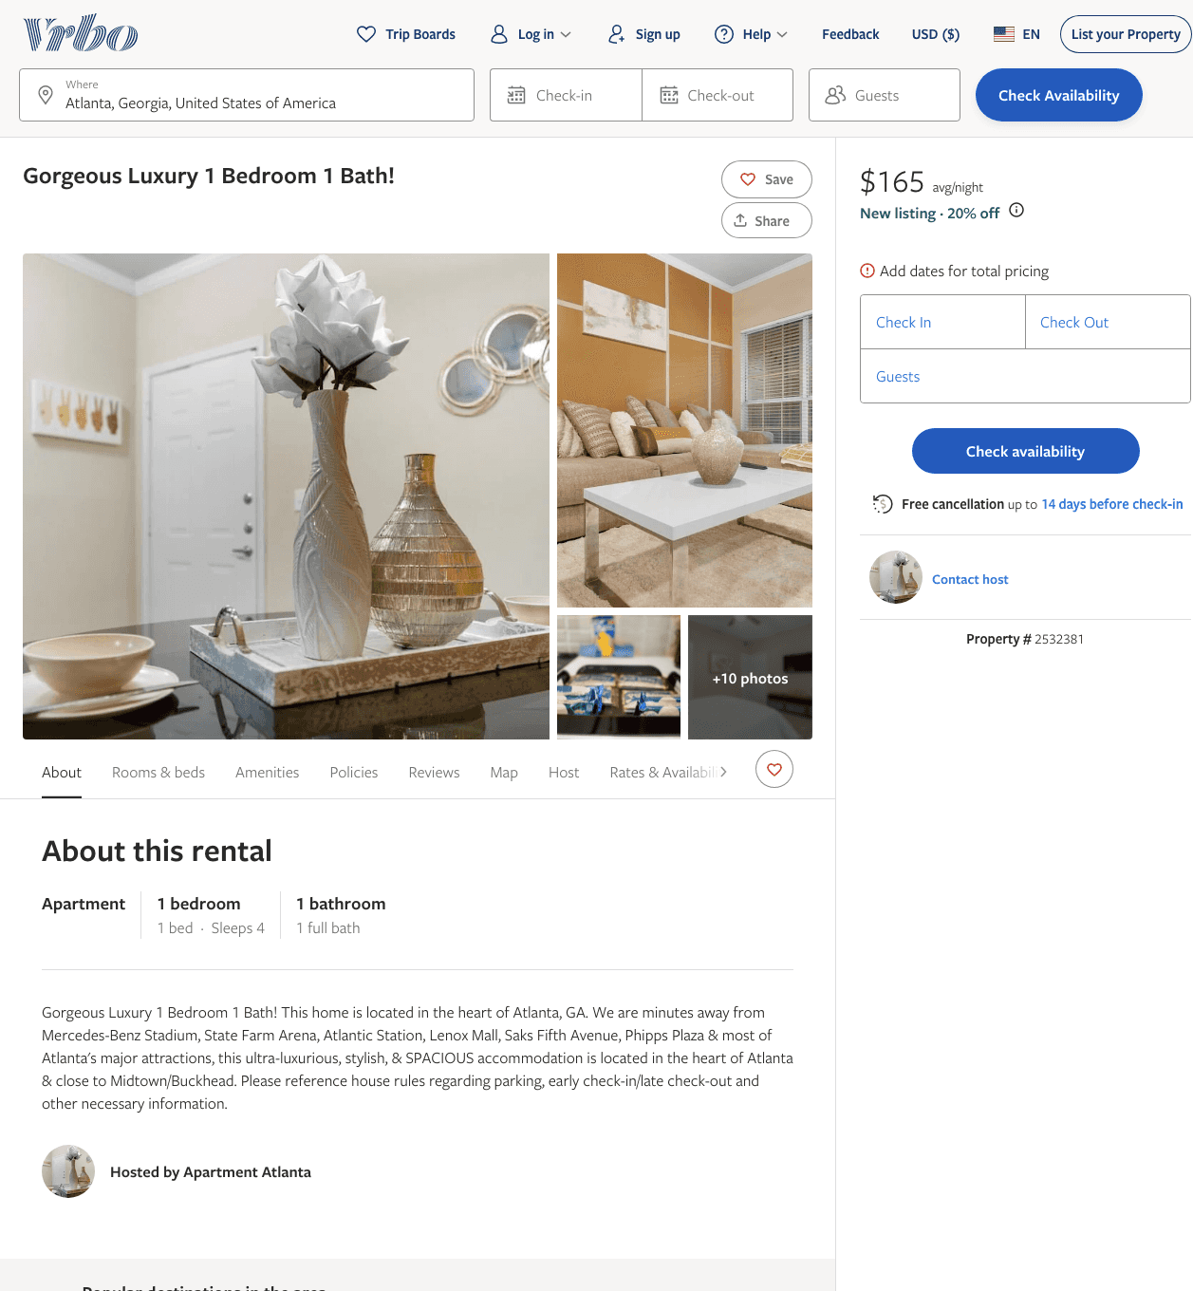
Listing 2532381
1
4
$128 - $165
2
https://www.vrbo.com/2532381
Aug 2022

Slide 6
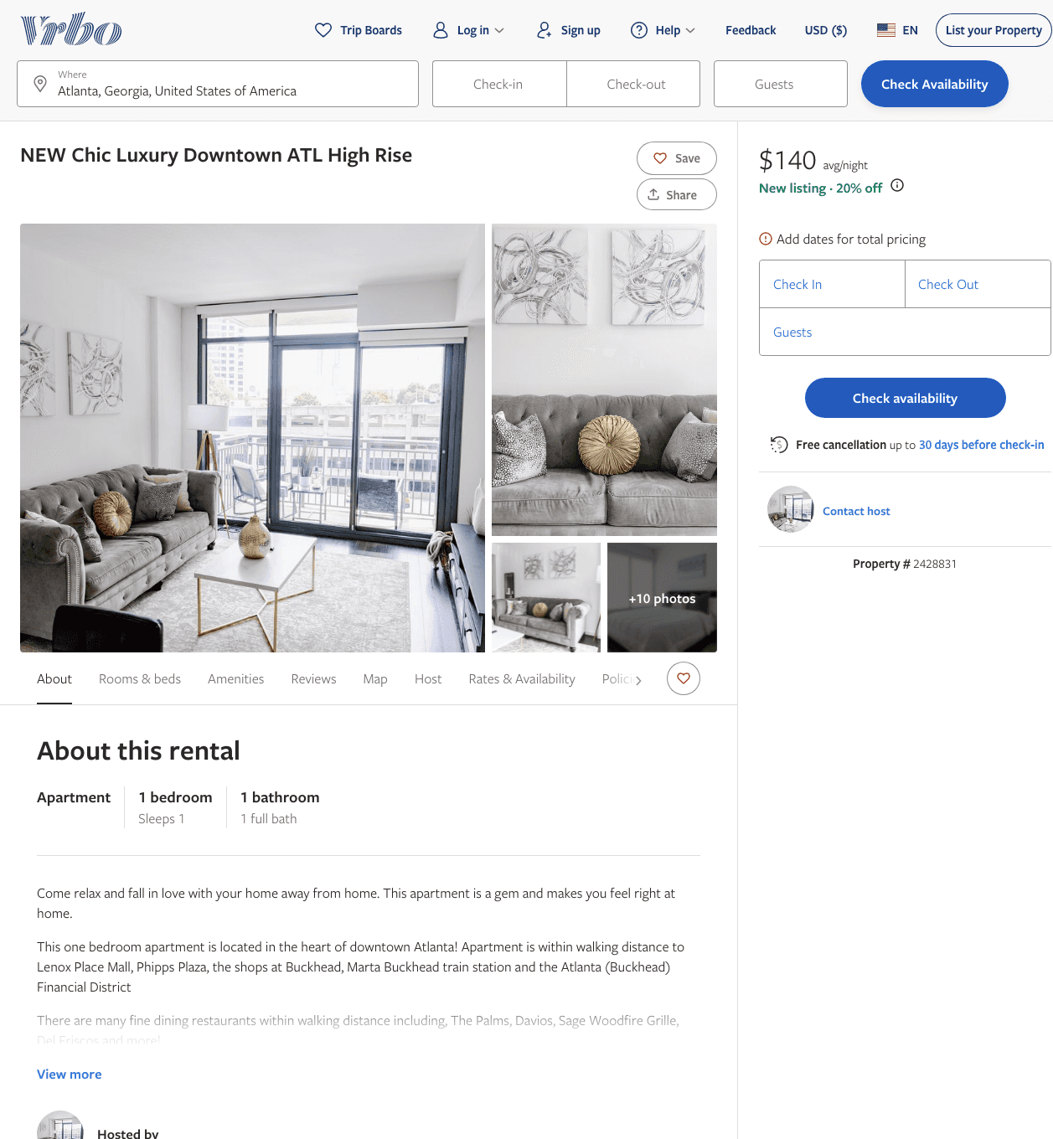
Listing 2428831
1
1
$112 - $140
4
Premier Management LLC
https://www.vrbo.com/2428831
Aug 2022

Slide 7
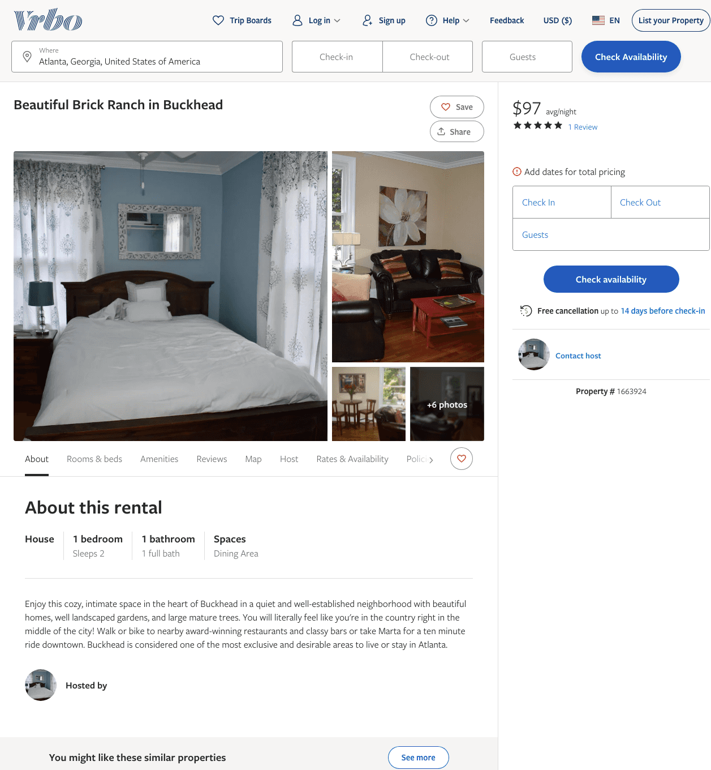
Listing 1663924
1
2
$97
5
2
https://www.vrbo.com/1663924
Aug 2022

Slide 8
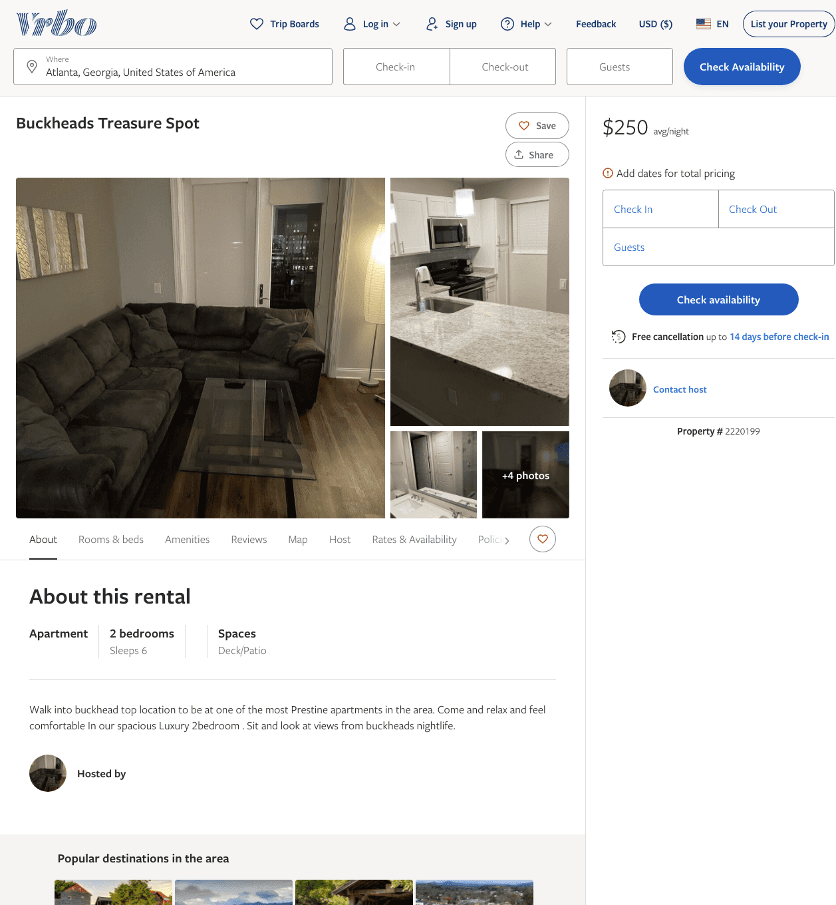
Listing 2220199
2
6
$250
2
https://www.vrbo.com/2220199
Aug 2022

Slide 9
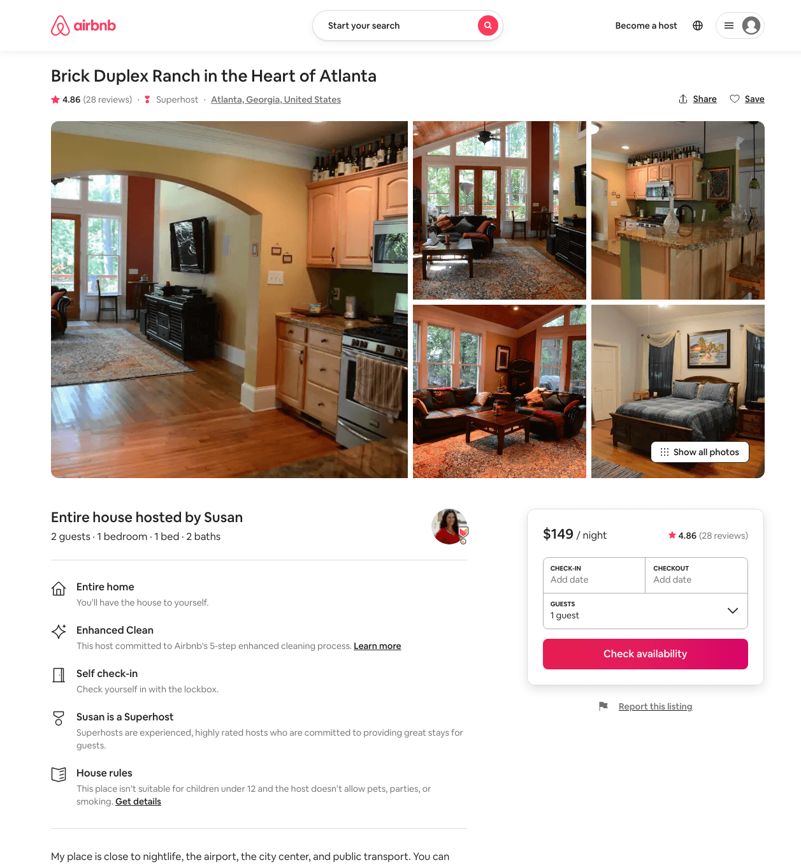
Listing 15674901
1
2
$98 - $169
4.82
31
Susan
569187
2
https://www.airbnb.com/rooms/15674901
Aug 2022

Slide 10
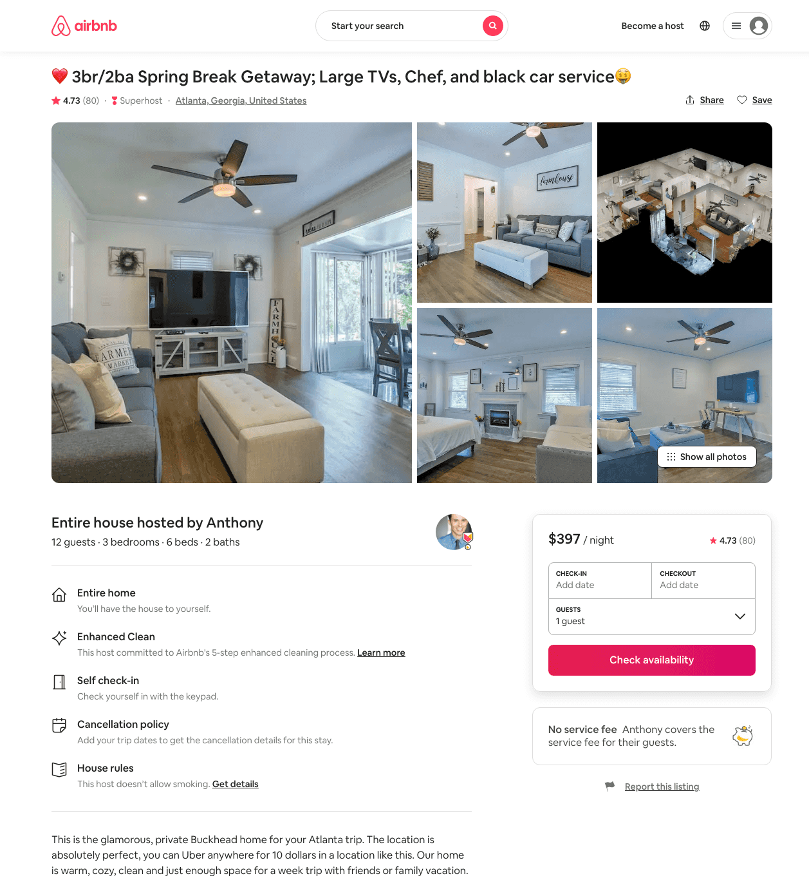
Listing 37804478
3
12
$161 - $1017
4.62
1
Anthony
234095061
5
https://www.airbnb.com/rooms/37804478
Jul 2022

Slide 11
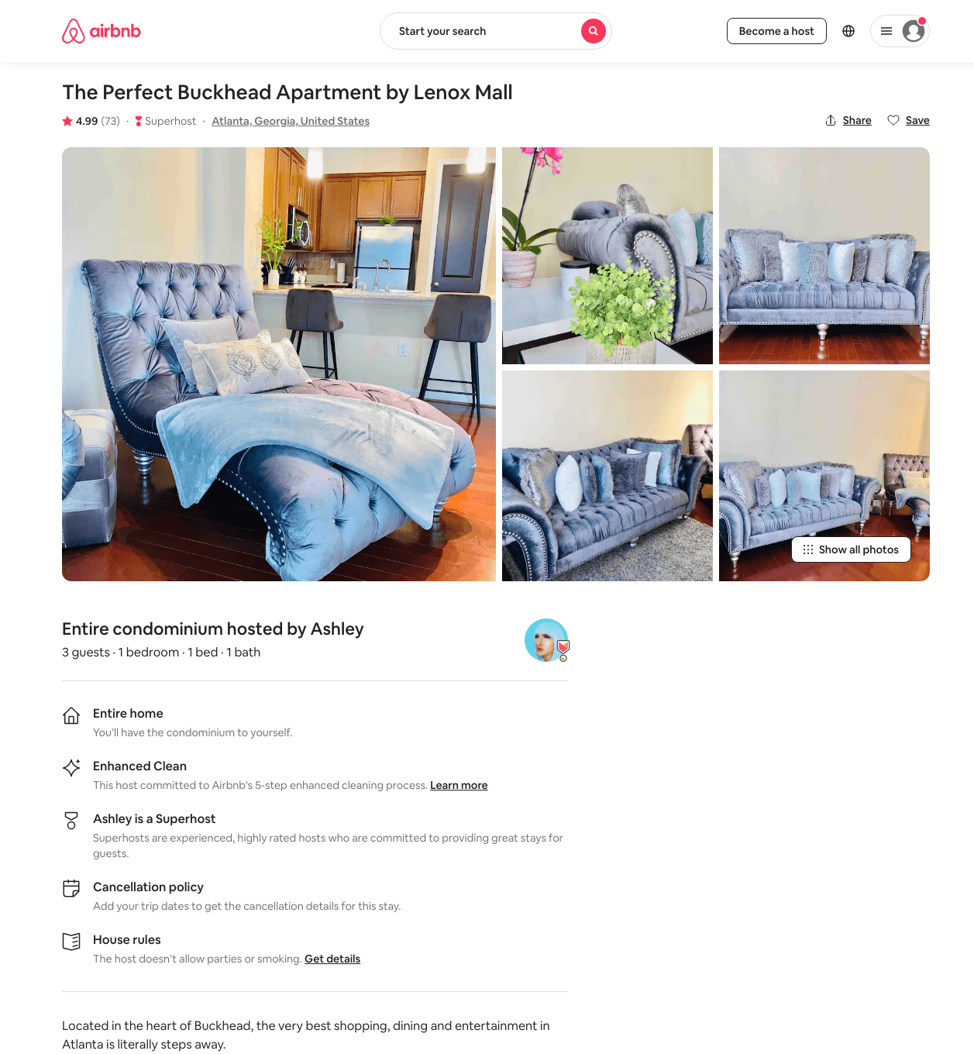
Listing 28567526
1
3
$130
4.99
1
Nicole
176845050
1
https://www.airbnb.com/rooms/28567526
Aug 2022

Slide 12
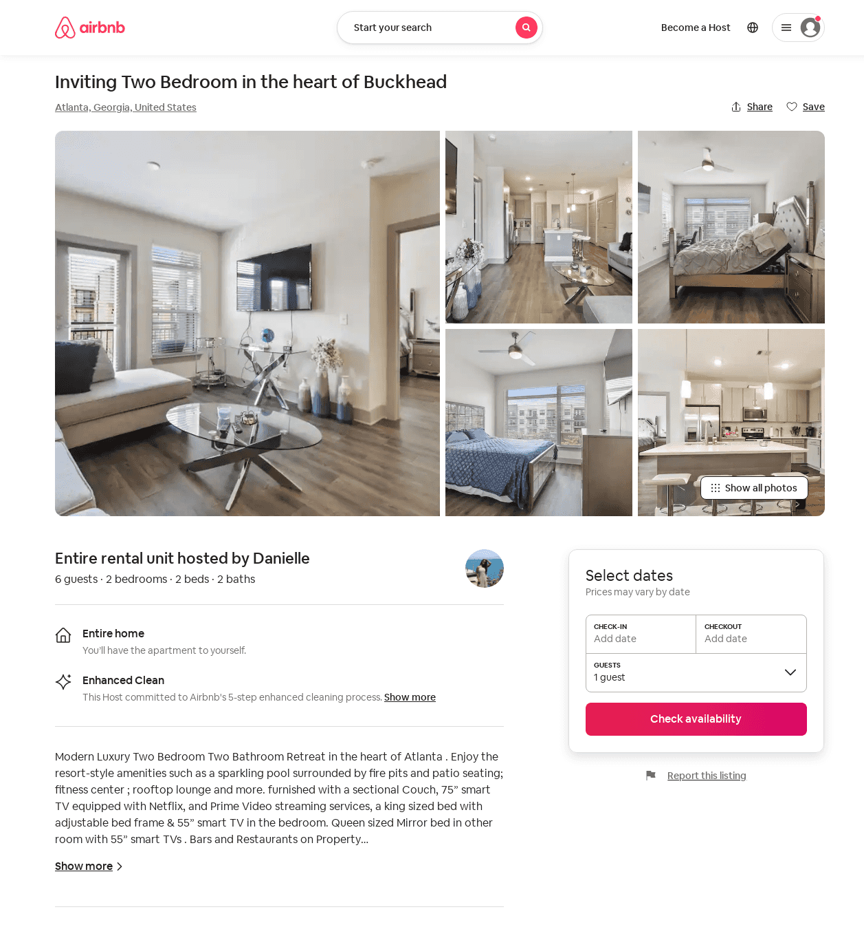
Listing 52538443
2
4
$77 - $170
5.0
2
MoneMonèt
92339648
1
https://www.airbnb.com/rooms/52538443
Jun 2022

Slide 13
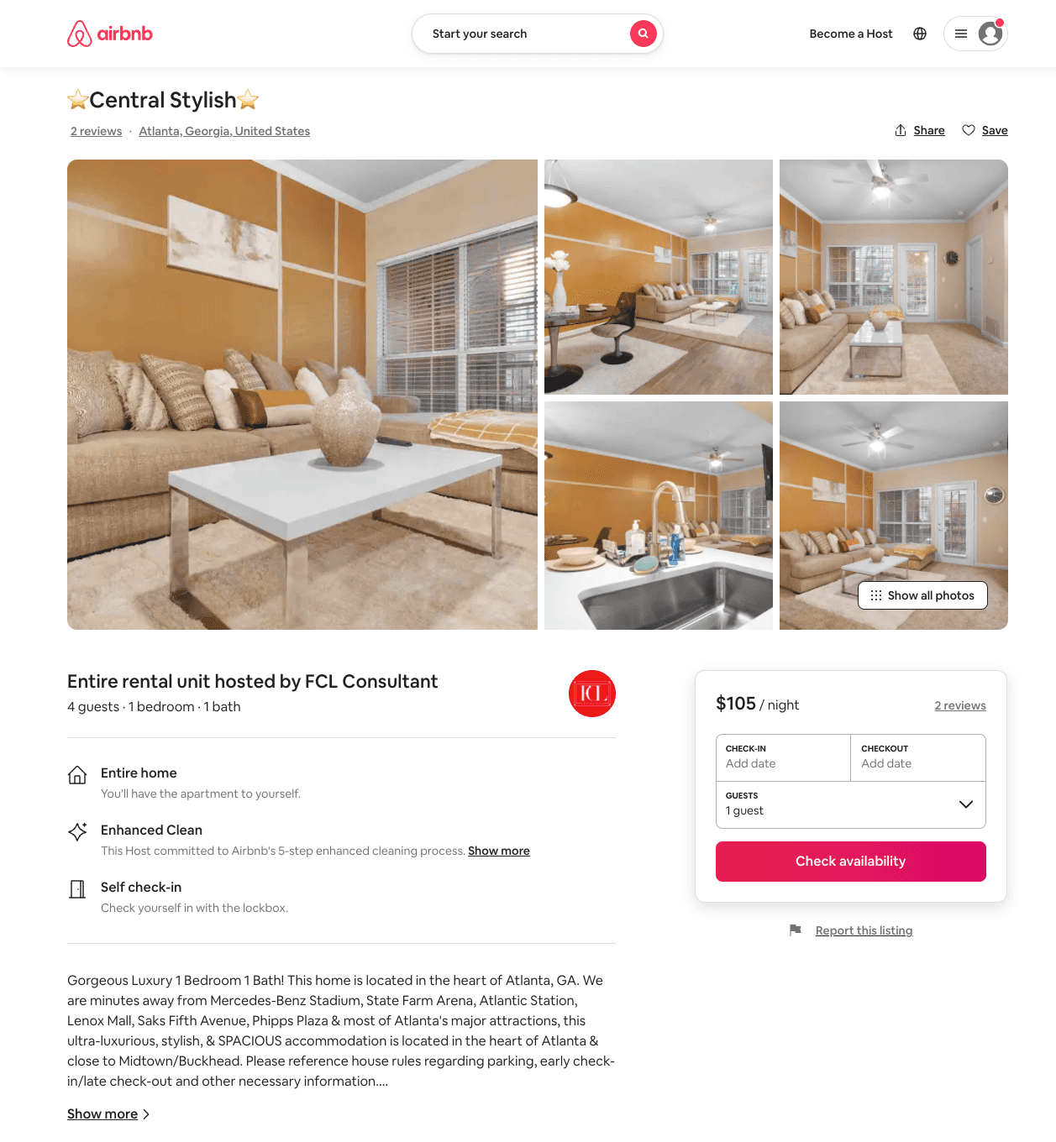
Listing 53131870
1
4
$95 - $133
4.86
1
FCL Consultant
375227901
1
https://www.airbnb.com/rooms/53131870
Aug 2022

Slide 14
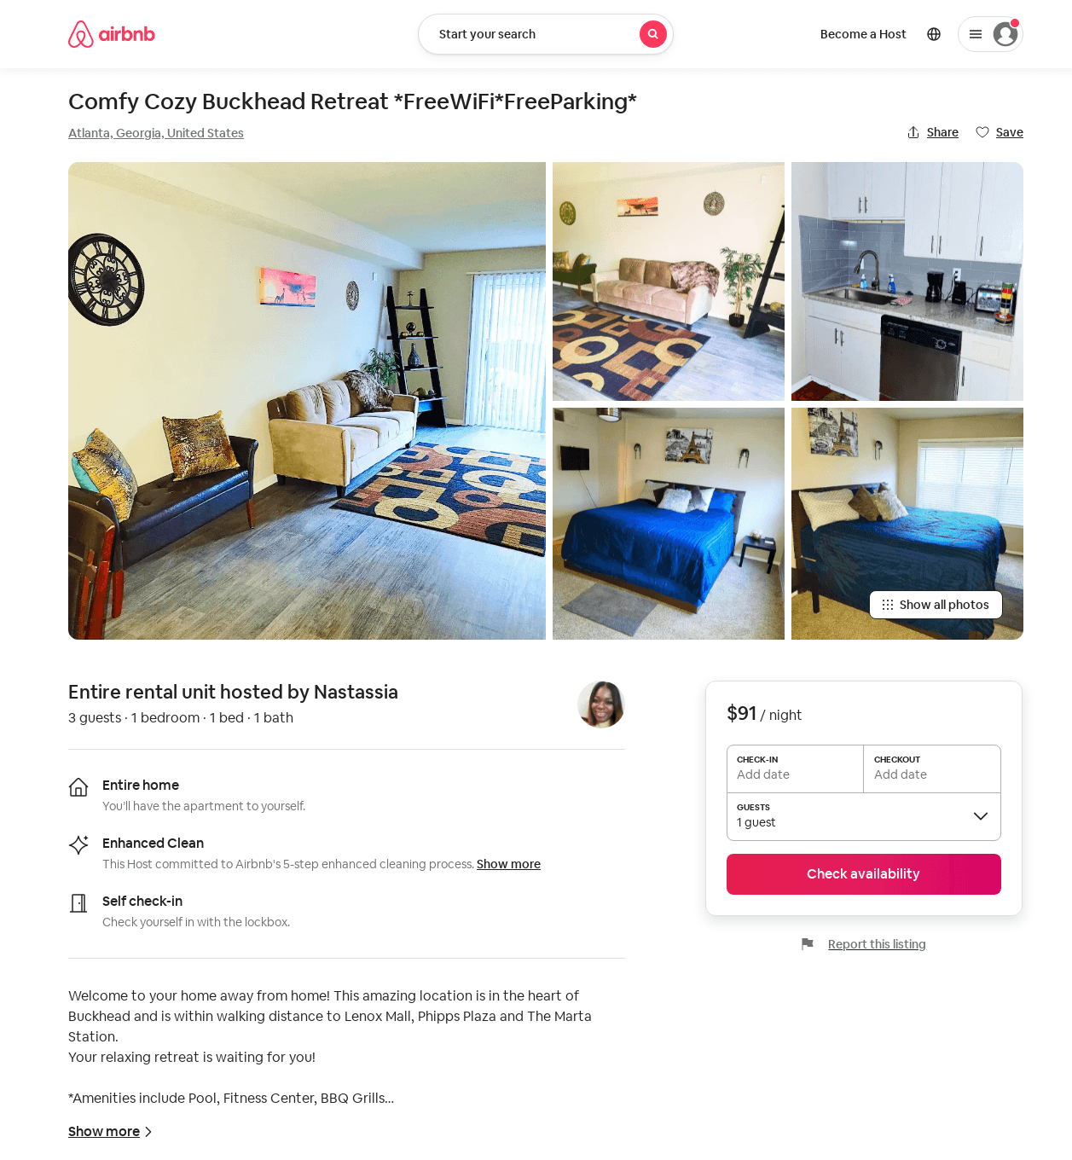
Listing 53547845
1
3
$61 - $115
4.44
3
Nastassia
321802171
1
https://www.airbnb.com/rooms/53547845
Aug 2022

Slide 15
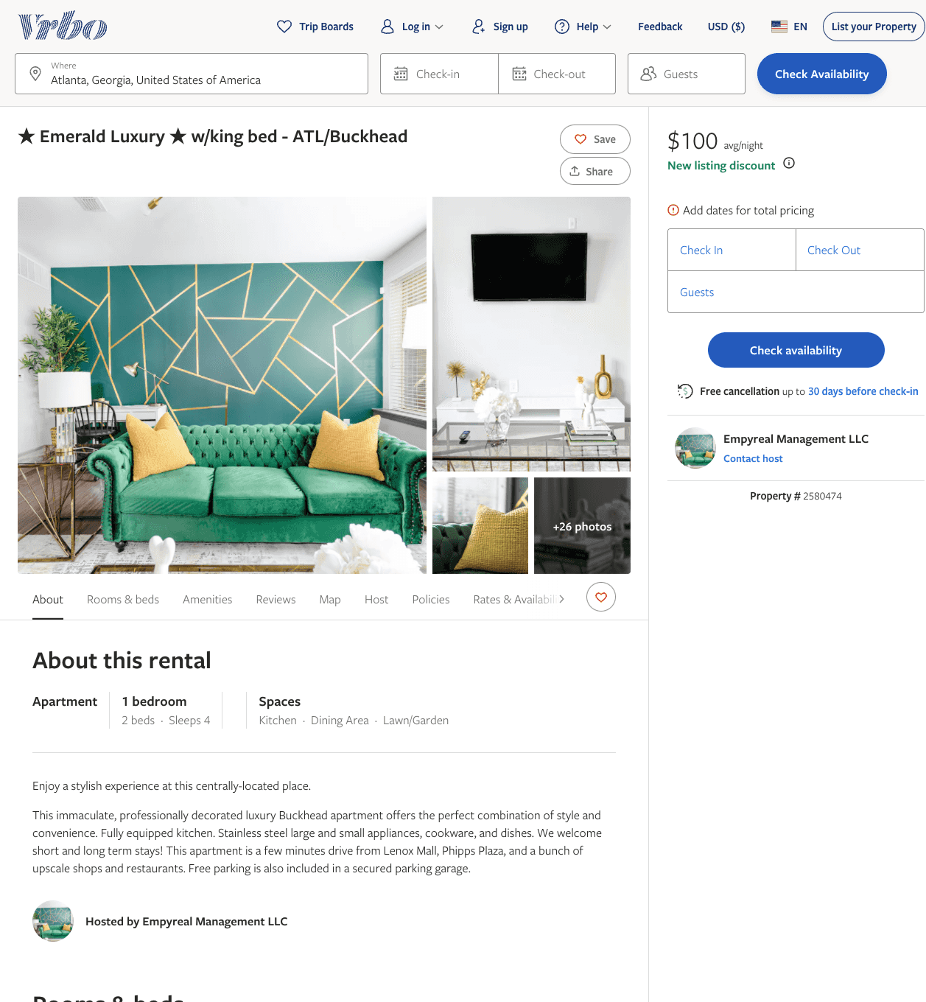
Listing 2580474
1
4
$100 - $127
4
1
Empyreal Management LLC
https://www.vrbo.com/2580474
Aug 2022

Slide 16
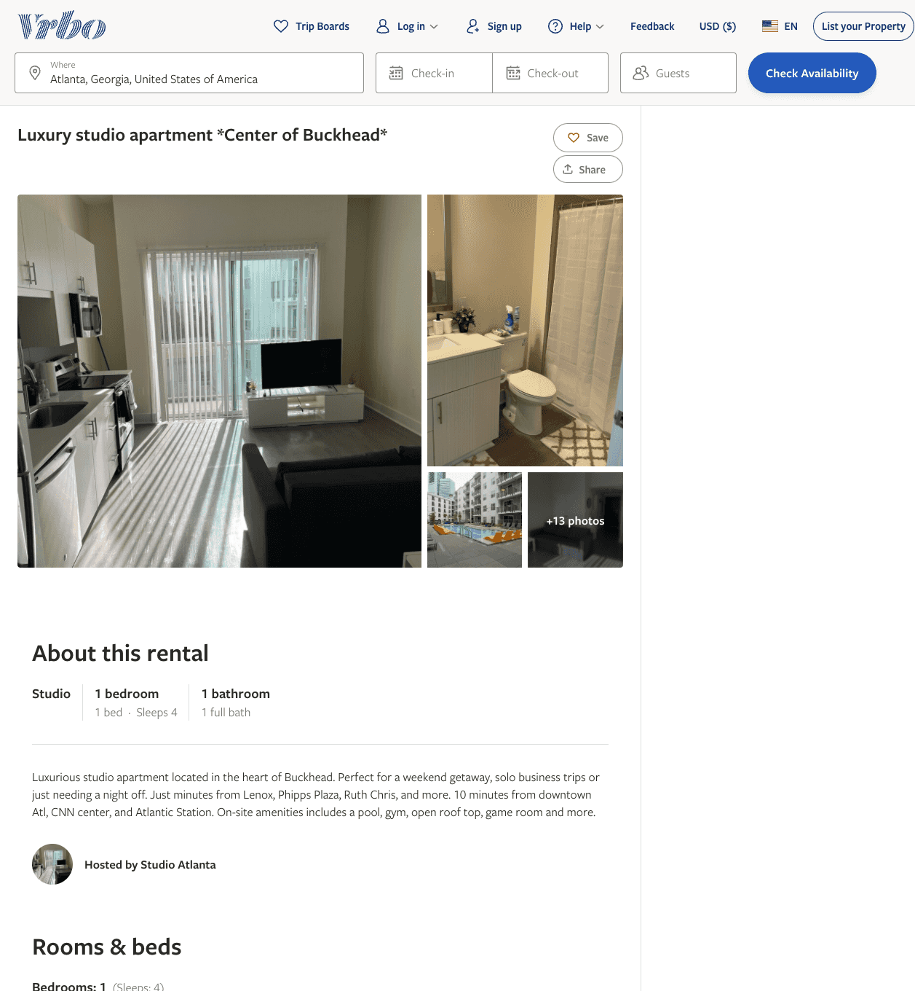
Listing 2608181
1
4
$209 - $95
2
Michael Britt
https://www.vrbo.com/2608181
Aug 2022

Slide 17
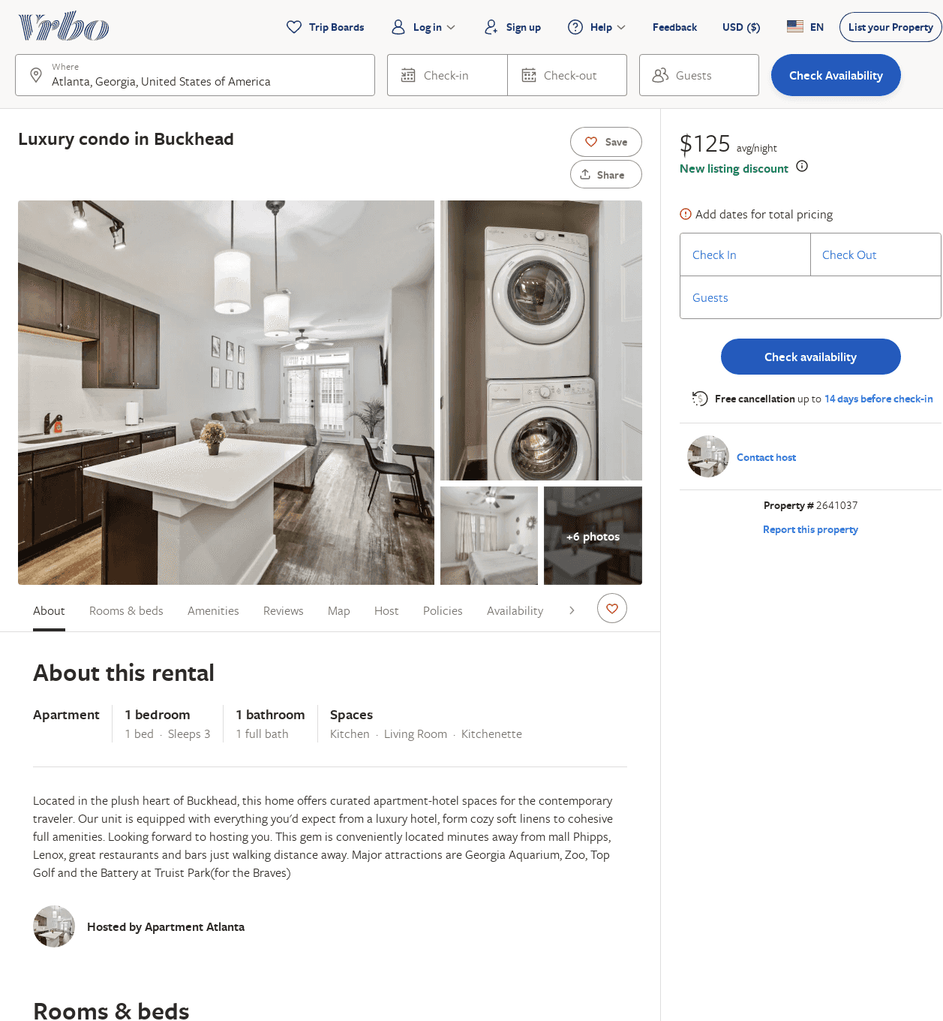
Listing 2641037
1
3
$158
4
2
https://www.vrbo.com/2641037
Aug 2022

Slide 18
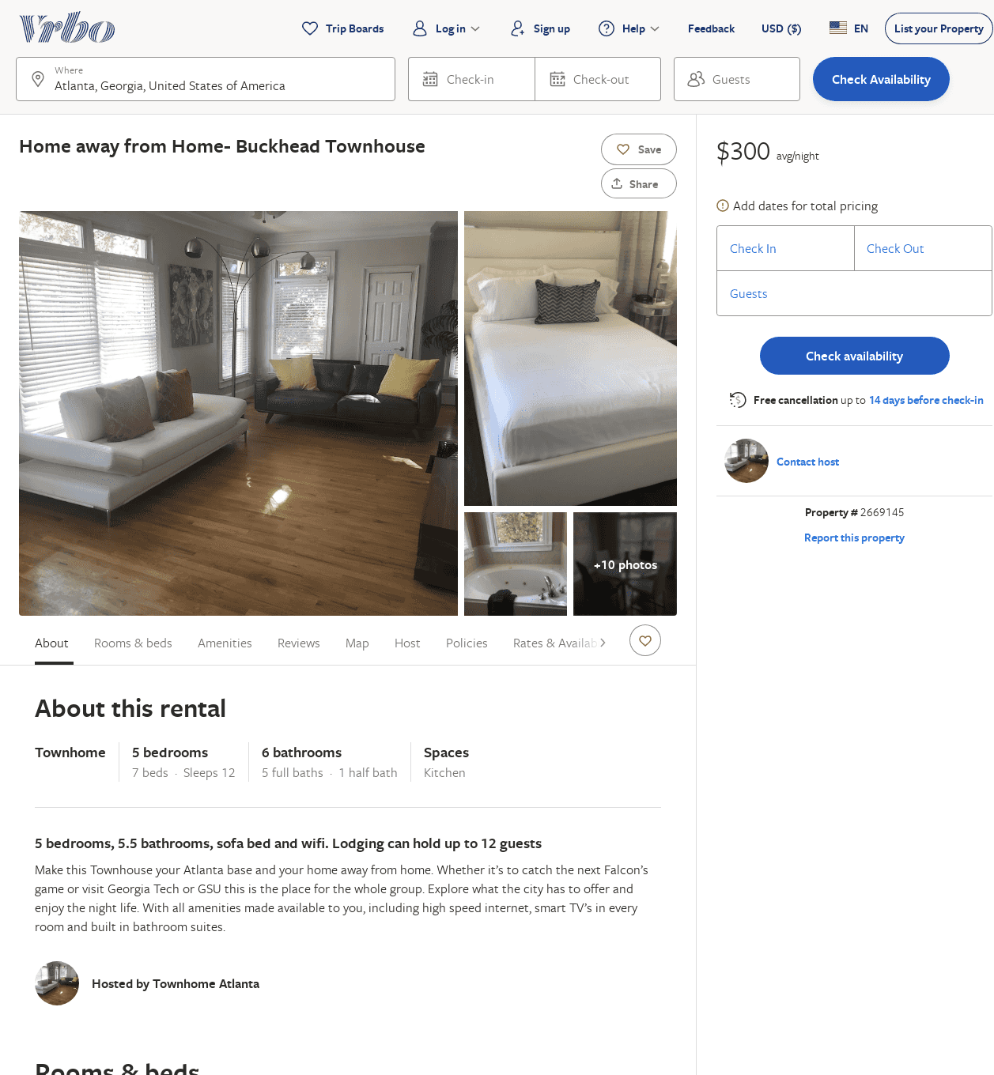
Listing 2669145
5
12
$300
28
Spare Space LLC
https://www.vrbo.com/2669145
Aug 2022

Slide 19
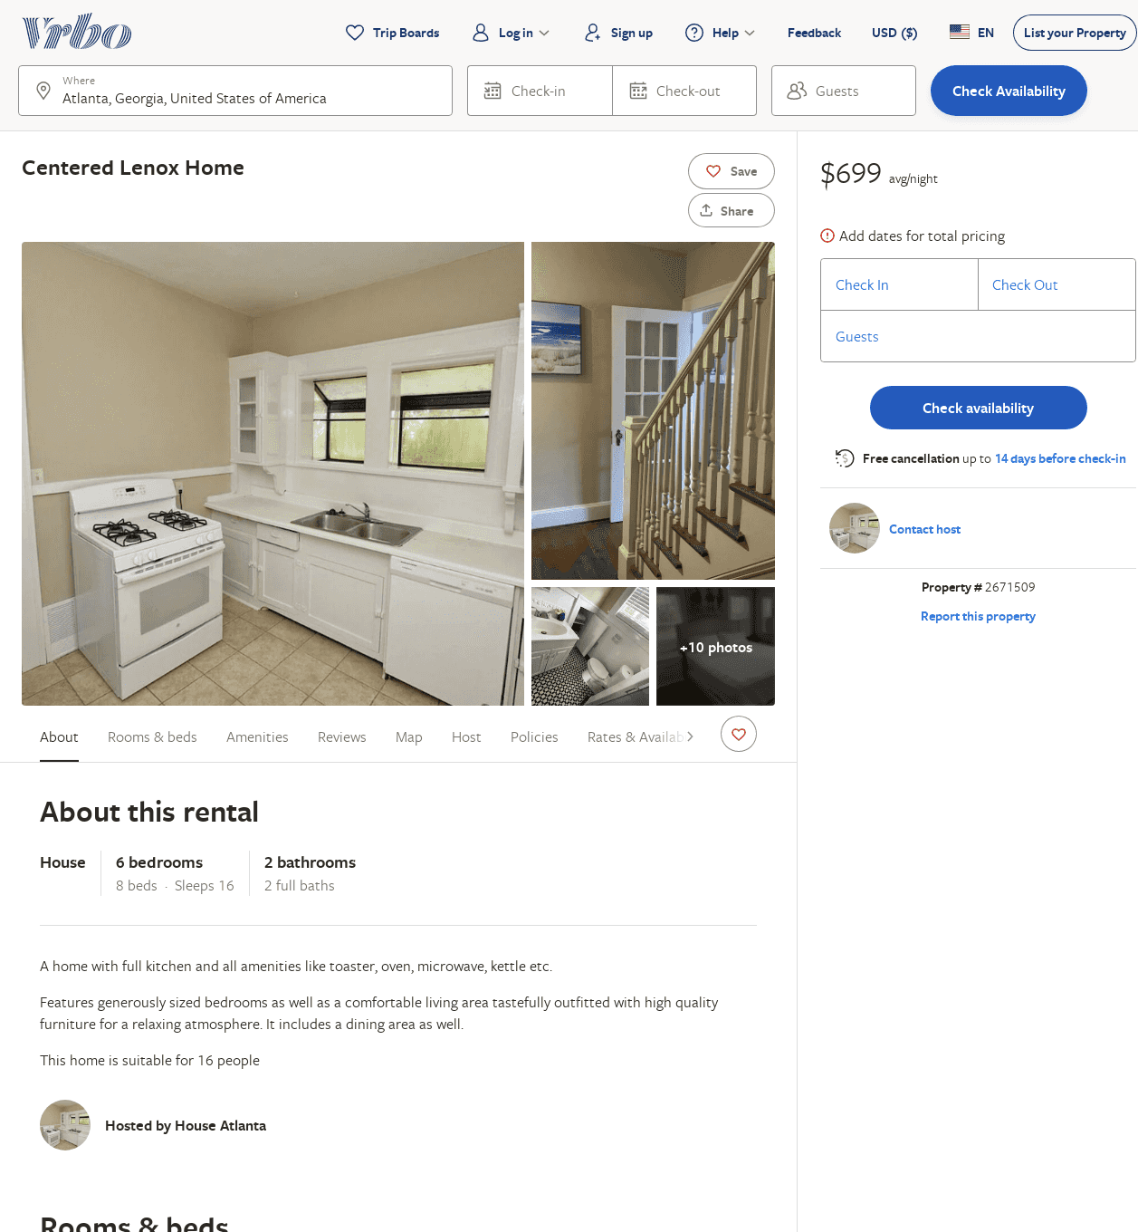
Listing 2671509
6
16
$699
1
Spare Space LLC
https://www.vrbo.com/2671509
Aug 2022

Slide 20
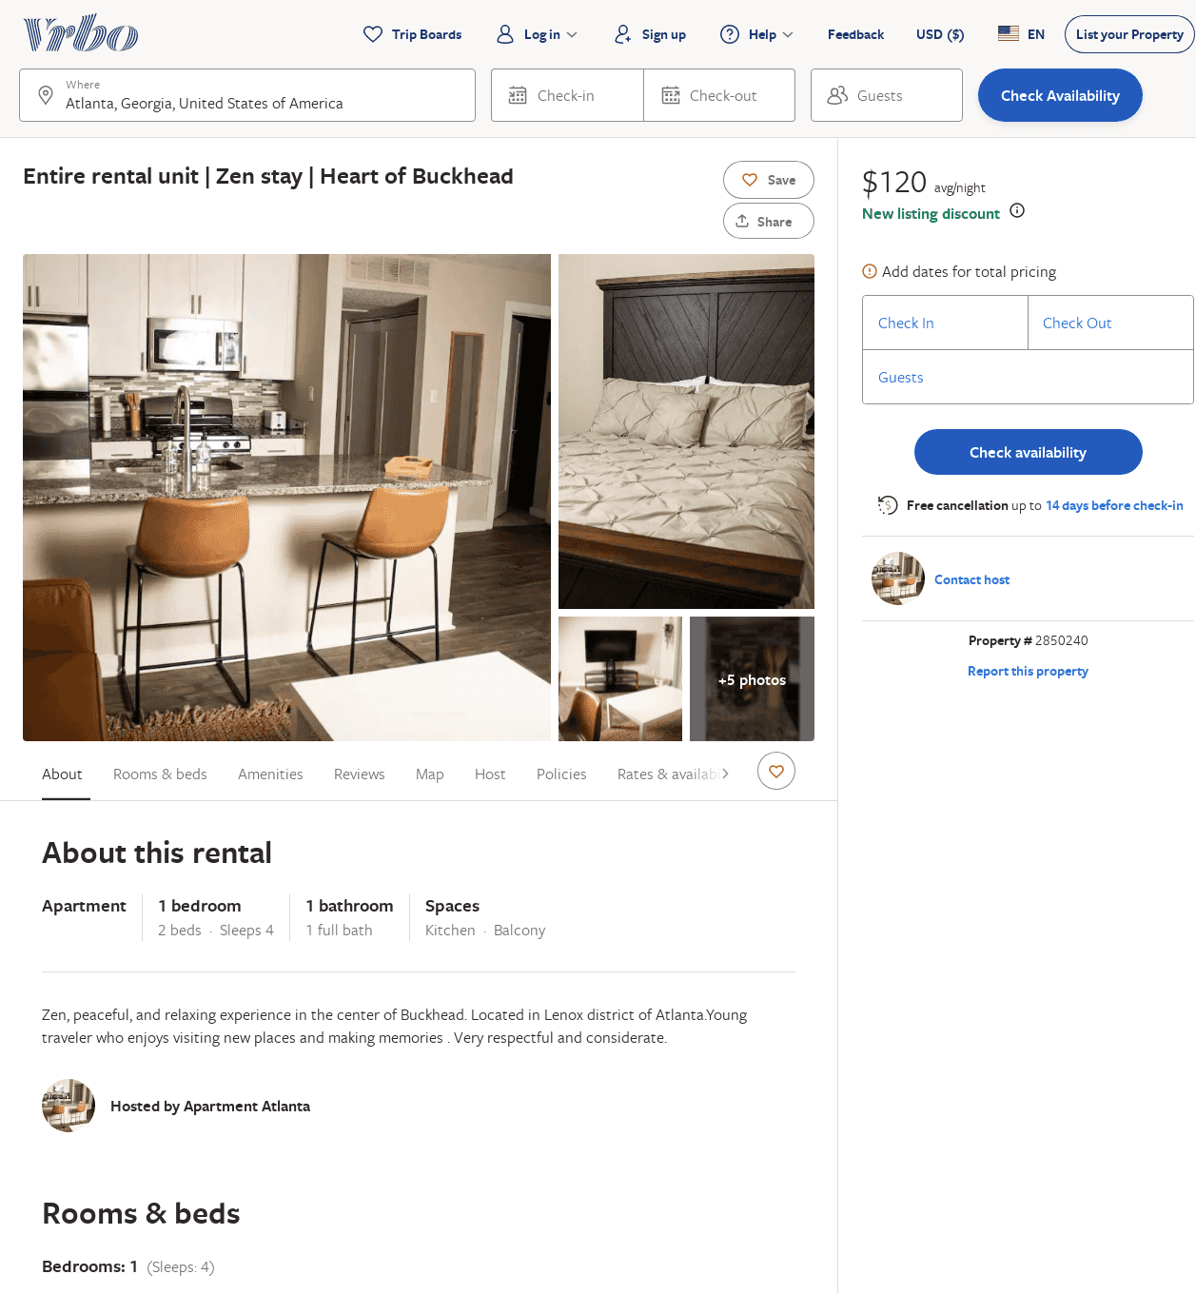
Listing 2850240
1
4
$121
4
2
https://www.vrbo.com/2850240
Aug 2022

Slide 21
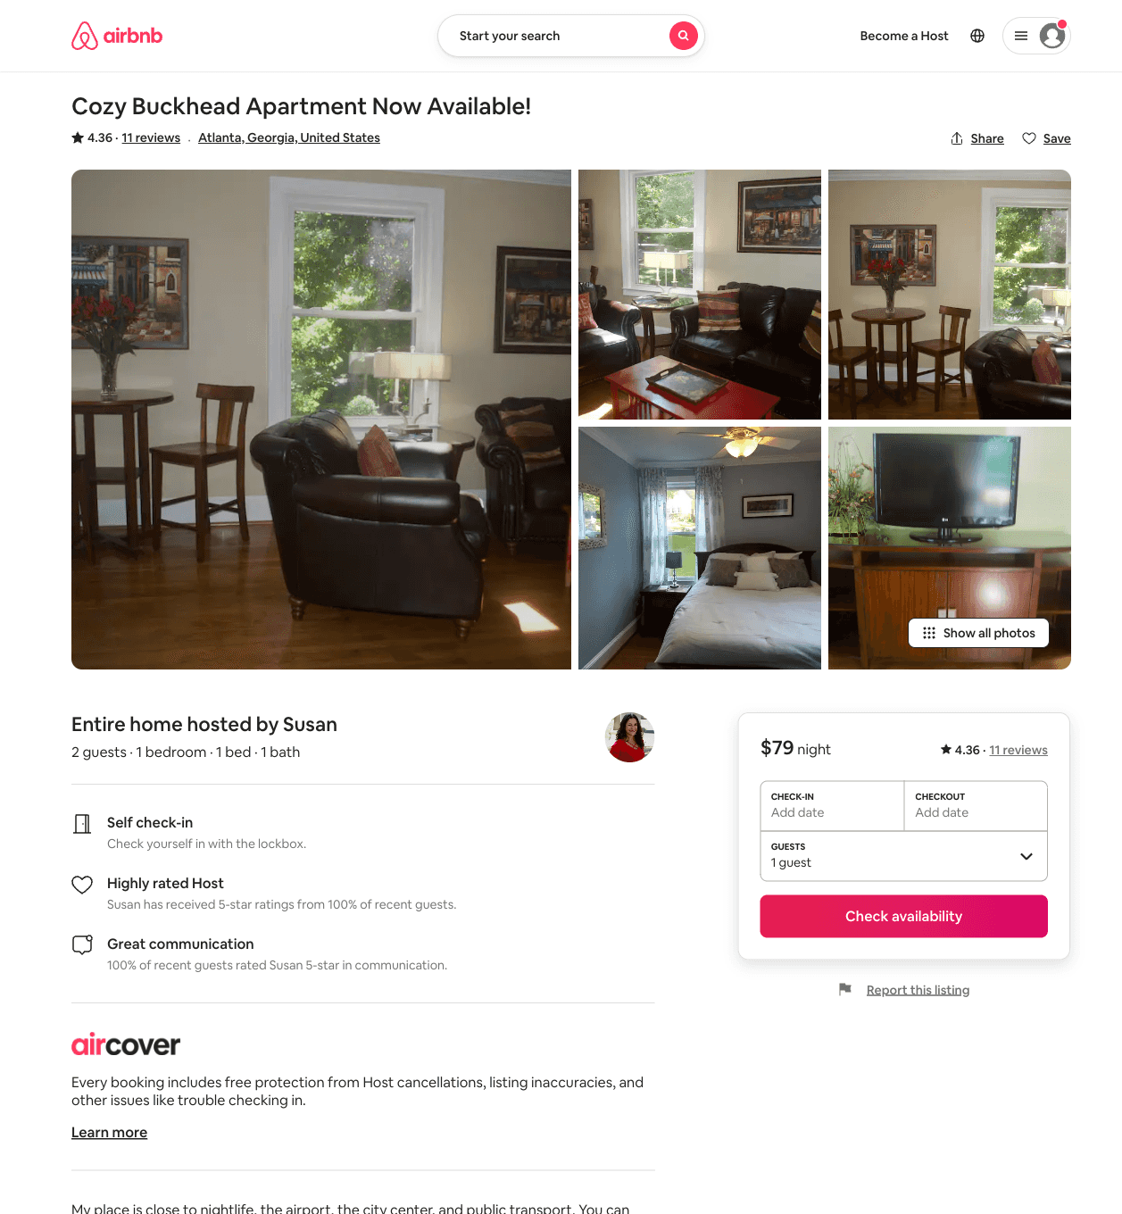
Listing 33718766
1
2
$89
4.36
31
Susan
569187
2
https://www.airbnb.com/rooms/33718766
Jun 2022

Slide 22
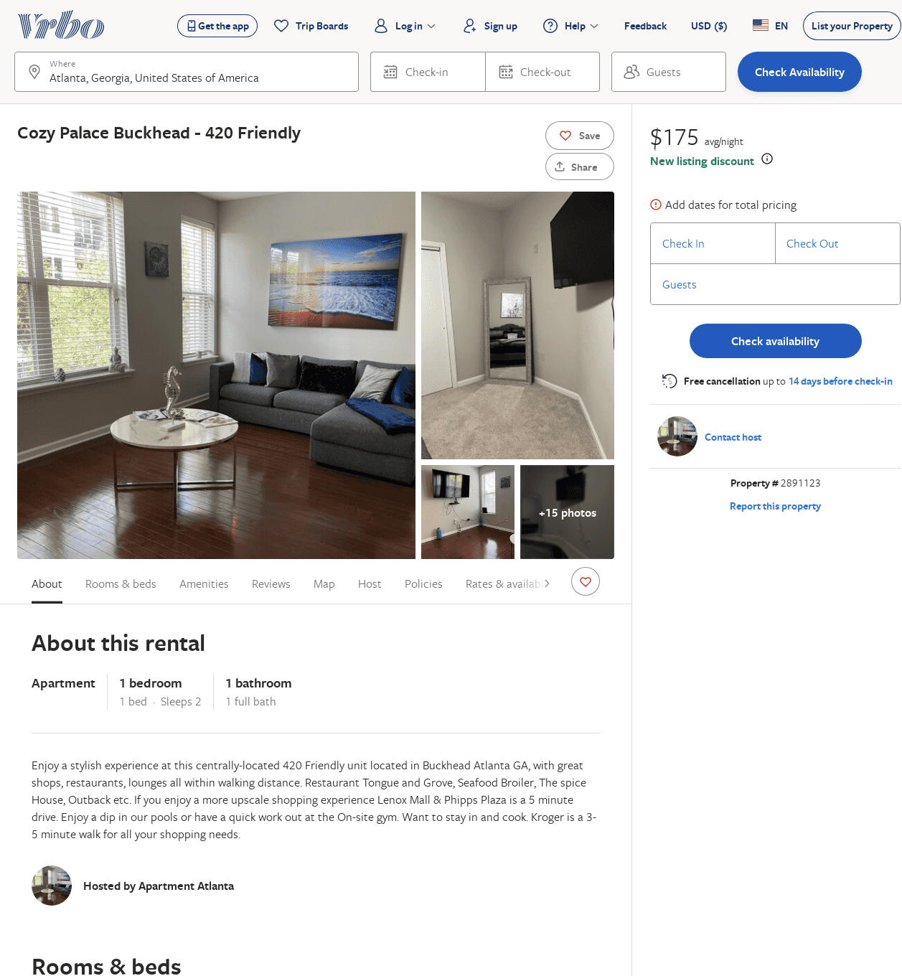
Listing 2891123
1
2
$175
2
https://www.vrbo.com/2891123
Aug 2022

Slide 23
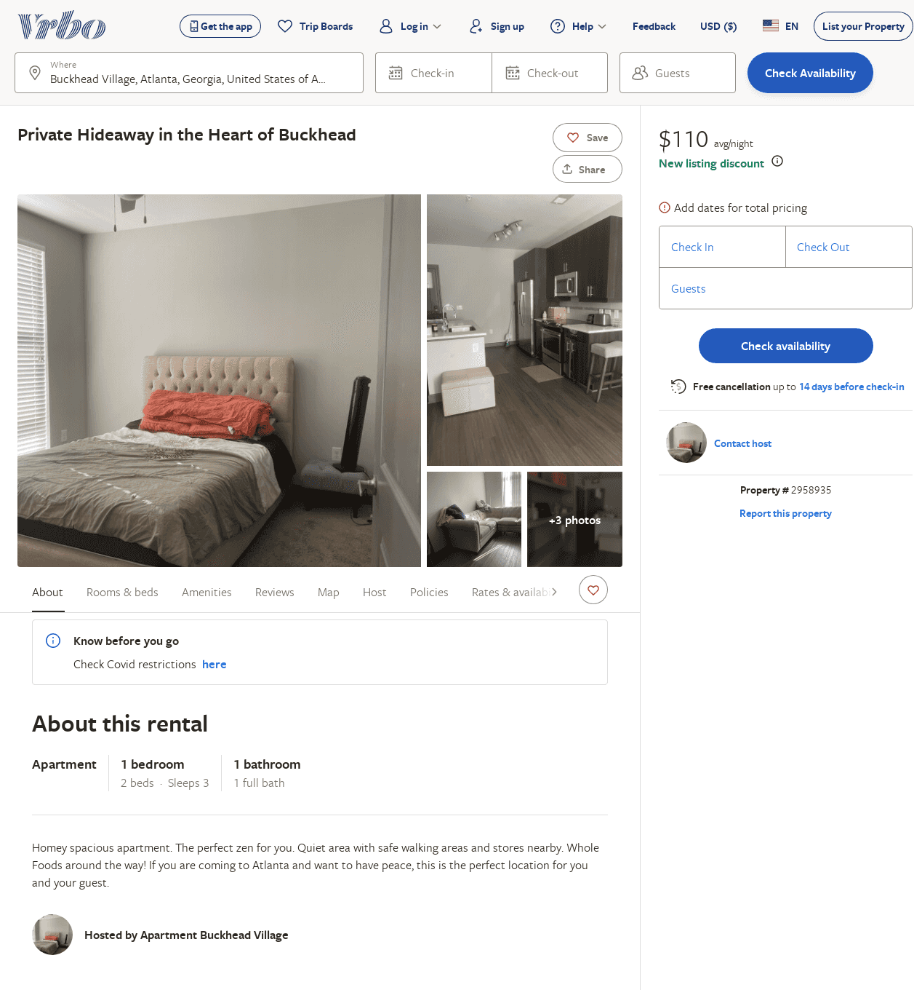
Listing 2958935
1
3
$110
2
https://www.vrbo.com/2958935
Aug 2022

