Slide 2
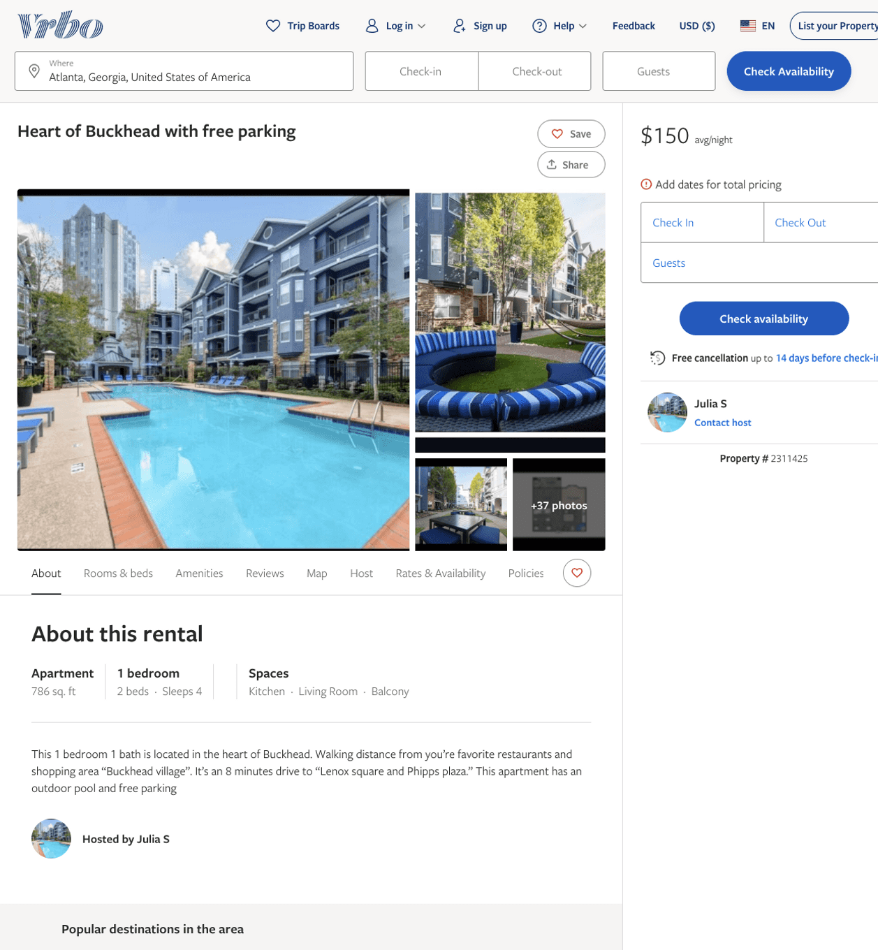
Listing 2311425
1
4
$150
2
Julia S
https://www.vrbo.com/2311425
Aug 2022

Slide 3
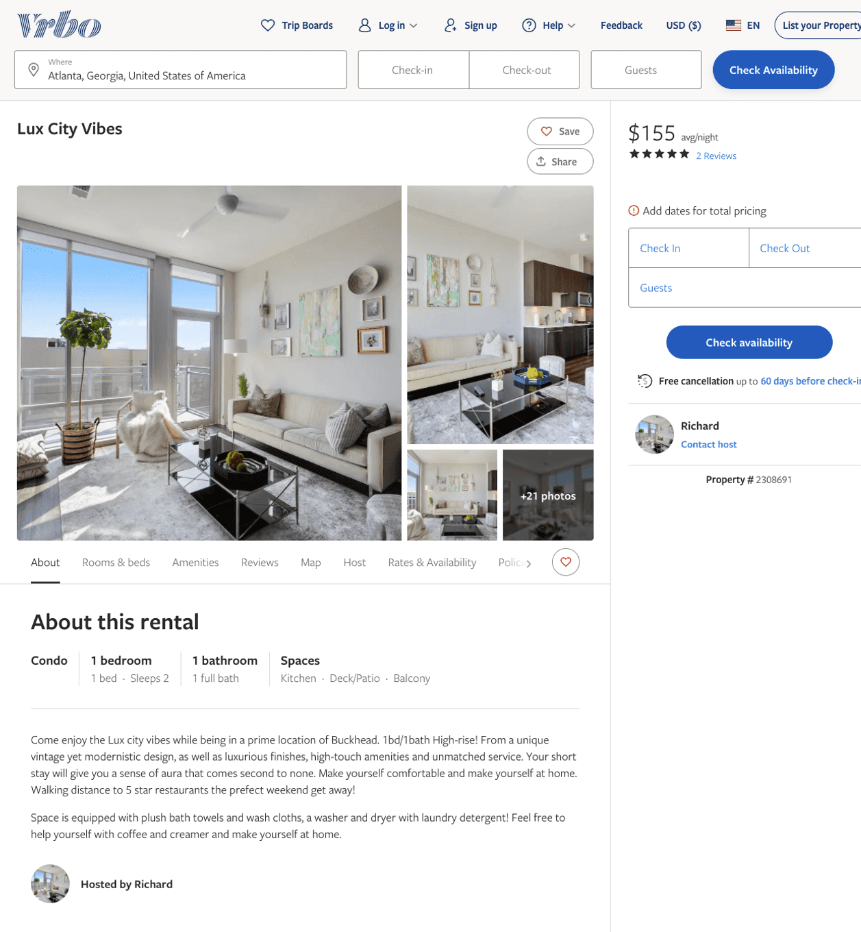
Listing 2308691
1
2
$147 - $155
4.5
1
Richard
https://www.vrbo.com/2308691
Aug 2022

Slide 4
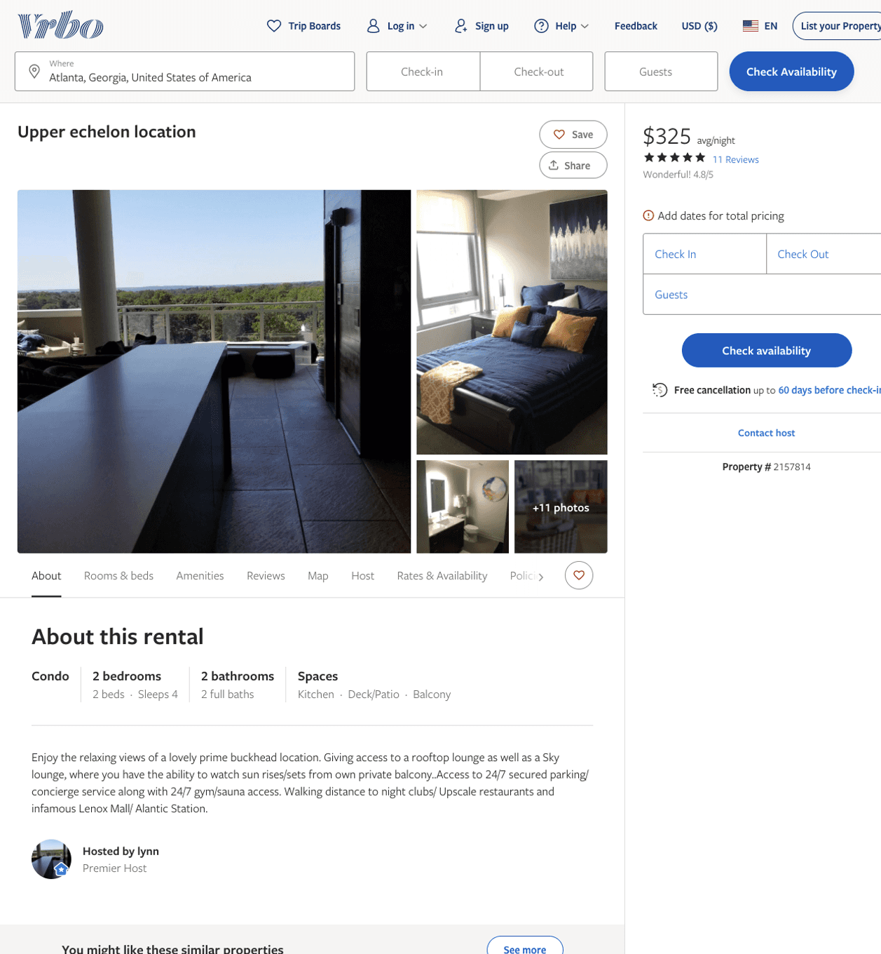
Listing 2157814
1
4
$130 - $325
4.8333335
1
lynn
https://www.vrbo.com/2157814
Aug 2022

Slide 5
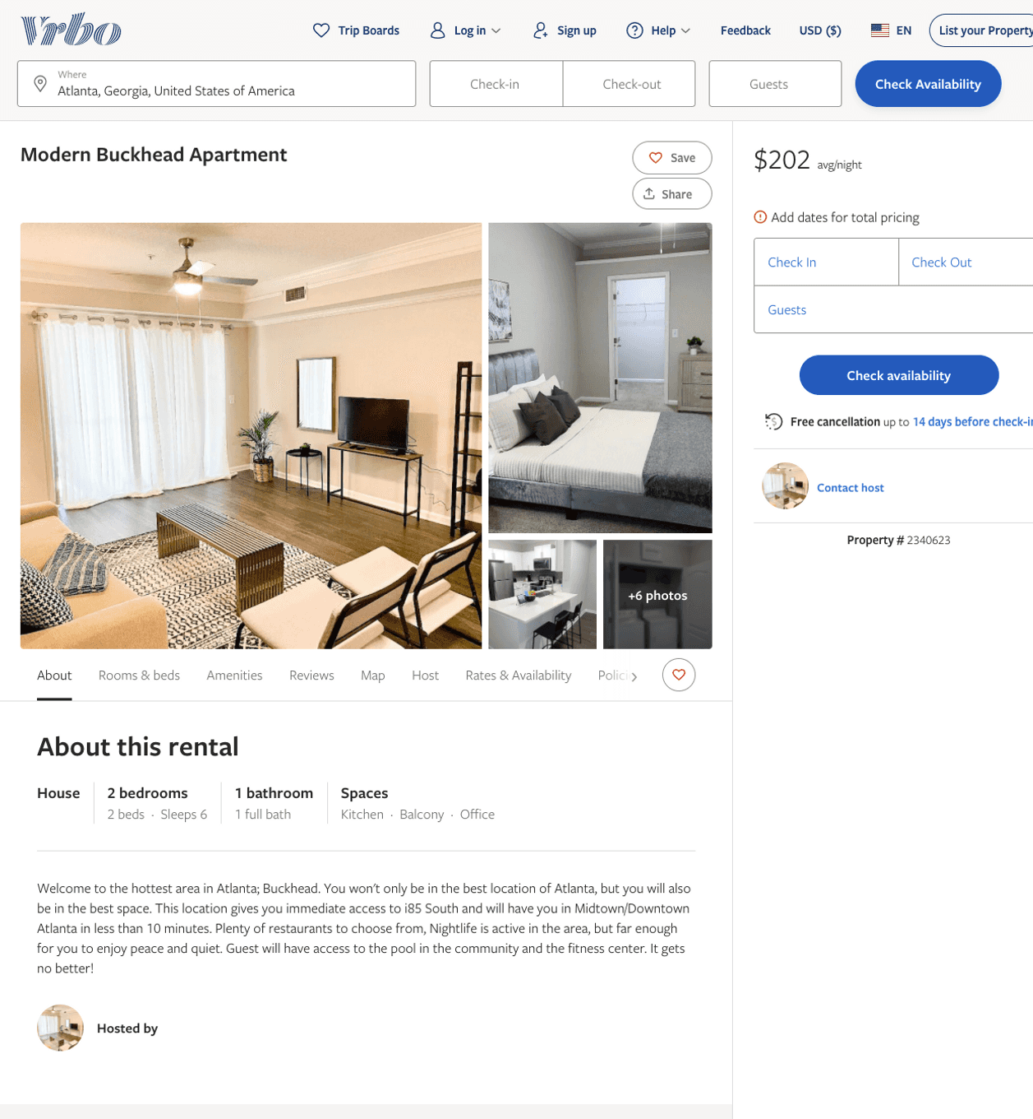
Listing 2340623
2
6
$206
2
https://www.vrbo.com/2340623
Aug 2022

Slide 6
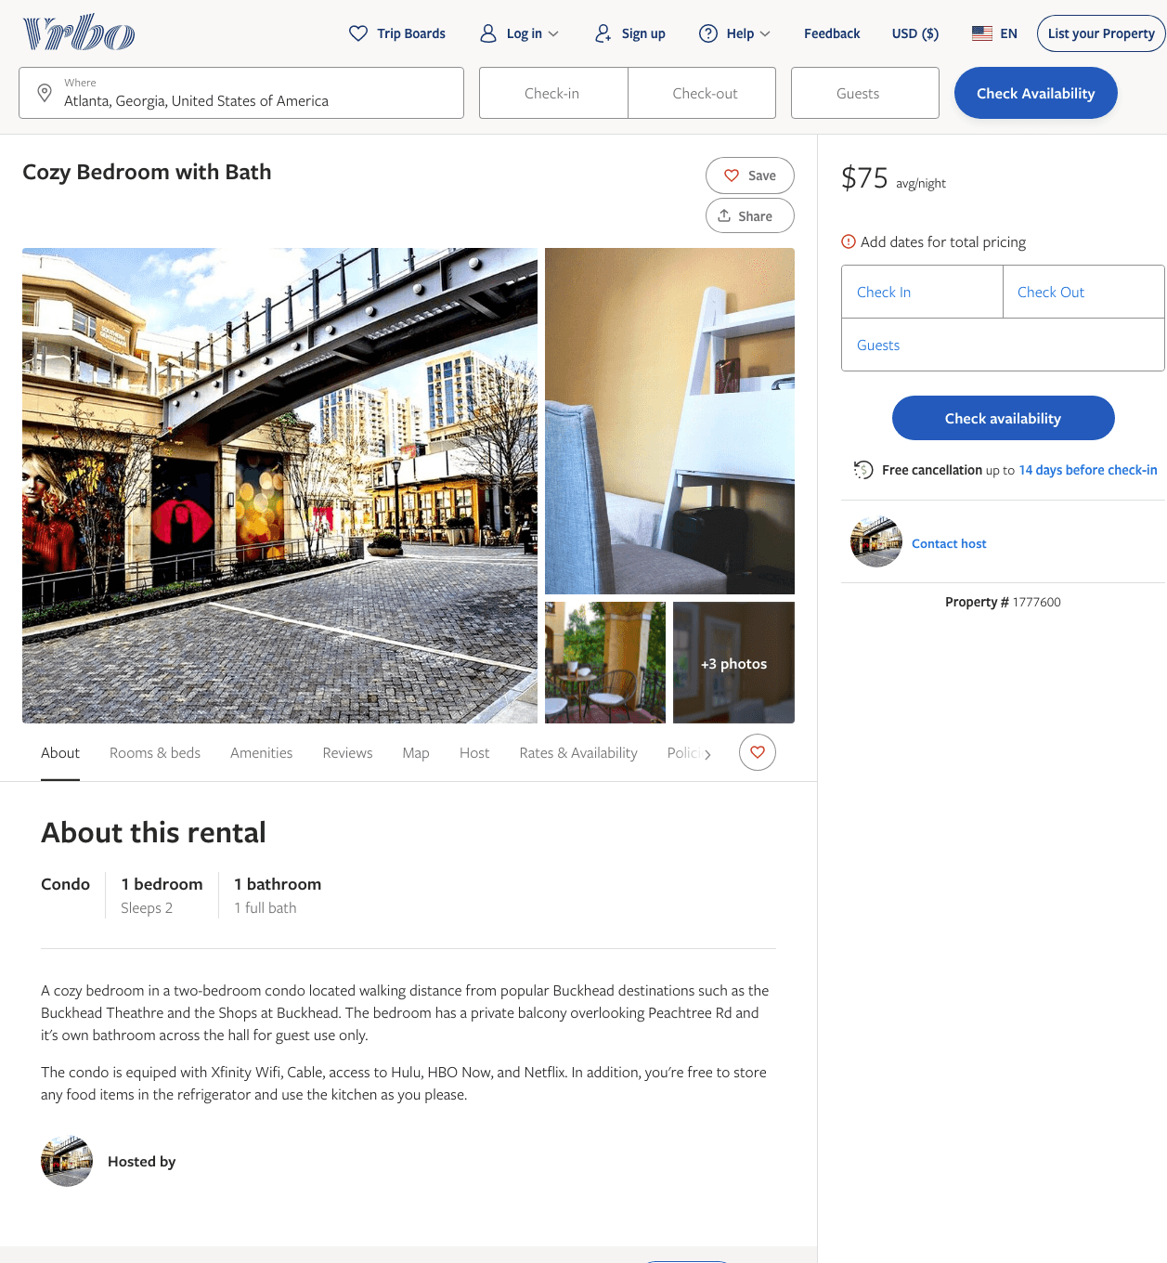
Listing 1777600
1
2
$75
1
https://www.vrbo.com/1777600
Aug 2022

Slide 7
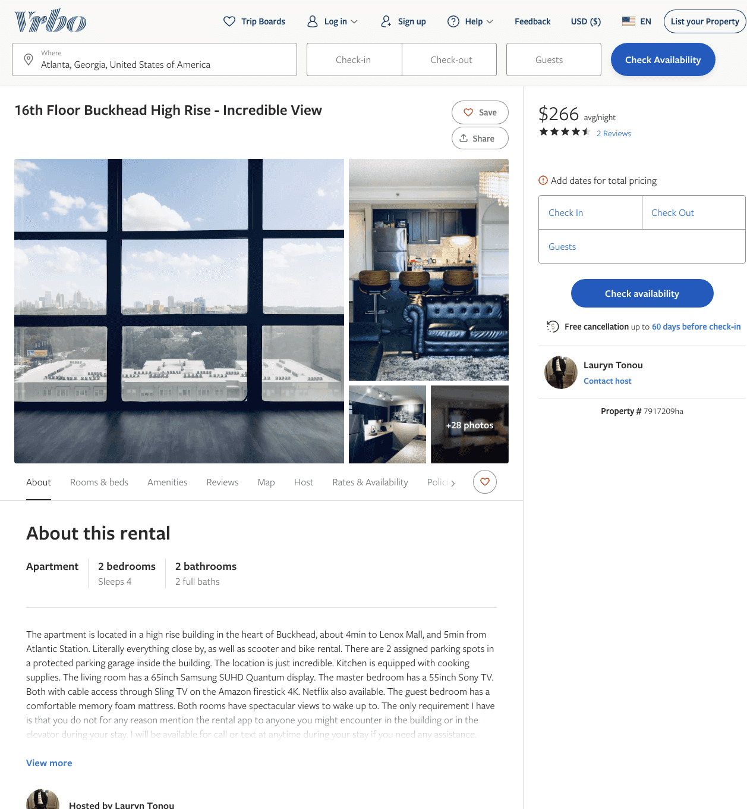
Listing 7917209
2
4
$143 - $295
4.6666665
1
Lauryn Tonou
https://www.vrbo.com/7917209ha
Aug 2022

Slide 8
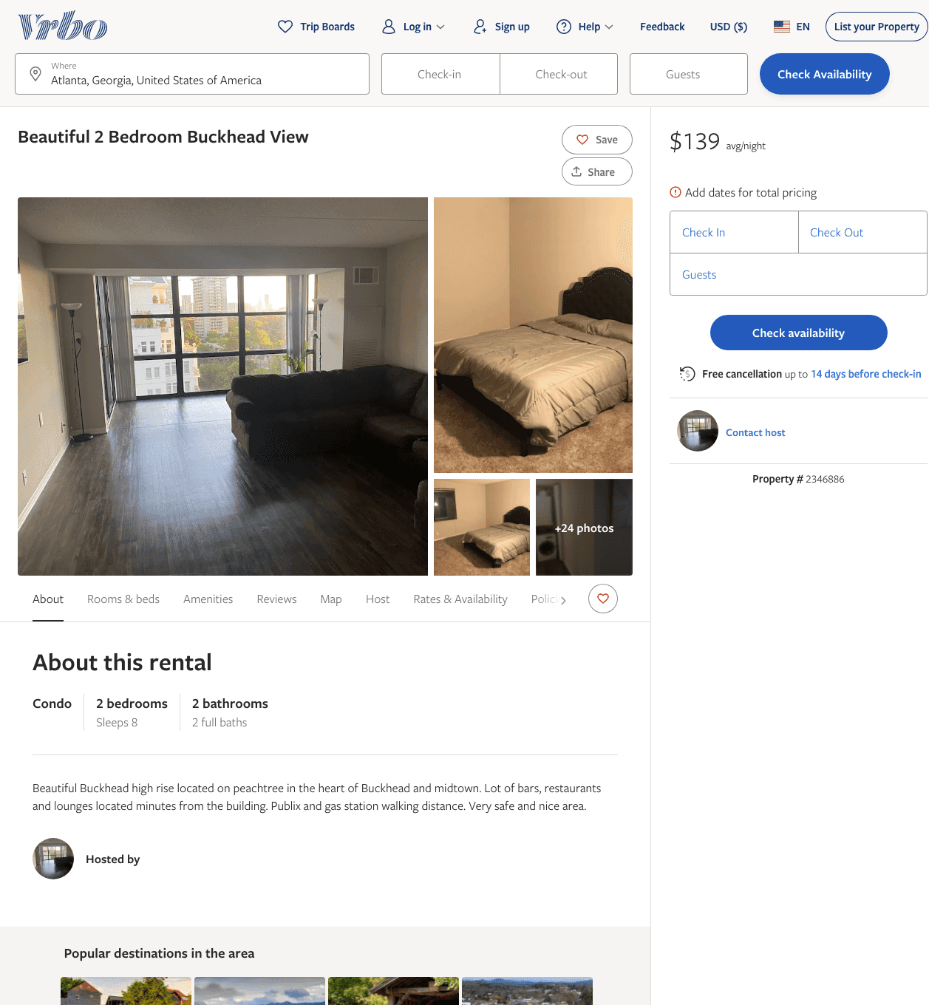
Listing 2346886
2
8
$139
1
7
https://www.vrbo.com/2346886
Aug 2022

Slide 9
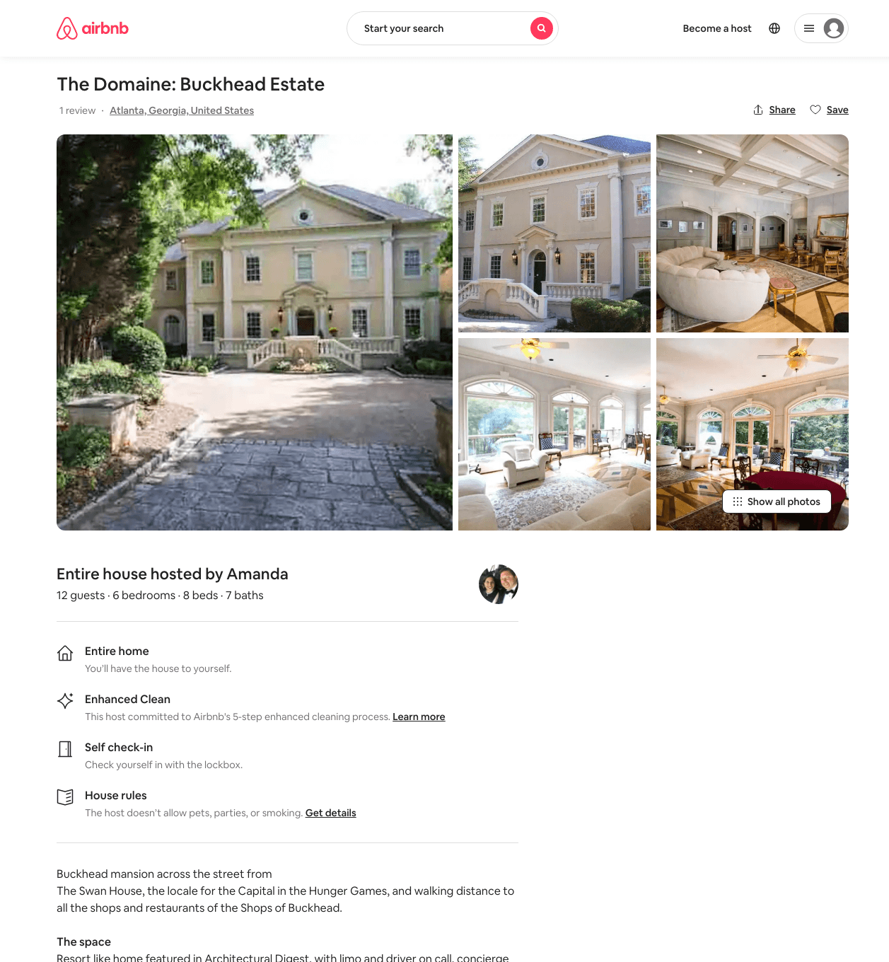
Listing 28255514
6
12
$3500
2
Amanda
134805367
2
https://www.airbnb.com/rooms/28255514
Aug 2022

Slide 10
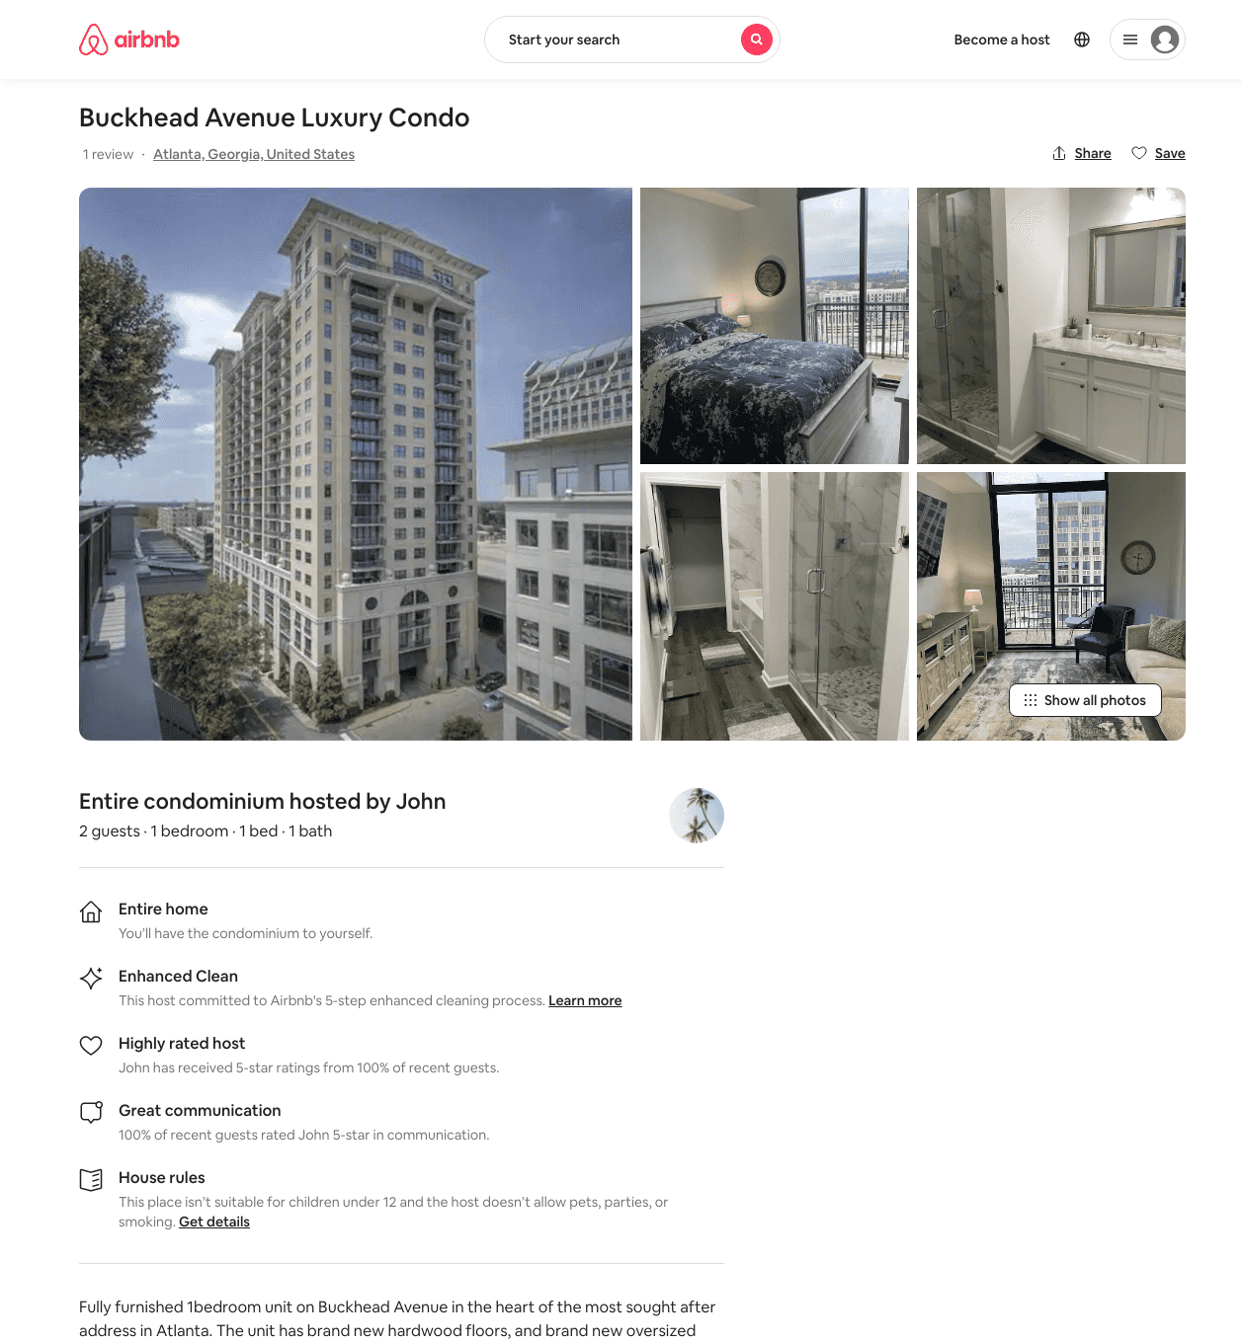
Listing 48118515
1
2
$221
3
John
36363148
2
https://www.airbnb.com/rooms/48118515
Jun 2022

Slide 11
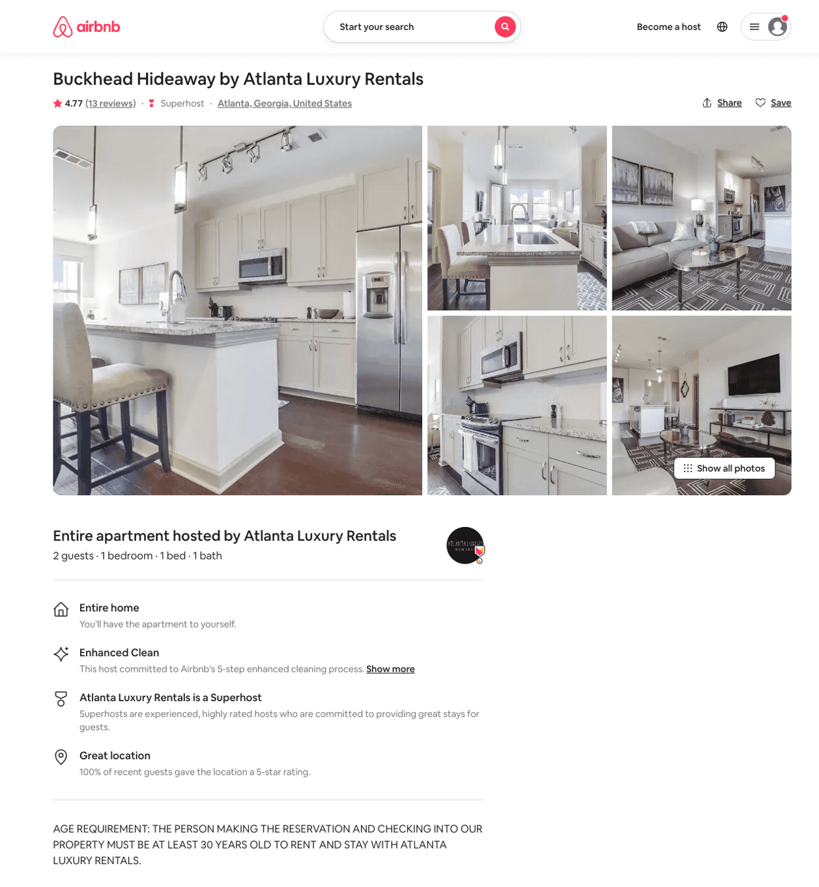
Listing 19049802
1
2
$132 - $216
4.79
3
Atlanta Luxury Rentals
115328988
54
https://www.airbnb.com/rooms/19049802
Aug 2022

Slide 12
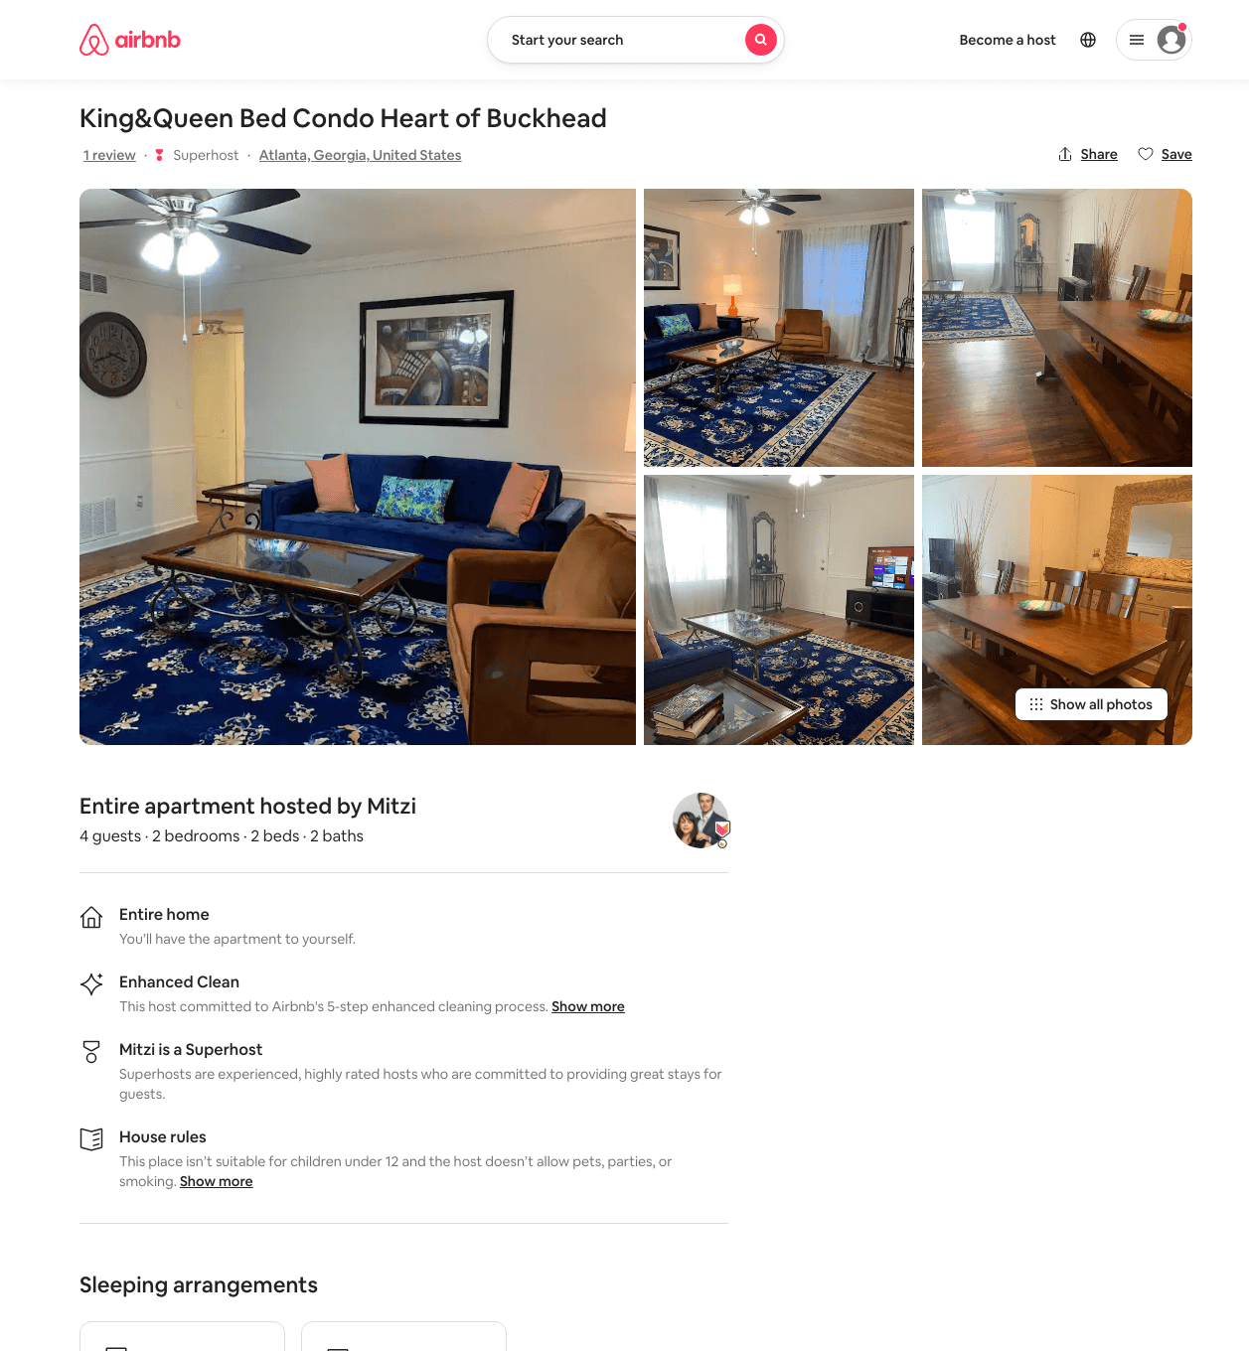
Listing 49504781
2
4
$95 - $124
4.68
1
Mitzi
314860360
5
https://www.airbnb.com/rooms/49504781
Aug 2022

Slide 13
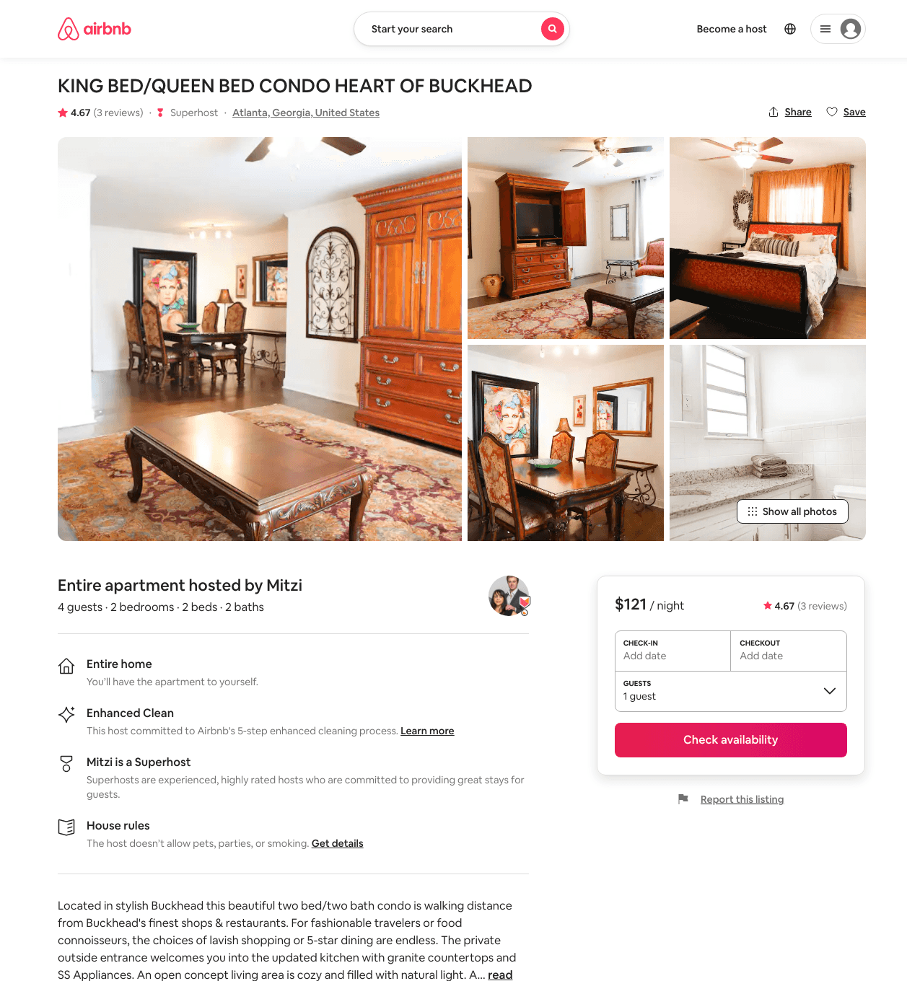
Listing 48767056
2
4
$99 - $125
4.81
30
Mitzi
314860360
5
https://www.airbnb.com/rooms/48767056
Aug 2022

Slide 14
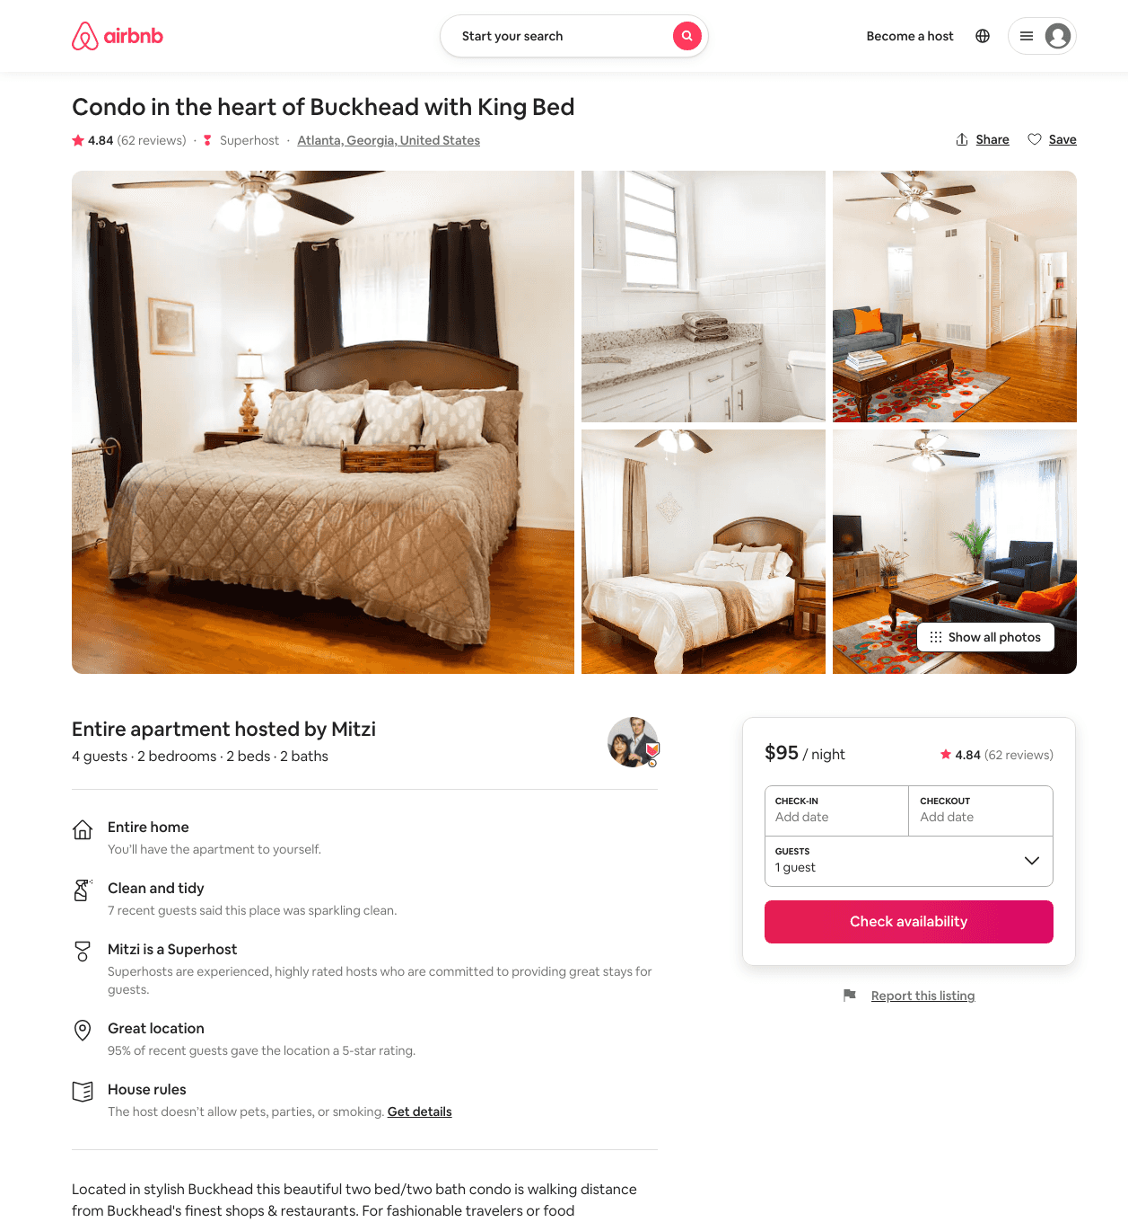
Listing 40631776
2
4
$95 - $110
4.87
1
Mitzi
314860360
5
https://www.airbnb.com/rooms/40631776
Aug 2022

Slide 15
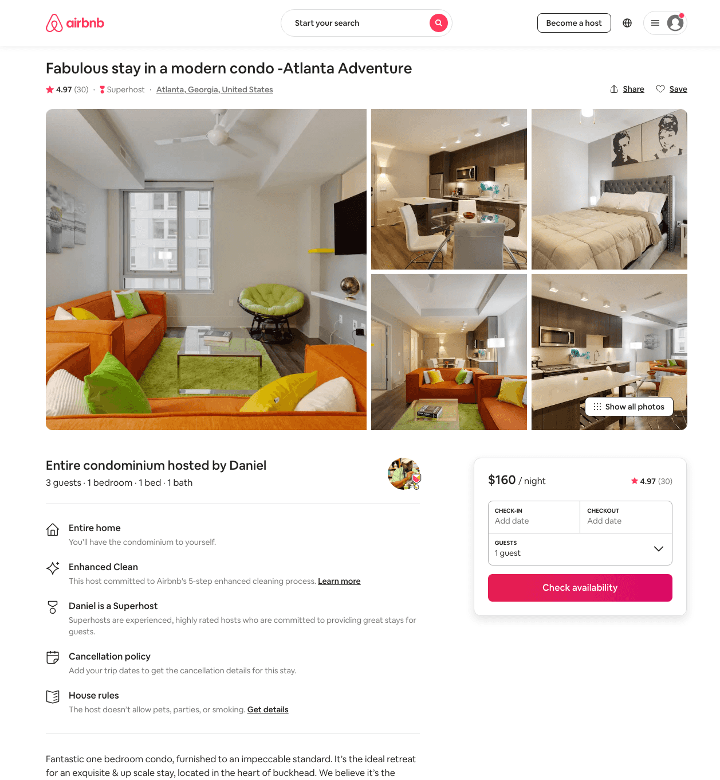
Listing 41586152
1
3
$160 - $326
4.88
1
Daniel
23828708
1
https://www.airbnb.com/rooms/41586152
Aug 2022

Slide 16
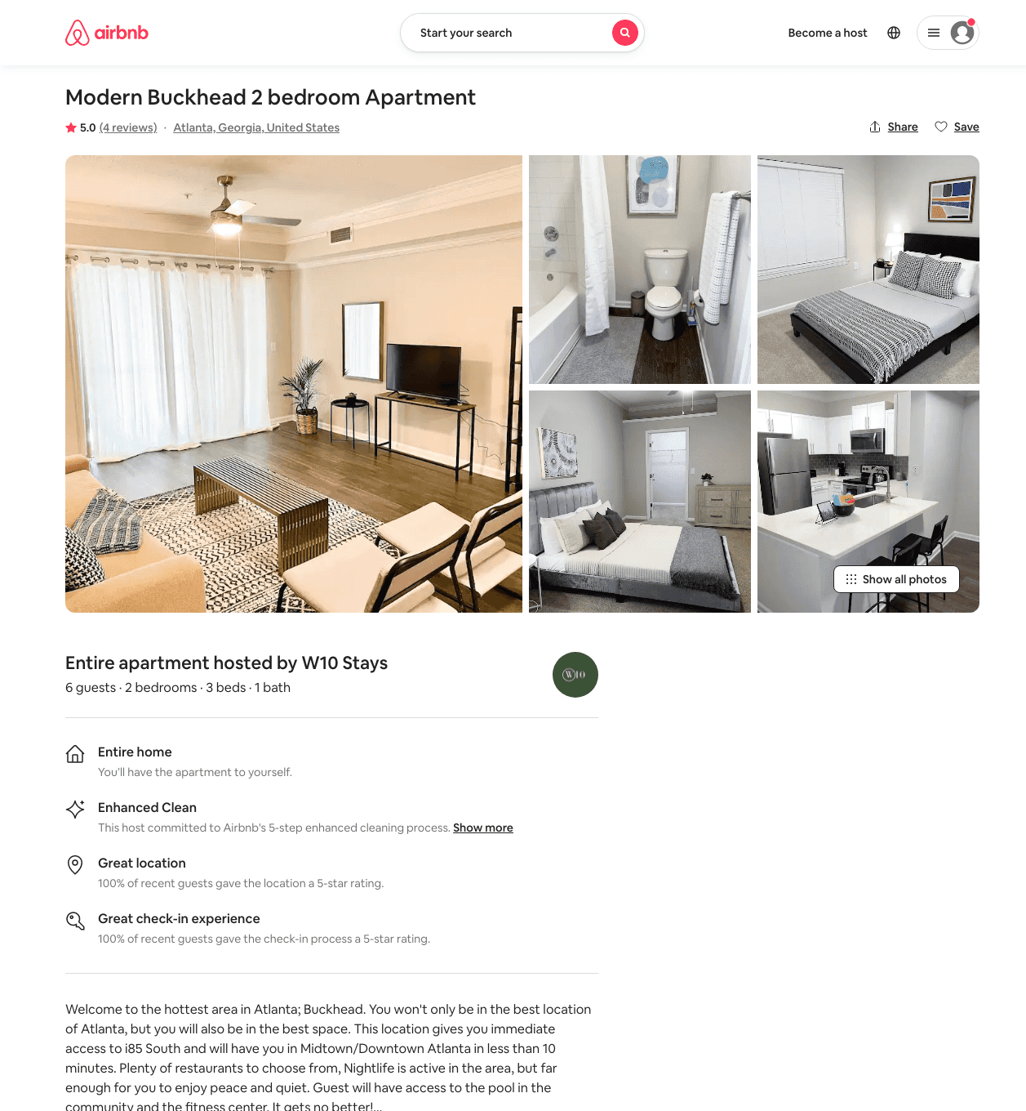
Listing 49758527
2
6
$120 - $200
4.75
2
W10 Stays
377670225
1
https://www.airbnb.com/rooms/49758527
Aug 2022

Slide 17
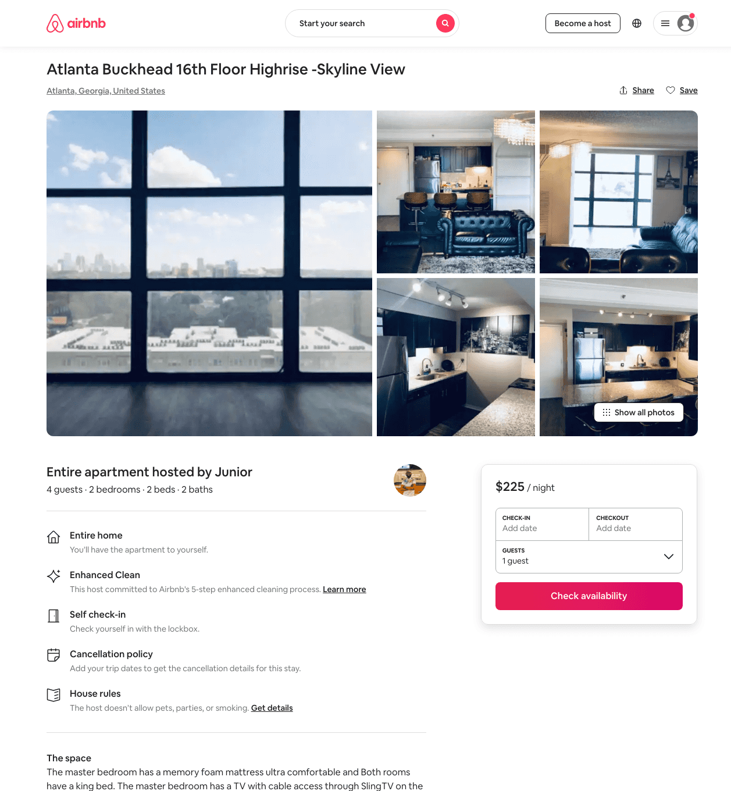
Listing 47936666
2
5
$107 - $248
4.41
1
Junior
171658689
1
https://www.airbnb.com/rooms/47936666
Jun 2022

Slide 18
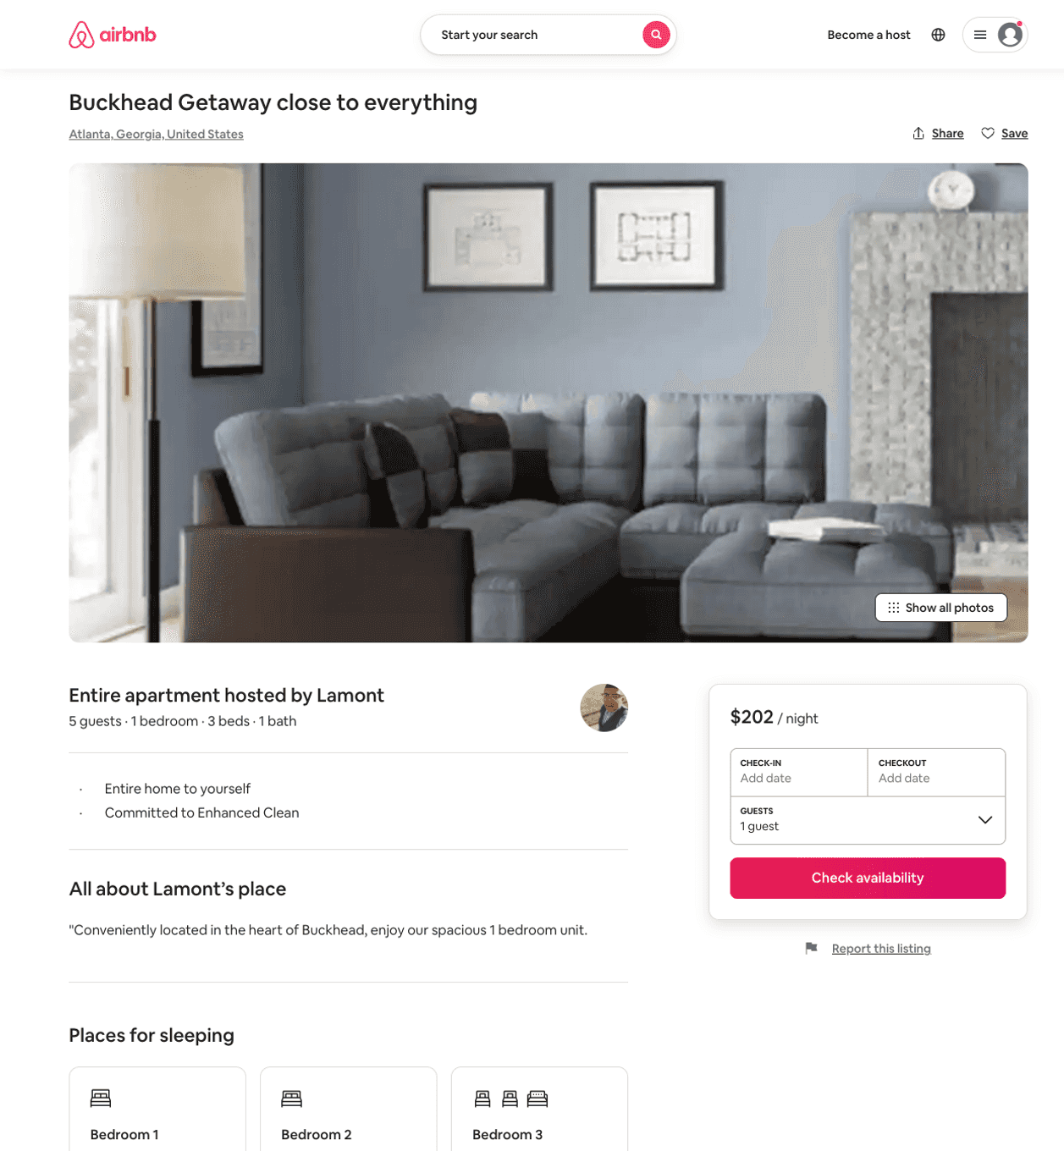
Listing 50009822
1
6
$70 - $998
5.0
5
Lamont
355263194
2
https://www.airbnb.com/rooms/50009822
Aug 2022

Slide 19
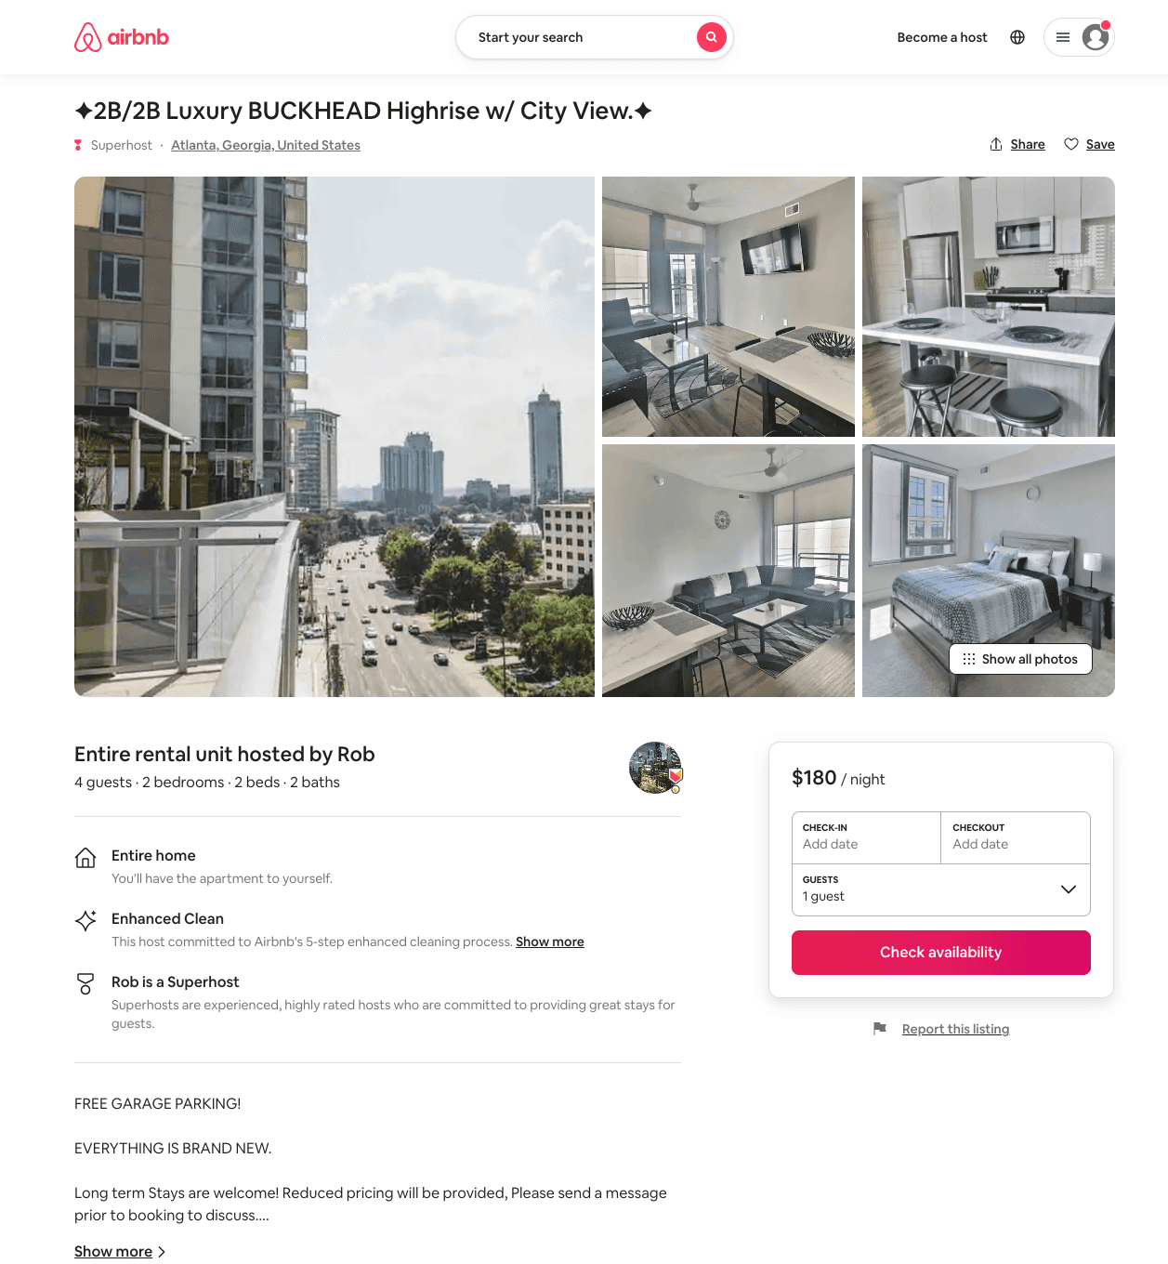
Listing 51105676
2
4
$161 - $211
4.71
2
Rob
394913304
3
https://www.airbnb.com/rooms/51105676
Aug 2022

Slide 20
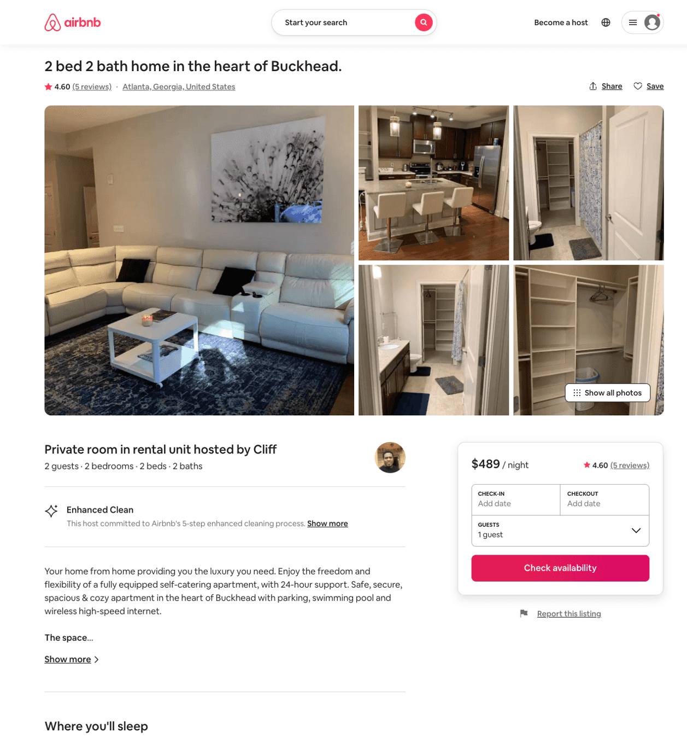
Listing 38410749
2
2
$489
4.60
1
Cliff
209758295
3
https://www.airbnb.com/rooms/38410749
Aug 2022

Slide 21
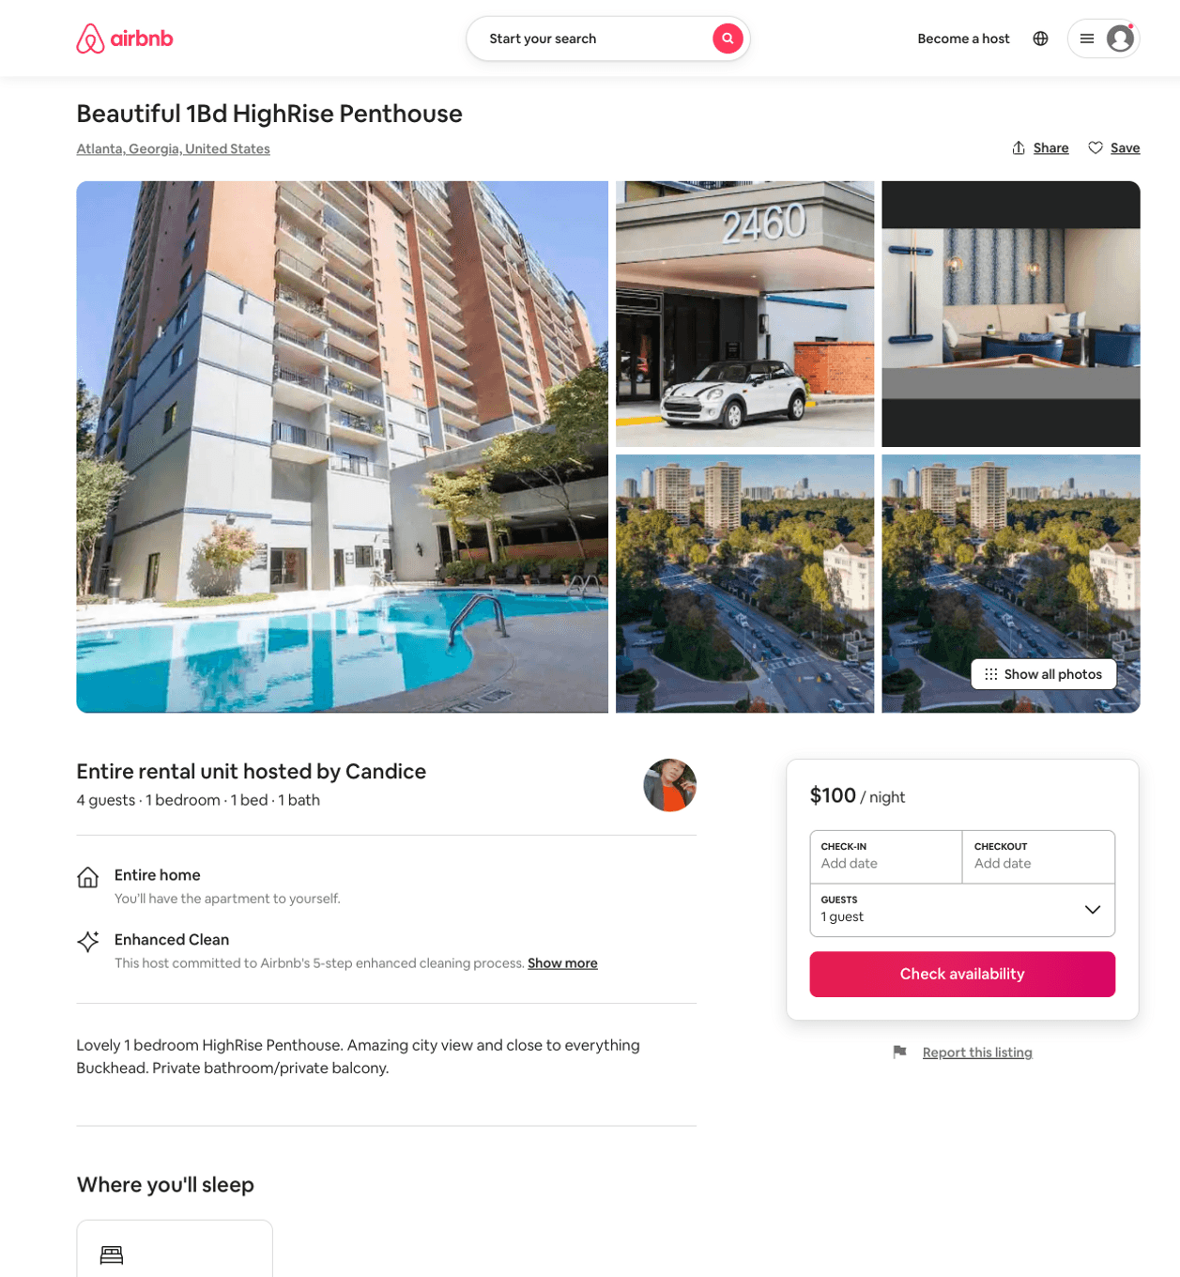
Listing 51167827
1
2
$100
1
Candice
376502817
2
https://www.airbnb.com/rooms/51167827
Aug 2022

Slide 22
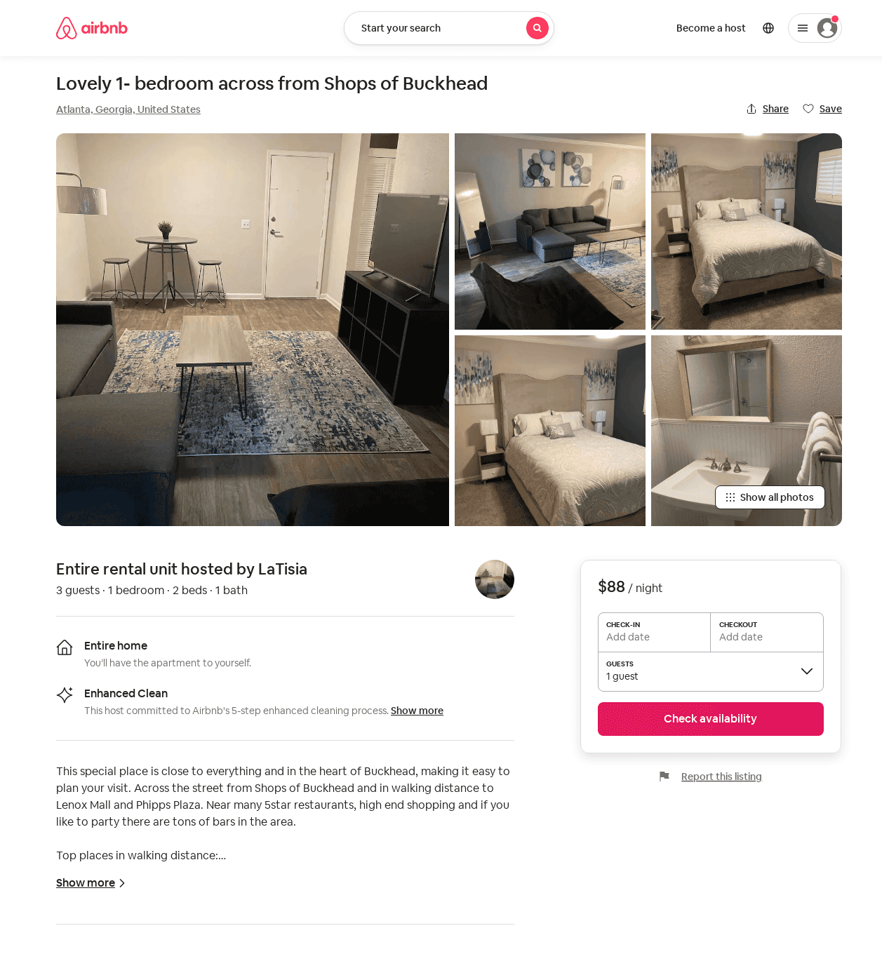
Listing 52287169
1
3
$45 - $96
4.66
1
LaTisia
53206948
1
https://www.airbnb.com/rooms/52287169
Jul 2022

Slide 23
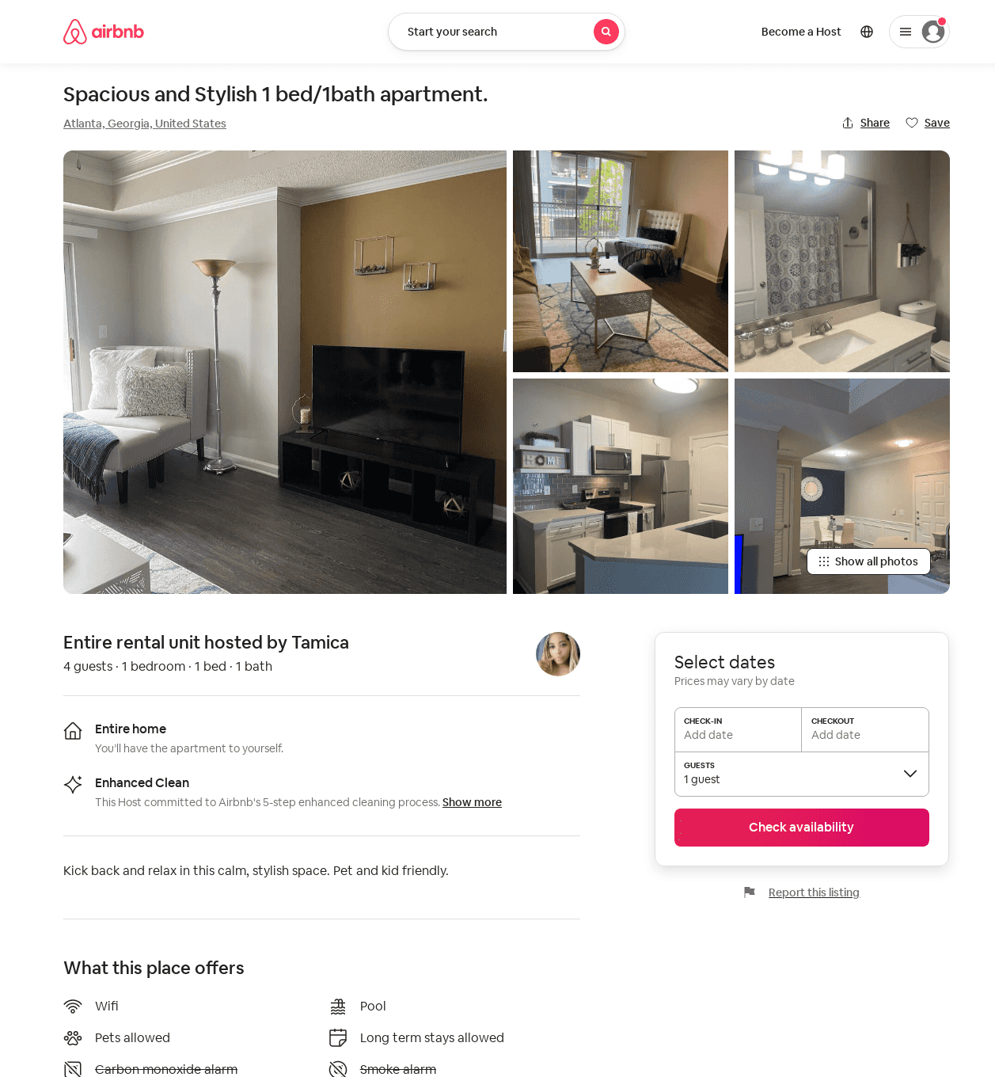
Listing 52500904
1
4
$115 - $123
1
Tamica
125262059
2
https://www.airbnb.com/rooms/52500904
Aug 2022

Slide 24
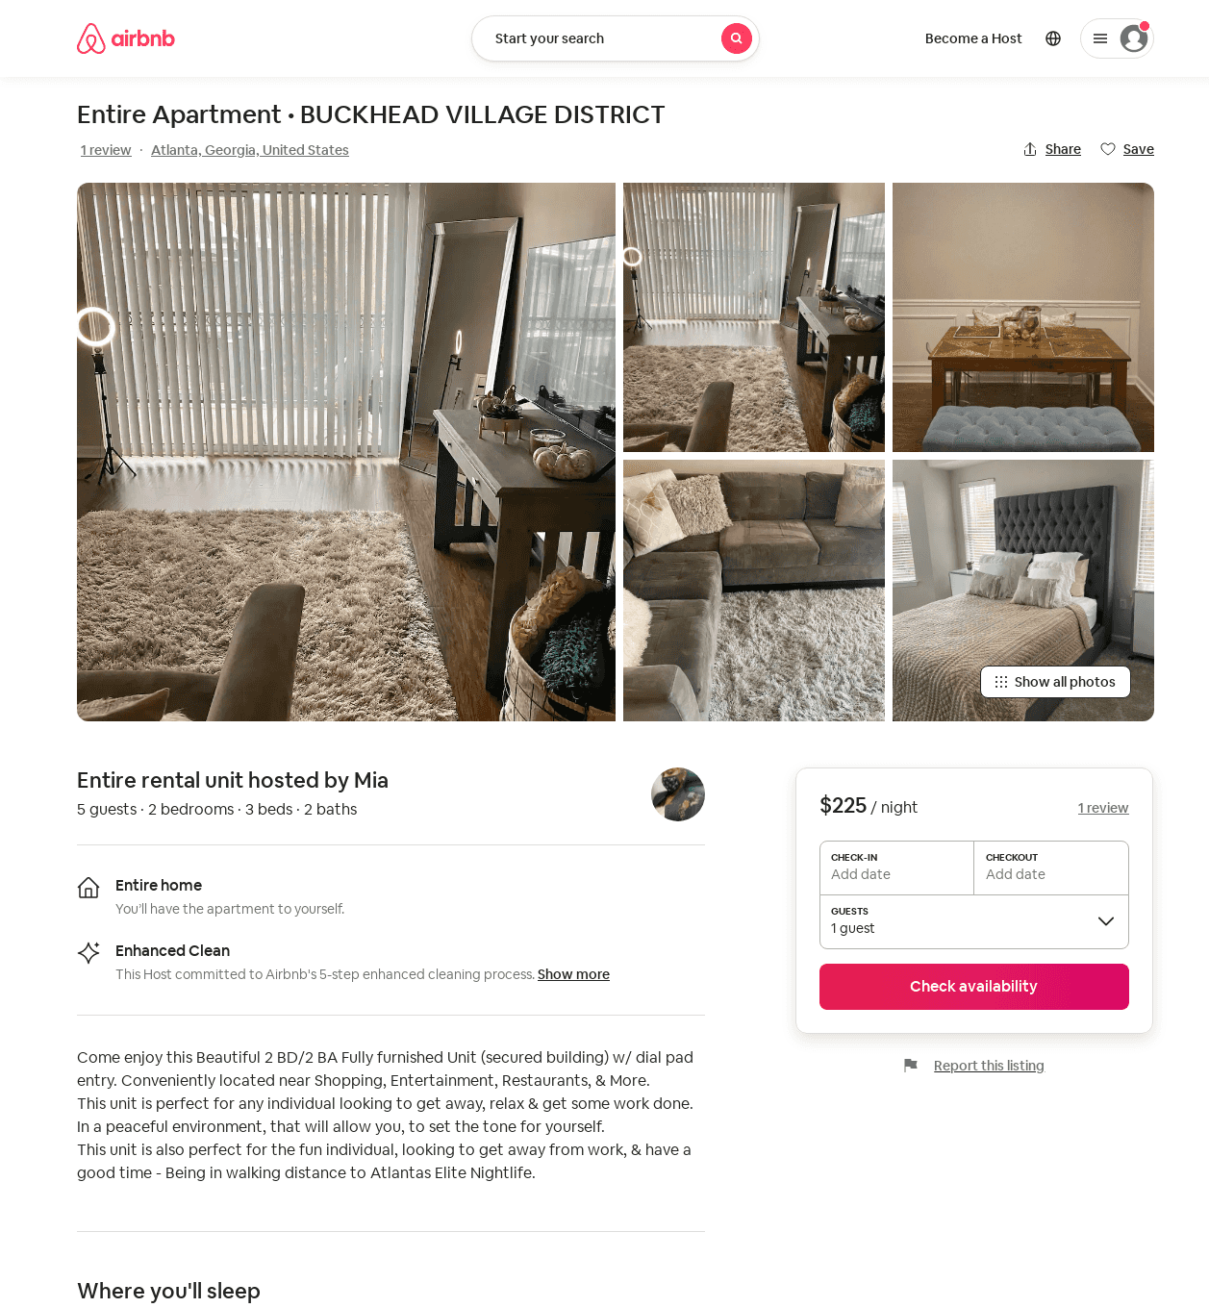
Listing 48144859
2
5
$225
3
Mia
387102820
1
https://www.airbnb.com/rooms/48144859
Jun 2022

Slide 25
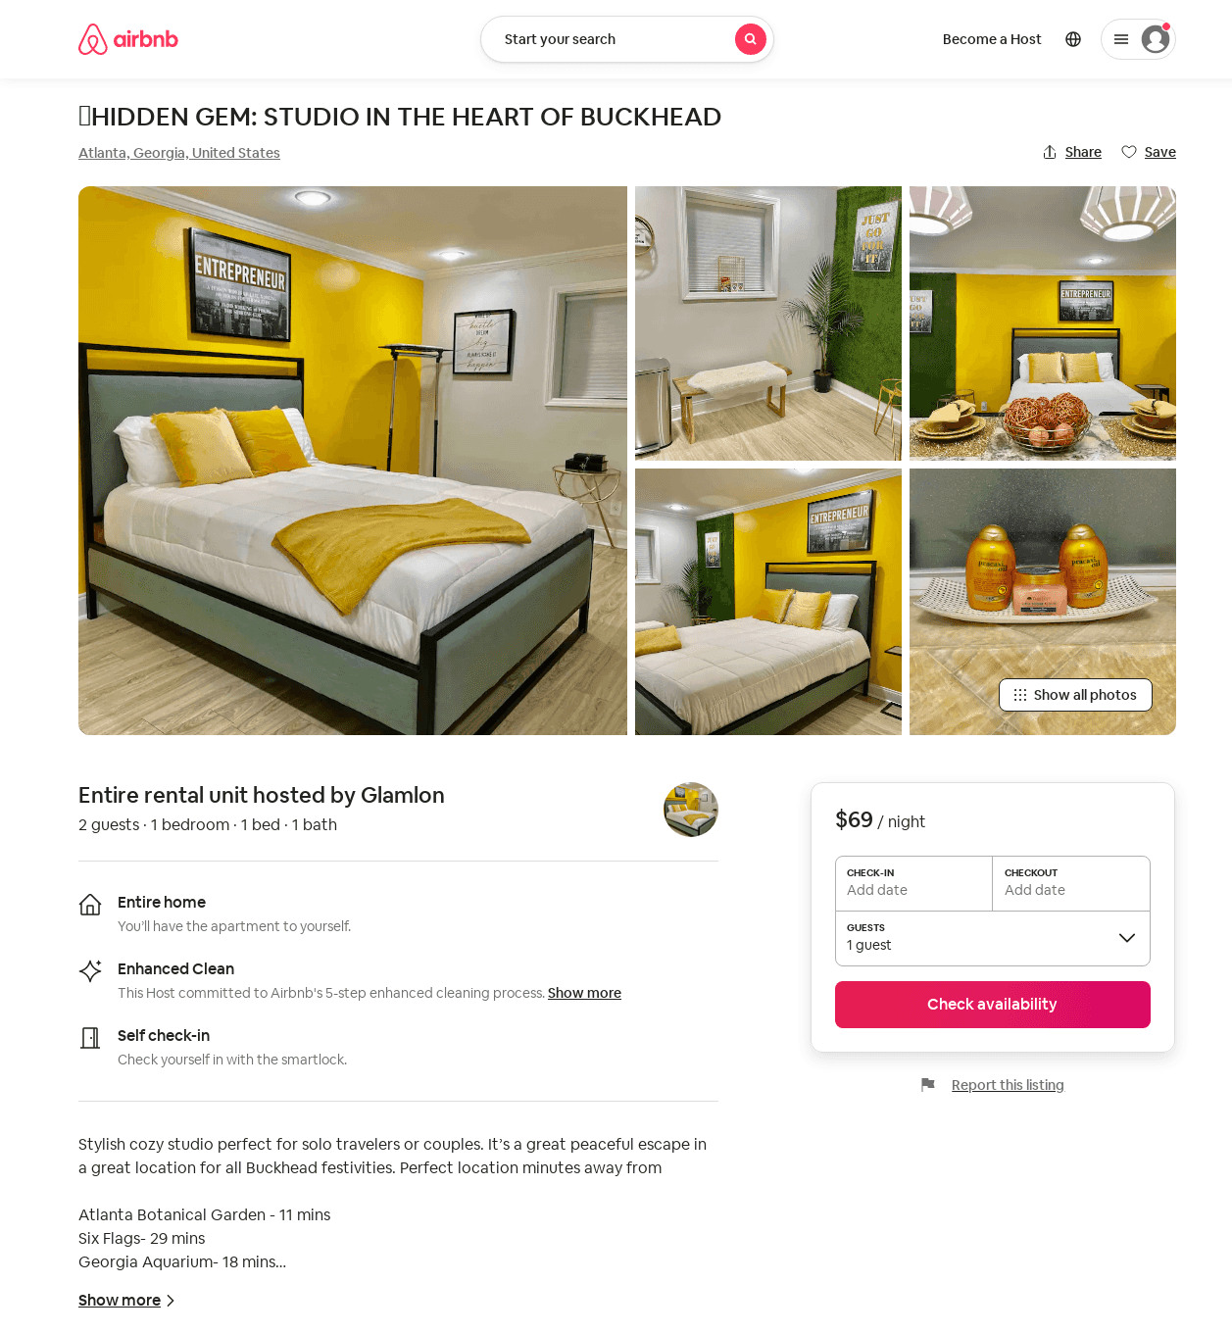
Listing 52685111
1
2
$69 - $99
5.0
2
Glamlon
366274329
1
https://www.airbnb.com/rooms/52685111
Jun 2022

Slide 26
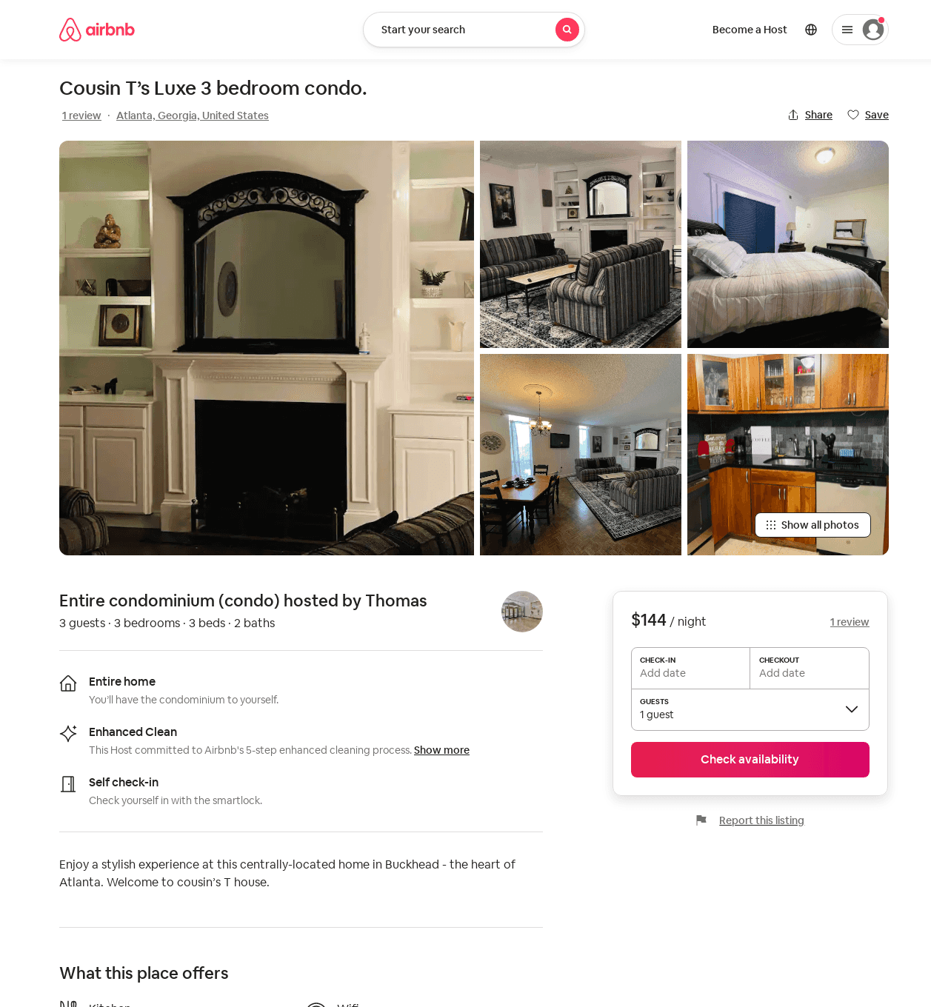
Listing 52729865
3
5
$110 - $221
4.86
2
Thomas
423332711
1
https://www.airbnb.com/rooms/52729865
Aug 2022

Slide 27
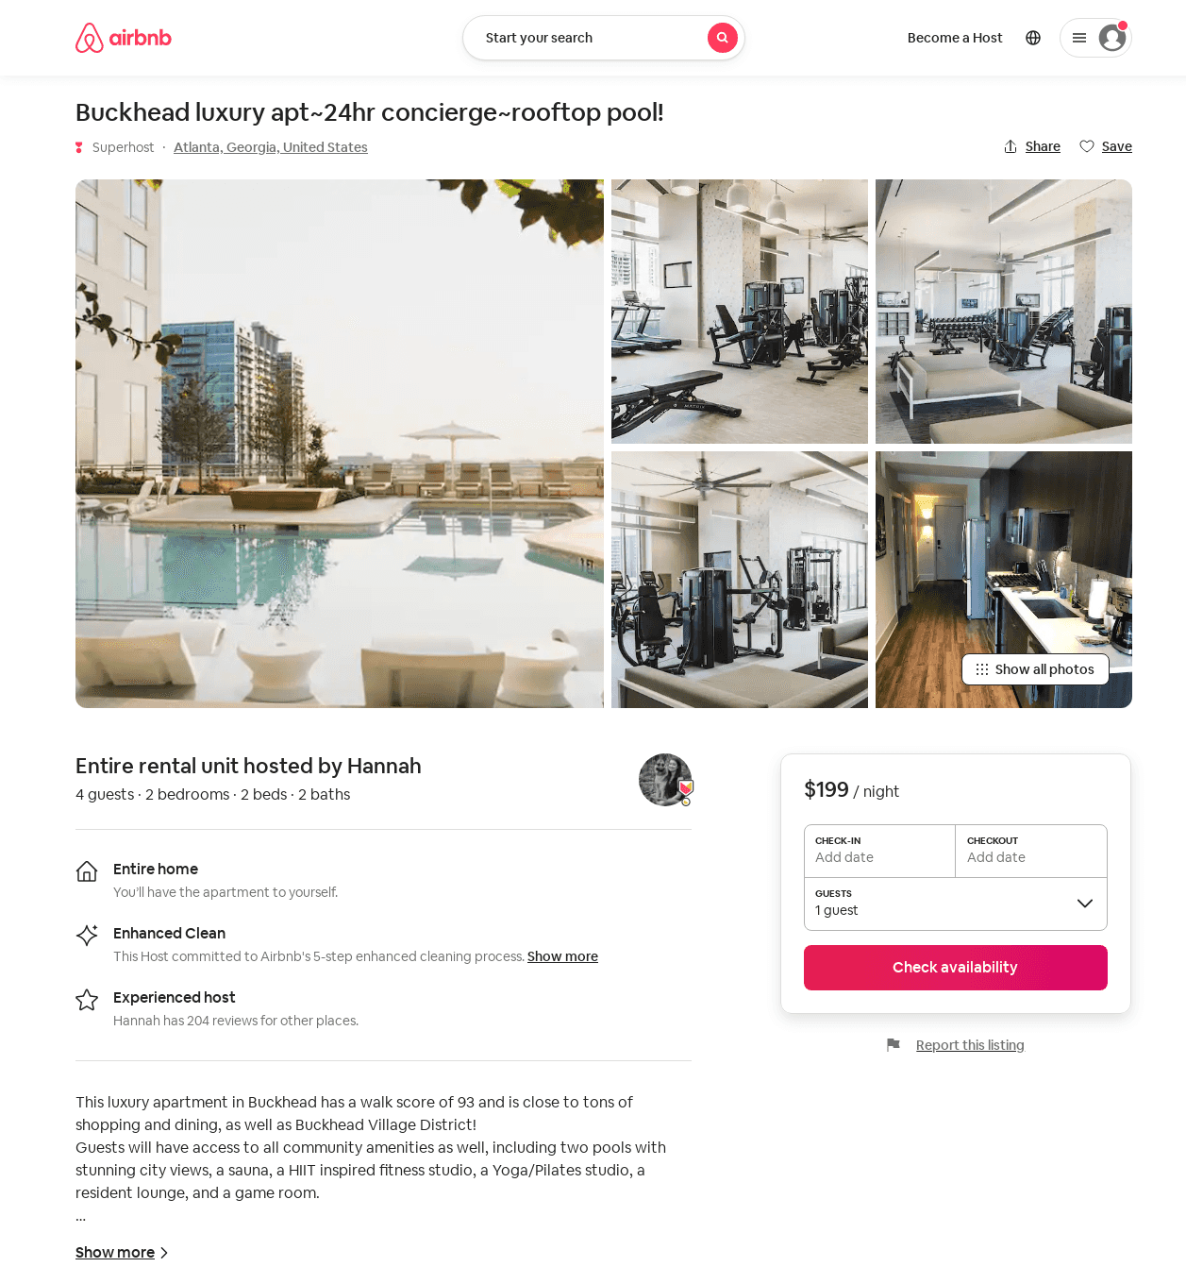
Listing 53122622
2
4
$198 - $199
4
Hannah
152046386
9
https://www.airbnb.com/rooms/53122622
Aug 2022

Slide 28
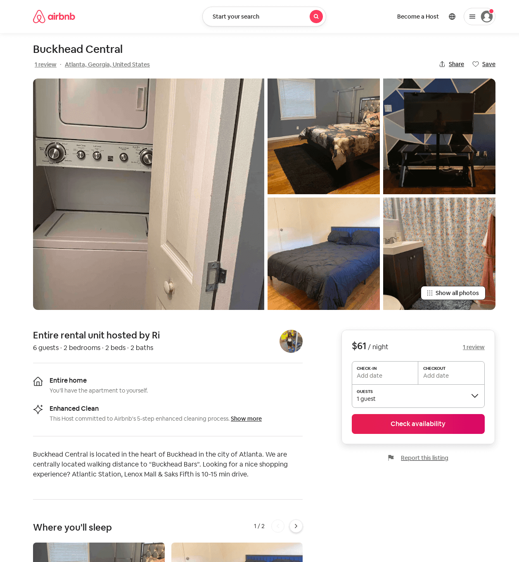
Listing 52582251
2
6
$53 - $97
4.50
2
Ri
425596457
1
https://www.airbnb.com/rooms/52582251
Jun 2022

Slide 29
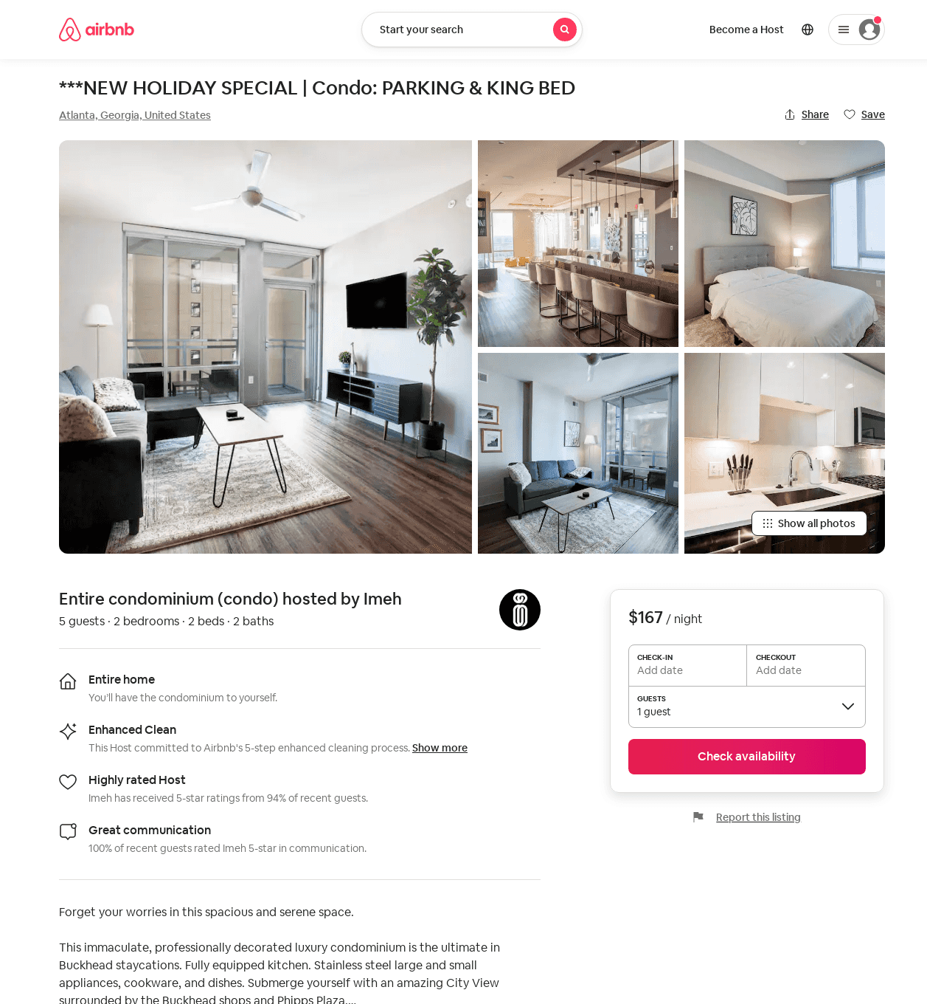
Listing 53283278
2
6
$126 - $210
4.87
1
Imeh
286057968
3
https://www.airbnb.com/rooms/53283278
Jul 2022

Slide 30
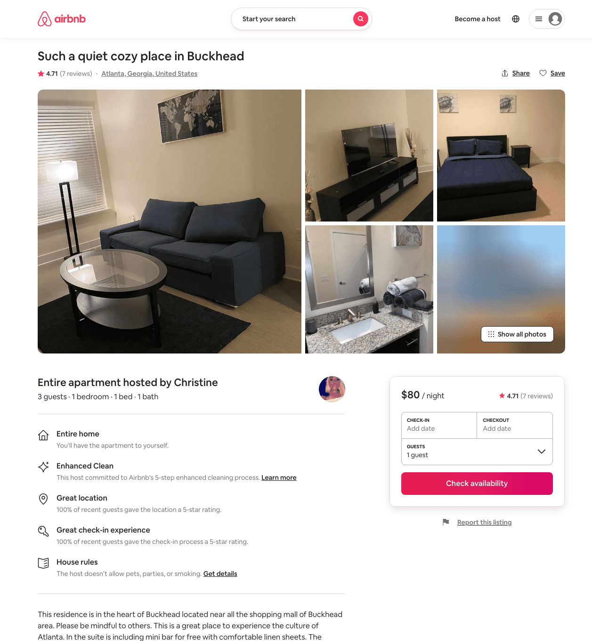
Listing 45367536
1
3
$80
4.71
2
Christine
256046819
1
https://www.airbnb.com/rooms/45367536
Aug 2022

Slide 31
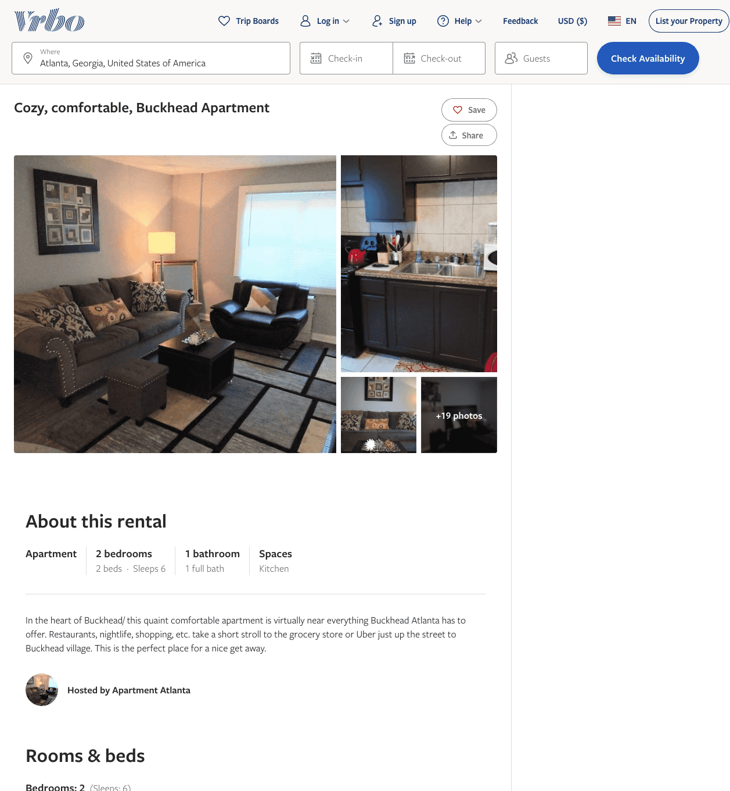
Listing 2137442
2
6
$100
5
1
https://www.vrbo.com/2137442
Aug 2022

Slide 32
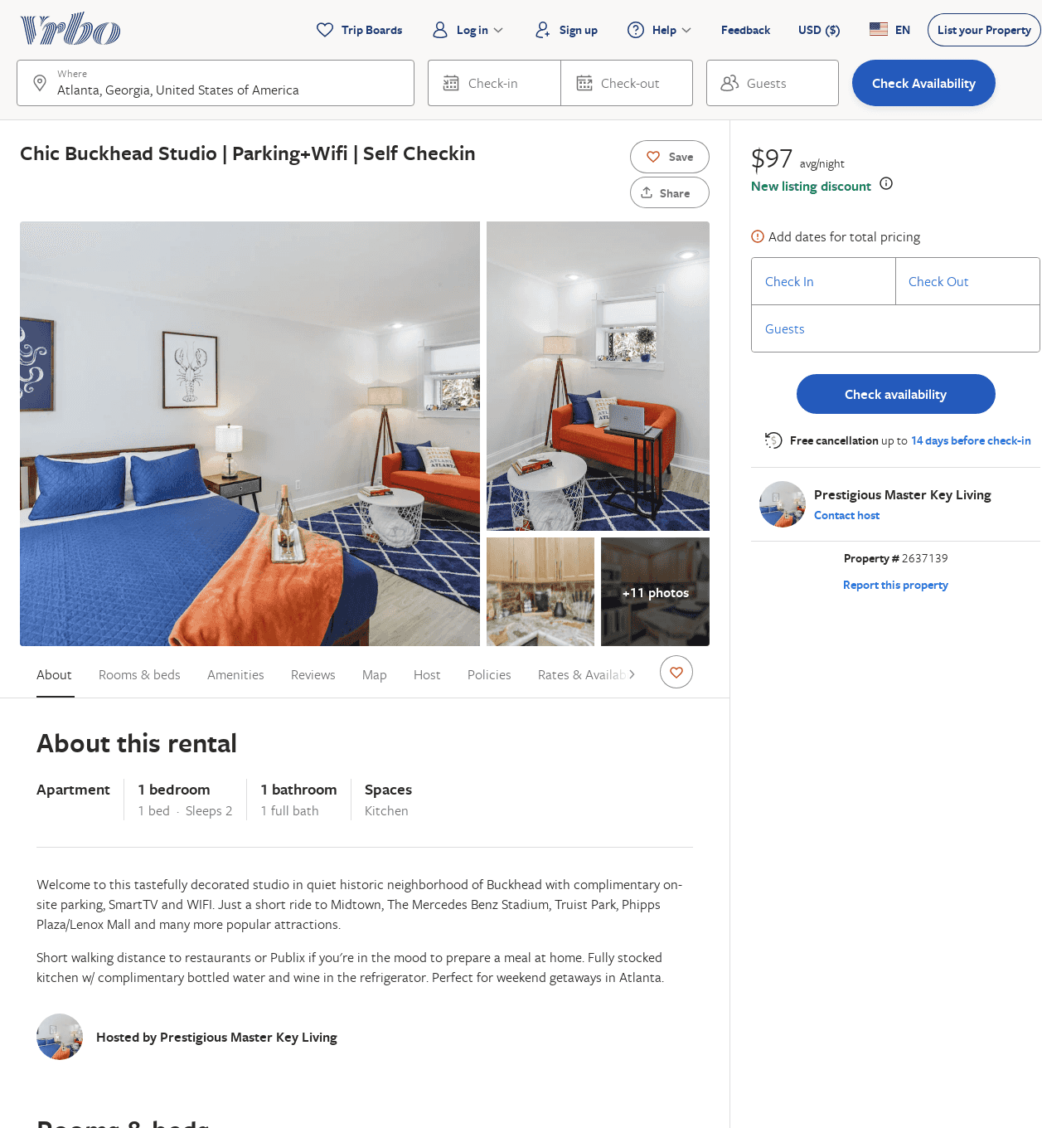
Listing 2637139
1
2
$97
5
2
Prestigious Master Key Living
https://www.vrbo.com/2637139
Aug 2022

Slide 33
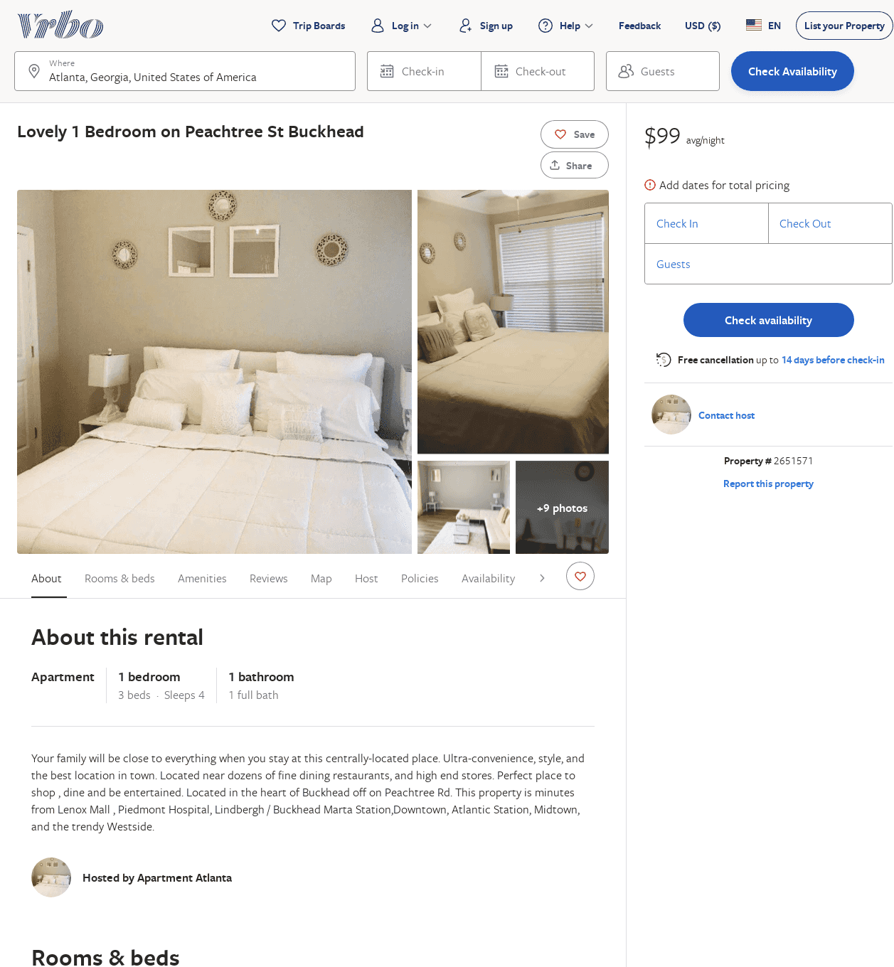
Listing 2651571
1
4
$99
30
https://www.vrbo.com/2651571
Aug 2022

Slide 34
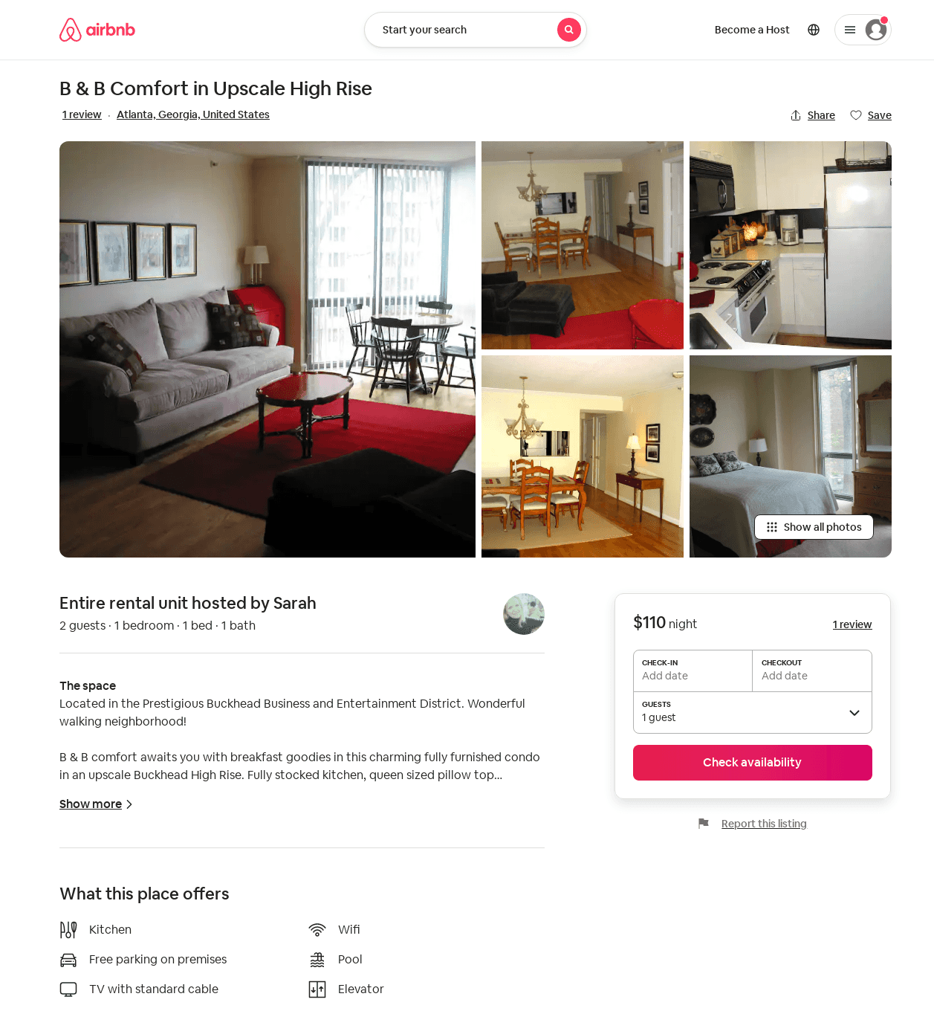
Listing 157998
1
2
$110
3
Sarah
92865
1
https://www.airbnb.com/rooms/157998
Jun 2022

Slide 35
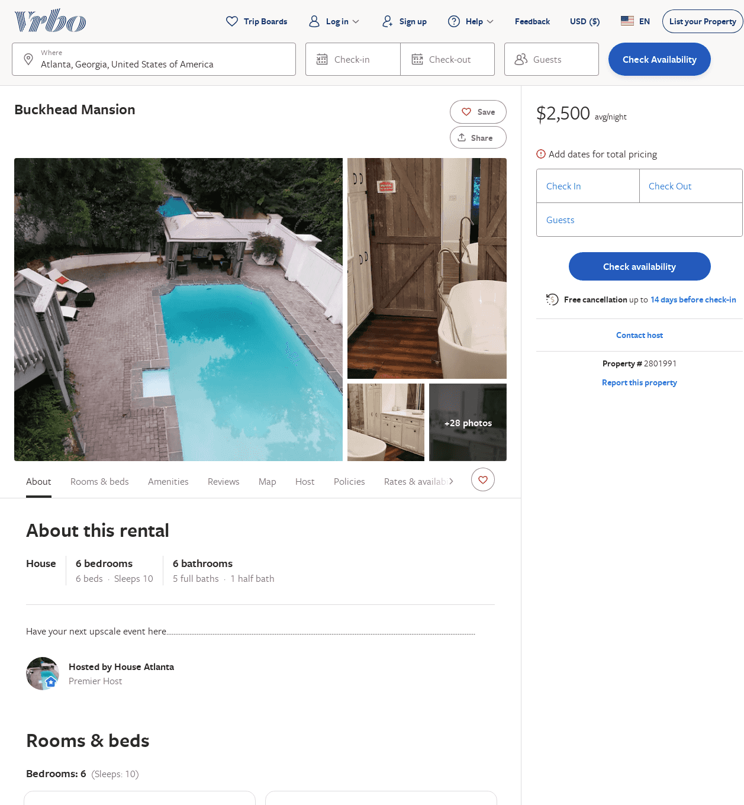
Listing 2801991
6
10
$2,277
1
Authentic Reservations
https://www.vrbo.com/2801991
Aug 2022

Slide 36
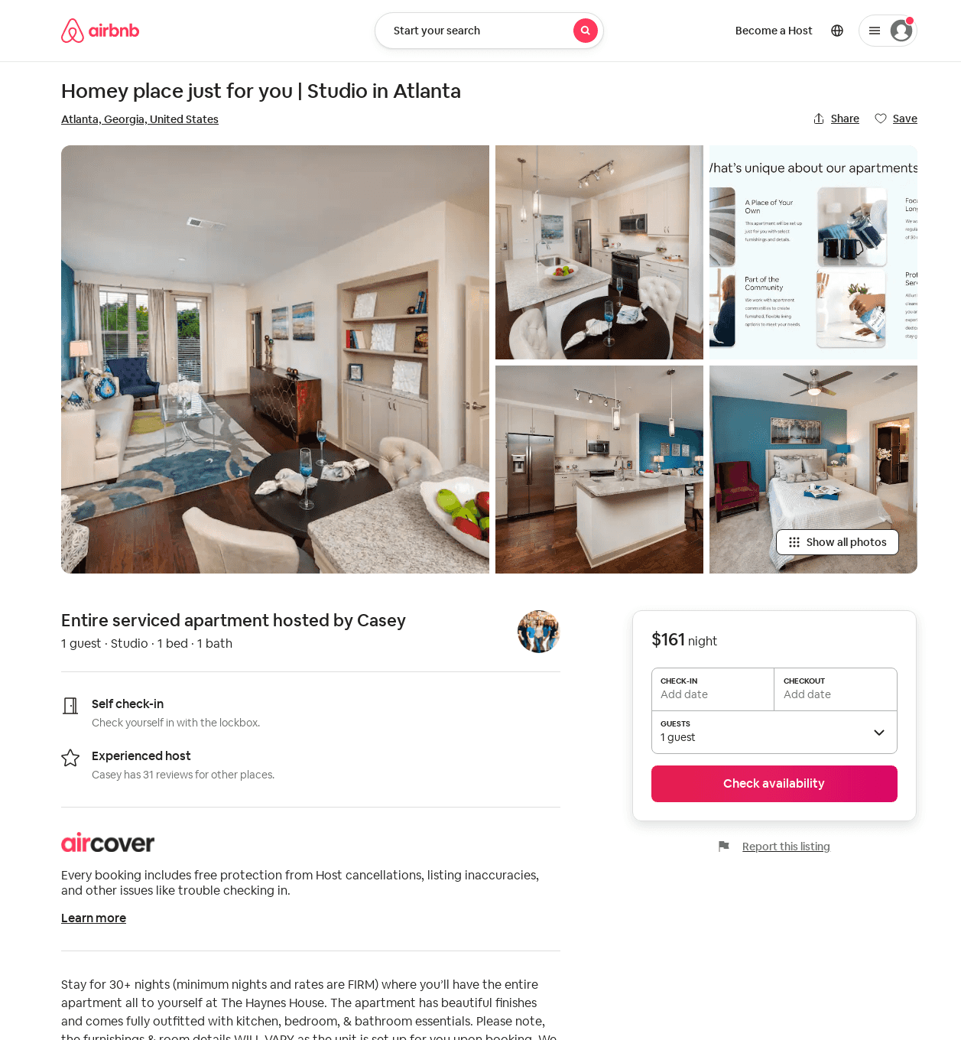
Listing 48811364
Studio
1
31
Casey
359231771
601
https://www.airbnb.com/rooms/48811364
Jun 2022

