Slide 2
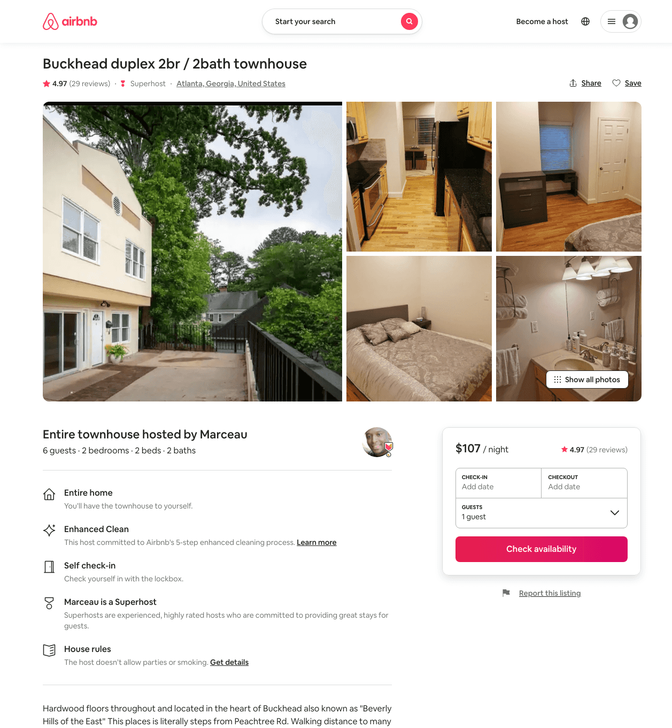
Listing 45540492
2
6
$104 - $175
4.87
1
Marceau
368706700
2
https://www.airbnb.com/rooms/45540492
Aug 2022

Slide 3
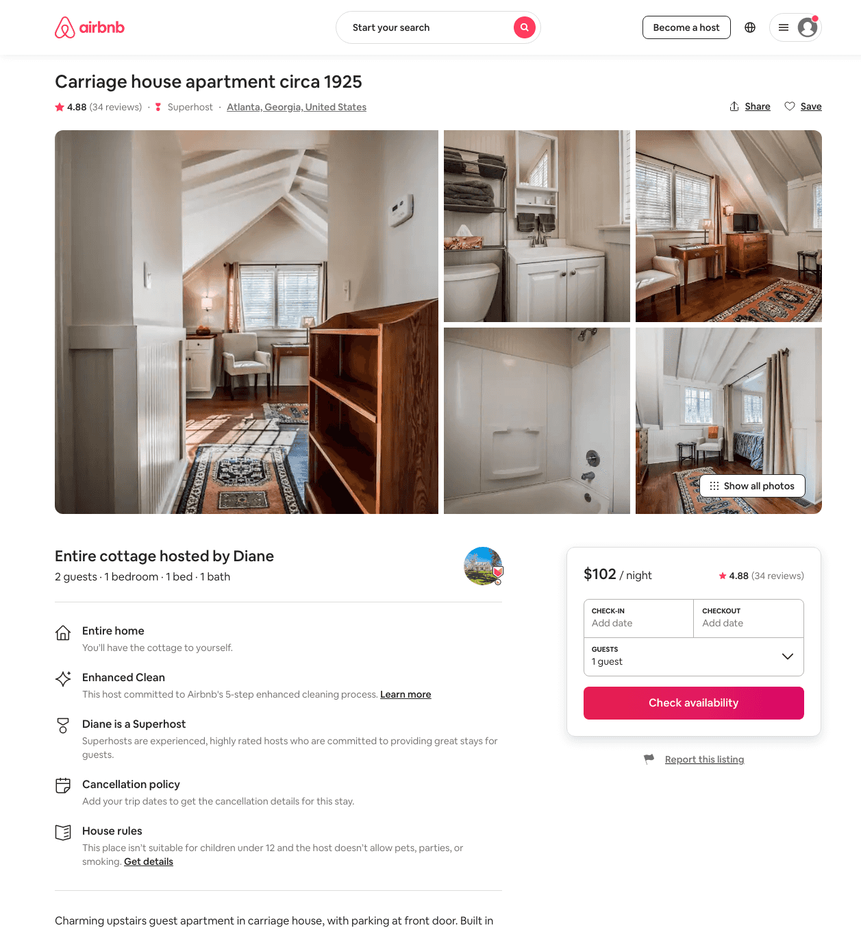
Listing 34772893
1
2
$99 - $142
4.91
30
Diane
39615854
1
https://www.airbnb.com/rooms/34772893
Aug 2022

Slide 4
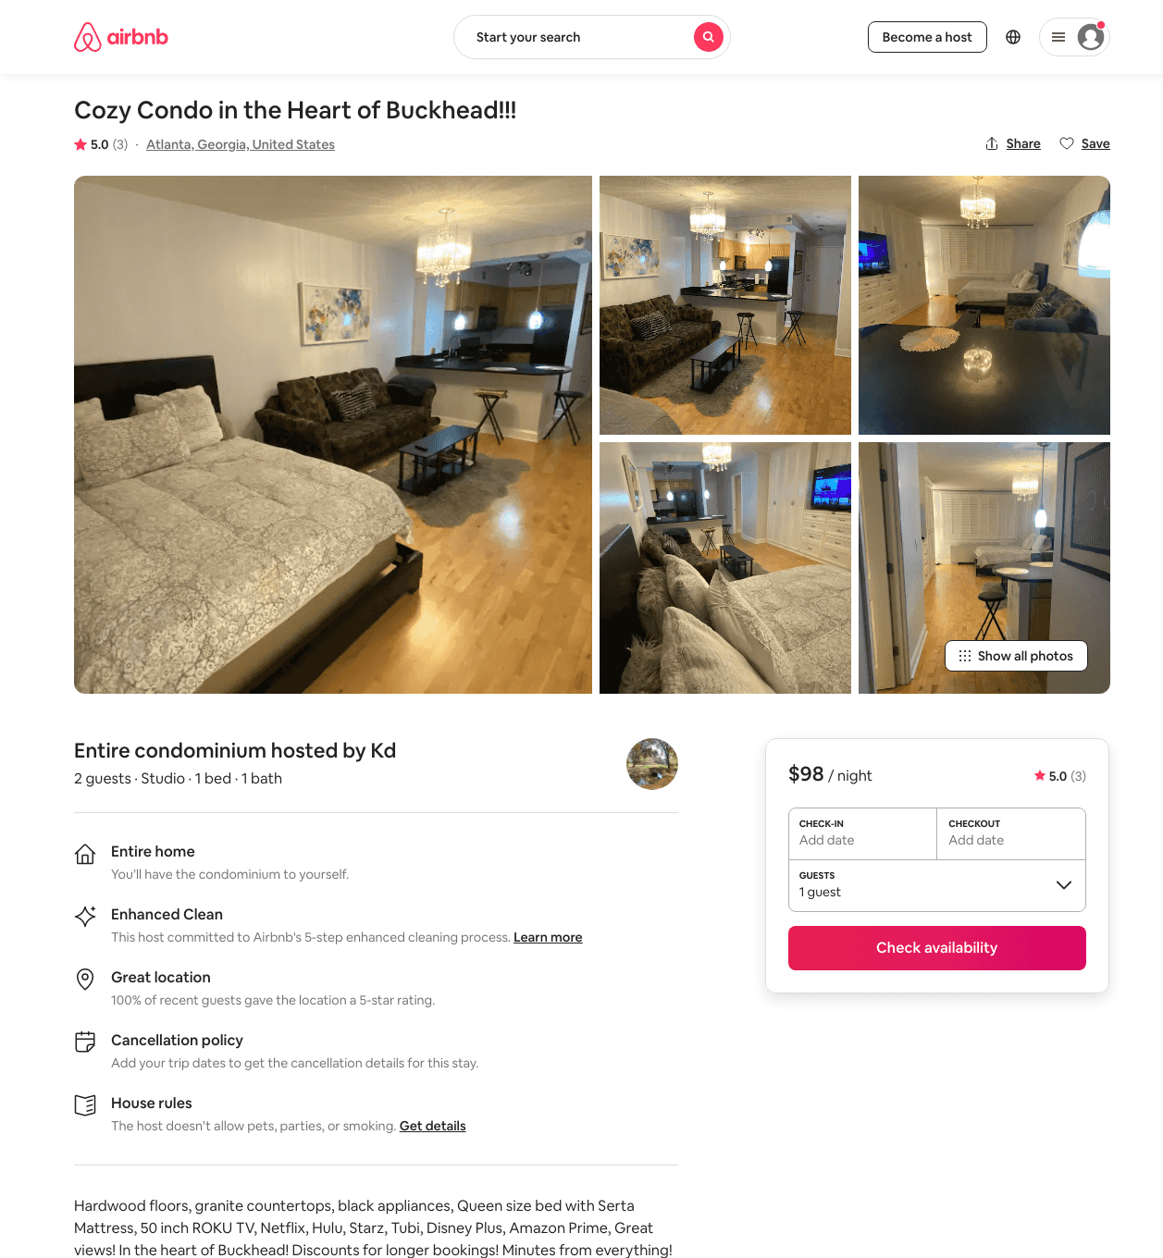
Listing 46679127
Studio
2
$91 - $116
4.67
2
Kd
376660275
1
https://www.airbnb.com/rooms/46679127
Jul 2022

Slide 5
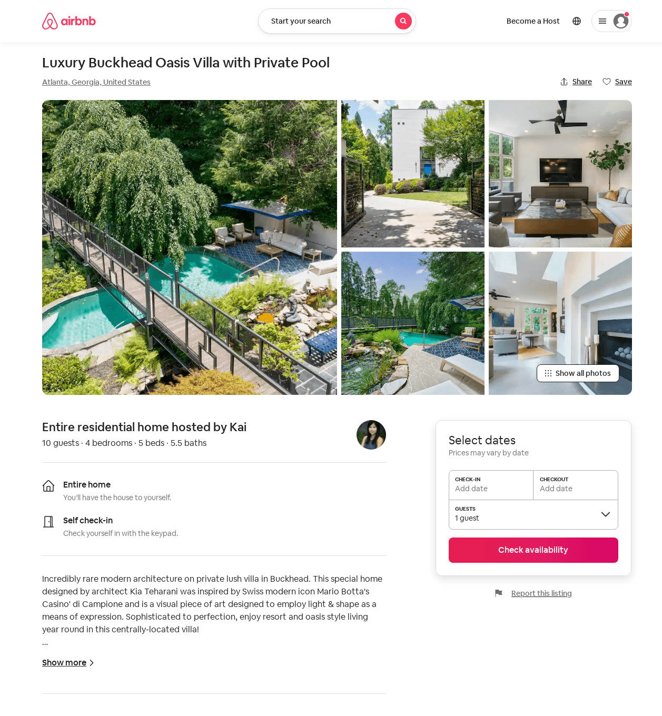
Listing 52370830
4
10
$903 - $1270
4.88
2
Kai
423900918
1
https://www.airbnb.com/rooms/52370830
Aug 2022

Slide 6
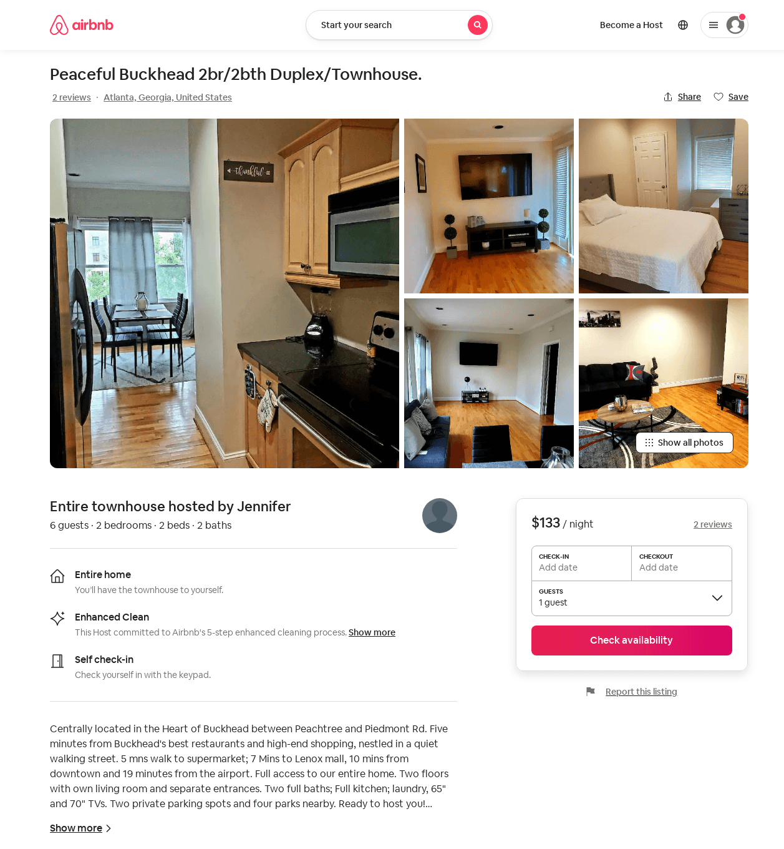
Listing 52371588
2
6
$92 - $155
4.80
2
Jennifer
423905675
1
https://www.airbnb.com/rooms/52371588
Aug 2022

Slide 7
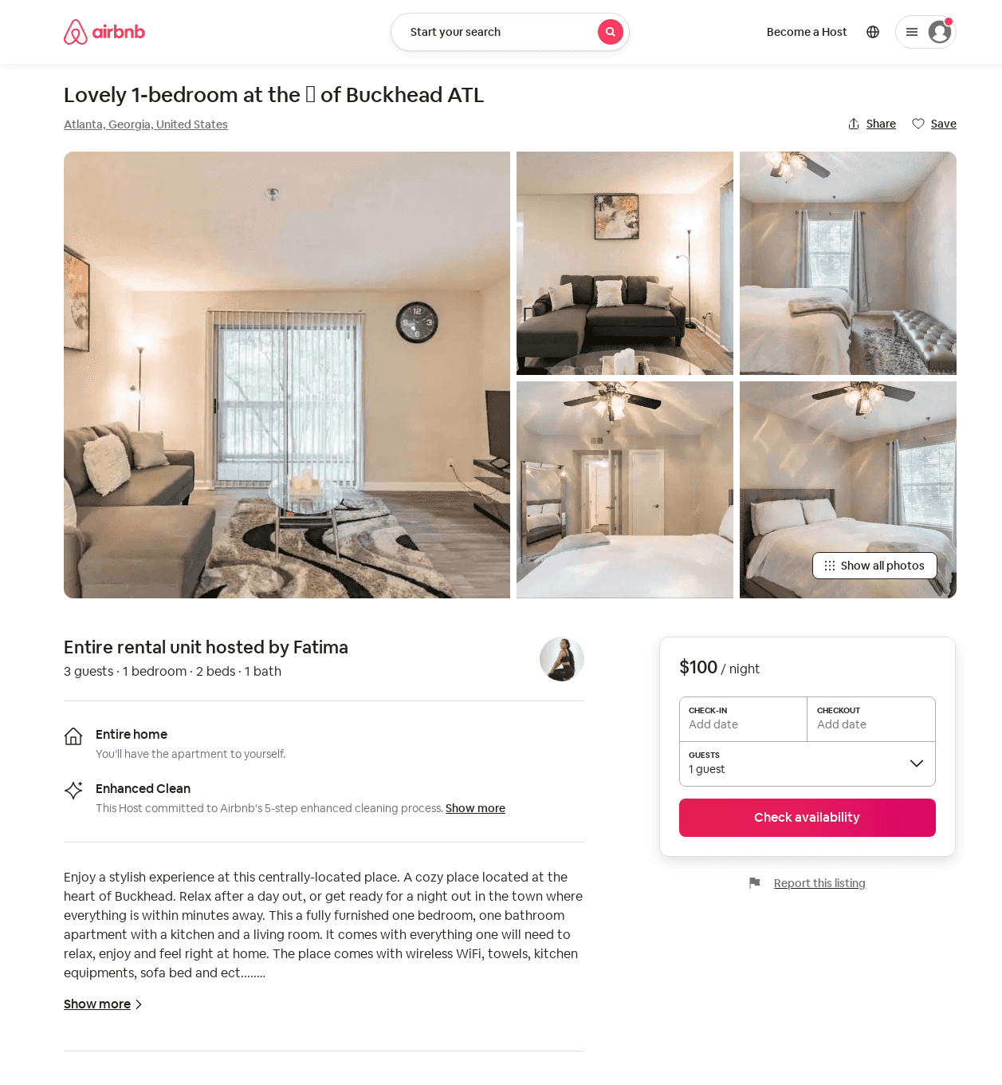
Listing 53015578
1
3
$75 - $125
4.47
2
Fatima
429187523
1
https://www.airbnb.com/rooms/53015578
Aug 2022

Slide 8
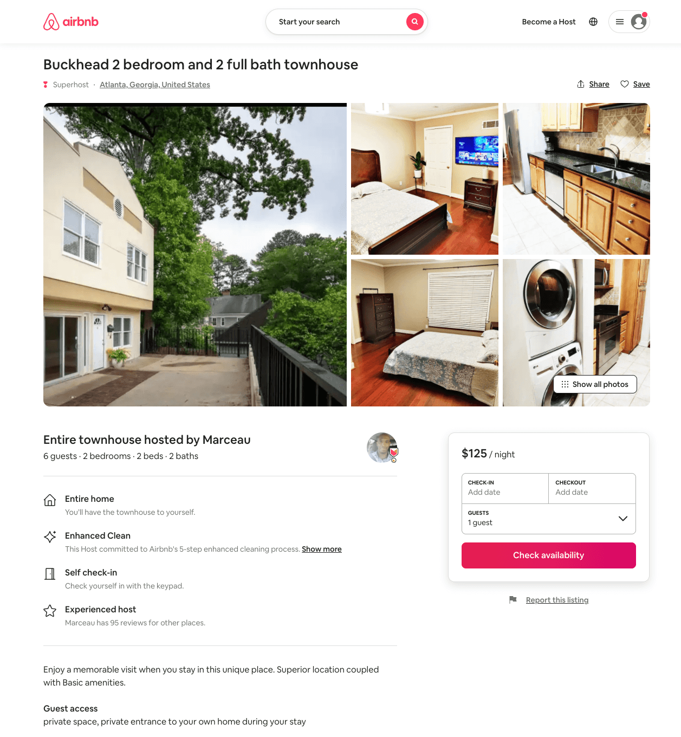
Listing 54267401
2
6
$113 - $132
5.0
2
Marceau
368706700
2
https://www.airbnb.com/rooms/54267401
Aug 2022

Slide 9
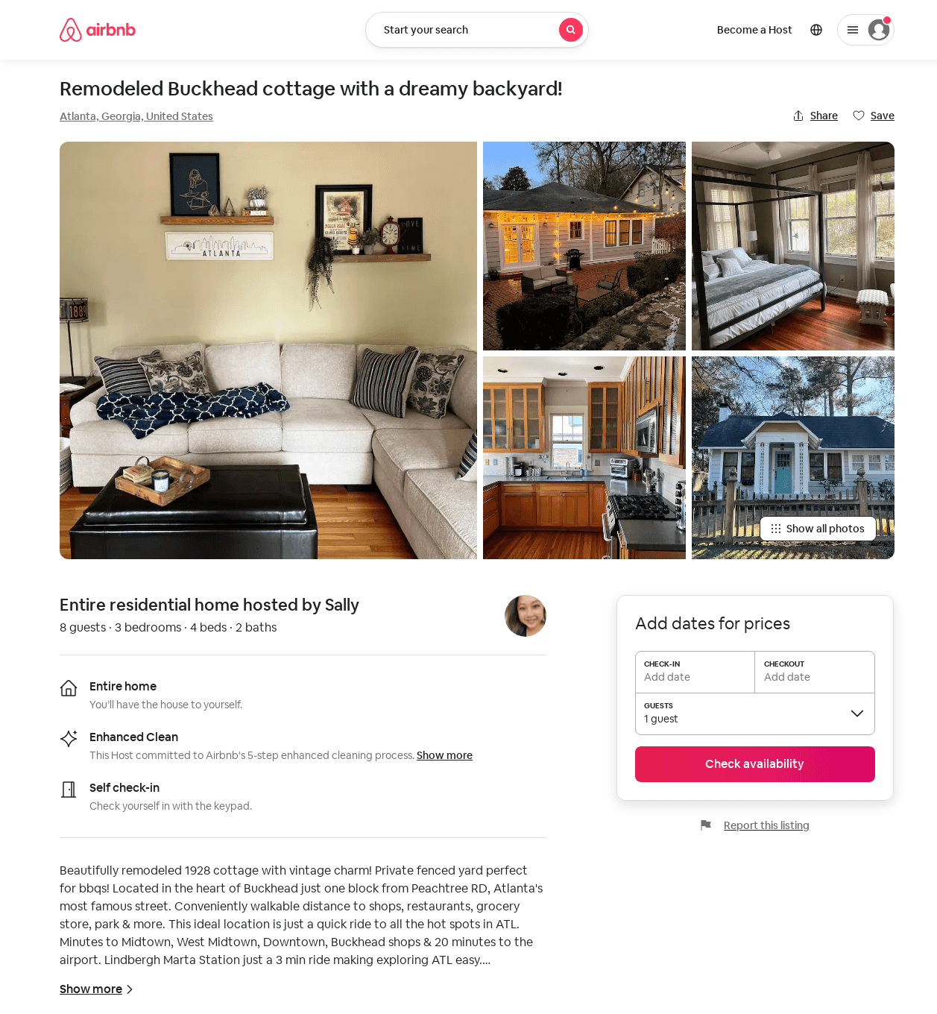
Listing 51868257
3
8
$161 - $286
5.0
2
Sally
8961526
1
https://www.airbnb.com/rooms/51868257
Aug 2022

Slide 10
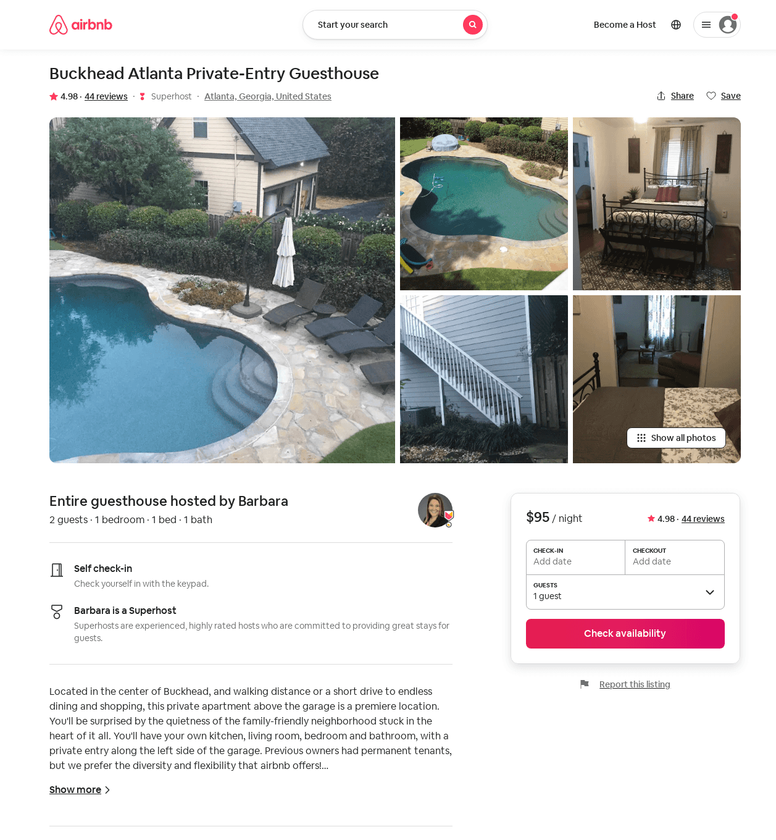
Listing 28365098
1
2
$95 - $111
4.98
2
Barbara
214156095
1
https://www.airbnb.com/rooms/28365098
Aug 2022

Slide 11
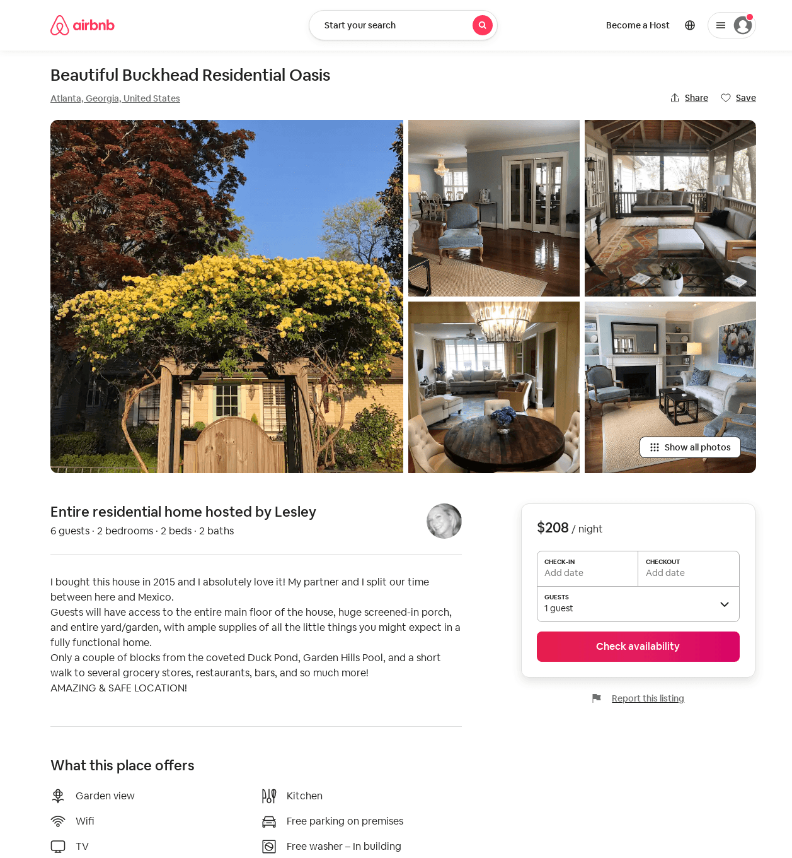
Listing 34704857
2
6
$206 - $261
5.0
2
Lesley
4339607
1
https://www.airbnb.com/rooms/34704857
Aug 2022

Slide 12
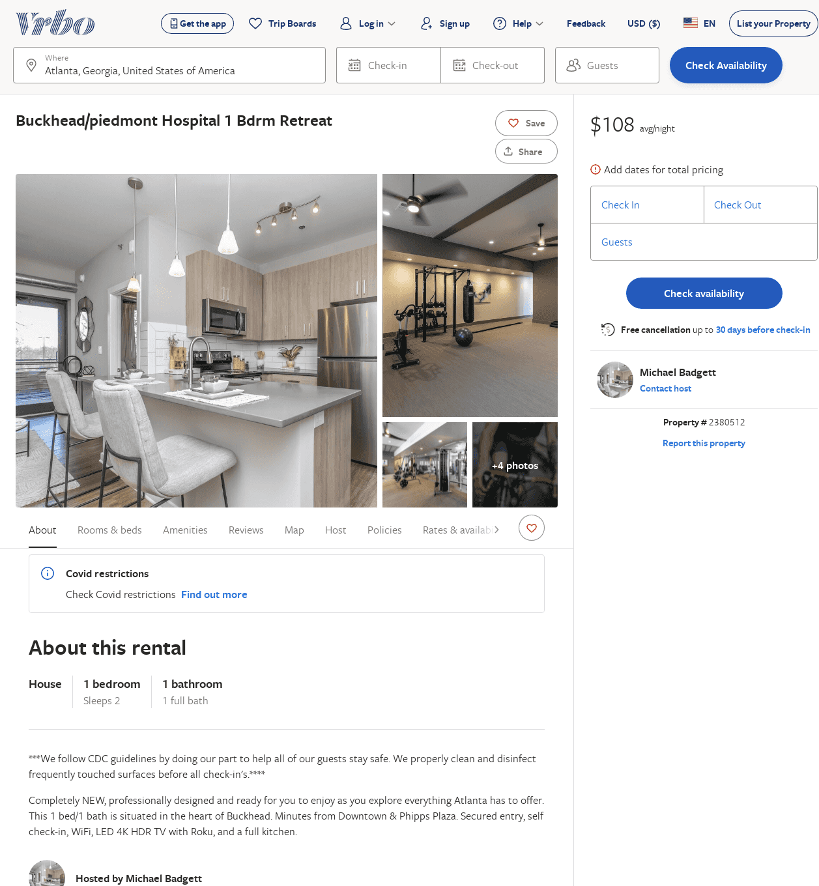
Listing 2380512
1
2
$108
7
Michael Badgett
https://www.vrbo.com/2380512
Aug 2022

