Slide 2
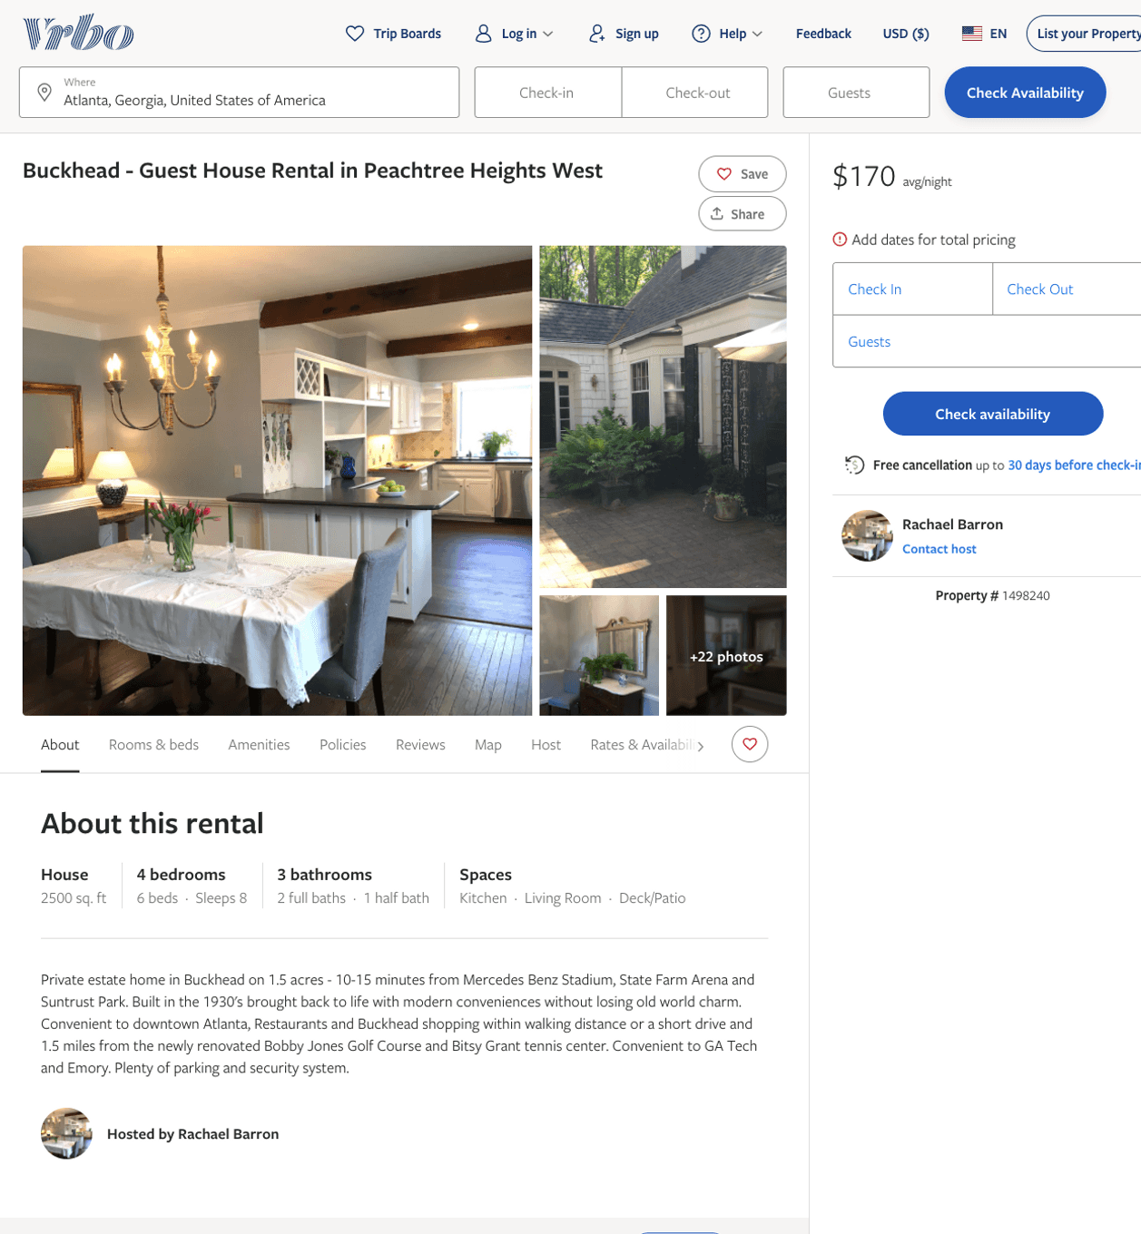
Listing 1498240
4
8
$145 - $350
5
3
Rachael Barron
https://www.vrbo.com/1498240
Aug 2022

Slide 3
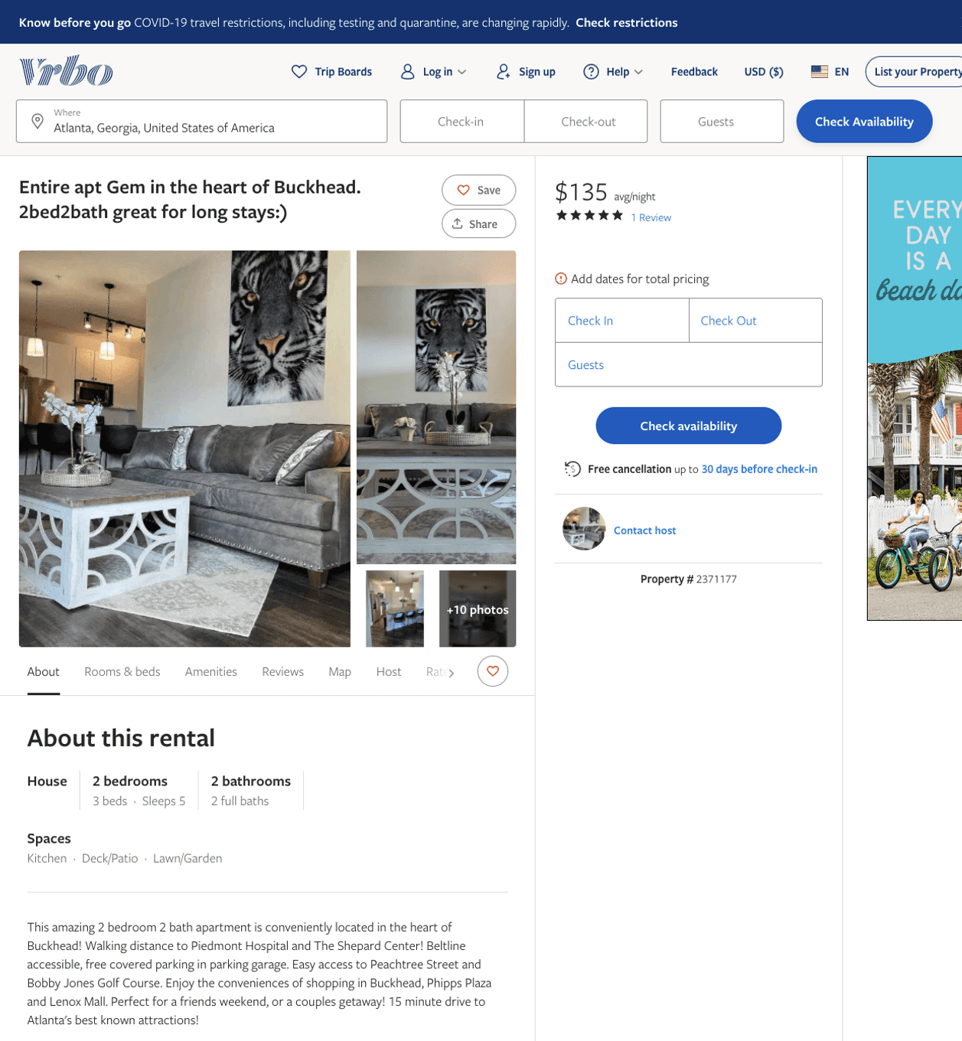
Listing 2371177
2
5
$134 - $185
4.875
2
Kason
https://www.vrbo.com/2371177
Aug 2022

Slide 4
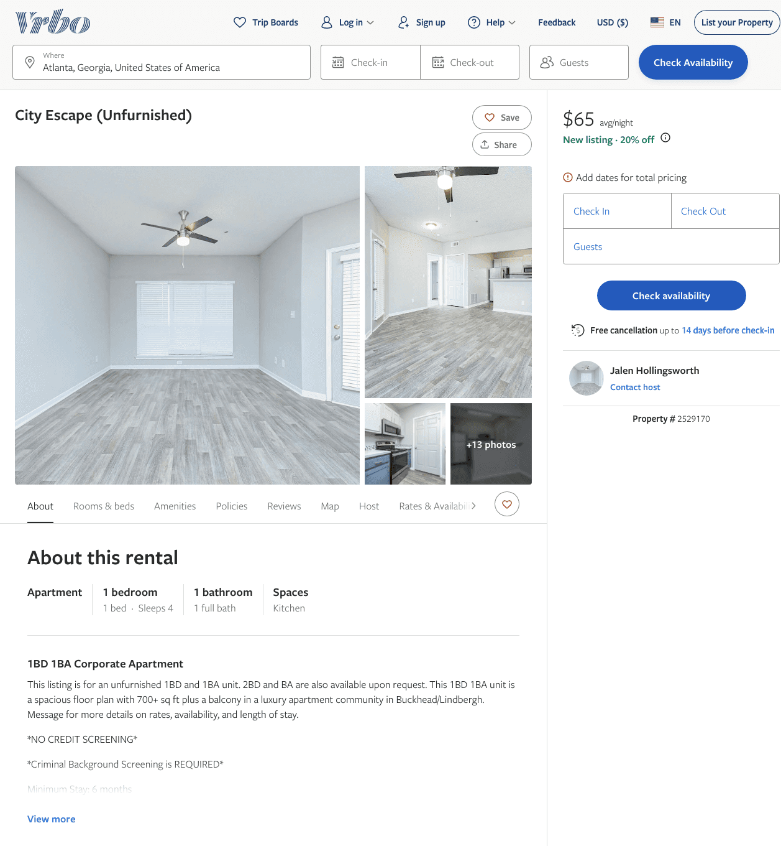
Listing 2529170
1
4
$65
28
Jalen Hollingsworth
https://www.vrbo.com/2529170
Aug 2022

Slide 5
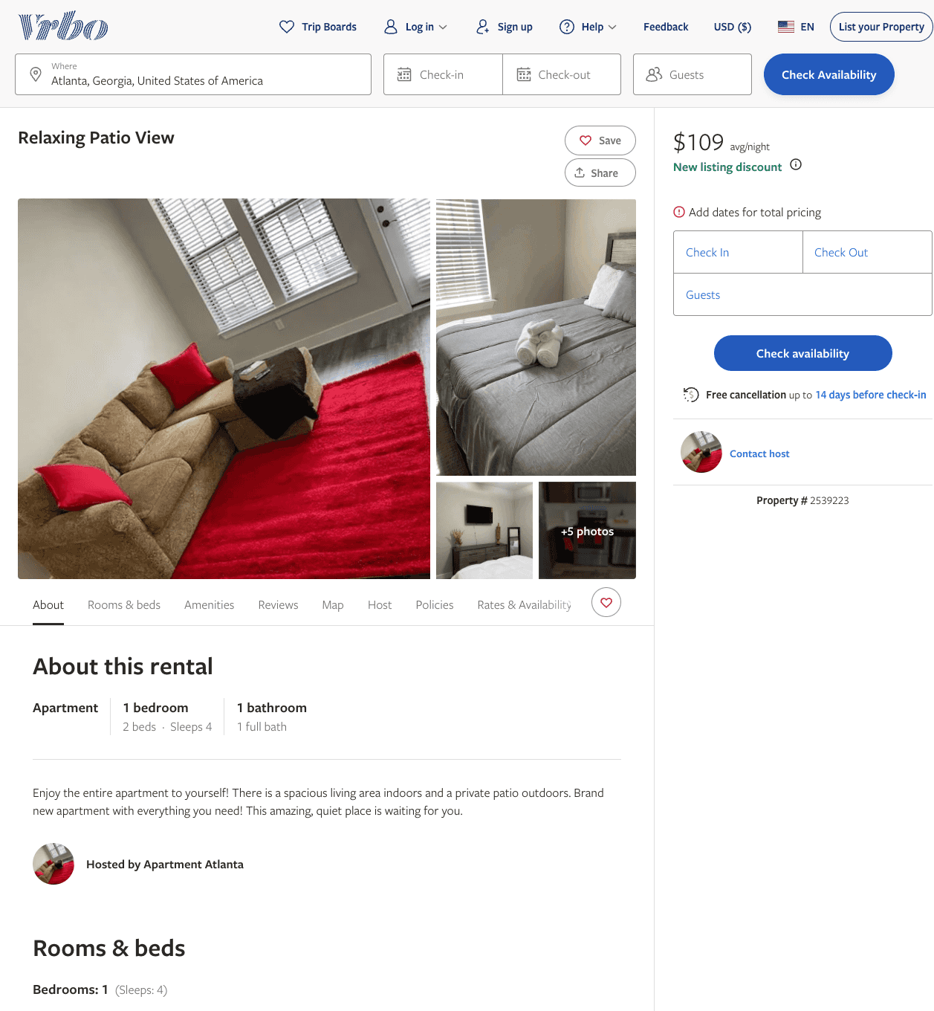
Listing 2539223
1
4
$109 - $117
1
https://www.vrbo.com/2539223
Aug 2022

Slide 6
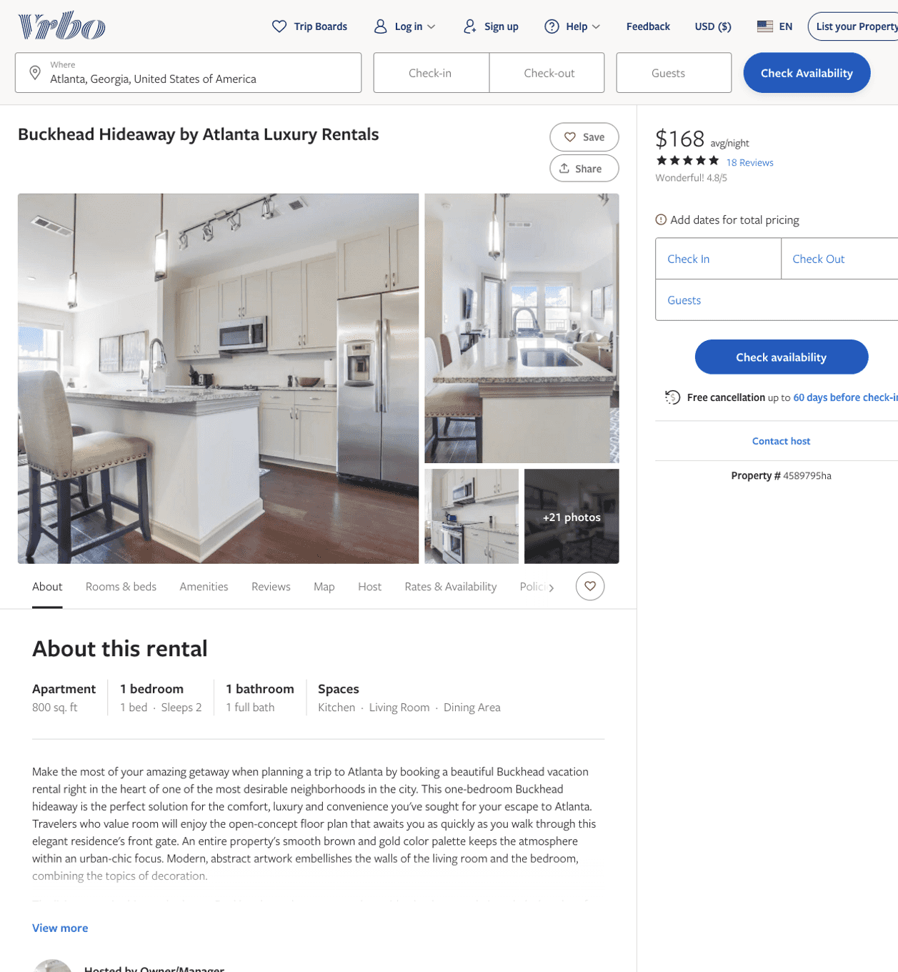
Listing 4589795
1
2
$165 - $196
4.85
30
Owner/Manager
https://www.vrbo.com/4589795ha
Aug 2022

Slide 7
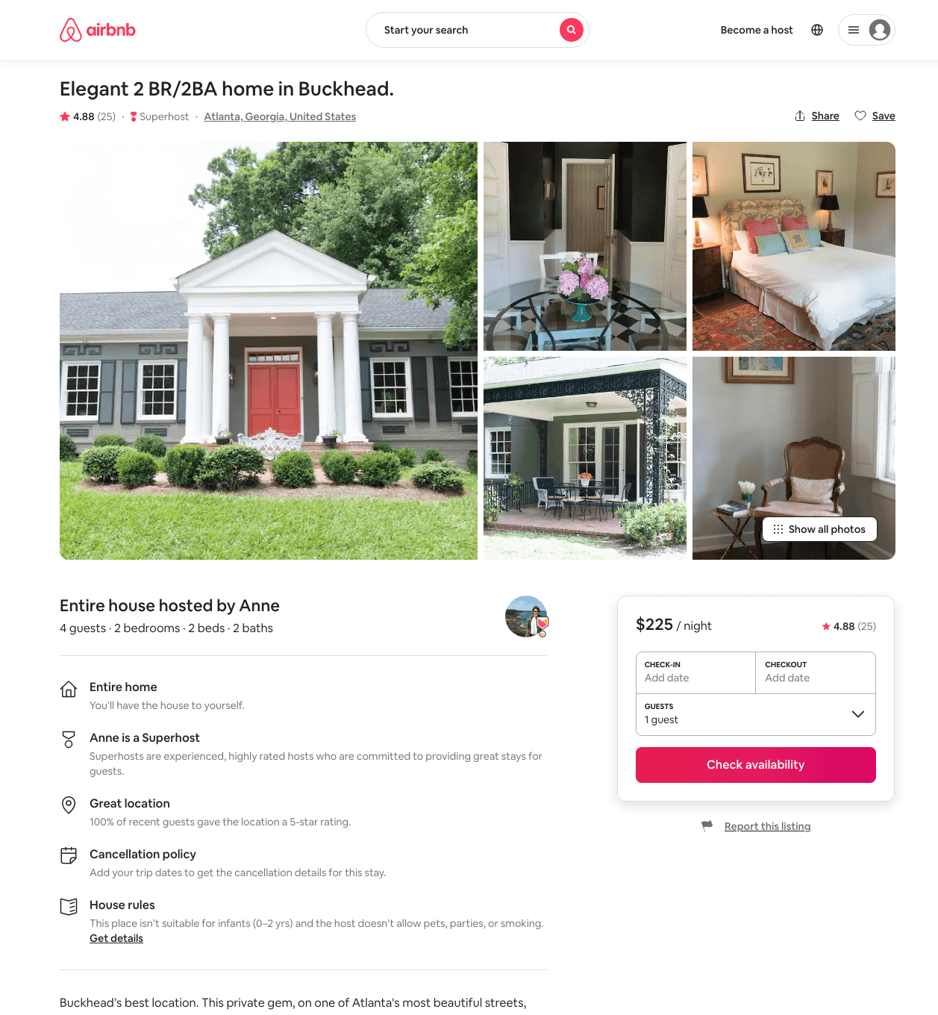
Listing 43228426
2
4
$216 - $300
4.86
2
Sam
7466753
1
https://www.airbnb.com/rooms/43228426
Aug 2022

Slide 8
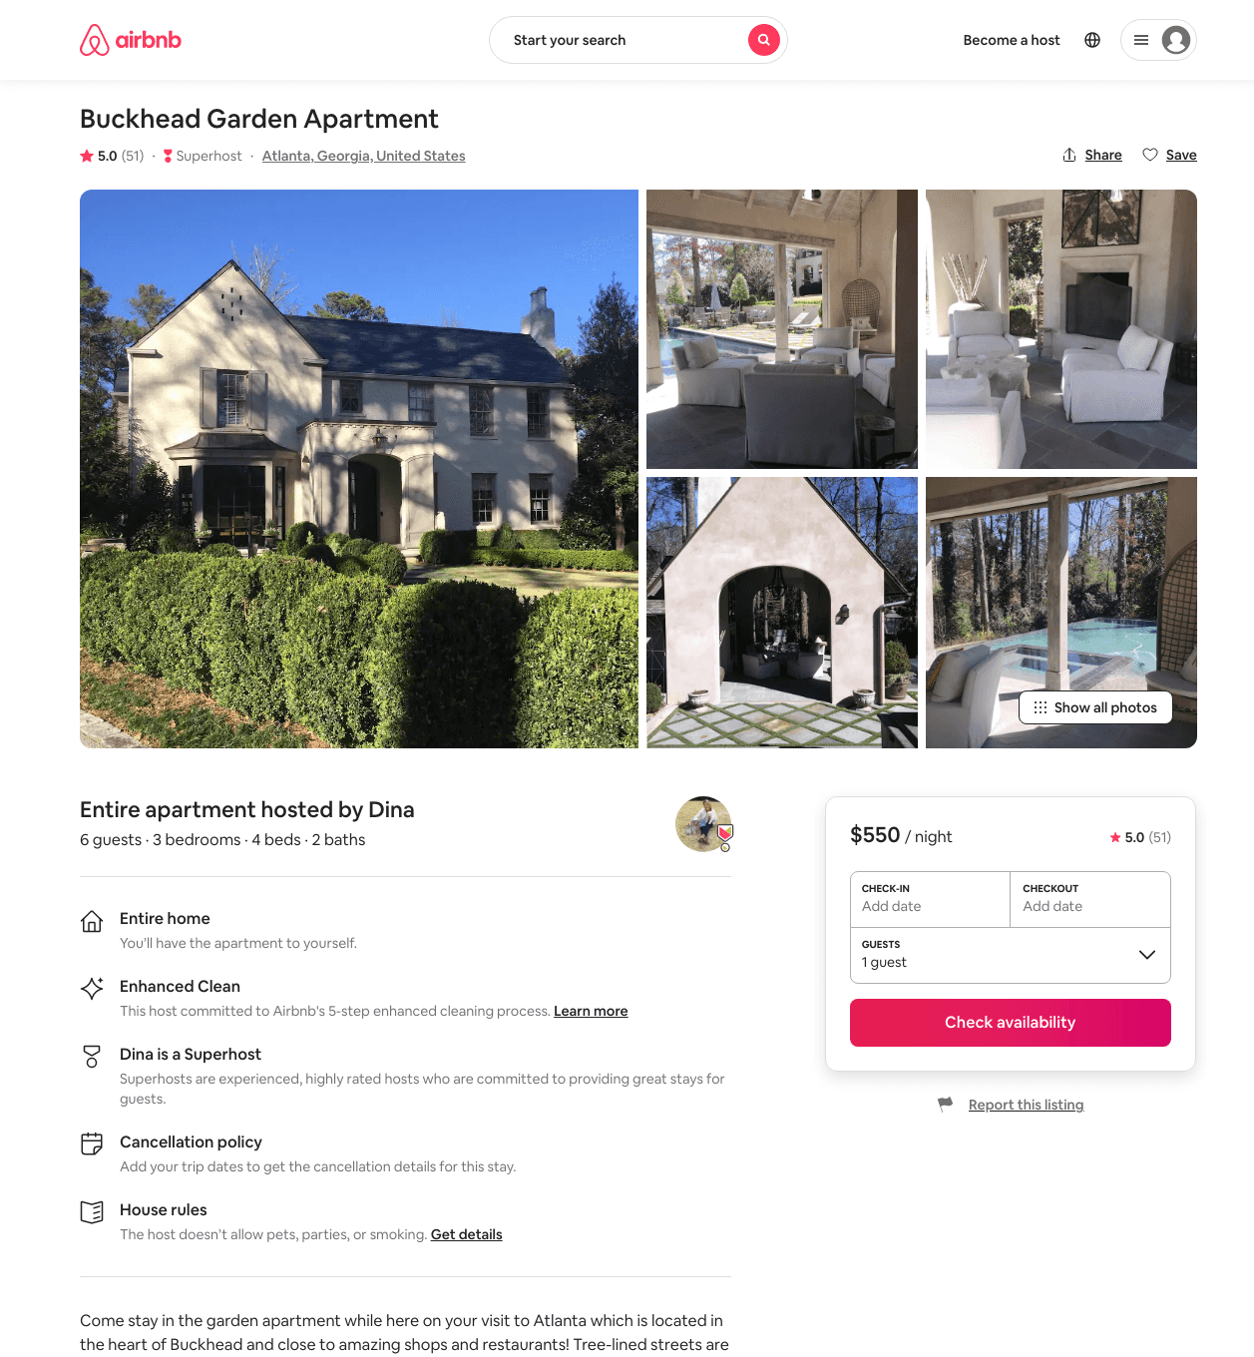
Listing 16766609
3
6
$550
4.91
2
Dina
111296891
1
https://www.airbnb.com/rooms/16766609
Aug 2022

Slide 9
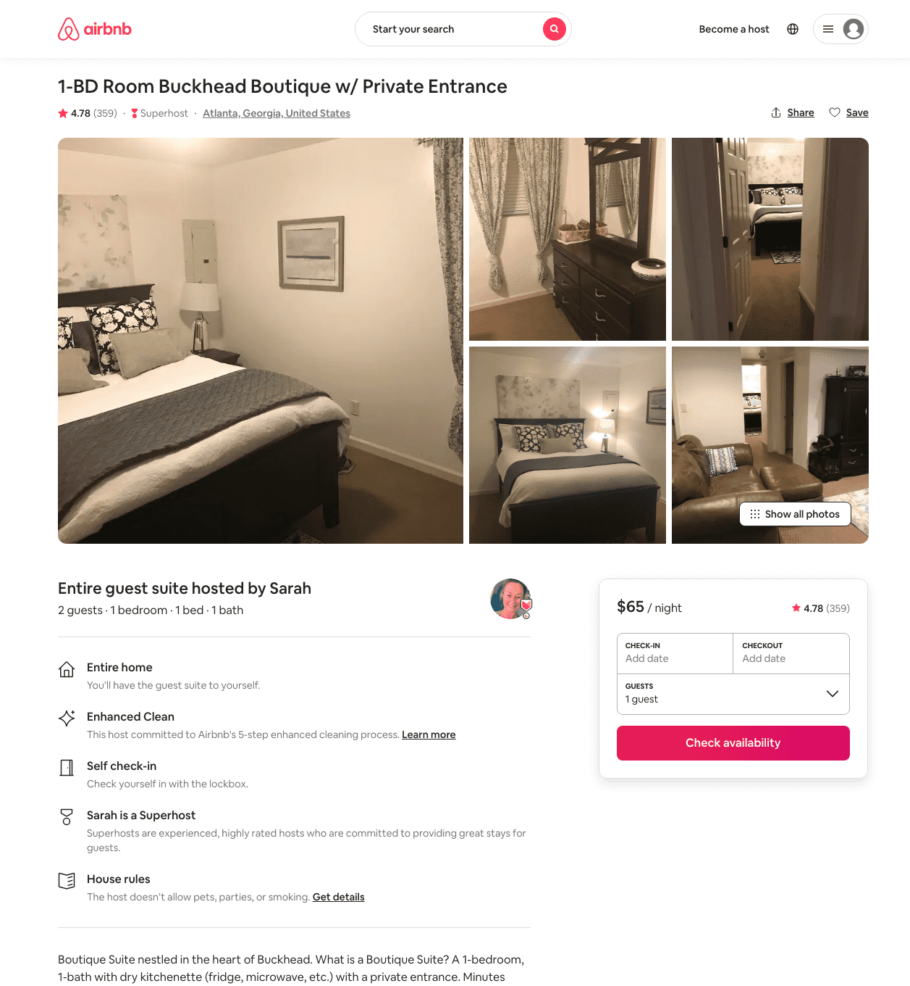
Listing 14283783
1
2
$65 - $115
4.78
1
Sarah
37940994
1
https://www.airbnb.com/rooms/14283783
Aug 2022

Slide 10
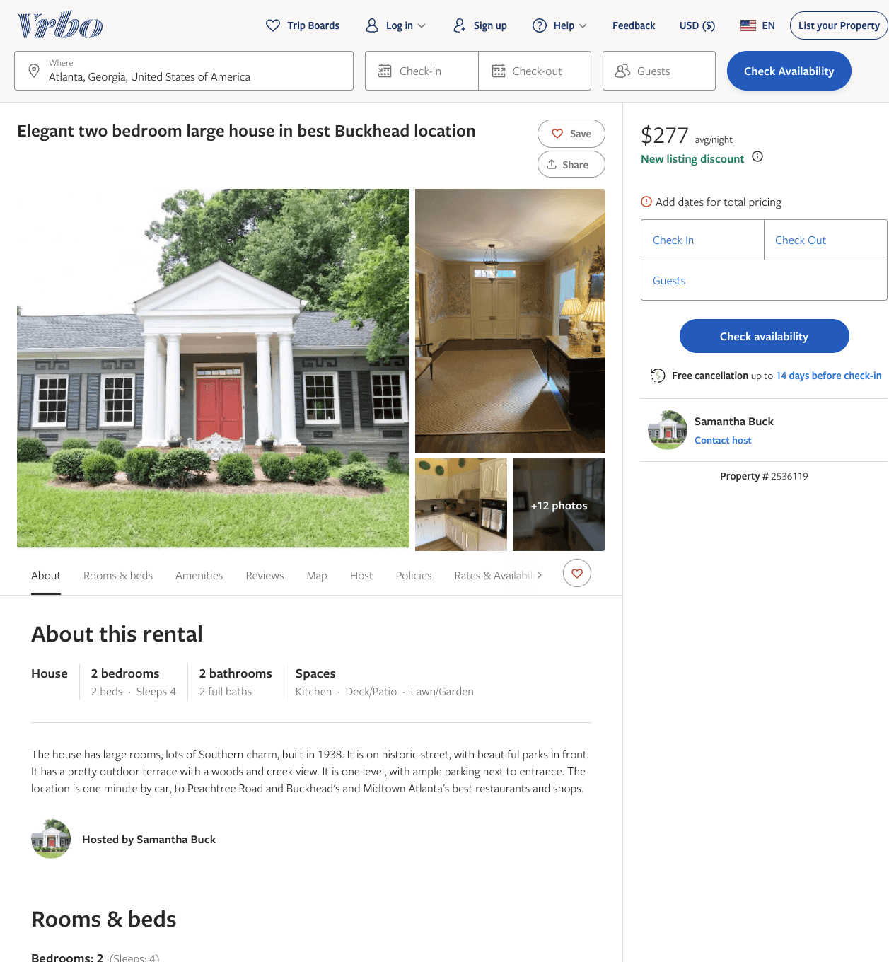
Listing 2536119
2
4
$266 - $283
5
2
Samantha Buck
https://www.vrbo.com/2536119
Aug 2022

Slide 11
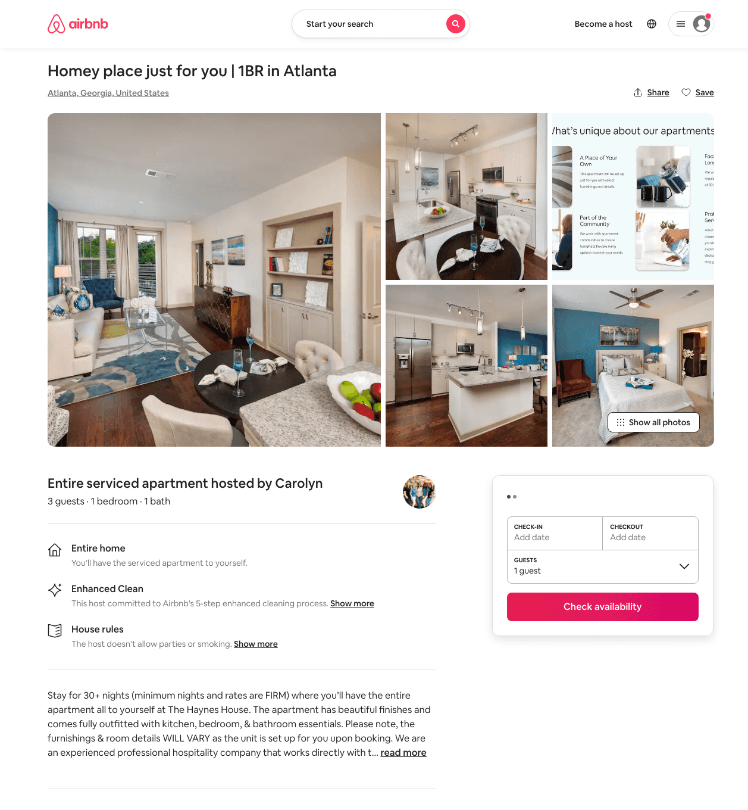
Listing 49629875
1
3
$121 - $163
31
Casey
359231771
601
https://www.airbnb.com/rooms/49629875
Jun 2022

Slide 12
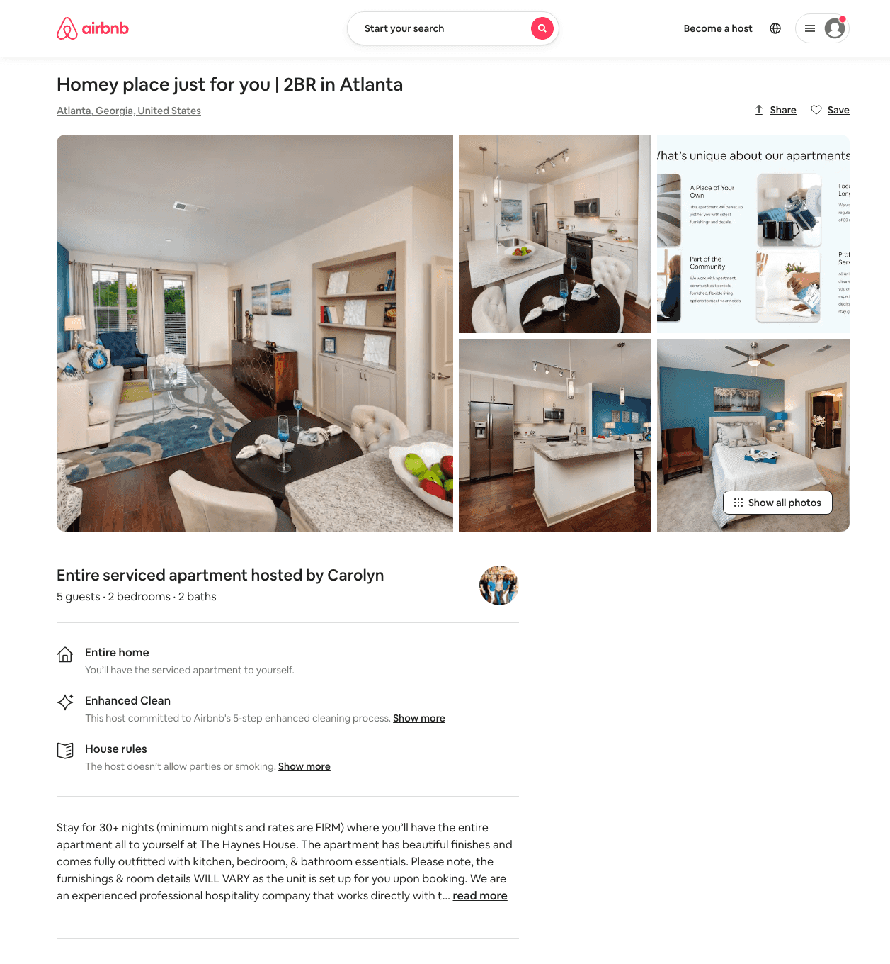
Listing 49654133
2
5
$169 - $171
31
Casey
359231771
601
https://www.airbnb.com/rooms/49654133
Jun 2022

