Slide 2
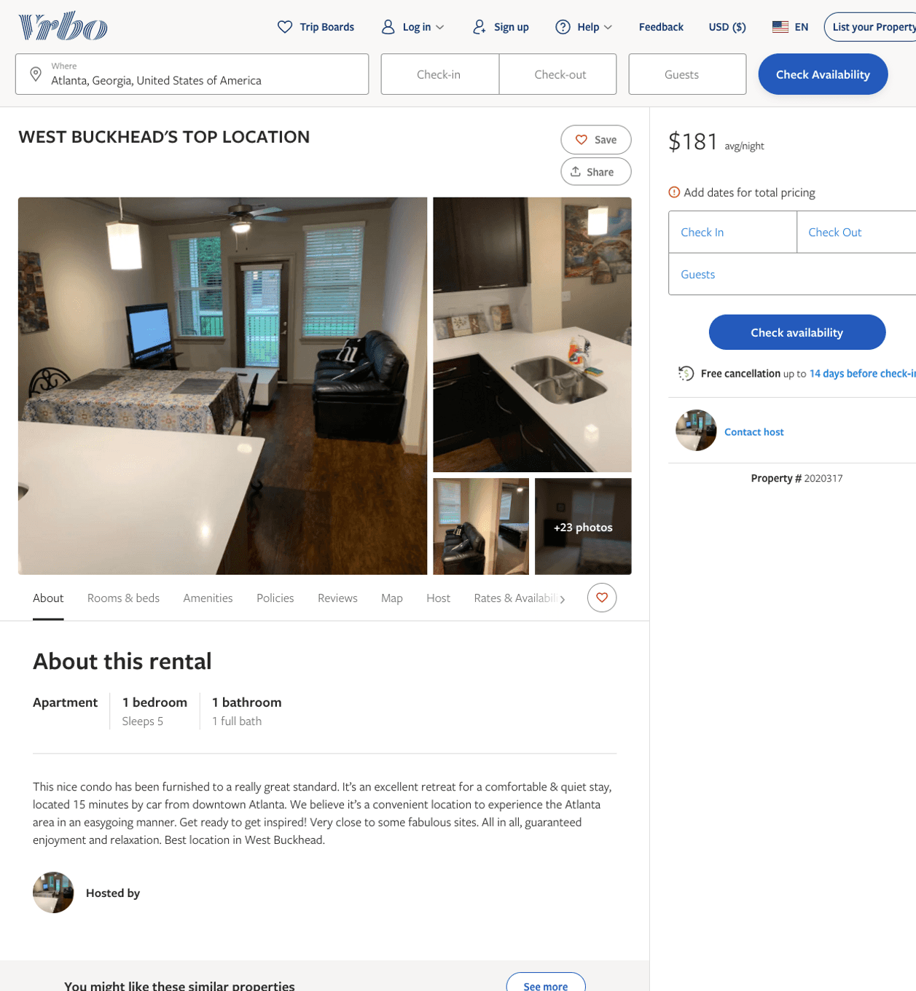
Listing 2020317
1
5
$181
2
https://www.vrbo.com/2020317
Aug 2022

Slide 3
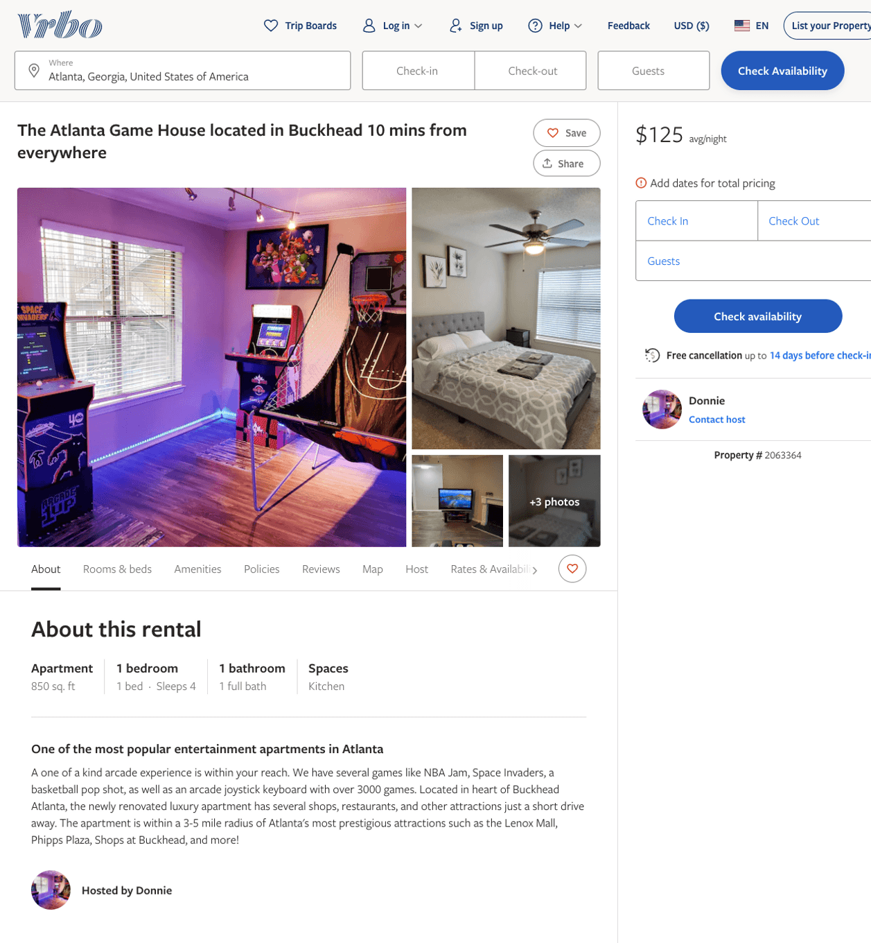
Listing 2063364
1
4
$125
2
Donnie
https://www.vrbo.com/2063364
Aug 2022

Slide 4
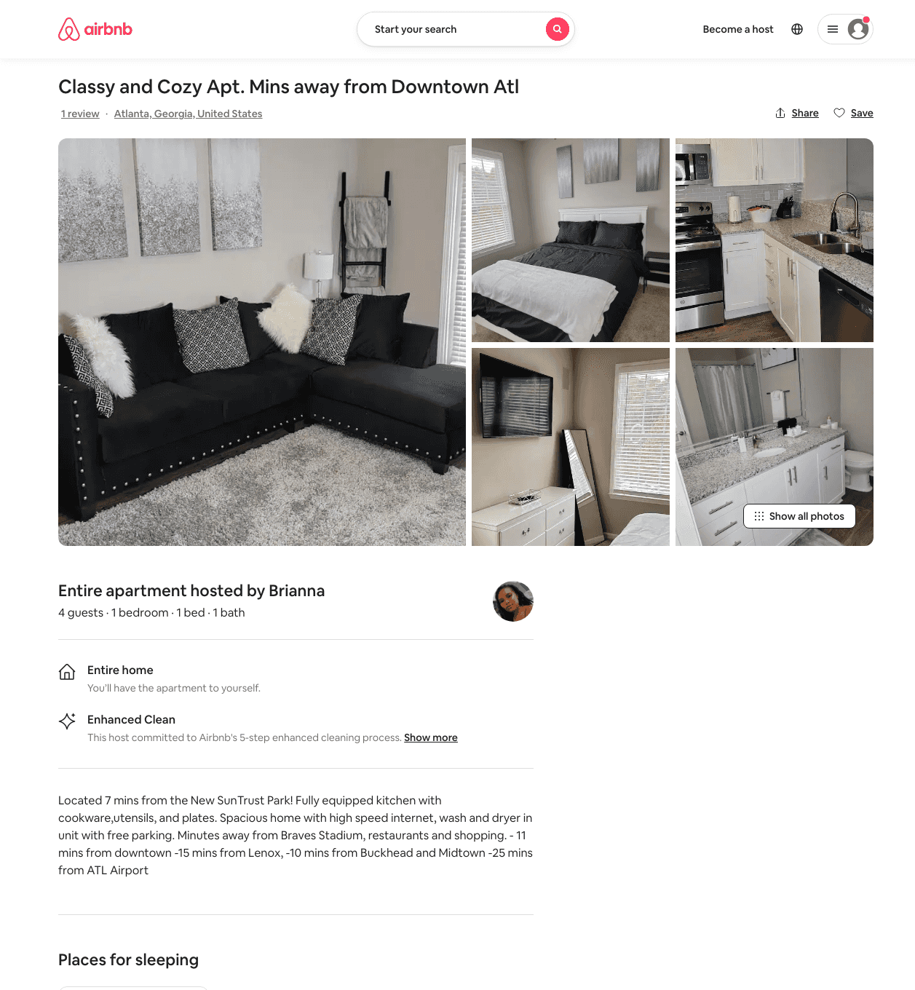
Listing 49116071
1
4
$136 - $170
4.33
2
Brianna
394660899
1
https://www.airbnb.com/rooms/49116071
Jun 2022

Slide 5
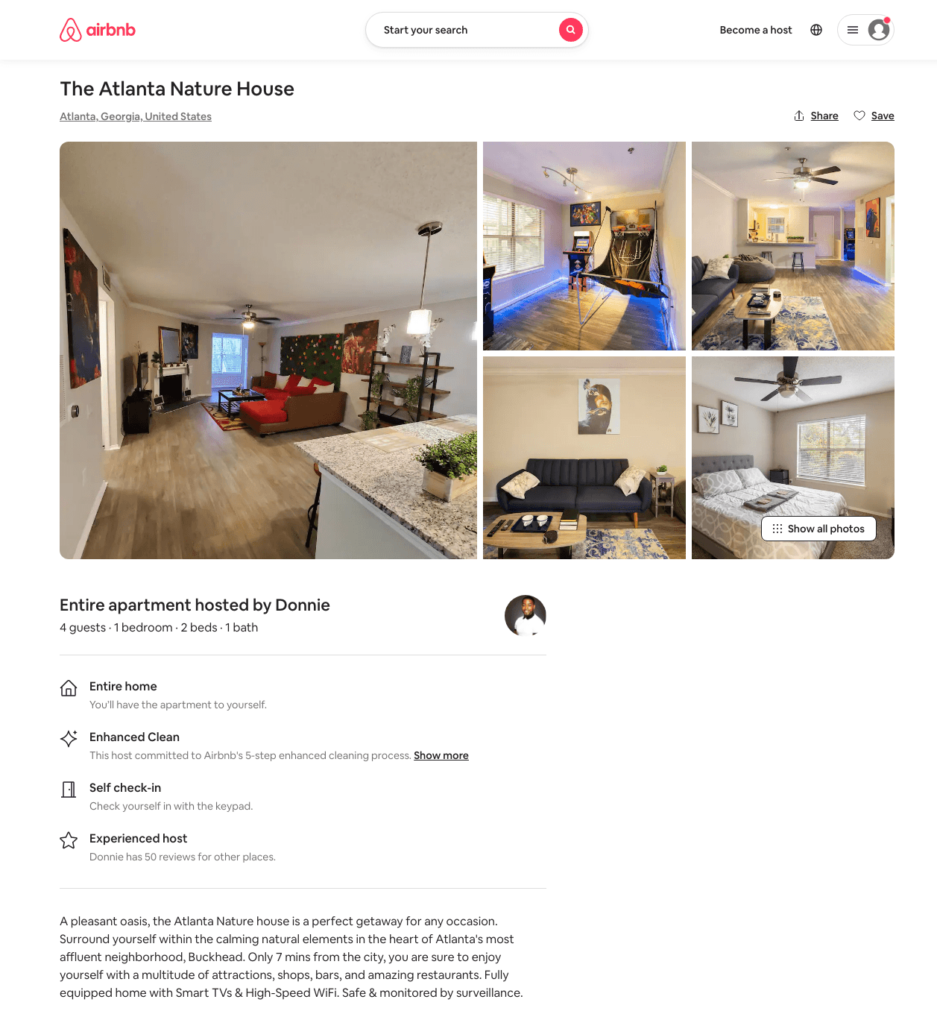
Listing 48402484
1
4
$87 - $126
4.67
1
Donnie
354521570
7
https://www.airbnb.com/rooms/48402484
Aug 2022

Slide 6
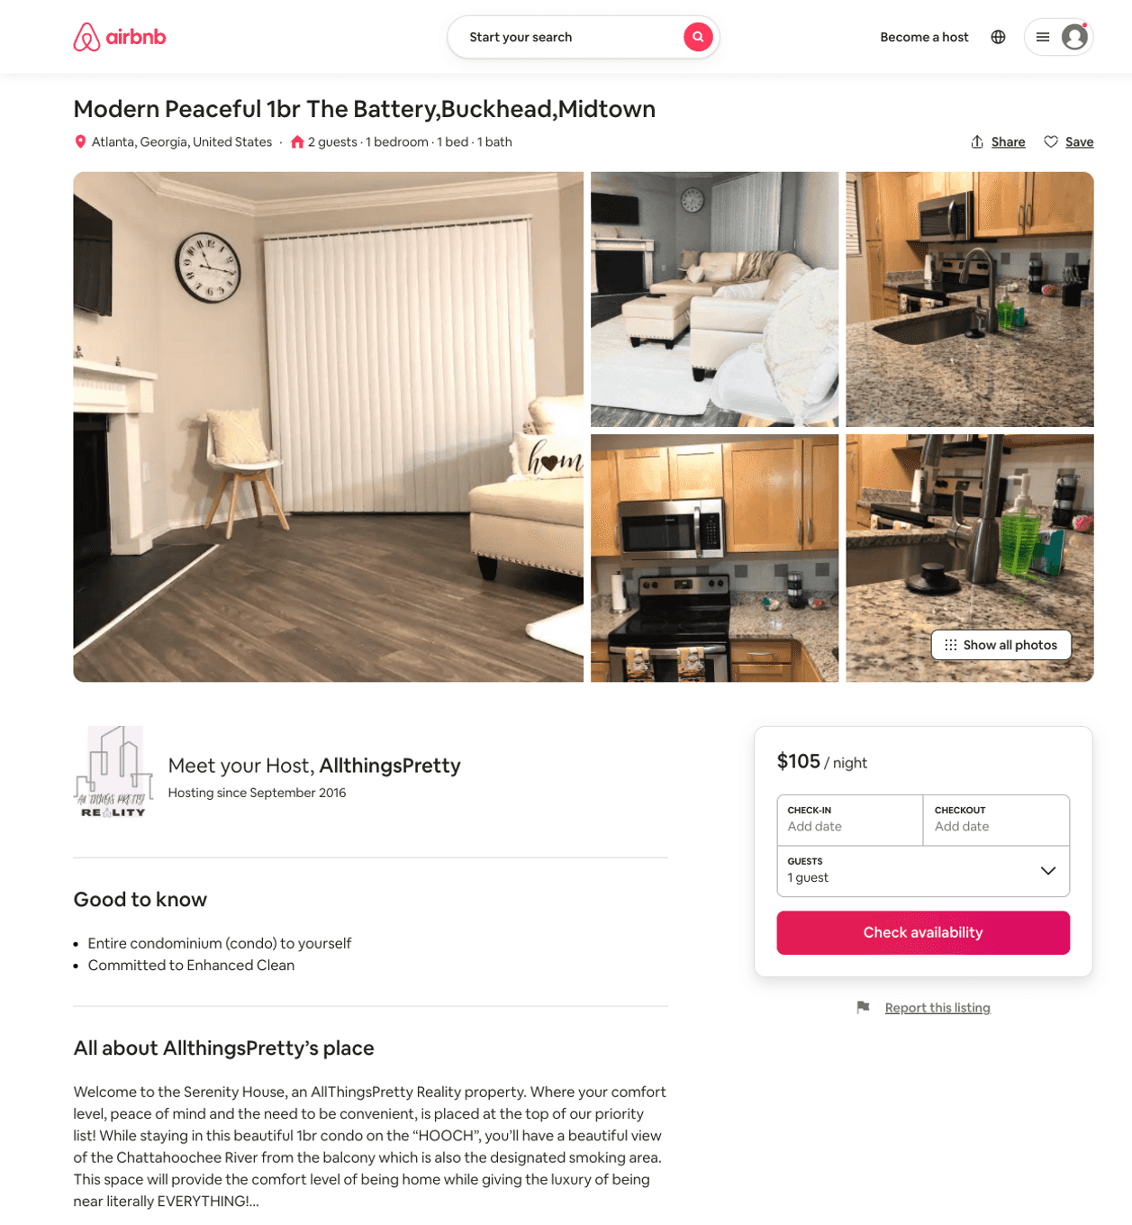
Listing 51733627
1
2
$74 - $153
4.63
1
AllthingsPretty
95102449
1
https://www.airbnb.com/rooms/51733627
Aug 2022

Slide 7
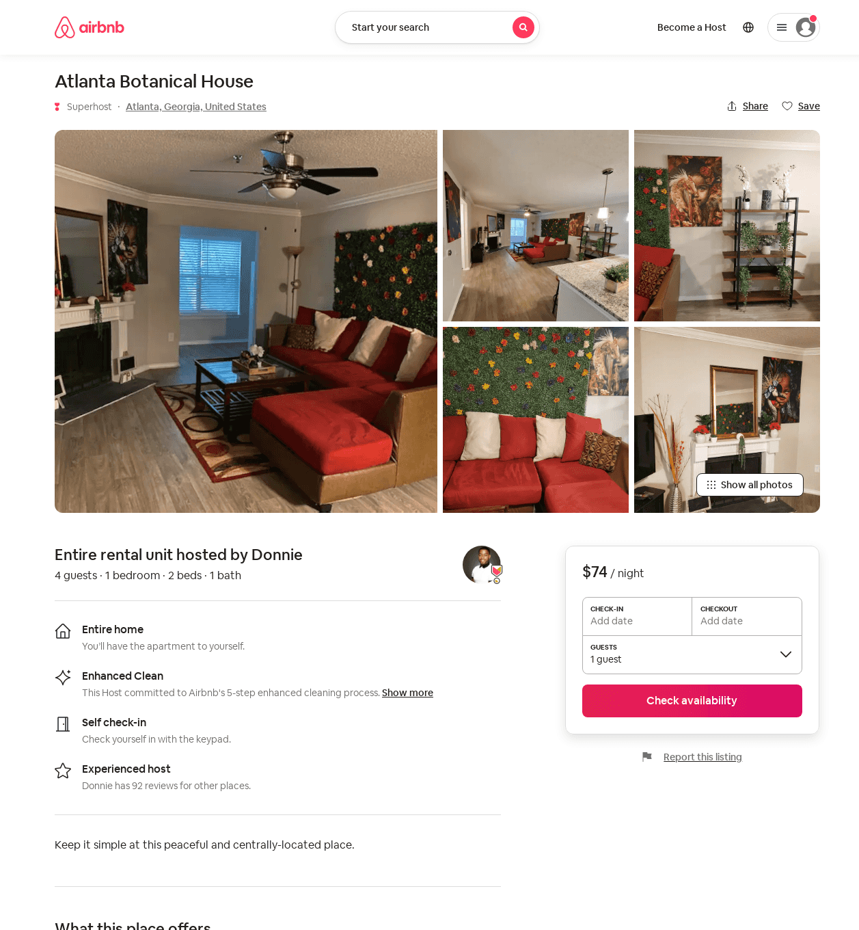
Listing 53946348
1
4
$74 - $94
1
Donnie
354521570
7
https://www.airbnb.com/rooms/53946348
Aug 2022

Slide 8
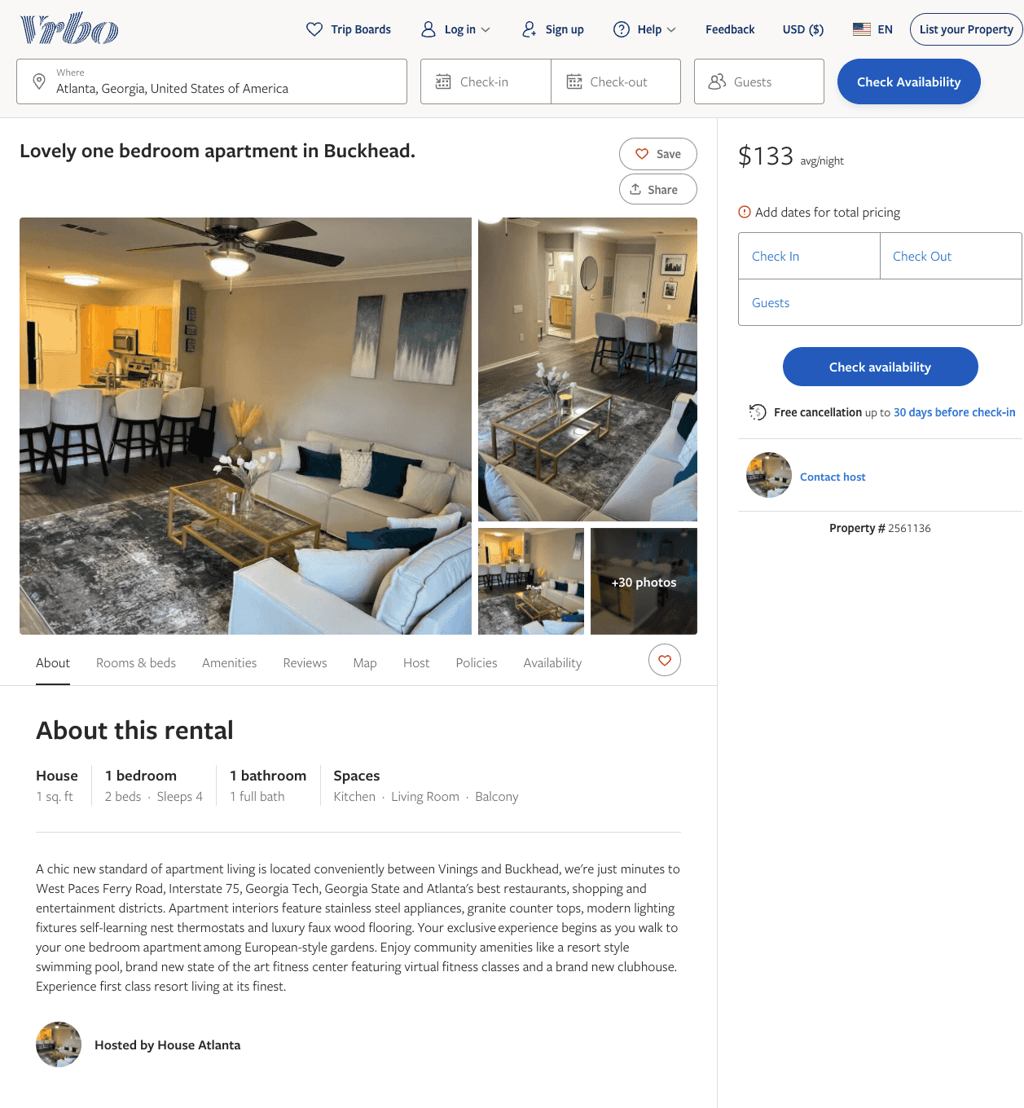
Listing 2561136
1
4
$105 - $92
5
2
https://www.vrbo.com/2561136
Aug 2022

Slide 9
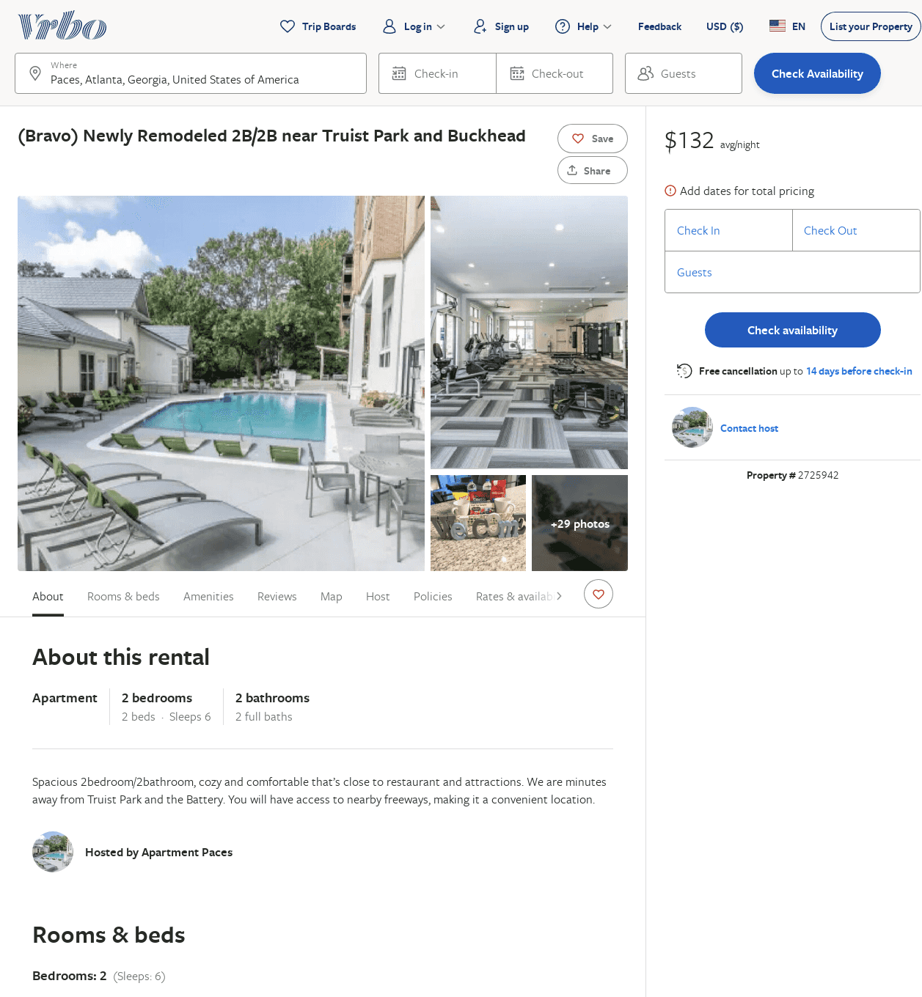
Listing 2725942
2
6
$185
5
2
Anthony Jefferson
https://www.vrbo.com/2725942
Aug 2022

Slide 10
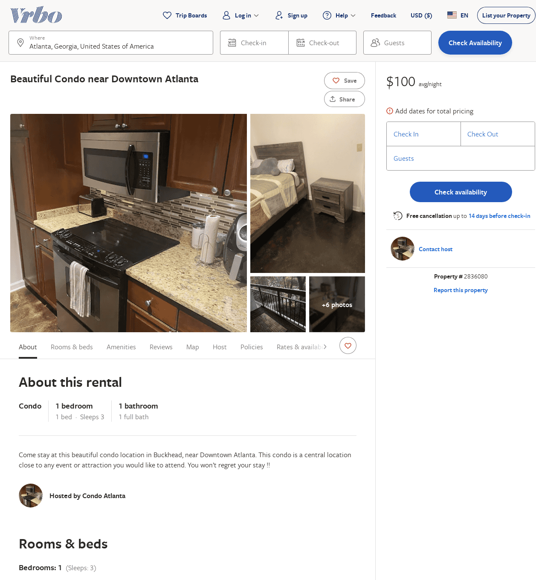
Listing 2836080
1
3
$115
4.857143
1
https://www.vrbo.com/2836080
Aug 2022

Slide 11
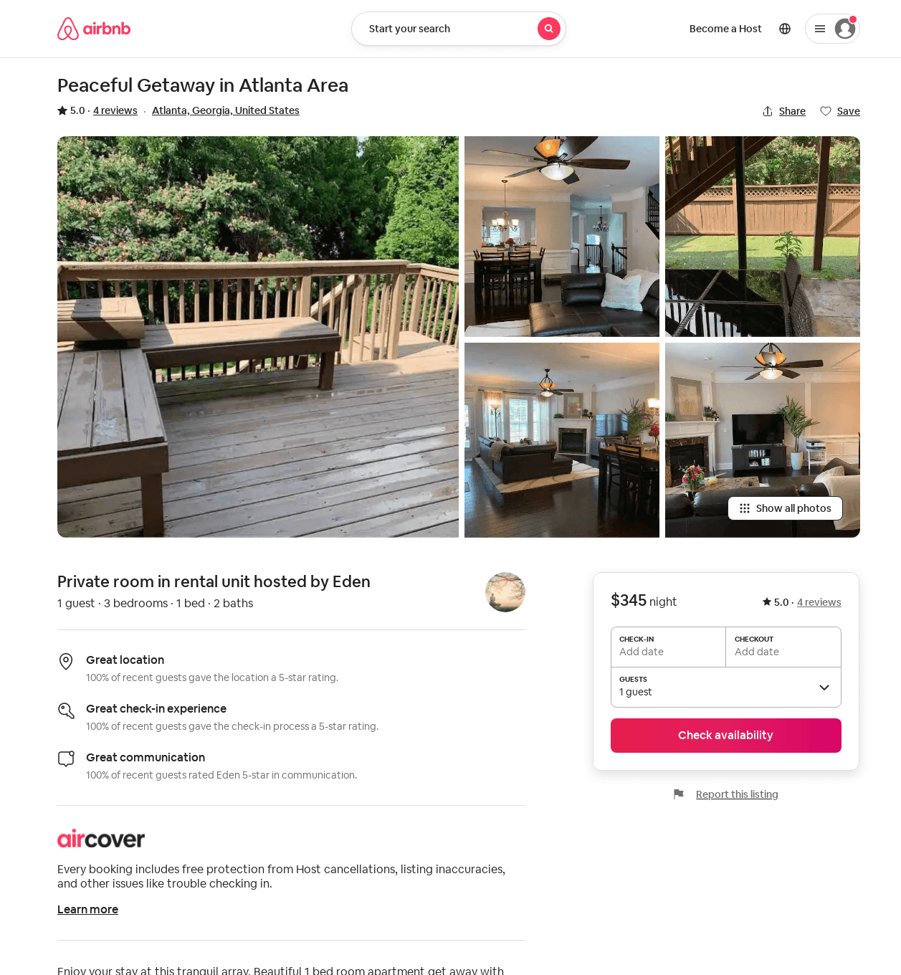
Listing 42720831
3
1
5.0
1
Eden
339245587
1
https://www.airbnb.com/rooms/42720831
Aug 2022

