Slide 2
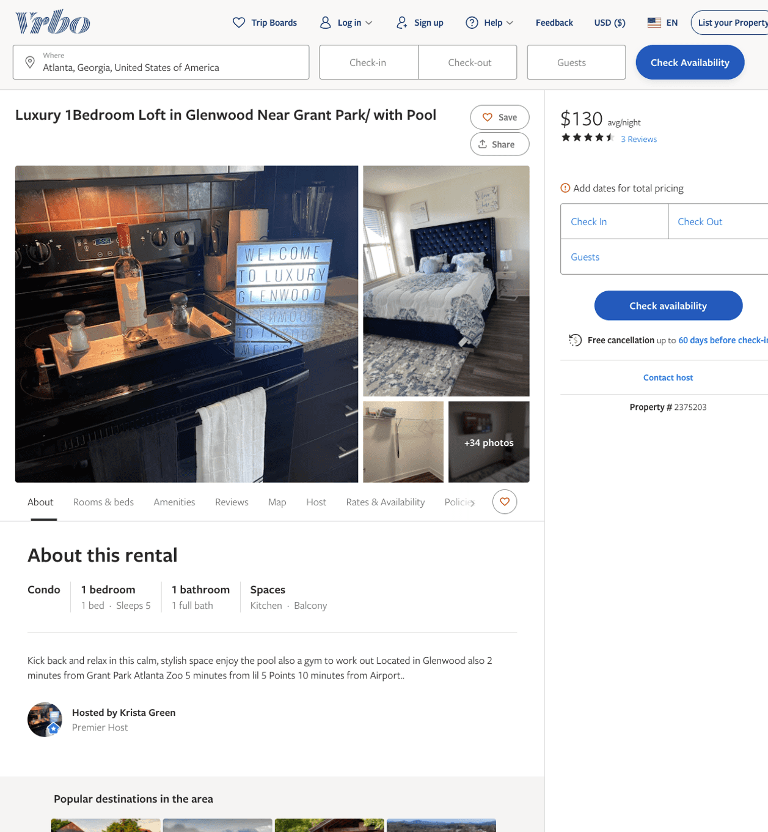
Listing 2375203
1
5
$126 - $141
4.75
1
Krista Green
https://www.vrbo.com/2375203
Aug 2022

Slide 3
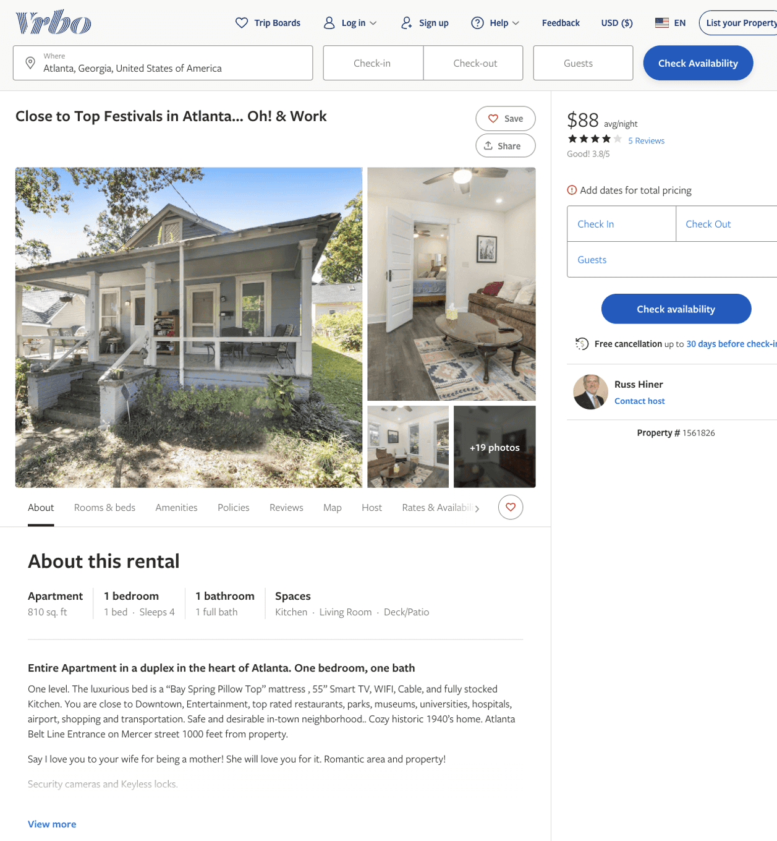
Listing 1561826
1
4
$83 - $95
3.8333333
2
Russ Hiner
https://www.vrbo.com/1561826
Aug 2022

Slide 4
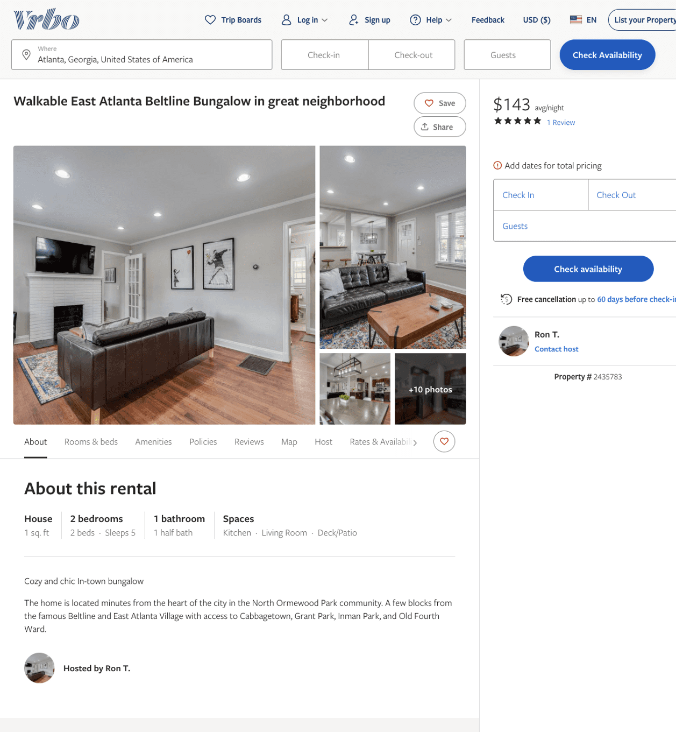
Listing 2435783
2
5
$100 - $143
5
21
Ron T.
https://www.vrbo.com/2435783
Aug 2022

Slide 5
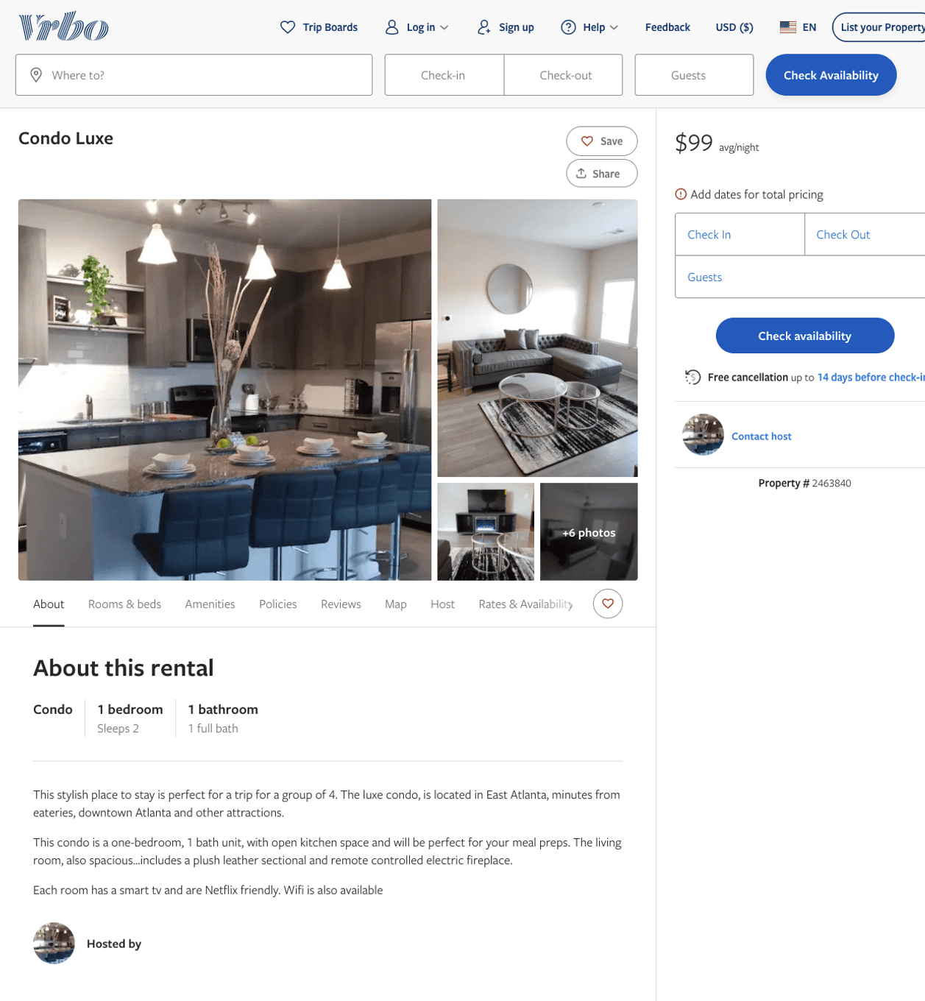
Listing 2463840
1
2
$102 - $99
1
https://www.vrbo.com/2463840
Aug 2022

Slide 6
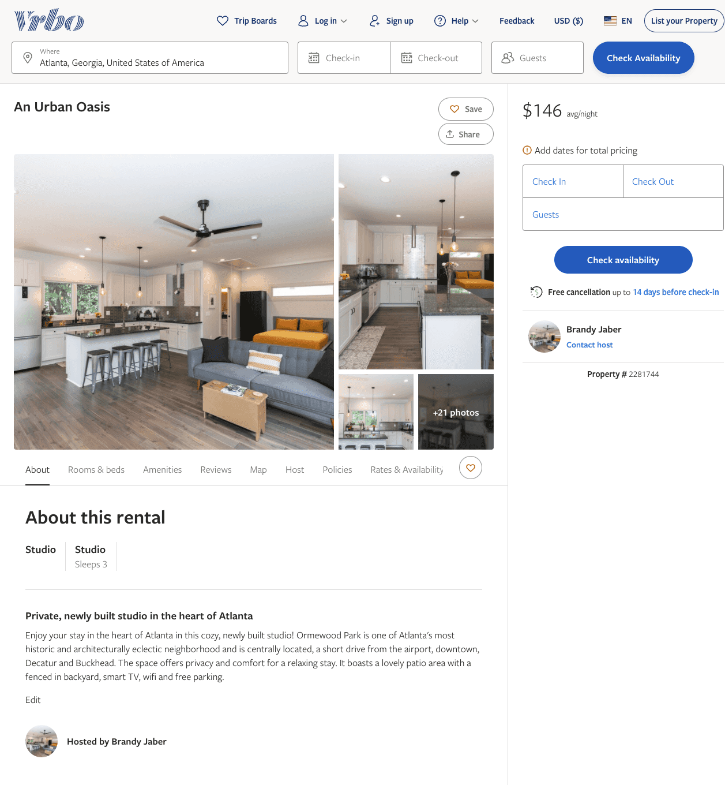
Listing 2281744
1
3
$125 - $170
1
Brandy Jaber
https://www.vrbo.com/2281744
Aug 2022

Slide 7
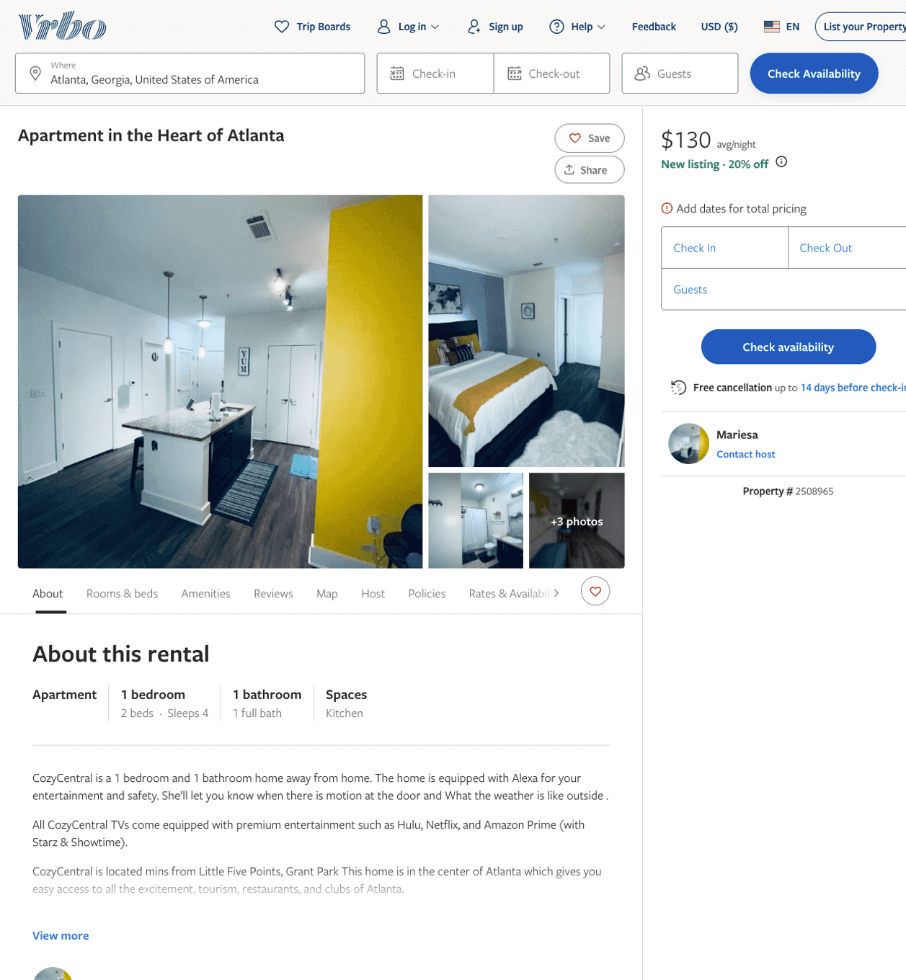
Listing 2508965
1
4
$119 - $130
1
Mariesa
https://www.vrbo.com/2508965
Aug 2022

Slide 8
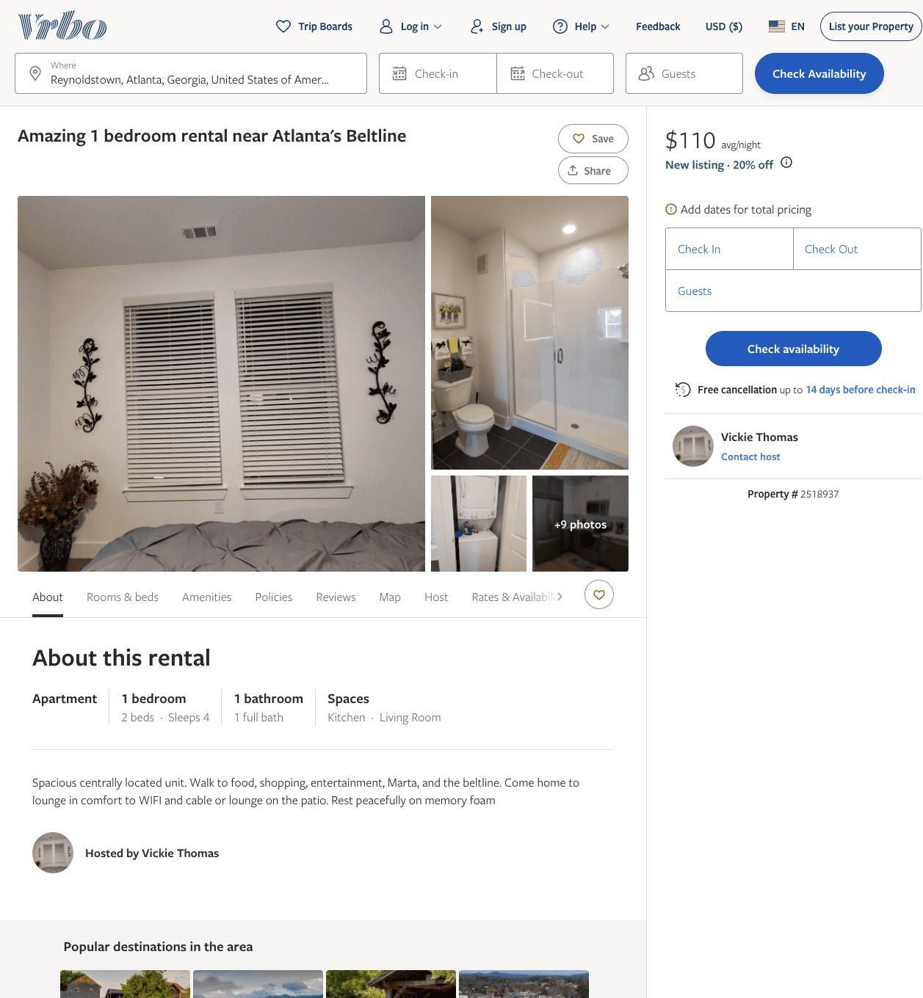
Listing 2518937
1
4
$110 - $121
3
Vickie Thomas
https://www.vrbo.com/2518937
Aug 2022

Slide 9
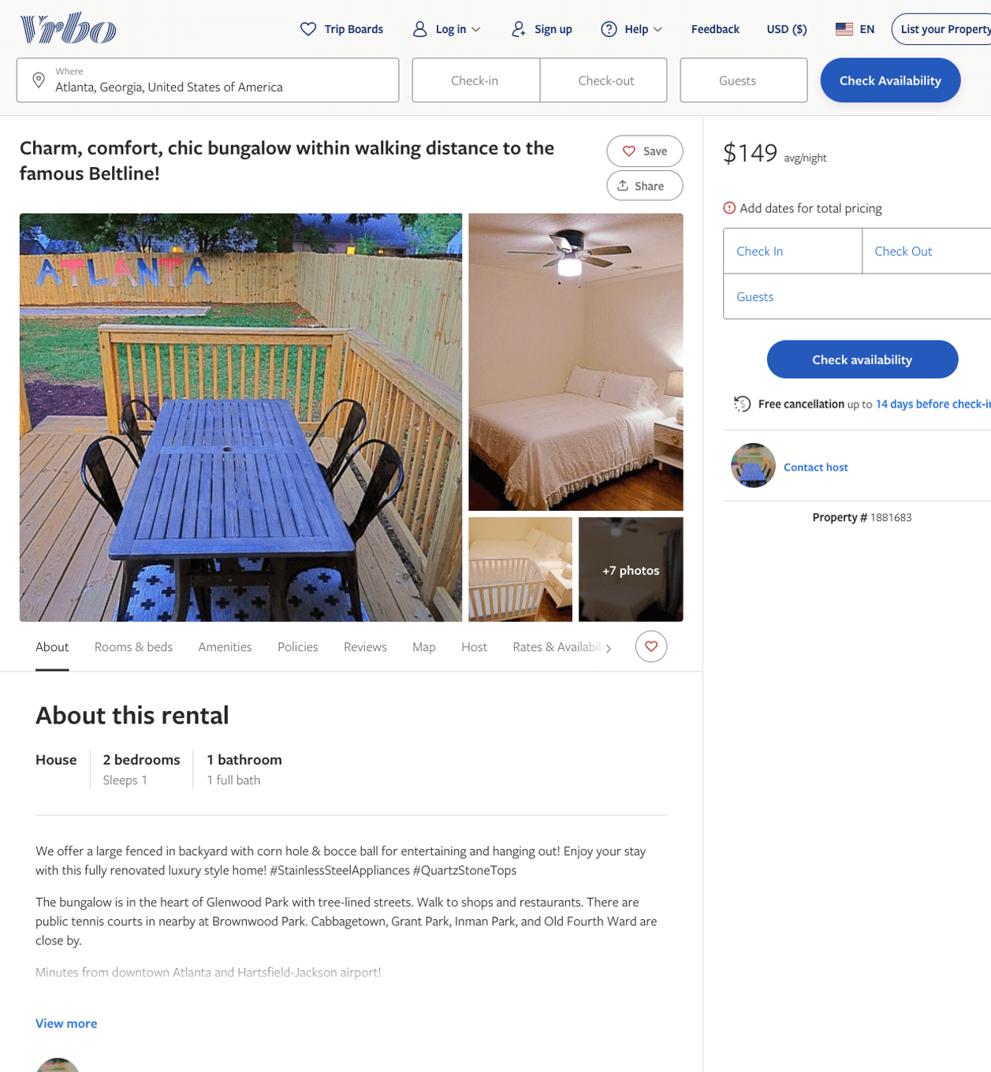
Listing 1881683
2
1
$149
1
Jeff Cox
https://www.vrbo.com/1881683
Aug 2022

Slide 10
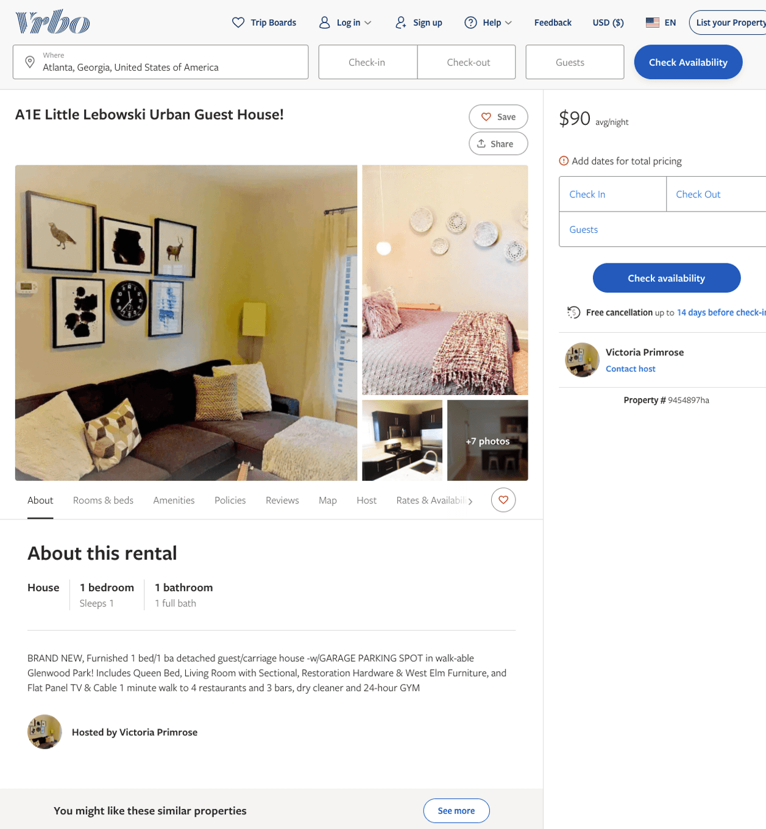
Listing 9454897
1
1
$90
30
Victoria Primrose
https://www.vrbo.com/9454897ha
Aug 2022

Slide 11
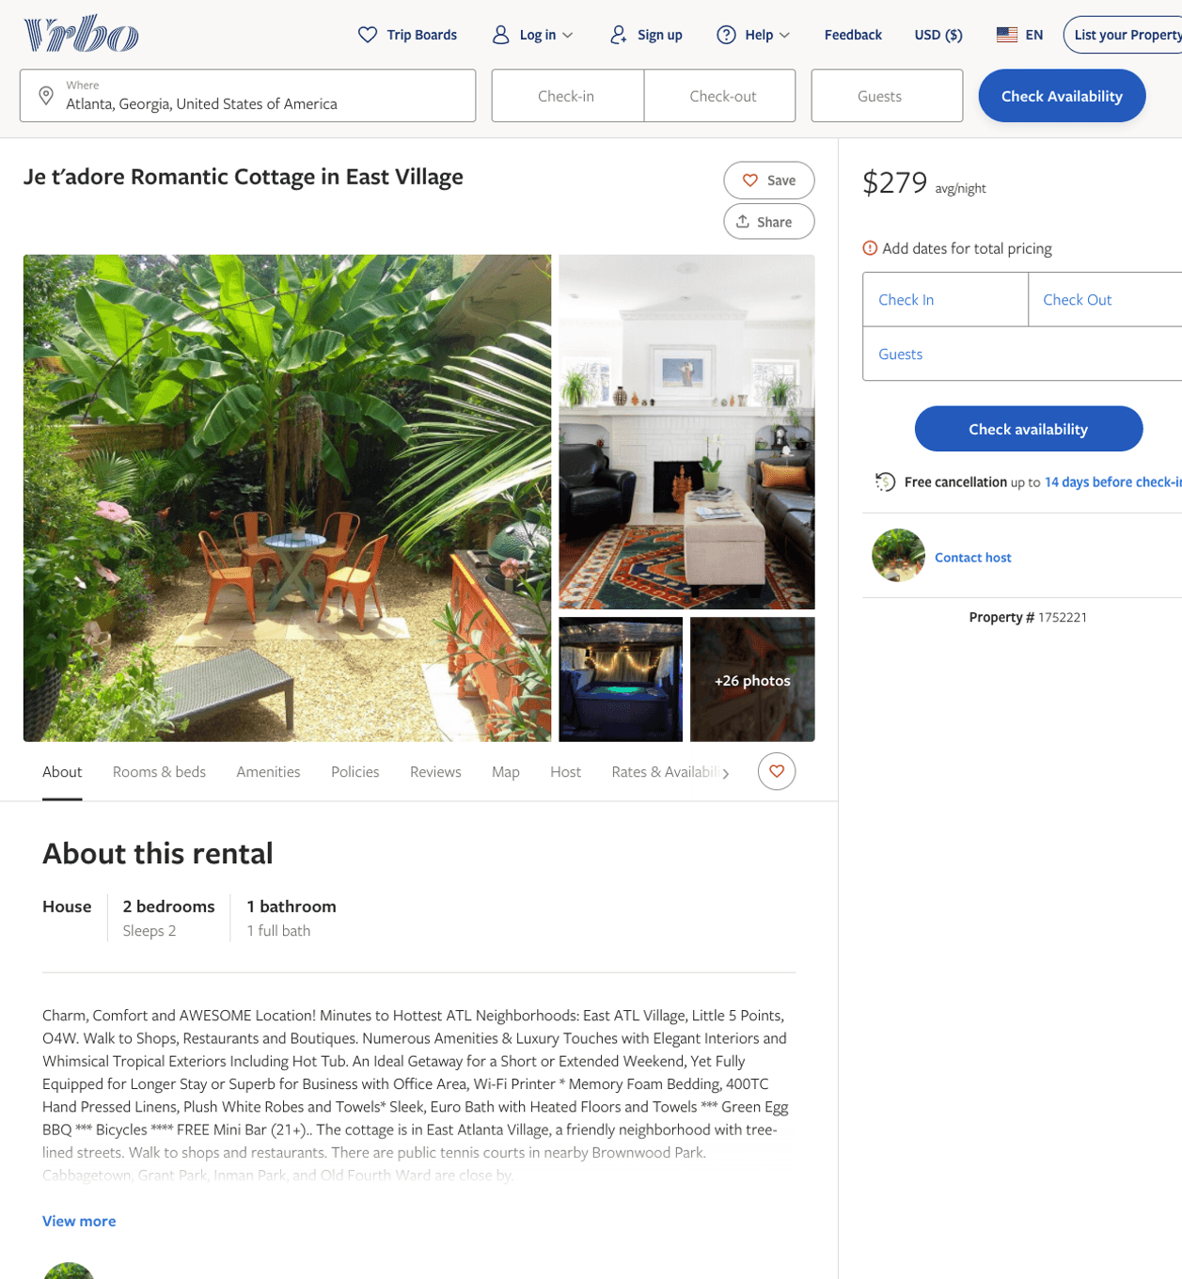
Listing 1752221
2
2
$279
2
https://www.vrbo.com/1752221
Aug 2022

Slide 12
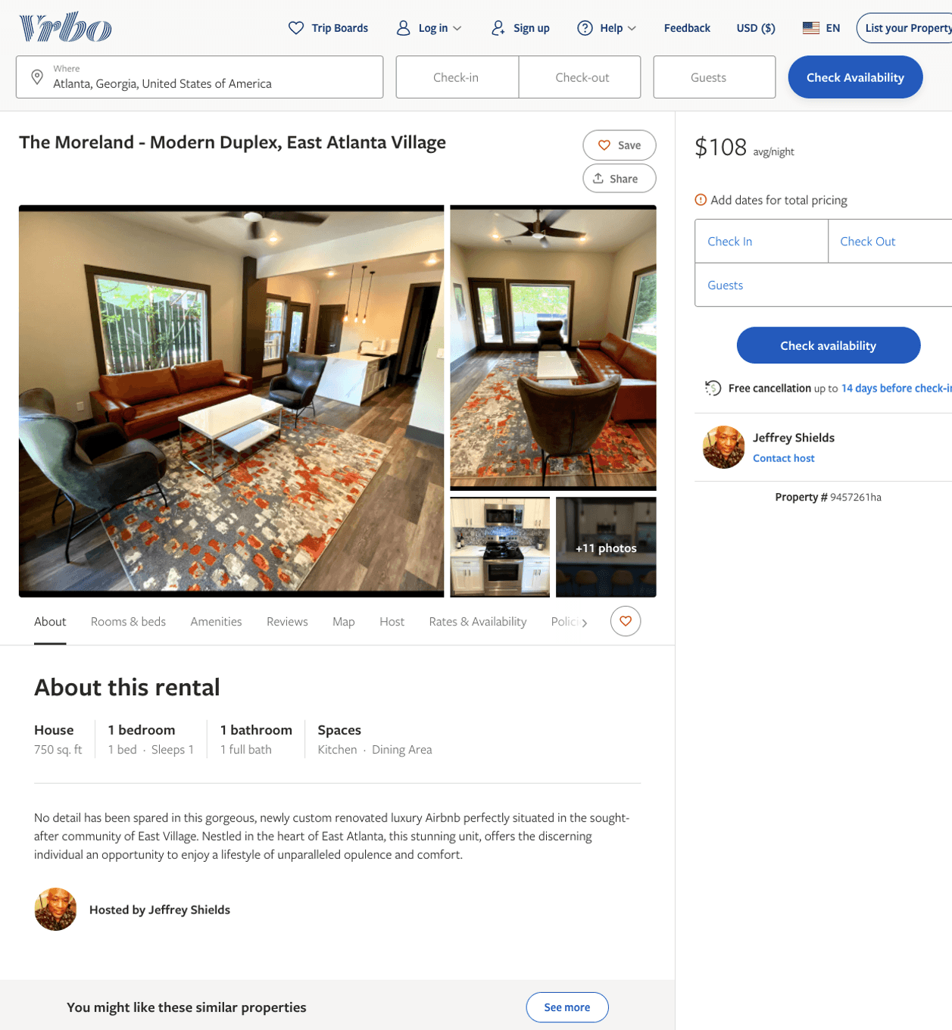
Listing 9457261
1
1
$108 - $110
2
Jeffrey Shields
https://www.vrbo.com/9457261ha
Aug 2022

Slide 13
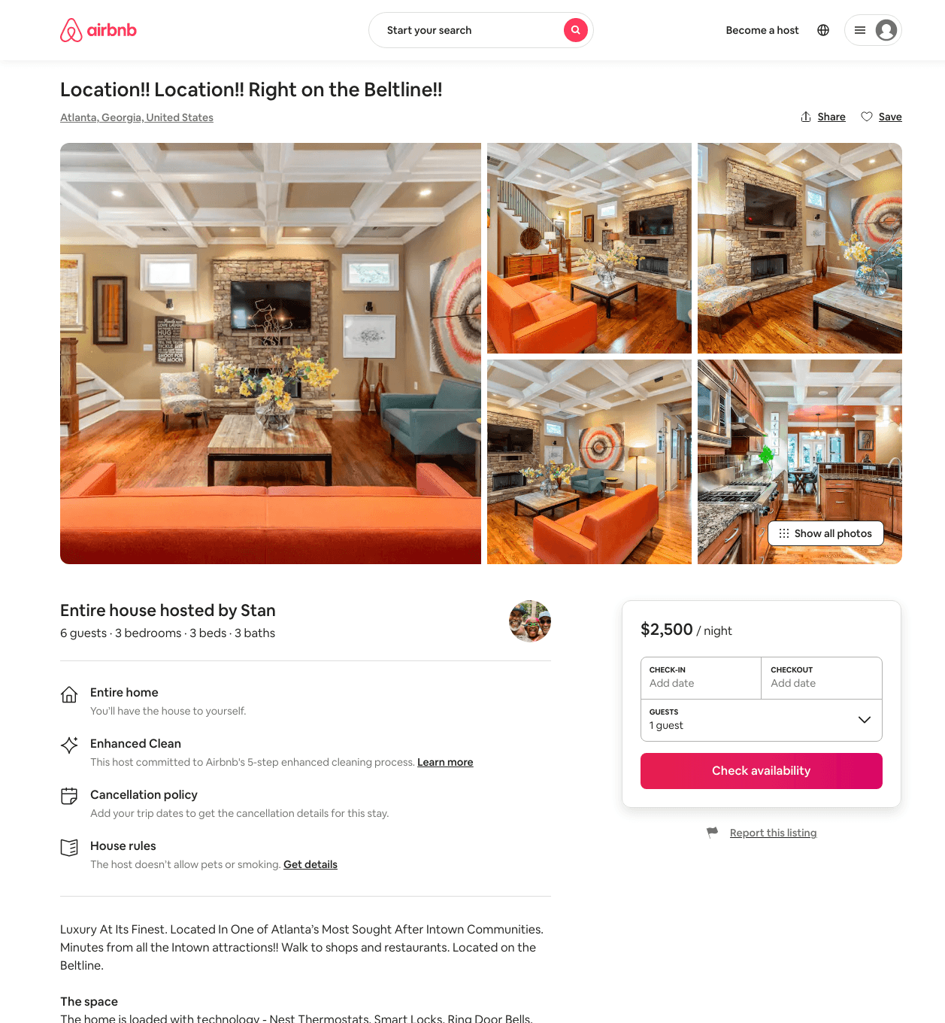
Listing 29728347
3
6
$500 - $2500
5.0
3
Stan
4098
1
https://www.airbnb.com/rooms/29728347
Aug 2022

Slide 14
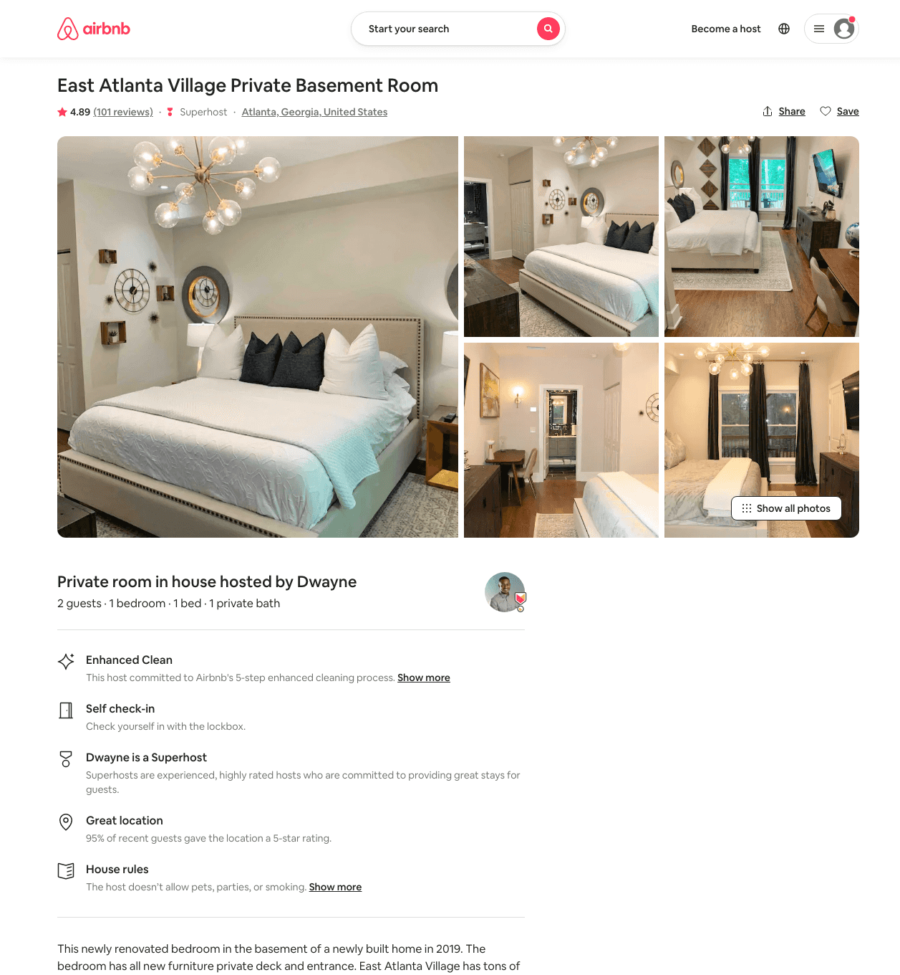
Listing 42667168
1
2
$69 - $110
4.91
1
Dwayne
11913512
1
https://www.airbnb.com/rooms/42667168
Aug 2022

Slide 15
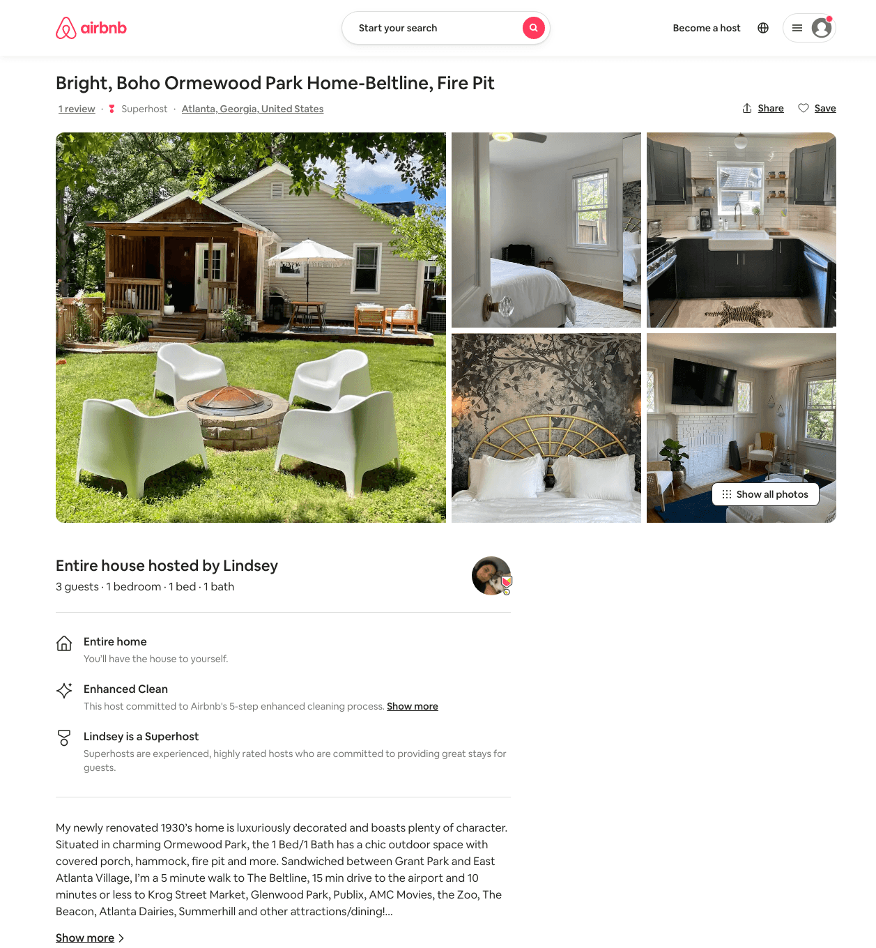
Listing 50101504
1
3
$140 - $200
5.0
3
Lindsey
13573886
2
https://www.airbnb.com/rooms/50101504
Aug 2022

Slide 16
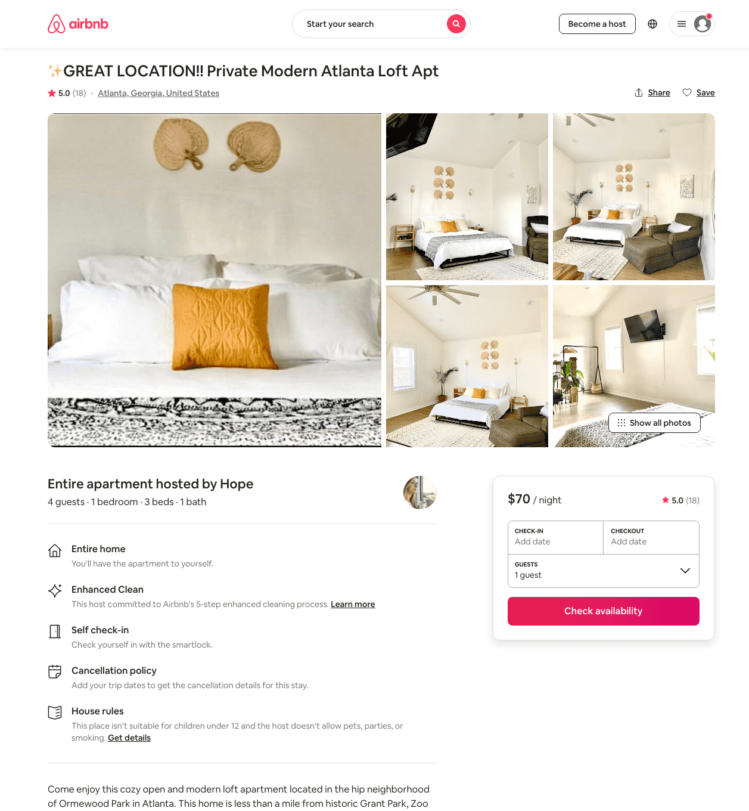
Listing 47331704
1
4
$65 - $109
4.89
2
Hope
124143732
9
https://www.airbnb.com/rooms/47331704
Aug 2022

Slide 17
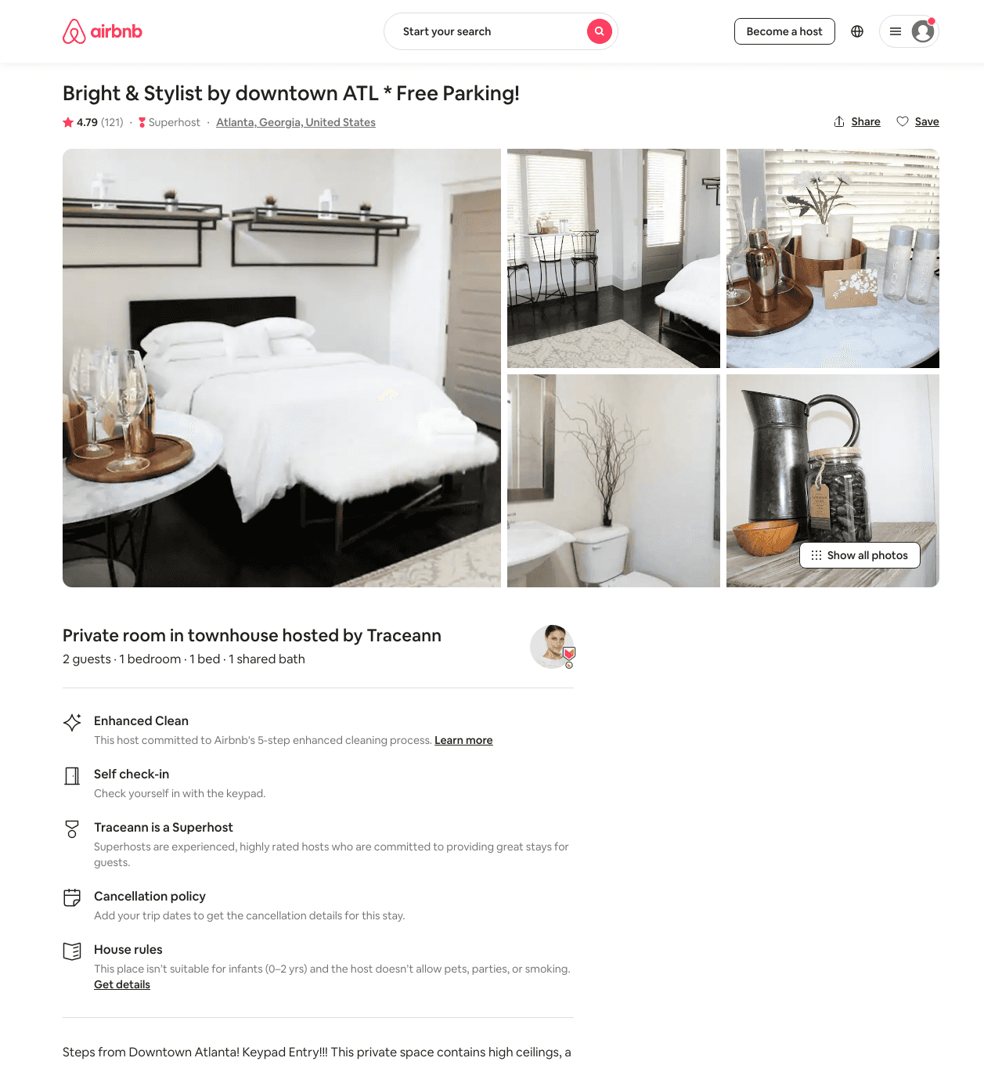
Listing 23468411
1
2
$30 - $96
4.81
3
Traceann
175145740
1
https://www.airbnb.com/rooms/23468411
Aug 2022

Slide 18
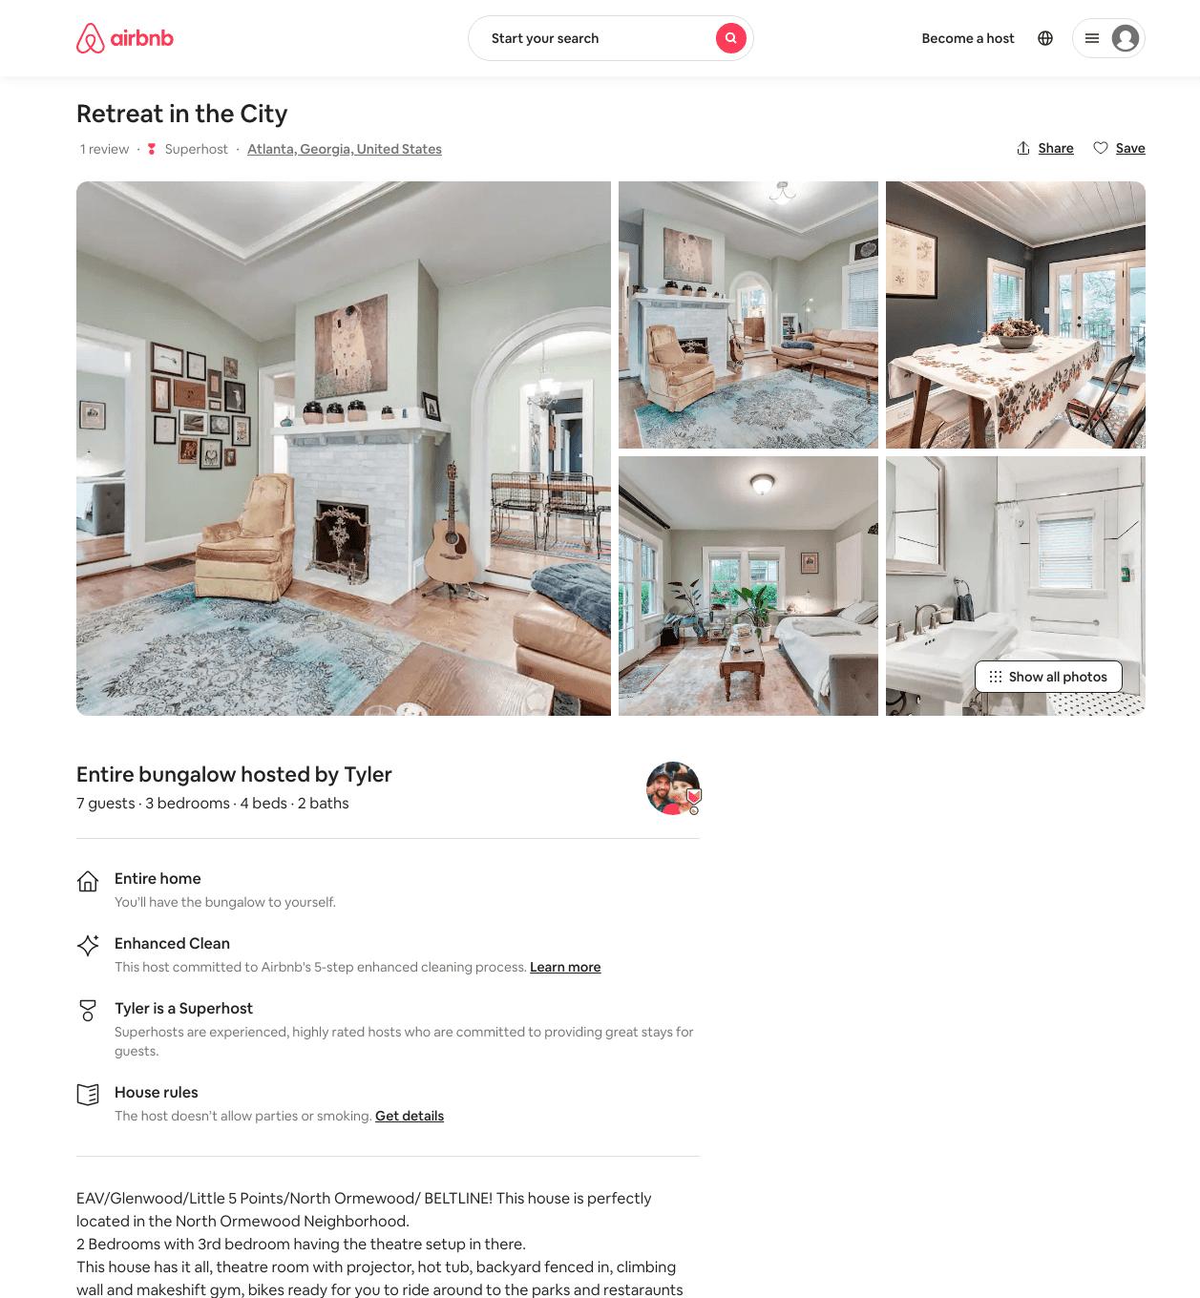
Listing 45638573
3
7
$170 - $226
4.81
3
Tyler
20362967
1
https://www.airbnb.com/rooms/45638573
Aug 2022

Slide 19
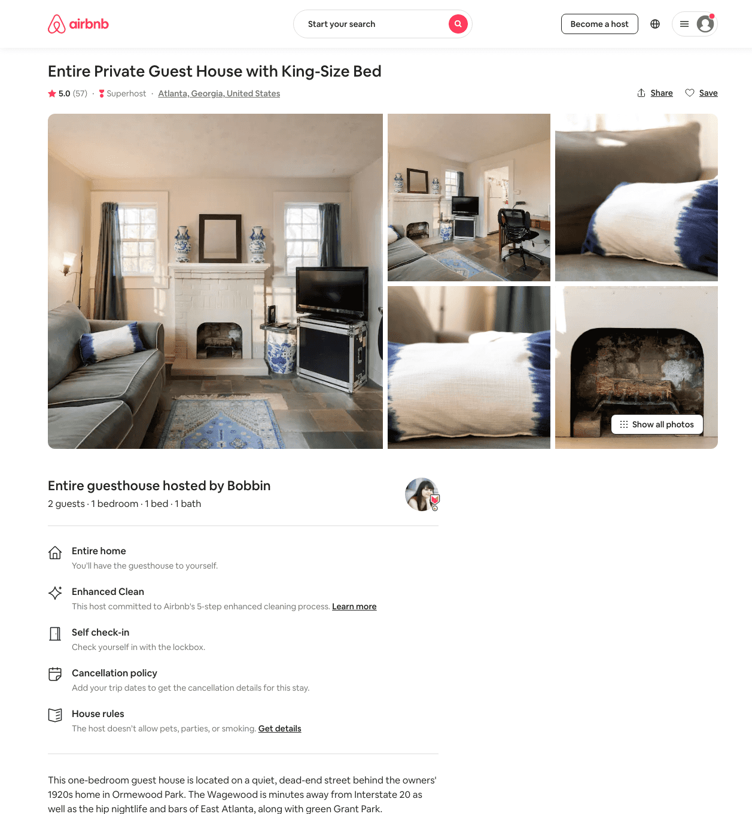
Listing 2513039
1
2
$75 - $95
5.0
5
Bobbin
12863900
1
https://www.airbnb.com/rooms/2513039
Aug 2022

Slide 20
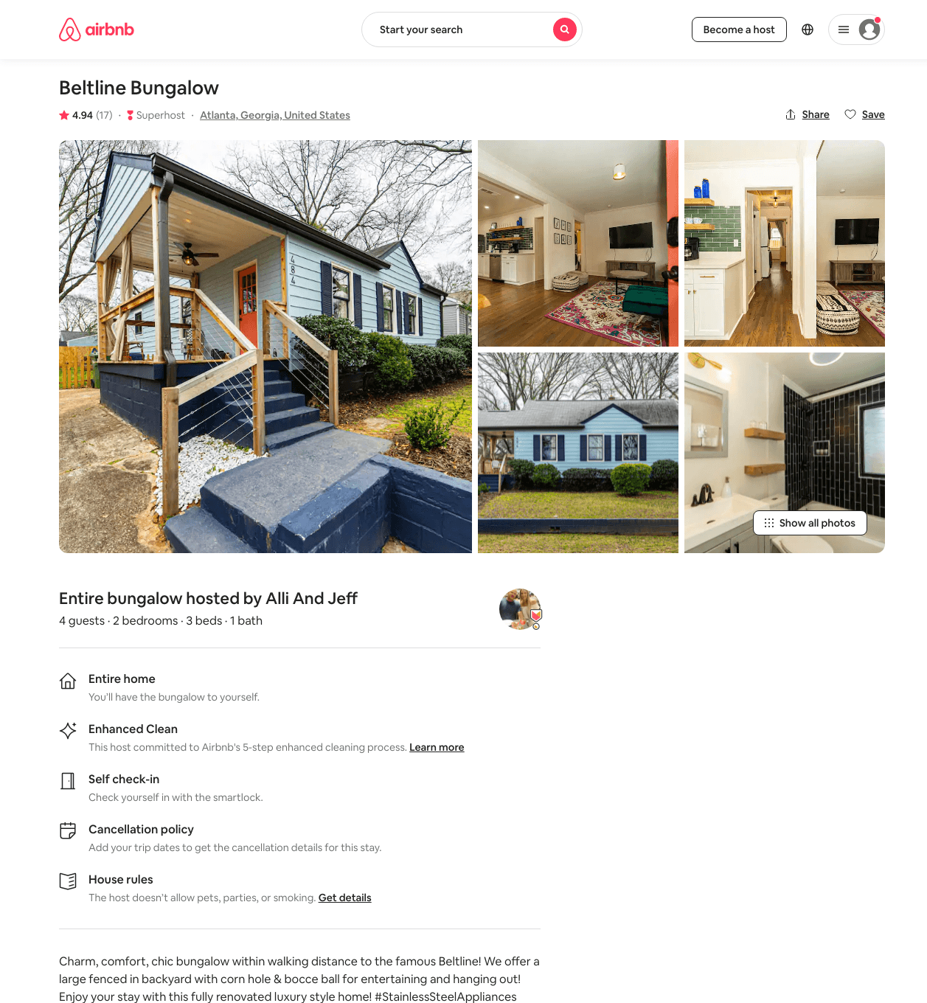
Listing 38435304
2
5
$111 - $200
4.94
1
Alli
292988771
2
https://www.airbnb.com/rooms/38435304
Aug 2022

Slide 21
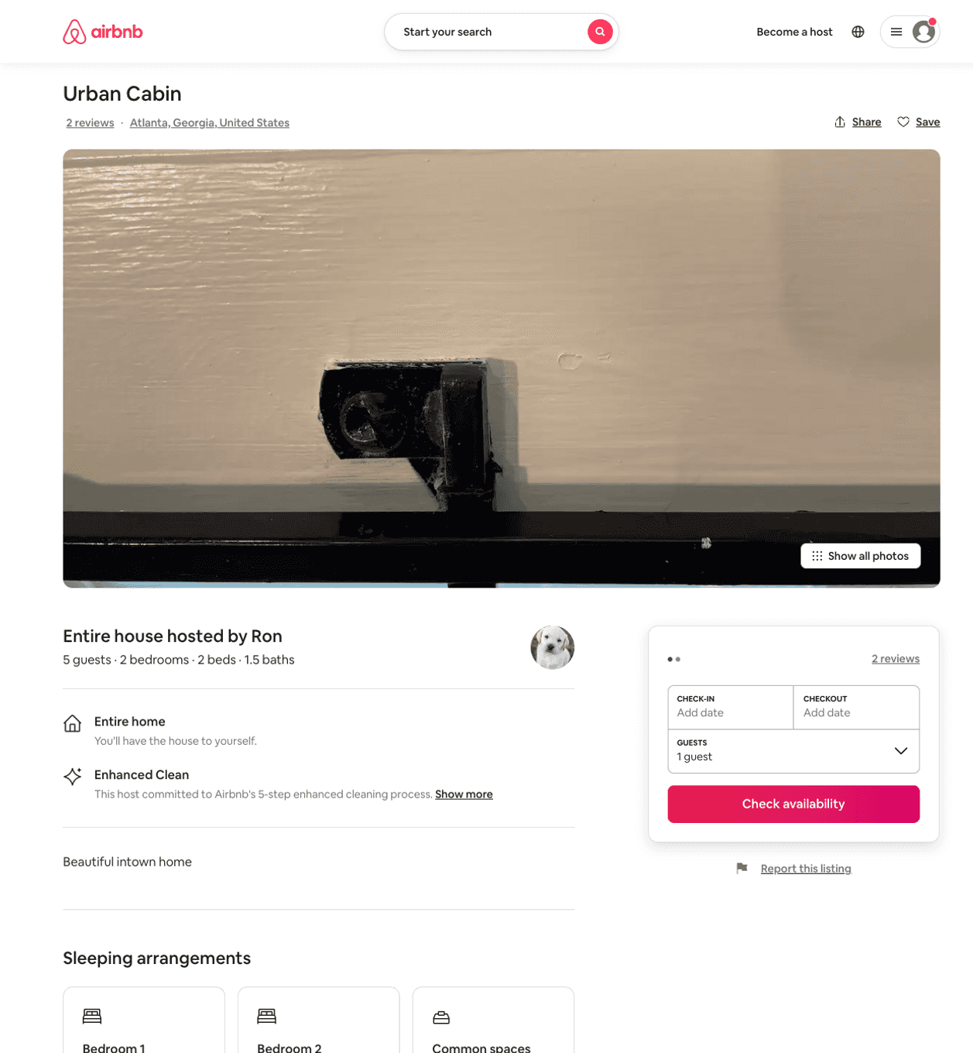
Listing 50416245
2
5
$114 - $221
4.75
28
Ron
13665735
3
https://www.airbnb.com/rooms/50416245
Jul 2022

Slide 22
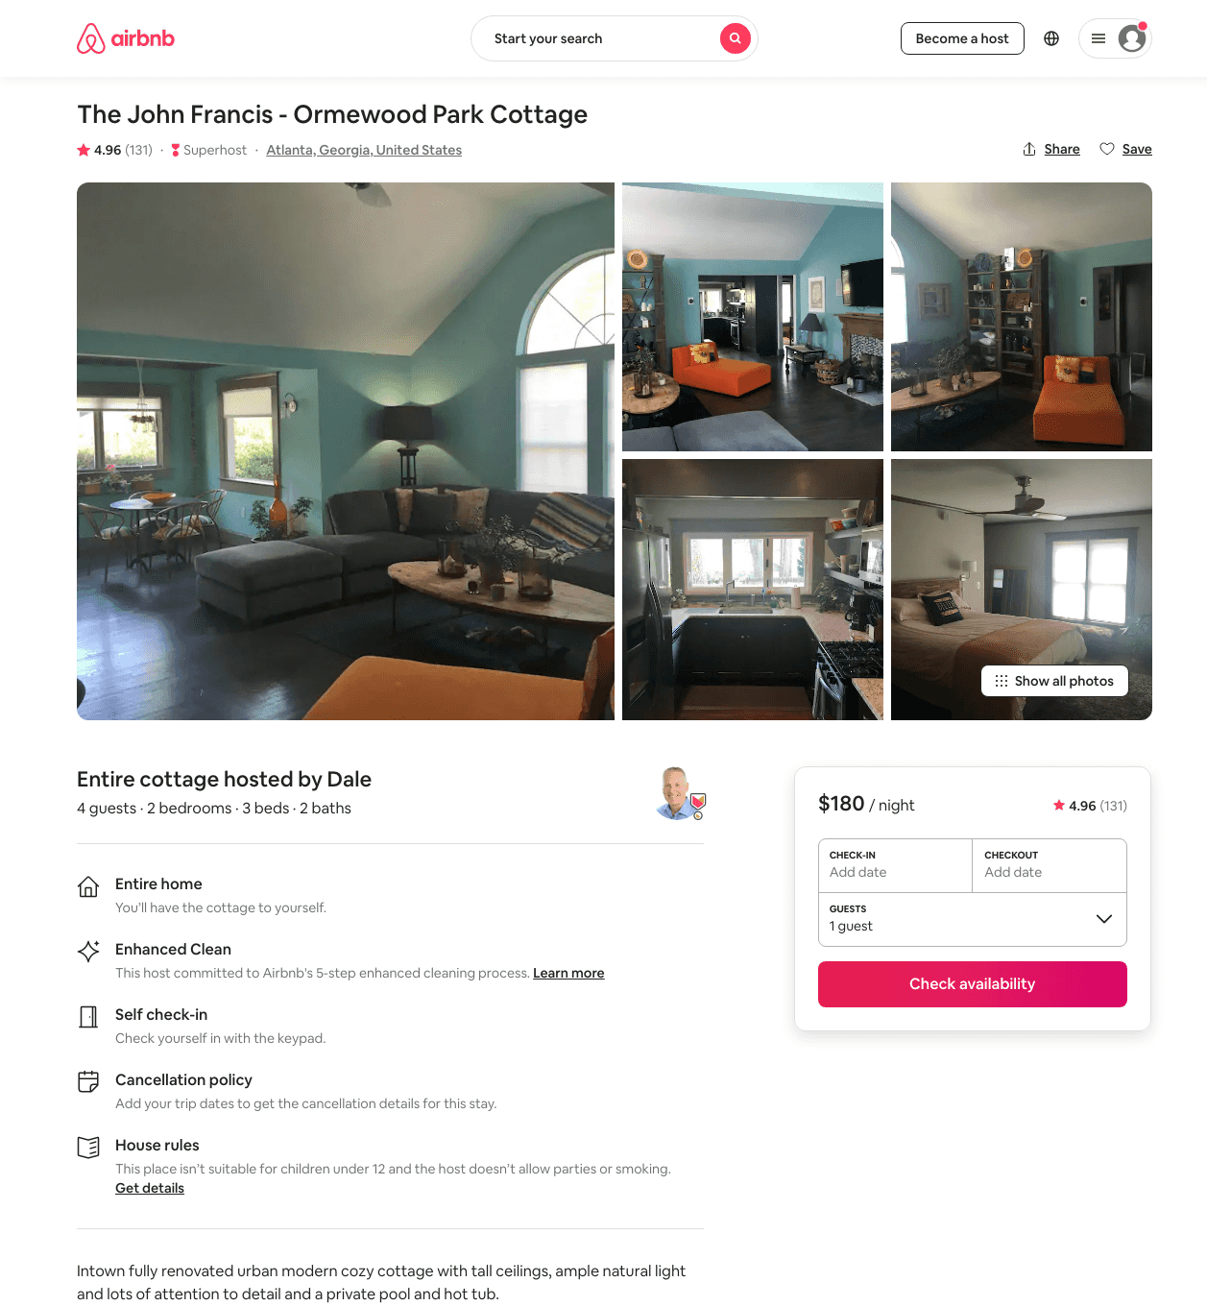
Listing 9511357
2
4
$180 - $250
4.96
2
Dale
41832704
1
https://www.airbnb.com/rooms/9511357
Aug 2022

Slide 23
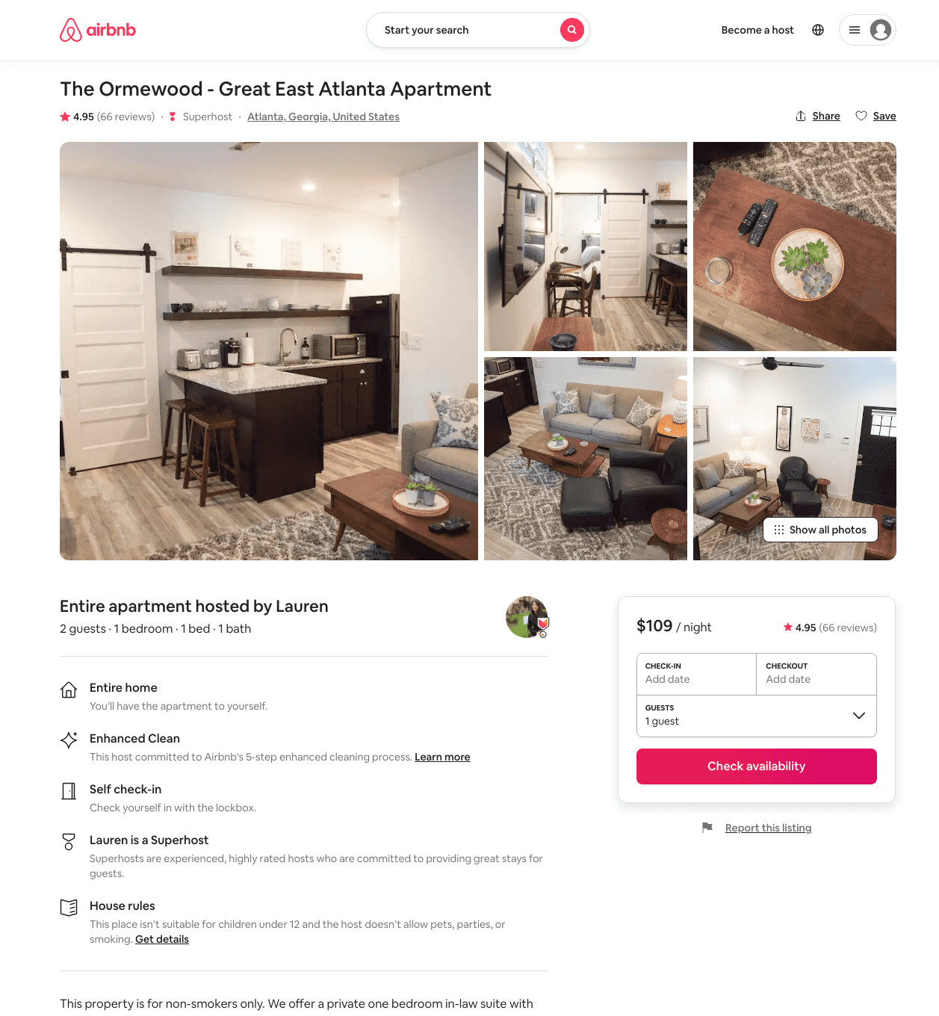
Listing 21846407
1
2
$109 - $130
4.95
2
Lauren
42924848
1
https://www.airbnb.com/rooms/21846407
Aug 2022

Slide 24
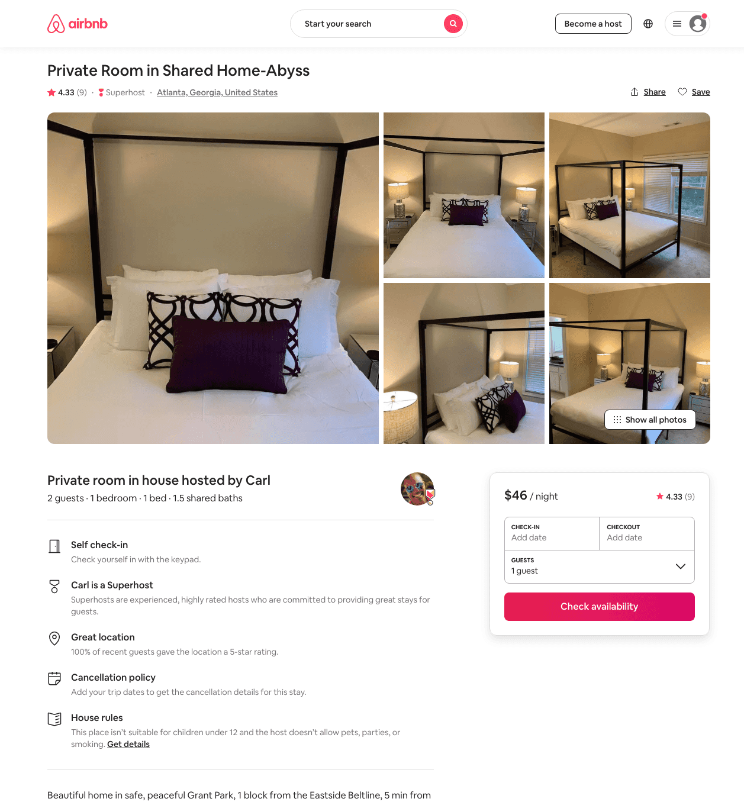
Listing 45724054
1
2
$43 - $56
4.66
2
Carl
22630533
9
https://www.airbnb.com/rooms/45724054
Aug 2022

Slide 25
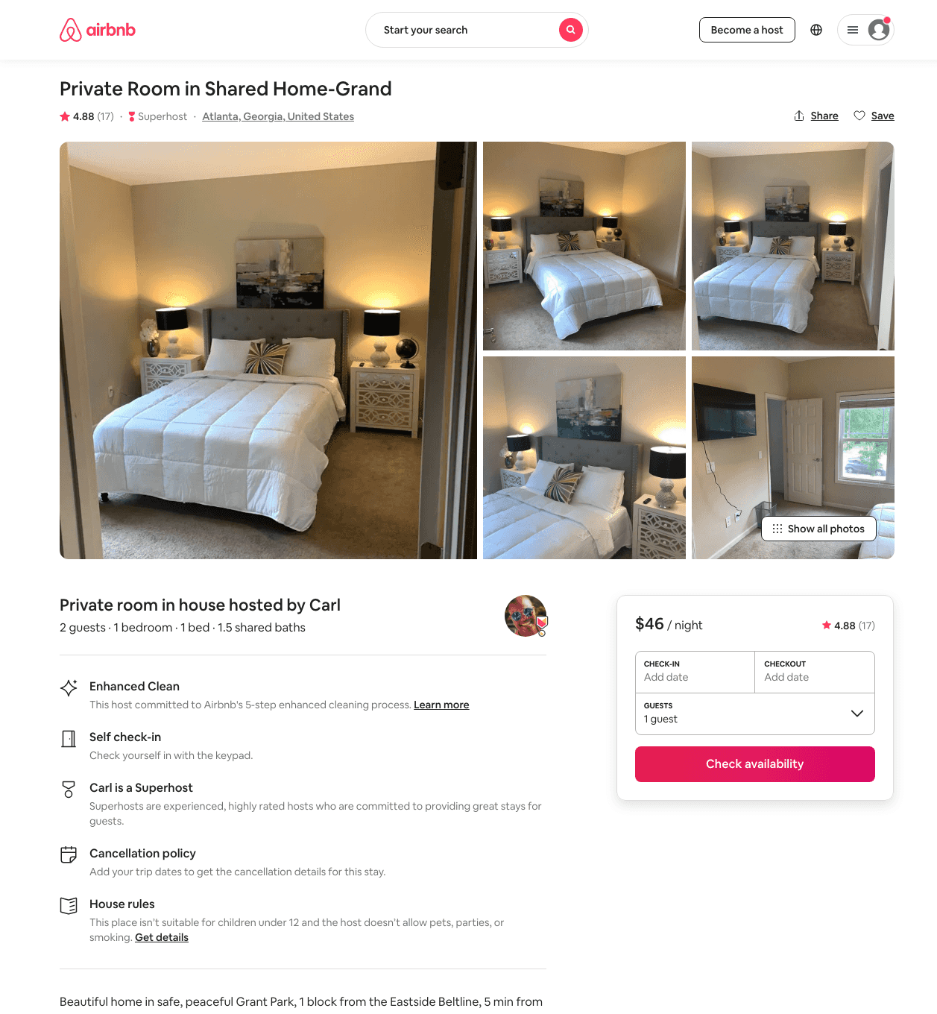
Listing 45584275
1
2
$37 - $56
4.83
2
Carl
22630533
9
https://www.airbnb.com/rooms/45584275
Aug 2022

Slide 26
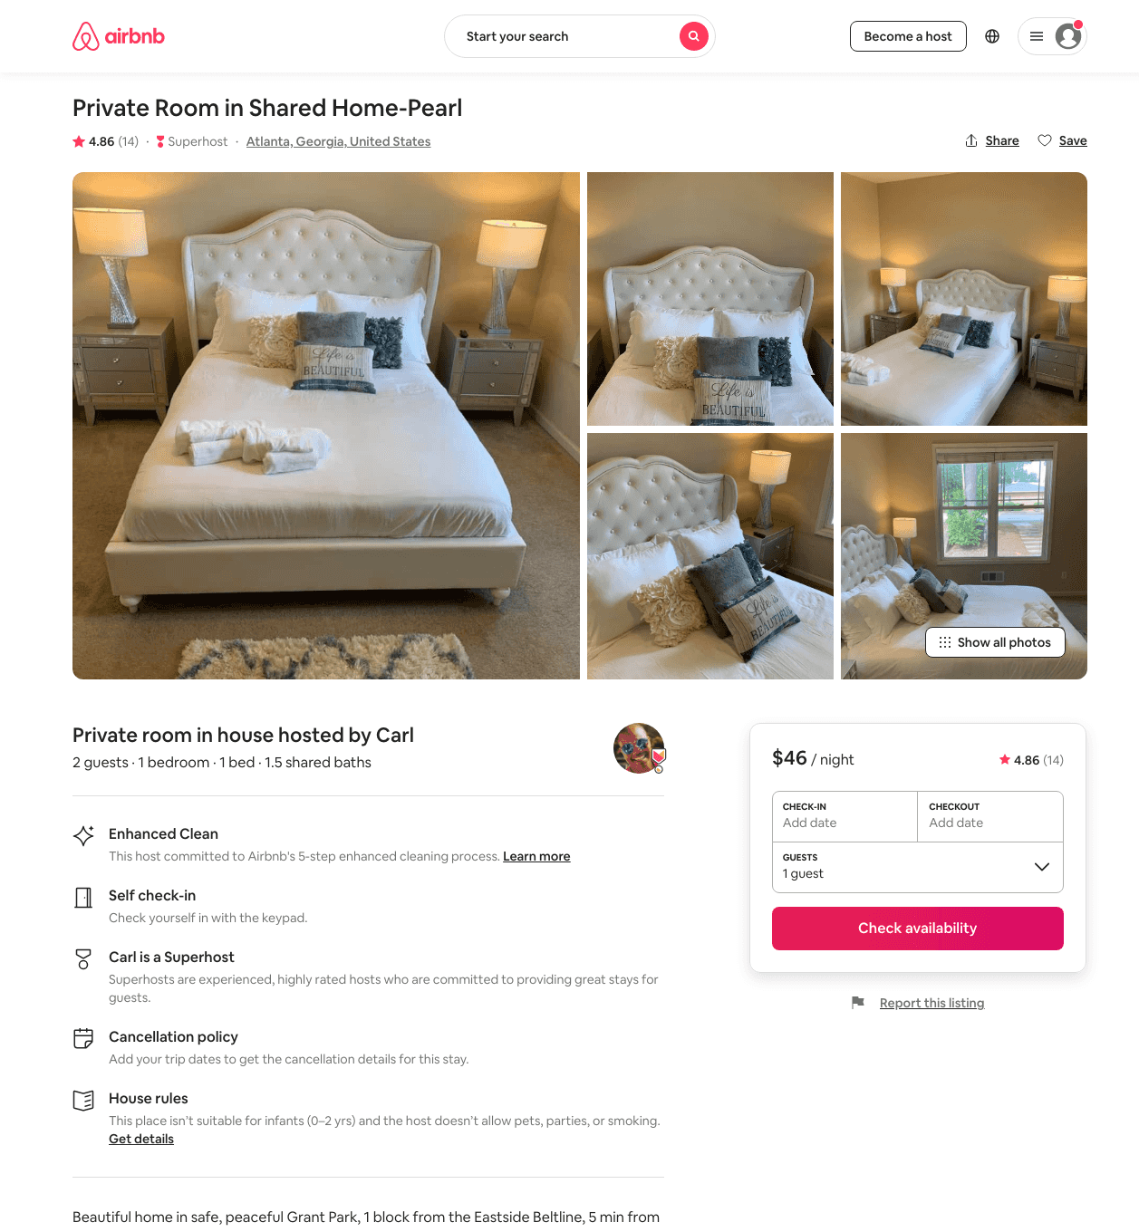
Listing 45724058
1
2
$41 - $61
4.80
2
Carl
22630533
9
https://www.airbnb.com/rooms/45724058
Aug 2022

Slide 27
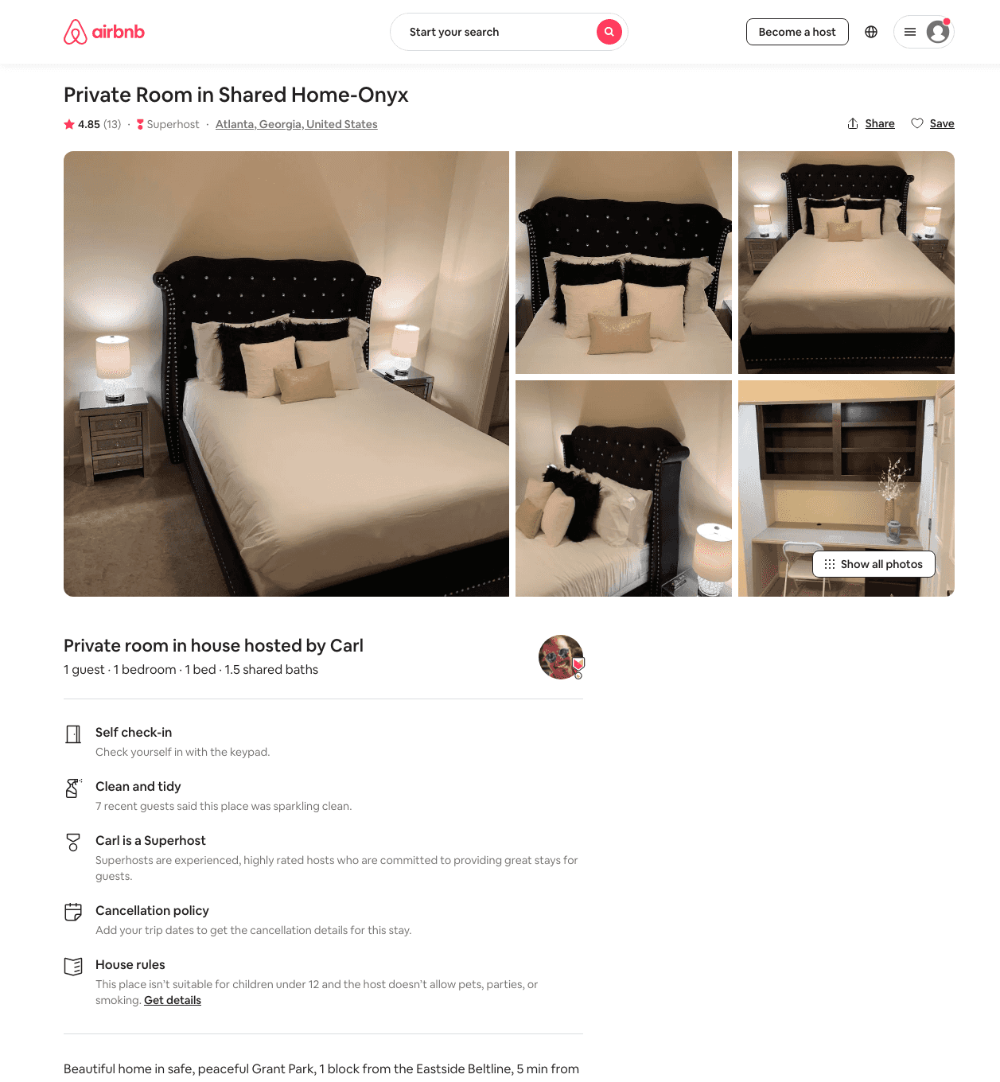
Listing 45584485
1
2
$40 - $54
4.71
2
Carl
22630533
9
https://www.airbnb.com/rooms/45584485
Aug 2022

Slide 28
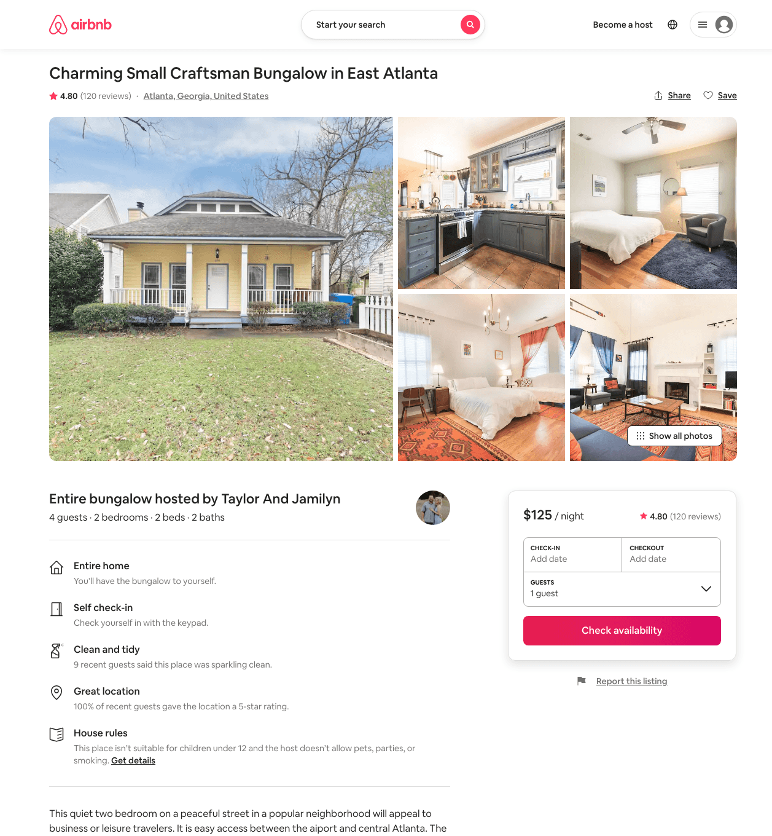
Listing 21539927
2
4
$110 - $174
4.81
3
Kassie
13822707
1
https://www.airbnb.com/rooms/21539927
Aug 2022

Slide 29
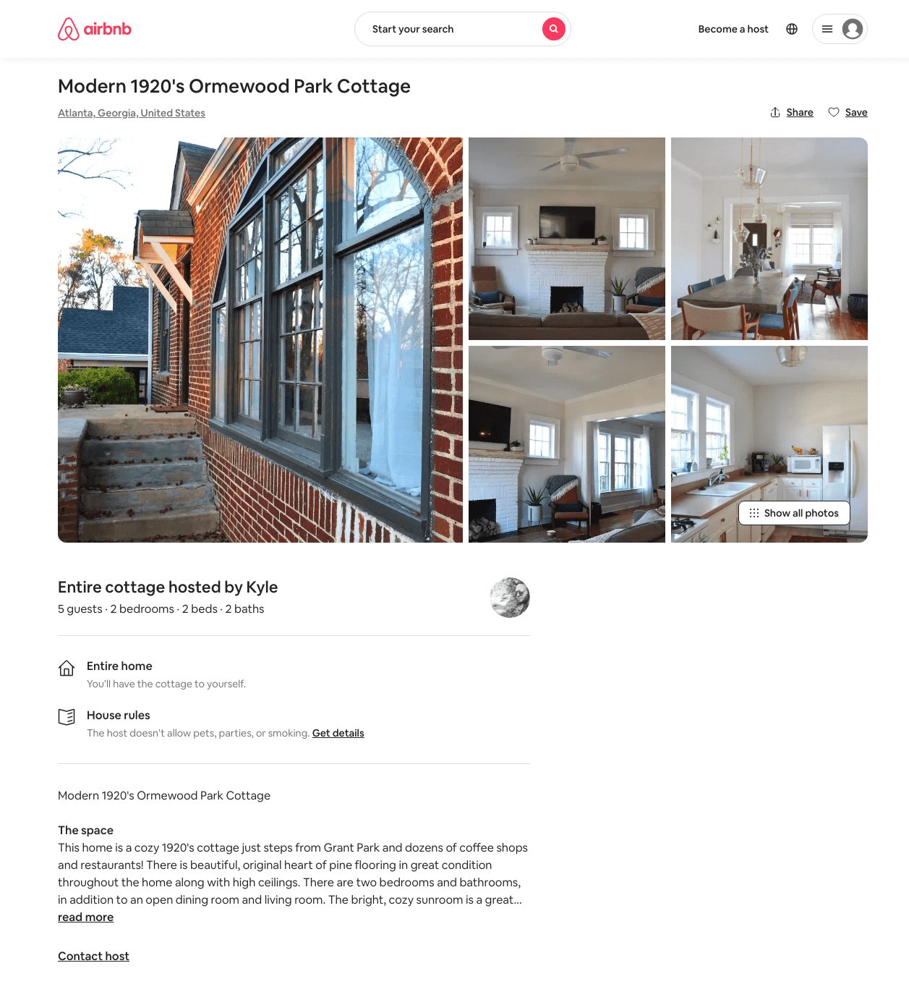
Listing 31445264
2
5
$500
2
Kyle
14846723
1
https://www.airbnb.com/rooms/31445264
Aug 2022

Slide 30
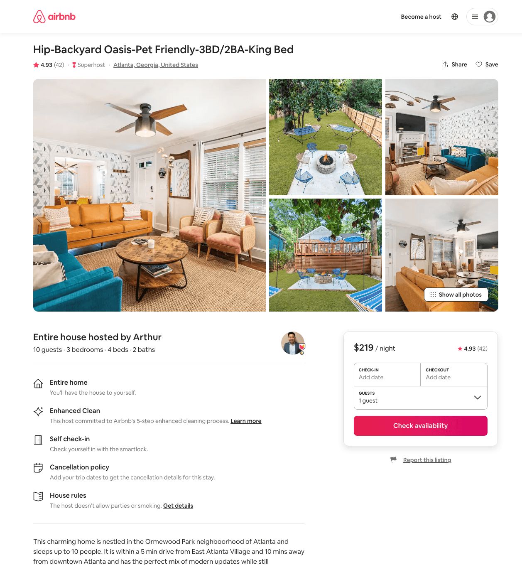
Listing 44696179
3
10
$188 - $254
4.87
3
Arthur
20905604
3
https://www.airbnb.com/rooms/44696179
Aug 2022

Slide 31
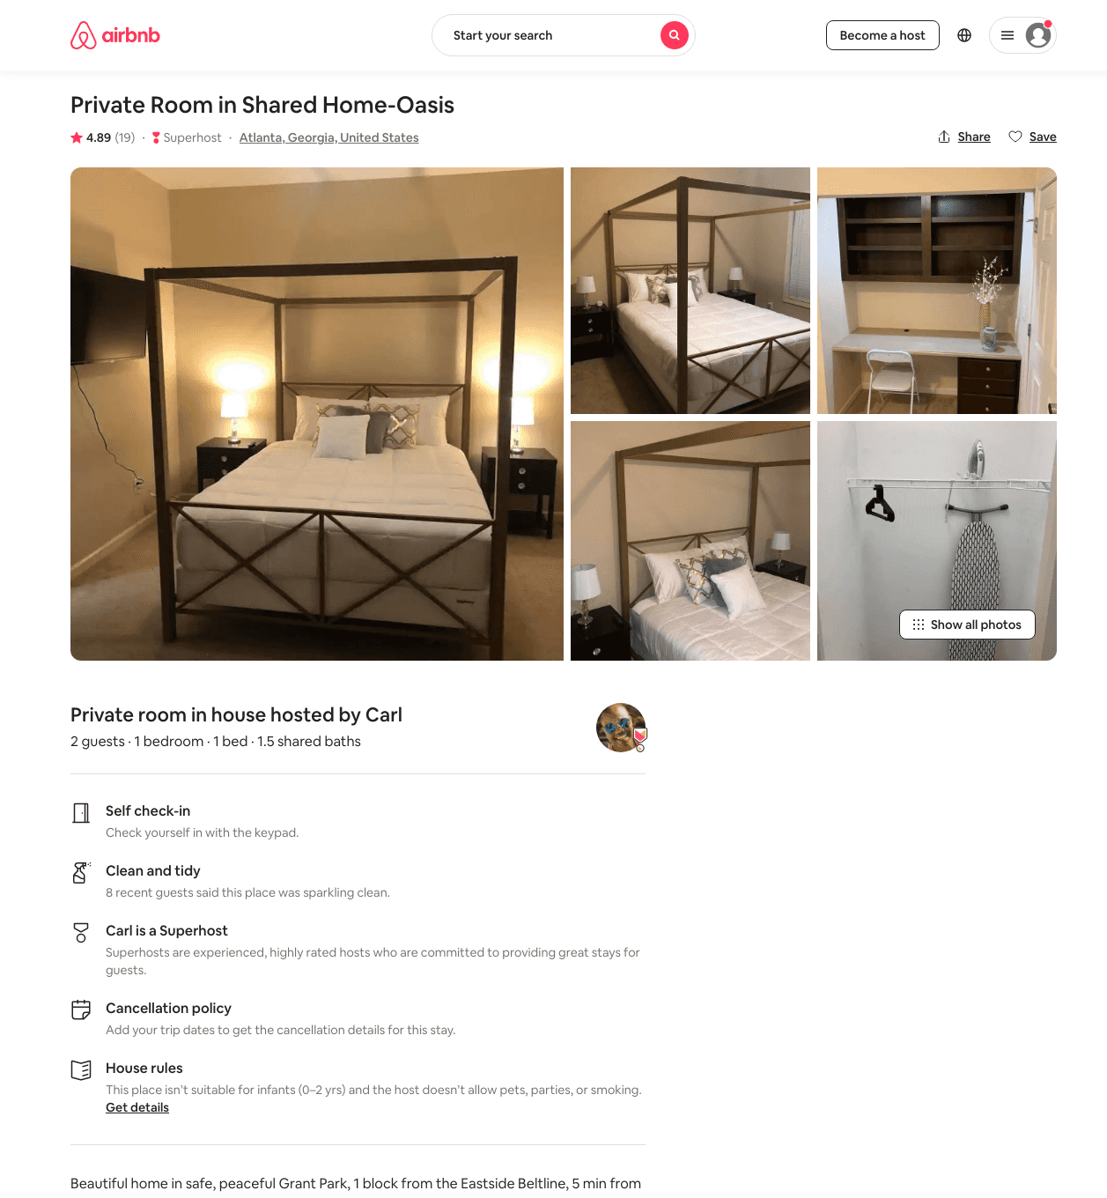
Listing 45724502
1
2
$32 - $63
4.73
2
Carl
22630533
9
https://www.airbnb.com/rooms/45724502
Aug 2022

Slide 32
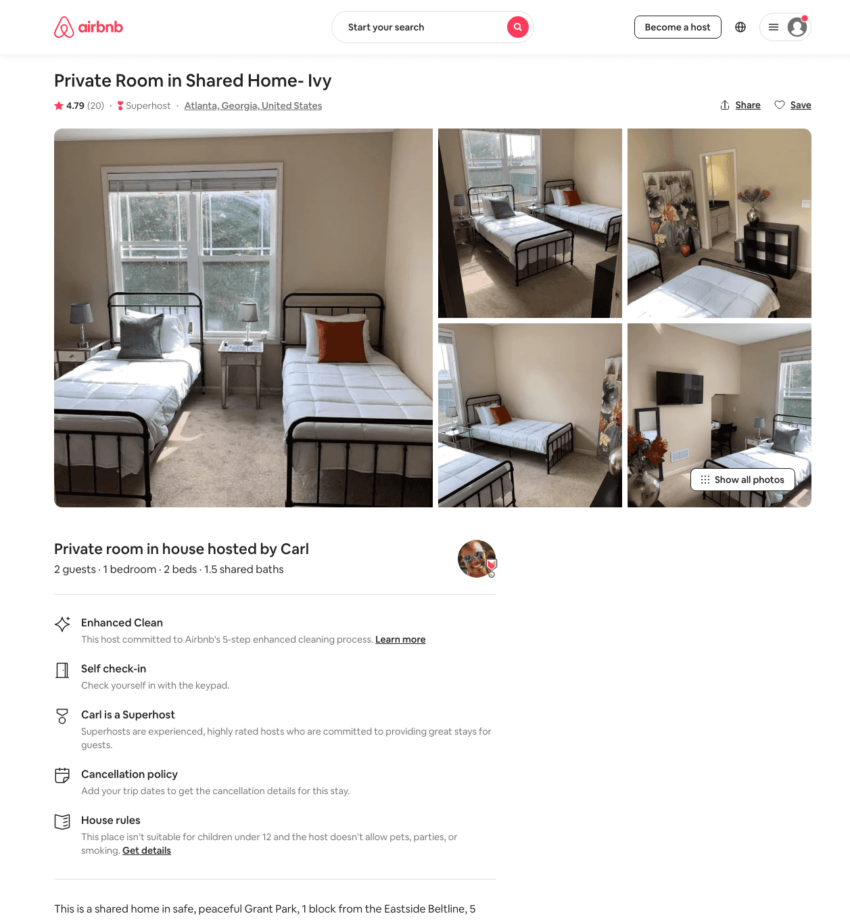
Listing 45360206
1
2
$29 - $62
4.72
2
Carl
22630533
9
https://www.airbnb.com/rooms/45360206
Aug 2022

Slide 33
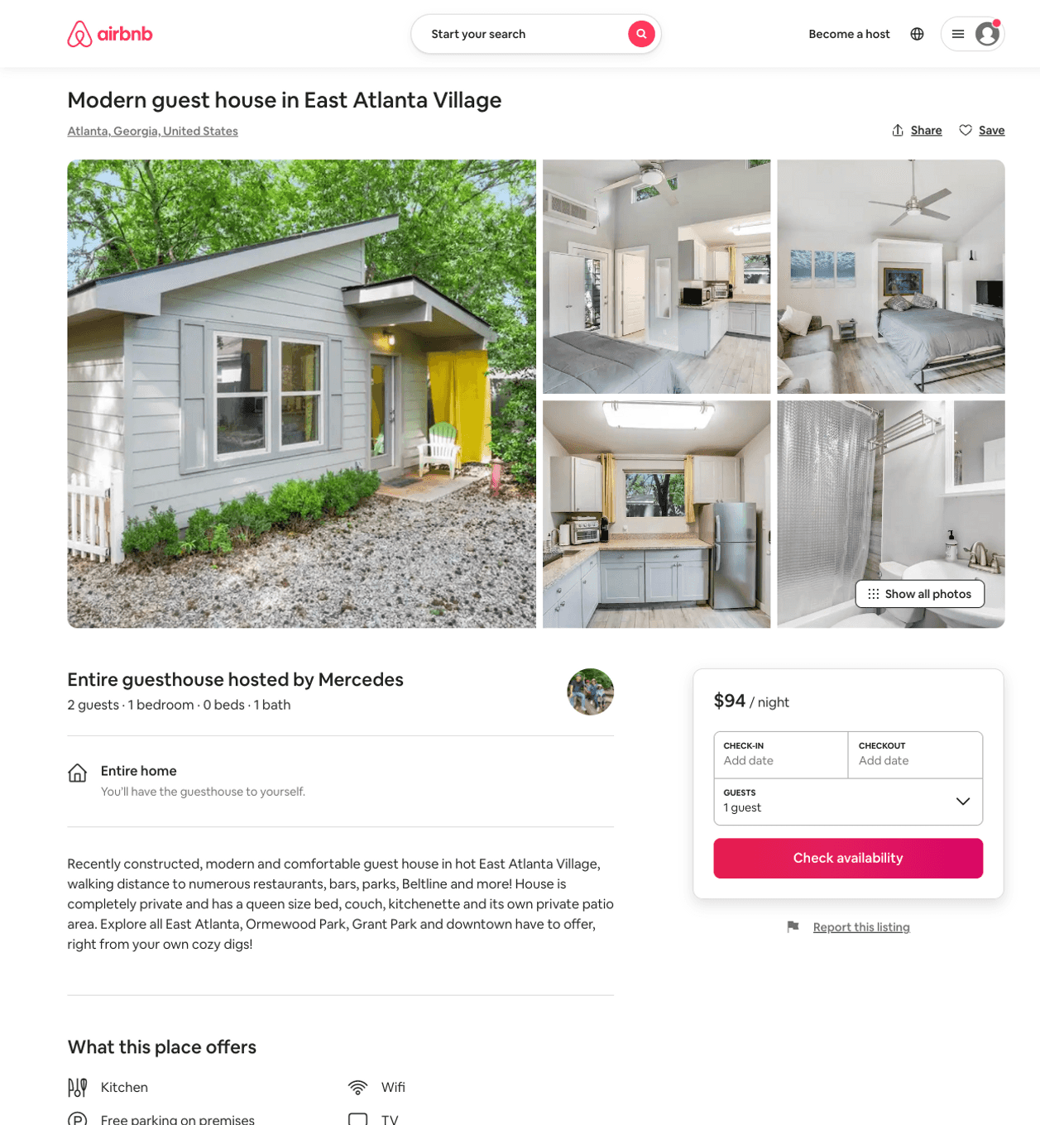
Listing 50725839
1
2
$90 - $99
4.95
1
Mercedes
7020878
1
https://www.airbnb.com/rooms/50725839
Aug 2022

Slide 34
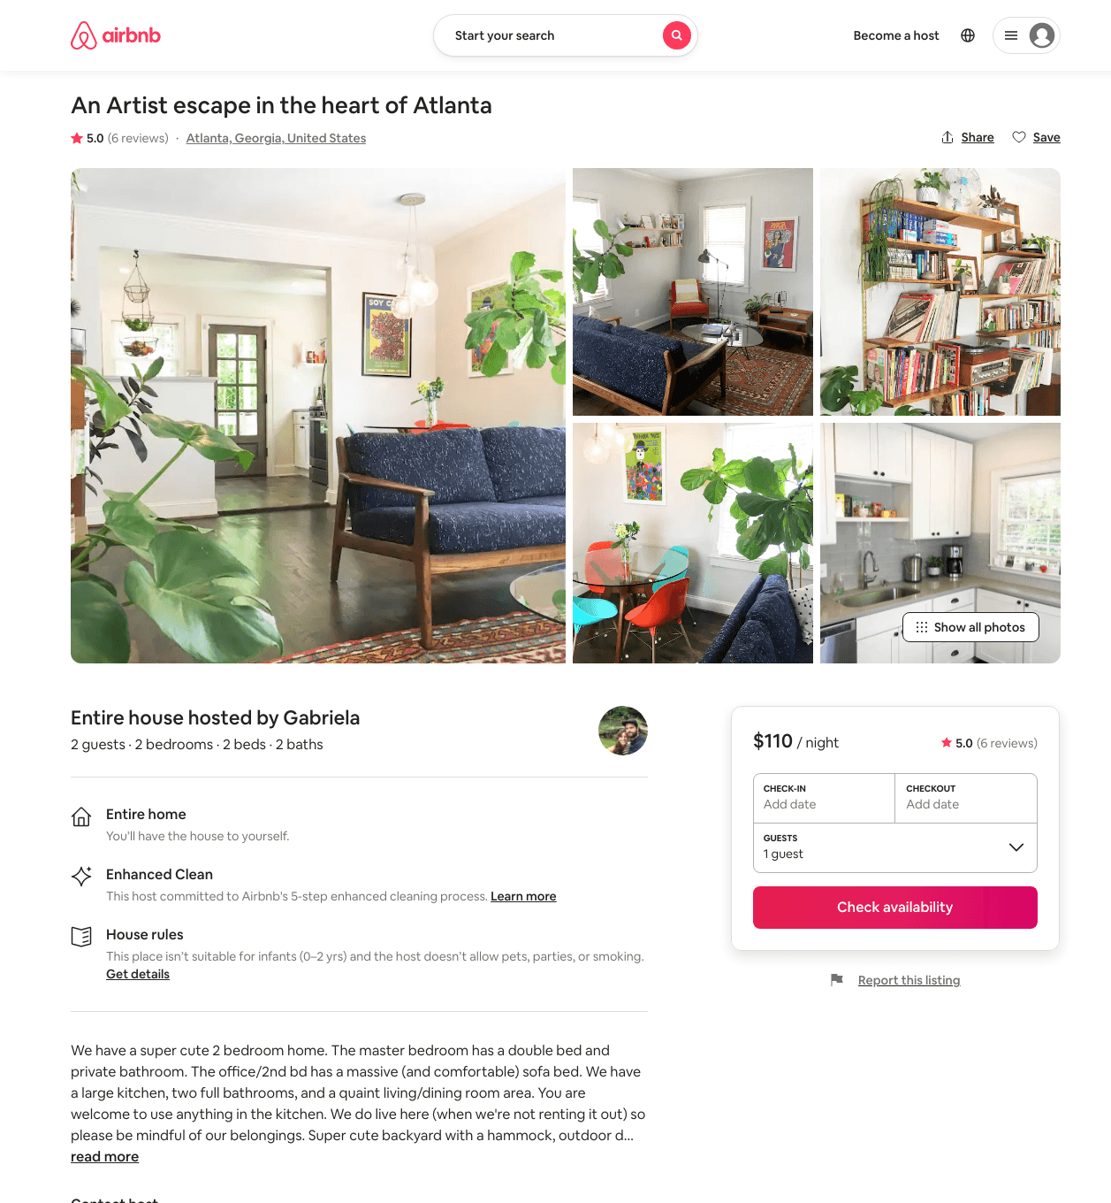
Listing 23766602
2
2
$110
5.0
30
Gabriela
26768278
1
https://www.airbnb.com/rooms/23766602
Aug 2022

Slide 35
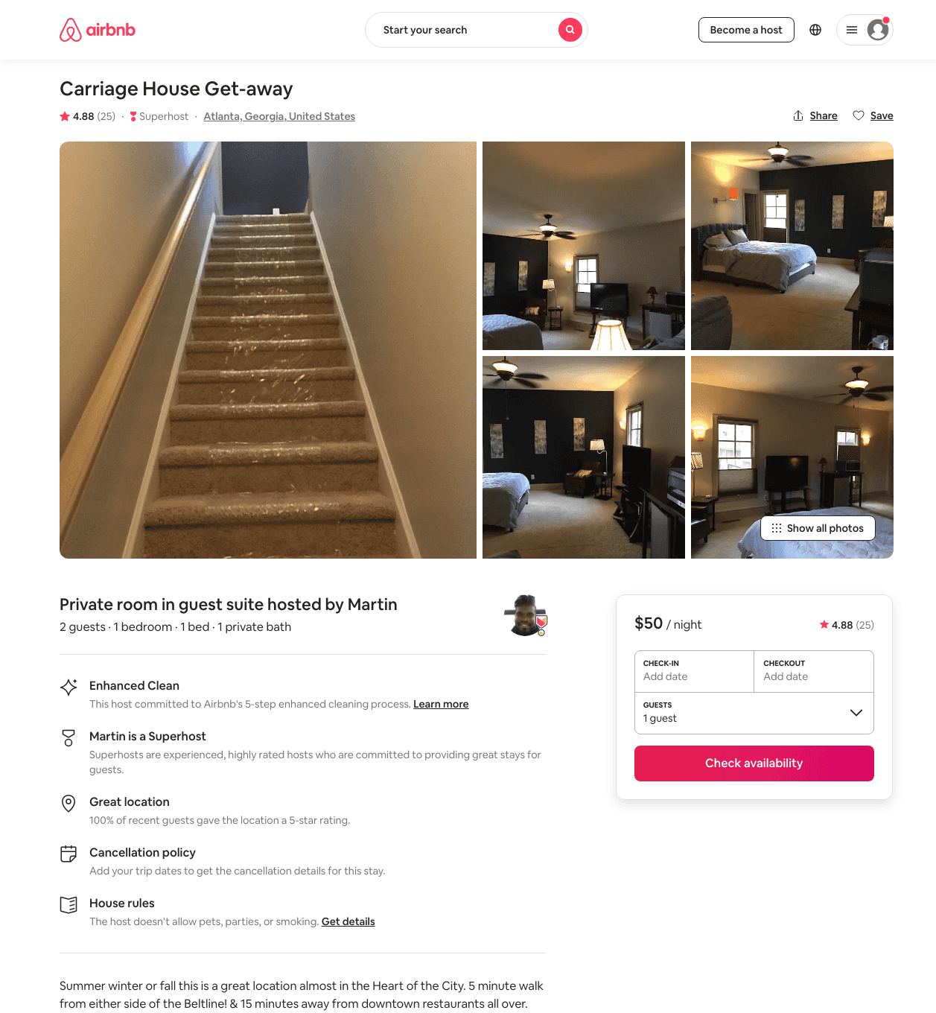
Listing 38489607
1
2
$50 - $85
4.92
3
Martin
239661030
1
https://www.airbnb.com/rooms/38489607
Aug 2022

Slide 36
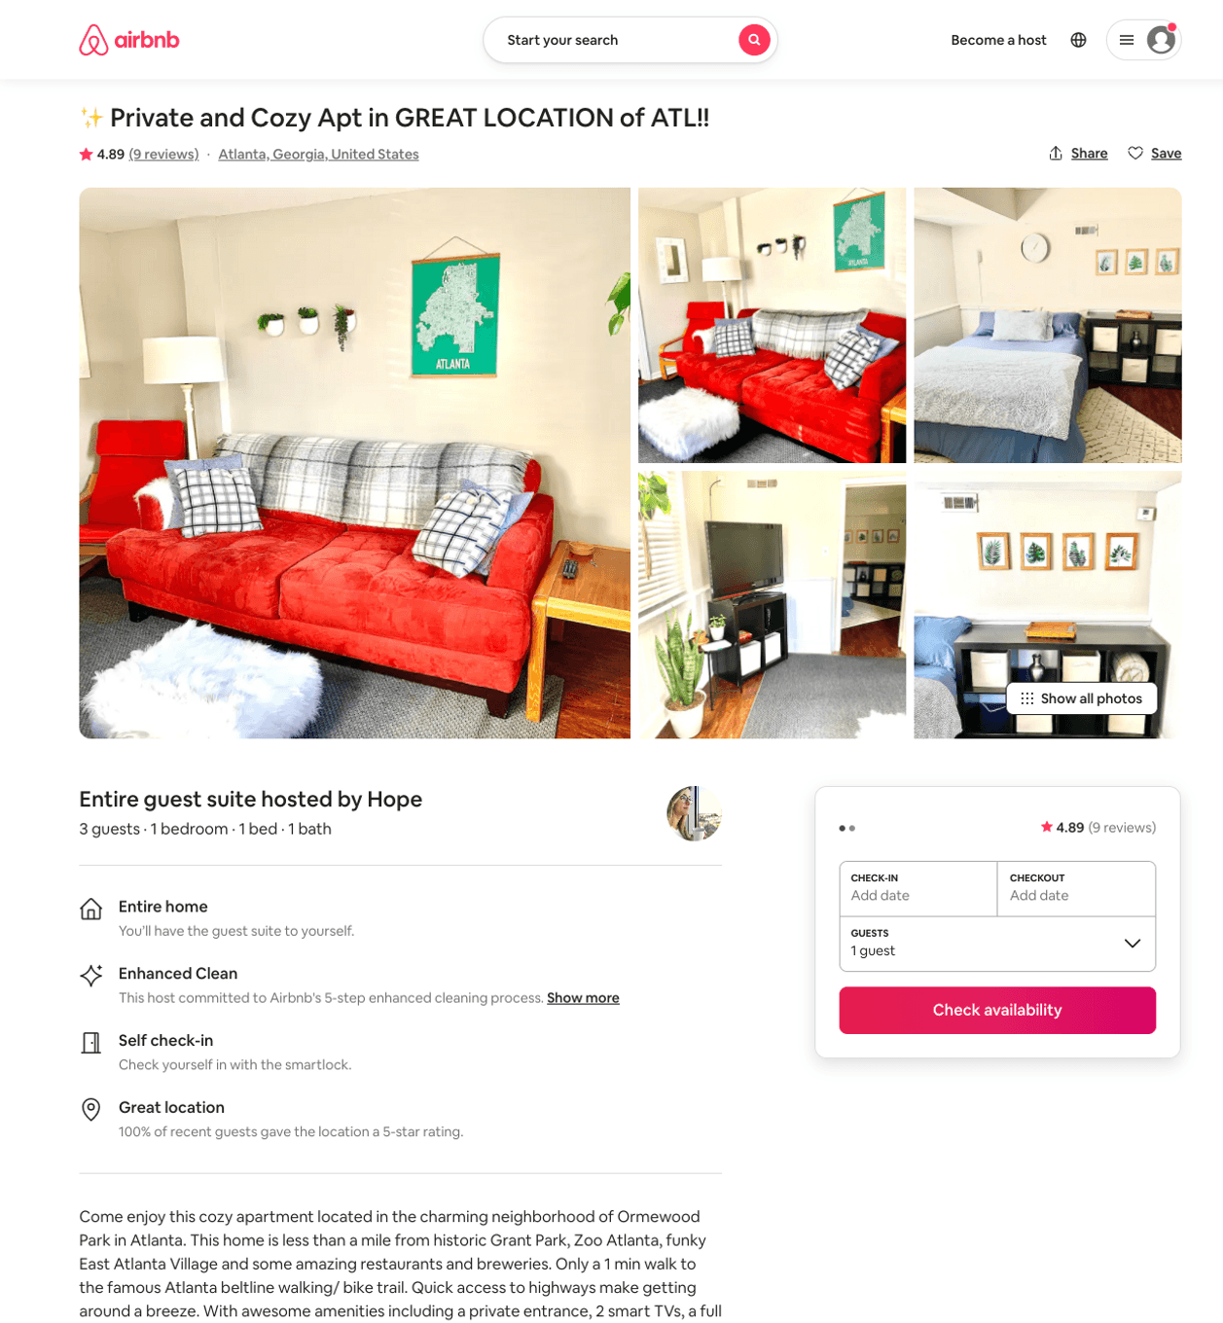
Listing 47469378
1
3
$64 - $86
4.83
3
Hope
124143732
9
https://www.airbnb.com/rooms/47469378
Aug 2022

Slide 37
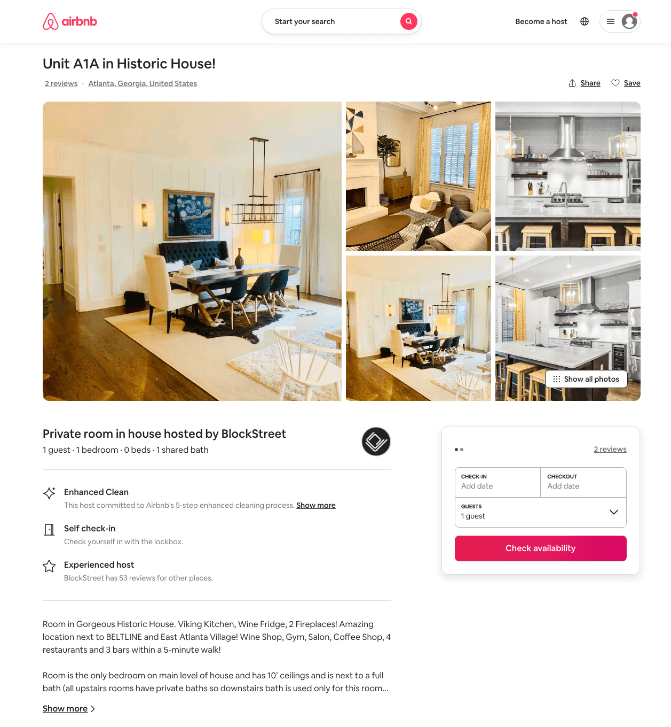
Listing 12548688
1
1
$26 - $30
3.75
30
BlockStreet
15113882
4
https://www.airbnb.com/rooms/12548688
Aug 2022

Slide 38
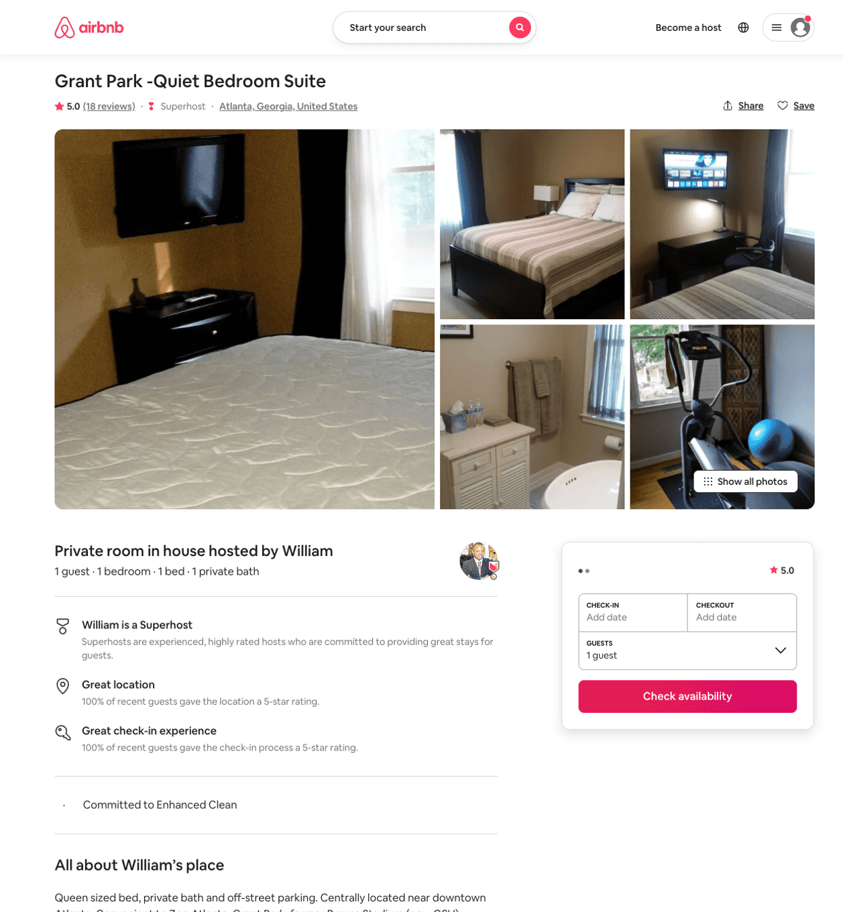
Listing 9736237
1
1
$60
5.0
30
William
50233999
1
https://www.airbnb.com/rooms/9736237
Jul 2022

Slide 39
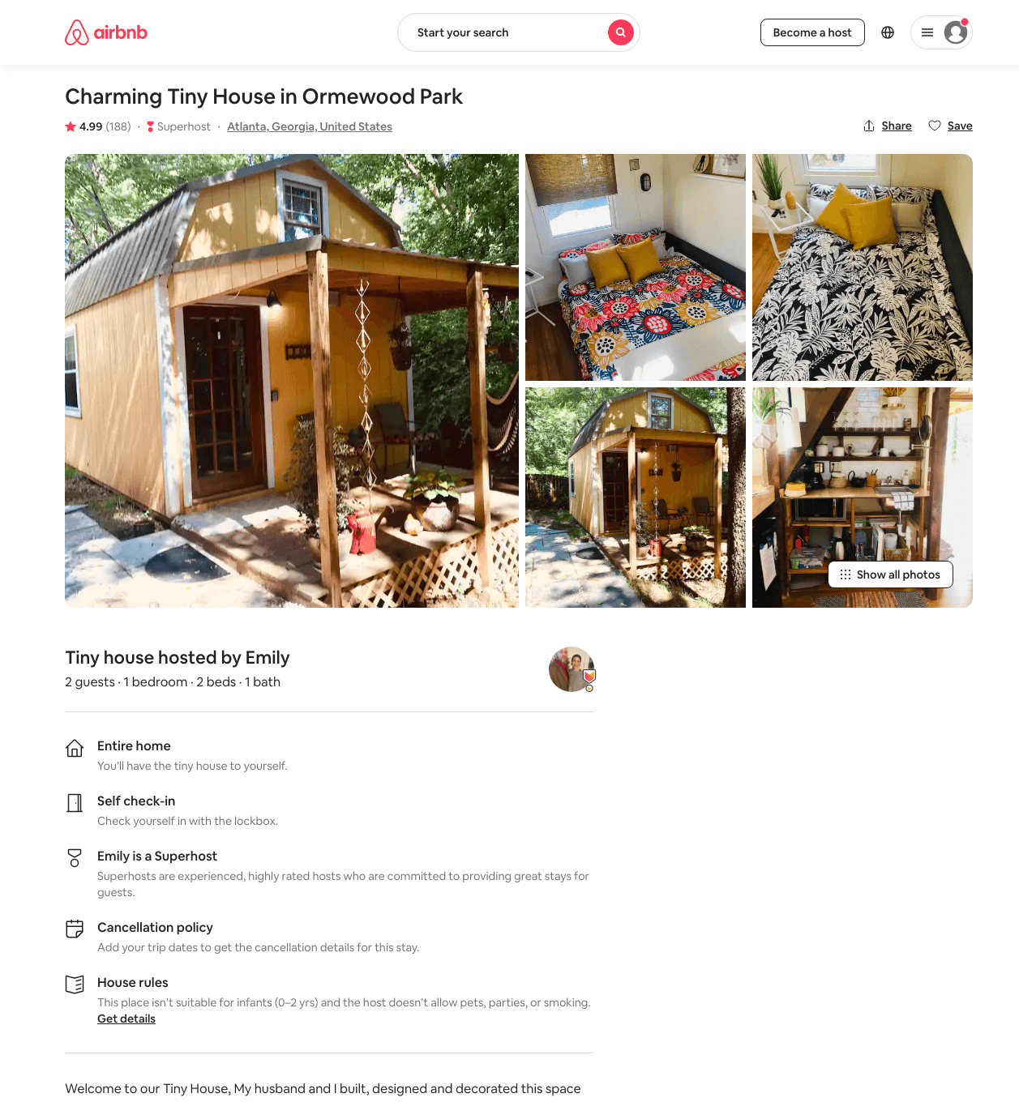
Listing 31469011
1
2
$60 - $85
4.98
2
Emily
184431971
1
https://www.airbnb.com/rooms/31469011
Aug 2022

Slide 40
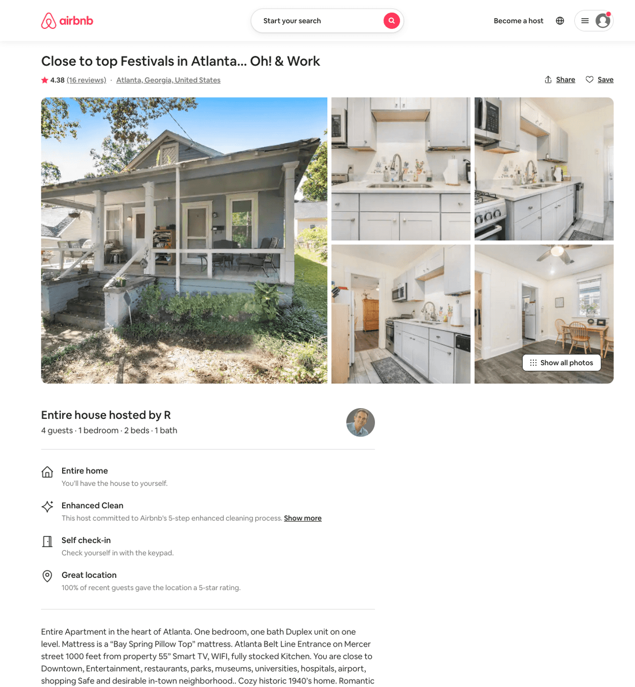
Listing 31932430
1
4
$82 - $111
4.36
1
R
239423384
1
https://www.airbnb.com/rooms/31932430
Aug 2022

Slide 41
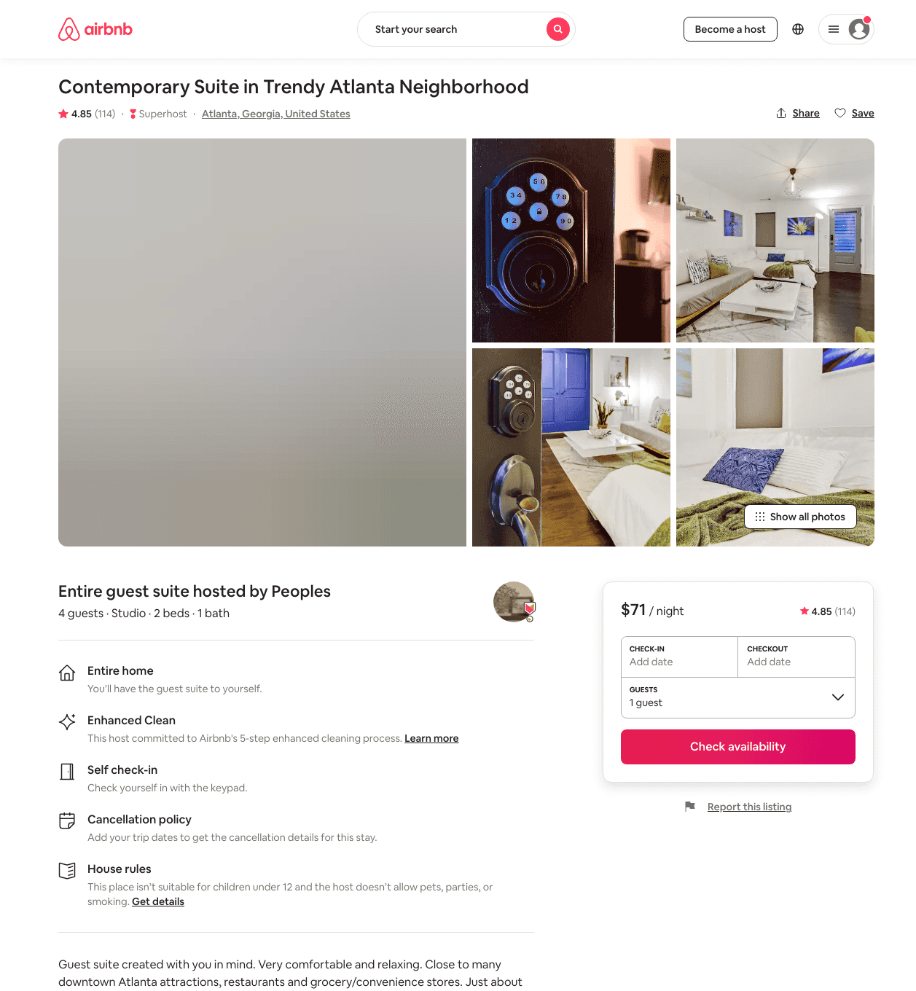
Listing 39754172
Studio
3
$71 - $104
4.79
2
Peoples
305523122
1
https://www.airbnb.com/rooms/39754172
Aug 2022

Slide 42
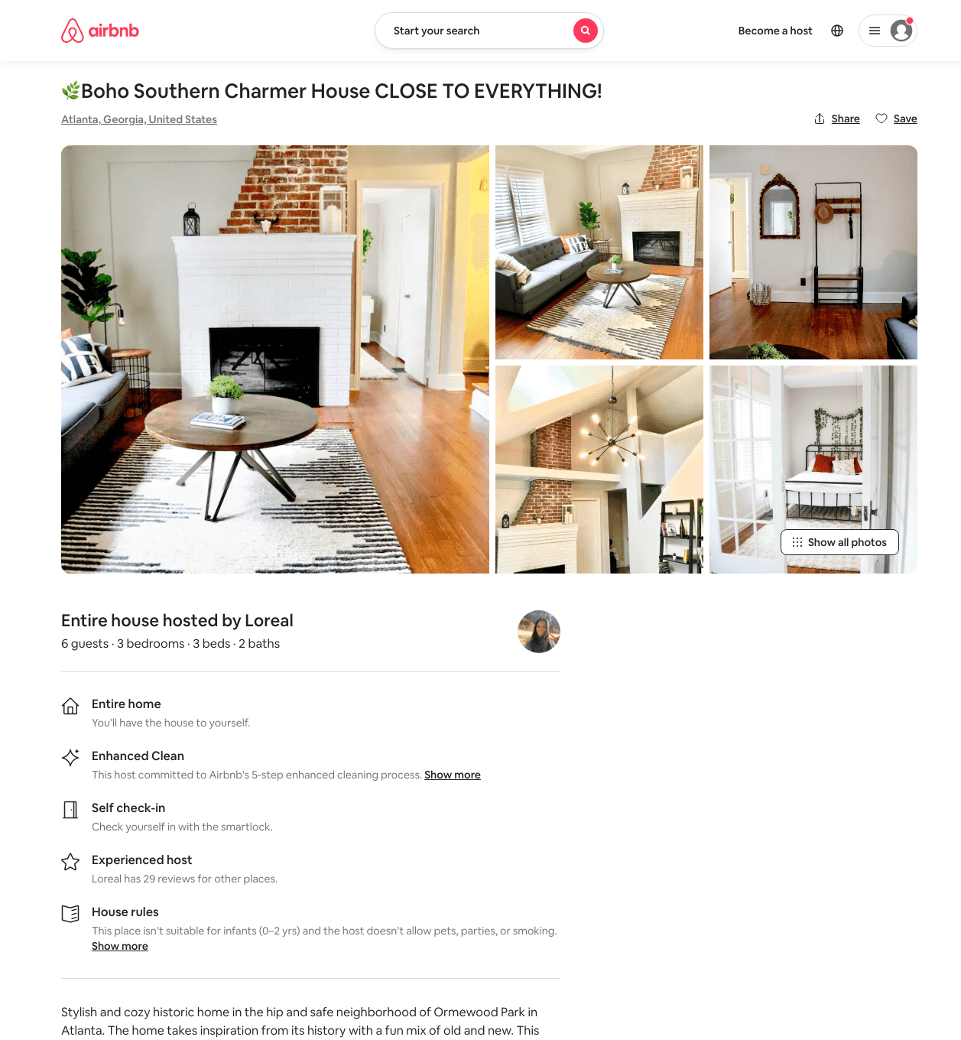
Listing 49345241
3
6
$157 - $264
4.77
3
Hope
124143732
9
https://www.airbnb.com/rooms/49345241
Aug 2022

Slide 43
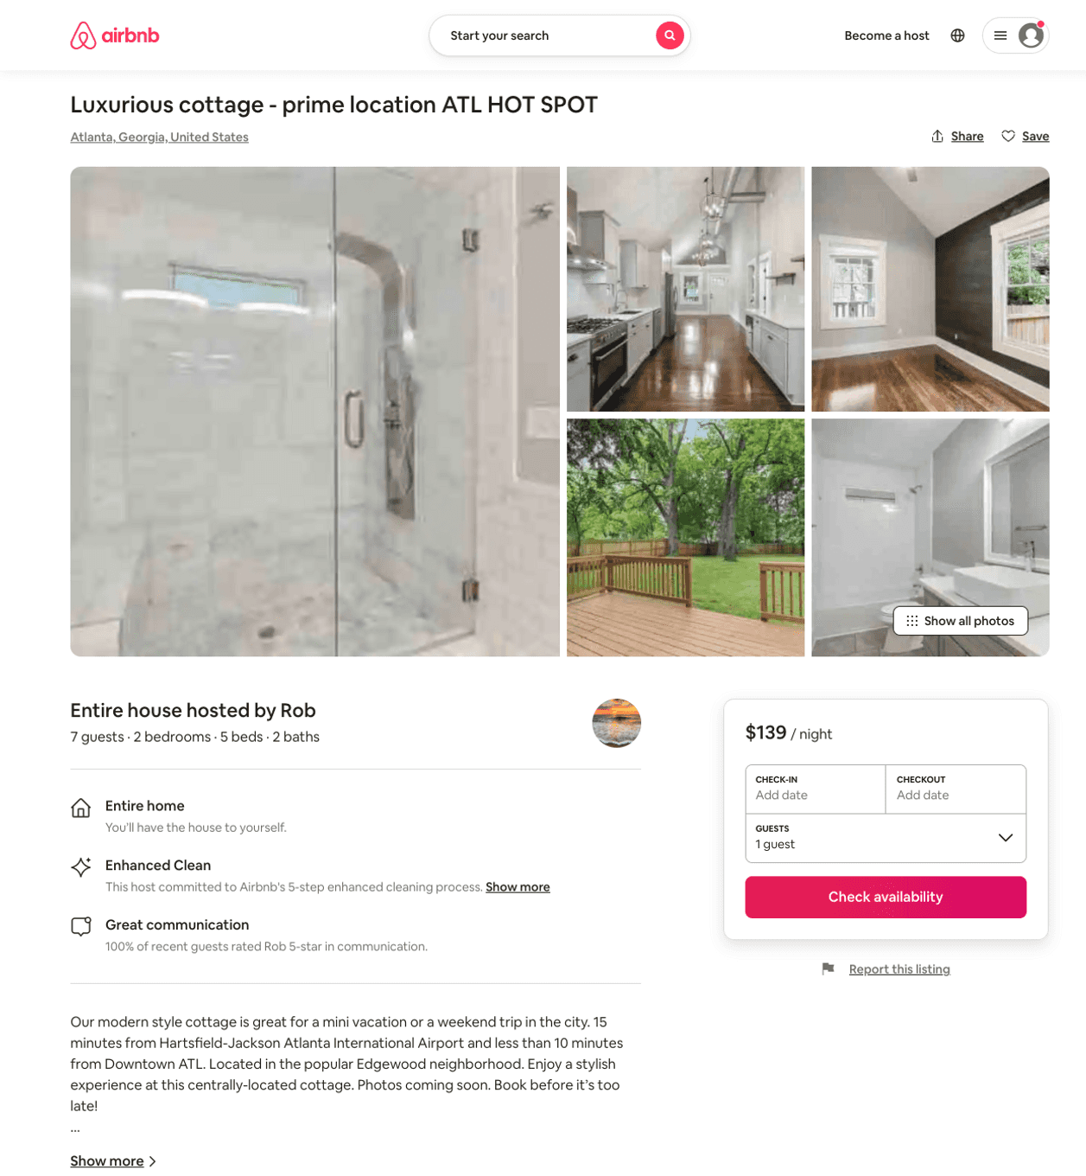
Listing 50747736
2
7
$78 - $149
4.26
2
Rob
197766779
2
https://www.airbnb.com/rooms/50747736
Jul 2022

Slide 44
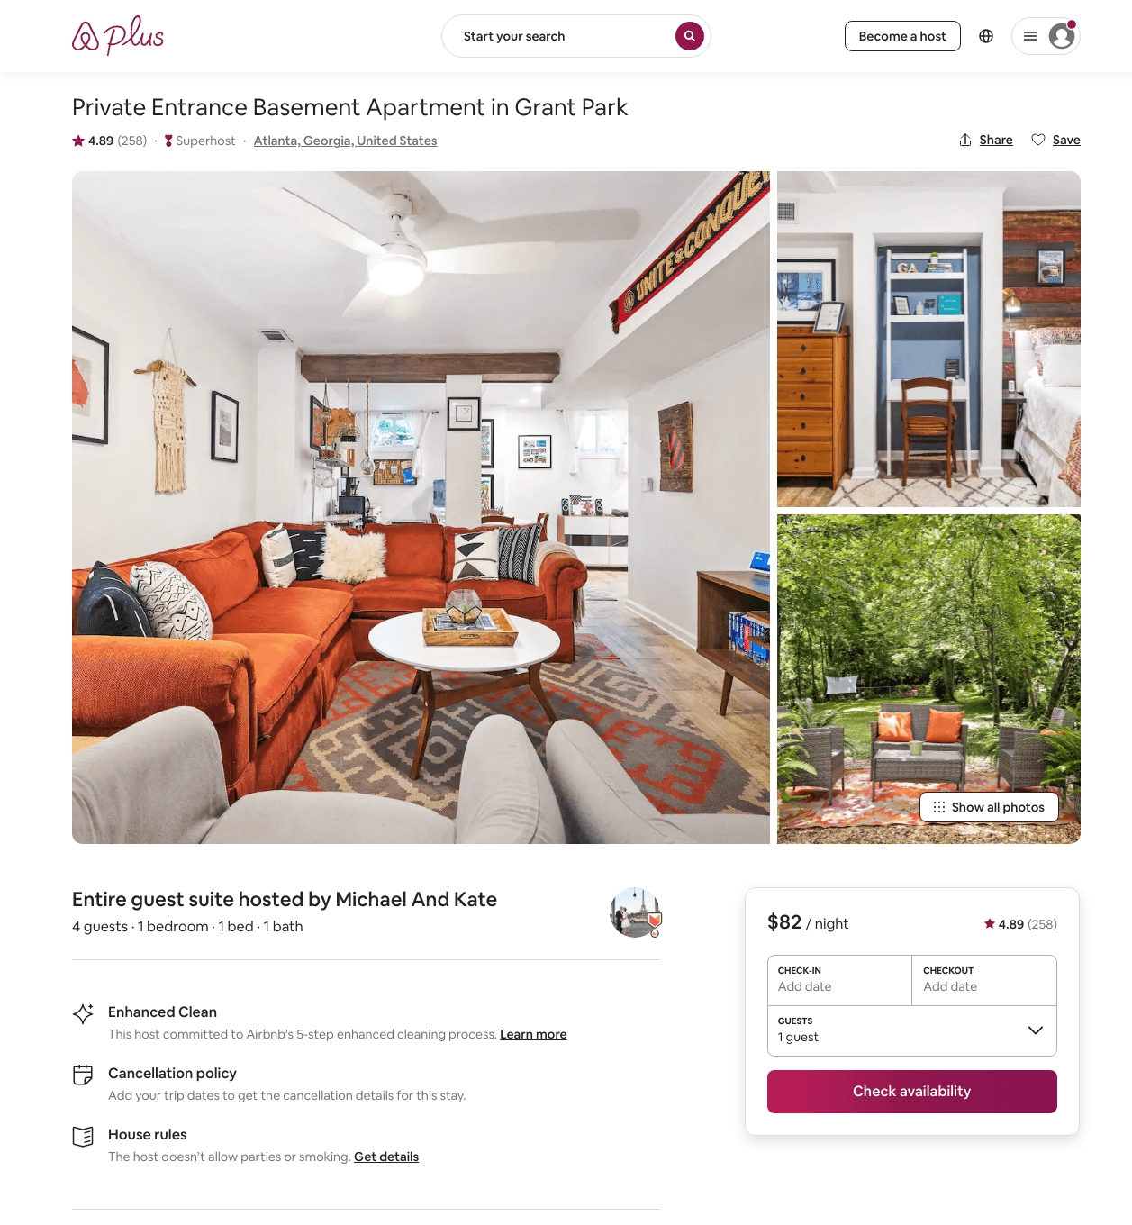
Listing 24442887
1
4
$70 - $102
4.87
2
Michael
51069063
1
https://www.airbnb.com/rooms/24442887
Aug 2022

Slide 45
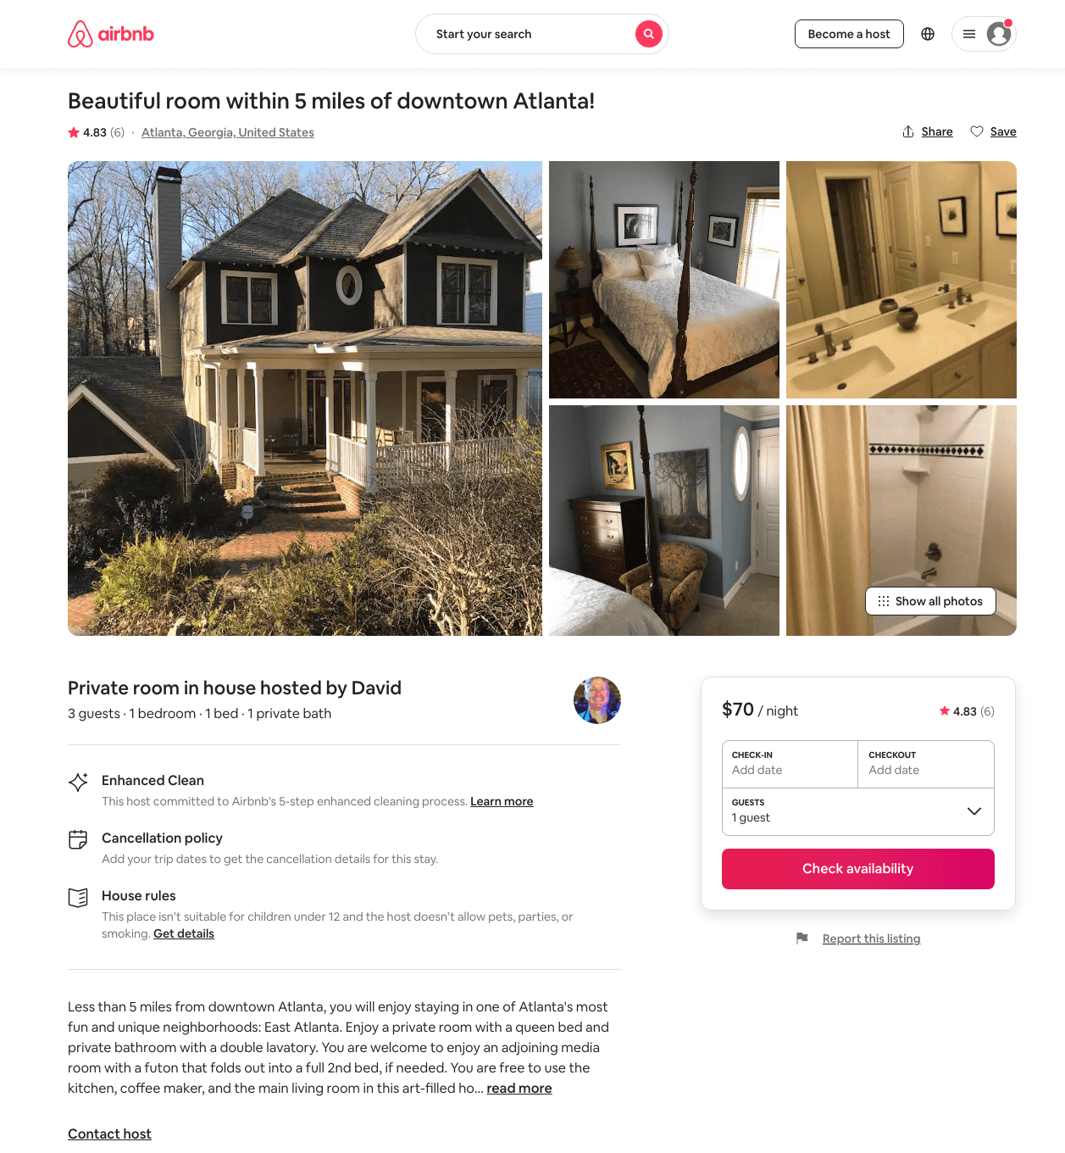
Listing 31712407
1
3
$65 - $70
4.83
2
David
77940343
1
https://www.airbnb.com/rooms/31712407
Aug 2022

Slide 46
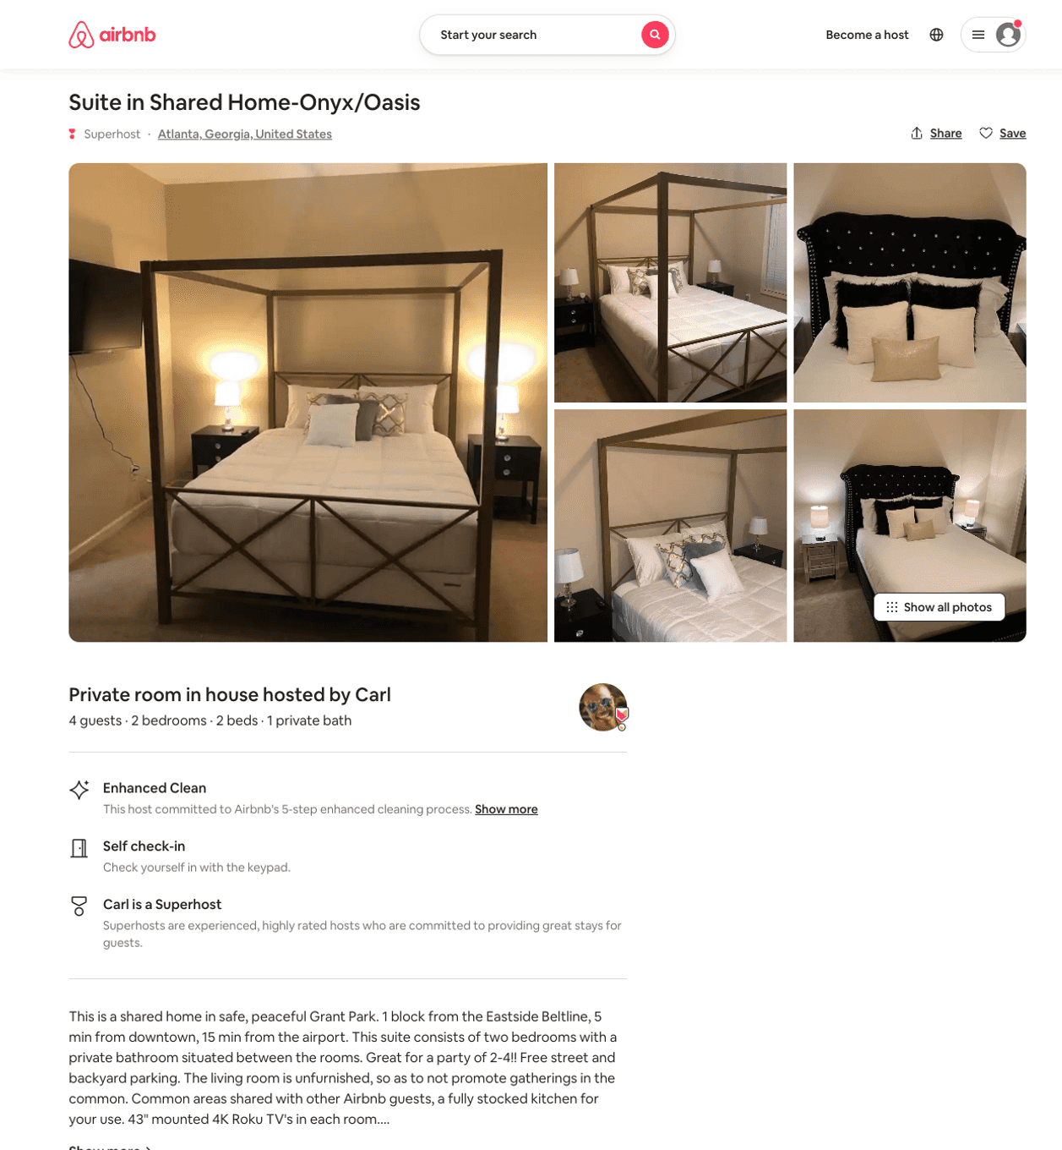
Listing 45849460
2
4
$94 - $117
5.0
2
Carl
22630533
9
https://www.airbnb.com/rooms/45849460
Aug 2022

Slide 47
Listing 45787906
2
5
$91 - $117
3.67
2
Carl
22630533
9
https://www.airbnb.com/rooms/45787906
Aug 2022

Slide 48
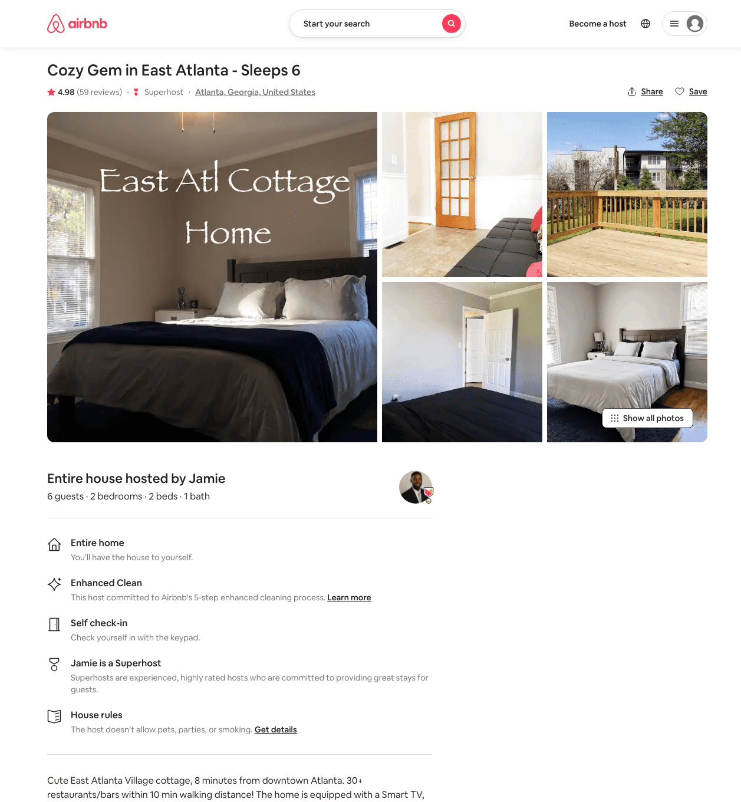
Listing 30581748
2
5
$139 - $169
4.94
4
Jamie
17497293
2
https://www.airbnb.com/rooms/30581748
Aug 2022

Slide 49
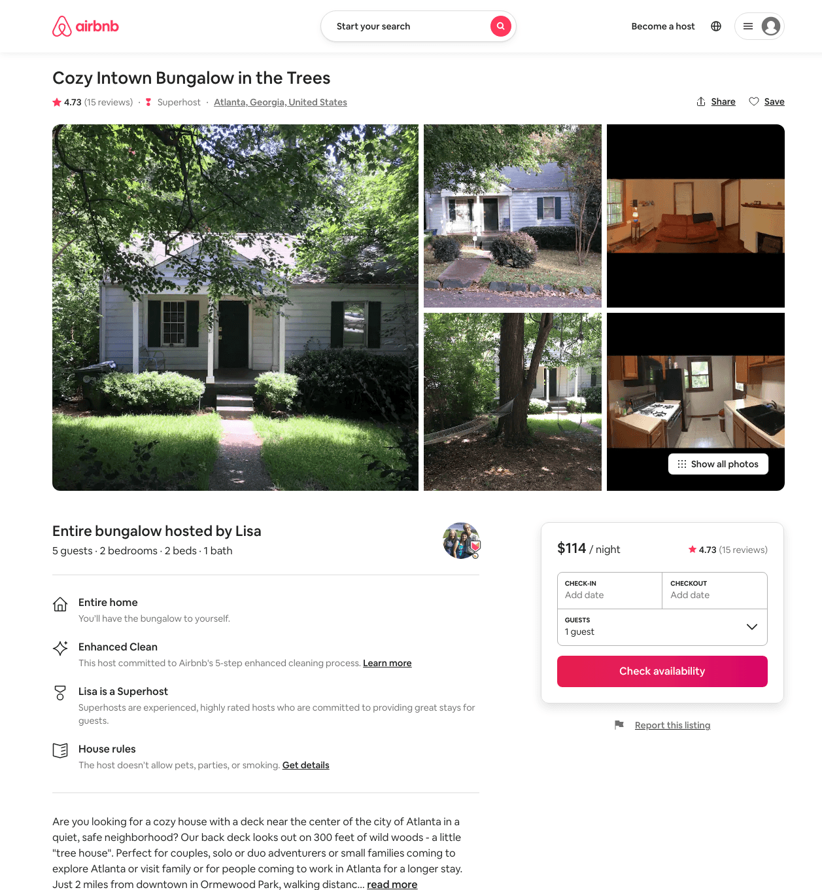
Listing 13933410
2
5
$114
4.73
5
Lisa
82814006
1
https://www.airbnb.com/rooms/13933410
Aug 2022

Slide 50
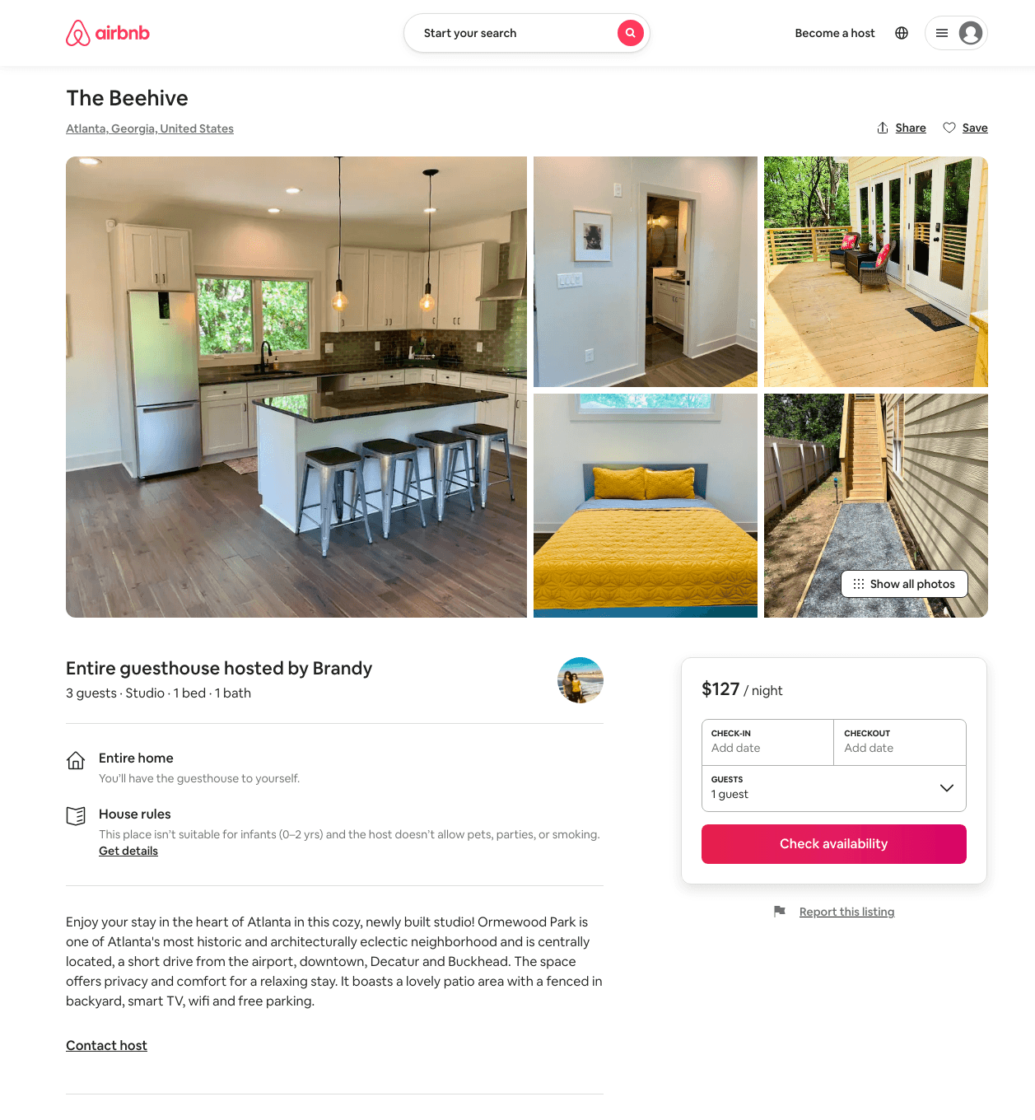
Listing 49246769
Studio
3
$105 - $150
4.79
2
Brandy
238293292
1
https://www.airbnb.com/rooms/49246769
Aug 2022

Slide 51
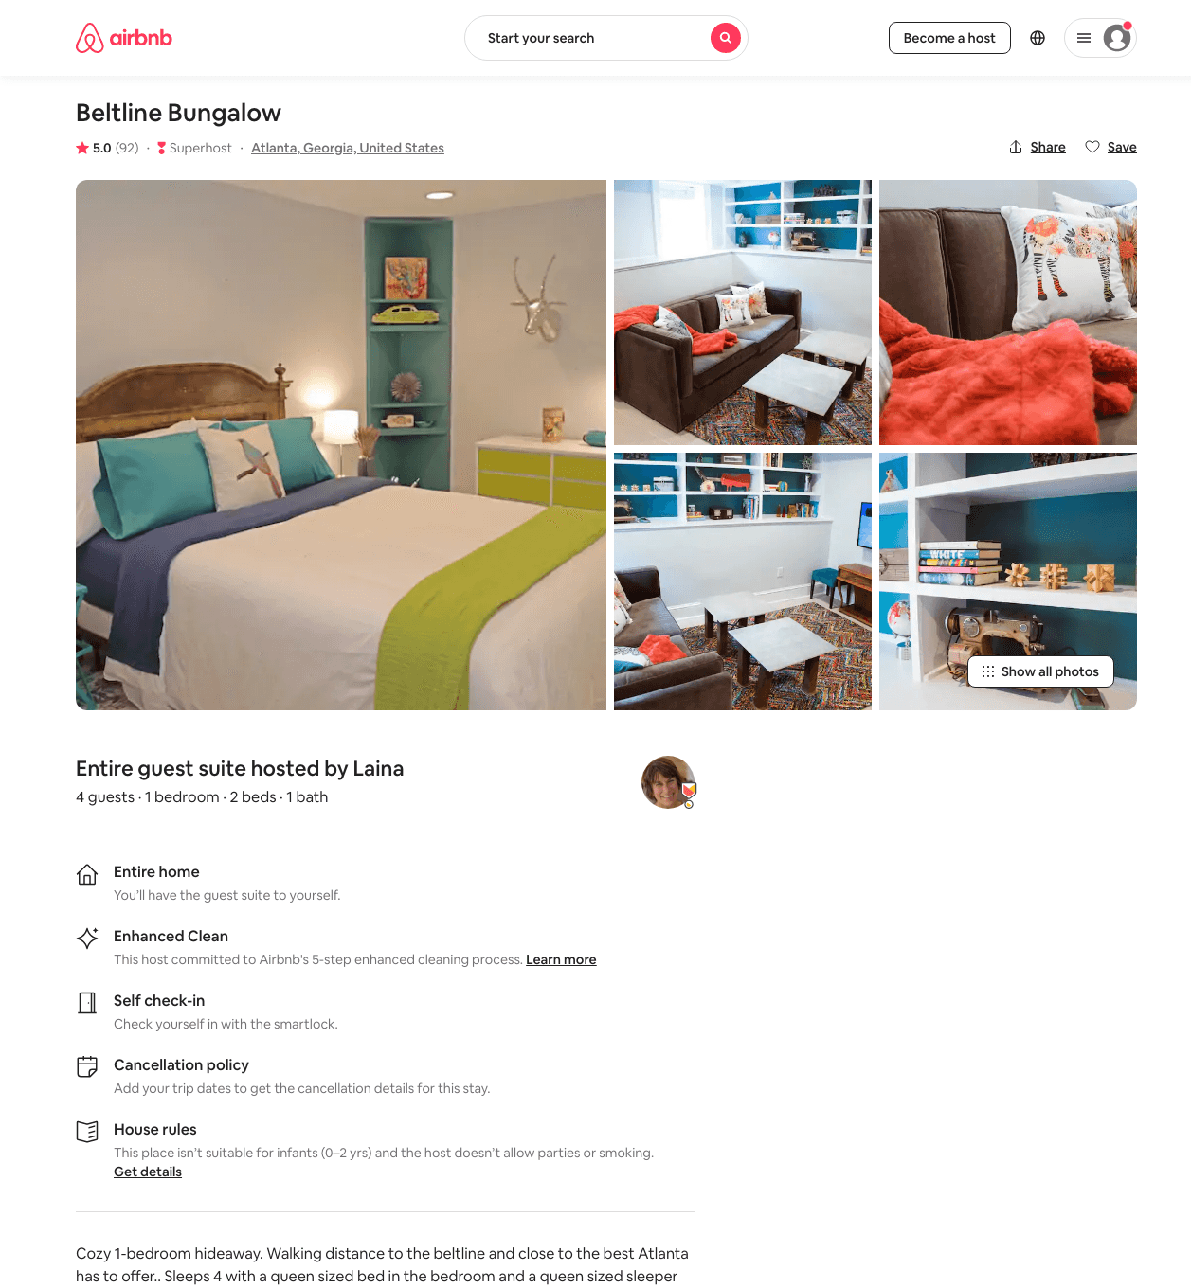
Listing 30891299
1
4
$64 - $70
4.98
3
Laina
53429415
1
https://www.airbnb.com/rooms/30891299
Aug 2022

Slide 52
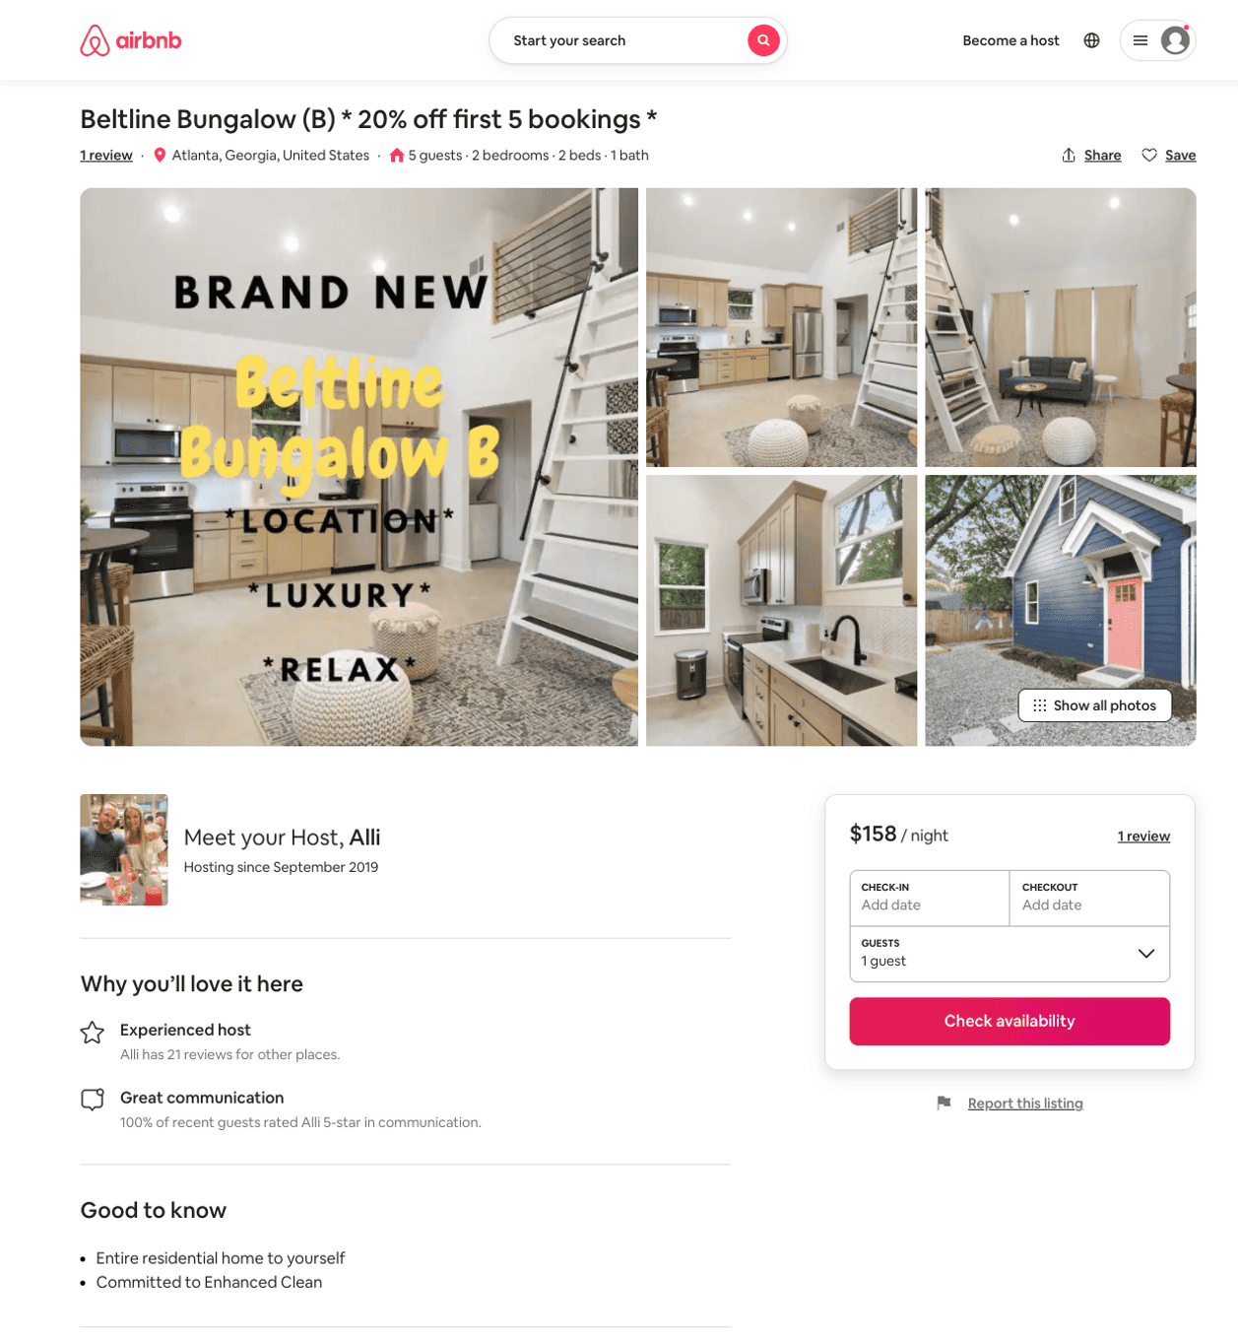
Listing 51488707
2
5
$107 - $193
4.96
1
Alli
292988771
2
https://www.airbnb.com/rooms/51488707
Aug 2022

Slide 53
Listing 31307781
Studio
2
$85 - $100
4.95
2
Melissa
28887155
1
https://www.airbnb.com/rooms/31307781
Aug 2022

Slide 54
Listing 46135657
2
4
$91 - $114
4.80
2
Carl
22630533
9
https://www.airbnb.com/rooms/46135657
Aug 2022

Slide 55
Listing 11926233
3
8
$286
4.77
3
Jackson
33283865
1
https://www.airbnb.com/rooms/11926233
Aug 2022

Slide 56
Listing 32020333
2
6
$585
2
Kim
222294108
1
https://www.airbnb.com/rooms/32020333
Aug 2022

Slide 57
Listing 52533518
2
6
$130 - $140
4.39
1
Maria
230939573
13
https://www.airbnb.com/rooms/52533518
Jul 2022

Slide 58
Listing 53324888
2
4
$119 - $192
4.90
2
Heidi
91582024
6
https://www.airbnb.com/rooms/53324888
Jul 2022

Slide 59
Listing 53359251
1
2
$75 - $110
5.0
1
Heather
372442456
1
https://www.airbnb.com/rooms/53359251
Aug 2022

Slide 60
Listing 53474919
1
2
$96
5.0
1
Nelson
25136465
1
https://www.airbnb.com/rooms/53474919
Jul 2022

Slide 61
Listing 53508545
3
10
$197 - $265
5.0
2
Candice
433289974
1
https://www.airbnb.com/rooms/53508545
Aug 2022

Slide 62
Listing 53415512
1
2
$109 - $135
5.0
2
Liza
211330058
1
https://www.airbnb.com/rooms/53415512
Aug 2022

Slide 63
Listing 49729796
1
3
$95 - $145
2.40
2
Mike
367882473
4
https://www.airbnb.com/rooms/49729796
Aug 2022

Slide 64
Listing 53736993
1
1
$41 - $60
4.13
2
Ninjah
30881650
5
https://www.airbnb.com/rooms/53736993
Aug 2022

Slide 65
Listing 53632104
4
16
$234 - $461
4.94
1
Khaleel
76385428
1
https://www.airbnb.com/rooms/53632104
Aug 2022

Slide 66
Listing 2571961
1
2
$105
2
Mike Walker
https://www.vrbo.com/2571961
Aug 2022

Slide 67
Listing 53942800
1
2
$37 - $62
4.87
2
Aaron
253981389
2
https://www.airbnb.com/rooms/53942800
Aug 2022

Slide 68
Listing 20394048
2
4
$175
5.0
3
Larissa
1183166
1
https://www.airbnb.com/rooms/20394048
Jun 2022

Slide 69
Listing 53228082
2
4
$74 - $120
5.0
2
Danielle
93004528
5
https://www.airbnb.com/rooms/53228082
Aug 2022

Slide 70
Listing 2606249
2
6
$146
4
Jamie Turner
https://www.vrbo.com/2606249
Aug 2022

Slide 71
Listing 2669688
4
16
$505
1
Khaleel
https://www.vrbo.com/2669688
Aug 2022

Slide 72
Listing 35824705
1
2
$65
30
Audrey
2283030
1
https://www.airbnb.com/rooms/35824705
Aug 2022

Slide 73
Listing 54286896
3
6
$117 - $147
4.70
2
Hope
124143732
9
https://www.airbnb.com/rooms/54286896
Aug 2022

Slide 74
Listing 2736828
1
2
$96
1
https://www.vrbo.com/2736828
Aug 2022

Slide 75
Listing 2902710
3
6
$245
2
Larissa Neto
https://www.vrbo.com/2902710
Aug 2022

Slide 76
Listing 2951100
3
6
$219
2
Elisabeth Richmond
https://www.vrbo.com/2951100
Aug 2022

Slide 77
Listing 2954611
3
8
$446
3
Brandy Jaber
https://www.vrbo.com/2954611
Aug 2022

