Slide 2
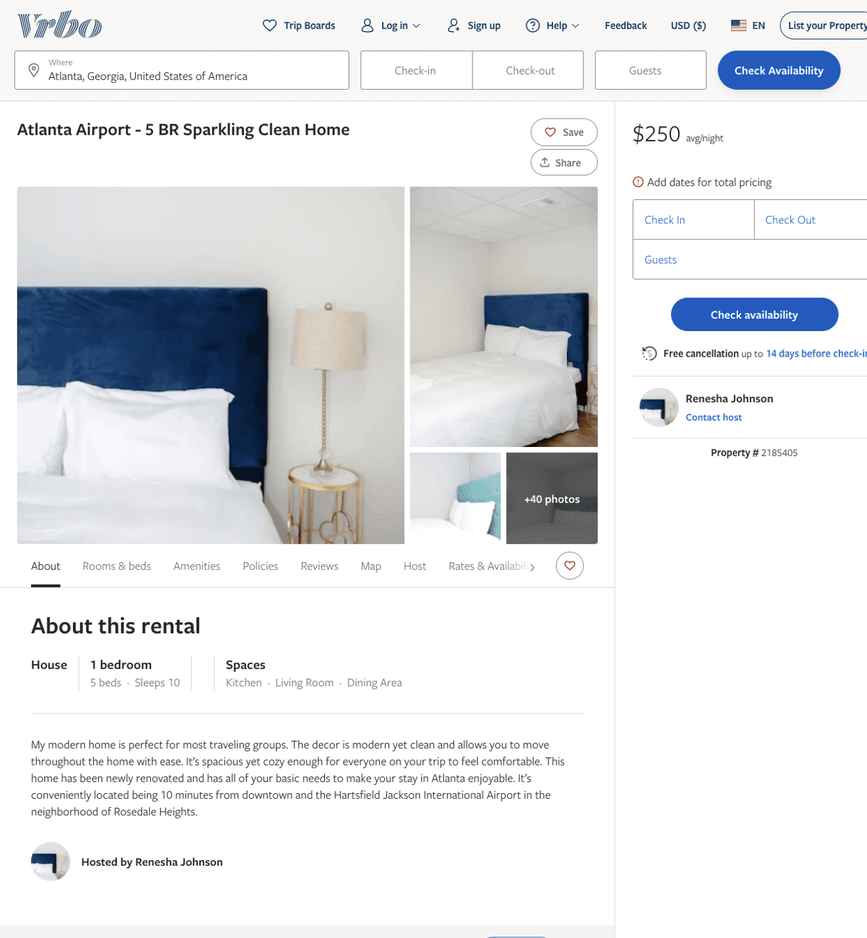
Listing 2185405
5
10
$183 - $250
3
2
Renesha Johnson
https://www.vrbo.com/2185405
Aug 2022

Slide 3
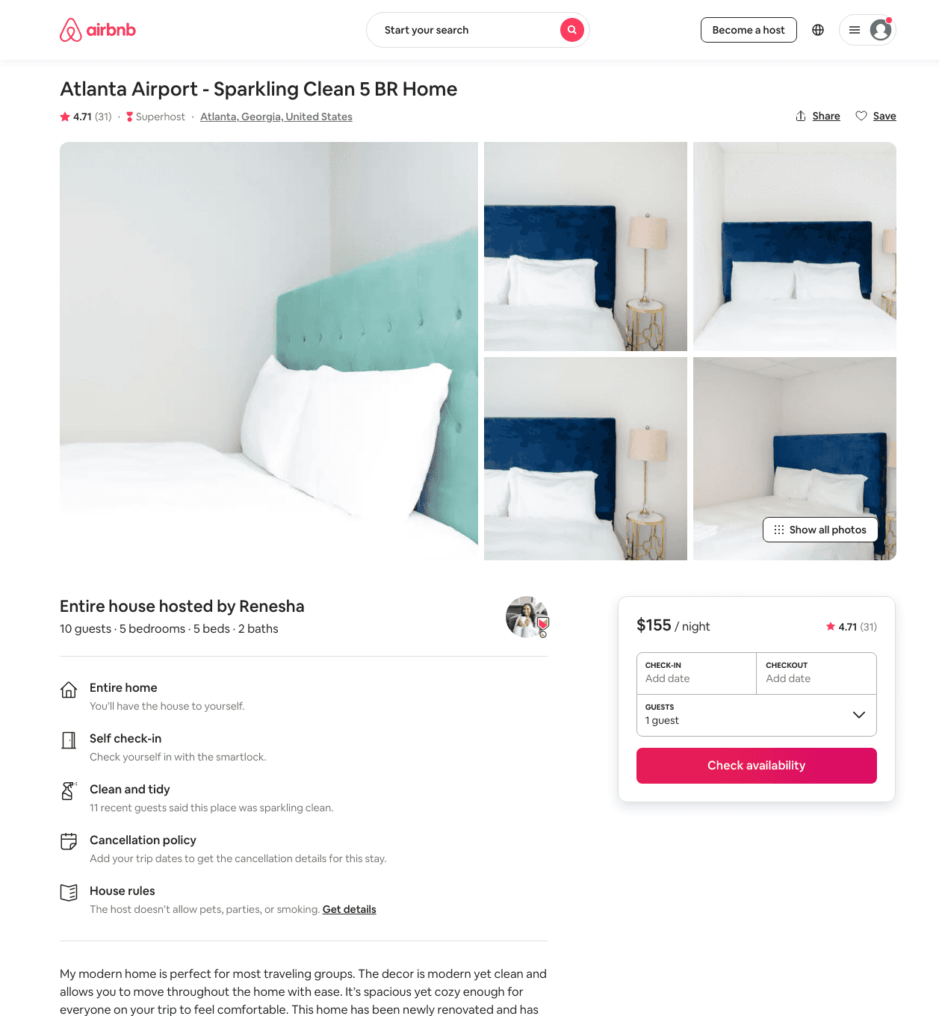
Listing 41554099
5
14
$153 - $276
4.64
2
Renesha
35038747
3
https://www.airbnb.com/rooms/41554099
Jul 2022

Slide 4
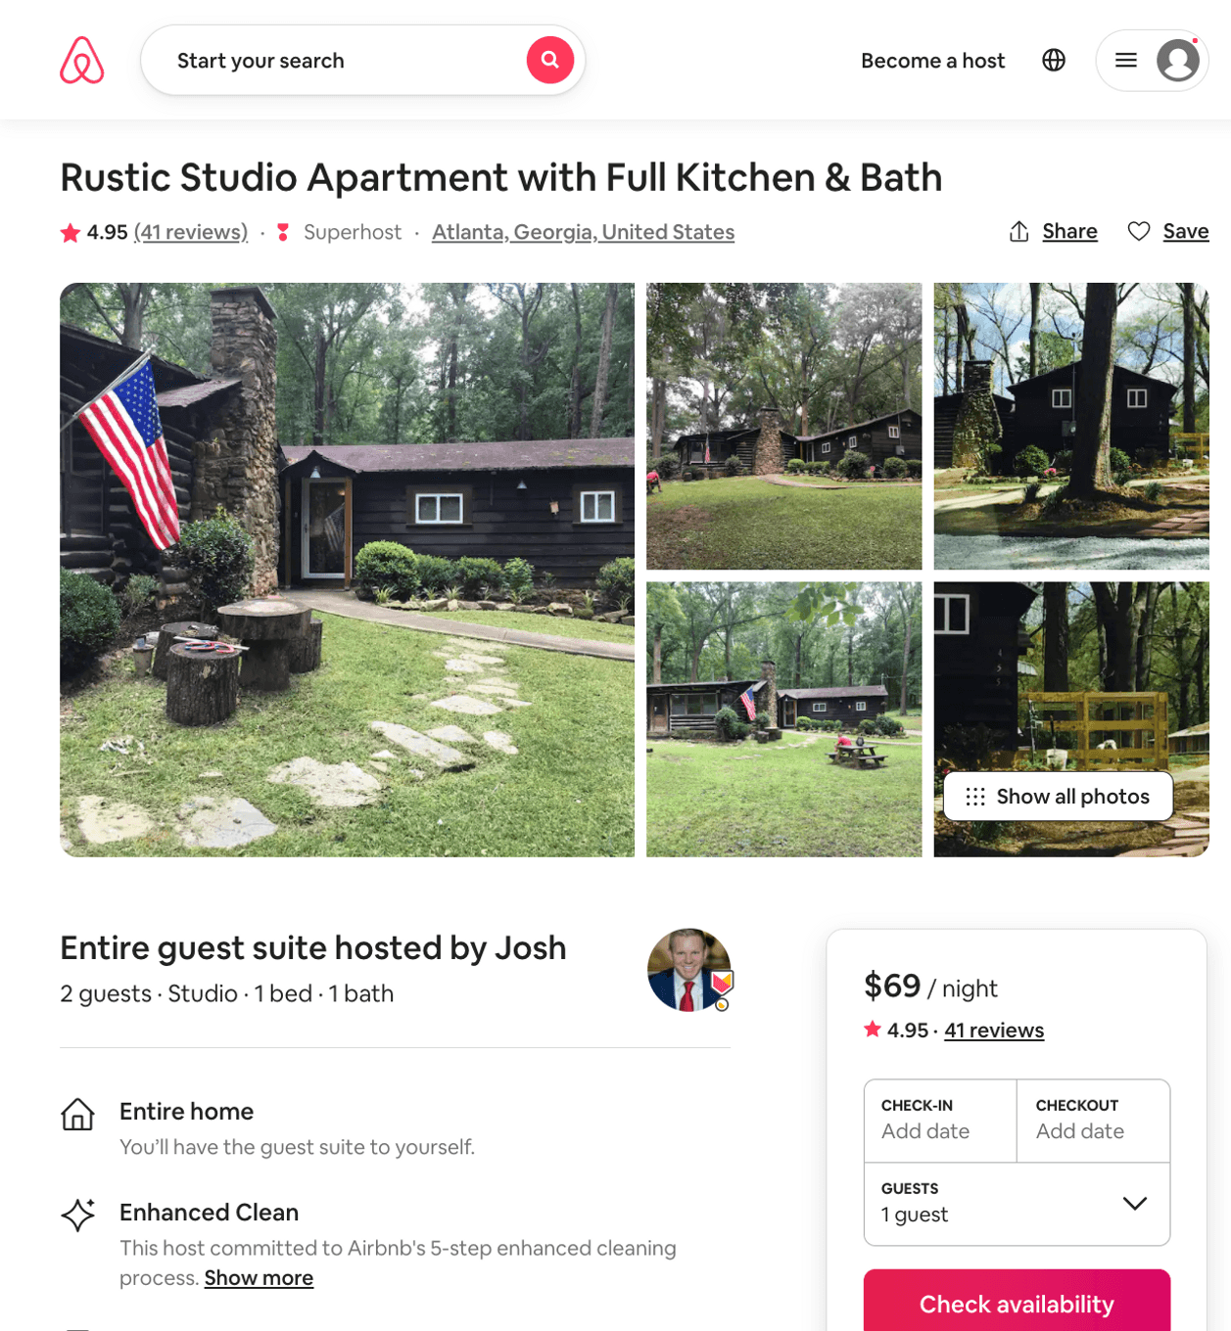
Listing 18625151
Studio
2
$69 - $70
4.95
30
Josh
31908662
1
https://www.airbnb.com/rooms/18625151
Aug 2022

Slide 5
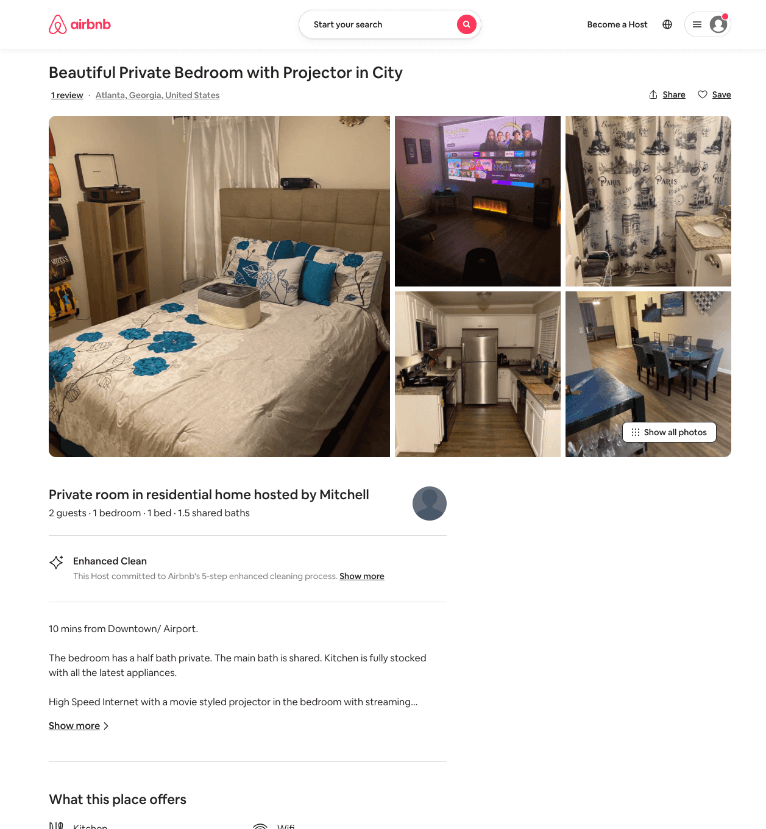
Listing 53955931
1
2
$37 - $46
4.81
1
Mitchell
247311888
4
https://www.airbnb.com/rooms/53955931
Aug 2022

Slide 6
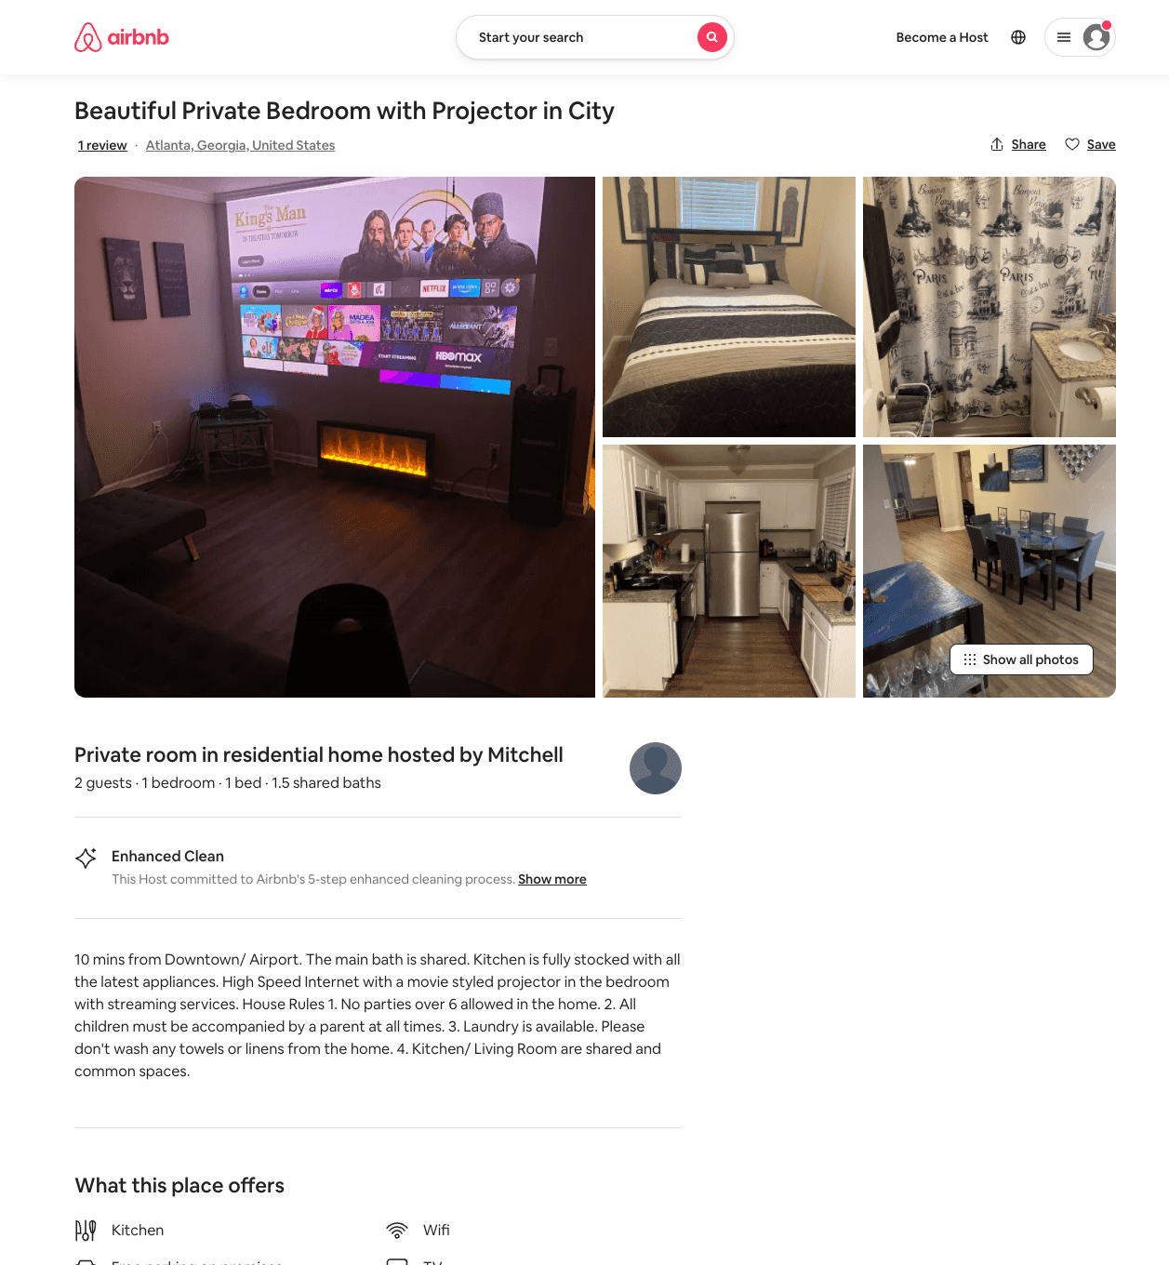
Listing 54004548
1
2
$37 - $60
4.73
1
Mitchell
247311888
4
https://www.airbnb.com/rooms/54004548
Aug 2022

Slide 7
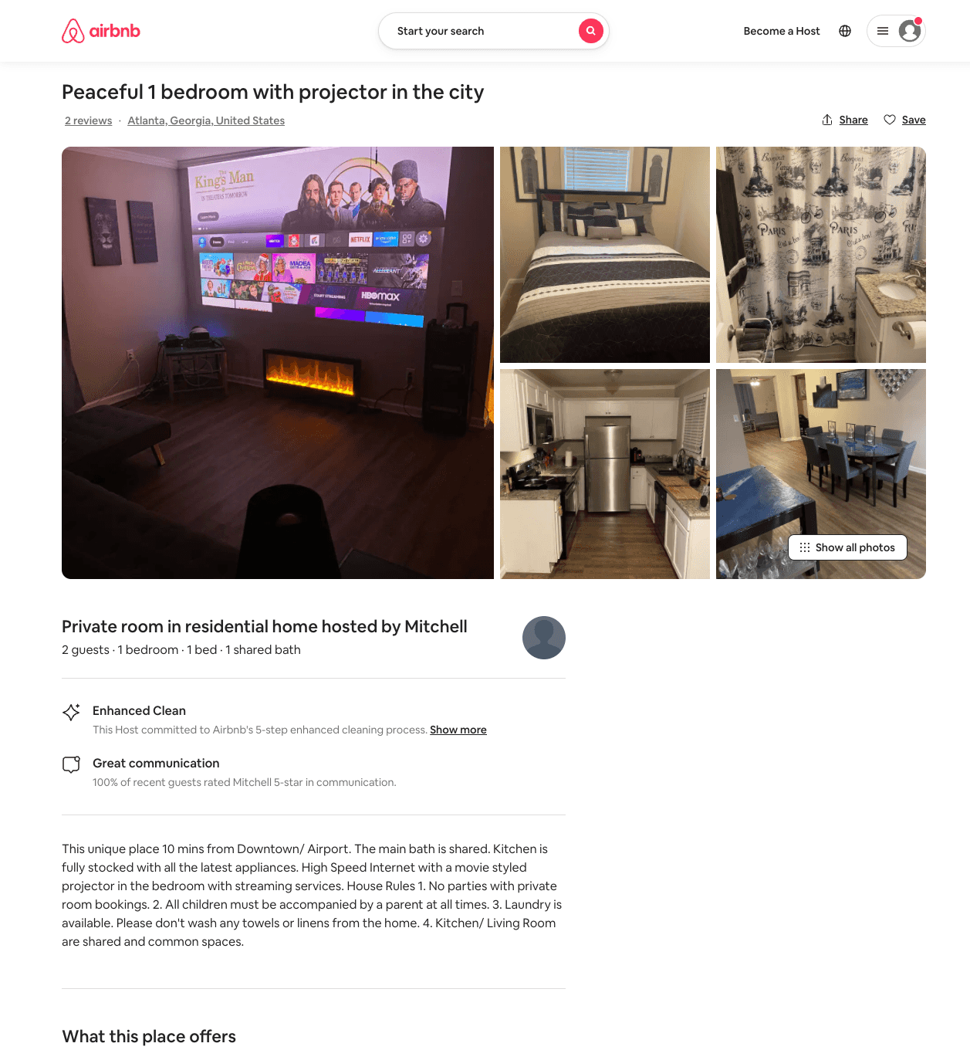
Listing 54088797
1
2
$37 - $50
4.80
1
Mitchell
247311888
4
https://www.airbnb.com/rooms/54088797
Aug 2022

