Slide 2
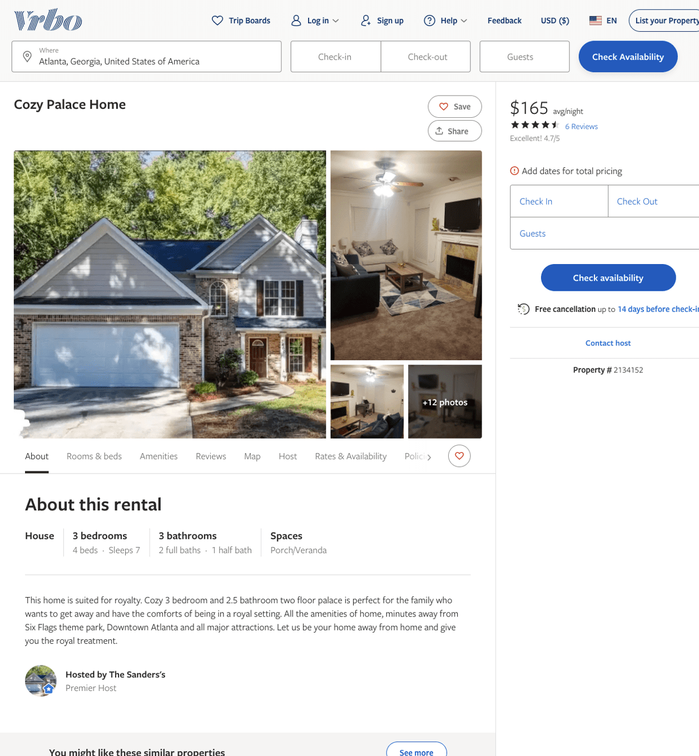
Listing 2134152
3
7
$165
4.6666665
2
The Sanders's
https://www.vrbo.com/2134152
Aug 2022

