Slide 2
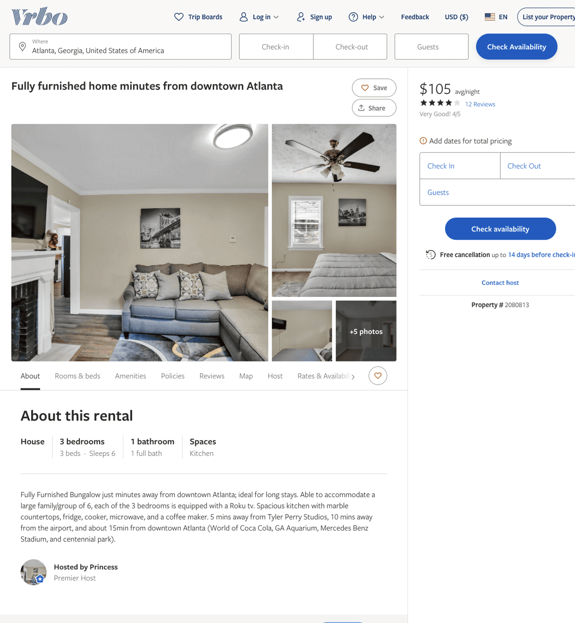
Listing 2080813
3
6
$100 - $93
3.45
2
Princess
https://www.vrbo.com/2080813
Aug 2022

Slide 3
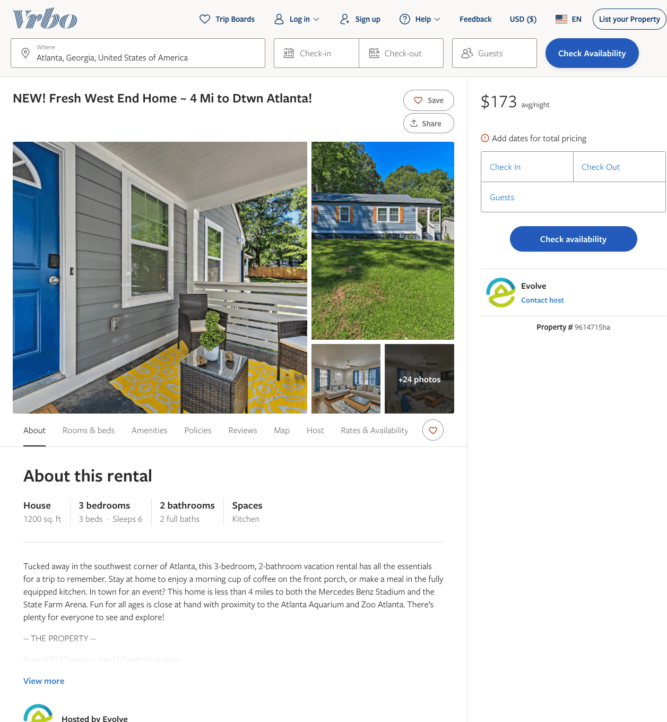
Listing 9614715
3
6
$114 - $173
4.6666665
2
Evolve
https://www.vrbo.com/9614715ha
Aug 2022

Slide 4
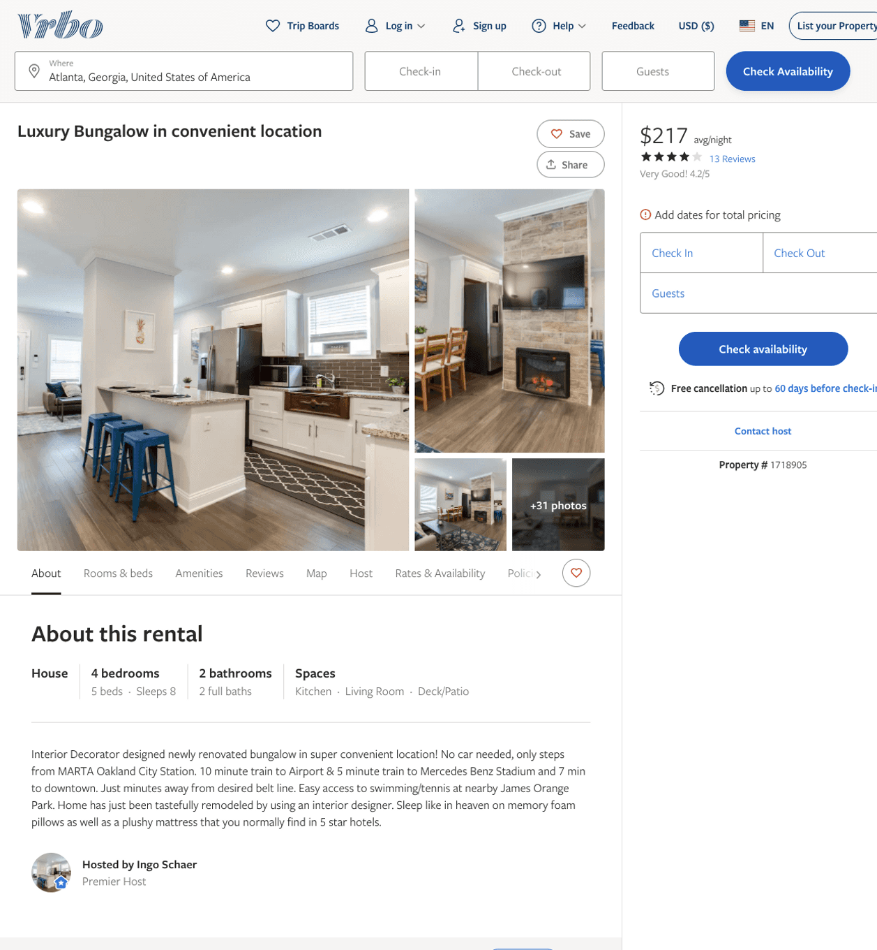
Listing 1718905
4
8
$142 - $217
4.34375
2
Ingo Schaer
https://www.vrbo.com/1718905
Aug 2022

Slide 5
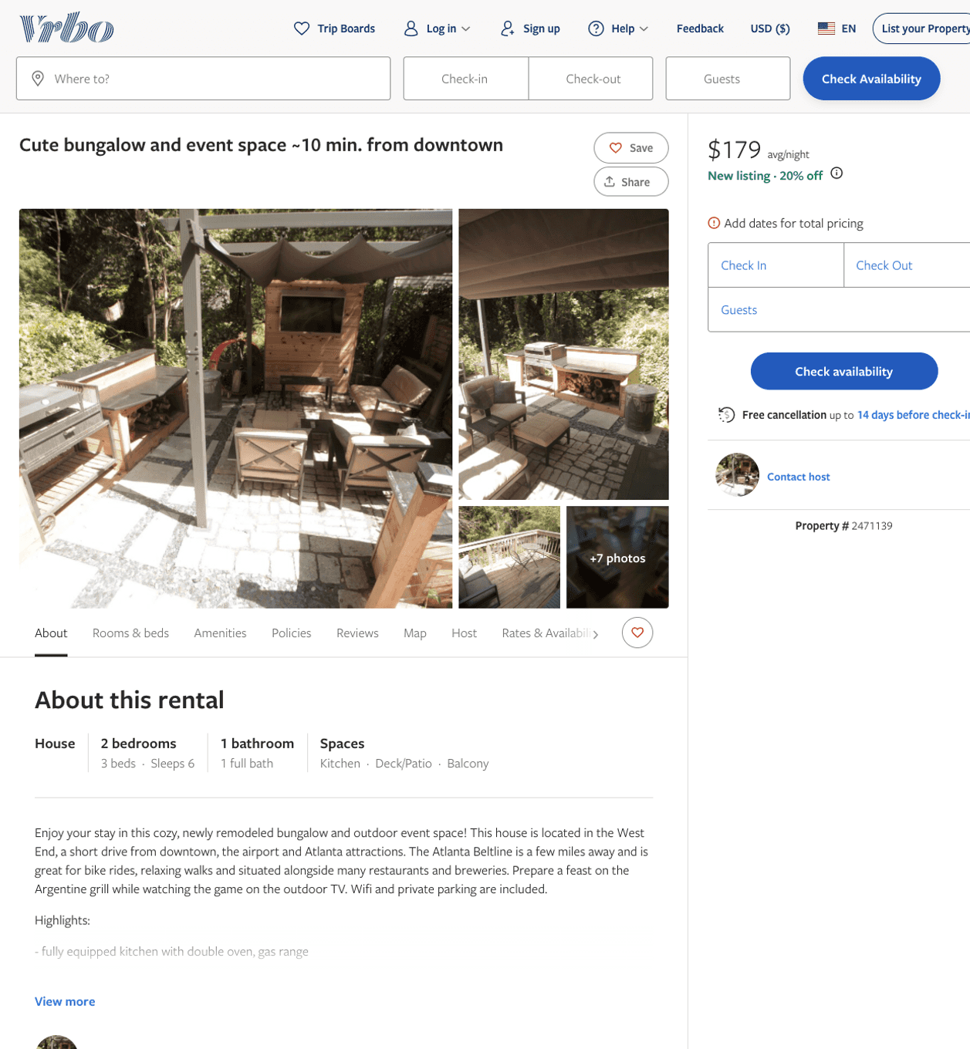
Listing 2471139
2
5
$179
5
2
Alexandria Cassagnol
https://www.vrbo.com/2471139
Aug 2022

Slide 6
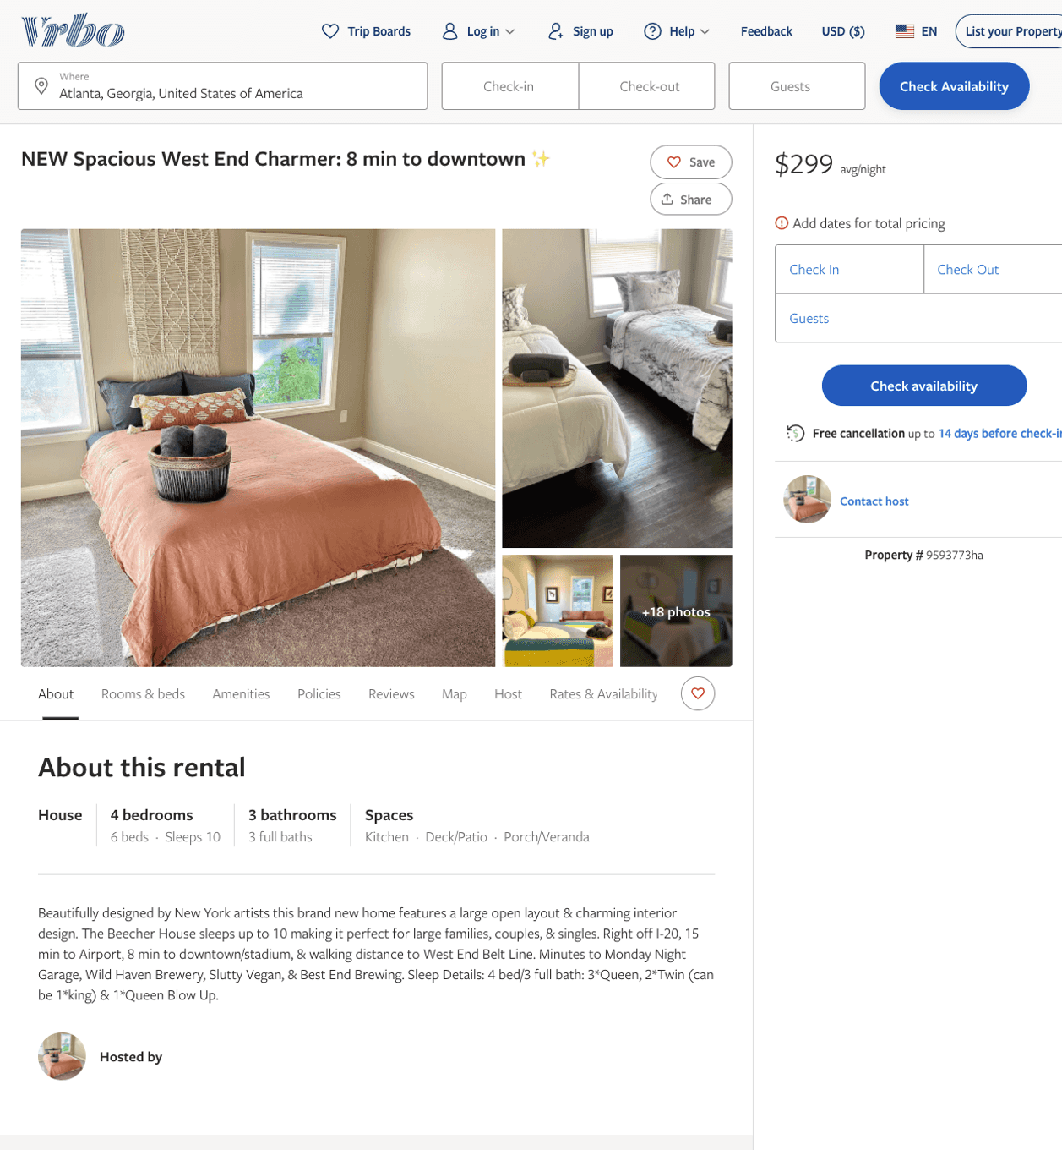
Listing 9593773
4
10
$299 - $336
3
2
https://www.vrbo.com/9593773ha
Aug 2022

Slide 7
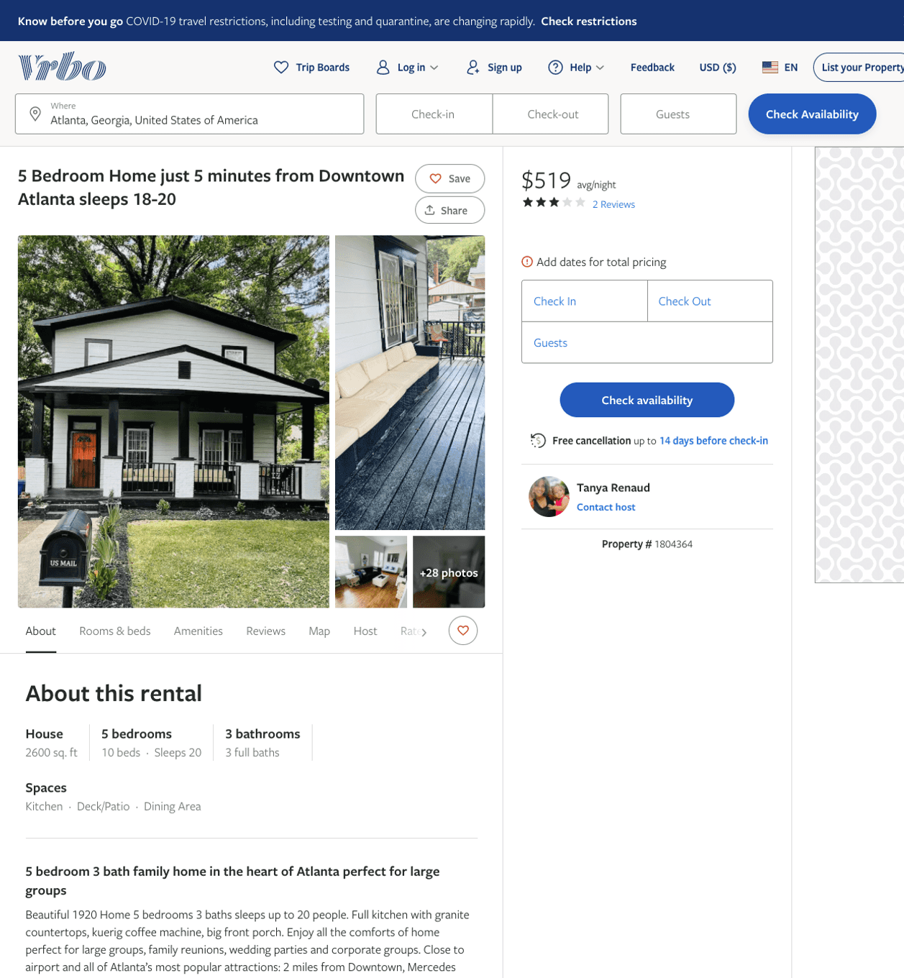
Listing 1804364
5
20
$481 - $549
2.3333333
2
Tanya Renaud
https://www.vrbo.com/1804364
Aug 2022

Slide 8
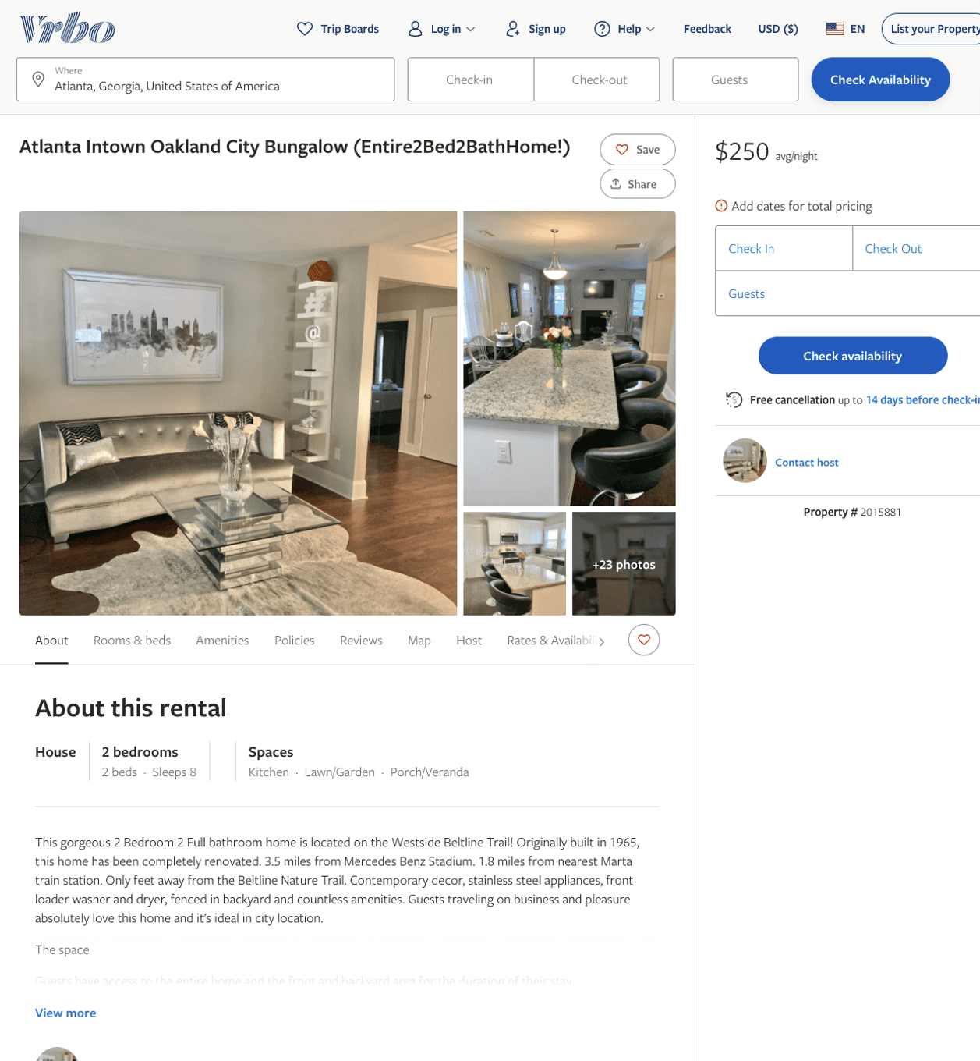
Listing 2015881
2
8
$250 - $275
3
https://www.vrbo.com/2015881
Aug 2022

Slide 9
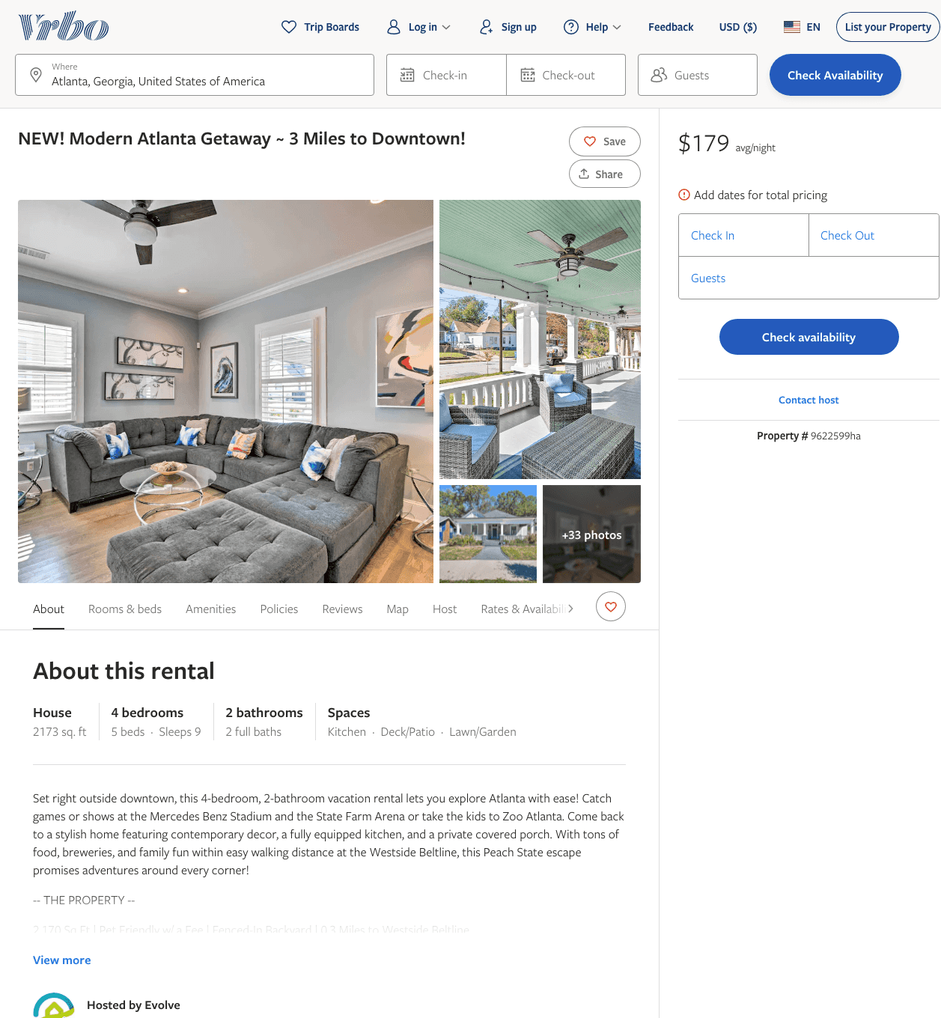
Listing 9622599
4
9
$192 - $291
3
Evolve
https://www.vrbo.com/9622599ha
Aug 2022

Slide 10
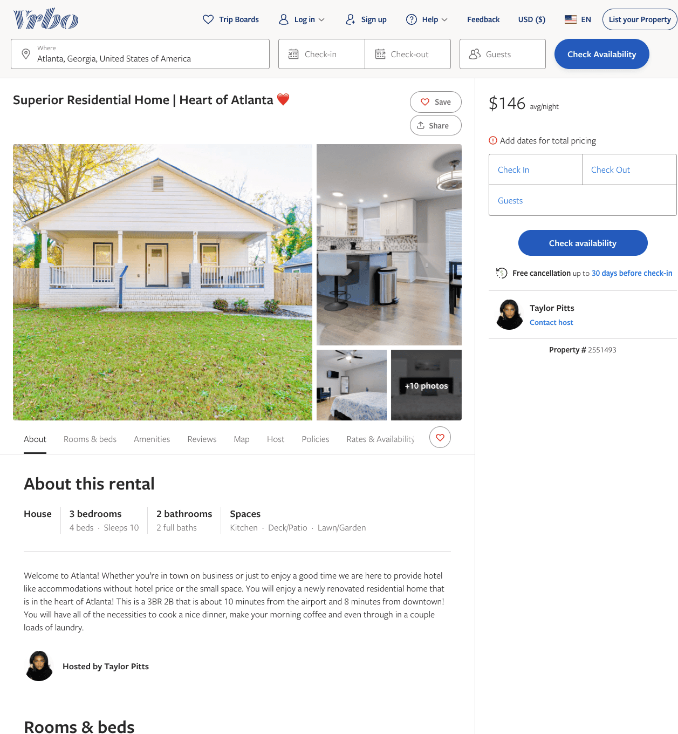
Listing 2551493
3
8
$130 - $232
4
2
Taylor Pitts
https://www.vrbo.com/2551493
Aug 2022

Slide 11
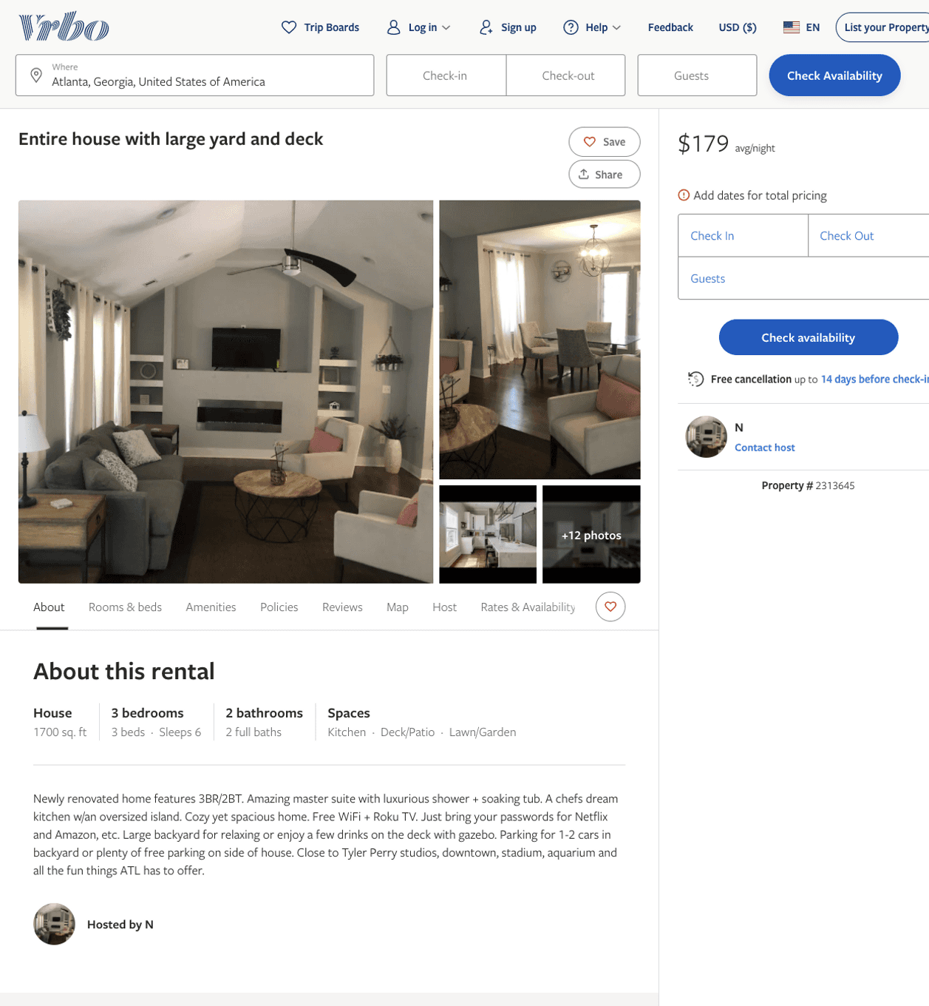
Listing 2313645
3
6
$179 - $211
5
3
N
https://www.vrbo.com/2313645
Aug 2022

Slide 12
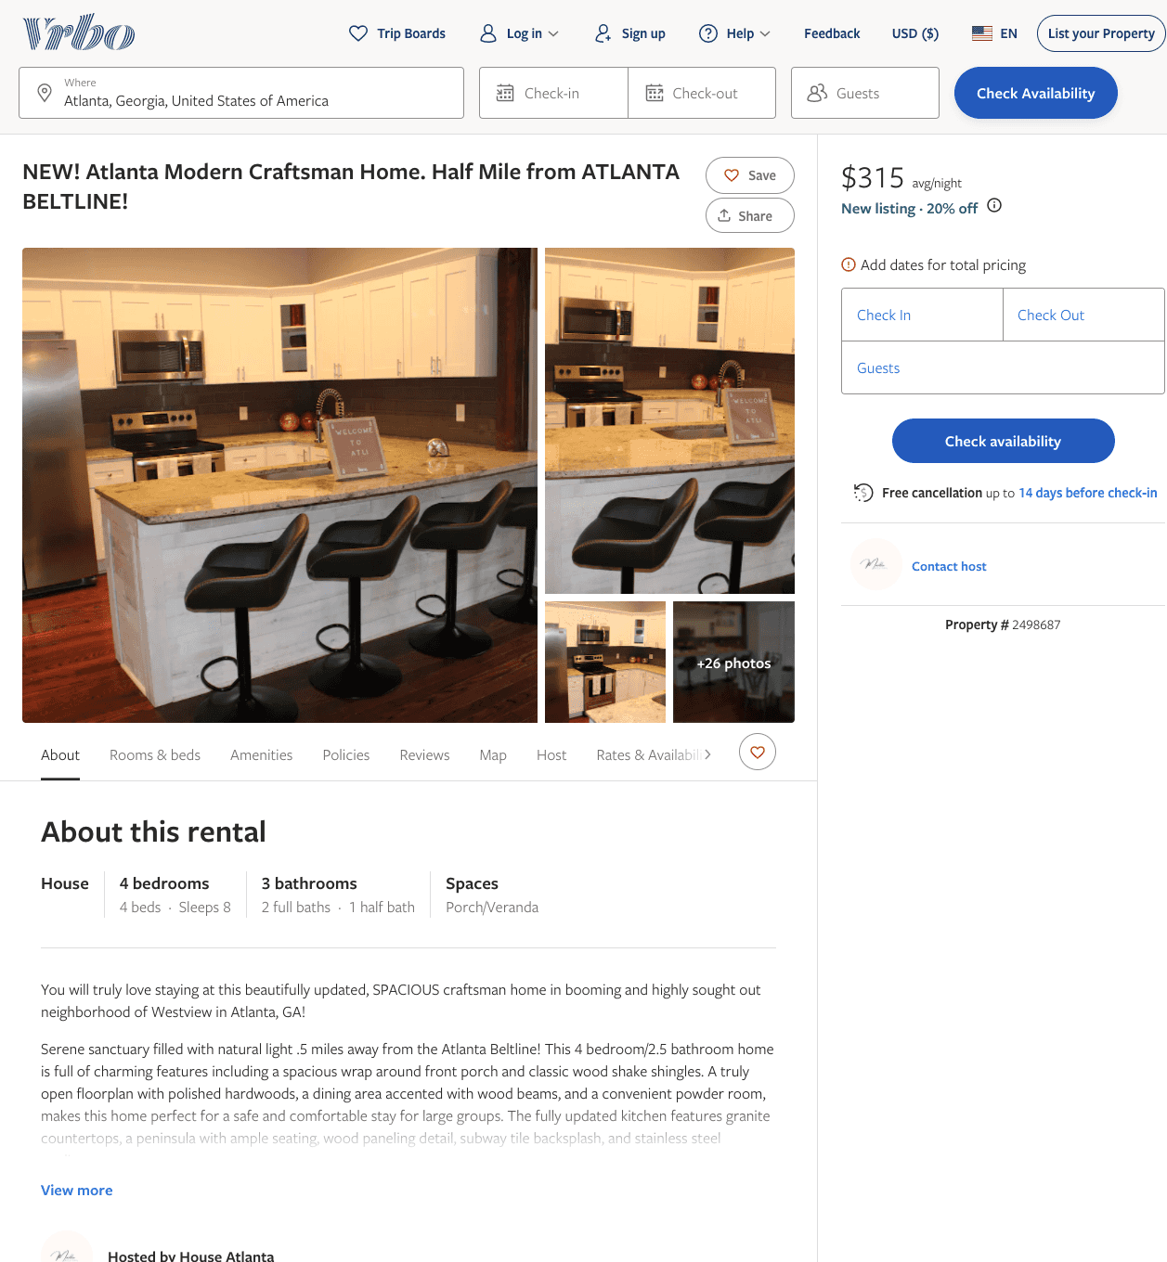
Listing 2498687
4
10
$269 - $315
5
2
https://www.vrbo.com/2498687
Aug 2022

Slide 13
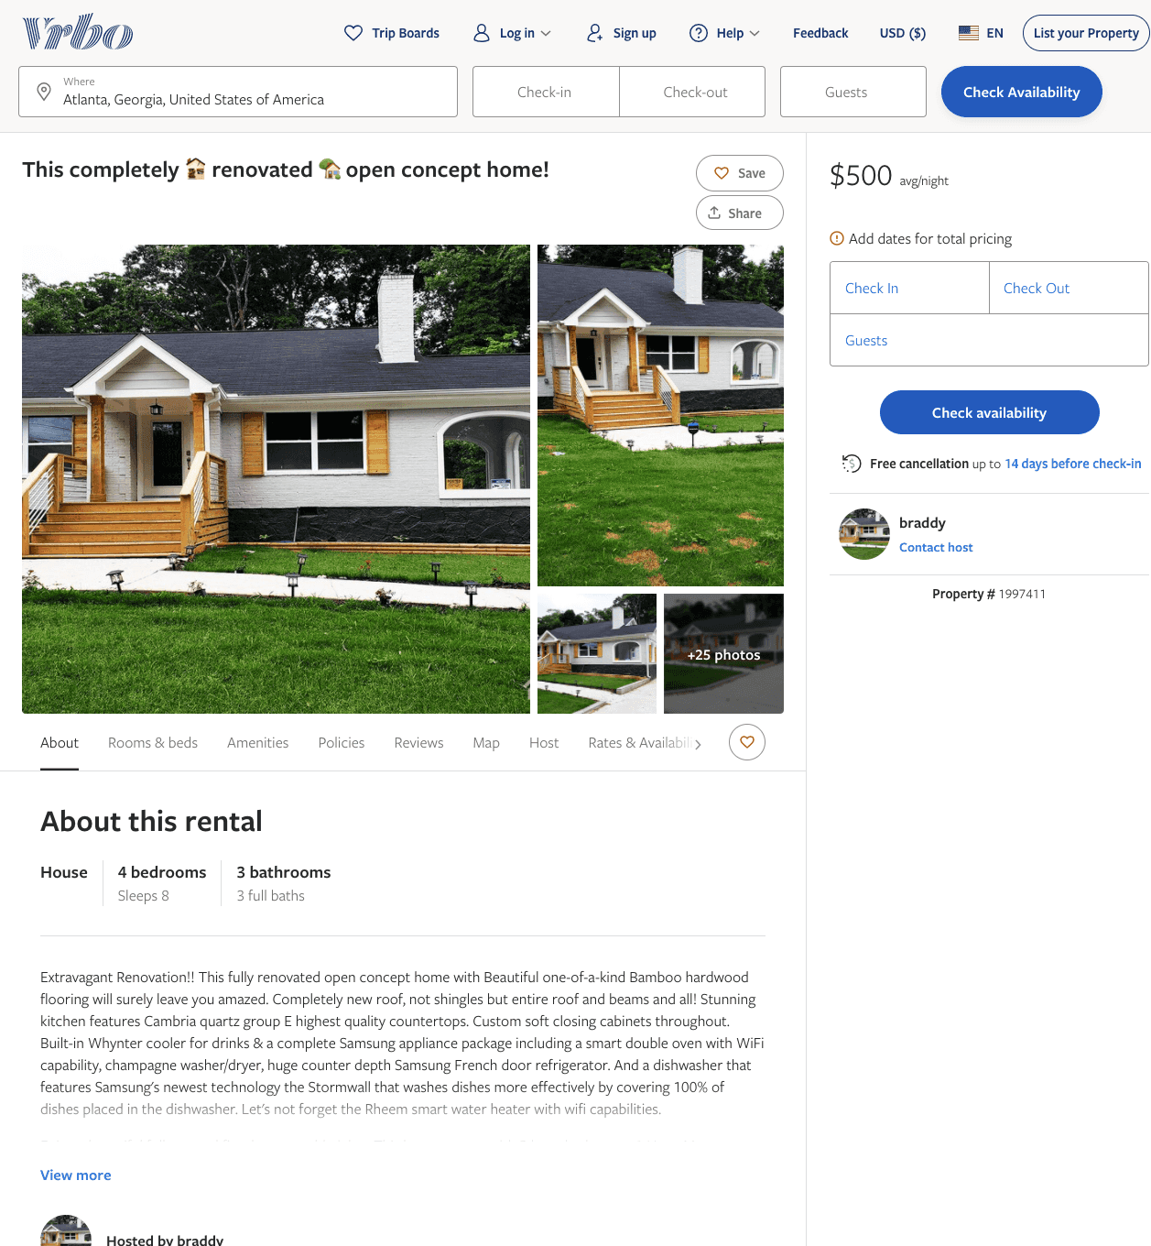
Listing 1997411
4
8
$500
4
braddy
https://www.vrbo.com/1997411
Aug 2022

Slide 14
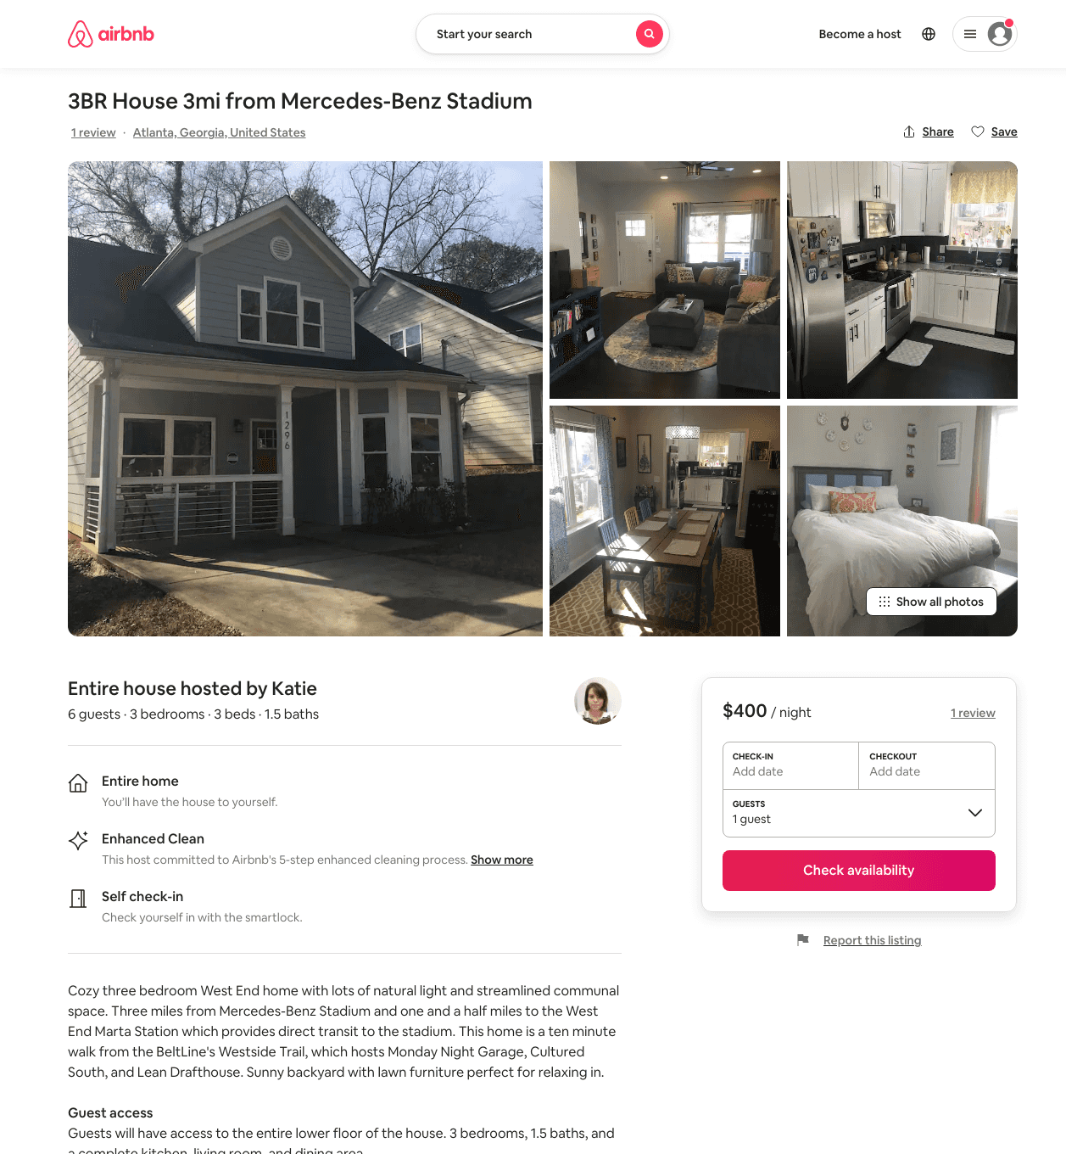
Listing 31379522
3
6
$400
1
Katie
27160809
1
https://www.airbnb.com/rooms/31379522
Aug 2022

Slide 15
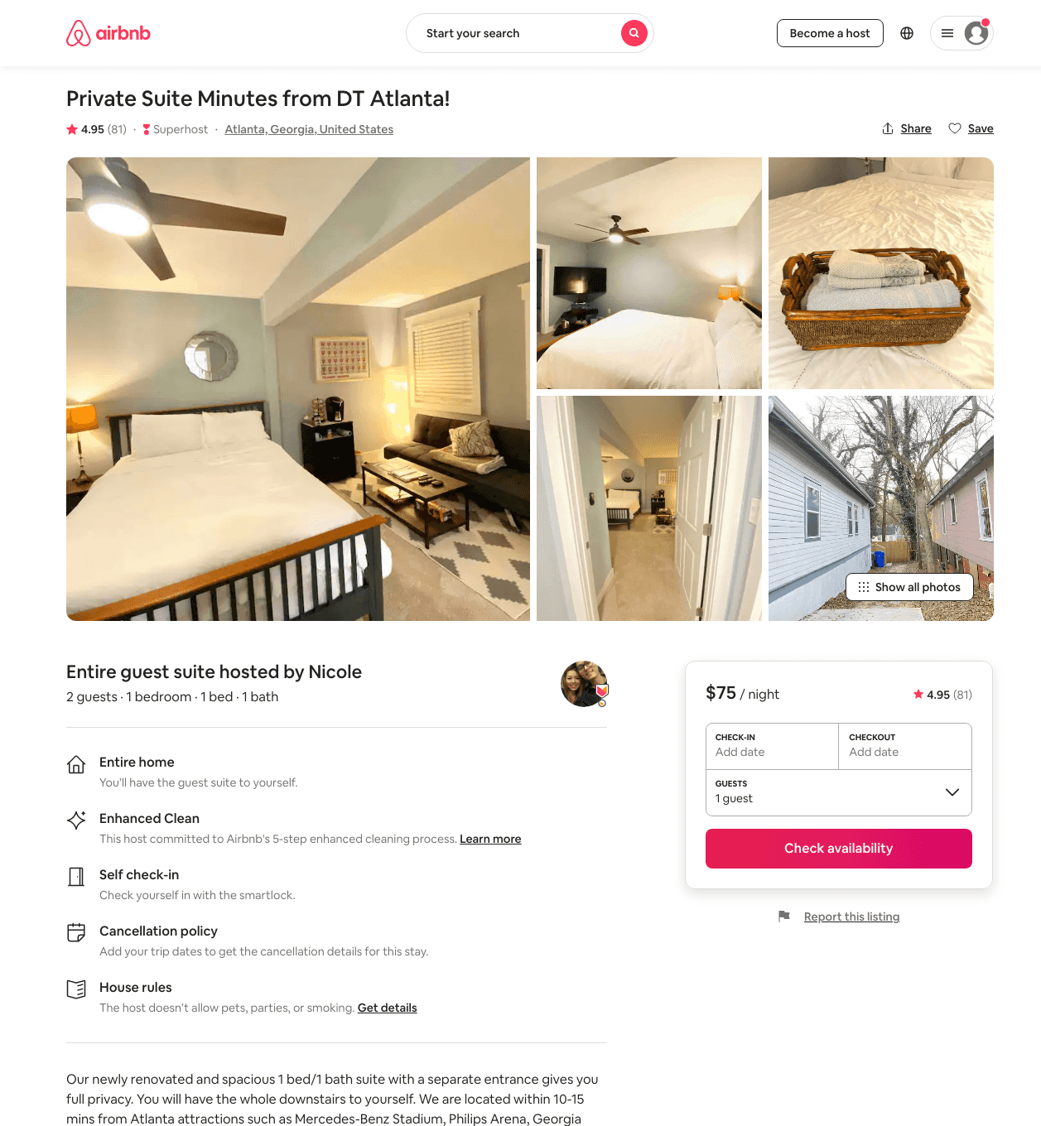
Listing 40173039
1
2
$70 - $102
4.90
2
Nicole
68927609
2
https://www.airbnb.com/rooms/40173039
Aug 2022

Slide 16
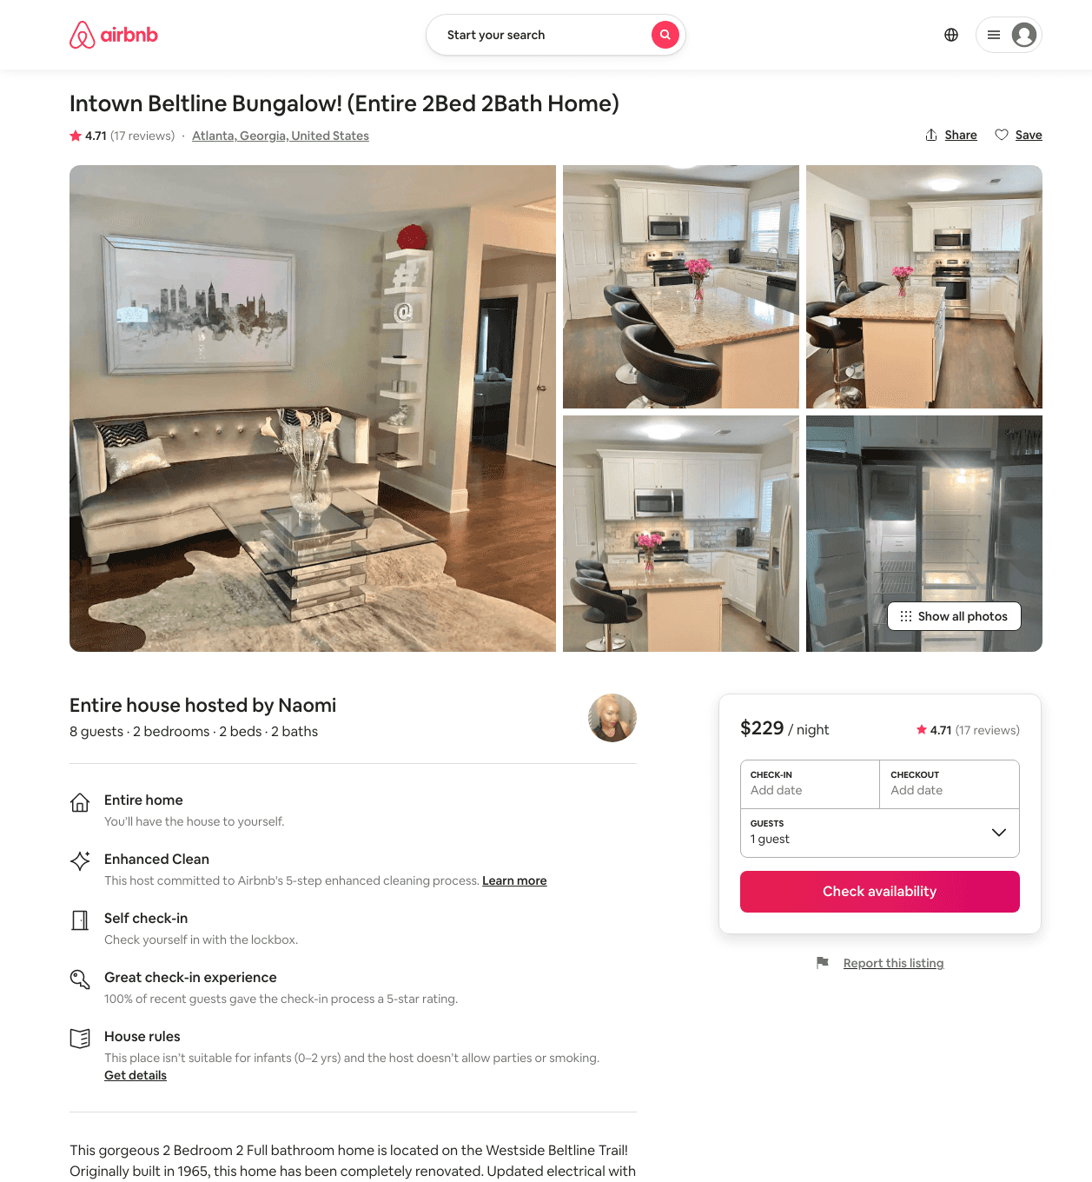
Listing 31825581
2
8
$129 - $263
4.83
1
Naomi
238468615
1
https://www.airbnb.com/rooms/31825581
Jun 2022

Slide 17
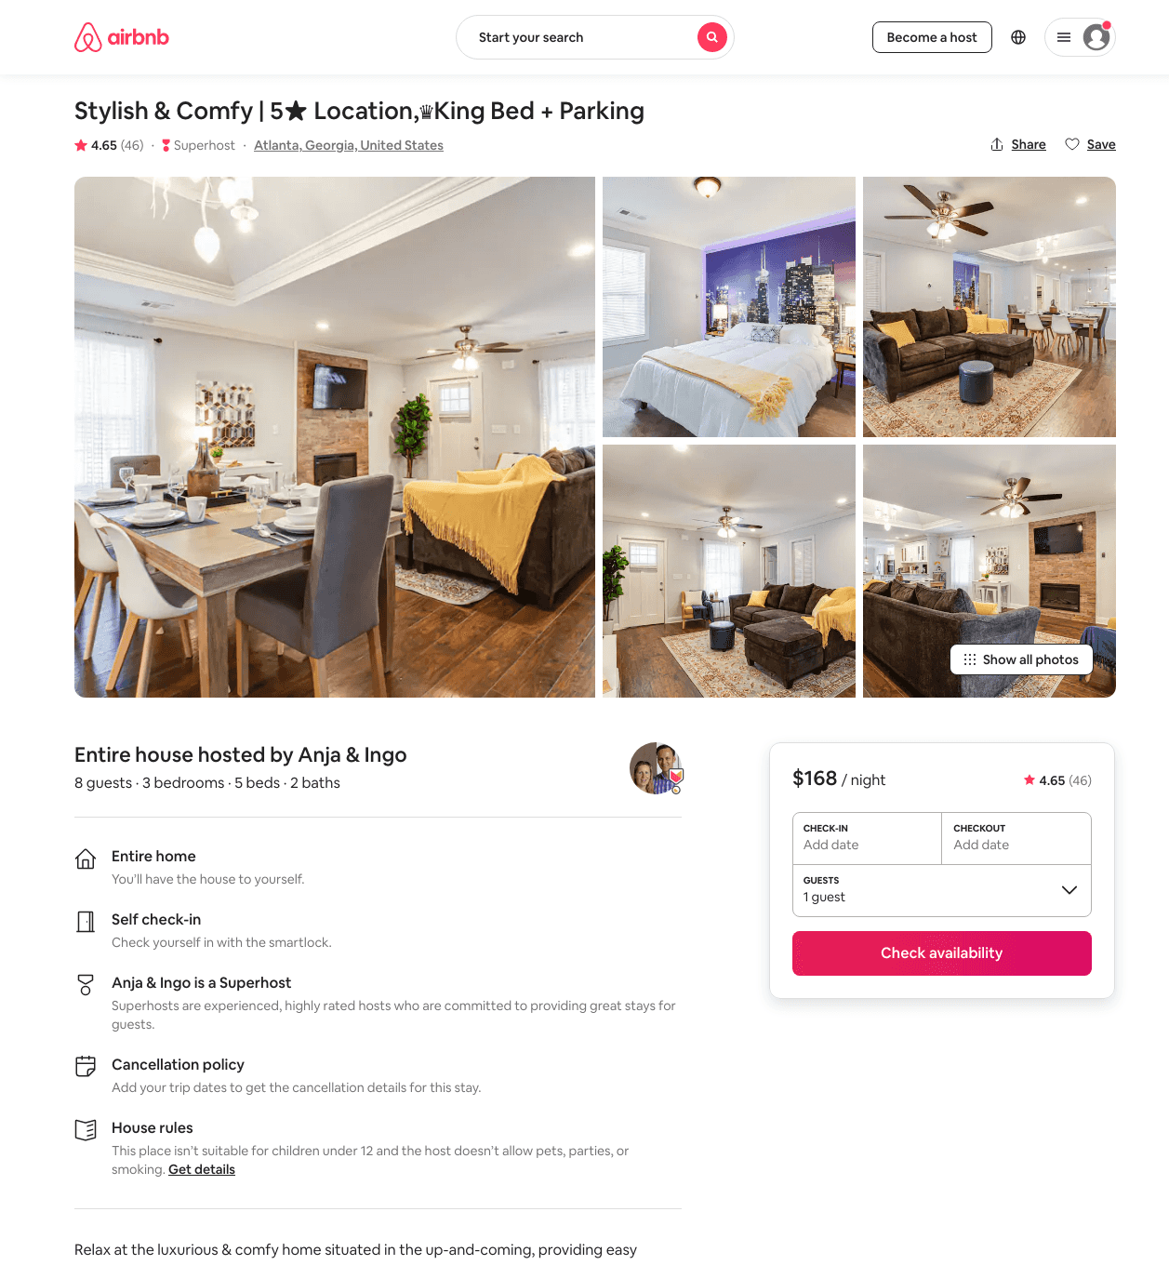
Listing 42638212
3
7
$102 - $222
4.72
1
Anja & Ingo
63783660
2
https://www.airbnb.com/rooms/42638212
Jul 2022

Slide 18
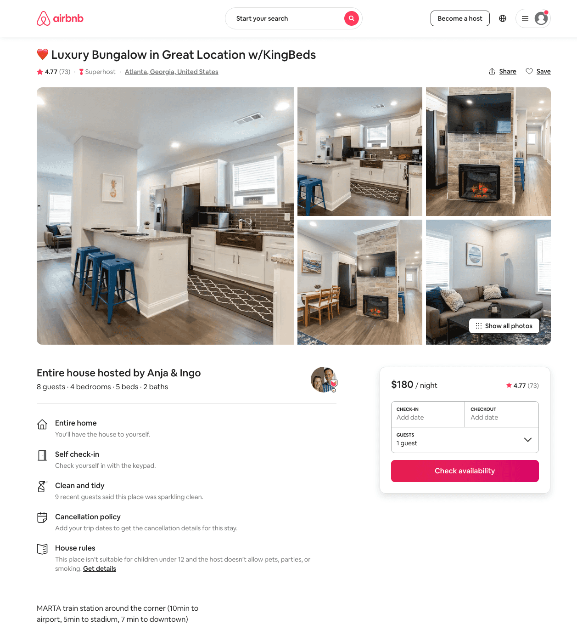
Listing 36176360
4
8
$110 - $228
4.67
1
Anja & Ingo
63783660
2
https://www.airbnb.com/rooms/36176360
Aug 2022

Slide 19
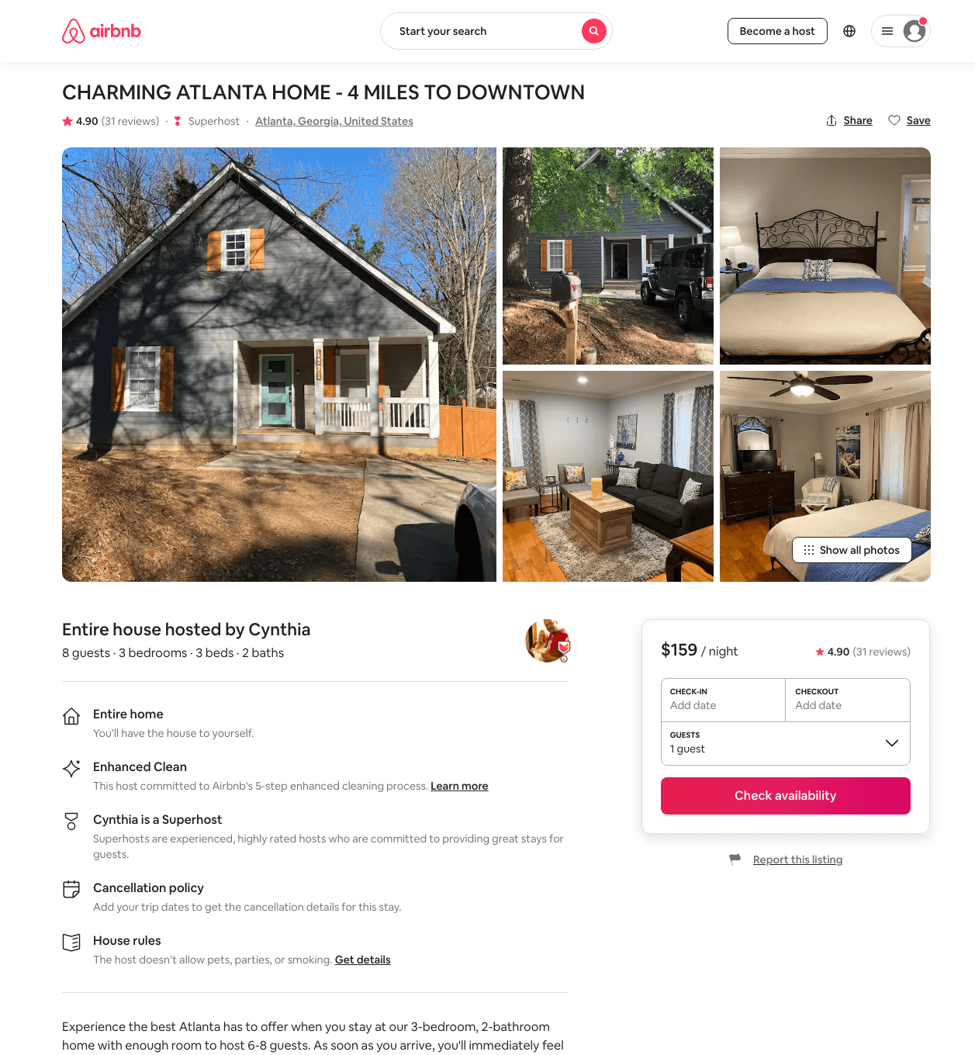
Listing 40922327
3
8
$139 - $166
4.91
3
Cynthia
318819403
1
https://www.airbnb.com/rooms/40922327
Aug 2022

Slide 20
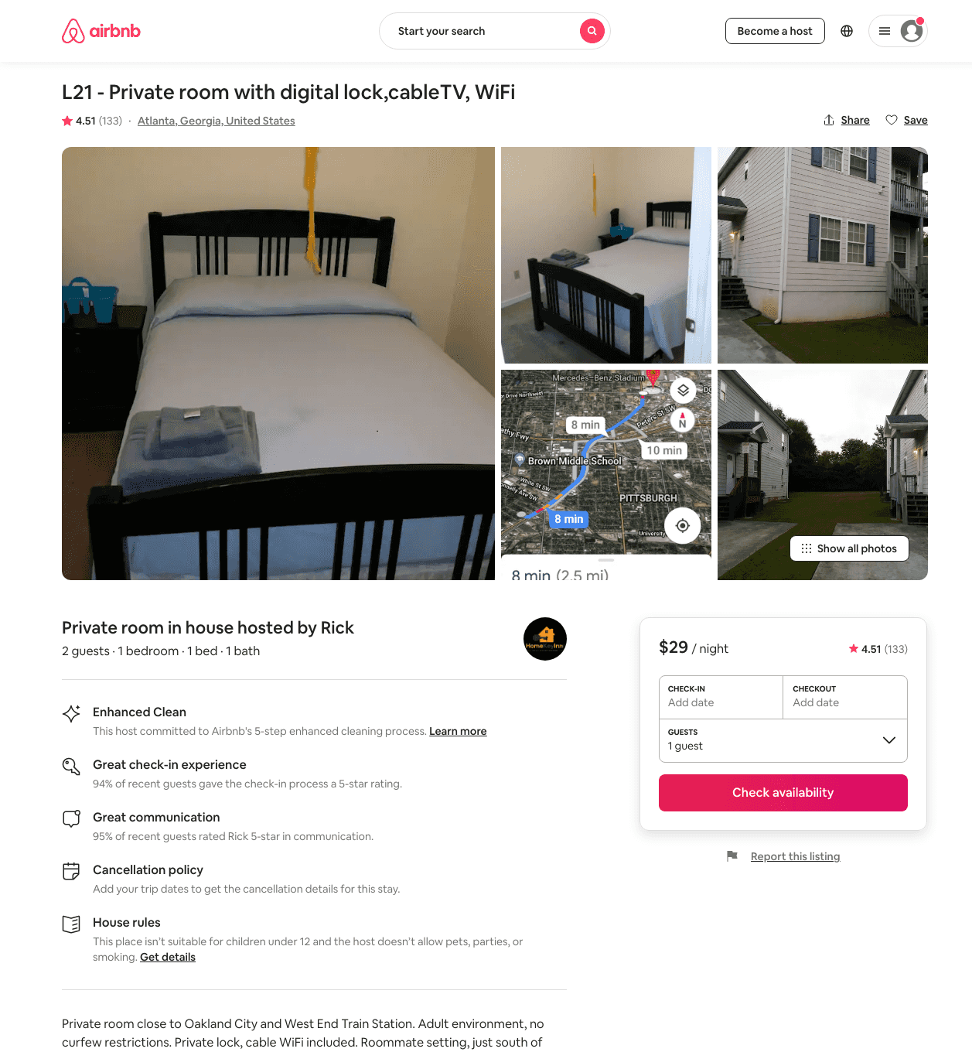
Listing 8128241
1
2
$29 - $39
4.42
1
Rick
42301069
34
https://www.airbnb.com/rooms/8128241
Jun 2022

Slide 21
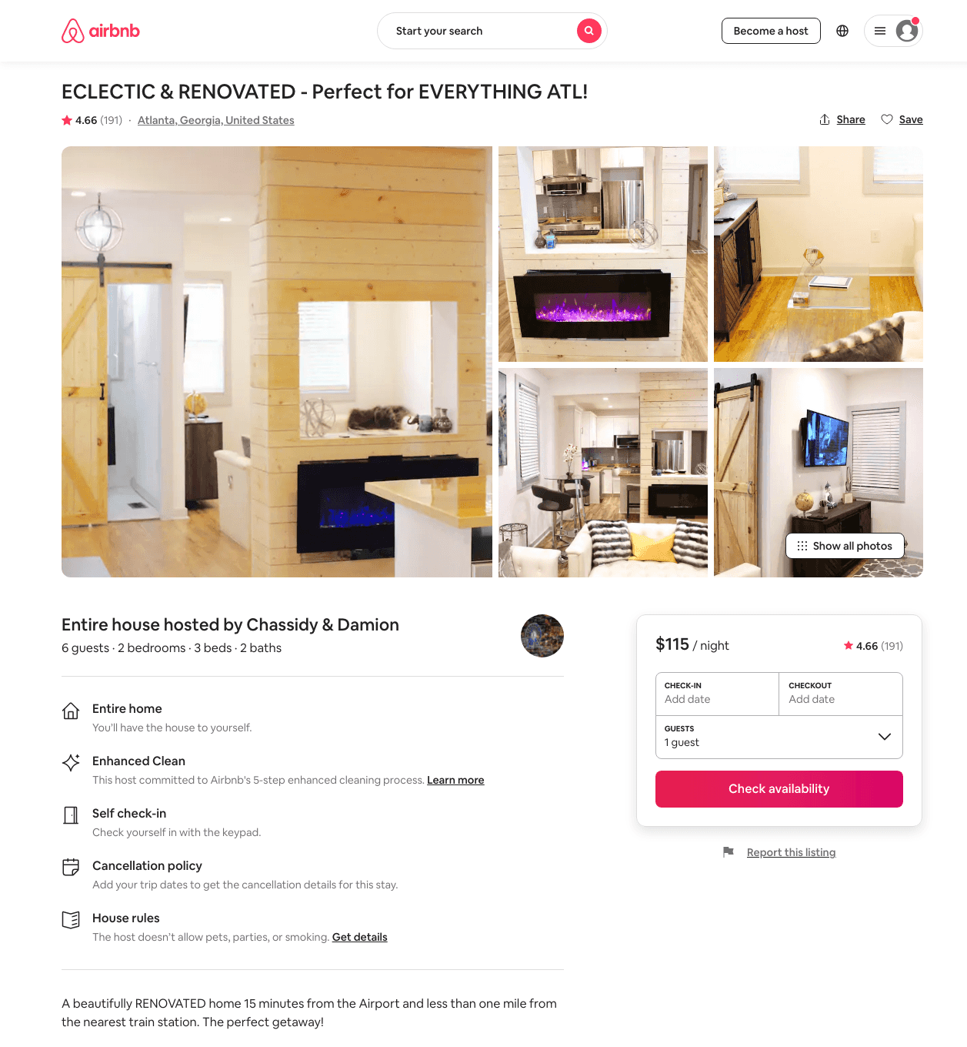
Listing 31617297
2
6
$91 - $145
4.58
1
Chassidy & Damion
105747515
6
https://www.airbnb.com/rooms/31617297
Aug 2022

Slide 22
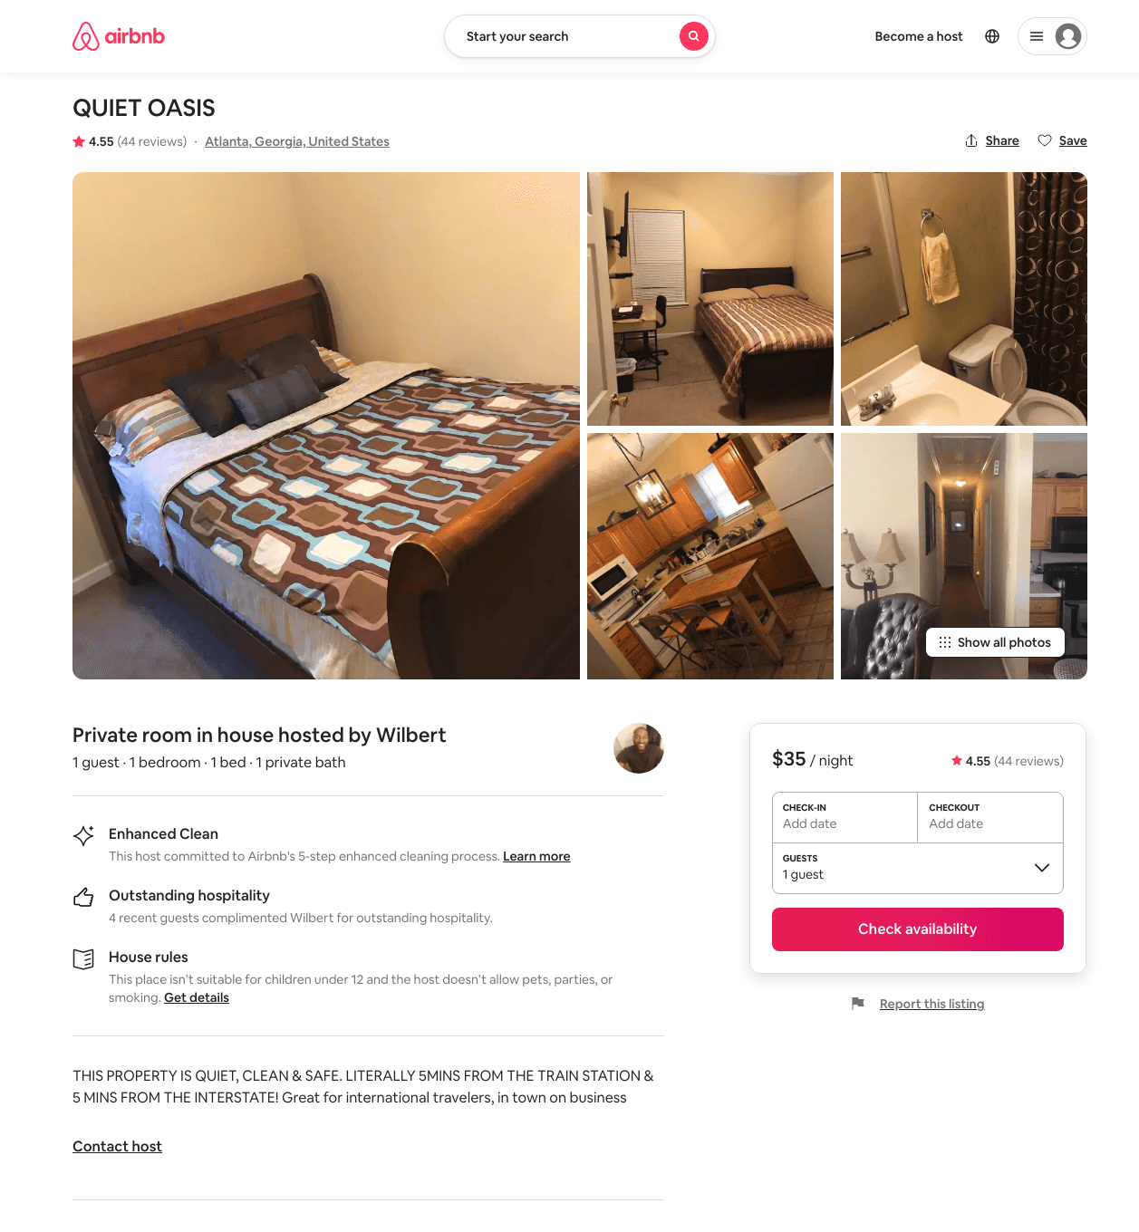
Listing 27846743
1
1
$35 - $37
4.53
5
Wilbert
210149061
3
https://www.airbnb.com/rooms/27846743
Jul 2022

Slide 23
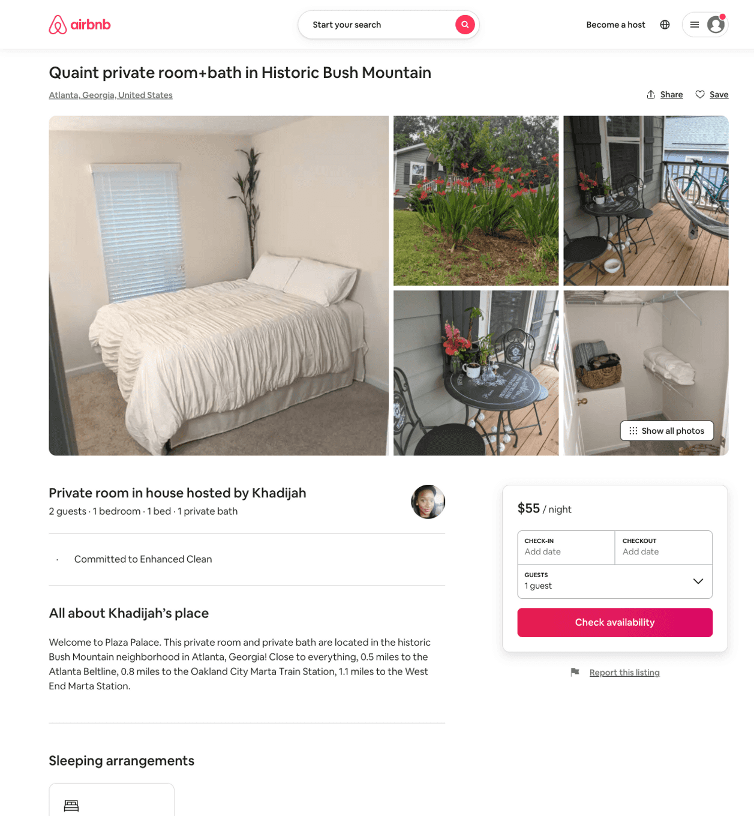
Listing 50505646
1
2
$28 - $55
5.0
7
Khadijah
5244574
1
https://www.airbnb.com/rooms/50505646
Jul 2022

Slide 24
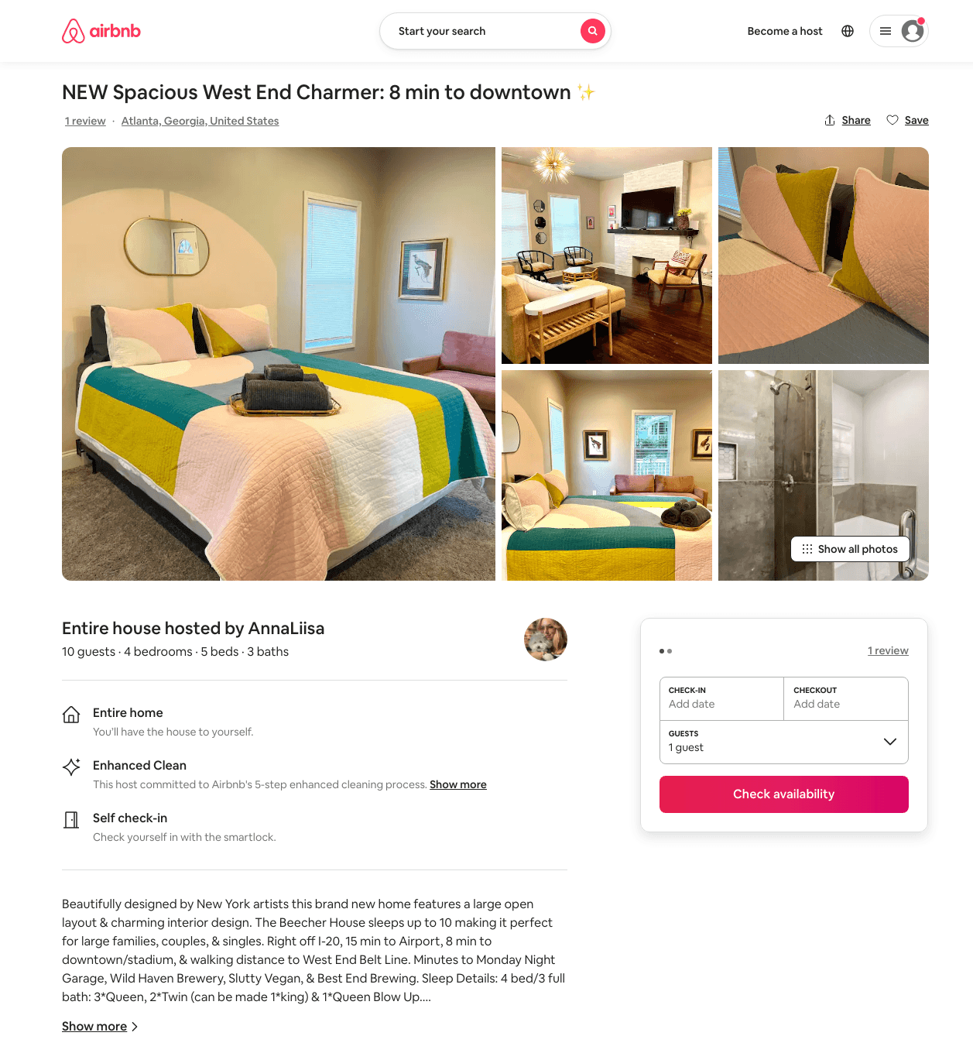
Listing 49445846
4
10
$225 - $674
4.64
1
AnnaLiisa
386437206
2
https://www.airbnb.com/rooms/49445846
Jun 2022

Slide 25
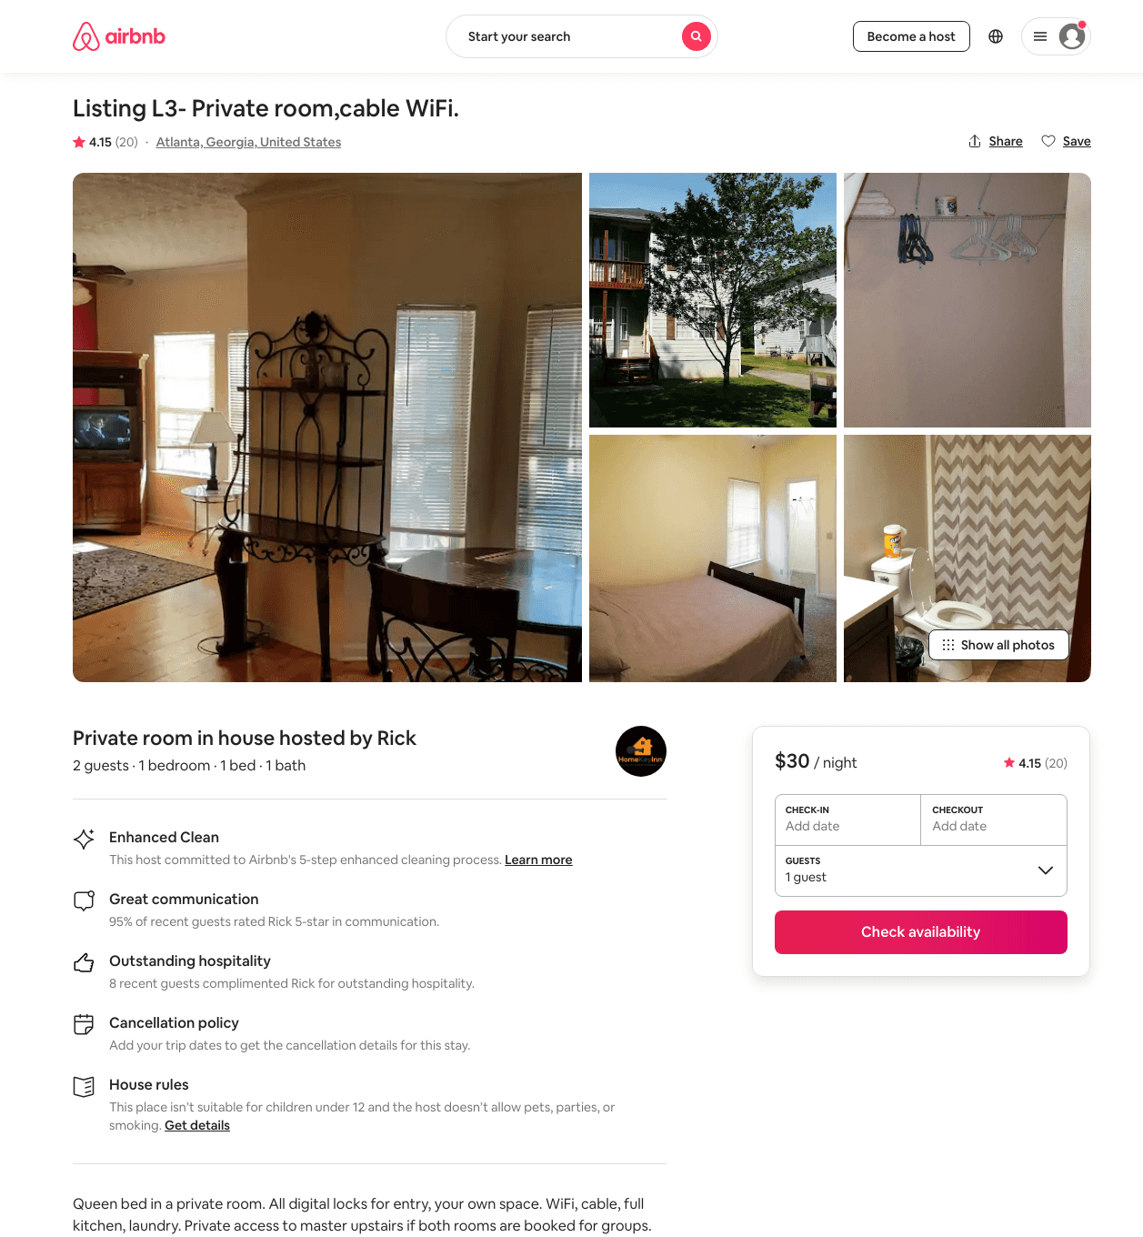
Listing 15396372
1
2
$30 - $31
4.14
2
Rick
42301069
34
https://www.airbnb.com/rooms/15396372
Aug 2022

Slide 26
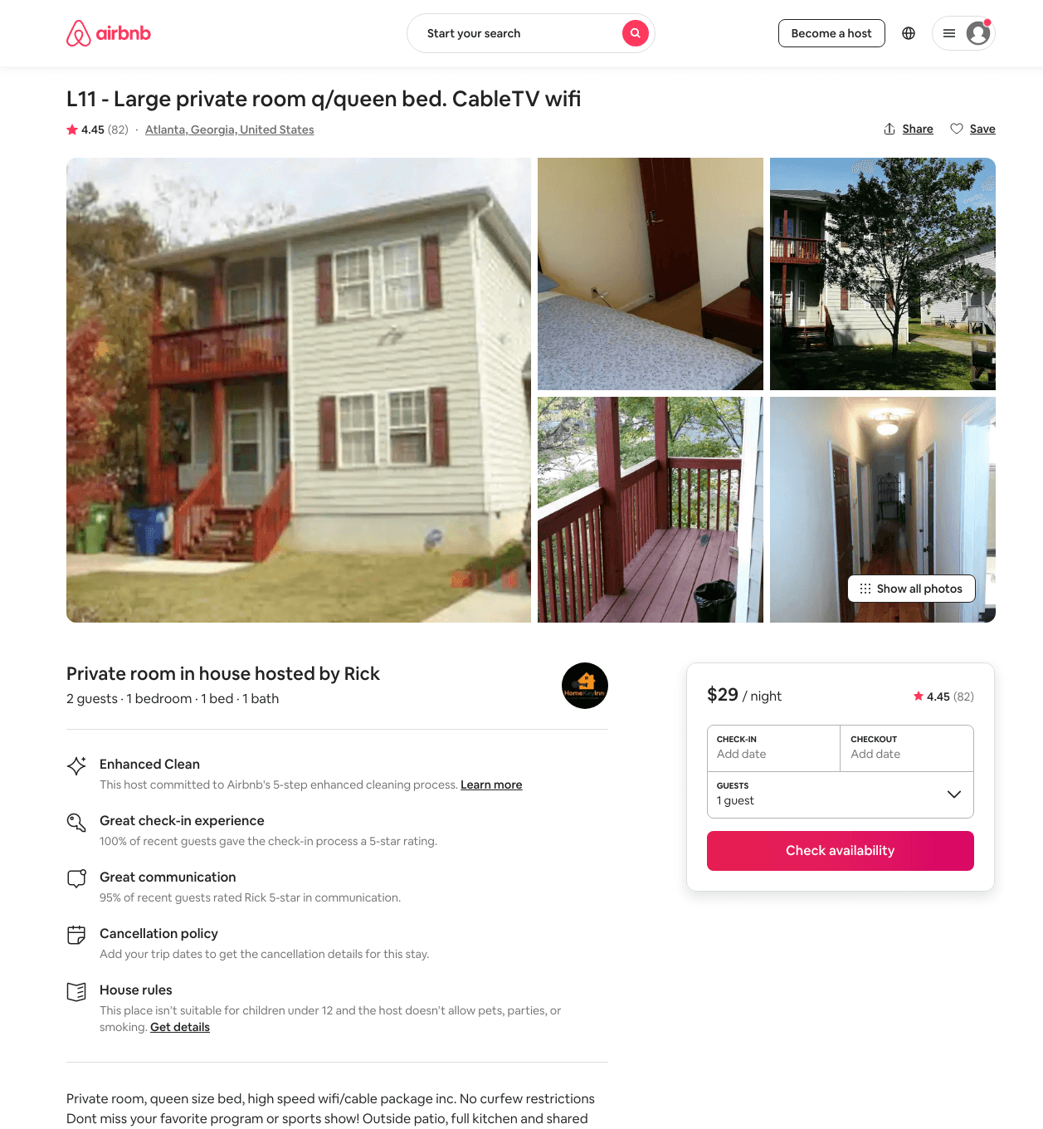
Listing 8011689
1
2
$29 - $36
4.37
2
Rick
42301069
34
https://www.airbnb.com/rooms/8011689
Aug 2022

Slide 27
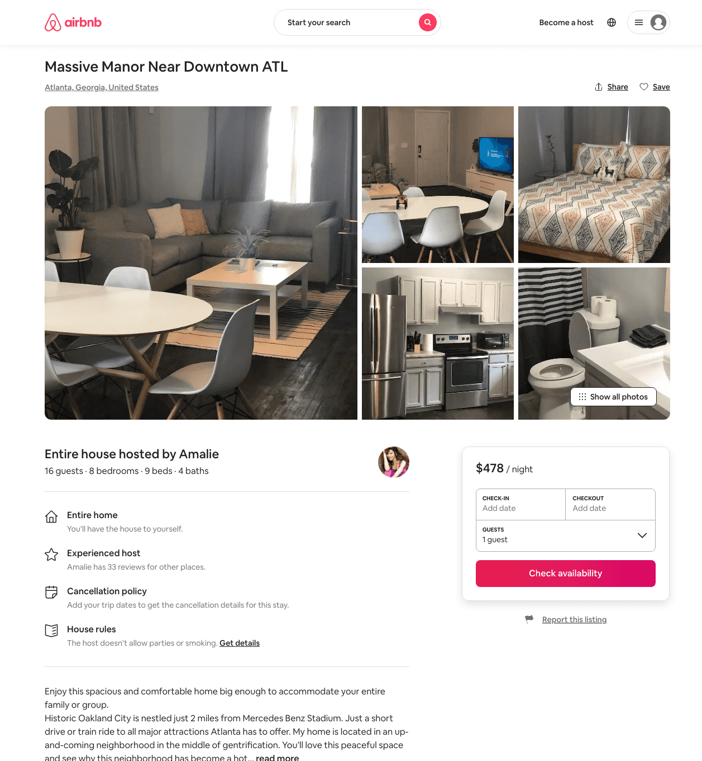
Listing 35235656
8
16
$366 - $604
4.42
3
Amalie
237536880
2
https://www.airbnb.com/rooms/35235656
Aug 2022

Slide 28
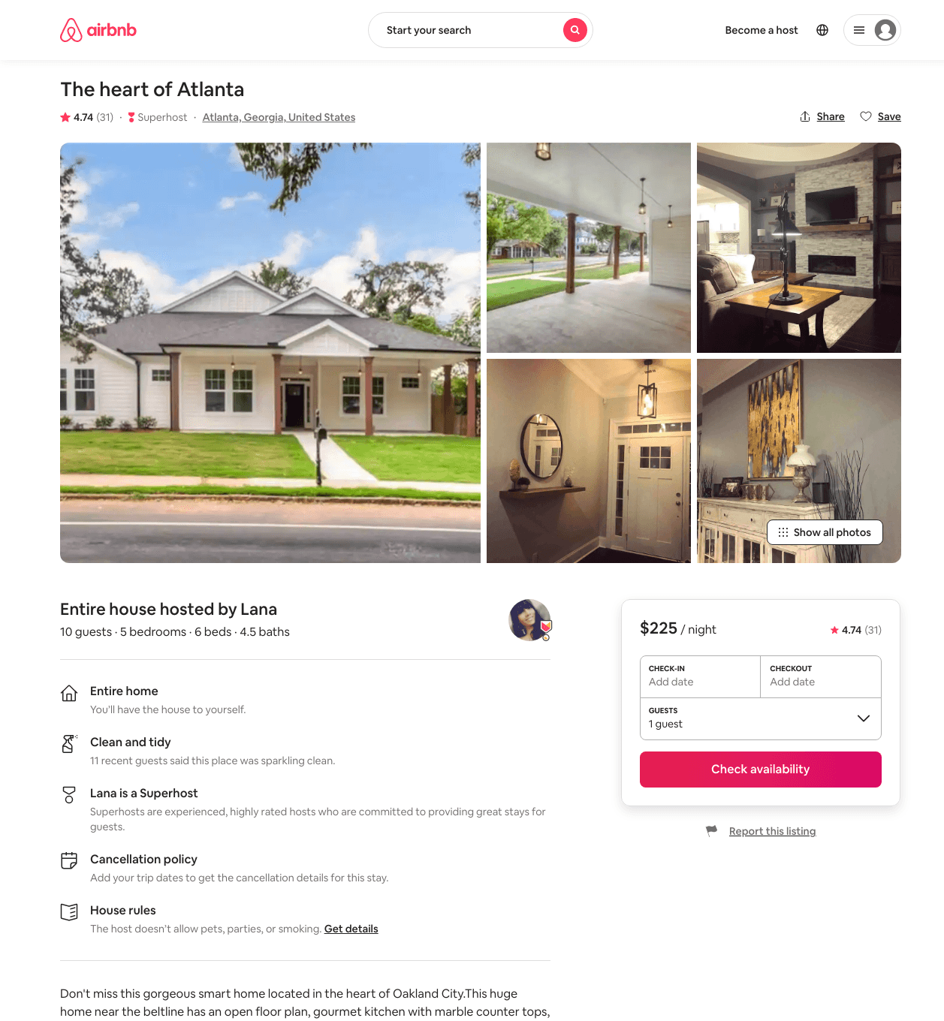
Listing 41130800
5
10
$191 - $282
4.68
3
Lana
164841068
1
https://www.airbnb.com/rooms/41130800
Aug 2022

Slide 29
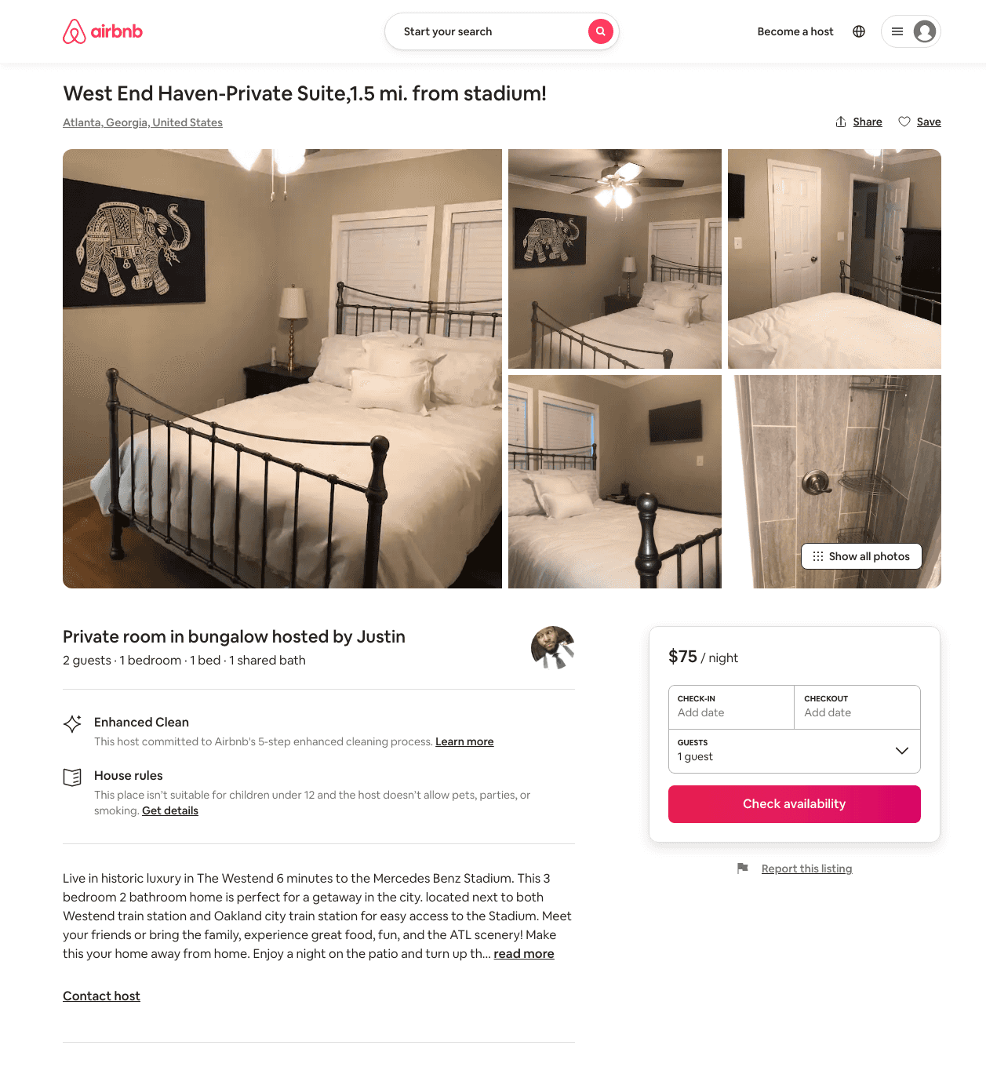
Listing 33894581
1
2
$75
2
Justin
55322936
1
https://www.airbnb.com/rooms/33894581
Aug 2022

Slide 30
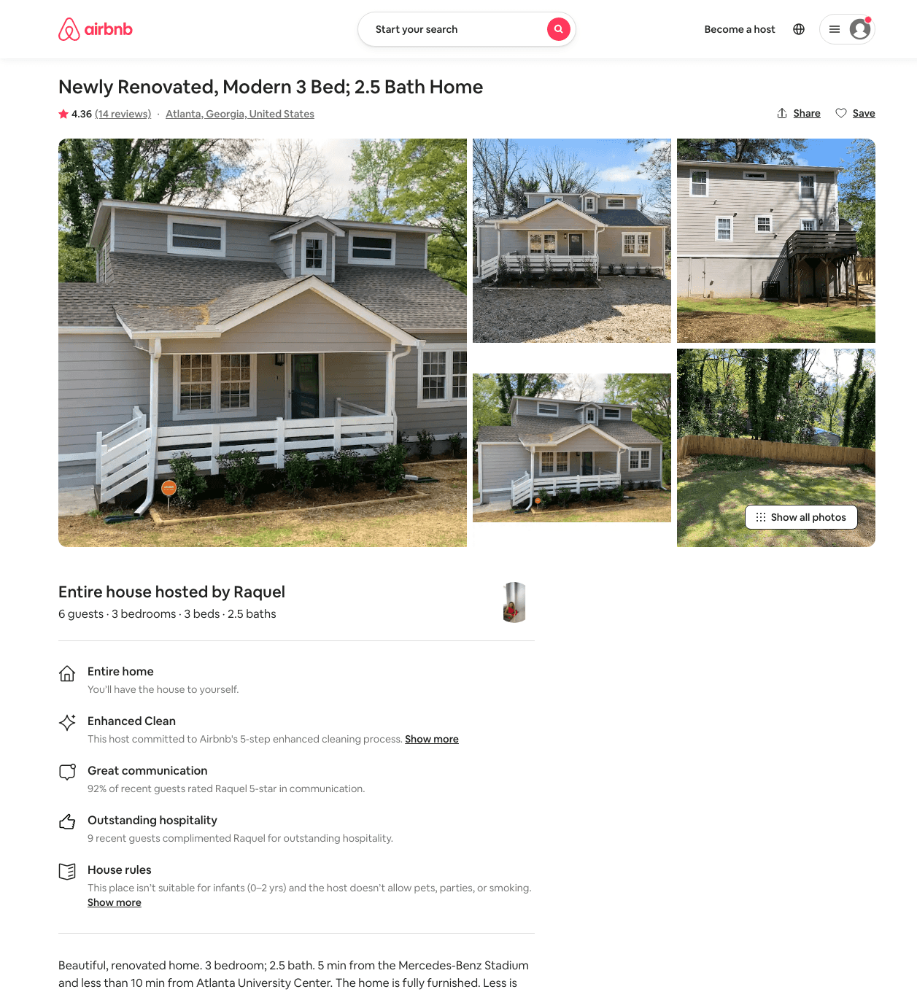
Listing 43115008
3
6
$223 - $313
4.19
1
Raquel
343191211
1
https://www.airbnb.com/rooms/43115008
Jul 2022

Slide 31
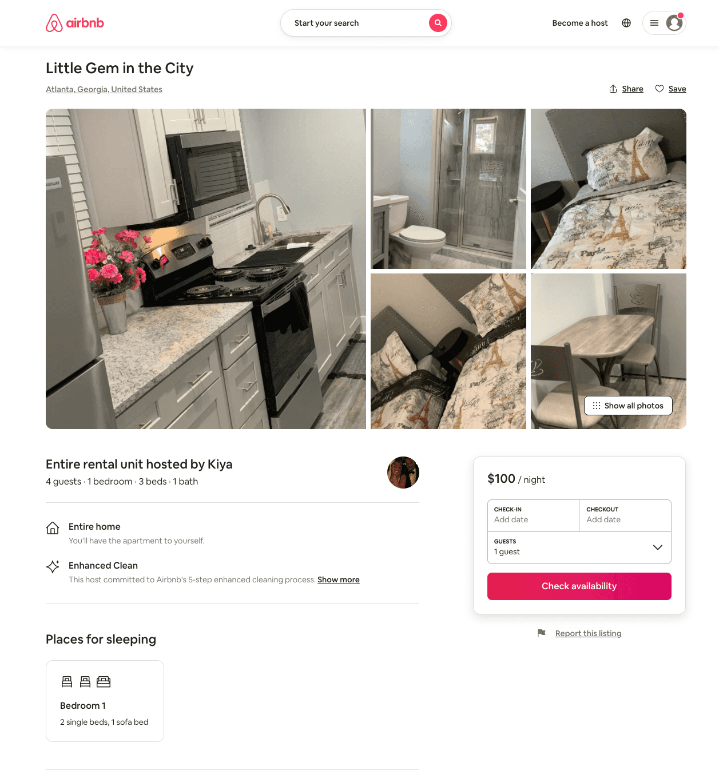
Listing 48764415
1
4
$86 - $103
4.60
2
Kiya
11621755
1
https://www.airbnb.com/rooms/48764415
Jun 2022

Slide 32
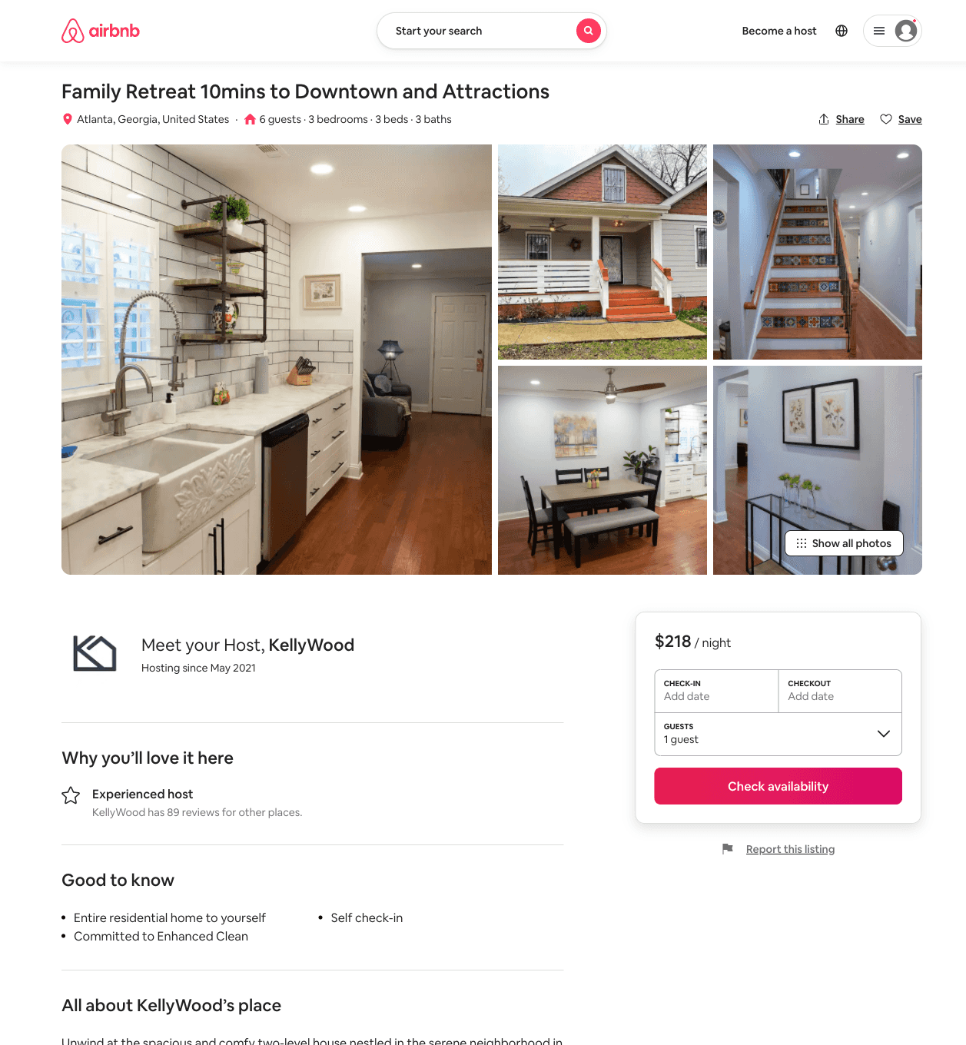
Listing 51413241
3
6
$95 - $240
4.53
2
Kellywood
399724992
24
https://www.airbnb.com/rooms/51413241
Aug 2022

Slide 33
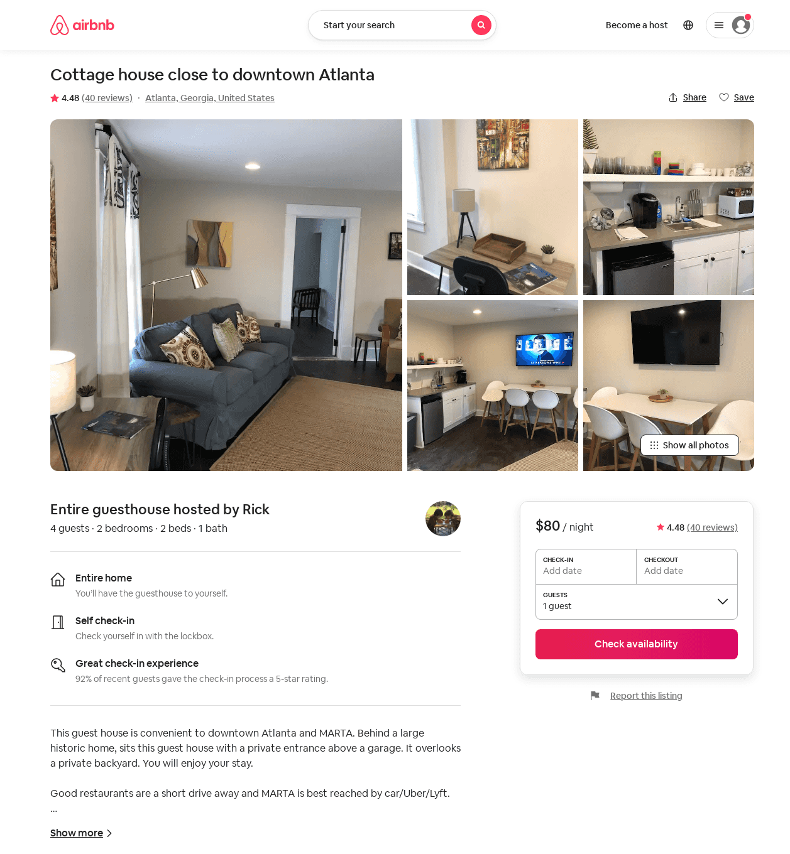
Listing 32449734
2
4
$71 - $87
4.51
4
Rick
133788524
3
https://www.airbnb.com/rooms/32449734
Jul 2022

Slide 34
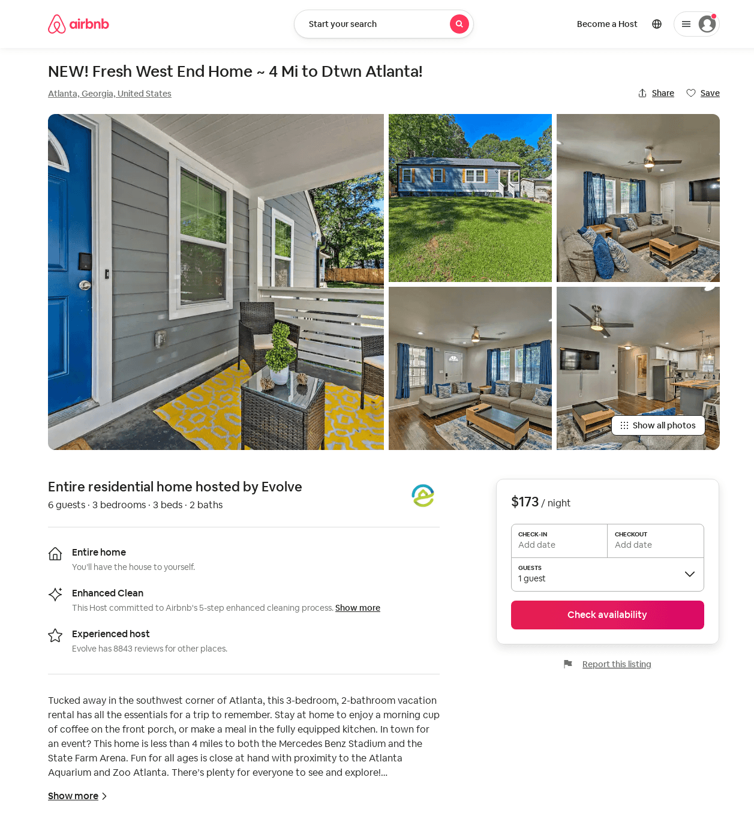
Listing 52649473
3
6
$127 - $173
4.94
2
Evolve
121682456
51
https://www.airbnb.com/rooms/52649473
Jun 2022

Slide 35
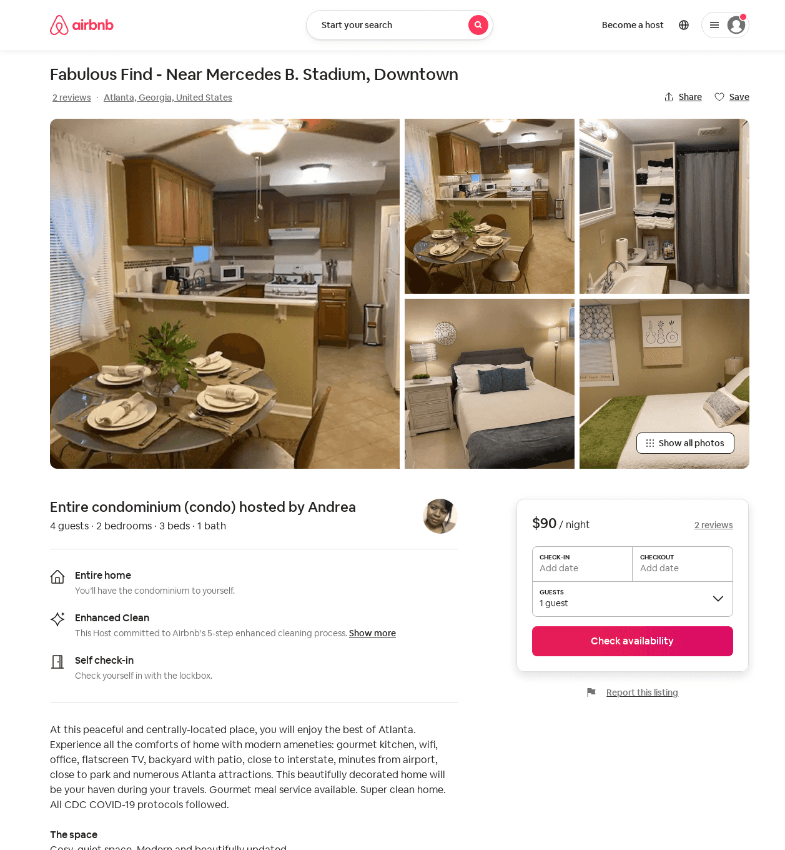
Listing 52084110
2
4
$90 - $110
4.89
3
Andrea
421703897
1
https://www.airbnb.com/rooms/52084110
Aug 2022

Slide 36
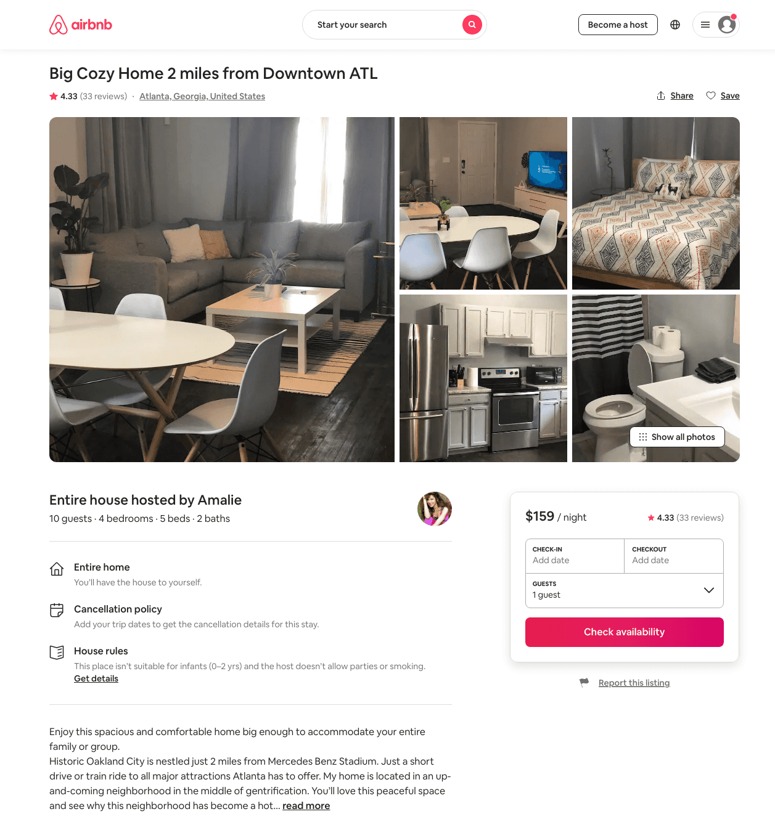
Listing 31678420
4
10
$142 - $159
4.37
3
Amalie
237536880
2
https://www.airbnb.com/rooms/31678420
Aug 2022

Slide 37
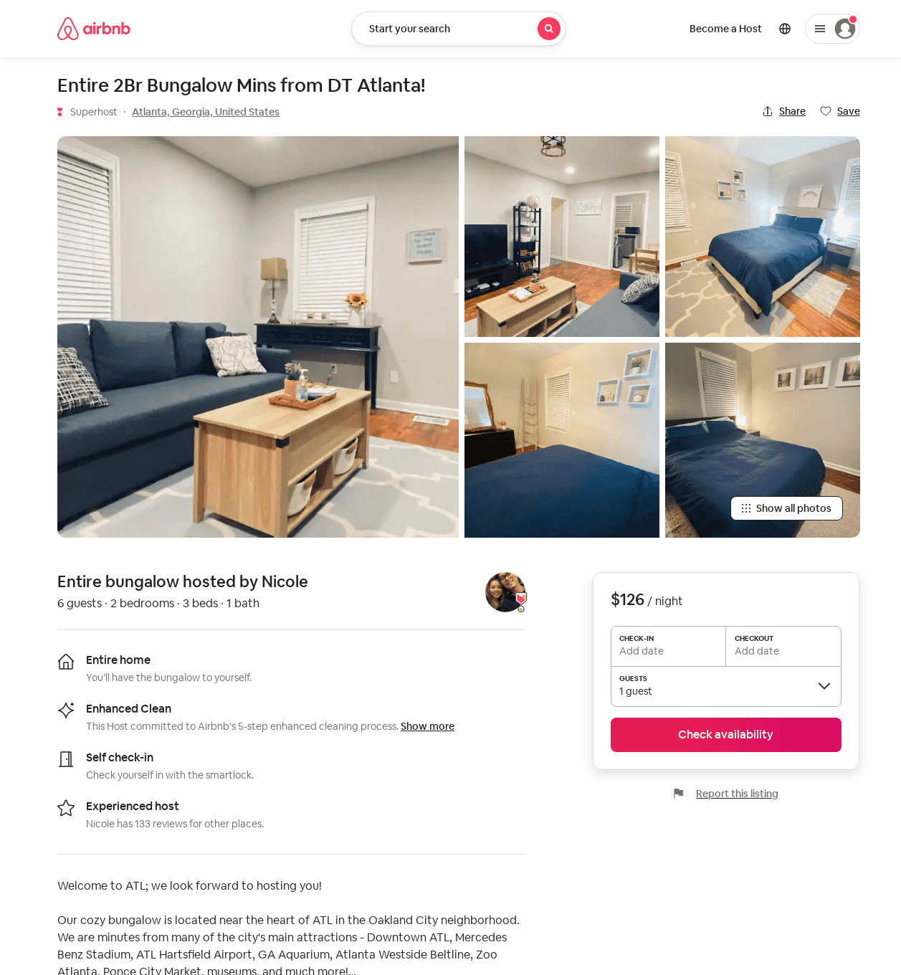
Listing 52222364
2
6
$126 - $165
4.33
2
Nicole
68927609
2
https://www.airbnb.com/rooms/52222364
Aug 2022

Slide 38
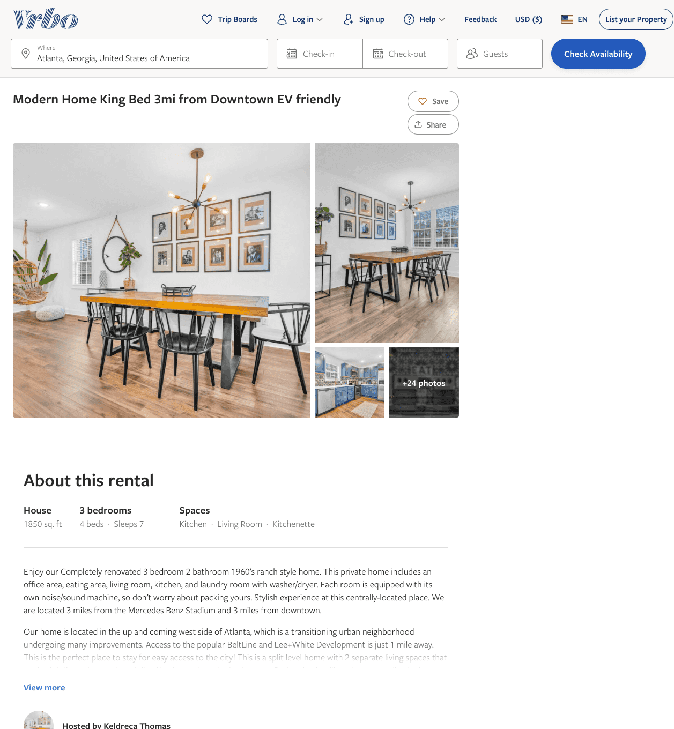
Listing 2612930
3
7
$210
3
Keldreca Thomas
https://www.vrbo.com/2612930
Aug 2022

Slide 39
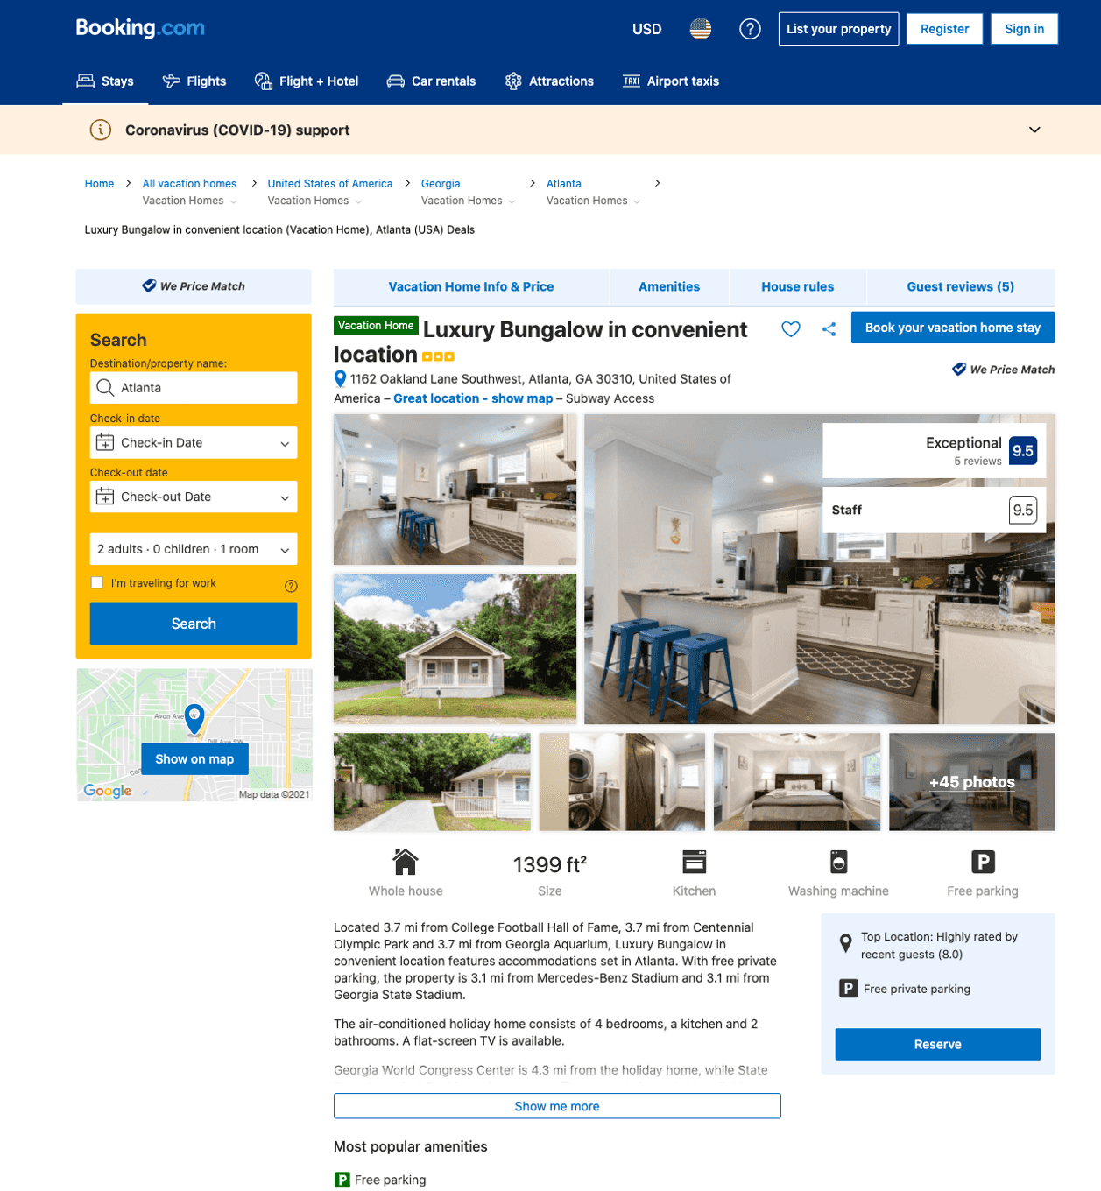
Listing luxury-bungalow-in-convenient-location-atlanta
undefined
8
9.5
https://www.booking.com/hotel/us/luxury-bungalow-in-convenient-location-atlanta.html
Sep 2022

Slide 40
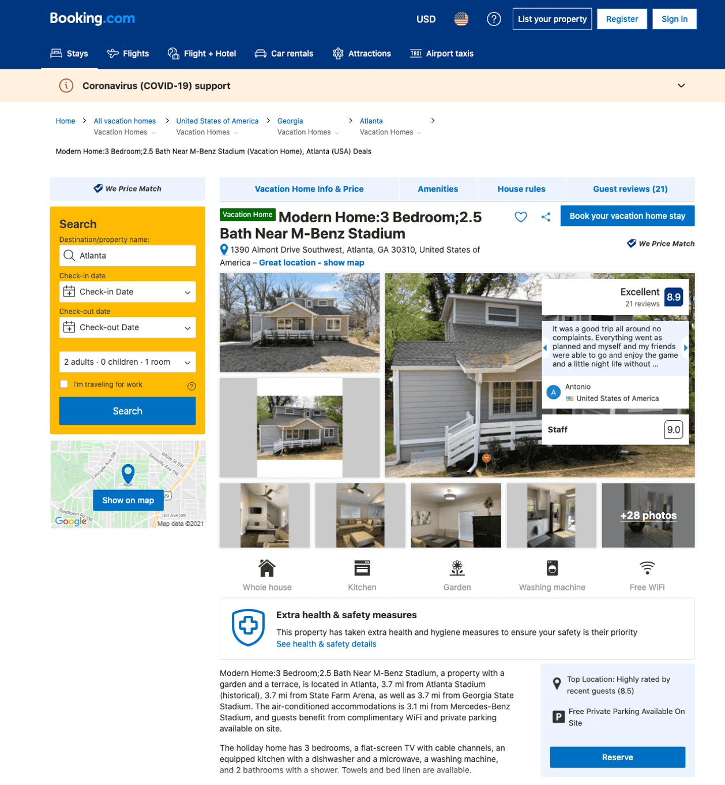
Listing modern-home-3-bedroom-2-5-bath-near-m-benz-stadium
undefined
6
9
https://www.booking.com/hotel/us/modern-home-3-bedroom-2-5-bath-near-m-benz-stadium.html
Sep 2022

Slide 41
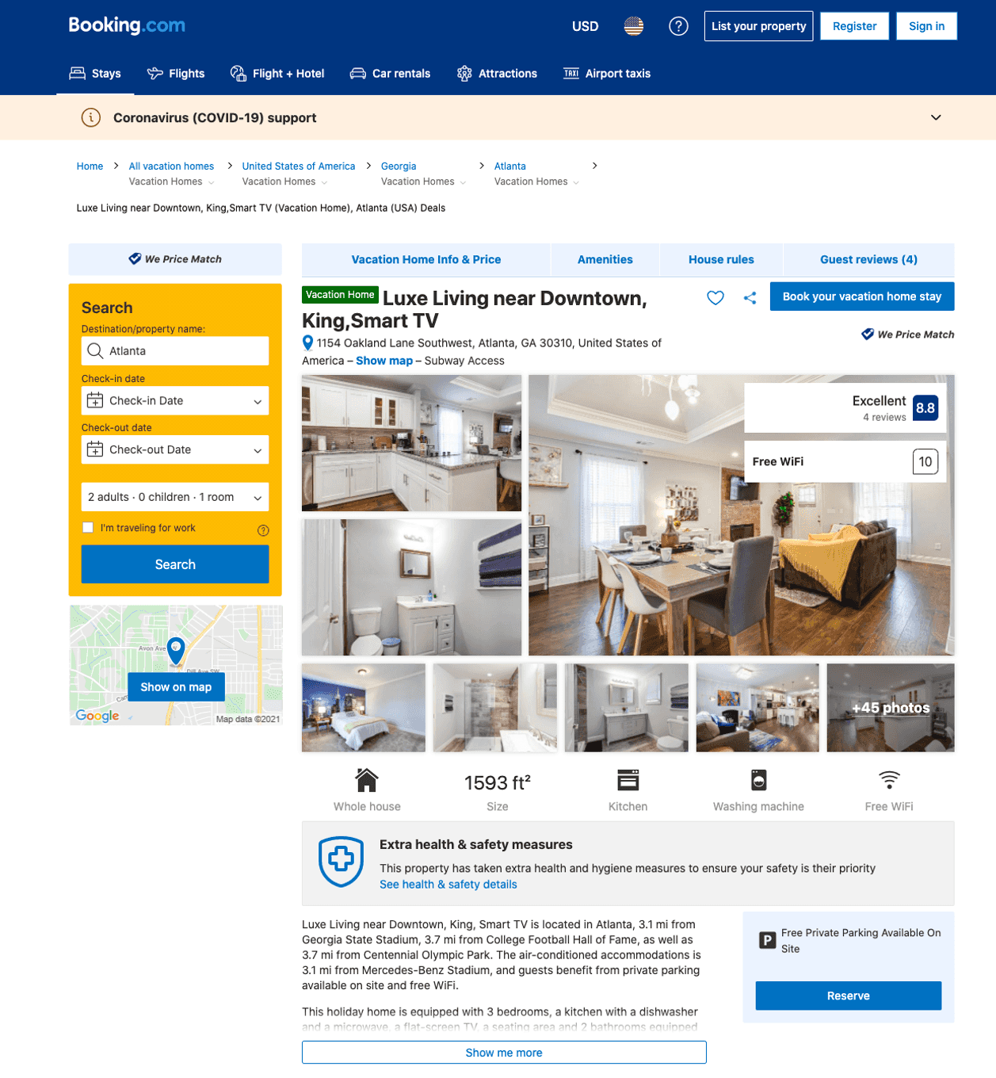
Listing luxe-living-near-downtown-king-smart-tv
undefined
7
8.8
https://www.booking.com/hotel/us/luxe-living-near-downtown-king-smart-tv.html
Sep 2022

Slide 42
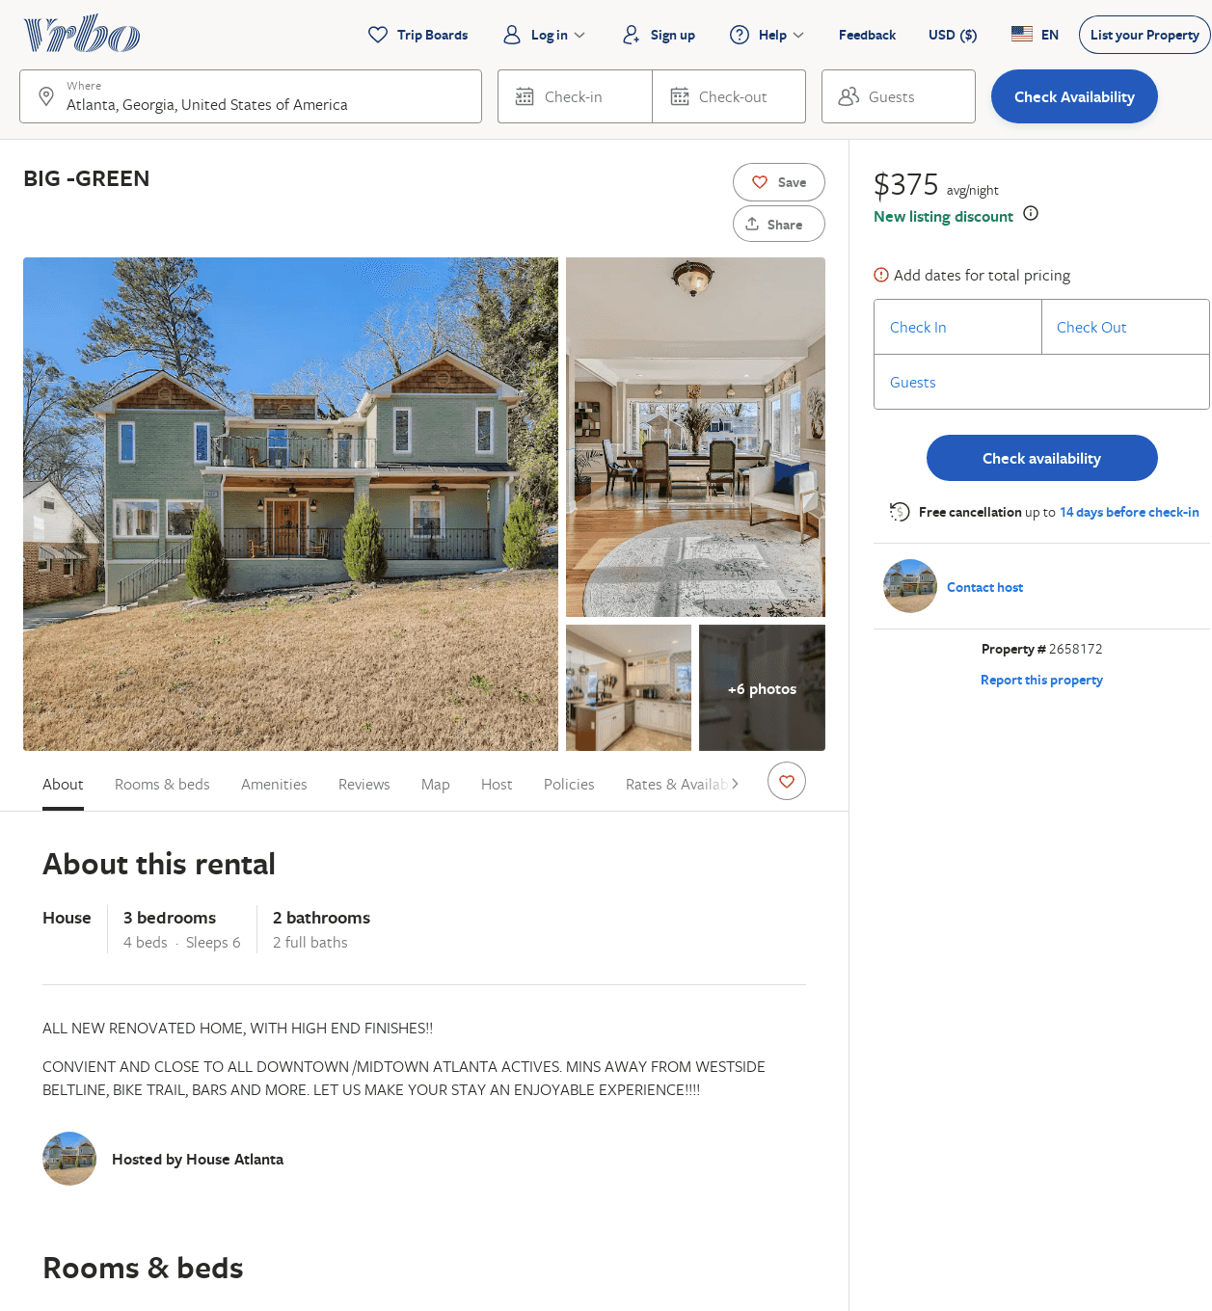
Listing 2658172
3
6
$255
2
Brandon
https://www.vrbo.com/2658172
Aug 2022

Slide 43
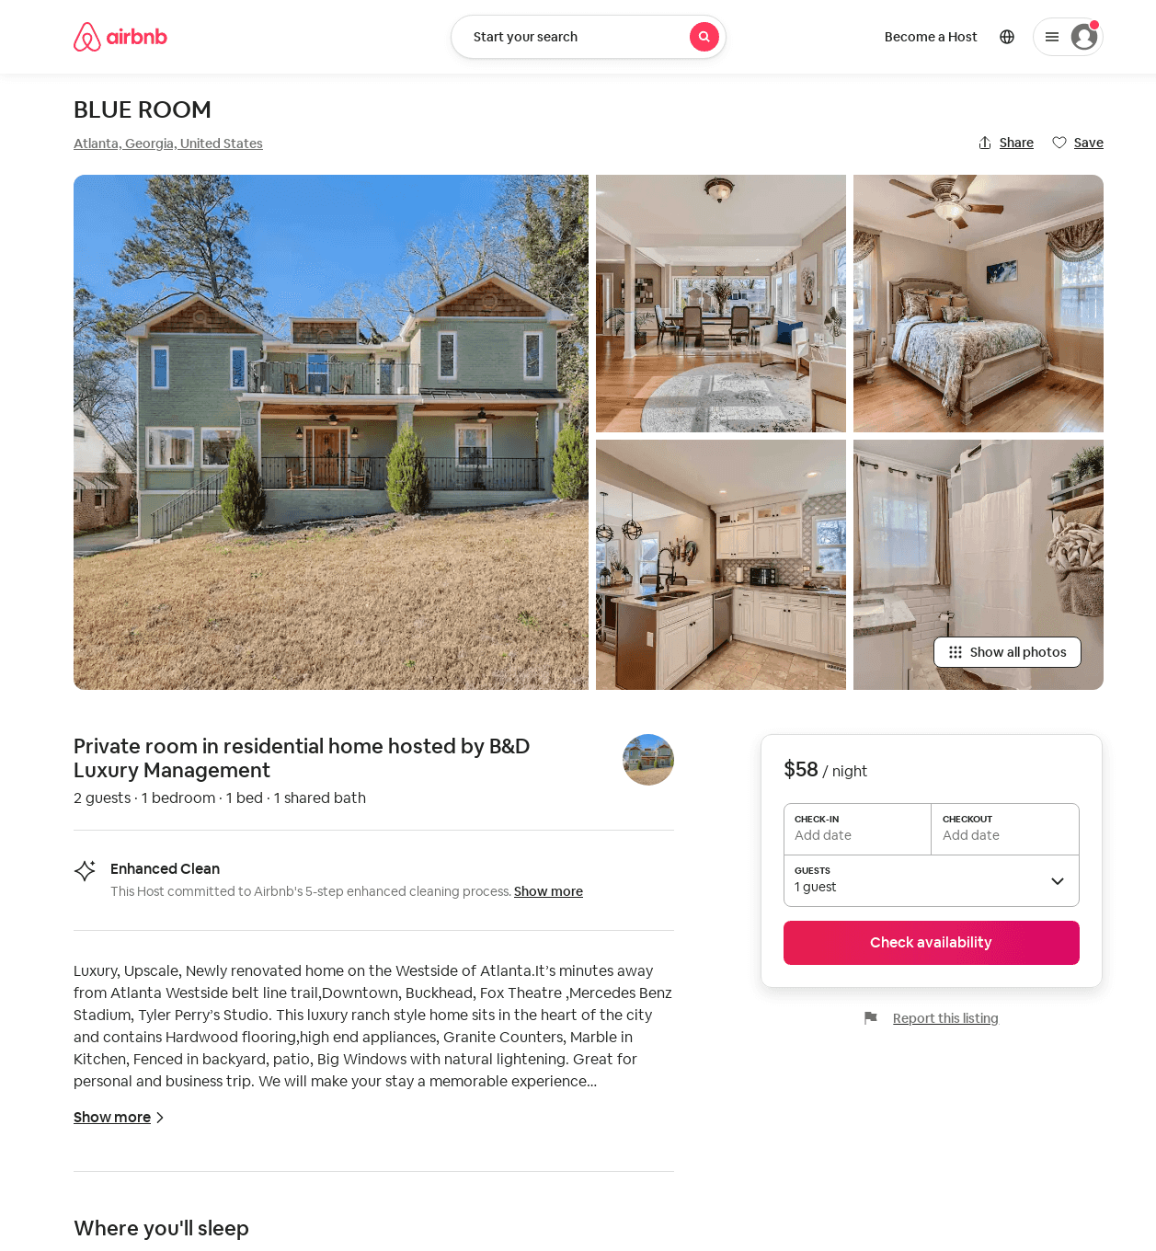
Listing 40287003
1
2
$58 - $73
4.42
1
B&D Luxury Management
311209899
1
https://www.airbnb.com/rooms/40287003
Aug 2022

Slide 44
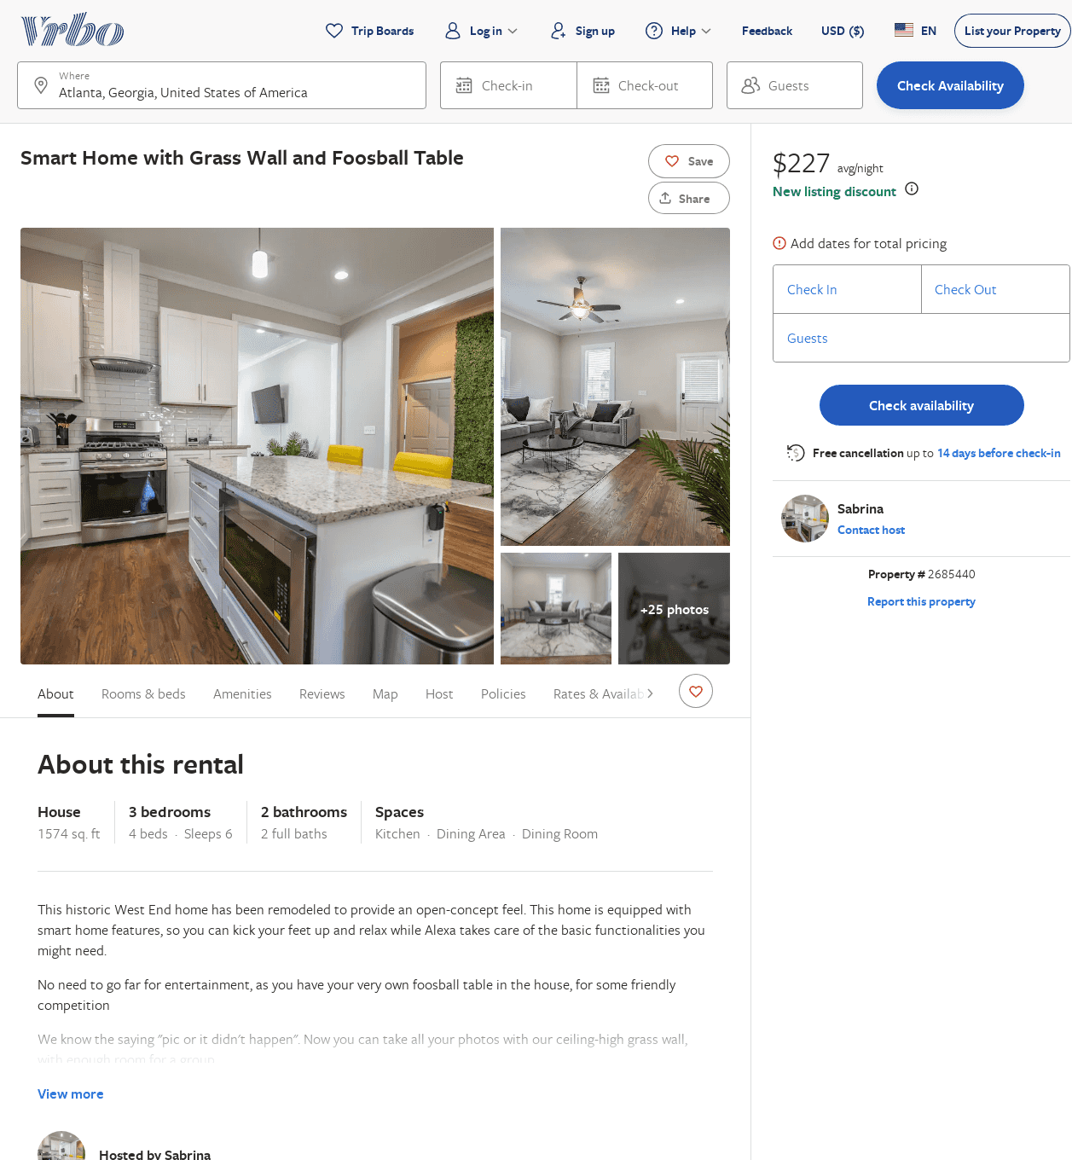
Listing 2685440
3
6
$231
2
Sabrina
https://www.vrbo.com/2685440
Aug 2022

Slide 45
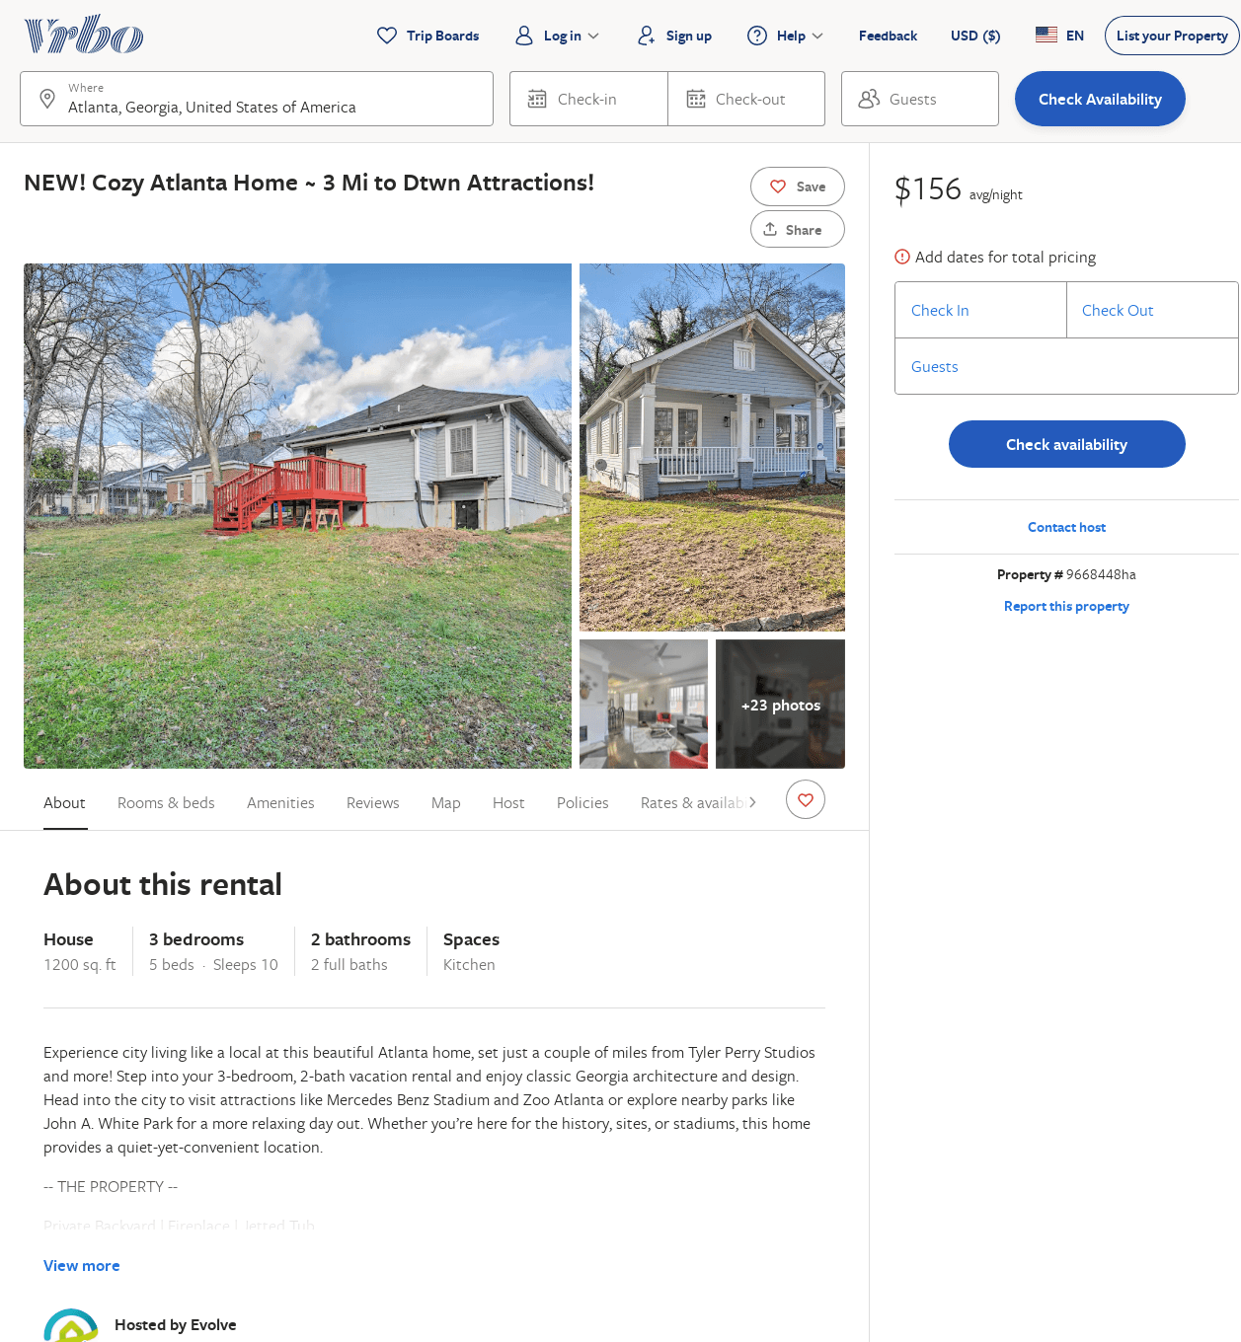
Listing 9668448
3
10
$115
2
Evolve
https://www.vrbo.com/9668448ha
Aug 2022

Slide 46
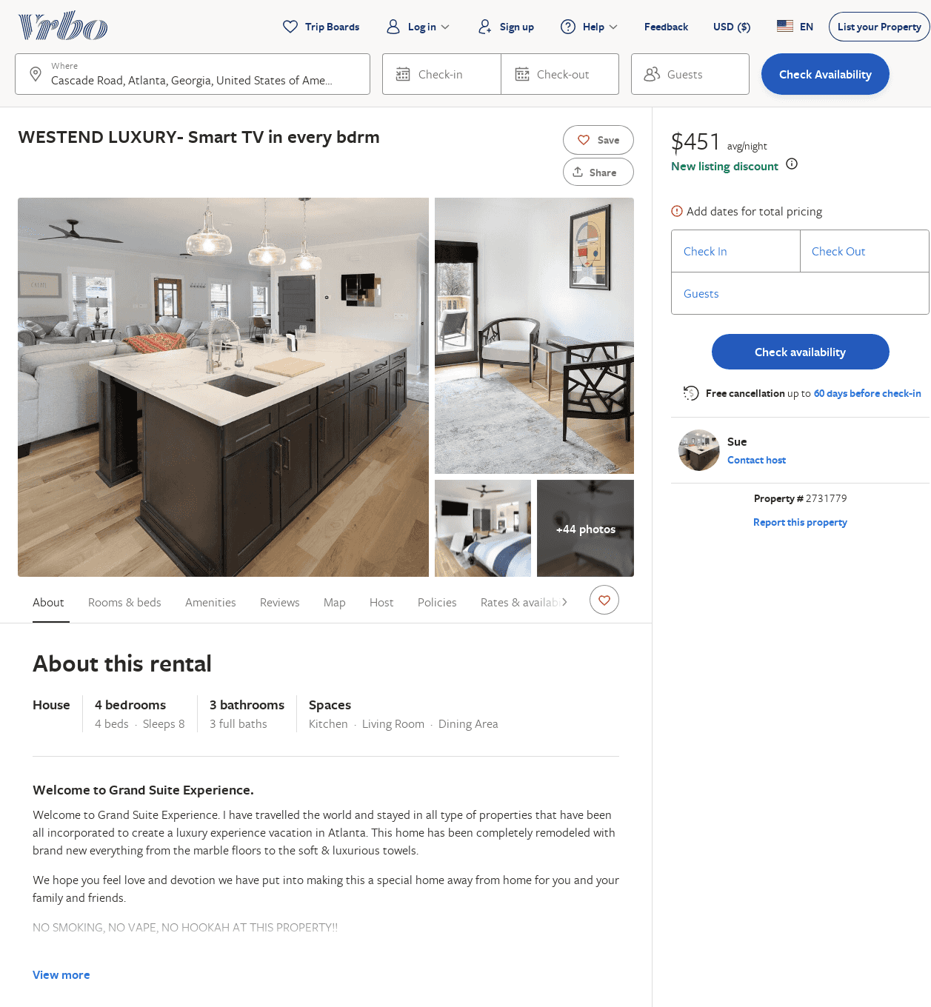
Listing 2731779
4
8
$451
4
Sue
https://www.vrbo.com/2731779
Aug 2022

Slide 47
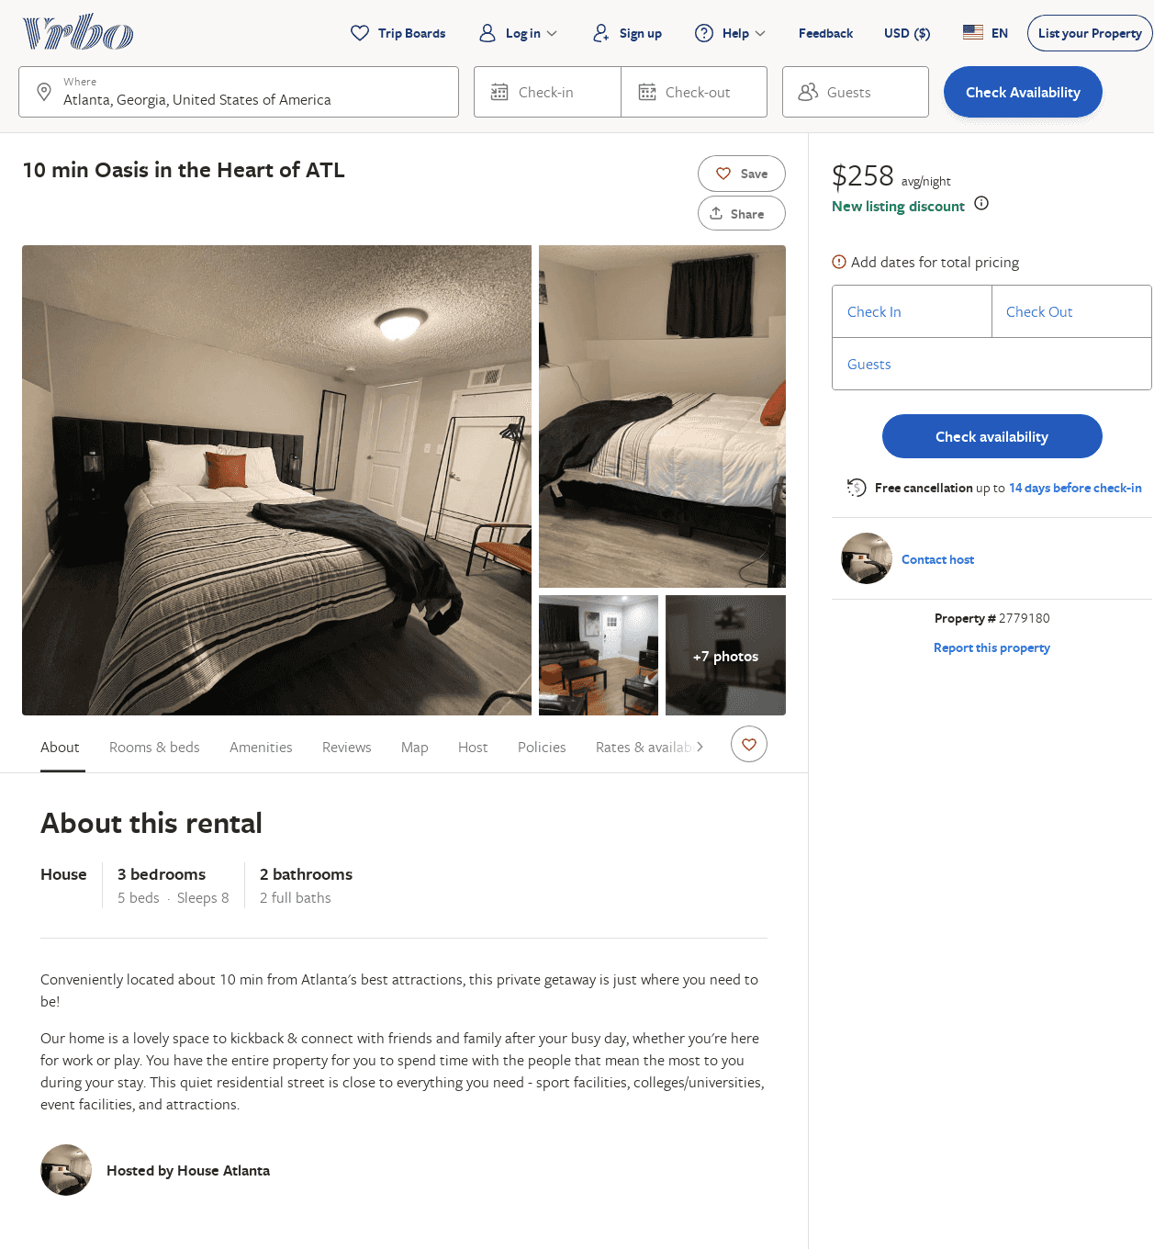
Listing 2779180
3
8
$218
2
https://www.vrbo.com/2779180
Aug 2022

Slide 48
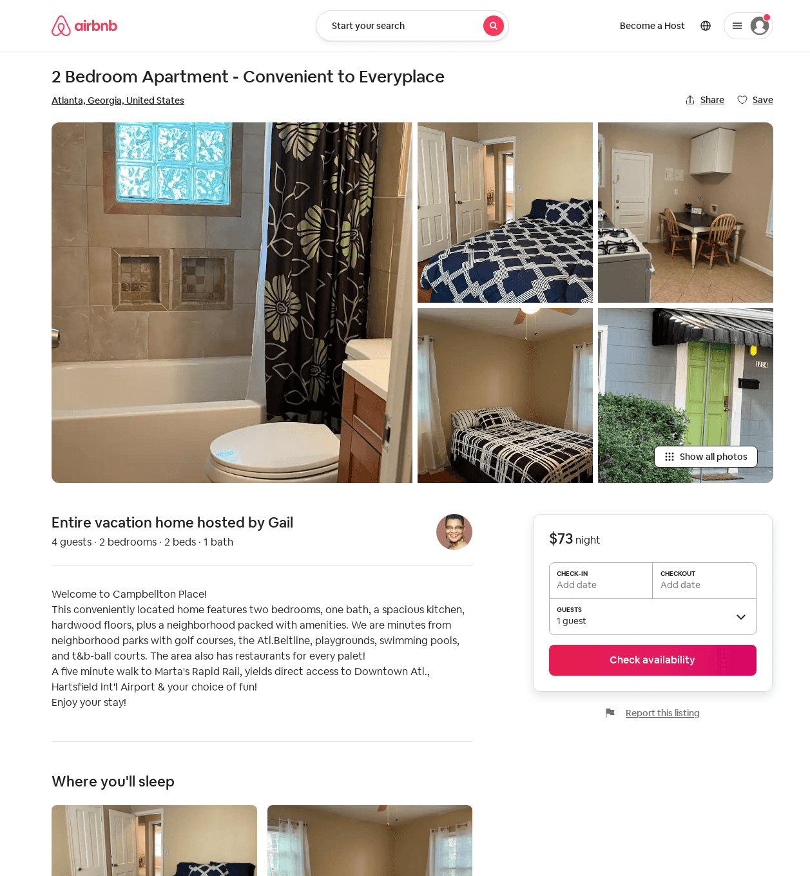
Listing 36475121
2
4
$68 - $73
3.50
2
Gail
274243818
1
https://www.airbnb.com/rooms/36475121
Jul 2022

Slide 49
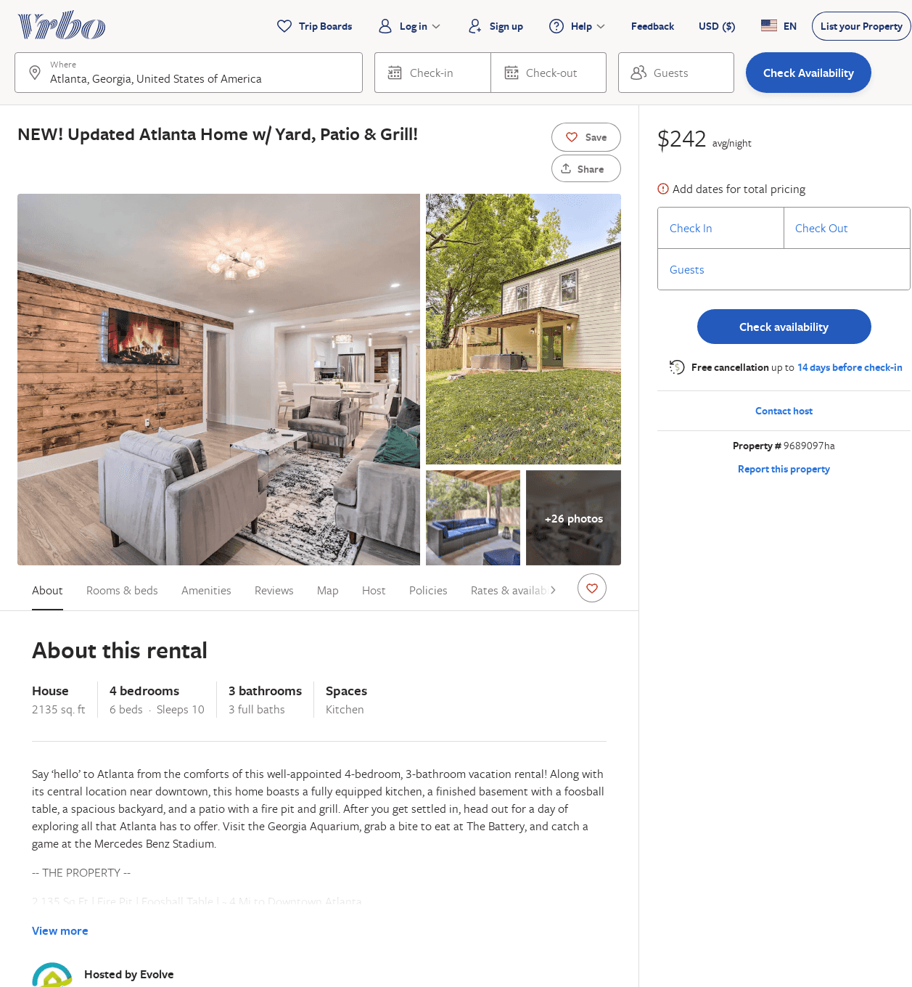
Listing 9689097
4
10
$264
2
Evolve
https://www.vrbo.com/9689097ha
Aug 2022

Slide 50
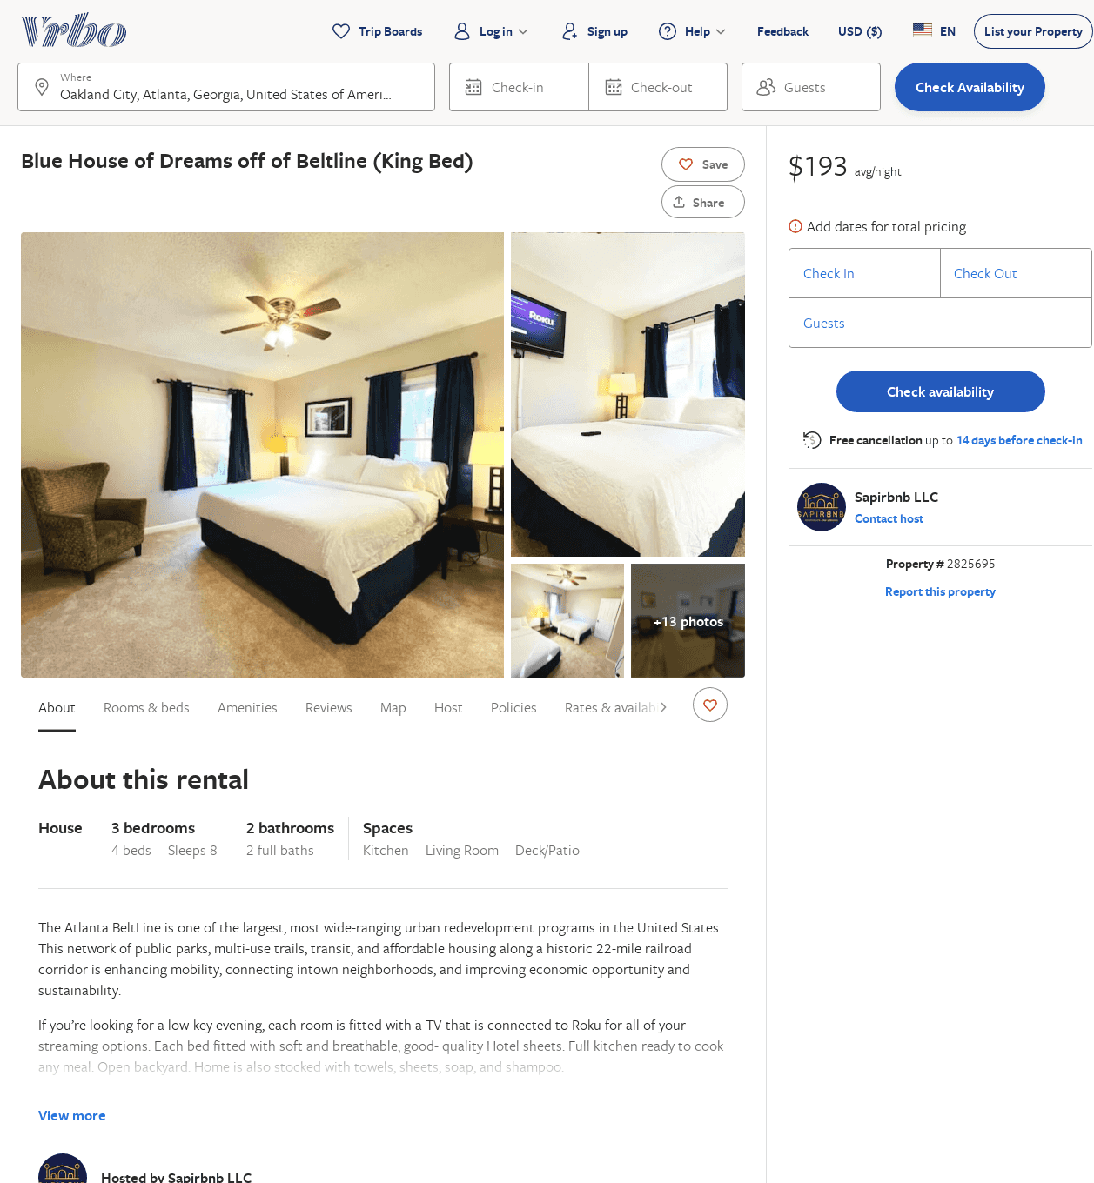
Listing 2825695
3
8
$140
2
Sapirbnb LLC
https://www.vrbo.com/2825695
Aug 2022

Slide 51
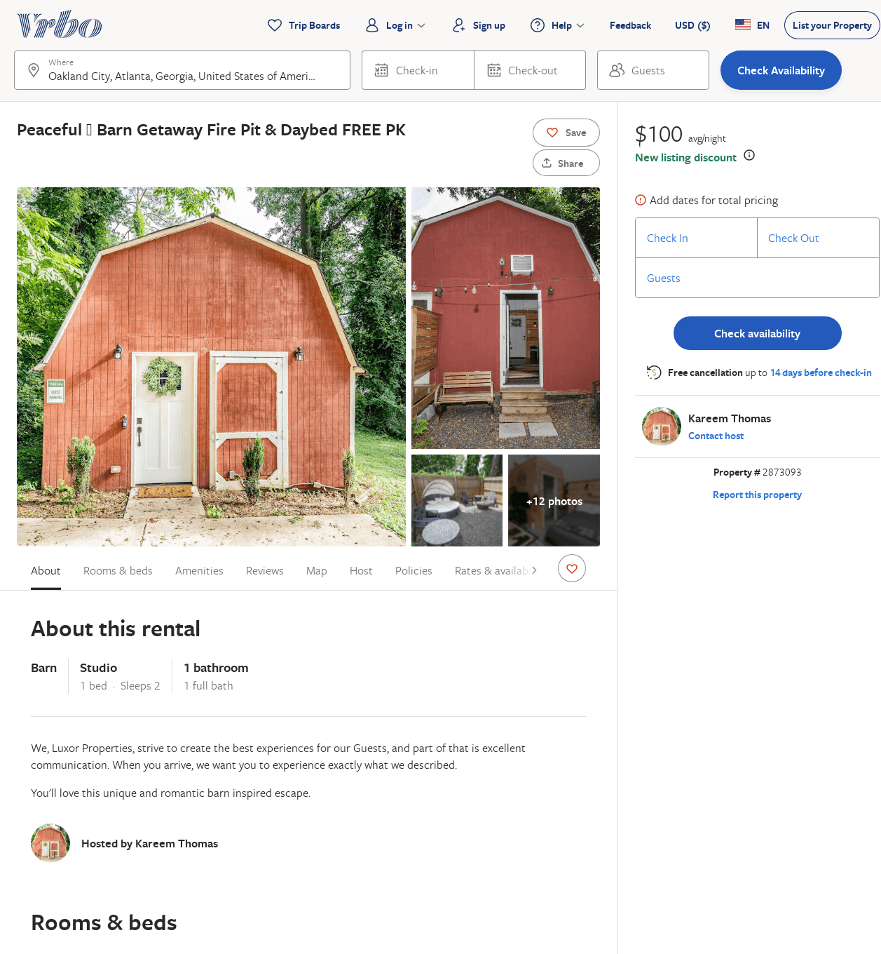
Listing 2873093
0
2
$93
3
Kareem Thomas
https://www.vrbo.com/2873093
Aug 2022

Slide 52
Listing 2875305
1
3
$95
1
https://www.vrbo.com/2875305
Aug 2022

Slide 53
Listing 2872508
2
7
$205
3
Kareem Thomas
https://www.vrbo.com/2872508
Aug 2022

Slide 54
Listing 9696368
3
11
$223
2
https://www.vrbo.com/9696368ha
Aug 2022

Slide 55
Listing 54096797
3
8
2
Amber
438493447
1
https://www.airbnb.com/rooms/54096797
Jun 2022

Slide 56
Listing 2899276
4
10
$185
2
https://www.vrbo.com/2899276
Aug 2022

Slide 57
Listing 2877899
3
6
$182
2
Mallerie Shirley
https://www.vrbo.com/2877899
Aug 2022

