Slide 2
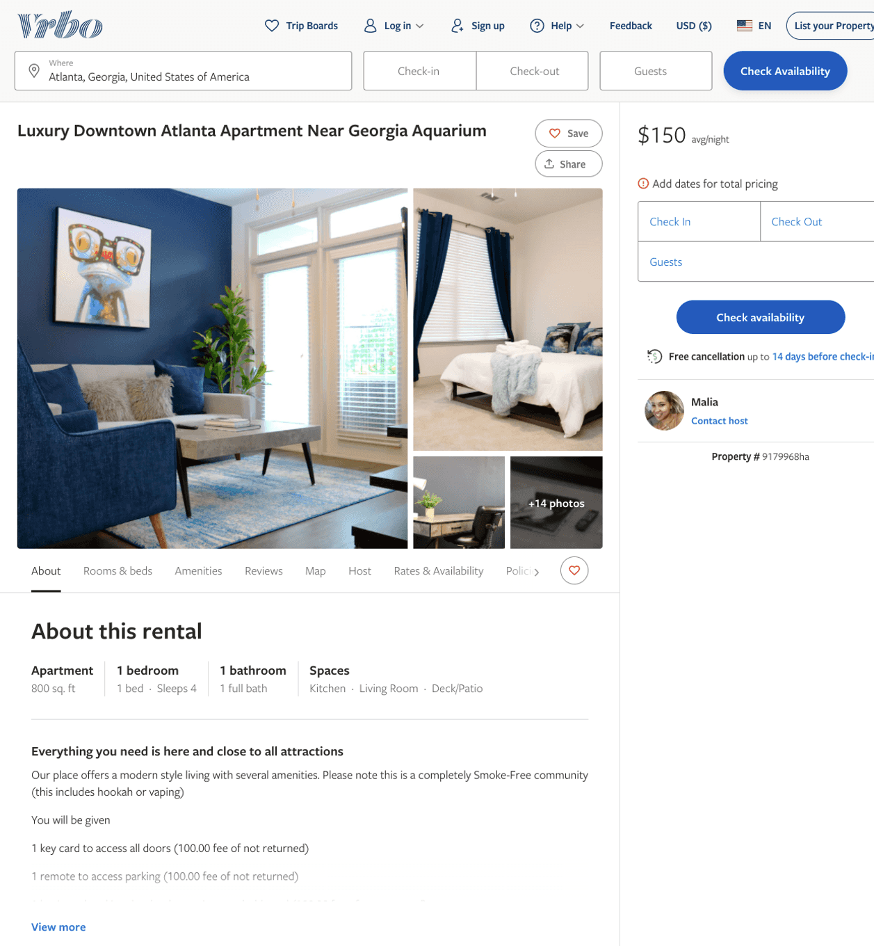
Listing 9179968
1
4
$150
1
Malia
https://www.vrbo.com/9179968ha
Aug 2022

Slide 3
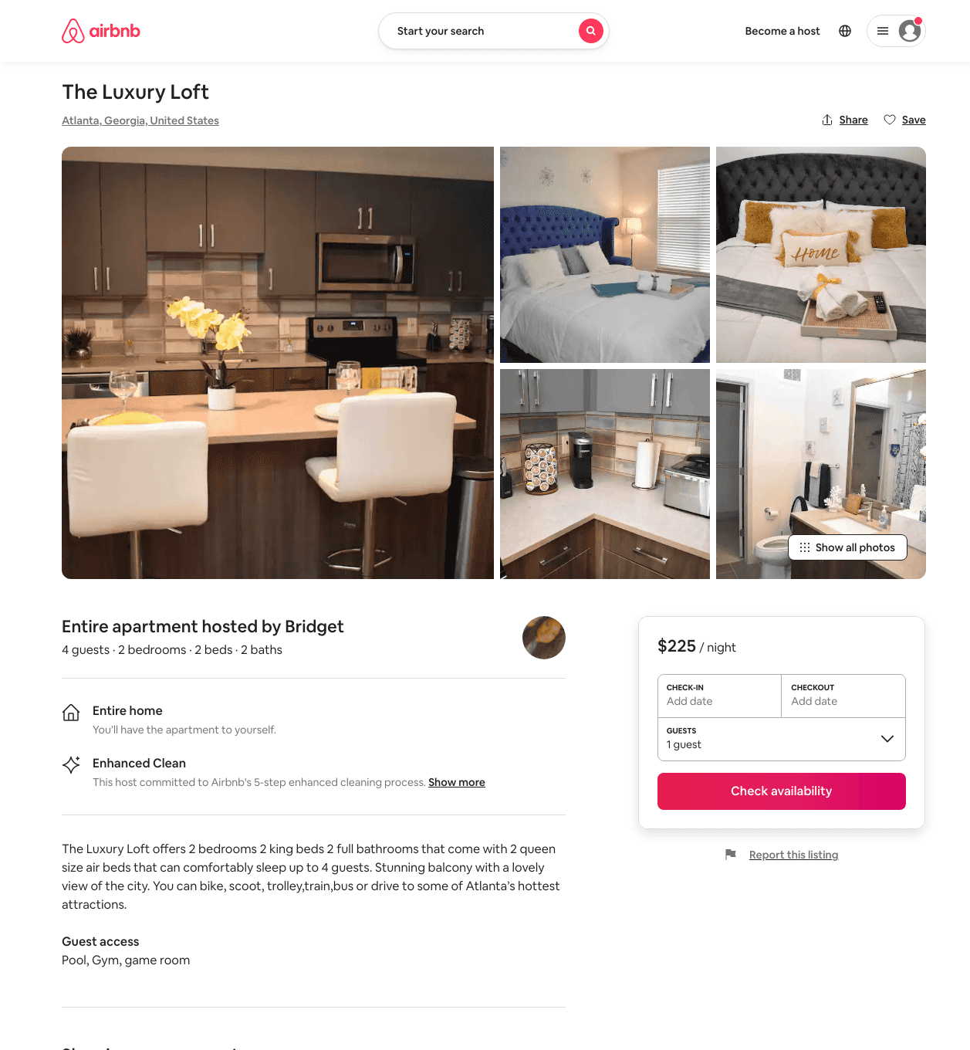
Listing 50177973
2
4
$121 - $225
4.73
2
Bri
28649301
1
https://www.airbnb.com/rooms/50177973
Aug 2022

Slide 4
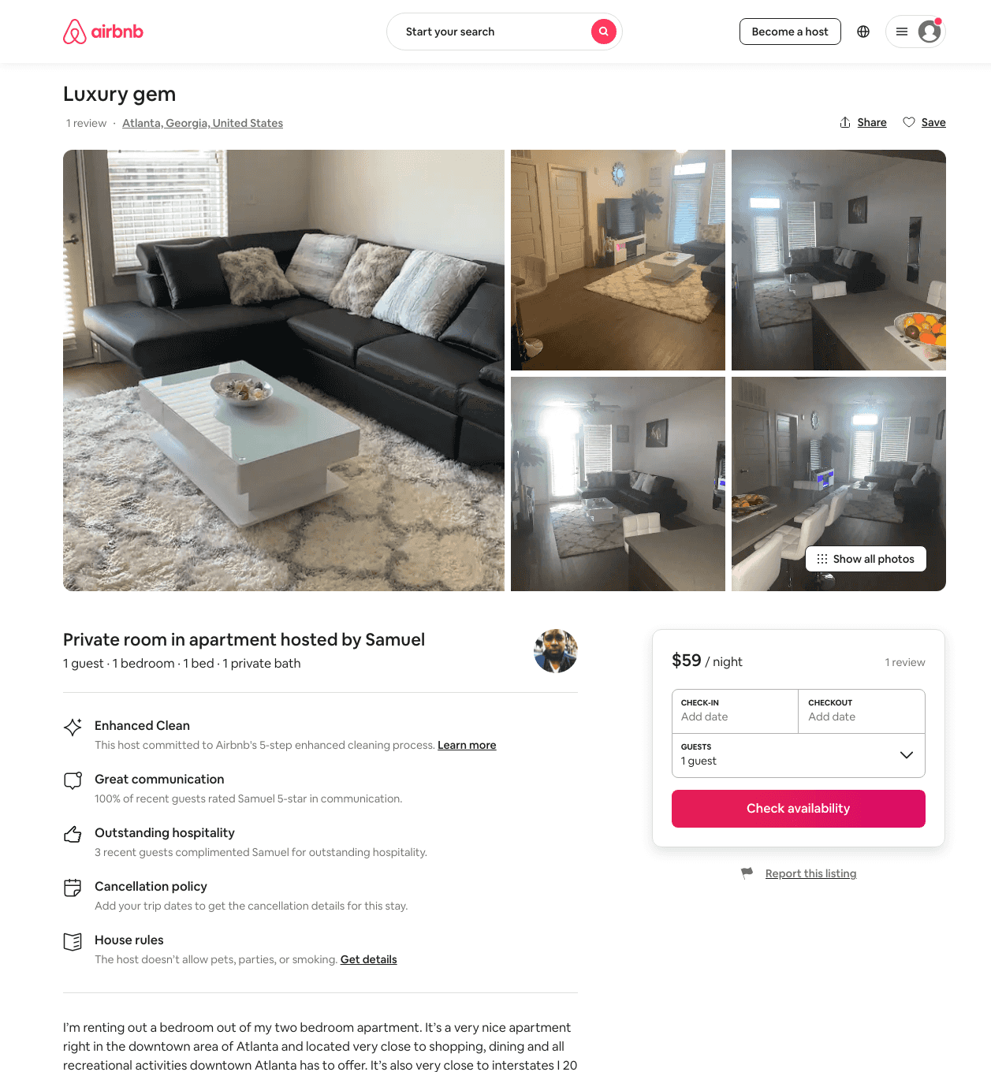
Listing 48863437
1
1
$59 - $79
4.55
1
Samuel
253497838
1
https://www.airbnb.com/rooms/48863437
Jul 2022

Slide 5
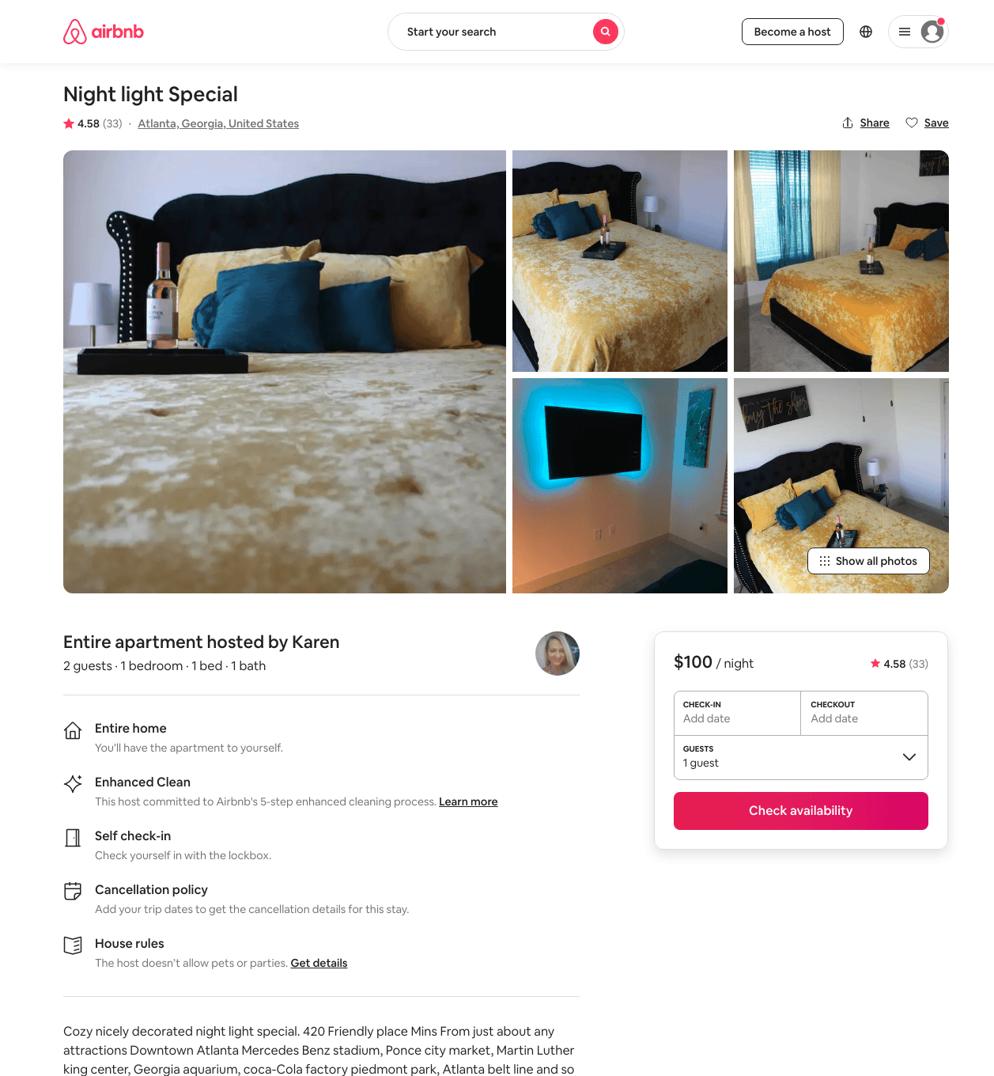
Listing 44796143
1
2
$80 - $125
4.70
1
Karen
184874098
2
https://www.airbnb.com/rooms/44796143
Aug 2022

Slide 6
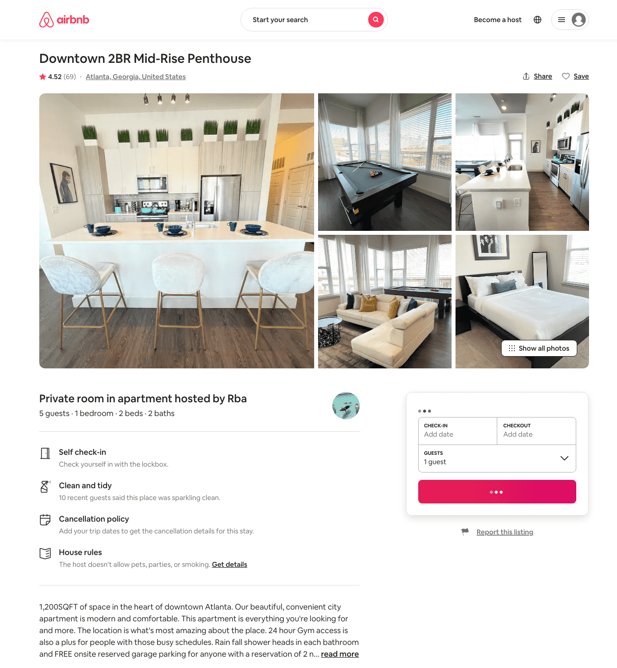
Listing 42114955
2
5
$152 - $235
4.39
2
Rba
627117
19
https://www.airbnb.com/rooms/42114955
Aug 2022

Slide 7
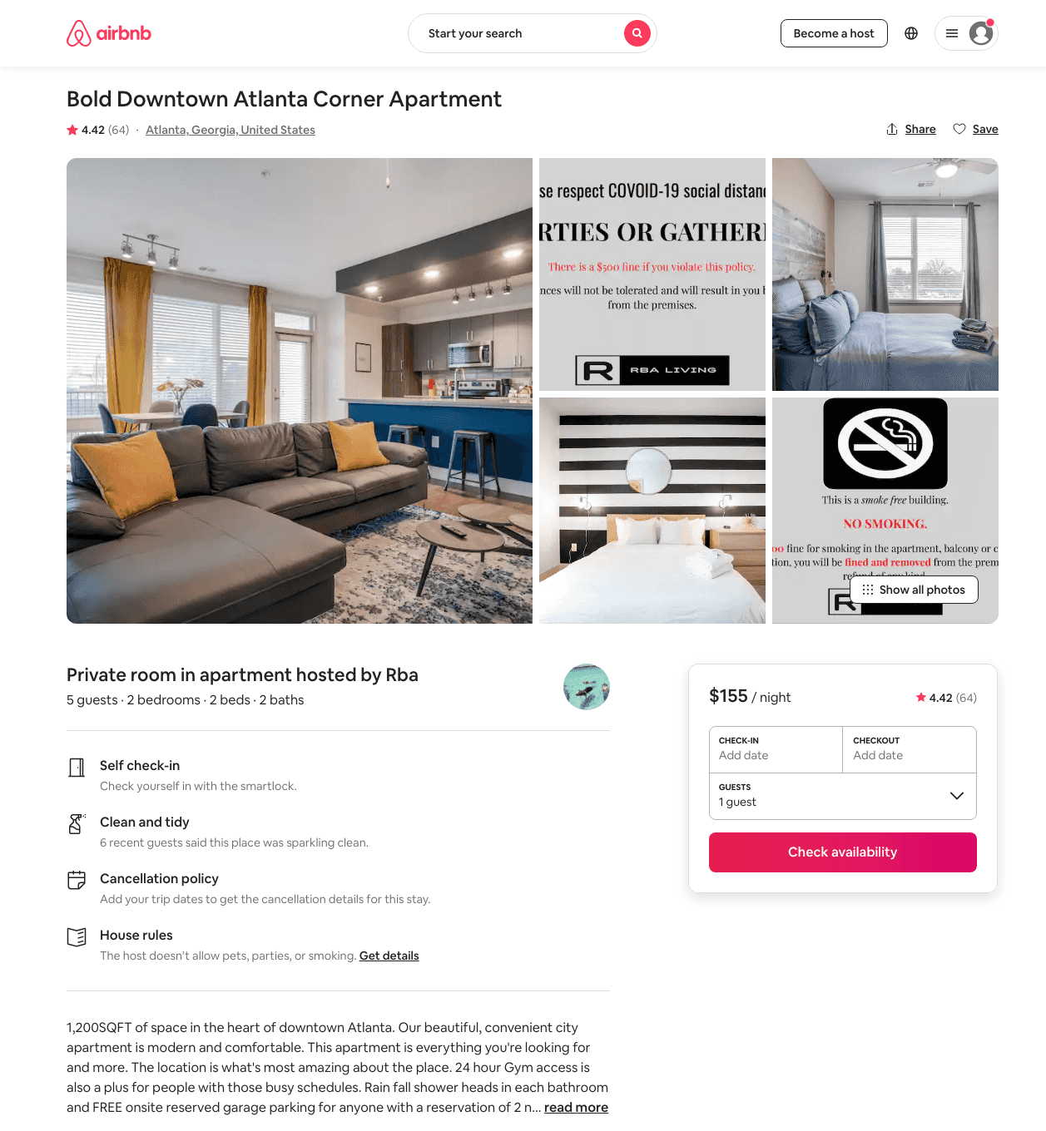
Listing 41818874
2
5
$139 - $198
4.44
2
Rba
627117
19
https://www.airbnb.com/rooms/41818874
Aug 2022

Slide 8
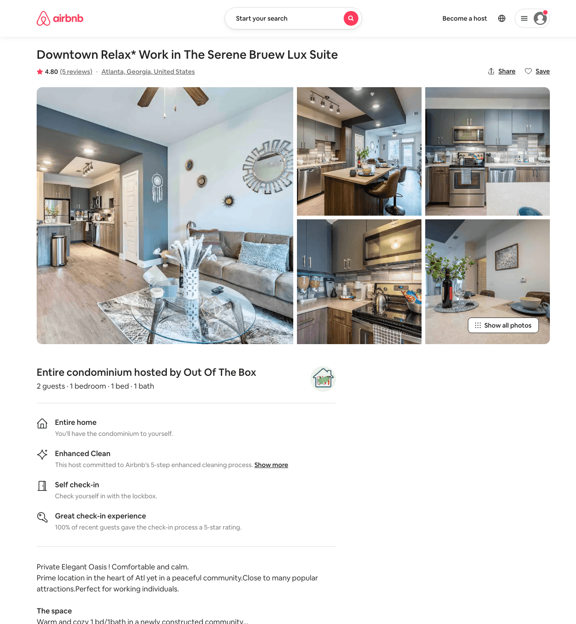
Listing 49596773
1
3
$72 - $250
4.74
1
Out Of The Box
208955740
7
https://www.airbnb.com/rooms/49596773
Aug 2022

Slide 9
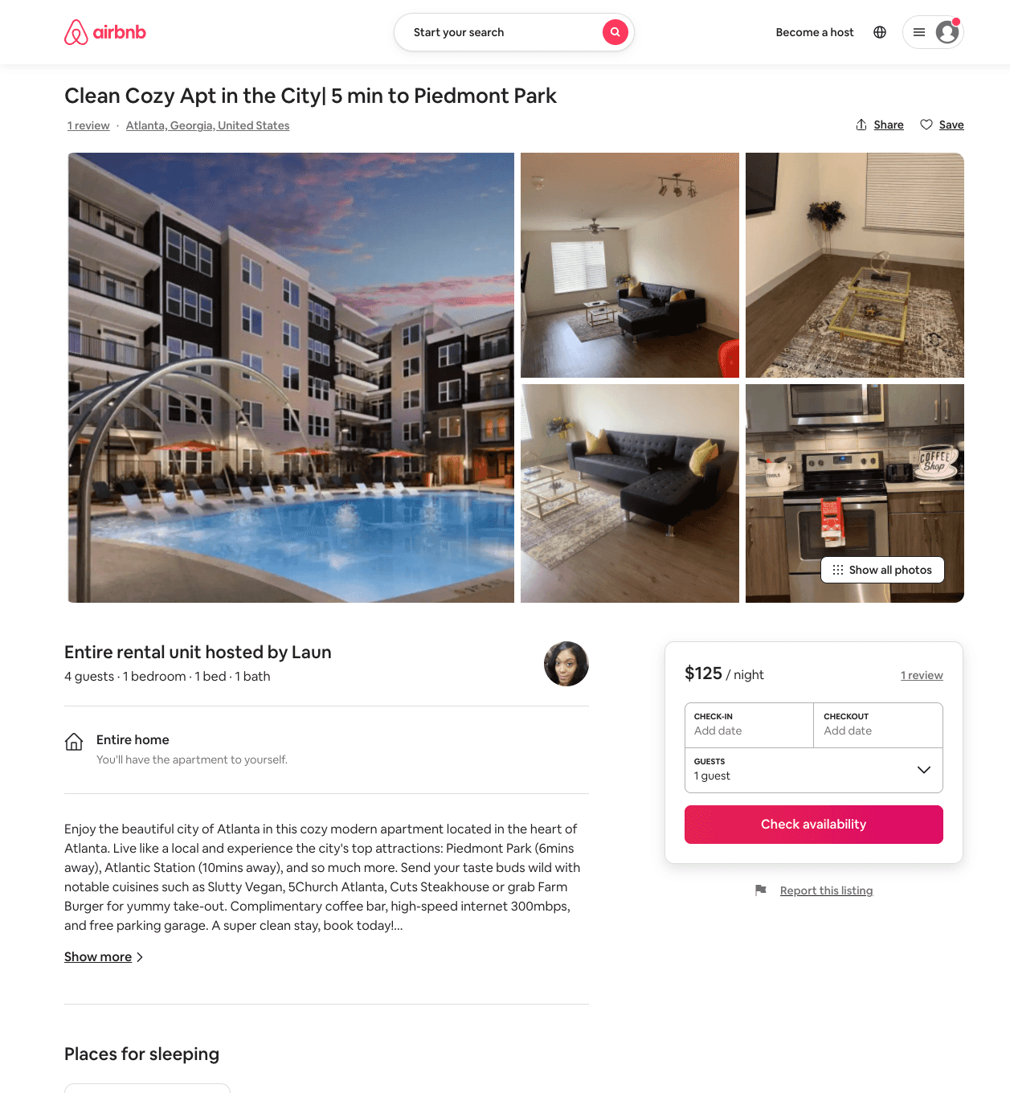
Listing 50792809
1
4
$90 - $135
5.0
1
Laun
367090106
2
https://www.airbnb.com/rooms/50792809
Aug 2022

Slide 10
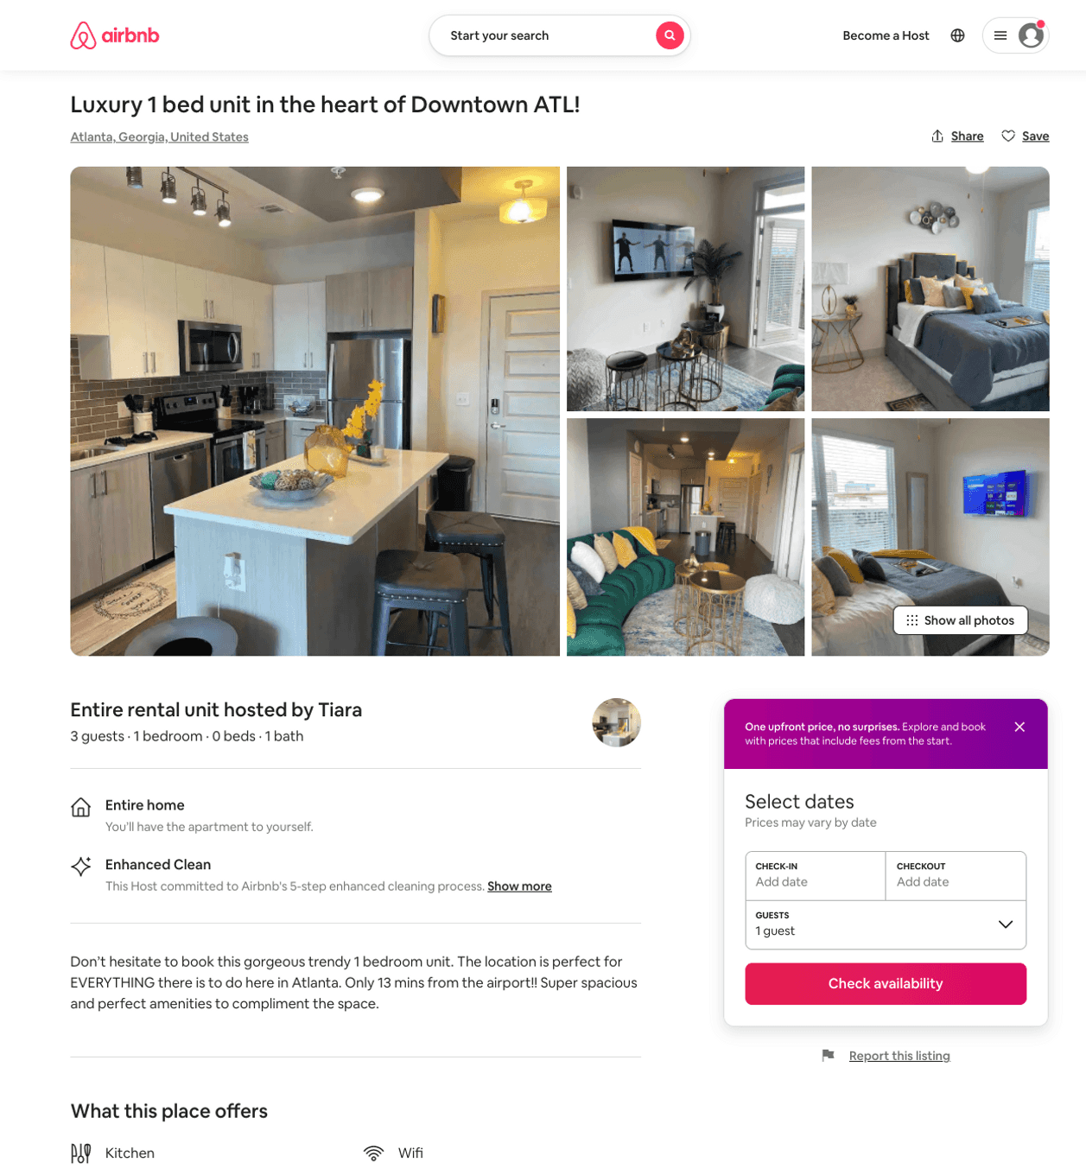
Listing 52322511
1
3
$81 - $125
4.41
2
Tia
423465197
1
https://www.airbnb.com/rooms/52322511
Aug 2022

Slide 11
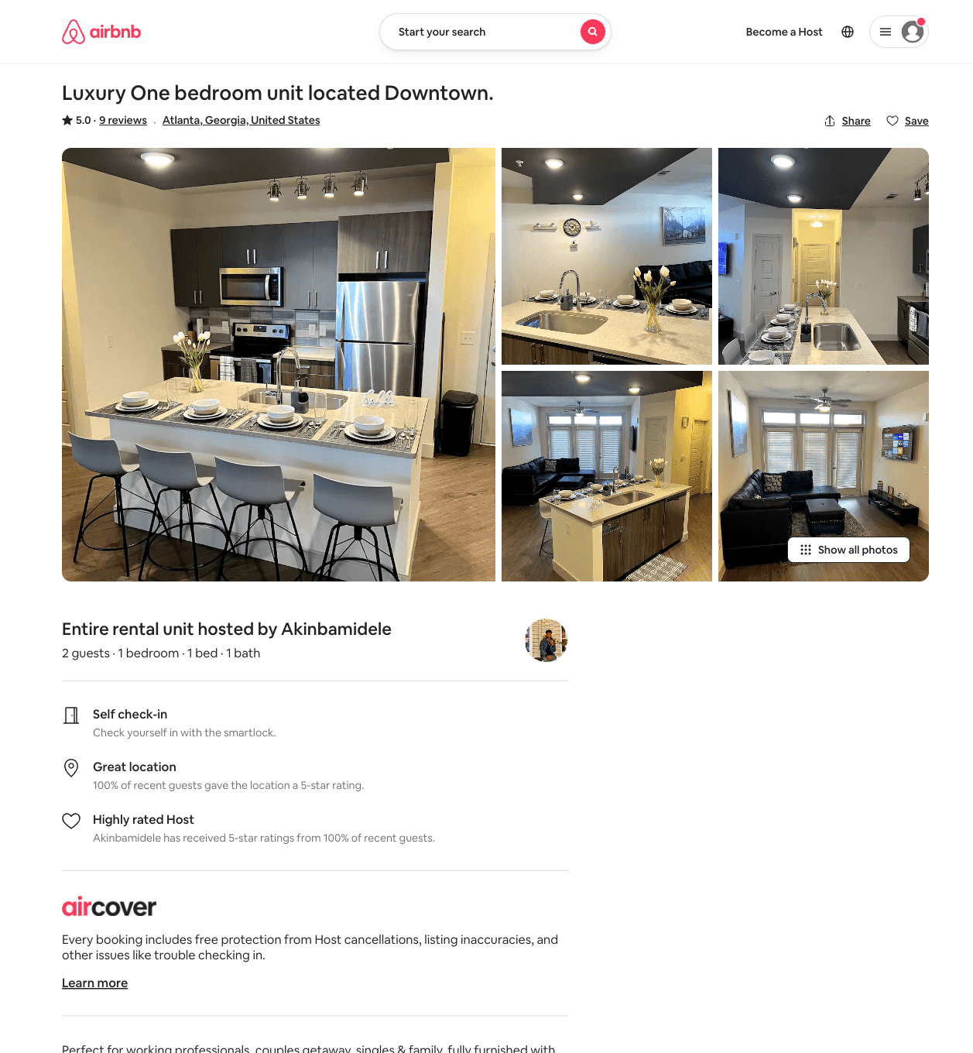
Listing 51999418
1
2
$115
5.0
1
Akinbamidele
298192028
1
https://www.airbnb.com/rooms/51999418
Aug 2022

Slide 12
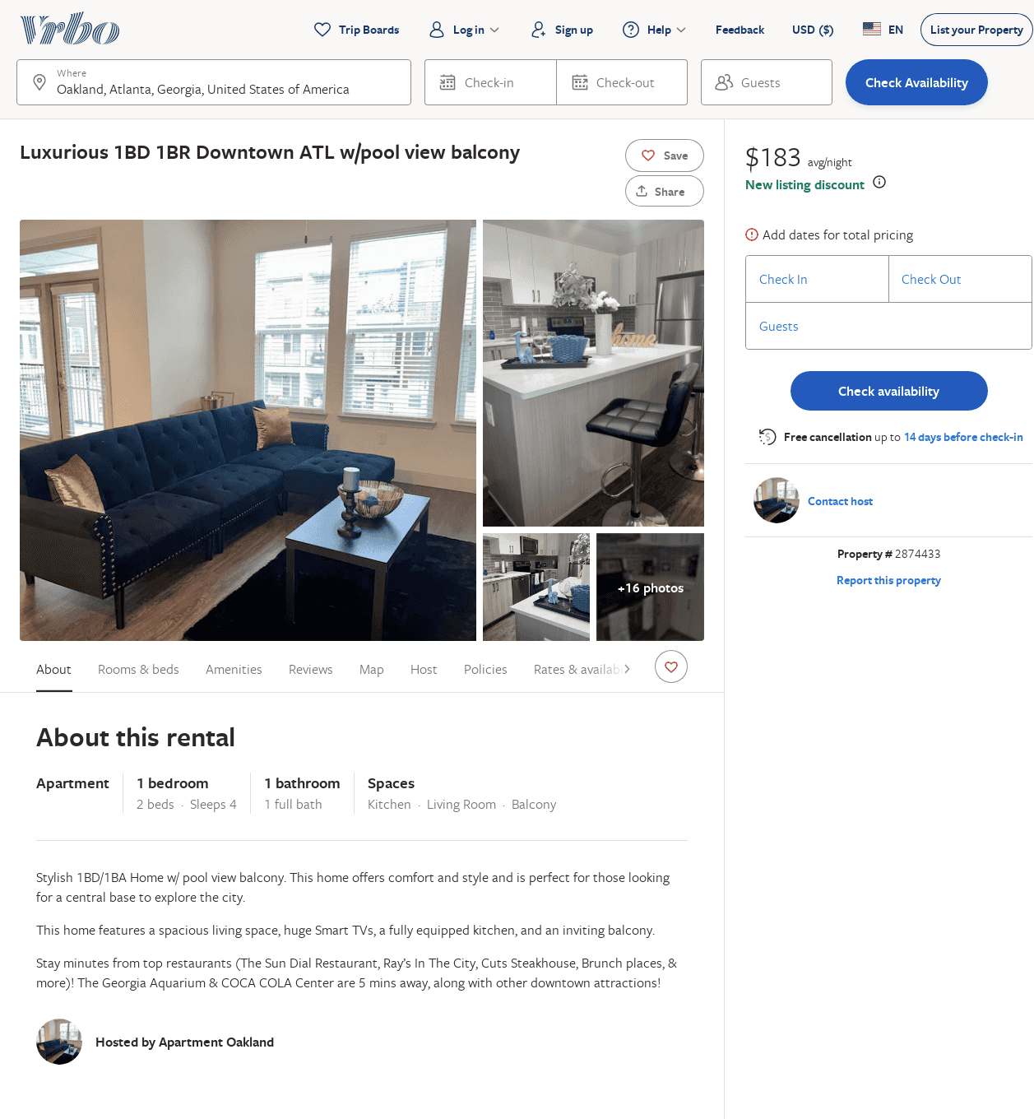
Listing 2874433
1
4
$151
1
https://www.vrbo.com/2874433
Aug 2022

