Slide 2
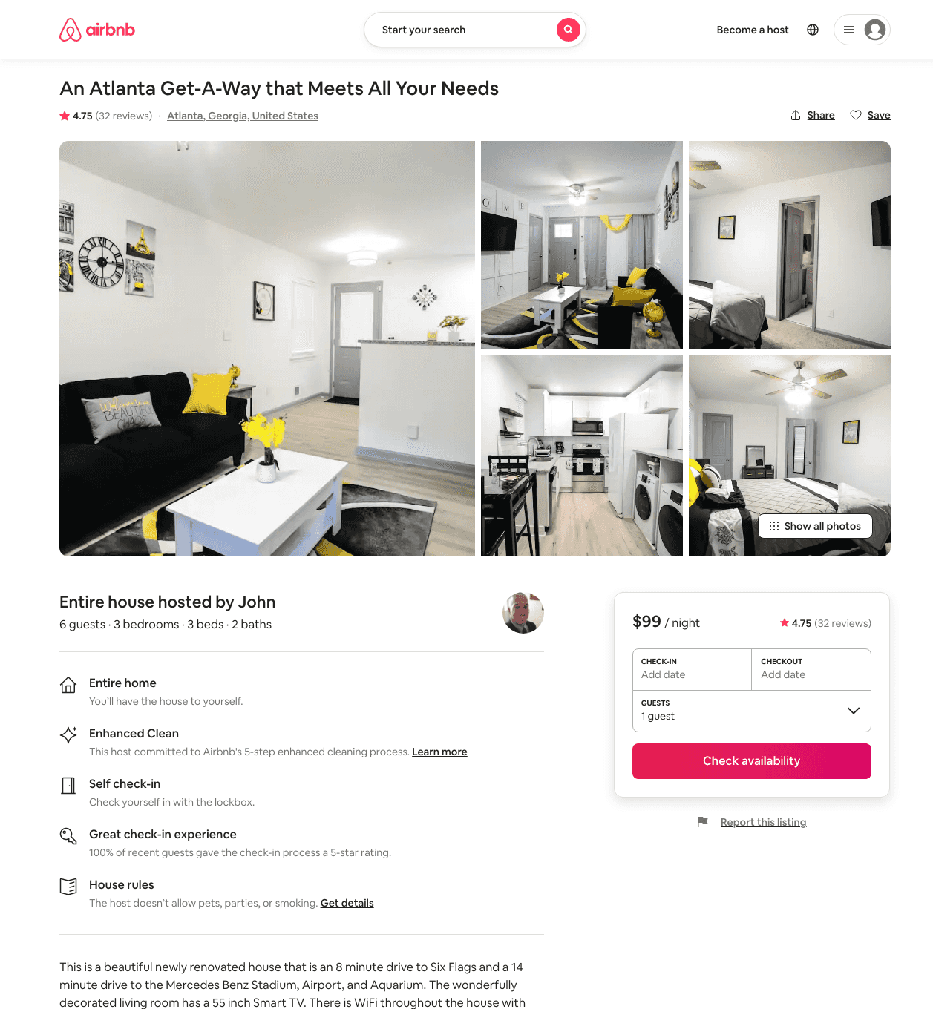
Listing 44631952
3
6
$99 - $114
4.60
2
John
130334037
1
https://www.airbnb.com/rooms/44631952
Aug 2022

Slide 3
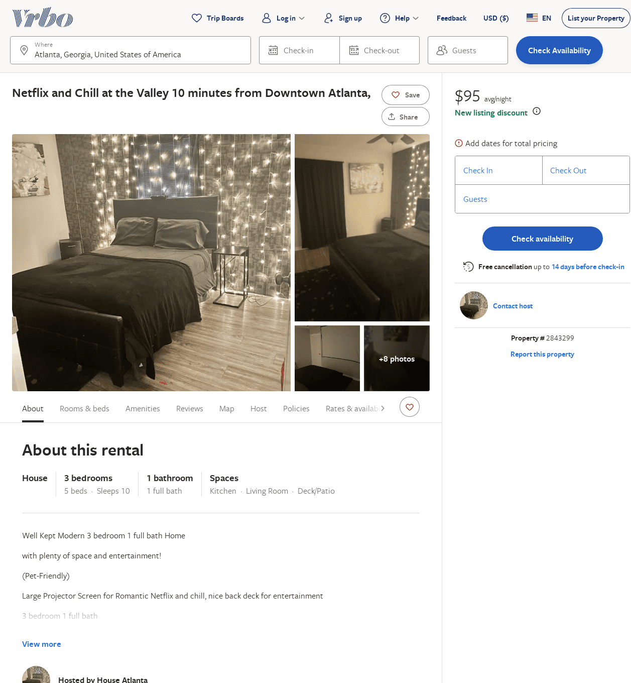
Listing 2843299
3
10
$95
3.875
1
https://www.vrbo.com/2843299
Aug 2022

