Slide 2
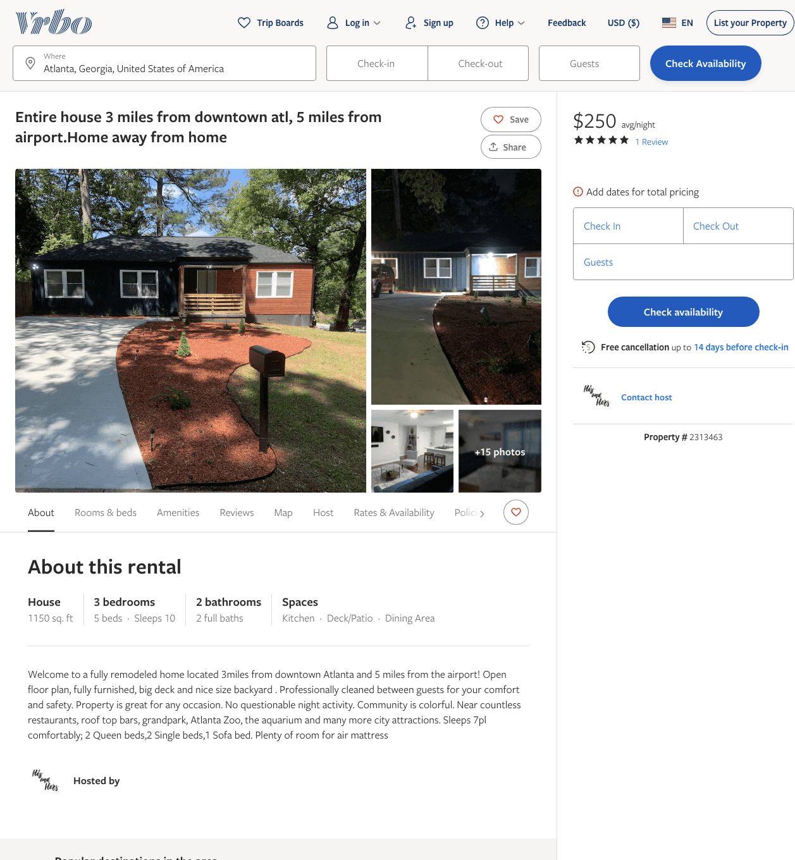
Listing 2313463
3
10
$173 - $257
5
2
Shaq Coleman
https://www.vrbo.com/2313463
Aug 2022

Slide 3
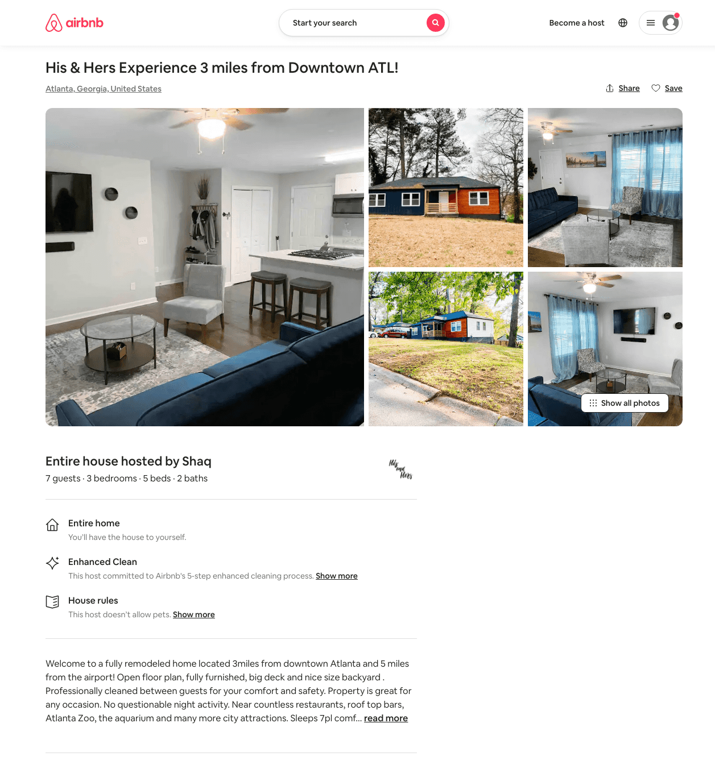
Listing 49390265
3
8
$115 - $243
5.0
2
Shaq
91686918
1
https://www.airbnb.com/rooms/49390265
Jun 2022

Slide 4
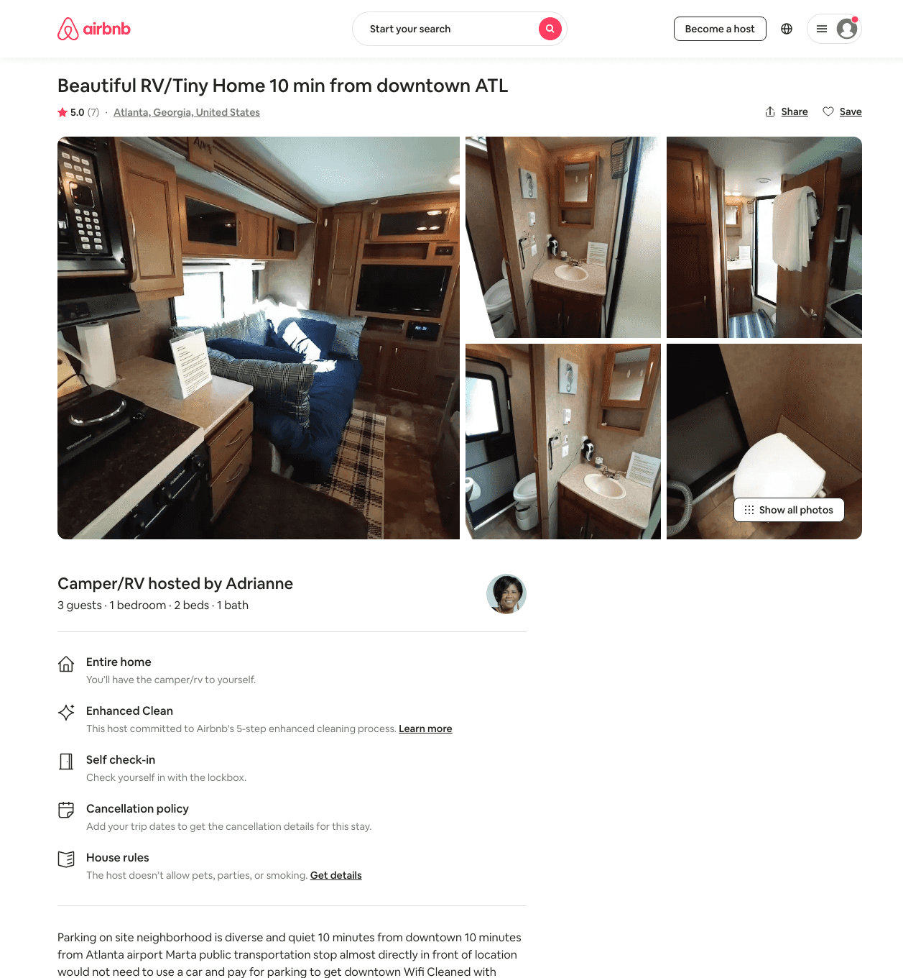
Listing 48447868
1
3
$45 - $79
4.83
1
Adrianne
146202877
1
https://www.airbnb.com/rooms/48447868
Aug 2022

Slide 5
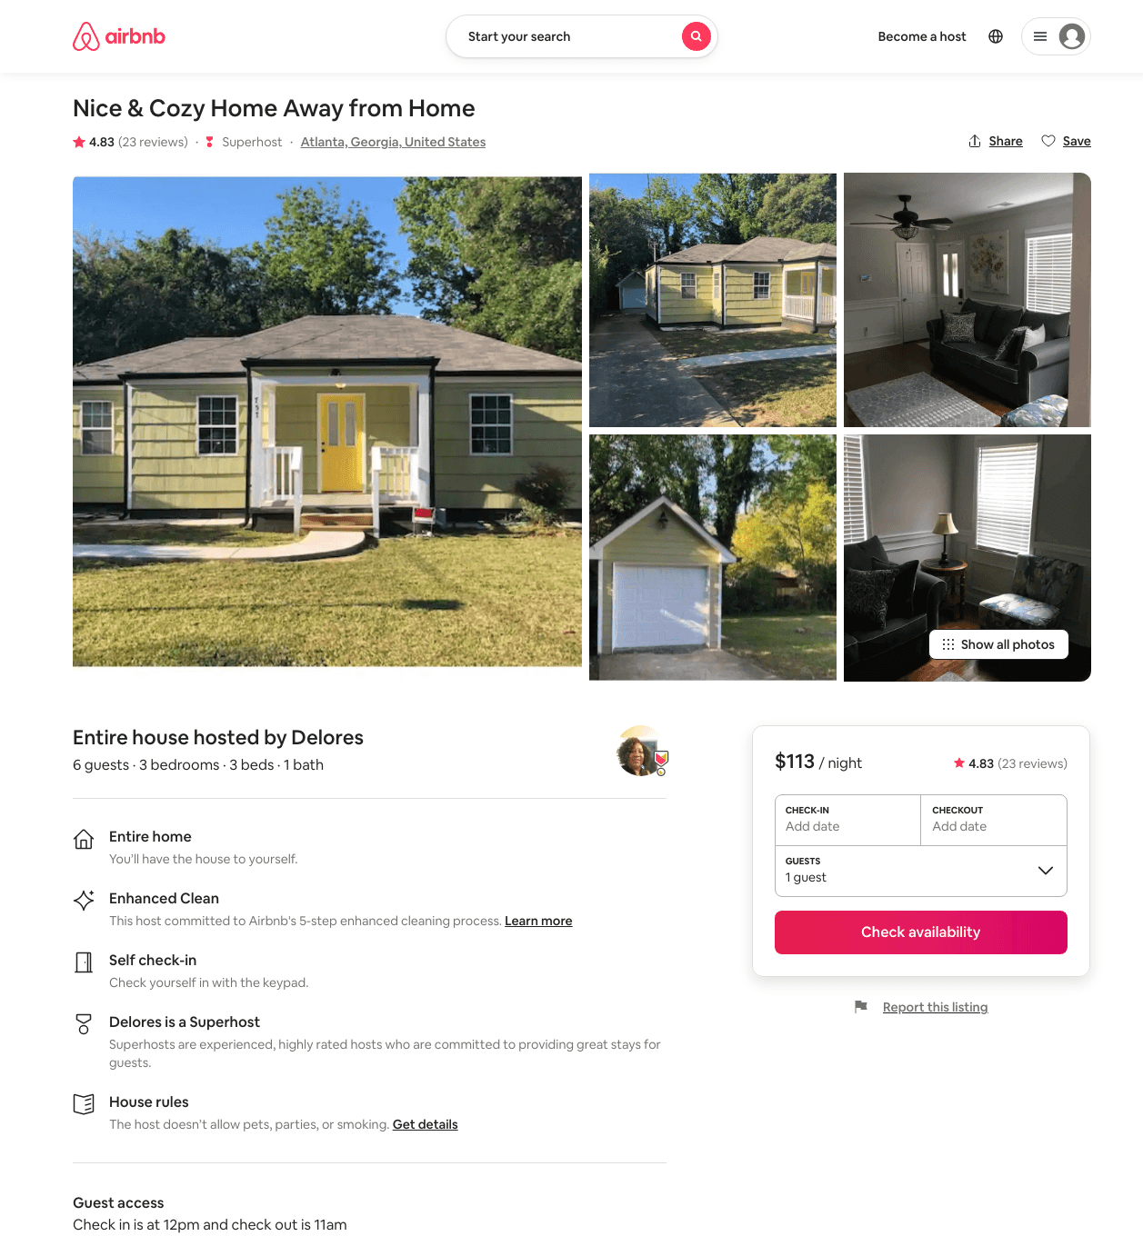
Listing 45330043
3
6
$113 - $134
4.89
3
Delores
366419531
2
https://www.airbnb.com/rooms/45330043
Aug 2022

Slide 6
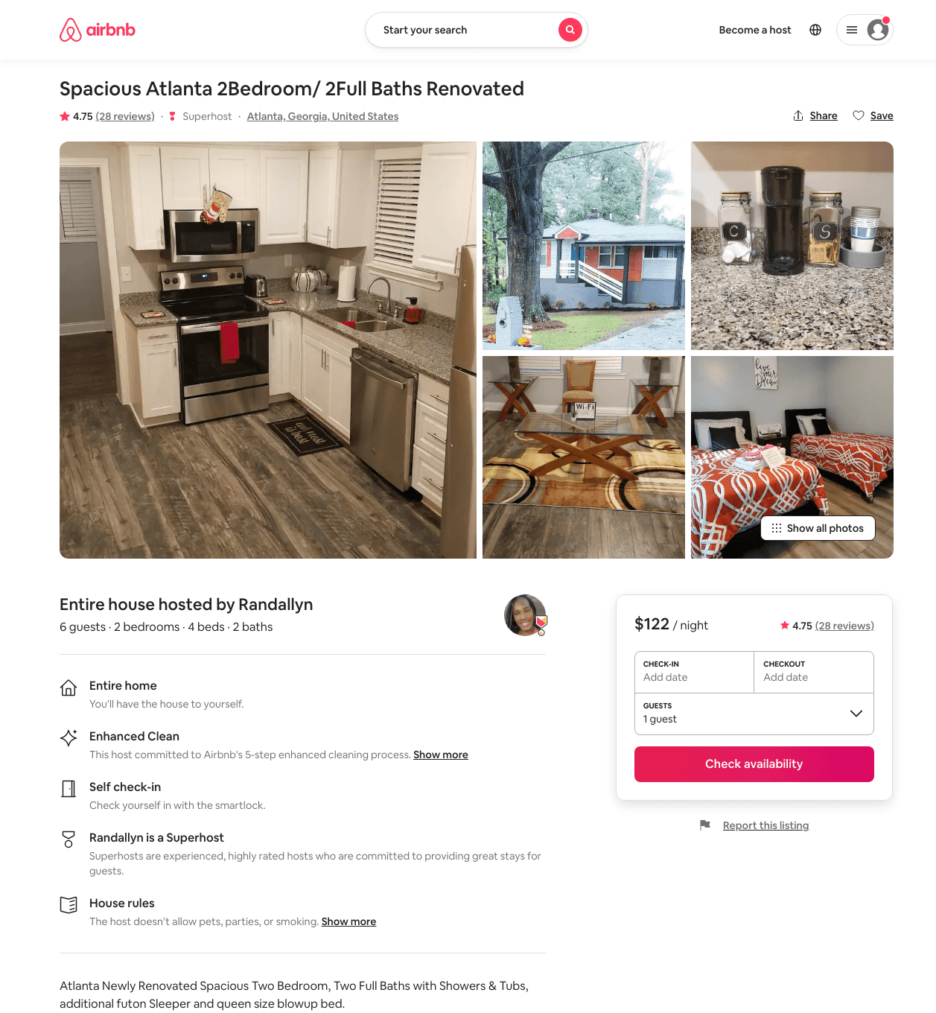
Listing 45202334
2
6
$122 - $166
4.82
3
Randallyn
34822115
1
https://www.airbnb.com/rooms/45202334
Aug 2022

Slide 7
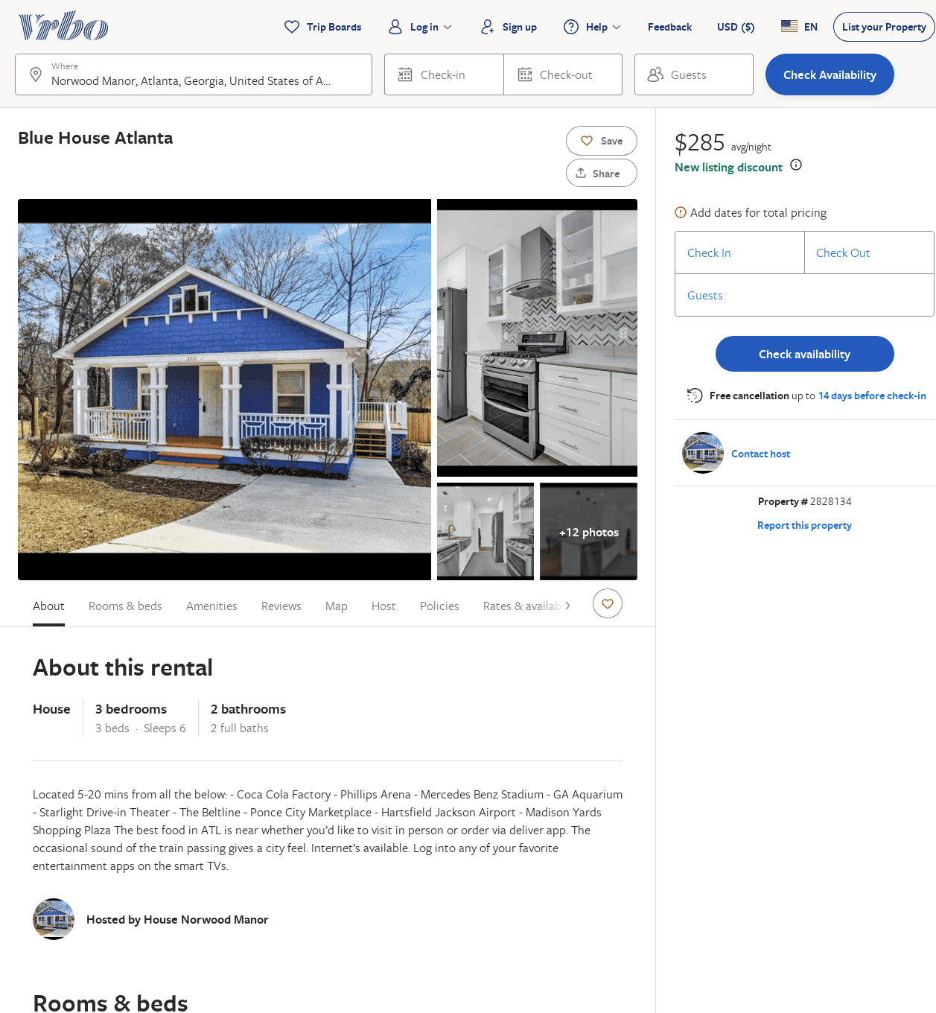
Listing 2828134
3
6
$285
3
Lyn Mitchell
https://www.vrbo.com/2828134
Aug 2022

