Slide 2
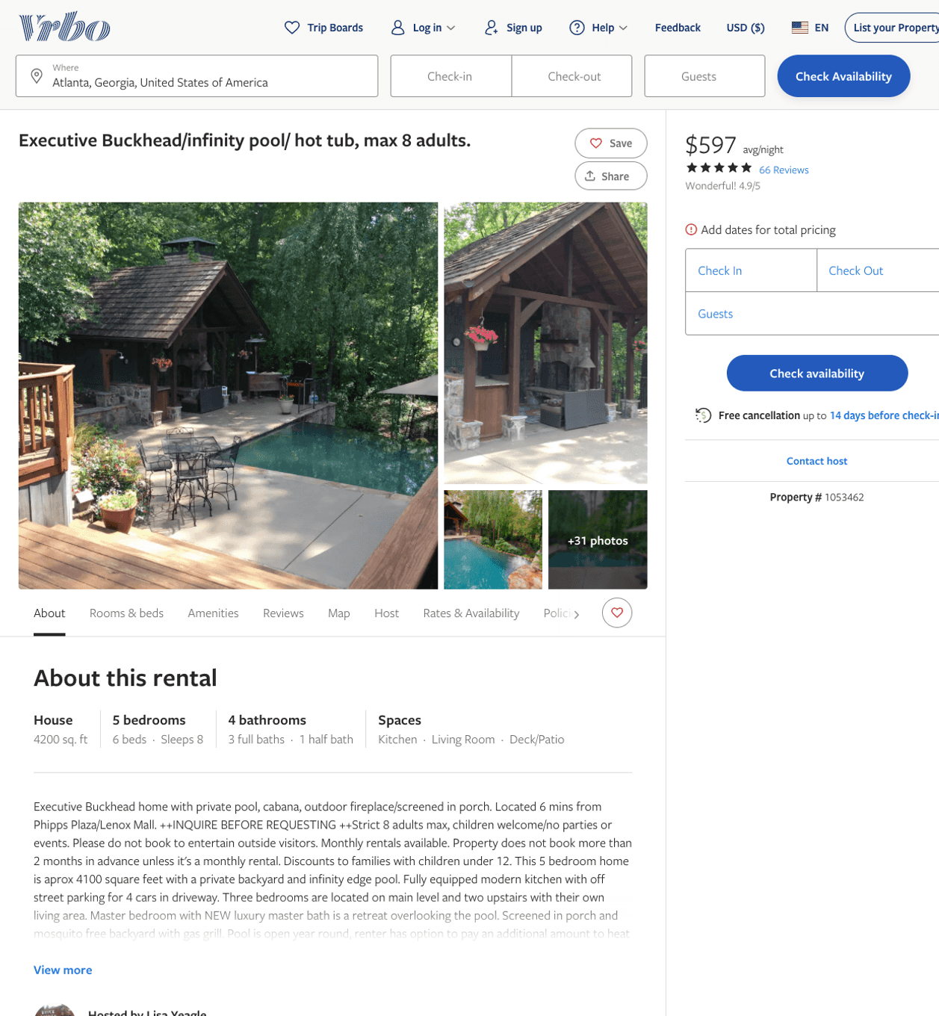
Listing 1053462
5
8
$525 - $650
4.9452057
1
Lisa Yeagle
https://www.vrbo.com/1053462
Aug 2022

Slide 3
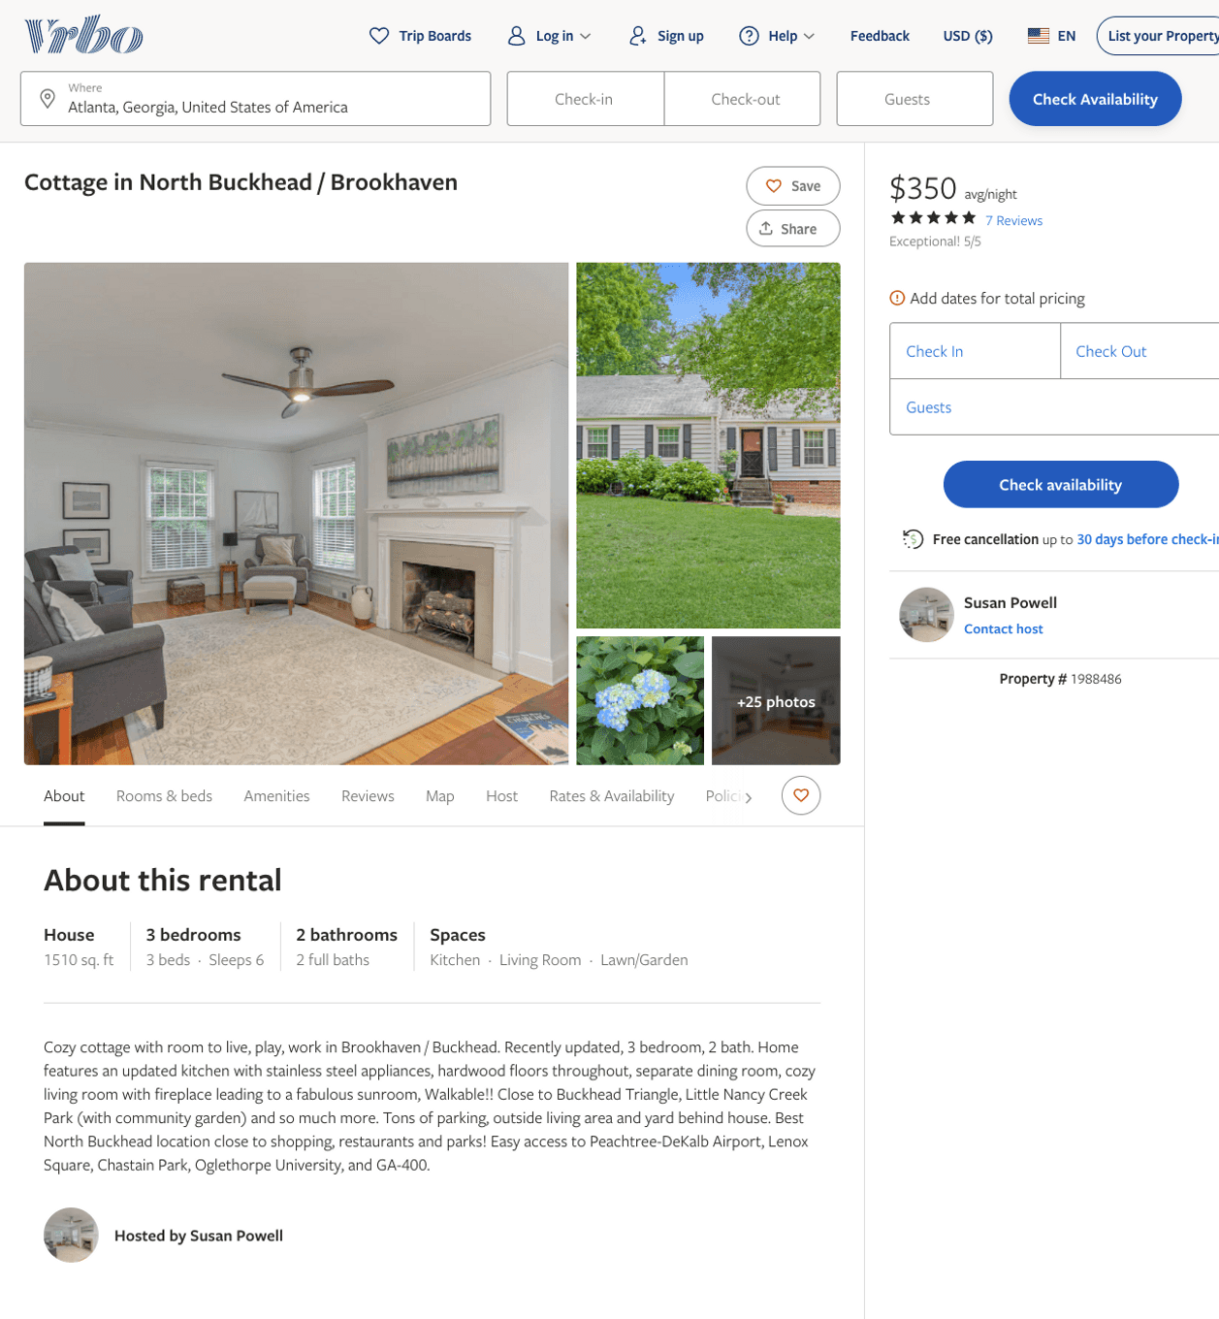
Listing 1988486
3
6
$350
5
3
Susan Powell
https://www.vrbo.com/1988486
Aug 2022

Slide 4
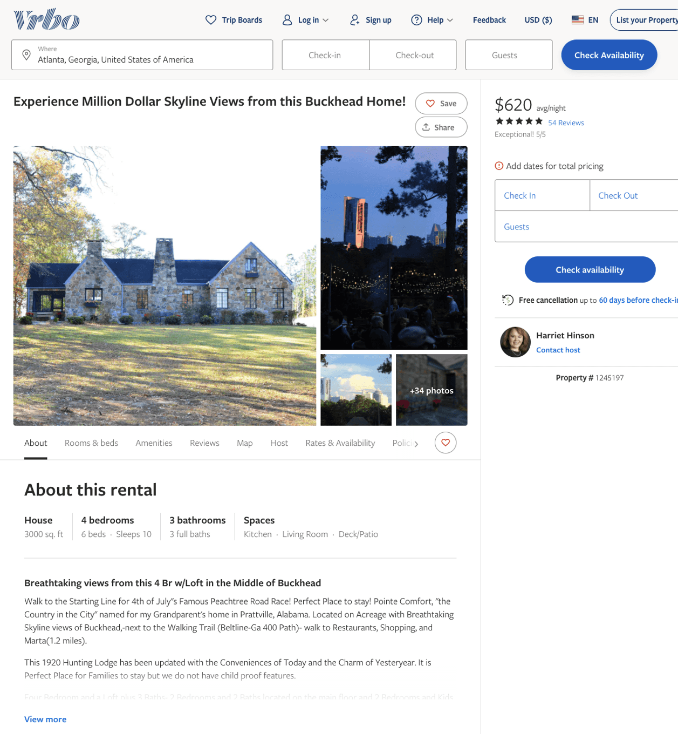
Listing 1245197
4
10
$595 - $629
5
2
Harriet Hinson
https://www.vrbo.com/1245197
Aug 2022

Slide 5
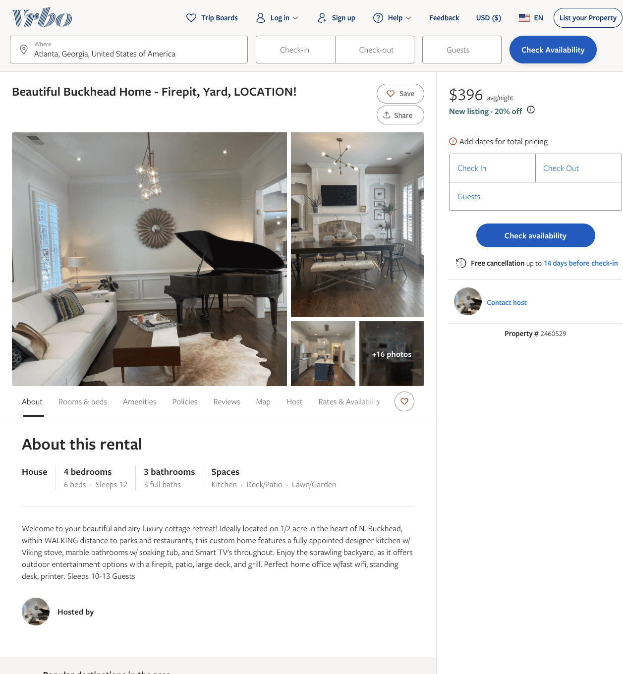
Listing 2460529
4
12
$396 - $828
5
2
https://www.vrbo.com/2460529
Aug 2022

Slide 6
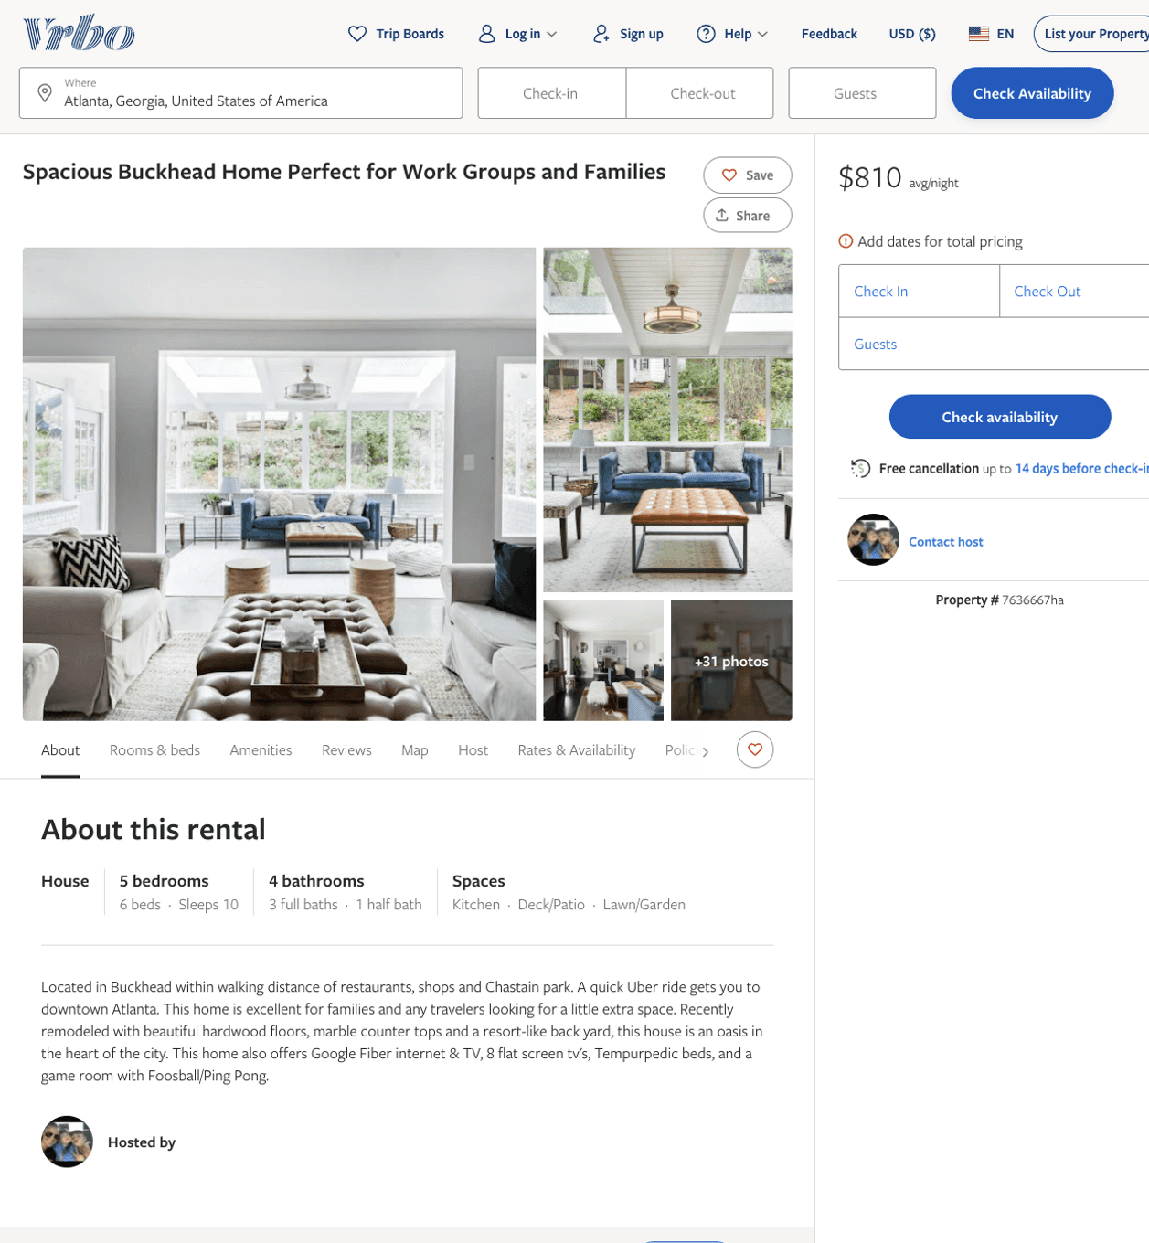
Listing 7636667
5
10
$771 - $819
5
3
https://www.vrbo.com/7636667ha
Aug 2022

Slide 7
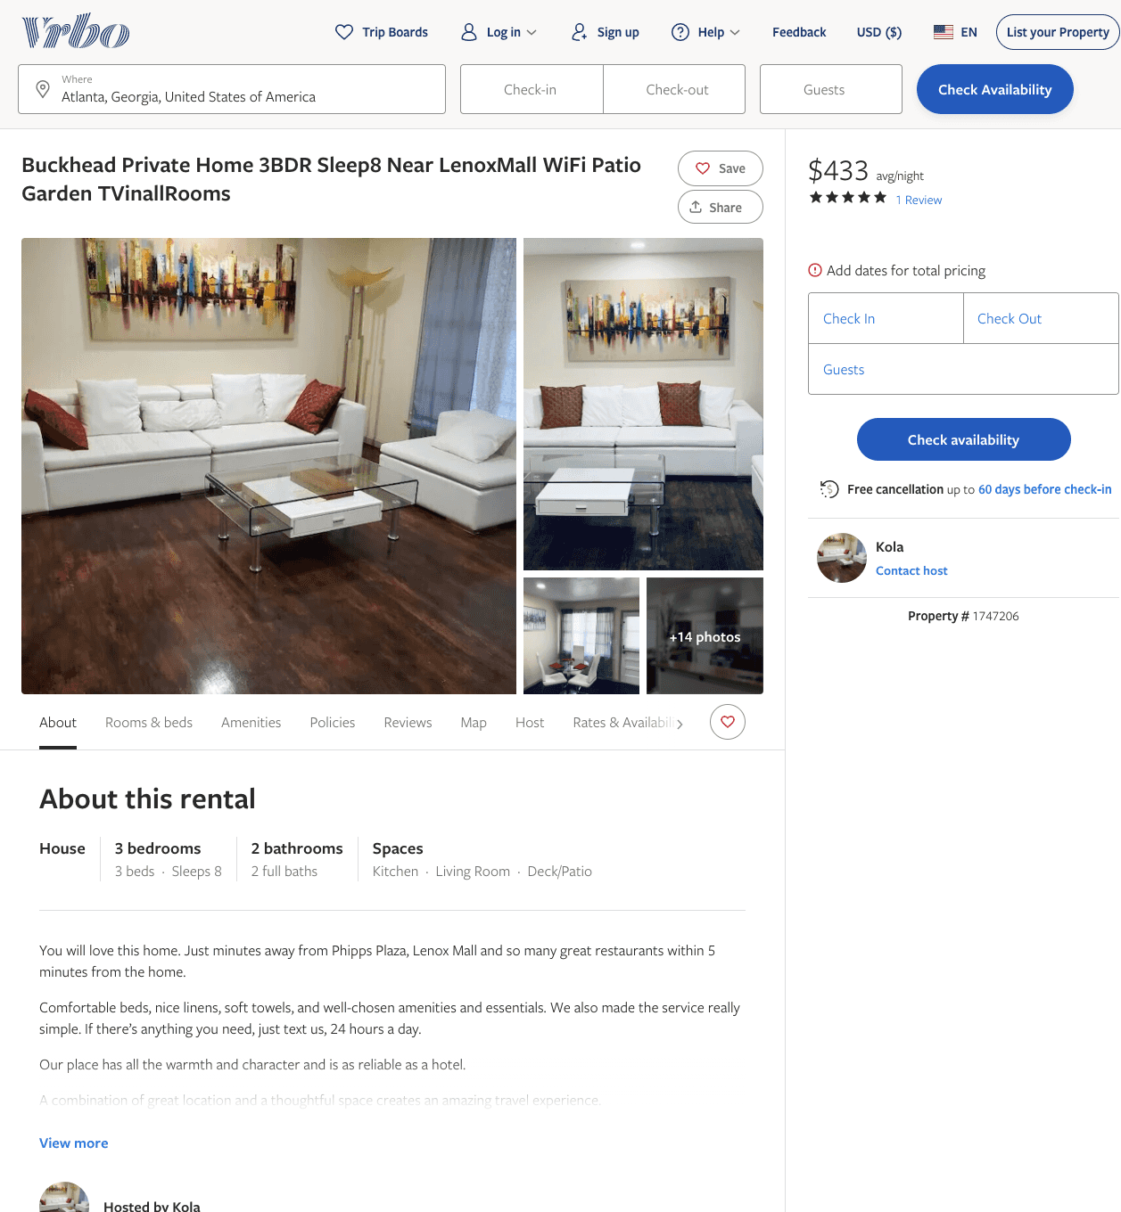
Listing 1747206
3
8
$433 - $443
3.6666667
3
Kola
https://www.vrbo.com/1747206
Aug 2022

Slide 8
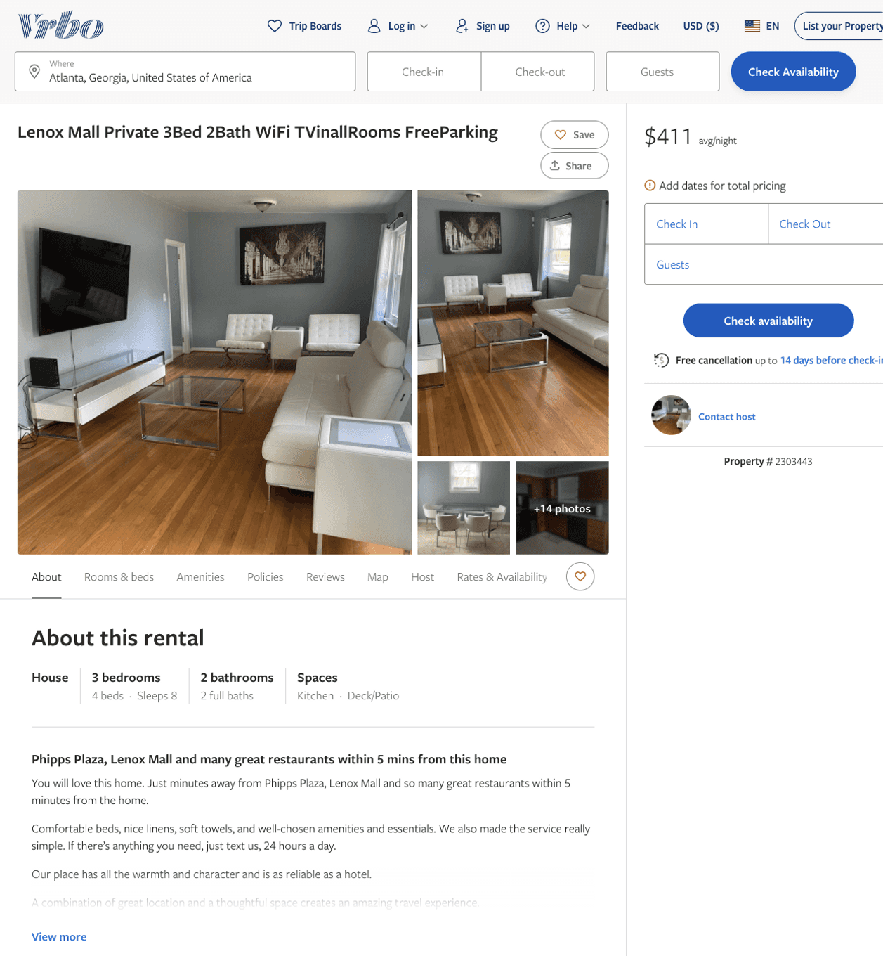
Listing 2303443
3
8
$308 - $411
2
https://www.vrbo.com/2303443
Aug 2022

Slide 9
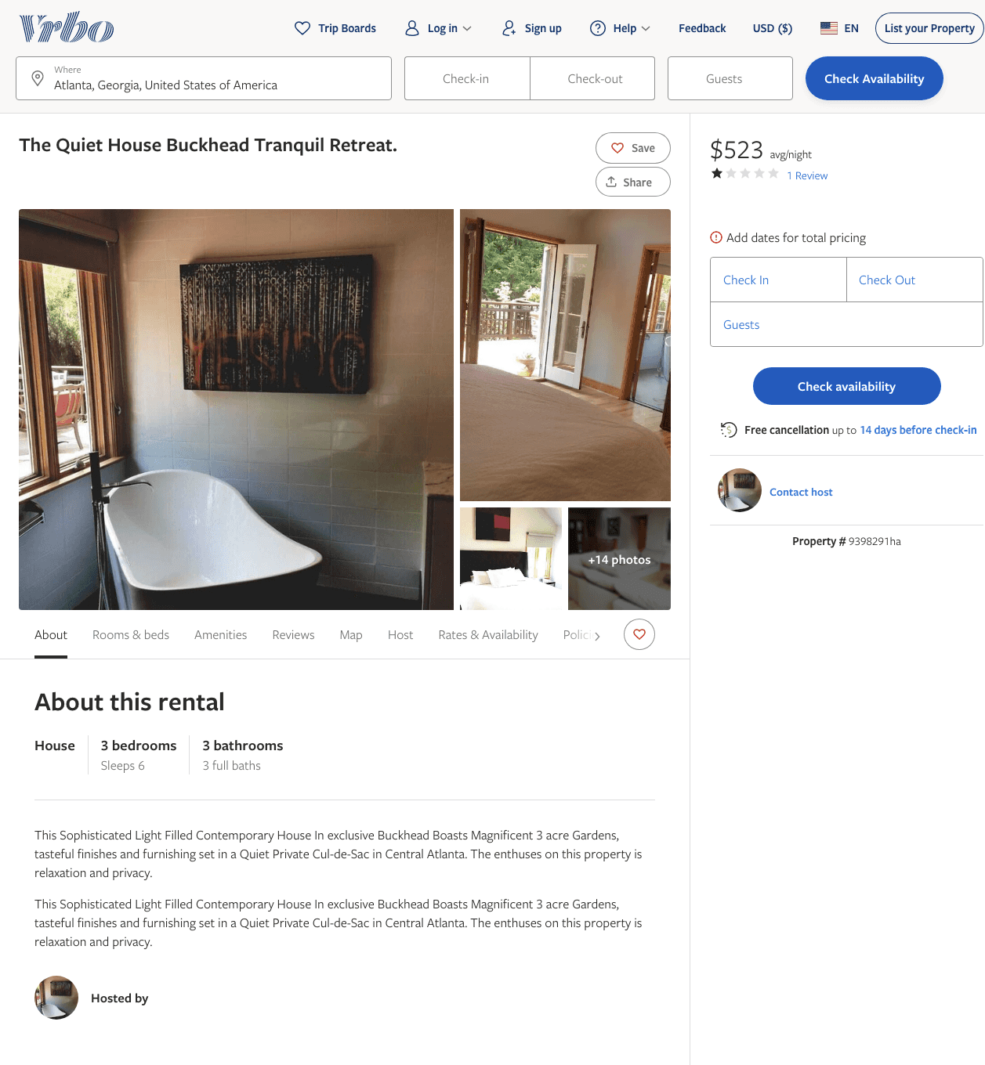
Listing 9398291
3
6
$523
1
5
https://www.vrbo.com/9398291ha
Aug 2022

Slide 10
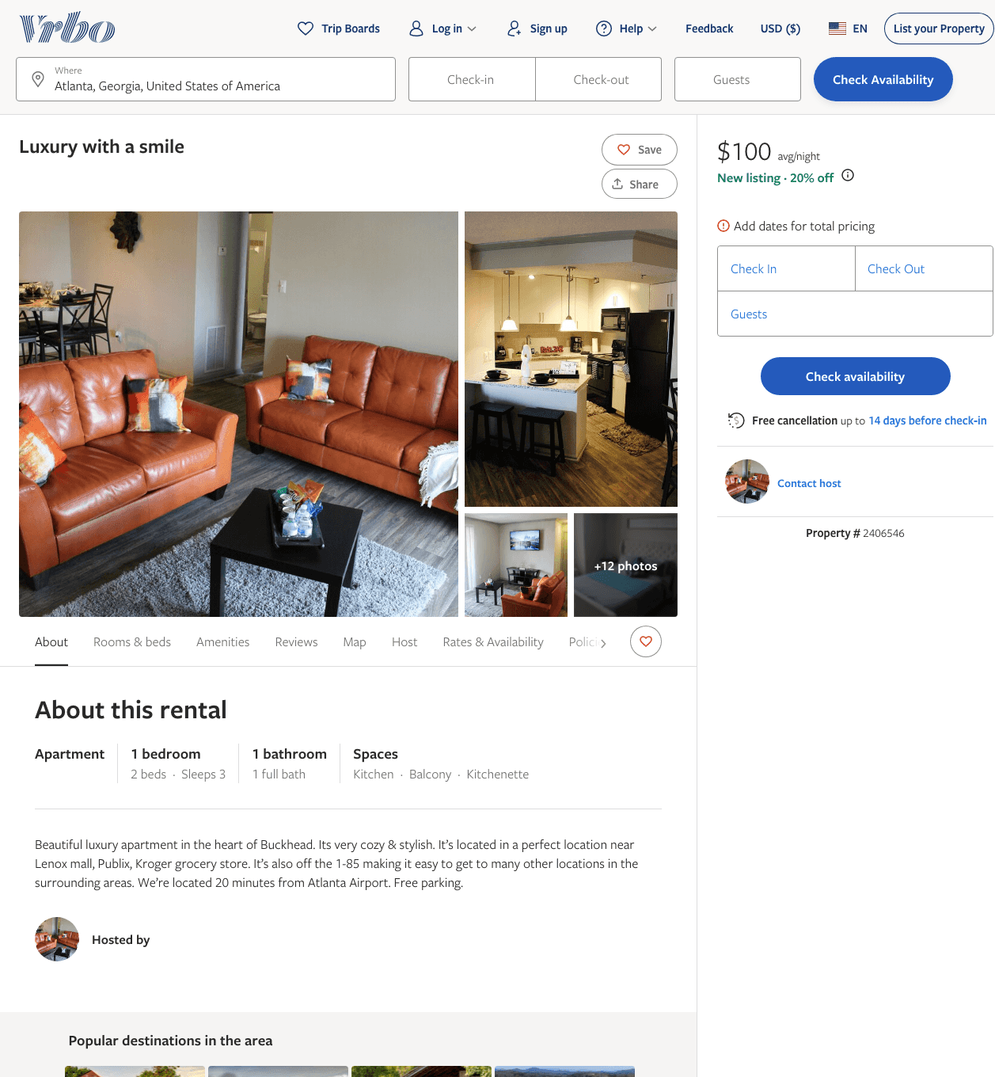
Listing 2406546
1
3
$100 - $132
3
Tasha
https://www.vrbo.com/2406546
Aug 2022

Slide 11
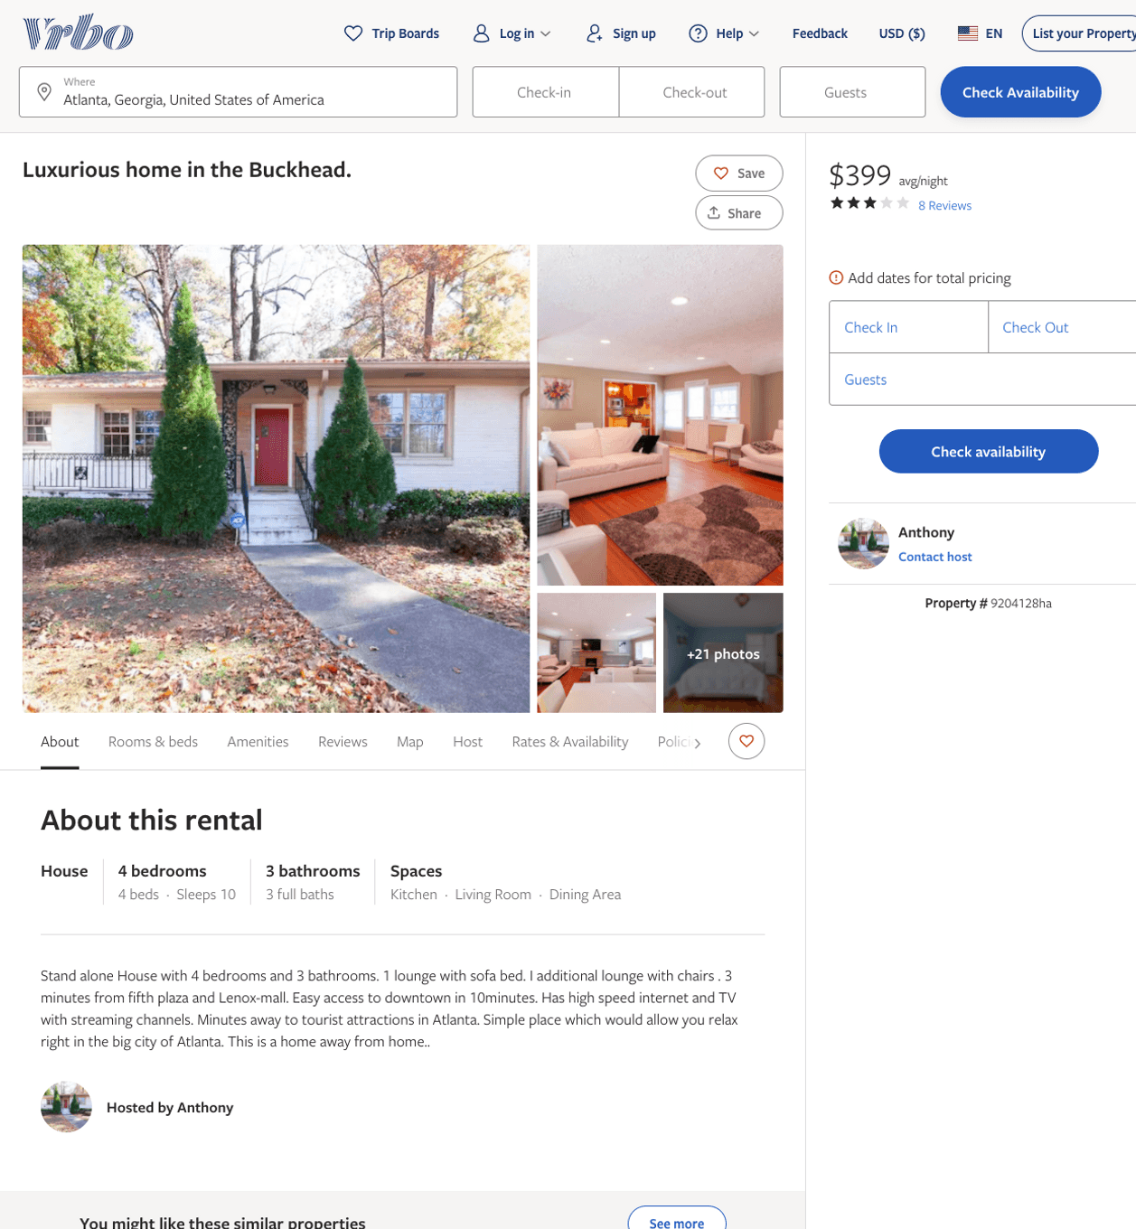
Listing 9204128
4
10
$399 - $540
3.125
1
Anthony
https://www.vrbo.com/9204128ha
Aug 2022

Slide 12
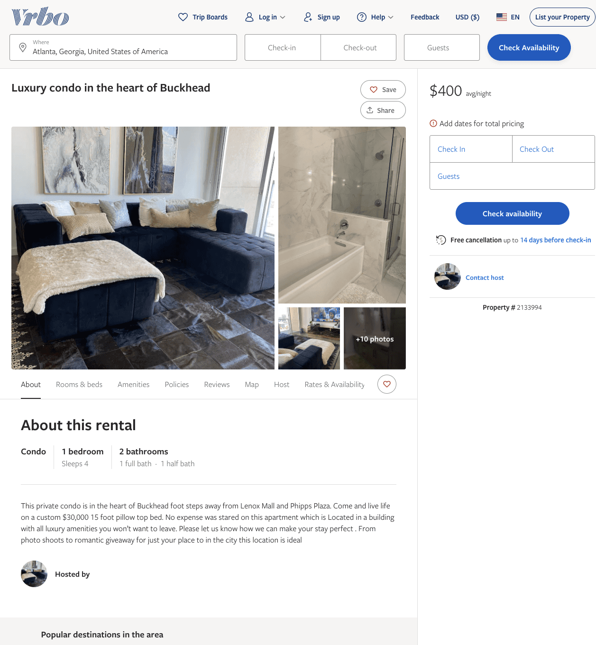
Listing 2133994
1
4
$400
2
https://www.vrbo.com/2133994
Aug 2022

Slide 13
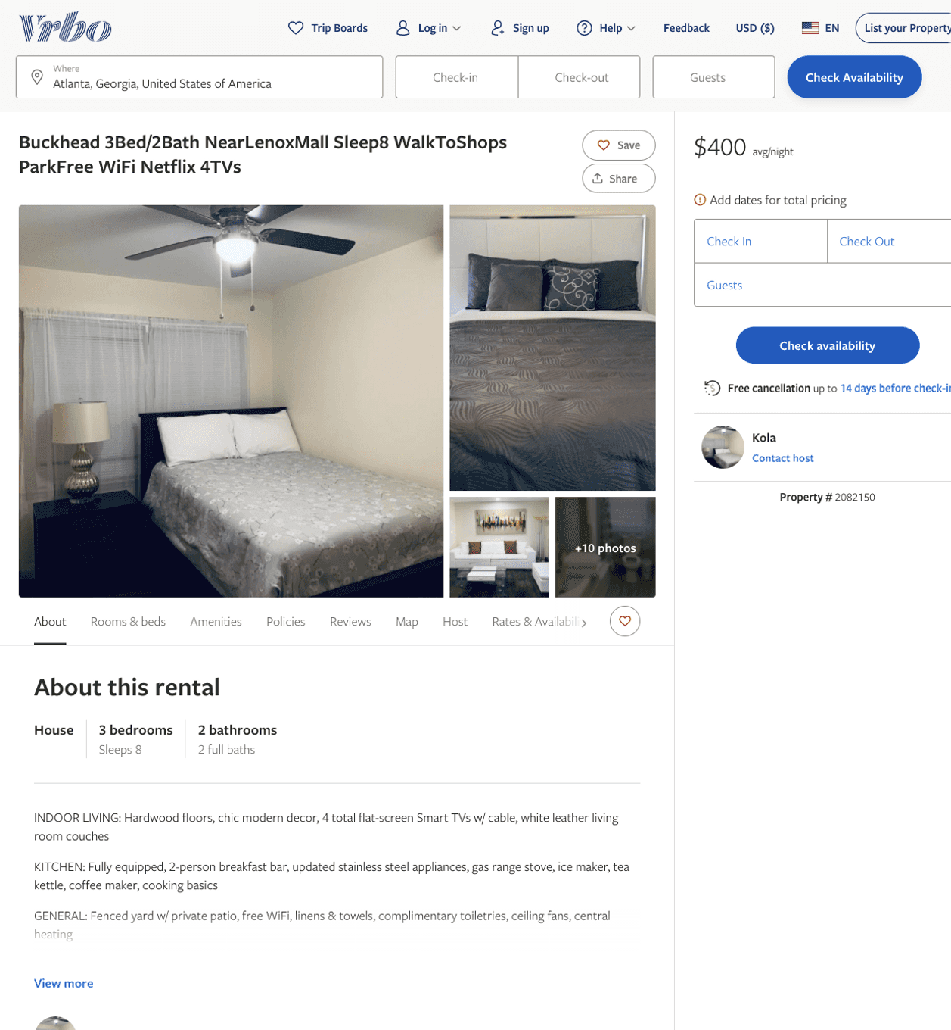
Listing 2082150
3
8
$400
3
Kola
https://www.vrbo.com/2082150
Aug 2022

Slide 14
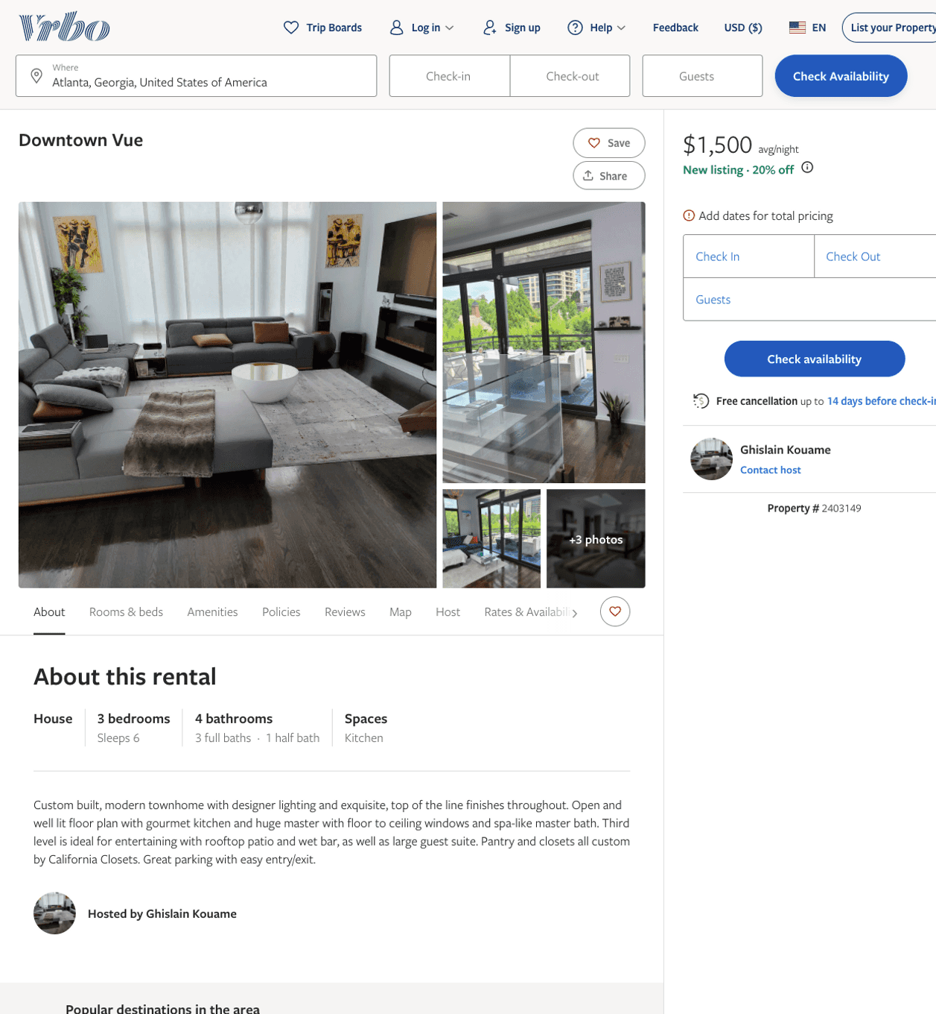
Listing 2403149
3
6
$1,500
2
Ghislain Kouame
https://www.vrbo.com/2403149
Aug 2022

Slide 15
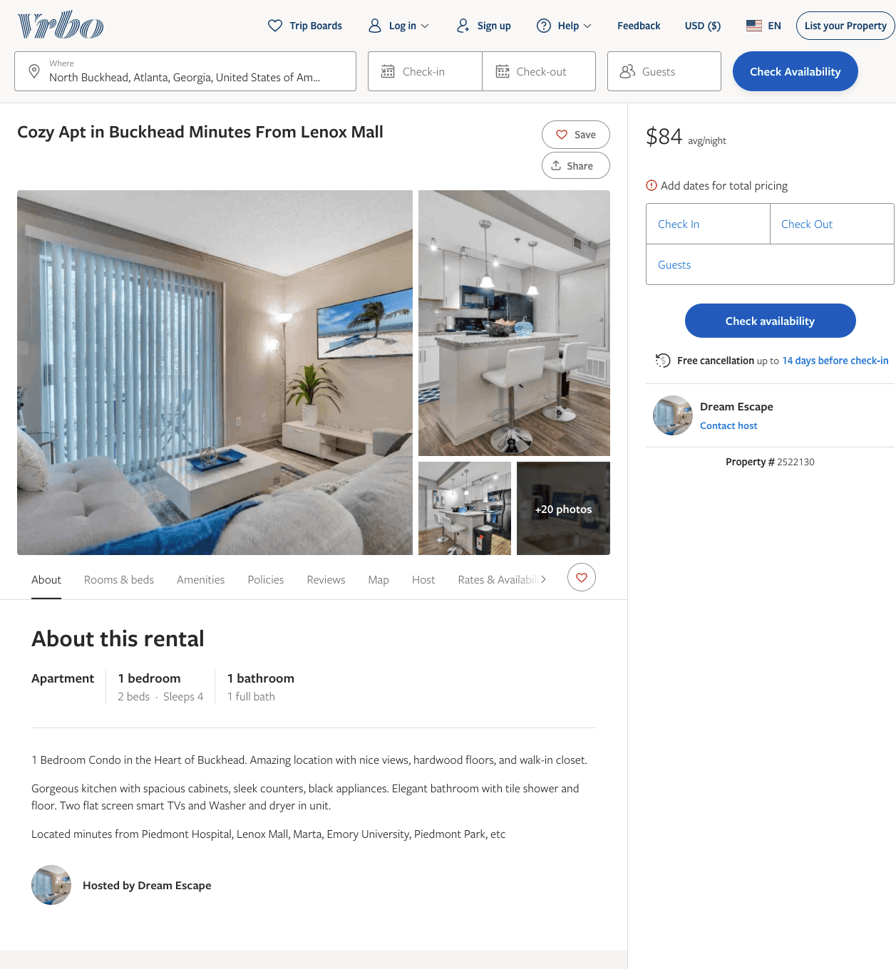
Listing 2522130
1
4
$75 - $84
5
1
Dream Escape
https://www.vrbo.com/2522130
Aug 2022

Slide 16
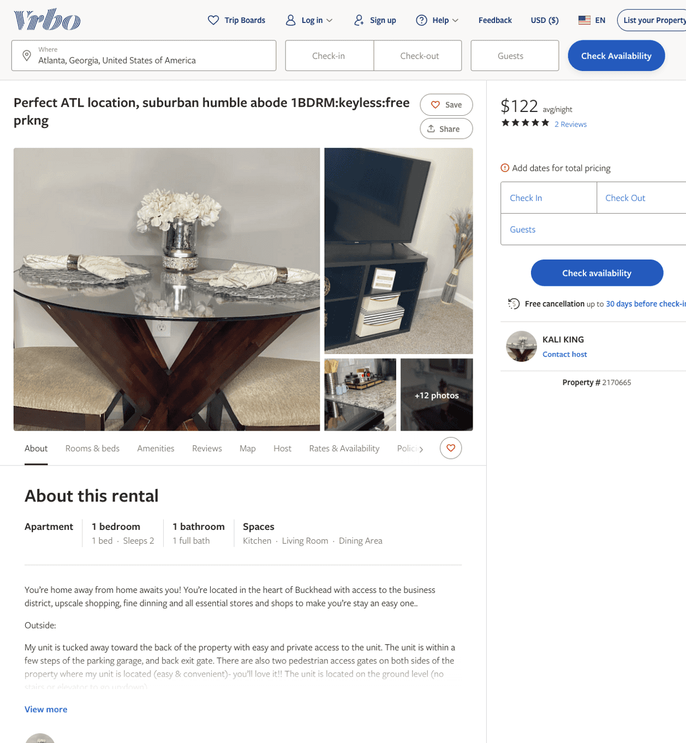
Listing 2170665
1
2
$120 - $136
5
2
KALI KING
https://www.vrbo.com/2170665
Aug 2022

Slide 17
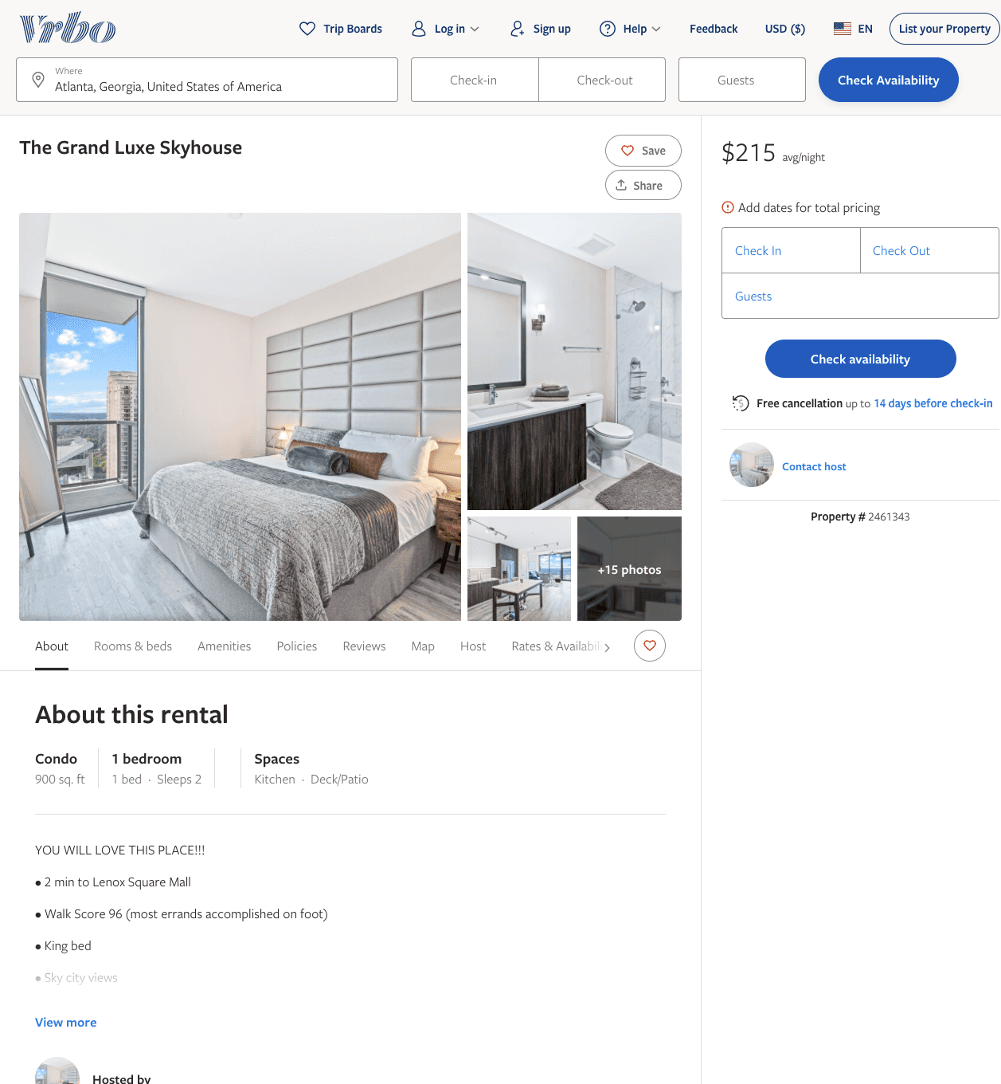
Listing 2461343
1
2
$215 - $447
4.3333335
2
THE HIVE LUXURY GROUP
https://www.vrbo.com/2461343
Aug 2022

Slide 18
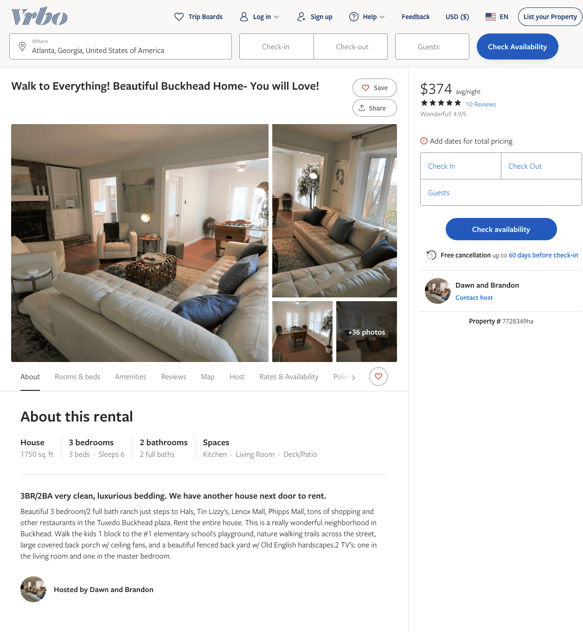
Listing 7728349
170 OLD IVY RD NE
3
6
$356 - $391
4.928571
3
Dawn and Brandon
https://www.vrbo.com/7728349ha
Aug 2022

Slide 19
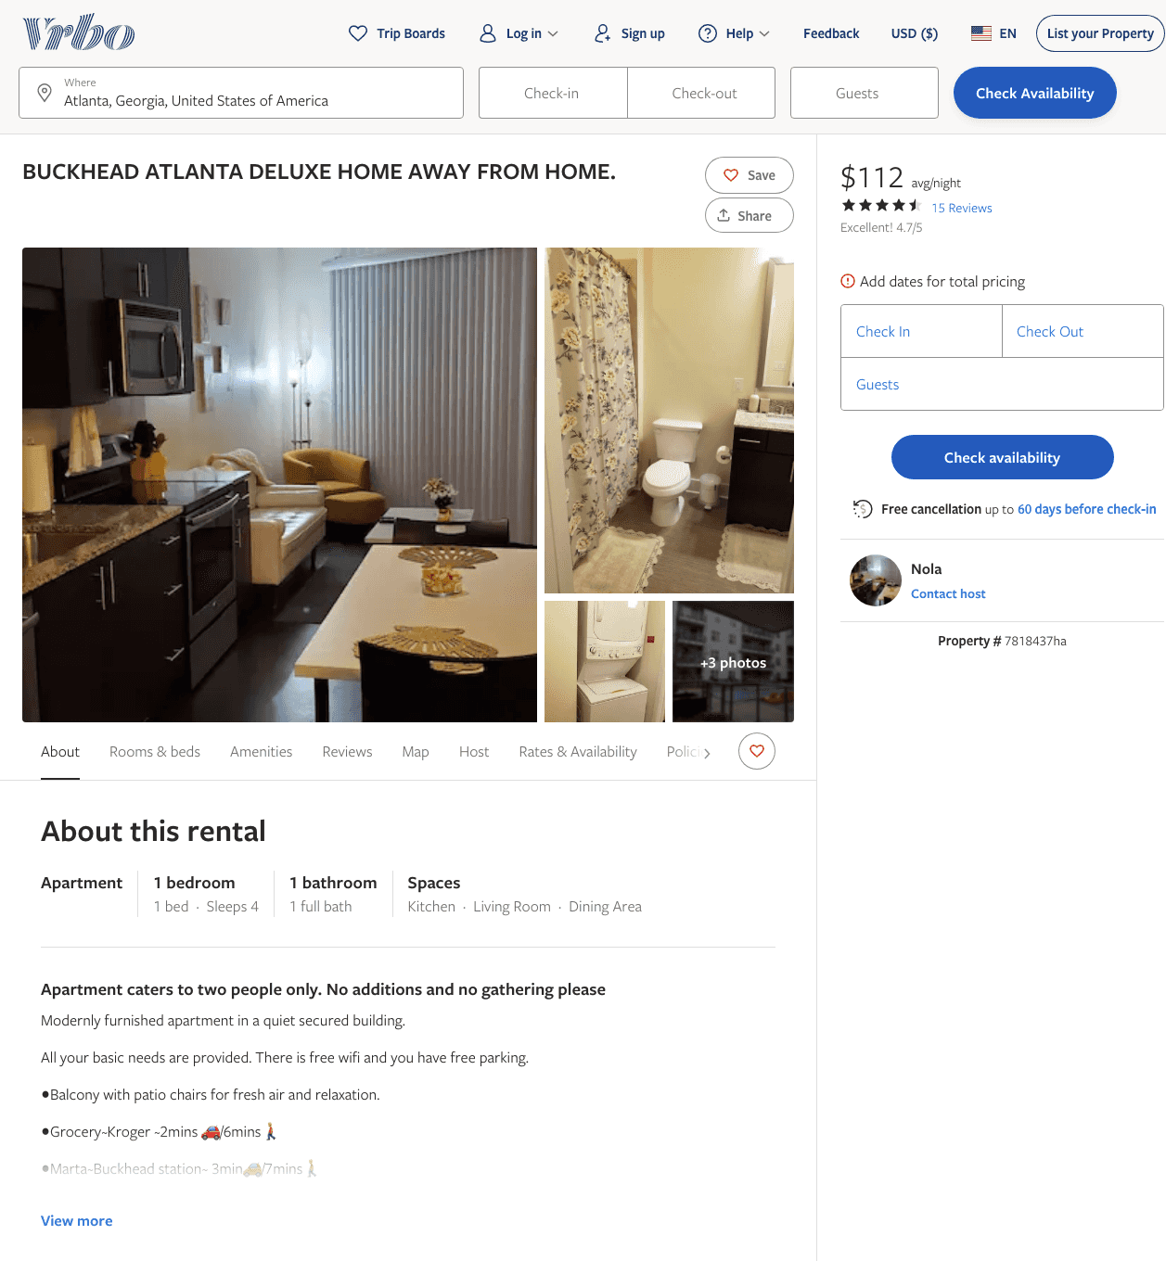
Listing 7818437
1
2
$111 - $117
4.75
1
Nola
https://www.vrbo.com/7818437ha
Aug 2022

Slide 20
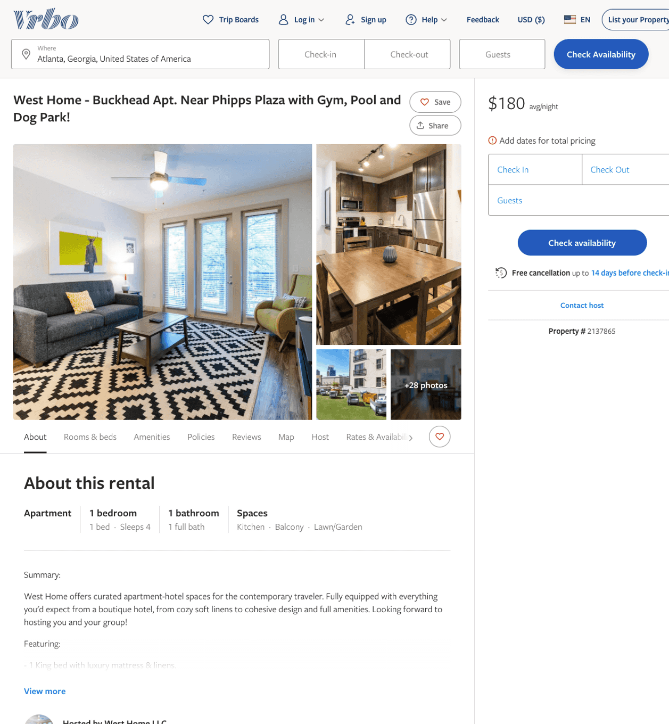
Listing 2137865
1
4
$139 - $183
3
2
West Home LLC
https://www.vrbo.com/2137865
Aug 2022

Slide 21
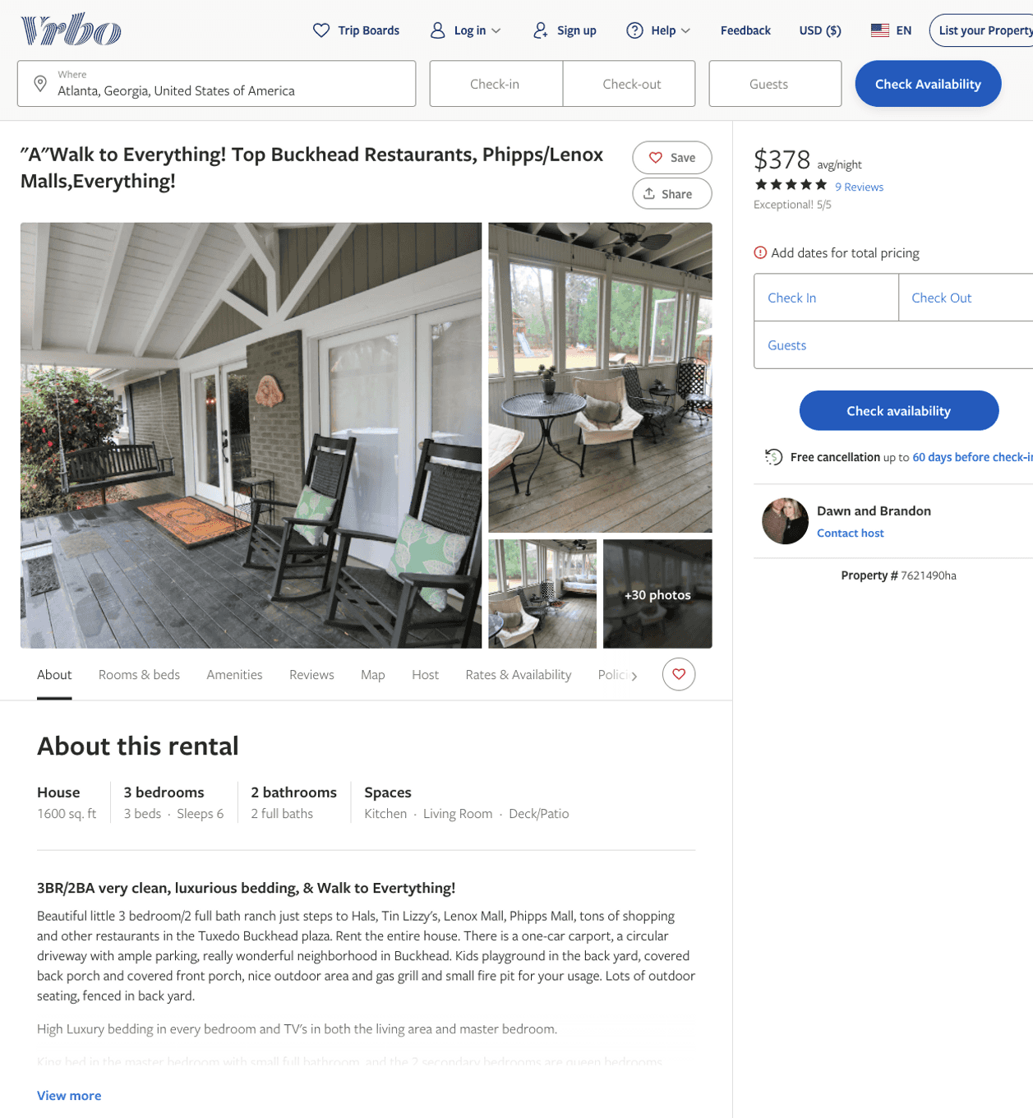
Listing 7621490
150 OLD IVY RD NE
3
6
$370 - $406
4.9473686
4
Dawn and Brandon
https://www.vrbo.com/7621490ha
Aug 2022

Slide 22
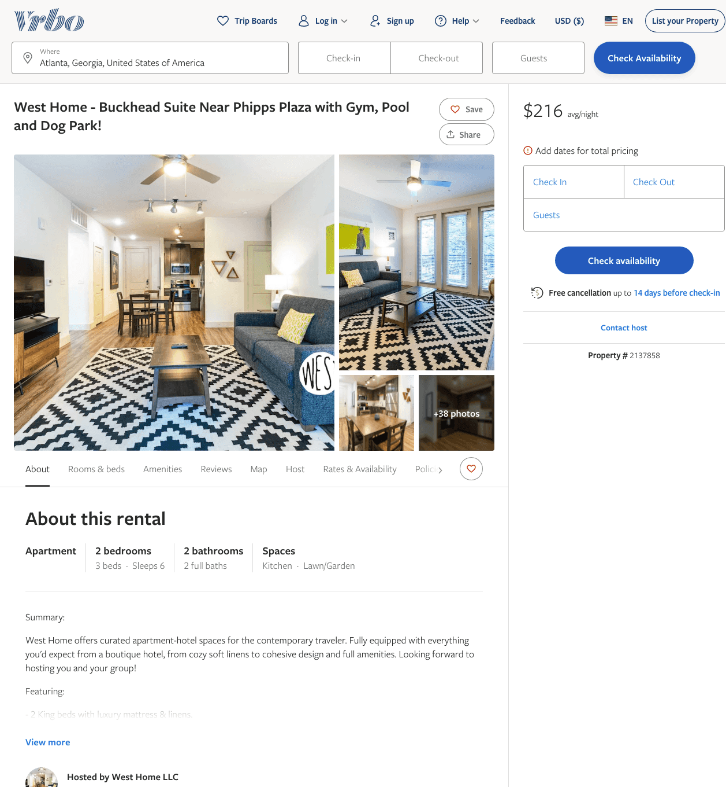
Listing 2137858
2
6
$188 - $245
3
2
West Home LLC
https://www.vrbo.com/2137858
Aug 2022

Slide 23
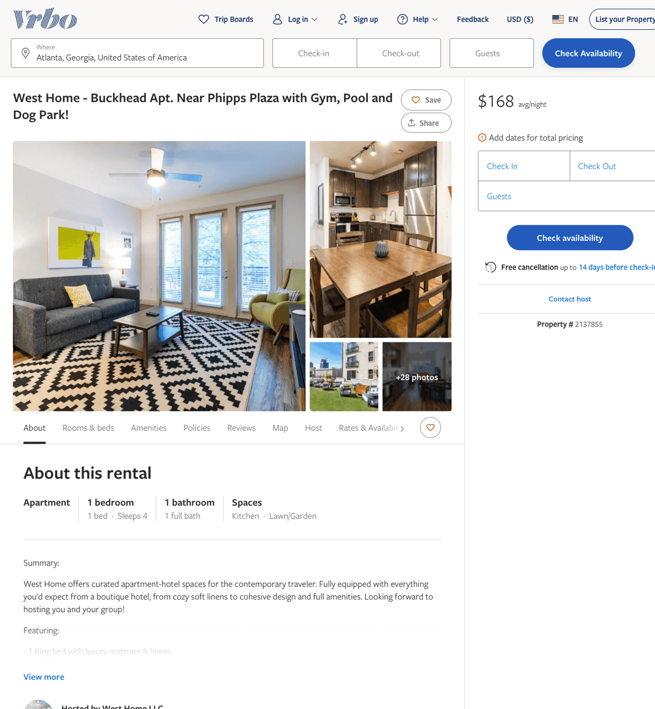
Listing 2137855
1
4
$152 - $188
2
West Home LLC
https://www.vrbo.com/2137855
Aug 2022

Slide 24
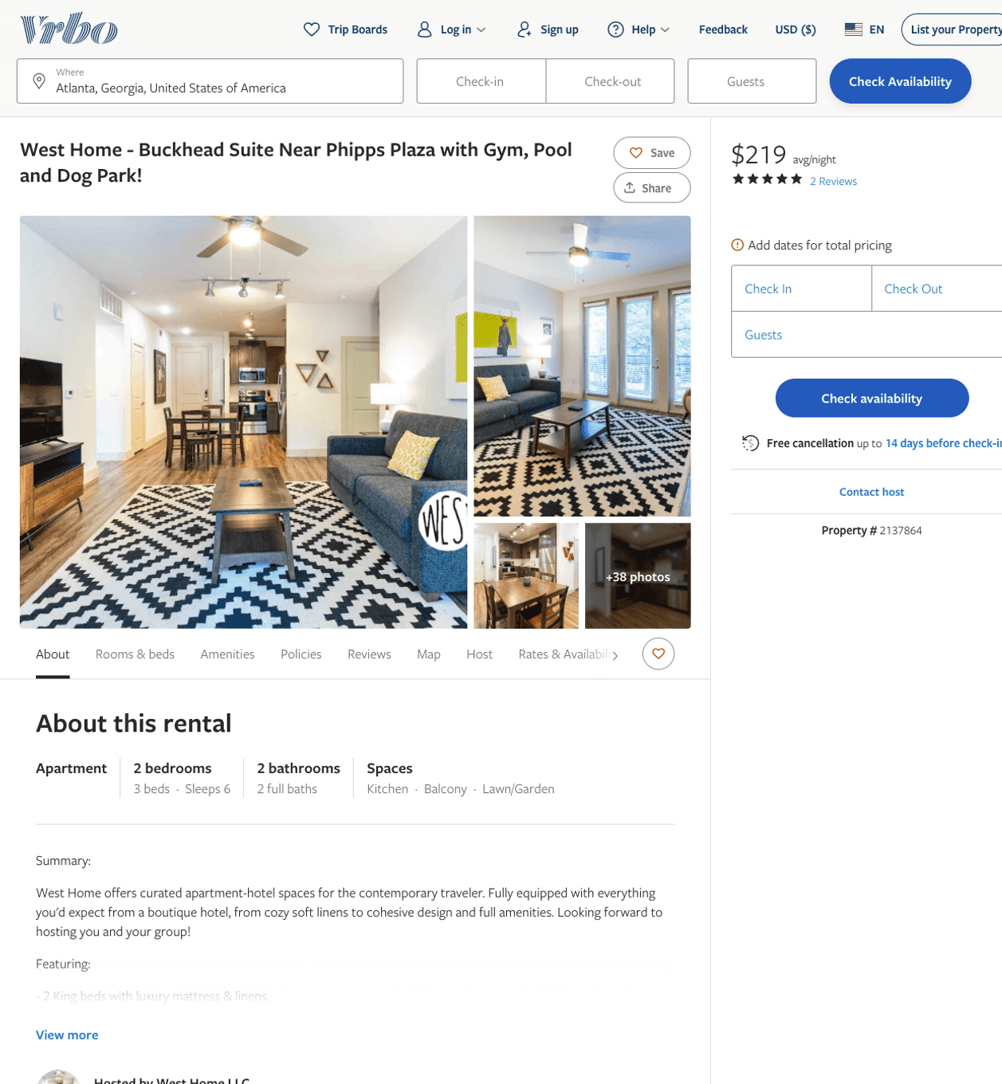
Listing 2137864
2
6
$195 - $286
3.6666667
2
West Home LLC
https://www.vrbo.com/2137864
Aug 2022

Slide 25
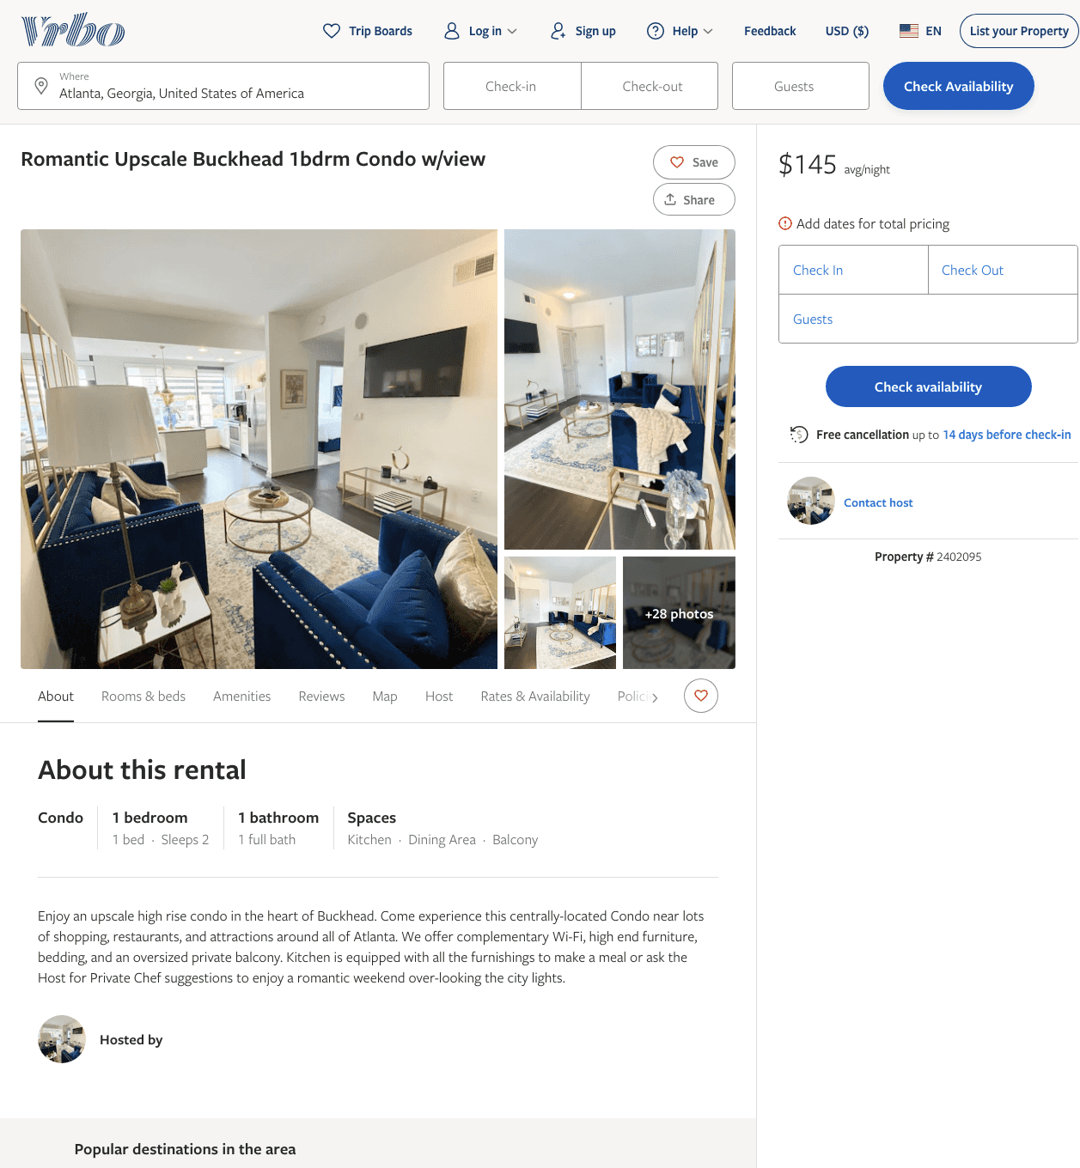
Listing 2402095
1
2
$145 - $167
5
2
https://www.vrbo.com/2402095
Aug 2022

Slide 26
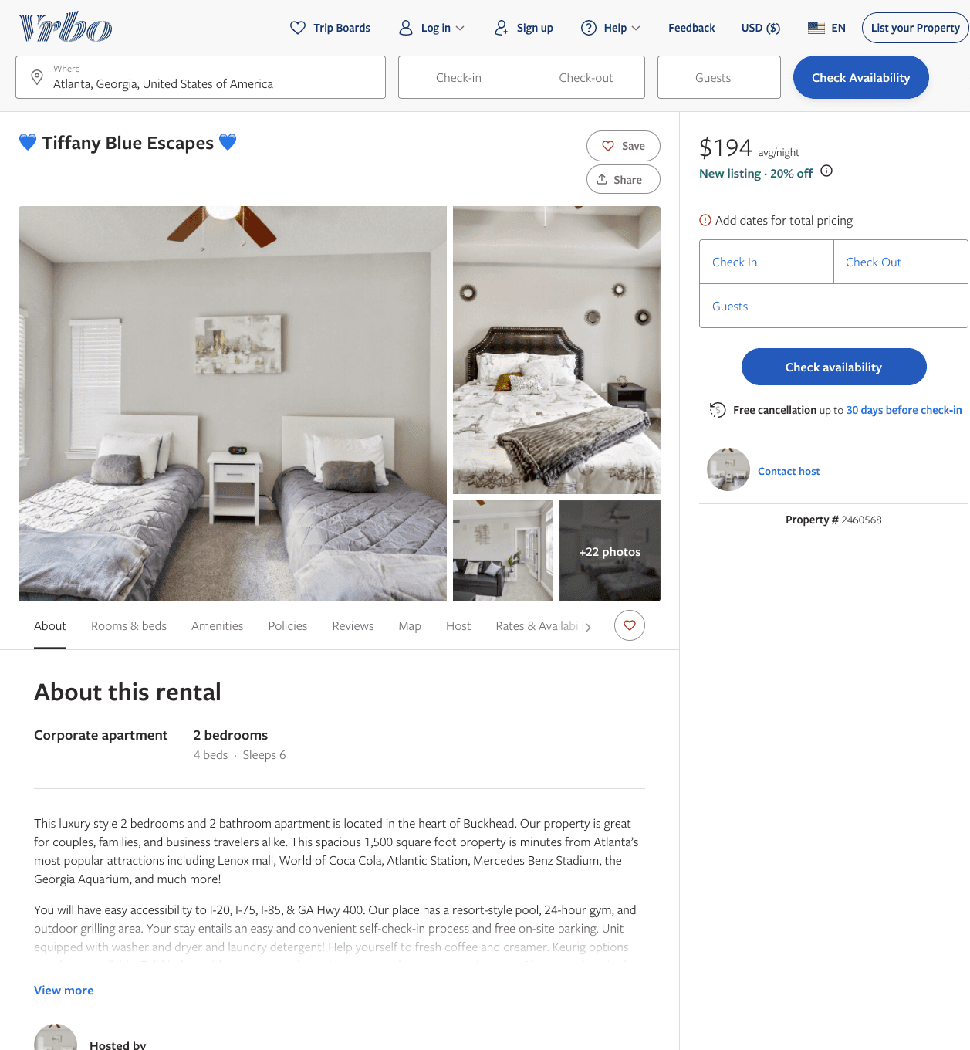
Listing 2460568
2
6
$165 - $194
3.25
3
K & W Luxury Enterprise
https://www.vrbo.com/2460568
Aug 2022

Slide 27
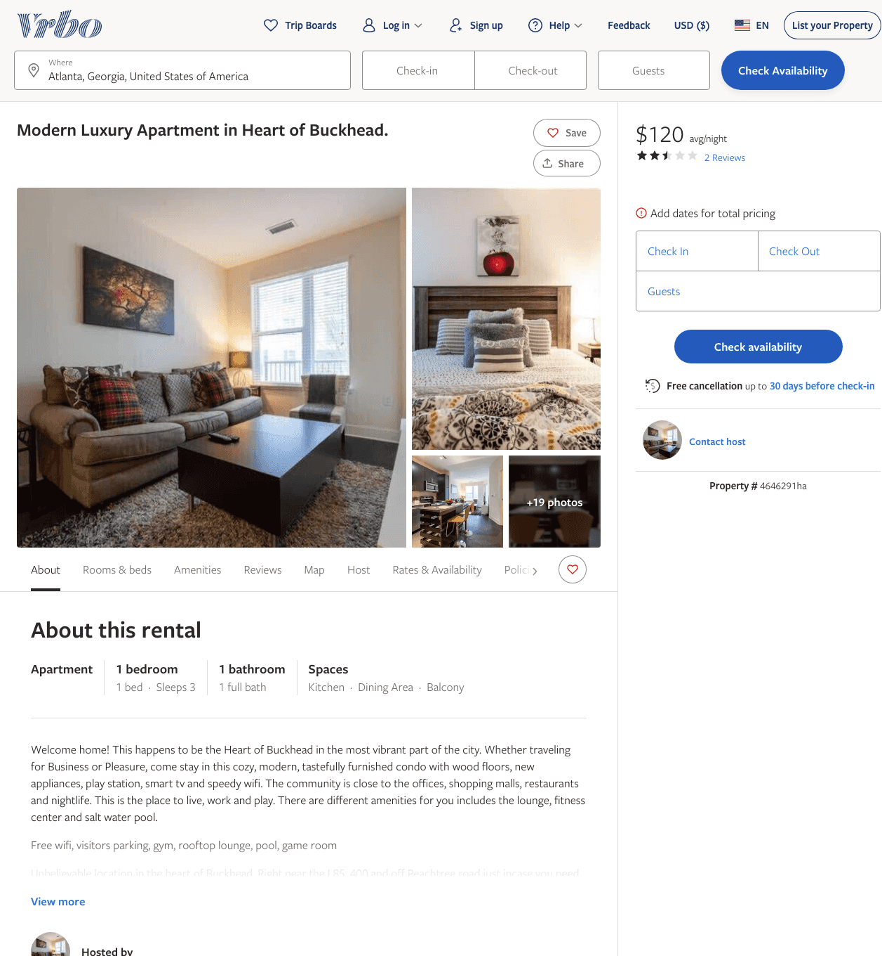
Listing 4646291
1
3
$120
2.5
2
https://www.vrbo.com/4646291ha
Aug 2022

Slide 28
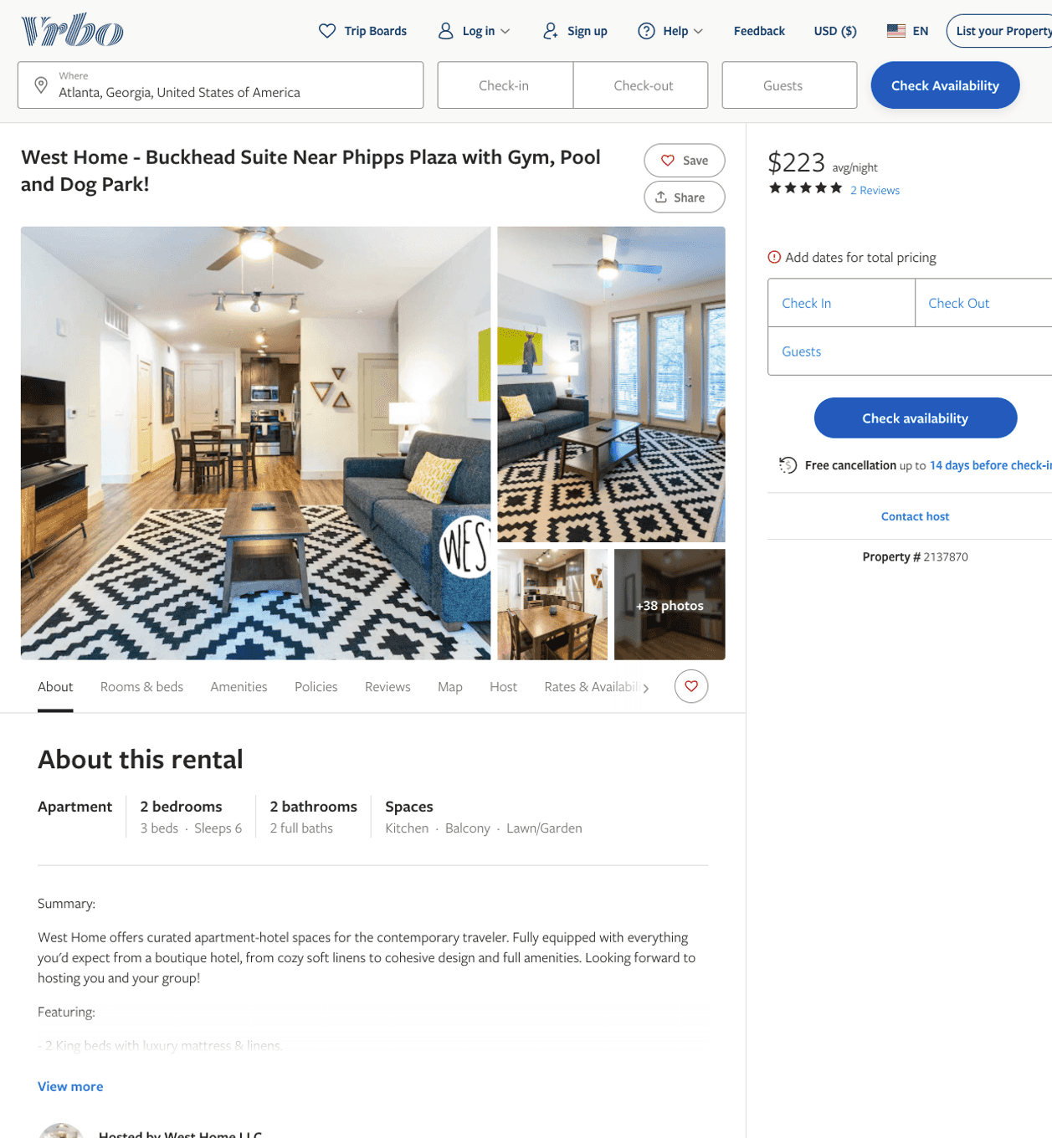
Listing 2137870
2
6
$197 - $268
4.3333335
2
West Home LLC
https://www.vrbo.com/2137870
Aug 2022

Slide 29
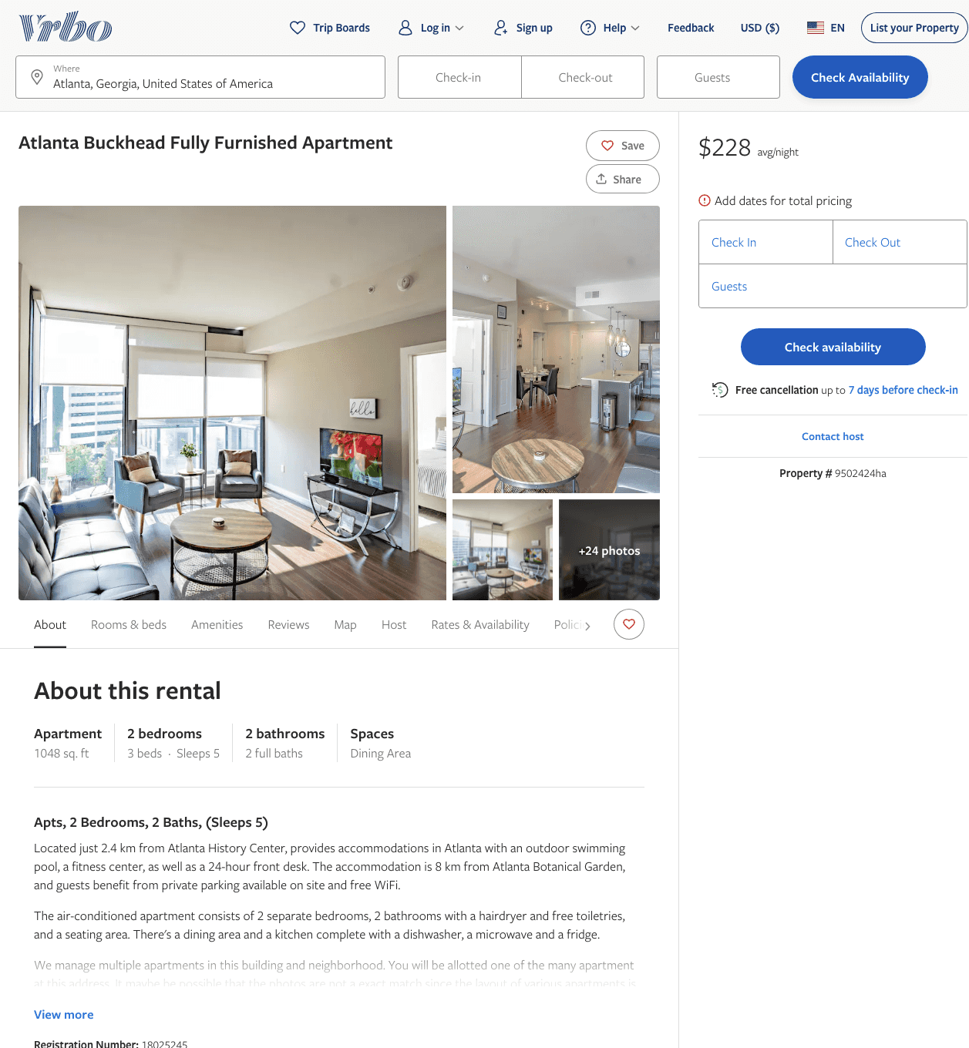
Listing 9502424
2
5
$198 - $306
1
RedAwning Vacation Rentals
https://www.vrbo.com/9502424ha
Aug 2022

Slide 30
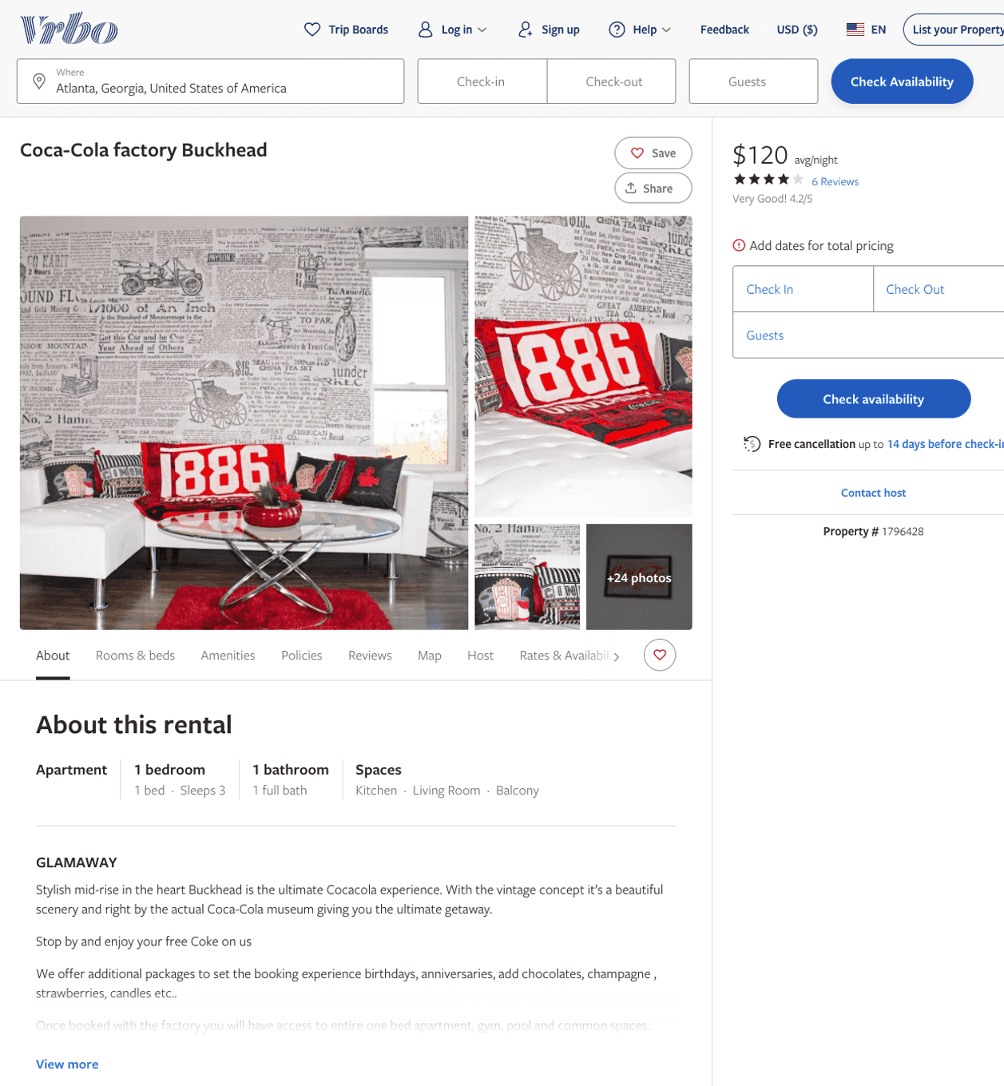
Listing 1796428
1
3
$120
4.1666665
1
https://www.vrbo.com/1796428
Aug 2022

Slide 31
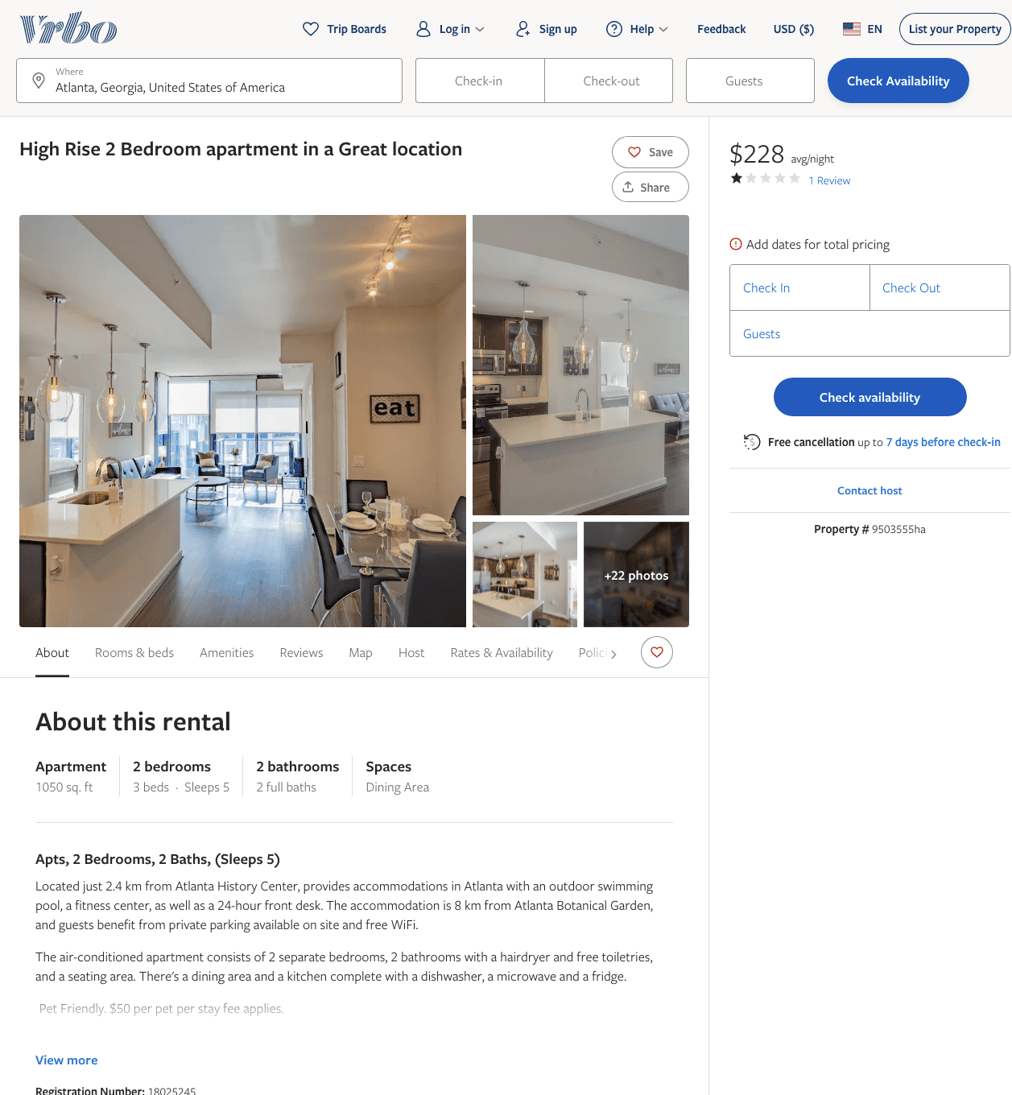
Listing 9503555
2
5
$209 - $285
1
1
RedAwning Vacation Rentals
https://www.vrbo.com/9503555ha
Aug 2022

Slide 32
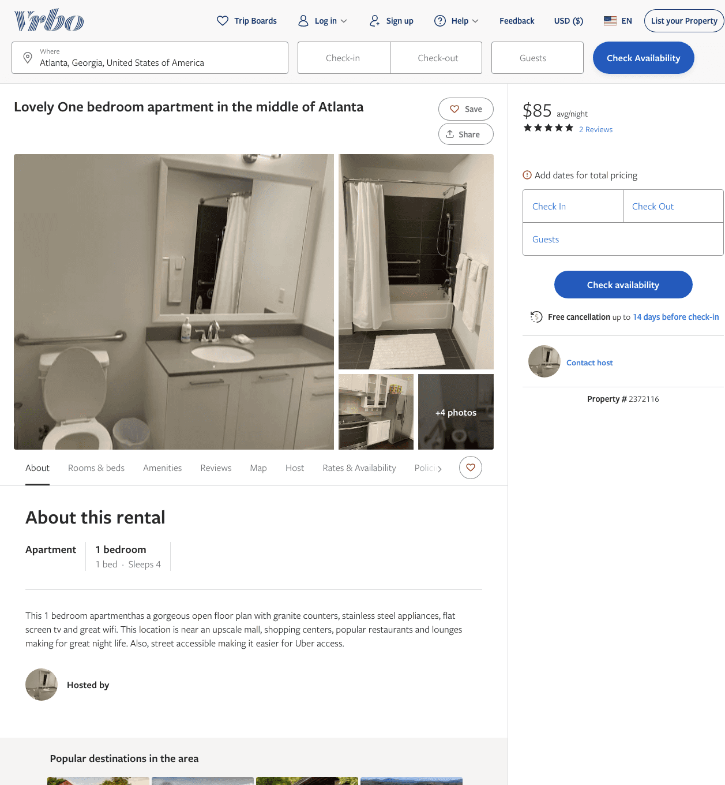
Listing 2372116
1
4
$85 - $90
5
1
https://www.vrbo.com/2372116
Aug 2022

Slide 33
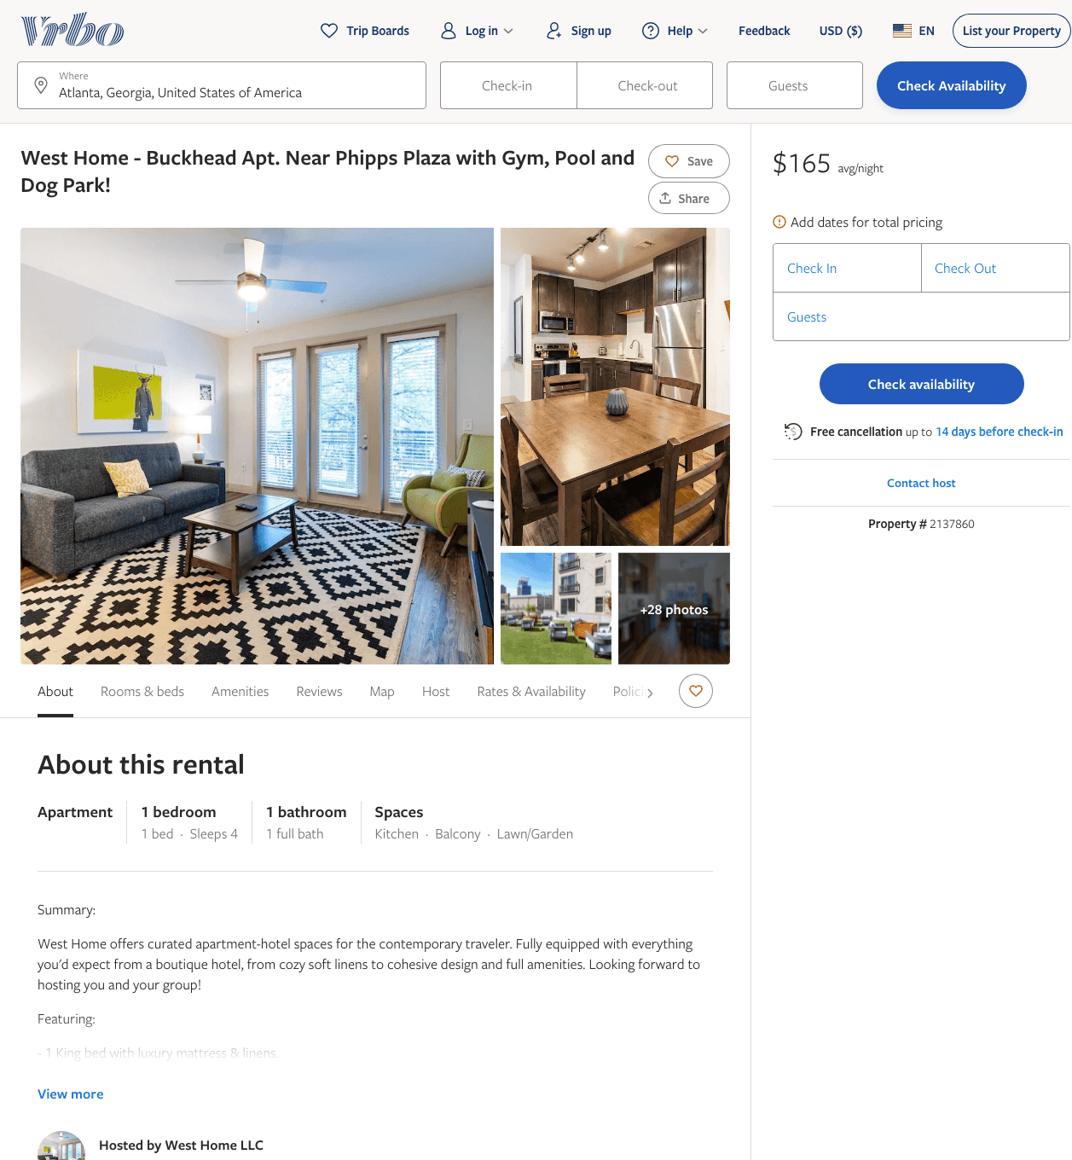
Listing 2137860
1
4
$139 - $195
2
West Home LLC
https://www.vrbo.com/2137860
Aug 2022

Slide 34
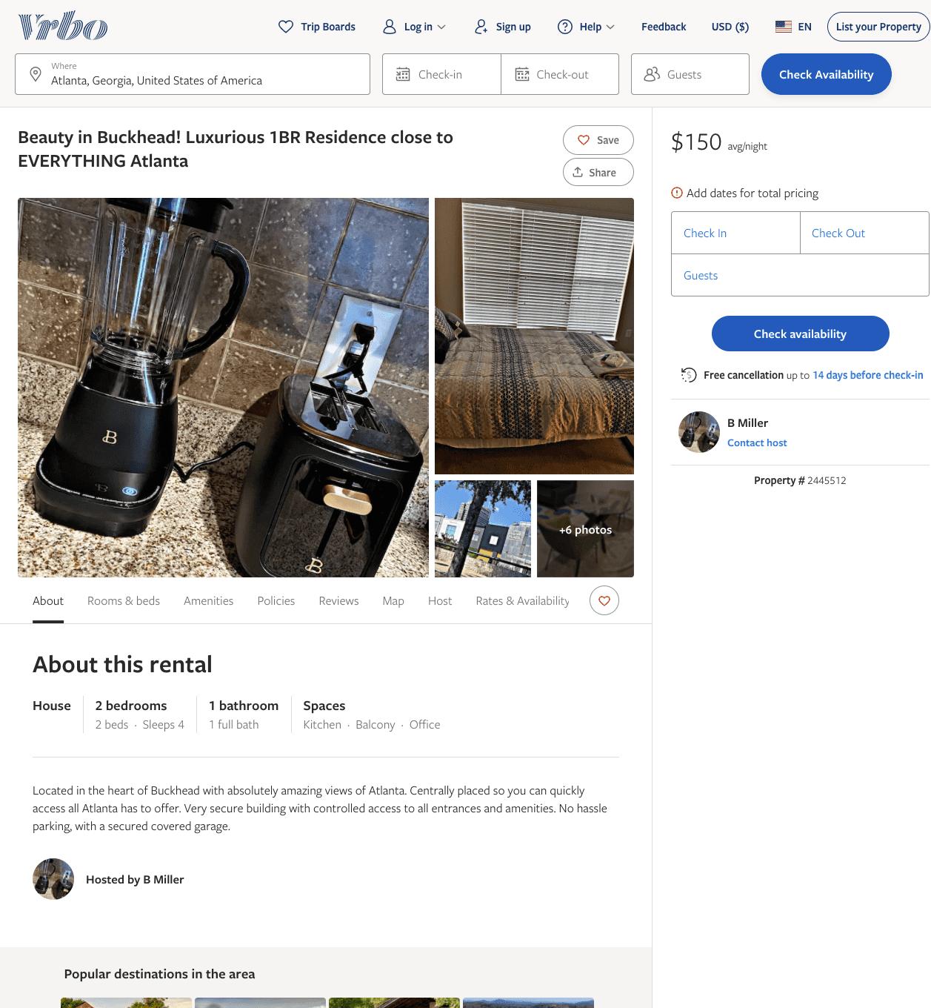
Listing 2445512
1
4
$125 - $90
5
1
B Miller
https://www.vrbo.com/2445512
Aug 2022

Slide 35
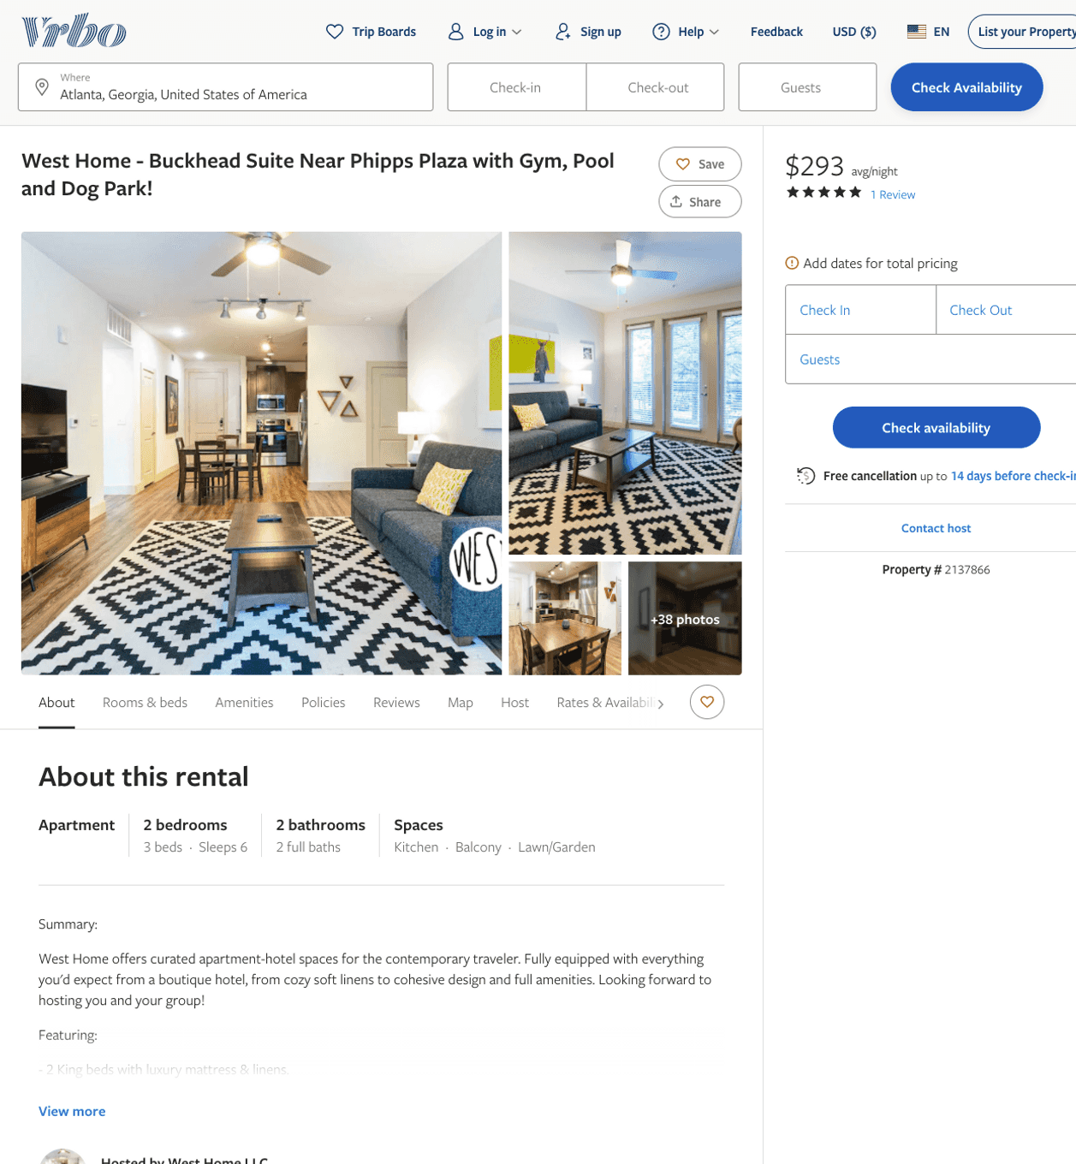
Listing 2137866
2
6
$188 - $282
5
2
West Home LLC
https://www.vrbo.com/2137866
Aug 2022

Slide 36
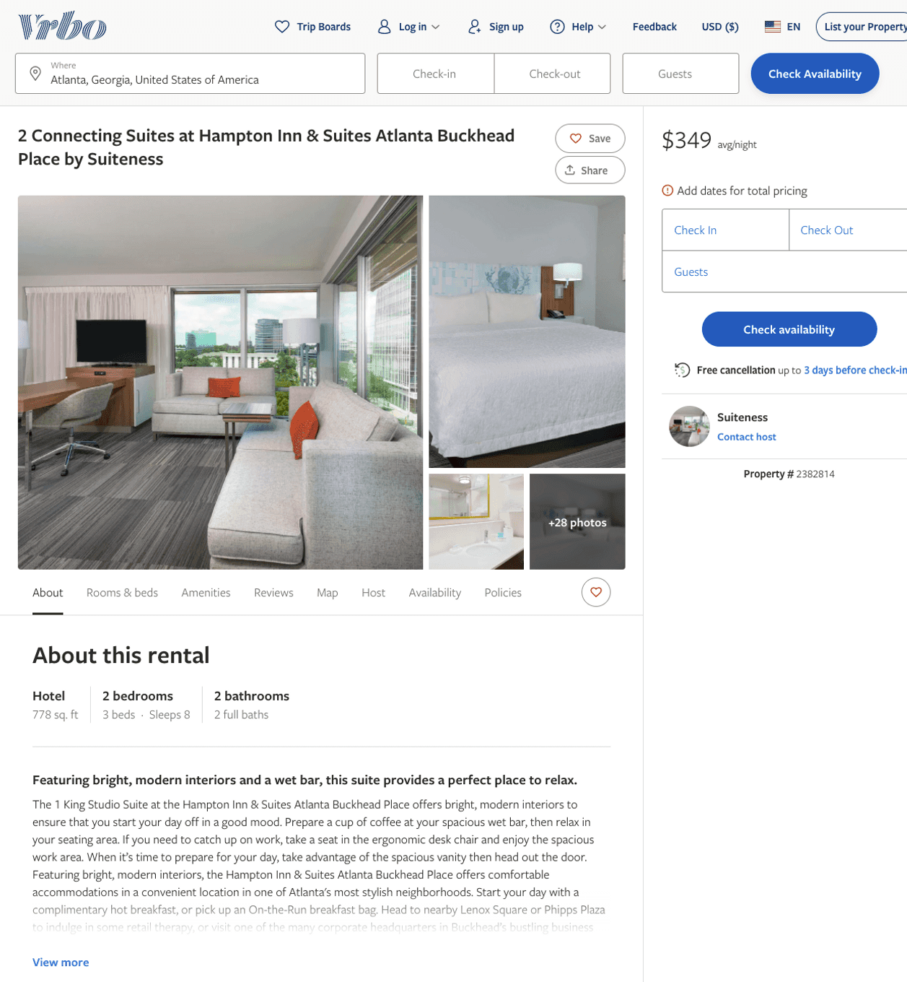
Listing 2382814
2
8
$301 - $375
3
1
Suiteness
https://www.vrbo.com/2382814
Aug 2022

Slide 37
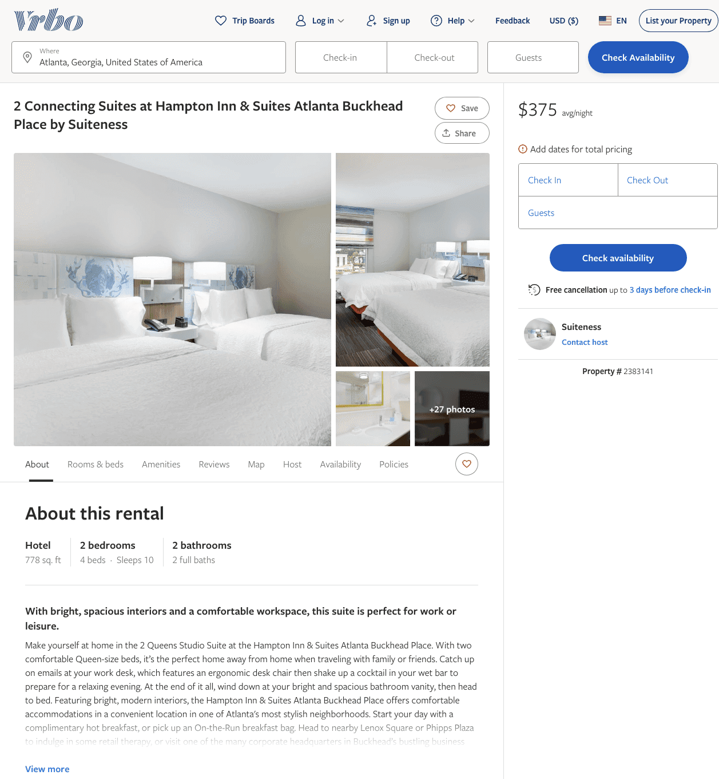
Listing 2383141
2
10
$320 - $394
5
1
Suiteness
https://www.vrbo.com/2383141
Aug 2022

Slide 38
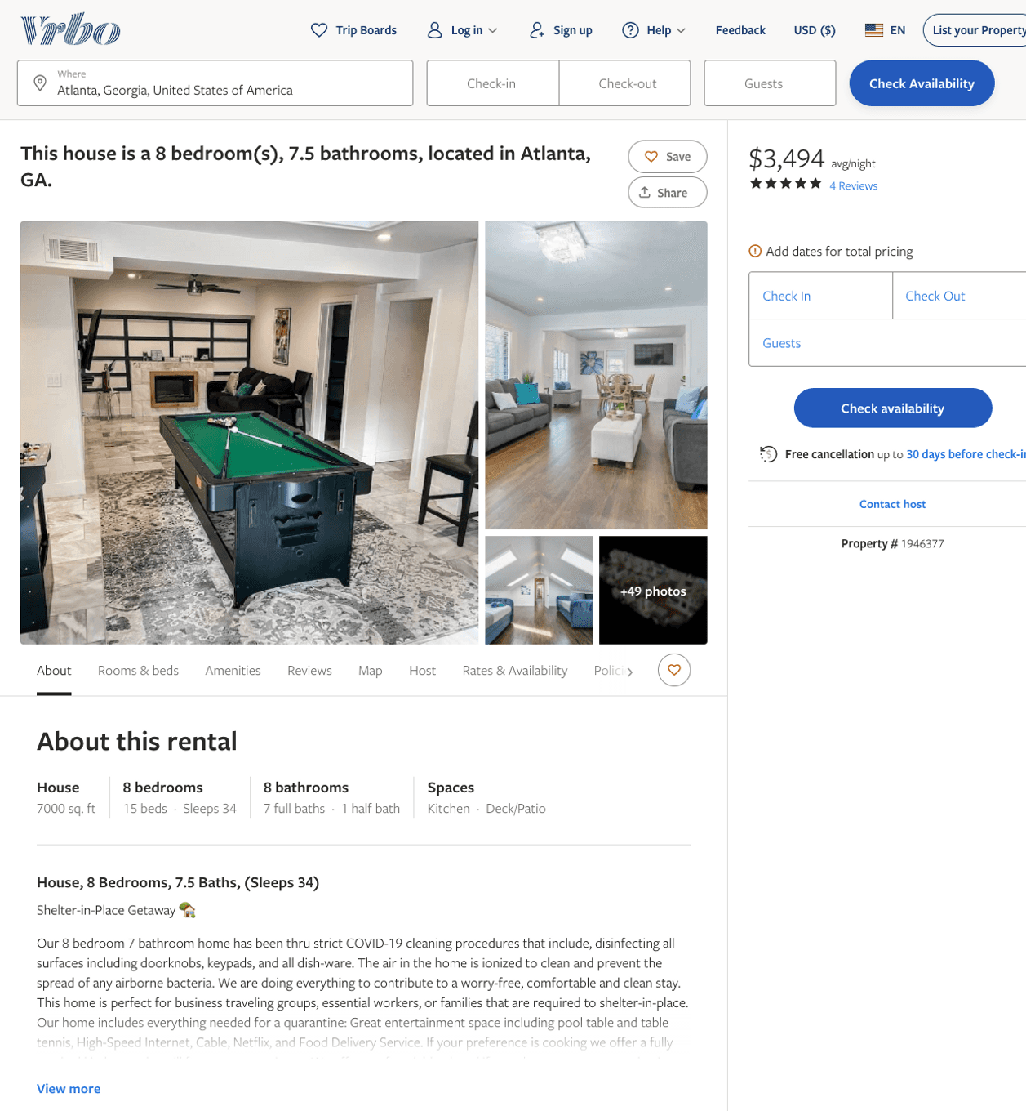
Listing 1946377
8
34
$1,675 - $3,628
4.909091
1
anthony williams
https://www.vrbo.com/1946377
Aug 2022

Slide 39
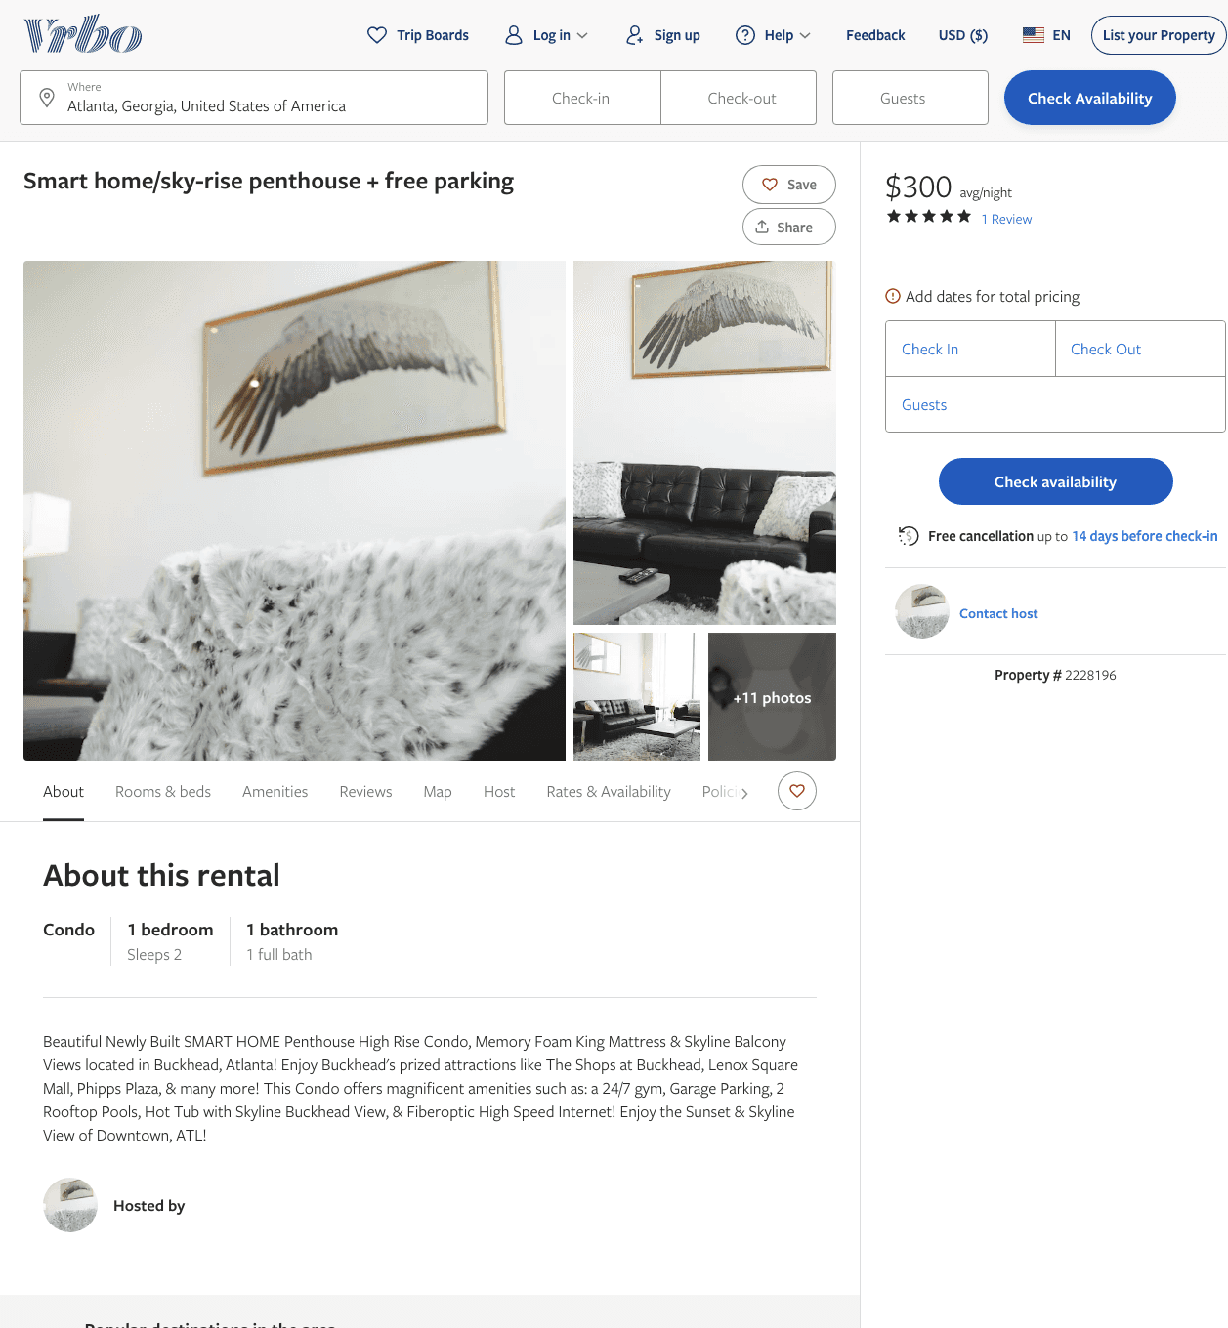
Listing 2228196
1
2
$300
3.6666667
1
https://www.vrbo.com/2228196
Aug 2022

Slide 40
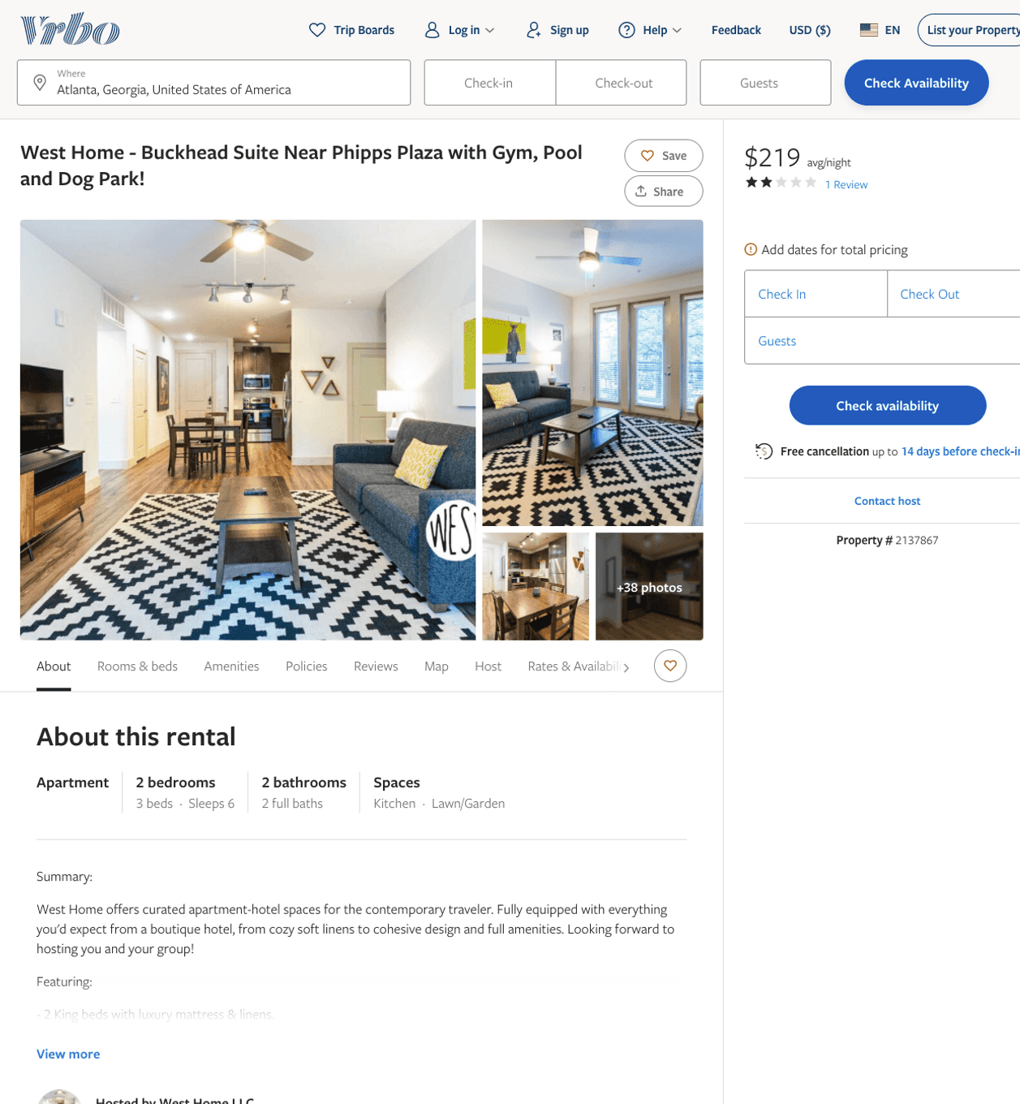
Listing 2137867
2
6
$188 - $240
2
2
West Home LLC
https://www.vrbo.com/2137867
Aug 2022

Slide 41
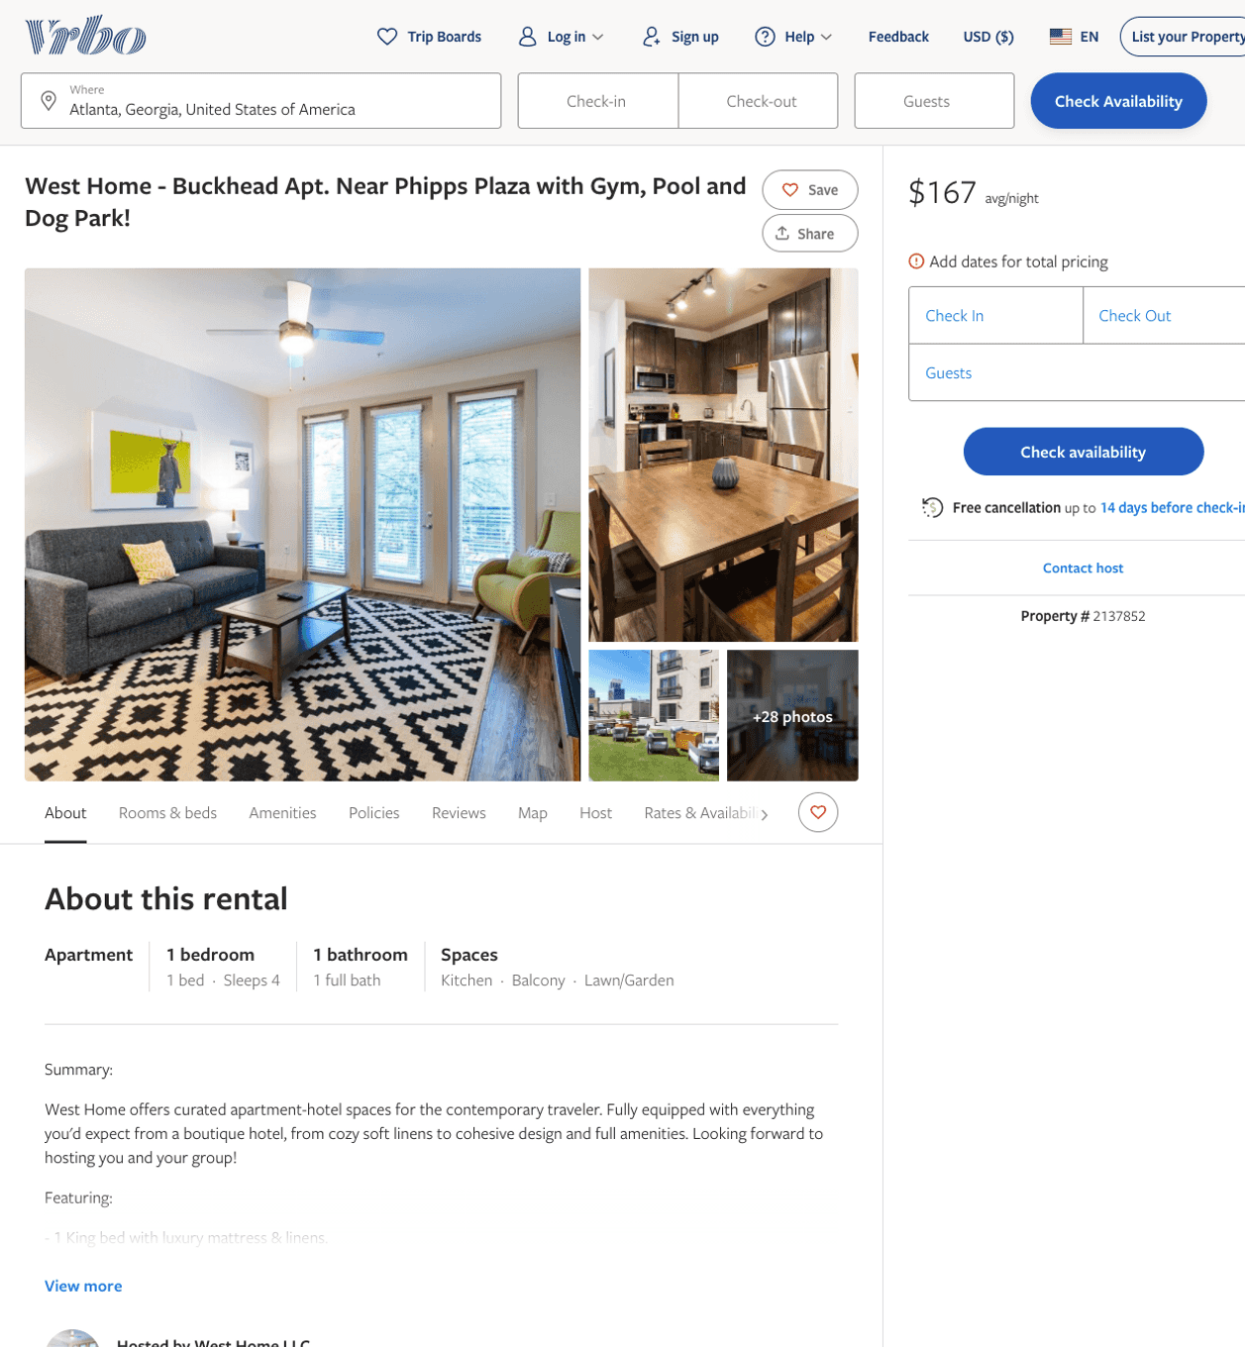
Listing 2137852
1
4
$160 - $192
2
West Home LLC
https://www.vrbo.com/2137852
Aug 2022

Slide 42
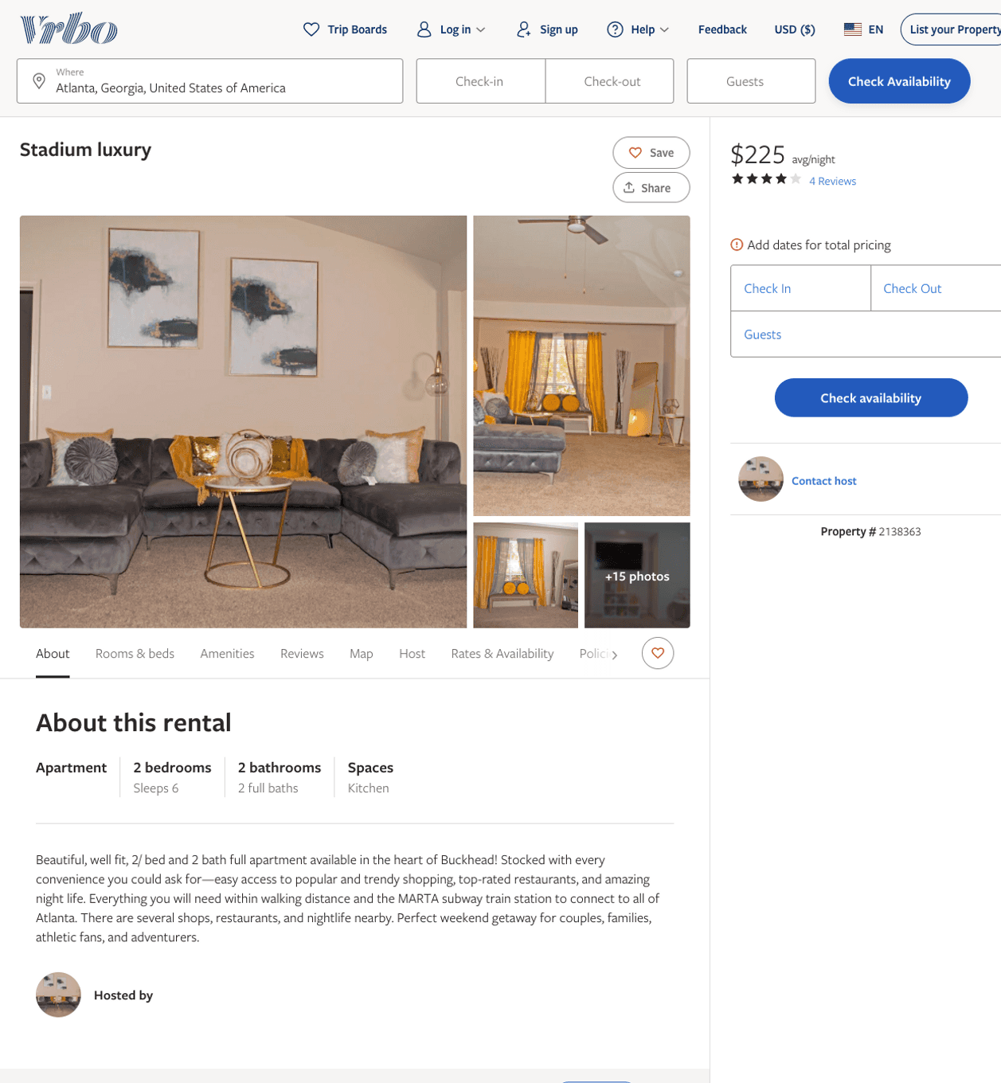
Listing 2138363
2
6
$220 - $225
4
1
https://www.vrbo.com/2138363
Aug 2022

Slide 43
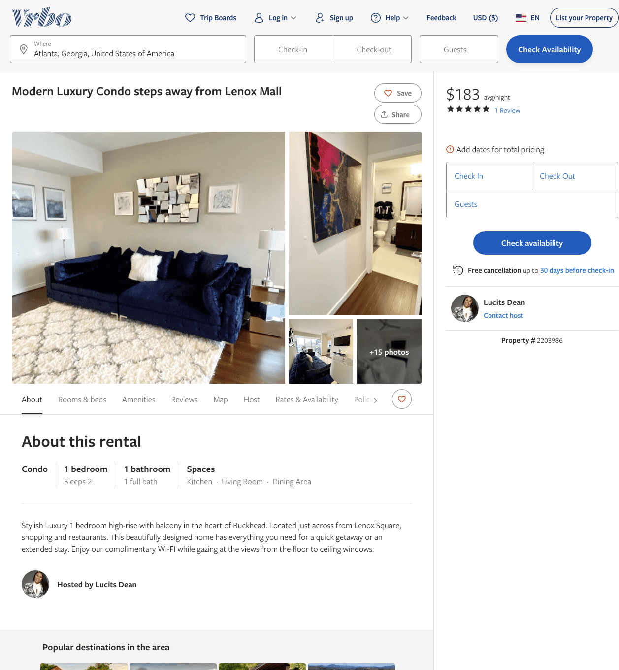
Listing 2203986
1
2
$175 - $183
5
2
Lucits Dean
https://www.vrbo.com/2203986
Aug 2022

Slide 44
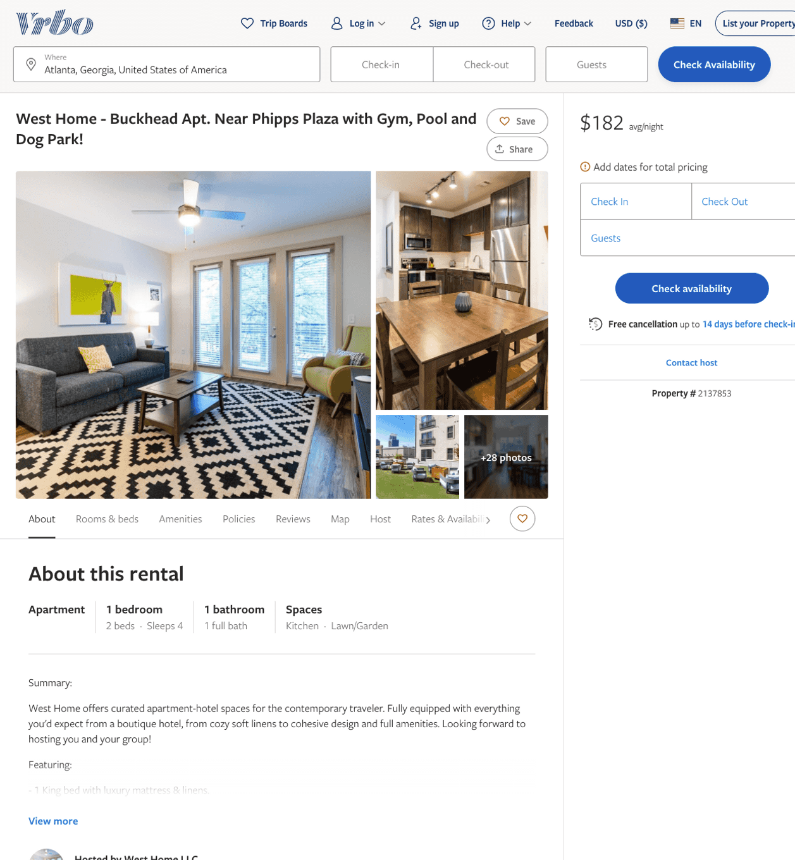
Listing 2137853
1
4
$160 - $207
2
West Home LLC
https://www.vrbo.com/2137853
Aug 2022

Slide 45
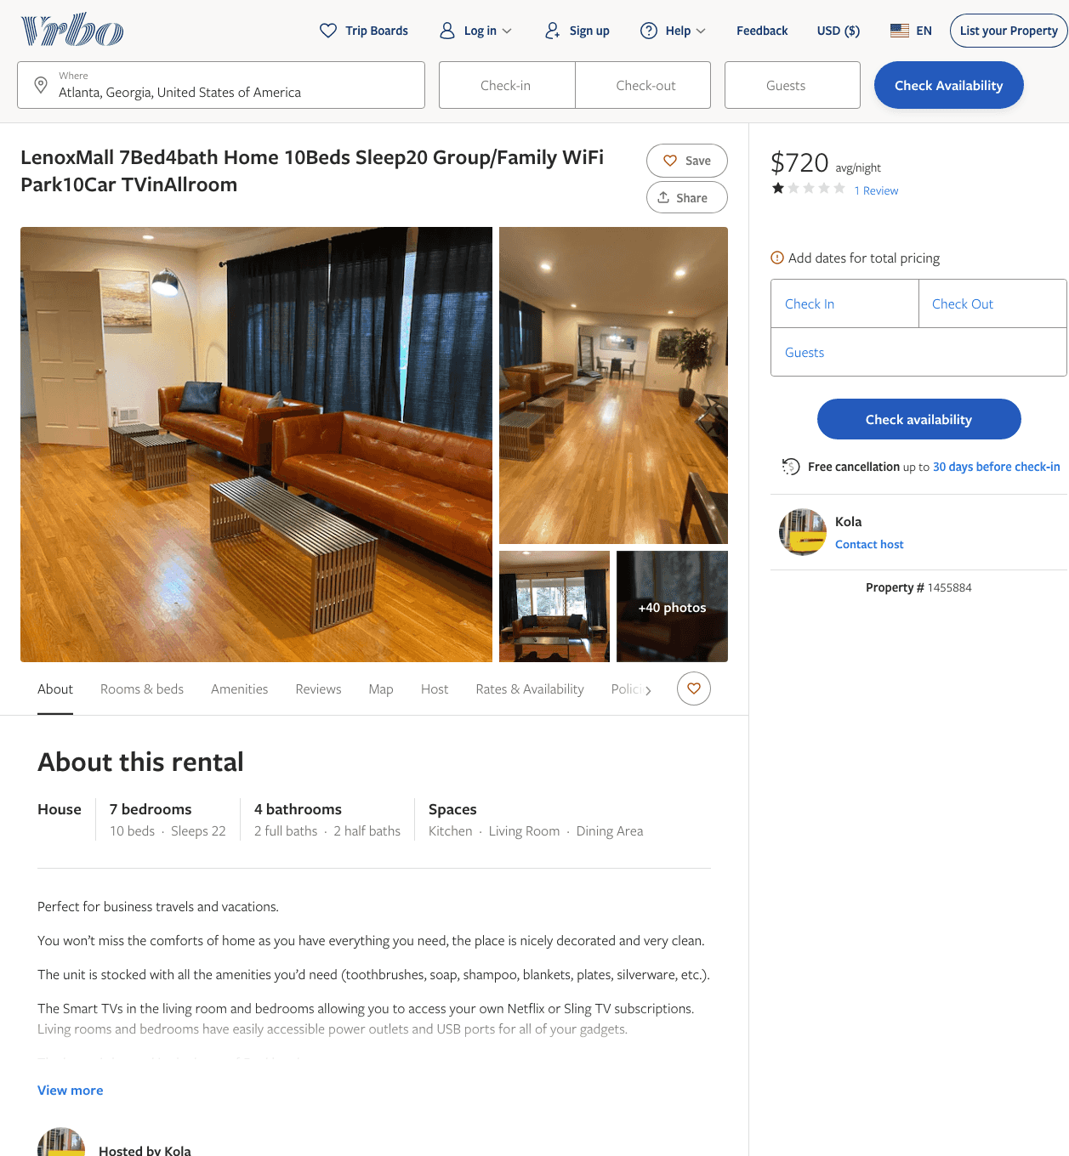
Listing 1455884
7
22
$720
1
3
Kola
https://www.vrbo.com/1455884
Aug 2022

Slide 46
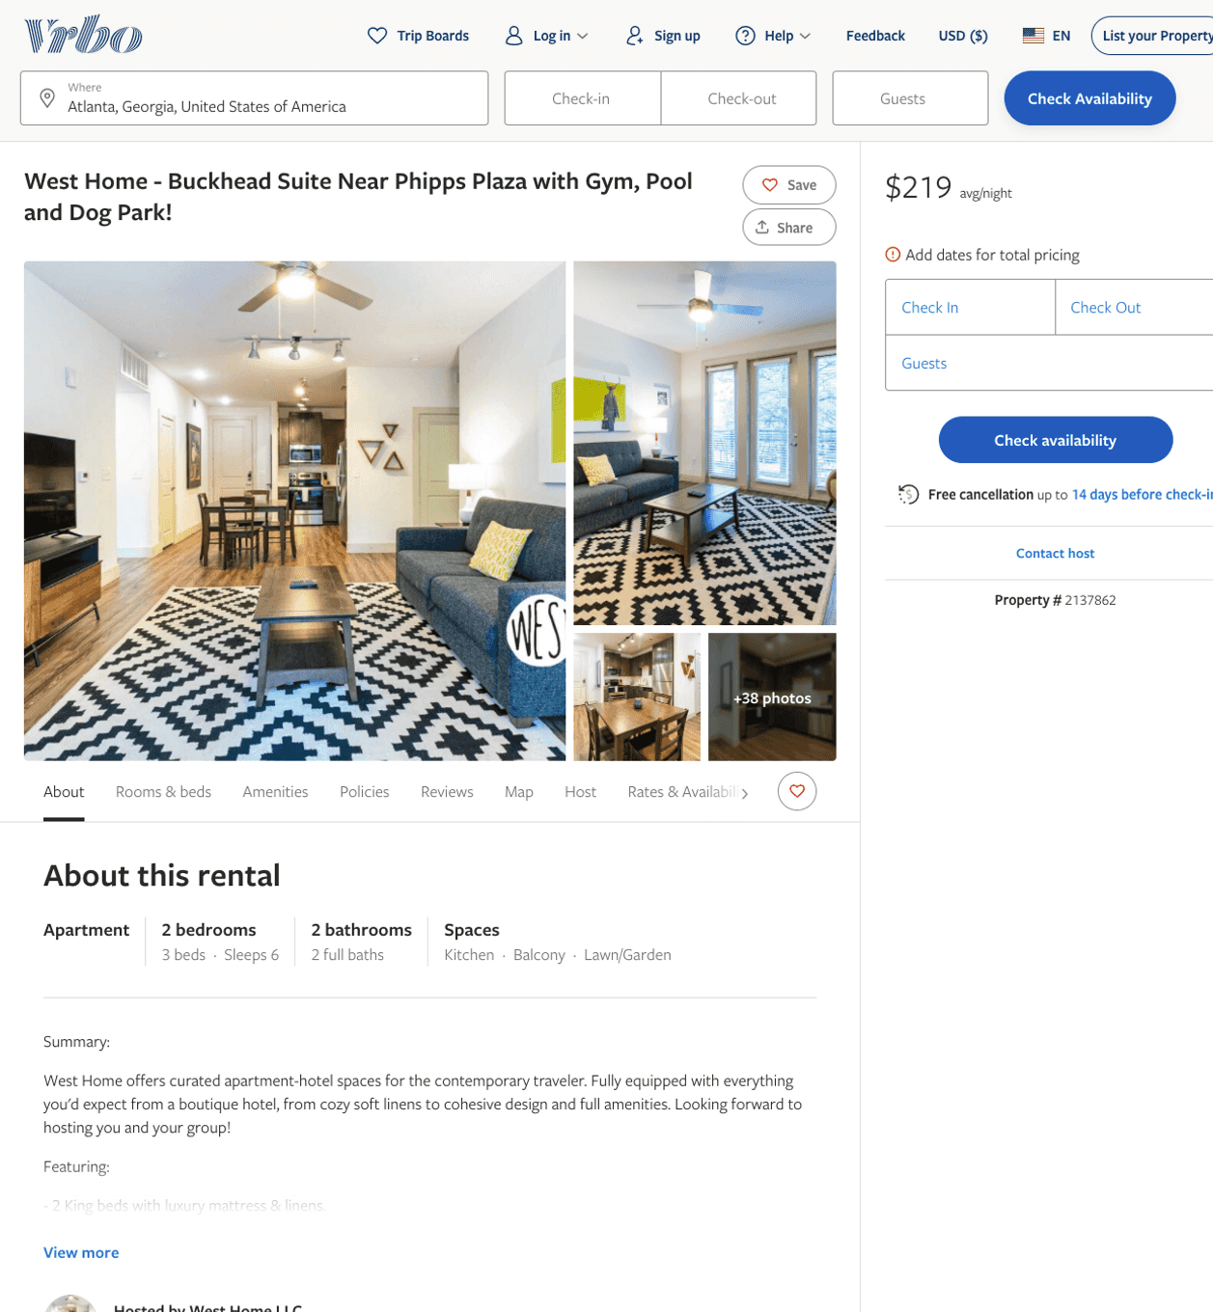
Listing 2137862
2
6
$187 - $249
2
West Home LLC
https://www.vrbo.com/2137862
Aug 2022

Slide 47
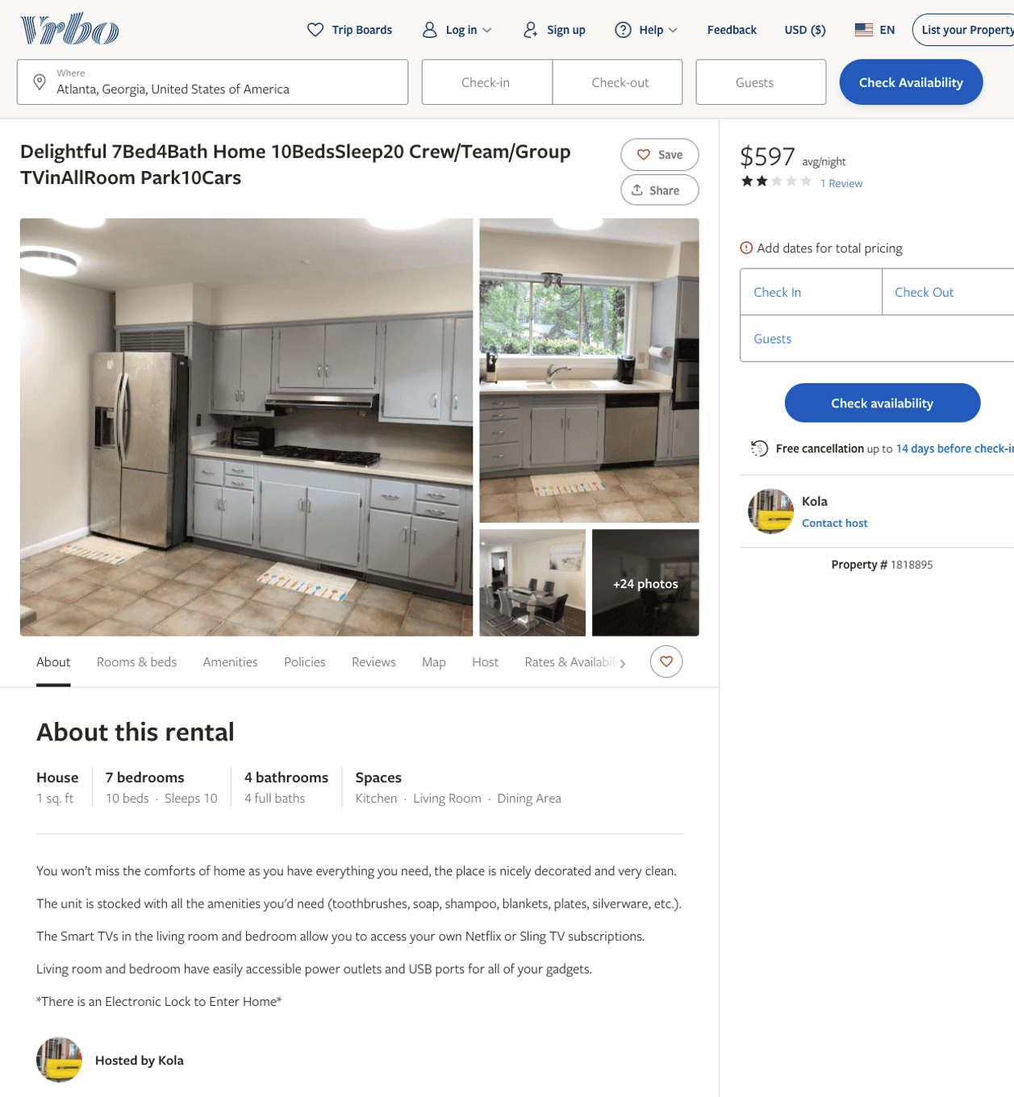
Listing 1818895
7
10
$597 - $598
2
3
Kola
https://www.vrbo.com/1818895
Aug 2022

Slide 48
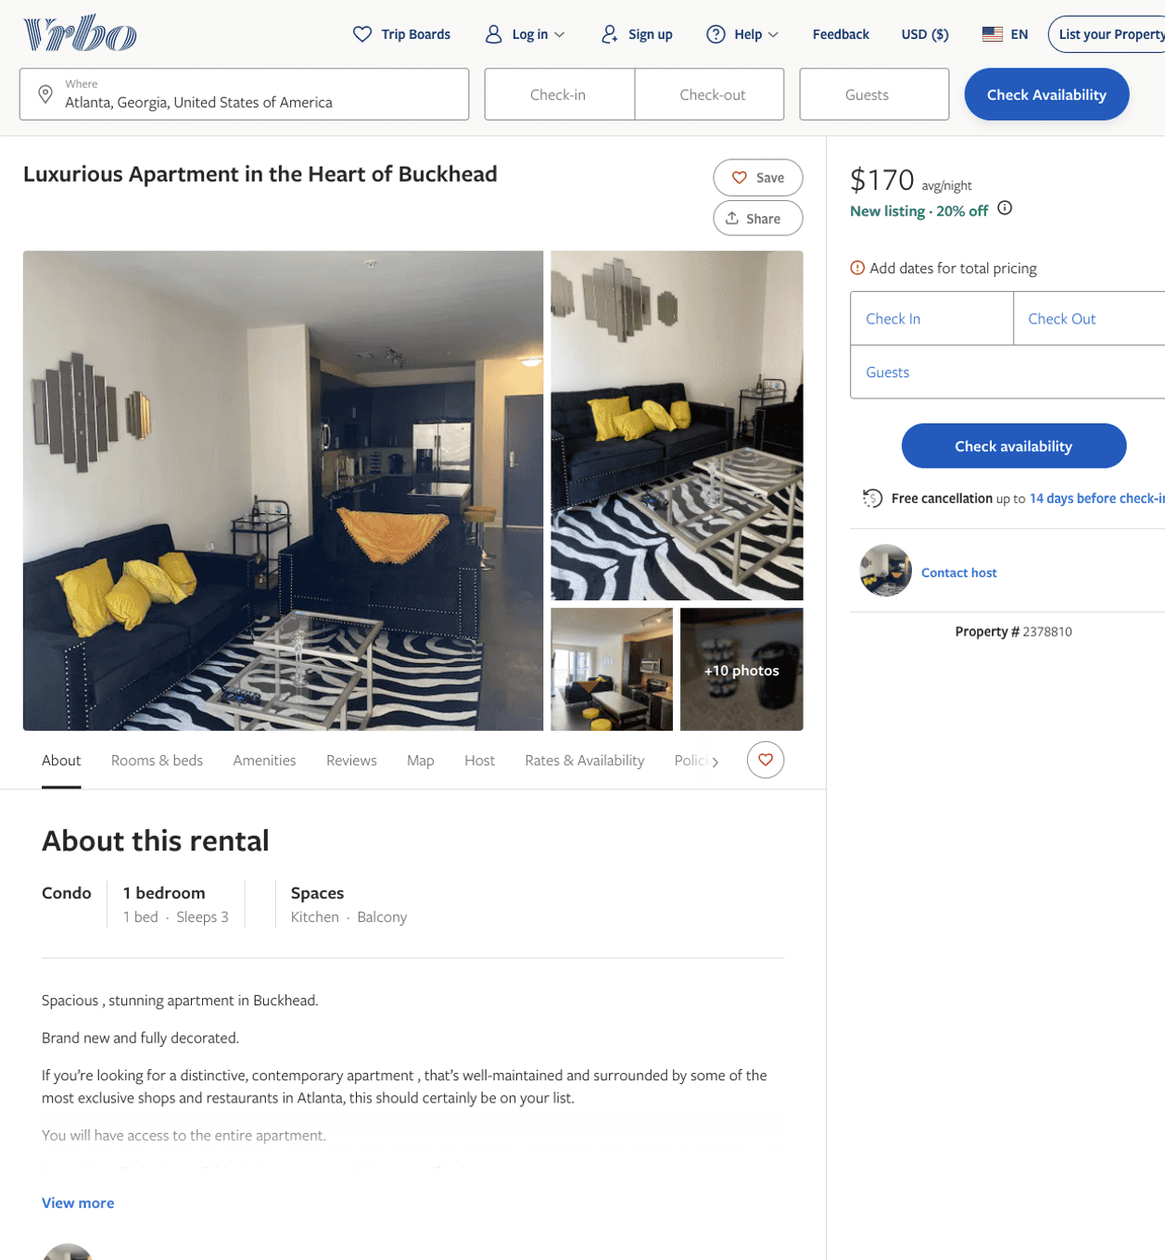
Listing 2378810
1
3
$170 - $208
2
https://www.vrbo.com/2378810
Aug 2022

Slide 49
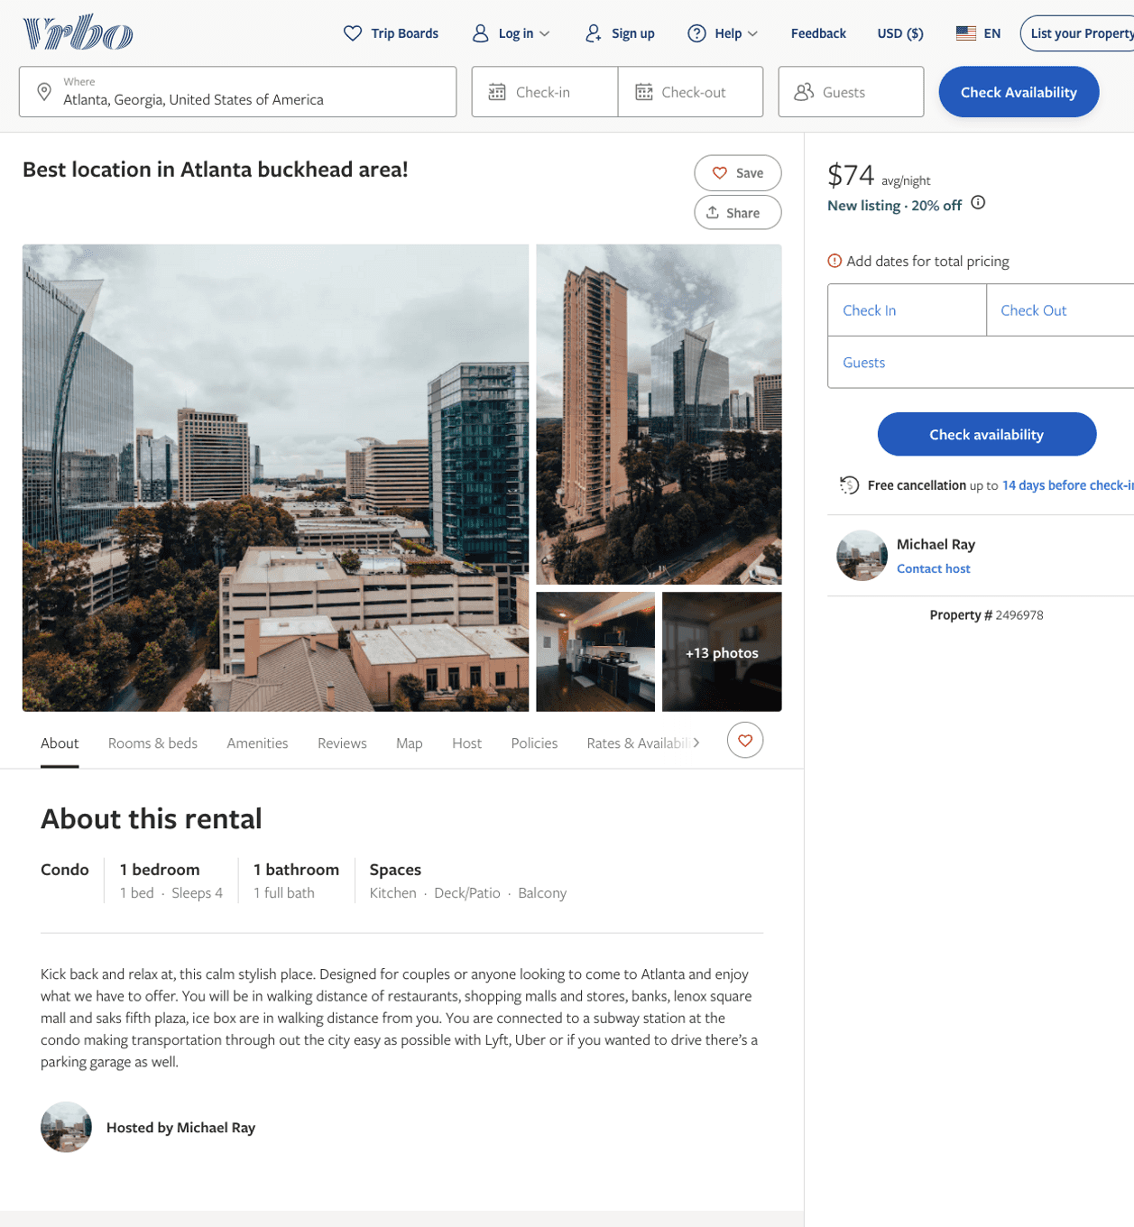
Listing 2496978
1
3
$100 - $88
4.8333335
3
Michael Ray
https://www.vrbo.com/2496978
Aug 2022

Slide 50
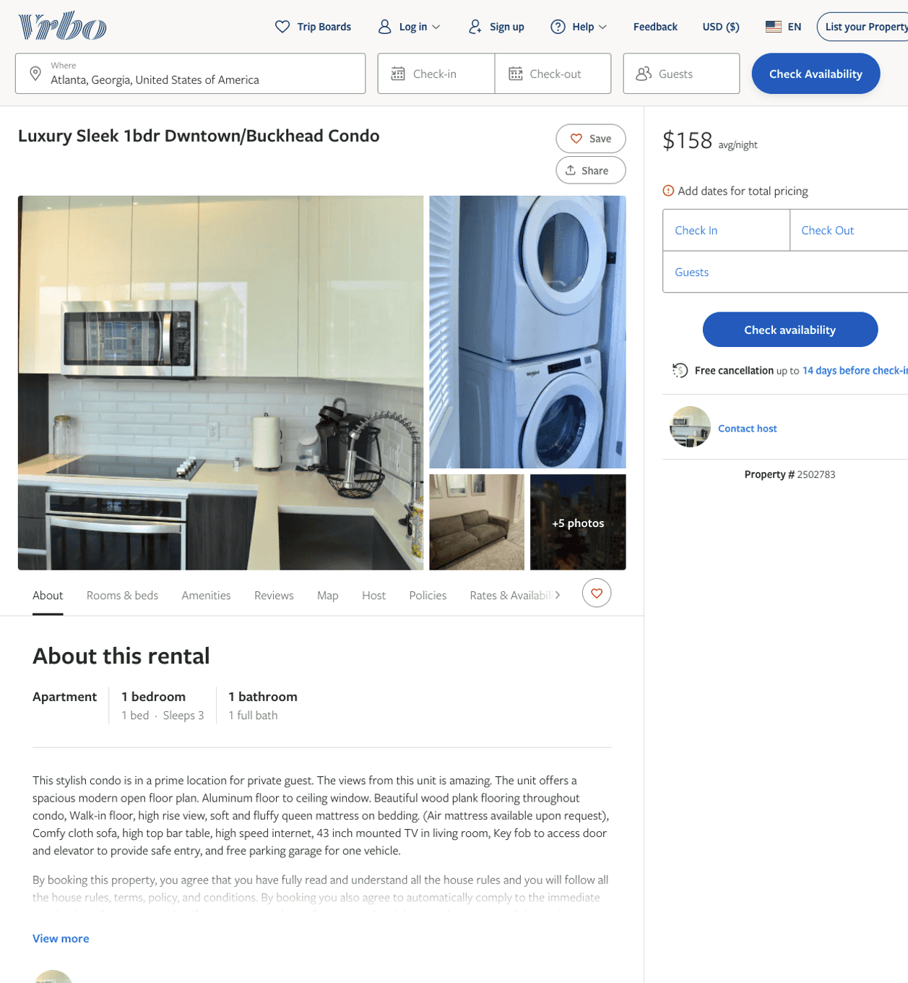
Listing 2502783
1
3
$158
2
https://www.vrbo.com/2502783
Aug 2022

Slide 51
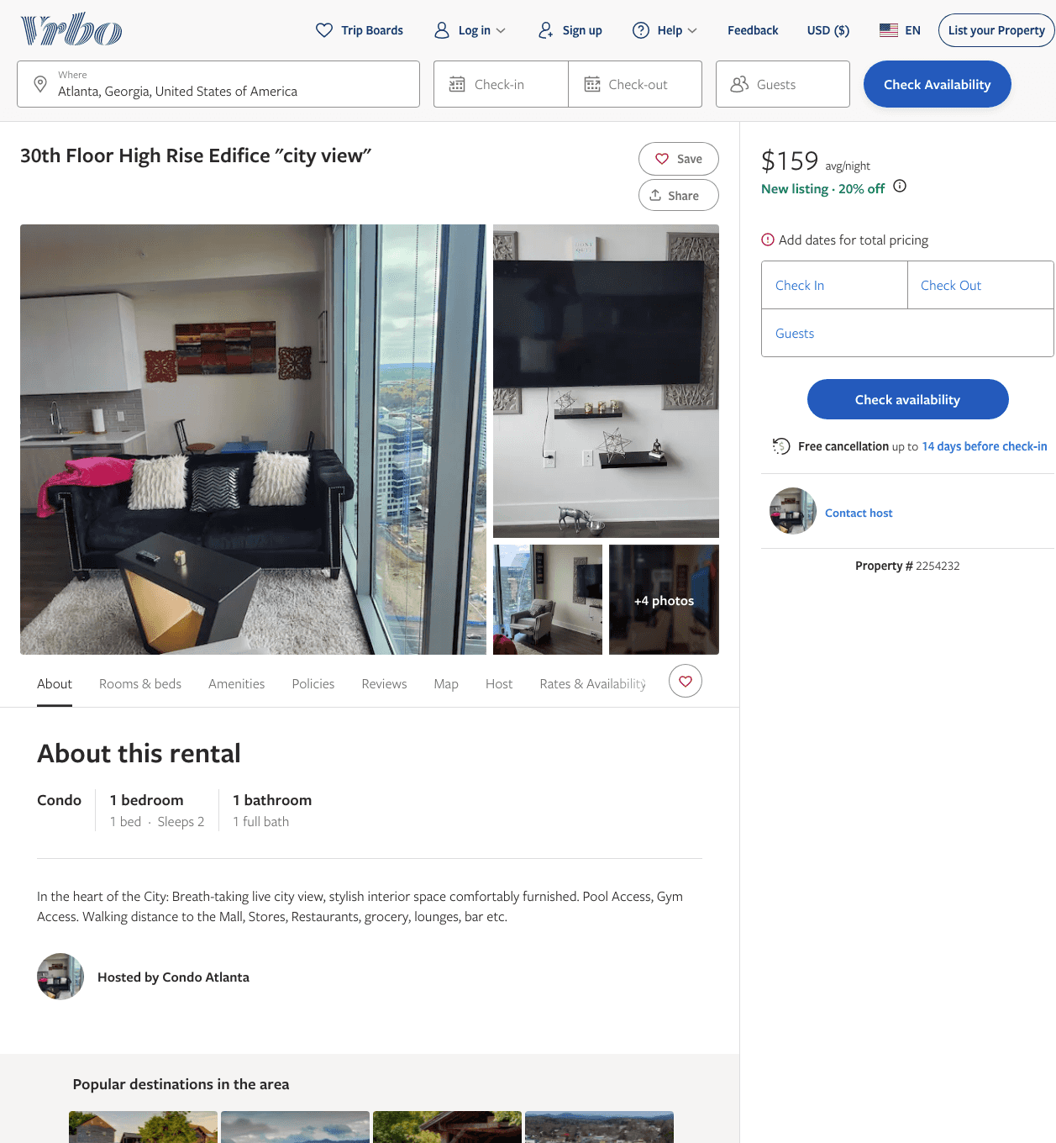
Listing 2254232
1
2
$159
2
https://www.vrbo.com/2254232
Aug 2022

Slide 52
Listing 2391482
2
4
$188 - $243
4
2
Ayomide Olanipekun
https://www.vrbo.com/2391482
Aug 2022

Slide 53
Listing 2137869
2
6
$196 - $266
2
West Home LLC
https://www.vrbo.com/2137869
Aug 2022

Slide 54
Listing 2137861
1
4
$160 - $188
2
West Home LLC
https://www.vrbo.com/2137861
Aug 2022

Slide 55
Listing 2137856
1
4
$139 - $183
2
West Home LLC
https://www.vrbo.com/2137856
Aug 2022

Slide 56
Listing 2137854
1
4
$167 - $226
2
West Home LLC
https://www.vrbo.com/2137854
Aug 2022

Slide 57
Listing 2404155
1
2
$100 - $90
2
Courtney
https://www.vrbo.com/2404155
Aug 2022

Slide 58
Listing 7567512
2
5
$151
2
https://www.vrbo.com/7567512ha
Aug 2022

Slide 59
Listing 1769361
2
1
$300
2
https://www.vrbo.com/1769361
Aug 2022

Slide 60
Listing 7593768
1
2
$2,000
1
https://www.vrbo.com/7593768ha
Aug 2022

Slide 61
Listing 2120121
5
10
$667 - $740
5
3
Katy Lyall
https://www.vrbo.com/2120121
Aug 2022

Slide 62
Listing 42791679
8
16
$380 - $2170
4.80
1
William
234095061
5
https://www.airbnb.com/rooms/42791679
Aug 2022

Slide 63
Listing 39478673
7
16
$1057 - $1206
4.50
2
Richard
275805993
7
https://www.airbnb.com/rooms/39478673
Aug 2022

Slide 64
Listing 14547899
5
7
$426 - $1146
4.94
4
Lisa Marie
61528765
1
https://www.airbnb.com/rooms/14547899
Aug 2022

Slide 65
Listing 18371268
5
11
$399 - $1028
4.94
1
Holly
79759771
1
https://www.airbnb.com/rooms/18371268
Aug 2022

Slide 66
Listing 19557666
3
6
$436 - $593
4.82
3
Paul
33365473
3
https://www.airbnb.com/rooms/19557666
Aug 2022

Slide 67
Listing 50044629
4
14
$329 - $556
2
William
373067383
7
https://www.airbnb.com/rooms/50044629
Aug 2022

Slide 68
Listing 21926819
5
10
$604 - $675
4.96
3
Harriet
159996753
1
https://www.airbnb.com/rooms/21926819
Aug 2022

Slide 69
Listing 32550129
3
6
$379 - $441
4.82
4
Brandon
190997518
7
https://www.airbnb.com/rooms/32550129
Aug 2022

Slide 70
Listing 31006784
2
4
$158 - $292
4.53
2
Vyvid Homes
31816953
20
https://www.airbnb.com/rooms/31006784
Aug 2022

Slide 71
Listing 44035264
2
6
$139 - $242
4.44
2
West Home
228384155
45
https://www.airbnb.com/rooms/44035264
Aug 2022

Slide 72
Listing 48640013
2
6
$197 - $220
4.11
1
Ashley
392374562
7
https://www.airbnb.com/rooms/48640013
Jun 2022

Slide 73
Listing 33290627
2
5
$143 - $200
4.67
1
Bella
150035863
5
https://www.airbnb.com/rooms/33290627
Aug 2022

Slide 74
Listing 50565290
1
3
$116 - $168
2
Riquelle
245356016
1
https://www.airbnb.com/rooms/50565290
Aug 2022

Slide 75
Listing 20900623
1
2
$114 - $157
4.77
1
Bella
150035863
5
https://www.airbnb.com/rooms/20900623
Aug 2022

Slide 76
Listing 44035261
1
4
$123 - $192
4.38
2
West Home
228384155
45
https://www.airbnb.com/rooms/44035261
Aug 2022

Slide 77
Listing 49714510
1
3
$90 - $187
4.99
2
Carley
72377500
2
https://www.airbnb.com/rooms/49714510
Jul 2022

Slide 78
Listing 50156186
2
4
$114 - $200
4.79
2
P
262291805
1
https://www.airbnb.com/rooms/50156186
Aug 2022

Slide 79
Listing 39585860
1
2
$95 - $102
4.73
1
Segun
275867945
1
https://www.airbnb.com/rooms/39585860
Jun 2022

Slide 80
Listing 27087657
1
2
$84 - $120
4.77
1
J.J
203838948
2
https://www.airbnb.com/rooms/27087657
Aug 2022

Slide 81
Listing 31963003
1
4
$94 - $140
4.88
2
Dee
135905092
1
https://www.airbnb.com/rooms/31963003
Aug 2022

Slide 82
Listing 16479441
9
16
$620 - $1120
4.98
2
Cam
15195304
1
https://www.airbnb.com/rooms/16479441
Aug 2022

Slide 83
Listing 47224051
3
4
$174 - $799
5.0
2
Mylin
165302662
1
https://www.airbnb.com/rooms/47224051
Aug 2022

Slide 84
Listing 36714672
7
16
$557 - $914
4.75
2
Richard
275805993
7
https://www.airbnb.com/rooms/36714672
Aug 2022

Slide 85
Listing 48148518
2
4
$163 - $251
4.97
2
Tee
387781626
2
https://www.airbnb.com/rooms/48148518
Aug 2022

Slide 86
Listing 49358540
2
4
$191 - $250
4.83
1
Kay
398131084
1
https://www.airbnb.com/rooms/49358540
Aug 2022

Slide 87
Listing 50106368
1
3
$146 - $225
2
Clet
344669499
2
https://www.airbnb.com/rooms/50106368
Jun 2022

Slide 88
Listing 40039904
3
6
$168 - $202
4.78
1
Roman
48633593
1
https://www.airbnb.com/rooms/40039904
Aug 2022

Slide 89
Listing 7415073
1
1
$34 - $49
5.0
14
Shirley
2615979
2
https://www.airbnb.com/rooms/7415073
Aug 2022

Slide 90
Listing 49692092
1
2
$115 - $263
4.82
2
The Hive
295549667
5
https://www.airbnb.com/rooms/49692092
Aug 2022

Slide 91
Listing 43293189
1
3
$349 - $470
4.88
1
Edgie
111028832
3
https://www.airbnb.com/rooms/43293189
Jul 2022

Slide 92
Listing 47586133
4
14
$219 - $589
4.70
1
Brittany
38567417
1
https://www.airbnb.com/rooms/47586133
Aug 2022

Slide 93
Listing 33985198
3
7
$339 - $426
4.86
4
Brandon
190997518
7
https://www.airbnb.com/rooms/33985198
Aug 2022

Slide 94
Listing 33549293
2
4
$48 - $74
4.84
2
Emily
154095383
1
https://www.airbnb.com/rooms/33549293
Aug 2022

Slide 95
Listing 46049412
1
2
$156 - $296
4.93
2
Jalynn
373249883
2
https://www.airbnb.com/rooms/46049412
Aug 2022

Slide 96
Listing 25395338
1
2
$99 - $121
4.65
30
Private Residences
130483392
3
https://www.airbnb.com/rooms/25395338
Aug 2022

Slide 97
Listing 31543131
2
5
$159 - $200
4.52
1
Bella
150035863
5
https://www.airbnb.com/rooms/31543131
Jun 2022

Slide 98
Listing 45864918
1
2
$113 - $167
4.60
2
Shon
371821498
1
https://www.airbnb.com/rooms/45864918
Aug 2022

Slide 99
Listing 50242987
2
5
$150 - $200
5.0
4
Hana
45844087
1
https://www.airbnb.com/rooms/50242987
Jul 2022

Slide 100
Listing 47073194
3
8
$1585 - $2099
1
Veronica
36392148
1
https://www.airbnb.com/rooms/47073194
Jun 2022

Slide 101
Listing 30512617
1
2
$121 - $159
4.61
1
James
227867184
4
https://www.airbnb.com/rooms/30512617
Aug 2022

Slide 102
Listing 39483222
7
16
$857 - $1086
3
Richard
275805993
7
https://www.airbnb.com/rooms/39483222
Aug 2022

Slide 103
Listing 29441678
1
2
$148
4.97
2
Heidi
135850474
1
https://www.airbnb.com/rooms/29441678
Aug 2022

Slide 104
Listing 50438480
4
12
$356 - $1052
5.0
2
Angelo
36560781
1
https://www.airbnb.com/rooms/50438480
Aug 2022

Slide 105
Listing 39362828
7
16
$914 - $1043
3
Richard
275805993
7
https://www.airbnb.com/rooms/39362828
Aug 2022

Slide 106
Listing 39482912
7
16
$914 - $1043
2
Richard
275805993
7
https://www.airbnb.com/rooms/39482912
Aug 2022

Slide 107
Listing 50671040
1
4
$118 - $188
4.64
1
Cordon
269812721
1
https://www.airbnb.com/rooms/50671040
Jul 2022

Slide 108
Listing 10512408
3
4
$346
10
Phil
54200982
1
https://www.airbnb.com/rooms/10512408
Aug 2022

Slide 109
Listing 36785512
3
6
$317 - $413
2
Richard
275805993
7
https://www.airbnb.com/rooms/36785512
Aug 2022

Slide 110
Listing 43579260
3
6
$250 - $350
4.67
3
Susan
236850983
1
https://www.airbnb.com/rooms/43579260
Aug 2022

Slide 111
Listing 51047434
1
2
$1400 - $1402
2
Ghislain
26973303
1
https://www.airbnb.com/rooms/51047434
Aug 2022

Slide 112
Listing 51069058
1
3
$140
1
Alexis
378011812
1
https://www.airbnb.com/rooms/51069058
Aug 2022

Slide 113
Listing 51142754
1
4
$124 - $188
4.07
1
Amber
83286968
1
https://www.airbnb.com/rooms/51142754
Aug 2022

Slide 114
Listing 47162598
1
2
$82 - $114
4.75
1
J.J
203838948
2
https://www.airbnb.com/rooms/47162598
Jun 2022

Slide 115
Listing 22547489
1
2
$87 - $124
4.95
1
Nola
161608290
3
https://www.airbnb.com/rooms/22547489
Aug 2022

Slide 116
Listing 51319450
7
16
$599 - $909
1
William
373067383
7
https://www.airbnb.com/rooms/51319450
Aug 2022

Slide 117
Listing 50642996
1
3
$61 - $160
4.91
1
Tasha
62024131
1
https://www.airbnb.com/rooms/50642996
Jul 2022

Slide 118
Listing 50944102
1
3
$89 - $150
1
Victoria
267007643
1
https://www.airbnb.com/rooms/50944102
Aug 2022

Slide 119
Listing 39483121
7
10
$886 - $1057
2
Richard
275805993
7
https://www.airbnb.com/rooms/39483121
Aug 2022

Slide 120
Listing 39406029
4
10
$316 - $443
4.28
1
Anthony
298377388
1
https://www.airbnb.com/rooms/39406029
Aug 2022

Slide 121
Listing 51081596
1
2
$175 - $250
4.74
2
Nicole
413310789
1
https://www.airbnb.com/rooms/51081596
Aug 2022

Slide 122
Listing 51478956
3
8
$242 - $485
1
William
373067383
7
https://www.airbnb.com/rooms/51478956
Aug 2022

Slide 123
Listing 51491969
1
4
$120 - $139
4.14
1
Ashley
392374562
7
https://www.airbnb.com/rooms/51491969
Aug 2022

Slide 124
Listing 51346029
2
6
$143 - $375
5.0
1
Luxe Stays
38762810
1
https://www.airbnb.com/rooms/51346029
Jul 2022

Slide 125
Listing 51620872
2
4
$200 - $350
4
Casso
151942410
2
https://www.airbnb.com/rooms/51620872
Jun 2022

Slide 126
Listing 48063872
1
3
$89 - $150
13
Darleen
332628915
1
https://www.airbnb.com/rooms/48063872
Jul 2022

Slide 127
Listing 46039237
1
4
$225 - $350
4.63
2
Kevin
373172675
1
https://www.airbnb.com/rooms/46039237
Aug 2022

Slide 128
Listing 52162562
1
2
$113 - $149
5.0
1
Power
294180845
8
https://www.airbnb.com/rooms/52162562
Jul 2022

Slide 129
Listing 52188070
1
3
$102 - $156
4.33
2
Edgie
111028832
3
https://www.airbnb.com/rooms/52188070
Aug 2022

Slide 130
Listing 52269669
1
3
$78 - $98
3.67
1
Raven
250524651
1
https://www.airbnb.com/rooms/52269669
Aug 2022

Slide 131
Listing 52283108
1
2
$82 - $124
4.61
2
Modern
399142980
1
https://www.airbnb.com/rooms/52283108
Aug 2022

Slide 132
Listing 52183944
1
4
$141 - $168
7
DeLuxe Stay
421191881
1
https://www.airbnb.com/rooms/52183944
Jun 2022

Slide 133
Listing 52524733
5
16
$1409 - $3011
3
Zee
278629740
3
https://www.airbnb.com/rooms/52524733
Aug 2022

Slide 134
Listing 52457813
1
4
$86 - $180
4.91
3
Michael
268829335
1
https://www.airbnb.com/rooms/52457813
Aug 2022

Slide 135
Listing 52779931
1
2
$214 - $386
4.76
1
Luxury Lyfe Suites
237419161
9
https://www.airbnb.com/rooms/52779931
Aug 2022

Slide 136
Listing 51584703
1
4
$500
1
Gloomy
415337826
1
https://www.airbnb.com/rooms/51584703
Aug 2022

Slide 137
Listing 52836916
1
4
$119 - $134
4.25
1
Sasha
203067287
17
https://www.airbnb.com/rooms/52836916
Jul 2022

Slide 138
Listing 52793050
1
4
$58 - $100
4.42
1
Dream Escapes
180151027
6
https://www.airbnb.com/rooms/52793050
Aug 2022

Slide 139
Listing 51960722
1
2
$165 - $205
365
Fred
420837679
1
https://www.airbnb.com/rooms/51960722
Aug 2022

Slide 140
Listing 53277469
3
6
$268 - $449
4.80
2
Blue
431314975
1
https://www.airbnb.com/rooms/53277469
Aug 2022

Slide 141
Listing 51329560
1
4
$159 - $200
4.61
2
Luxury Rental LLC
359875608
1
https://www.airbnb.com/rooms/51329560
Aug 2022

Slide 142
Listing 52256672
1
4
$109 - $170
4.30
1
Seanice
184852385
1
https://www.airbnb.com/rooms/52256672
Jul 2022

Slide 143
Listing 53609873
3
5
$120 - $180
14
K & S
89596337
7
https://www.airbnb.com/rooms/53609873
Aug 2022

Slide 144
Listing 52952538
1
4
$130 - $170
4.70
2
Tiffany
428690888
1
https://www.airbnb.com/rooms/52952538
Aug 2022

Slide 145
Listing 53631329
1
2
$129 - $150
31
Latoya
421045841
2
https://www.airbnb.com/rooms/53631329
Aug 2022

Slide 146
Listing 53624296
2
5
$130 - $181
4.75
1
J Luxe
144283005
2
https://www.airbnb.com/rooms/53624296
Aug 2022

Slide 147
Listing 53715549
1
2
$103 - $322
4.64
2
R.B.A
26534449
17
https://www.airbnb.com/rooms/53715549
Aug 2022

Slide 148
Listing 53684836
1
4
$93 - $121
4.52
1
Antonett
369678044
2
https://www.airbnb.com/rooms/53684836
Aug 2022

Slide 149
Listing 33639669
1
2
$94 - $117
4.85
1
Nola
161608290
3
https://www.airbnb.com/rooms/33639669
Aug 2022

Slide 150
Listing 52592525
1
4
$98 - $121
4.93
2
Yas
167954926
1
https://www.airbnb.com/rooms/52592525
Aug 2022

Slide 151
Listing 53952806
1
4
$4000
12
Grinch
268860712
1
https://www.airbnb.com/rooms/53952806
Aug 2022

Slide 152
Listing 53925251
6
15
$331 - $500
4.88
1
Kahail
17170187
1
https://www.airbnb.com/rooms/53925251
Aug 2022

Slide 153
Listing 53936441
1
3
$138 - $169
31
Isabel
388805011
66
https://www.airbnb.com/rooms/53936441
Jun 2022

Slide 154
Listing 53835366
2
4
$182 - $301
4.50
2
Jones
403689070
2
https://www.airbnb.com/rooms/53835366
Jul 2022

Slide 155
Listing 2565587
2
6
$145 - $200
1
CSLUXURYSTAYS Corporation
https://www.vrbo.com/2565587
Aug 2022

Slide 156
Listing 2300945
3
12
$399
2
Kola
https://www.vrbo.com/2300945
Aug 2022

Slide 157
Listing 2568930
1
4
$146
1
1
https://www.vrbo.com/2568930
Aug 2022

Slide 158
Listing 2462814
2
5
$185
2
Garikayi Tembo
https://www.vrbo.com/2462814
Aug 2022

Slide 159
Listing 2580481
2
5
$225 - $350
1
2
https://www.vrbo.com/2580481
Aug 2022

Slide 160
Listing 1470515
2
4
$225 - $250
3.5
2
https://www.vrbo.com/1470515
Aug 2022

Slide 161
Listing 54121010
5
16
$602 - $2653
3
A Luxury
385710143
2
https://www.airbnb.com/rooms/54121010
Aug 2022

Slide 162
Listing 49858872
1
3
$105
1
Solomon
242847345
1
https://www.airbnb.com/rooms/49858872
Aug 2022

Slide 163
Listing 2612311
3
6
$289 - $301
4.25
2
https://www.vrbo.com/2612311
Aug 2022

Slide 164
Listing 54307549
1
3
$111 - $197
4.71
1
Pink Palace
26510689
3
https://www.airbnb.com/rooms/54307549
Aug 2022

Slide 165
Listing 2625624
3
6
$155
28
Left Hand Properties LLC
https://www.vrbo.com/2625624
Aug 2022

Slide 166
Listing 2631371
2
5
$110
3
1
Johnniey Hill
https://www.vrbo.com/2631371
Aug 2022

Slide 167
Listing 2625615
4
12
$512
5
2
Chris
https://www.vrbo.com/2625615
Aug 2022

Slide 168
Listing 7331172
1
4
$164 - $167
4
2
https://www.vrbo.com/7331172ha
Aug 2022

Slide 169
Listing 52122430
1
4
$99 - $139
4.92
2
Kendra
65665825
1
https://www.airbnb.com/rooms/52122430
Jul 2022

Slide 170
Listing 54371140
2
5
$162 - $202
1
RedAwning
395672427
4
https://www.airbnb.com/rooms/54371140
Jun 2022

Slide 171
Listing 53936513
2
5
$165 - $194
31
Isabel
388805011
66
https://www.airbnb.com/rooms/53936513
Jul 2022

Slide 172
Listing luxurious-home-in-the-buckhead-atlanta
undefined
8
8.6
https://www.booking.com/hotel/us/luxurious-home-in-the-buckhead-atlanta.html
Sep 2022

Slide 173
Listing 2b-47-2b-luxury-buckhead-highrise-w-47-city-view
undefined
4
9.1
https://www.booking.com/hotel/us/2b-47-2b-luxury-buckhead-highrise-w-47-city-view.html
Sep 2022

Slide 174
Listing atlanta-furnished-apartments-great-location-in-the-heart-of-the-city
undefined
5
8.6
https://www.booking.com/hotel/us/atlanta-furnished-apartments-great-location-in-the-heart-of-the-city.html
Sep 2022

Slide 175
Listing 53936418
1
3
$124 - $160
31
Isabel
388805011
66
https://www.airbnb.com/rooms/53936418
Jul 2022

Slide 176
Listing 54097112
1
2
$110 - $131
4.69
1
James
227867184
4
https://www.airbnb.com/rooms/54097112
Aug 2022

Slide 177
Listing 2653393
1
2
$140
1
Latasha
https://www.vrbo.com/2653393
Aug 2022

Slide 178
Listing 2664687
4
14
$399
2
1
Temp Home LLC
https://www.vrbo.com/2664687
Aug 2022

Slide 179
Listing 53936397
1
3
$124 - $153
31
Isabel
388805011
66
https://www.airbnb.com/rooms/53936397
Jun 2022

Slide 180
Listing 48470067
4
14
$615
3
Meagan
73062098
1
https://www.airbnb.com/rooms/48470067
Aug 2022

Slide 181
Listing 2695492
1
4
$170
2
lisa
https://www.vrbo.com/2695492
Aug 2022

Slide 182
Listing 53334749
3
6
$109 - $159
4.57
1
Ahmed
364349047
1
https://www.airbnb.com/rooms/53334749
Aug 2022

Slide 183
Listing 2728986
1
4
$460
2
LEO and MARIE
https://www.vrbo.com/2728986
Aug 2022

Slide 184
Listing 2729638
7
1
$699
3
https://www.vrbo.com/2729638
Aug 2022

Slide 185
Listing 2727858
6
15
$400
4
1
Tracia reid
https://www.vrbo.com/2727858
Aug 2022

Slide 186
Listing 2729614
1
6
$348
2
LEO and MARIE
https://www.vrbo.com/2729614
Aug 2022

Slide 187
Listing 53936405
2
5
$172 - $191
31
Isabel
388805011
66
https://www.airbnb.com/rooms/53936405
Jun 2022

Slide 188
Listing 40031953
2
6
$279 - $349
5.0
1
Kenric
247627694
1
https://www.airbnb.com/rooms/40031953
Jun 2022

Slide 189
Listing 52902964
1
2
$154 - $175
1
Calvin
160677693
1
https://www.airbnb.com/rooms/52902964
Aug 2022

Slide 190
Listing 2763867
1
7
$199
1
https://www.vrbo.com/2763867
Aug 2022

Slide 191
Listing 2761913
1
4
$167
1
https://www.vrbo.com/2761913
Aug 2022

Slide 192
Listing 2240948
1
5
$150
1
Christopher Haughton
https://www.vrbo.com/2240948
Aug 2022

Slide 193
Listing 53936438
2
5
$174 - $190
31
Isabel
388805011
66
https://www.airbnb.com/rooms/53936438
Jun 2022

Slide 194
Listing 53936453
2
5
$176 - $245
31
Isabel
388805011
66
https://www.airbnb.com/rooms/53936453
Jul 2022

Slide 195
Listing 29793160
1
2
$89 - $99
5.0
2
Jaime
1936236
1
https://www.airbnb.com/rooms/29793160
Jun 2022

Slide 196
Listing 2798566
2
5
$152
2
https://www.vrbo.com/2798566
Aug 2022

Slide 197
Listing 2845379
1
1
$135
4
1
https://www.vrbo.com/2845379
Aug 2022

Slide 198
Listing 31594086
3
16
$3000
2
James
226863781
4
https://www.airbnb.com/rooms/31594086
Aug 2022

Slide 199
Listing 53936382
1
3
$156 - $158
31
Isabel
388805011
66
https://www.airbnb.com/rooms/53936382
Jul 2022

Slide 200
Listing 53936474
2
5
$211 - $212
31
Isabel
388805011
66
https://www.airbnb.com/rooms/53936474
Jul 2022

Slide 201
Listing 53936479
2
5
$211
31
Isabel
388805011
66
https://www.airbnb.com/rooms/53936479
Jul 2022

Slide 202
Listing 2863098
1
3
$120
1
https://www.vrbo.com/2863098
Aug 2022

Slide 203
Listing 2858718
2
6
$217
4
3
Dreama Kimbrough
https://www.vrbo.com/2858718
Aug 2022

Slide 204
Listing 53936505
Studio
2
$134
31
Isabel
388805011
66
https://www.airbnb.com/rooms/53936505
Jun 2022

Slide 205
Listing 52870527
2
4
$144
2
Dcarius
168784855
1
https://www.airbnb.com/rooms/52870527
Jun 2022

Slide 206
Listing 663338
1
2
$150
4.89
365
Paxton
3349721
2
https://www.airbnb.com/rooms/663338
Jun 2022

Slide 207
Listing 2336224
1
3
$157
2
https://www.vrbo.com/2336224
Aug 2022

Slide 208
Listing 2865022
1
4
$135
3
https://www.vrbo.com/2865022
Aug 2022

Slide 209
Listing 43615294
2
4
2
David
37731844
1
https://www.airbnb.com/rooms/43615294
Aug 2022

Slide 210
Listing 2882288
1
4
$155
2
Jhaedee Richards
https://www.vrbo.com/2882288
Aug 2022

Slide 211
Listing 53936401
1
3
31
Isabel
388805011
66
https://www.airbnb.com/rooms/53936401
Jul 2022

Slide 212
Listing 53936495
1
3
31
Isabel
388805011
66
https://www.airbnb.com/rooms/53936495
Jul 2022

Slide 213
Listing 53936433
1
3
31
Isabel
388805011
66
https://www.airbnb.com/rooms/53936433
Jul 2022

Slide 214
Listing 53936564
2
5
31
Isabel
388805011
66
https://www.airbnb.com/rooms/53936564
Jul 2022

Slide 215
Listing 2891137
1
3
$105
5
1
https://www.vrbo.com/2891137
Aug 2022

Slide 216
Listing 2894687
1
4
$180
1
https://www.vrbo.com/2894687
Aug 2022

Slide 217
Listing 2931279
1
3
$189
1
Walter Burch
https://www.vrbo.com/2931279
Aug 2022

Slide 218
Listing 52682081
2
2
1
Miroslav
226804666
16
https://www.airbnb.com/rooms/52682081
Aug 2022

Slide 219
Listing 52682168
2
2
1
Miroslav
226804666
16
https://www.airbnb.com/rooms/52682168
Aug 2022

Slide 220
Listing 48988852
1
2
3
Stevie
376388043
1
https://www.airbnb.com/rooms/48988852
Aug 2022

Slide 221
Listing 2957387
1
2
$150
1
https://www.vrbo.com/2957387
Aug 2022

Slide 222
Listing 38411978
1
2
1
Quintus
159633592
1
https://www.airbnb.com/rooms/38411978
Aug 2022

Slide 223
Listing 52114423
1
2
2
Will
421665392
1
https://www.airbnb.com/rooms/52114423
Aug 2022

Slide 224
Listing 2962680
8
16
$1,984
1
anthony williams
https://www.vrbo.com/2962680
Aug 2022

Slide 225
Listing 2967814
1
4
$175
2
https://www.vrbo.com/2967814
Aug 2022

Slide 226
Listing 2959737
1
4
$145
2
https://www.vrbo.com/2959737
Aug 2022

Slide 227
Listing 2966562
2
8
$300
3
https://www.vrbo.com/2966562
Aug 2022

