Slide 2
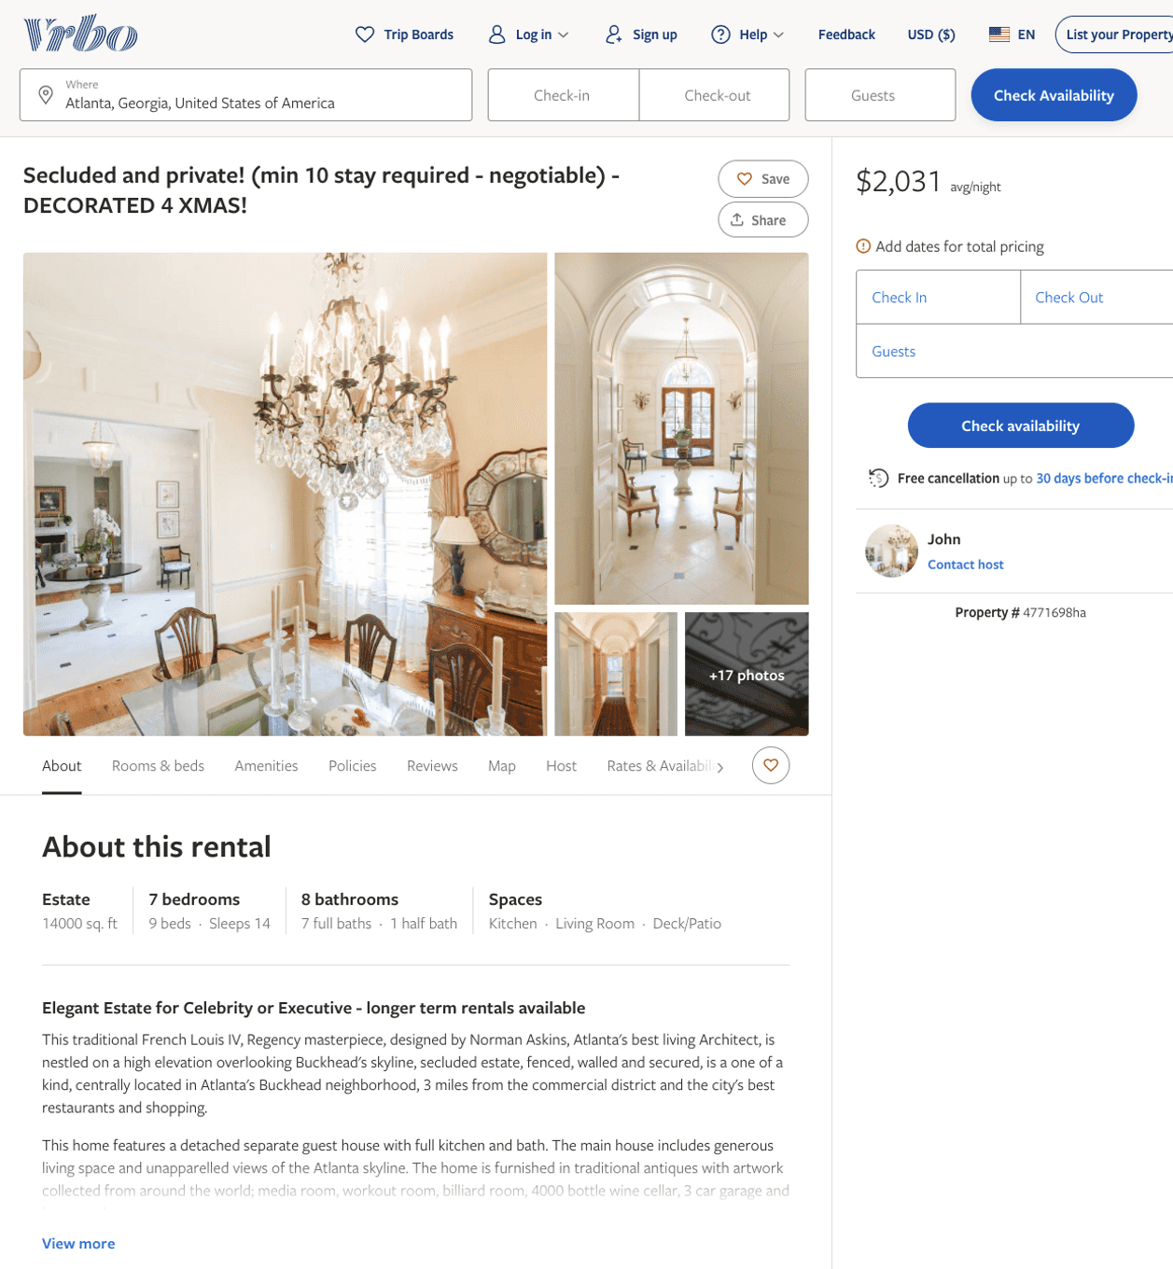
Listing 4771698
7
14
$2,031
4
John
https://www.vrbo.com/4771698ha
Aug 2022

Slide 3
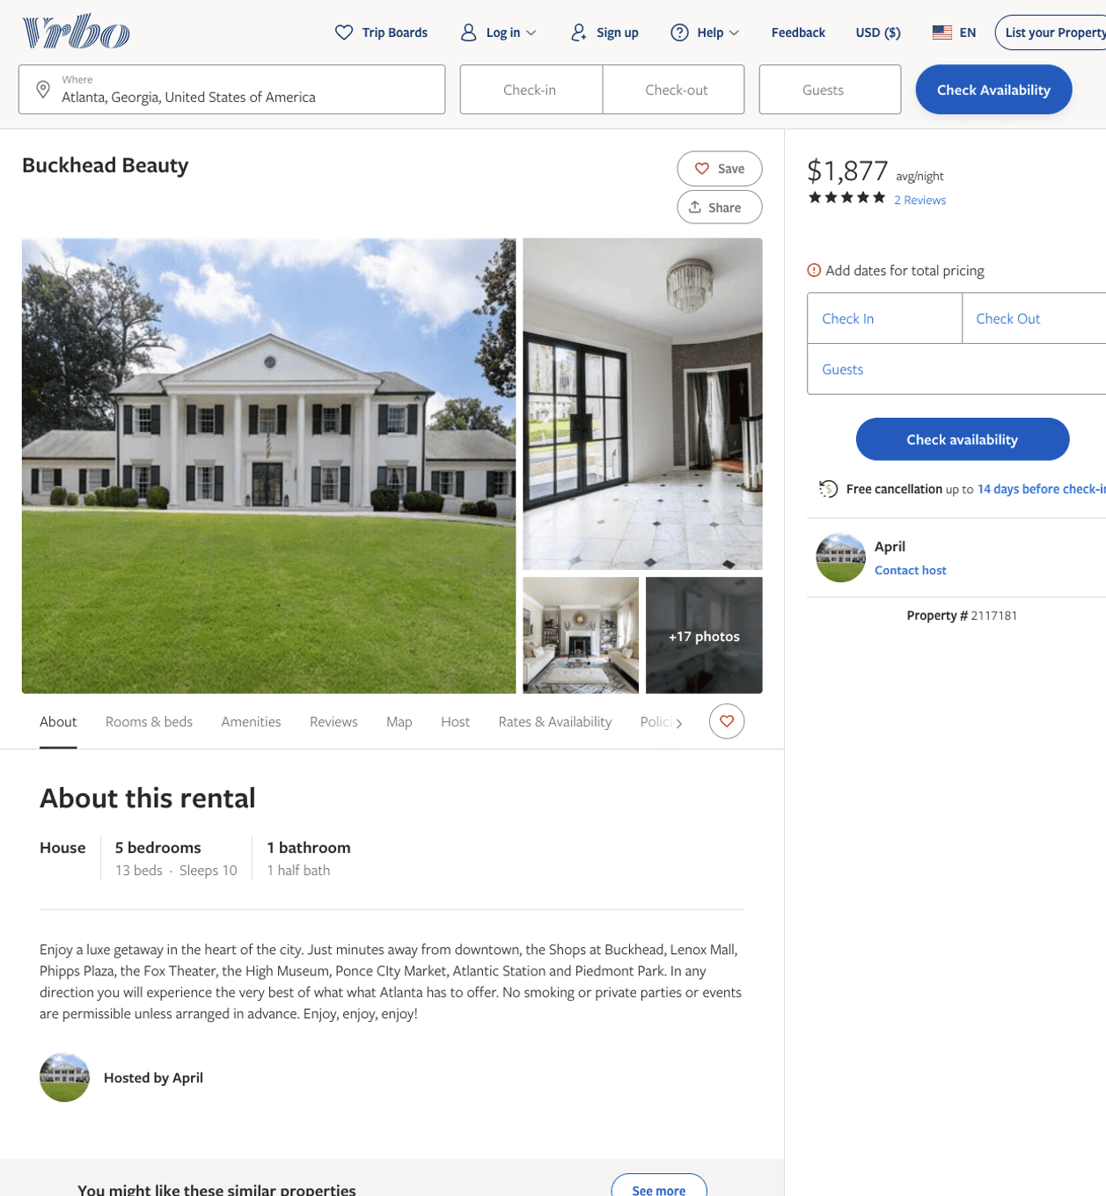
Listing 2117181
5
10
$1,876 - $1,989
5
3
April
https://www.vrbo.com/2117181
Aug 2022

Slide 4
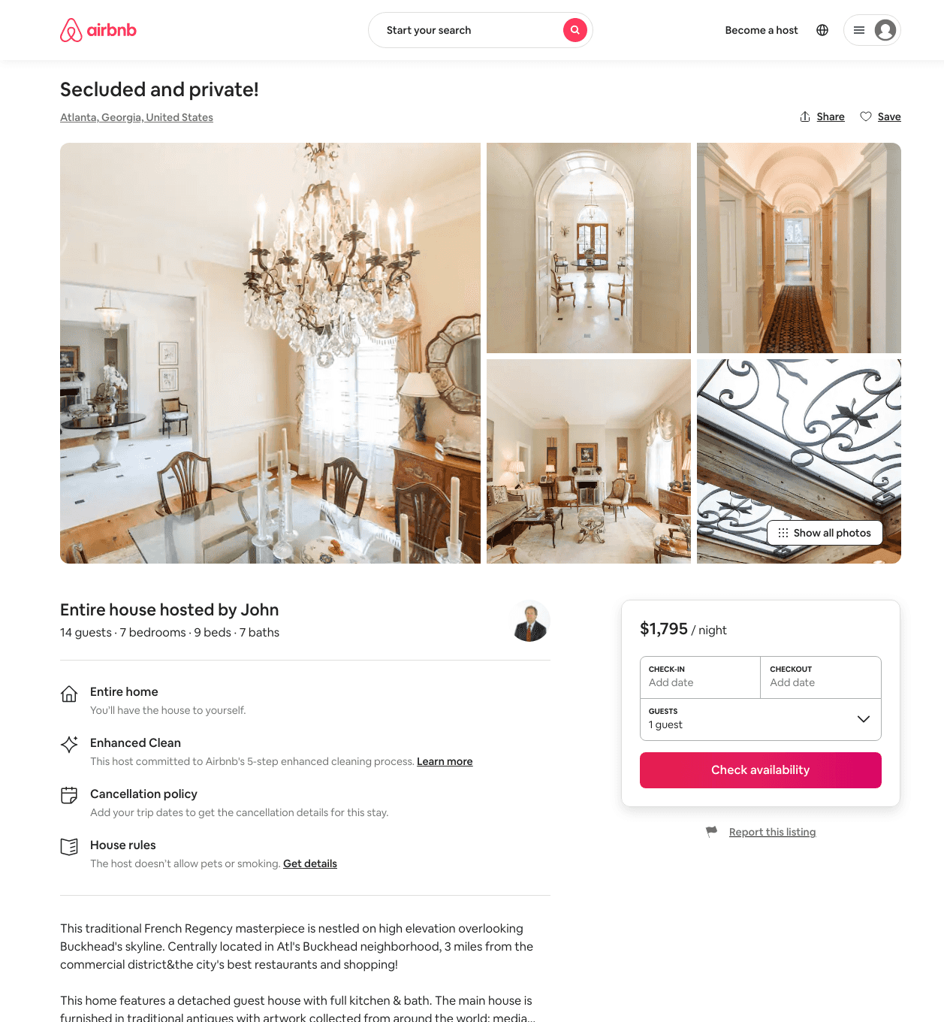
Listing 32067818
7
12
$1795 - $2995
5
John
67809867
1
https://www.airbnb.com/rooms/32067818
Aug 2022

Slide 5
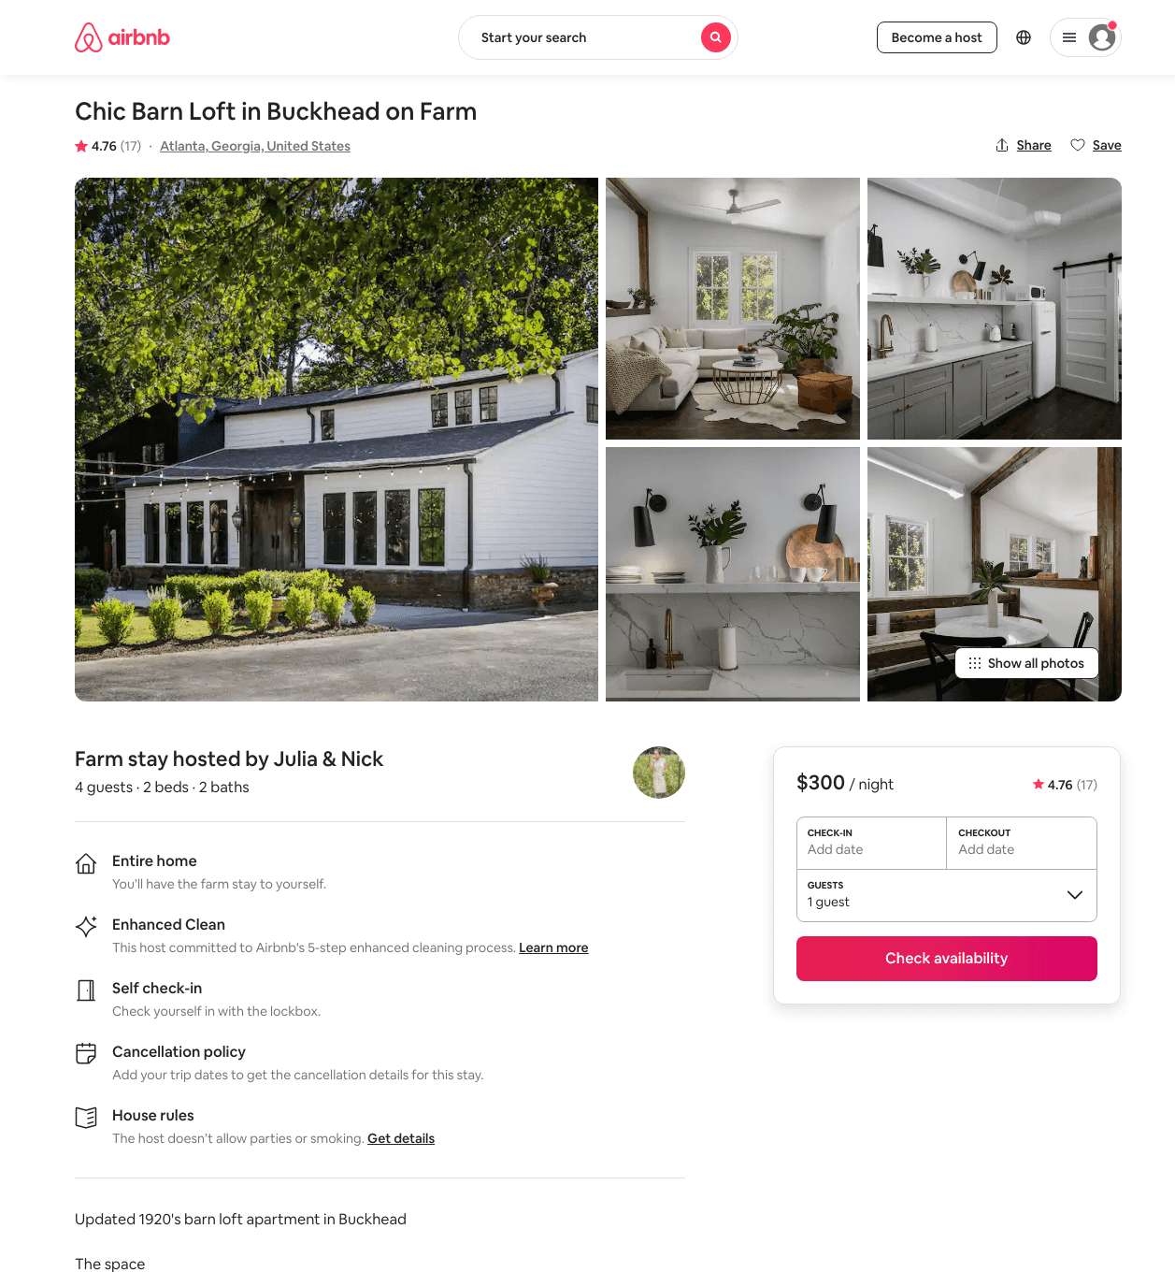
Listing 41153248
4
$261 - $347
4.86
3
Julia & Nick
12598618
1
https://www.airbnb.com/rooms/41153248
Jul 2022

