Slide 2
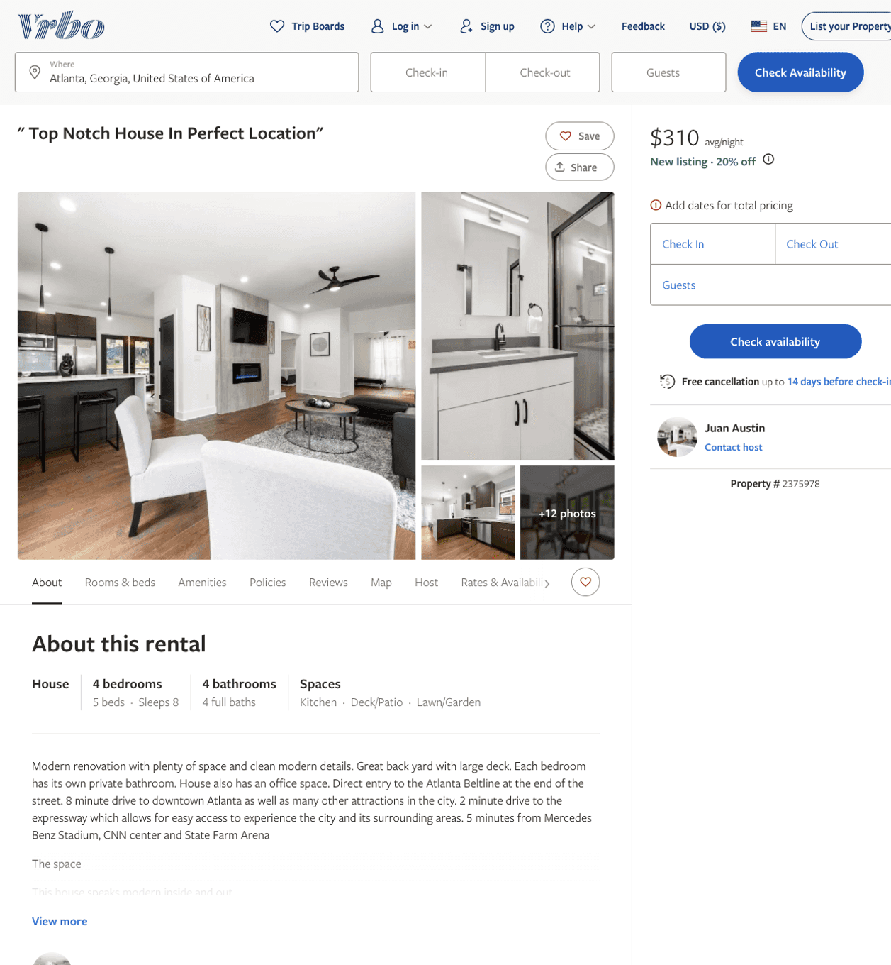
Listing 2375978
4
8
$310 - $354
4.75
2
Juan Austin
https://www.vrbo.com/2375978
Aug 2022

Slide 3
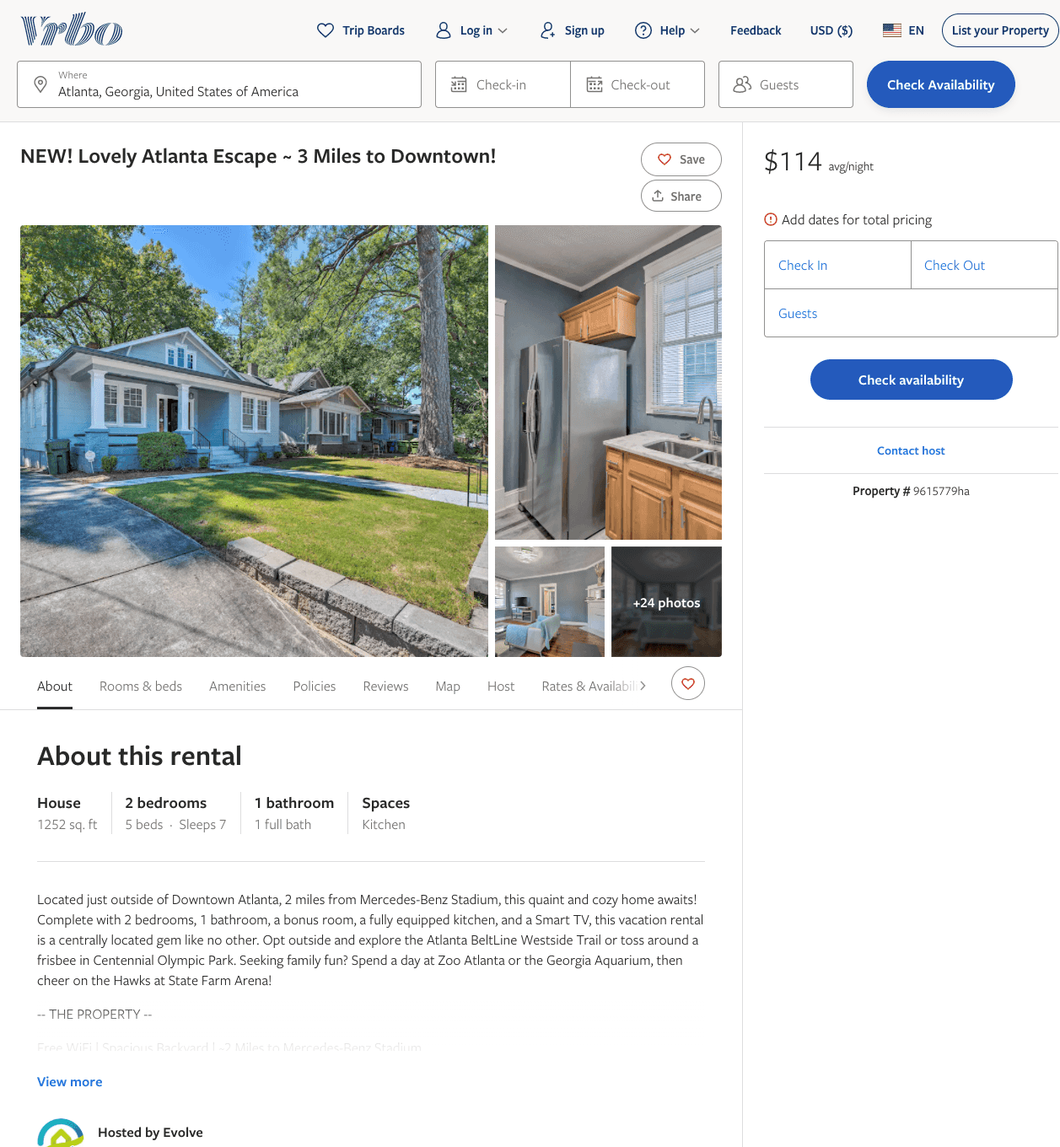
Listing 9615779
2
7
$104 - $97
2
Evolve
https://www.vrbo.com/9615779ha
Aug 2022

Slide 4
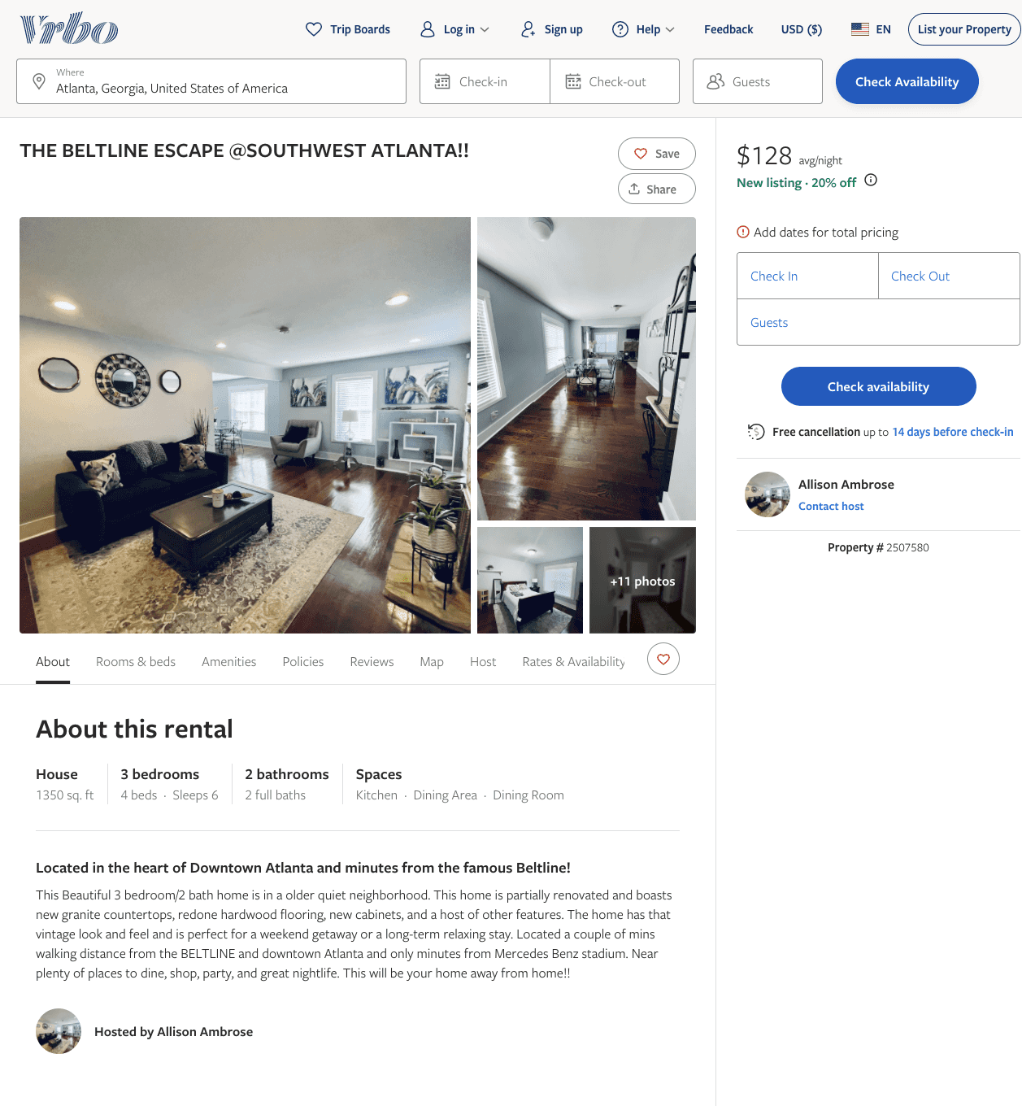
Listing 2507580
3
6
$125 - $134
5
2
Allison Ambrose
https://www.vrbo.com/2507580
Aug 2022

Slide 5
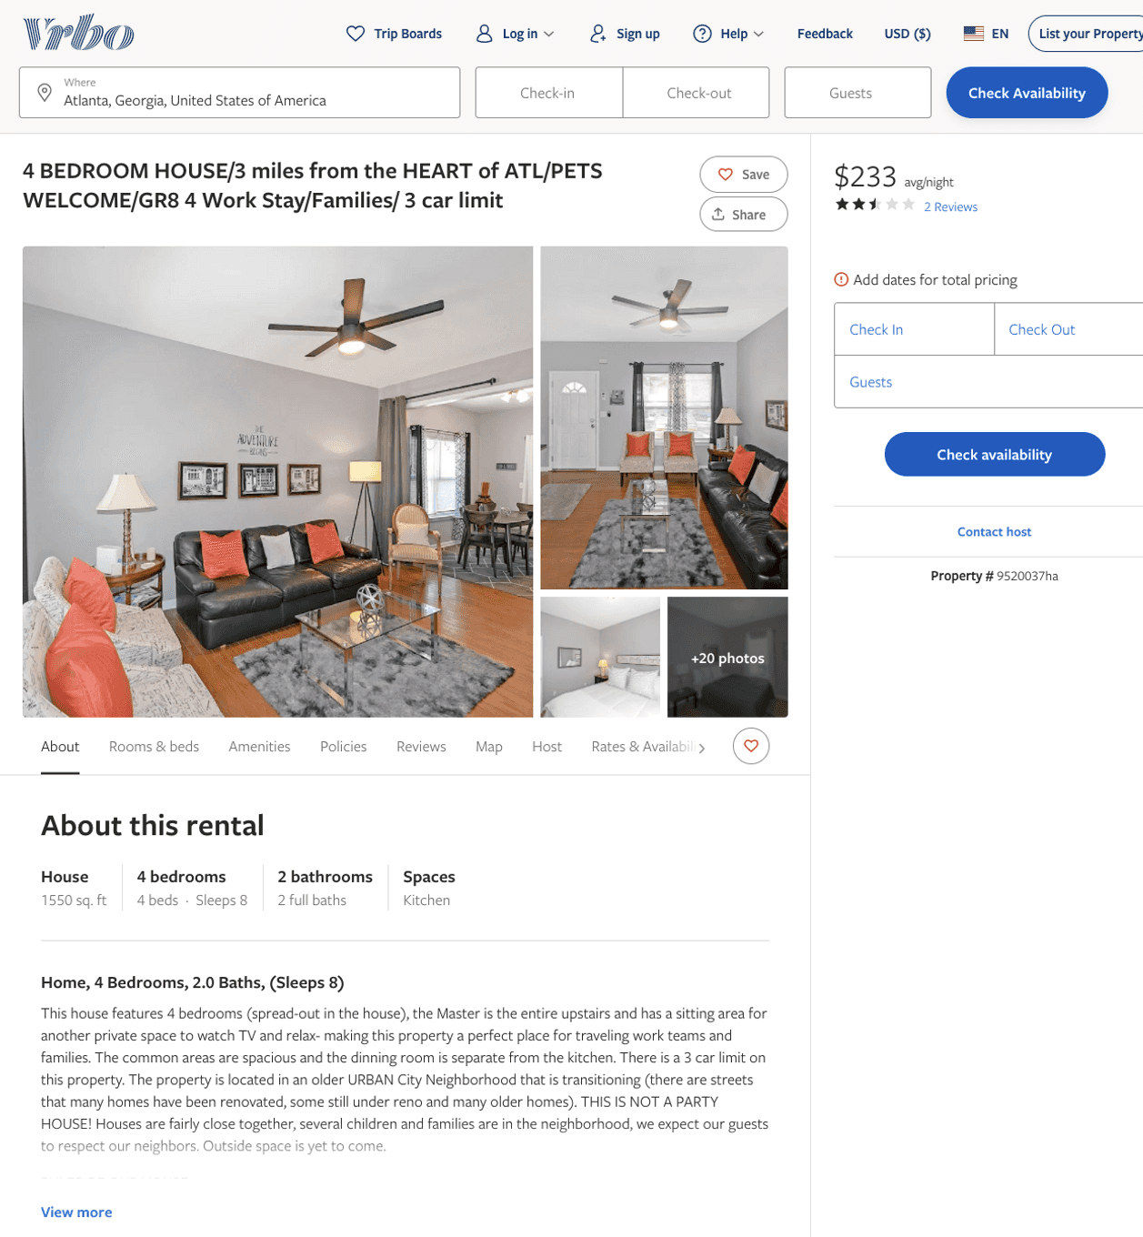
Listing 9520037
4
8
$115 - $233
4
2
https://www.vrbo.com/9520037ha
Aug 2022

Slide 6
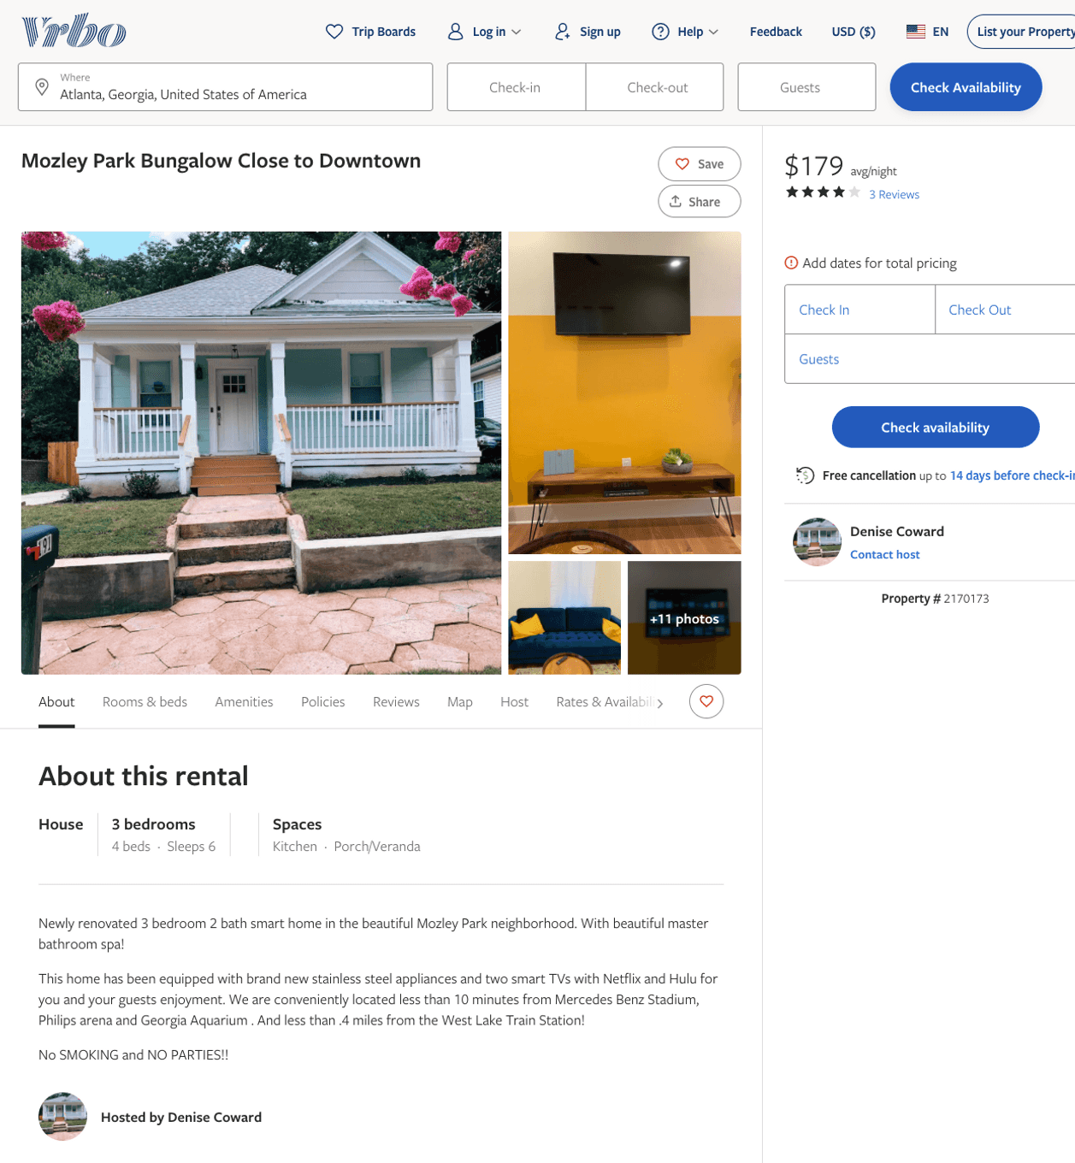
Listing 2170173
3
6
$150 - $179
4
2
Denise Coward
https://www.vrbo.com/2170173
Aug 2022

Slide 7
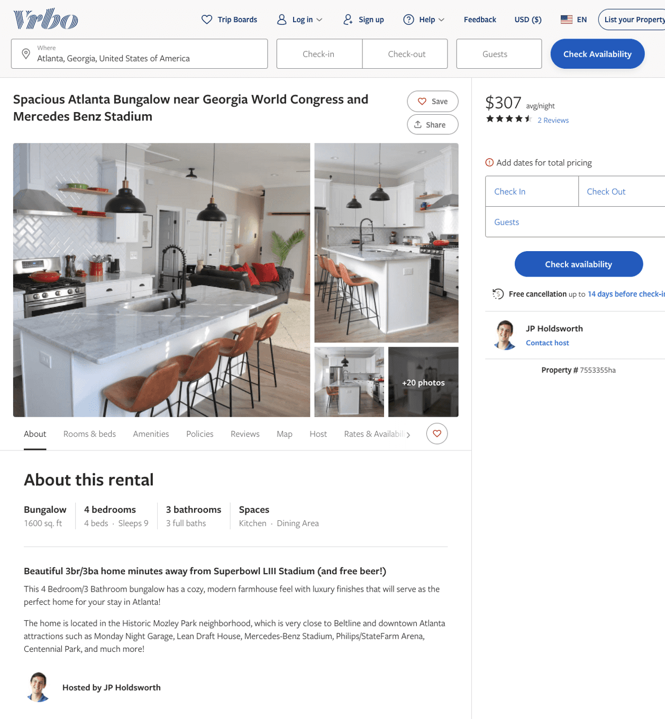
Listing 7553355
4
9
$237 - $307
4.5
3
JP Holdsworth
https://www.vrbo.com/7553355ha
Aug 2022

Slide 8
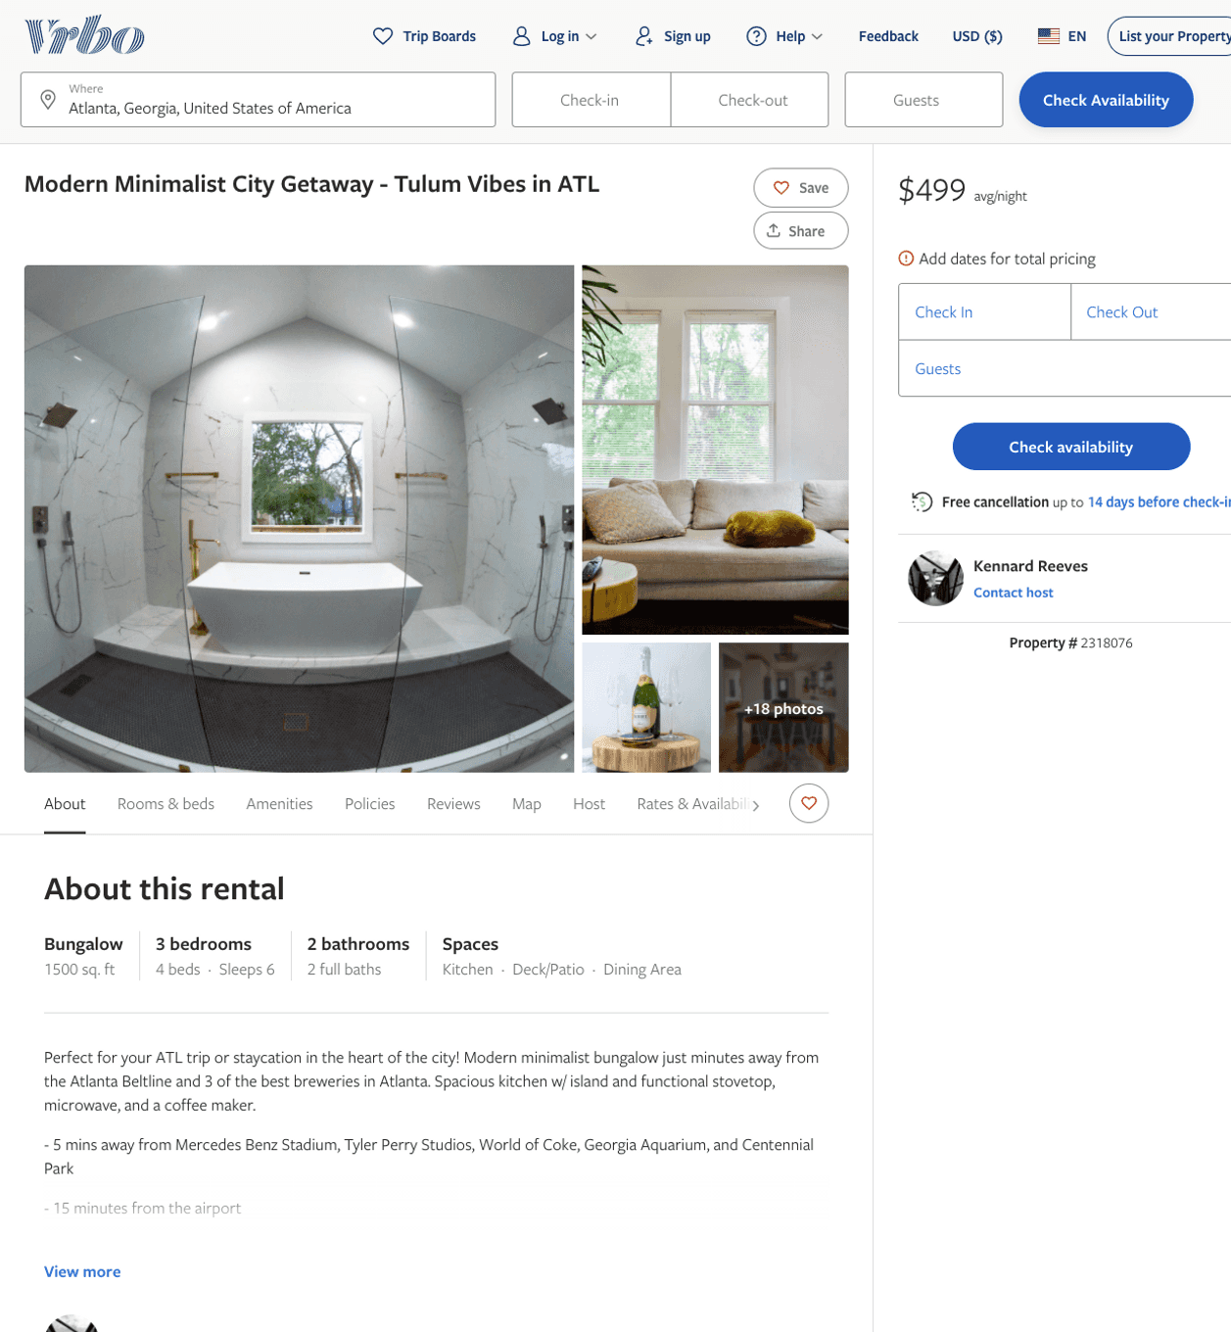
Listing 2318076
3
6
$250 - $499
5
2
Nardo
https://www.vrbo.com/2318076
Aug 2022

Slide 9
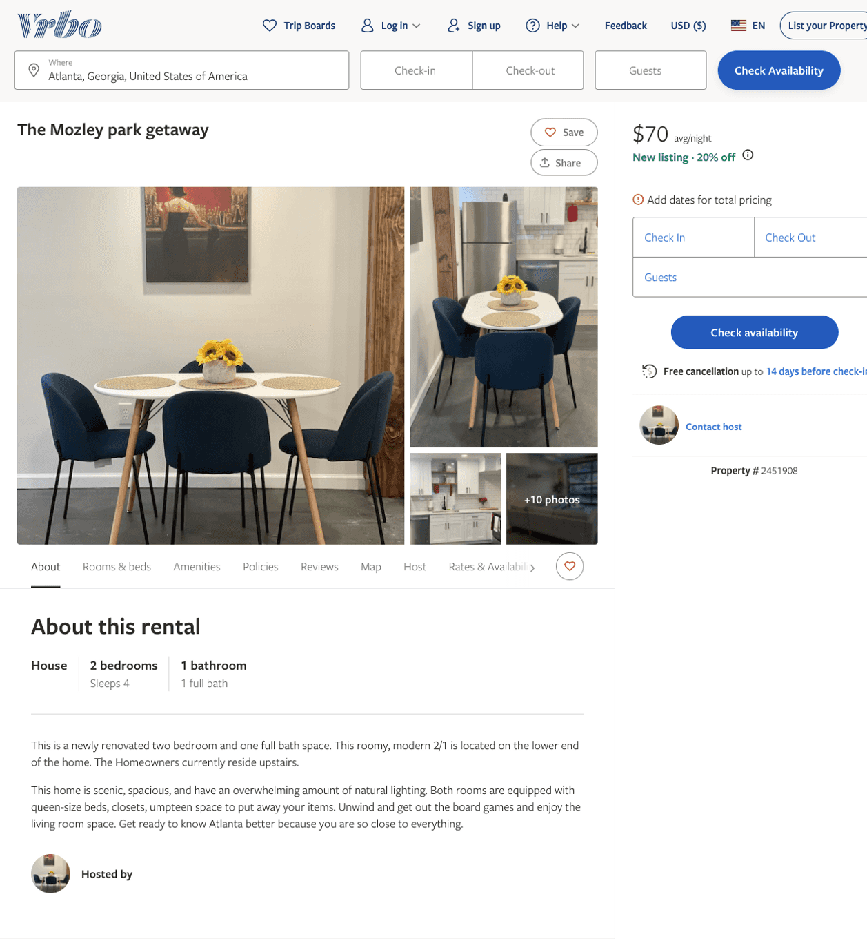
Listing 2451908
2
4
$70 - $90
4.5
2
Claudia Joseph
https://www.vrbo.com/2451908
Aug 2022

Slide 10
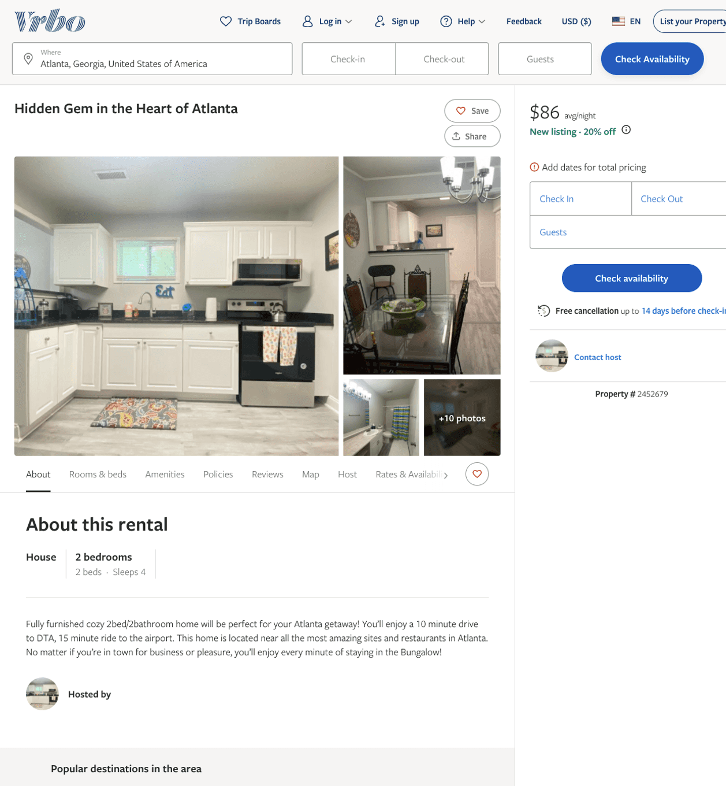
Listing 2452679
2
4
$86
1
https://www.vrbo.com/2452679
Aug 2022

Slide 11
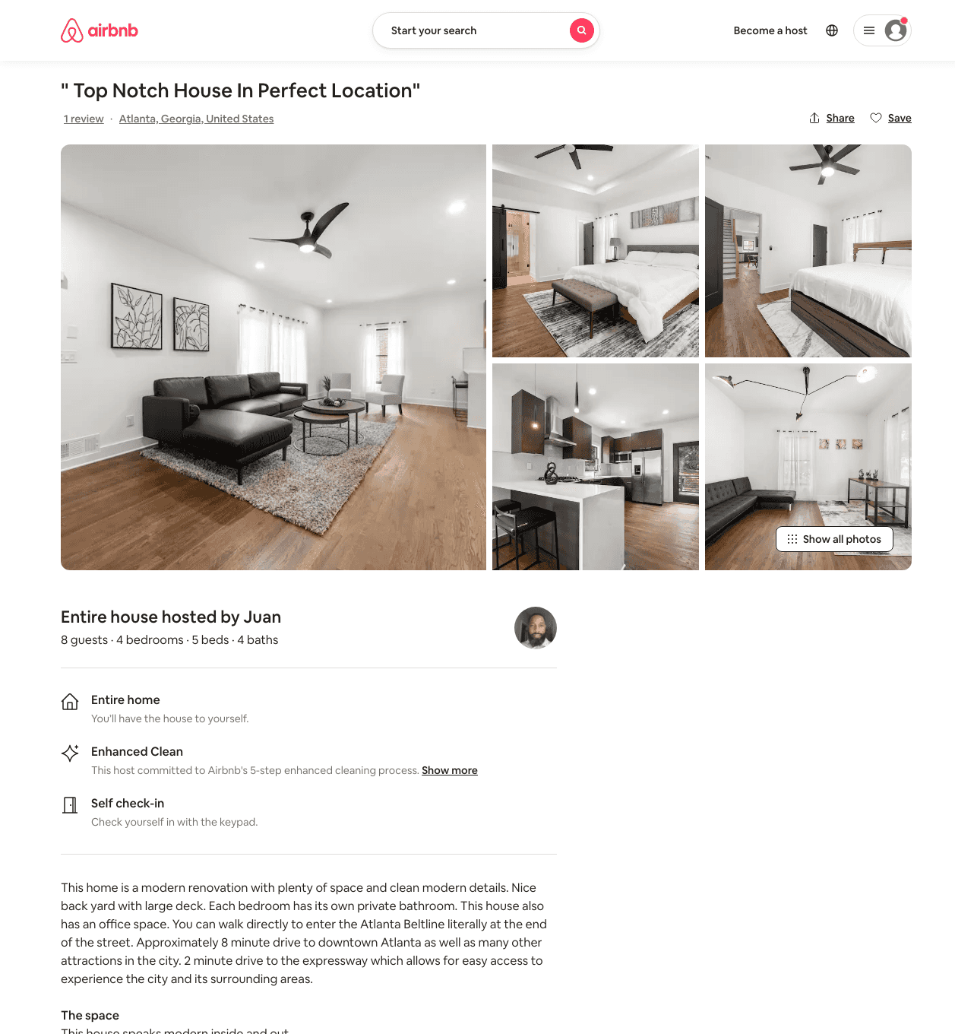
Listing 49737996
4
8
$275 - $503
4.80
2
Juan
401144852
1
https://www.airbnb.com/rooms/49737996
Aug 2022

Slide 12
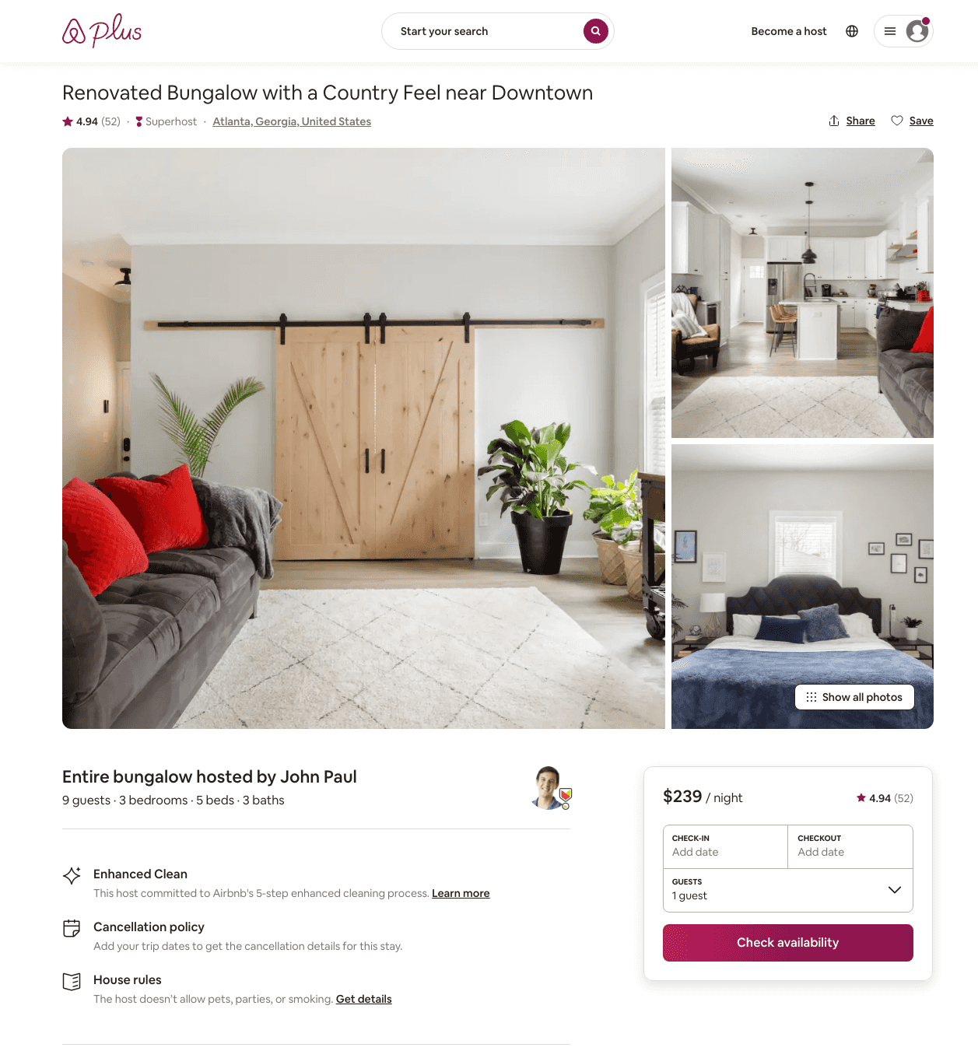
Listing 30070768
3
9
$212 - $472
4.92
3
John Paul
26182238
1
https://www.airbnb.com/rooms/30070768
Aug 2022

Slide 13
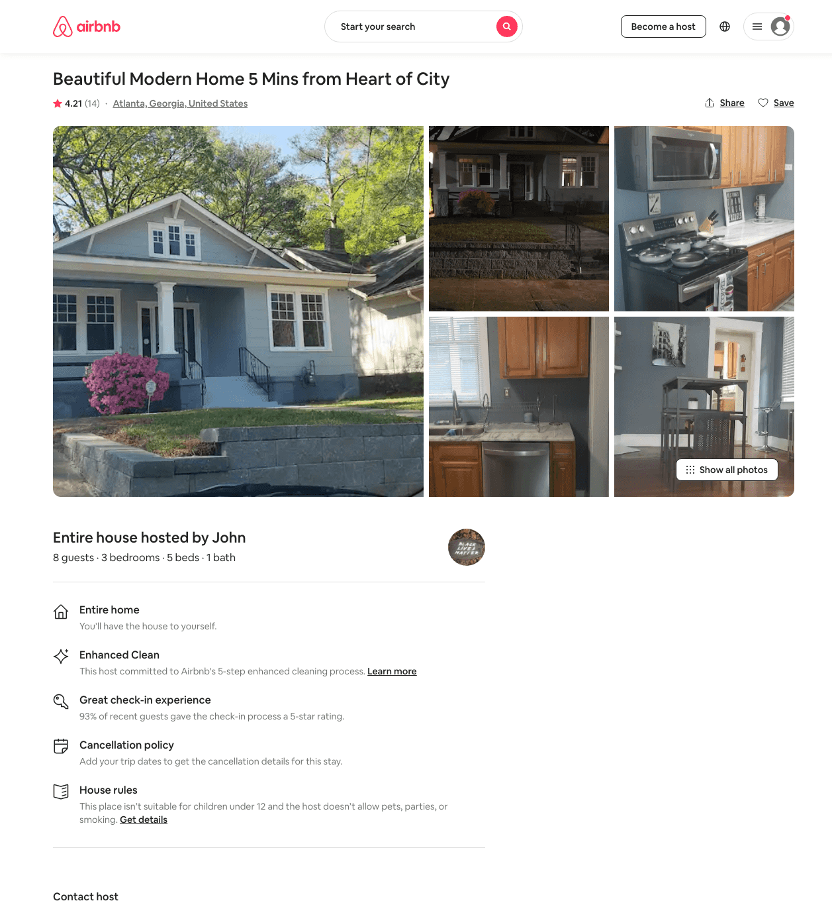
Listing 44611893
3
6
$150 - $269
4.33
2
John
106560156
1
https://www.airbnb.com/rooms/44611893
Jun 2022

Slide 14
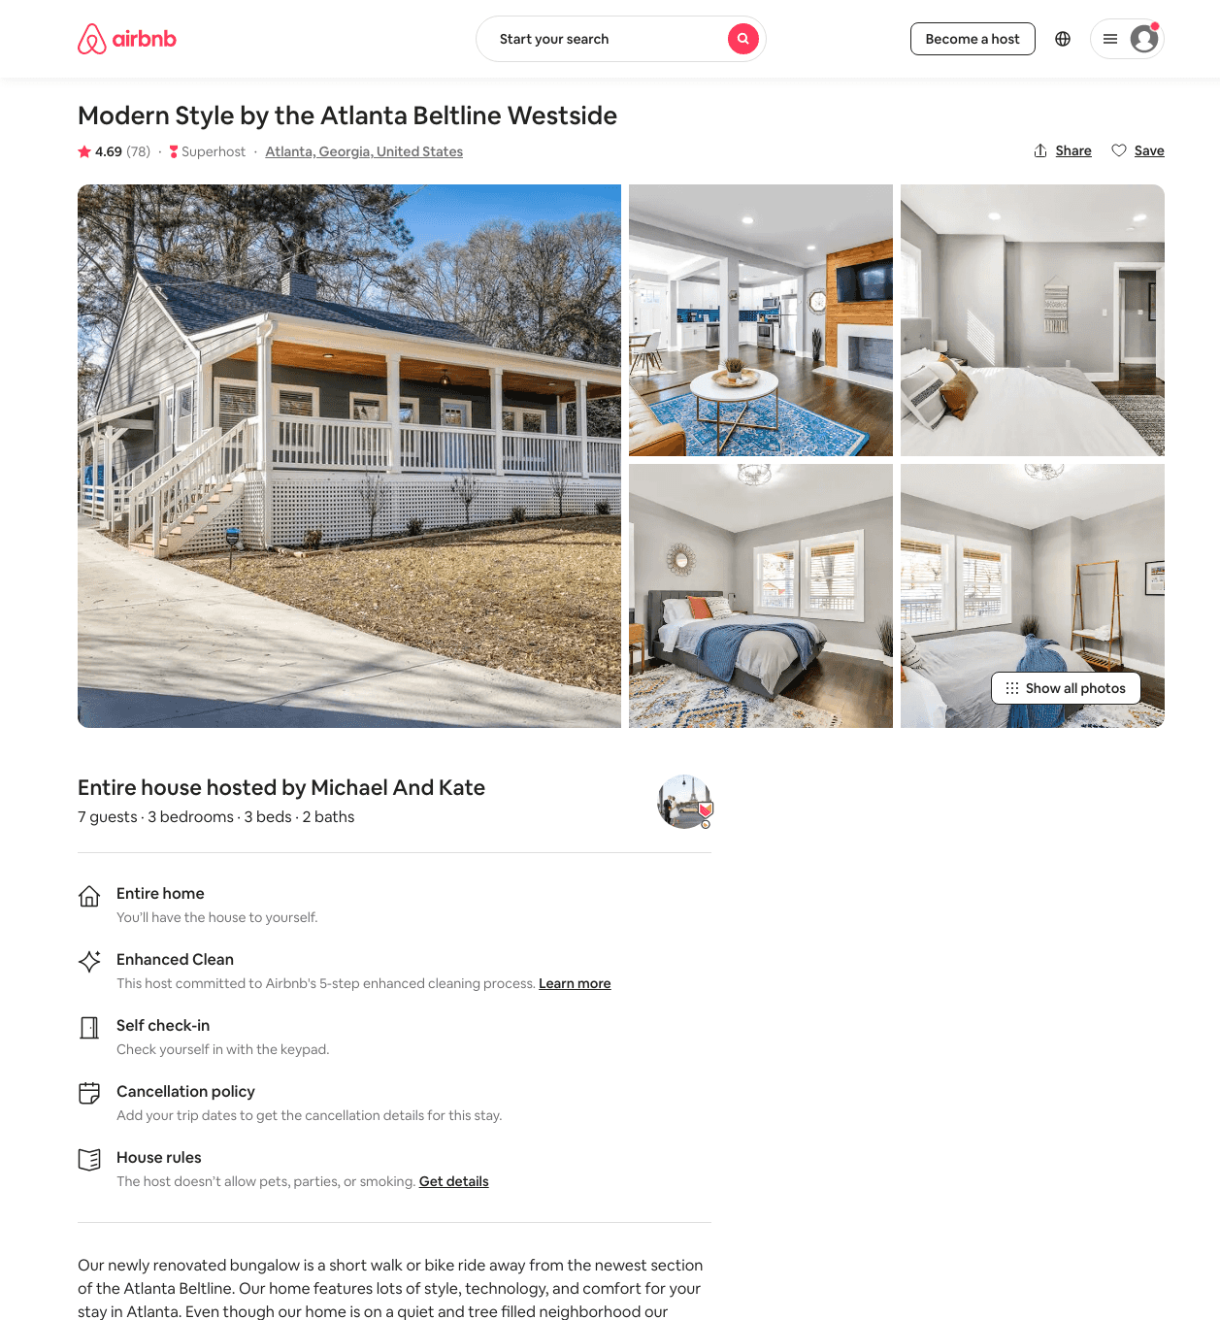
Listing 41505247
3
7
$117 - $222
4.69
1
Riaz
318845375
2
https://www.airbnb.com/rooms/41505247
Aug 2022

Slide 15
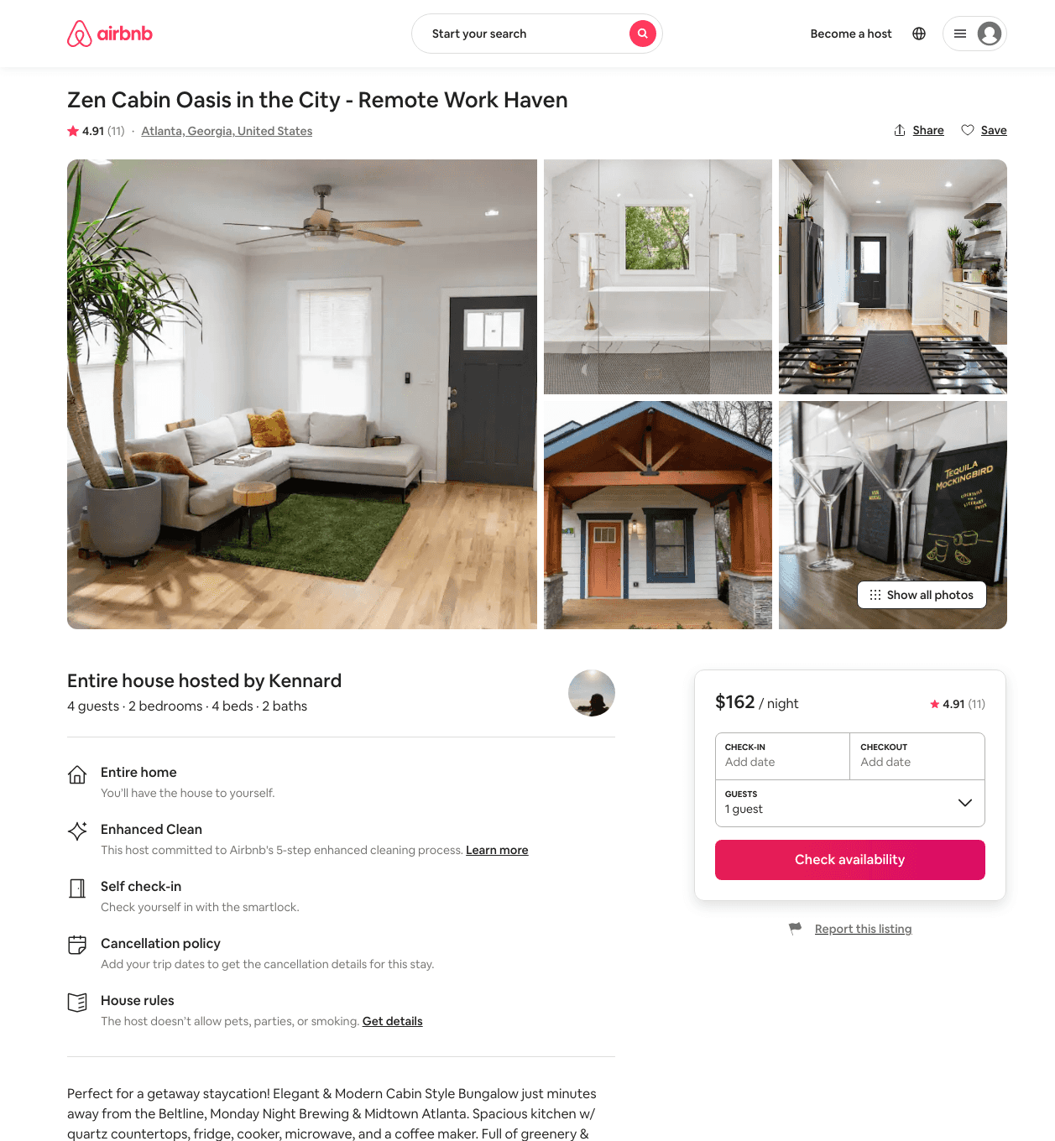
Listing 47327583
2
5
$151 - $413
4.80
2
Kennard
382132162
1
https://www.airbnb.com/rooms/47327583
Aug 2022

Slide 16
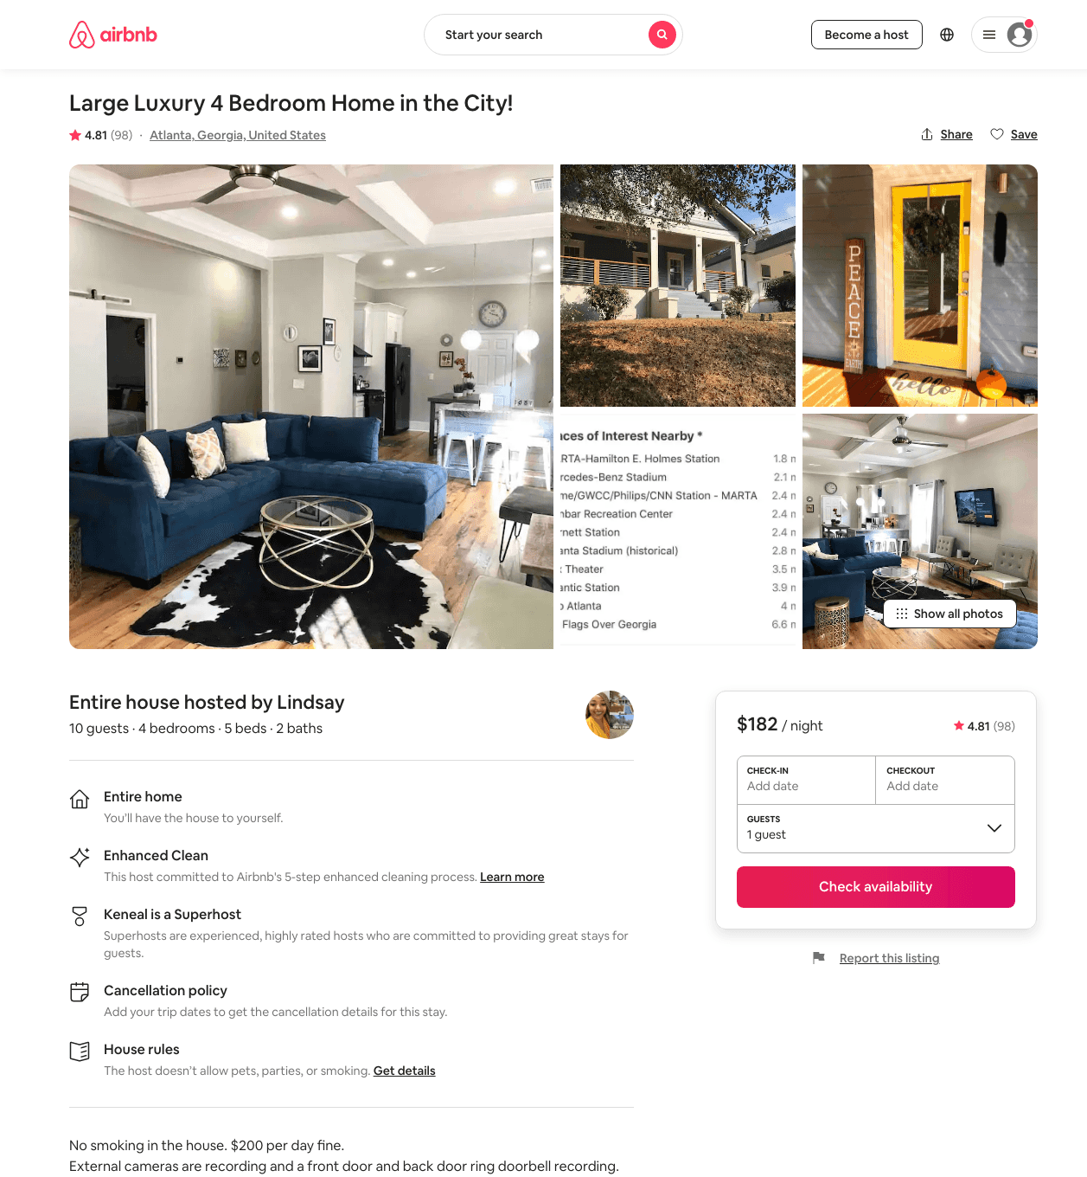
Listing 38664572
4
10
$171 - $286
4.66
2
Lindsay
101857797
1
https://www.airbnb.com/rooms/38664572
Aug 2022

Slide 17
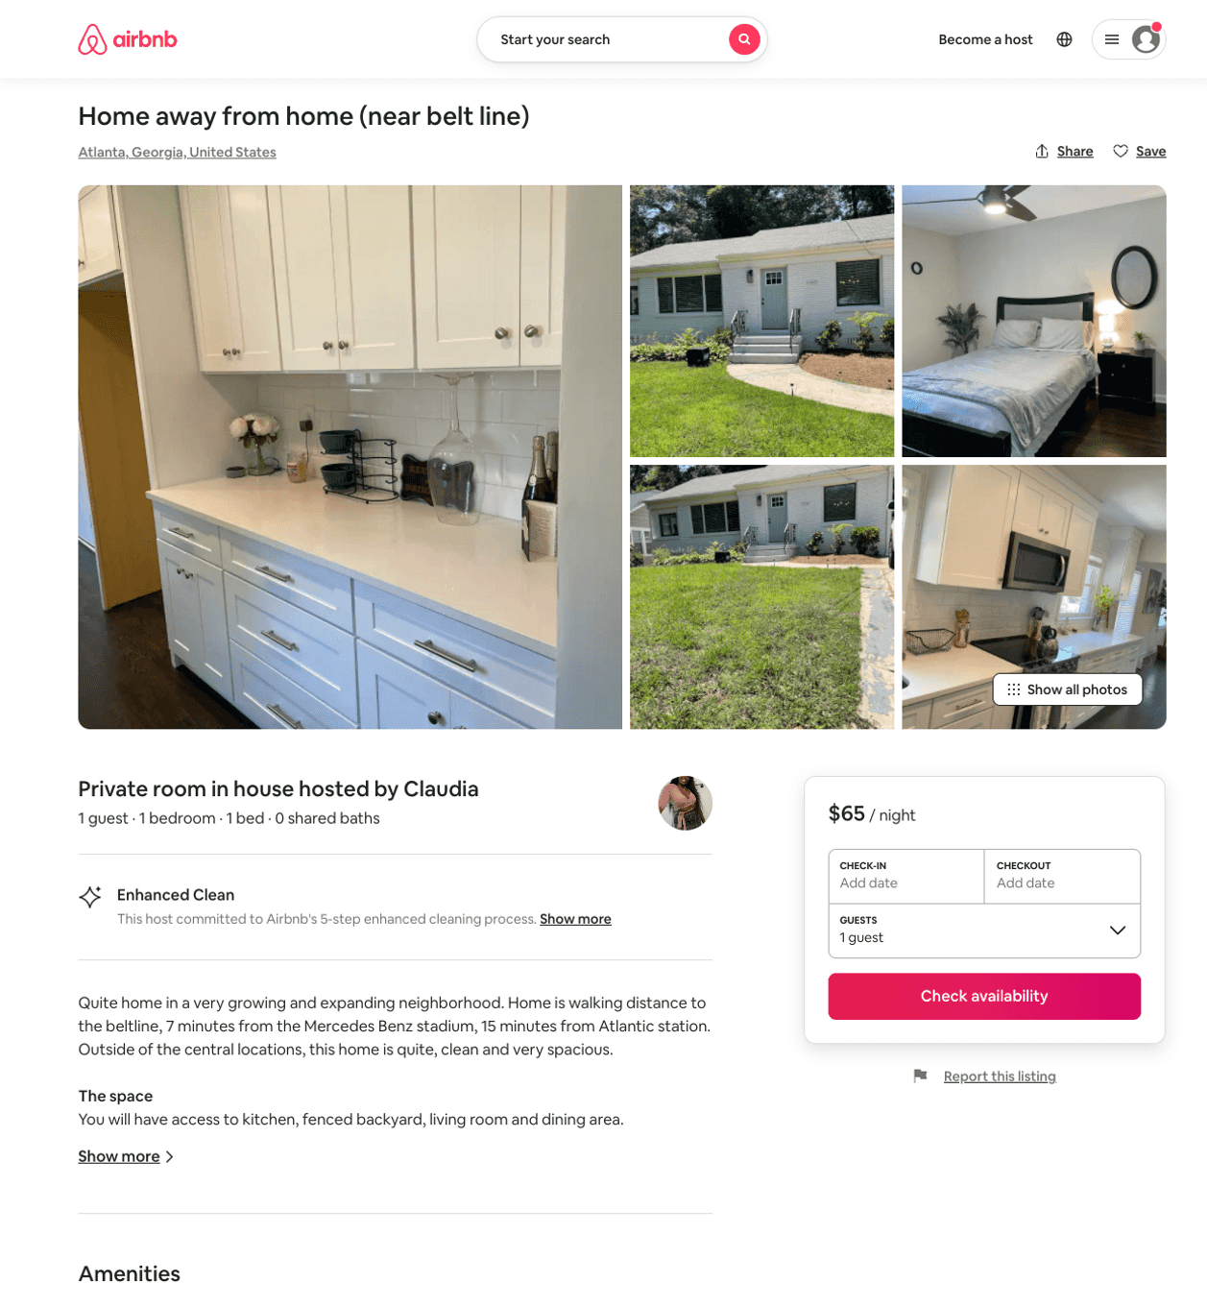
Listing 50416244
1
2
$49 - $65
4.63
2
Claudia
119922285
6
https://www.airbnb.com/rooms/50416244
Aug 2022

Slide 18
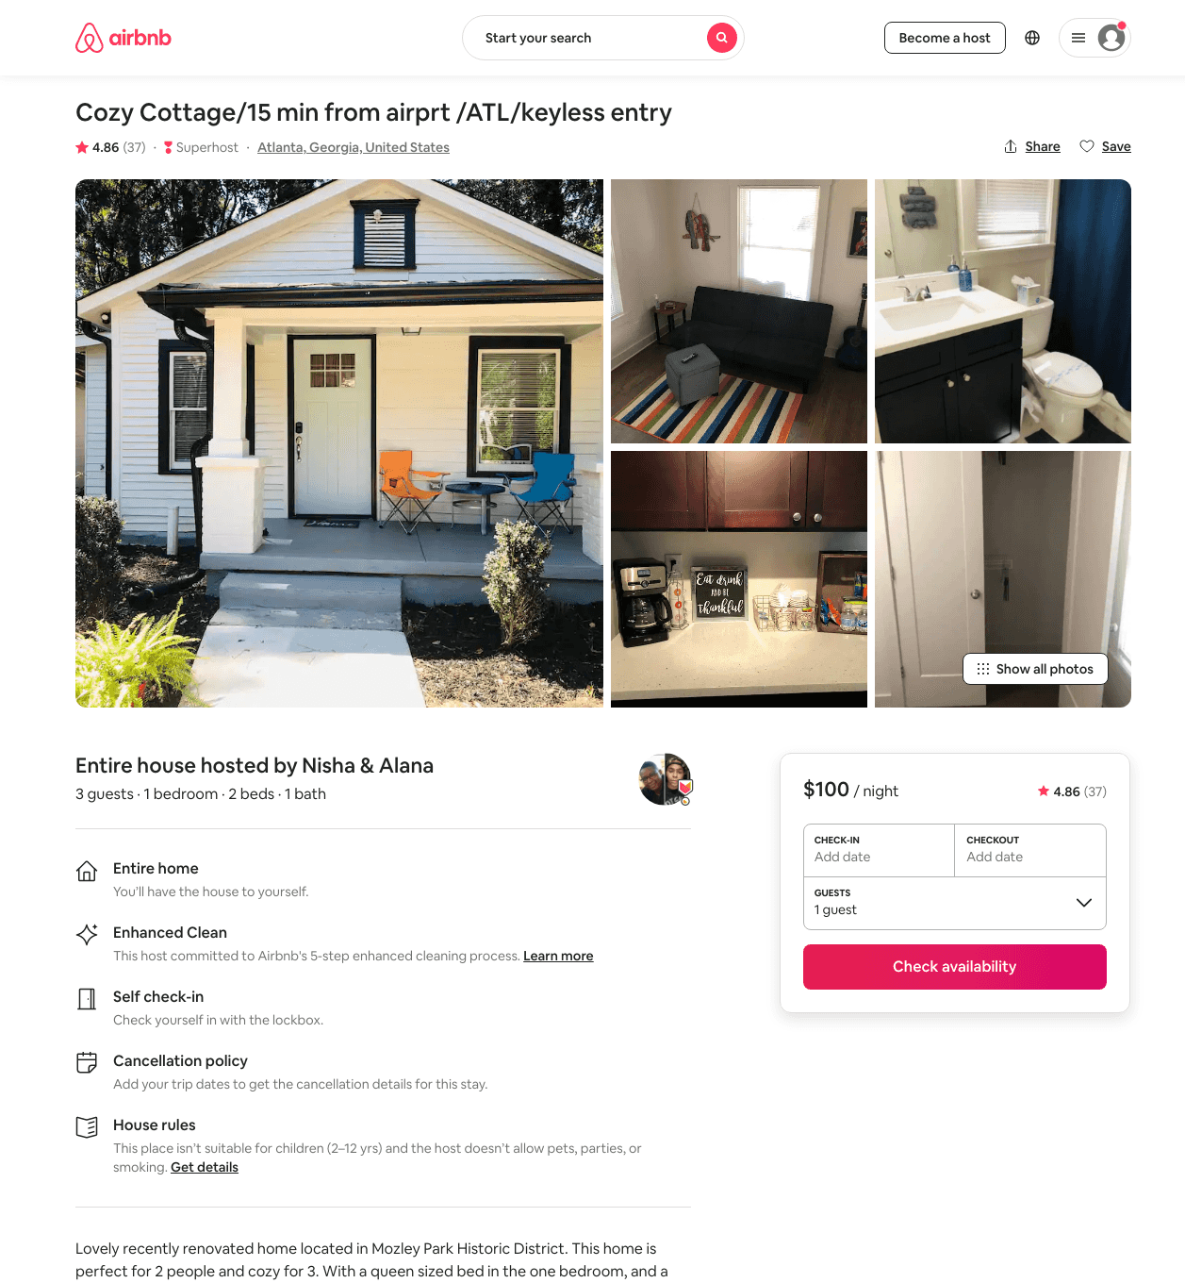
Listing 44658392
1
2
$77 - $111
4.80
1
Ariginal Properties
361560090
1
https://www.airbnb.com/rooms/44658392
Jul 2022

Slide 19
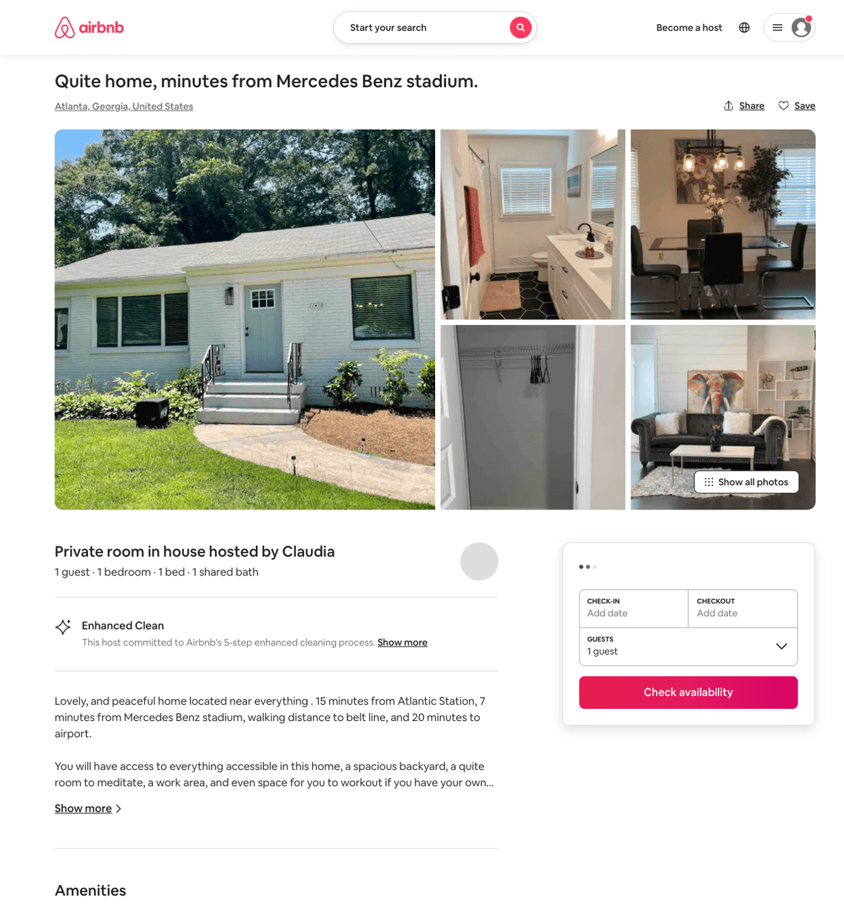
Listing 50415373
1
2
$48 - $66
5.0
2
Claudia
119922285
6
https://www.airbnb.com/rooms/50415373
Aug 2022

Slide 20
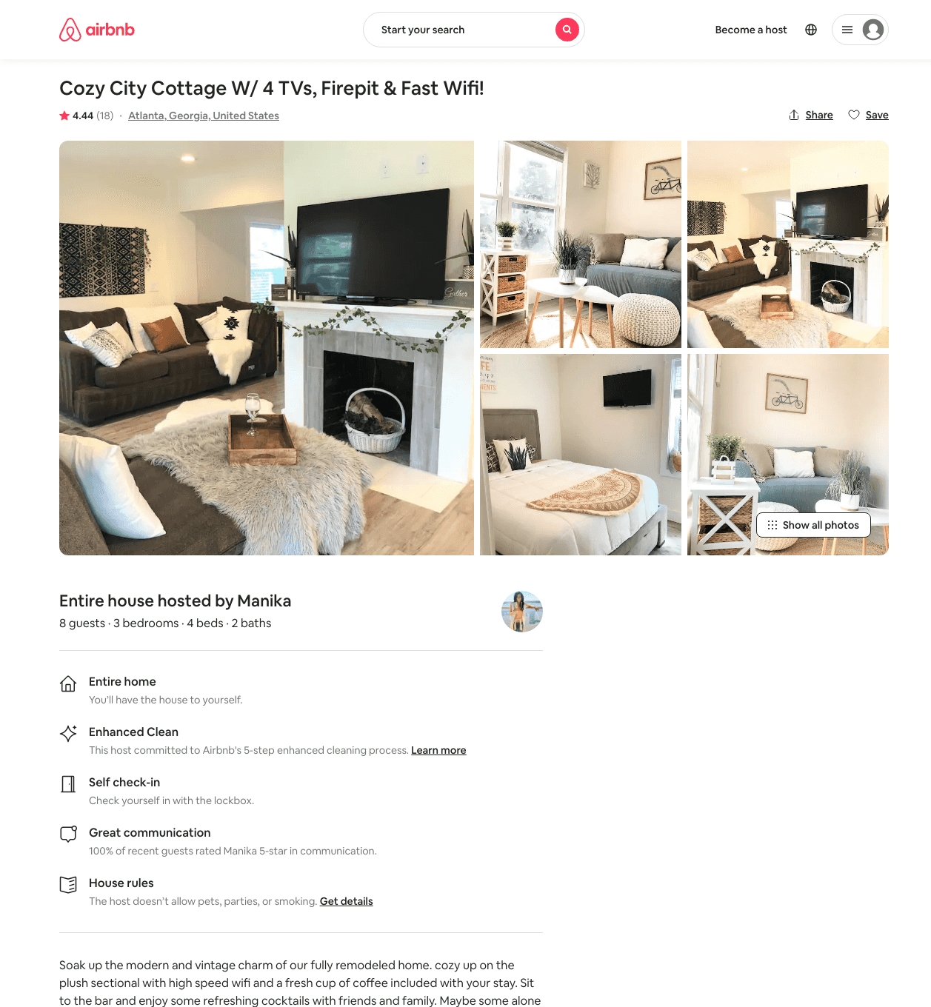
Listing 45274420
3
8
$116 - $217
4.49
2
Manika
49819100
11
https://www.airbnb.com/rooms/45274420
Aug 2022

Slide 21
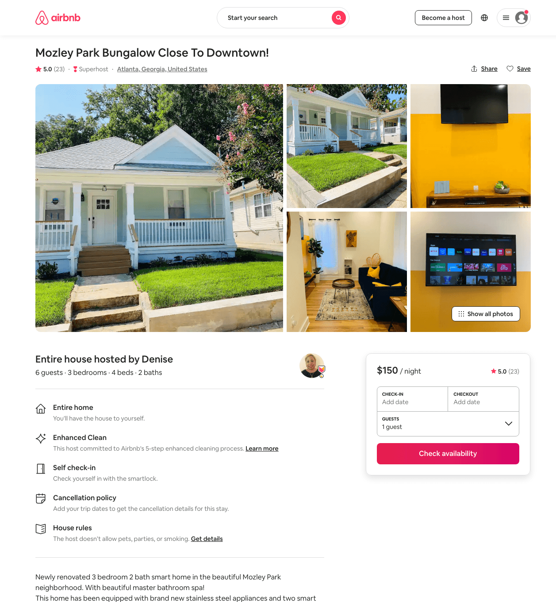
Listing 45216623
3
6
$143 - $182
4.95
1
Denise
259497631
1
https://www.airbnb.com/rooms/45216623
Aug 2022

Slide 22
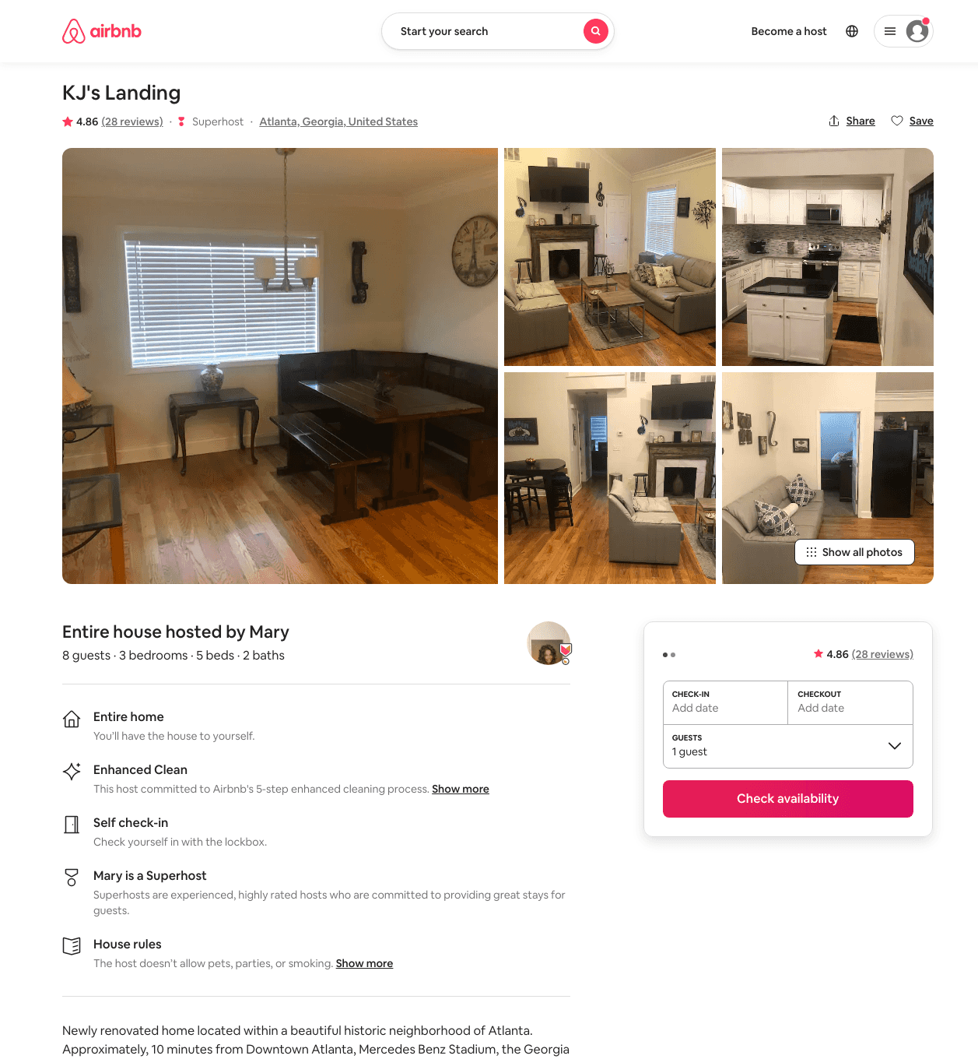
Listing 42253238
3
8
$149 - $189
4.81
2
Mary
335688876
1
https://www.airbnb.com/rooms/42253238
Aug 2022

Slide 23
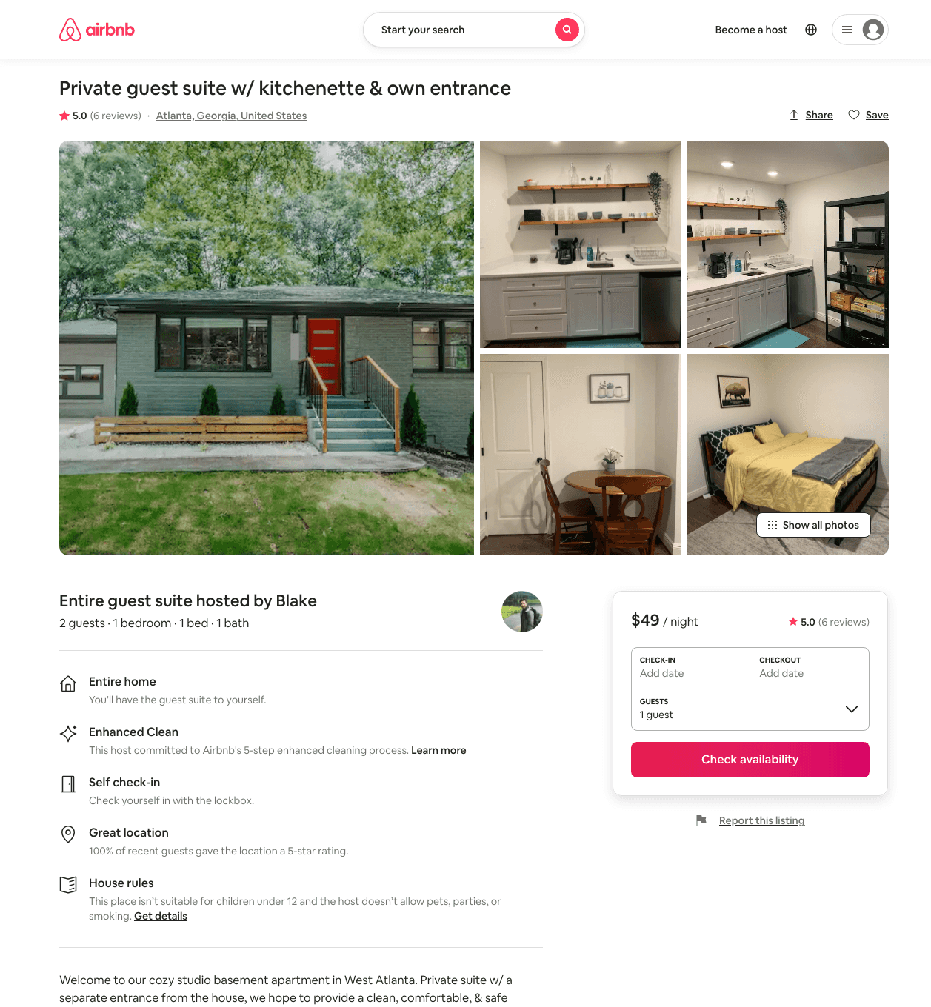
Listing 47567316
1
2
$46 - $75
4.89
2
Blake
15575696
1
https://www.airbnb.com/rooms/47567316
Aug 2022

Slide 24
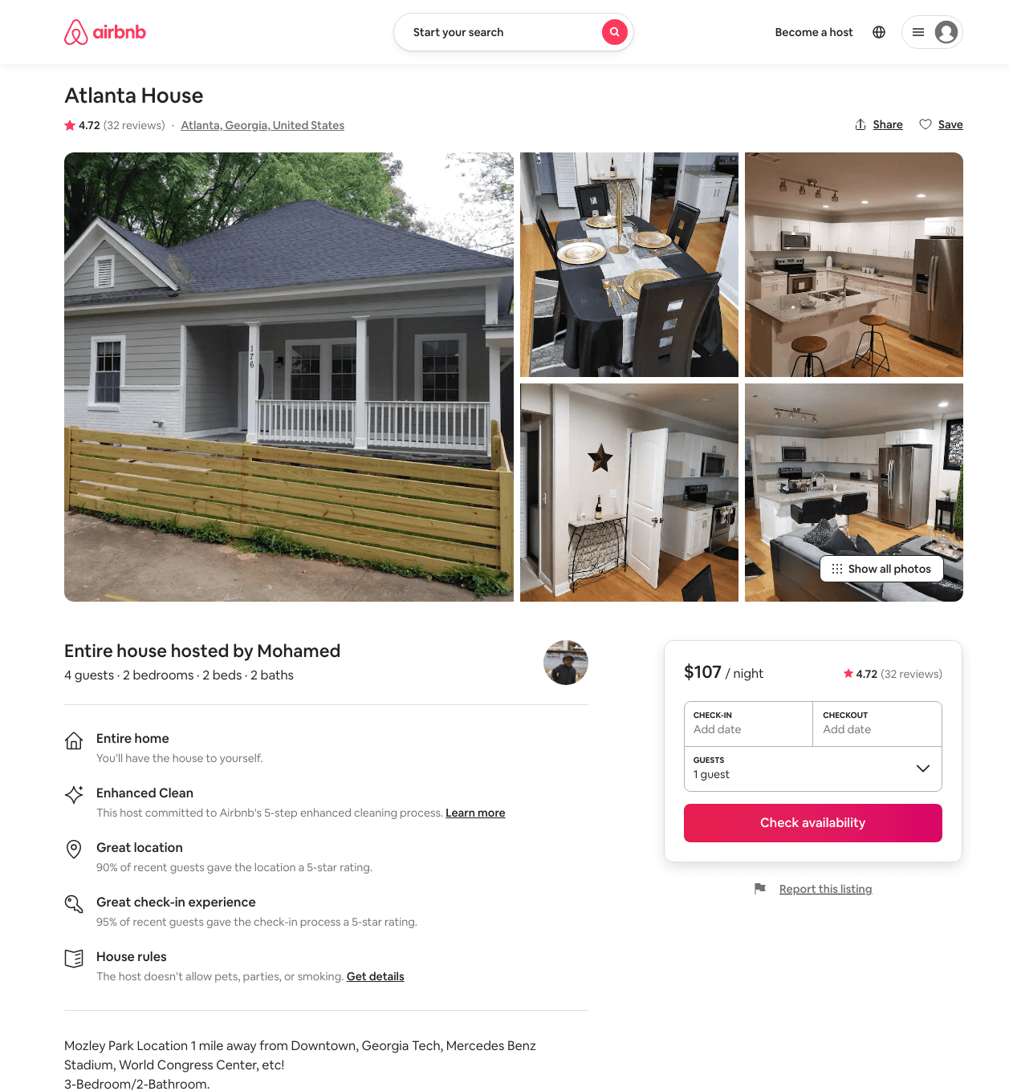
Listing 27786720
2
4
$107 - $125
4.78
1
Mohamed
196276022
1
https://www.airbnb.com/rooms/27786720
Jul 2022

Slide 25
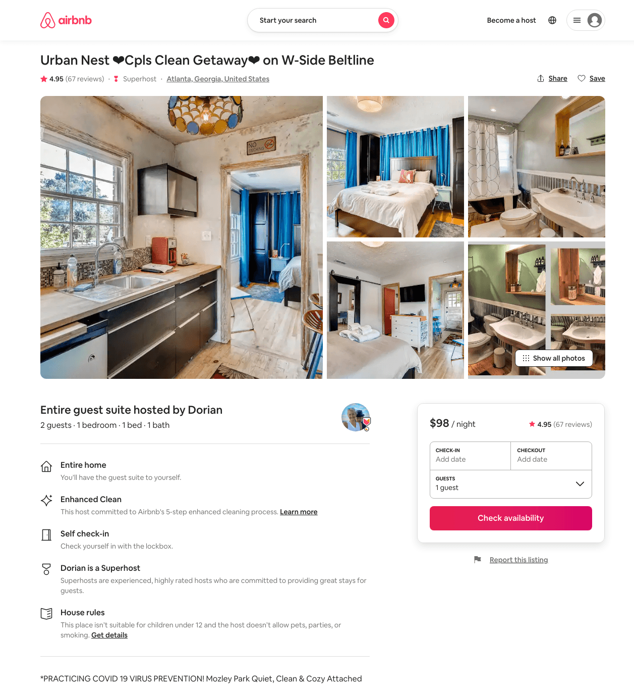
Listing 10424318
1
2
$98 - $120
4.96
5
Dorian
5977631
2
https://www.airbnb.com/rooms/10424318
Aug 2022

Slide 26
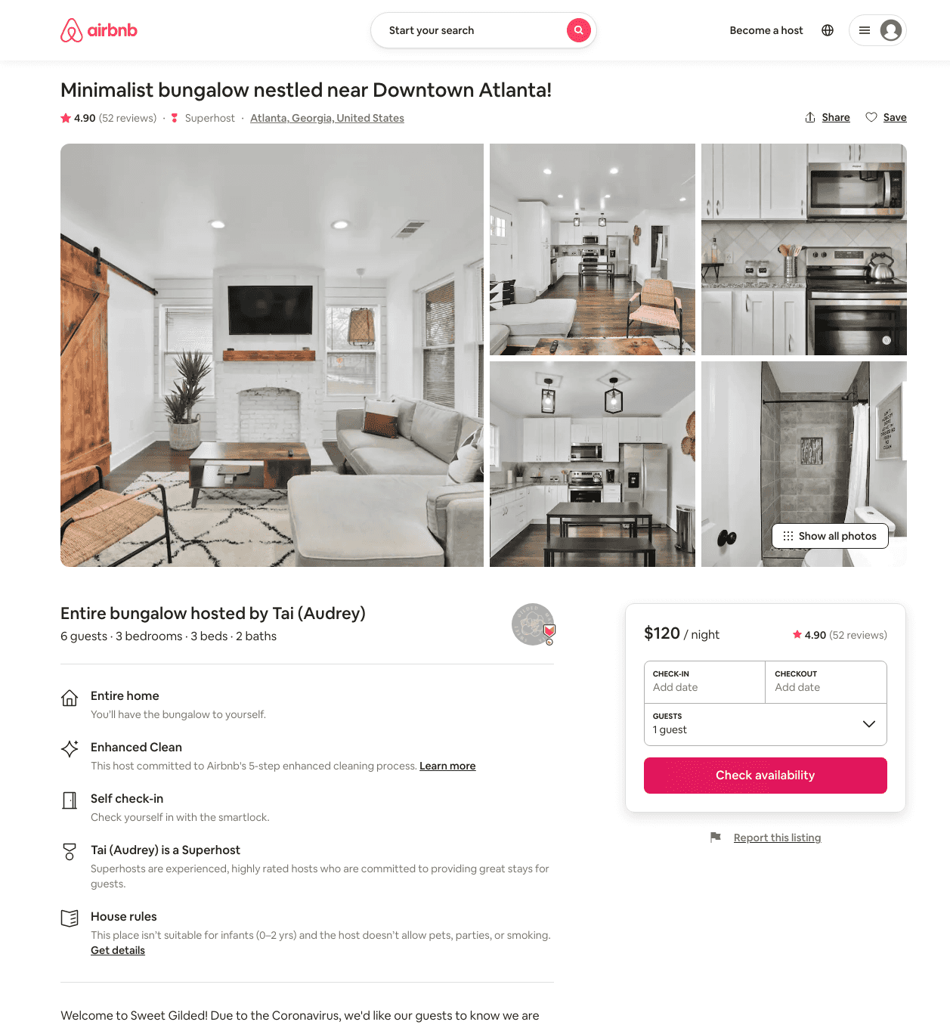
Listing 40426707
3
6
$117 - $162
4.88
2
Tai (Audrey)
312587503
1
https://www.airbnb.com/rooms/40426707
Aug 2022

Slide 27
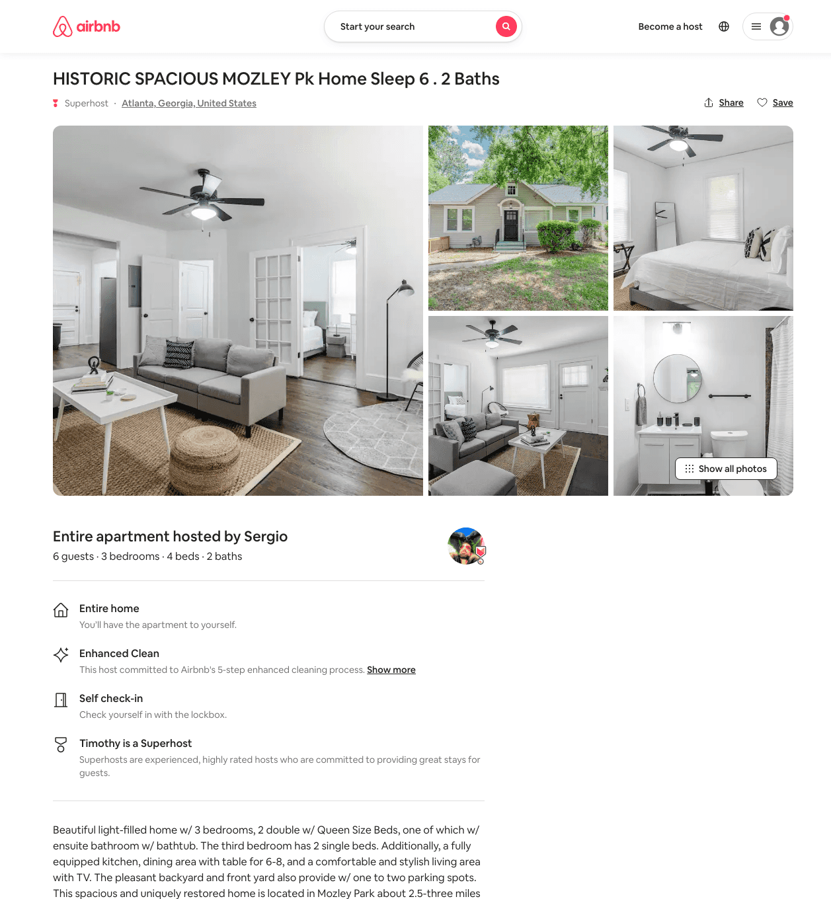
Listing 50031444
3
6
$77 - $195
4.82
2
Sergio
106508052
7
https://www.airbnb.com/rooms/50031444
Aug 2022

Slide 28
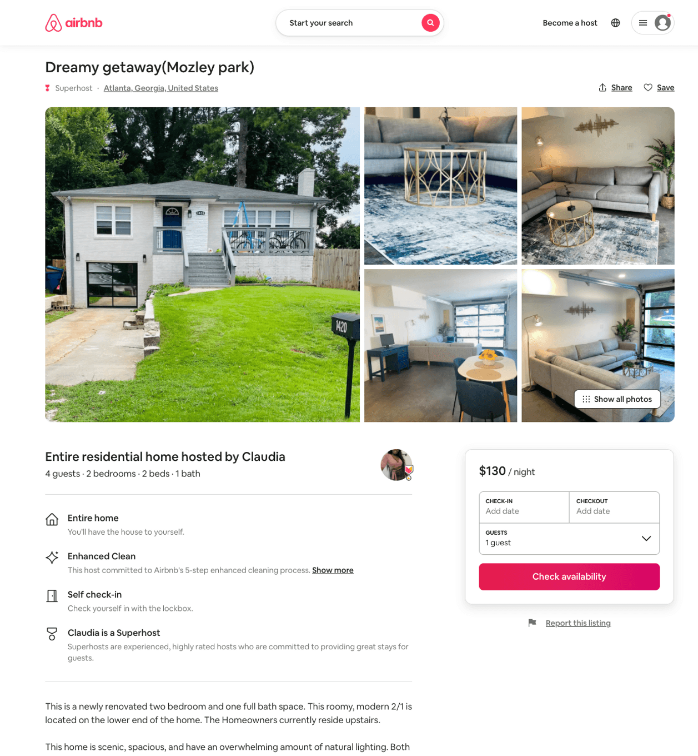
Listing 51522683
2
6
$77 - $130
4.57
2
Claudia
119922285
6
https://www.airbnb.com/rooms/51522683
Aug 2022

Slide 29
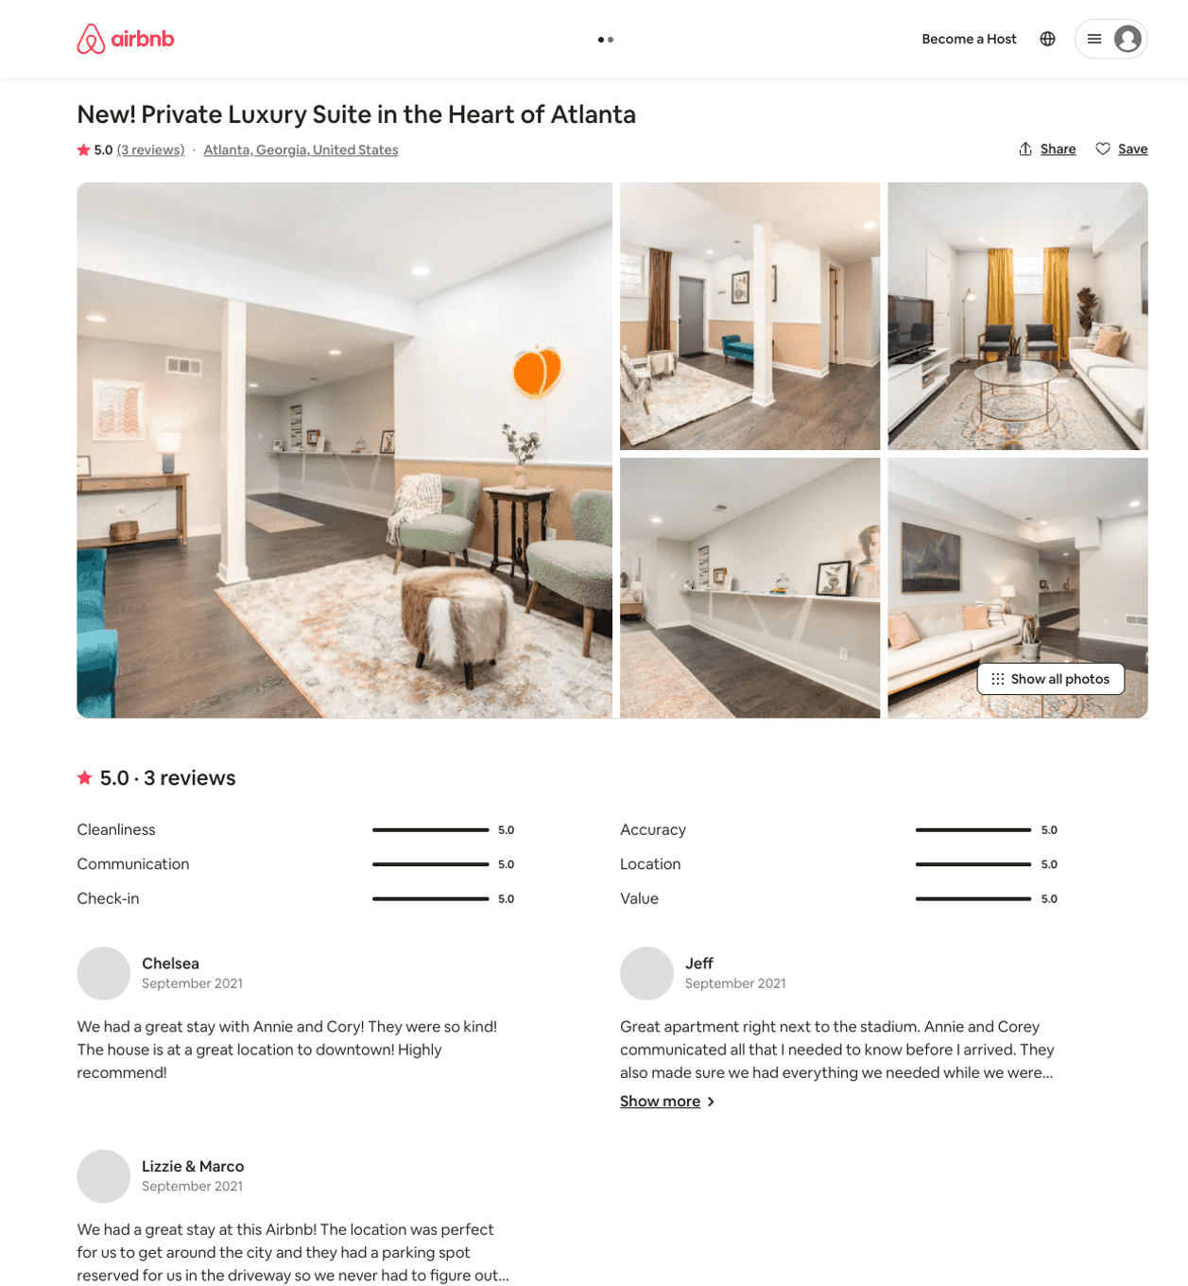
Listing 49750878
2
4
$82 - $140
5.0
1
Annie & Corey
74044898
1
https://www.airbnb.com/rooms/49750878
Aug 2022

Slide 30
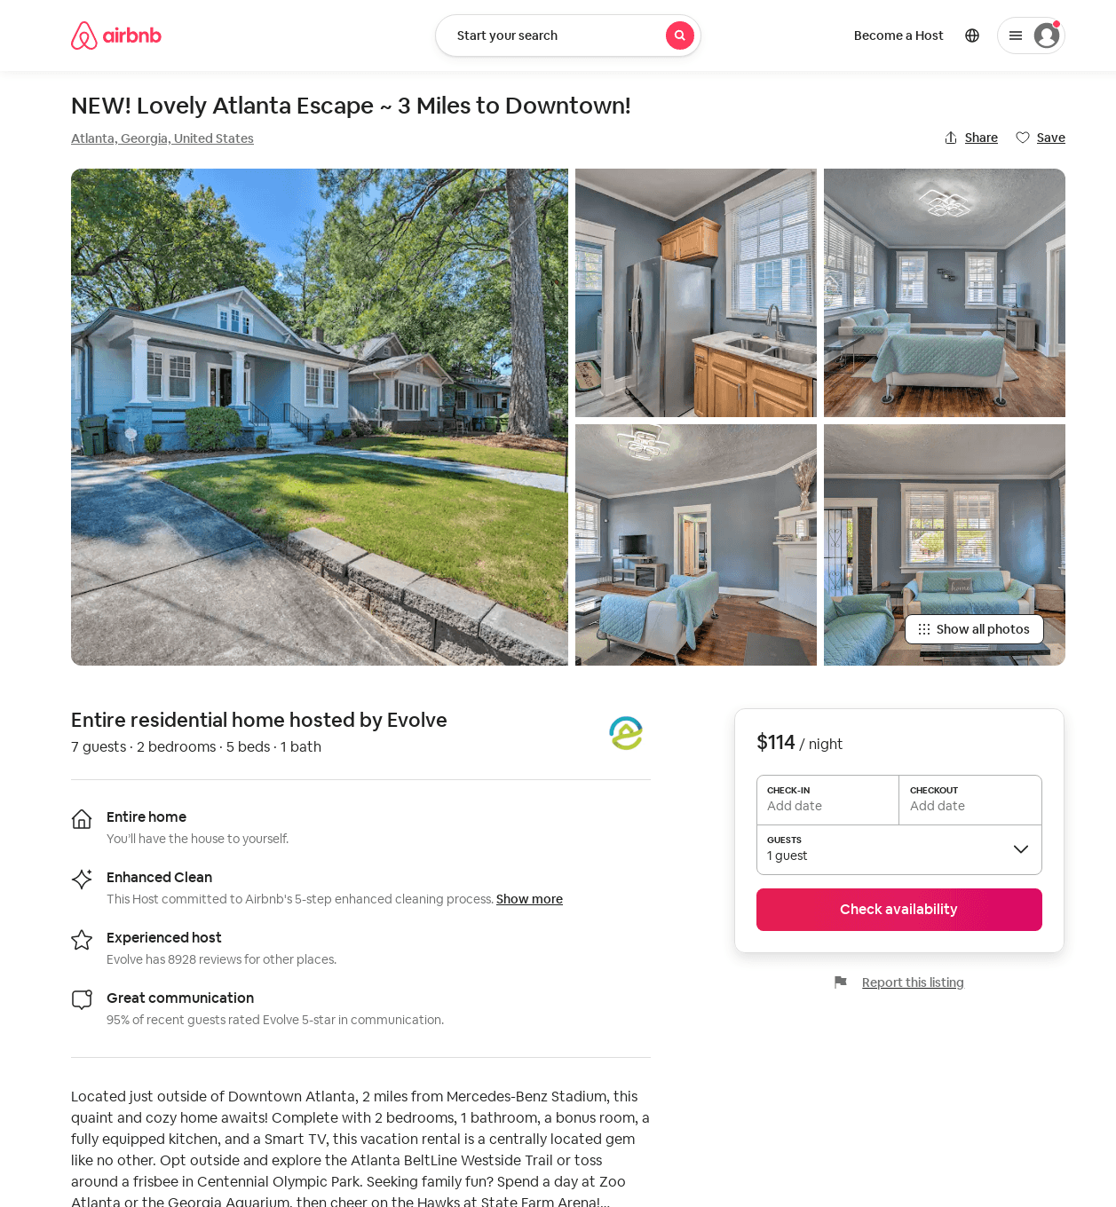
Listing 52732210
2
7
$91 - $114
4.36
2
Evolve
121682456
51
https://www.airbnb.com/rooms/52732210
Aug 2022

Slide 31
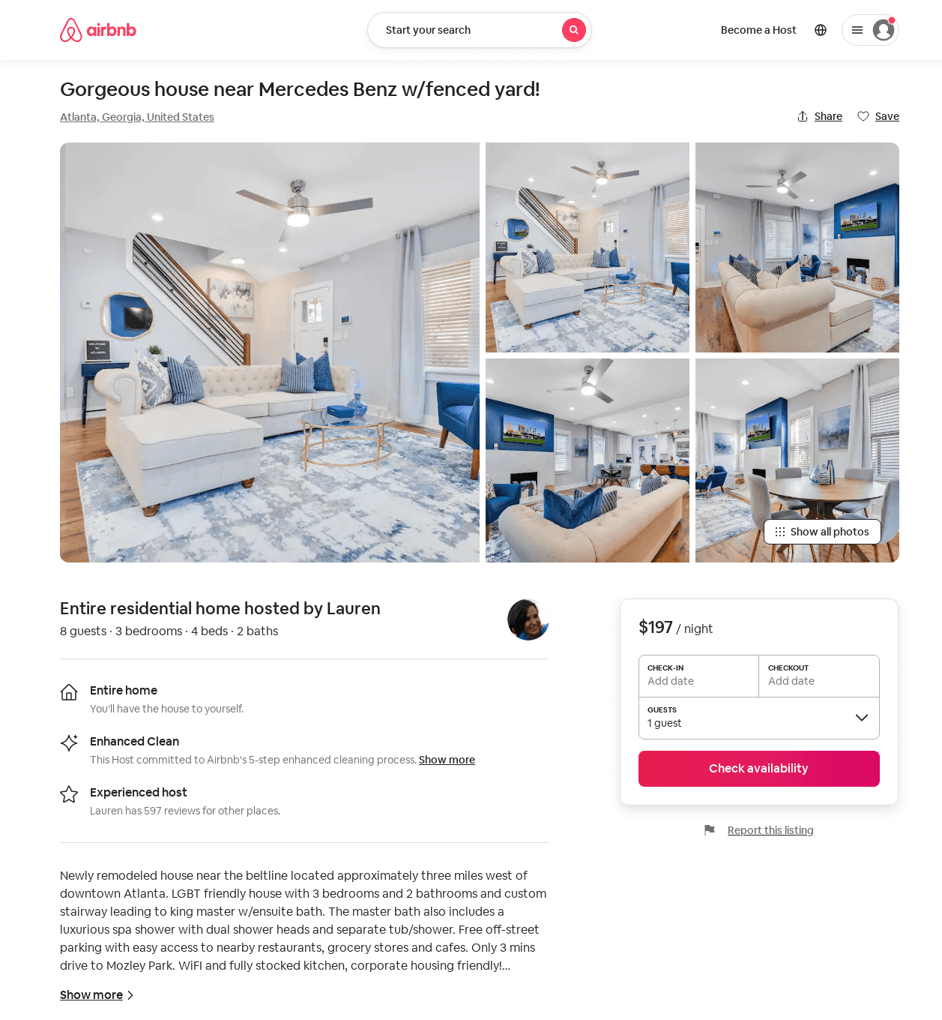
Listing 50155224
3
8
$159 - $214
4.85
2
Lindsey
120710928
1
https://www.airbnb.com/rooms/50155224
Aug 2022

Slide 32
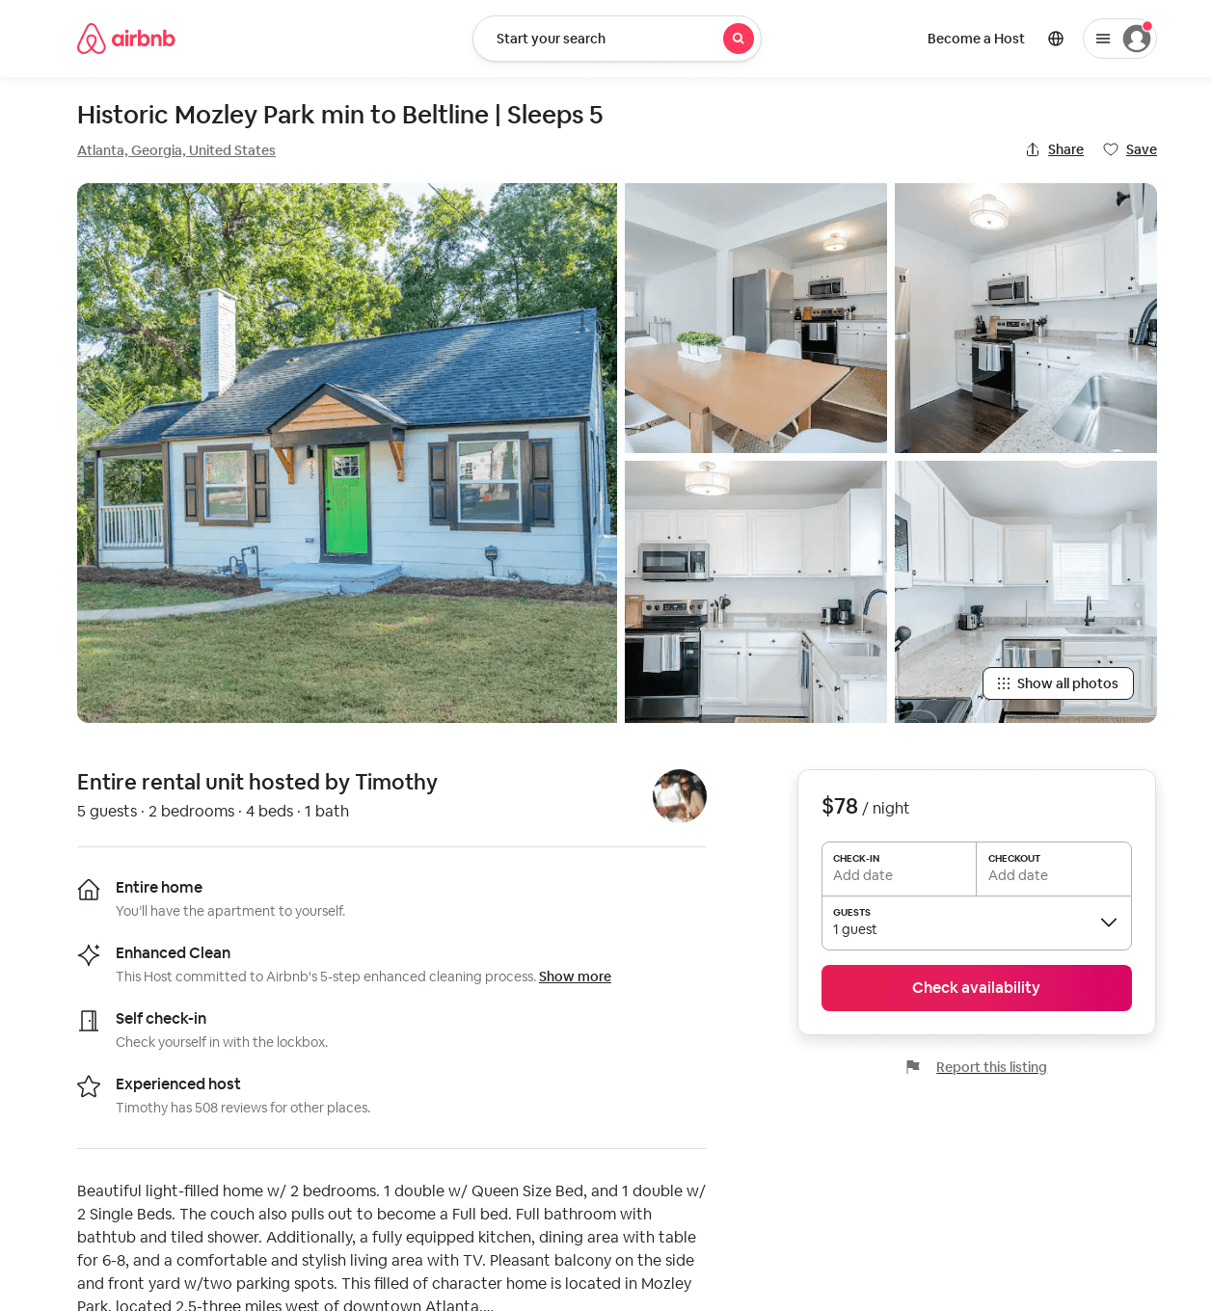
Listing 52772625
2
5
$54 - $92
4.30
2
Sergio
106508052
7
https://www.airbnb.com/rooms/52772625
Aug 2022

Slide 33
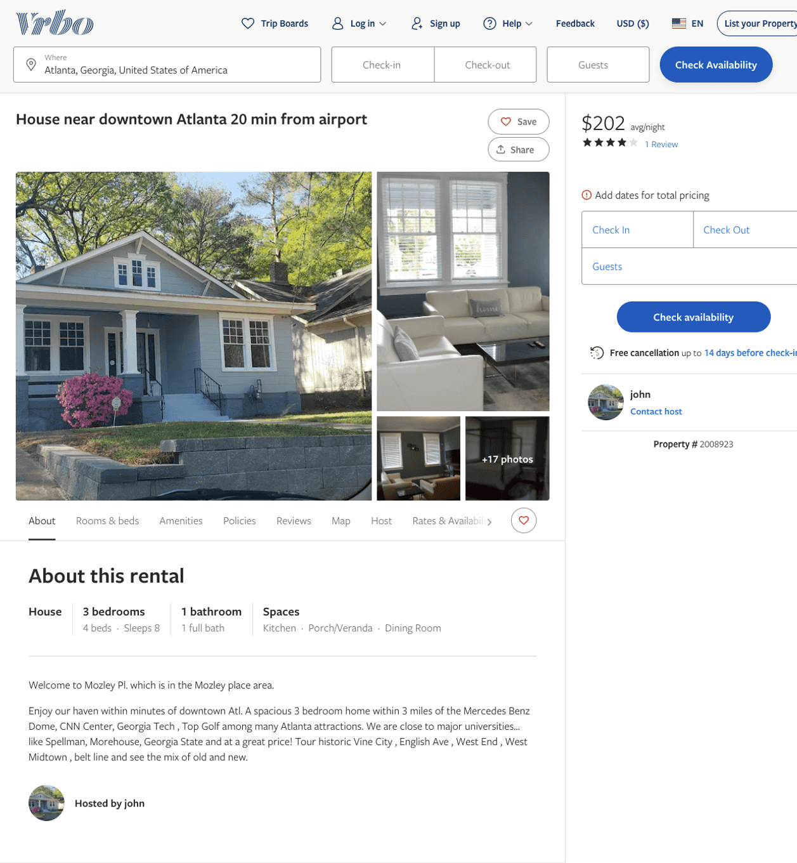
Listing 2008923
3
8
$202 - $217
4
3
john
https://www.vrbo.com/2008923
Aug 2022

Slide 34
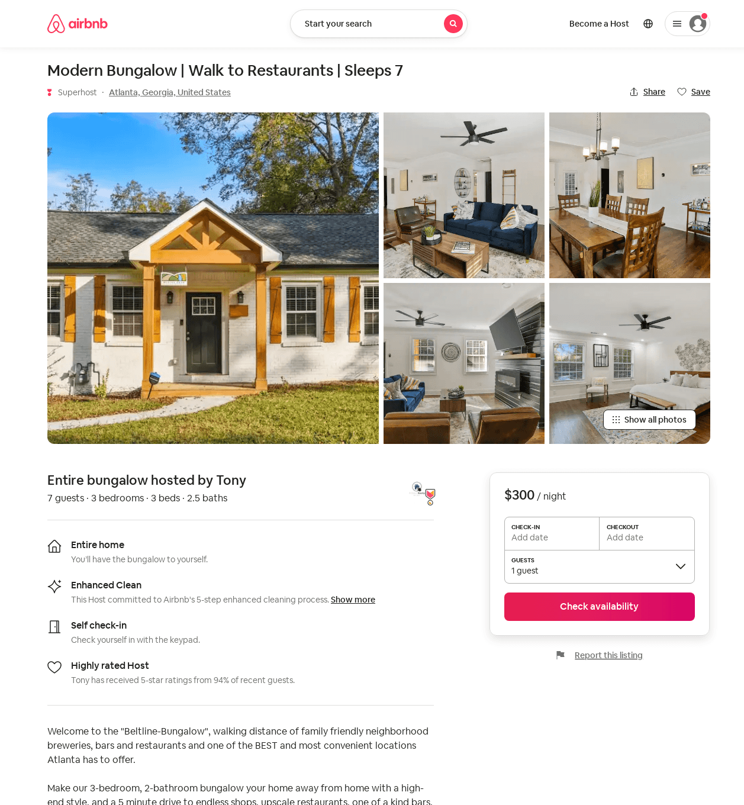
Listing 52277337
3
8
$125 - $300
4.79
2
Tony
10995394
2
https://www.airbnb.com/rooms/52277337
Aug 2022

Slide 35
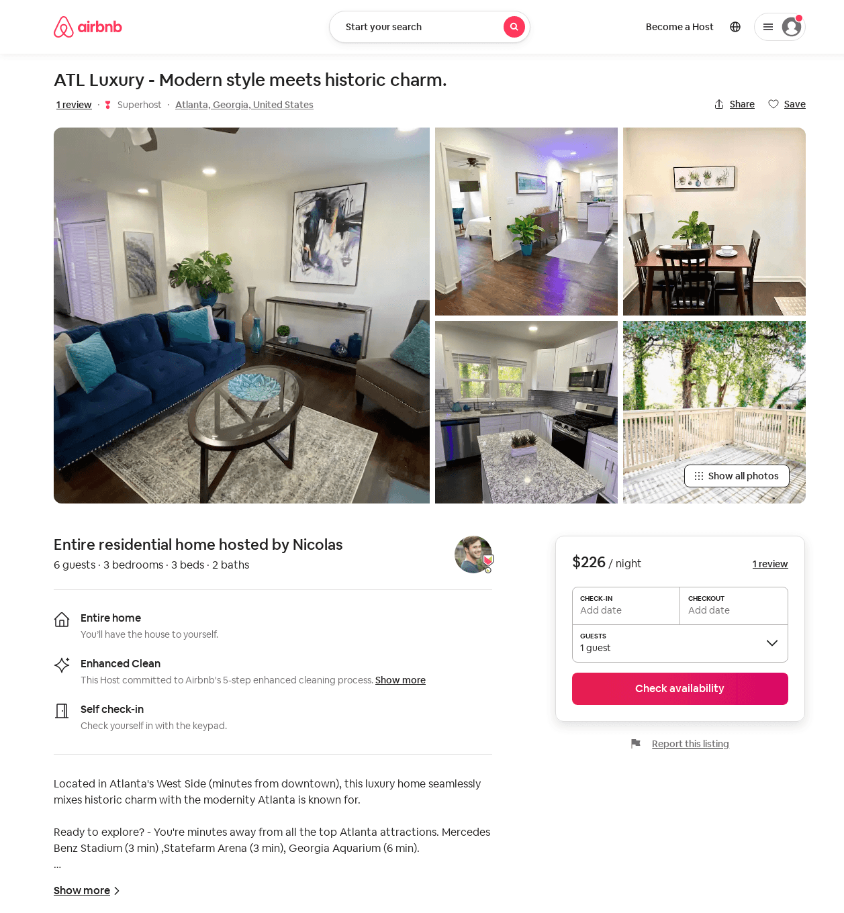
Listing 53814608
3
6
$125 - $226
4.53
3
Nicolas
50753158
1
https://www.airbnb.com/rooms/53814608
Aug 2022

Slide 36
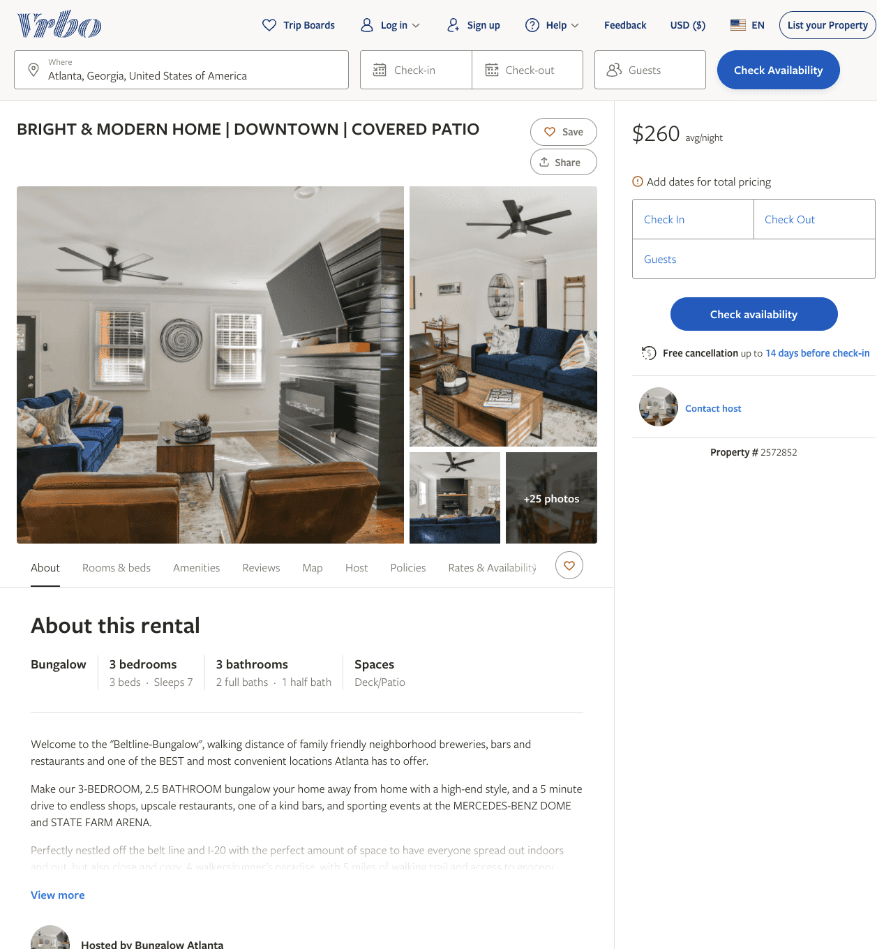
Listing 2572852
3
7
$167 - $260
4.5
2
https://www.vrbo.com/2572852
Aug 2022

Slide 37
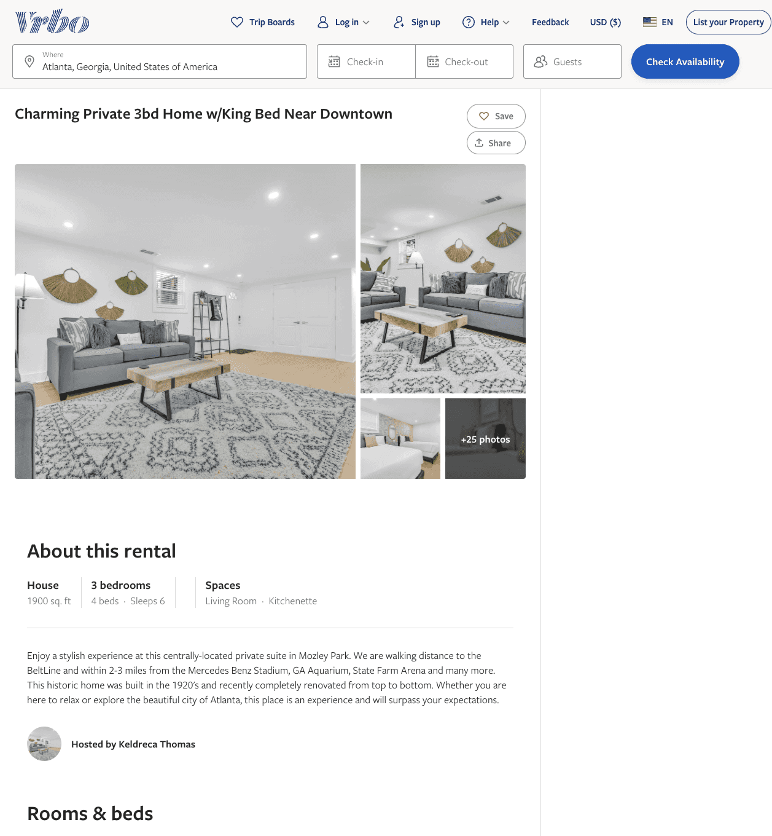
Listing 2612913
3
6
$210
4
3
Keldreca Thomas
https://www.vrbo.com/2612913
Aug 2022

Slide 38
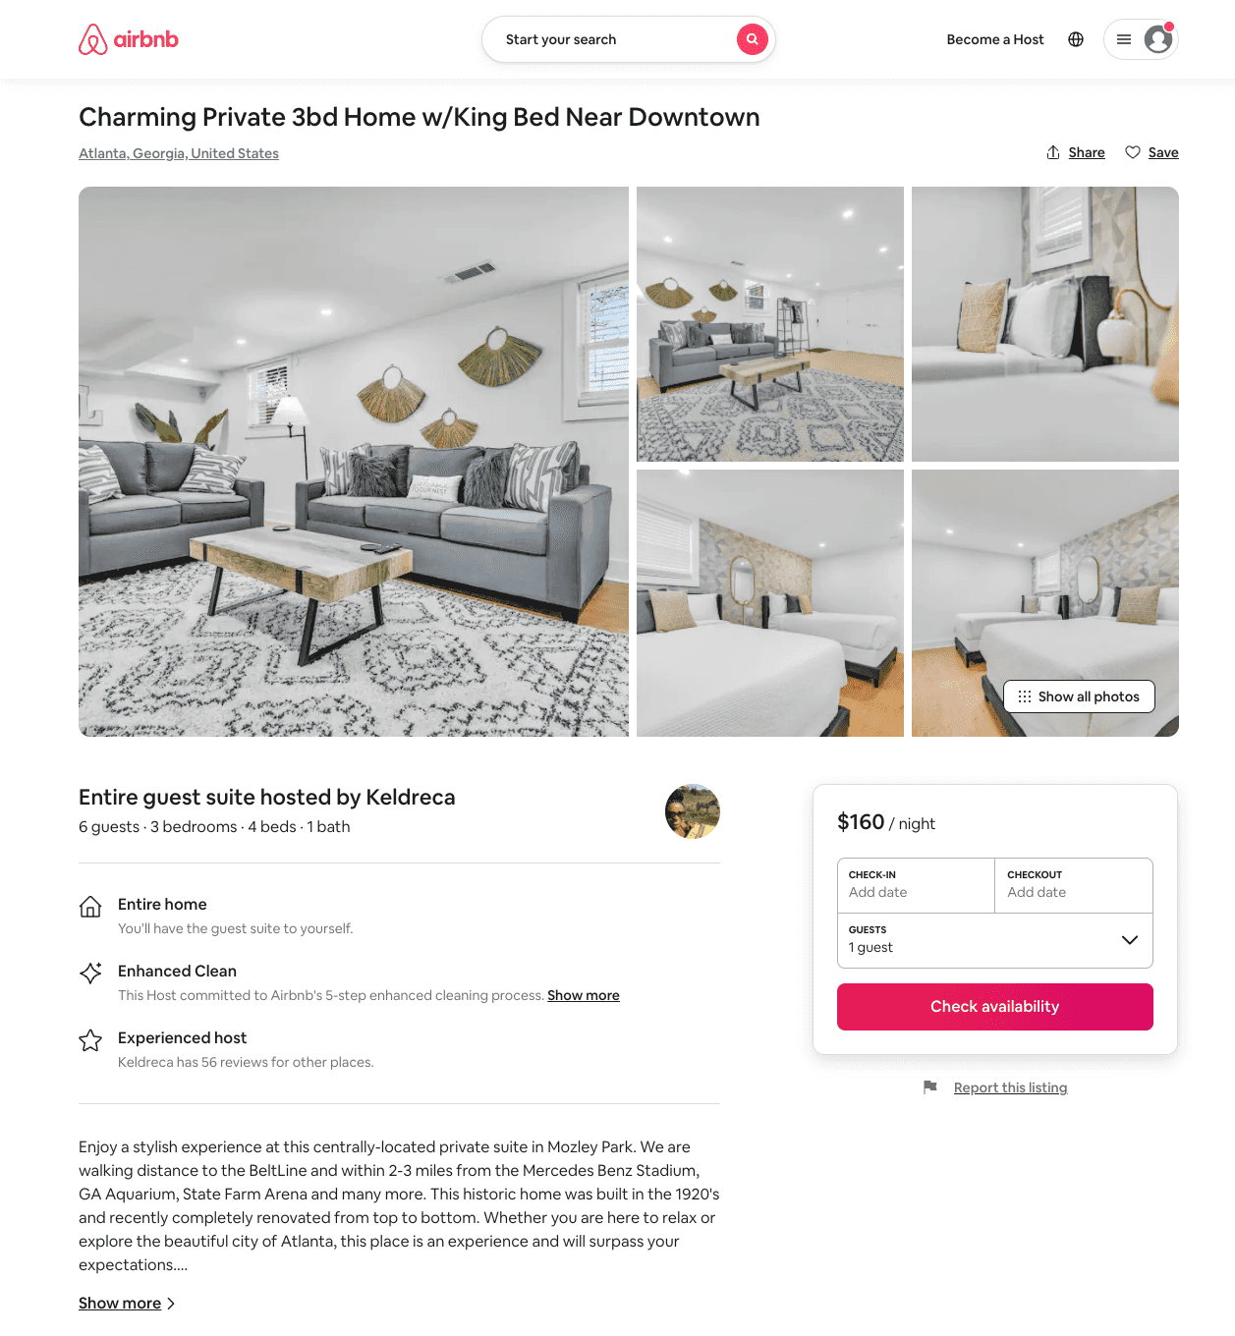
Listing 53574023
3
6
$109 - $170
4.71
2
Keldreca
54071913
3
https://www.airbnb.com/rooms/53574023
Aug 2022

Slide 39
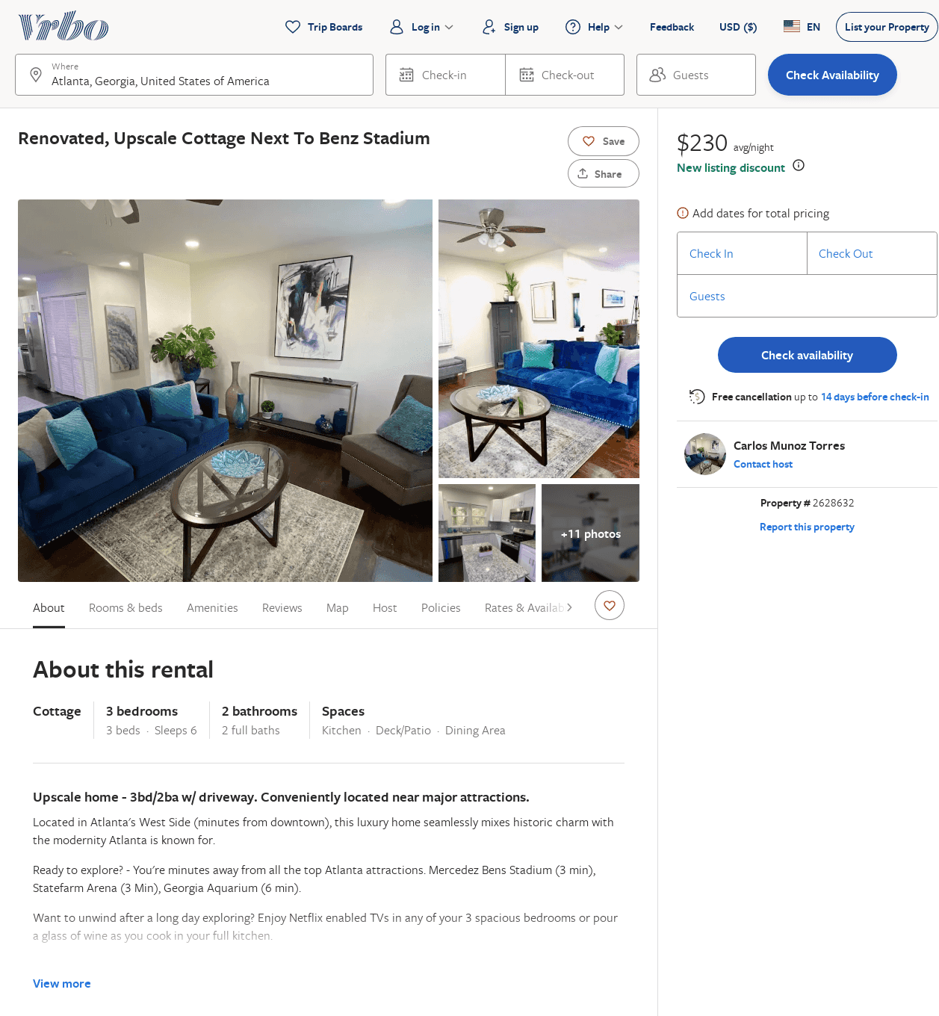
Listing 2628632
3
6
$166
4.5
3
Carlos Munoz Torres
https://www.vrbo.com/2628632
Aug 2022

Slide 40
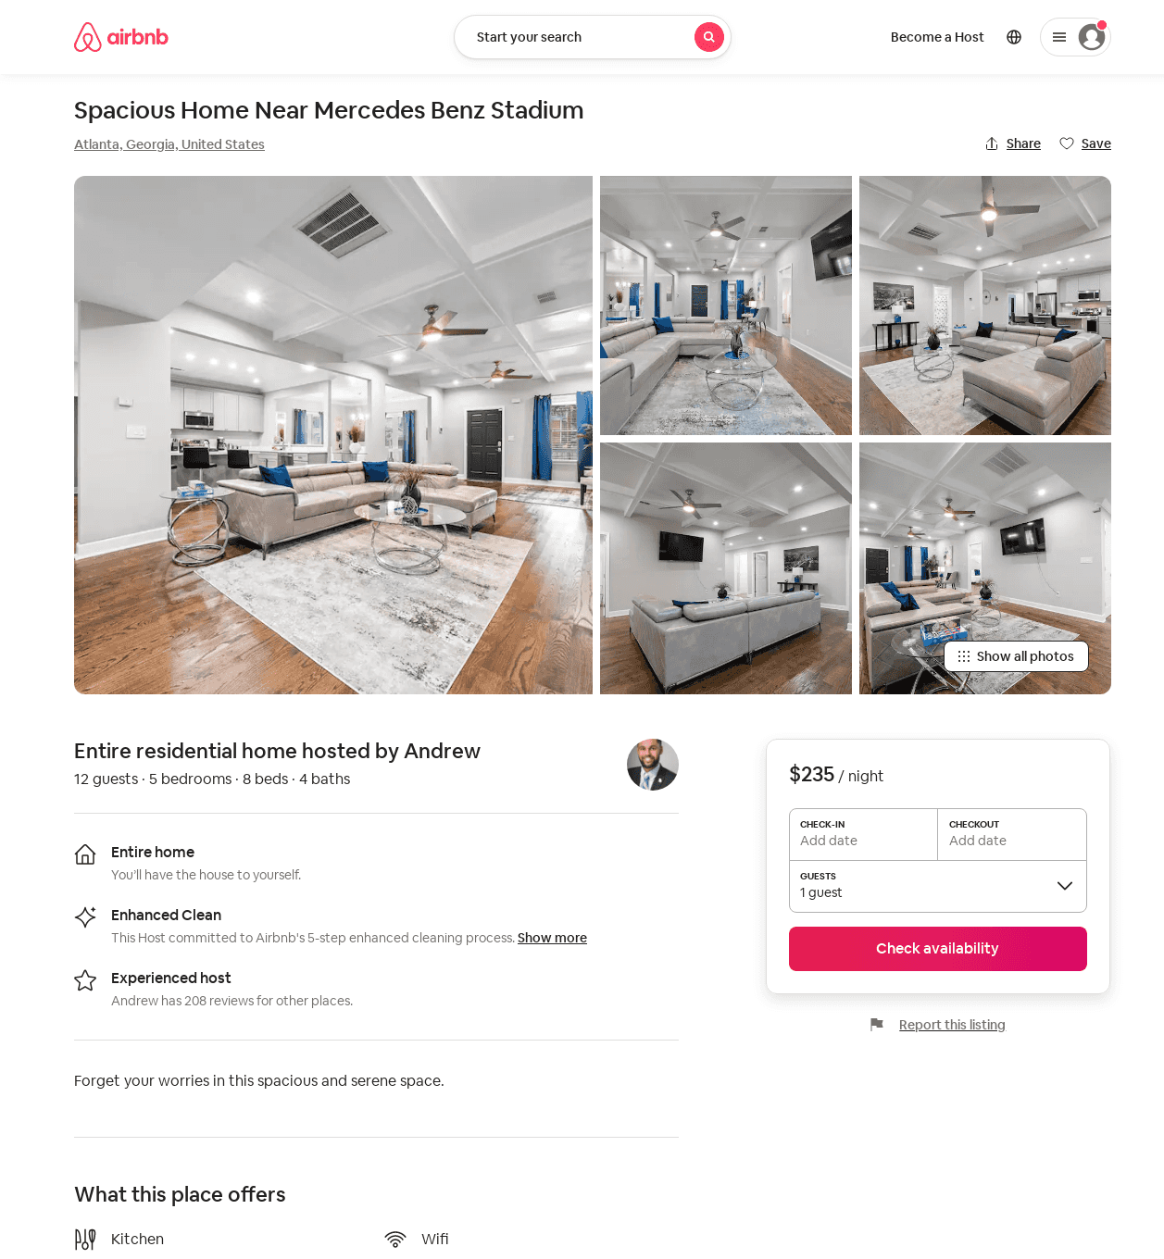
Listing 54112604
5
12
$230 - $400
2
Andrew
228013133
8
https://www.airbnb.com/rooms/54112604
Aug 2022

Slide 41
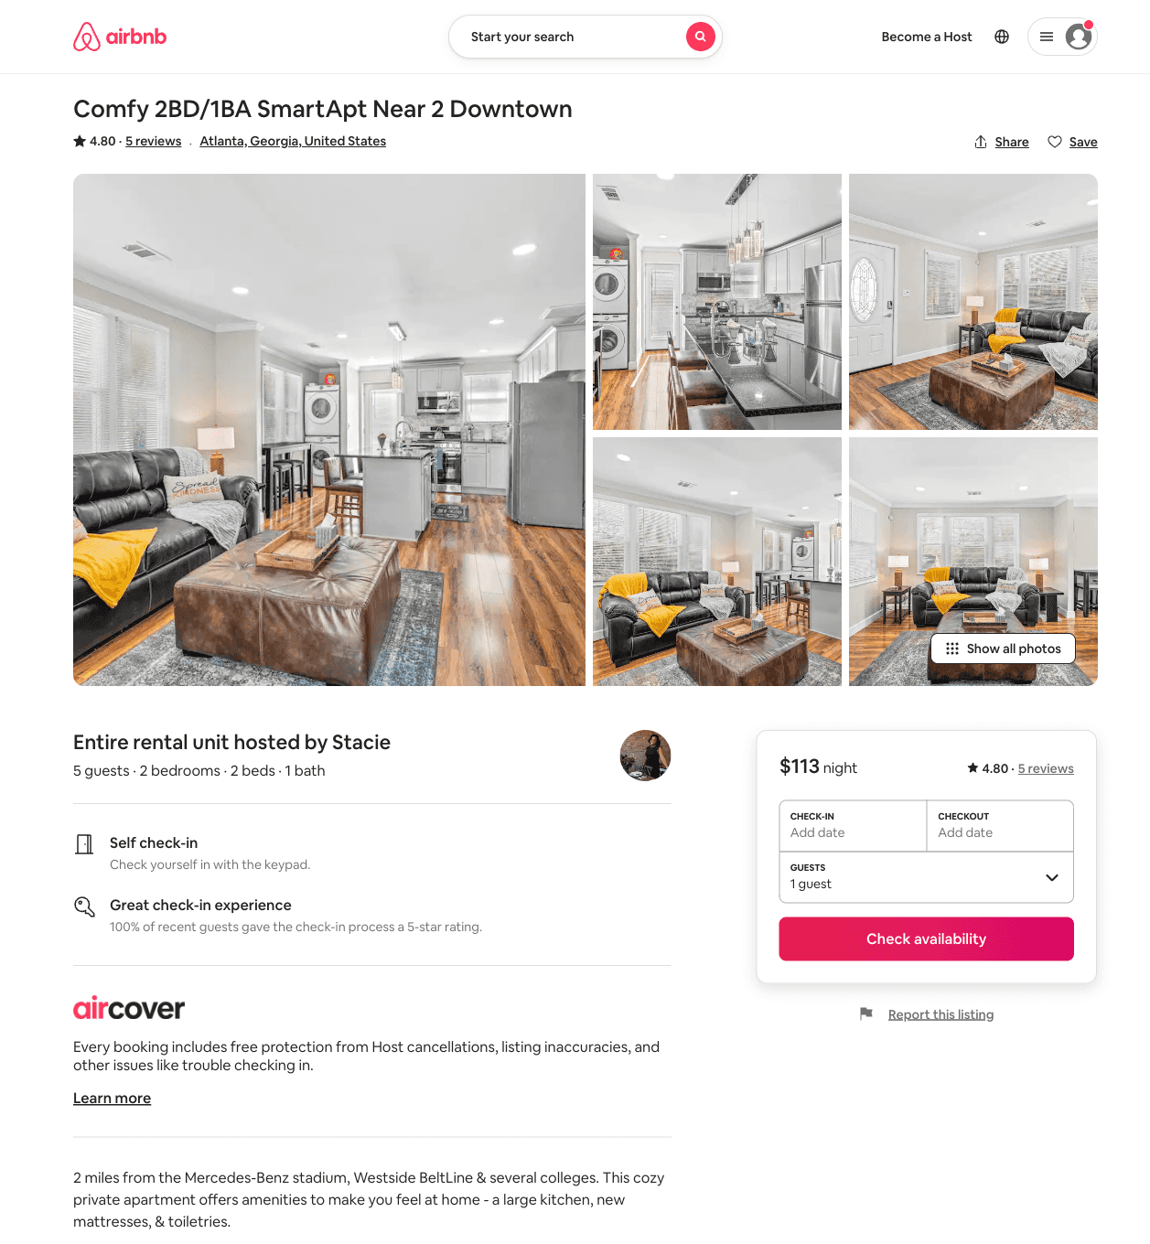
Listing 32206581
2
5
$108 - $169
4.80
2
Stacie
6903713
1
https://www.airbnb.com/rooms/32206581
Aug 2022

Slide 42
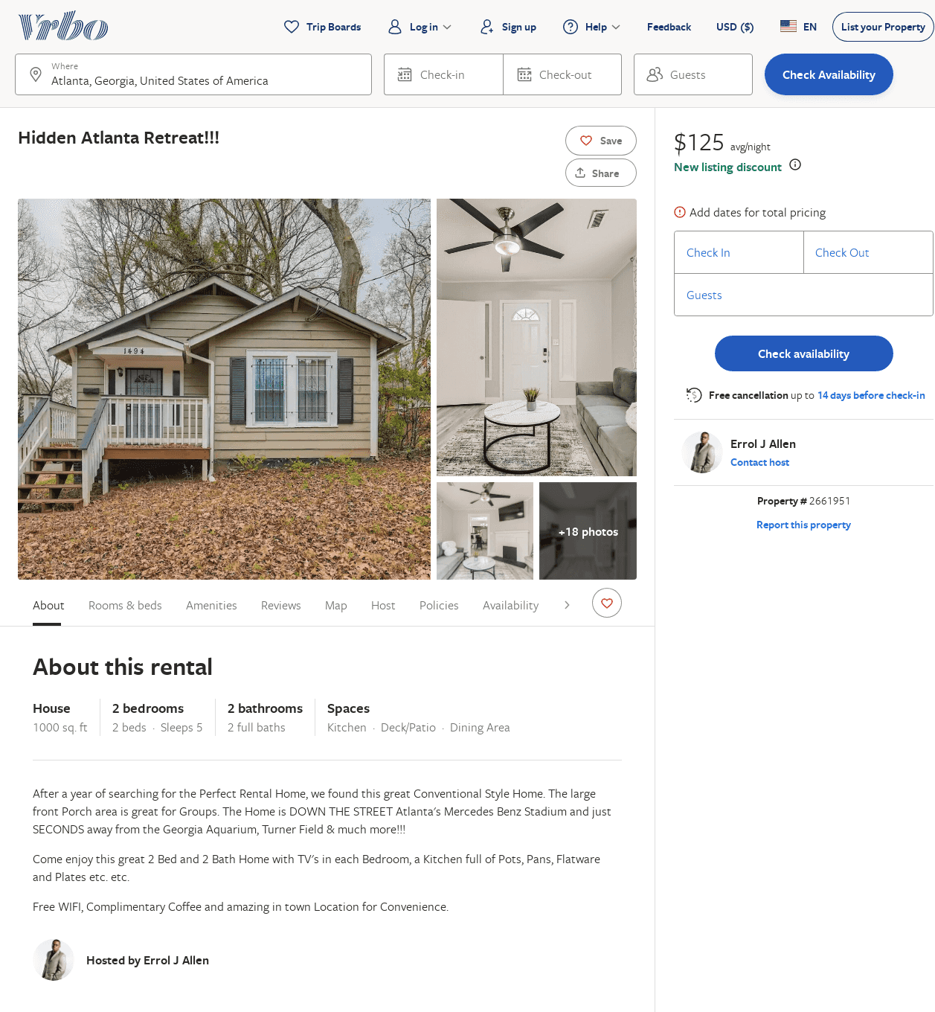
Listing 2661951
2
5
$146
4
2
Errol J Allen
https://www.vrbo.com/2661951
Aug 2022

Slide 43
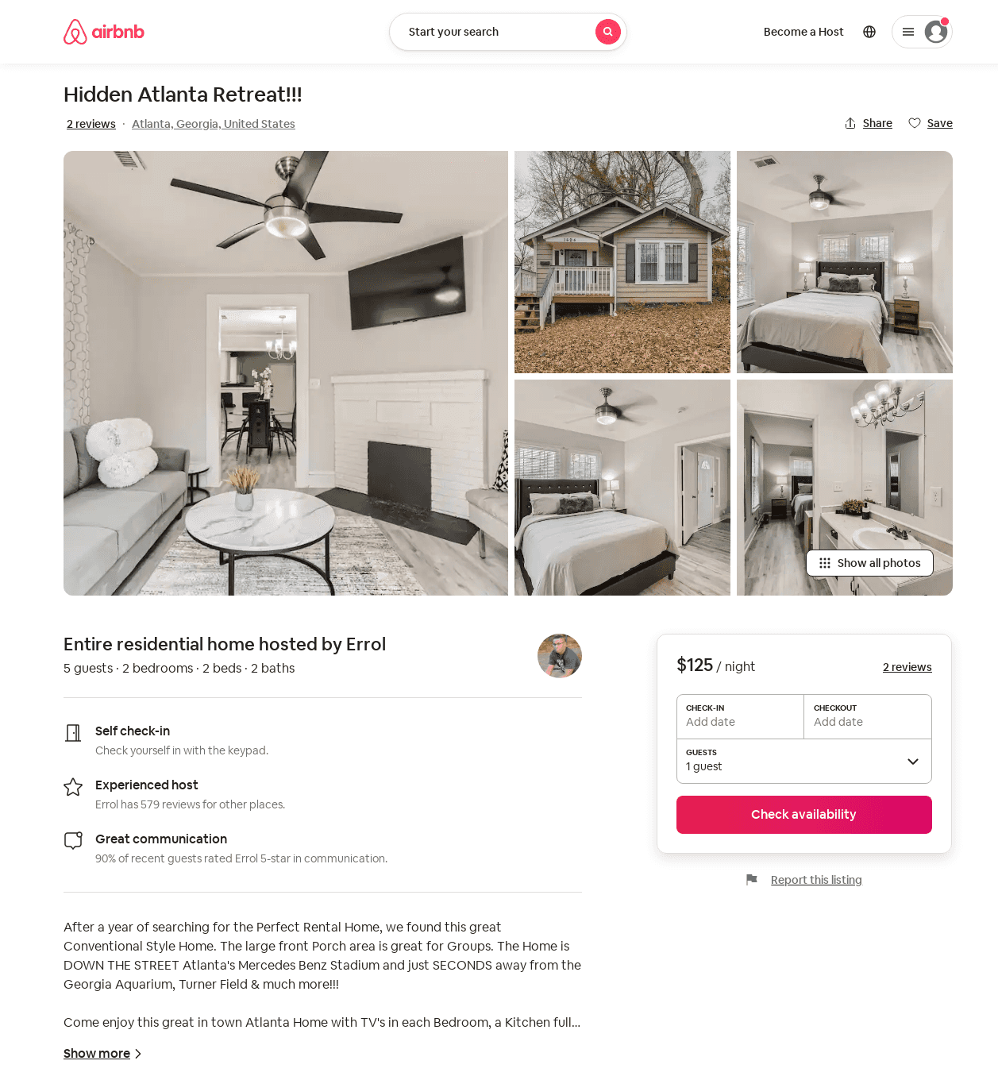
Listing 562291072084986500
2
5
$125 - $146
4.80
2
Errol
97037186
12
https://www.airbnb.com/rooms/562291072084986500
Aug 2022

Slide 44
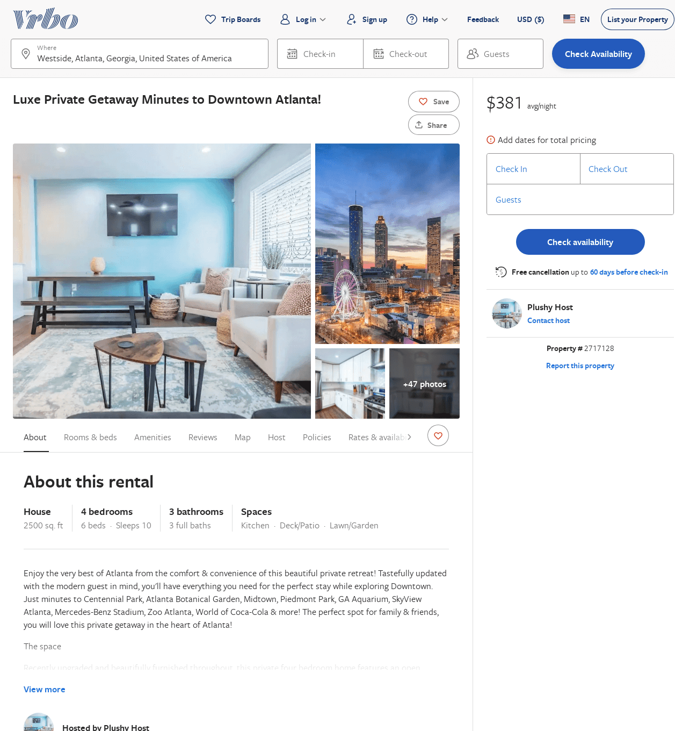
Listing 2717128
4
10
$191
2
2
Plushy Host
https://www.vrbo.com/2717128
Aug 2022

Slide 45
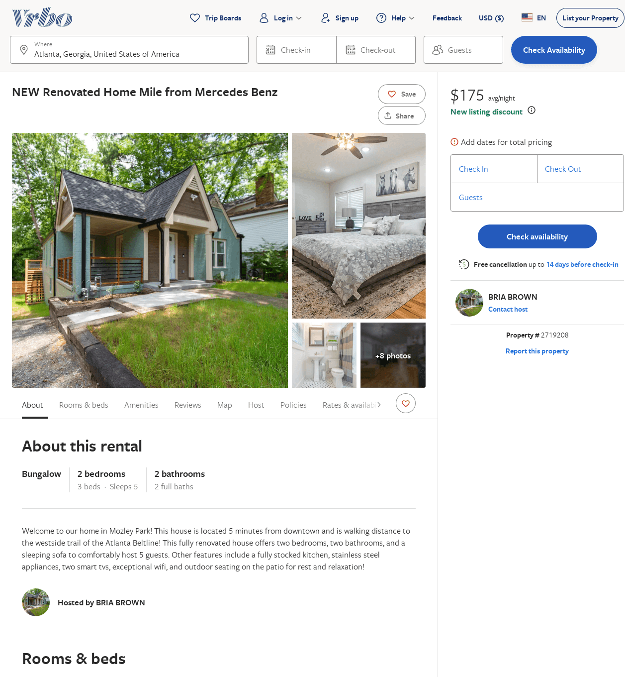
Listing 2719208
2
5
$225
4.888889
2
BRIA BROWN
https://www.vrbo.com/2719208
Aug 2022

Slide 46
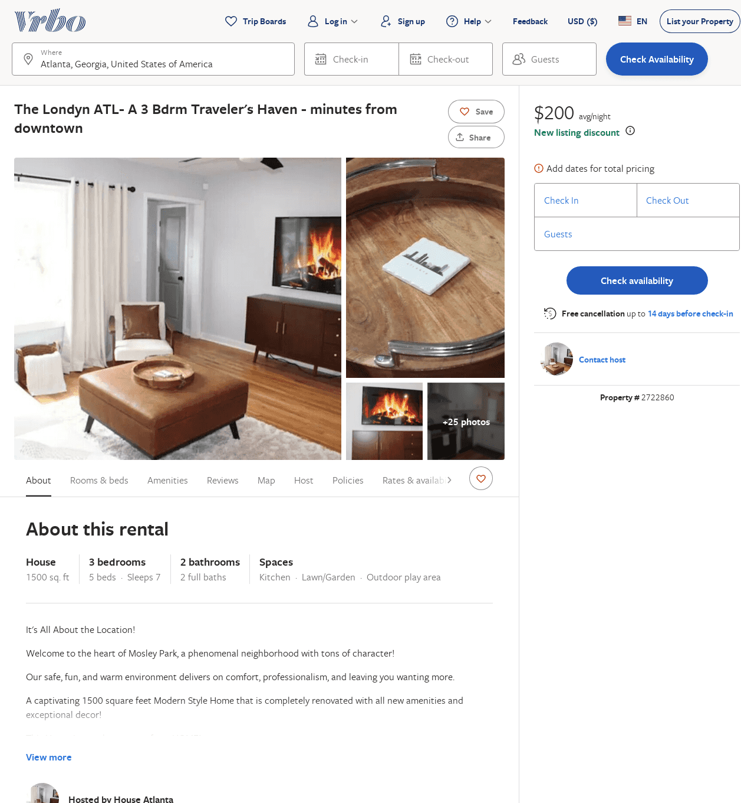
Listing 2722860
3
7
$194
5
2
Unlimited Networks Property Management
https://www.vrbo.com/2722860
Aug 2022

Slide 47
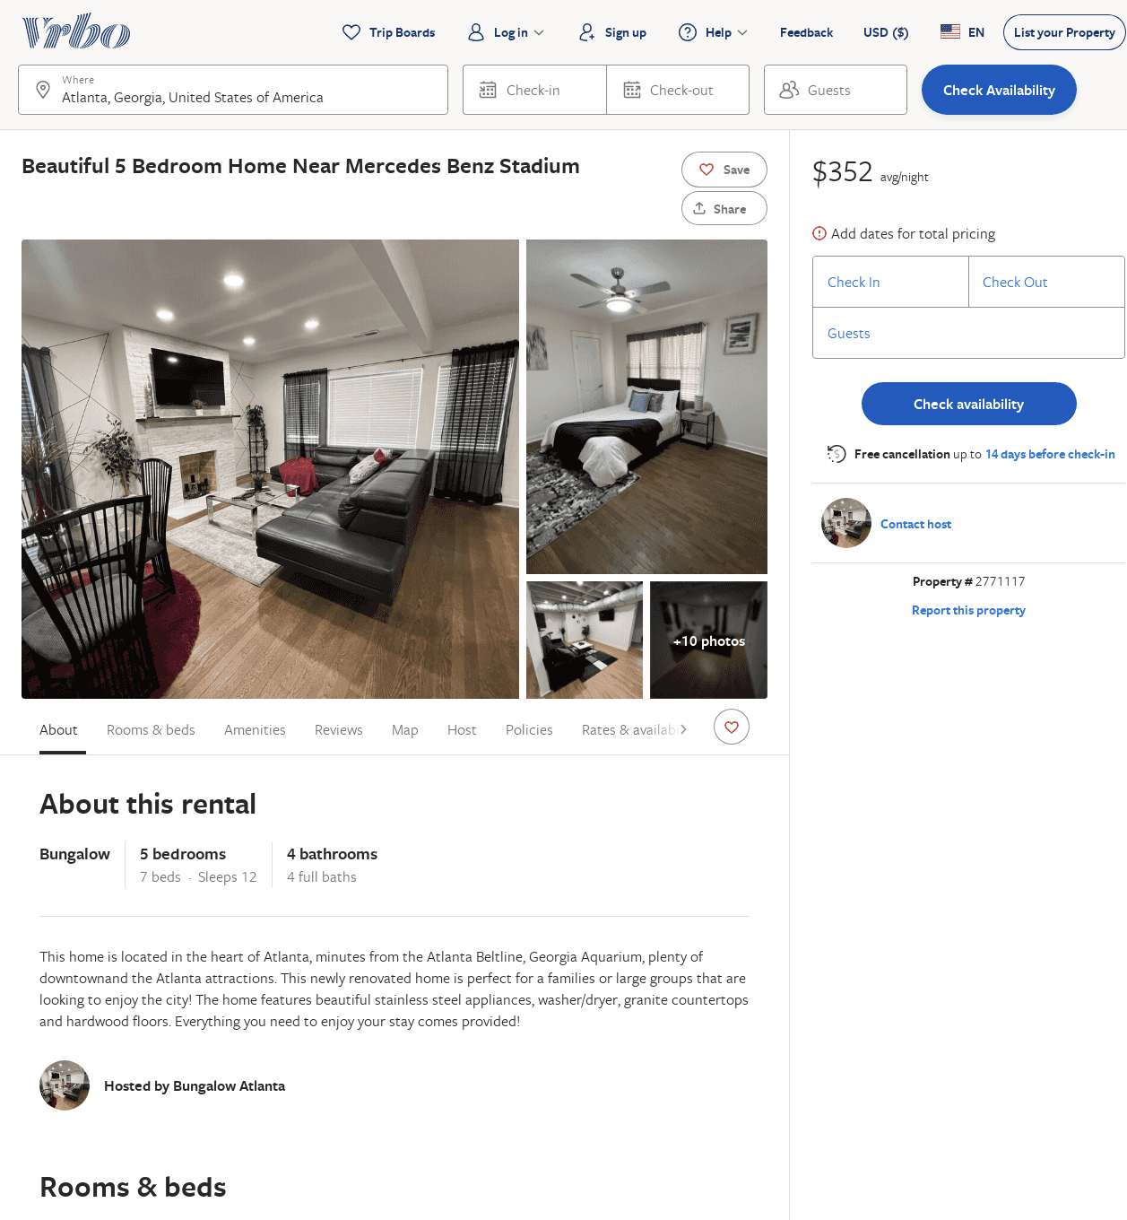
Listing 2771117
5
12
$350
2
1
https://www.vrbo.com/2771117
Aug 2022

Slide 48
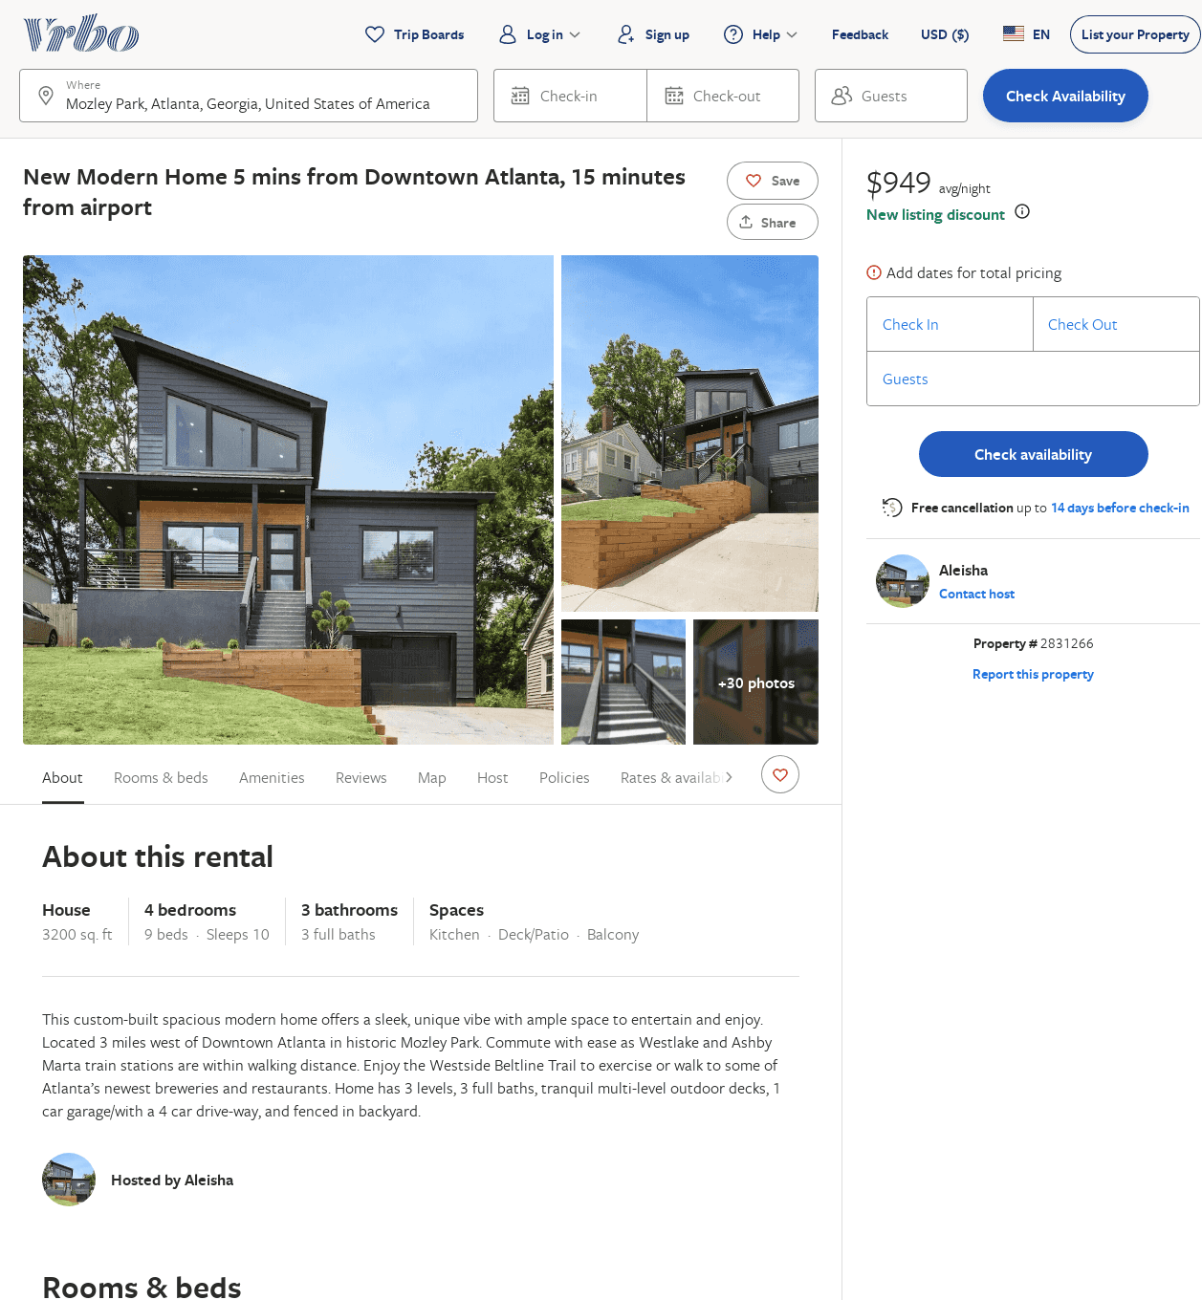
Listing 2831266
4
10
$949
1
Aleisha
https://www.vrbo.com/2831266
Aug 2022

Slide 49
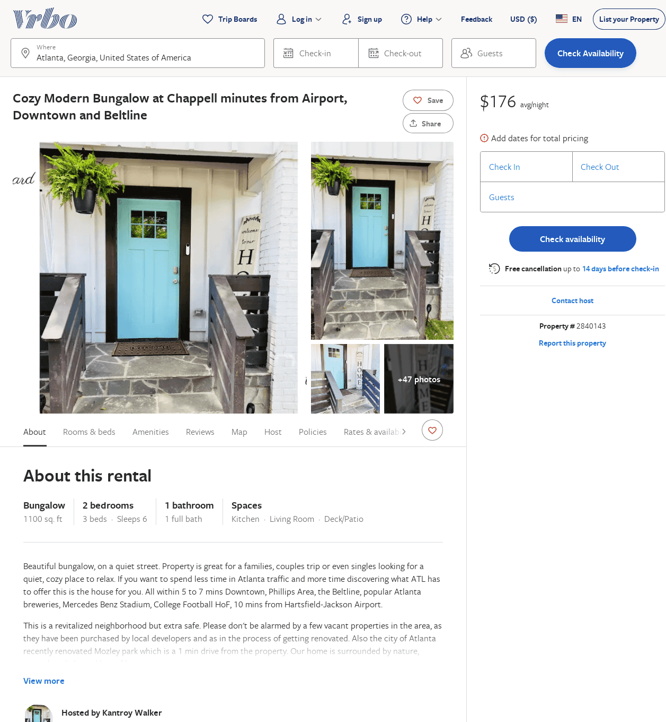
Listing 2840143
2
6
$138
4.75
1
Kantroy Walker
https://www.vrbo.com/2840143
Aug 2022

Slide 50
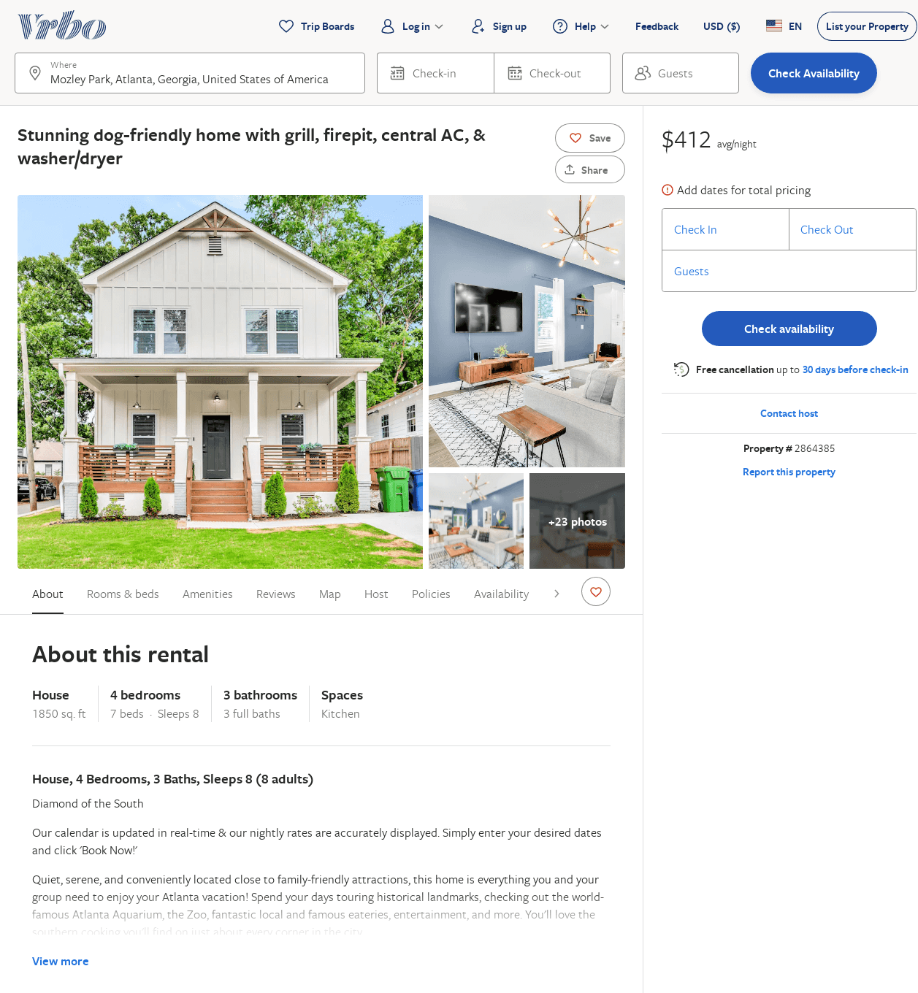
Listing 2864385
4
8
$245
5
2
Vacasa of Georgia
https://www.vrbo.com/2864385
Aug 2022

Slide 51
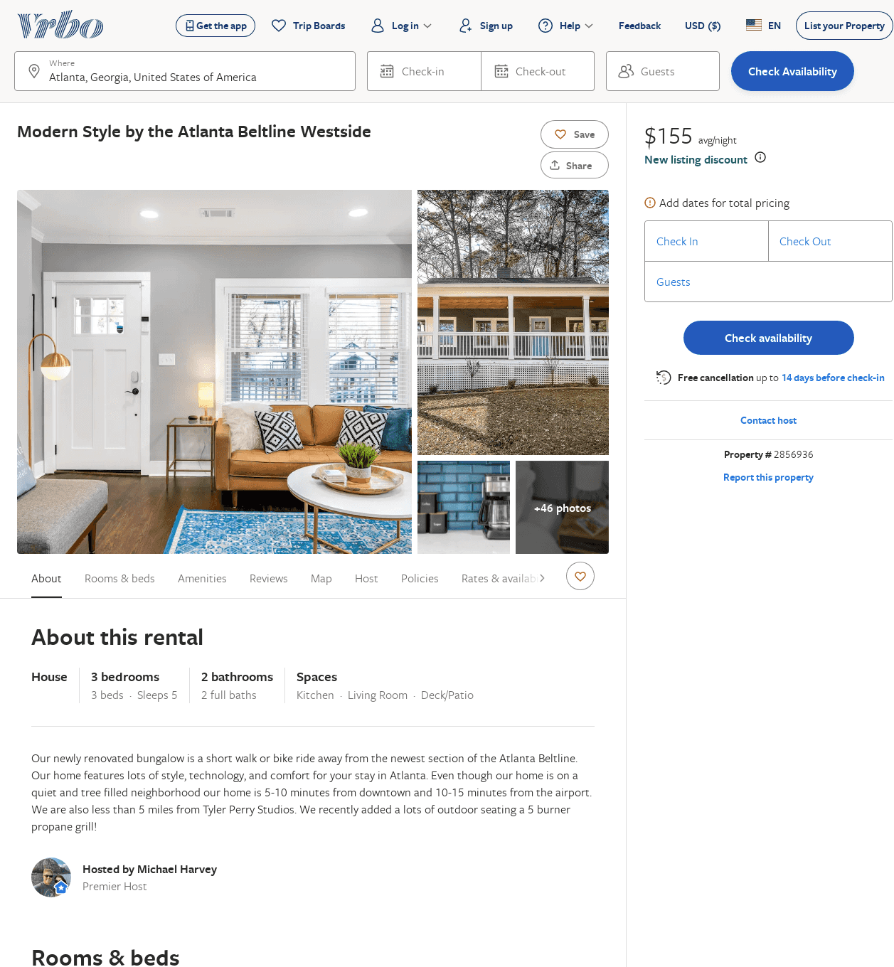
Listing 2856936
3
5
$262
1
Michael Harvey
https://www.vrbo.com/2856936
Aug 2022

Slide 52
Listing 2908933
5
12
$220
2
https://www.vrbo.com/2908933
Aug 2022

Slide 53
Listing 2956583
4
8
$340
2
Juan Austin
https://www.vrbo.com/2956583
Aug 2022

