Slide 2
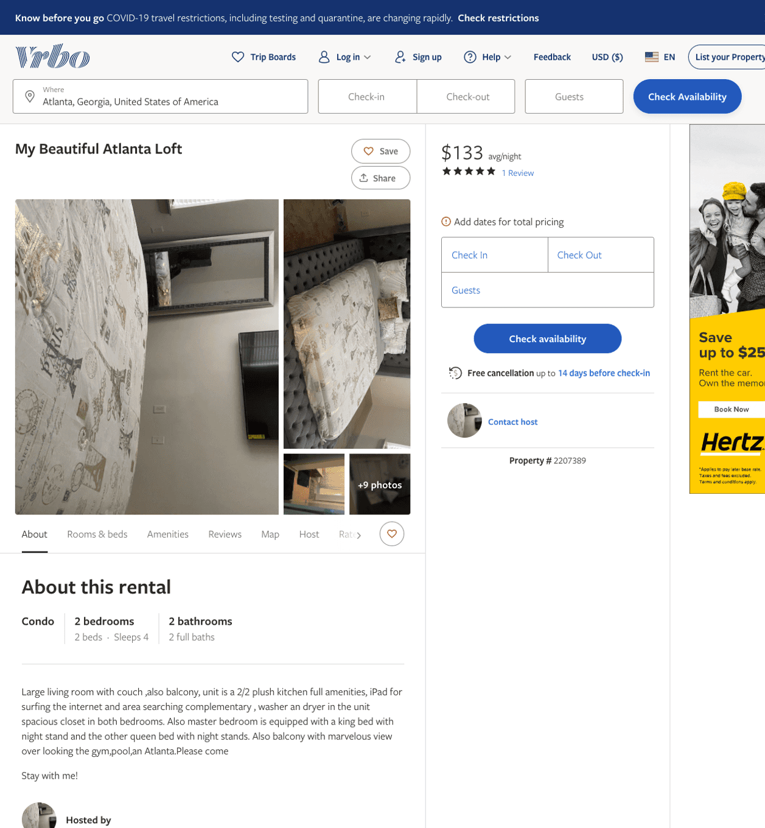
Listing 2207389
2
4
$133 - $143
4.285714
2
https://www.vrbo.com/2207389
Aug 2022

Slide 3
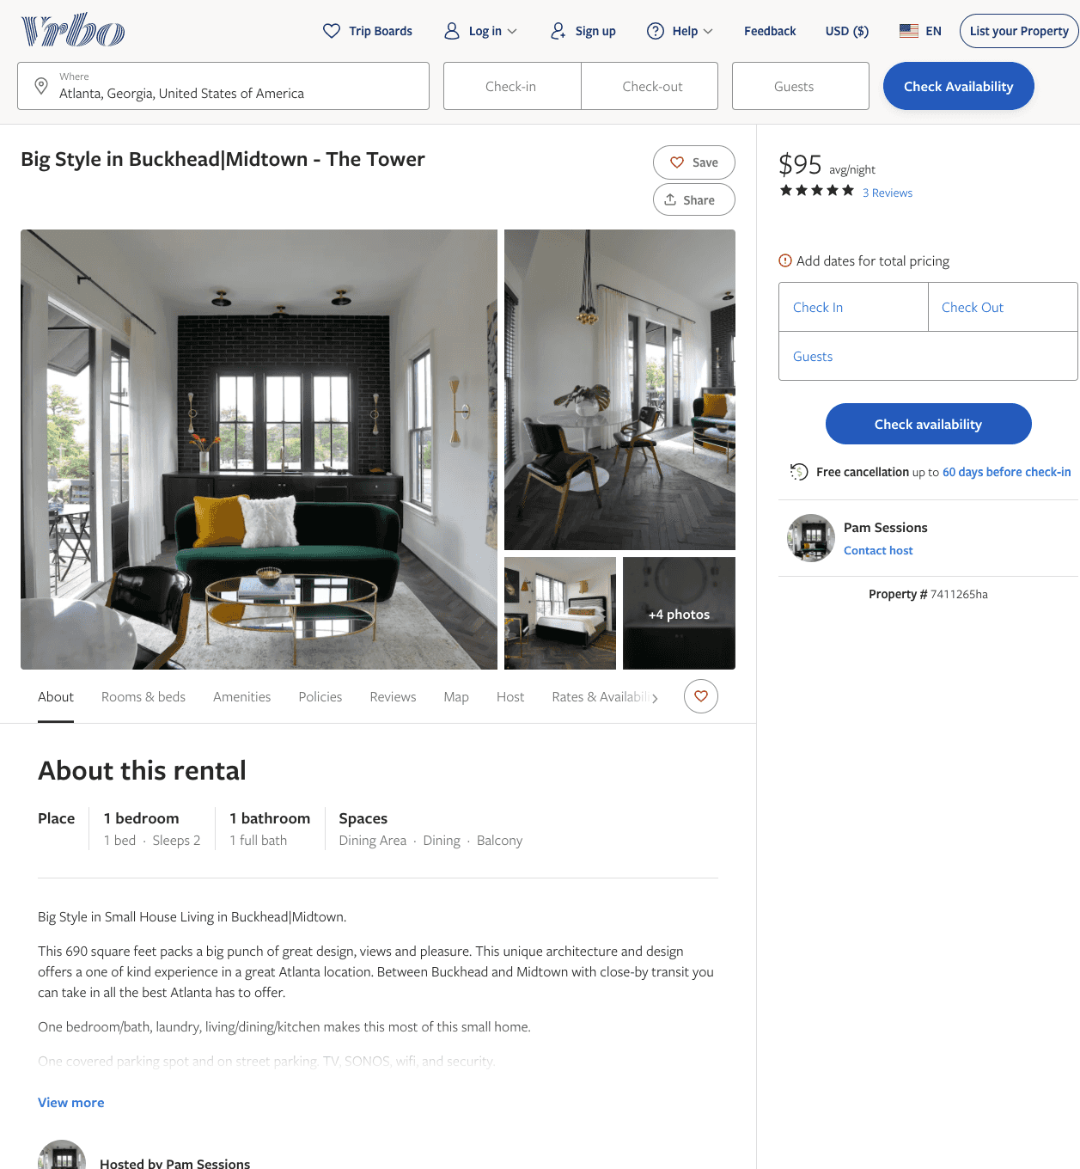
Listing 7411265
1
2
$95
5
30
Pam Sessions
https://www.vrbo.com/7411265ha
Aug 2022

Slide 4
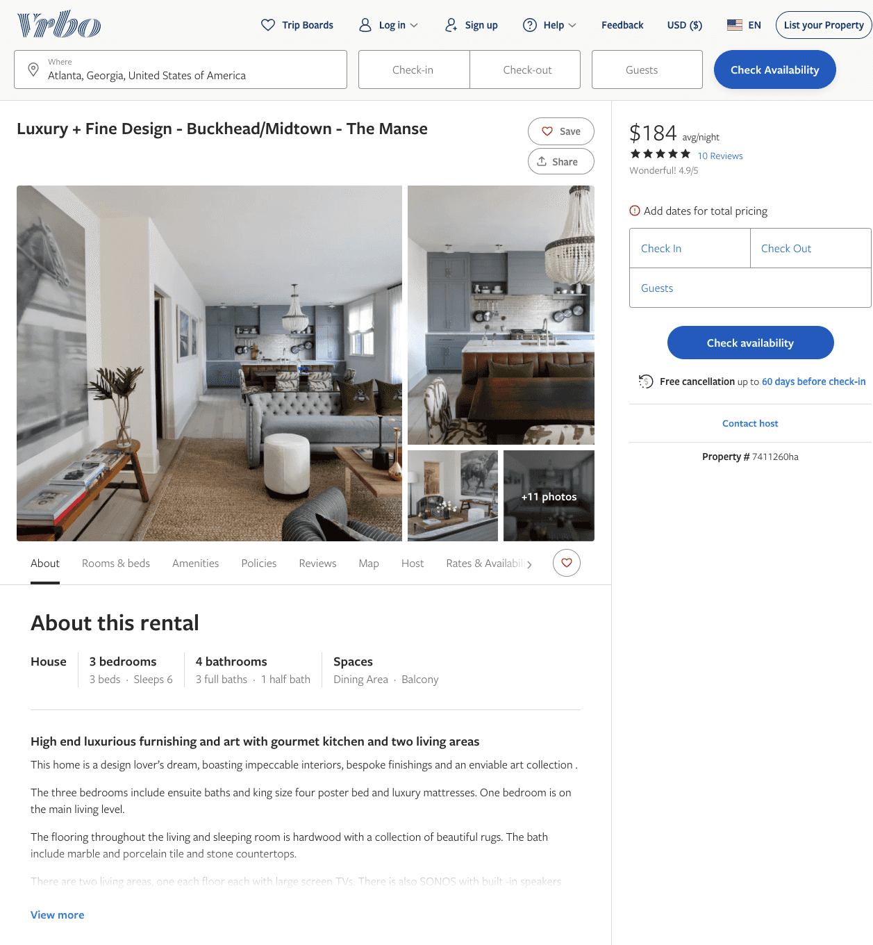
Listing 7411260
3
6
$184 - $195
4.9
30
Pam Sessions
https://www.vrbo.com/7411260ha
Aug 2022

Slide 5
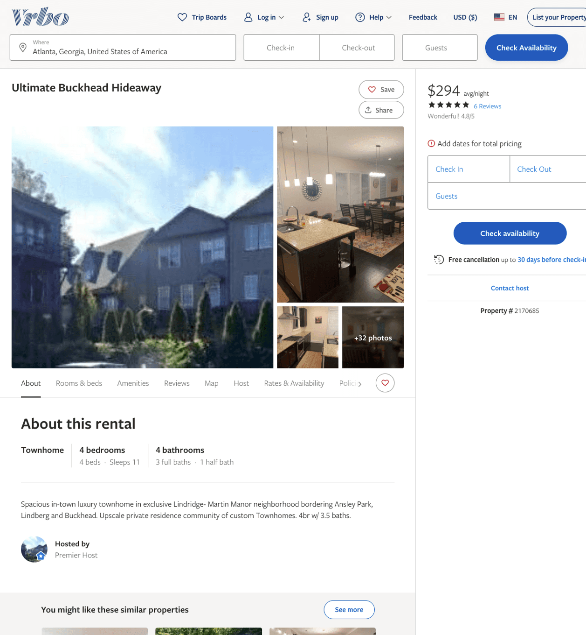
Listing 2170685
4
11
$254 - $321
4.8235292
3
https://www.vrbo.com/2170685
Aug 2022

Slide 6
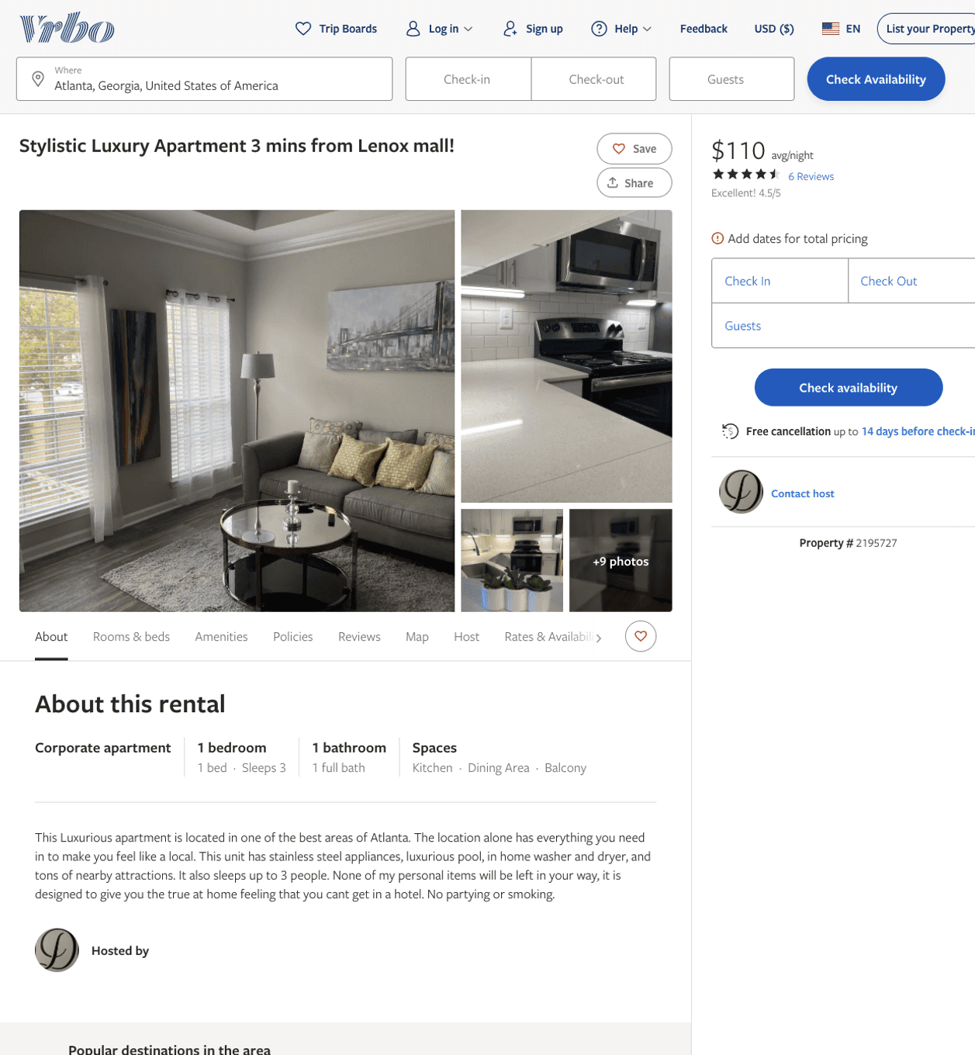
Listing 2195727
2
3
$110 - $113
4.5
2
https://www.vrbo.com/2195727
Aug 2022

Slide 7
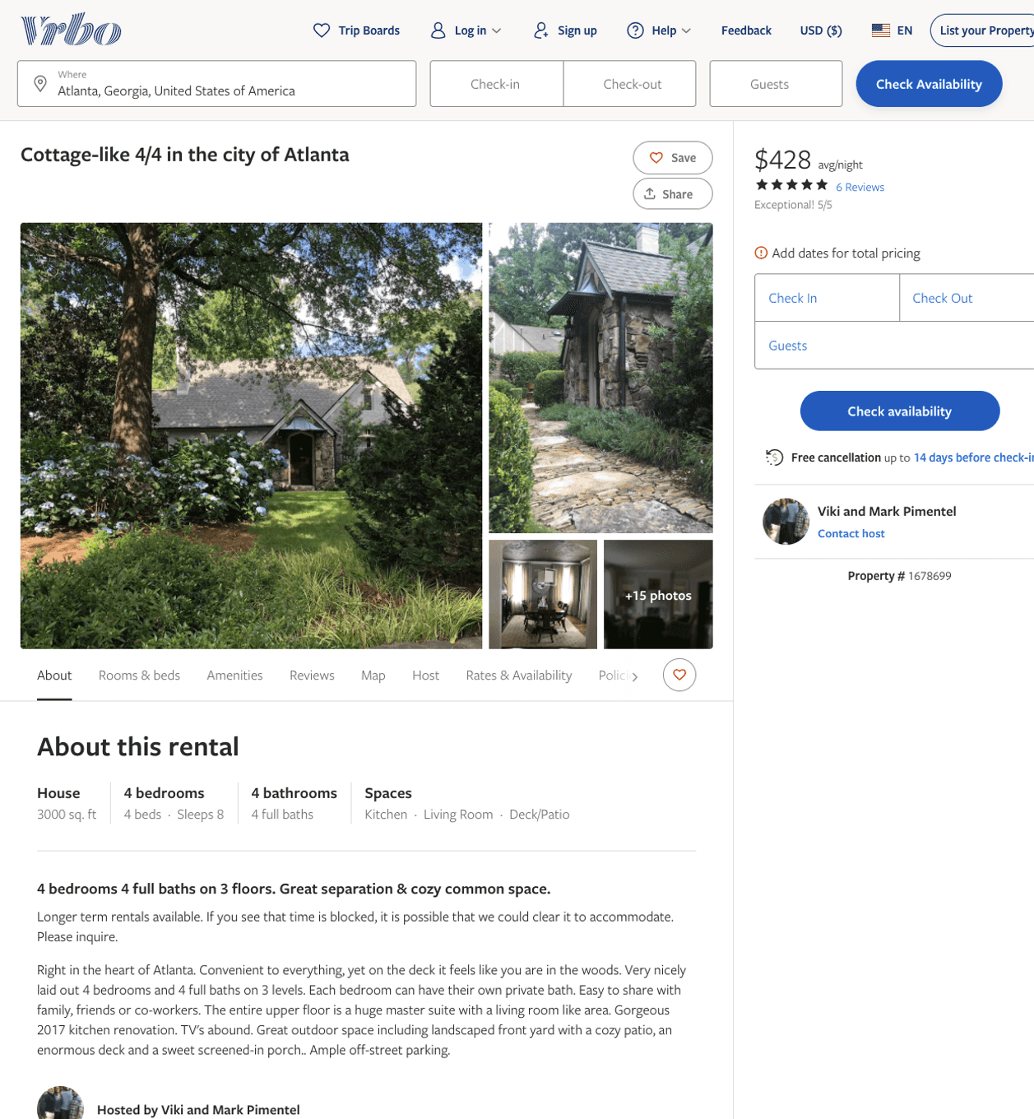
Listing 1678699
4
8
$428 - $495
5
3
Viki and Mark Pimentel
https://www.vrbo.com/1678699
Aug 2022

Slide 8
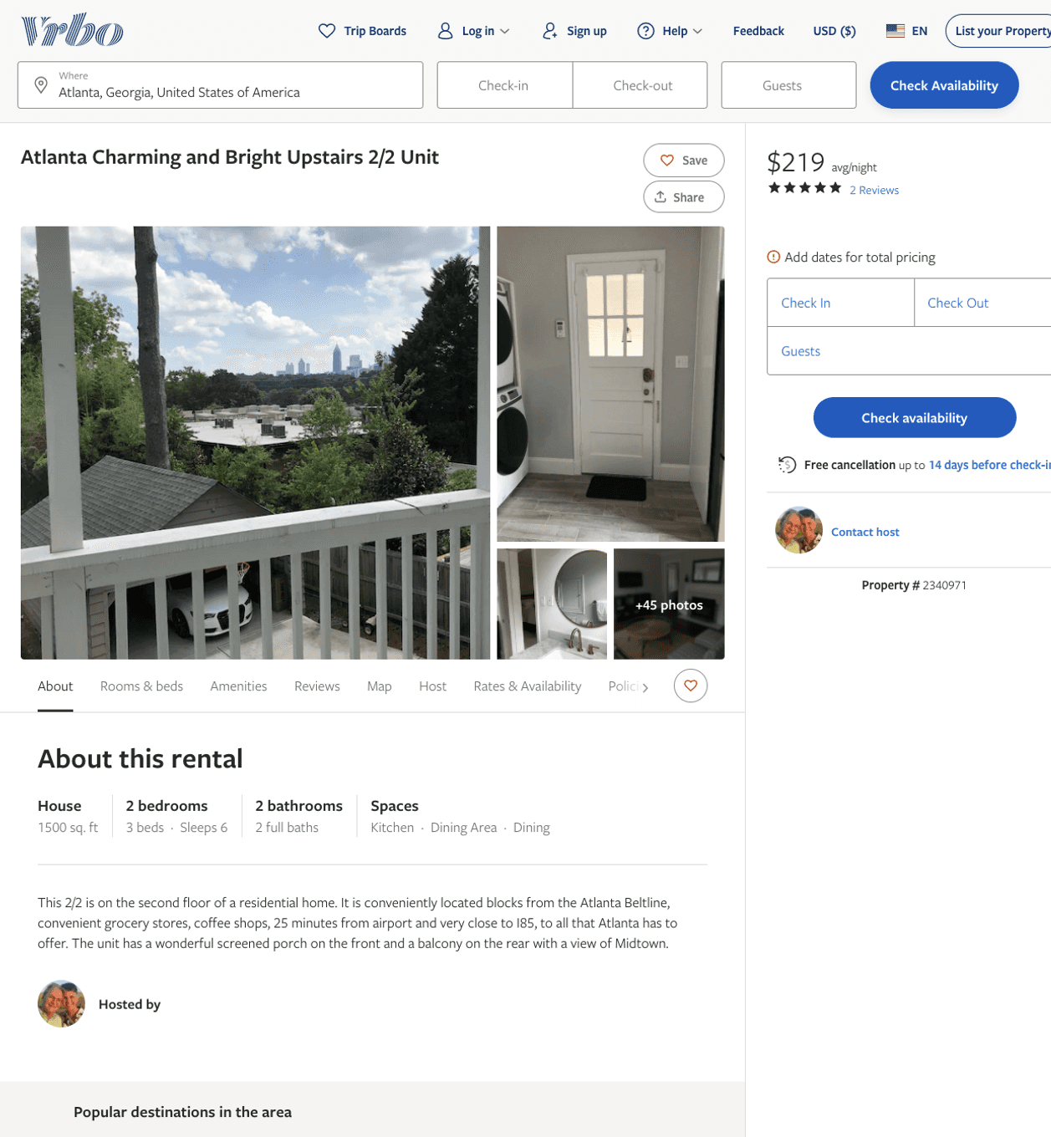
Listing 2340971
2
6
$213 - $219
3.6666667
3
https://www.vrbo.com/2340971
Aug 2022

Slide 9
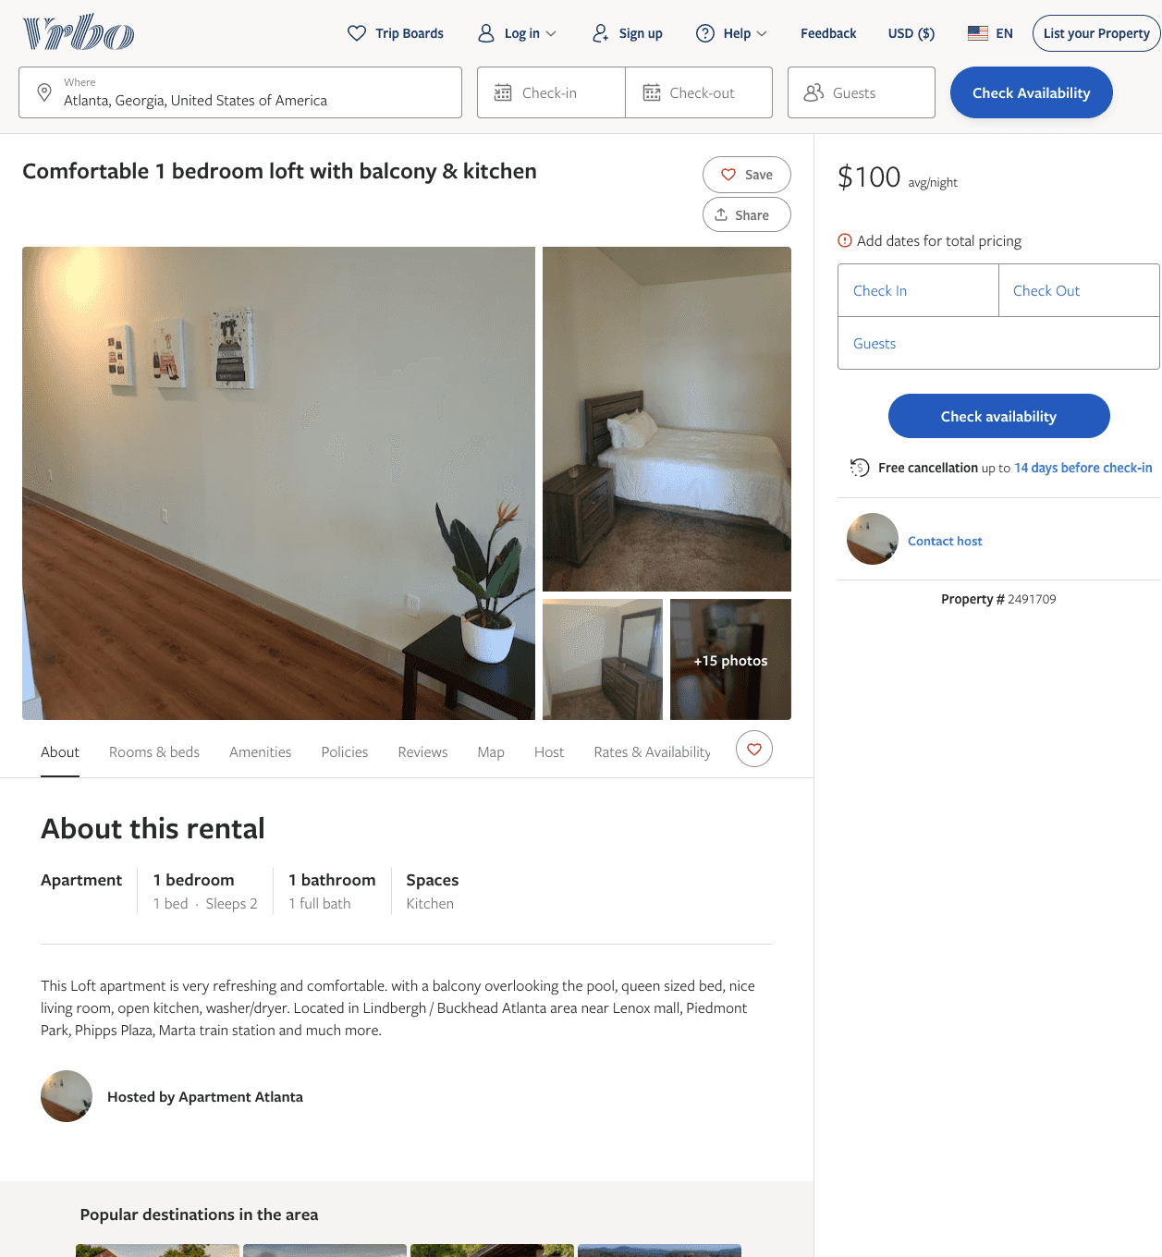
Listing 2491709
1
2
$100
2
https://www.vrbo.com/2491709
Aug 2022

Slide 10
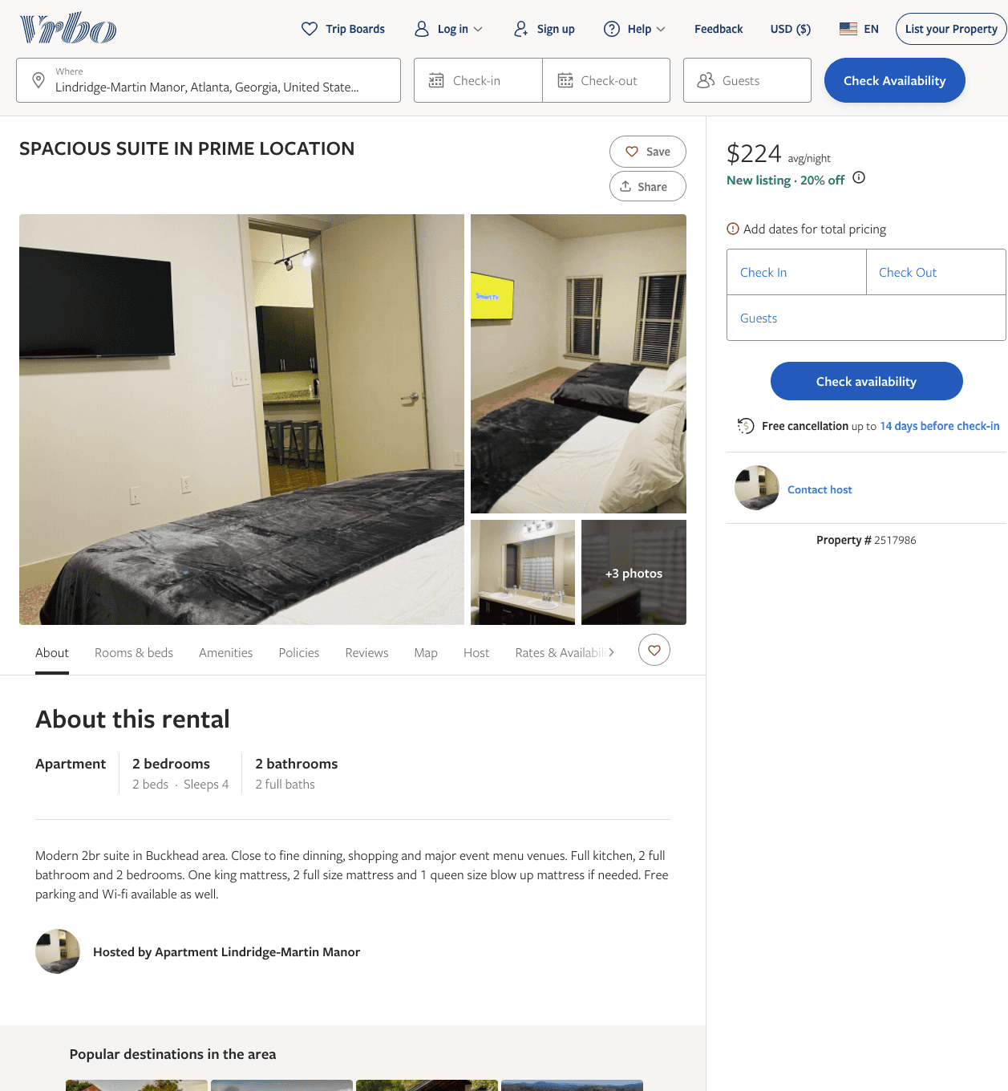
Listing 2517986
2
4
$224
2
https://www.vrbo.com/2517986
Aug 2022

Slide 11
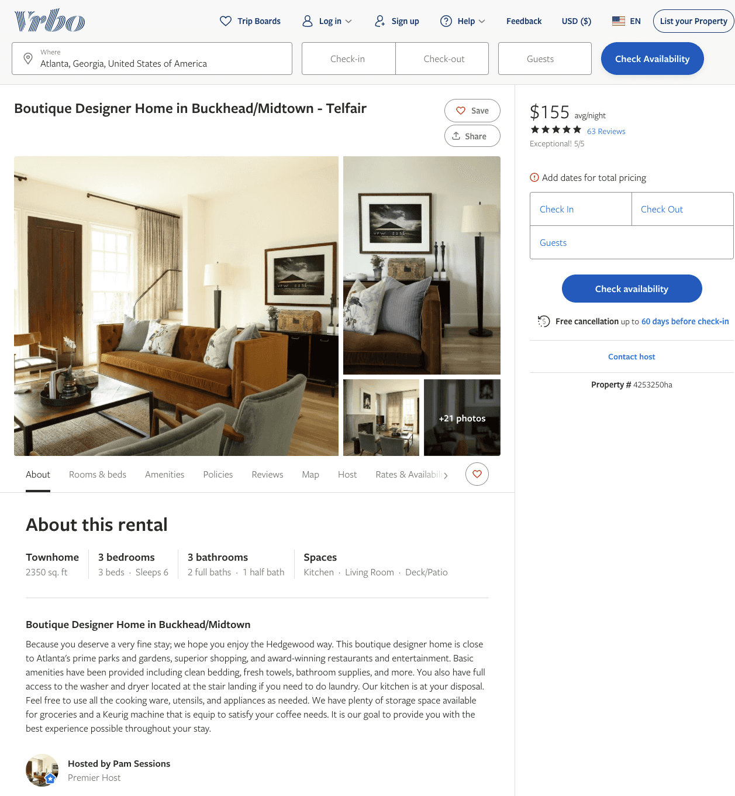
Listing 4253250
3
6
$155
4.968254
30
Pam Sessions
https://www.vrbo.com/4253250ha
Aug 2022

Slide 12
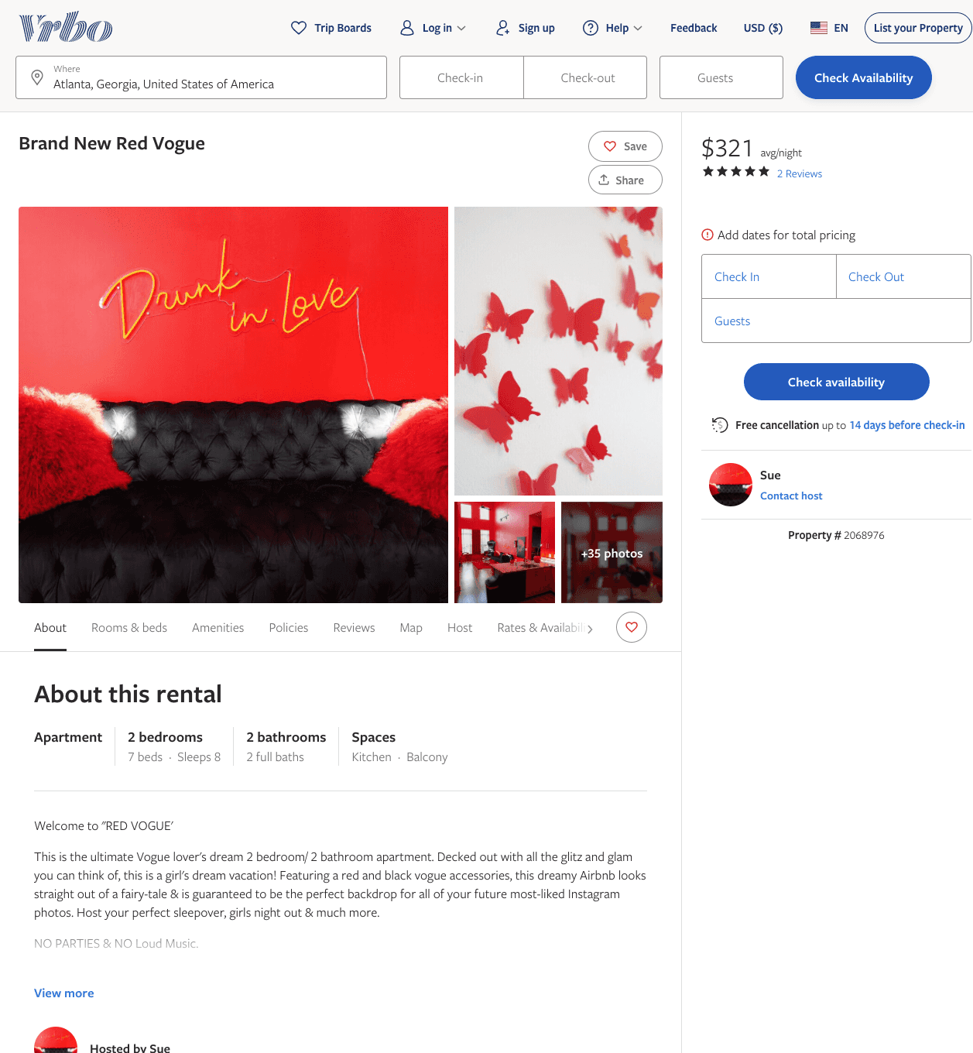
Listing 2068976
2
8
$299 - $379
5
1
Sue
https://www.vrbo.com/2068976
Aug 2022

Slide 13
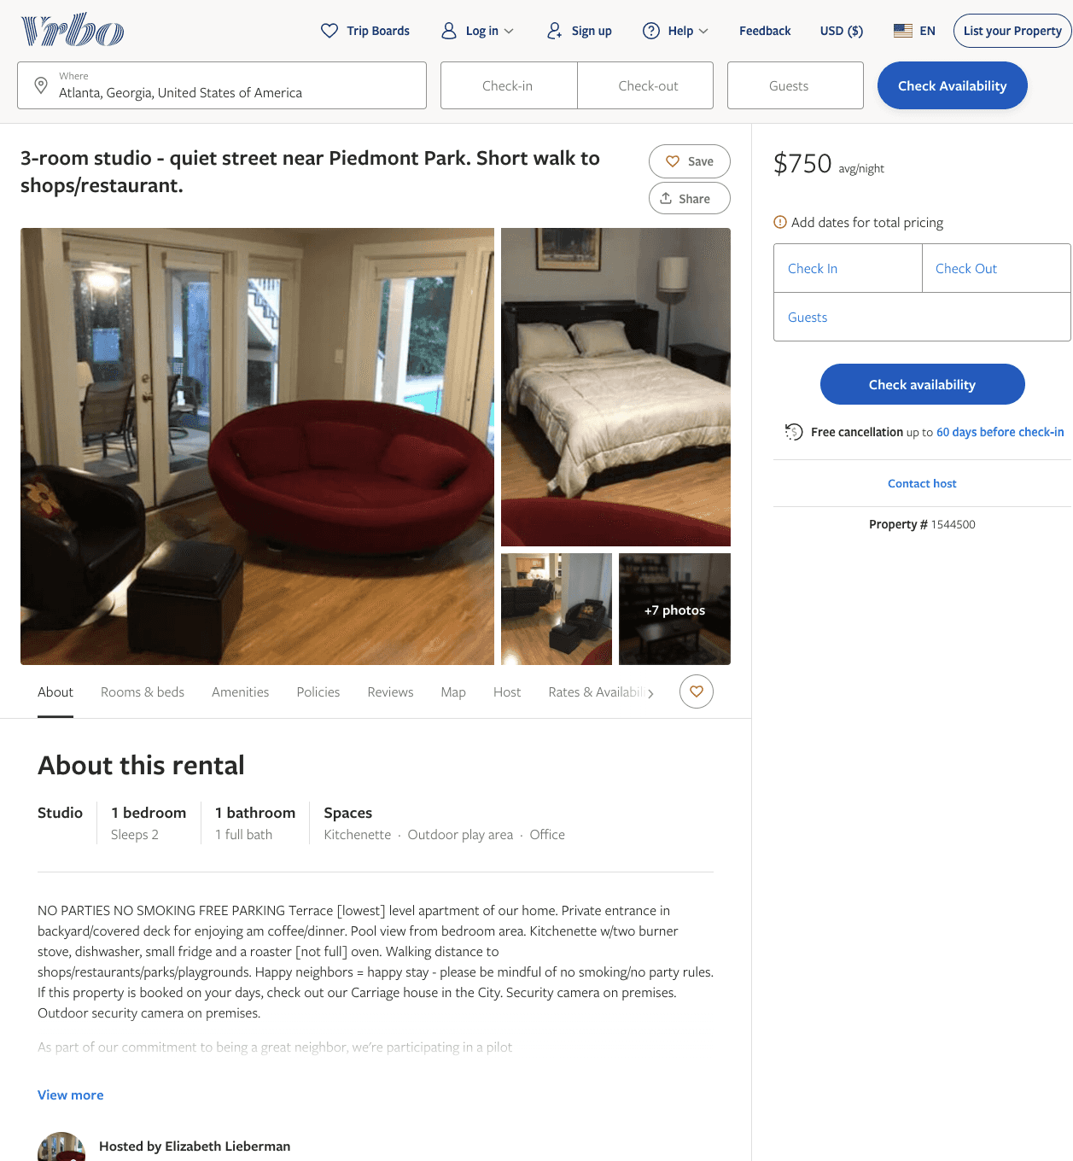
Listing 1544500
1
2
$750
2
Elizabeth Lieberman
https://www.vrbo.com/1544500
Aug 2022

Slide 14
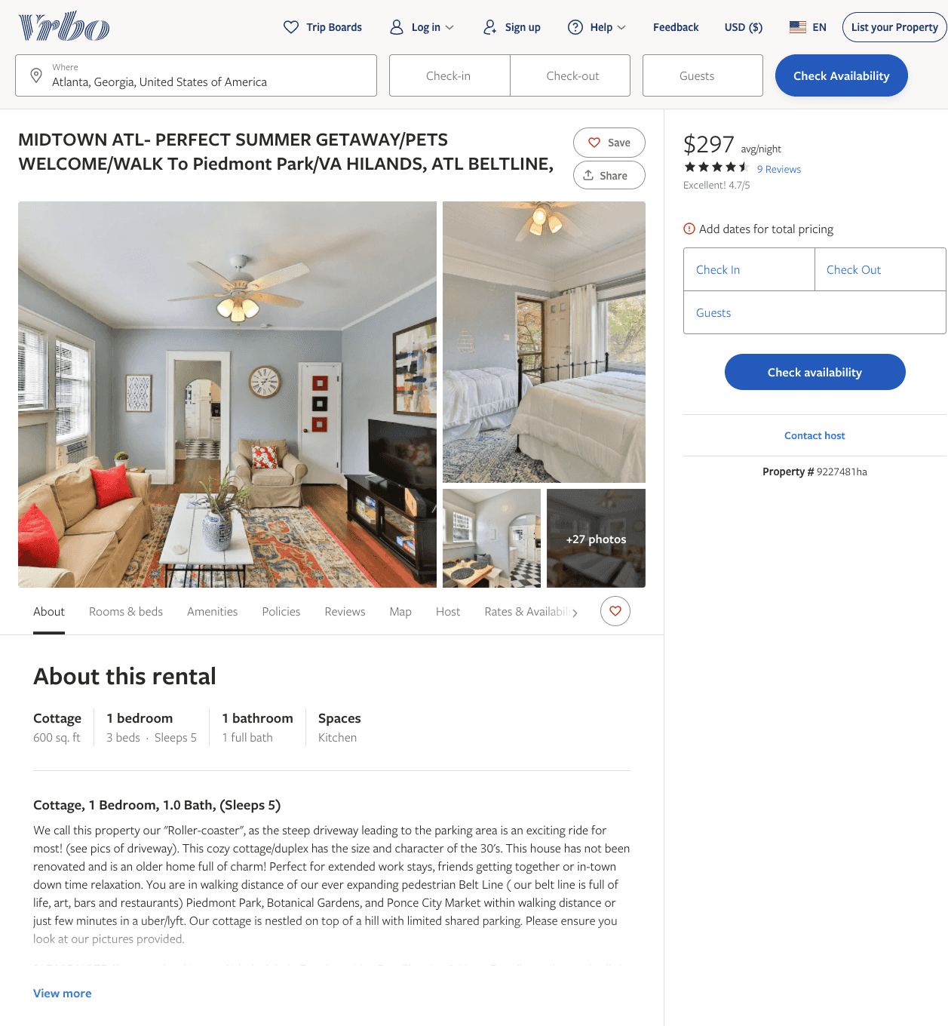
Listing 9227481
1
4
$100 - $82
4.611111
1
https://www.vrbo.com/9227481ha
Aug 2022

Slide 15
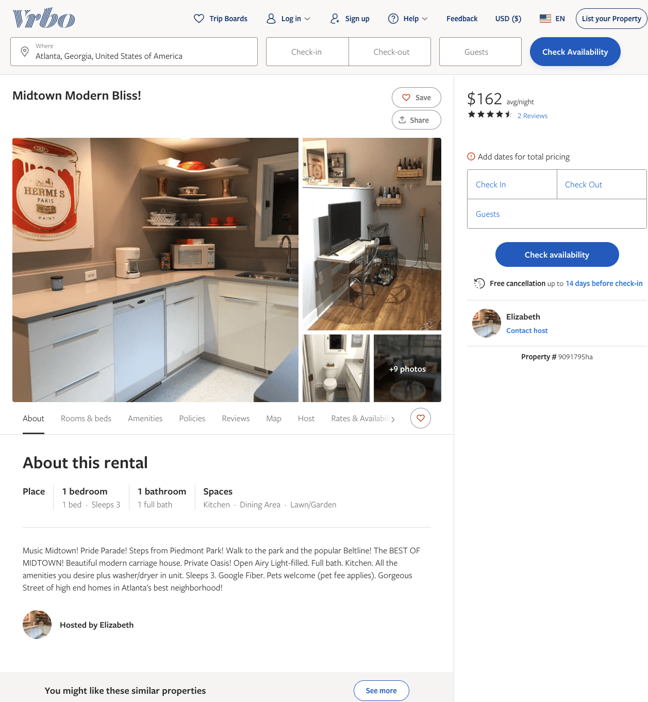
Listing 9091795
1
3
$151 - $197
4.5
2
Elizabeth
https://www.vrbo.com/9091795ha
Aug 2022

Slide 16
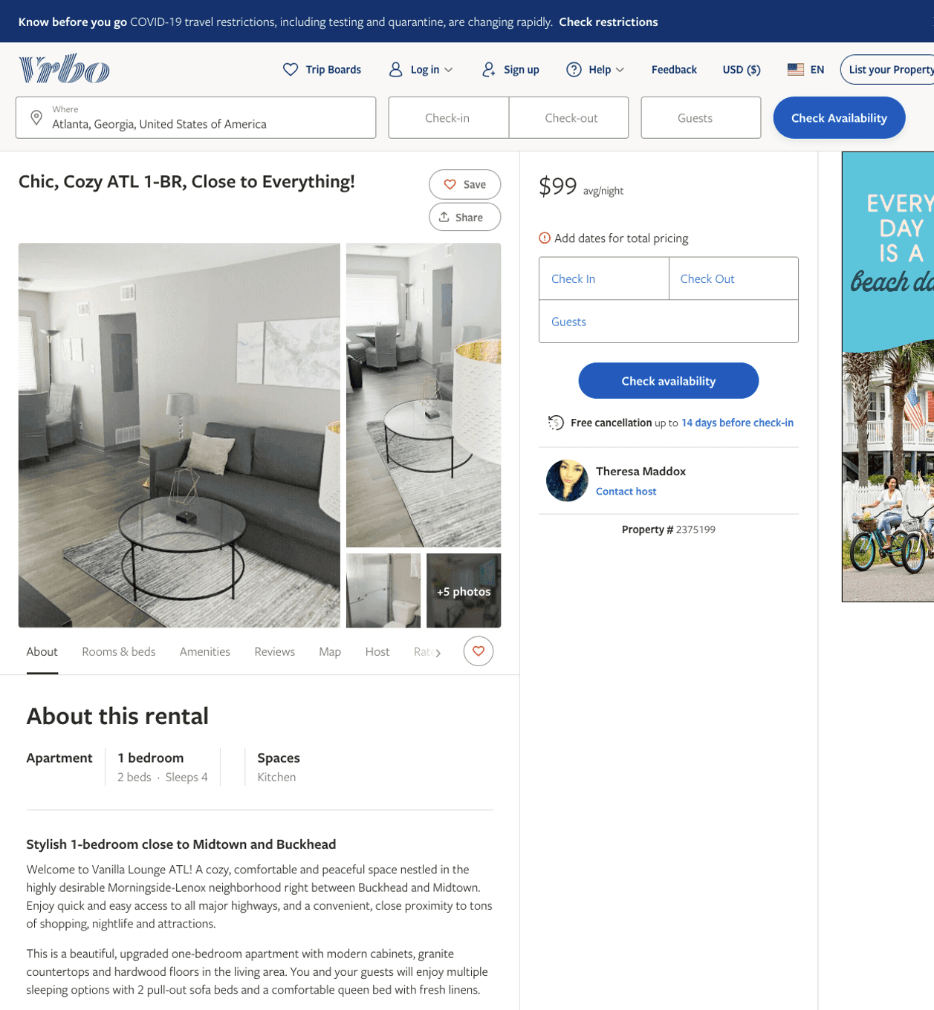
Listing 2375199
1
4
$100 - $99
4.5
2
Theresa Maddox
https://www.vrbo.com/2375199
Aug 2022

Slide 17
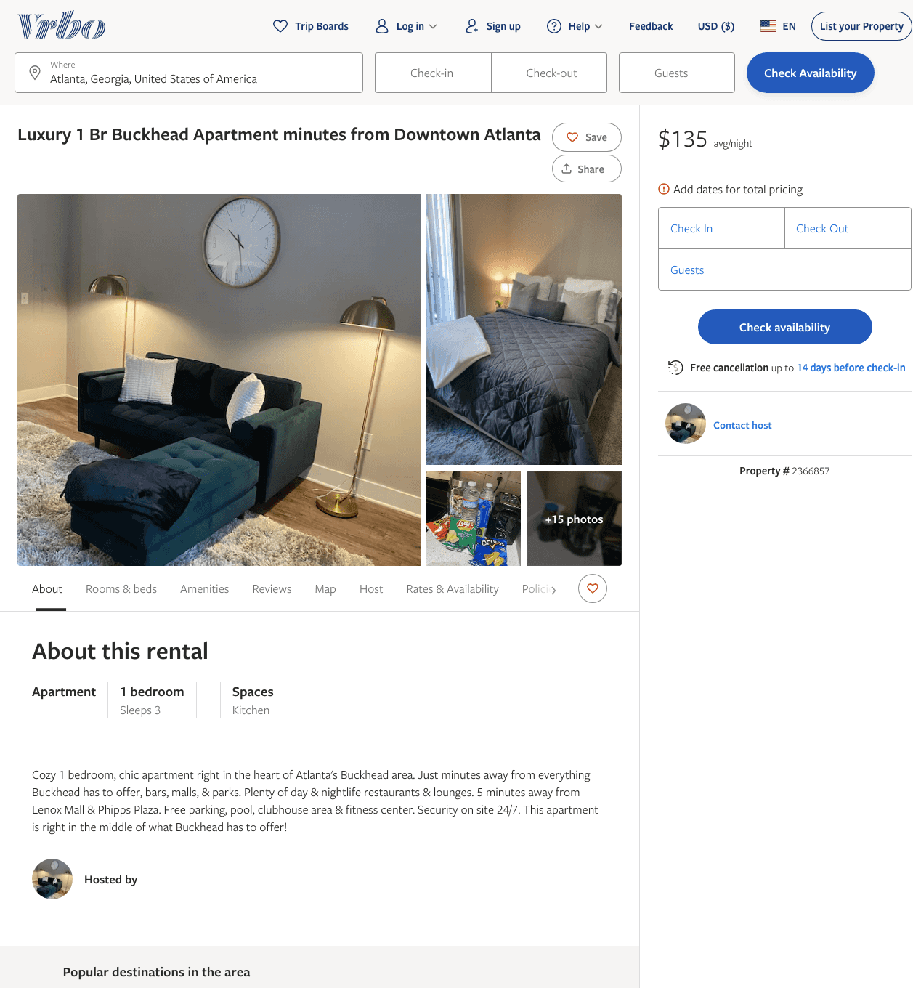
Listing 2366857
1
3
$135
1
https://www.vrbo.com/2366857
Aug 2022

Slide 18
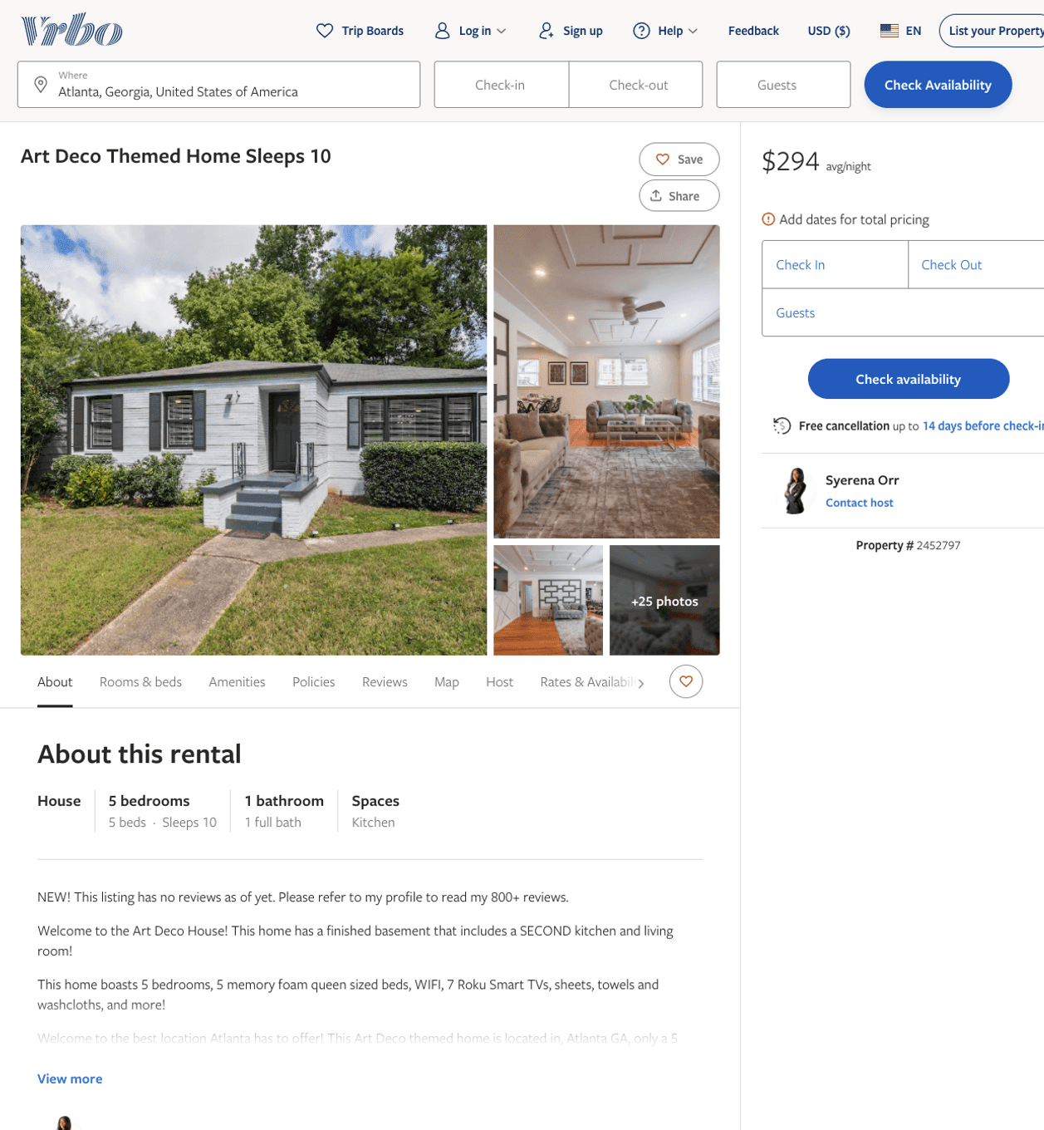
Listing 2452797
5
10
$189 - $312
2
Syerena Orr
https://www.vrbo.com/2452797
Aug 2022

Slide 19
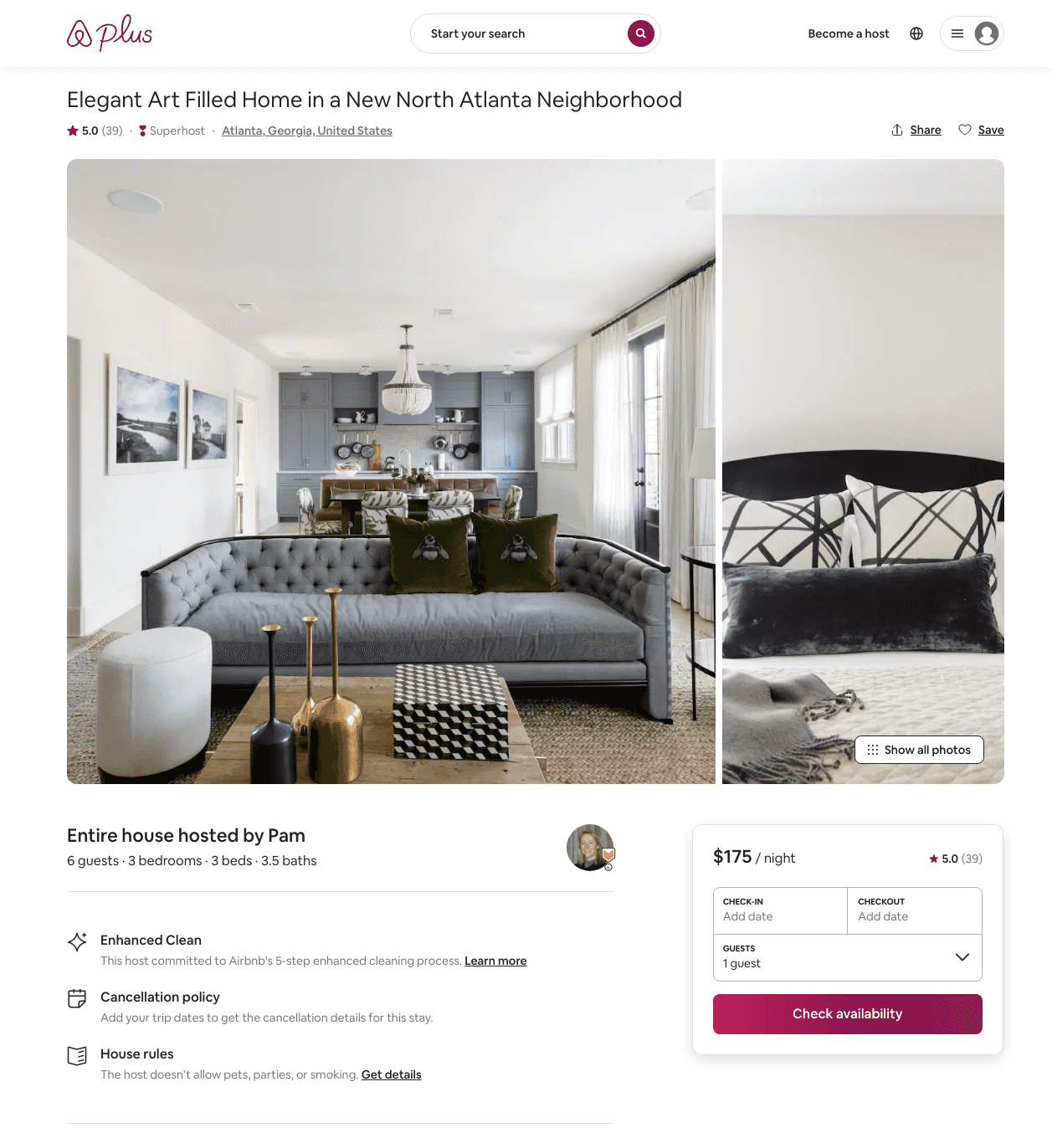
Listing 29486455
3
6
$175 - $425
5.0
30
Pam
4790157
5
https://www.airbnb.com/rooms/29486455
Aug 2022

Slide 20
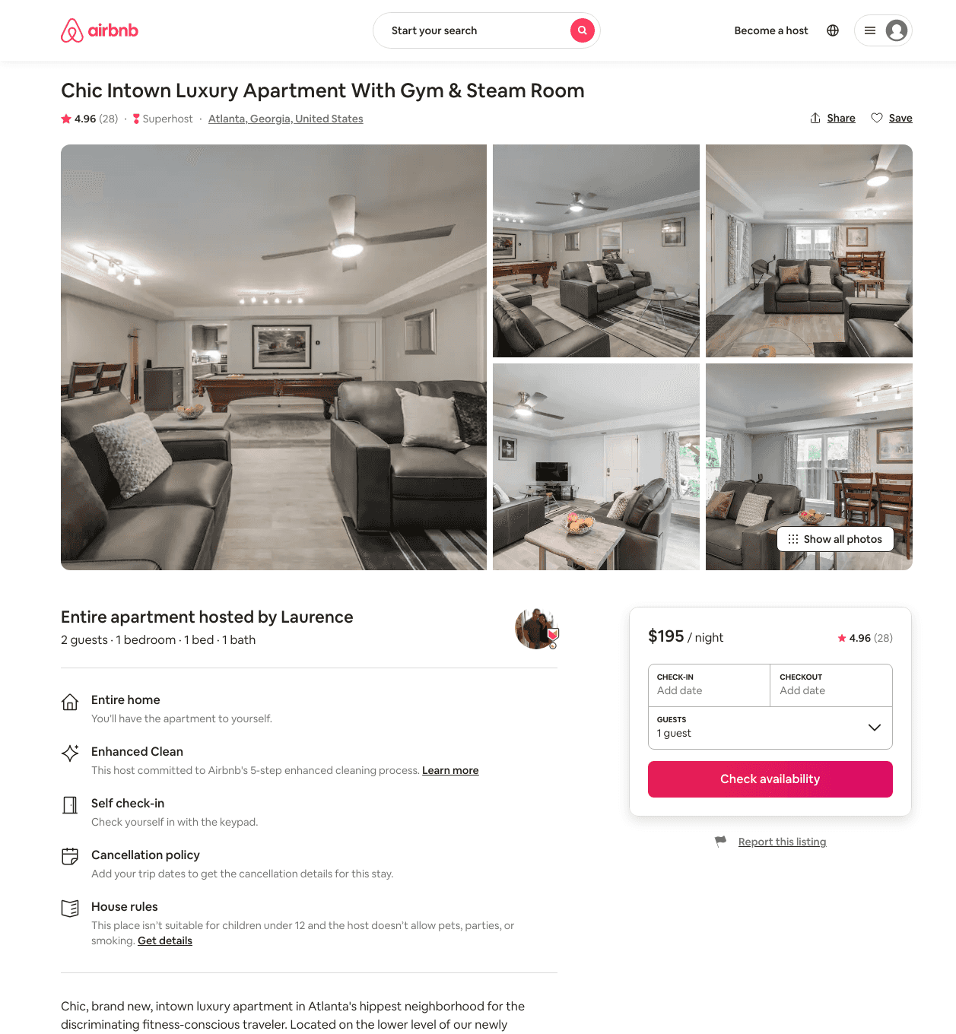
Listing 31939120
1
2
$195
4.98
2
Laurence
114844842
1
https://www.airbnb.com/rooms/31939120
Aug 2022

Slide 21
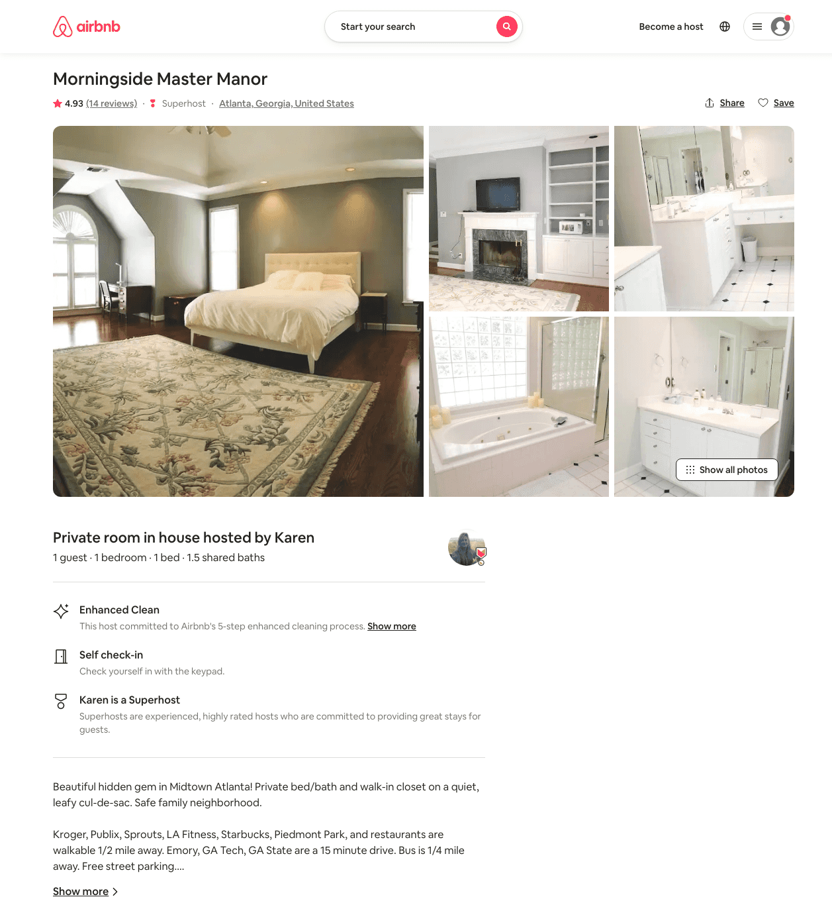
Listing 21948537
1
1
$75 - $76
4.94
30
Karen
14025457
4
https://www.airbnb.com/rooms/21948537
Aug 2022

Slide 22
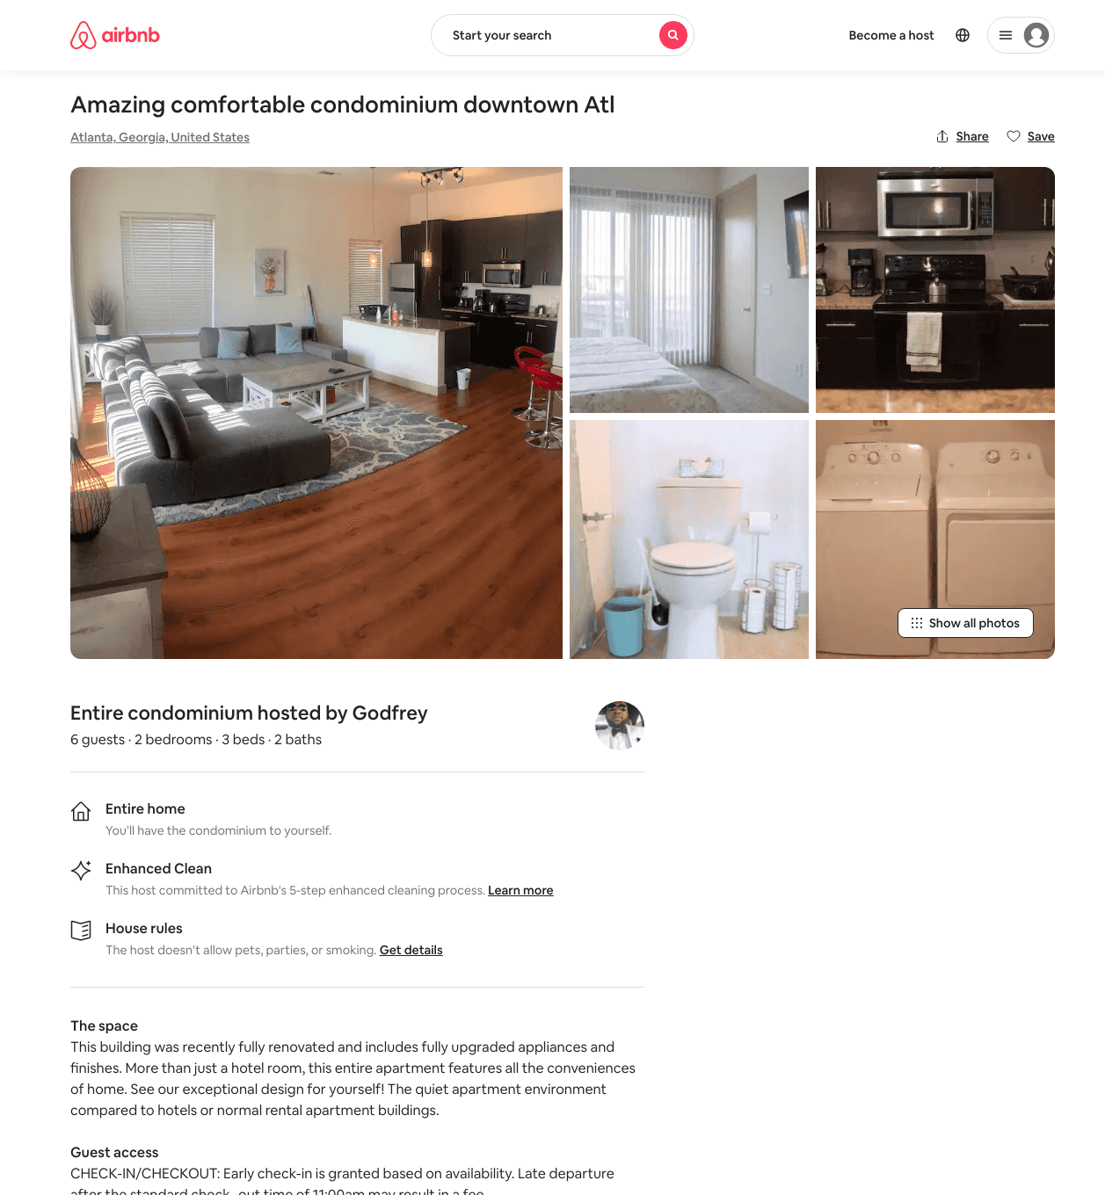
Listing 48956872
2
6
$174 - $500
5.0
3
Godfrey
243178119
1
https://www.airbnb.com/rooms/48956872
Jun 2022

Slide 23
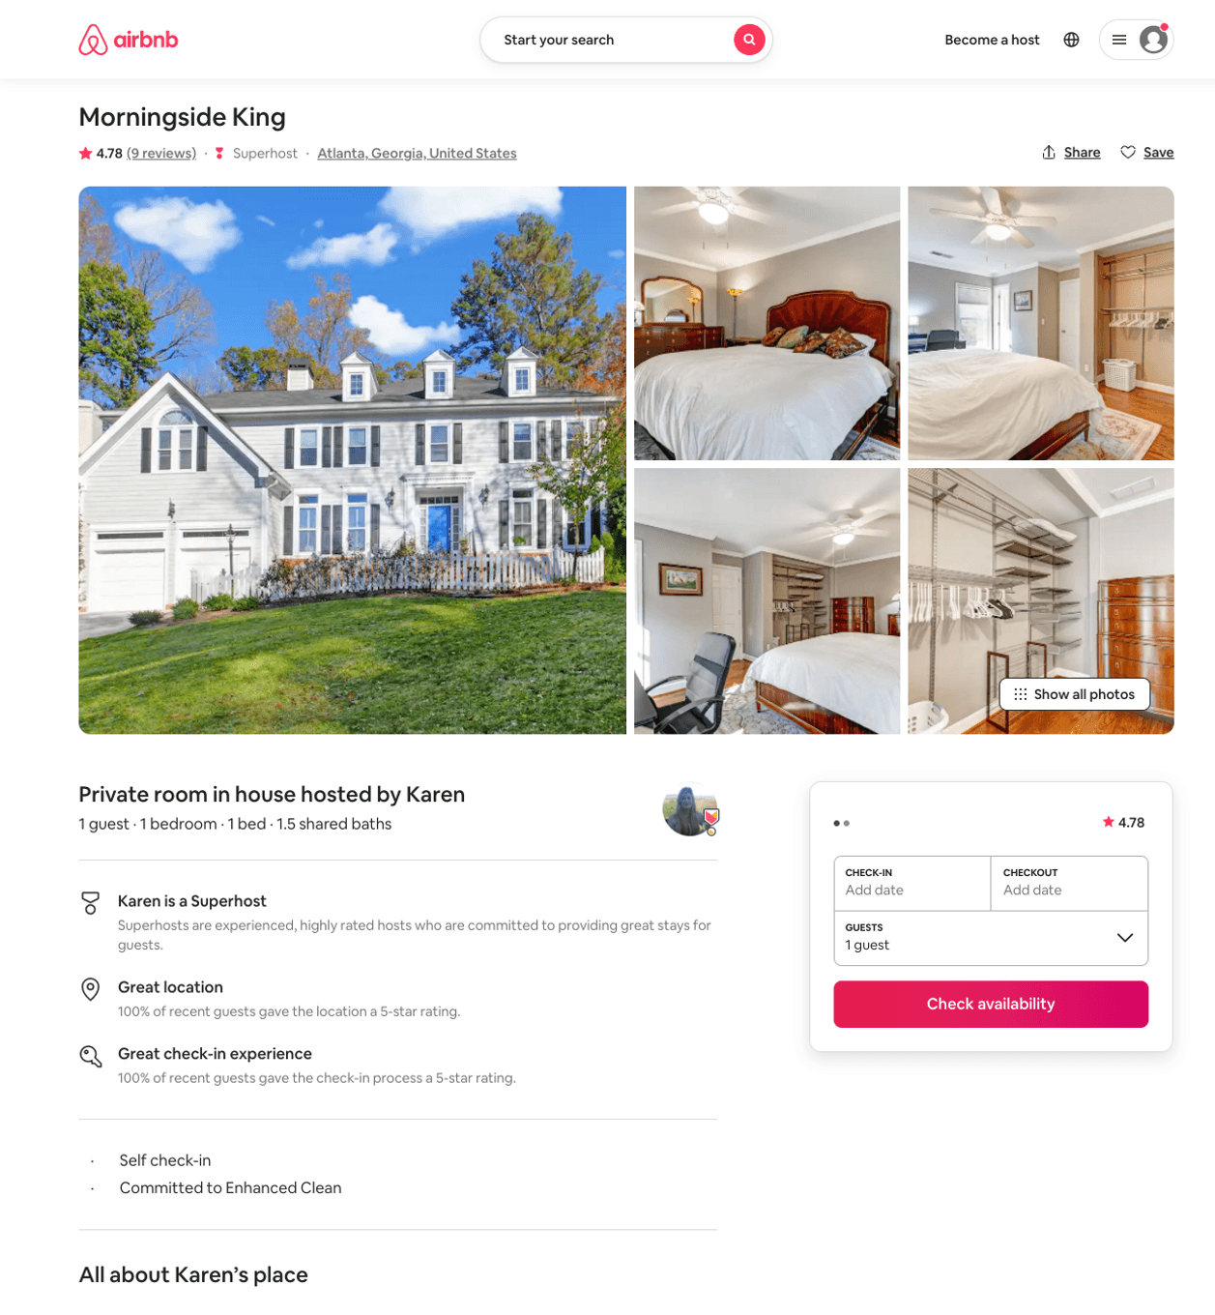
Listing 22166279
1
1
$65
4.82
30
Karen
14025457
4
https://www.airbnb.com/rooms/22166279
Jul 2022

Slide 24
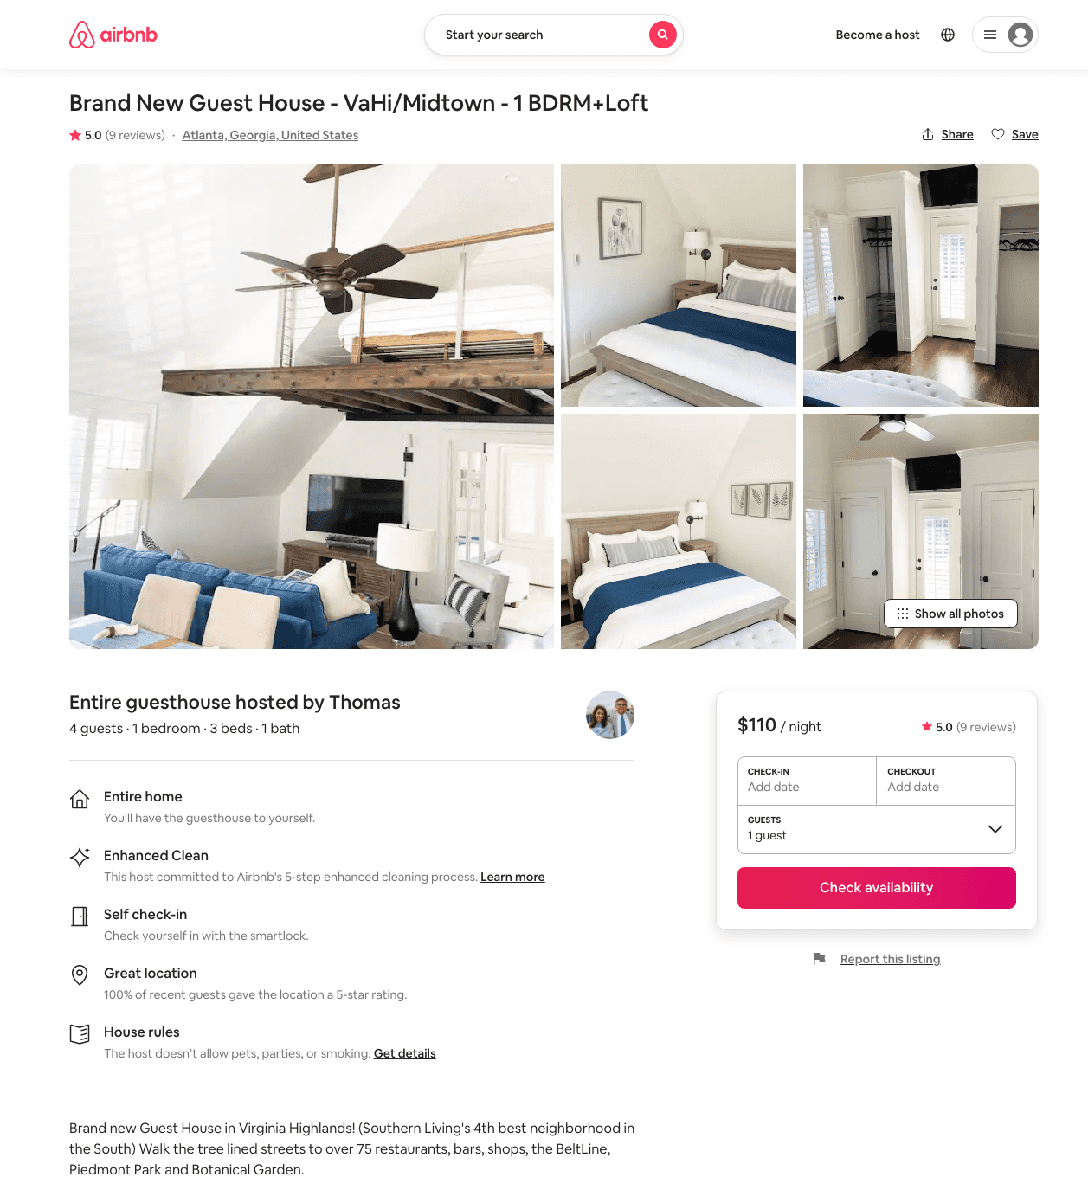
Listing 44471026
1
4
$110 - $157
4.99
3
Thomas
359447494
1
https://www.airbnb.com/rooms/44471026
Aug 2022

Slide 25
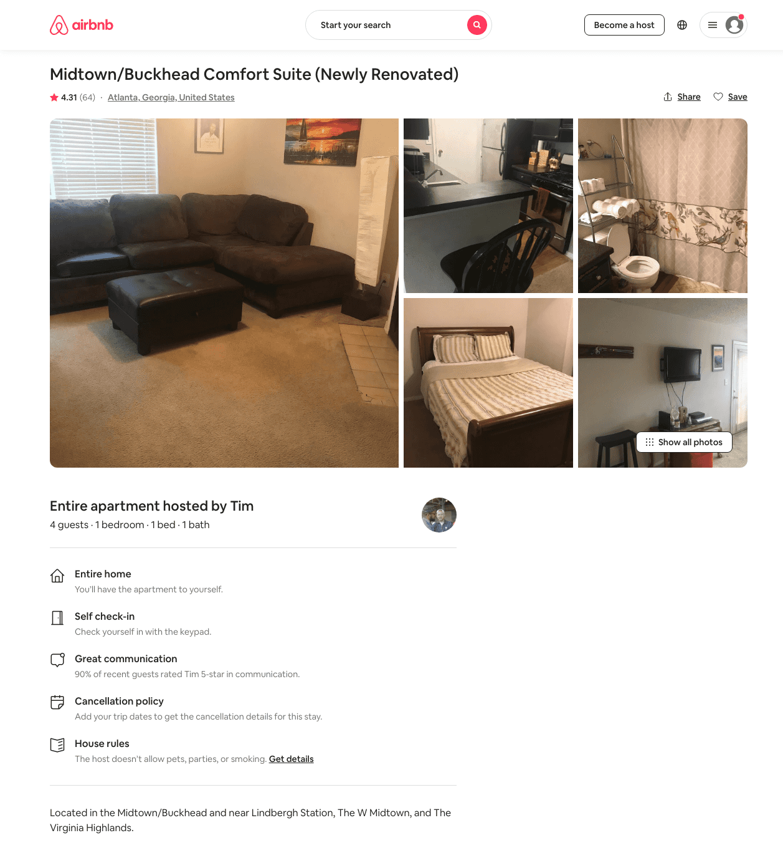
Listing 18941399
1
4
$73 - $75
4.33
2
Tim
132039530
1
https://www.airbnb.com/rooms/18941399
Aug 2022

Slide 26
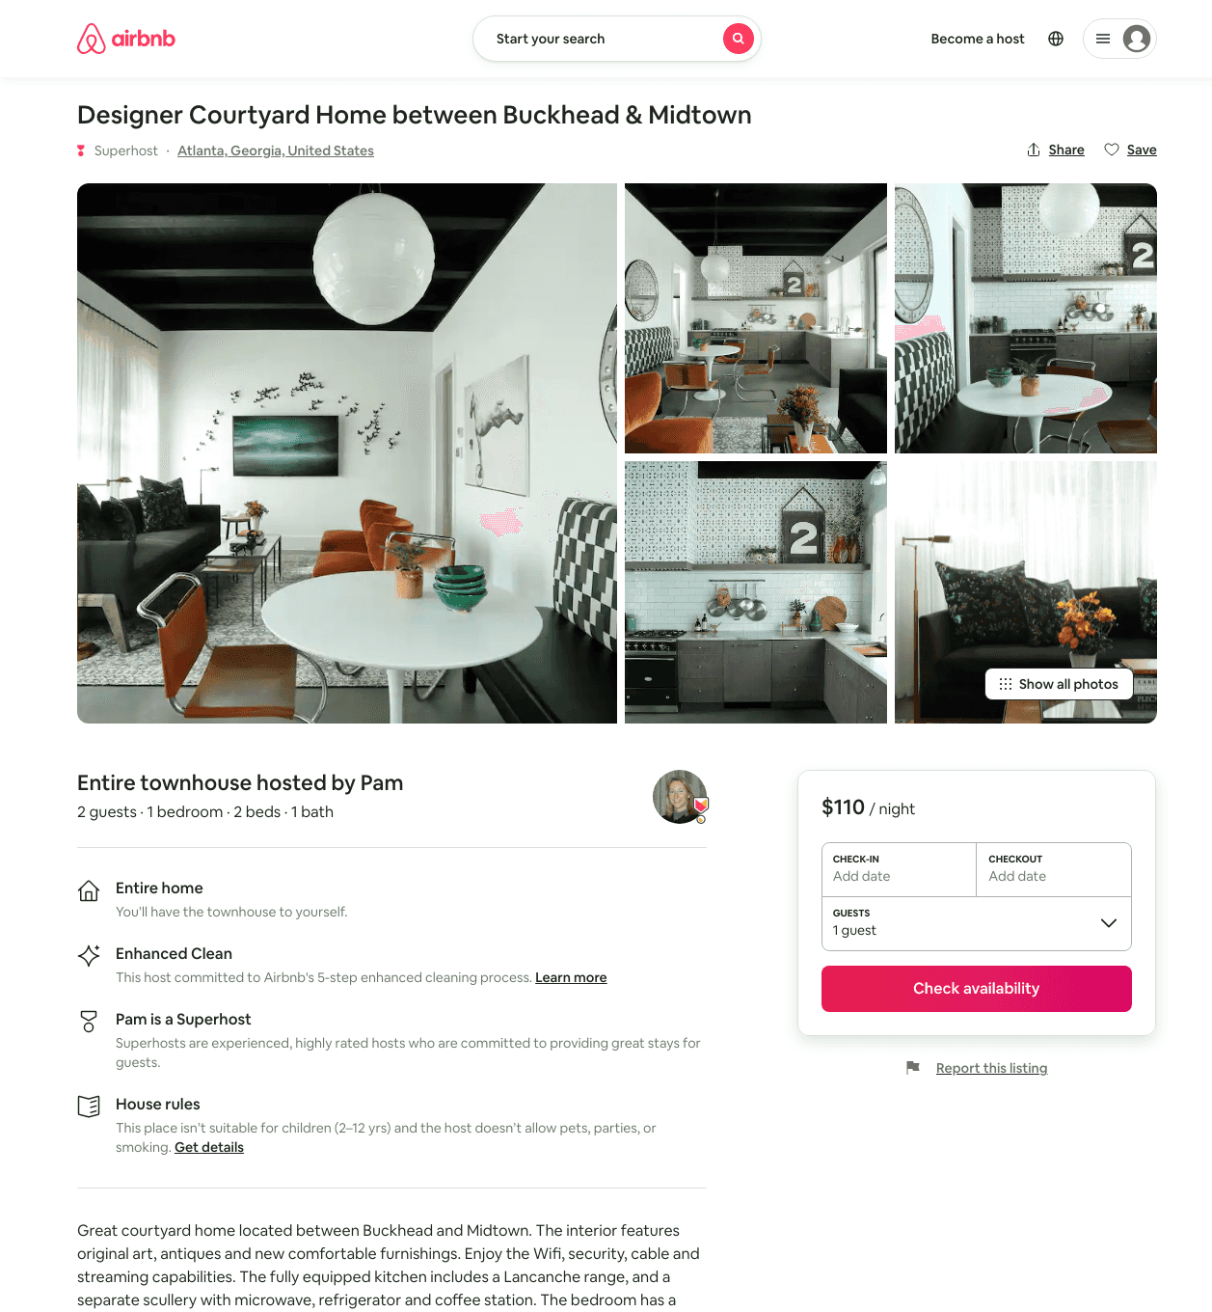
Listing 48087874
1
2
$110
30
Pam
4790157
5
https://www.airbnb.com/rooms/48087874
Jul 2022

Slide 27
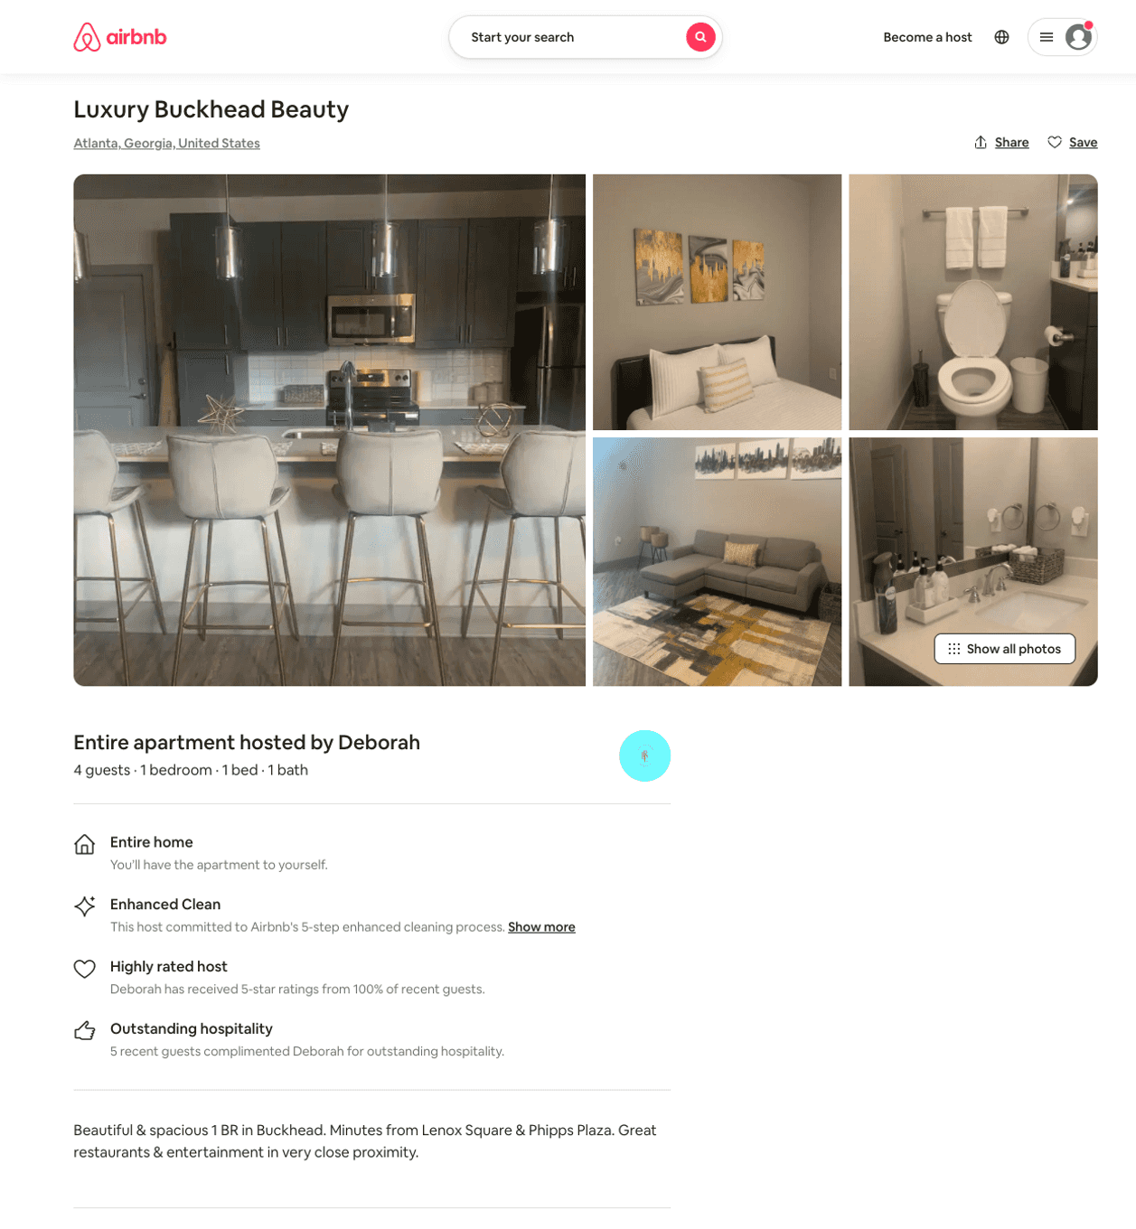
Listing 48459944
1
4
$125 - $175
4.86
1
Deborah
162538654
3
https://www.airbnb.com/rooms/48459944
Aug 2022

Slide 28
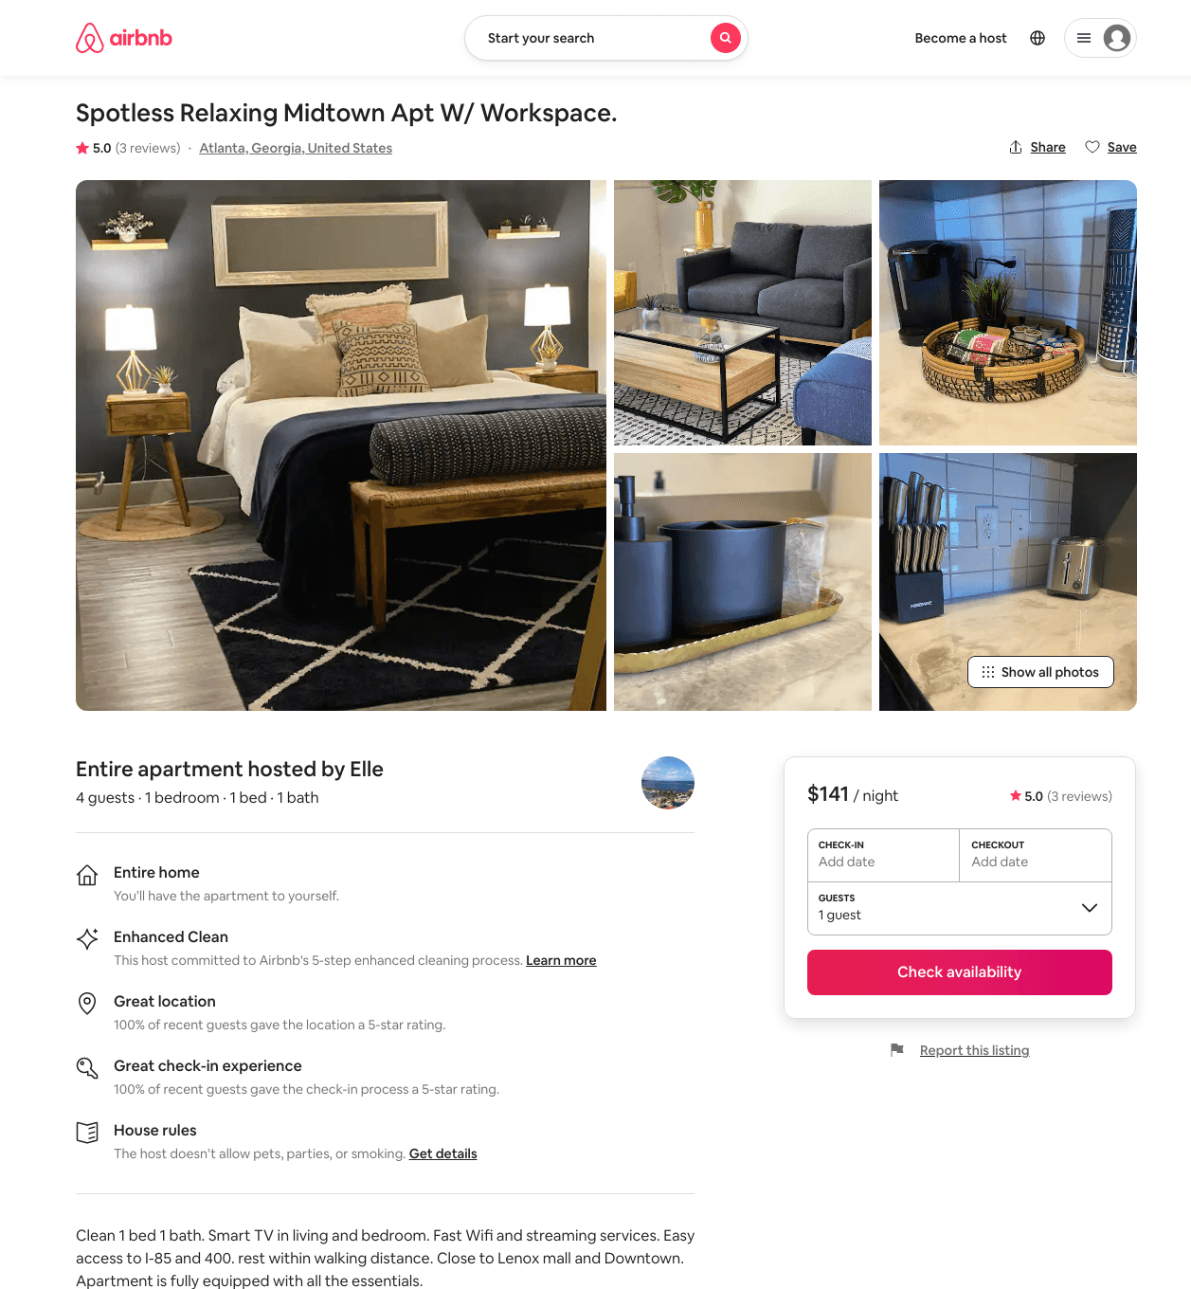
Listing 45806975
1
4
$116 - $161
5.0
3
Elle
367270546
4
https://www.airbnb.com/rooms/45806975
Jun 2022

Slide 29
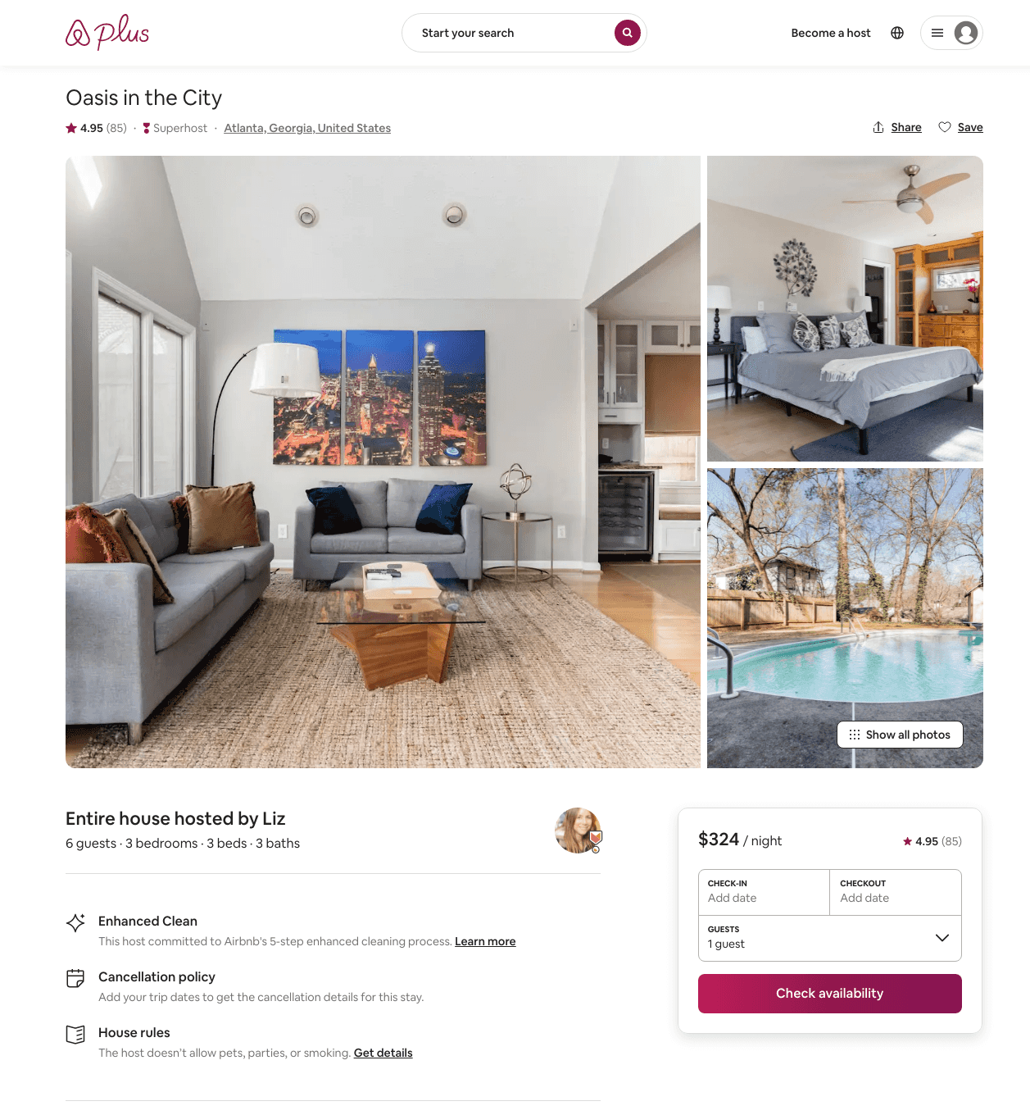
Listing 19404479
3
6
$274 - $533
4.94
3
Liz
126452688
3
https://www.airbnb.com/rooms/19404479
Aug 2022

Slide 30
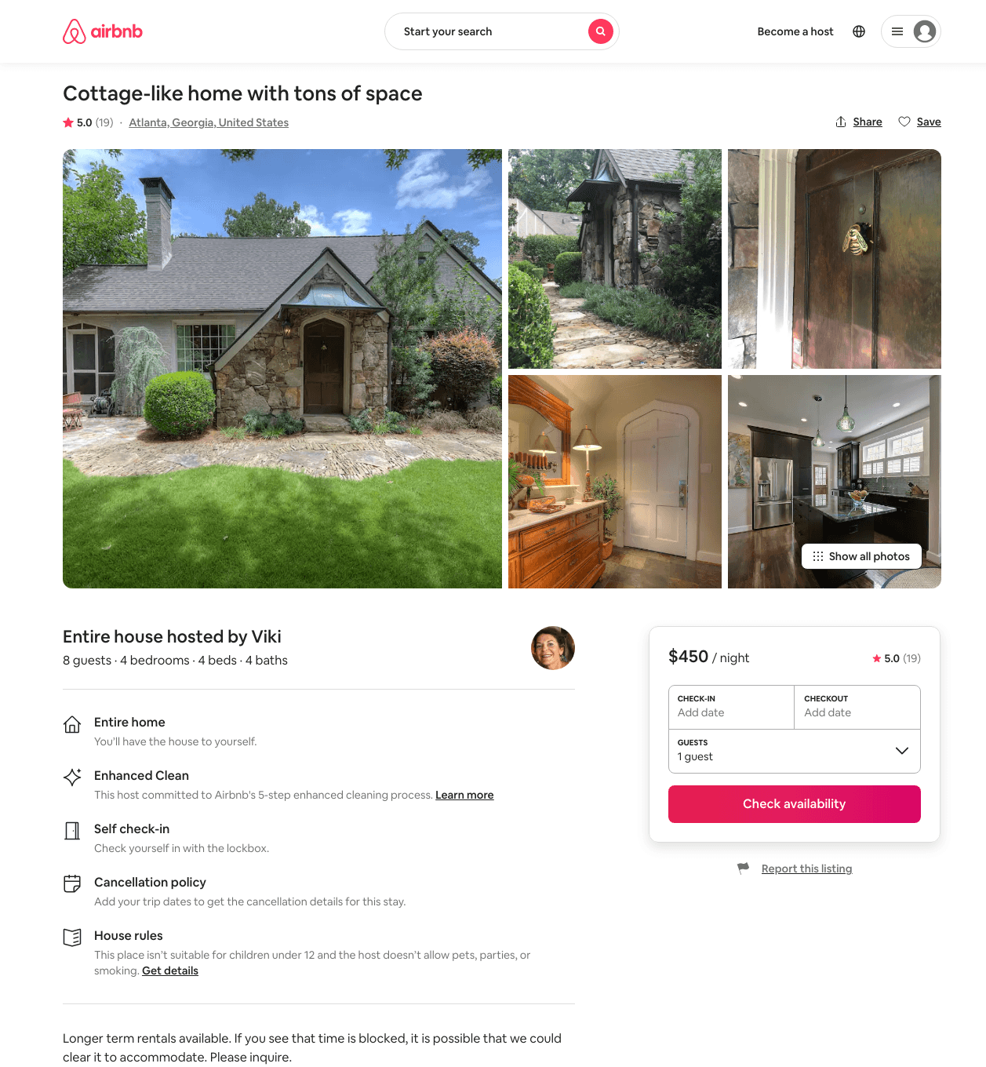
Listing 28662979
4
8
$450 - $495
5.0
3
Viki
63256004
1
https://www.airbnb.com/rooms/28662979
Aug 2022

Slide 31
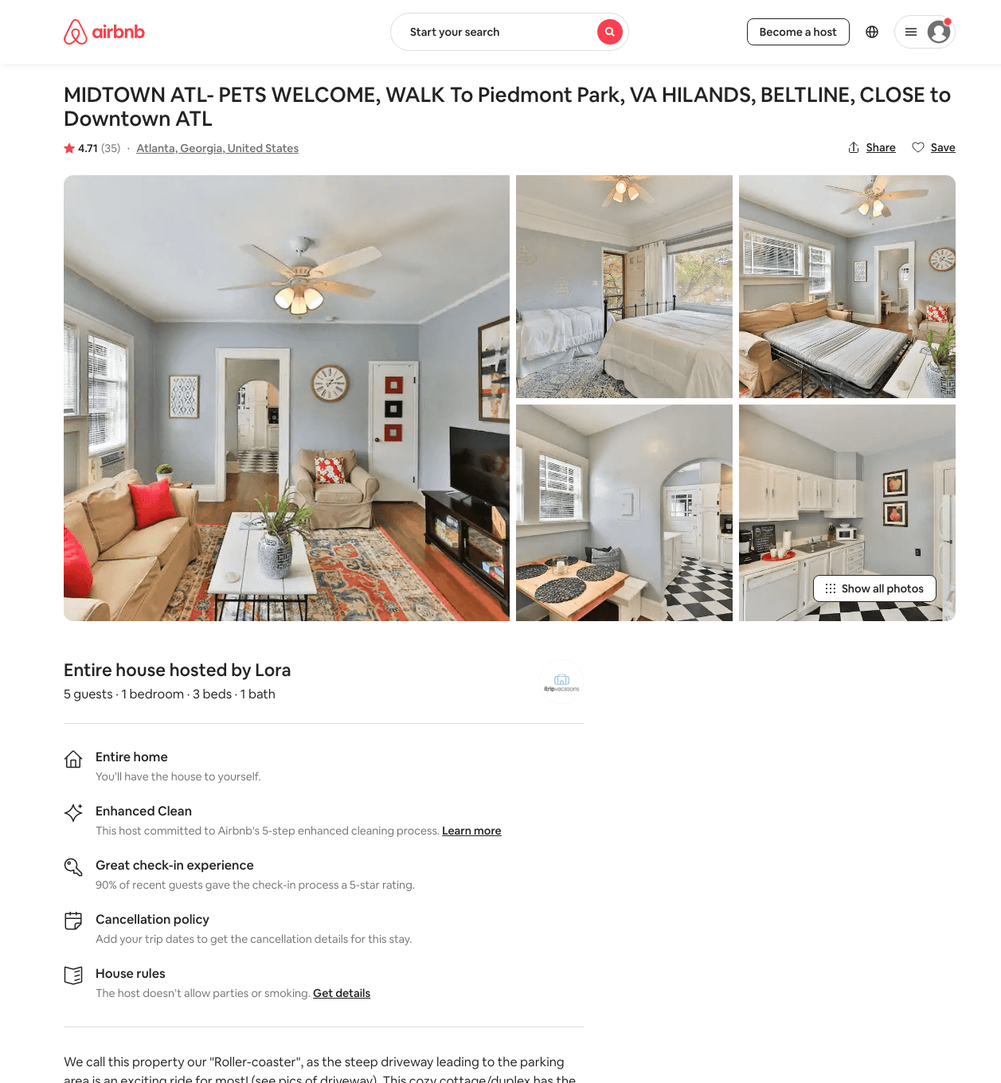
Listing 39769700
1
4
$95 - $216
4.60
1
Blitz Girlz
305467402
16
https://www.airbnb.com/rooms/39769700
Aug 2022

Slide 32
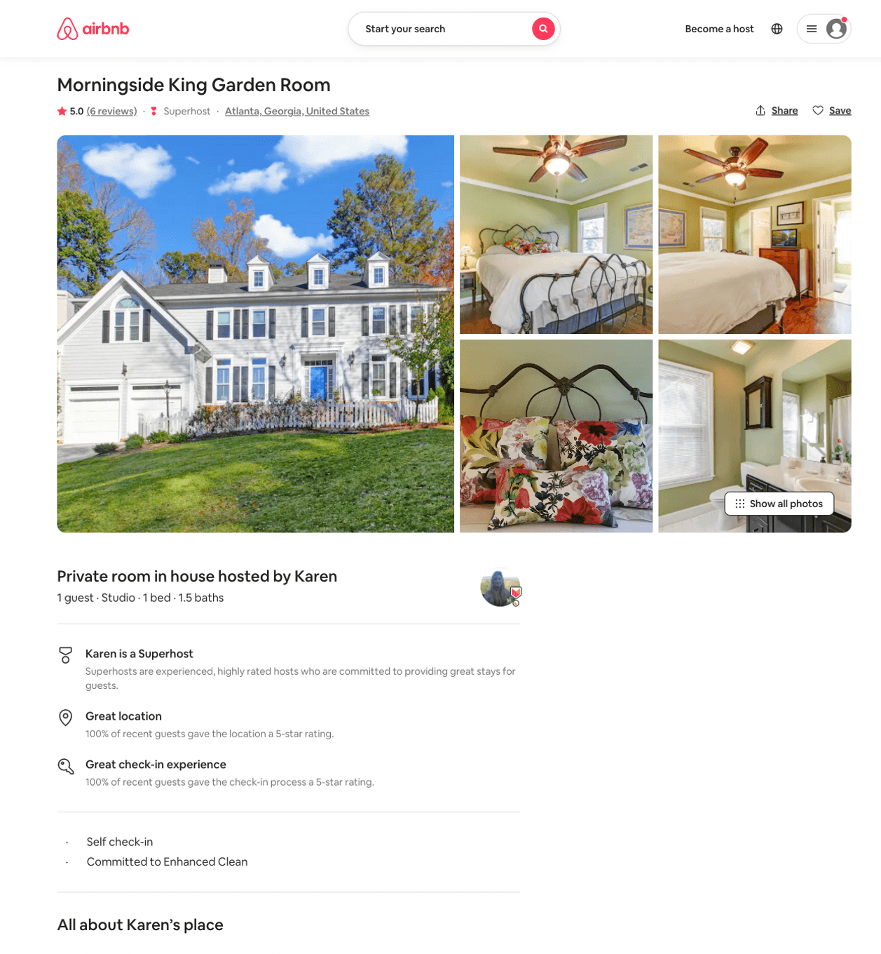
Listing 40330037
Studio
1
$60
5.0
30
Karen
14025457
4
https://www.airbnb.com/rooms/40330037
Jul 2022

Slide 33
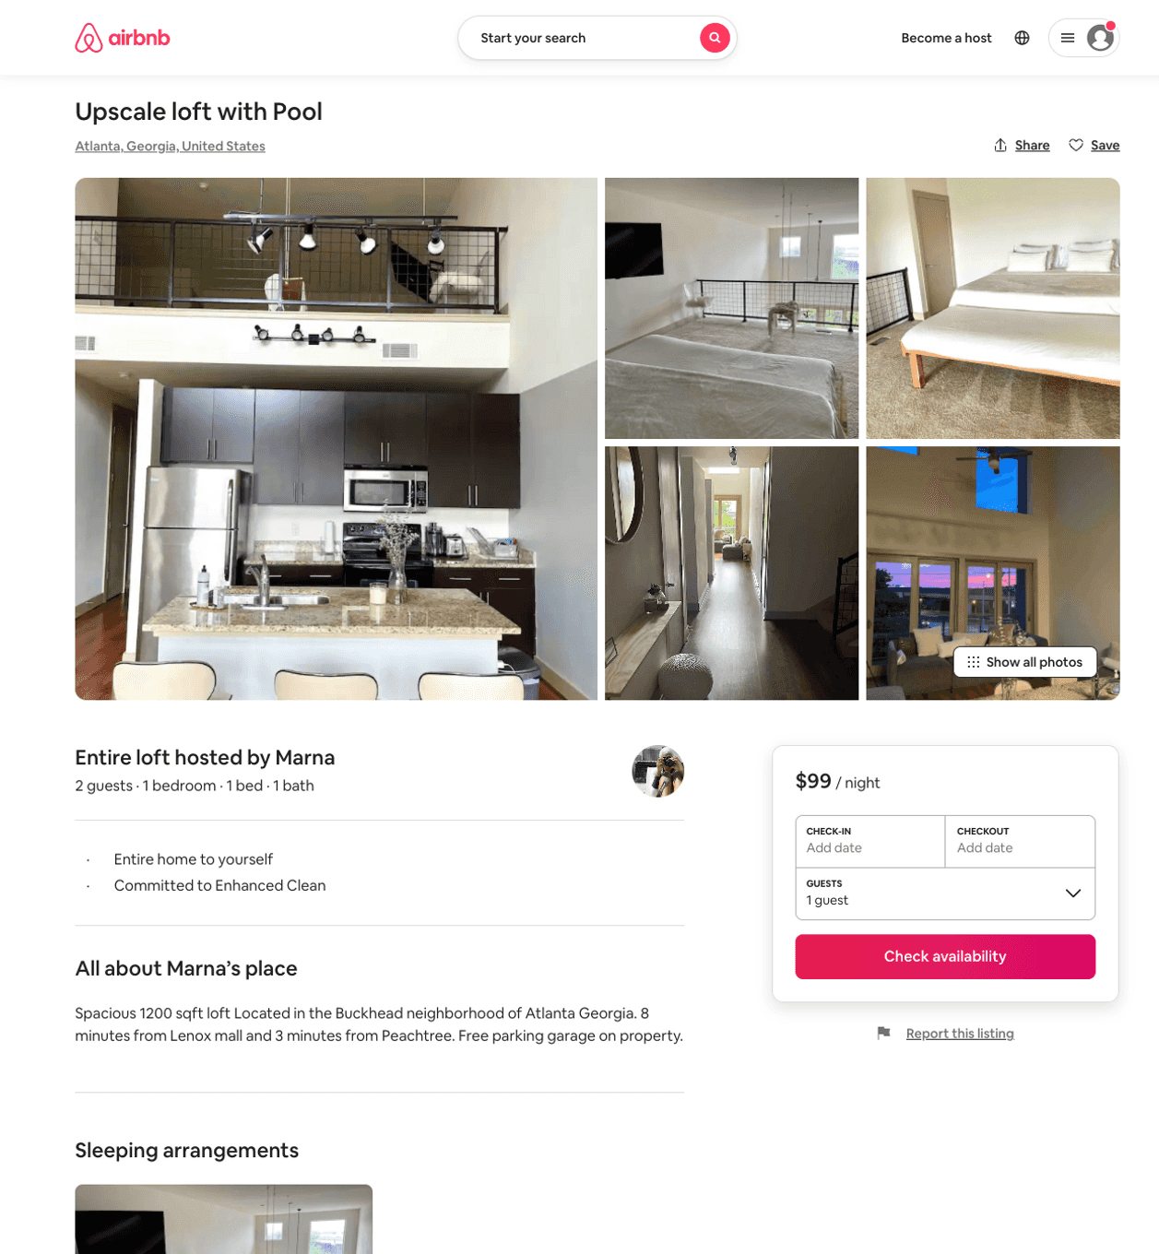
Listing 50486076
1
2
$99 - $124
4.53
1
Marna
79566393
1
https://www.airbnb.com/rooms/50486076
Aug 2022

Slide 34
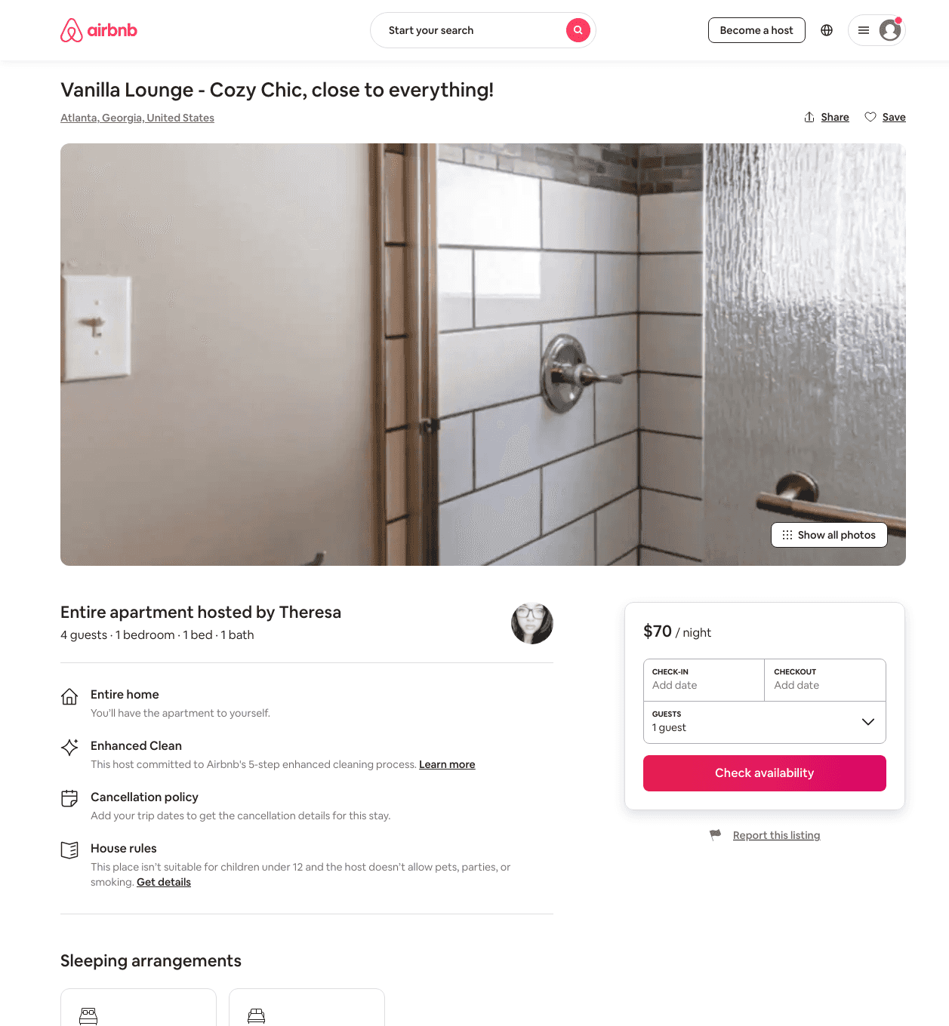
Listing 48992623
1
4
$69 - $146
4.93
1
Keisha
458630514
1
https://www.airbnb.com/rooms/48992623
Jul 2022

Slide 35
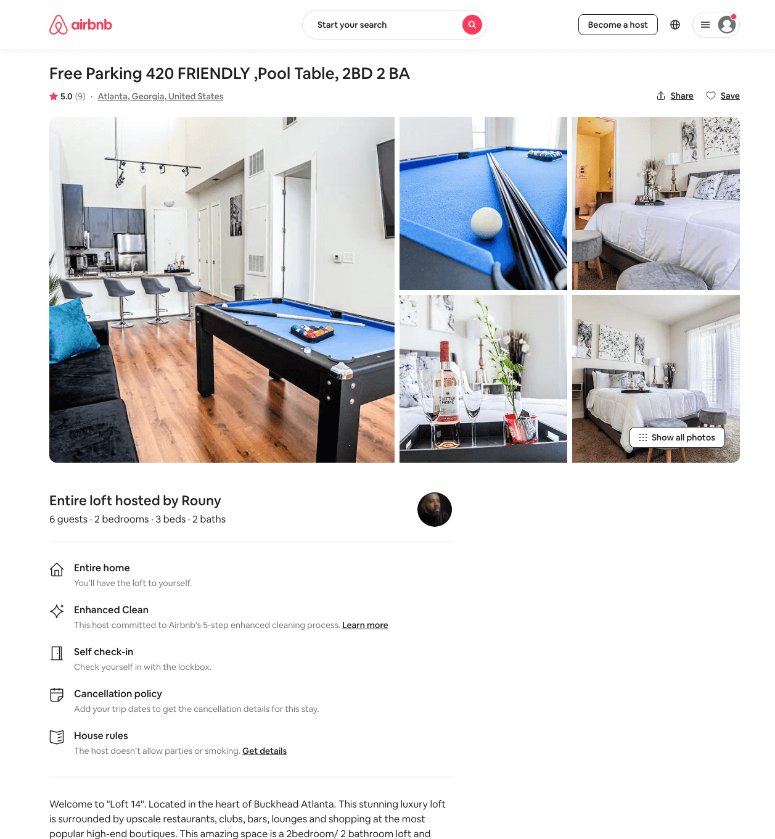
Listing 48458272
2
5
$145 - $275
4.73
1
Rouny
103347045
2
https://www.airbnb.com/rooms/48458272
Aug 2022

Slide 36
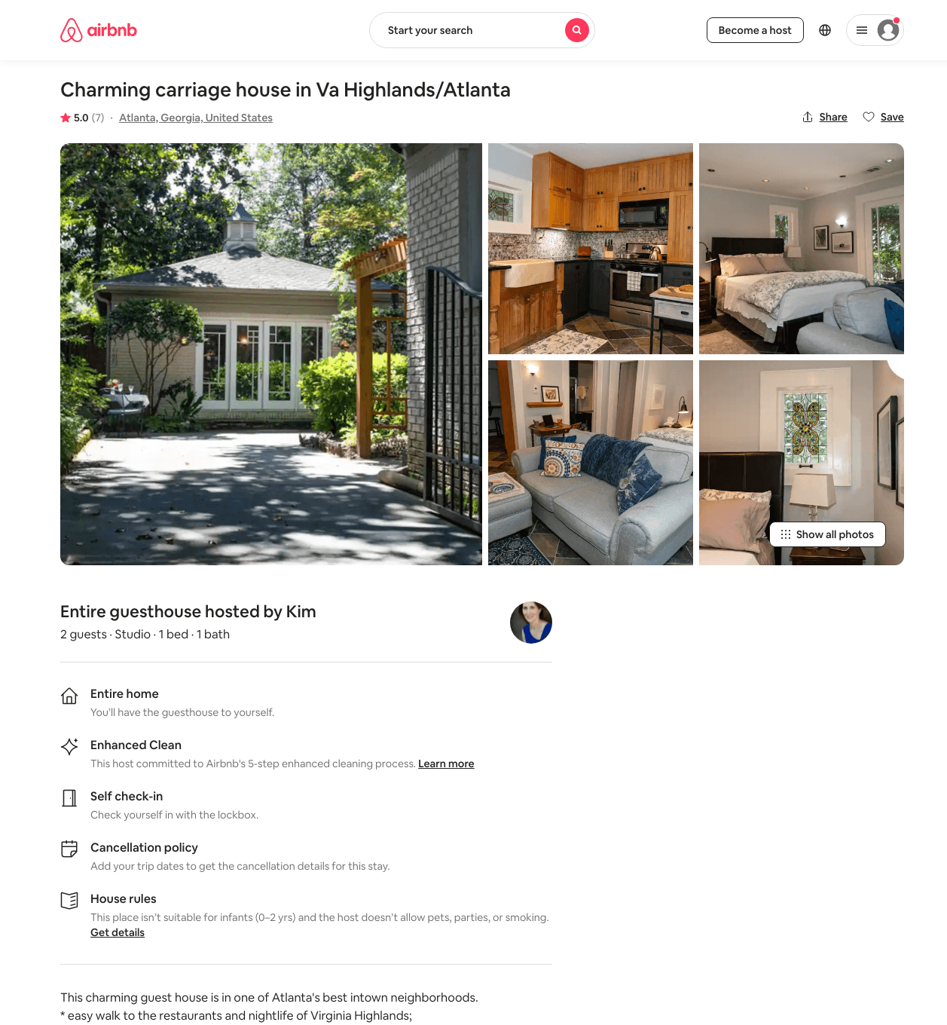
Listing 16809626
Studio
2
$128 - $156
4.89
7
Kim
73556864
1
https://www.airbnb.com/rooms/16809626
Aug 2022

Slide 37
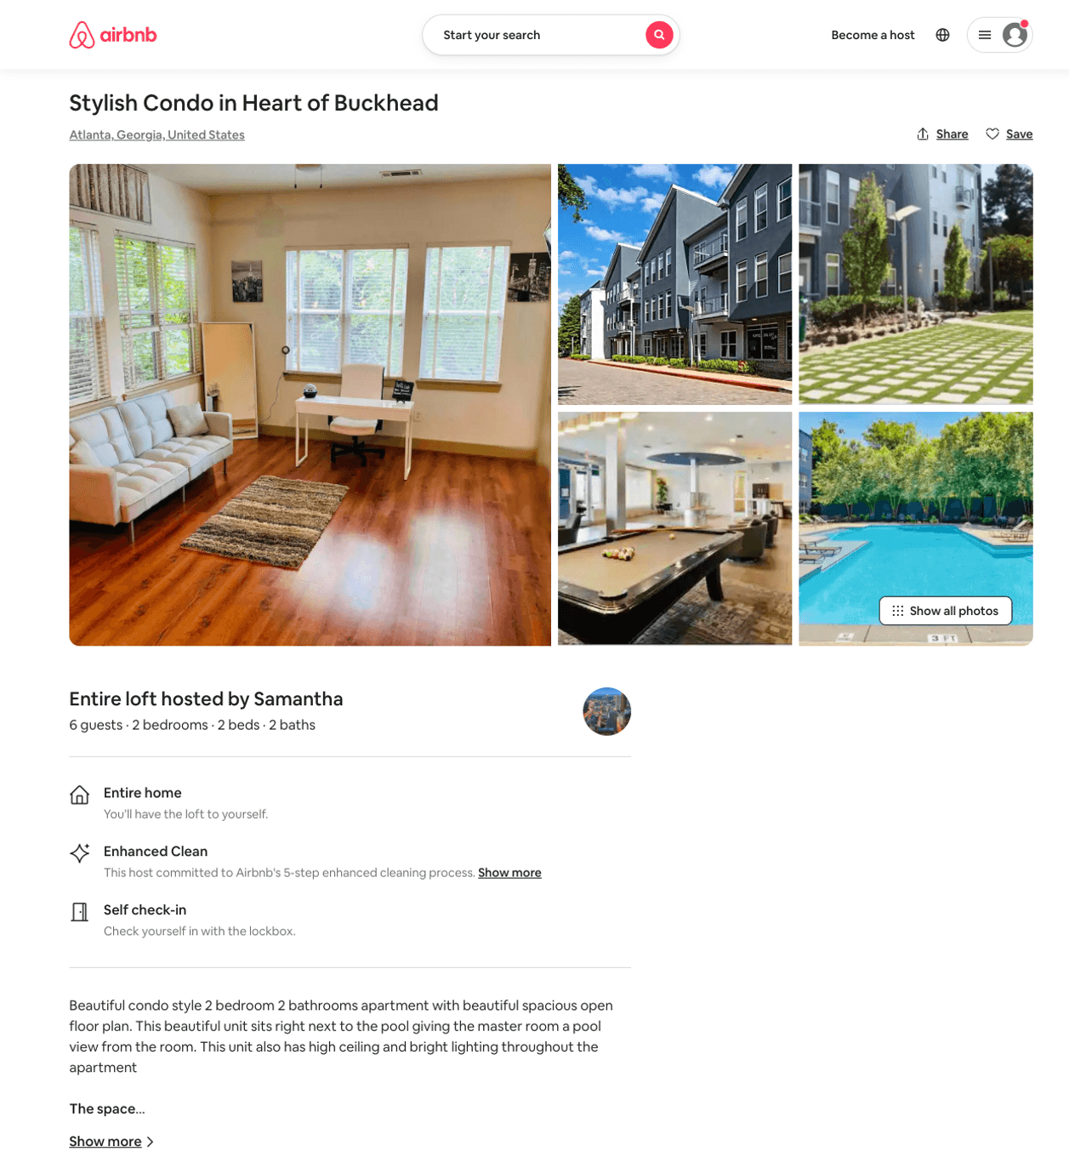
Listing 50261813
2
5
$83 - $233
4.77
1
Samantha
65941310
2
https://www.airbnb.com/rooms/50261813
Aug 2022

Slide 38
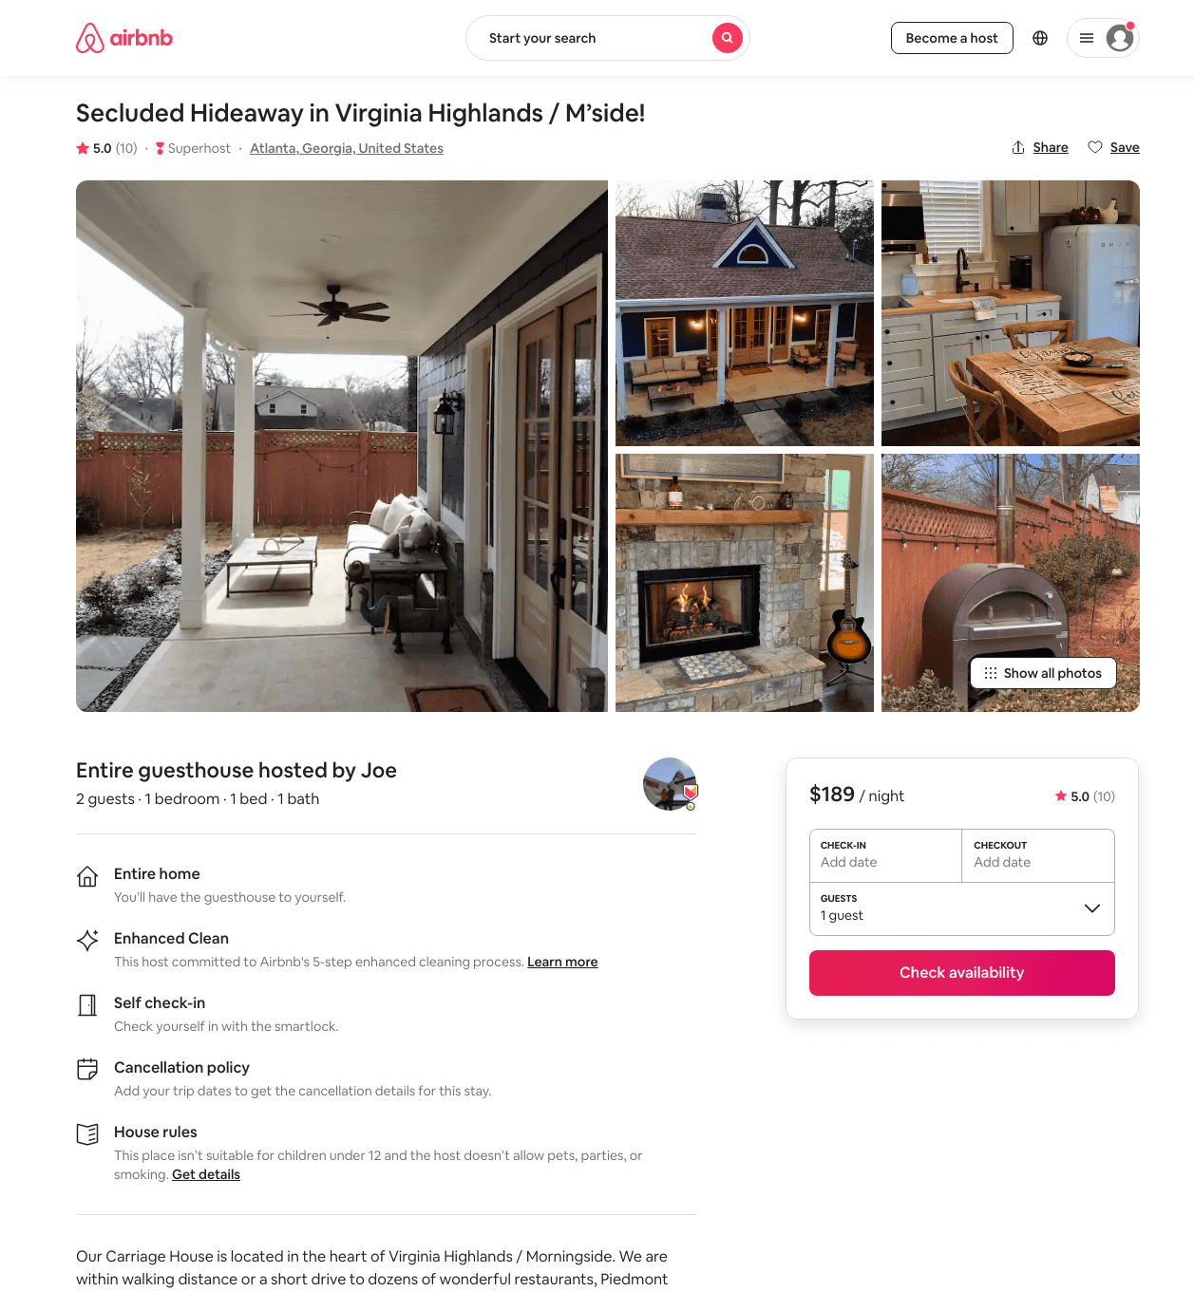
Listing 32253498
1
2
$189
5.0
2
Joe
41501236
1
https://www.airbnb.com/rooms/32253498
Aug 2022

Slide 39
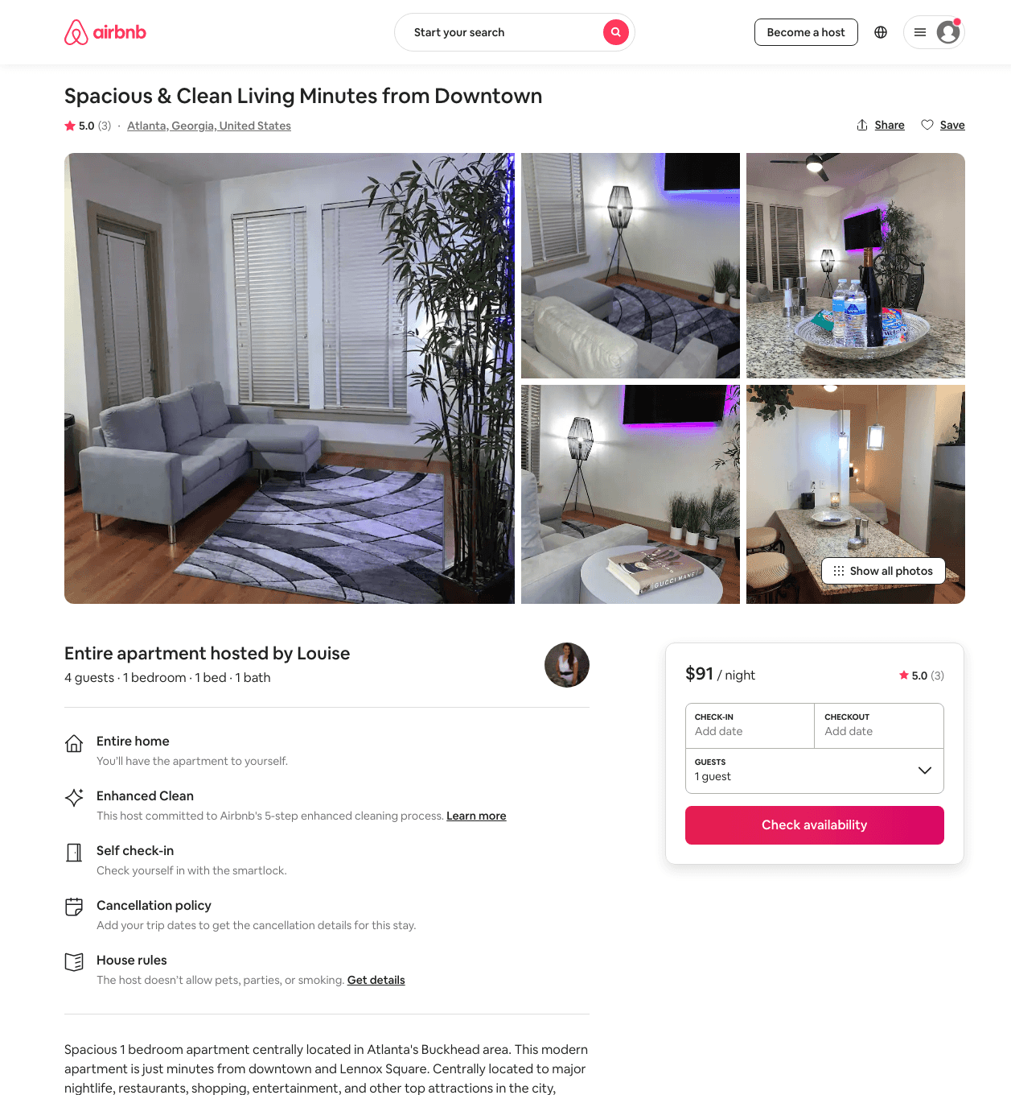
Listing 48459923
1
3
$76 - $134
4.73
2
Louise
391100205
1
https://www.airbnb.com/rooms/48459923
Aug 2022

Slide 40
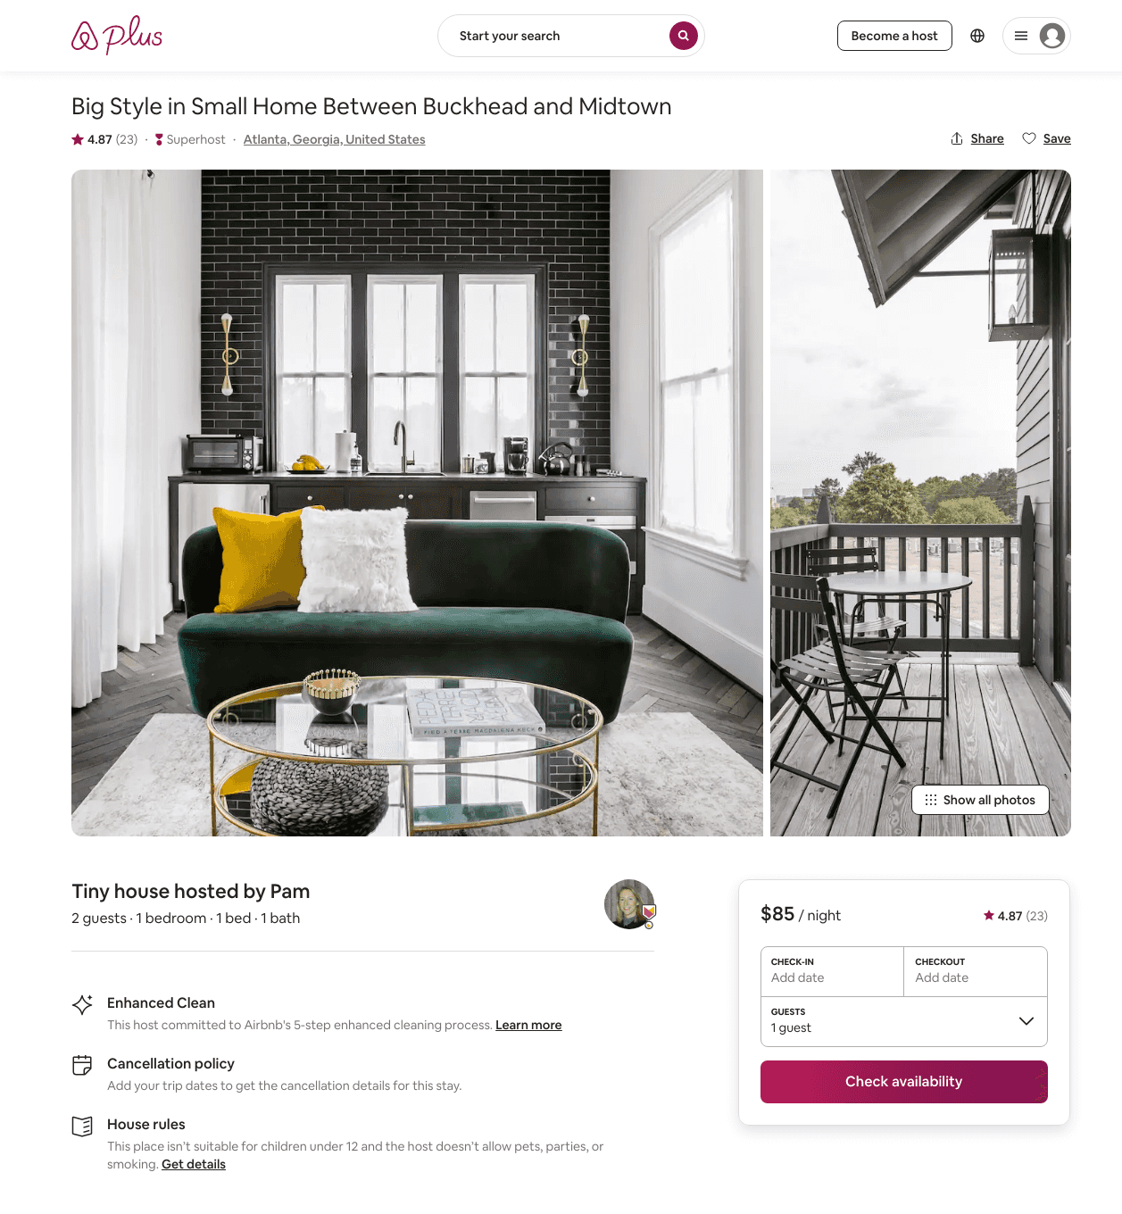
Listing 29487726
1
2
$85
4.84
30
Pam
4790157
5
https://www.airbnb.com/rooms/29487726
Aug 2022

Slide 41
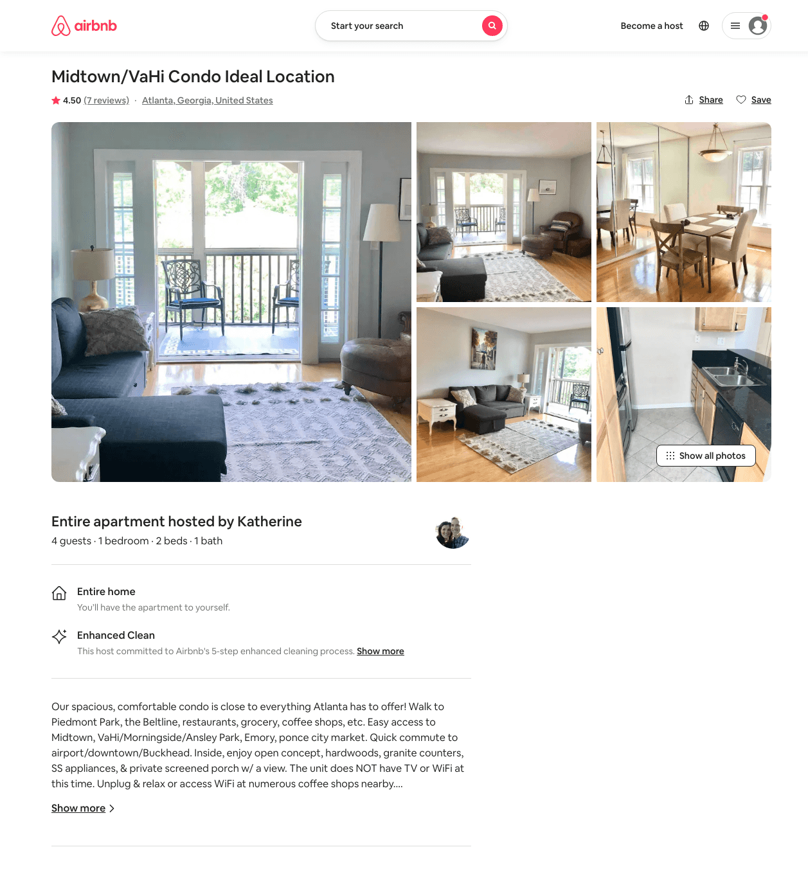
Listing 16594883
1
4
$107
4.50
2
Katherine
100383096
1
https://www.airbnb.com/rooms/16594883
Jun 2022

Slide 42
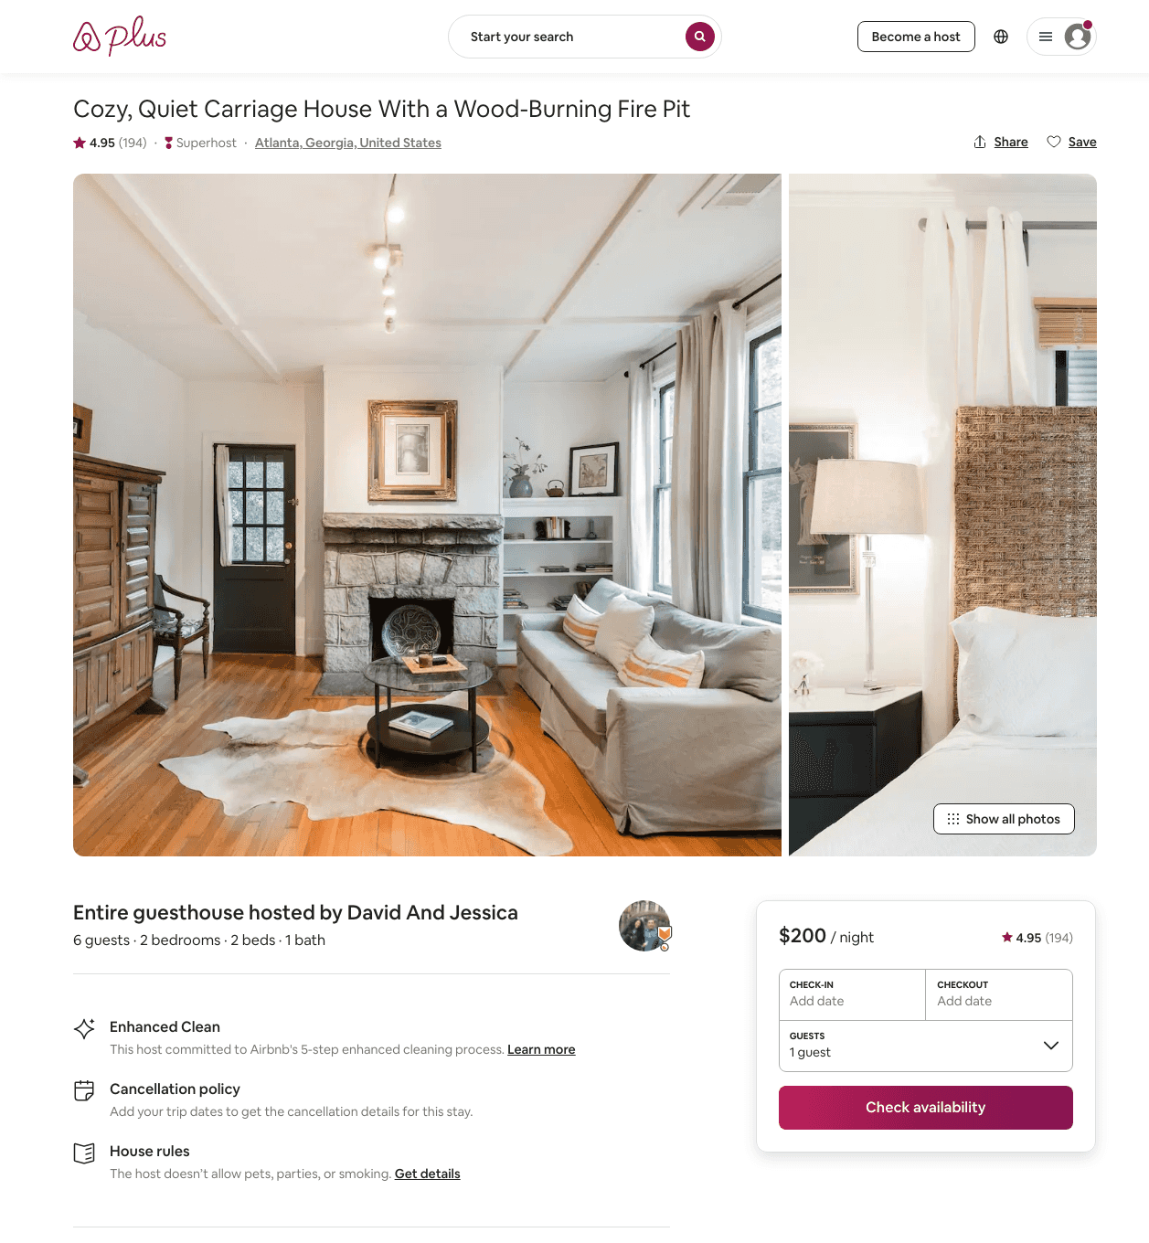
Listing 6141986
2
6
$189 - $245
4.93
2
David And Jessica
31859430
1
https://www.airbnb.com/rooms/6141986
Aug 2022

Slide 43
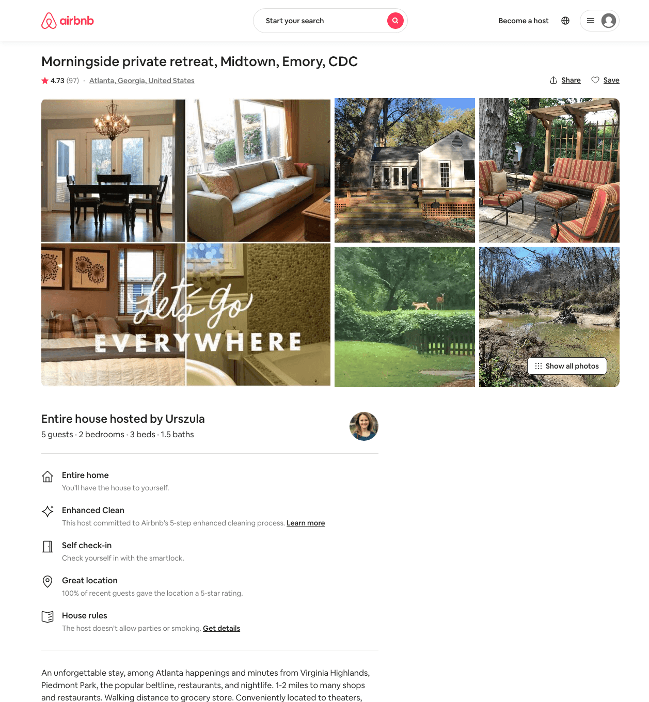
Listing 21476581
2
5
$140 - $220
4.74
3
Urszula
117702157
1
https://www.airbnb.com/rooms/21476581
Jul 2022

Slide 44
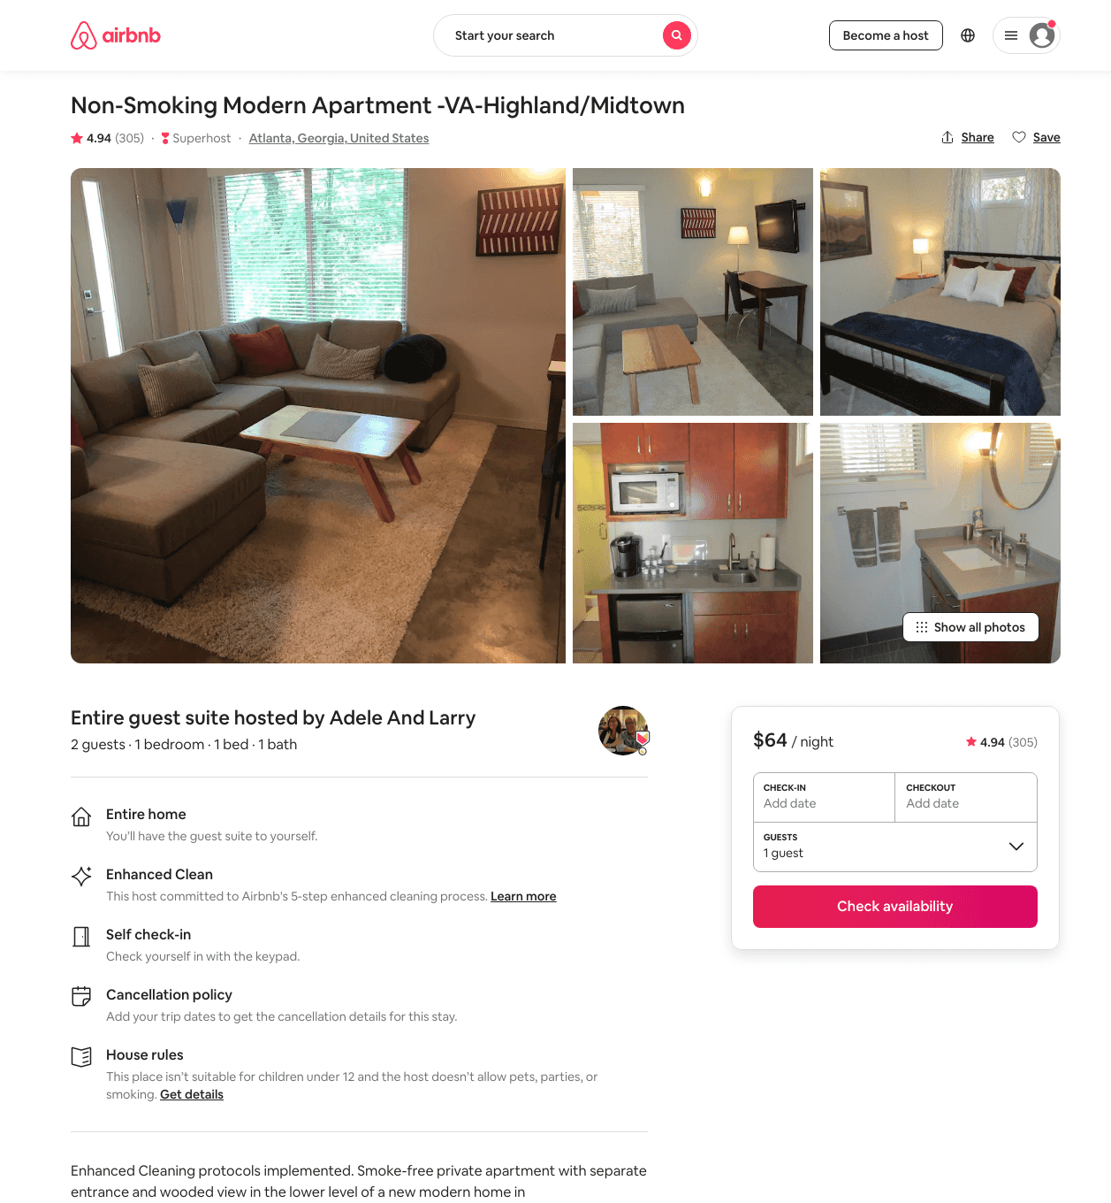
Listing 16689425
1
2
$64 - $70
4.94
2
Adele And Larry
51924904
1
https://www.airbnb.com/rooms/16689425
Aug 2022

Slide 45
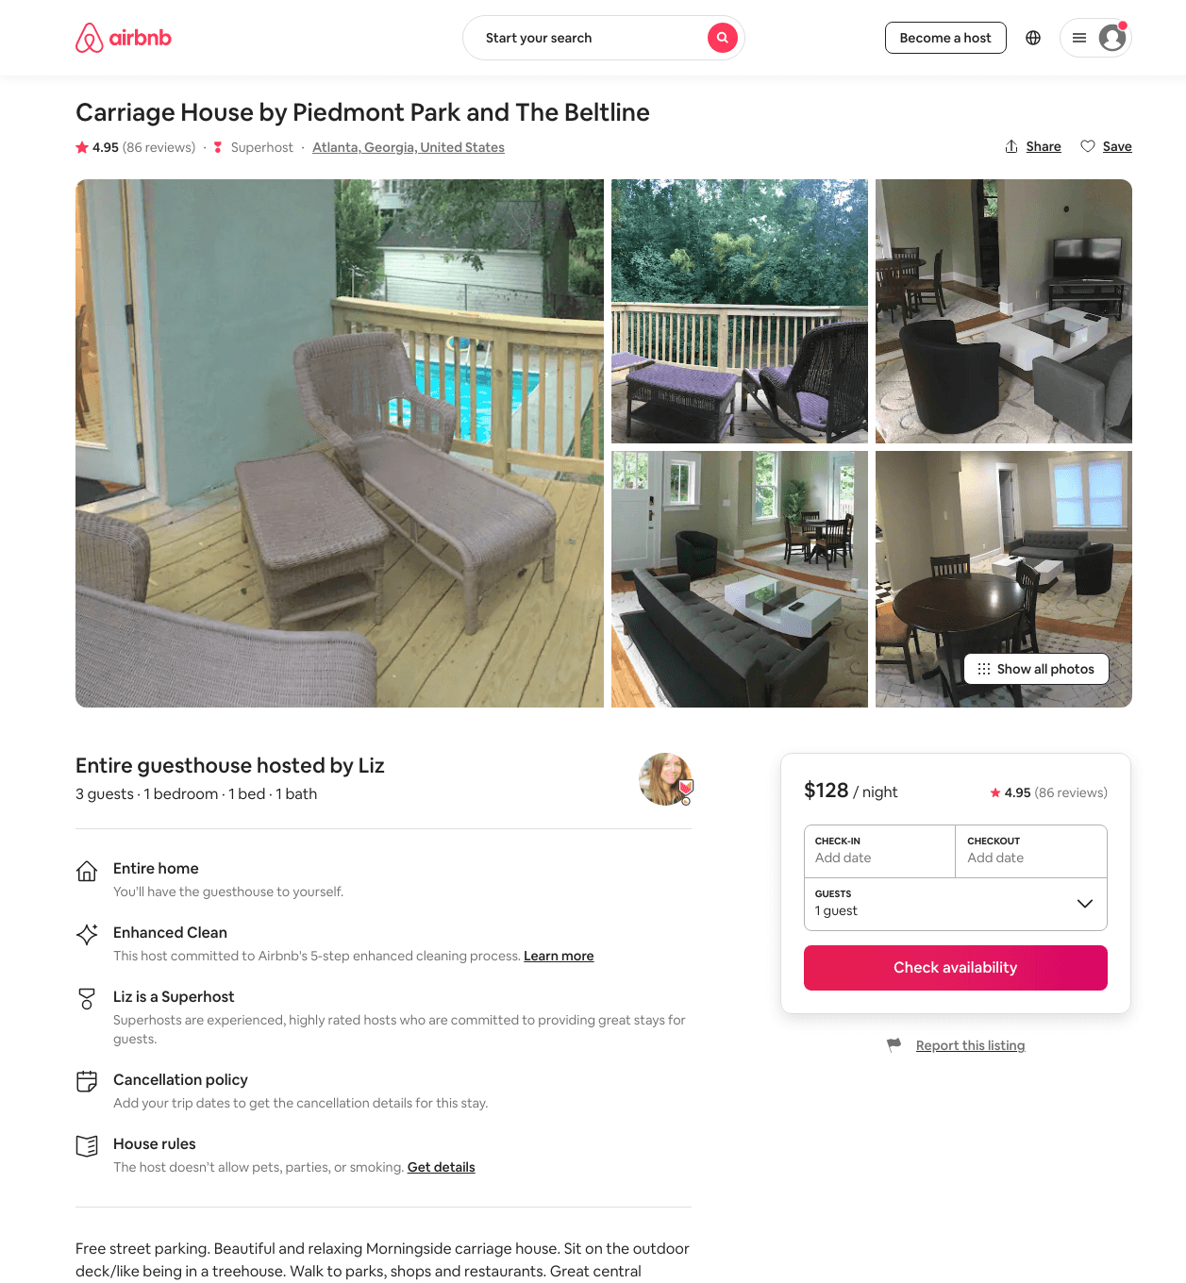
Listing 28496332
1
3
$97 - $205
4.94
3
Liz
126452688
3
https://www.airbnb.com/rooms/28496332
Aug 2022

Slide 46
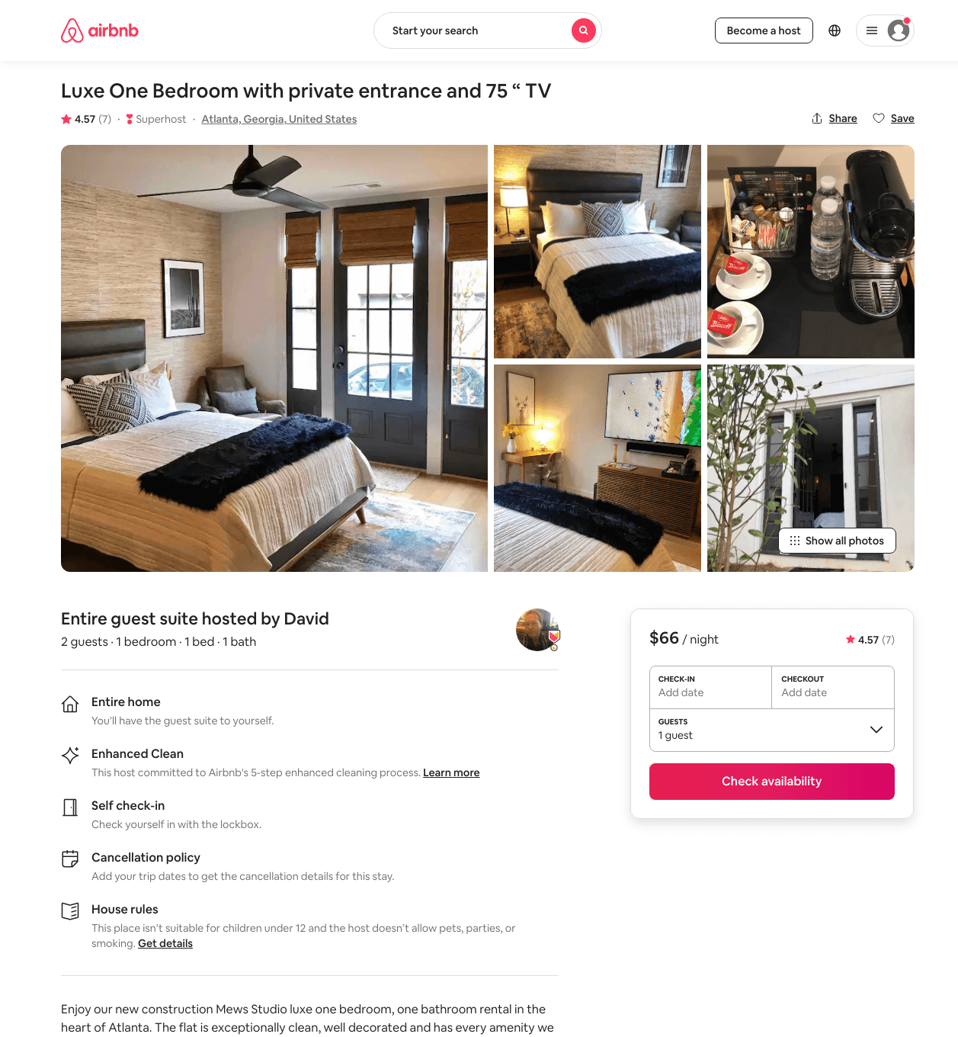
Listing 47203968
1
2
$59 - $83
4.82
2
David
152097355
1
https://www.airbnb.com/rooms/47203968
Aug 2022

Slide 47
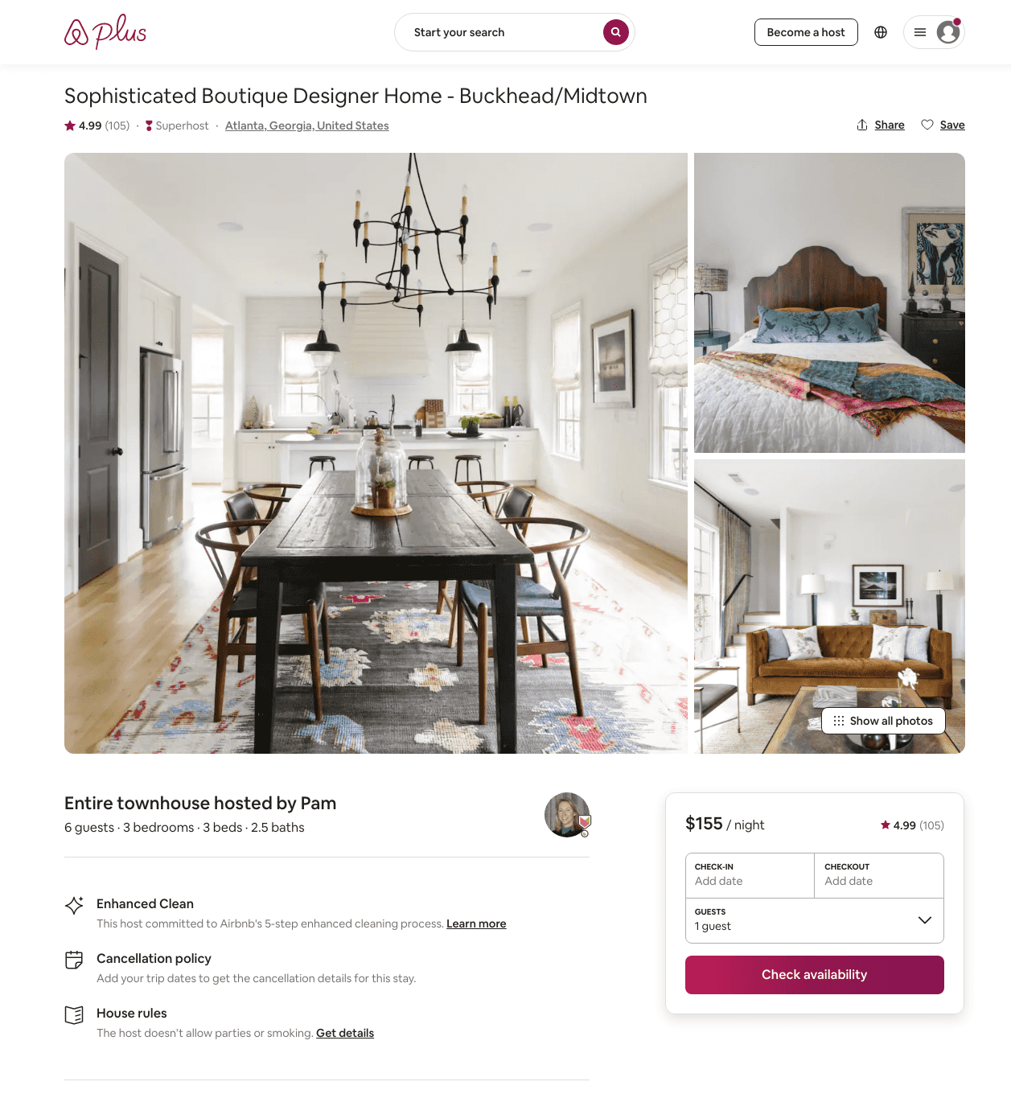
Listing 13936091
3
6
$155
4.99
30
Pam
4790157
5
https://www.airbnb.com/rooms/13936091
Aug 2022

Slide 48
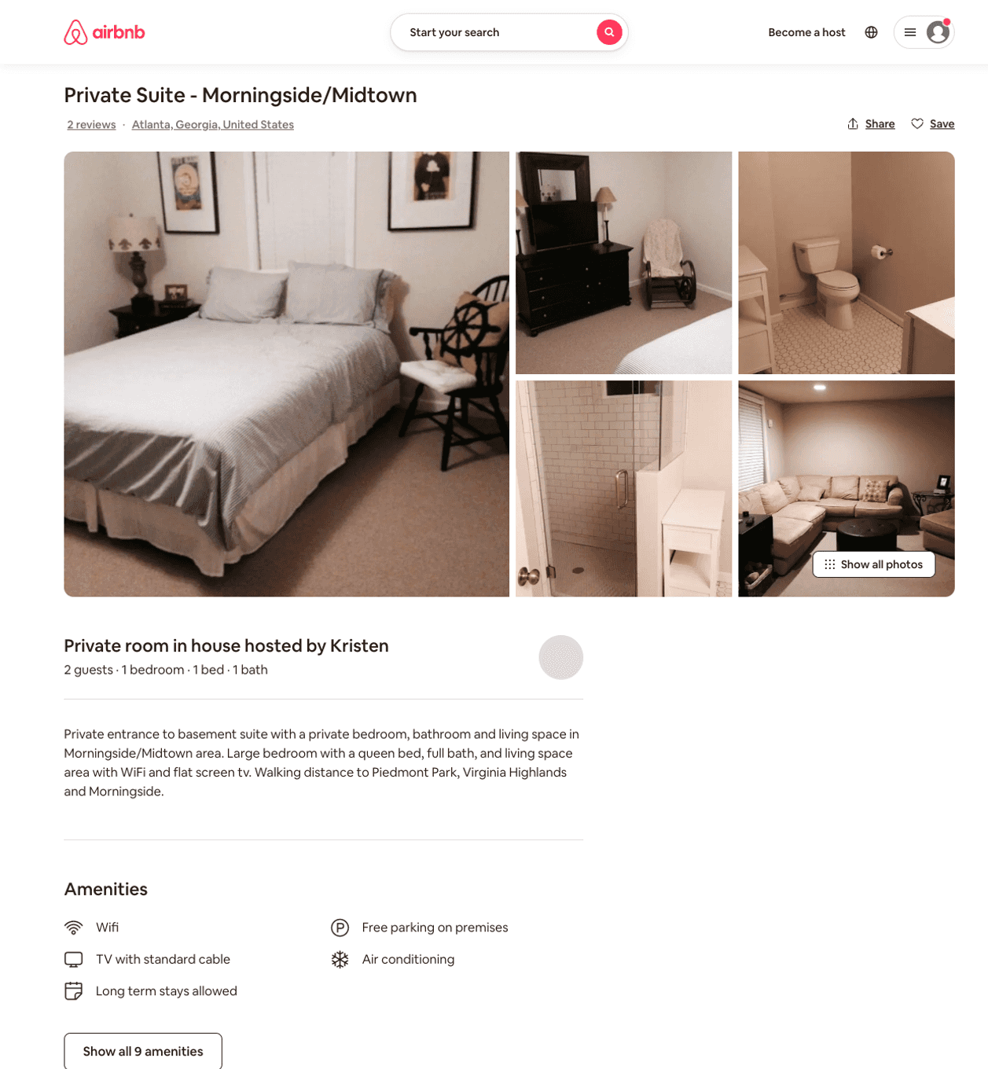
Listing 4279387
1
2
$220
4
Kristen
22217498
1
https://www.airbnb.com/rooms/4279387
Jun 2022

Slide 49
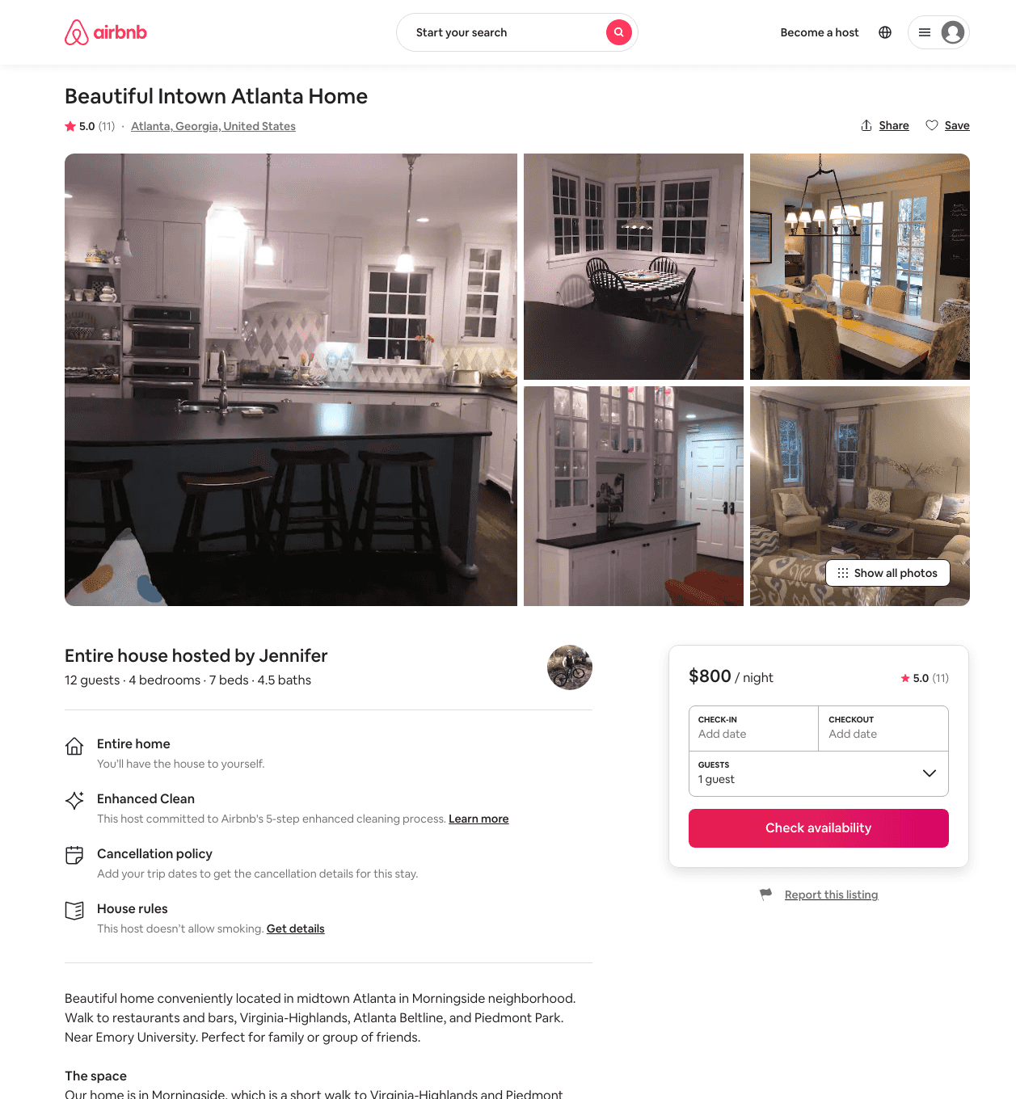
Listing 6005523
4
12
$800
5.0
3
Jennifer
16479515
1
https://www.airbnb.com/rooms/6005523
Aug 2022

Slide 50
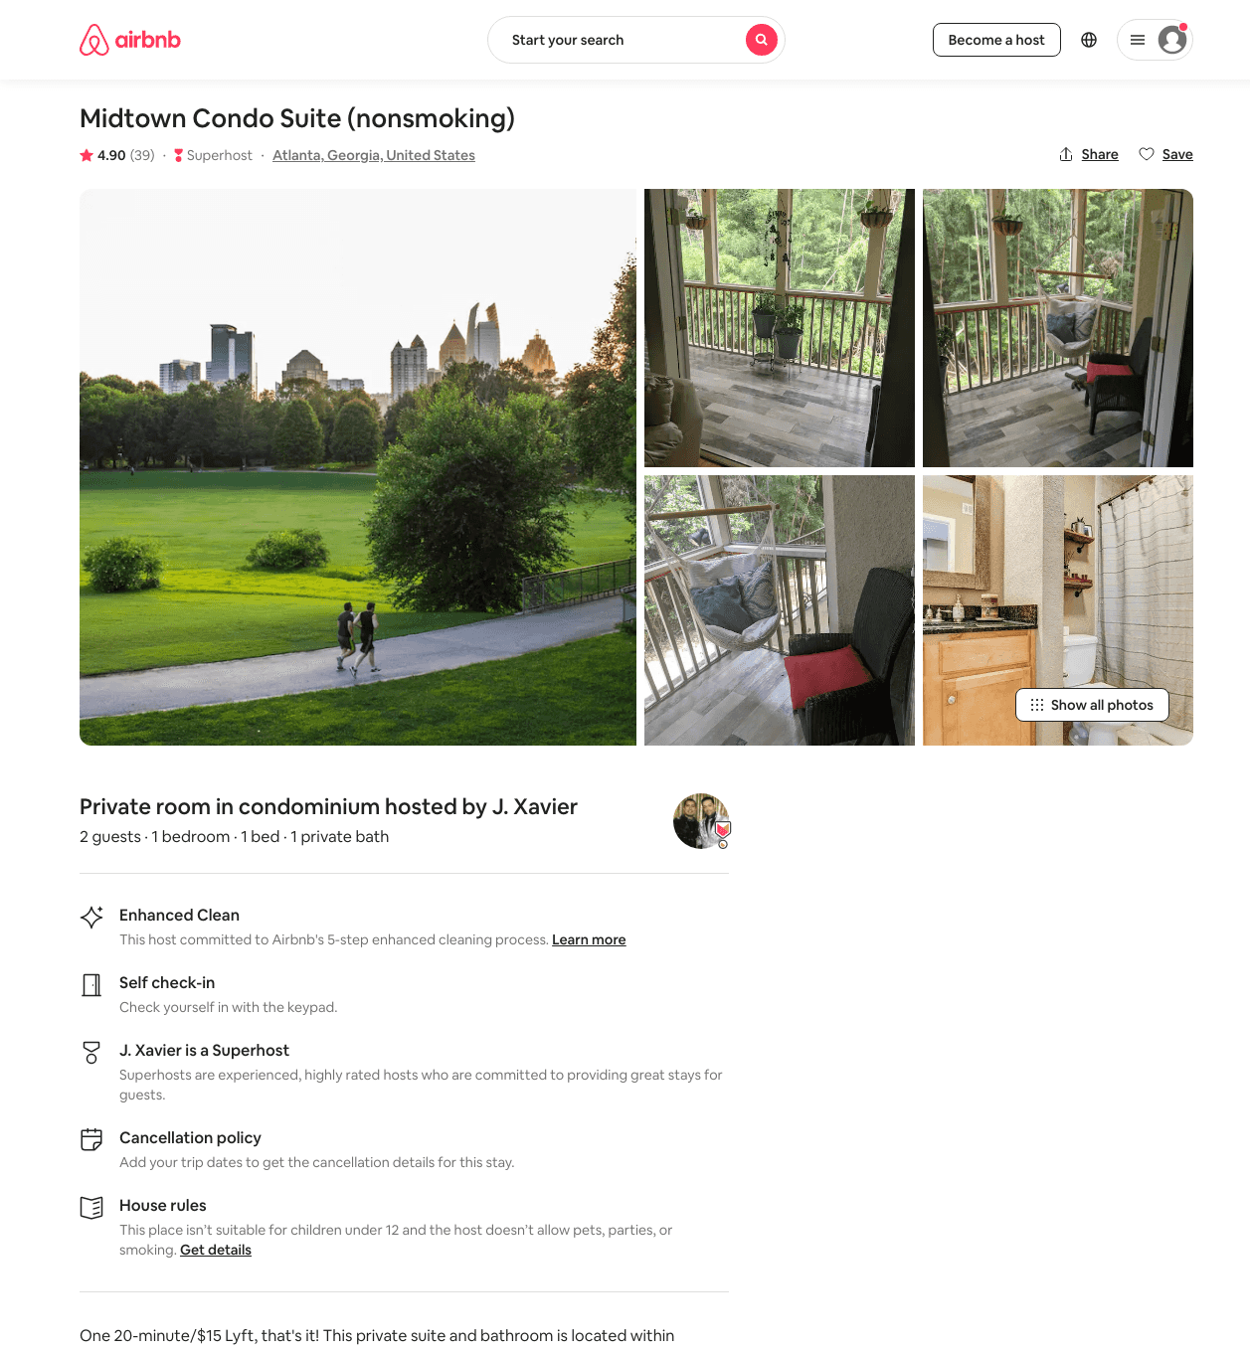
Listing 31684288
1
2
$68 - $1022
4.83
1
Xavier
84448896
1
https://www.airbnb.com/rooms/31684288
Jun 2022

Slide 51
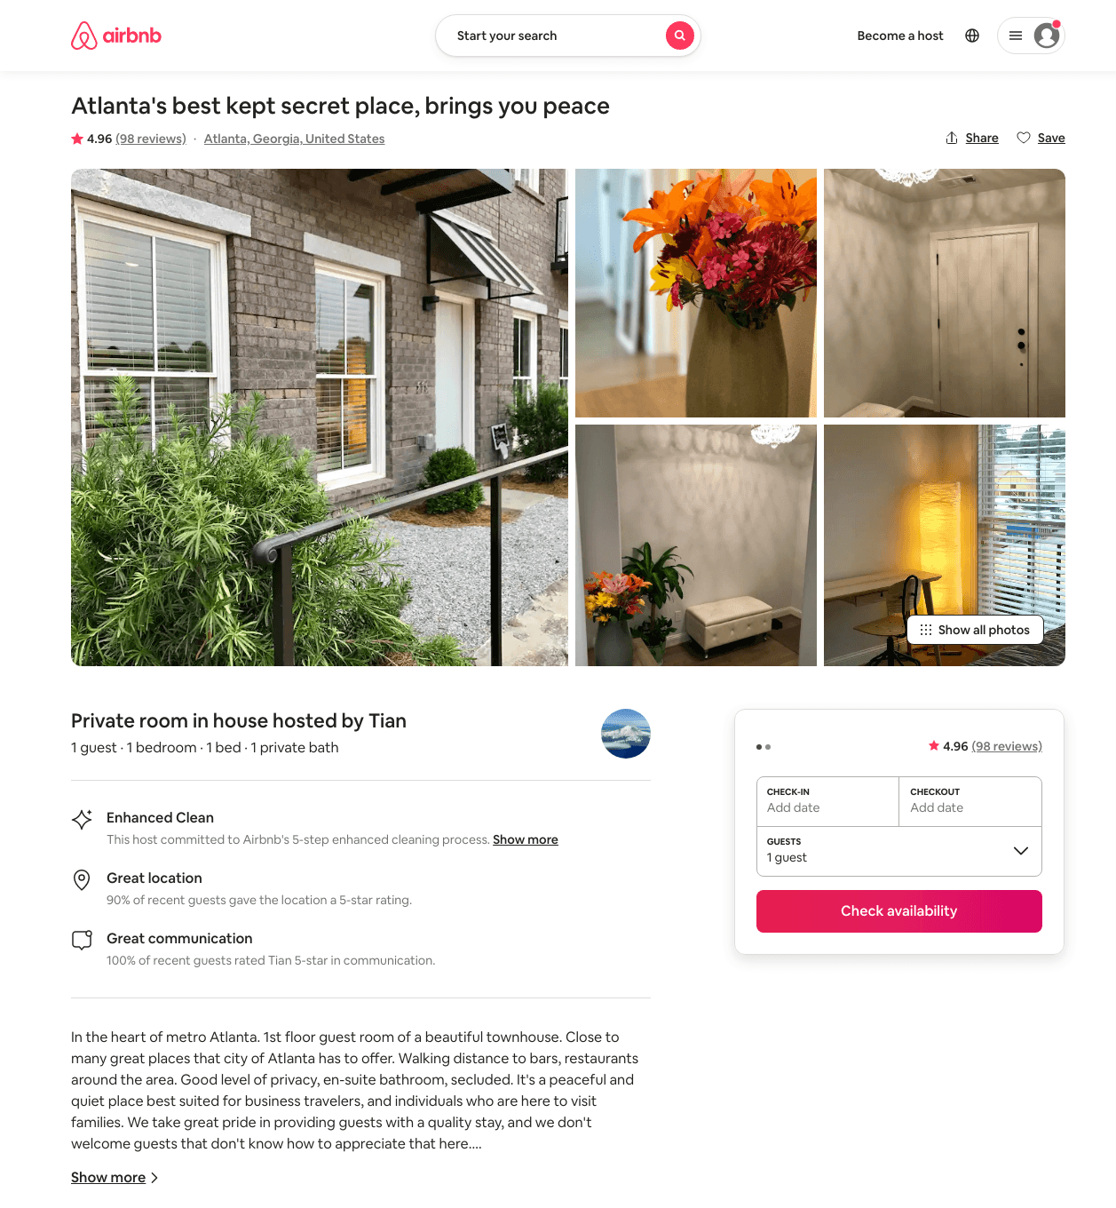
Listing 20686380
1
1
$81
4.96
1
Tian
48160544
1
https://www.airbnb.com/rooms/20686380
Jun 2022

Slide 52
Listing 50053664
2
5
$238 - $242
60
Mrs Jay
403737133
1
https://www.airbnb.com/rooms/50053664
Aug 2022

Slide 53
Listing 51989554
1
2
$73 - $120
4.30
2
Tc
375007158
3
https://www.airbnb.com/rooms/51989554
Jul 2022

Slide 54
Listing 51969215
2
5
$116 - $242
4.83
1
Tenesha
420902083
1
https://www.airbnb.com/rooms/51969215
Aug 2022

Slide 55
Listing 35088082
2
7
$85 - $202
4.70
1
Blitz Girlz
238758764
6
https://www.airbnb.com/rooms/35088082
Jun 2022

Slide 56
Listing 51805179
1
3
$75 - $139
4.96
1
Kirk
395396979
1
https://www.airbnb.com/rooms/51805179
Aug 2022

Slide 57
Listing 52183242
2
5
$87 - $150
4.82
1
Elaine & Marcus
120862837
5
https://www.airbnb.com/rooms/52183242
Aug 2022

Slide 58
Listing 52565194
1
3
$87 - $145
4.65
1
Tiffany
210752333
1
https://www.airbnb.com/rooms/52565194
Jul 2022

Slide 59
Listing 42953643
1
2
$120
28
Didem
130464324
8
https://www.airbnb.com/rooms/42953643
Jun 2022

Slide 60
Listing 53261556
1
3
$88 - $192
4.88
1
Bishop
431127135
2
https://www.airbnb.com/rooms/53261556
Aug 2022

Slide 61
Listing 53068283
1
4
$79 - $120
4.84
1
Ml
186113634
1
https://www.airbnb.com/rooms/53068283
Aug 2022

Slide 62
Listing 36968385
1
3
$85 - $180
4.63
2
Elizabeth
105986251
5
https://www.airbnb.com/rooms/36968385
Aug 2022

Slide 63
Listing 53211289
2
5
$86 - $239
4.83
1
Universal Rentals
60560861
3
https://www.airbnb.com/rooms/53211289
Aug 2022

Slide 64
Listing 53511418
7
15
$560 - $1383
7
Jason
136239447
4
https://www.airbnb.com/rooms/53511418
Aug 2022

Slide 65
Listing 52863279
1
3
$107 - $136
4.62
1
Urania
427927411
1
https://www.airbnb.com/rooms/52863279
Jun 2022

Slide 66
Listing 53739829
2
7
$76 - $123
4.23
1
Justin
103717743
3
https://www.airbnb.com/rooms/53739829
Aug 2022

Slide 67
Listing 53457191
1
2
$136 - $169
4.90
1
Joshua
385794048
1
https://www.airbnb.com/rooms/53457191
Aug 2022

Slide 68
Listing 53970584
2
5
$127 - $246
4.65
1
N&N Empire
437192504
1
https://www.airbnb.com/rooms/53970584
Jun 2022

Slide 69
Listing 2557128
2
5
$200
3
https://www.vrbo.com/2557128
Aug 2022

Slide 70
Listing 2604393
1
4
$110
1
1
Ancinio
https://www.vrbo.com/2604393
Aug 2022

Slide 71
Listing 23379190
1206 LANIER BLVD NE
2
2
$24 - $34
4.67
5
Al
69553712
2
https://www.airbnb.com/rooms/23379190
Aug 2022

Slide 72
Listing 53771882
2
4
$120 - $192
4.96
1
Ryan
73653064
1
https://www.airbnb.com/rooms/53771882
Aug 2022

Slide 73
Listing 30209583
1
2
$50 - $70
4.71
1
Stan
33783427
1
https://www.airbnb.com/rooms/30209583
Aug 2022

Slide 74
Listing 9128377
1
4
$95
1
Shon
https://www.vrbo.com/9128377ha
Aug 2022

Slide 75
Listing 53799084
1
3
$90 - $178
4.92
1
Gabrielle
86119578
1
https://www.airbnb.com/rooms/53799084
Aug 2022

Slide 76
Listing 2619590
1
4
$312
1
30
https://www.vrbo.com/2619590
Aug 2022

Slide 77
Listing 53955849
1
3
$103 - $122
4.92
1
Rdl
437054746
1
https://www.airbnb.com/rooms/53955849
Aug 2022

Slide 78
Listing 10247812
2
2
$108
4.82
300
CecilIa
8611385
1
https://www.airbnb.com/rooms/10247812
Jun 2022

Slide 79
Listing 2643904
1
3
$101
4.5
1
Brea
https://www.vrbo.com/2643904
Aug 2022

Slide 80
Listing 2653084
3
6
$324
5
3
Susan Powell
https://www.vrbo.com/2653084
Aug 2022

Slide 81
Listing 2683650
6
15
$916
5
3
Jason Sterner
https://www.vrbo.com/2683650
Aug 2022

Slide 82
Listing 2694239
1
3
$150
2
https://www.vrbo.com/2694239
Aug 2022

Slide 83
Listing 2749744
1
2
$115
1
2
Supreme Suites
https://www.vrbo.com/2749744
Aug 2022

Slide 84
Listing 25475963
1
1
$65
30
Karen
14025457
4
https://www.airbnb.com/rooms/25475963
Jun 2022

Slide 85
Listing 2809371
1
3
$124
3.5
1
Brittany Page
https://www.vrbo.com/2809371
Aug 2022

Slide 86
Listing 2813341
2
4
$250
3
1
Ms. Curry
https://www.vrbo.com/2813341
Aug 2022

Slide 87
Listing 2773120
2
4
$228
1
Christine Toner
https://www.vrbo.com/2773120
Aug 2022

Slide 88
Listing 2822369
4
10
$509
3
https://www.vrbo.com/2822369
Aug 2022

Slide 89
Listing 51432014
2
4
$127
5.0
2
Tess
239283916
1
https://www.airbnb.com/rooms/51432014
Aug 2022

Slide 90
Listing 25936190
3
6
$495
5.0
4
Ryan
19450490
1
https://www.airbnb.com/rooms/25936190
Jul 2022

Slide 91
Listing 2872092
1
4
$123
5
2
https://www.vrbo.com/2872092
Aug 2022

Slide 92
Listing 50186292
1
2
$200
1
Kristian
310174793
2
https://www.airbnb.com/rooms/50186292
Jun 2022

Slide 93
Listing 2932450
1
3
$160
2
https://www.vrbo.com/2932450
Aug 2022

Slide 94
Listing 2941516
1
3
$104
1
https://www.vrbo.com/2941516
Aug 2022

Slide 95
Listing 2938856
1
3
$122
2
https://www.vrbo.com/2938856
Aug 2022

