Slide 2
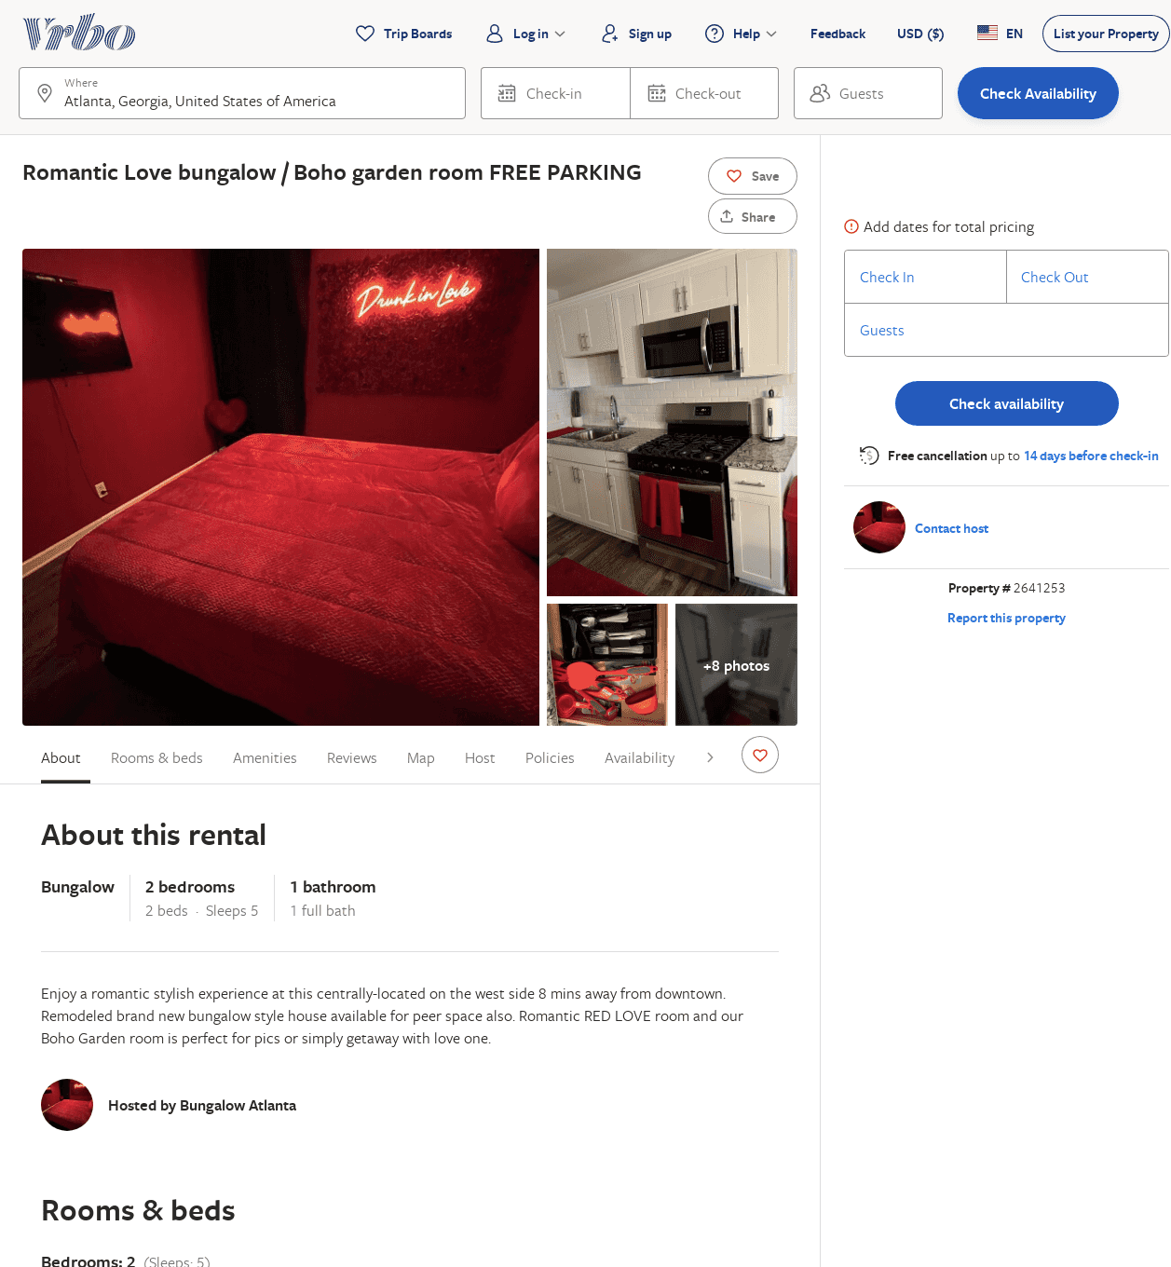
Listing 2641253
2
5
$185
2
Gorgeous Bridges
https://www.vrbo.com/2641253
Aug 2022

