Slide 2
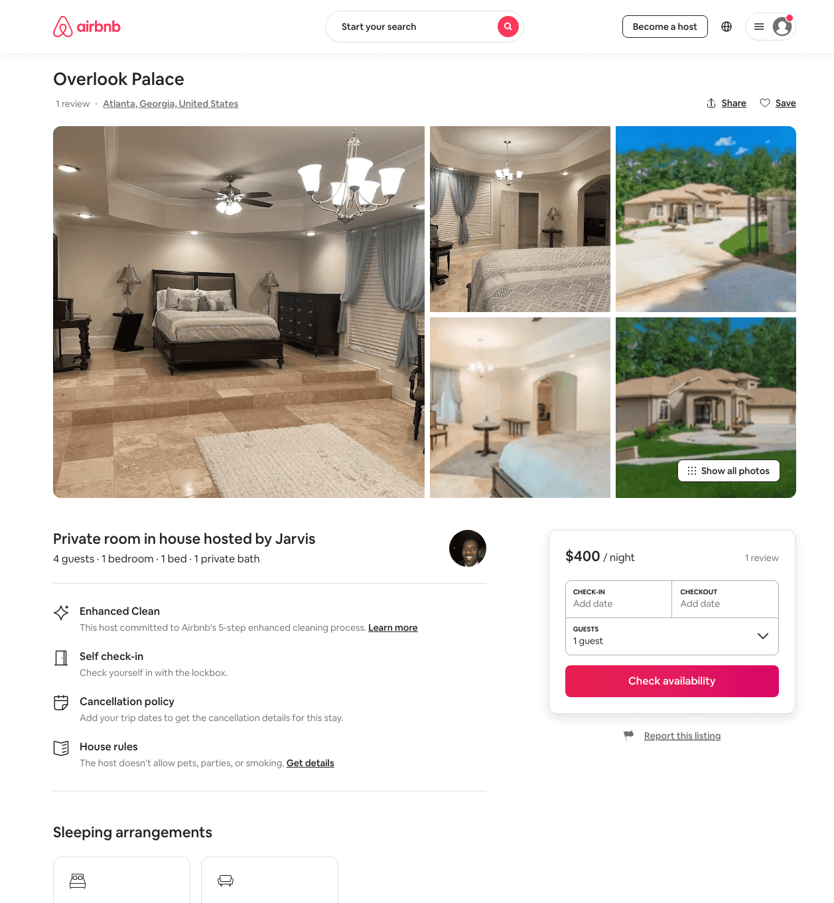
Listing 47870374
1
4
$400
2
Jarvis
140477959
1
https://www.airbnb.com/rooms/47870374
Aug 2022

Slide 3
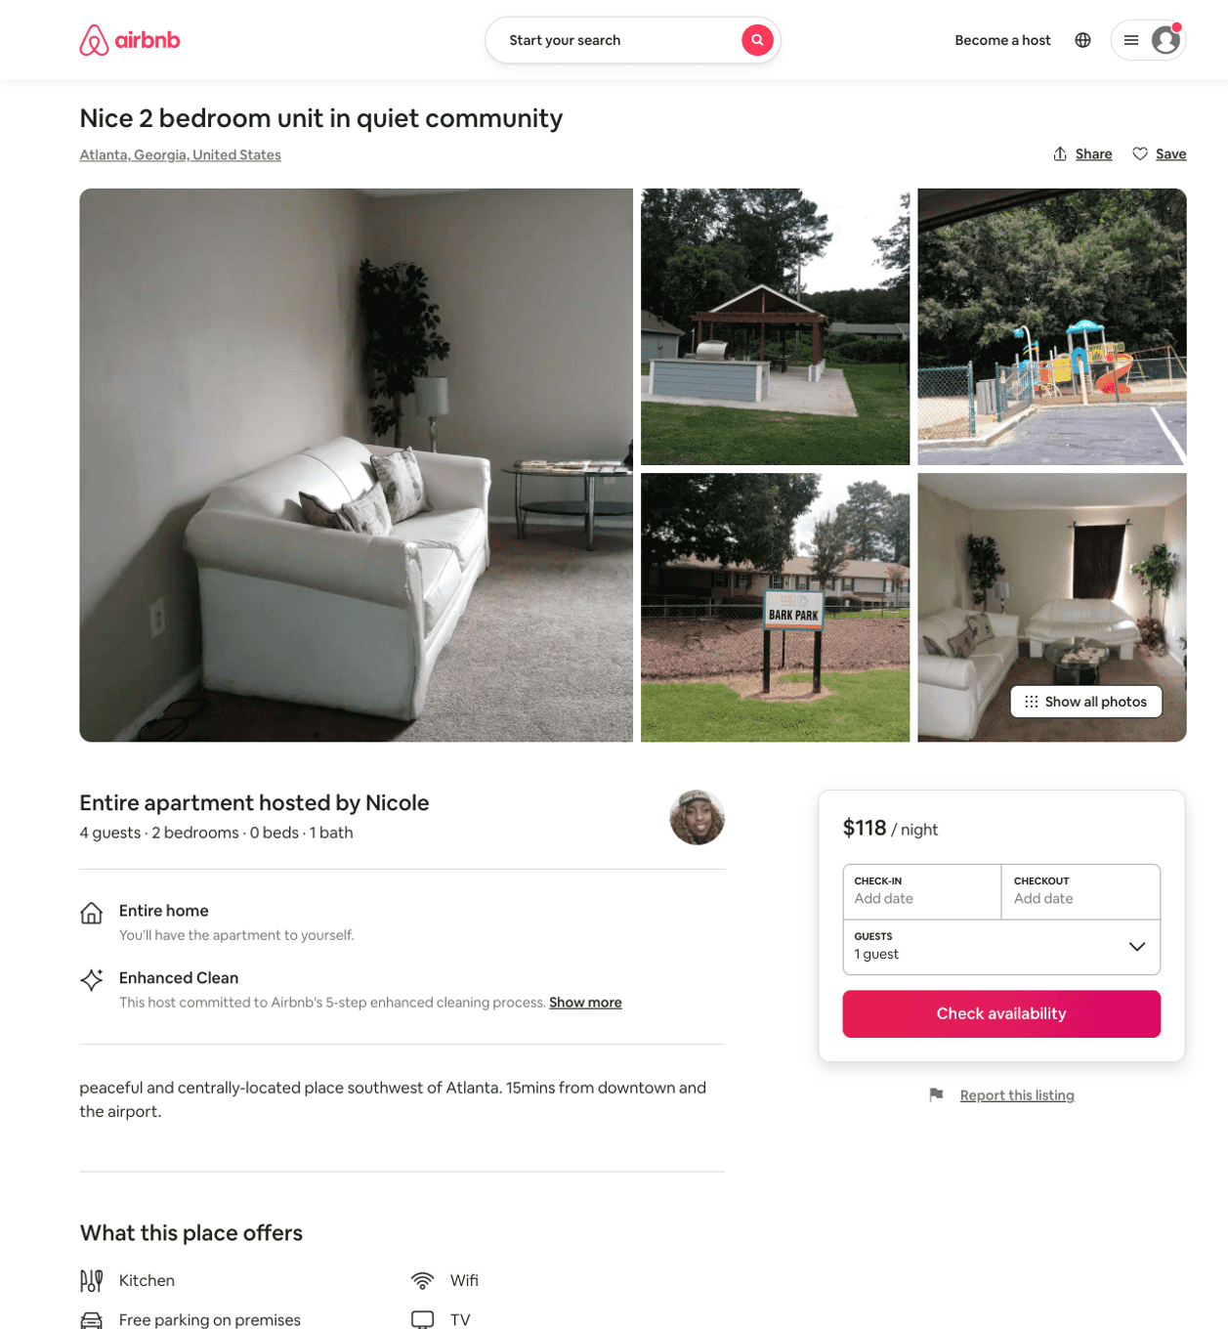
Listing 50725343
2
4
$118
1
Nicole
180472520
1
https://www.airbnb.com/rooms/50725343
Aug 2022

Slide 4
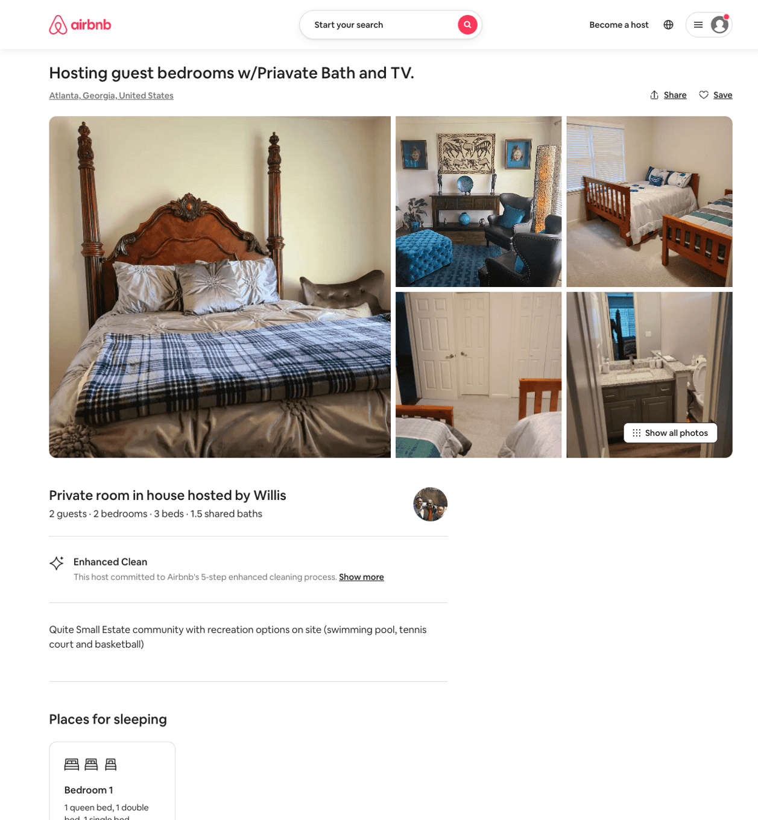
Listing 50080194
2
4
$75 - $95
4.88
2
Willis
403968343
1
https://www.airbnb.com/rooms/50080194
Aug 2022

Slide 5
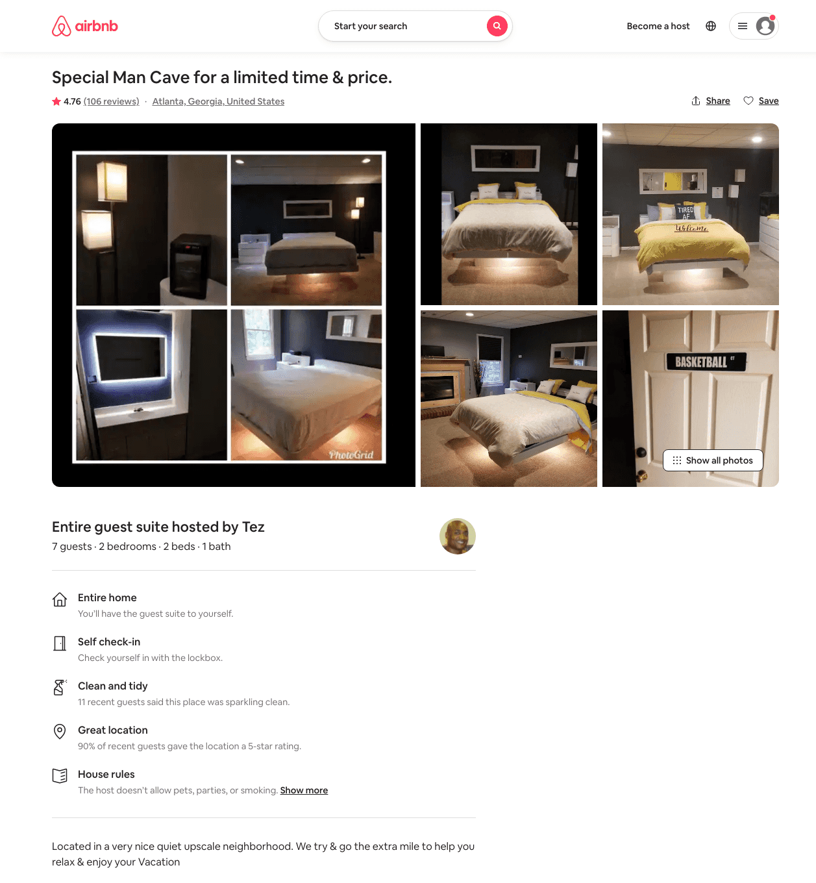
Listing 4776351
2
7
$89 - $110
4.73
1
Tez
21984282
1
https://www.airbnb.com/rooms/4776351
Aug 2022

