Slide 2
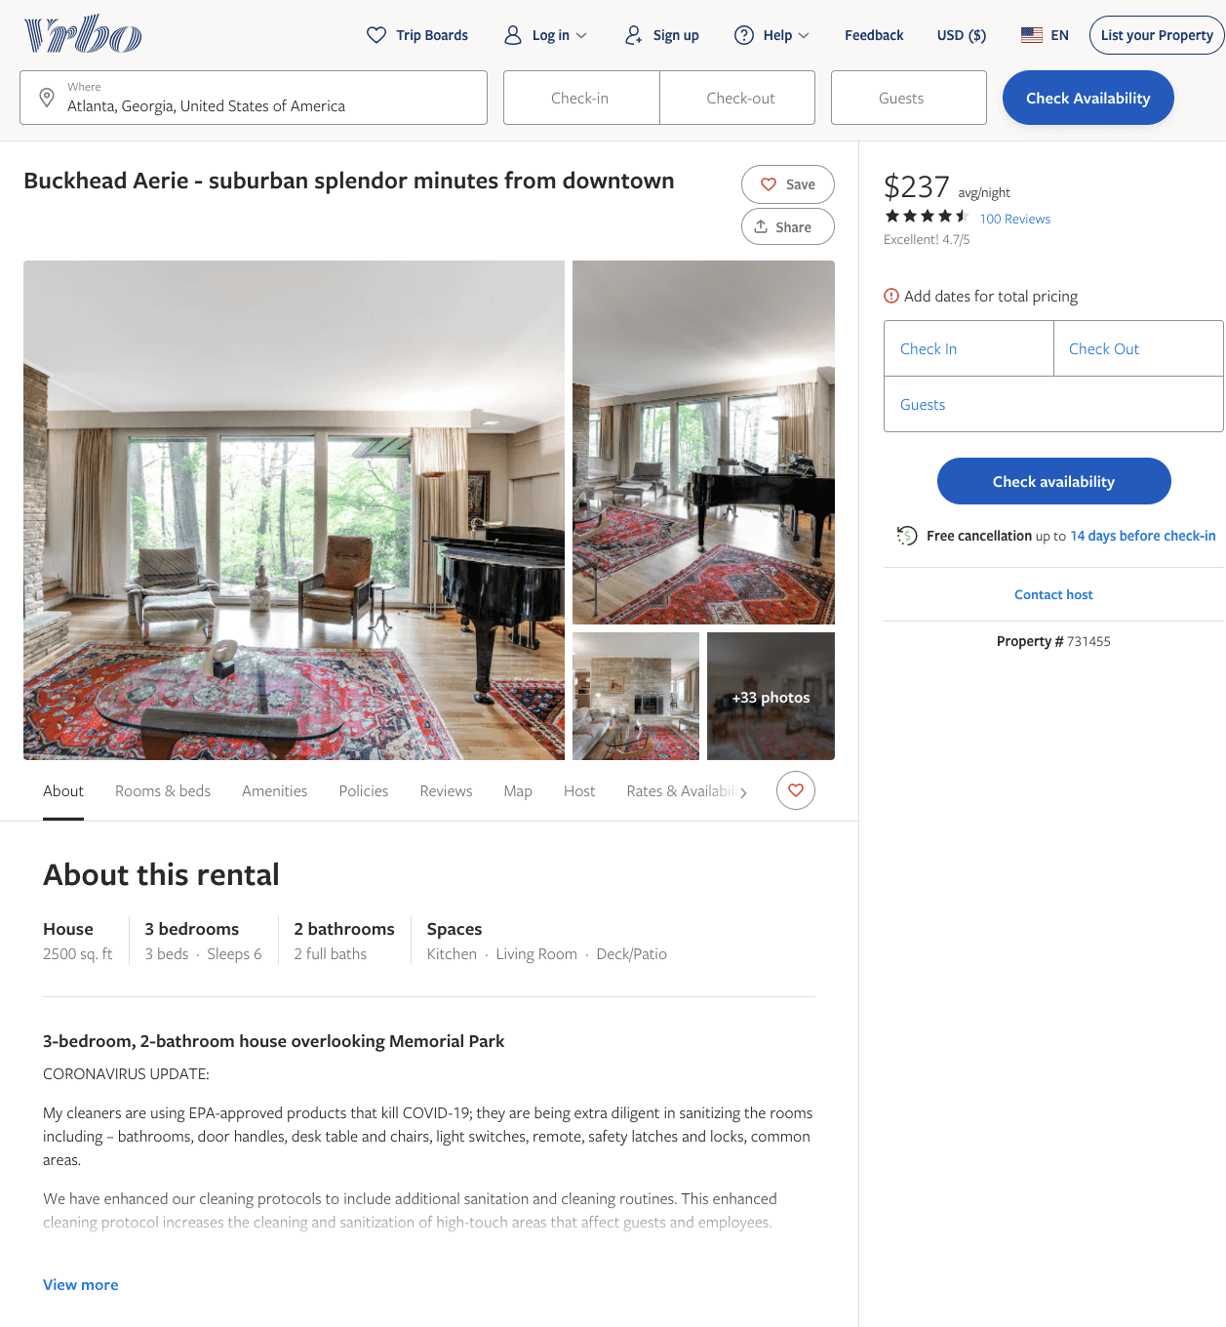
Listing 731455
3
6
$170 - $265
4.6666665
3
Tom Watkins
https://www.vrbo.com/731455
Aug 2022

