Slide 2
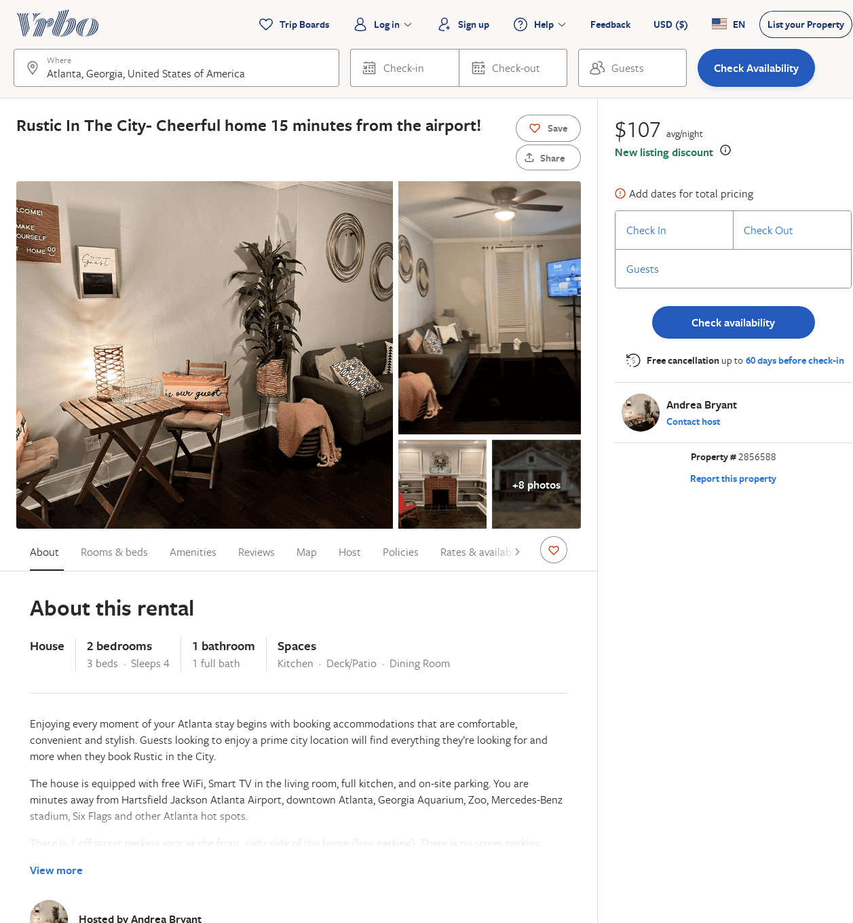
Listing 2856588
2
4
$107
2
Andrea Bryant
https://www.vrbo.com/2856588
Aug 2022

