Slide 2
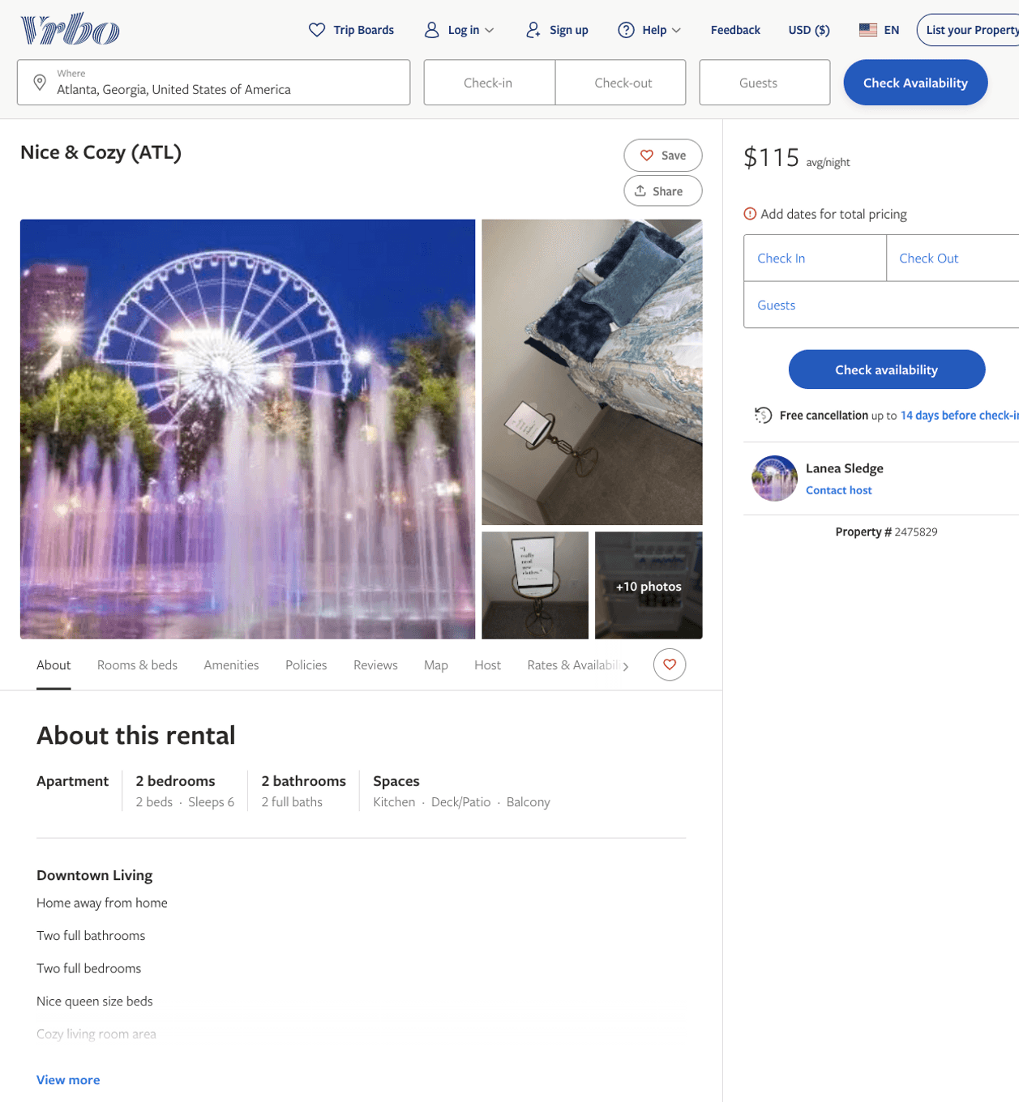
Listing 2475829
2
6
$115 - $150
3
Lanea Sledge
https://www.vrbo.com/2475829
Aug 2022

Slide 3
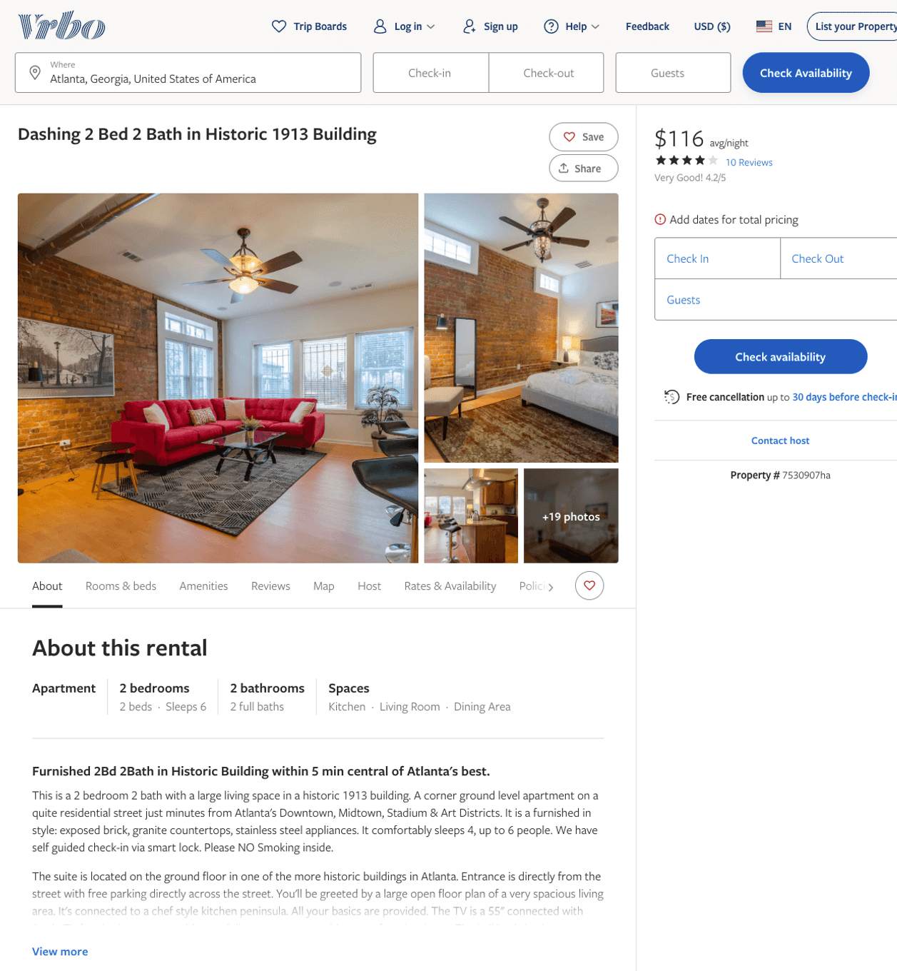
Listing 7530907
2
6
$104 - $119
4.076923
3
Senya
https://www.vrbo.com/7530907ha
Aug 2022

Slide 4
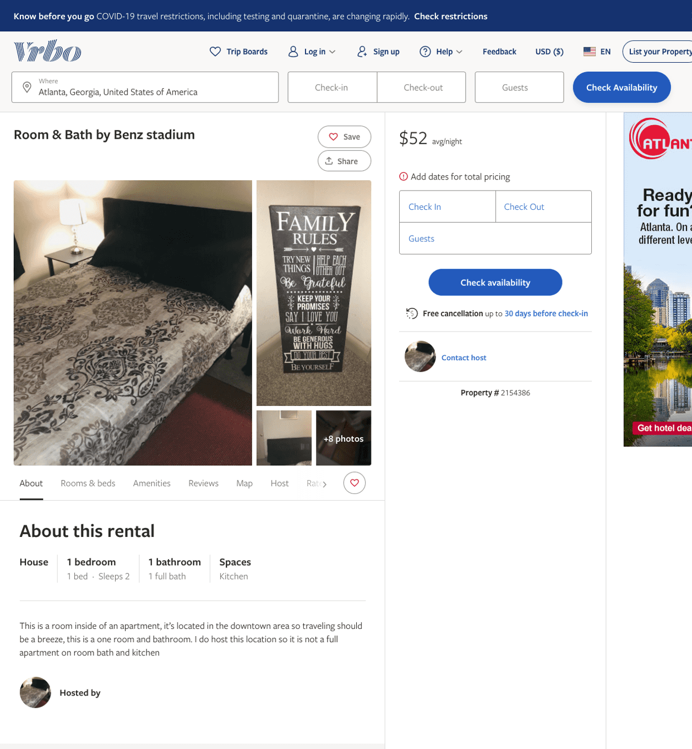
Listing 2154386
1
2
$50 - $52
3
1
https://www.vrbo.com/2154386
Aug 2022

Slide 5
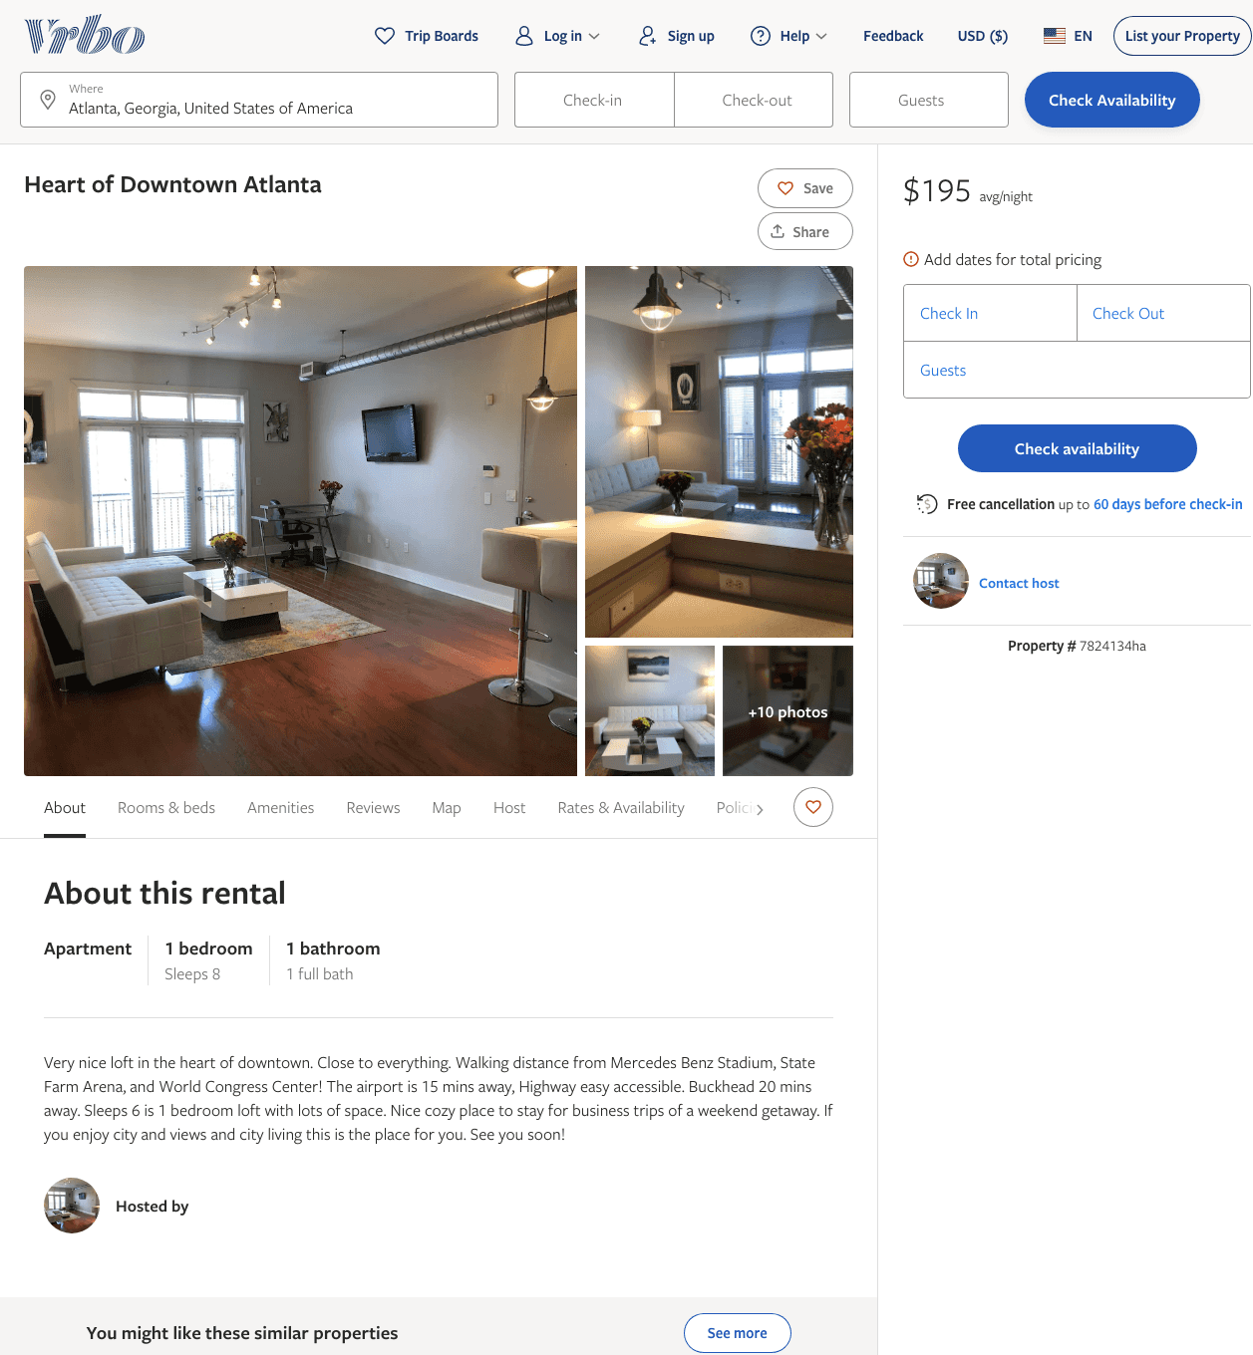
Listing 7824134
1
8
$195
2
https://www.vrbo.com/7824134ha
Aug 2022

Slide 6
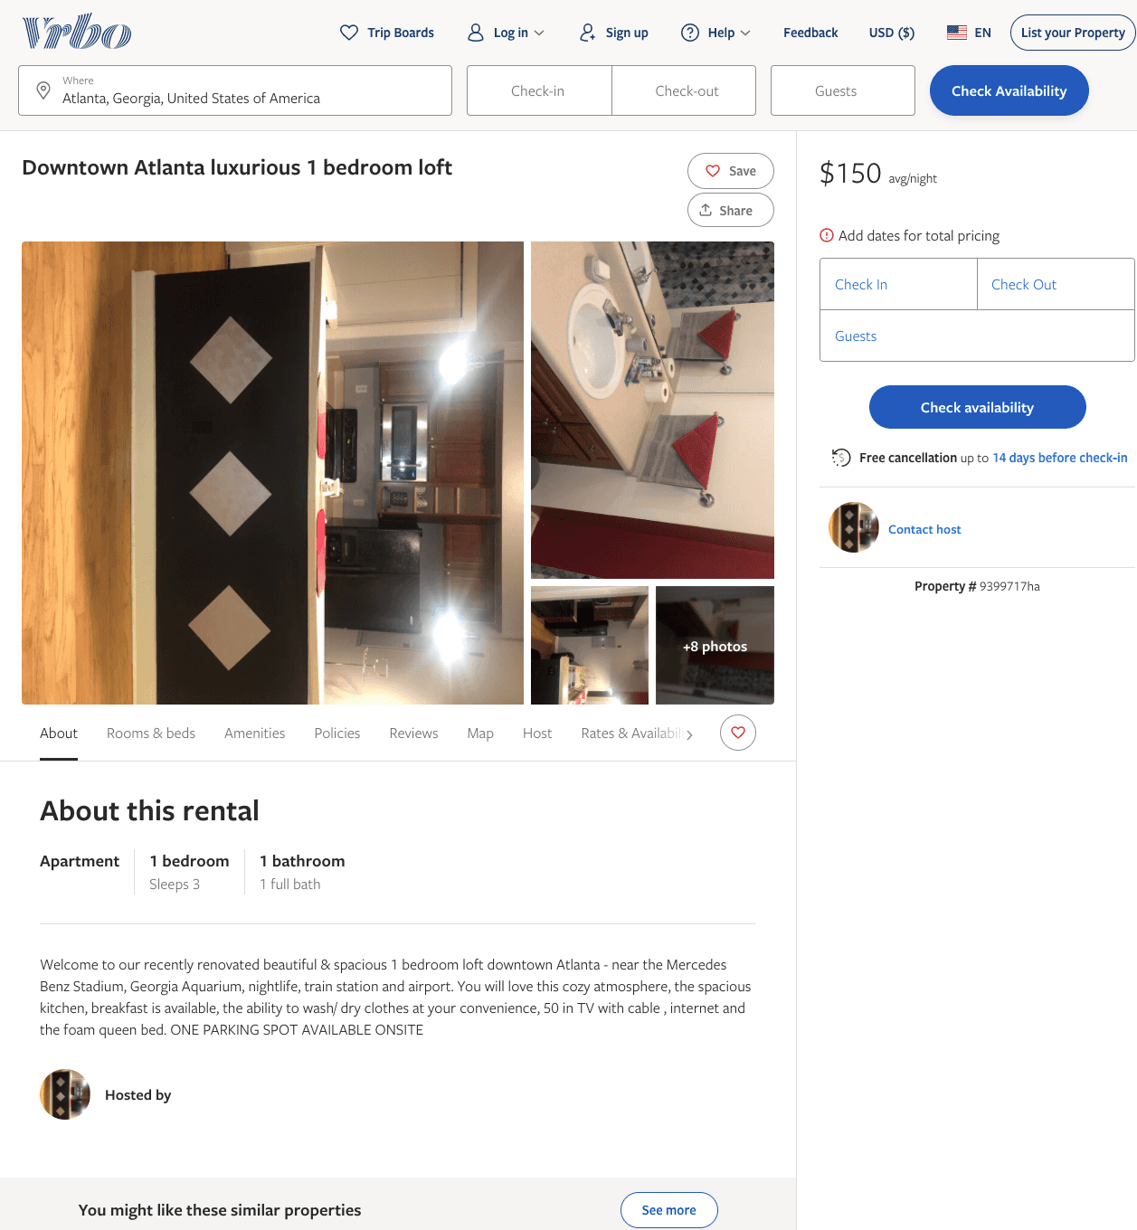
Listing 9399717
1
3
$150
80
https://www.vrbo.com/9399717ha
Aug 2022

Slide 7
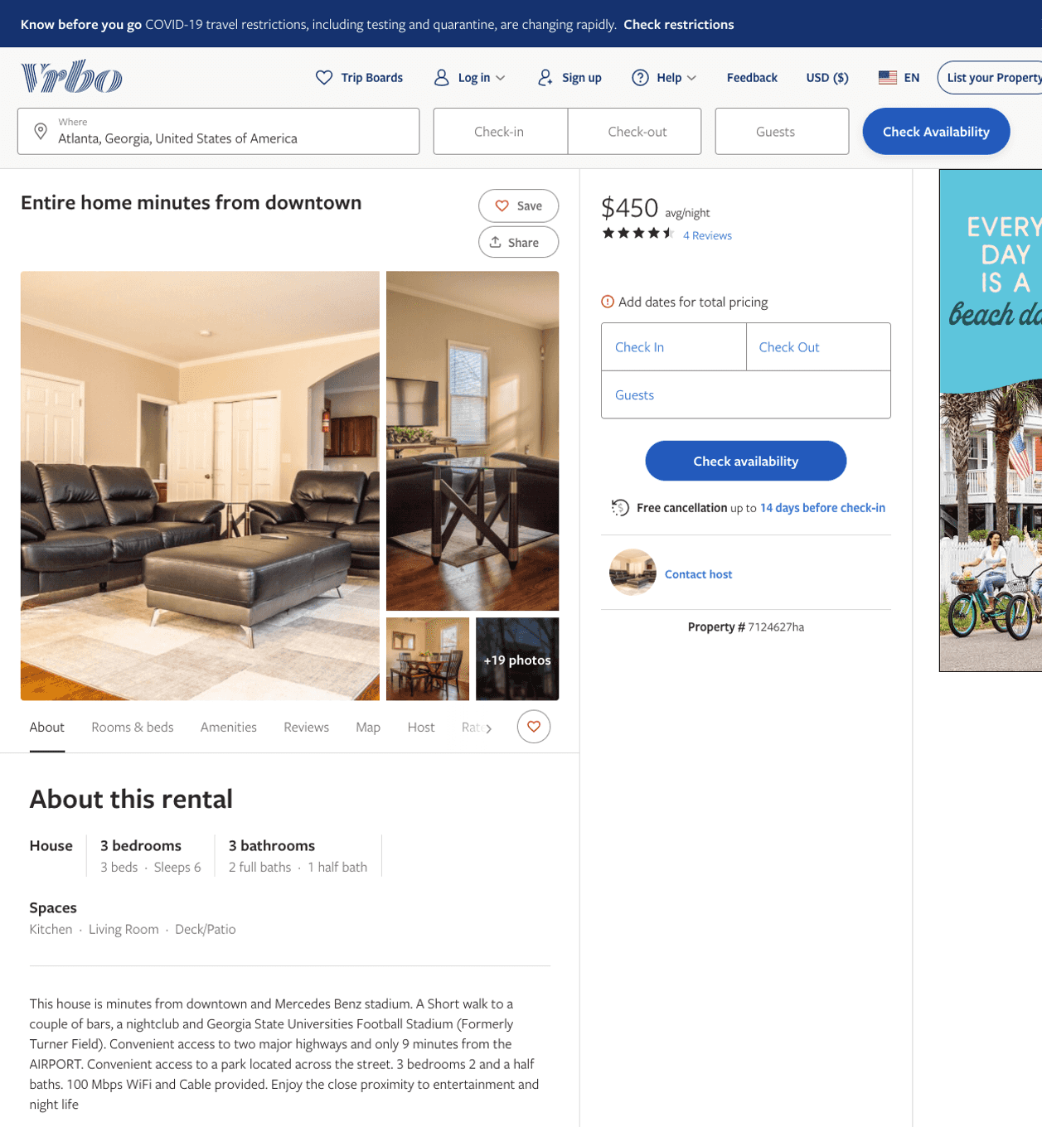
Listing 7124627
3
6
$450
4.5
3
https://www.vrbo.com/7124627ha
Aug 2022

Slide 8
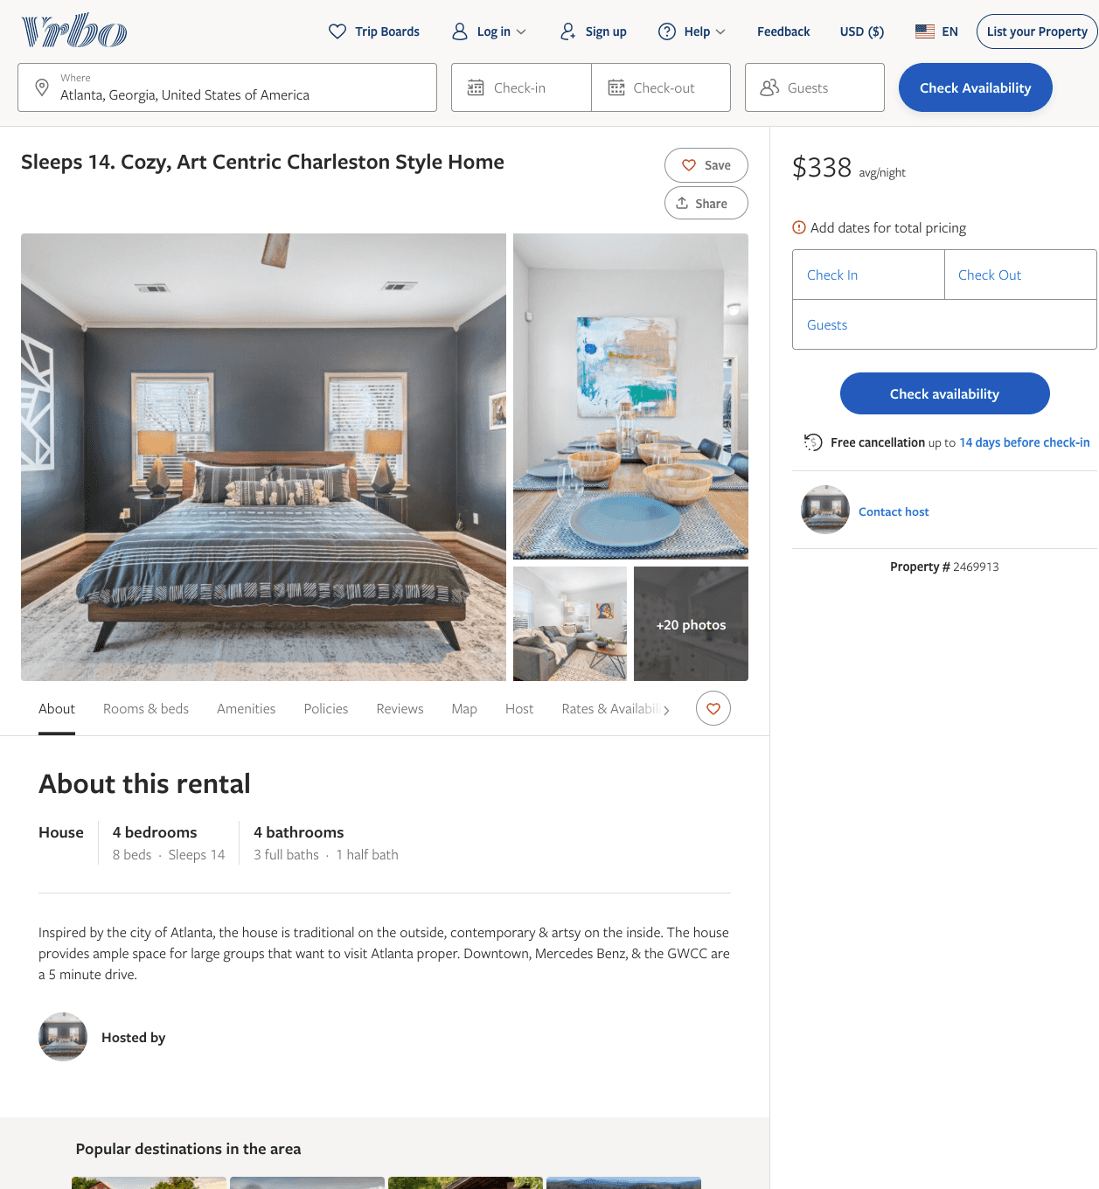
Listing 2469913
4
14
$338
3
https://www.vrbo.com/2469913
Aug 2022

Slide 9
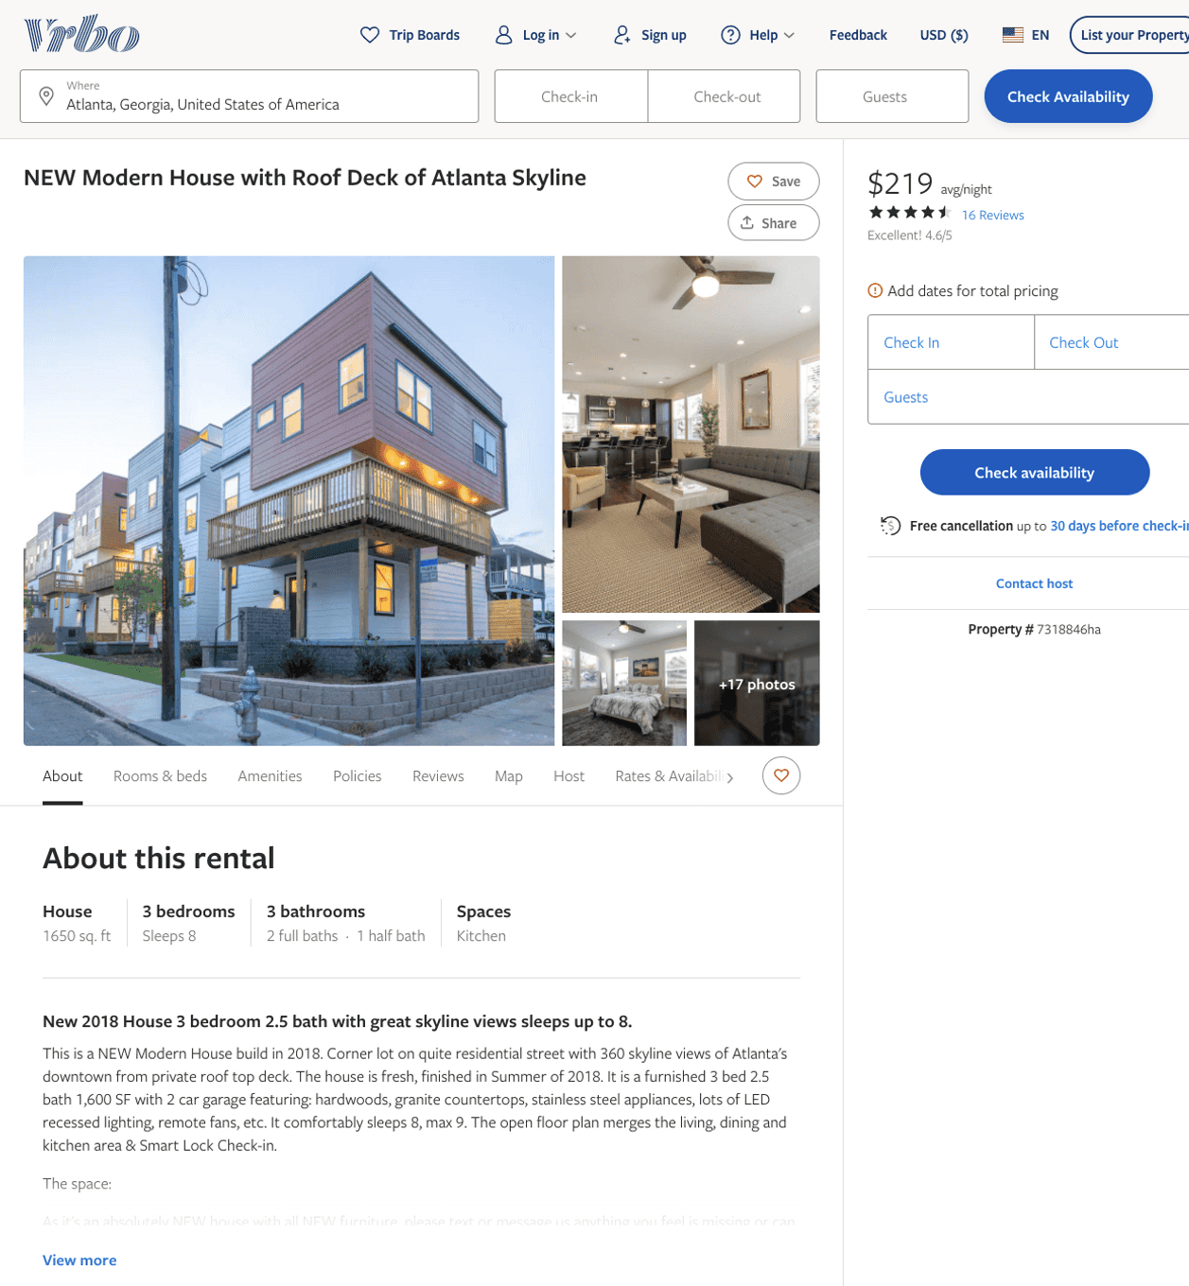
Listing 7318846
3
8
$189 - $224
4.6538463
3
Senya
https://www.vrbo.com/7318846ha
Aug 2022

Slide 10
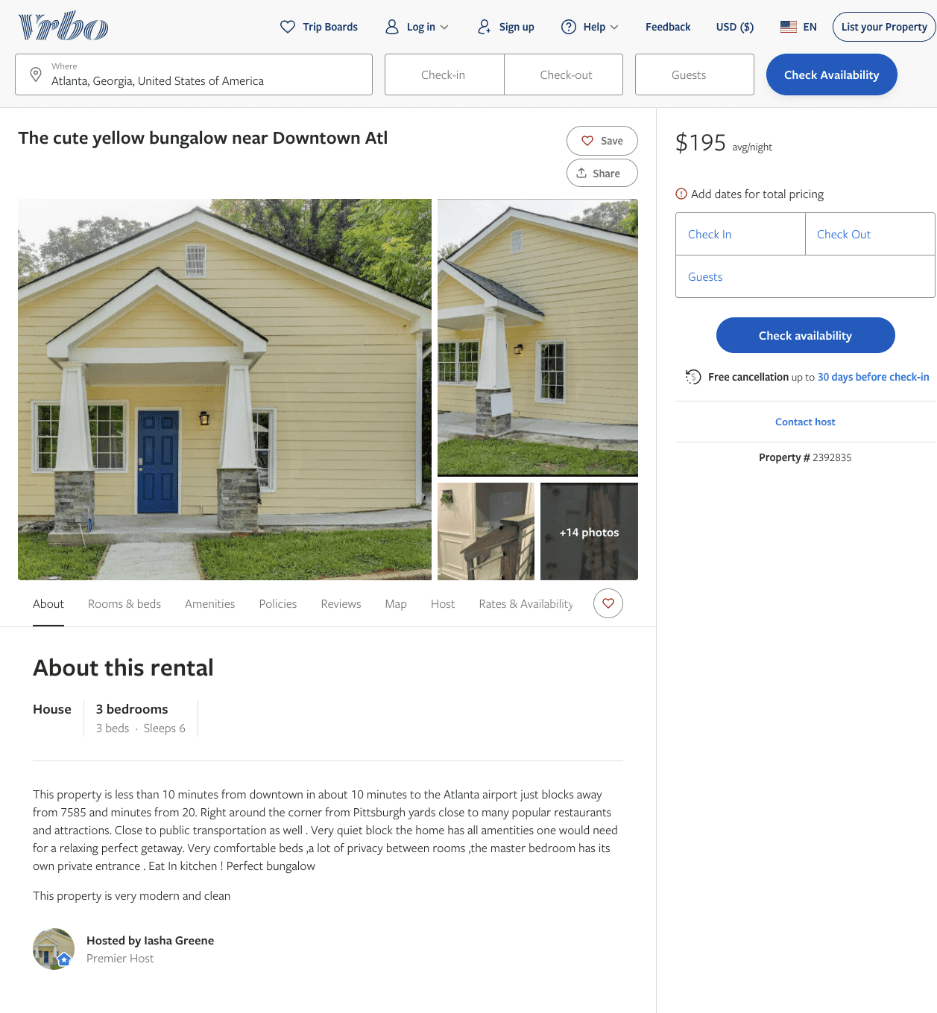
Listing 2392835
3
6
$111 - $223
4.181818
2
Iasha Greene
https://www.vrbo.com/2392835
Aug 2022

Slide 11
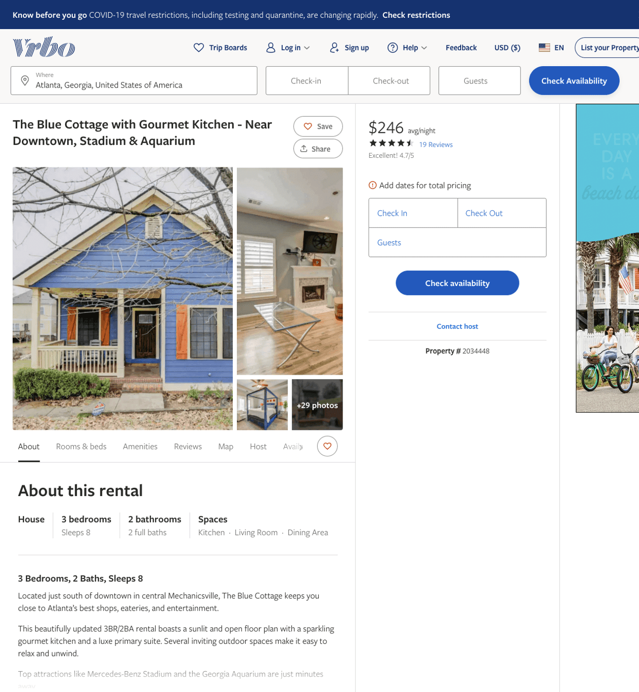
Listing 2034448
3
8
$126 - $203
4.3333335
2
Vacasa
https://www.vrbo.com/2034448
Aug 2022

Slide 12
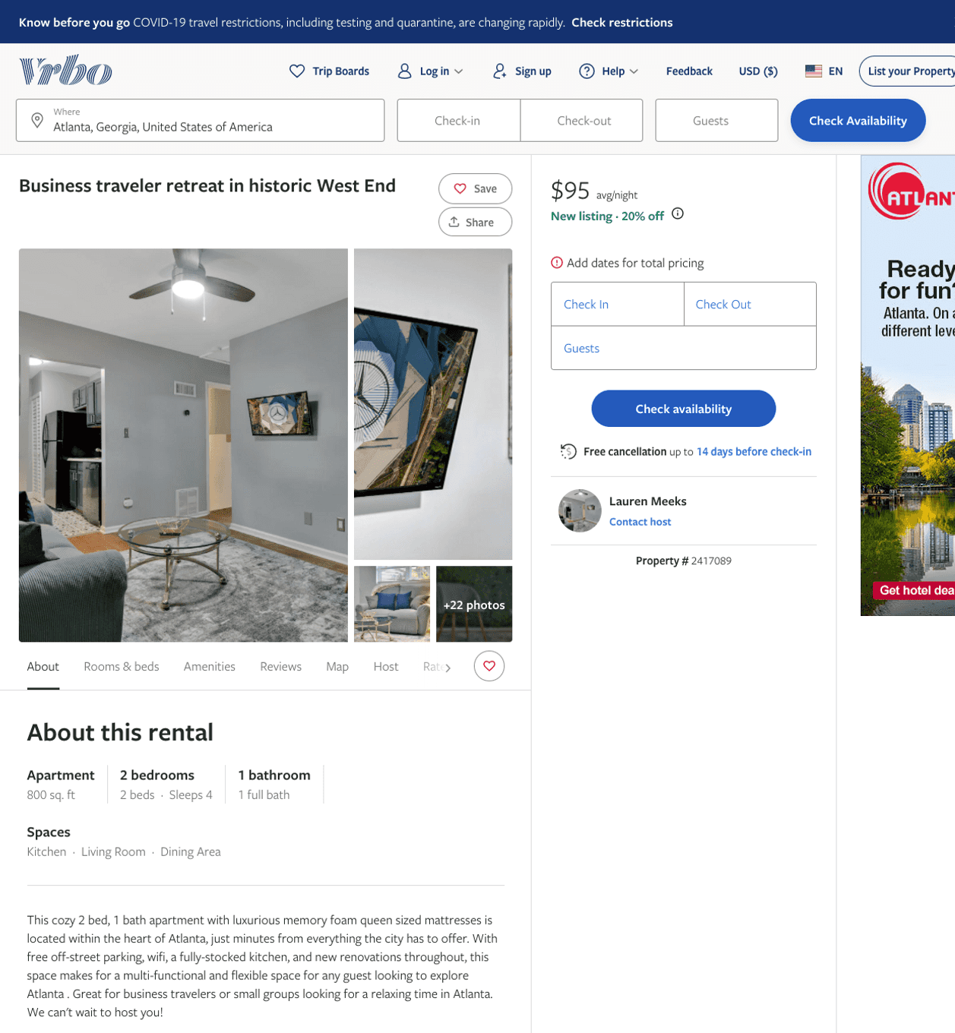
Listing 2417089
2
4
$103 - $96
5
2
Lauren Meeks
https://www.vrbo.com/2417089
Aug 2022

Slide 13
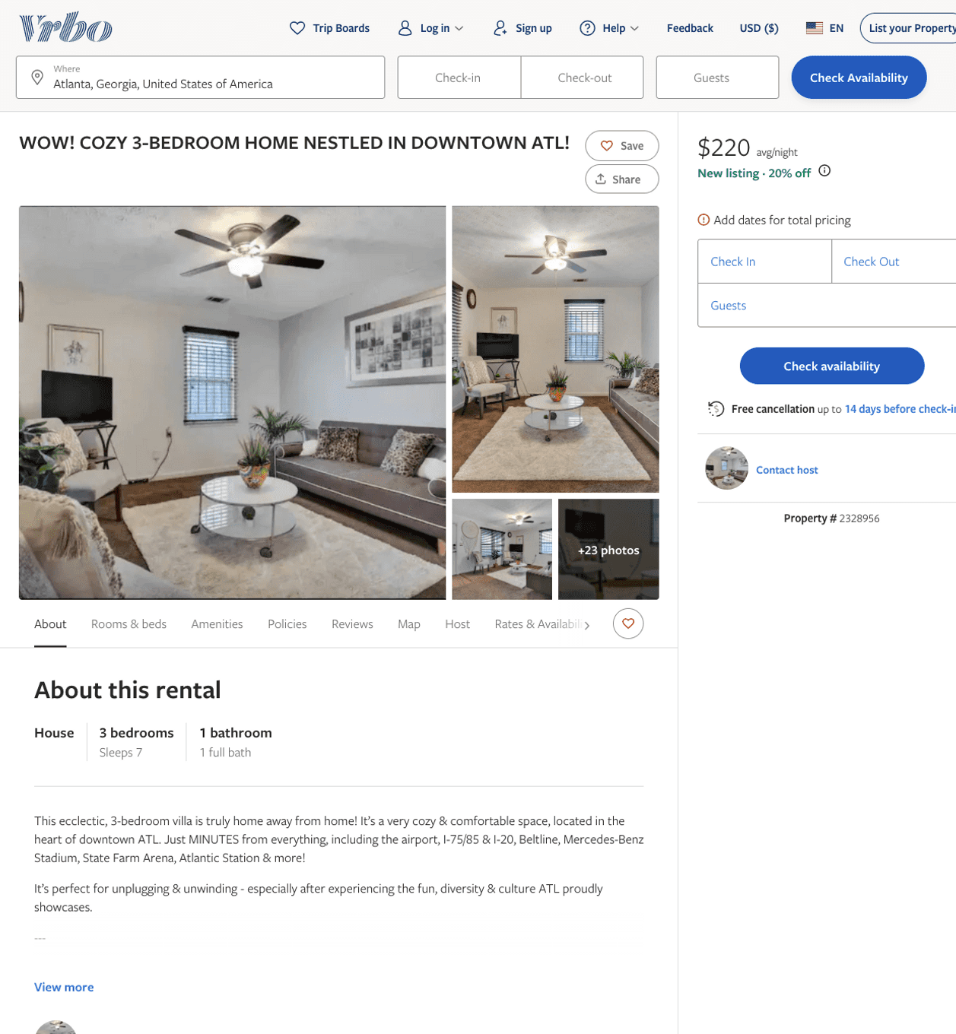
Listing 2328956
3
7
$142 - $223
5
2
Jon-Rico Wigfall
https://www.vrbo.com/2328956
Aug 2022

Slide 14
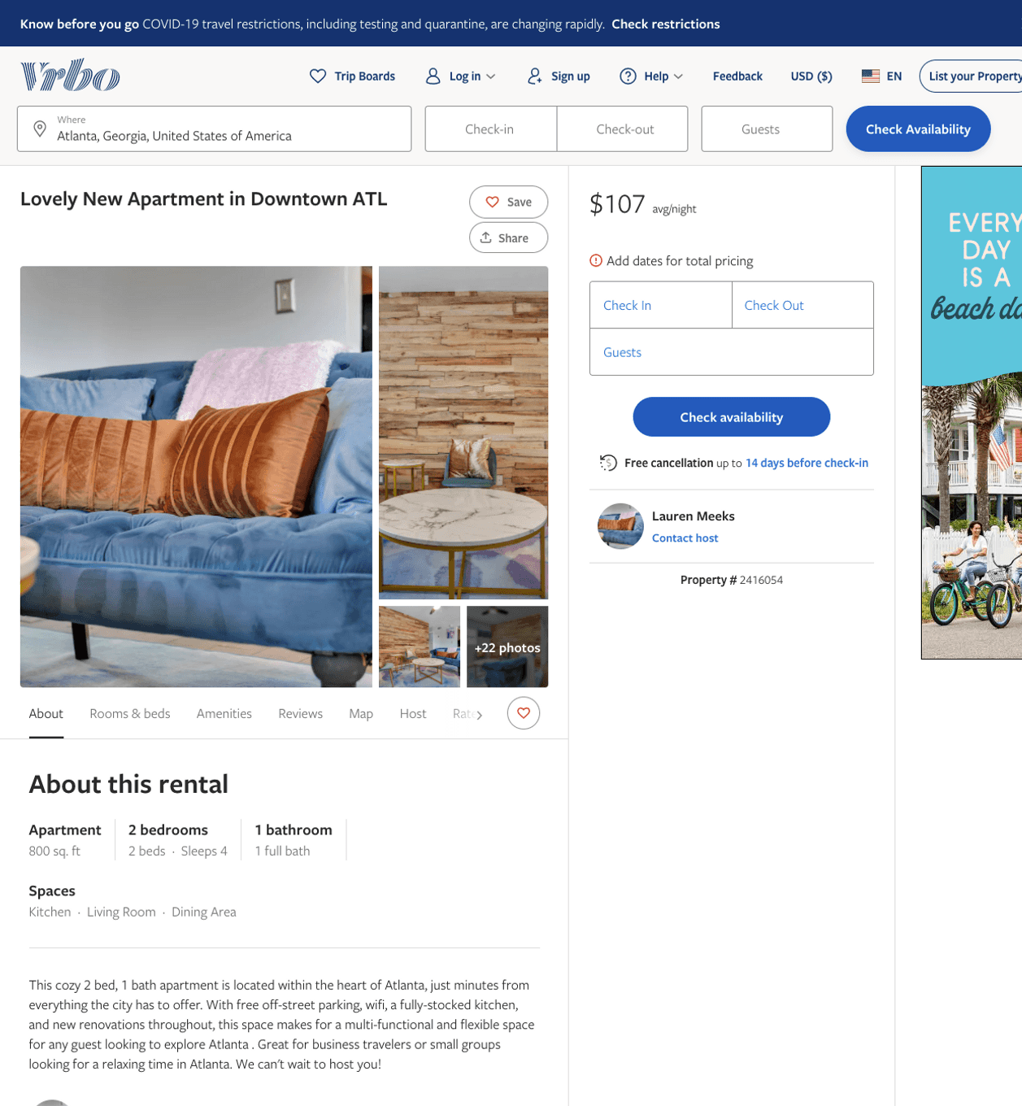
Listing 2416054
2
4
$100 - $89
3.5
2
Lauren Meeks
https://www.vrbo.com/2416054
Aug 2022

Slide 15
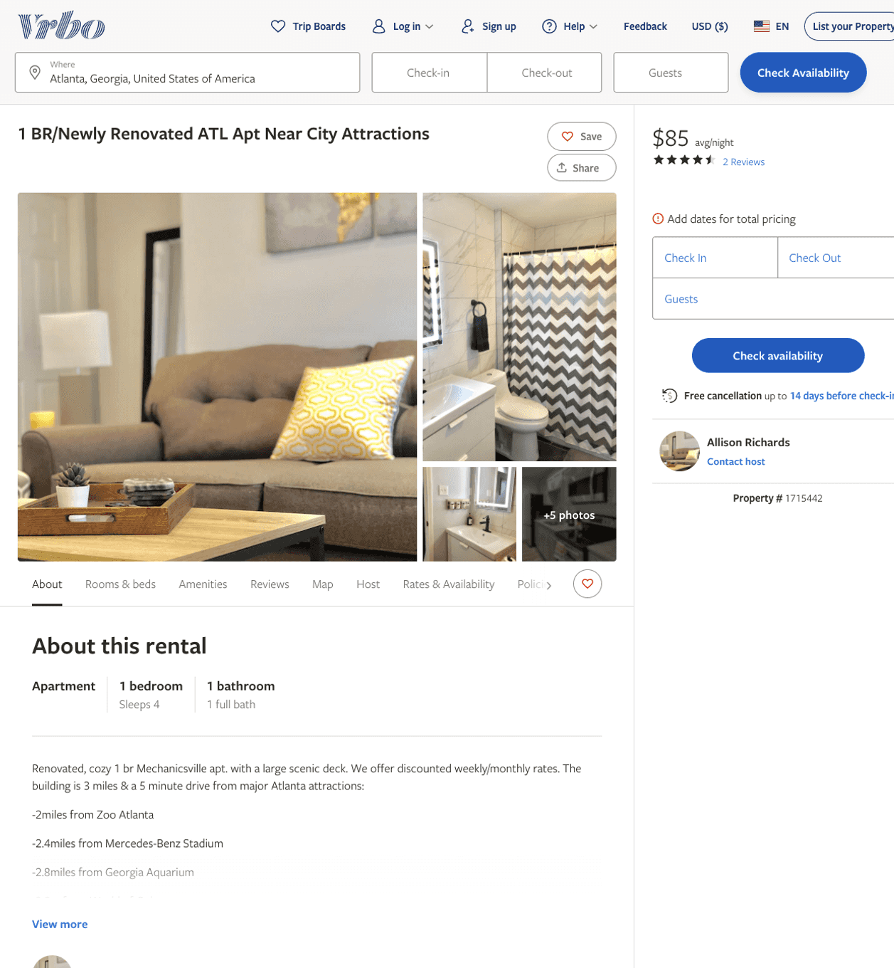
Listing 1715442
1
4
$85 - $92
3.6666667
2
Allison Richards
https://www.vrbo.com/1715442
Aug 2022

Slide 16
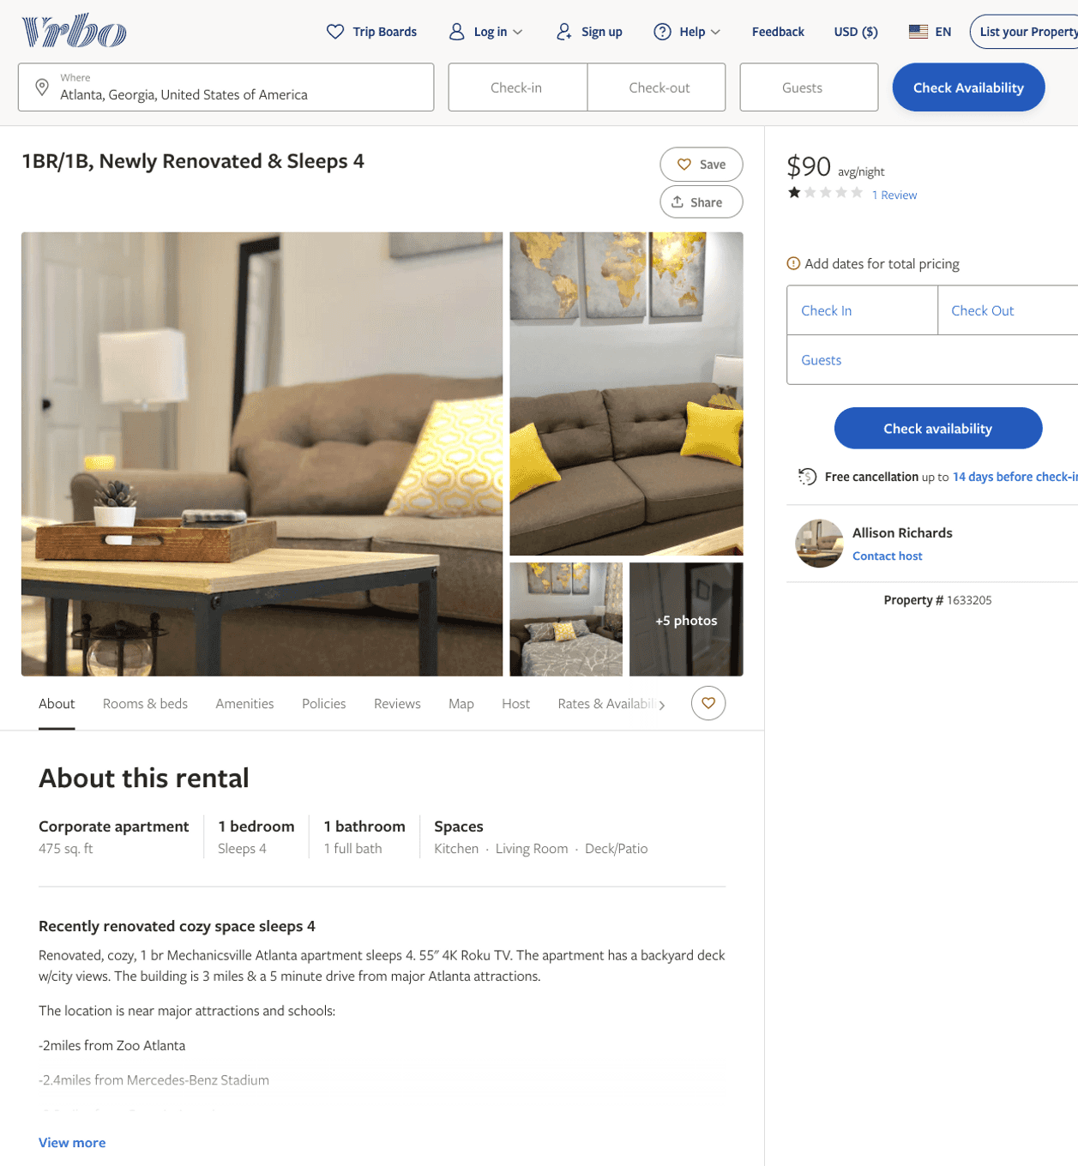
Listing 1633205
1
4
$83 - $90
1
2
Allison Richards
https://www.vrbo.com/1633205
Aug 2022

Slide 17
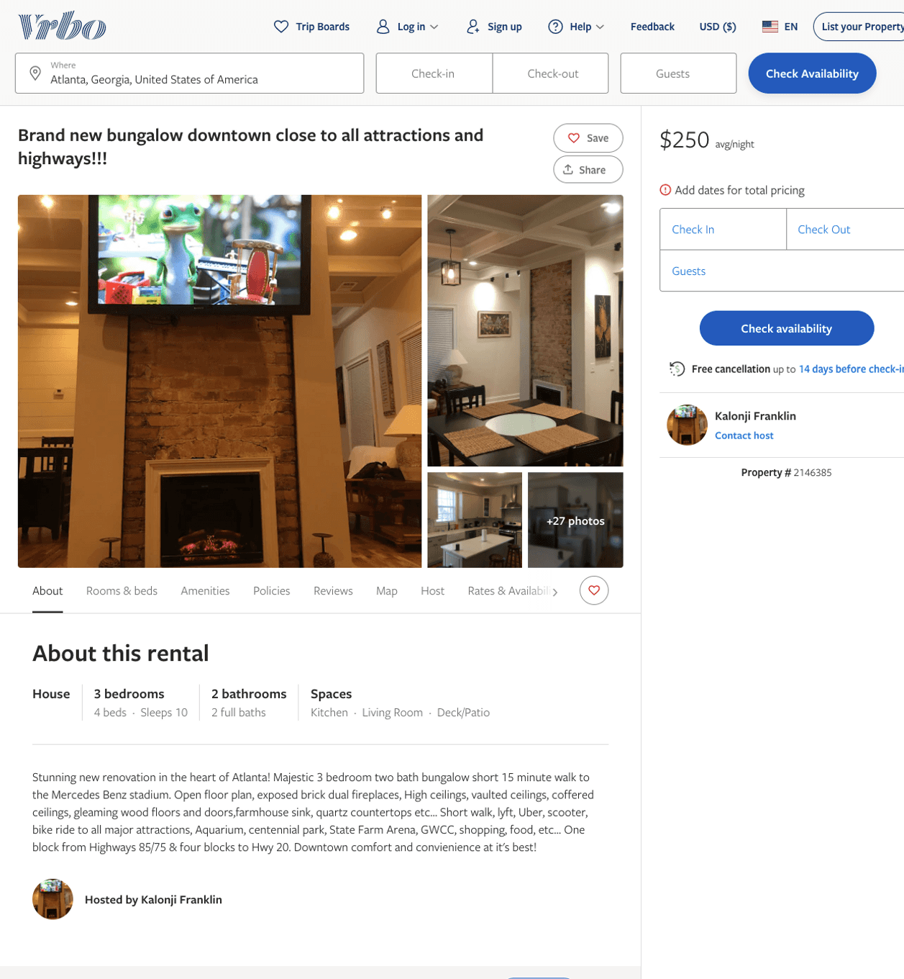
Listing 2146385
3
10
$150 - $333
3
2
Kalonji Franklin
https://www.vrbo.com/2146385
Aug 2022

Slide 18
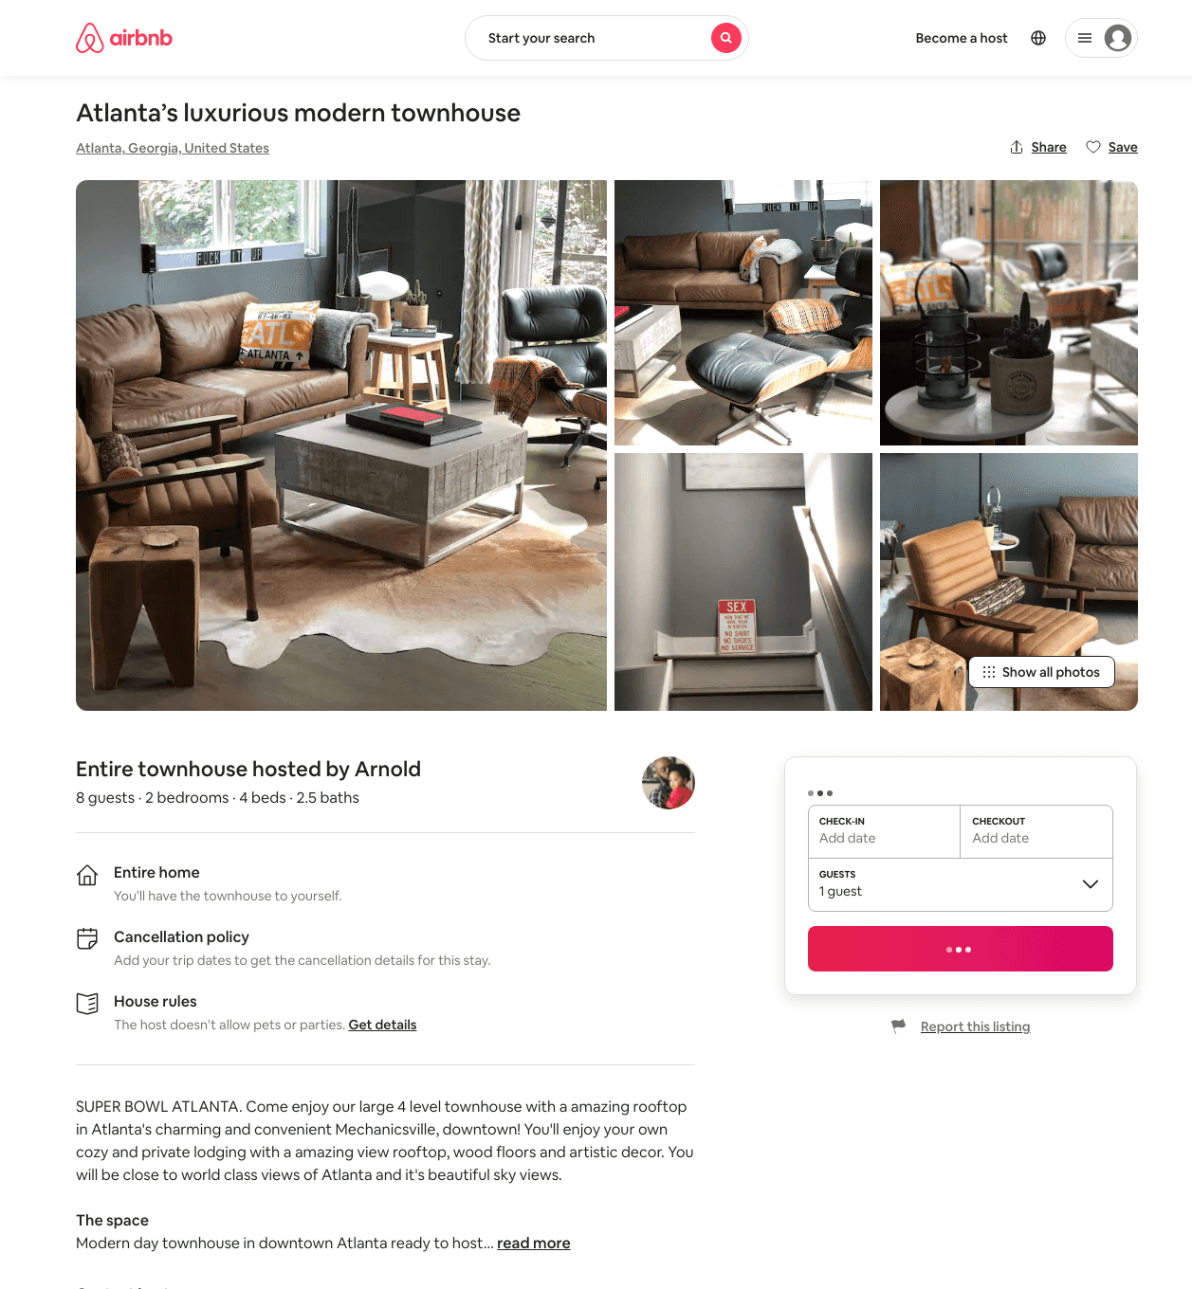
Listing 29569575
2
8
$2500
3
Arnold
48900052
1
https://www.airbnb.com/rooms/29569575
Aug 2022

Slide 19
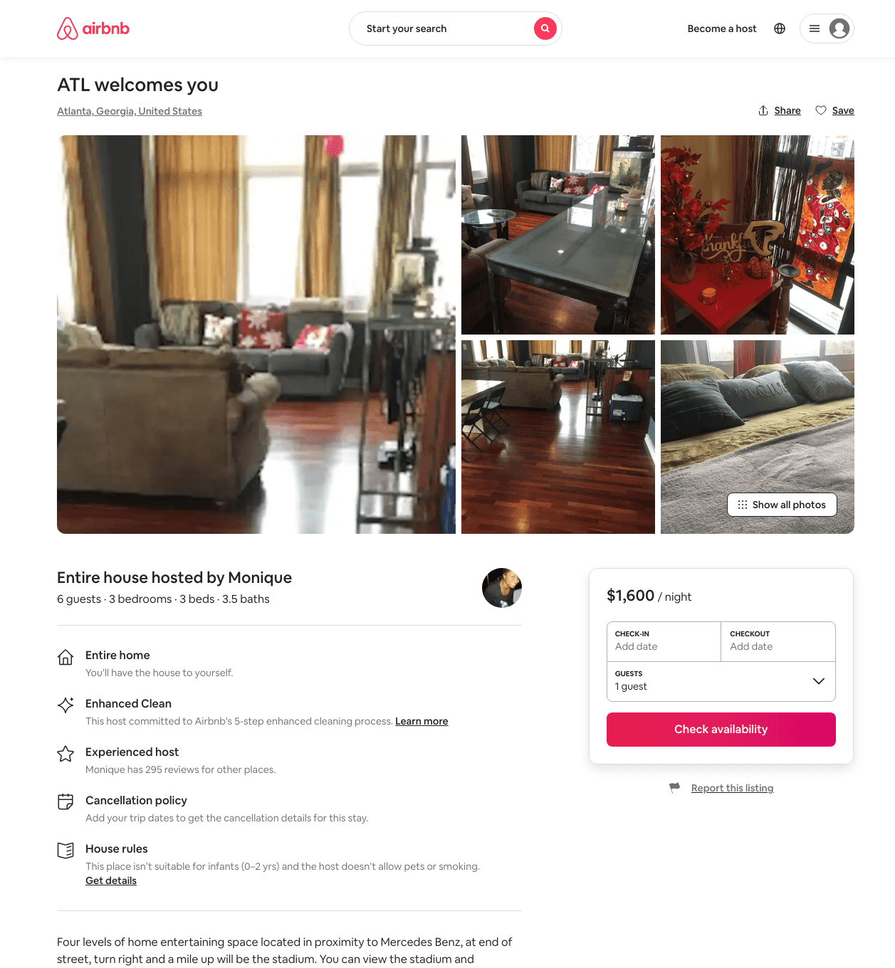
Listing 30721563
3
6
$1600
3
Monique
17056909
1
https://www.airbnb.com/rooms/30721563
Aug 2022

Slide 20
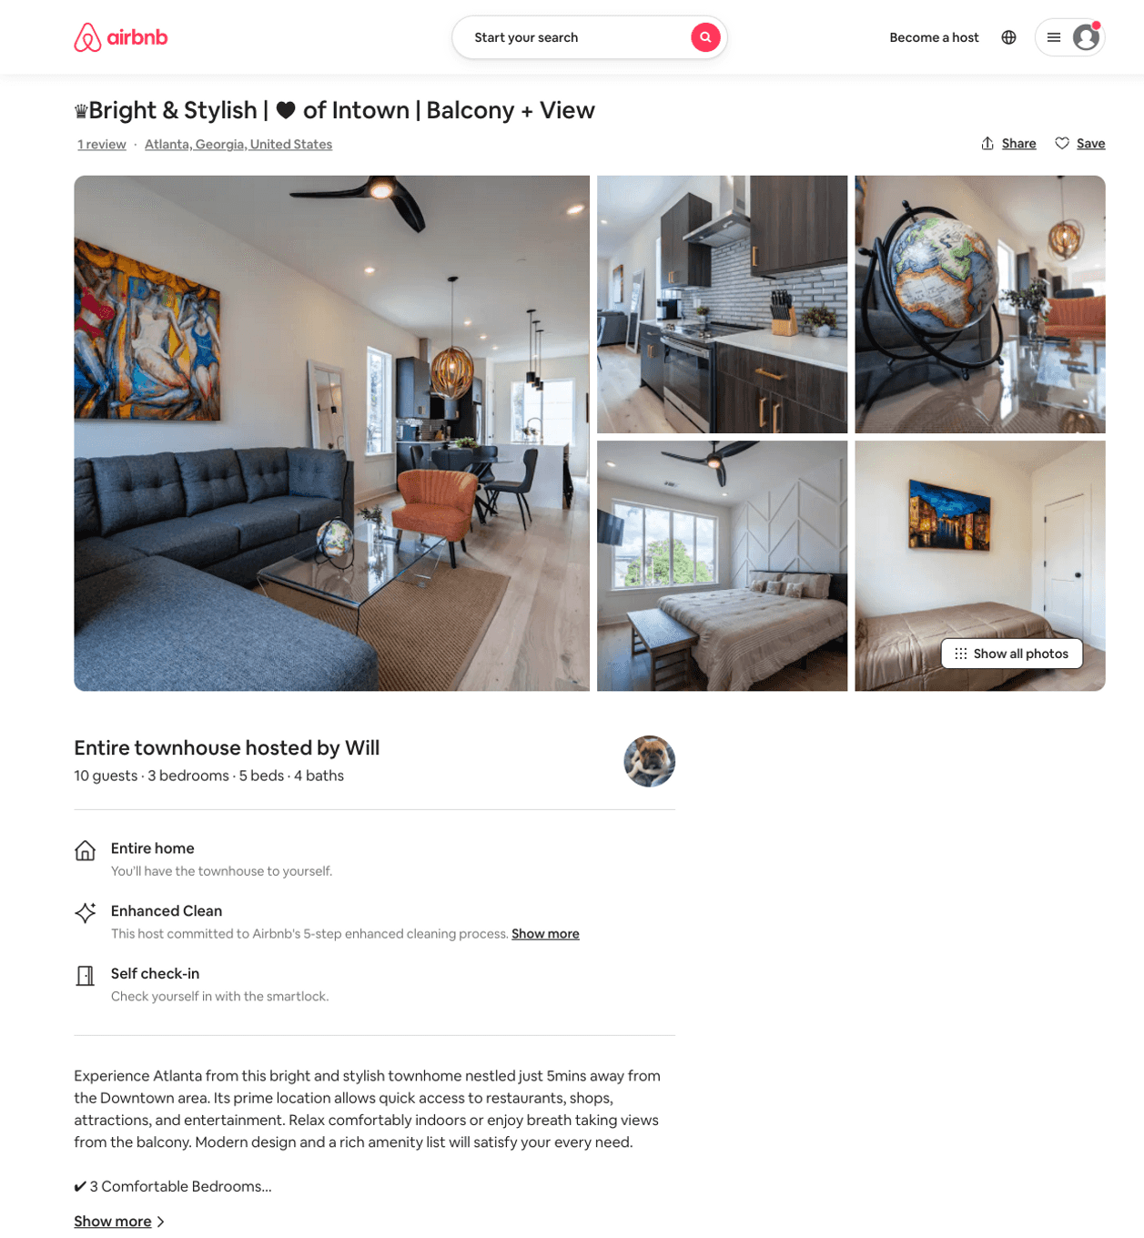
Listing 49611300
3
8
$193 - $481
4.81
2
Will
24956709
1
https://www.airbnb.com/rooms/49611300
Aug 2022

Slide 21
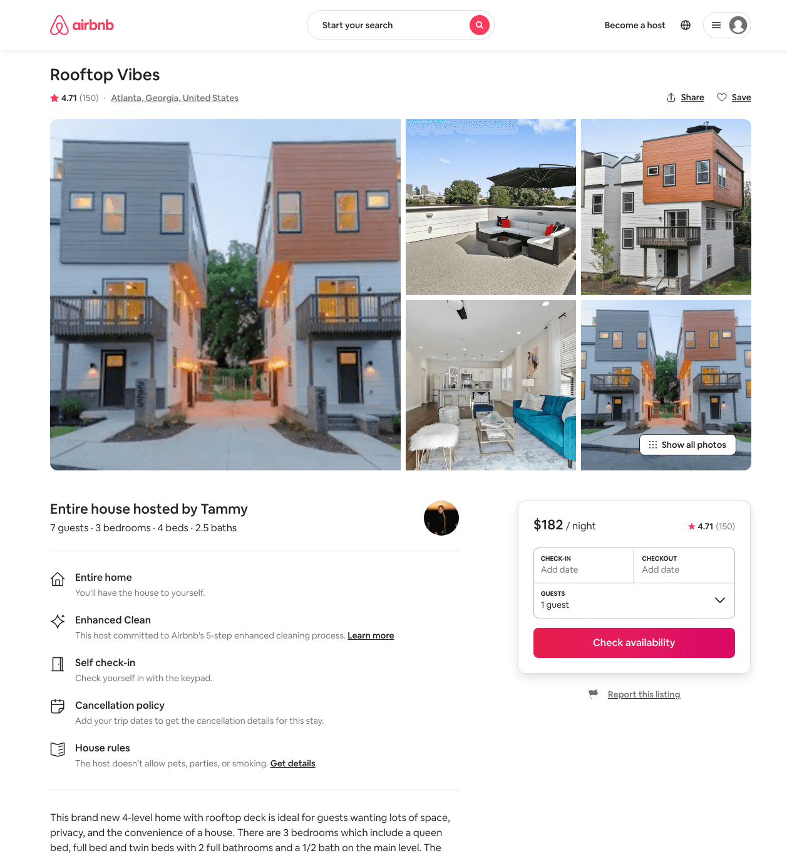
Listing 27965890
3
6
$157 - $286
4.61
2
Tammy
111197272
2
https://www.airbnb.com/rooms/27965890
Aug 2022

Slide 22
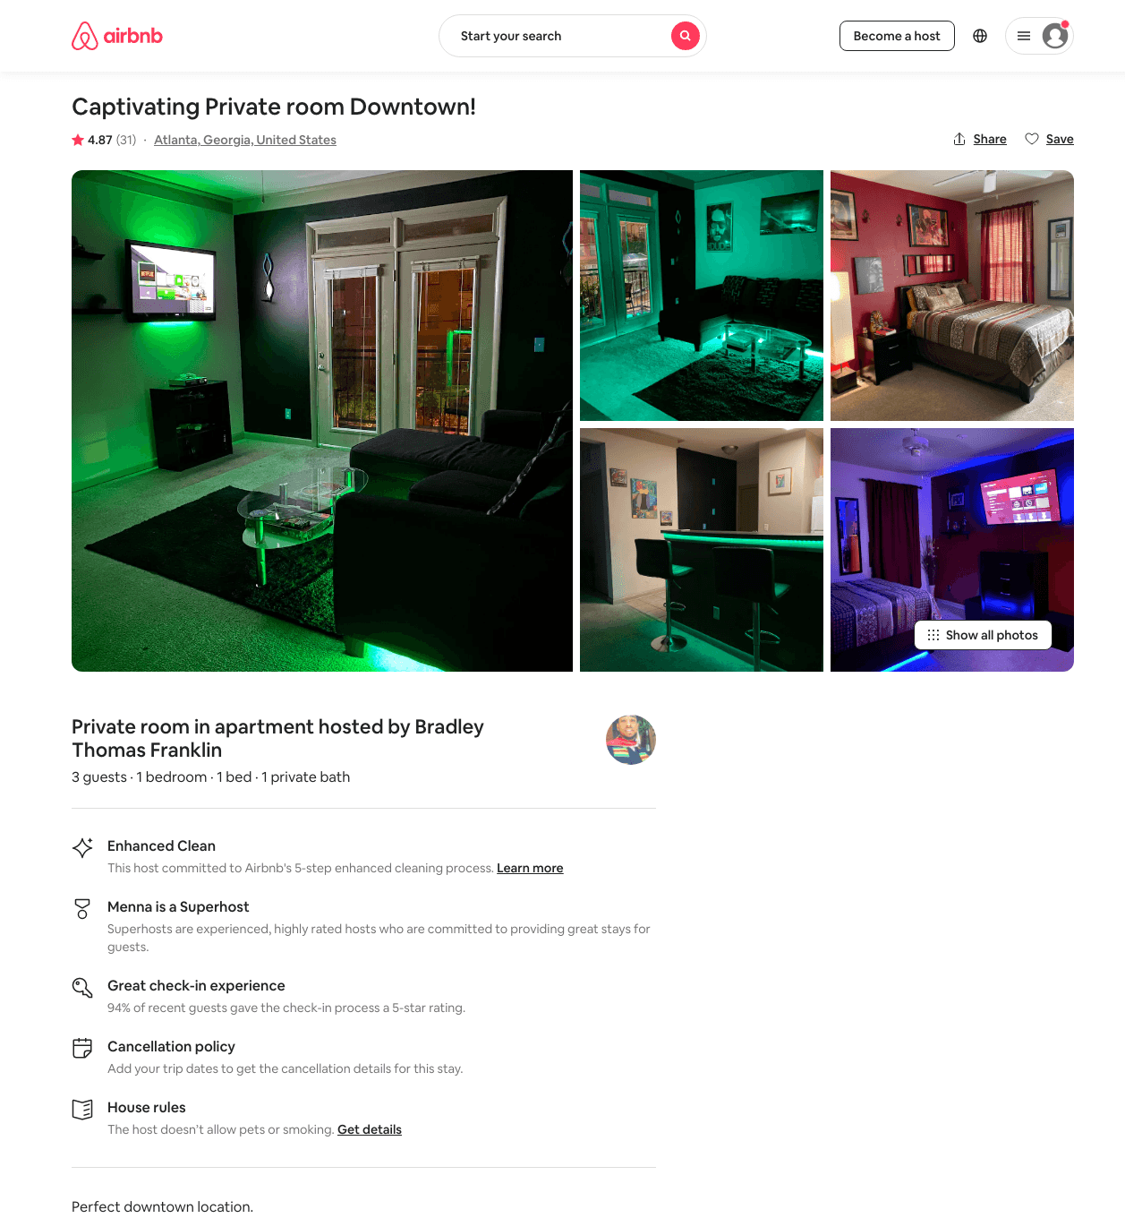
Listing 31626090
1
2
$44 - $82
4.81
1
Bradley Thomas Franklin
237121166
1
https://www.airbnb.com/rooms/31626090
Aug 2022

Slide 23
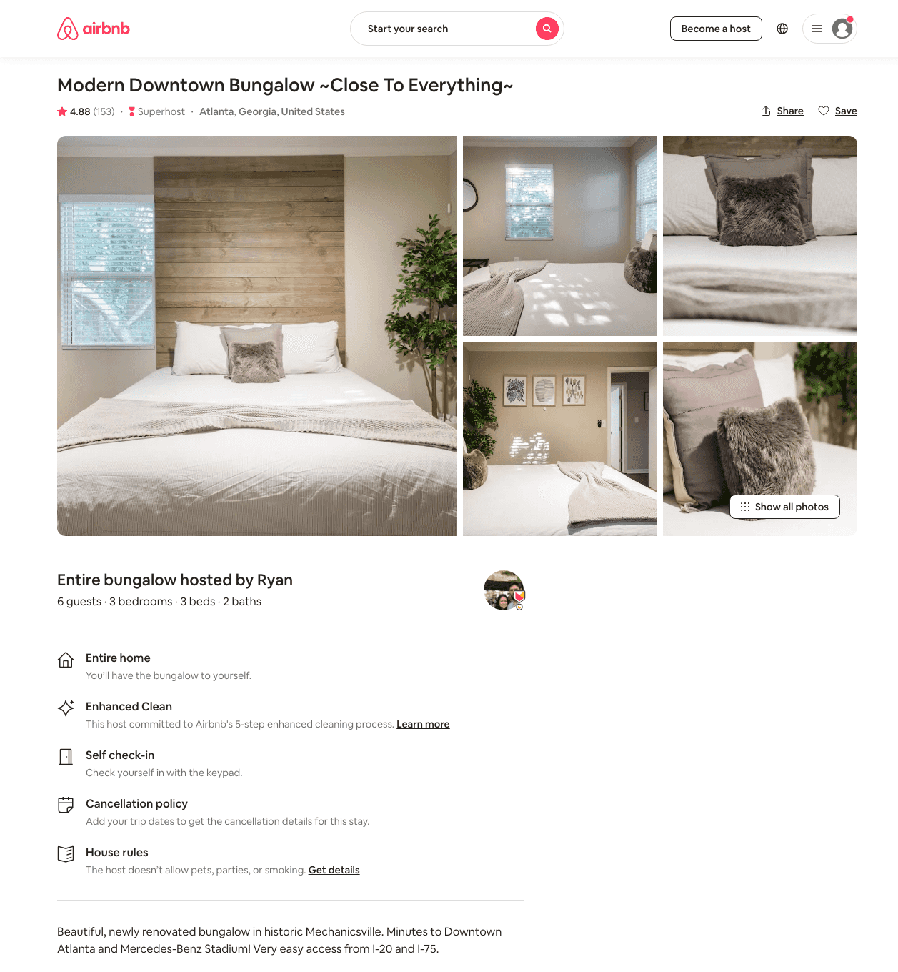
Listing 22481663
3
6
$151 - $218
4.82
2
Ryan
12221407
2
https://www.airbnb.com/rooms/22481663
Aug 2022

Slide 24
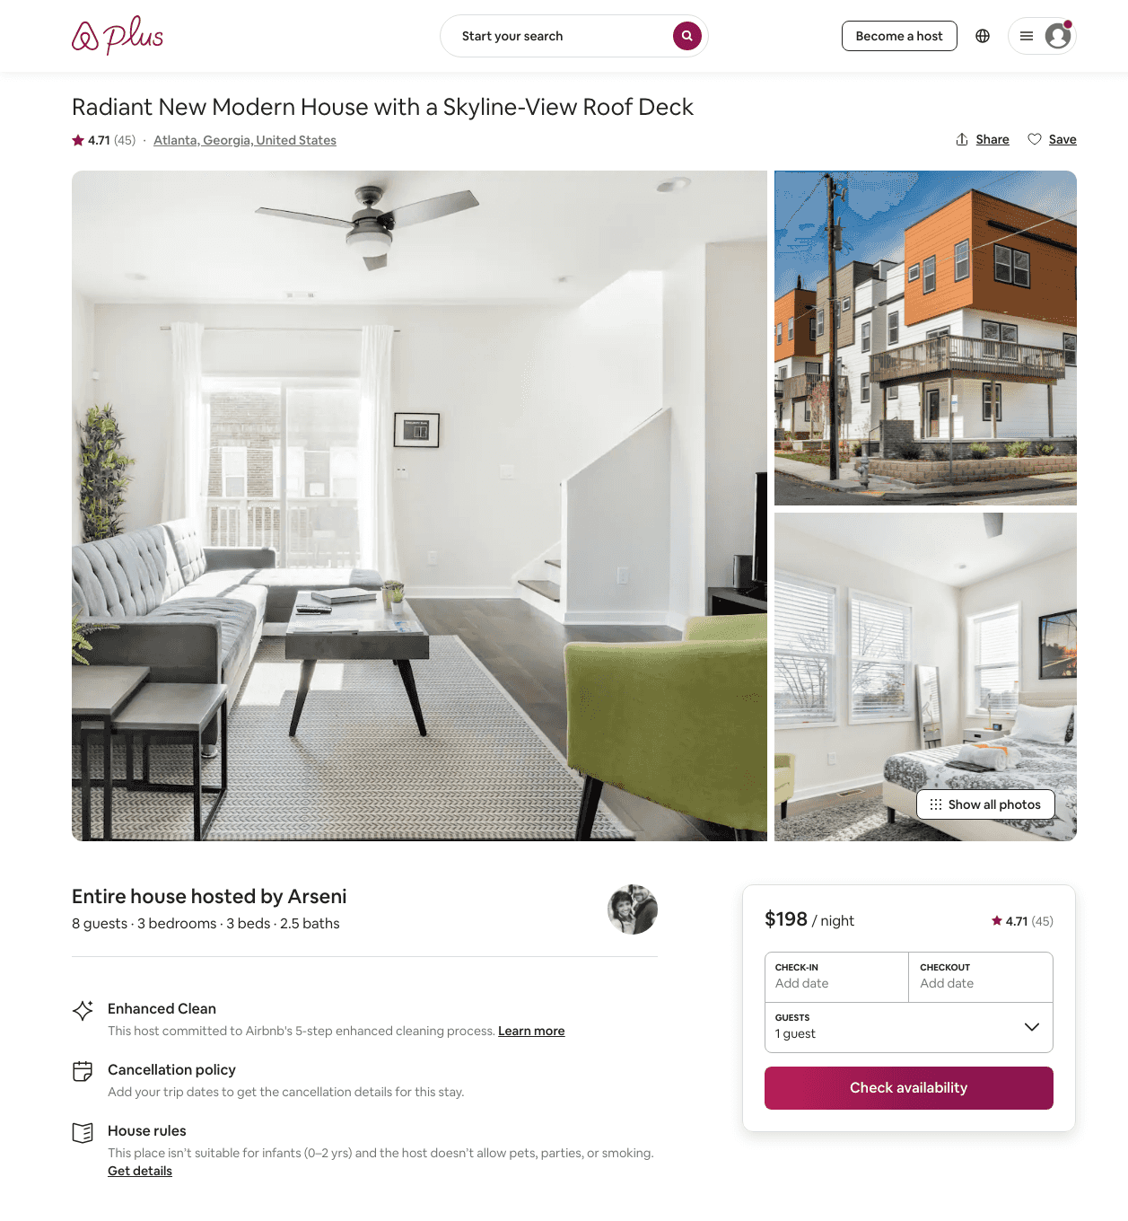
Listing 28331766
3
8
$180 - $233
4.75
3
Arseni
4487934
7
https://www.airbnb.com/rooms/28331766
Aug 2022

Slide 25
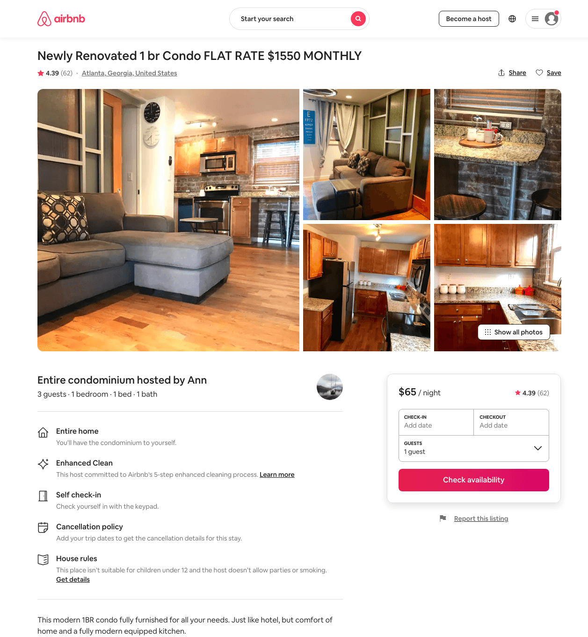
Listing 21942714
1
3
$65 - $75
4.42
6
Ann
17642625
1
https://www.airbnb.com/rooms/21942714
Aug 2022

Slide 26
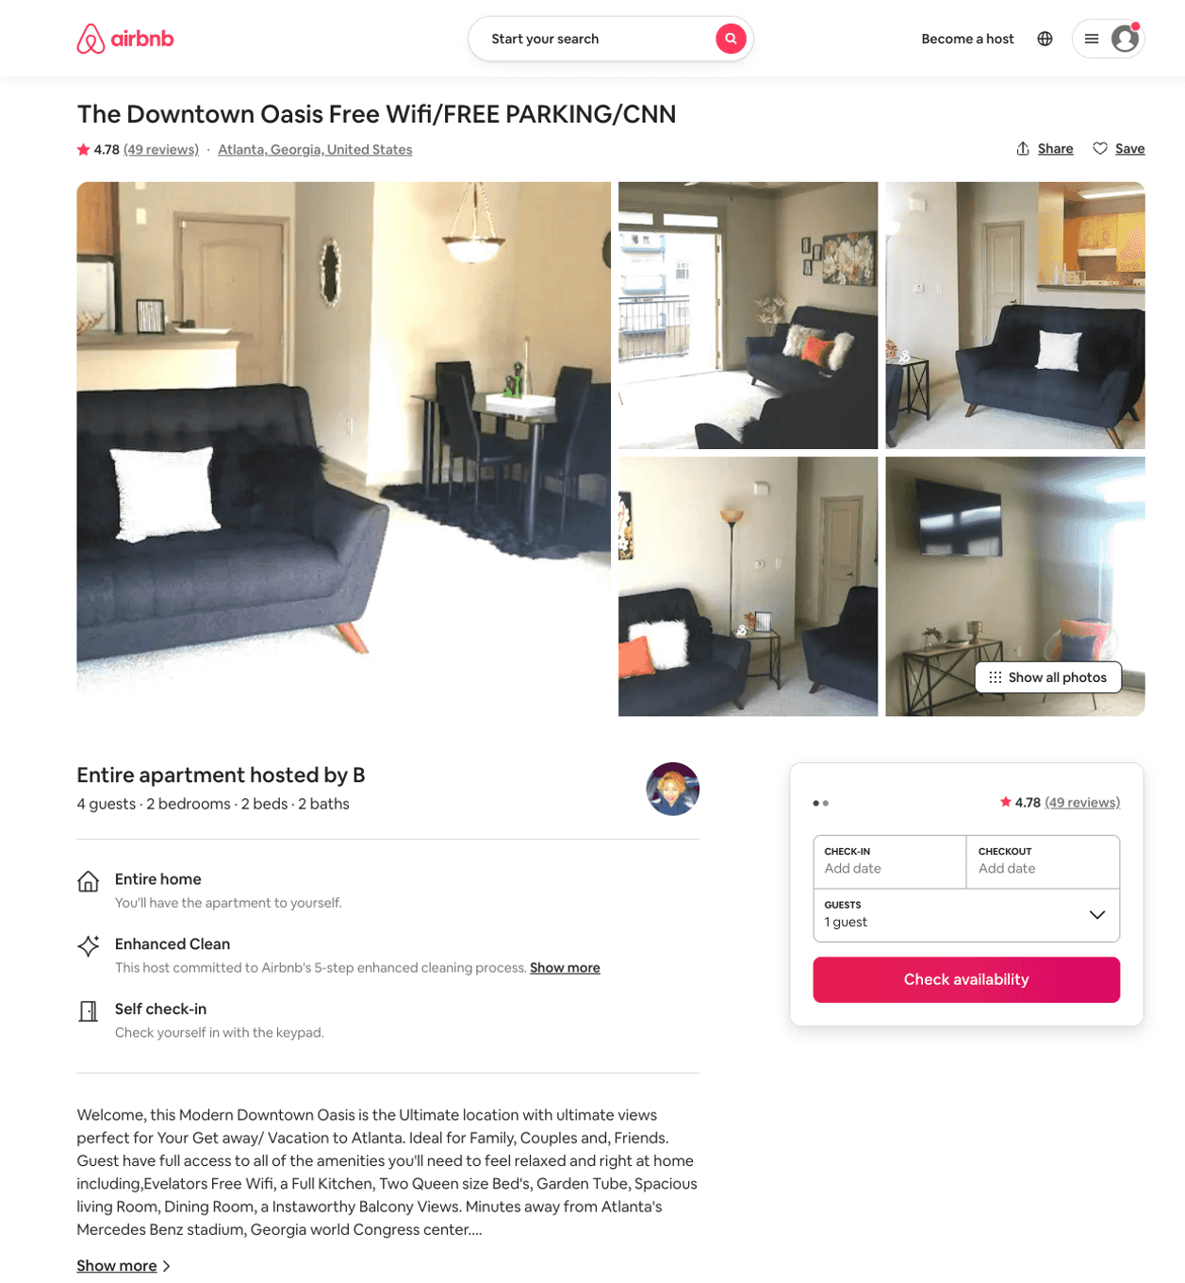
Listing 31675770
2
4
$69 - $85
4.78
2
B
182355463
1
https://www.airbnb.com/rooms/31675770
Jul 2022

Slide 27
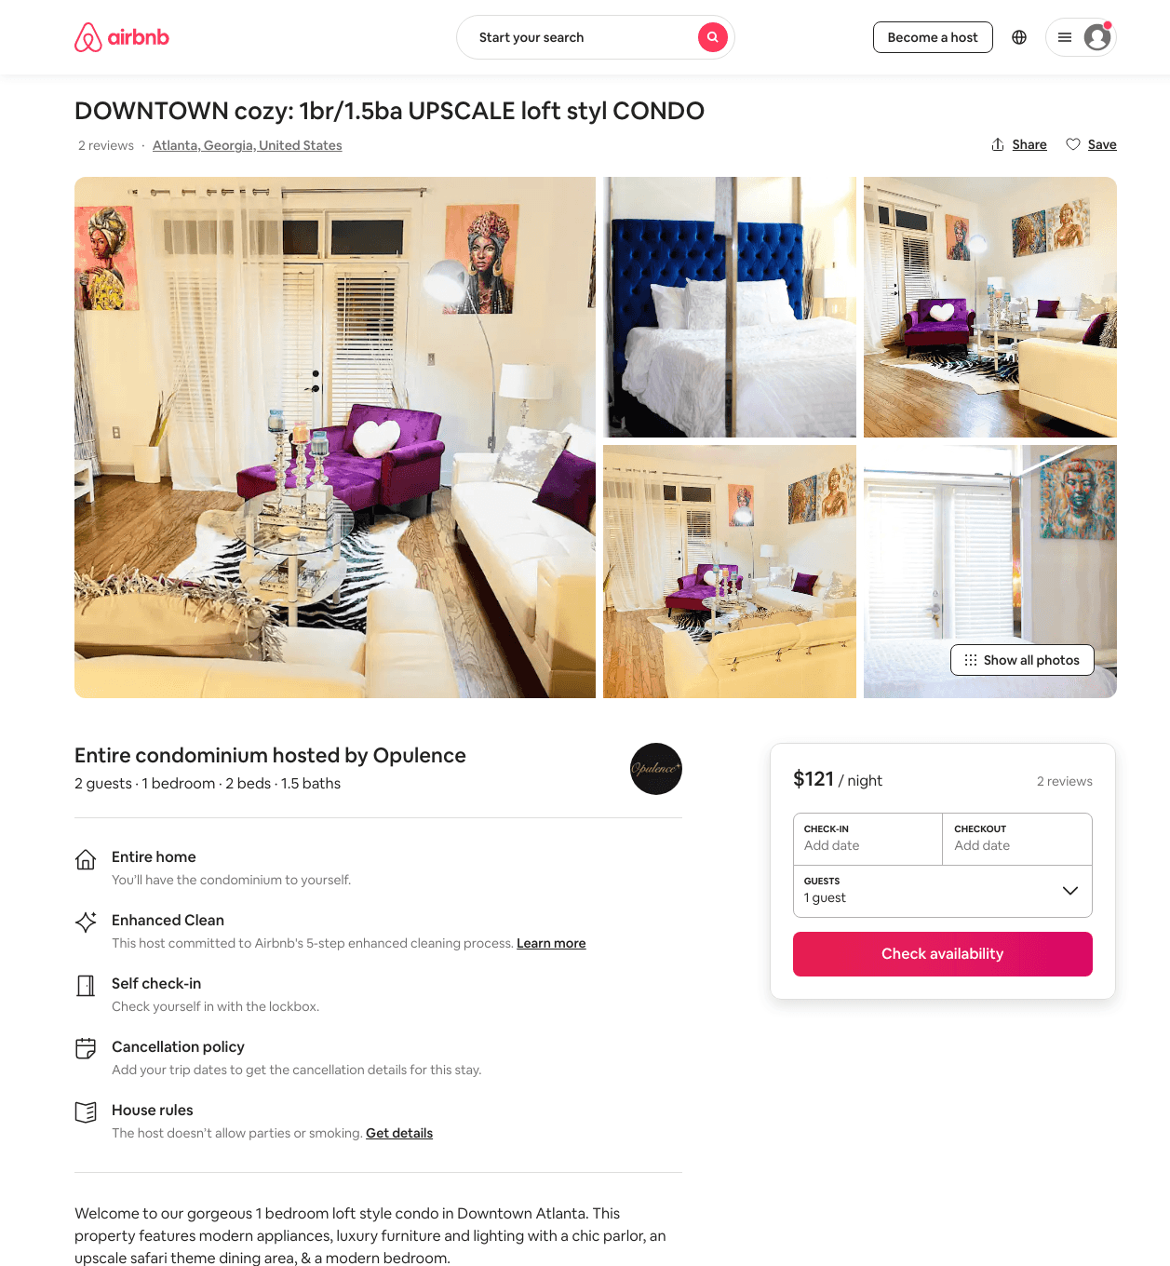
Listing 48471271
1
2
$43 - $133
4.36
2
Opulence
363152798
1
https://www.airbnb.com/rooms/48471271
Jul 2022

Slide 28
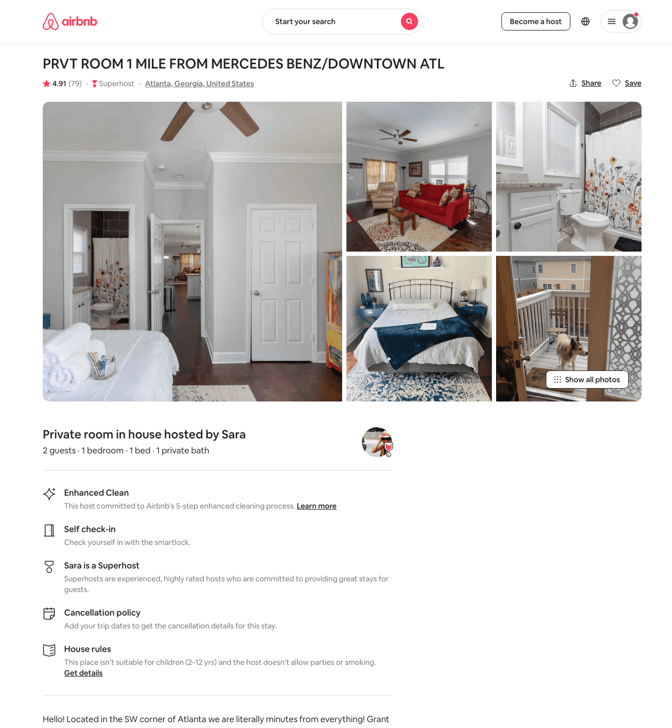
Listing 31985658
1
2
$45 - $56
4.89
1
Sara
27127174
2
https://www.airbnb.com/rooms/31985658
Aug 2022

Slide 29
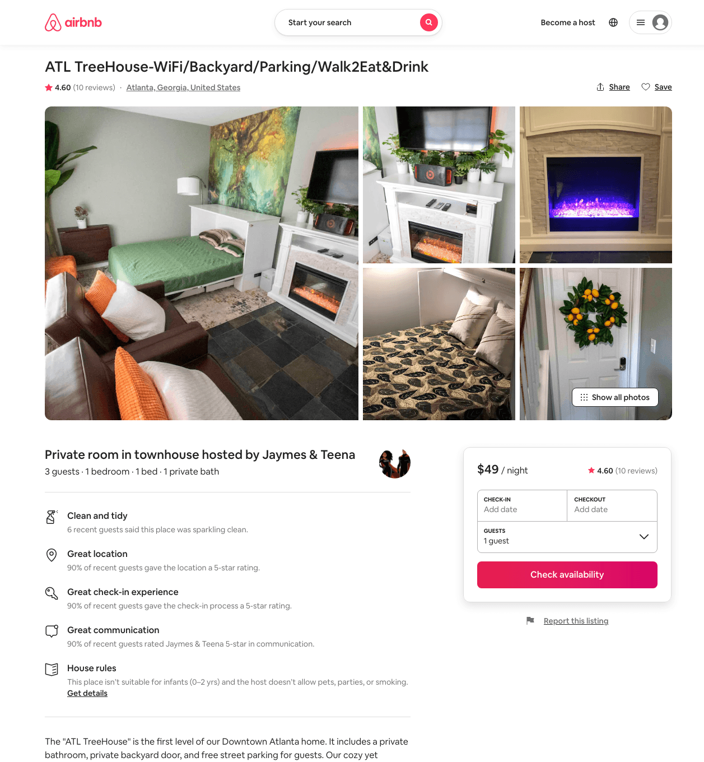
Listing 47097270
1
3
$42 - $55
4.84
2
Jaymes & Teena
95350764
3
https://www.airbnb.com/rooms/47097270
Aug 2022

Slide 30
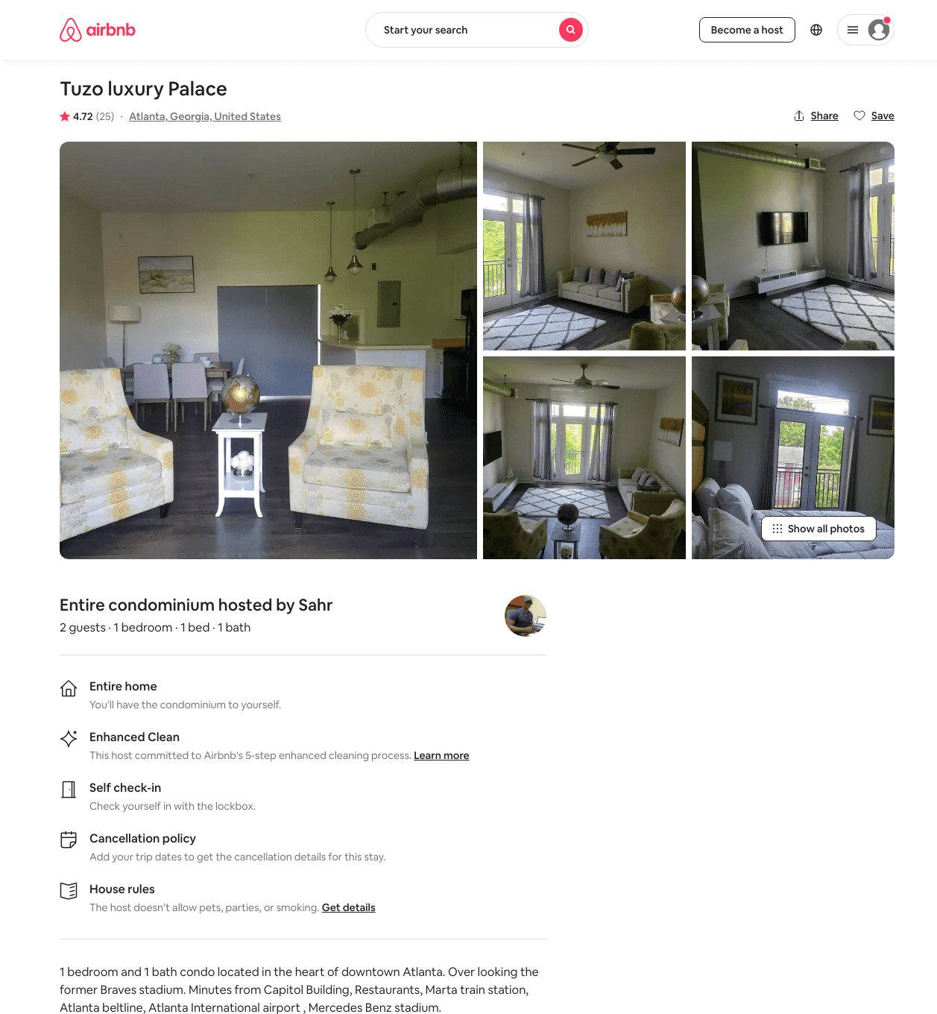
Listing 43527834
1
2
$100 - $109
4.72
1
Sahr
220231630
1
https://www.airbnb.com/rooms/43527834
Aug 2022

Slide 31
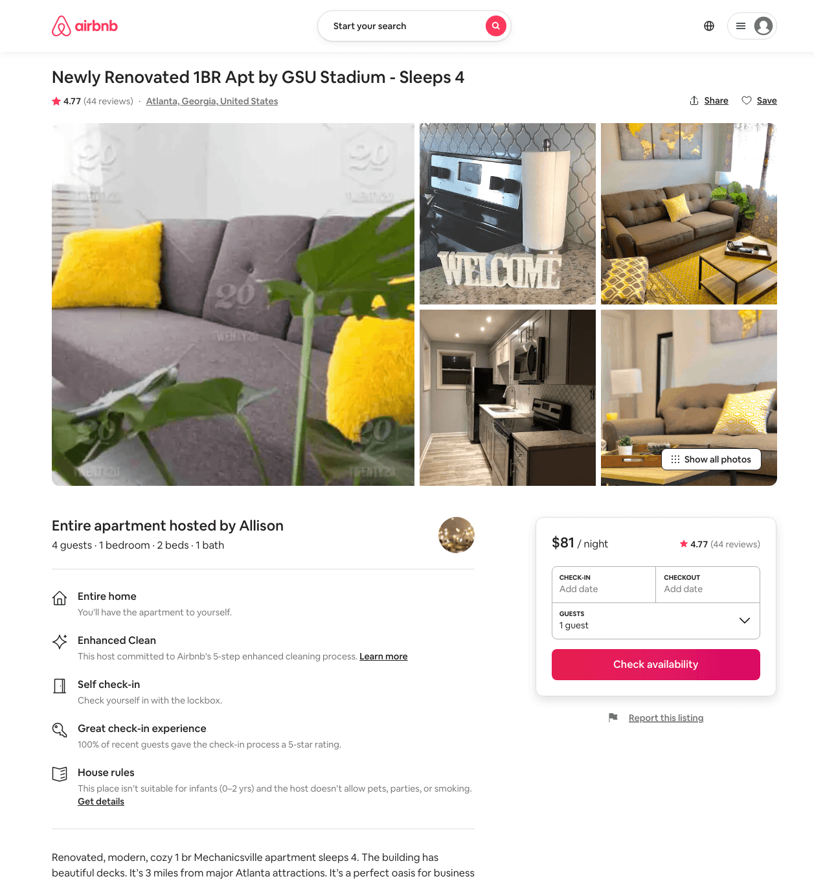
Listing 31893182
1
4
$76 - $104
4.70
2
Allison
239065618
3
https://www.airbnb.com/rooms/31893182
Aug 2022

Slide 32
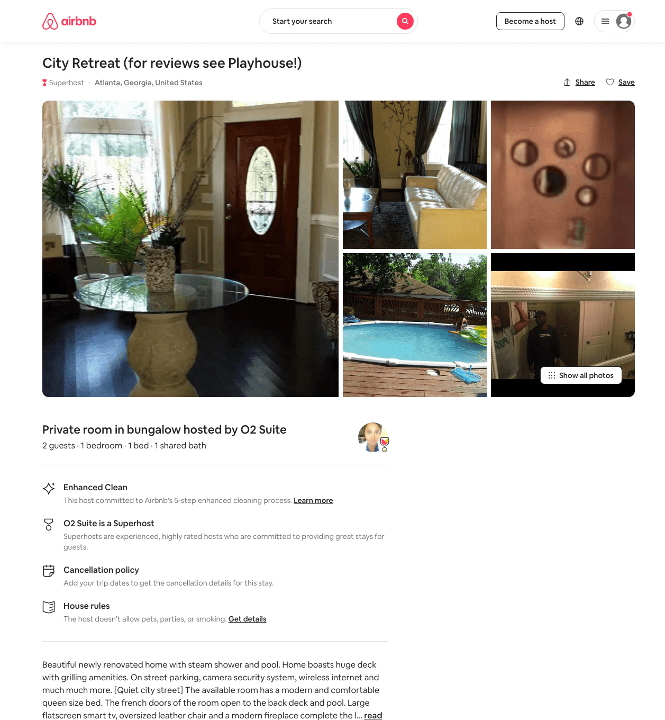
Listing 26941723
1
2
$55
1
O2 Suite
53857090
2
https://www.airbnb.com/rooms/26941723
Aug 2022

Slide 33
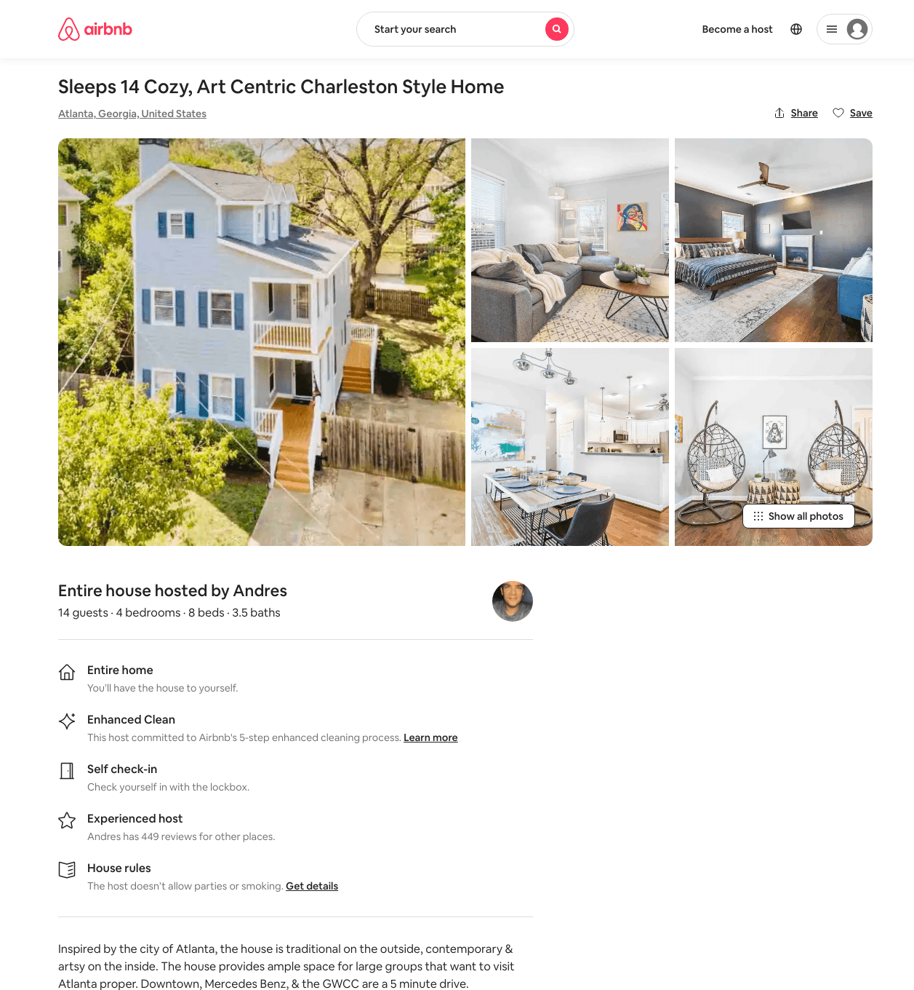
Listing 48901205
5
16
$263 - $603
4.68
1
Andres
14695069
8
https://www.airbnb.com/rooms/48901205
Jun 2022

Slide 34
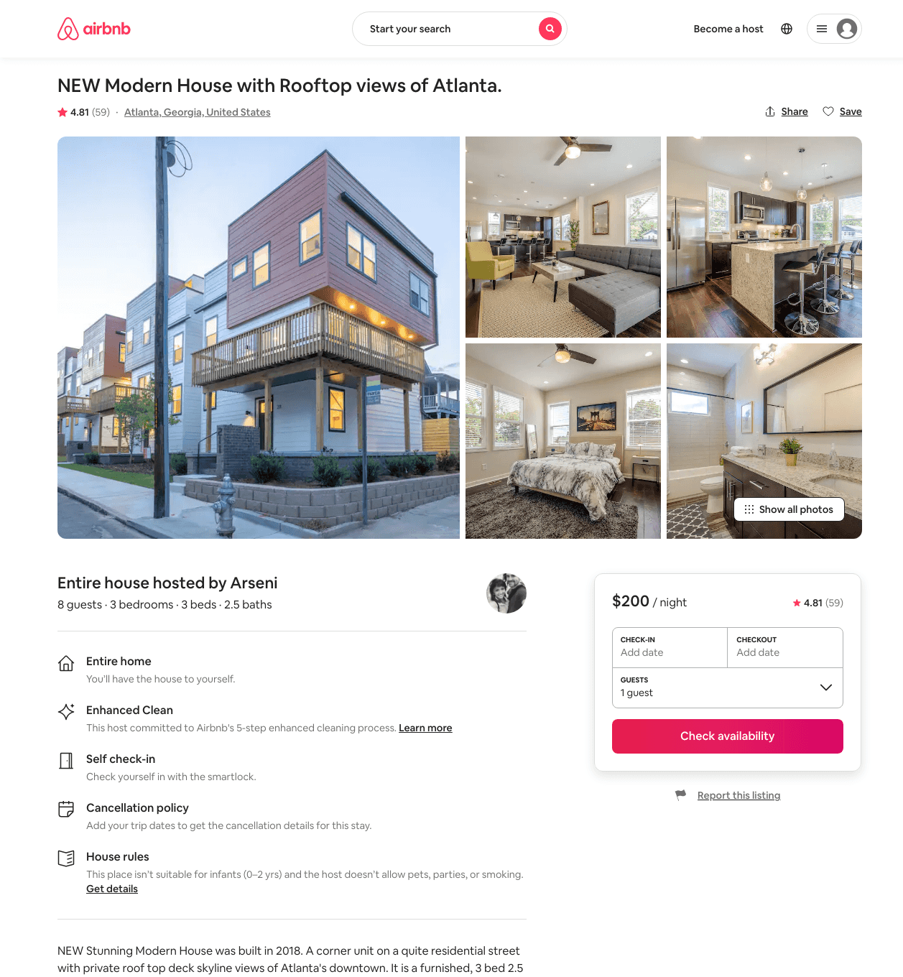
Listing 32738183
3
8
$180 - $250
4.80
3
Arseni
4487934
7
https://www.airbnb.com/rooms/32738183
Aug 2022

Slide 35
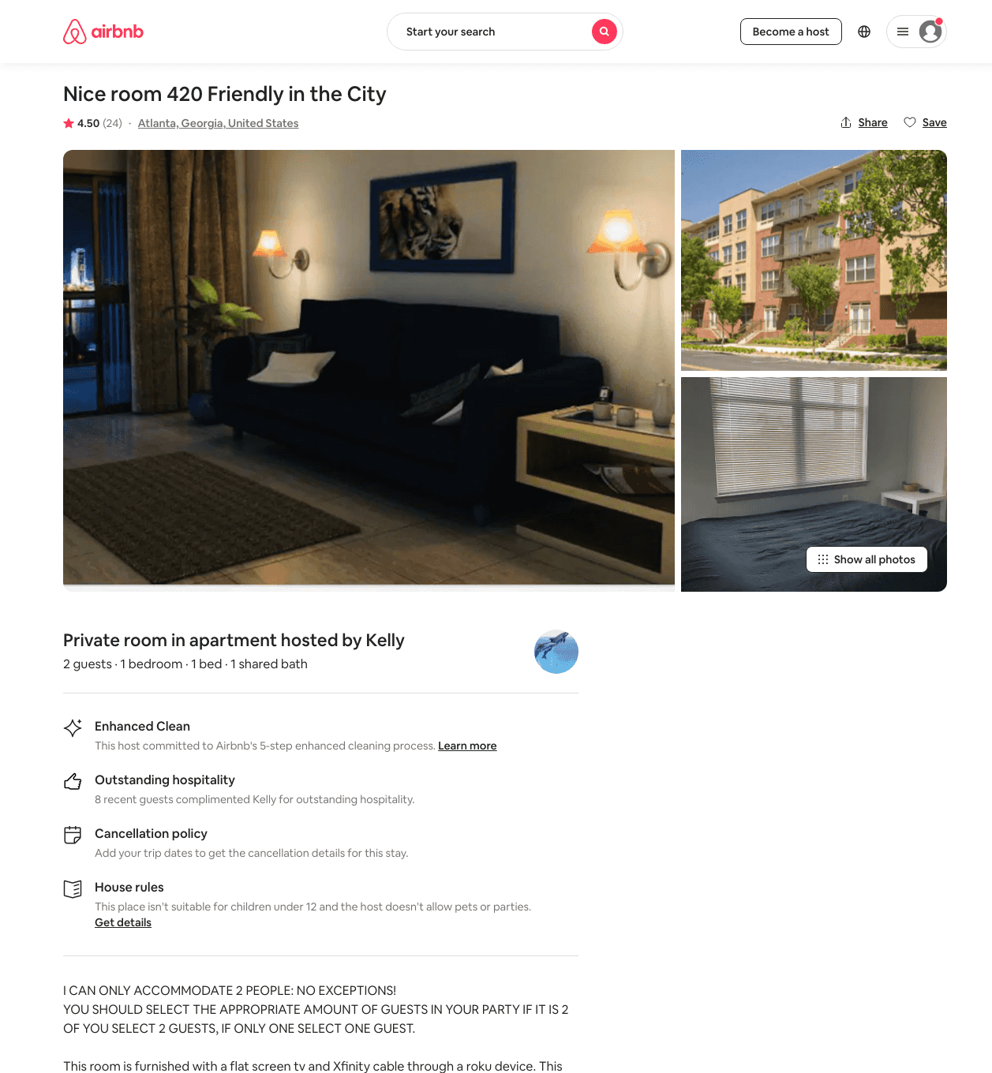
Listing 36277266
1
1
$35 - $45
4.58
28
Kelly
139330113
2
https://www.airbnb.com/rooms/36277266
Aug 2022

Slide 36
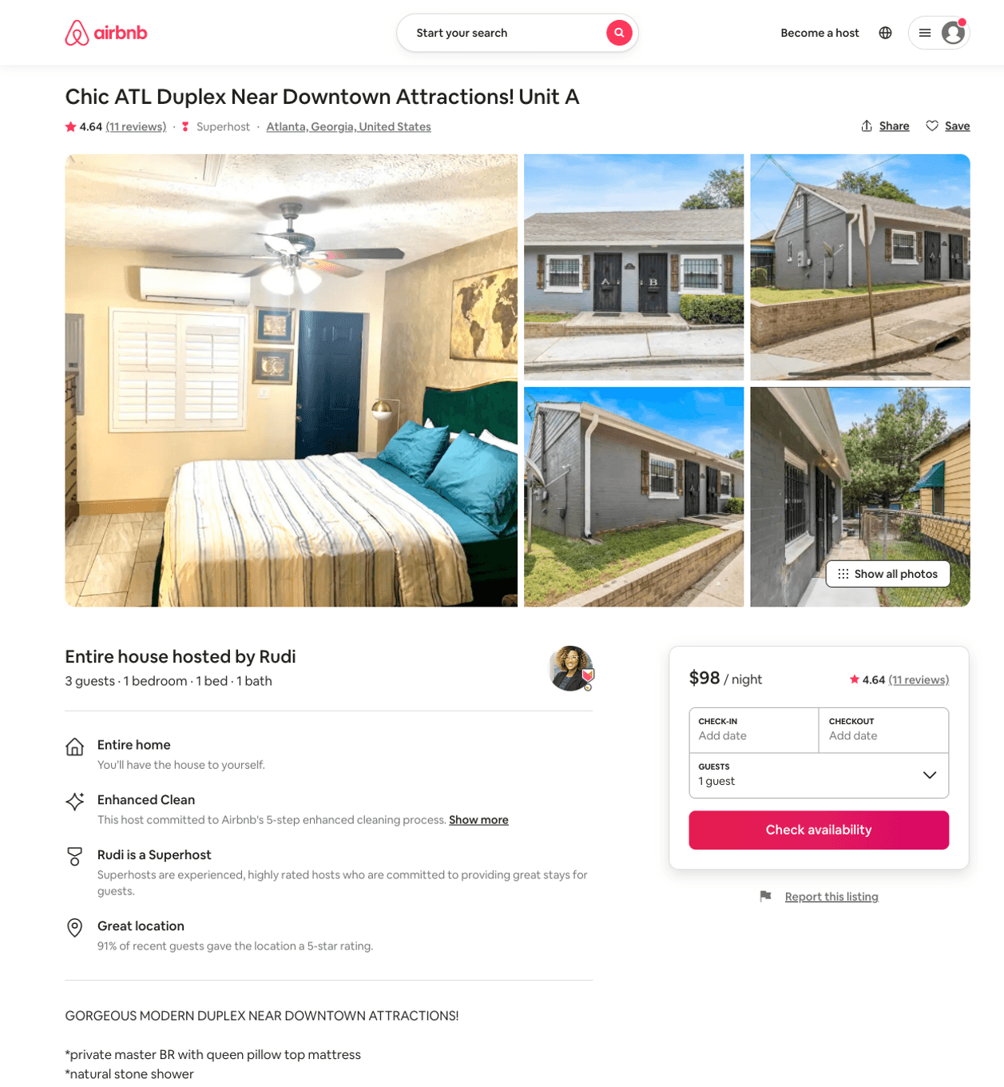
Listing 45179170
1
2
$68 - $106
4.77
2
Rudi
89220257
2
https://www.airbnb.com/rooms/45179170
Aug 2022

Slide 37
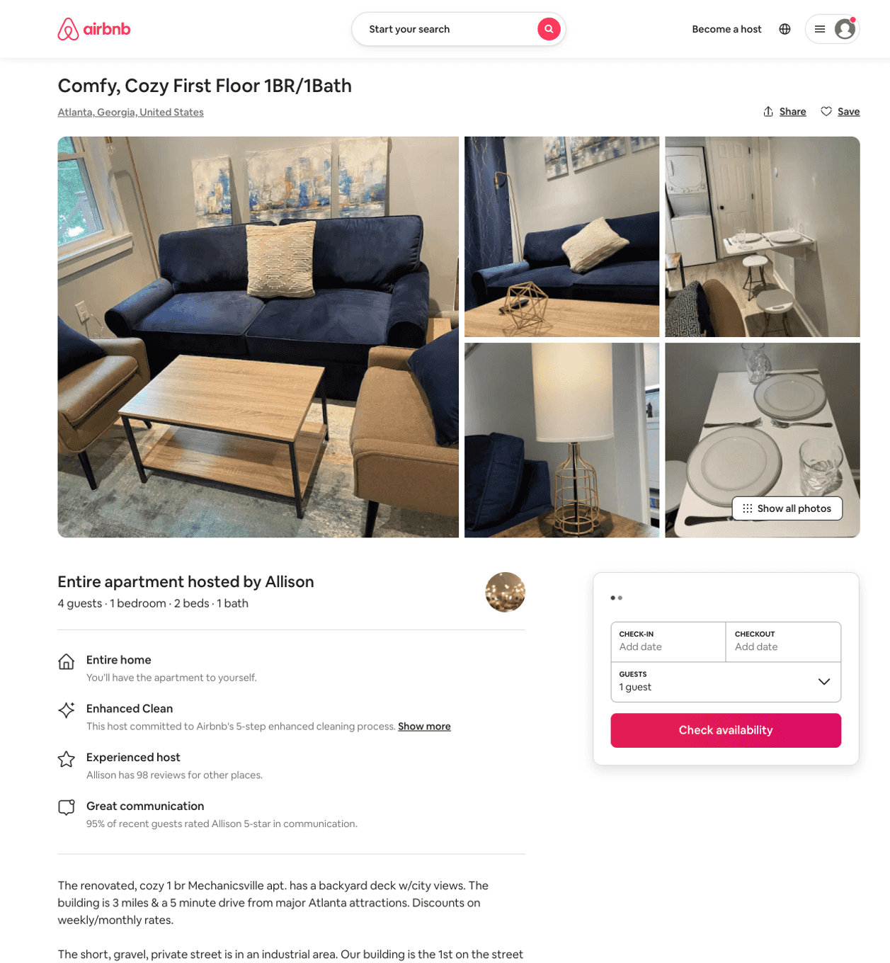
Listing 50706866
1
4
$83 - $102
4.86
2
Allison
239065618
3
https://www.airbnb.com/rooms/50706866
Aug 2022

Slide 38
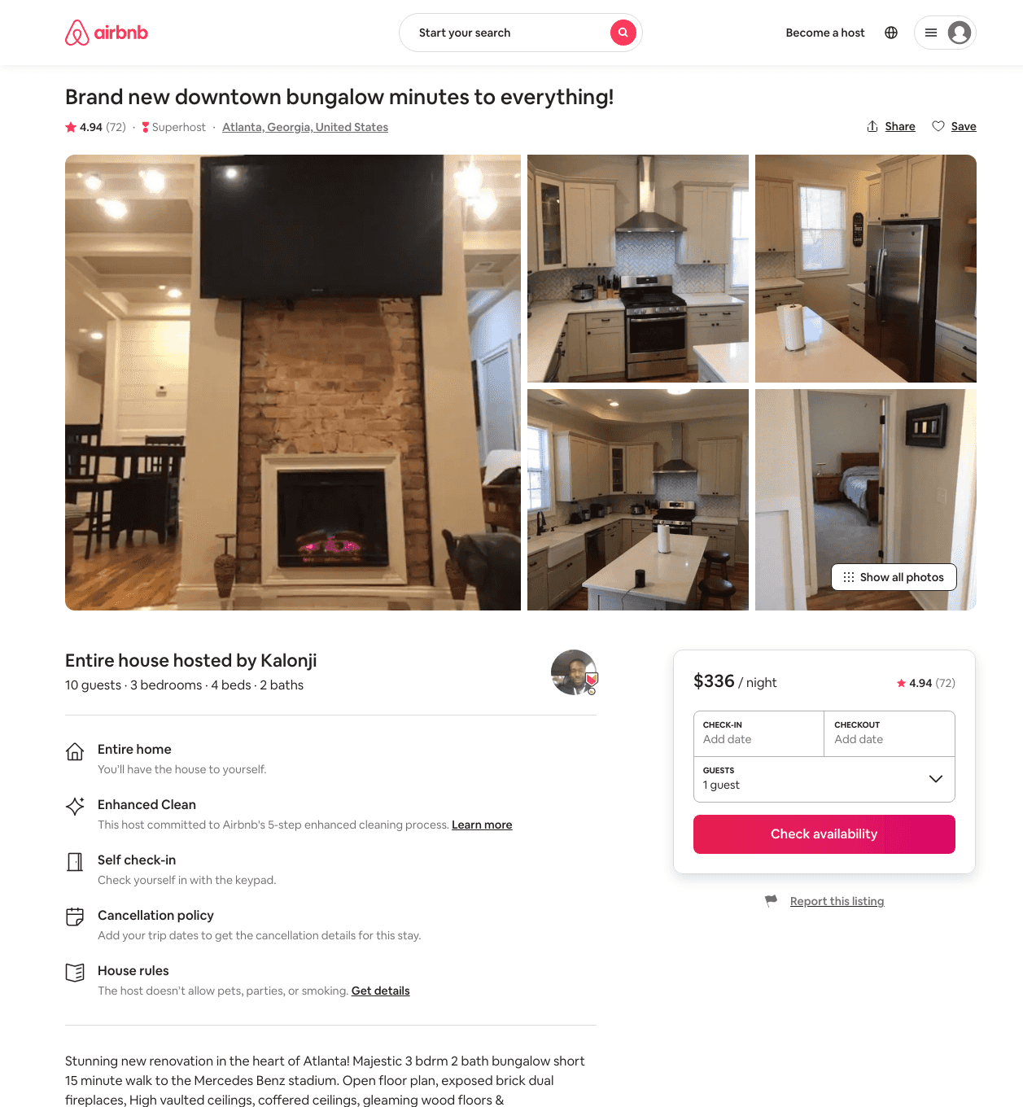
Listing 31900813
3
10
$182 - $536
4.92
2
Kalonji
239136949
1
https://www.airbnb.com/rooms/31900813
Jun 2022

Slide 39
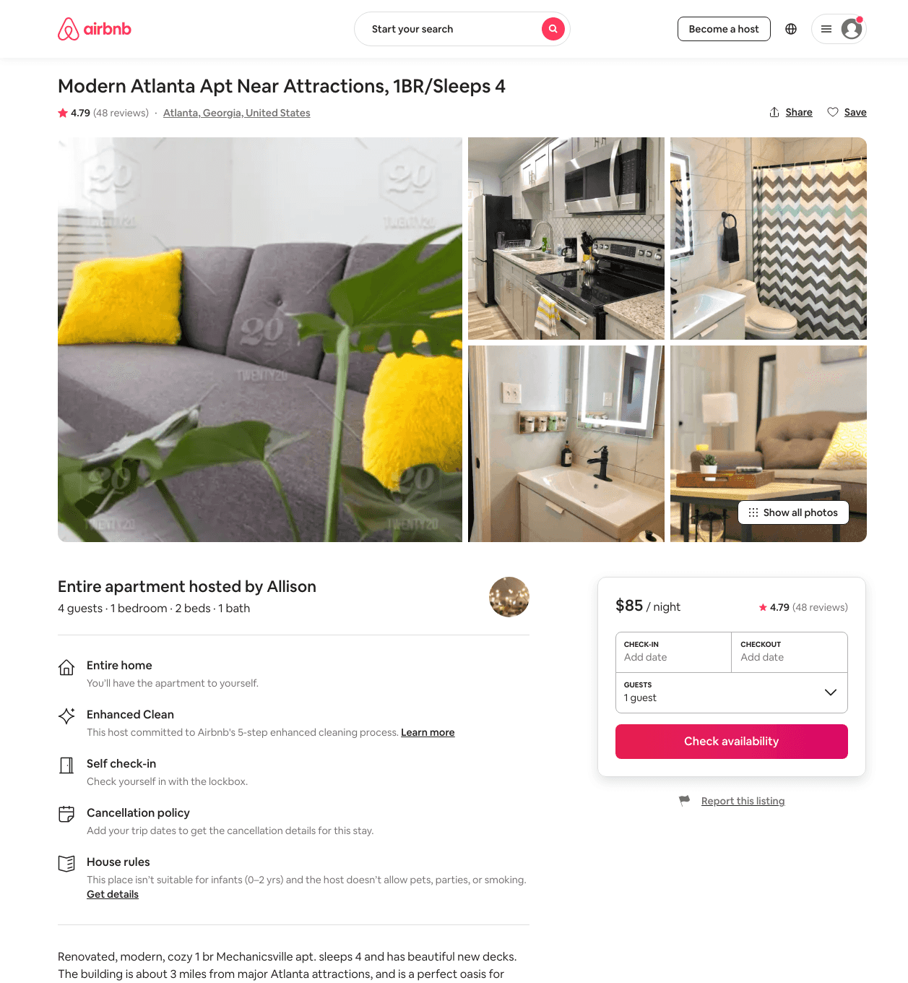
Listing 31894231
1
4
$79 - $123
4.74
2
Allison
239065618
3
https://www.airbnb.com/rooms/31894231
Aug 2022

Slide 40
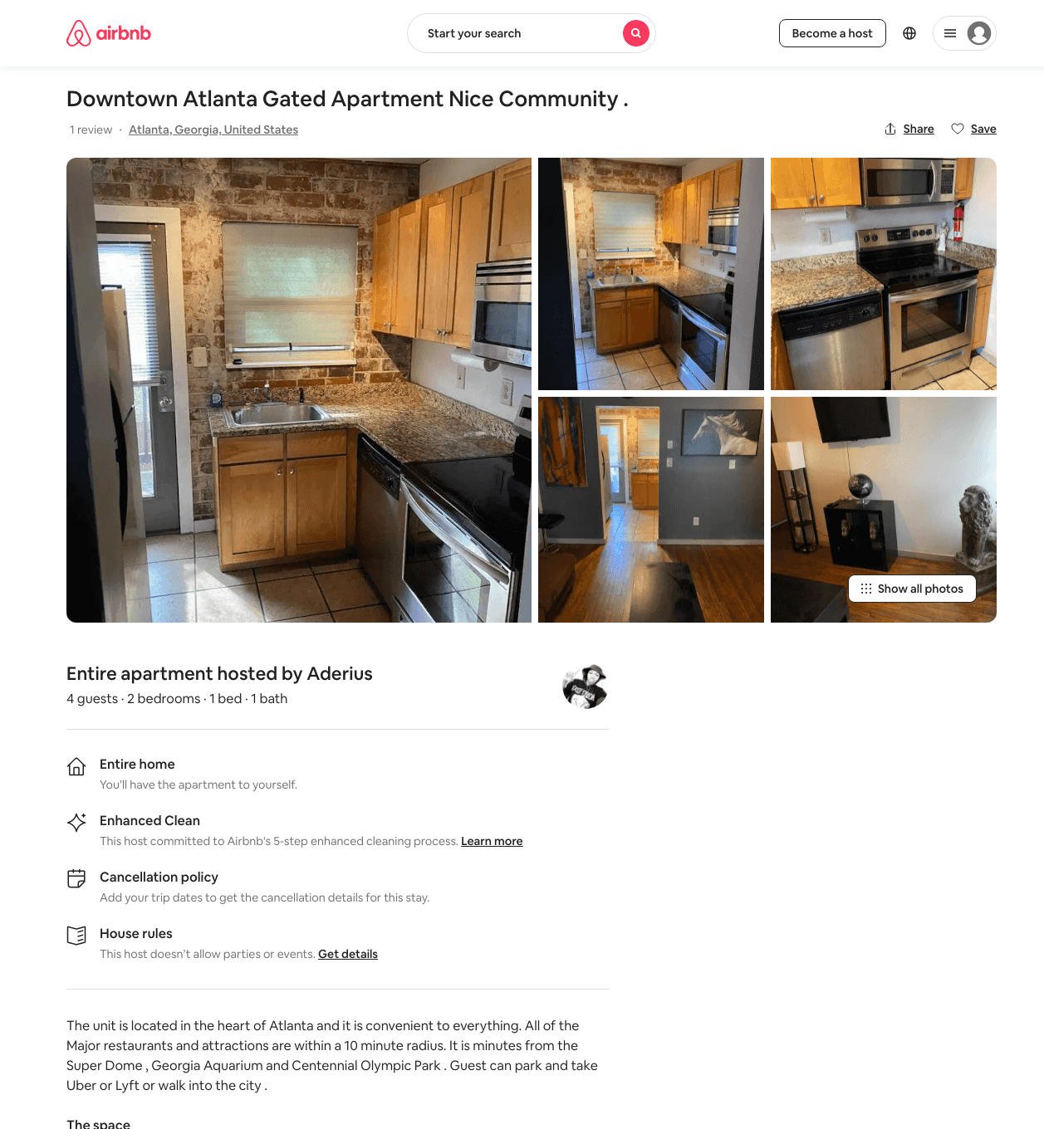
Listing 48561754
2
5
$80 - $95
4.45
1
Aderius
73326733
1
https://www.airbnb.com/rooms/48561754
Aug 2022

Slide 41
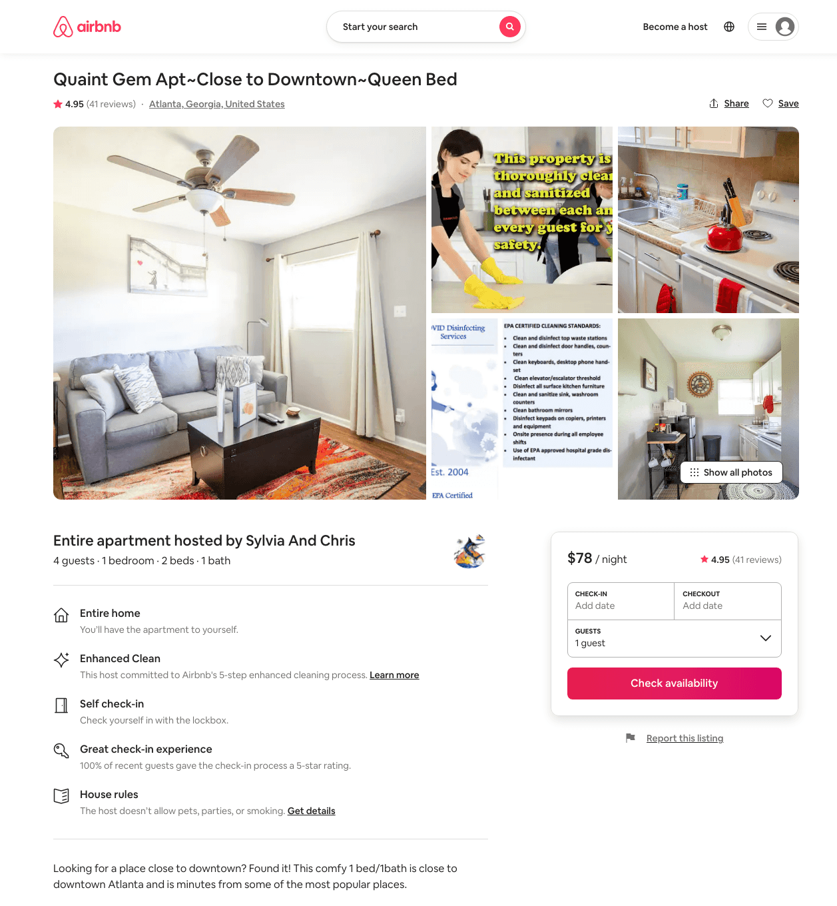
Listing 31523264
1
4
$78 - $101
4.95
2
Sylvia And Chris
143997218
4
https://www.airbnb.com/rooms/31523264
Aug 2022

Slide 42
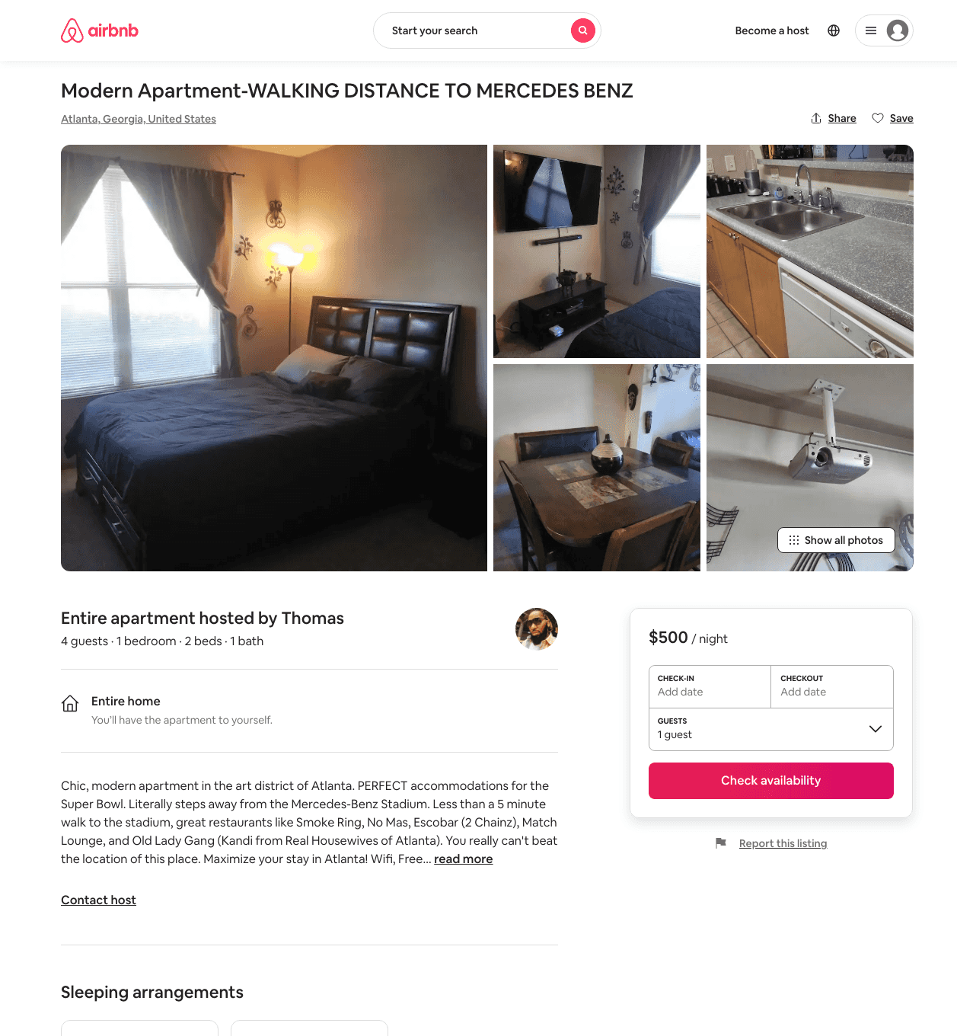
Listing 31495465
1
4
$500
2
Thomas
183719308
1
https://www.airbnb.com/rooms/31495465
Aug 2022

Slide 43
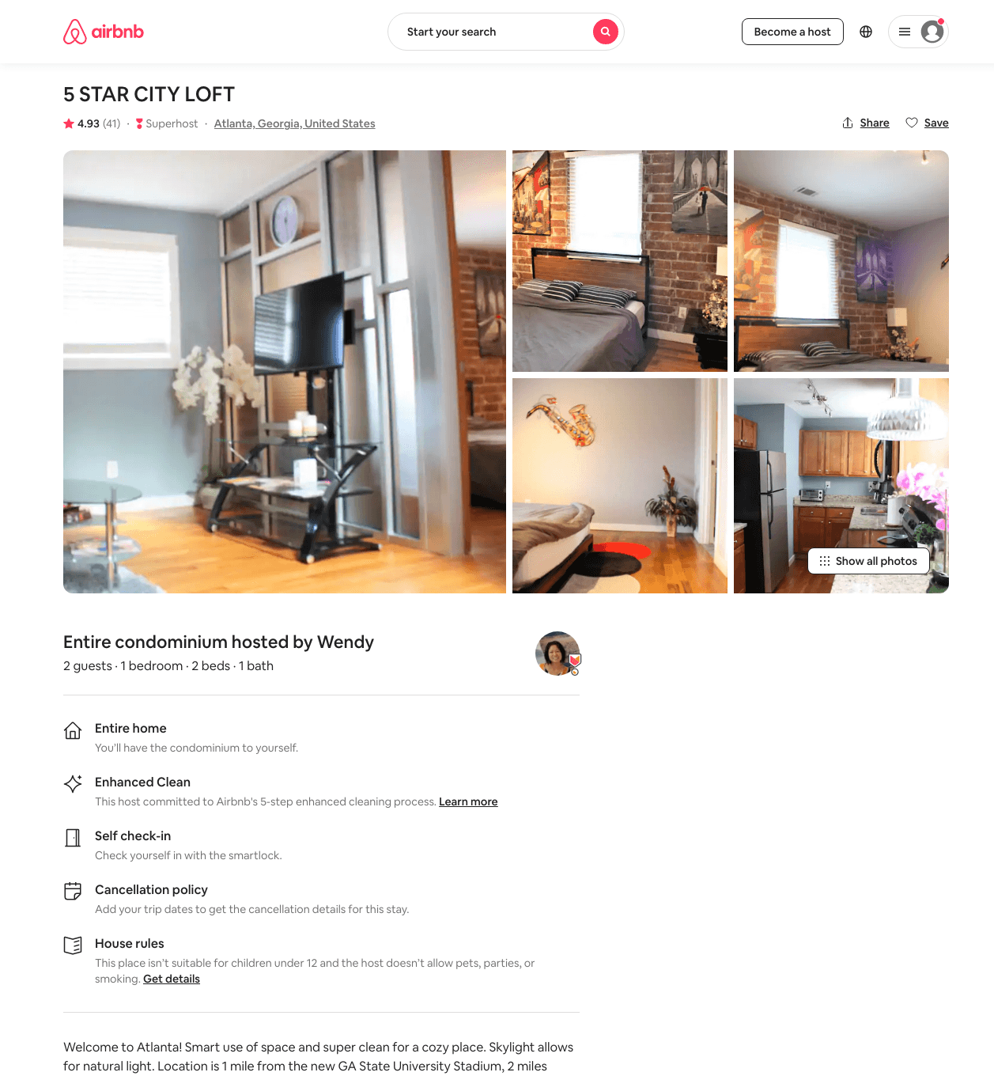
Listing 39303763
1
2
$67 - $308
4.87
2
Wendy
301761999
1
https://www.airbnb.com/rooms/39303763
Aug 2022

Slide 44
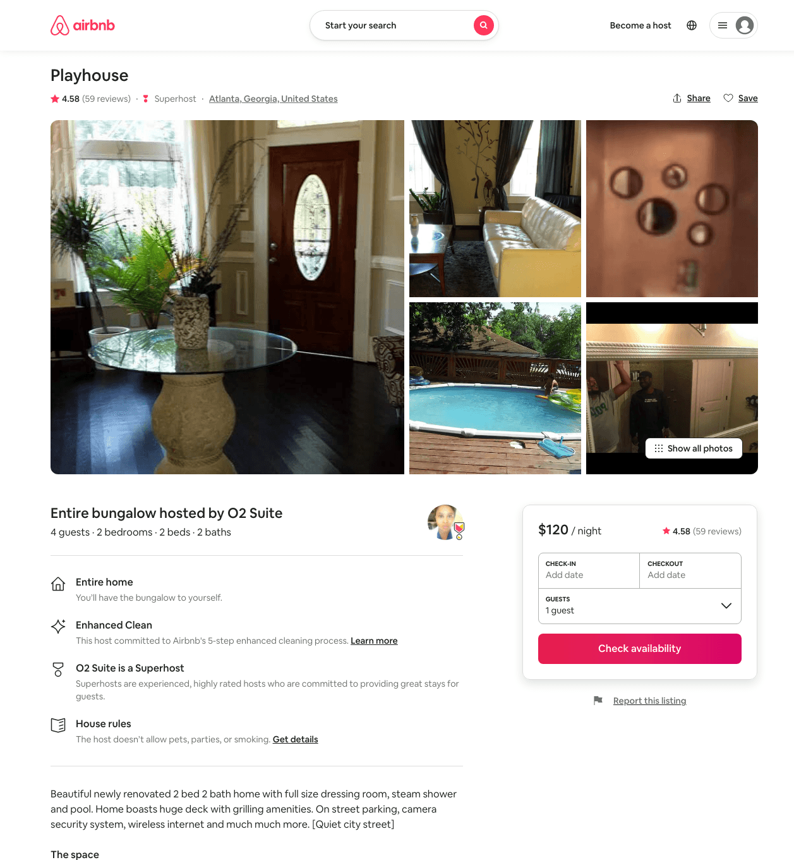
Listing 10453390
2
4
$120
4.58
1
O2 Suite
53857090
2
https://www.airbnb.com/rooms/10453390
Aug 2022

Slide 45
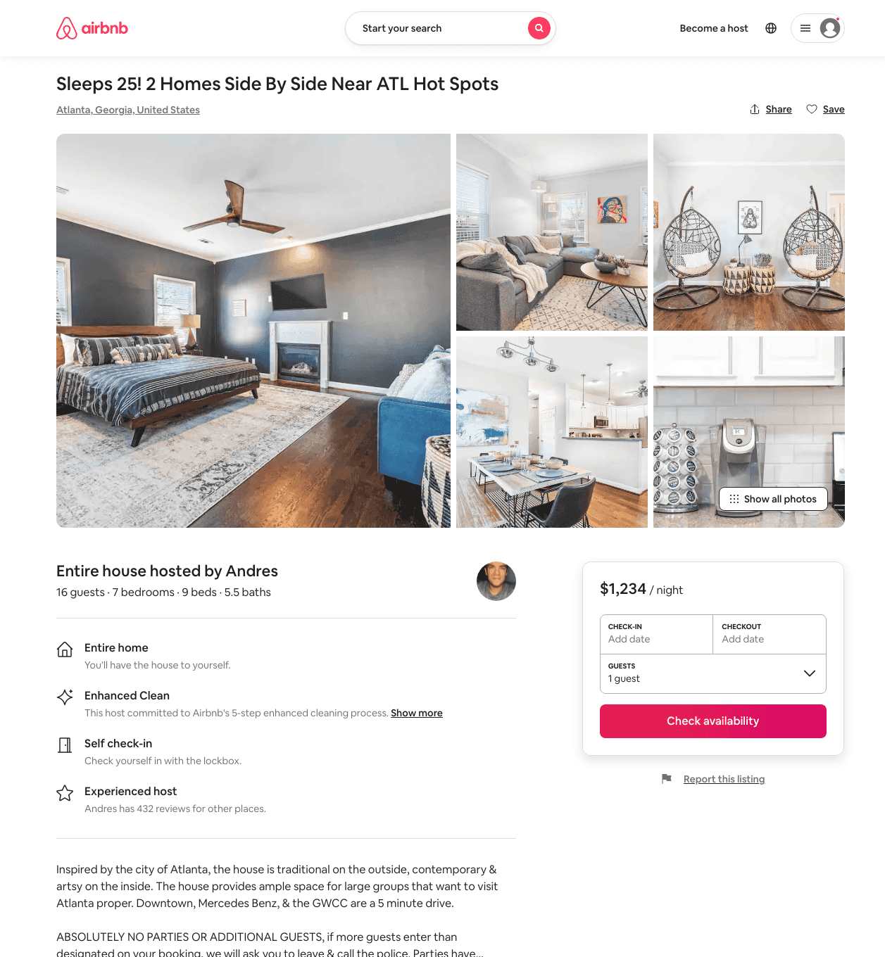
Listing 50158062
9
16
$890 - $1543
1
Andres
14695069
8
https://www.airbnb.com/rooms/50158062
Aug 2022

Slide 46
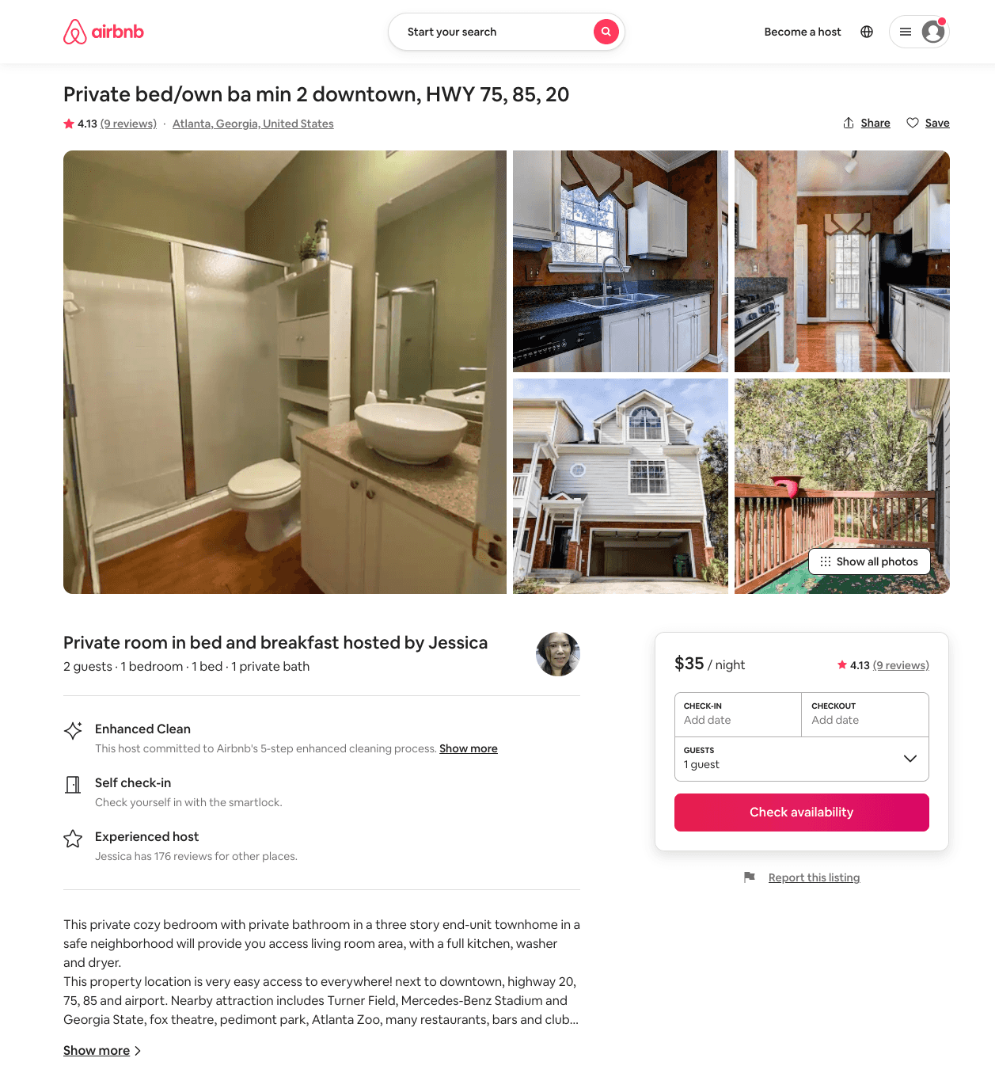
Listing 23148793
1
2
$33 - $38
4.0
31
Jessica
5650180
5
https://www.airbnb.com/rooms/23148793
Jun 2022

Slide 47
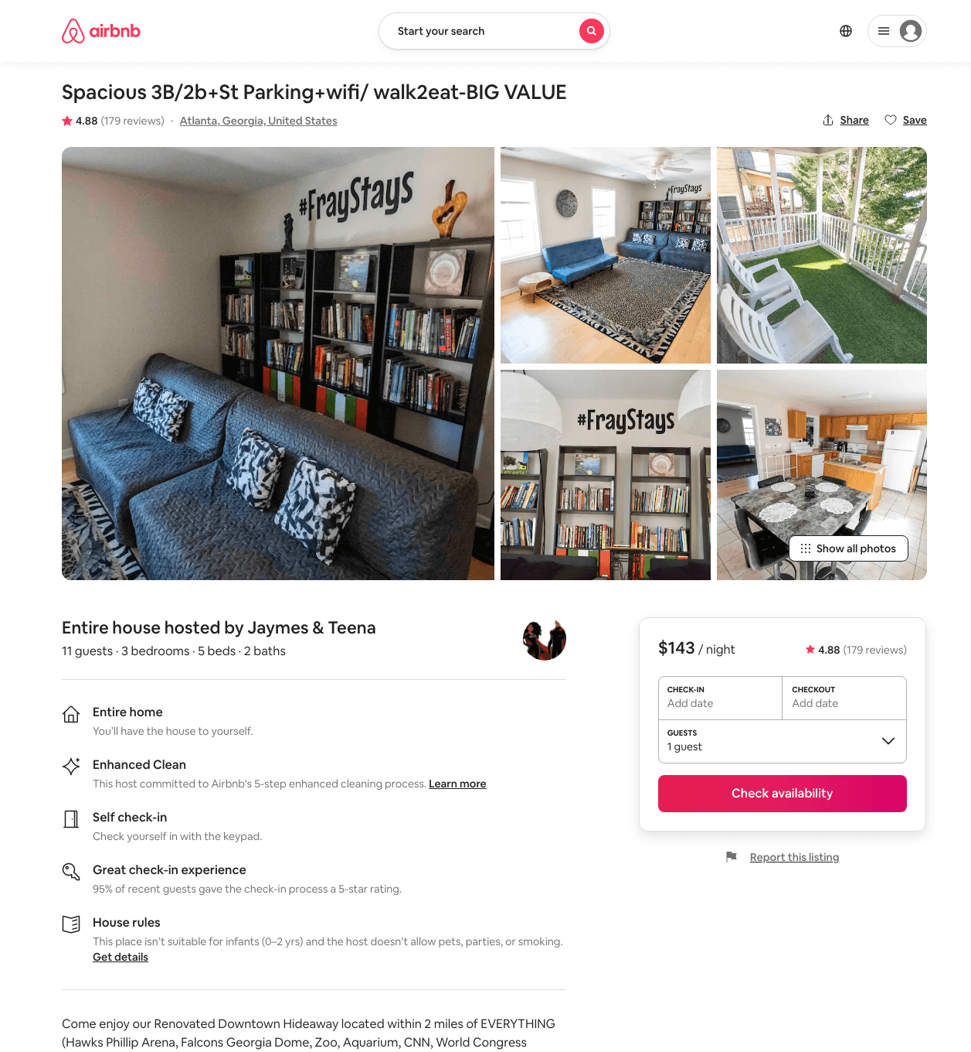
Listing 15253076
3
11
$124 - $203
4.86
1
Jaymes & Teena
95350764
3
https://www.airbnb.com/rooms/15253076
Aug 2022

Slide 48
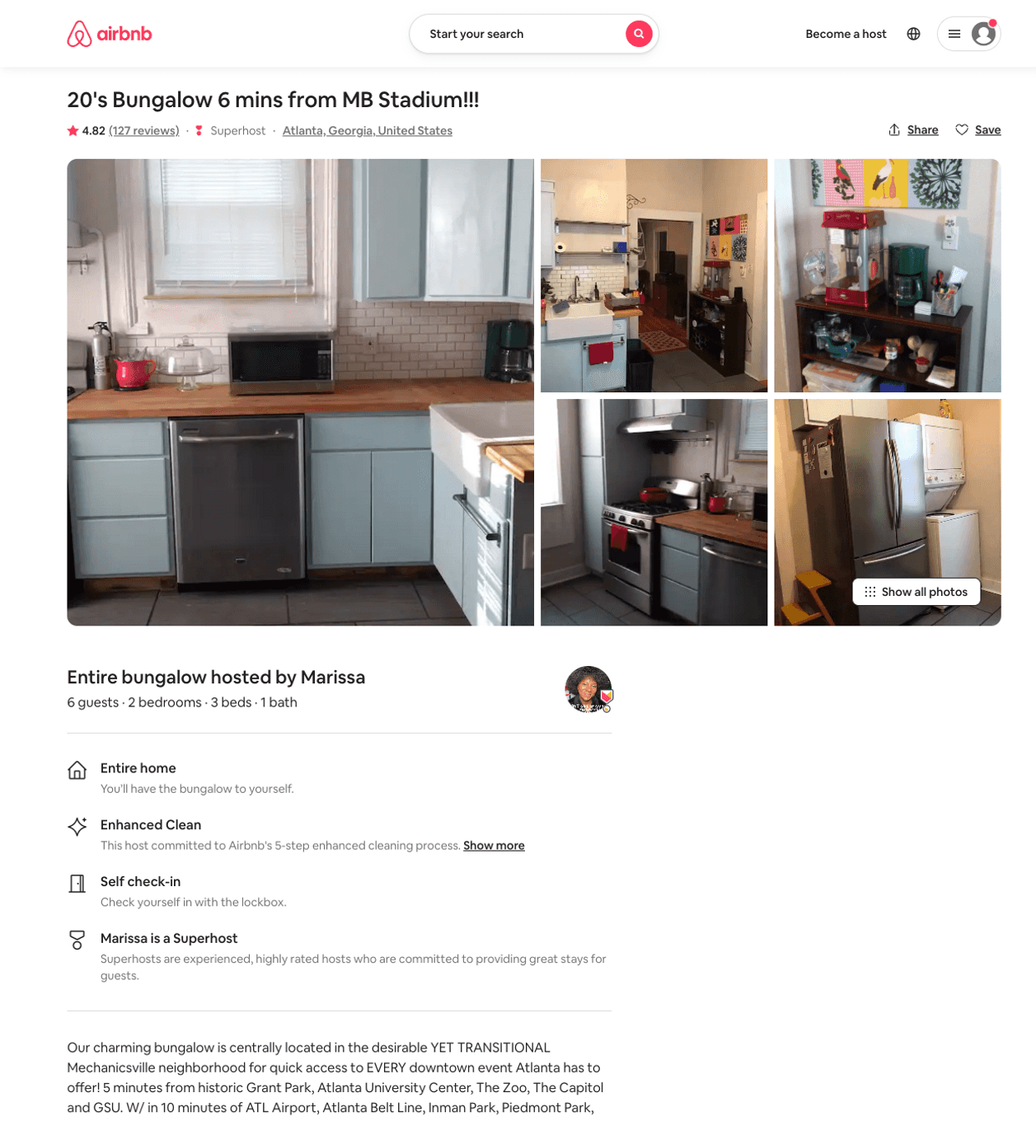
Listing 13380046
2
6
$87 - $113
4.82
2
Marissa
13102503
1
https://www.airbnb.com/rooms/13380046
Aug 2022

Slide 49
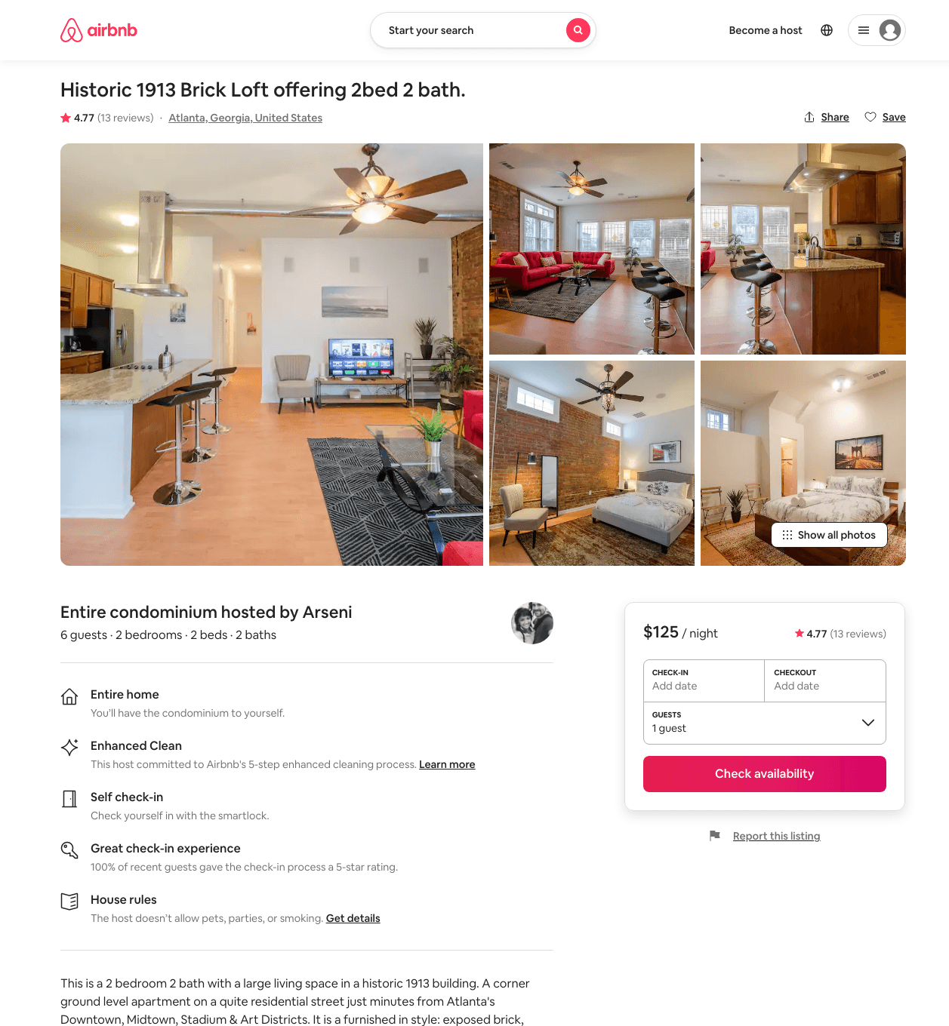
Listing 37527964
2
7
$92 - $146
4.85
3
Arseni
4487934
7
https://www.airbnb.com/rooms/37527964
Aug 2022

Slide 50
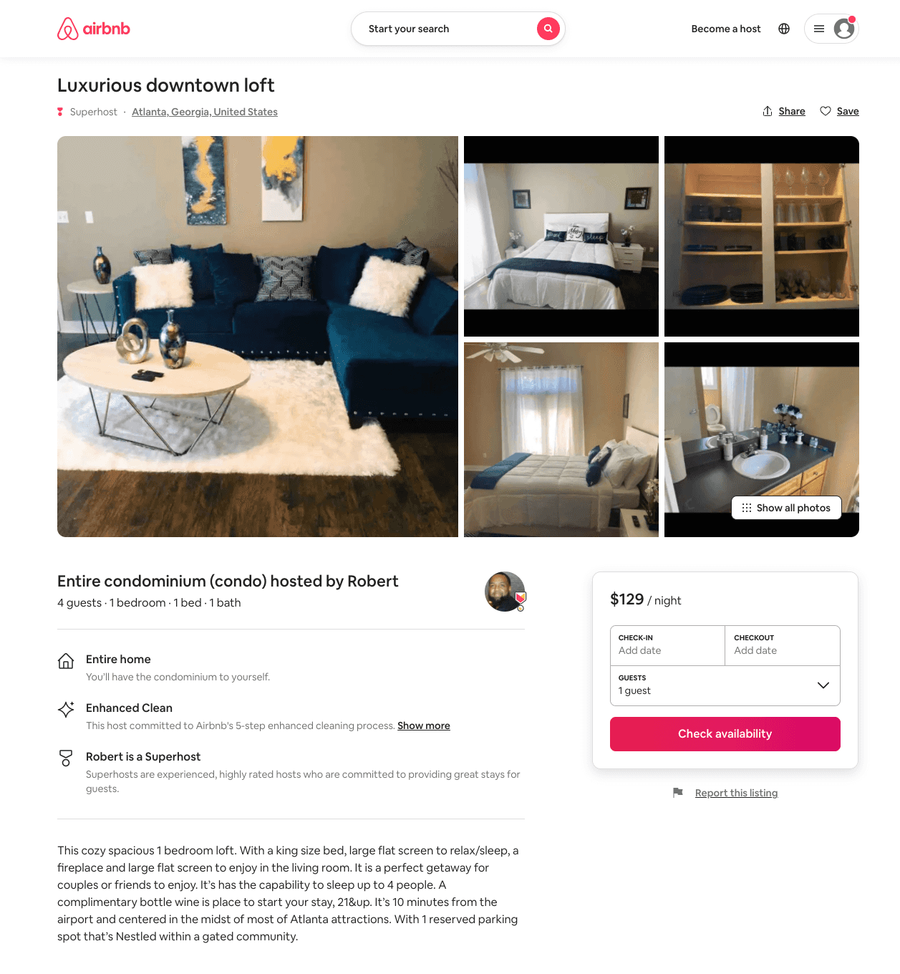
Listing 51217862
1
5
$89 - $143
5.0
2
Robert
375629442
2
https://www.airbnb.com/rooms/51217862
Aug 2022

Slide 51
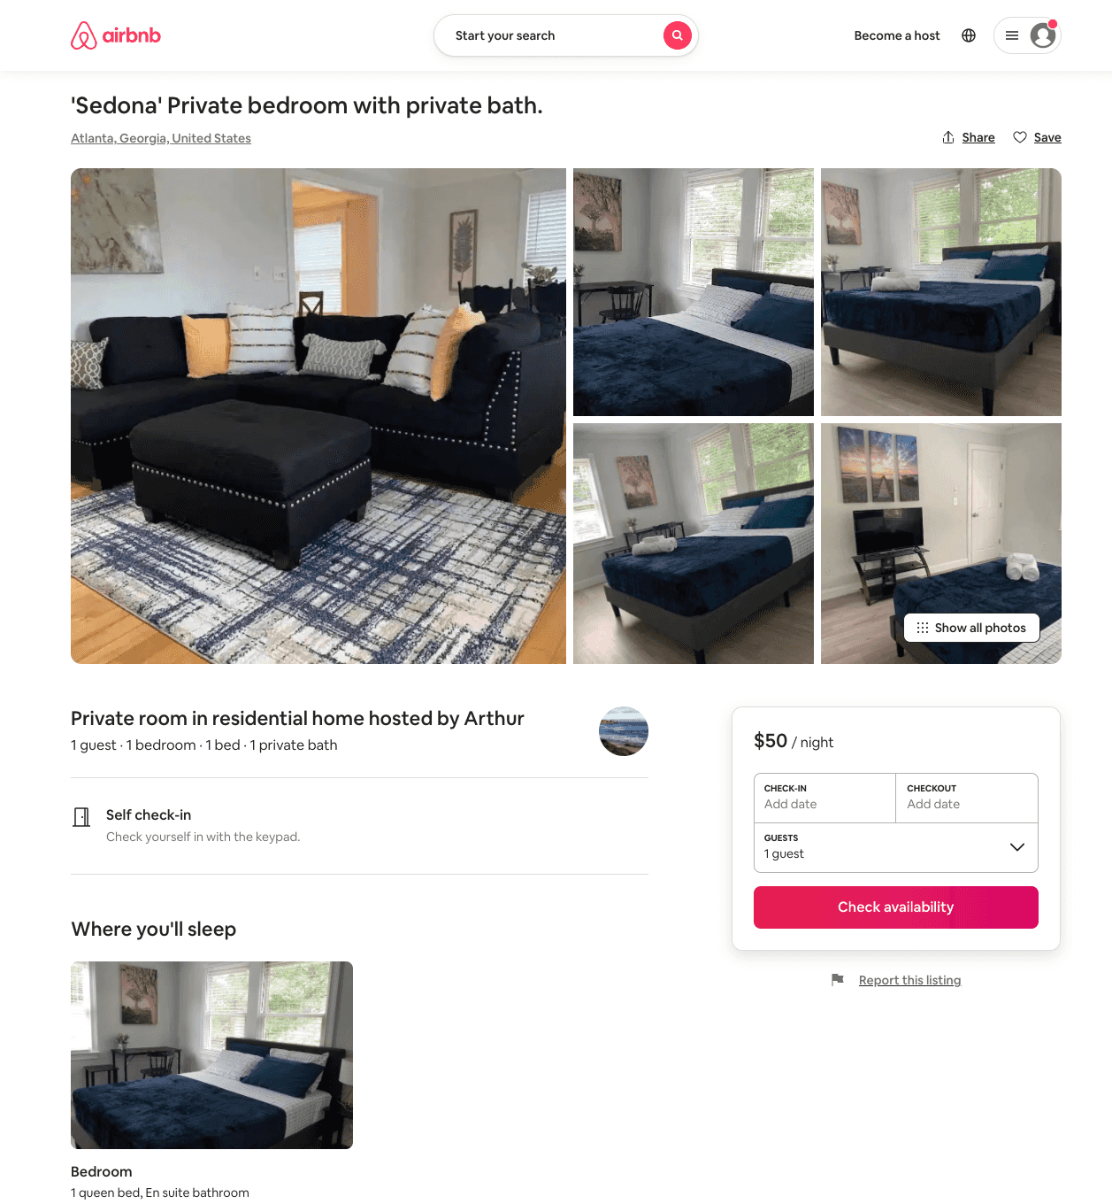
Listing 51312240
1
2
$43 - $62
5.0
1
Anna
292767528
16
https://www.airbnb.com/rooms/51312240
Jun 2022

Slide 52
Listing 51290395
3
10
$174 - $243
4.89
1
Christian
414973621
1
https://www.airbnb.com/rooms/51290395
Aug 2022

Slide 53
Listing 31601812
2
7
$750
2
Keenan
49443591
1
https://www.airbnb.com/rooms/31601812
Aug 2022

Slide 54
Listing 51584605
2
6
$64 - $425
4.08
2
Energy
27366766
1
https://www.airbnb.com/rooms/51584605
Jun 2022

Slide 55
Listing 44302677
1
2
$92 - $102
4.80
2
Rudi
89220257
2
https://www.airbnb.com/rooms/44302677
Aug 2022

Slide 56
Listing 52014493
1
2
$54 - $69
4.82
1
Anna
292767528
16
https://www.airbnb.com/rooms/52014493
Jul 2022

Slide 57
Listing 48009272
3
7
$82 - $117
4.46
1
Yannet
23272410
1
https://www.airbnb.com/rooms/48009272
Aug 2022

Slide 58
Listing 41064405
2
4
$80 - $254
4.78
2
Sequoia
173717897
1
https://www.airbnb.com/rooms/41064405
Jun 2022

Slide 59
Listing 52131340
2
4
$135 - $163
4.31
2
Olajide
422060018
1
https://www.airbnb.com/rooms/52131340
Aug 2022

Slide 60
Listing 52452371
2
3
$61 - $103
4.90
1
Israel
149373305
1
https://www.airbnb.com/rooms/52452371
Aug 2022

Slide 61
Listing 52317030
4
15
$180 - $441
4.80
1
Andres
14695069
8
https://www.airbnb.com/rooms/52317030
Aug 2022

Slide 62
Listing 2186450
2
6
$199 - $205
5
1
TONY GARLAND
https://www.vrbo.com/2186450
Aug 2022

Slide 63
Listing 53376393
3
7
$163 - $221
4.68
2
Loop12
432164438
1
https://www.airbnb.com/rooms/53376393
Aug 2022

Slide 64
Listing 52515090
1
3
$101 - $126
5.0
2
Melissa
334758525
1
https://www.airbnb.com/rooms/52515090
Aug 2022

Slide 65
Listing 53264454
2
4
$175
4.80
1
Keith
333398358
1
https://www.airbnb.com/rooms/53264454
Jun 2022

Slide 66
Listing 53964750
2
4
$63 - $69
4.60
2
Lauren
132056933
15
https://www.airbnb.com/rooms/53964750
Jul 2022

Slide 67
Listing 2570770
2
4
$150
31
https://www.vrbo.com/2570770
Aug 2022

Slide 68
Listing 1179406
1
4
$1,000
3.6666667
30
owner/property owner
https://www.vrbo.com/1179406
Aug 2022

Slide 69
Listing 2533302
3
6
$95
3.8333333
1
Yannet Tekie
https://www.vrbo.com/2533302
Aug 2022

Slide 70
Listing lovely-new-apartment-in-downtown-atl-atlanta
undefined
4
9
https://www.booking.com/hotel/us/lovely-new-apartment-in-downtown-atl-atlanta.html
Sep 2022

Slide 71
Listing cool-and-comfy-apartment-in-mechanicsville-atlanta
undefined
4
8.8
https://www.booking.com/hotel/us/cool-and-comfy-apartment-in-mechanicsville-atlanta.html
Sep 2022

Slide 72
Listing your-serene-green-villa
undefined
7
9.9
https://www.booking.com/hotel/us/your-serene-green-villa.html
Sep 2022

Slide 73
Listing 2680427
2
7
$89
3
Senya
https://www.vrbo.com/2680427
Aug 2022

Slide 74
Listing 52031080
1
4
$49 - $63
4.86
1
Terence
85211395
1
https://www.airbnb.com/rooms/52031080
Jun 2022

Slide 75
Listing 2739220
2
5
$200
2
Host
https://www.vrbo.com/2739220
Aug 2022

Slide 76
Listing 52031327
3
7
$350 - $400
3
Toya
247786543
1
https://www.airbnb.com/rooms/52031327
Aug 2022

Slide 77
Listing 2780208
3
10
$204
5
3
Shalondra Moody
https://www.vrbo.com/2780208
Aug 2022

Slide 78
Listing 2817117
1
4
$81
1
Sapirbnb LLC
https://www.vrbo.com/2817117
Aug 2022

Slide 79
Listing 25740763
1
4
$135
3
Brandon
12672900
1
https://www.airbnb.com/rooms/25740763
Jun 2022

Slide 80
Listing 2732077
3
8
$400
3
Toya
https://www.vrbo.com/2732077
Aug 2022

Slide 81
Listing 44583571
3
8
$150
4.57
2
TurnKey Vacation Rentals
266122732
2
https://www.airbnb.com/rooms/44583571
Jun 2022

Slide 82
Listing 2859271
2
6
$110
2
Sapirbnb LLC
https://www.vrbo.com/2859271
Aug 2022

