Slide 2
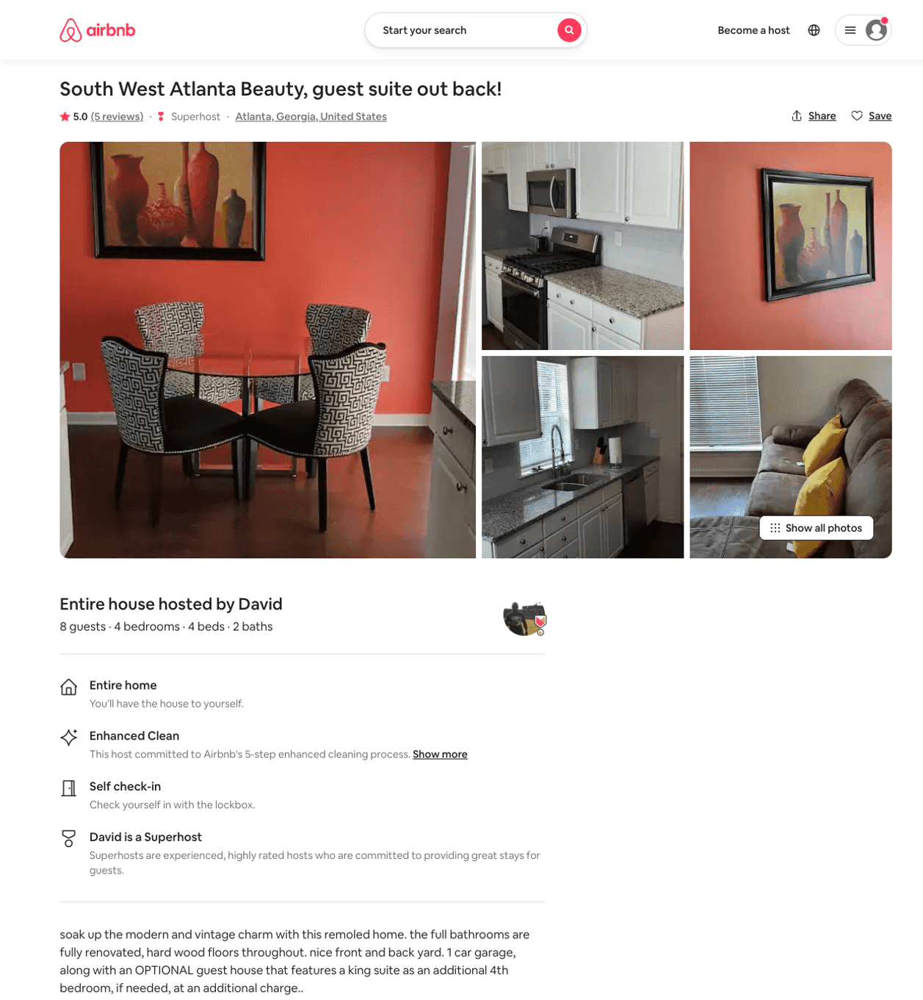
Listing 44802496
4
8
$185 - $500
4.88
2
David
132450261
1
https://www.airbnb.com/rooms/44802496
Aug 2022

Slide 3
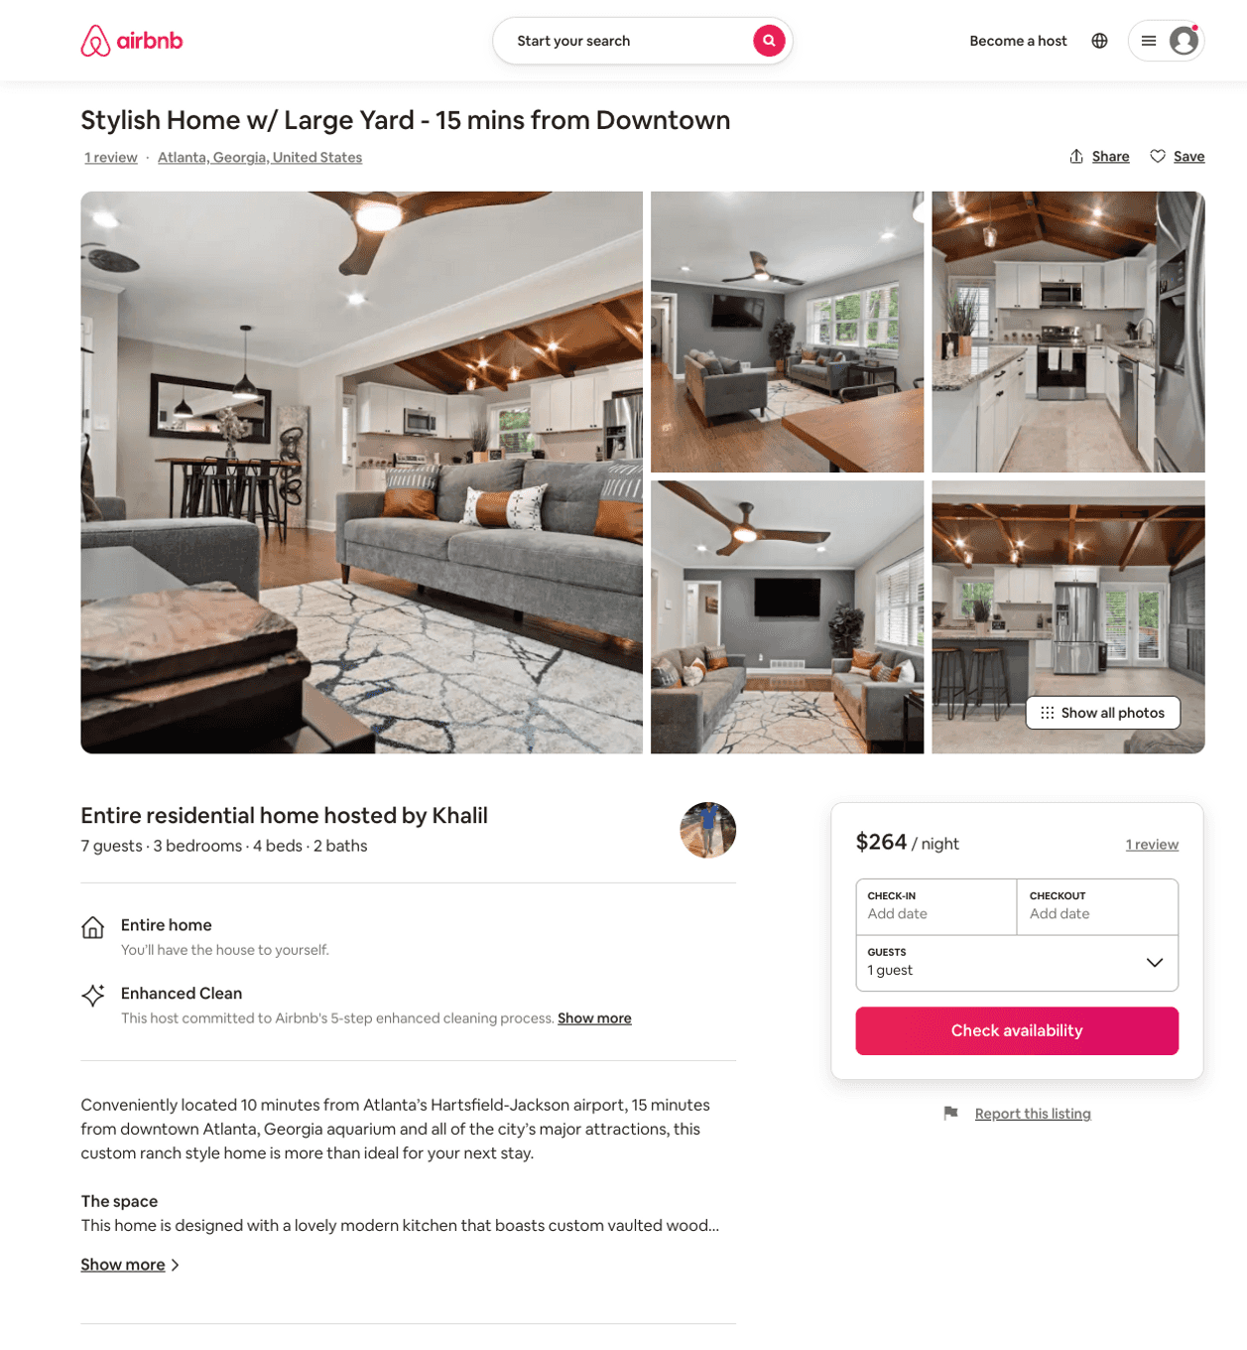
Listing 51347178
3
7
$144 - $293
4.84
2
Khalil
415859948
1
https://www.airbnb.com/rooms/51347178
Aug 2022

