Slide 2
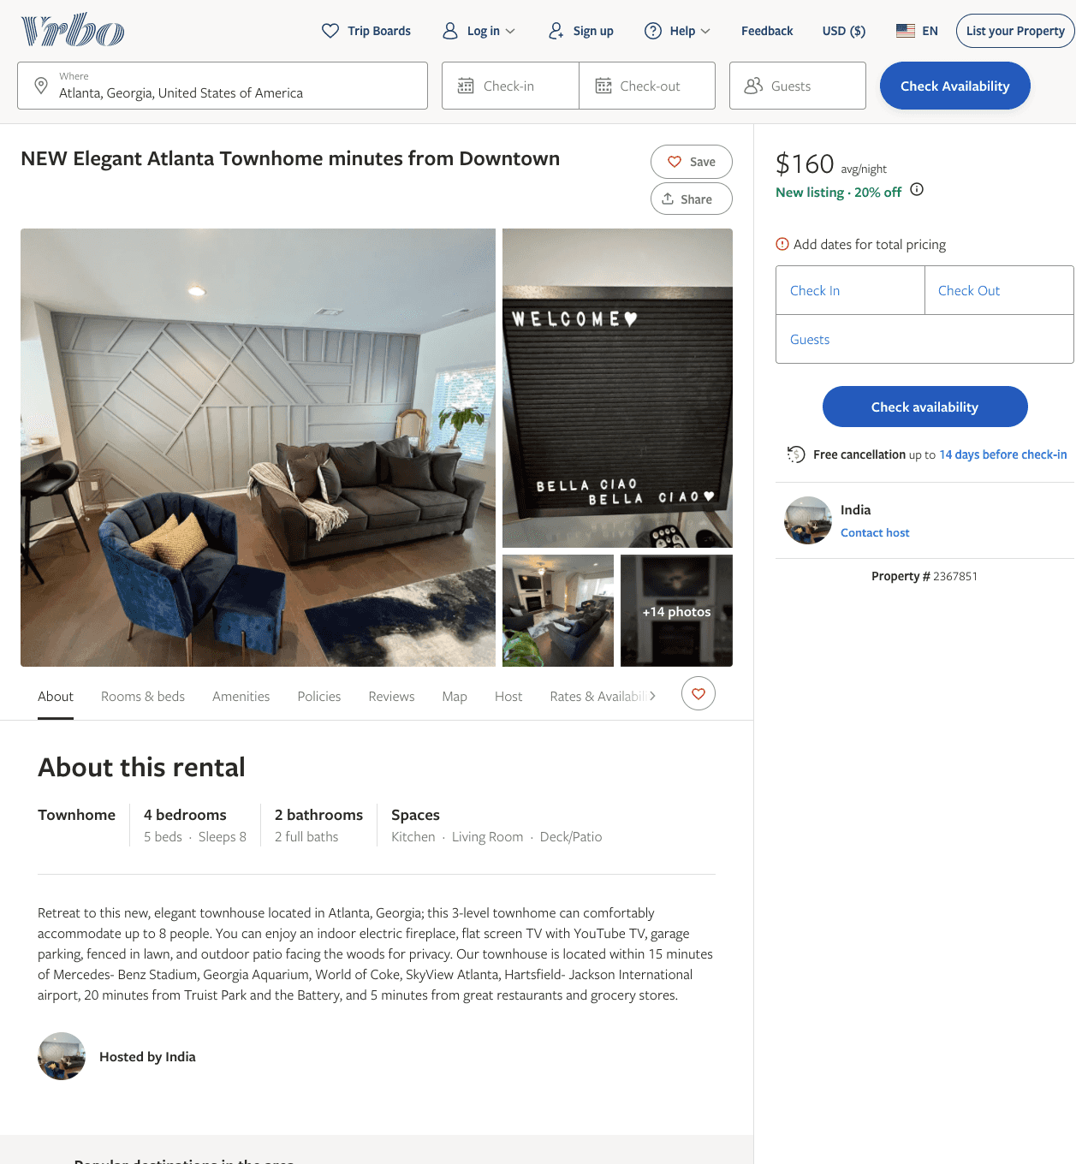
Listing 2367851
4
8
$160 - $267
5
2
India
https://www.vrbo.com/2367851
Aug 2022

Slide 3
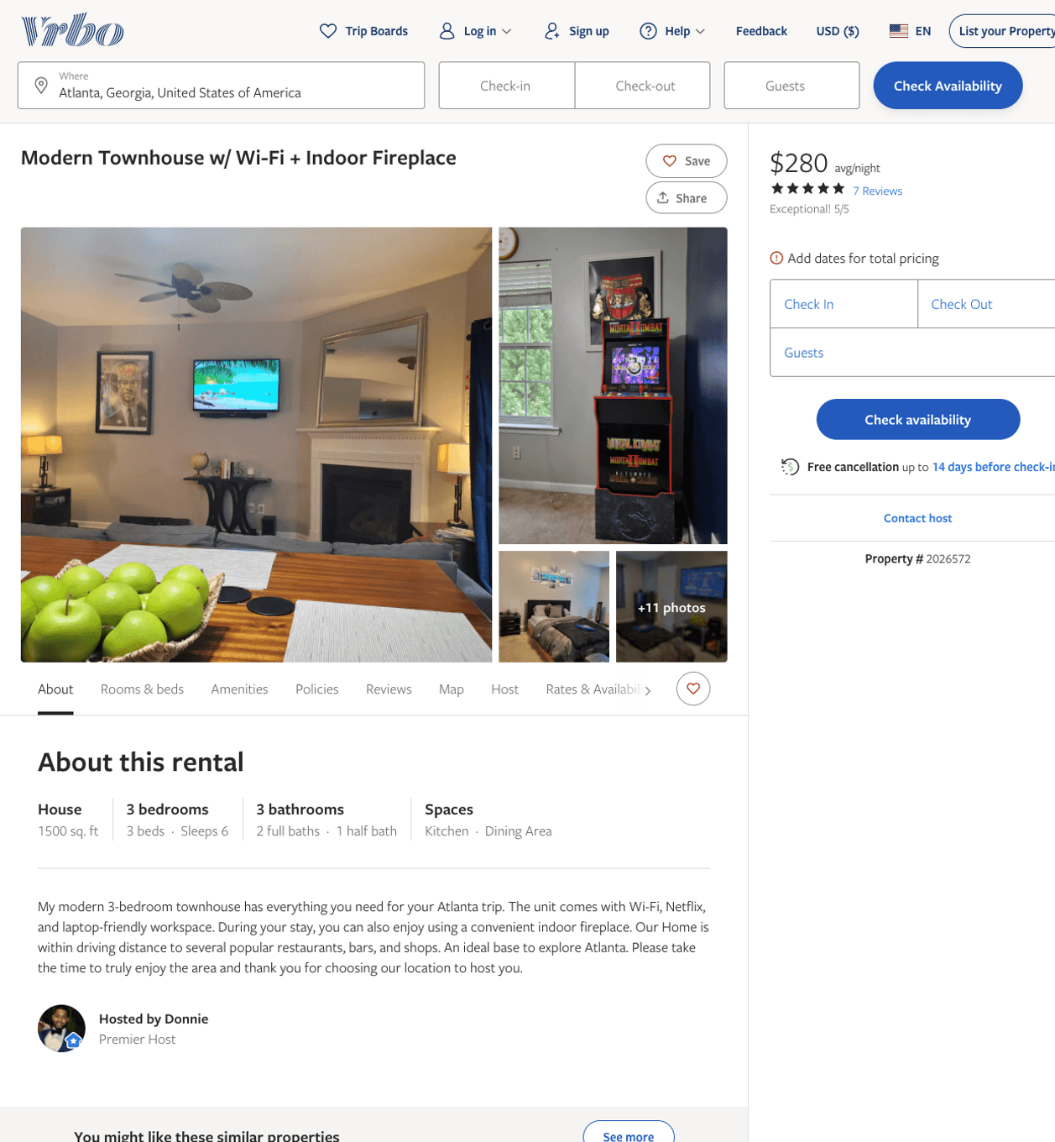
Listing 2026572
3
6
$280
5
3
Donnie
https://www.vrbo.com/2026572
Aug 2022

Slide 4
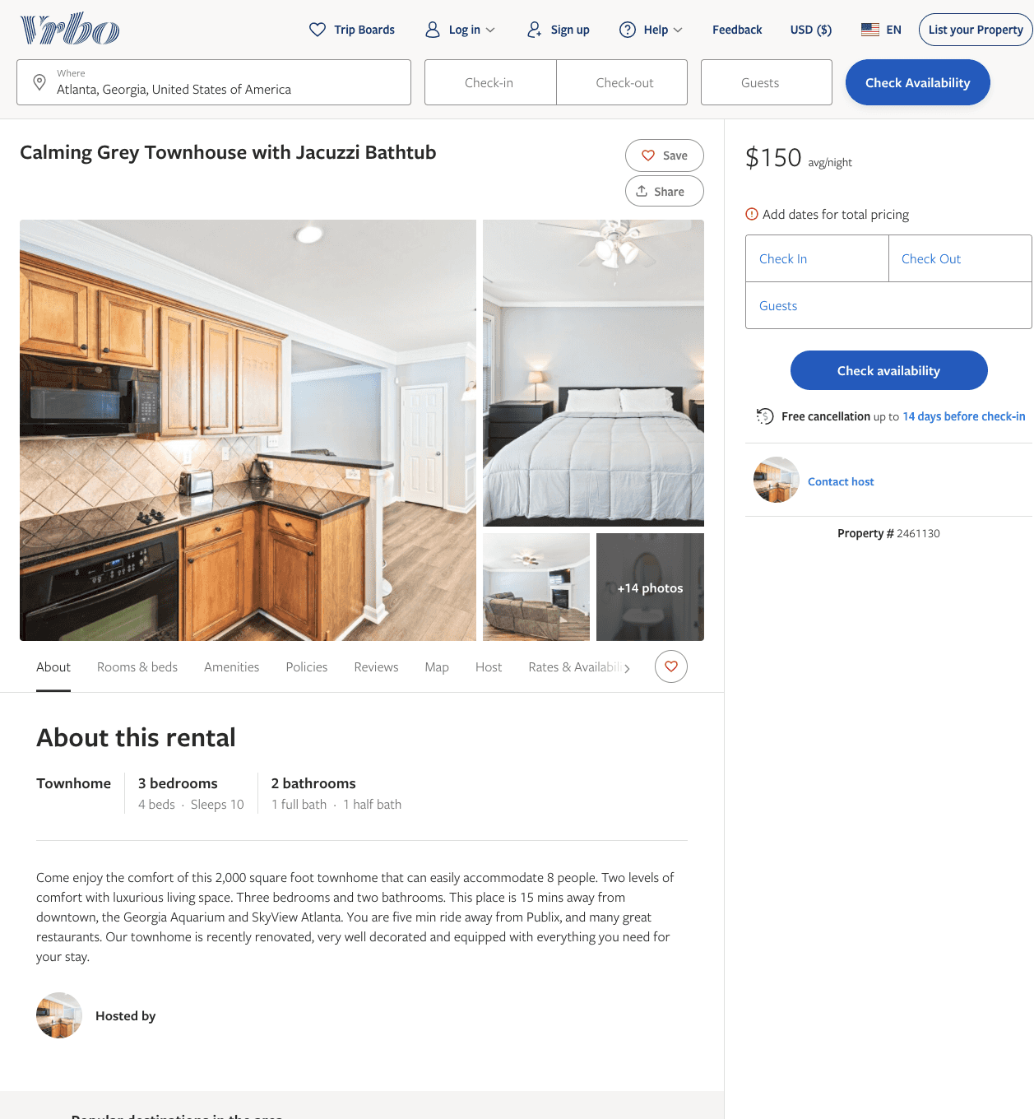
Listing 2461130
3
7
$148 - $210
4
2
Dearious Floyd
https://www.vrbo.com/2461130
Aug 2022

Slide 5
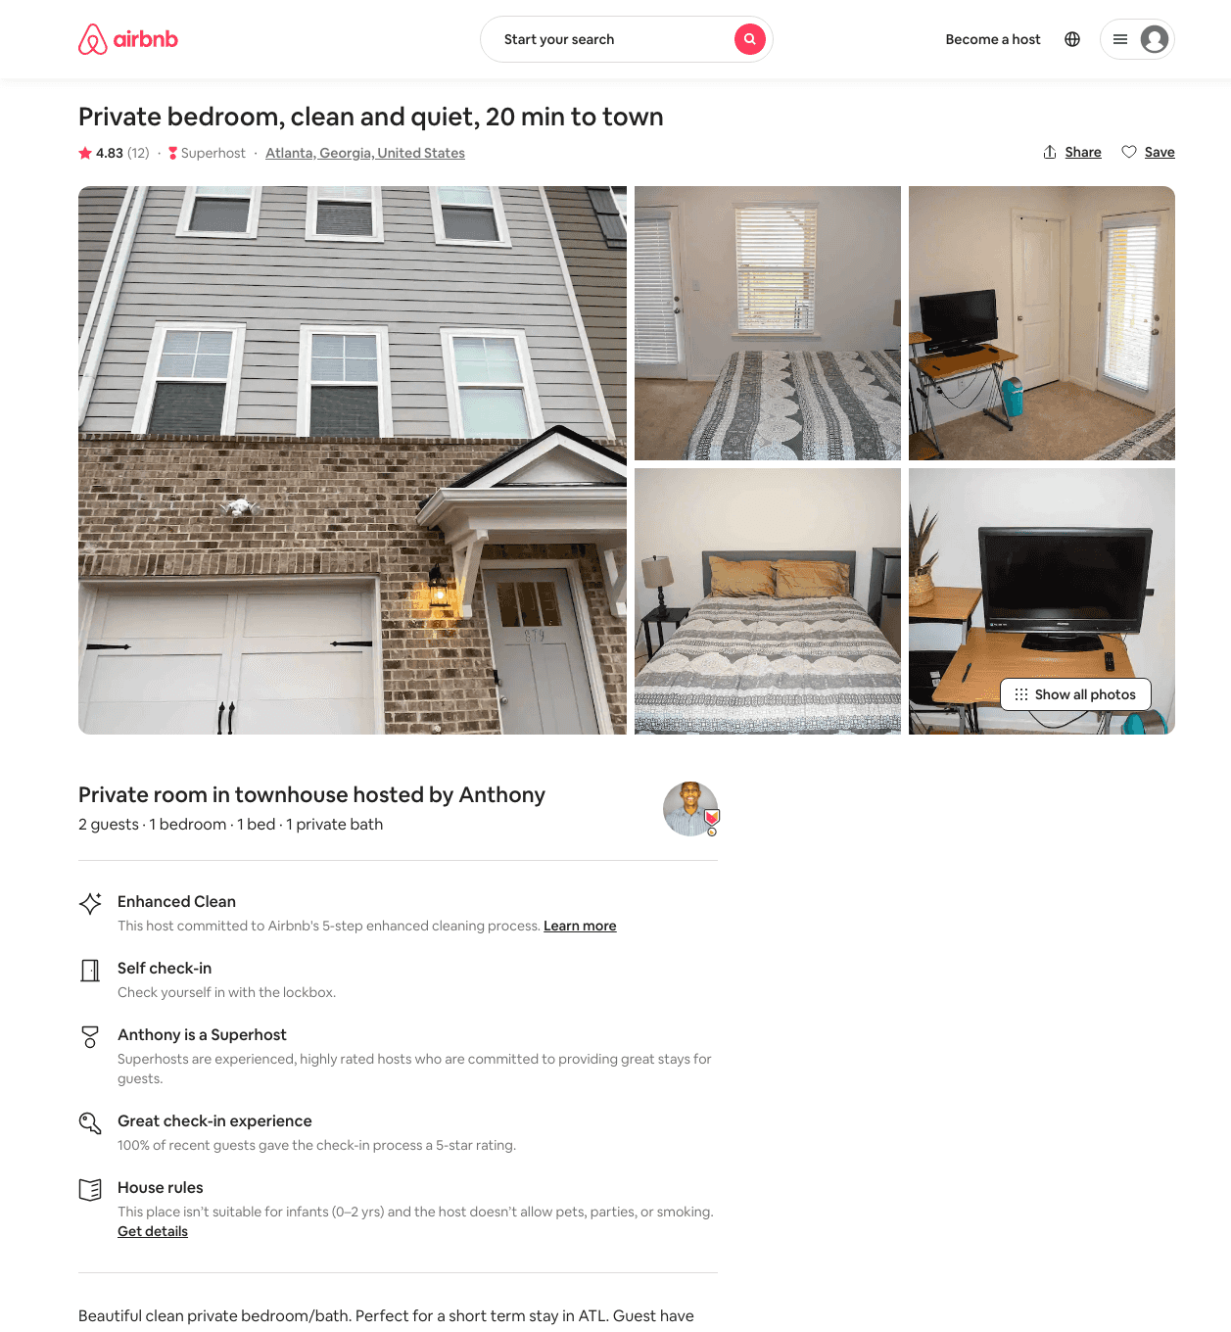
Listing 48058097
1
2
$34 - $75
4.92
1
Anthony
69127777
1
https://www.airbnb.com/rooms/48058097
Aug 2022

Slide 6
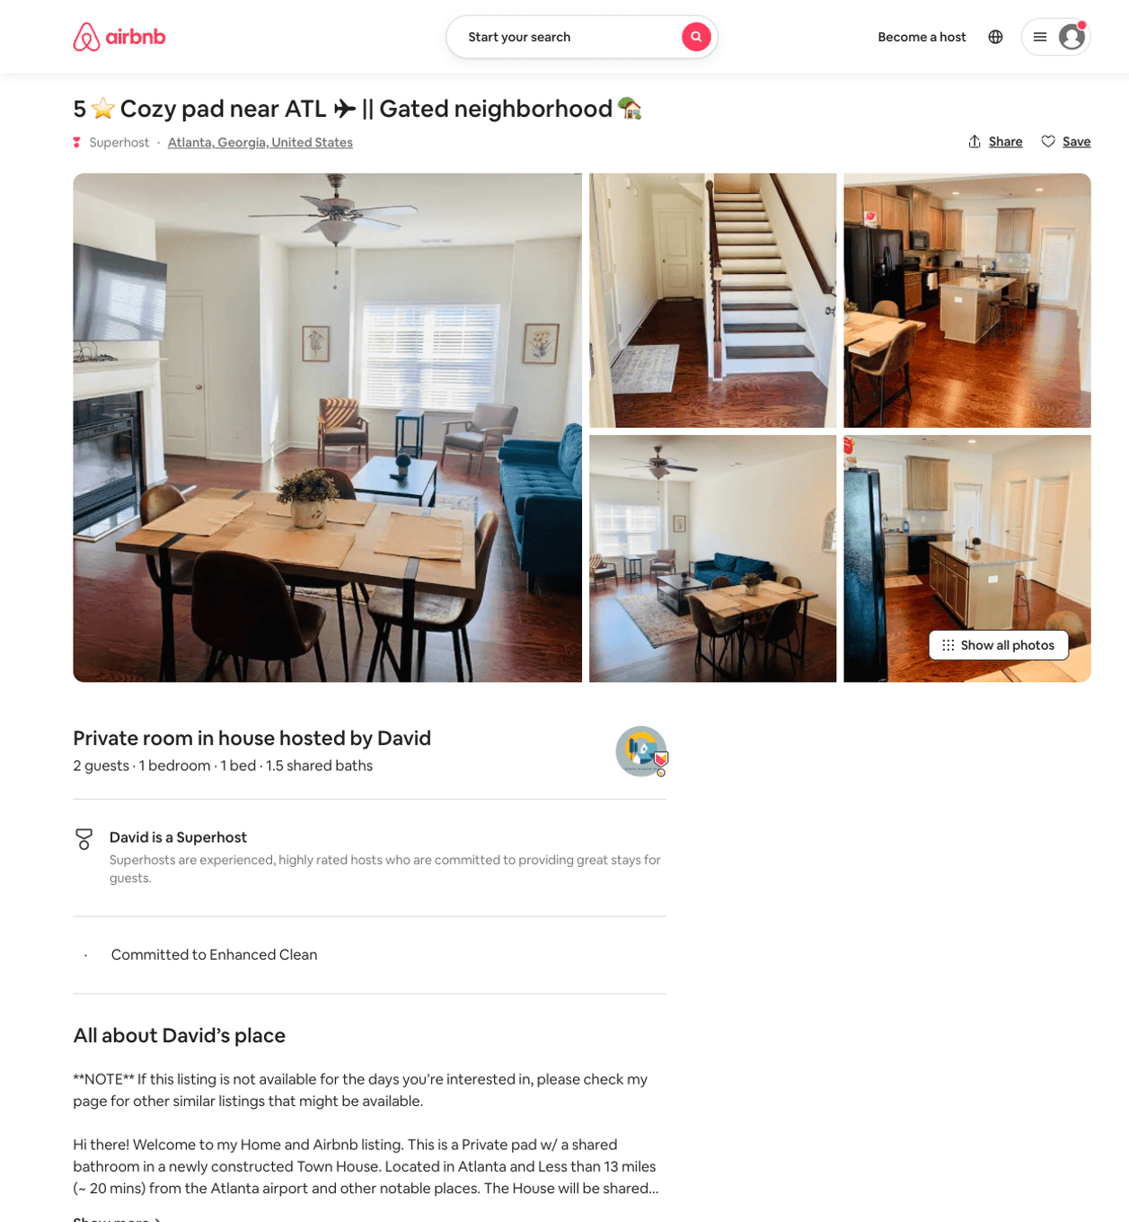
Listing 50679820
1
2
$33 - $51
4.94
2
David
151411292
3
https://www.airbnb.com/rooms/50679820
Aug 2022

Slide 7
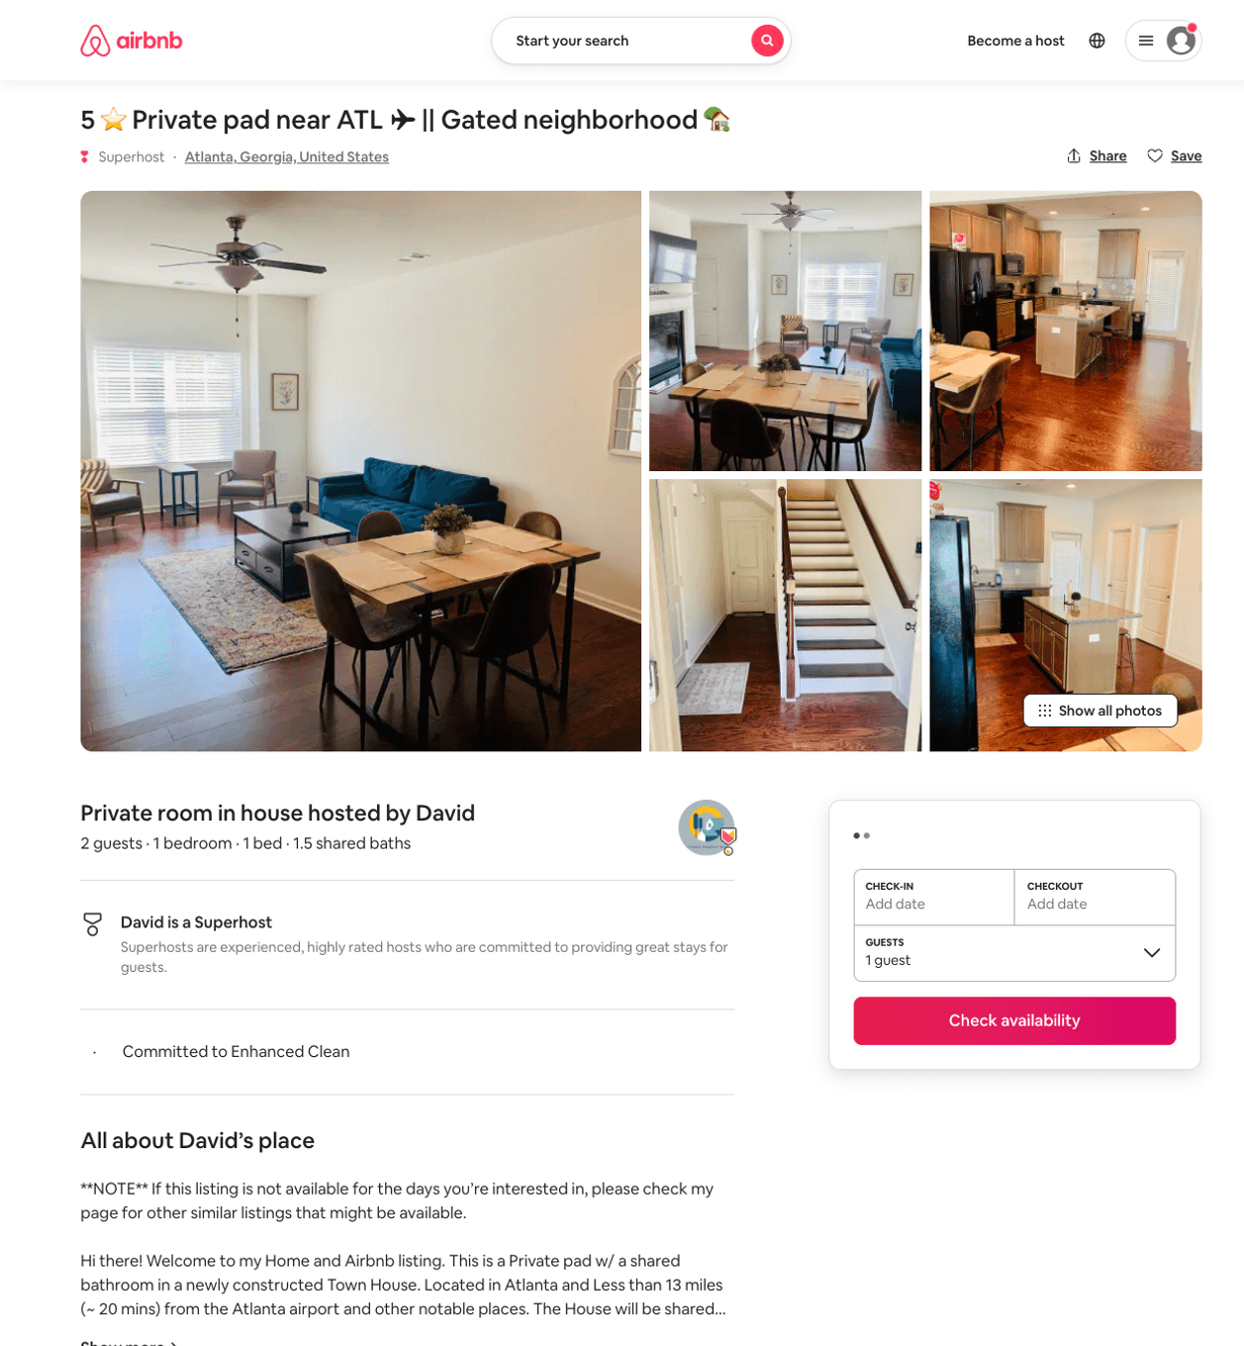
Listing 50680121
1
2
$33 - $50
4.95
2
David
151411292
3
https://www.airbnb.com/rooms/50680121
Aug 2022

Slide 8
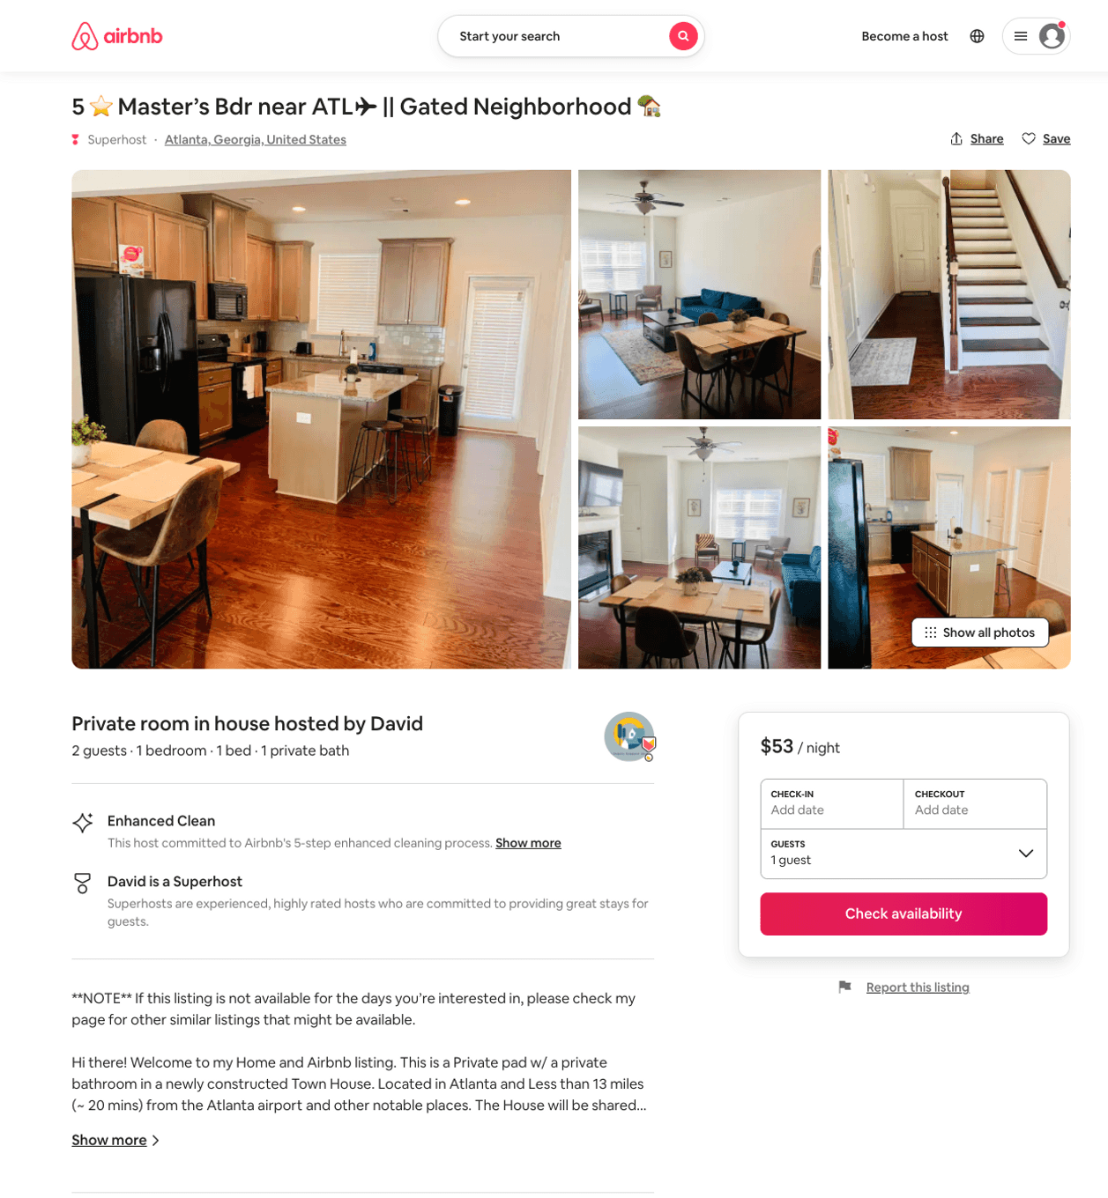
Listing 50681281
1
2
$33 - $59
5.0
2
David
151411292
3
https://www.airbnb.com/rooms/50681281
Jul 2022

Slide 9
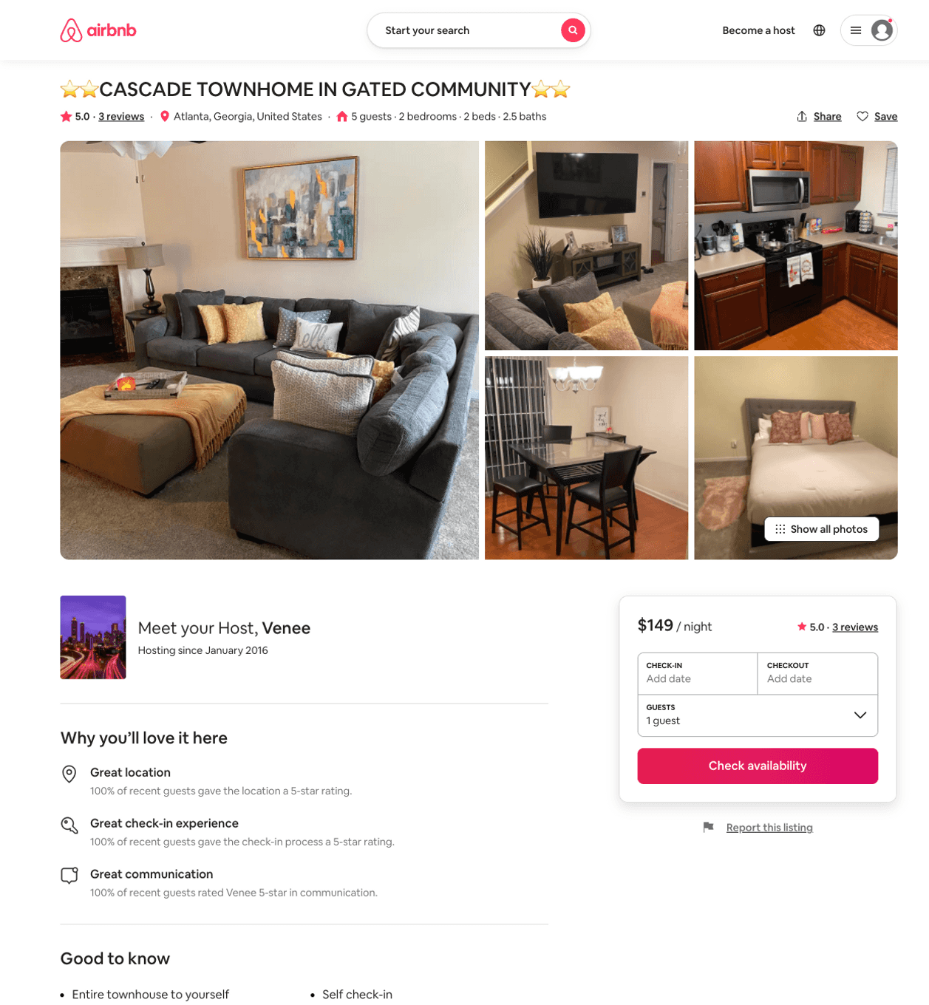
Listing 50630791
2
5
$136 - $143
5.0
2
Venee
56417643
1
https://www.airbnb.com/rooms/50630791
Jun 2022

Slide 10
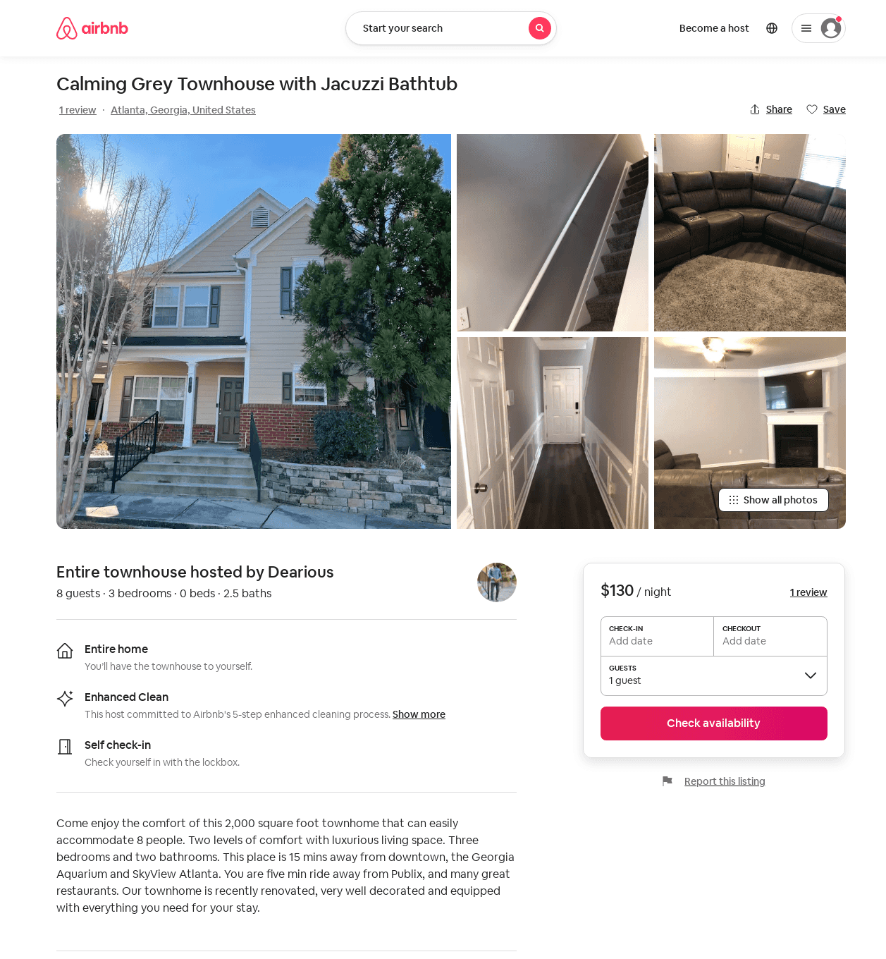
Listing 51988093
3
6
$121 - $220
4.80
2
Dearious
68065412
2
https://www.airbnb.com/rooms/51988093
Aug 2022

Slide 11
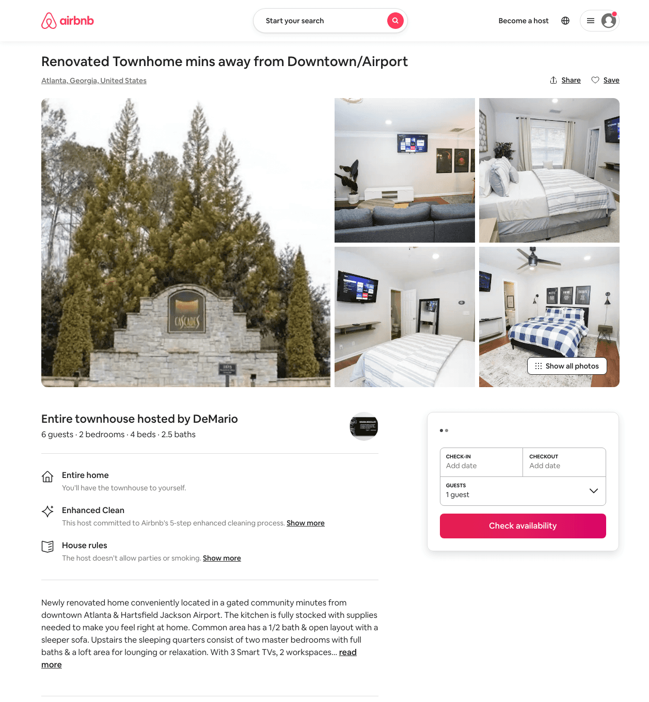
Listing 49675658
2
6
$106 - $166
4.66
2
DeMario
400650157
1
https://www.airbnb.com/rooms/49675658
Jun 2022

Slide 12
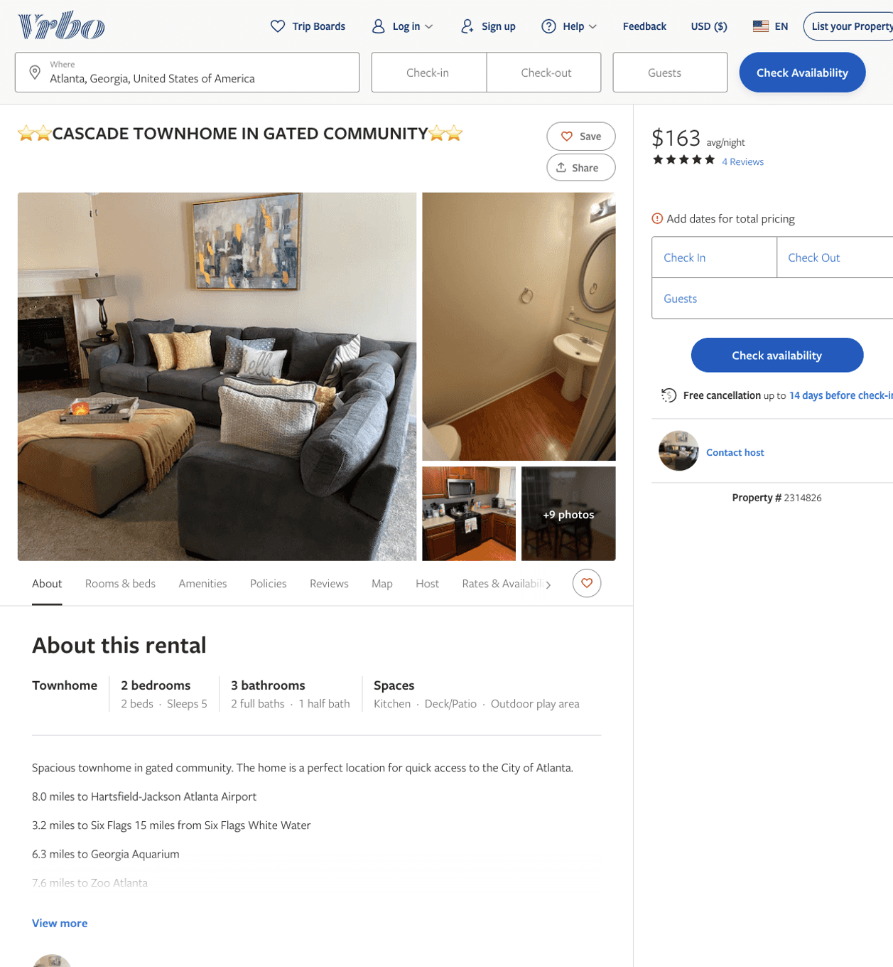
Listing 2314826
2
5
$156 - $185
5
3
https://www.vrbo.com/2314826
Aug 2022

Slide 13
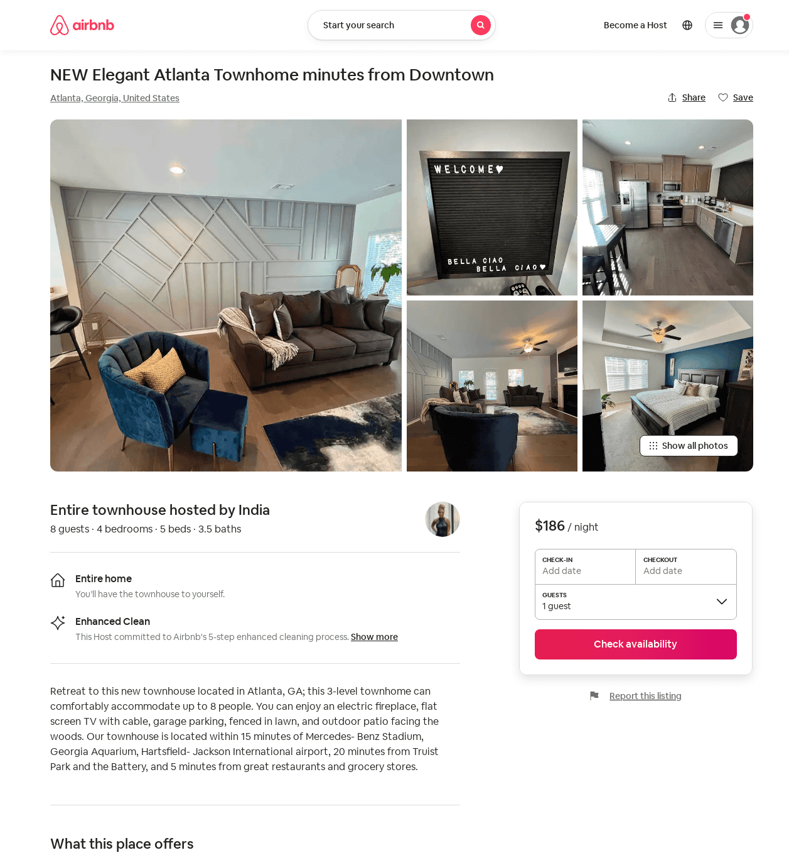
Listing 53049454
4
8
$167 - $207
5.0
2
India
189768929
1
https://www.airbnb.com/rooms/53049454
Jun 2022

Slide 14
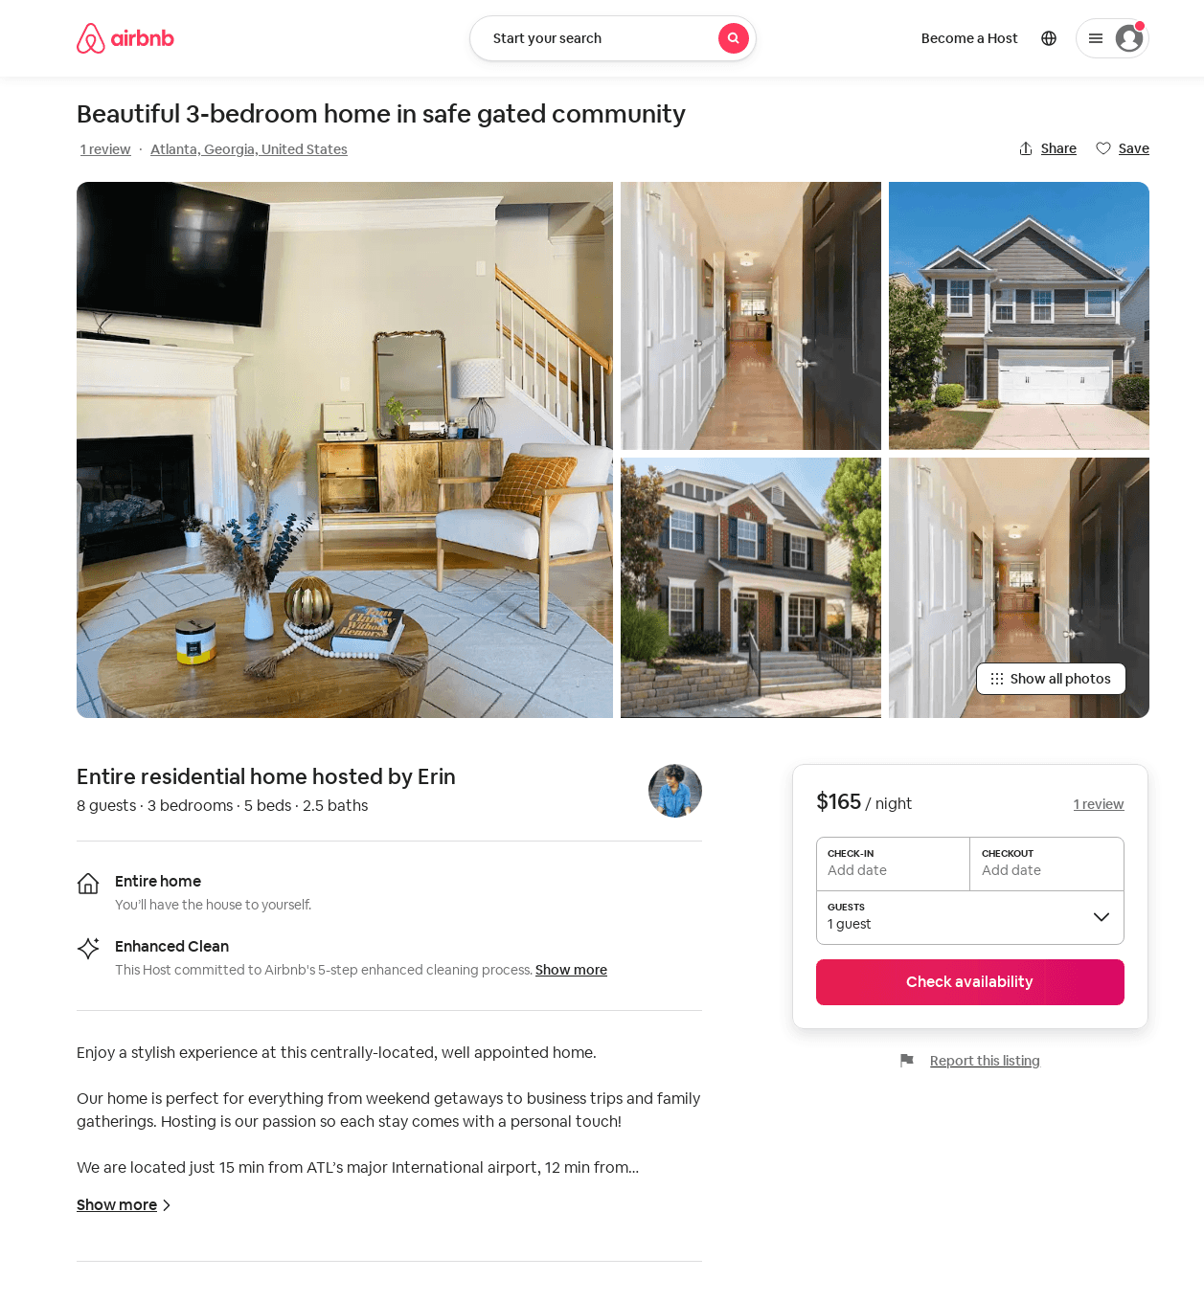
Listing 52741936
3
8
$165 - $205
4.64
2
Erin
170215711
1
https://www.airbnb.com/rooms/52741936
Jun 2022

Slide 15
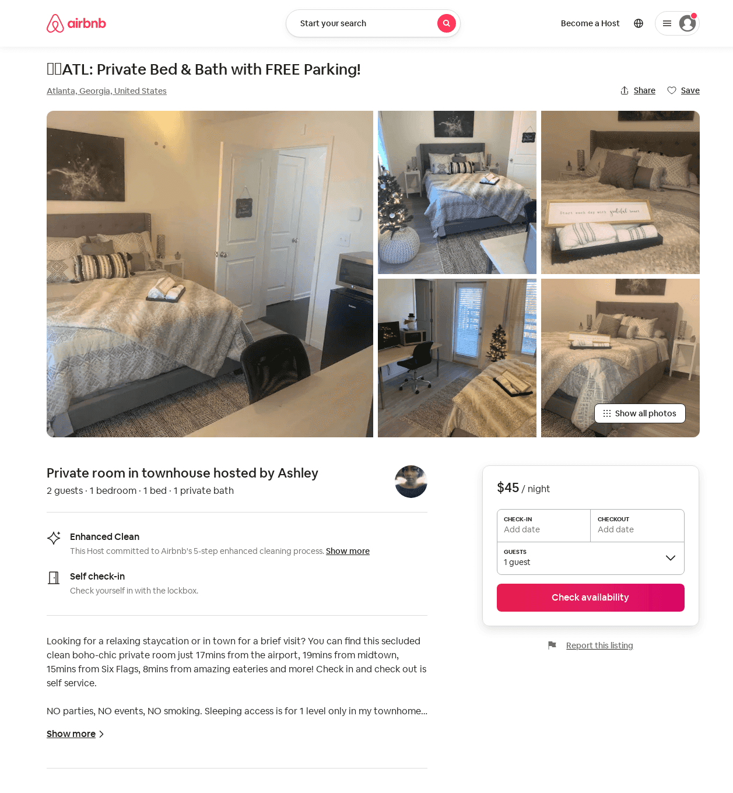
Listing 52476297
1
2
$33 - $66
5.0
3
Ashley
182663125
1
https://www.airbnb.com/rooms/52476297
Aug 2022

Slide 16
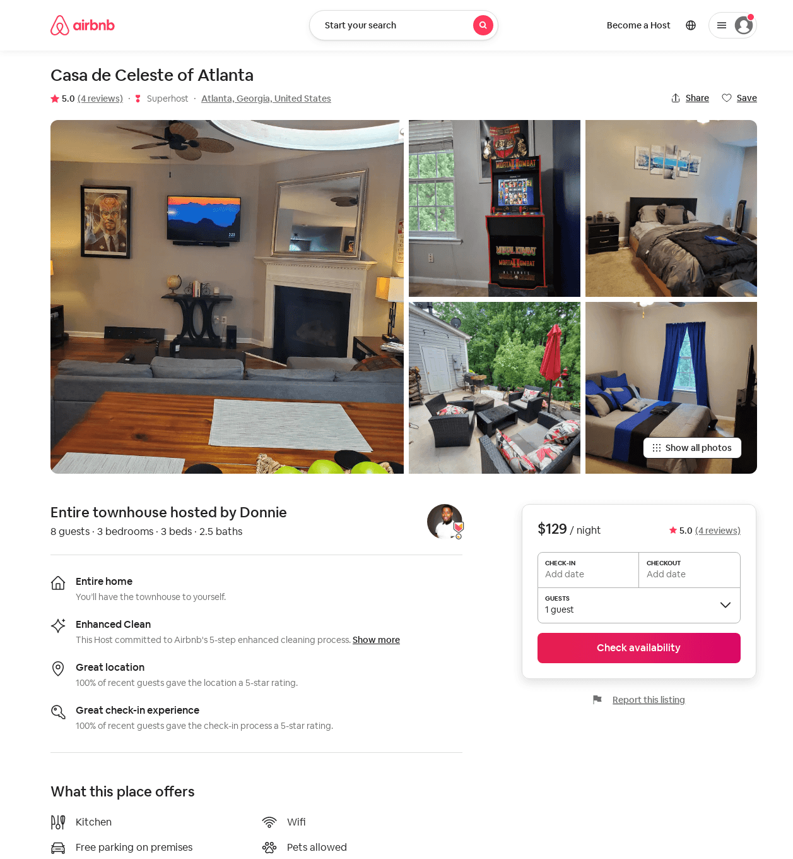
Listing 53121251
3
8
$90 - $164
5.0
1
Donnie
354521570
7
https://www.airbnb.com/rooms/53121251
Aug 2022

Slide 17
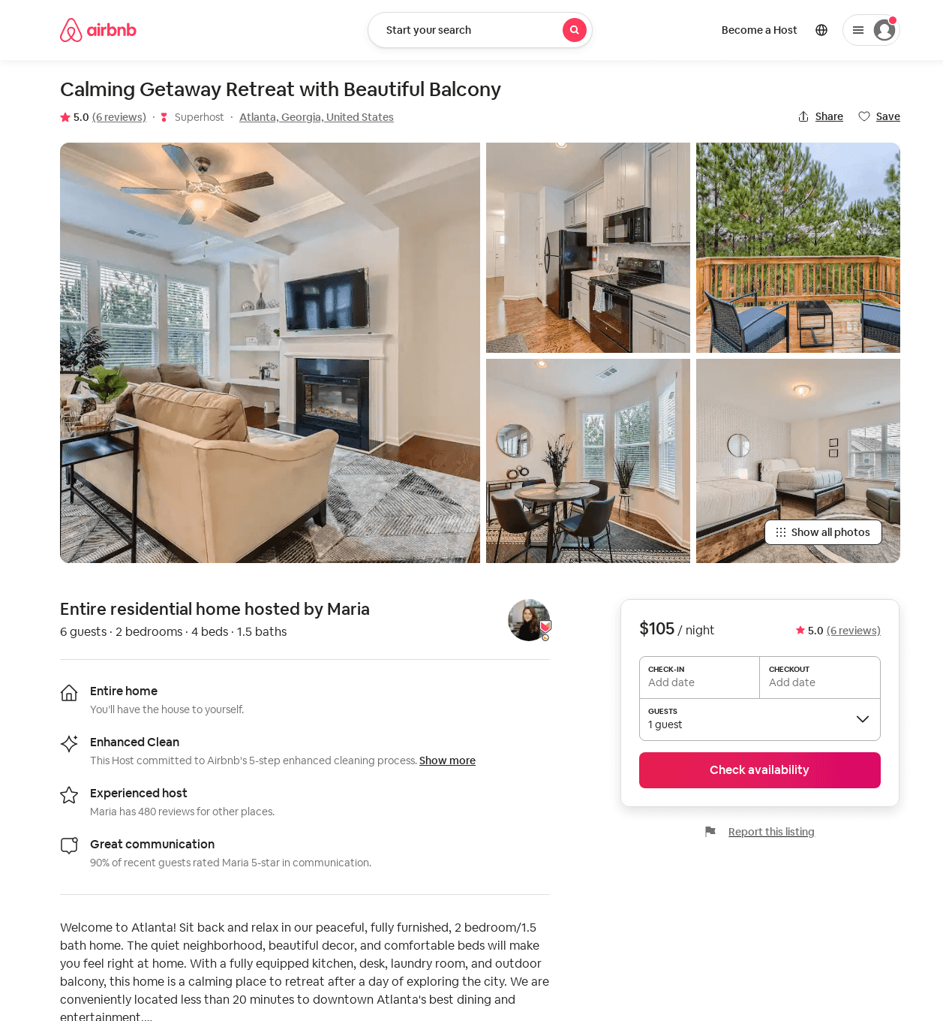
Listing 53107508
2
8
$82 - $150
5.0
1
Maria
230939573
13
https://www.airbnb.com/rooms/53107508
Jun 2022

Slide 18
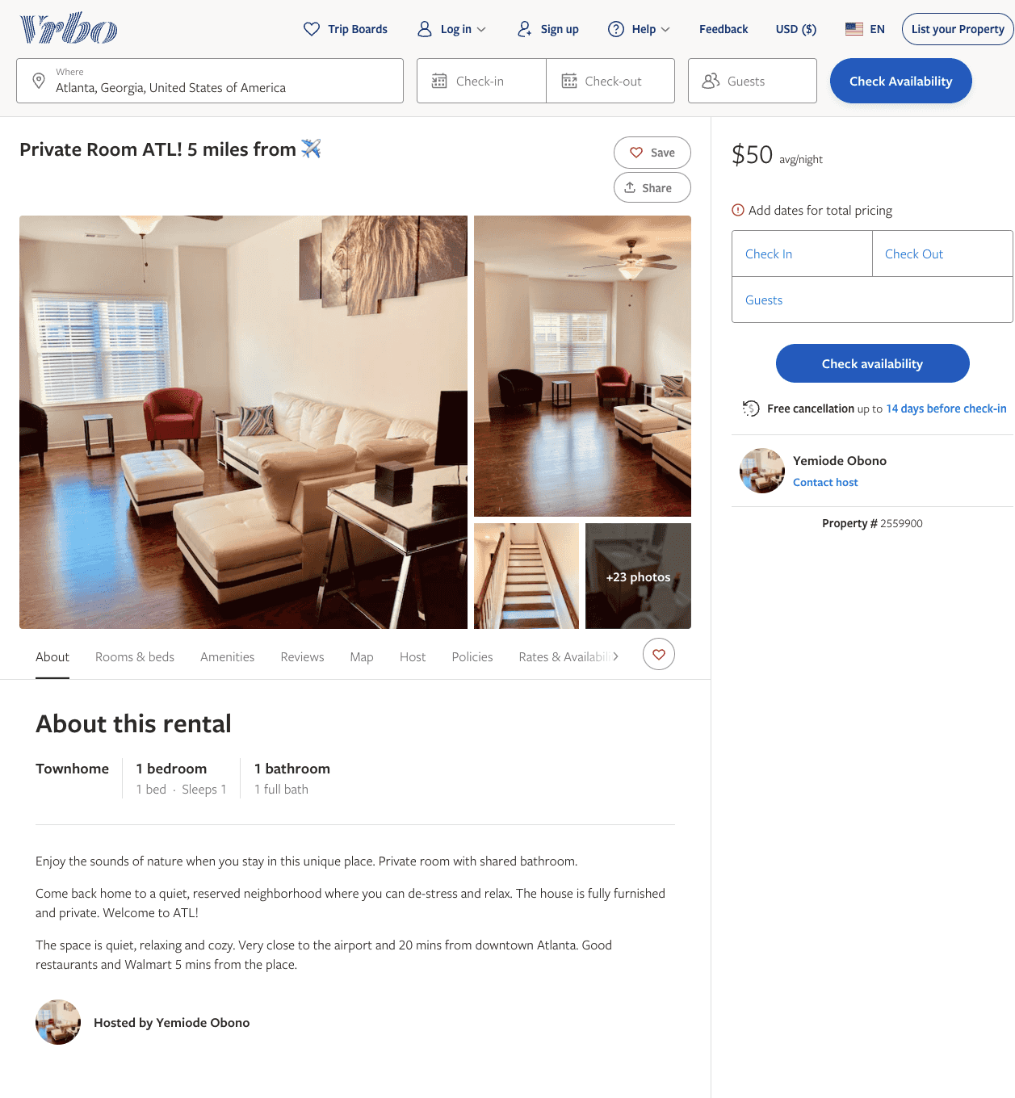
Listing 2559900
1
1
$45 - $50
15
Yemiode Obono
https://www.vrbo.com/2559900
Aug 2022

Slide 19
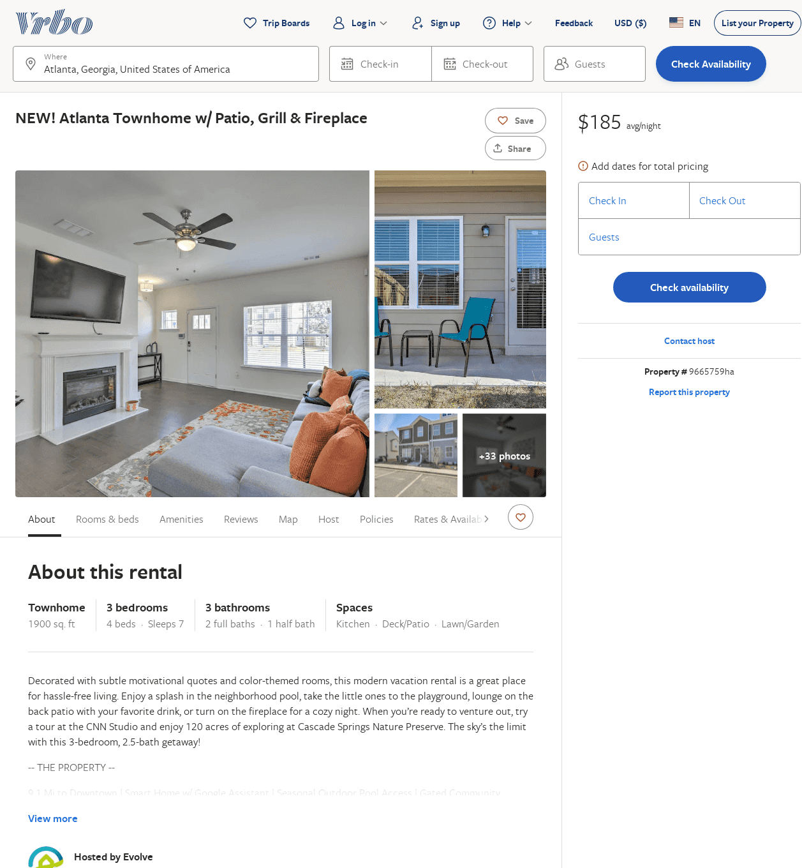
Listing 9665759
3
7
$185
3.5
2
Evolve
https://www.vrbo.com/9665759ha
Aug 2022

Slide 20
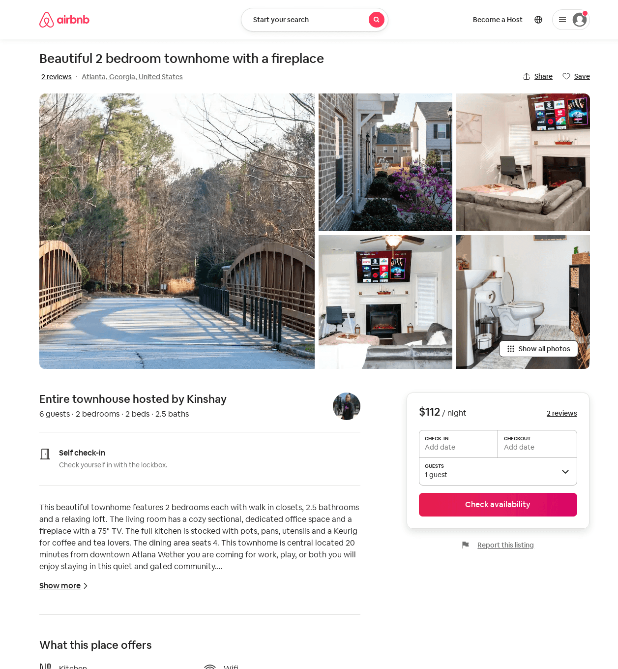
Listing 41105567
2
6
$112
5.0
3
Kinshay
28889918
1
https://www.airbnb.com/rooms/41105567
Aug 2022

Slide 21
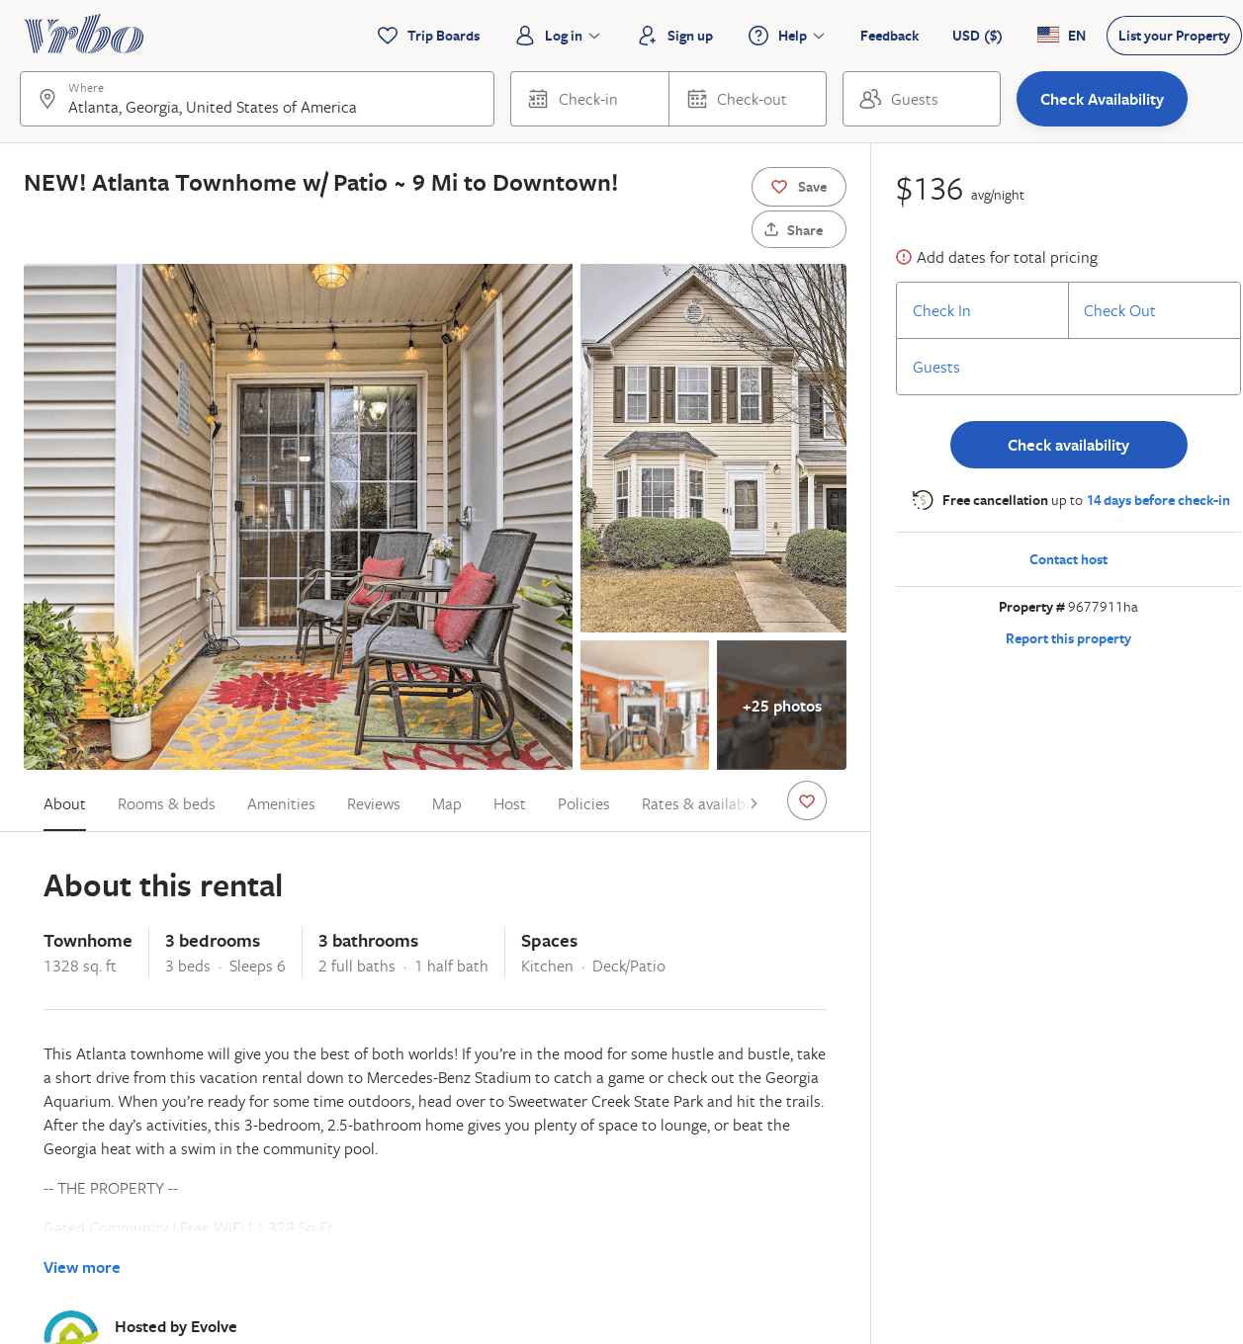
Listing 9677911
3
8
$124
2
Evolve
https://www.vrbo.com/9677911ha
Aug 2022

Slide 22
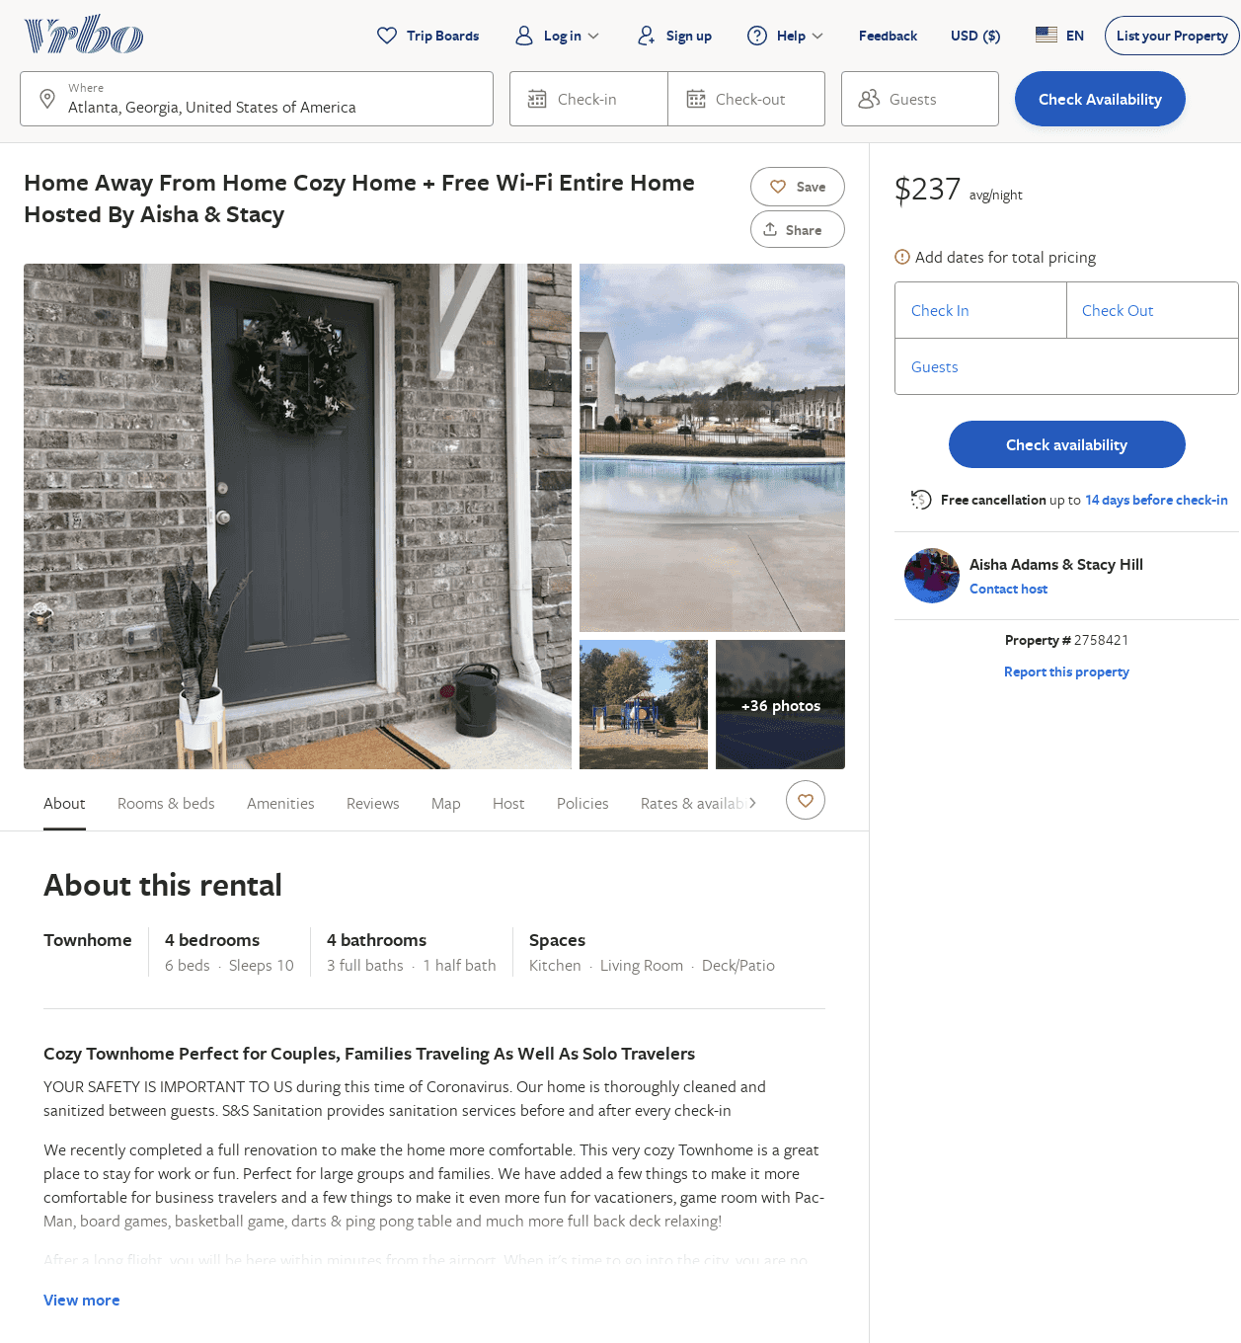
Listing 2758421
4
10
$264
5
2
Aisha Adams & Stacy Hill
https://www.vrbo.com/2758421
Aug 2022

Slide 23
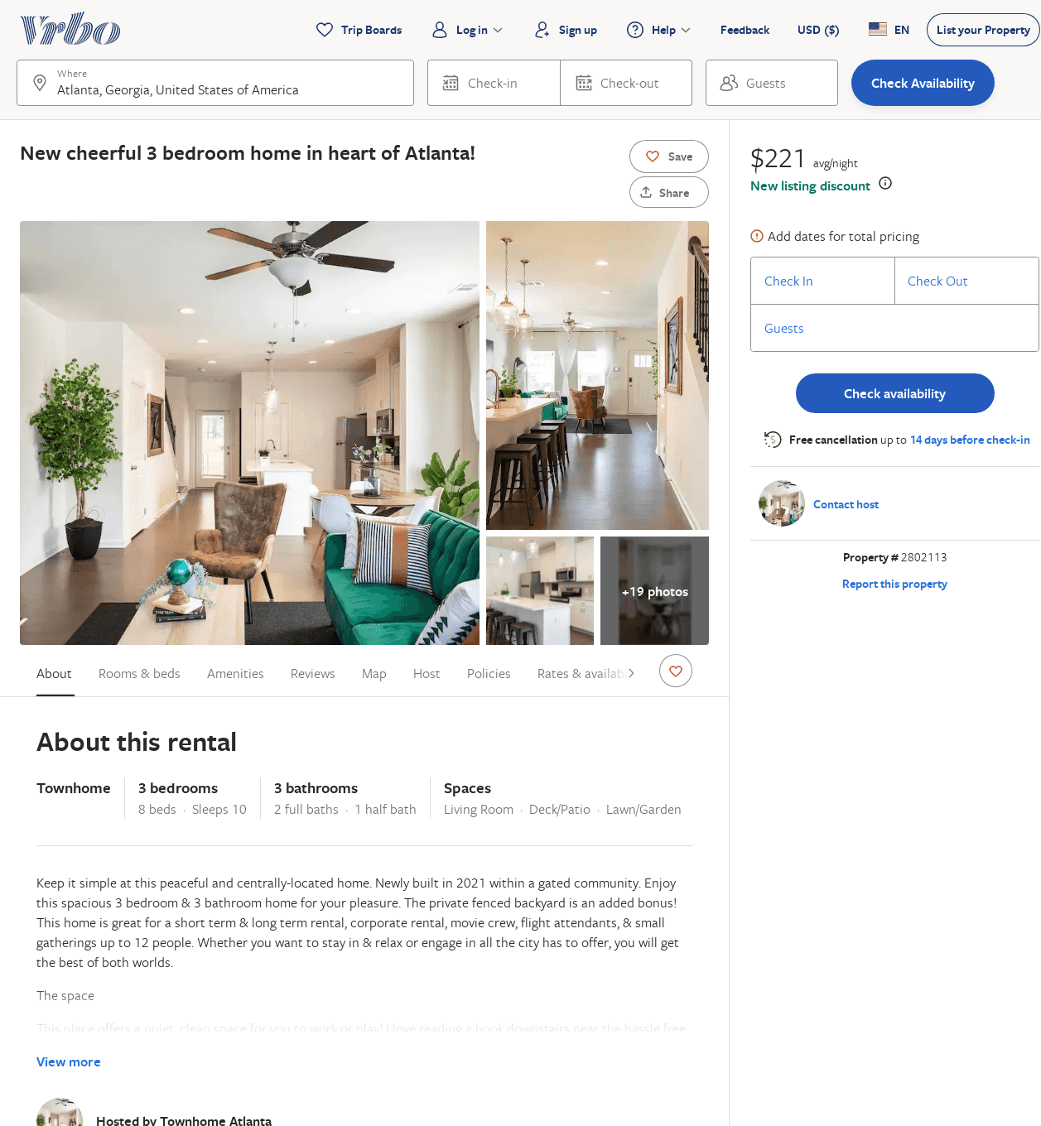
Listing 2802113
3
8
$205
4.6666665
3
https://www.vrbo.com/2802113
Aug 2022

Slide 24
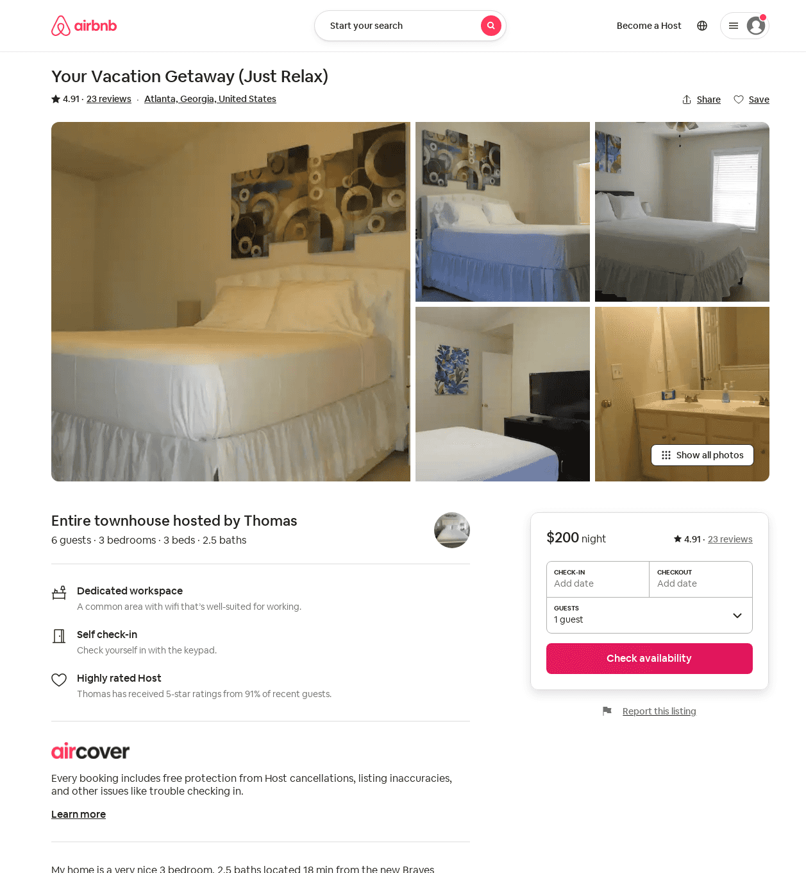
Listing 29312550
3
6
4.91
2
Thomas
135734253
1
https://www.airbnb.com/rooms/29312550
Jun 2022

