Slide 2
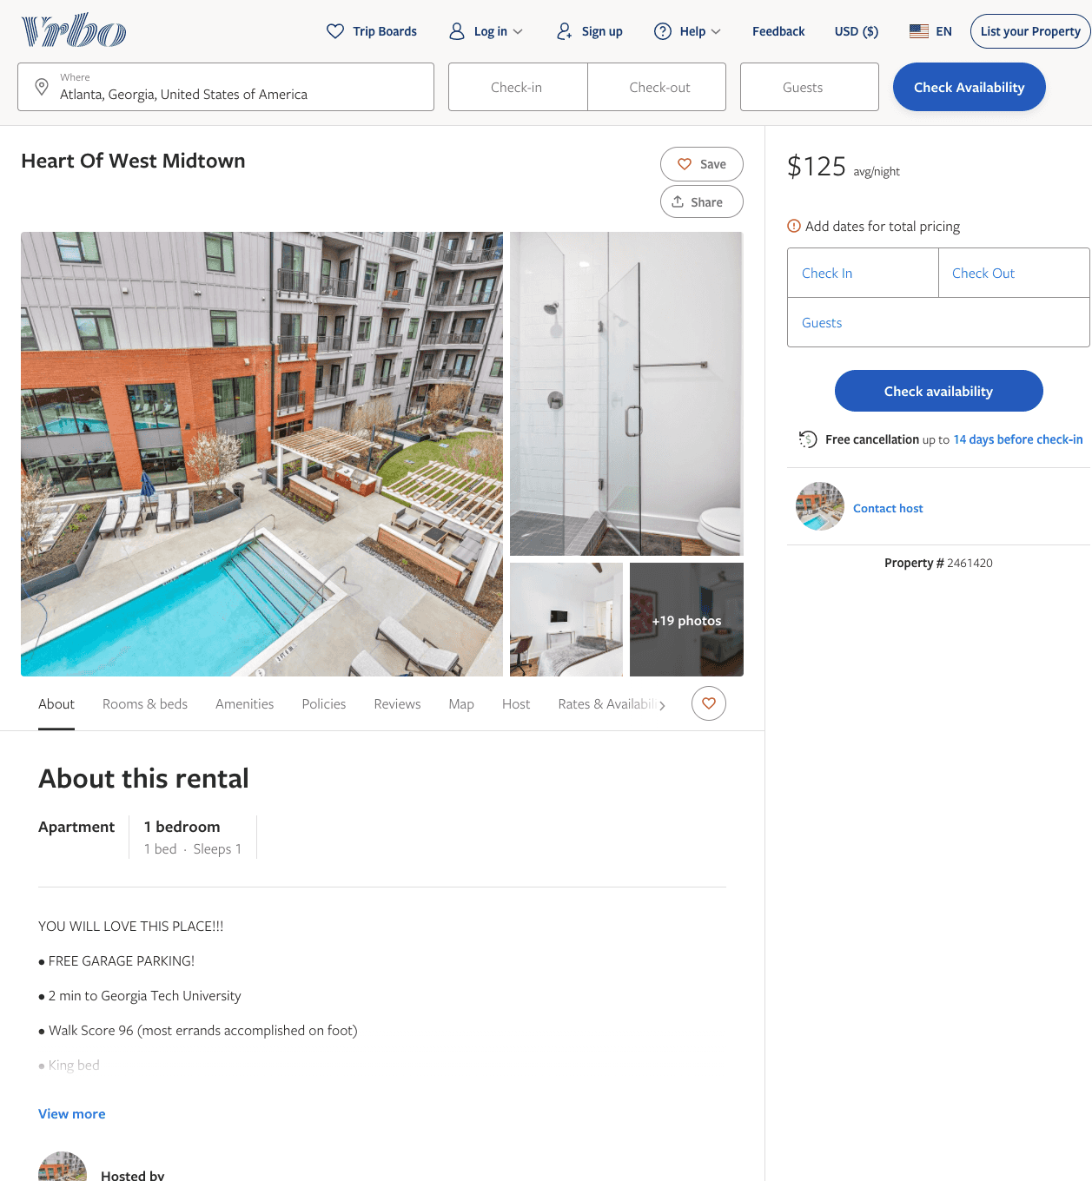
Listing 2461420
1
1
$100 - $131
5
1
THE HIVE LUXURY GROUP
https://www.vrbo.com/2461420
Aug 2022

Slide 3
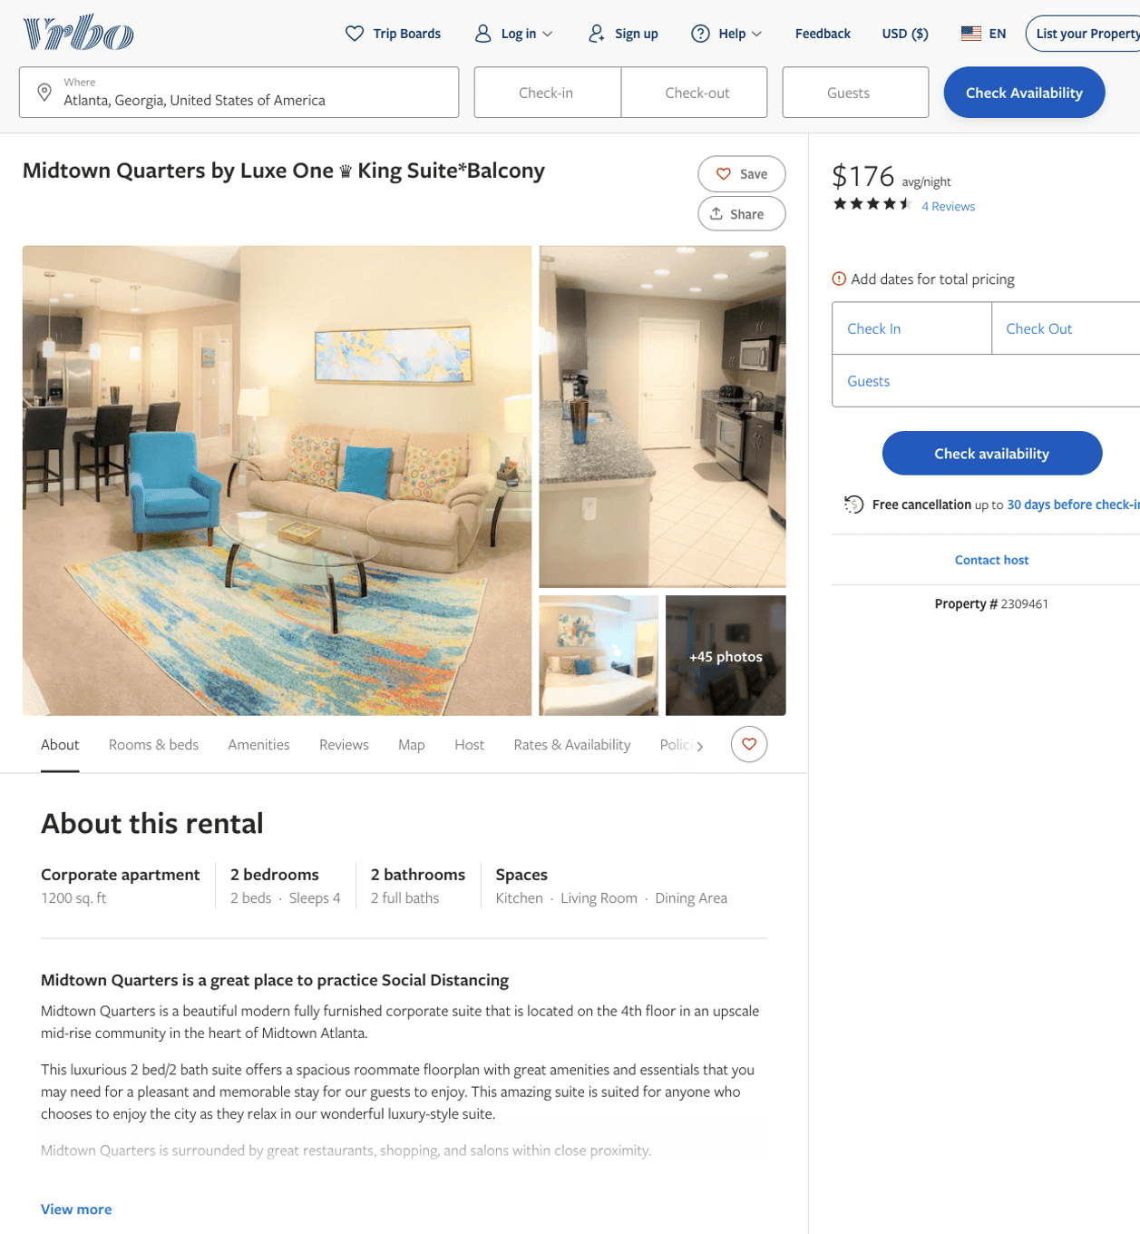
Listing 2309461
643 10TH ST NW
2
5
$144 - $227
4.6666665
1
Suite Connect
https://www.vrbo.com/2309461
Aug 2022

Slide 4
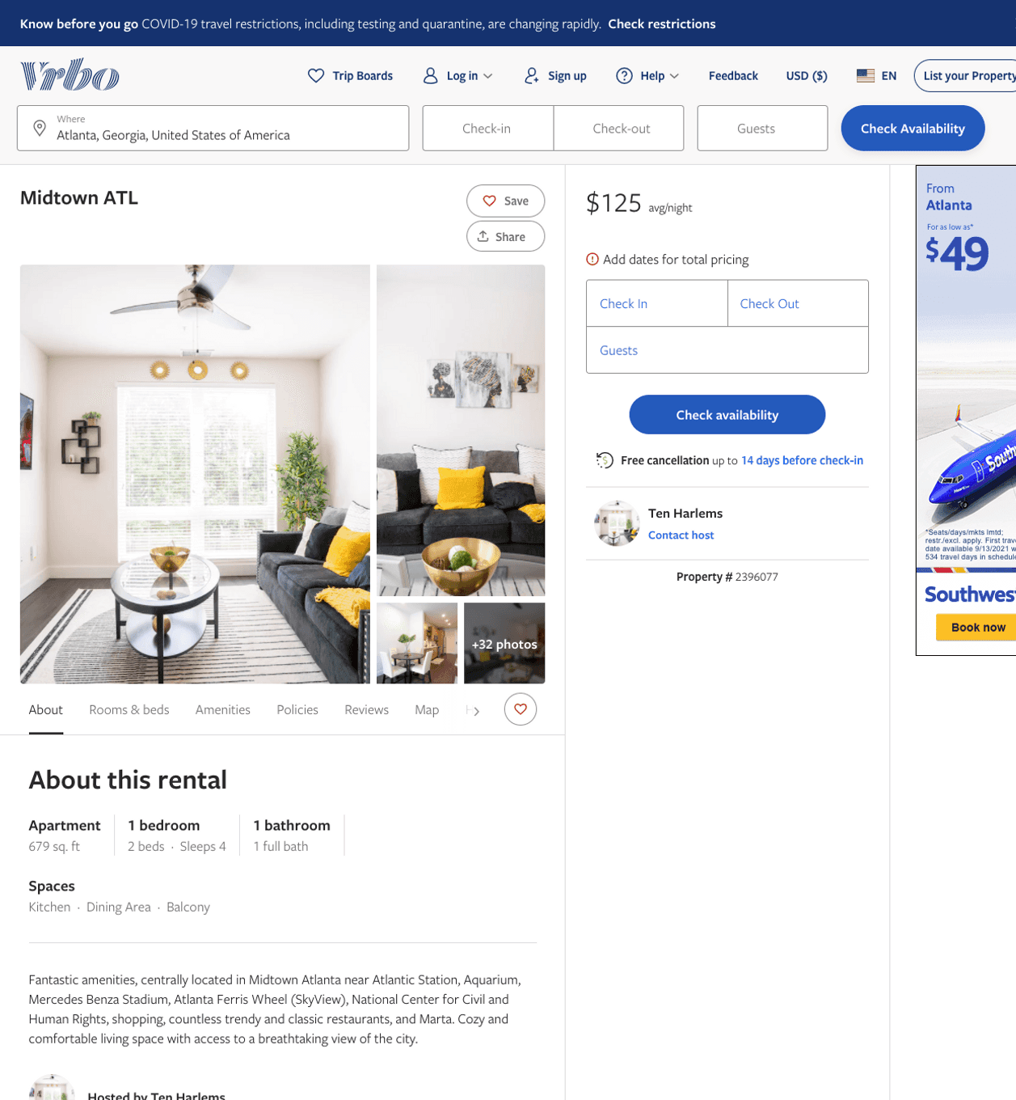
Listing 2396077
1
4
$113 - $250
1
1
Ten Harlems
https://www.vrbo.com/2396077
Aug 2022

Slide 5
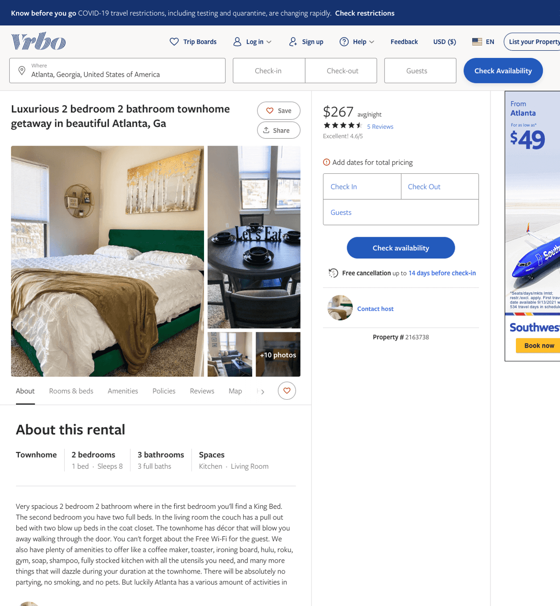
Listing 2163738
940 MARIETTA ST NW
2
8
$180 - $285
4.6
1
https://www.vrbo.com/2163738
Aug 2022

Slide 6
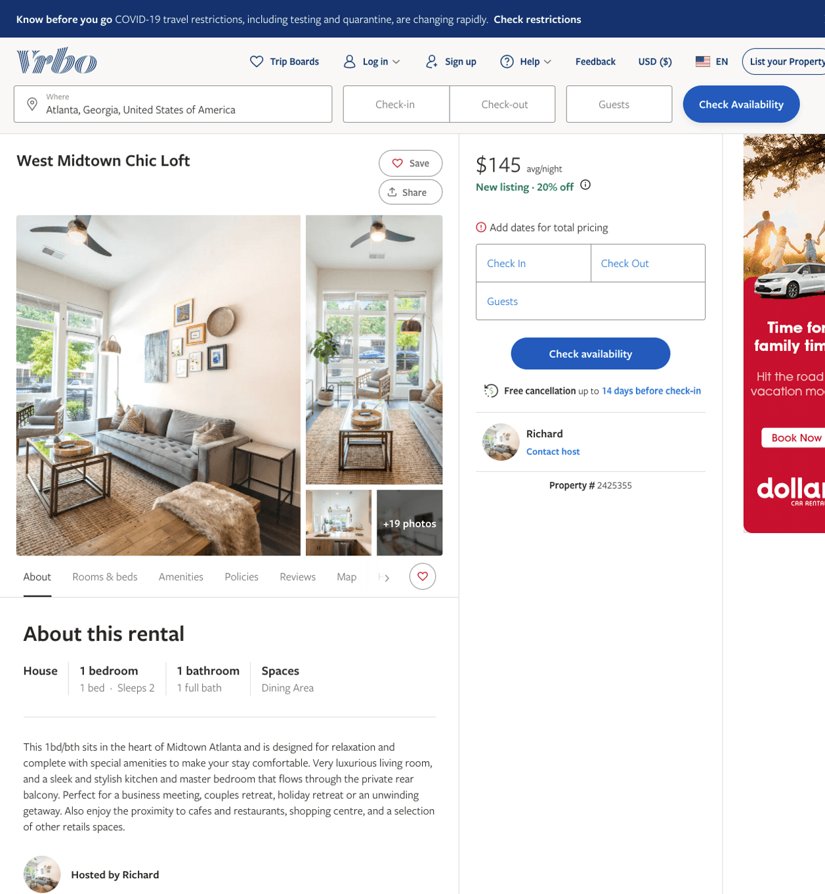
Listing 2425355
1
2
$135 - $140
1
Richard
https://www.vrbo.com/2425355
Aug 2022

Slide 7
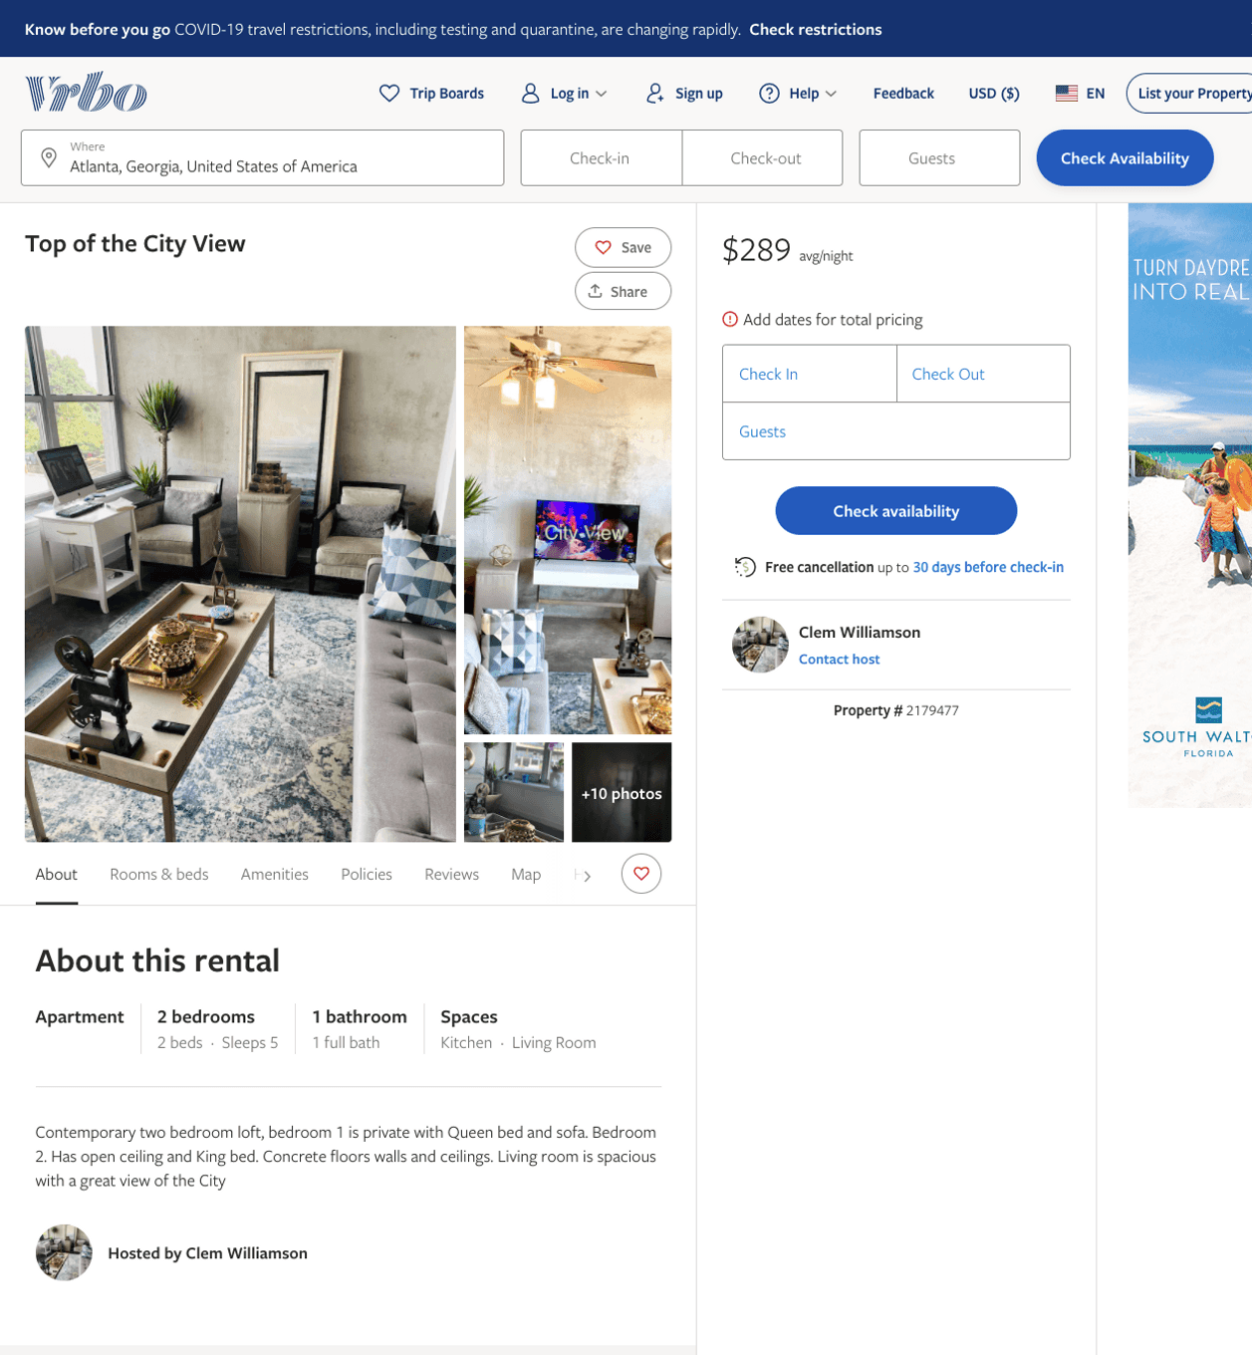
Listing 2179477
2
5
$289
2
Clem Williamson
https://www.vrbo.com/2179477
Aug 2022

Slide 8
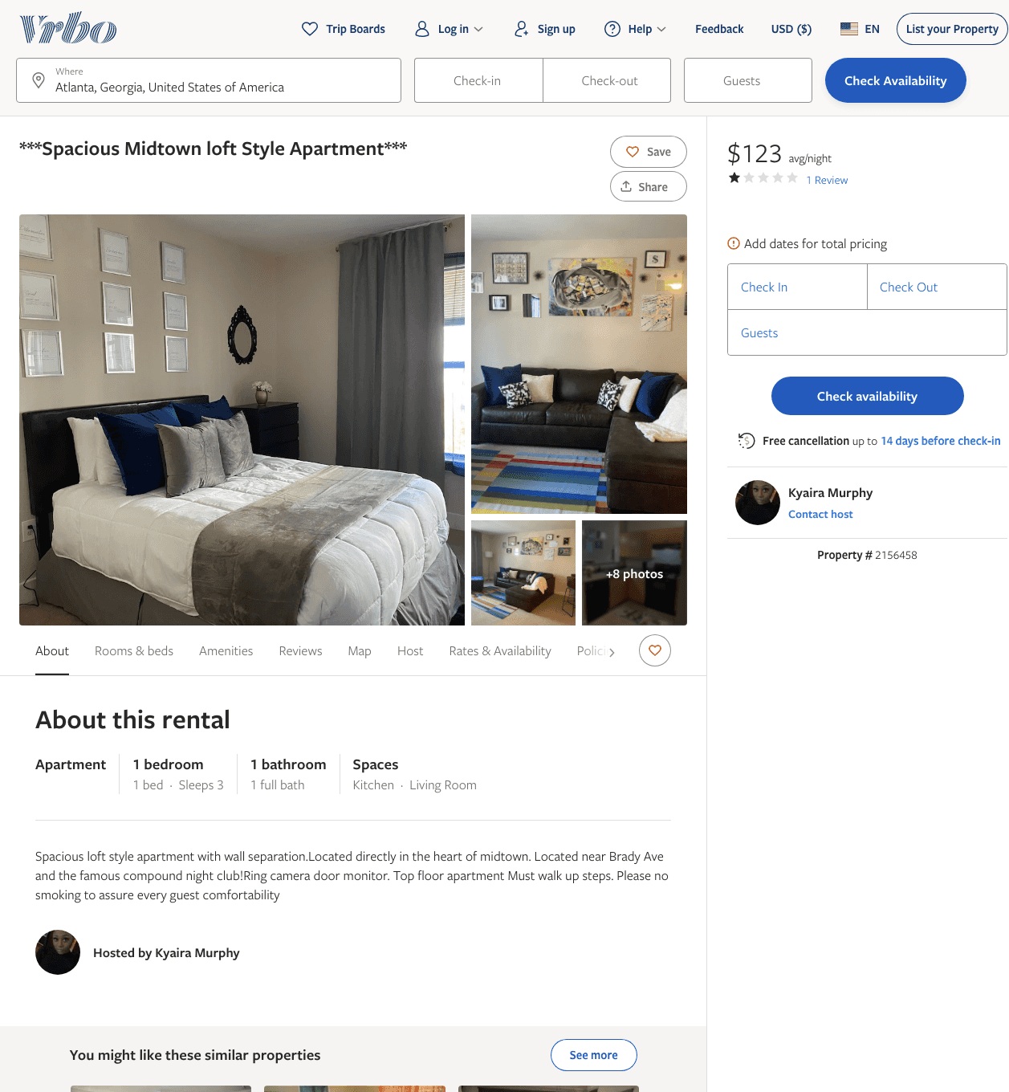
Listing 2156458
1
3
$121 - $124
1
2
Kyaira Murphy
https://www.vrbo.com/2156458
Aug 2022

Slide 9
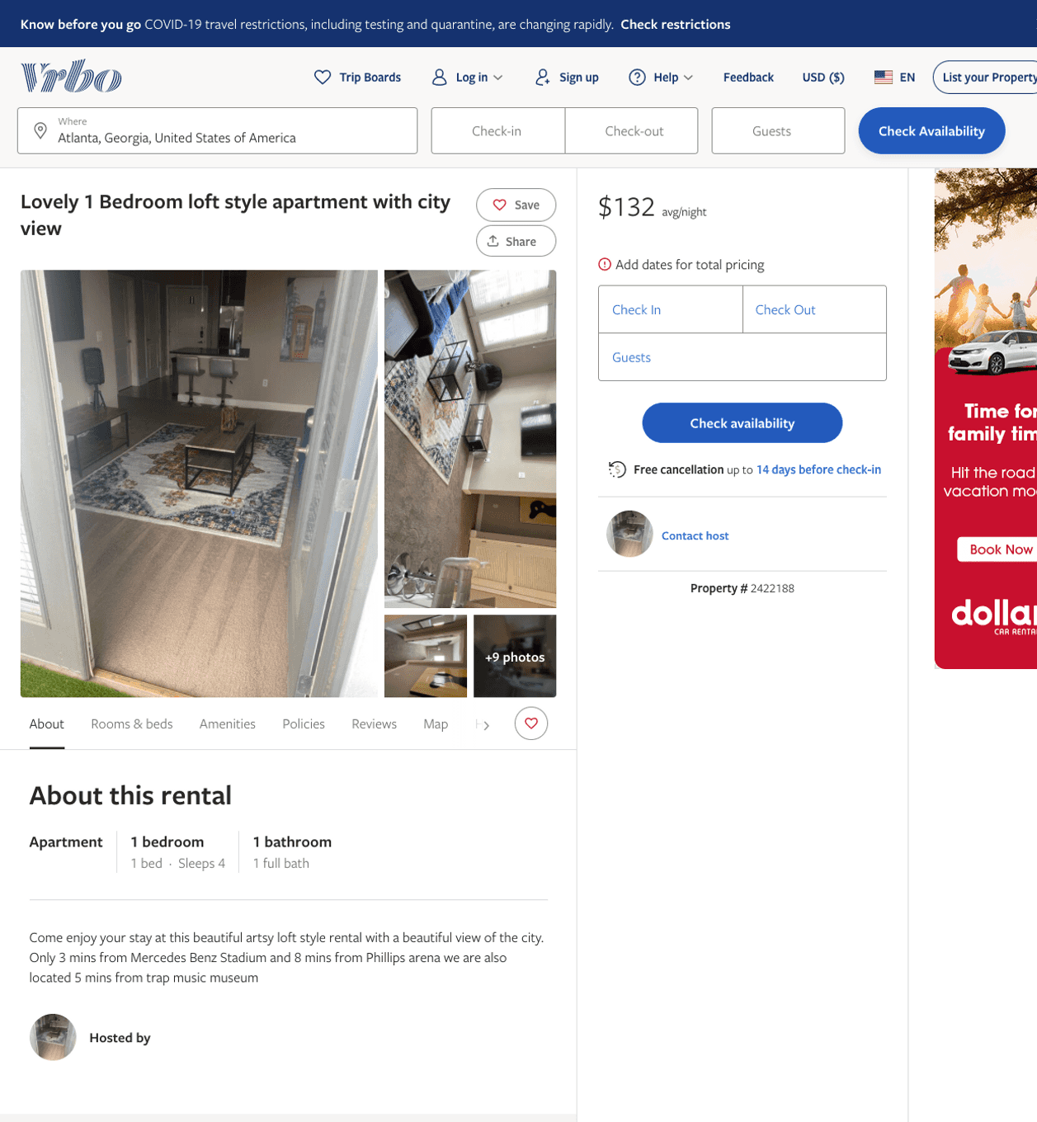
Listing 2422188
643 10TH ST NW
1
4
$101 - $95
5
2
https://www.vrbo.com/2422188
Aug 2022

Slide 10
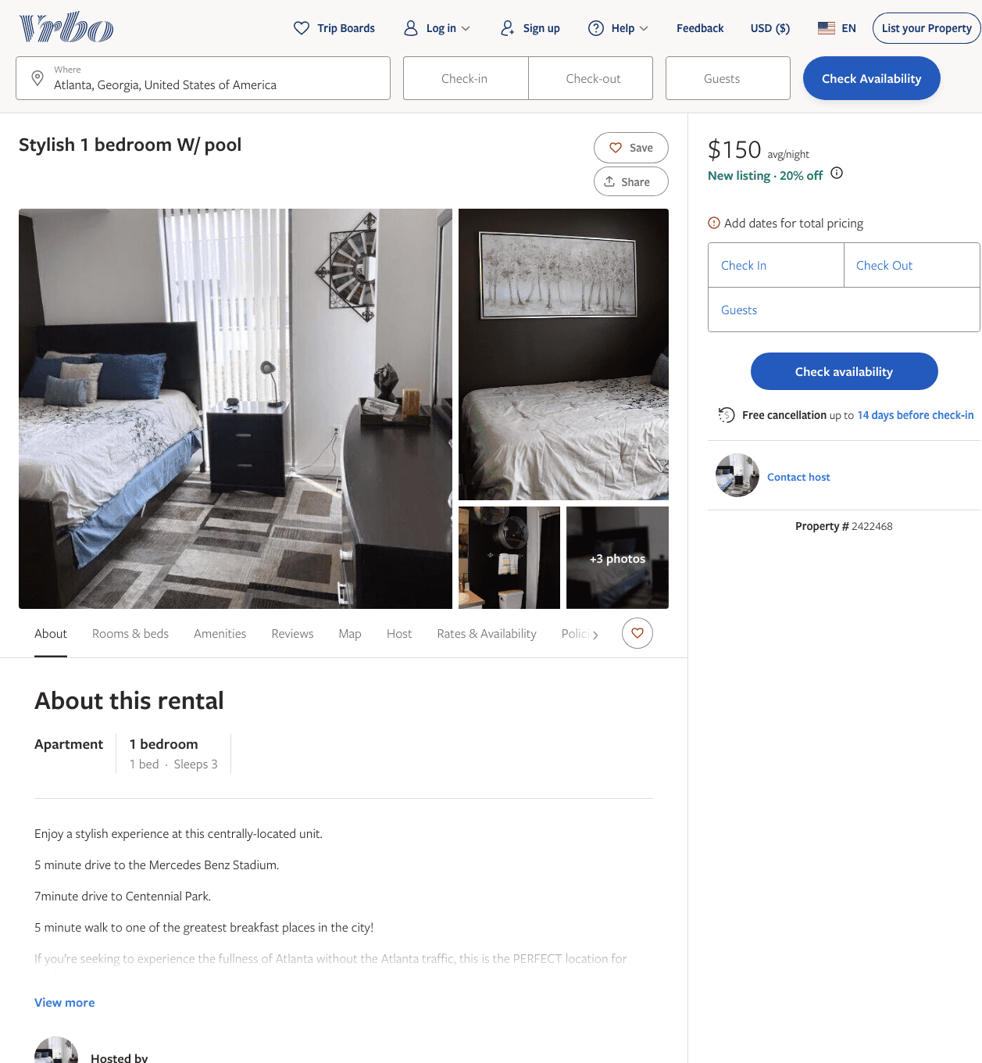
Listing 2422468
1
3
$150
5
1
https://www.vrbo.com/2422468
Aug 2022

Slide 11
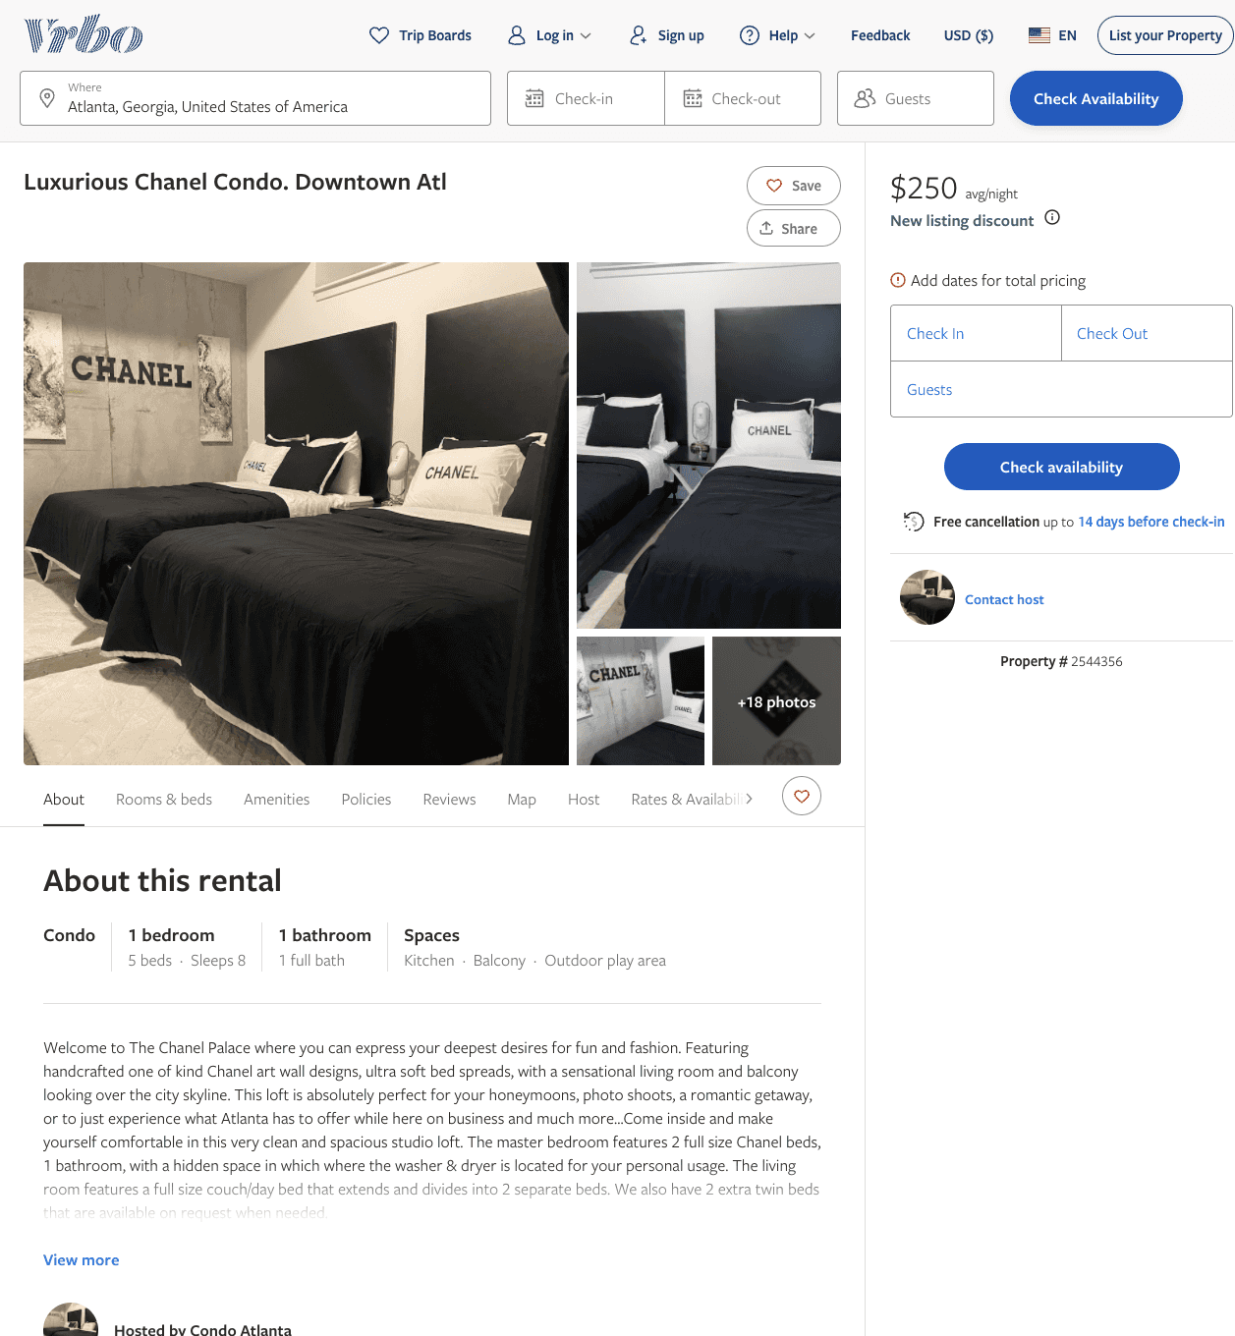
Listing 2544356
1
6
$111 - $250
5
2
Relax and Comfort
https://www.vrbo.com/2544356
Aug 2022

Slide 12
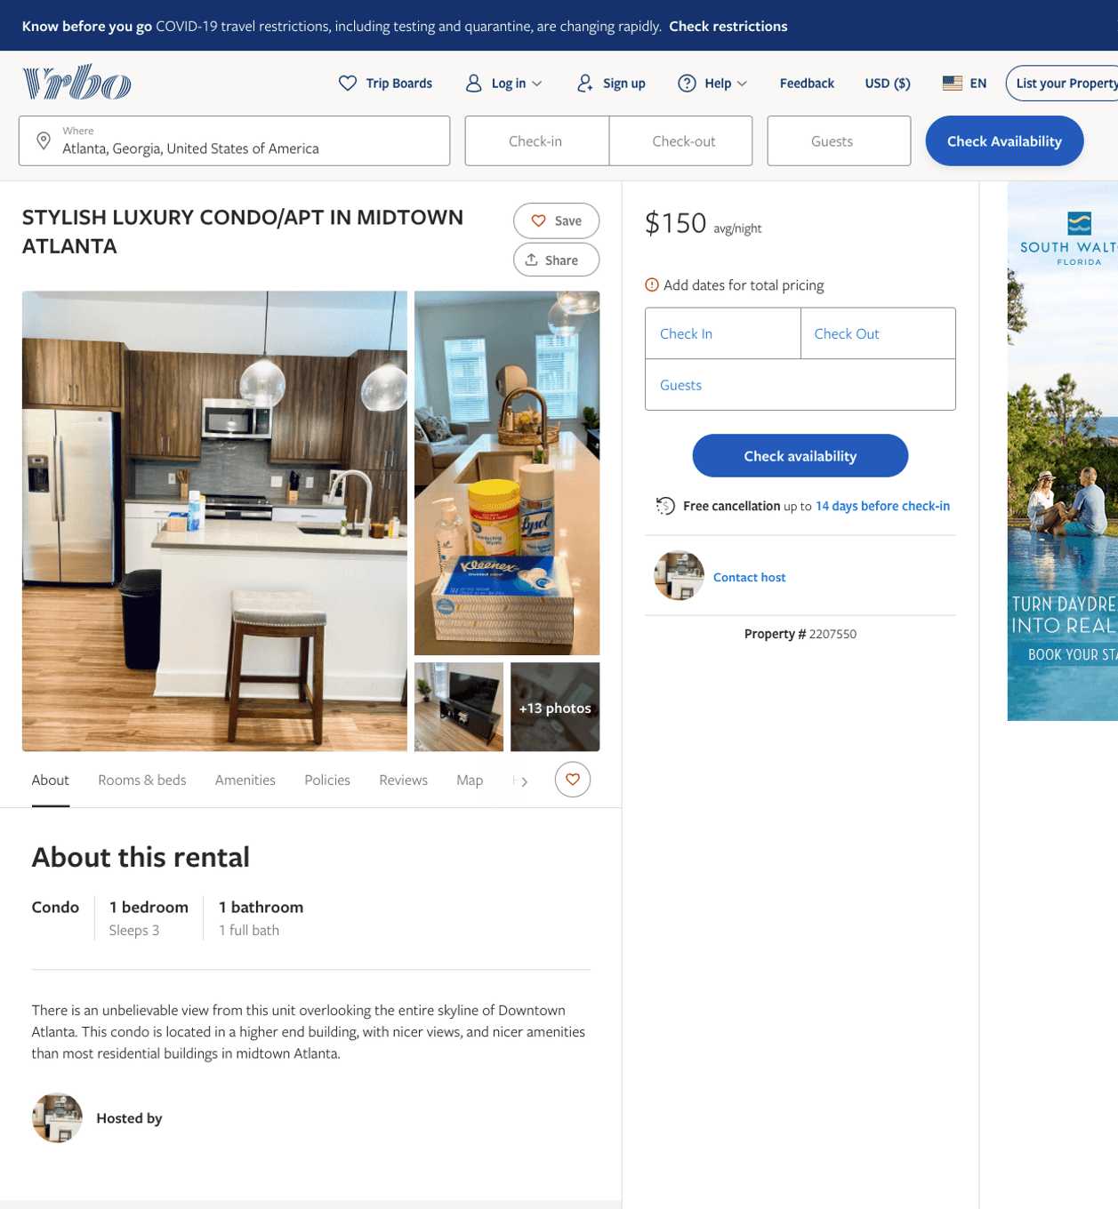
Listing 2207550
2
3
$150
2
https://www.vrbo.com/2207550
Aug 2022

Slide 13
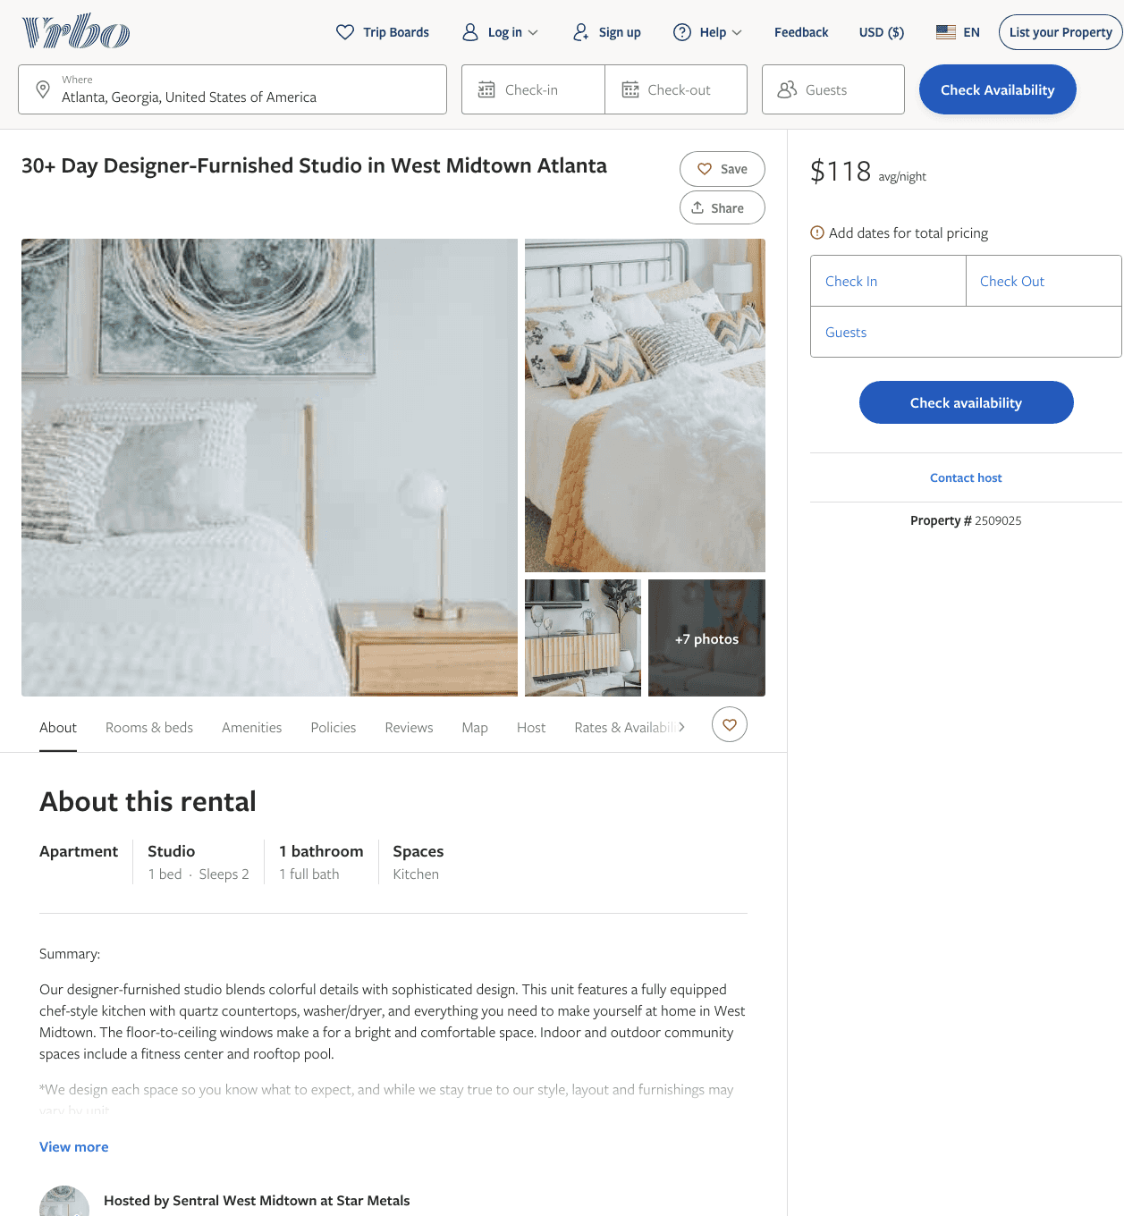
Listing 2509025
0
2
$103 - $91
30
Sentral West Midtown at Star Metals
https://www.vrbo.com/2509025
Aug 2022

Slide 14
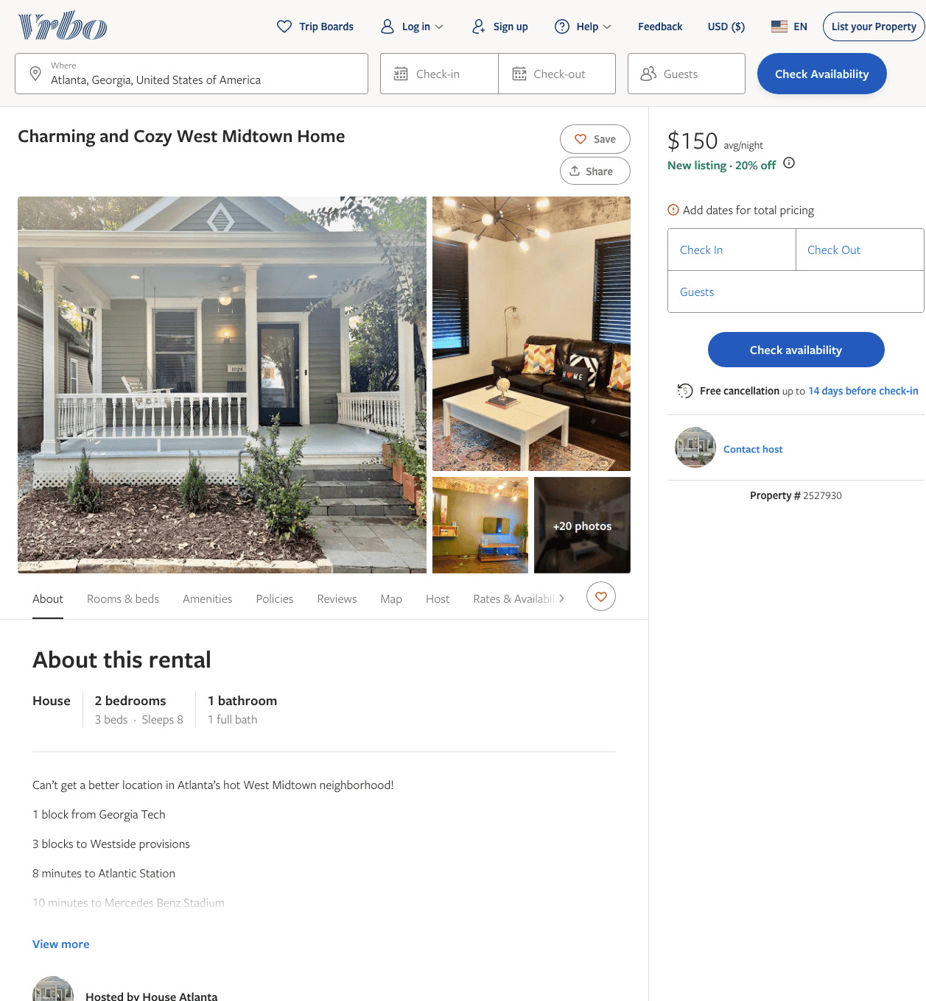
Listing 2527930
2
8
$150 - $173
7
https://www.vrbo.com/2527930
Aug 2022

Slide 15
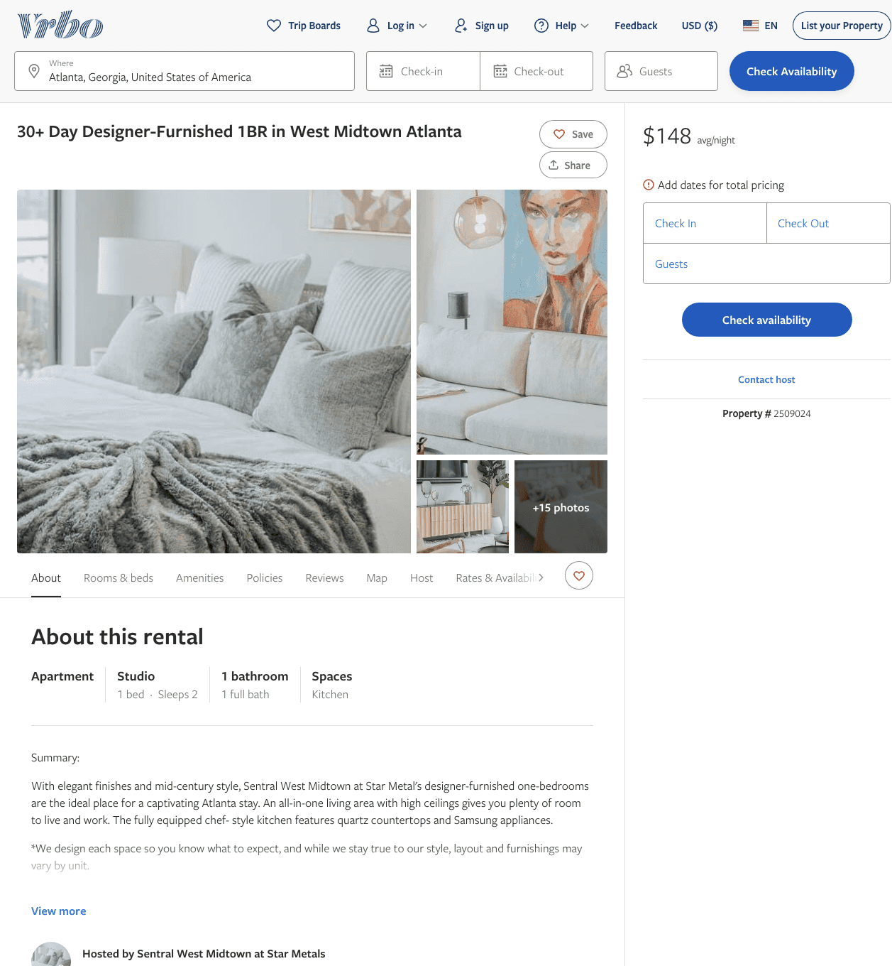
Listing 2509024
0
2
$117 - $151
30
Sentral West Midtown at Star Metals
https://www.vrbo.com/2509024
Aug 2022

Slide 16
Listing 2509026
0
2
$113 - $151
30
Sentral West Midtown at Star Metals
https://www.vrbo.com/2509026
Aug 2022

Slide 17
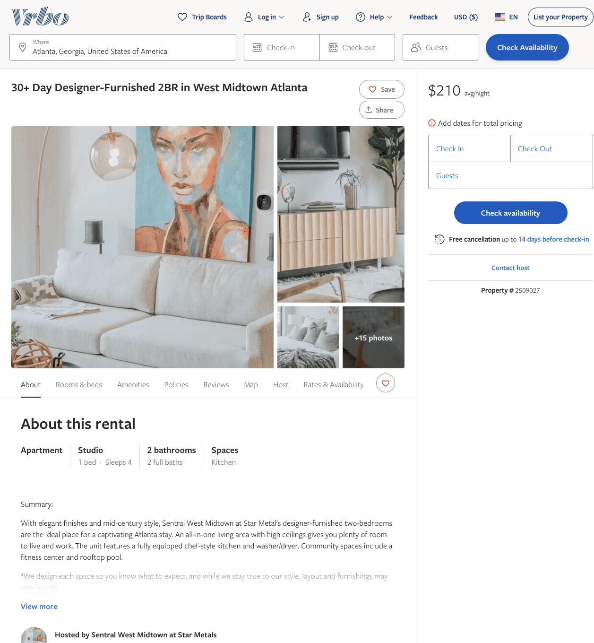
Listing 2509027
0
4
$140 - $212
30
Sentral West Midtown at Star Metals
https://www.vrbo.com/2509027
Aug 2022

Slide 18
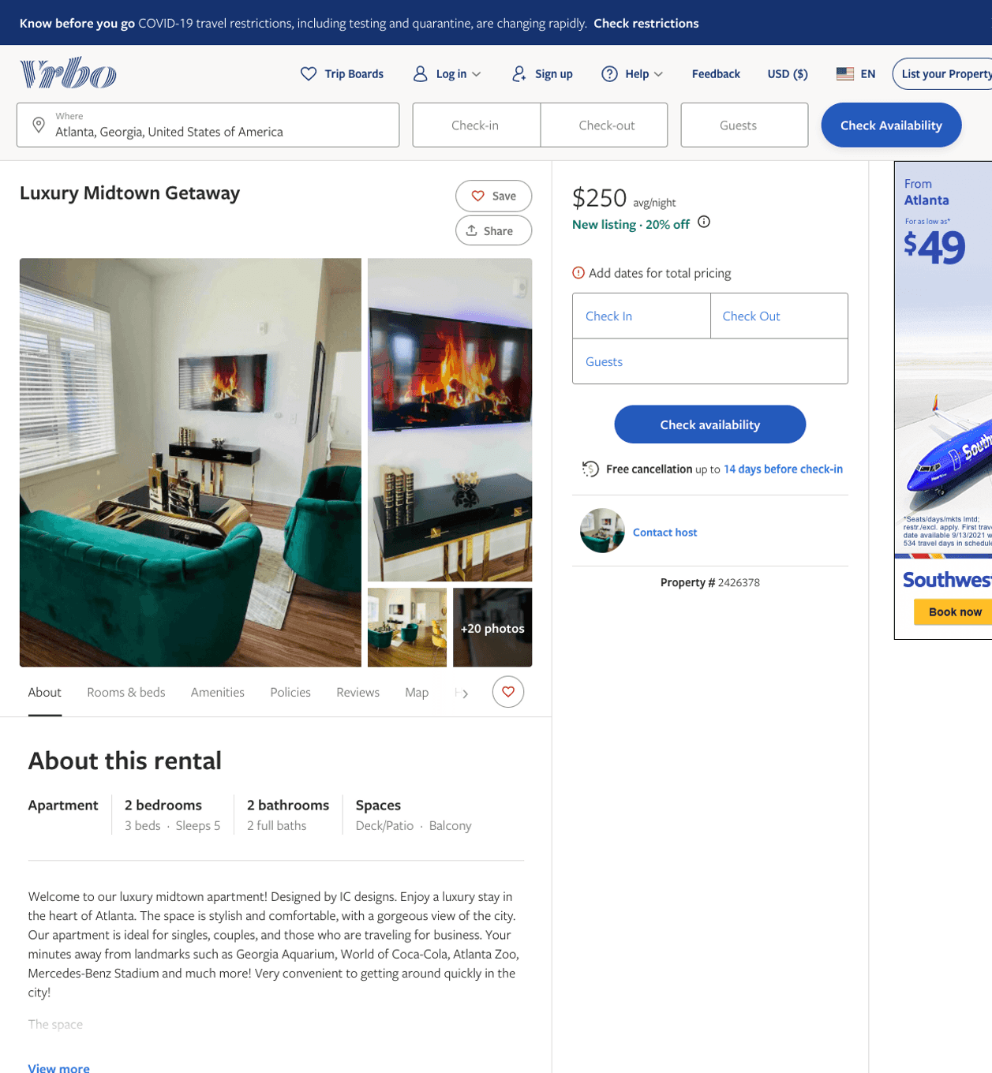
Listing 2426378
2
5
$250
3
https://www.vrbo.com/2426378
Aug 2022

Slide 19
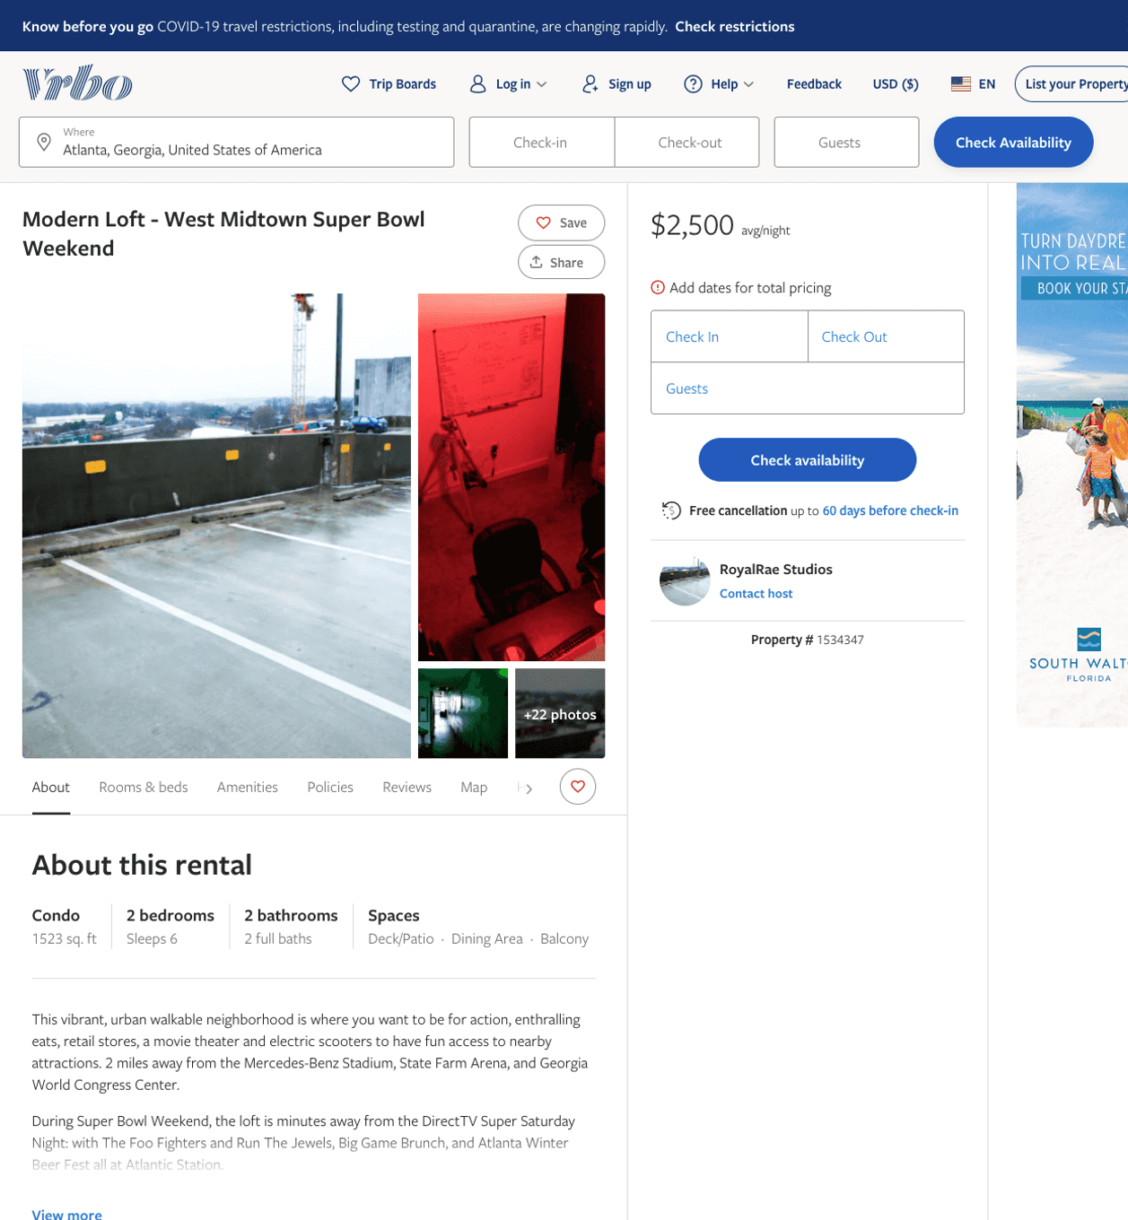
Listing 1534347
2
6
$2,500
2
RoyalRae Studios
https://www.vrbo.com/1534347
Aug 2022

Slide 20
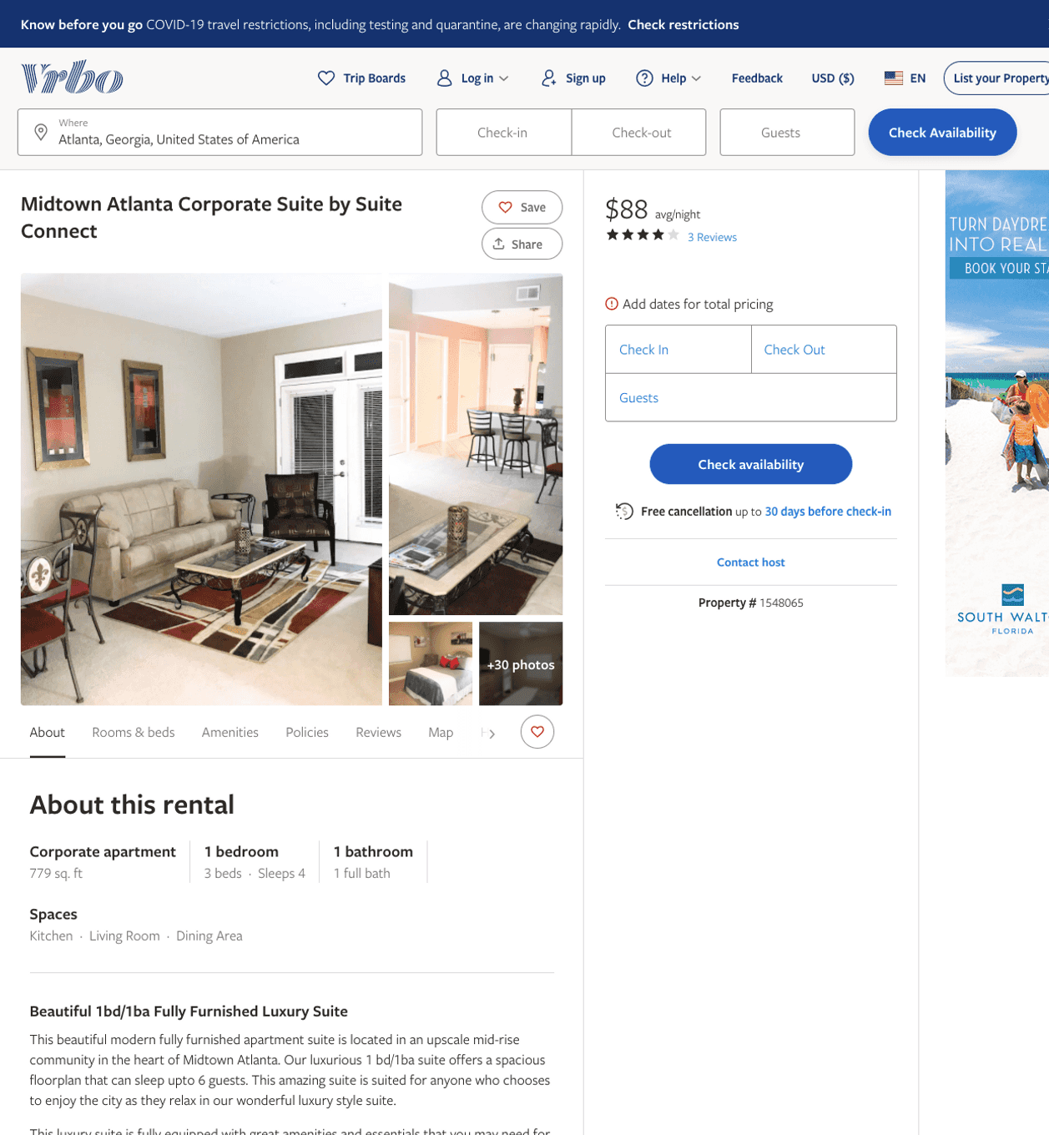
Listing 1548065
1
4
$152 - $88
4
1
Suite Connect
https://www.vrbo.com/1548065
Aug 2022

Slide 21
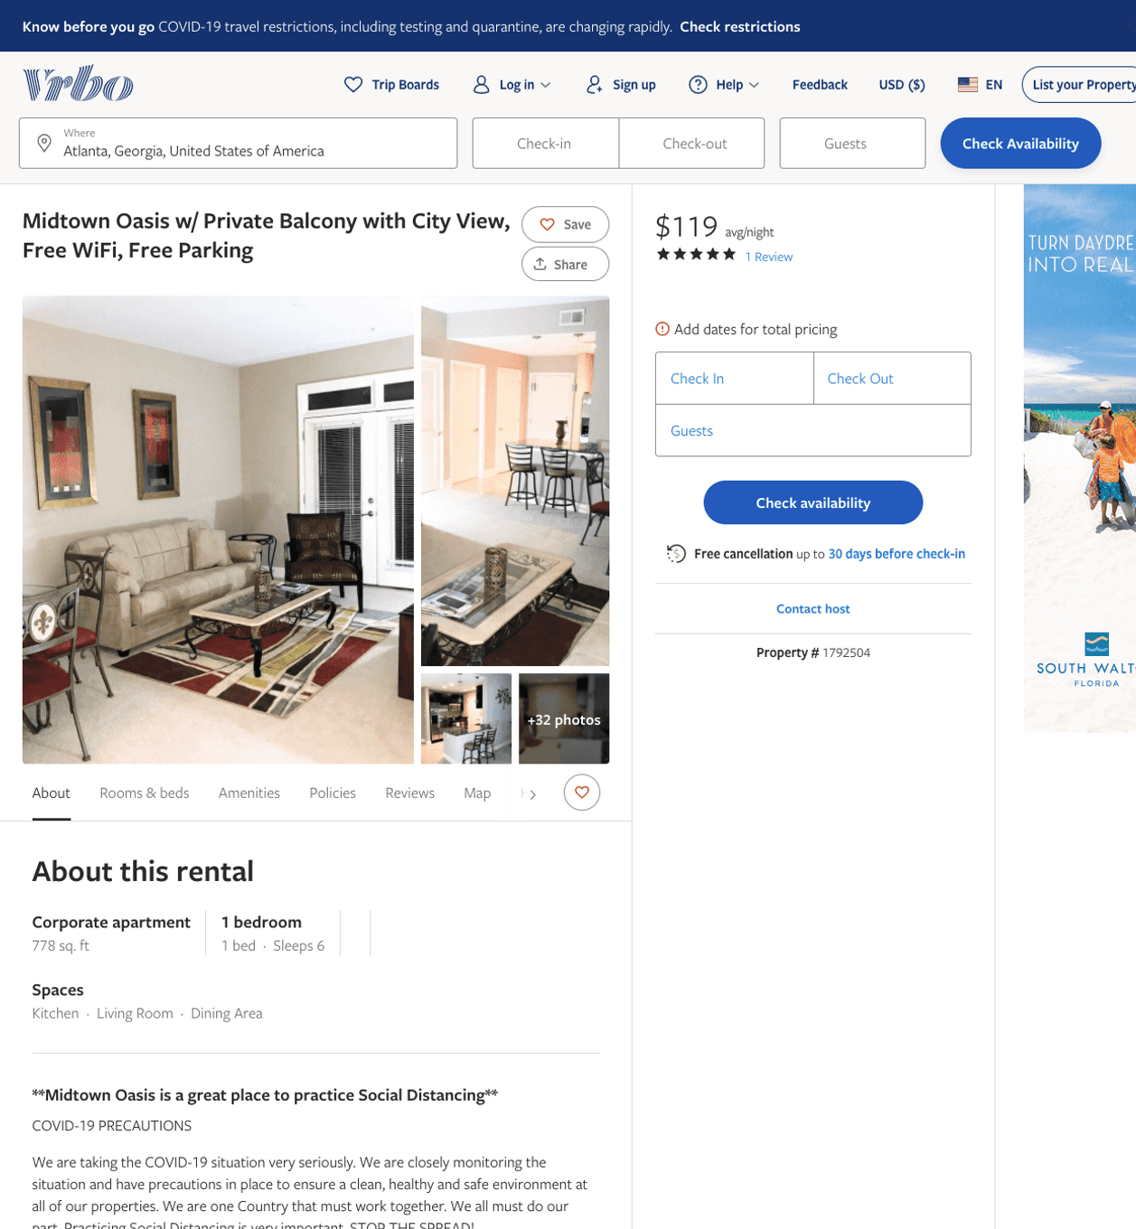
Listing 1792504
1
4
$107 - $162
5
1
Suite Connect
https://www.vrbo.com/1792504
Aug 2022

Slide 22
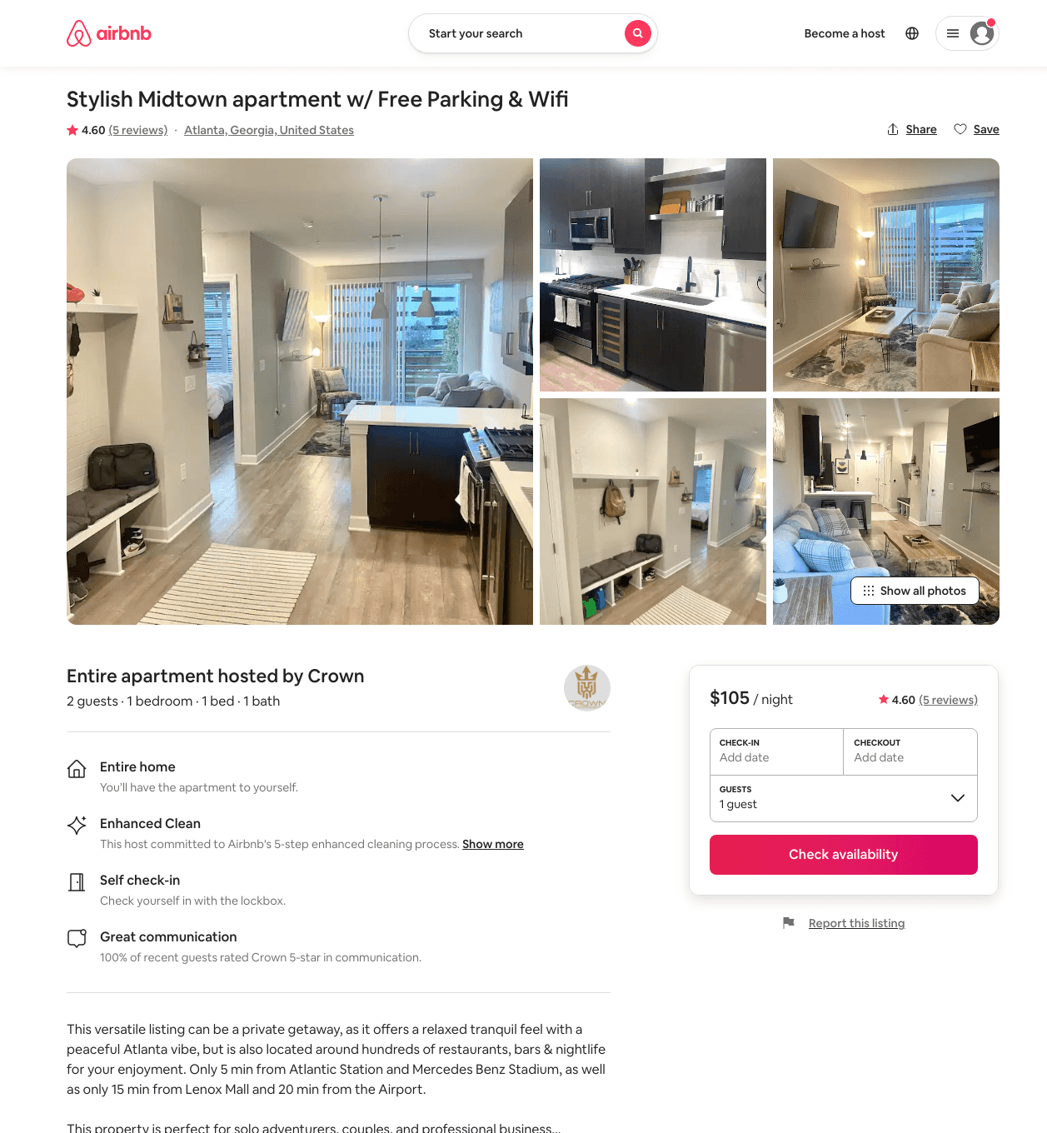
Listing 49199059
1
2
$91 - $149
4.79
2
Crown
297493854
1
https://www.airbnb.com/rooms/49199059
Aug 2022

Slide 23
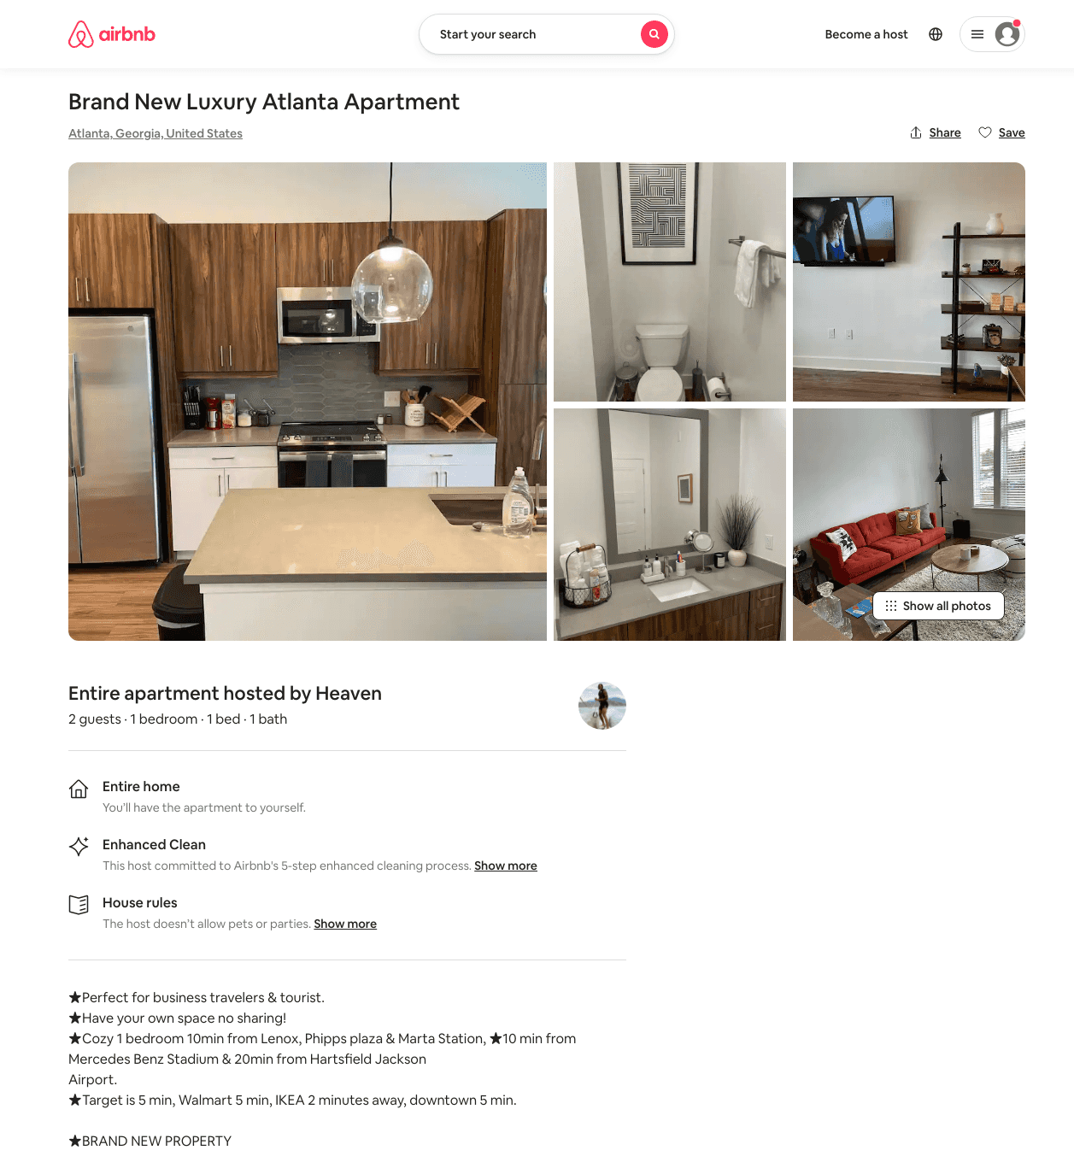
Listing 49710005
1
3
$64 - $250
4.98
2
Heaven
46718151
1
https://www.airbnb.com/rooms/49710005
Jun 2022

Slide 24
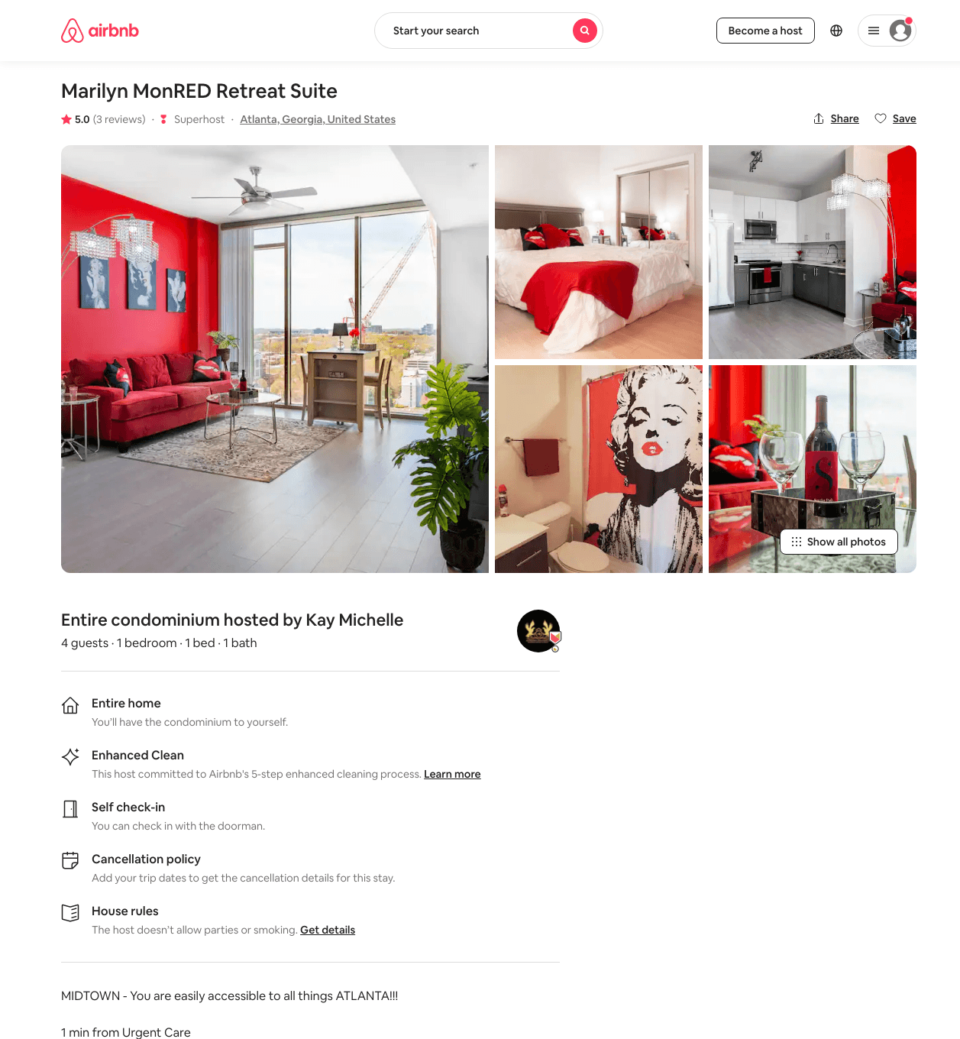
Listing 48831281
1
4
$77 - $149
4.81
1
Kay Michelle
313383699
4
https://www.airbnb.com/rooms/48831281
Aug 2022

Slide 25
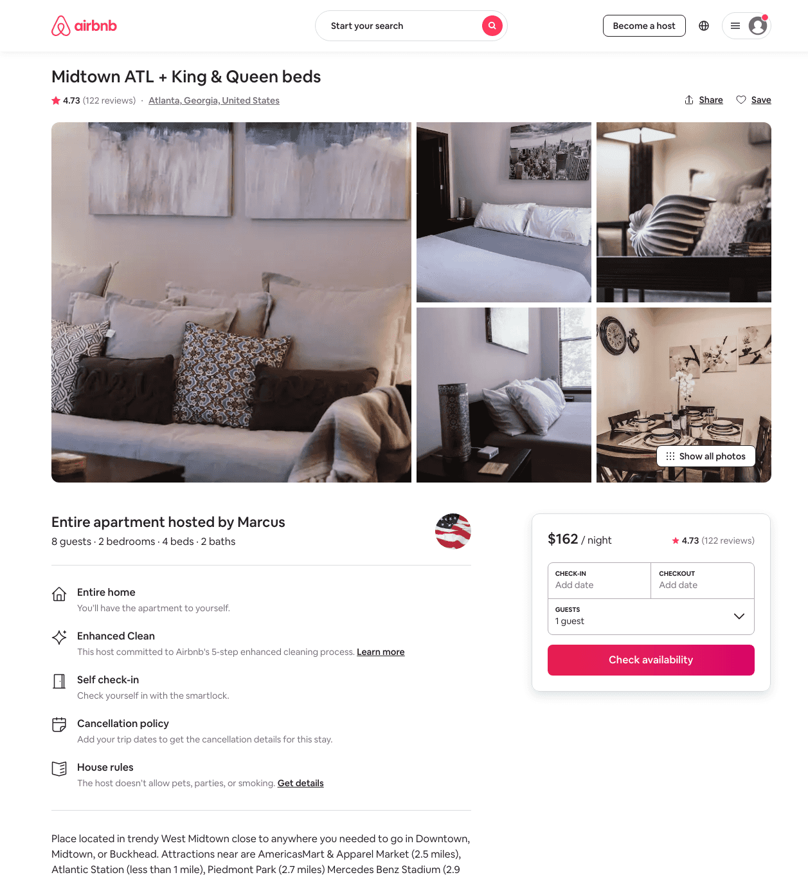
Listing 25123355
2
8
$99 - $172
4.69
1
Marcus
39818421
5
https://www.airbnb.com/rooms/25123355
Aug 2022

Slide 26
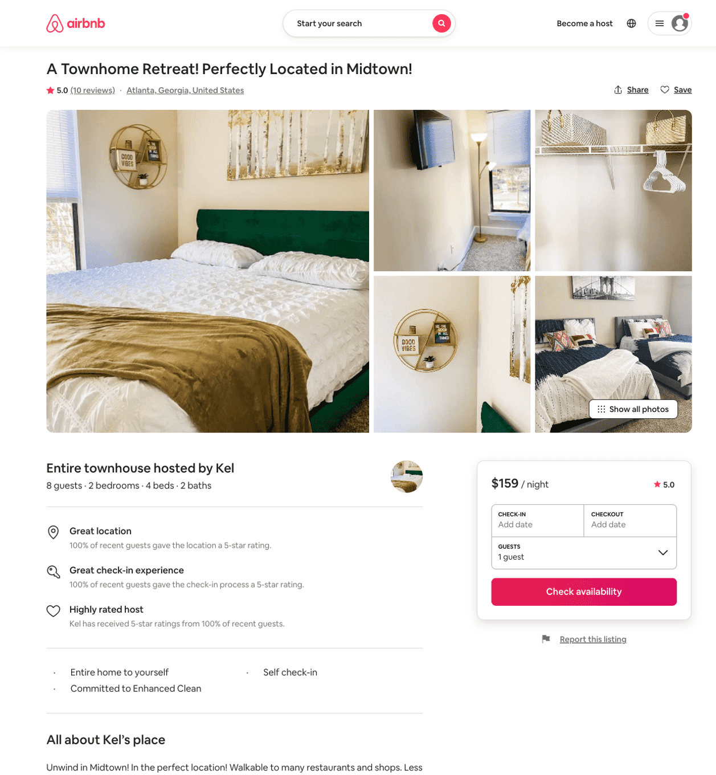
Listing 47319406
2
8
$121 - $389
4.70
1
Kel
304963179
1
https://www.airbnb.com/rooms/47319406
Aug 2022

Slide 27
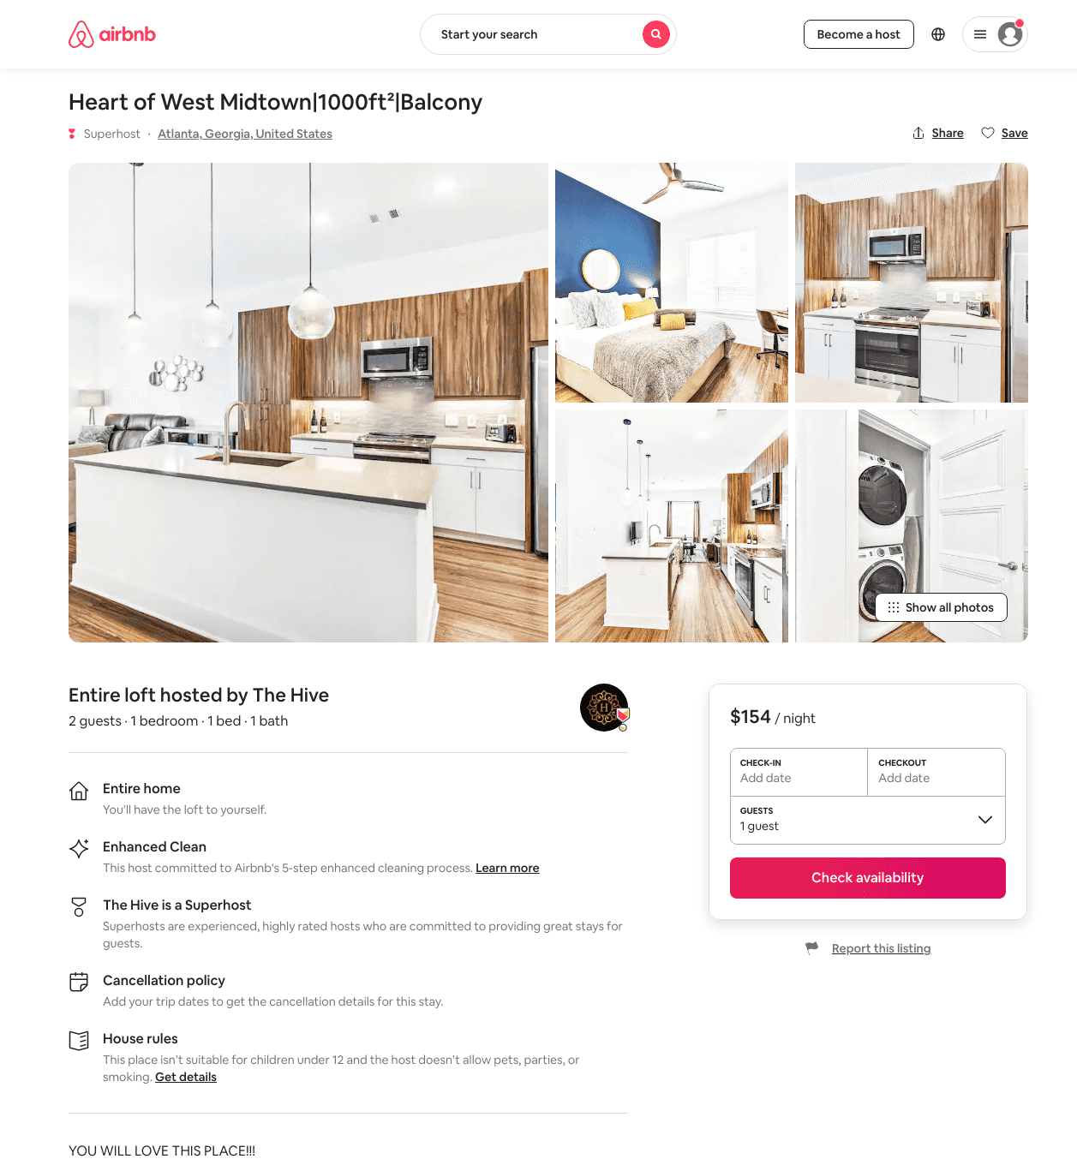
Listing 48941955
1
2
$106 - $171
4.77
1
The Hive
295549667
5
https://www.airbnb.com/rooms/48941955
Aug 2022

Slide 28
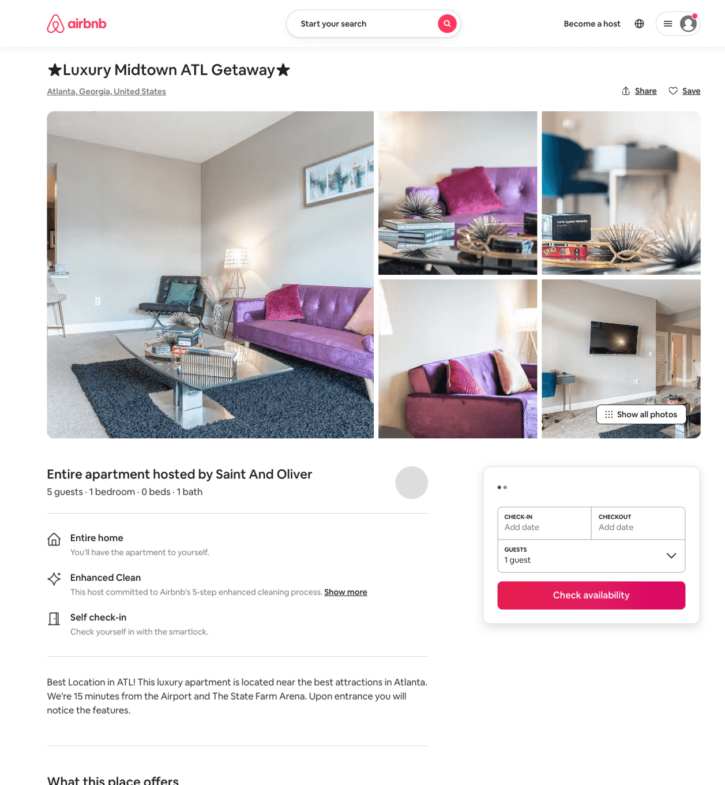
Listing 50680038
643 10TH ST NW
1
5
$59 - $132
4.63
27
Saint And Oliver
360546605
1
https://www.airbnb.com/rooms/50680038
Aug 2022

Slide 29
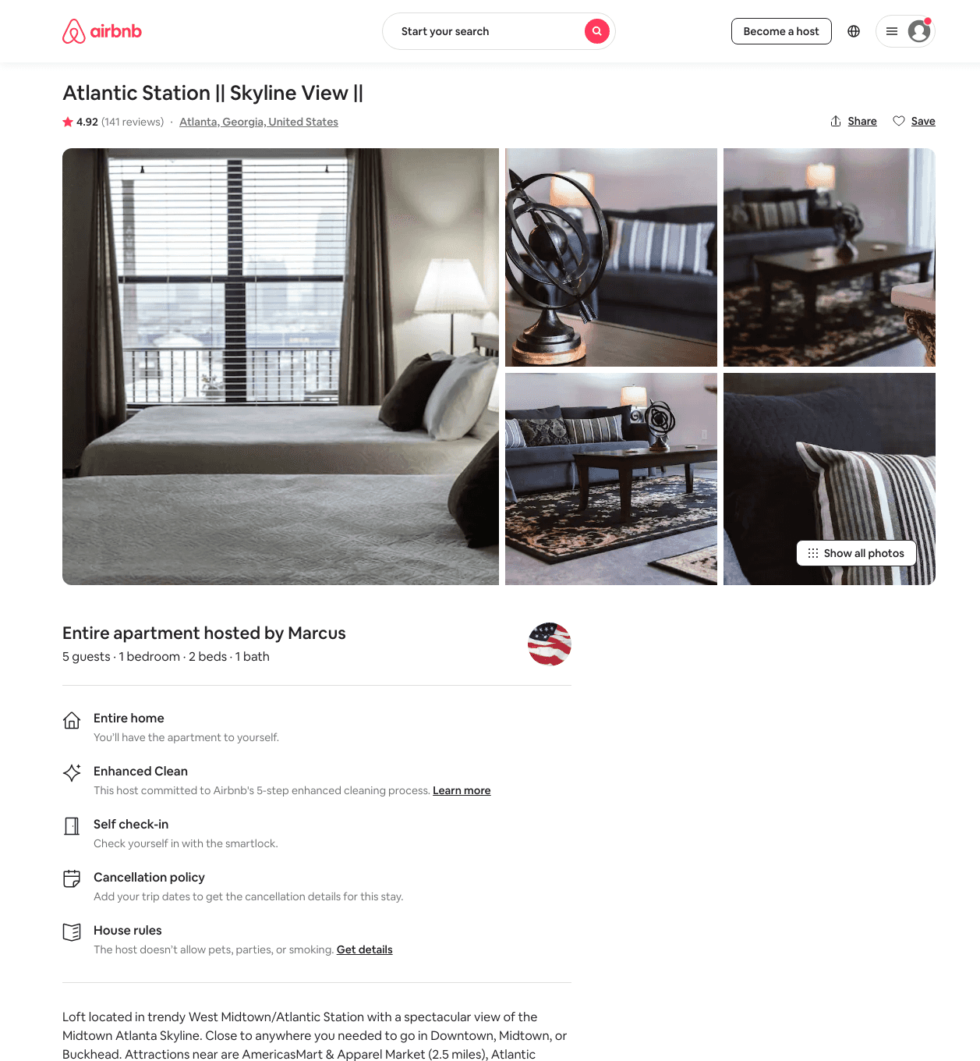
Listing 21370032
1
5
$79 - $147
4.86
3
Marcus
39818421
5
https://www.airbnb.com/rooms/21370032
Jul 2022

Slide 30
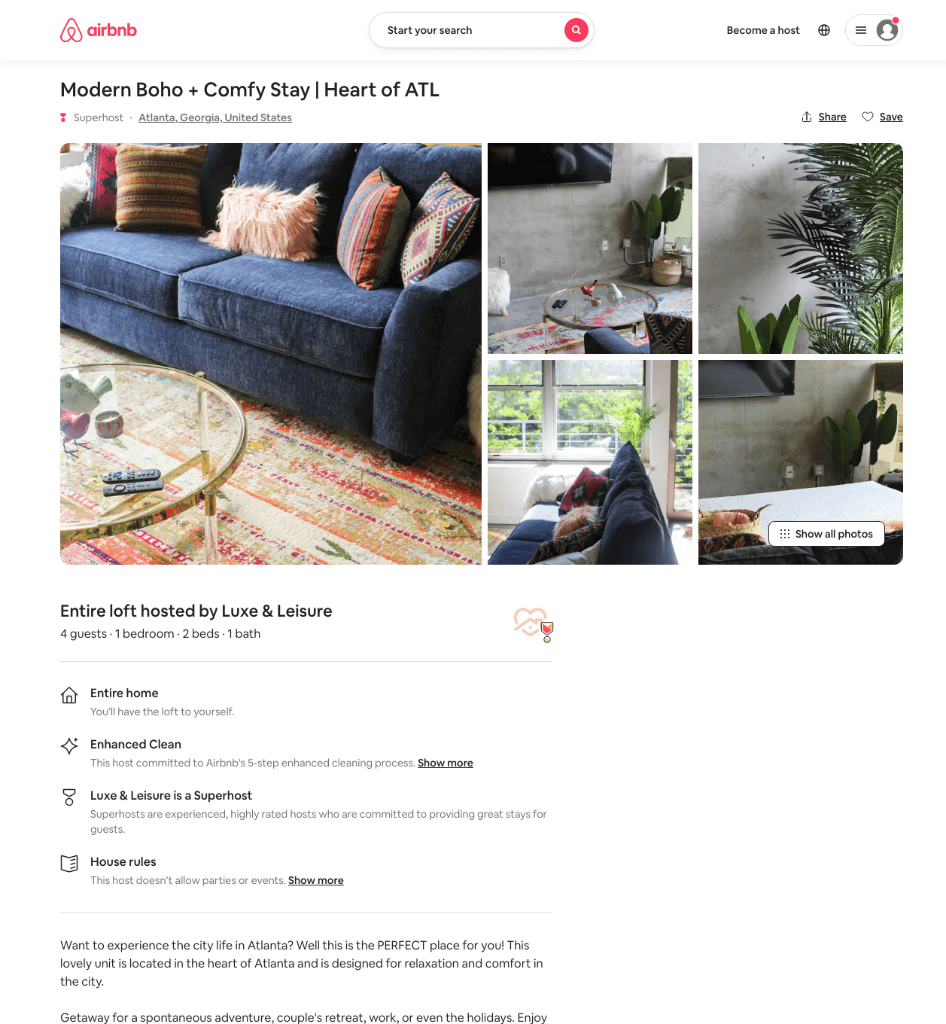
Listing 49810465
1016 HOWELL MILL RD NW
1
4
$100 - $161
4.96
2
Luxe & Leisure
235673403
1
https://www.airbnb.com/rooms/49810465
Aug 2022

Slide 31
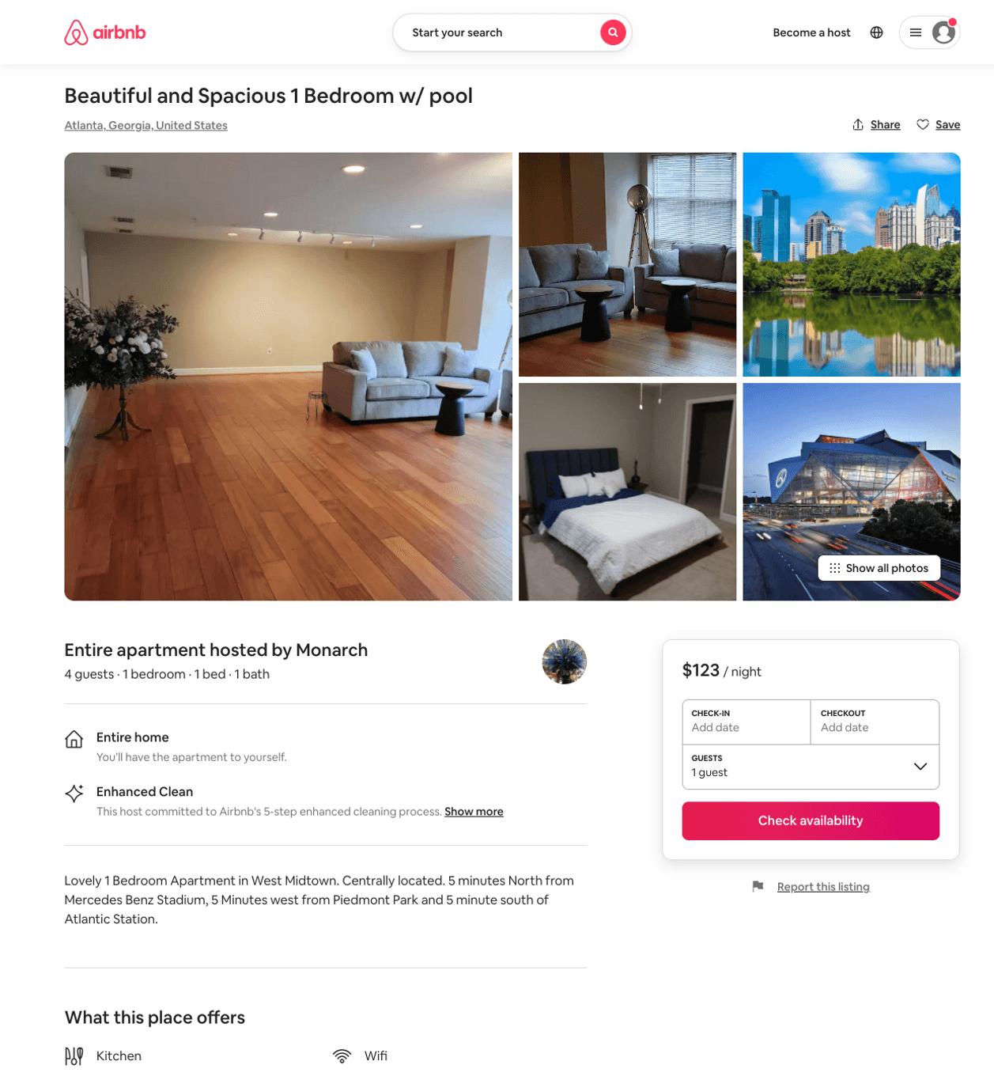
Listing 50543824
643 10TH ST NW
1
4
$107 - $214
4.50
2
Elegant
408350374
1
https://www.airbnb.com/rooms/50543824
Aug 2022

Slide 32
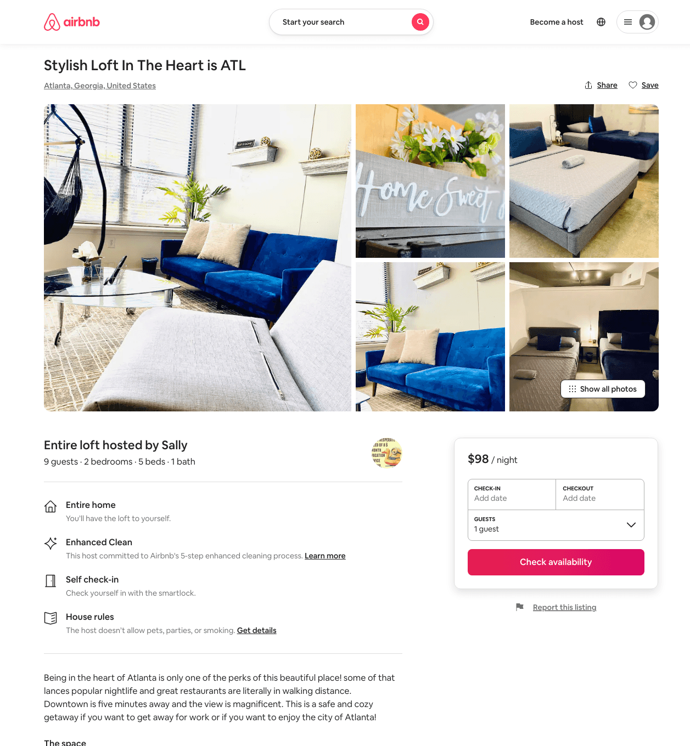
Listing 49036693
2
8
$81 - $3623
4.49
1
Avanna
111469086
6
https://www.airbnb.com/rooms/49036693
Aug 2022

Slide 33
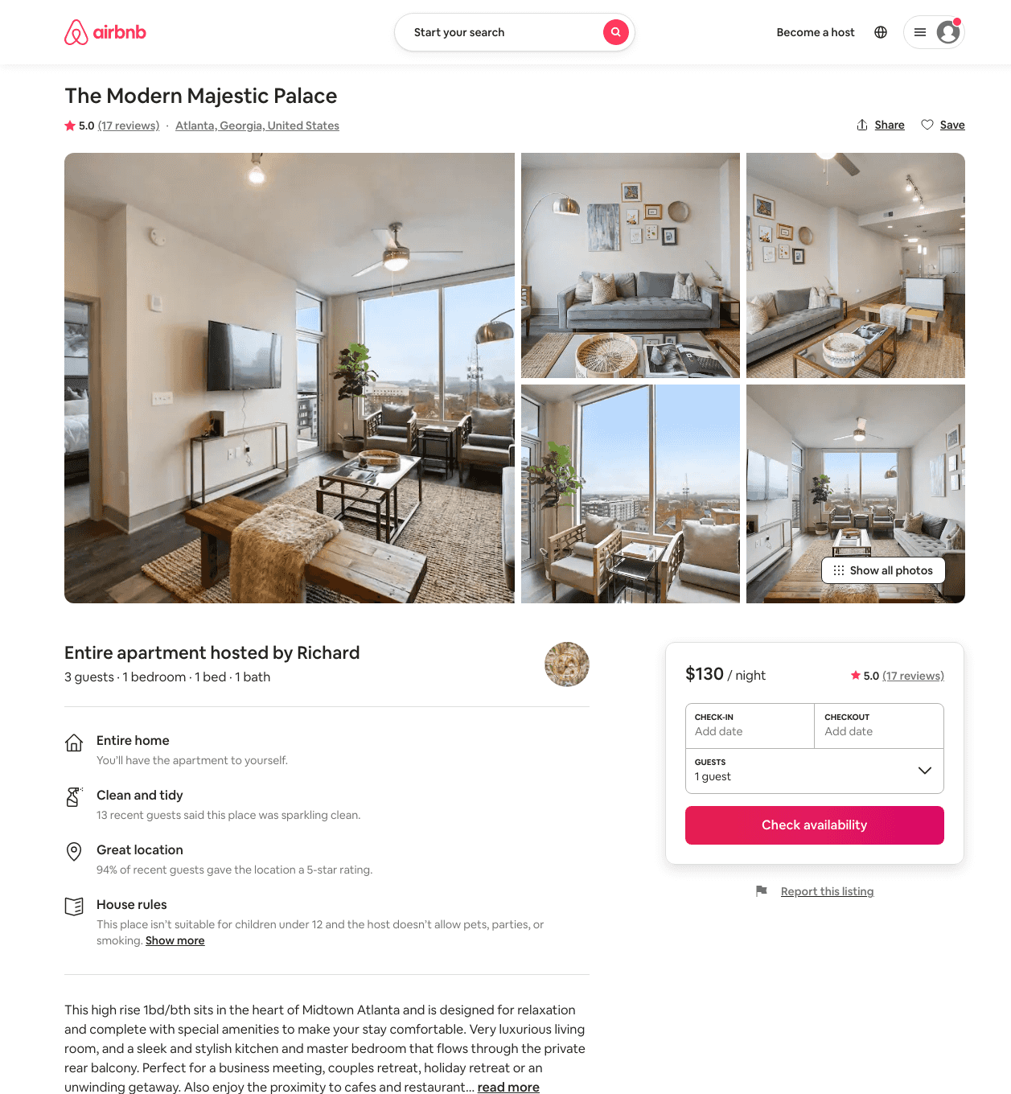
Listing 47214895
1
3
$104 - $162
4.67
1
Richard
309516005
5
https://www.airbnb.com/rooms/47214895
Jun 2022

Slide 34
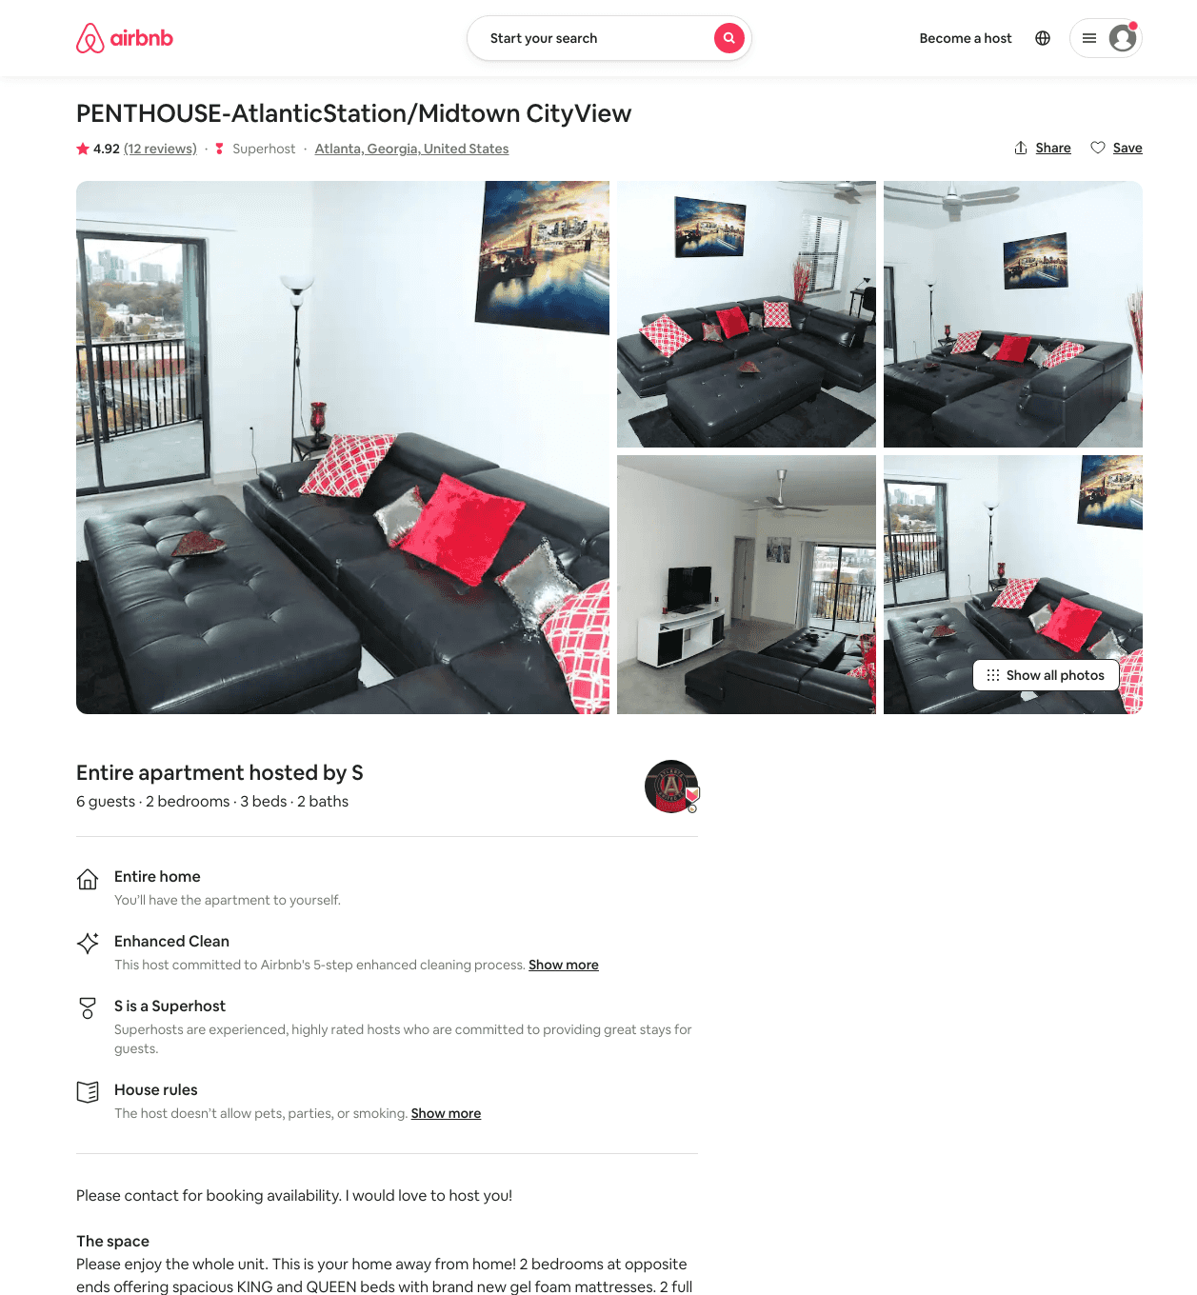
Listing 18877811
2
6
$599
4.92
14
Kevin
131544161
1
https://www.airbnb.com/rooms/18877811
Aug 2022

Slide 35
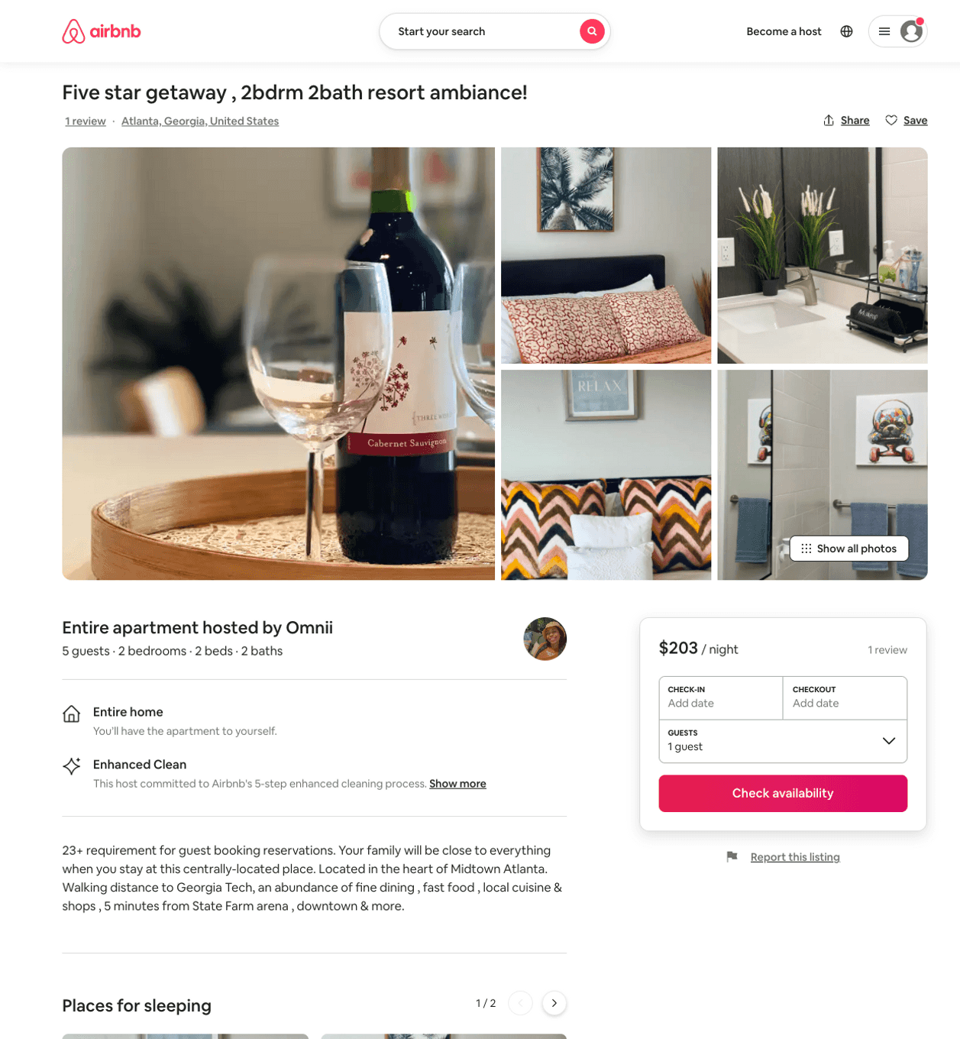
Listing 50751683
2
5
$141 - $378
5.0
2
Ohm
349480669
1
https://www.airbnb.com/rooms/50751683
Aug 2022

Slide 36
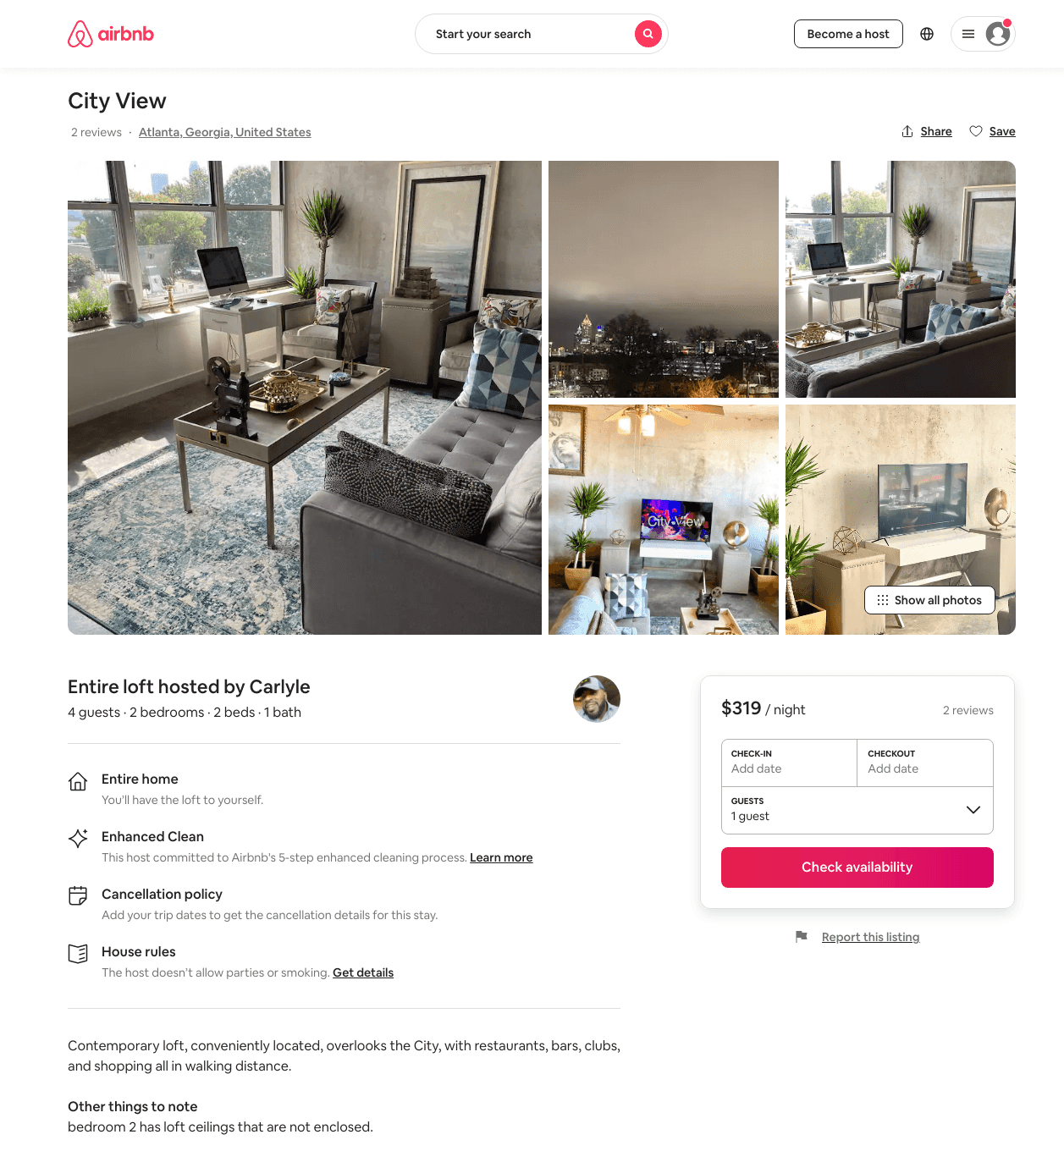
Listing 47359779
2
4
$229 - $379
3
Carlyle
287983672
1
https://www.airbnb.com/rooms/47359779
Aug 2022

Slide 37
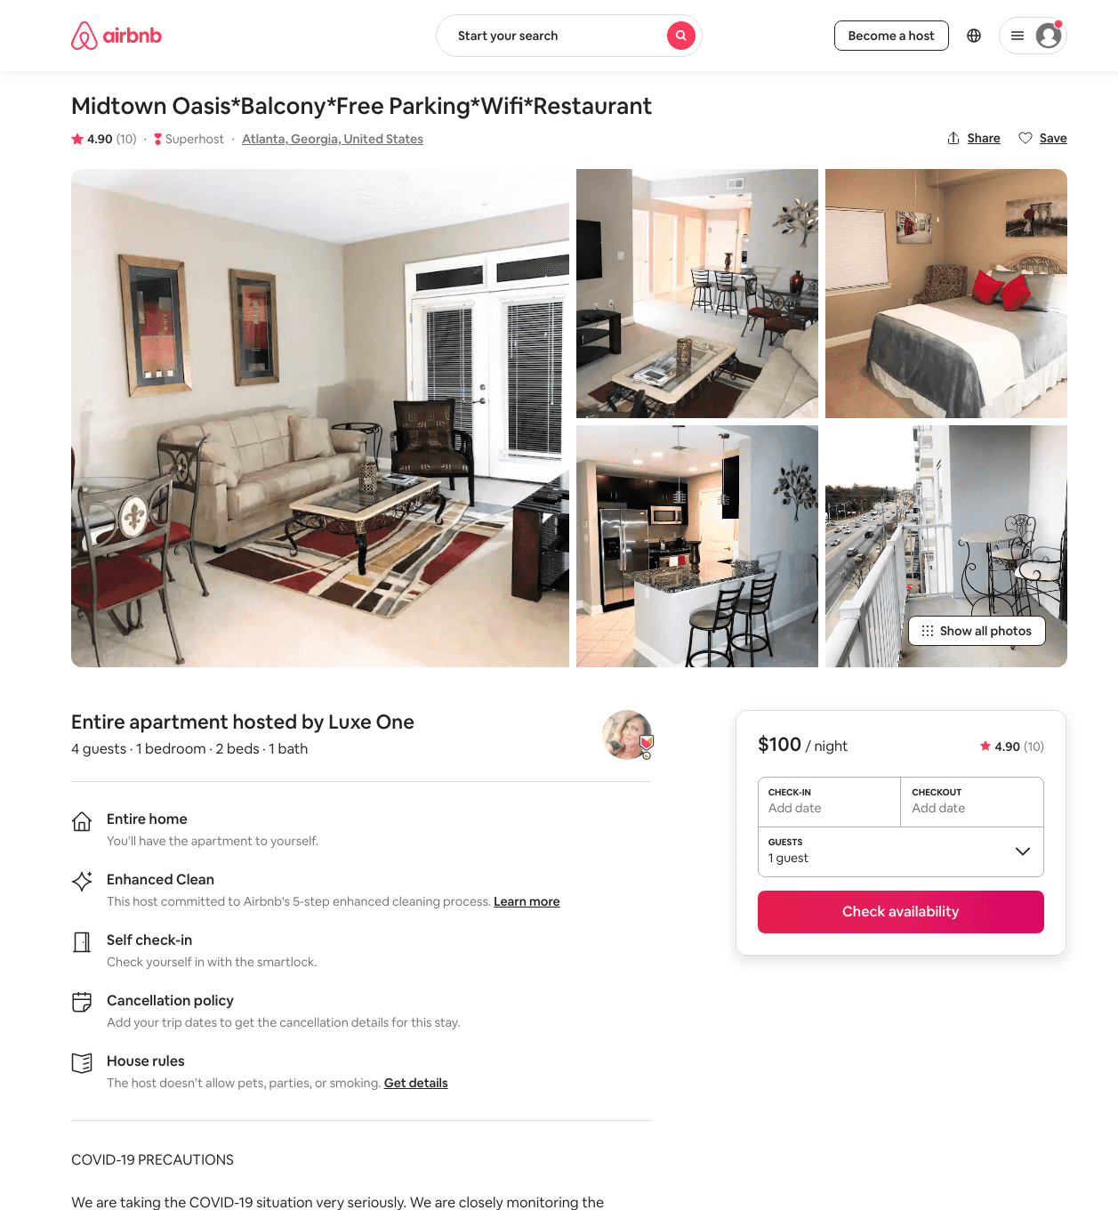
Listing 31719287
1
5
$100 - $350
4.90
1
Luxe One
139621289
14
https://www.airbnb.com/rooms/31719287
Aug 2022

Slide 38
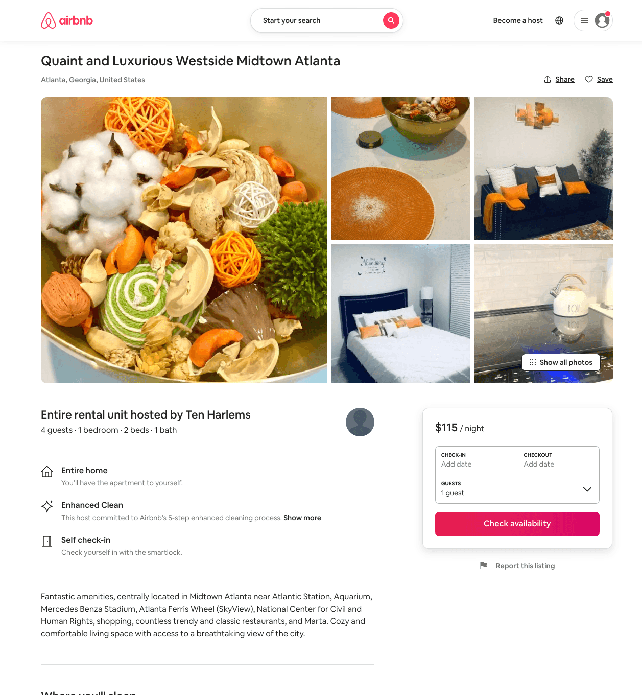
Listing 51088344
1
4
$95 - $125
4.44
1
Ten Harlems
389103599
2
https://www.airbnb.com/rooms/51088344
Aug 2022

Slide 39
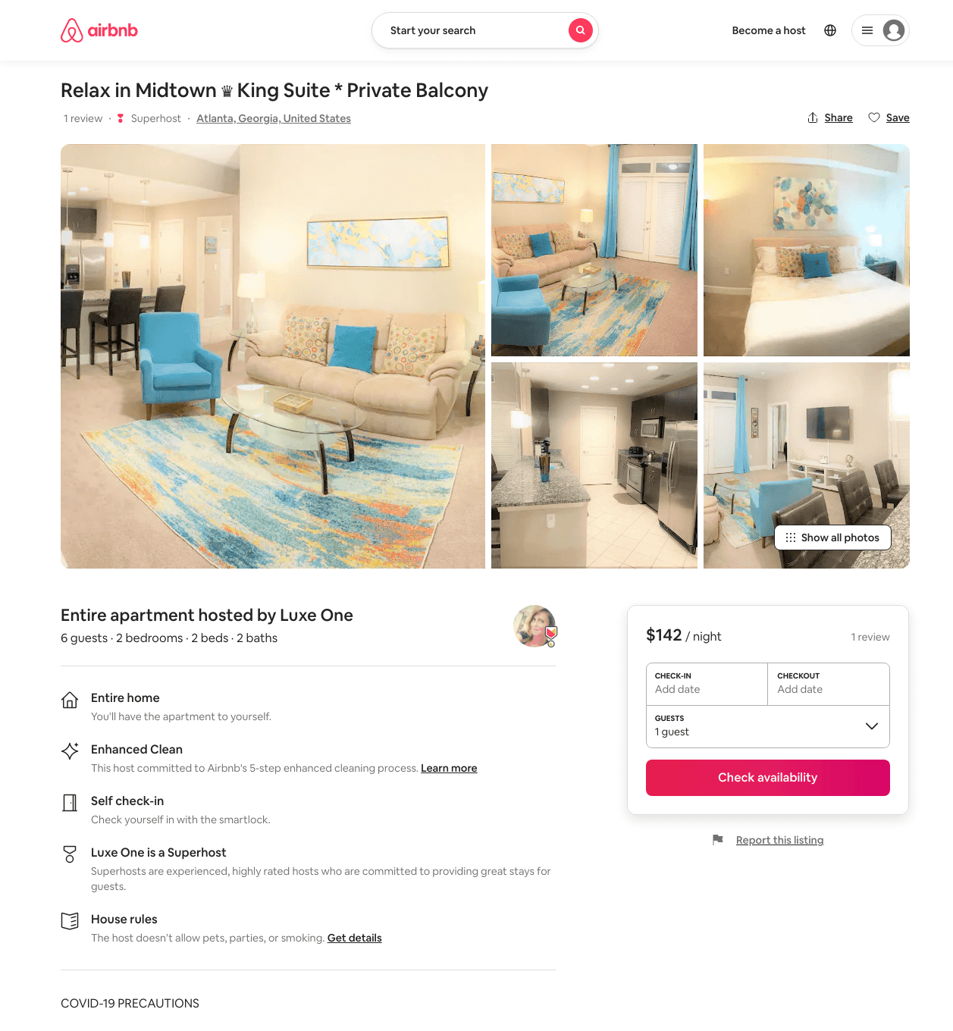
Listing 48210736
643 10TH ST NW
2
4
$111 - $158
4.93
1
Luxe One
139621289
14
https://www.airbnb.com/rooms/48210736
Jun 2022

Slide 40
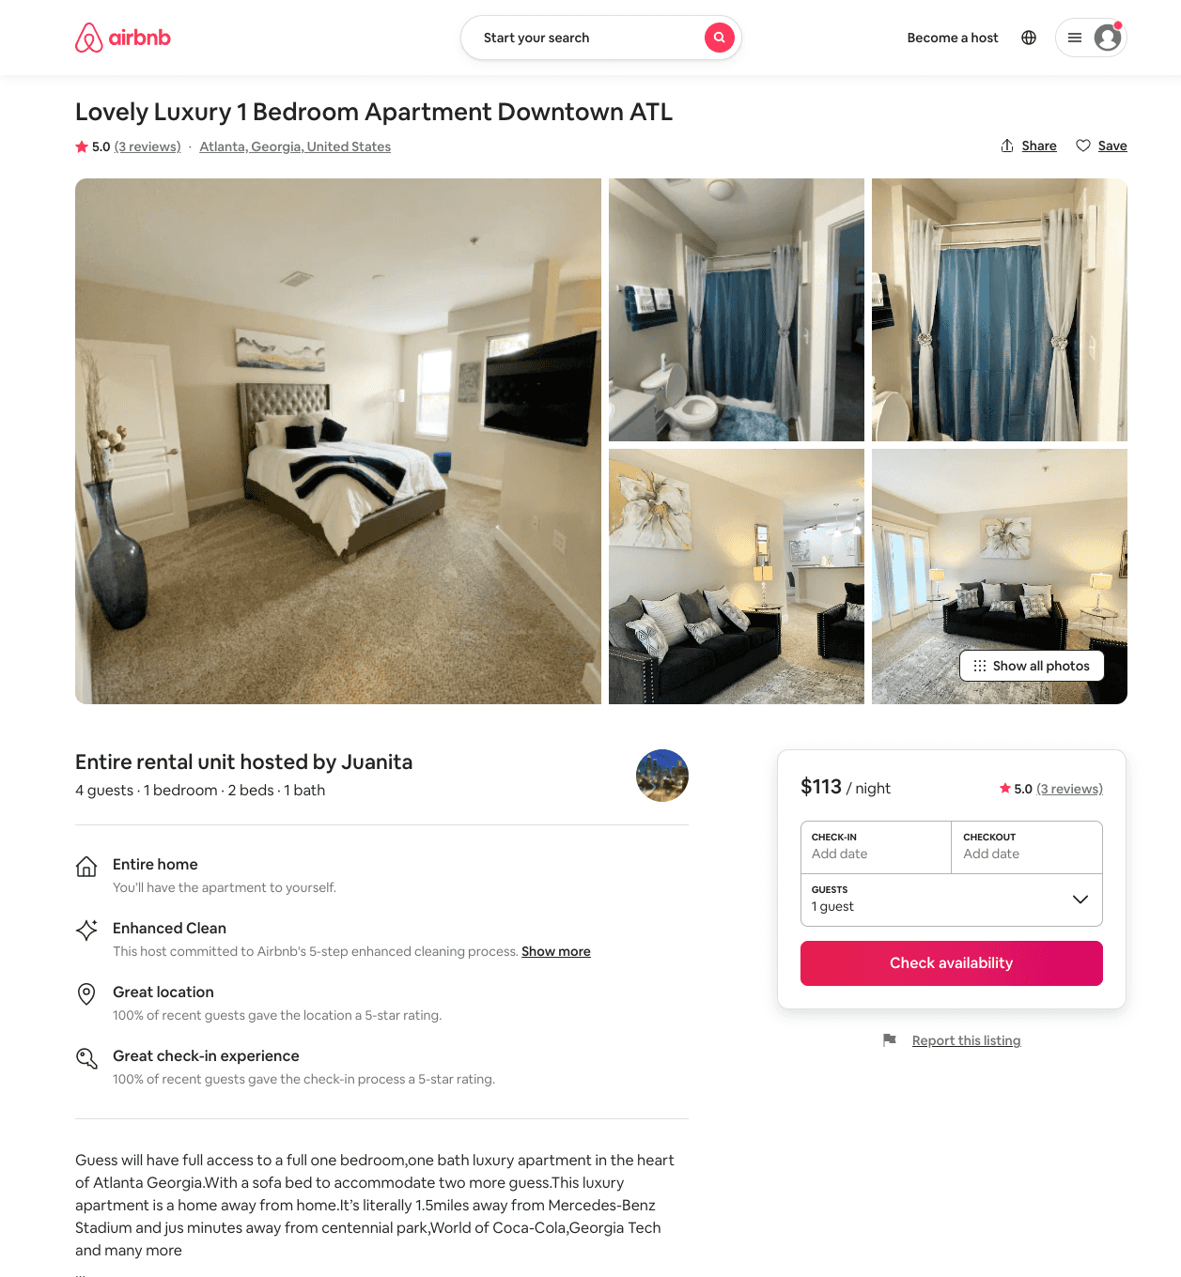
Listing 50923159
1
4
$90 - $158
4.80
1
Juanita
411789283
1
https://www.airbnb.com/rooms/50923159
Jul 2022

Slide 41
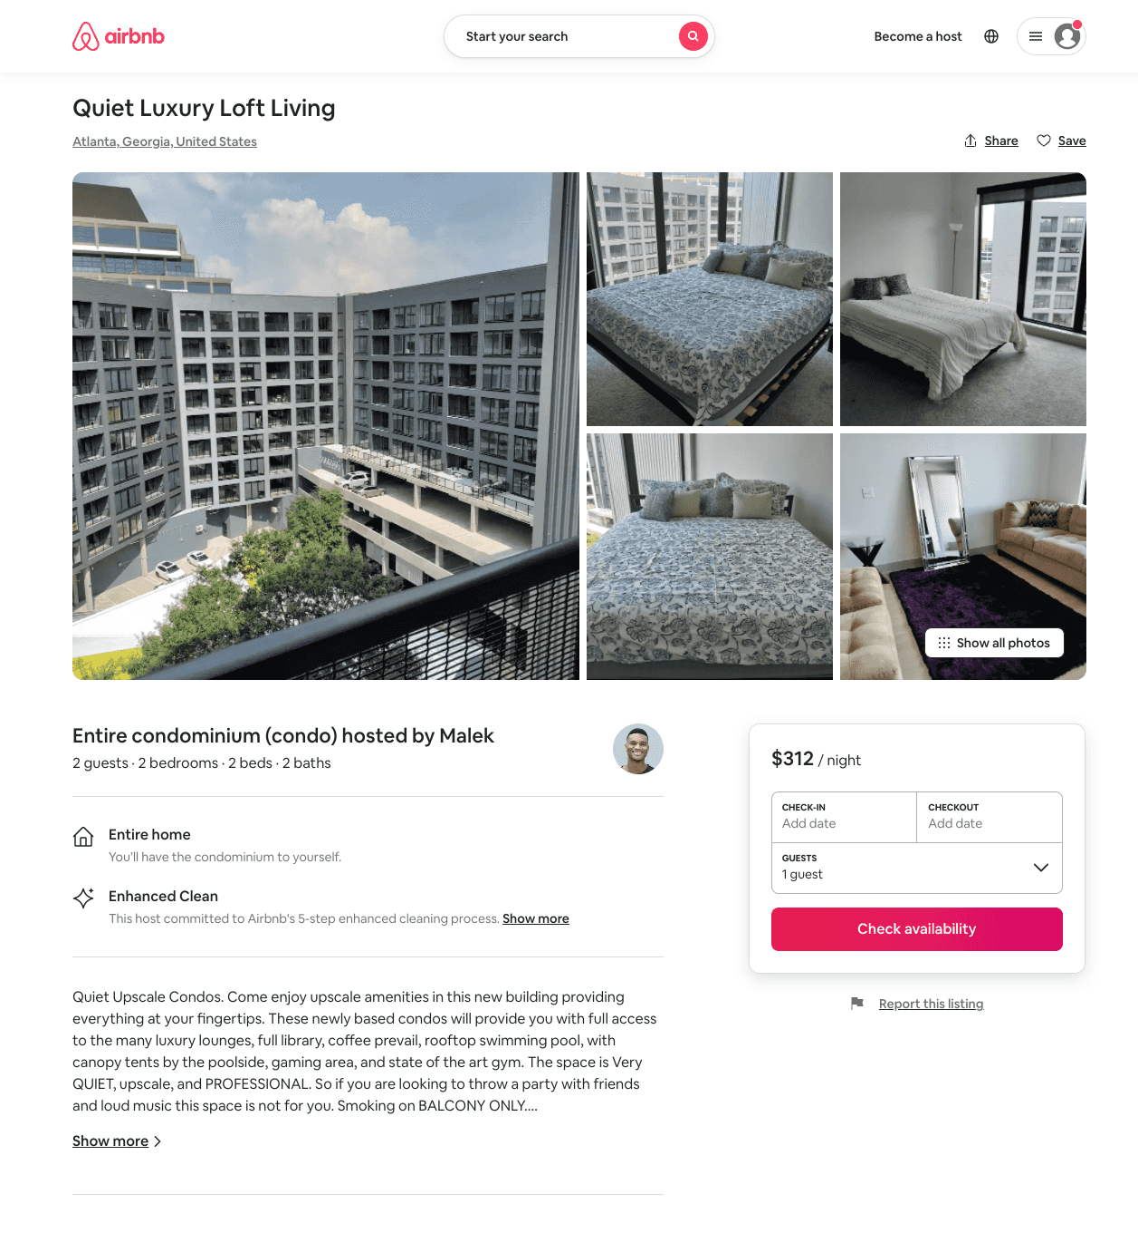
Listing 21268379
2
1
$100 - $200
5.0
3
Malek
140099008
2
https://www.airbnb.com/rooms/21268379
Aug 2022

Slide 42
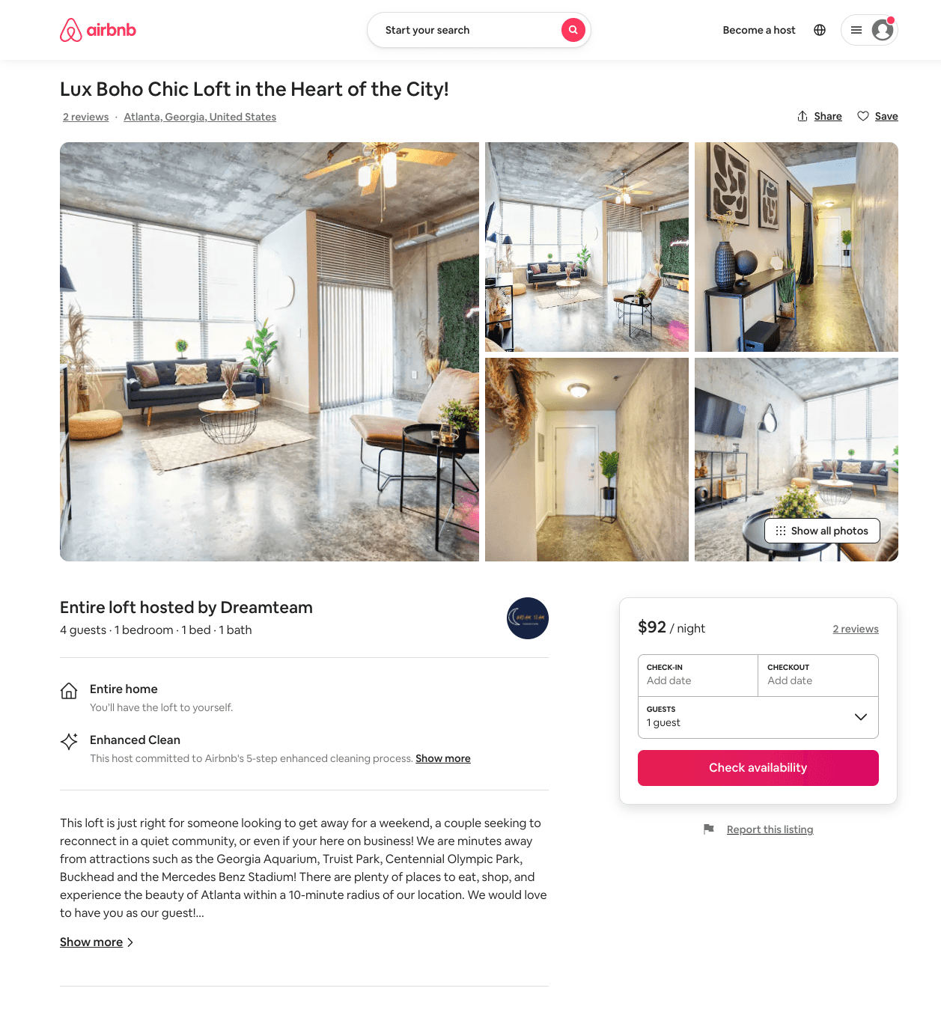
Listing 51131499
1
4
$89 - $169
4.73
1
Dreamteam
413791223
1
https://www.airbnb.com/rooms/51131499
Aug 2022

Slide 43
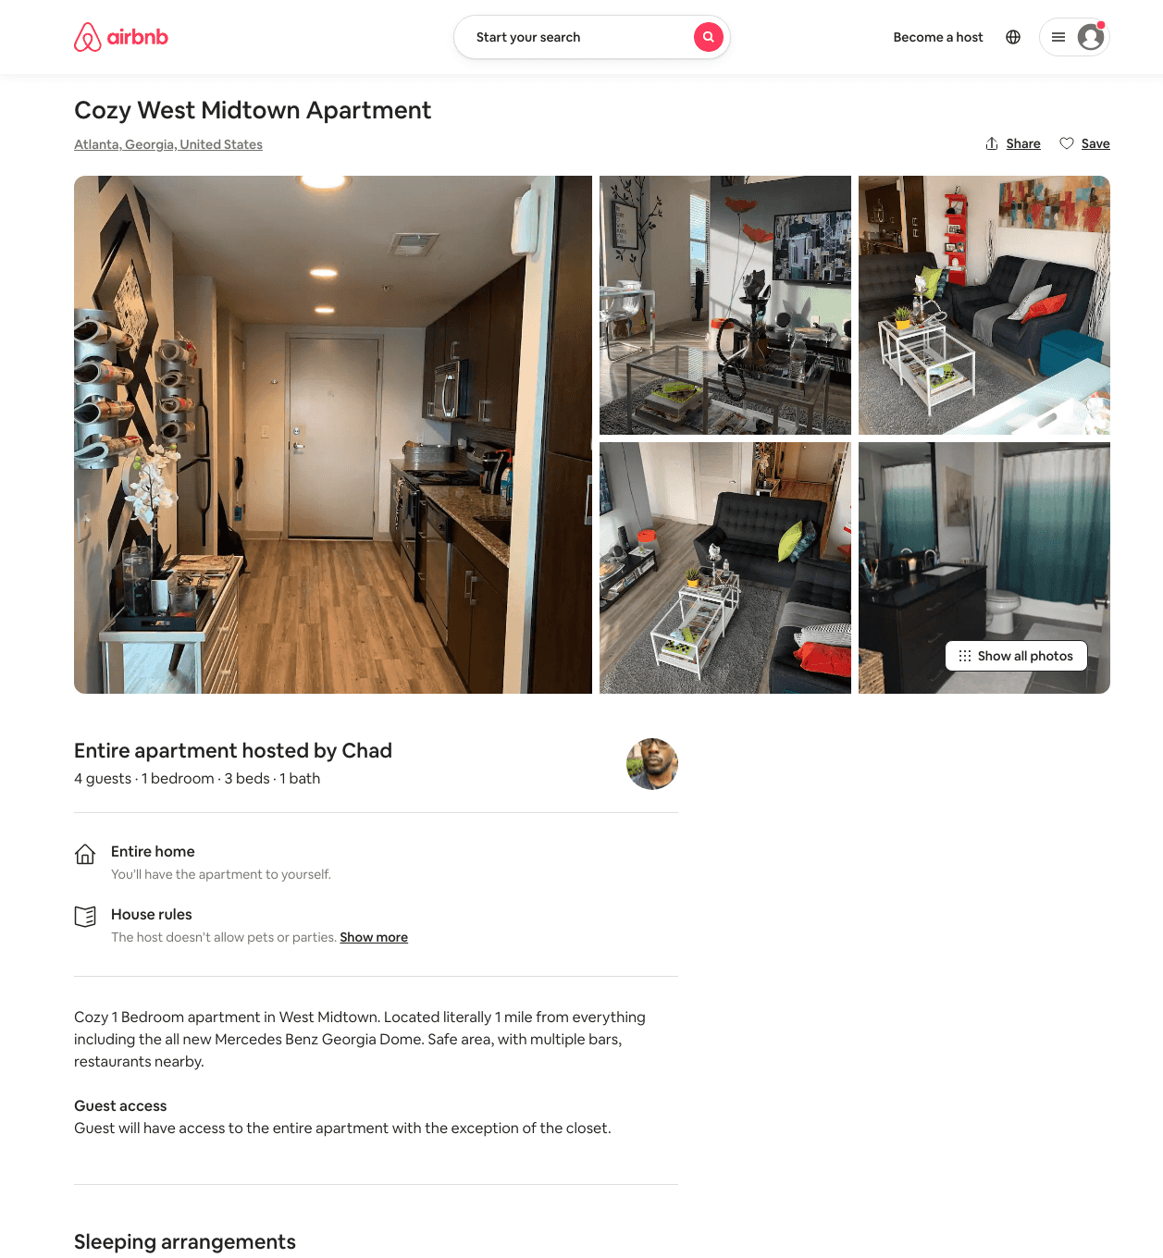
Listing 31587586
1
4
$950
3
Chad
236780233
2
https://www.airbnb.com/rooms/31587586
Aug 2022

Slide 44
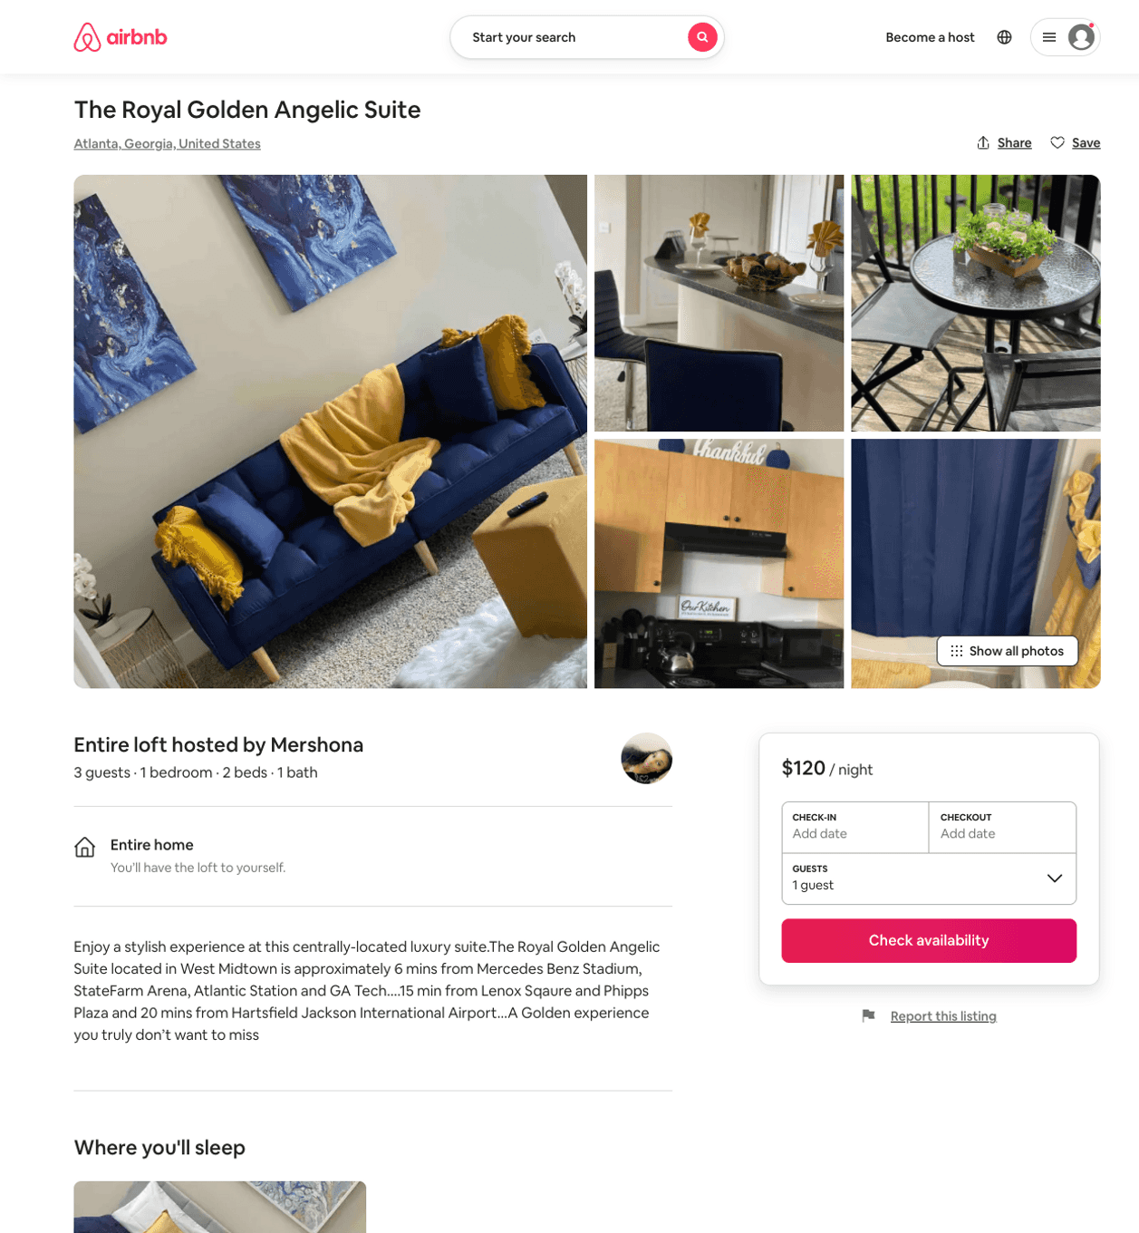
Listing 51802854
1
4
$122 - $150
4.89
1
Mershona
216618358
1
https://www.airbnb.com/rooms/51802854
Aug 2022

Slide 45
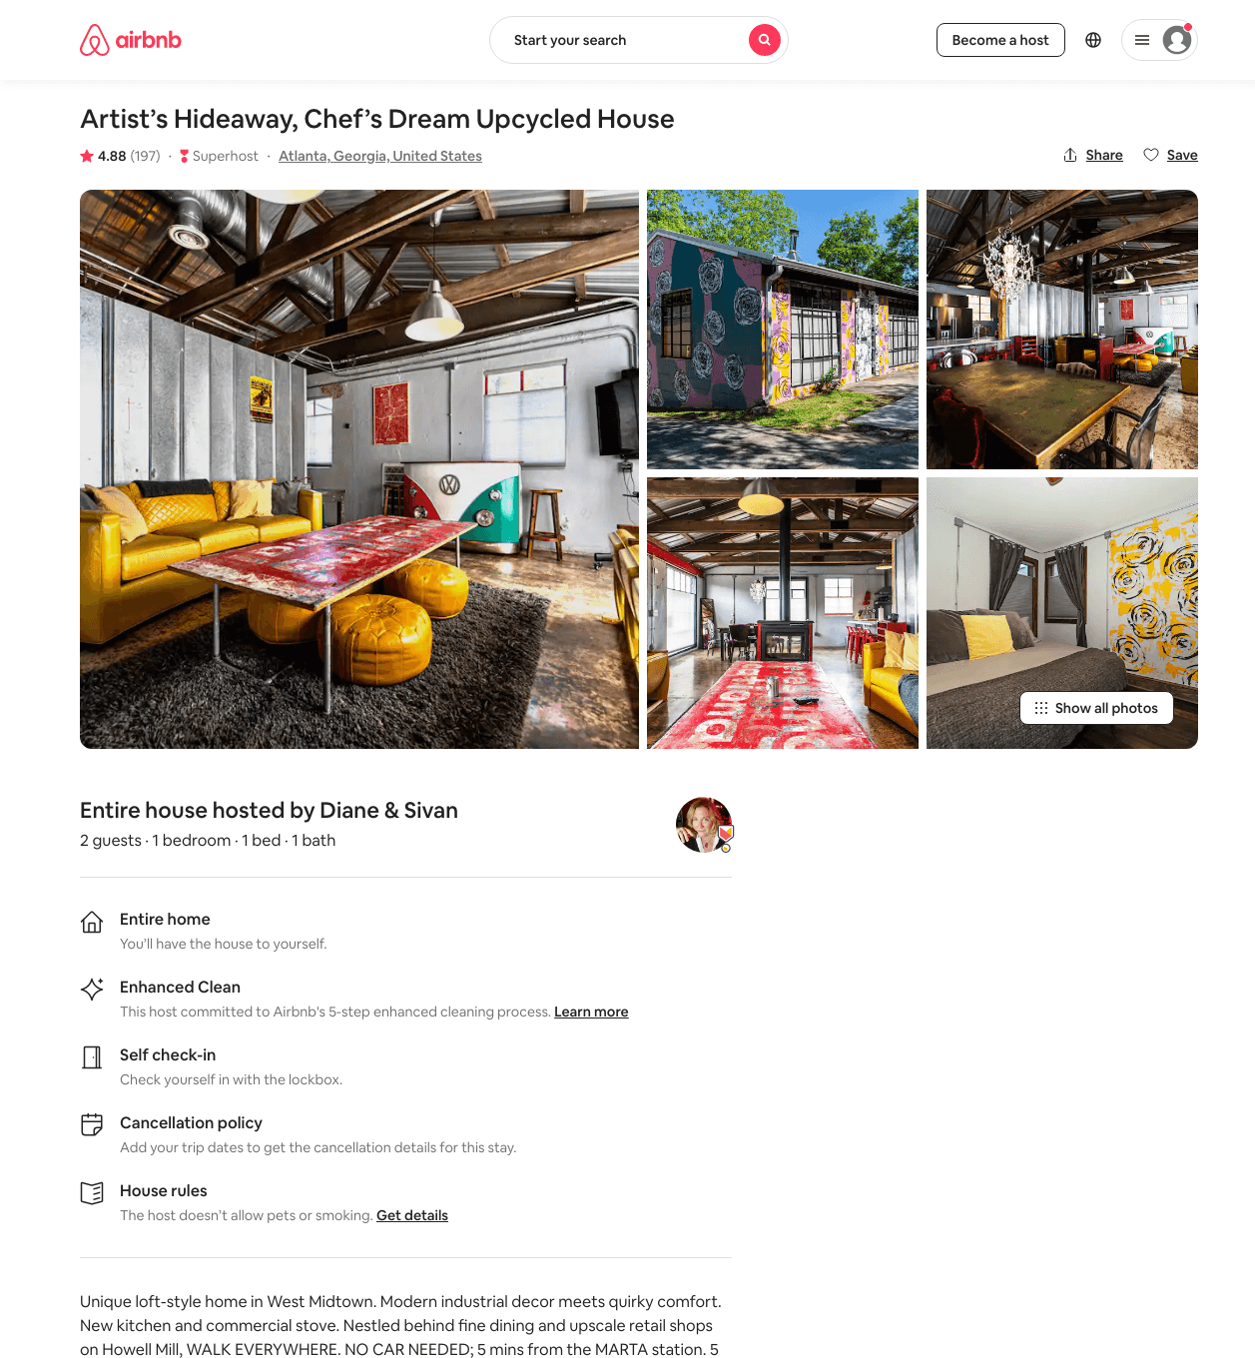
Listing 19751121
1
2
$125 - $193
4.85
1
Diane And Sivan
23226405
1
https://www.airbnb.com/rooms/19751121
Aug 2022

Slide 46
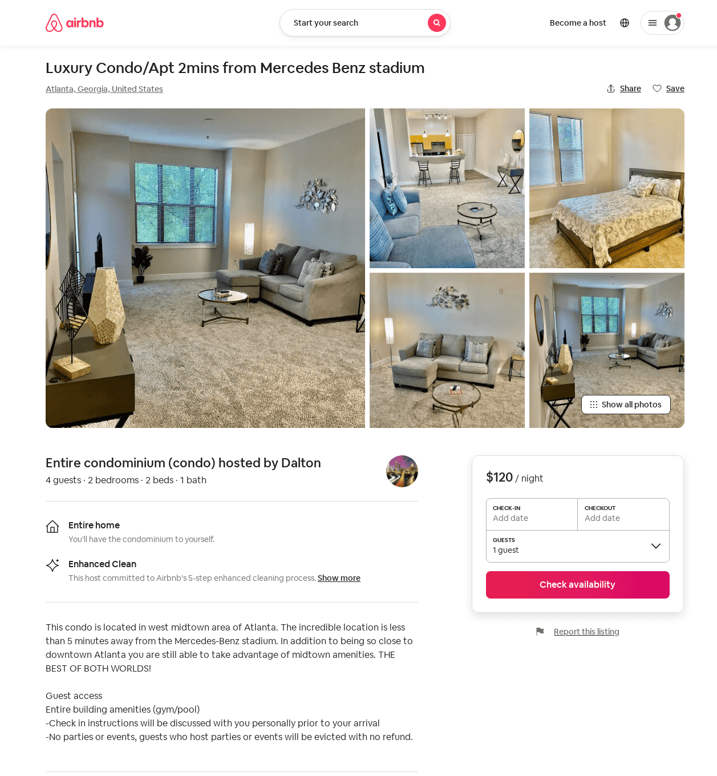
Listing 49127698
2
4
$85 - $135
4.76
2
Dalton
388298781
2
https://www.airbnb.com/rooms/49127698
Aug 2022

Slide 47
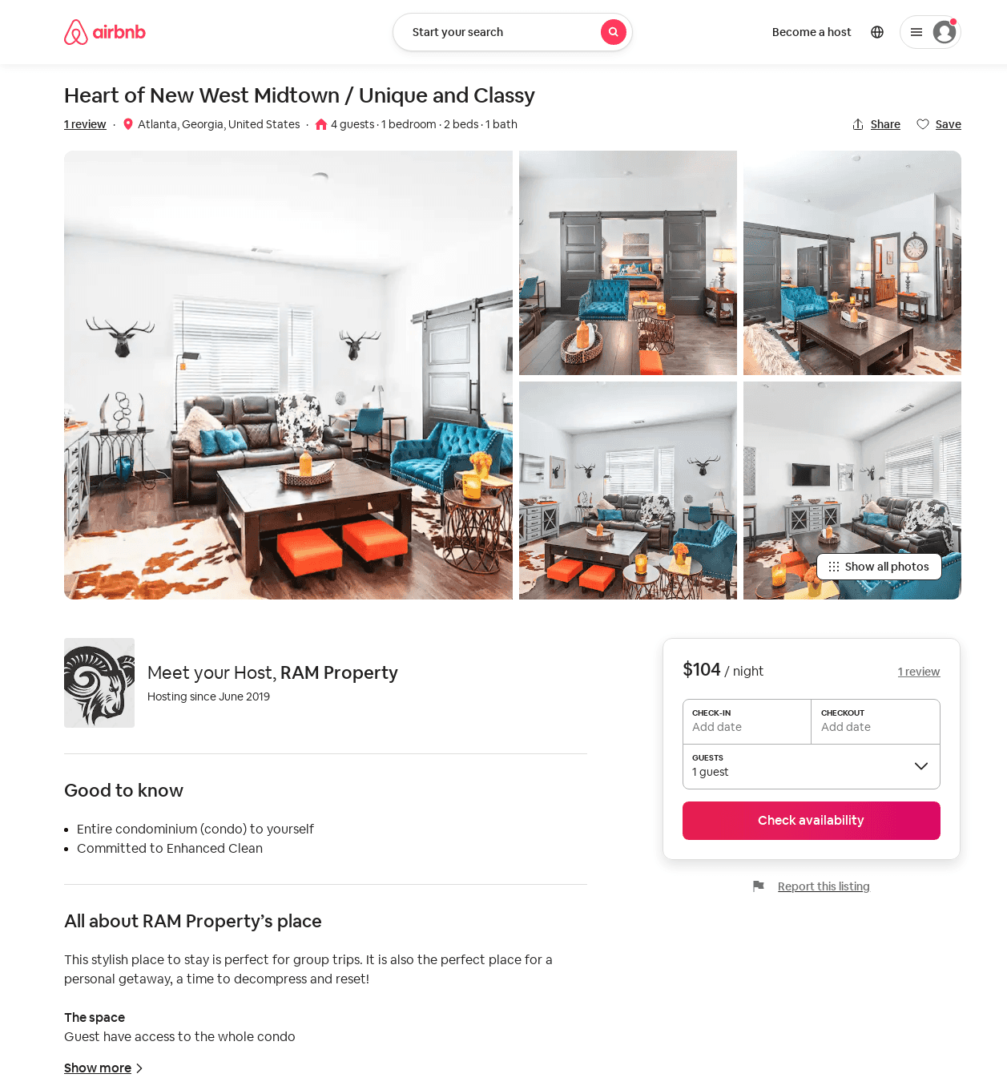
Listing 51363197
1
4
$104 - $125
4.75
1
RAM Property
272323587
1
https://www.airbnb.com/rooms/51363197
Jul 2022

Slide 48
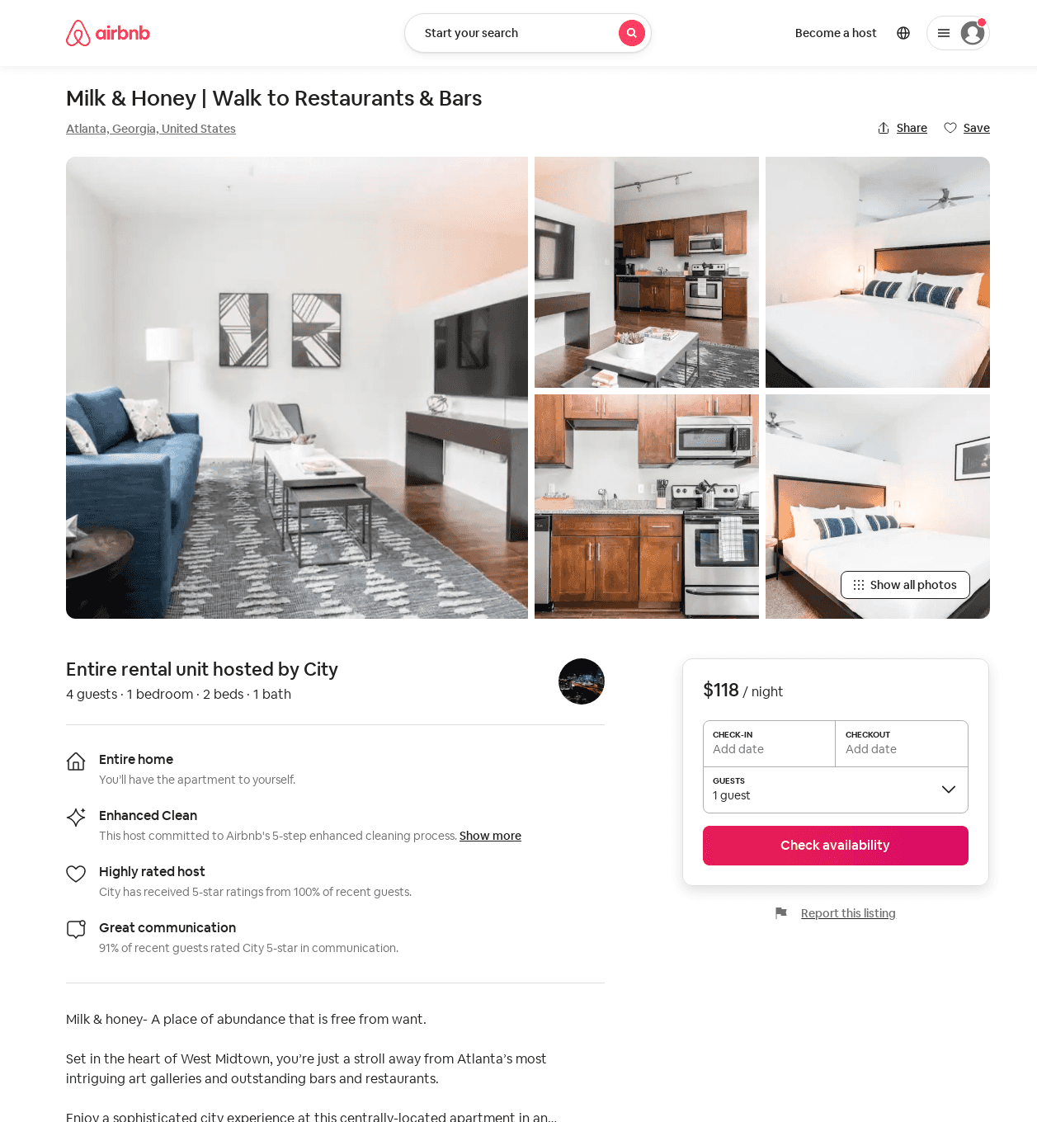
Listing 52221542
1
3
$93 - $130
4.92
1
City
413979076
3
https://www.airbnb.com/rooms/52221542
Aug 2022

Slide 49
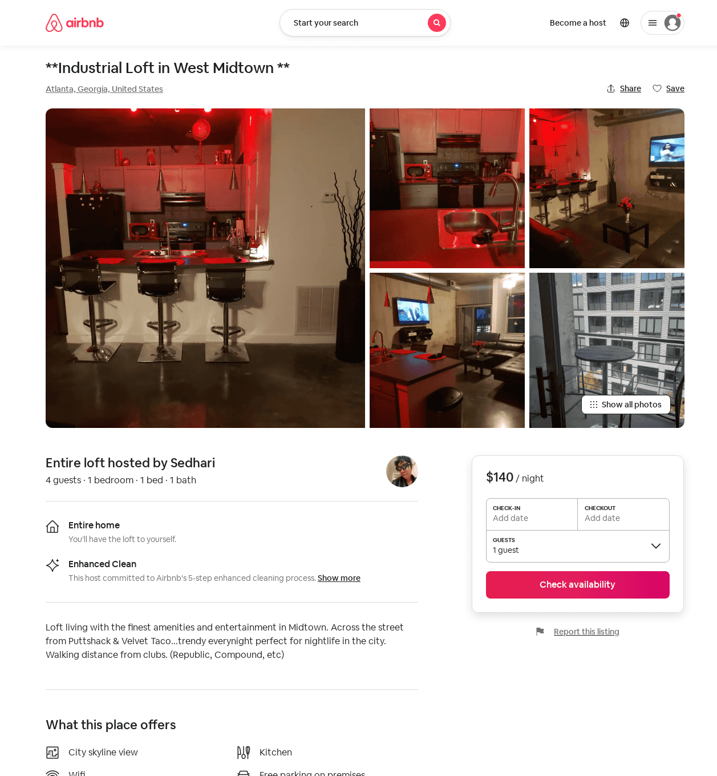
Listing 50324940
1
4
$94 - $157
4.75
3
Sedhari
46273901
1
https://www.airbnb.com/rooms/50324940
Jul 2022

Slide 50
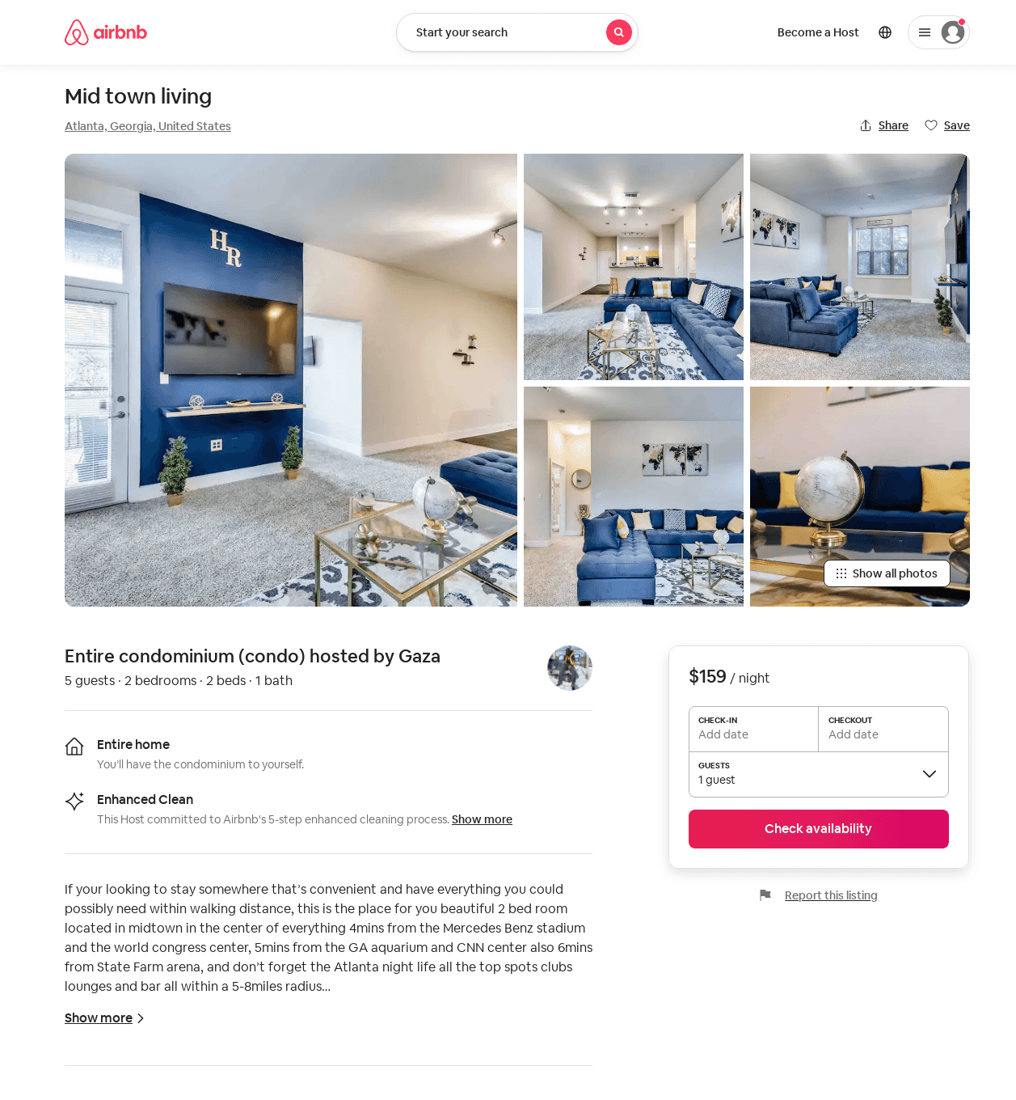
Listing 51642953
2
5
$159
4.75
1
Gaza
392789316
1
https://www.airbnb.com/rooms/51642953
Aug 2022

Slide 51
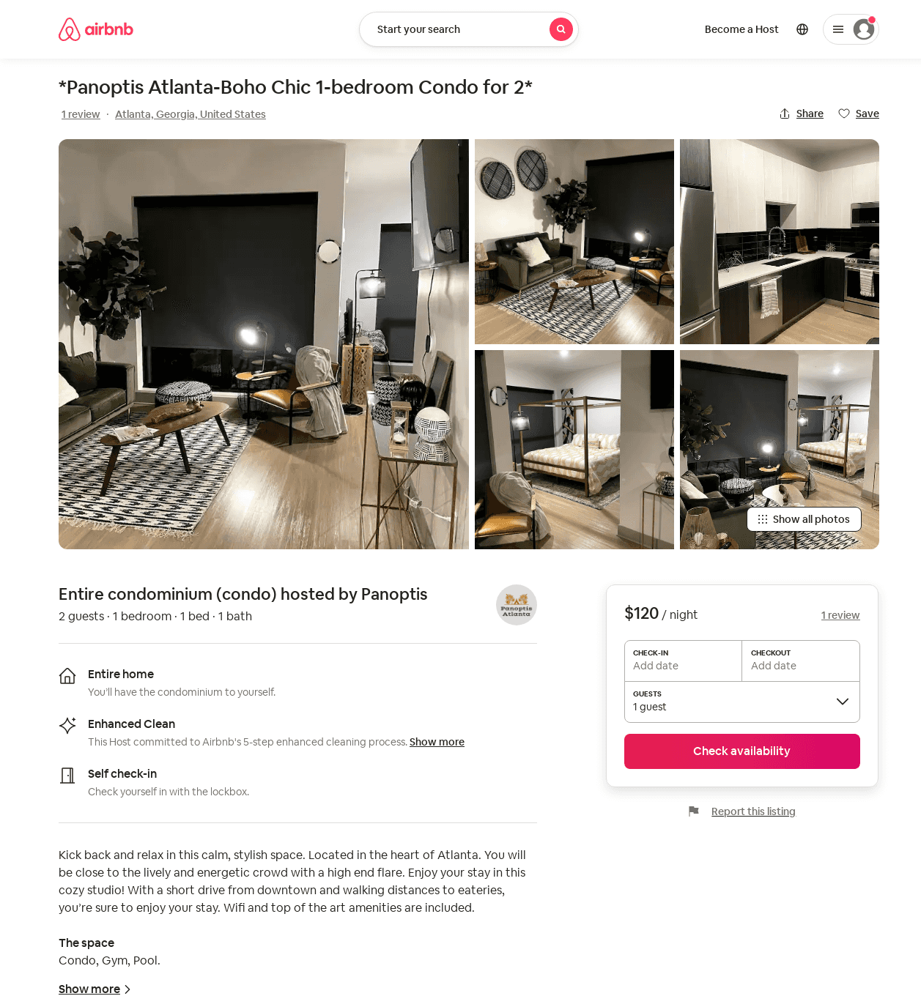
Listing 52569374
1
2
$78 - $123
4.94
2
Panoptis
425458561
1
https://www.airbnb.com/rooms/52569374
Aug 2022

Slide 52
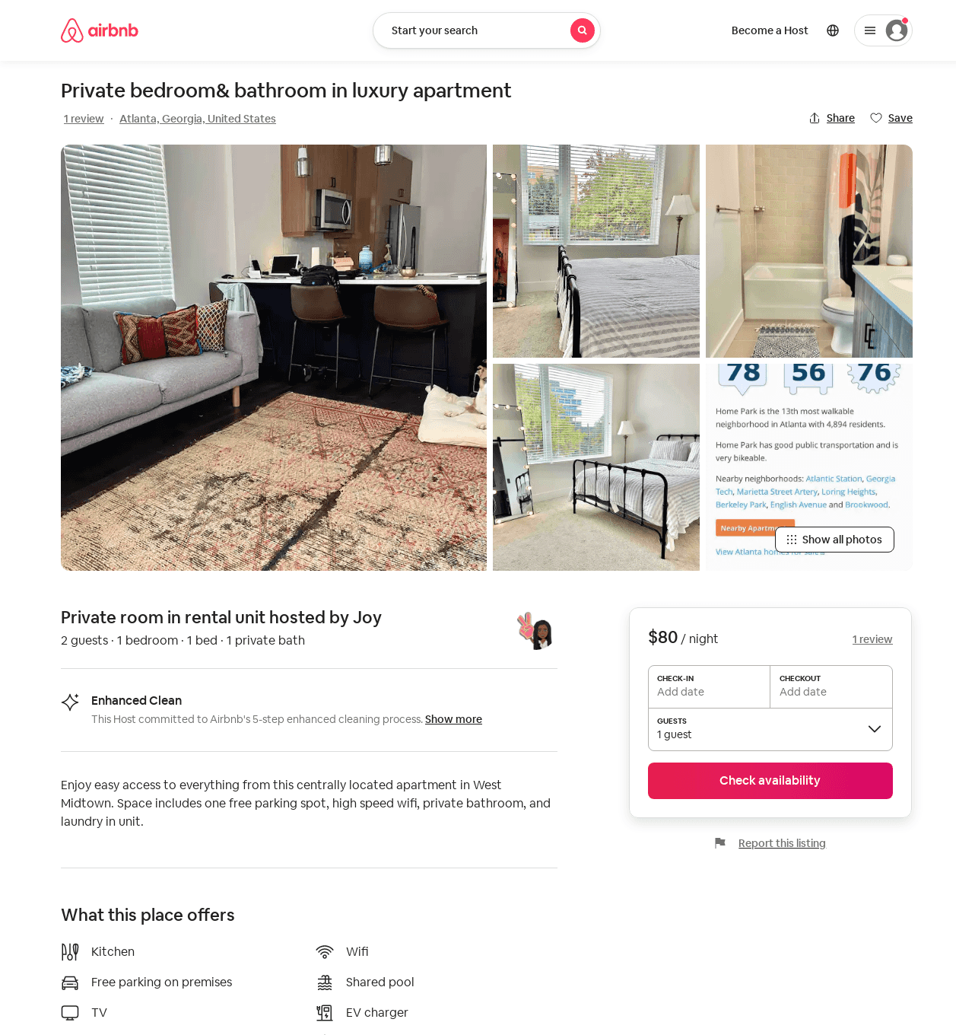
Listing 52630321
2
4
$80 - $90
5.0
3
Joy
99926367
1
https://www.airbnb.com/rooms/52630321
Jun 2022

Slide 53
Listing 52827939
1
4
$94 - $163
5.0
1
Camille
53844194
1
https://www.airbnb.com/rooms/52827939
Aug 2022

Slide 54
Listing 52848576
2
5
$99 - $129
4.63
2
Natalie
215574089
1
https://www.airbnb.com/rooms/52848576
Aug 2022

Slide 55
Listing 2392989
1
3
$129 - $139
2
2
https://www.vrbo.com/2392989
Aug 2022

Slide 56
Listing 2451459
1
2
$140 - $169
5
2
Crown Management
https://www.vrbo.com/2451459
Aug 2022

Slide 57
Listing 53151658
1
4
$76 - $133
4.06
2
Michael
143682164
2
https://www.airbnb.com/rooms/53151658
Aug 2022

Slide 58
Listing 53091855
1
6
$70 - $117
4.80
2
John
429797241
1
https://www.airbnb.com/rooms/53091855
Jul 2022

Slide 59
Listing 53629715
1
3
$103 - $129
2
Craig
62443018
1
https://www.airbnb.com/rooms/53629715
Aug 2022

Slide 60
Listing 43170914
643 10TH ST NW
1
5
$350
1
Luxe One
139621289
14
https://www.airbnb.com/rooms/43170914
Aug 2022

Slide 61
Listing m-street-atlanta
940 MARIETTA ST NW
undefined
1
8.1
https://www.booking.com/hotel/us/m-street-atlanta.html
Sep 2022

Slide 62
Listing 54233351
1
4
$118 - $195
4.88
2
Zen Aroma
33306784
1
https://www.airbnb.com/rooms/54233351
Aug 2022

Slide 63
Listing 54296841
1
4
$81 - $136
4.87
2
Chelle
440016718
1
https://www.airbnb.com/rooms/54296841
Aug 2022

Slide 64
Listing midtown-quarters-king-suite-balcony-cityview-free-parking
undefined
1
7.8
https://www.booking.com/hotel/us/midtown-quarters-king-suite-balcony-cityview-free-parking.html
Sep 2022

Slide 65
Listing 54288137
1
16
$480 - $600
1
Dawan
41851234
2
https://www.airbnb.com/rooms/54288137
Aug 2022

Slide 66
Listing 53751242
1
2
$109 - $158
5.0
2
Lauren
435339813
1
https://www.airbnb.com/rooms/53751242
Aug 2022

Slide 67
Listing 49198785
1
4
$98 - $154
4.67
7
Meshelle
388811999
1
https://www.airbnb.com/rooms/49198785
Jul 2022

Slide 68
Listing 2546641
1
4
$176
3
https://www.vrbo.com/2546641
Aug 2022

Slide 69
Listing 52925769
643 10TH ST NW
1
4
$95
4.80
2
Lataunya
43359580
1
https://www.airbnb.com/rooms/52925769
Aug 2022

Slide 70
Listing 2782491
1
3
$205
1
https://www.vrbo.com/2782491
Aug 2022

Slide 71
Listing 2788630
1
4
$130
1
https://www.vrbo.com/2788630
Aug 2022

Slide 72
Listing 2818275
2
2
$163
4.75
2
Authentic Reservations
https://www.vrbo.com/2818275
Aug 2022

Slide 73
Listing 2832128
2
6
$132
3
1
Kortni
https://www.vrbo.com/2832128
Aug 2022

Slide 74
Listing 2843735
2
5
$174
5
1
Monique
https://www.vrbo.com/2843735
Aug 2022

Slide 75
Listing 2948203
1
3
$133
2
Beugaret Properties
https://www.vrbo.com/2948203
Aug 2022

Slide 76
Listing 52862774
2
4
5.0
1
Sentral West Midtown
424460592
4
https://www.airbnb.com/rooms/52862774
Aug 2022

