Slide 2
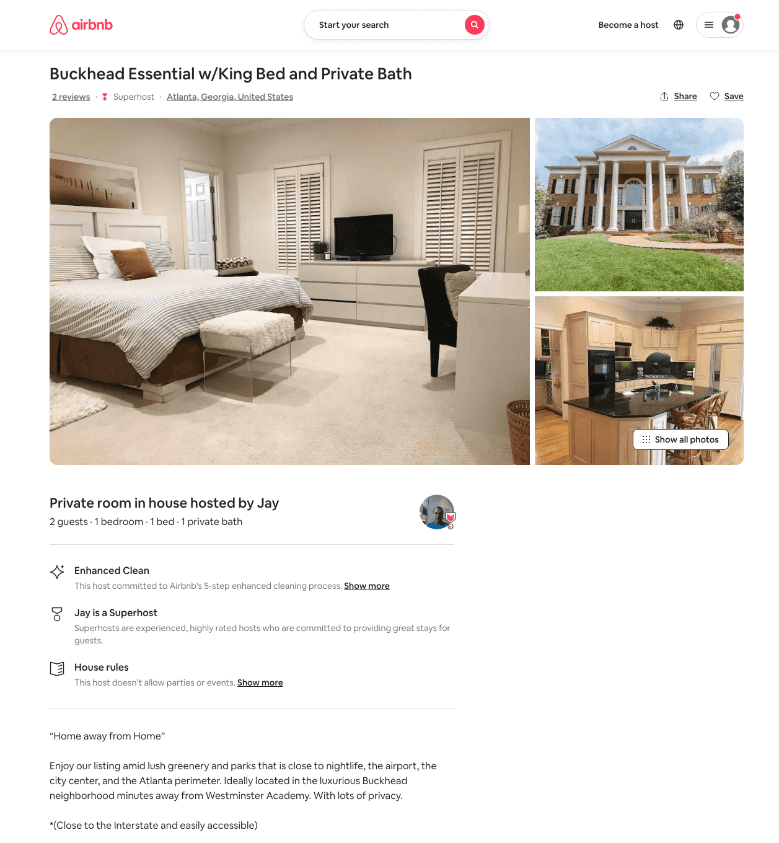
Listing 46036766
1
2
$79 - $89
4.0
1
Jay
63237758
4
https://www.airbnb.com/rooms/46036766
Aug 2022

Slide 3
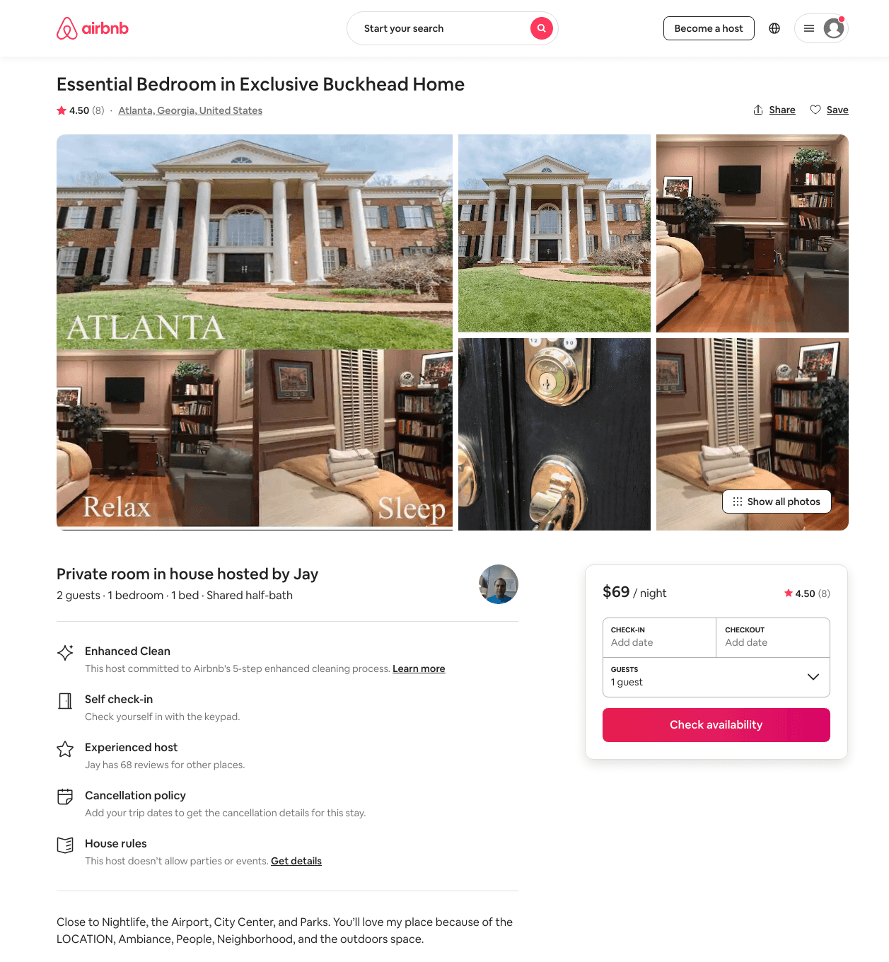
Listing 31034825
1
2
$69 - $70
4.64
1
Jay
63237758
4
https://www.airbnb.com/rooms/31034825
Jul 2022

Slide 4
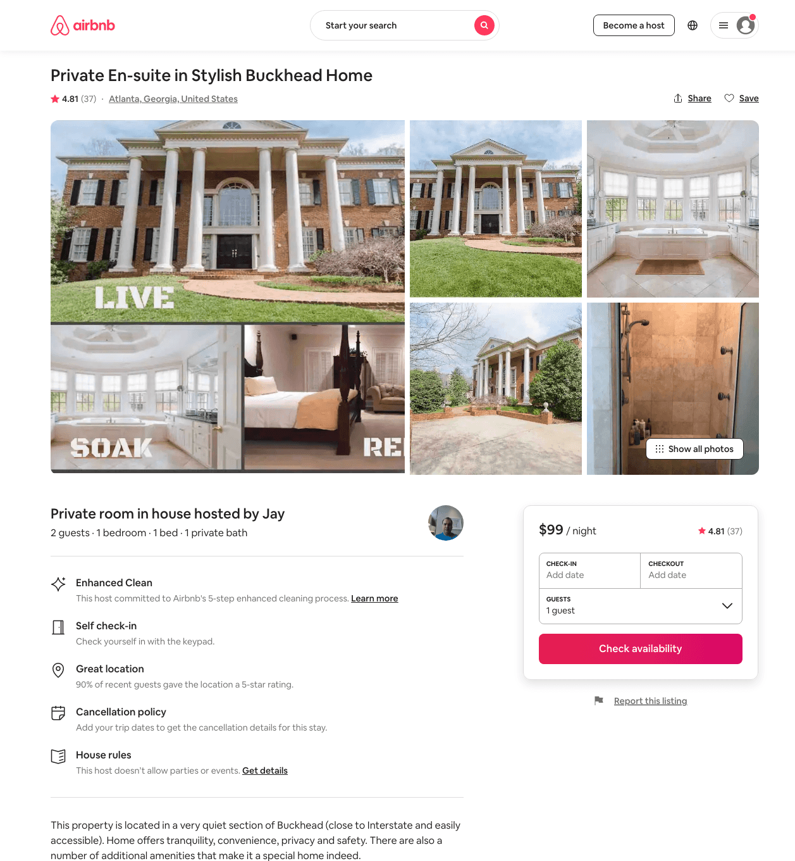
Listing 14483786
1
2
$99 - $109
4.83
1
Jay
63237758
4
https://www.airbnb.com/rooms/14483786
Jun 2022

Slide 5
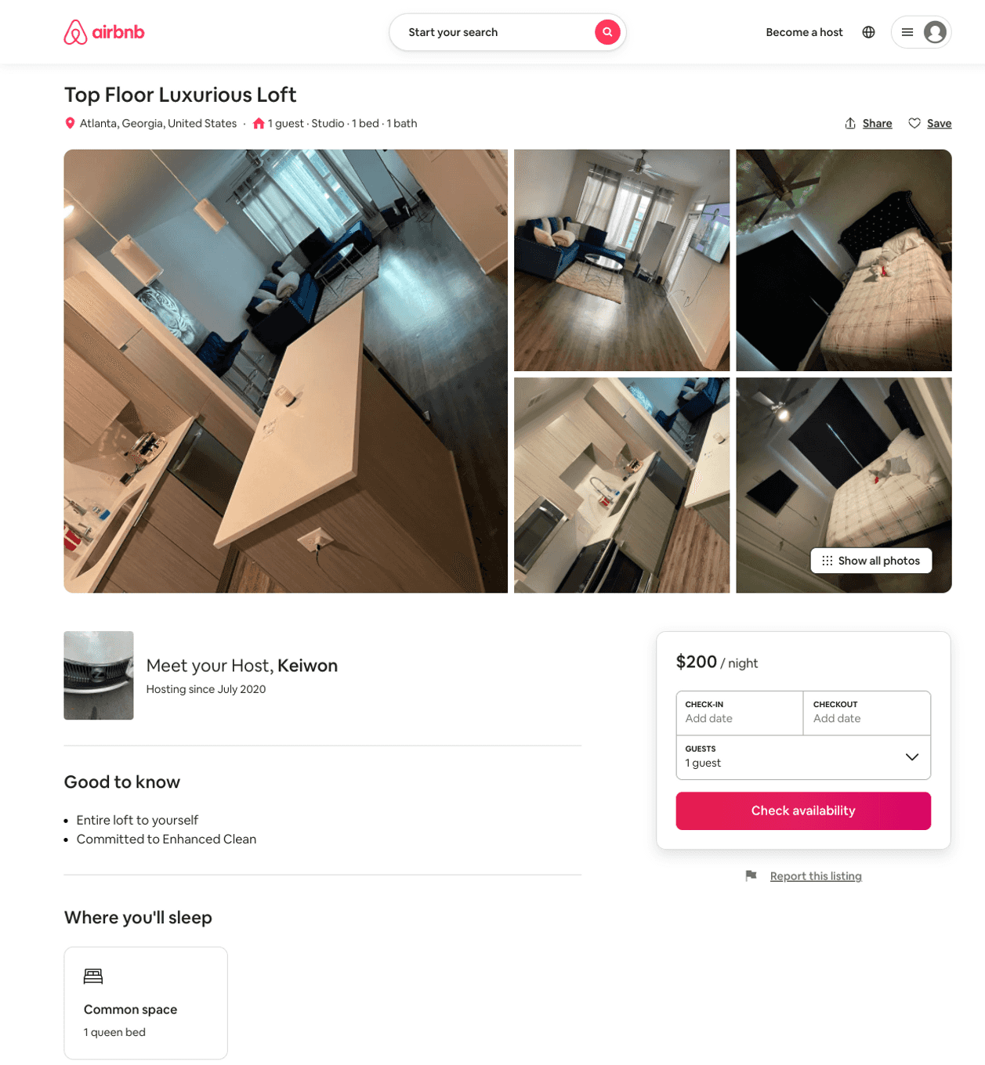
Listing 51910280
1
2
$218
5.0
1
Keiwon
354918149
1
https://www.airbnb.com/rooms/51910280
Aug 2022

Slide 6
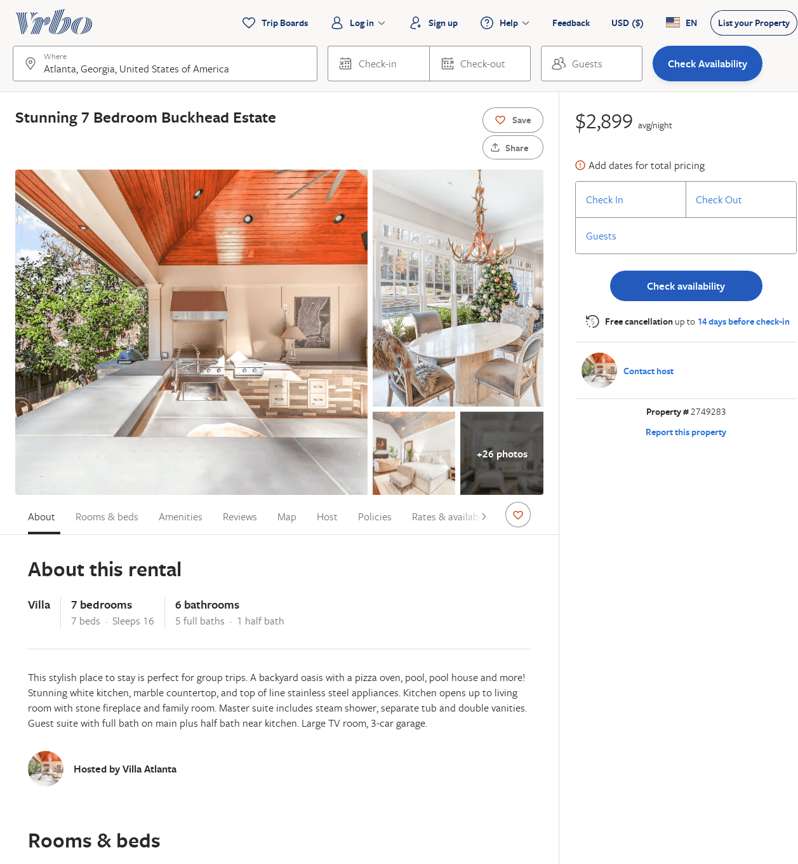
Listing 2749283
7
16
$2,899
2
https://www.vrbo.com/2749283
Aug 2022

Slide 7
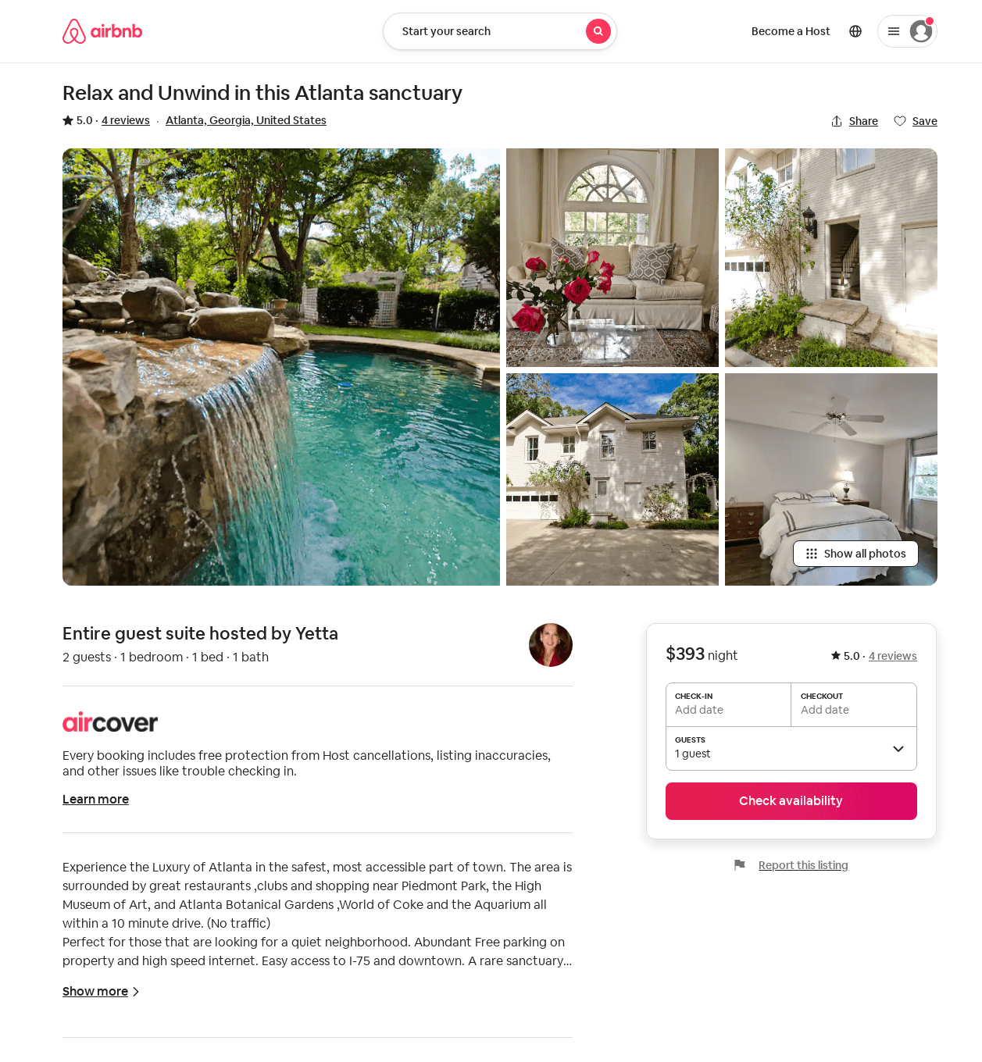
Listing 32012589
1
2
$350 - $393
5.0
2
Yetta
2385955
1
https://www.airbnb.com/rooms/32012589
Aug 2022

