Slide 2
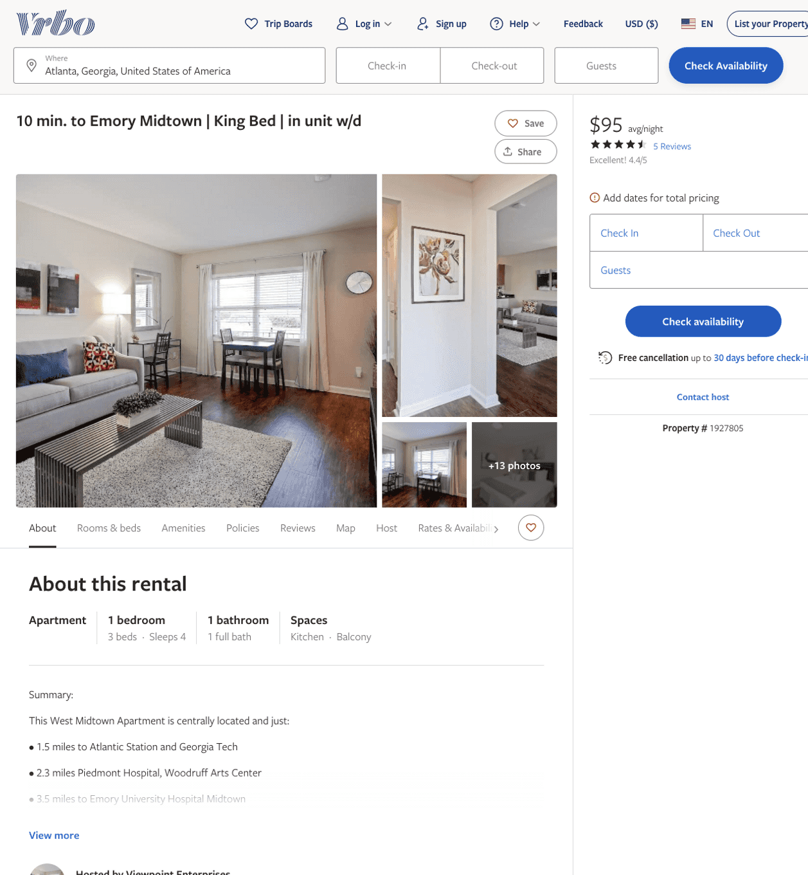
Listing 1927805
1
4
$106 - $99
4.6538463
1
Viewpoint Enterprises
https://www.vrbo.com/1927805
Aug 2022

Slide 3
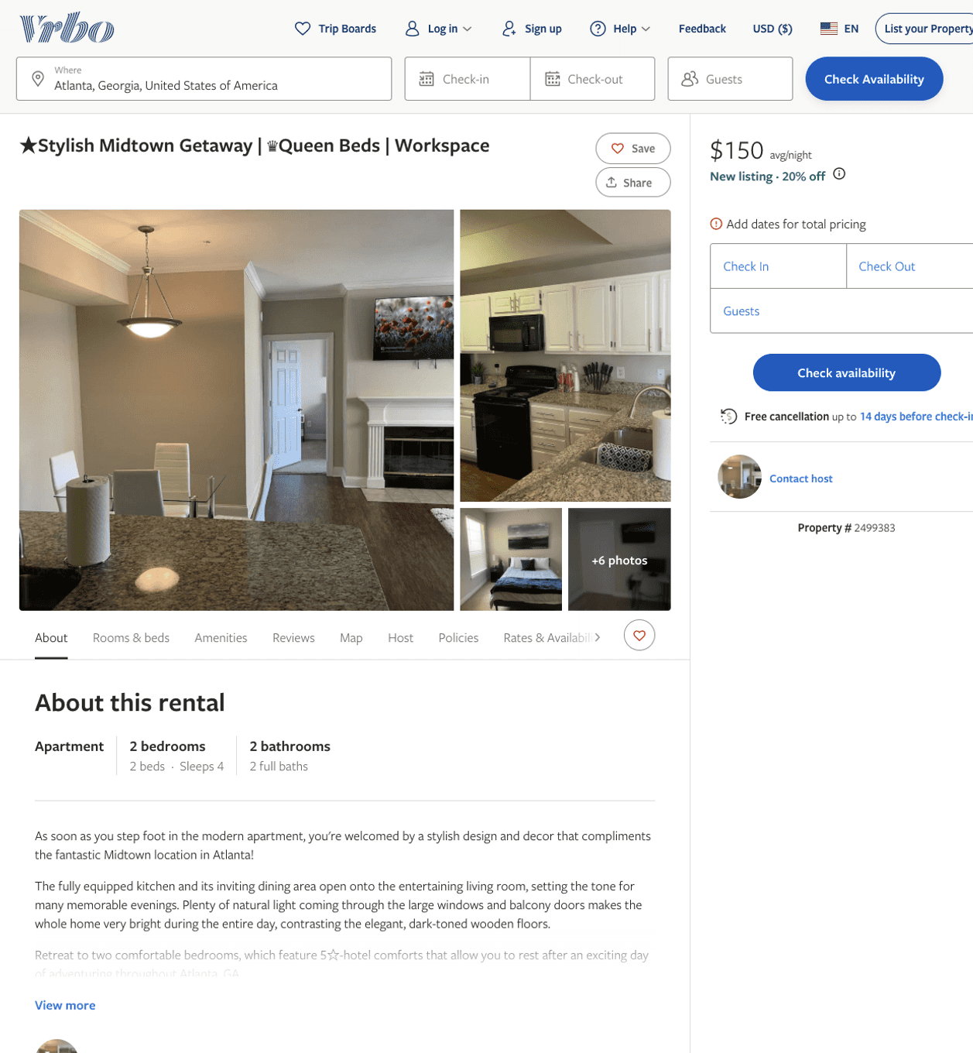
Listing 2499383
2
4
$150 - $163
4.857143
2
https://www.vrbo.com/2499383
Aug 2022

Slide 4
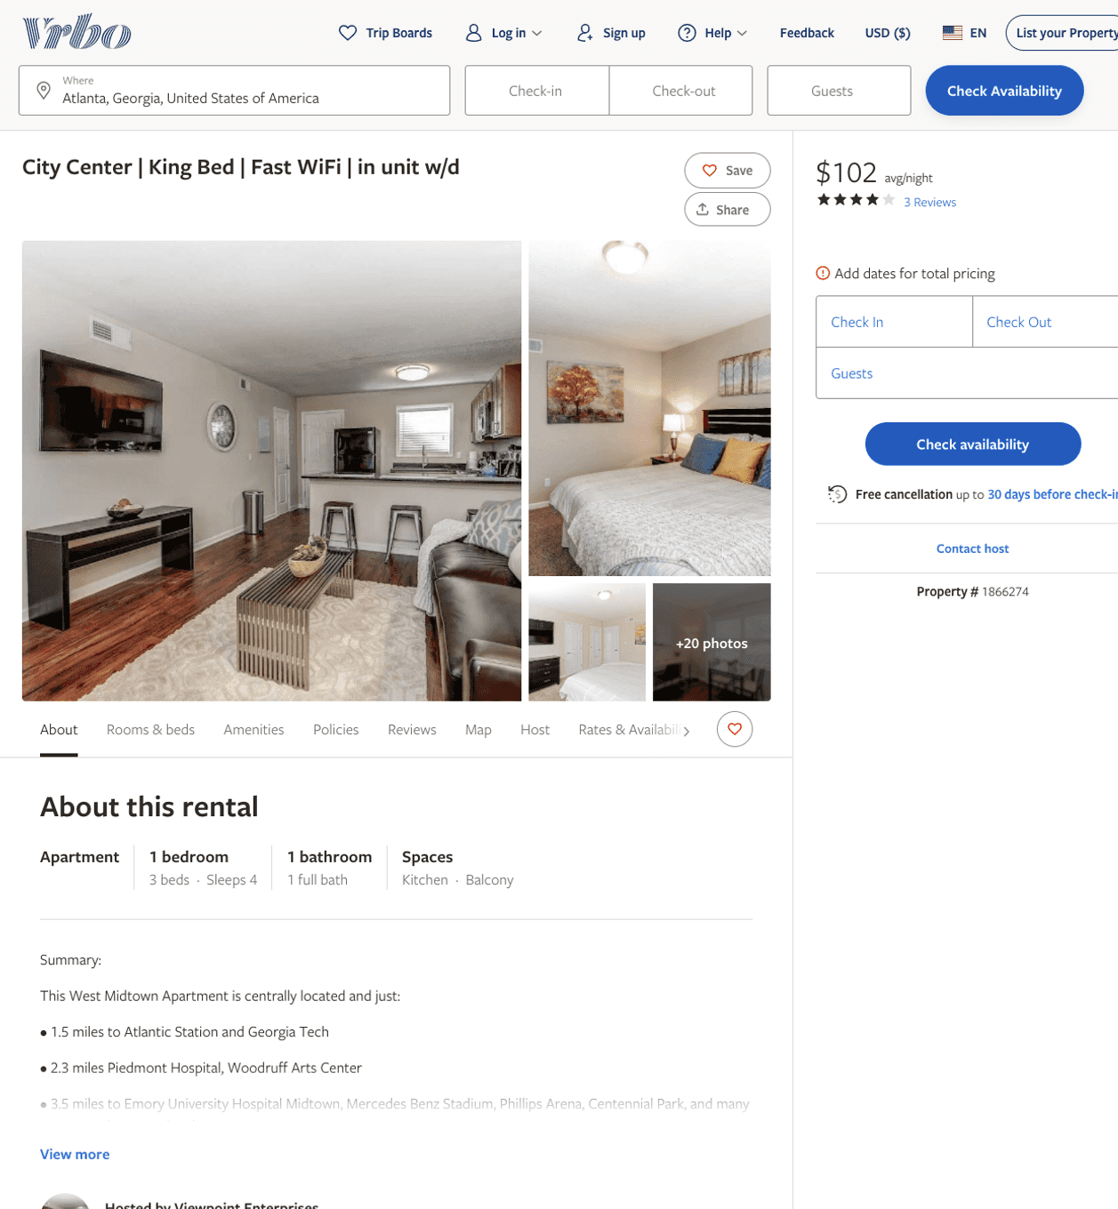
Listing 1866274
1
4
$102 - $99
4.3333335
1
Viewpoint Enterprises
https://www.vrbo.com/1866274
Aug 2022

Slide 5
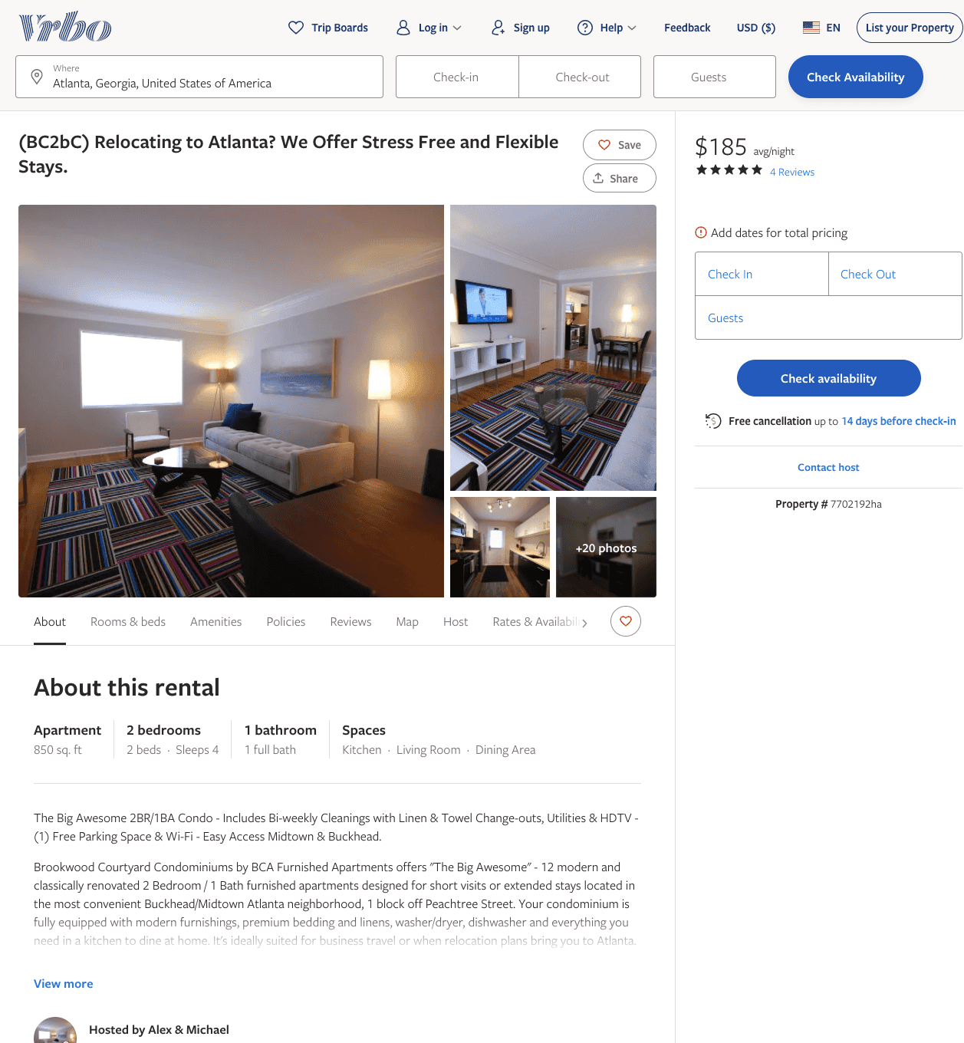
Listing 7702192
2
4
$173 - $191
4.8333335
1
Alex & Michael
https://www.vrbo.com/7702192ha
Aug 2022

Slide 6
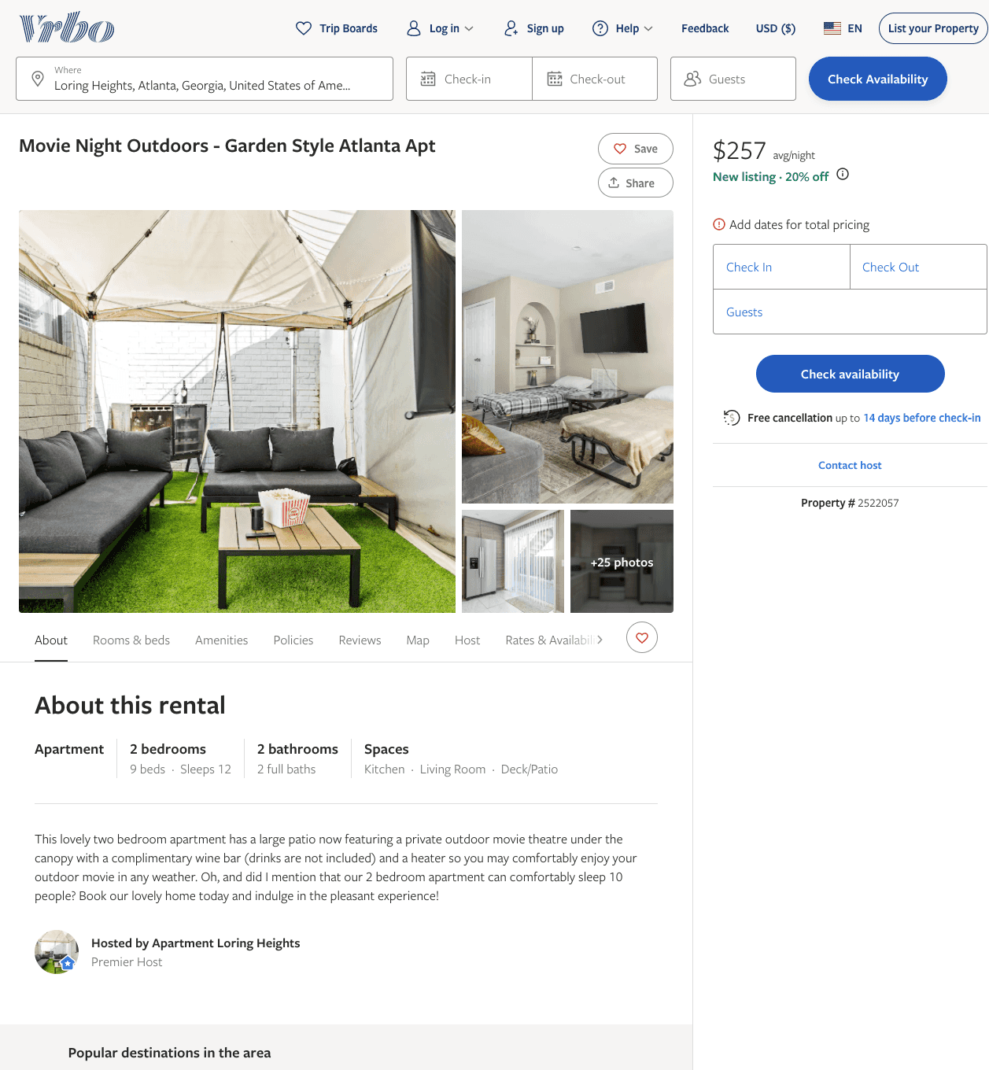
Listing 2522057
2
12
$129 - $257
4.6666665
2
https://www.vrbo.com/2522057
Aug 2022

Slide 7
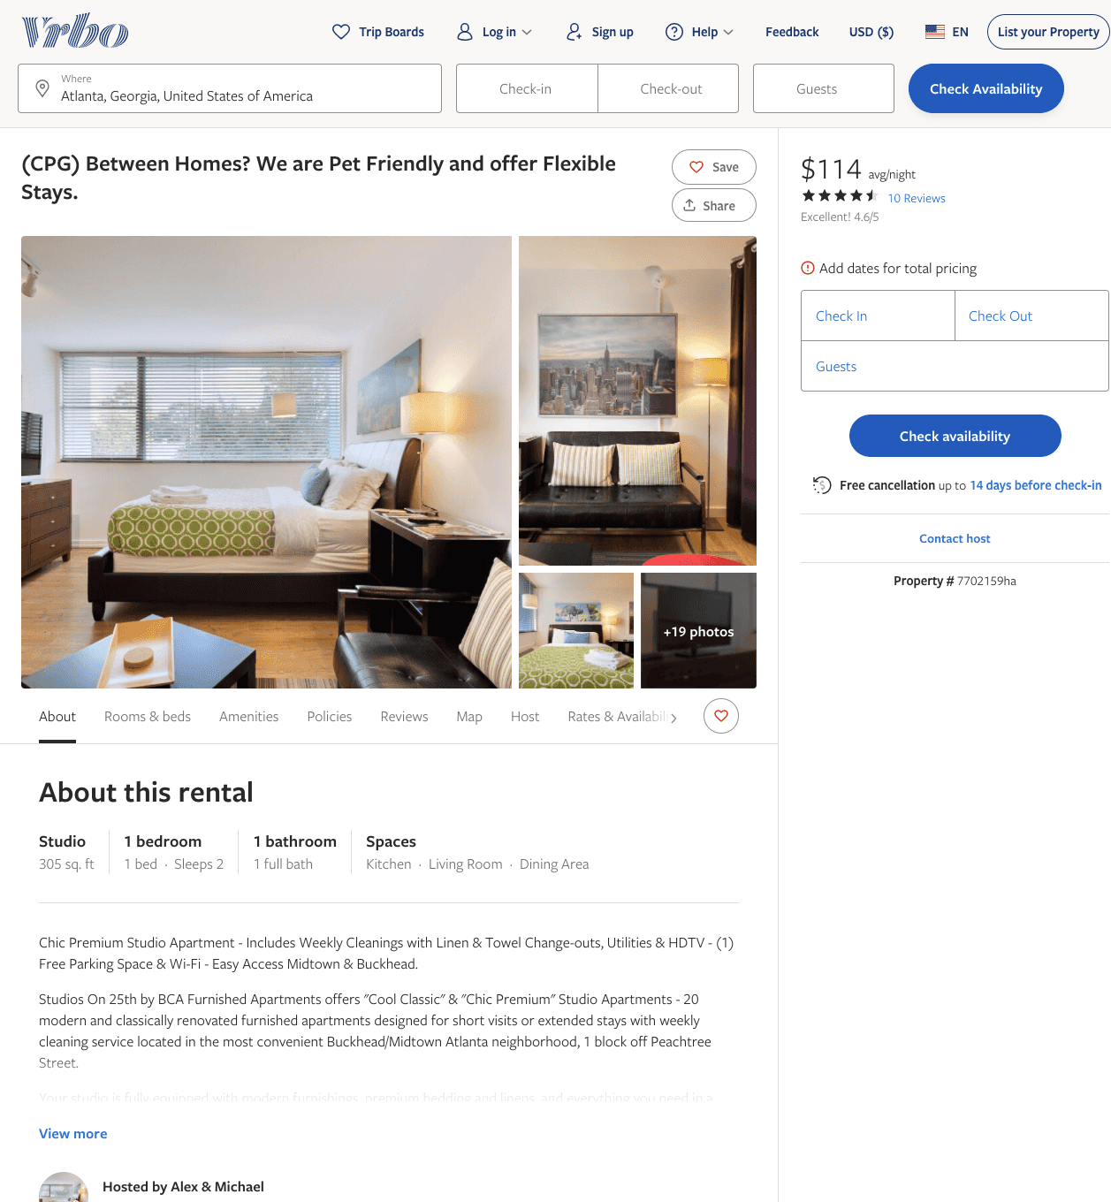
Listing 7702159
1
2
$109 - $134
4.6666665
1
Alex & Michael
https://www.vrbo.com/7702159ha
Aug 2022

Slide 8
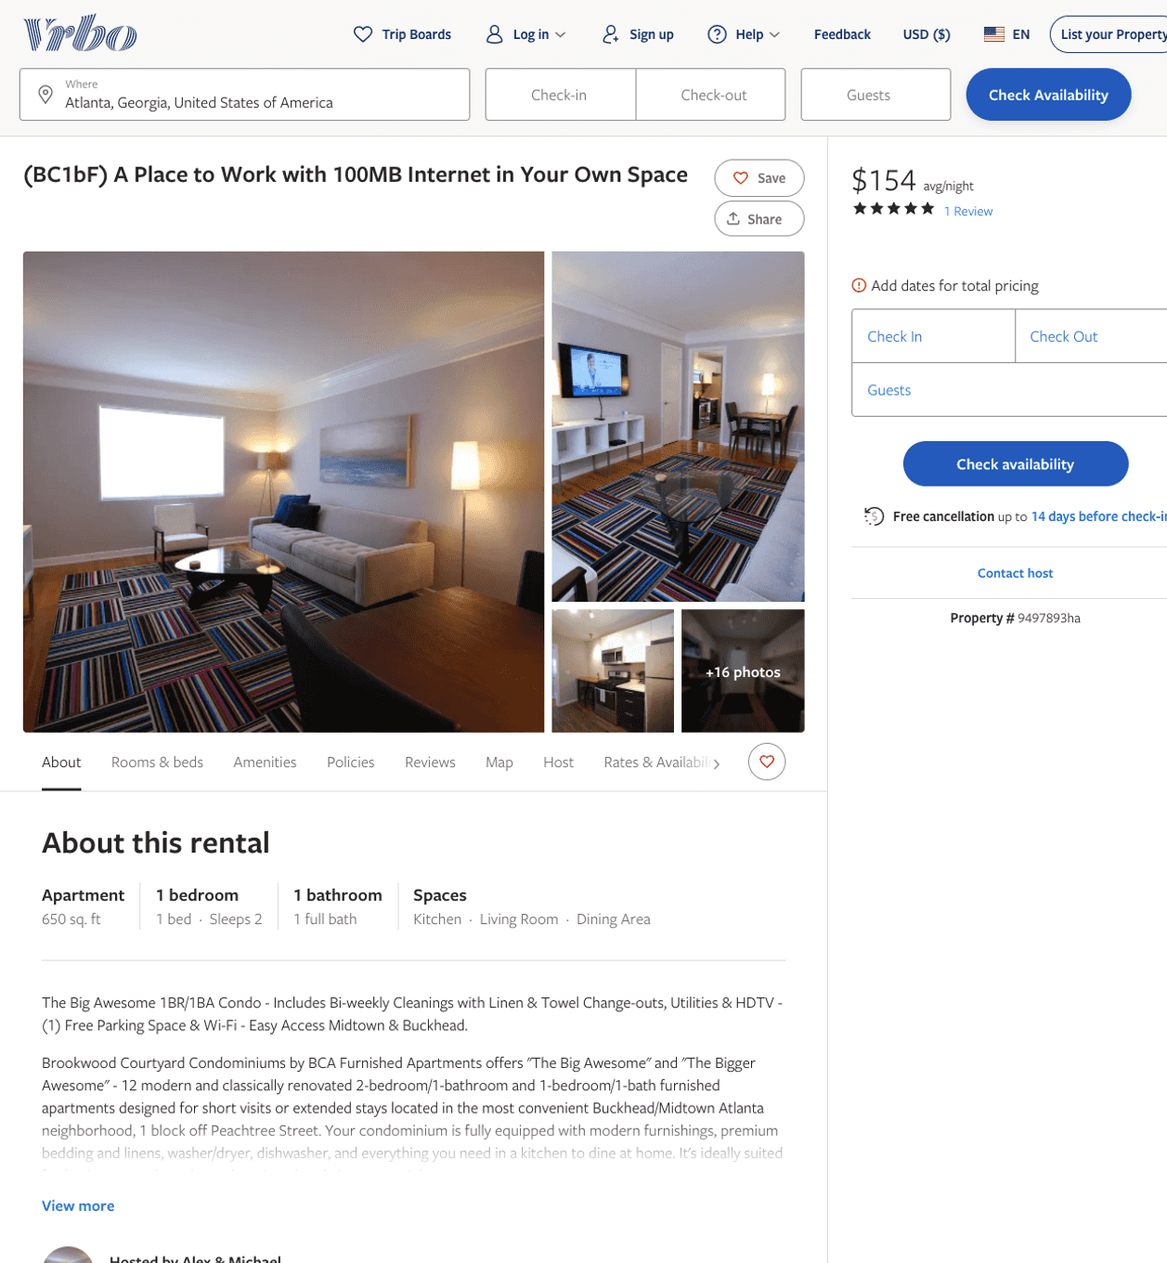
Listing 9497893
1
2
$130 - $166
5
1
Alex & Michael
https://www.vrbo.com/9497893ha
Aug 2022

Slide 9
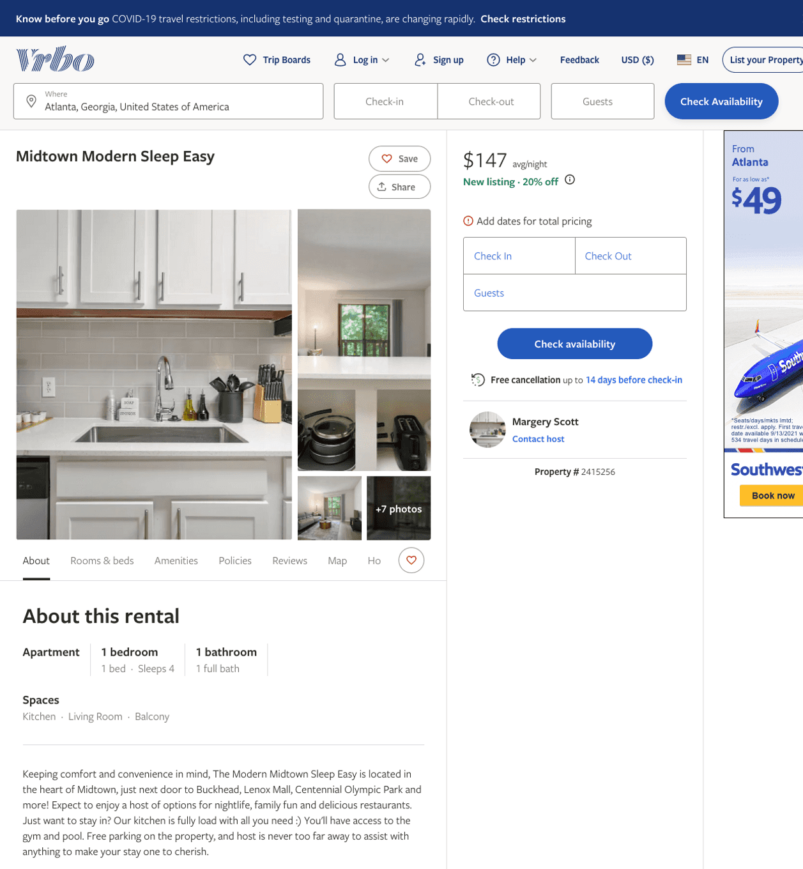
Listing 2415256
1
4
$147 - $150
5
2
Margery Scott
https://www.vrbo.com/2415256
Aug 2022

Slide 10
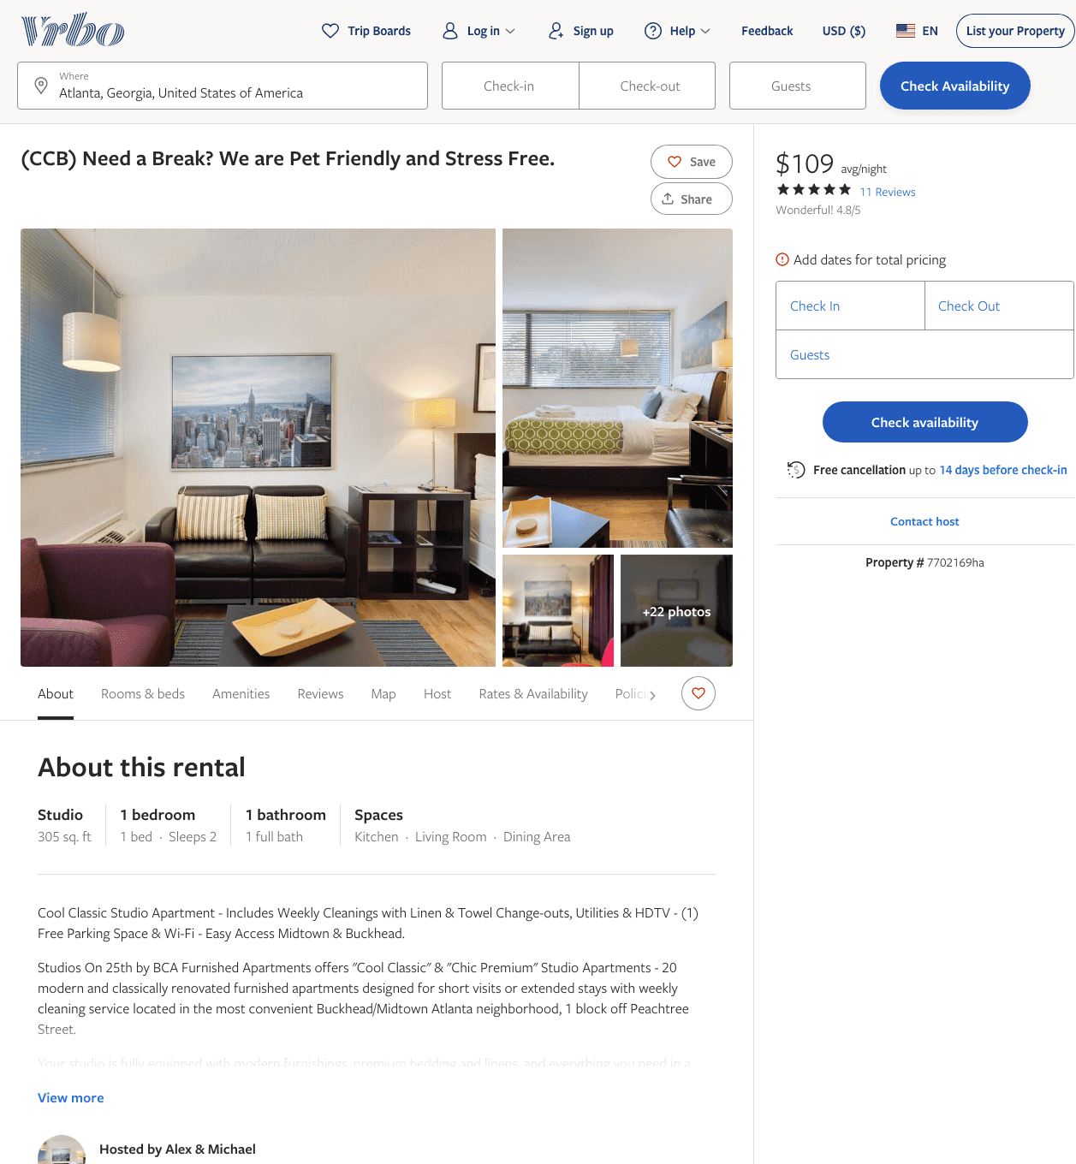
Listing 7702169
1
2
$100 - $115
4.875
1
Alex & Michael
https://www.vrbo.com/7702169ha
Aug 2022

Slide 11
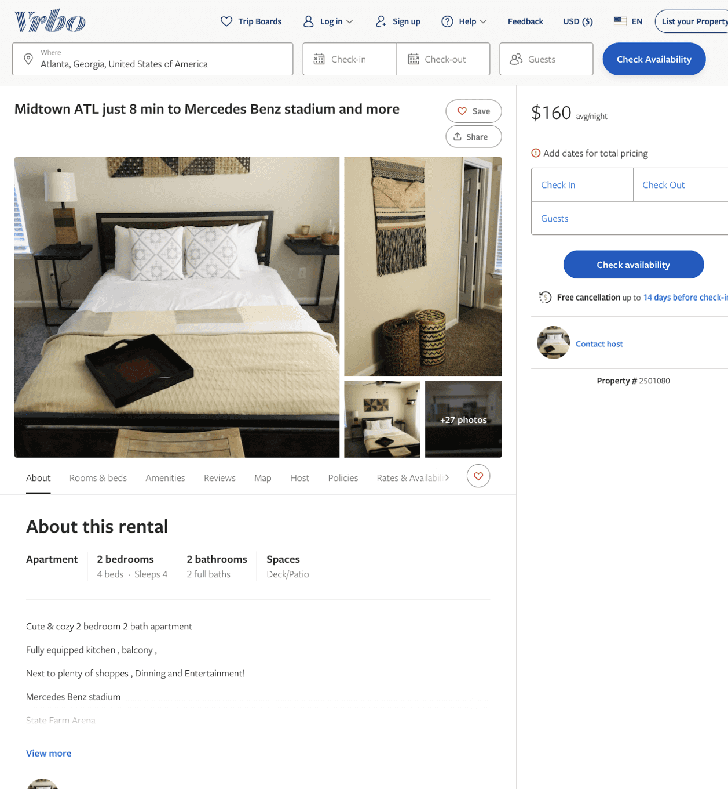
Listing 2501080
2
4
$154 - $89
4.5
1
https://www.vrbo.com/2501080
Aug 2022

Slide 12
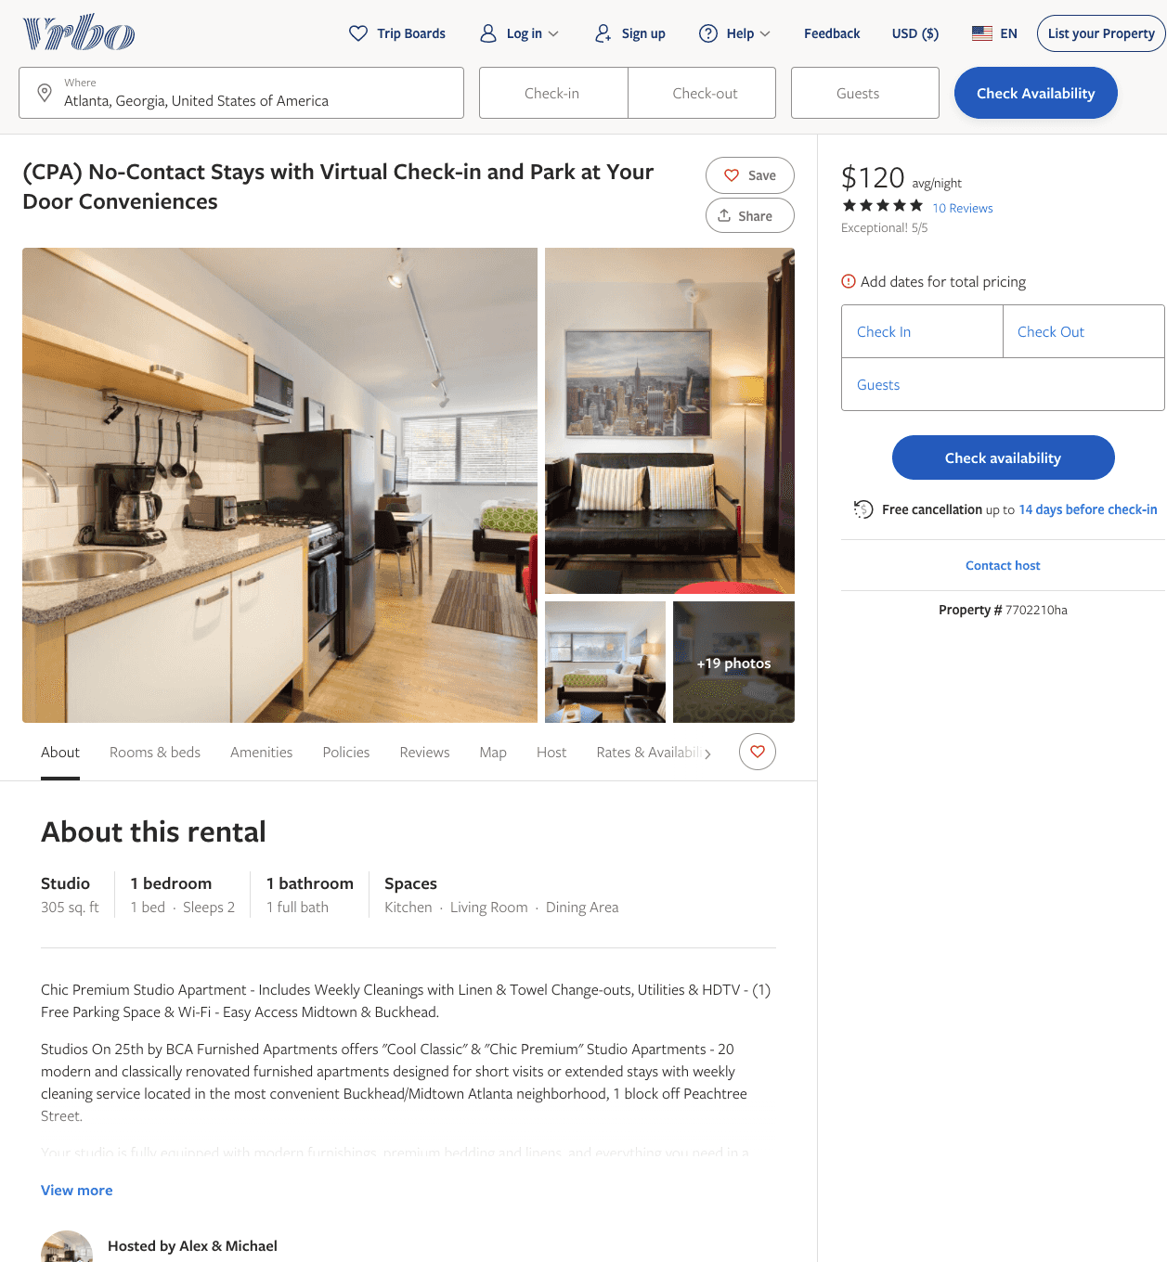
Listing 7702210
1
2
$109 - $126
5
1
Alex & Michael
https://www.vrbo.com/7702210ha
Aug 2022

Slide 13
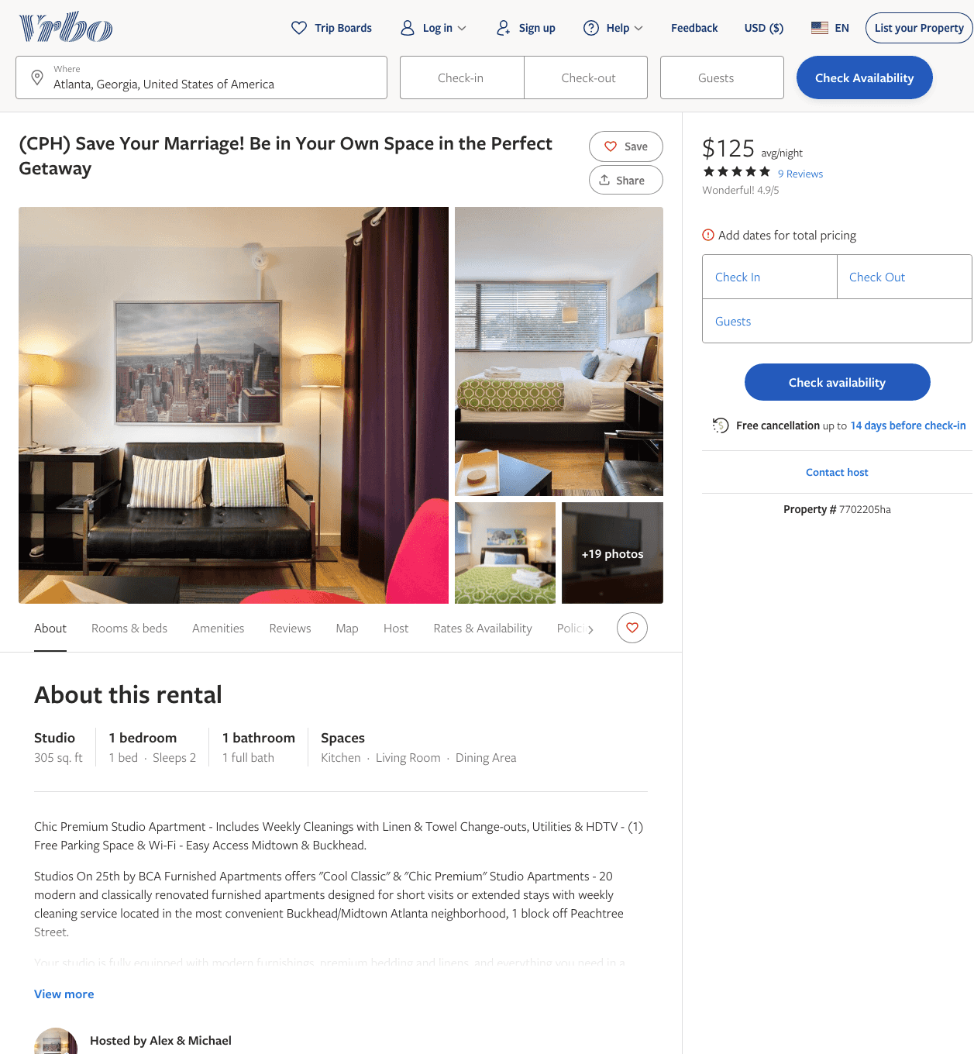
Listing 7702205
1
2
$103 - $125
4.909091
1
Alex & Michael
https://www.vrbo.com/7702205ha
Aug 2022

Slide 14
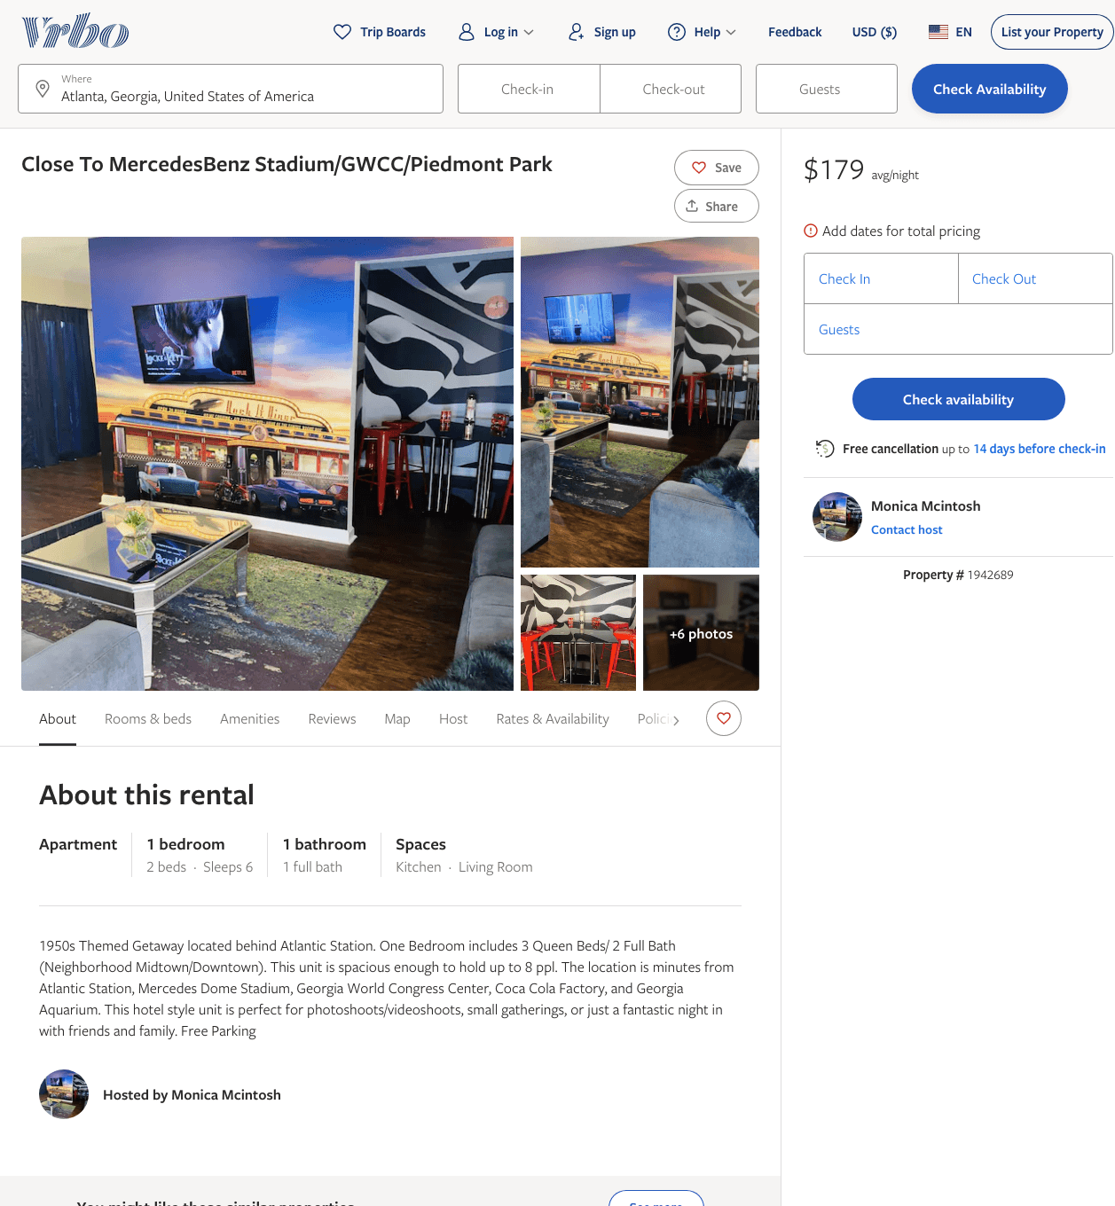
Listing 1942689
1
6
$179
1
Monica Mcintosh
https://www.vrbo.com/1942689
Aug 2022

Slide 15
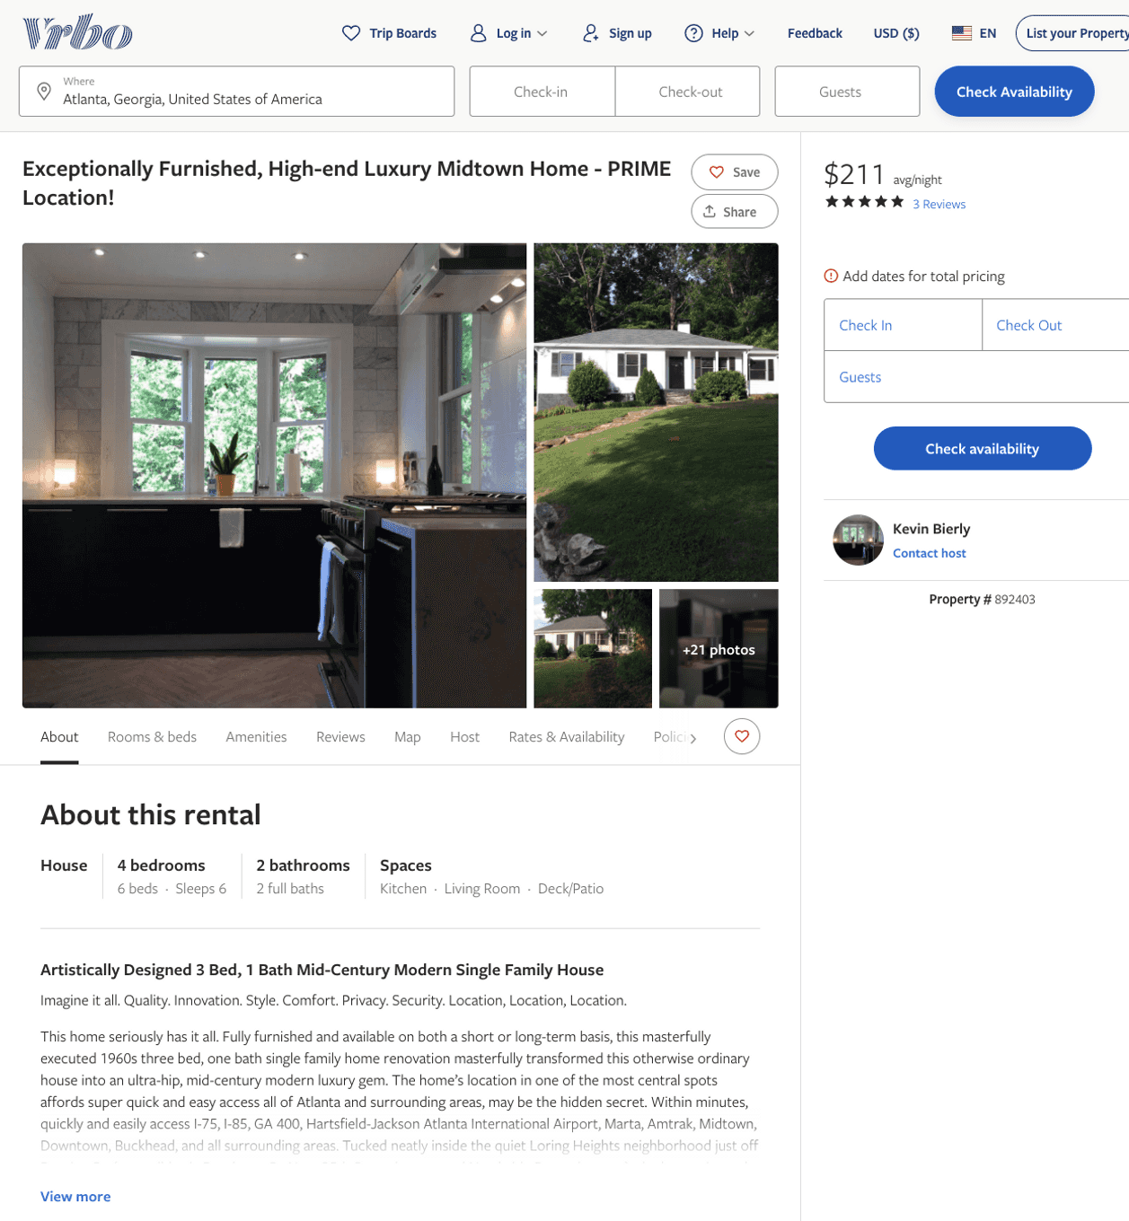
Listing 892403
4
6
$211 - $326
5
7
Kevin Bierly
https://www.vrbo.com/892403
Aug 2022

Slide 16
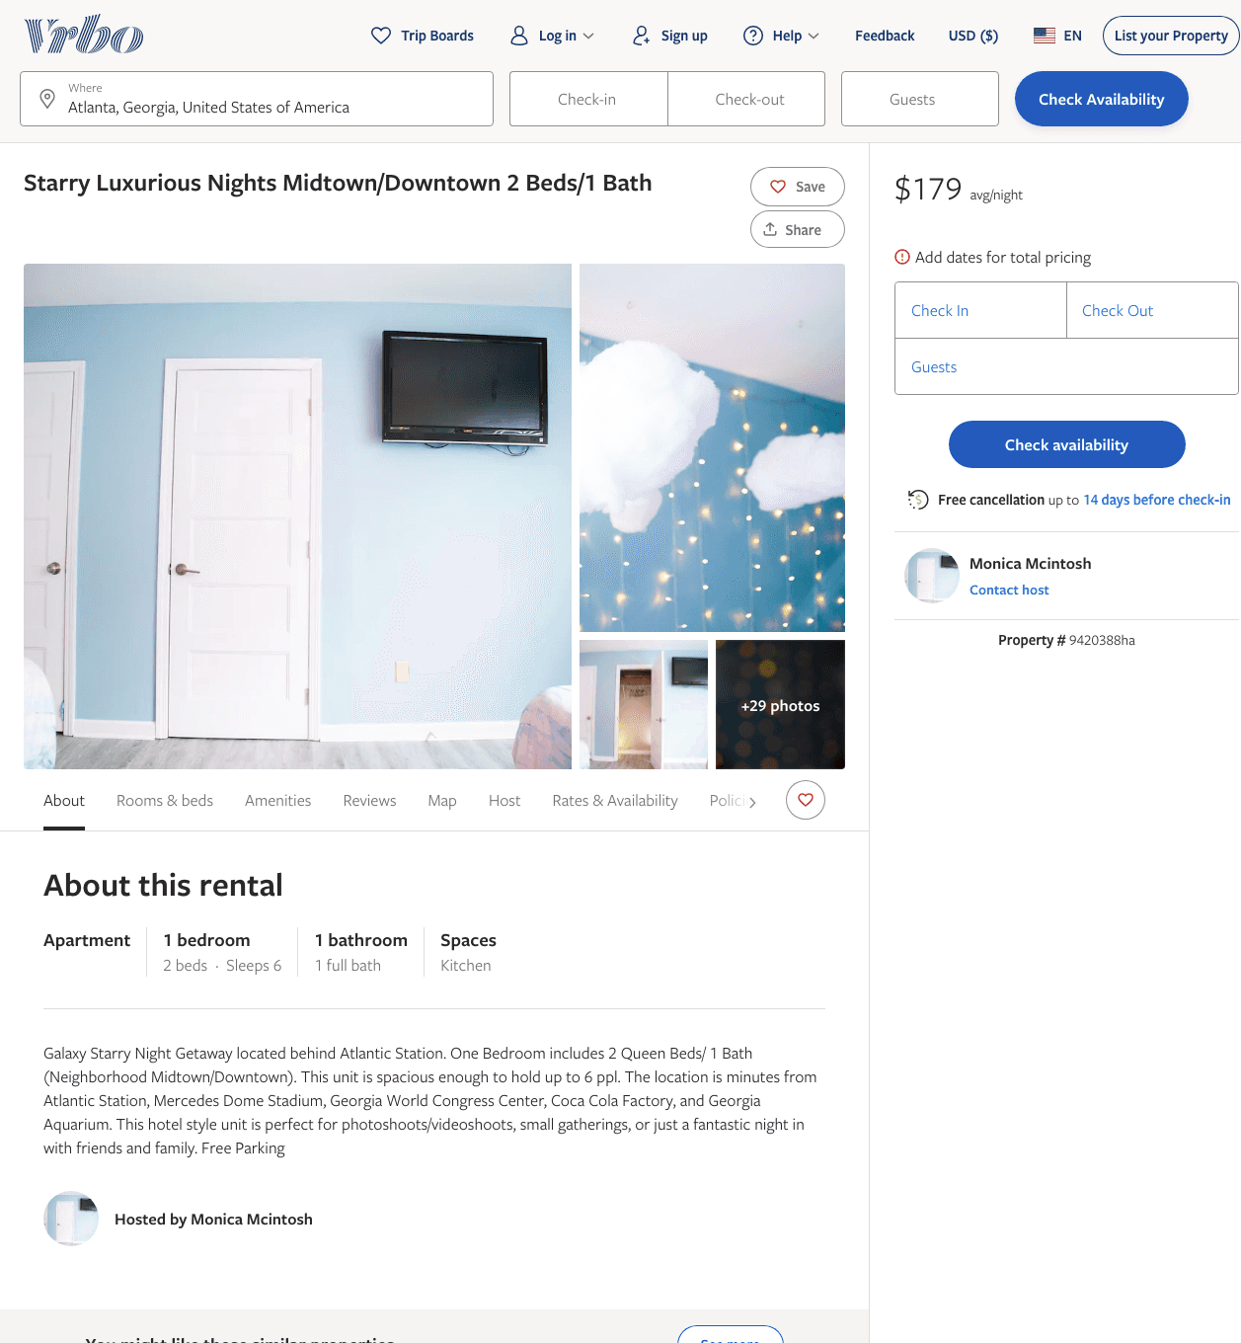
Listing 9420388
1
6
$179
1
Monica Mcintosh
https://www.vrbo.com/9420388ha
Aug 2022

Slide 17
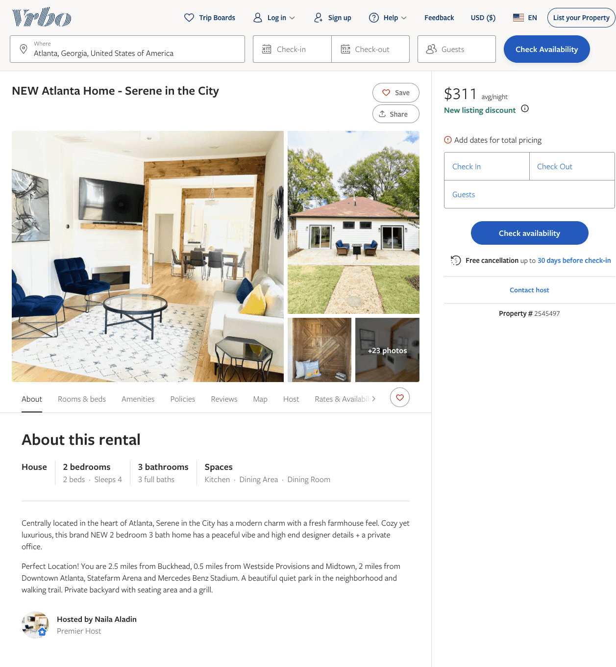
Listing 2545497
3
6
$278 - $311
5
3
Naila Aladin
https://www.vrbo.com/2545497
Aug 2022

Slide 18
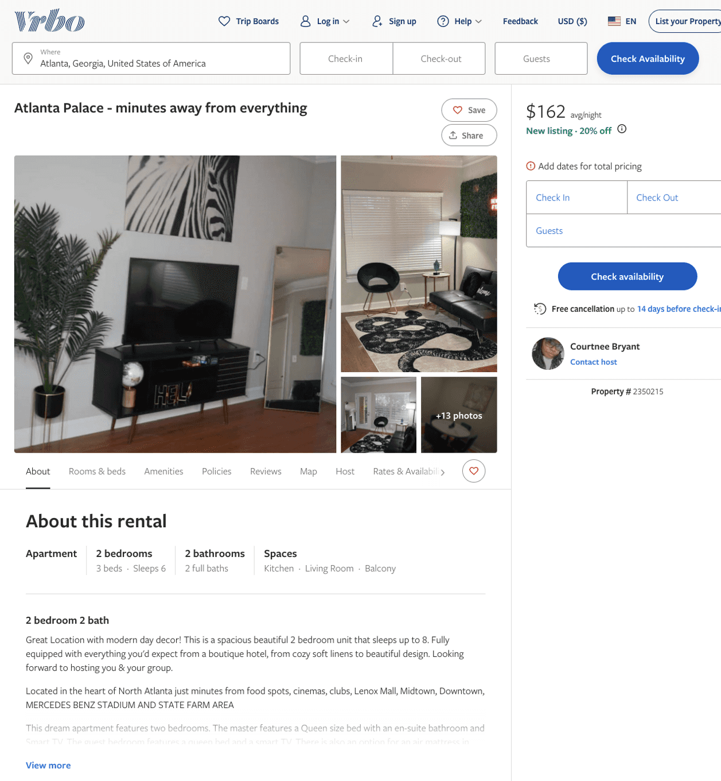
Listing 2350215
2
6
$152 - $165
2
Courtnee Bryant
https://www.vrbo.com/2350215
Aug 2022

Slide 19
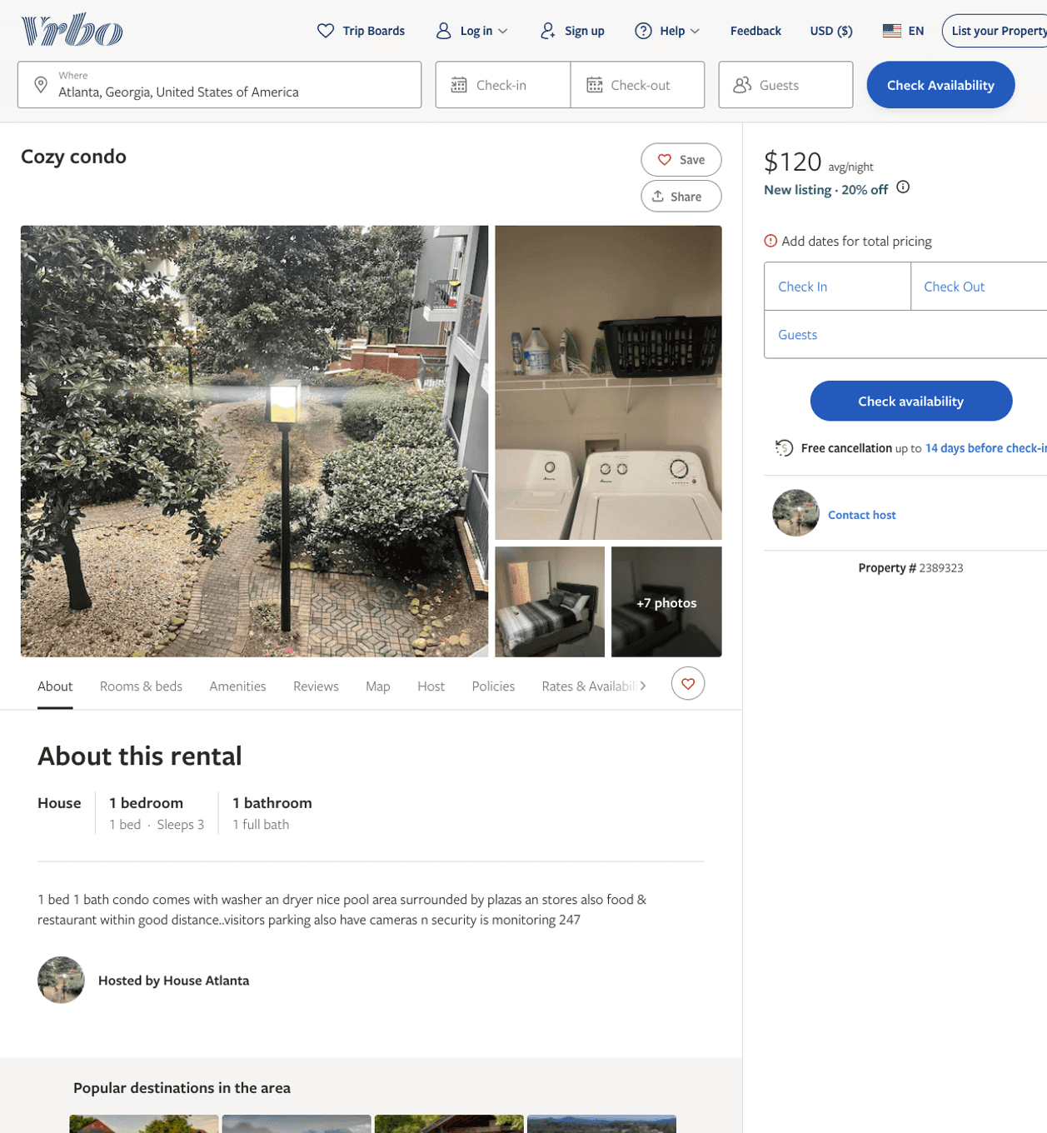
Listing 2389323
1
3
$113 - $175
2
https://www.vrbo.com/2389323
Aug 2022

Slide 20
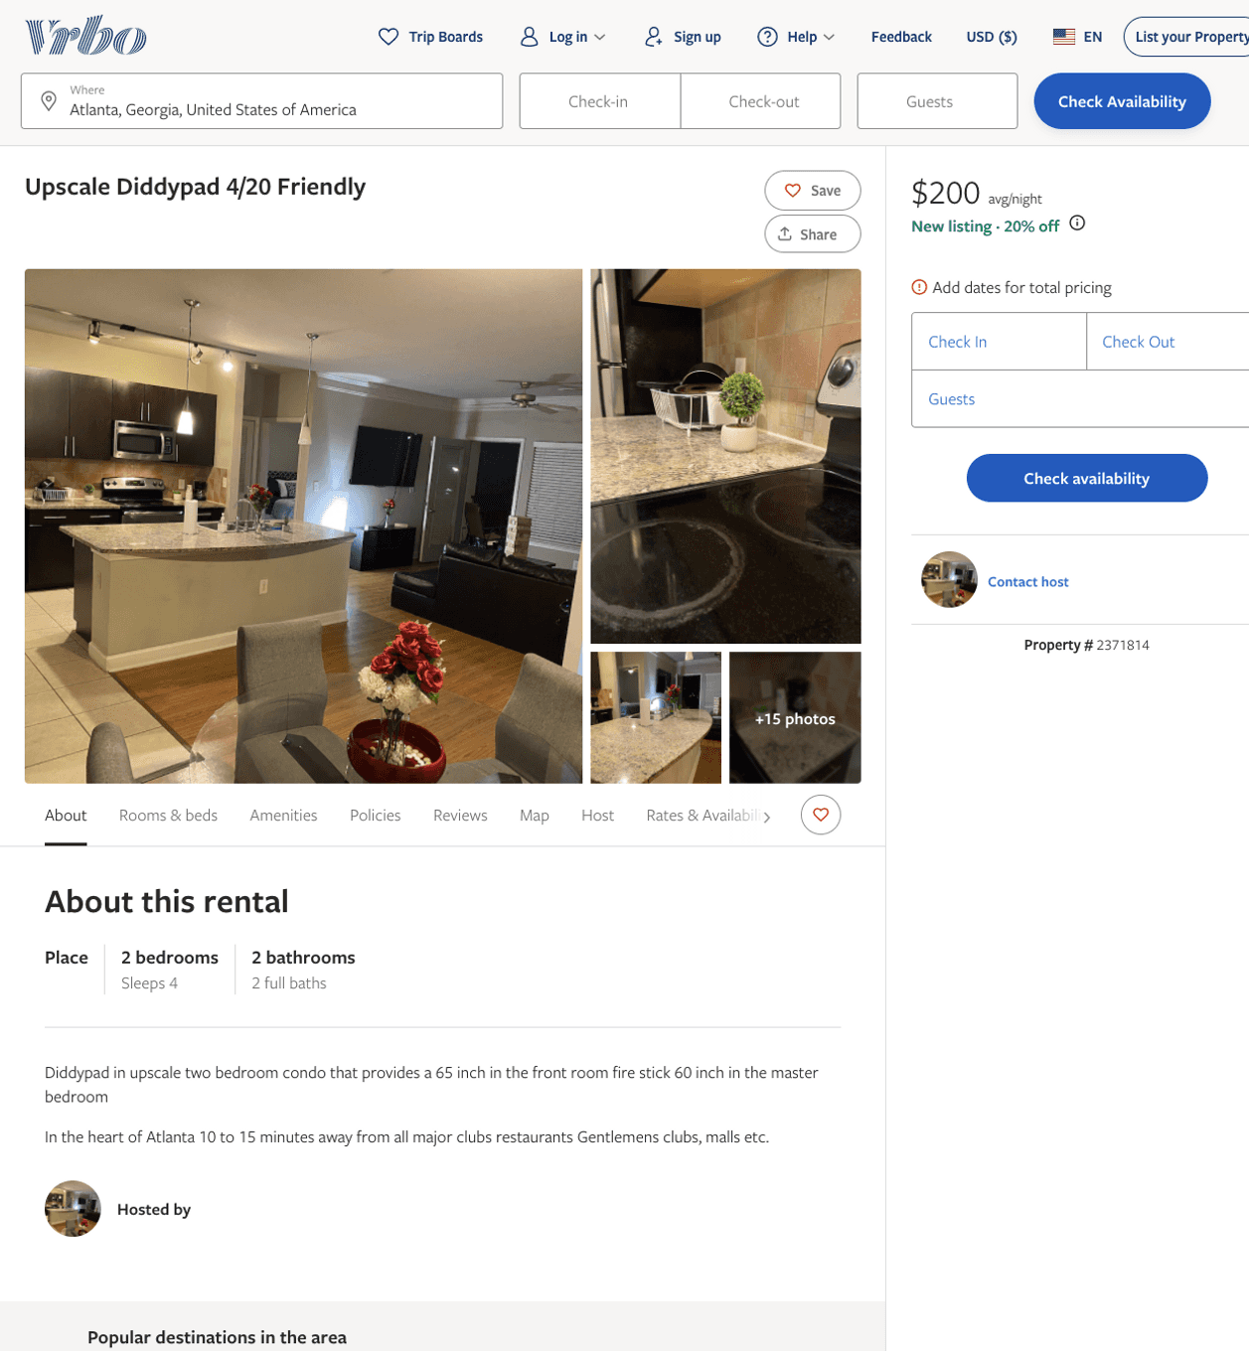
Listing 2371814
2
4
$128 - $200
3
Ryan Strong
https://www.vrbo.com/2371814
Aug 2022

Slide 21
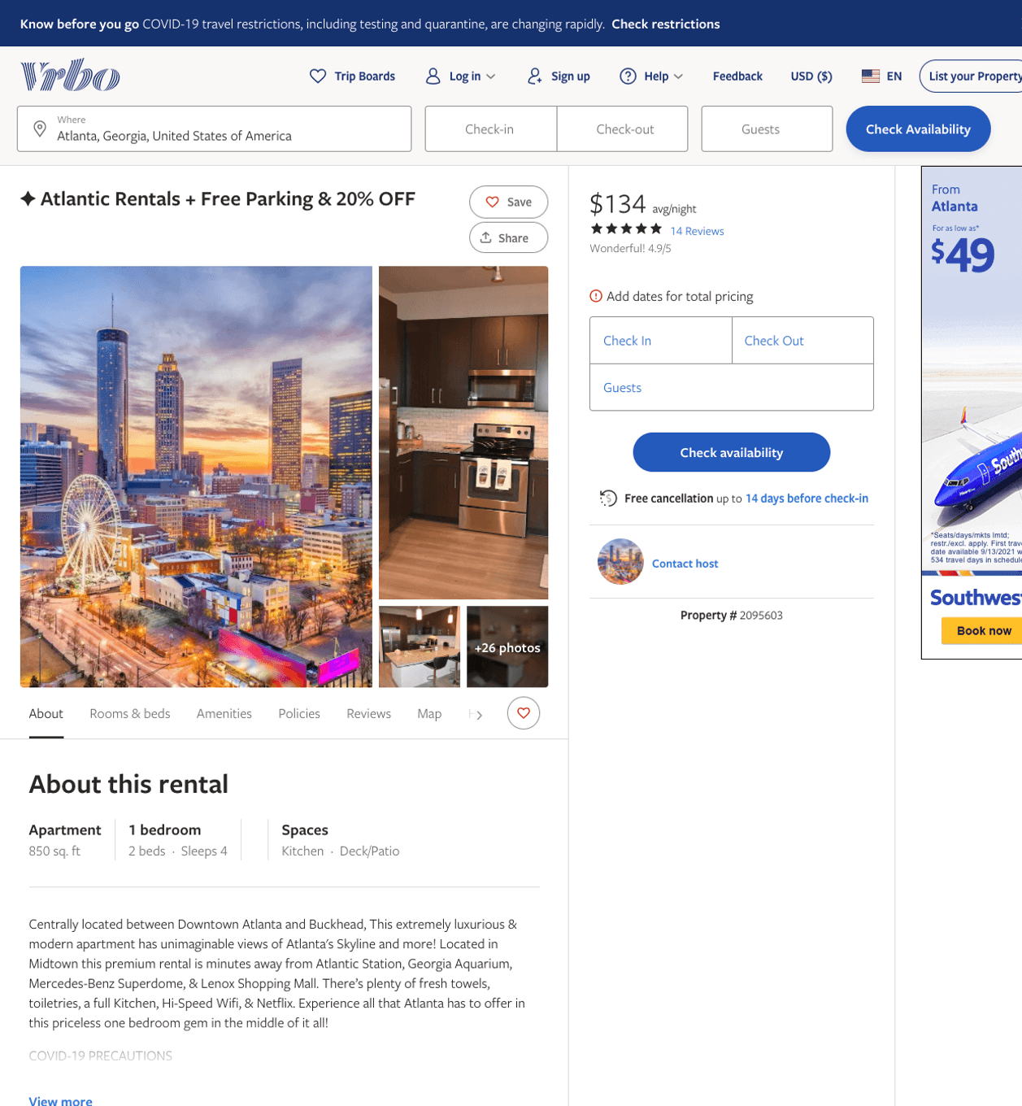
Listing 2095603
1
4
$102 - $95
4.806452
2
https://www.vrbo.com/2095603
Aug 2022

Slide 22
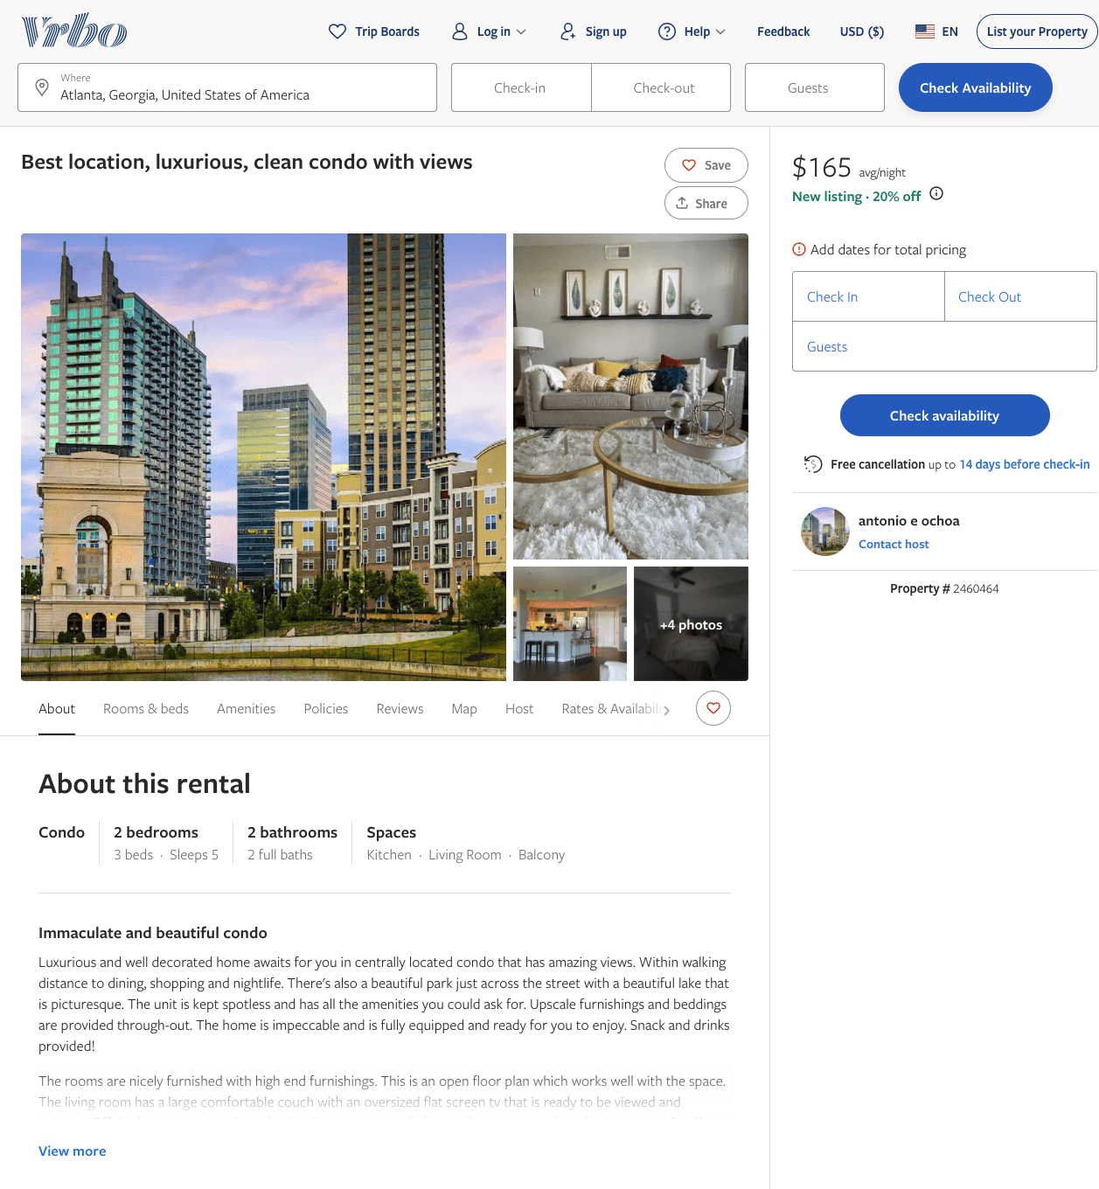
Listing 2460464
2
5
$165 - $195
4.736842
2
antonio e ochoa
https://www.vrbo.com/2460464
Aug 2022

Slide 23
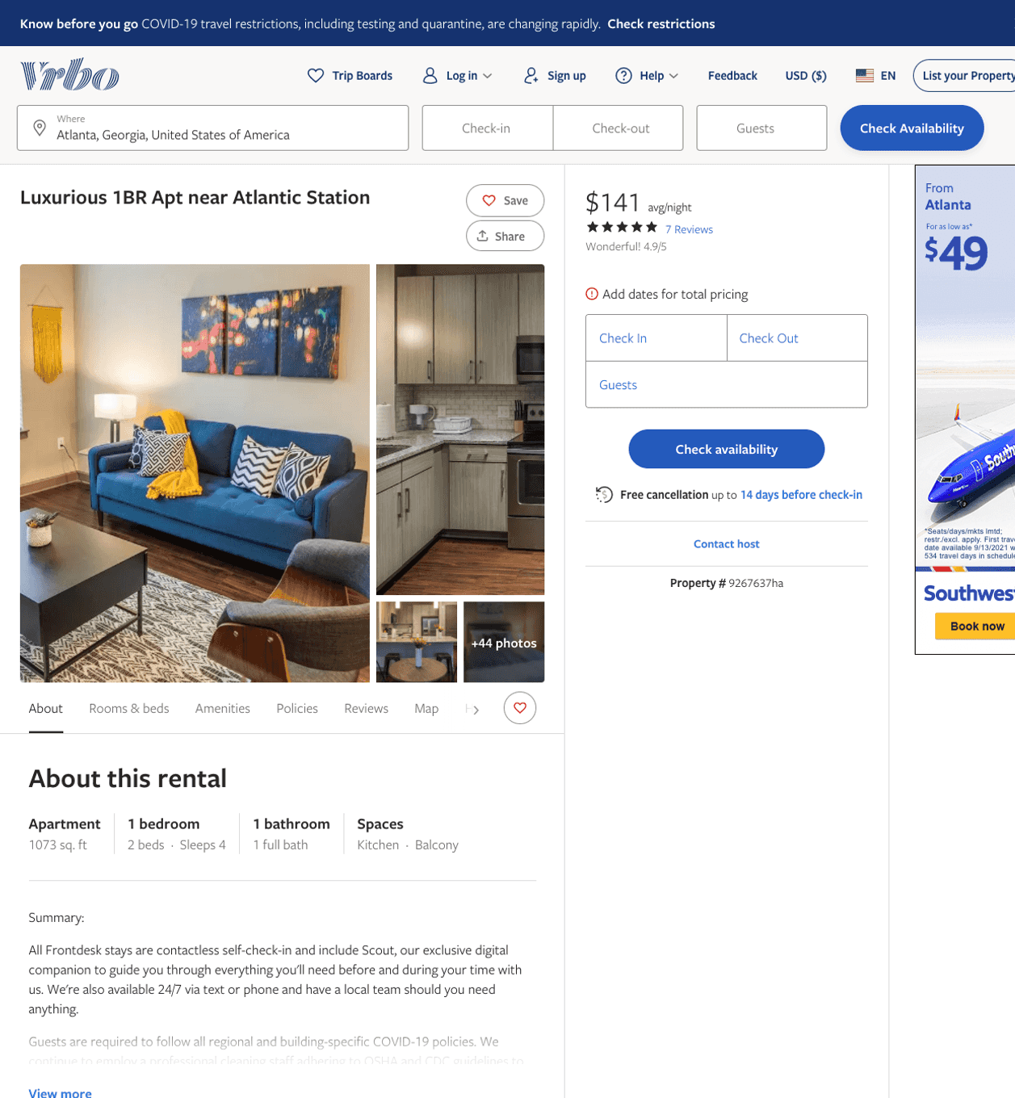
Listing 9267637
1
4
$114 - $162
4.909091
1
Frontdesk, Inc.
https://www.vrbo.com/9267637ha
Aug 2022

Slide 24
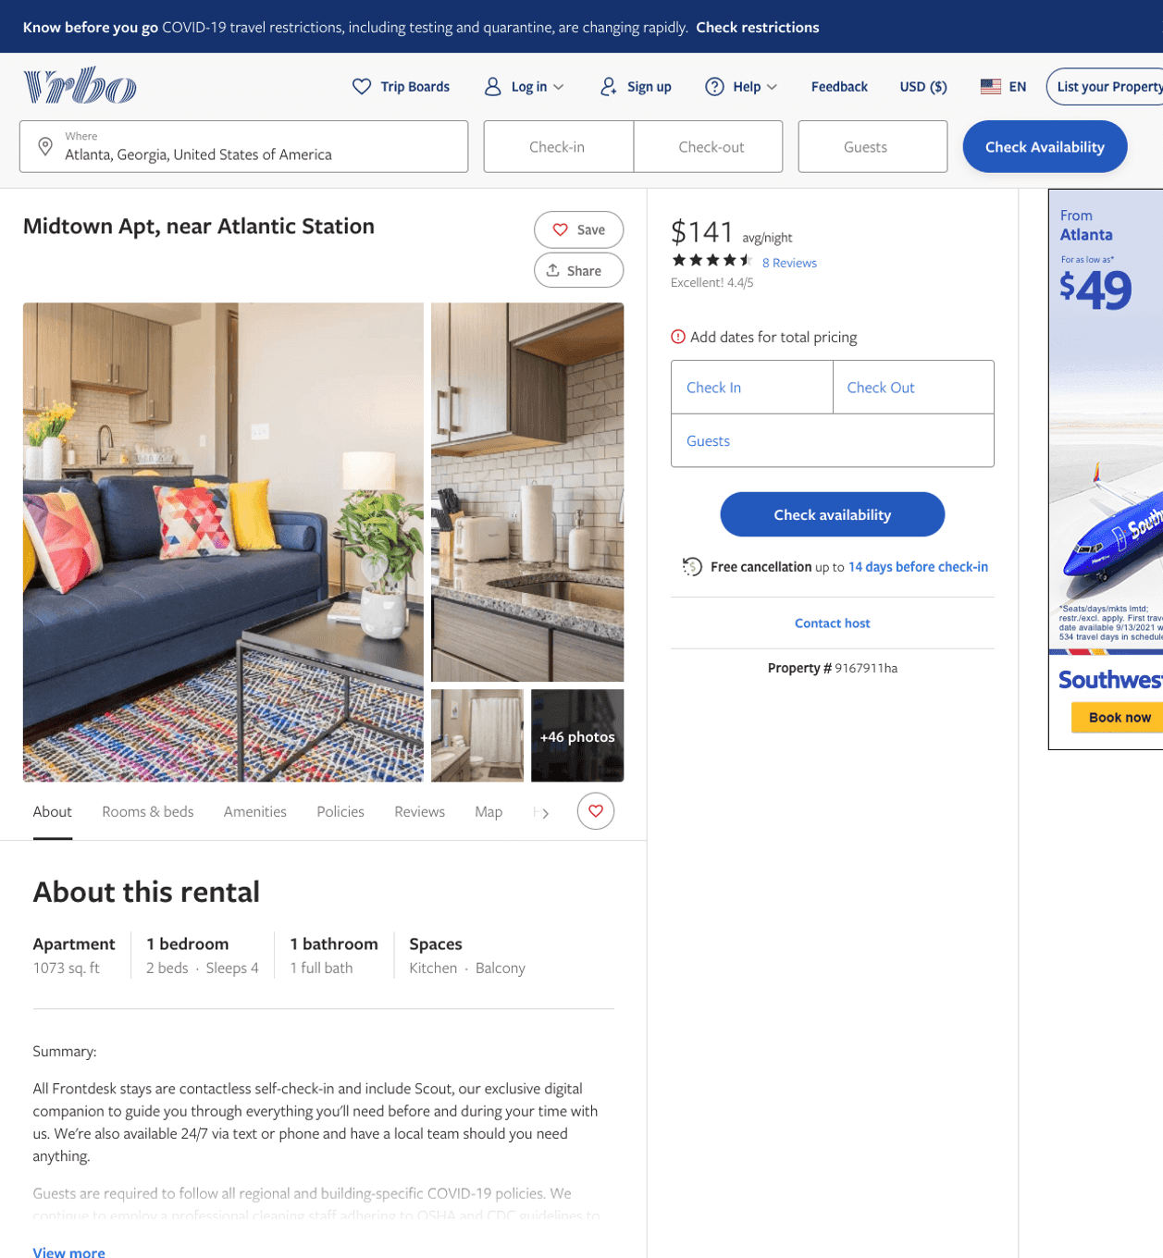
Listing 9167911
1
4
$114 - $145
4.4
1
Frontdesk, Inc.
https://www.vrbo.com/9167911ha
Aug 2022

Slide 25
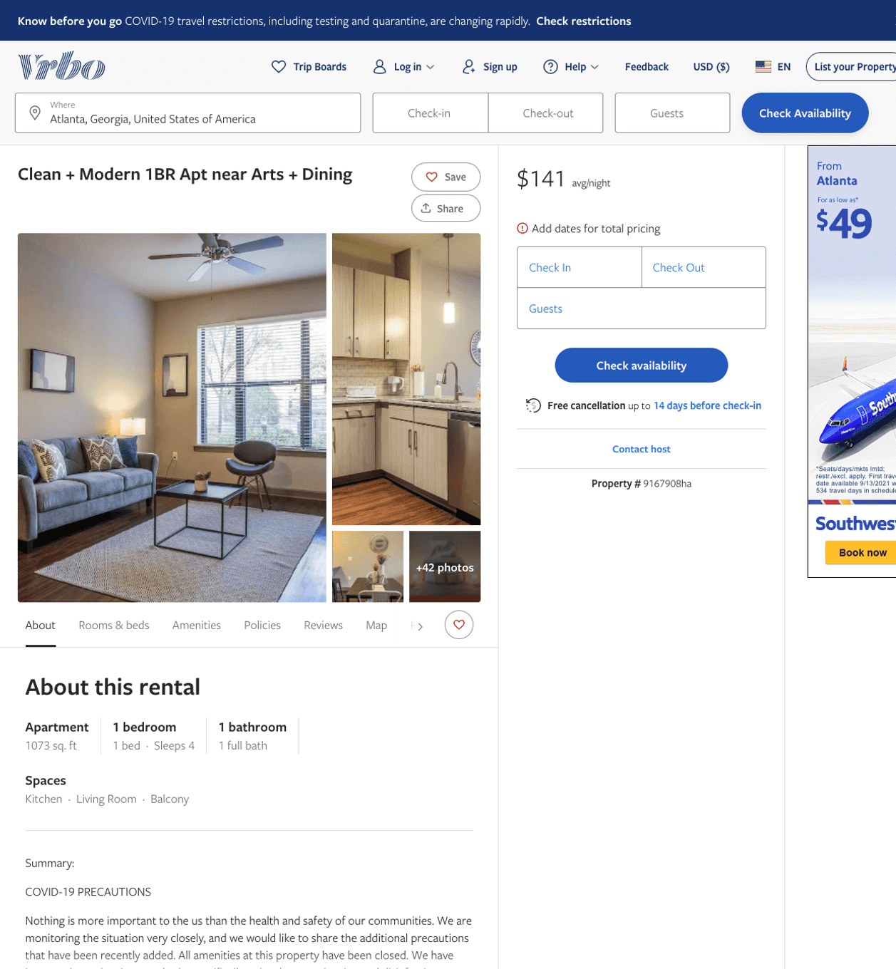
Listing 9167908
1
4
$117 - $177
1
Frontdesk, Inc.
https://www.vrbo.com/9167908ha
Aug 2022

Slide 26
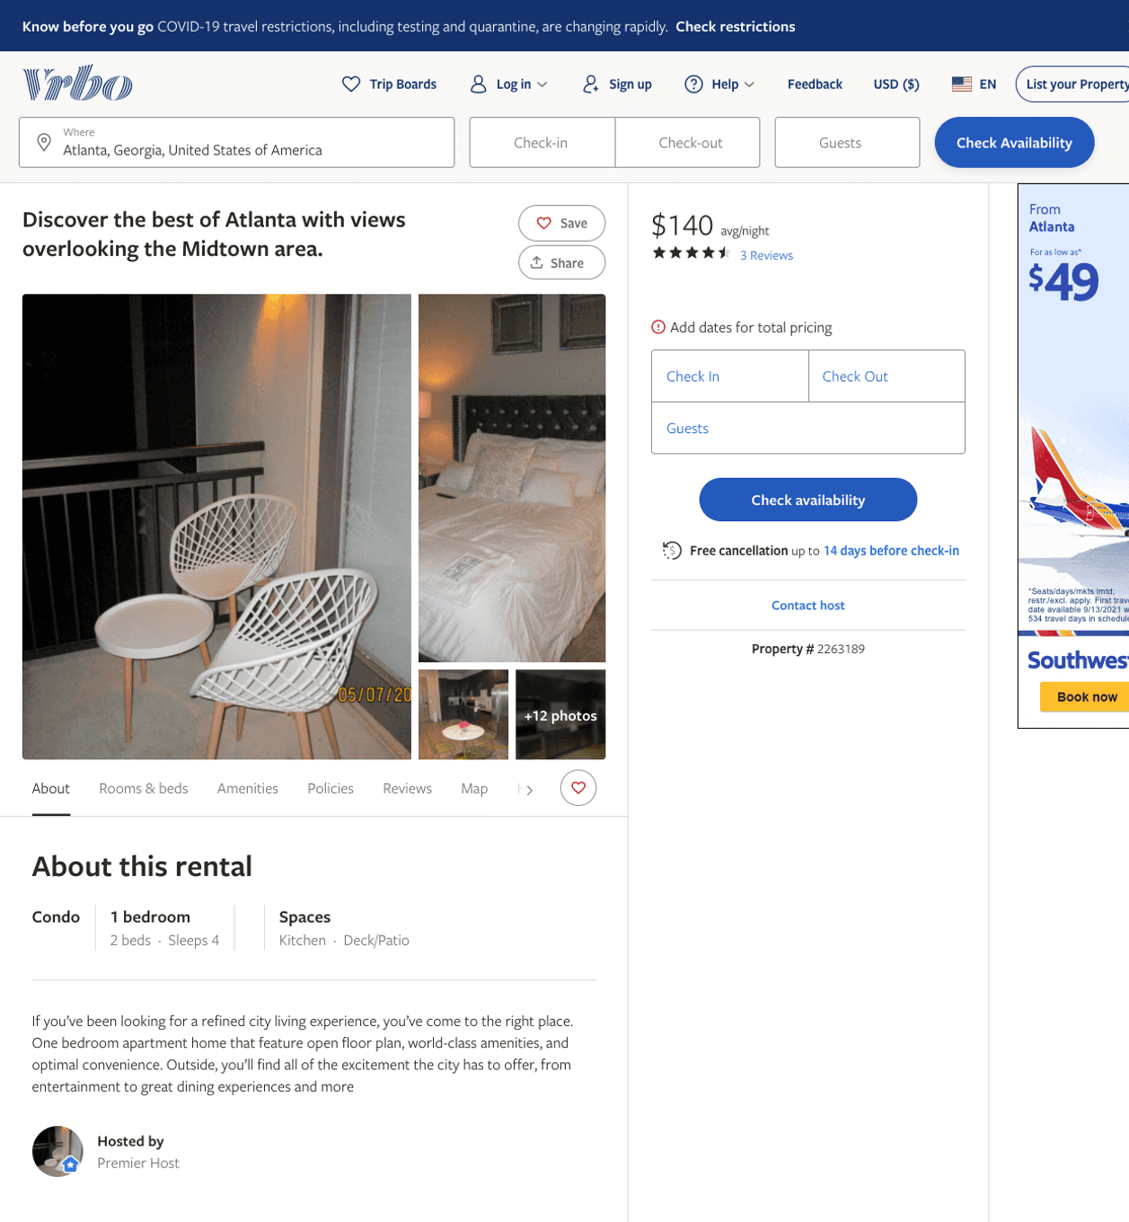
Listing 2263189
1
4
$140
4.6666665
1
https://www.vrbo.com/2263189
Aug 2022

Slide 27
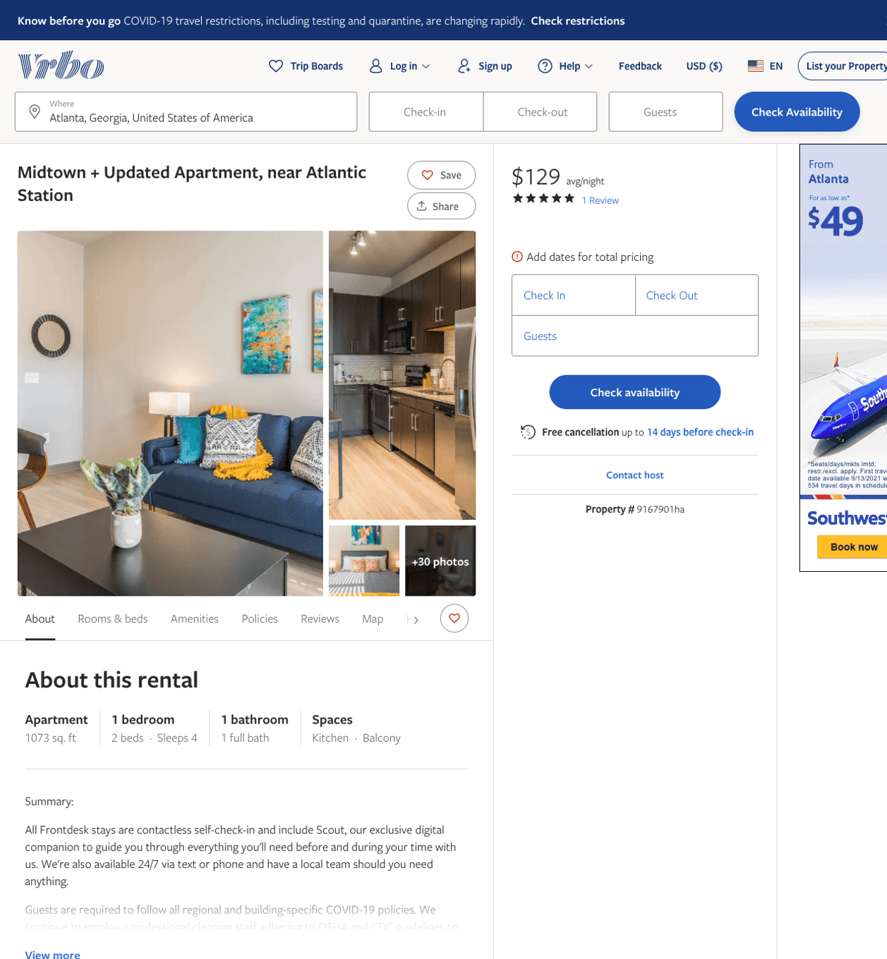
Listing 9167901
1
4
$117 - $160
5
1
Frontdesk, Inc.
https://www.vrbo.com/9167901ha
Aug 2022

Slide 28
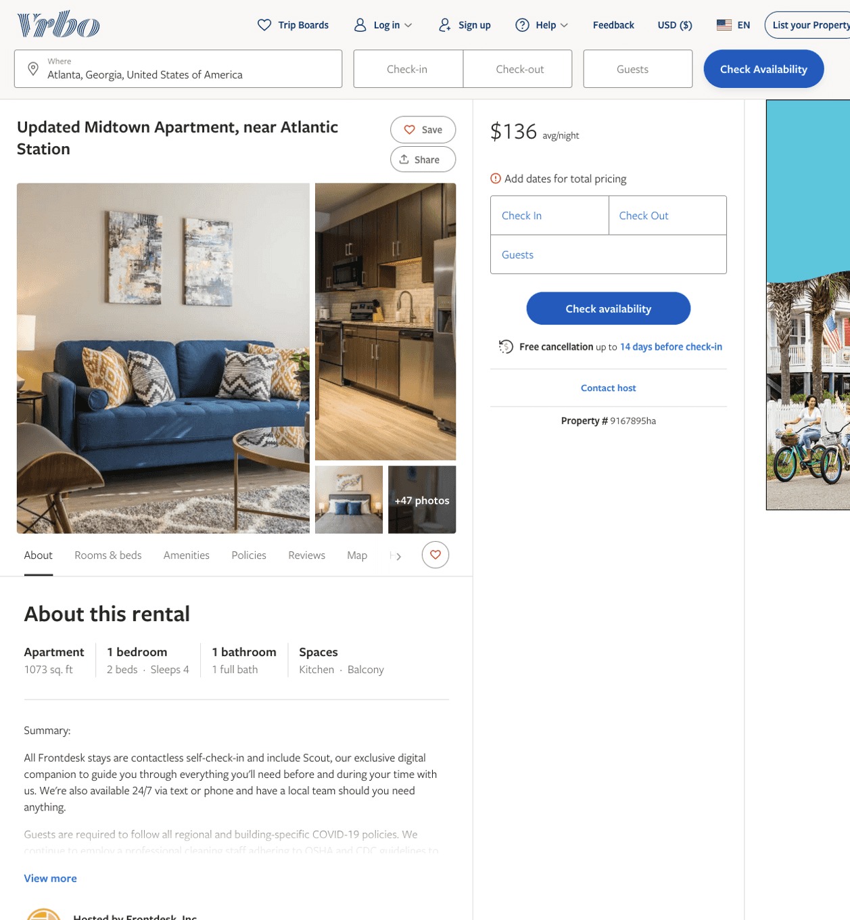
Listing 9167895
1
4
$118 - $151
1
Frontdesk, Inc.
https://www.vrbo.com/9167895ha
Aug 2022

Slide 29
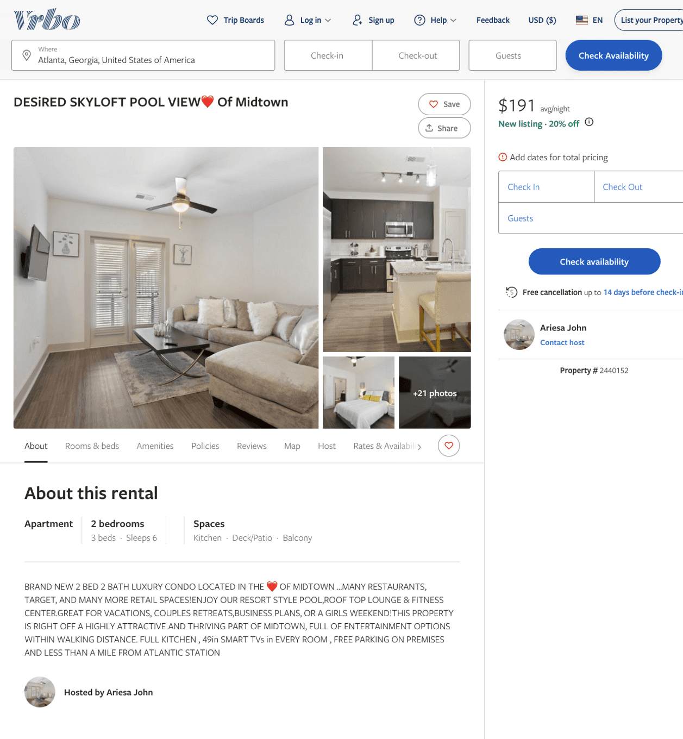
Listing 2440152
2
6
$191 - $231
4
2
Ariesa John
https://www.vrbo.com/2440152
Aug 2022

Slide 30
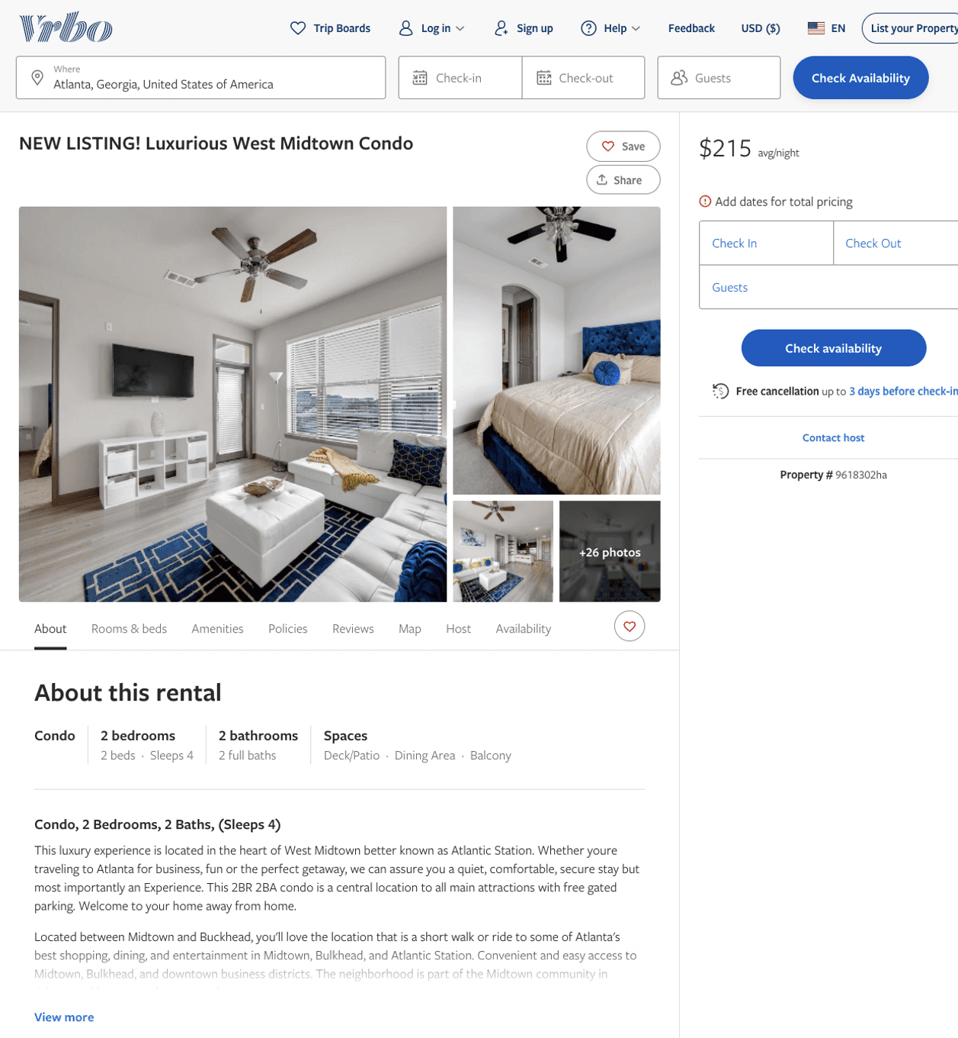
Listing 9618302
2
4
$180 - $227
5
1
RedAwning Vacation Rentals
https://www.vrbo.com/9618302ha
Aug 2022

Slide 31
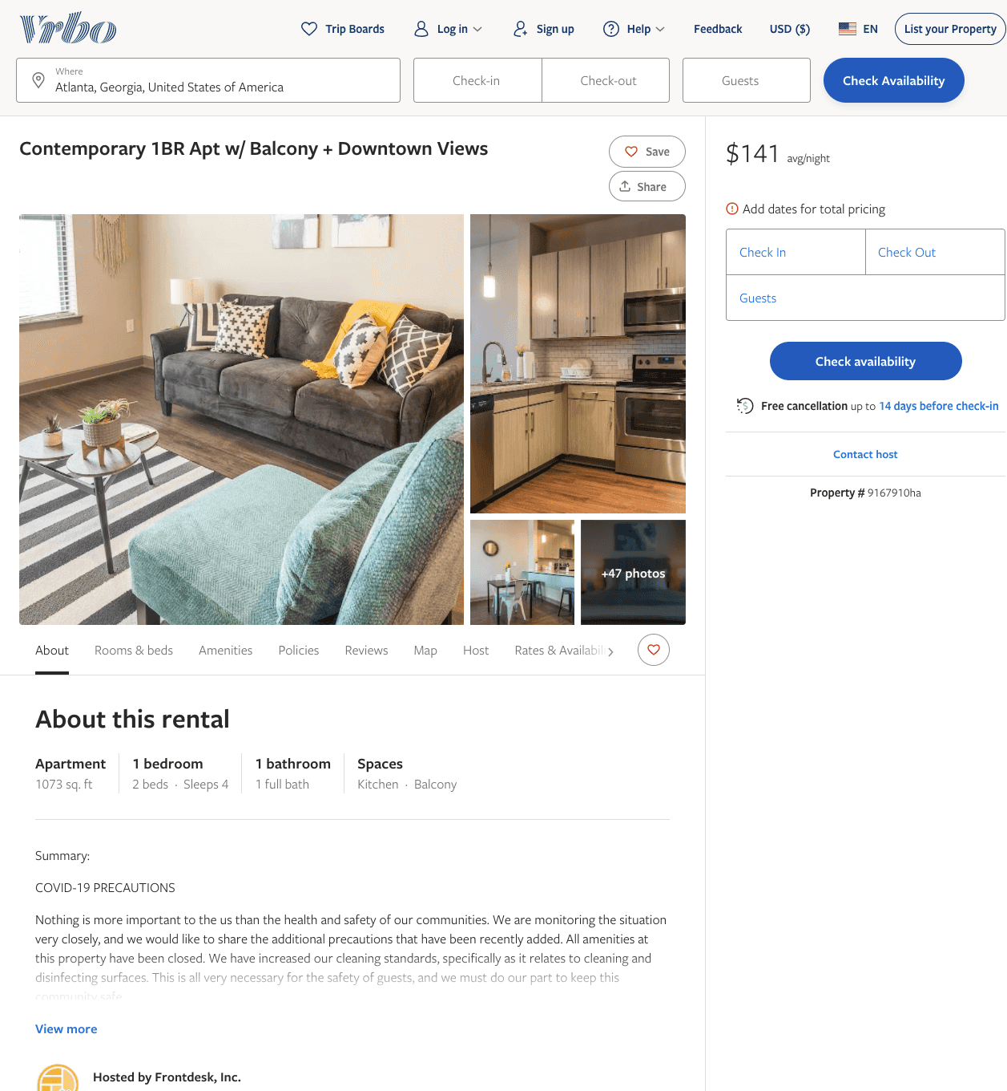
Listing 9167910
1
4
$117 - $160
4
1
Frontdesk, Inc.
https://www.vrbo.com/9167910ha
Aug 2022

Slide 32
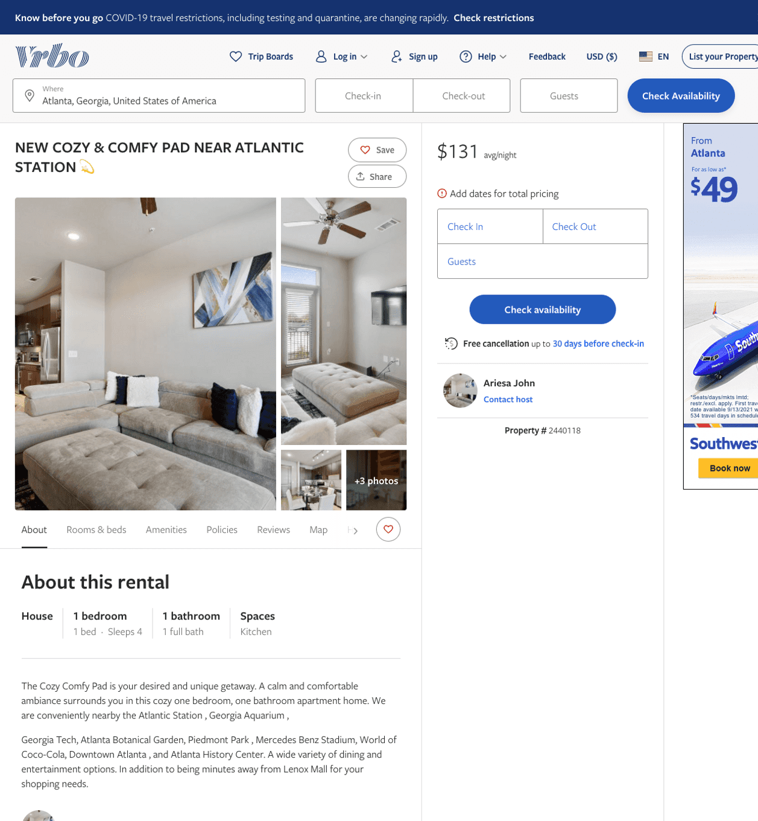
Listing 2440118
1
4
$131 - $188
2
Ariesa John
https://www.vrbo.com/2440118
Aug 2022

Slide 33
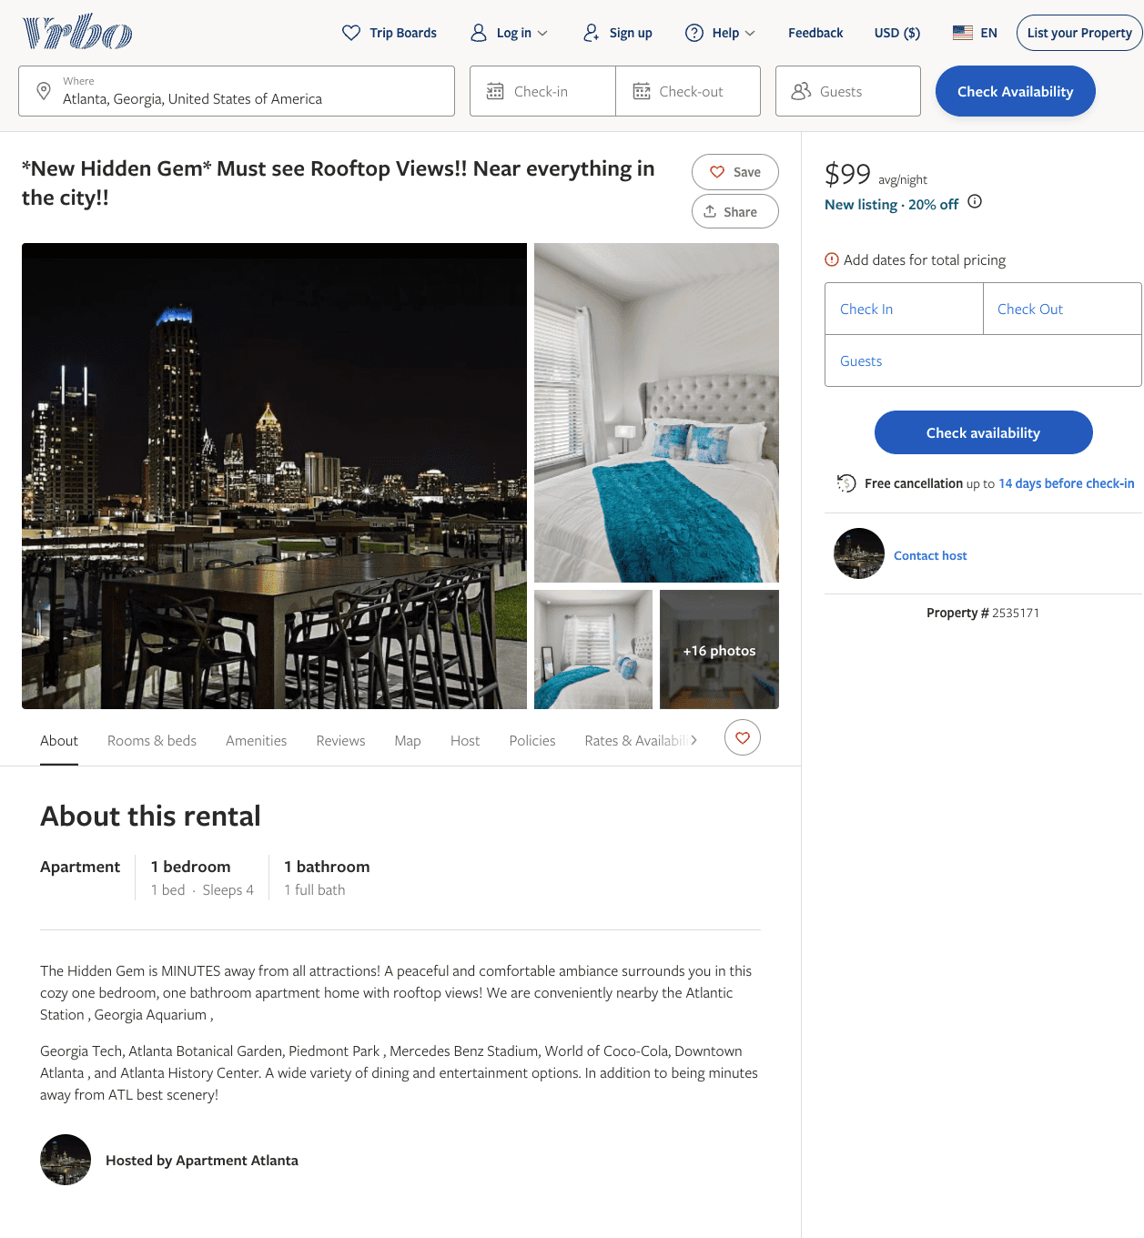
Listing 2535171
1
4
$101 - $99
2
Glam Luxury Suites
https://www.vrbo.com/2535171
Aug 2022

Slide 34
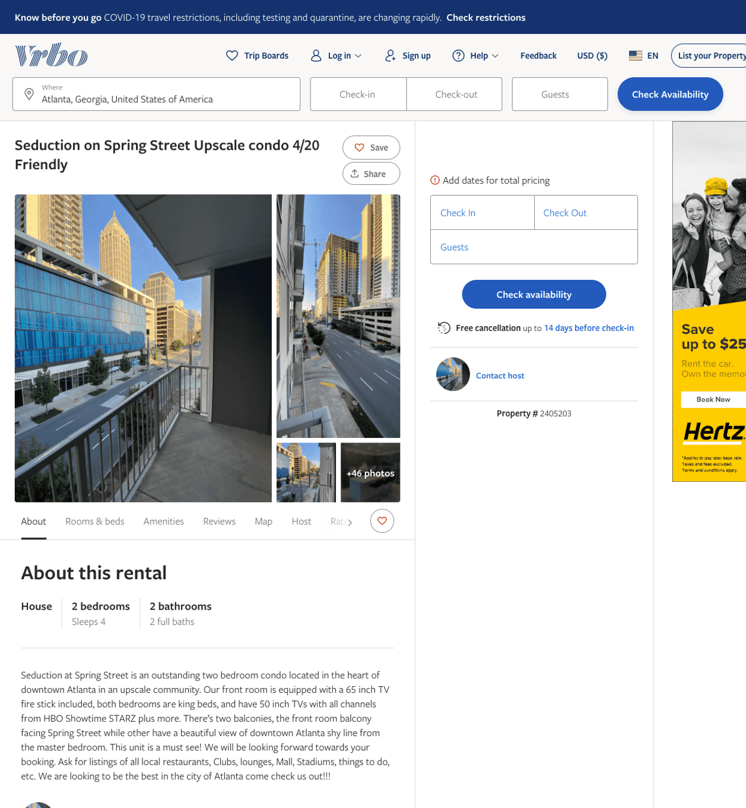
Listing 2405203
2
4
$132
111
Ryan Strong
https://www.vrbo.com/2405203
Aug 2022

Slide 35
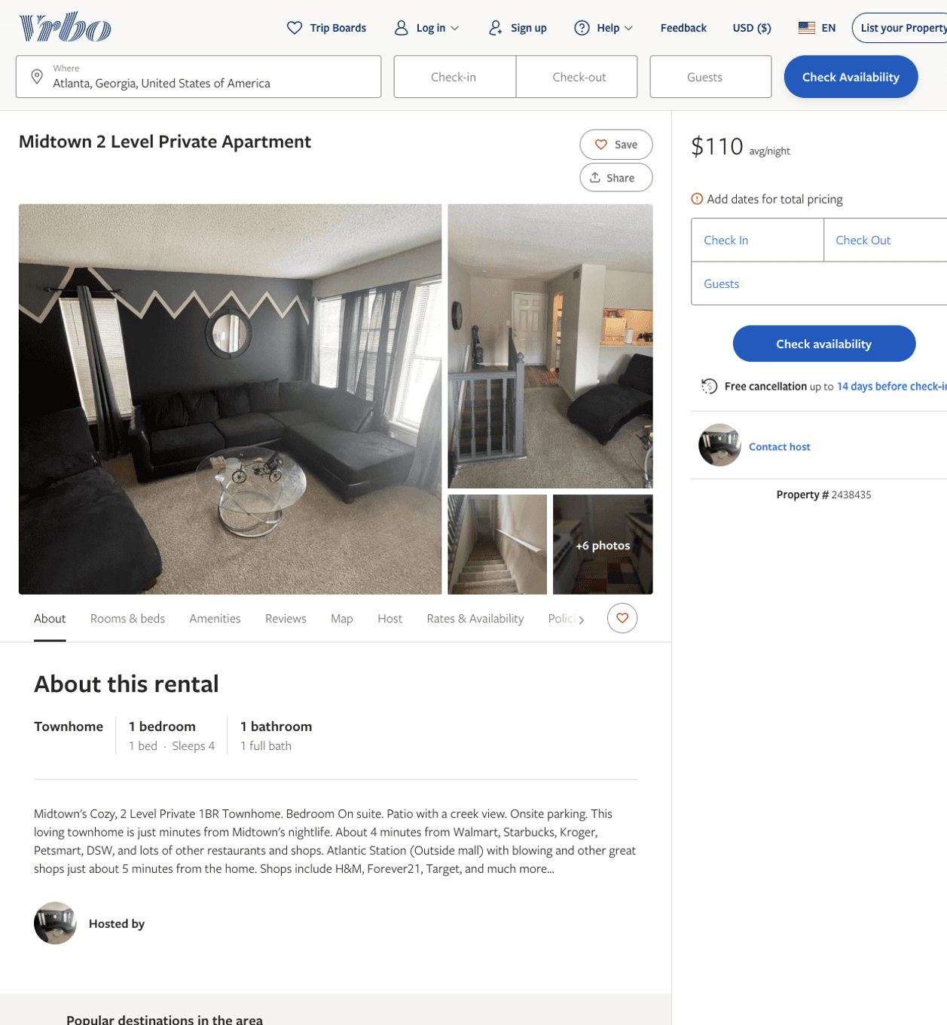
Listing 2438435
1
4
$110 - $116
3
https://www.vrbo.com/2438435
Aug 2022

Slide 36
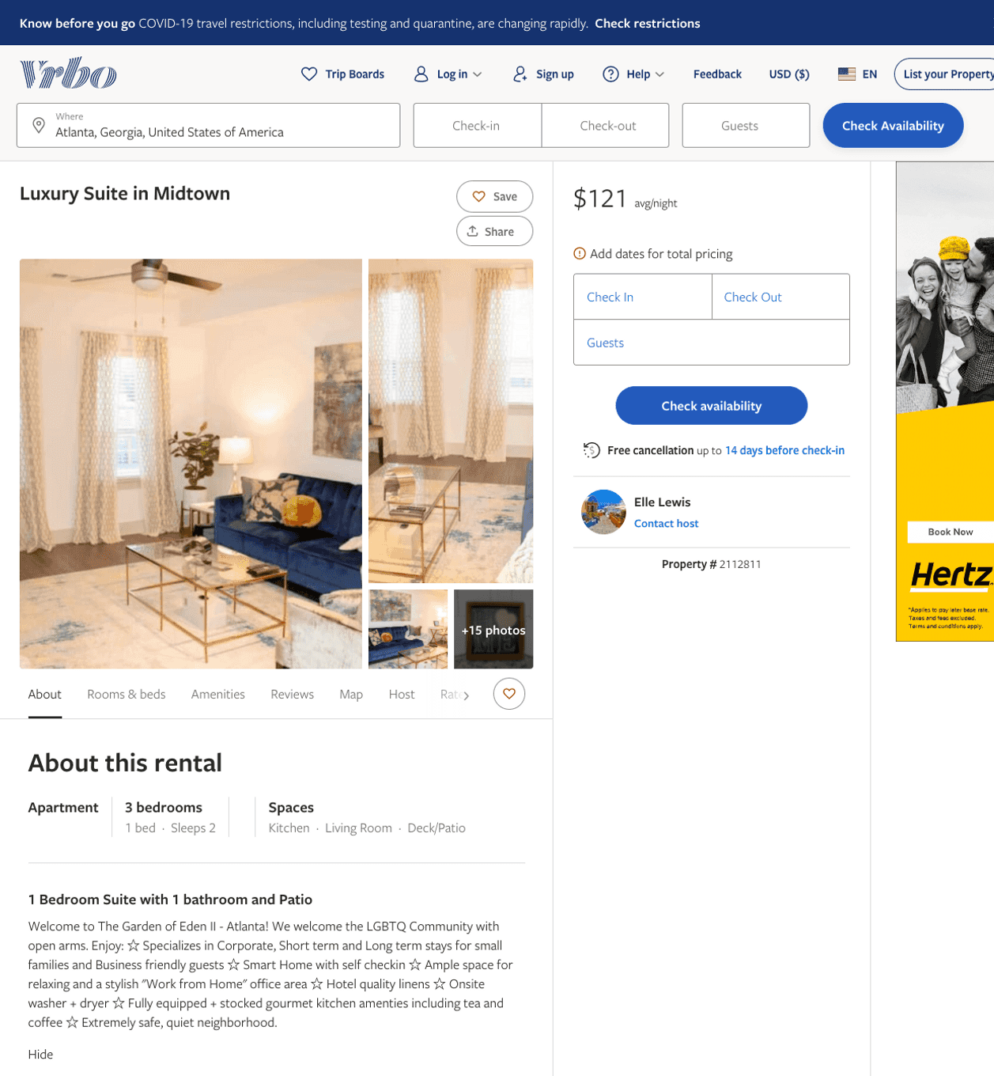
Listing 2112811
1
2
$126 - $153
2
Elle Lewis
https://www.vrbo.com/2112811
Aug 2022

Slide 37
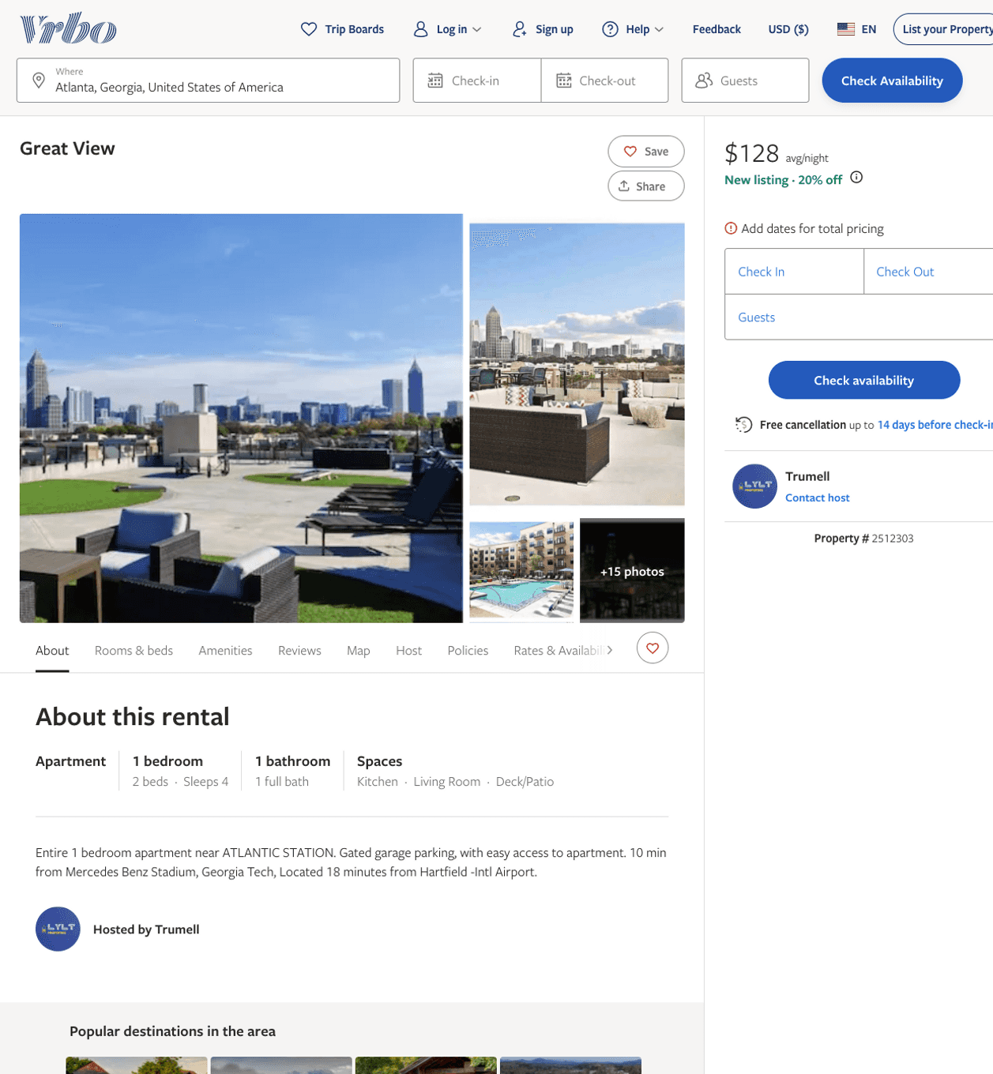
Listing 2512303
1
4
$124 - $133
2
Trumell
https://www.vrbo.com/2512303
Aug 2022

Slide 38
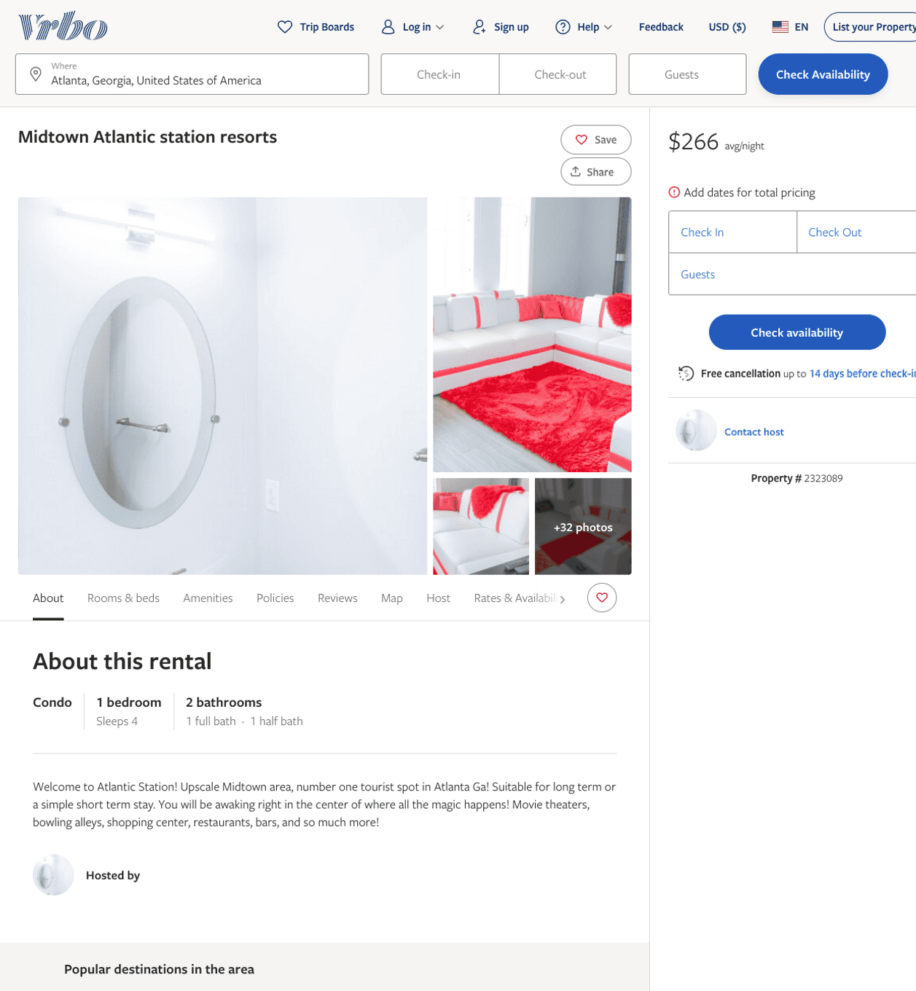
Listing 2323089
1
4
$266
3
https://www.vrbo.com/2323089
Aug 2022

Slide 39
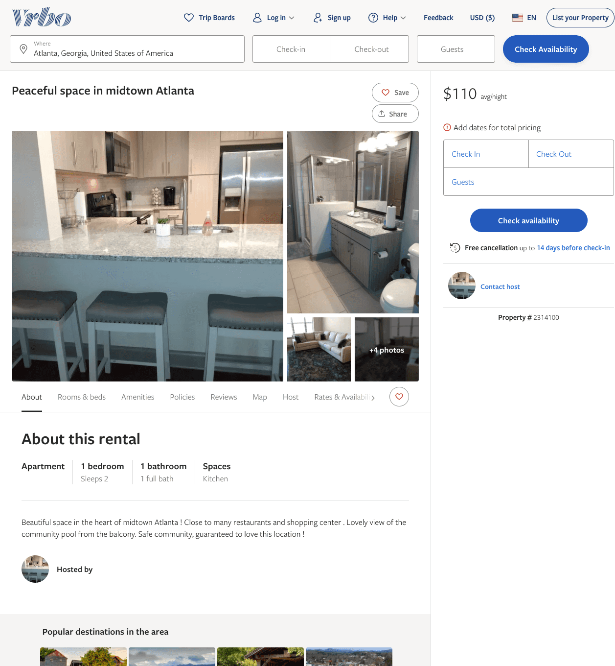
Listing 2314100
1
2
$110 - $153
1
https://www.vrbo.com/2314100
Aug 2022

Slide 40
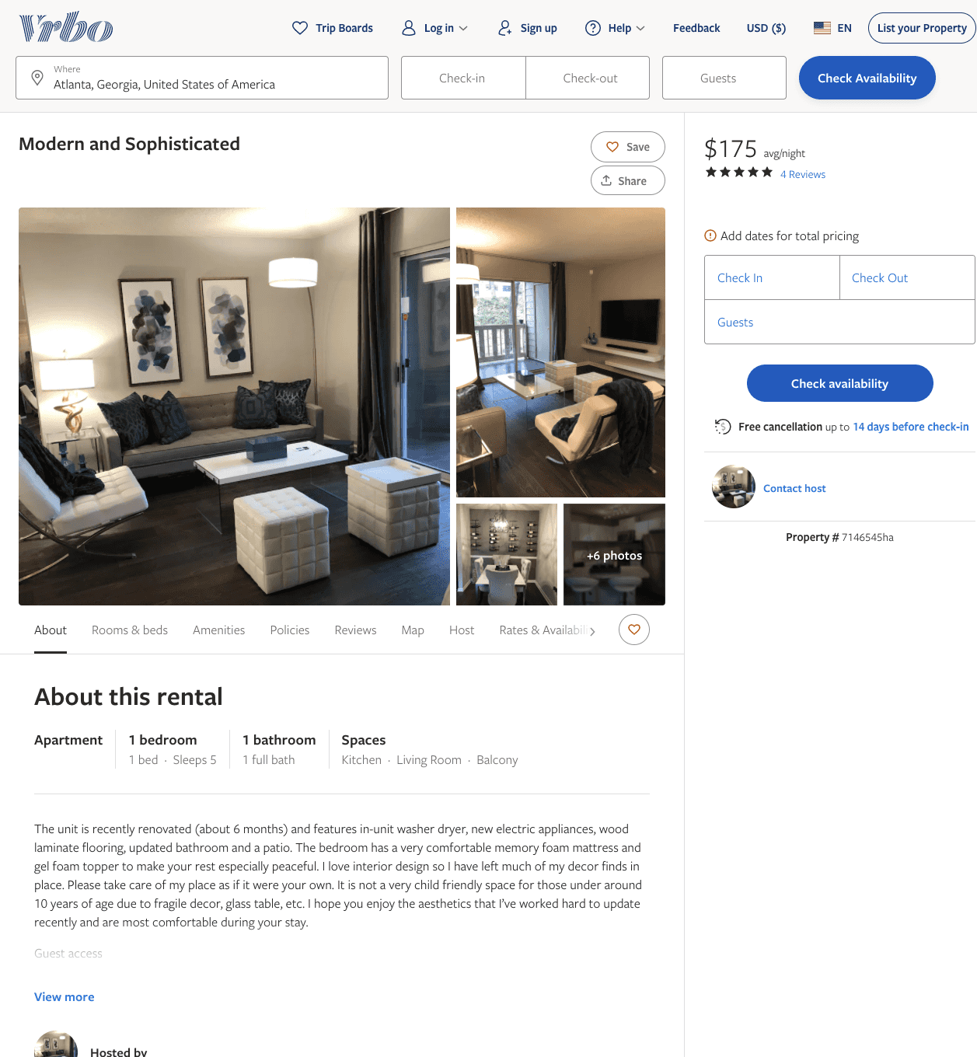
Listing 7146545
1
5
$175
4.75
1
https://www.vrbo.com/7146545ha
Aug 2022

Slide 41
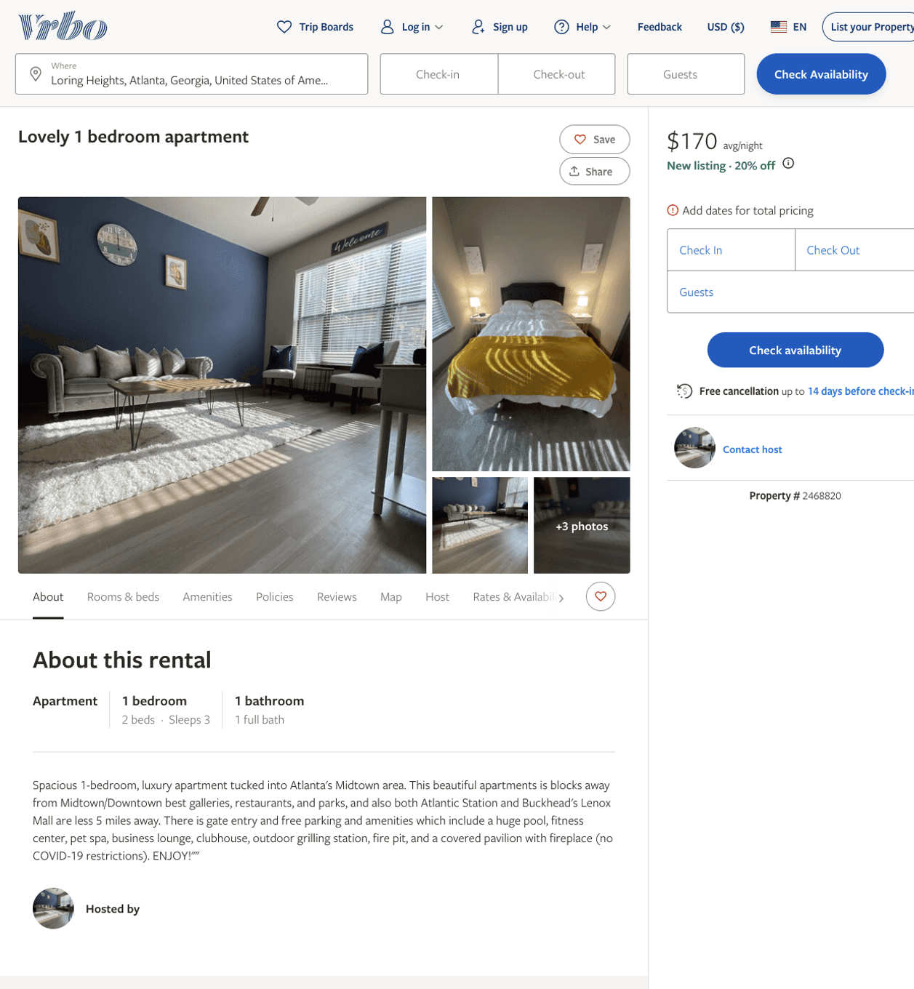
Listing 2468820
1
3
$170 - $199
2
https://www.vrbo.com/2468820
Aug 2022

Slide 42
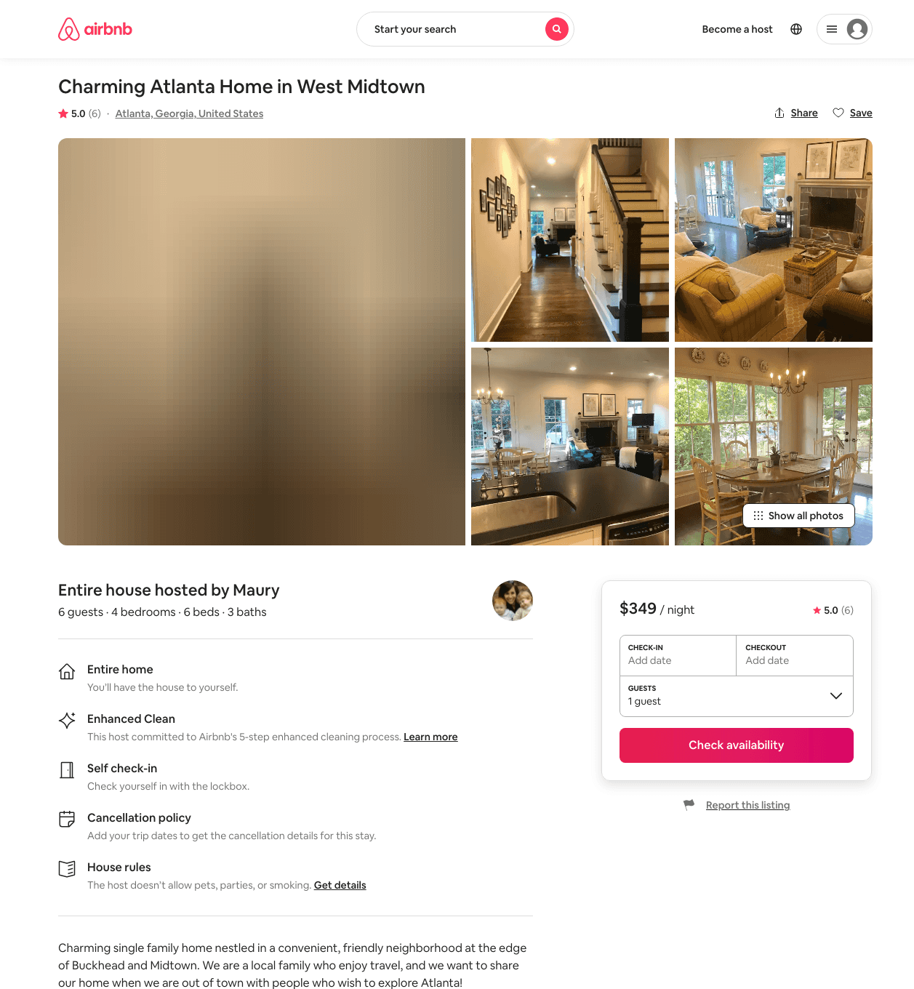
Listing 27363584
4
6
$349
5.0
3
Maury
57186843
1
https://www.airbnb.com/rooms/27363584
Aug 2022

Slide 43
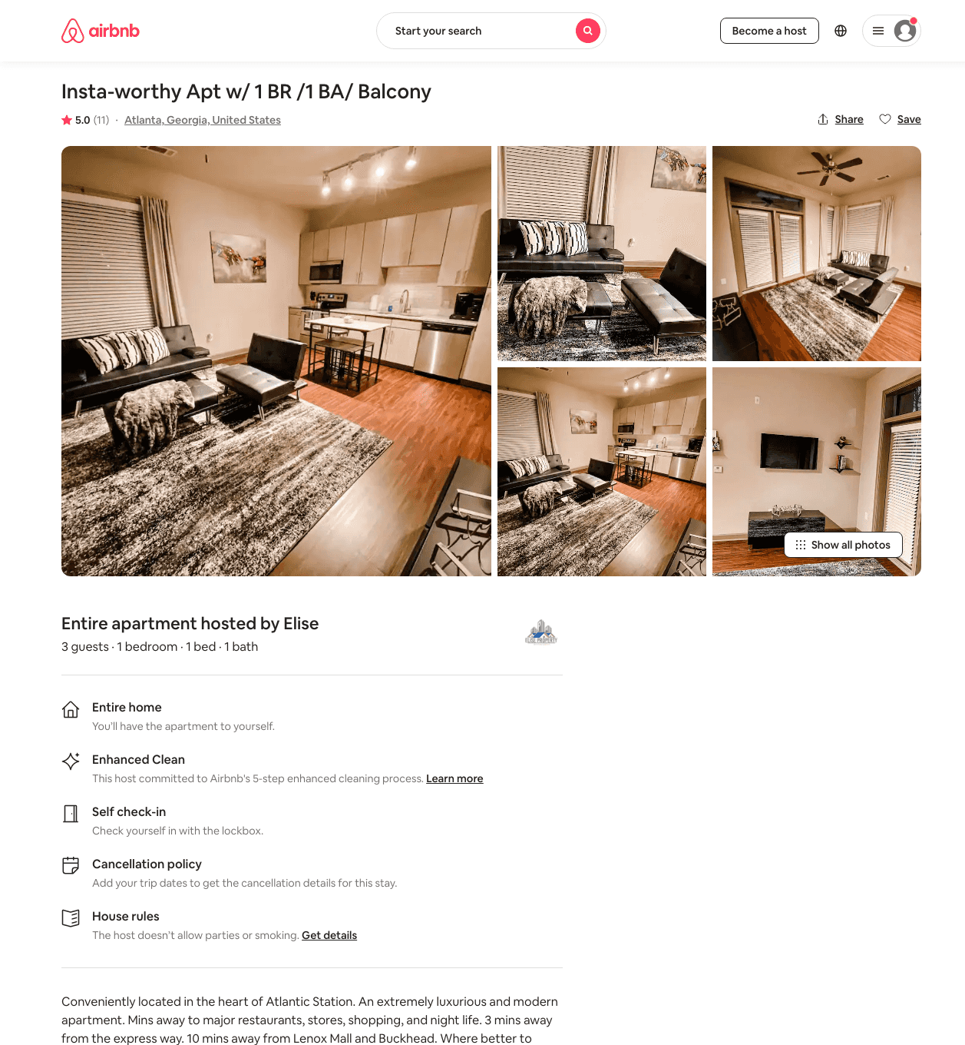
Listing 47745956
1
4
$68 - $95
4.97
2
Elise
384708173
1
https://www.airbnb.com/rooms/47745956
Jul 2022

Slide 44
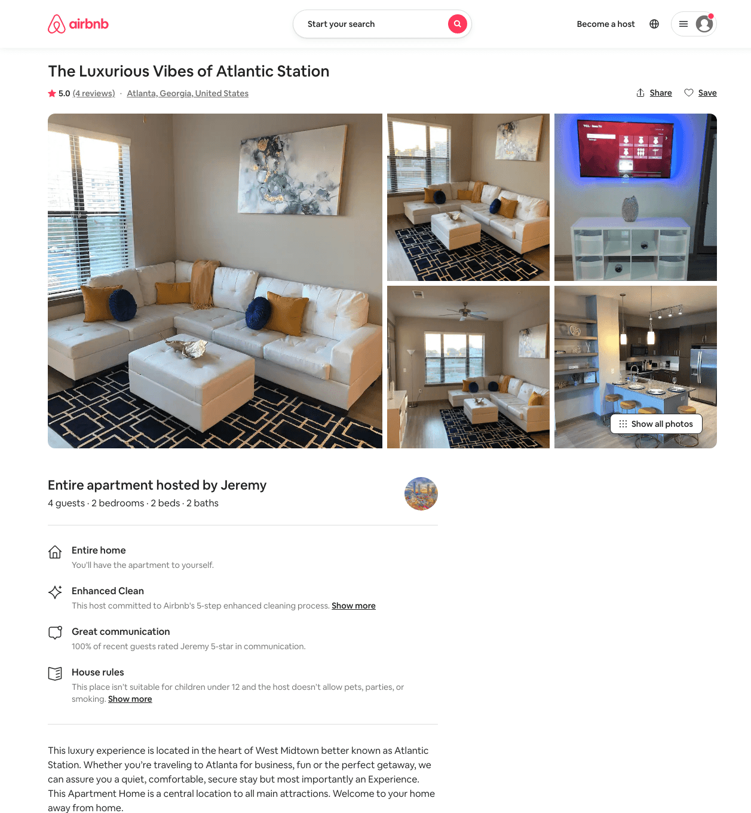
Listing 49364117
2
4
$111 - $239
4.88
2
Jeremy
395844264
1
https://www.airbnb.com/rooms/49364117
Aug 2022

Slide 45
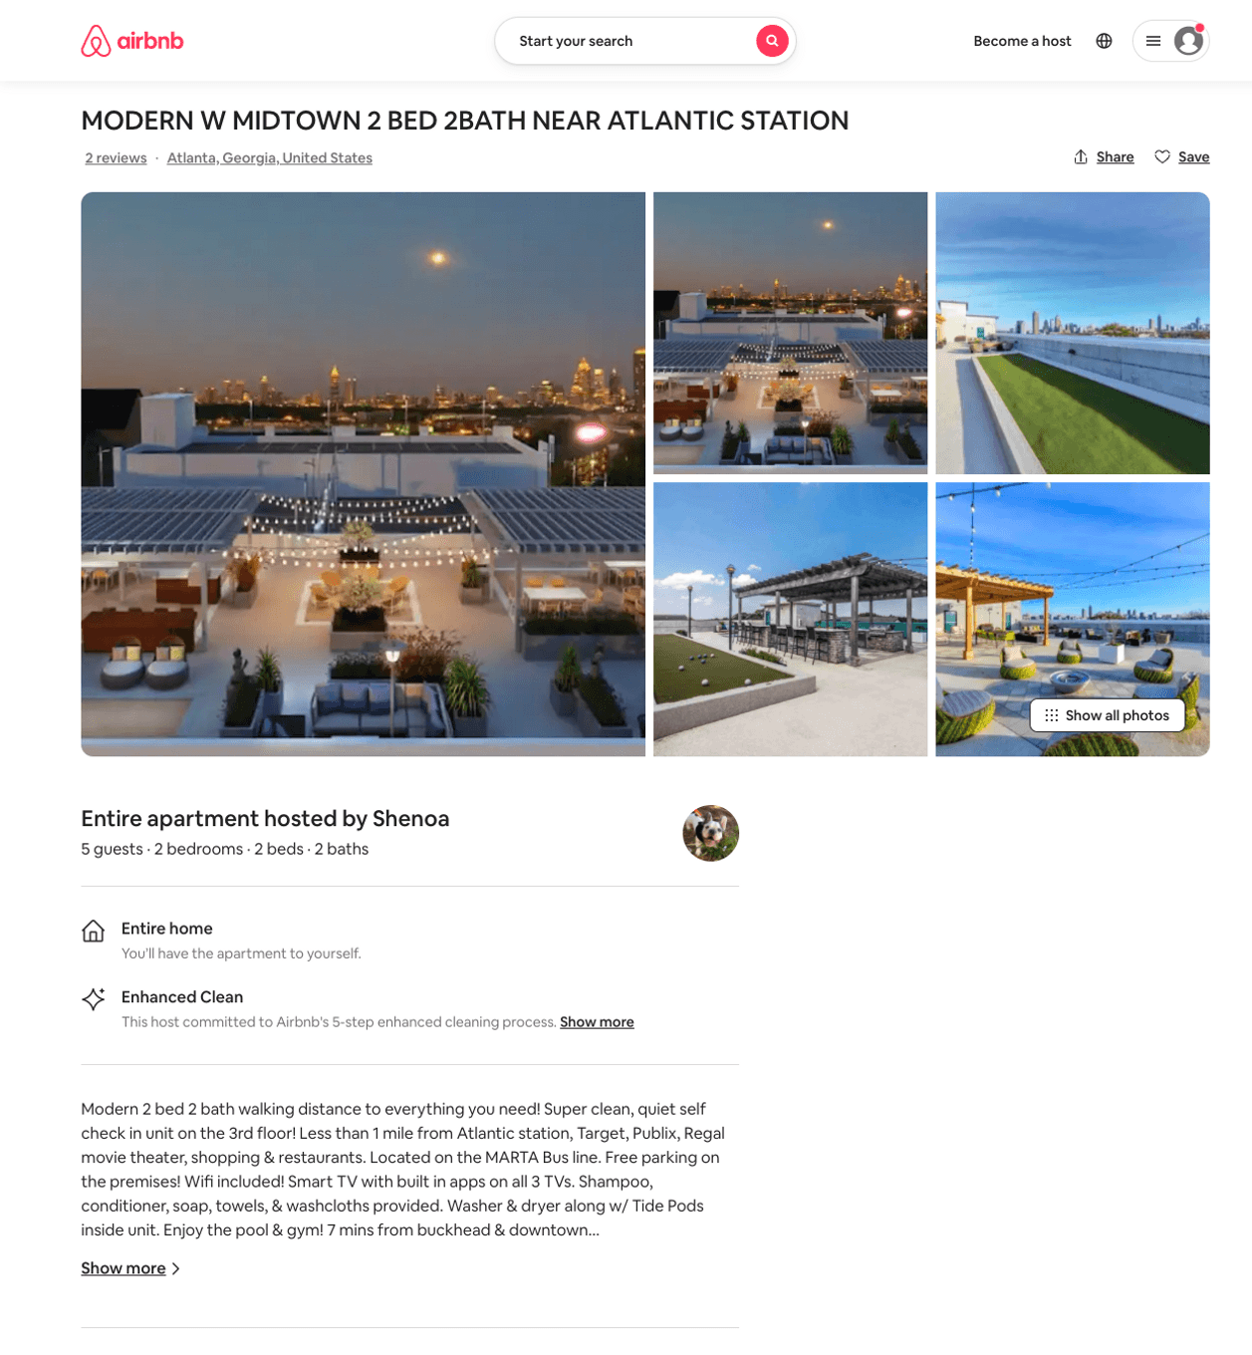
Listing 49562150
2
6
$96 - $232
4.81
1
Shenoa
31022186
1
https://www.airbnb.com/rooms/49562150
Aug 2022

Slide 46
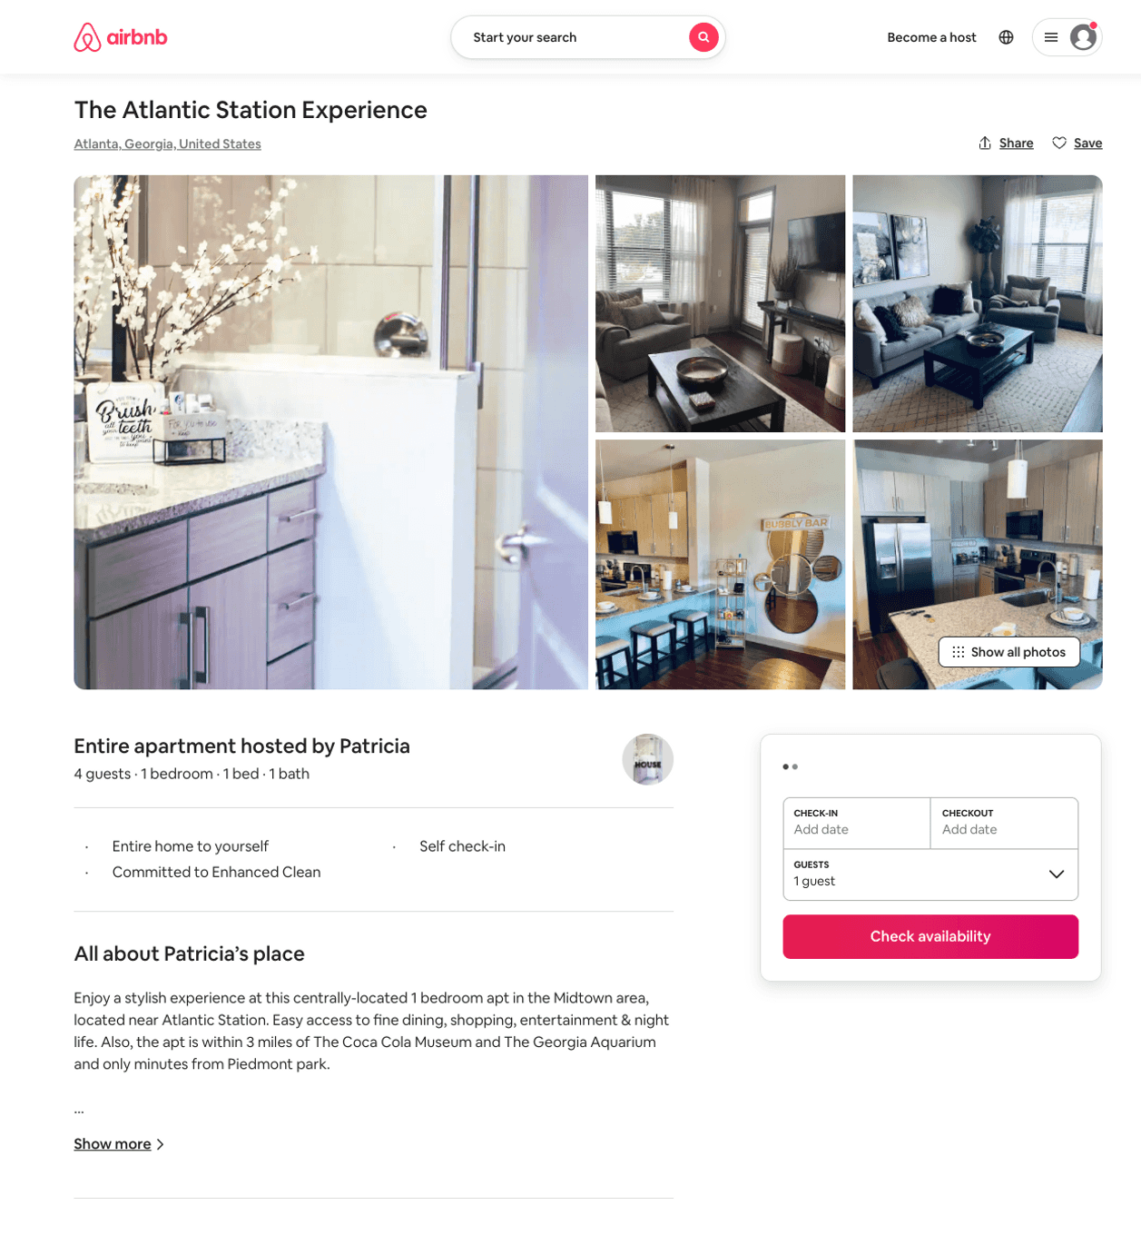
Listing 50458201
1
4
$90 - $167
4.87
1
Patricia
407559280
2
https://www.airbnb.com/rooms/50458201
Jul 2022

Slide 47
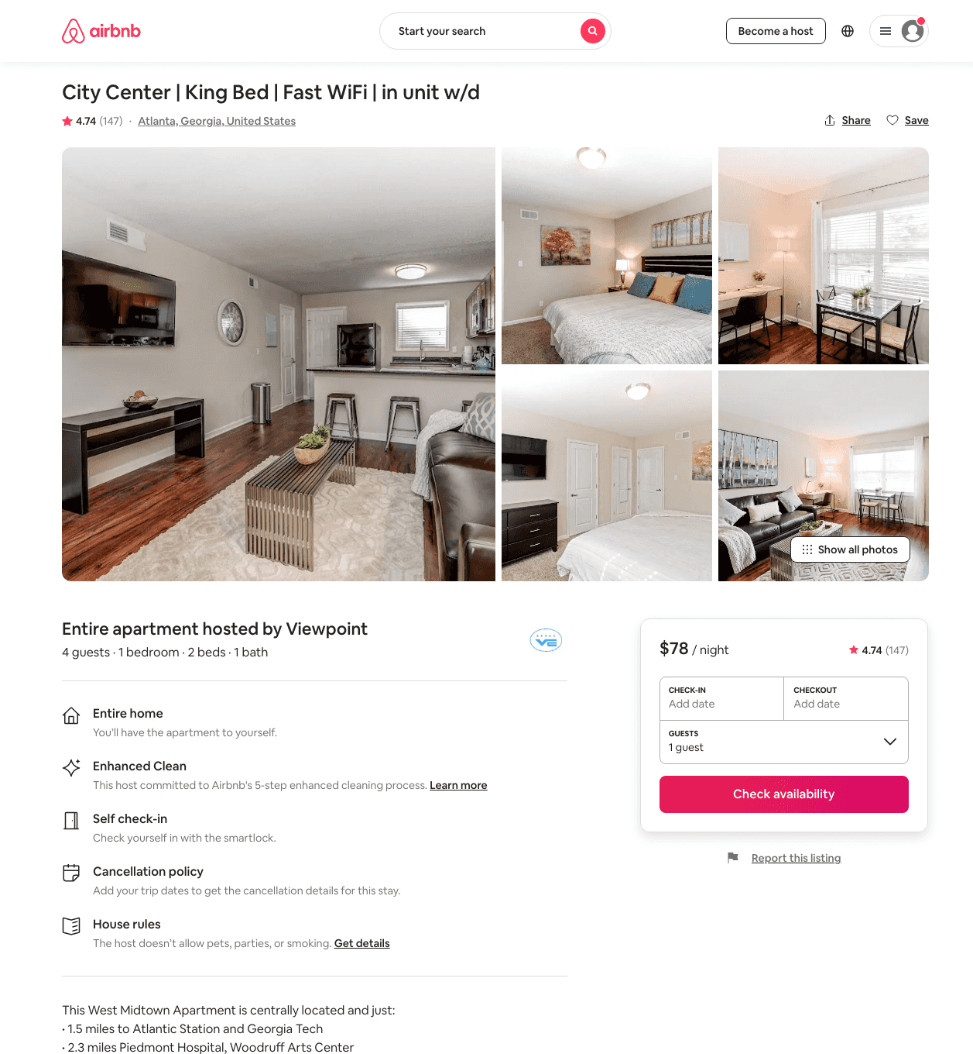
Listing 21226940
1
4
$72 - $108
4.72
1
Viewpoint
122590712
2
https://www.airbnb.com/rooms/21226940
Aug 2022

Slide 48
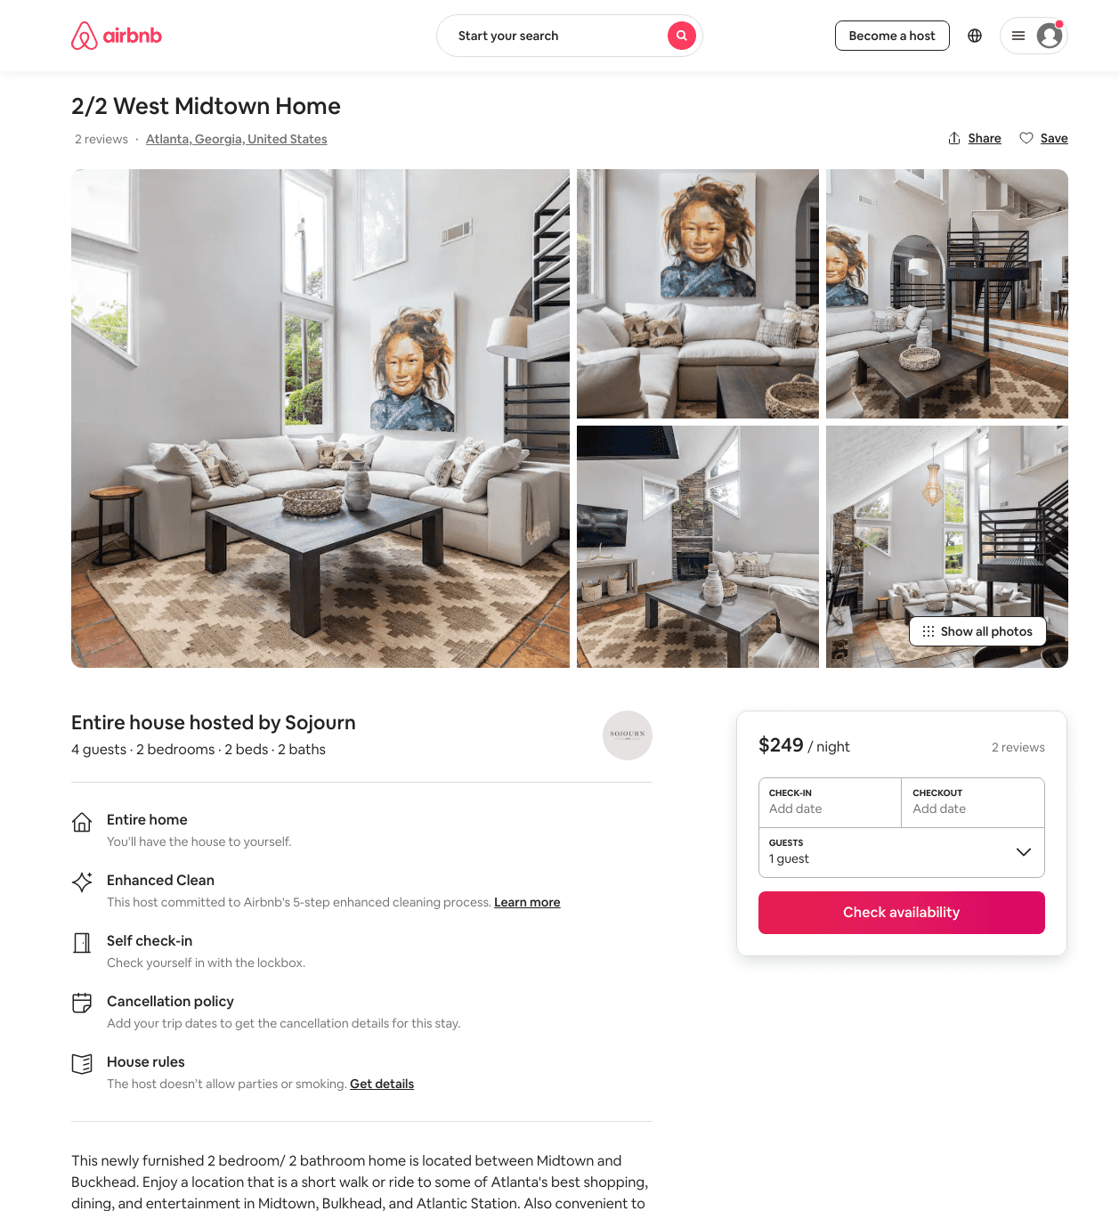
Listing 44662631
2
4
$249
5.0
5
Sojourn
146616483
9
https://www.airbnb.com/rooms/44662631
Aug 2022

Slide 49
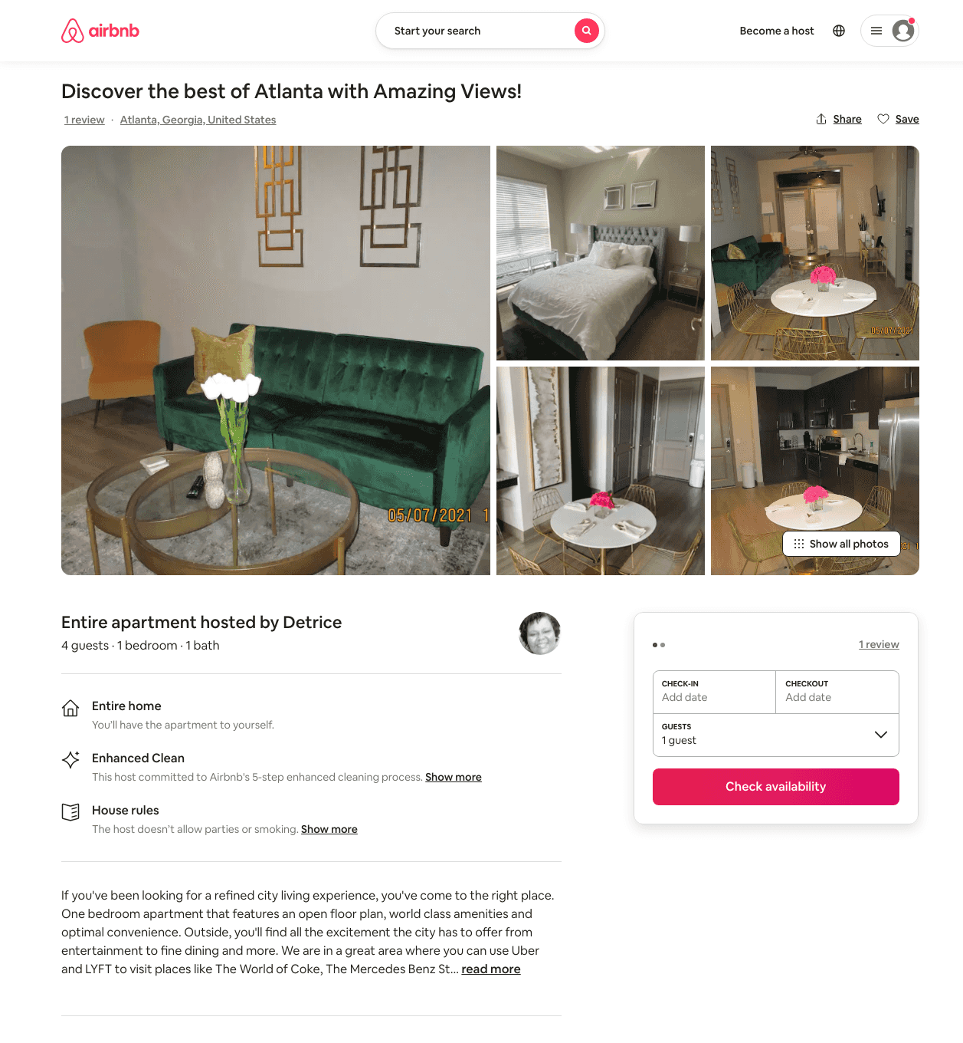
Listing 49727446
1
4
$104 - $158
5.0
1
Detrice
401055233
1
https://www.airbnb.com/rooms/49727446
Jul 2022

Slide 50
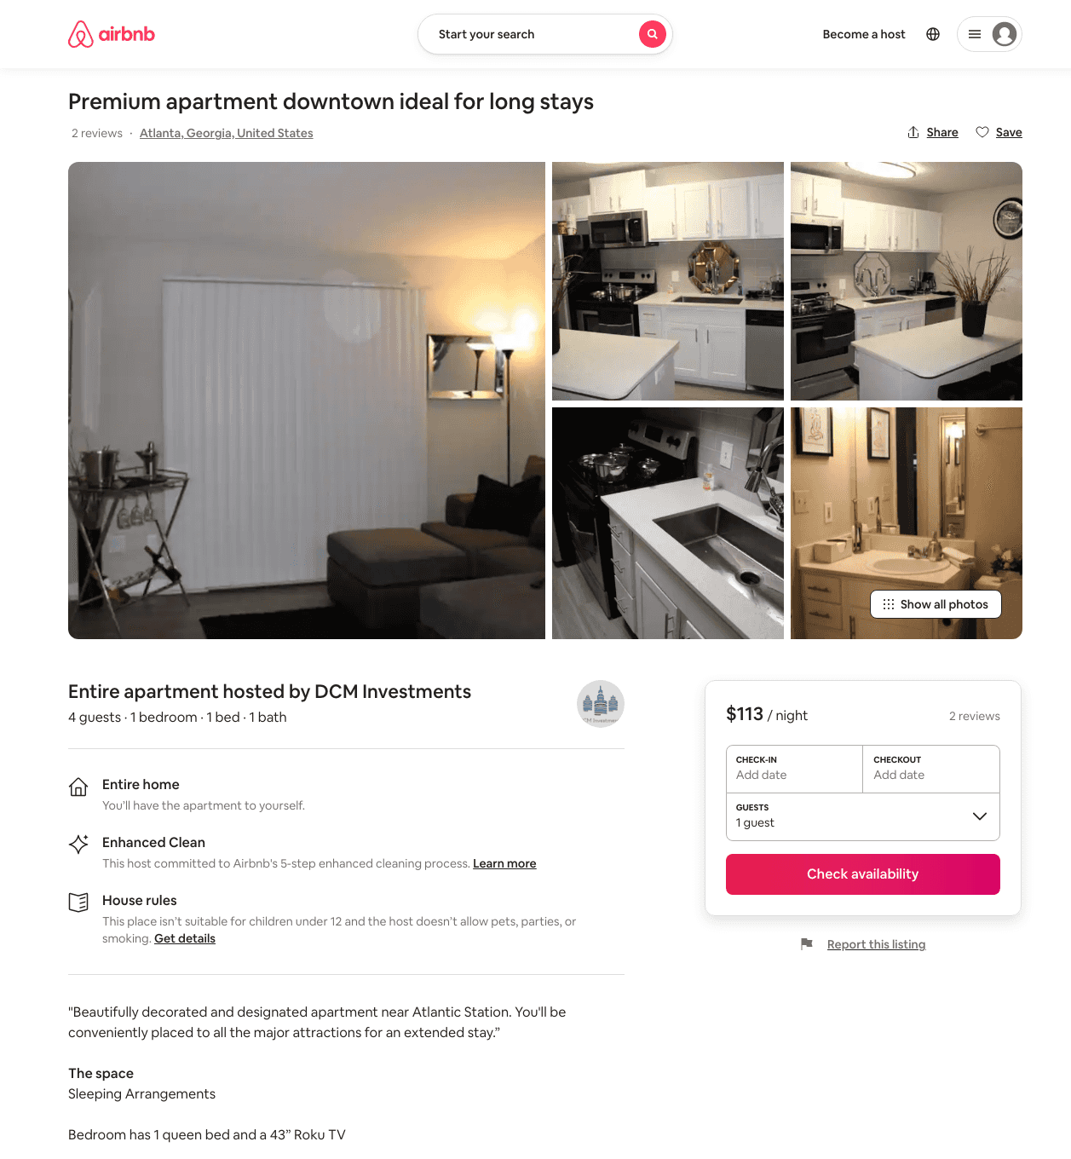
Listing 47370689
1
4
$92 - $132
4.83
21
DCM Investments
382428989
2
https://www.airbnb.com/rooms/47370689
Aug 2022

Slide 51
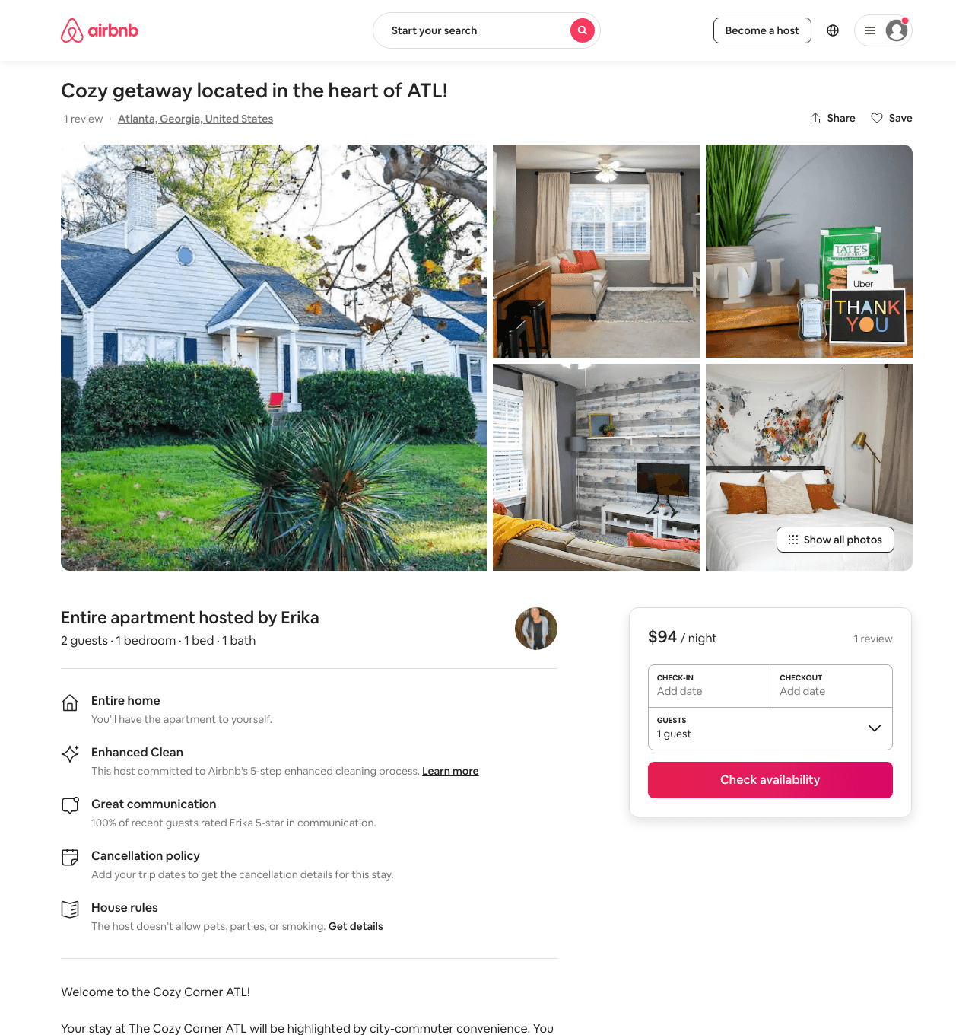
Listing 46551672
1
2
$95 - $137
4.89
2
Erika
376452701
1
https://www.airbnb.com/rooms/46551672
Aug 2022

Slide 52
Listing 27432229
1
4
$86 - $250
4.83
1
Rachel
114396785
2
https://www.airbnb.com/rooms/27432229
Aug 2022

Slide 53
Listing 50011526
1
3
$109 - $169
4.69
2
Luxury Is Key
220964416
1
https://www.airbnb.com/rooms/50011526
Aug 2022

Slide 54
Listing 49466500
1
4
$92 - $160
4.80
1
Marie
71042899
5
https://www.airbnb.com/rooms/49466500
Aug 2022

Slide 55
Listing 39723881
1
5
$100
4.76
1
Soleezy
88046324
2
https://www.airbnb.com/rooms/39723881
Aug 2022

Slide 56
Listing 49772518
1
2
$85 - $137
4.79
2
Renee
400362583
1
https://www.airbnb.com/rooms/49772518
Aug 2022

Slide 57
Listing 46700376
2
4
$116 - $203
4.69
2
Mignon
79071941
2
https://www.airbnb.com/rooms/46700376
Aug 2022

Slide 58
Listing 48384468
1
2
$99 - $152
4.35
1
Grizzly Getaways
313171077
4
https://www.airbnb.com/rooms/48384468
Aug 2022

Slide 59
Listing 38801141
1
2
$66 - $165
4.72
1
Frontdesk
296368012
12
https://www.airbnb.com/rooms/38801141
Aug 2022

Slide 60
Listing 40422982
1
2
$66 - $165
4.75
1
Frontdesk
296368012
12
https://www.airbnb.com/rooms/40422982
Aug 2022

Slide 61
Listing 38997827
1
2
$70 - $173
4.76
1
Frontdesk
296368012
12
https://www.airbnb.com/rooms/38997827
Aug 2022

Slide 62
Listing 39050811
1
2
$70 - $173
4.70
1
Frontdesk
296368012
12
https://www.airbnb.com/rooms/39050811
Aug 2022

Slide 63
Listing 38132505
1
2
$143 - $211
4.91
1
Angel
289694280
1
https://www.airbnb.com/rooms/38132505
Aug 2022

Slide 64
Listing 45605862
1
2
$89 - $136
4.85
1
Briahna
234001629
2
https://www.airbnb.com/rooms/45605862
Aug 2022

Slide 65
Listing 47803212
1
6
$92 - $134
4.78
1
Mdcl
385285117
1
https://www.airbnb.com/rooms/47803212
Aug 2022

Slide 66
Listing 49131854
1
3
$85 - $156
4.78
2
Dk
364273039
1
https://www.airbnb.com/rooms/49131854
Aug 2022

Slide 67
Listing 46790241
1
3
$106 - $130
4.92
2
Superlative
378104471
1
https://www.airbnb.com/rooms/46790241
Aug 2022

Slide 68
Listing 45929402
1
4
$76 - $142
4.93
2
Atlantic Rentals
372002086
1
https://www.airbnb.com/rooms/45929402
Aug 2022

Slide 69
Listing 22468957
1
4
$70 - $113
4.53
1
Viewpoint
122590712
2
https://www.airbnb.com/rooms/22468957
Aug 2022

Slide 70
Listing 38797677
1
2
$66 - $165
4.66
1
Frontdesk
296368012
12
https://www.airbnb.com/rooms/38797677
Aug 2022

Slide 71
Listing 44787277
1
3
$95 - $130
4.87
2
Timothy
362275415
1
https://www.airbnb.com/rooms/44787277
Jul 2022

Slide 72
Listing 14104779
3
6
$215
7
Kevin
17685637
1
https://www.airbnb.com/rooms/14104779
Aug 2022

Slide 73
Listing 32662858
1
4
$65 - $66
4.40
7
Shawn
115405929
1
https://www.airbnb.com/rooms/32662858
Aug 2022

Slide 74
Listing 38979970
1
2
$70 - $173
4.78
1
Frontdesk
296368012
12
https://www.airbnb.com/rooms/38979970
Aug 2022

Slide 75
Listing 49061149
1
4
$68 - $103
4.63
1
Ashley
352409565
1
https://www.airbnb.com/rooms/49061149
Aug 2022

Slide 76
Listing 50037421
1
4
$119 - $149
4.83
1
Alkissa
403589005
1
https://www.airbnb.com/rooms/50037421
Jul 2022

Slide 77
Listing 46306418
2
6
$136 - $228
5.0
3
Jay
234769560
10
https://www.airbnb.com/rooms/46306418
Aug 2022

Slide 78
Listing 50352946
1
4
$79 - $125
4.84
1
Guy
406667970
1
https://www.airbnb.com/rooms/50352946
Jul 2022

Slide 79
Listing 50809563
1
4
$72 - $184
4.94
1
Shayla
349086746
1
https://www.airbnb.com/rooms/50809563
Aug 2022

Slide 80
Listing 43802239
2
6
$105 - $166
4.66
1
Eric
290073416
3
https://www.airbnb.com/rooms/43802239
Jun 2022

Slide 81
Listing 51361112
1
4
$88 - $124
4.85
1
Margery
48654948
1
https://www.airbnb.com/rooms/51361112
Aug 2022

Slide 82
Listing 51274487
1
3
$79 - $141
4.79
2
Marie
71042899
5
https://www.airbnb.com/rooms/51274487
Jun 2022

Slide 83
Listing 51291423
1
4
$109 - $150
5.0
3
Magnolia
414812846
1
https://www.airbnb.com/rooms/51291423
Aug 2022

Slide 84
Listing 51196747
1
4
$70 - $193
4.70
1
Mia
414378964
2
https://www.airbnb.com/rooms/51196747
Aug 2022

Slide 85
Listing 18548971
1
4
$220
4.52
1
Kahseem
128766493
2
https://www.airbnb.com/rooms/18548971
Jun 2022

Slide 86
Listing 51623051
1
2
$79 - $108
4.91
2
J
404045645
1
https://www.airbnb.com/rooms/51623051
Jul 2022

Slide 87
Listing 41639146
1
3
$160
4.71
3
Rico
328462748
1
https://www.airbnb.com/rooms/41639146
Aug 2022

Slide 88
Listing 51814805
1
4
$110 - $171
4.92
2
De Luxe Stays
5362640
2
https://www.airbnb.com/rooms/51814805
Aug 2022

Slide 89
Listing 51847872
1
3
$79 - $91
4.66
1
Property Management
420004629
1
https://www.airbnb.com/rooms/51847872
Aug 2022

Slide 90
Listing 52040159
1
2
$80 - $129
4.76
1
Mari
421328539
1
https://www.airbnb.com/rooms/52040159
Aug 2022

Slide 91
Listing 52092117
1
3
$97 - $98
4.33
2
Sabrina
421771442
1
https://www.airbnb.com/rooms/52092117
Aug 2022

Slide 92
Listing 52134282
2
5
$100 - $177
4.75
1
Timothy
391495500
1
https://www.airbnb.com/rooms/52134282
Aug 2022

Slide 93
Listing 51664974
2
4
$190 - $250
2
Glam
418561427
1
https://www.airbnb.com/rooms/51664974
Aug 2022

Slide 94
Listing 52346951
1
3
$85 - $141
4.63
2
Kris
391763890
2
https://www.airbnb.com/rooms/52346951
Aug 2022

Slide 95
Listing 52714663
464 BISHOP ST NW
1
4
$70 - $1816
4.65
1
Atlanta Elite
69883747
3
https://www.airbnb.com/rooms/52714663
Aug 2022

Slide 96
Listing 52805031
2
4
$134 - $194
1
RedAwning
373042041
2
https://www.airbnb.com/rooms/52805031
Aug 2022

Slide 97
Listing 52779210
1
3
$85 - $92
4.80
1
Kiwi
364462831
1
https://www.airbnb.com/rooms/52779210
Aug 2022

Slide 98
Listing 52801436
1
4
$82 - $131
4.74
2
Trumell
420576646
1
https://www.airbnb.com/rooms/52801436
Aug 2022

Slide 99
Listing 52524757
1
4
$68 - $125
4.91
2
Midtown Estates
423554685
1
https://www.airbnb.com/rooms/52524757
Aug 2022

Slide 100
Listing 52752599
2
5
$121 - $201
4.35
2
ShaY & ShaQ
427066624
2
https://www.airbnb.com/rooms/52752599
Aug 2022

Slide 101
Listing 52922215
1
2
$36 - $52
4.44
1
Atlanta
17525339
3
https://www.airbnb.com/rooms/52922215
Aug 2022

Slide 102
Listing 52446258
2
12
$145 - $260
4.61
2
Eric
290073416
3
https://www.airbnb.com/rooms/52446258
Aug 2022

Slide 103
Listing 52815498
1
5
$96 - $174
4.20
1
Dayla
273696129
1
https://www.airbnb.com/rooms/52815498
Aug 2022

Slide 104
Listing 52986680
1
4
$74 - $91
4.61
1
Bluu
17386799
1
https://www.airbnb.com/rooms/52986680
Jun 2022

Slide 105
Listing 53124378
1
4
$73 - $123
4.92
1
Kay Michelle
313383699
4
https://www.airbnb.com/rooms/53124378
Aug 2022

Slide 106
Listing 53237823
3
5
$220 - $329
4.86
3
Naila
236977791
2
https://www.airbnb.com/rooms/53237823
Aug 2022

Slide 107
Listing 53171478
1
4
$100 - $203
4.91
1
Jamaica
82183587
1
https://www.airbnb.com/rooms/53171478
Jul 2022

Slide 108
Listing 50775535
1
4
$102 - $149
4.84
1
Shae
369224284
1
https://www.airbnb.com/rooms/50775535
Aug 2022

Slide 109
Listing 53290900
1
4
$84 - $145
4.87
2
JR Stays
174759973
3
https://www.airbnb.com/rooms/53290900
Aug 2022

Slide 110
Listing 53110933
1
3
$67 - $86
4.33
1
Jasmine
331562673
1
https://www.airbnb.com/rooms/53110933
Aug 2022

Slide 111
Listing 53006337
1
5
$77 - $116
4.67
2
Shannon
429110581
1
https://www.airbnb.com/rooms/53006337
Aug 2022

Slide 112
Listing 53512918
1
2
$26 - $78
4.26
1
Atlanta
17525339
3
https://www.airbnb.com/rooms/53512918
Aug 2022

Slide 113
Listing 53799985
1
2
$40 - $49
4.80
4
William
3492135
1
https://www.airbnb.com/rooms/53799985
Aug 2022

Slide 114
Listing 53816326
1
2
$90 - $101
4.87
30
Quest
215736822
1
https://www.airbnb.com/rooms/53816326
Aug 2022

Slide 115
Listing 53807081
1
4
$100 - $160
4.47
1
Amanda
410206337
2
https://www.airbnb.com/rooms/53807081
Aug 2022

Slide 116
Listing 2595780
2
8
$141 - $178
4
2
https://www.vrbo.com/2595780
Aug 2022

Slide 117
Listing 2180968
1
6
$140
4.285714
1
https://www.vrbo.com/2180968
Aug 2022

Slide 118
Listing 2577384
2
4
$125 - $183
3.875
2
dwayne
https://www.vrbo.com/2577384
Aug 2022

Slide 119
Listing 2414289
1
4
$130
2
https://www.vrbo.com/2414289
Aug 2022

Slide 120
Listing 2561368
2
9
$314 - $394
5
1
Yvonne
https://www.vrbo.com/2561368
Aug 2022

Slide 121
Listing updated-midtown-apartment-near-atlantic-station-atlanta
464 BISHOP ST NW
undefined
1
8.6
https://www.booking.com/hotel/us/updated-midtown-apartment-near-atlantic-station-atlanta.html
Sep 2022

Slide 122
Listing 2200318
2
7
$129 - $145
2
Andrew Jean-Baptiste
https://www.vrbo.com/2200318
Aug 2022

Slide 123
Listing 54101211
1
2
$67 - $114
4.23
2
Jon. H
205001965
1
https://www.airbnb.com/rooms/54101211
Aug 2022

Slide 124
Listing 54275248
2
8
$108 - $255
4.79
1
Gerard
428546427
2
https://www.airbnb.com/rooms/54275248
Jul 2022

Slide 125
Listing 54306358
1
4
$47 - $130
4.82
2
Deshiana
233133207
1
https://www.airbnb.com/rooms/54306358
Aug 2022

Slide 126
Listing 54158833
1
3
$55 - $102
3.75
1
Kem
129337370
1
https://www.airbnb.com/rooms/54158833
Jun 2022

Slide 127
Listing 54341042
2
5
$119 - $201
4.53
1
YourHome
416586975
2
https://www.airbnb.com/rooms/54341042
Aug 2022

Slide 128
Listing 2645118
2
4
$144
4
2
TJ
https://www.vrbo.com/2645118
Aug 2022

Slide 129
Listing 2644654
2
5
$127
3.5
1
YourHome
https://www.vrbo.com/2644654
Aug 2022

Slide 130
Listing 549624408399164600
1
4
$73 - $110
4.84
1
Luxuri
426847895
1
https://www.airbnb.com/rooms/549624408399164600
Aug 2022

Slide 131
Listing 29833228
1
2
$150
4.57
1
Martin
151644552
1
https://www.airbnb.com/rooms/29833228
Aug 2022

Slide 132
Listing 2663292
1
4
$90
2
https://www.vrbo.com/2663292
Aug 2022

Slide 133
Listing 54306188
1
4
$79 - $104
4.94
1
Santel
140083051
1
https://www.airbnb.com/rooms/54306188
Aug 2022

Slide 134
Listing 2664368
1
2
$170
1
Parker Bell
https://www.vrbo.com/2664368
Aug 2022

Slide 135
Listing 54393026
2
6
$105 - $123
4.29
1
Rachel
441668065
1
https://www.airbnb.com/rooms/54393026
Aug 2022

Slide 136
Listing 2690186
1
5
$130
3
2
Ariel Smith
https://www.vrbo.com/2690186
Aug 2022

Slide 137
Listing 2694856
2
7
$129
2
https://www.vrbo.com/2694856
Aug 2022

Slide 138
Listing 2684404
1
2
$118
3.3333333
2
LaTonya
https://www.vrbo.com/2684404
Aug 2022

Slide 139
Listing 598004718400669400
2
5
$132 - $162
4.92
1
LaTroya
452770699
1
https://www.airbnb.com/rooms/598004718400669400
Aug 2022

Slide 140
Listing 49908911
1
2
$150 - $151
2
Grizzly Getaways
313171077
4
https://www.airbnb.com/rooms/49908911
Jun 2022

Slide 141
Listing 2766267
1
4
$140
1
https://www.vrbo.com/2766267
Aug 2022

Slide 142
Listing 2767799
1
2
$92
3
https://www.vrbo.com/2767799
Aug 2022

Slide 143
Listing 2772147
1
2
$115
3
LaLa
https://www.vrbo.com/2772147
Aug 2022

Slide 144
Listing 53398195
1
4
$72 - $75
1
Kalen
347001597
1
https://www.airbnb.com/rooms/53398195
Jun 2022

Slide 145
Listing 2831894
2
7
$145
3
https://www.vrbo.com/2831894
Aug 2022

Slide 146
Listing 2840827
2
5
$169
1
Tashae Wright
https://www.vrbo.com/2840827
Aug 2022

Slide 147
Listing 9700060
1
4
$131
1
Frontdesk, Inc.
https://www.vrbo.com/9700060ha
Aug 2022

Slide 148
Listing 9700072
1
4
$120
1
Frontdesk, Inc.
https://www.vrbo.com/9700072ha
Aug 2022

Slide 149
Listing 9700075
1
4
$128
1
Frontdesk, Inc.
https://www.vrbo.com/9700075ha
Aug 2022

Slide 150
Listing 9700076
1
4
$128
1
Frontdesk, Inc.
https://www.vrbo.com/9700076ha
Aug 2022

Slide 151
Listing 9700074
1
4
$128
1
Frontdesk, Inc.
https://www.vrbo.com/9700074ha
Aug 2022

Slide 152
Listing 2840261
1
4
$180
3
https://www.vrbo.com/2840261
Aug 2022

Slide 153
Listing 2857630
1
2
$60
1
https://www.vrbo.com/2857630
Aug 2022

Slide 154
Listing 9700073
1
4
$134
1
Frontdesk, Inc.
https://www.vrbo.com/9700073ha
Aug 2022

Slide 155
Listing 2857271
1
2
$80
1
https://www.vrbo.com/2857271
Aug 2022

Slide 156
Listing 48679180
1
3
$88 - $108
4.85
1
Rose
349162854
1
https://www.airbnb.com/rooms/48679180
Aug 2022

Slide 157
Listing 2864855
1
2
$167
2
Lux Royalty Rentals LLC
https://www.vrbo.com/2864855
Aug 2022

Slide 158
Listing 51770003
2
5
1
De Luxe Stays
5362640
2
https://www.airbnb.com/rooms/51770003
Jul 2022

Slide 159
Listing 49440035
1
4
3
Joseph
352897578
1
https://www.airbnb.com/rooms/49440035
Jul 2022

Slide 160
Listing 2883784
2
11
$246
5
2
Michelle
https://www.vrbo.com/2883784
Aug 2022

Slide 161
Listing 45532410
1
3
1
G SeasonsX
344854953
1
https://www.airbnb.com/rooms/45532410
Aug 2022

Slide 162
Listing 2936292
1
4
$85
1
https://www.vrbo.com/2936292
Aug 2022

Slide 163
Listing 2893904
2
4
$249
1
Parker Bell
https://www.vrbo.com/2893904
Aug 2022

Slide 164
Listing 2950714
2
4
$150
2
Vacasa of Georgia
https://www.vrbo.com/2950714
Aug 2022

Slide 165
Listing 50837827
1
1
2
Dani
213008260
1
https://www.airbnb.com/rooms/50837827
Aug 2022

