Slide 2
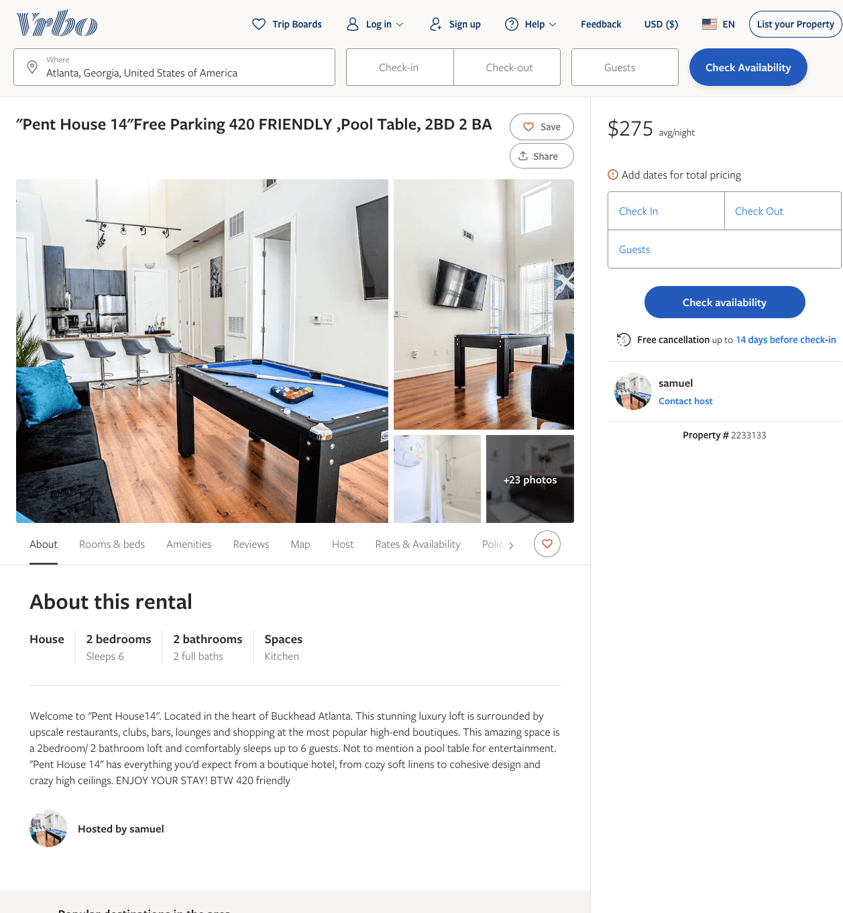
Listing 2233133
2
6
$275
2
samuel
https://www.vrbo.com/2233133
Aug 2022

Slide 3
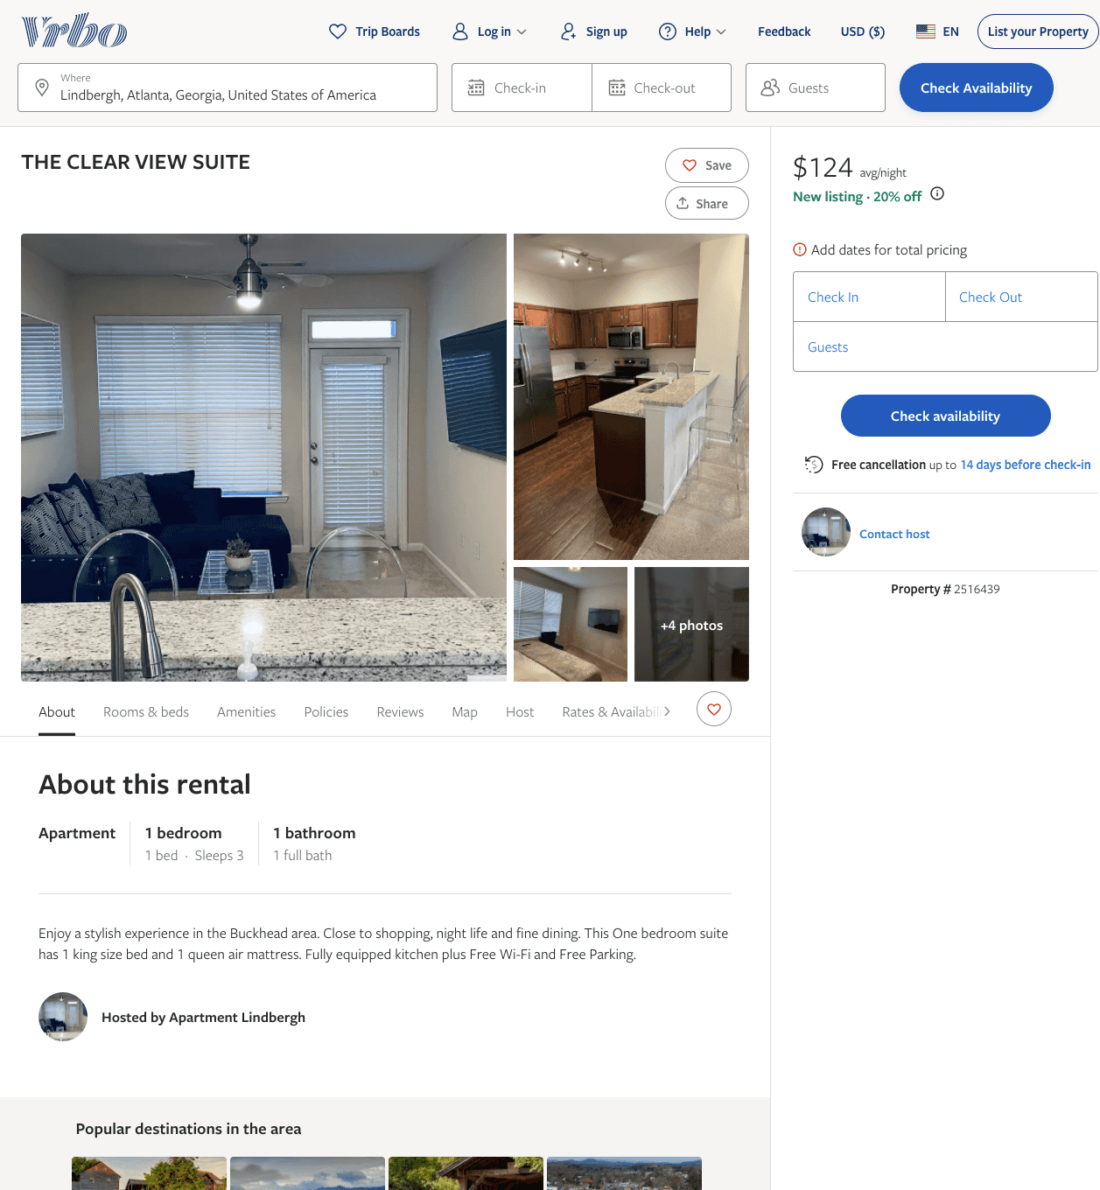
Listing 2516439
1
3
$124
2
https://www.vrbo.com/2516439
Aug 2022

Slide 4
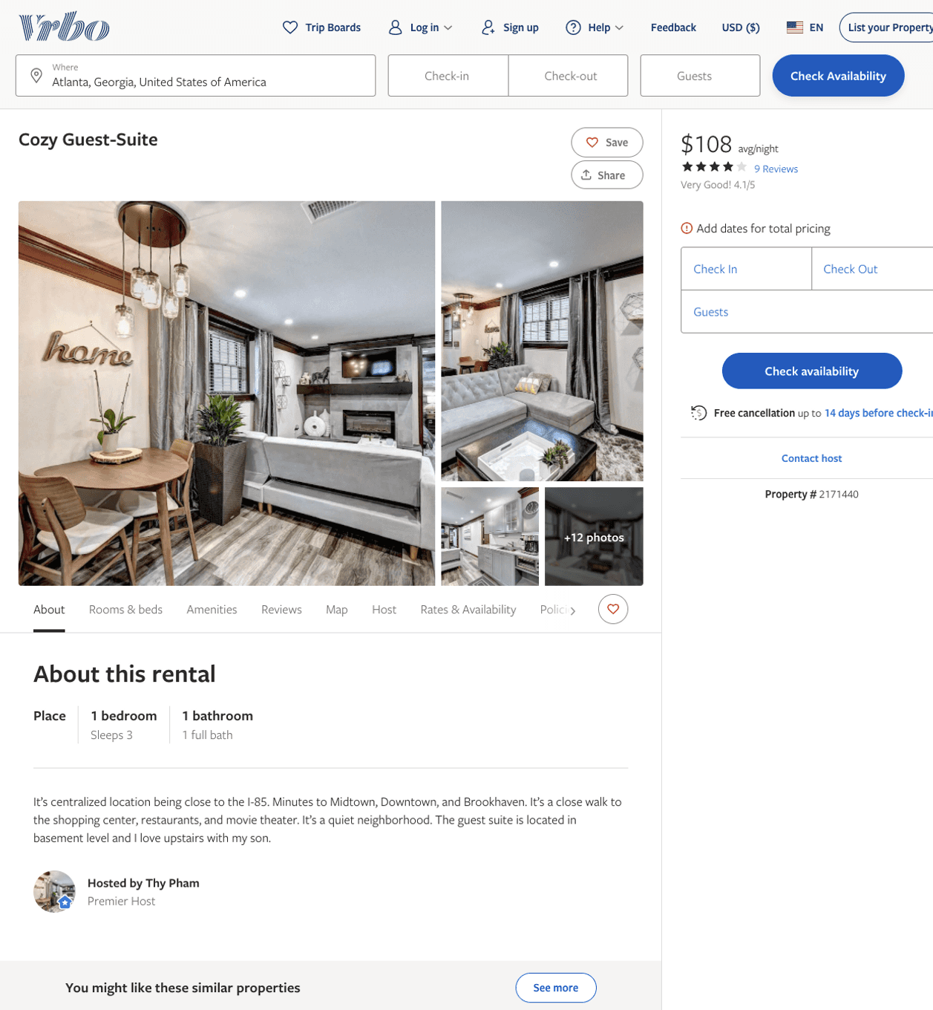
Listing 2171440
1
3
$108
3.8947368
2
Thy Pham
https://www.vrbo.com/2171440
Aug 2022

Slide 5
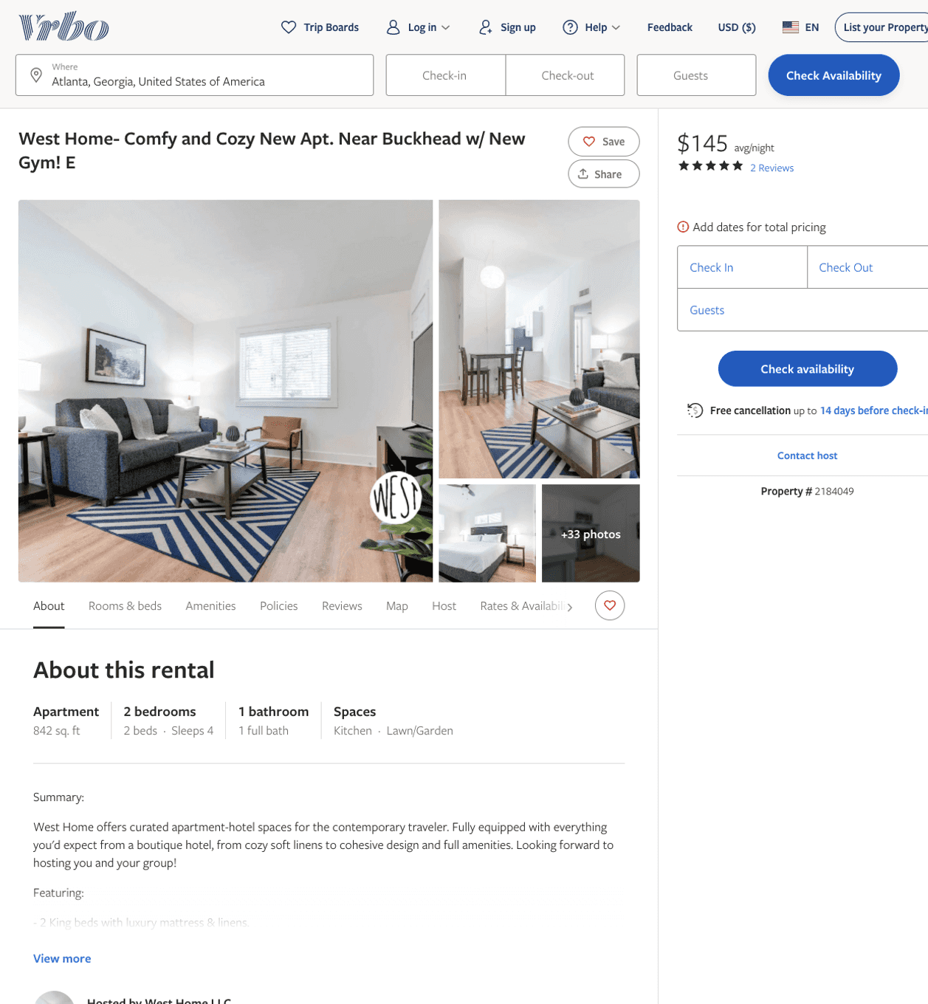
Listing 2184049
2
6
$107 - $151
5
1
West Home LLC
https://www.vrbo.com/2184049
Aug 2022

Slide 6
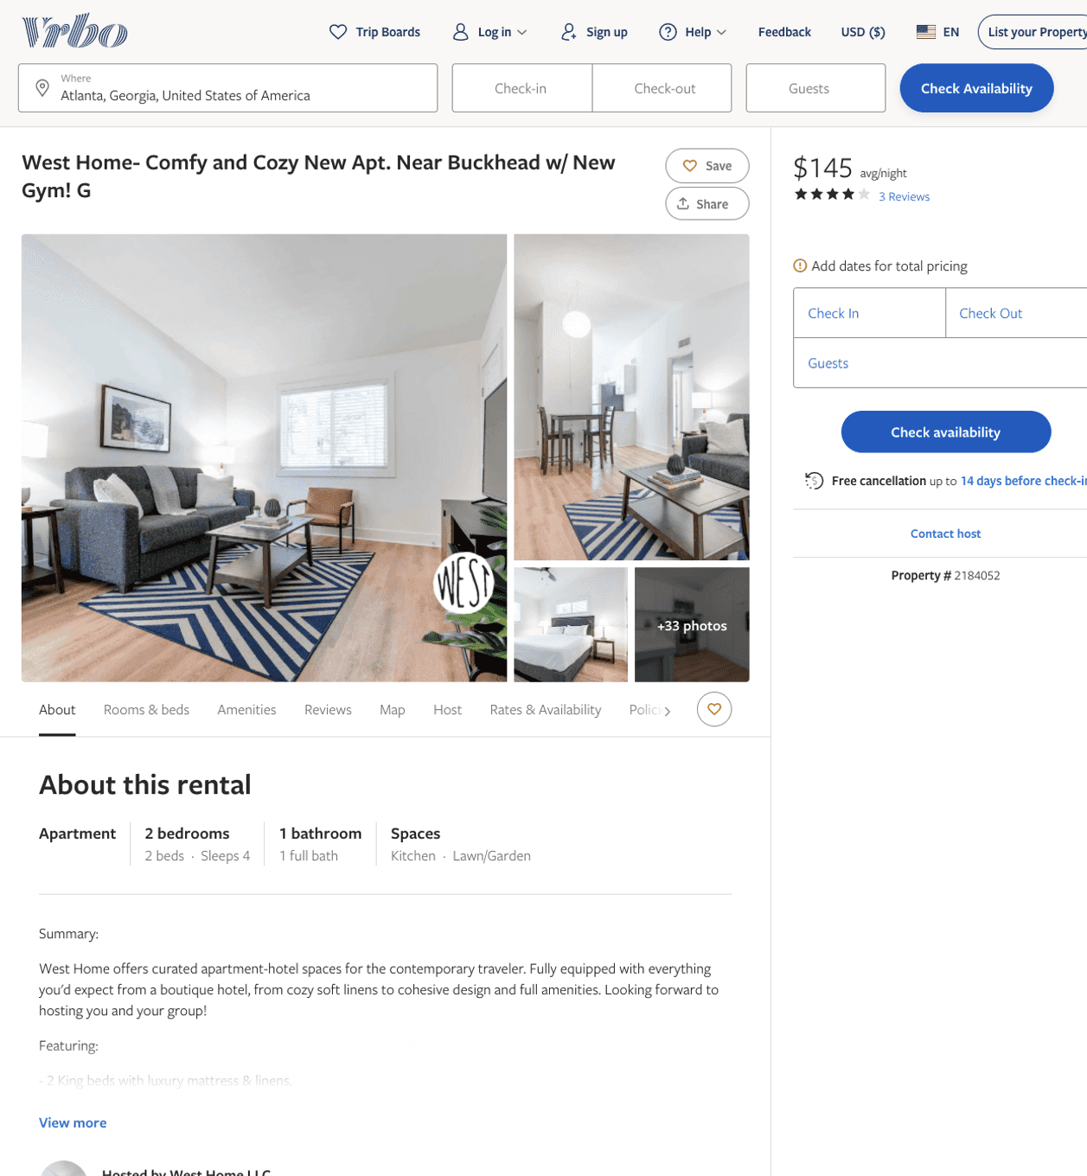
Listing 2184052
2
6
$104 - $152
4.25
1
West Home LLC
https://www.vrbo.com/2184052
Aug 2022

Slide 7
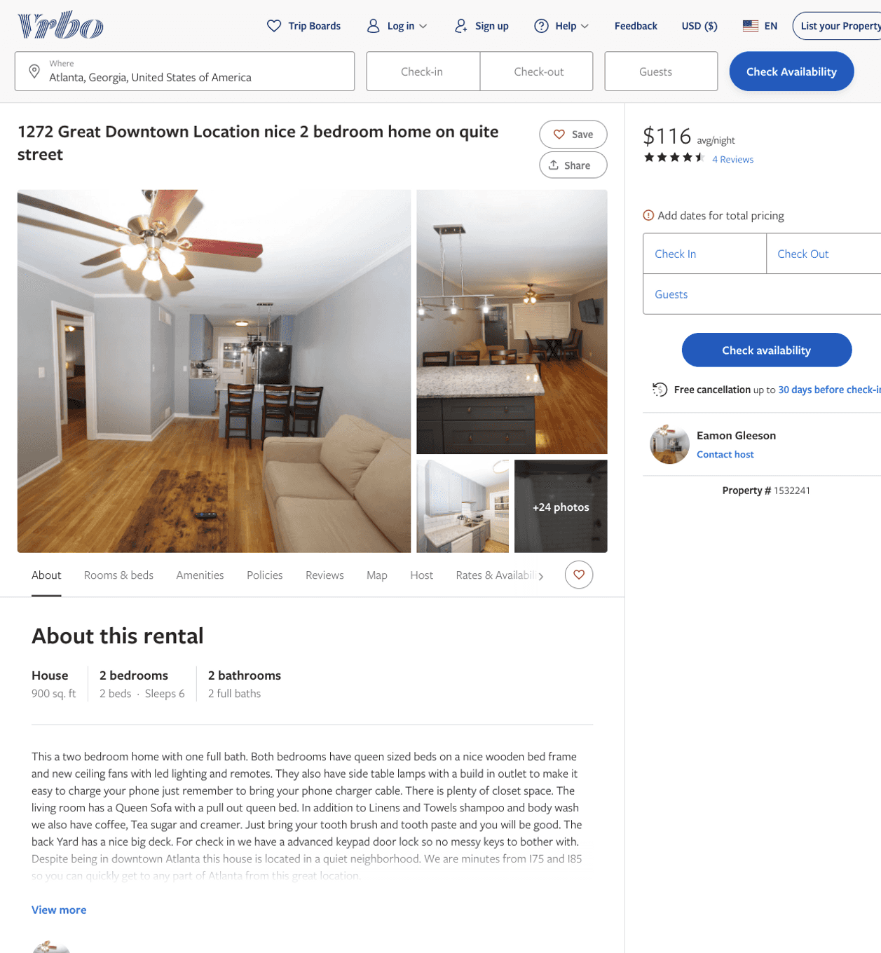
Listing 1532241
2
6
$114 - $99
4
2
Eamon Gleeson
https://www.vrbo.com/1532241
Aug 2022

Slide 8
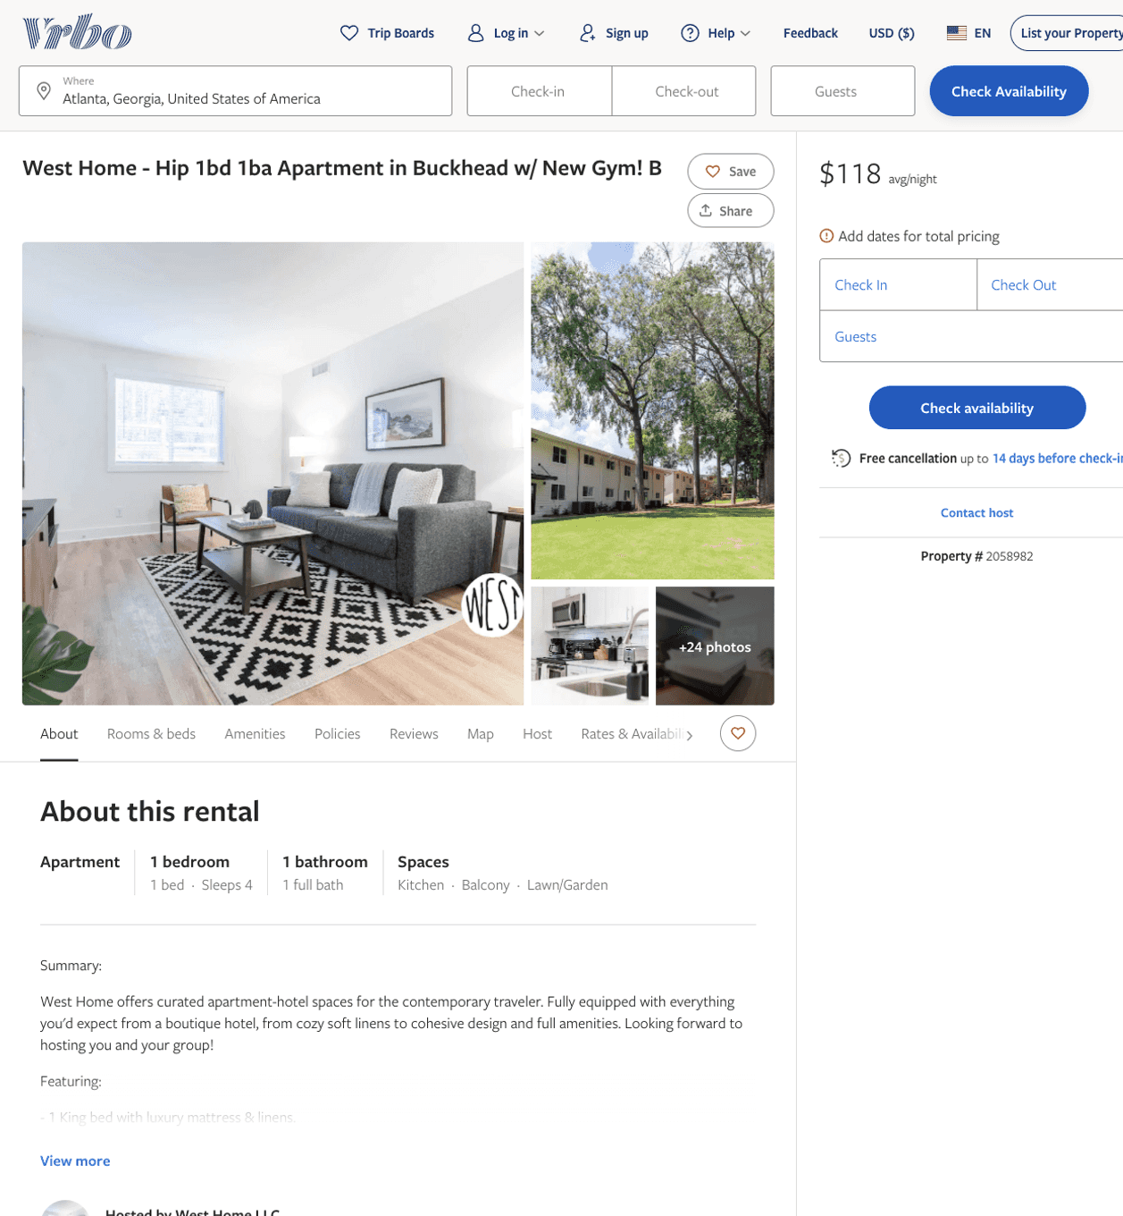
Listing 2058982
1
4
$107 - $135
1
West Home LLC
https://www.vrbo.com/2058982
Aug 2022

Slide 9
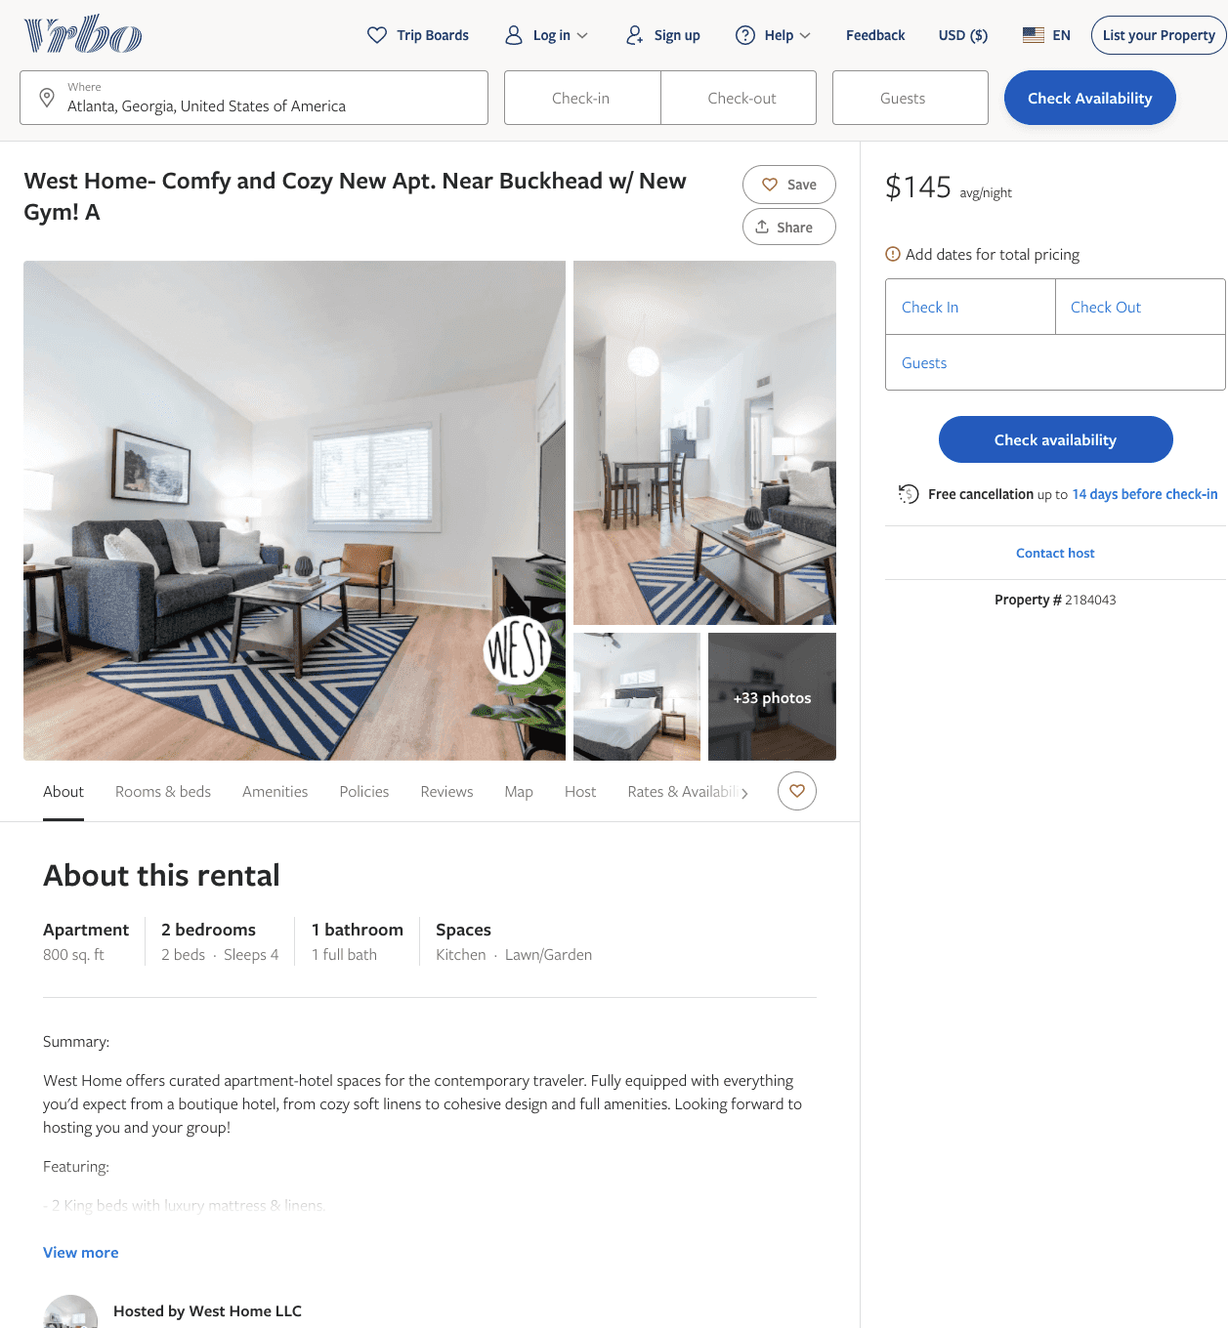
Listing 2184043
2
6
$101 - $150
1
West Home LLC
https://www.vrbo.com/2184043
Aug 2022

Slide 10
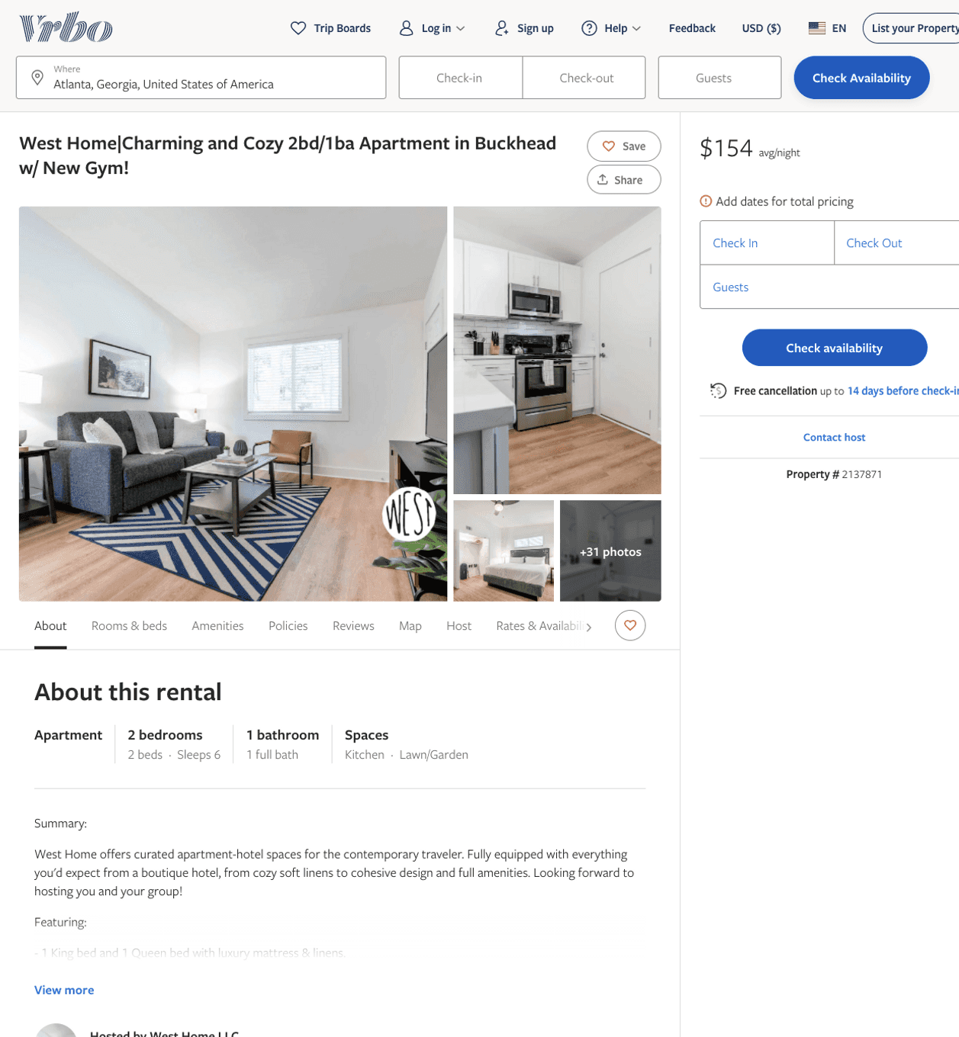
Listing 2137871
2
6
$114 - $99
1
West Home LLC
https://www.vrbo.com/2137871
Aug 2022

Slide 11
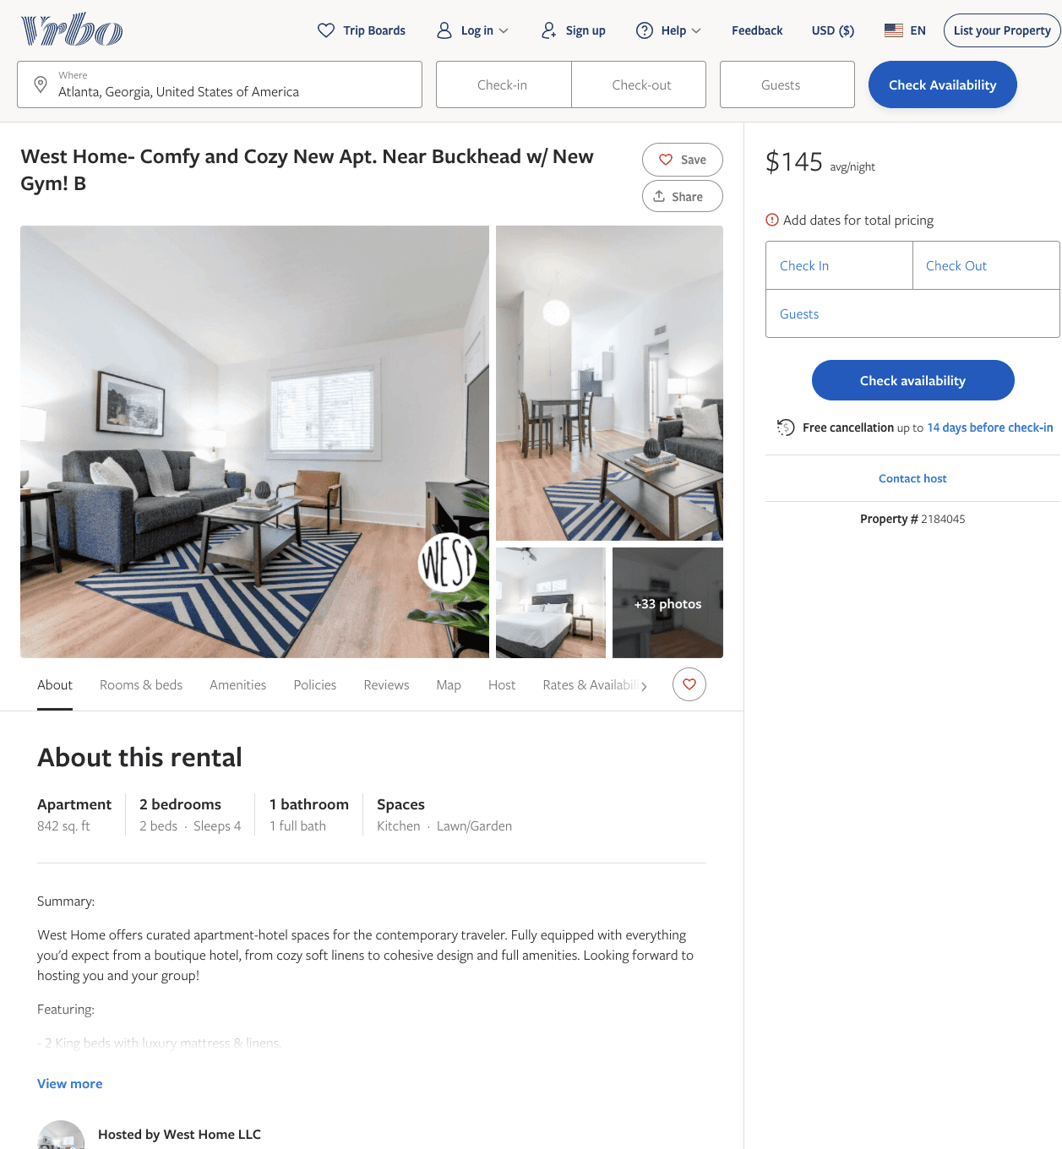
Listing 2184045
2
6
$107 - $152
1
West Home LLC
https://www.vrbo.com/2184045
Aug 2022

Slide 12
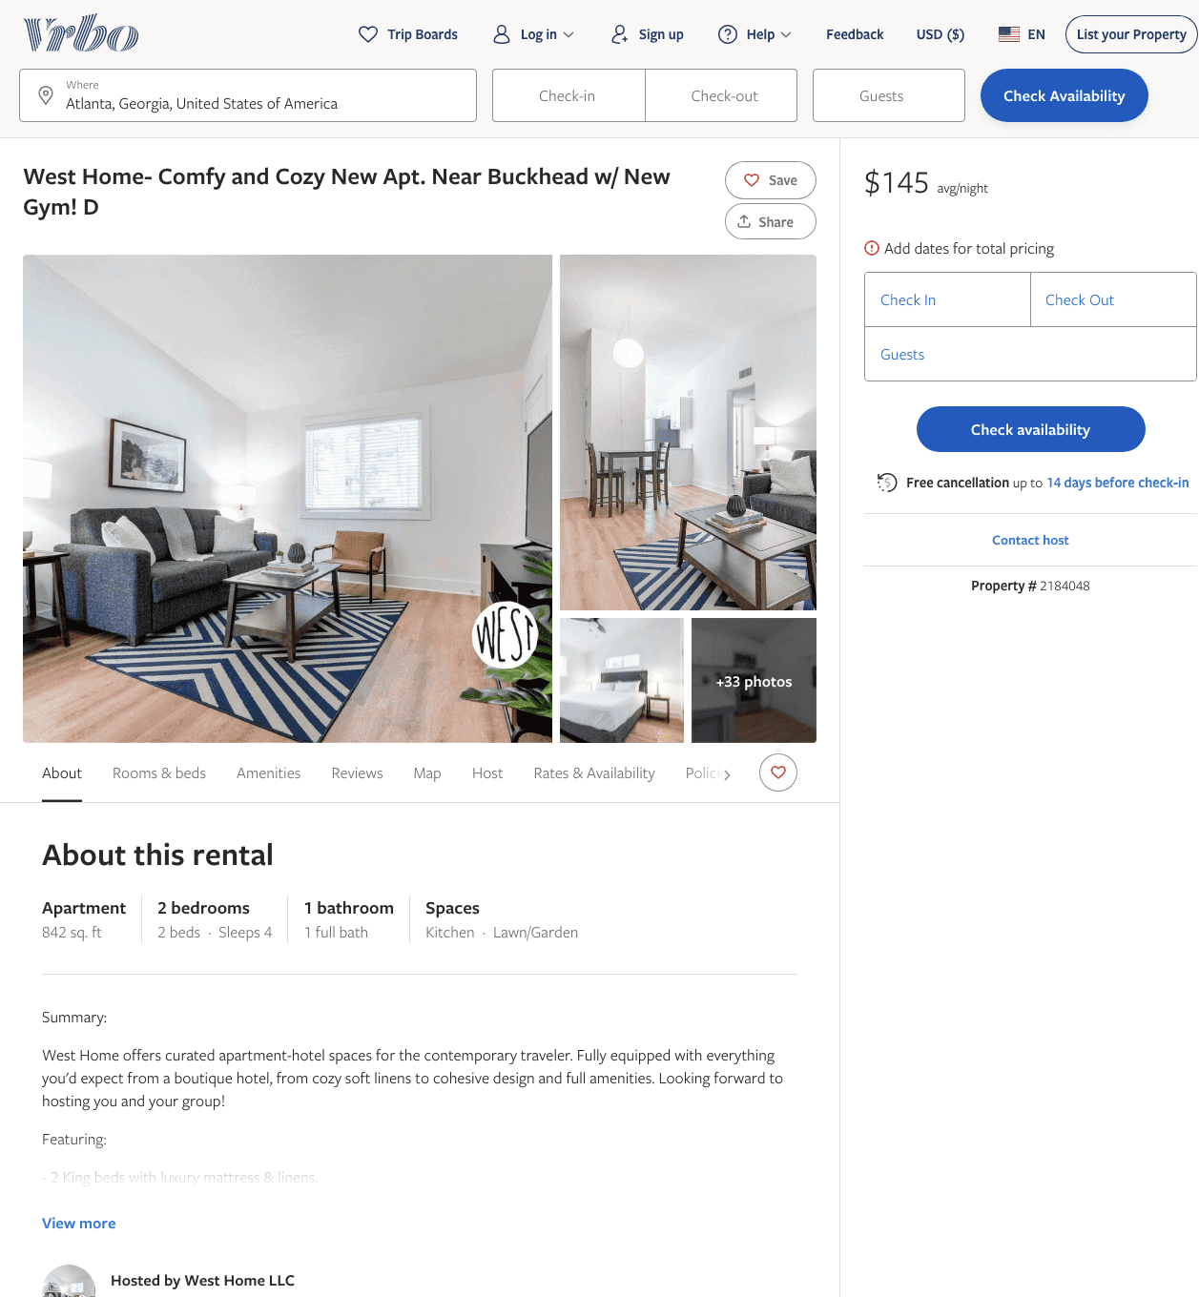
Listing 2184048
2
6
$107 - $151
1
West Home LLC
https://www.vrbo.com/2184048
Aug 2022

Slide 13
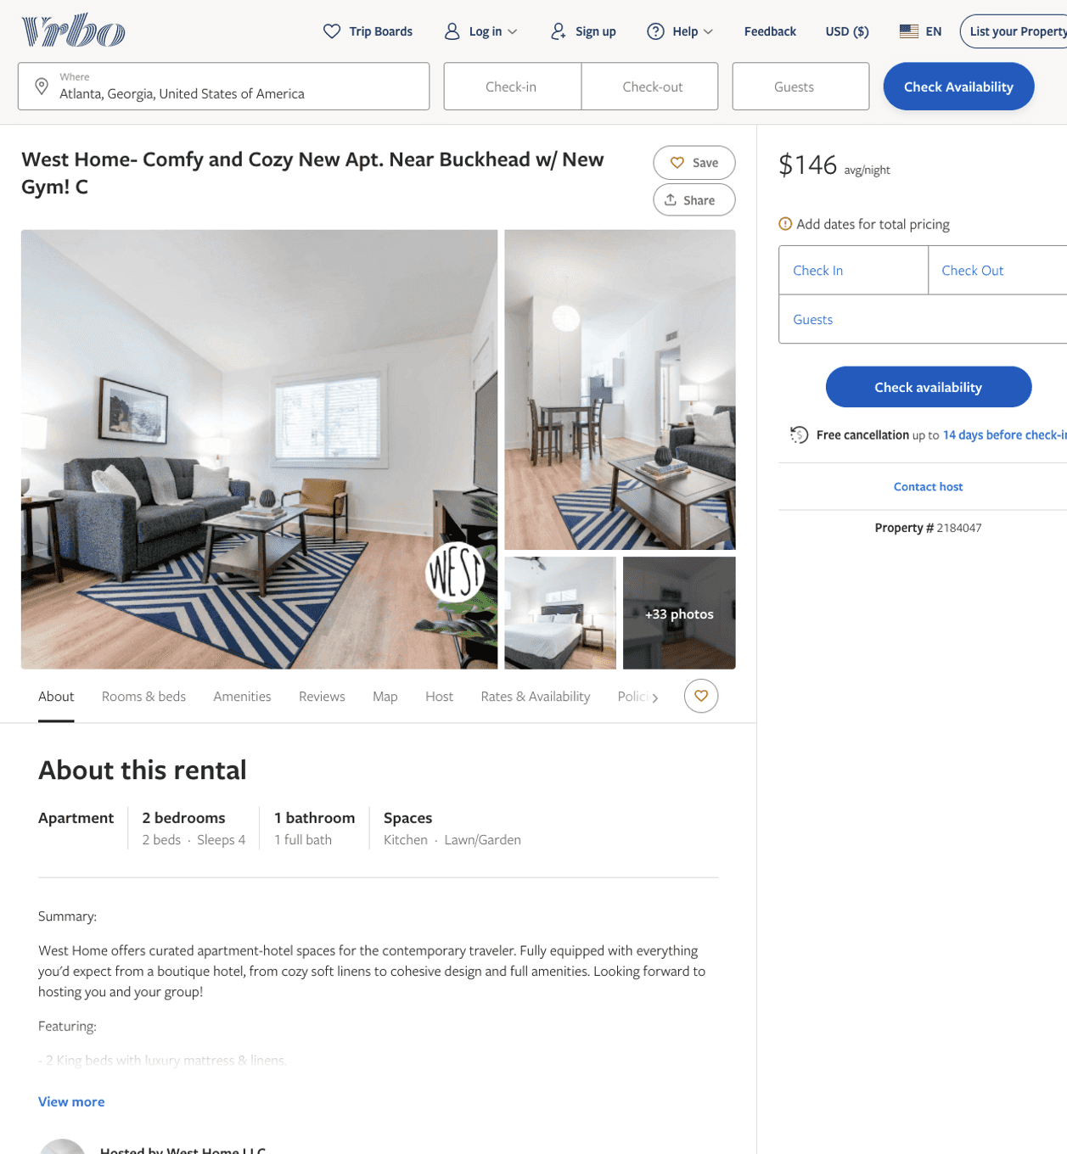
Listing 2184047
2
6
$107 - $145
5
1
West Home LLC
https://www.vrbo.com/2184047
Aug 2022

Slide 14
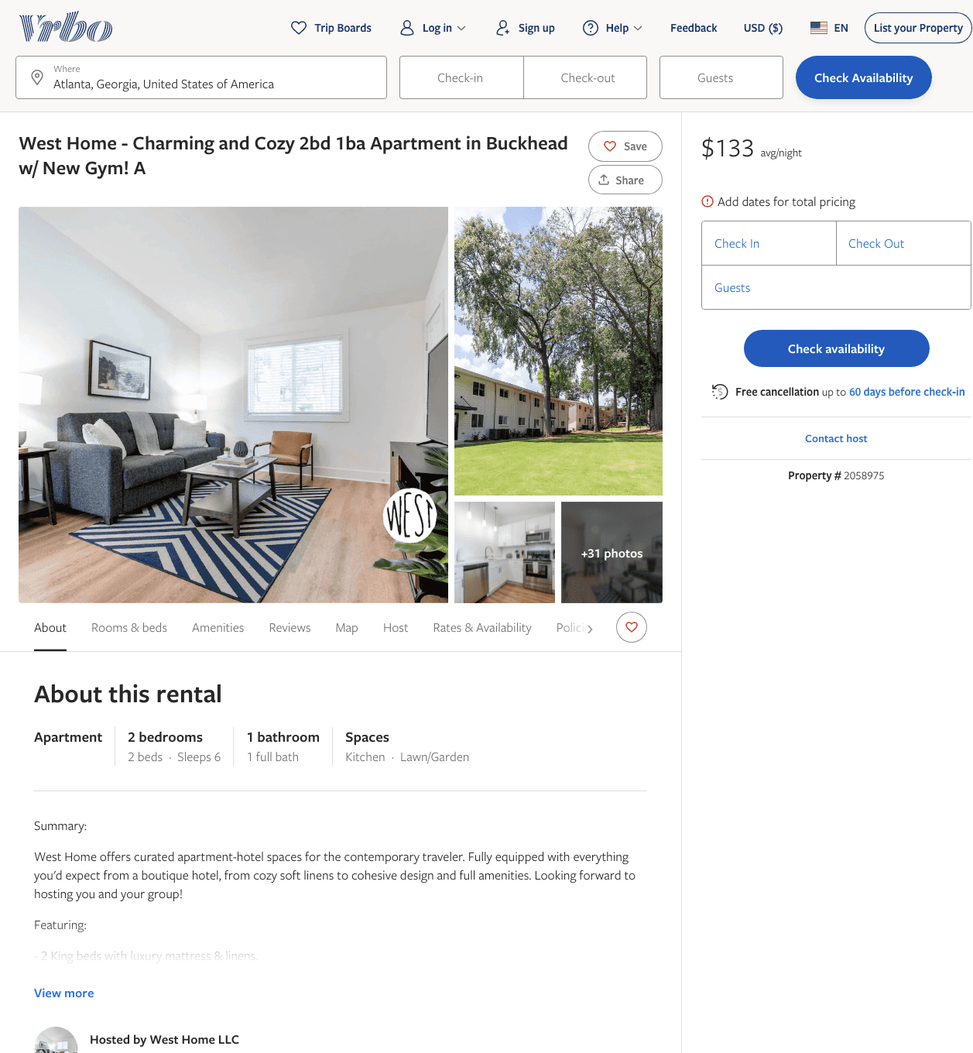
Listing 2058975
2
6
$107 - $149
1
West Home LLC
https://www.vrbo.com/2058975
Aug 2022

Slide 15
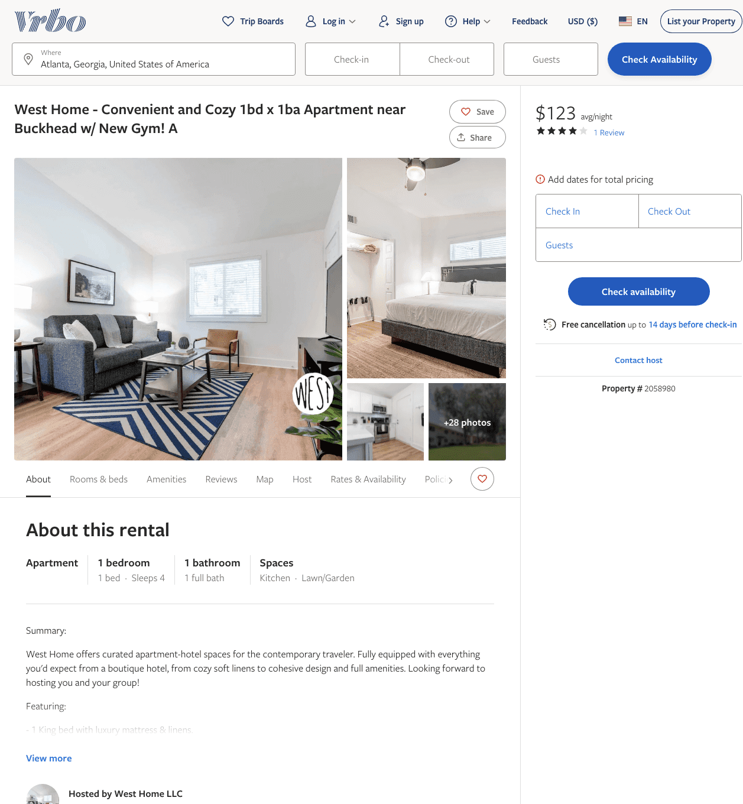
Listing 2058980
1
4
$104 - $143
4.5
1
West Home LLC
https://www.vrbo.com/2058980
Aug 2022

Slide 16
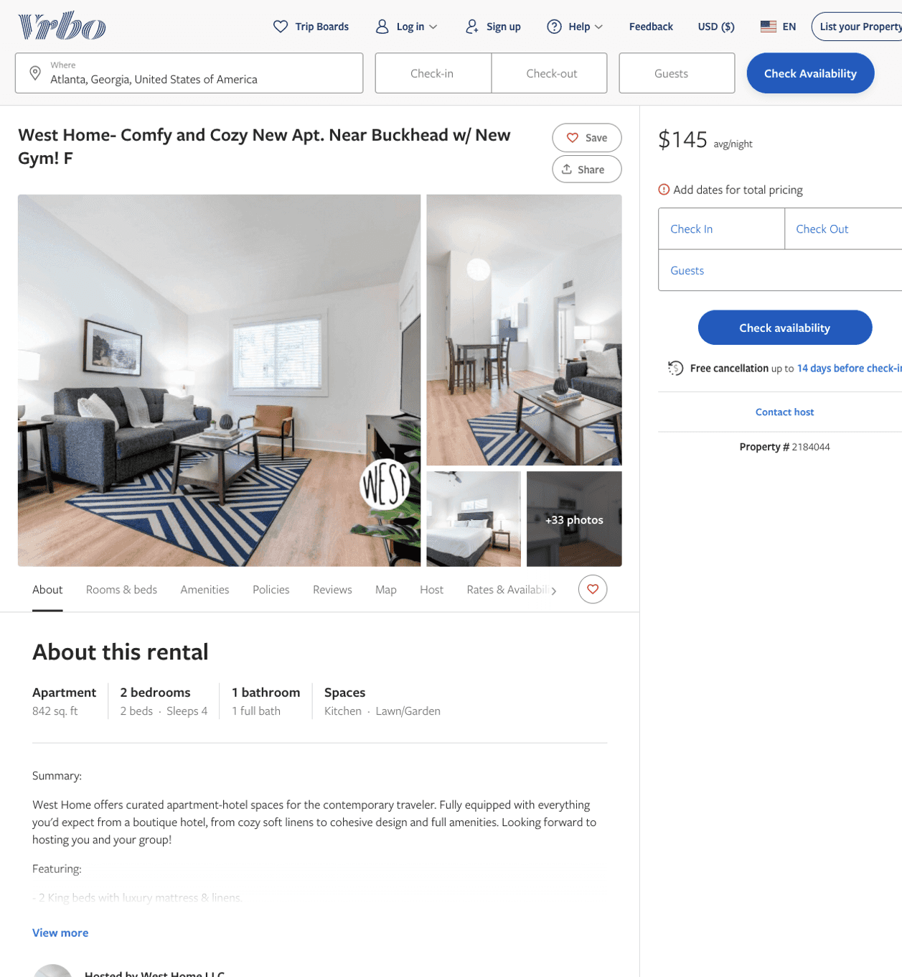
Listing 2184044
2
6
$107 - $147
1
West Home LLC
https://www.vrbo.com/2184044
Aug 2022

Slide 17
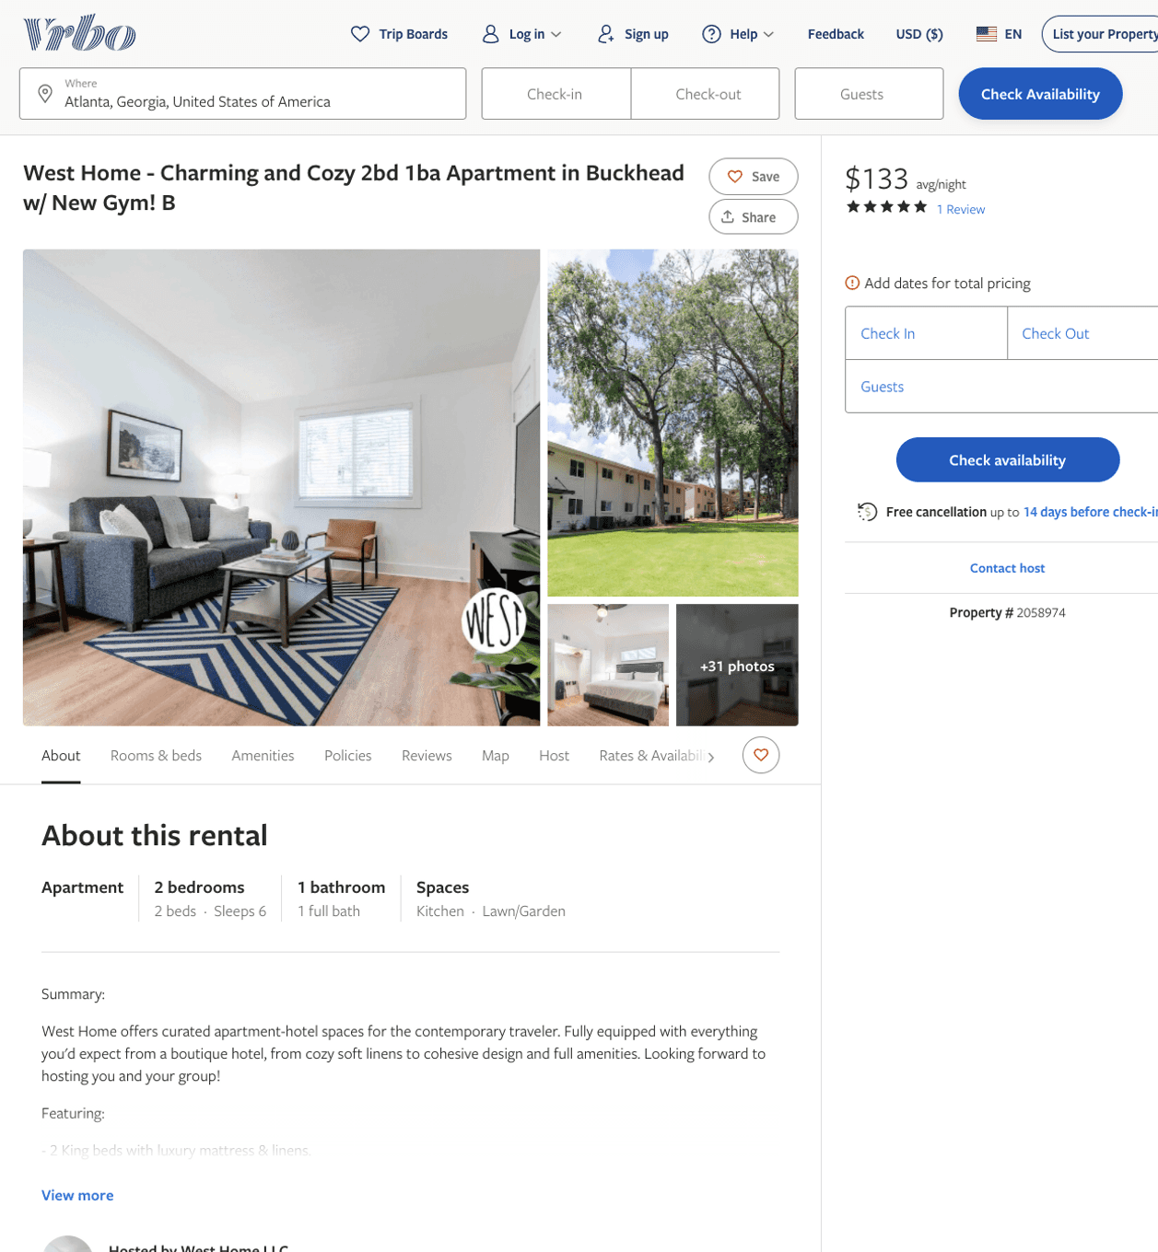
Listing 2058974
2
6
$101 - $150
5
1
West Home LLC
https://www.vrbo.com/2058974
Aug 2022

Slide 18
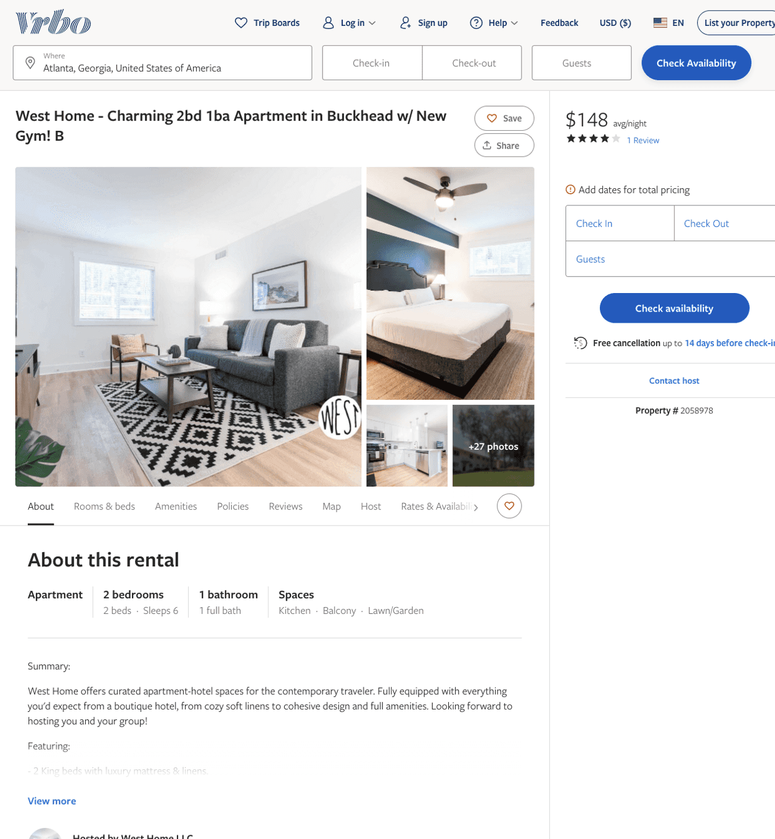
Listing 2058978
2
6
$107 - $166
4
1
West Home LLC
https://www.vrbo.com/2058978
Aug 2022

Slide 19
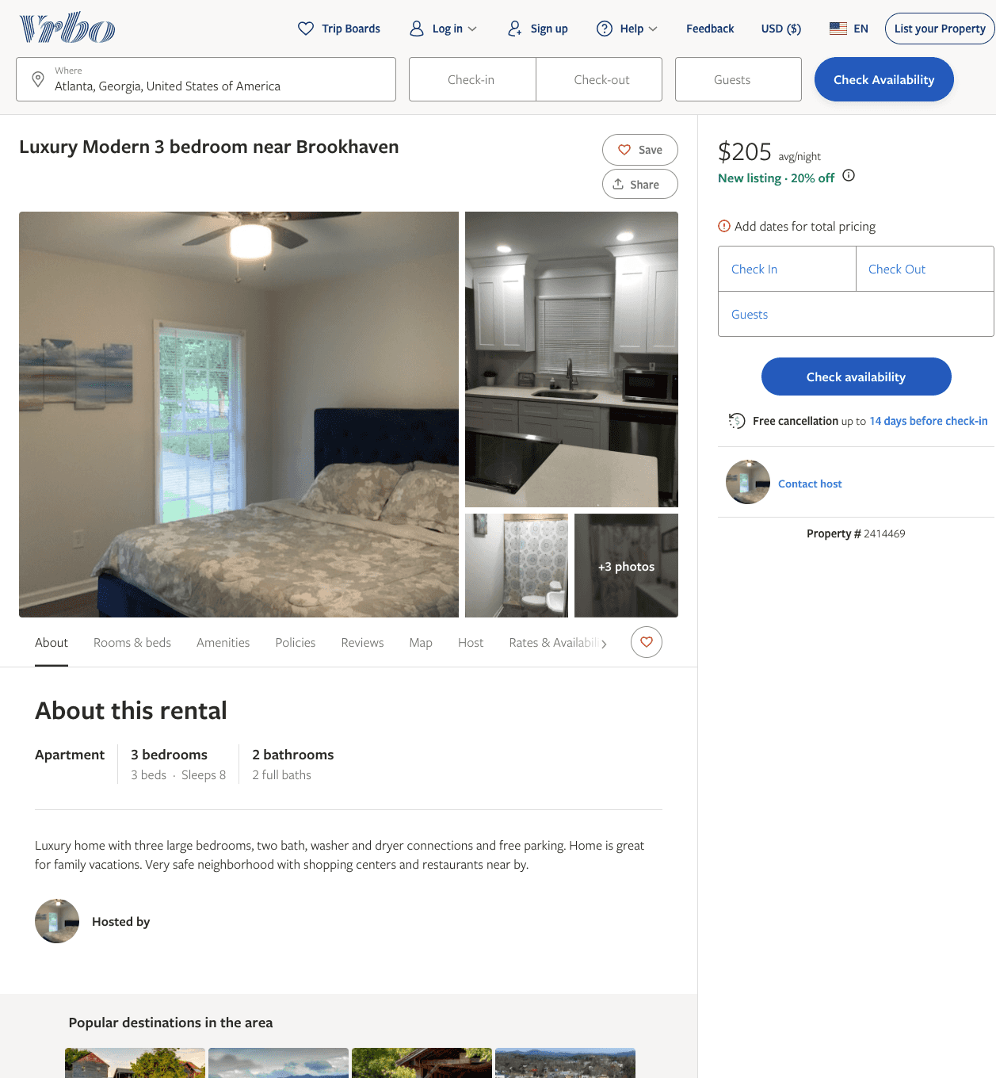
Listing 2414469
3
8
$174 - $224
3
Porsha Reeder
https://www.vrbo.com/2414469
Aug 2022

Slide 20
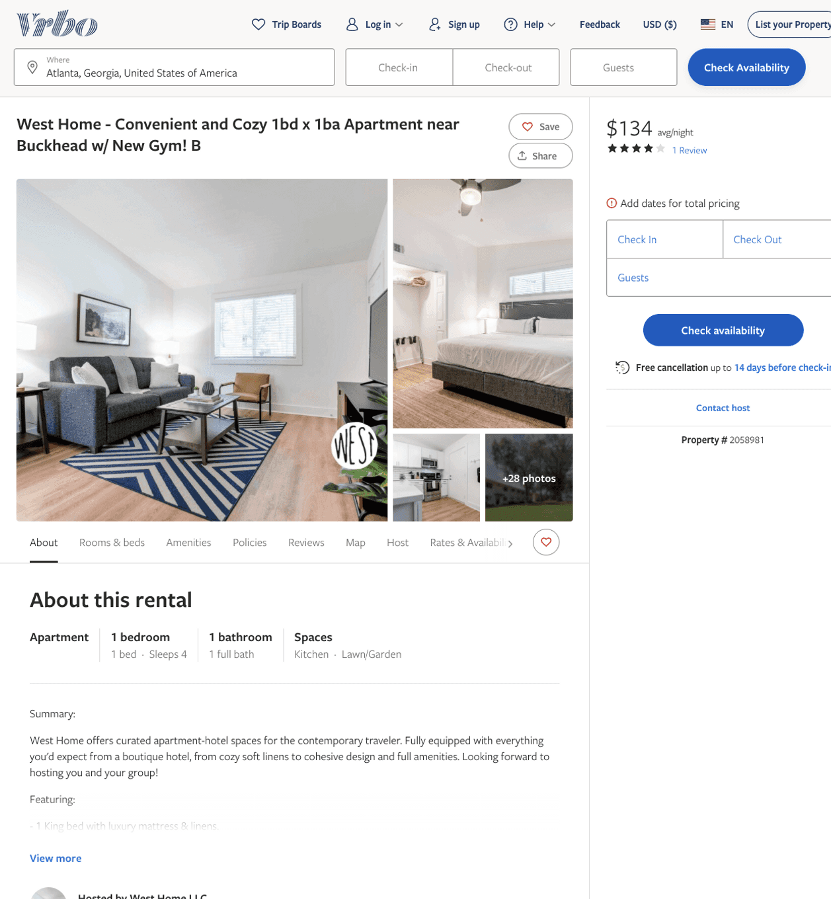
Listing 2058981
1
4
$102 - $99
4
1
West Home LLC
https://www.vrbo.com/2058981
Aug 2022

Slide 21
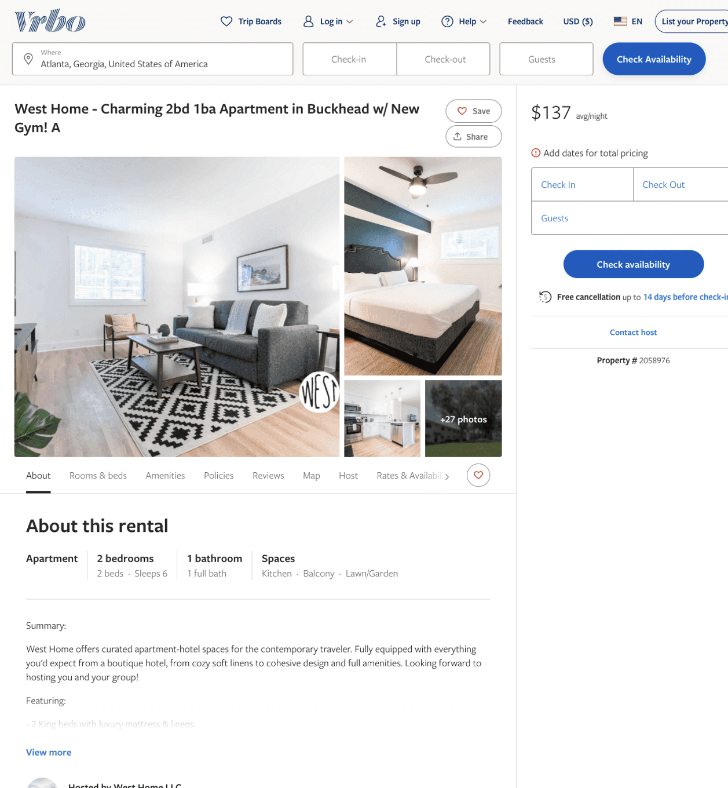
Listing 2058976
2
6
$107 - $149
1
West Home LLC
https://www.vrbo.com/2058976
Aug 2022

Slide 22
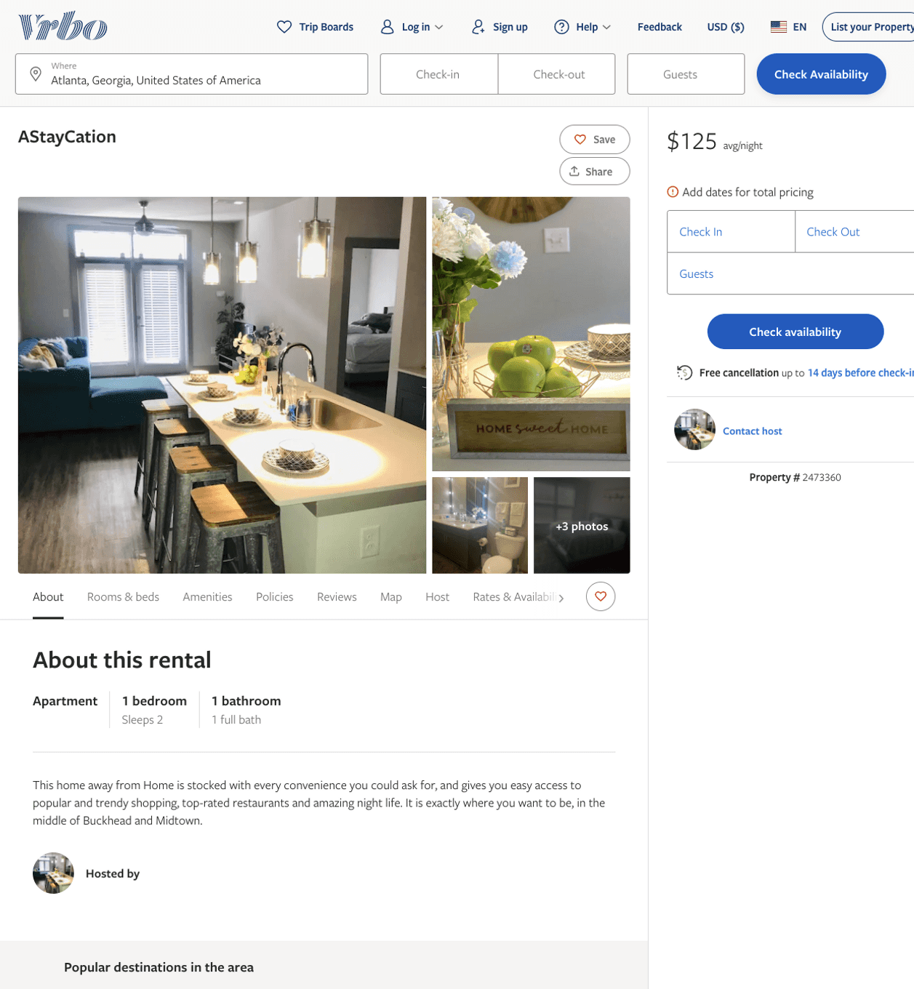
Listing 2473360
1
2
$125
2
https://www.vrbo.com/2473360
Aug 2022

Slide 23
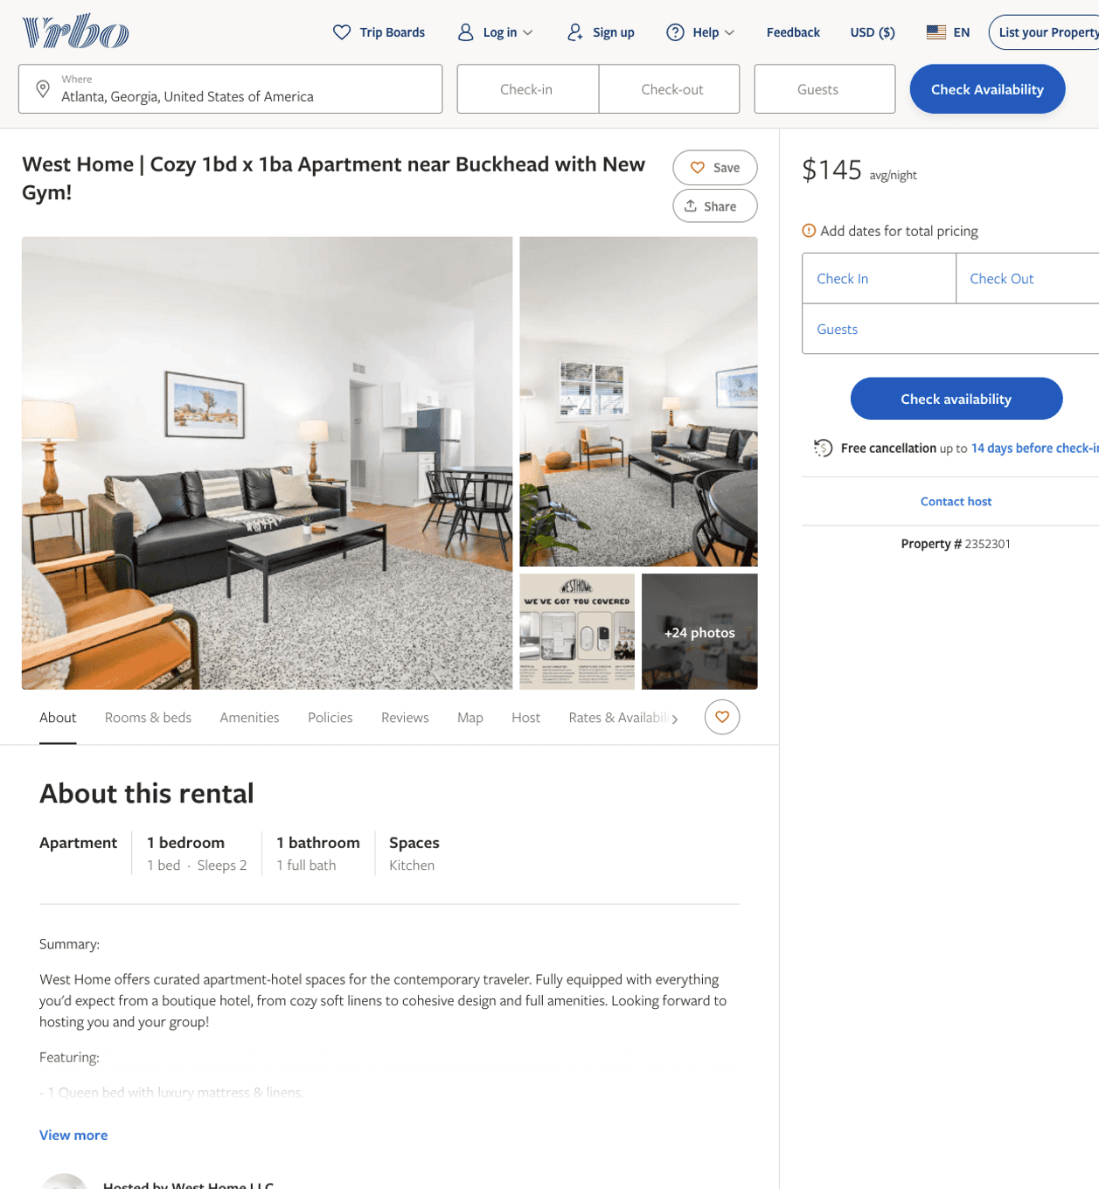
Listing 2352301
1
2
$112 - $98
4
1
West Home LLC
https://www.vrbo.com/2352301
Aug 2022

Slide 24
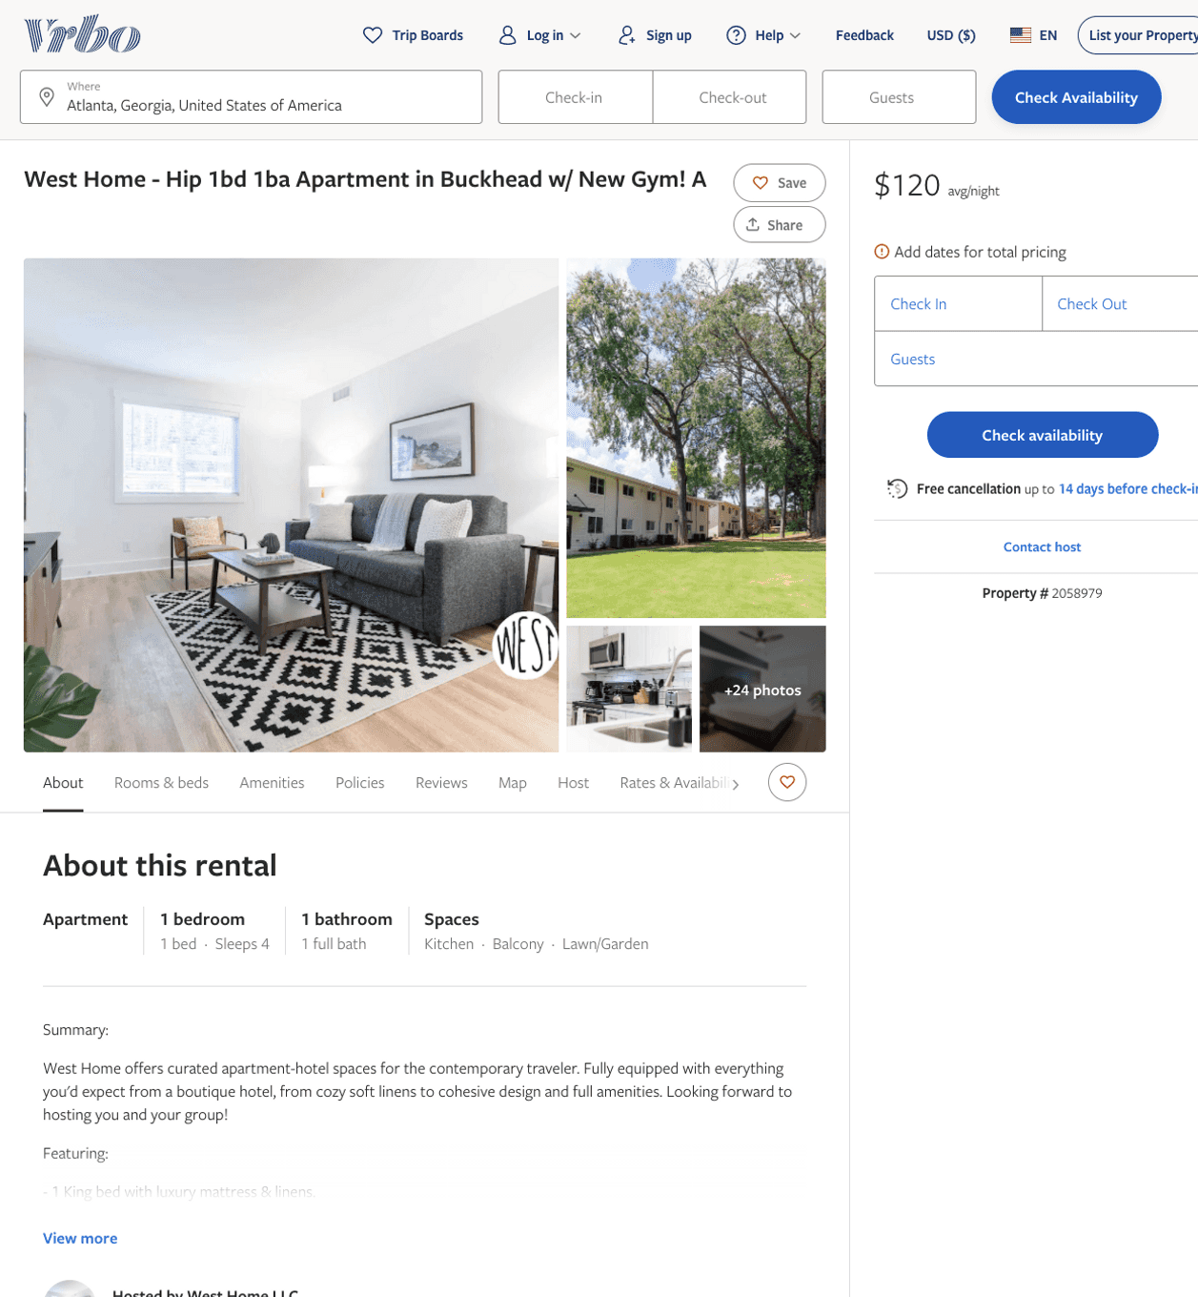
Listing 2058979
1
4
$113 - $130
1
West Home LLC
https://www.vrbo.com/2058979
Aug 2022

Slide 25
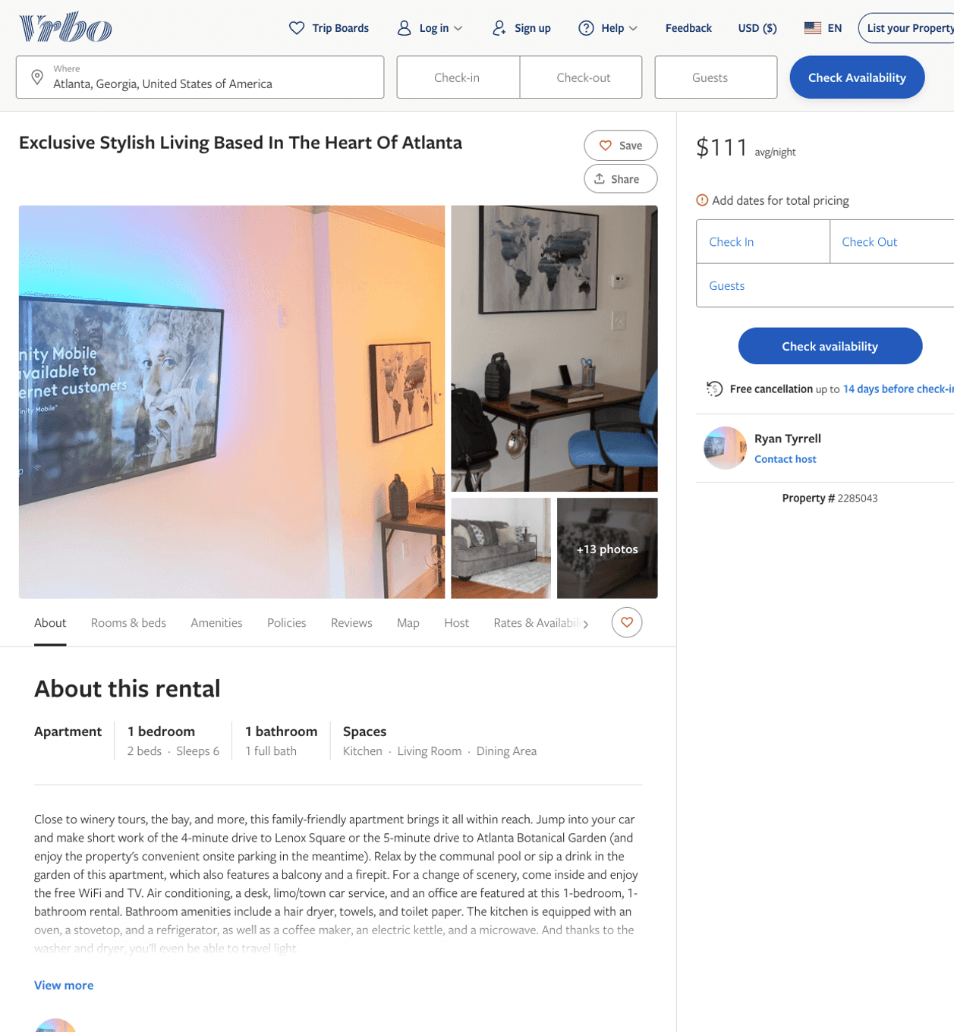
Listing 2285043
1
4
$111 - $94
4.25
1
Ryan Tyrrell
https://www.vrbo.com/2285043
Aug 2022

Slide 26
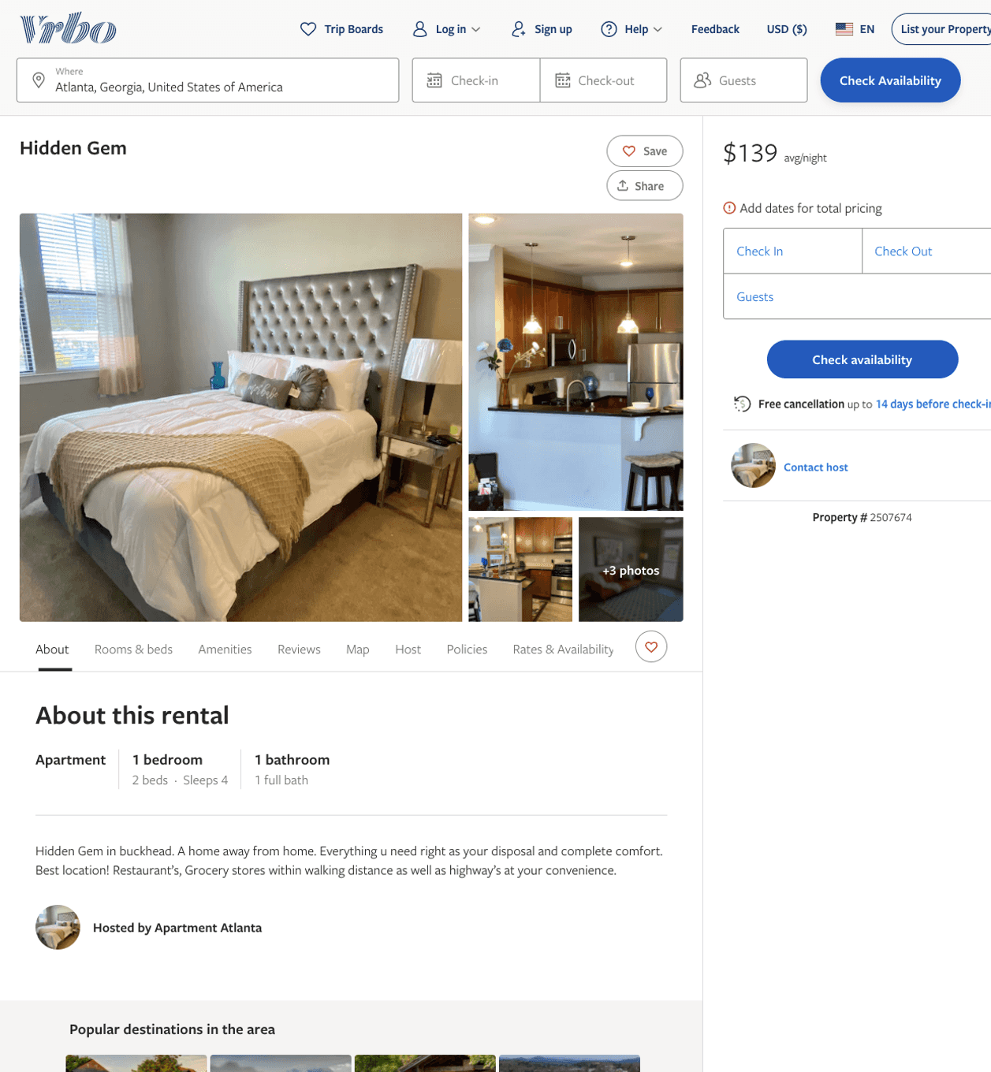
Listing 2507674
1
4
$139
1
https://www.vrbo.com/2507674
Aug 2022

Slide 27
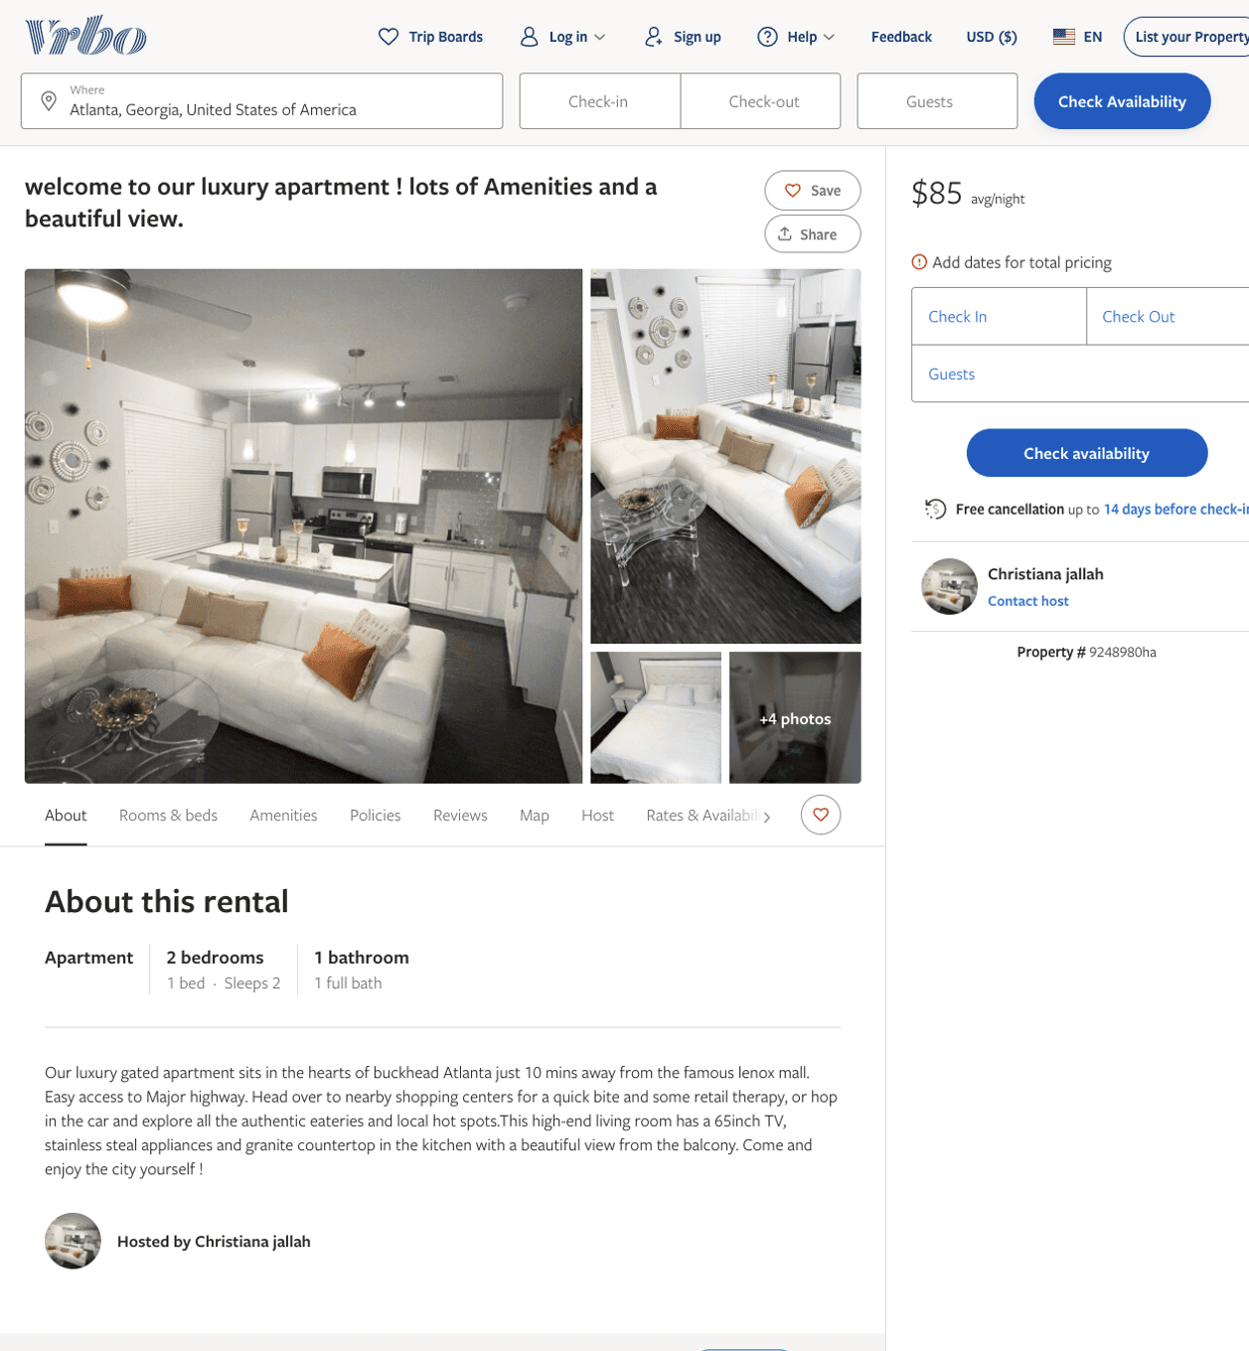
Listing 9248980
2
2
$85
1
Christiana jallah
https://www.vrbo.com/9248980ha
Aug 2022

Slide 28
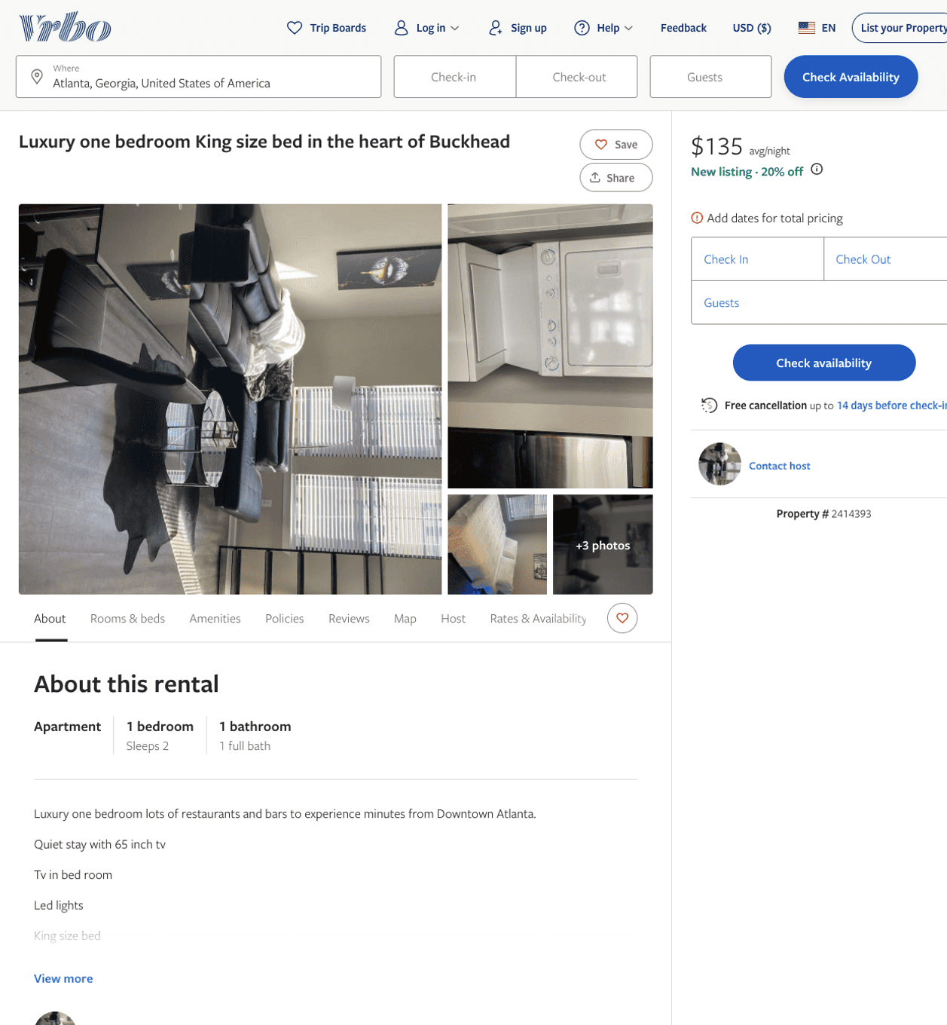
Listing 2414393
1
2
$135
1
https://www.vrbo.com/2414393
Aug 2022

Slide 29
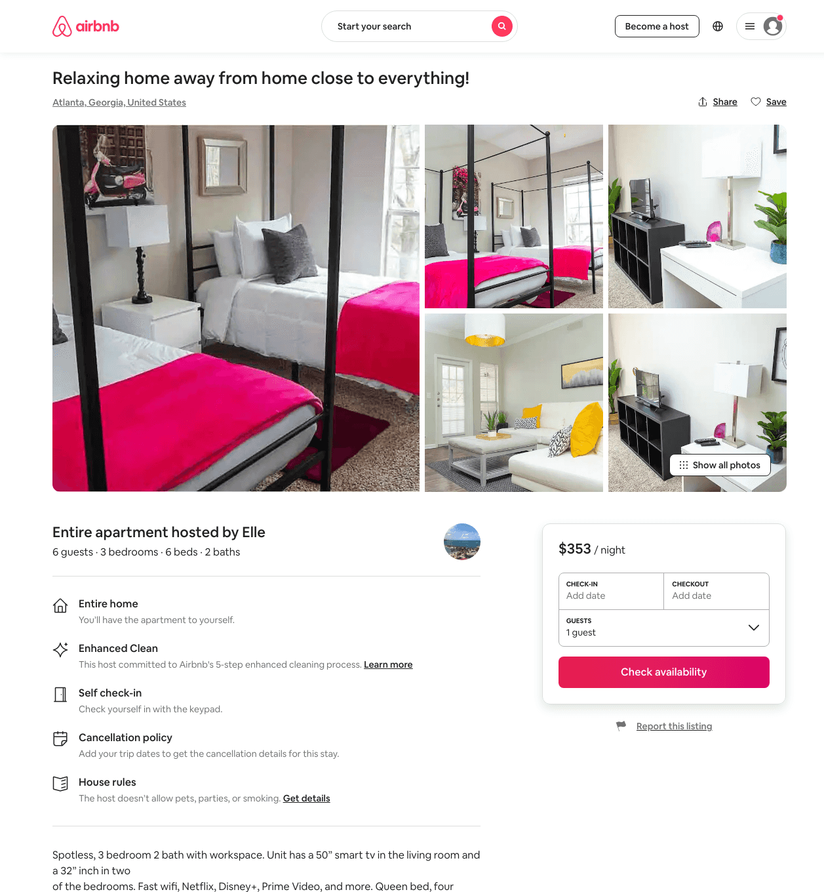
Listing 48806316
3
6
$293 - $463
3
Elle
367270546
4
https://www.airbnb.com/rooms/48806316
Aug 2022

Slide 30
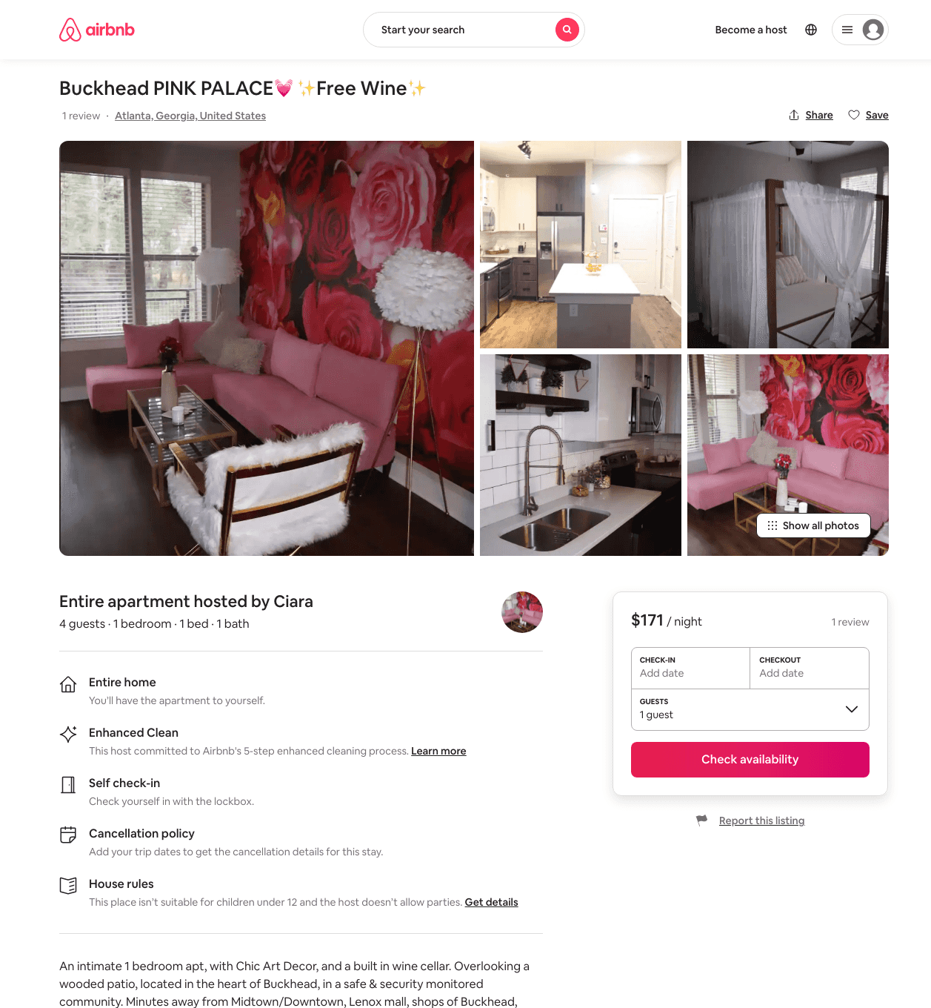
Listing 48401603
1
4
$110 - $223
4.80
1
Pink Palace
26510689
3
https://www.airbnb.com/rooms/48401603
Aug 2022

Slide 31
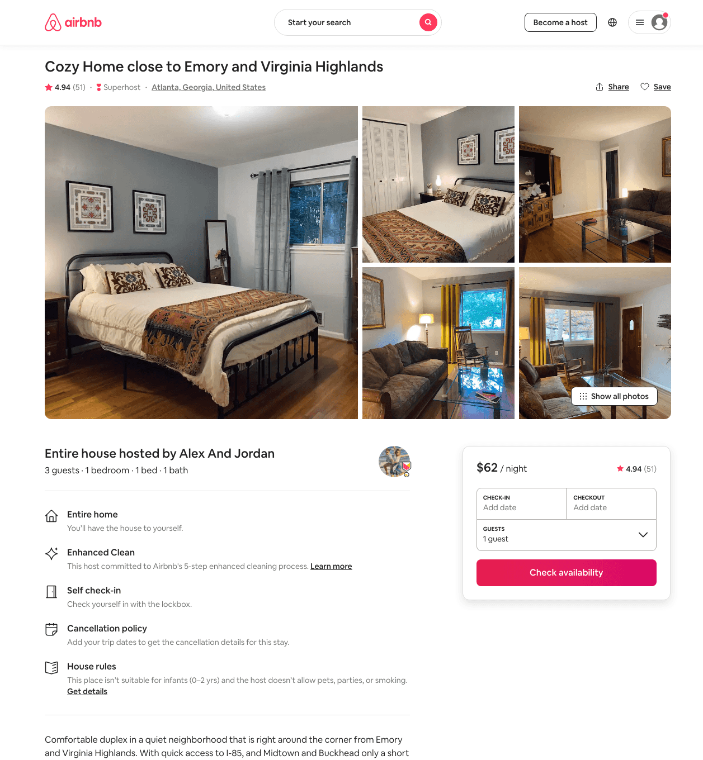
Listing 44521989
2
5
$58 - $107
4.92
1
Alex And Jordan
72603808
1
https://www.airbnb.com/rooms/44521989
Aug 2022

Slide 32
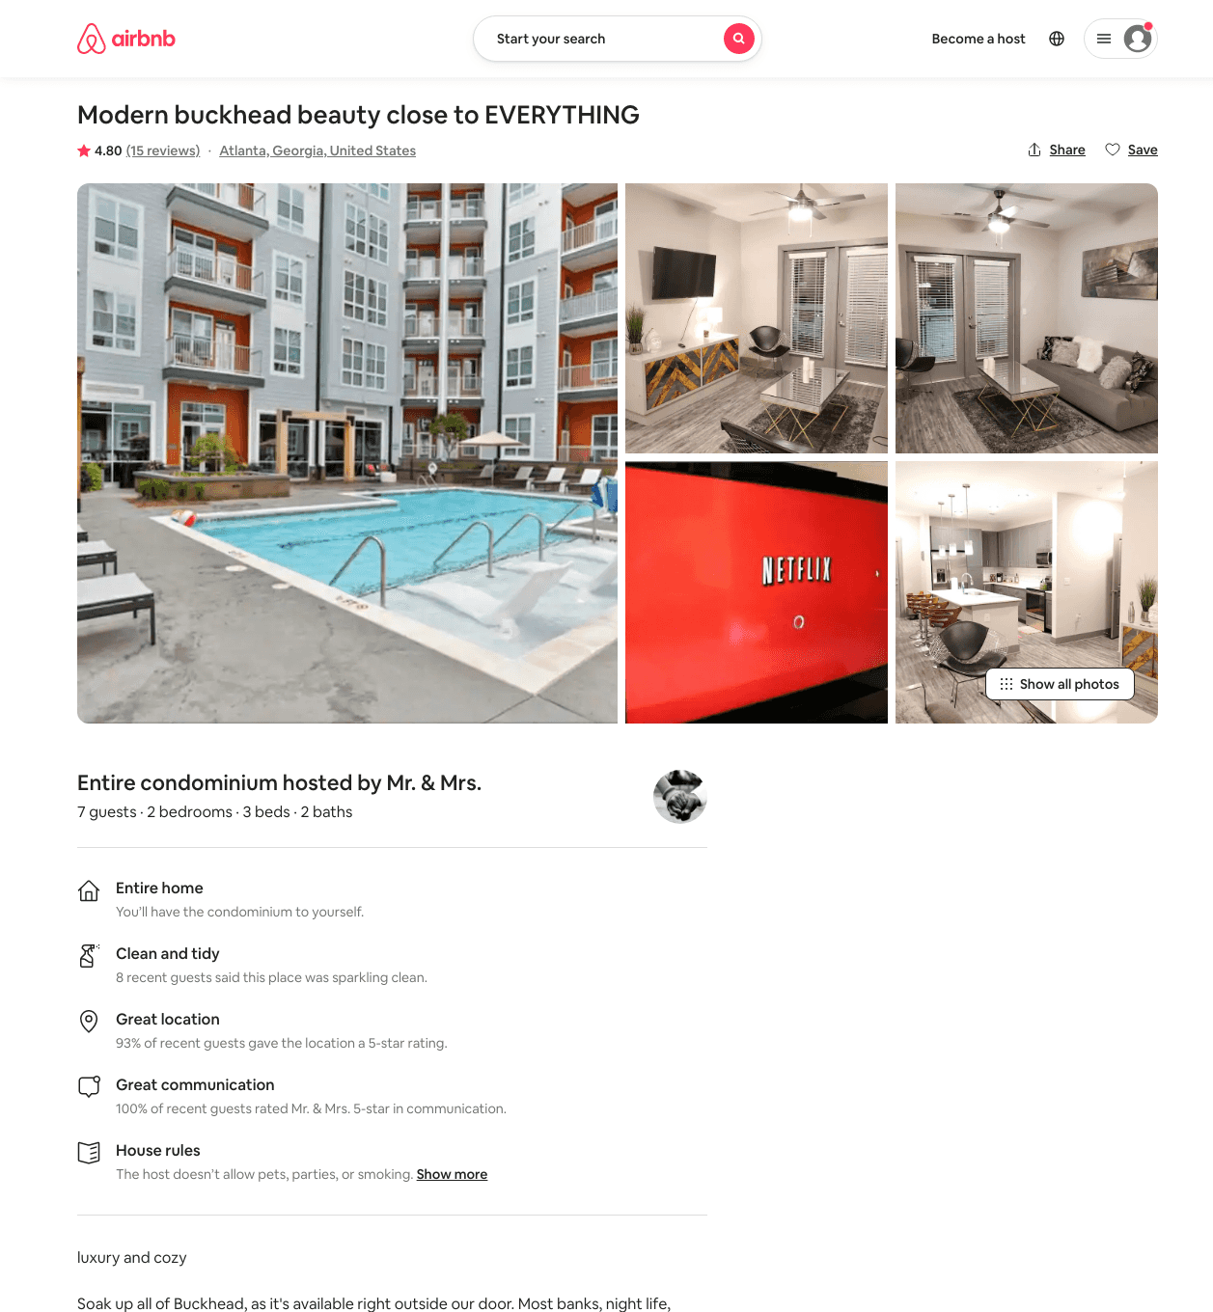
Listing 46144801
2
7
$155 - $208
4.64
1
Mr. & Mrs.
114681992
4
https://www.airbnb.com/rooms/46144801
Jul 2022

Slide 33
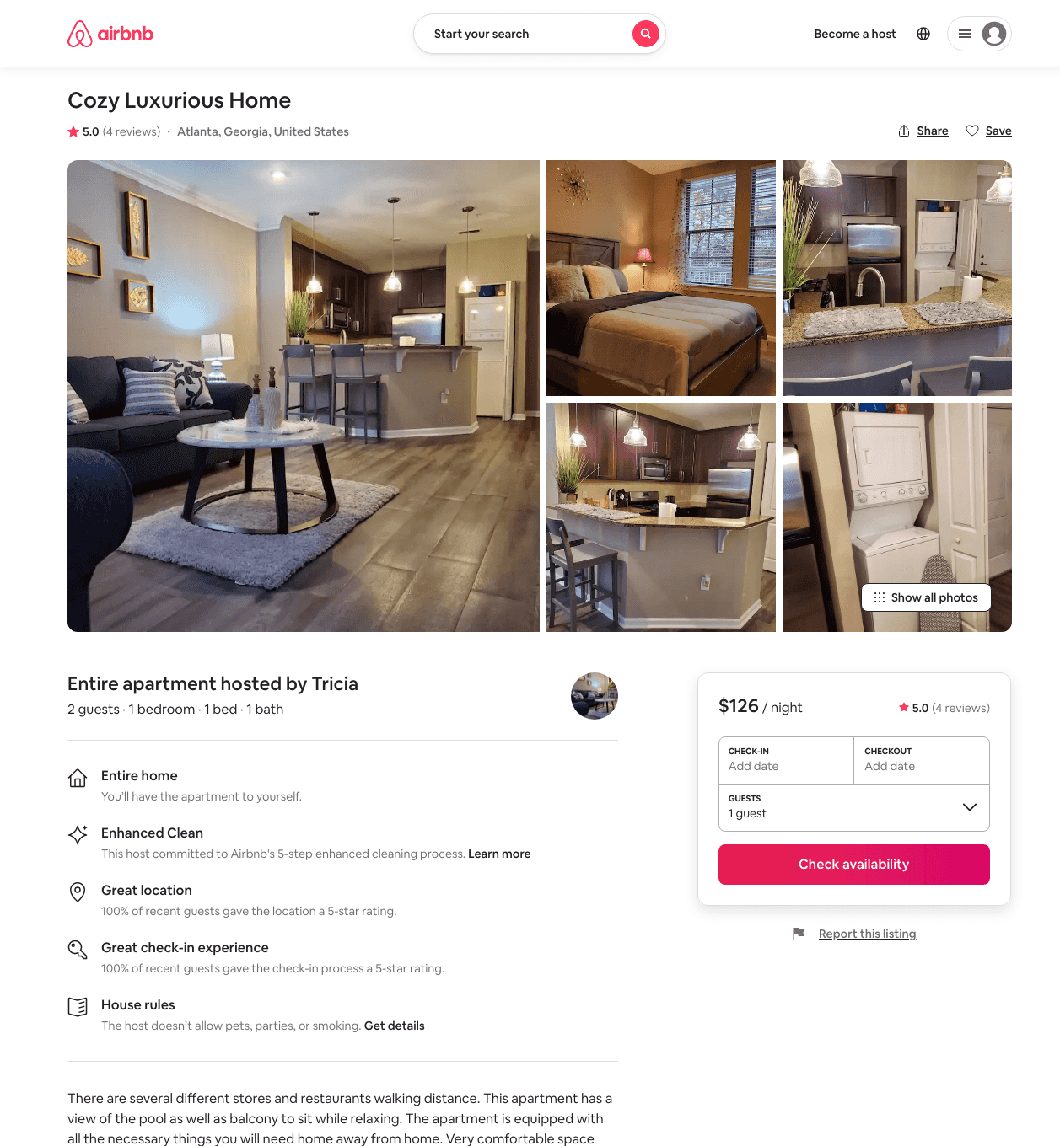
Listing 47340945
1
2
$99 - $127
4.63
2
Tricia
290642214
3
https://www.airbnb.com/rooms/47340945
Aug 2022

Slide 34
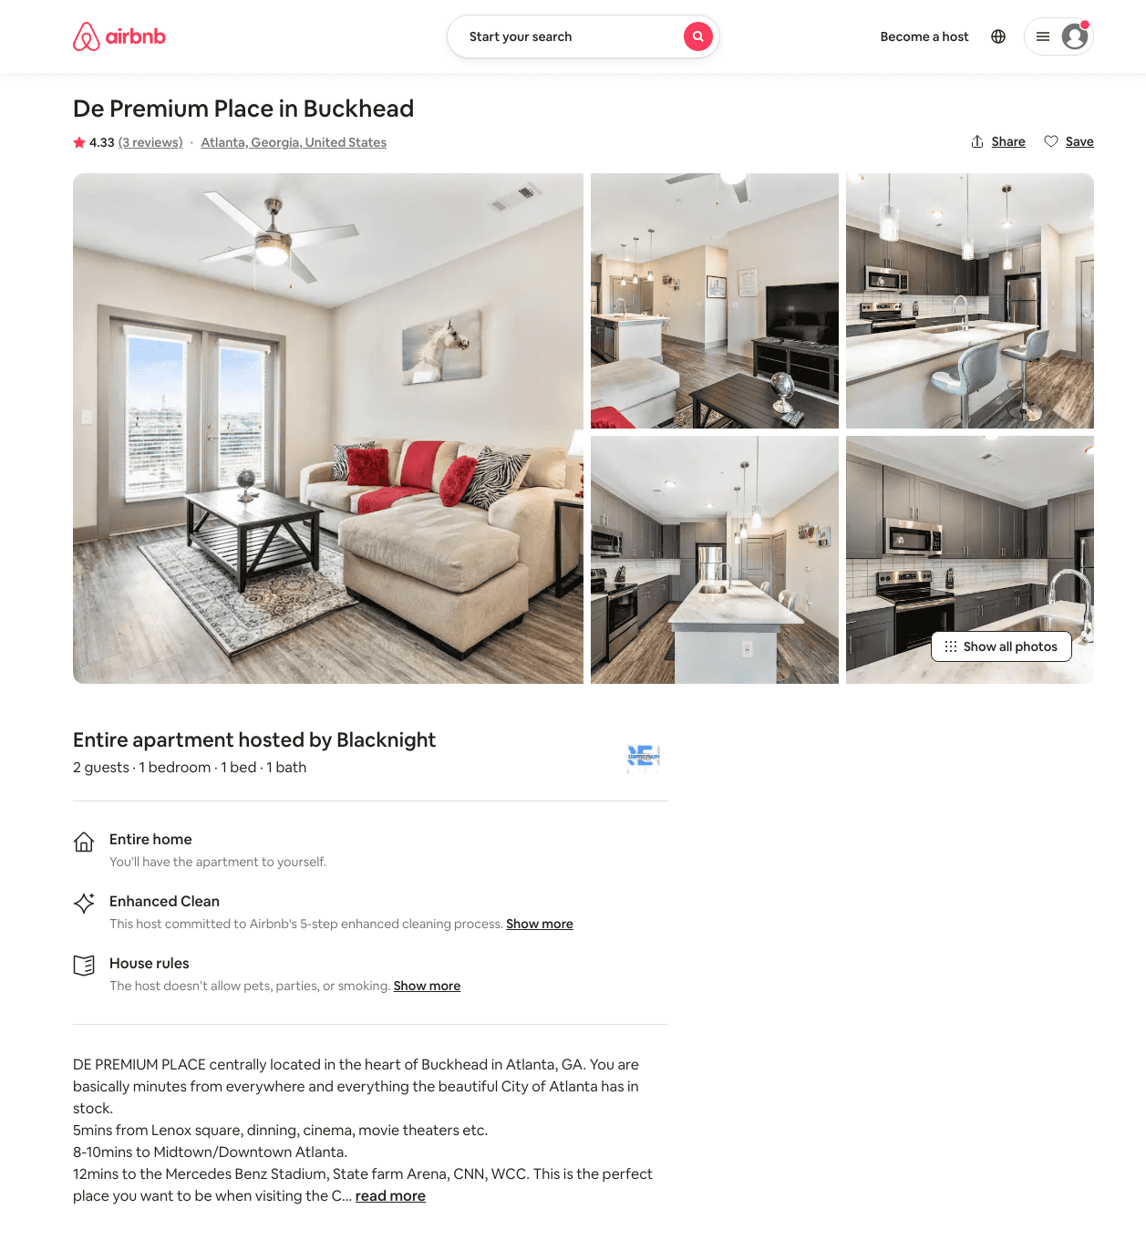
Listing 45610185
1
2
$92 - $131
4.17
3
Blacknight
154860852
2
https://www.airbnb.com/rooms/45610185
Aug 2022

Slide 35
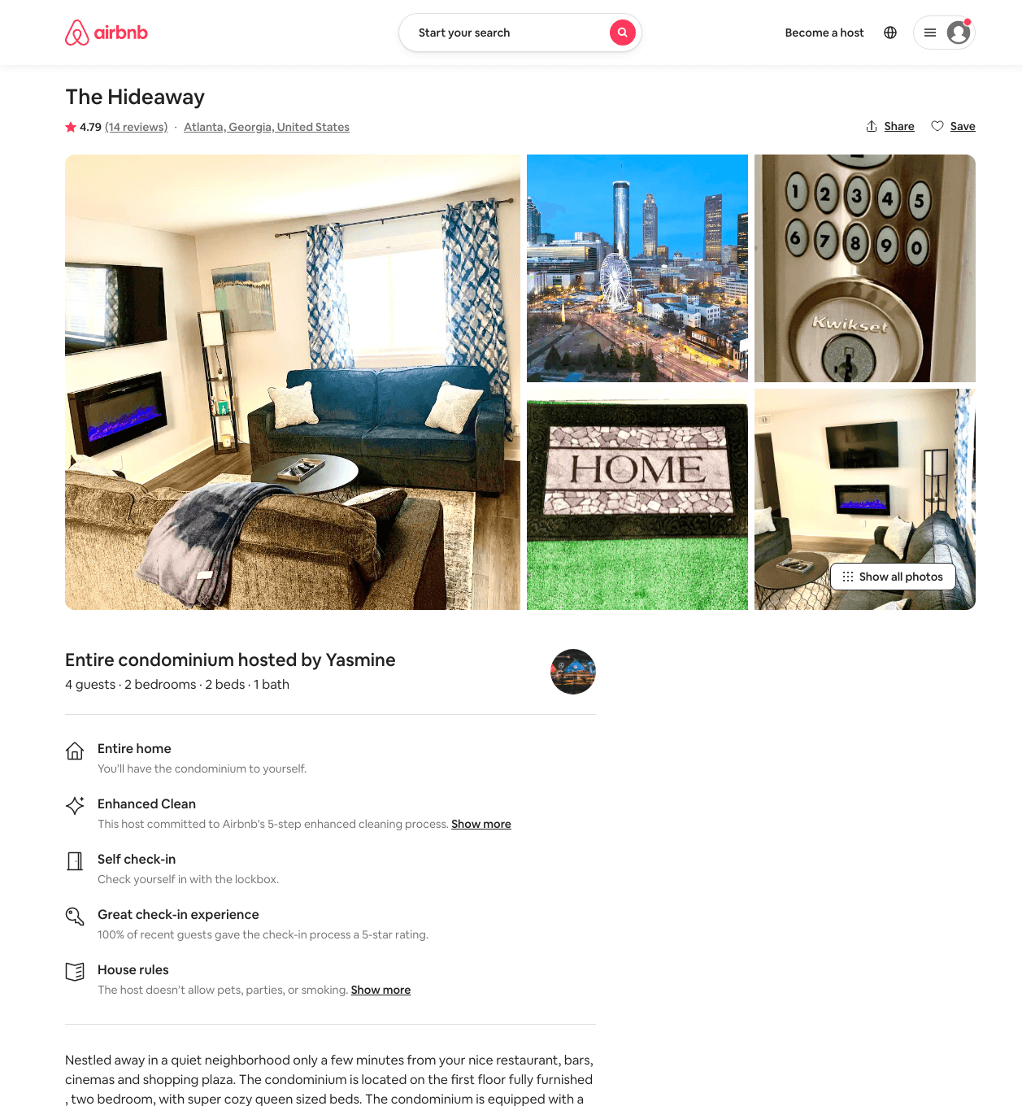
Listing 48348612
2
4
$80 - $116
4.84
1
Yasmine
389998823
1
https://www.airbnb.com/rooms/48348612
Aug 2022

Slide 36
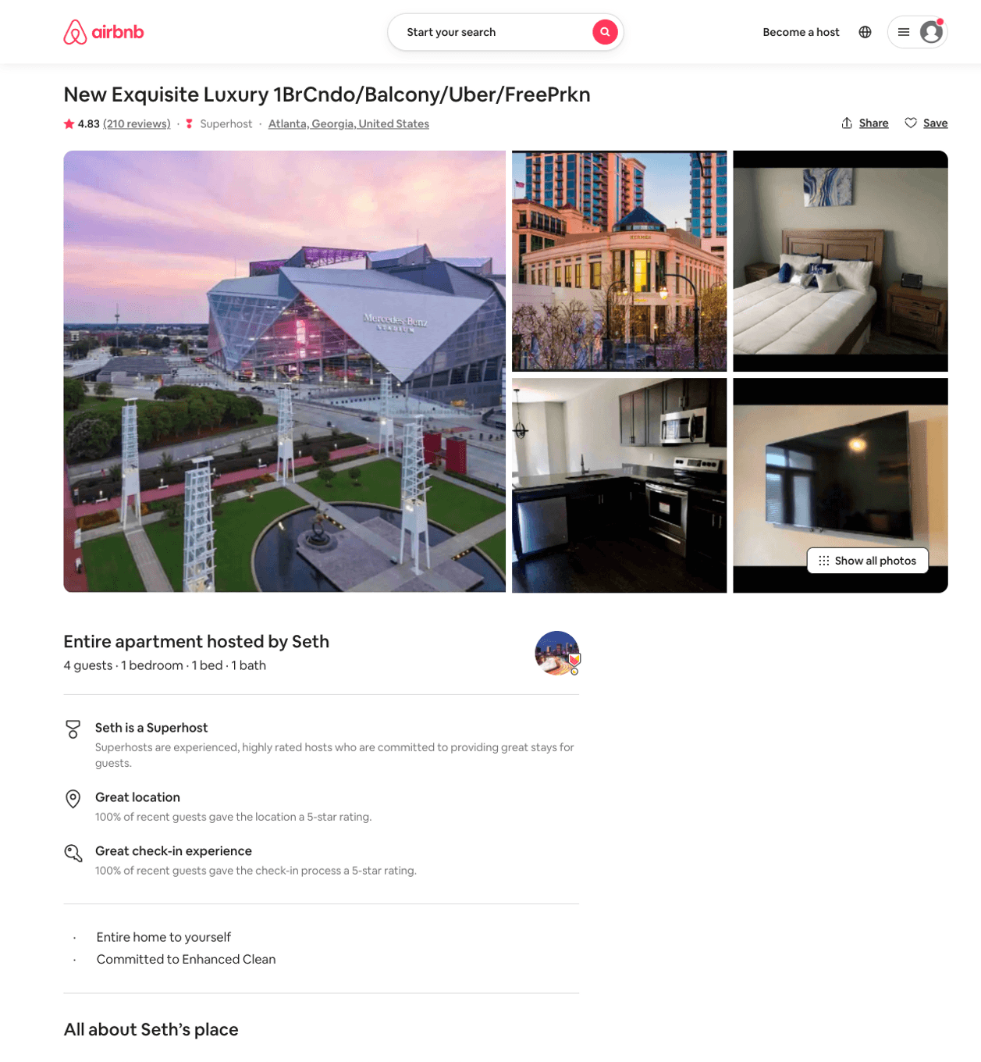
Listing 15010068
1
4
$66 - $94
4.80
1
Mr
28347223
2
https://www.airbnb.com/rooms/15010068
Aug 2022

Slide 37
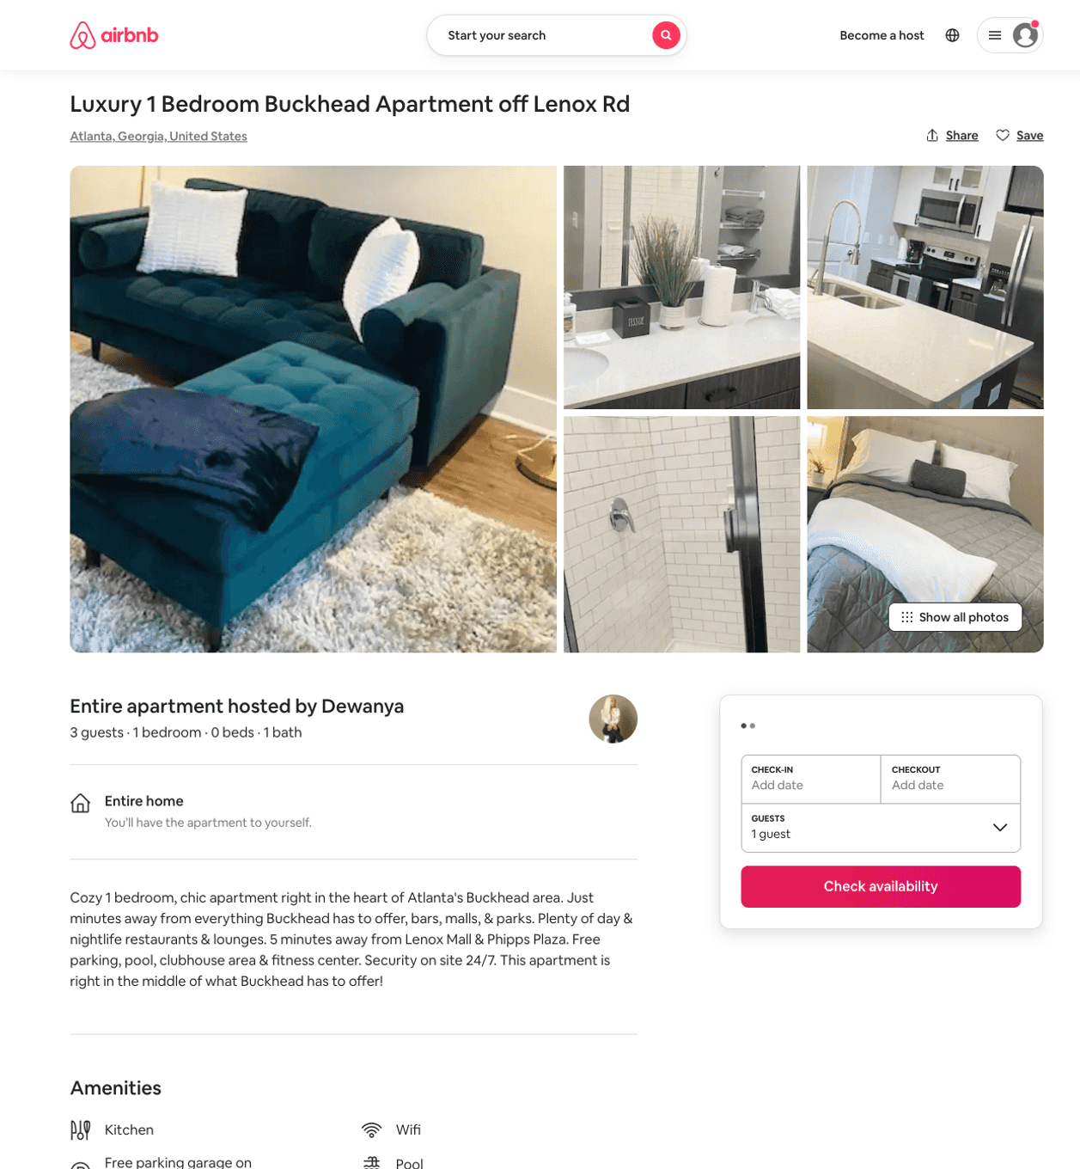
Listing 50415231
1
2
$72 - $161
4.60
2
Luxury
19443571
1
https://www.airbnb.com/rooms/50415231
Aug 2022

Slide 38
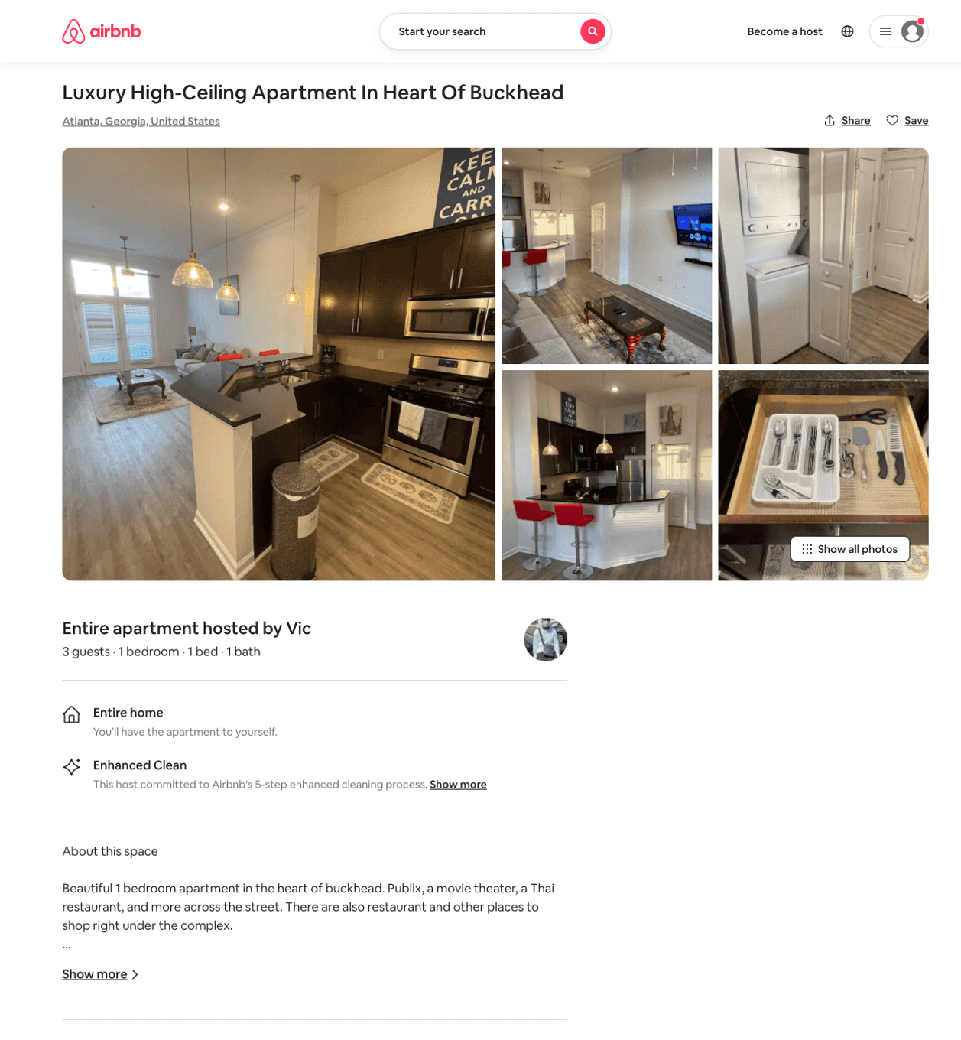
Listing 50626661
1
3
$131 - $142
4.25
2
Victor
352773288
1
https://www.airbnb.com/rooms/50626661
Jun 2022

Slide 39
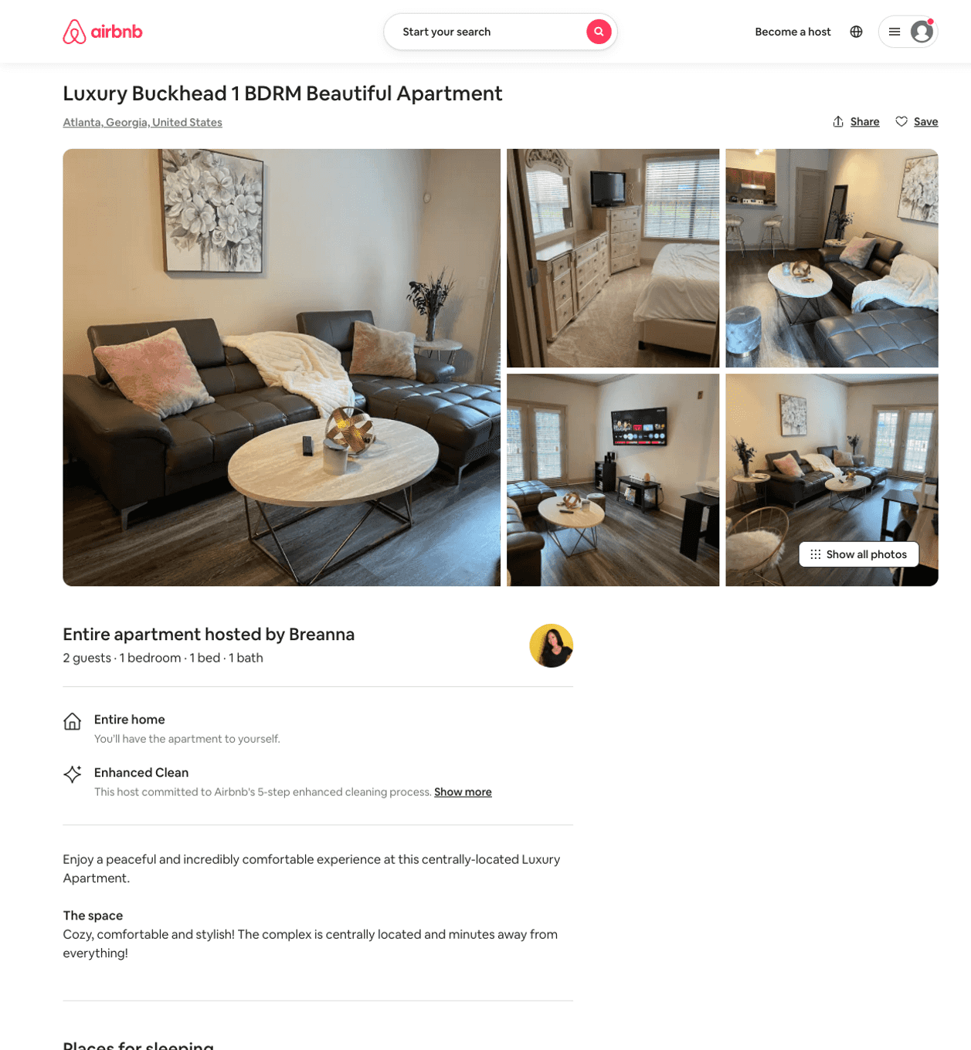
Listing 50641018
1
2
$110 - $125
5.0
3
Breanna
409165896
1
https://www.airbnb.com/rooms/50641018
Aug 2022

Slide 40
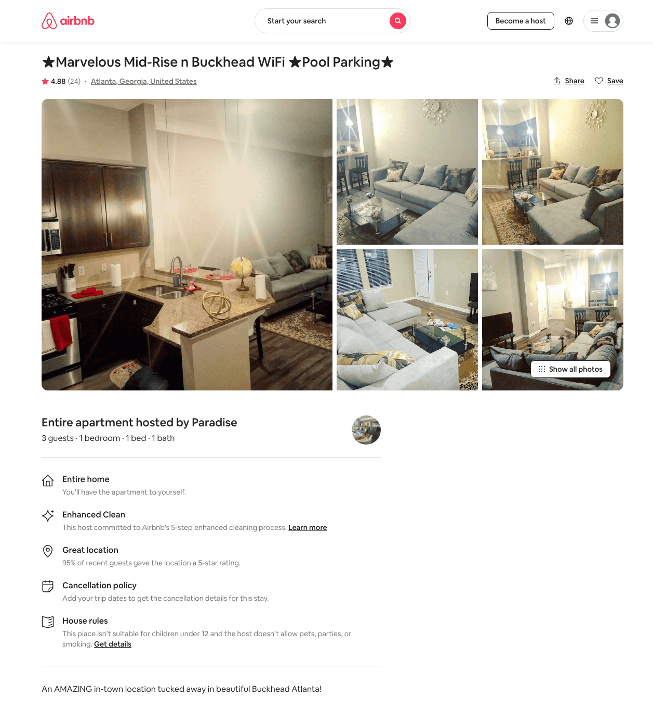
Listing 44995385
1
3
$68 - $100
4.62
1
Paradise
191441686
12
https://www.airbnb.com/rooms/44995385
Aug 2022

Slide 41
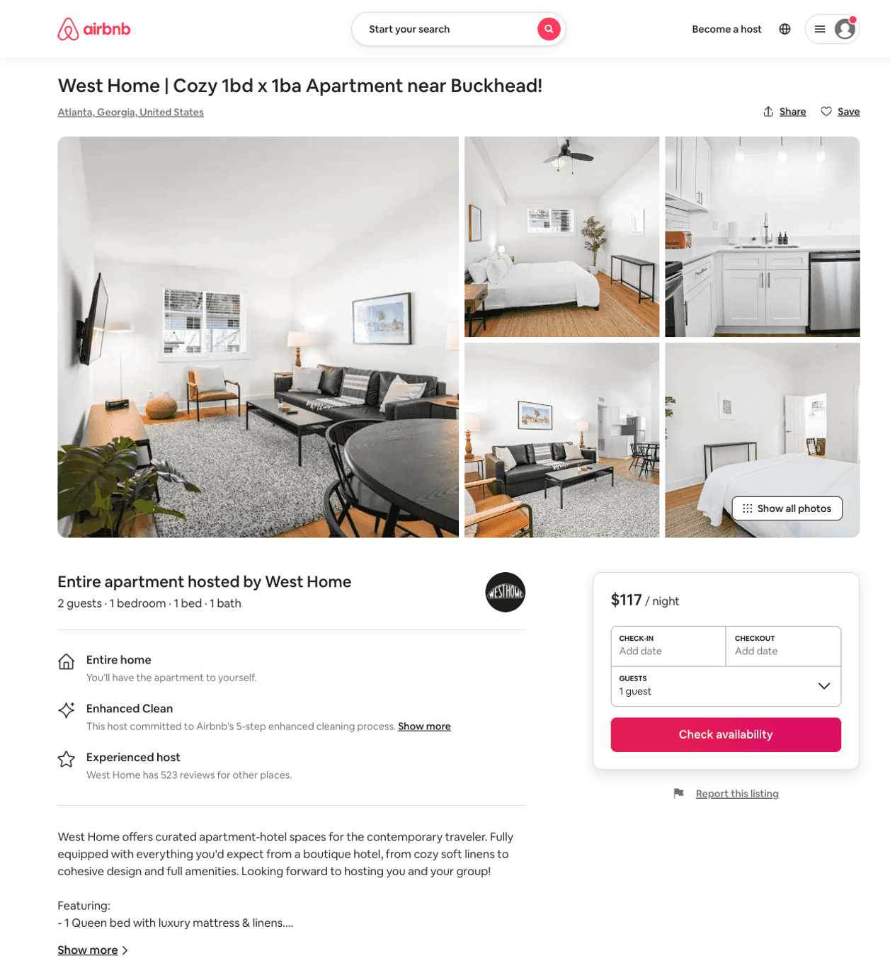
Listing 50399267
1
2
$84 - $140
4.44
1
West Home
228384155
45
https://www.airbnb.com/rooms/50399267
Aug 2022

Slide 42
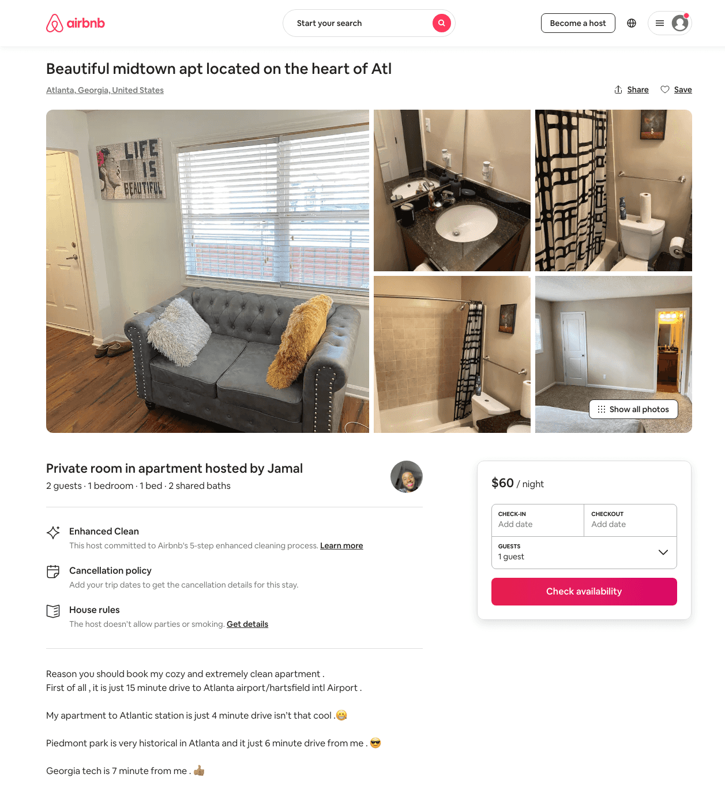
Listing 47113075
1
2
$60 - $63
4.86
2
Adam
107932264
1
https://www.airbnb.com/rooms/47113075
Aug 2022

Slide 43
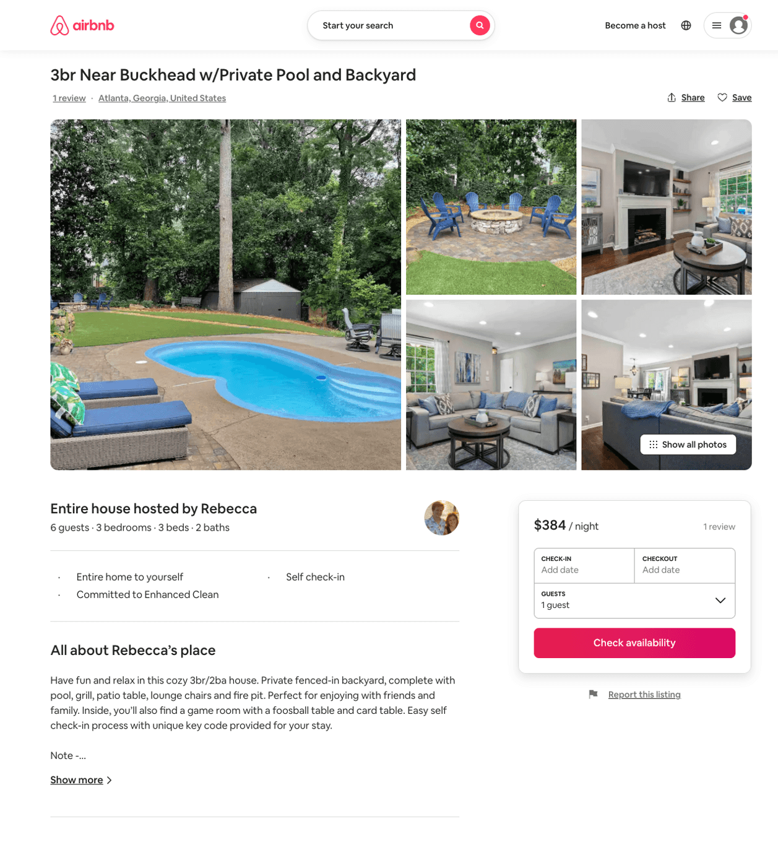
Listing 46034555
3
6
$252 - $422
4.95
3
Rebecca
12452774
1
https://www.airbnb.com/rooms/46034555
Aug 2022

Slide 44
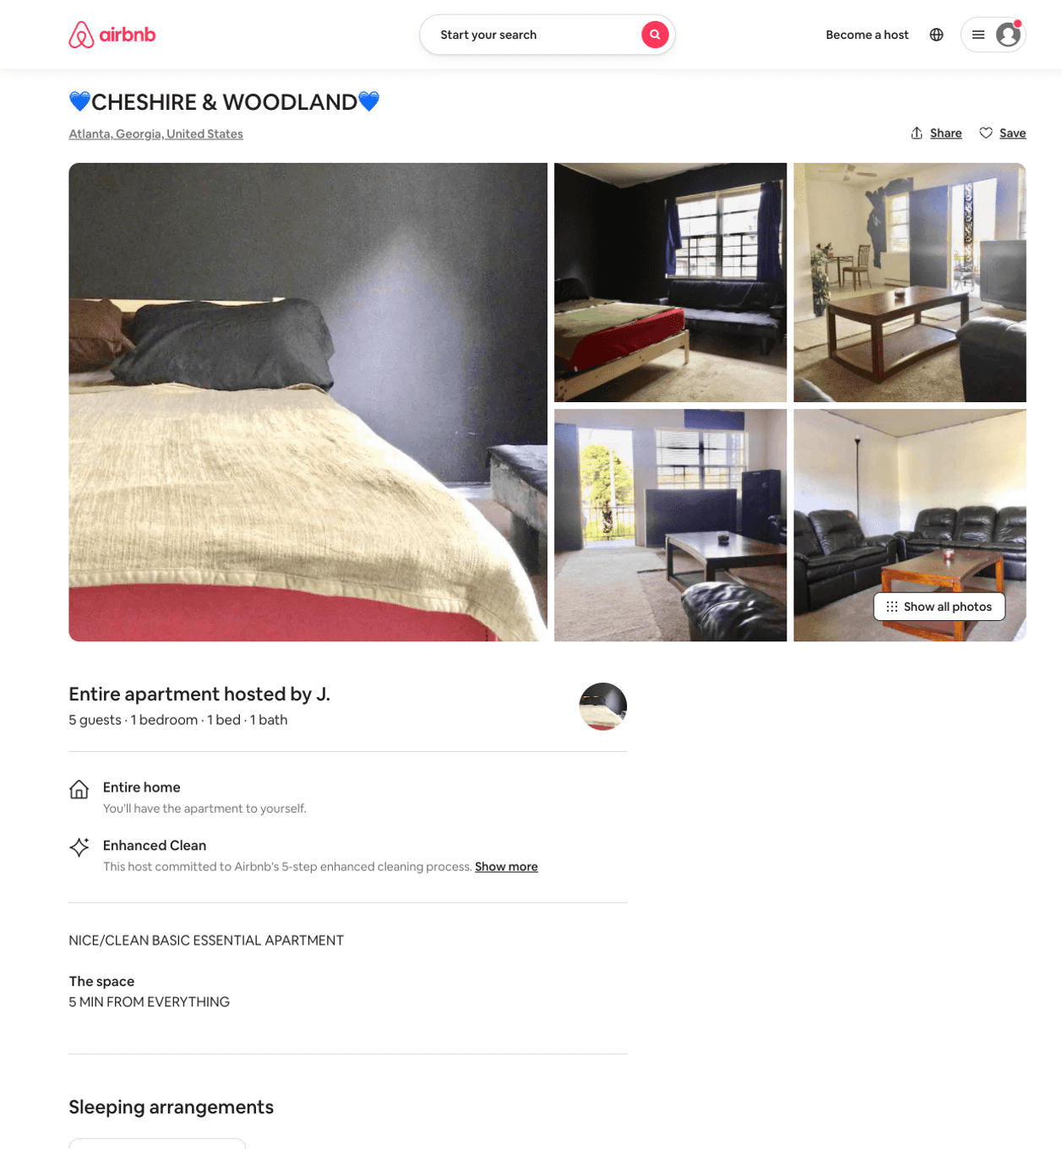
Listing 41588201
1
5
$300
1
J.
327785456
1
https://www.airbnb.com/rooms/41588201
Aug 2022

Slide 45
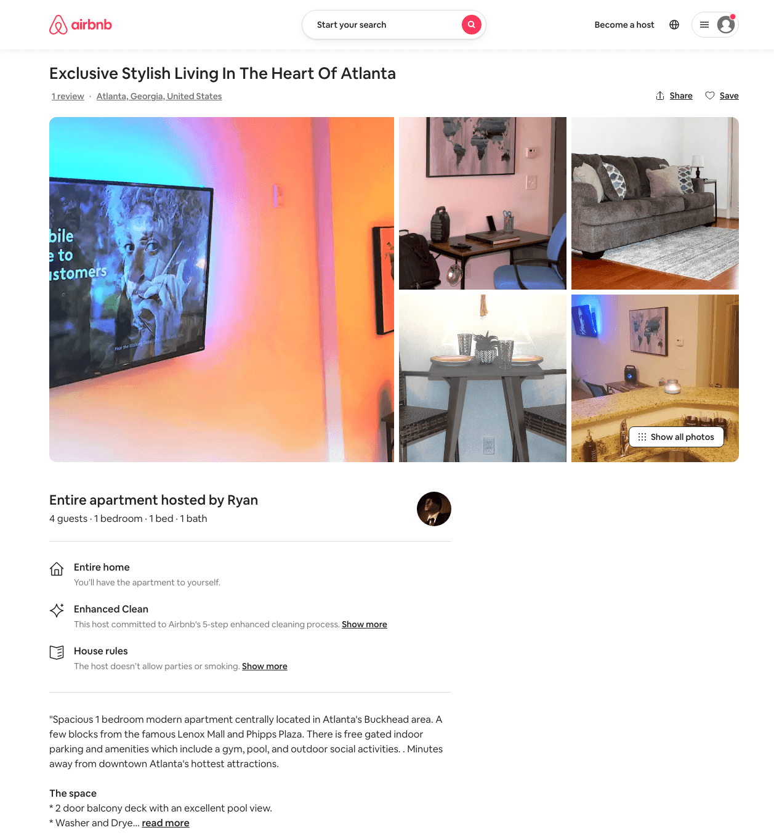
Listing 49159104
1
4
$84 - $129
4.87
1
Ryan
396523445
1
https://www.airbnb.com/rooms/49159104
Aug 2022

Slide 46
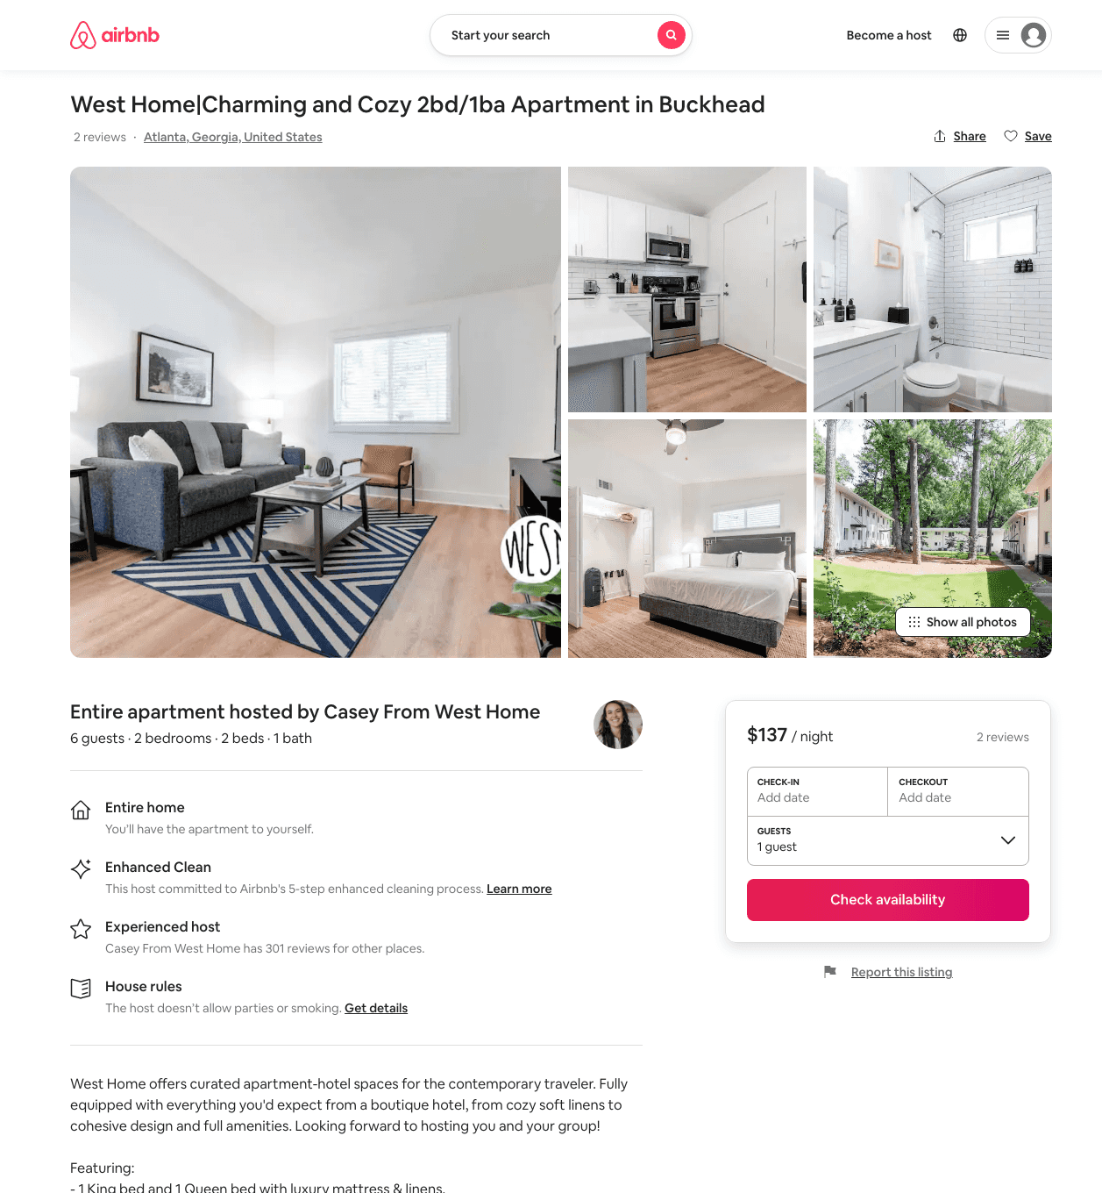
Listing 46067173
2
6
$106 - $152
4.11
2
West Home
228384155
45
https://www.airbnb.com/rooms/46067173
Aug 2022

Slide 47
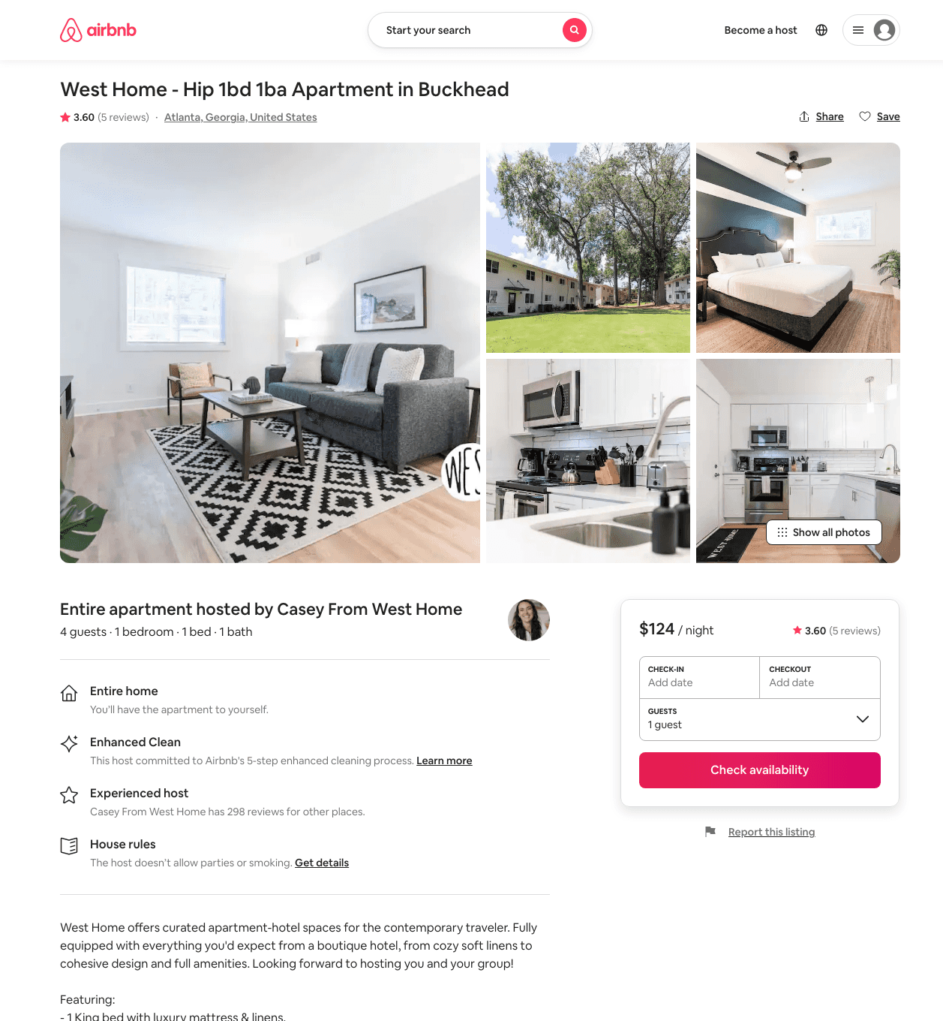
Listing 44269717
1
4
$85 - $125
4.48
2
West Home
228384155
45
https://www.airbnb.com/rooms/44269717
Aug 2022

Slide 48
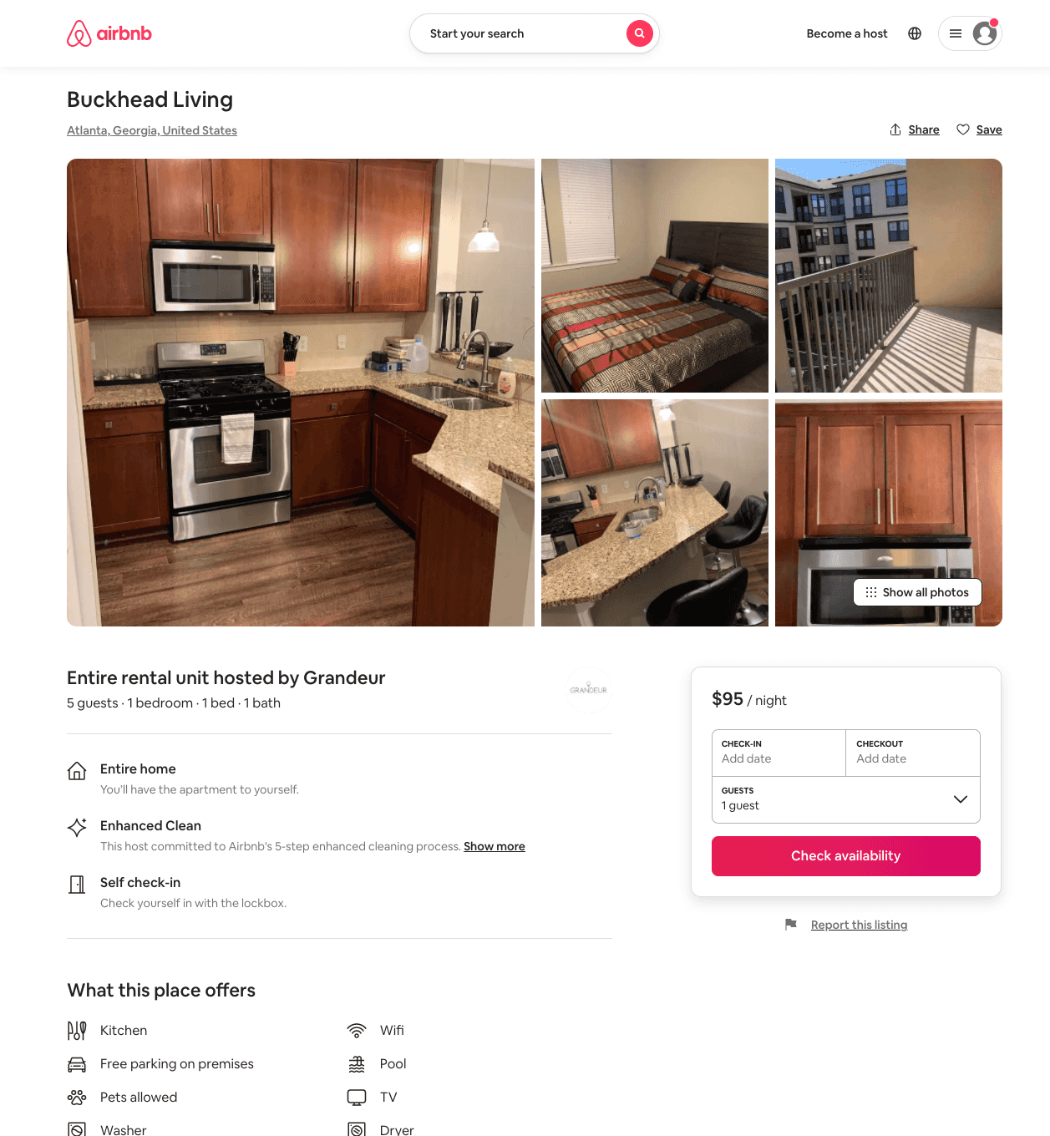
Listing 50994057
1
5
$90 - $100
4.60
1
Grandeur
77956307
2
https://www.airbnb.com/rooms/50994057
Jul 2022

Slide 49
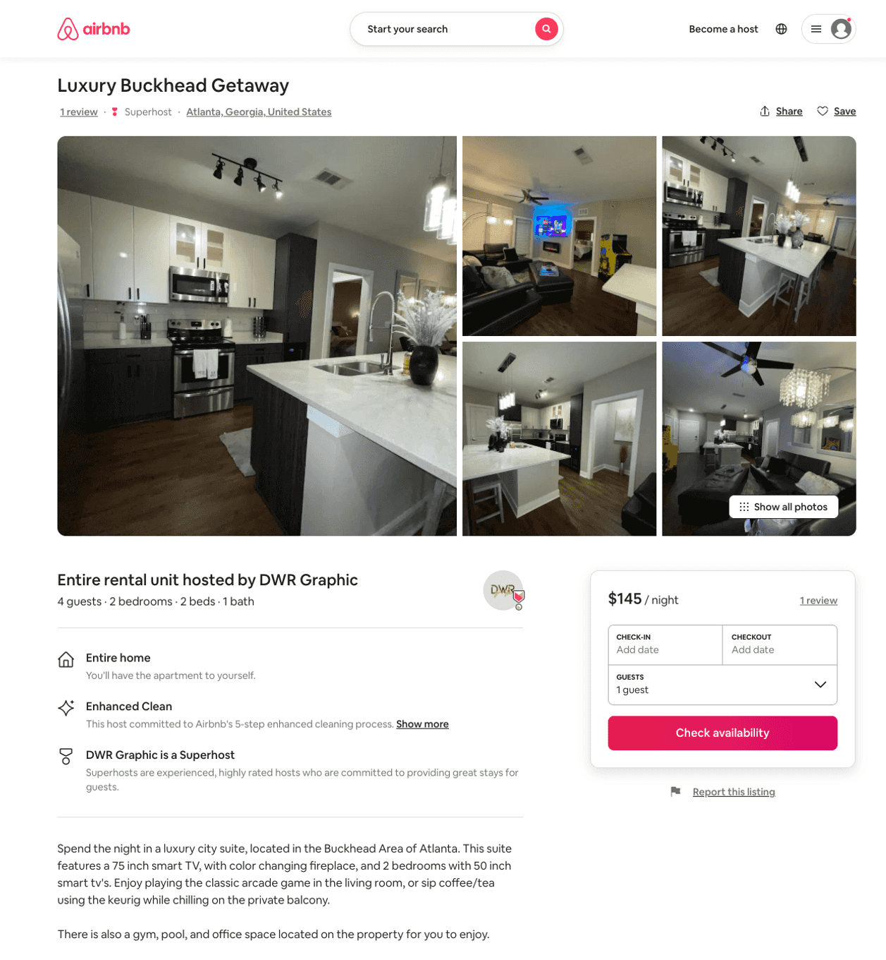
Listing 51311477
2
4
$102 - $200
4.40
2
DWR Graphic
390668963
1
https://www.airbnb.com/rooms/51311477
Aug 2022

Slide 50
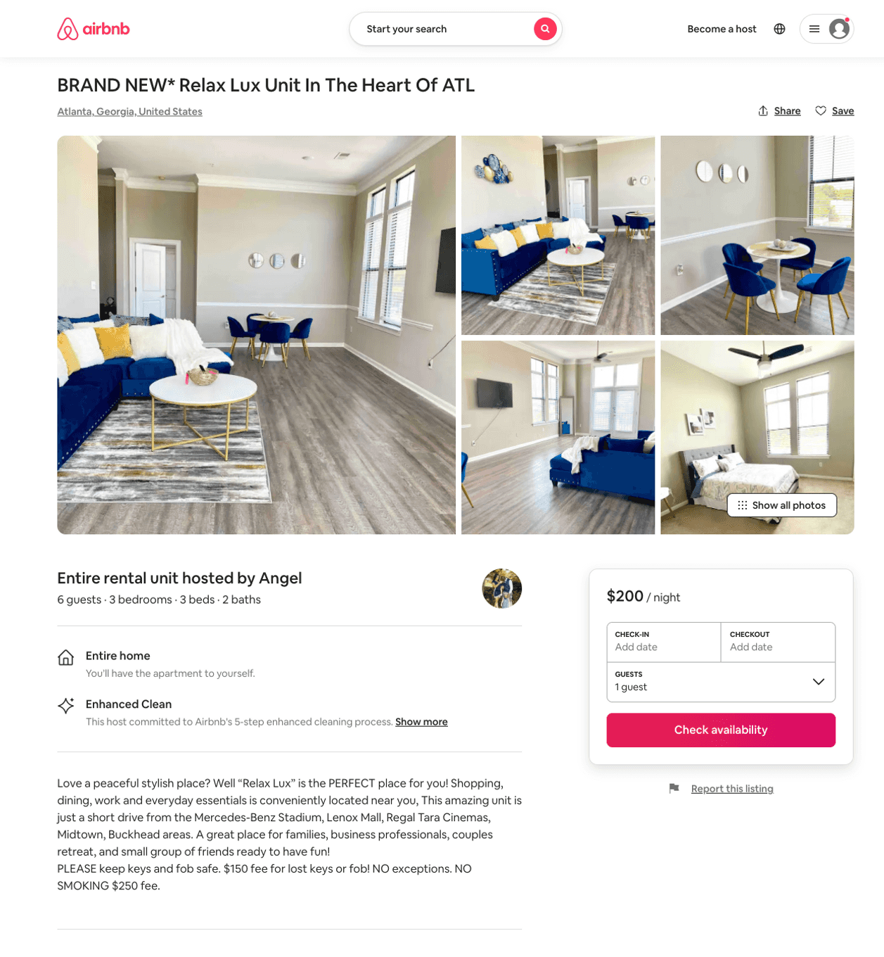
Listing 51118969
3
6
$200 - $250
5.0
2
Angel
307308663
1
https://www.airbnb.com/rooms/51118969
Jun 2022

Slide 51
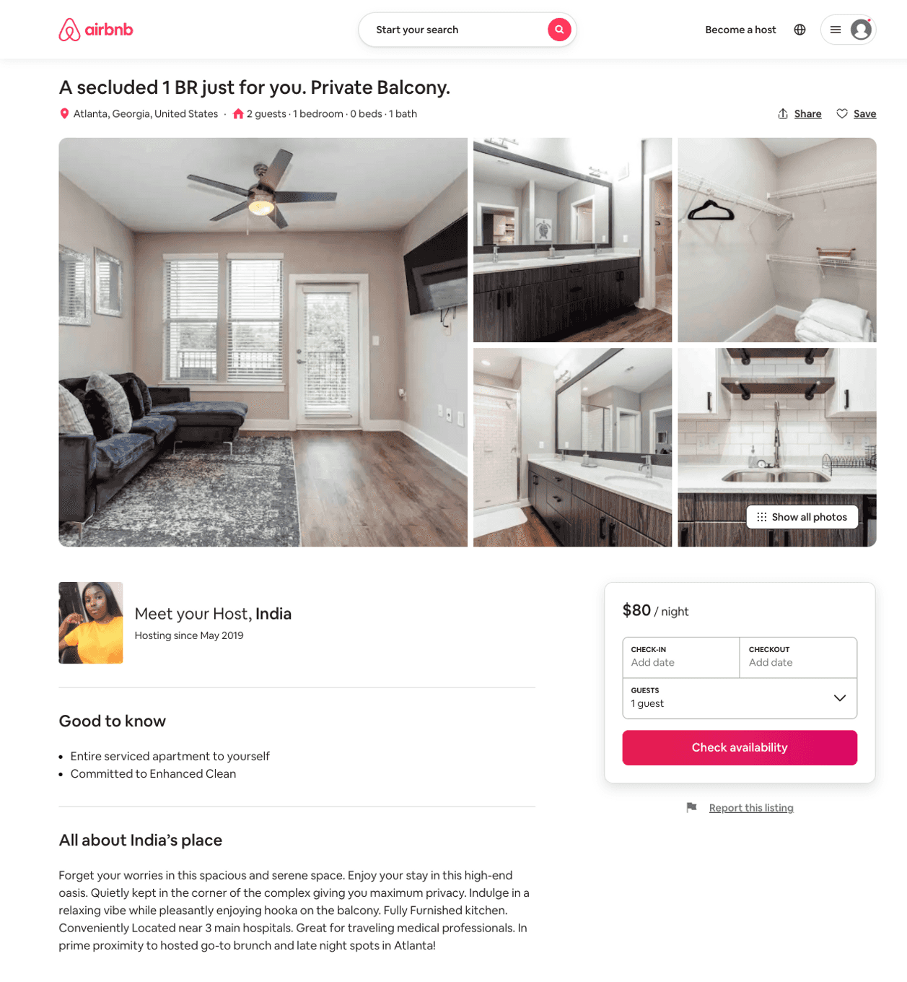
Listing 51694677
1
2
$80 - $125
4.71
2
India
261092600
1
https://www.airbnb.com/rooms/51694677
Aug 2022

Slide 52
Listing 41177597
1
2
$320
1
Cliff
209758295
3
https://www.airbnb.com/rooms/41177597
Aug 2022

Slide 53
Listing 52043701
2
4
$94 - $111
4.92
3
Creflo
421344391
1
https://www.airbnb.com/rooms/52043701
Jun 2022

Slide 54
Listing 52857662
1
4
$72 - $73
4.0
1
Mikey
161872779
1
https://www.airbnb.com/rooms/52857662
Aug 2022

Slide 55
Listing 53104353
1
3
$65 - $67
5
Malika
390872332
7
https://www.airbnb.com/rooms/53104353
Aug 2022

Slide 56
Listing 53056432
2
7
$135 - $250
4.94
1
Joy
429498216
1
https://www.airbnb.com/rooms/53056432
Aug 2022

Slide 57
Listing 53412710
1
4
$119 - $184
1
Pink Palace
26510689
3
https://www.airbnb.com/rooms/53412710
Aug 2022

Slide 58
Listing 53511014
1
4
$85 - $126
3.80
2
West Home
228384155
45
https://www.airbnb.com/rooms/53511014
Aug 2022

Slide 59
Listing 53388586
2
6
$81
4.79
1
Lux
389040915
1
https://www.airbnb.com/rooms/53388586
Aug 2022

Slide 60
Listing 2581380
2
6
$103 - $98
1
Lux
https://www.vrbo.com/2581380
Aug 2022

Slide 61
Listing 2558915
1
6
$160
2
https://www.vrbo.com/2558915
Aug 2022

Slide 62
Listing 52270519
1
1
$45
1
GoLuxe Real Estate LLC.
69624817
4
https://www.airbnb.com/rooms/52270519
Jul 2022

Slide 63
Listing 54039723
1
6
$91 - $130
4.15
1
Aaliyah
332470126
2
https://www.airbnb.com/rooms/54039723
Aug 2022

Slide 64
Listing 53775922
1
3
$96 - $137
2
Chrissy
187365620
2
https://www.airbnb.com/rooms/53775922
Aug 2022

Slide 65
Listing 53478386
5
16
$214 - $243
5.0
1
Atlanta Property Pros
289386972
4
https://www.airbnb.com/rooms/53478386
Jun 2022

Slide 66
Listing 54241240
2
6
$101 - $136
4.21
2
West Home
228384155
45
https://www.airbnb.com/rooms/54241240
Jun 2022

Slide 67
Listing 49061579
3
5
$142 - $226
5.0
2
Trub
150322981
1
https://www.airbnb.com/rooms/49061579
Aug 2022

Slide 68
Listing 2635488
1
3
$116
5
2
https://www.vrbo.com/2635488
Aug 2022

Slide 69
Listing 2353671
1
2
$200
5
1
https://www.vrbo.com/2353671
Aug 2022

Slide 70
Listing 54038889
2
4
$139 - $159
4.67
1
Good
399420933
2
https://www.airbnb.com/rooms/54038889
Aug 2022

Slide 71
Listing 2749191
1
2
$148
3
Alix
https://www.vrbo.com/2749191
Aug 2022

Slide 72
Listing 2802798
1
5
$132
3.6666667
1
Antwain Johnson
https://www.vrbo.com/2802798
Aug 2022

Slide 73
Listing 2842607
1
3
$129
2
Osmand Enterprises
https://www.vrbo.com/2842607
Aug 2022

Slide 74
Listing 2885912
2
5
$250
3
https://www.vrbo.com/2885912
Aug 2022

Slide 75
Listing 51451677
1
4
2
Davis Lux Solutions
272314259
1
https://www.airbnb.com/rooms/51451677
Aug 2022

Slide 76
Listing 2915608
1
4
$125
2
https://www.vrbo.com/2915608
Aug 2022

Slide 77
Listing 51409485
2
5
4.33
1
James
402549188
1
https://www.airbnb.com/rooms/51409485
Aug 2022

Slide 78
Listing 40774594
1
2
$75 - $99
4.07
1
Westie
316774565
1
https://www.airbnb.com/rooms/40774594
Aug 2022

Slide 79
Listing 54048689
2
6
1
Chanel
438013653
1
https://www.airbnb.com/rooms/54048689
Aug 2022

