Slide 2
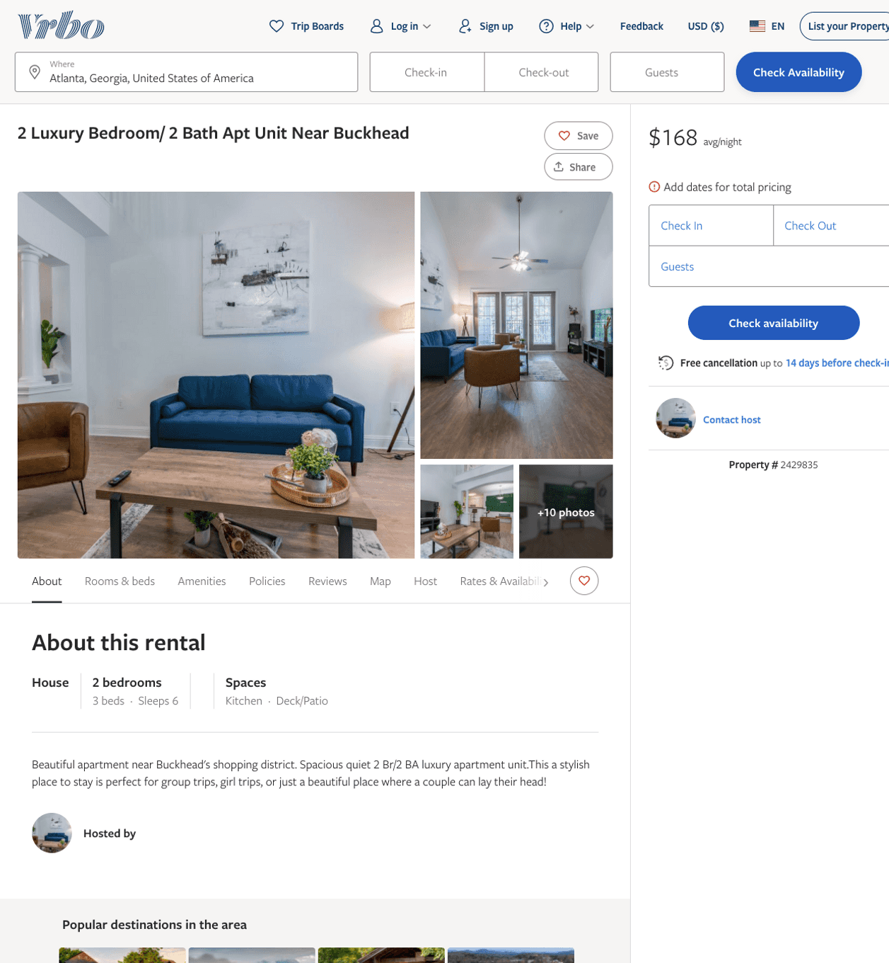
Listing 2429835
2
6
$130 - $168
2
https://www.vrbo.com/2429835
Aug 2022

Slide 3
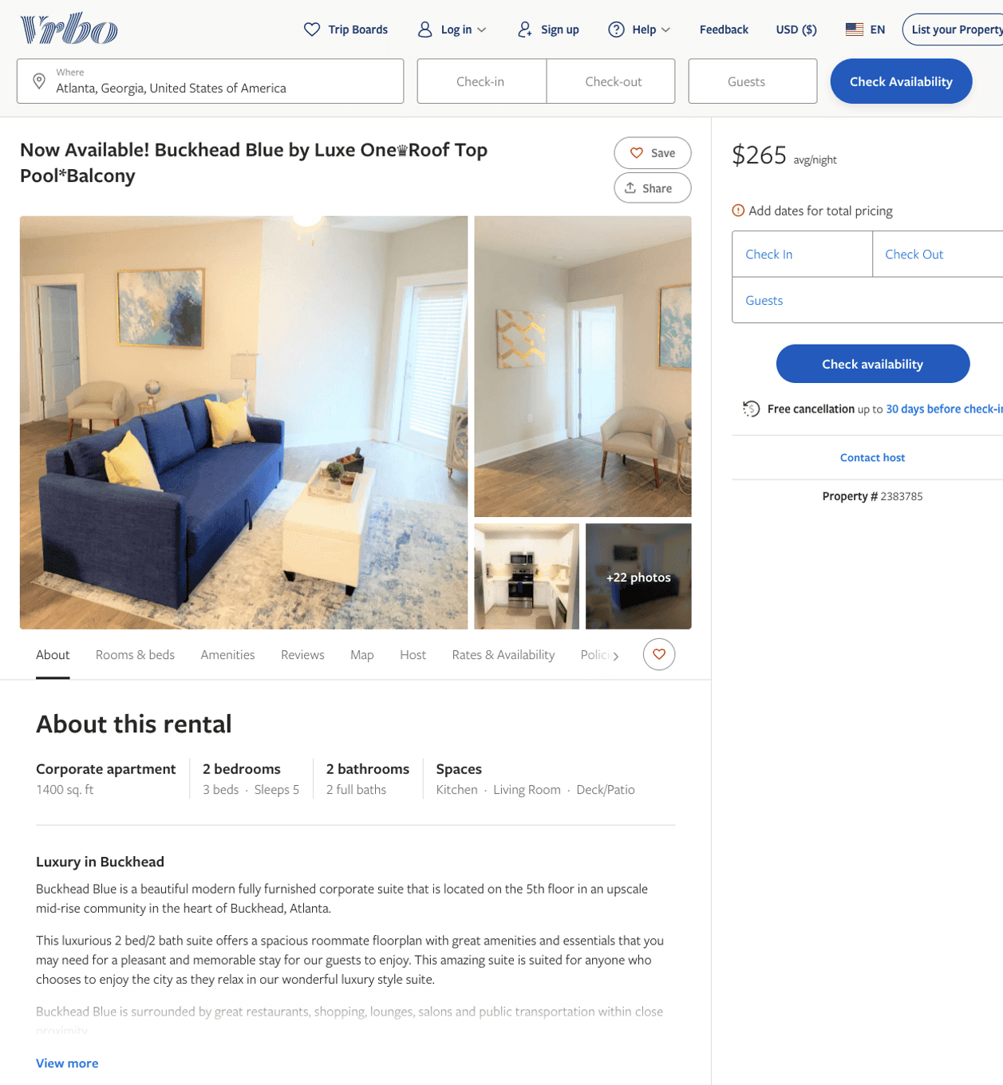
Listing 2383785
2
5
$155 - $287
5
1
Suite Connect
https://www.vrbo.com/2383785
Aug 2022

Slide 4
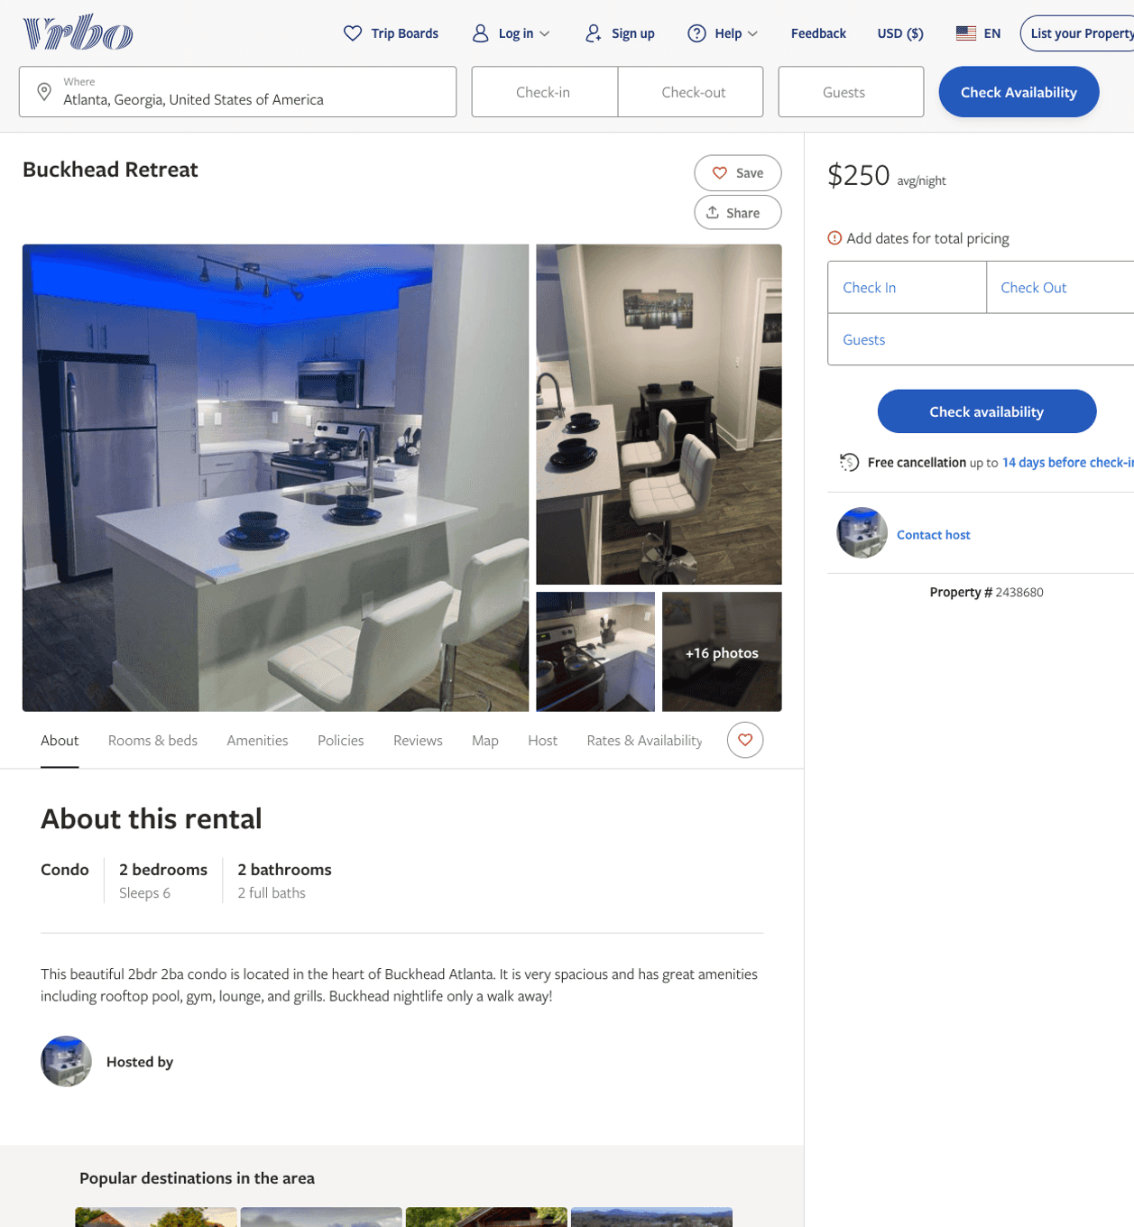
Listing 2438680
2
6
$250 - $280
1
Damon Chatman
https://www.vrbo.com/2438680
Aug 2022

Slide 5
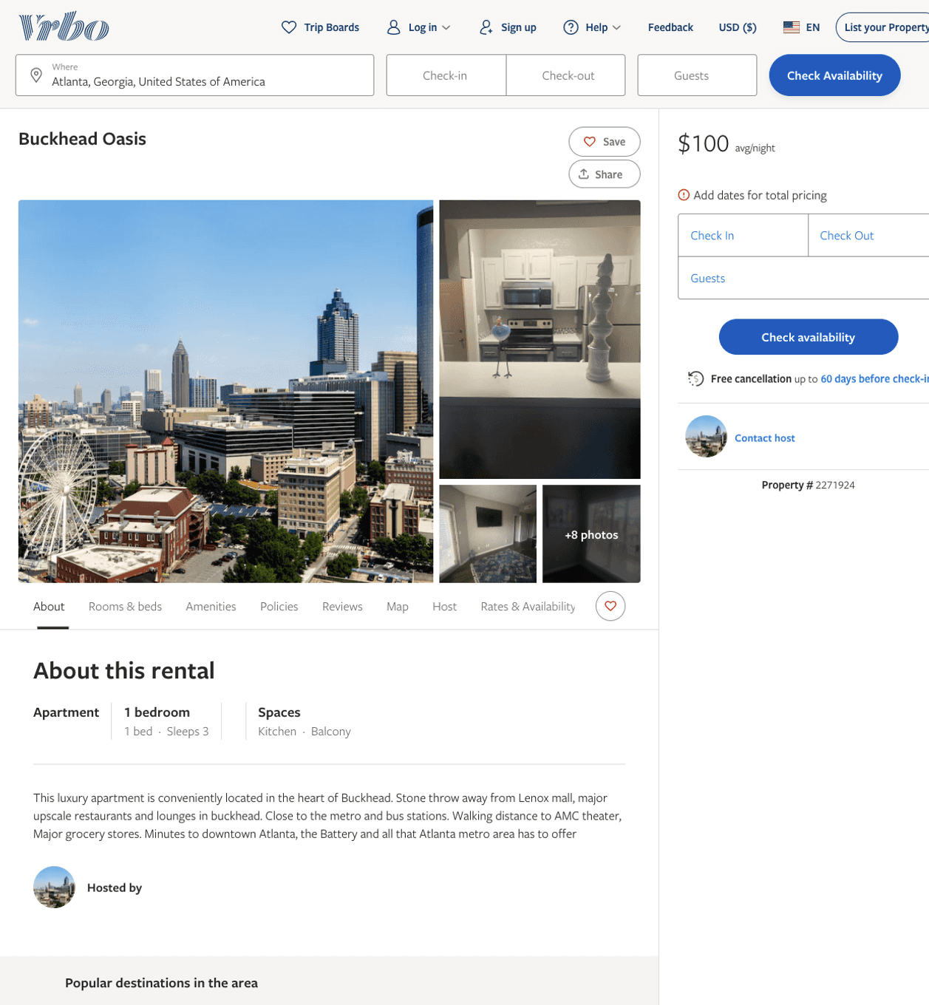
Listing 2271924
1
3
$100 - $99
3
https://www.vrbo.com/2271924
Aug 2022

Slide 6
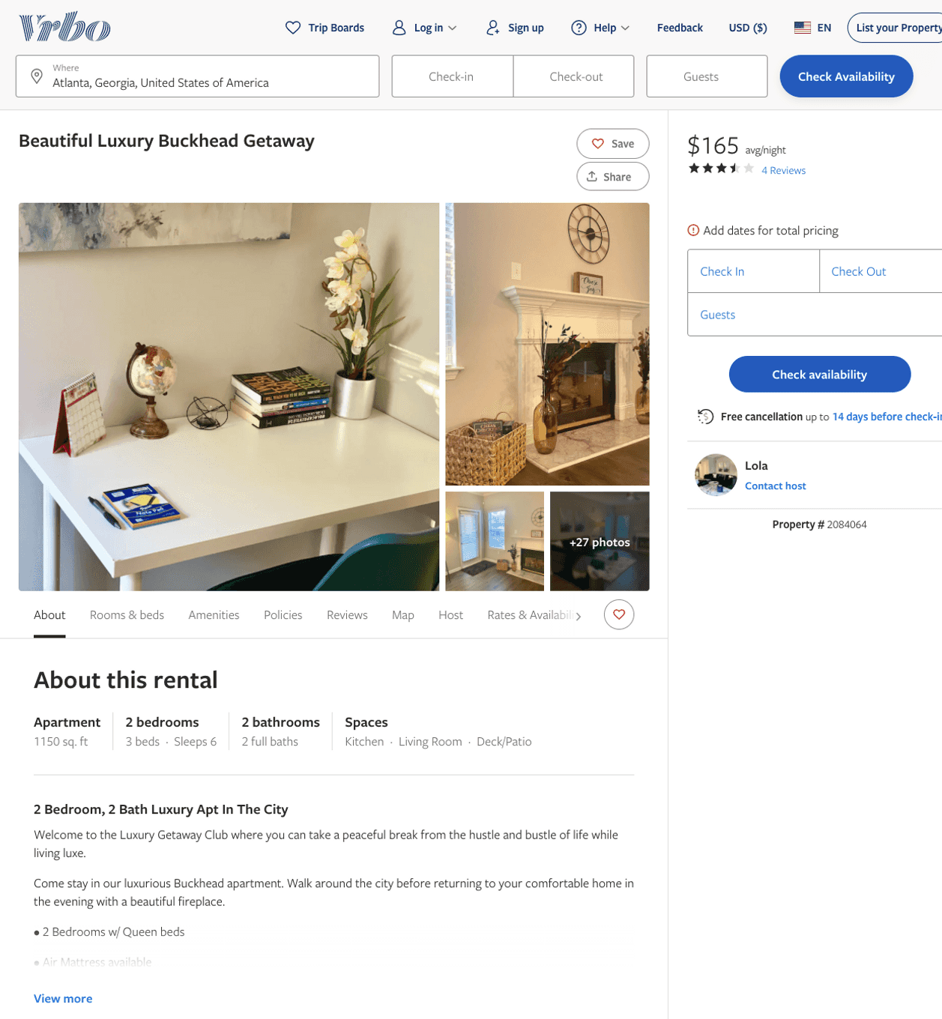
Listing 2084064
2
6
$145 - $165
3.8
1
Lola
https://www.vrbo.com/2084064
Aug 2022

Slide 7
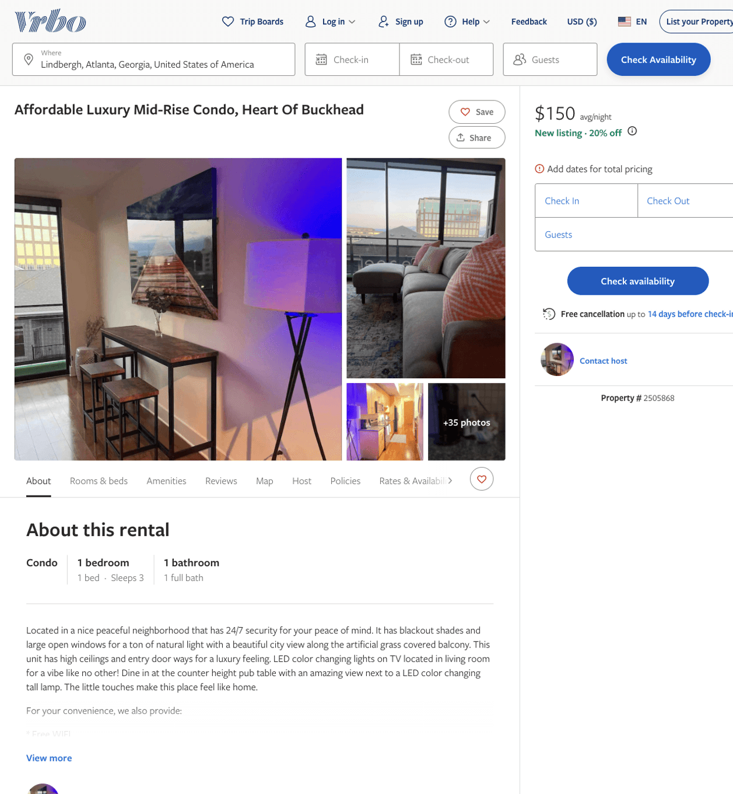
Listing 2505868
1
3
$150 - $153
4.888889
2
Michael
https://www.vrbo.com/2505868
Aug 2022

Slide 8
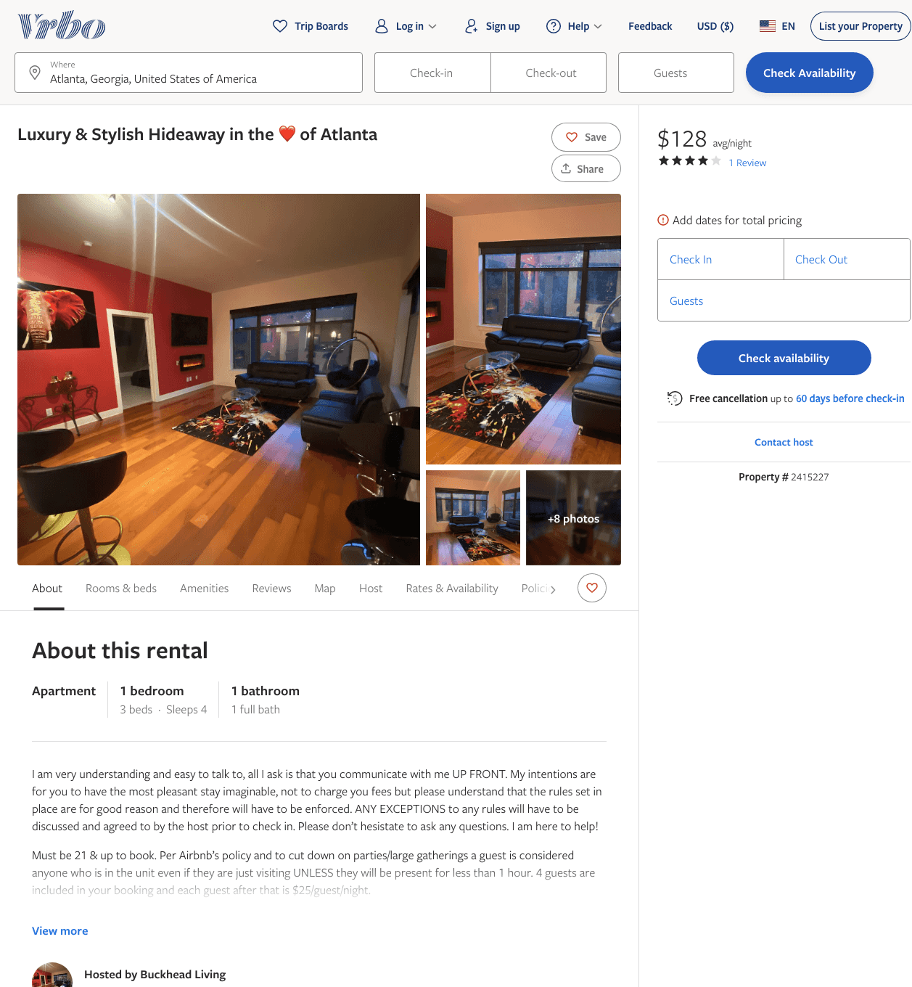
Listing 2415227
1
4
$115 - $99
2.5
1
Buckhead Living
https://www.vrbo.com/2415227
Aug 2022

Slide 9
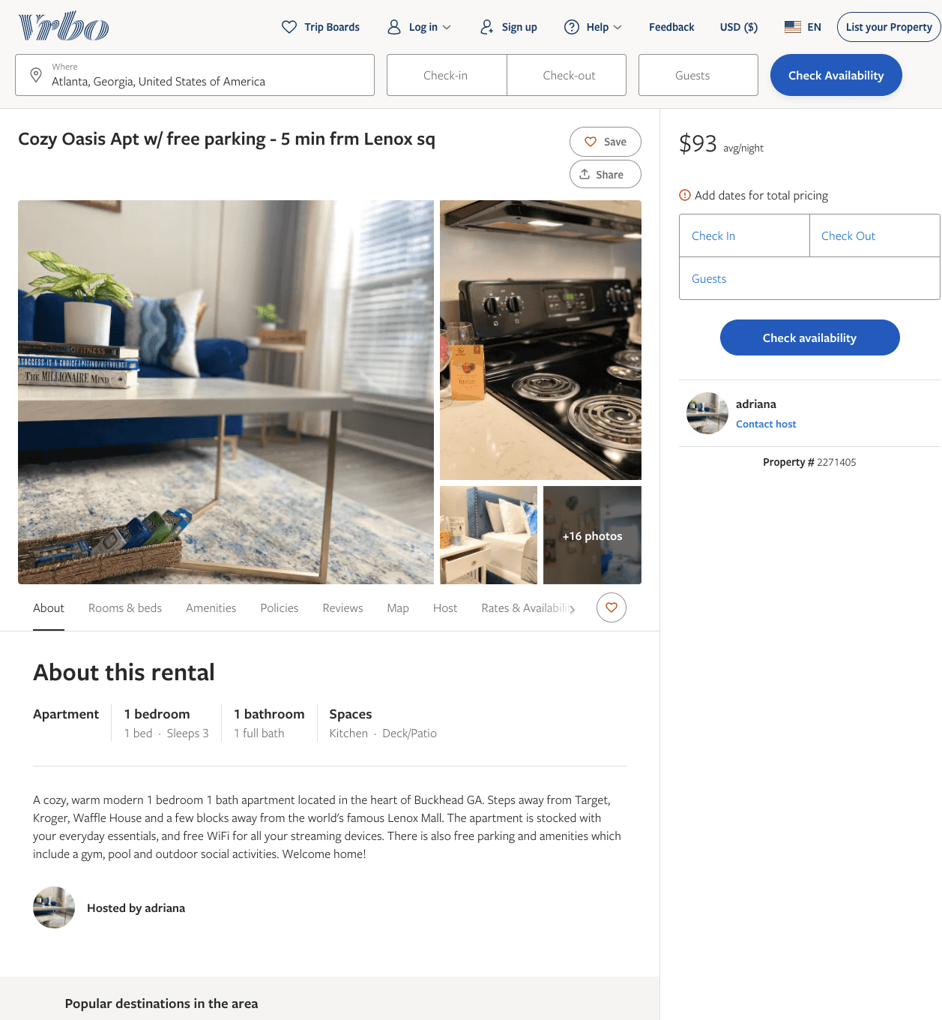
Listing 2271405
1
3
$91 - $94
2
adriana
https://www.vrbo.com/2271405
Aug 2022

Slide 10
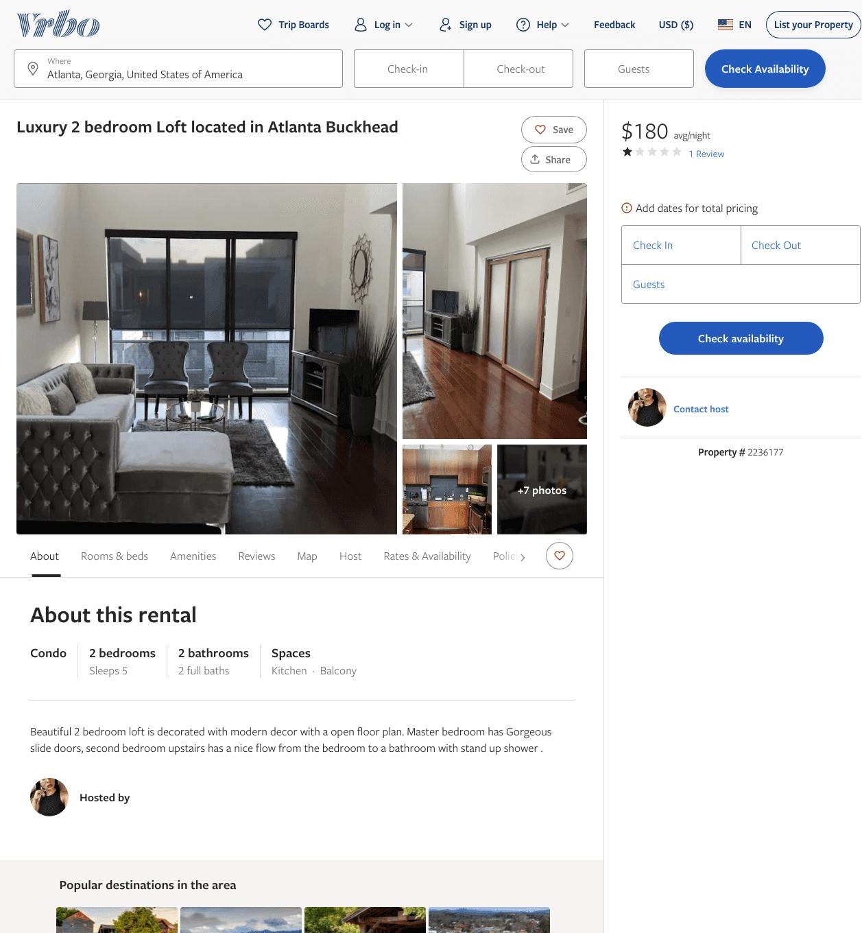
Listing 2236177
2
5
$180
3
1
https://www.vrbo.com/2236177
Aug 2022

Slide 11
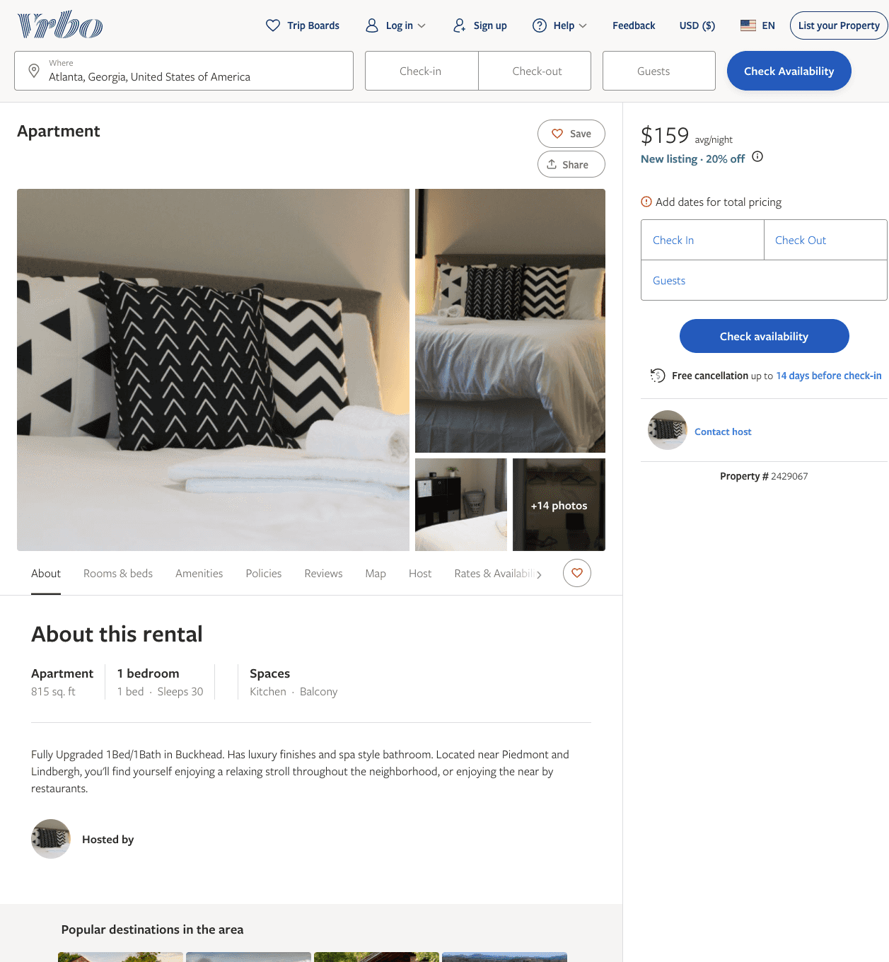
Listing 2429067
1
4
$145 - $166
4
1
https://www.vrbo.com/2429067
Aug 2022

Slide 12
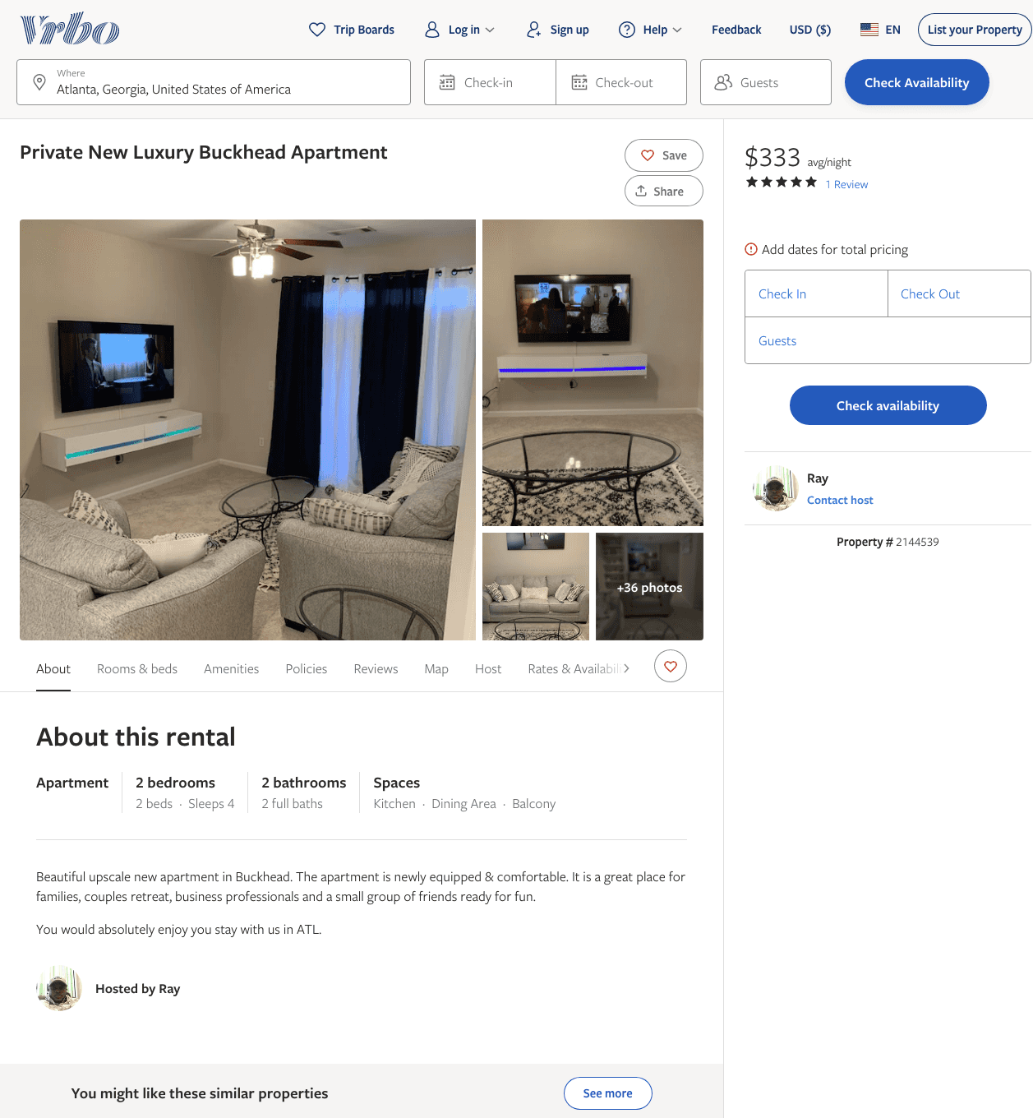
Listing 2144539
2
4
$333
5
3
Ray
https://www.vrbo.com/2144539
Aug 2022

Slide 13
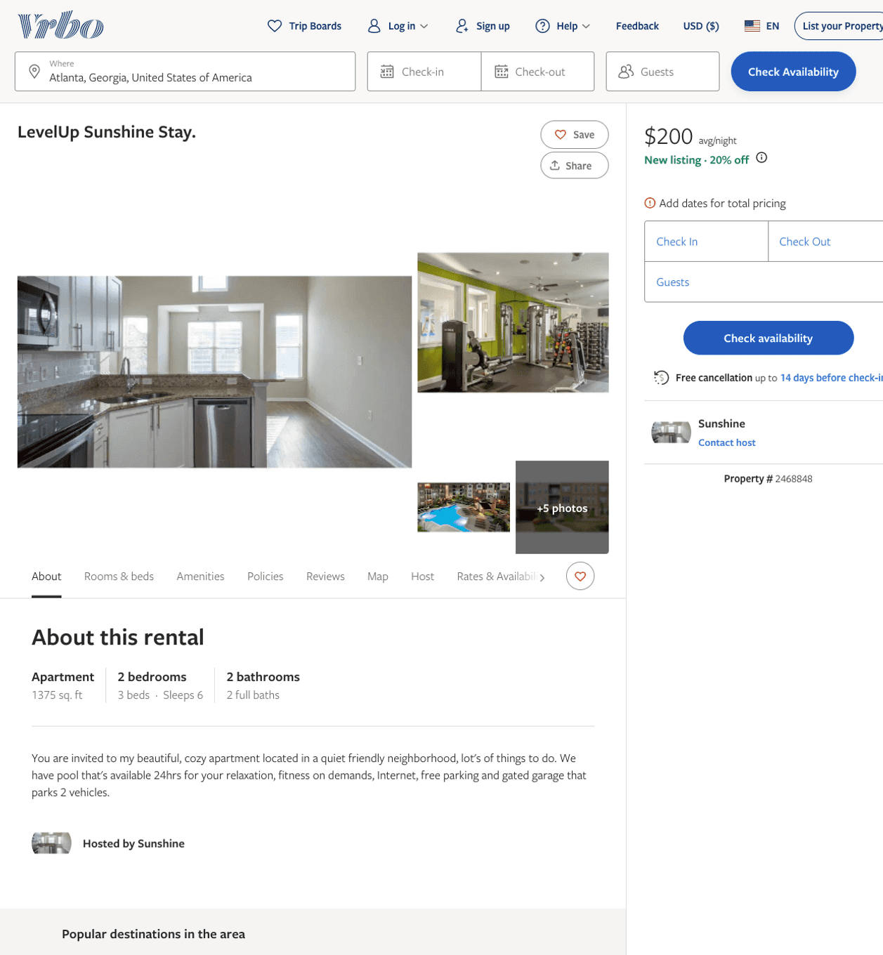
Listing 2468848
2
6
$177 - $200
3
Sunshine
https://www.vrbo.com/2468848
Aug 2022

Slide 14
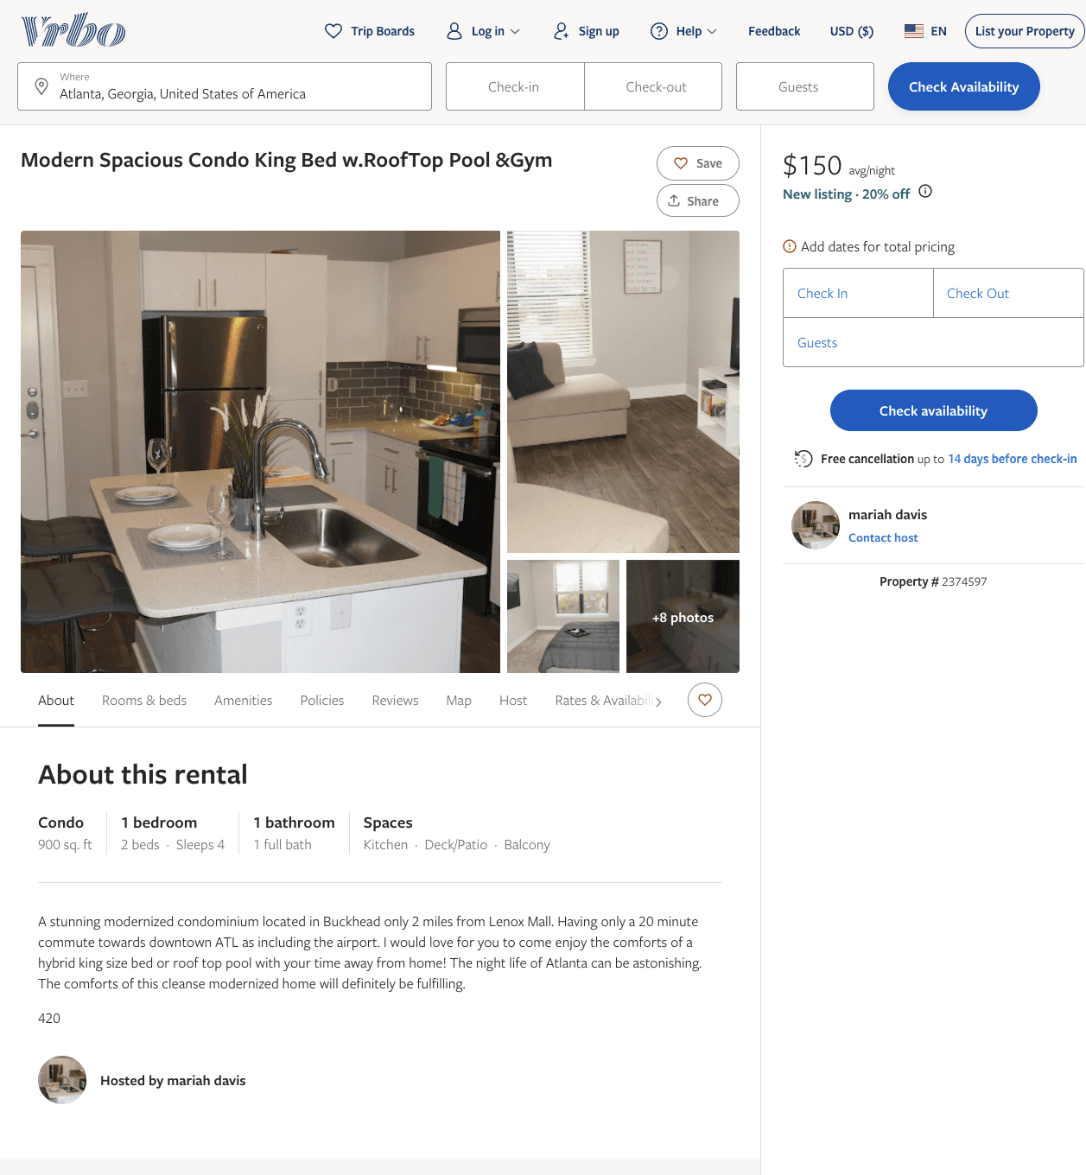
Listing 2374597
1
4
$150
30
mariah davis
https://www.vrbo.com/2374597
Aug 2022

Slide 15
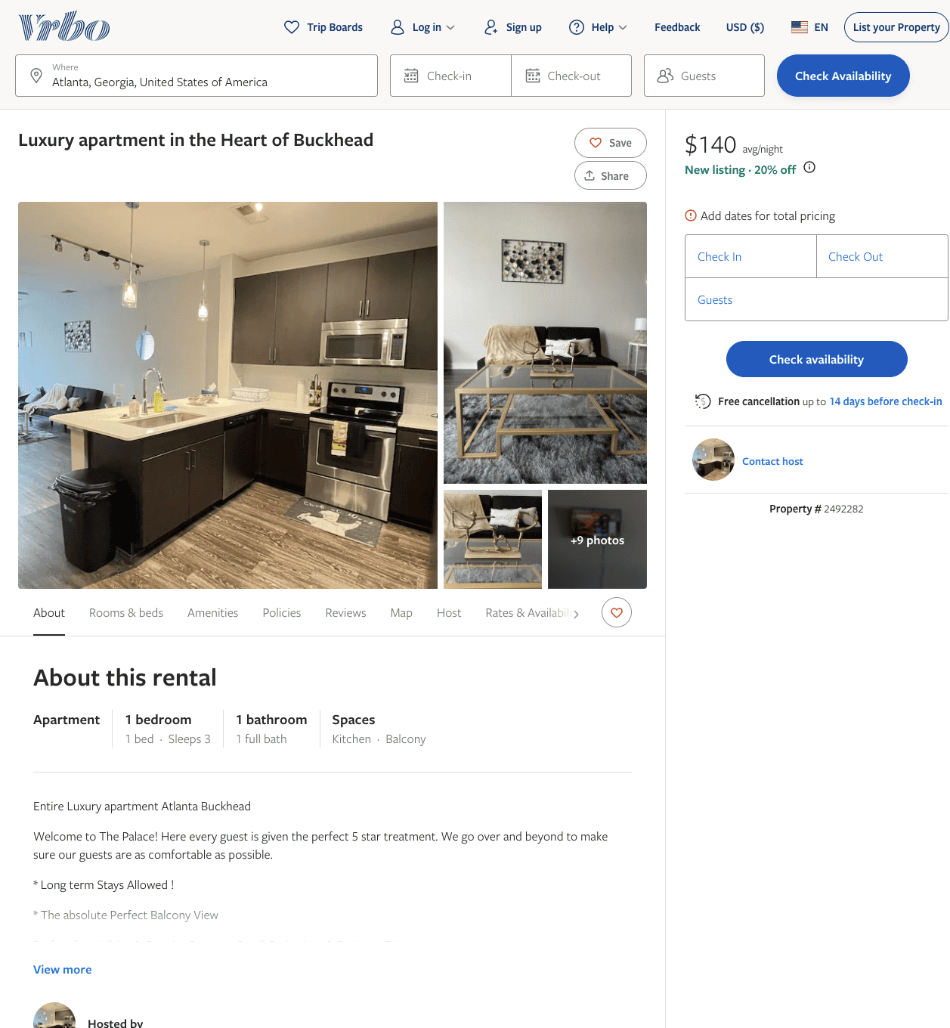
Listing 2492282
1
3
$140
2
Jey
https://www.vrbo.com/2492282
Aug 2022

Slide 16
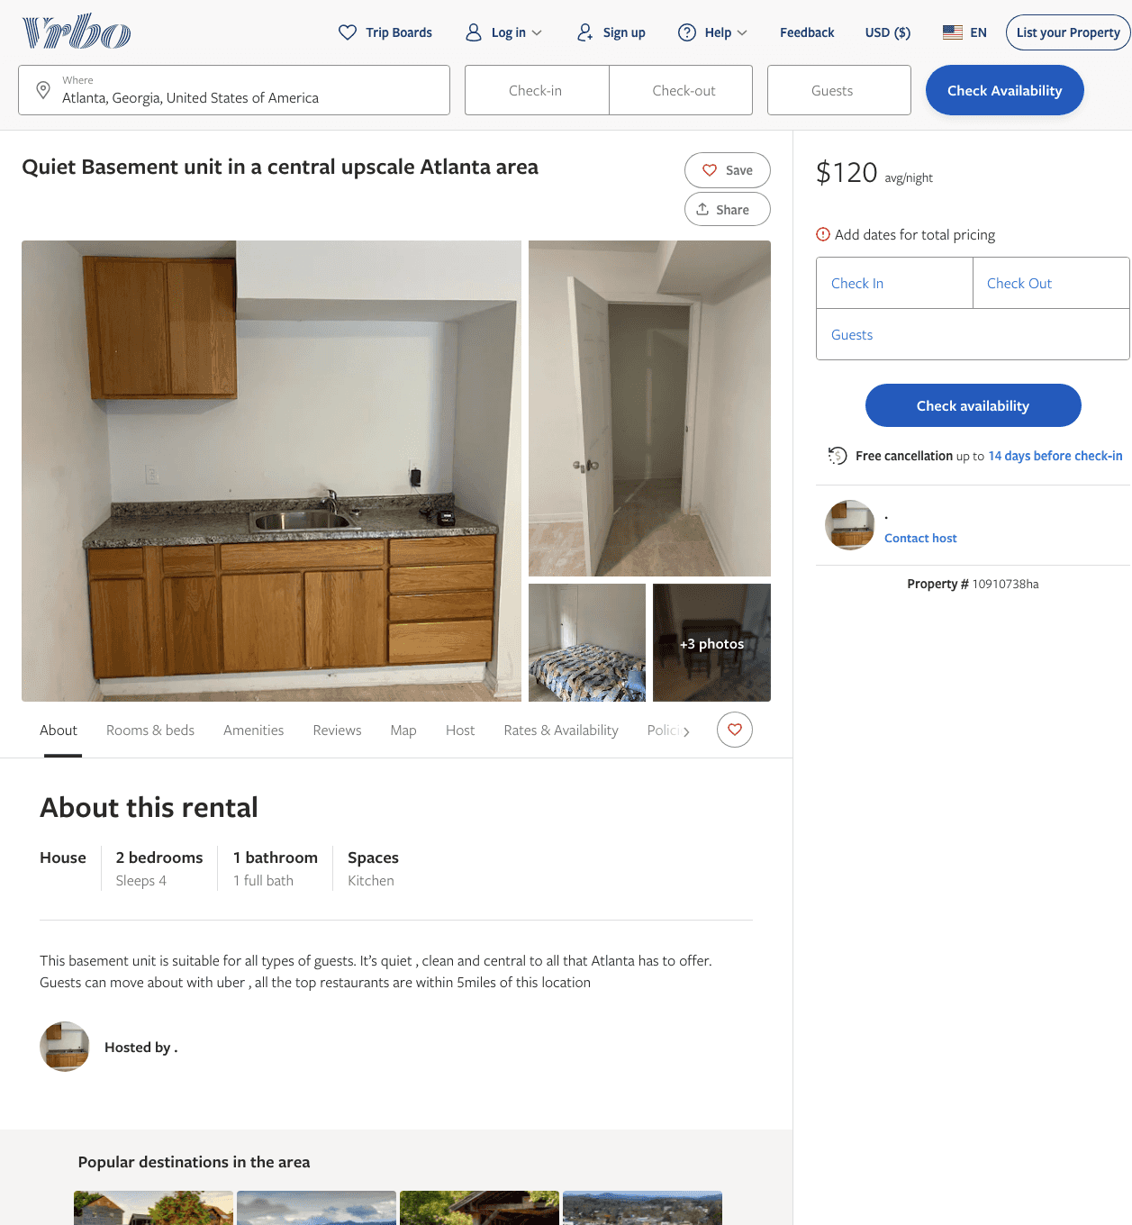
Listing 10910738
2
4
$120
2
.
https://www.vrbo.com/10910738ha
Aug 2022

Slide 17
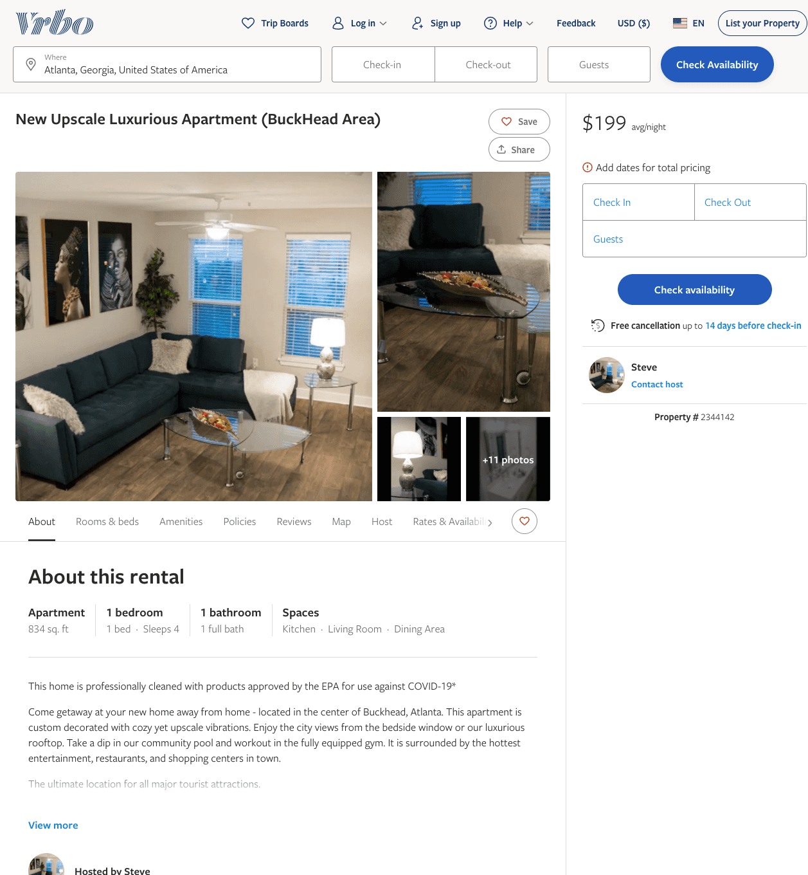
Listing 2344142
1
4
$139 - $203
1
Steve
https://www.vrbo.com/2344142
Aug 2022

Slide 18
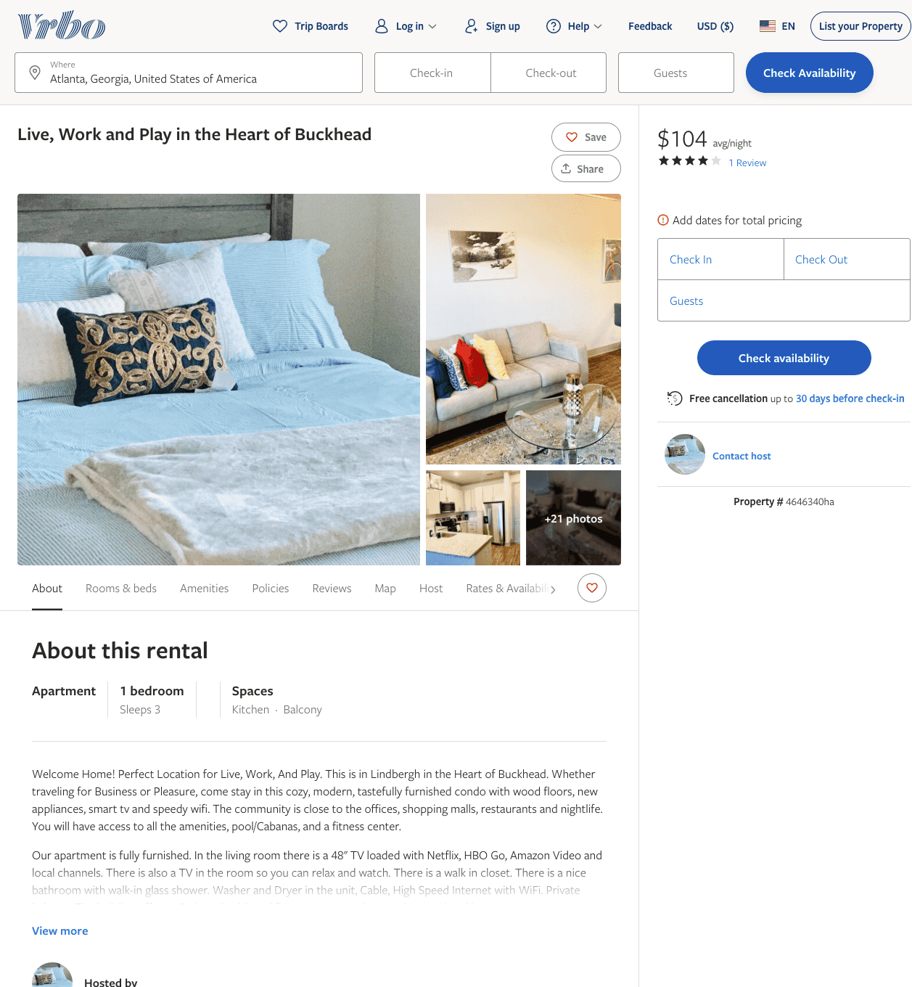
Listing 4646340
1
3
$104 - $107
4
2
https://www.vrbo.com/4646340ha
Aug 2022

Slide 19
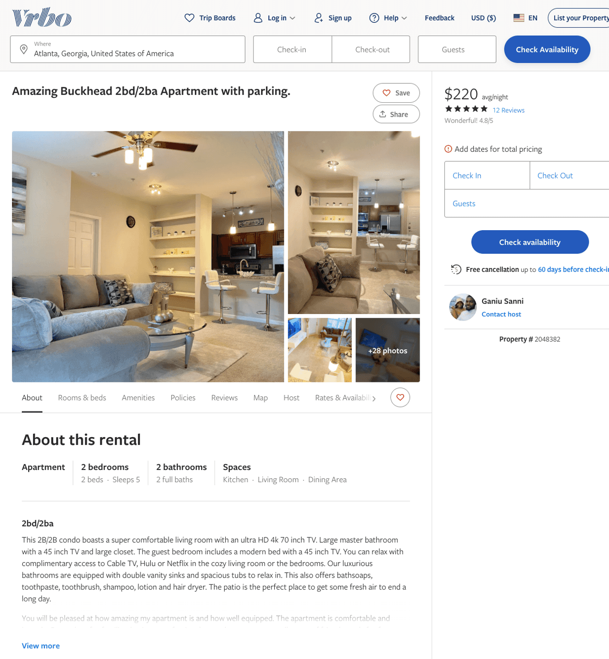
Listing 2048382
2
5
$150 - $220
4.8333335
2
Ganiu Sanni
https://www.vrbo.com/2048382
Aug 2022

Slide 20
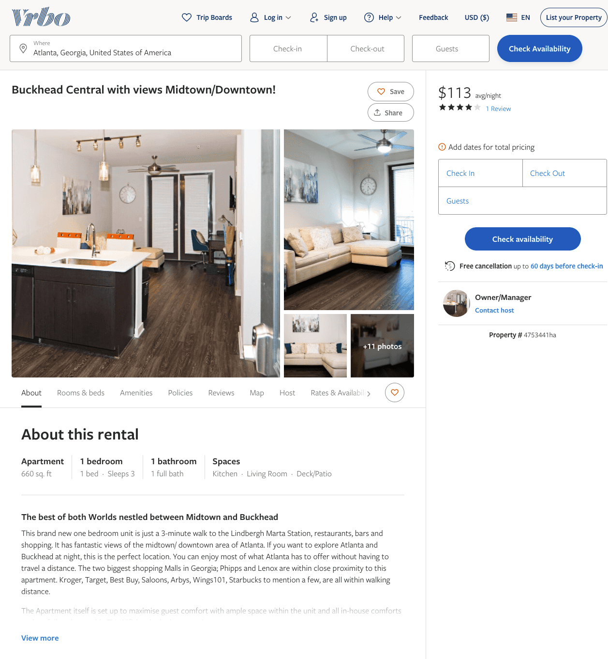
Listing 4753441
1
3
$113
4
2
Owner/Manager
https://www.vrbo.com/4753441ha
Aug 2022

Slide 21
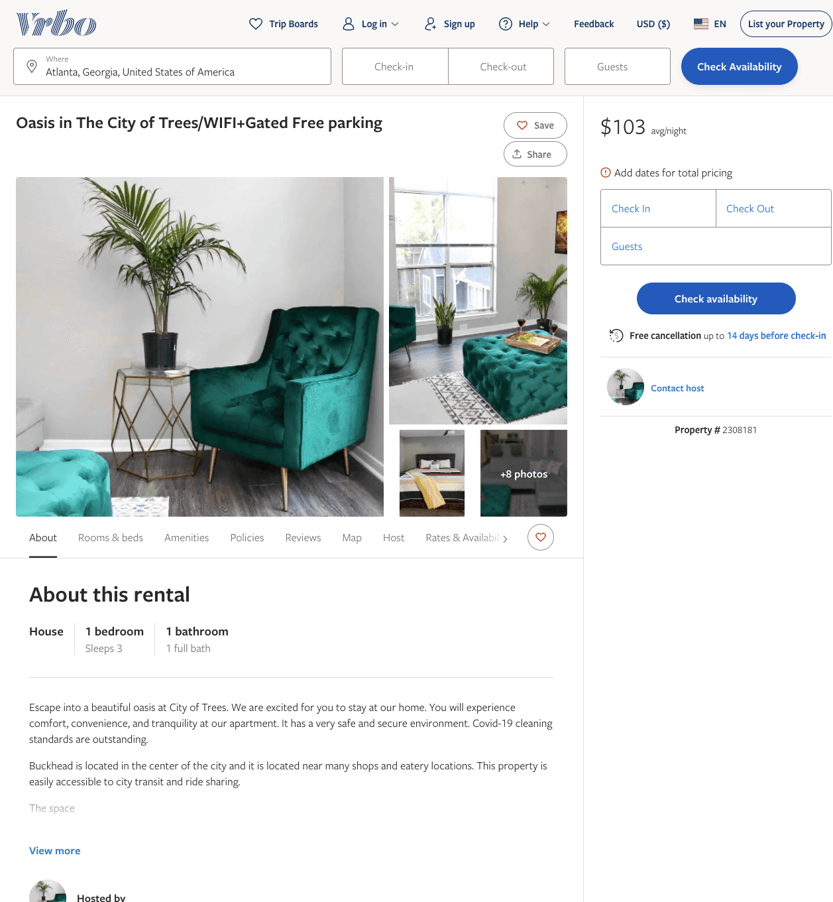
Listing 2308181
1
3
$103
3
https://www.vrbo.com/2308181
Aug 2022

Slide 22
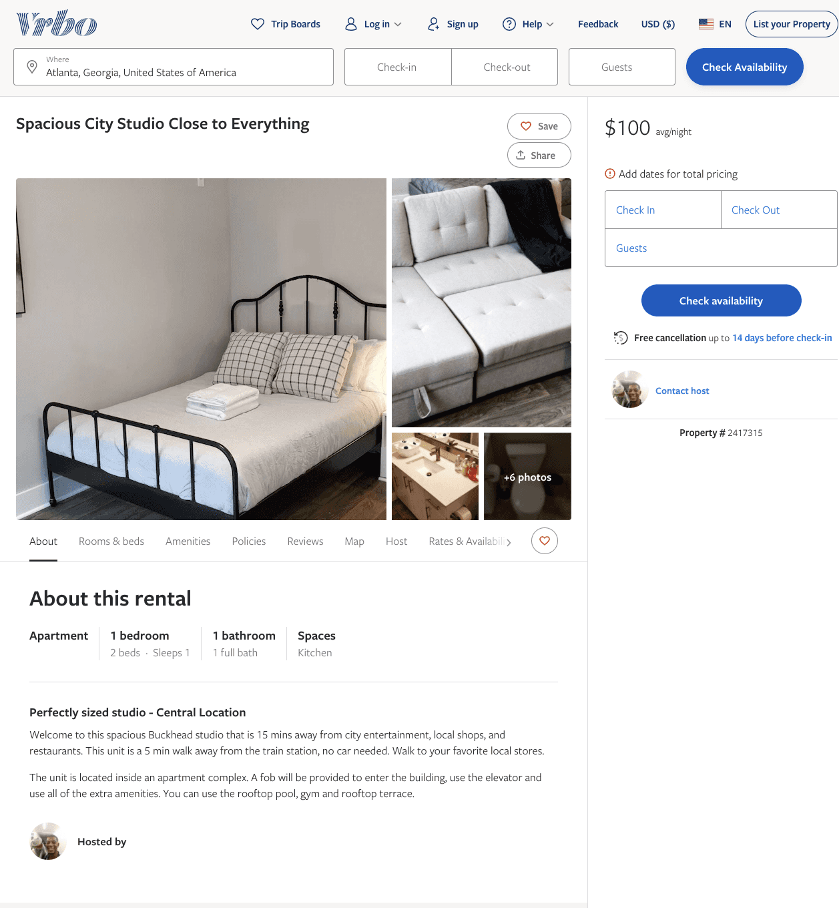
Listing 2417315
1
1
$100
1
https://www.vrbo.com/2417315
Aug 2022

Slide 23
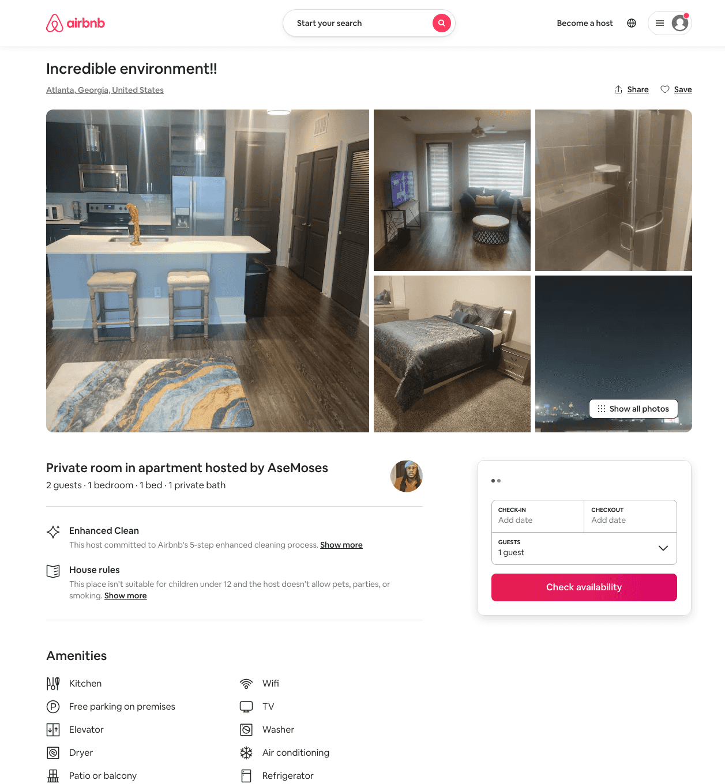
Listing 49923132
1
2
$56 - $93
4.74
1
Moses
235984817
1
https://www.airbnb.com/rooms/49923132
Aug 2022

Slide 24
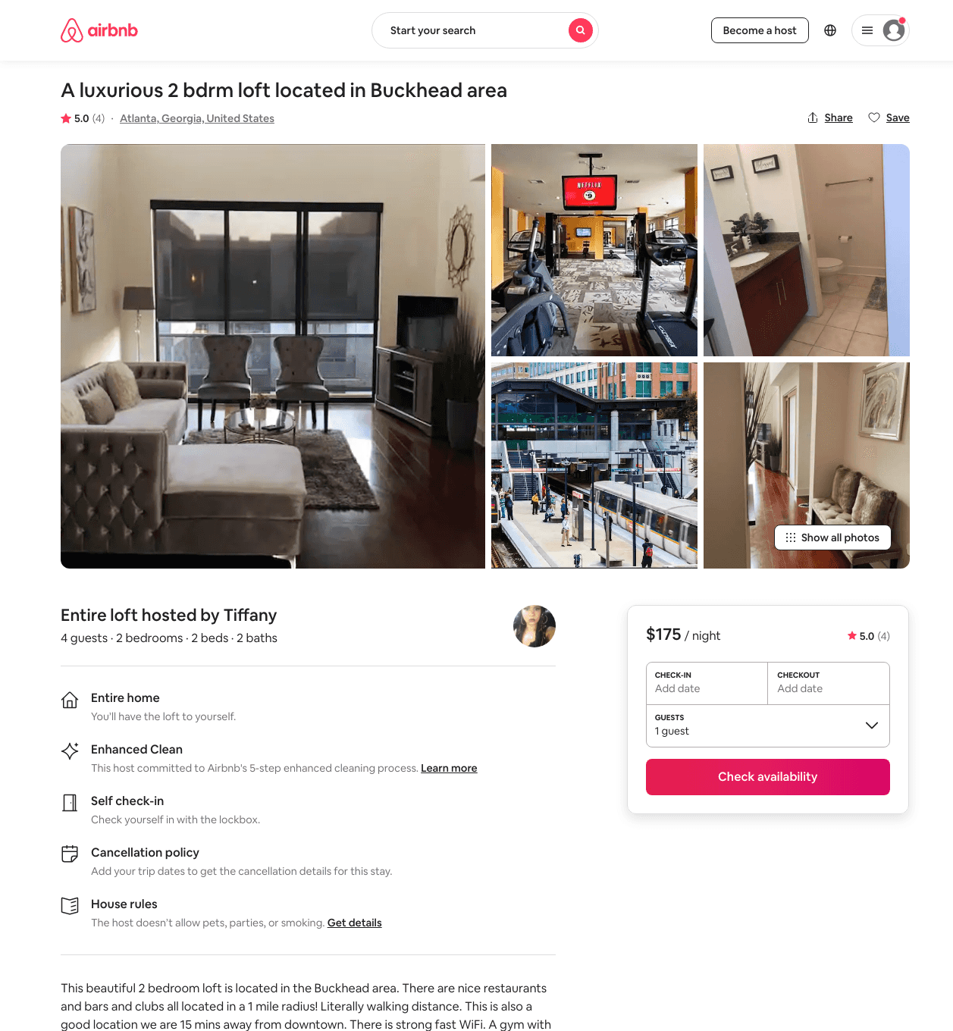
Listing 48209065
2
4
$115 - $281
4.30
1
Tiffany
324147987
3
https://www.airbnb.com/rooms/48209065
Jul 2022

Slide 25
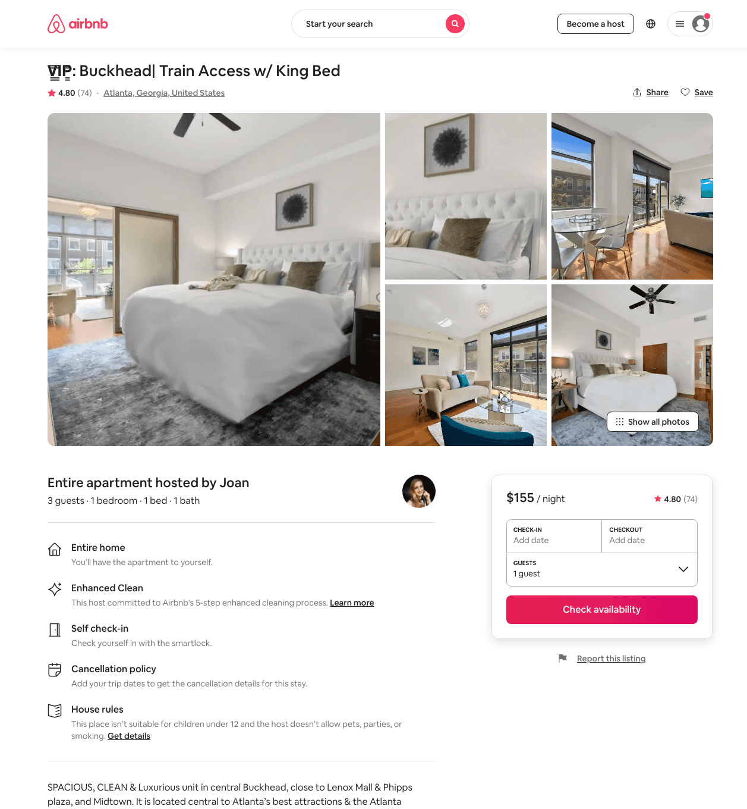
Listing 37543114
1
3
$108 - $257
4.76
2
Joan
328249010
1
https://www.airbnb.com/rooms/37543114
Jul 2022

Slide 26
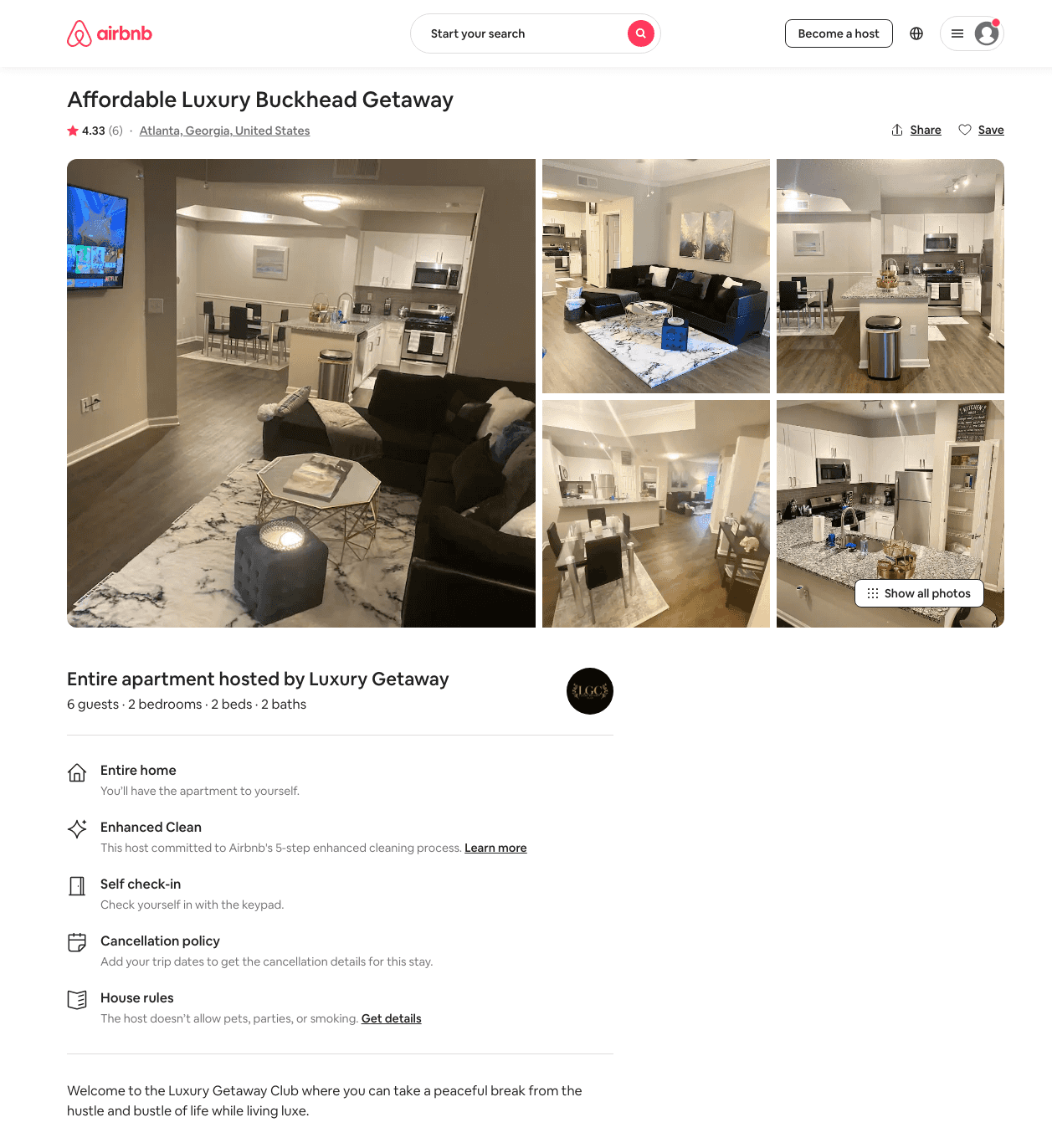
Listing 46273376
2
6
$116 - $202
4.68
2
Luxury Getaway
374647210
1
https://www.airbnb.com/rooms/46273376
Jul 2022

Slide 27
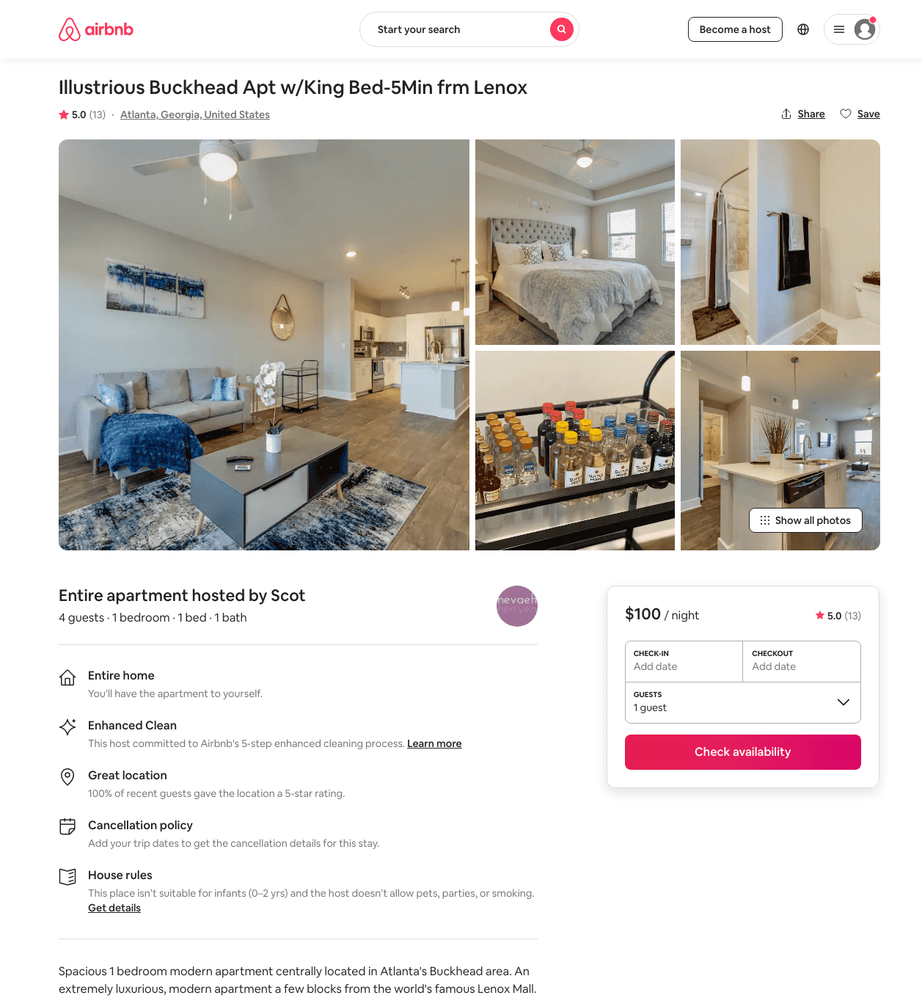
Listing 48253376
1
4
$67 - $129
4.86
1
Nevaeh
385967773
2
https://www.airbnb.com/rooms/48253376
Aug 2022

Slide 28
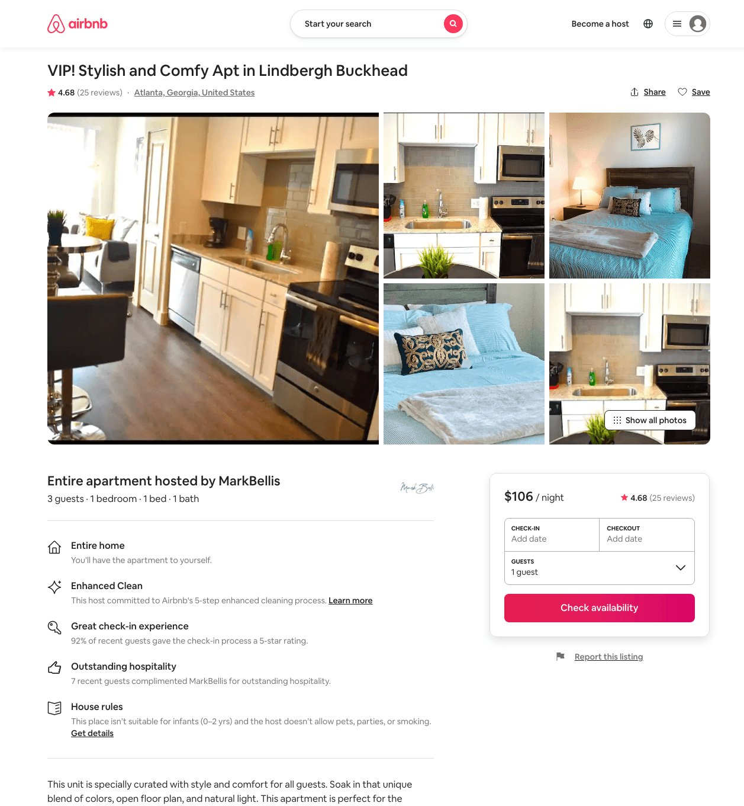
Listing 38868551
1
3
$78 - $106
4.48
1
MarkBellis
297379269
4
https://www.airbnb.com/rooms/38868551
Aug 2022

Slide 29
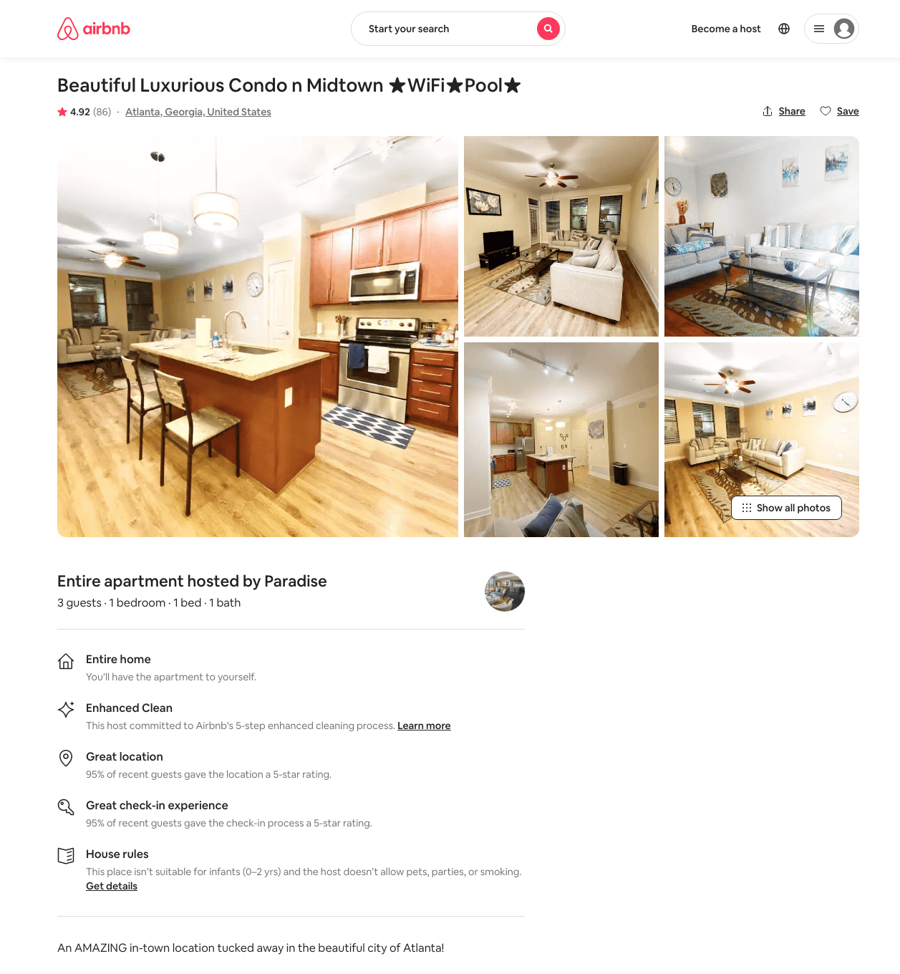
Listing 33025663
1
3
$68 - $110
4.88
1
Paradise
191441686
12
https://www.airbnb.com/rooms/33025663
Aug 2022

Slide 30
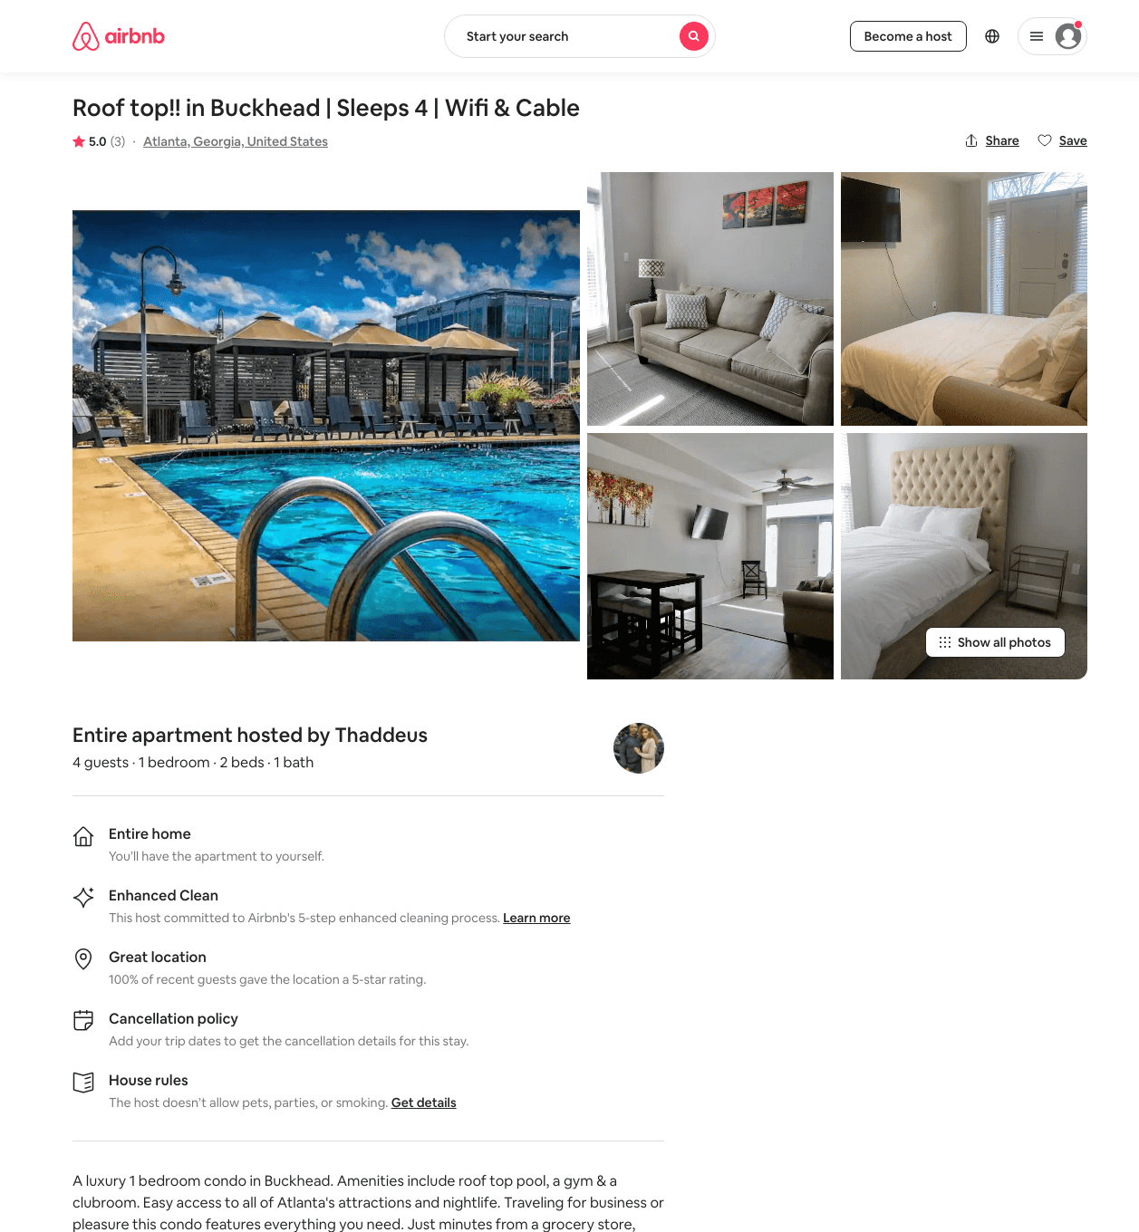
Listing 48382997
1
4
$94 - $236
4.71
1
Jessica
383766825
4
https://www.airbnb.com/rooms/48382997
Jun 2022

Slide 31
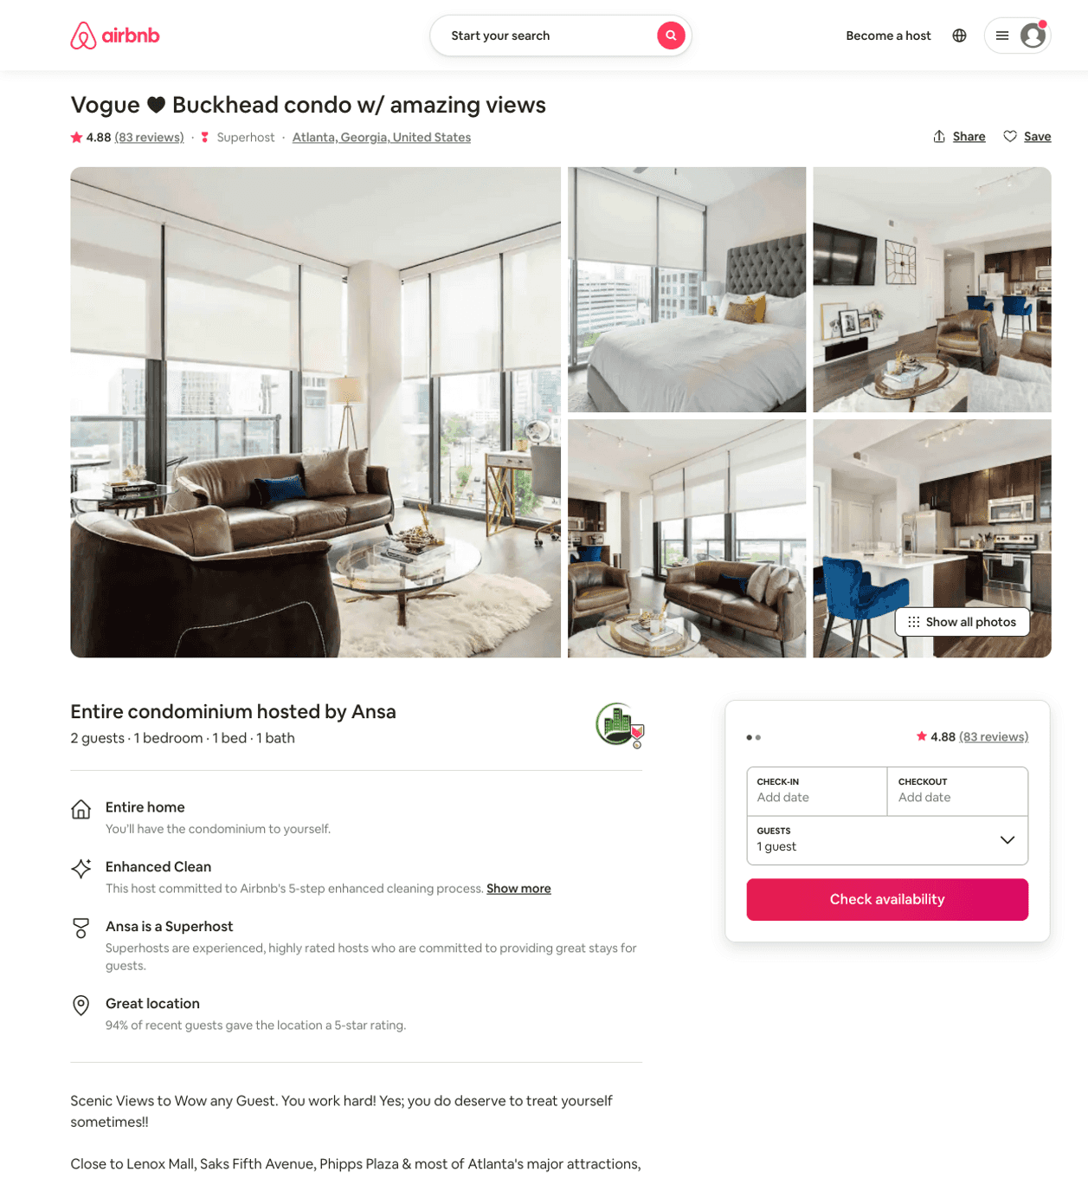
Listing 33916889
1
2
$257 - $500
4.89
2
Ansa
207896278
2
https://www.airbnb.com/rooms/33916889
Aug 2022

Slide 32
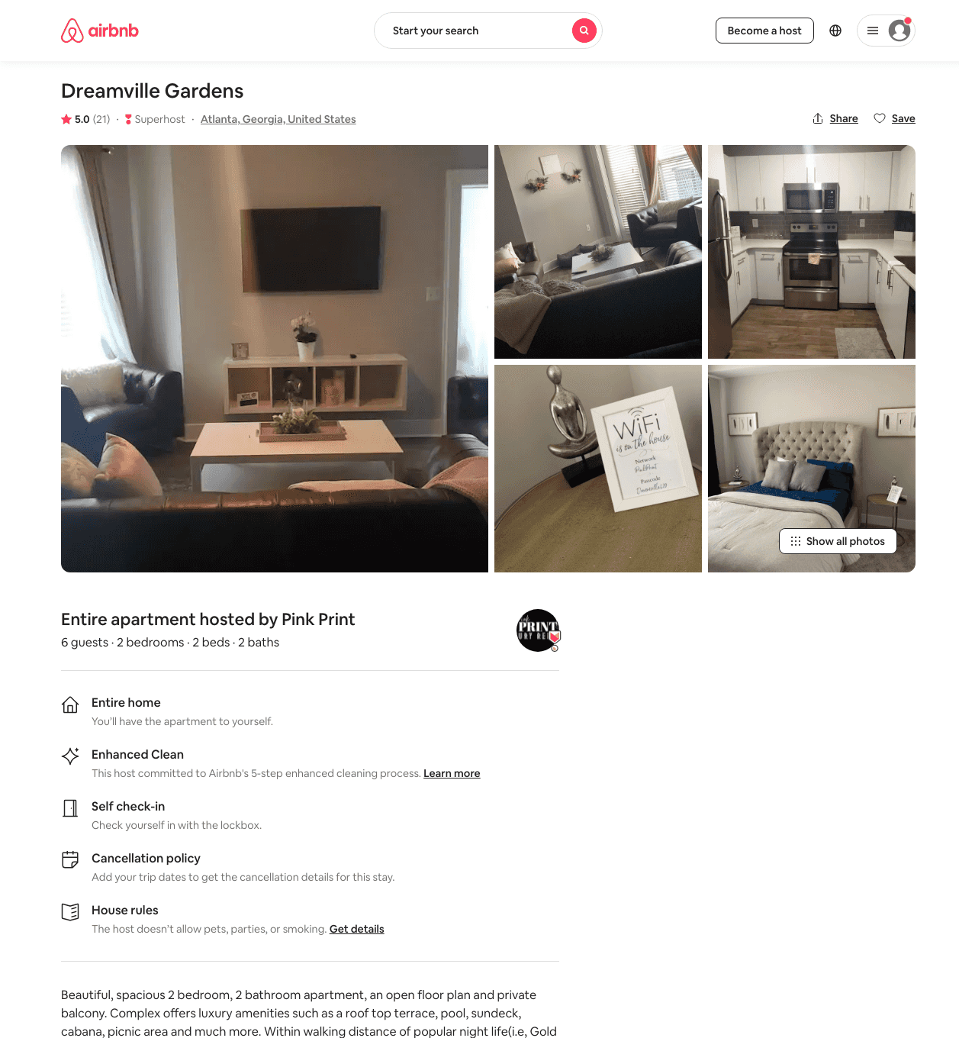
Listing 44533417
2
6
$135 - $263
4.76
1
Pink Print
360222334
3
https://www.airbnb.com/rooms/44533417
Aug 2022

Slide 33
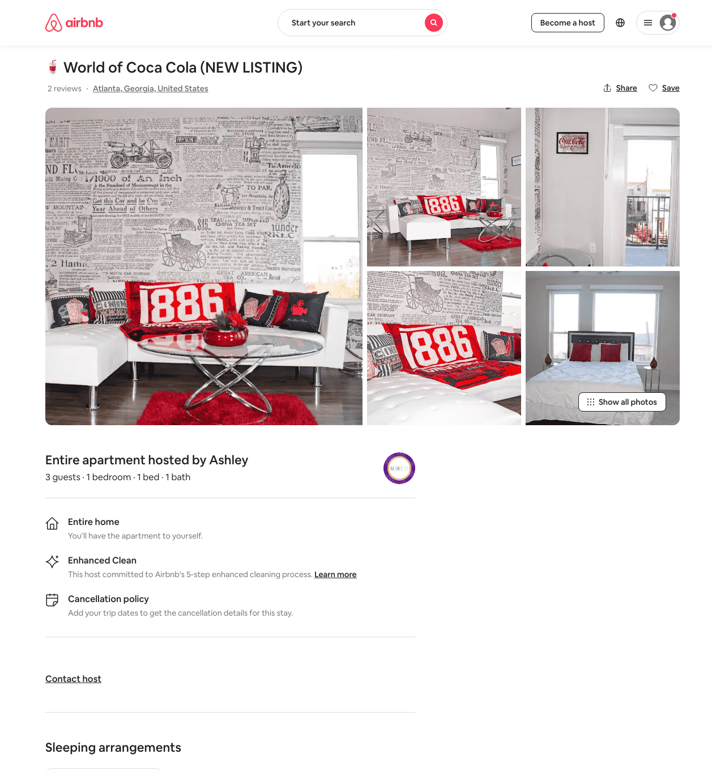
Listing 48691196
1
3
$105 - $150
4.78
1
Ashley
392374562
7
https://www.airbnb.com/rooms/48691196
Jul 2022

Slide 34
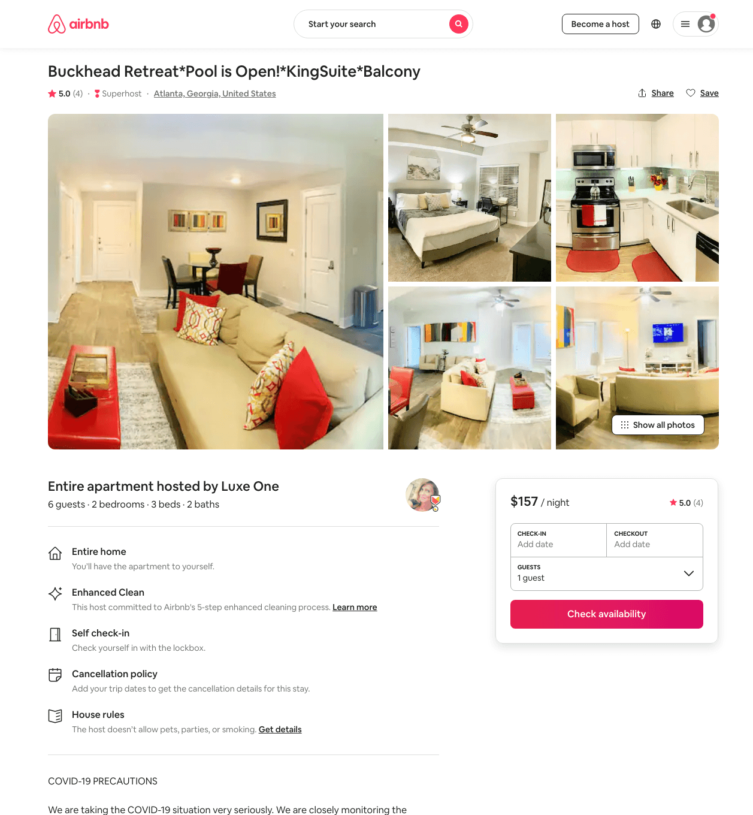
Listing 48471787
2
6
$141 - $339
4.80
1
Luxe One
139621289
14
https://www.airbnb.com/rooms/48471787
Aug 2022

Slide 35
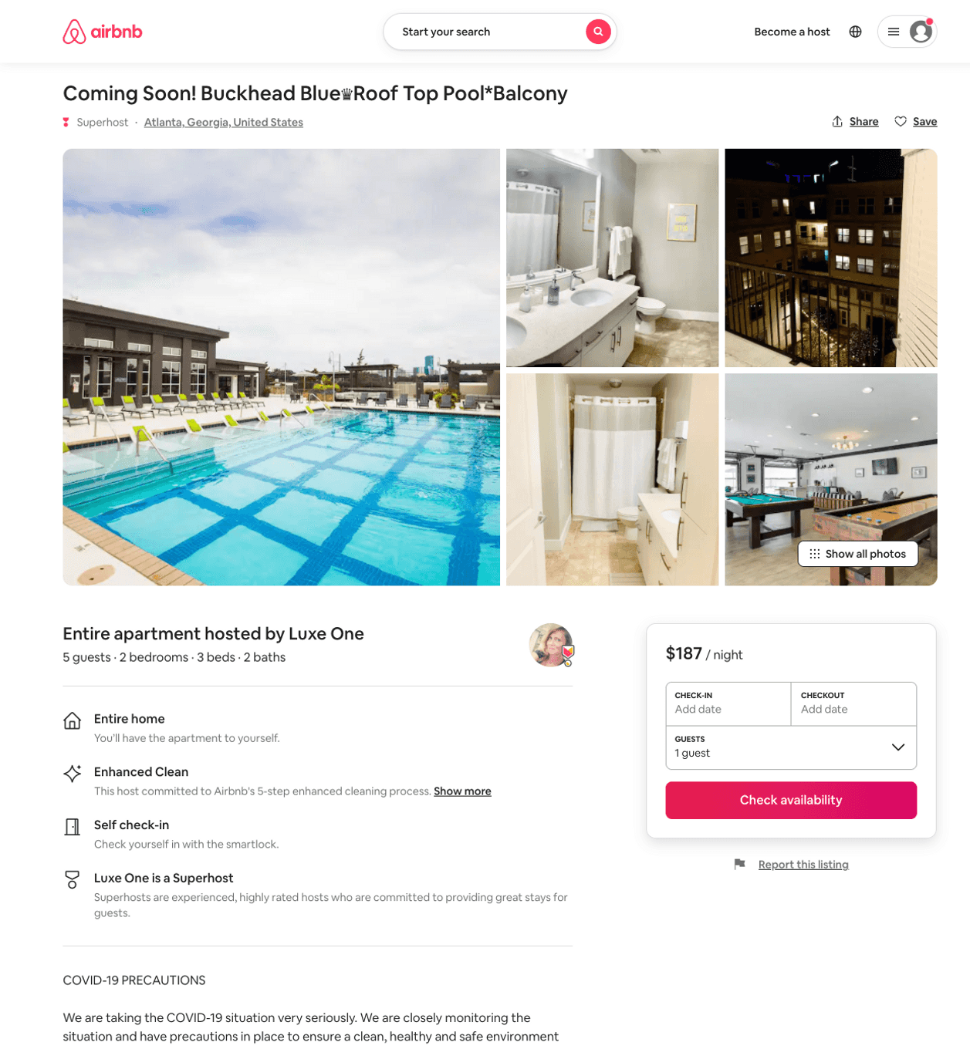
Listing 50653059
2
6
$143 - $228
4.89
1
Luxe One
139621289
14
https://www.airbnb.com/rooms/50653059
Aug 2022

Slide 36
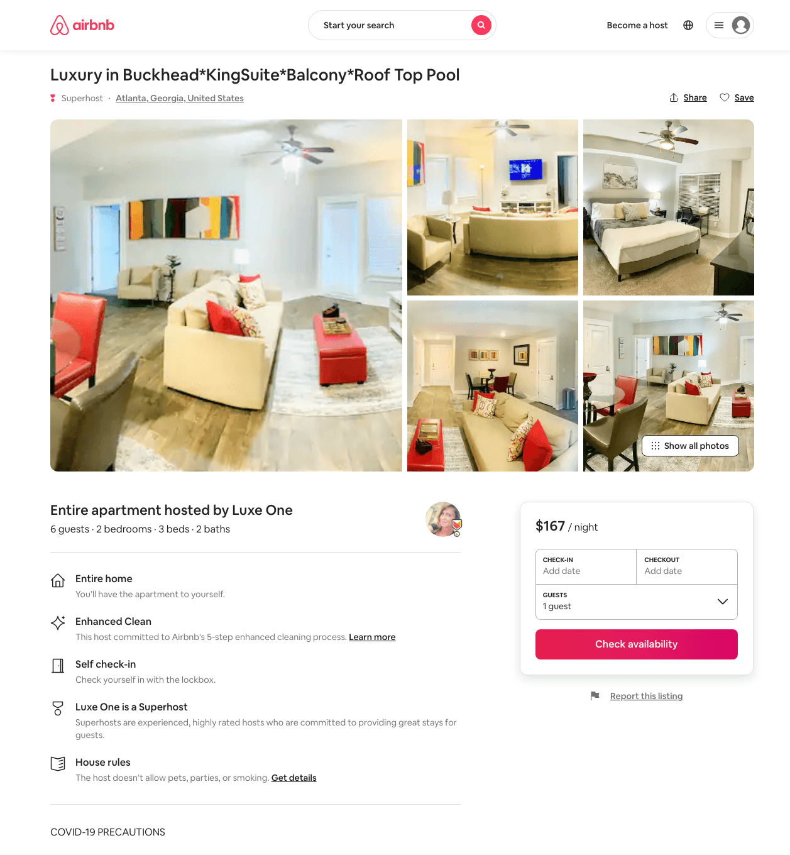
Listing 48503967
2
6
$136 - $339
5.0
1
Luxe One
139621289
14
https://www.airbnb.com/rooms/48503967
Aug 2022

Slide 37
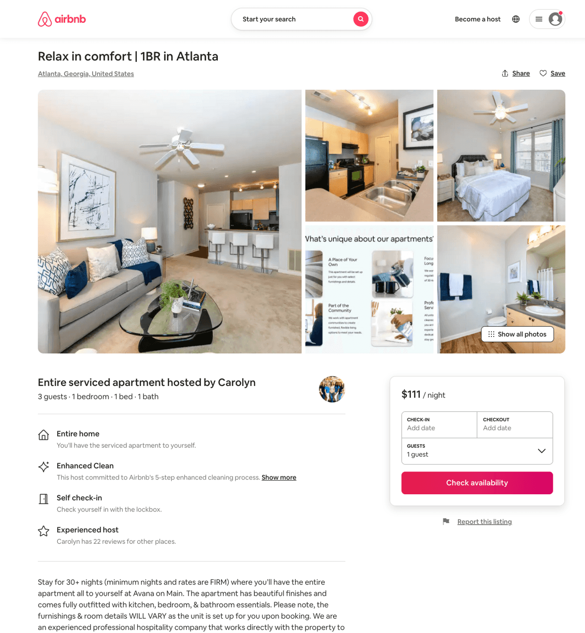
Listing 45882142
1
3
$111
31
Casey
359231771
601
https://www.airbnb.com/rooms/45882142
Aug 2022

Slide 38
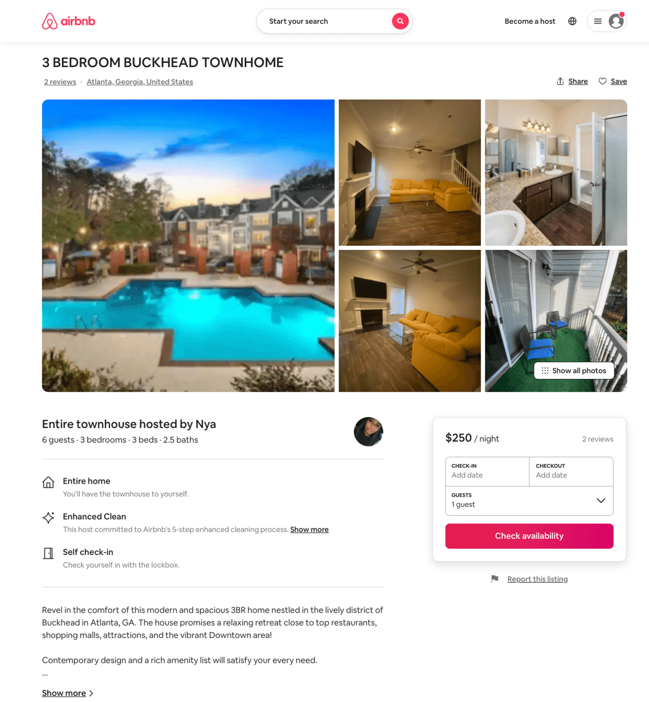
Listing 50019558
3
8
$183 - $350
5.0
2
Nya
25473181
1
https://www.airbnb.com/rooms/50019558
Jun 2022

Slide 39
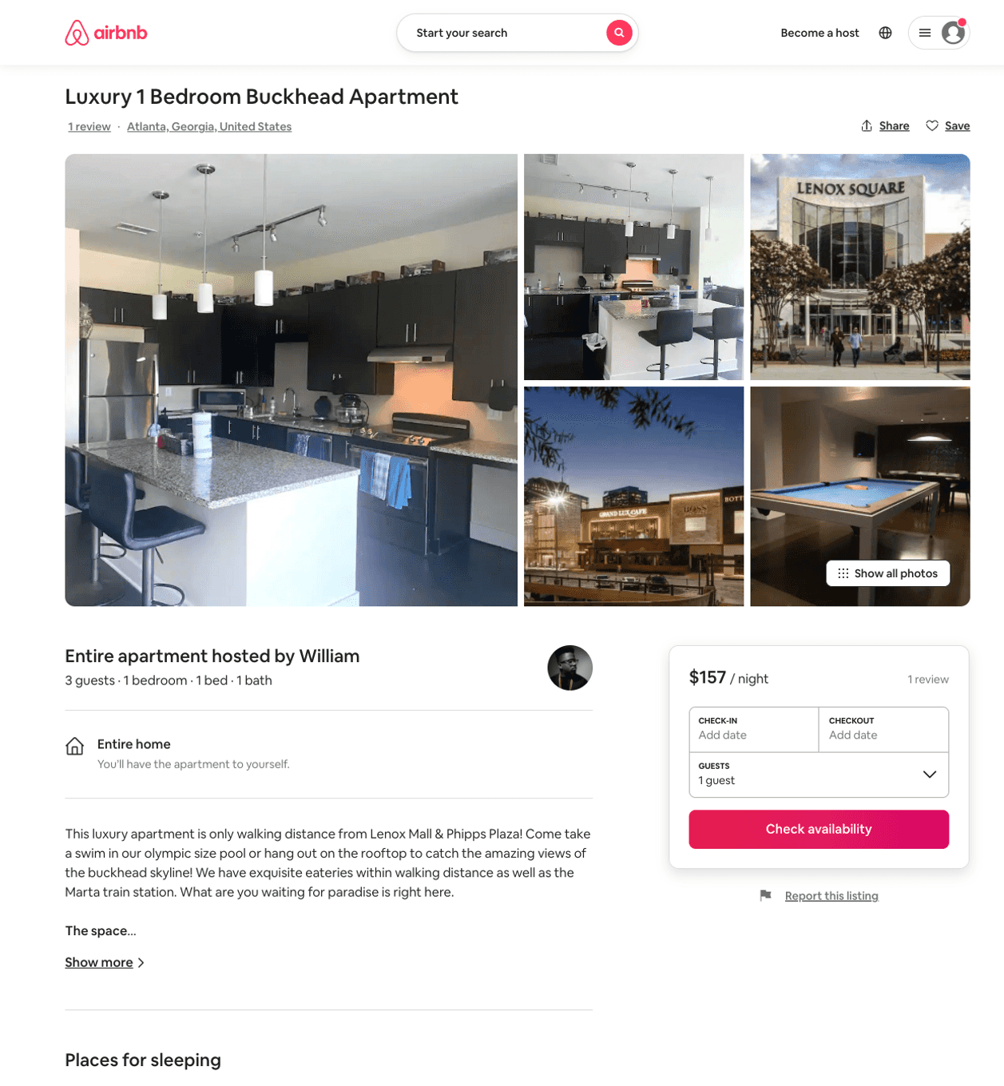
Listing 50444097
1
3
$157
2
William
177541538
2
https://www.airbnb.com/rooms/50444097
Aug 2022

Slide 40
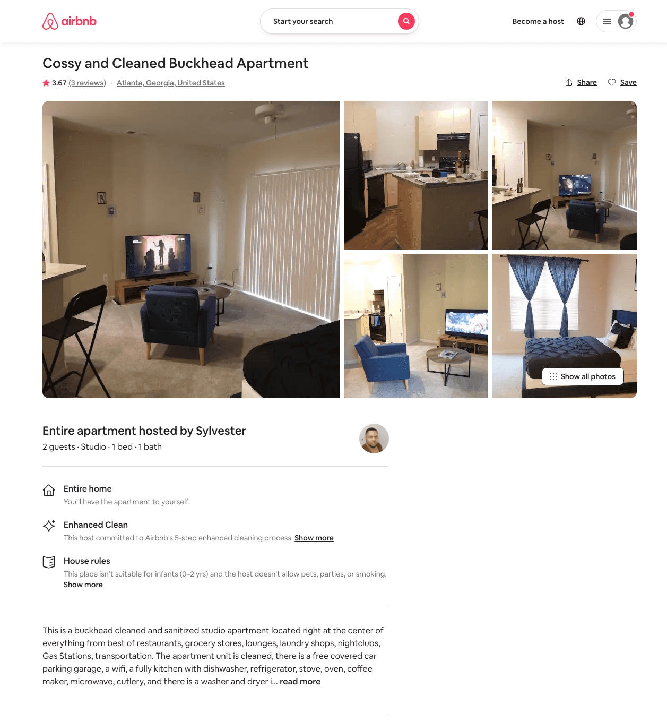
Listing 49113219
Studio
2
$99 - $124
4.60
2
Sylvester
396109671
1
https://www.airbnb.com/rooms/49113219
Jun 2022

Slide 41
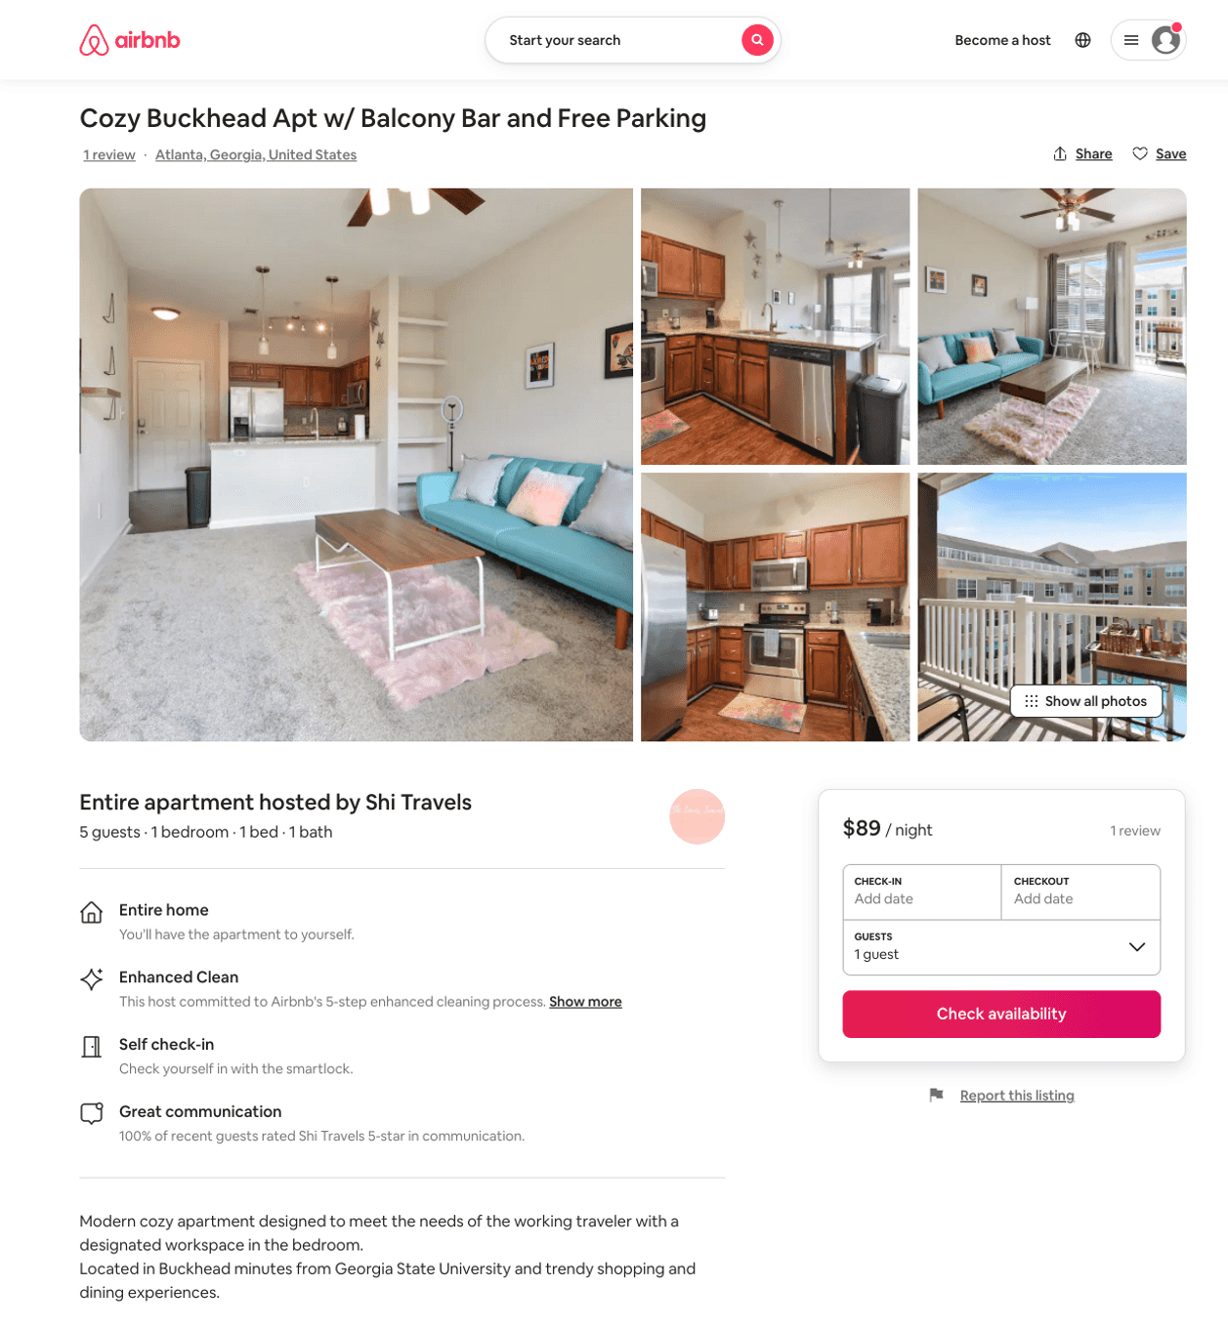
Listing 50137362
1
3
$61 - $97
4.75
2
Shi Travels
359170173
1
https://www.airbnb.com/rooms/50137362
Aug 2022

Slide 42
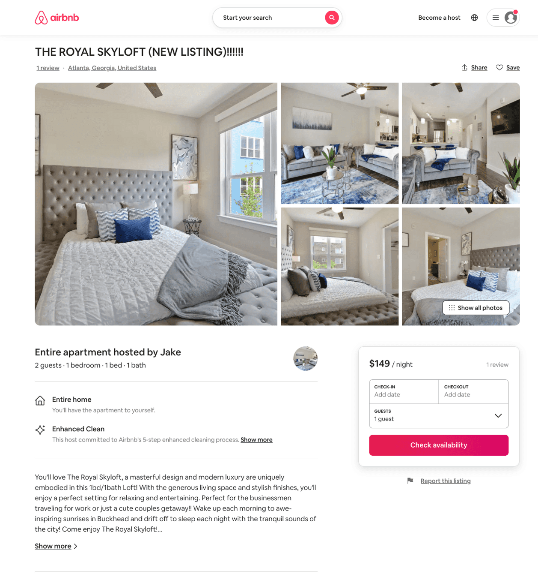
Listing 50877662
1
2
$103 - $197
4.92
1
Jake
411363488
1
https://www.airbnb.com/rooms/50877662
Aug 2022

Slide 43
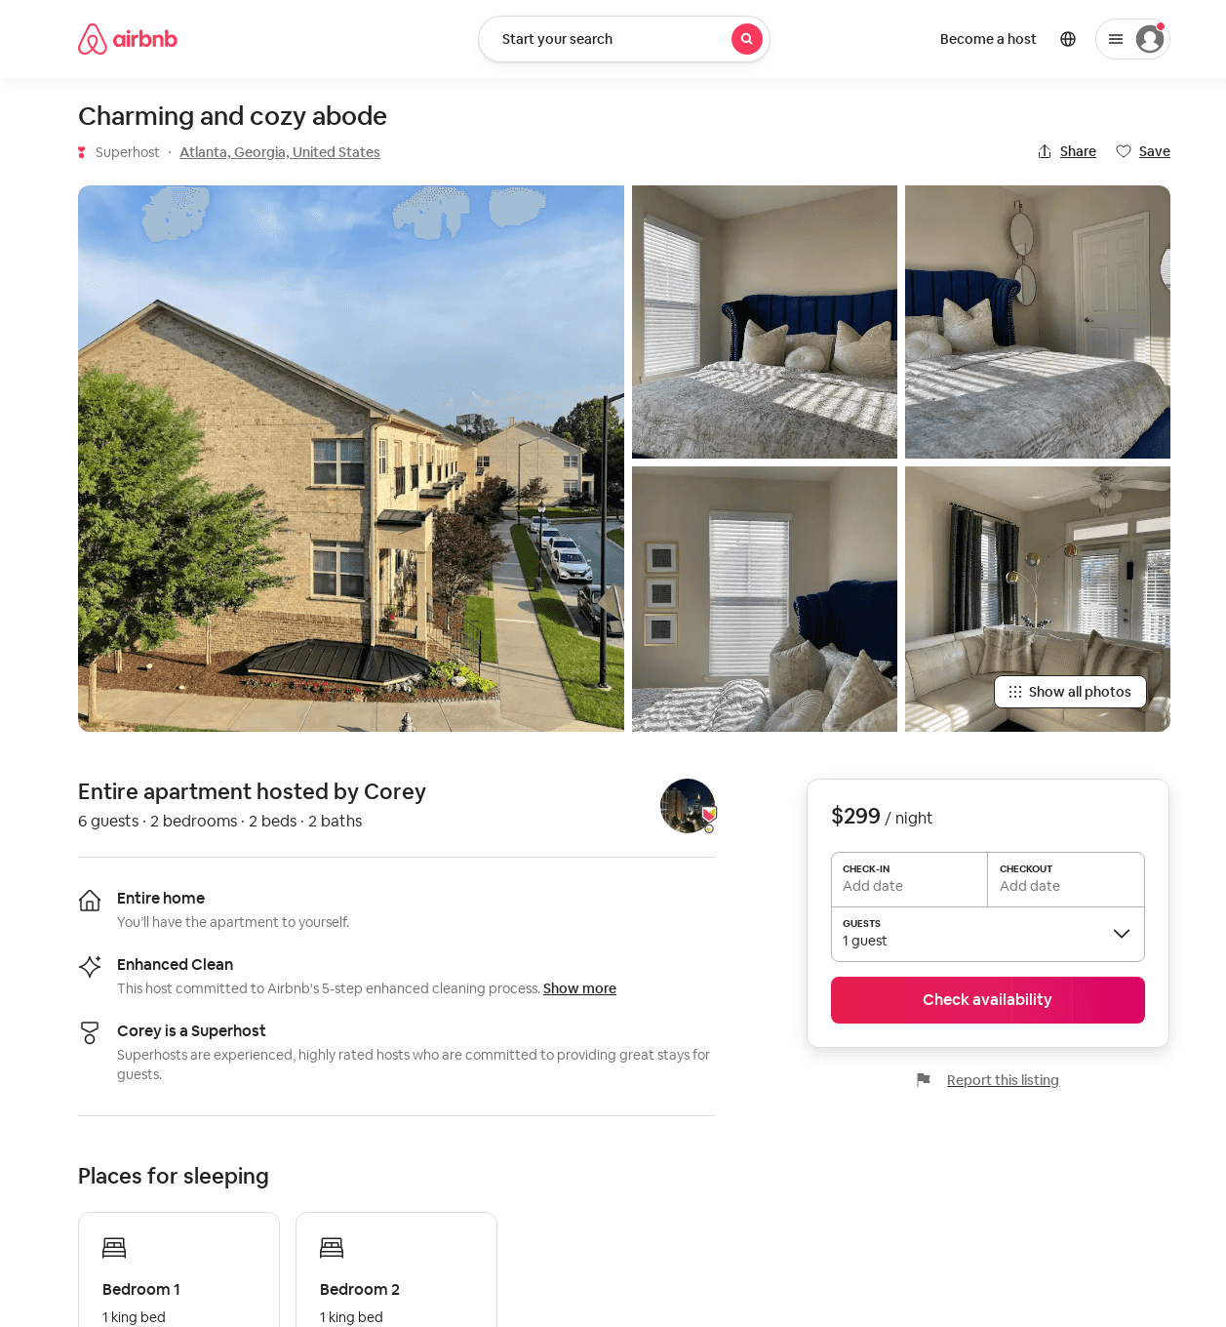
Listing 50399995
2
6
$299
2
Corey
155798916
1
https://www.airbnb.com/rooms/50399995
Jun 2022

Slide 44
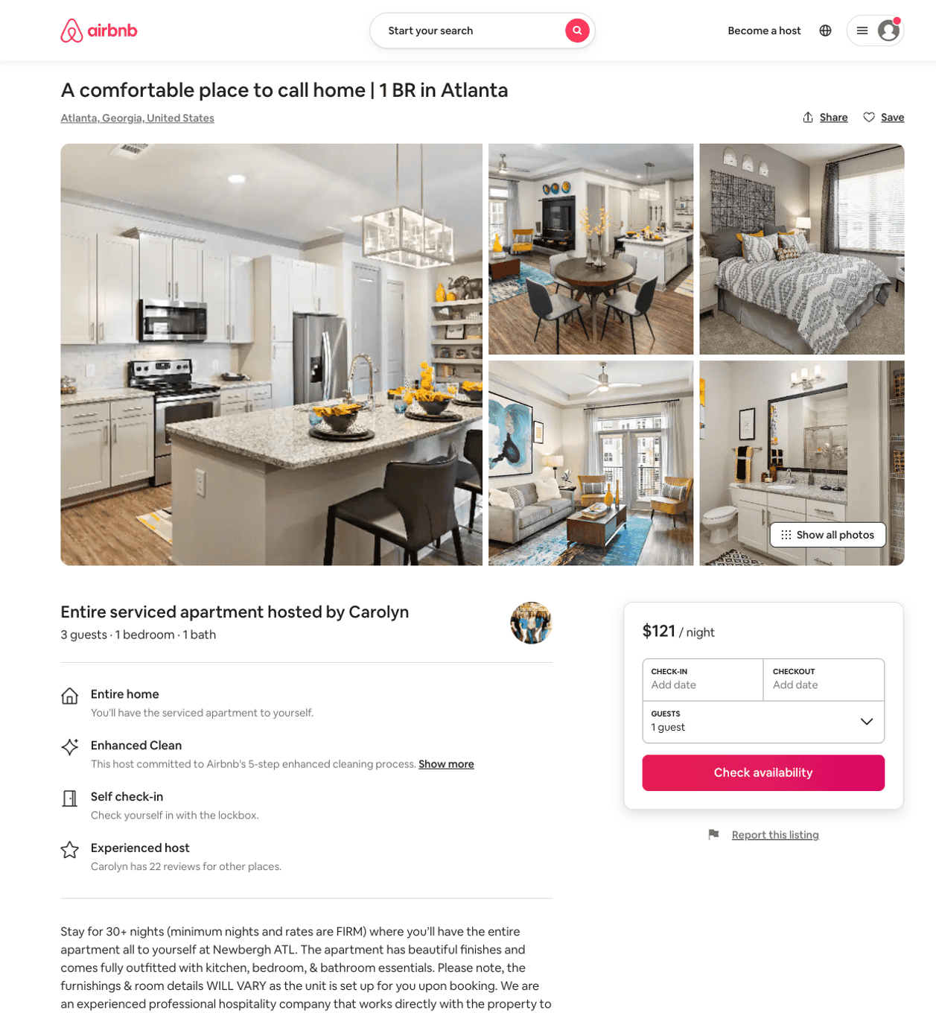
Listing 50194493
1
3
$120 - $123
31
Casey
359231771
601
https://www.airbnb.com/rooms/50194493
Jul 2022

Slide 45
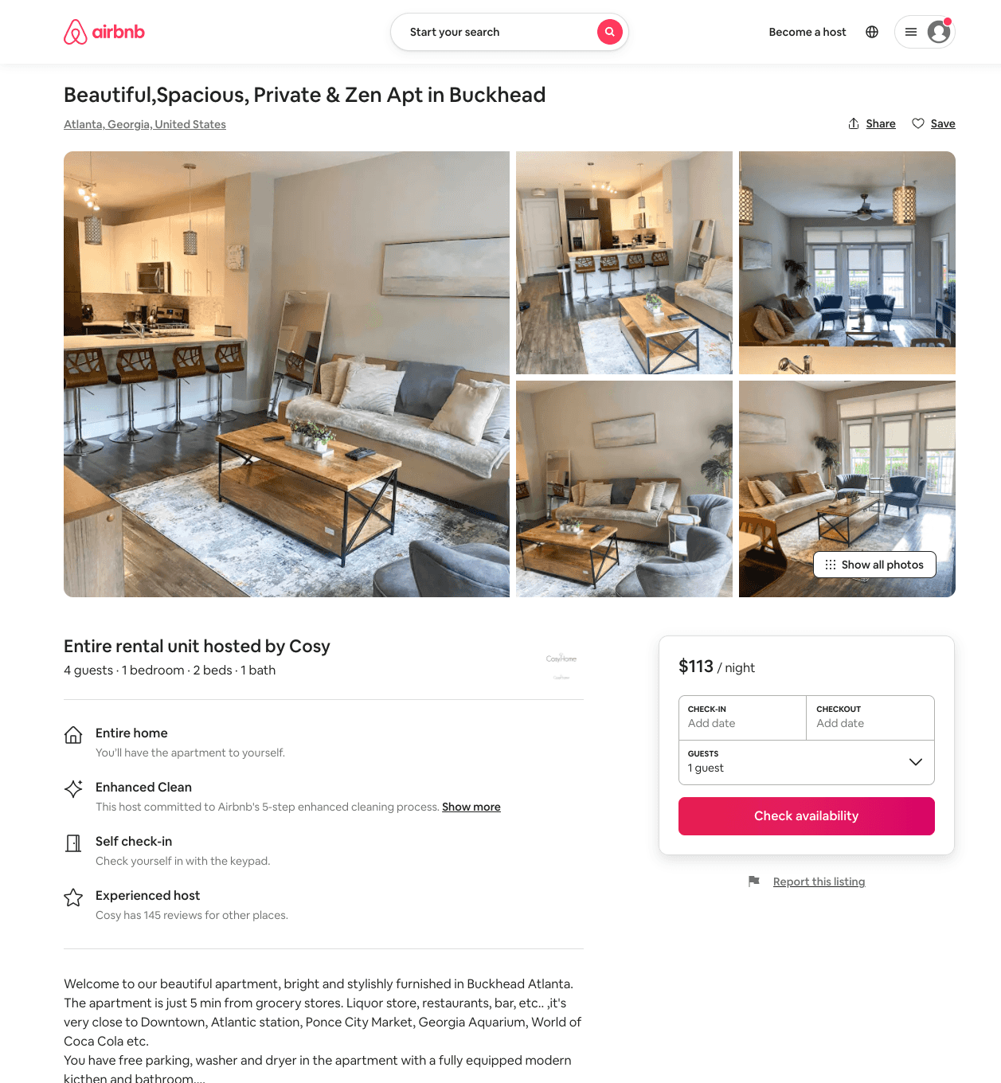
Listing 51043048
1
4
$91 - $144
4.69
3
Cosy
230844143
2
https://www.airbnb.com/rooms/51043048
Aug 2022

Slide 46
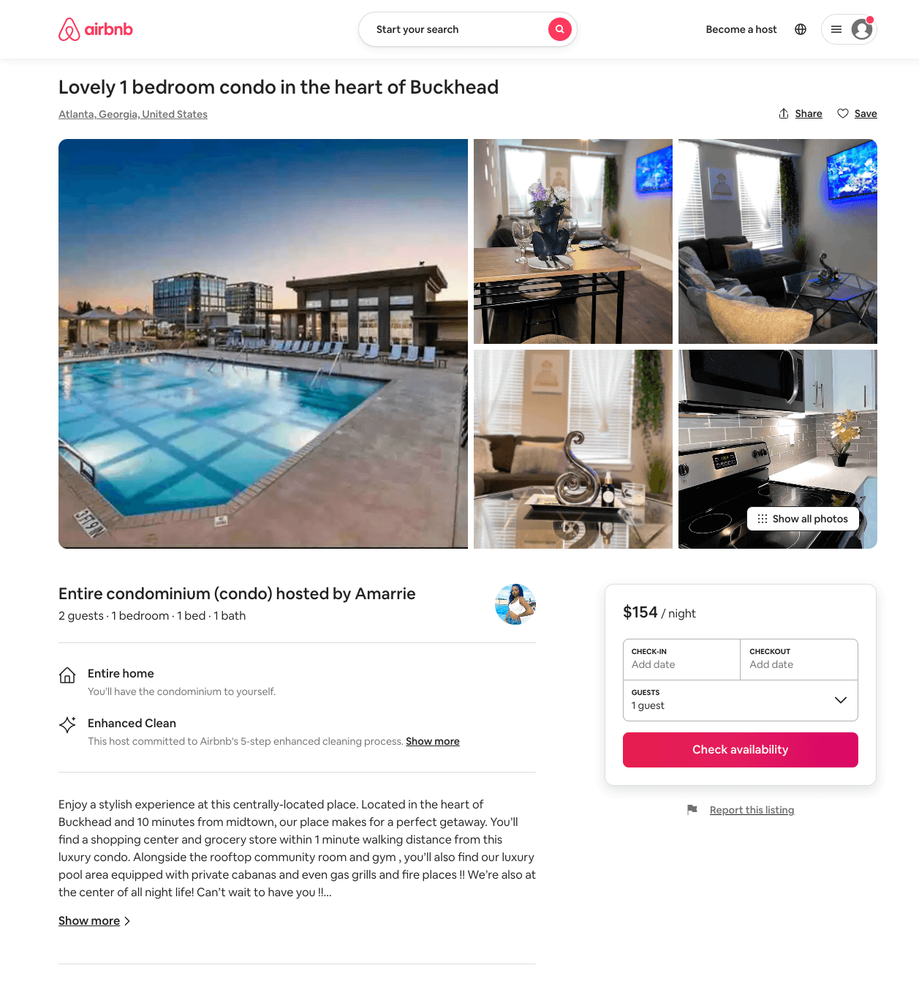
Listing 50229696
1
2
$121 - $200
4.40
2
Amarrie
388241879
1
https://www.airbnb.com/rooms/50229696
Aug 2022

Slide 47
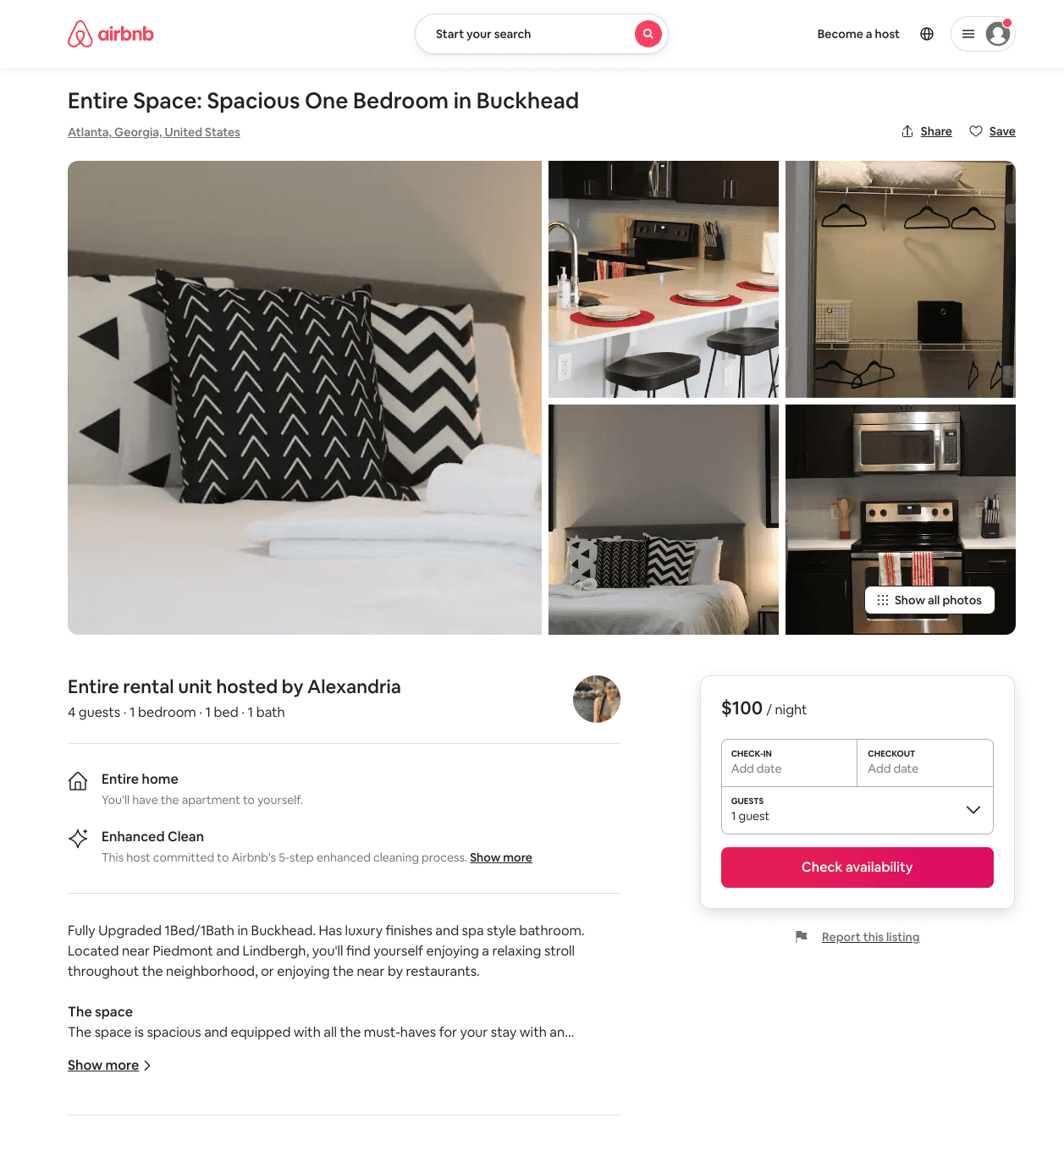
Listing 51072566
1
4
$90 - $144
4.94
2
Alexandria
413231250
1
https://www.airbnb.com/rooms/51072566
Aug 2022

Slide 48
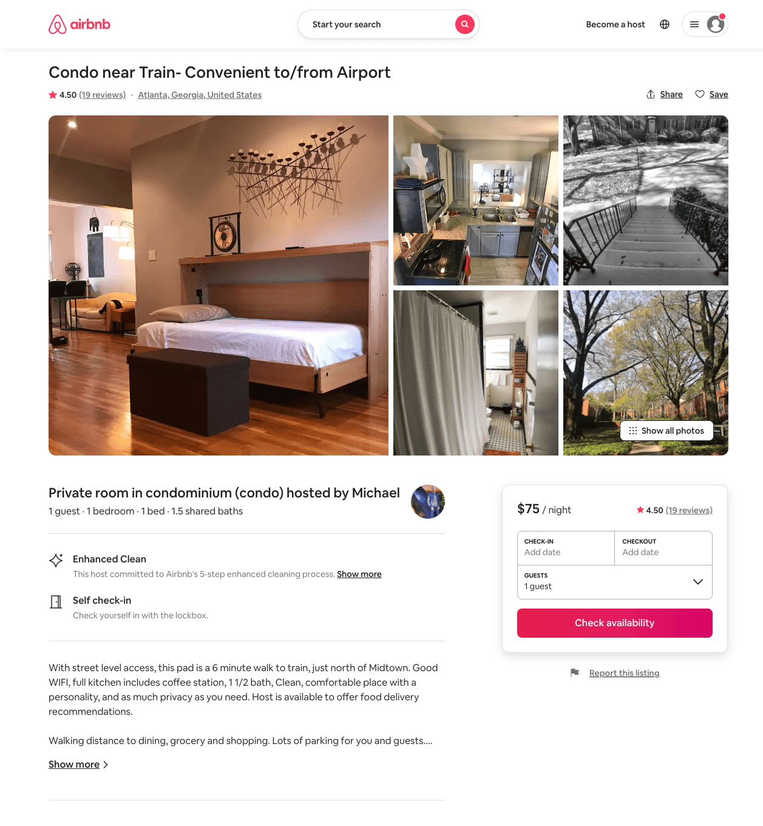
Listing 12123275
1
1
$75
4.50
1
Michael
65041496
1
https://www.airbnb.com/rooms/12123275
Aug 2022

Slide 49
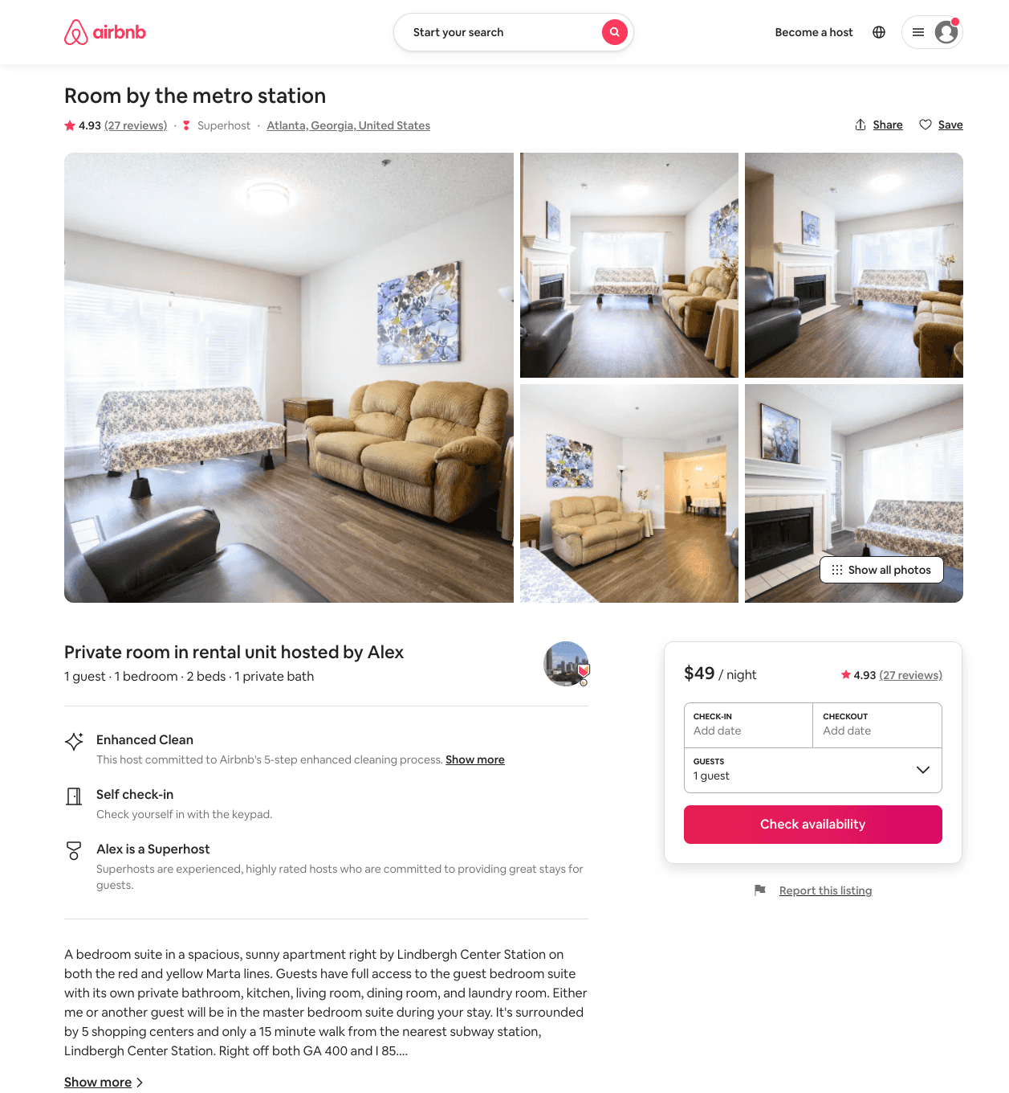
Listing 28865600
1
1
$33 - $64
4.93
60
Alex
27662351
3
https://www.airbnb.com/rooms/28865600
Jun 2022

Slide 50
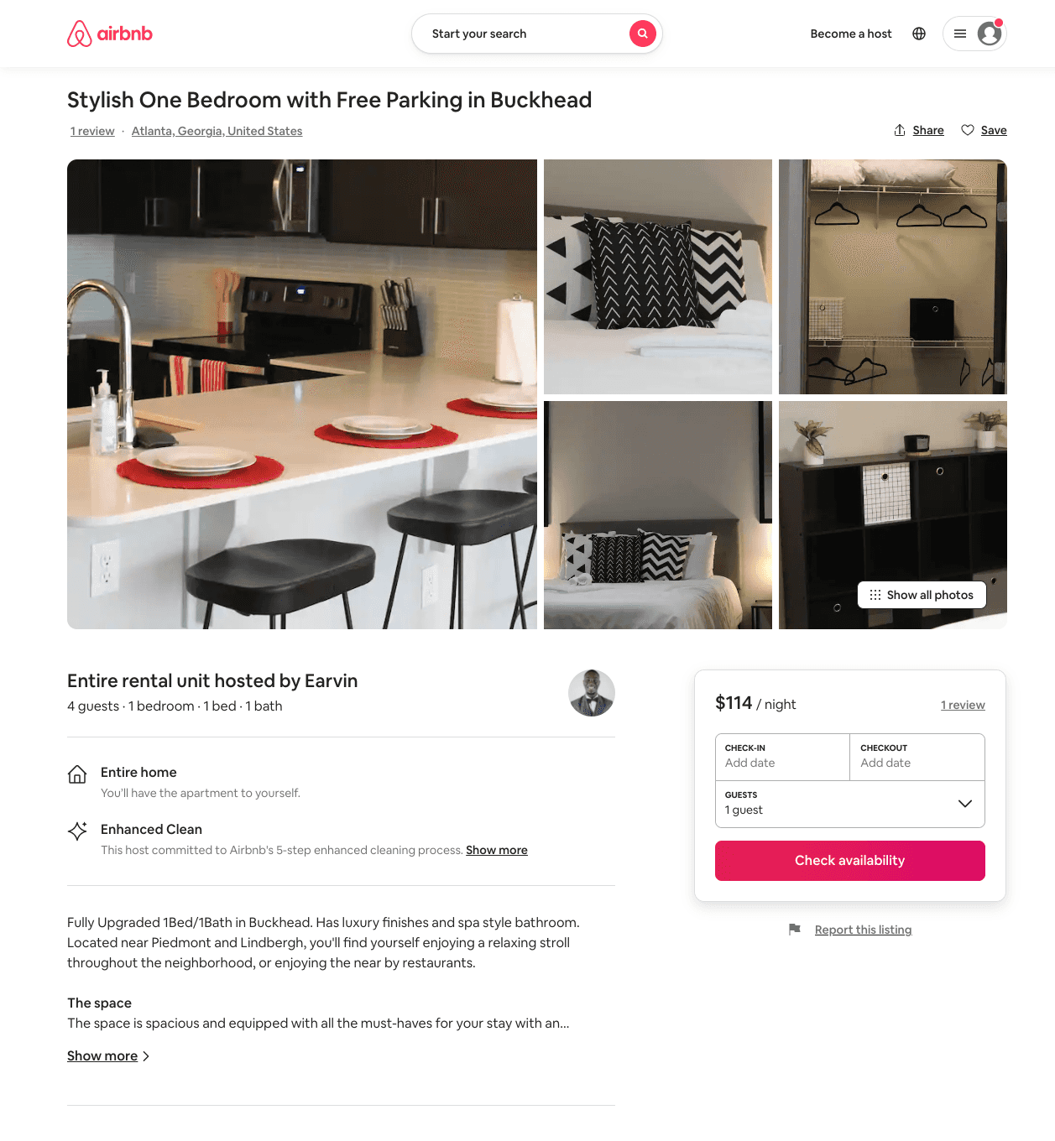
Listing 51073558
1
4
$92 - $114
2
Earvin
106822695
1
https://www.airbnb.com/rooms/51073558
Jun 2022

Slide 51
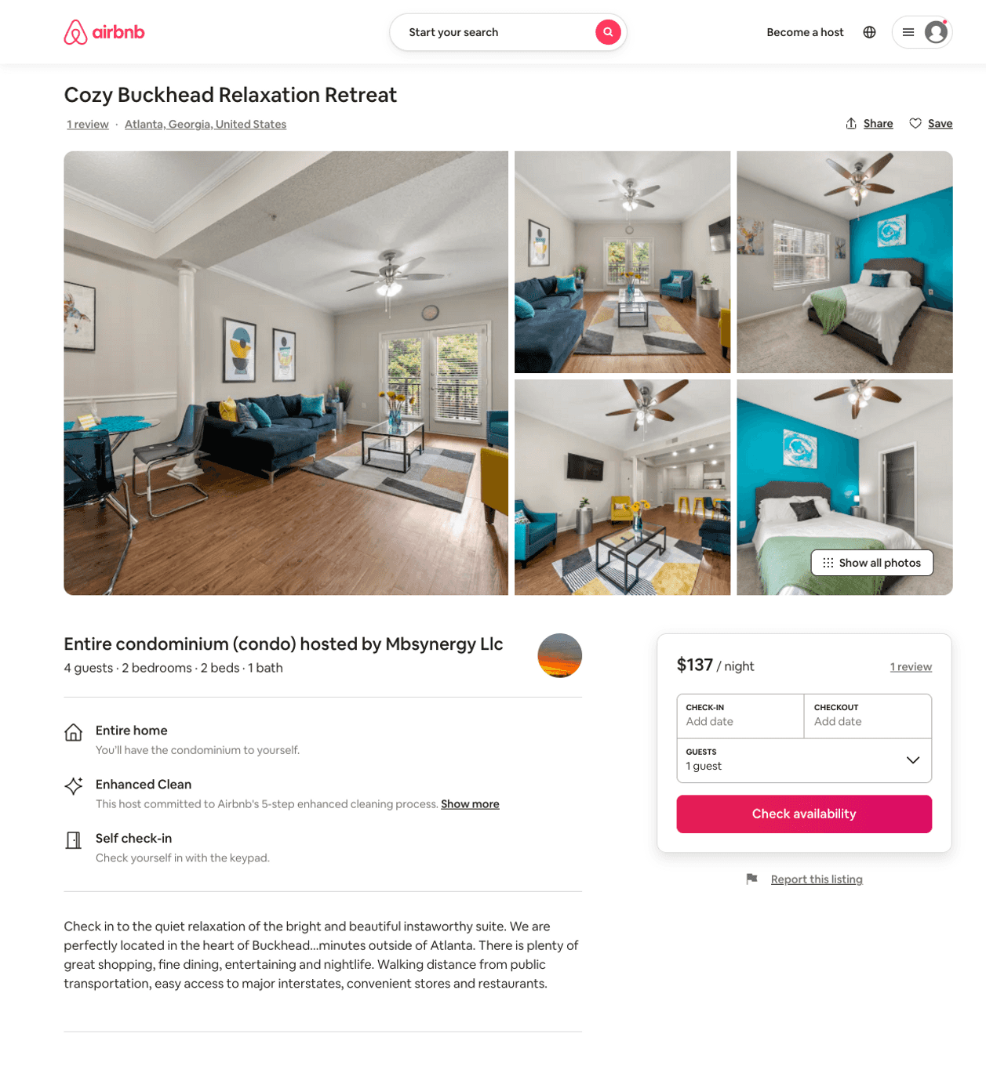
Listing 50959151
2
5
$96 - $169
4.84
2
Mbsynergy Llc
114334000
1
https://www.airbnb.com/rooms/50959151
Jul 2022

Slide 52
Listing 50286187
2
6
$146 - $250
4.44
2
T & D Rental Properties
105174755
1
https://www.airbnb.com/rooms/50286187
Jun 2022

Slide 53
Listing 50625434
1
3
$94 - $135
4.41
2
Jay
371543147
1
https://www.airbnb.com/rooms/50625434
Aug 2022

Slide 54
Listing 50568095
2
5
$112 - $130
5.0
1
Jamie
247505099
1
https://www.airbnb.com/rooms/50568095
Jul 2022

Slide 55
Listing 51469681
2
4
$75 - $164
4.50
1
Sterling
84982035
1
https://www.airbnb.com/rooms/51469681
Jul 2022

Slide 56
Listing 51491742
1
2
$105 - $200
3
Joyceline
331447464
1
https://www.airbnb.com/rooms/51491742
Jun 2022

Slide 57
Listing 51380796
1
3
$100 - $247
4.89
1
Hiatus
369690820
2
https://www.airbnb.com/rooms/51380796
Aug 2022

Slide 58
Listing 51640533
1
3
$128 - $154
31
Casey
359231771
601
https://www.airbnb.com/rooms/51640533
Aug 2022

Slide 59
Listing 51813027
1
2
$60 - $110
4.52
1
Ray
214791975
2
https://www.airbnb.com/rooms/51813027
Jun 2022

Slide 60
Listing 52074637
2
2
$120
1
Tics
421616168
2
https://www.airbnb.com/rooms/52074637
Jul 2022

Slide 61
Listing 50640282
2
5
$111 - $176
4.60
1
Fortune
254072975
1
https://www.airbnb.com/rooms/50640282
Aug 2022

Slide 62
Listing 26234766
1
3
$101
4.88
2
Tee
178748704
1
https://www.airbnb.com/rooms/26234766
Aug 2022

Slide 63
Listing 52840192
1
4
$85 - $112
4.78
1
Jessica
383766825
4
https://www.airbnb.com/rooms/52840192
Jun 2022

Slide 64
Listing 52954313
1
4
$79 - $110
5.0
1
Prestige
75305813
2
https://www.airbnb.com/rooms/52954313
Jun 2022

Slide 65
Listing 2478168
2
4
$182 - $215
5
2
Chelsea Sellars-Wilson
https://www.vrbo.com/2478168
Aug 2022

Slide 66
Listing 52406219
1
3
$138 - $165
31
Casey
359231771
601
https://www.airbnb.com/rooms/52406219
Jun 2022

Slide 67
Listing 48851791
1
4
$89 - $120
4.84
2
TurnKey
10468807
2
https://www.airbnb.com/rooms/48851791
Jul 2022

Slide 68
Listing 53130527
1
6
$105 - $148
4.52
1
Luxury
429569288
2
https://www.airbnb.com/rooms/53130527
Aug 2022

Slide 69
Listing 53327684
1
2
$60 - $92
4.64
2
Arian
389394805
1
https://www.airbnb.com/rooms/53327684
Jun 2022

Slide 70
Listing 53316733
2
5
$85 - $133
4.25
1
Samantha
65941310
2
https://www.airbnb.com/rooms/53316733
Aug 2022

Slide 71
Listing 53291007
2
2
$184 - $334
2
Kemoh
431433170
1
https://www.airbnb.com/rooms/53291007
Jun 2022

Slide 72
Listing 53530624
1
4
$70 - $71
29
Jalen
326079135
7
https://www.airbnb.com/rooms/53530624
Aug 2022

Slide 73
Listing 53591462
3
8
$136 - $179
4.86
2
Jason
433996104
1
https://www.airbnb.com/rooms/53591462
Aug 2022

Slide 74
Listing 53587262
1
2
$56 - $94
3
Oludare
160107222
1
https://www.airbnb.com/rooms/53587262
Aug 2022

Slide 75
Listing 53232660
1
3
$133 - $134
31
Casey
359231771
601
https://www.airbnb.com/rooms/53232660
Aug 2022

Slide 76
Listing 53680098
2
3
$102 - $164
4.46
2
Nokey
434743111
1
https://www.airbnb.com/rooms/53680098
Aug 2022

Slide 77
Listing 53474443
1
2
$92 - $144
4.68
1
Infinity Wealth
83899049
4
https://www.airbnb.com/rooms/53474443
Aug 2022

Slide 78
Listing 53611411
2
7
$179 - $229
5.0
1
William
177541538
2
https://www.airbnb.com/rooms/53611411
Aug 2022

Slide 79
Listing 53934908
1
4
$87 - $138
4.93
3
Cho
436911748
1
https://www.airbnb.com/rooms/53934908
Jul 2022

Slide 80
Listing 53152515
1
3
$135 - $149
31
Casey
359231771
601
https://www.airbnb.com/rooms/53152515
Jun 2022

Slide 81
Listing 2570511
2
6
$175 - $215
2
Samantha Castillo
https://www.vrbo.com/2570511
Aug 2022

Slide 82
Listing 2121503
1
2
$159
2
Pagedron Fleetwood
https://www.vrbo.com/2121503
Aug 2022

Slide 83
Listing 2592202
2
3
$309
1
Antwon Ford
https://www.vrbo.com/2592202
Aug 2022

Slide 84
Listing 54227662
2
4
$161 - $220
4.54
1
Lux
439734153
1
https://www.airbnb.com/rooms/54227662
Aug 2022

Slide 85
Listing 2615087
1
4
$99
1
2
https://www.vrbo.com/2615087
Aug 2022

Slide 86
Listing 2621875
1
3
$150
2
https://www.vrbo.com/2621875
Aug 2022

Slide 87
Listing 54249237
1
2
$85 - $91
4.63
1
Bgm
382561451
1
https://www.airbnb.com/rooms/54249237
Aug 2022

Slide 88
Listing 54211490
2
4
$111 - $200
4.80
1
Mac
439567619
1
https://www.airbnb.com/rooms/54211490
Aug 2022

Slide 89
Listing 2622591
1
3
$107
2
https://www.vrbo.com/2622591
Aug 2022

Slide 90
Listing 2626443
1
3
$124
4.5
1
https://www.vrbo.com/2626443
Aug 2022

Slide 91
Listing 54397527
1
2
$69 - $140
4.67
2
Kunle
136216829
1
https://www.airbnb.com/rooms/54397527
Aug 2022

Slide 92
Listing top-floor-2br-2b
undefined
5
8
https://www.booking.com/hotel/us/top-floor-2br-2b.html
Sep 2022

Slide 93
Listing 2663925
1
4
$118
4
Tony Semadeni
https://www.vrbo.com/2663925
Aug 2022

Slide 94
Listing 2664424
1
4
$157
4.6666665
4
Tony Semadeni
https://www.vrbo.com/2664424
Aug 2022

Slide 95
Listing 2613596
1
2
$144
4.5
2
Mbw Solutions
https://www.vrbo.com/2613596
Aug 2022

Slide 96
Listing 53448427
2
4
$75 - $120
5.0
1
Angela
134020098
2
https://www.airbnb.com/rooms/53448427
Aug 2022

Slide 97
Listing 44531165
2
4
$77
2
Antonio
228398725
1
https://www.airbnb.com/rooms/44531165
Jul 2022

Slide 98
Listing 2673972
2
5
$243
3
Jackey (J)
https://www.vrbo.com/2673972
Aug 2022

Slide 99
Listing 50572994
2
4
$141 - $165
4.43
1
Gigi
388849051
2
https://www.airbnb.com/rooms/50572994
Jul 2022

Slide 100
Listing 2701070
1
2
$118
3
feyisayo
https://www.vrbo.com/2701070
Aug 2022

Slide 101
Listing 2710896
2
6
$149
4
1
Jovian
https://www.vrbo.com/2710896
Aug 2022

Slide 102
Listing 2720361
2
5
$209
4.8
2
https://www.vrbo.com/2720361
Aug 2022

Slide 103
Listing 2728007
1
4
$145
7
https://www.vrbo.com/2728007
Aug 2022

Slide 104
Listing 2729313
2
5
$193
2
salih ansari
https://www.vrbo.com/2729313
Aug 2022

Slide 105
Listing 29569925
2
5
$115 - $116
4.96
2
PreferredOne
188599655
1
https://www.airbnb.com/rooms/29569925
Aug 2022

Slide 106
Listing 2739529
1
2
$132
3
Mbw Solutions
https://www.vrbo.com/2739529
Aug 2022

Slide 107
Listing 2768107
0
2
$121
4.5
1
Diamond Lamb Management LLC
https://www.vrbo.com/2768107
Aug 2022

Slide 108
Listing 2761553
2
4
$220
1
2
Ryan Strong
https://www.vrbo.com/2761553
Aug 2022

Slide 109
Listing 53663674
2
6
$166 - $168
4.86
3
Your Life Vibes
417696862
1
https://www.airbnb.com/rooms/53663674
Jun 2022

Slide 110
Listing 2801458
2
6
$166
2
https://www.vrbo.com/2801458
Aug 2022

Slide 111
Listing 2846570
2
10
$225
5
7
https://www.vrbo.com/2846570
Aug 2022

Slide 112
Listing 2838974
1
5
$150
3
https://www.vrbo.com/2838974
Aug 2022

Slide 113
Listing 50876078
2
5
$166 - $168
31
Casey
359231771
601
https://www.airbnb.com/rooms/50876078
Jun 2022

Slide 114
Listing 50683231
1
2
$78
4.91
2
Troy
409573850
1
https://www.airbnb.com/rooms/50683231
Aug 2022

Slide 115
Listing 2827981
1
1
$125
4.4
2
Alana
https://www.vrbo.com/2827981
Aug 2022

Slide 116
Listing 49881208
1
3
$126 - $150
31
Casey
359231771
601
https://www.airbnb.com/rooms/49881208
Jun 2022

Slide 117
Listing 49703010
Studio
2
$117
31
Casey
359231771
601
https://www.airbnb.com/rooms/49703010
Jun 2022

Slide 118
Listing 49708011
Studio
2
$116
31
Casey
359231771
601
https://www.airbnb.com/rooms/49708011
Jul 2022

Slide 119
Listing 49702972
Studio
2
$120
31
Casey
359231771
601
https://www.airbnb.com/rooms/49702972
Jul 2022

Slide 120
Listing 49080304
1
3
$130
2
Tamyria
192482840
2
https://www.airbnb.com/rooms/49080304
Jul 2022

Slide 121
Listing 2937877
1
2
$150
2
https://www.vrbo.com/2937877
Aug 2022

Slide 122
Listing 49702992
1
3
$124
31
Casey
359231771
601
https://www.airbnb.com/rooms/49702992
Aug 2022

Slide 123
Listing 49908271
1
3
$126
31
Casey
359231771
601
https://www.airbnb.com/rooms/49908271
Aug 2022

Slide 124
Listing 49702978
1
3
31
Casey
359231771
601
https://www.airbnb.com/rooms/49702978
Aug 2022

Slide 125
Listing 50173173
2
5
31
Casey
359231771
601
https://www.airbnb.com/rooms/50173173
Aug 2022

Slide 126
Listing 51071920
1
2
2
Kayla
62570028
1
https://www.airbnb.com/rooms/51071920
Aug 2022

Slide 127
Listing 26474331
1
2
30
Umut
32696911
1
https://www.airbnb.com/rooms/26474331
Aug 2022

Slide 128
Listing 2926929
1
2
$60
2
https://www.vrbo.com/2926929
Aug 2022

Slide 129
Listing 50979697
1
4
5.0
1
Kevin
179860163
1
https://www.airbnb.com/rooms/50979697
Aug 2022

Slide 130
Listing 50412462
1
3
31
Casey
359231771
601
https://www.airbnb.com/rooms/50412462
Aug 2022

Slide 131
Listing 692139029397381500
1
4
1
Luxury Lyfe Suites
237419161
9
https://www.airbnb.com/rooms/692139029397381500
Aug 2022

Slide 132
Listing 2946057
1
4
$150
2
https://www.vrbo.com/2946057
Aug 2022

