Slide 2
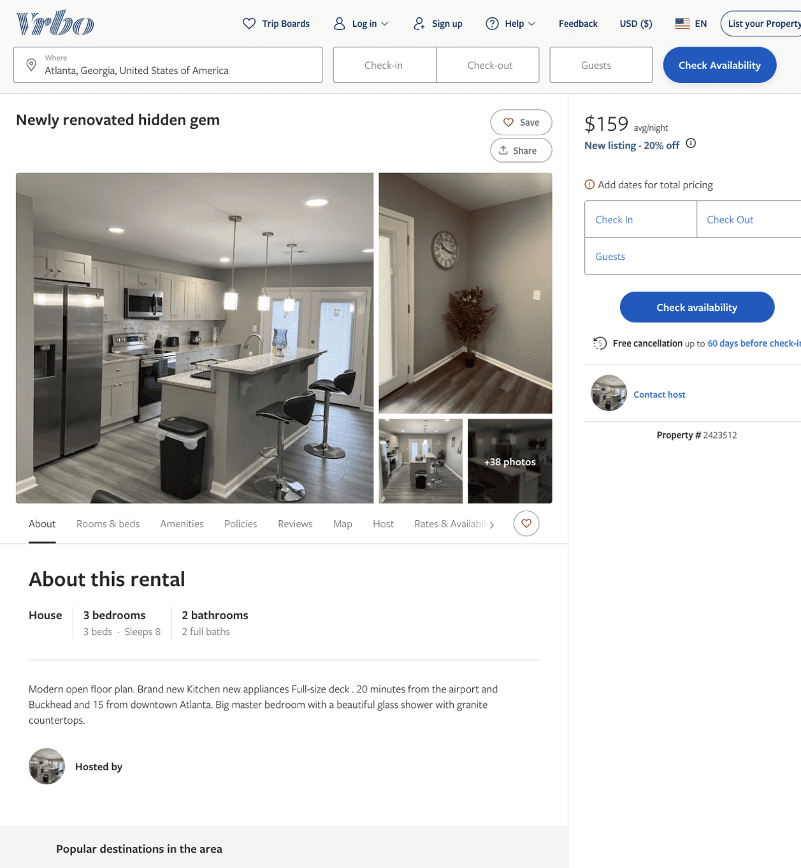
Listing 2423512
3
8
$127 - $217
5
1
sylvia & sylvia
https://www.vrbo.com/2423512
Aug 2022

Slide 3
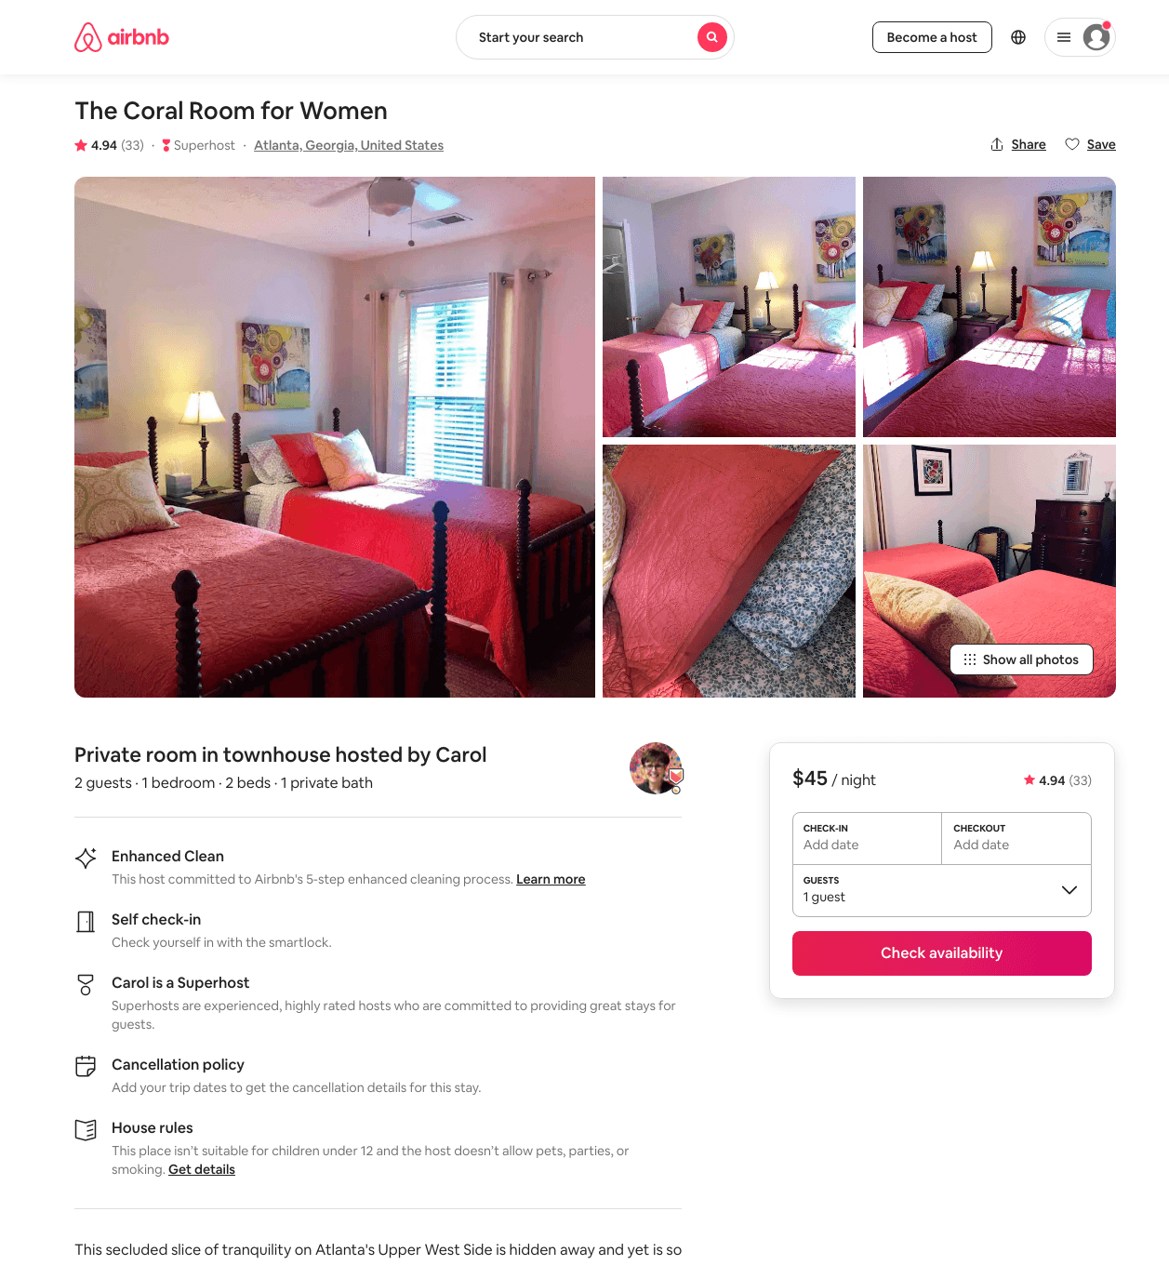
Listing 37014965
1
2
$41 - $48
4.94
2
Carol
62679211
3
https://www.airbnb.com/rooms/37014965
Aug 2022

Slide 4
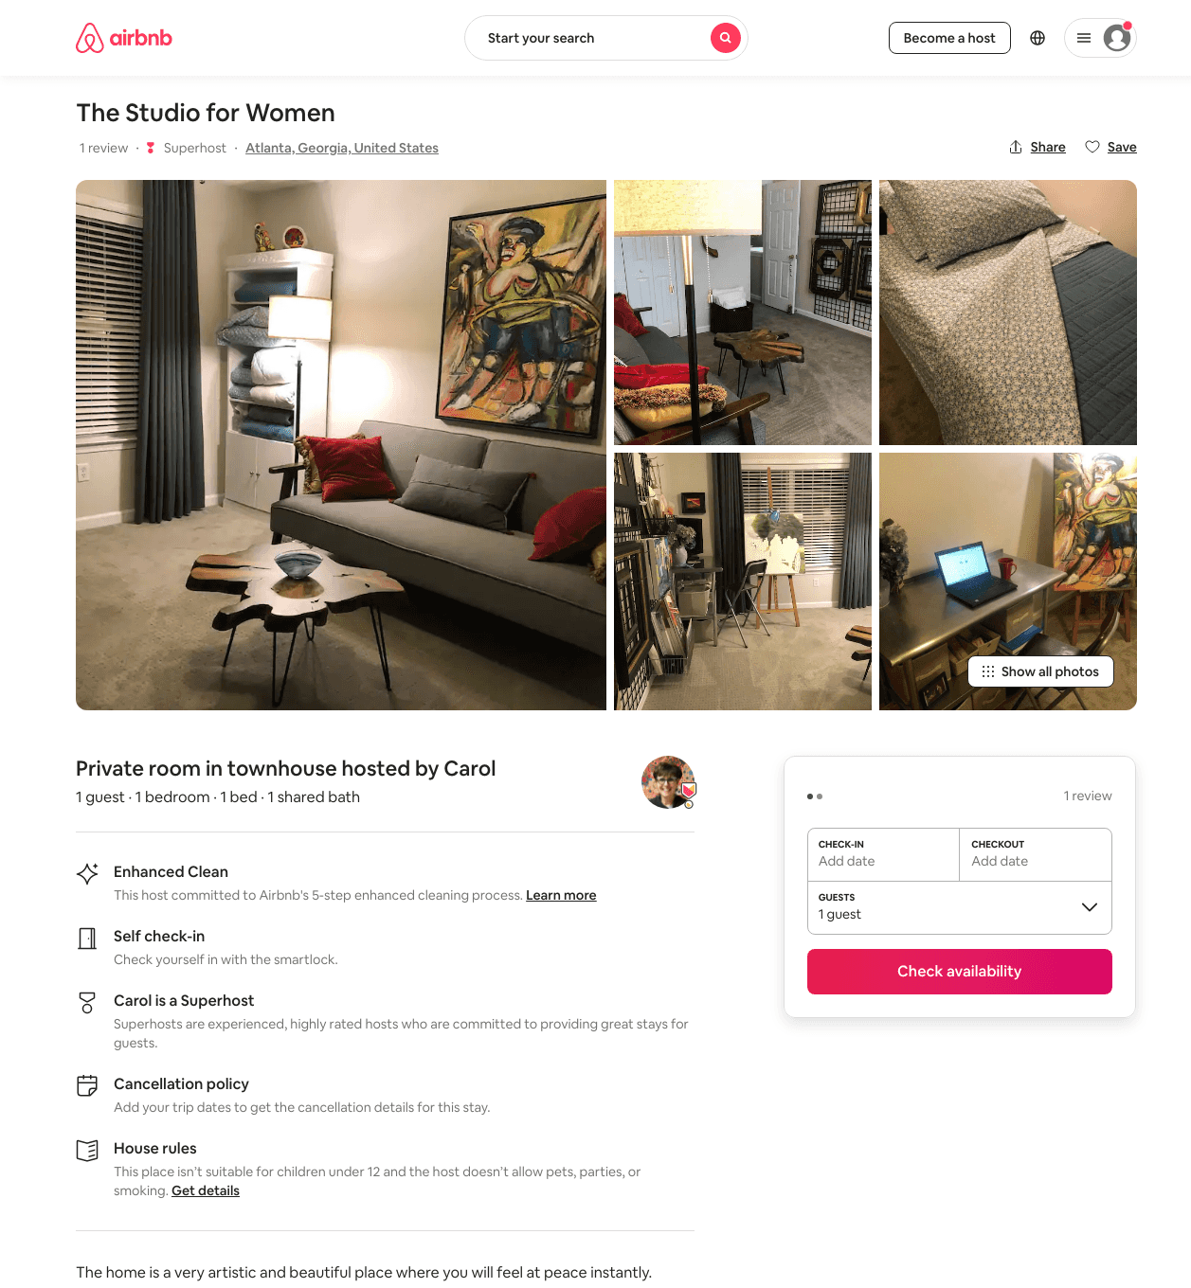
Listing 40736211
1
1
$33 - $46
4.91
2
Carol
62679211
3
https://www.airbnb.com/rooms/40736211
Aug 2022

Slide 5
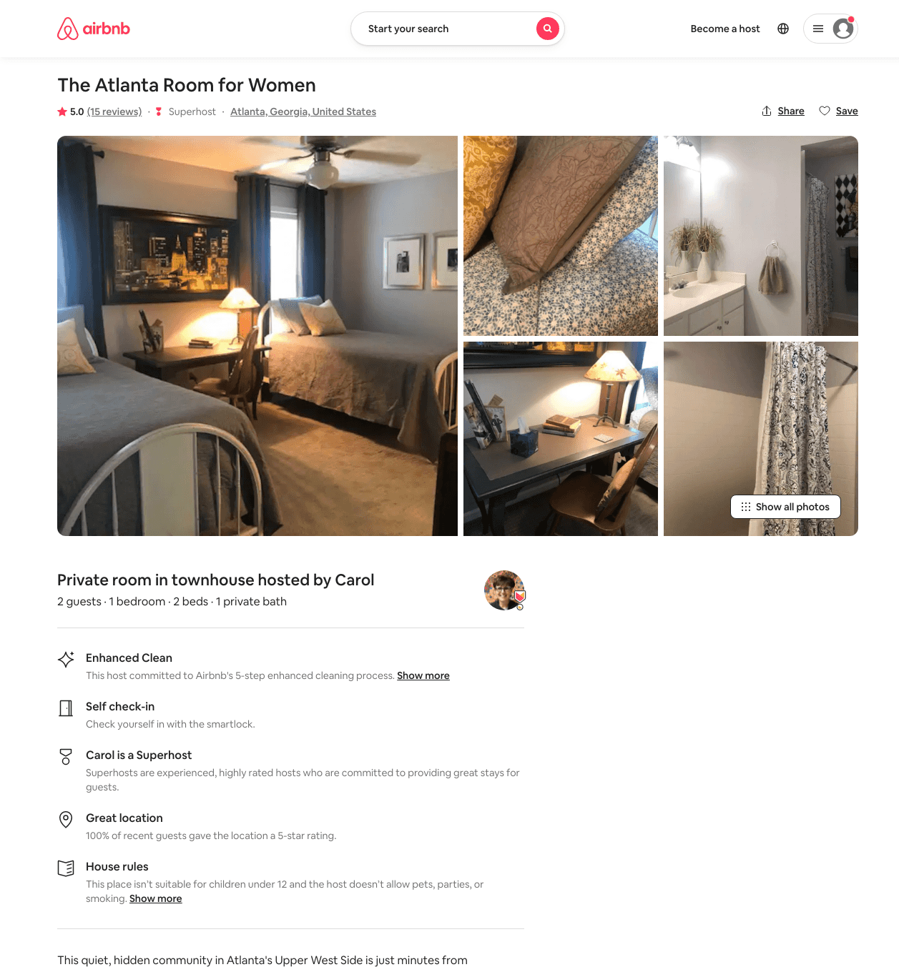
Listing 37008503
1
2
$45 - $63
4.94
2
Carol
62679211
3
https://www.airbnb.com/rooms/37008503
Aug 2022

Slide 6
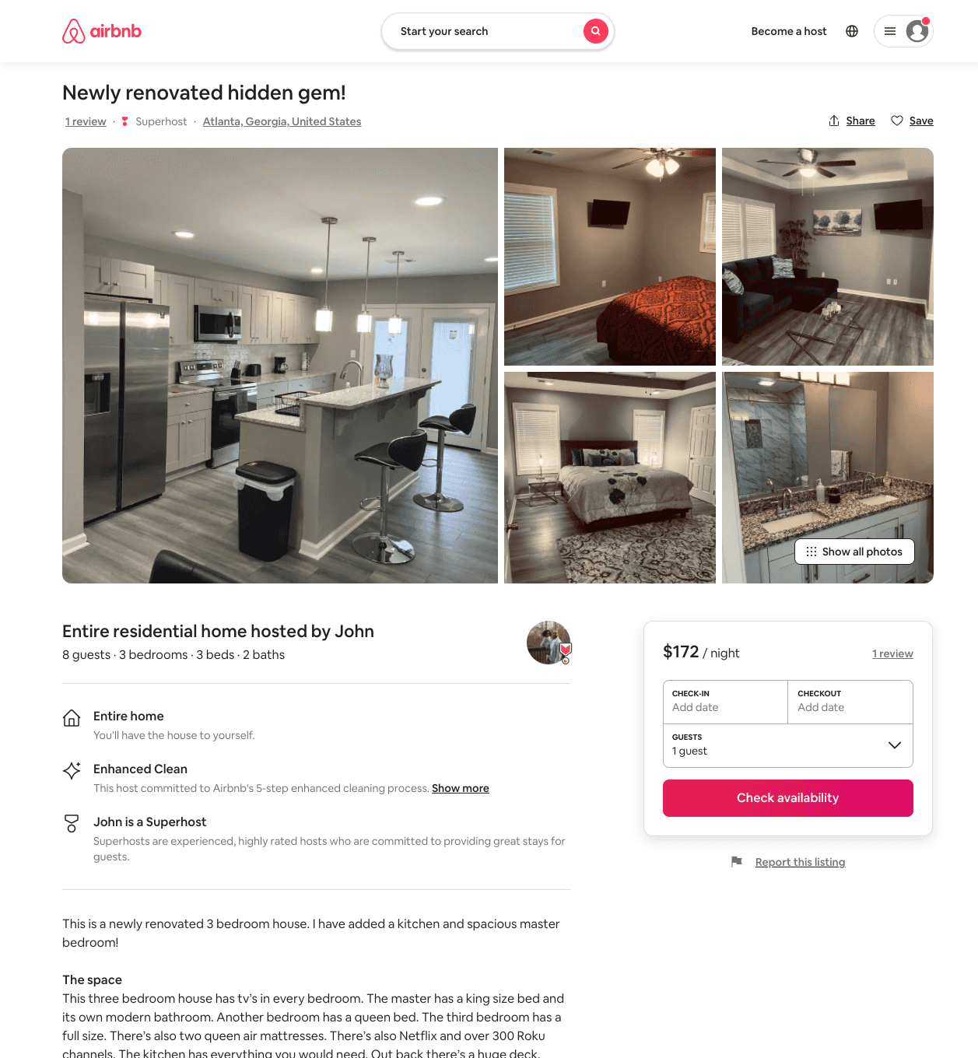
Listing 51091685
3
6
$139 - $215
4.93
1
John
288866579
5
https://www.airbnb.com/rooms/51091685
Aug 2022

Slide 7
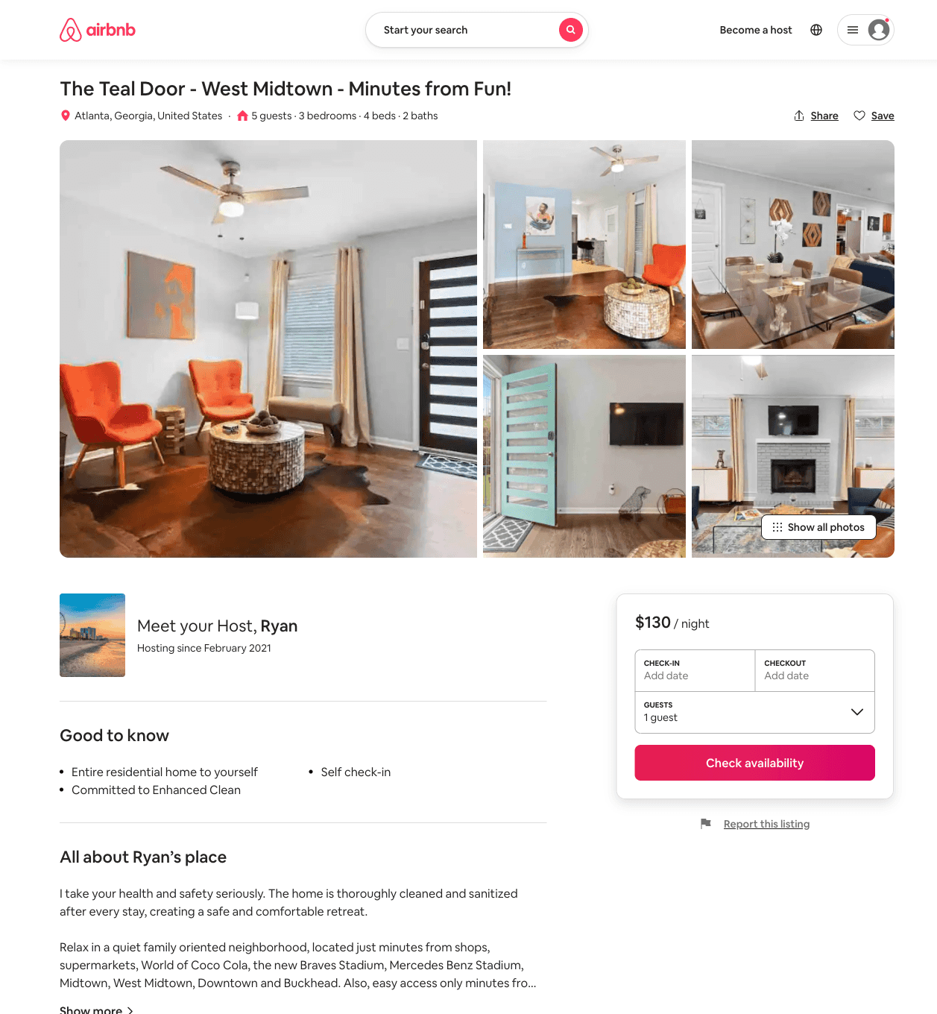
Listing 50909266
3
5
$81 - $128
4.87
2
Ryan
387054671
1
https://www.airbnb.com/rooms/50909266
Aug 2022

Slide 8
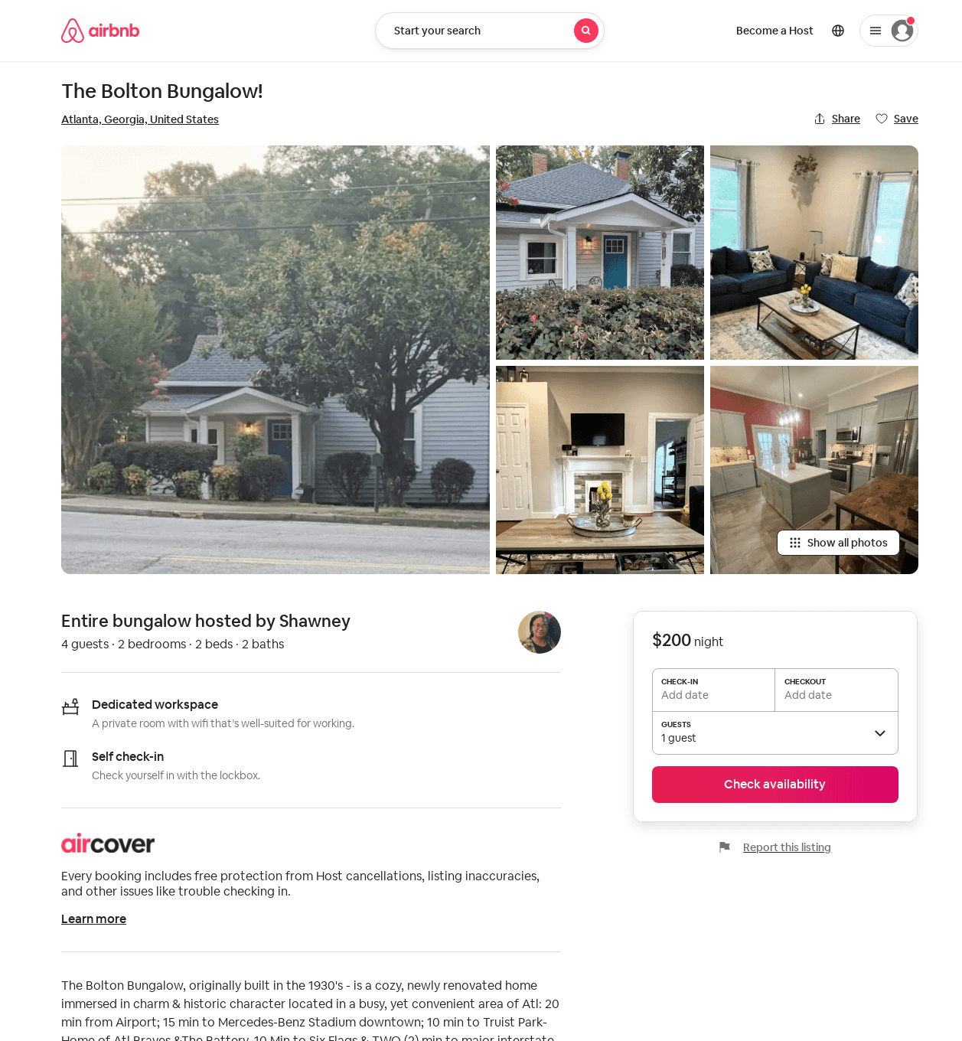
Listing 52703504
2
4
1
Shawney
285425430
1
https://www.airbnb.com/rooms/52703504
Aug 2022

