Slide 2
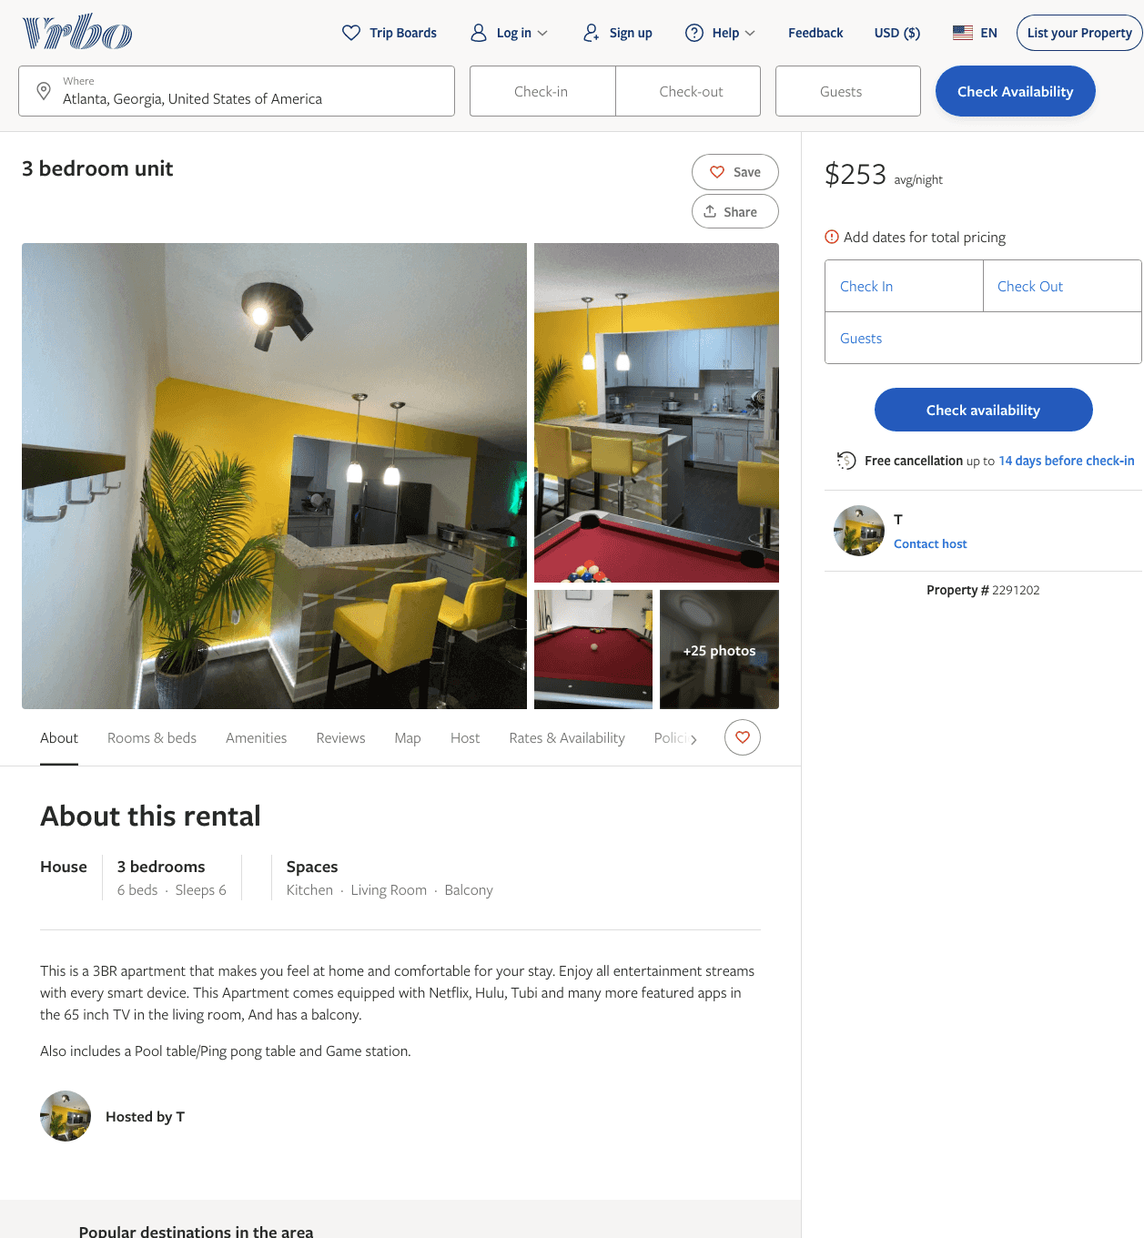
Listing 2291202
3
6
$230 - $253
5
2
T
https://www.vrbo.com/2291202
Aug 2022

Slide 3
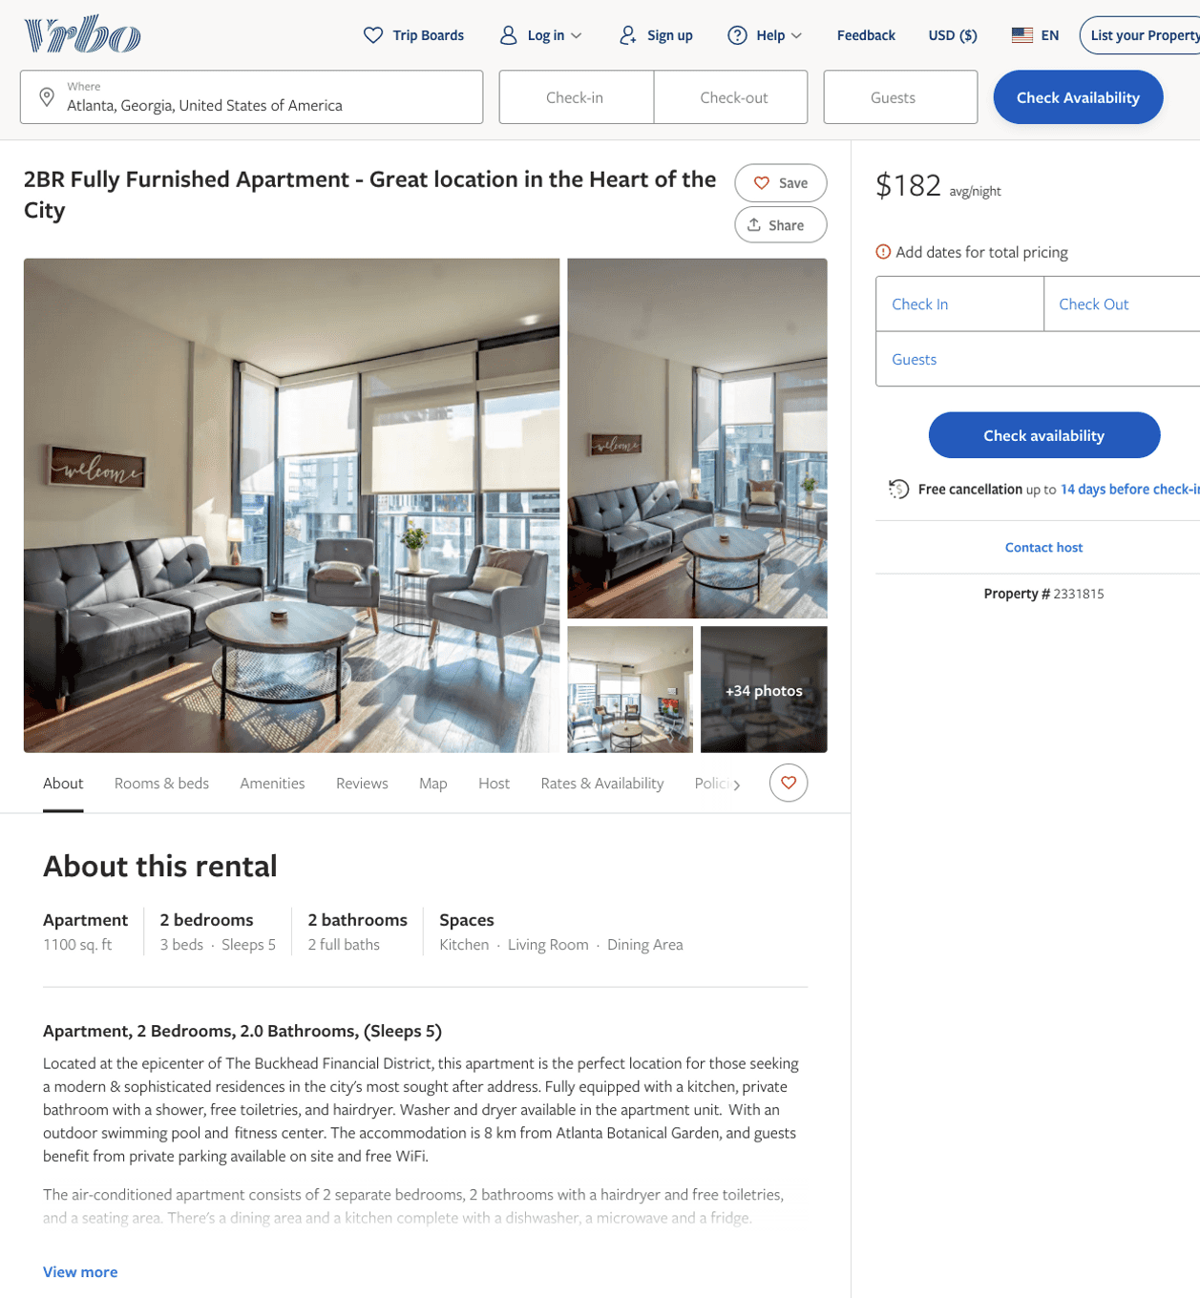
Listing 2331815
2
5
$192 - $252
3
2
Corporate Housing
https://www.vrbo.com/2331815
Aug 2022

Slide 4
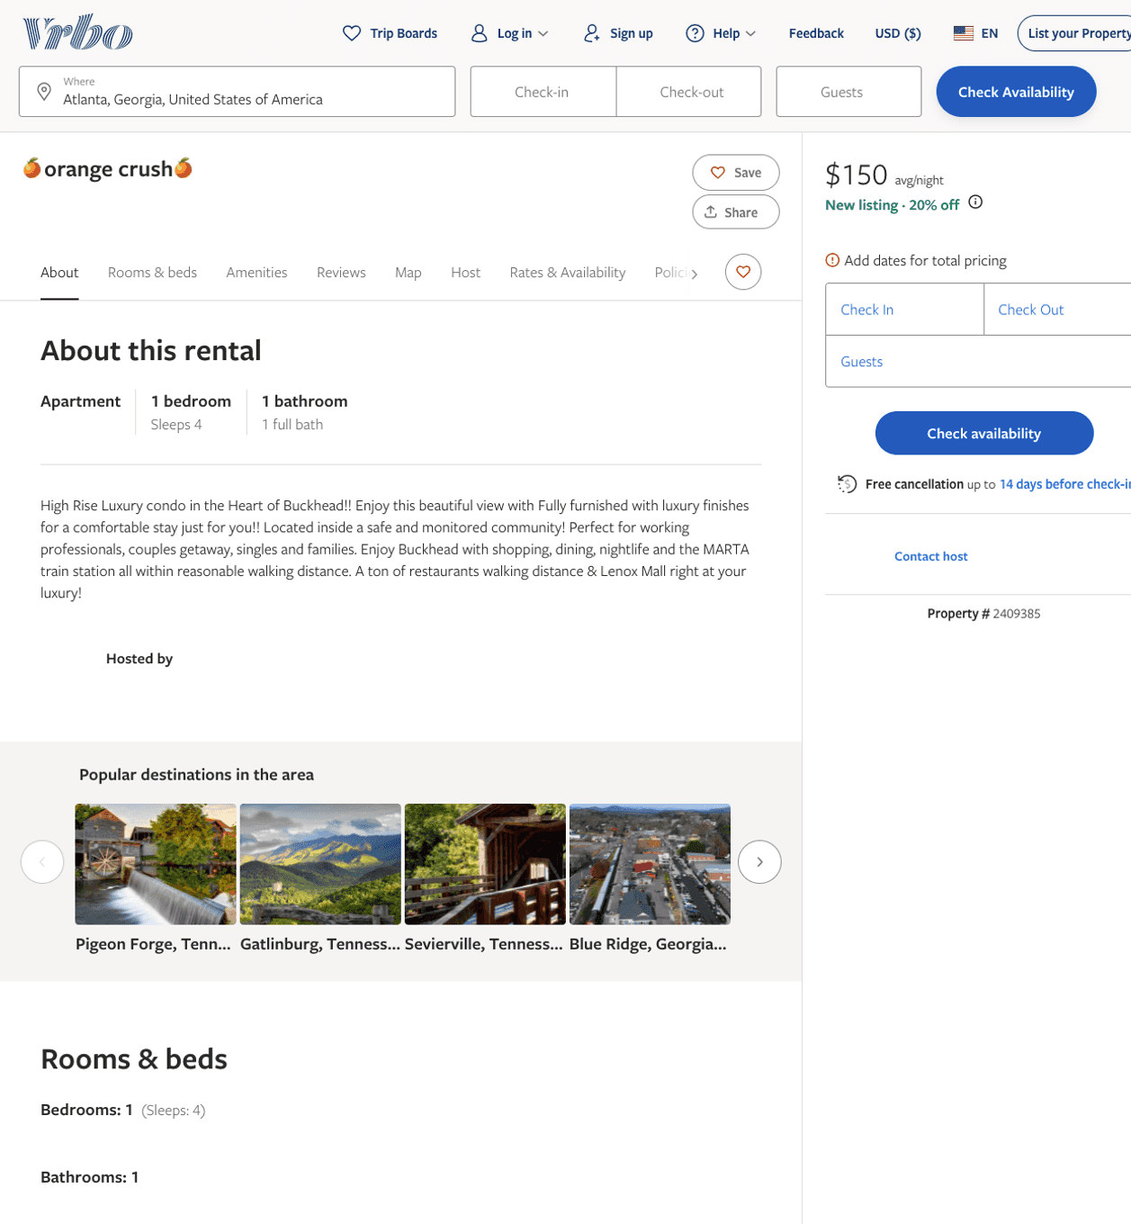
Listing 2409385
1
4
$150
1
https://www.vrbo.com/2409385
Aug 2022

Slide 5
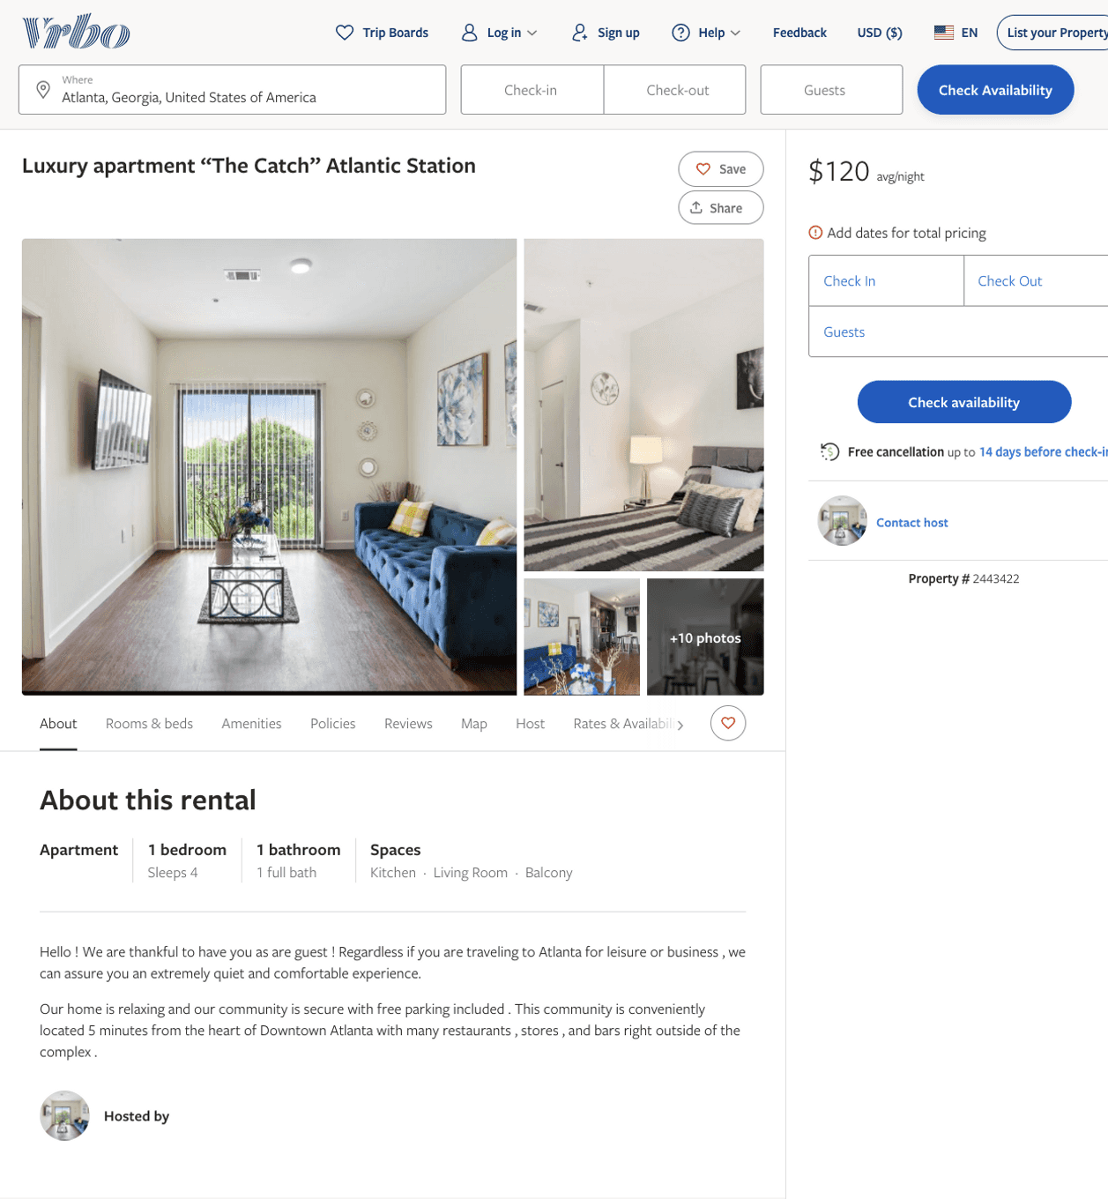
Listing 2443422
1
4
$120
20
https://www.vrbo.com/2443422
Aug 2022

Slide 6
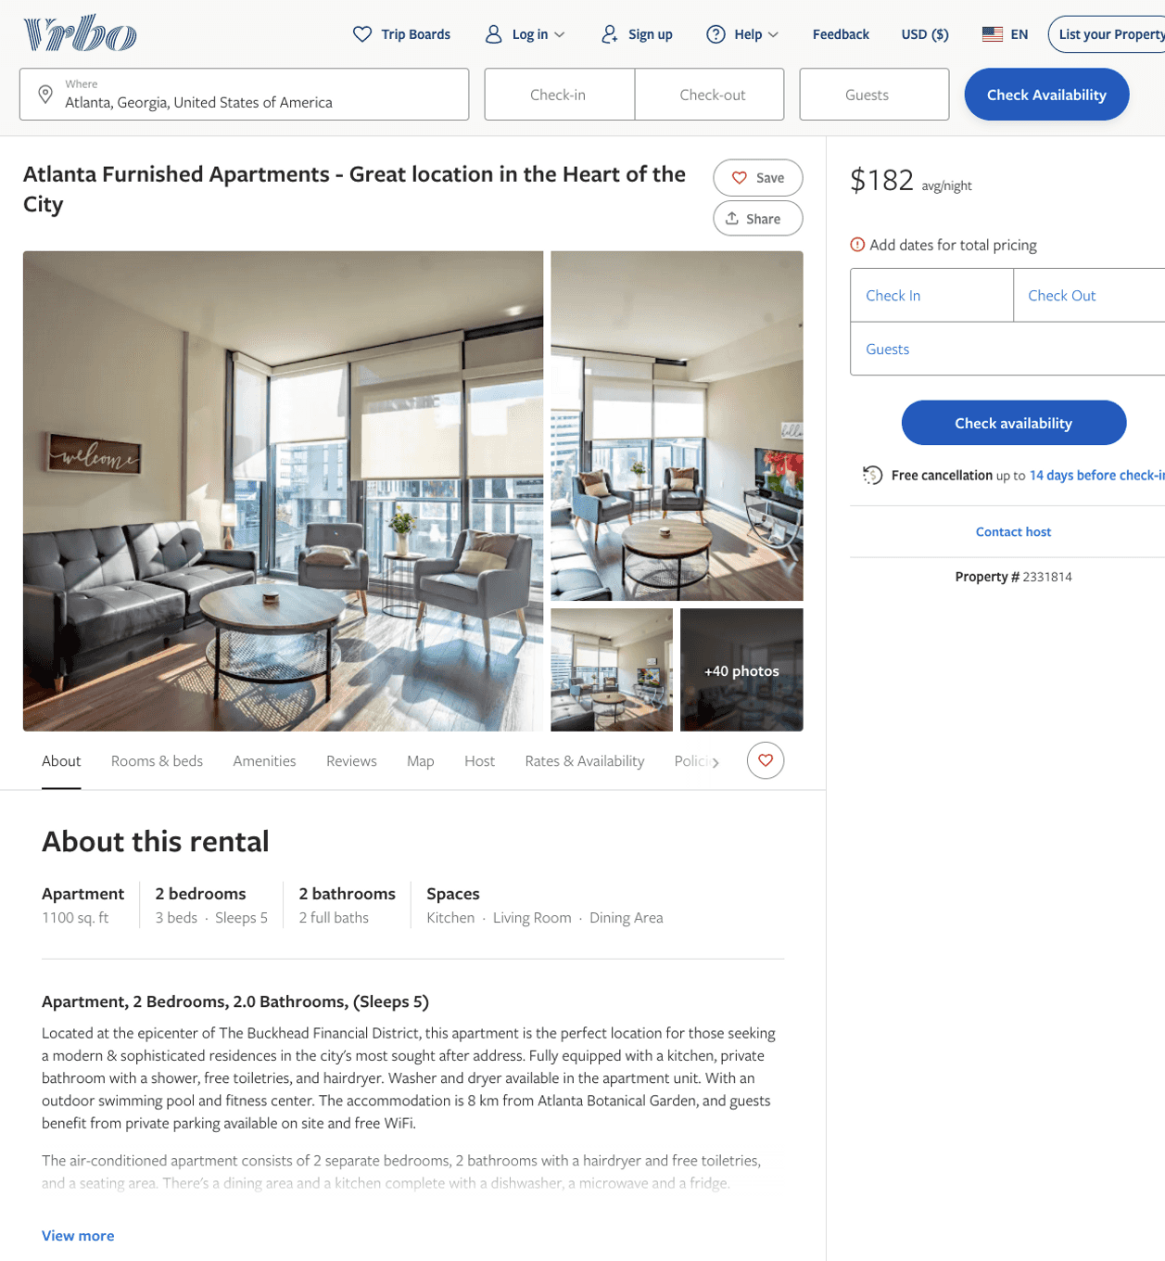
Listing 2331814
2
5
$192 - $261
2
Corporate Housing
https://www.vrbo.com/2331814
Aug 2022

Slide 7
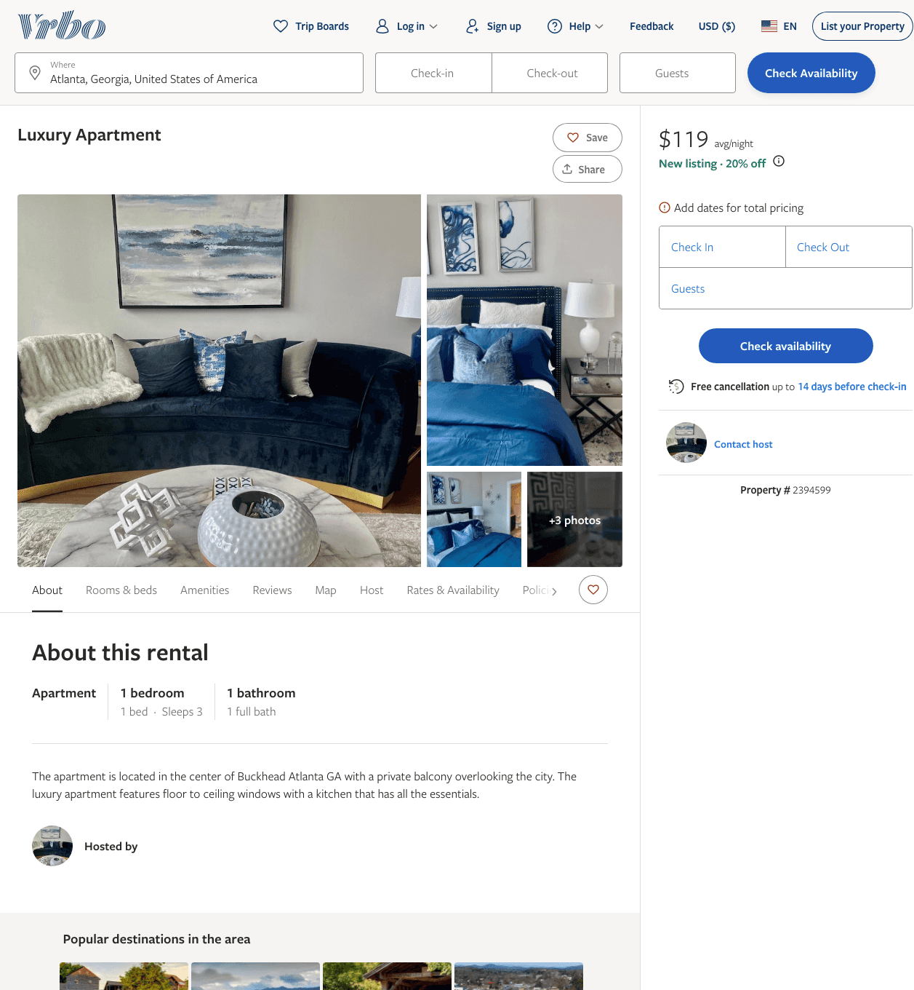
Listing 2394599
1
3
$119 - $140
4
1
https://www.vrbo.com/2394599
Aug 2022

Slide 8
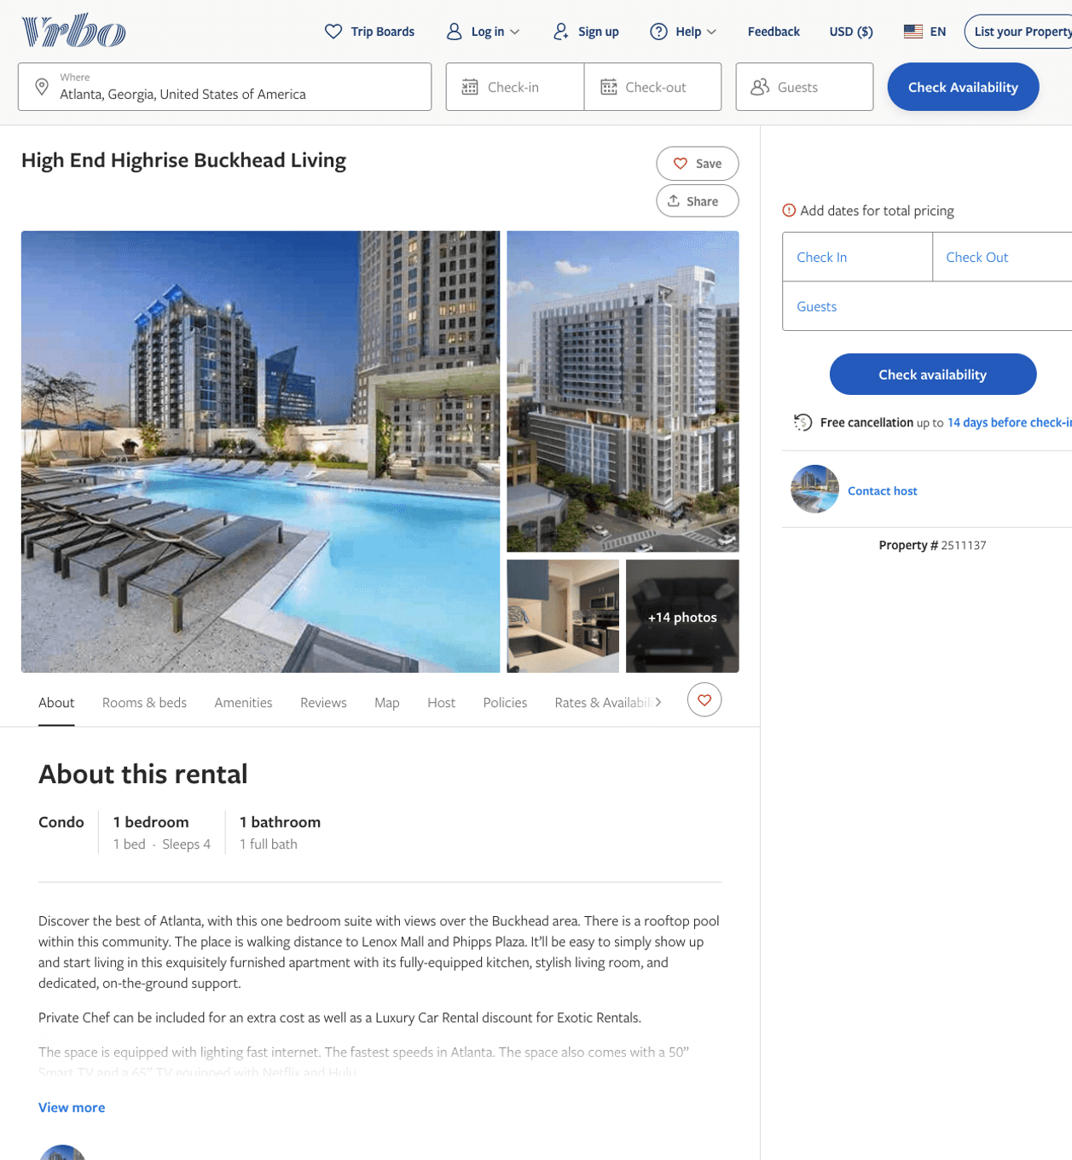
Listing 2511137
1
4
$185
3
Nathaniel
https://www.vrbo.com/2511137
Aug 2022

Slide 9
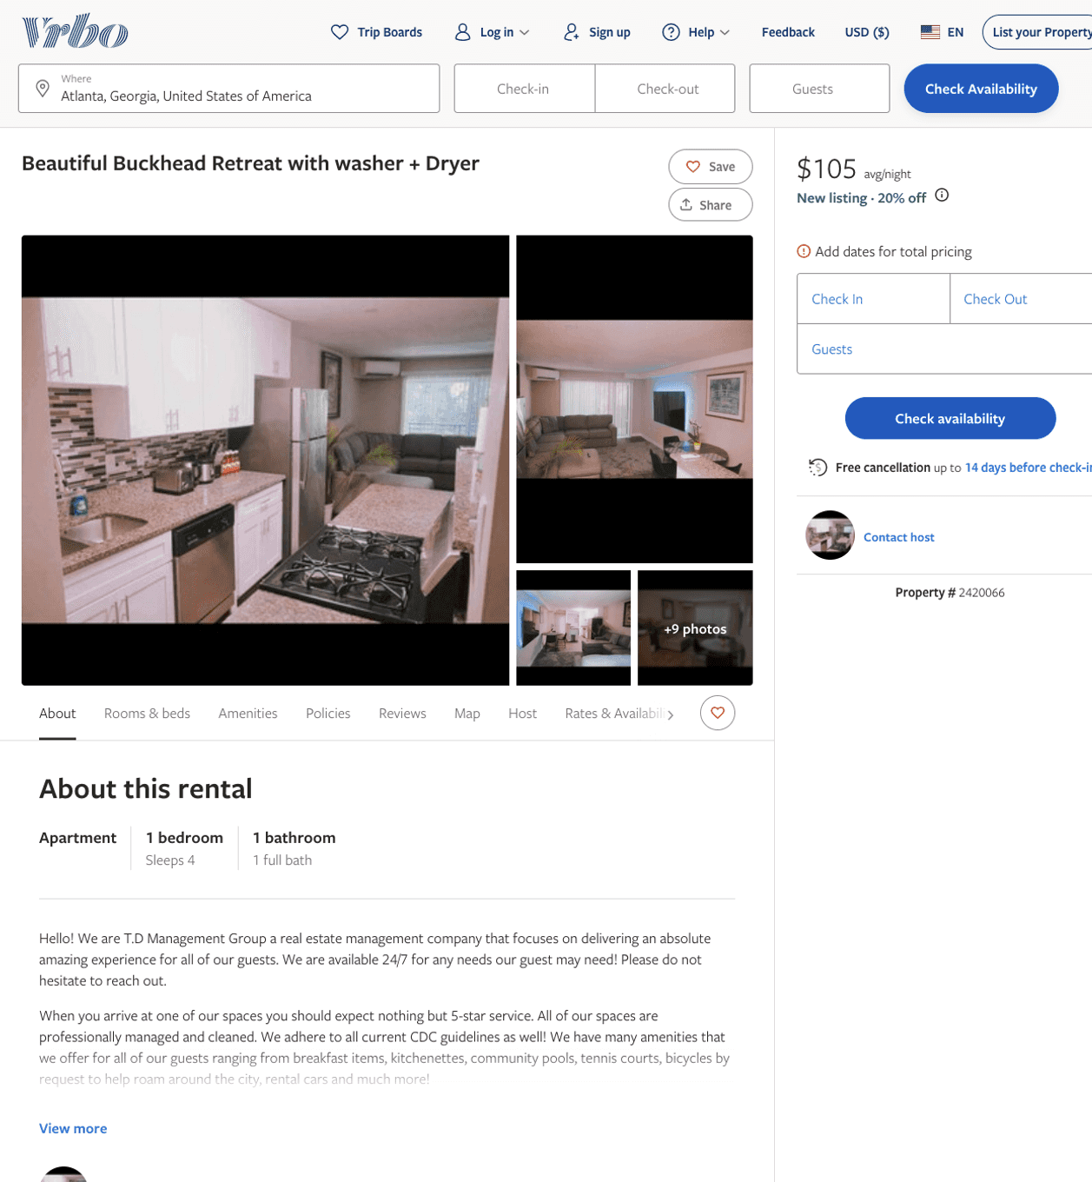
Listing 2420066
1
4
$105
1
https://www.vrbo.com/2420066
Aug 2022

Slide 10
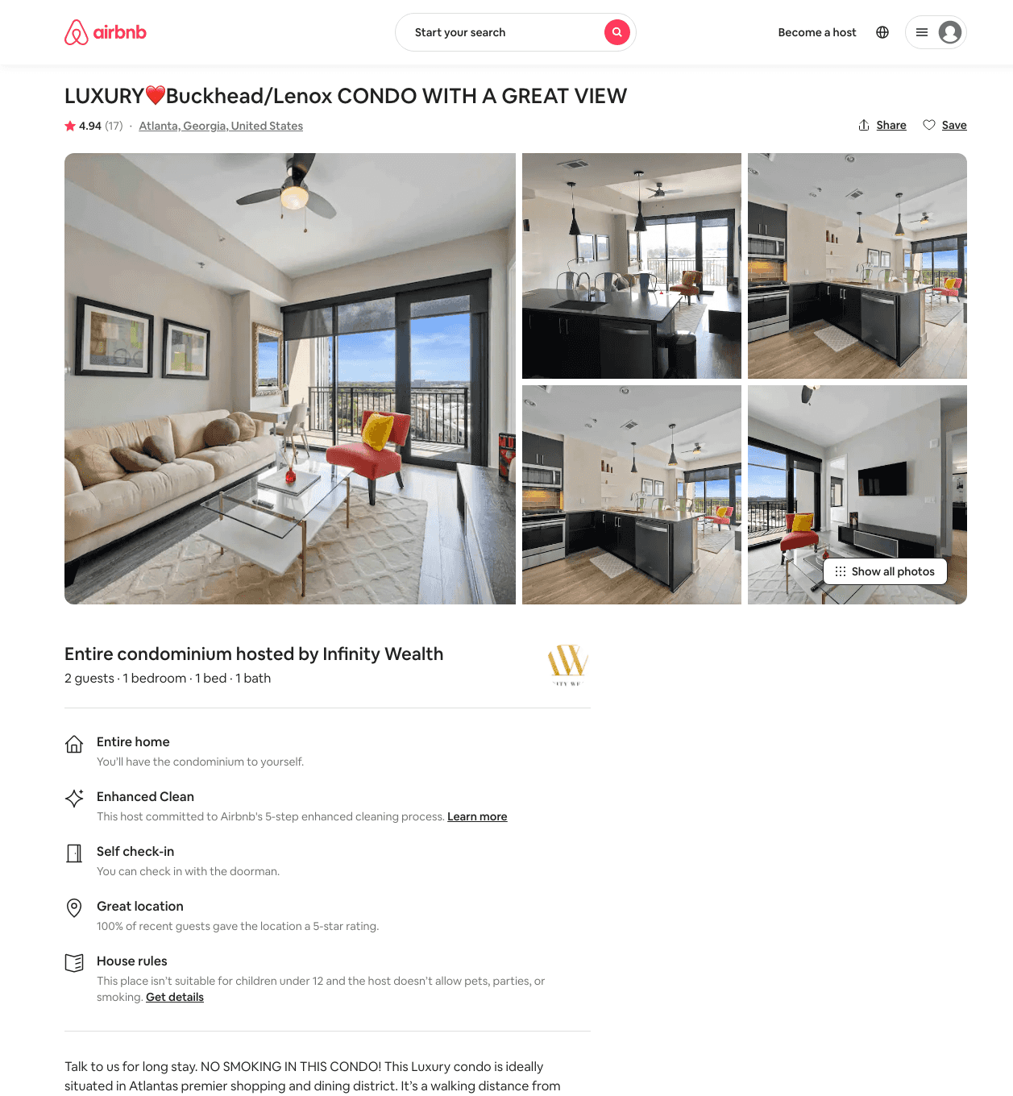
Listing 42926124
1
2
$144 - $306
4.91
2
Infinity Wealth
83899049
4
https://www.airbnb.com/rooms/42926124
Aug 2022

Slide 11
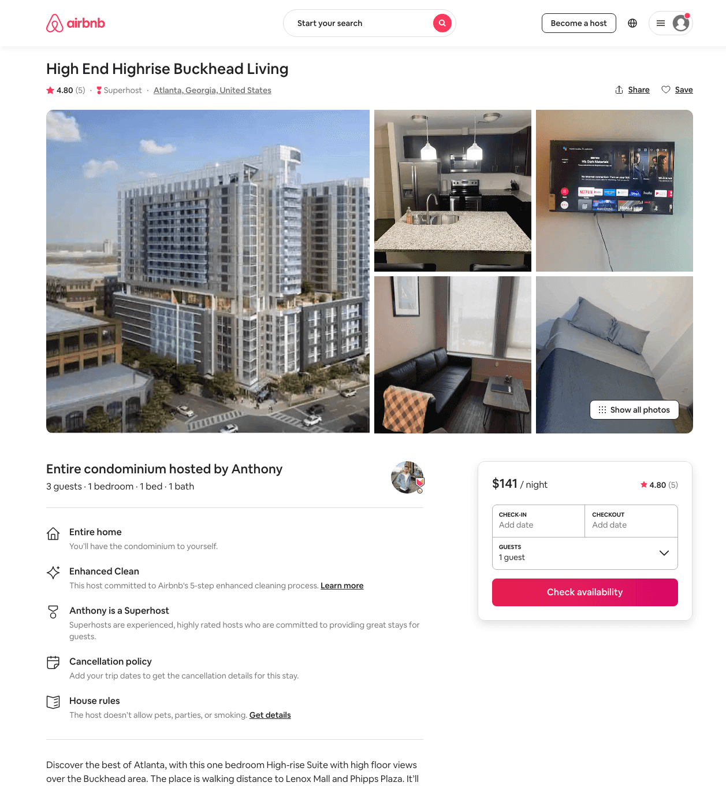
Listing 47339039
1
3
$119 - $250
4.59
5
A And J
209499361
2
https://www.airbnb.com/rooms/47339039
Aug 2022

Slide 12
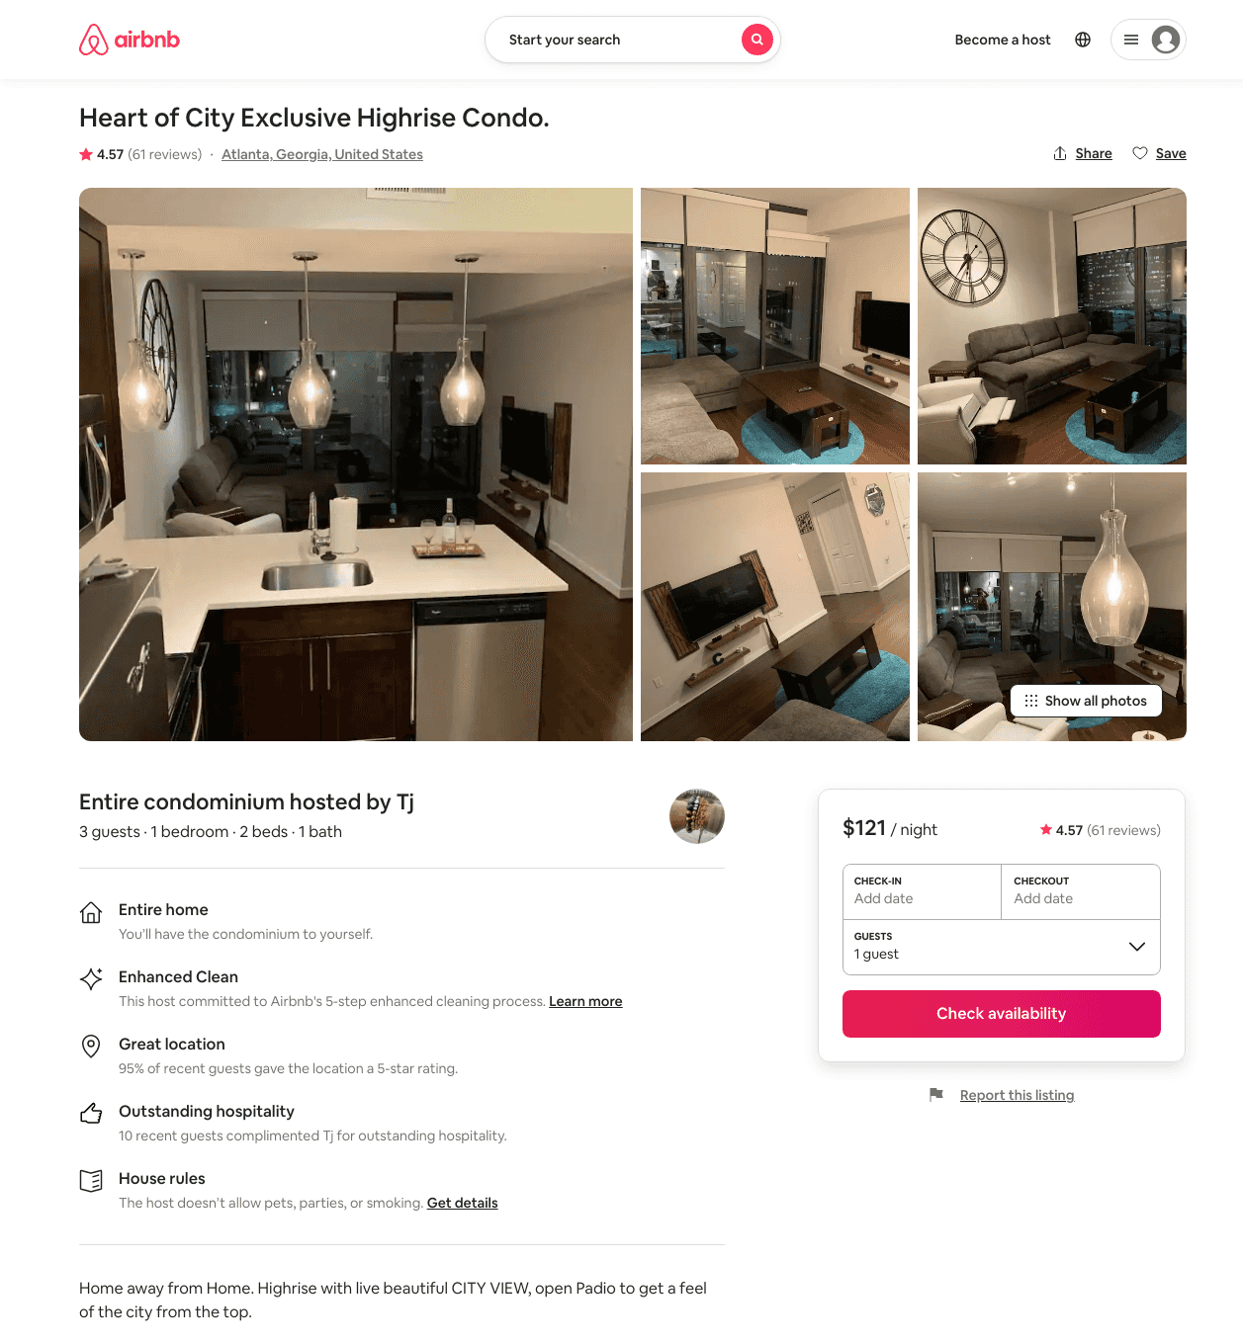
Listing 40760095
1
2
$90 - $149
4.56
1
James
227867184
4
https://www.airbnb.com/rooms/40760095
Aug 2022

Slide 13
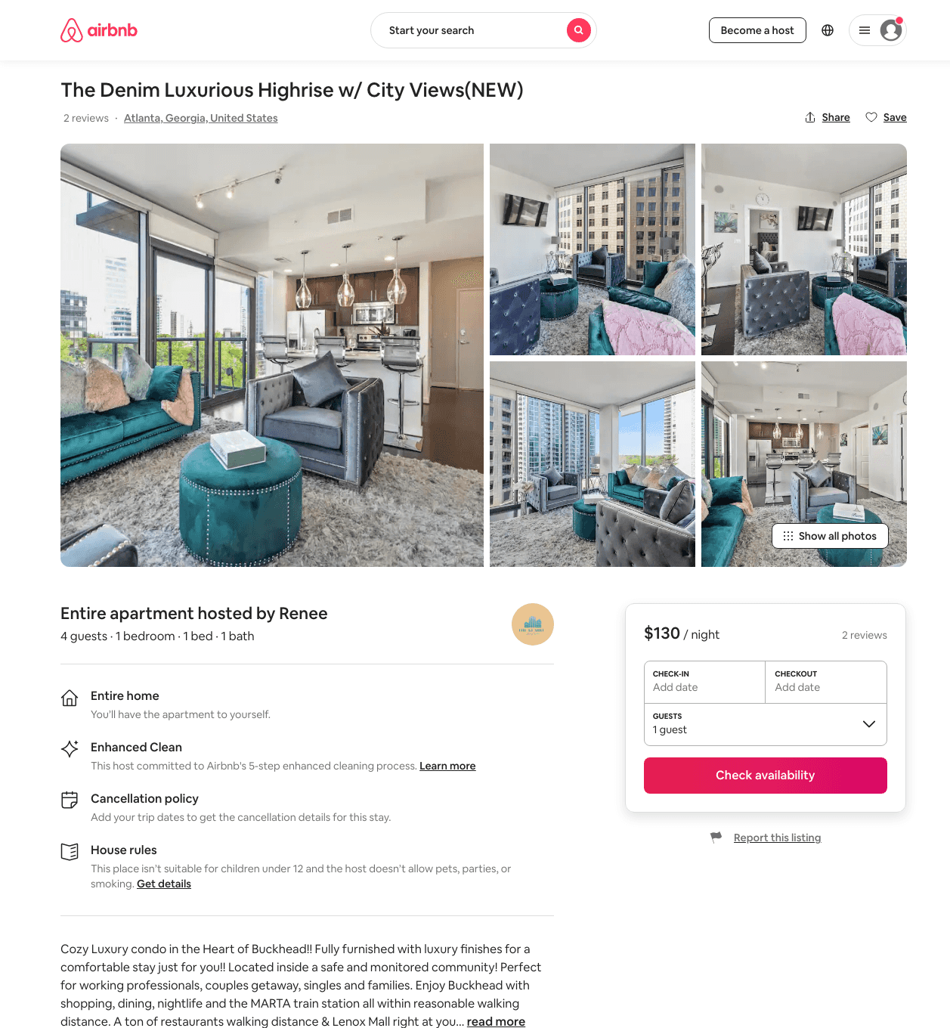
Listing 49060906
1
4
$119 - $204
4.73
1
Renee
395672318
1
https://www.airbnb.com/rooms/49060906
Aug 2022

Slide 14
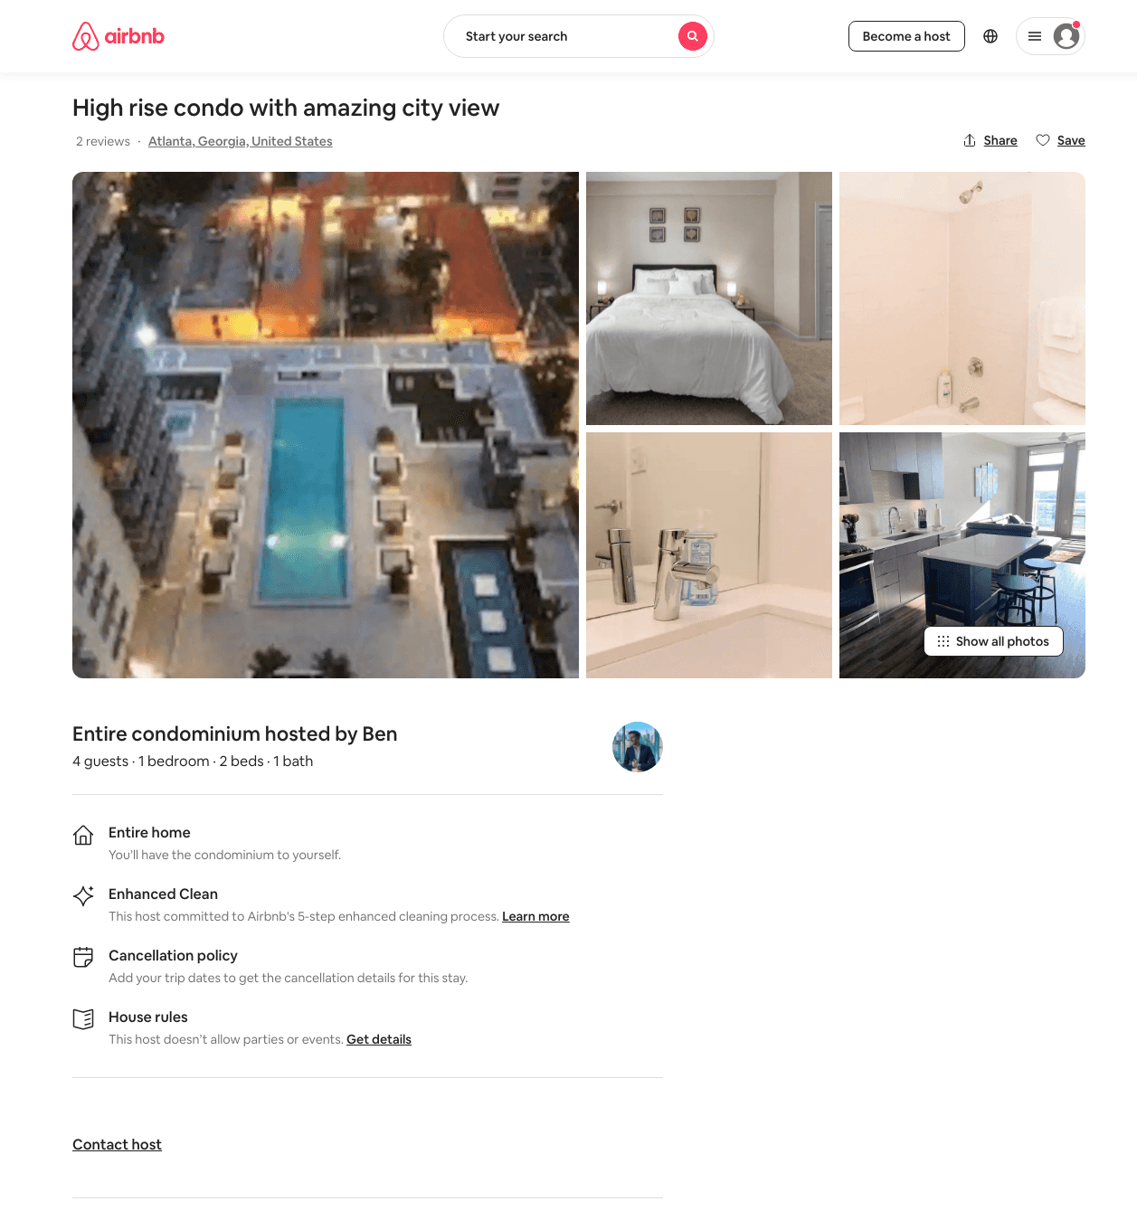
Listing 48448225
1
4
$140 - $224
4.54
2
Ben
156931004
1
https://www.airbnb.com/rooms/48448225
Jul 2022

Slide 15
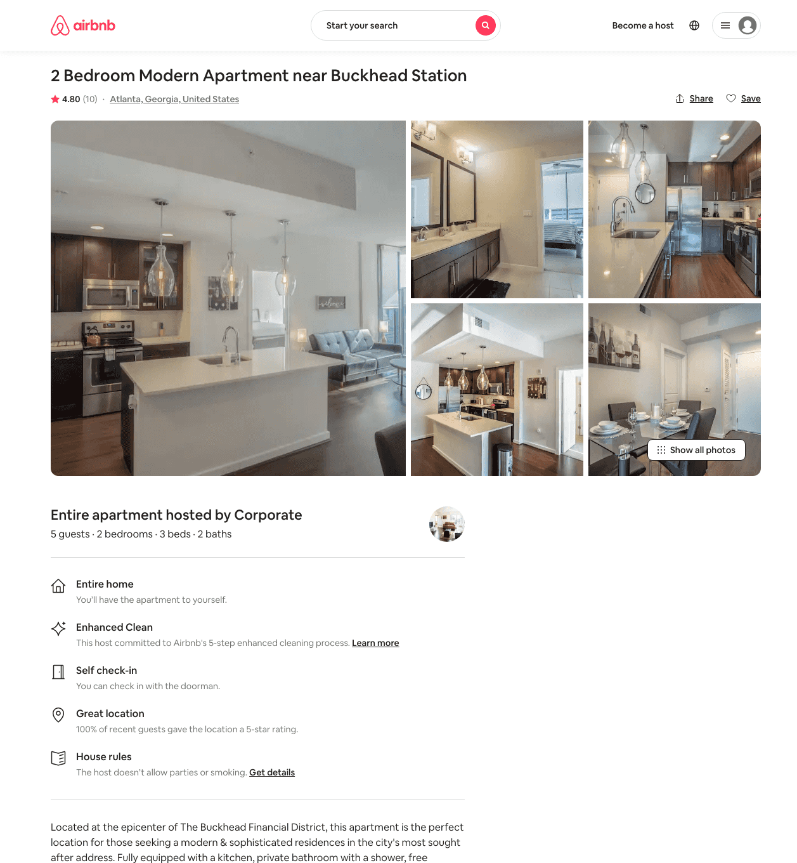
Listing 38697896
2
5
$168 - $366
4.80
3
Corporate
16644446
12
https://www.airbnb.com/rooms/38697896
Aug 2022

Slide 16
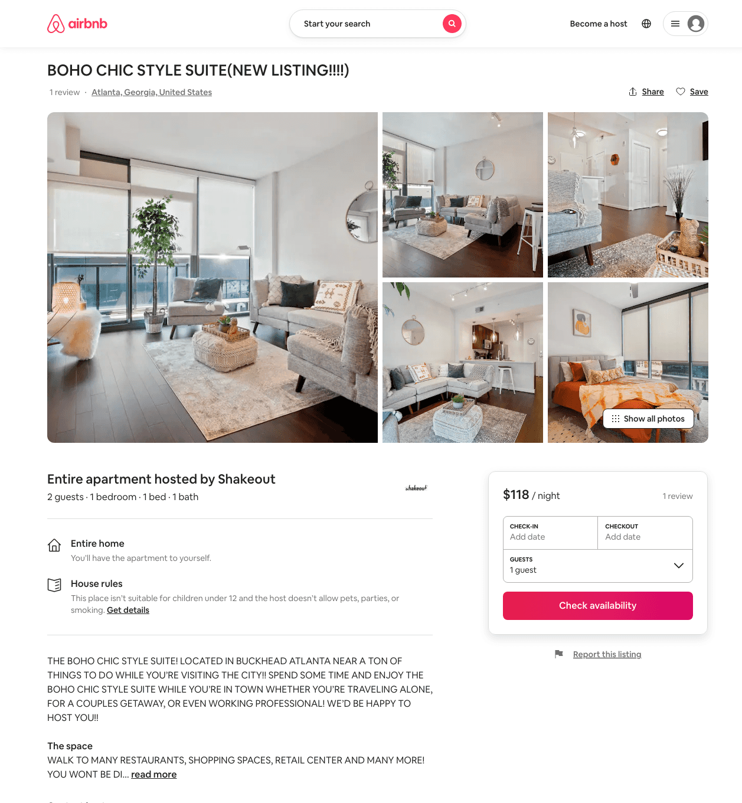
Listing 49198994
1
2
$89 - $214
4.84
2
Shakeout
73597352
1
https://www.airbnb.com/rooms/49198994
Jun 2022

Slide 17
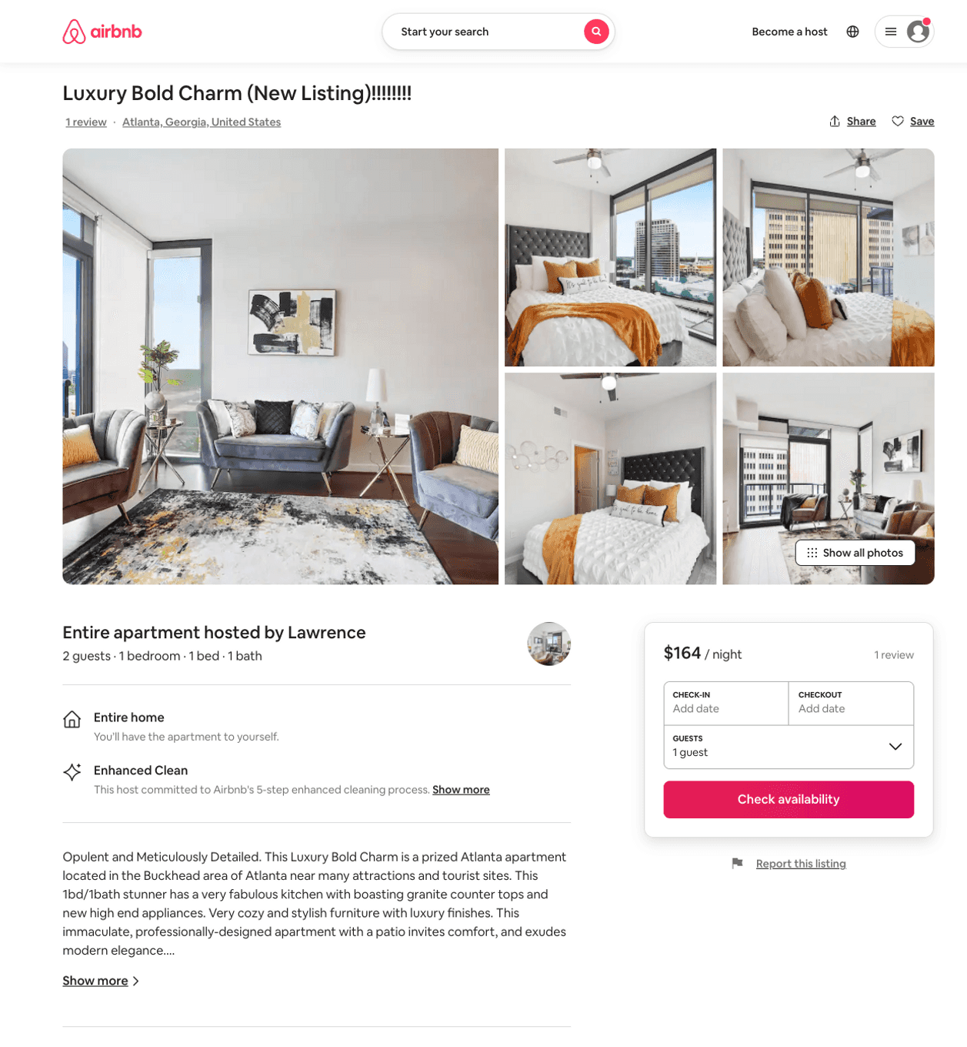
Listing 50259943
1
2
$132 - $164
4.56
1
Lawrence
68935150
1
https://www.airbnb.com/rooms/50259943
Aug 2022

Slide 18
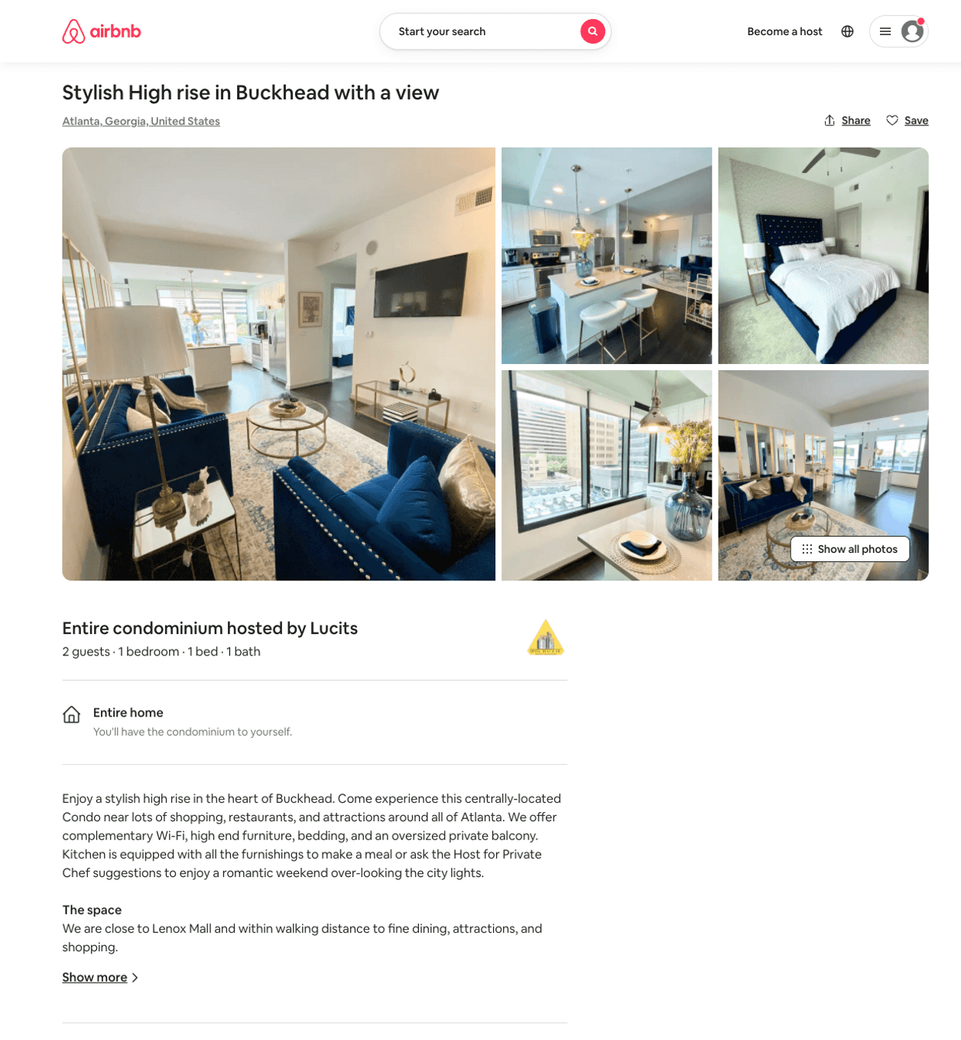
Listing 50049248
1
2
$124 - $265
5.0
2
Jones
403689070
2
https://www.airbnb.com/rooms/50049248
Jul 2022

Slide 19
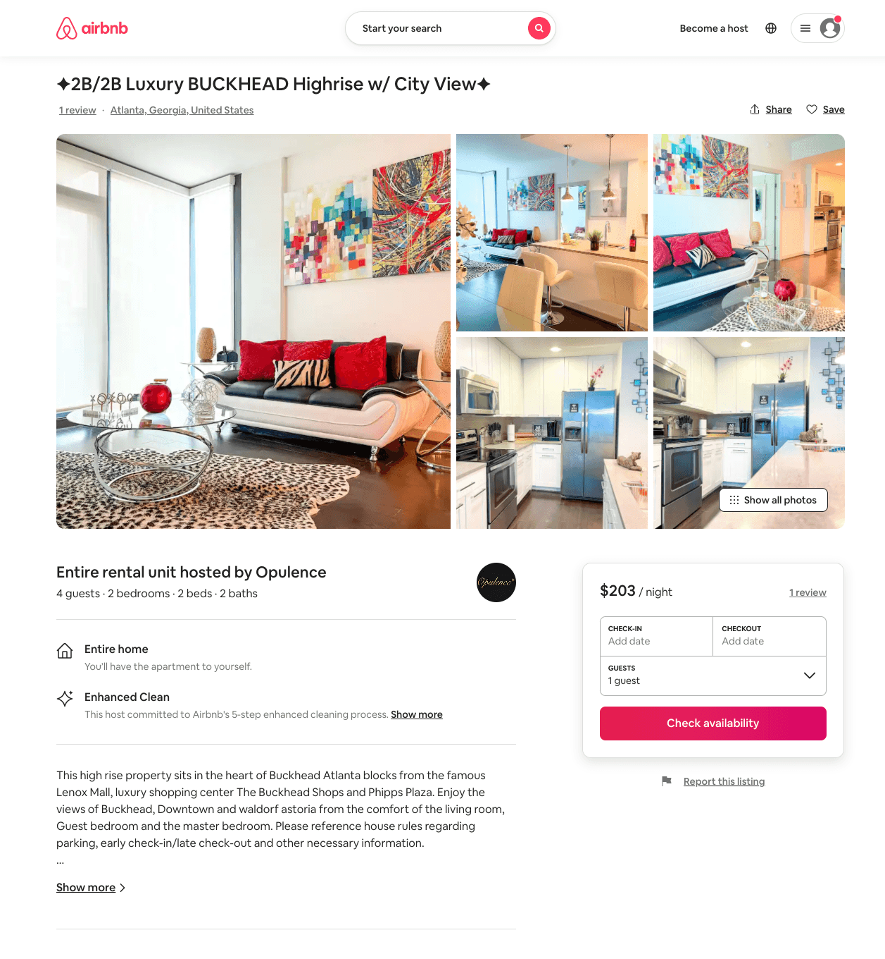
Listing 51024421
2
5
$150 - $229
4.90
2
Opulence
139241351
1
https://www.airbnb.com/rooms/51024421
Aug 2022

Slide 20
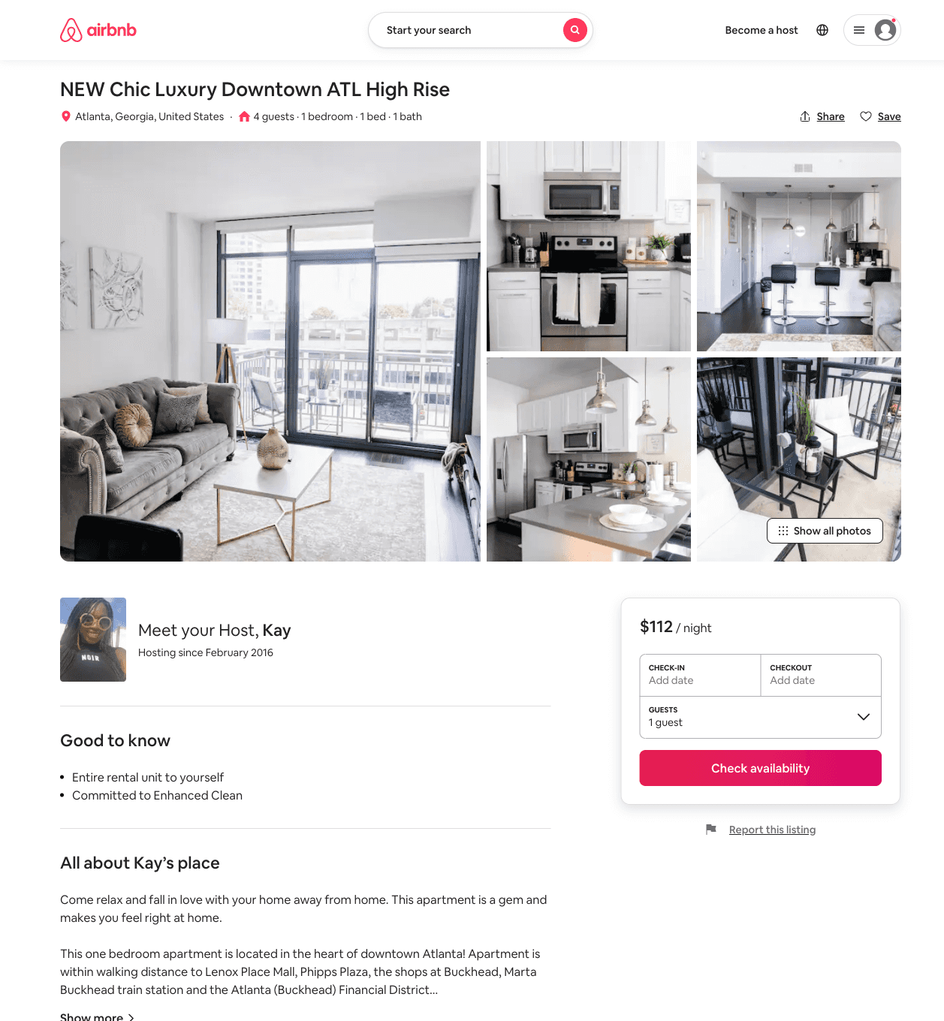
Listing 51217454
1
4
$100 - $146
4.82
3
Top Tier Management
57888219
2
https://www.airbnb.com/rooms/51217454
Aug 2022

Slide 21
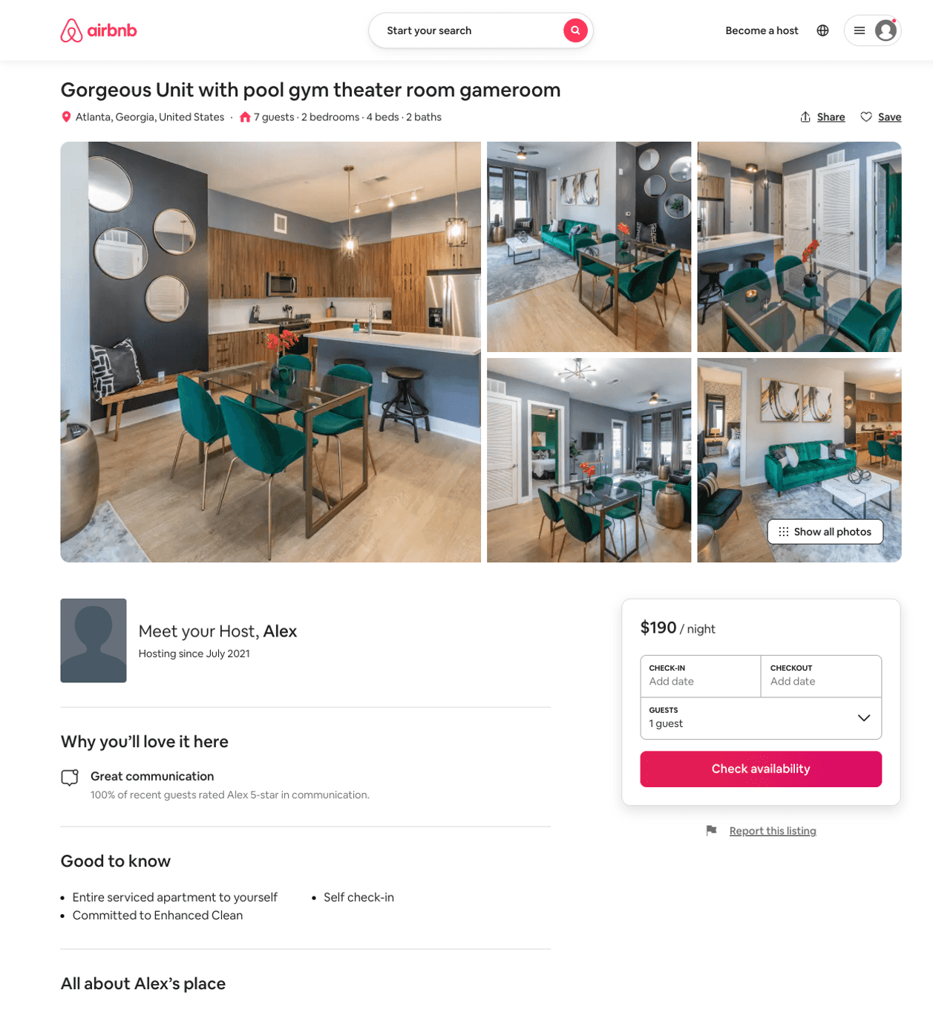
Listing 51730066
2
7
$190 - $442
4.70
1
Alex
411957415
2
https://www.airbnb.com/rooms/51730066
Aug 2022

Slide 22
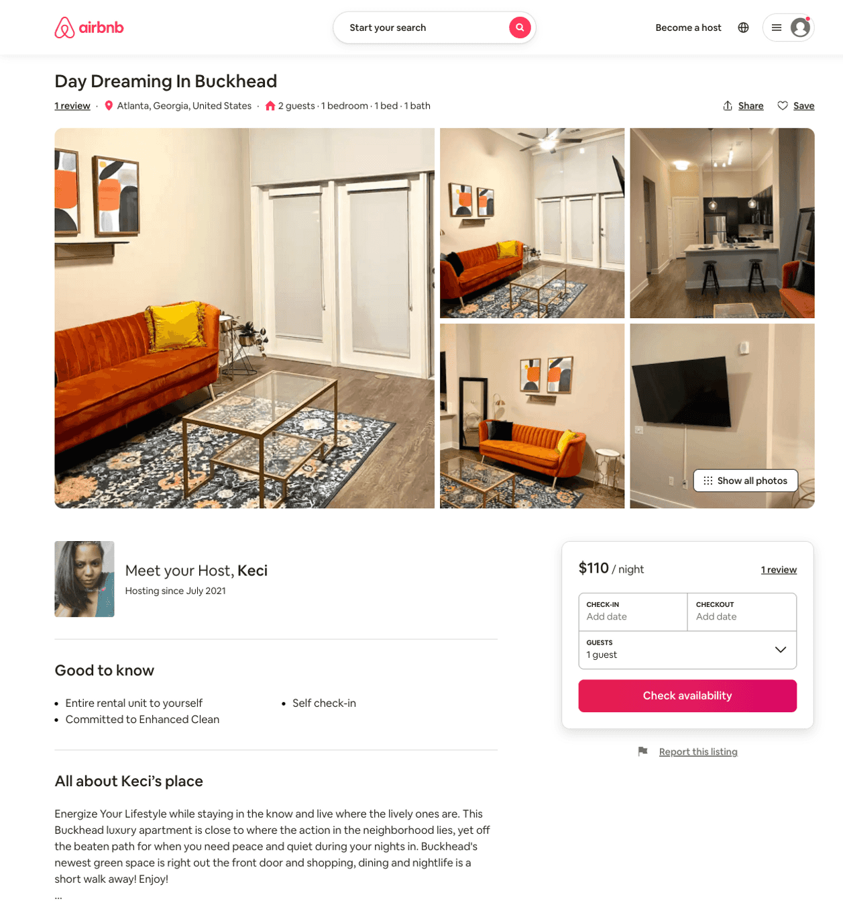
Listing 51459290
1
2
$95 - $121
5.0
2
Keci
412559091
1
https://www.airbnb.com/rooms/51459290
Jul 2022

Slide 23
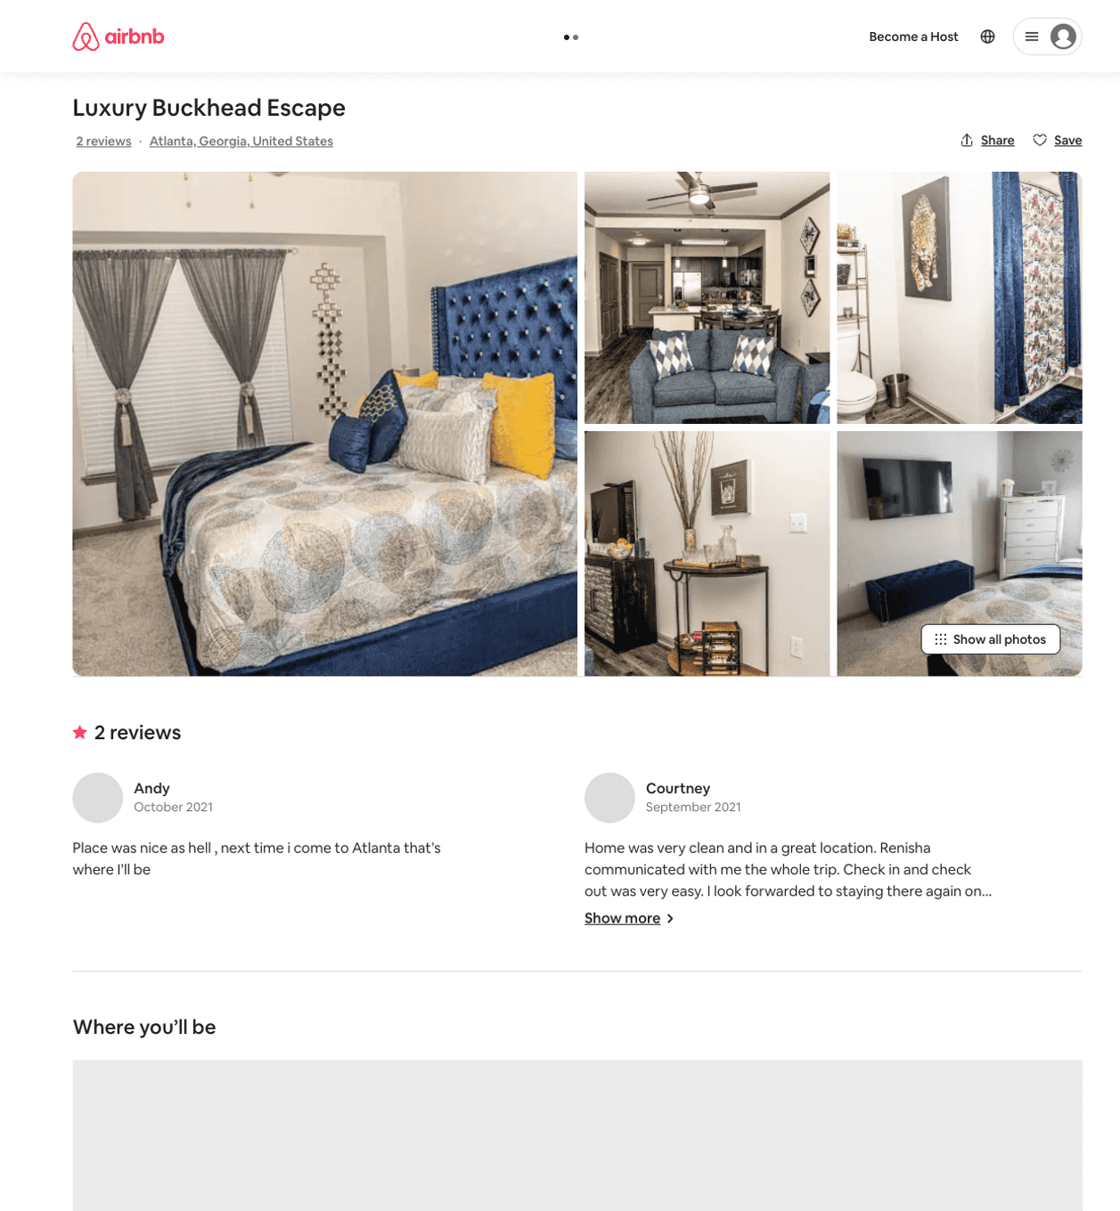
Listing 52279438
1
4
$99 - $199
4.88
2
Renisha
387331785
1
https://www.airbnb.com/rooms/52279438
Aug 2022

Slide 24
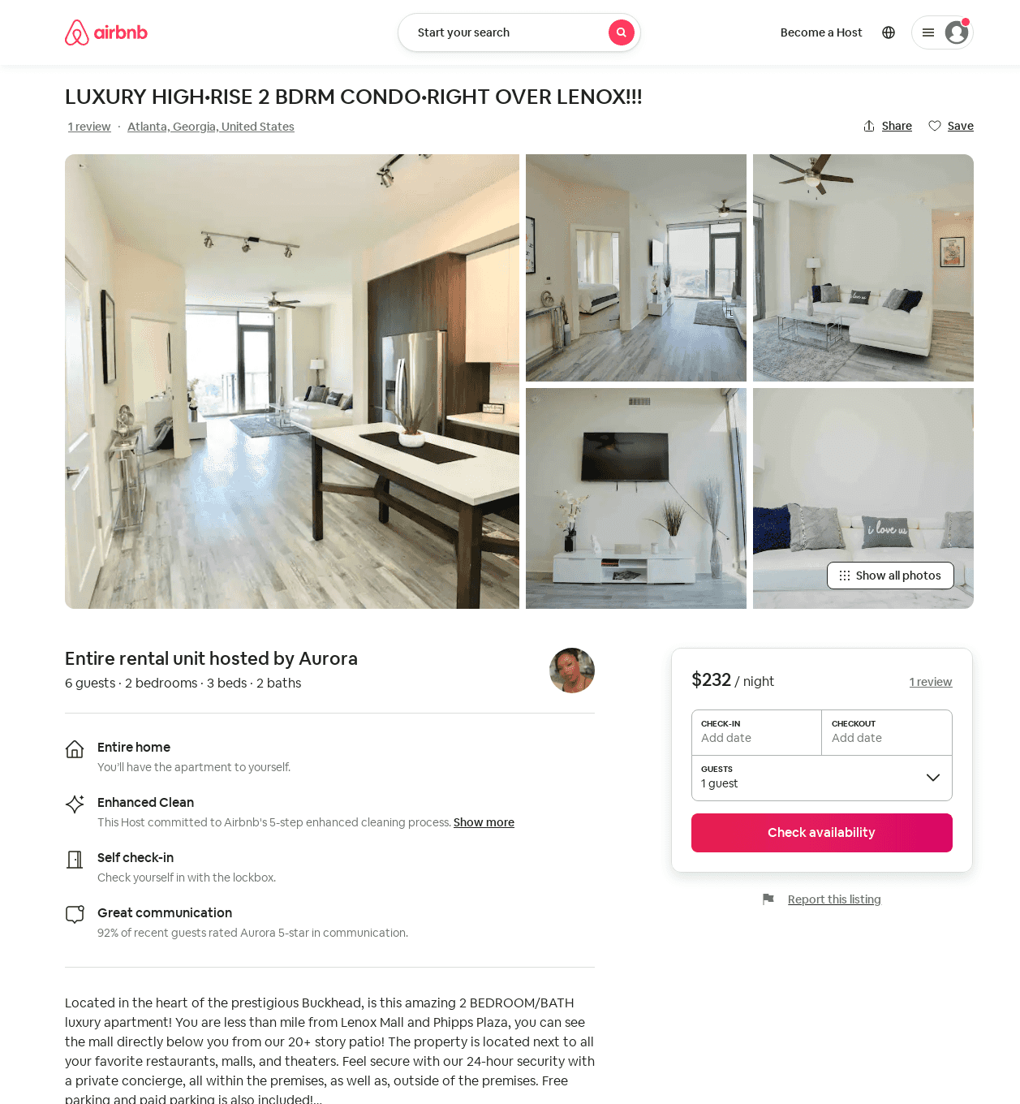
Listing 53280757
2
10
$131 - $268
4.83
1
Cho Realty
223703355
1
https://www.airbnb.com/rooms/53280757
Jul 2022

Slide 25
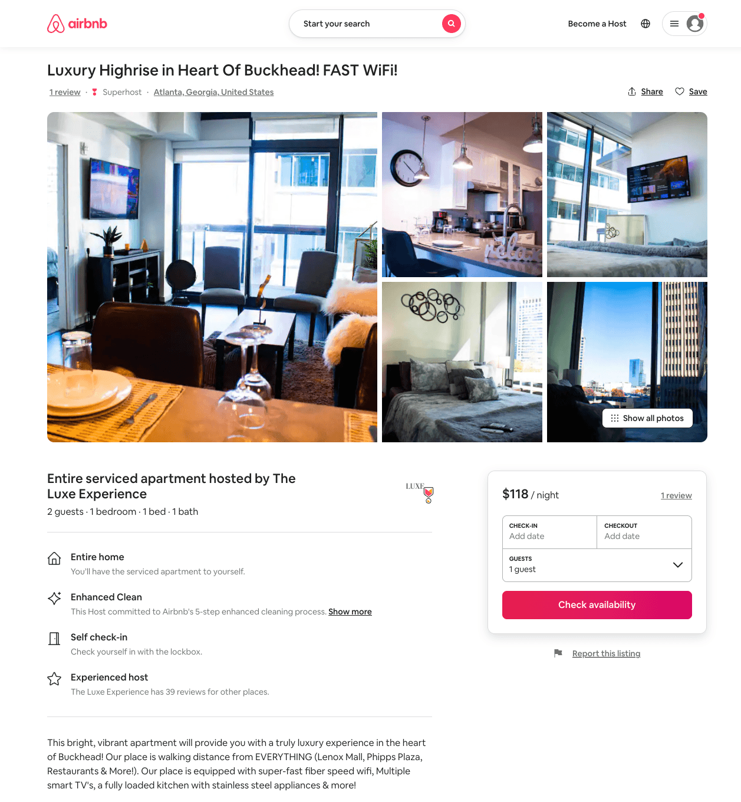
Listing 53216482
1
2
$100 - $144
4.57
1
The Luxe Experience
379947901
2
https://www.airbnb.com/rooms/53216482
Jul 2022

Slide 26
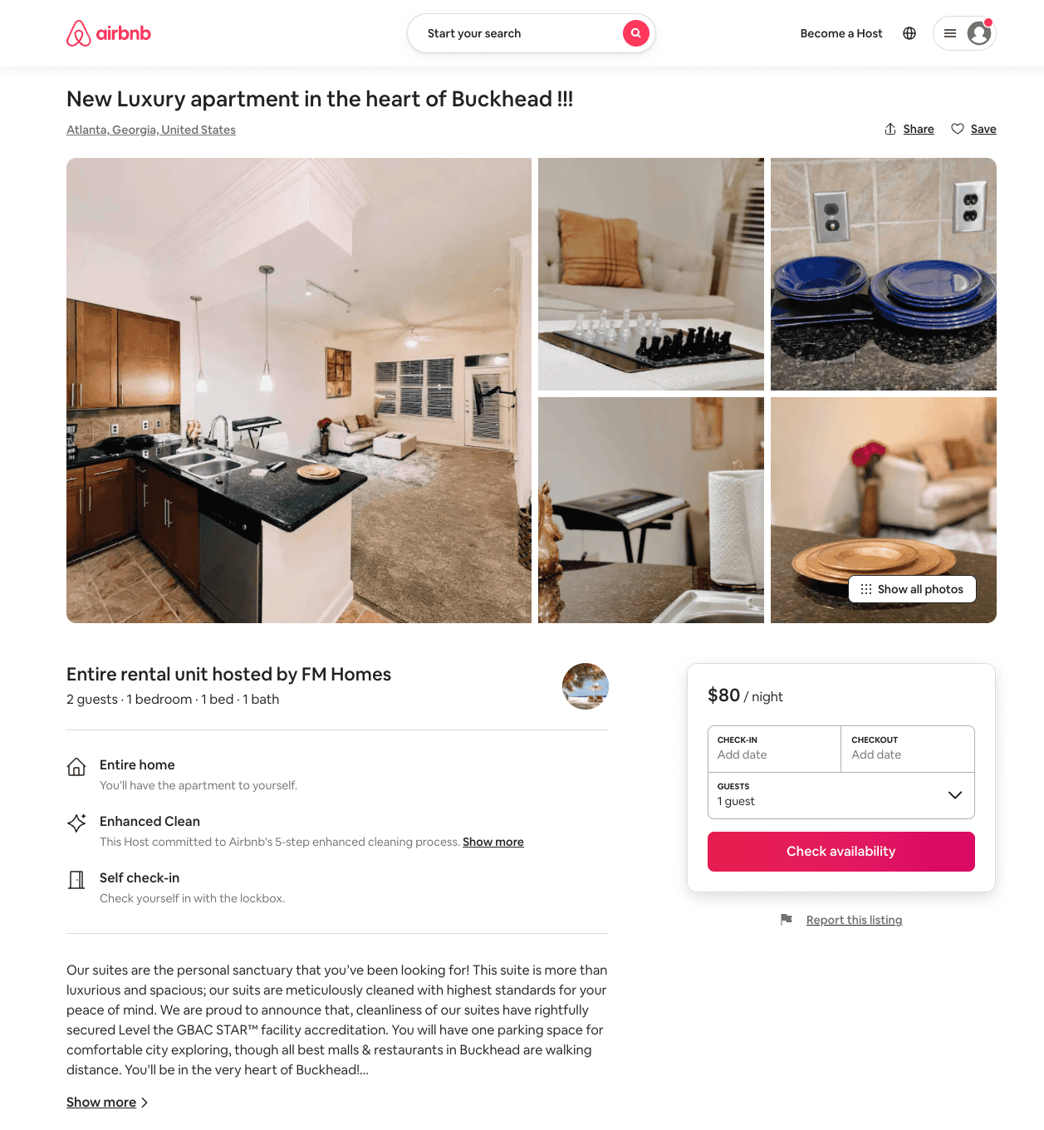
Listing 53380315
1
2
$80 - $120
4.71
1
FM Homes
432199192
1
https://www.airbnb.com/rooms/53380315
Aug 2022

Slide 27
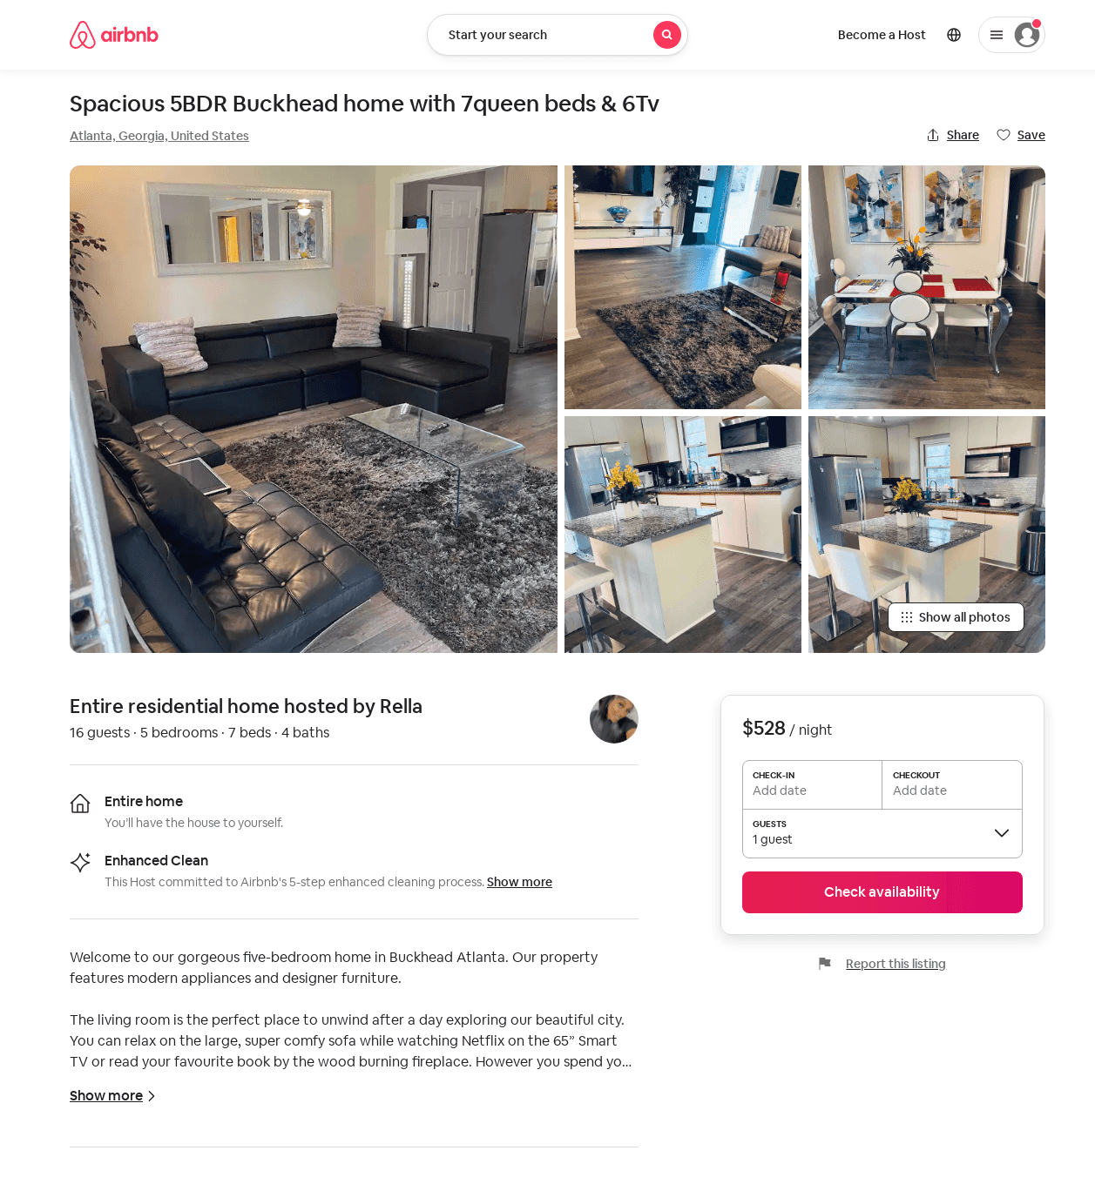
Listing 53175054
5
16
$428 - $528
3.85
1
Kolawole
430463503
2
https://www.airbnb.com/rooms/53175054
Aug 2022

Slide 28
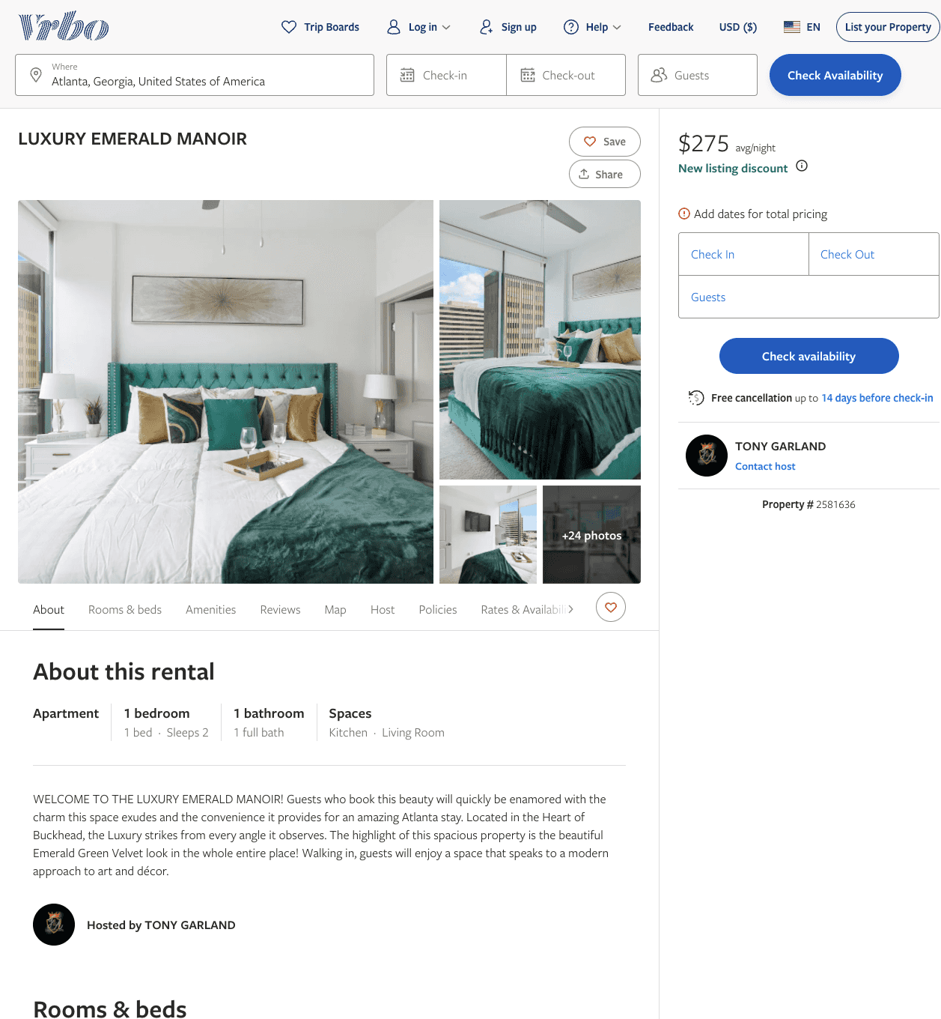
Listing 2581636
1
2
$275 - $350
1
TONY GARLAND
https://www.vrbo.com/2581636
Aug 2022

Slide 29
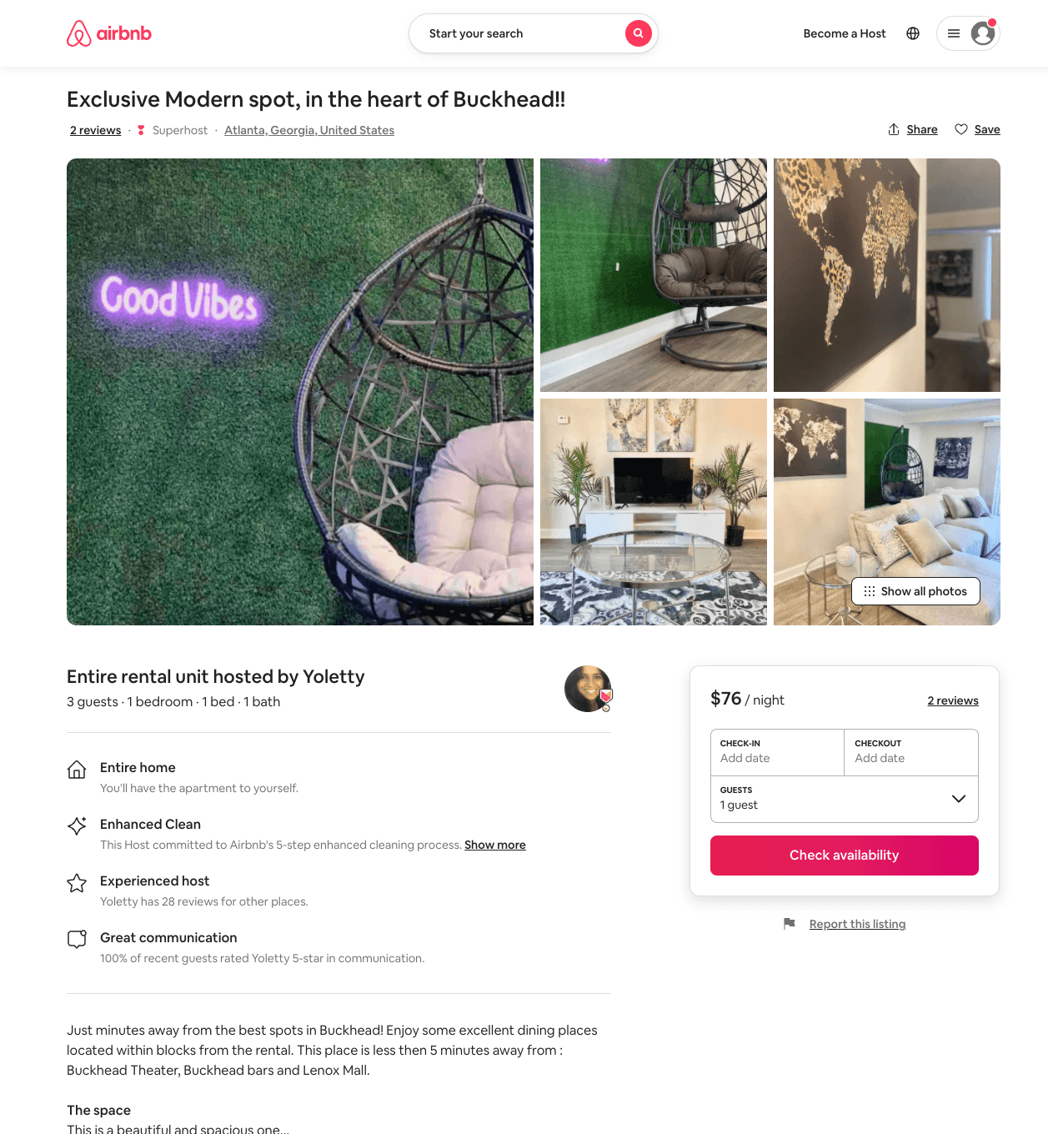
Listing 52610845
1
3
$68 - $89
4.27
1
Yoletty
274744765
2
https://www.airbnb.com/rooms/52610845
Aug 2022

Slide 30
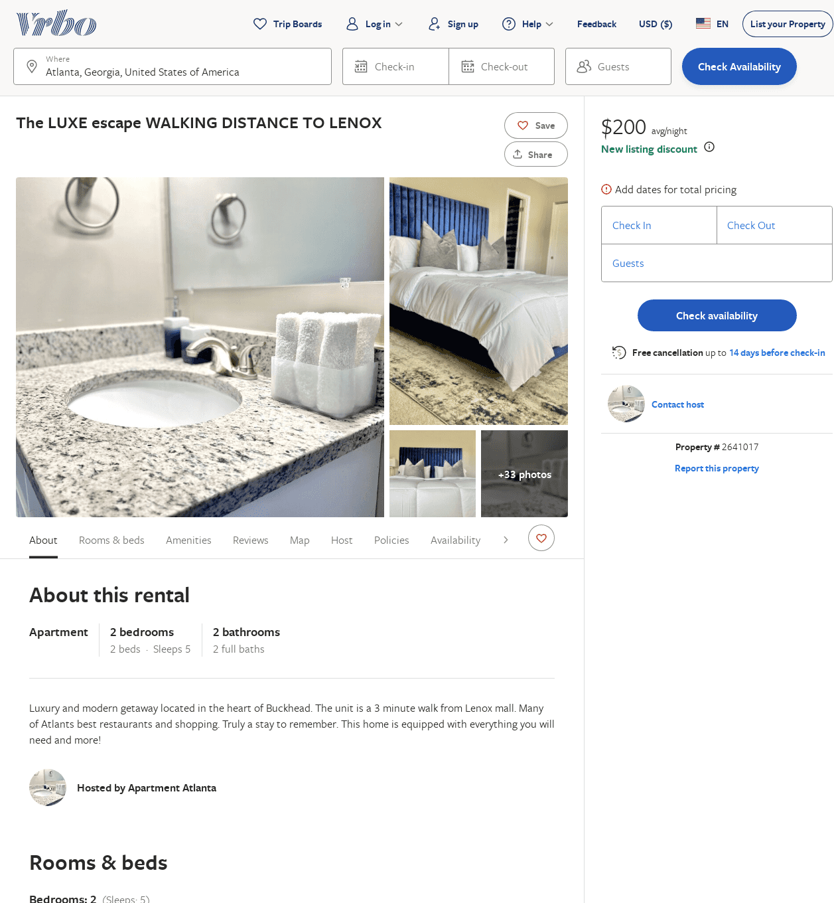
Listing 2641017
2
5
$200
1
1
https://www.vrbo.com/2641017
Aug 2022

Slide 31
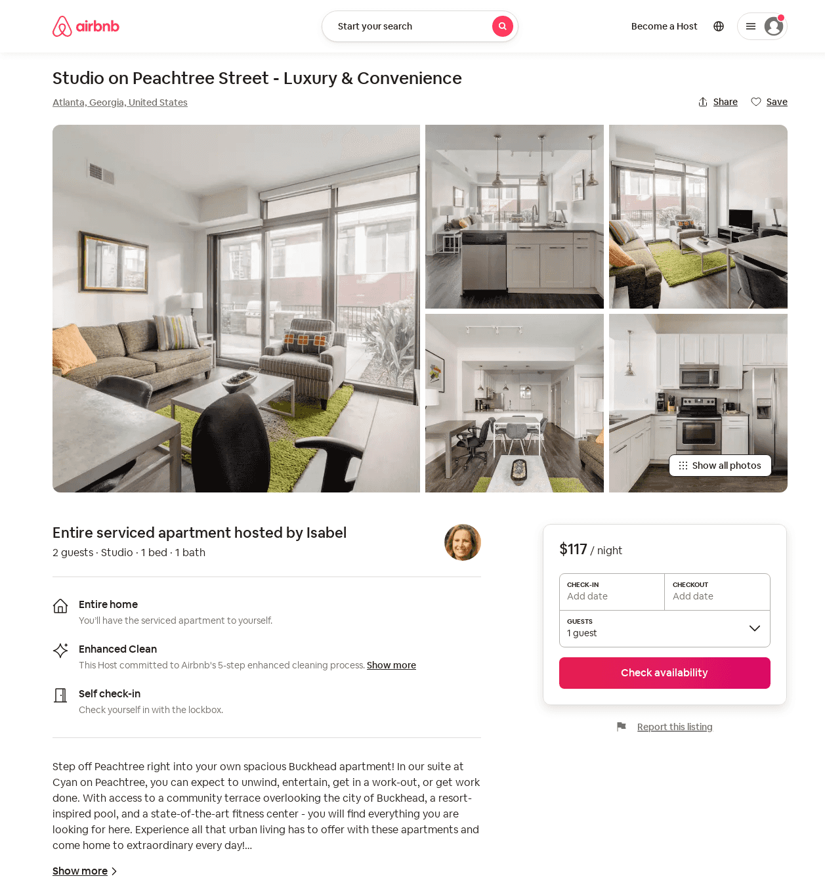
Listing 53936404
Studio
2
$116 - $134
31
Isabel
388805011
66
https://www.airbnb.com/rooms/53936404
Jul 2022

Slide 32
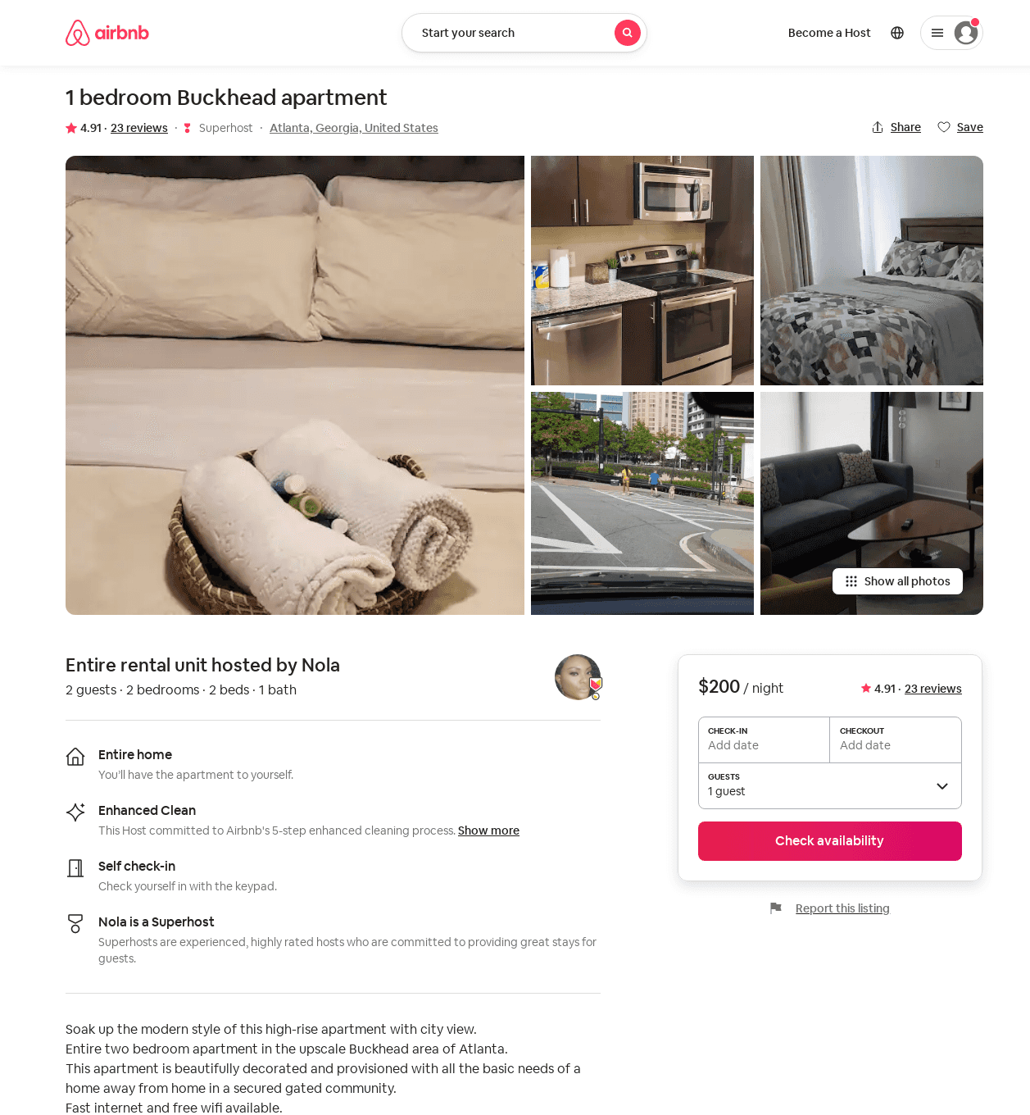
Listing 36982537
2
2
$200
4.91
14
Nola
161608290
3
https://www.airbnb.com/rooms/36982537
Aug 2022

Slide 33
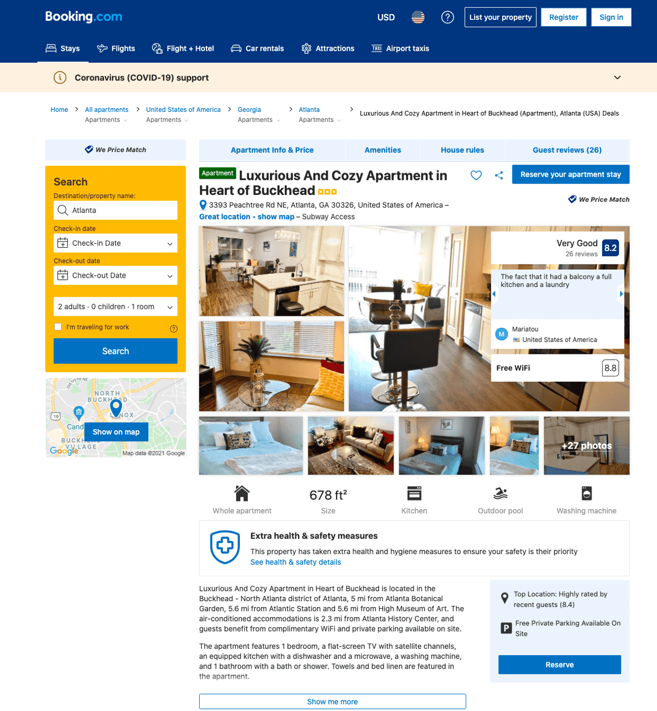
Listing luxurious-and-cozy-apartment-in-heart-of-buckhead-atlanta
undefined
1
7.9
https://www.booking.com/hotel/us/luxurious-and-cozy-apartment-in-heart-of-buckhead-atlanta.html
Sep 2022

Slide 34
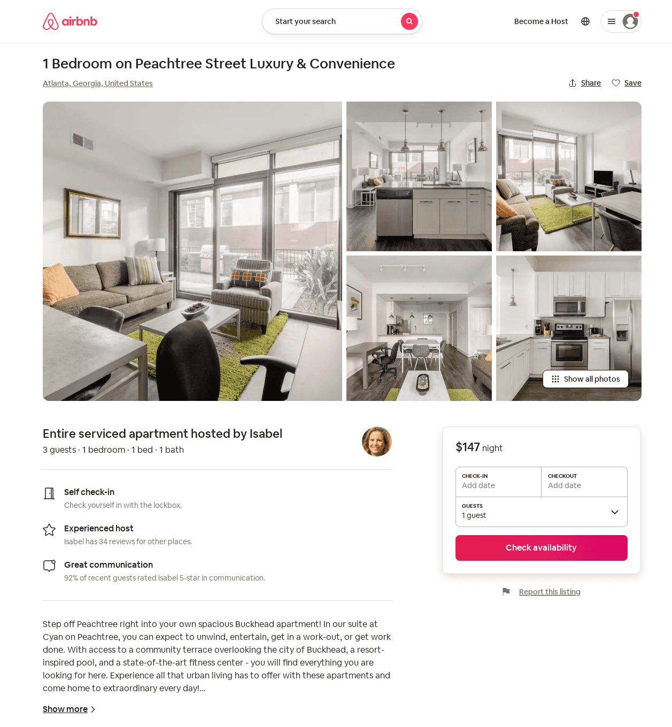
Listing 53936464
1
3
$141 - $164
31
Isabel
388805011
66
https://www.airbnb.com/rooms/53936464
Jul 2022

Slide 35
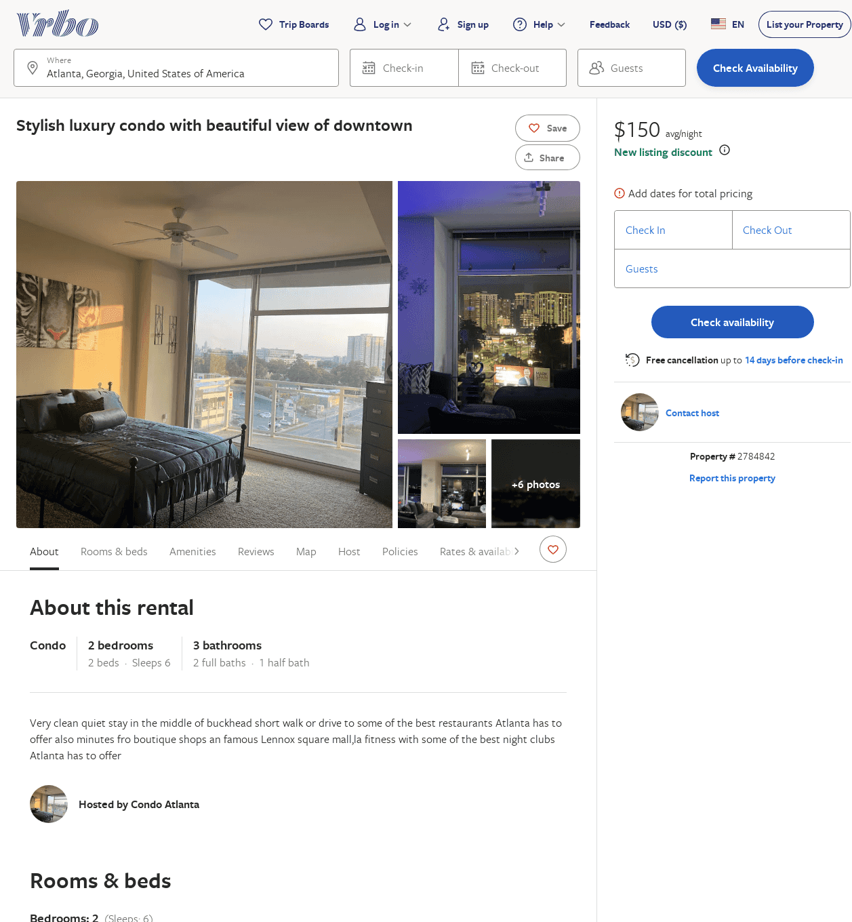
Listing 2784842
2
6
$151
3
https://www.vrbo.com/2784842
Aug 2022

Slide 36
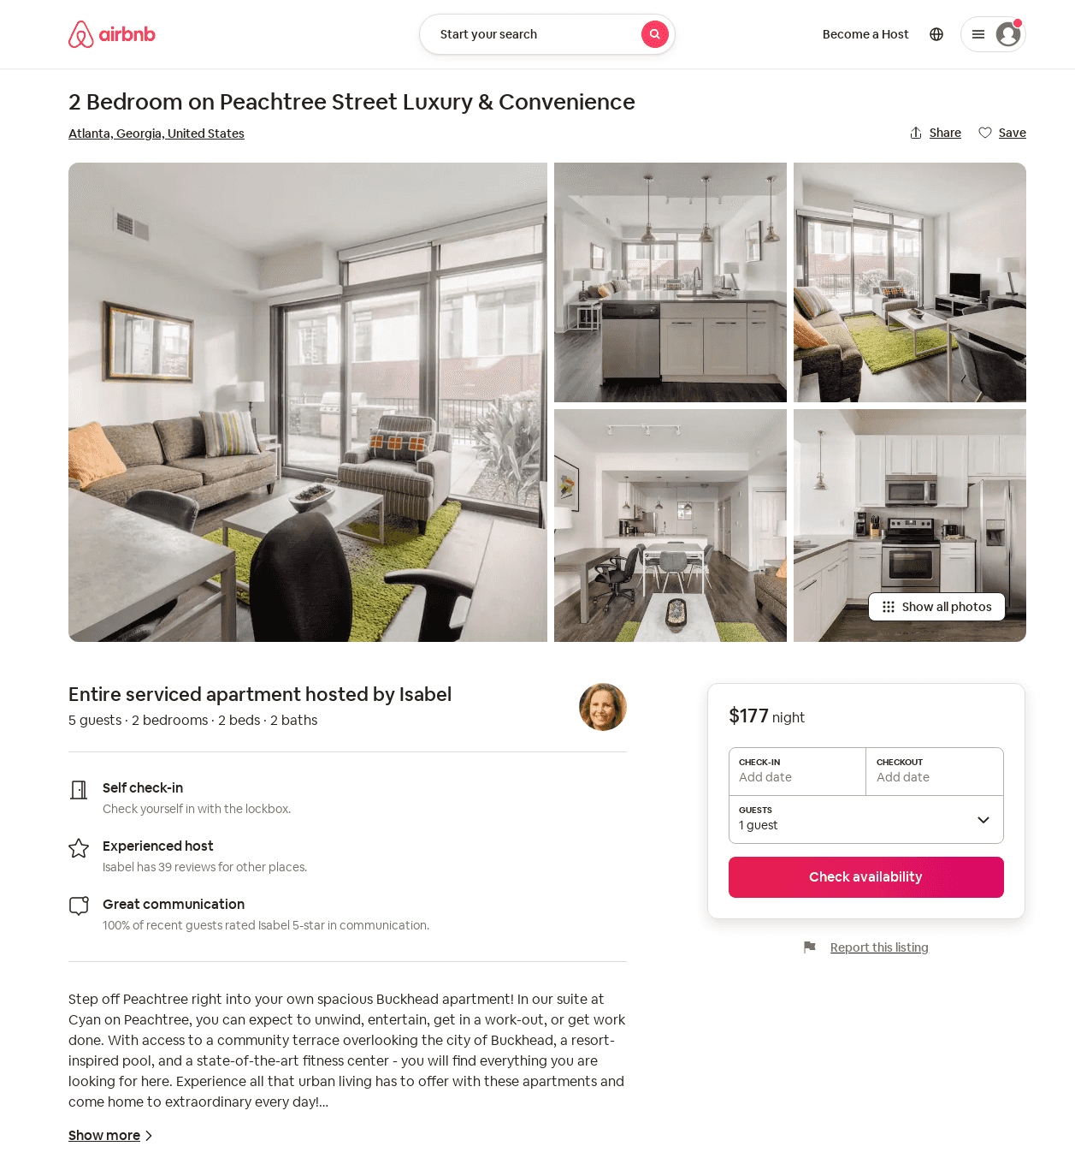
Listing 53936502
2
5
$177 - $205
31
Isabel
388805011
66
https://www.airbnb.com/rooms/53936502
Jul 2022

Slide 37
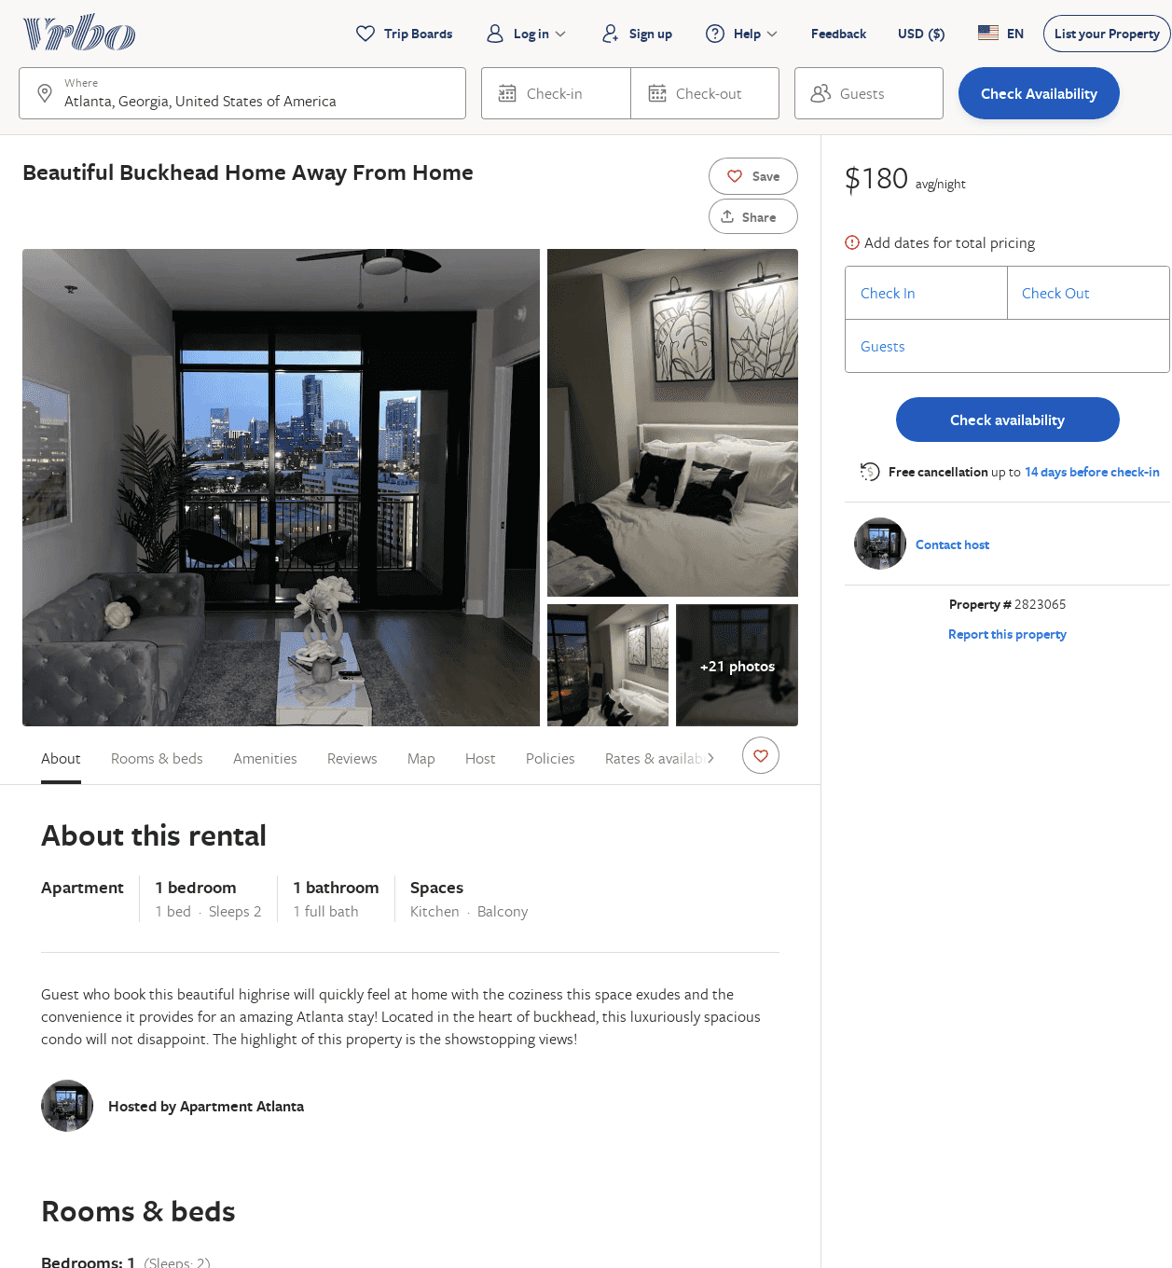
Listing 2823065
1
2
$173
5
1
https://www.vrbo.com/2823065
Aug 2022

Slide 38
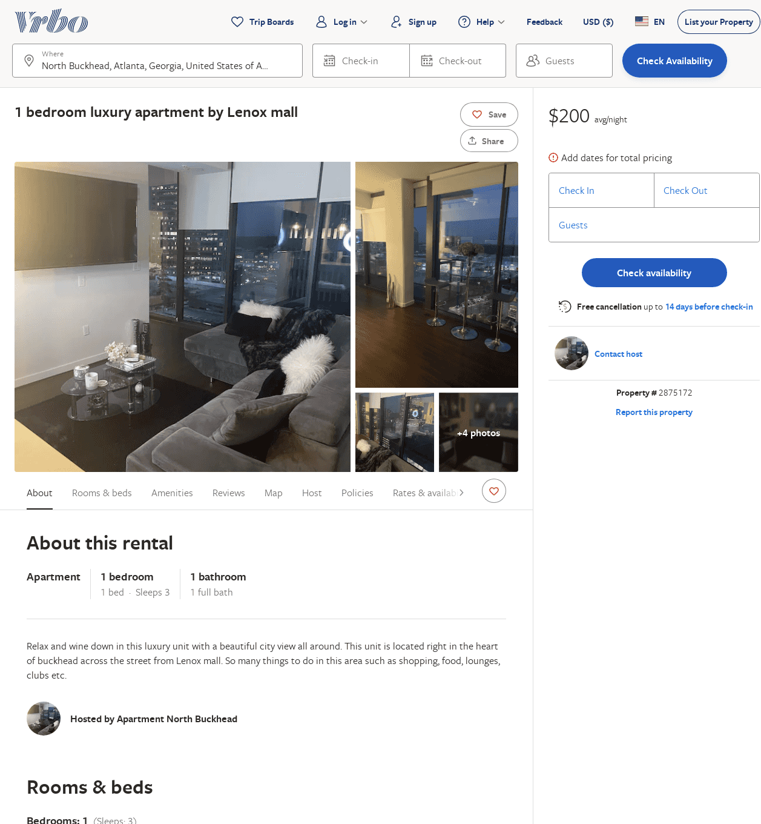
Listing 2875172
1
3
$200
3
https://www.vrbo.com/2875172
Aug 2022

Slide 39
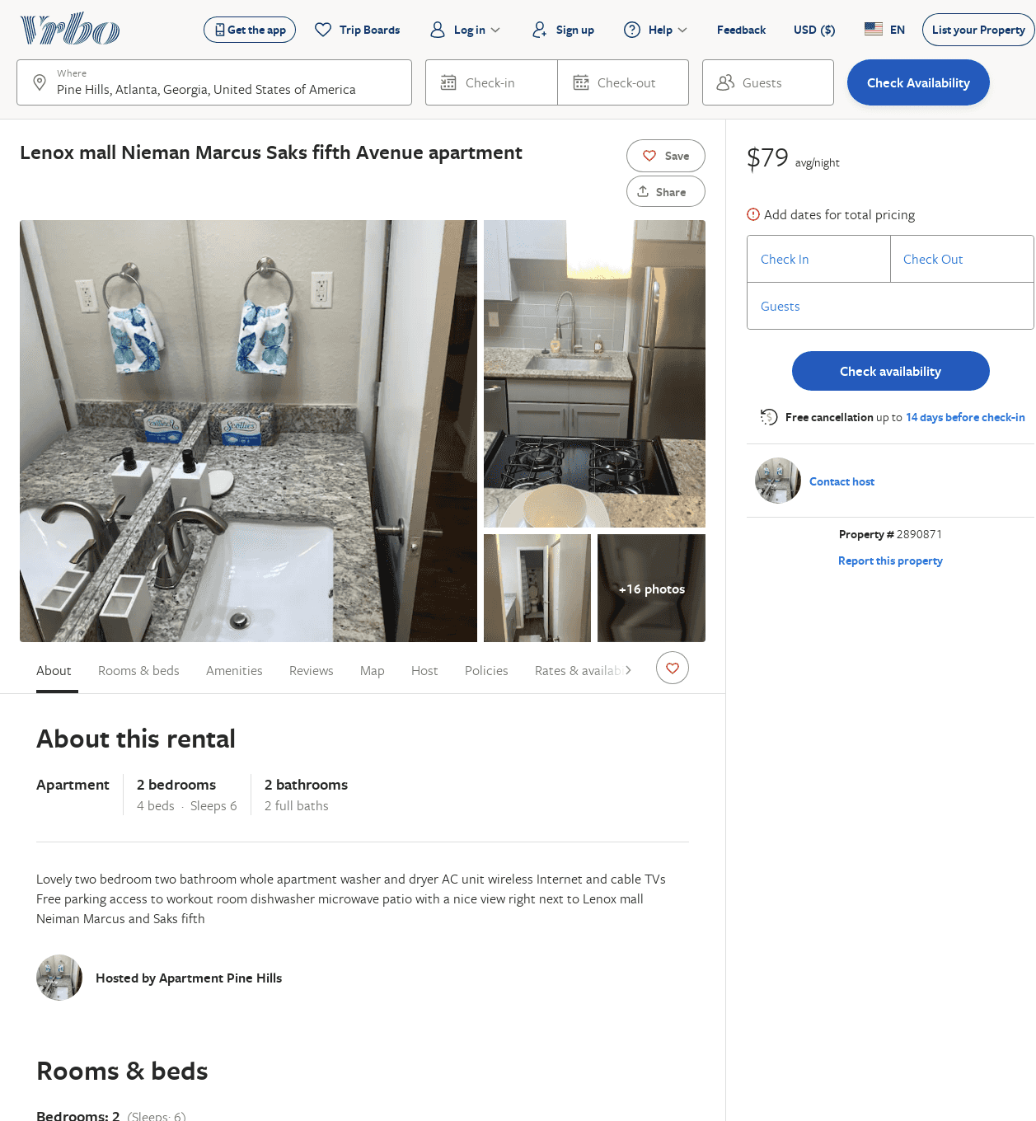
Listing 2890871
2
6
$140
1
https://www.vrbo.com/2890871
Aug 2022

Slide 40
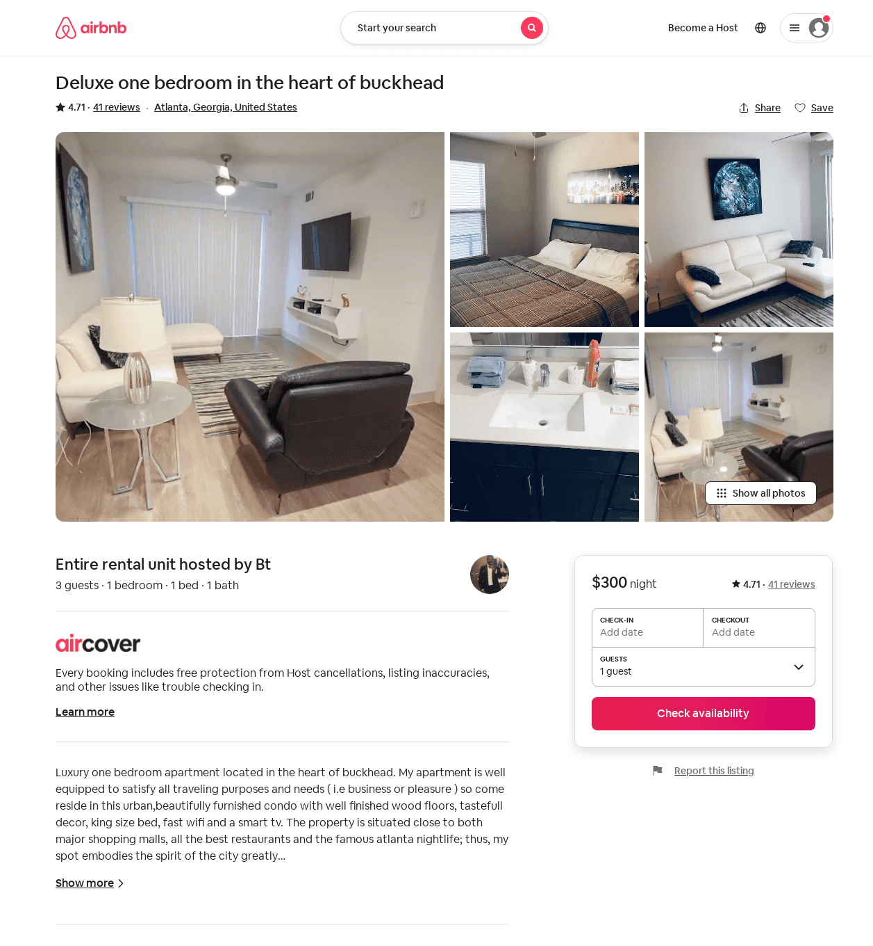
Listing 30420950
1
3
4.71
2
Bt
55480490
2
https://www.airbnb.com/rooms/30420950
Aug 2022

