Slide 2
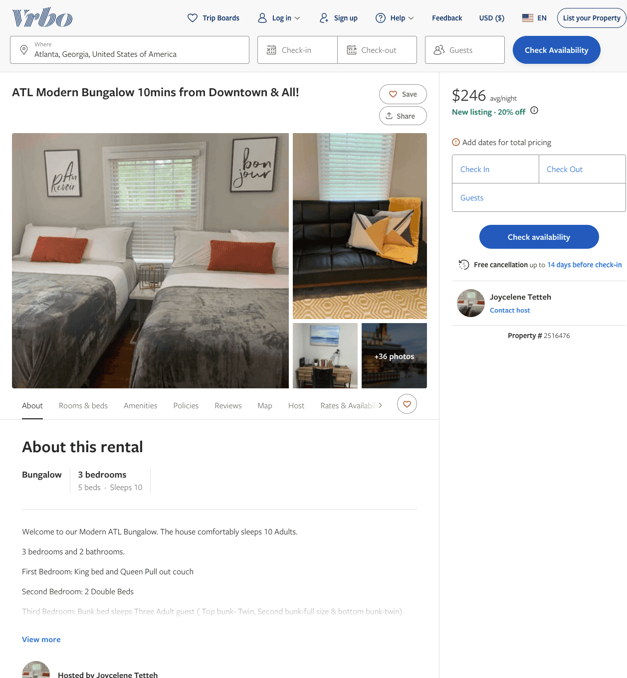
Listing 2516476
3
13
$160 - $291
4
2
Experience Host Rentals
https://www.vrbo.com/2516476
Aug 2022

Slide 3
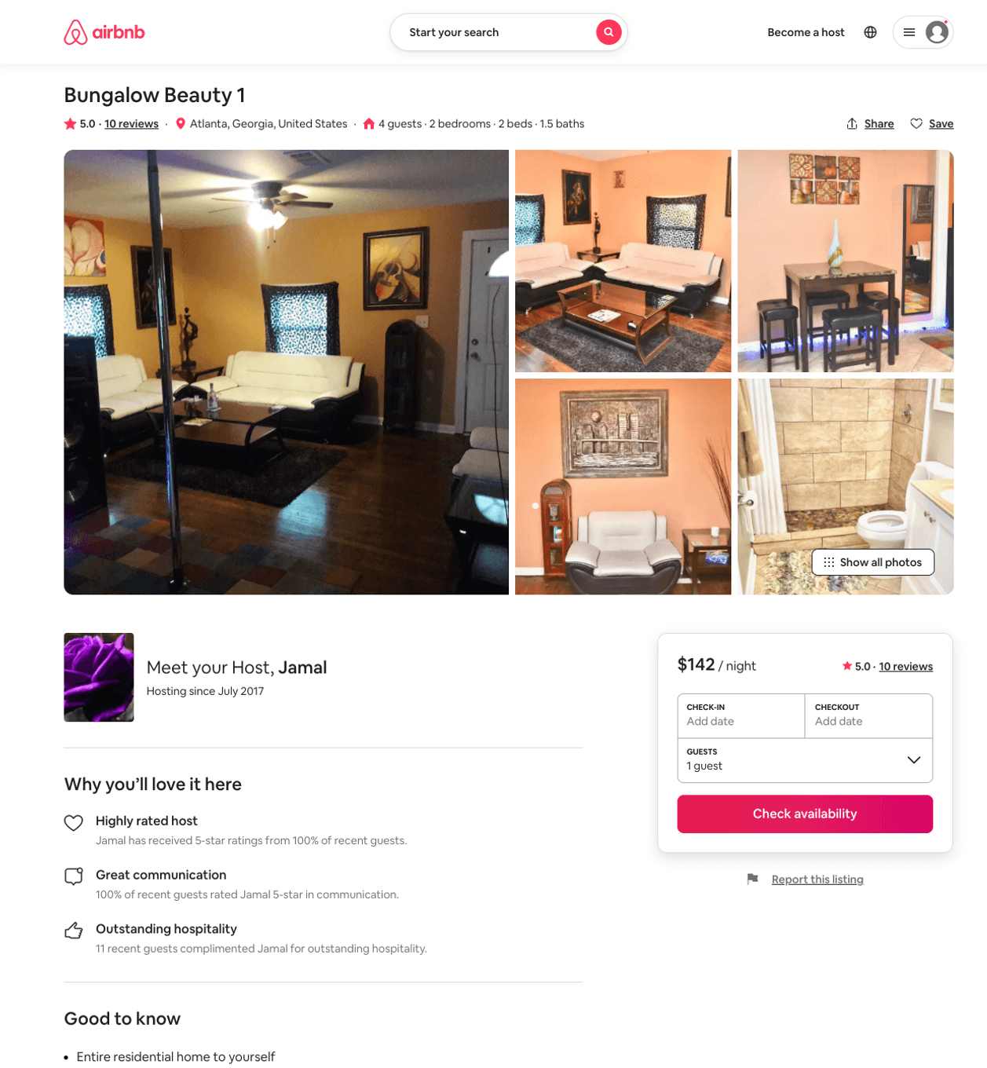
Listing 25318063
2
4
$124 - $147
4.83
2
Jamal
142618381
2
https://www.airbnb.com/rooms/25318063
Aug 2022

Slide 4
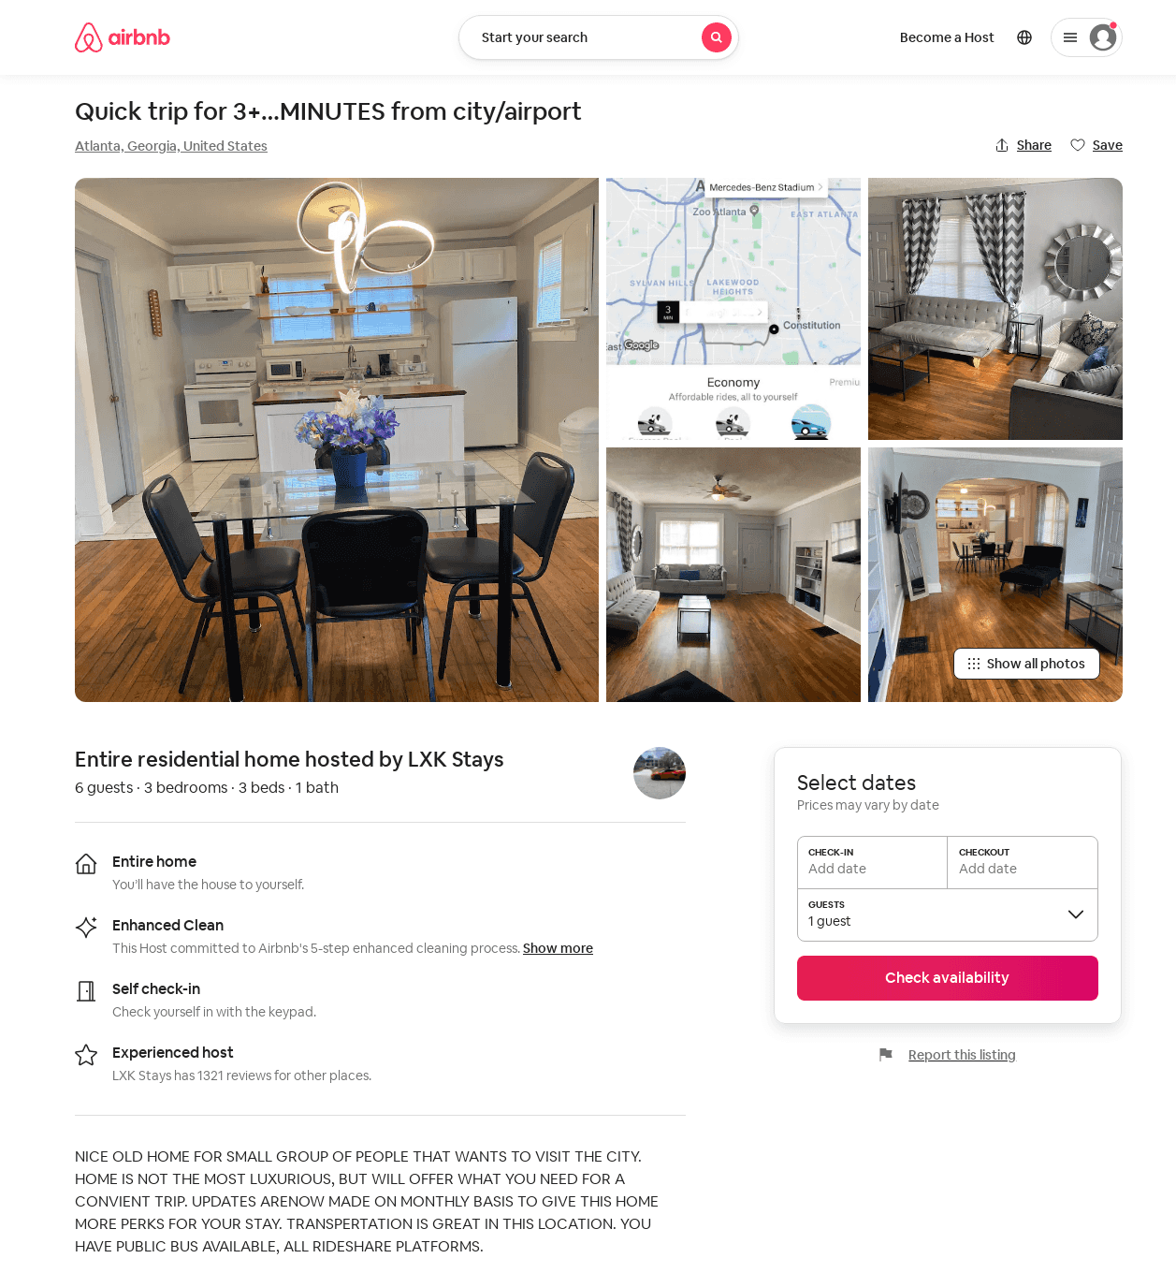
Listing 52572521
3
6
$96 - $149
3.88
1
LXK Stays
100582128
9
https://www.airbnb.com/rooms/52572521
Jun 2022

Slide 5
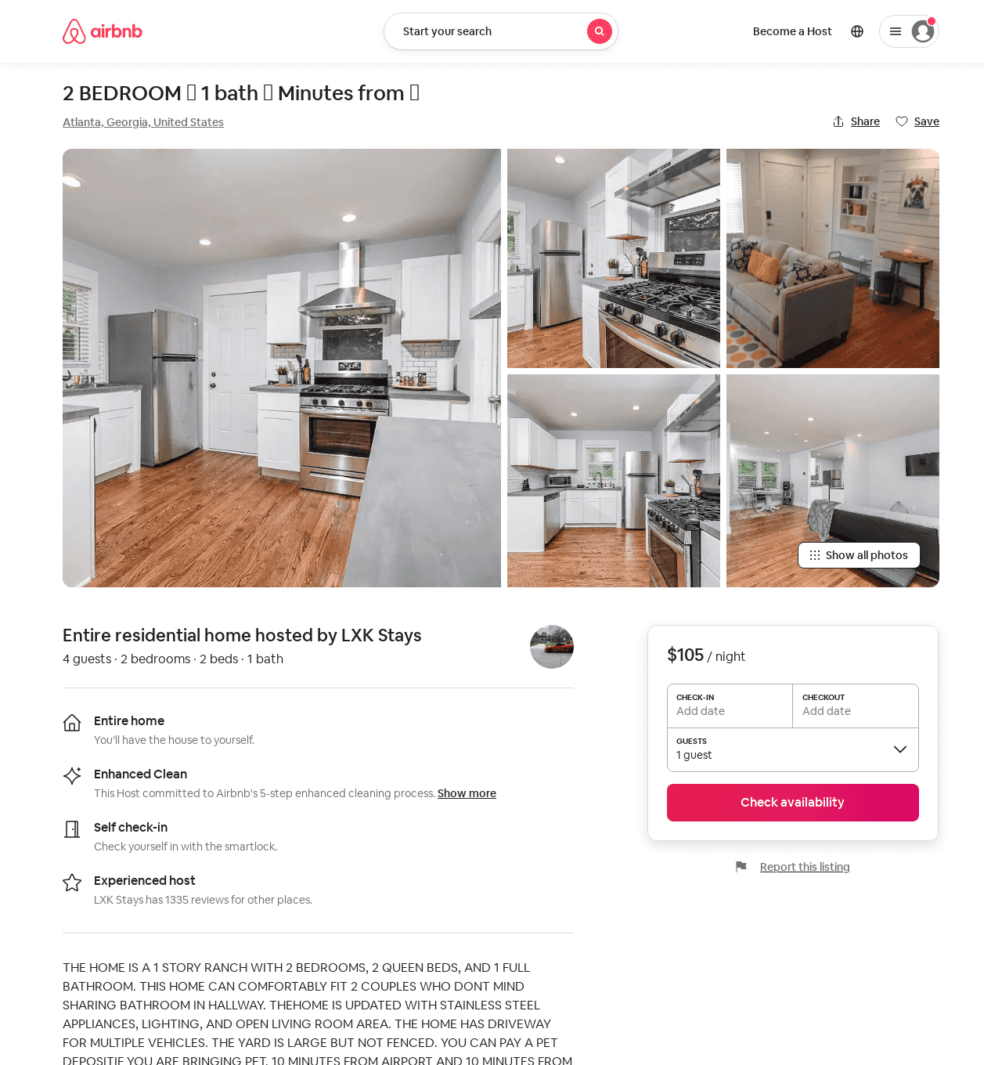
Listing 53272973
2
4
$105 - $163
4.34
1
LXK Stays
100582128
9
https://www.airbnb.com/rooms/53272973
Jul 2022

