Slide 2
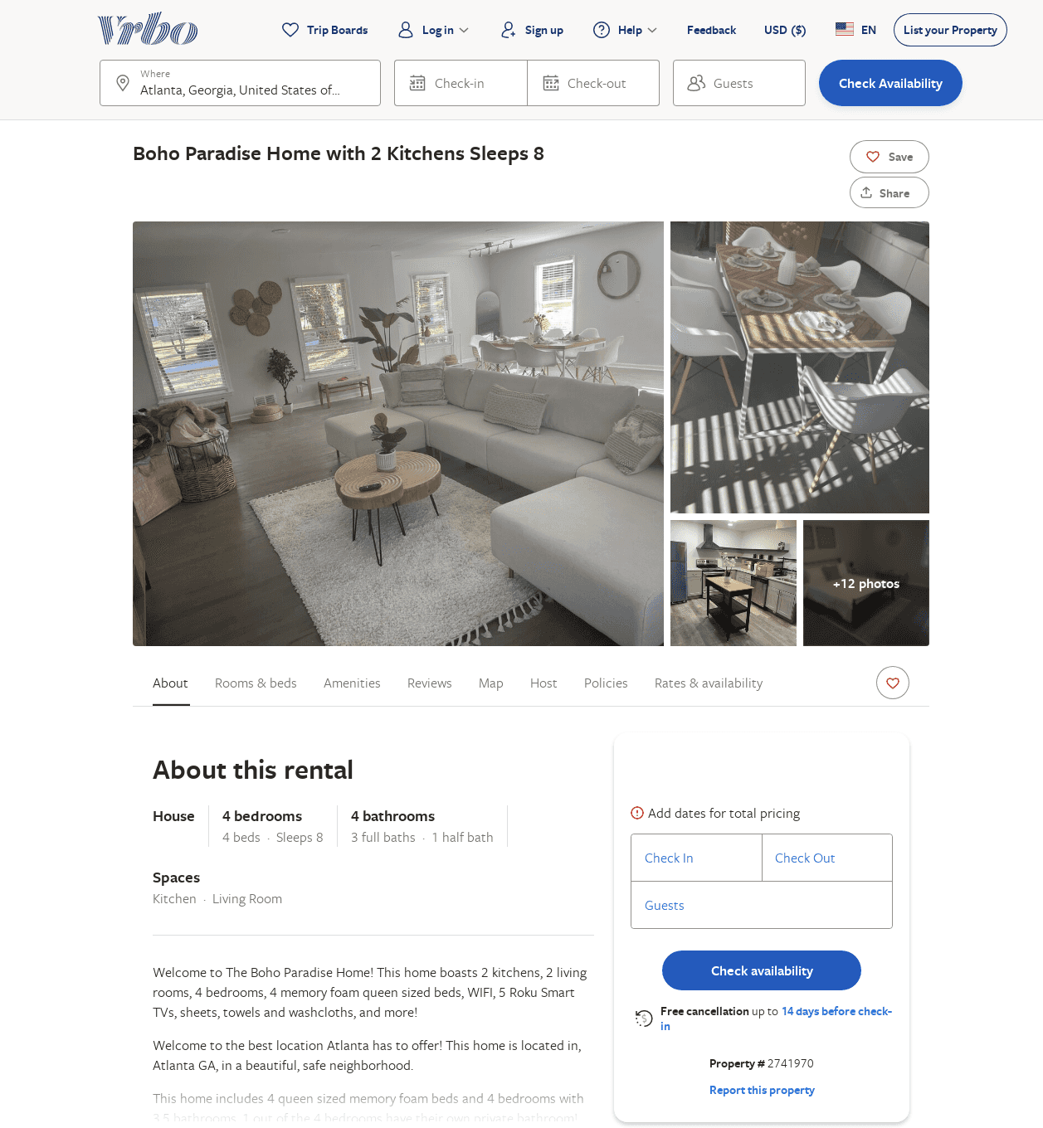
Listing 2741970
4
8
$192
2
Syerena Orr
https://www.vrbo.com/2741970
Aug 2022

