Slide 2
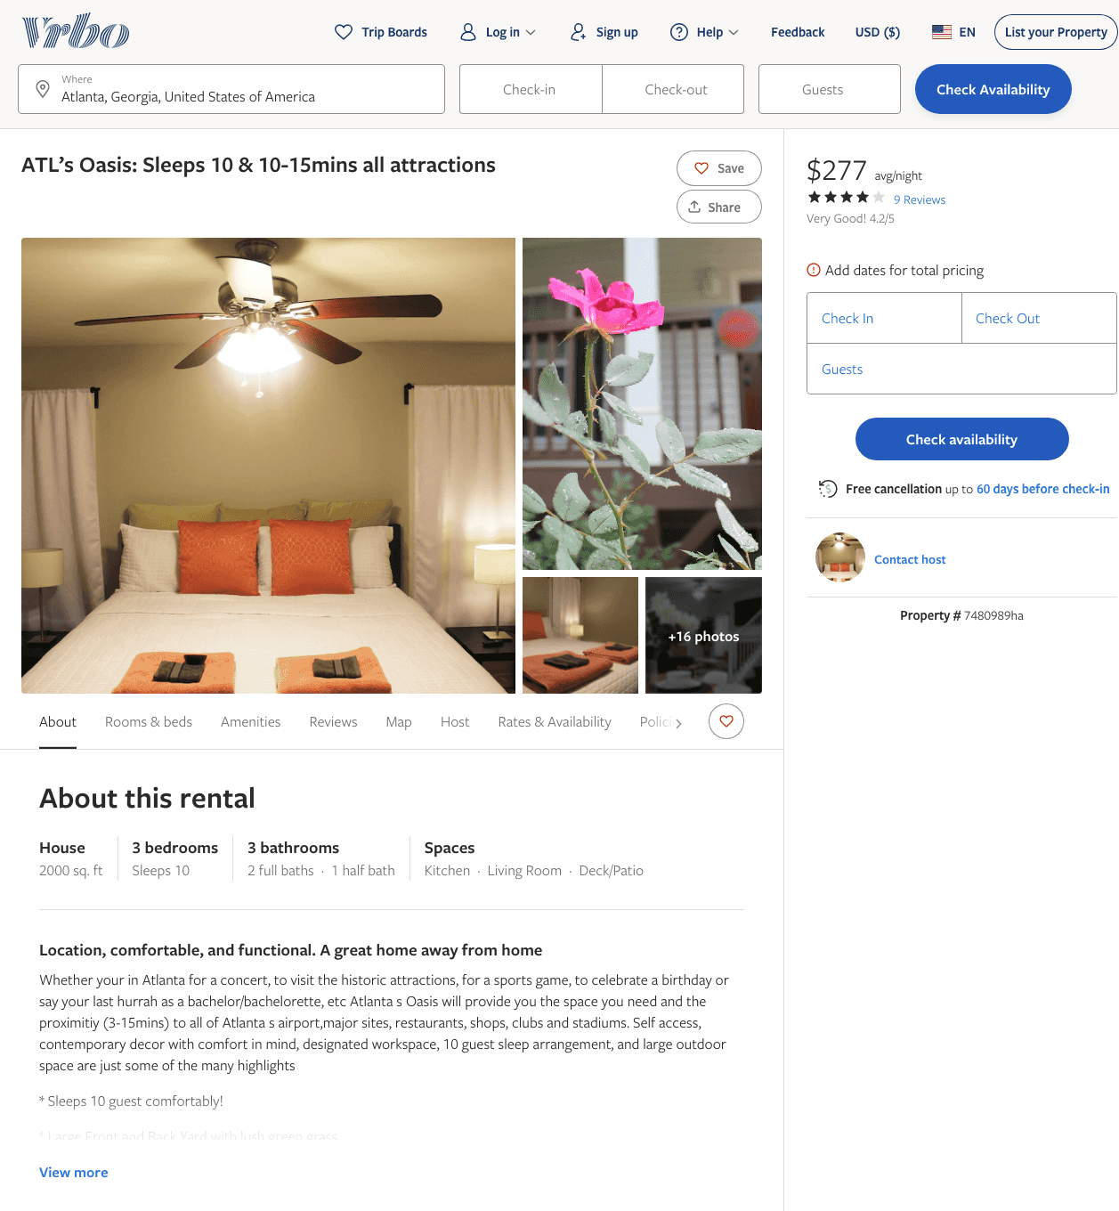
Listing 7480989
3
10
$210 - $283
4.214286
2
https://www.vrbo.com/7480989ha
Aug 2022

Slide 3
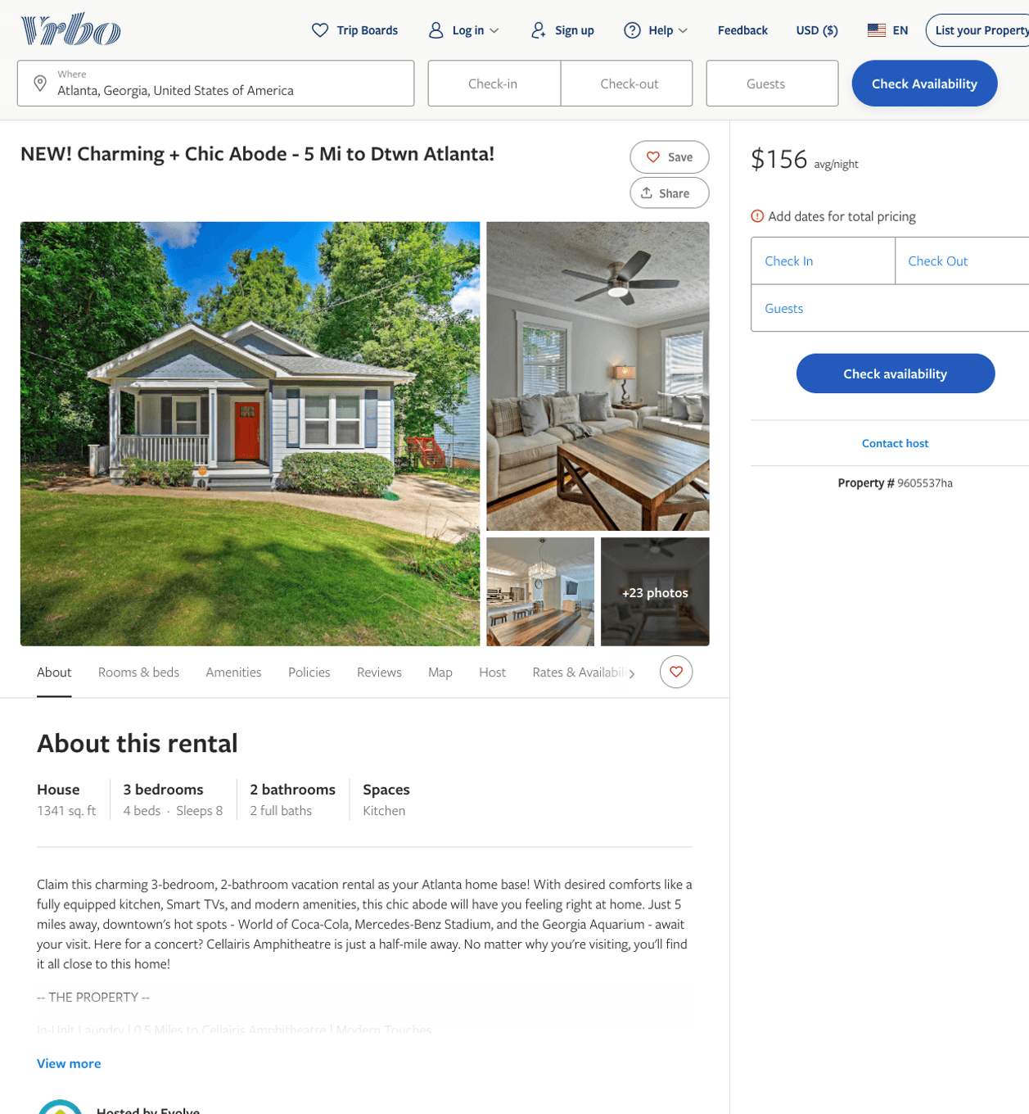
Listing 9605537
3
8
$150 - $221
4
2
Evolve
https://www.vrbo.com/9605537ha
Aug 2022

Slide 4
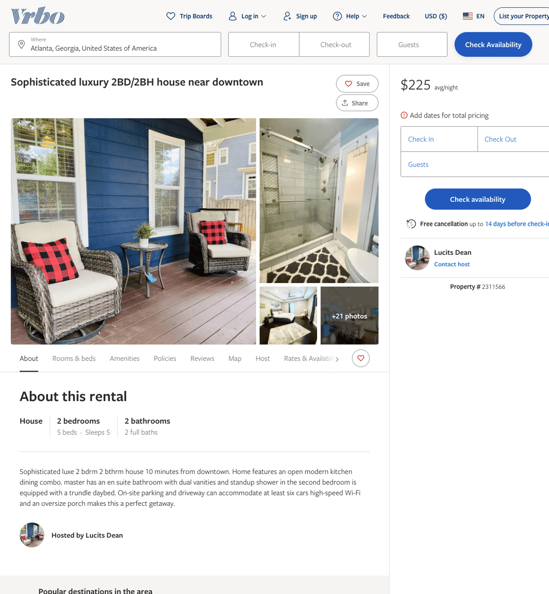
Listing 2311566
2
5
$200 - $225
2
Lucits Dean
https://www.vrbo.com/2311566
Aug 2022

Slide 5
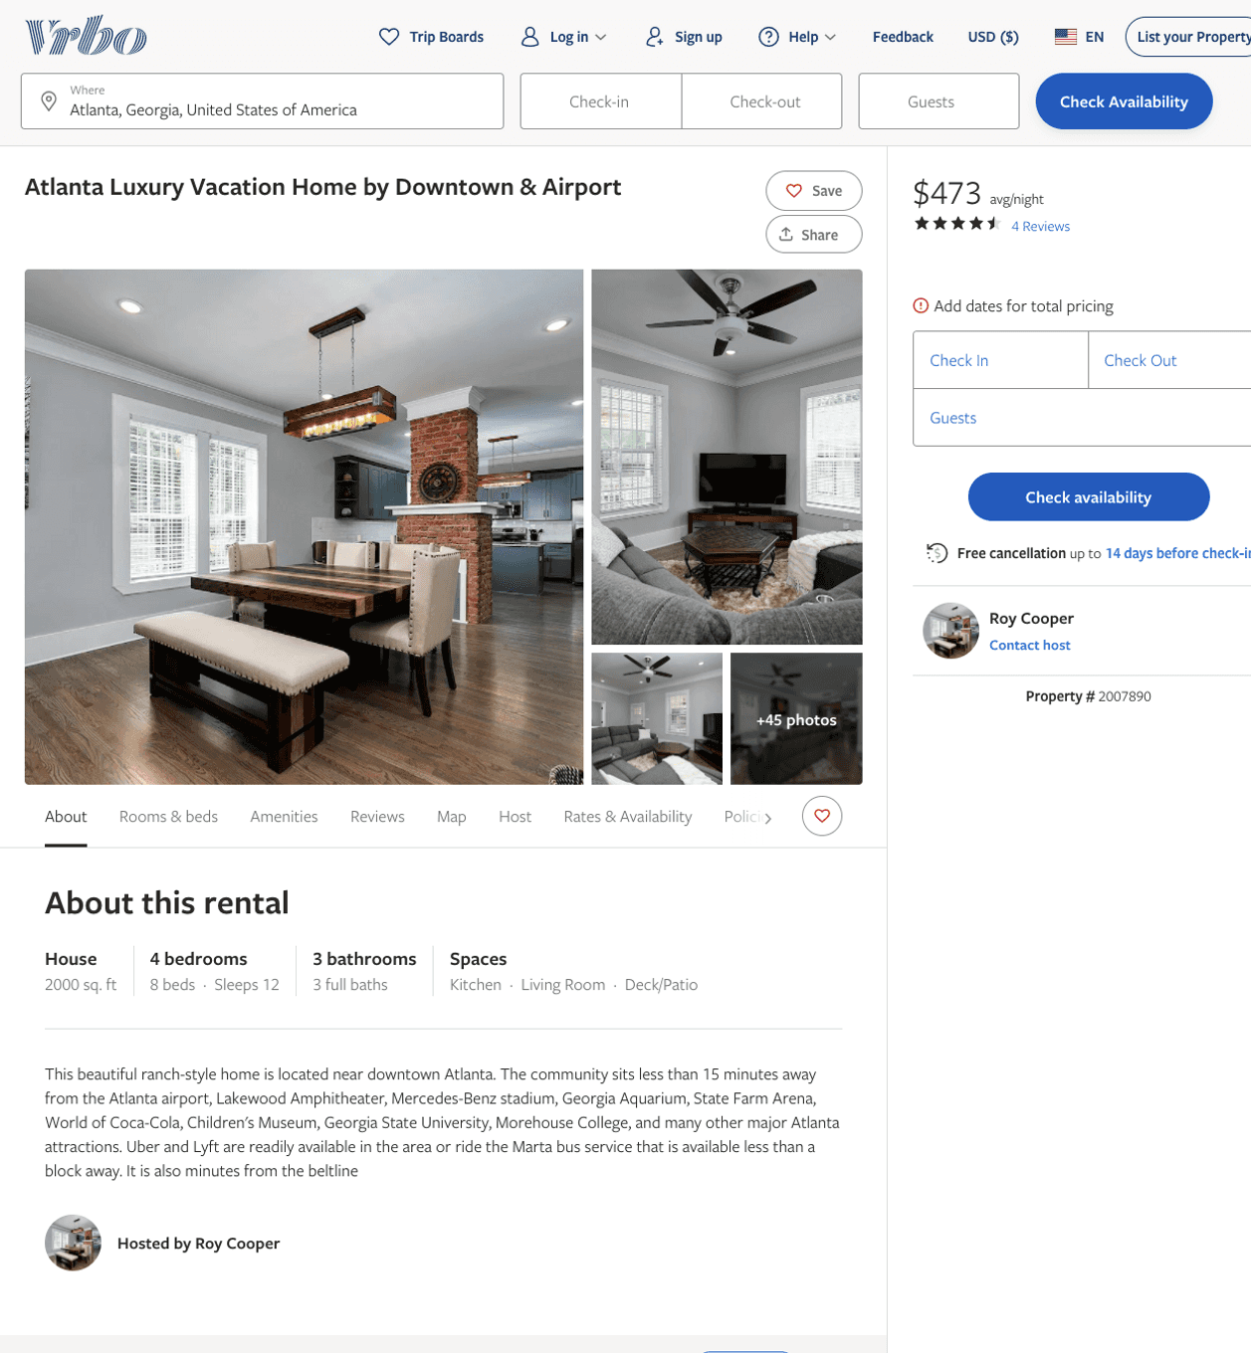
Listing 2007890
4
12
$427 - $496
4.5
3
Roy Cooper
https://www.vrbo.com/2007890
Aug 2022

Slide 6
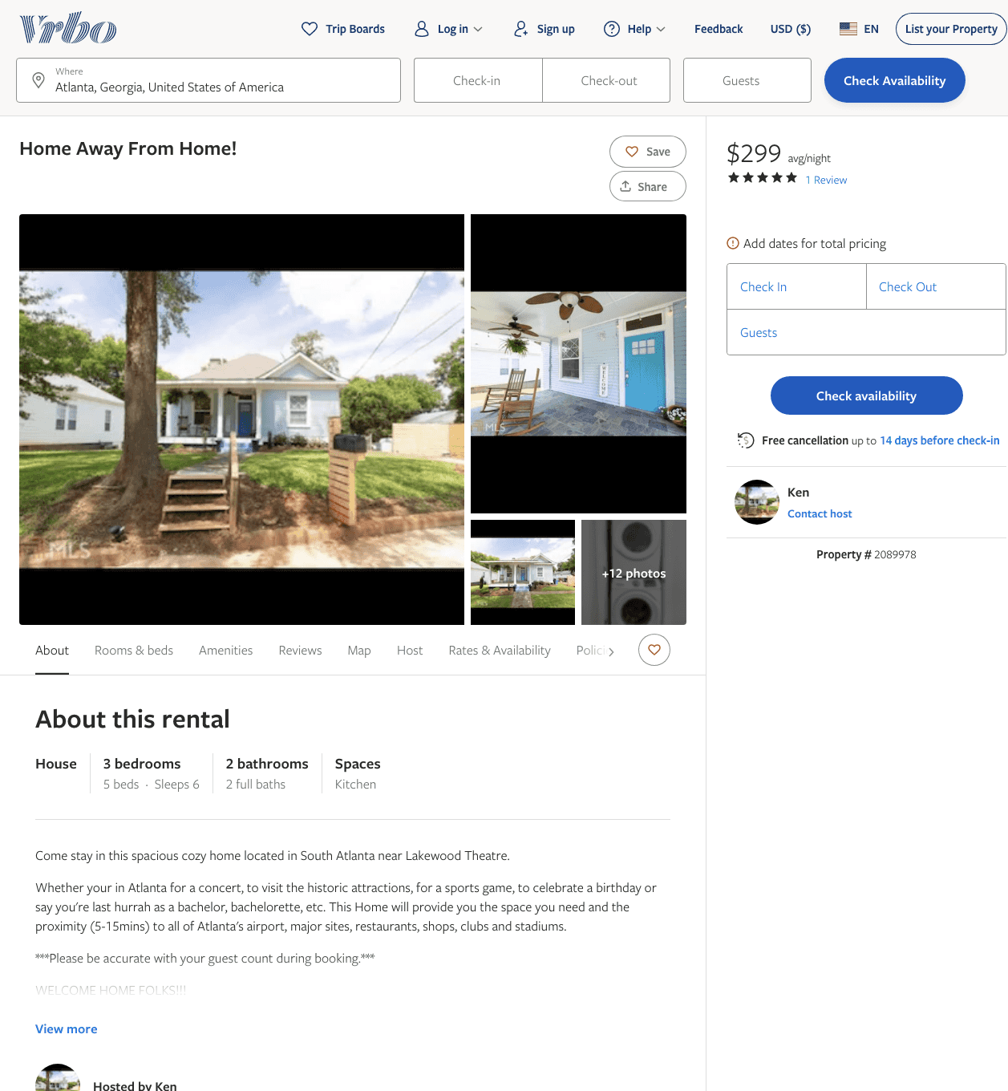
Listing 2089978
3
9
$226 - $299
5
3
Ken
https://www.vrbo.com/2089978
Aug 2022

Slide 7
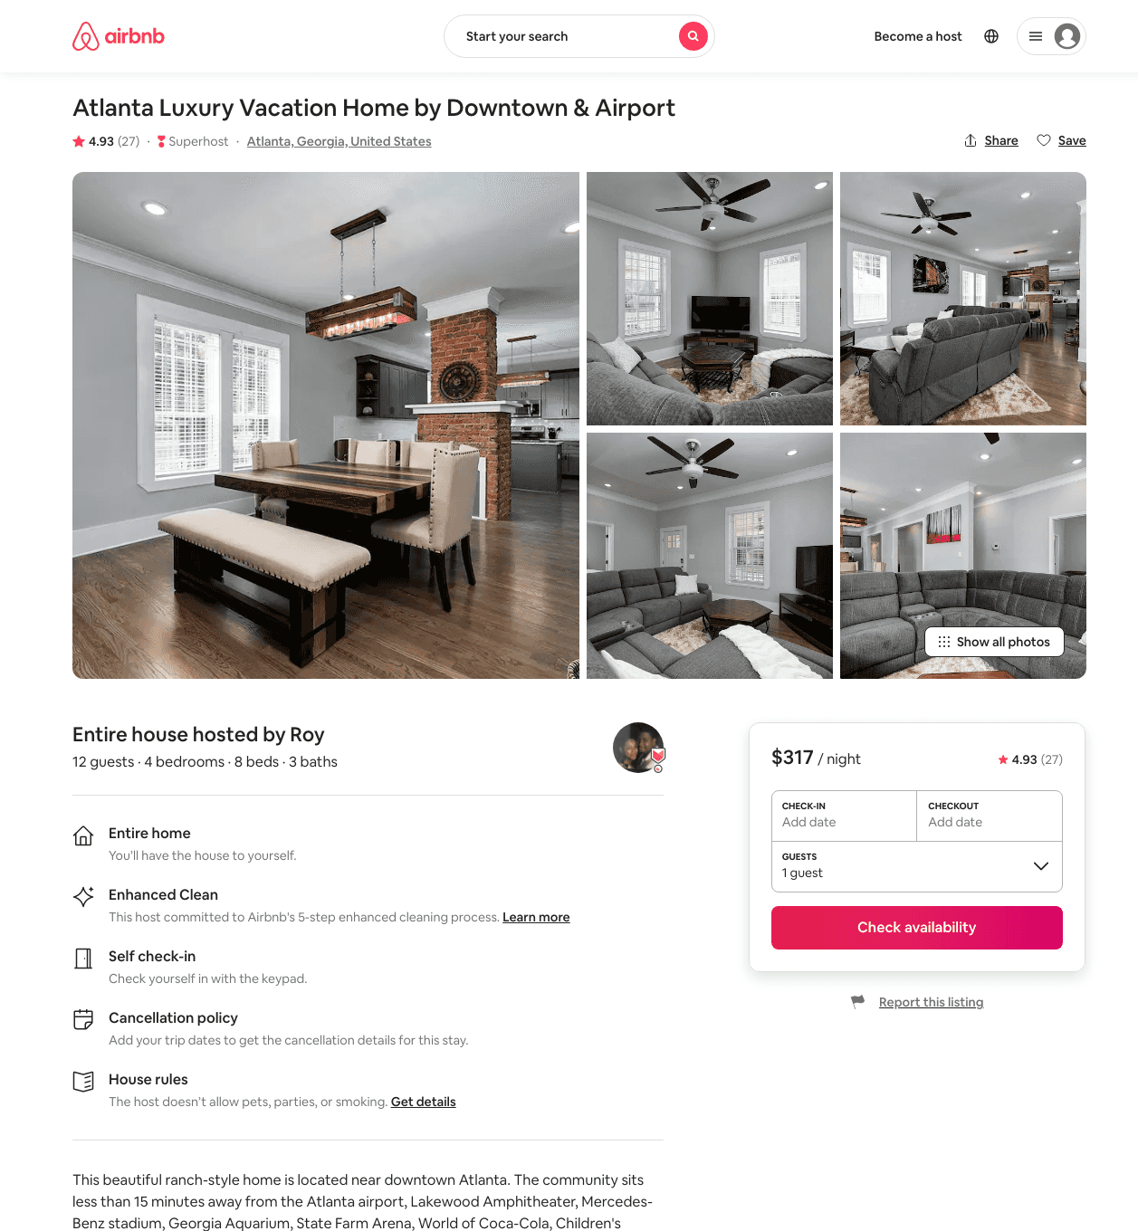
Listing 44036340
4
14
$281 - $436
4.89
3
Roy
352975534
1
https://www.airbnb.com/rooms/44036340
Aug 2022

Slide 8
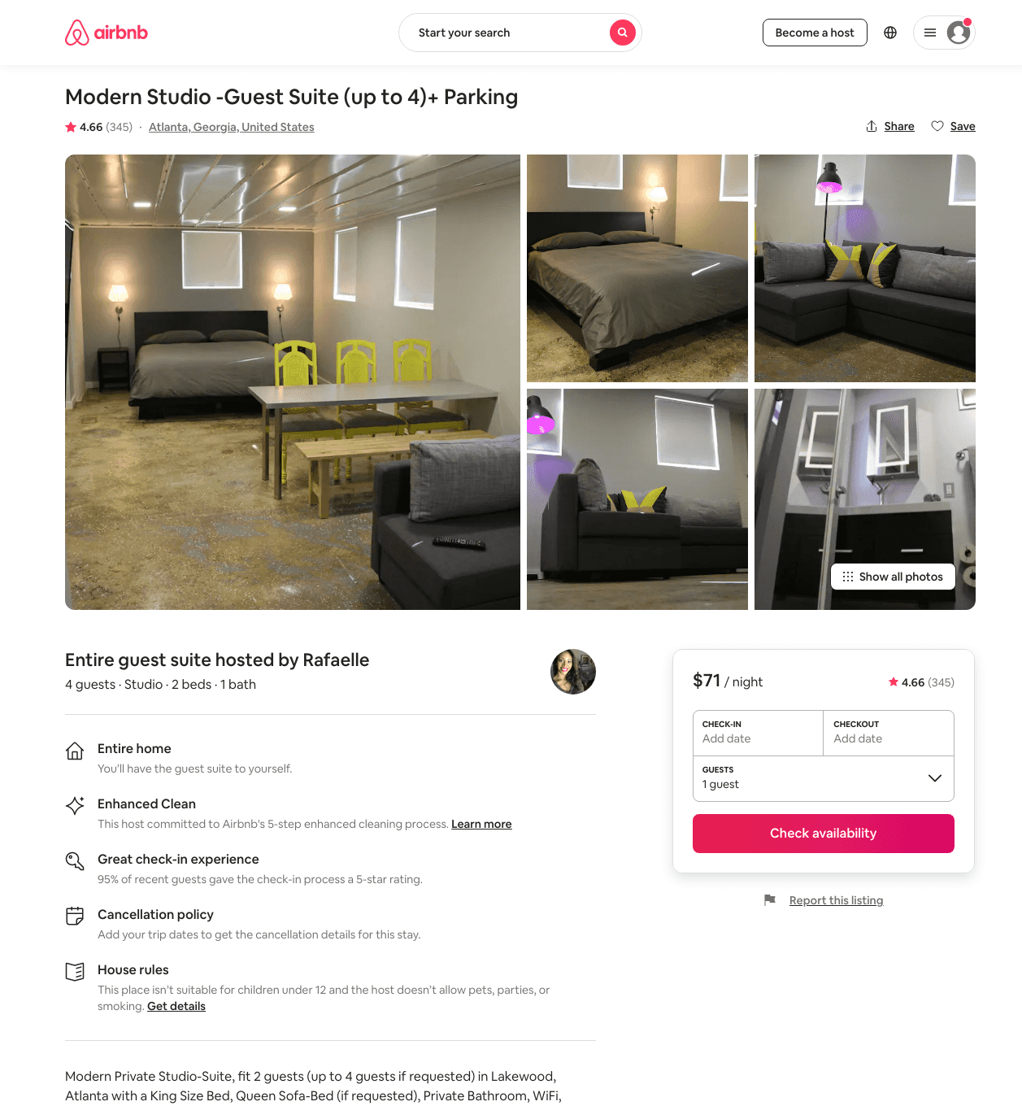
Listing 6105795
Studio
2
$69 - $122
4.69
2
Rafaelle
21411608
1
https://www.airbnb.com/rooms/6105795
Aug 2022

Slide 9
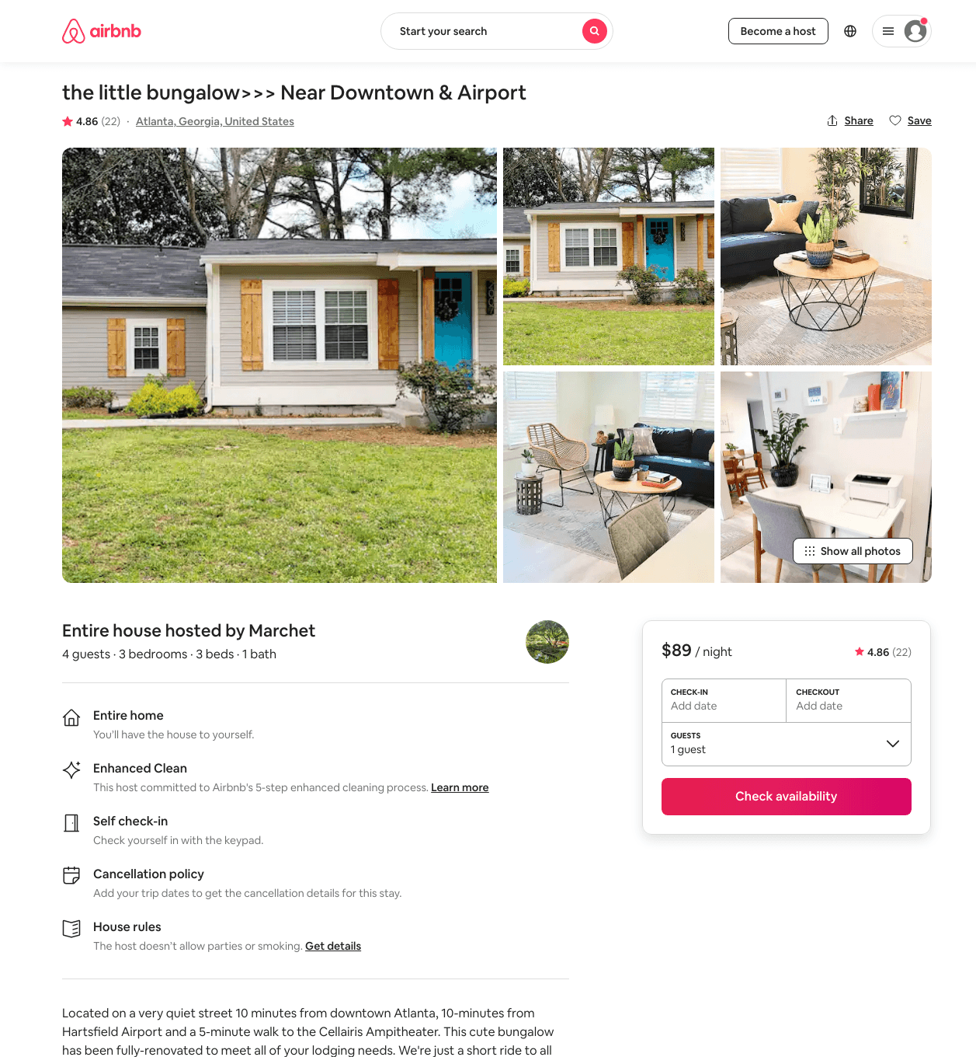
Listing 47131958
3
4
$88 - $119
4.94
2
Marchet
47023204
1
https://www.airbnb.com/rooms/47131958
Aug 2022

Slide 10
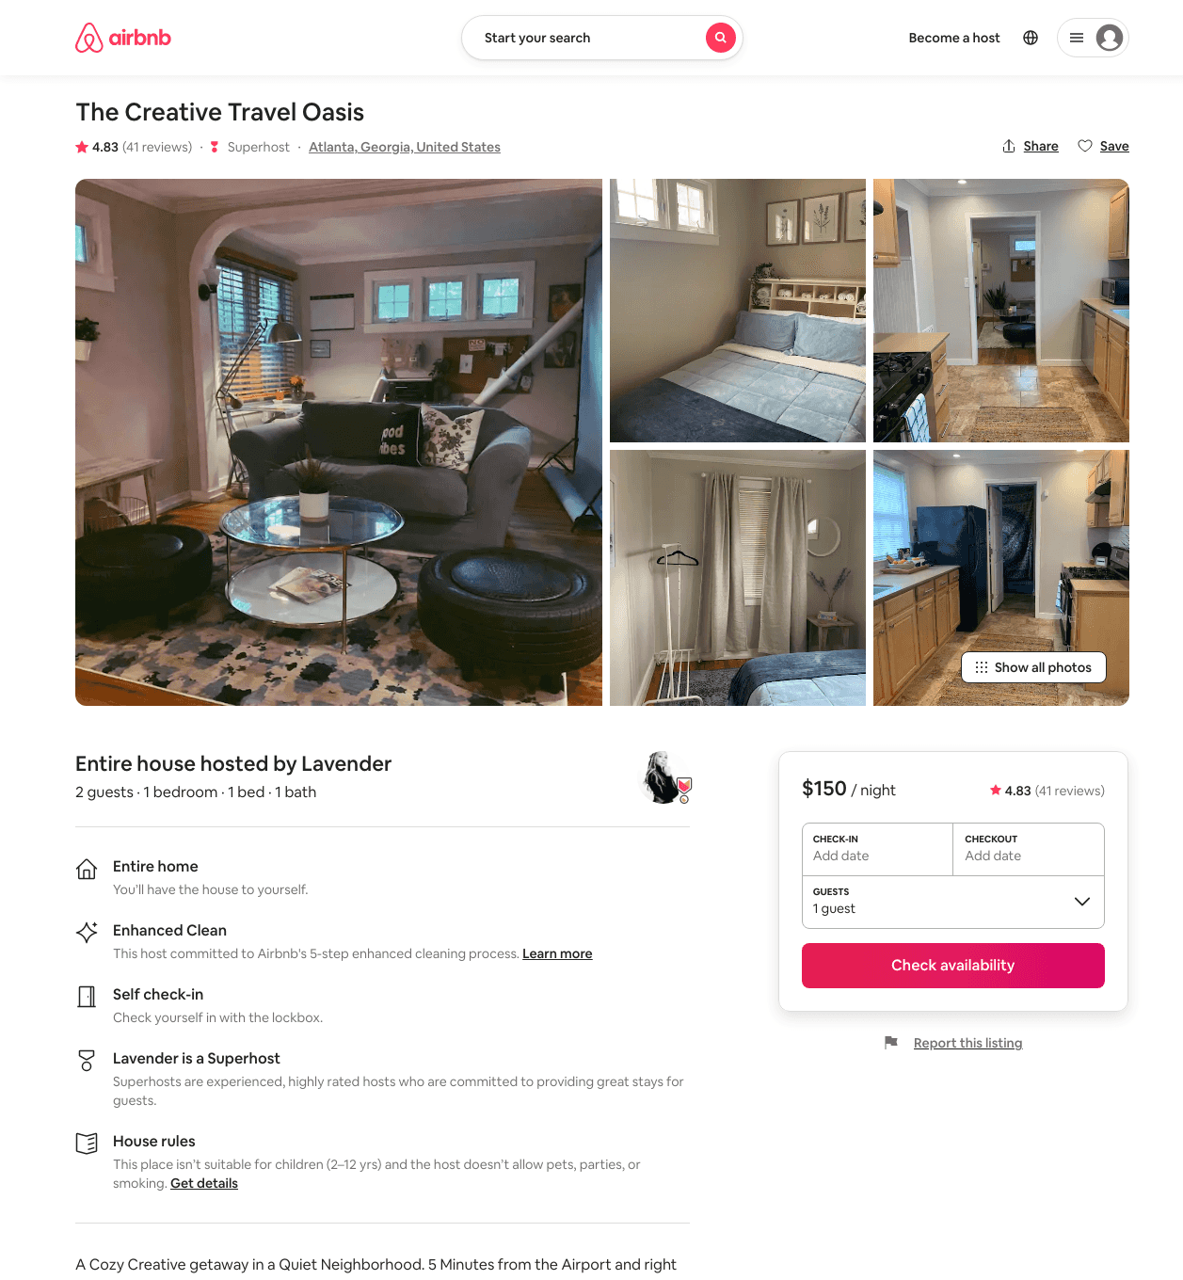
Listing 40887588
1
2
$123 - $151
4.84
1
Lavender
318407758
1
https://www.airbnb.com/rooms/40887588
Jun 2022

Slide 11
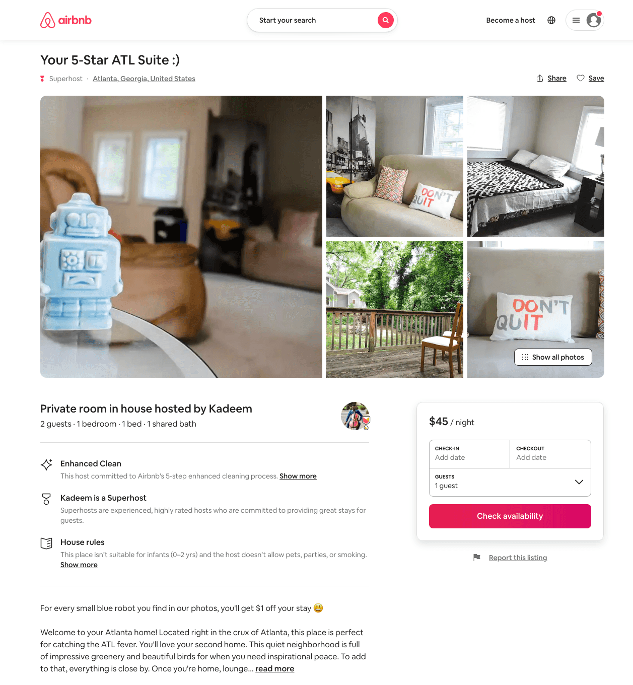
Listing 49798931
1
2
$33 - $45
4.62
2
Kadeem
158765025
4
https://www.airbnb.com/rooms/49798931
Aug 2022

Slide 12
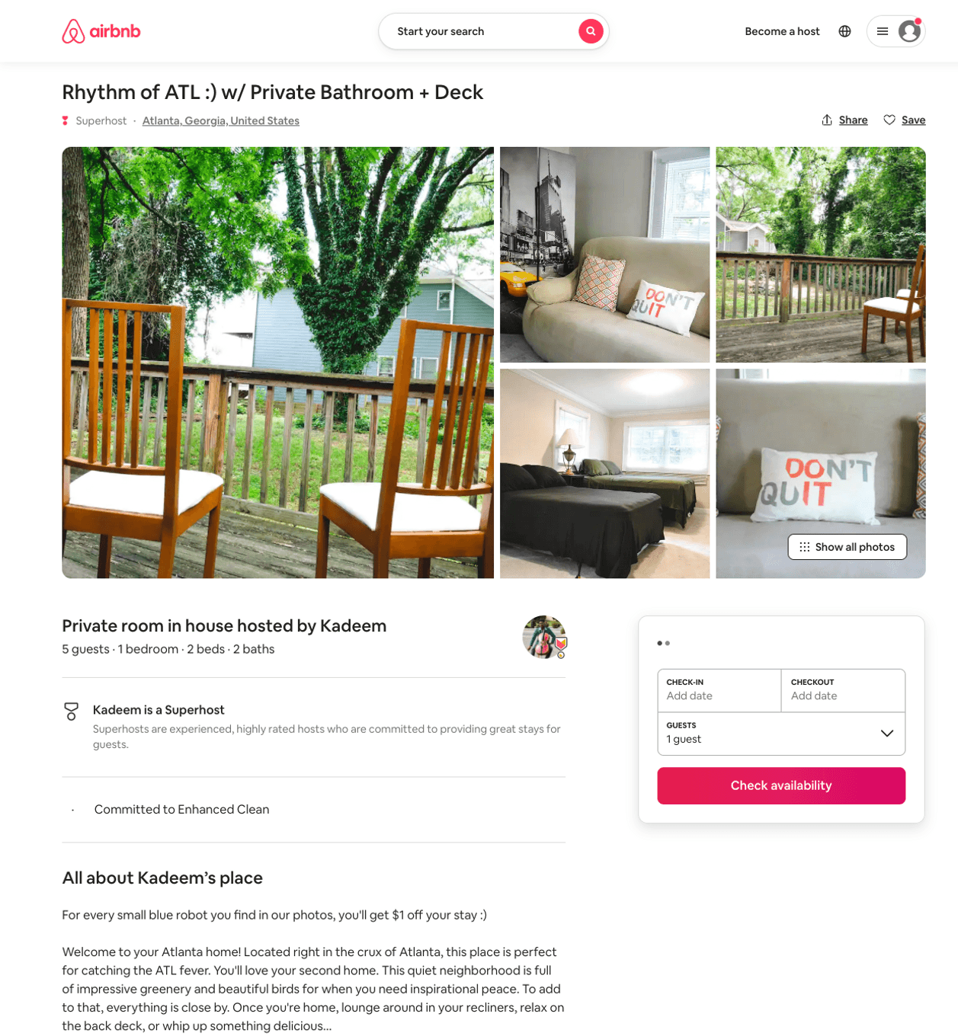
Listing 50174938
1
2
$36 - $48
4.67
2
Kadeem
158765025
4
https://www.airbnb.com/rooms/50174938
Aug 2022

Slide 13
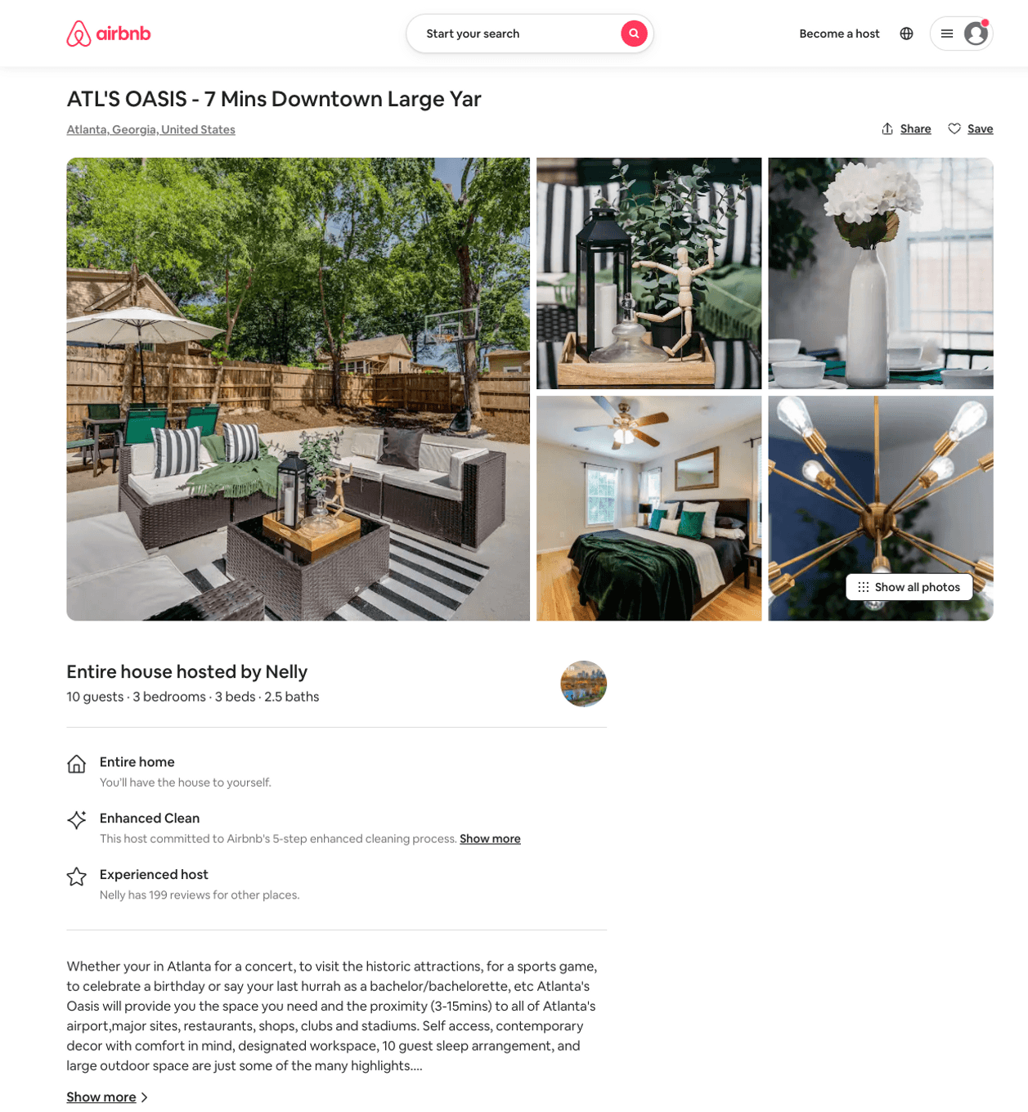
Listing 50324655
3
10
$139 - $348
4.54
2
Nelly
5467335
6
https://www.airbnb.com/rooms/50324655
Aug 2022

Slide 14
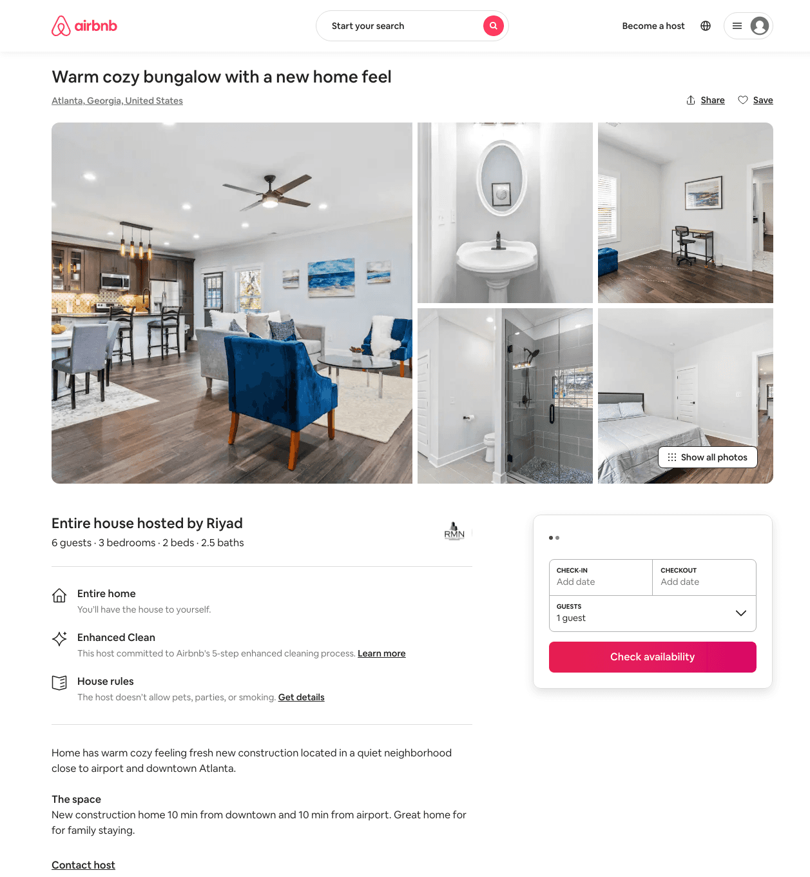
Listing 49010164
3
6
$137 - $211
4.58
1
Rob
123347174
1
https://www.airbnb.com/rooms/49010164
Aug 2022

Slide 15
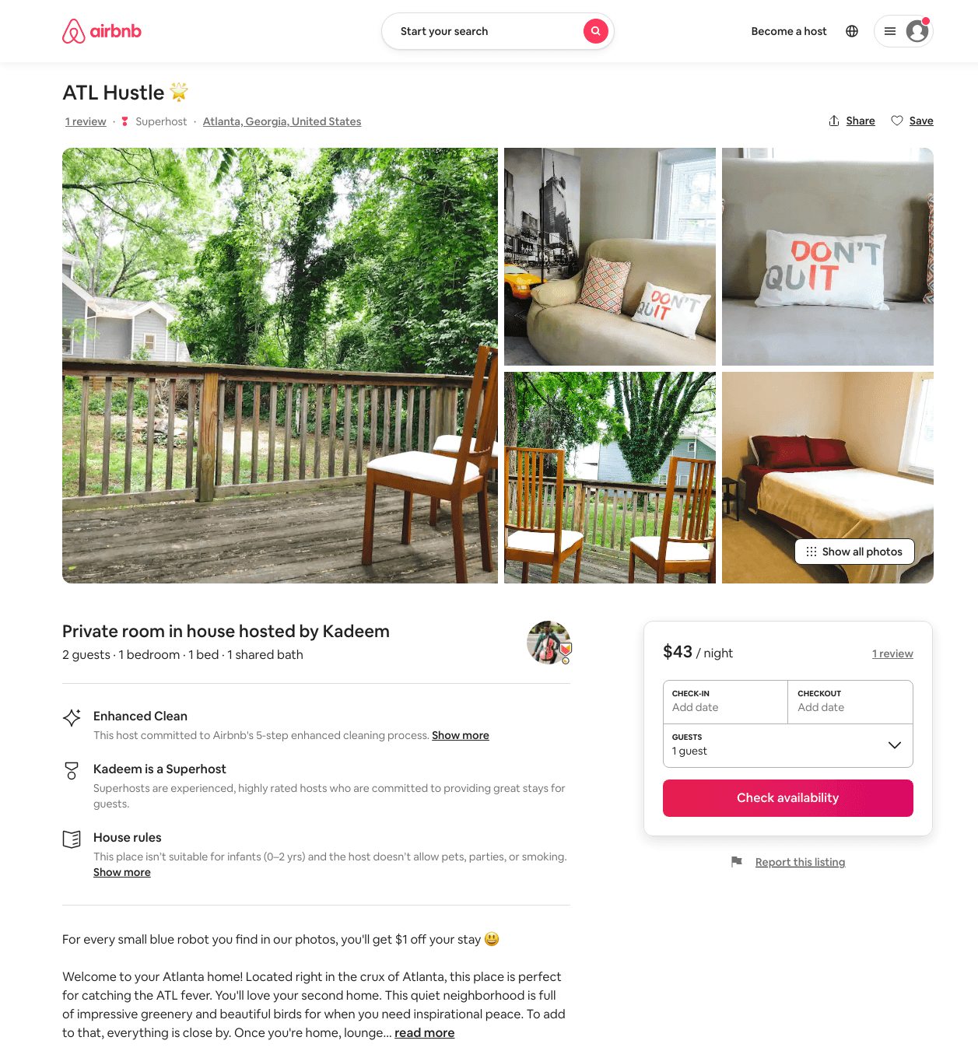
Listing 49798801
1
2
$35 - $45
4.73
2
Kadeem
158765025
4
https://www.airbnb.com/rooms/49798801
Aug 2022

Slide 16
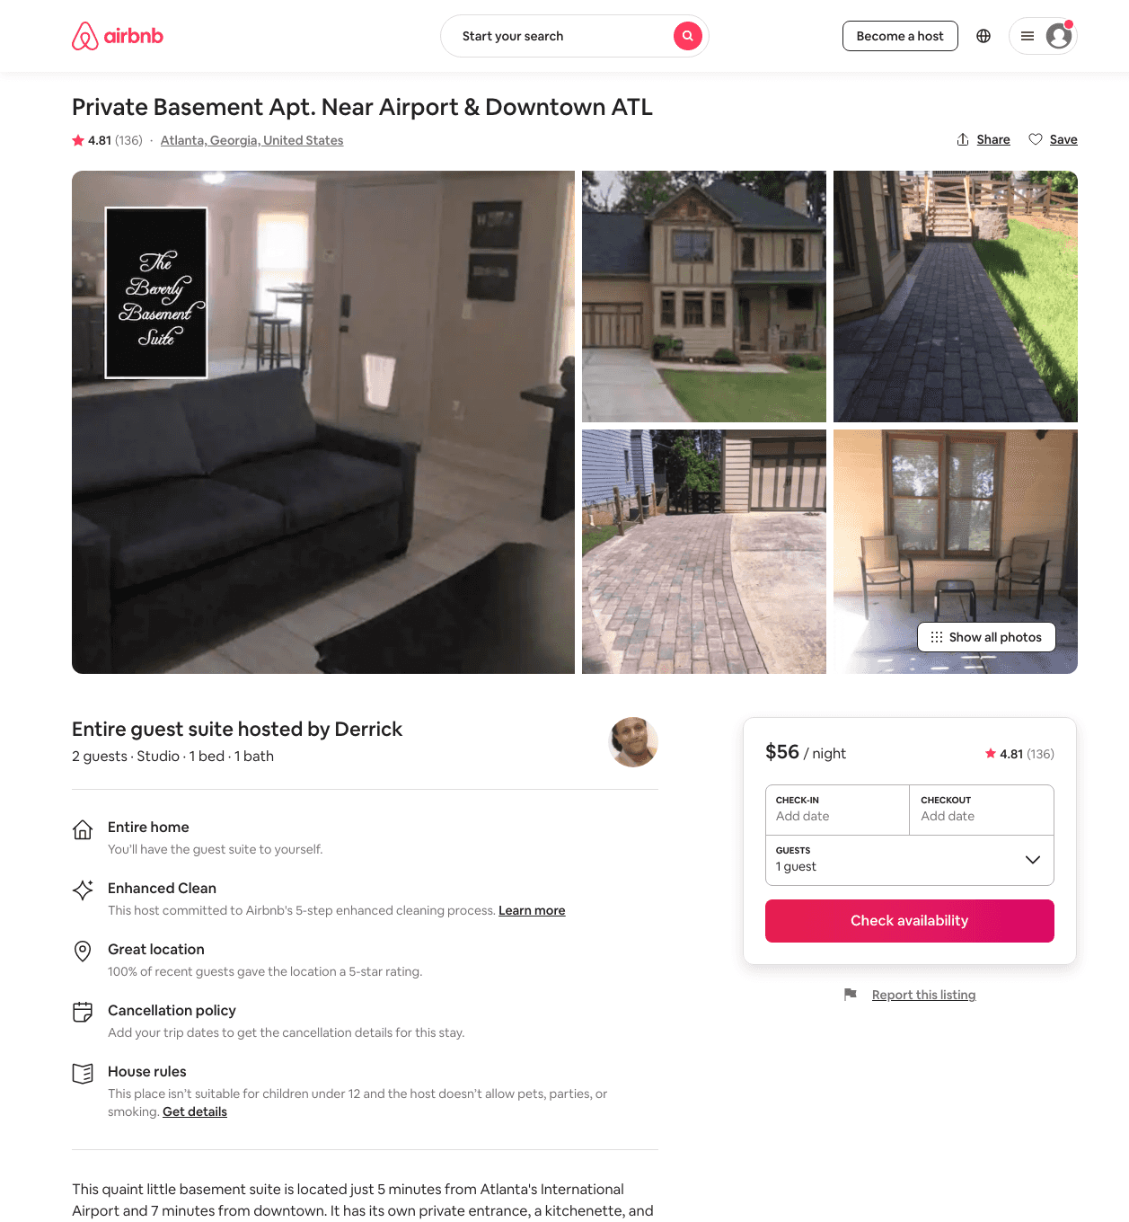
Listing 18594333
Studio
2
$55 - $68
4.82
3
Derrick
129121773
1
https://www.airbnb.com/rooms/18594333
Aug 2022

Slide 17
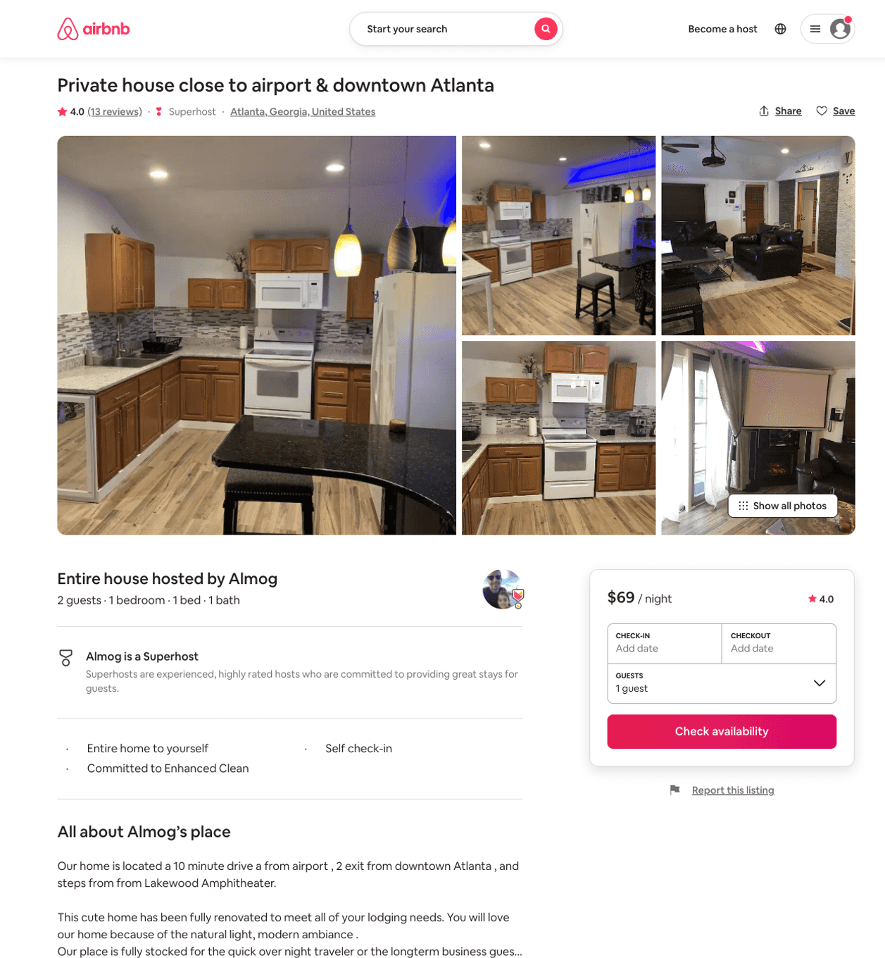
Listing 29275898
1
2
$69 - $85
3.93
3
Almog
20745810
1
https://www.airbnb.com/rooms/29275898
Aug 2022

Slide 18
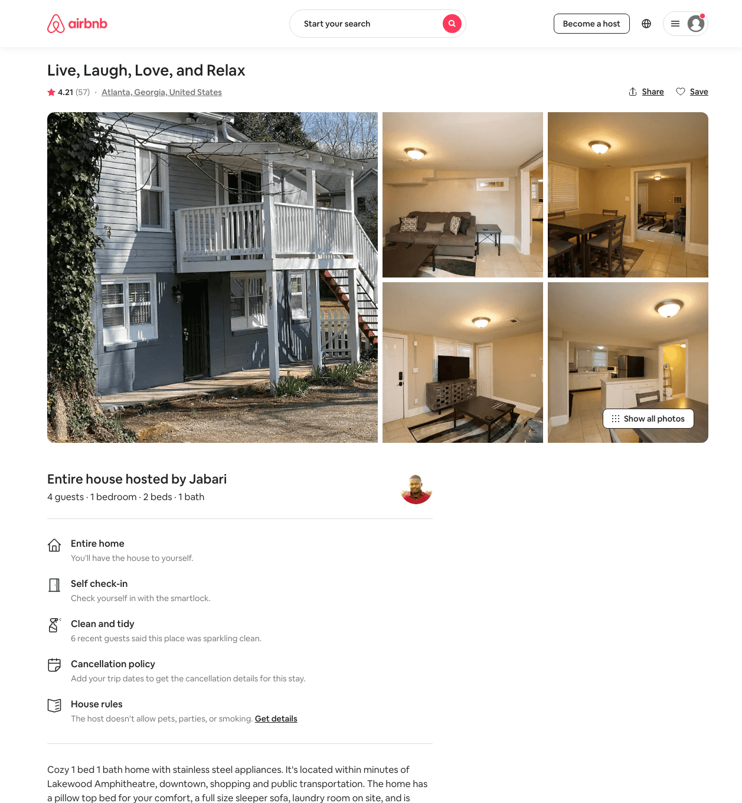
Listing 29557065
1
4
$76 - $125
4.33
2
Jabari
68062937
3
https://www.airbnb.com/rooms/29557065
Jun 2022

Slide 19
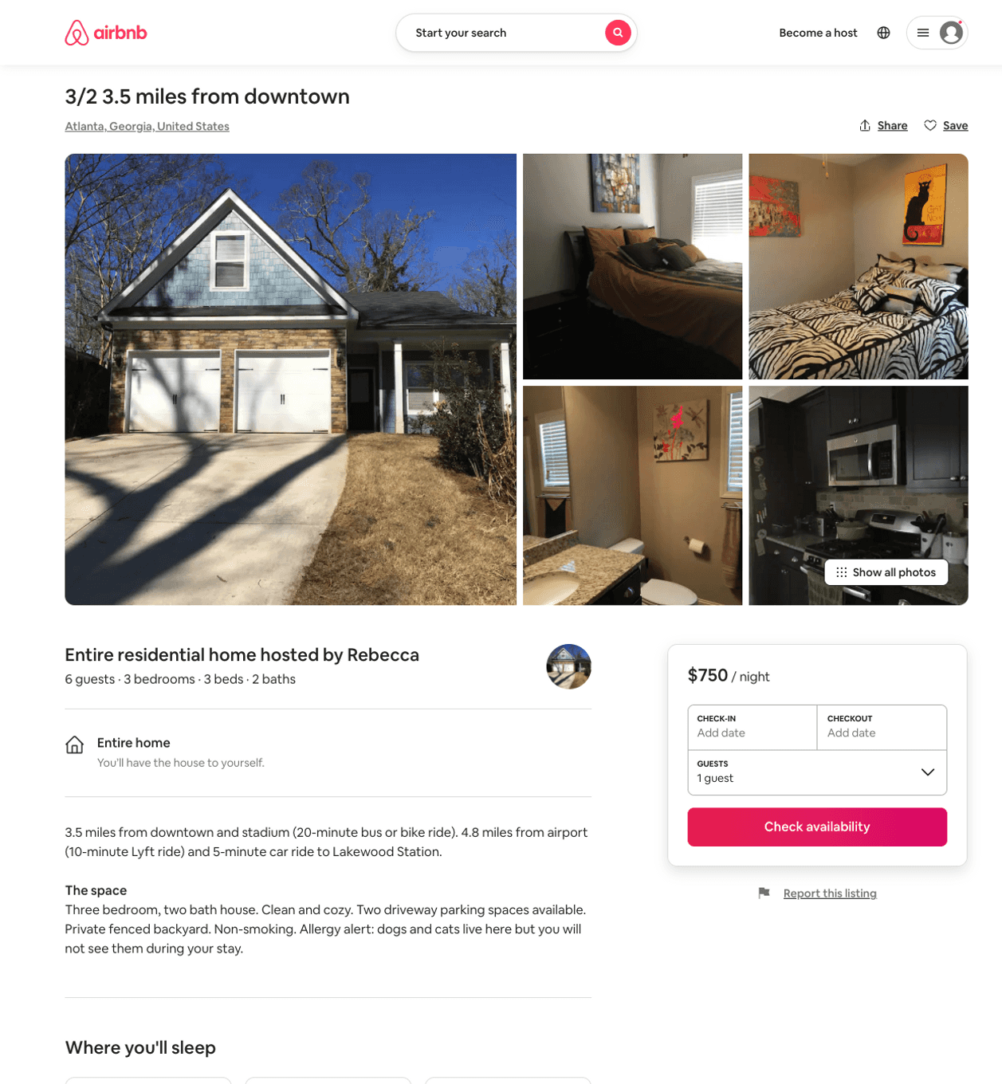
Listing 31885860
3
6
$750
2
Rebecca
176446859
1
https://www.airbnb.com/rooms/31885860
Aug 2022

Slide 20
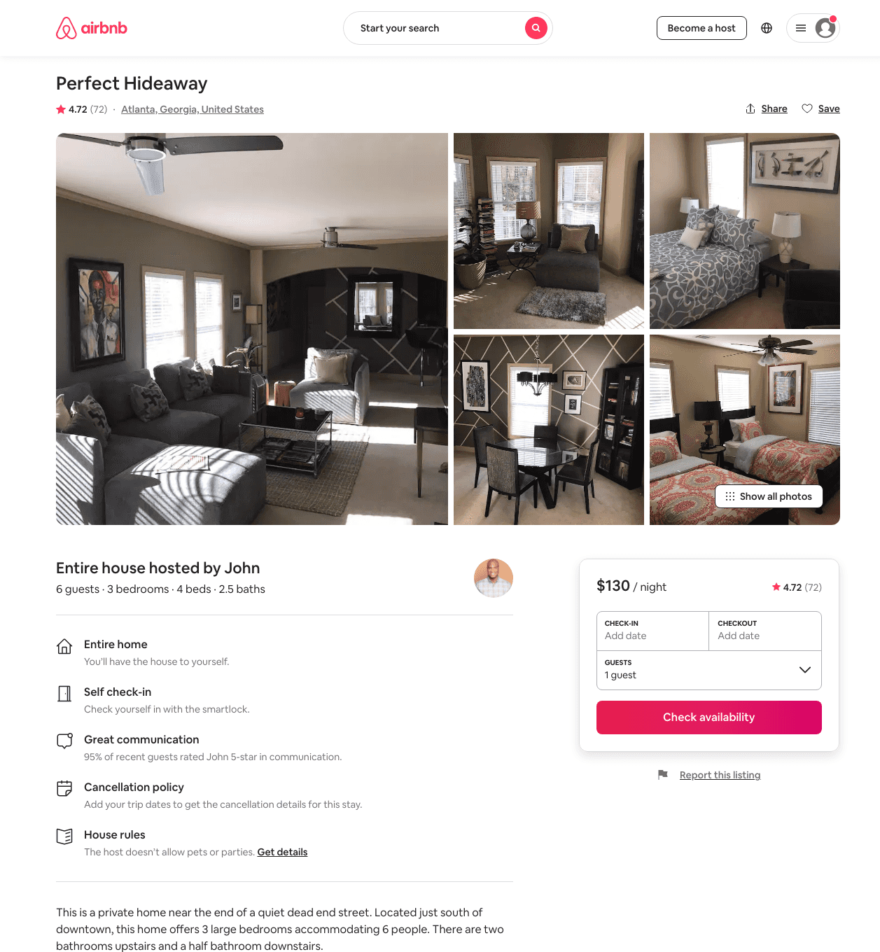
Listing 32135881
3
6
$130 - $150
4.64
4
John
87508166
3
https://www.airbnb.com/rooms/32135881
Aug 2022

Slide 21
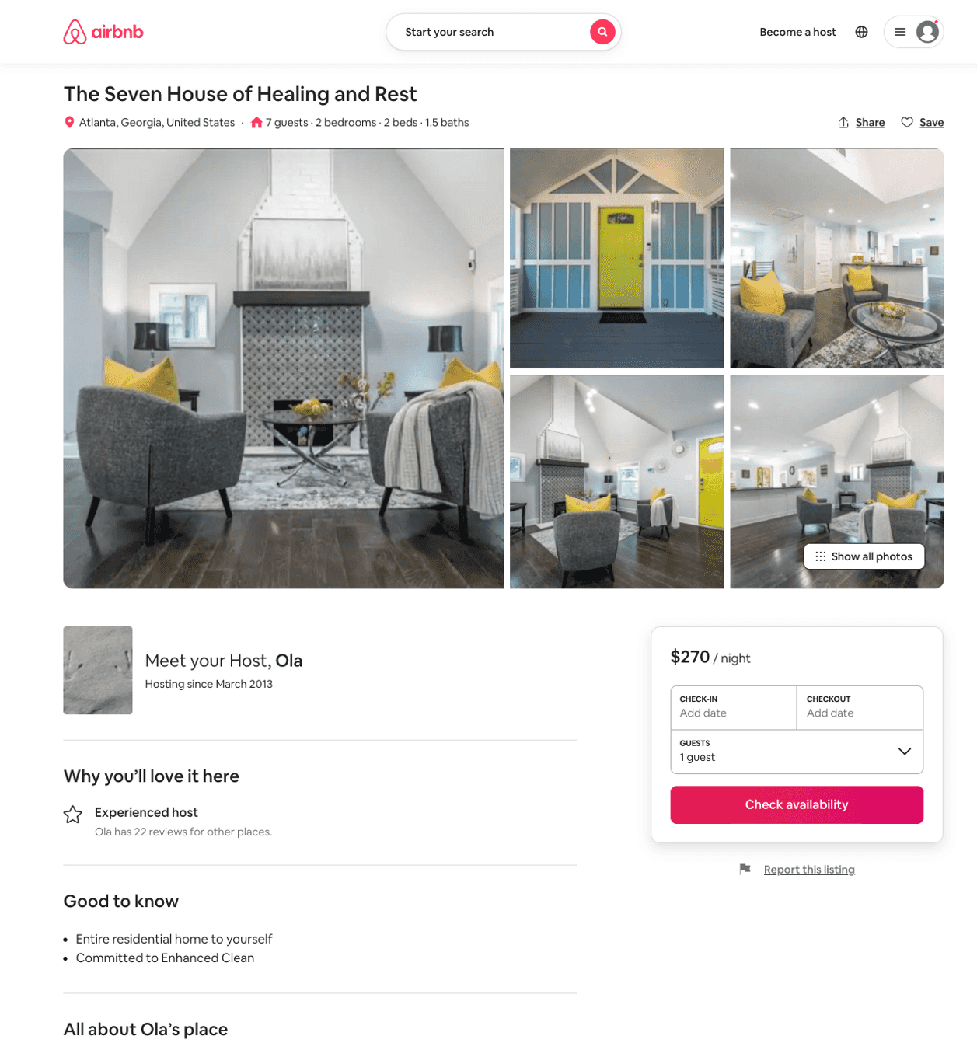
Listing 51849077
2
2
$127 - $300
4.56
28
Ola
5663714
3
https://www.airbnb.com/rooms/51849077
Aug 2022

Slide 22
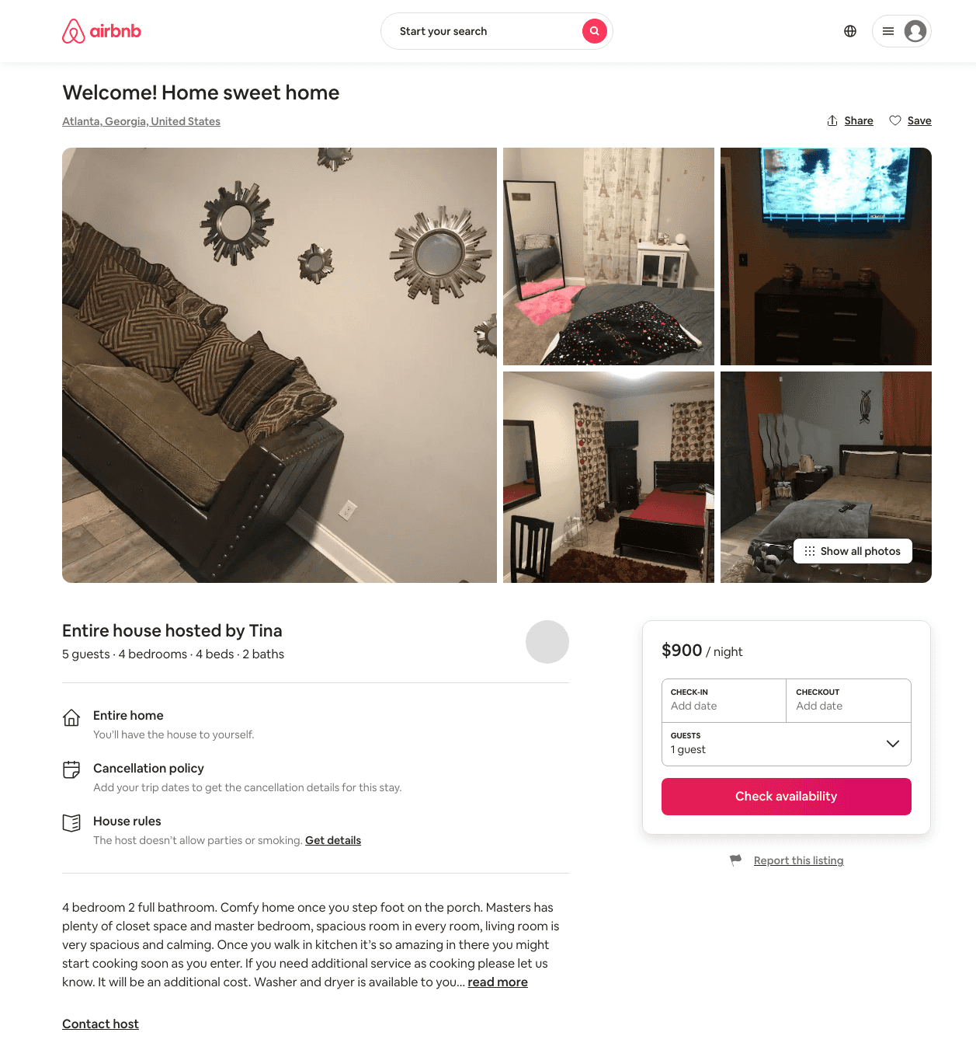
Listing 31850285
4
5
$800 - $900
10
Tina
238155096
2
https://www.airbnb.com/rooms/31850285
Aug 2022

Slide 23
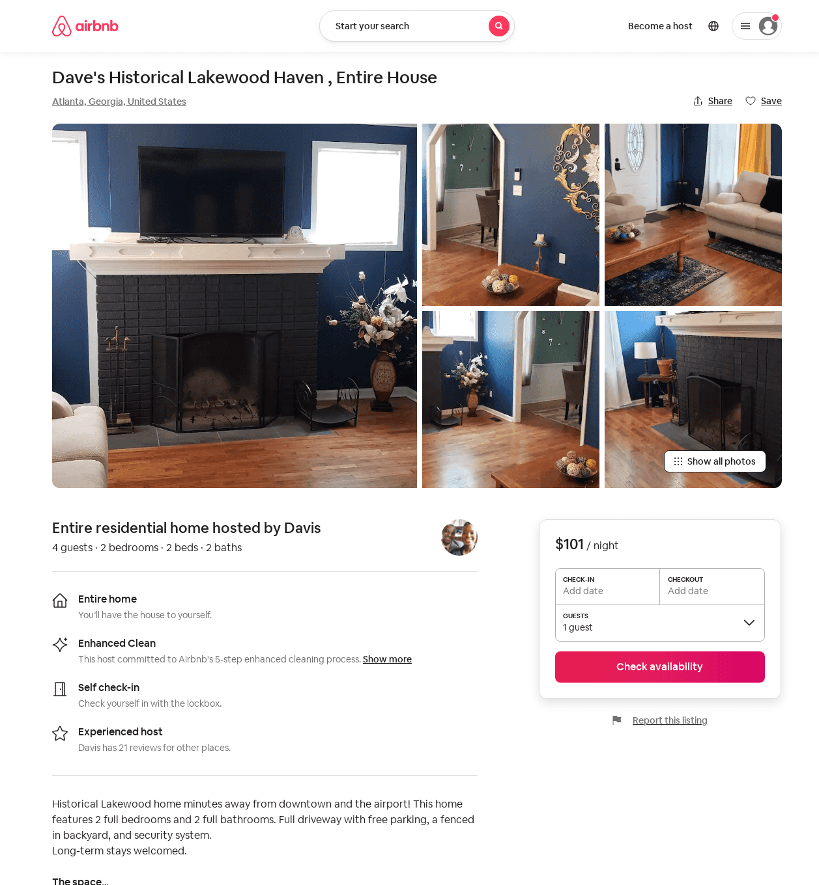
Listing 51989581
2
4
$101 - $154
4.88
3
Marcia
232960693
1
https://www.airbnb.com/rooms/51989581
Aug 2022

Slide 24
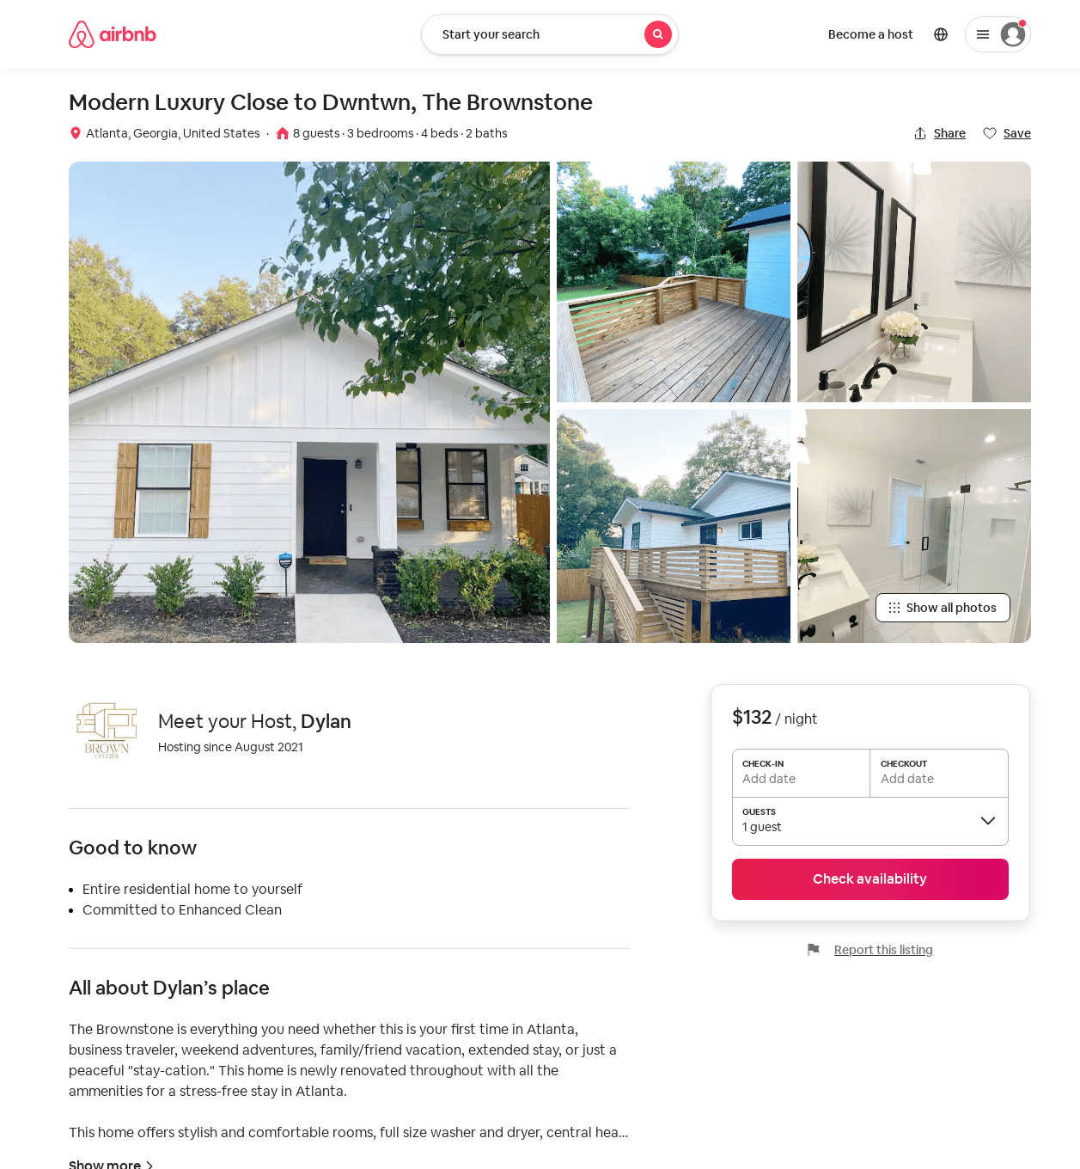
Listing 51850847
3
8
$124 - $230
4.74
2
Dylan
418726414
1
https://www.airbnb.com/rooms/51850847
Jun 2022

Slide 25
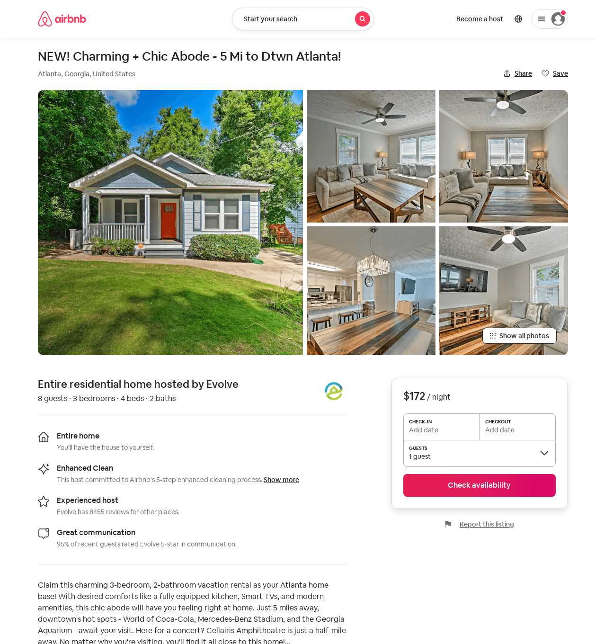
Listing 51979292
3
8
$163 - $186
2
Evolve
121682456
51
https://www.airbnb.com/rooms/51979292
Aug 2022

Slide 26
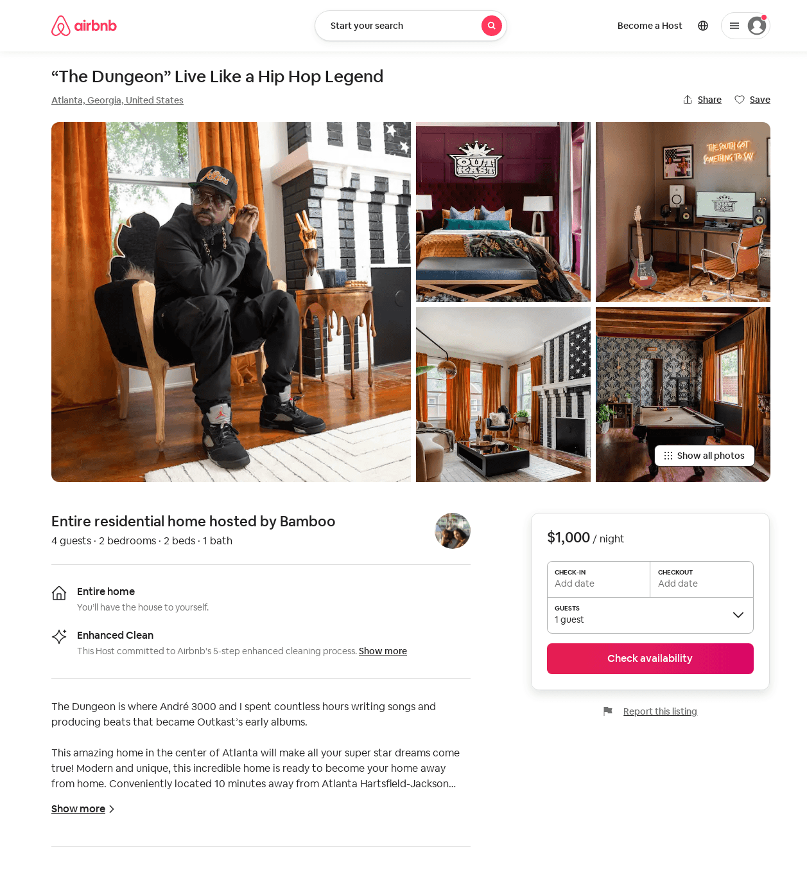
Listing 52403292
1907 LAKEWOOD TER SE
2
4
$290 - $1000
5.0
2
Bamboo
424005622
1
https://www.airbnb.com/rooms/52403292
Aug 2022

Slide 27
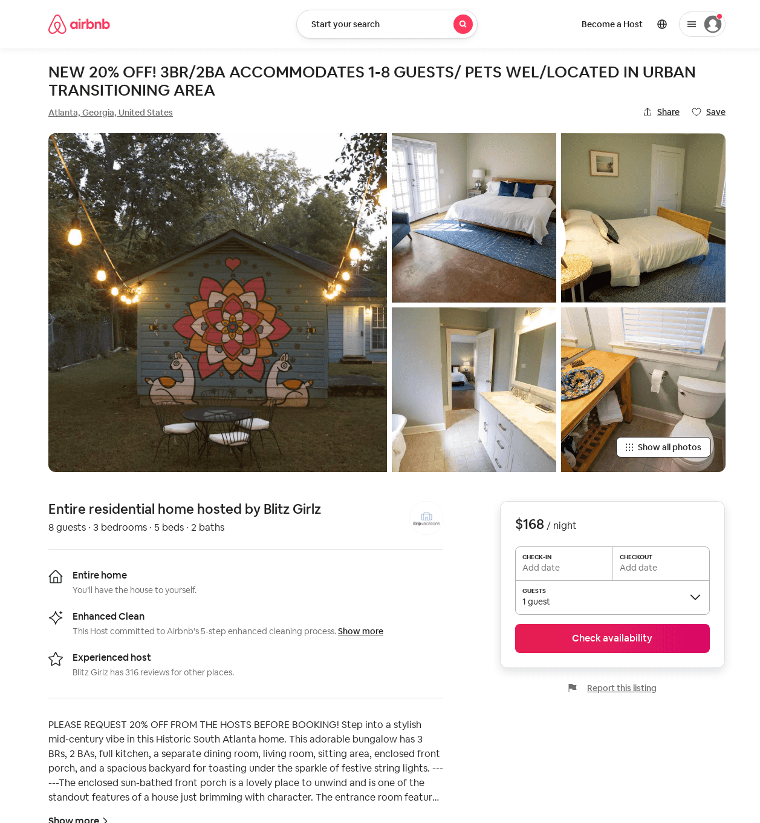
Listing 52698779
3
8
$110 - $168
4.88
2
Blitz Girlz
305467402
16
https://www.airbnb.com/rooms/52698779
Jun 2022

Slide 28
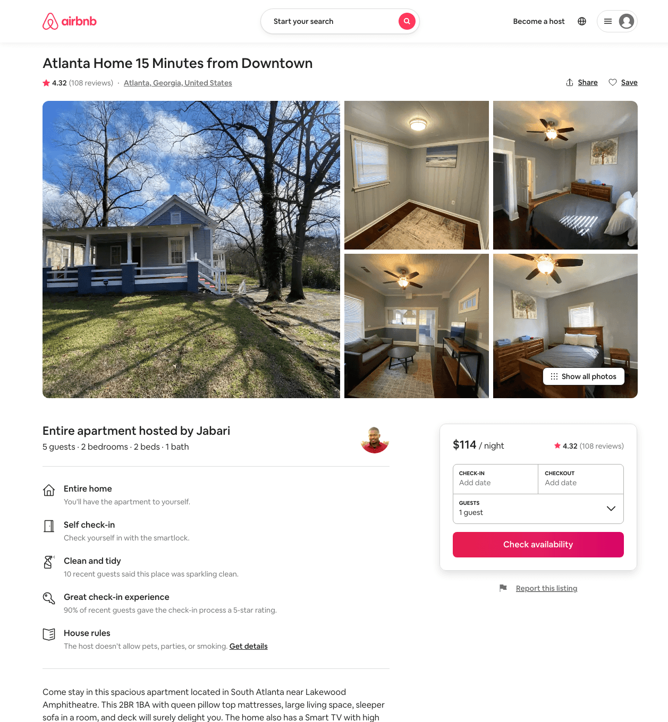
Listing 25202206
3
8
$114 - $141
4.31
1
Jabari
68062937
3
https://www.airbnb.com/rooms/25202206
Aug 2022

Slide 29
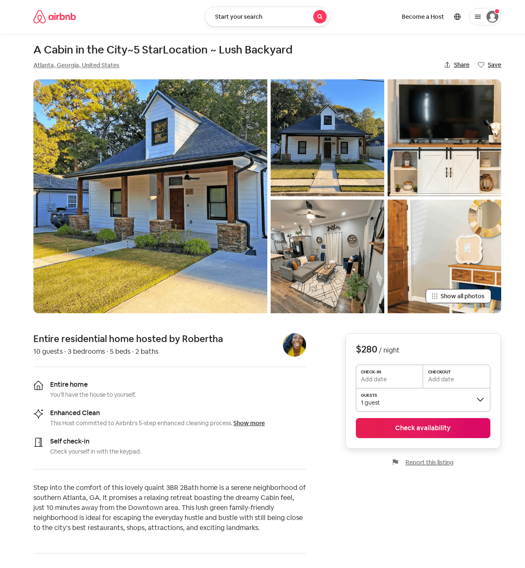
Listing 52900787
3
10
$231 - $333
4.81
2
Robertha
428276342
1
https://www.airbnb.com/rooms/52900787
Aug 2022

Slide 30
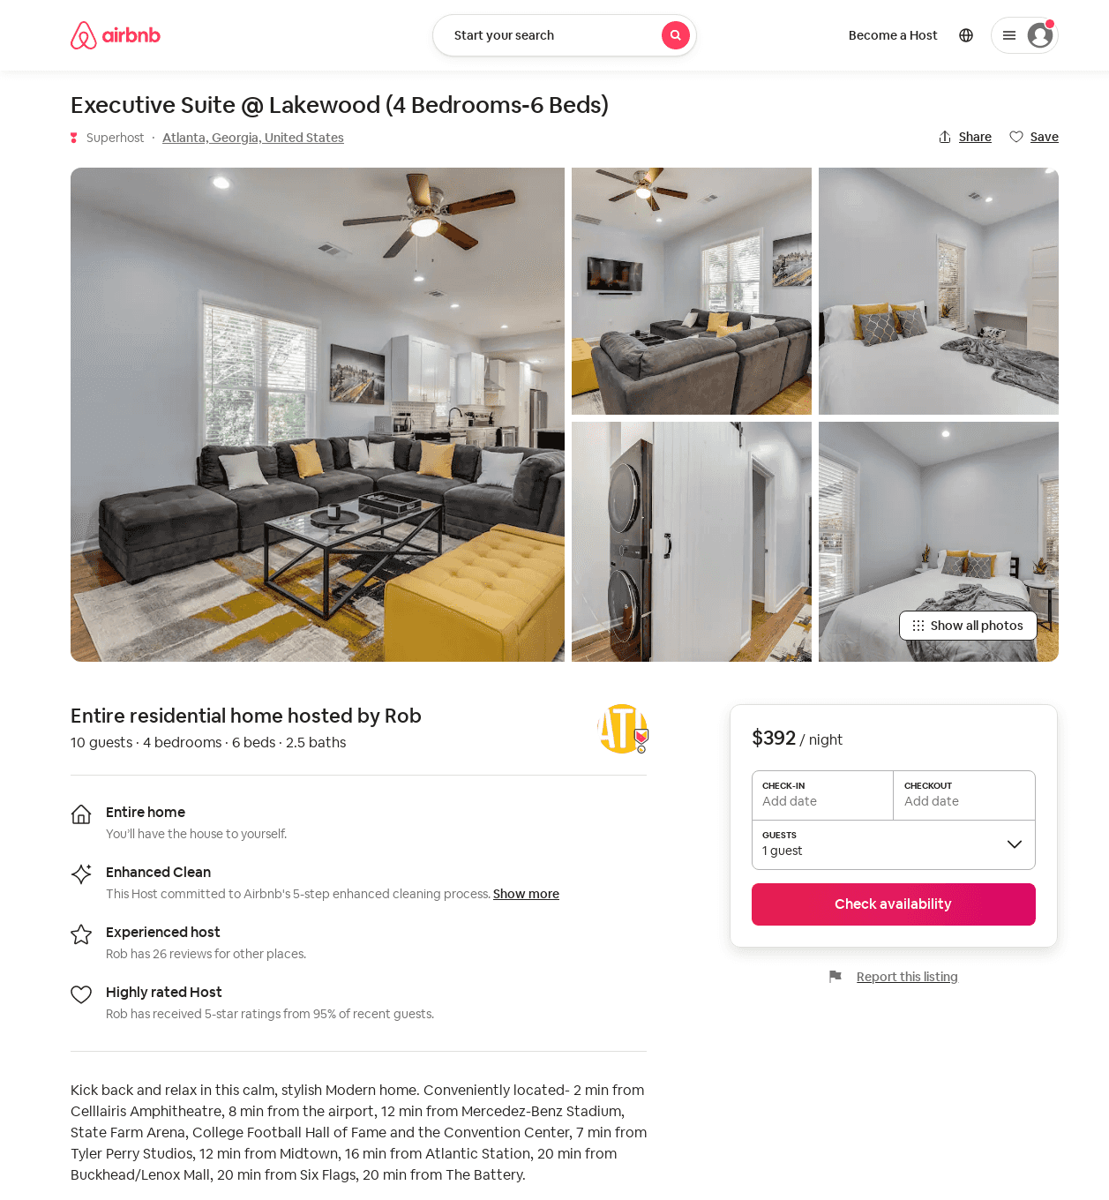
Listing 52987892
4
10
$308 - $397
5.0
3
Rob
375072231
2
https://www.airbnb.com/rooms/52987892
Aug 2022

Slide 31
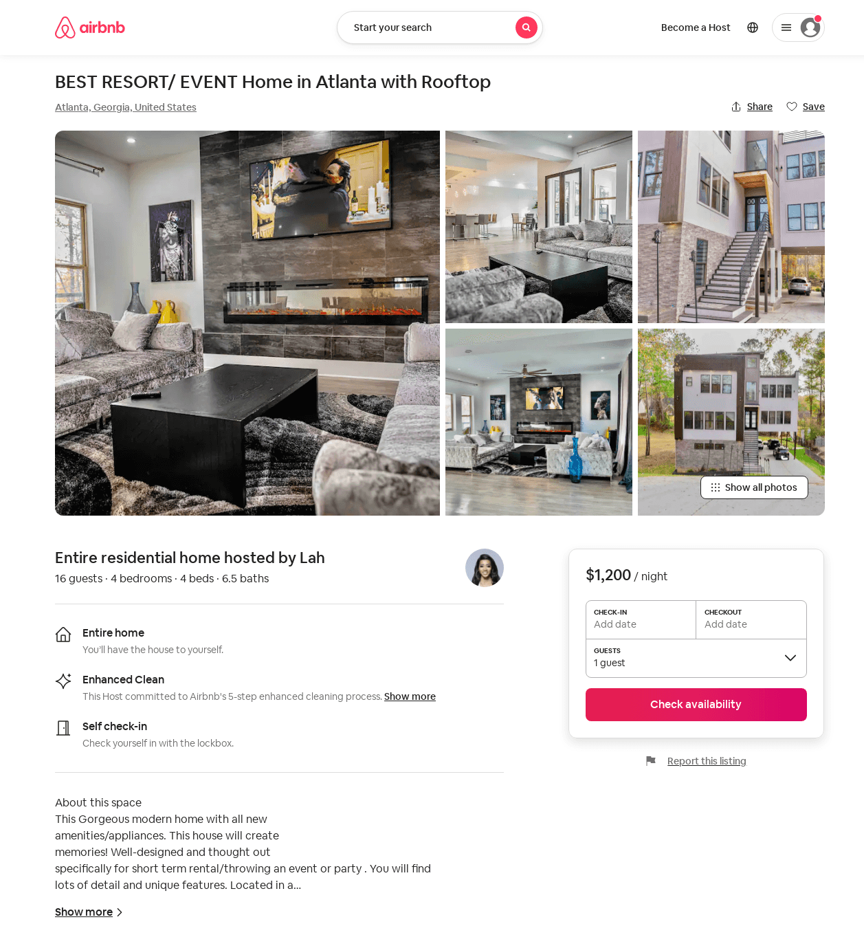
Listing 53785322
4
16
$1200 - $2500
2
Lah
434282286
2
https://www.airbnb.com/rooms/53785322
Jul 2022

Slide 32
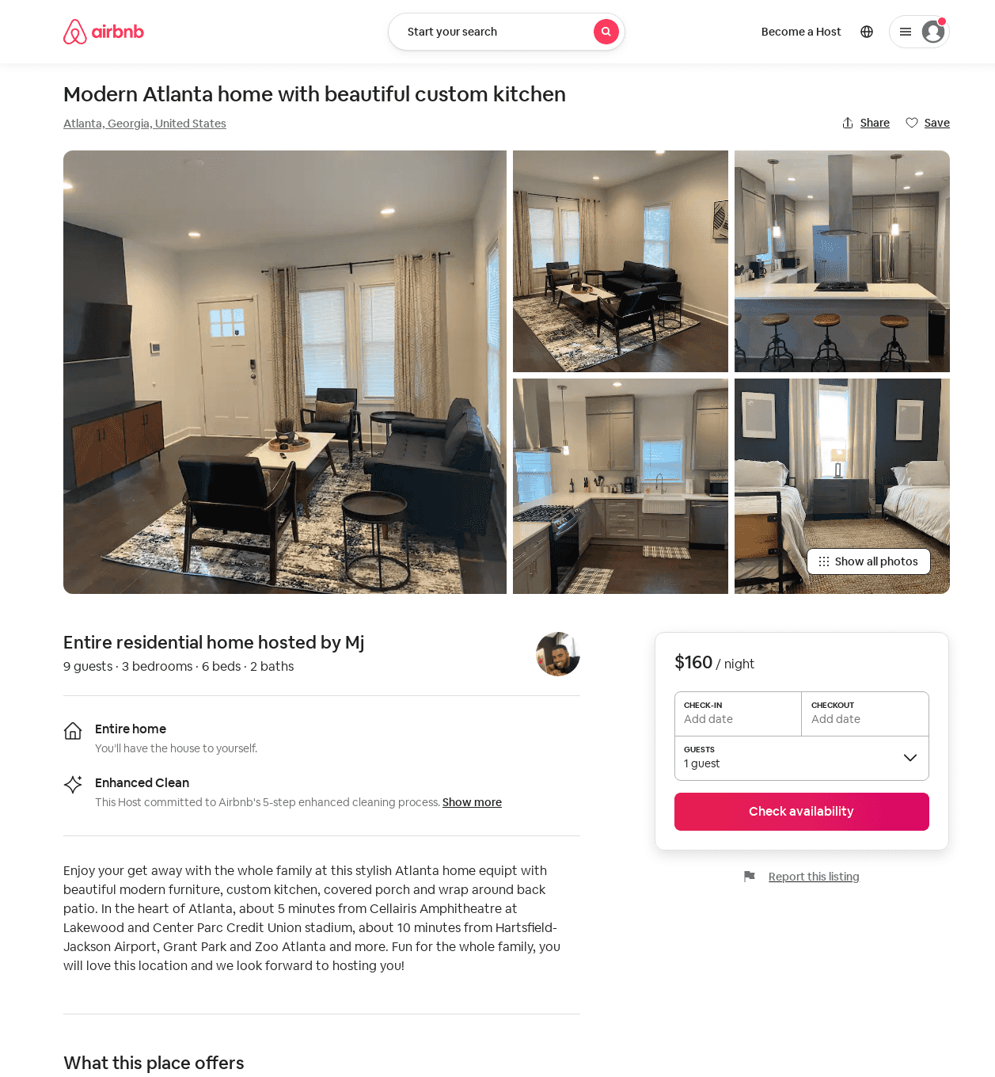
Listing 53874935
3
8
$160 - $264
4.94
3
Mj
26763923
1
https://www.airbnb.com/rooms/53874935
Aug 2022

Slide 33
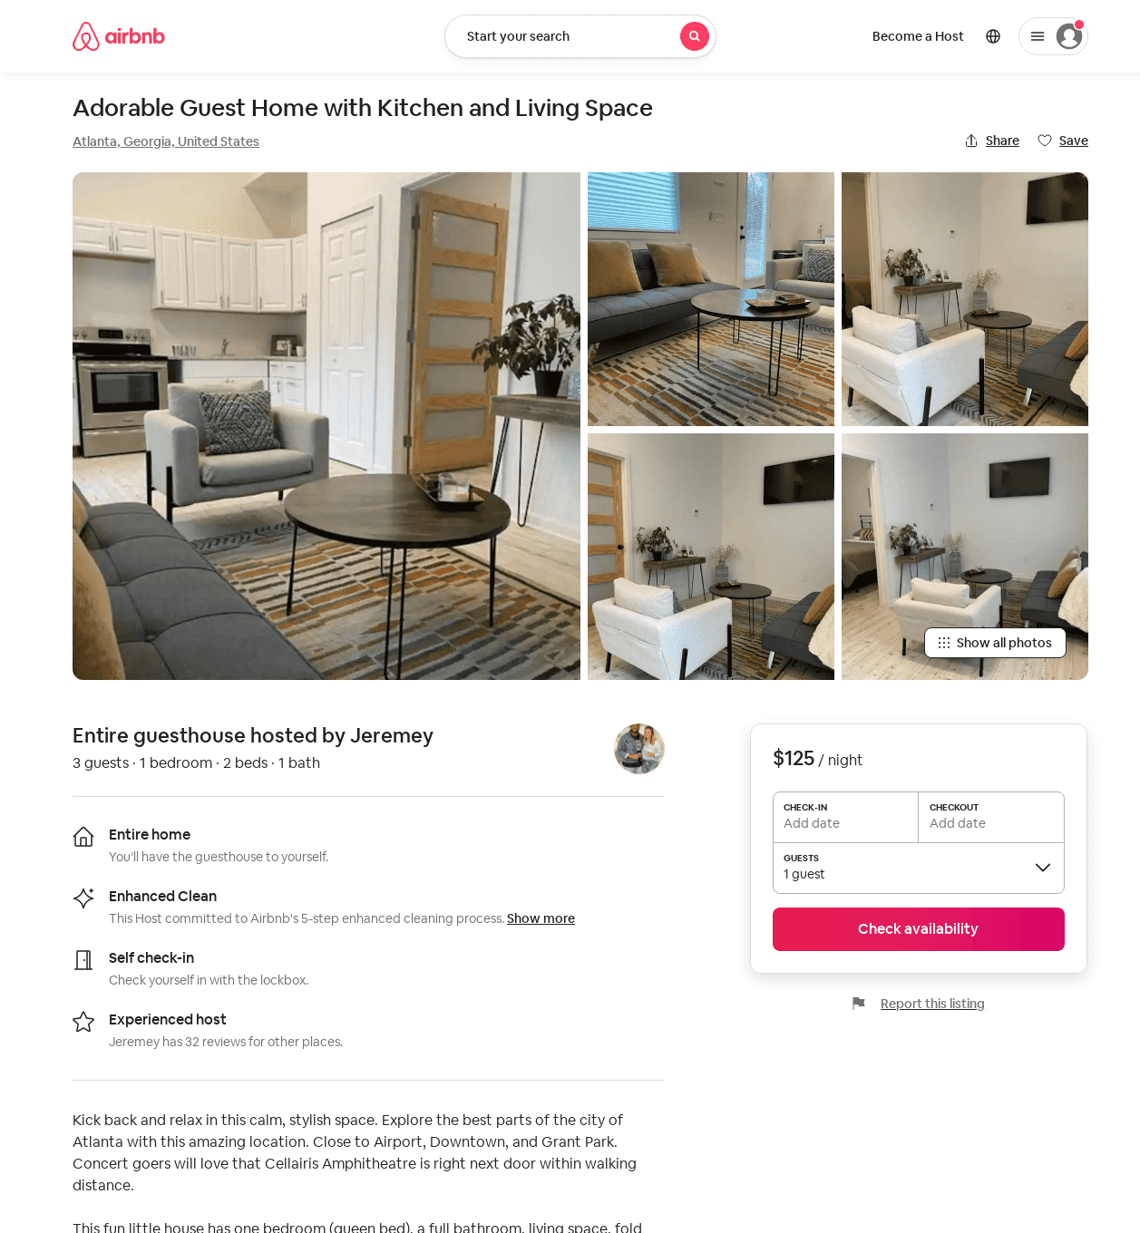
Listing 53933225
1
2
$115 - $144
4.78
2
Jeremey
19920779
1
https://www.airbnb.com/rooms/53933225
Aug 2022

Slide 34
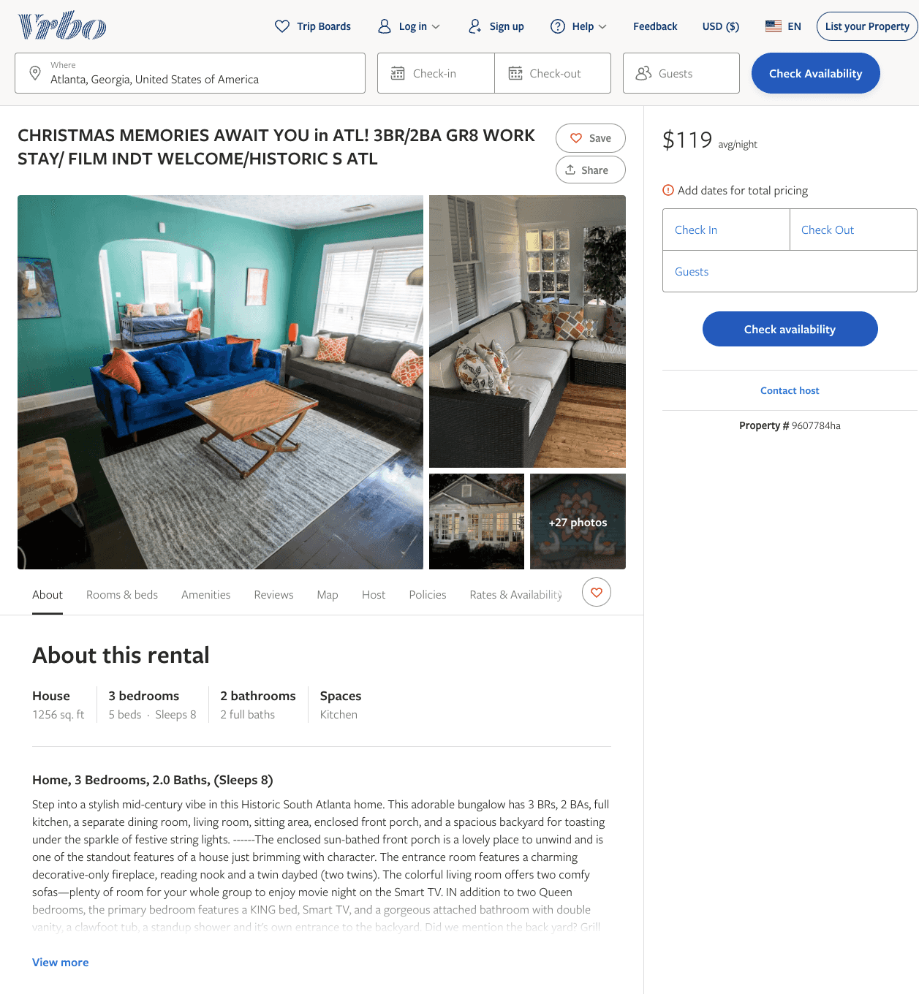
Listing 9607784
3
8
$107 - $129
4.5
1
https://www.vrbo.com/9607784ha
Aug 2022

Slide 35
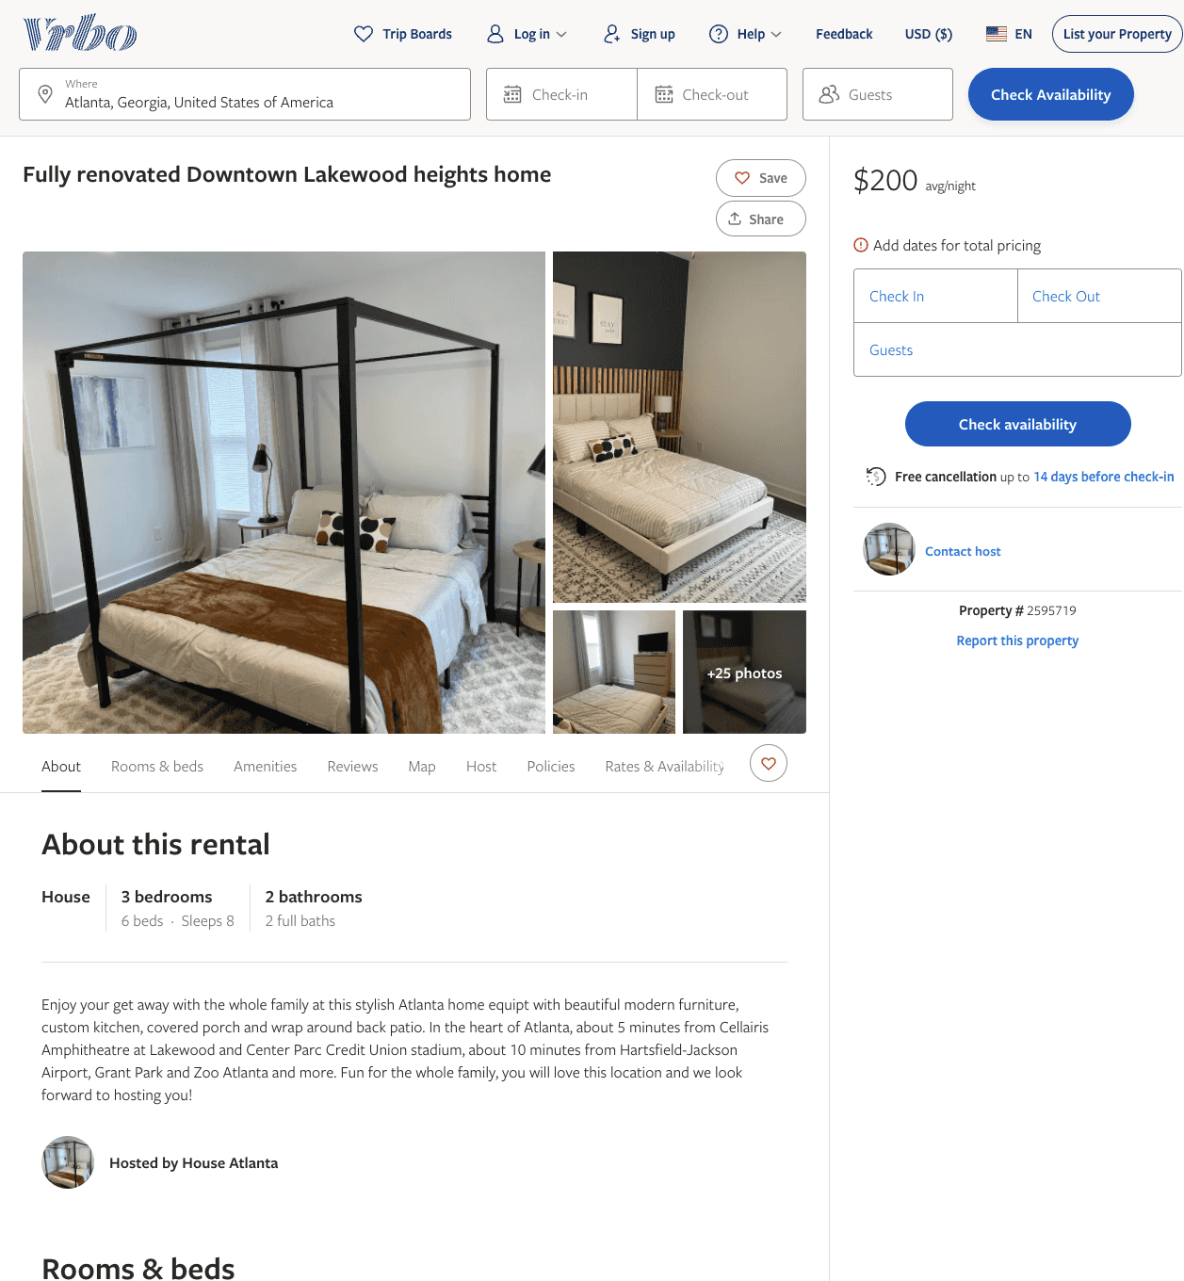
Listing 2595719
3
8
$200 - $268
4.857143
3
Melvin Bridges Jr
https://www.vrbo.com/2595719
Aug 2022

Slide 36
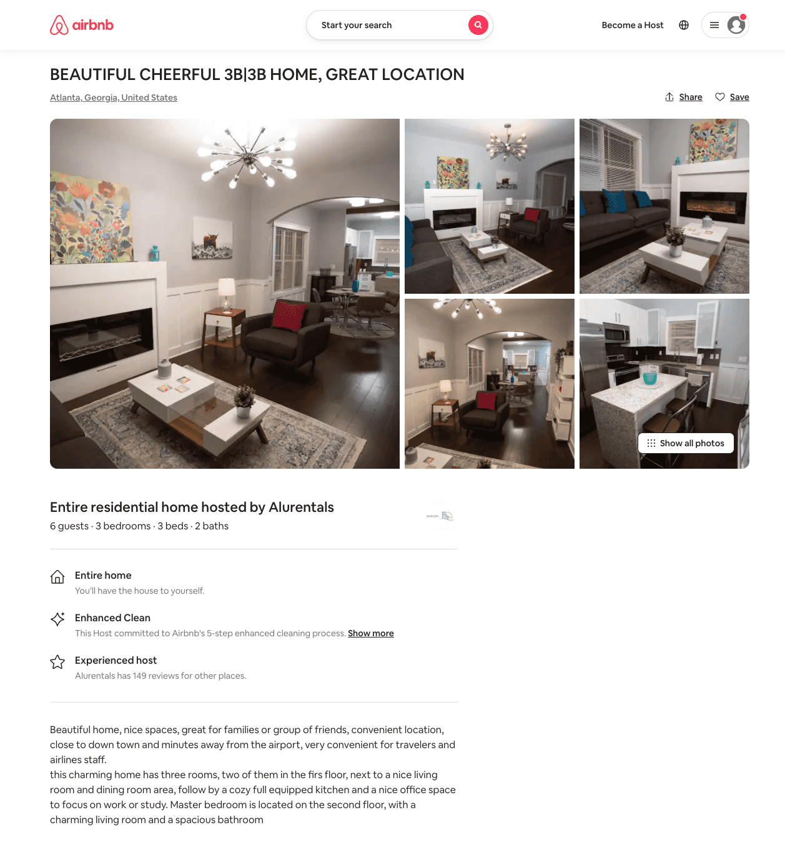
Listing 54046975
3
6
$124 - $164
4.57
1
Alurentals
170442586
5
https://www.airbnb.com/rooms/54046975
Aug 2022

Slide 37
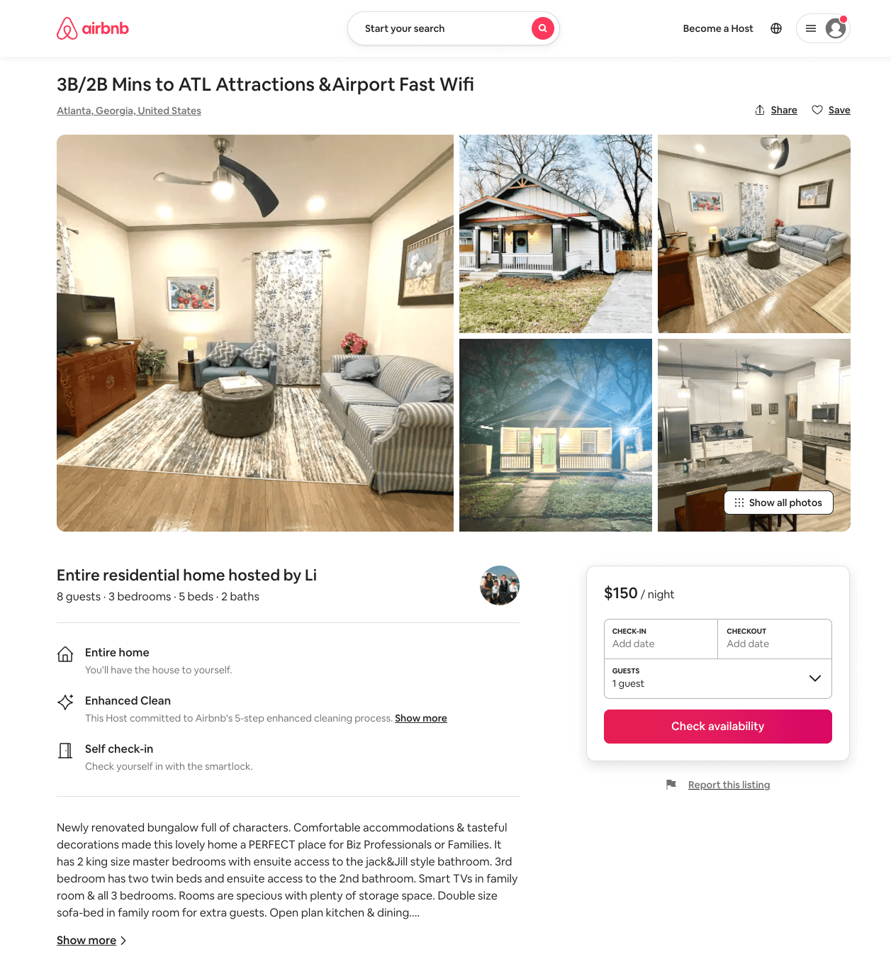
Listing 53615925
3
8
$103 - $173
5.0
4
Li
423499585
3
https://www.airbnb.com/rooms/53615925
Aug 2022

Slide 38
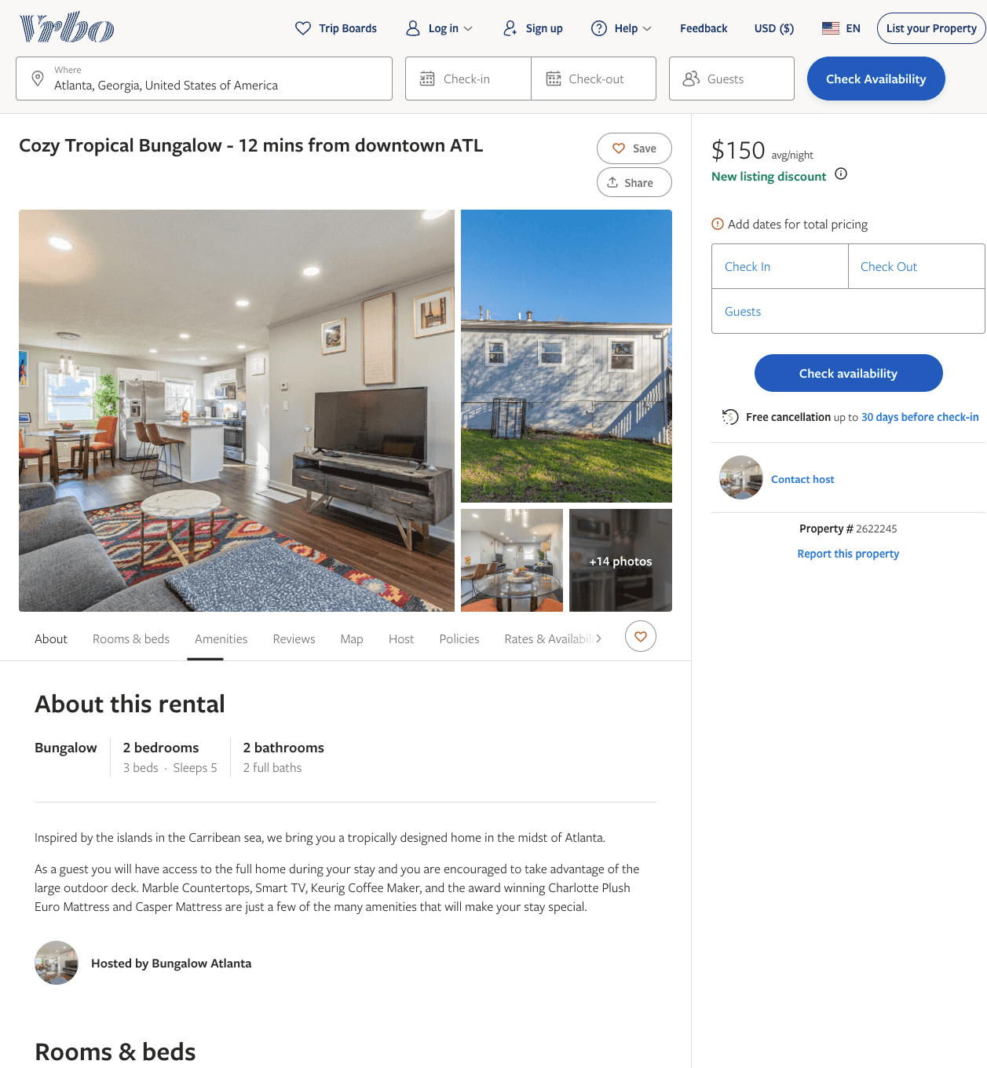
Listing 2622245
2
5
$77
5
1
Niyi
https://www.vrbo.com/2622245
Aug 2022

Slide 39
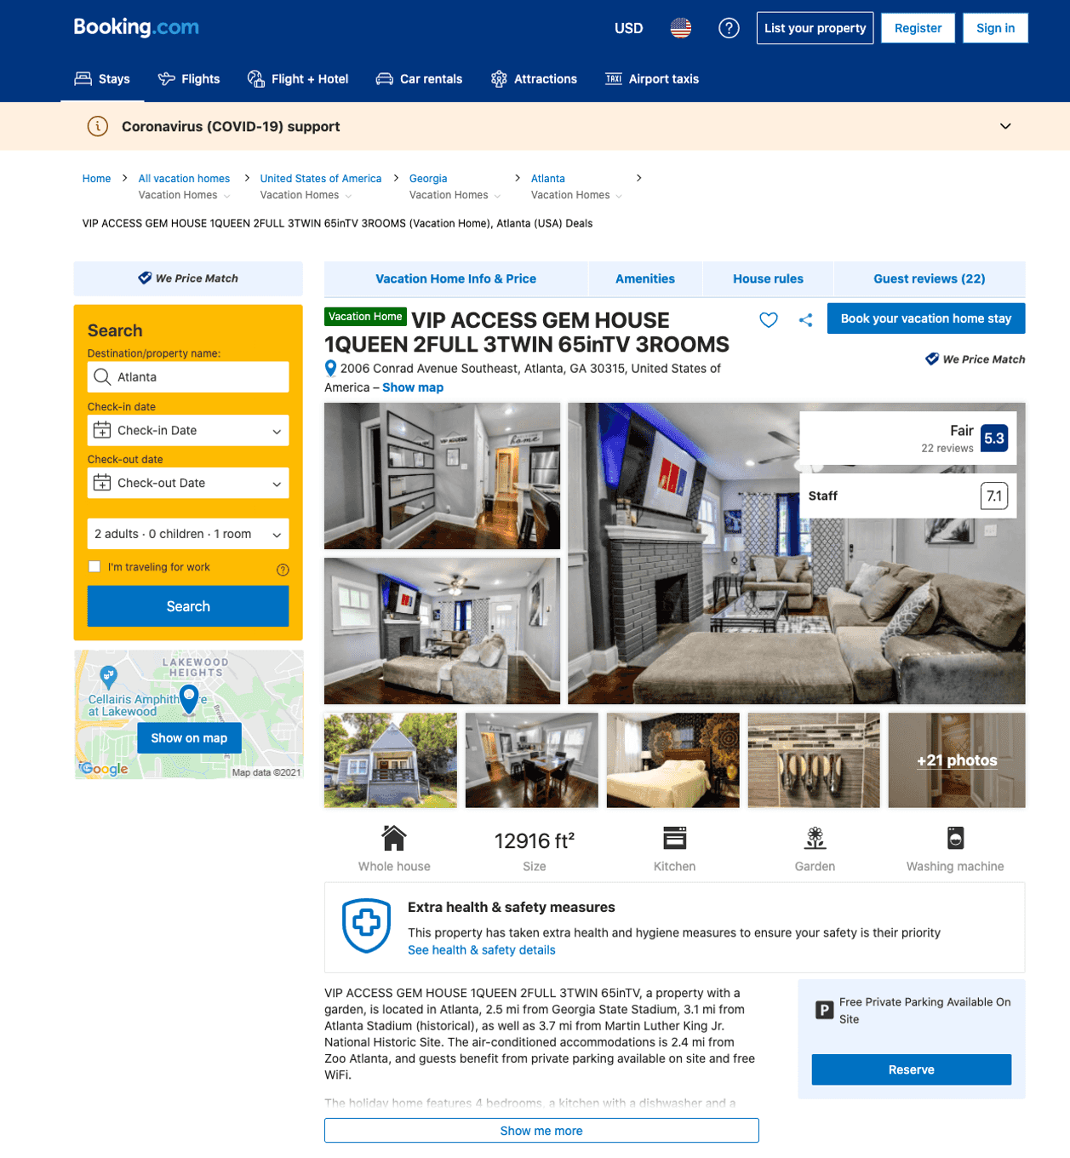
Listing vip-access-gem-house-1queen-2full-3twin-65intv
undefined
10
5.8
https://www.booking.com/hotel/us/vip-access-gem-house-1queen-2full-3twin-65intv.html
Sep 2022

Slide 40
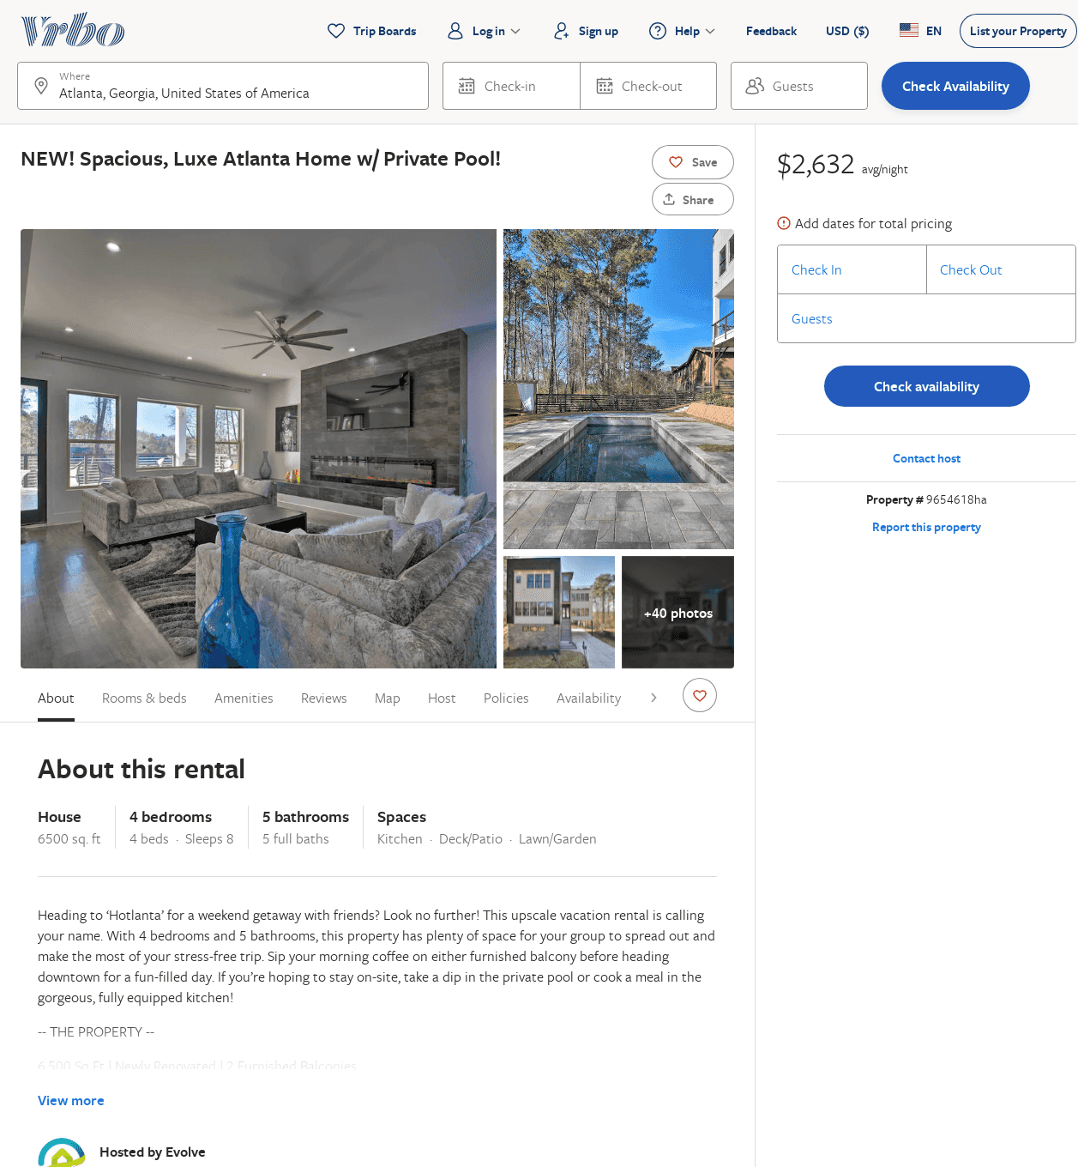
Listing 9654618
4
8
$2,001
2
Evolve
https://www.vrbo.com/9654618ha
Aug 2022

Slide 41
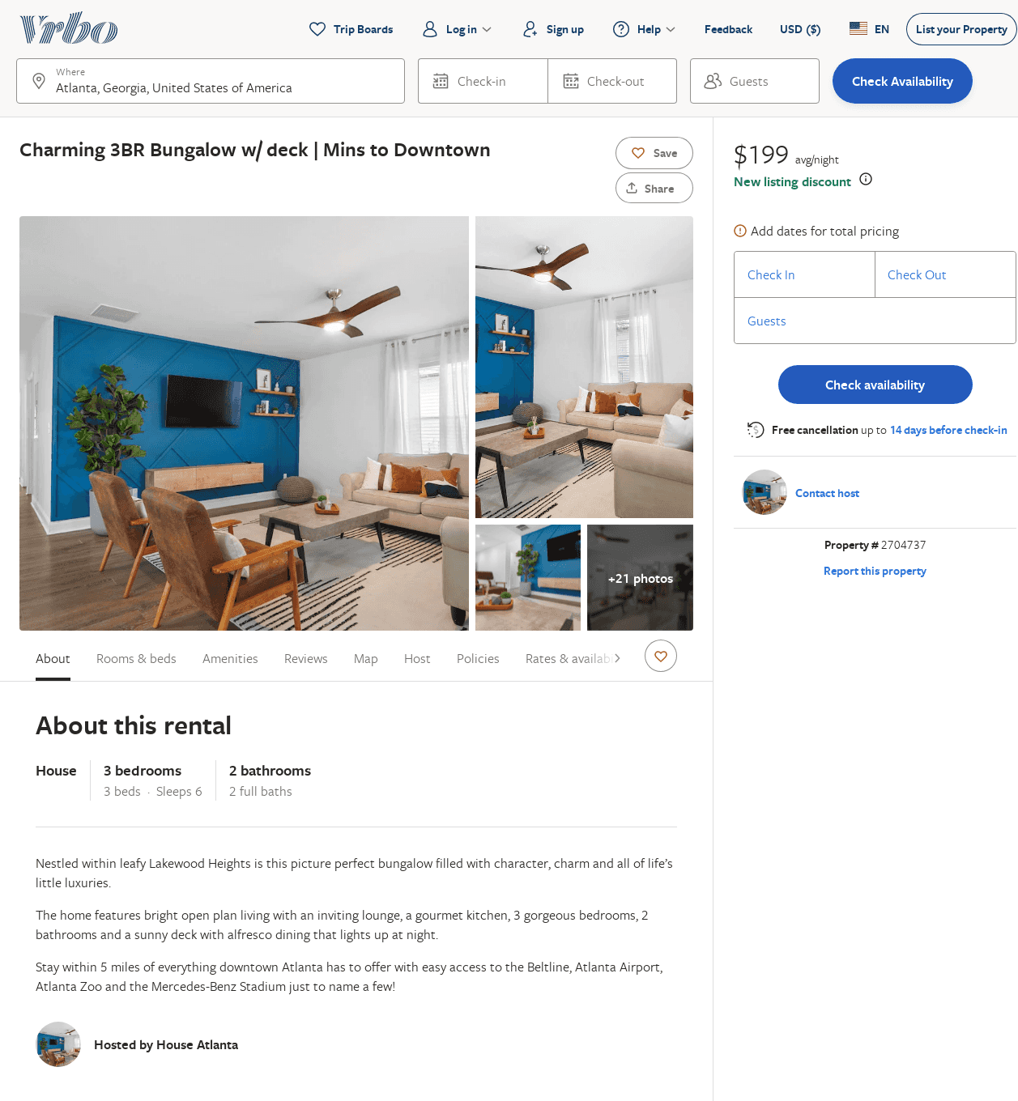
Listing 2704737
3
6
$199
5
2
https://www.vrbo.com/2704737
Aug 2022

Slide 42
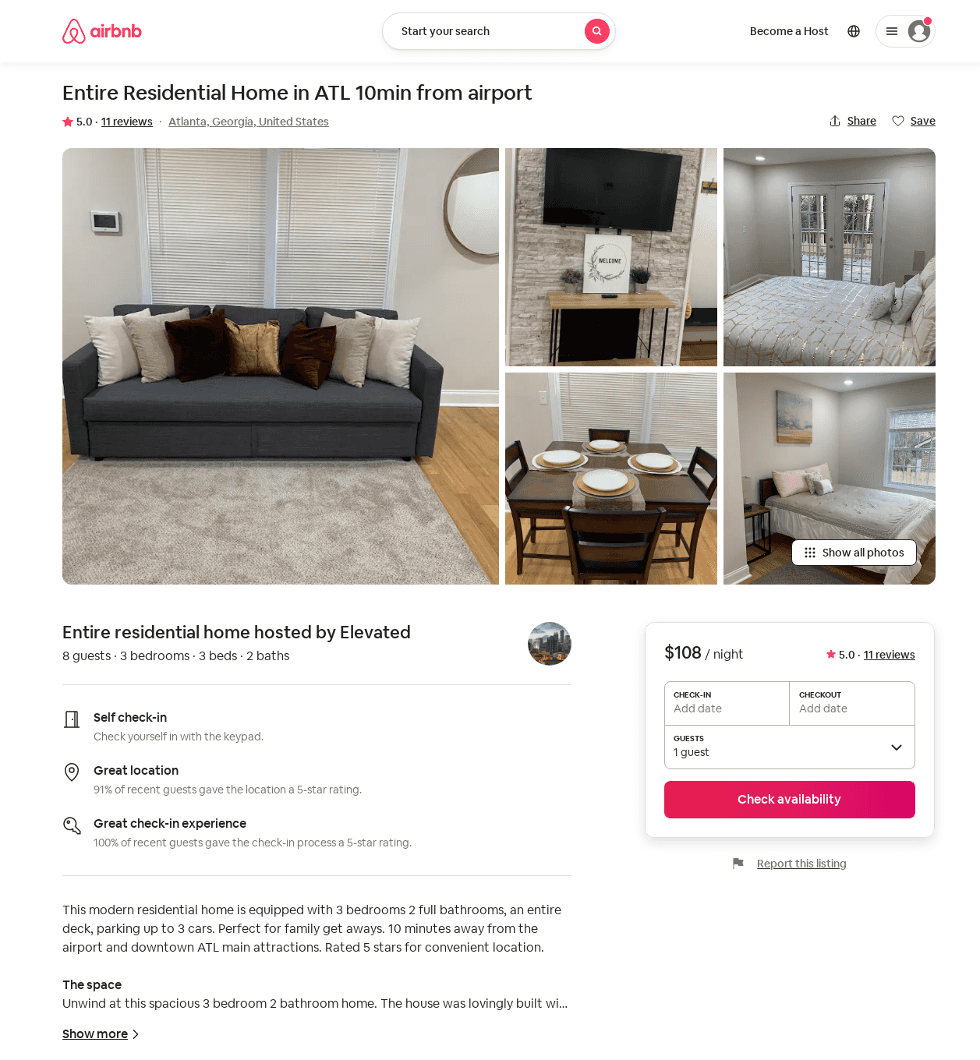
Listing 52648627
3
8
$107 - $108
4.88
2
Elevated
394798285
1
https://www.airbnb.com/rooms/52648627
Aug 2022

Slide 43
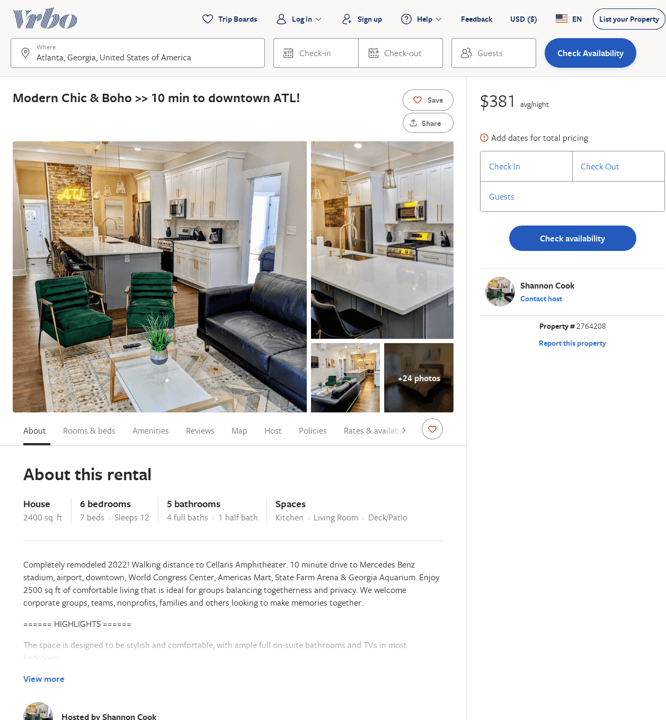
Listing 2764208
6
14
$429 - $433
5
1
Shannon Cook
https://www.vrbo.com/2764208
Aug 2022

Slide 44
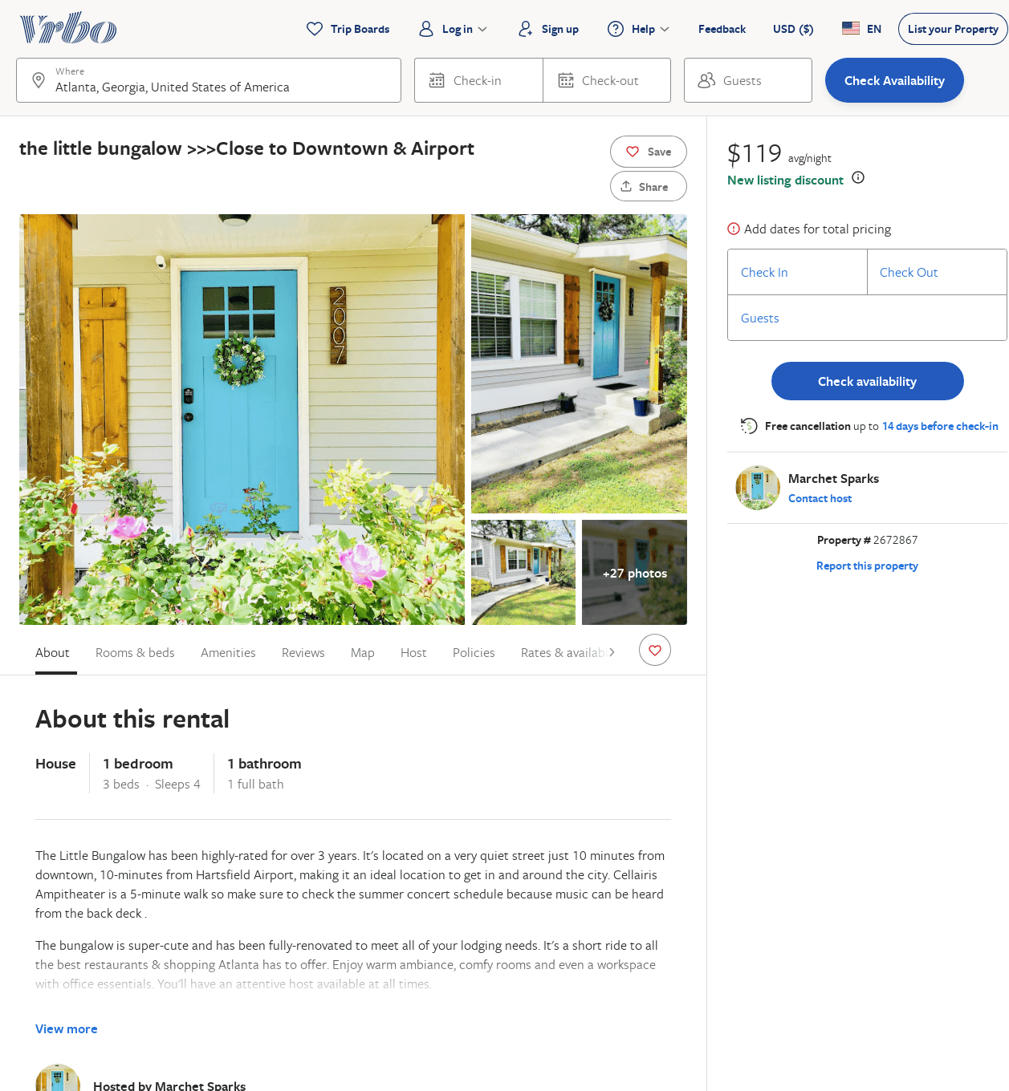
Listing 2672867
3
4
$119
3
Marchet Sparks
https://www.vrbo.com/2672867
Aug 2022

Slide 45
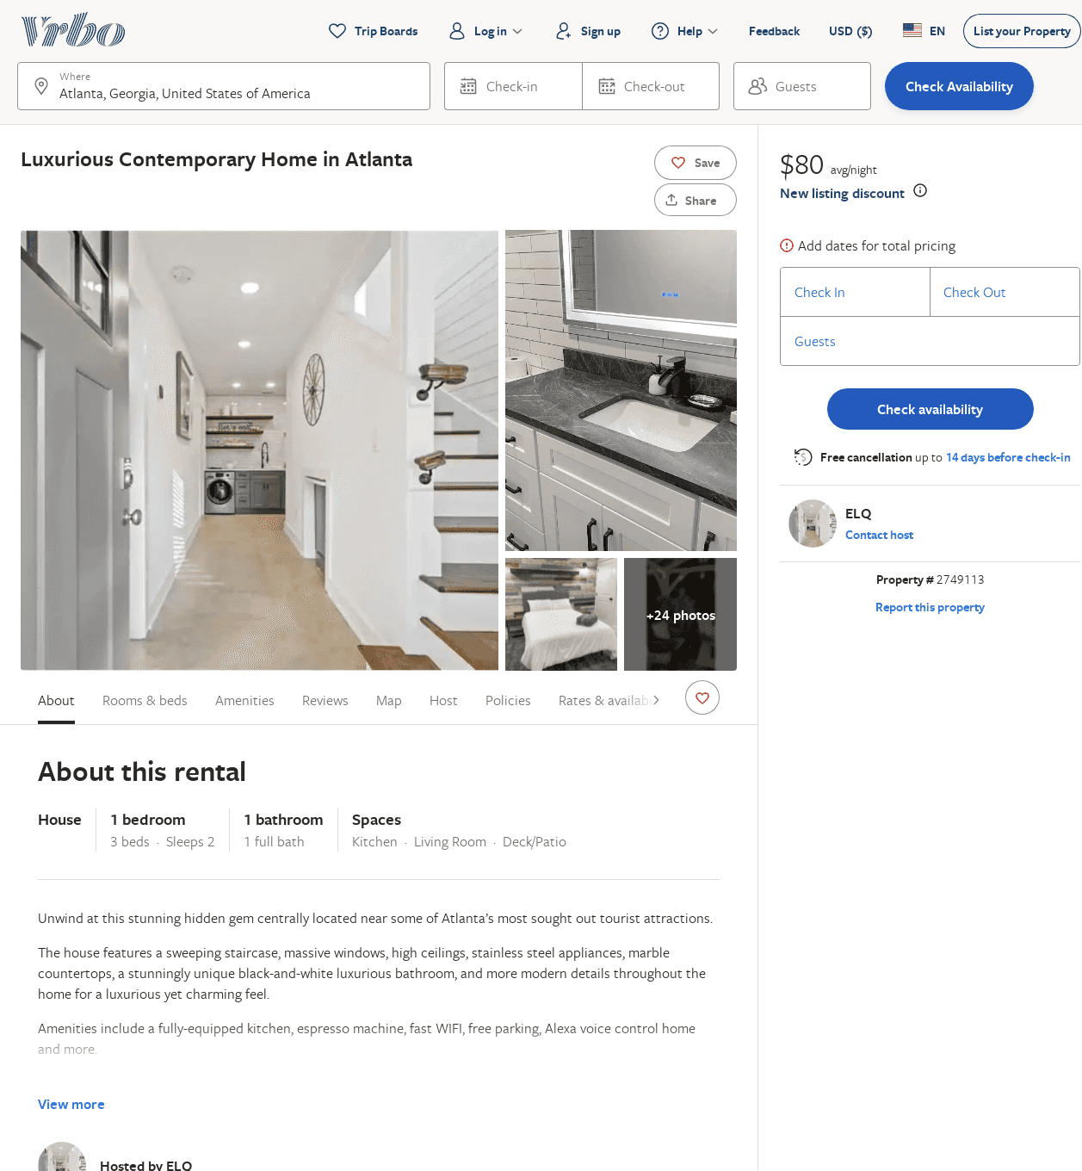
Listing 2749113
1
2
$99
2
ELQ
https://www.vrbo.com/2749113
Aug 2022

Slide 46
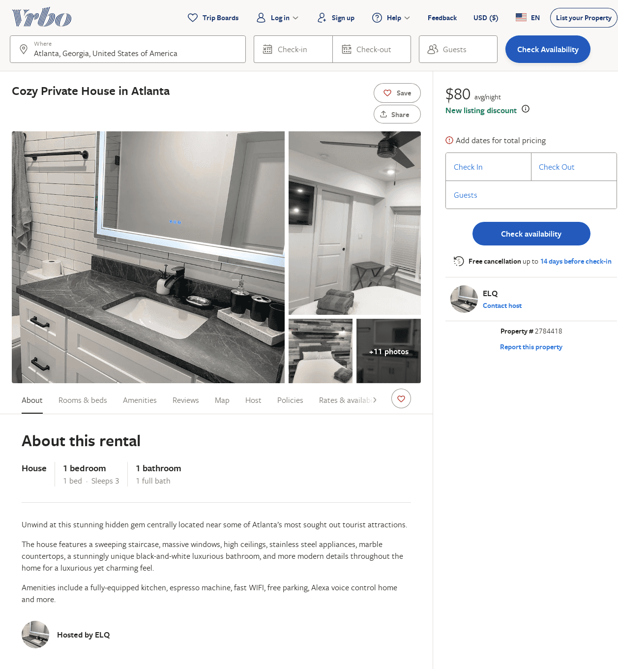
Listing 2784418
1
3
$99
2
ELQ
https://www.vrbo.com/2784418
Aug 2022

Slide 47
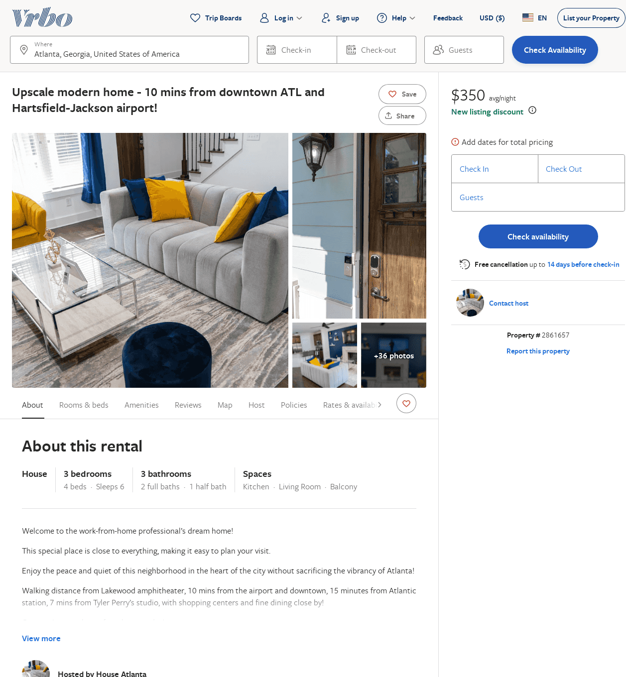
Listing 2861657
3
6
$371
5
2
https://www.vrbo.com/2861657
Aug 2022

Slide 48
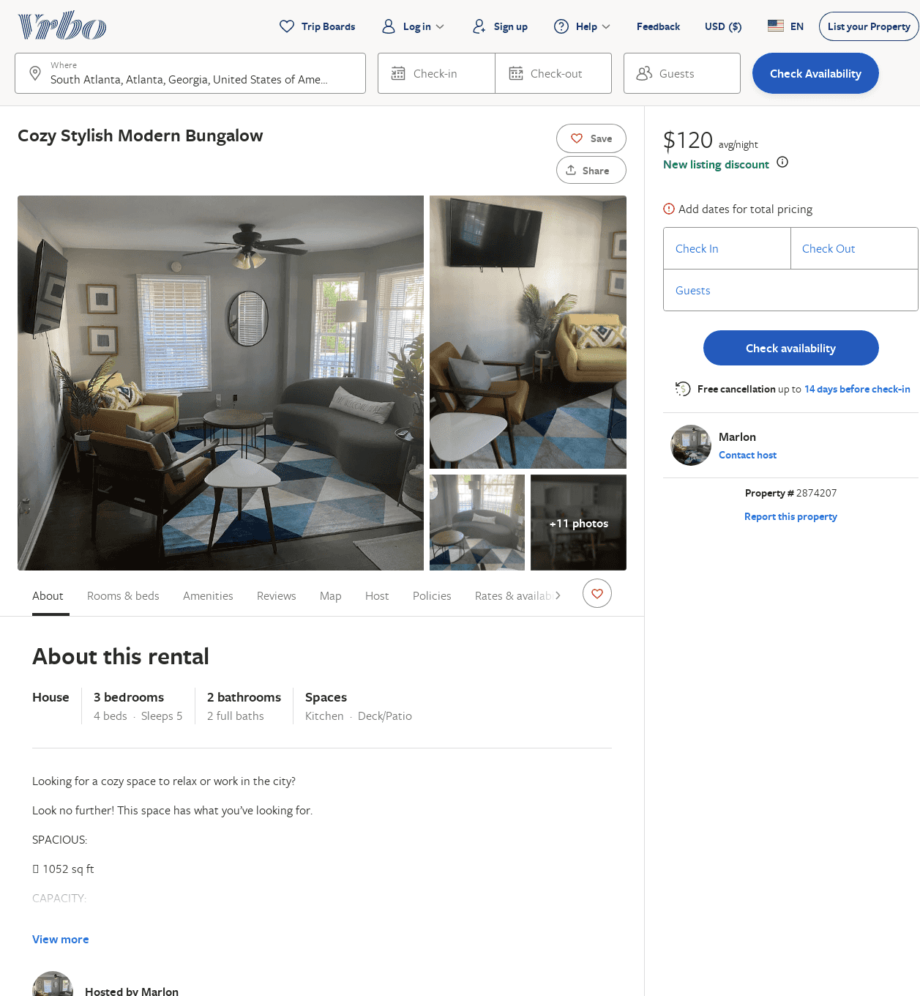
Listing 2874207
3
5
$133
4.8
2
Marlon
https://www.vrbo.com/2874207
Aug 2022

Slide 49
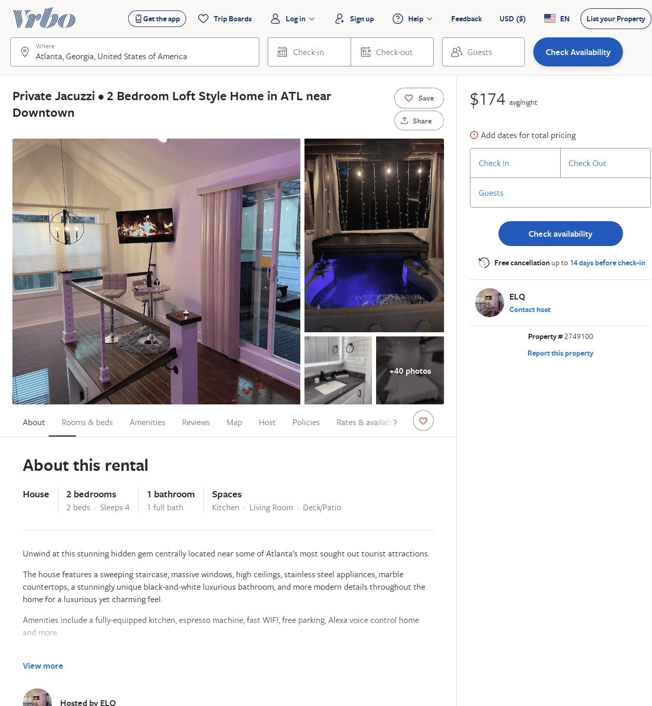
Listing 2749100
2
4
$173
2
ELQ
https://www.vrbo.com/2749100
Aug 2022

