Slide 2
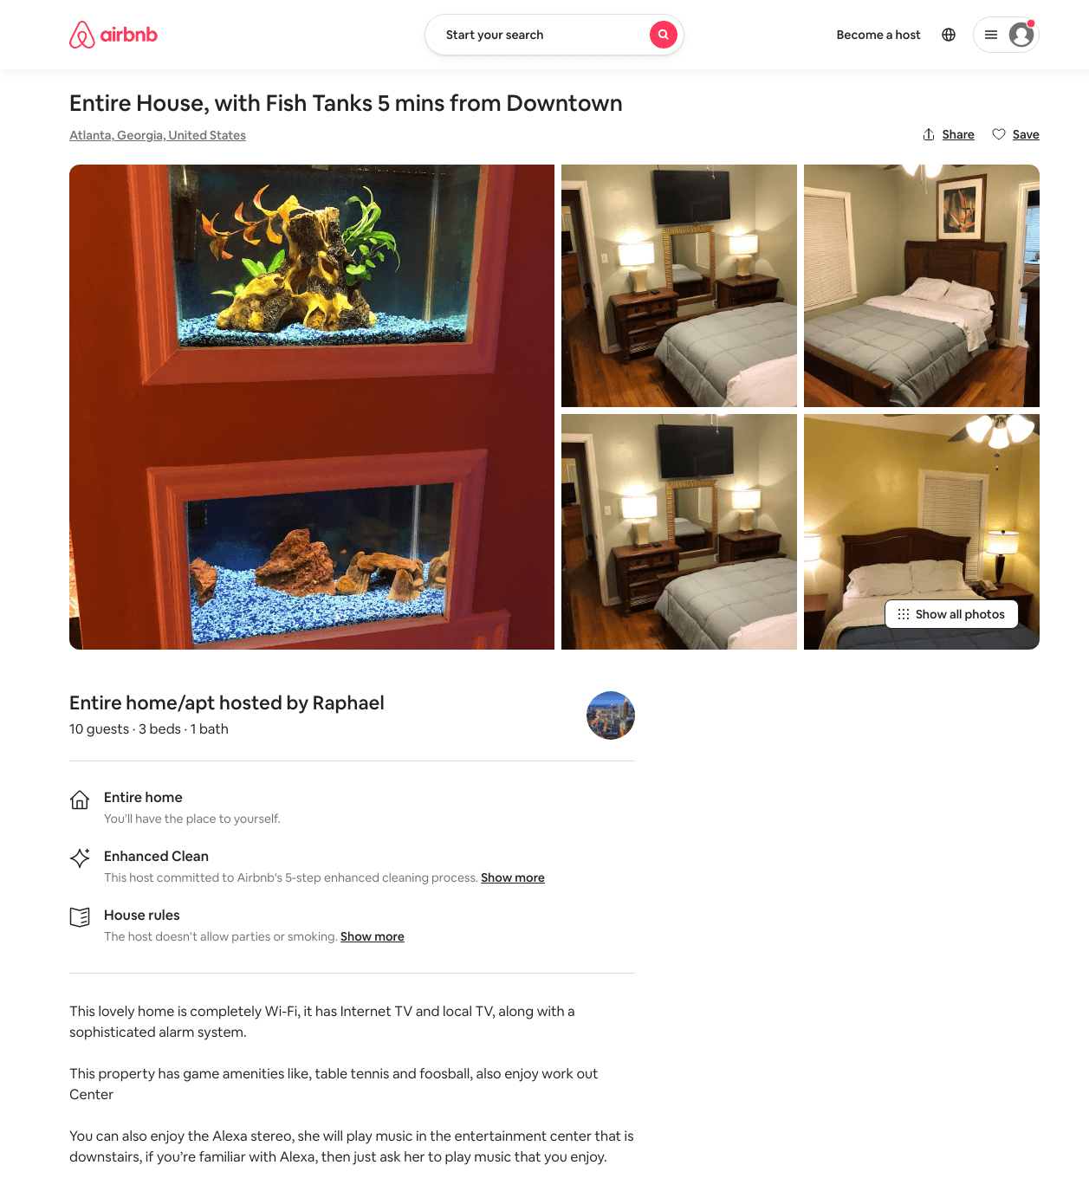
Listing 49297114
3
10
$114 - $154
4.68
2
Raphael
291020784
1
https://www.airbnb.com/rooms/49297114
Jun 2022

Slide 3
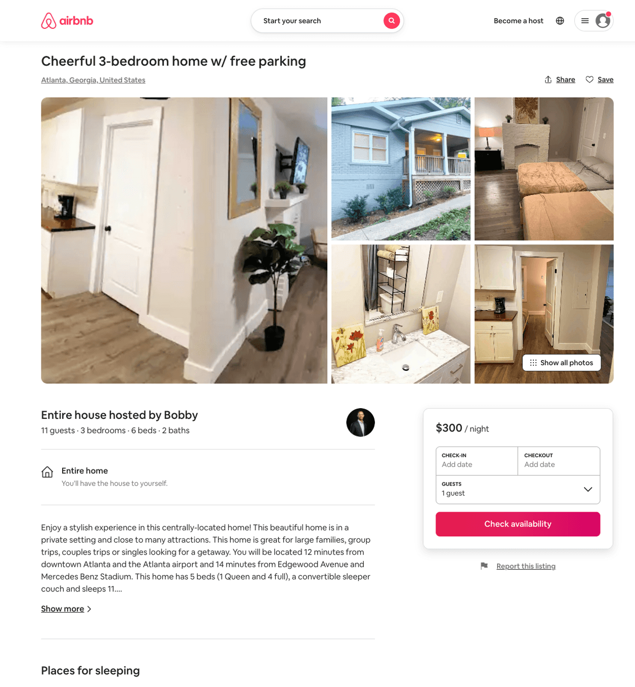
Listing 50734169
3
11
$219 - $300
4.43
1
Bobby
134583404
1
https://www.airbnb.com/rooms/50734169
Aug 2022

Slide 4
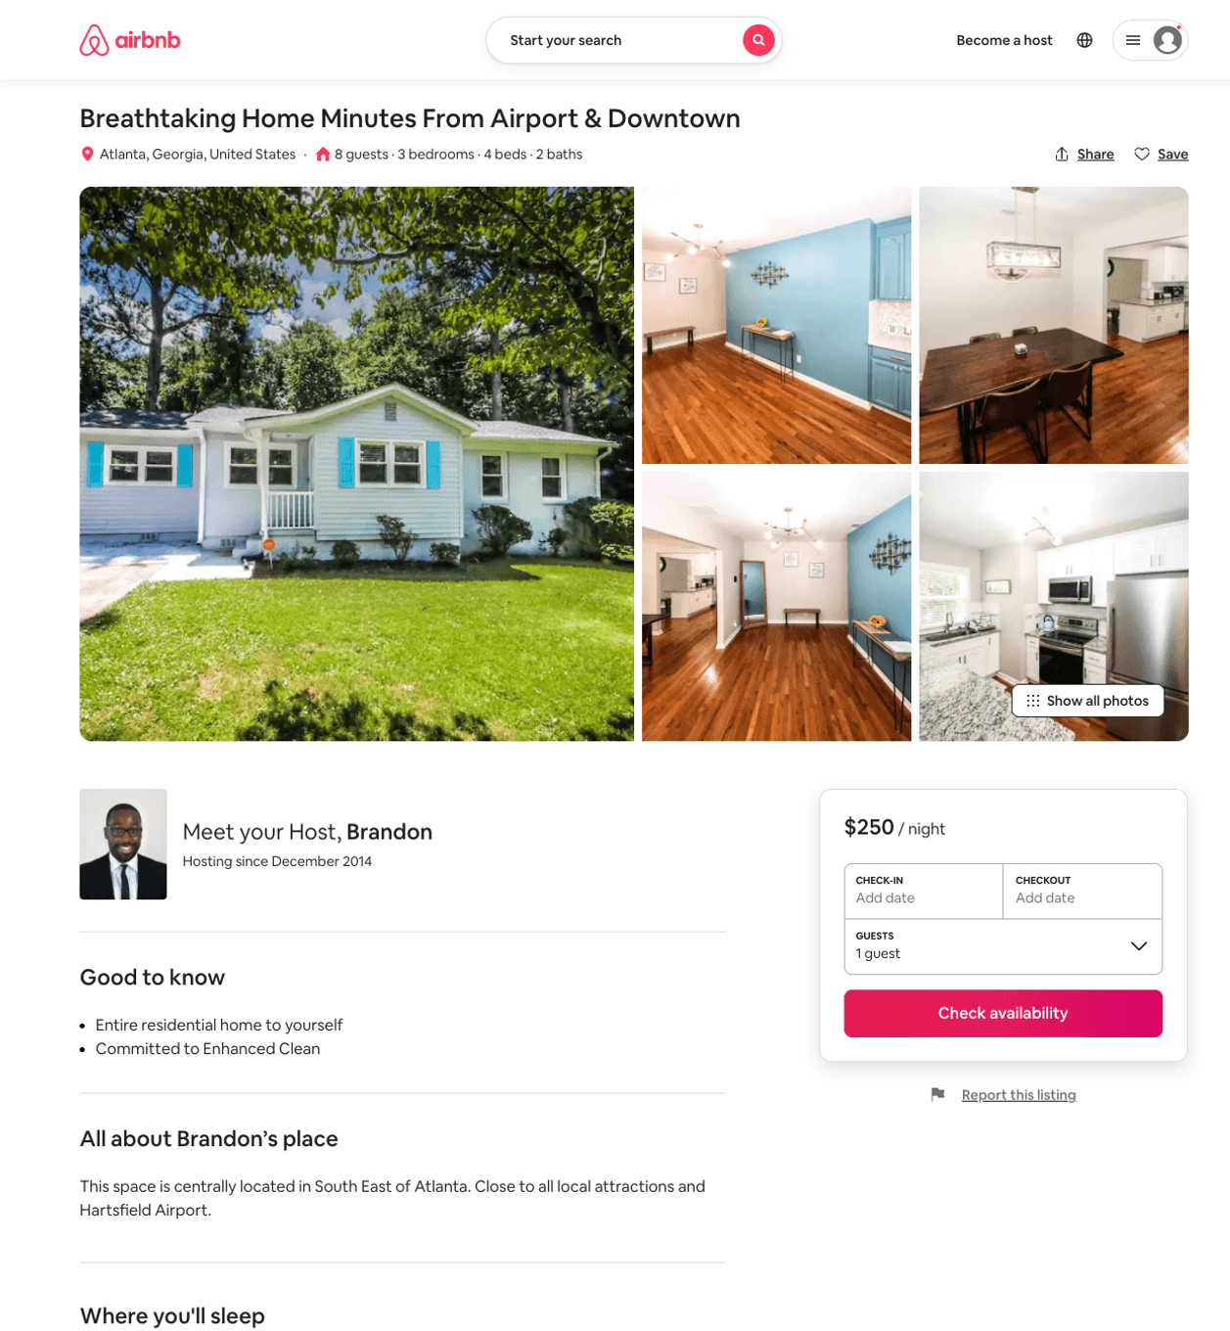
Listing 50779146
3
8
$130 - $252
5.0
2
Brandon
25203728
1
https://www.airbnb.com/rooms/50779146
Aug 2022

Slide 5
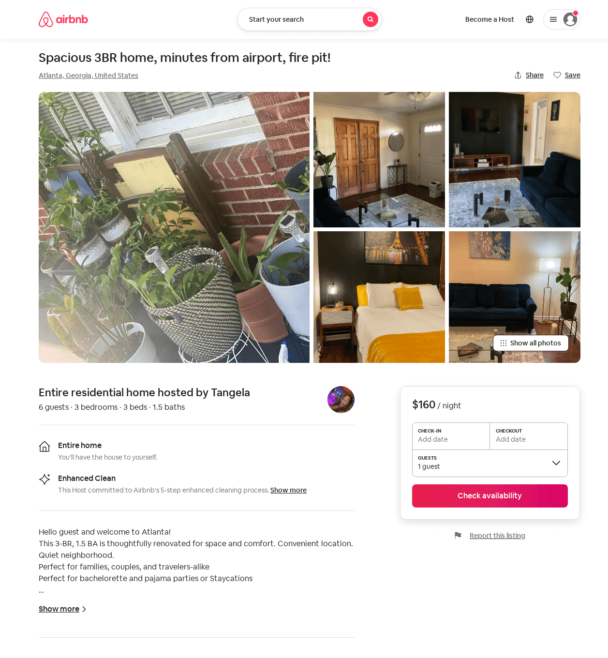
Listing 31931717
3
6
$117 - $134
2
Tangela
2134212
2
https://www.airbnb.com/rooms/31931717
Aug 2022

Slide 6
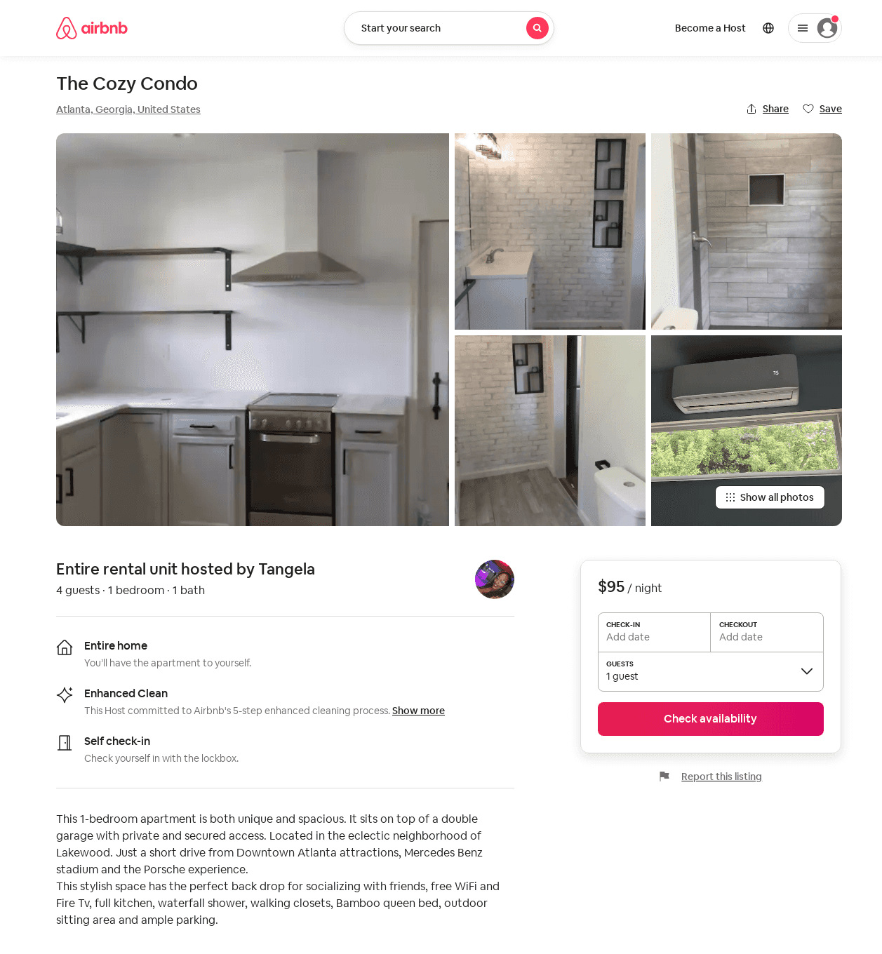
Listing 53265075
1
4
$95
2
Tangela
2134212
2
https://www.airbnb.com/rooms/53265075
Aug 2022

Slide 7
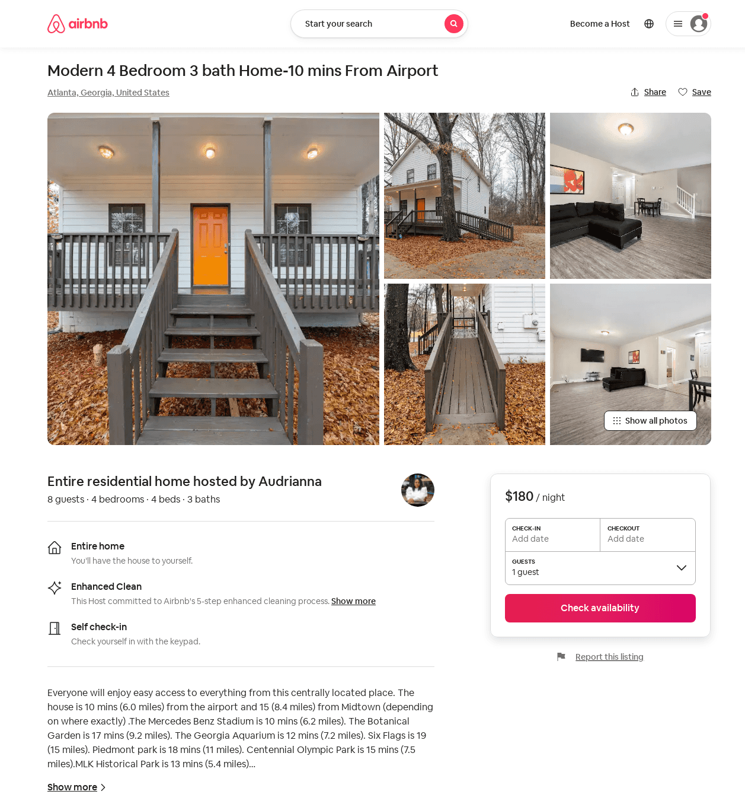
Listing 53778301
4
8
$180 - $202
4.43
2
Audrianna
195394798
1
https://www.airbnb.com/rooms/53778301
Jun 2022

Slide 8
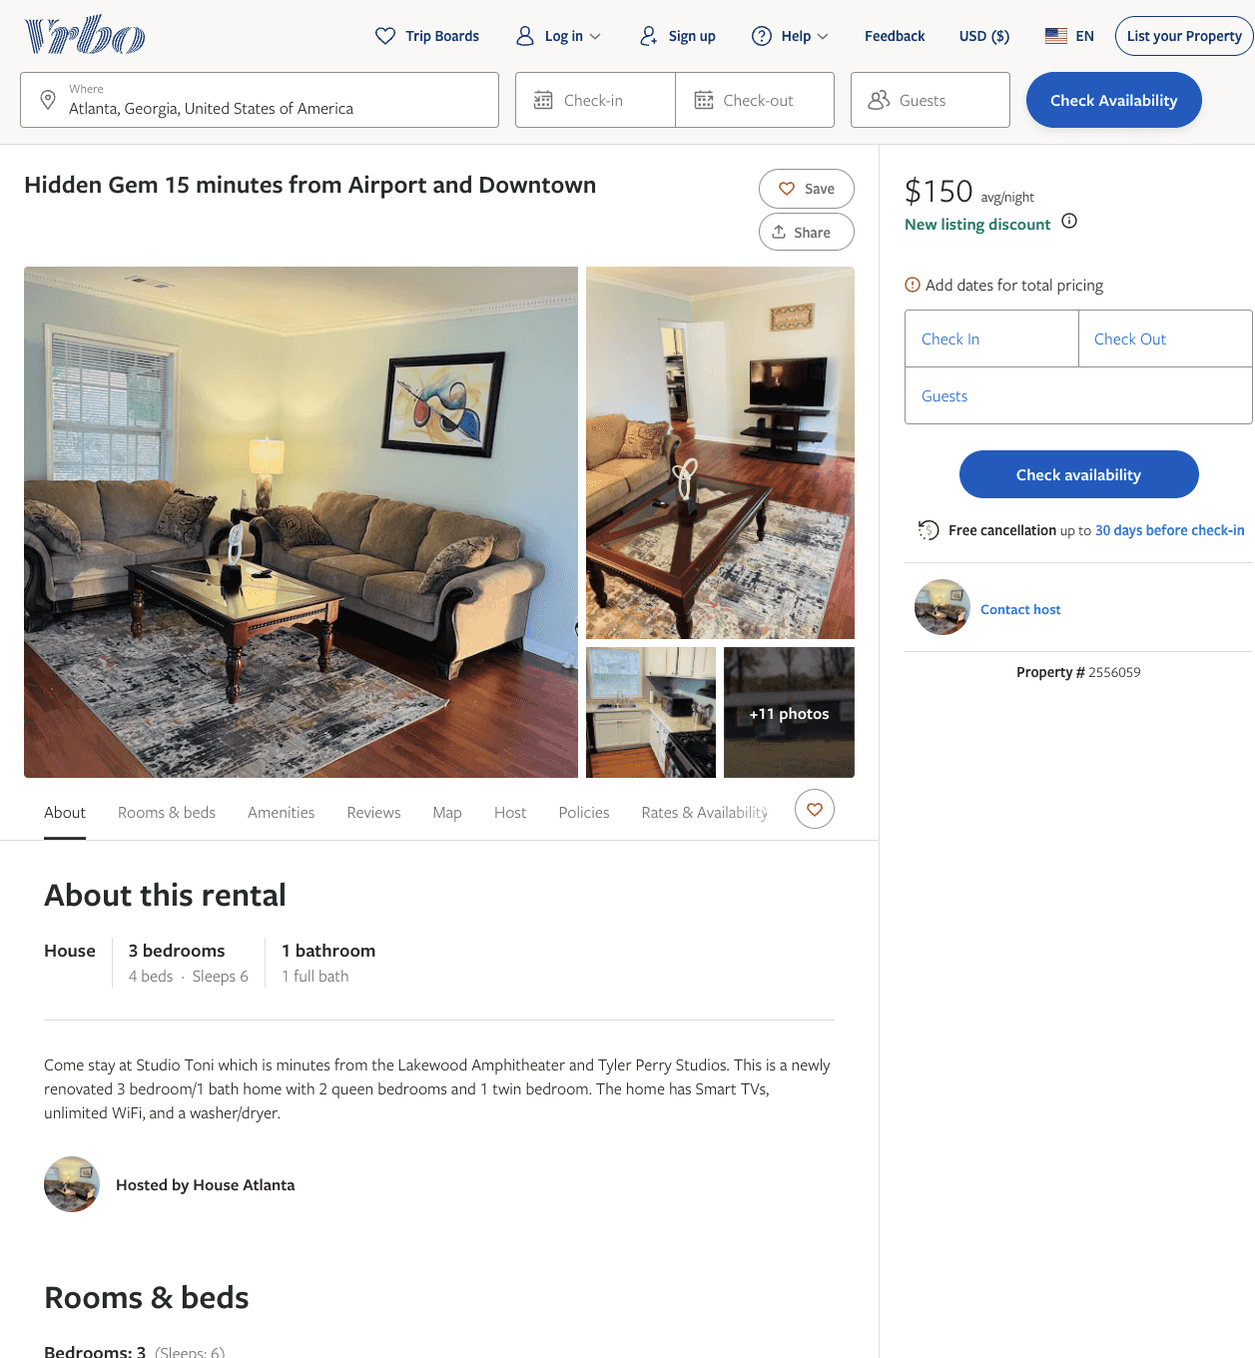
Listing 2556059
3
6
$115 - $150
5
1
https://www.vrbo.com/2556059
Aug 2022

Slide 9
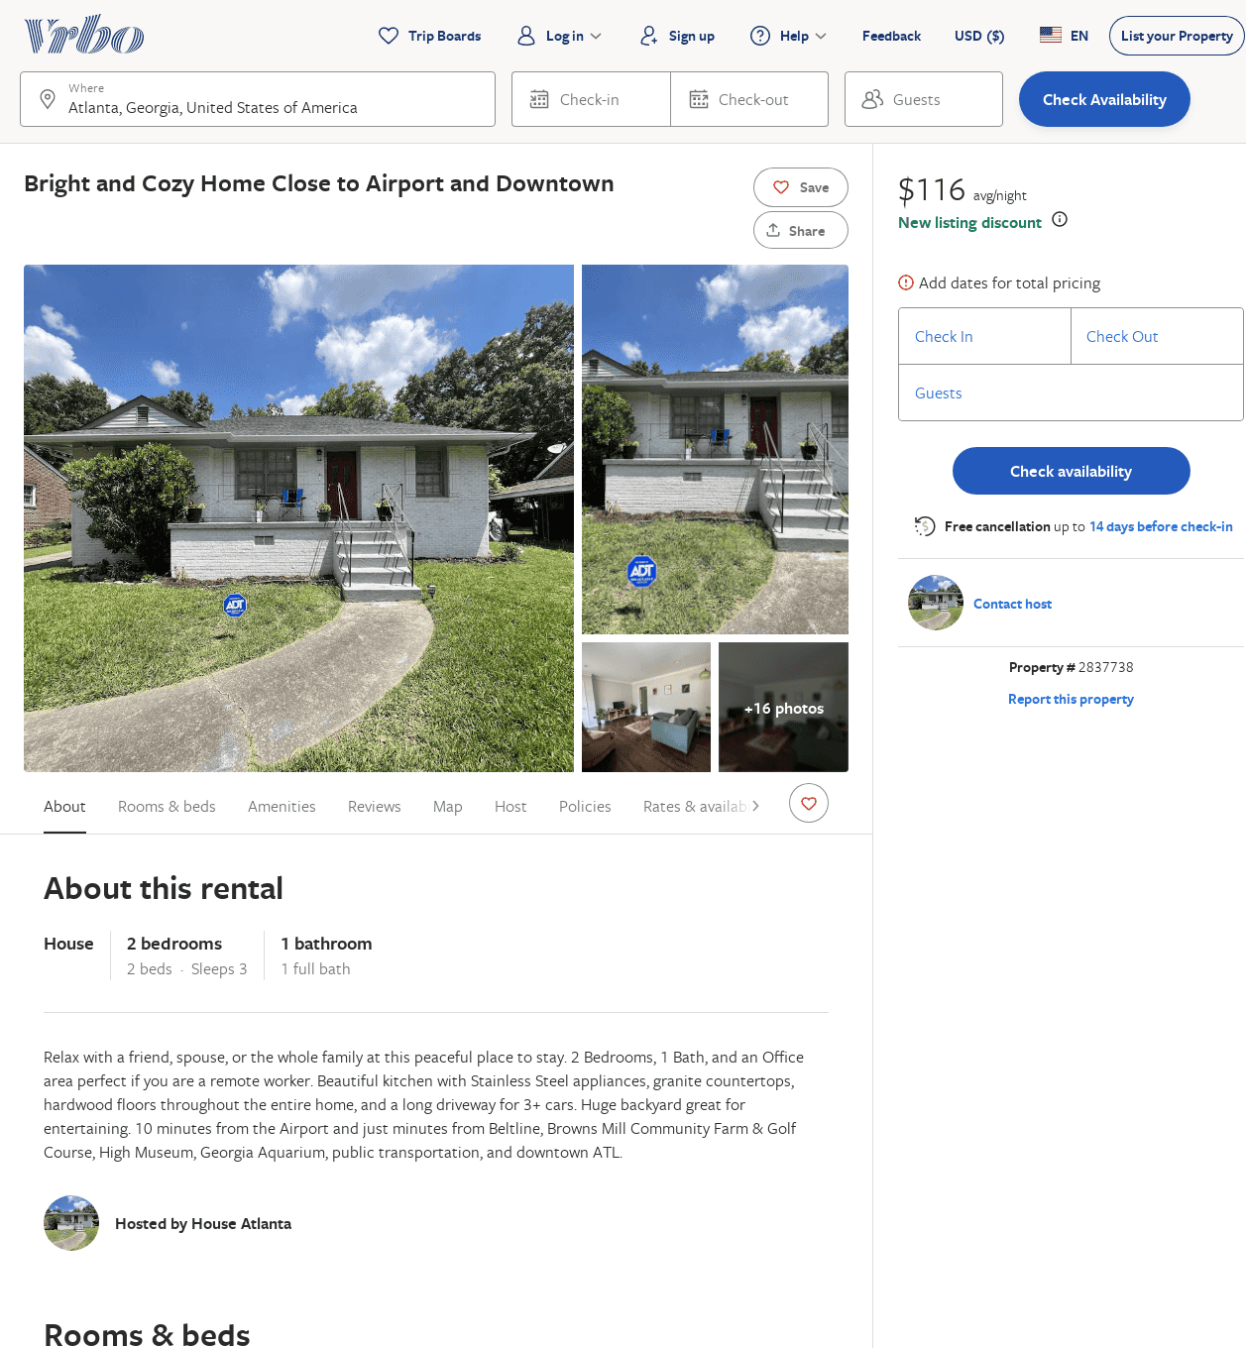
Listing 2837738
2
3
$116
2
https://www.vrbo.com/2837738
Aug 2022

Slide 10
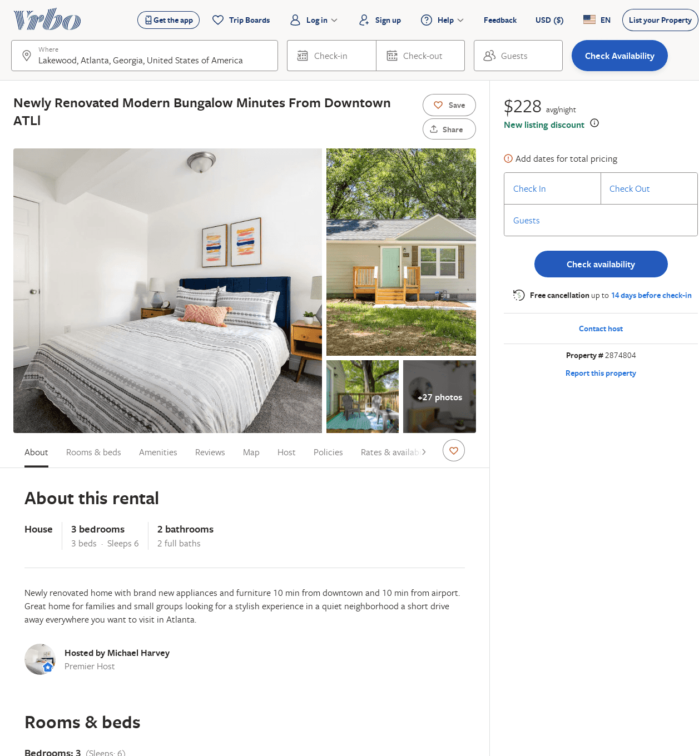
Listing 2874804
3
6
$159
2
Michael Harvey
https://www.vrbo.com/2874804
Aug 2022

Slide 11
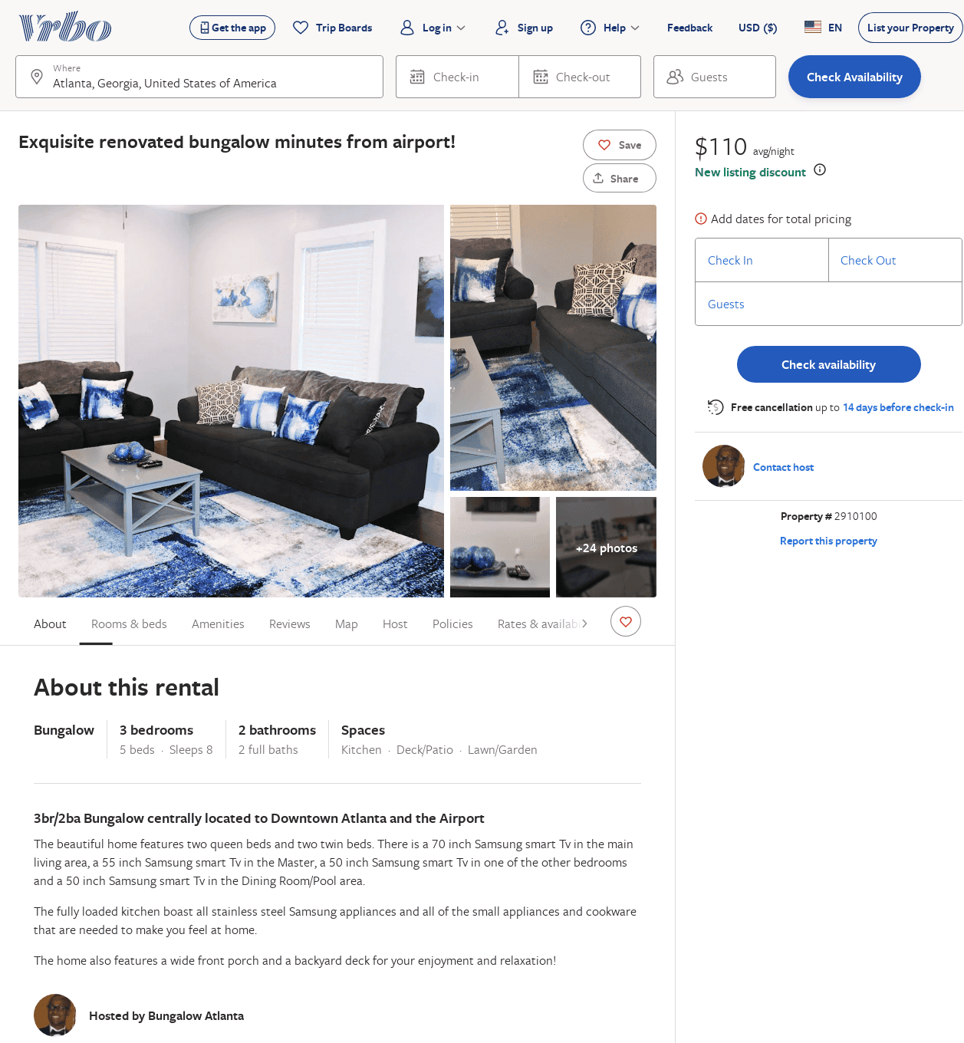
Listing 2910100
3
8
$143
1
https://www.vrbo.com/2910100
Aug 2022

Slide 12
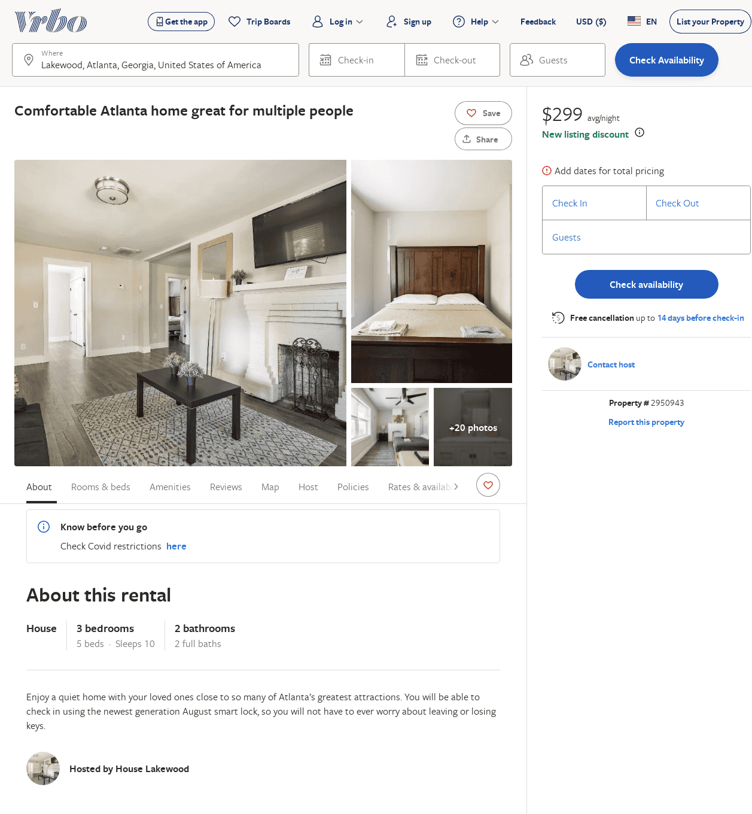
Listing 2950943
3
10
$299
1
https://www.vrbo.com/2950943
Aug 2022

