Slide 2
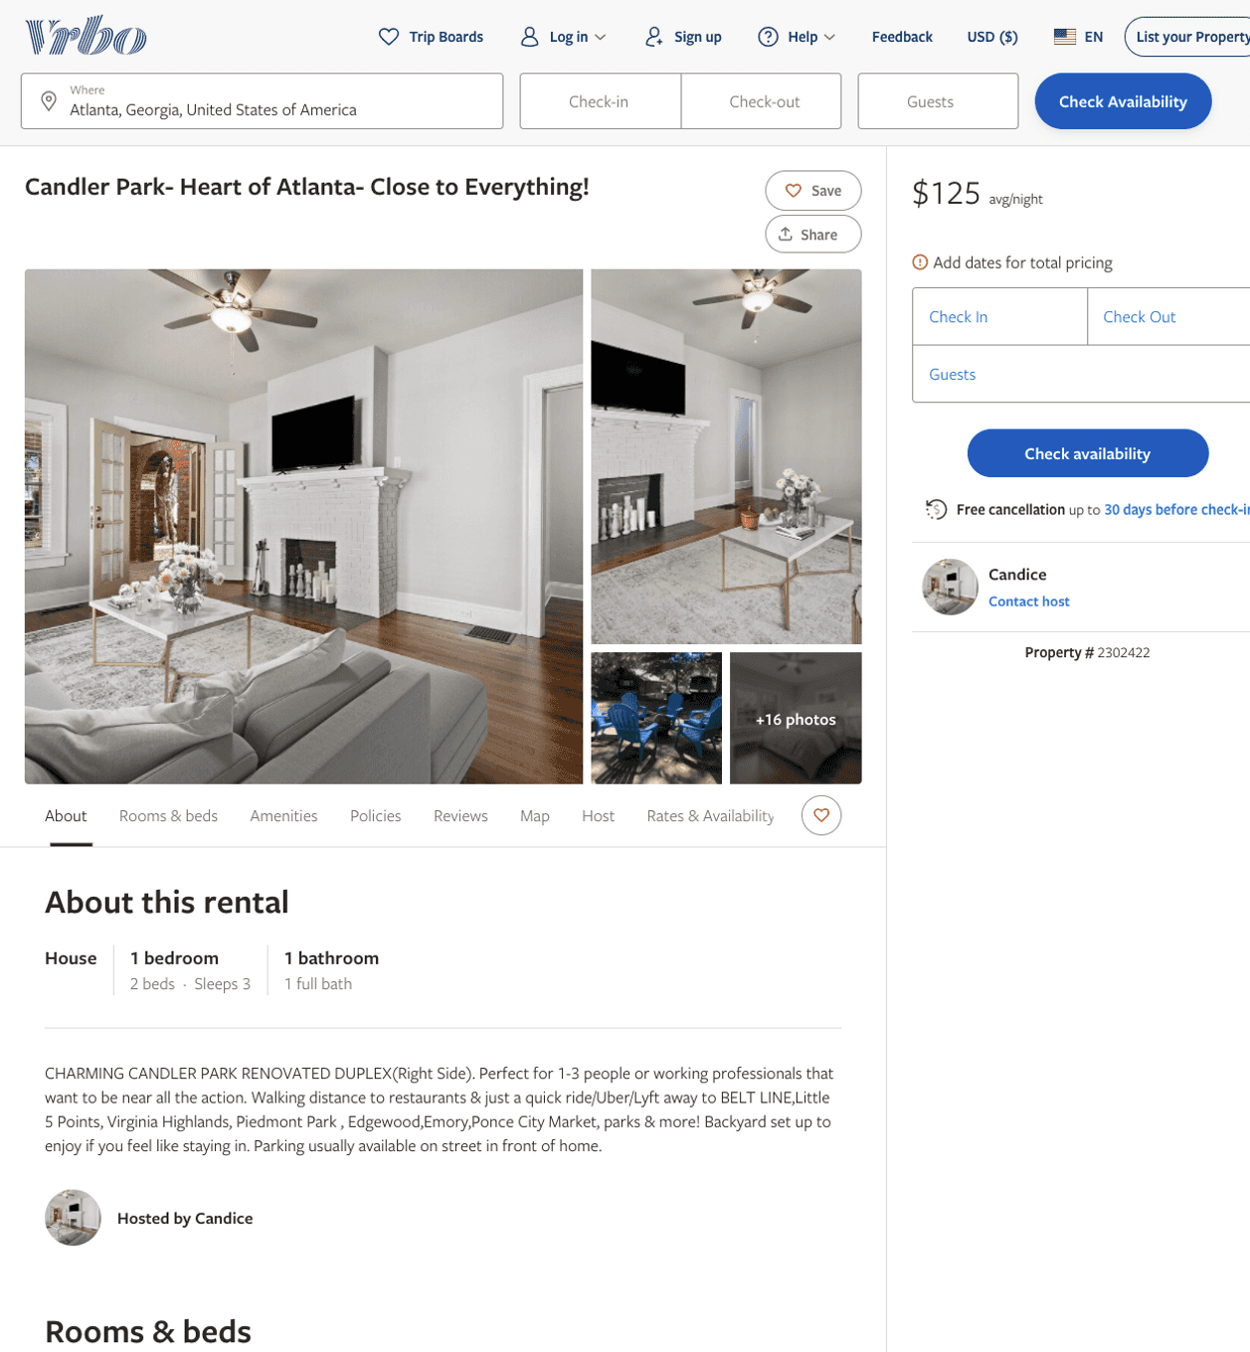
Listing 2302422
1
3
$125
1
Candice
https://www.vrbo.com/2302422
Aug 2022

Slide 3
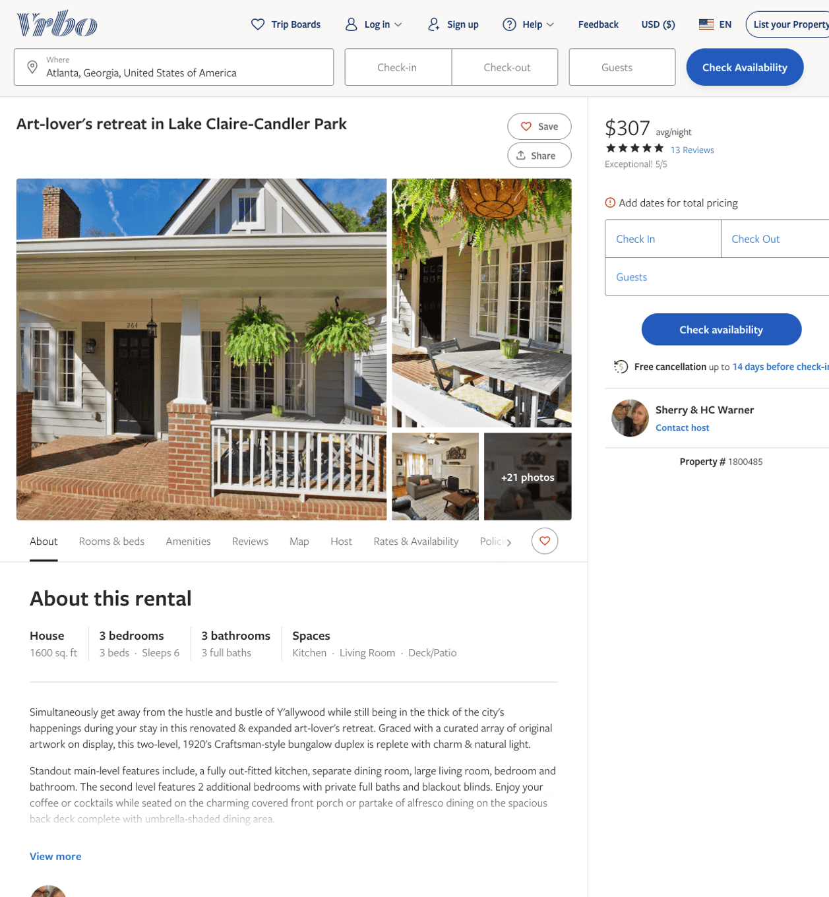
Listing 1800485
3
6
$307 - $396
5
3
Sherry & HC Warner
https://www.vrbo.com/1800485
Aug 2022

Slide 4
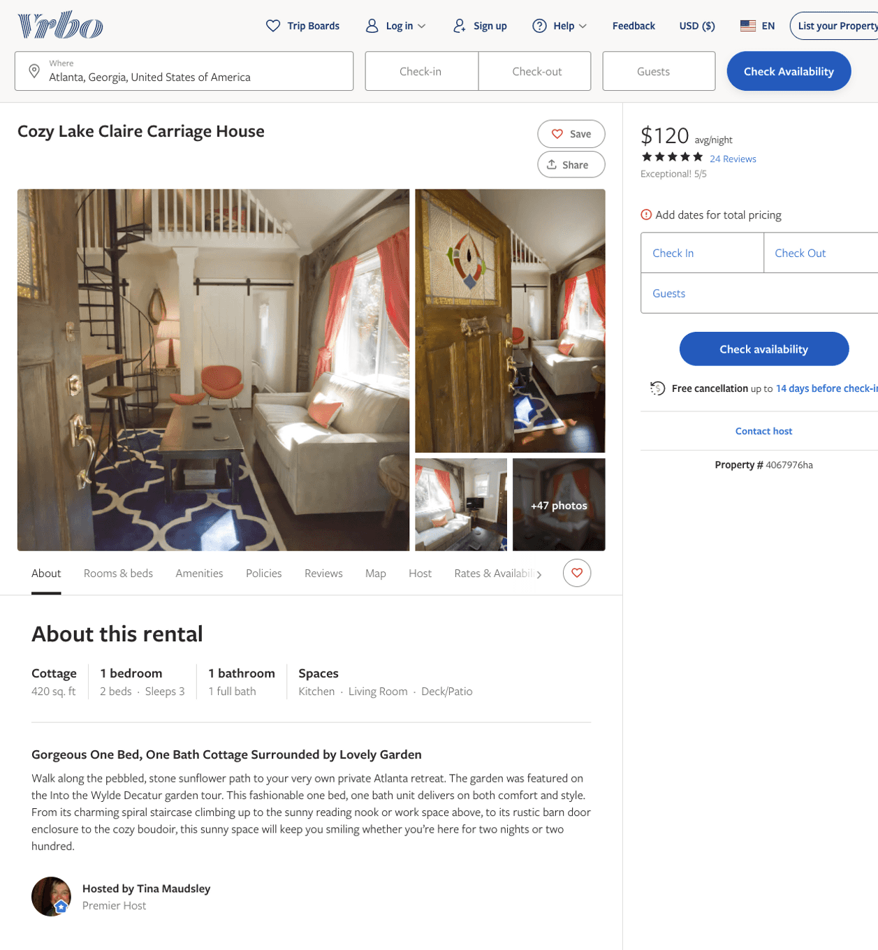
Listing 4067976
1
3
$120 - $133
5
7
Tina Maudsley
https://www.vrbo.com/4067976ha
Aug 2022

Slide 5
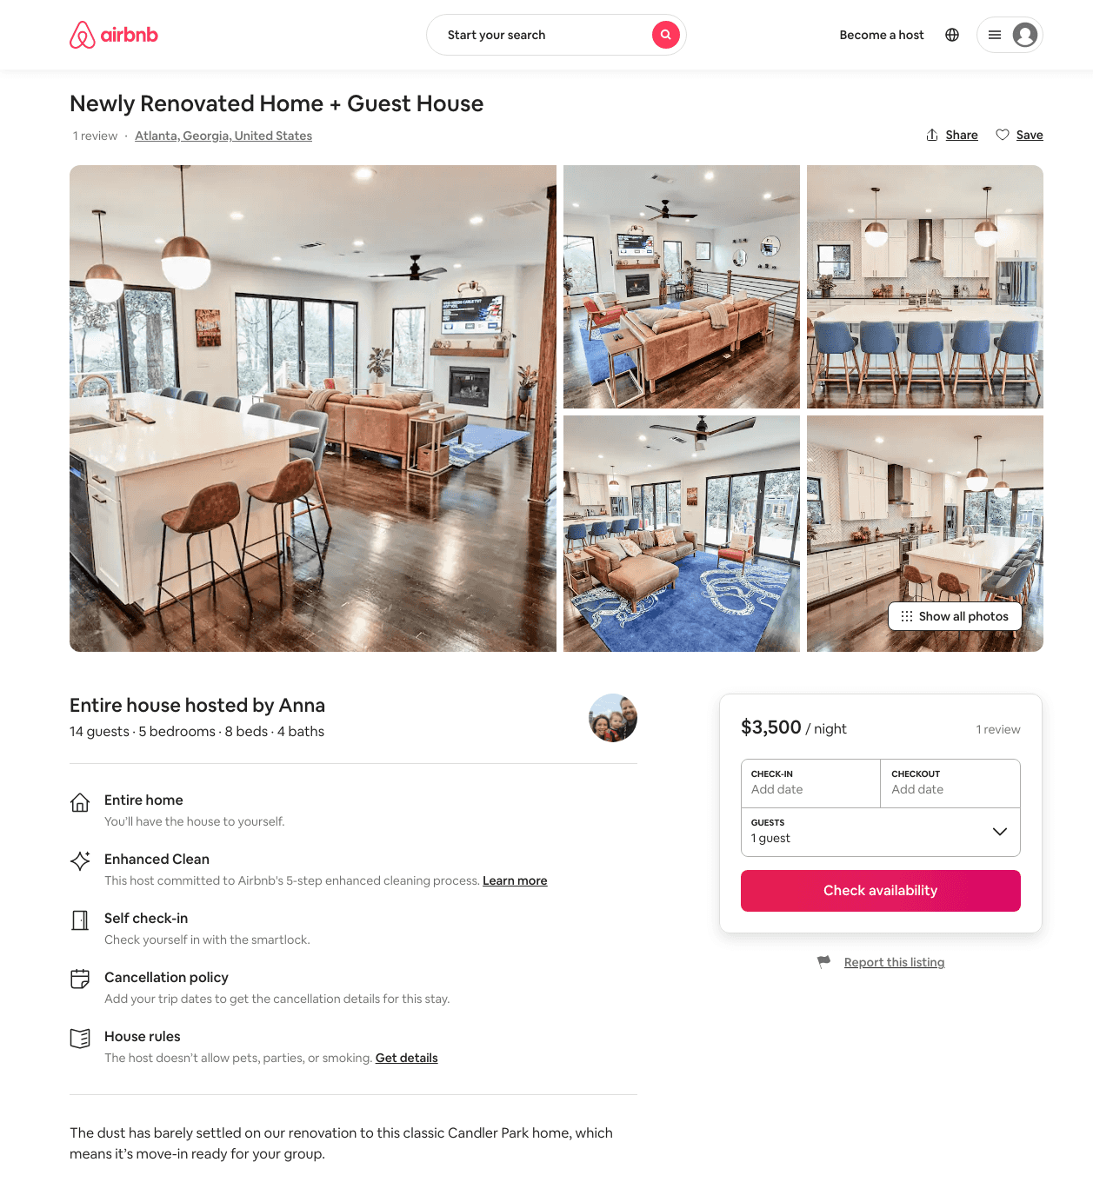
Listing 31586531
5
14
$3500
3
Anna
17787608
2
https://www.airbnb.com/rooms/31586531
Aug 2022

Slide 6
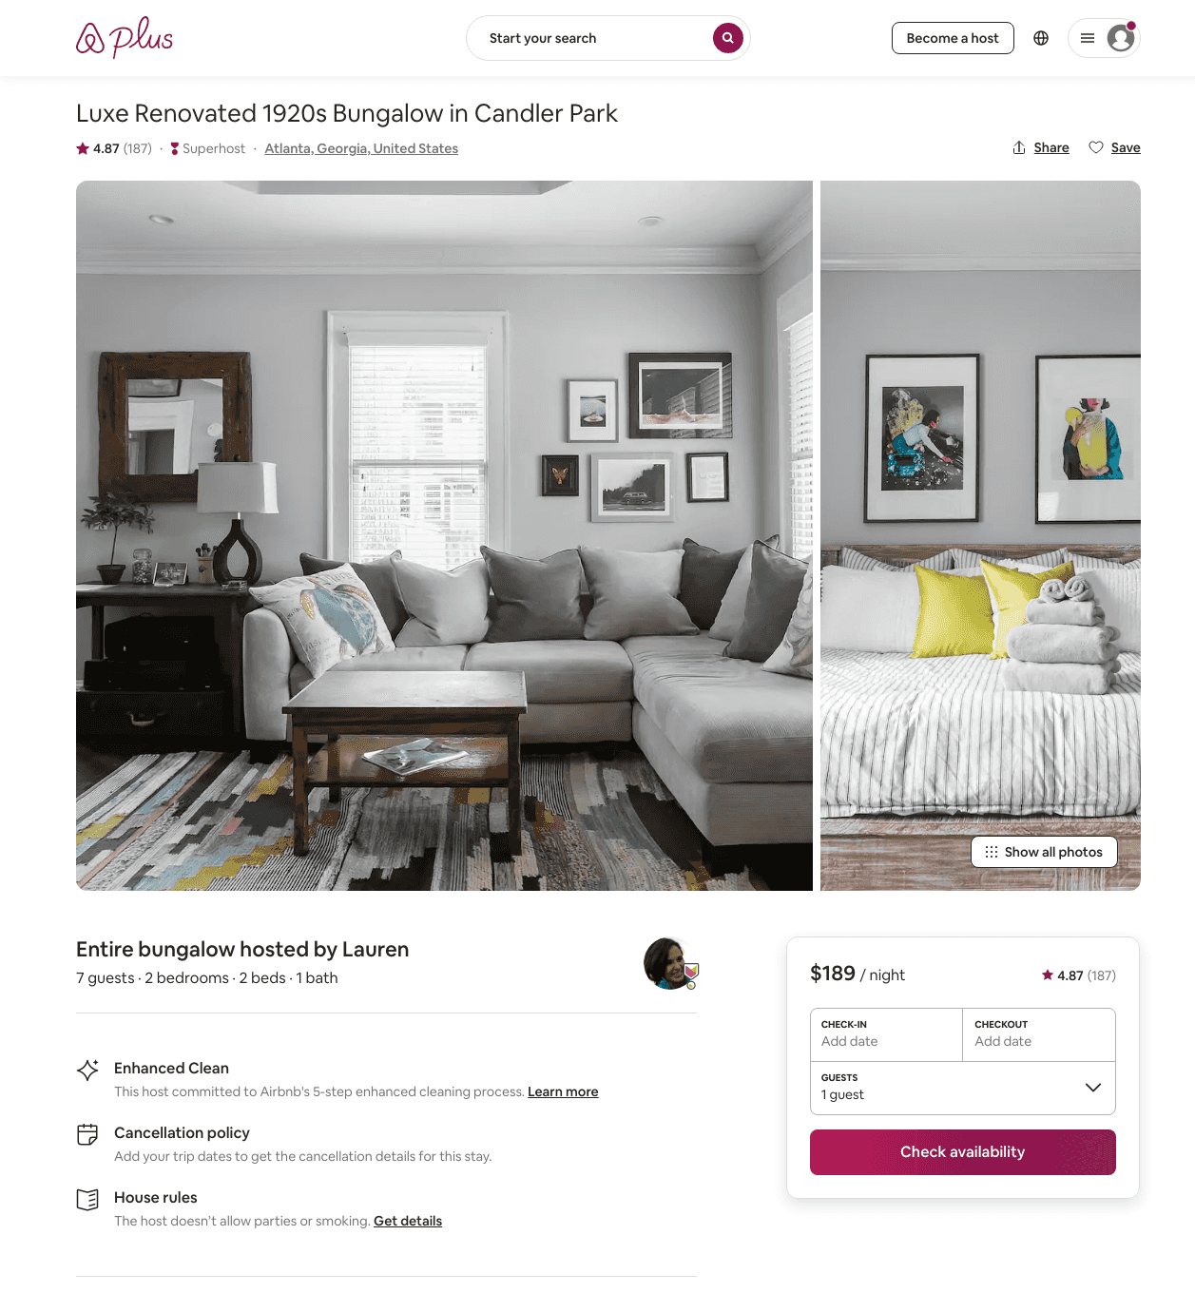
Listing 23285716
2
6
$120 - $281
4.83
2
Lauren
132056933
15
https://www.airbnb.com/rooms/23285716
Aug 2022

Slide 7
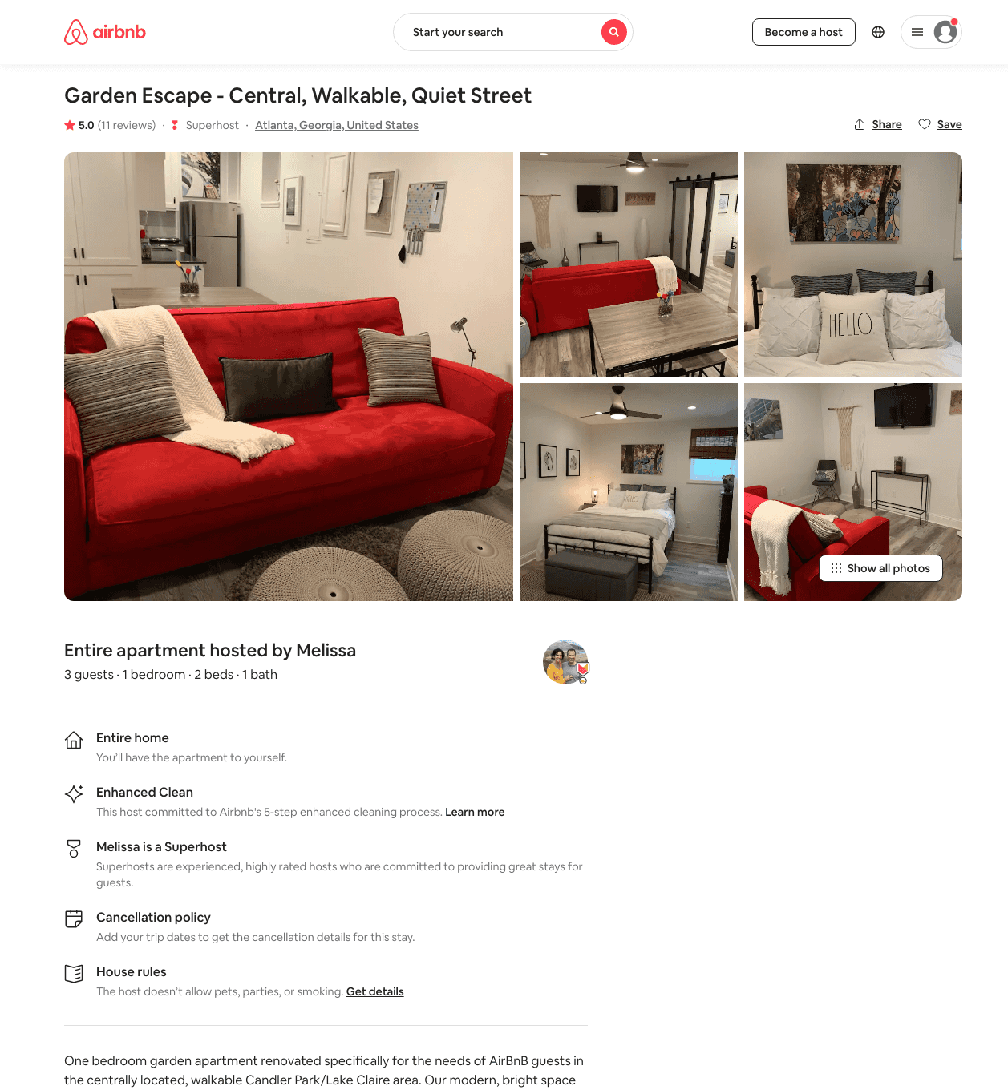
Listing 40126692
1
2
$89 - $109
5.0
3
Melissa
309670063
1
https://www.airbnb.com/rooms/40126692
Aug 2022

Slide 8
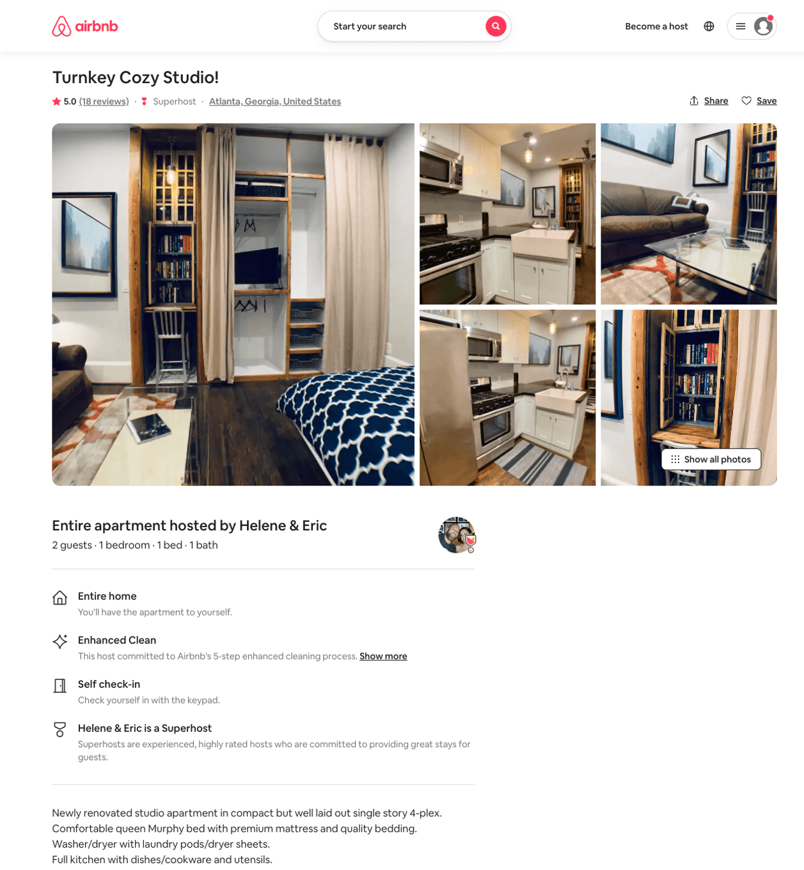
Listing 31806085
1
2
$90 - $100
4.92
31
Helene & Eric
42230053
10
https://www.airbnb.com/rooms/31806085
Aug 2022

Slide 9
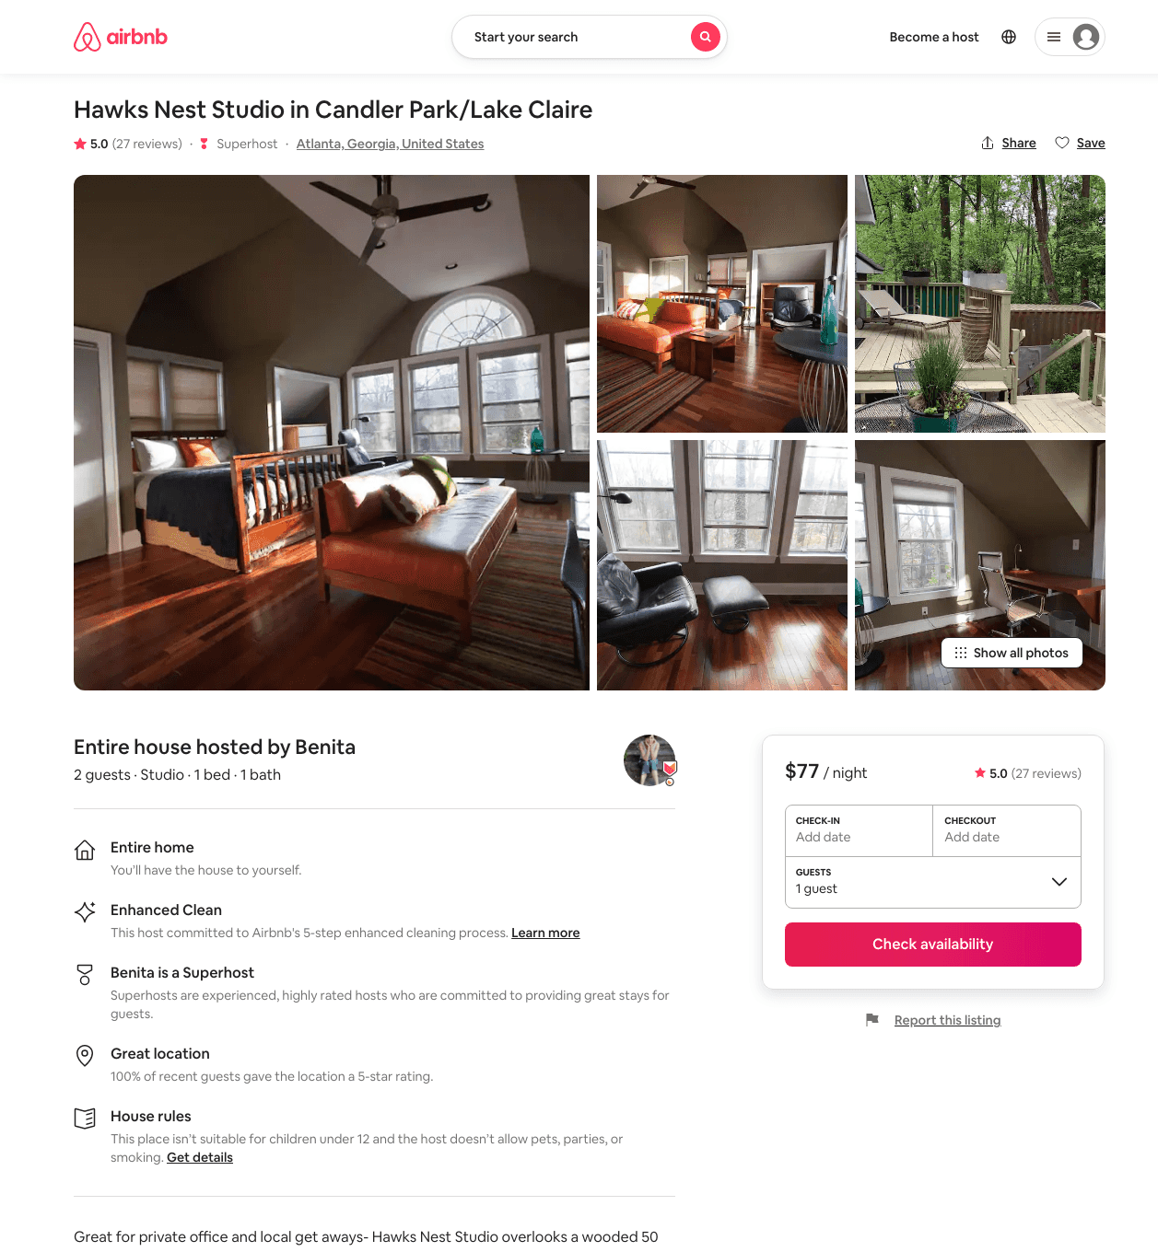
Listing 12970719
Studio
1
$77 - $82
4.97
31
Benita
4434129
2
https://www.airbnb.com/rooms/12970719
Jun 2022

Slide 10
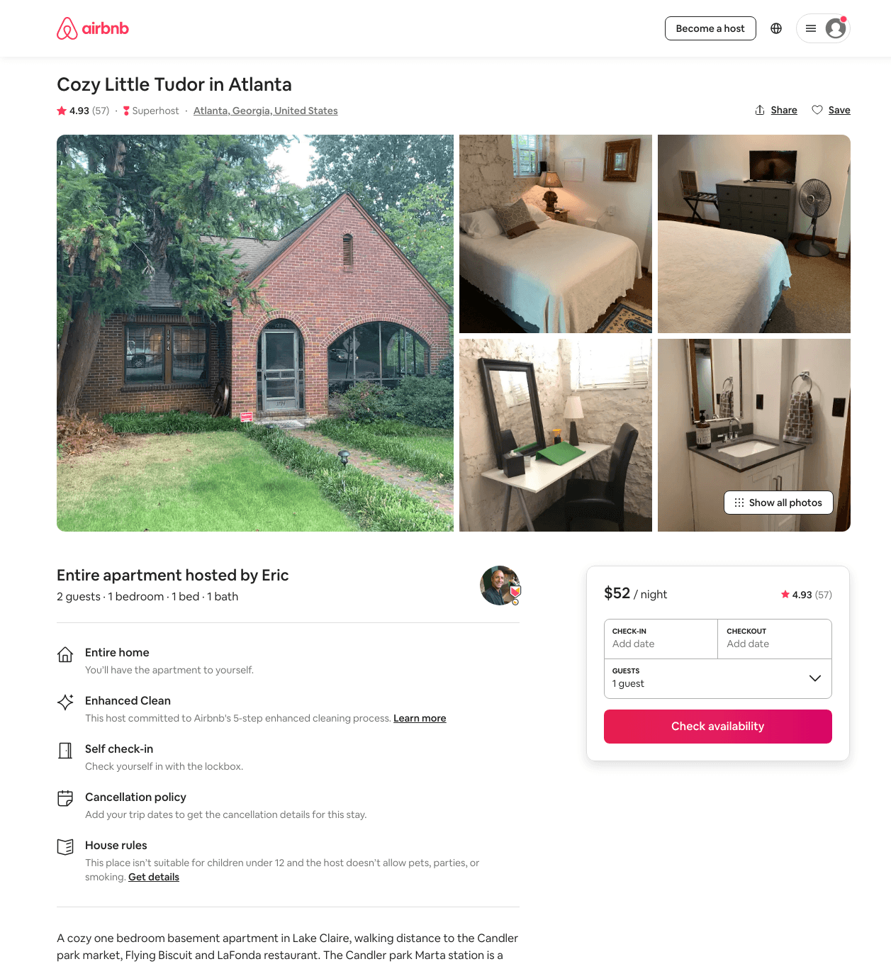
Listing 16015111
1
2
$50 - $106
4.87
2
Eric
34727244
1
https://www.airbnb.com/rooms/16015111
Aug 2022

Slide 11
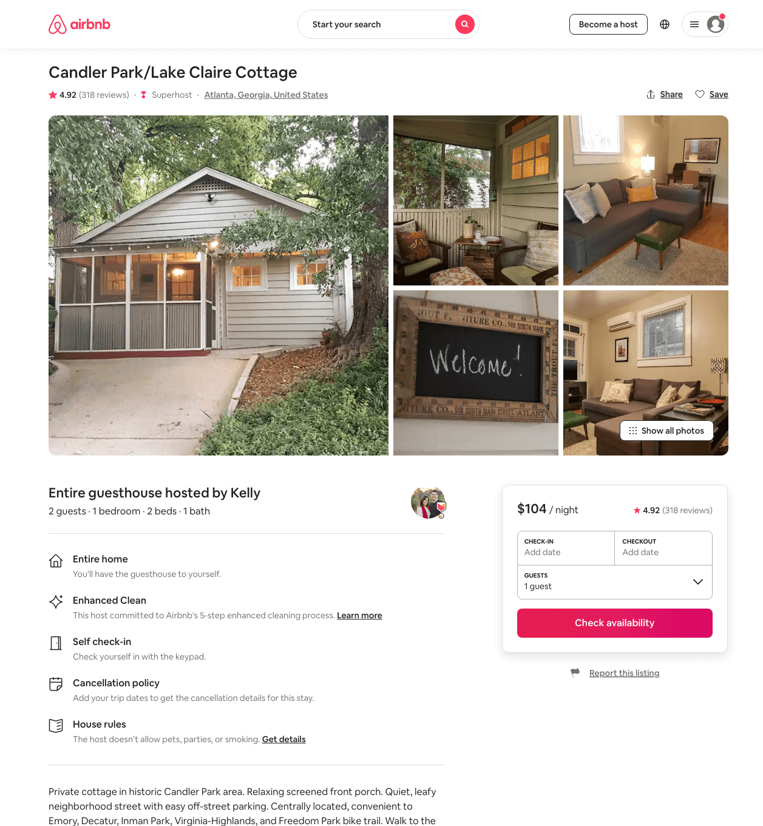
Listing 1217846
1
2
$102 - $149
4.93
2
Kelly
6645780
1
https://www.airbnb.com/rooms/1217846
Aug 2022

Slide 12
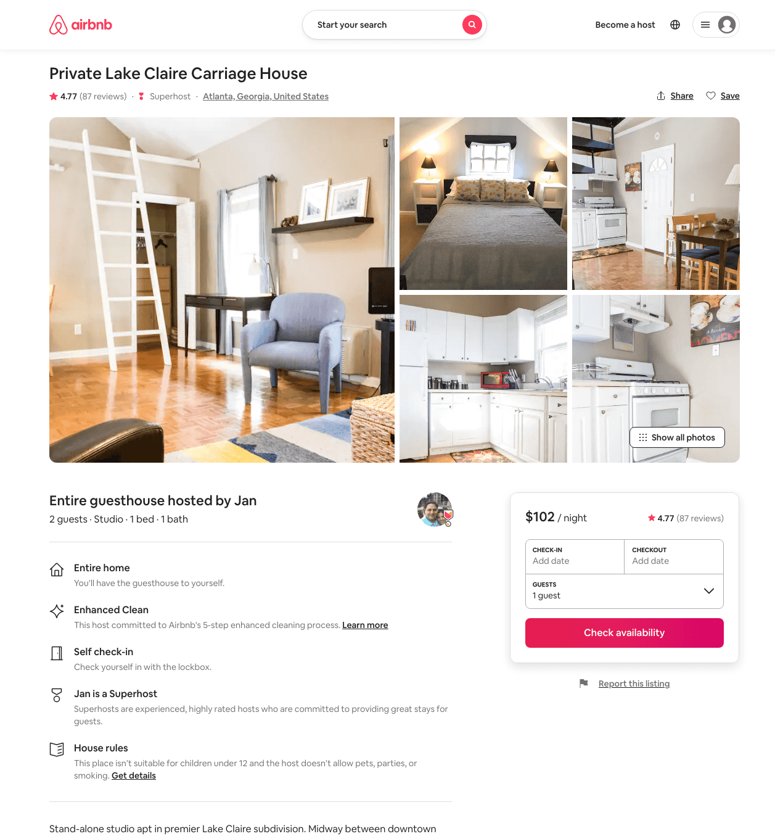
Listing 3768941
Studio
2
$102 - $109
4.78
28
Jan
19313278
2
https://www.airbnb.com/rooms/3768941
Aug 2022

Slide 13
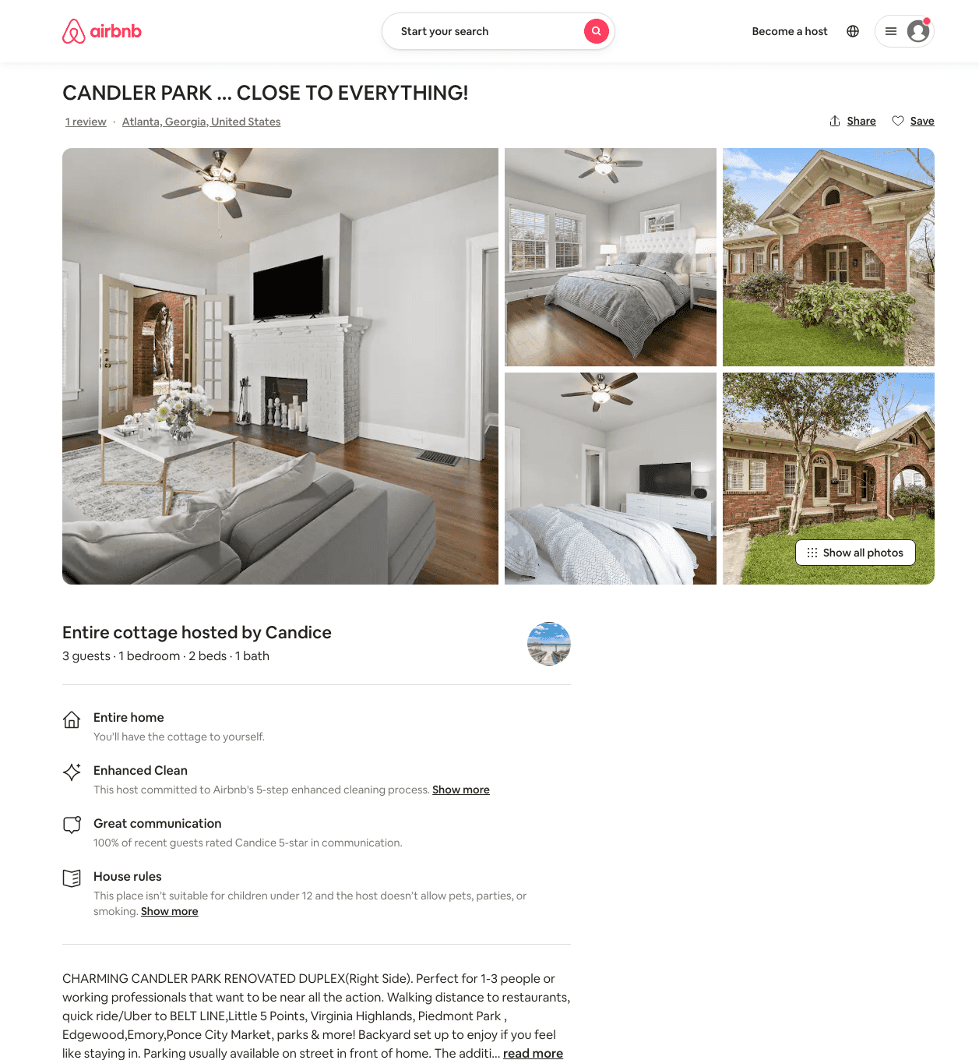
Listing 31929392
1
3
$89 - $146
4.75
1
Candice
125668492
2
https://www.airbnb.com/rooms/31929392
Aug 2022

Slide 14
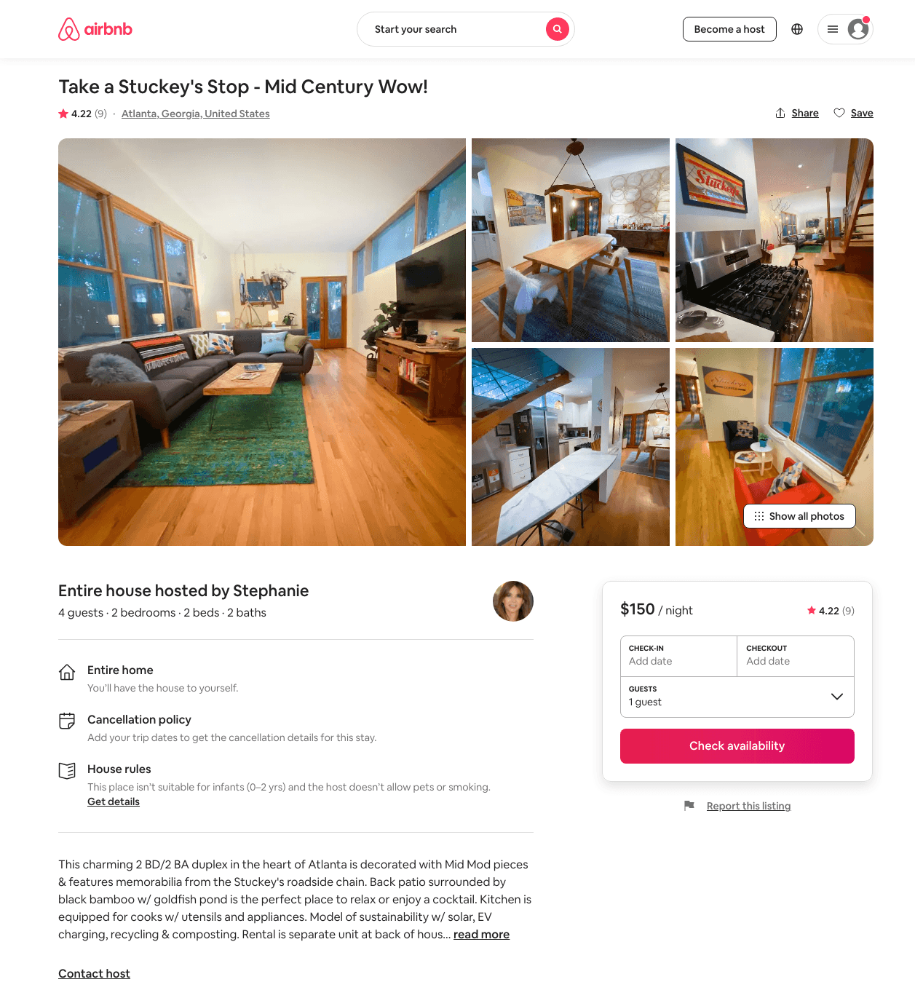
Listing 44859017
2
4
$115 - $175
4.77
1
Stephanie
194980341
1
https://www.airbnb.com/rooms/44859017
Aug 2022

Slide 15
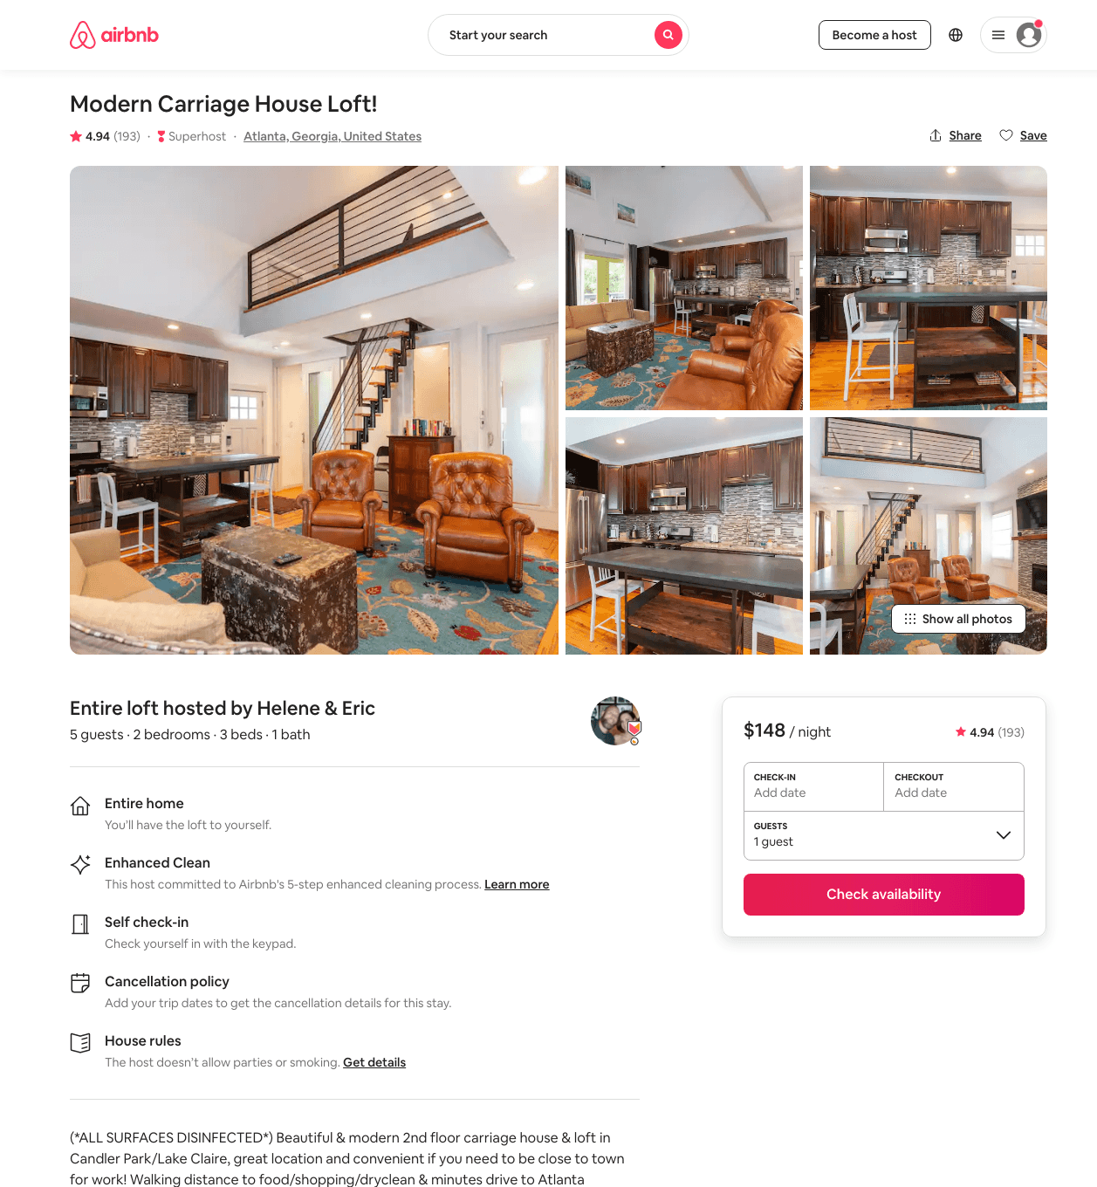
Listing 10087895
2
4
$145 - $161
4.93
31
Helene & Eric
42230053
10
https://www.airbnb.com/rooms/10087895
Aug 2022

Slide 16
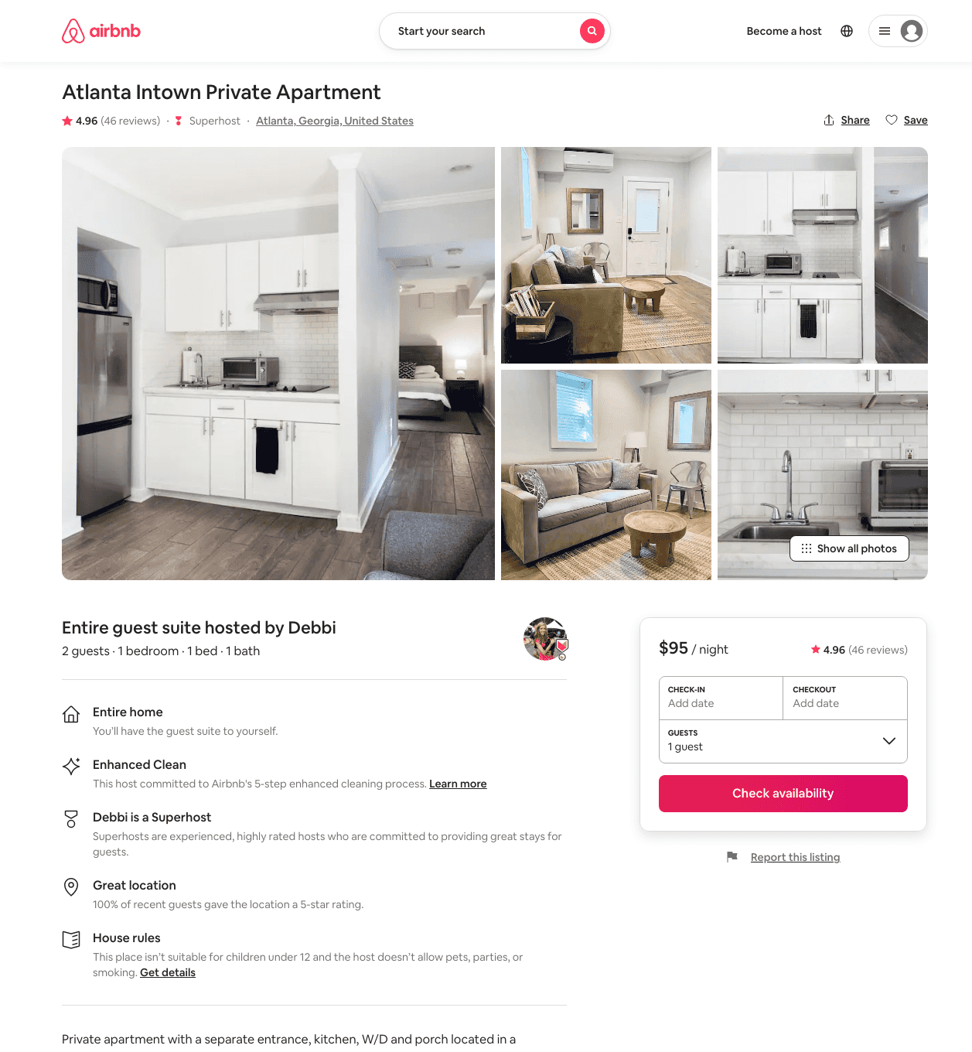
Listing 14623377
1
2
$90 - $95
4.94
4
Debbi
35547939
2
https://www.airbnb.com/rooms/14623377
Aug 2022

Slide 17
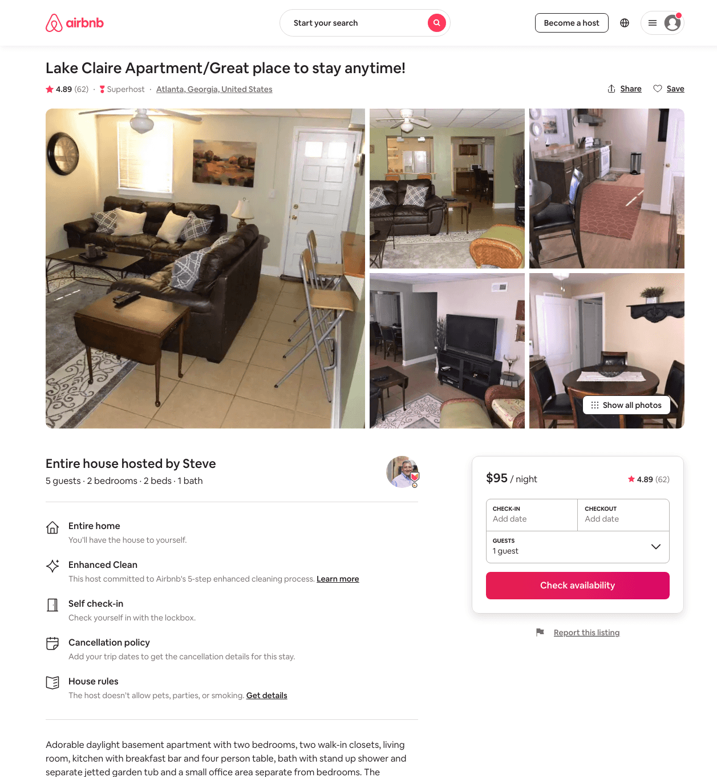
Listing 30714890
2
5
$95
4.91
2
Steve
47265165
1
https://www.airbnb.com/rooms/30714890
Aug 2022

Slide 18
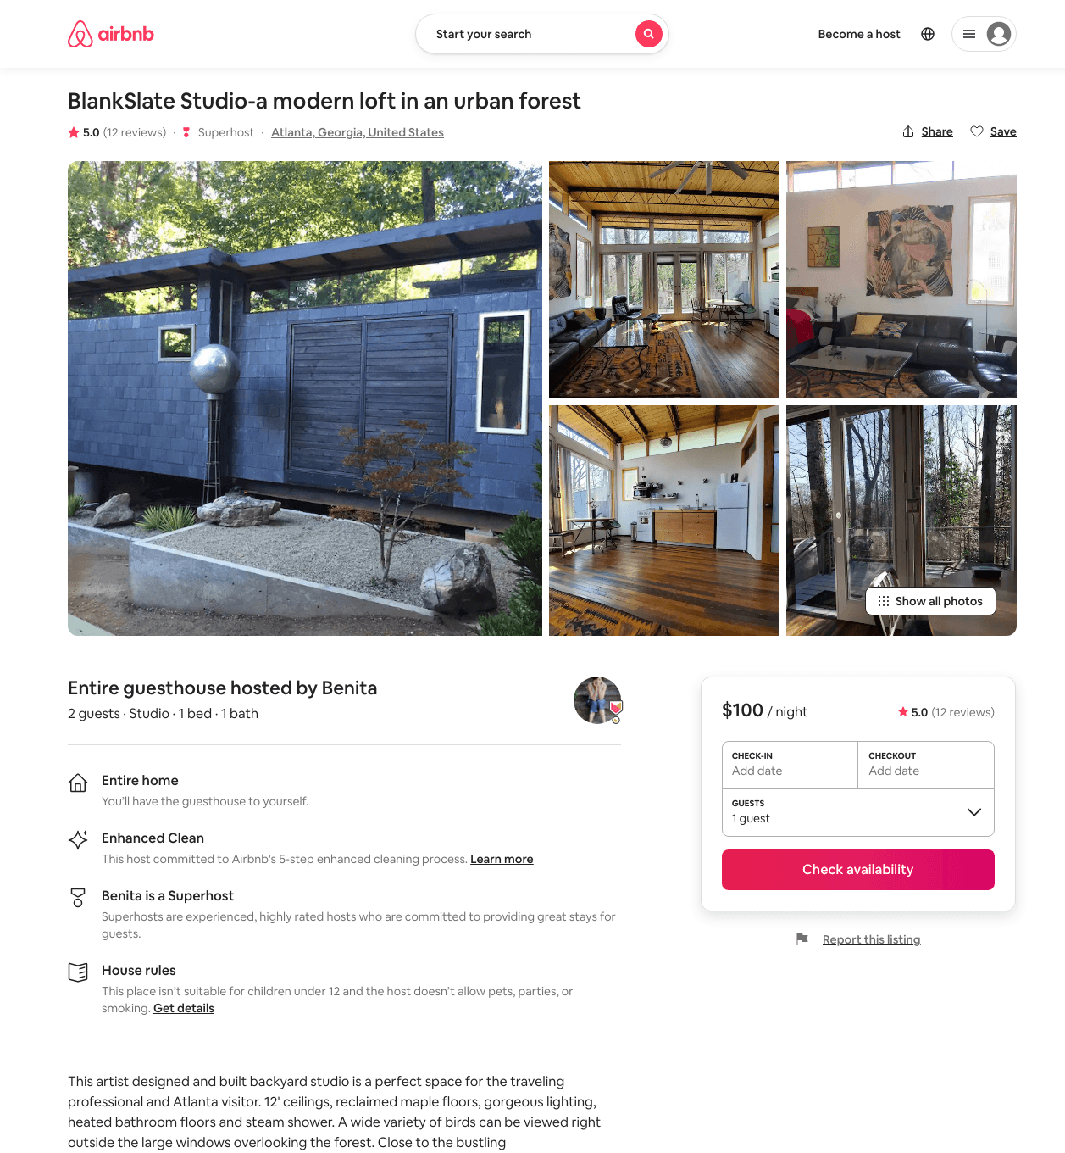
Listing 18592178
1
2
$100
5.0
31
Benita
4434129
2
https://www.airbnb.com/rooms/18592178
Aug 2022

Slide 19
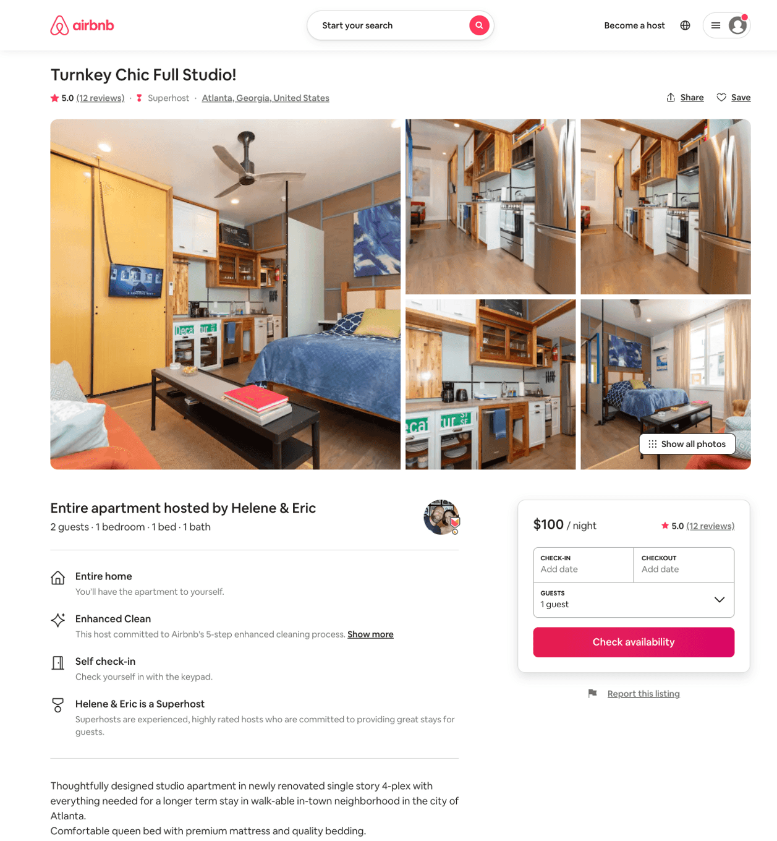
Listing 34251569
1
2
$100 - $107
4.90
31
Helene & Eric
42230053
10
https://www.airbnb.com/rooms/34251569
Jun 2022

Slide 20
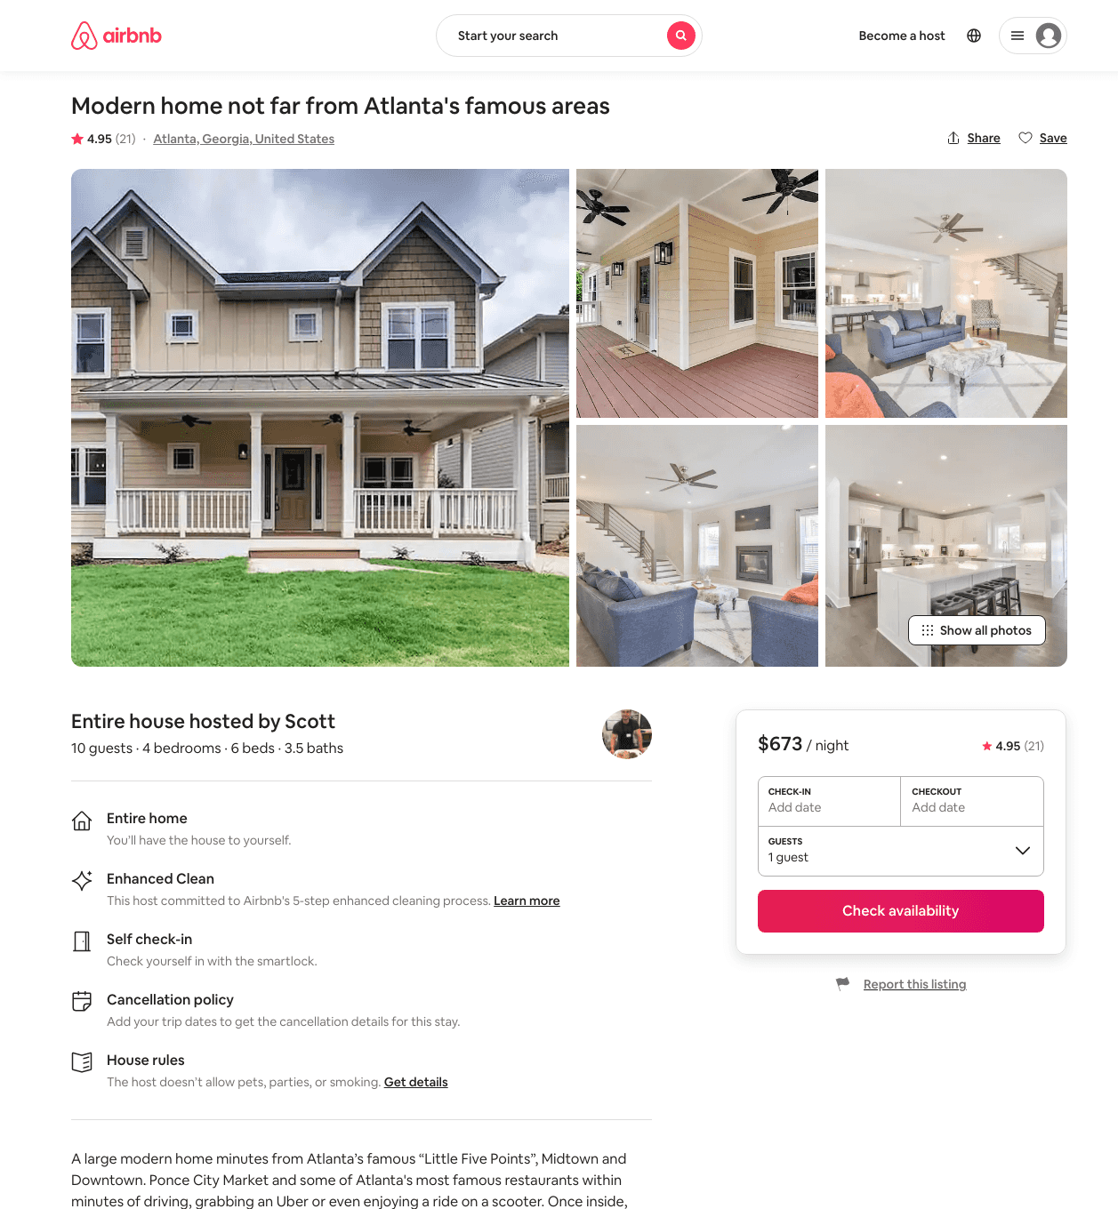
Listing 39746030
4
10
$433 - $735
4.84
2
Scott
117109391
4
https://www.airbnb.com/rooms/39746030
Aug 2022

Slide 21
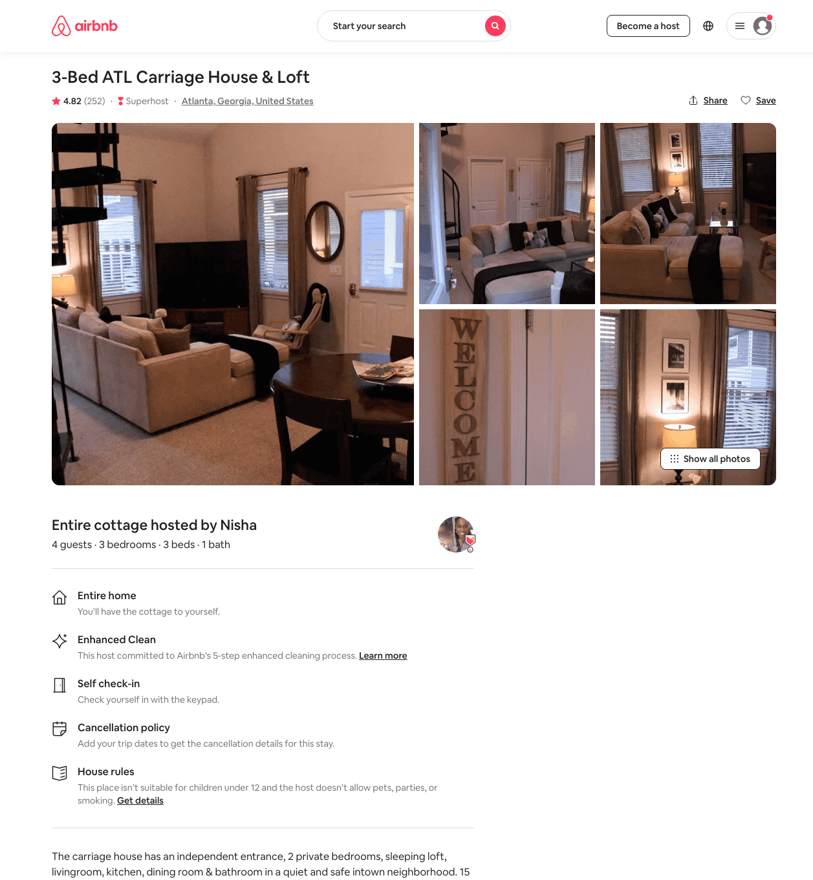
Listing 9332638
3
4
$149 - $165
4.82
2
Sonia
115969567
1
https://www.airbnb.com/rooms/9332638
Aug 2022

Slide 22
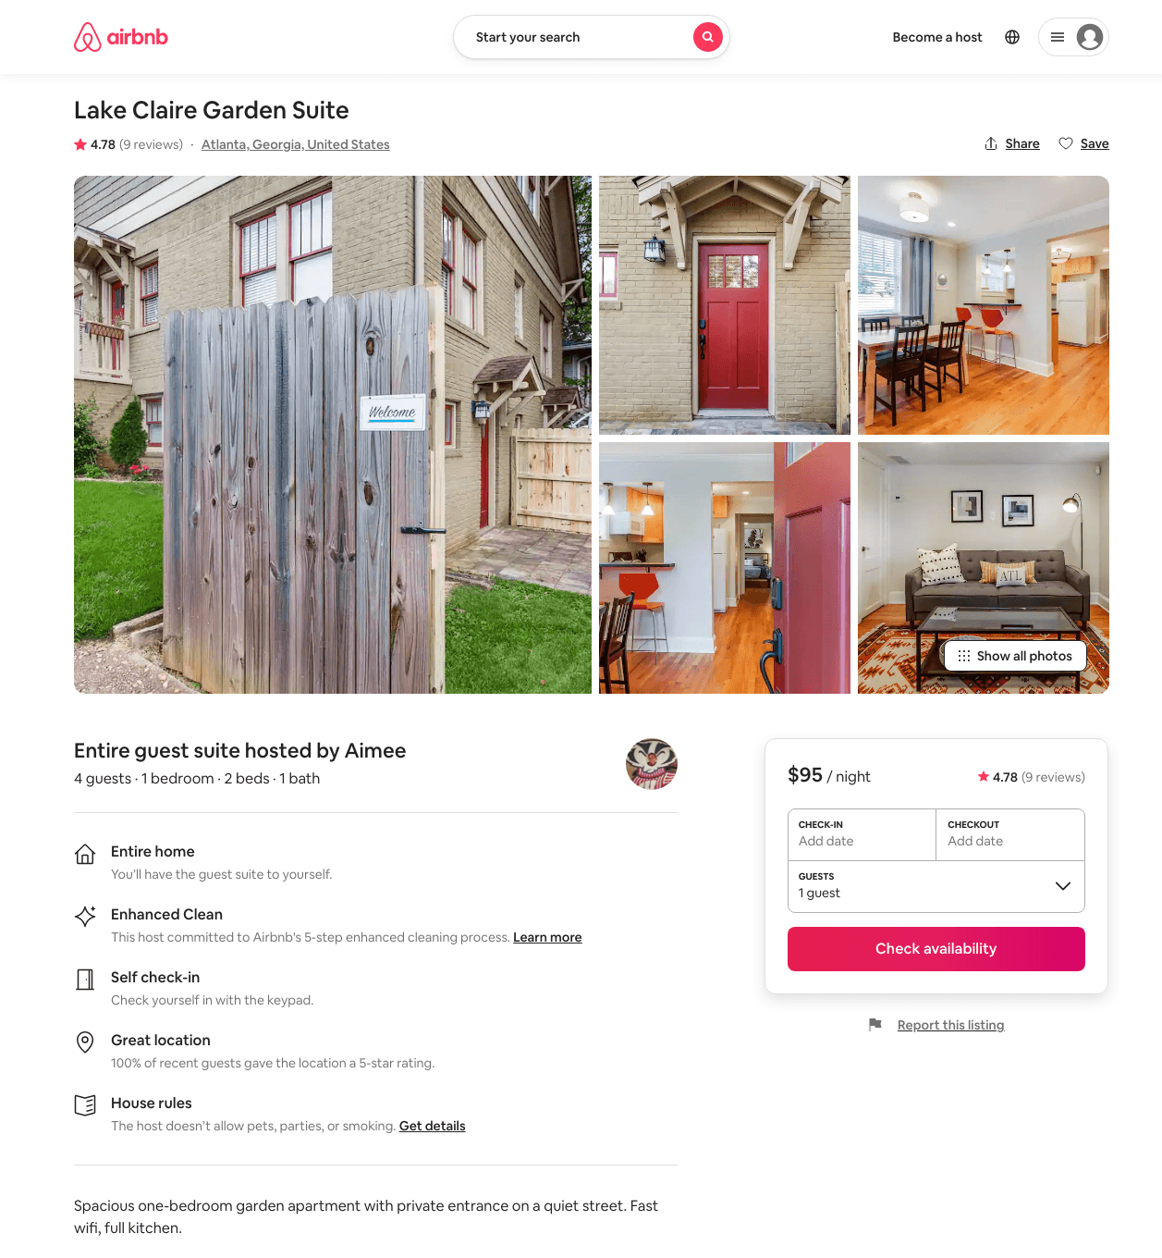
Listing 43544498
1
4
$91 - $127
4.72
2
Jaya
4241392
5
https://www.airbnb.com/rooms/43544498
Aug 2022

Slide 23
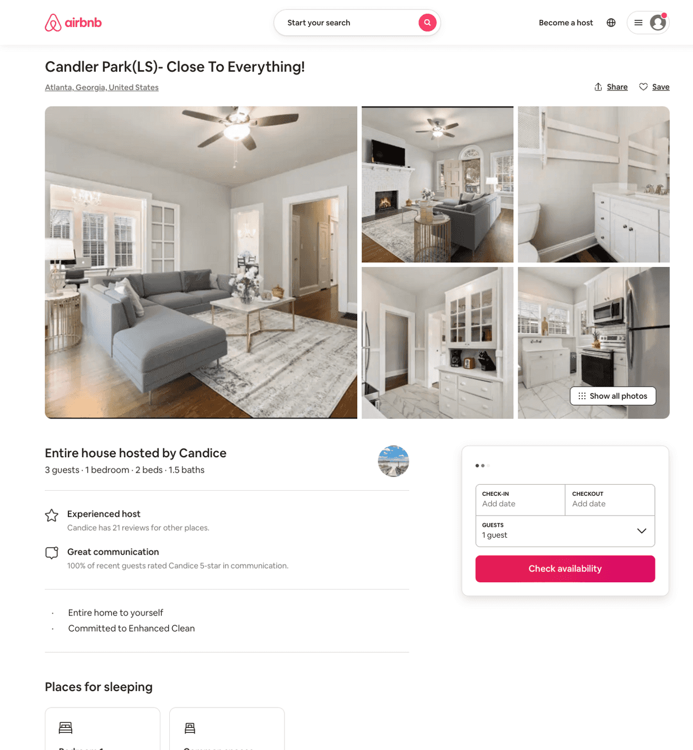
Listing 50941247
1
3
$107 - $132
4.35
1
Candice
125668492
2
https://www.airbnb.com/rooms/50941247
Aug 2022

Slide 24
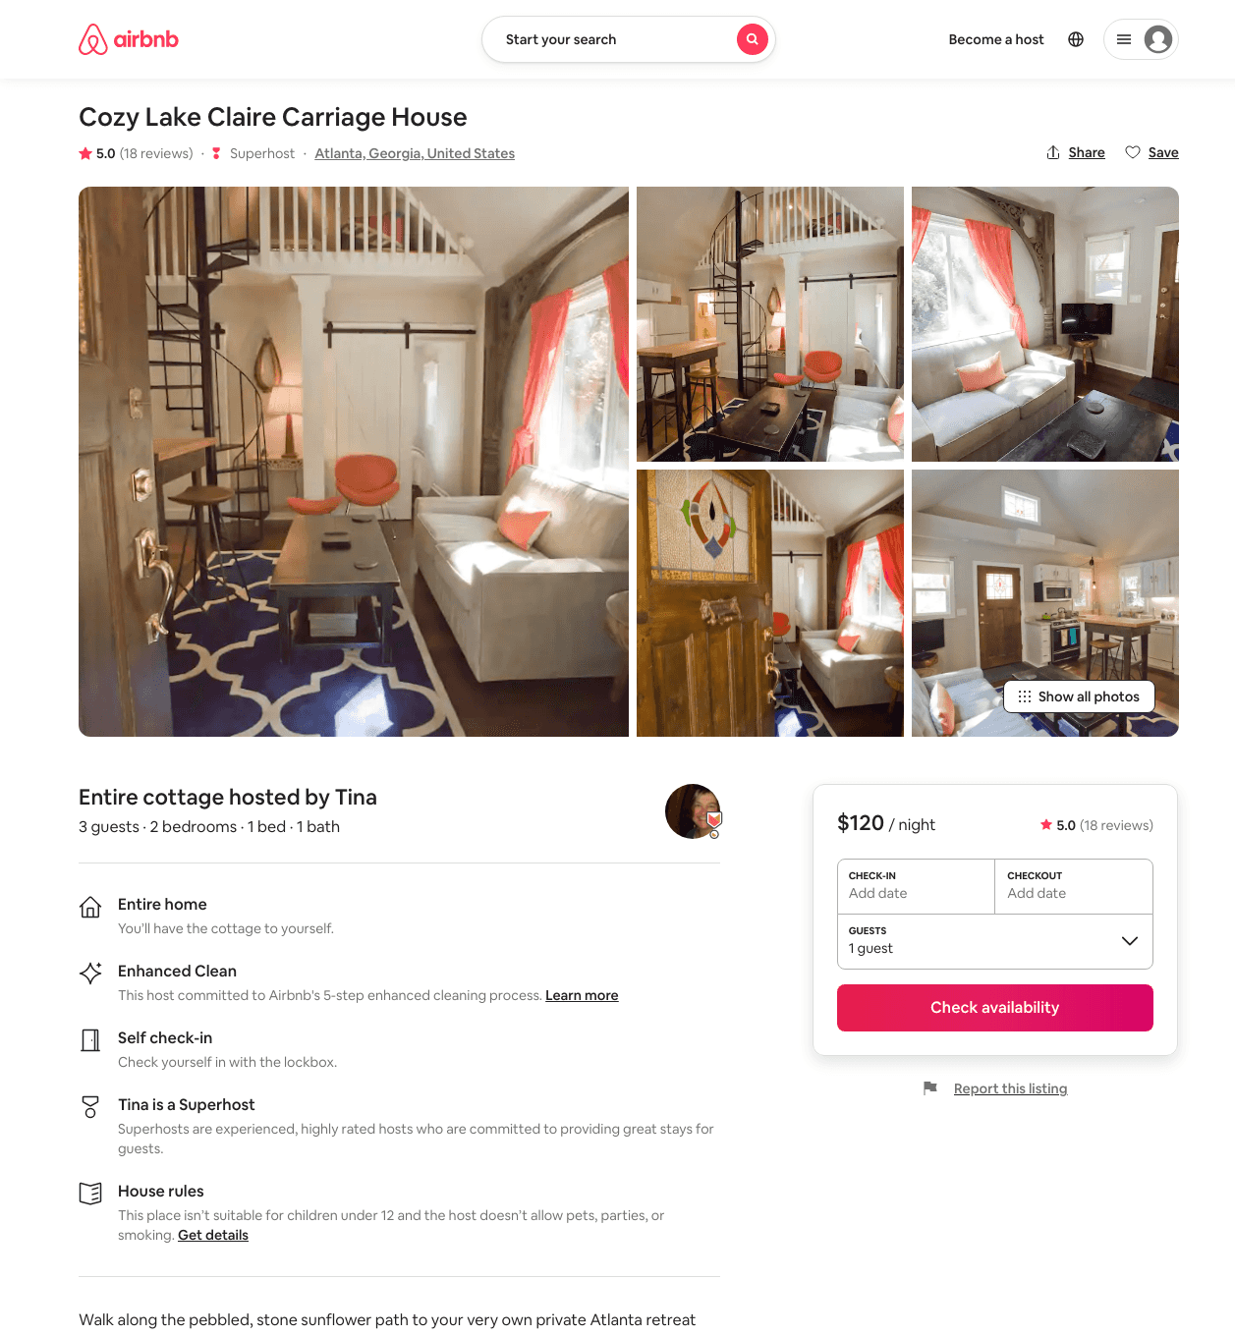
Listing 9270624
2
3
$120
5.0
7
Tina
45102544
1
https://www.airbnb.com/rooms/9270624
Aug 2022

Slide 25
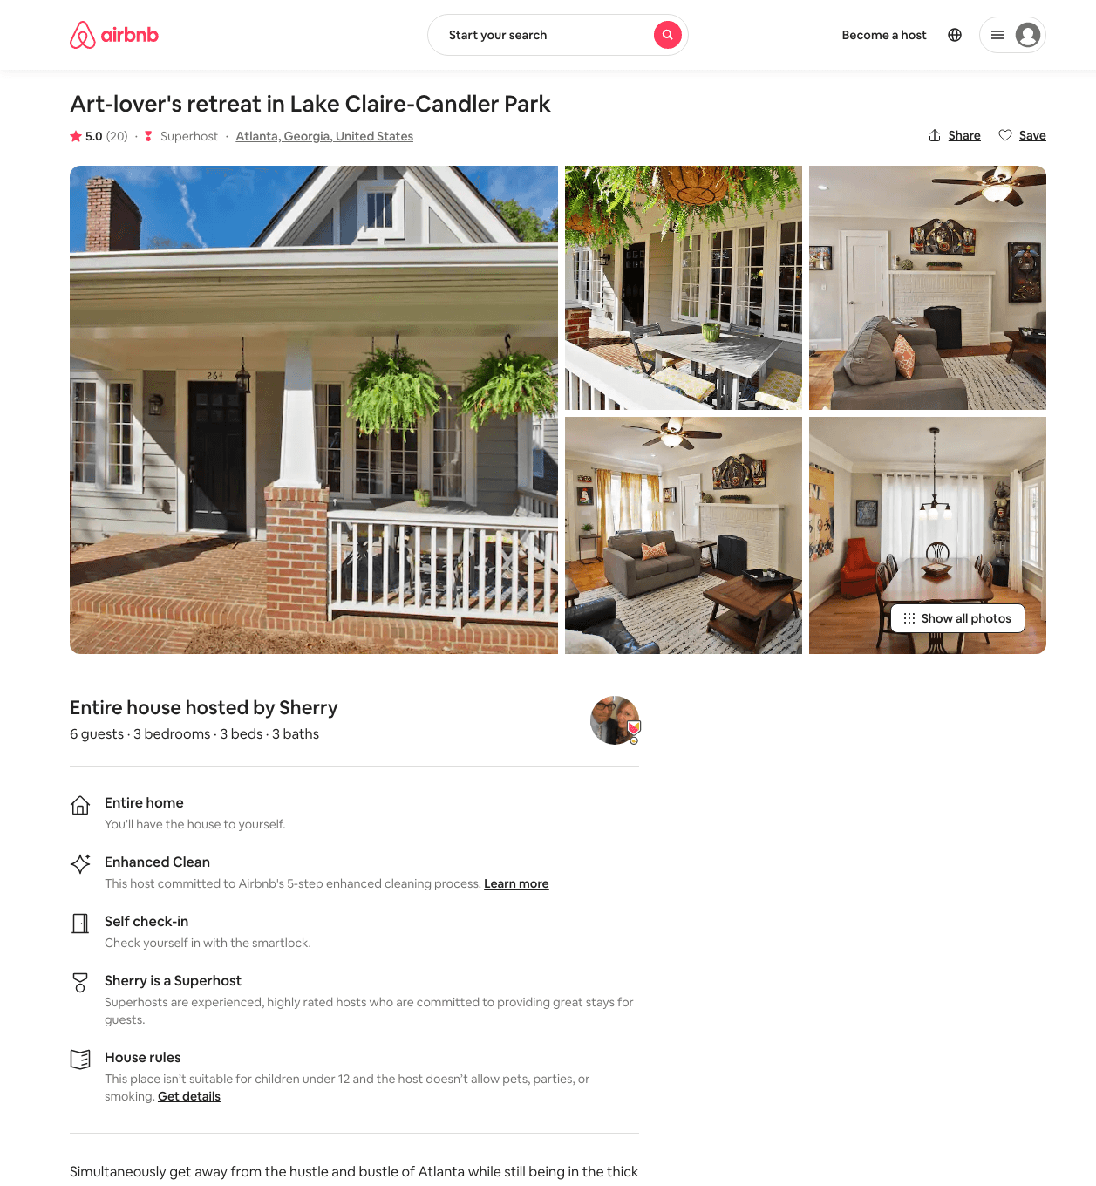
Listing 38091515
3
6
$250 - $421
5.0
3
Sherry
13849590
1
https://www.airbnb.com/rooms/38091515
Aug 2022

Slide 26
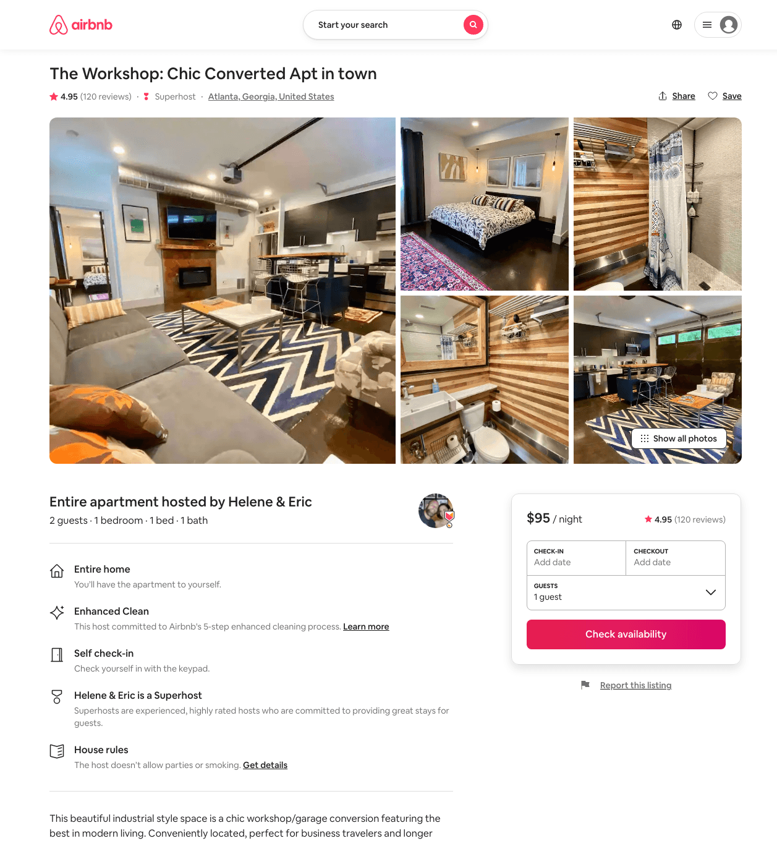
Listing 9897786
1
2
$95 - $104
4.96
31
Helene & Eric
42230053
10
https://www.airbnb.com/rooms/9897786
Aug 2022

Slide 27
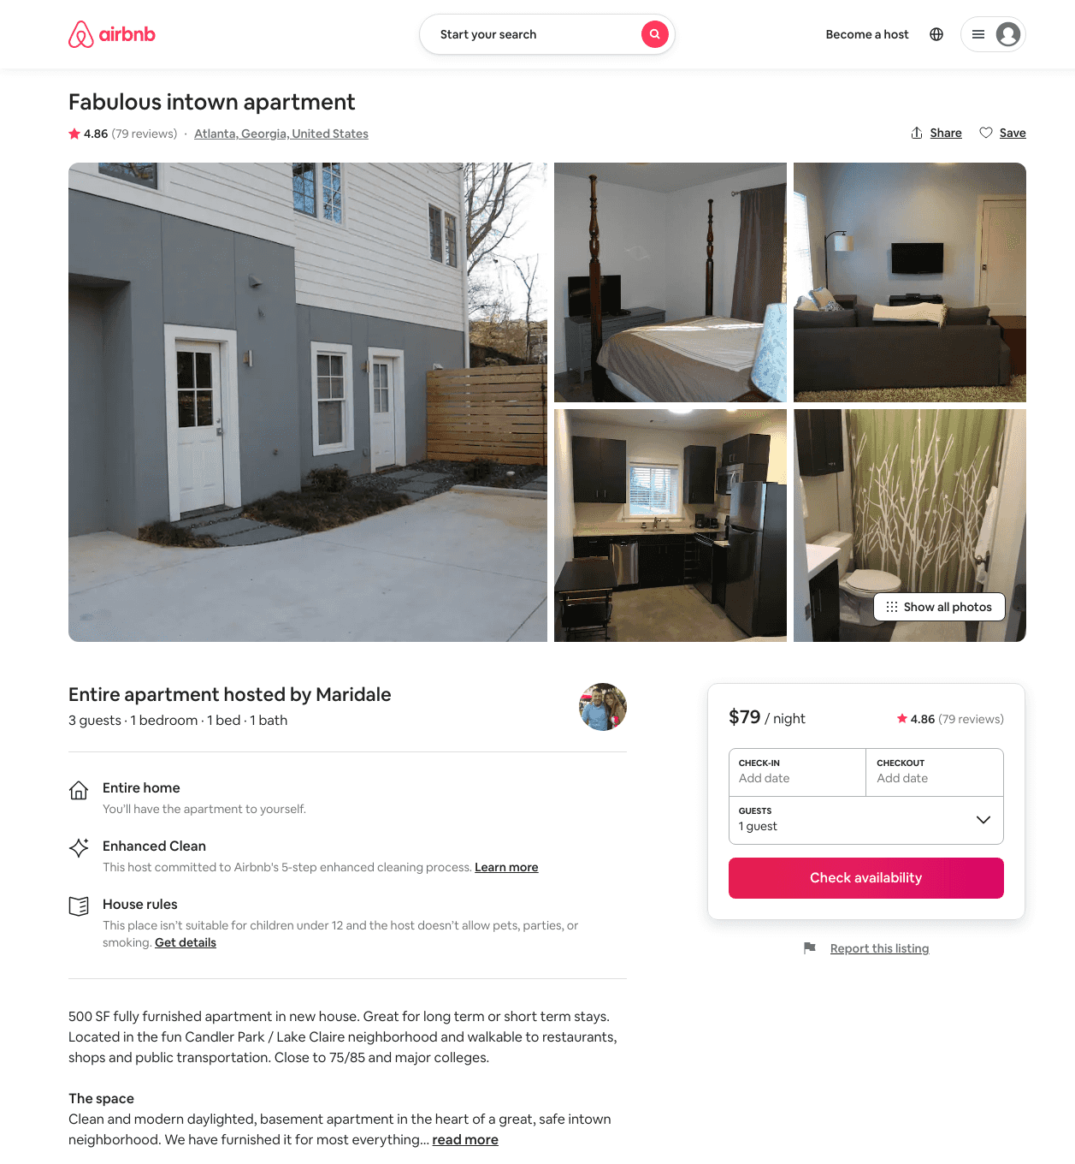
Listing 4020664
1
3
$79 - $125
4.86
3
Maridale
20845026
1
https://www.airbnb.com/rooms/4020664
Aug 2022

Slide 28
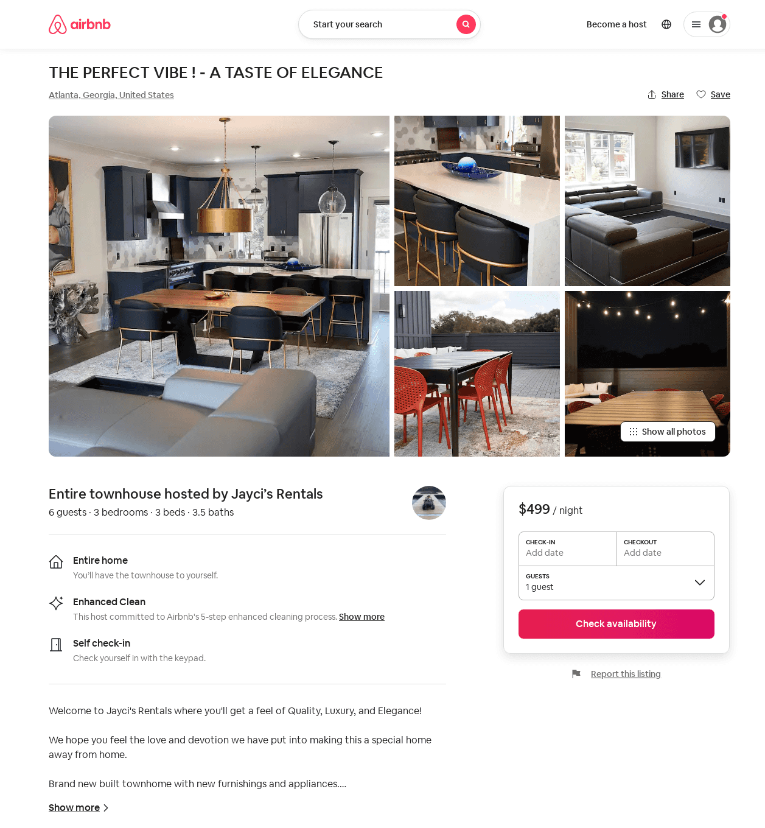
Listing 51985104
3
6
$400 - $500
5.0
1
Jayci’s Rentals
28074755
1
https://www.airbnb.com/rooms/51985104
Aug 2022

Slide 29
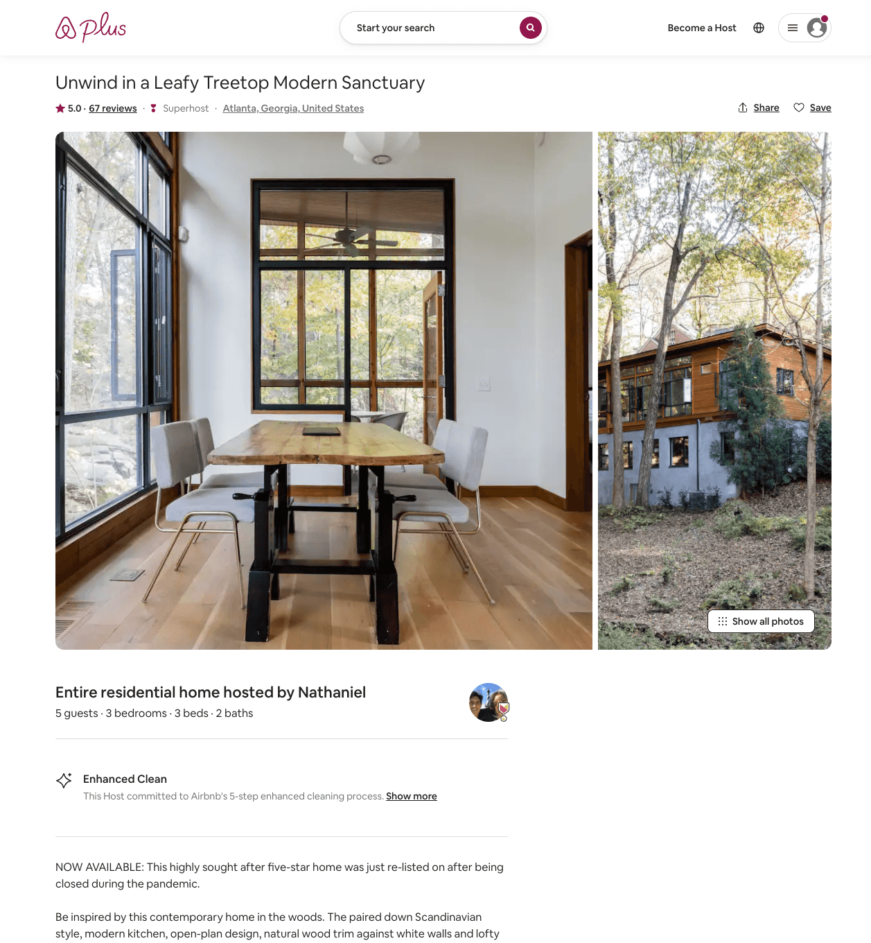
Listing 19506018
3
5
$205 - $499
4.99
3
Nathaniel
136983275
2
https://www.airbnb.com/rooms/19506018
Aug 2022

Slide 30
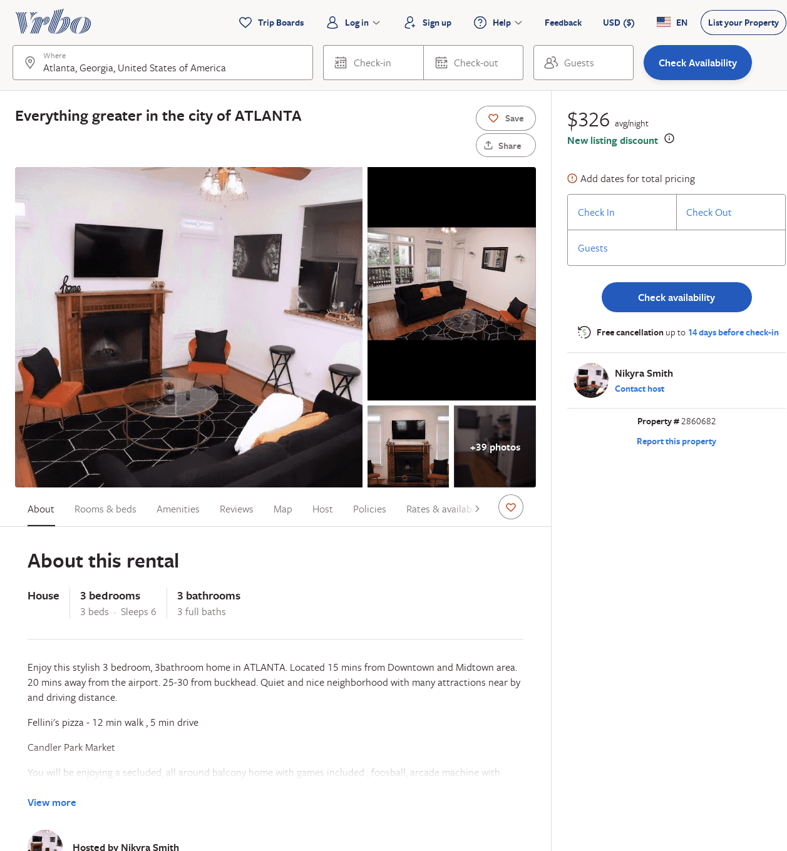
Listing 2860682
3
8
$230
3
2
Nikyra
https://www.vrbo.com/2860682
Aug 2022

Slide 31
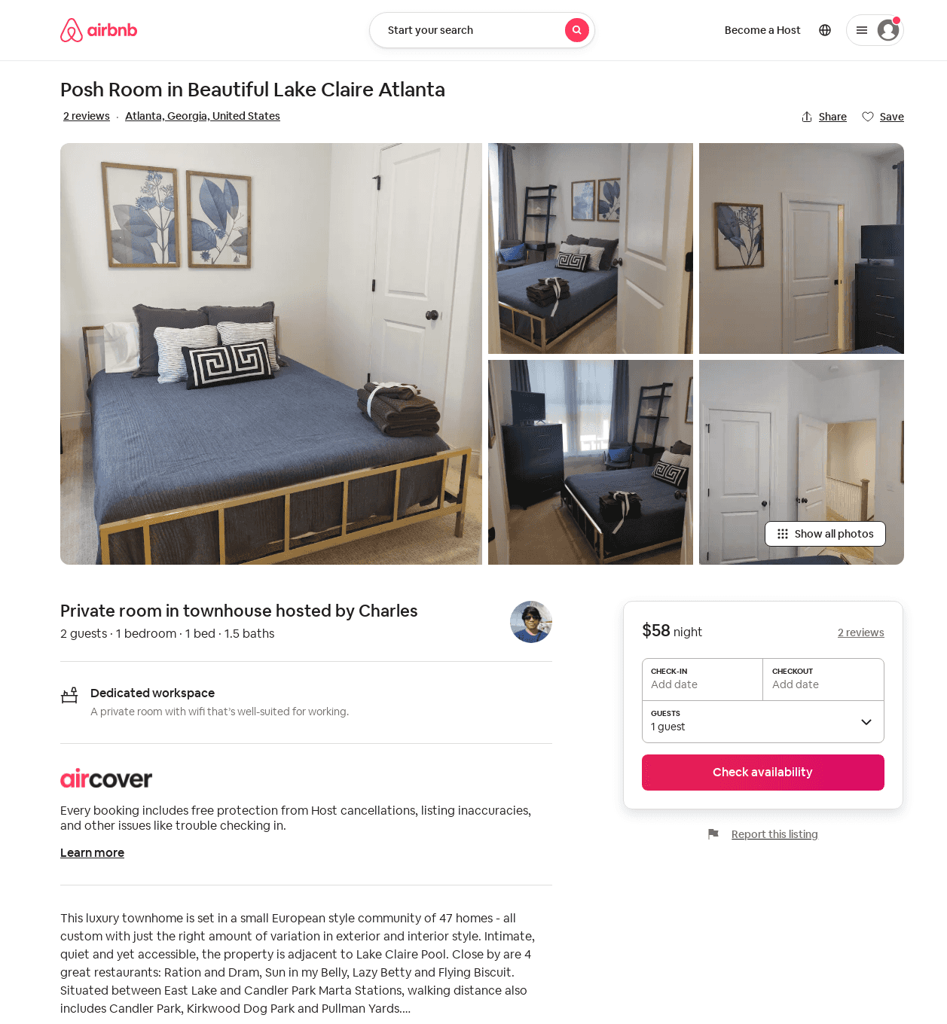
Listing 49689175
1
2
2
Charles
33240402
1
https://www.airbnb.com/rooms/49689175
Aug 2022

