Slide 2
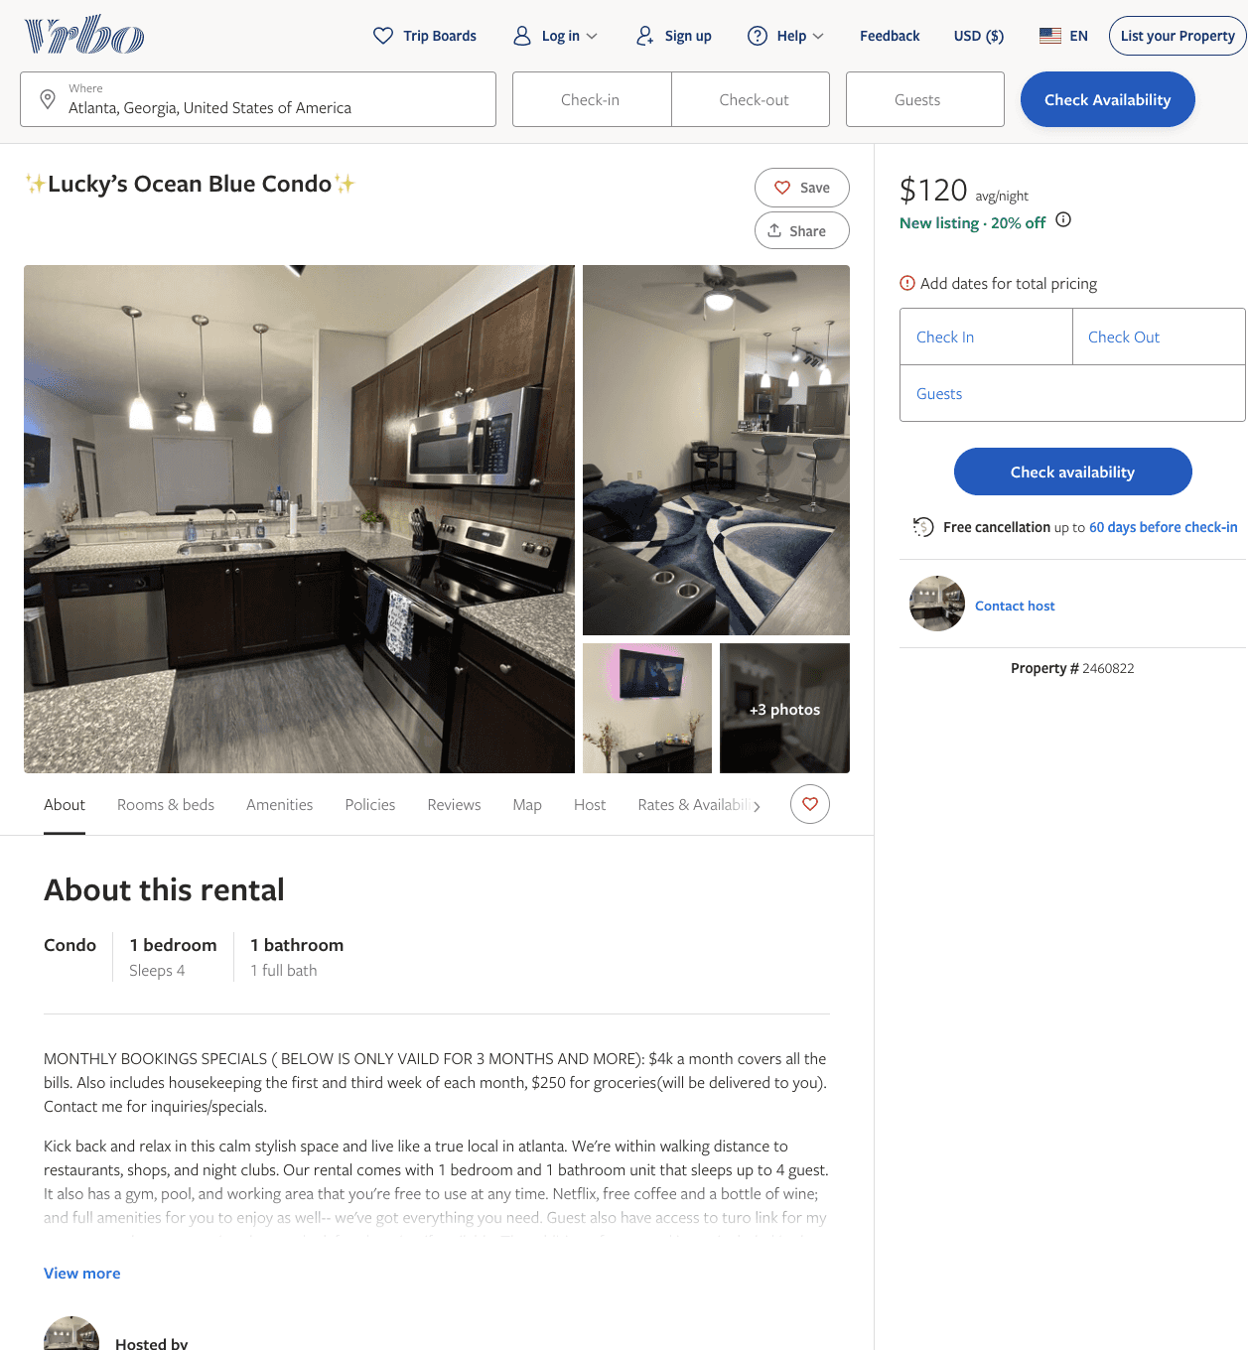
Listing 2460822
1
4
$110 - $89
5
2
cookie
https://www.vrbo.com/2460822
Aug 2022

Slide 3
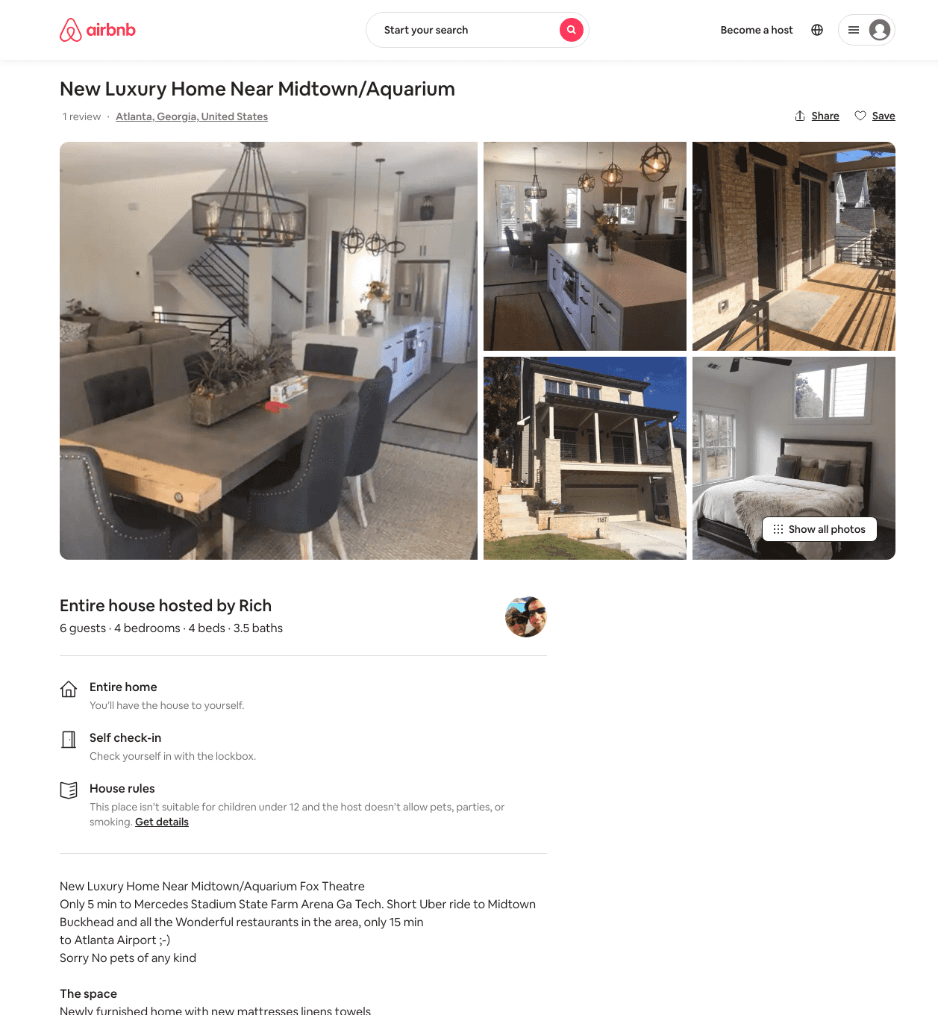
Listing 31801588
4
6
$950
2
Rich
25351742
1
https://www.airbnb.com/rooms/31801588
Aug 2022

Slide 4
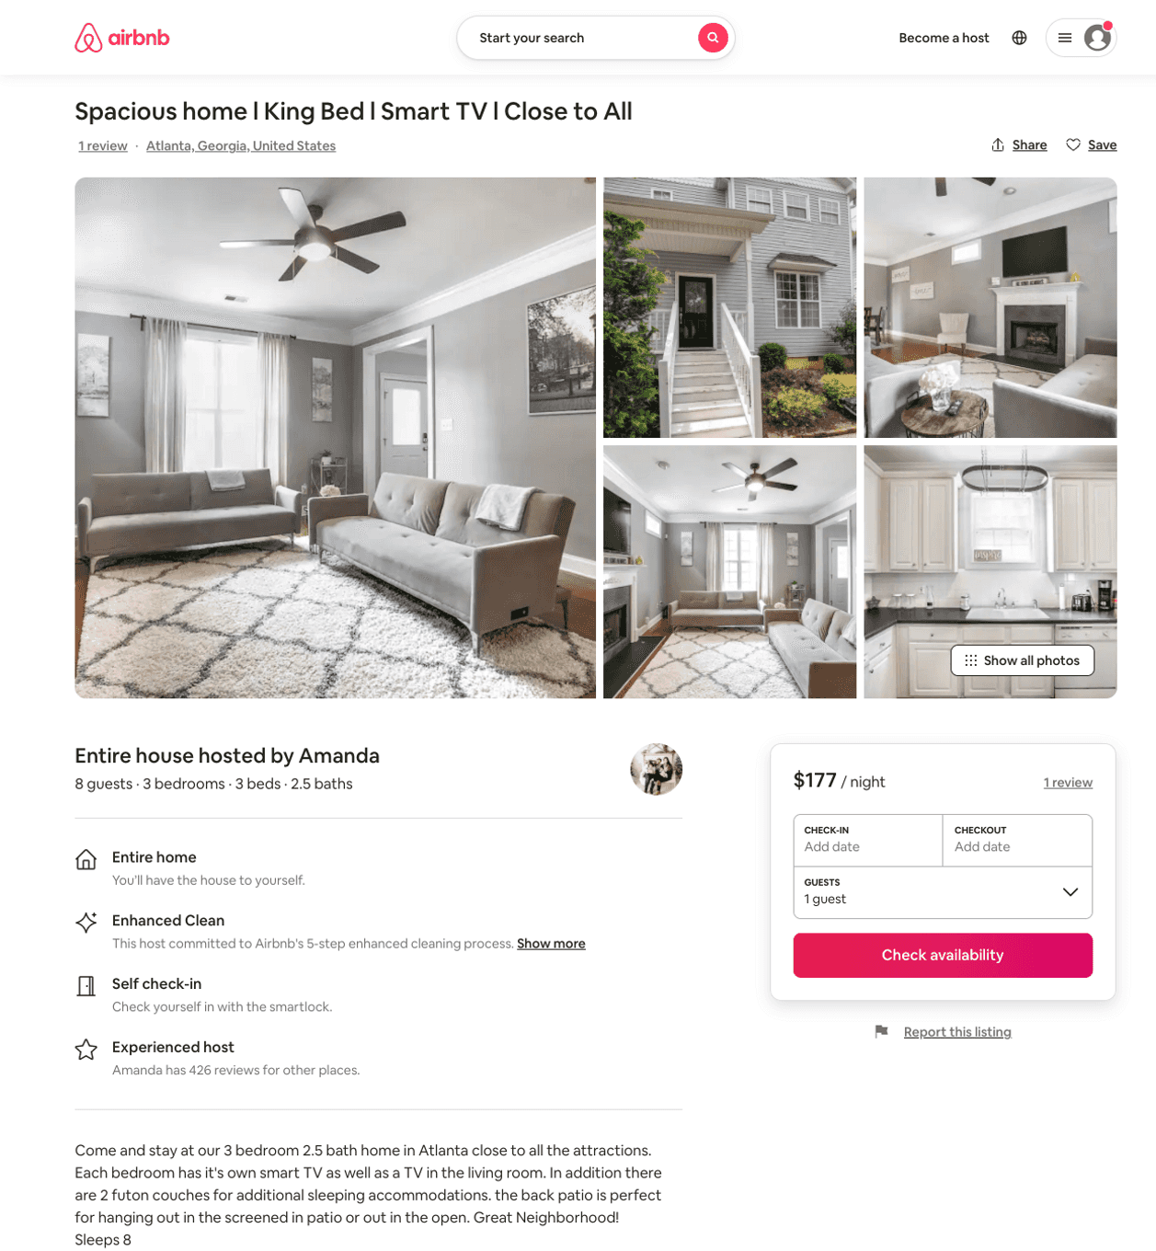
Listing 50283290
3
8
$126 - $185
4.54
1
David
390237268
12
https://www.airbnb.com/rooms/50283290
Jun 2022

Slide 5
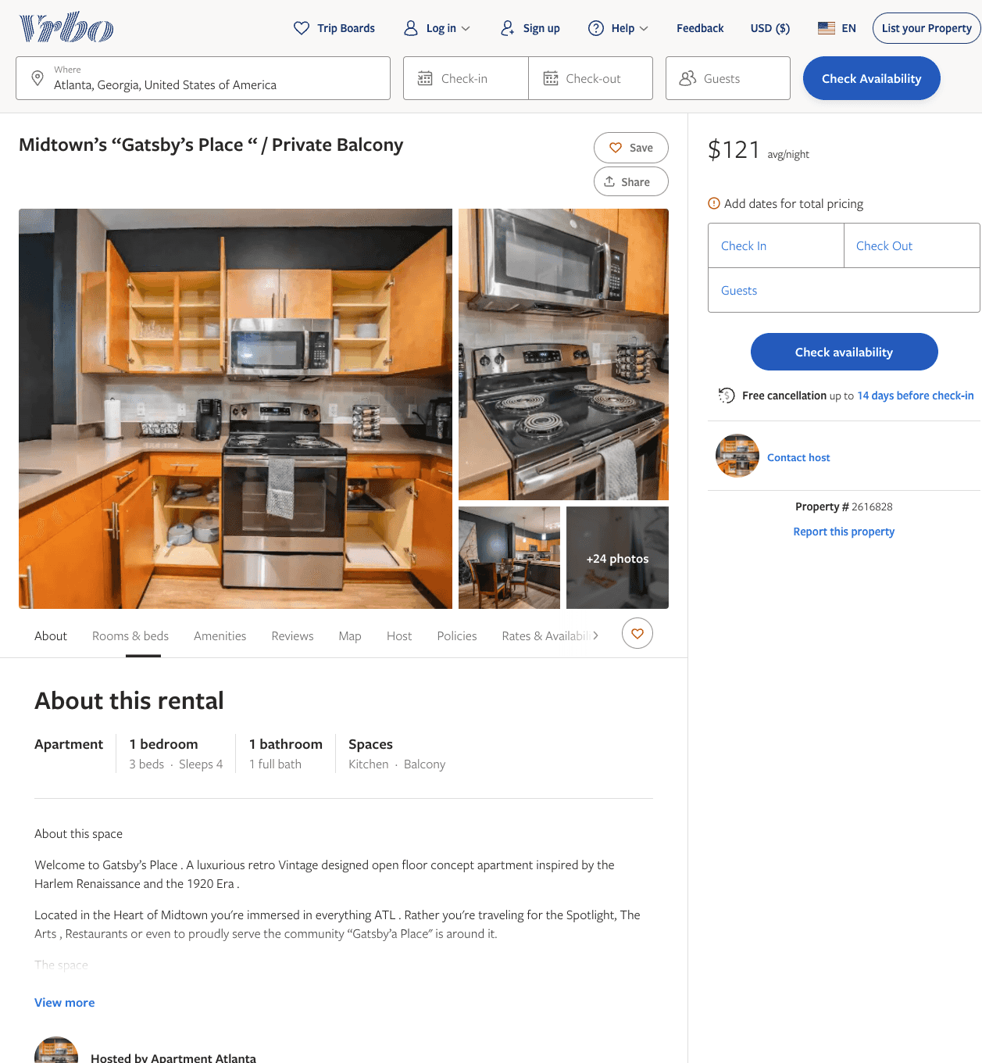
Listing 2616828
1
4
$147
1
https://www.vrbo.com/2616828
Aug 2022

Slide 6
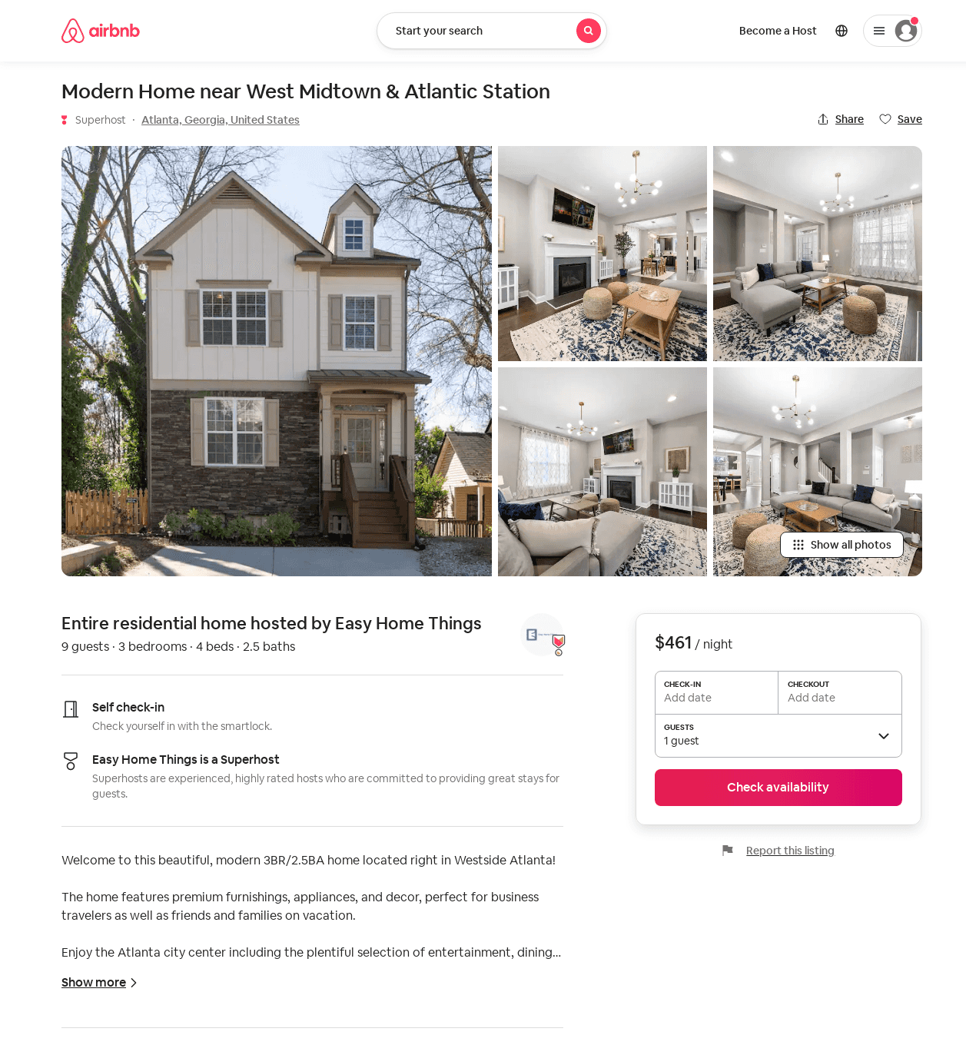
Listing 54370035
3
9
$339 - $461
28
Easy Home Things
435067207
2
https://www.airbnb.com/rooms/54370035
Jun 2022

Slide 7
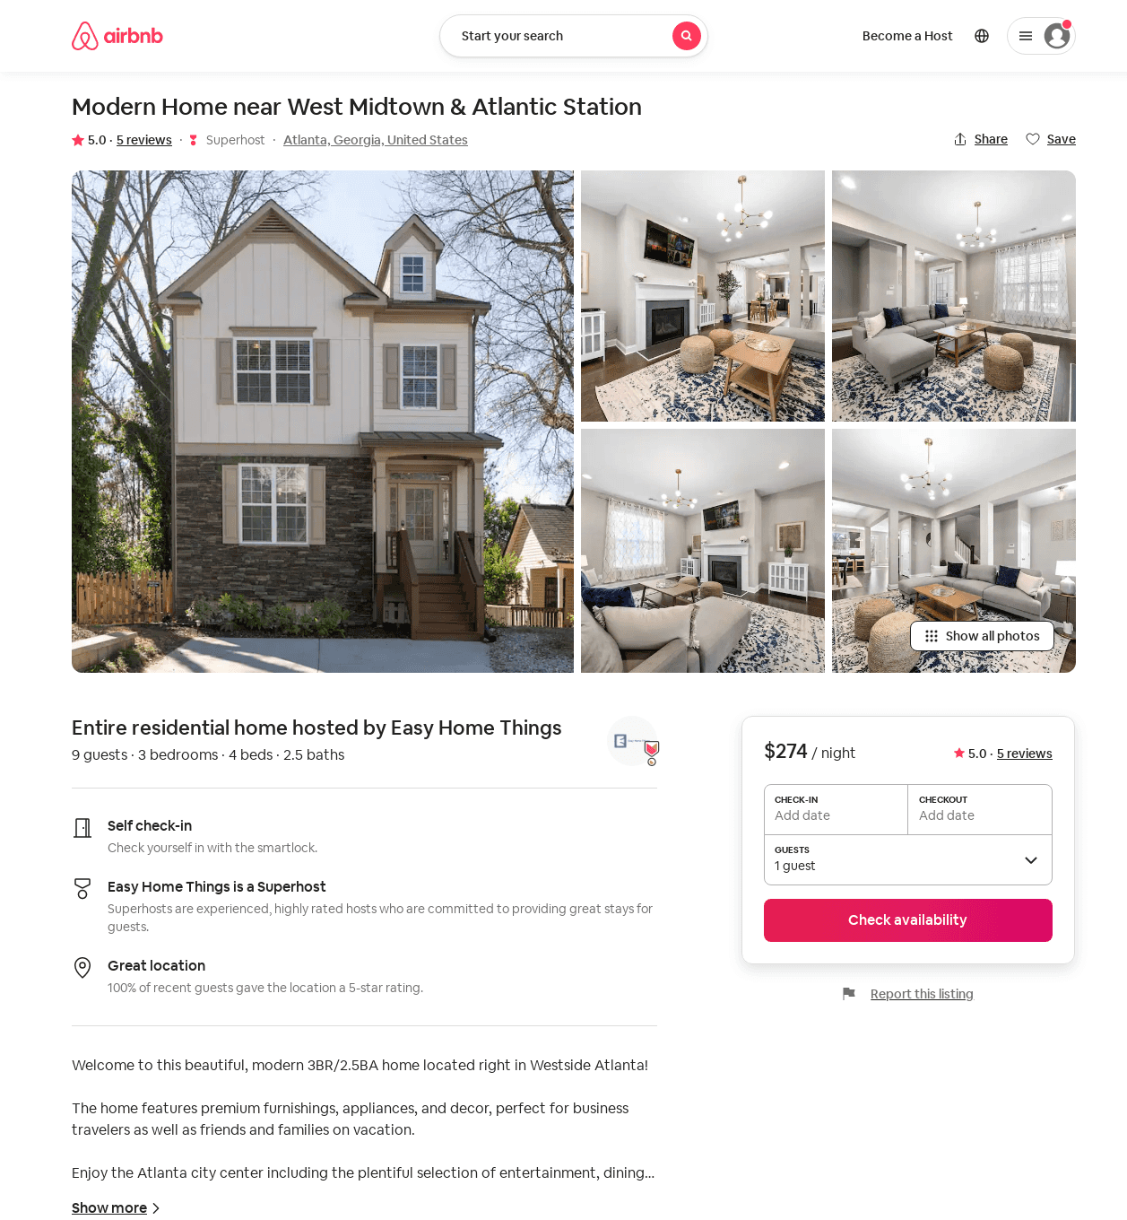
Listing 54201090
3
9
$271 - $392
5.0
1
Easy Home Things
435067207
2
https://www.airbnb.com/rooms/54201090
Aug 2022

Slide 8
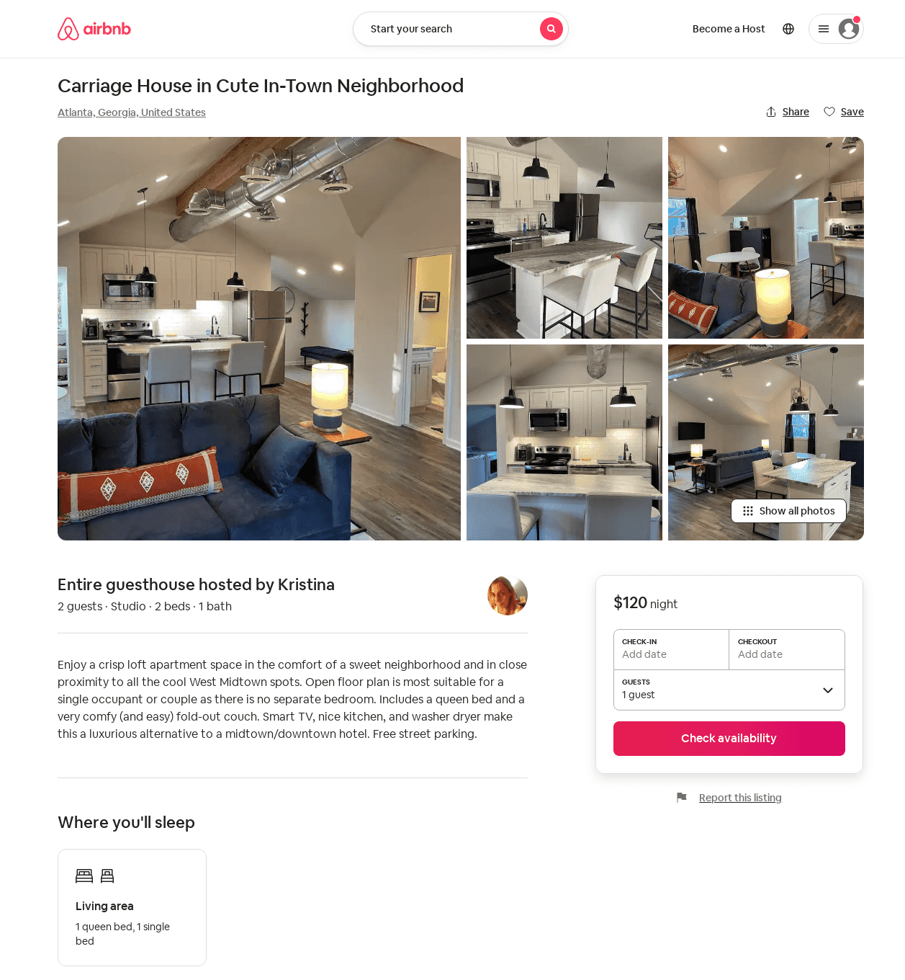
Listing 53899282
Studio
2
$120
2
Kristina
22302383
1
https://www.airbnb.com/rooms/53899282
Aug 2022

