Slide 2
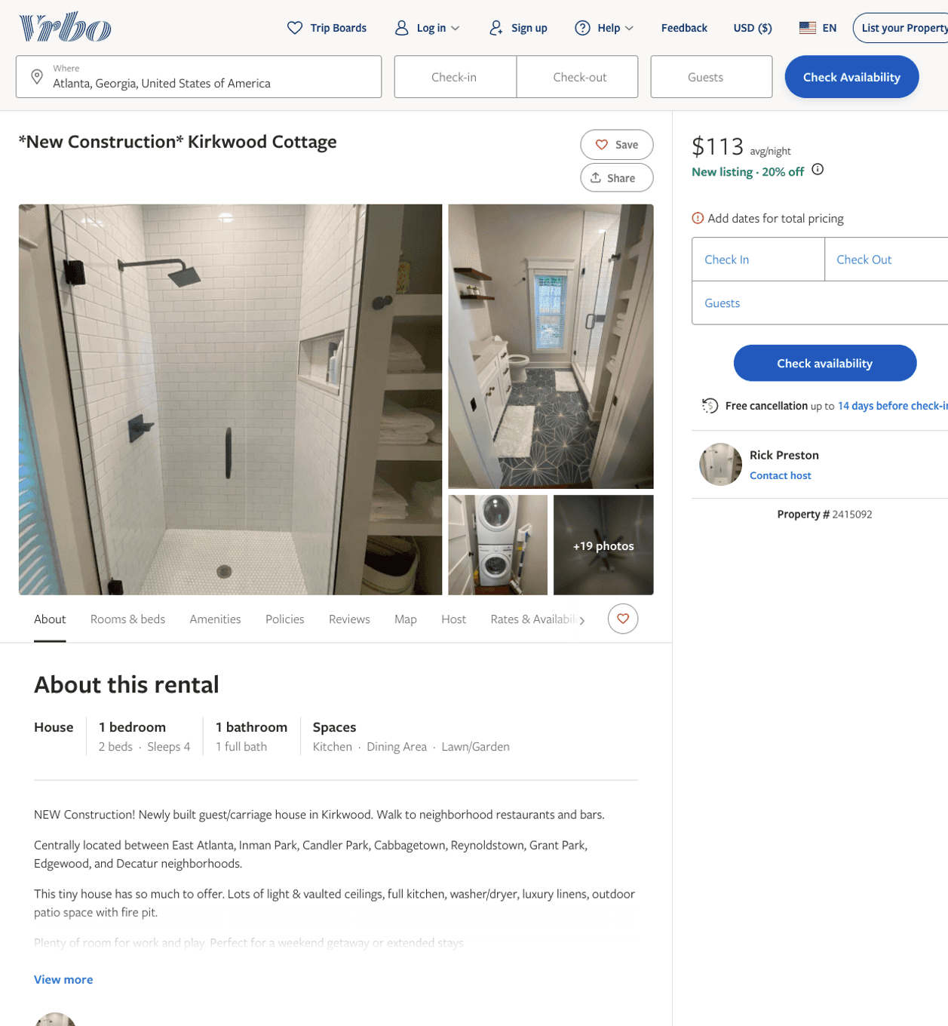
Listing 2415092
1
4
$102 - $90
5
1
Rick Preston
https://www.vrbo.com/2415092
Aug 2022

Slide 3
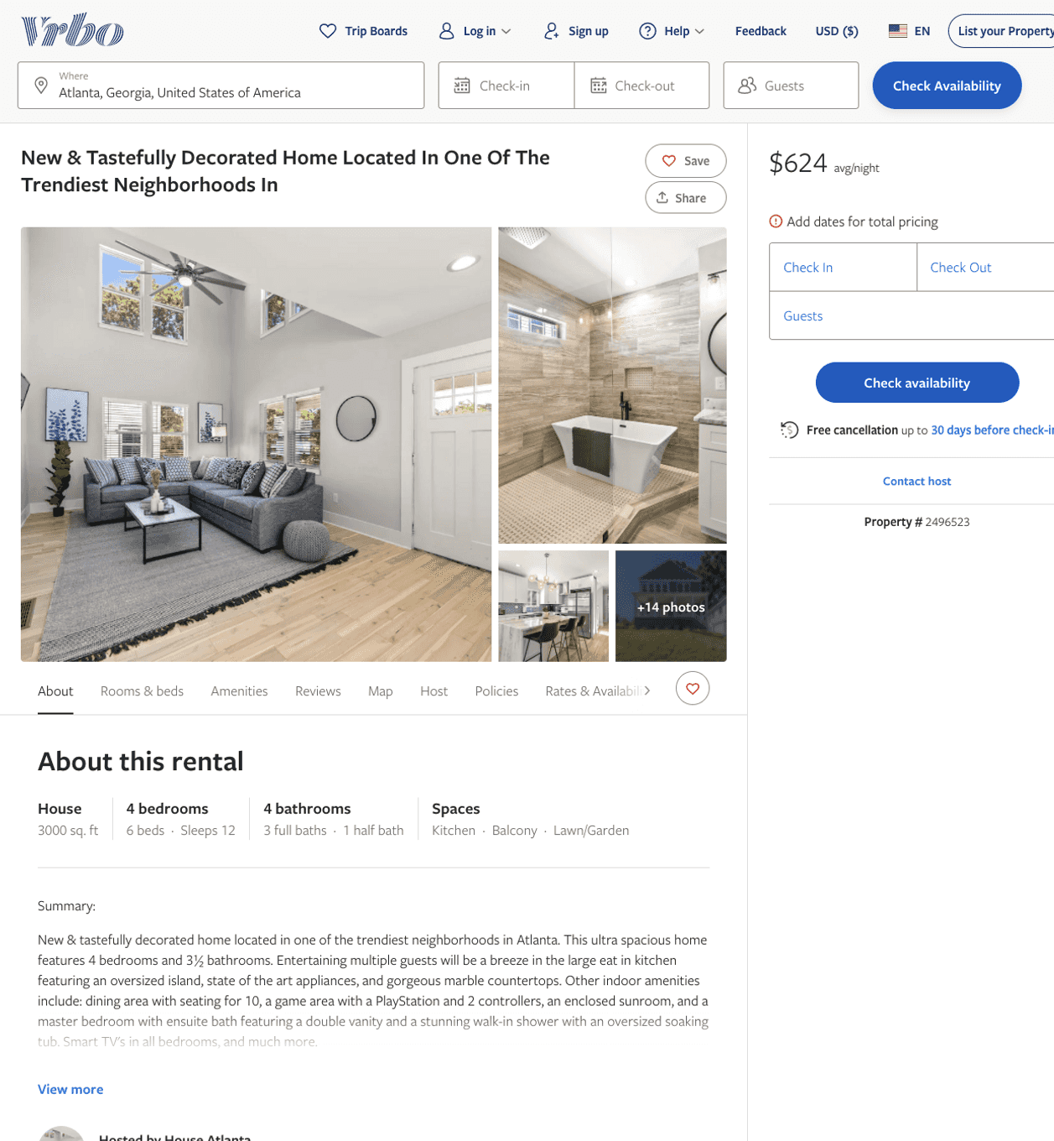
Listing 2496523
4
12
$476 - $624
5
2
Mountain Sights Rentals
https://www.vrbo.com/2496523
Aug 2022

Slide 4
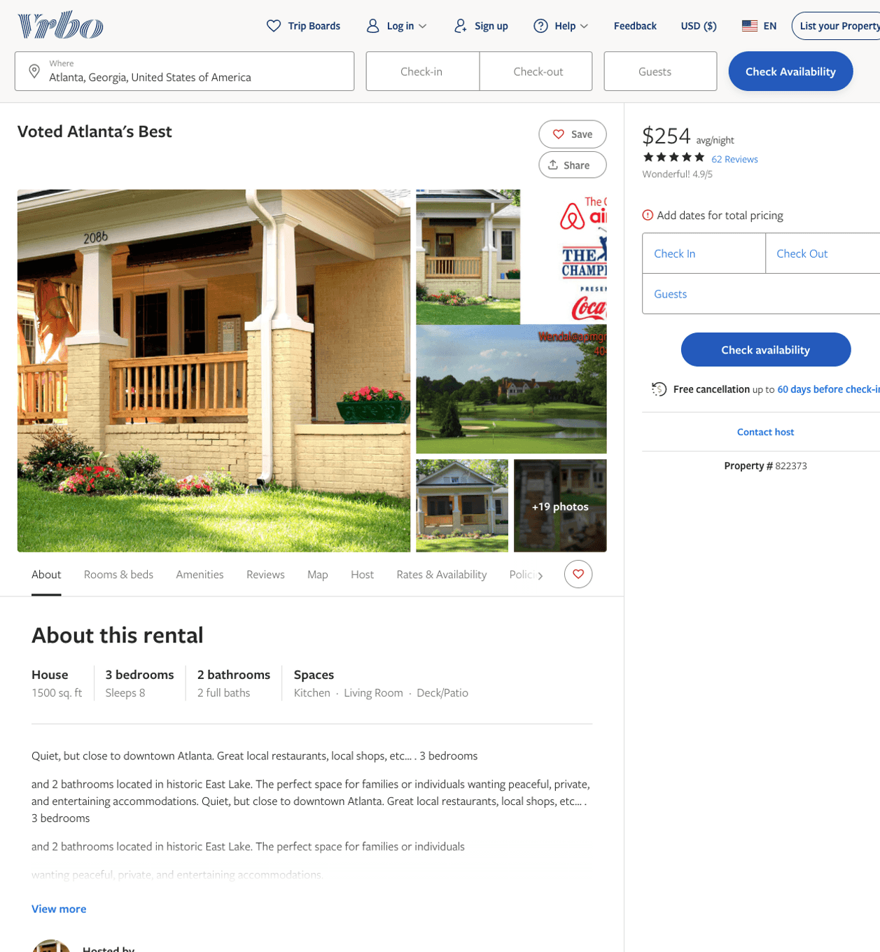
Listing 822373
3
8
$246 - $286
4.855263
3
https://www.vrbo.com/822373
Aug 2022

Slide 5
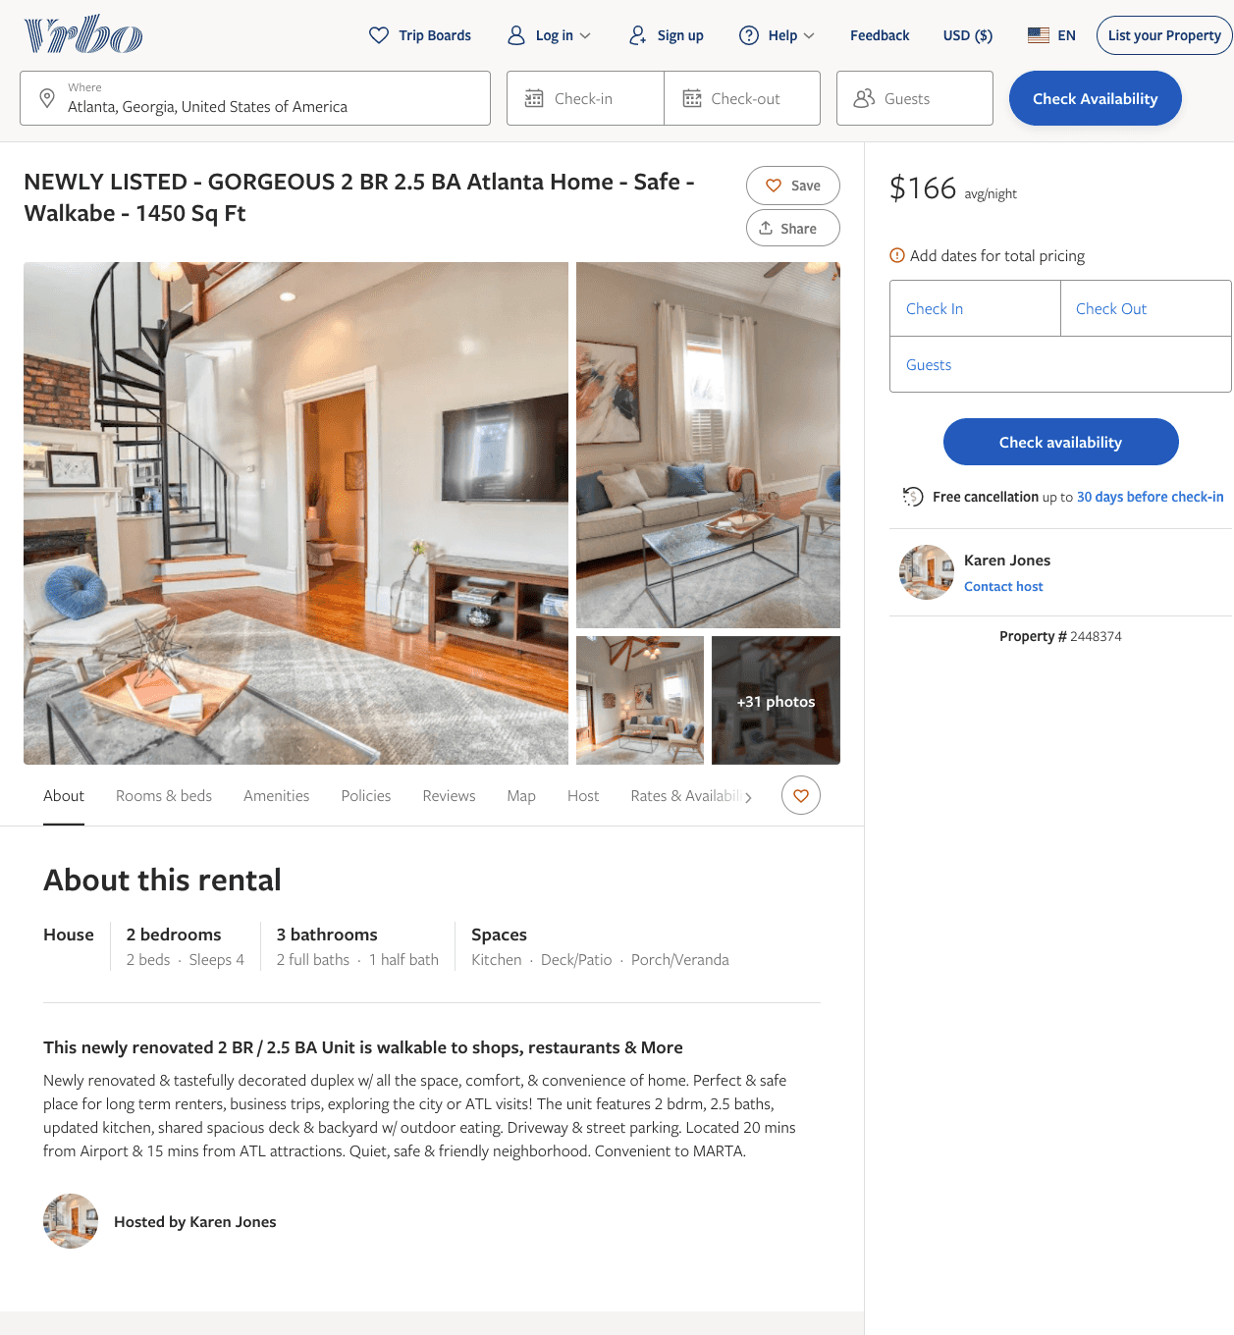
Listing 2448374
2
4
$162 - $166
4
Karen Jones
https://www.vrbo.com/2448374
Aug 2022

Slide 6
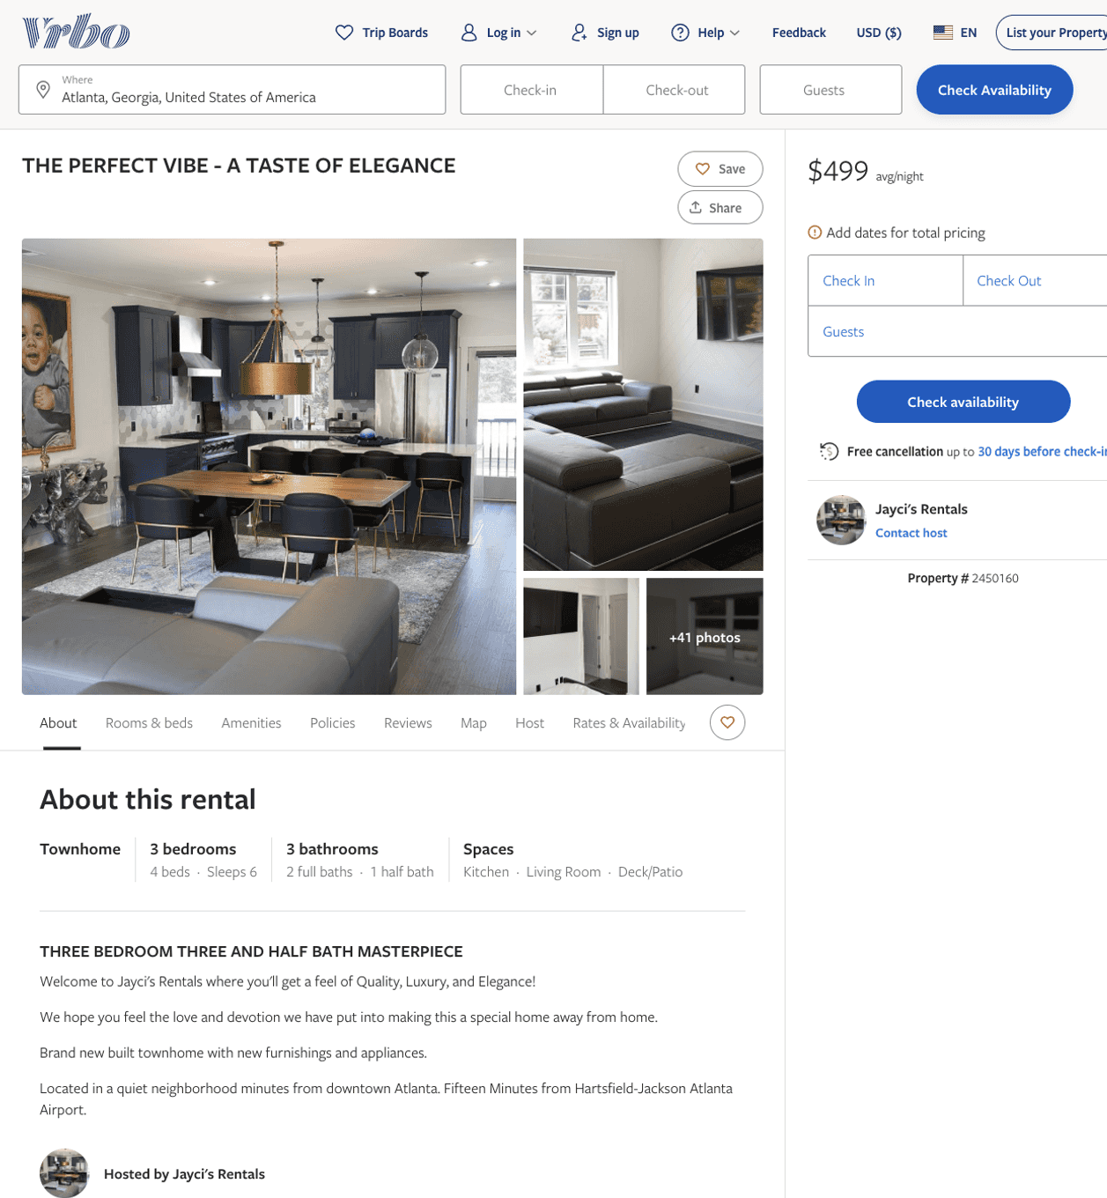
Listing 2450160
3
6
$499
5
1
Jayci's Rentals
https://www.vrbo.com/2450160
Aug 2022

Slide 7
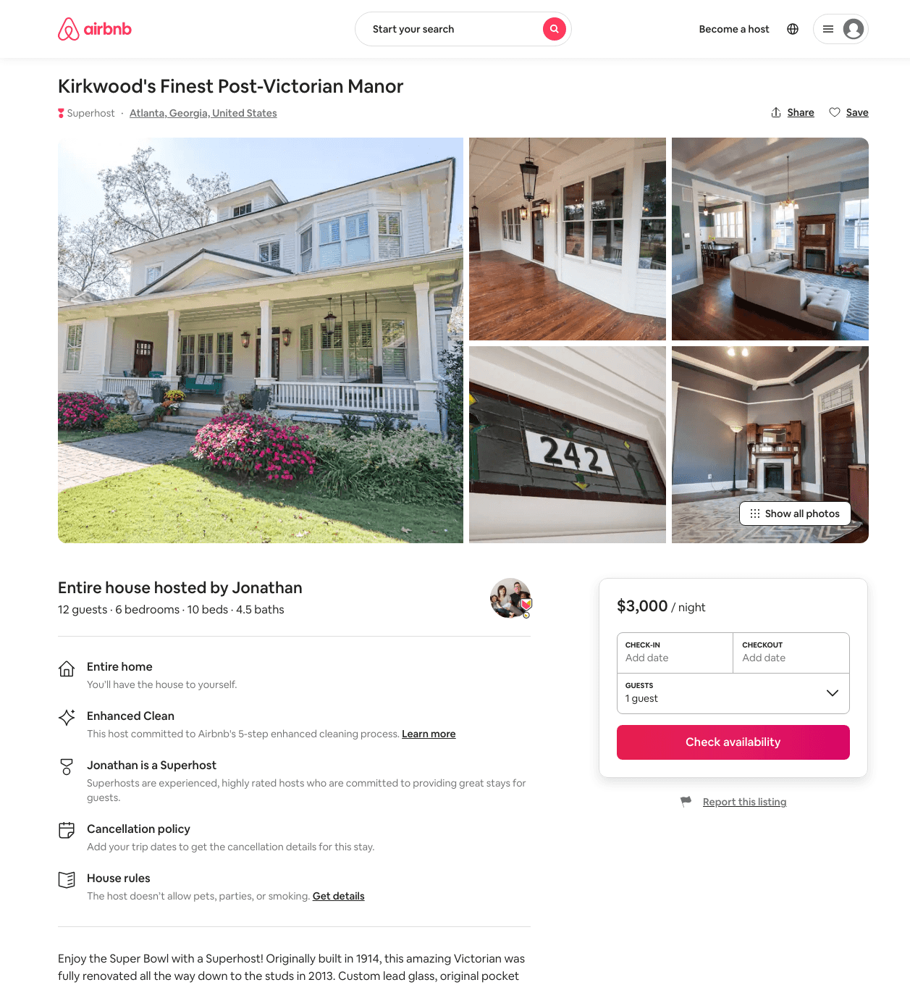
Listing 31798283
6
12
$3000
3
Jonathan
163585738
1
https://www.airbnb.com/rooms/31798283
Aug 2022

Slide 8
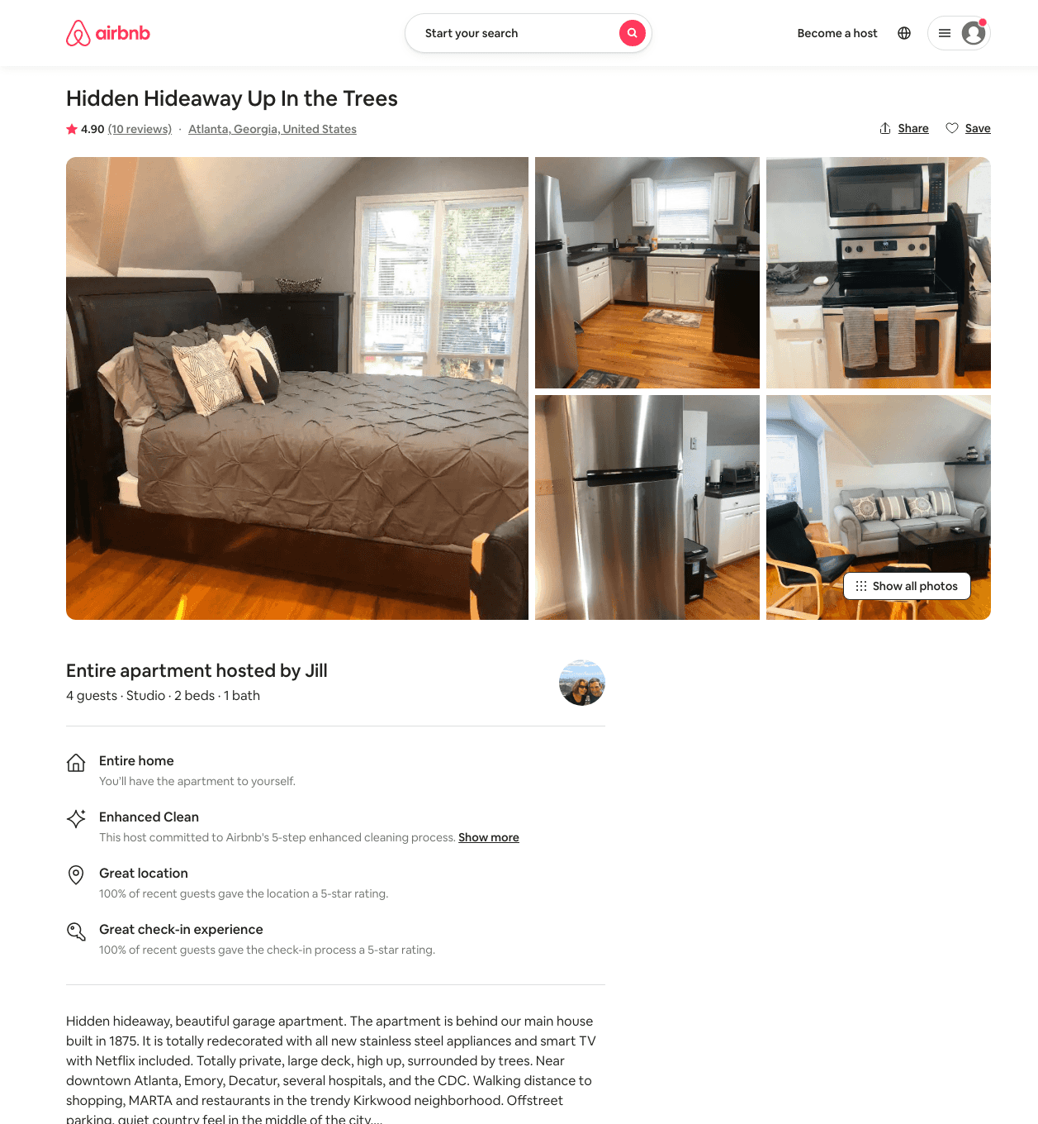
Listing 39134383
Studio
4
$79 - $81
4.94
28
Jill
10998489
2
https://www.airbnb.com/rooms/39134383
Aug 2022

Slide 9
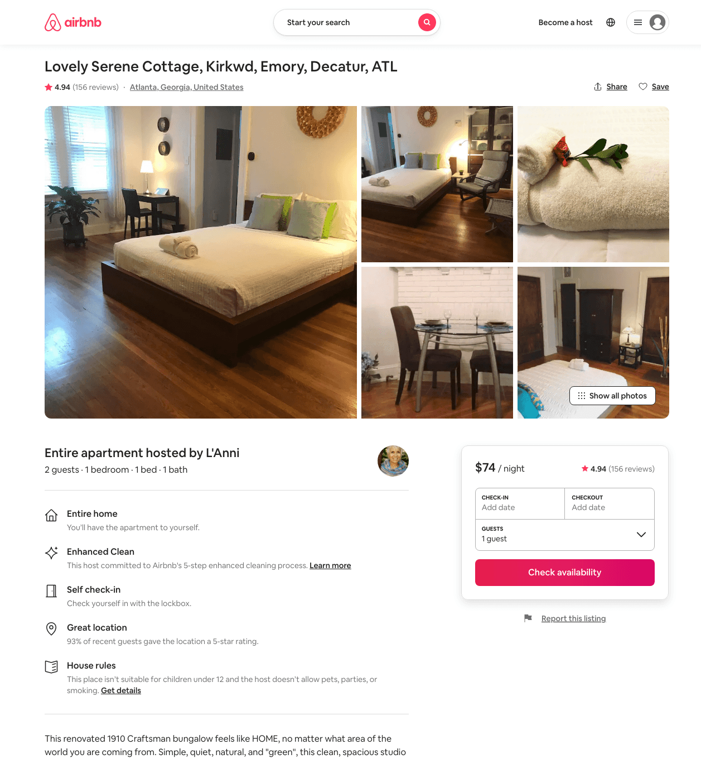
Listing 19995402
1
2
$74 - $102
4.92
1
L'Anni
28660481
2
https://www.airbnb.com/rooms/19995402
Aug 2022

Slide 10
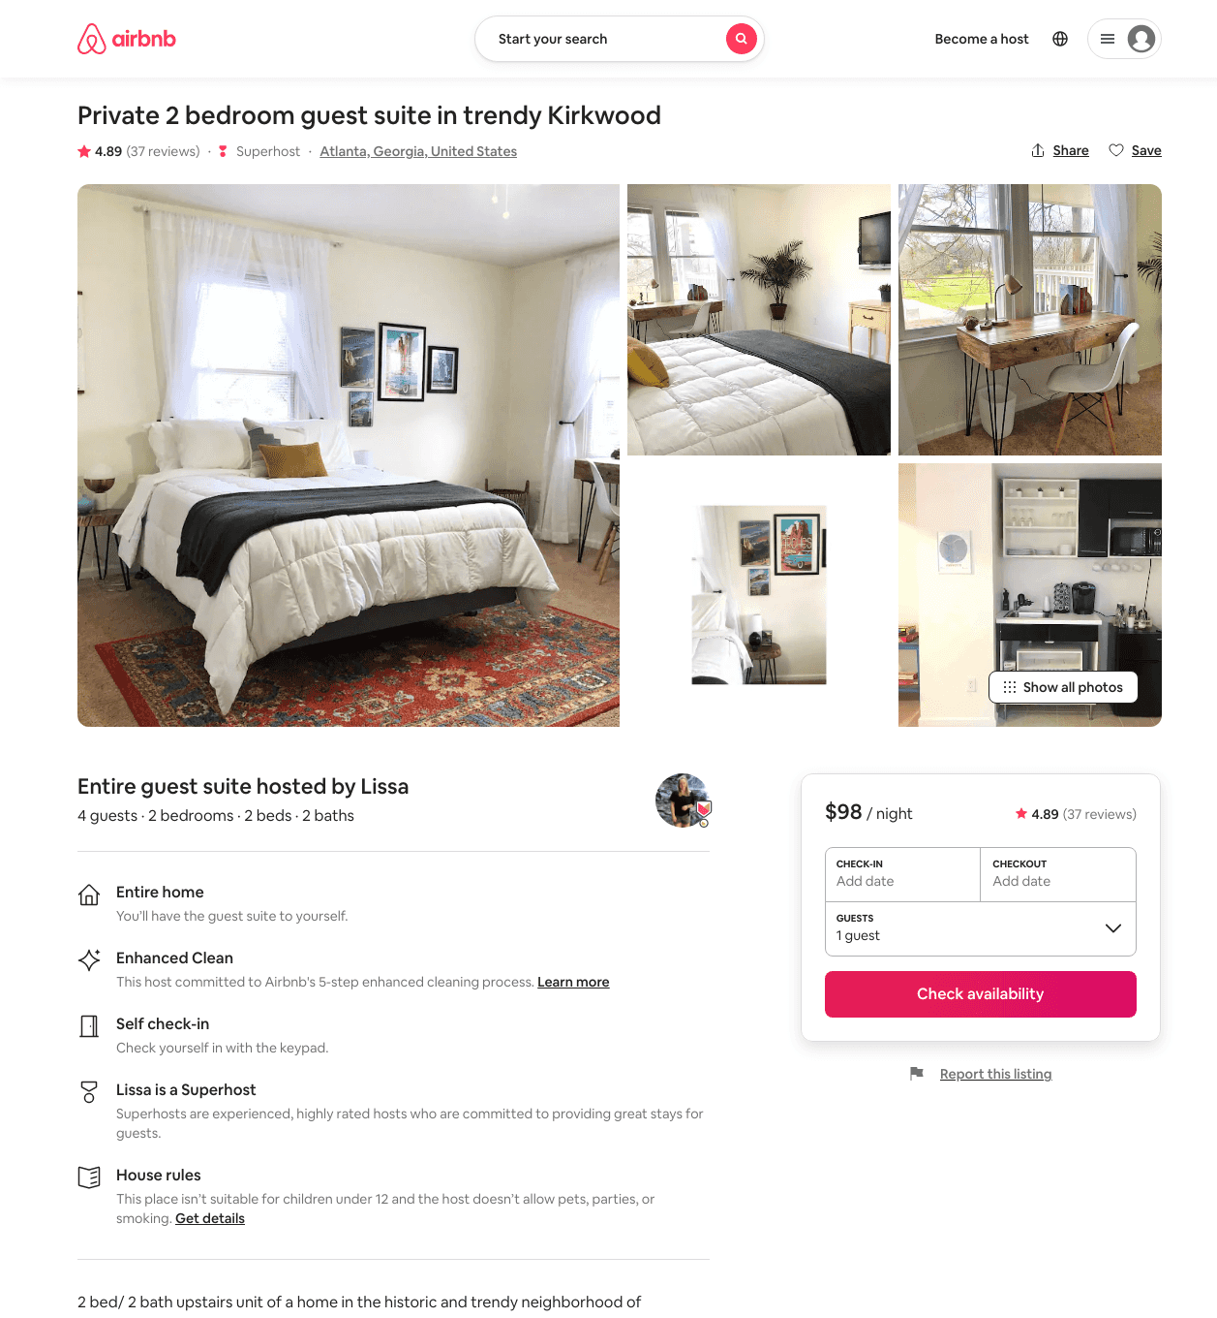
Listing 42494830
2
4
$84 - $140
4.92
1
Lissa
30498231
2
https://www.airbnb.com/rooms/42494830
Aug 2022

Slide 11
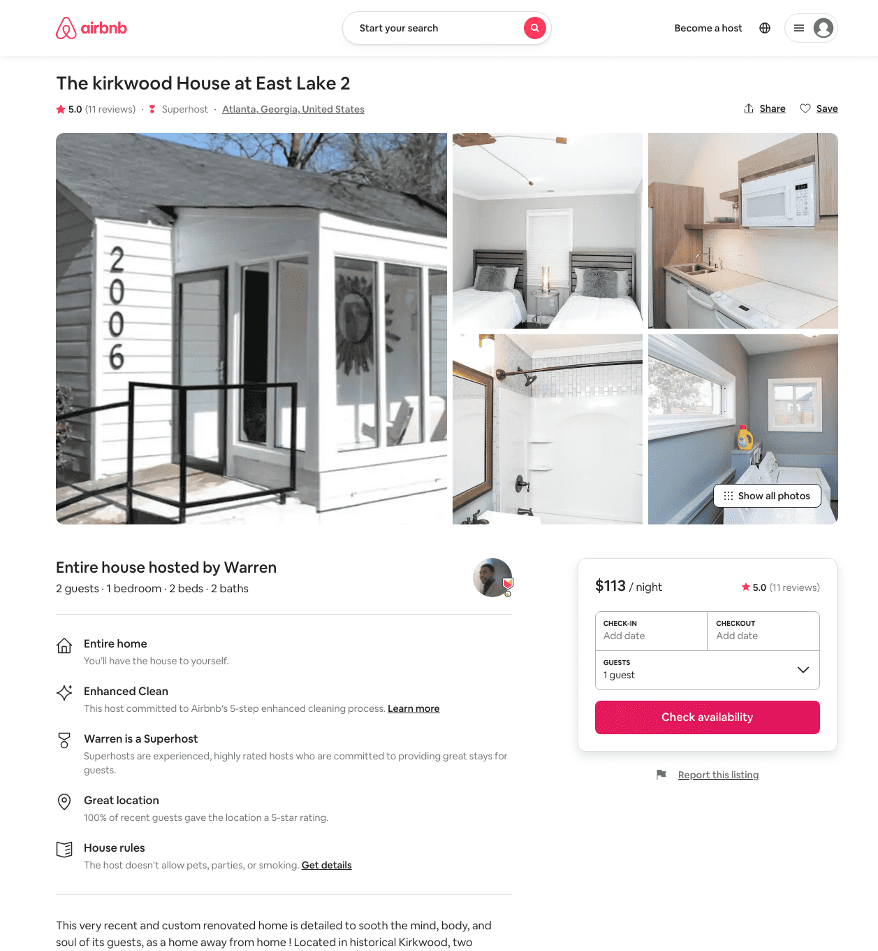
Listing 35083935
1
2
$113 - $172
5.0
1
Warren
231424400
6
https://www.airbnb.com/rooms/35083935
Jun 2022

Slide 12
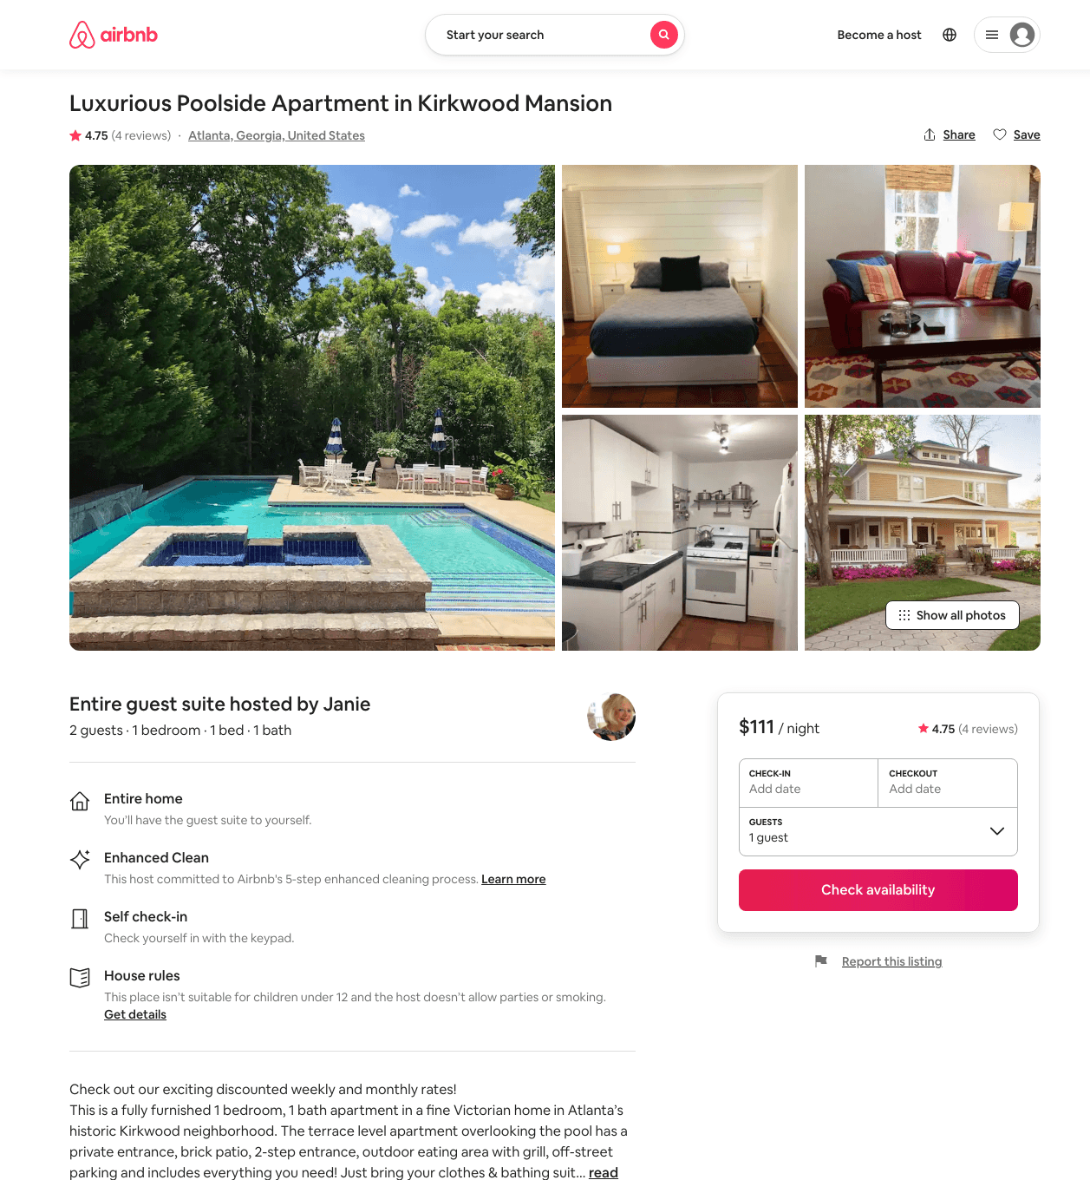
Listing 27330080
1
2
$91 - $111
4.85
10
Janie
61858987
2
https://www.airbnb.com/rooms/27330080
Aug 2022

Slide 13
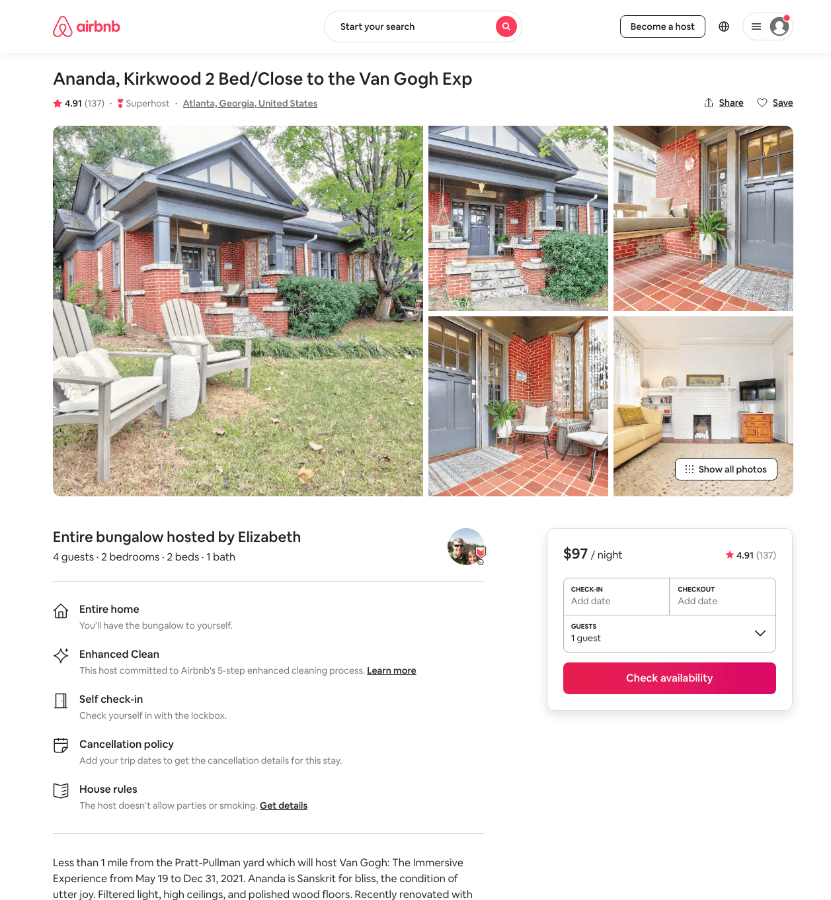
Listing 24279169
2
4
$84 - $136
4.89
2
Elizabeth
1173988
1
https://www.airbnb.com/rooms/24279169
Aug 2022

Slide 14
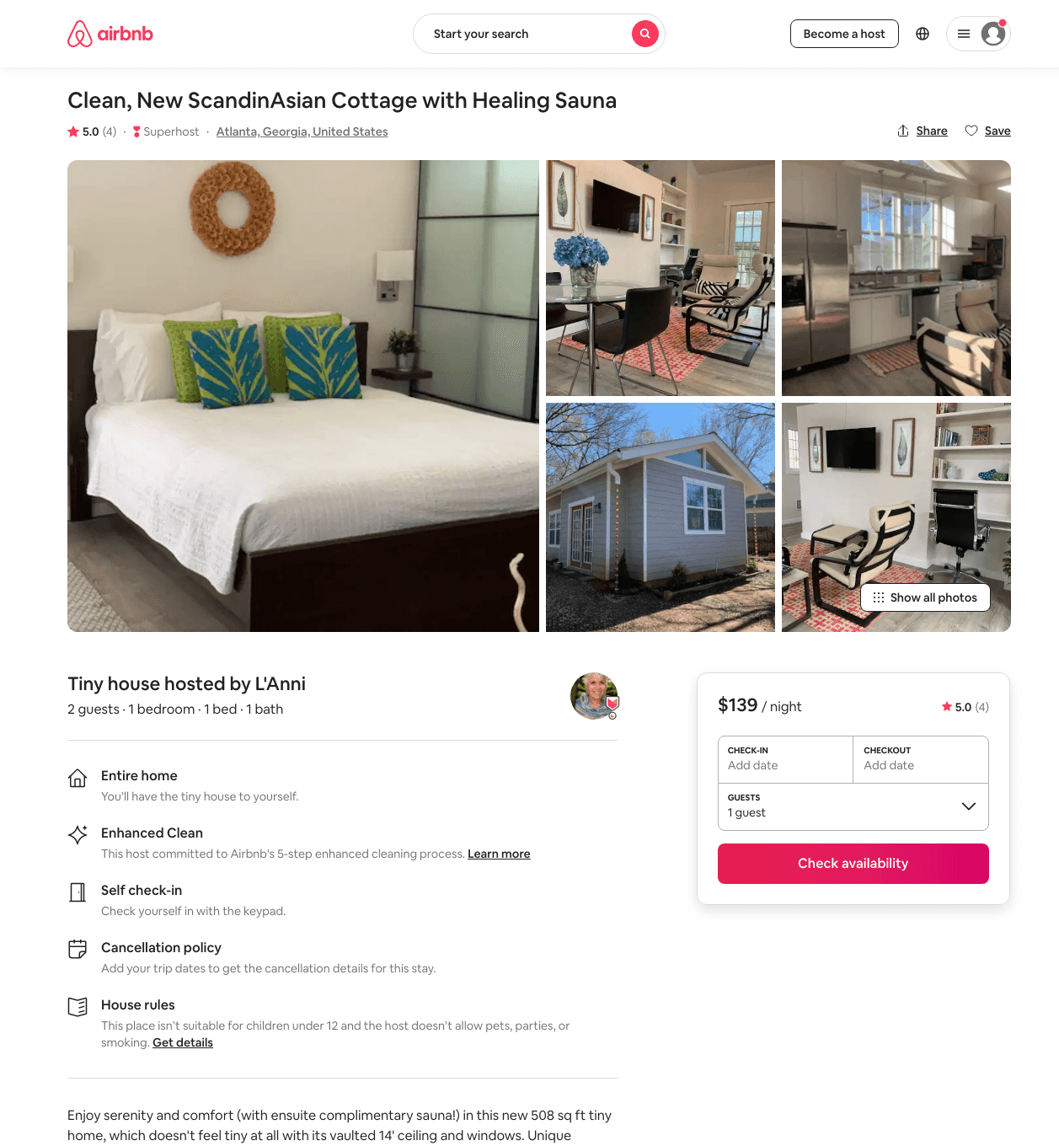
Listing 48382904
1
2
$134 - $170
4.95
1
L'Anni
28660481
2
https://www.airbnb.com/rooms/48382904
Aug 2022

Slide 15
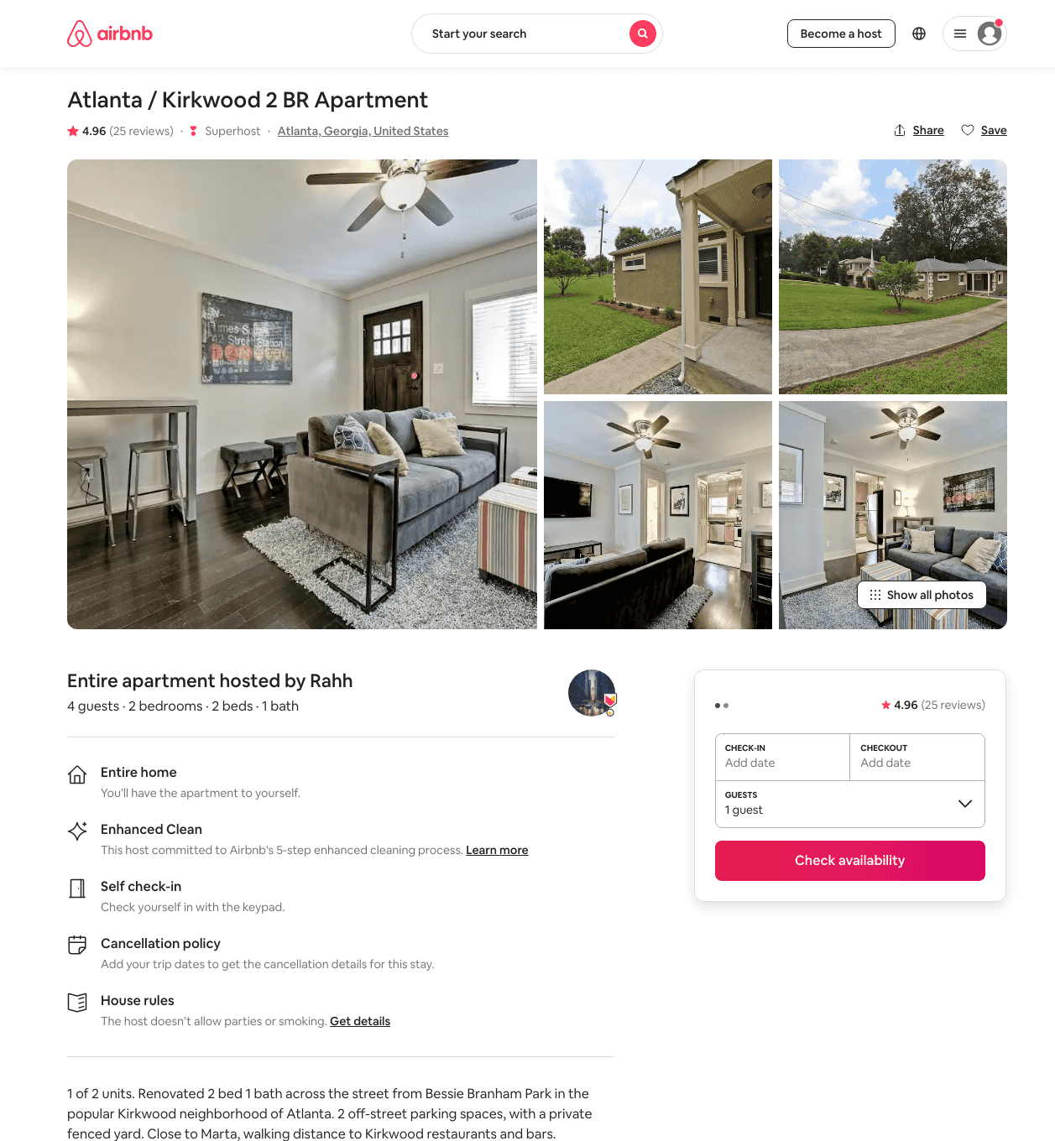
Listing 45257822
2
4
$125 - $196
4.94
2
Rahh
365658352
3
https://www.airbnb.com/rooms/45257822
Jun 2022

Slide 16
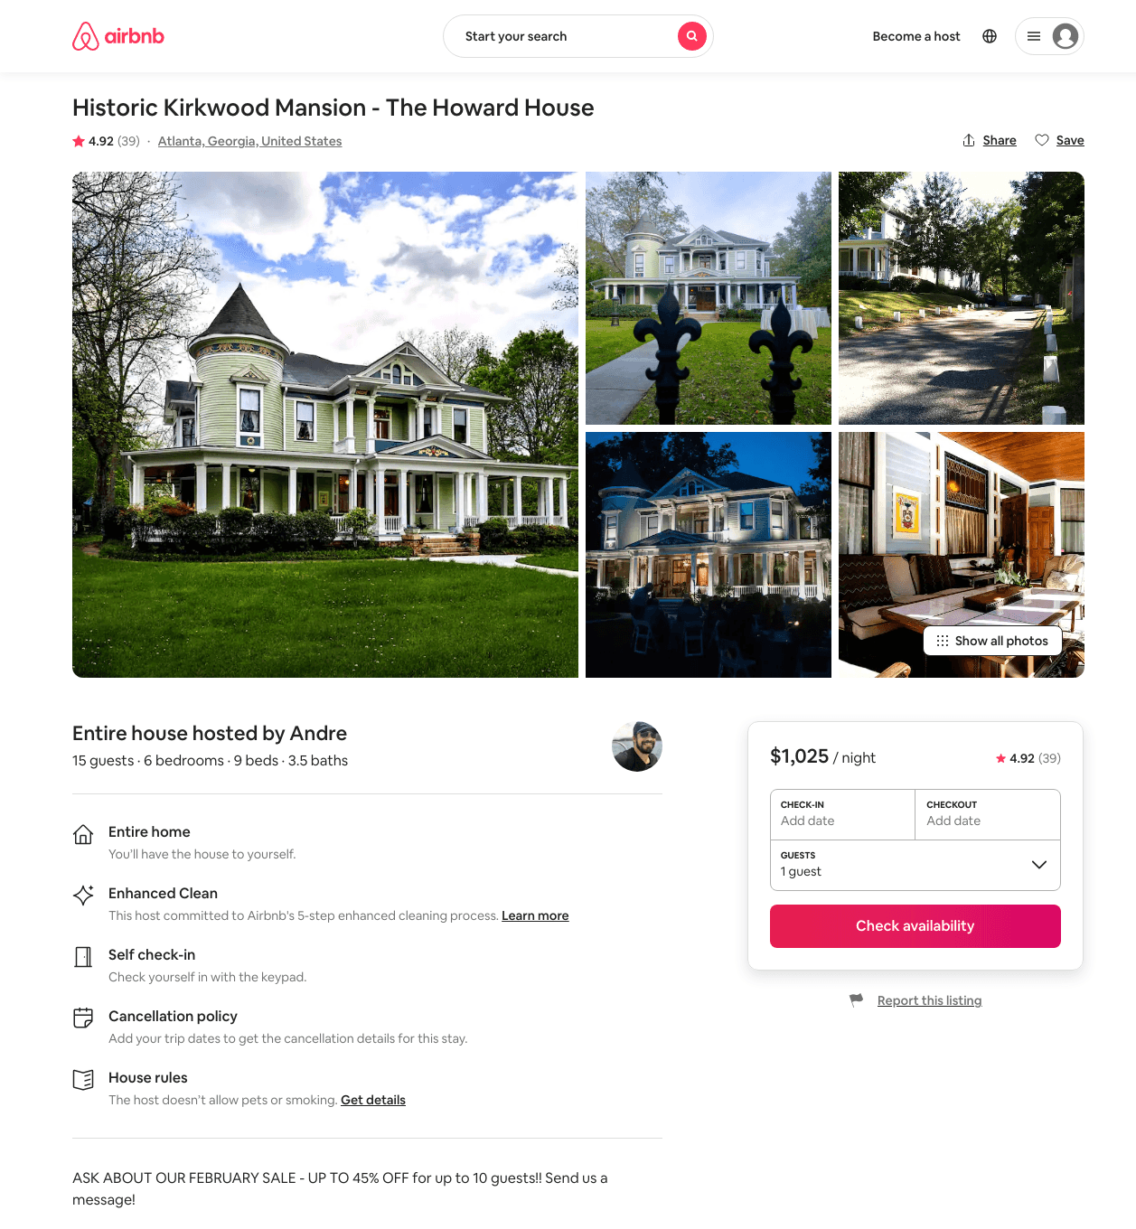
Listing 1929452
6
12
$1025 - $1520
4.93
2
Andre
9991296
1
https://www.airbnb.com/rooms/1929452
Aug 2022

Slide 17
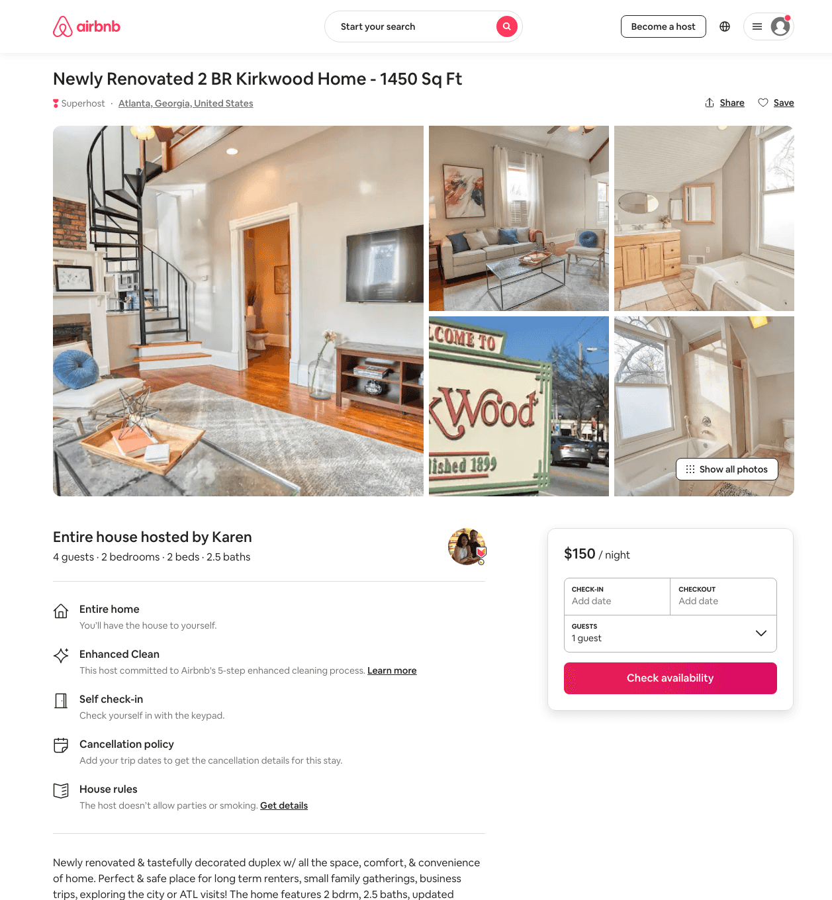
Listing 48549548
2
4
$146 - $178
4.76
4
Karen
27280072
2
https://www.airbnb.com/rooms/48549548
Aug 2022

Slide 18
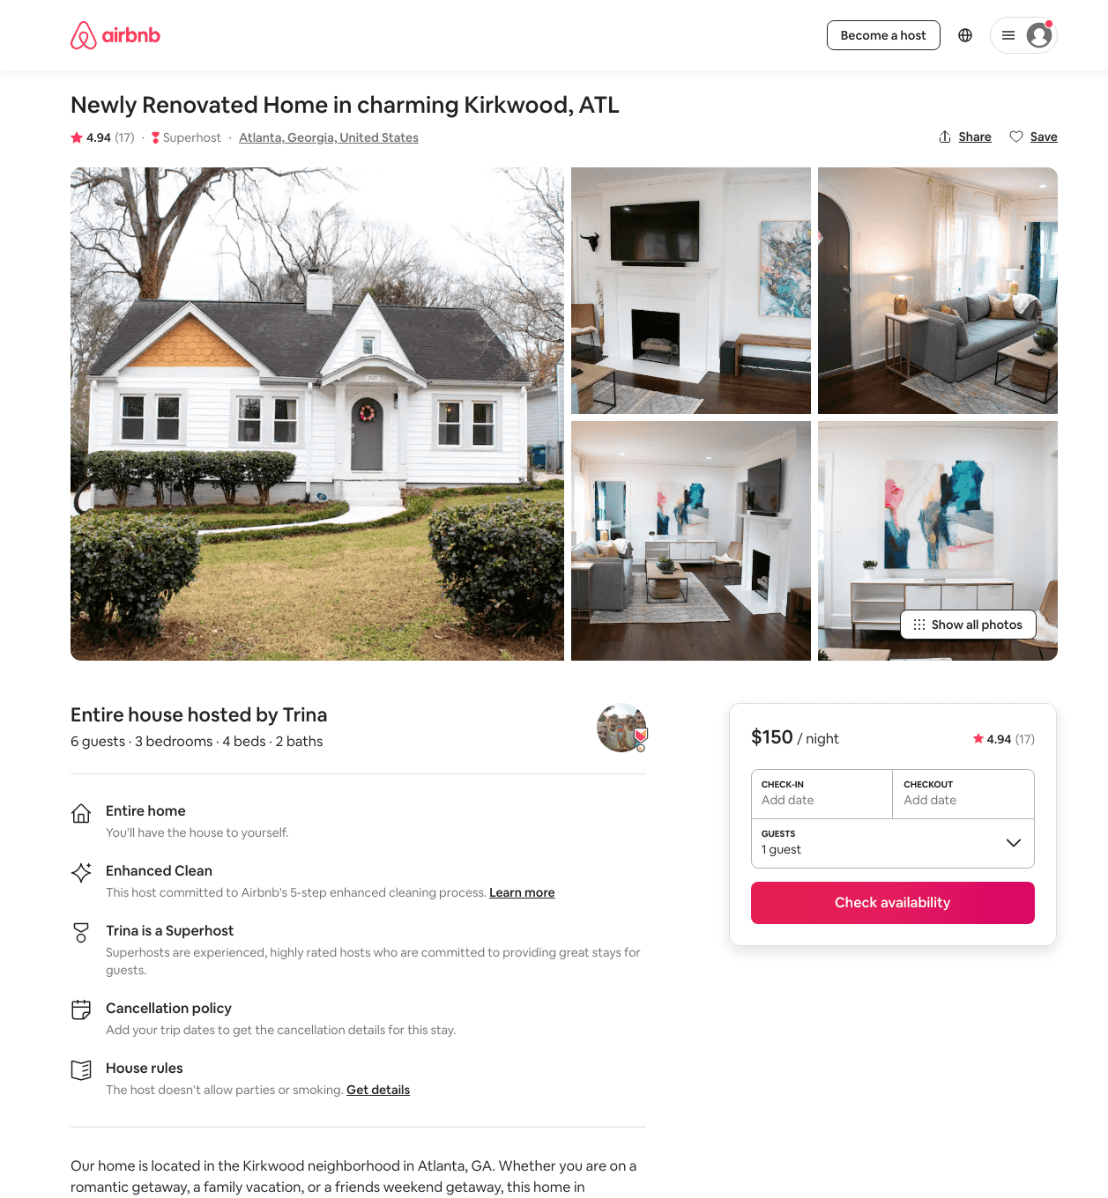
Listing 42274592
3
6
$150 - $197
4.98
5
Trina
60108866
1
https://www.airbnb.com/rooms/42274592
Aug 2022

Slide 19
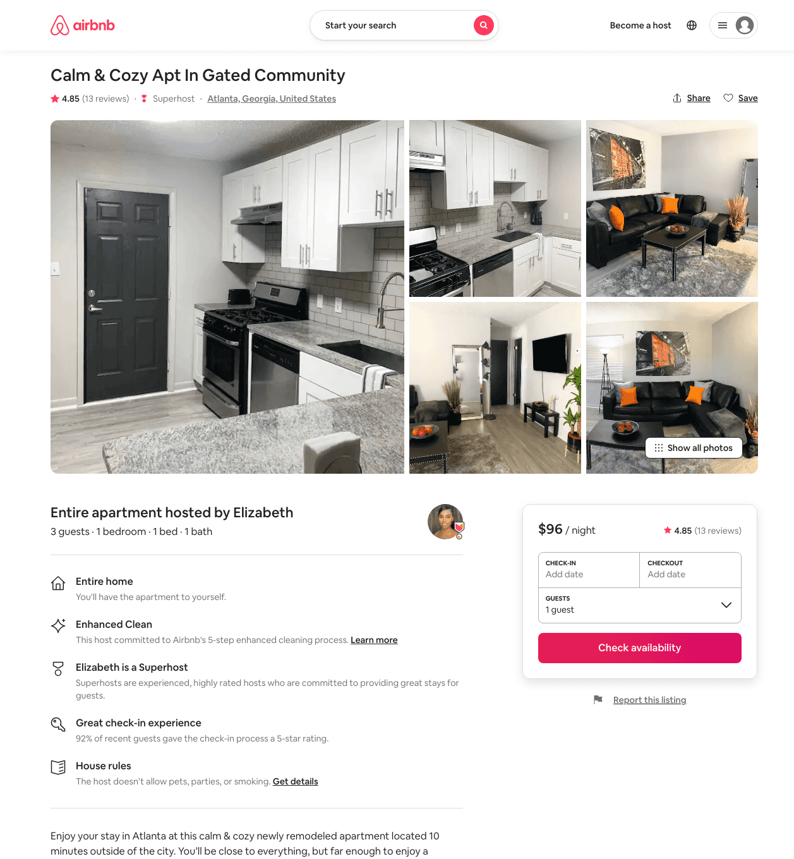
Listing 46584421
1
3
$69 - $133
4.66
2
Elizabeth
191458445
2
https://www.airbnb.com/rooms/46584421
Aug 2022

Slide 20
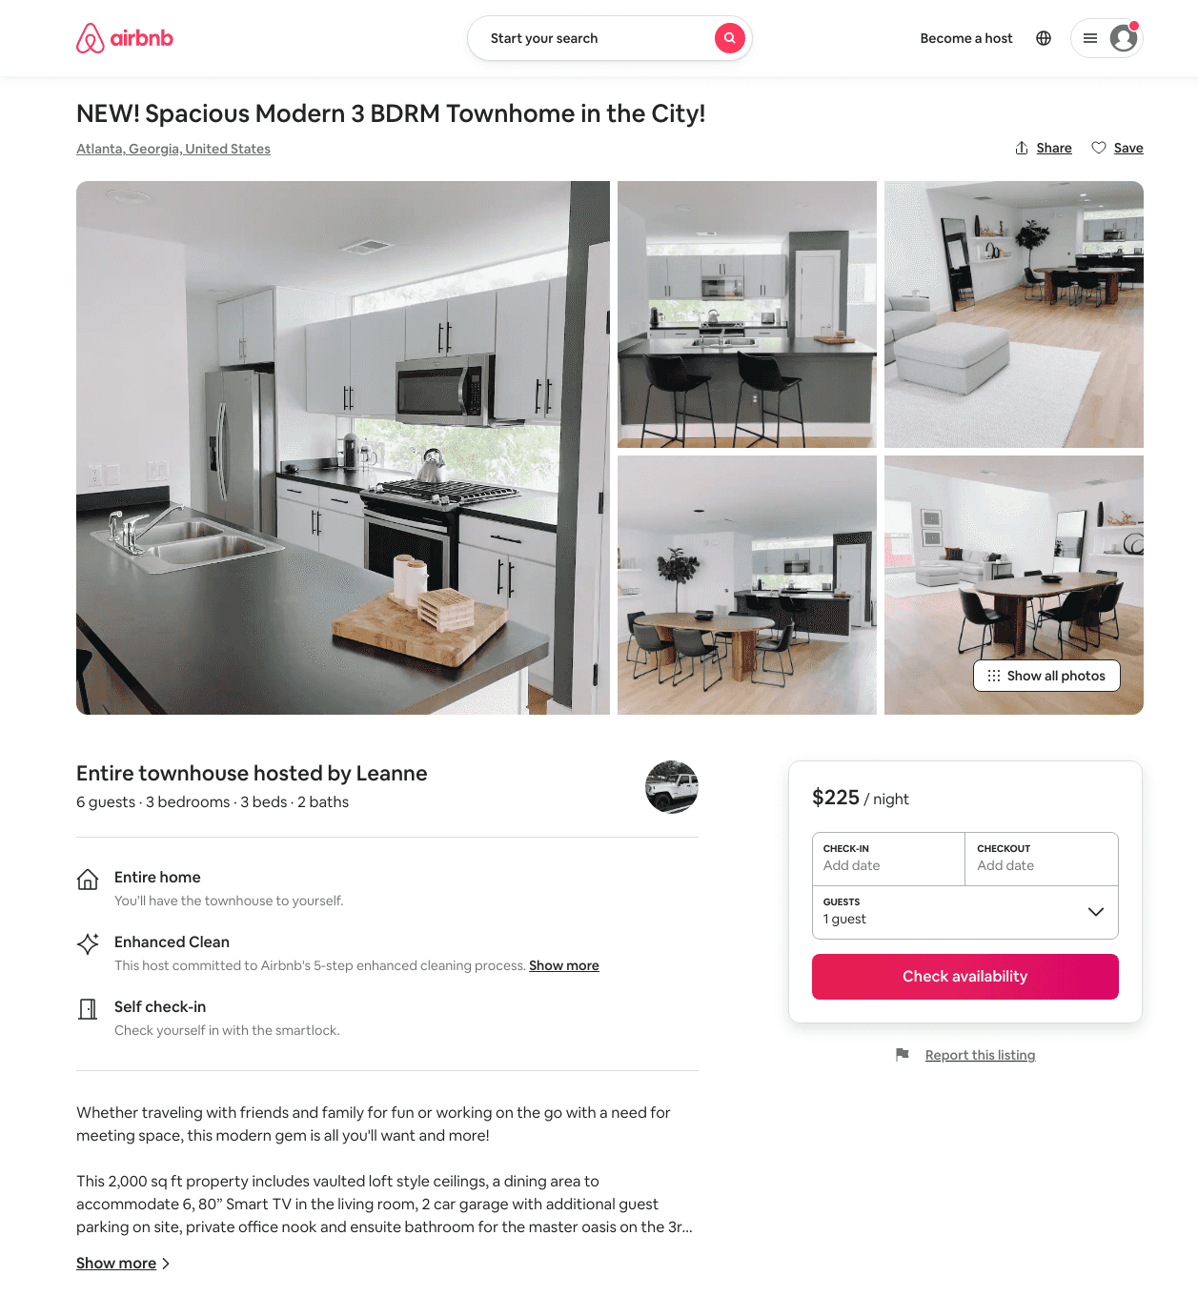
Listing 48462053
3
6
$150 - $265
4.93
3
Leanne
218225771
1
https://www.airbnb.com/rooms/48462053
Aug 2022

Slide 21
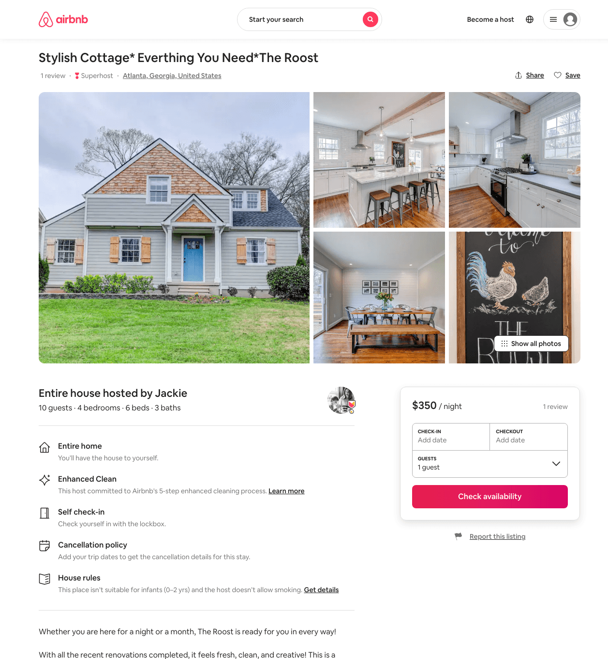
Listing 43010912
4
10
$350 - $371
5.0
28
Jackie
7105482
3
https://www.airbnb.com/rooms/43010912
Aug 2022

Slide 22
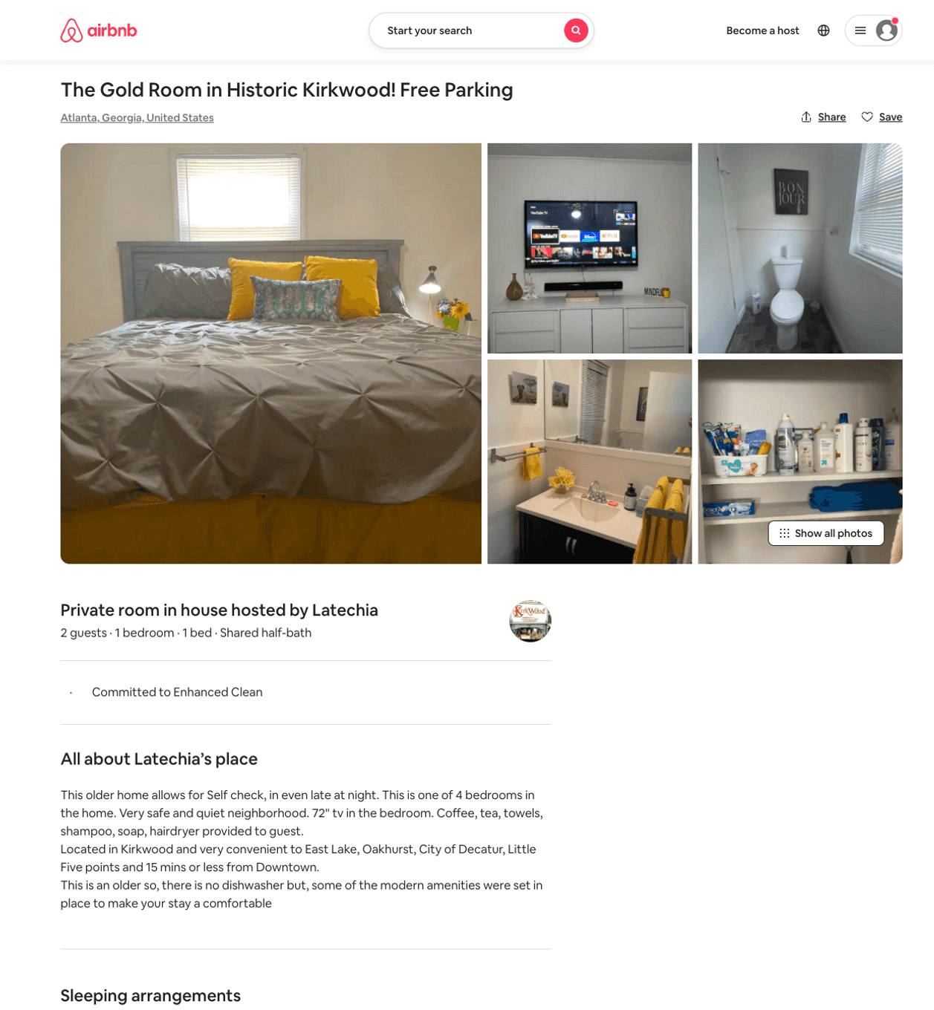
Listing 50097079
1
2
$50 - $500
4.70
1
Latechia
187282997
2
https://www.airbnb.com/rooms/50097079
Aug 2022

Slide 23
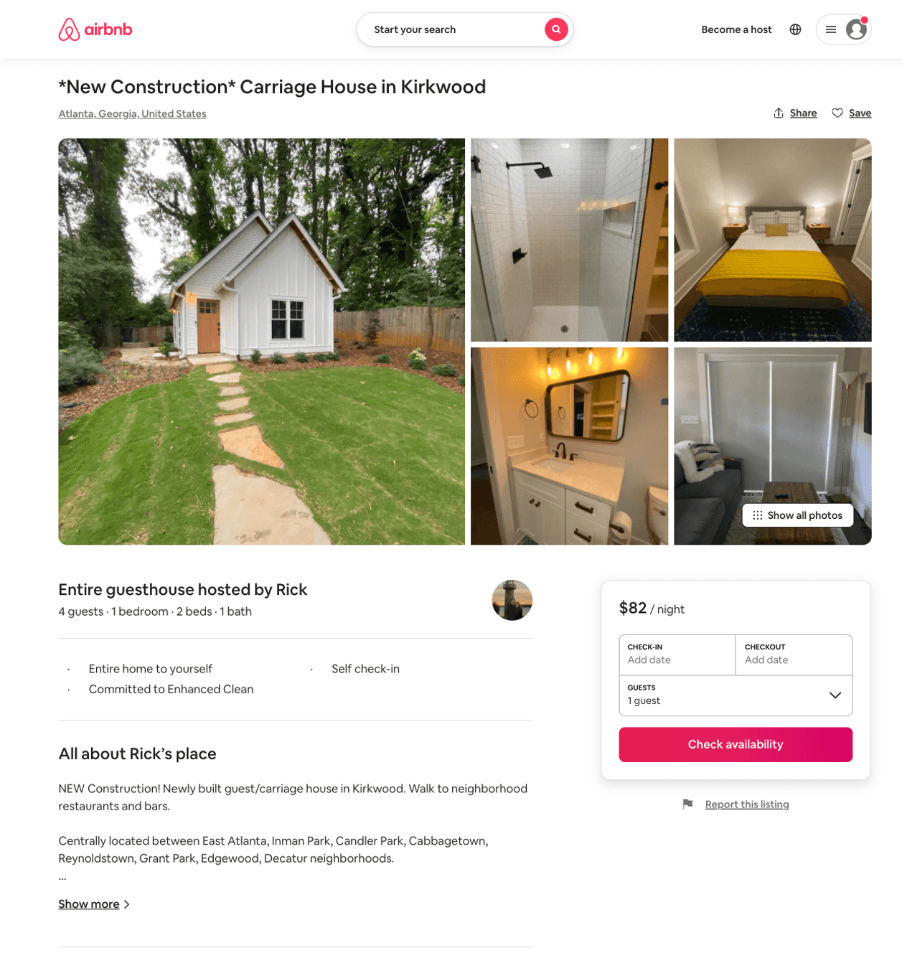
Listing 48110274
1
4
$82 - $119
5.0
2
Rick
24356183
1
https://www.airbnb.com/rooms/48110274
Aug 2022

Slide 24
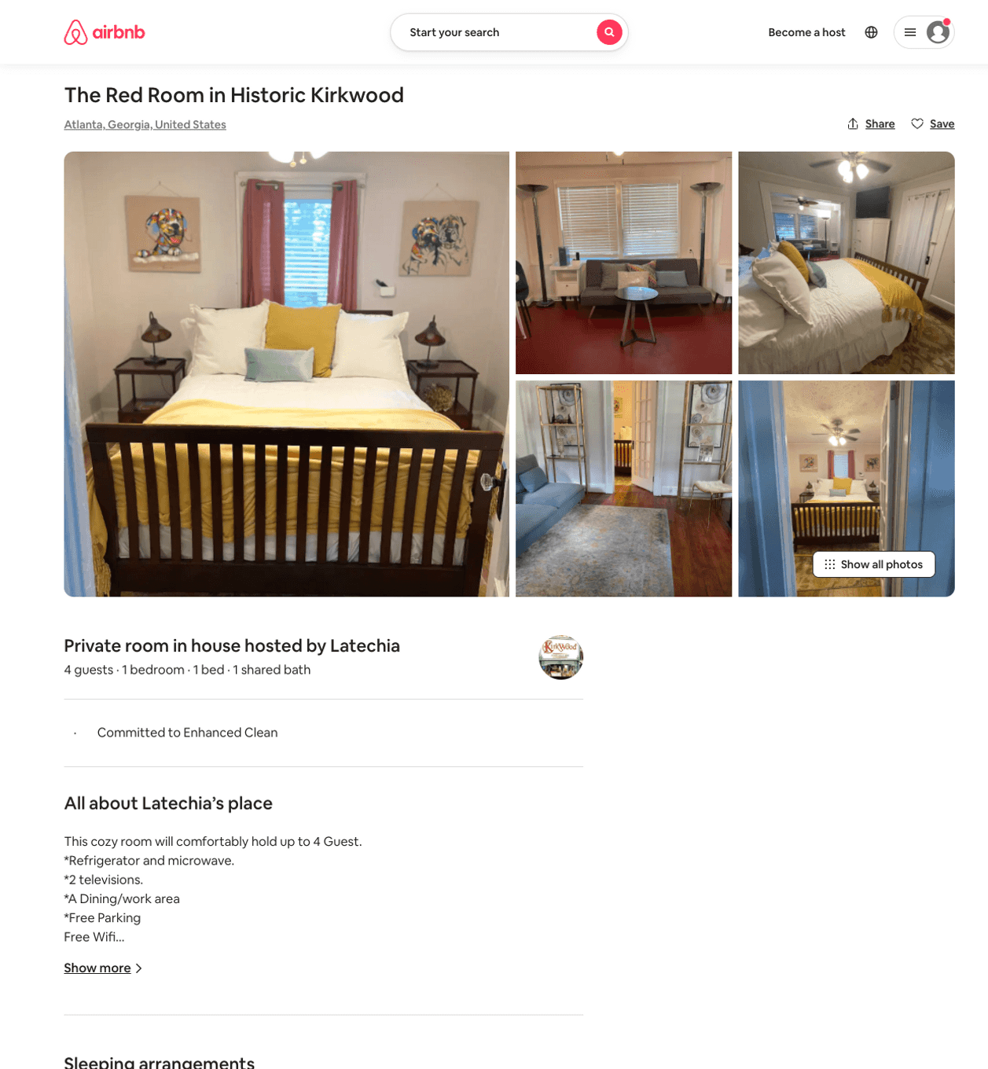
Listing 48740344
1
3
$57 - $74
4.94
1
Latechia
187282997
2
https://www.airbnb.com/rooms/48740344
Jul 2022

Slide 25
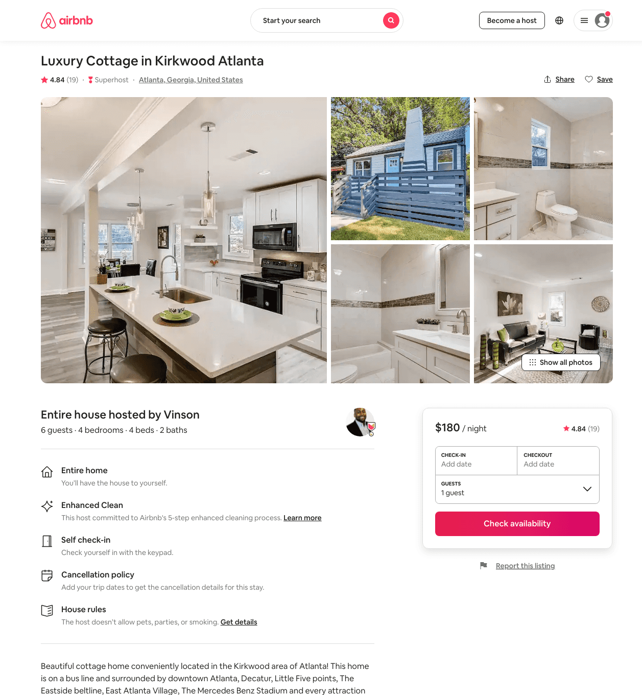
Listing 45465213
4
7
$139 - $214
4.74
2
Vinson
161685811
2
https://www.airbnb.com/rooms/45465213
Aug 2022

Slide 26
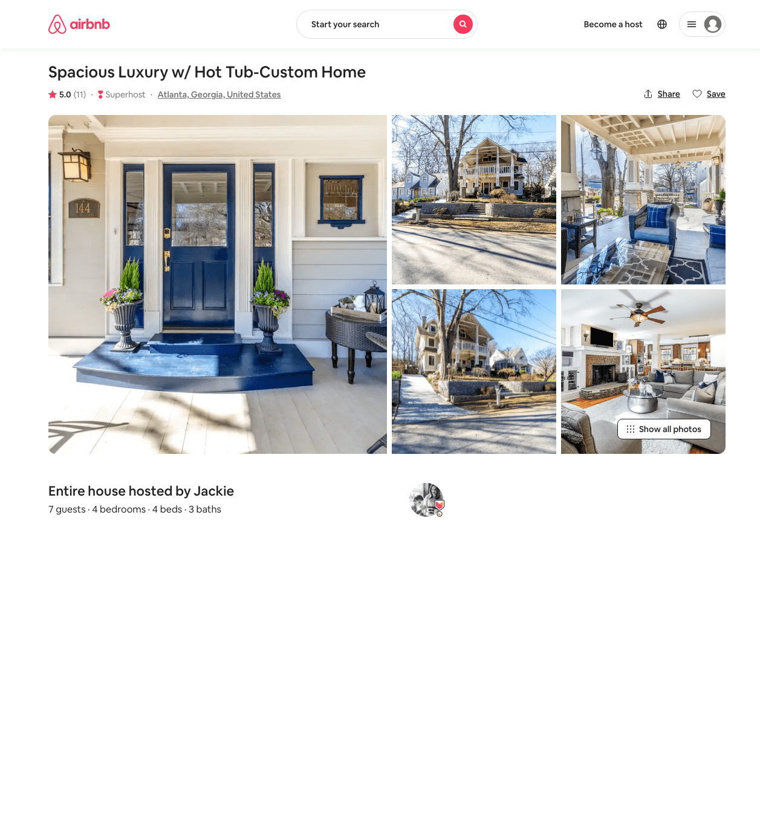
Listing 31593580
4
7
$400 - $450
5.0
3
Jackie
7105482
3
https://www.airbnb.com/rooms/31593580
Aug 2022

Slide 27
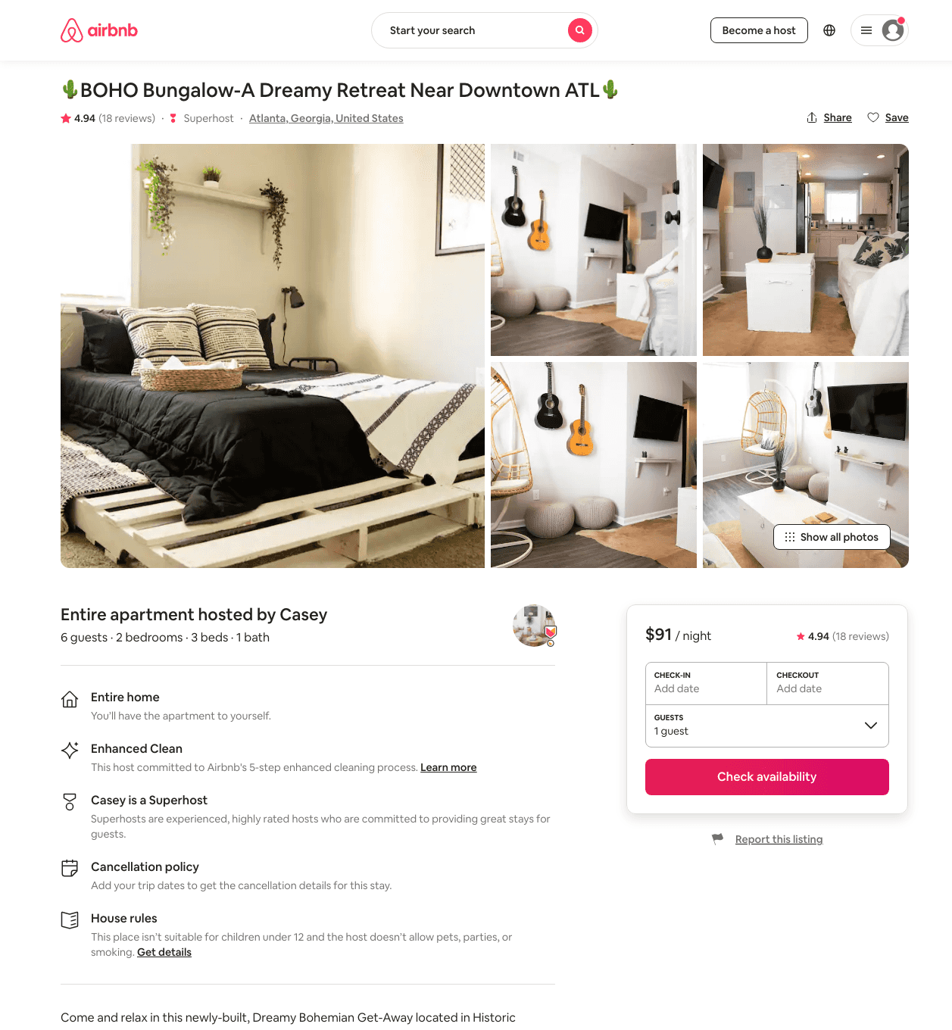
Listing 47741959
2
4
$68 - $106
4.73
14
Casey
372914851
1
https://www.airbnb.com/rooms/47741959
Aug 2022

Slide 28
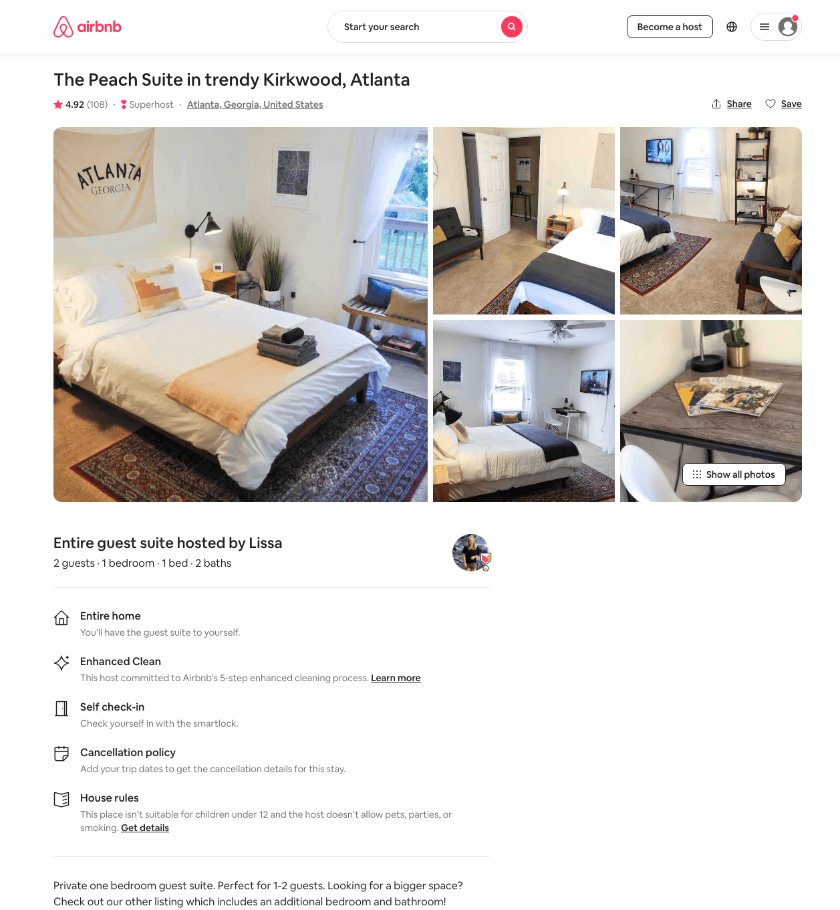
Listing 41496015
1
2
$70 - $98
4.91
1
Lissa
30498231
2
https://www.airbnb.com/rooms/41496015
Aug 2022

Slide 29
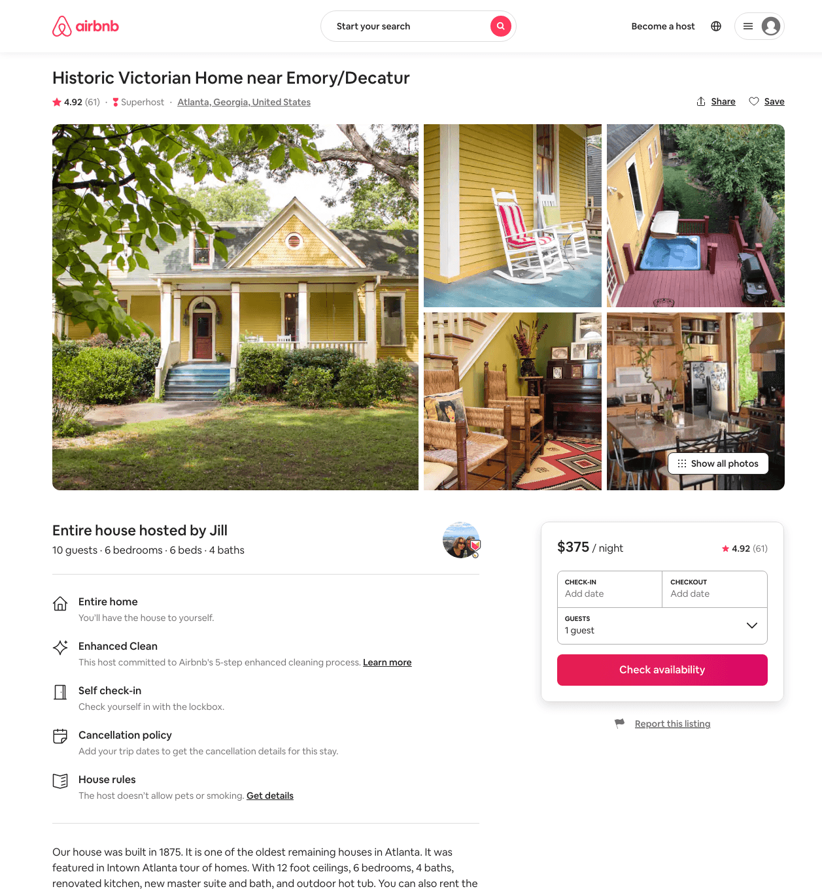
Listing 2155301
6
8
$375 - $482
4.92
5
Jill
10998489
2
https://www.airbnb.com/rooms/2155301
Aug 2022

Slide 30
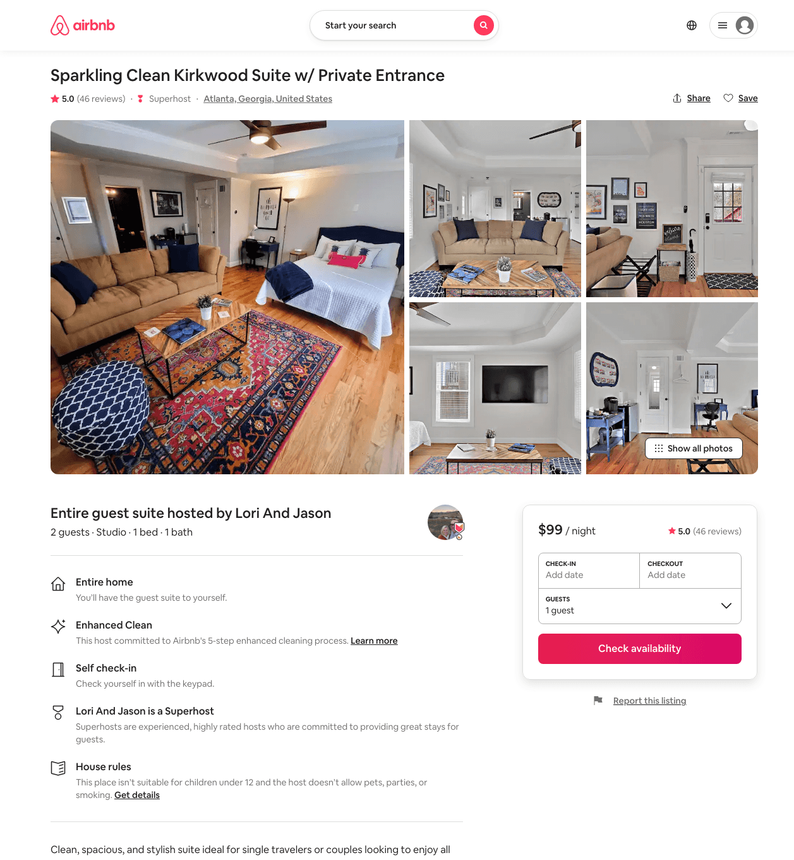
Listing 37854113
Studio
2
$90 - $125
5.0
2
Lori And Jason
36820838
1
https://www.airbnb.com/rooms/37854113
Jun 2022

Slide 31
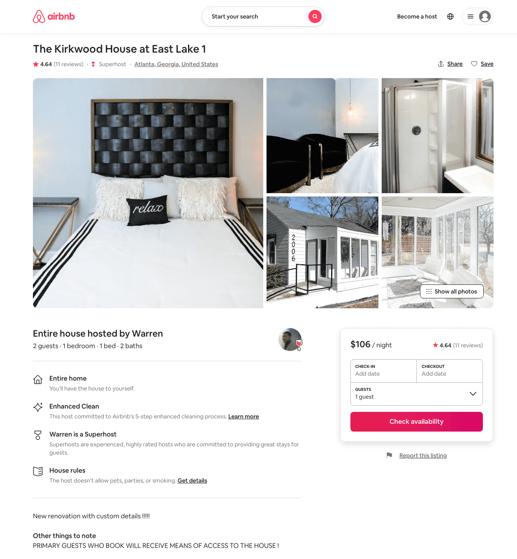
Listing 35276995
1
2
$106 - $144
4.86
1
Warren
231424400
6
https://www.airbnb.com/rooms/35276995
Aug 2022

Slide 32
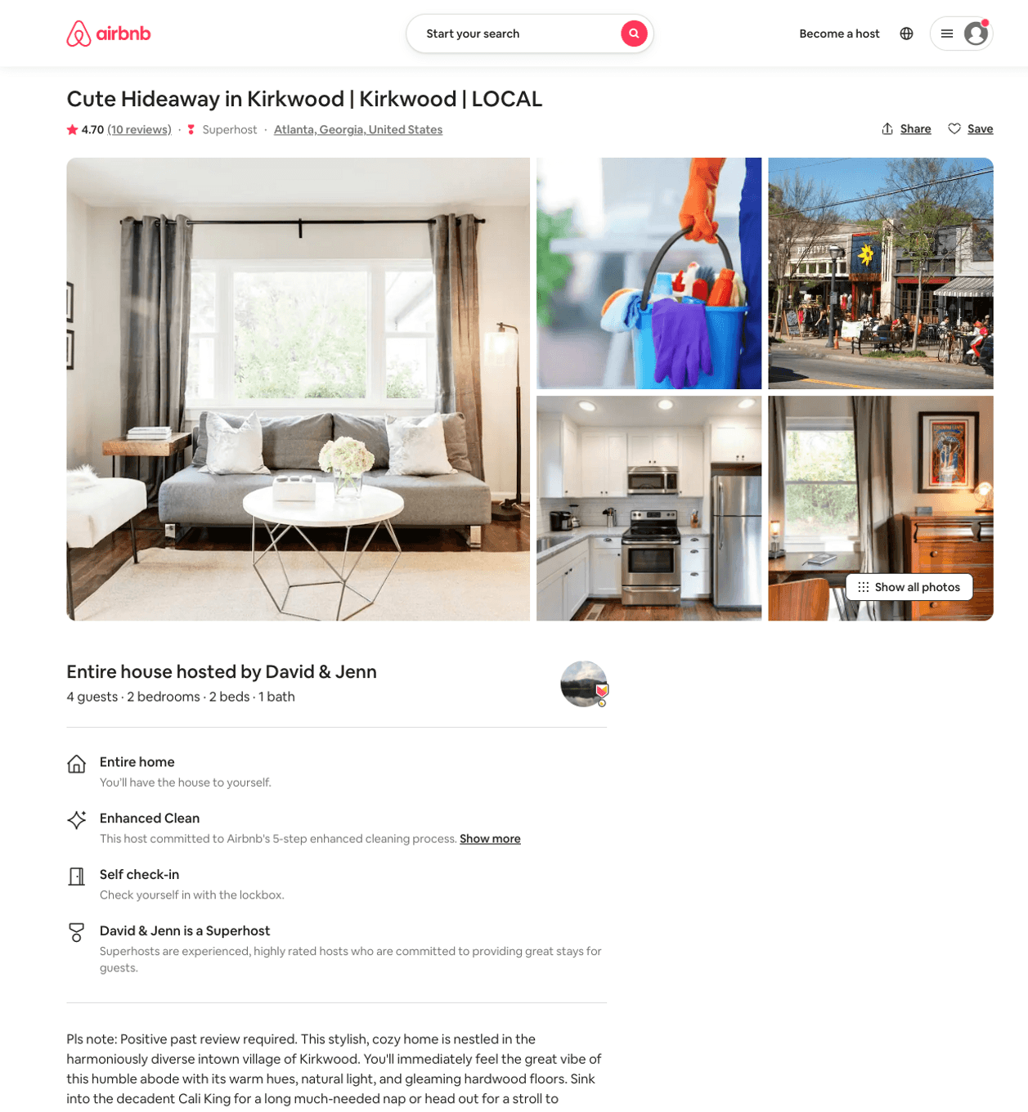
Listing 21473269
2
3
$106 - $120
4.75
28
David & Jenn
46666704
24
https://www.airbnb.com/rooms/21473269
Aug 2022

Slide 33
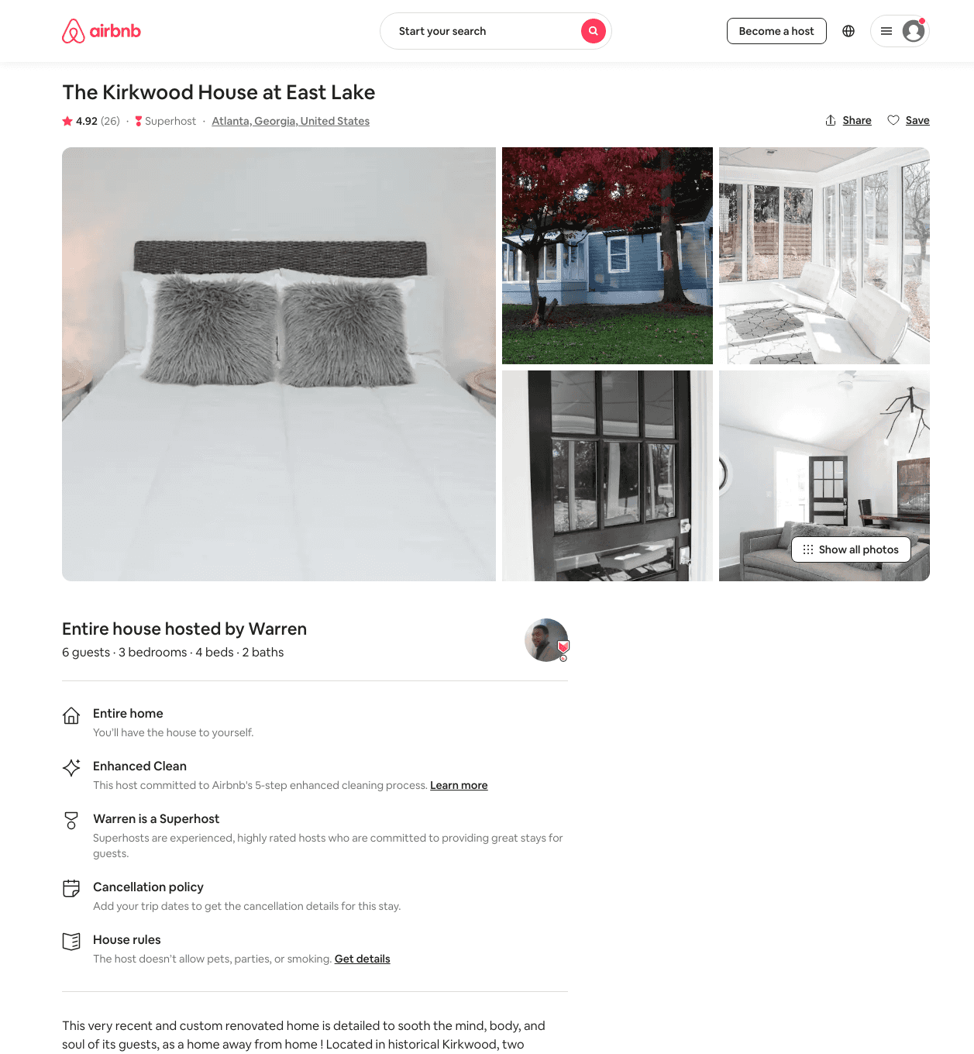
Listing 30975037
3
6
$289 - $381
4.95
1
Warren
231424400
6
https://www.airbnb.com/rooms/30975037
Aug 2022

Slide 34
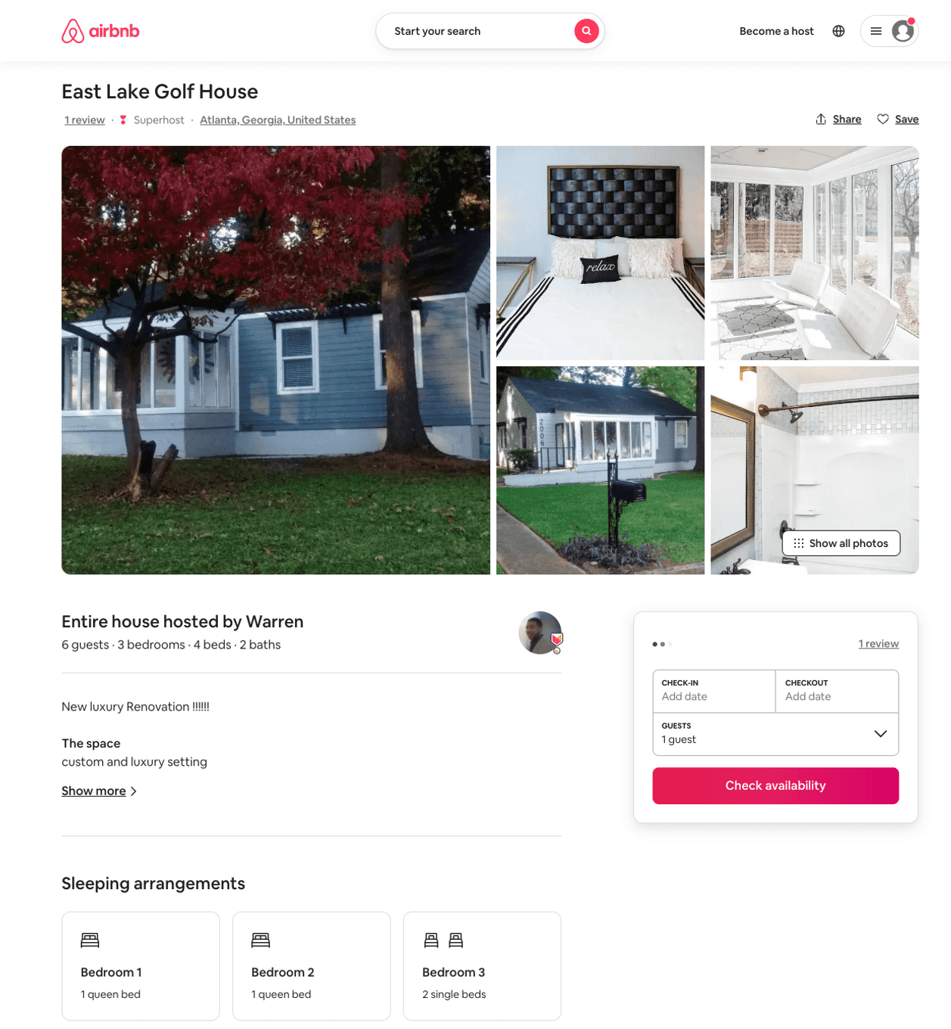
Listing 34978053
3
6
$289 - $381
5.0
1
Warren
231424400
6
https://www.airbnb.com/rooms/34978053
Aug 2022

Slide 35
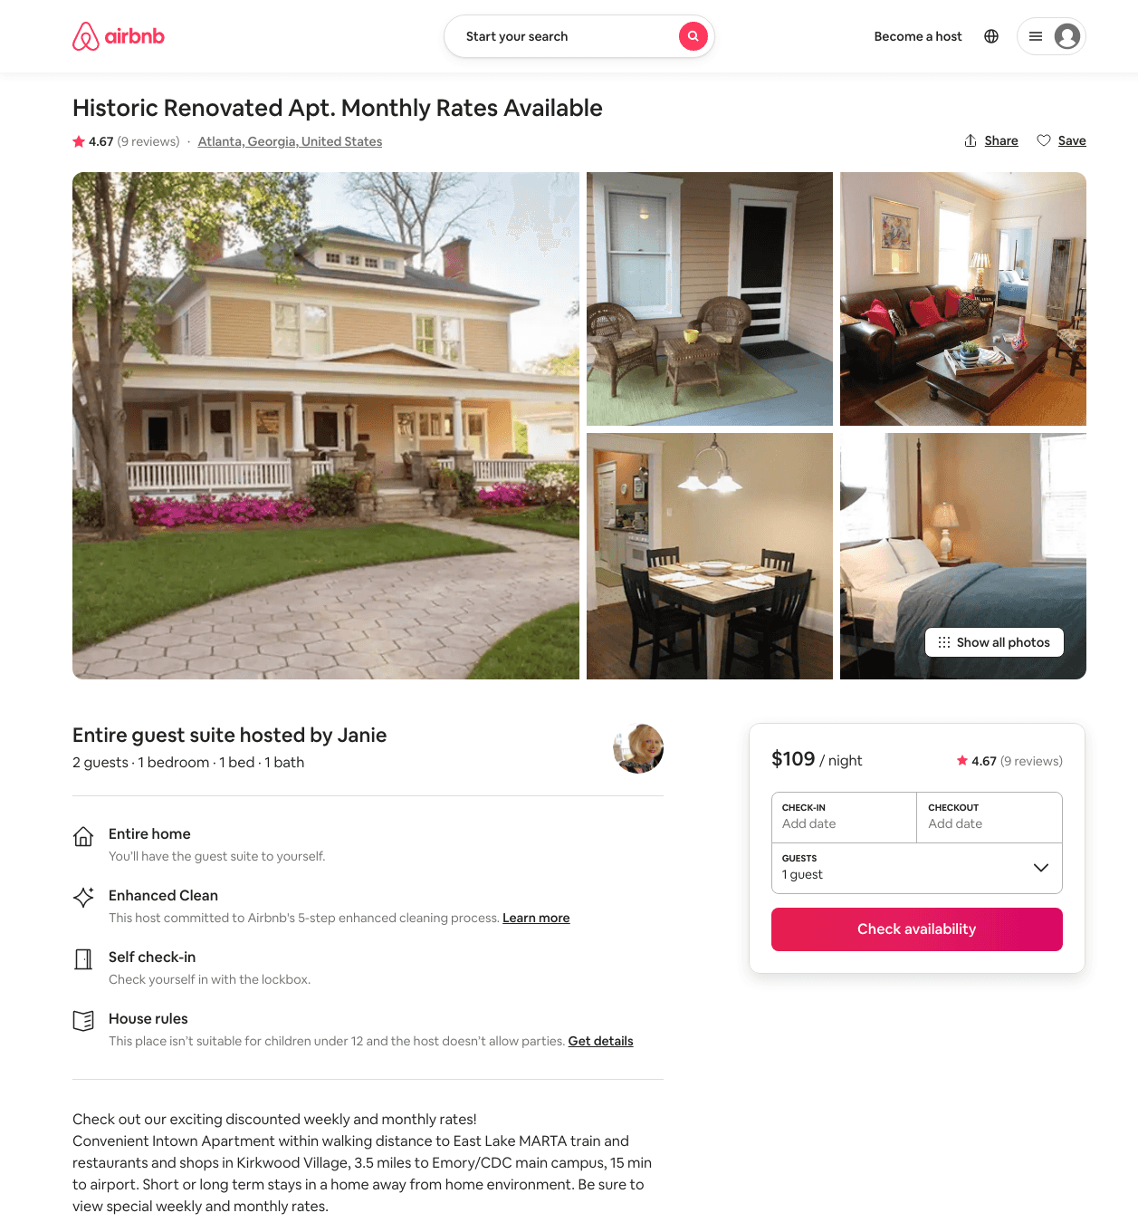
Listing 11657511
1
2
$95 - $156
4.50
10
Janie
61858987
2
https://www.airbnb.com/rooms/11657511
Jun 2022

Slide 36
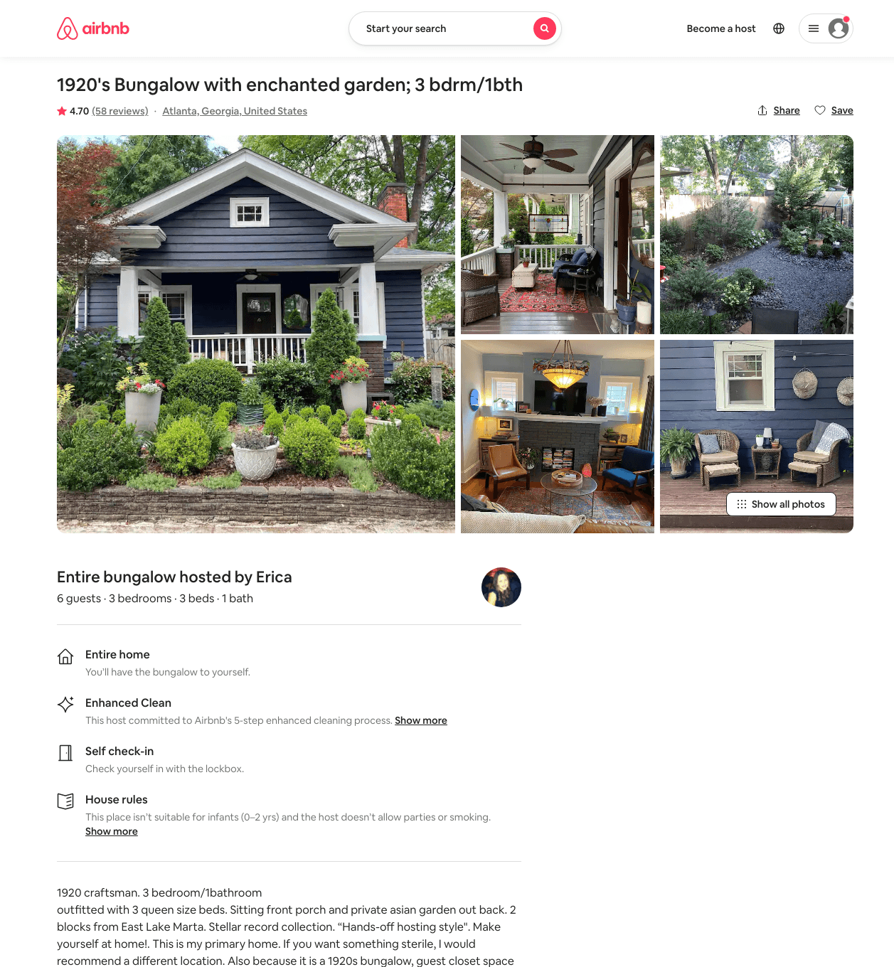
Listing 20012130
3
6
$177 - $250
4.74
2
Erica
4322380
1
https://www.airbnb.com/rooms/20012130
Aug 2022

Slide 37
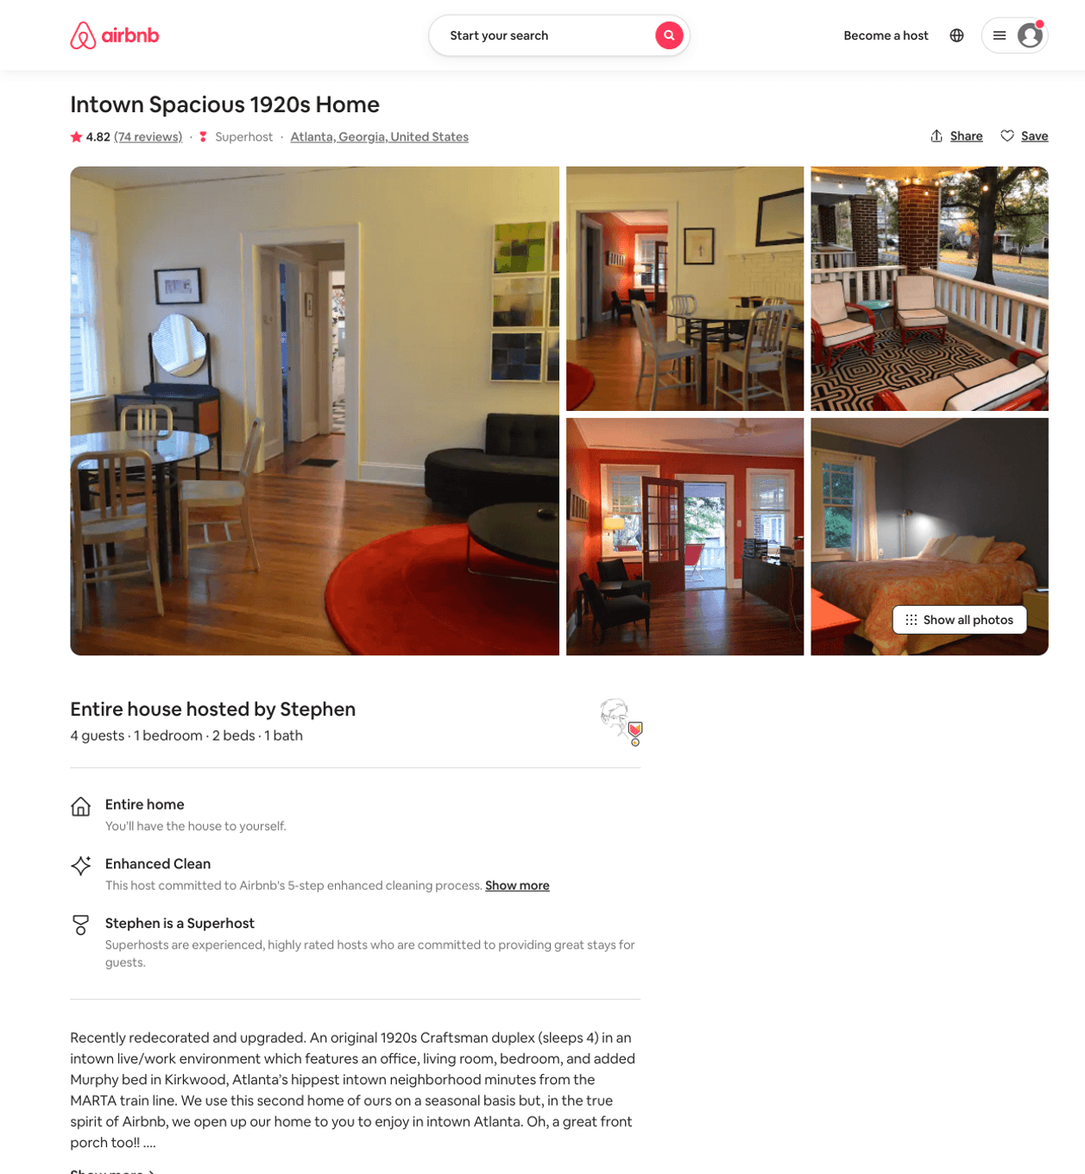
Listing 6323543
1
4
$85 - $95
4.84
5
Stephen
5502274
1
https://www.airbnb.com/rooms/6323543
Aug 2022

Slide 38
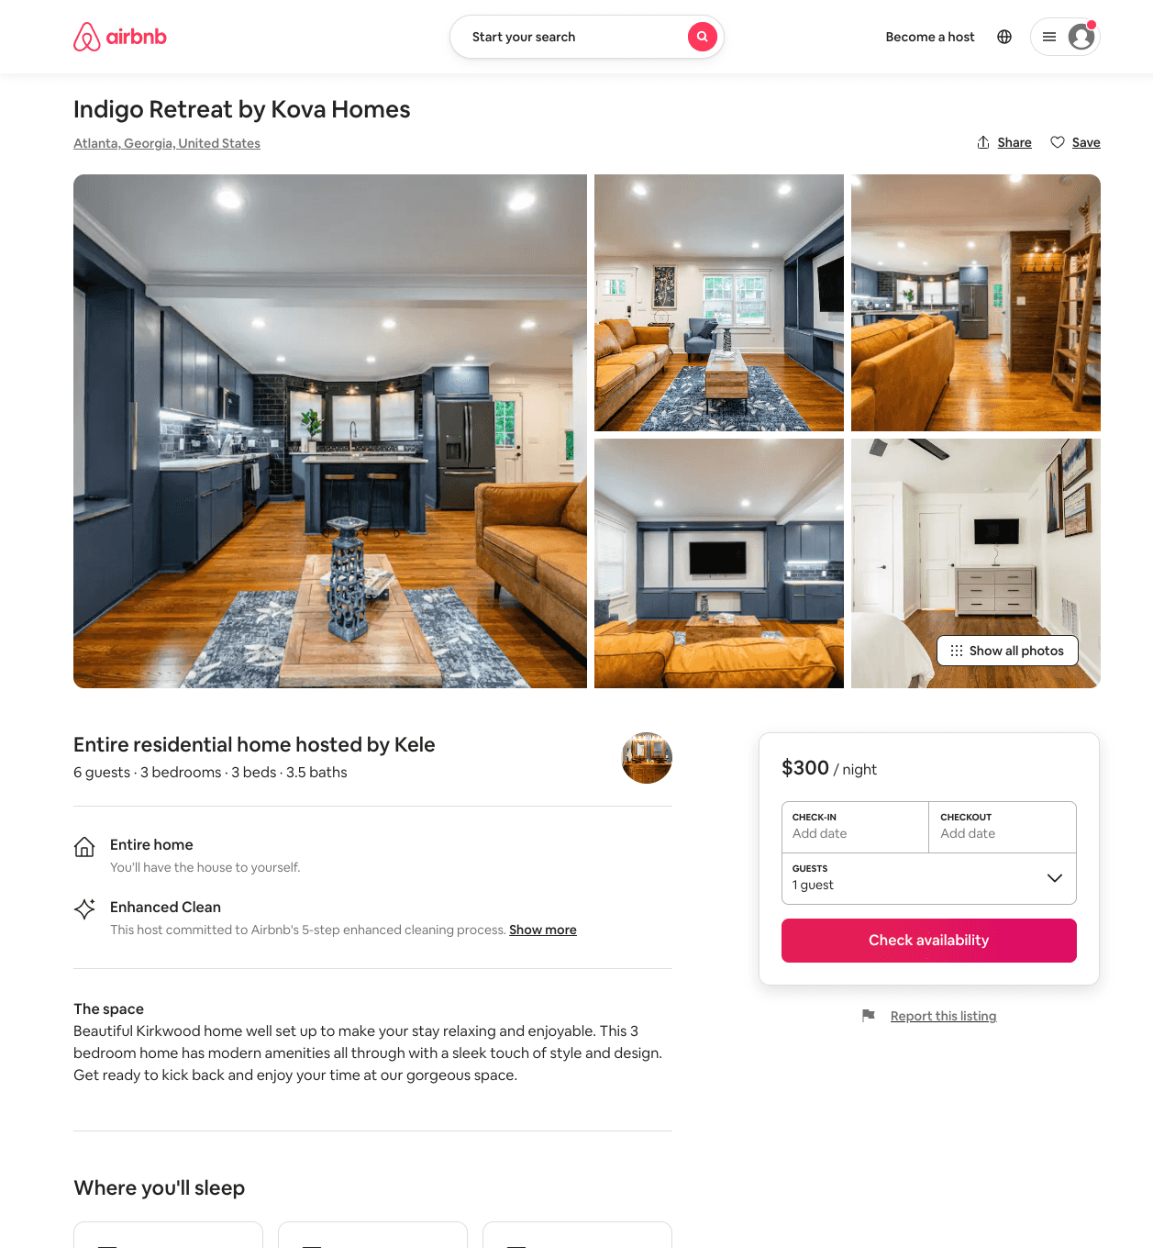
Listing 51213139
3
6
$137 - $302
4.64
2
Kele
208001940
9
https://www.airbnb.com/rooms/51213139
Aug 2022

Slide 39
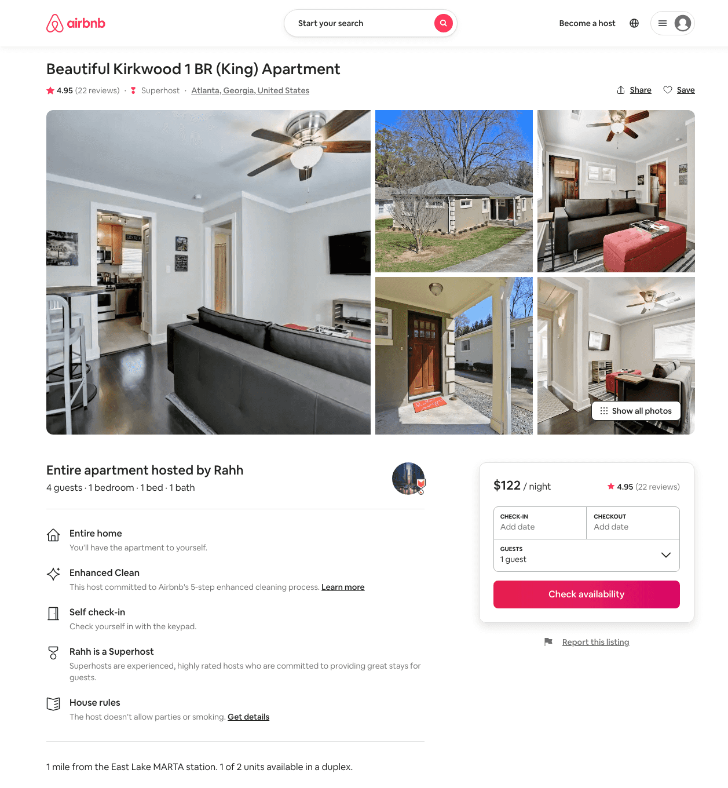
Listing 45258683
1
4
$115 - $166
4.98
2
Rahh
365658352
3
https://www.airbnb.com/rooms/45258683
Jun 2022

Slide 40
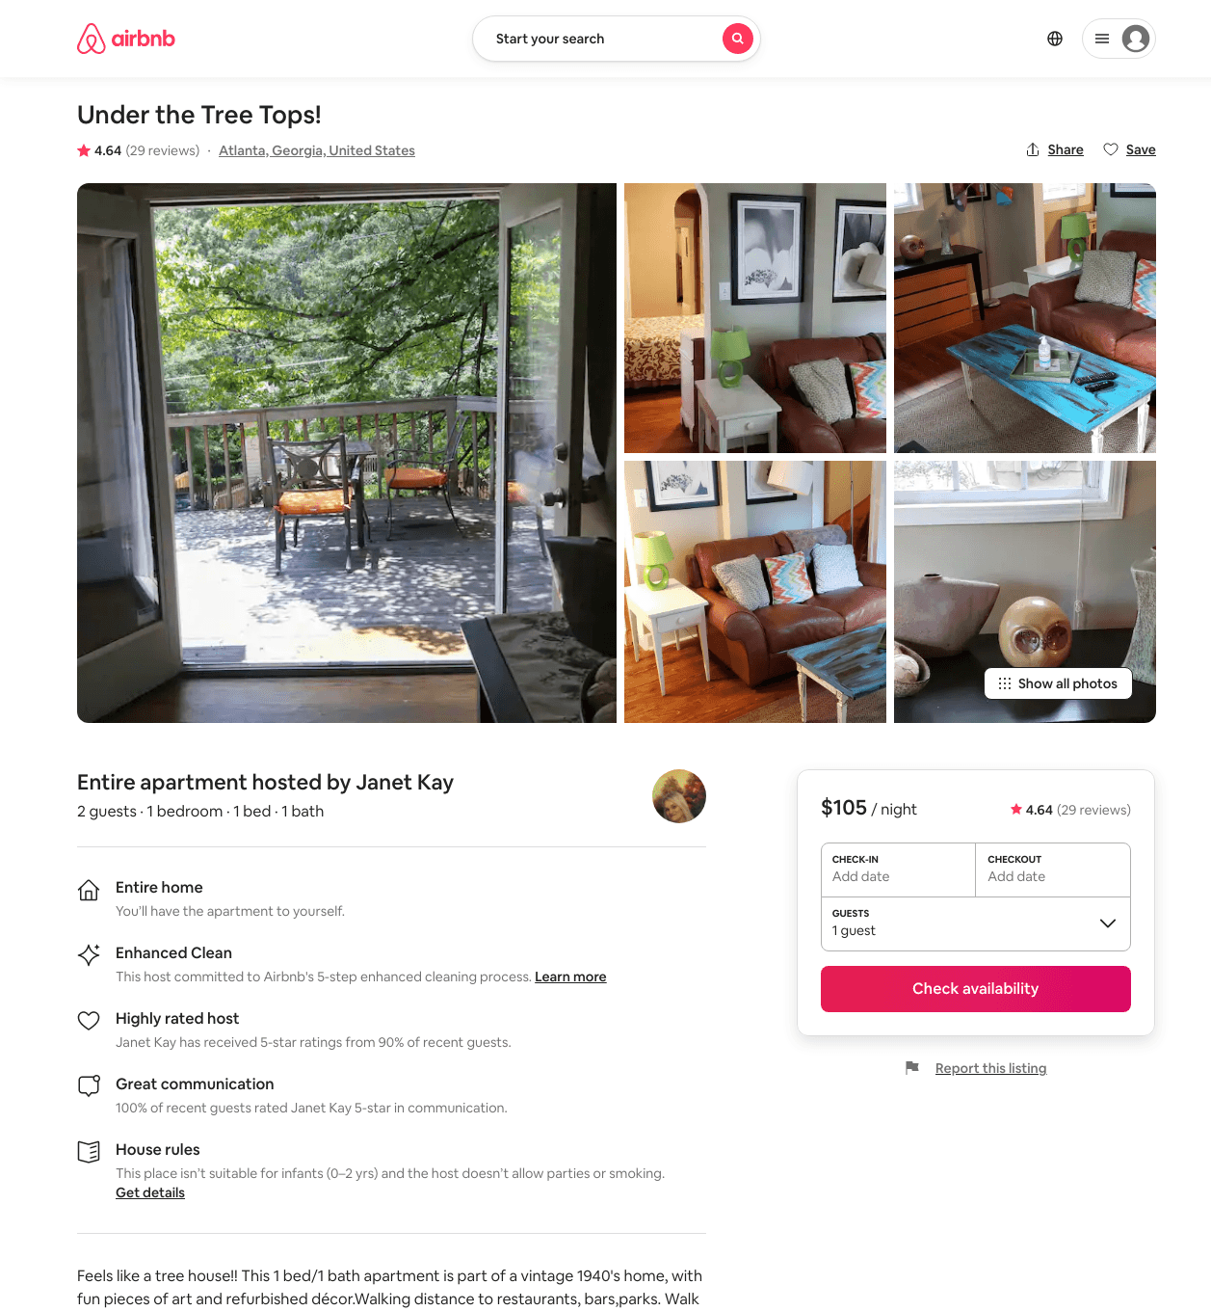
Listing 13334503
1
2
$105 - $111
4.65
7
Janet Kay
46421292
2
https://www.airbnb.com/rooms/13334503
Aug 2022

Slide 41
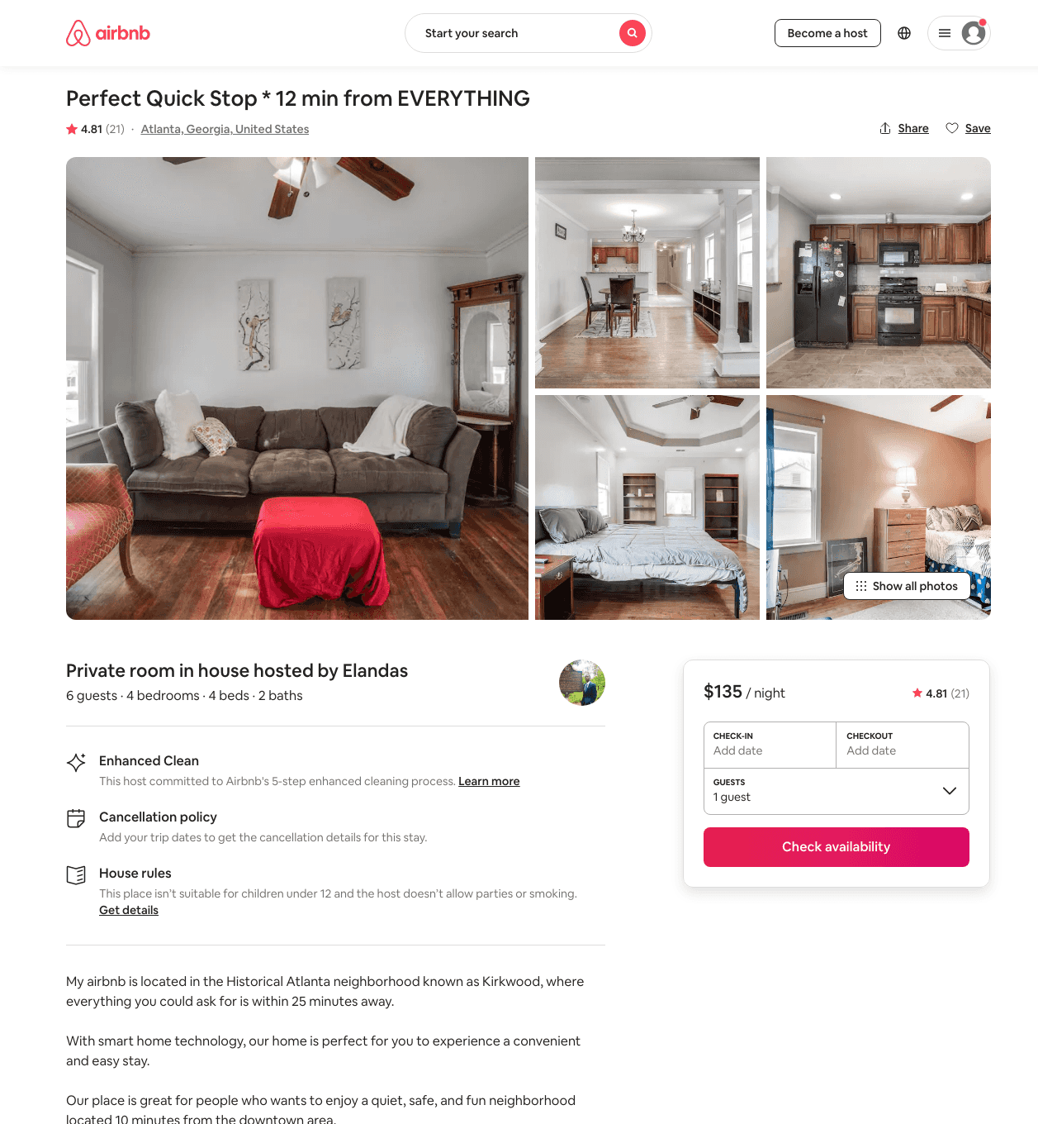
Listing 38454756
4
6
$135
4.50
1
Elandas
17872472
1
https://www.airbnb.com/rooms/38454756
Aug 2022

Slide 42
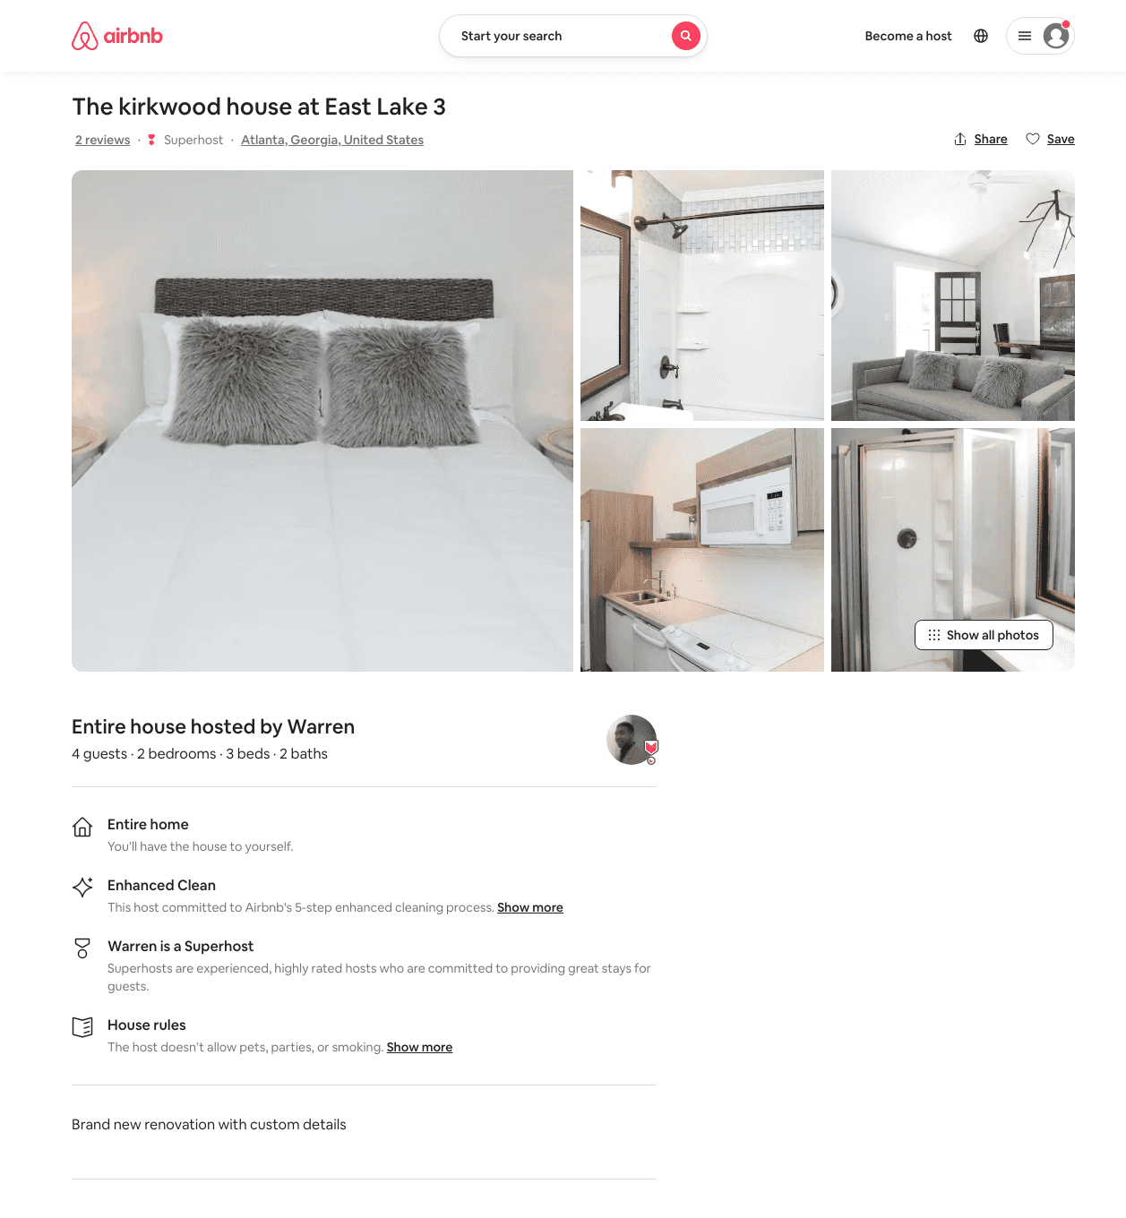
Listing 35277620
2
4
$206 - $246
4.60
1
Warren
231424400
6
https://www.airbnb.com/rooms/35277620
Jun 2022

Slide 43
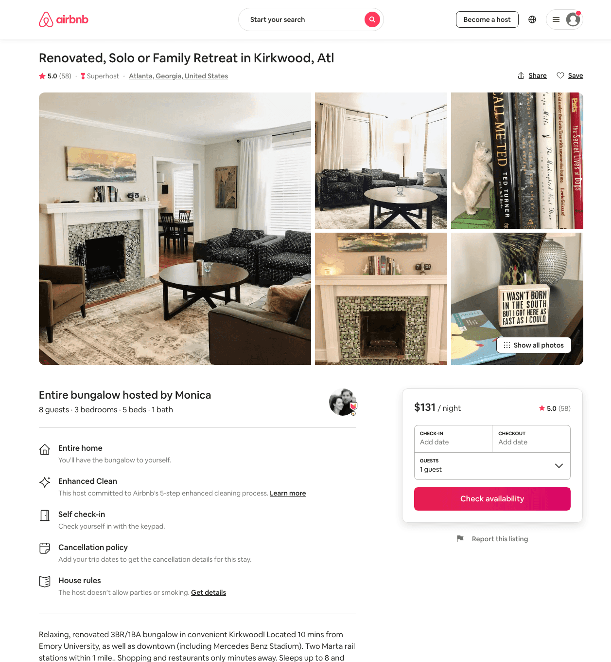
Listing 24134466
3
8
$131 - $163
4.98
4
Monica
15963601
1
https://www.airbnb.com/rooms/24134466
Aug 2022

Slide 44
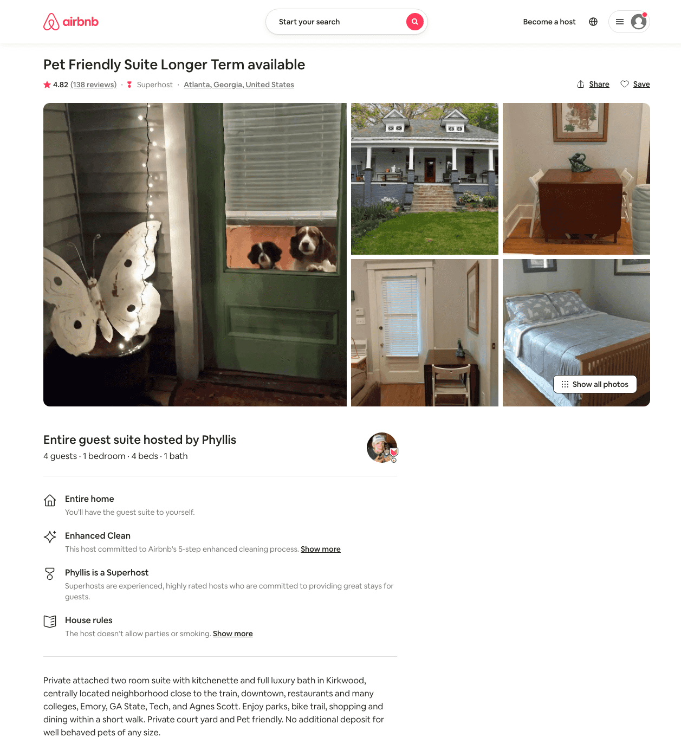
Listing 9503541
1
5
$65 - $97
4.82
2
Phyllis
46016491
1
https://www.airbnb.com/rooms/9503541
Aug 2022

Slide 45
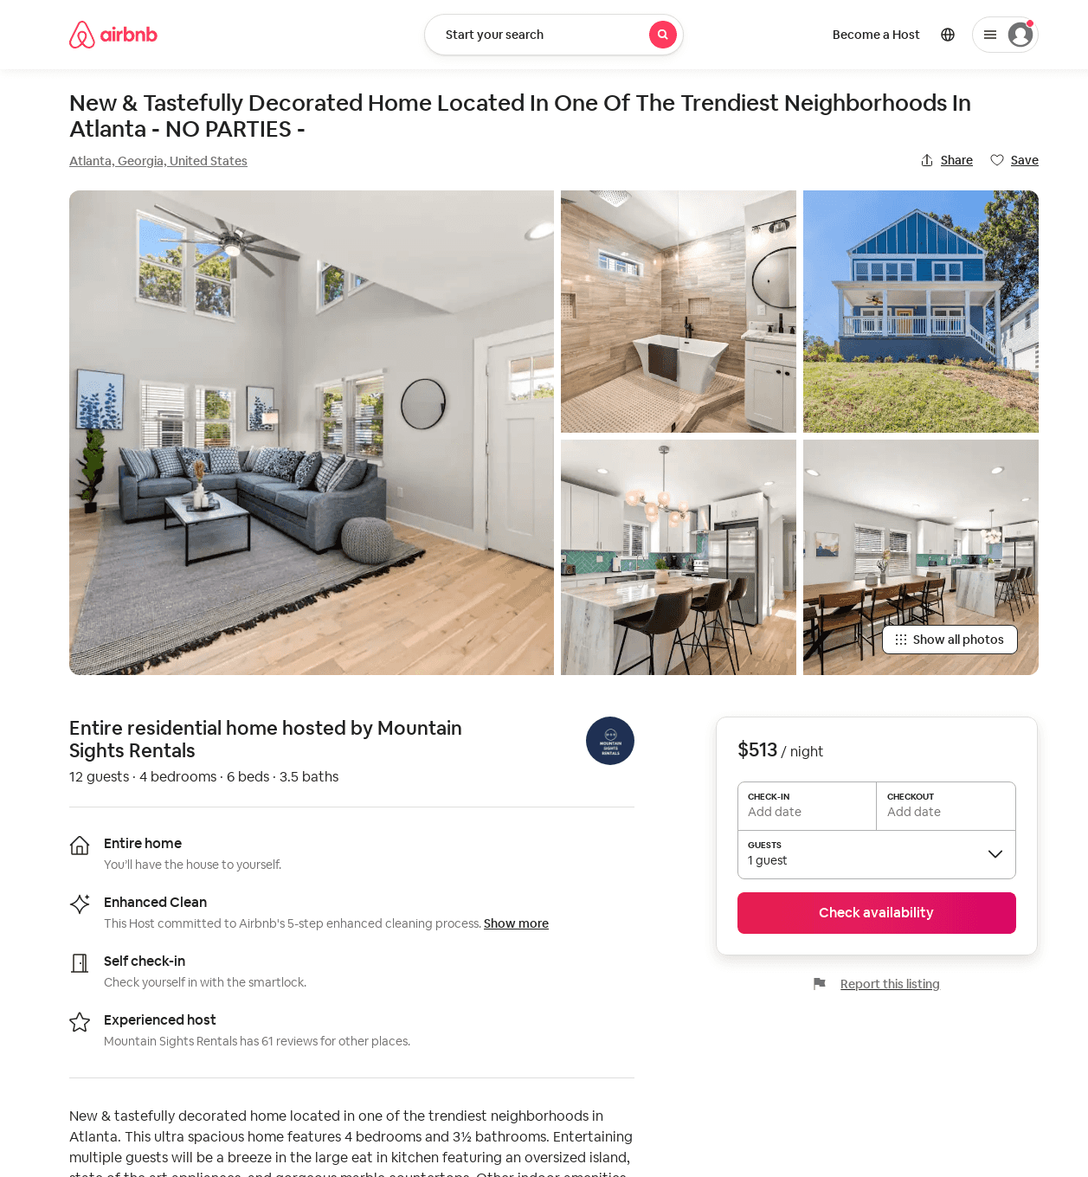
Listing 52620127
4
12
$313 - $552
4.57
3
Mountain Sights Rentals
48880561
13
https://www.airbnb.com/rooms/52620127
Aug 2022

Slide 46
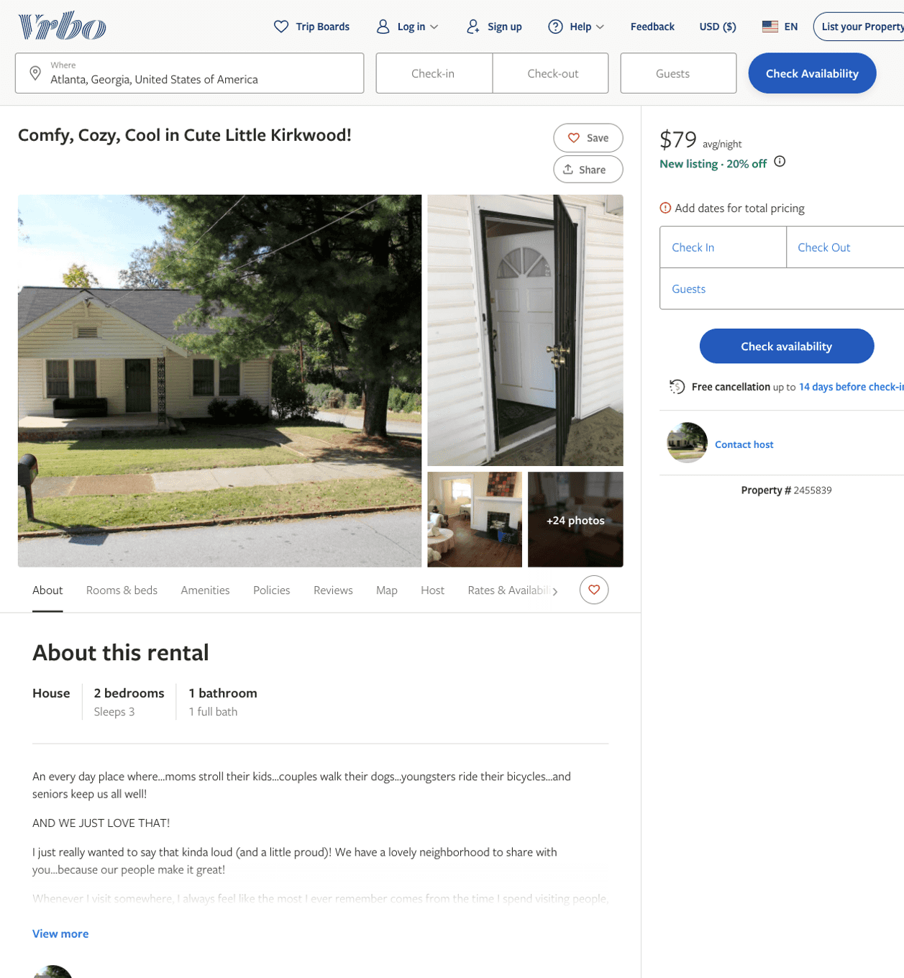
Listing 2455839
2
3
$79 - $89
31
https://www.vrbo.com/2455839
Aug 2022

Slide 47
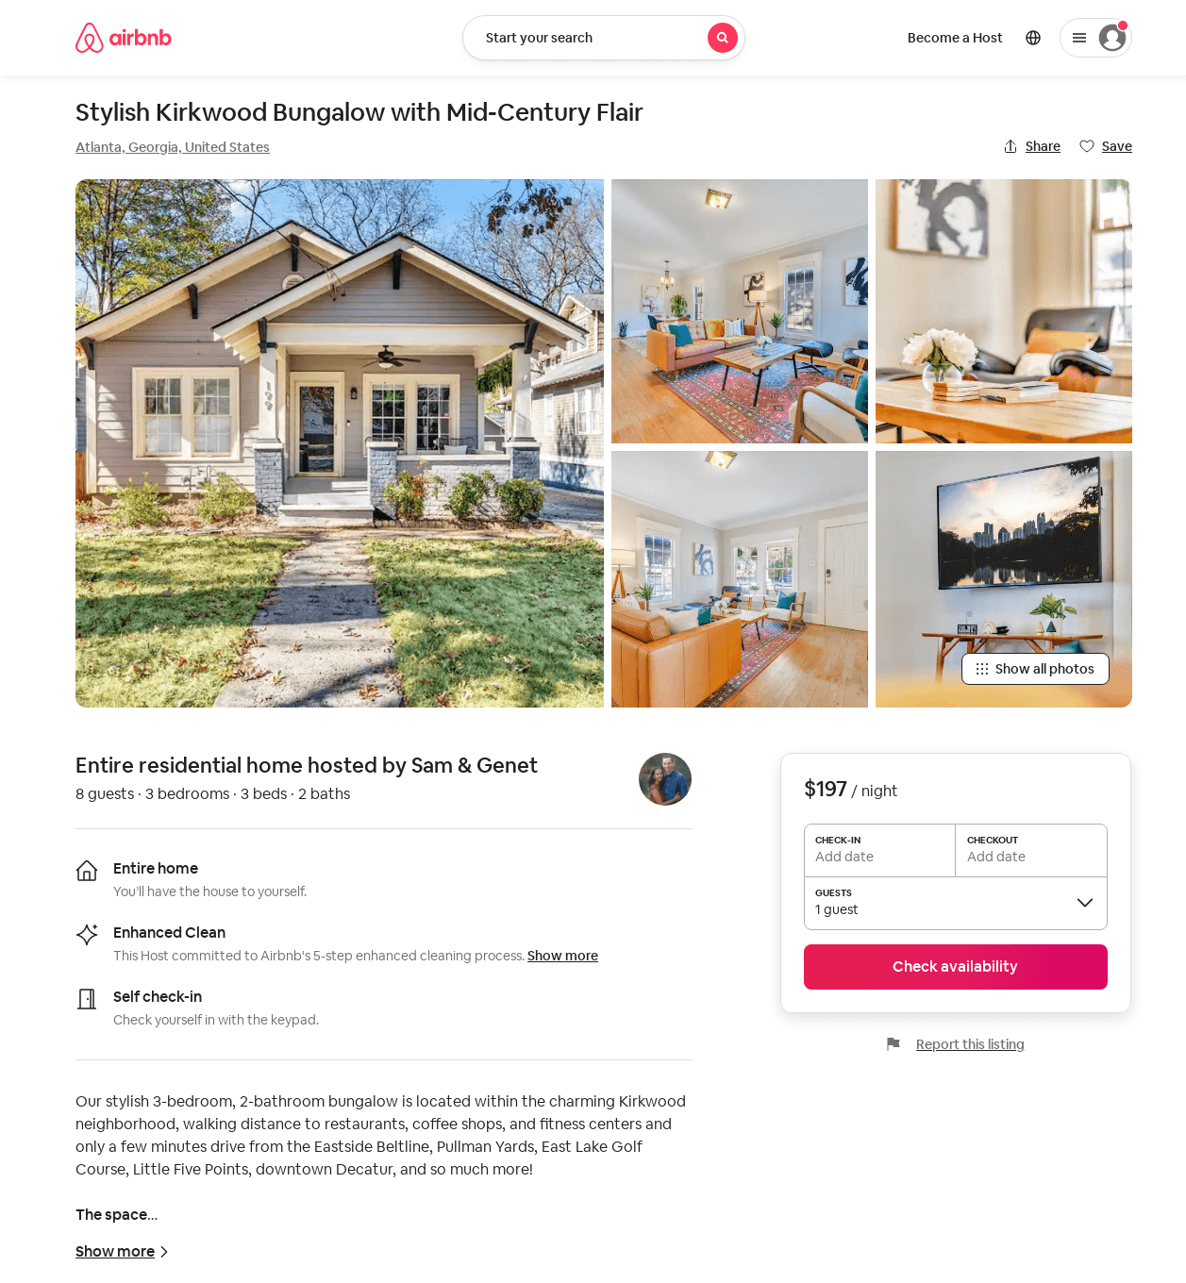
Listing 53239571
3
6
$179 - $240
4.97
3
Sam & Genet
431025978
1
https://www.airbnb.com/rooms/53239571
Aug 2022

Slide 48
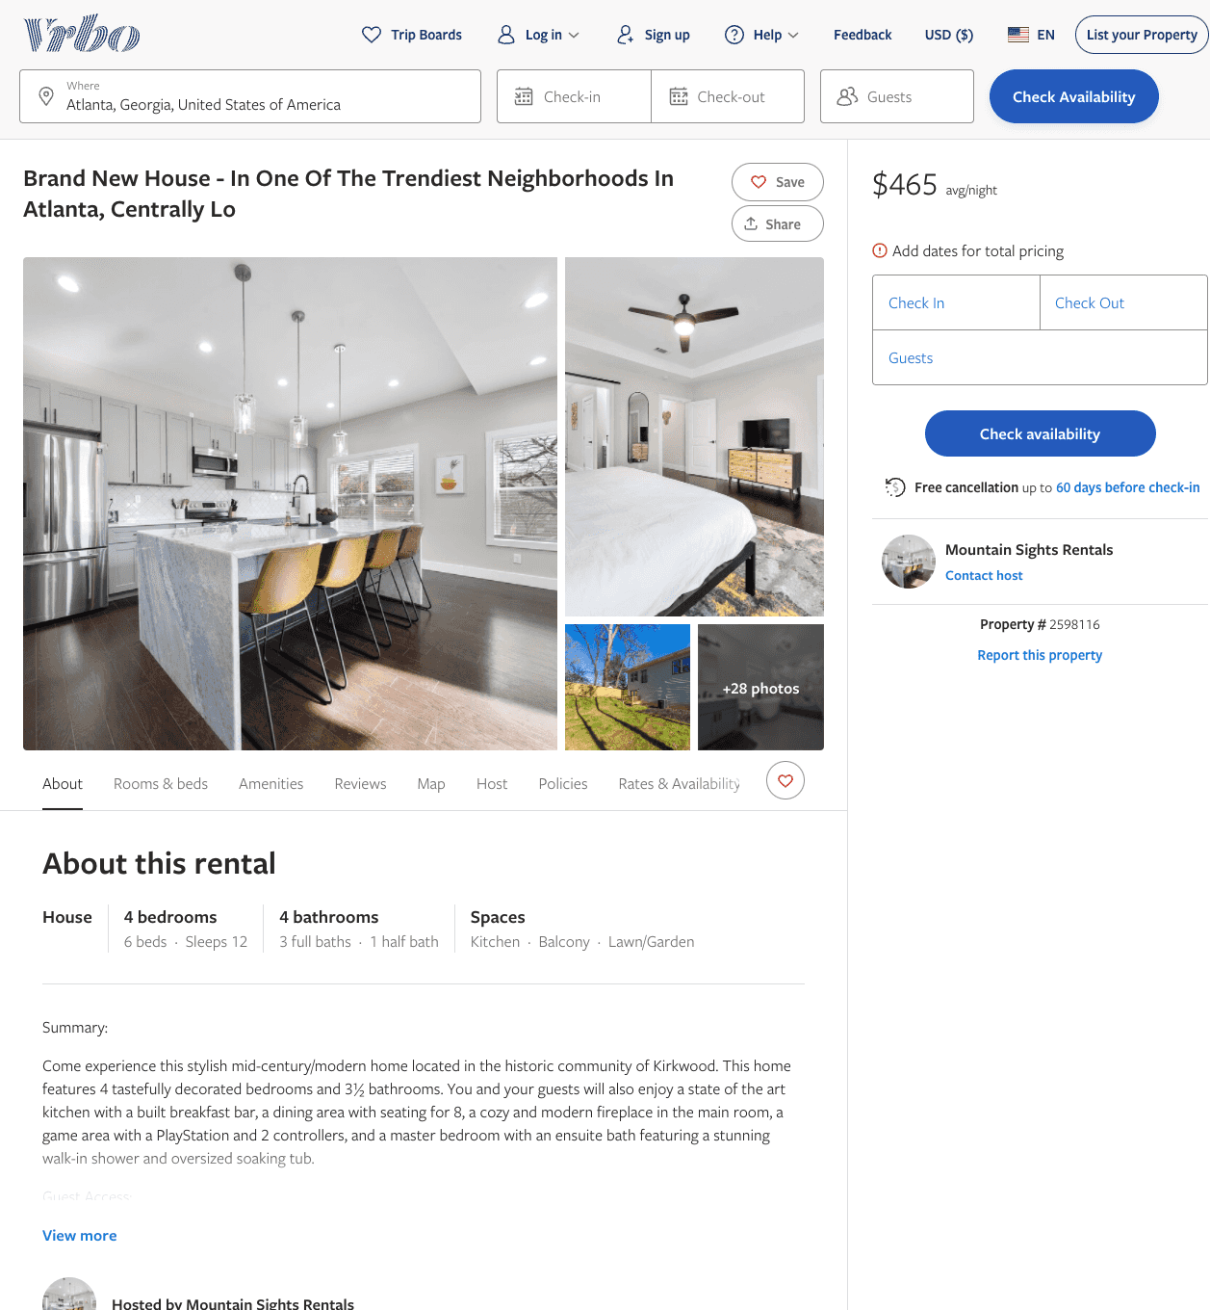
Listing 2598116
4
12
$465 - $584
3
Mountain Sights Rentals
https://www.vrbo.com/2598116
Aug 2022

Slide 49
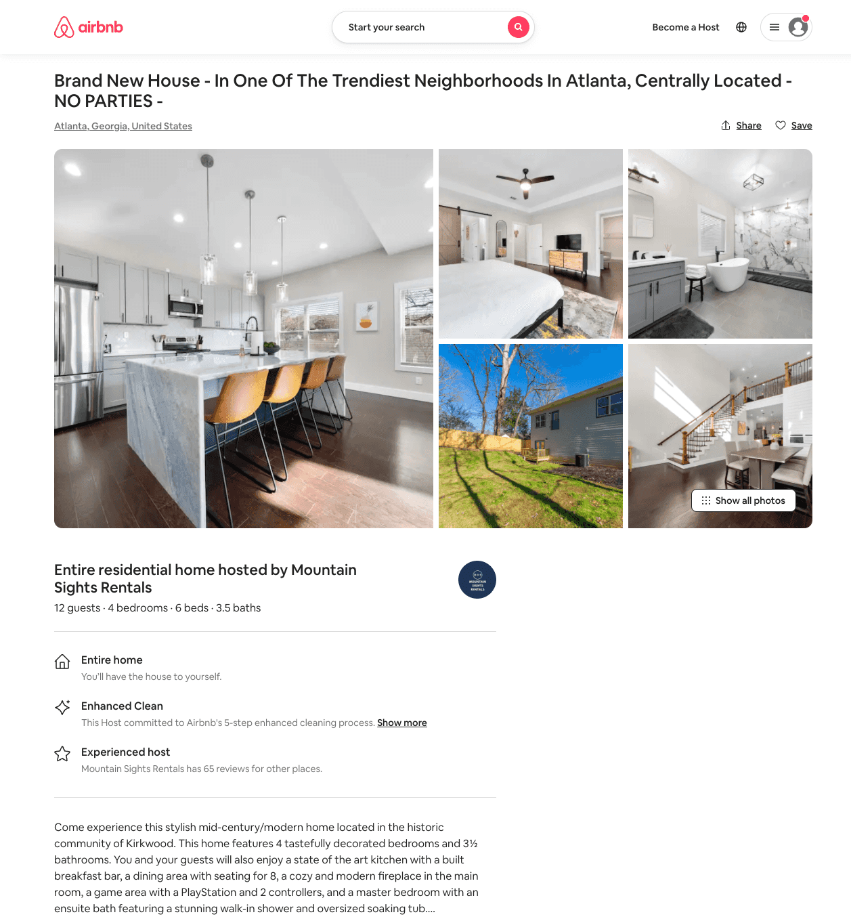
Listing 54016881
4
12
$323 - $460
4.69
3
Mountain Sights Rentals
48880561
13
https://www.airbnb.com/rooms/54016881
Aug 2022

Slide 50
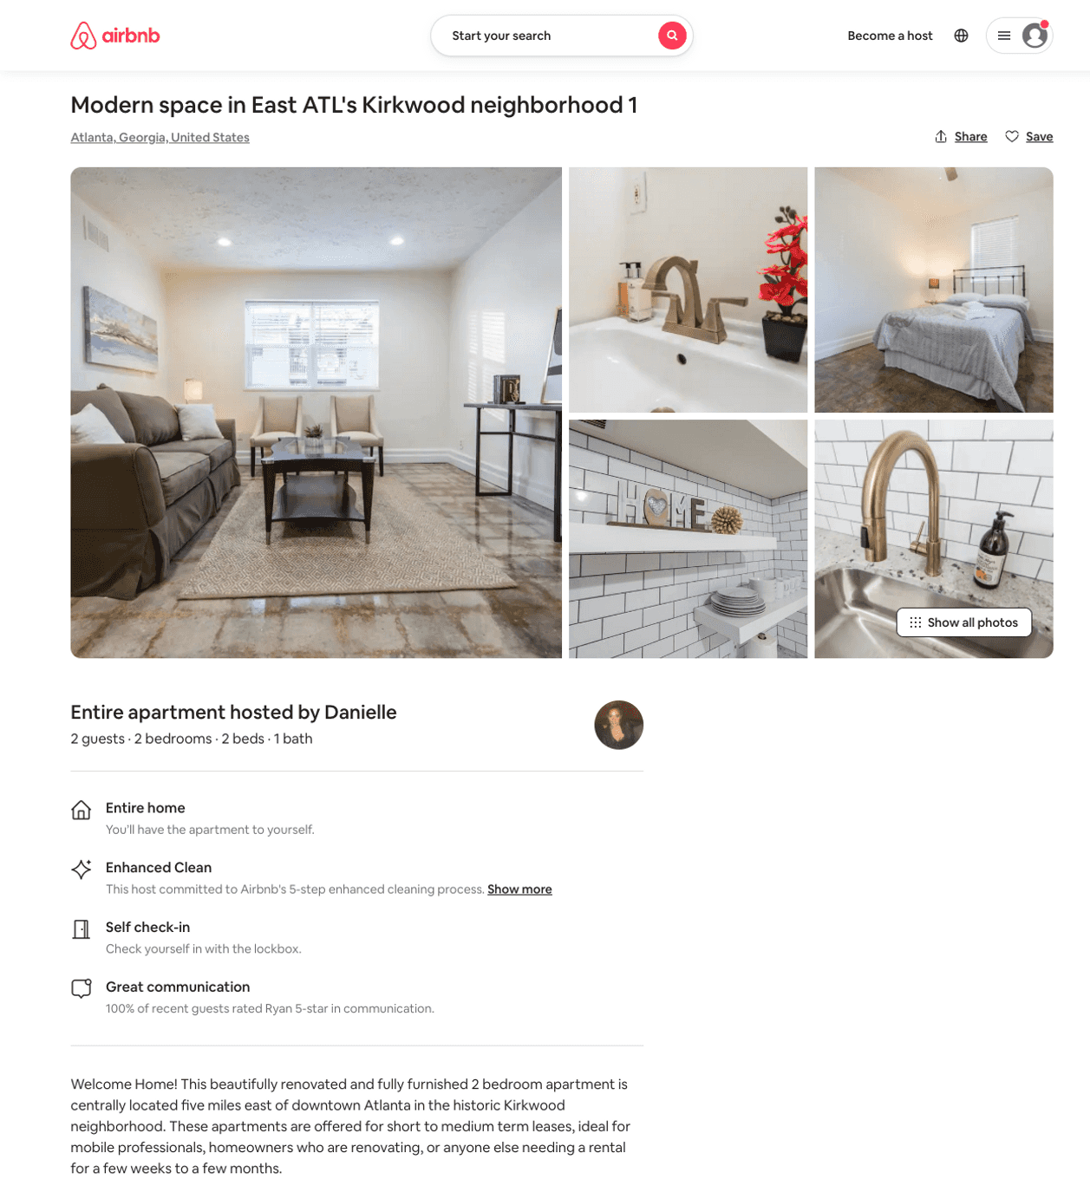
Listing 44448198
2
2
$90 - $94
5.0
45
Danielle
55044020
3
https://www.airbnb.com/rooms/44448198
Jul 2022

Slide 51
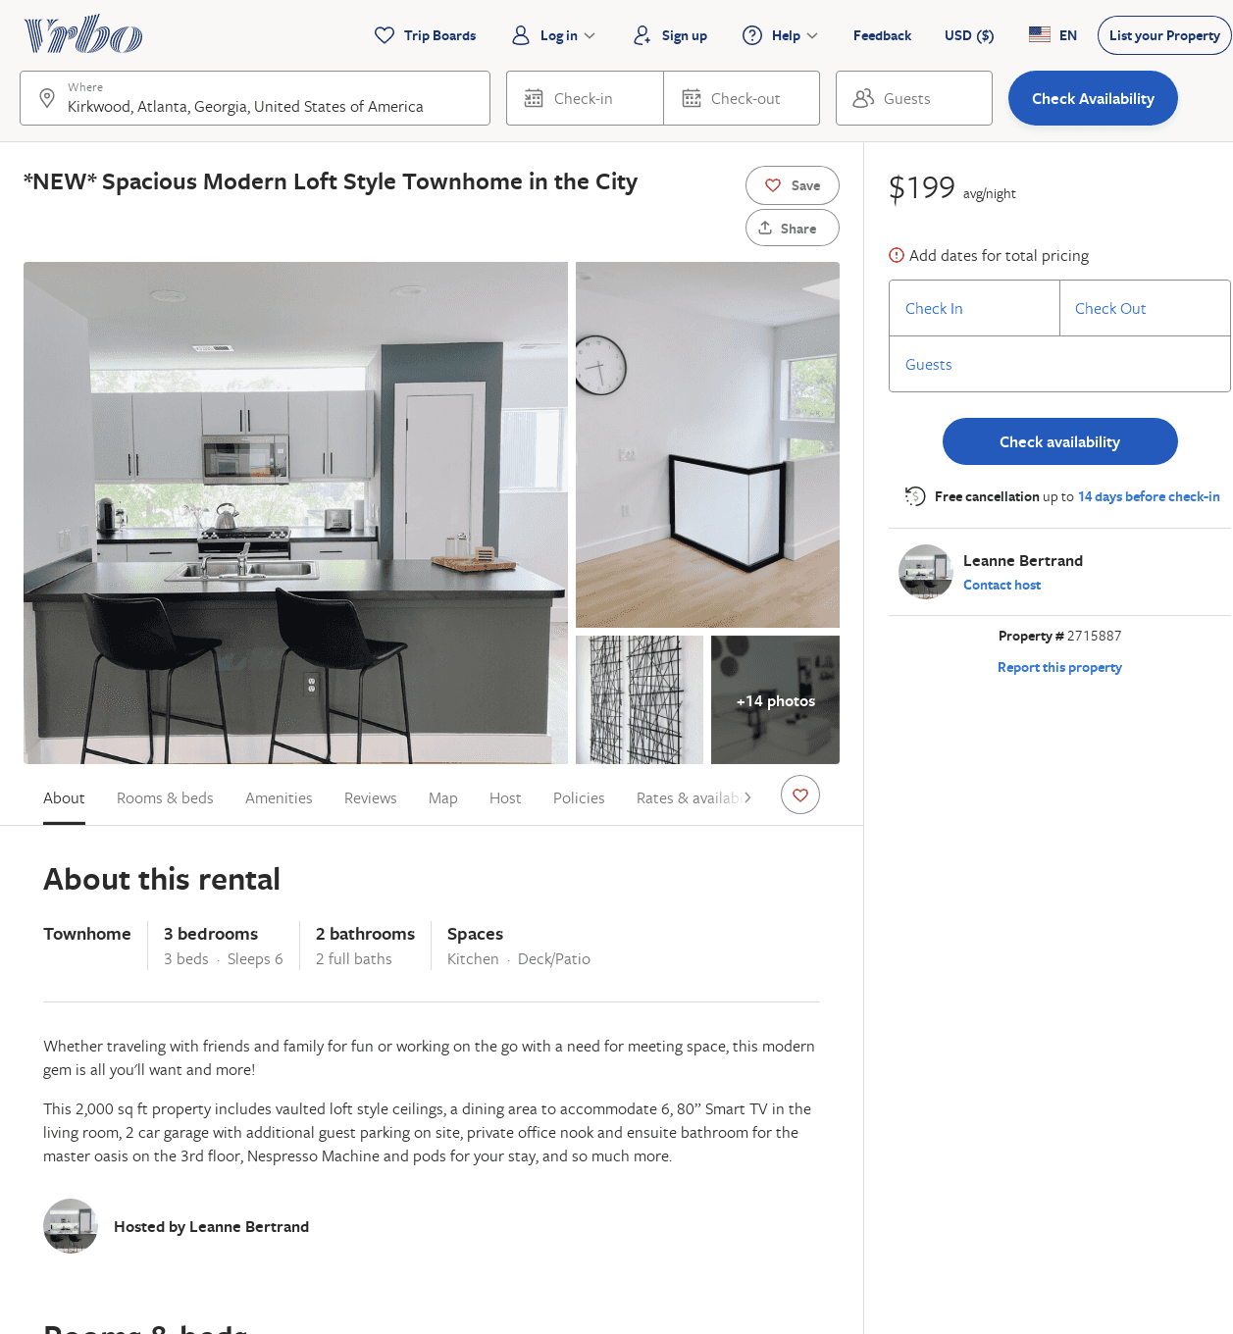
Listing 2715887
3
6
$187
3
Leanne Bertrand
https://www.vrbo.com/2715887
Aug 2022

Slide 52
Listing 42412180
1
4
$120 - $217
31
Jennifer
26904958
1
https://www.airbnb.com/rooms/42412180
Jul 2022

Slide 53
Listing 40139807
1
2
$99
28
Jan
19313278
2
https://www.airbnb.com/rooms/40139807
Jul 2022

Slide 54
Listing 4647190
1
2
$71
31
Kay Baxter
https://www.vrbo.com/4647190ha
Aug 2022

Slide 55
Listing 6419283
3
8
$142
4.94
14
Carrie
22658957
1
https://www.airbnb.com/rooms/6419283
Aug 2022

Slide 56
Listing 2895339
2
6
$190
2
Nikyra
https://www.vrbo.com/2895339
Aug 2022

Slide 57
Listing 17864763
1
2
$80
4.98
2
Claire & Dustin
71458313
1
https://www.airbnb.com/rooms/17864763
Aug 2022

Slide 58
Listing 54280628
1
2
1
J
108703789
1
https://www.airbnb.com/rooms/54280628
Aug 2022

Slide 59
Listing 52965115
2
4
28
Bryan
14606140
1
https://www.airbnb.com/rooms/52965115
Aug 2022

Slide 60
Listing 51288641
1
4
2
Brittany
413151817
1
https://www.airbnb.com/rooms/51288641
Aug 2022

