Slide 2
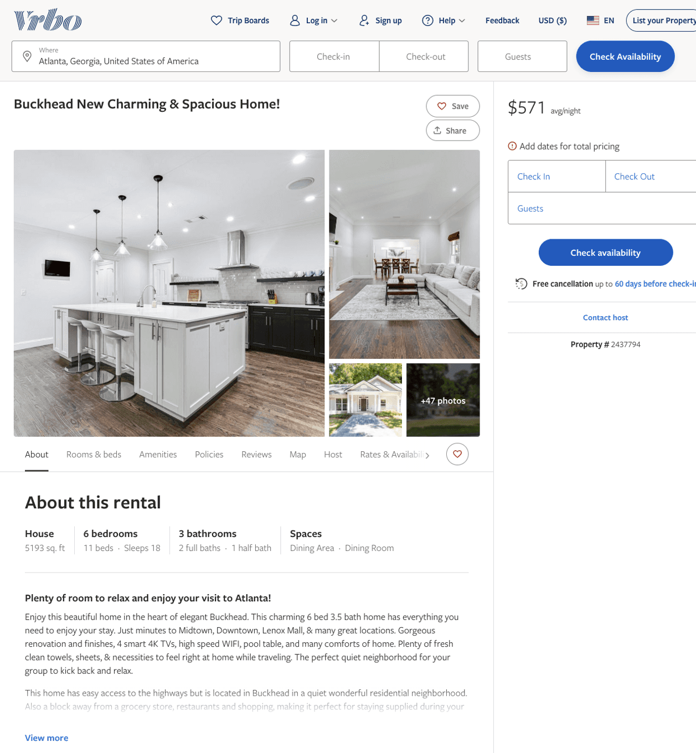
Listing 2437794
6
18
$545 - $615
4.875
1
Michael
https://www.vrbo.com/2437794
Aug 2022

Slide 3
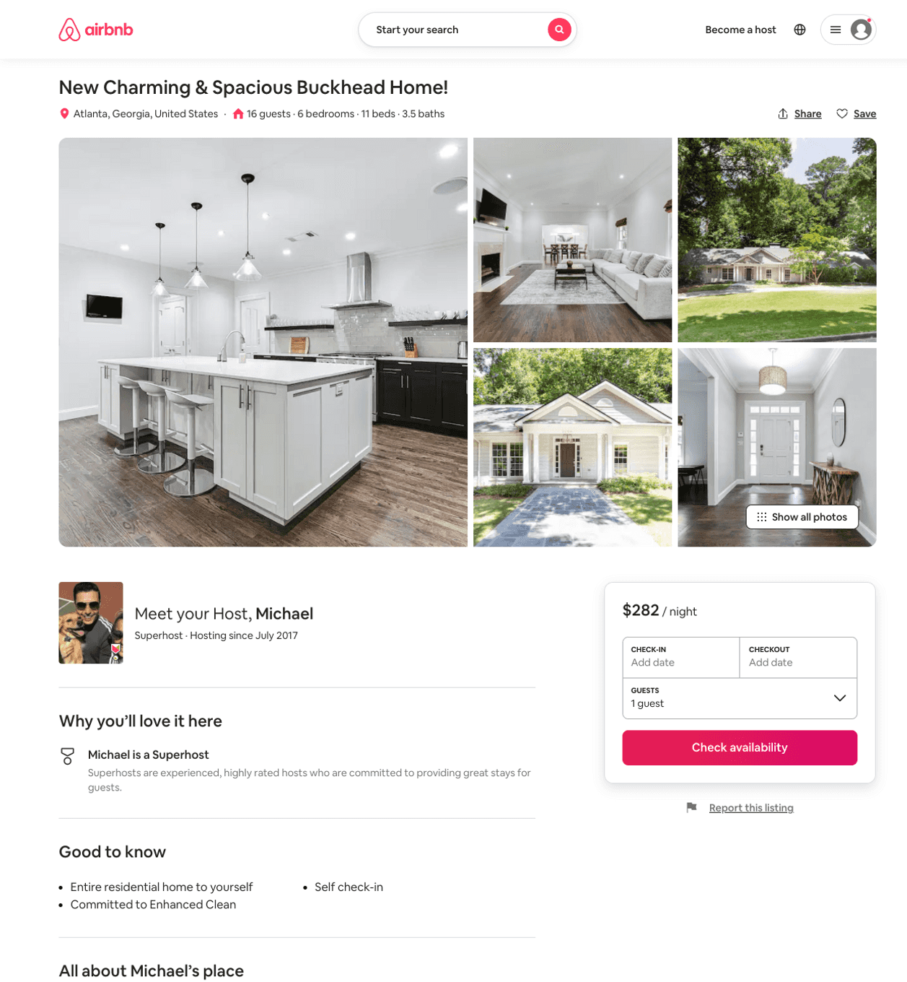
Listing 51741575
6
16
$282 - $428
4.85
1
Michael
143143166
5
https://www.airbnb.com/rooms/51741575
Aug 2022

