Slide 2
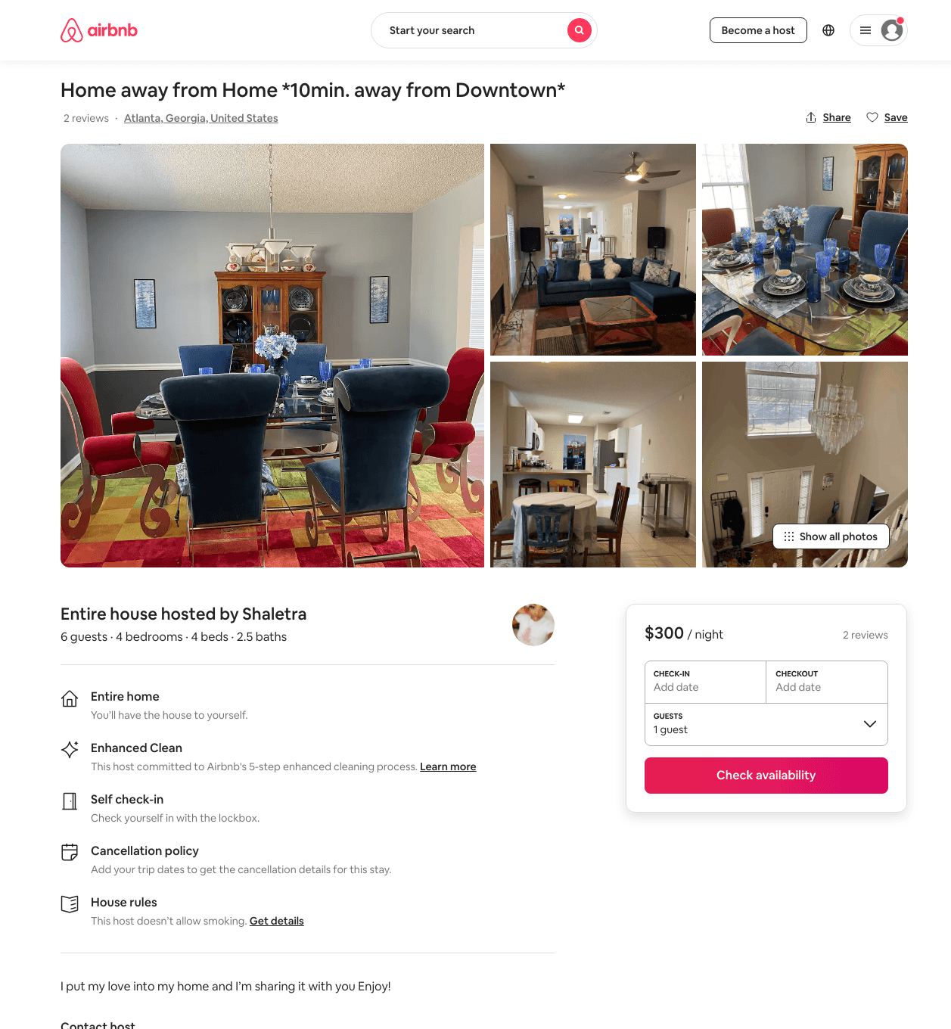
Listing 48523372
5
6
$300 - $400
4.83
1
Shaletra
361045050
1
https://www.airbnb.com/rooms/48523372
Aug 2022

Slide 3
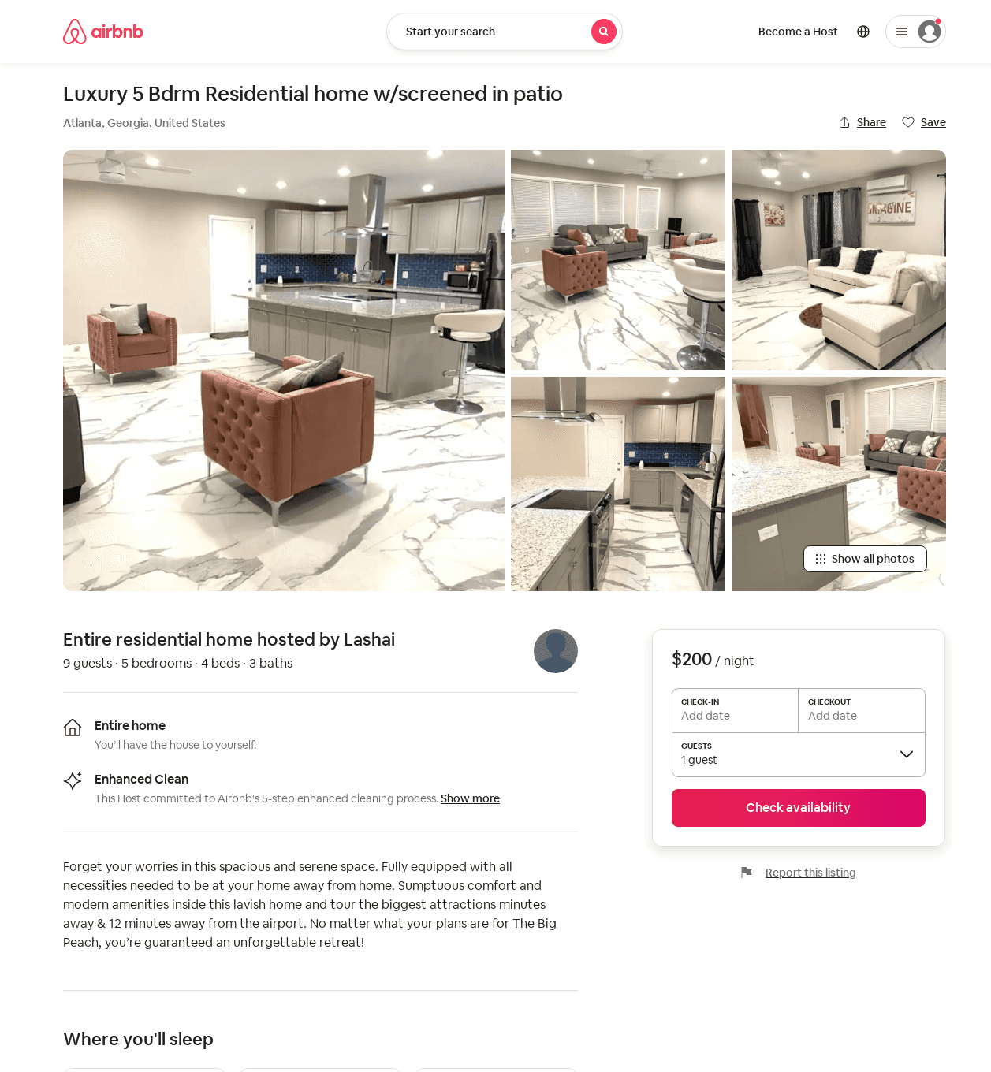
Listing 52707266
5
5
$200 - $300
3.80
2
Lashai
135710487
1
https://www.airbnb.com/rooms/52707266
Jun 2022

