Slide 2
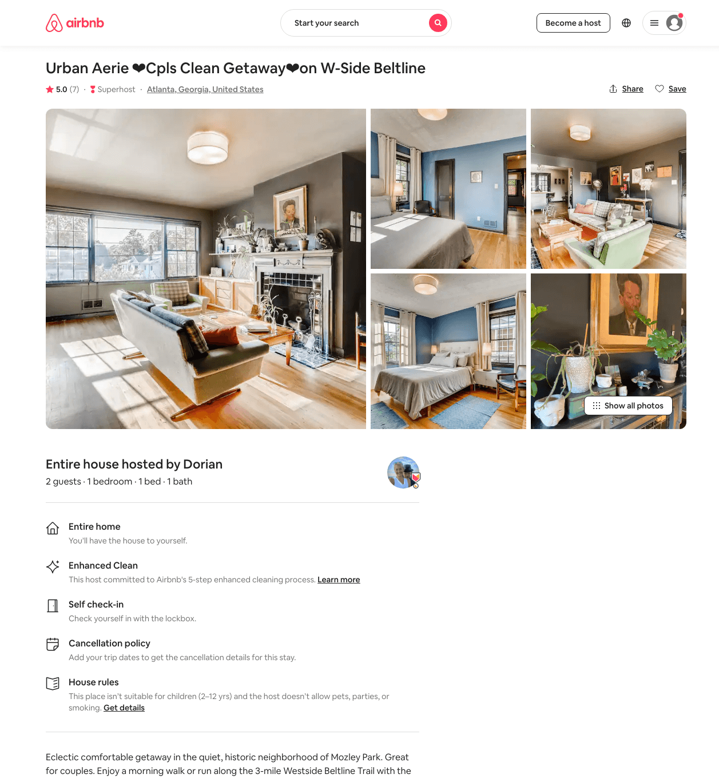
Listing 44443763
1
2
$145 - $290
4.92
2
Dorian
5977631
2
https://www.airbnb.com/rooms/44443763
Jun 2022

Slide 3
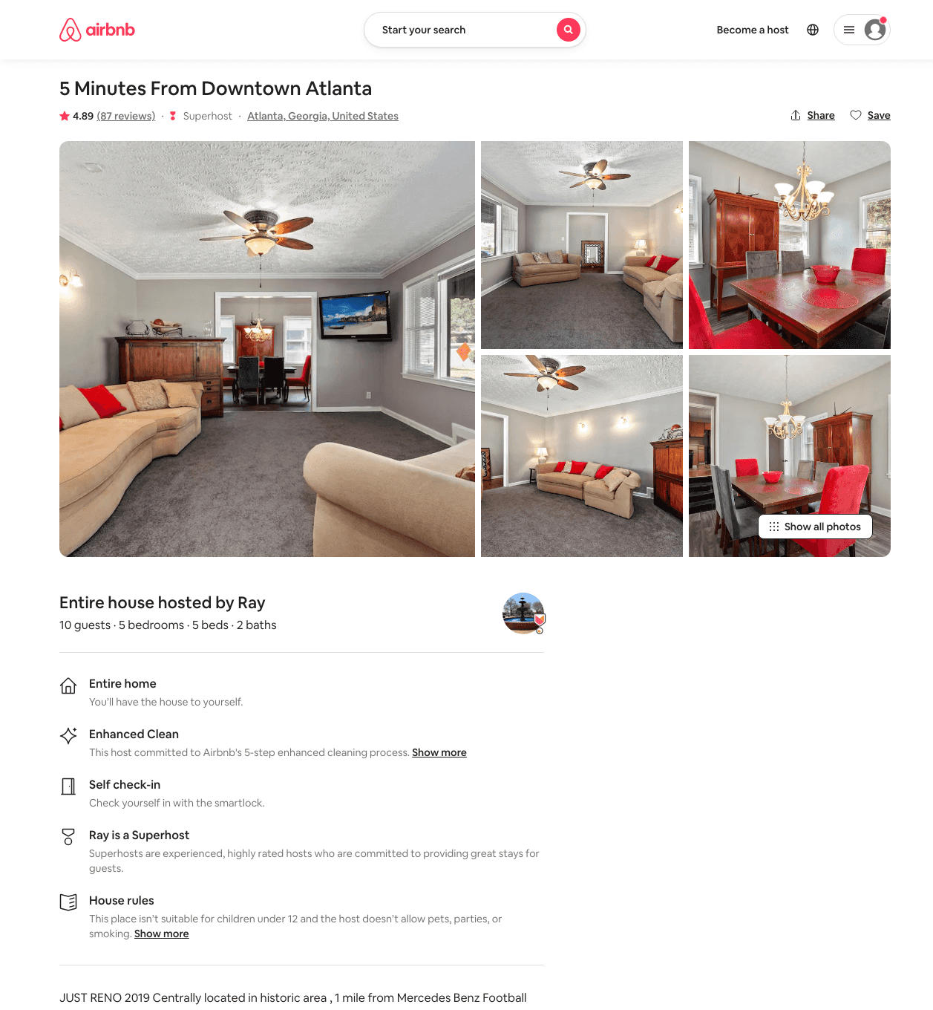
Listing 31999220
5
9
$149 - $250
4.83
3
Ray
1732528
1
https://www.airbnb.com/rooms/31999220
Aug 2022

Slide 4
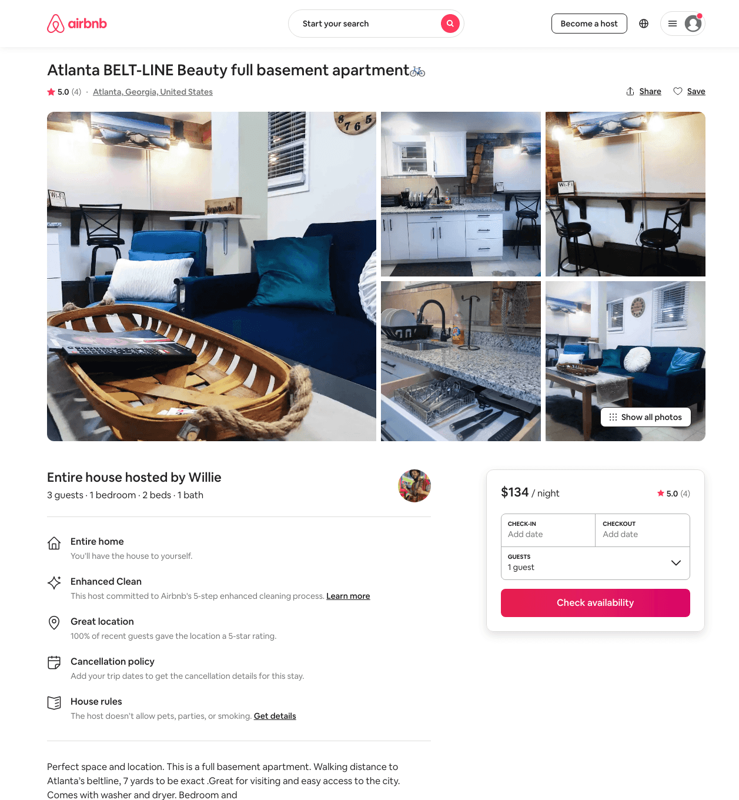
Listing 47059469
1
3
$134 - $151
4.92
1
Willie
365032895
1
https://www.airbnb.com/rooms/47059469
Jun 2022

Slide 5
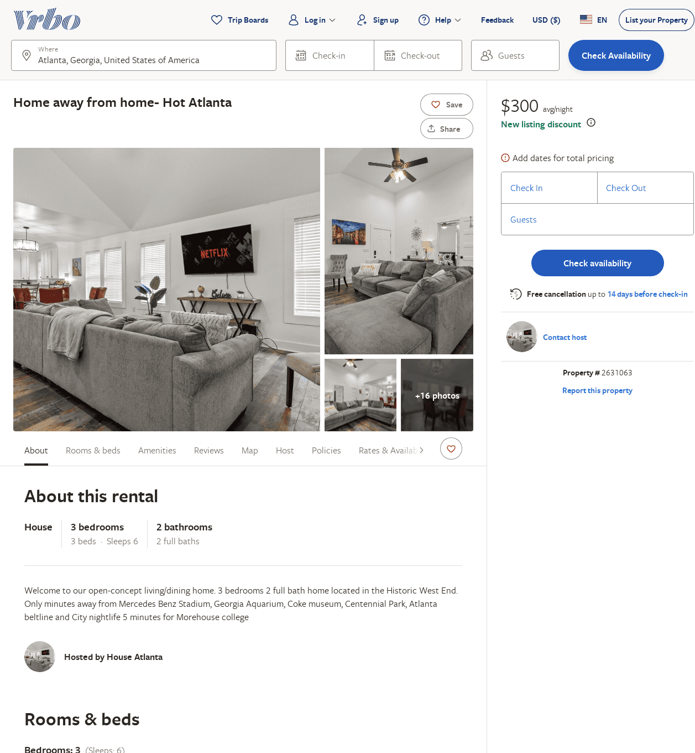
Listing 2631063
3
6
$300
2
https://www.vrbo.com/2631063
Aug 2022

Slide 6
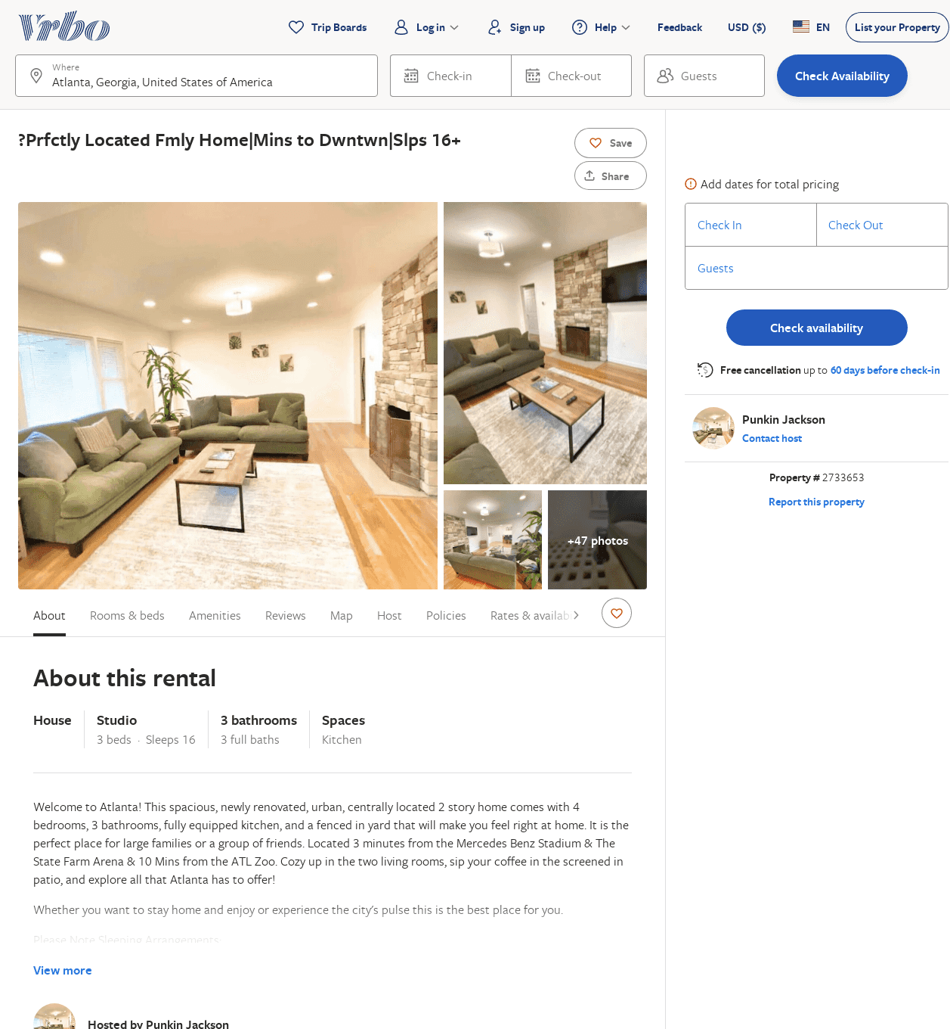
Listing 2733653
4
16
$368
5
1
Punkin Jackson
https://www.vrbo.com/2733653
Aug 2022

Slide 7
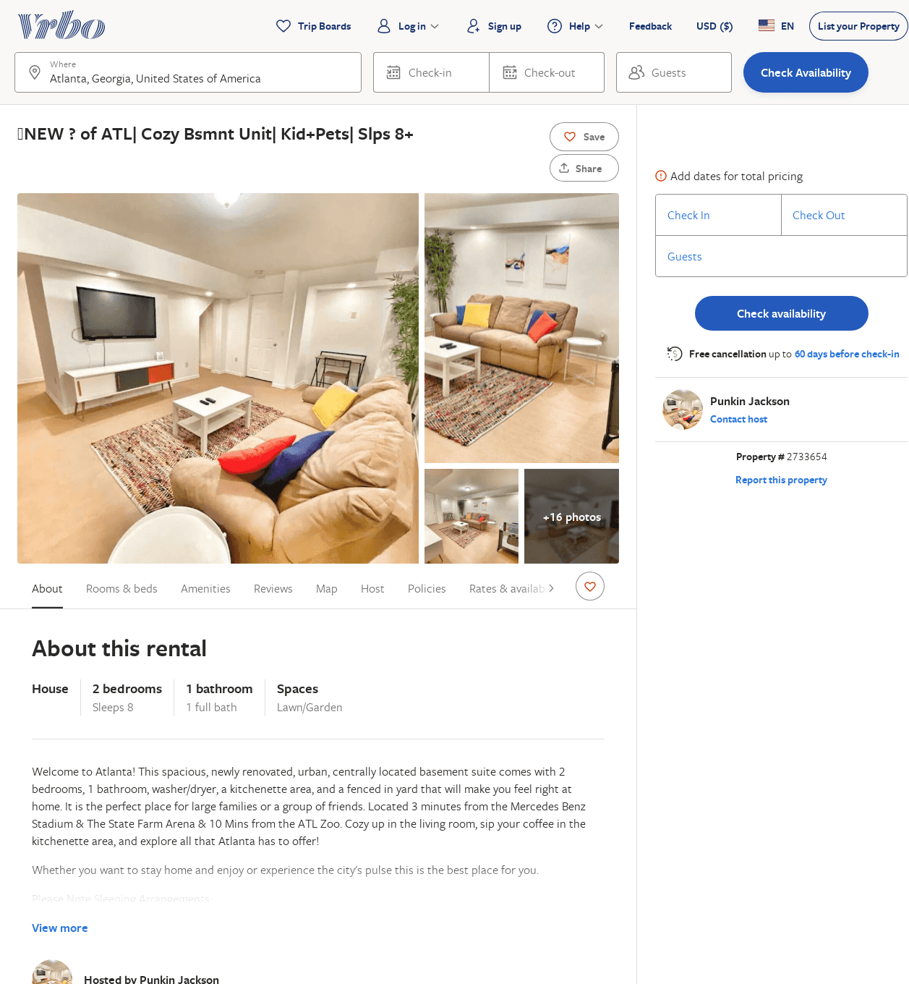
Listing 2733654
2
8
$137
5
1
Punkin Jackson
https://www.vrbo.com/2733654
Aug 2022

