Slide 2
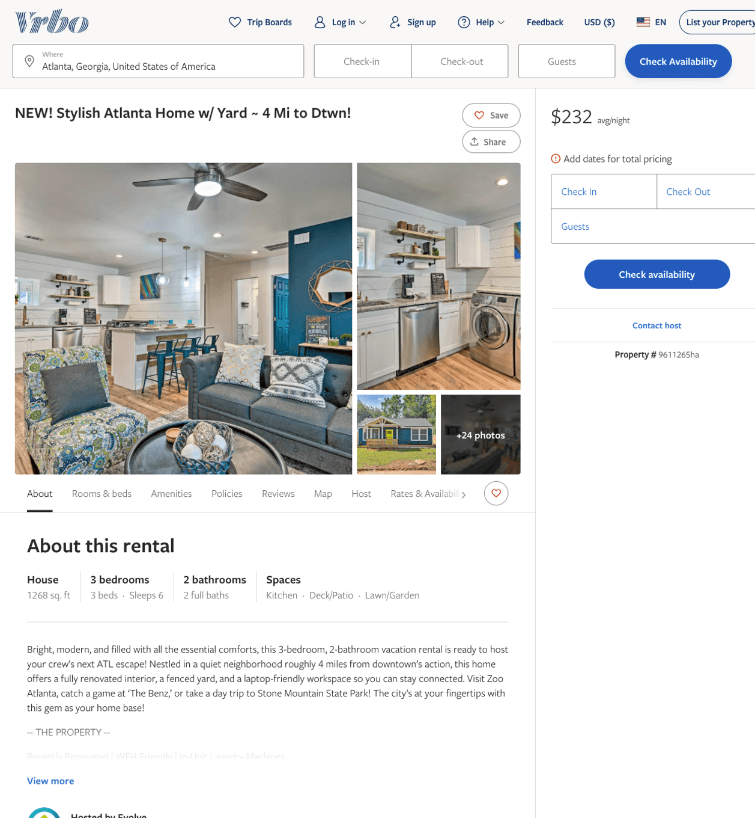
Listing 9611265
3
6
$179 - $232
2
Evolve
https://www.vrbo.com/9611265ha
Aug 2022

Slide 3
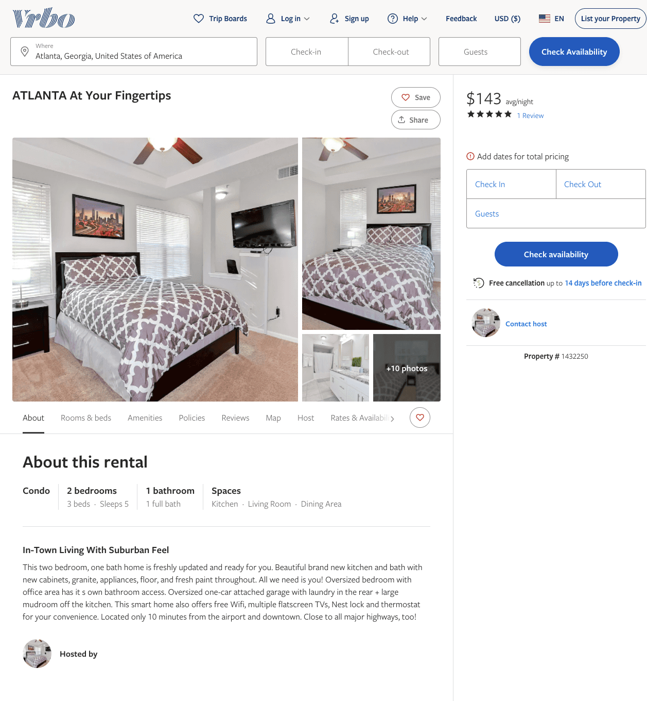
Listing 1432250
2
5
$143 - $158
5
4
https://www.vrbo.com/1432250
Aug 2022

Slide 4
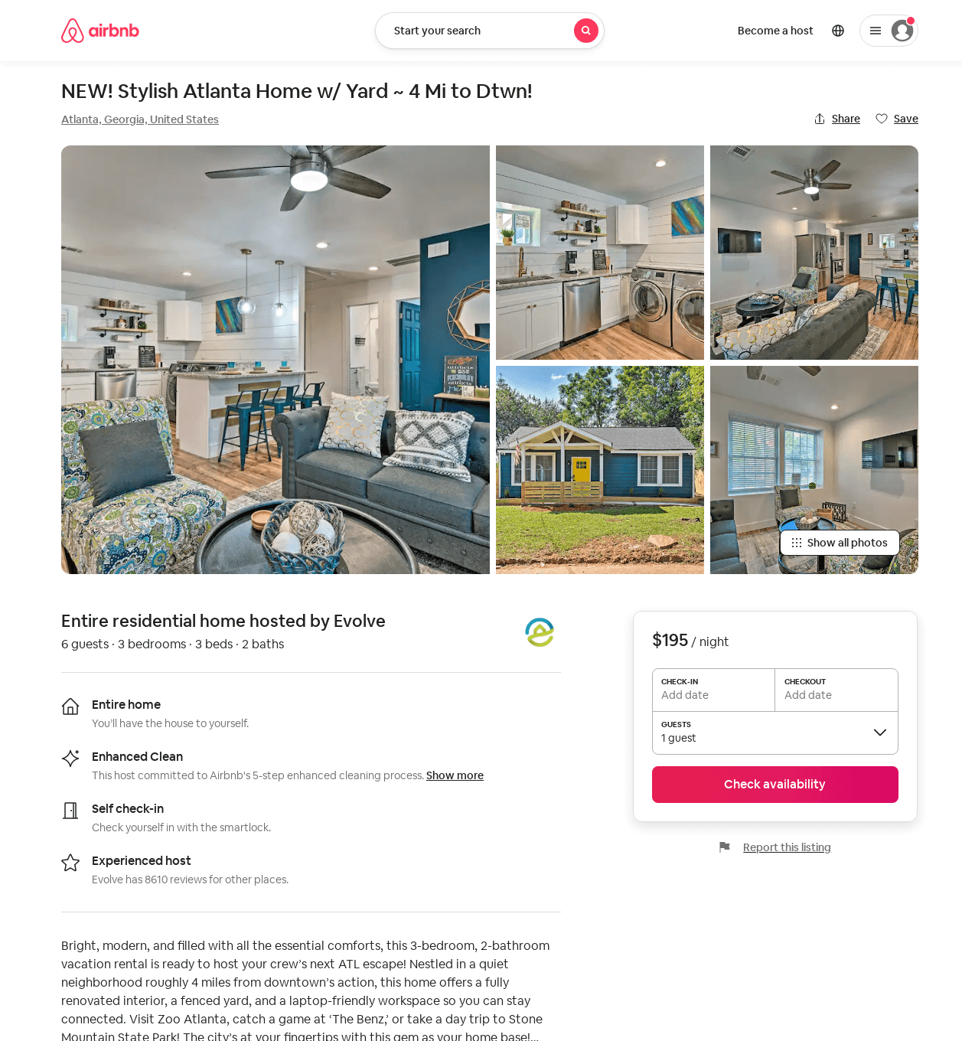
Listing 52406313
3
6
$178 - $207
4.33
2
Evolve
121682456
51
https://www.airbnb.com/rooms/52406313
Aug 2022

Slide 5
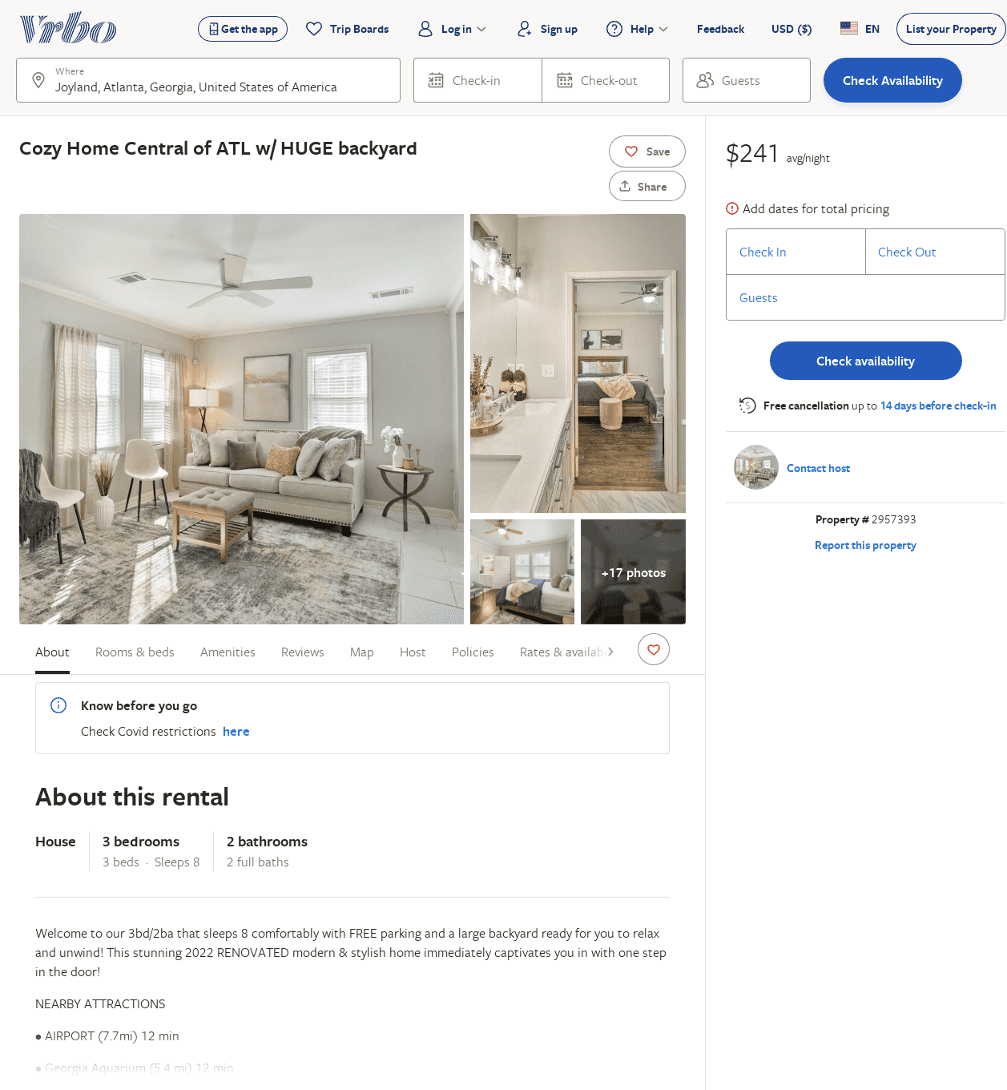
Listing 2957393
3
8
$241
2
https://www.vrbo.com/2957393
Aug 2022

