Slide 2
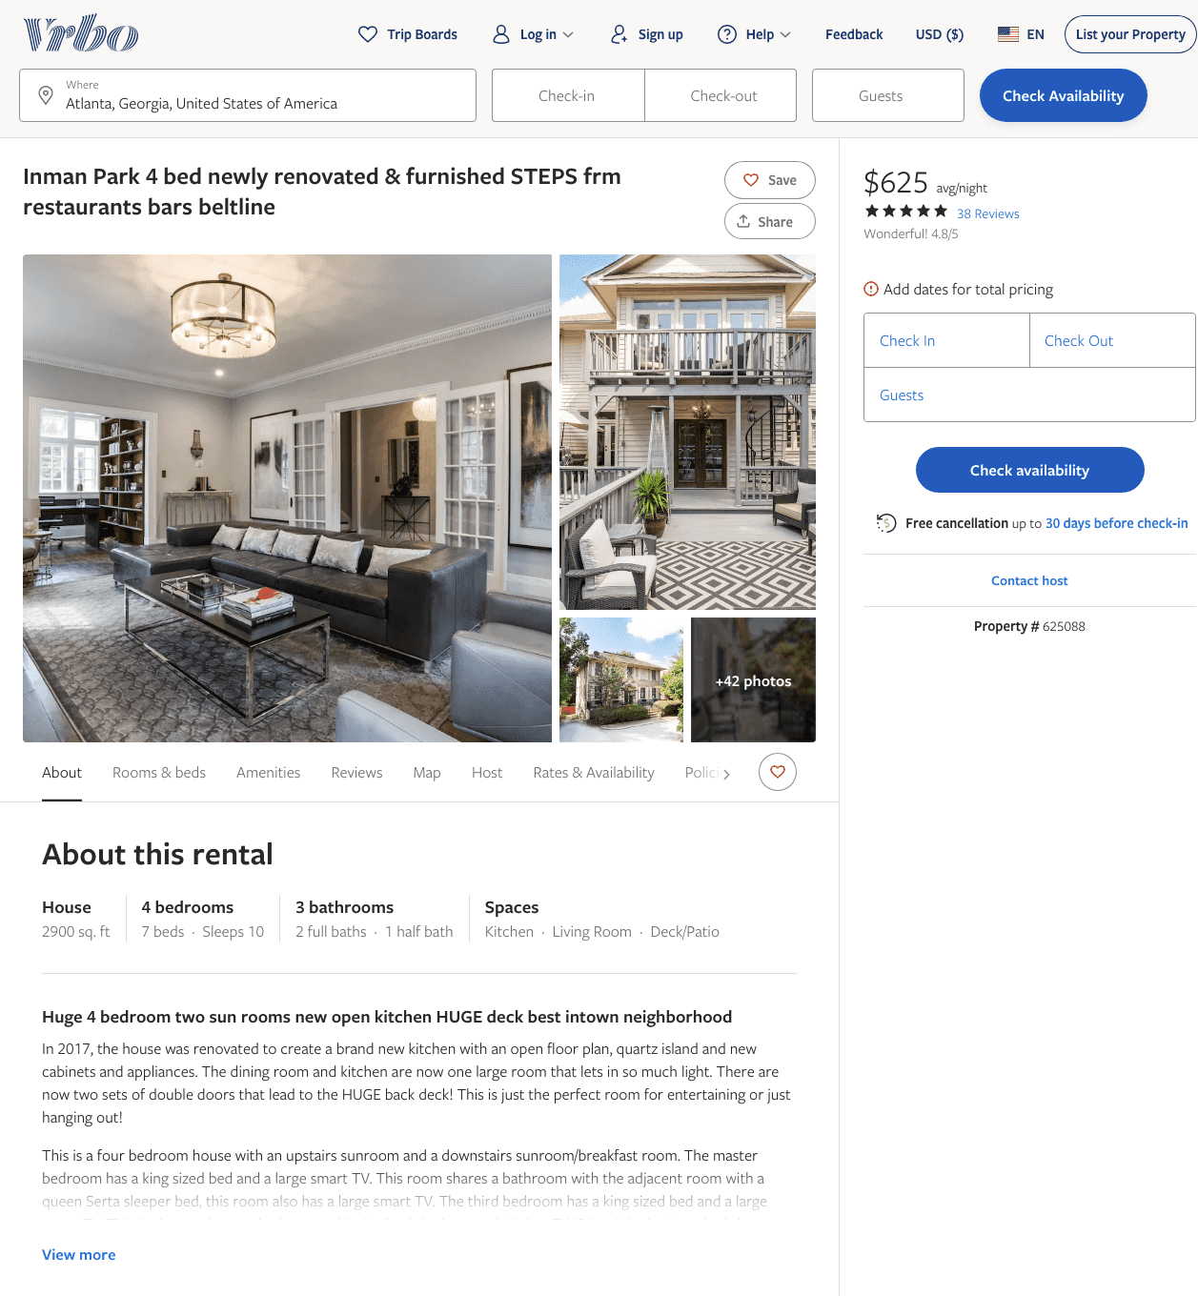
Listing 625088
4
10
$558 - $627
4.7708335
2
Nancy Leacock Daly
https://www.vrbo.com/625088
Aug 2022

Slide 3
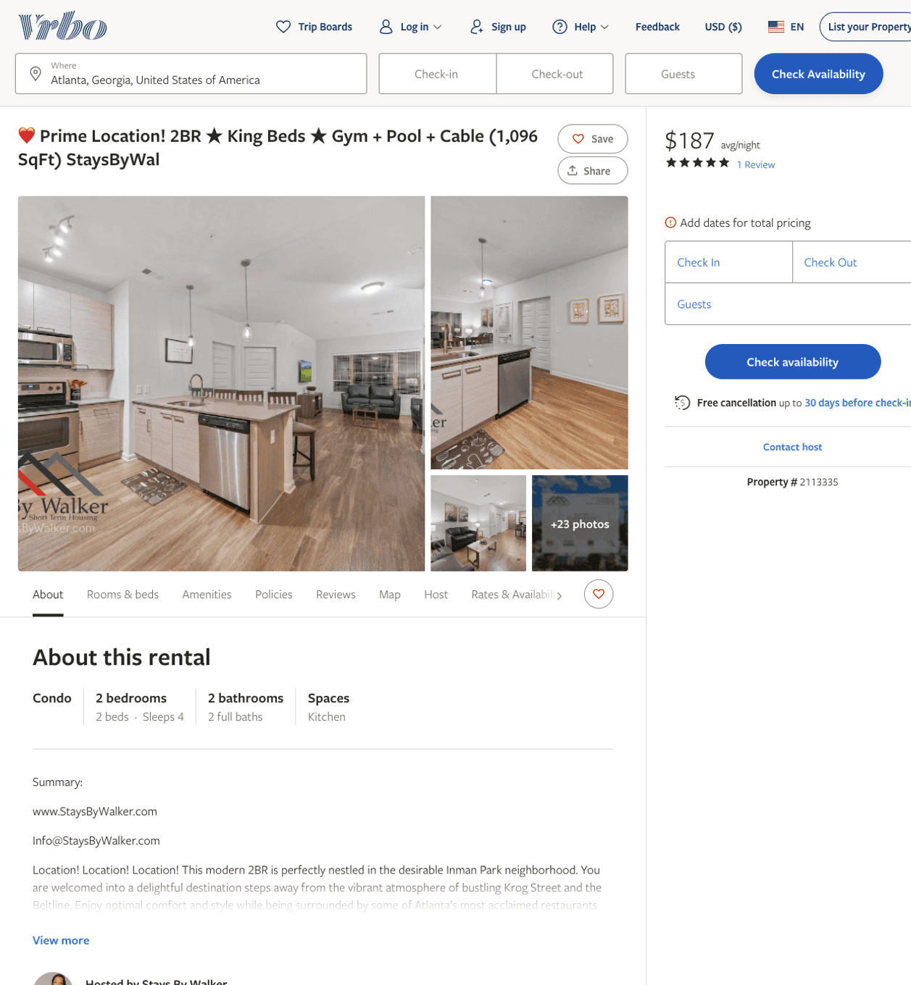
Listing 2113335
2
4
$181 - $266
5
7
Stays By Walker
https://www.vrbo.com/2113335
Aug 2022

Slide 4
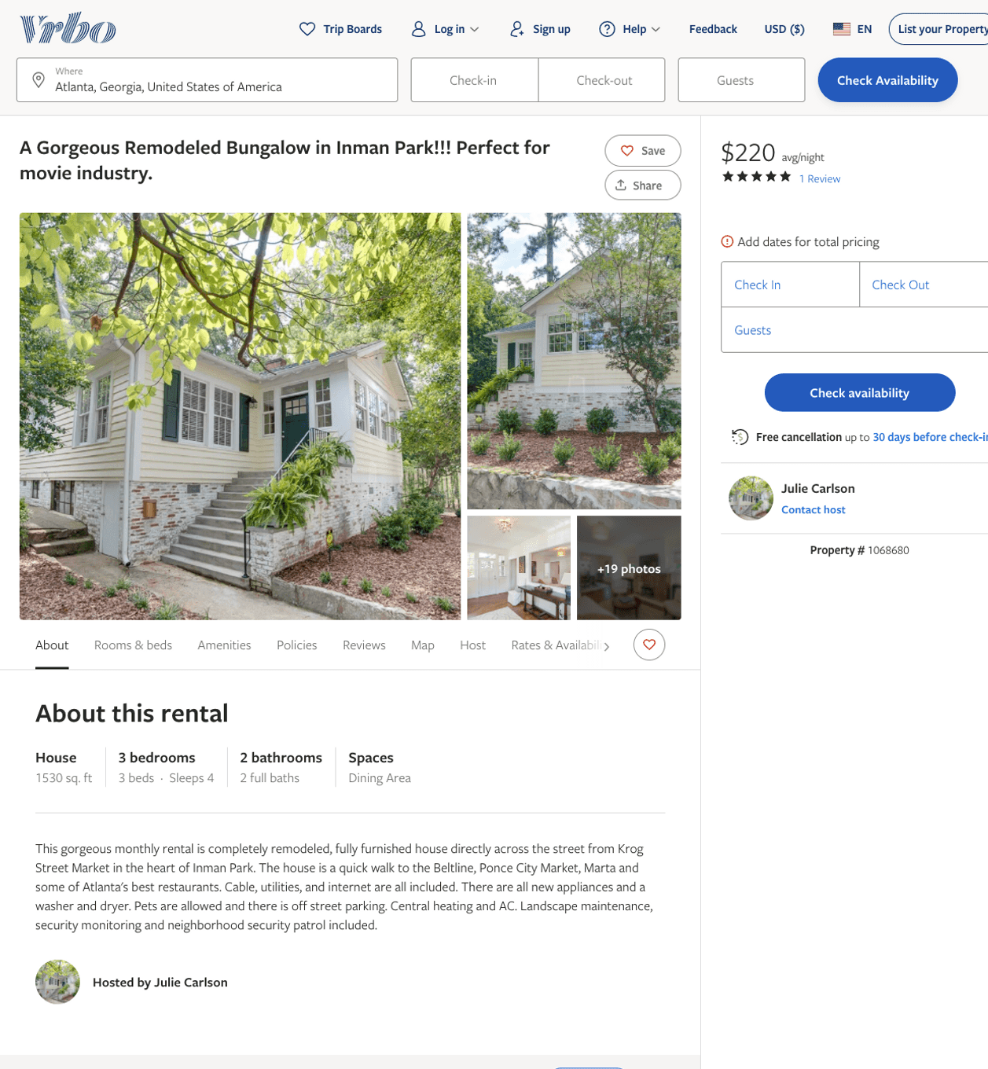
Listing 1068680
3
4
$220 - $250
5
30
Julie Carlson
https://www.vrbo.com/1068680
Aug 2022

Slide 5
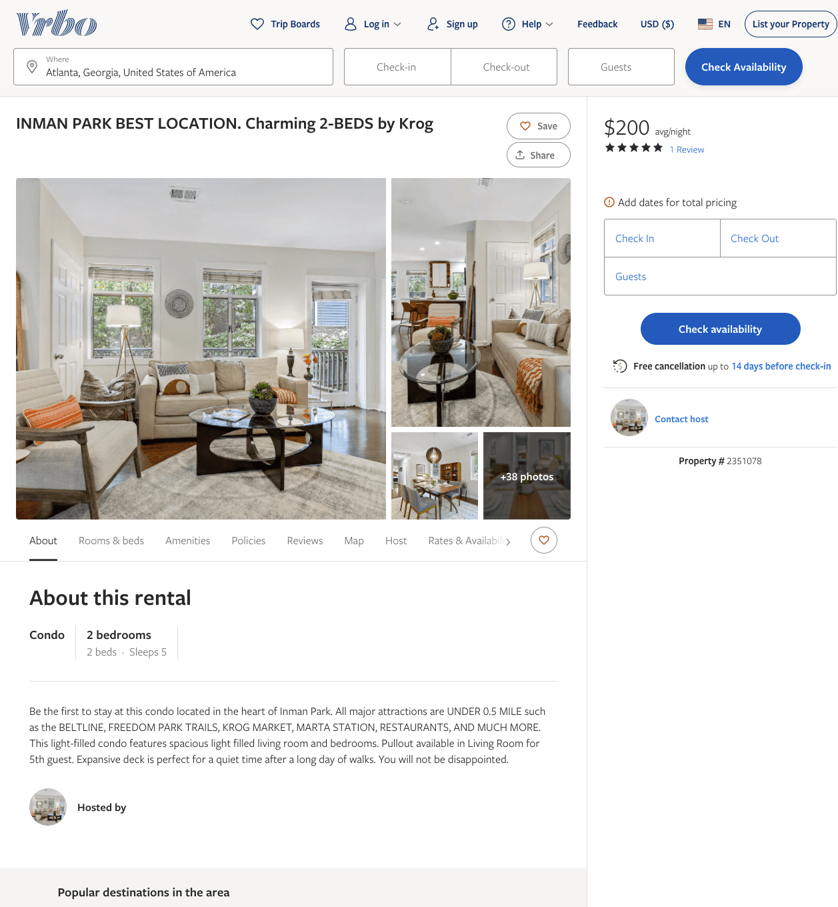
Listing 2351078
2
3
$159 - $200
5
4
https://www.vrbo.com/2351078
Aug 2022

Slide 6
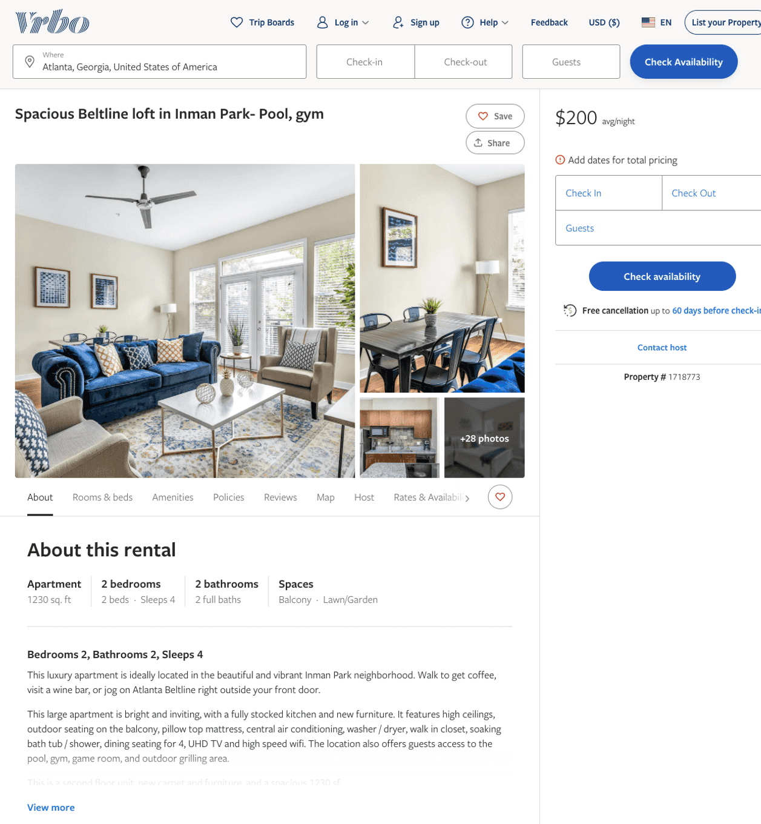
Listing 1718773
2
4
$180 - $200
4
Stewart Wyne
https://www.vrbo.com/1718773
Aug 2022

Slide 7
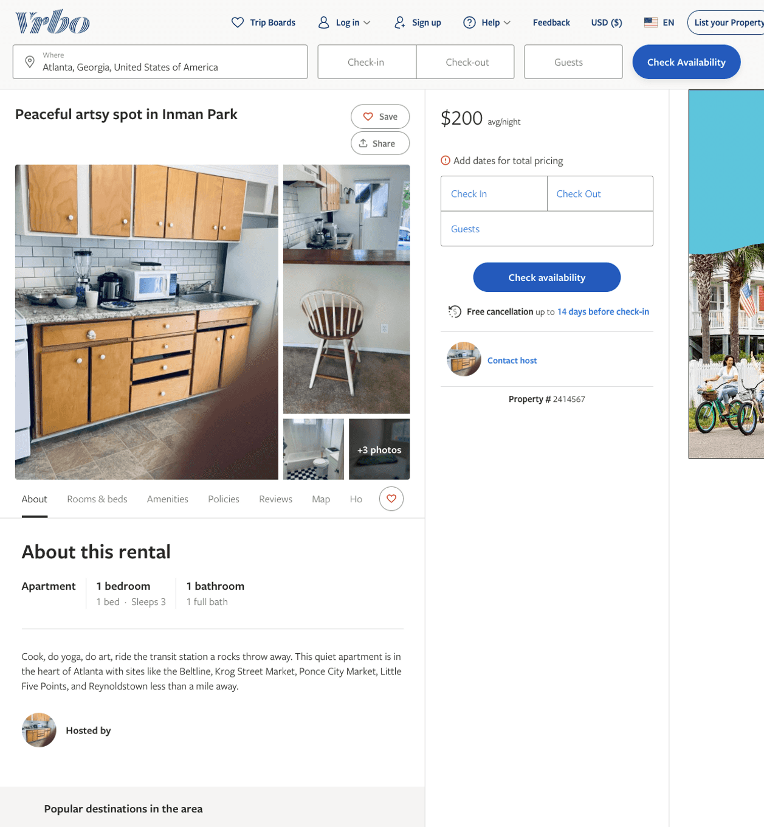
Listing 2414567
1
3
$200
1
https://www.vrbo.com/2414567
Aug 2022

Slide 8
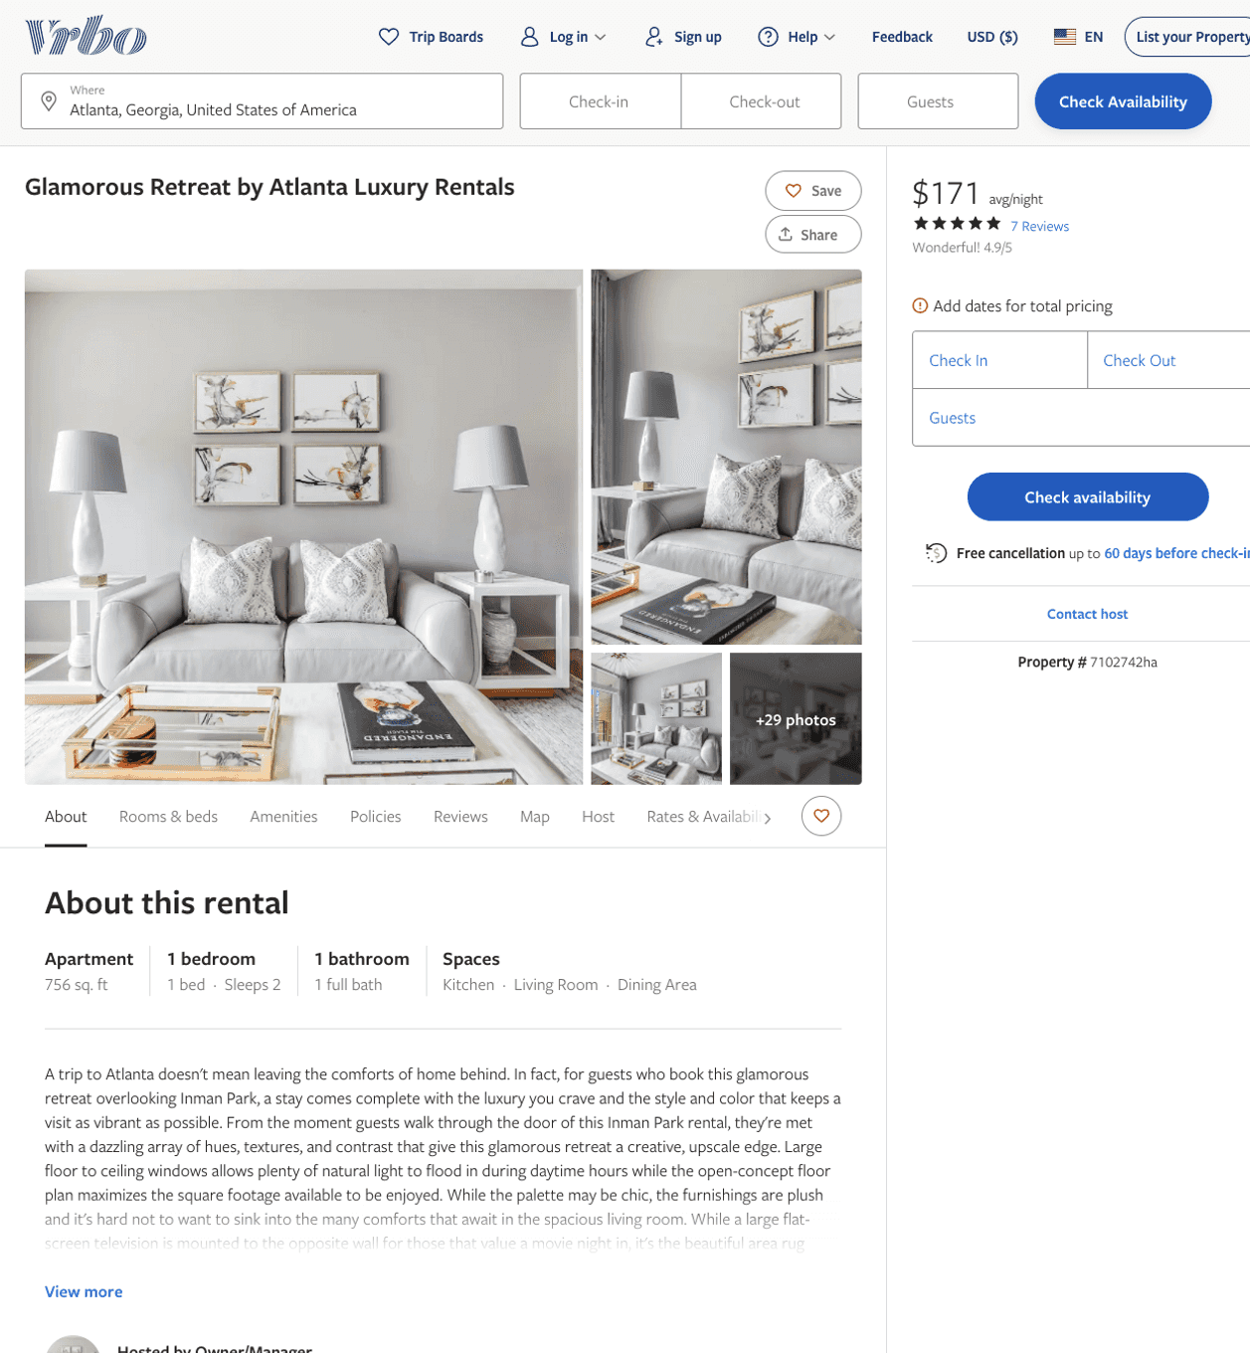
Listing 7102742
1
2
$155 - $211
4.9333334
2
Owner/Manager
https://www.vrbo.com/7102742ha
Aug 2022

Slide 9
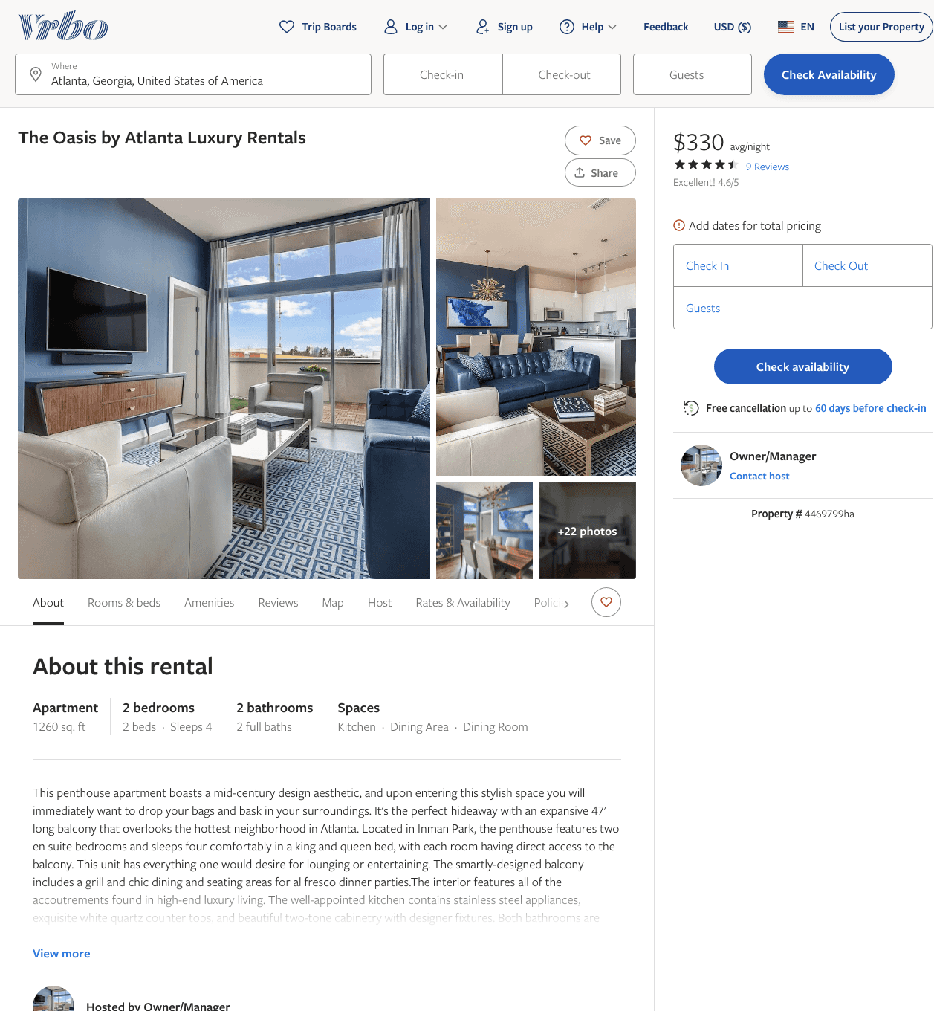
Listing 4469799
2
4
$277 - $385
4.6
2
Owner/Manager
https://www.vrbo.com/4469799ha
Aug 2022

Slide 10
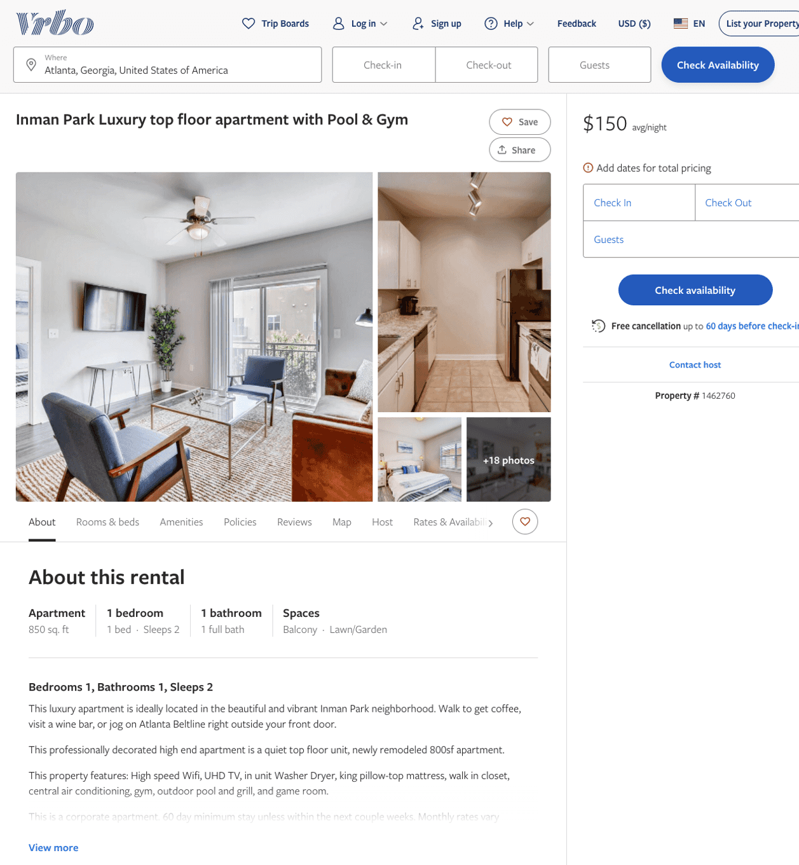
Listing 1462760
1
2
$126 - $172
4
Stewart Wyne
https://www.vrbo.com/1462760
Aug 2022

Slide 11
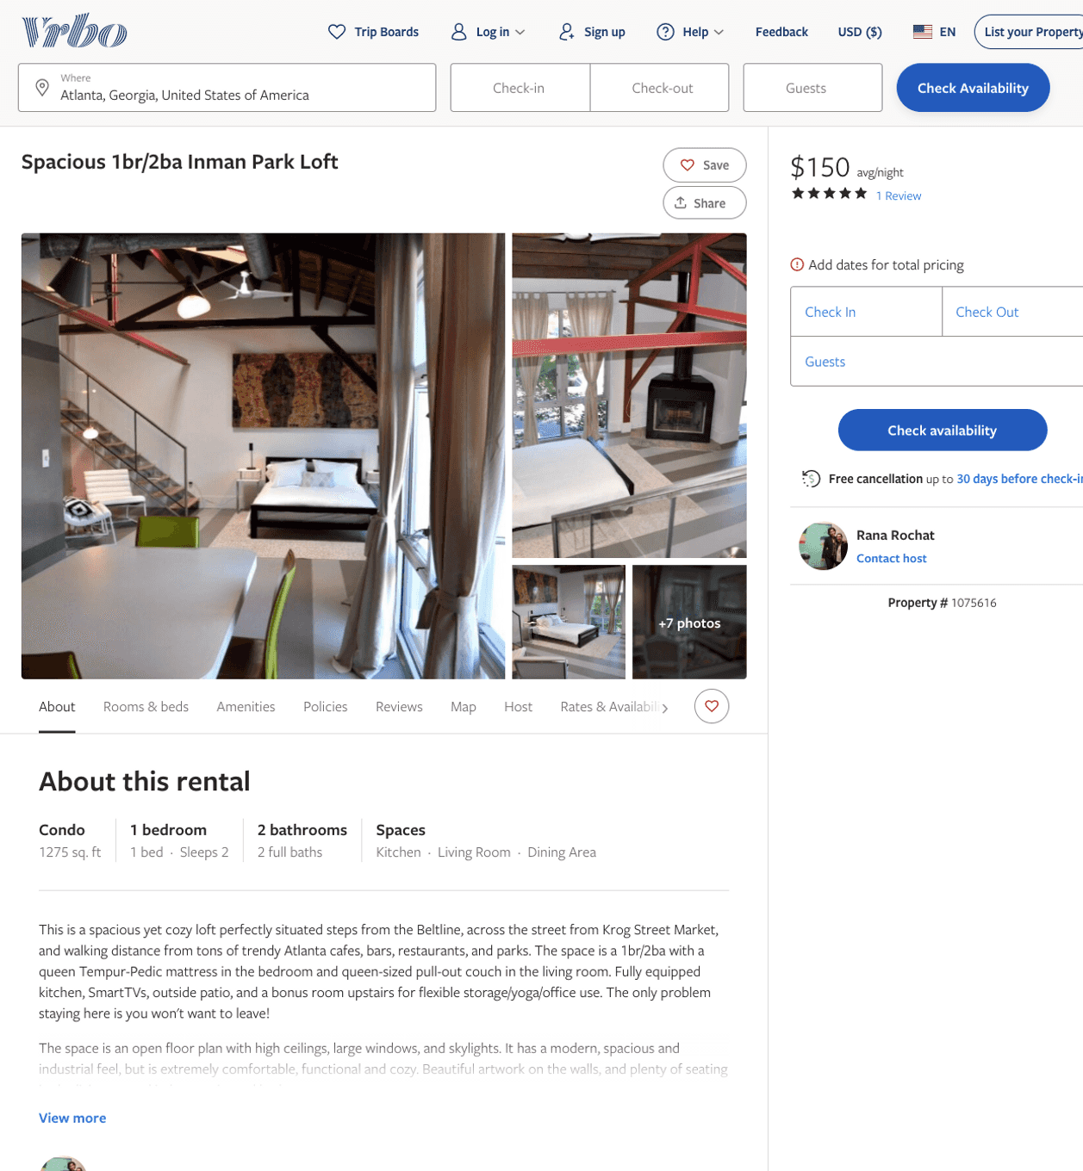
Listing 1075616
1
2
$150
5
15
Rana Rochat
https://www.vrbo.com/1075616
Aug 2022

Slide 12
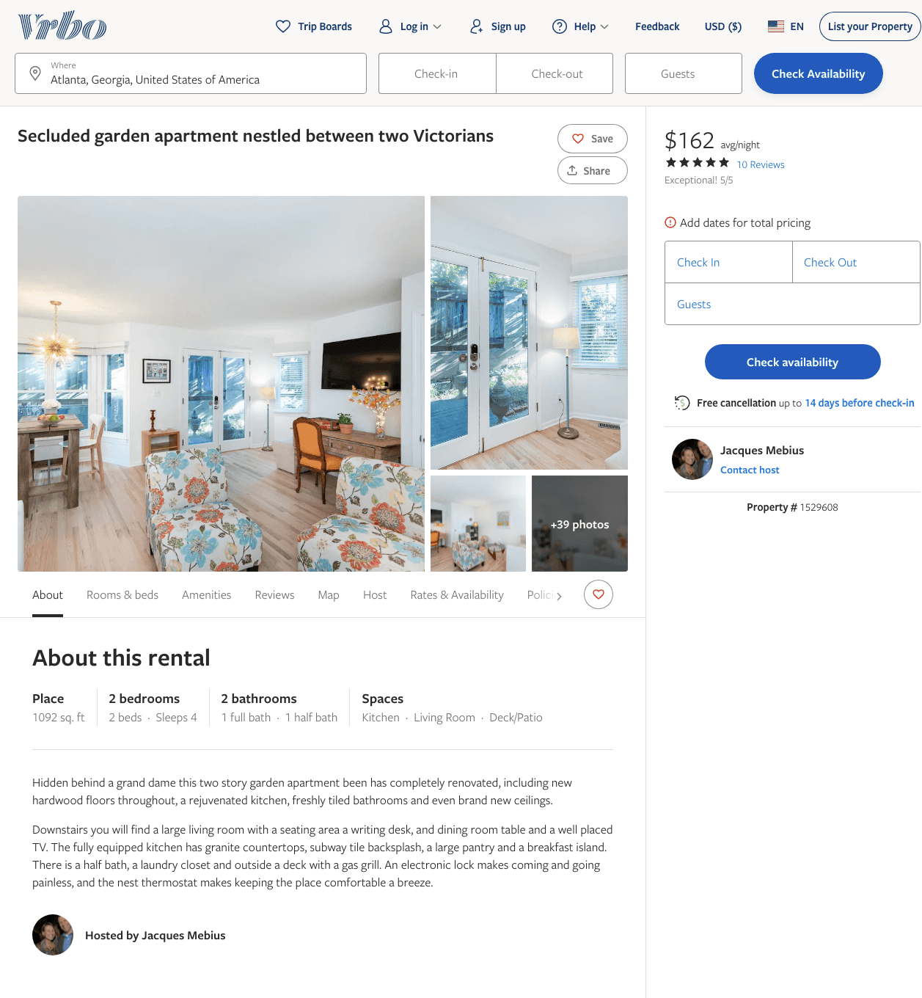
Listing 1529608
2
4
$116 - $162
5
30
Jacques Mebius
https://www.vrbo.com/1529608
Aug 2022

Slide 13
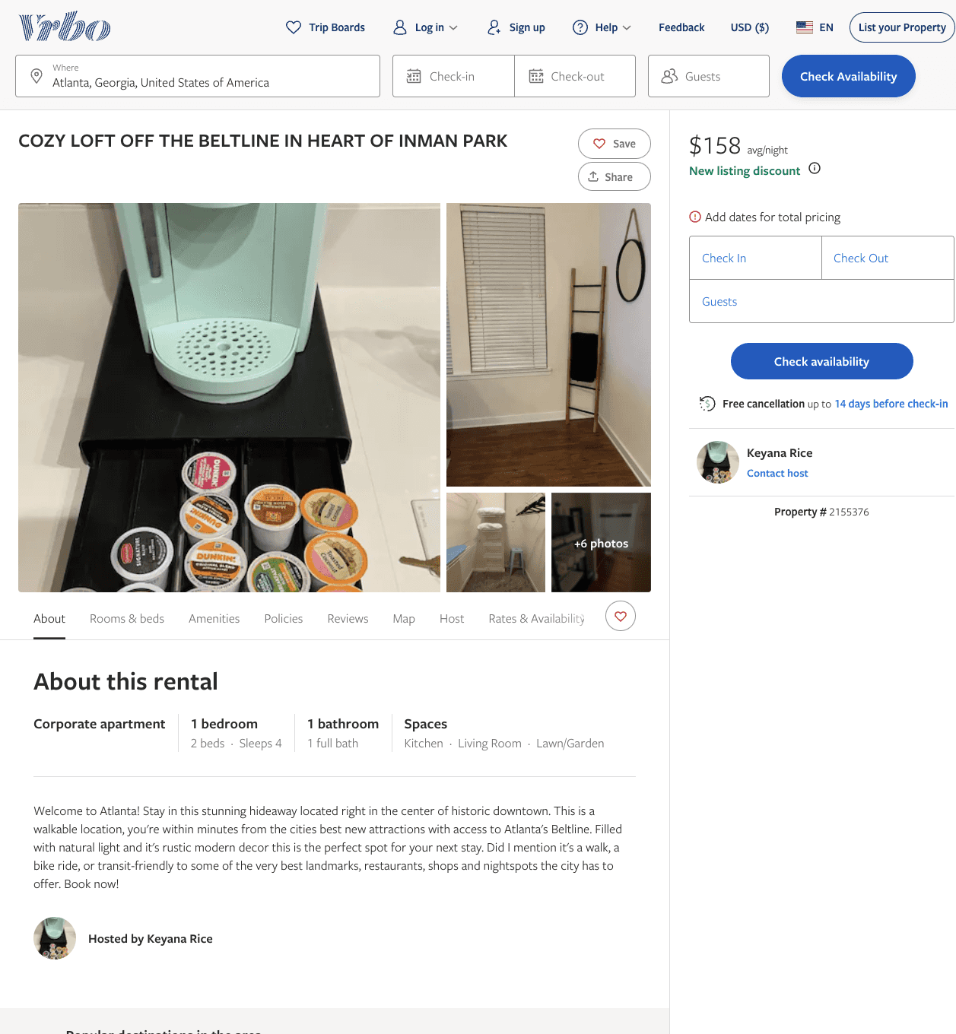
Listing 2155376
1
4
$158 - $202
2
Keyana Rice
https://www.vrbo.com/2155376
Aug 2022

Slide 14
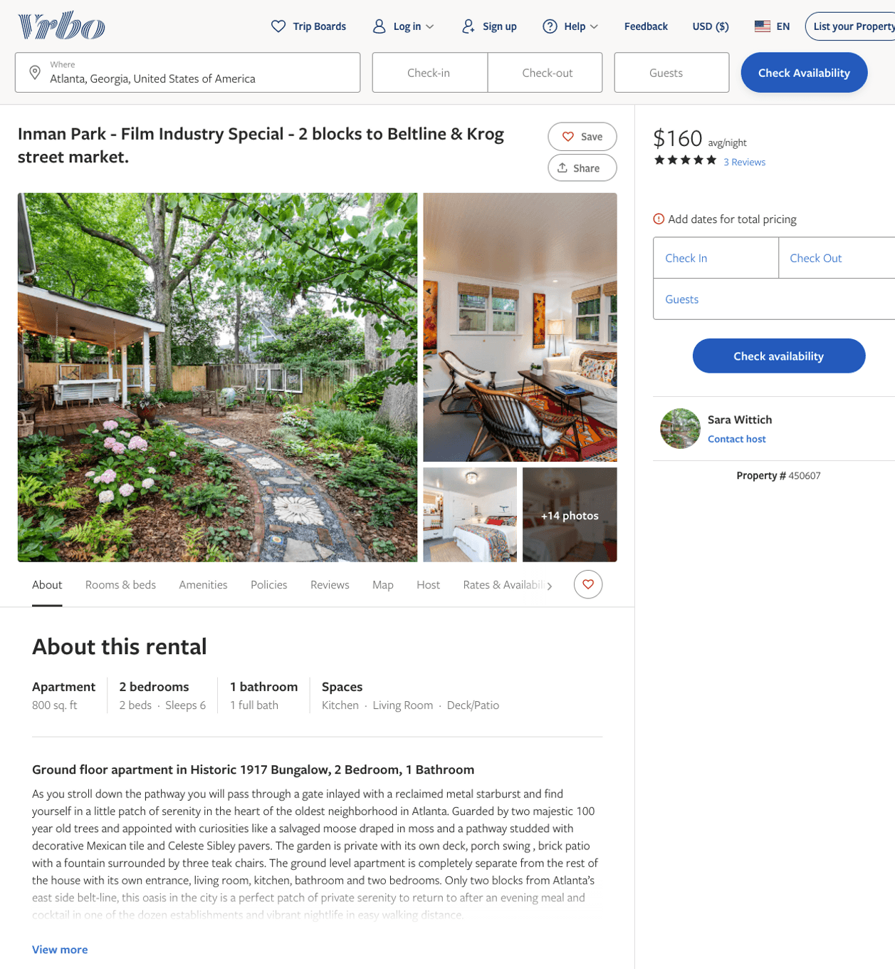
Listing 450607
2
6
$160
5
90
Sara Wittich
https://www.vrbo.com/450607
Aug 2022

Slide 15
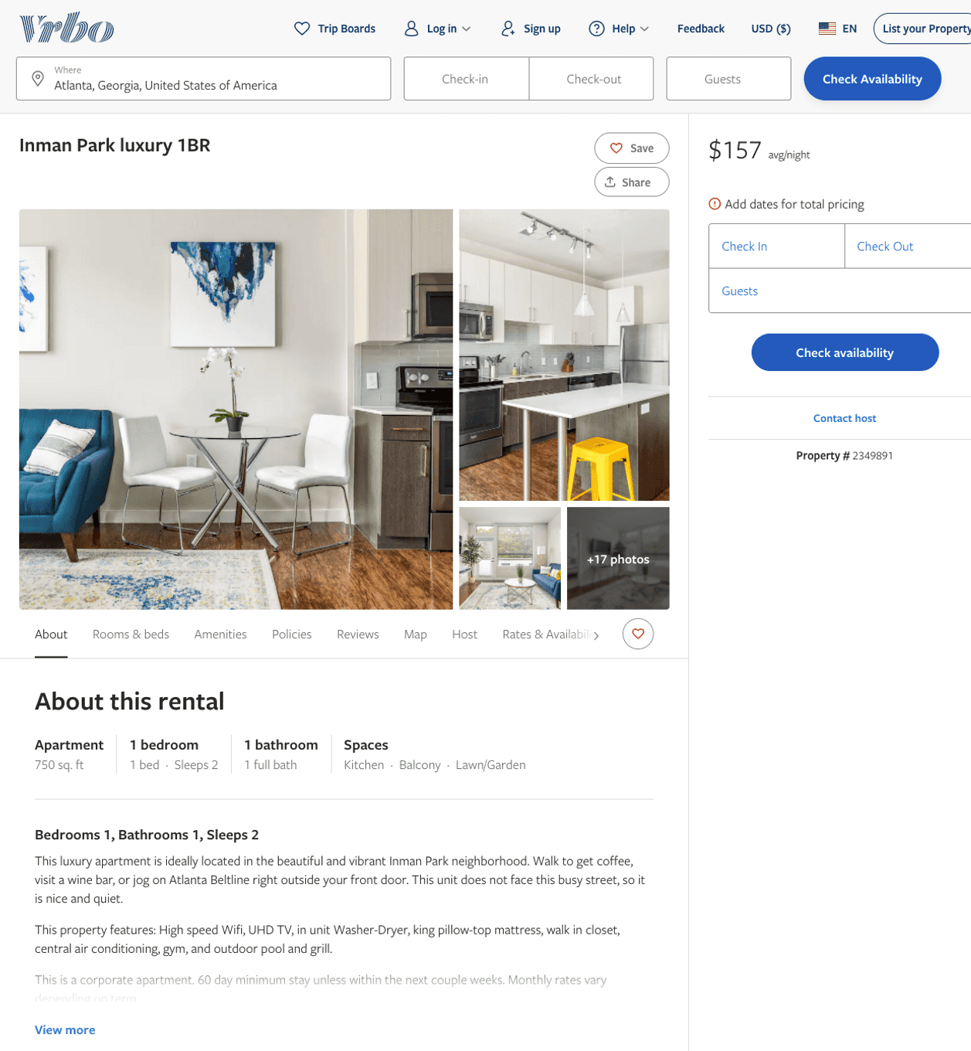
Listing 2349891
1
2
$135 - $165
4
Stewart Wyne
https://www.vrbo.com/2349891
Aug 2022

Slide 16
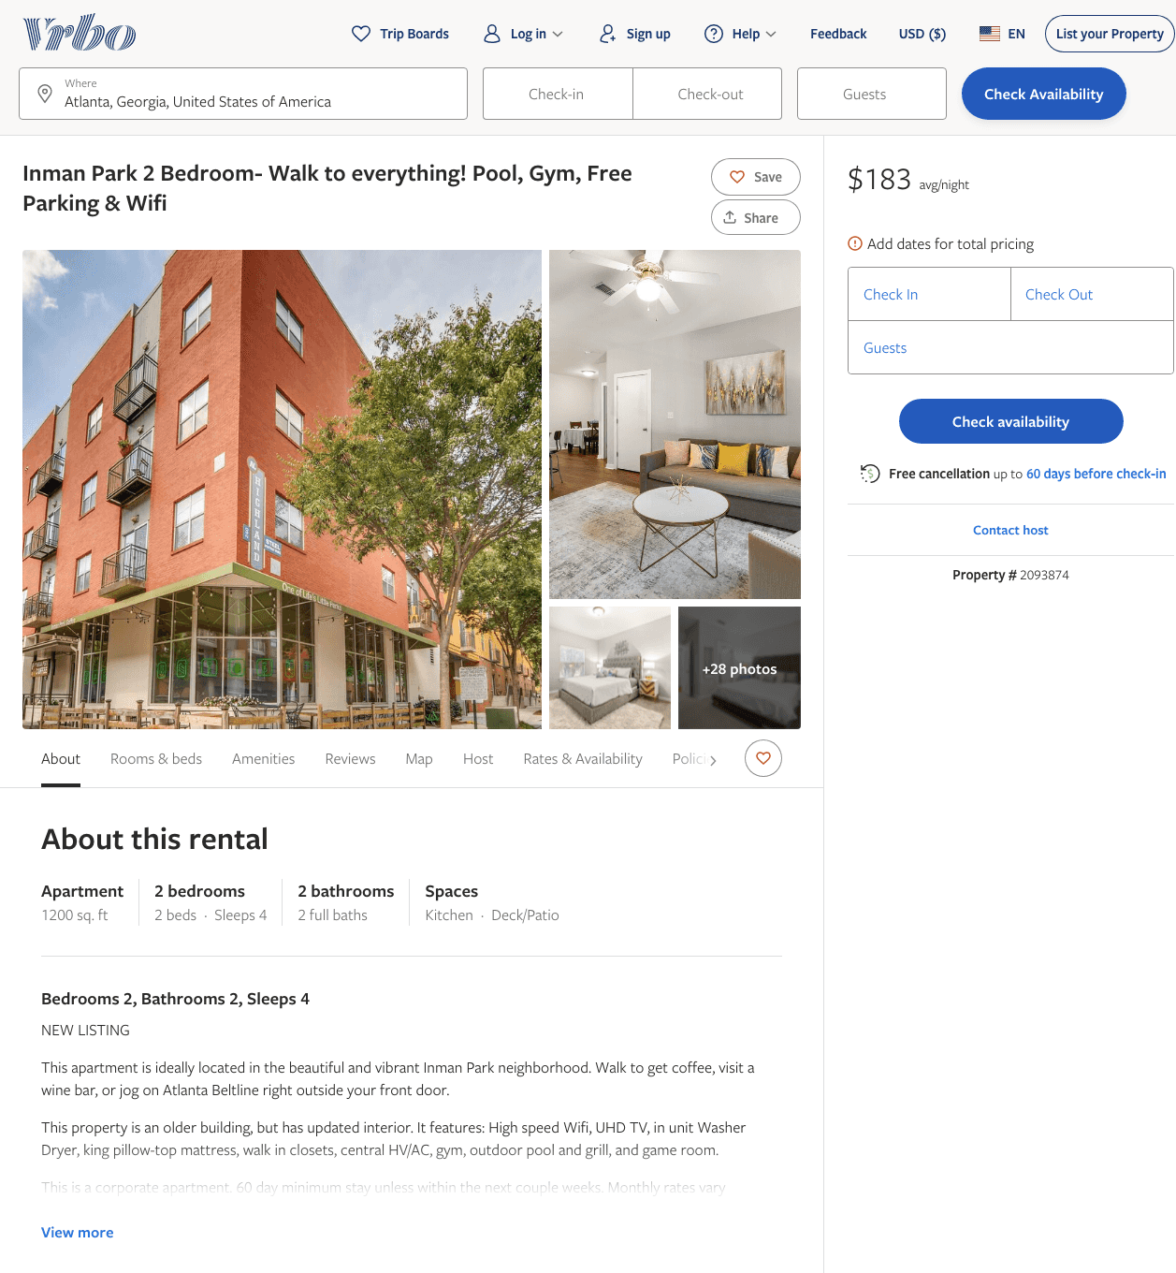
Listing 2093874
2
4
$160 - $400
4
Stewart Wyne
https://www.vrbo.com/2093874
Aug 2022

Slide 17
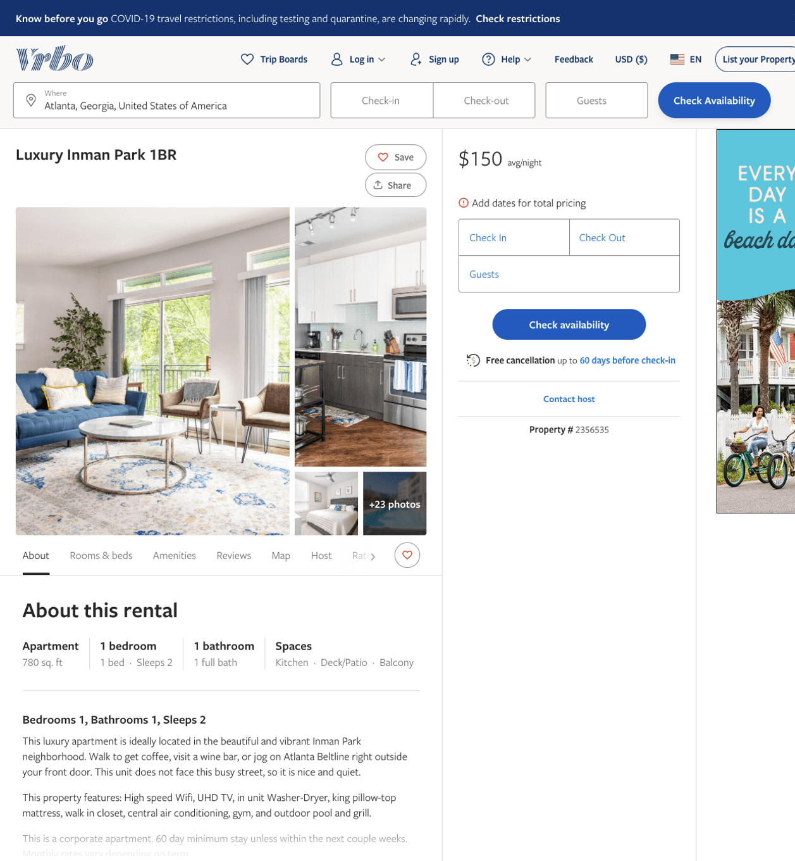
Listing 2356535
1
2
$150 - $205
4
Stewart Wyne
https://www.vrbo.com/2356535
Aug 2022

Slide 18
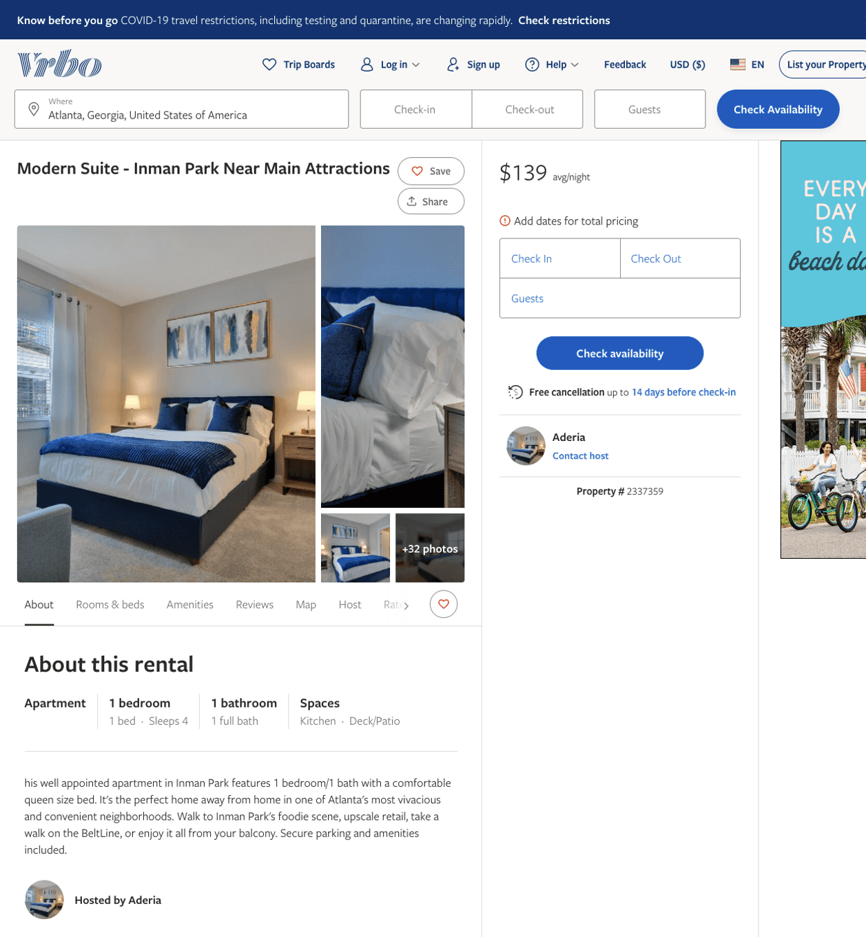
Listing 2337359
1
4
$139
5
Aderia
https://www.vrbo.com/2337359
Aug 2022

Slide 19
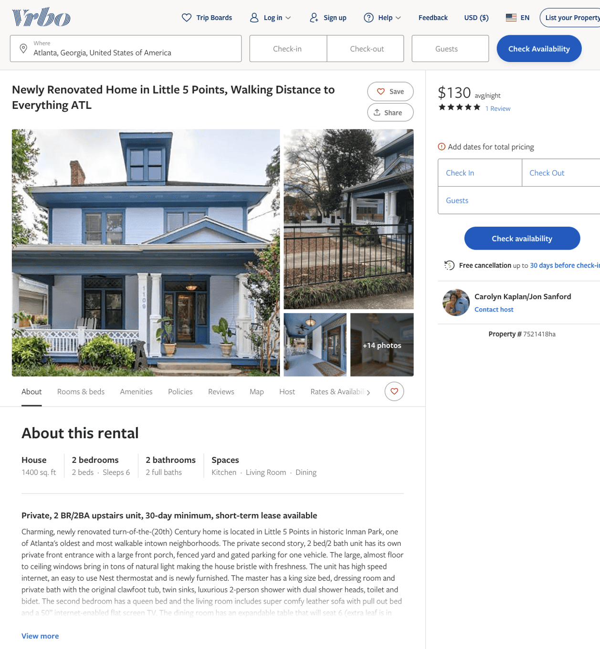
Listing 7521418
2
6
$124 - $150
5
30
Carolyn Kaplan/Jon Sanford
https://www.vrbo.com/7521418ha
Aug 2022

Slide 20
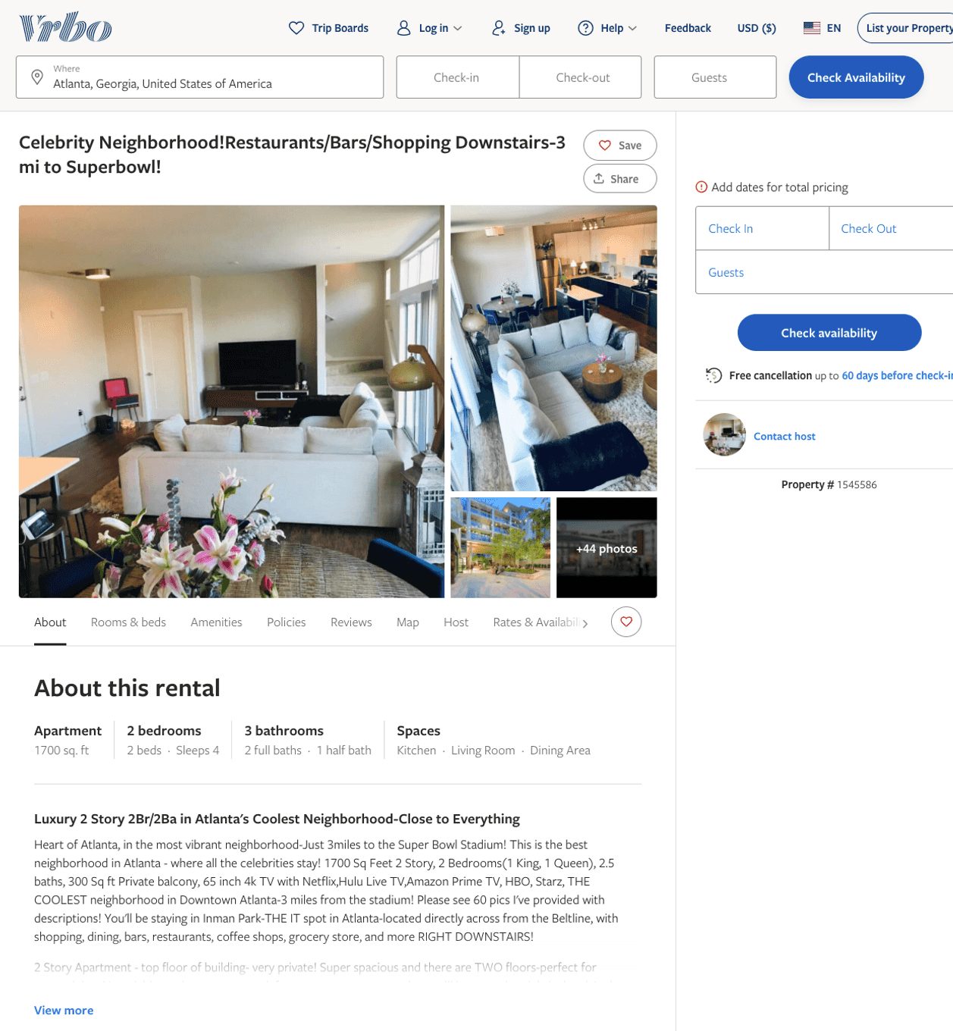
Listing 1545586
2
4
2
https://www.vrbo.com/1545586
Aug 2022

Slide 21
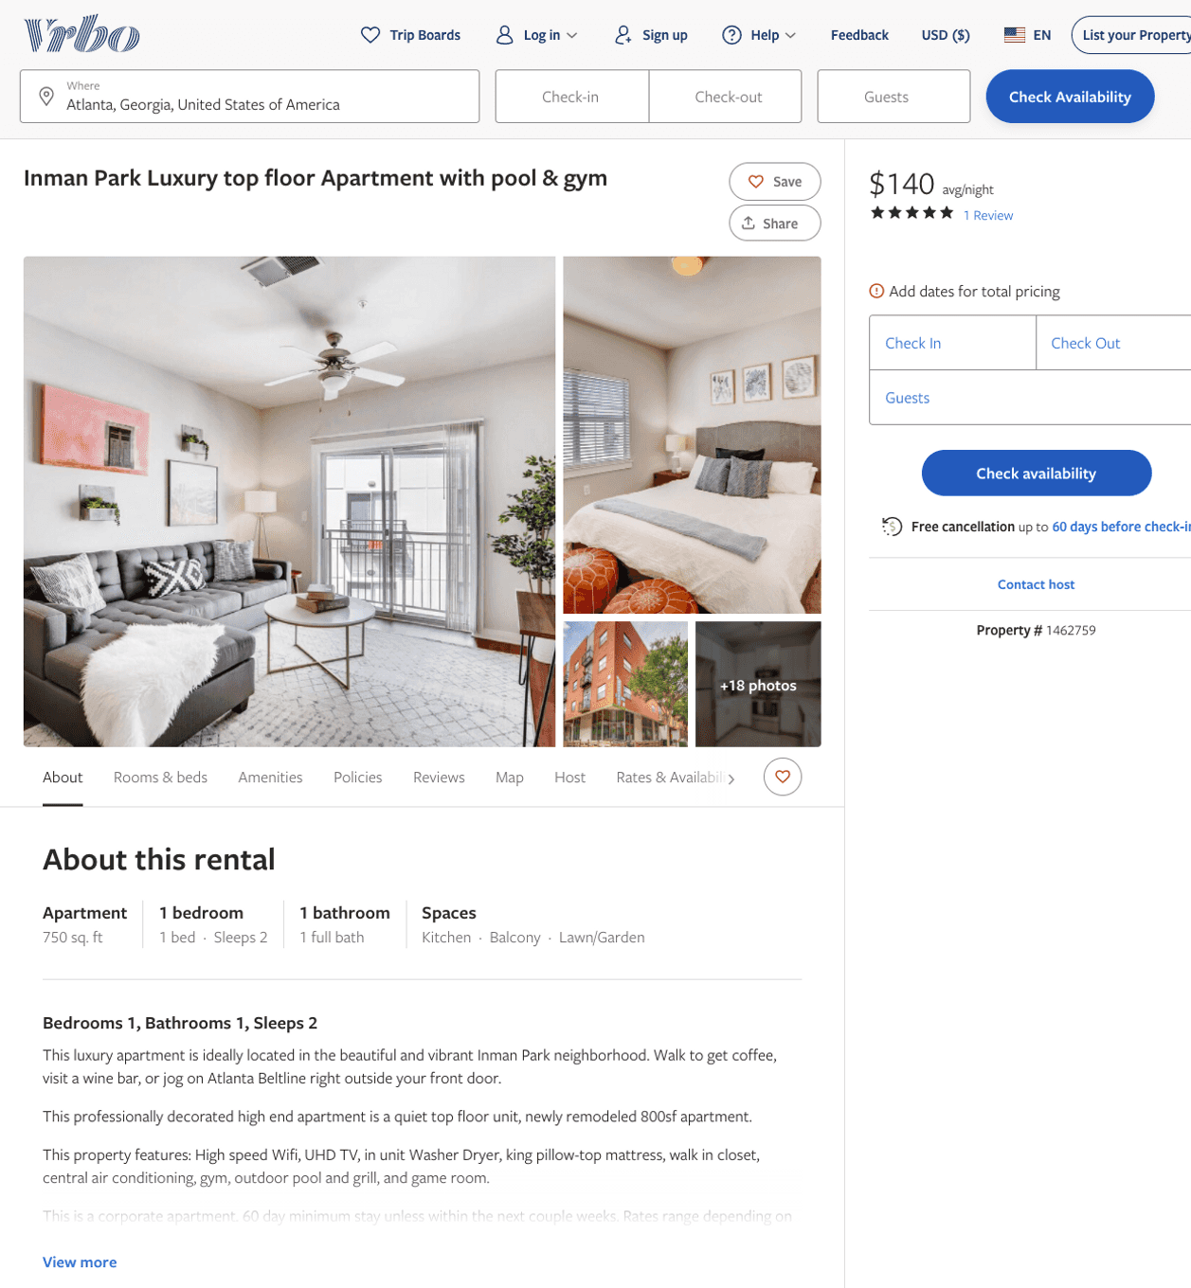
Listing 1462759
1
2
$140 - $152
5
4
Stewart Wyne
https://www.vrbo.com/1462759
Aug 2022

Slide 22
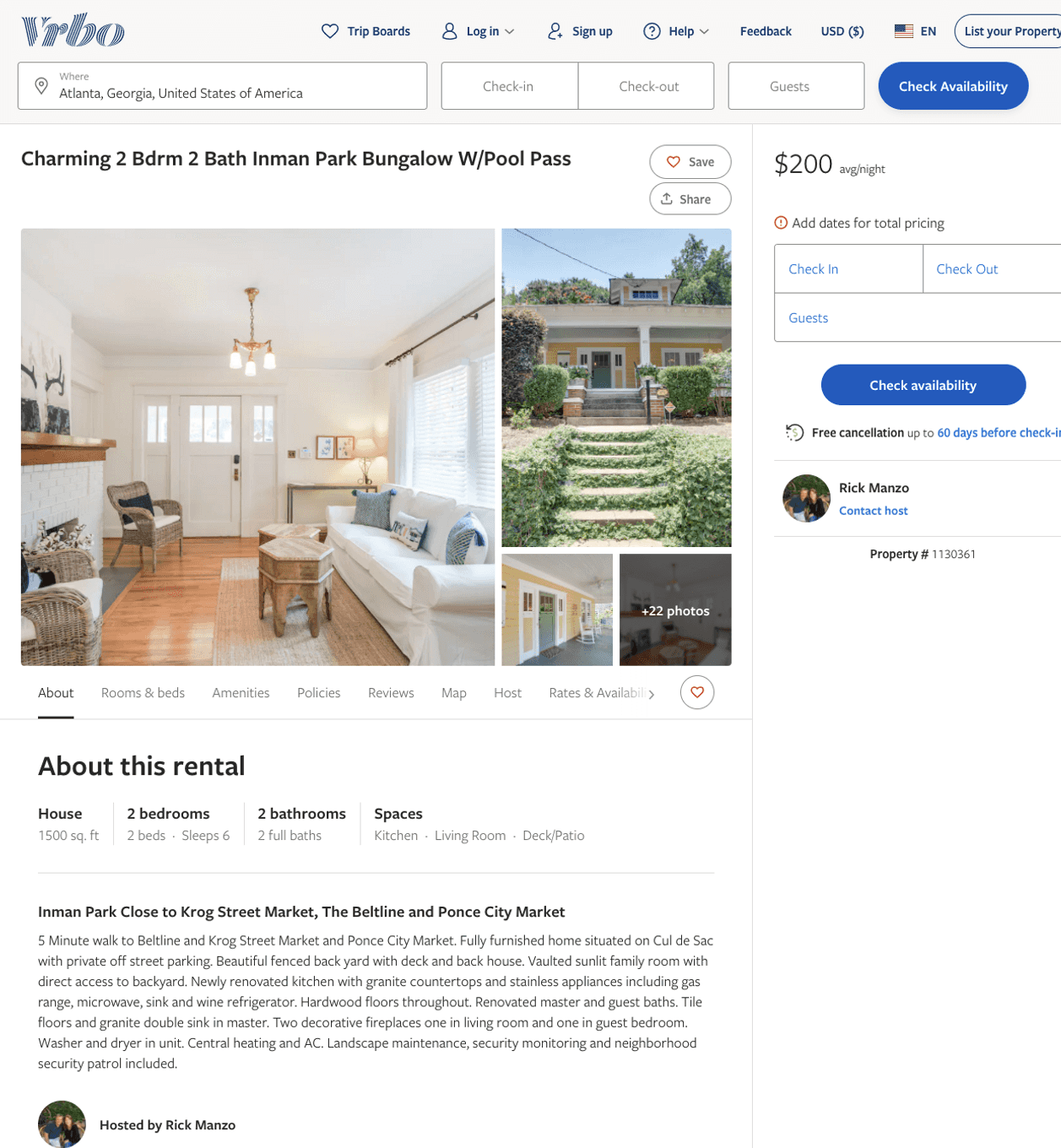
Listing 1130361
2
6
$200
4
Rick Manzo
https://www.vrbo.com/1130361
Aug 2022

Slide 23
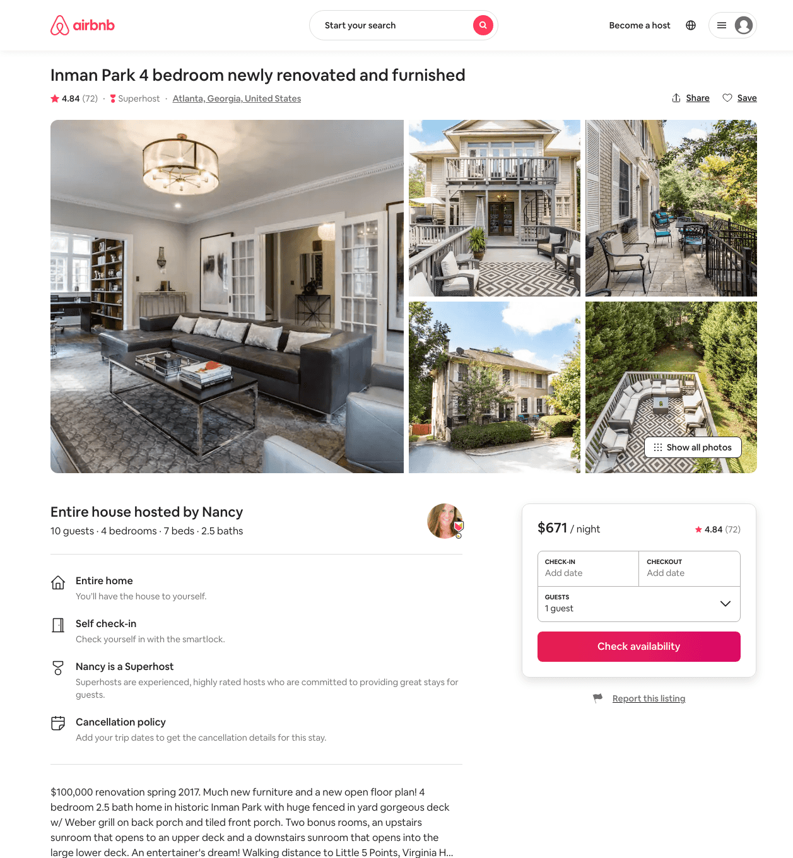
Listing 3217443
4
10
$420 - $795
4.88
3
Nancy
2773373
9
https://www.airbnb.com/rooms/3217443
Aug 2022

Slide 24
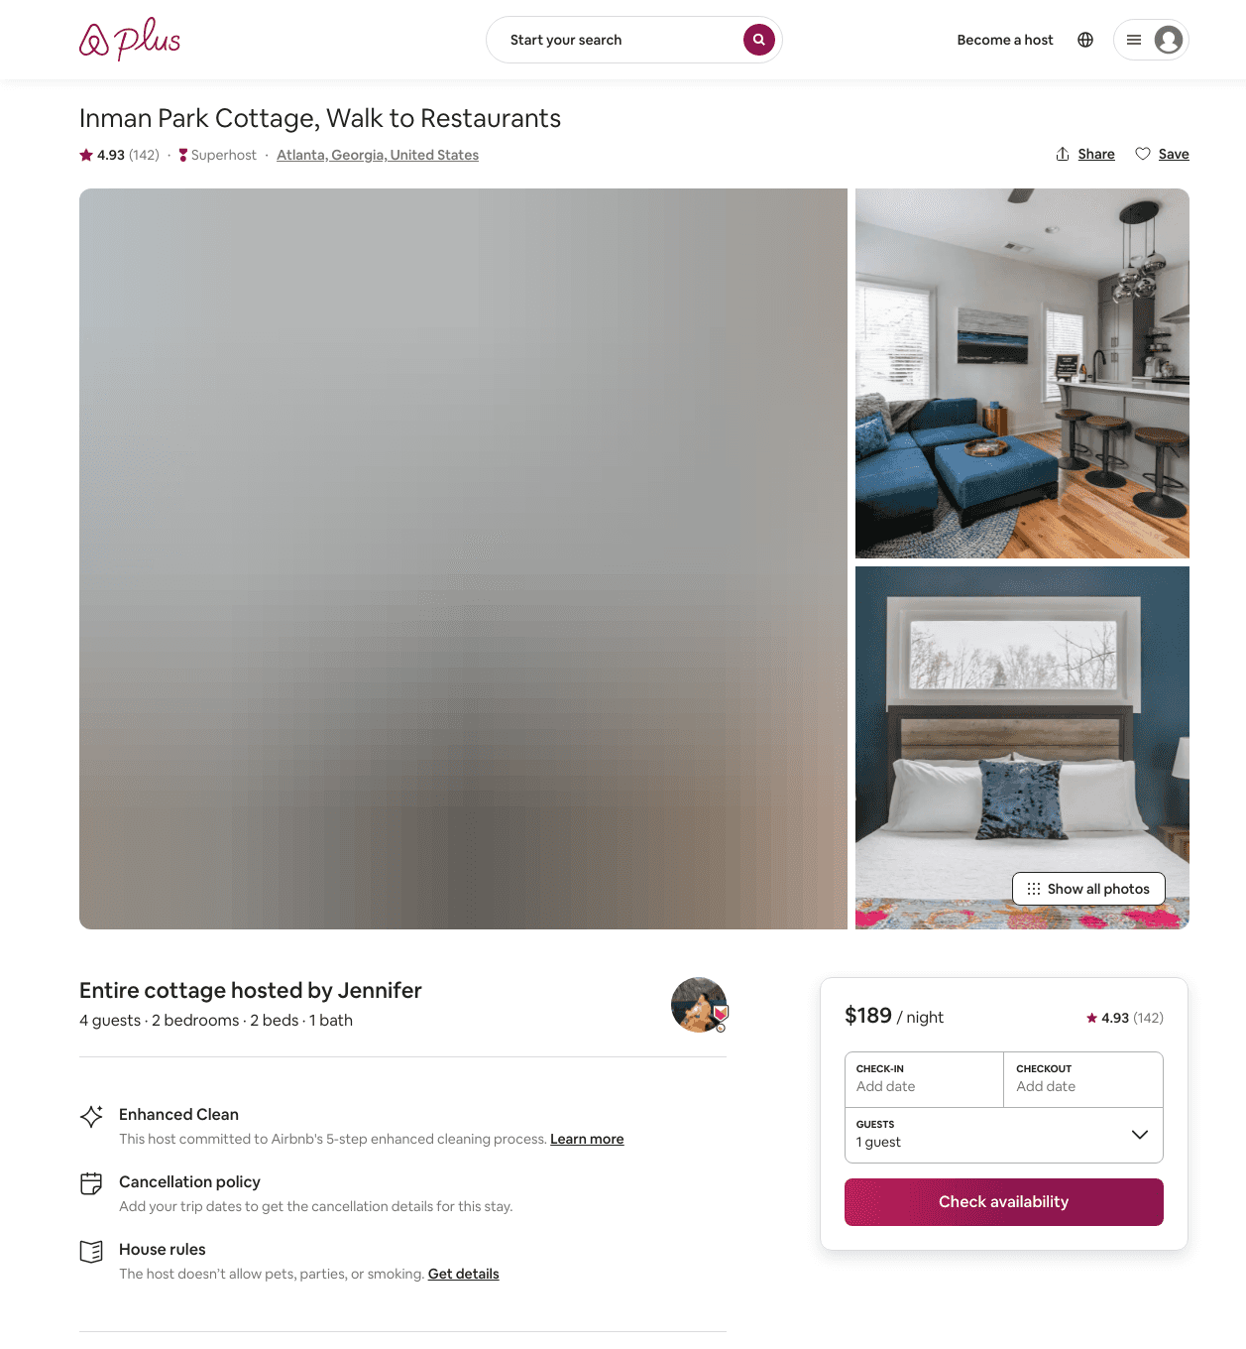
Listing 27624323
2
4
$151 - $189
4.96
2
Jennifer
99288147
1
https://www.airbnb.com/rooms/27624323
Aug 2022

Slide 25
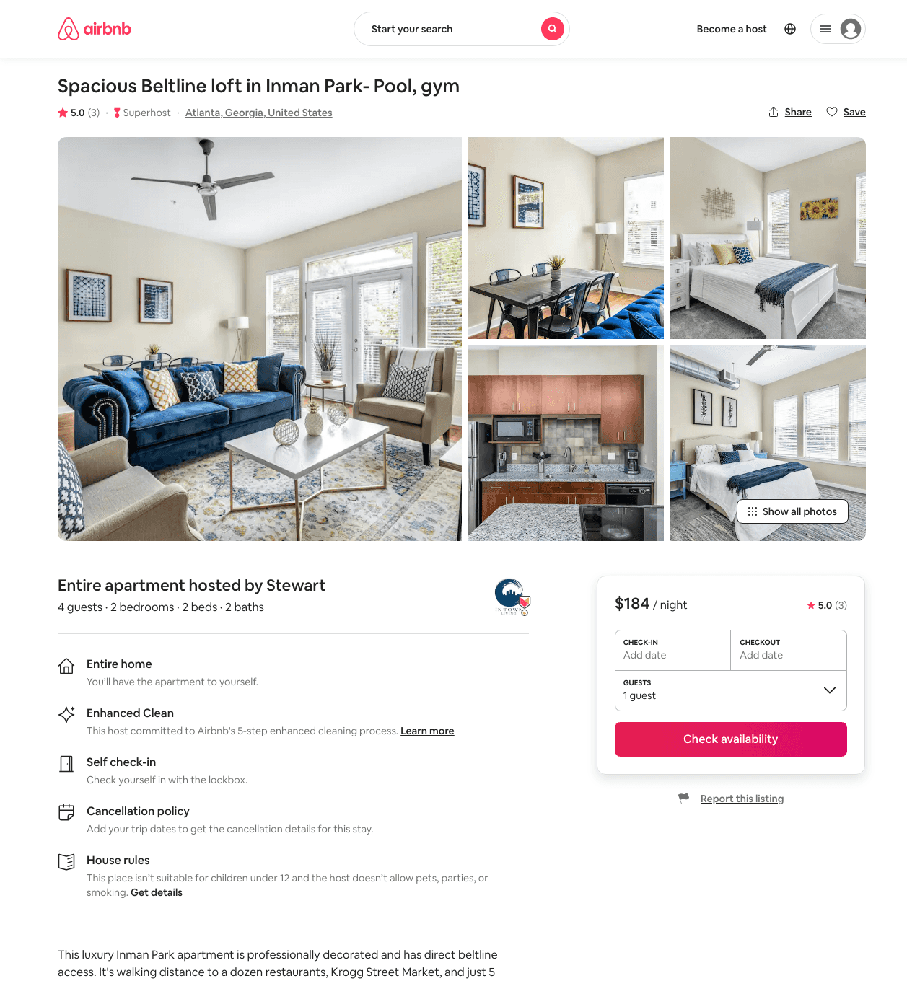
Listing 37089340
2
4
$180 - $255
5.0
58
Stewart
26798403
14
https://www.airbnb.com/rooms/37089340
Aug 2022

Slide 26
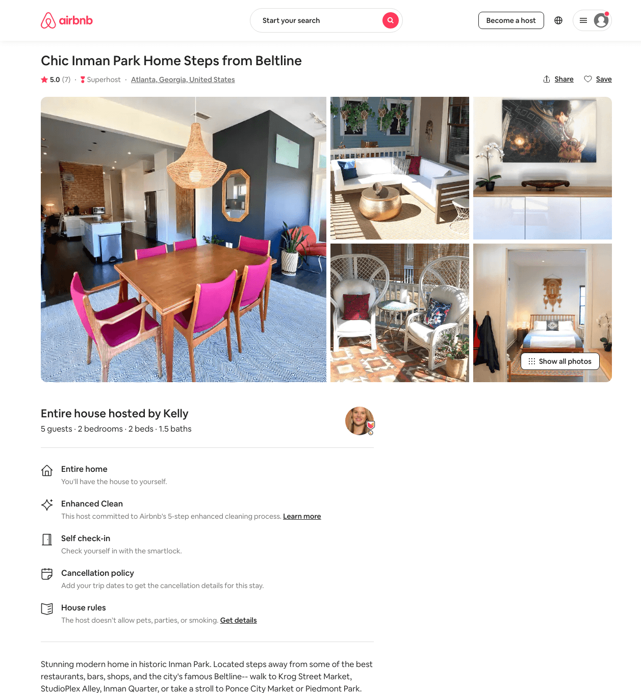
Listing 40368457
2
5
$175 - $282
4.95
3
Kelly
4632178
1
https://www.airbnb.com/rooms/40368457
Aug 2022

Slide 27
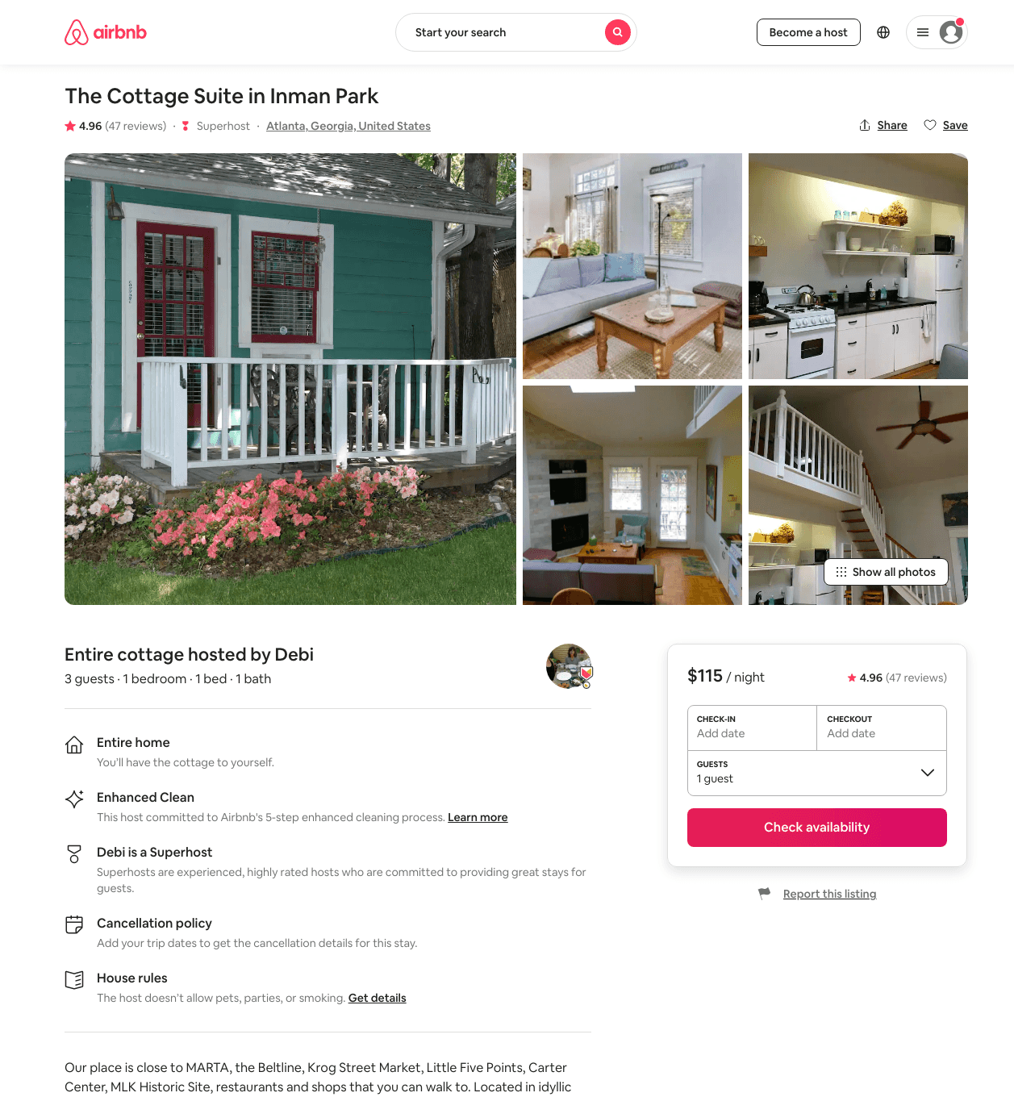
Listing 16576221
1
3
$115 - $127
4.97
2
Debi
17070866
1
https://www.airbnb.com/rooms/16576221
Aug 2022

Slide 28
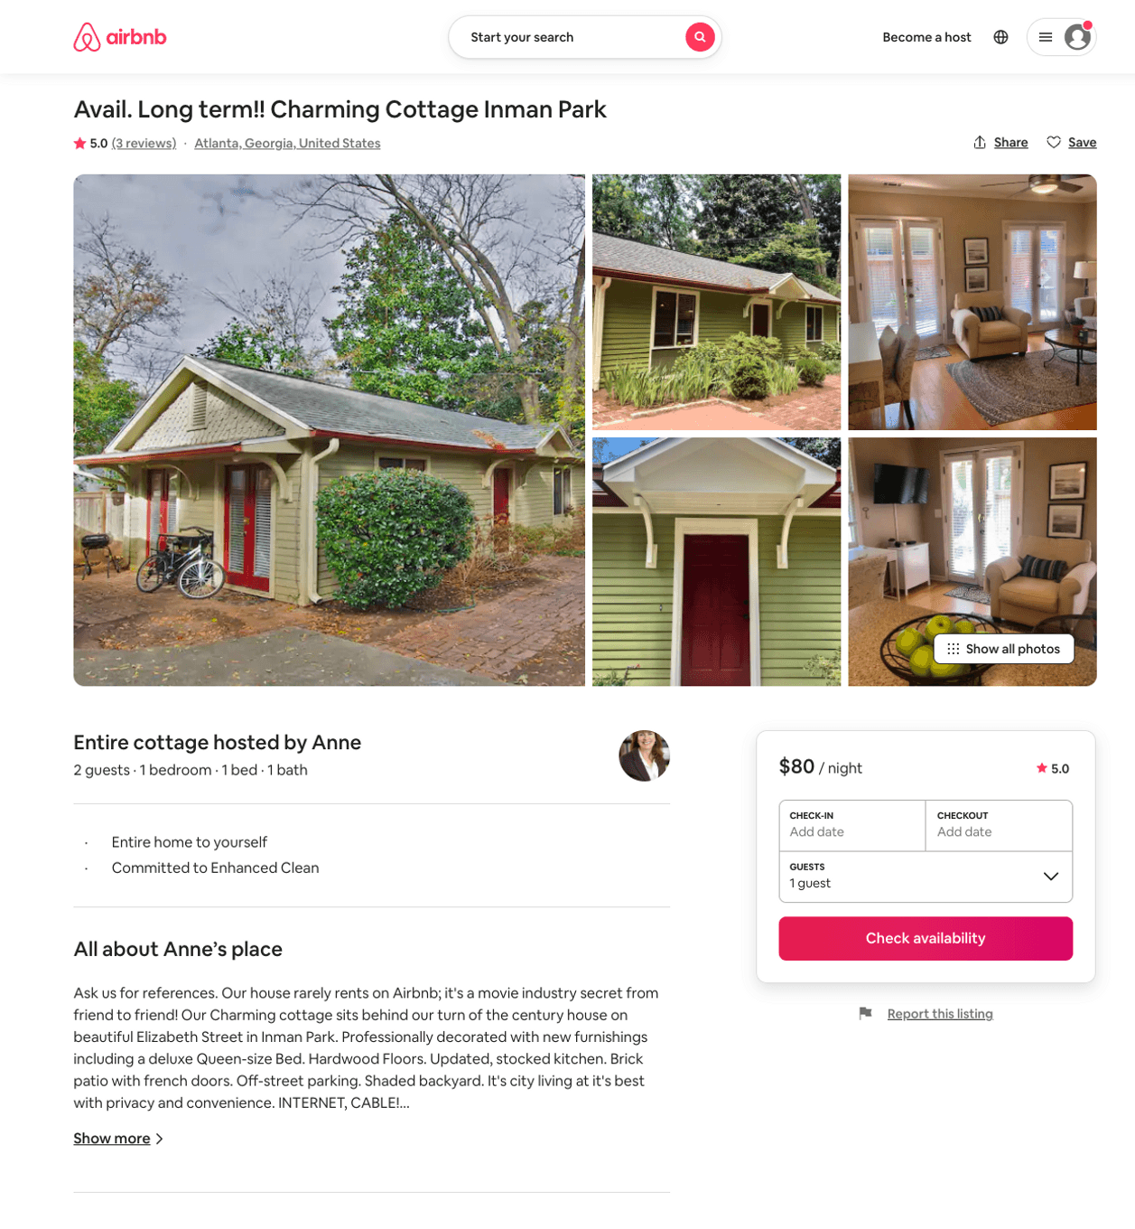
Listing 19656406
1
2
$75 - $80
5.0
30
Anne
44371401
1
https://www.airbnb.com/rooms/19656406
Aug 2022

Slide 29
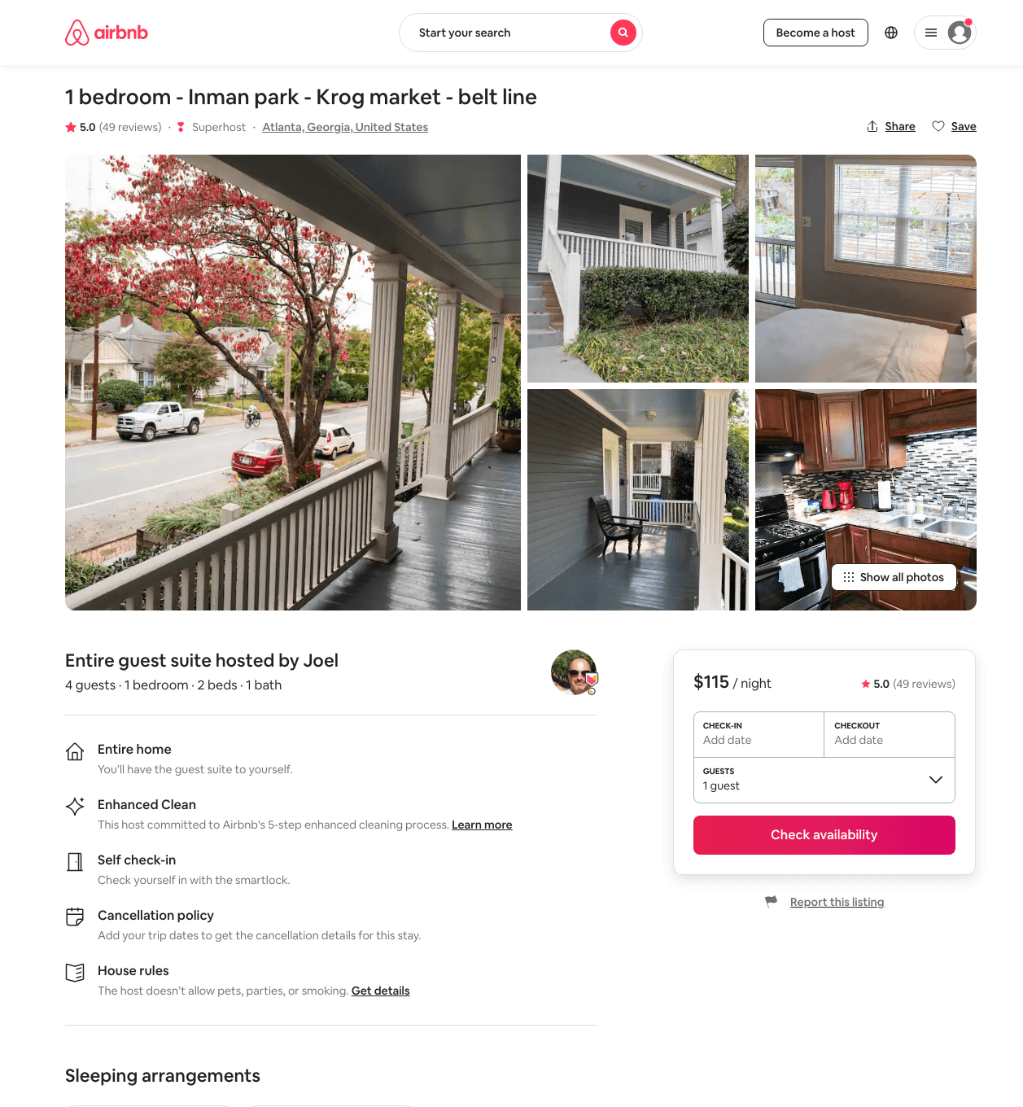
Listing 29079687
1
4
$110 - $124
5.0
3
Joel
13621491
2
https://www.airbnb.com/rooms/29079687
Aug 2022

Slide 30
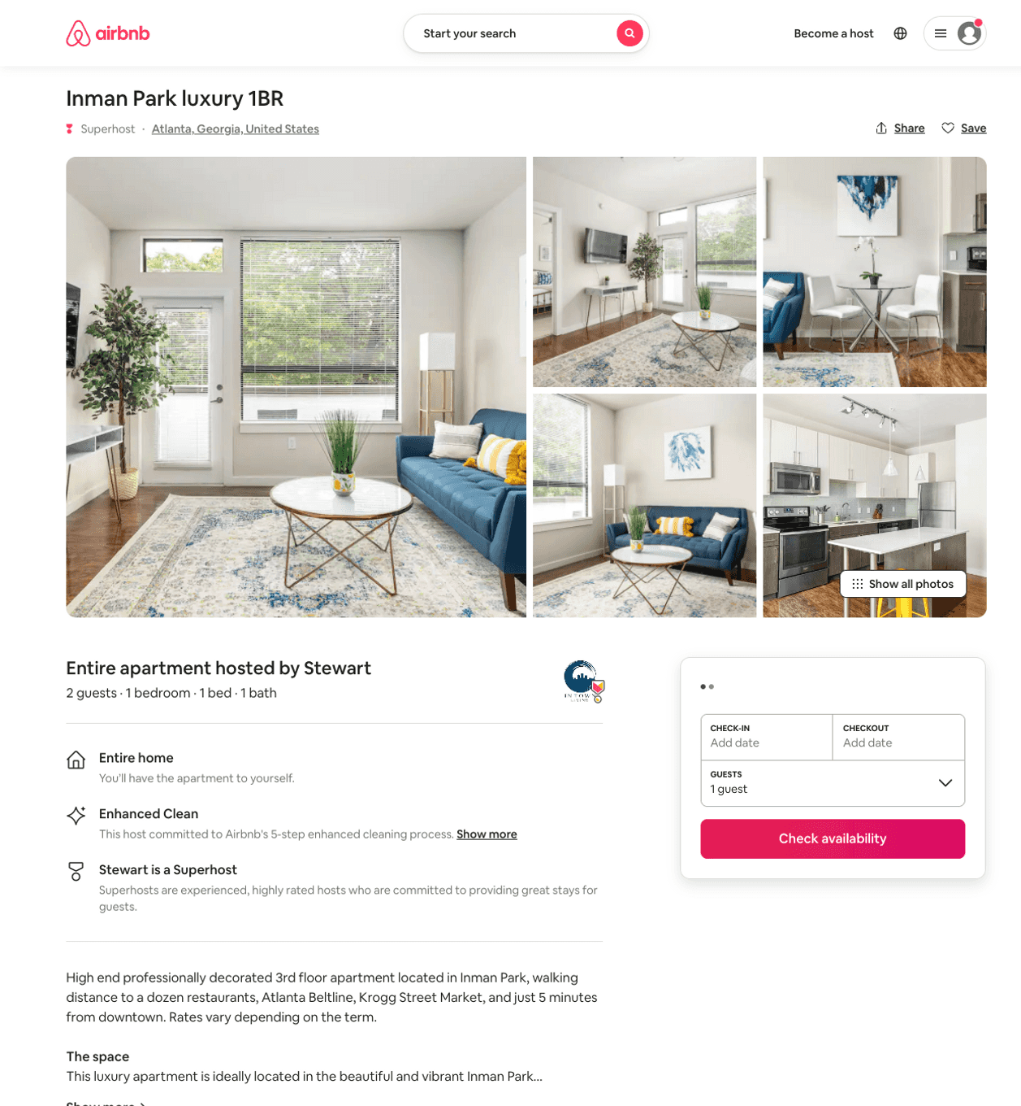
Listing 50459828
1
2
$142 - $203
5.0
58
Stewart
26798403
14
https://www.airbnb.com/rooms/50459828
Aug 2022

Slide 31
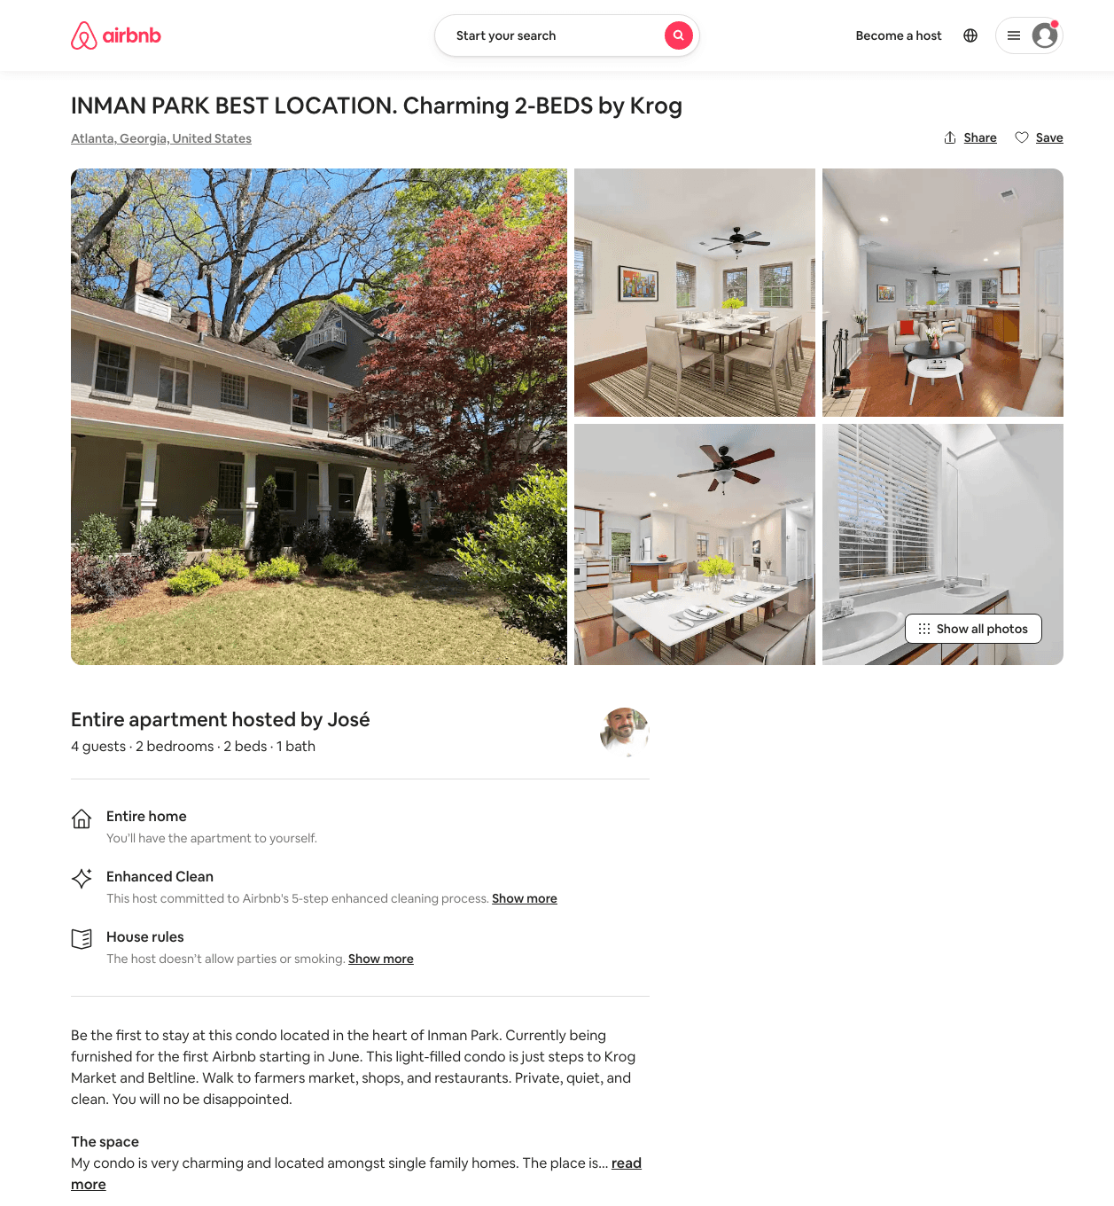
Listing 29029418
2
4
$143 - $203
4.91
3
José
1176151
2
https://www.airbnb.com/rooms/29029418
Aug 2022

Slide 32
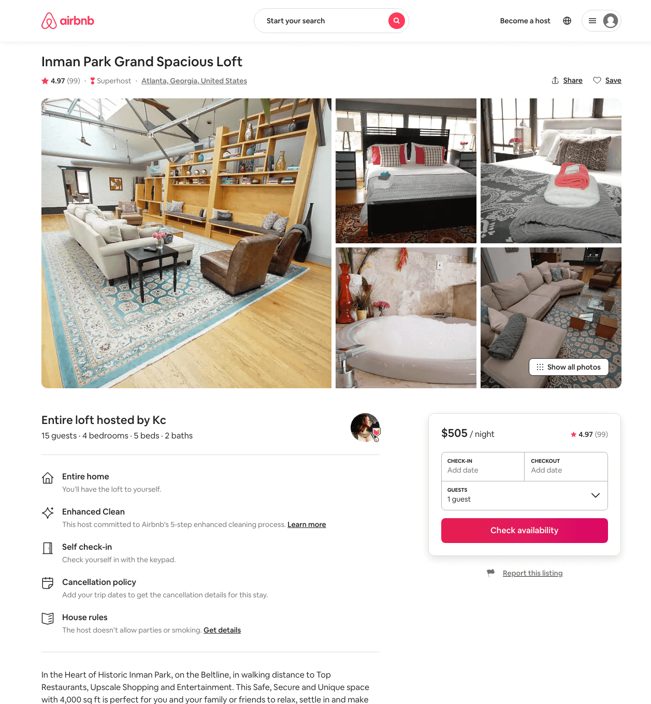
Listing 20897092
4
12
$315 - $575
4.97
2
Dana
2371044
1
https://www.airbnb.com/rooms/20897092
Aug 2022

Slide 33
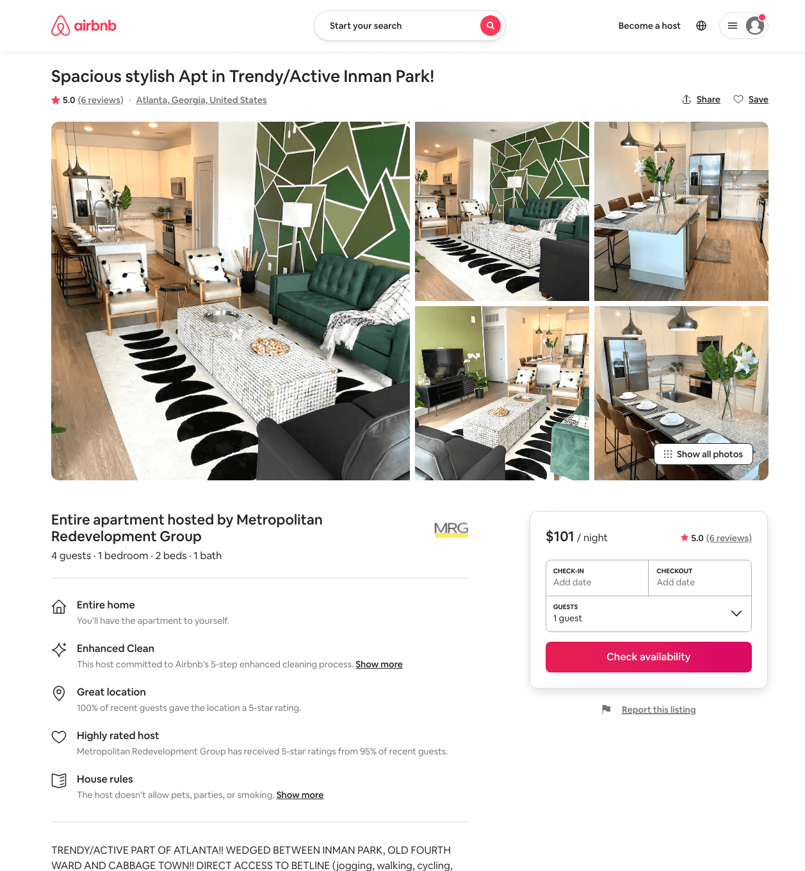
Listing 48899353
1
4
$102 - $182
4.95
1
Mindy
168965866
3
https://www.airbnb.com/rooms/48899353
Aug 2022

Slide 34
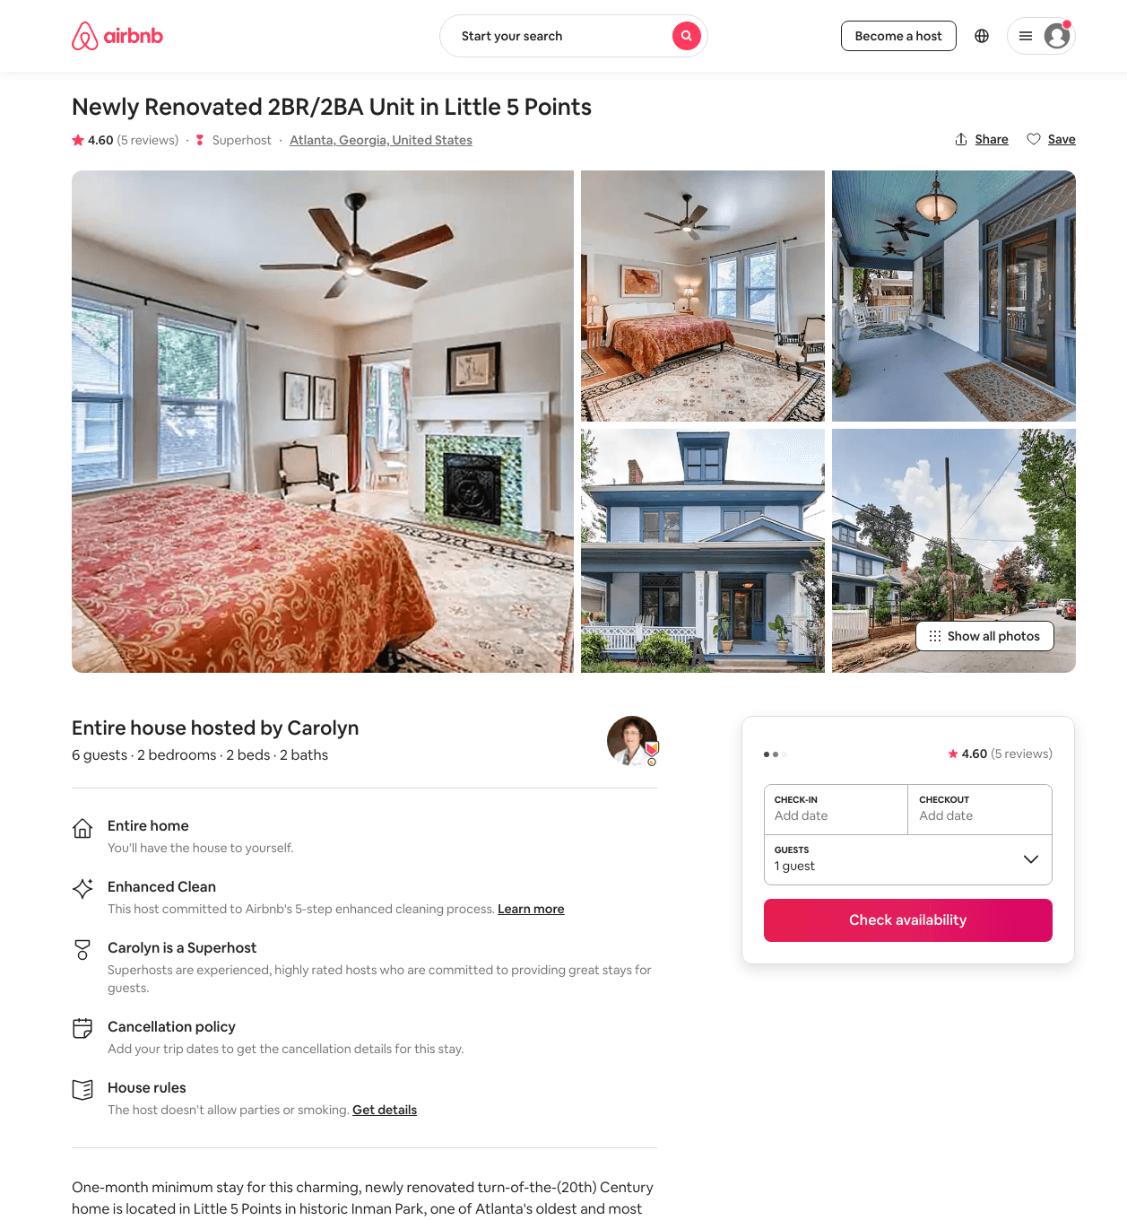
Listing 31366095
2
6
$120 - $135
4.71
30
Carolyn
31859355
1
https://www.airbnb.com/rooms/31366095
Aug 2022

Slide 35
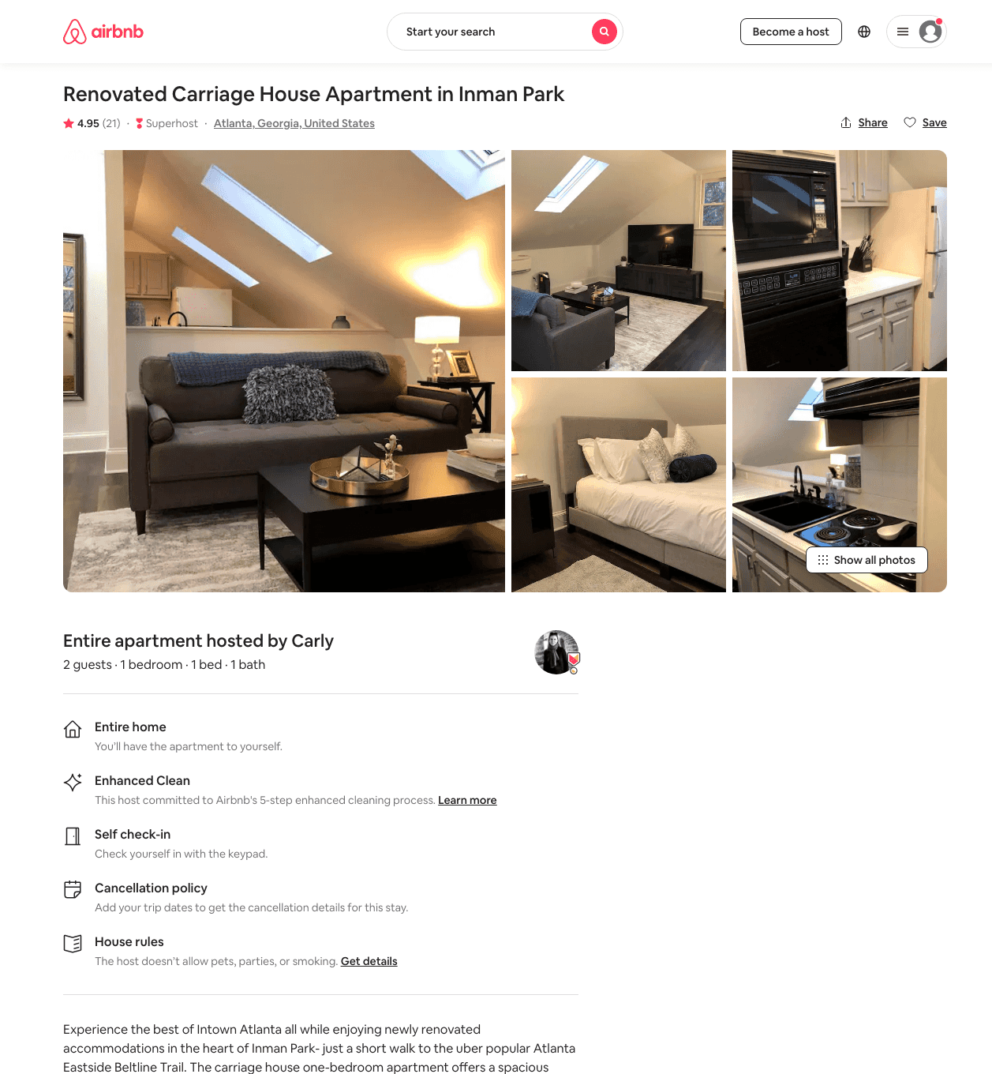
Listing 42180184
1
2
$105 - $122
4.97
1
Carly
334834397
1
https://www.airbnb.com/rooms/42180184
Aug 2022

Slide 36
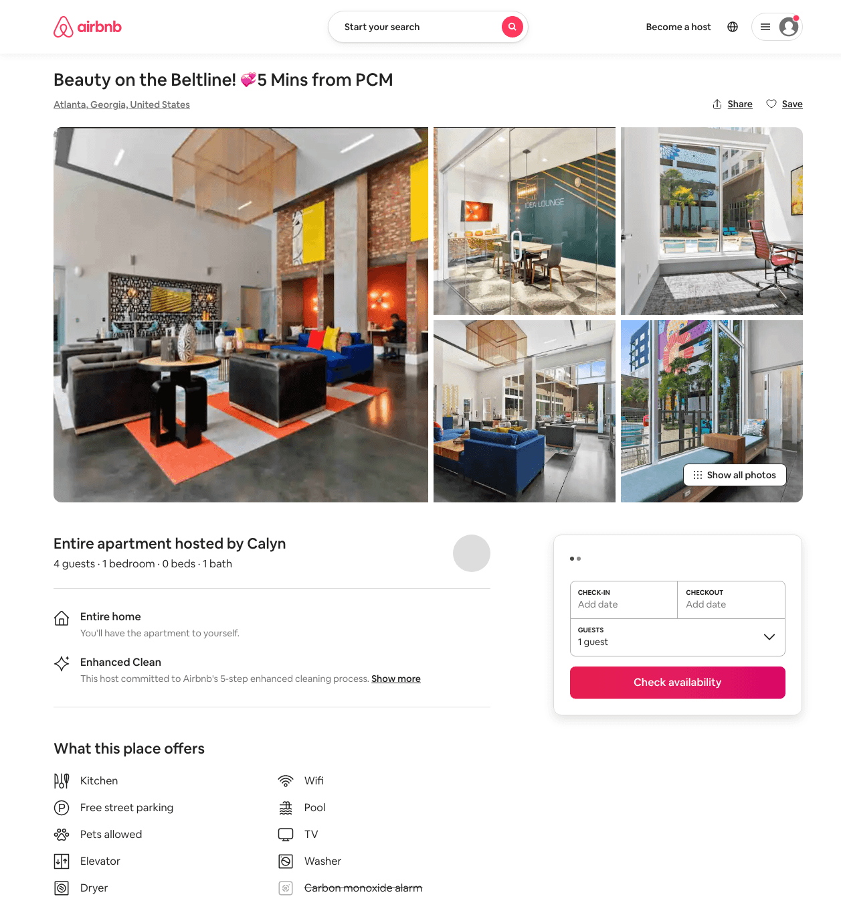
Listing 50138932
1
4
$130 - $204
4.60
1
The Collection
397547334
4
https://www.airbnb.com/rooms/50138932
Jun 2022

Slide 37
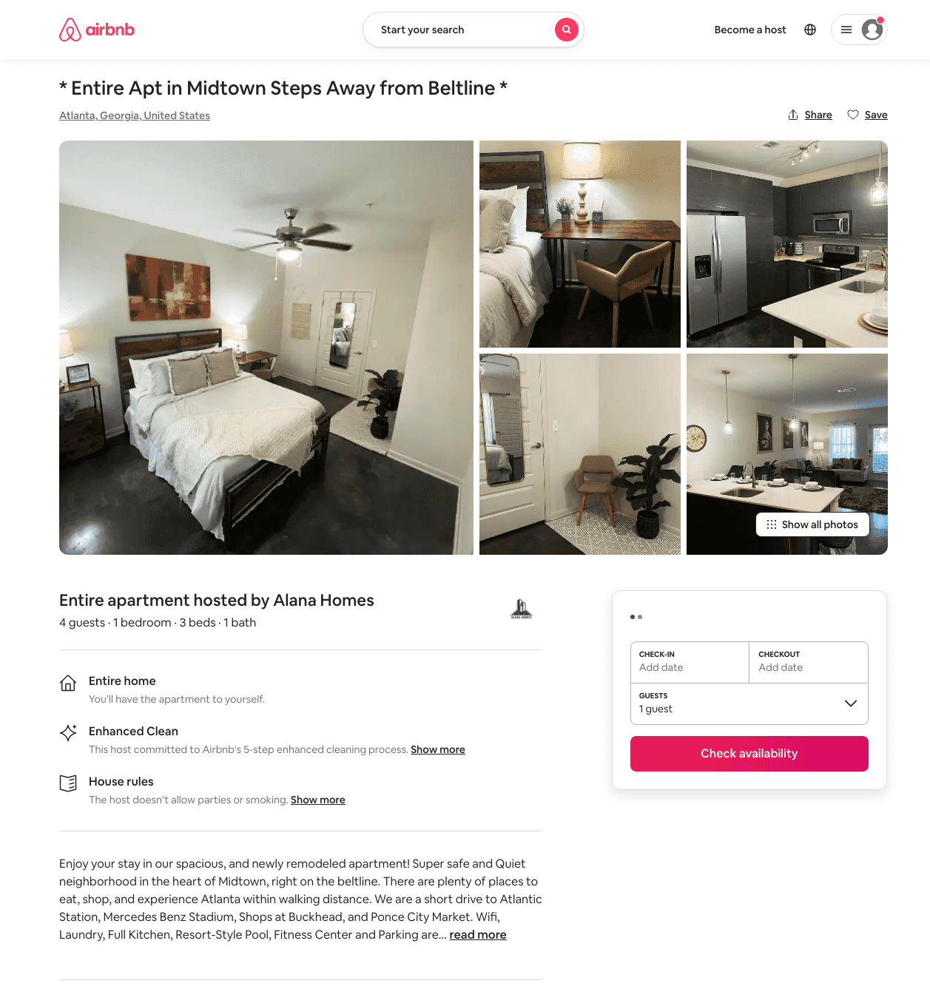
Listing 38163675
1
3
$99 - $211
4.84
2
Alana Stay
129768597
1
https://www.airbnb.com/rooms/38163675
Jul 2022

Slide 38
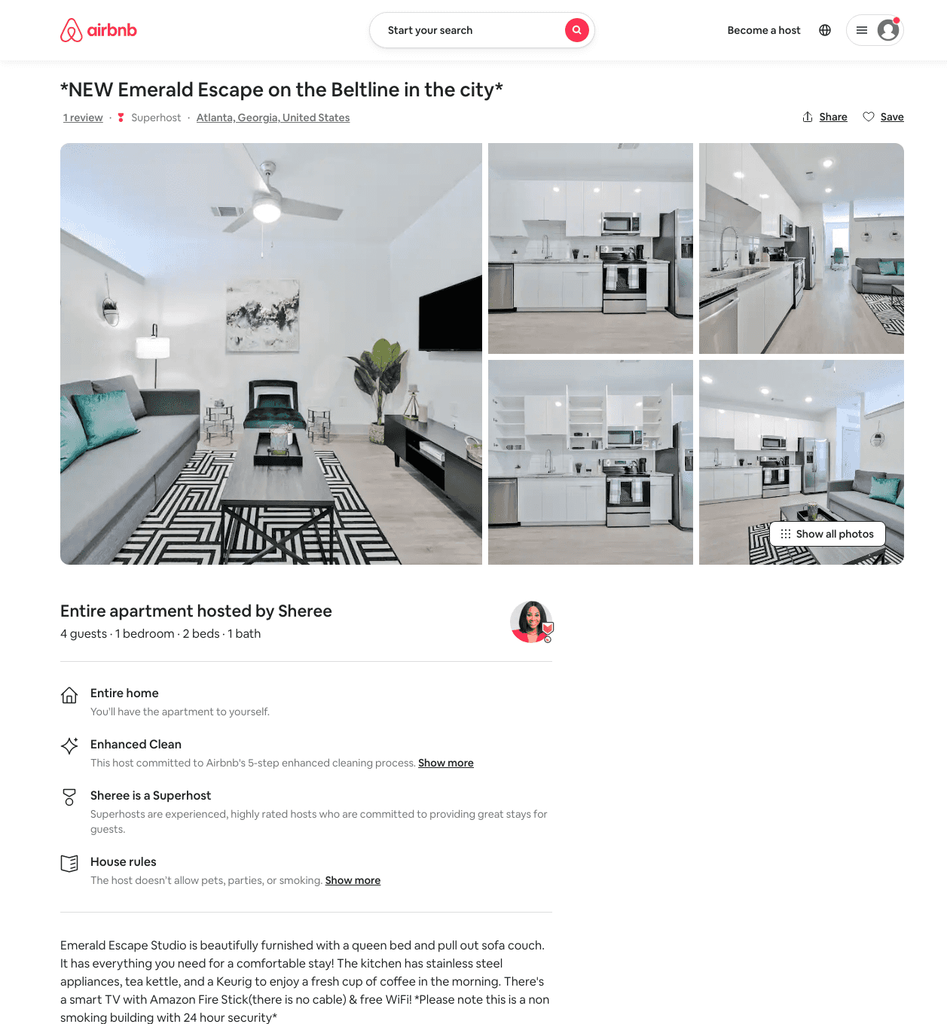
Listing 49060615
1
4
$93 - $150
5.0
2
Luxe
112870276
2
https://www.airbnb.com/rooms/49060615
Aug 2022

Slide 39
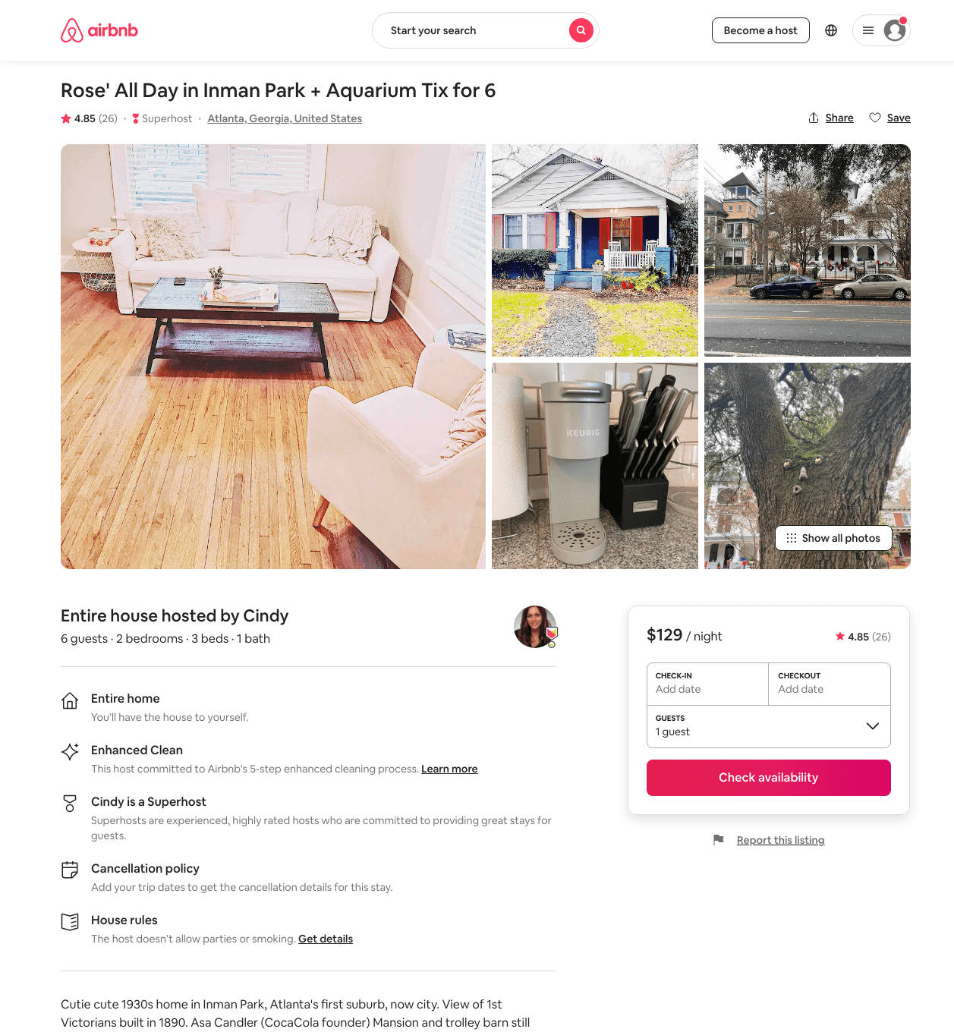
Listing 38292427
2
6
$129 - $180
4.94
1
Cindy
65974419
3
https://www.airbnb.com/rooms/38292427
Aug 2022

Slide 40
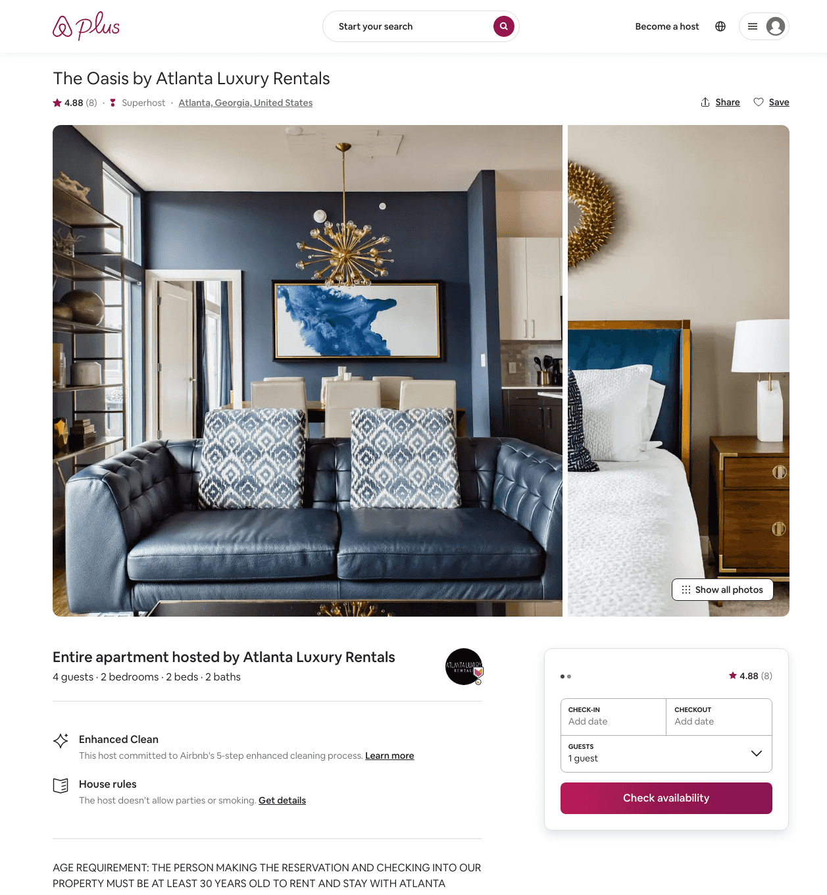
Listing 17150817
2
4
$249 - $420
4.86
3
Atlanta Luxury Rentals
115328988
54
https://www.airbnb.com/rooms/17150817
Aug 2022

Slide 41
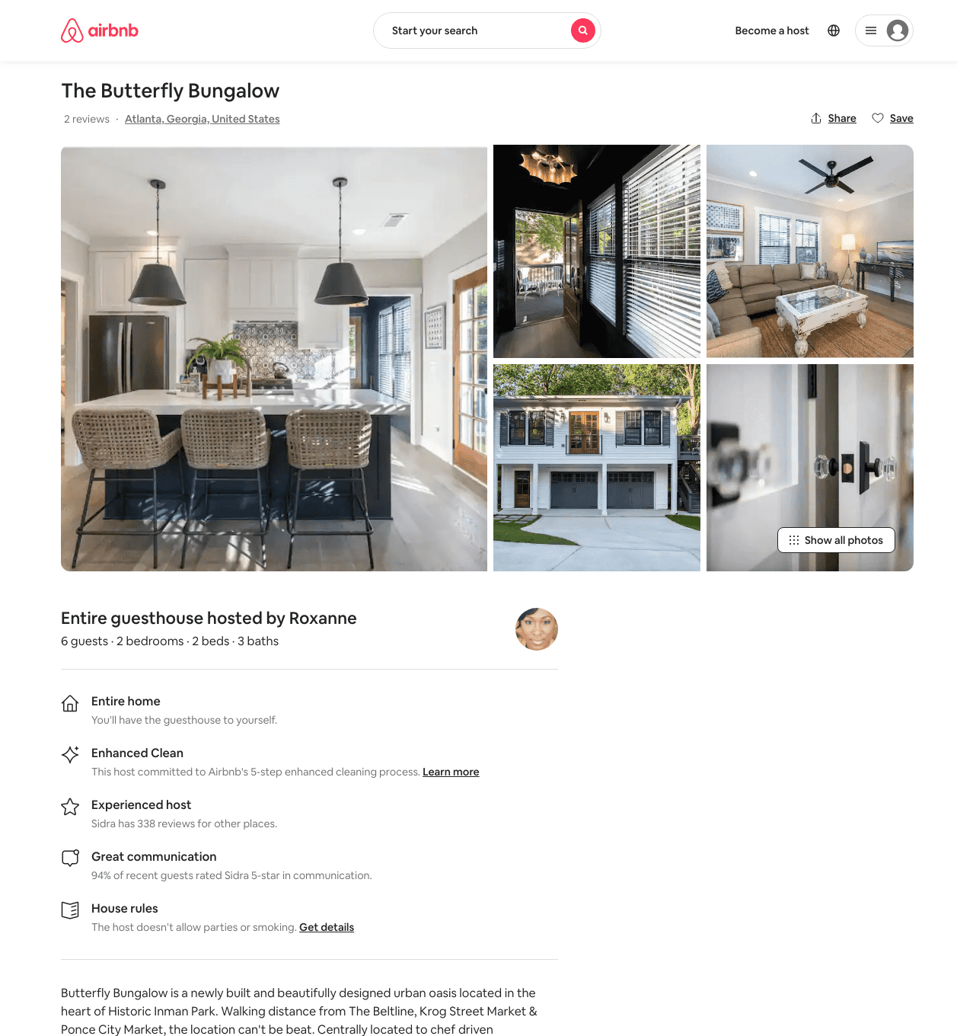
Listing 46757656
2
4
$199 - $302
4.83
2
Minty
3976298
79
https://www.airbnb.com/rooms/46757656
Aug 2022

Slide 42
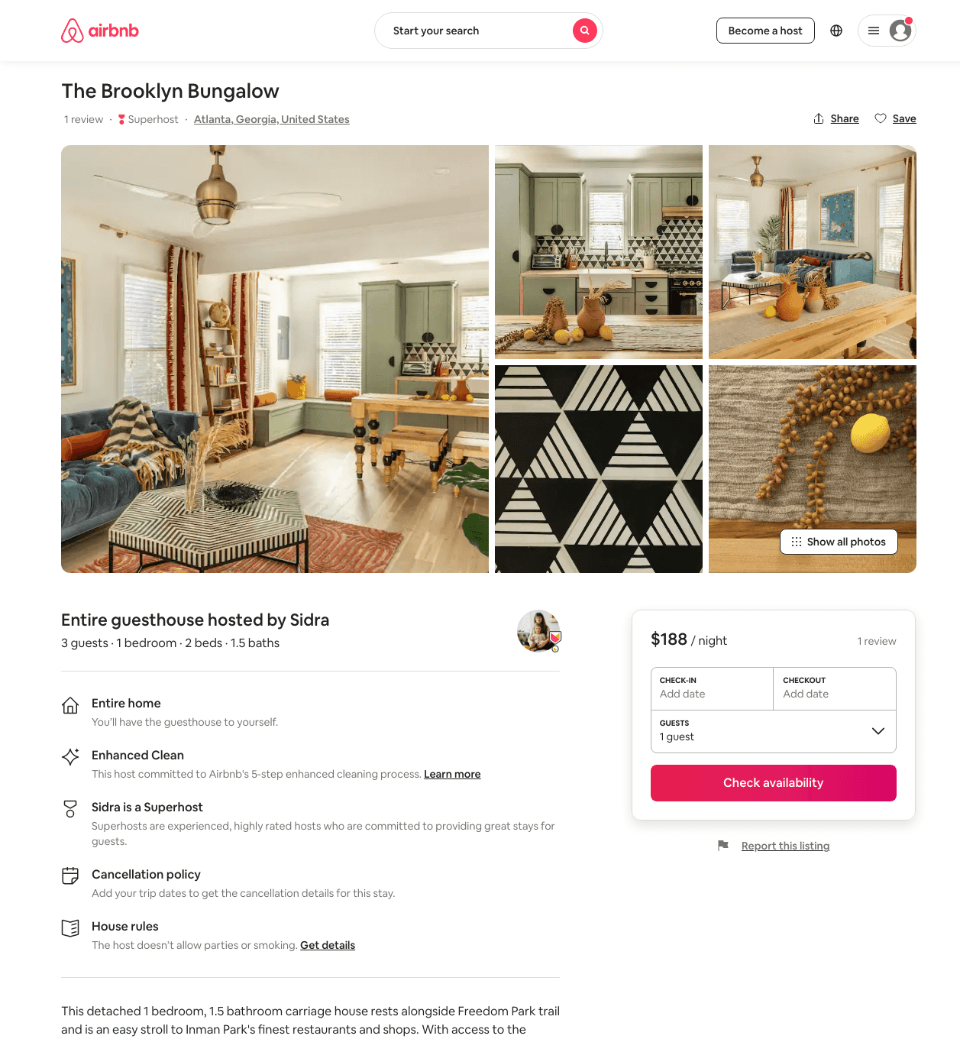
Listing 46316938
1
3
$173 - $216
2
Minty
3976298
79
https://www.airbnb.com/rooms/46316938
Aug 2022

Slide 43
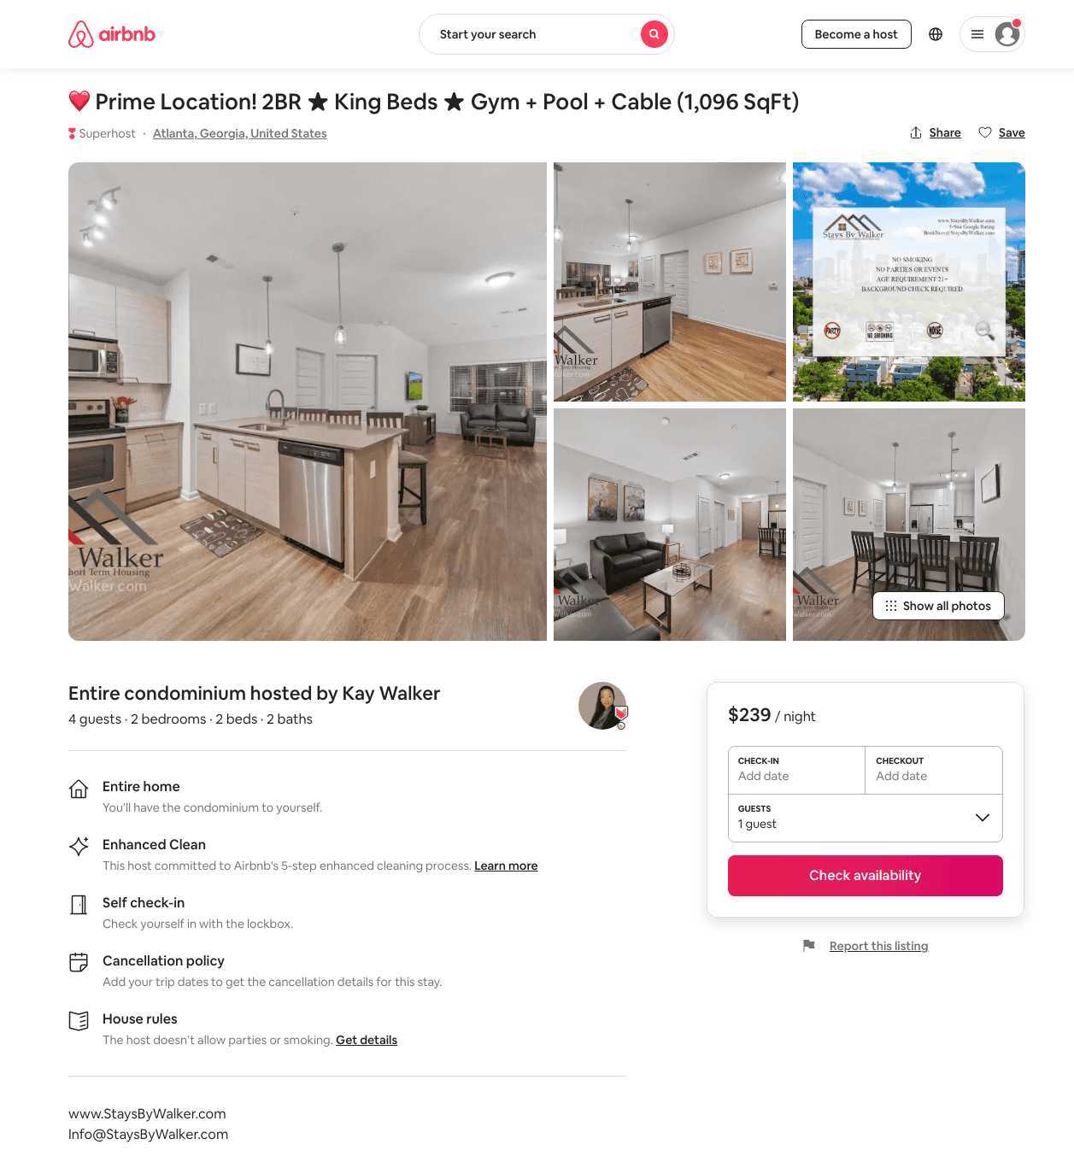
Listing 46175106
2
4
$172 - $285
7
Kay Walker
371963940
14
https://www.airbnb.com/rooms/46175106
Aug 2022

Slide 44
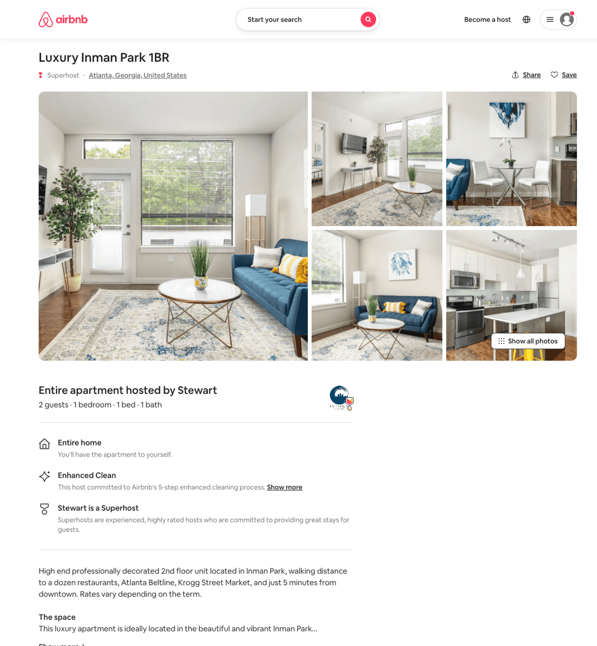
Listing 50459829
1
2
$158 - $202
58
Stewart
26798403
14
https://www.airbnb.com/rooms/50459829
Jul 2022

Slide 45
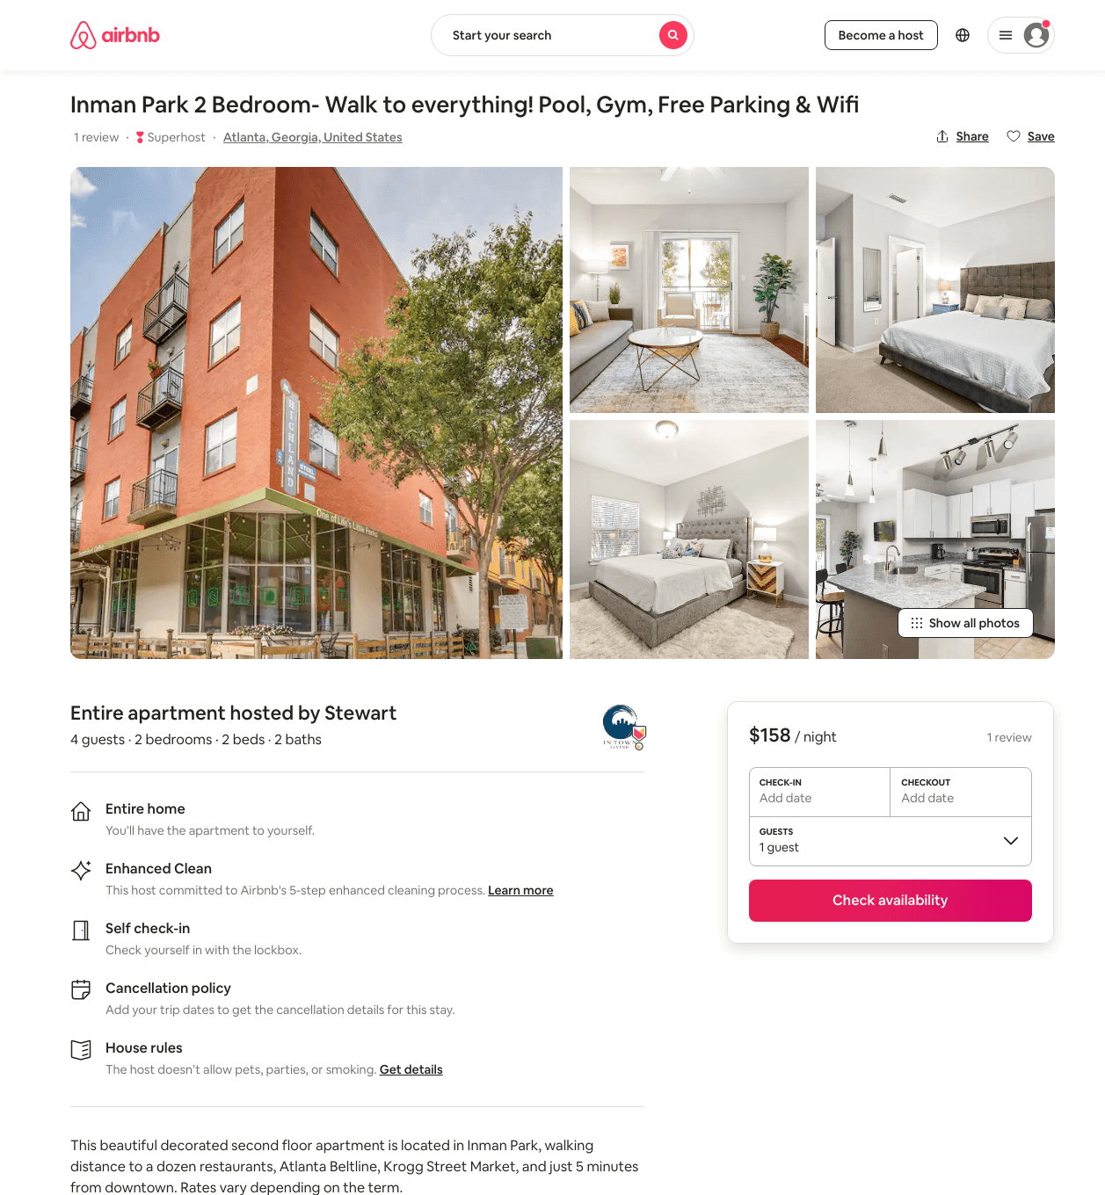
Listing 45894122
2
4
$158 - $270
4.83
58
Stewart
26798403
14
https://www.airbnb.com/rooms/45894122
Aug 2022

Slide 46
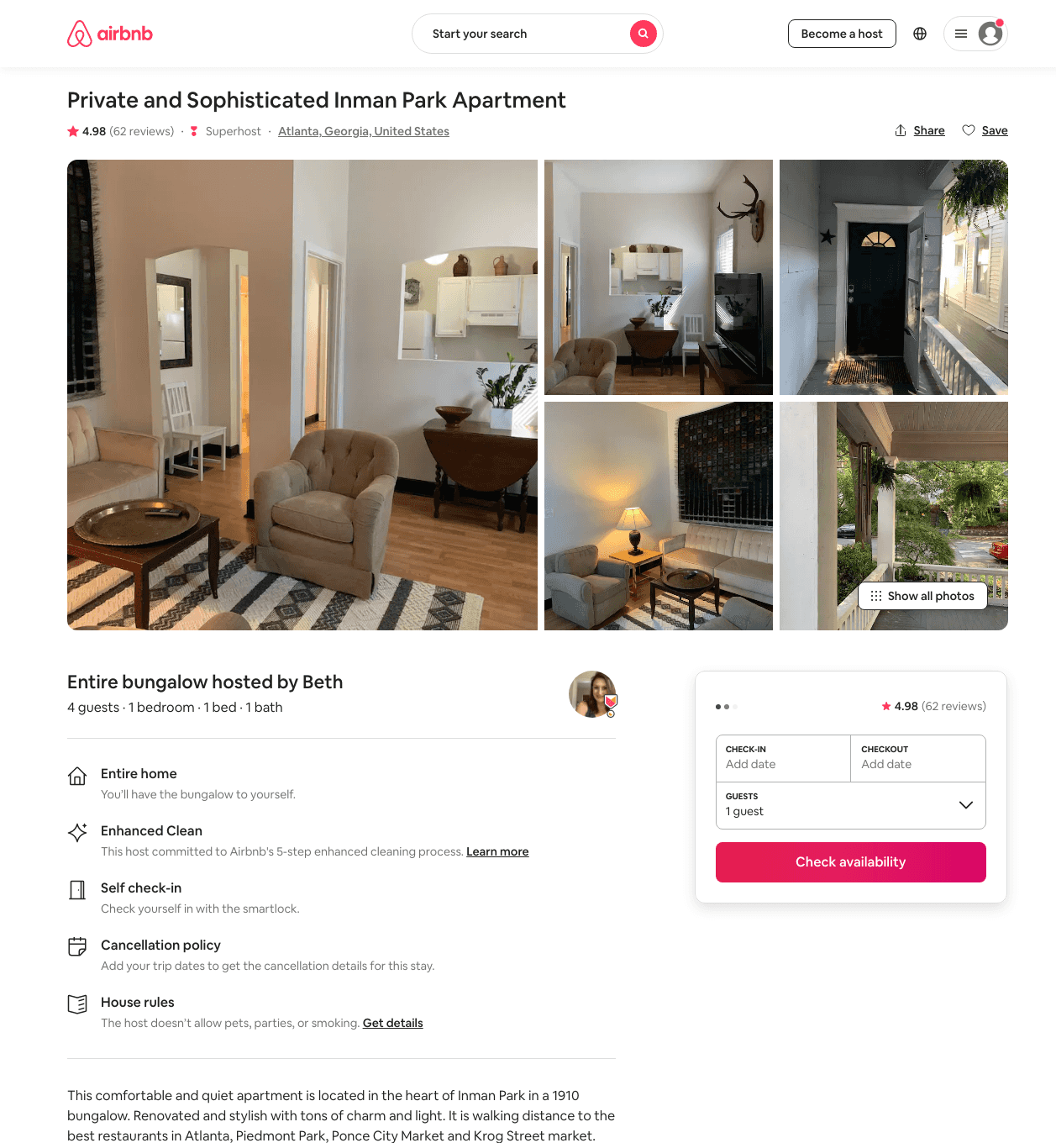
Listing 38023092
1
4
$109 - $143
4.97
2
Beth
288486438
1
https://www.airbnb.com/rooms/38023092
Aug 2022

Slide 47
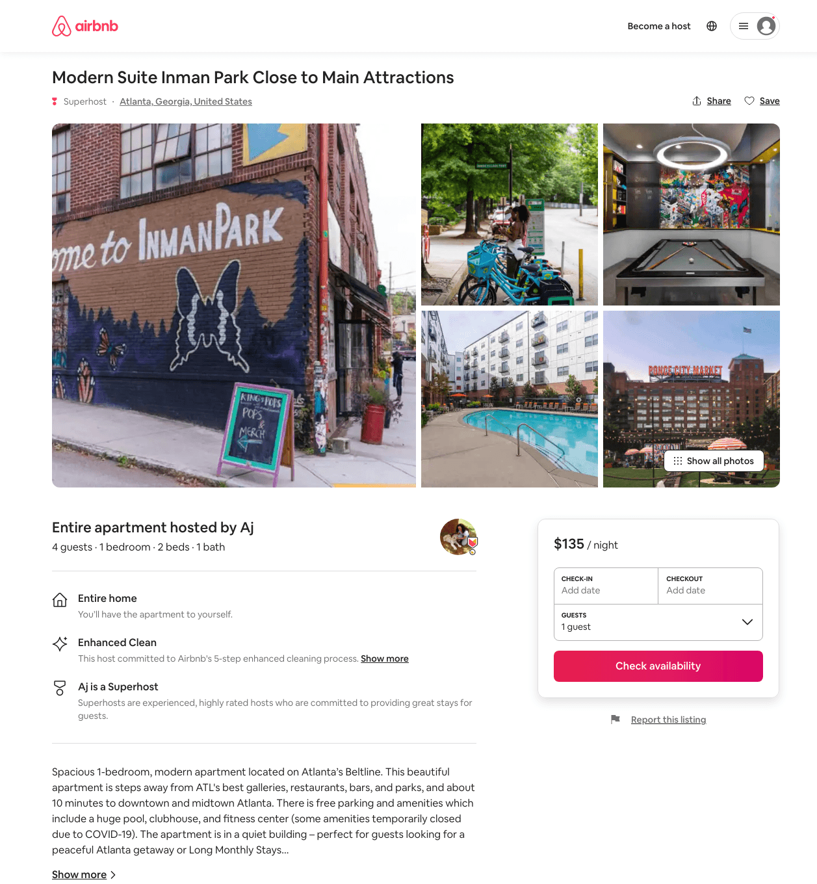
Listing 50160471
1
4
$92 - $154
4.86
1
Aj
333471461
2
https://www.airbnb.com/rooms/50160471
Aug 2022

Slide 48
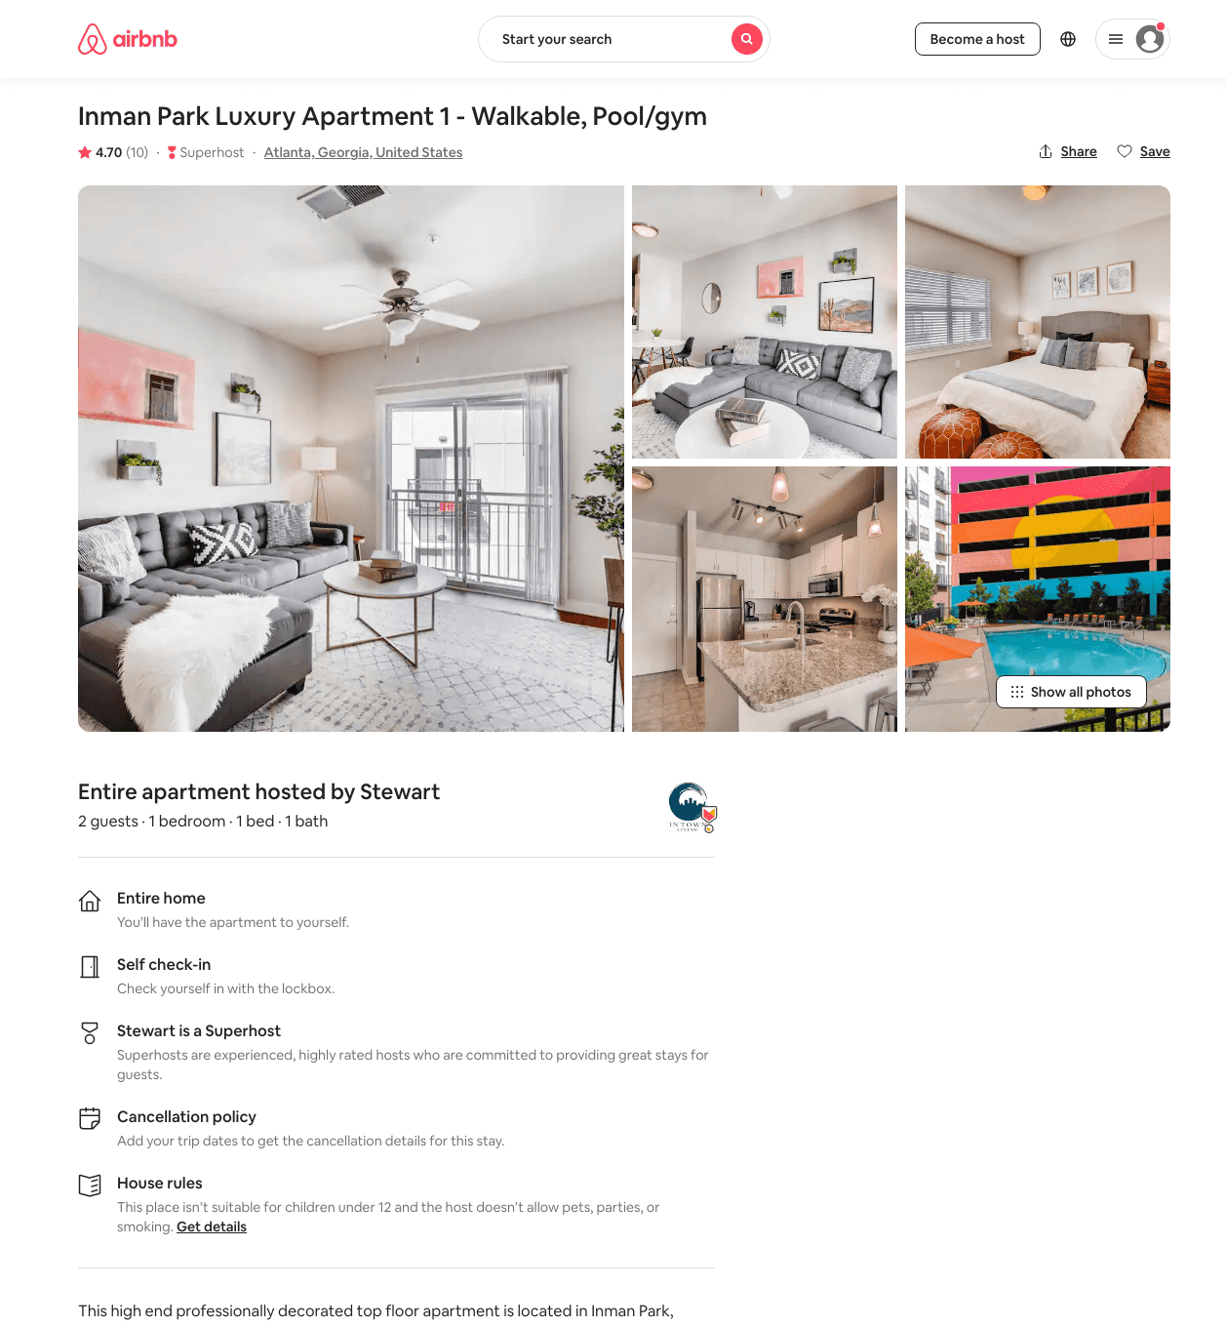
Listing 29284861
1
2
$136 - $147
4.53
60
Stewart
26798403
14
https://www.airbnb.com/rooms/29284861
Aug 2022

Slide 49
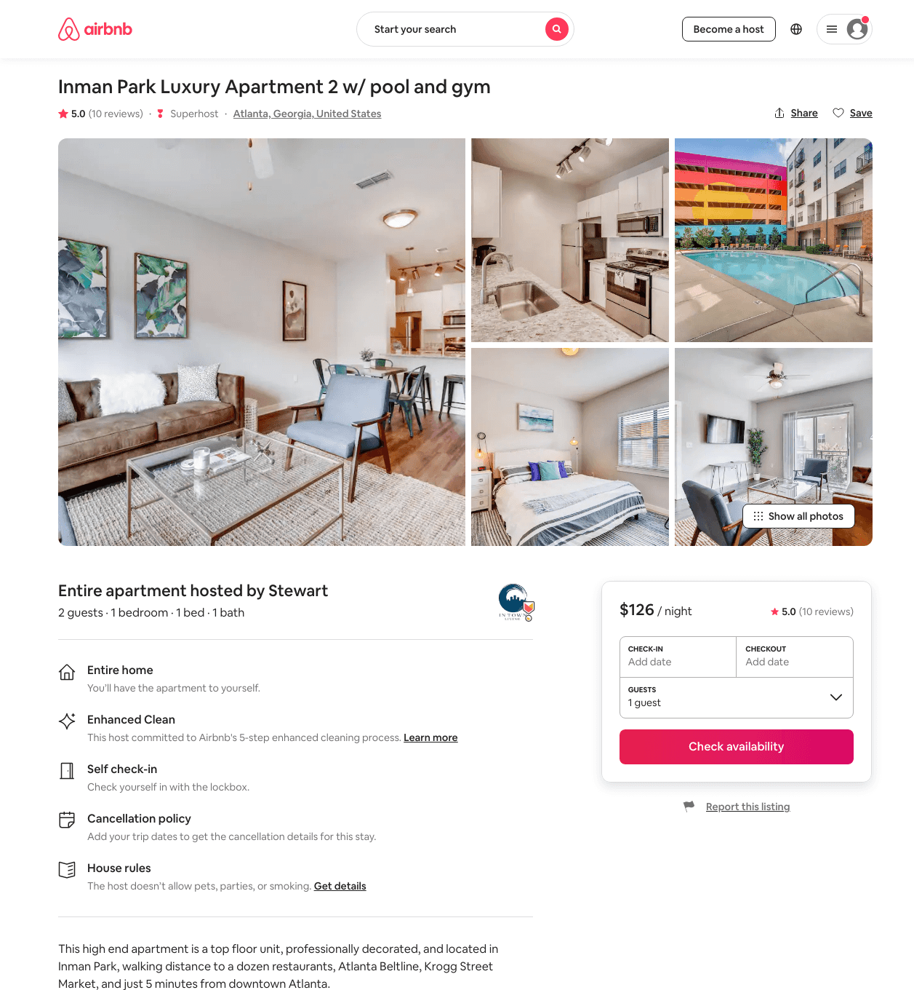
Listing 29285433
1
2
$126 - $173
4.86
58
Stewart
26798403
14
https://www.airbnb.com/rooms/29285433
Aug 2022

Slide 50
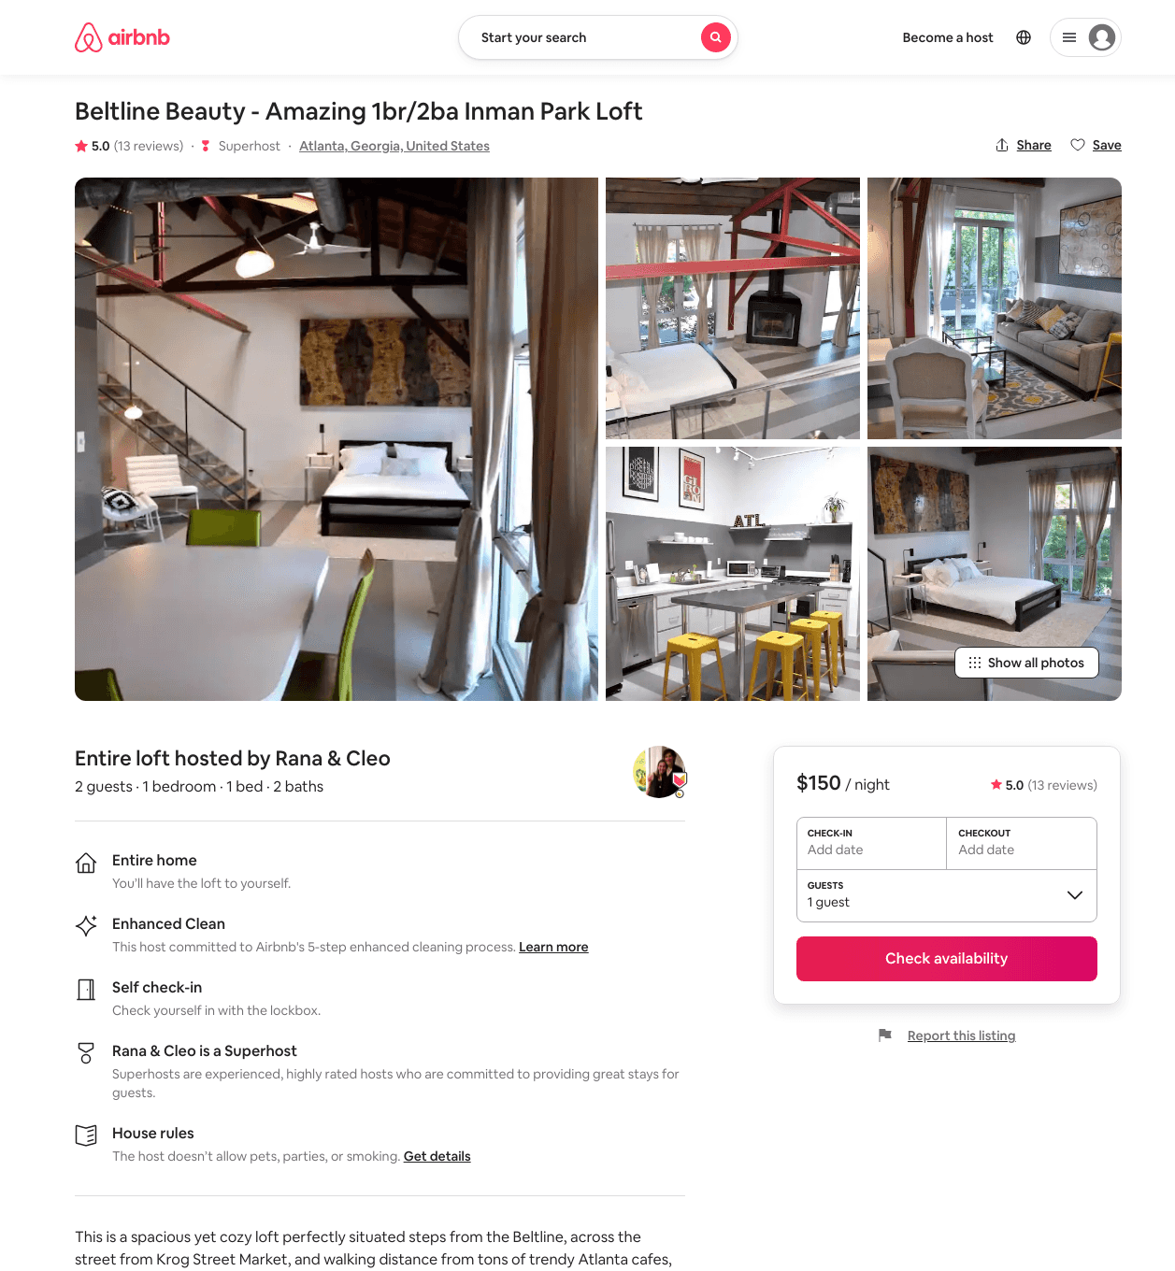
Listing 15454179
1
2
$150
5.0
30
Rana
96184559
1
https://www.airbnb.com/rooms/15454179
Aug 2022

Slide 51
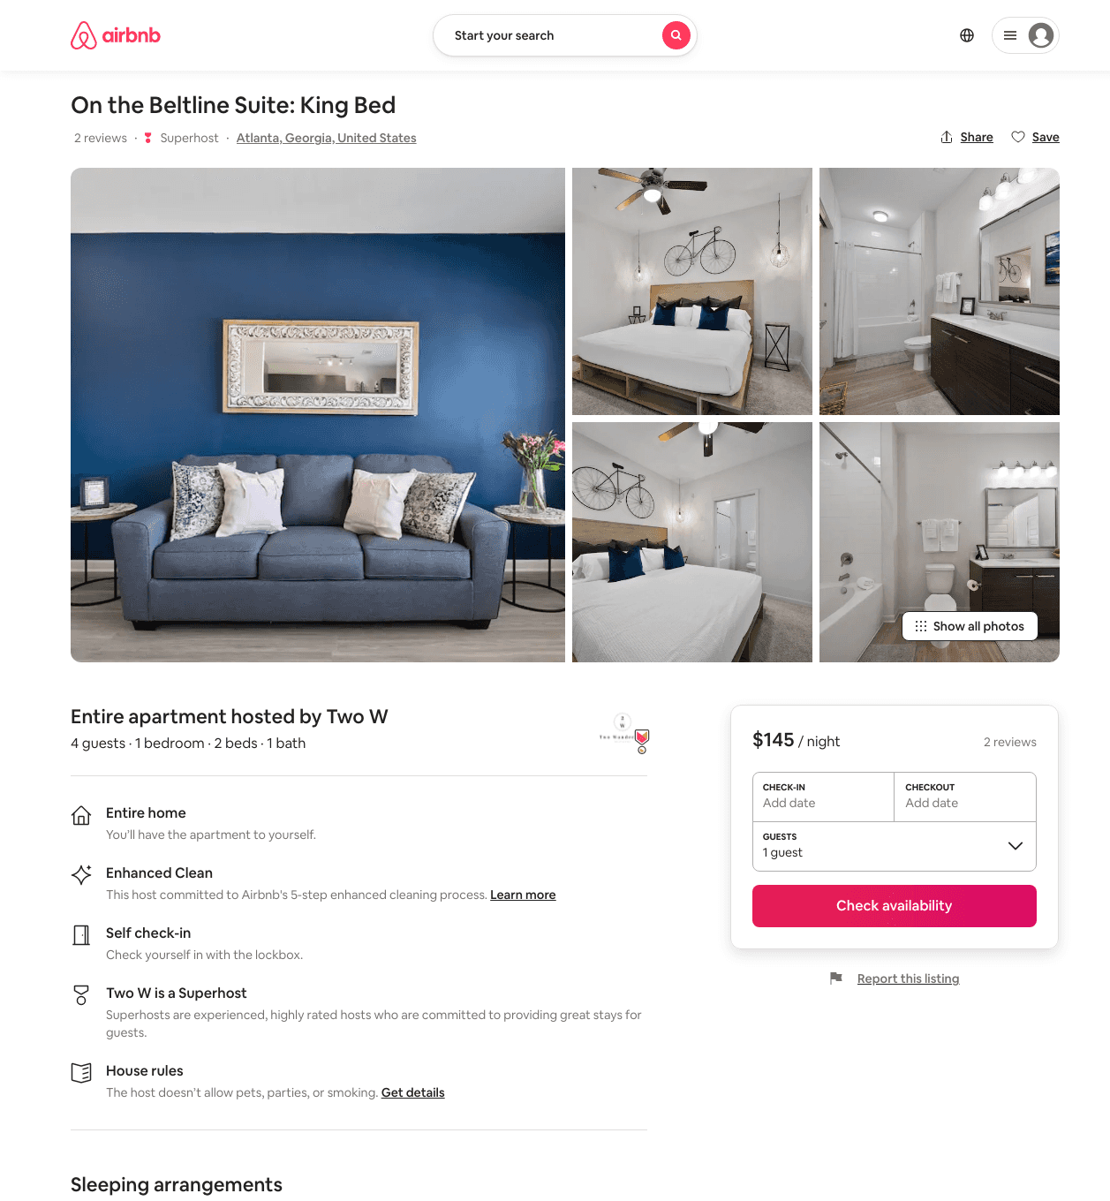
Listing 45481598
1
3
$145
5.0
1
Two W
302222159
7
https://www.airbnb.com/rooms/45481598
Jul 2022

Slide 52
Listing 28867673
1
2
$114 - $131
4.90
2
Nicci
15922433
1
https://www.airbnb.com/rooms/28867673
Aug 2022

Slide 53
Listing 35708540
1
4
$116 - $137
5.0
2
Tom
43372796
1
https://www.airbnb.com/rooms/35708540
Aug 2022

Slide 54
Listing 14542370
1
2
$58 - $62
4.96
1
Patricia And Michael
37828122
1
https://www.airbnb.com/rooms/14542370
Aug 2022

Slide 55
Listing 4087352
1
3
$64 - $125
4.89
2
Alex And Christina
20605441
40
https://www.airbnb.com/rooms/4087352
Aug 2022

Slide 56
Listing 33518131
Studio
2
$60 - $80
4.67
2
Rodney
30377877
1
https://www.airbnb.com/rooms/33518131
Aug 2022

Slide 57
Listing 17907884
1
3
$77 - $96
4.96
1
Maureen
56920482
1
https://www.airbnb.com/rooms/17907884
Aug 2022

Slide 58
Listing 31572431
1
2
$89 - $100
4.86
28
Amy
179974974
1
https://www.airbnb.com/rooms/31572431
Aug 2022

Slide 59
Listing 37826896
1
2
$94 - $167
3
Brianna
268681506
1
https://www.airbnb.com/rooms/37826896
Jun 2022

Slide 60
Listing 46864724
2
7
$98 - $371
4.44
1
Atlanta Host
378574317
1
https://www.airbnb.com/rooms/46864724
Aug 2022

Slide 61
Listing 28864338
2
2
$121 - $195
4.81
31
Nancy
2773373
9
https://www.airbnb.com/rooms/28864338
Aug 2022

Slide 62
Listing 49045453
Studio
2
$121 - $181
5.0
2
Minty
3976298
79
https://www.airbnb.com/rooms/49045453
Jul 2022

Slide 63
Listing 25340409
1
2
$151 - $263
4.79
3
Atlanta Luxury Rentals
115328988
54
https://www.airbnb.com/rooms/25340409
Aug 2022

Slide 64
Listing 50571925
2
5
$173
90
Casey
359231771
601
https://www.airbnb.com/rooms/50571925
Aug 2022

Slide 65
Listing 22073416
2
4
$250
7
Marcus
160511698
4
https://www.airbnb.com/rooms/22073416
Aug 2022

Slide 66
Listing 30372563
3
3
$185 - $250
30
Julie
142463954
1
https://www.airbnb.com/rooms/30372563
Jun 2022

Slide 67
Listing 30688838
3
7
$538 - $995
5.0
2
Alex
27357505
1
https://www.airbnb.com/rooms/30688838
Aug 2022

Slide 68
Listing 15866318
2
4
$179 - $195
5.0
60
Jenn
99252075
22
https://www.airbnb.com/rooms/15866318
Aug 2022

Slide 69
Listing 42999411
Studio
2
$90 - $125
5.0
31
David & Jenn
46666704
24
https://www.airbnb.com/rooms/42999411
Aug 2022

Slide 70
Listing 24600852
Studio
2
$105 - $120
4.71
4
Pasha Luxury
11490196
7
https://www.airbnb.com/rooms/24600852
Aug 2022

Slide 71
Listing 21983392
3
6
$350
1
Marcus
160511698
4
https://www.airbnb.com/rooms/21983392
Jul 2022

Slide 72
Listing 49123872
Studio
2
$70 - $91
30
Shannon
5111463
14
https://www.airbnb.com/rooms/49123872
Jul 2022

Slide 73
Listing 41875590
1
2
$149
4.75
3
Sojourn
146616483
9
https://www.airbnb.com/rooms/41875590
Jun 2022

Slide 74
Listing 49730042
3
6
$335 - $404
5.0
8
Minty
3976298
79
https://www.airbnb.com/rooms/49730042
Aug 2022

Slide 75
Listing 50307076
2
6
$250 - $312
5.0
2
Kelsey
129645102
1
https://www.airbnb.com/rooms/50307076
Aug 2022

Slide 76
Listing 46949800
2
6
$192 - $386
4.63
3
Minty
3976298
79
https://www.airbnb.com/rooms/46949800
Aug 2022

Slide 77
Listing 17626097
1
2
$135 - $155
5.0
90
Jenn
99252075
22
https://www.airbnb.com/rooms/17626097
Jun 2022

Slide 78
Listing 51189189
3
4
$200 - $300
5.0
2
Minty
3976298
79
https://www.airbnb.com/rooms/51189189
Aug 2022

Slide 79
Listing 51282709
2
2
$163 - $239
5.0
2
Minty
3976298
79
https://www.airbnb.com/rooms/51282709
Aug 2022

Slide 80
Listing 38292774
2
6
$130 - $208
4.96
1
Cindy
65974419
3
https://www.airbnb.com/rooms/38292774
Aug 2022

Slide 81
Listing 51270744
2
4
$152 - $289
59
Stewart
26798403
14
https://www.airbnb.com/rooms/51270744
Aug 2022

Slide 82
Listing 17839247
2
4
$186 - $195
5.0
60
Jenn
99252075
22
https://www.airbnb.com/rooms/17839247
Aug 2022

Slide 83
Listing 49481354
1
5
$126 - $129
5.0
2
Jackie
74160593
1
https://www.airbnb.com/rooms/49481354
Aug 2022

Slide 84
Listing 5303509
1
2
$98 - $122
4.97
3
Kathleen
4652977
1
https://www.airbnb.com/rooms/5303509
Jun 2022

Slide 85
Listing 51282520
1
3
$137 - $178
2
Minty
3976298
79
https://www.airbnb.com/rooms/51282520
Aug 2022

Slide 86
Listing 31314142
2
4
$147 - $164
5.0
91
Jacques
20717449
2
https://www.airbnb.com/rooms/31314142
Aug 2022

Slide 87
Listing 50961166
1
2
$107 - $199
4.97
2
Shani
78086701
2
https://www.airbnb.com/rooms/50961166
Aug 2022

Slide 88
Listing 51048525
1
2
$96 - $171
4.55
1
CV Realty LLC
122190569
2
https://www.airbnb.com/rooms/51048525
Aug 2022

Slide 89
Listing 49755511
Studio
2
$104 - $181
4.60
2
Minty
3976298
79
https://www.airbnb.com/rooms/49755511
Aug 2022

Slide 90
Listing 39467389
1
2
$145 - $150
5.0
28
Jenn
99252075
22
https://www.airbnb.com/rooms/39467389
Aug 2022

Slide 91
Listing 24604080
1
2
$139
4.71
5
Charlie
86770964
1
https://www.airbnb.com/rooms/24604080
Aug 2022

Slide 92
Listing 35376553
2
4
$199
4.67
3
Sojourn
146616483
9
https://www.airbnb.com/rooms/35376553
Aug 2022

Slide 93
Listing 52206937
1
4
$94 - $133
4.79
1
Daniela
223721490
2
https://www.airbnb.com/rooms/52206937
Aug 2022

Slide 94
Listing 38043179
2
4
$120 - $130
4.70
31
David & Jenn
46666704
24
https://www.airbnb.com/rooms/38043179
Aug 2022

Slide 95
Listing 51281921
1
2
$147 - $174
2
Minty
3976298
79
https://www.airbnb.com/rooms/51281921
Aug 2022

Slide 96
Listing 52457499
1
3
$114 - $174
4.56
10
Rahsaan
28658517
1
https://www.airbnb.com/rooms/52457499
Aug 2022

Slide 97
Listing 52620061
1
3
$92 - $115
4.92
2
BizzyMind Solutions
425960916
1
https://www.airbnb.com/rooms/52620061
Aug 2022

Slide 98
Listing 52450235
1
4
$124 - $162
4.95
2
Kristie
135971700
2
https://www.airbnb.com/rooms/52450235
Jun 2022

Slide 99
Listing 51688376
1
4
$136 - $189
2
Minty
3976298
79
https://www.airbnb.com/rooms/51688376
Aug 2022

Slide 100
Listing 52990359
2
3
$128 - $174
2
Minty
3976298
79
https://www.airbnb.com/rooms/52990359
Jul 2022

Slide 101
Listing 2385370
1
4
$140 - $178
2
Shani Moore-Patterson
https://www.vrbo.com/2385370
Aug 2022

Slide 102
Listing 31582408
2
4
$295 - $479
5.0
2
K.C.
28406736
3
https://www.airbnb.com/rooms/31582408
Aug 2022

Slide 103
Listing 52990453
2
3
$139 - $179
4.67
2
Minty
3976298
79
https://www.airbnb.com/rooms/52990453
Aug 2022

Slide 104
Listing 24653501
2
6
$179 - $239
5.0
30
Laura
180560460
2
https://www.airbnb.com/rooms/24653501
Jun 2022

Slide 105
Listing 53151864
2
4
$85 - $129
4.97
1
Aboozar
7110429
1
https://www.airbnb.com/rooms/53151864
Aug 2022

Slide 106
Listing 53124617
1
3
$88 - $133
4.41
2
Kenya
164334925
1
https://www.airbnb.com/rooms/53124617
Jul 2022

Slide 107
Listing 53416259
1
3
$72 - $136
4.29
1
Lej
228117027
1
https://www.airbnb.com/rooms/53416259
Aug 2022

Slide 108
Listing 28694912
2
4
$165 - $199
5.0
60
Jenn
99252075
22
https://www.airbnb.com/rooms/28694912
Aug 2022

Slide 109
Listing 15867436
1
2
$120 - $145
5.0
90
Jenn
99252075
22
https://www.airbnb.com/rooms/15867436
Jun 2022

Slide 110
Listing 53736831
3
6
$185 - $325
4.80
5
Minty
3976298
79
https://www.airbnb.com/rooms/53736831
Aug 2022

Slide 111
Listing 53849263
2
6
$143 - $201
4.65
2
Top Tier Rentals
224983102
1
https://www.airbnb.com/rooms/53849263
Aug 2022

Slide 112
Listing 23880324
1
2
$160 - $199
5.0
3
Pasha Luxury
11490196
7
https://www.airbnb.com/rooms/23880324
Jun 2022

Slide 113
Listing 53709058
1
4
$95 - $174
4.88
3
BellaLife Stays
412818521
2
https://www.airbnb.com/rooms/53709058
Jul 2022

Slide 114
Listing 53737235
3
6
$185 - $334
5
Minty
3976298
79
https://www.airbnb.com/rooms/53737235
Aug 2022

Slide 115
Listing 54033185
1
3
$232 - $550
3
Tanya
310686654
1
https://www.airbnb.com/rooms/54033185
Aug 2022

Slide 116
Listing 53464840
2
5
$117 - $214
4.81
1
Jay
53742086
1
https://www.airbnb.com/rooms/53464840
Aug 2022

Slide 117
Listing 51283333
2
5
$214 - $252
2
Minty
3976298
79
https://www.airbnb.com/rooms/51283333
Aug 2022

Slide 118
Listing modern-suite-inman-park-near-main-attractions
240 NORTH HIGHLAND AVE NE
undefined
1
9.5
https://www.booking.com/hotel/us/modern-suite-inman-park-near-main-attractions.html
Sep 2022

Slide 119
Listing 53027645
4
8
$406 - $700
2
Minty
3976298
79
https://www.airbnb.com/rooms/53027645
Aug 2022

Slide 120
Listing 53309961
1
8
$122 - $215
4.75
2
Minty
3976298
79
https://www.airbnb.com/rooms/53309961
Aug 2022

Slide 121
Listing 53734464
1
8
$156 - $221
2
Minty
3976298
79
https://www.airbnb.com/rooms/53734464
Aug 2022

Slide 122
Listing 36350552
1
2
$131 - $138
5.0
91
David & Jenn
46666704
24
https://www.airbnb.com/rooms/36350552
Jun 2022

Slide 123
Listing 54005590
1
4
$144 - $158
5.0
1
Tremaine
417832822
1
https://www.airbnb.com/rooms/54005590
Aug 2022

Slide 124
Listing 2404327
2
4
$168
4
Stewart Wyne
https://www.vrbo.com/2404327
Aug 2022

Slide 125
Listing 49226768
2
5
$237
90
Casey
359231771
601
https://www.airbnb.com/rooms/49226768
Jun 2022

Slide 126
Listing 2819826
1
3
$130
30
https://www.vrbo.com/2819826
Aug 2022

Slide 127
Listing 2825243
2
3
$150
3
https://www.vrbo.com/2825243
Aug 2022

Slide 128
Listing 2837912
1
1
$95
2
Kedra Daniel
https://www.vrbo.com/2837912
Aug 2022

Slide 129
Listing 27752845
2
2
$98
3
Adam
118657621
1
https://www.airbnb.com/rooms/27752845
Aug 2022

Slide 130
Listing 43382511
2
4
$150
90
Marcus
160511698
4
https://www.airbnb.com/rooms/43382511
Jun 2022

Slide 131
Listing 2867938
1
3
$179
5
1
Jonathan Brewer
https://www.vrbo.com/2867938
Aug 2022

Slide 132
Listing 48014012
2
5
90
Casey
359231771
601
https://www.airbnb.com/rooms/48014012
Jun 2022

Slide 133
Listing 46463809
1
3
90
Casey
359231771
601
https://www.airbnb.com/rooms/46463809
Jul 2022

Slide 134
Listing 2937325
1
28
$165
2
https://www.vrbo.com/2937325
Aug 2022

Slide 135
Listing 45367973
1
3
90
Casey
359231771
601
https://www.airbnb.com/rooms/45367973
Aug 2022

Slide 136
Listing 2962120
2
3
$152
1
Minty Living
https://www.vrbo.com/2962120
Aug 2022

Slide 137
Listing 2962094
2
3
$193
1
Minty Living
https://www.vrbo.com/2962094
Aug 2022

Slide 138
Listing 2962087
2
4
$263
2
Minty Living
https://www.vrbo.com/2962087
Aug 2022

Slide 139
Listing 2962108
2
4
$300
2
Minty Living
https://www.vrbo.com/2962108
Aug 2022

Slide 140
Listing 2962106
1
8
$148
2
Minty Living
https://www.vrbo.com/2962106
Aug 2022

Slide 141
Listing 2962133
2
4
$177
2
Minty Living
https://www.vrbo.com/2962133
Aug 2022

Slide 142
Listing 2962105
1
2
$194
2
Minty Living
https://www.vrbo.com/2962105
Aug 2022

Slide 143
Listing 2962090
0
2
$155
2
Minty Living
https://www.vrbo.com/2962090
Aug 2022

Slide 144
Listing 2962083
1
8
$219
2
Minty Living
https://www.vrbo.com/2962083
Aug 2022

Slide 145
Listing 2962068
1
3
$223
2
Minty Living
https://www.vrbo.com/2962068
Aug 2022

Slide 146
Listing 2962109
3
6
$221
4
Minty Living
https://www.vrbo.com/2962109
Aug 2022

Slide 147
Listing 2962067
1
2
$228
2
Minty Living
https://www.vrbo.com/2962067
Aug 2022

Slide 148
Listing 2962098
3
4
$228
2
Minty Living
https://www.vrbo.com/2962098
Aug 2022

Slide 149
Listing 2962069
2
5
$238
2
Minty Living
https://www.vrbo.com/2962069
Aug 2022

Slide 150
Listing 2962078
3
6
$328
2
Minty Living
https://www.vrbo.com/2962078
Aug 2022

Slide 151
Listing 2966993
4
8
$320
2
Minty Living
https://www.vrbo.com/2966993
Aug 2022

Slide 152
Listing 2962071
2
6
$353
3
Minty Living
https://www.vrbo.com/2962071
Aug 2022

Slide 153
Listing 2962066
3
6
$438
8
Minty Living
https://www.vrbo.com/2962066
Aug 2022

Slide 154
Listing 2962129
1
4
$192
2
Minty Living
https://www.vrbo.com/2962129
Aug 2022

