Slide 2
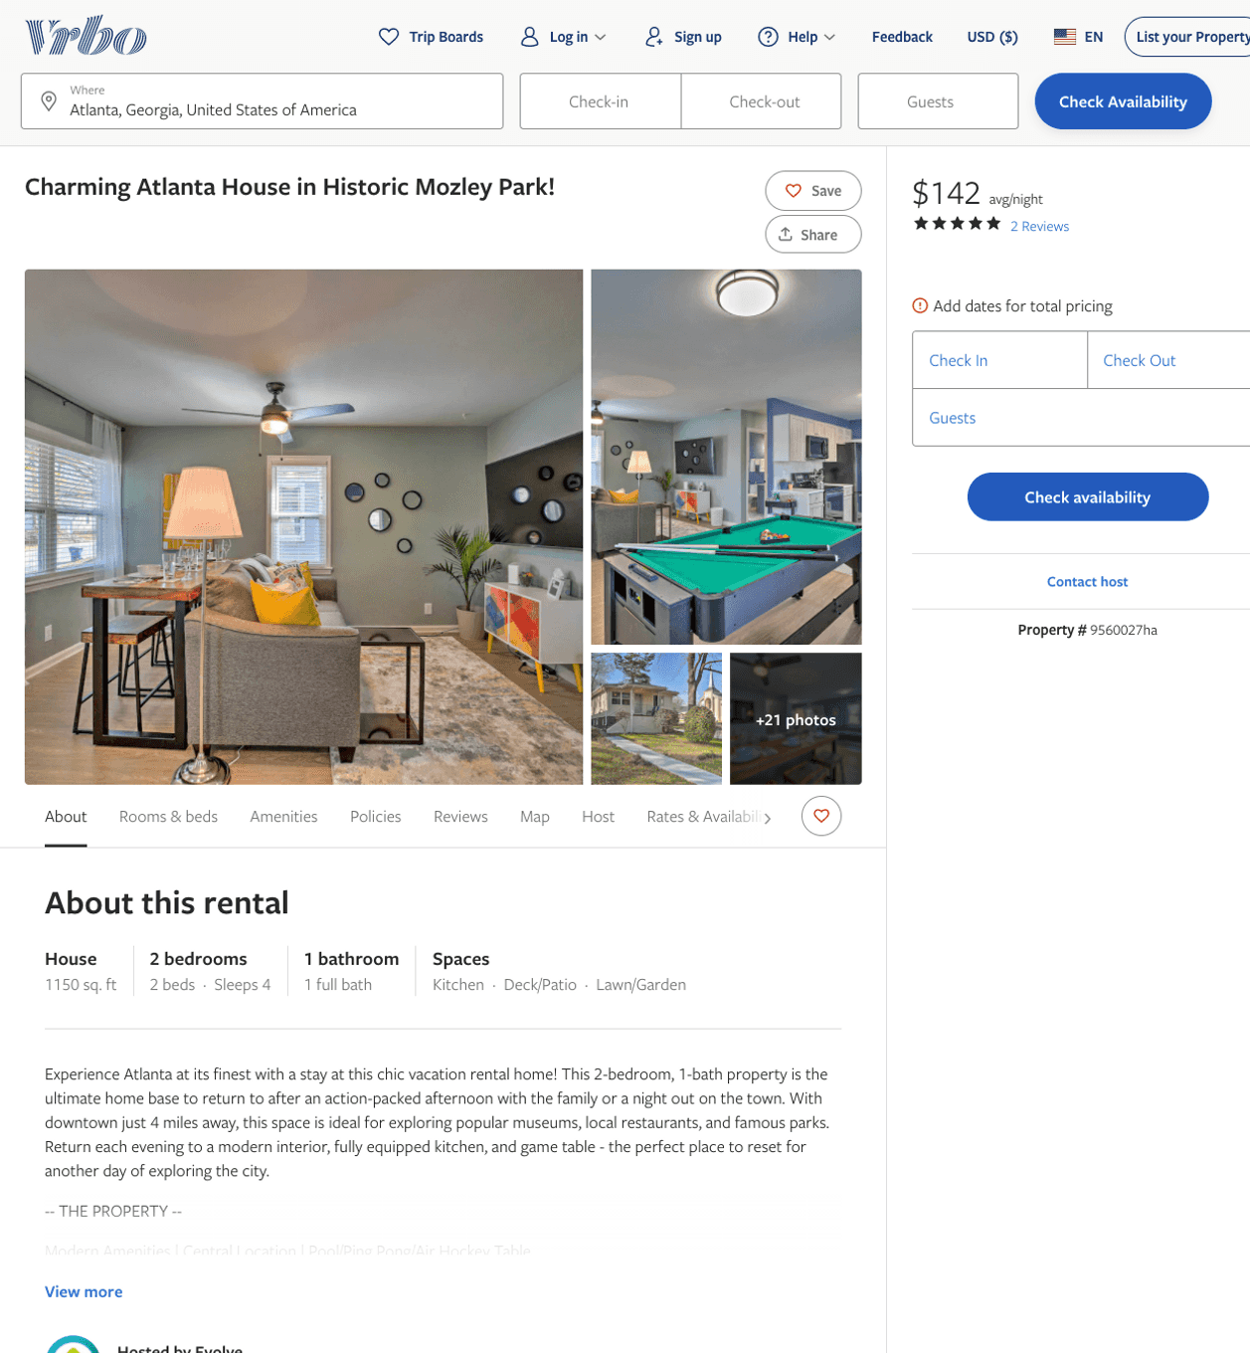
Listing 9560027
2
4
$106 - $93
5
3
Evolve
https://www.vrbo.com/9560027ha
Aug 2022

Slide 3
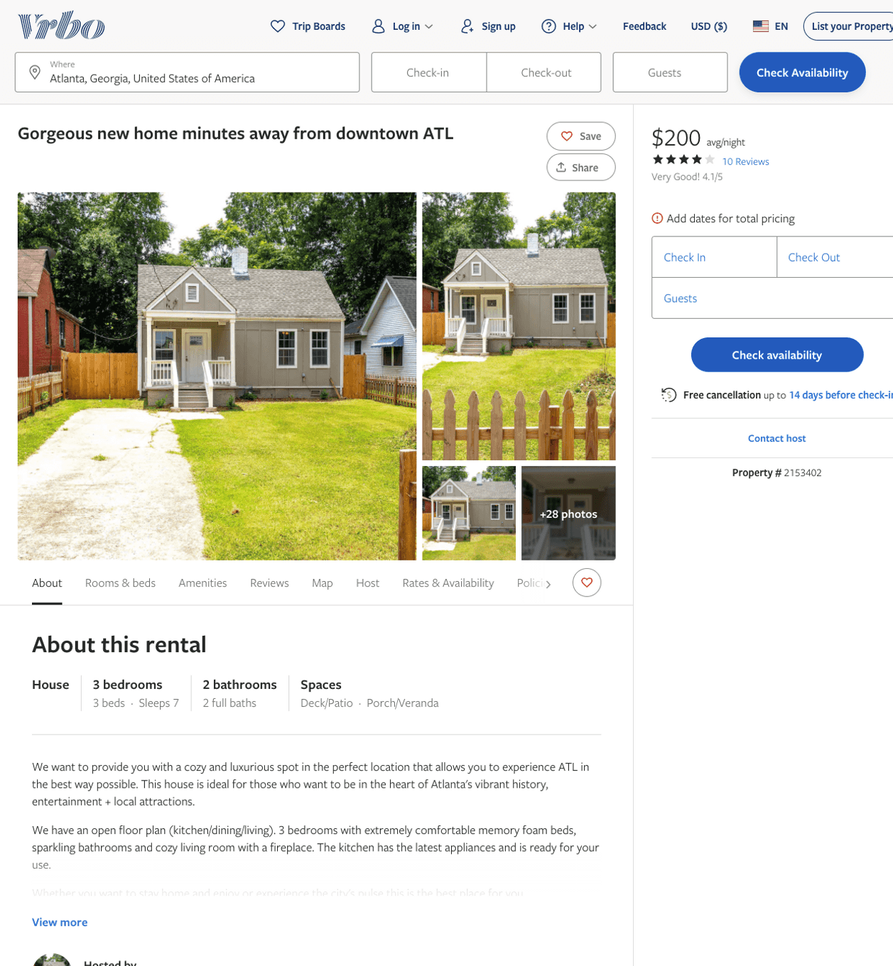
Listing 2153402
3
7
$160 - $200
4
1
https://www.vrbo.com/2153402
Aug 2022

Slide 4
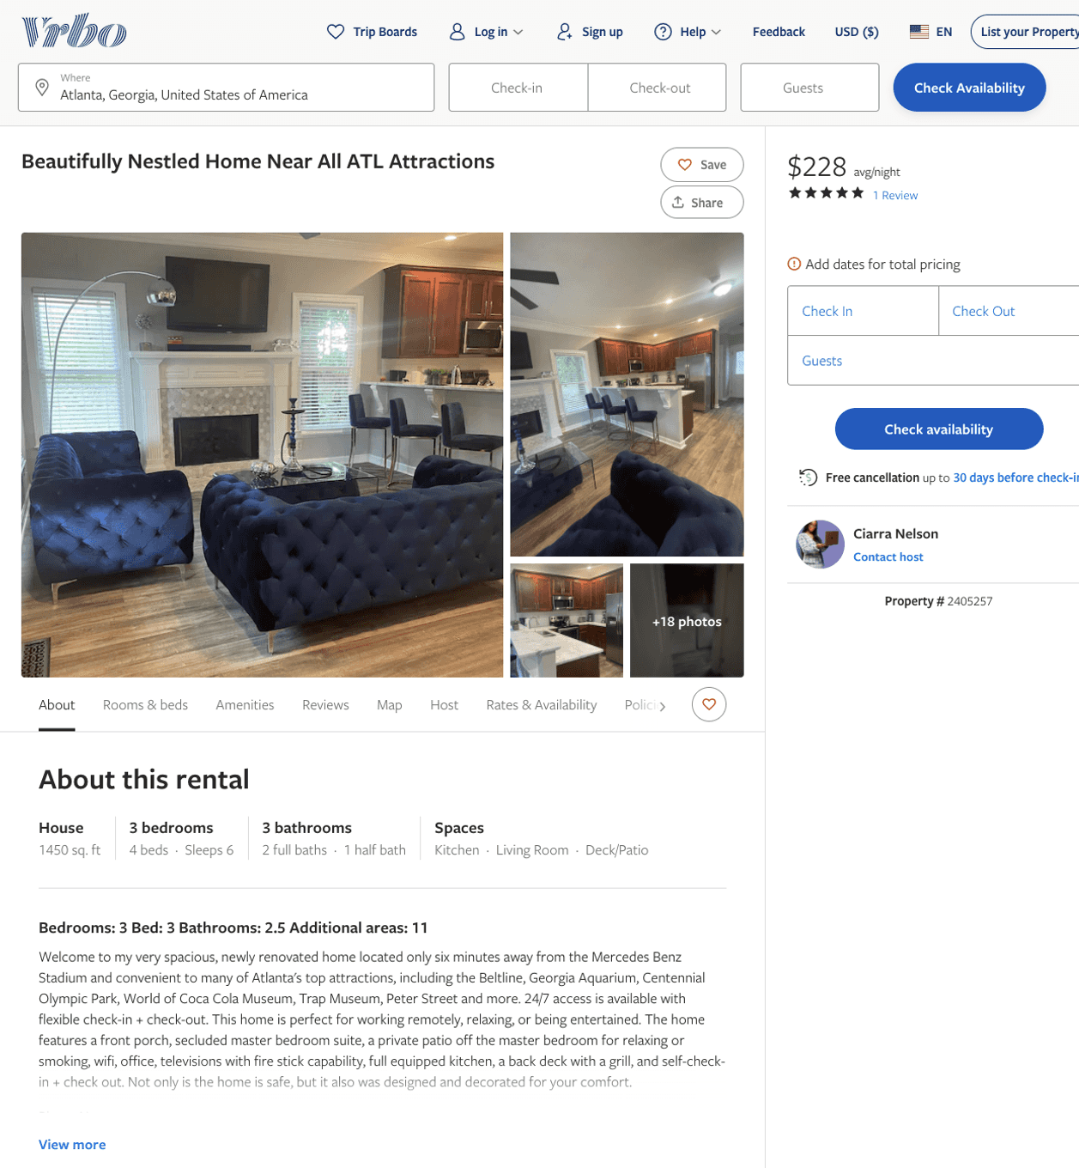
Listing 2405257
3
7
$228 - $314
4.6666665
2
Ciarra Nelson
https://www.vrbo.com/2405257
Aug 2022

Slide 5
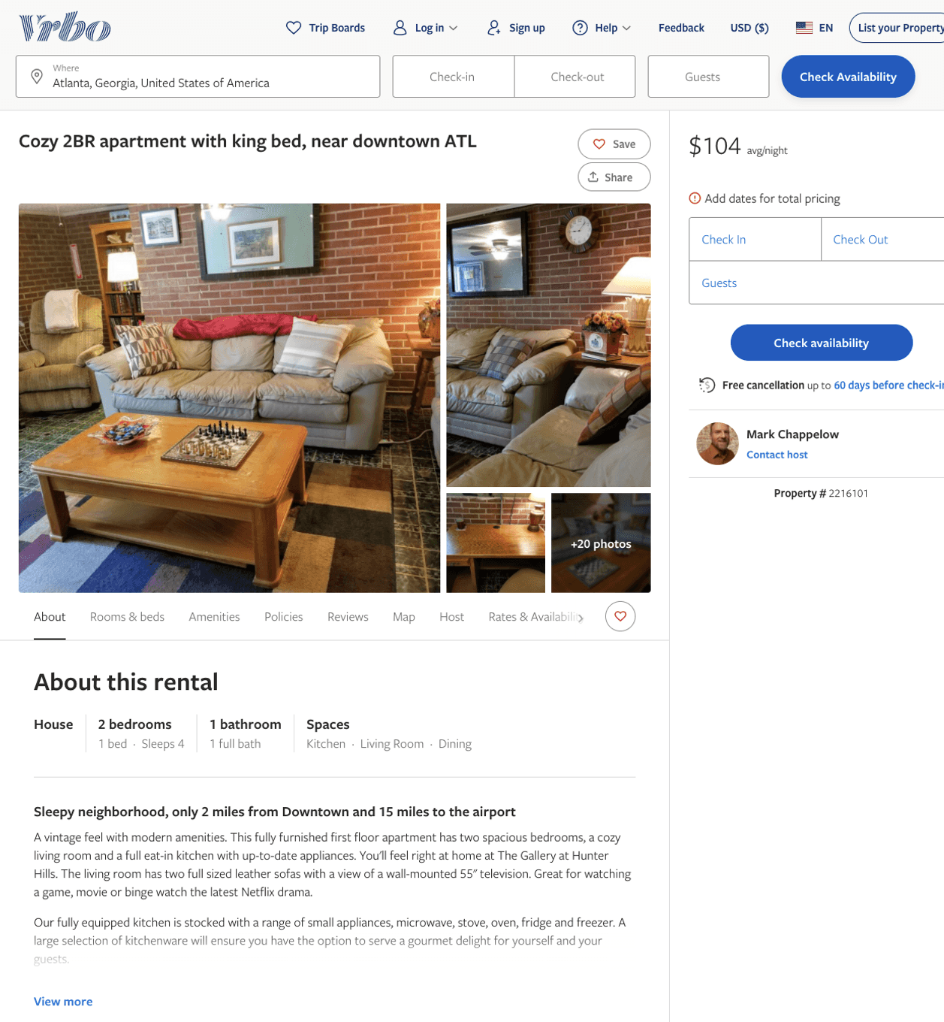
Listing 2216101
2
4
$104
3
Mark Chappelow
https://www.vrbo.com/2216101
Aug 2022

Slide 6
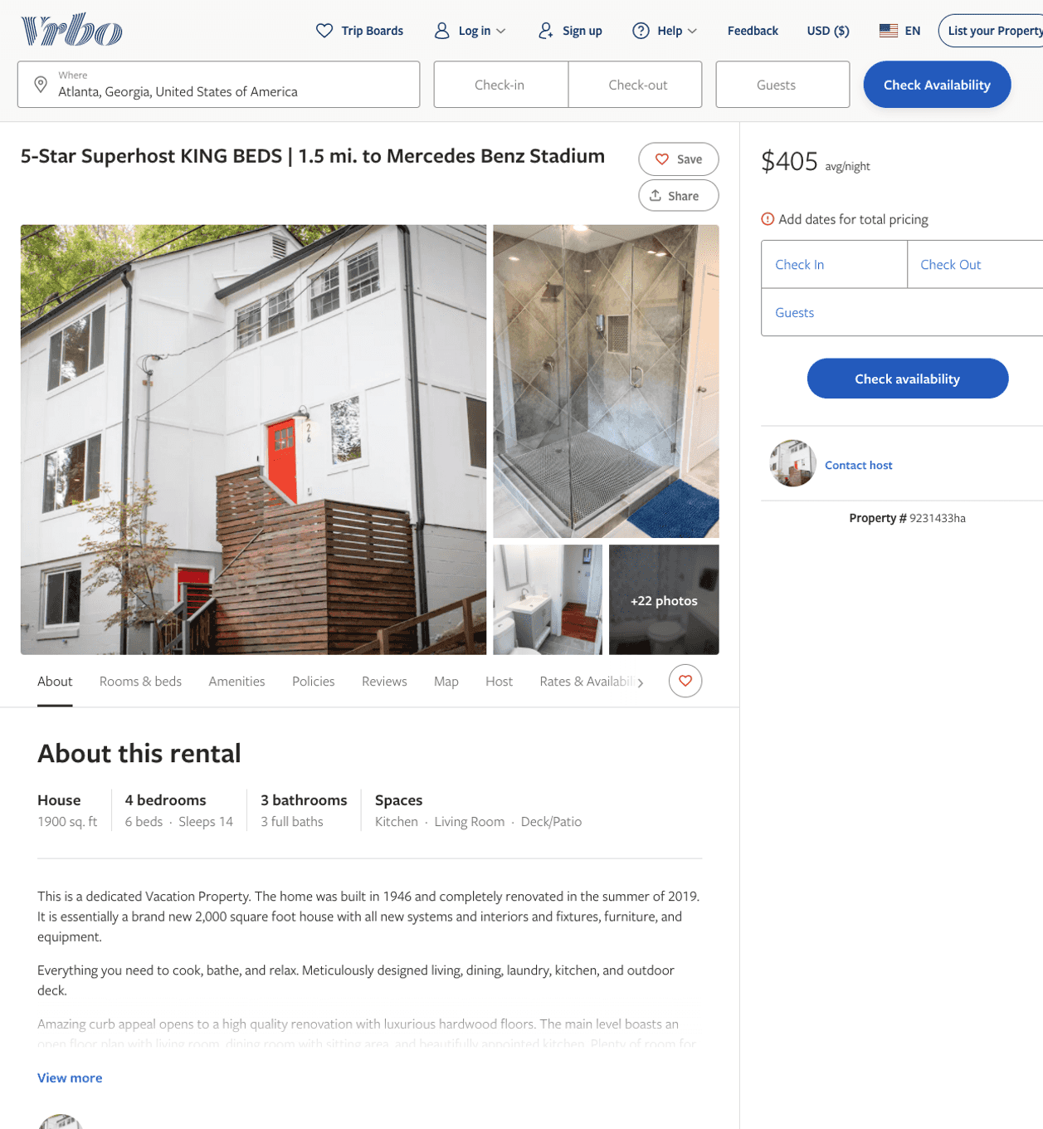
Listing 9231433
4
14
$340 - $414
4.6666665
3
https://www.vrbo.com/9231433ha
Aug 2022

Slide 7
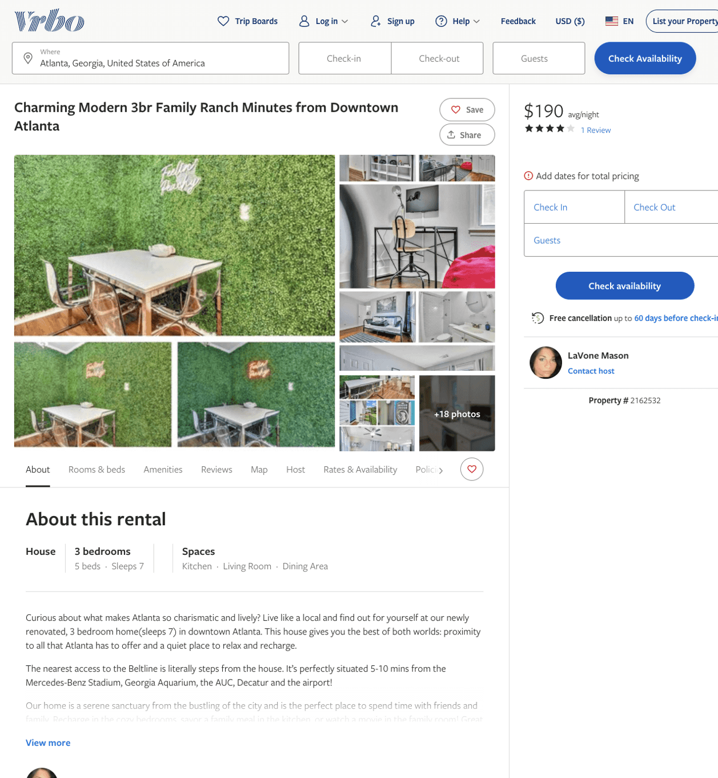
Listing 2162532
3
7
$170 - $189
4
2
LaVone Mason
https://www.vrbo.com/2162532
Aug 2022

Slide 8
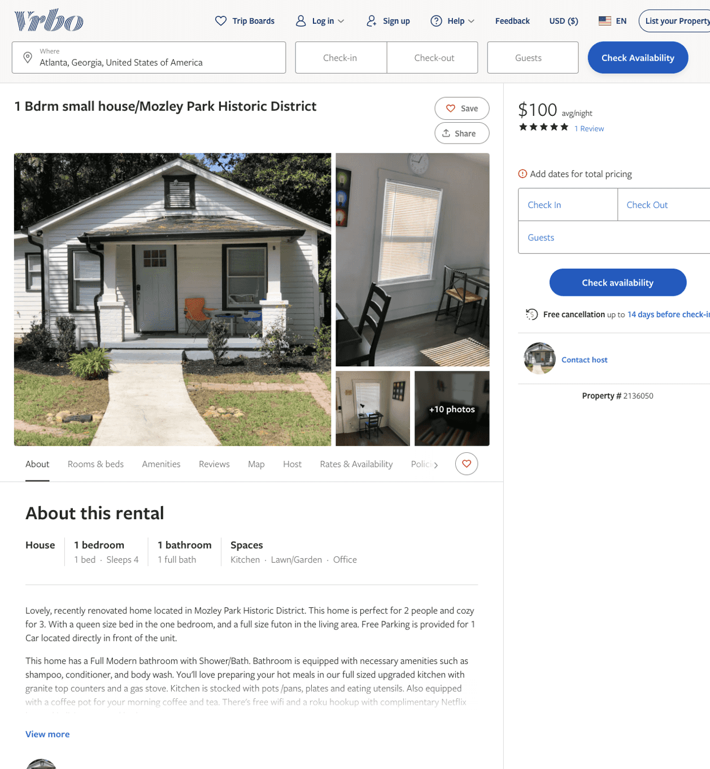
Listing 2136050
1
4
$100 - $98
4.5
2
https://www.vrbo.com/2136050
Aug 2022

Slide 9
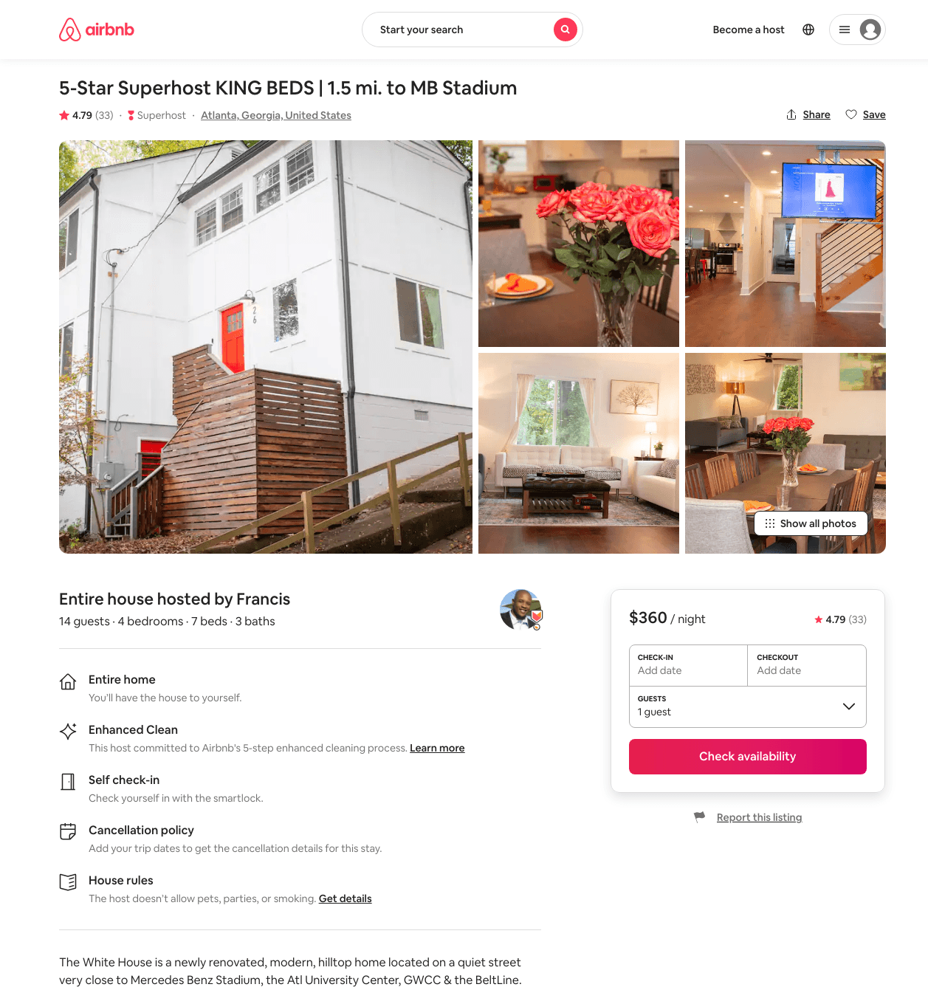
Listing 39609554
4
14
$340 - $862
4.77
2
Bin
12600145
2
https://www.airbnb.com/rooms/39609554
Aug 2022

Slide 10
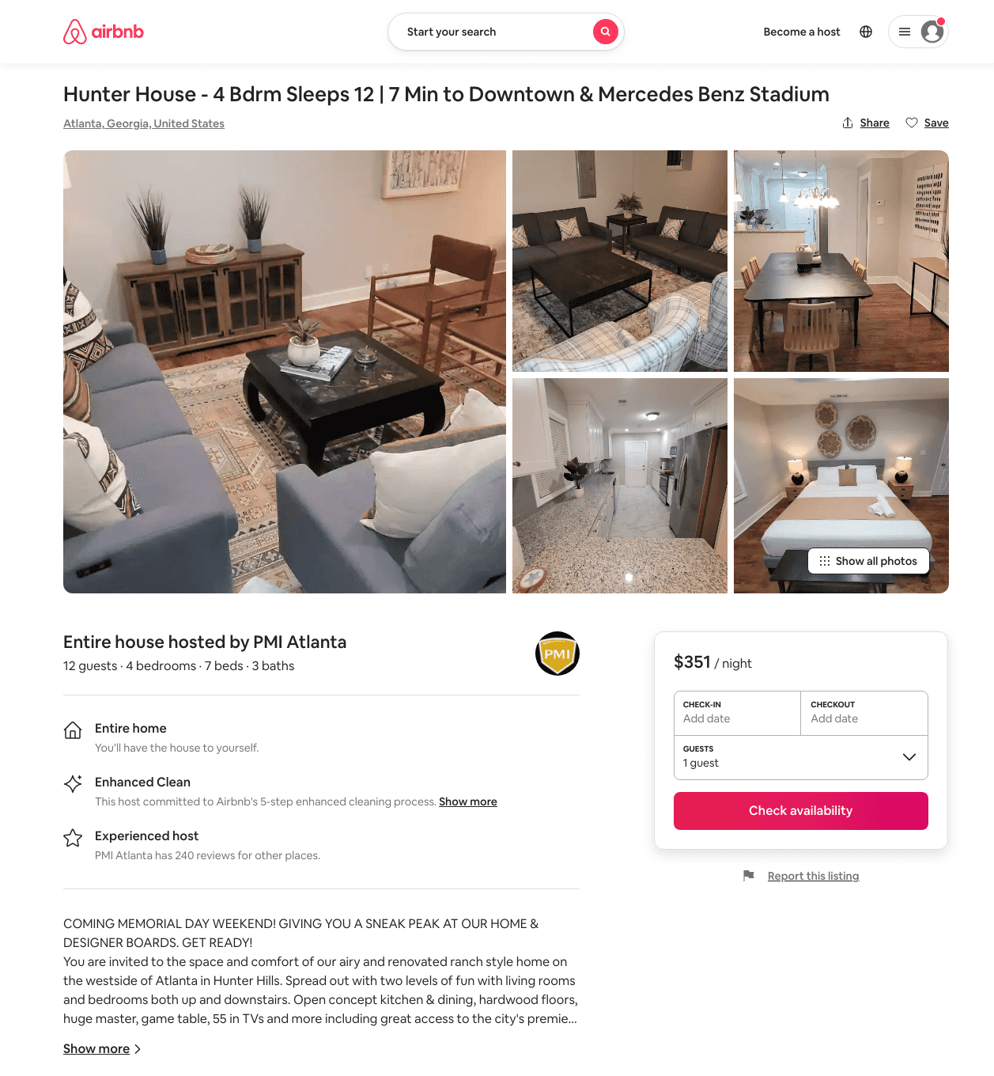
Listing 49967024
4
12
$198 - $397
4.60
1
PMI Atlanta
218820950
14
https://www.airbnb.com/rooms/49967024
Aug 2022

Slide 11
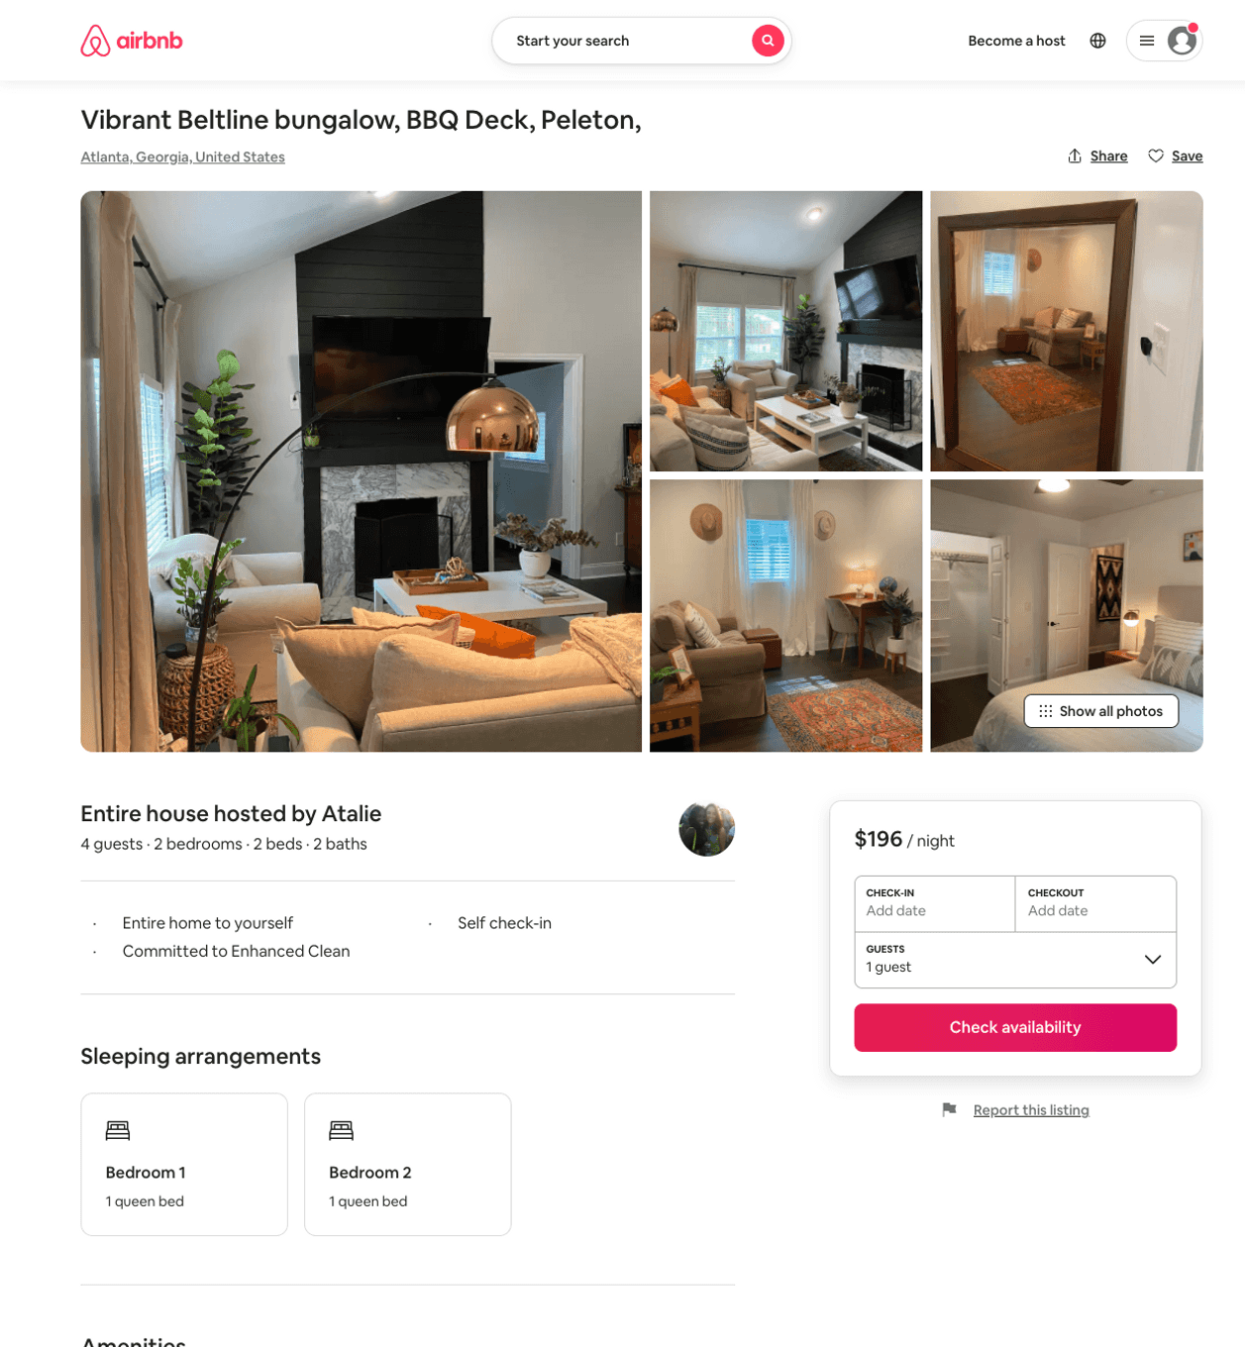
Listing 50447308
3
6
$139 - $336
4.88
2
Atalie
17931966
1
https://www.airbnb.com/rooms/50447308
Aug 2022

Slide 12
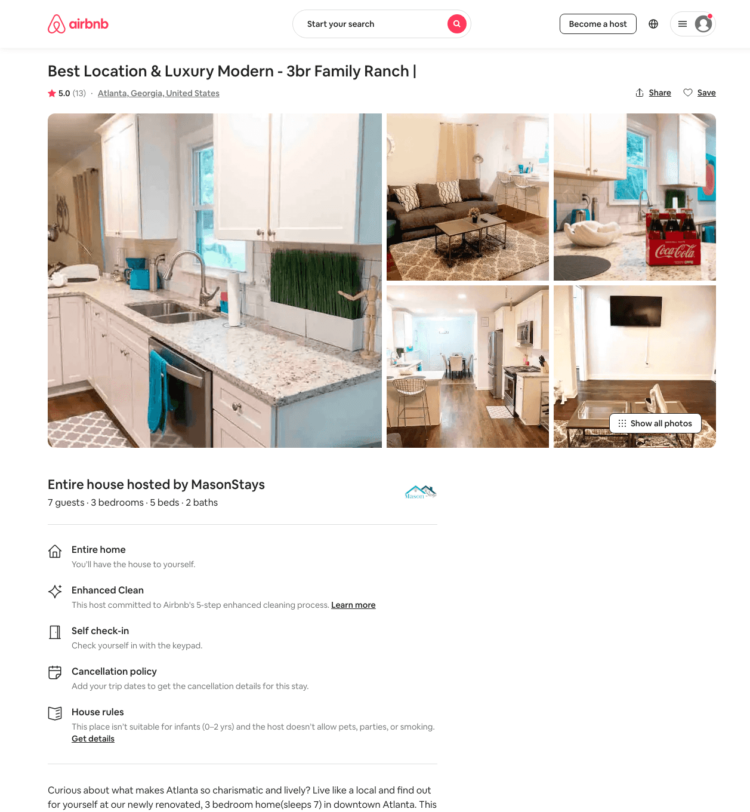
Listing 44229239
3
7
$120 - $257
4.78
2
MasonStays
352215861
1
https://www.airbnb.com/rooms/44229239
Jun 2022

Slide 13
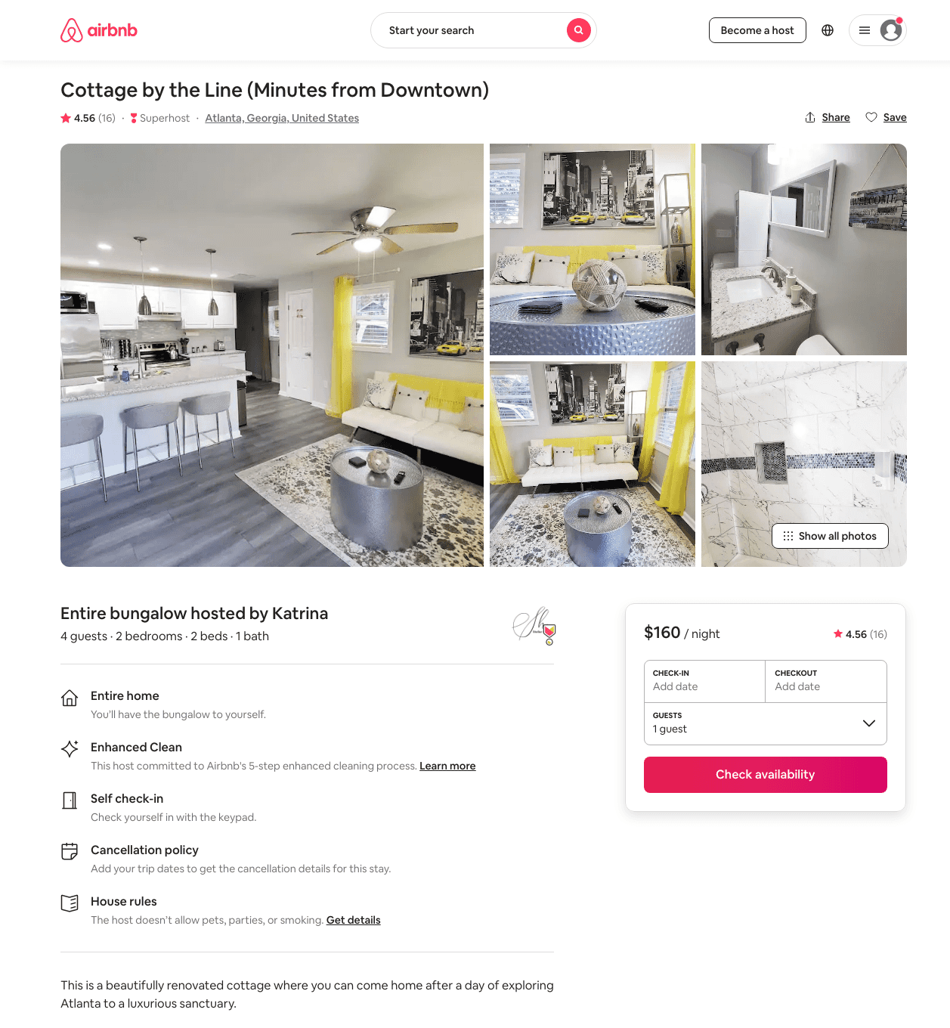
Listing 45600930
2
4
$109 - $194
4.71
2
Katrina
313117383
1
https://www.airbnb.com/rooms/45600930
Aug 2022

Slide 14
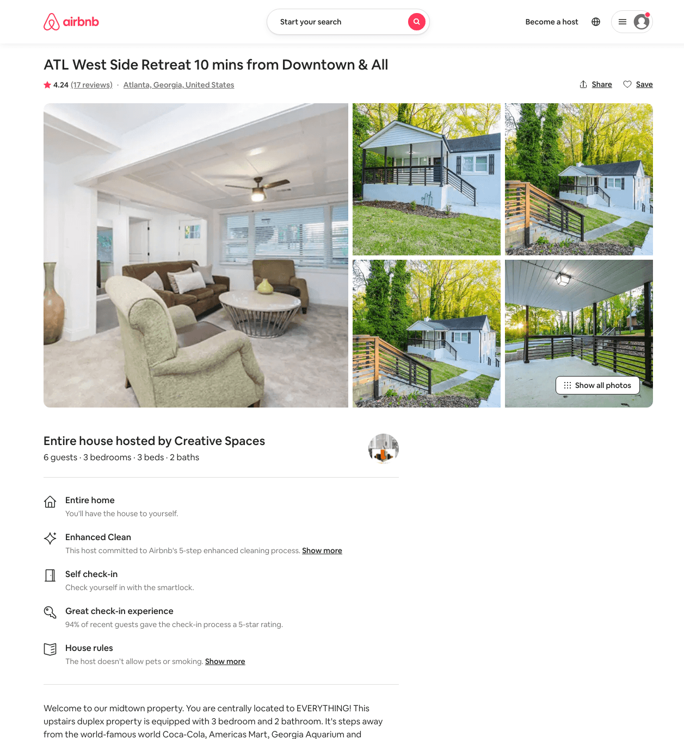
Listing 44166763
3
6
$157 - $200
4.36
2
Creative Spaces
223375402
3
https://www.airbnb.com/rooms/44166763
Jun 2022

Slide 15
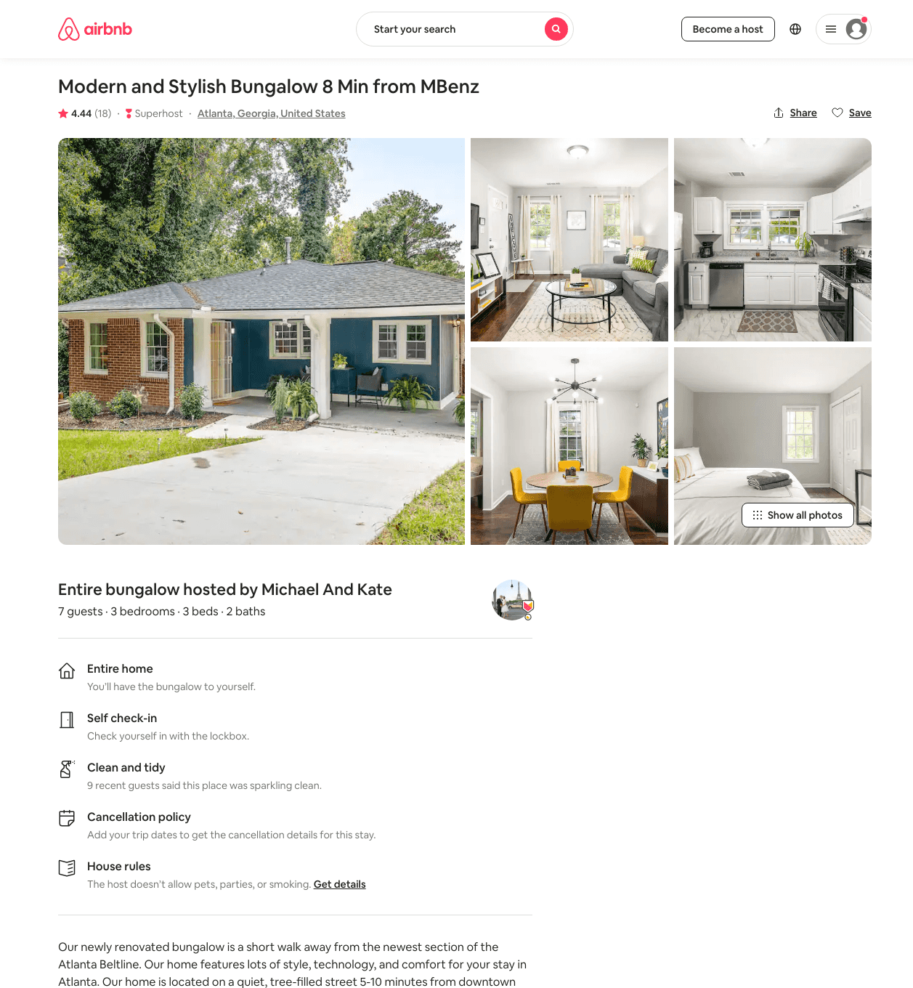
Listing 45789792
3
7
$124 - $179
4.73
2
Riaz
371221711
3
https://www.airbnb.com/rooms/45789792
Aug 2022

Slide 16
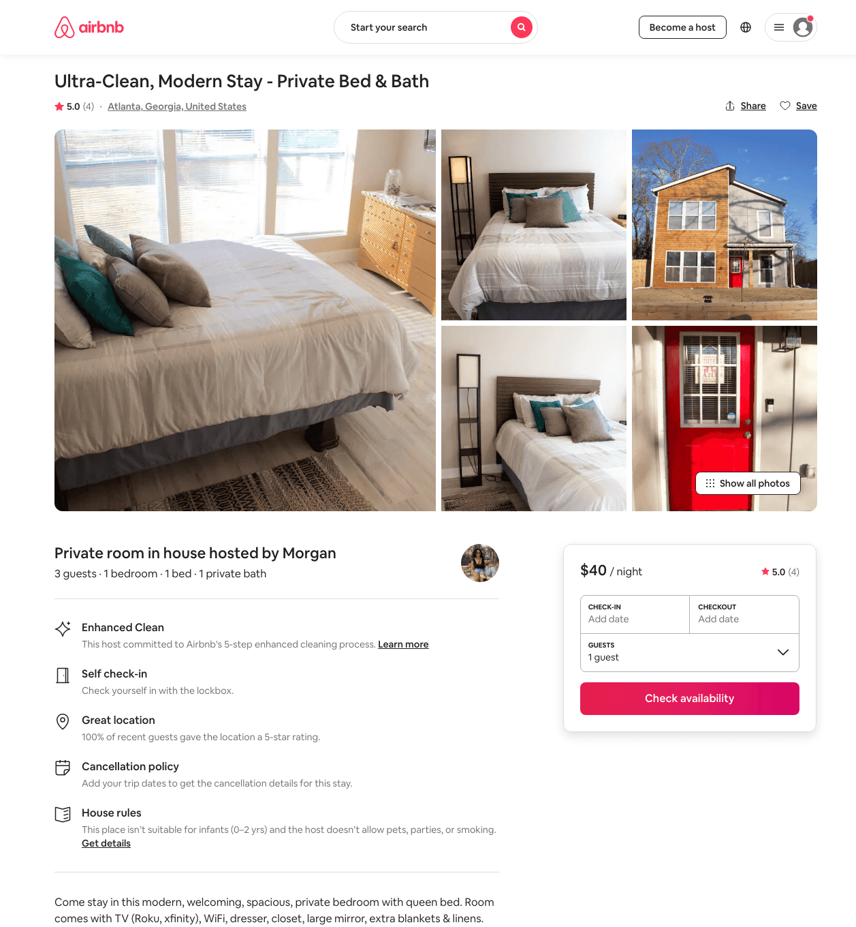
Listing 47780464
1
2
$40 - $56
4.96
2
Morgan
172878971
1
https://www.airbnb.com/rooms/47780464
Jun 2022

Slide 17
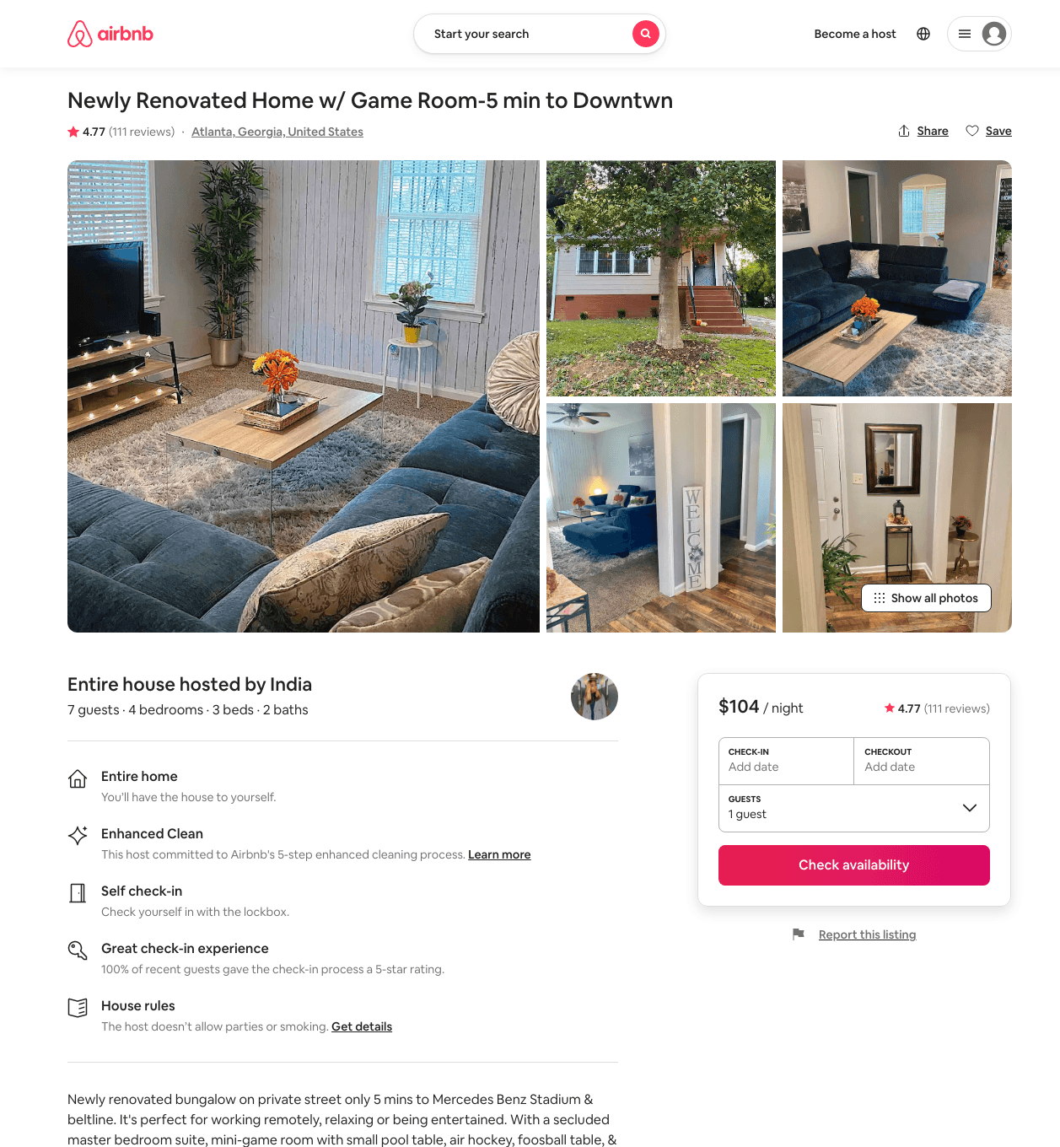
Listing 39920041
4
7
$83 - $119
4.65
1
India
74147278
1
https://www.airbnb.com/rooms/39920041
Aug 2022

Slide 18
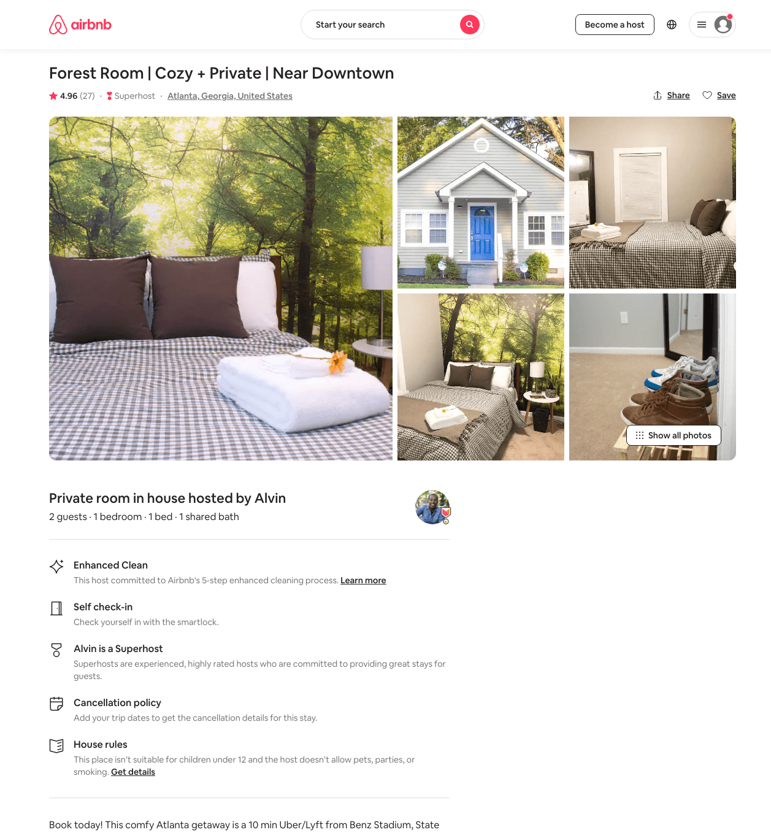
Listing 37884756
1
2
$38 - $61
4.92
3
Alvin
75240897
2
https://www.airbnb.com/rooms/37884756
Aug 2022

Slide 19
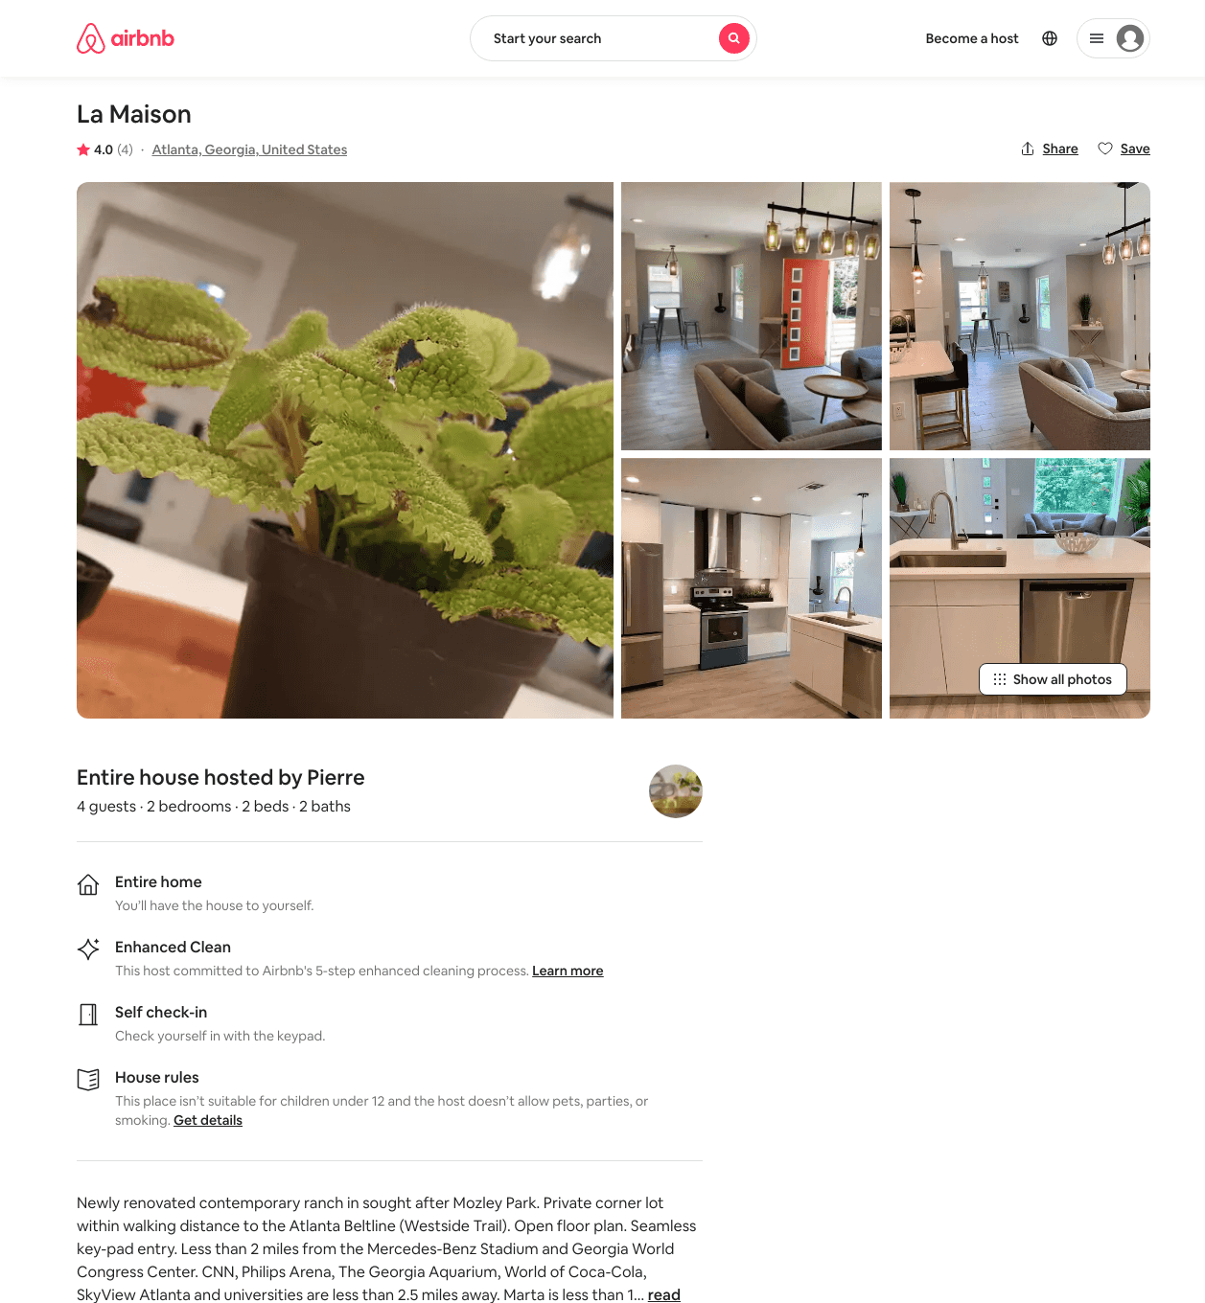
Listing 38133158
2
4
$540
4.0
2
Pierre
286032327
3
https://www.airbnb.com/rooms/38133158
Aug 2022

Slide 20
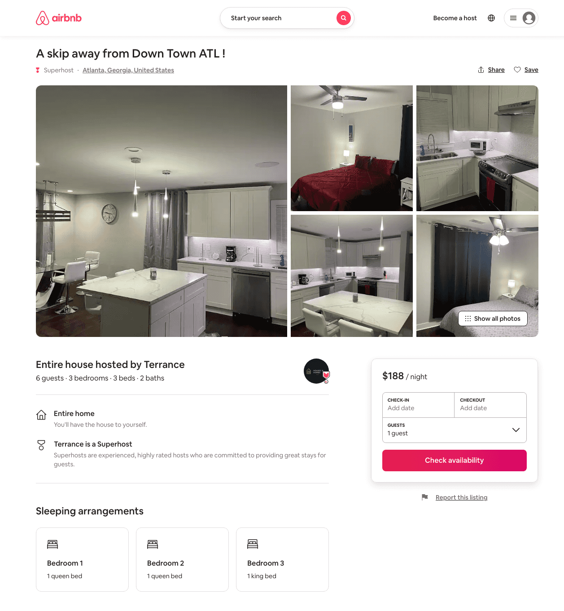
Listing 49249428
3
6
$140 - $236
4.65
1
Terrance
286511730
3
https://www.airbnb.com/rooms/49249428
Aug 2022

Slide 21
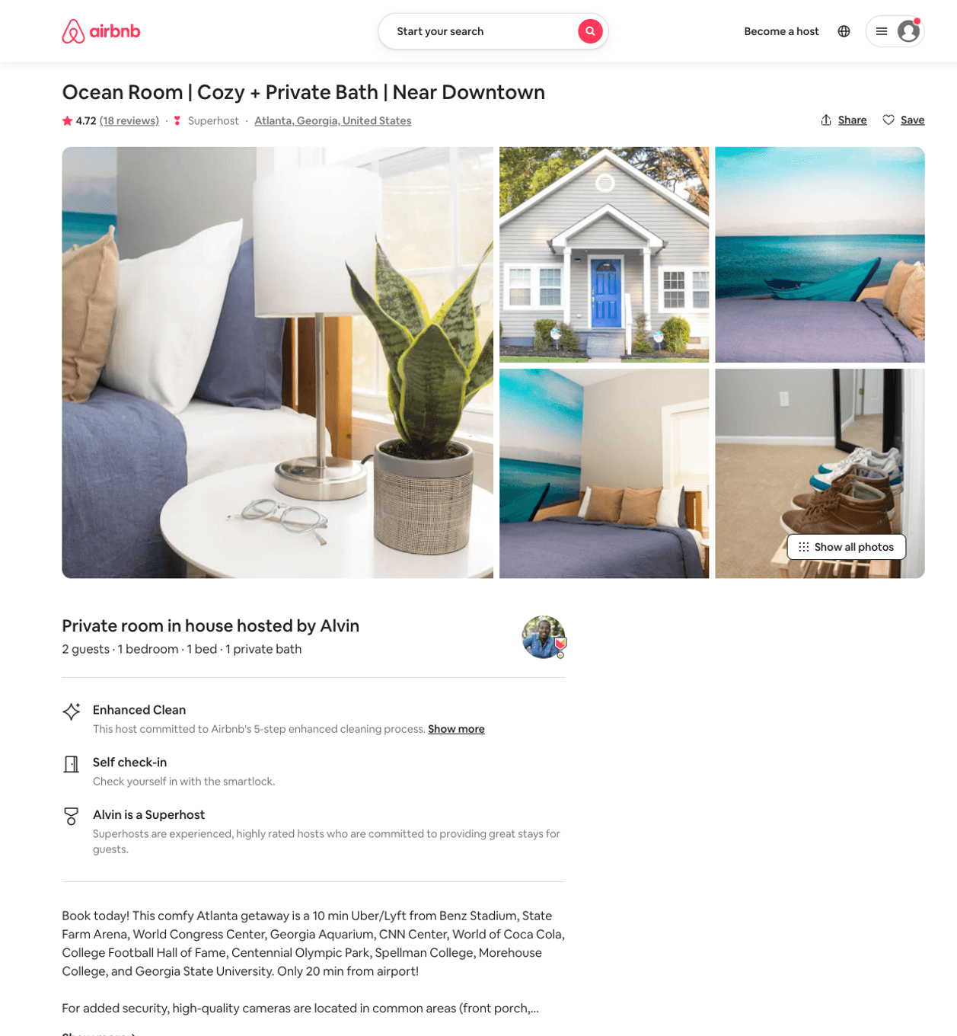
Listing 37884862
1
2
$48 - $58
4.79
3
Alvin
75240897
2
https://www.airbnb.com/rooms/37884862
Aug 2022

Slide 22
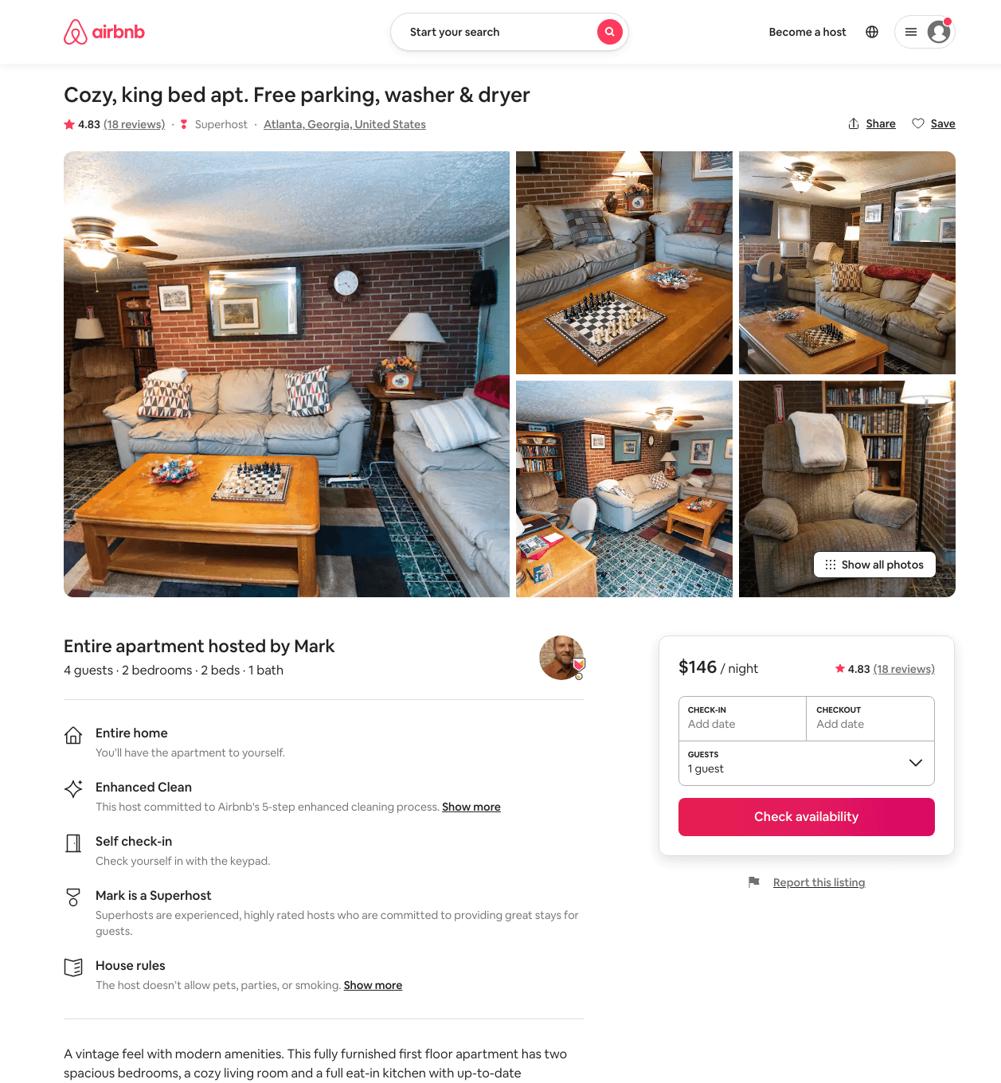
Listing 43397940
2
4
$85 - $144
4.80
1
Mark
337950455
1
https://www.airbnb.com/rooms/43397940
Aug 2022

Slide 23
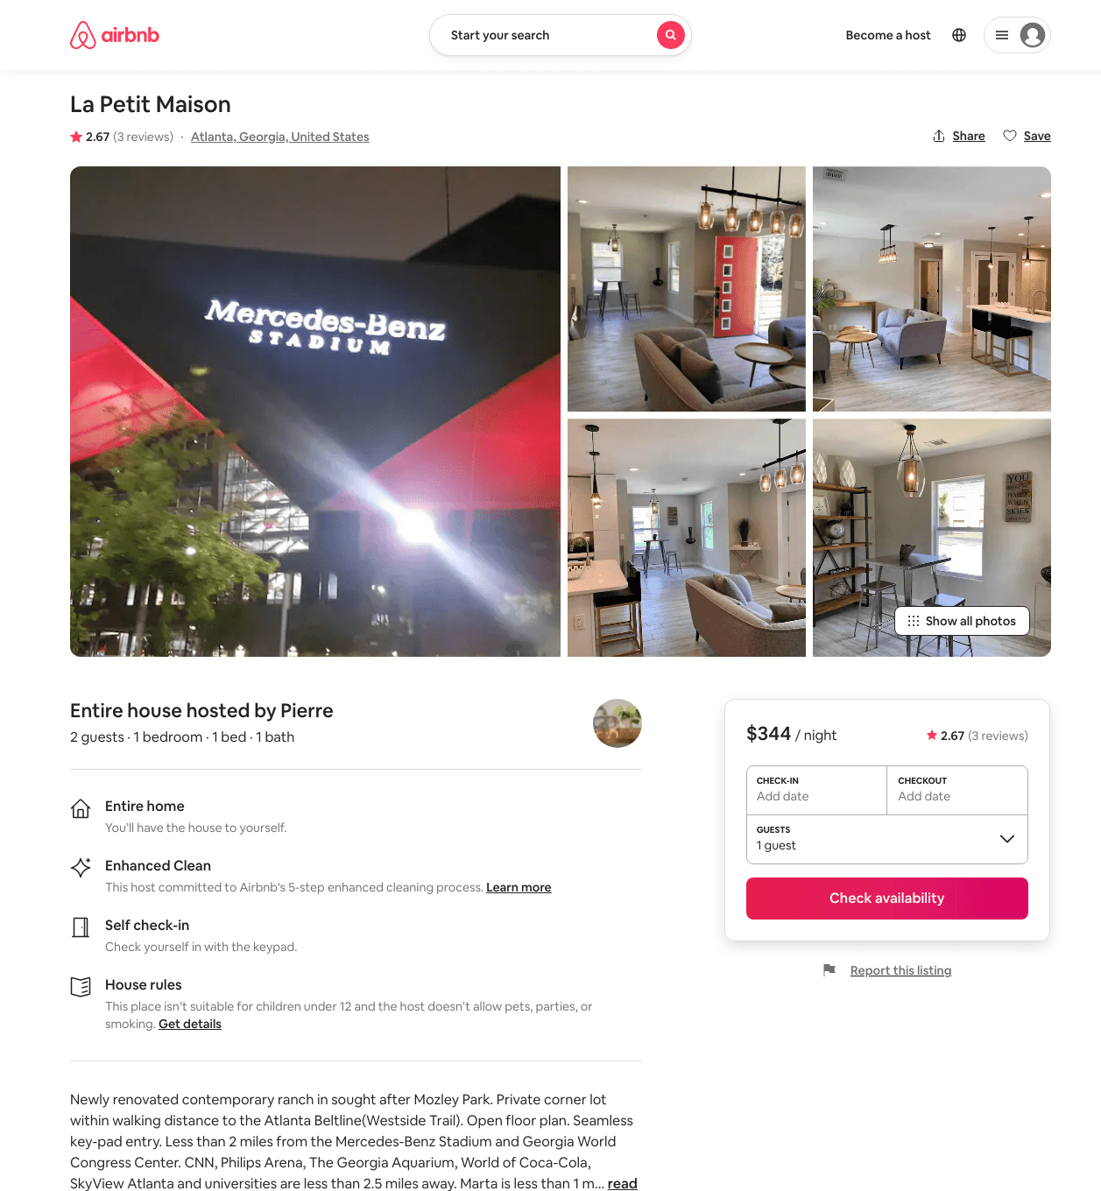
Listing 38459045
1
2
$344
2.67
2
Pierre
286032327
3
https://www.airbnb.com/rooms/38459045
Aug 2022

Slide 24
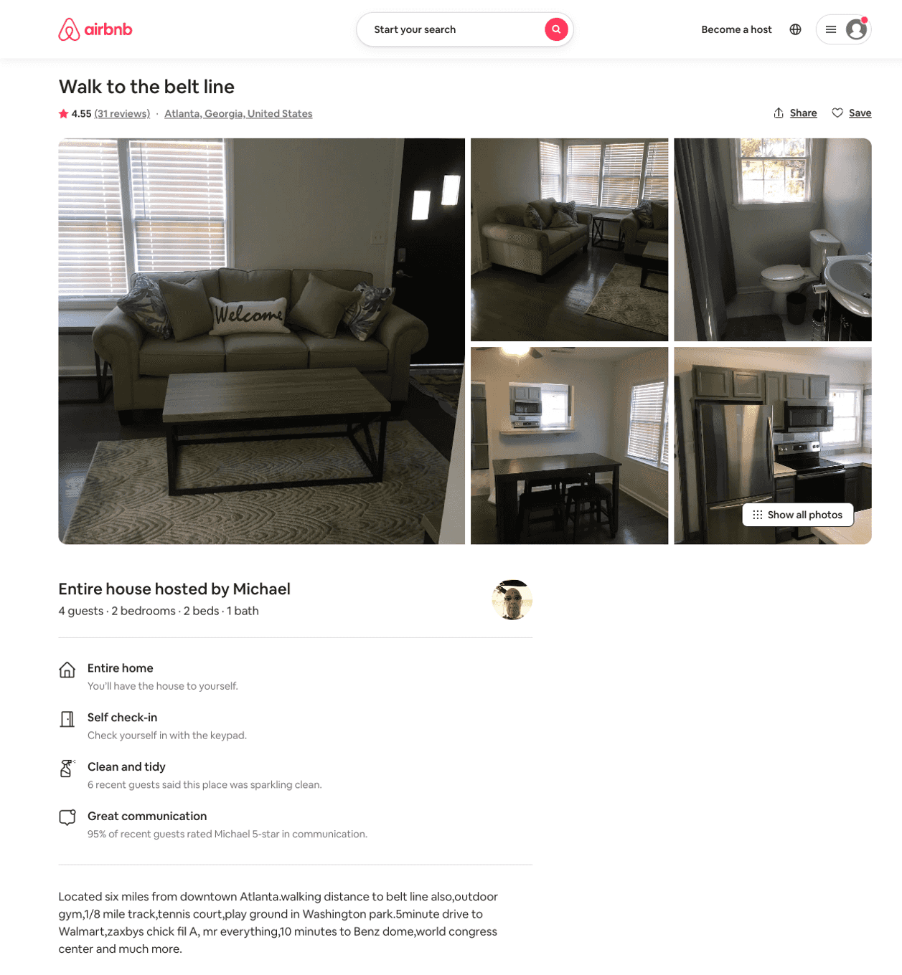
Listing 42777640
2
4
$80 - $110
4.65
2
Michael
325398735
1
https://www.airbnb.com/rooms/42777640
Jun 2022

Slide 25
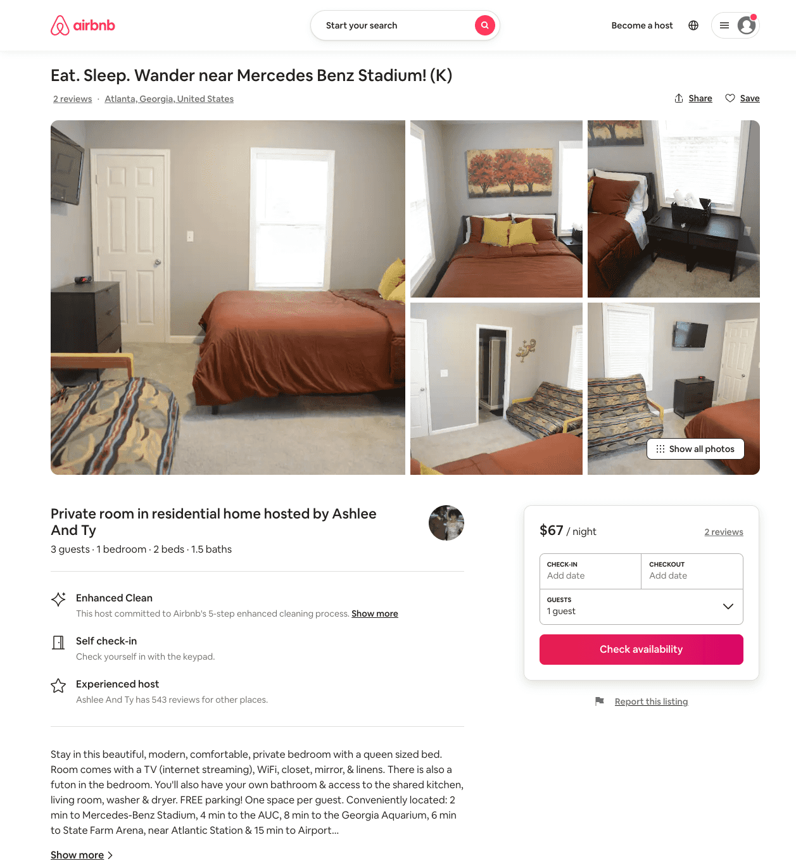
Listing 51063913
1
3
$40 - $75
4.76
1
Ashlee And Ty
33398144
5
https://www.airbnb.com/rooms/51063913
Aug 2022

Slide 26
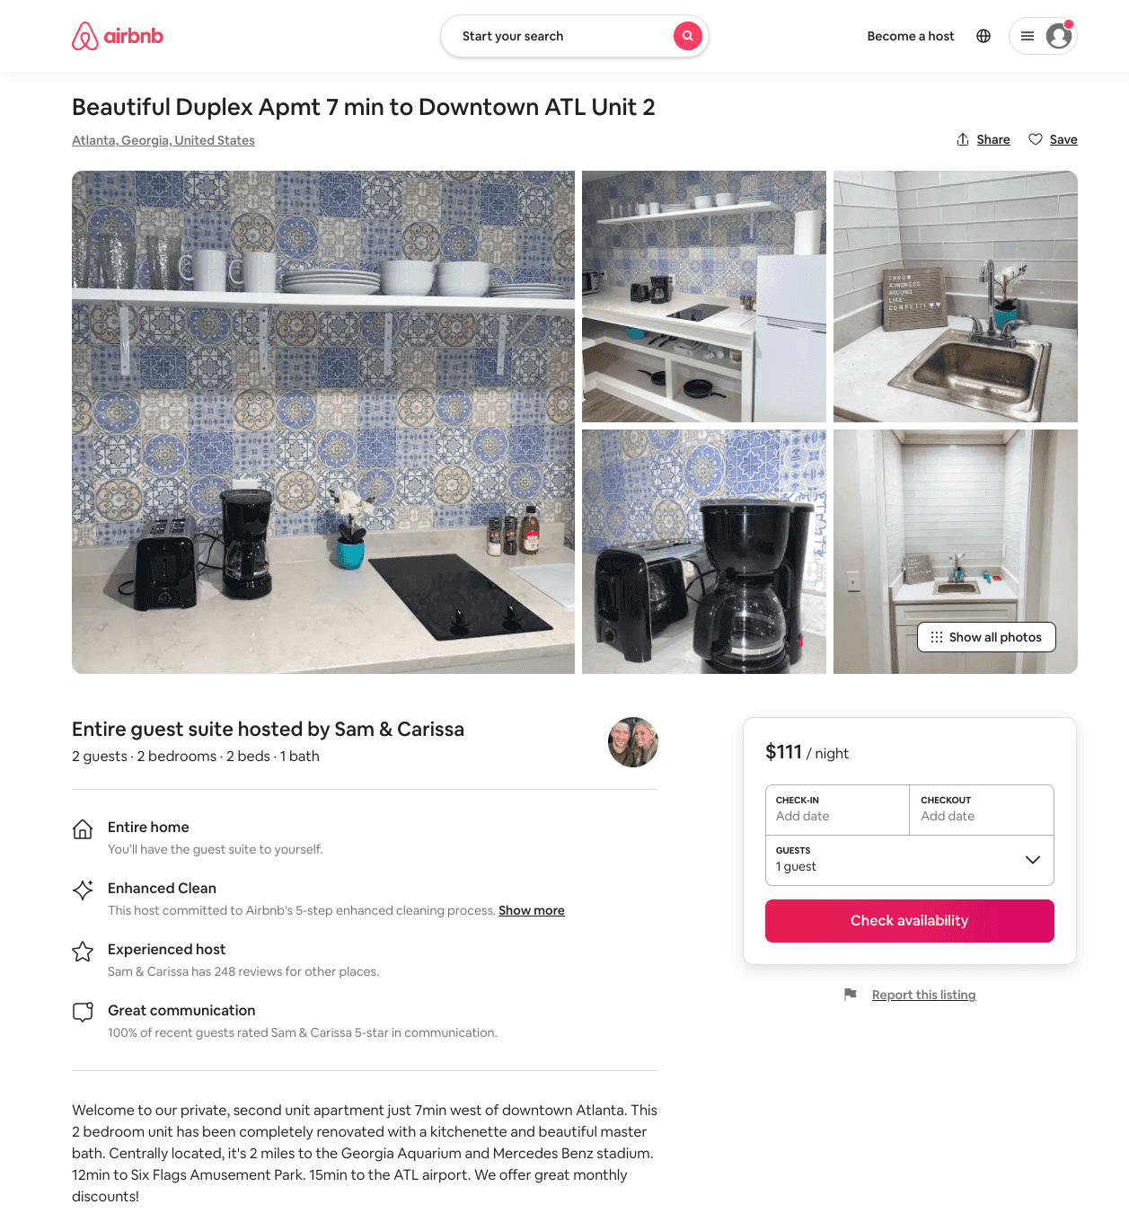
Listing 51006536
2
2
$83 - $198
4.36
28
Carissa And Sam
15489385
3
https://www.airbnb.com/rooms/51006536
Aug 2022

Slide 27
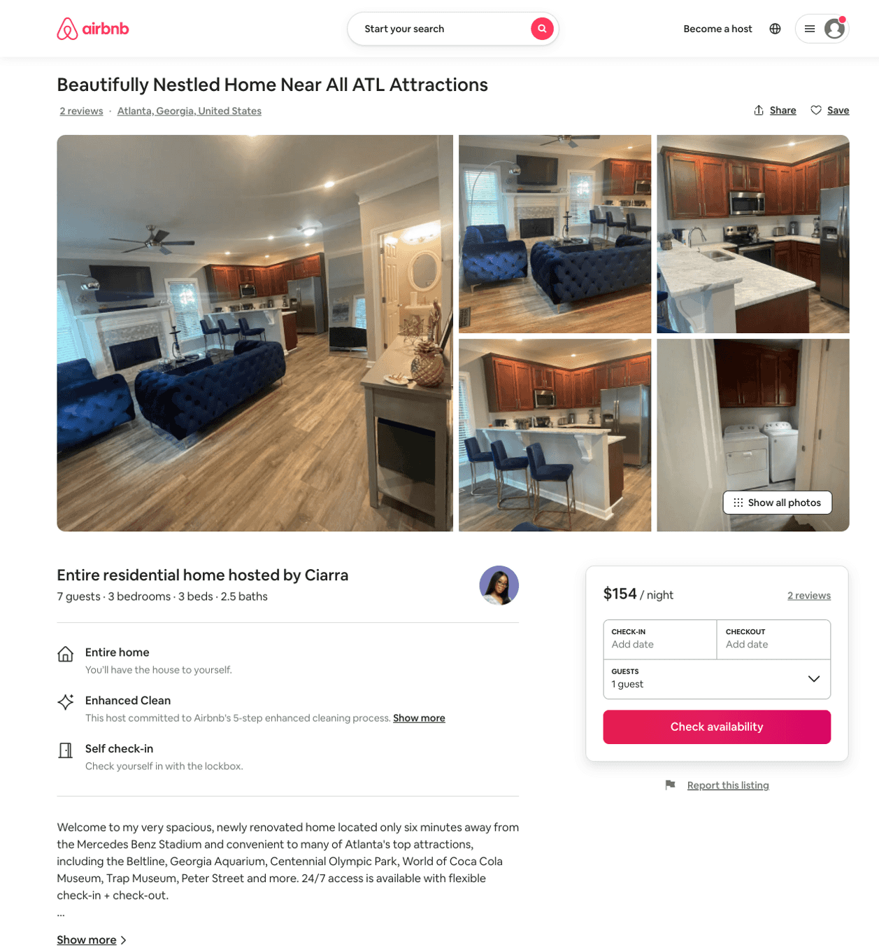
Listing 51270101
3
7
$146 - $291
4.94
3
Ciarra
66252092
1
https://www.airbnb.com/rooms/51270101
Aug 2022

Slide 28
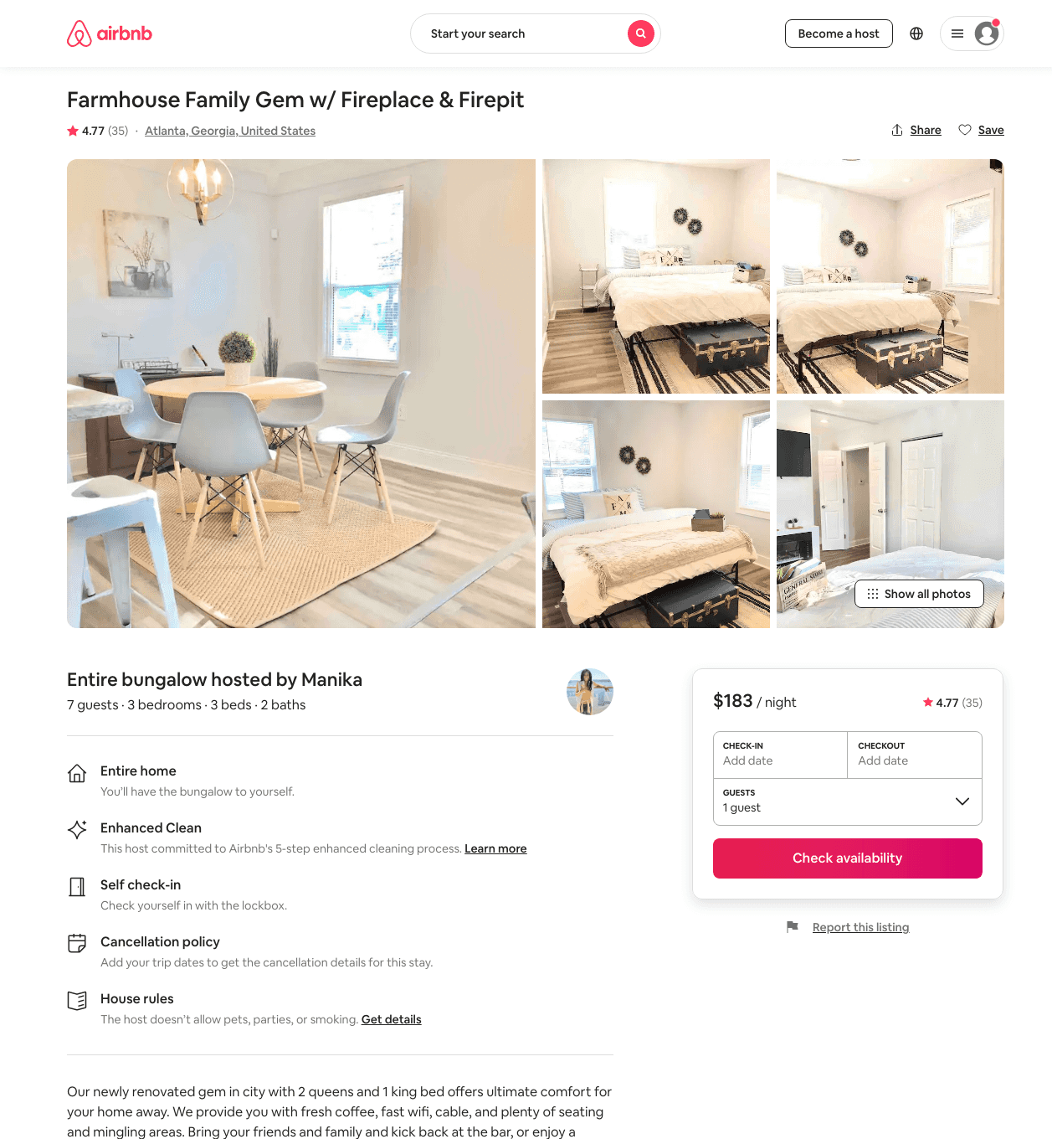
Listing 42322367
3
7
$99 - $1588
4.62
2
Manika
49819100
11
https://www.airbnb.com/rooms/42322367
Aug 2022

Slide 29
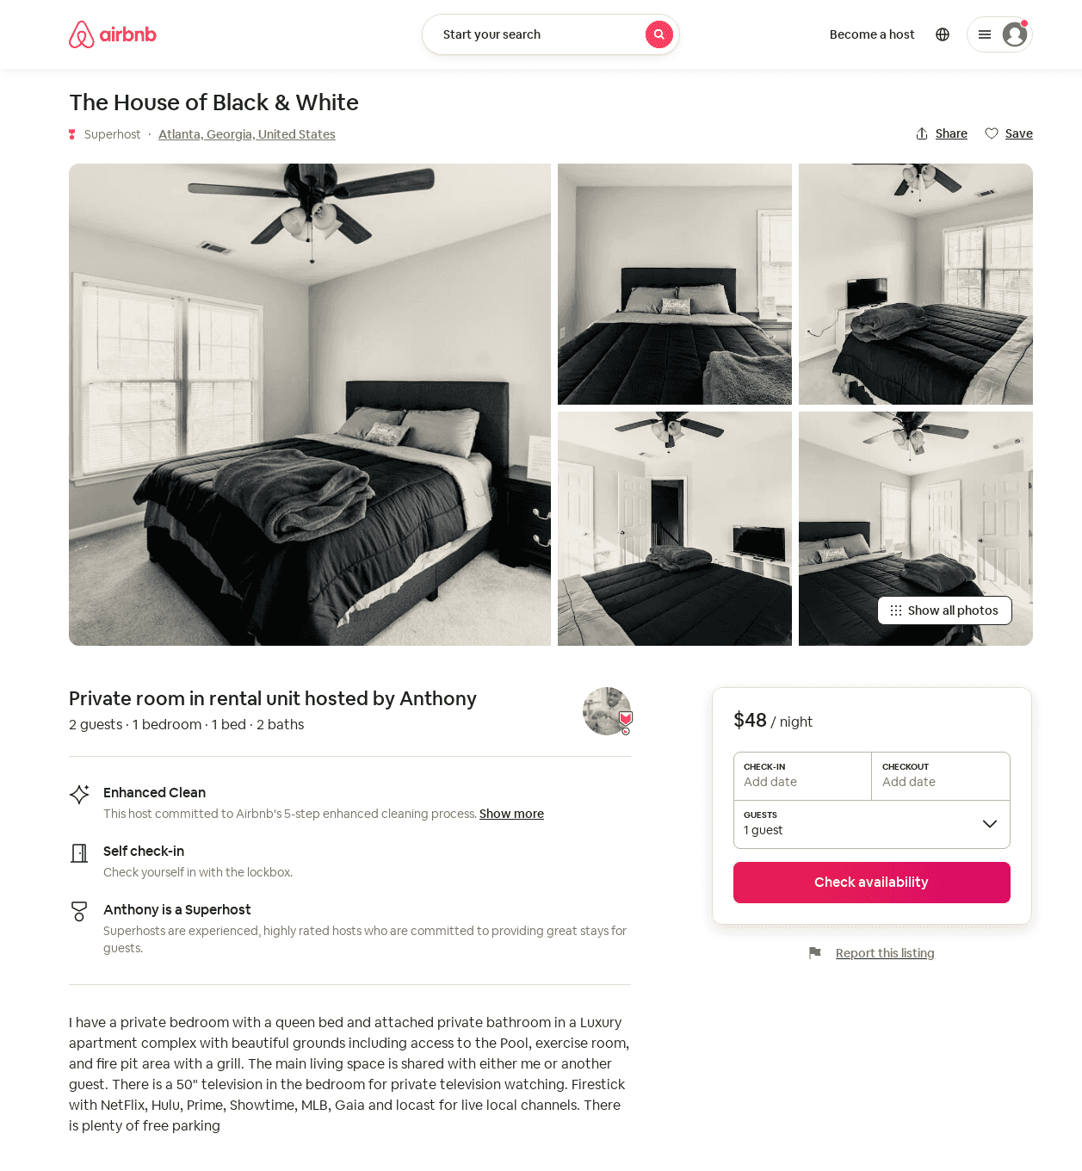
Listing 52059732
1
2
$48 - $150
4.78
1
Anthony
151098865
4
https://www.airbnb.com/rooms/52059732
Aug 2022

Slide 30
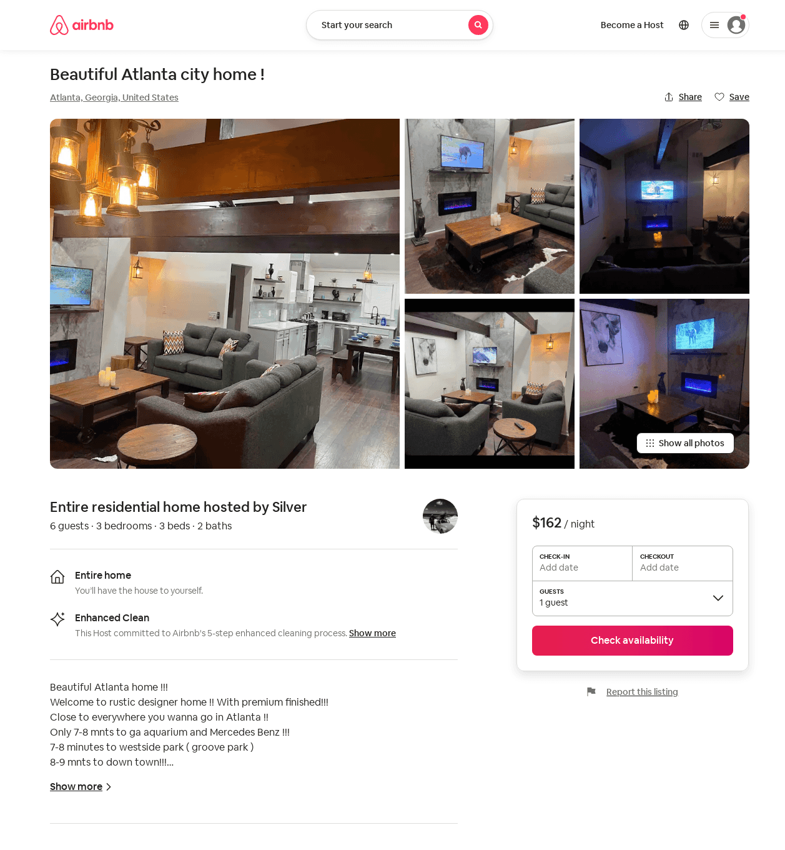
Listing 52784248
3
6
$162 - $286
4.67
2
Silver
387307368
2
https://www.airbnb.com/rooms/52784248
Aug 2022

Slide 31
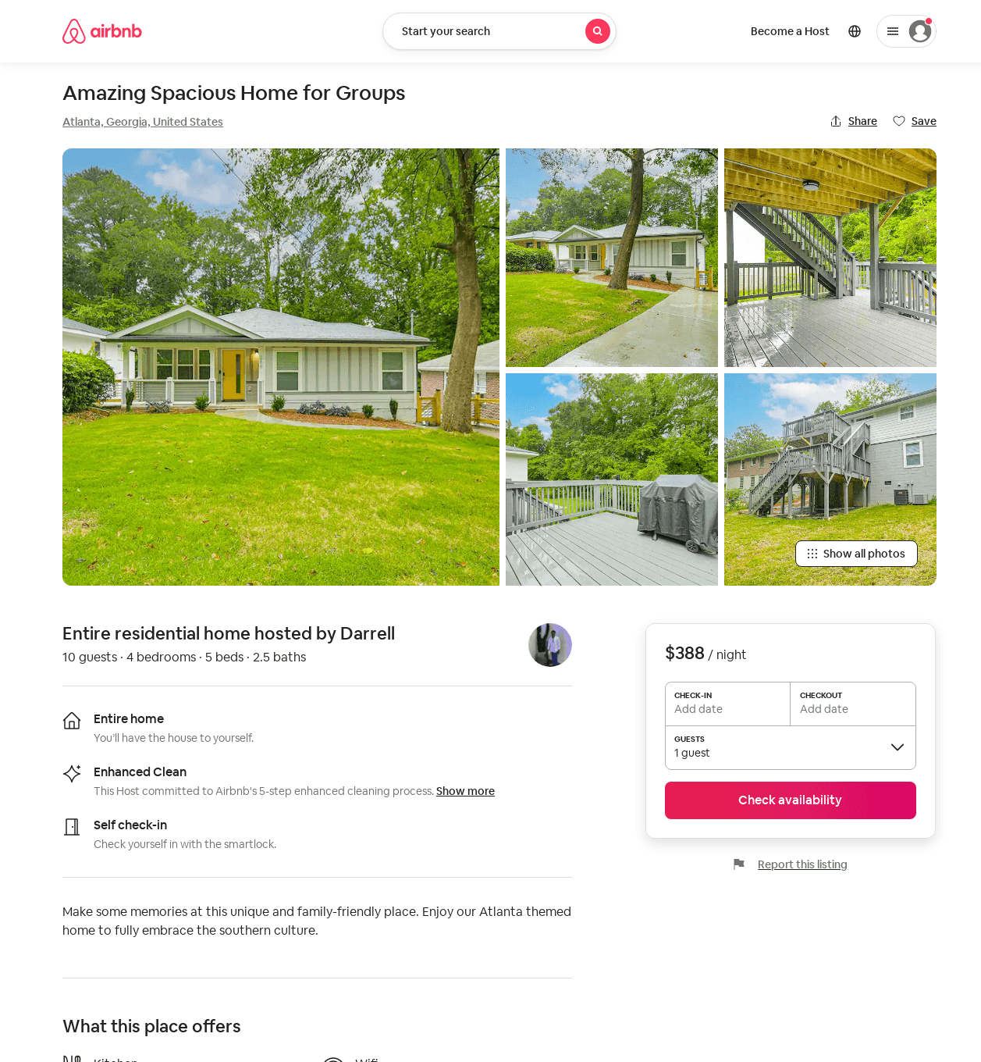
Listing 52798434
4
10
$146 - $388
4.63
2
Renesha
35038747
3
https://www.airbnb.com/rooms/52798434
Jun 2022

Slide 32
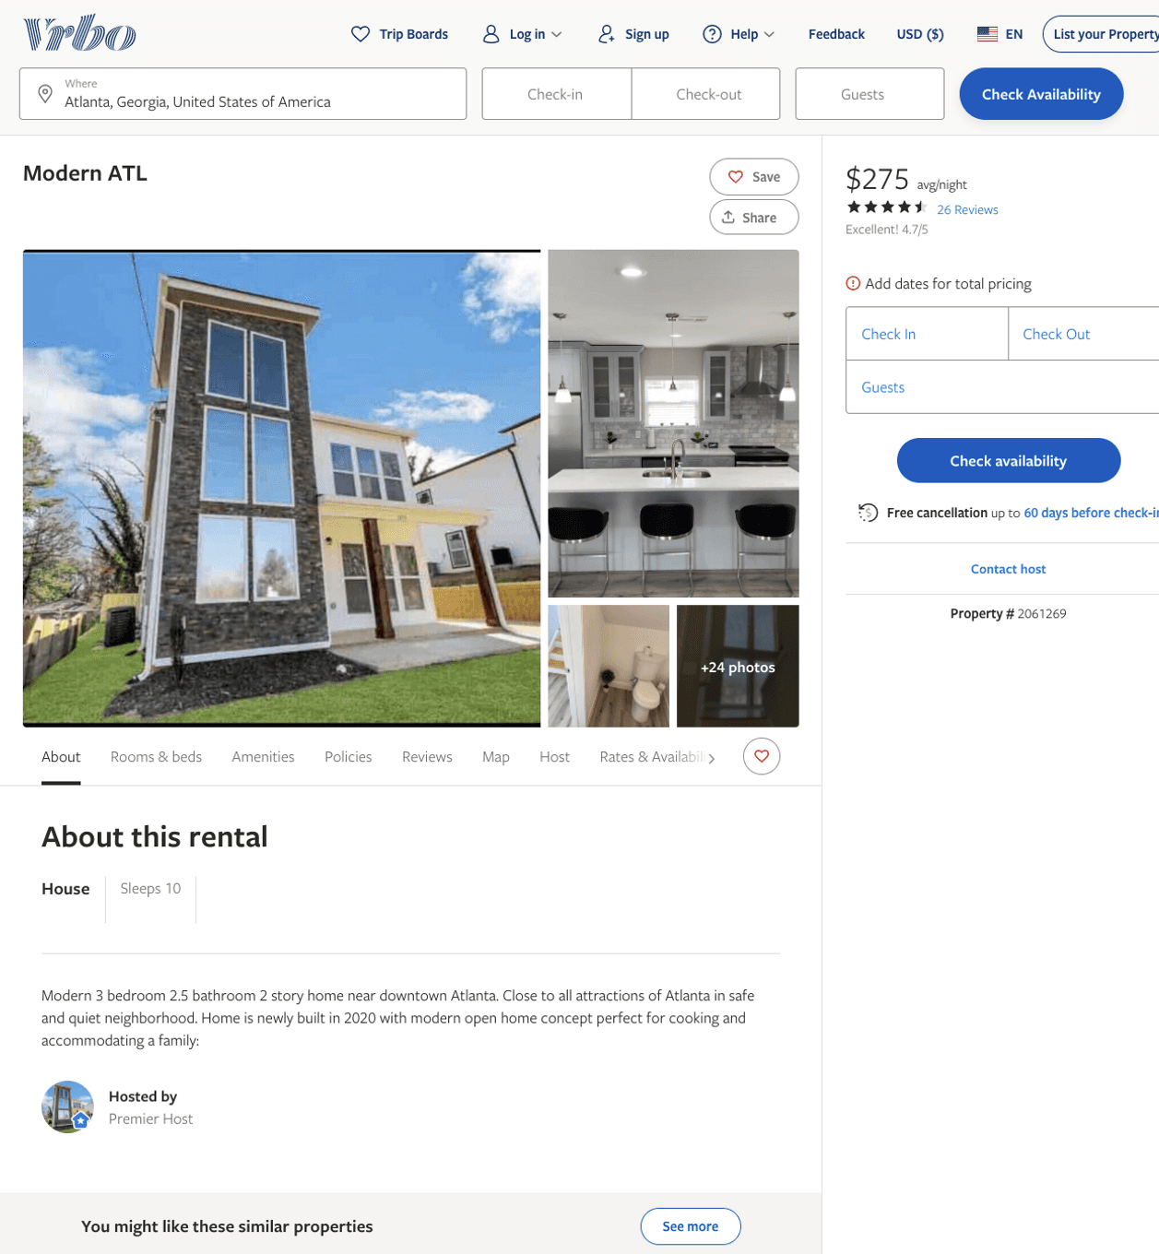
Listing 2061269
3
10
$275
4.571429
2
Anthony Collier
https://www.vrbo.com/2061269
Aug 2022

Slide 33
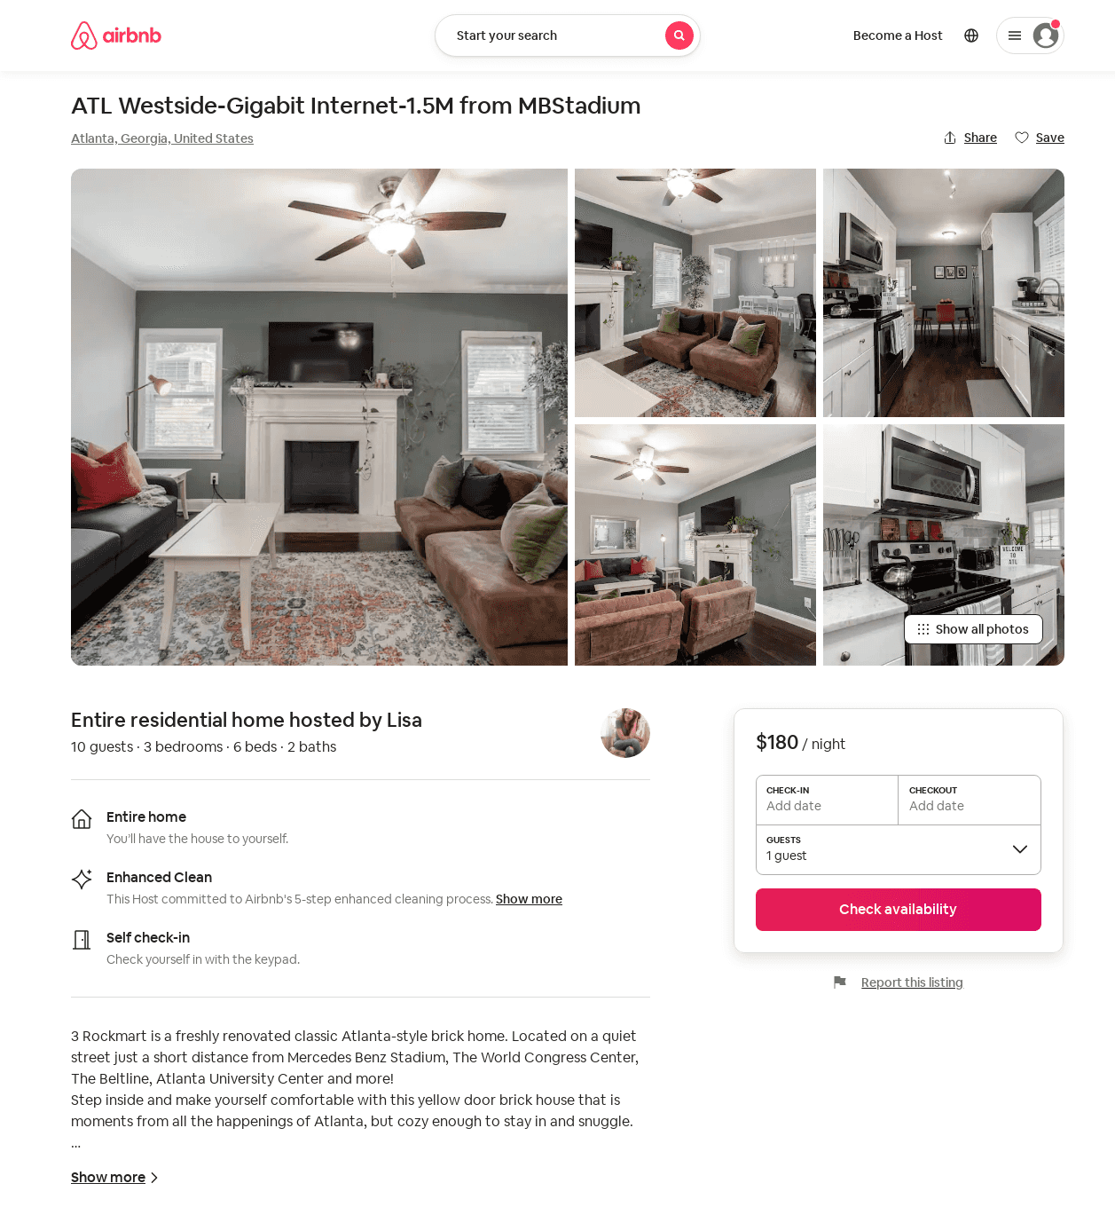
Listing 47332103
3
10
$149 - $193
4.93
2
Lisa
86382411
1
https://www.airbnb.com/rooms/47332103
Jun 2022

Slide 34
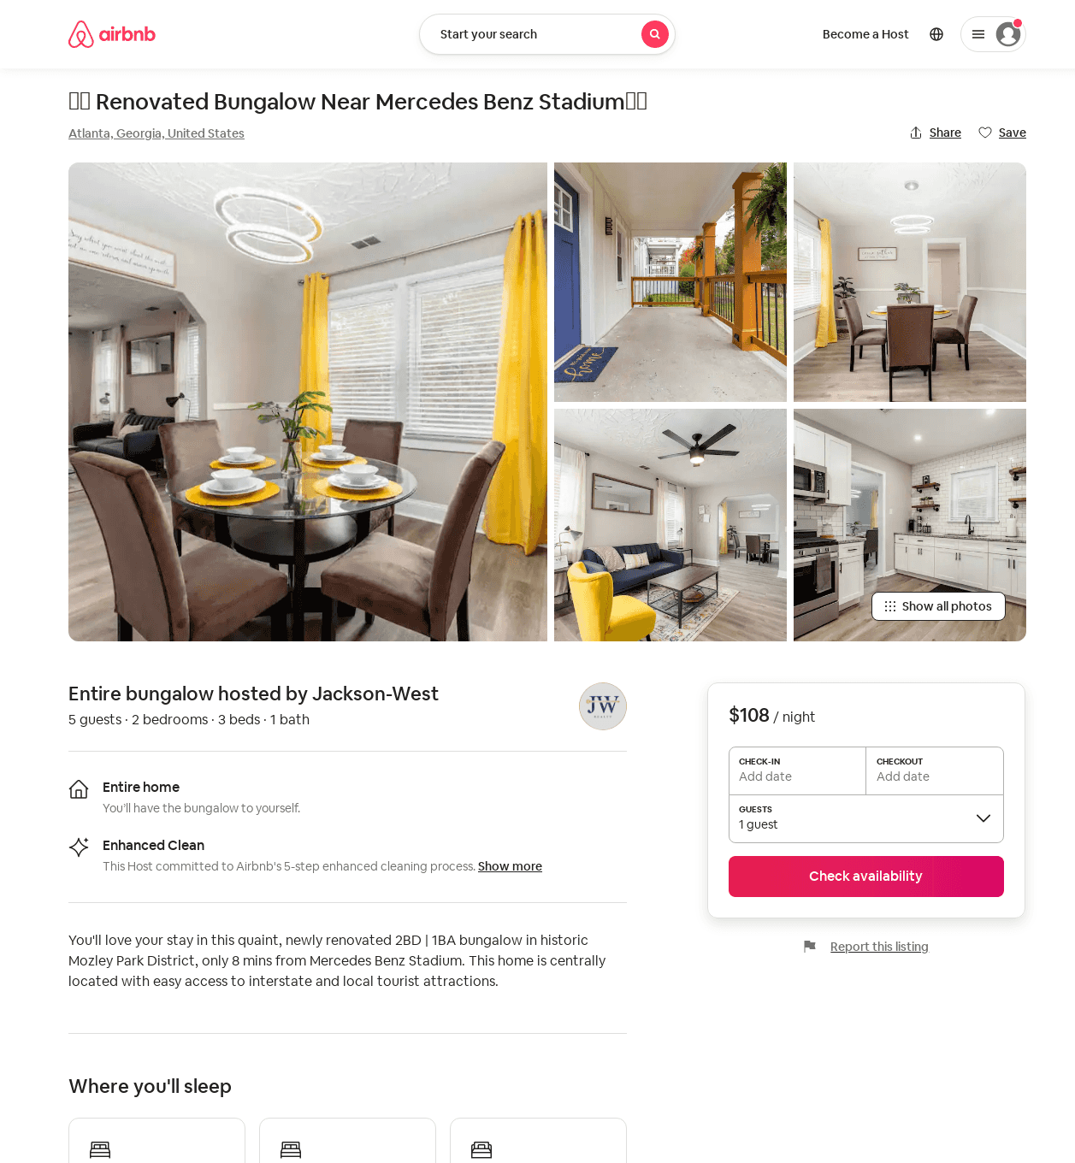
Listing 52810540
2
5
$86 - $146
4.68
2
Jackson-West
427544803
1
https://www.airbnb.com/rooms/52810540
Jul 2022

Slide 35
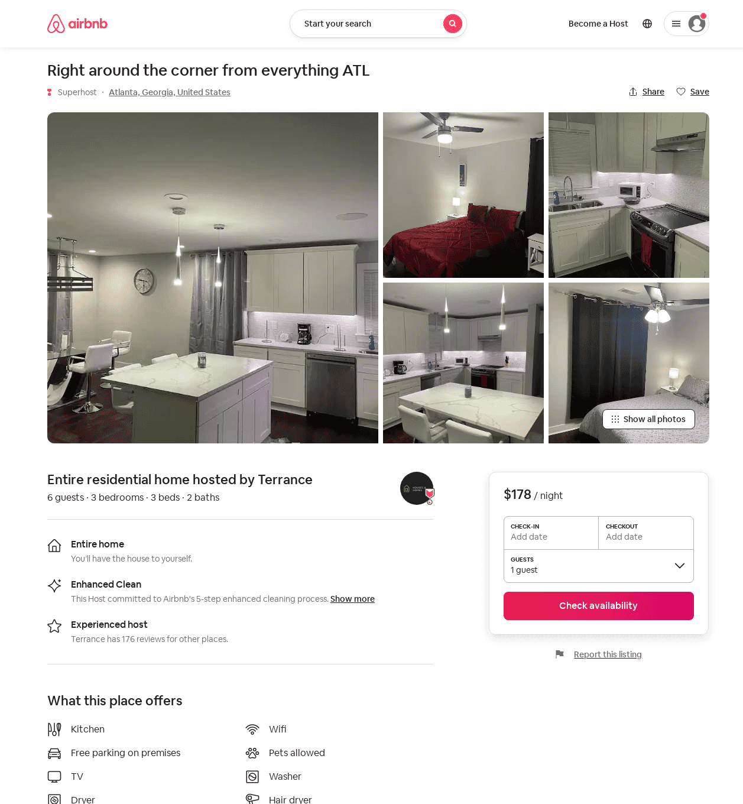
Listing 52996495
3
6
$142 - $249
4.96
1
Terrance
286511730
3
https://www.airbnb.com/rooms/52996495
Aug 2022

Slide 36
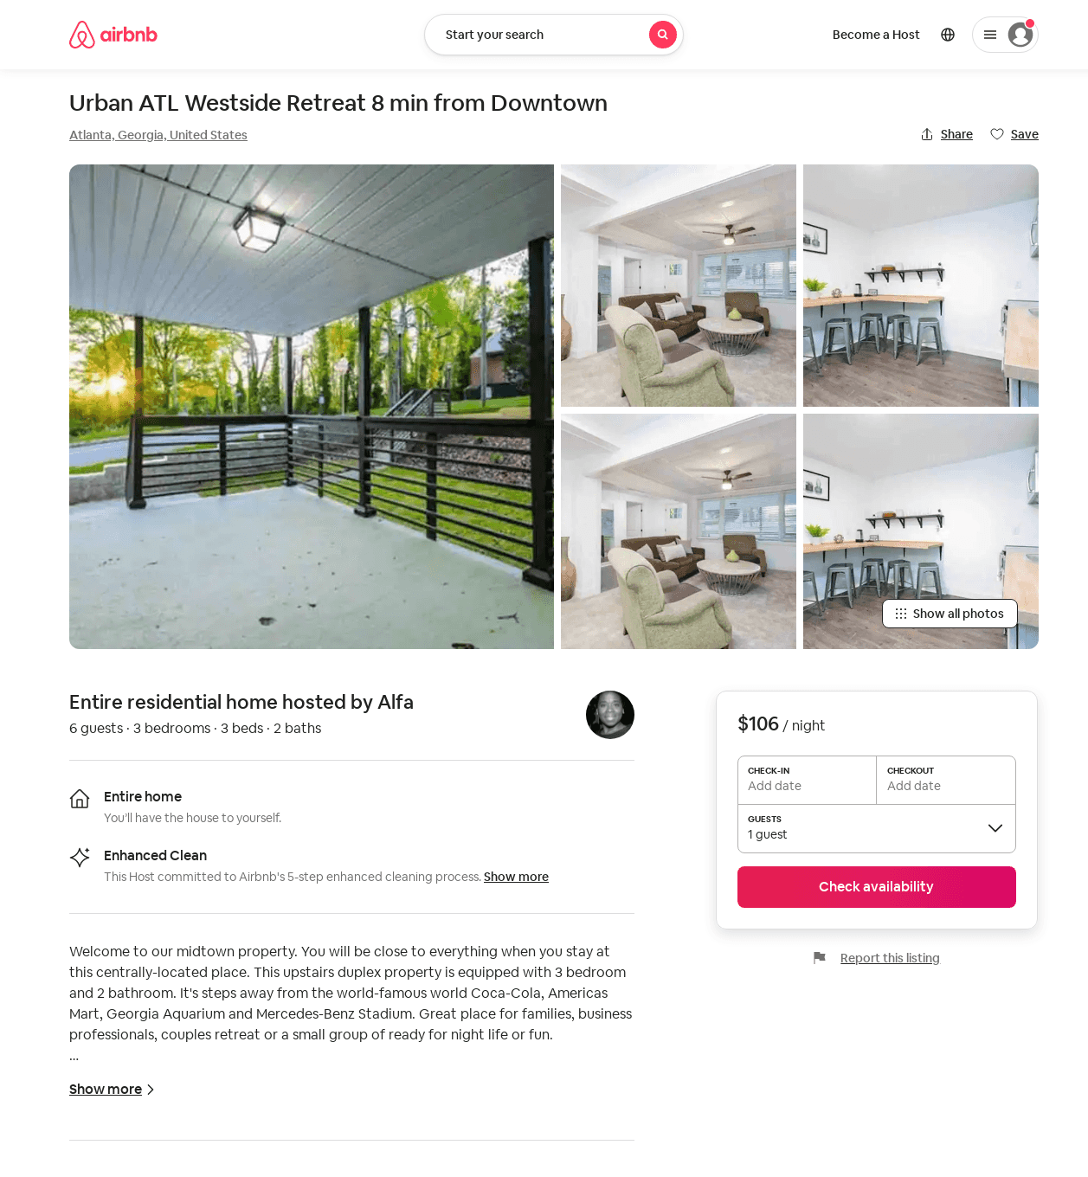
Listing 53877912
3
5
$106 - $155
3.75
2
Alfa
429808710
1
https://www.airbnb.com/rooms/53877912
Aug 2022

Slide 37
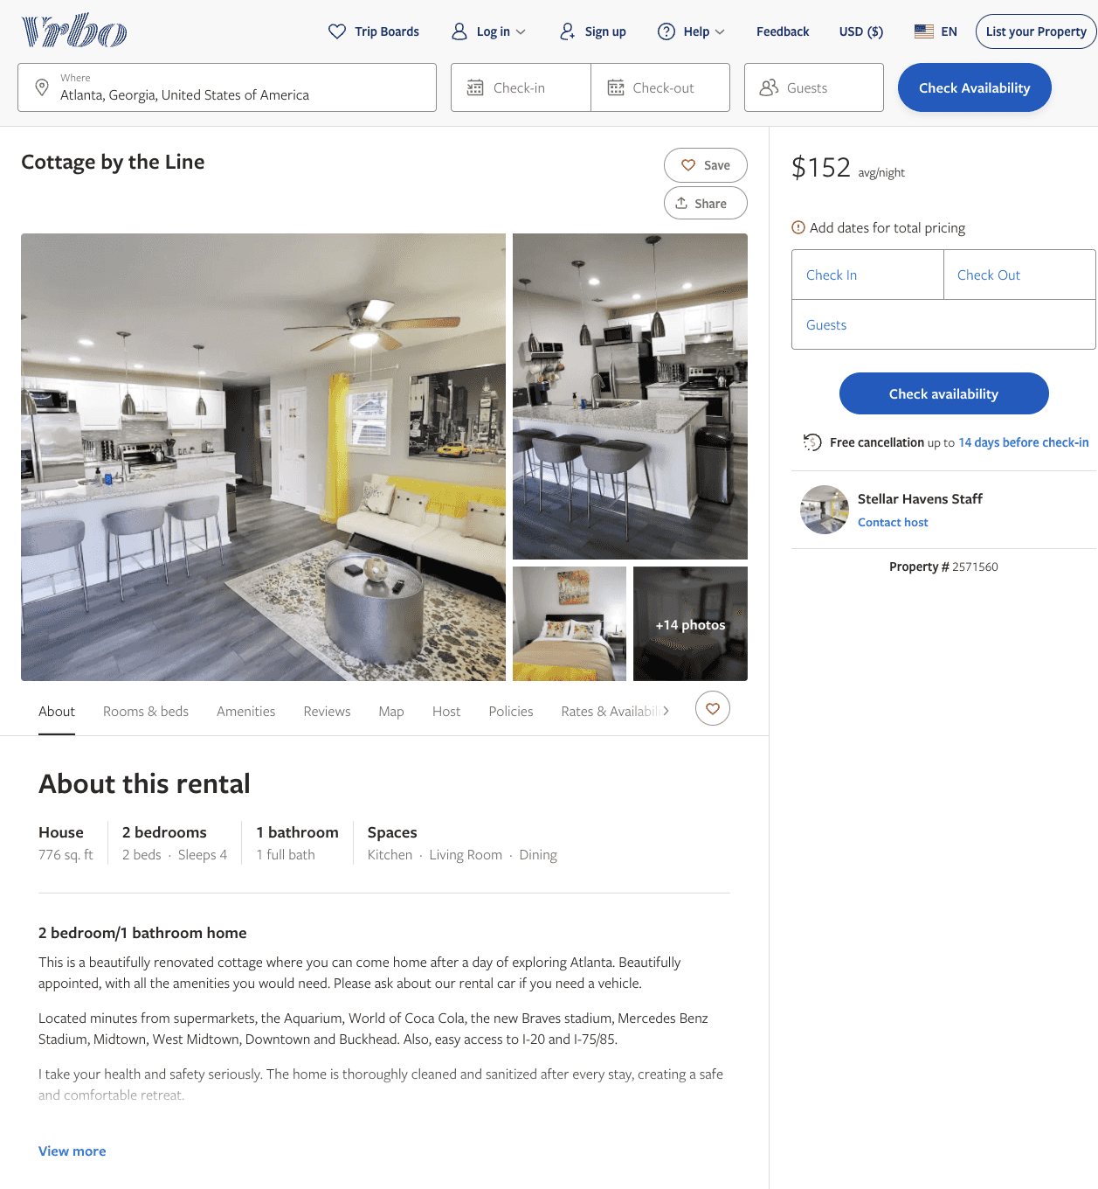
Listing 2571560
2
4
$152
5
2
Stellar Havens Staff
https://www.vrbo.com/2571560
Aug 2022

Slide 38
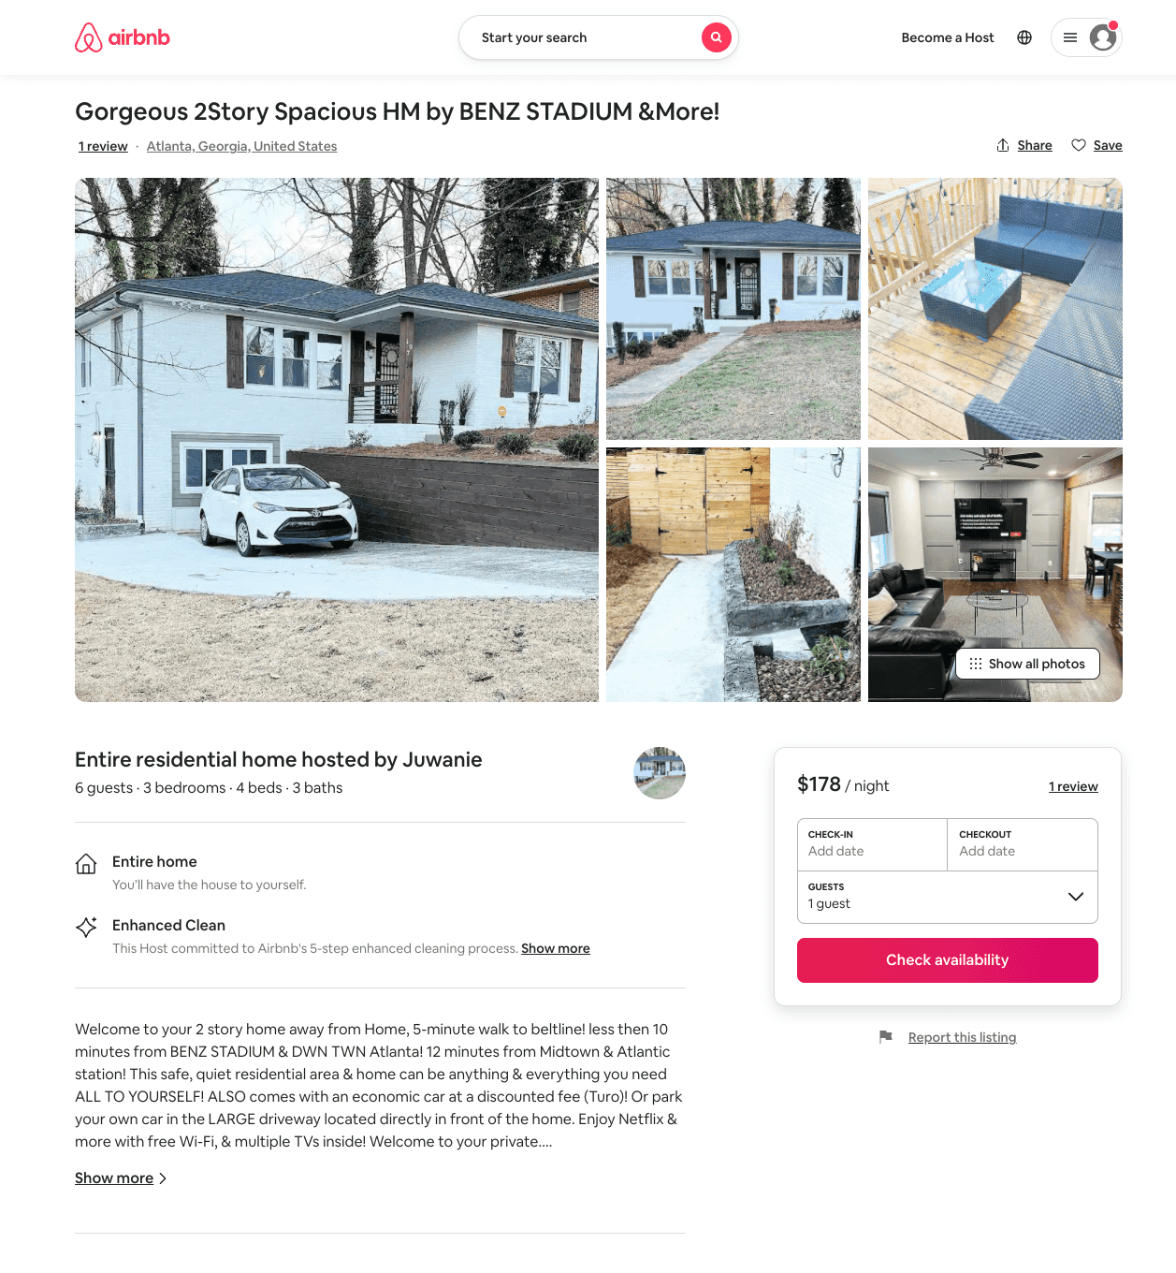
Listing 54212761
3
6
$155 - $178
4.77
2
Juwanie
439581997
1
https://www.airbnb.com/rooms/54212761
Aug 2022

Slide 39
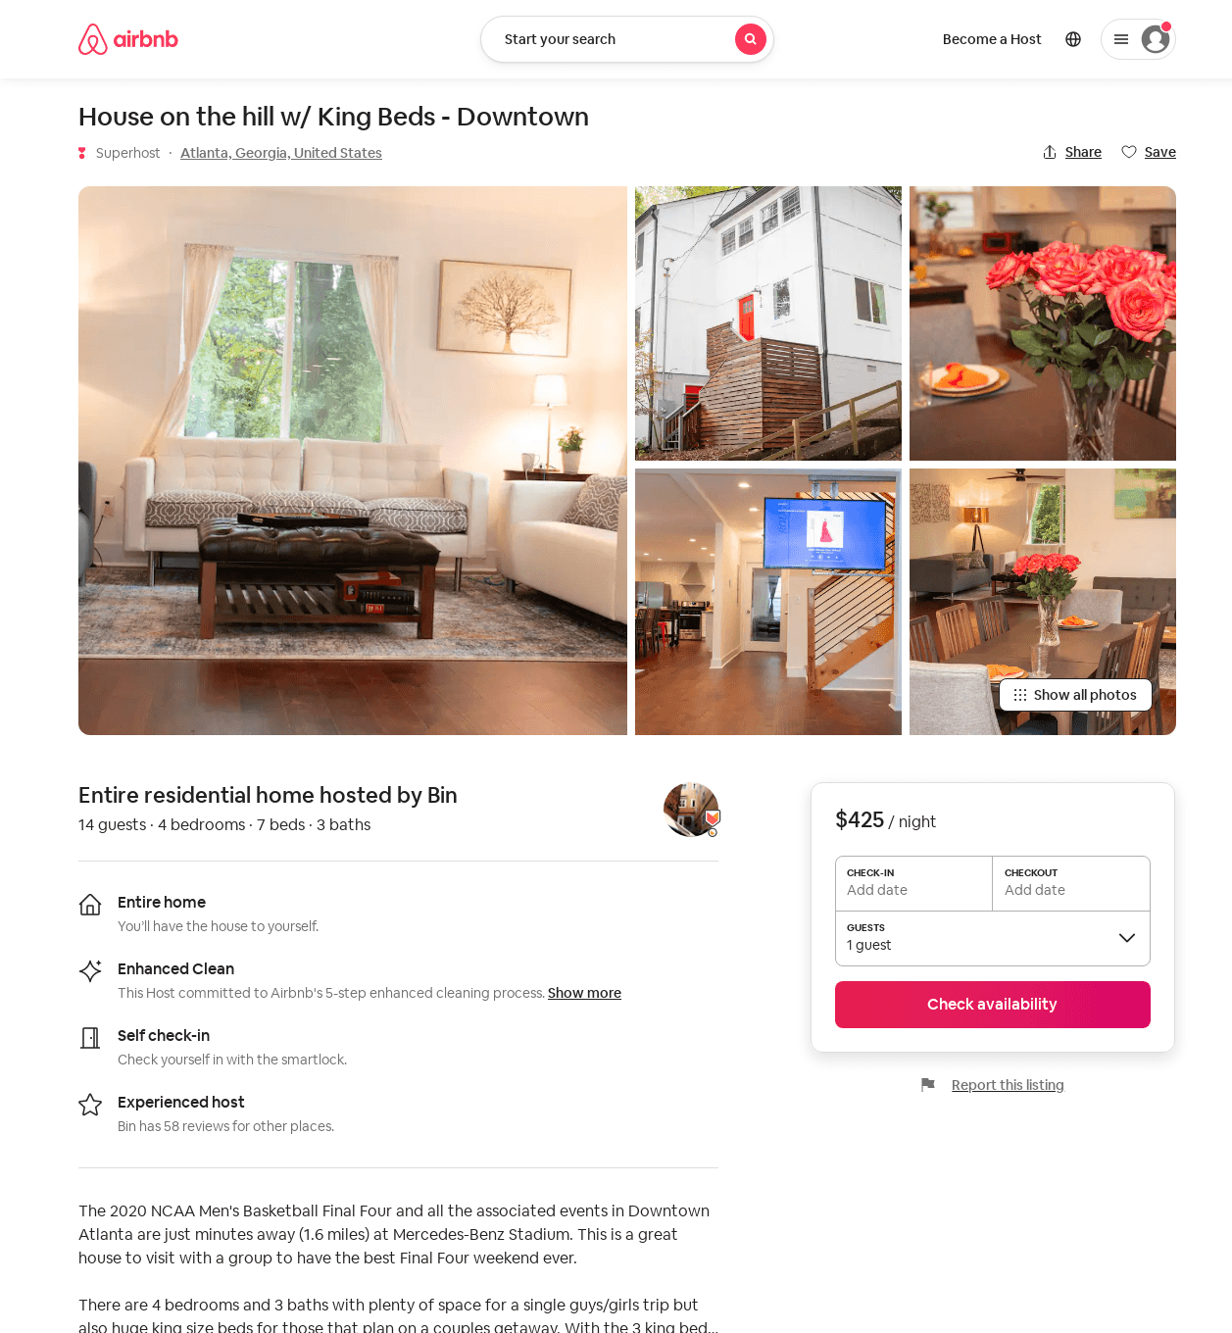
Listing 42654305
4
14
$363 - $425
4.50
2
Bin
12600145
2
https://www.airbnb.com/rooms/42654305
Aug 2022

Slide 40
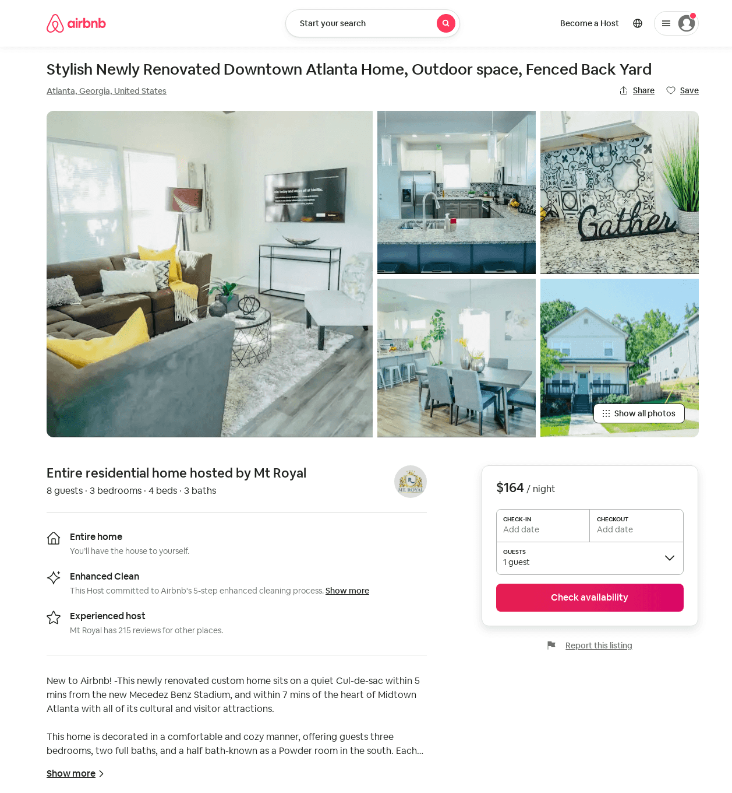
Listing 54383577
3
8
$153 - $182
4.13
1
Mt Royal
305477597
14
https://www.airbnb.com/rooms/54383577
Aug 2022

Slide 41
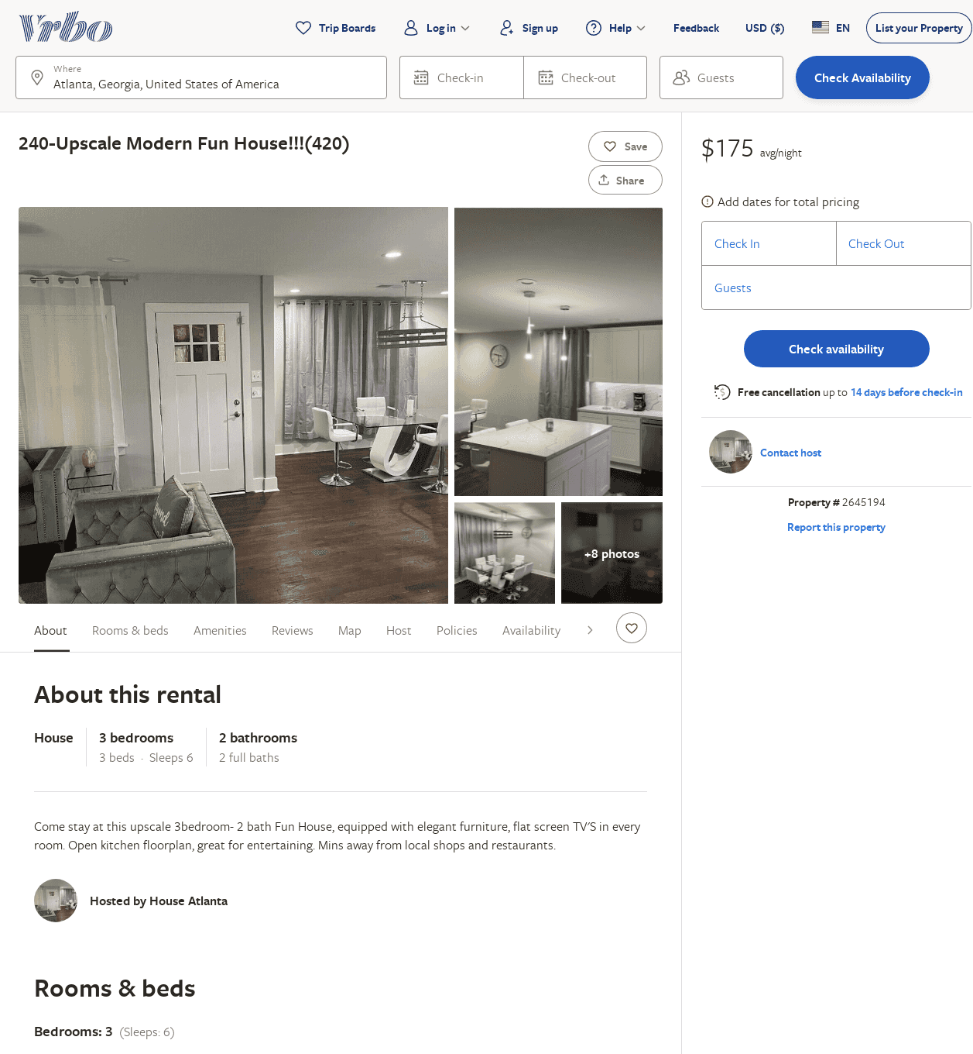
Listing 2645194
3
8
$200
5
1
Terrance BeasleyT
https://www.vrbo.com/2645194
Aug 2022

Slide 42
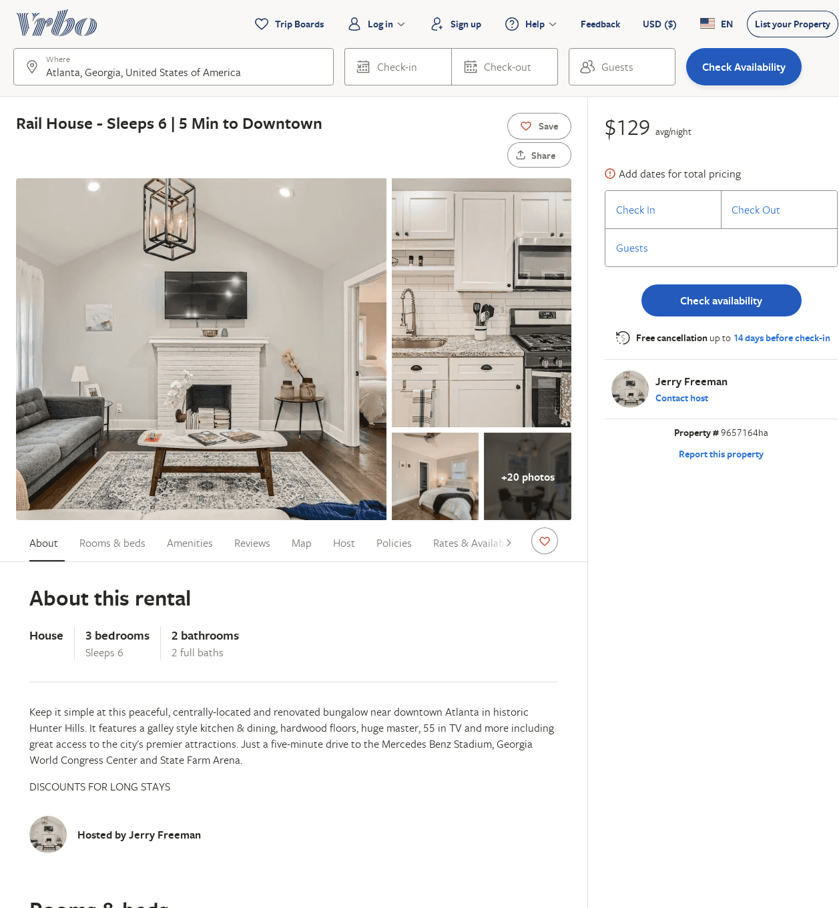
Listing 9657164
3
6
$143
2
Jerry Freeman
https://www.vrbo.com/9657164ha
Aug 2022

Slide 43
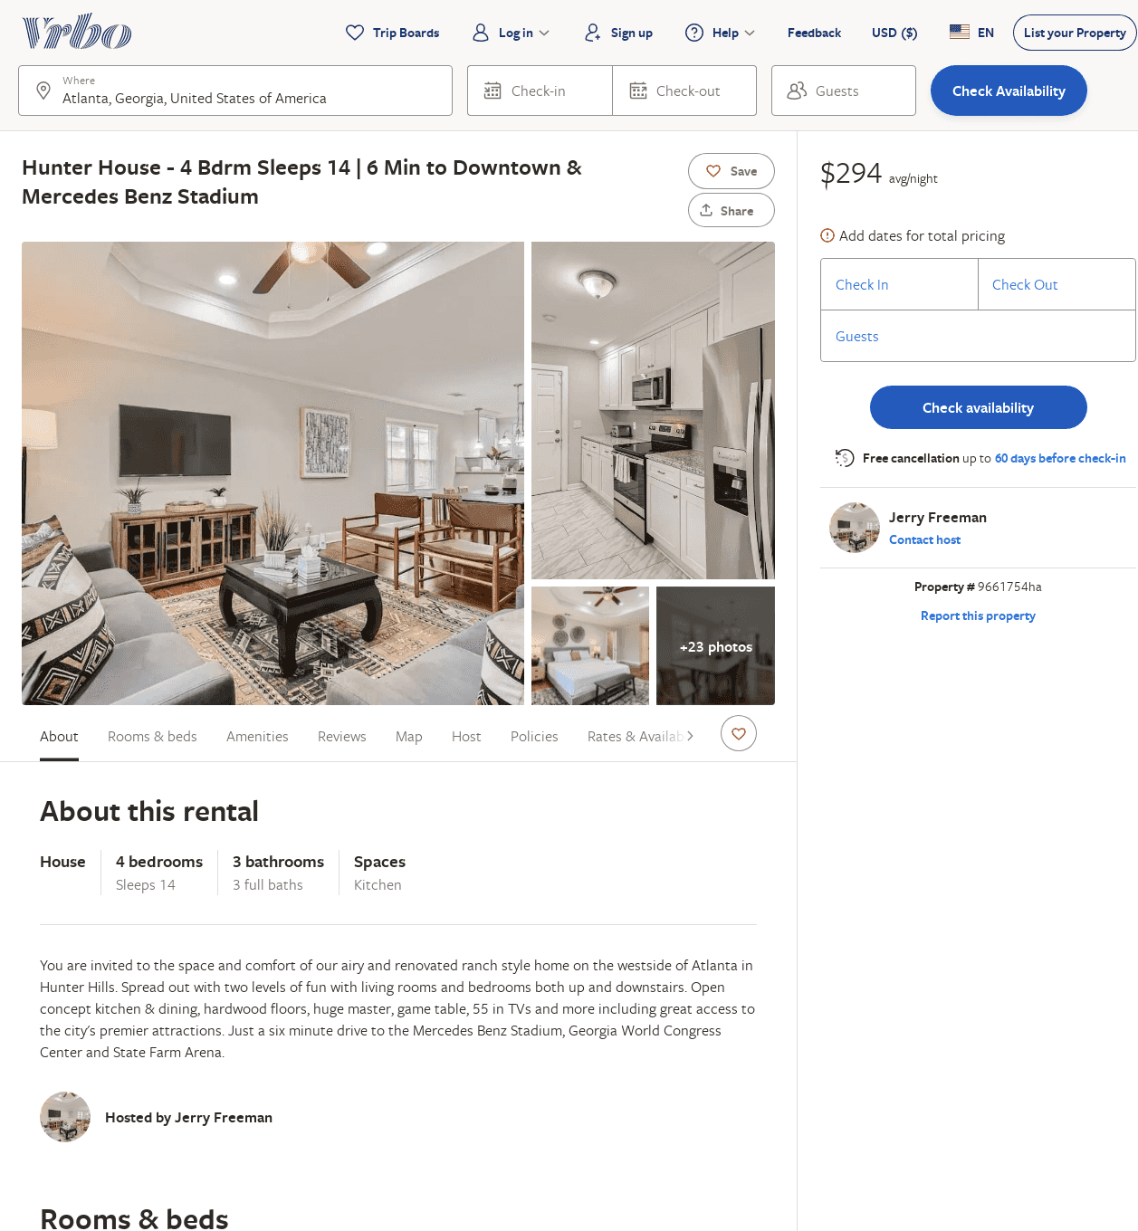
Listing 9661754
4
14
$364
5
2
Jerry Freeman
https://www.vrbo.com/9661754ha
Aug 2022

Slide 44
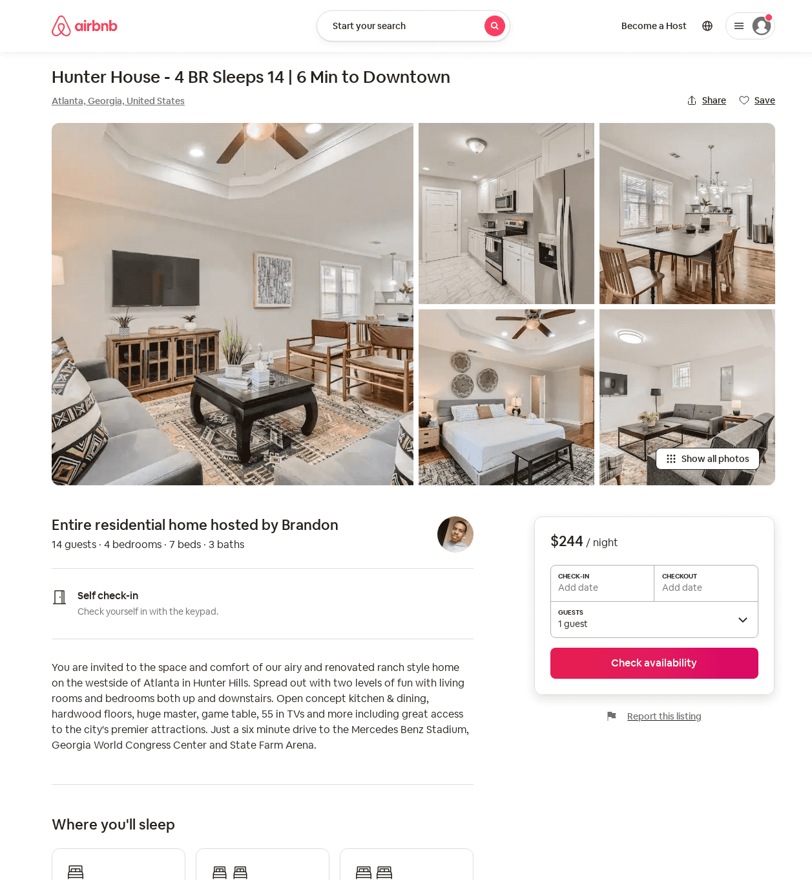
Listing 53916288
4
14
$231 - $244
4.44
1
PMI Atlanta
218820950
14
https://www.airbnb.com/rooms/53916288
Aug 2022

Slide 45
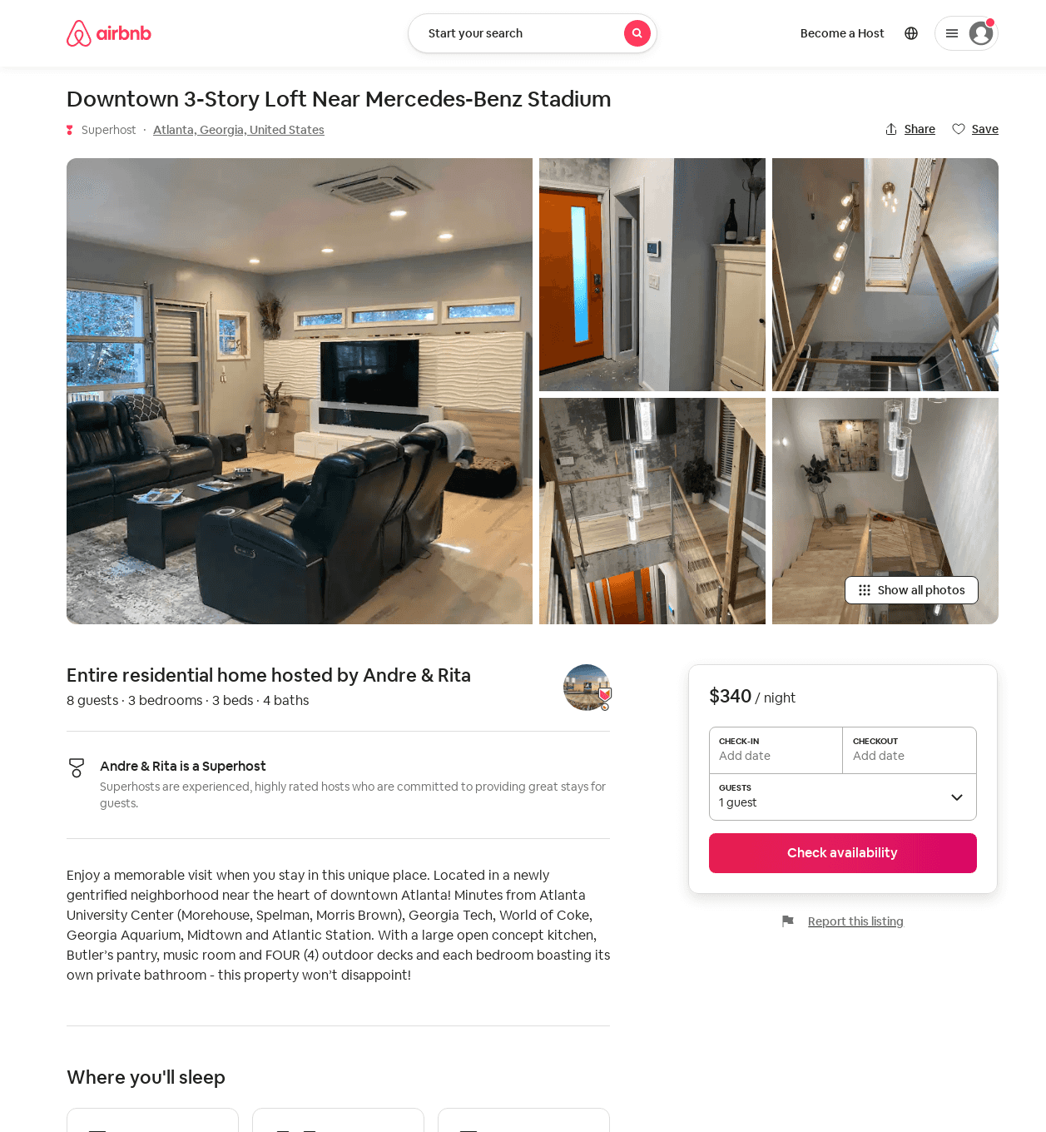
Listing 47880975
3
8
$340 - $375
4
Andre & Rita
14588805
1
https://www.airbnb.com/rooms/47880975
Aug 2022

Slide 46
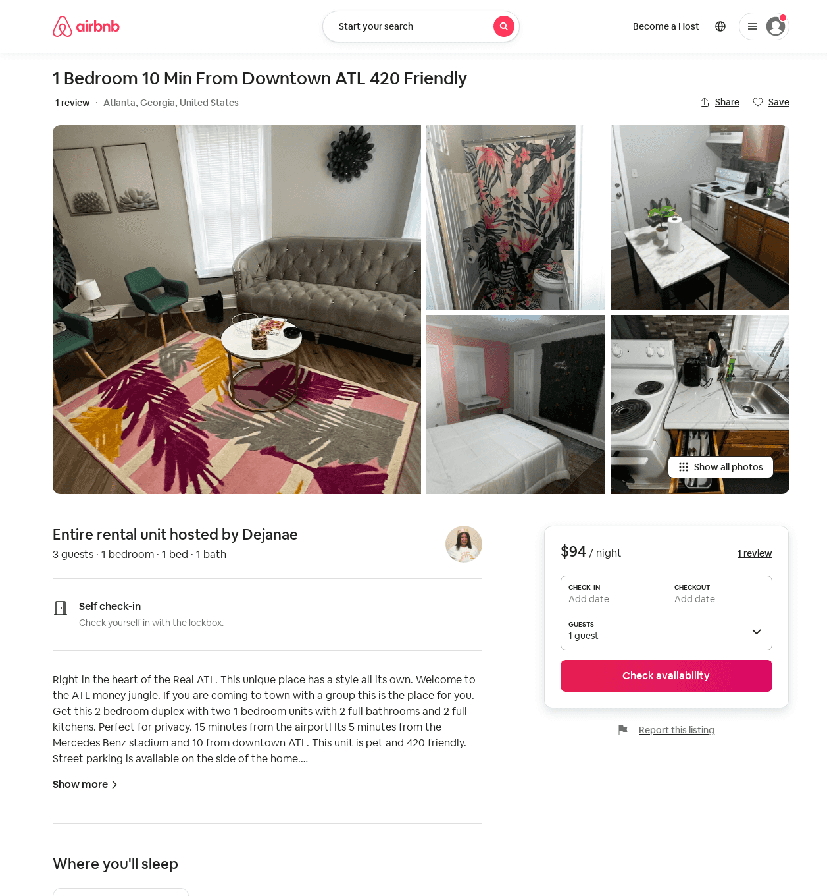
Listing 52402638
1
4
$91 - $118
4.30
1
Dejanae
71378606
1
https://www.airbnb.com/rooms/52402638
Aug 2022

Slide 47
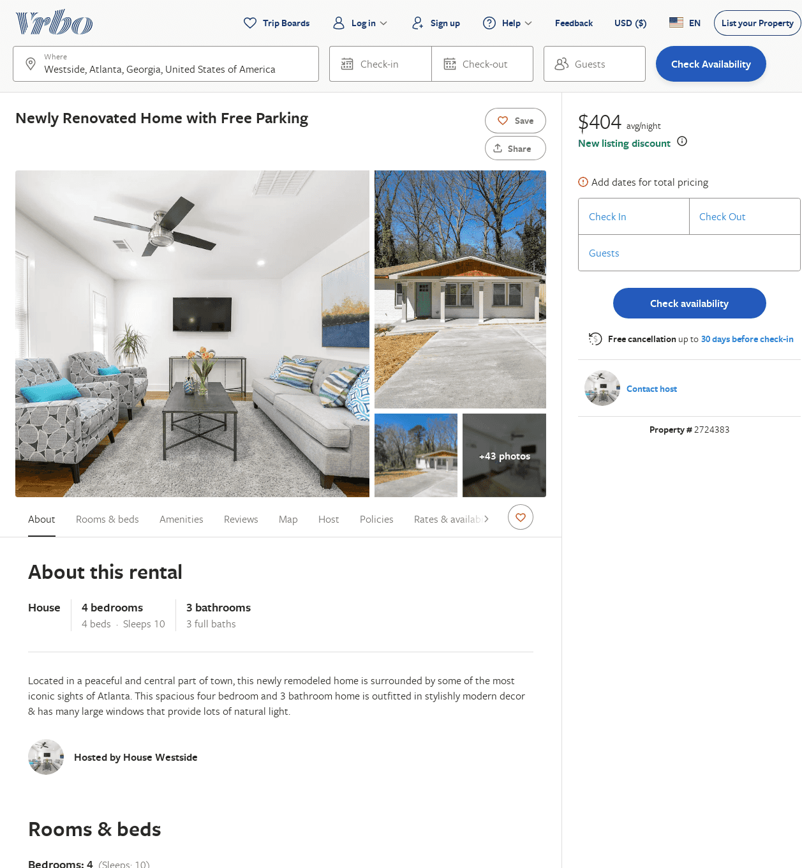
Listing 2724383
4
10
$224
5
2
https://www.vrbo.com/2724383
Aug 2022

Slide 48
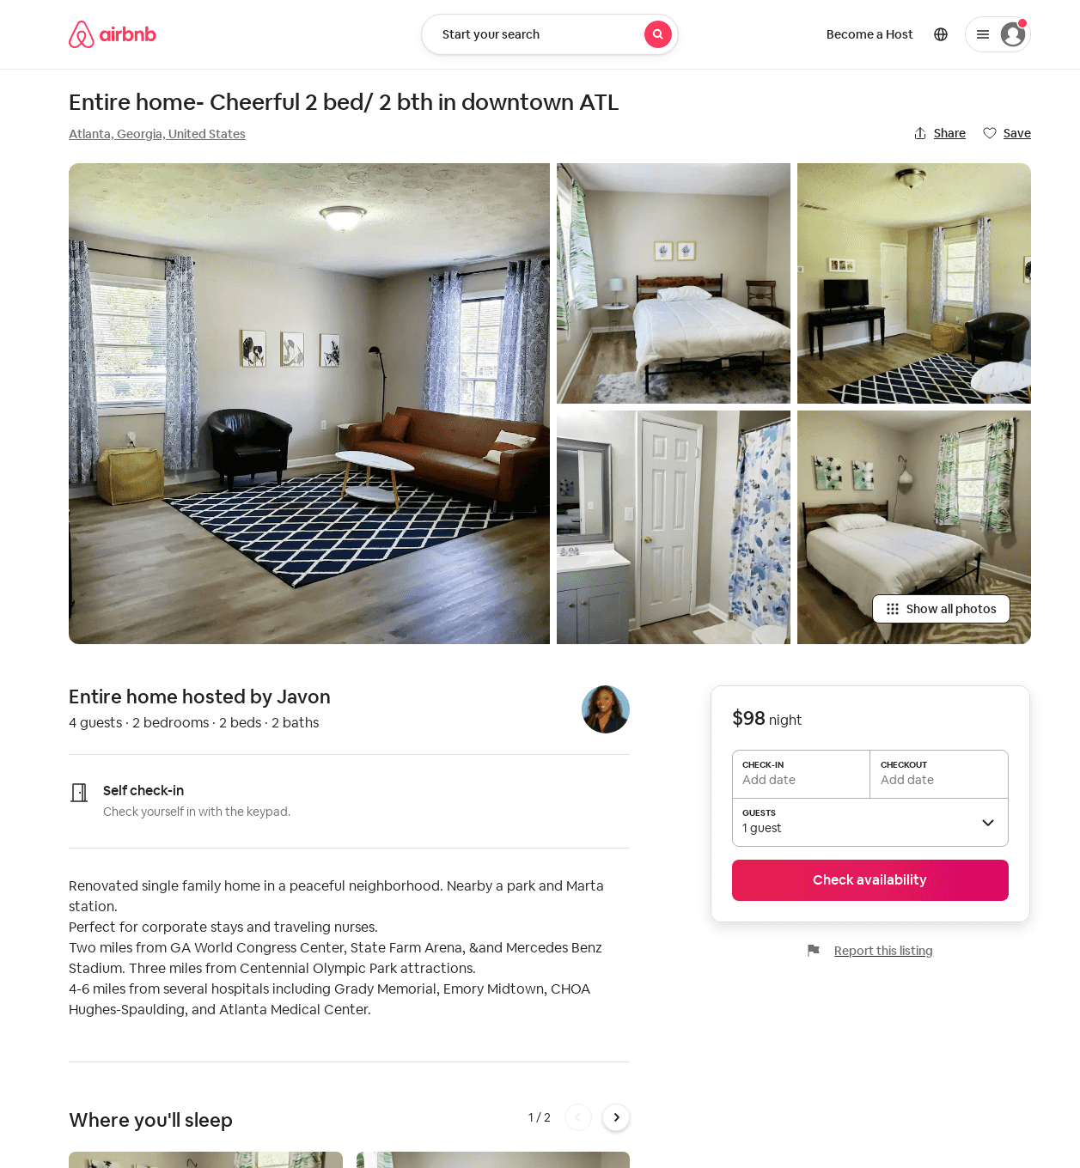
Listing 29161937
2
4
$98 - $99
4
Javon
70237237
1
https://www.airbnb.com/rooms/29161937
Aug 2022

Slide 49
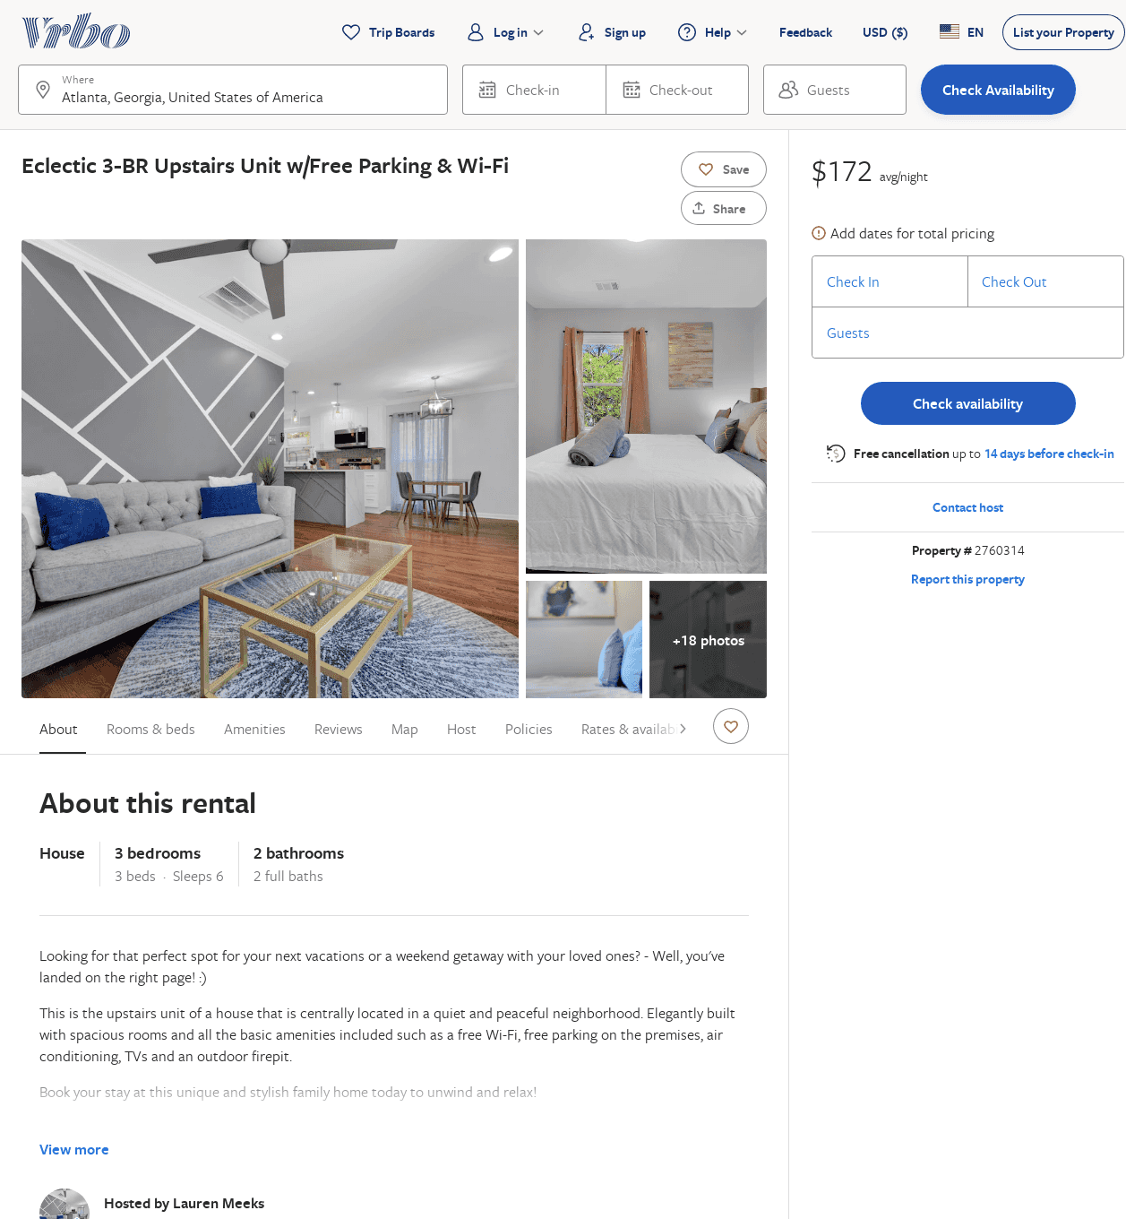
Listing 2760314
3
6
$180
2
Lauren Meeks
https://www.vrbo.com/2760314
Aug 2022

Slide 50
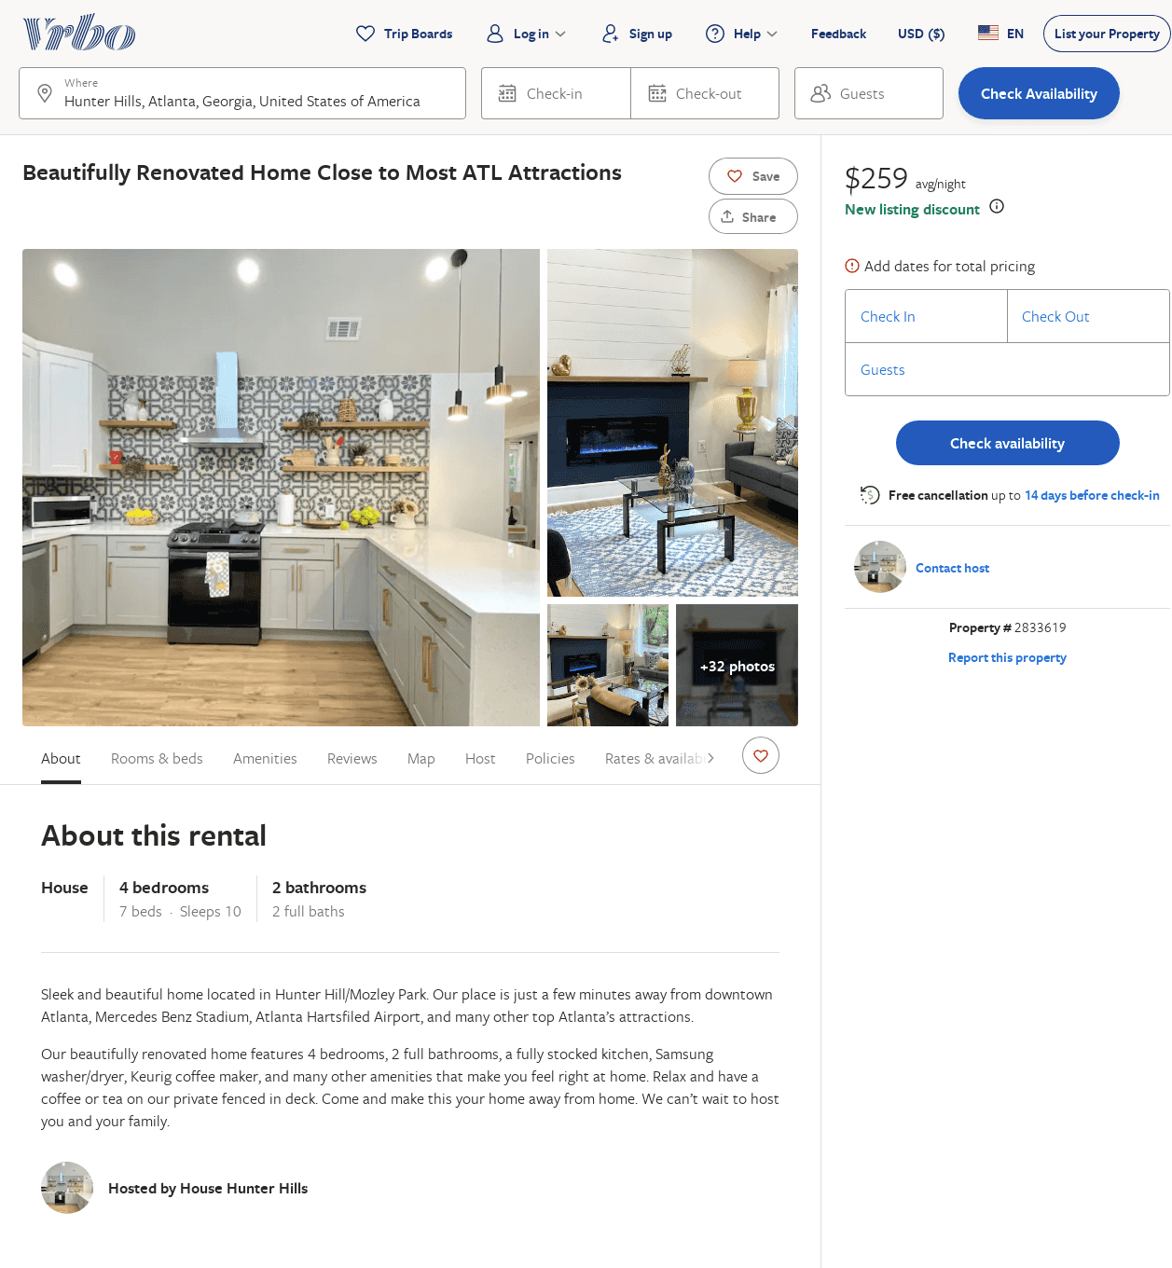
Listing 2833619
4
10
$303
5
2
https://www.vrbo.com/2833619
Aug 2022

Slide 51
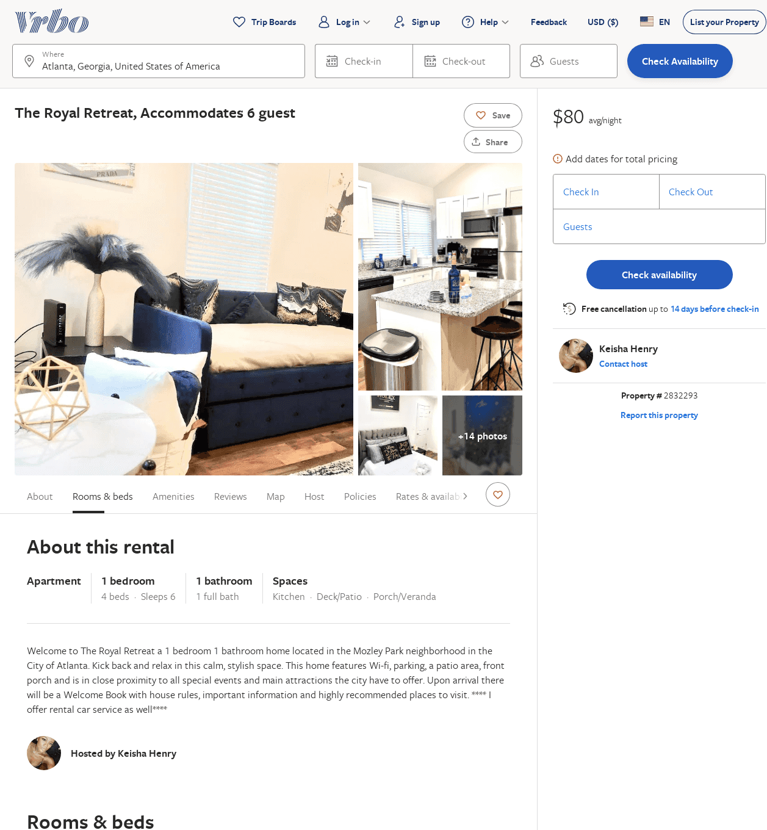
Listing 2832293
1
6
$90
1
Keisha Henry
https://www.vrbo.com/2832293
Aug 2022

Slide 52
Listing 2857113
3
4
$171
4.5
2
Michael Harvey
https://www.vrbo.com/2857113
Aug 2022

Slide 53
Listing 54120027
4
8
$113
4.39
3
Alexandria
313647630
2
https://www.airbnb.com/rooms/54120027
Aug 2022

Slide 54
Listing 33447614
2
6
$111
2
Marvin
251953179
1
https://www.airbnb.com/rooms/33447614
Jun 2022

Slide 55
Listing 2869433
3
8
$191
1
https://www.vrbo.com/2869433
Aug 2022

Slide 56
Listing 2893323
3
6
$195
5
2
https://www.vrbo.com/2893323
Aug 2022

Slide 57
Listing 2894411
2
4
$182
1
894 Property Management LLC
https://www.vrbo.com/2894411
Aug 2022

Slide 58
Listing 2894639
4
8
$125
2
https://www.vrbo.com/2894639
Aug 2022

