Slide 2
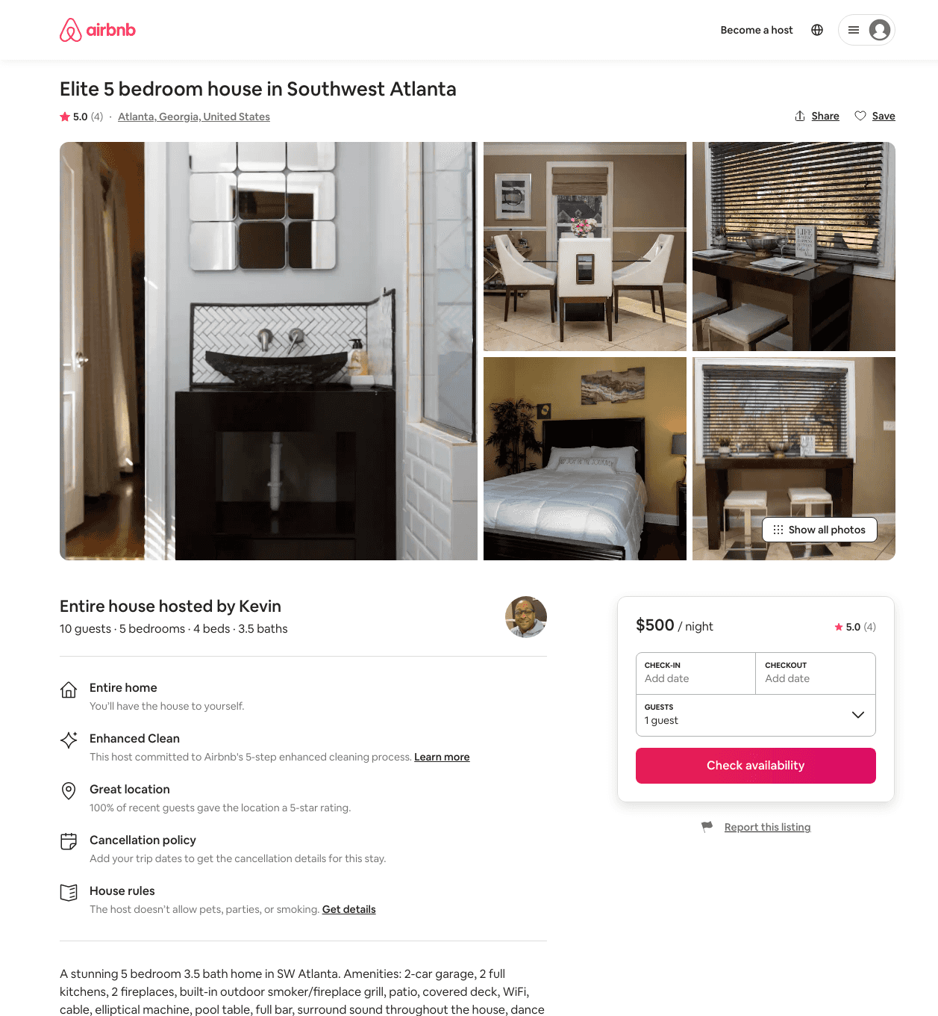
Listing 48309998
4
10
$500 - $510
5.0
2
Kevin
389910164
1
https://www.airbnb.com/rooms/48309998
Jun 2022

