Slide 2
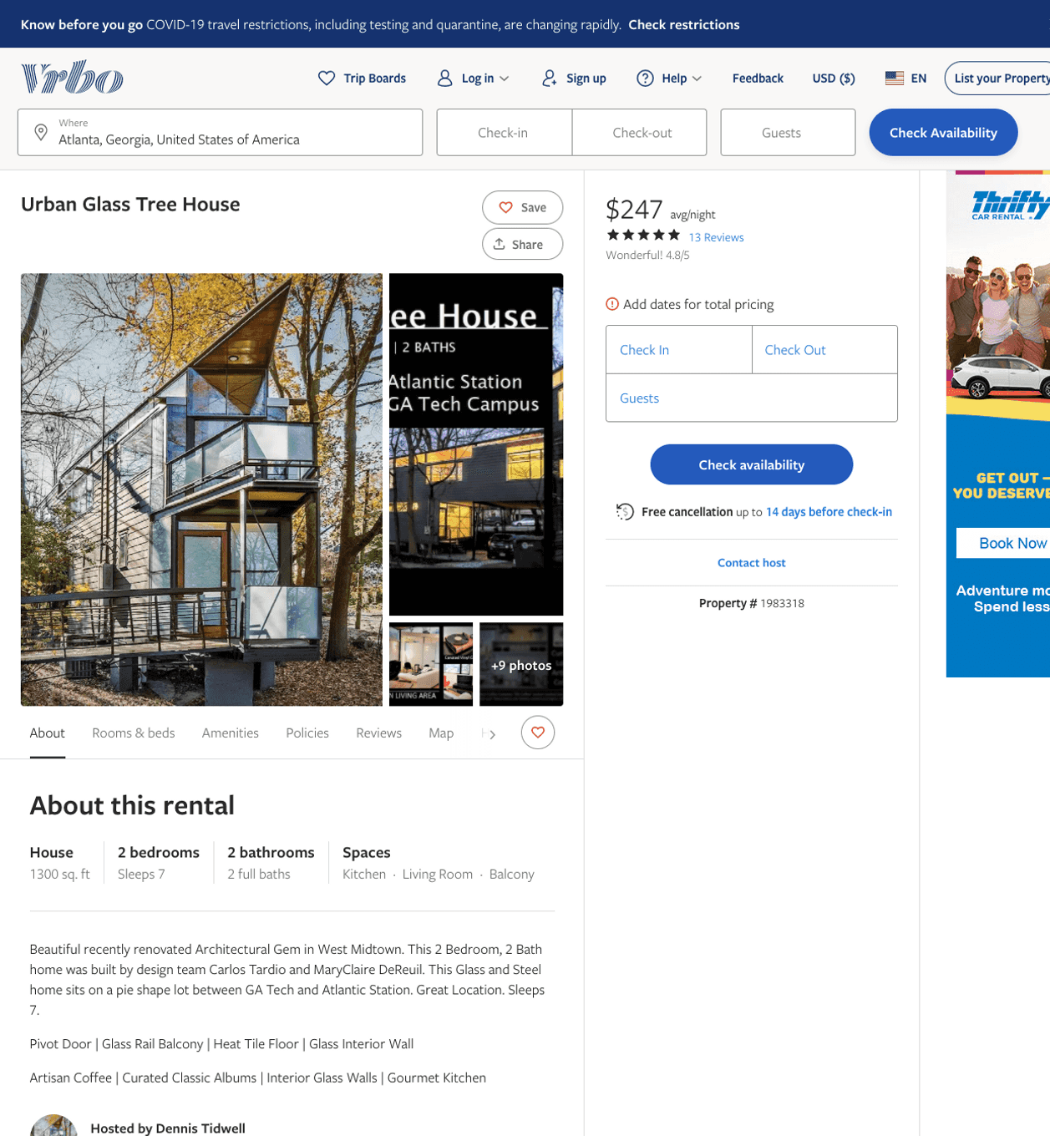
Listing 1983318
1086 HEMPHILL AVE NW
2
7
$220 - $247
4.8717947
1
Dennis Tidwell
https://www.vrbo.com/1983318
Aug 2022

Slide 3
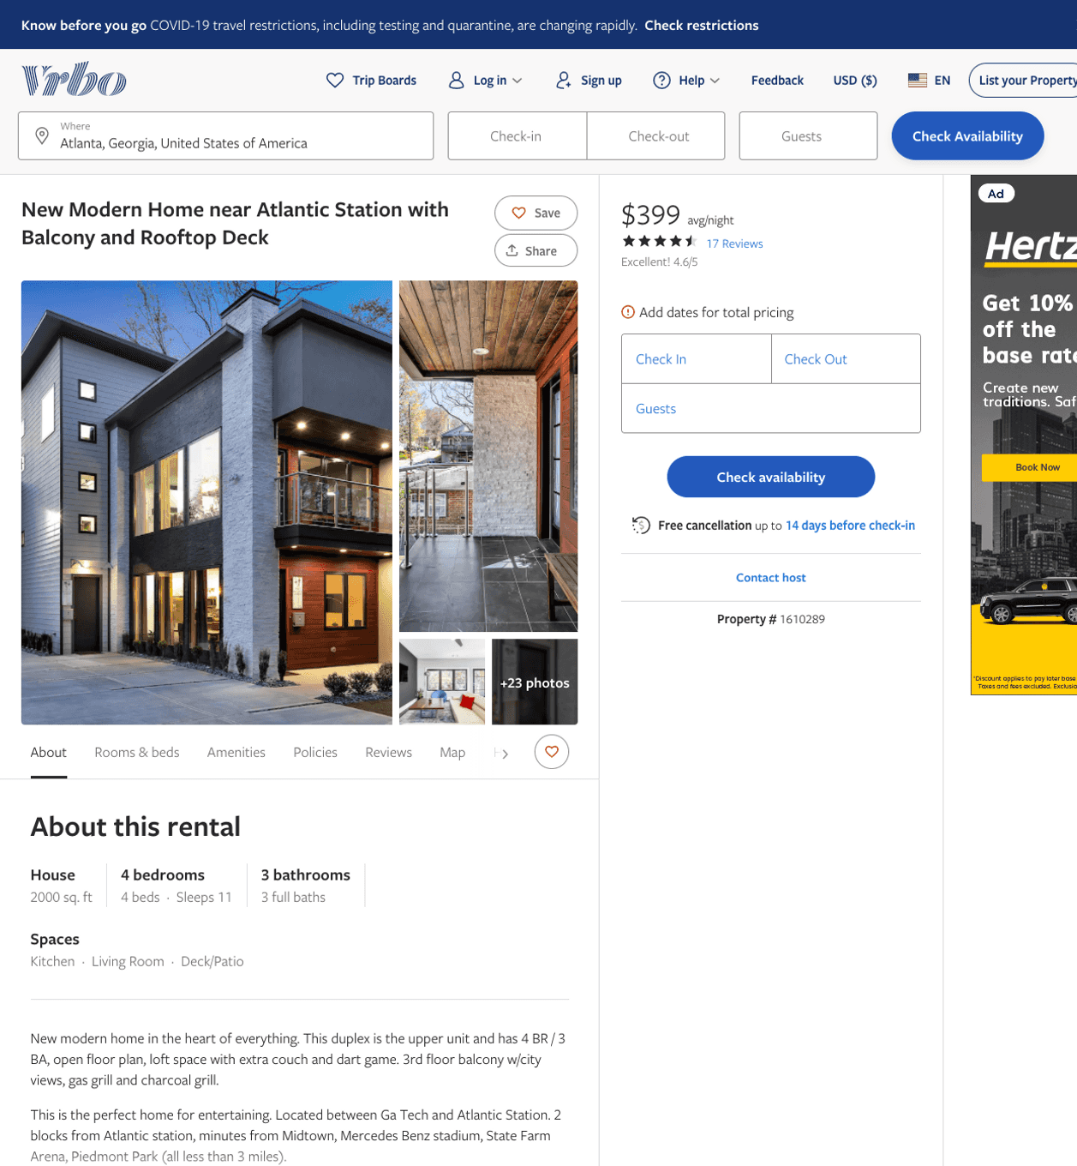
Listing 1610289
1112 MECASLIN ST NW
4
8
$399 - $449
4.7391305
1
David den Haring
https://www.vrbo.com/1610289
Aug 2022

Slide 4
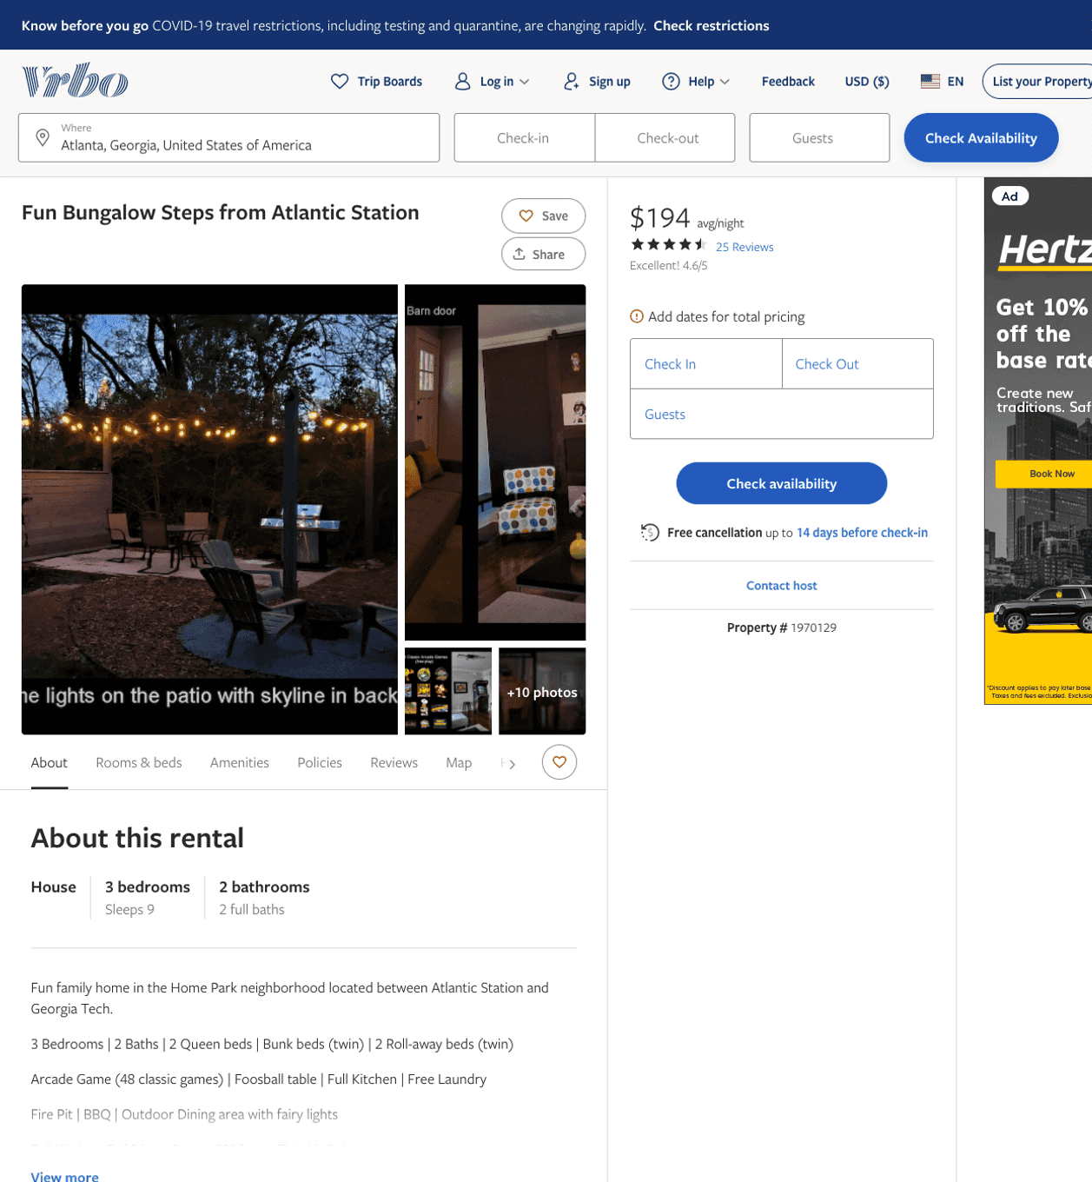
Listing 1970129
1179 MECASLIN ST NW
3
9
$180 - $203
4.612903
2
Dennis Tidwell
https://www.vrbo.com/1970129
Aug 2022

Slide 5
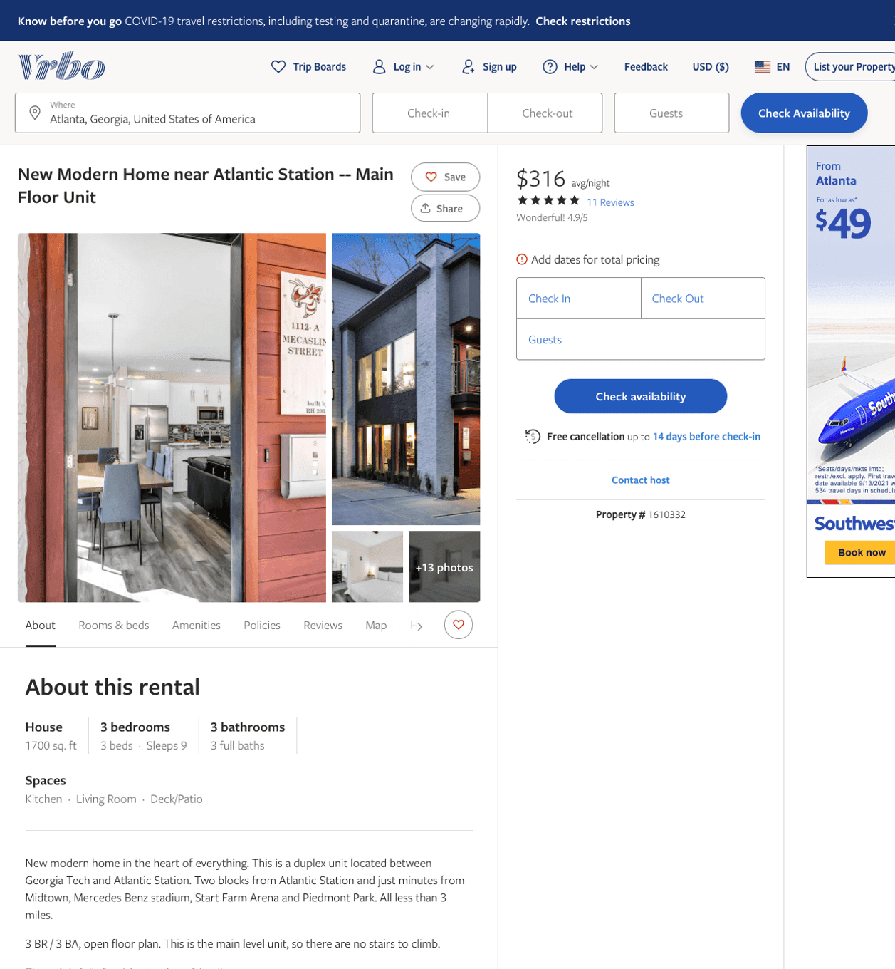
Listing 1610332
1112 MECASLIN ST NW
3
6
$299 - $374
4.6153846
1
David den Haring
https://www.vrbo.com/1610332
Aug 2022

Slide 6
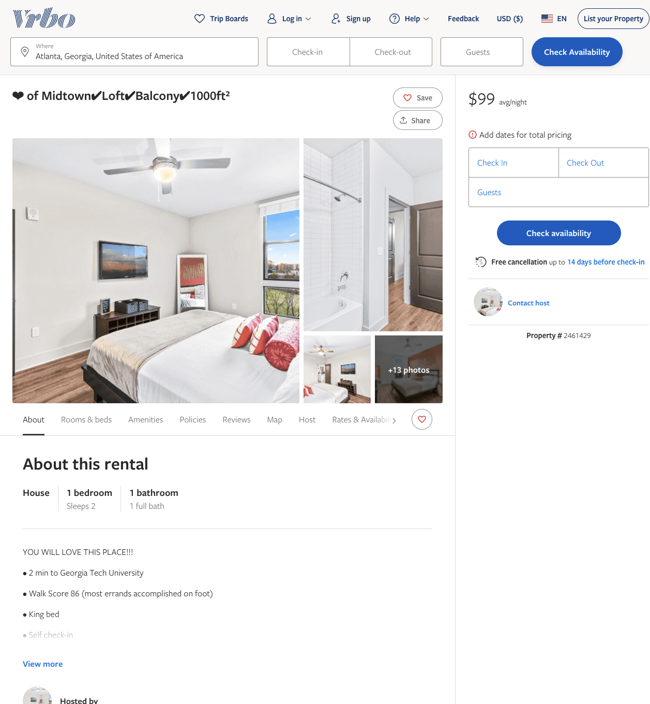
Listing 2461429
455 14TH ST NW
1
2
$106 - $99
4.8333335
1
THE HIVE LUXURY GROUP
https://www.vrbo.com/2461429
Aug 2022

Slide 7
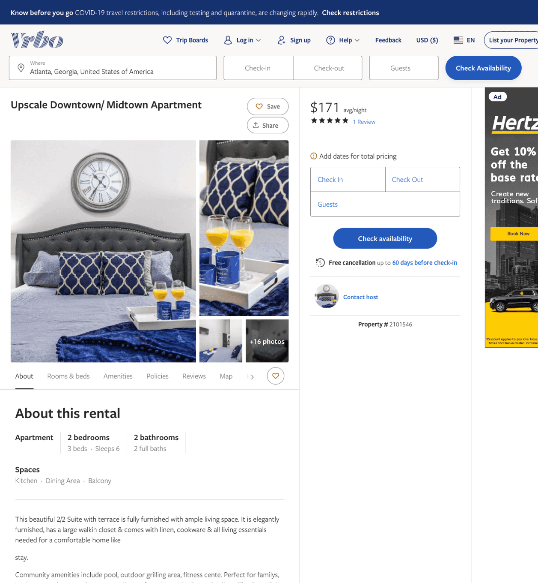
Listing 2101546
455 14TH ST NW
2
6
$119 - $195
4.6666665
1
Luxury Suites
https://www.vrbo.com/2101546
Aug 2022

Slide 8
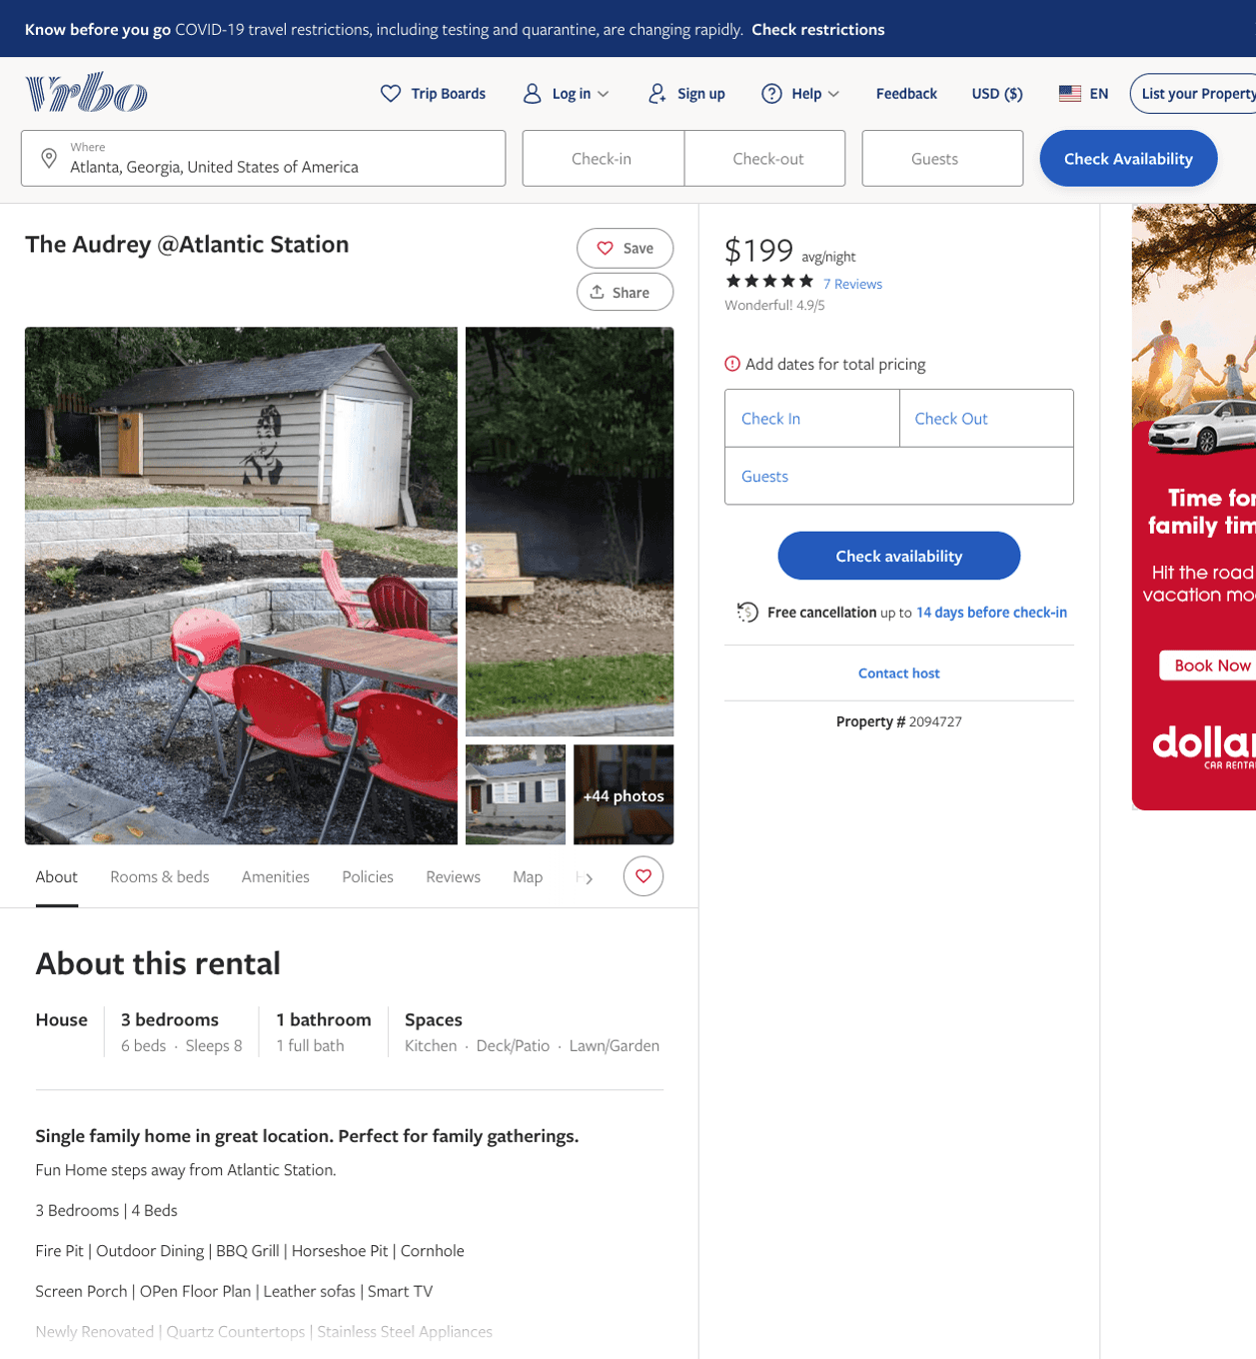
Listing 2094727
1244 ATLANTIC DR NW
3
8
$191 - $237
4.875
2
Dennis Tidwell
https://www.vrbo.com/2094727
Aug 2022

Slide 9
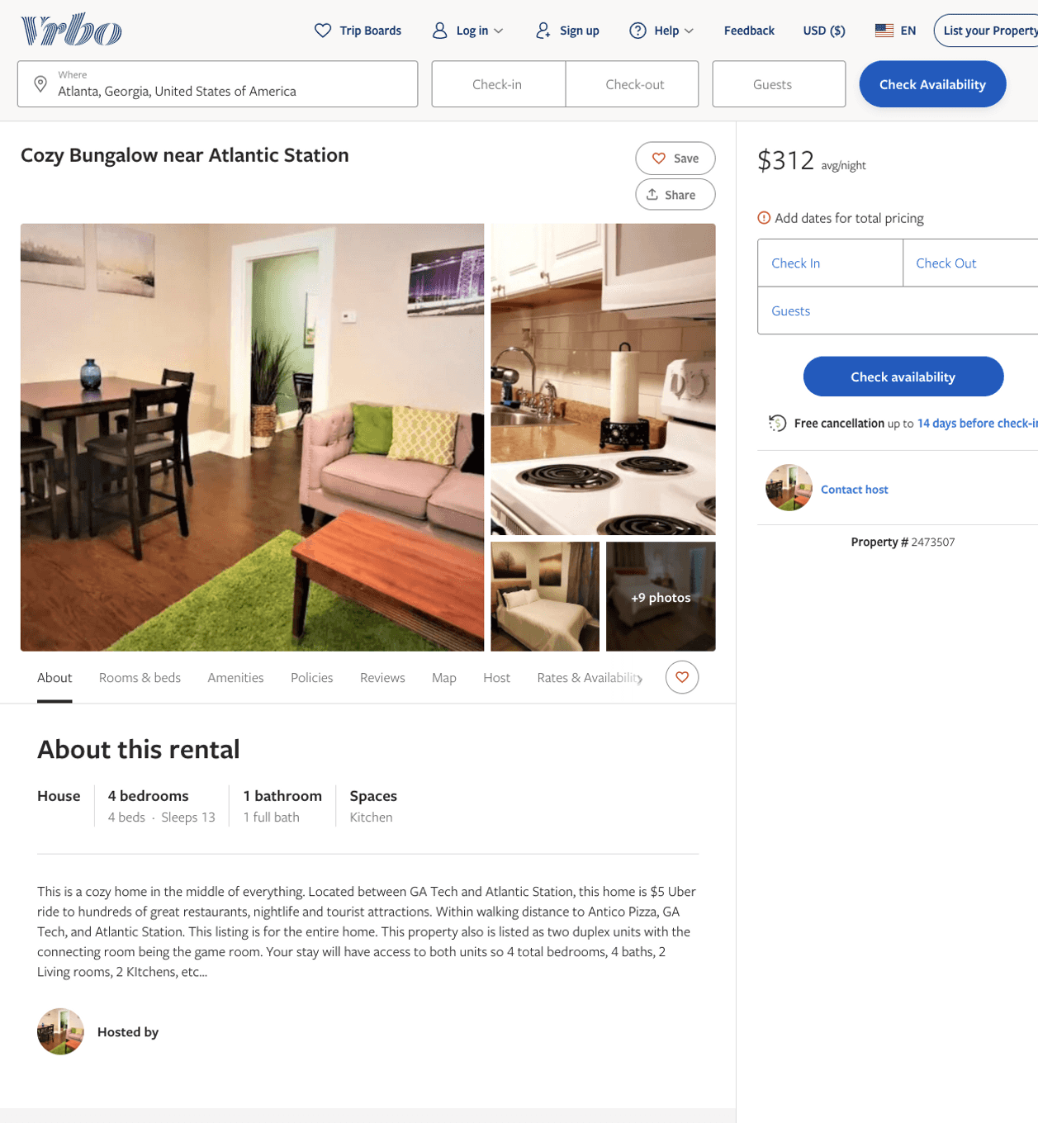
Listing 2473507
1120 SNYDER ST NW
4
13
$246 - $511
5
1
Clark and Henry
https://www.vrbo.com/2473507
Aug 2022

Slide 10
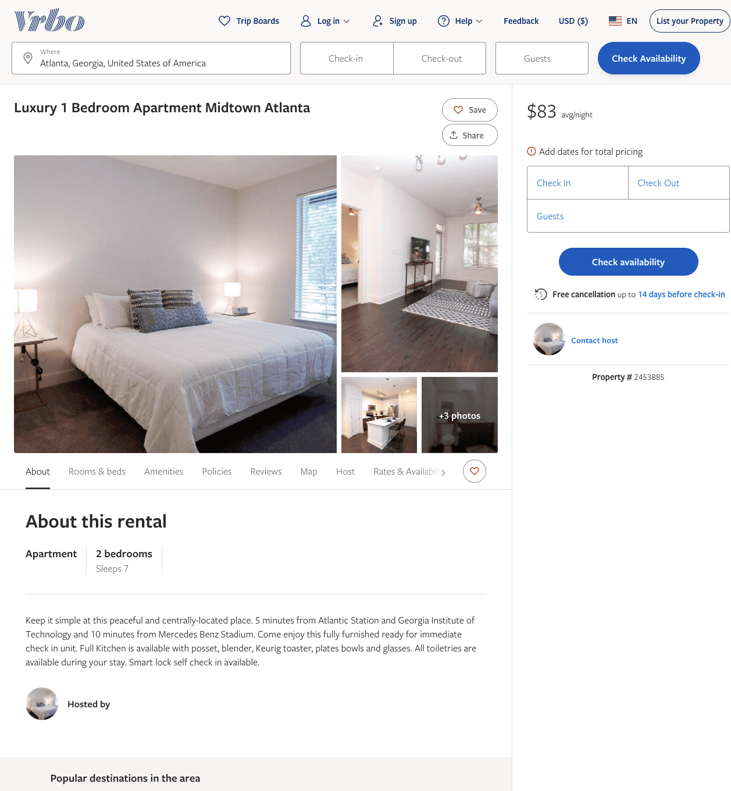
Listing 2453885
1220 MECASLIN ST NW
1
7
$104 - $99
2
https://www.vrbo.com/2453885
Aug 2022

Slide 11
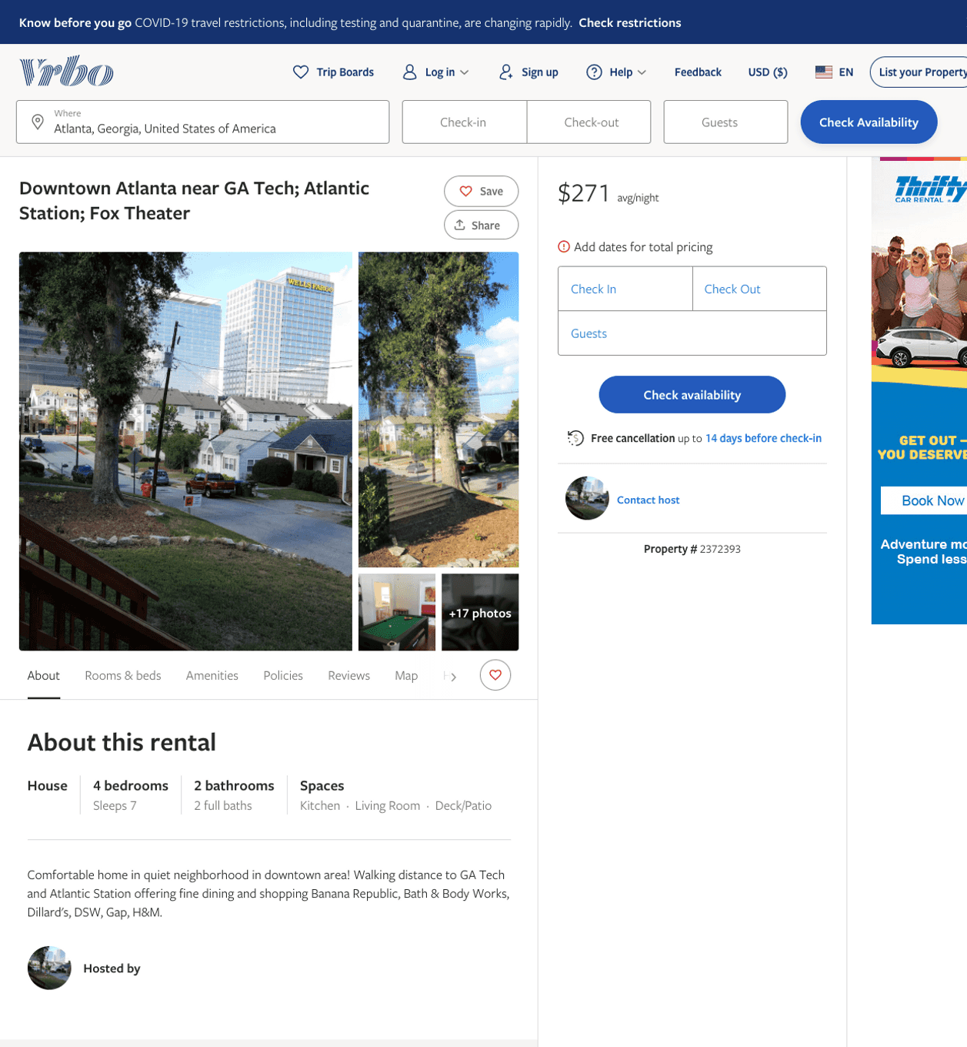
Listing 2372393
1258 HOLLY ST NW
4
7
$258 - $275
5
2
Barbara Wilson
https://www.vrbo.com/2372393
Aug 2022

Slide 12
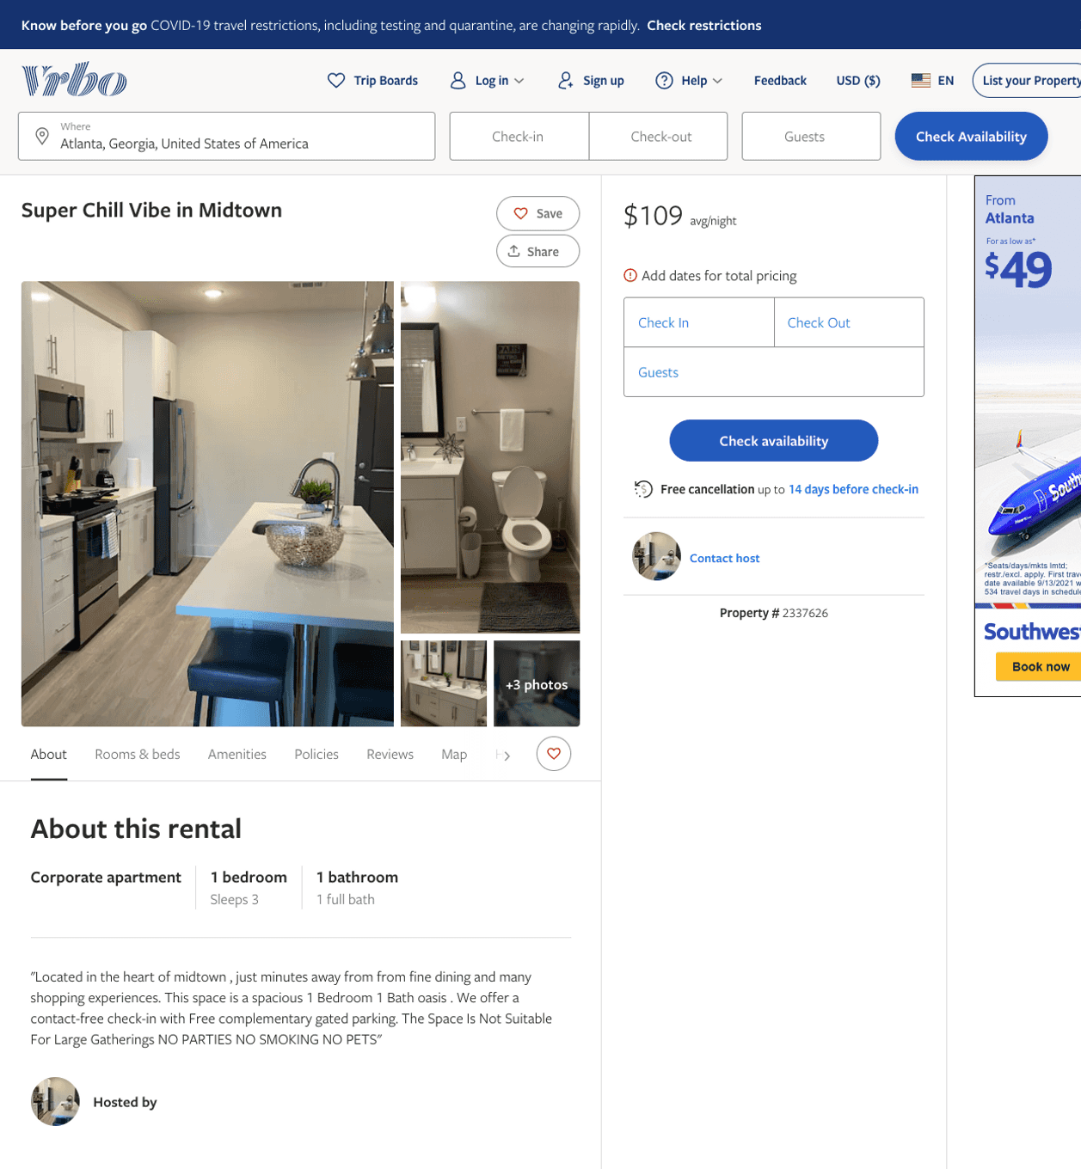
Listing 2337626
455 14TH ST NW
1
3
$109
2
https://www.vrbo.com/2337626
Aug 2022

Slide 13
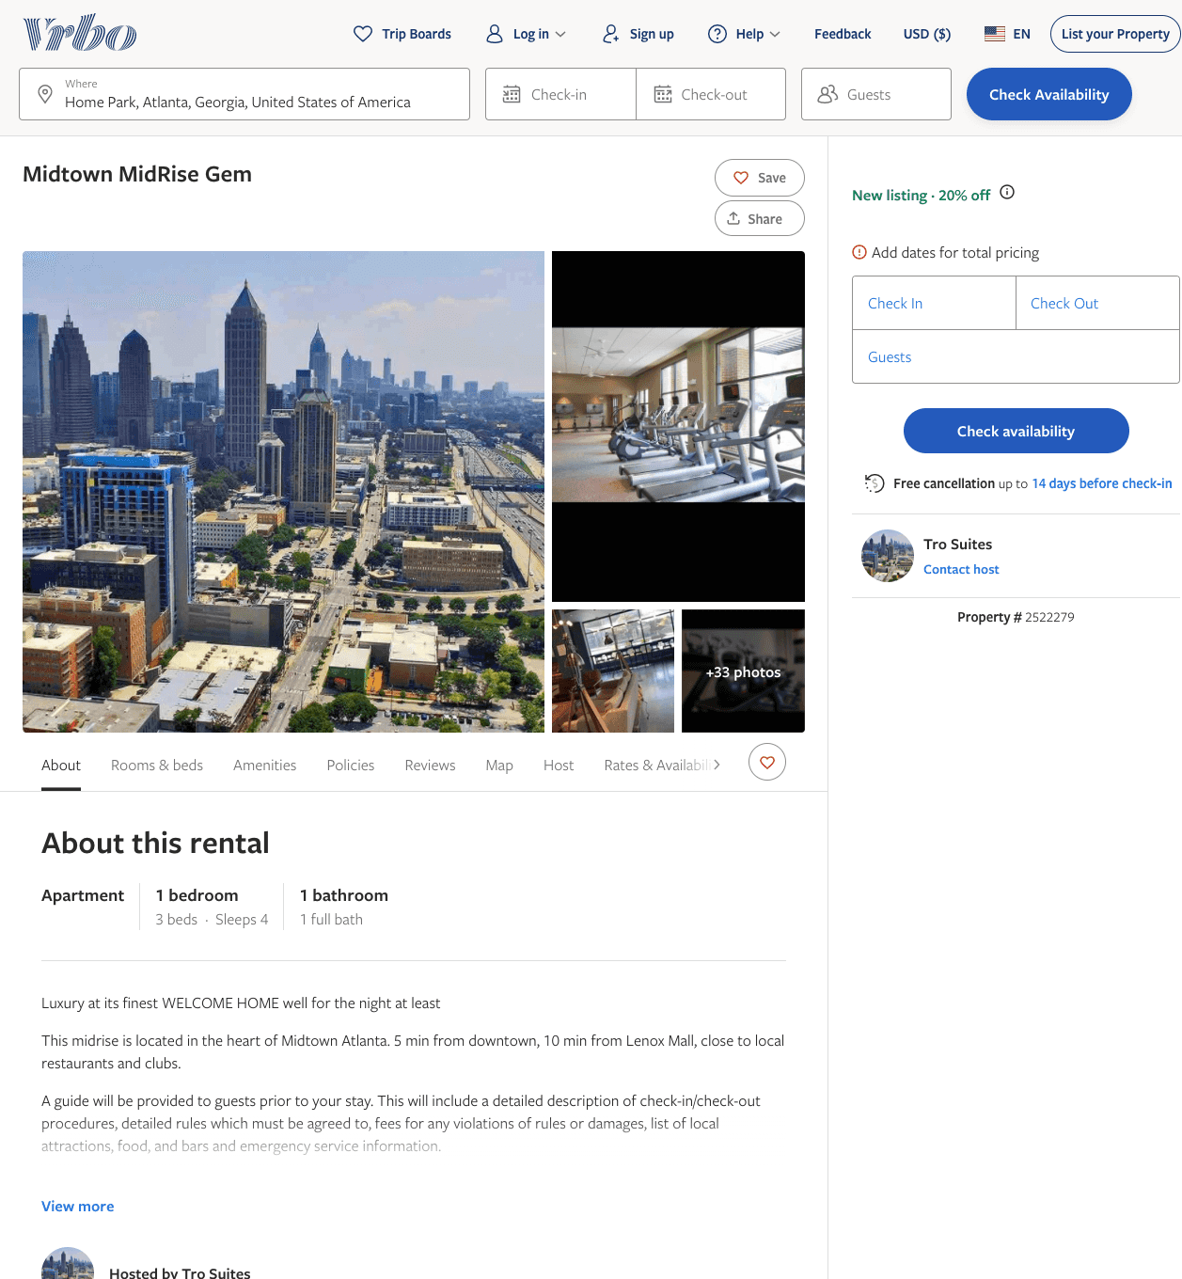
Listing 2522279
455 10TH ST NW
1
3
$105 - $113
5
1
Tro Suites
https://www.vrbo.com/2522279
Aug 2022

Slide 14
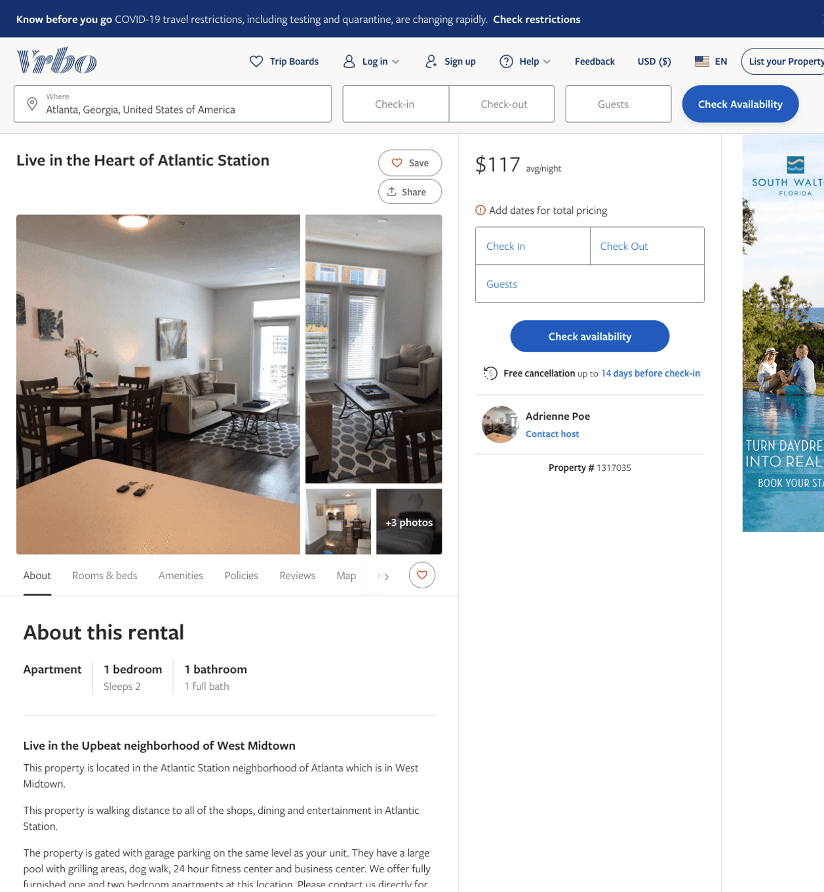
Listing 1317035
470 16TH ST NW
1
2
$117
30
Adrienne Poe
https://www.vrbo.com/1317035
Aug 2022

Slide 15
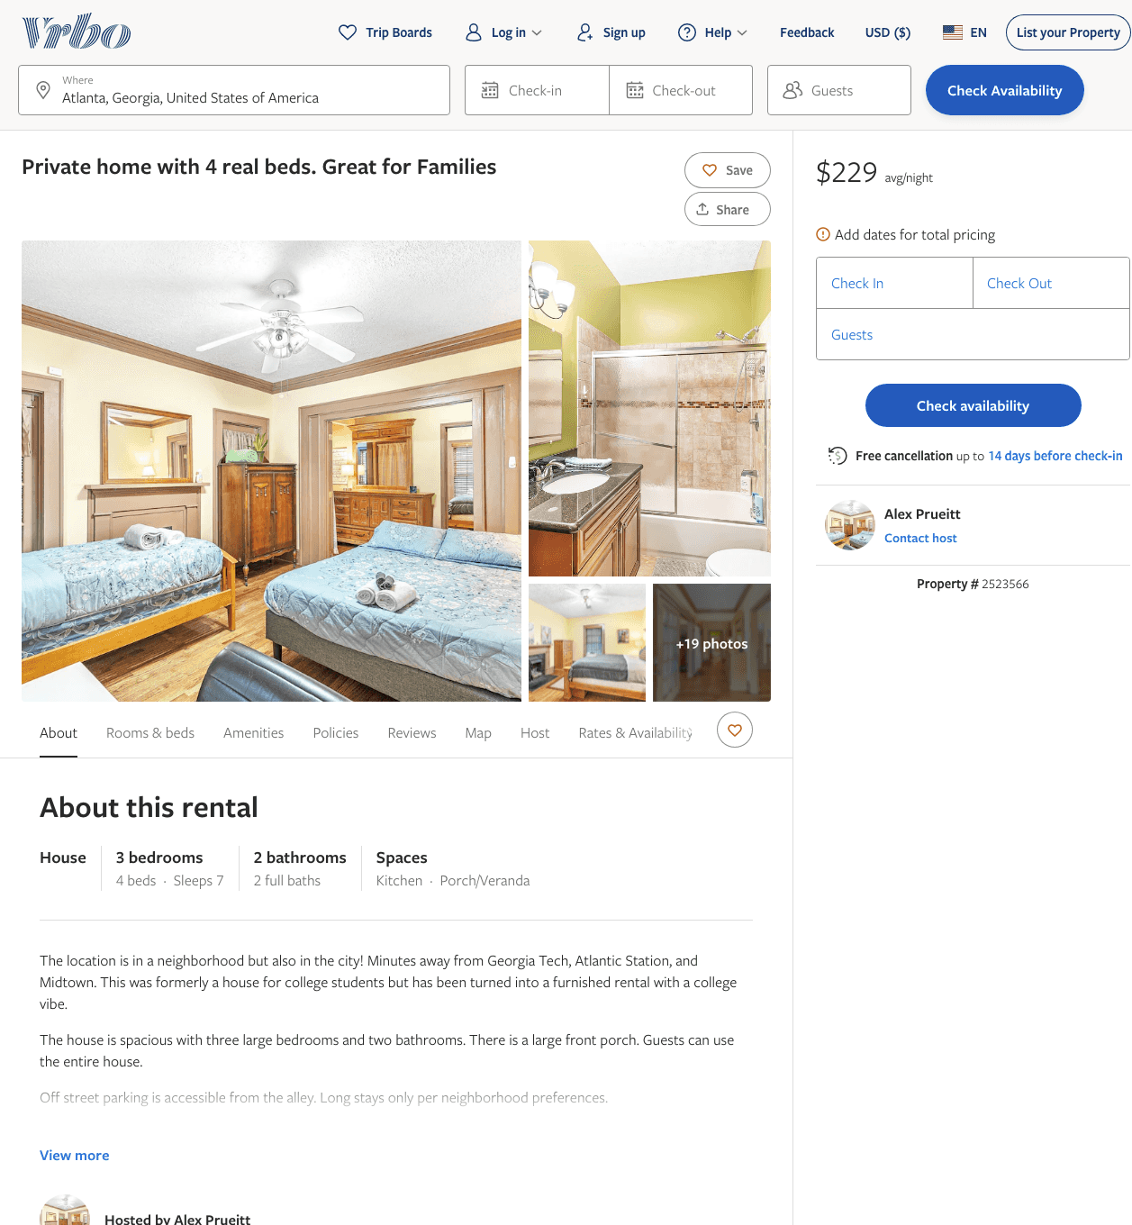
Listing 2523566
447 LYNCH AVE NW
3
7
$190 - $229
7
Alex Prueitt
https://www.vrbo.com/2523566
Aug 2022

Slide 16
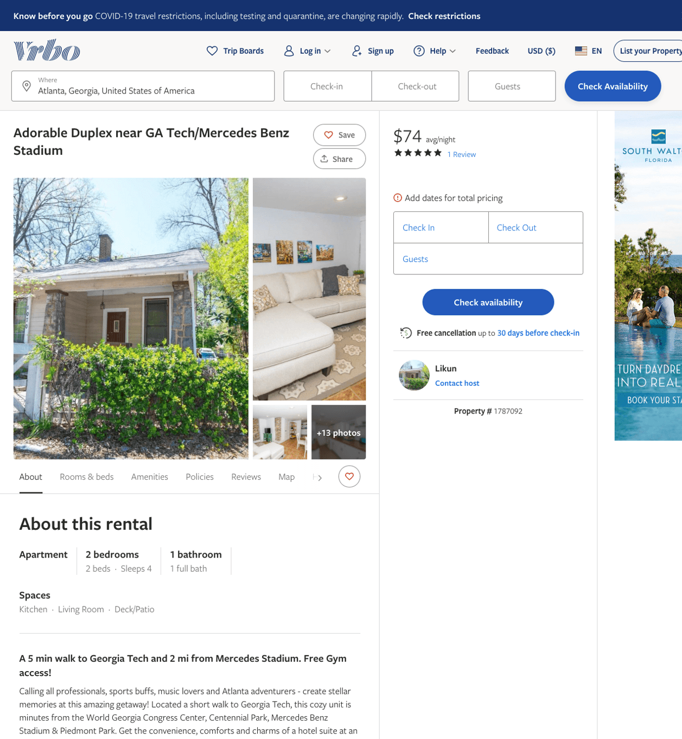
Listing 1787092
1070 HEMPHILL AVE NW
2
4
$71 - $78
5
3
Likun
https://www.vrbo.com/1787092
Aug 2022

Slide 17
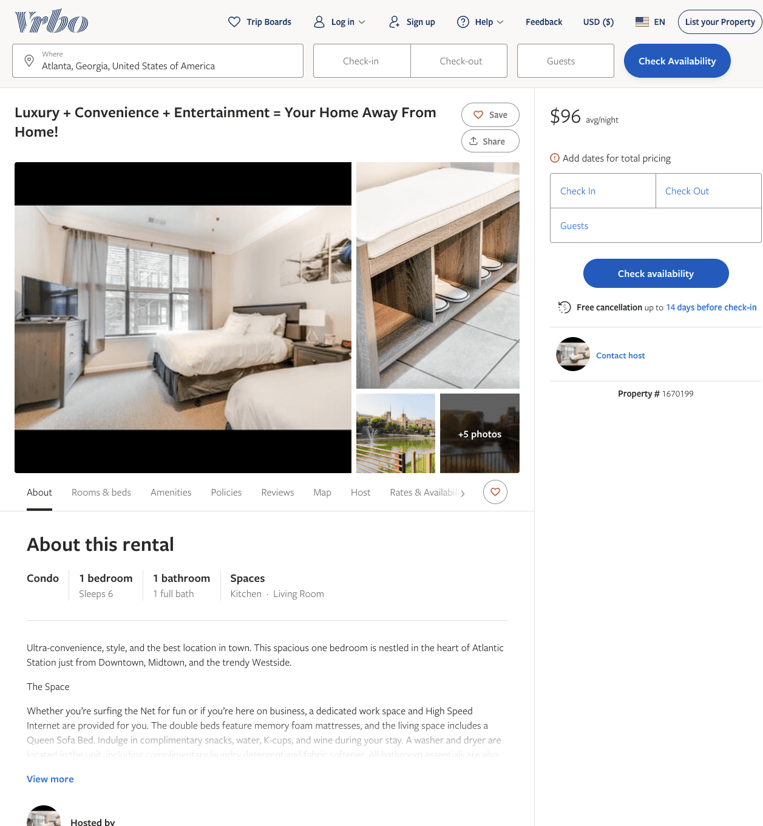
Listing 1670199
1
6
$96
2
https://www.vrbo.com/1670199
Aug 2022

Slide 18
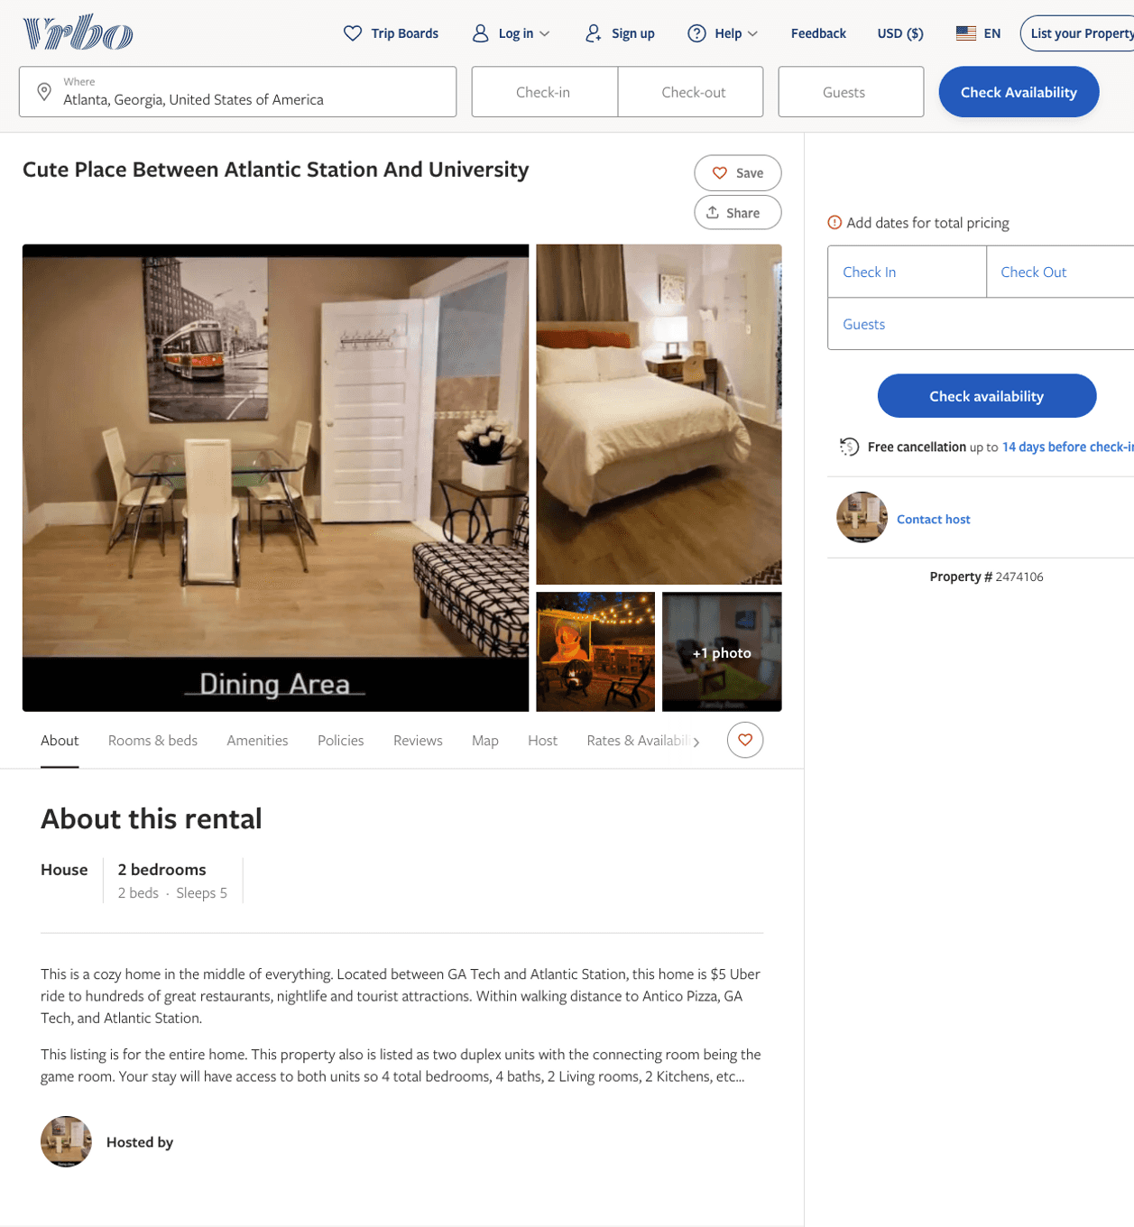
Listing 2474106
1120 SNYDER ST NW
2
5
$143 - $399
1
Clark and Henry
https://www.vrbo.com/2474106
Aug 2022

Slide 19
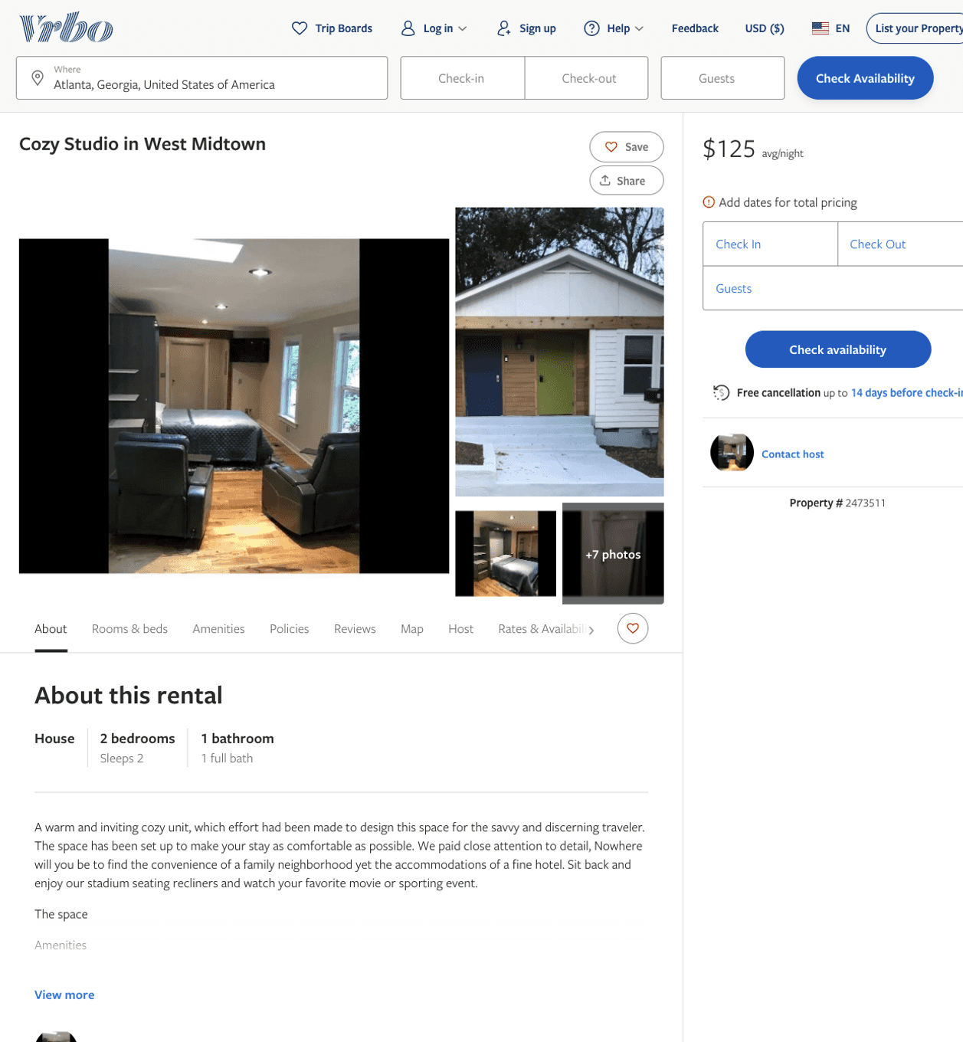
Listing 2473511
1120 SNYDER ST NW
2
2
$125 - $293
1
Clark and Henry
https://www.vrbo.com/2473511
Aug 2022

Slide 20
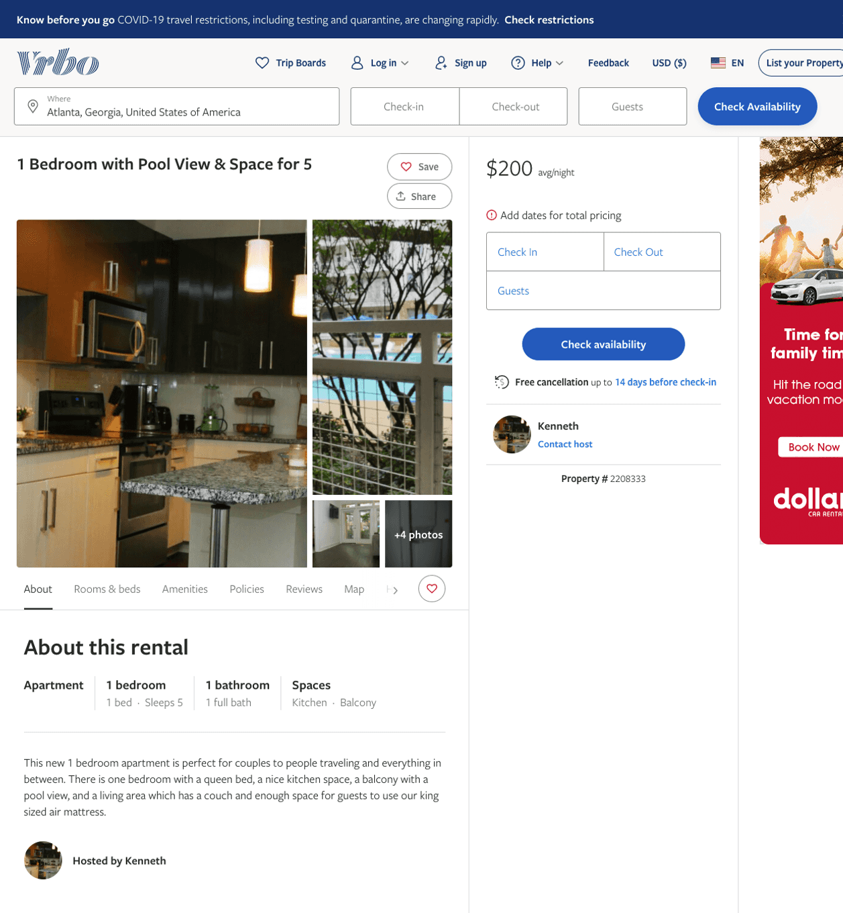
Listing 2208333
1220 MECASLIN ST NW
1
5
$200
3
Kenneth
https://www.vrbo.com/2208333
Aug 2022

Slide 21
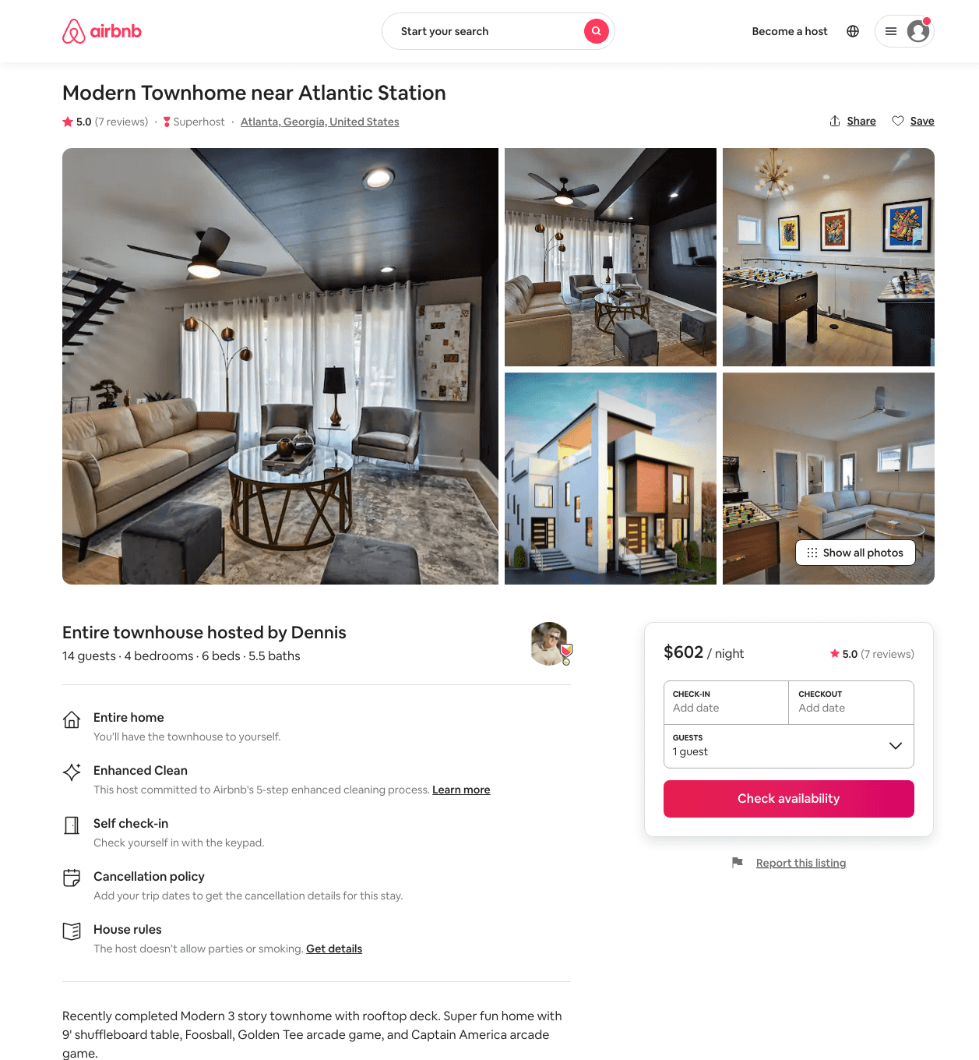
Listing 48045994
421-A ETHEL ST NW
4
14
$467 - $763
4.67
2
Dennis
225005812
7
https://www.airbnb.com/rooms/48045994
Jul 2022

Slide 22
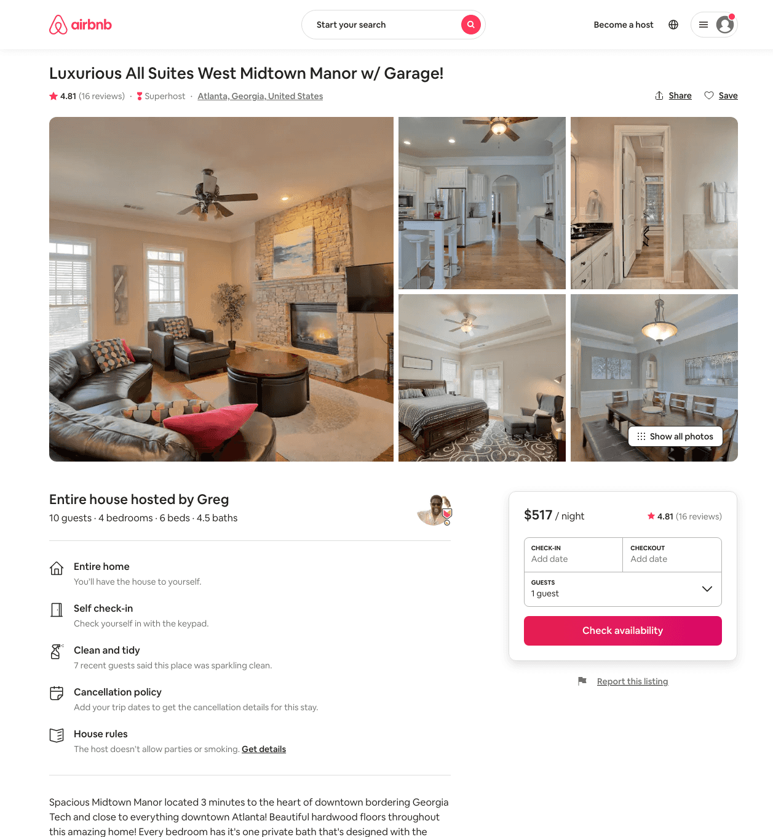
Listing 6603934
1264 FOWLER ST NW 12
4
10
$398 - $642
4.85
3
Greg
34553771
3
https://www.airbnb.com/rooms/6603934
Aug 2022

Slide 23
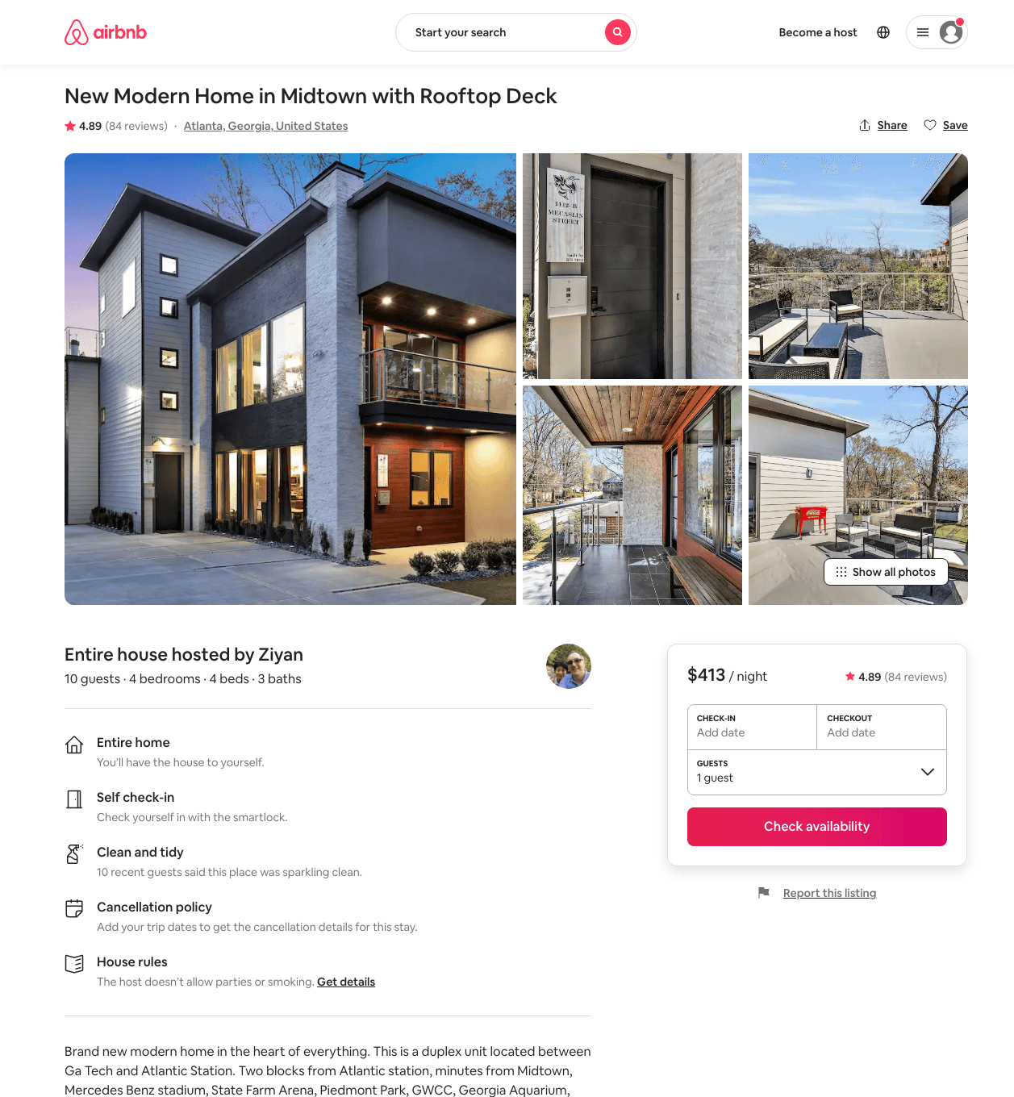
Listing 33507899
1112-B MECASLIN ST NW
4
8
$413
4.86
1
Ziyan
224730643
3
https://www.airbnb.com/rooms/33507899
Aug 2022

Slide 24
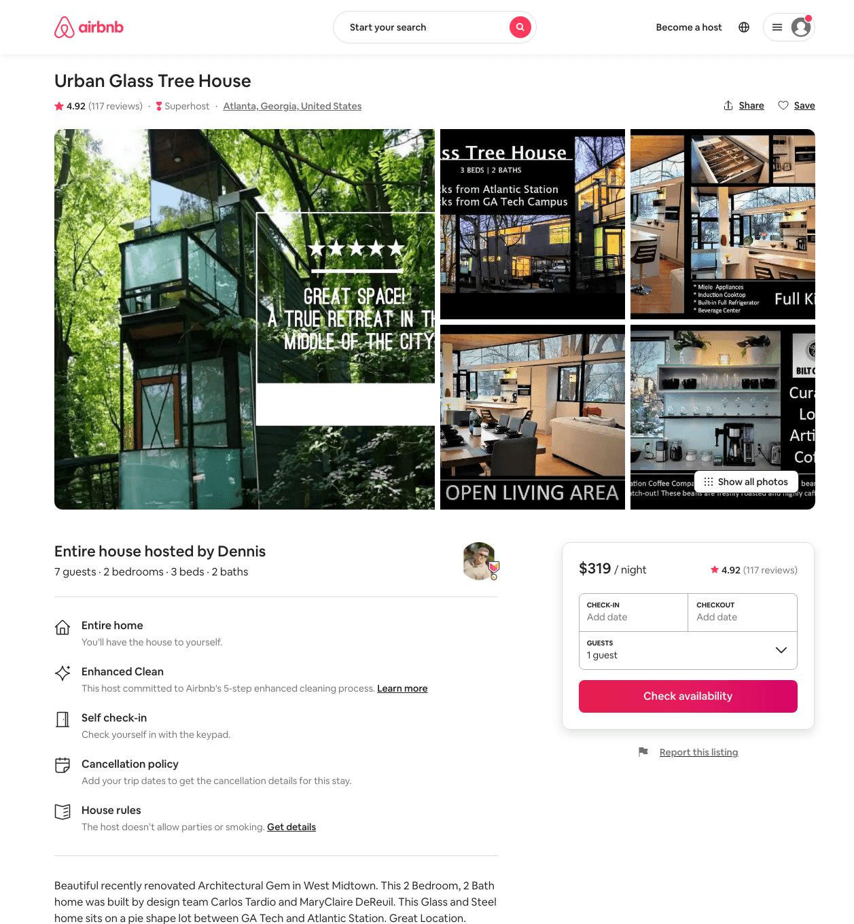
Listing 40065810
1086 HEMPHILL AVE NW
2
7
$277 - $331
4.89
2
Dennis
225005812
7
https://www.airbnb.com/rooms/40065810
Aug 2022

Slide 25
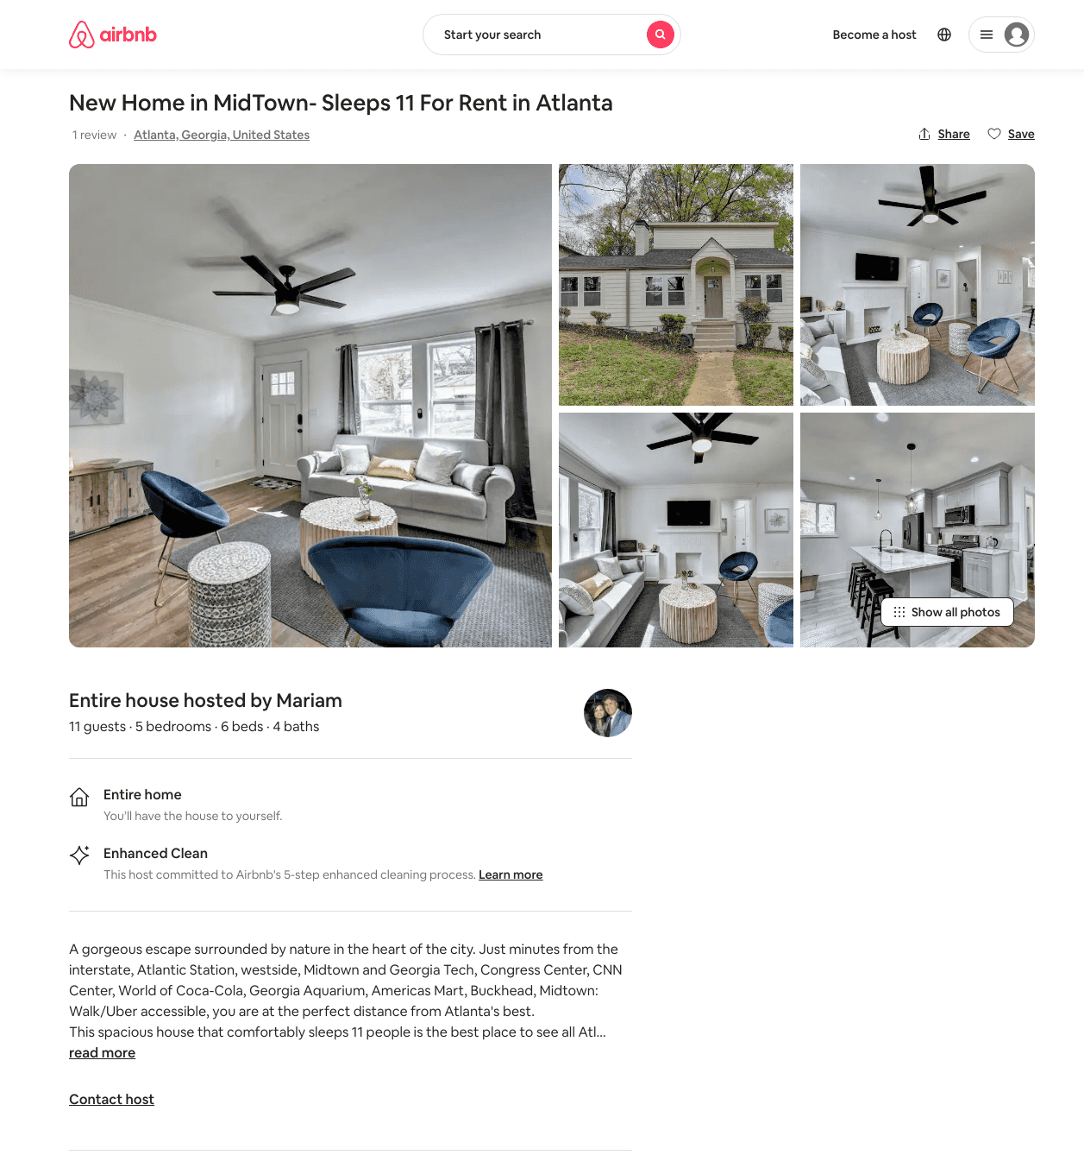
Listing 48976152
1068 WESTSHIRE PL NW
5
11
$213 - $415
4.55
3
Mariam
101528711
3
https://www.airbnb.com/rooms/48976152
Aug 2022

Slide 26
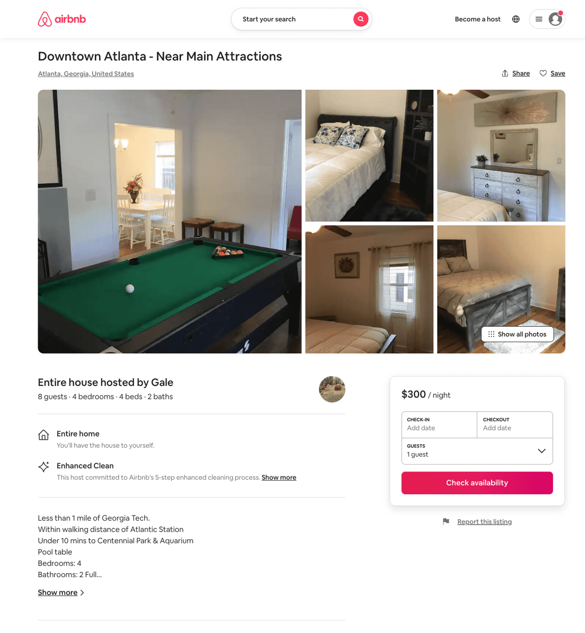
Listing 50259826
1258 HOLLY ST NW
4
7
$187 - $300
4.85
1
Gale
405777615
1
https://www.airbnb.com/rooms/50259826
Aug 2022

Slide 27
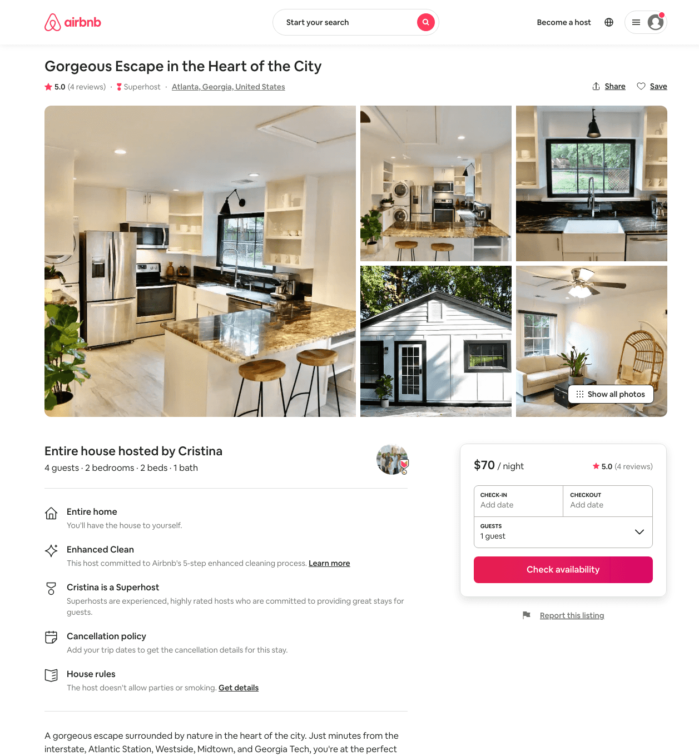
Listing 45754995
1200 ATLANTIC DR NW
2
4
$70 - $114
5.0
4
Cristina
15193140
2
https://www.airbnb.com/rooms/45754995
Aug 2022

Slide 28
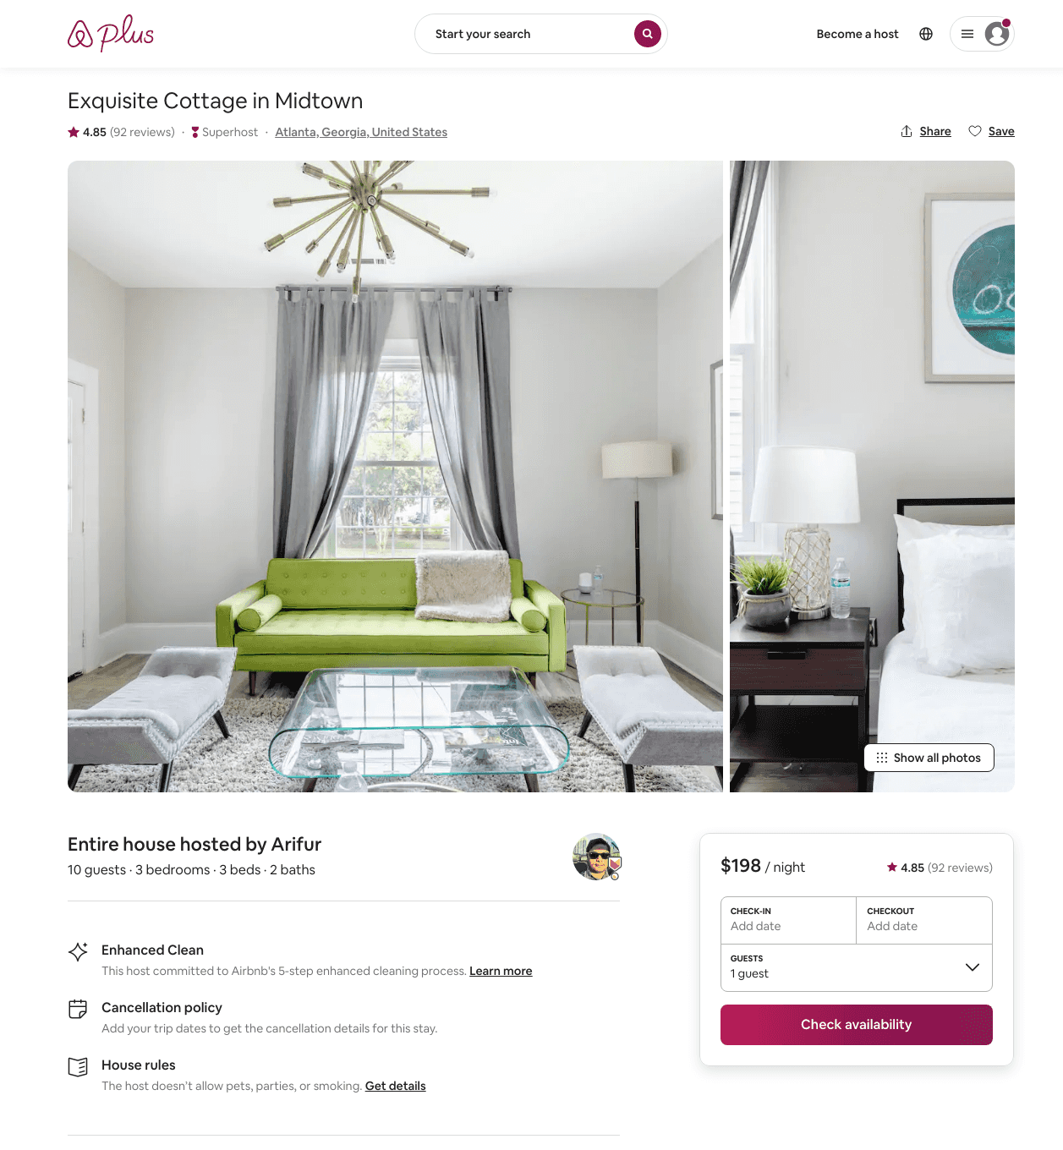
Listing 30588087
1099 CENTER ST NW
2
8
$184 - $302
4.91
3
Arifur
229448368
3
https://www.airbnb.com/rooms/30588087
Aug 2022

Slide 29
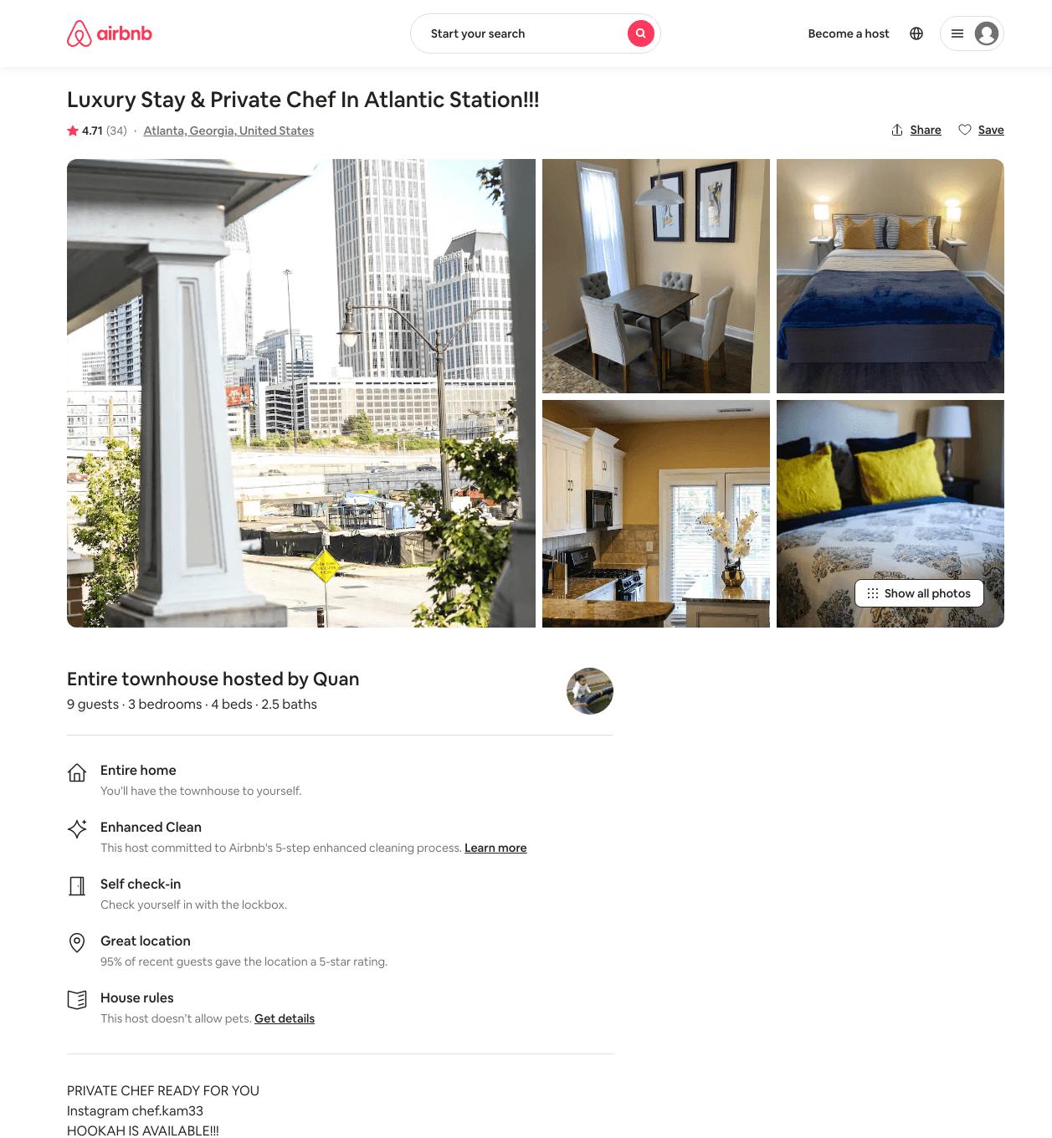
Listing 45243894
3
9
$145 - $243
4.60
1
Quan
332393049
3
https://www.airbnb.com/rooms/45243894
Aug 2022

Slide 30
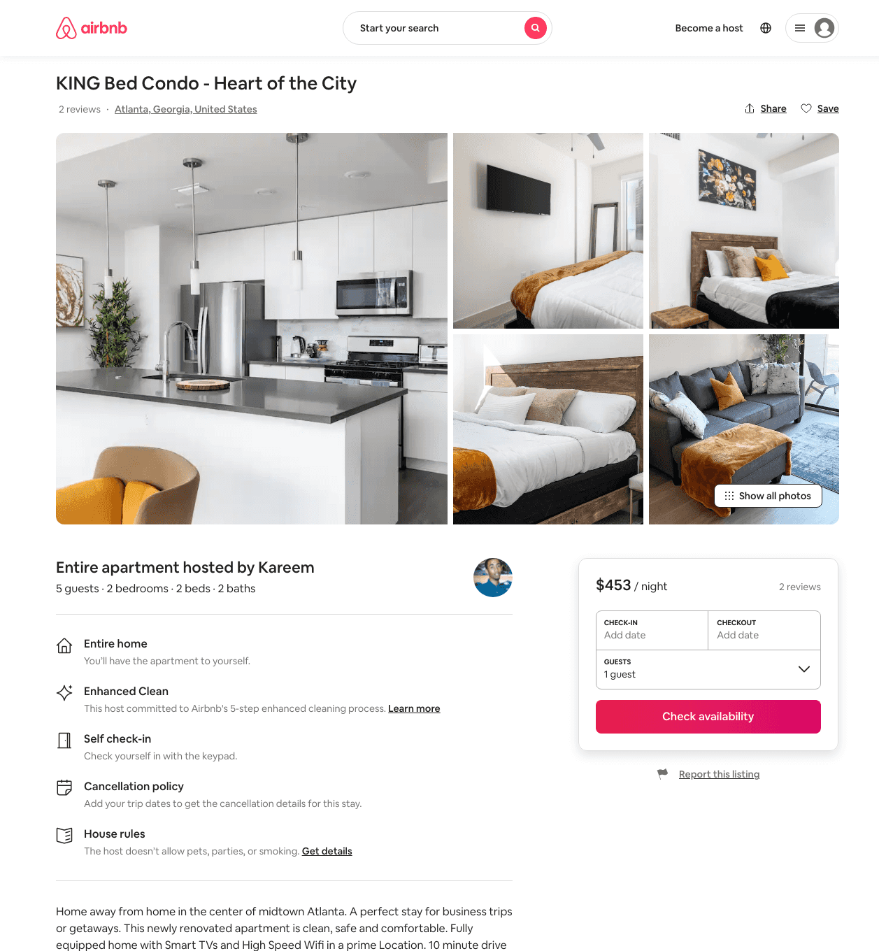
Listing 48397206
455 14TH ST NW
2
6
$123 - $435
4.69
2
Kareem
348845626
2
https://www.airbnb.com/rooms/48397206
Aug 2022

Slide 31
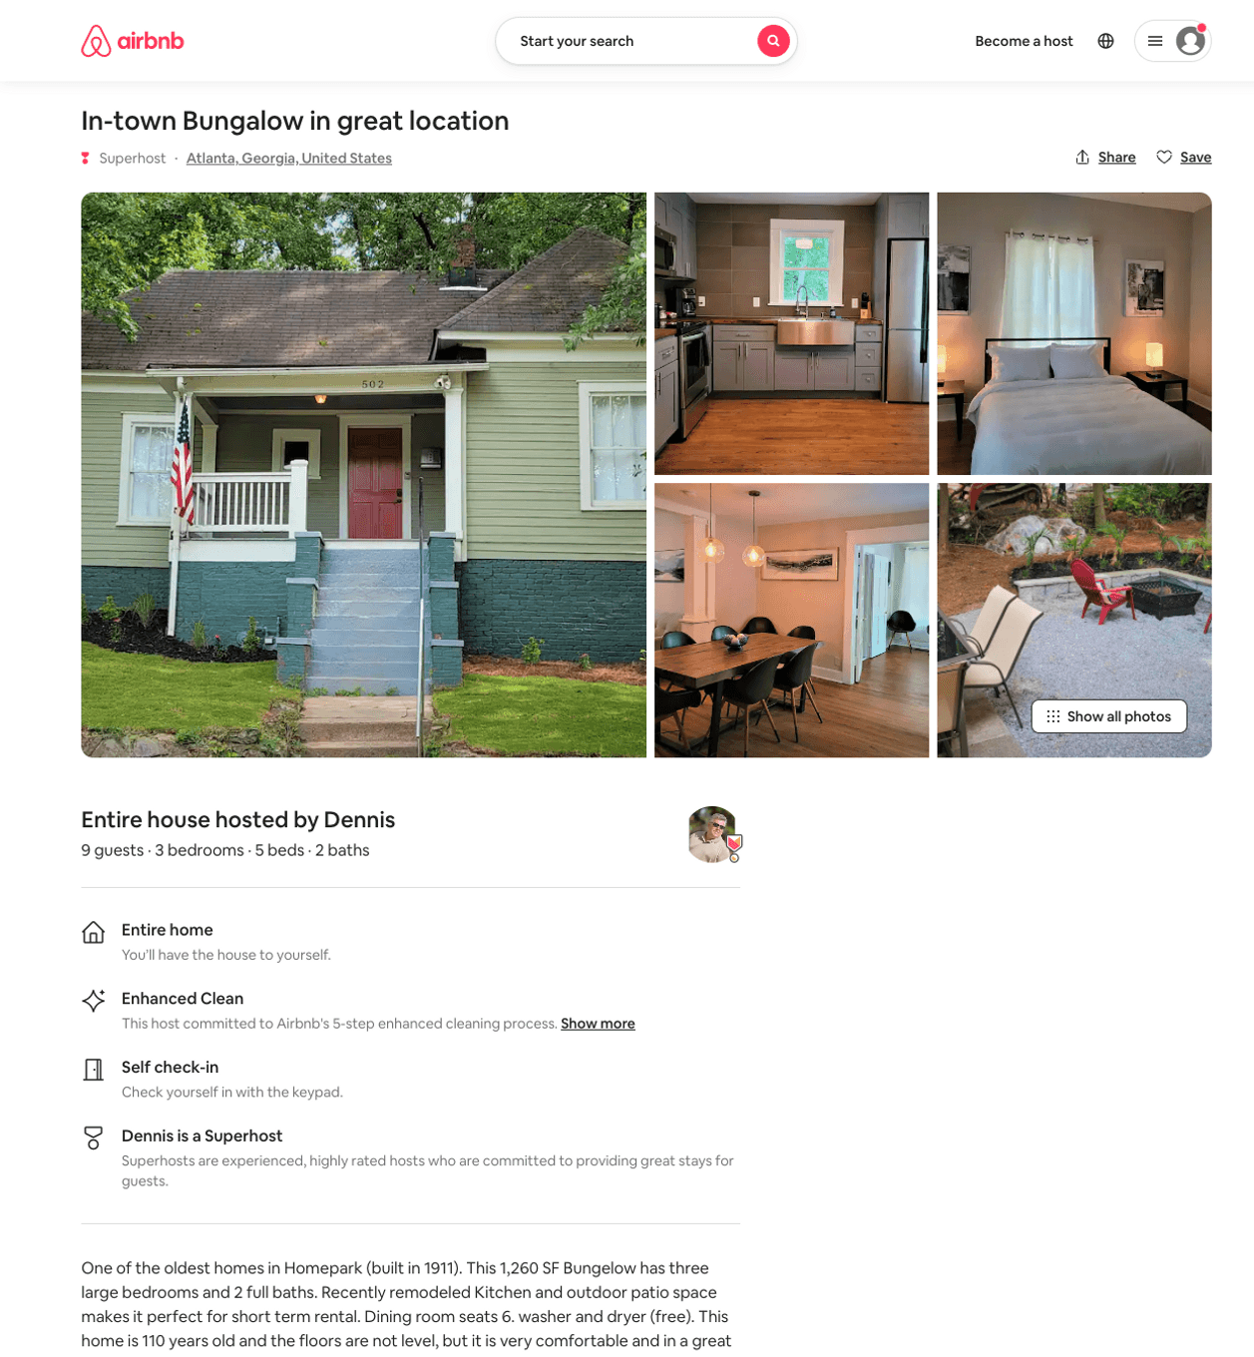
Listing 50489047
502 ETHEL ST NW
3
9
$155 - $236
4.93
2
Dennis
225005812
7
https://www.airbnb.com/rooms/50489047
Jul 2022

Slide 32
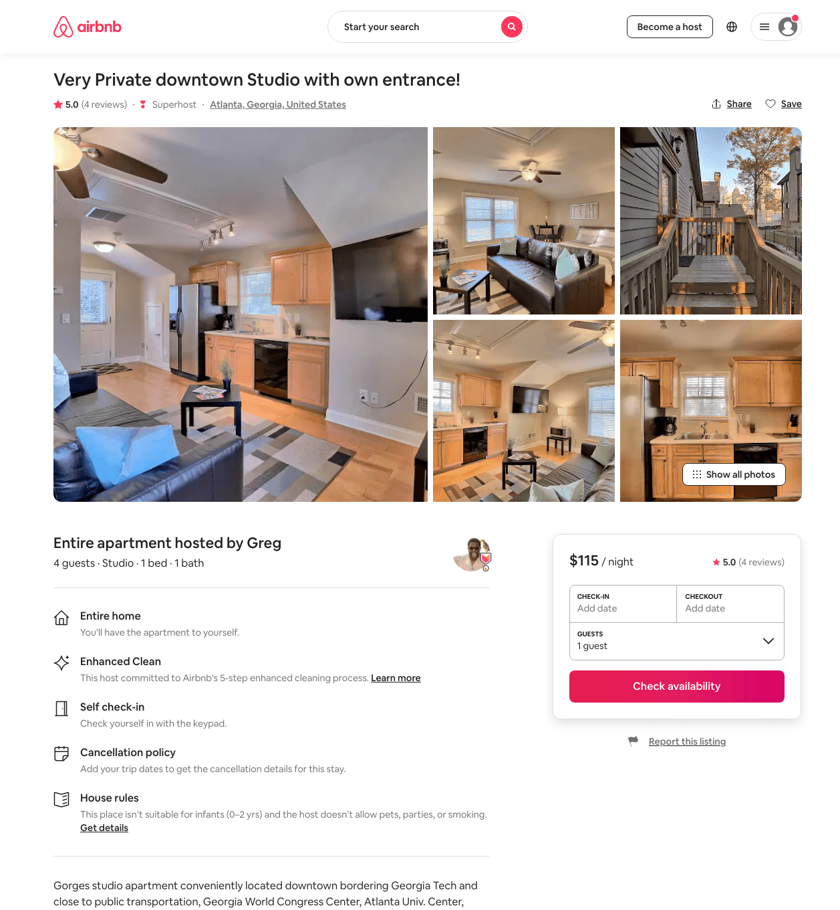
Listing 45677131
1264 FOWLER ST NW 12
Studio
4
$110 - $128
5.0
31
Greg
34553771
3
https://www.airbnb.com/rooms/45677131
Aug 2022

Slide 33
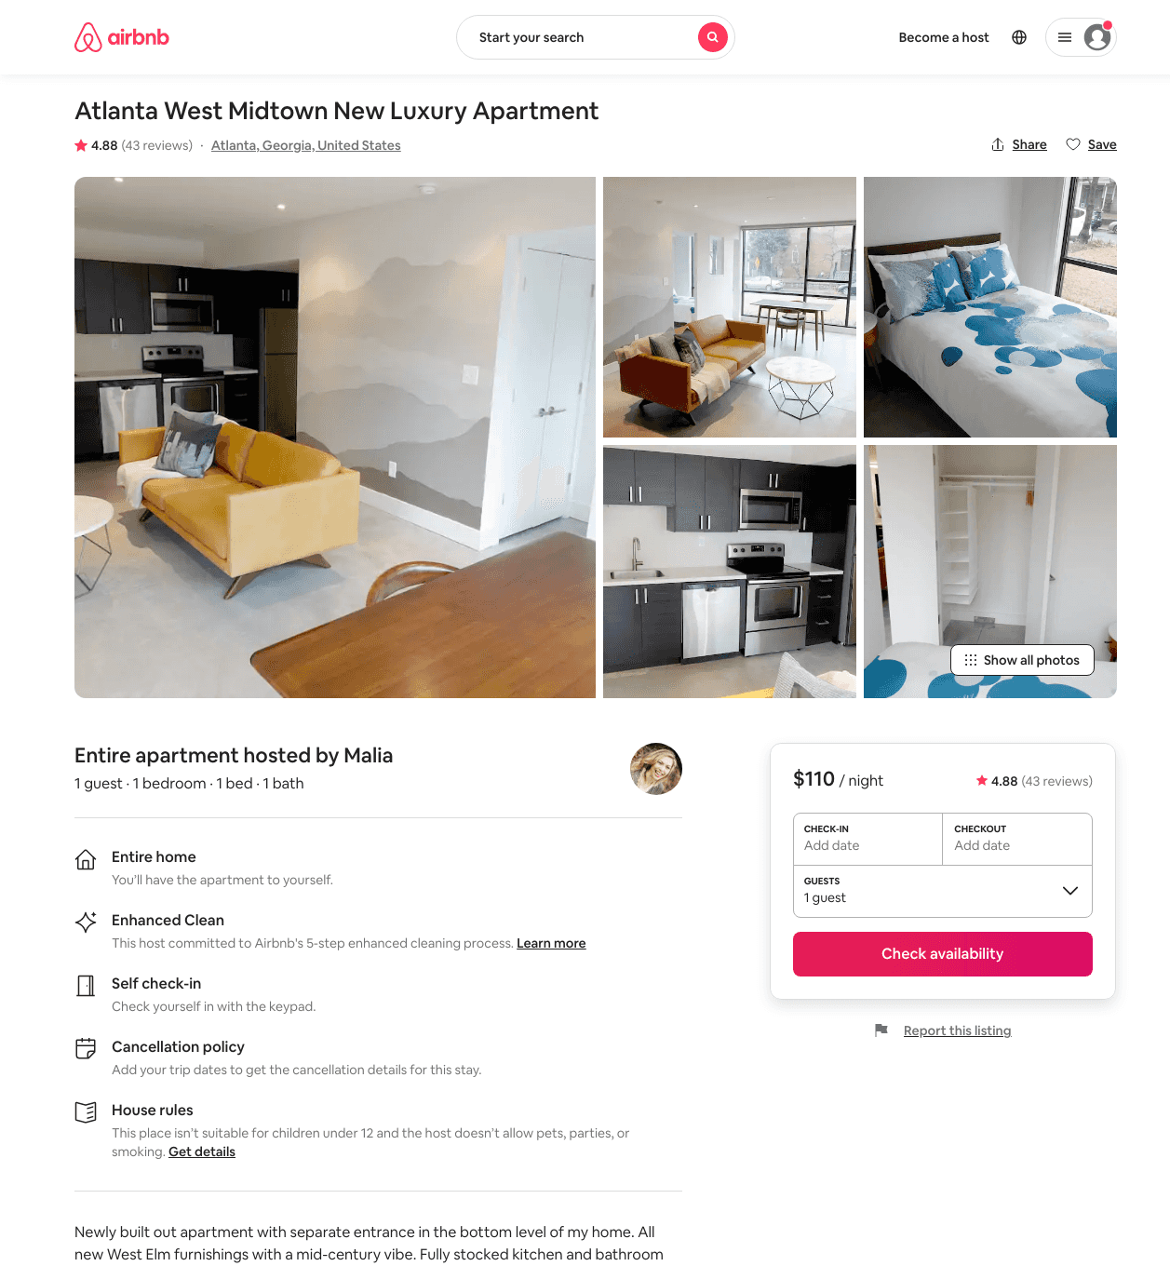
Listing 23234200
1092 CENTER ST NW
1
1
$110 - $134
4.87
7
Malia
96947802
1
https://www.airbnb.com/rooms/23234200
Aug 2022

Slide 34
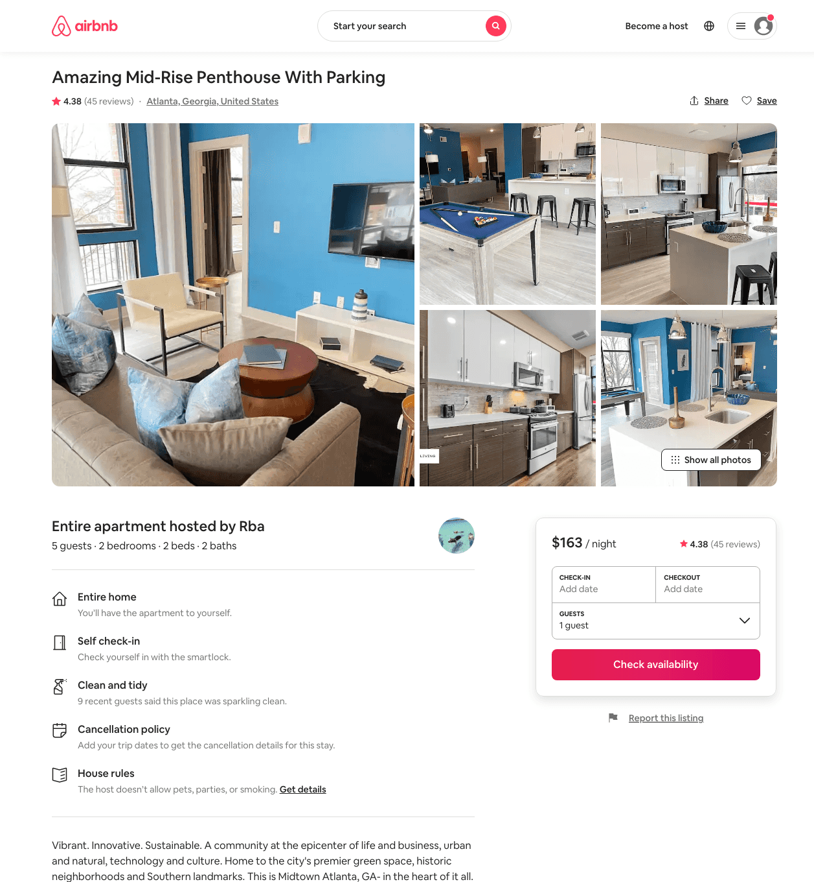
Listing 42830949
455 14TH ST NW
2
5
$149 - $209
4.32
2
Rba
627117
19
https://www.airbnb.com/rooms/42830949
Jun 2022

Slide 35
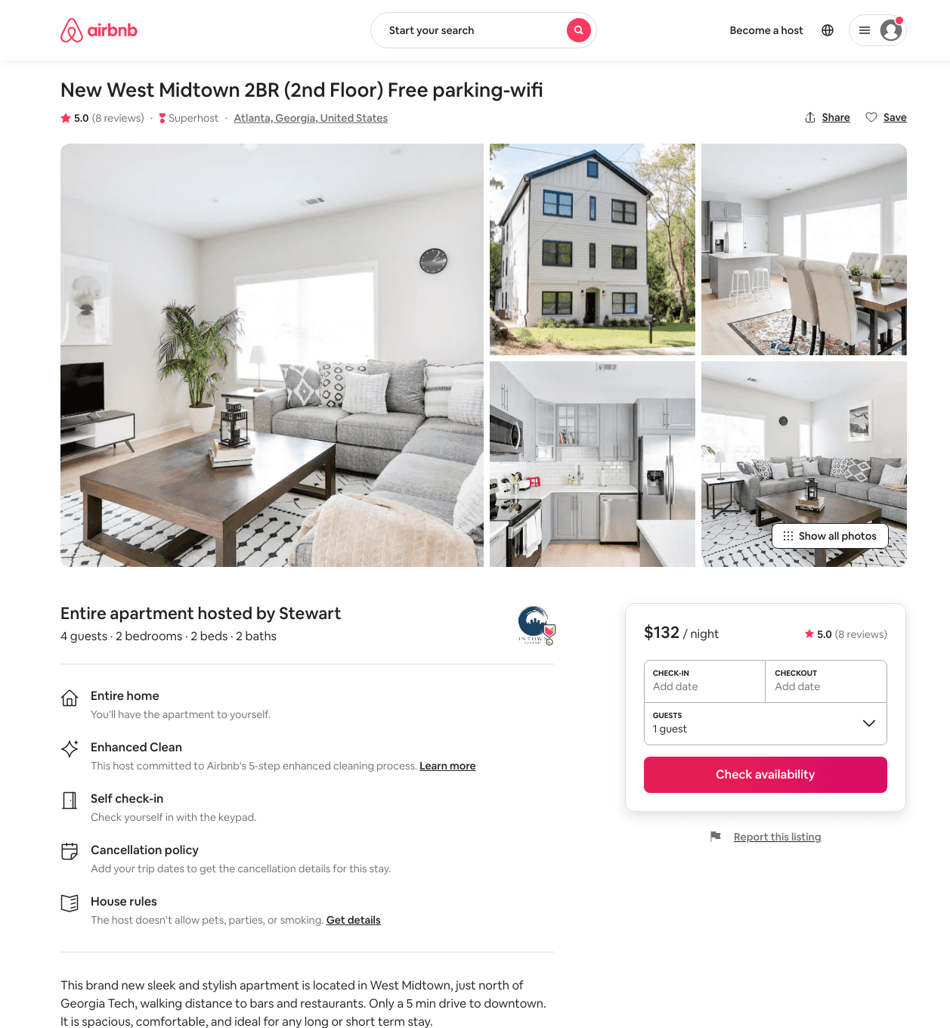
Listing 29075946
1054 MCMILLAN ST NW
2
4
$109 - $211
4.92
58
Stewart
26798403
14
https://www.airbnb.com/rooms/29075946
Aug 2022

Slide 36
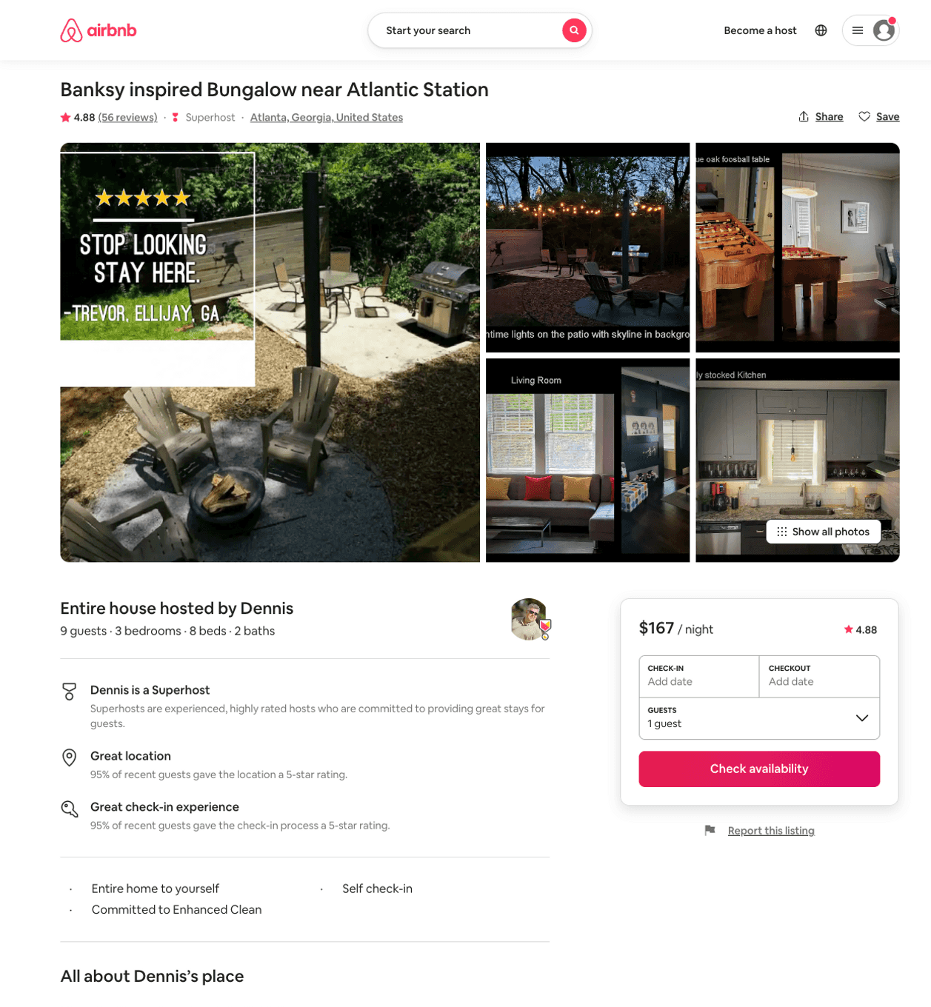
Listing 42795638
1179 MECASLIN ST NW
3
9
$141 - $188
4.81
2
Dennis
225005812
7
https://www.airbnb.com/rooms/42795638
Aug 2022

Slide 37
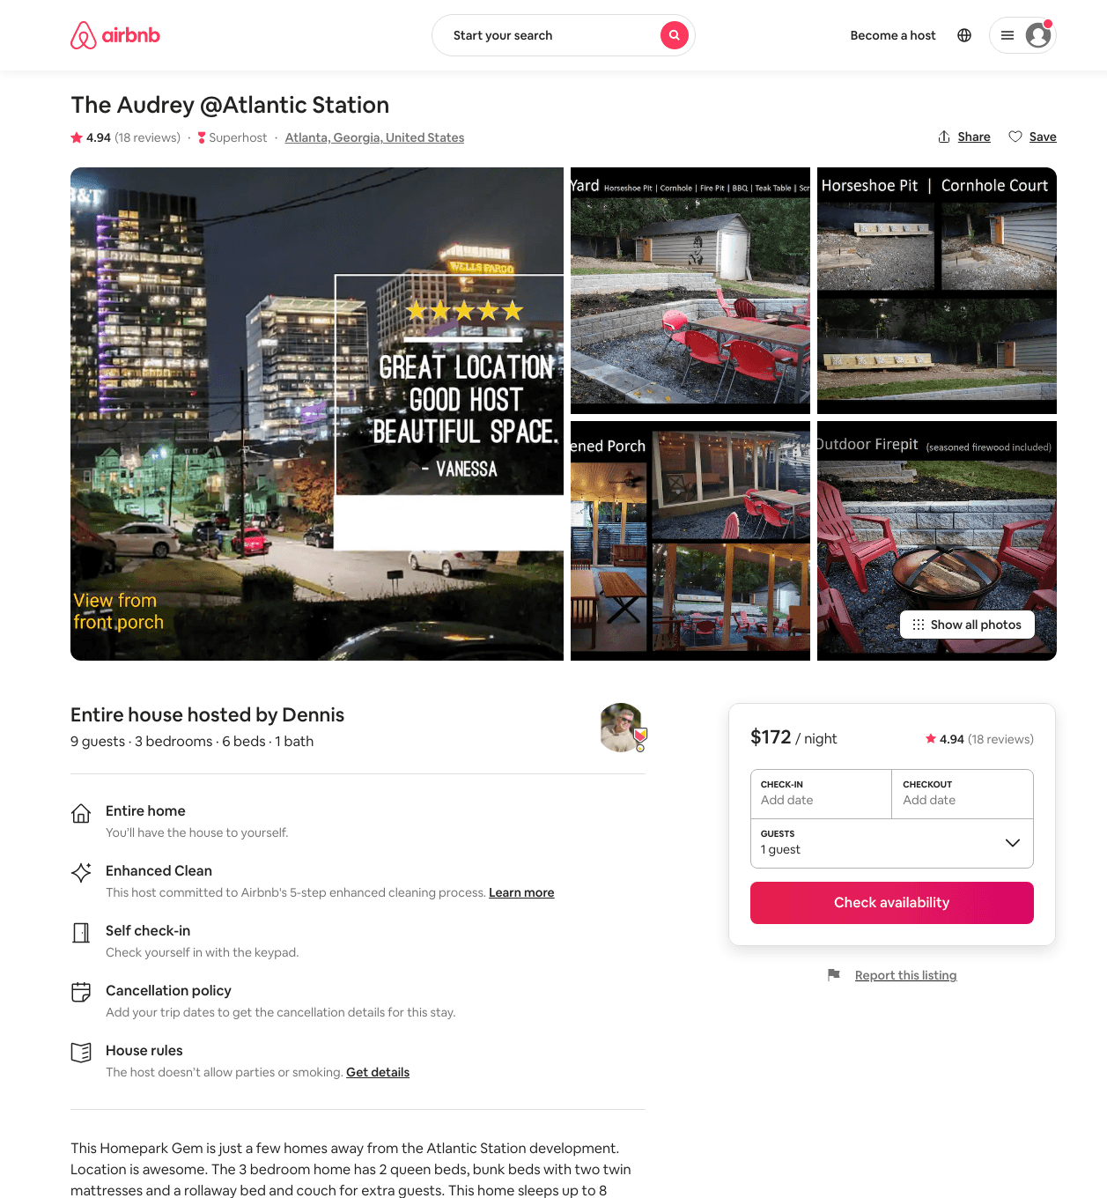
Listing 45772149
1244 HOLLY ST NW
3
9
$153 - $205
4.88
2
Dennis
225005812
7
https://www.airbnb.com/rooms/45772149
Aug 2022

Slide 38
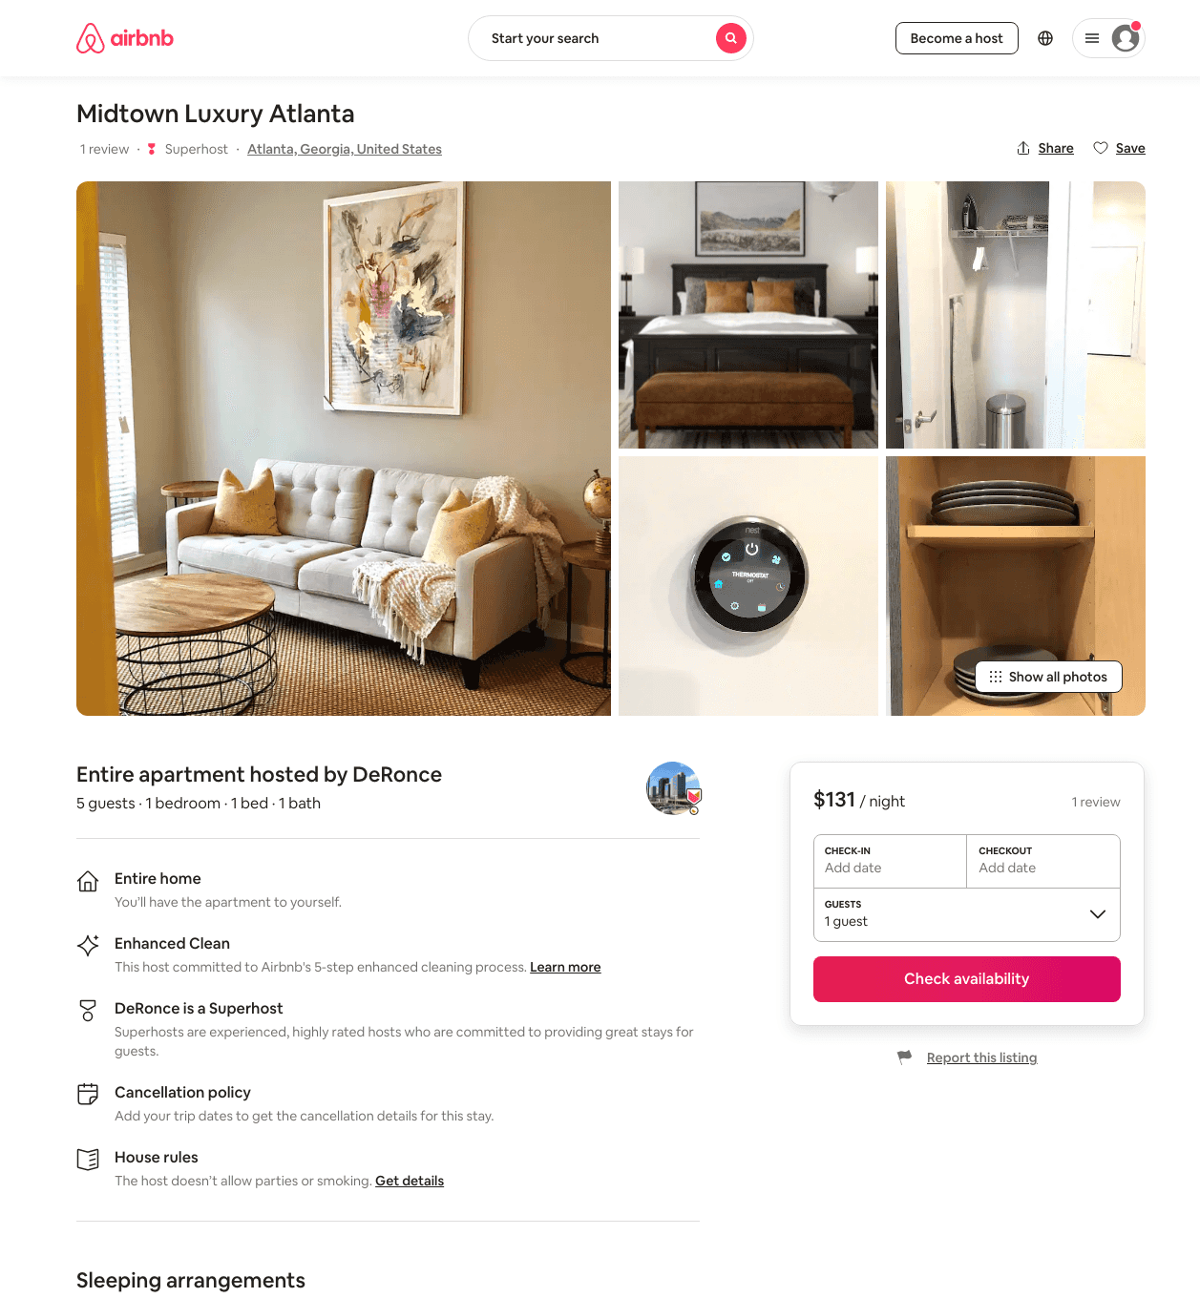
Listing 48870388
455 10TH ST NW
1
5
$111 - $270
4.92
1
DeRonce
165352378
6
https://www.airbnb.com/rooms/48870388
Aug 2022

Slide 39
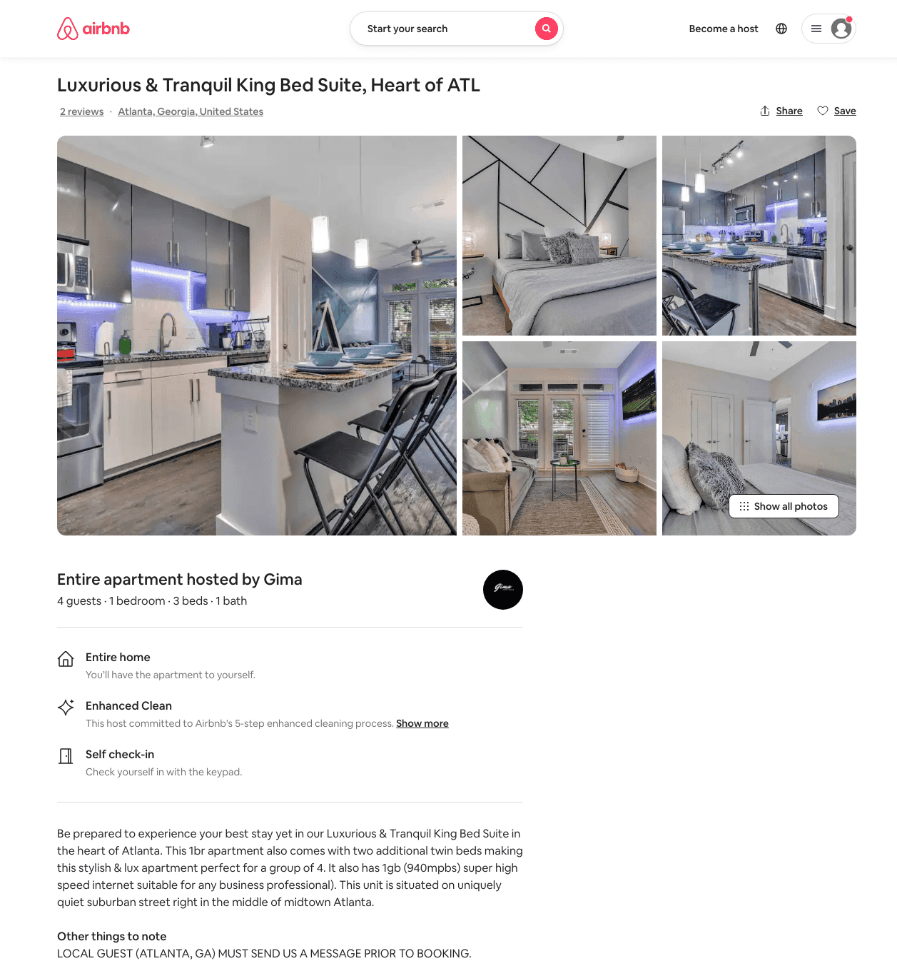
Listing 50021456
1220 MECASLIN ST NW
1
4
$91 - $153
4.95
1
Gima
274911590
1
https://www.airbnb.com/rooms/50021456
Aug 2022

Slide 40
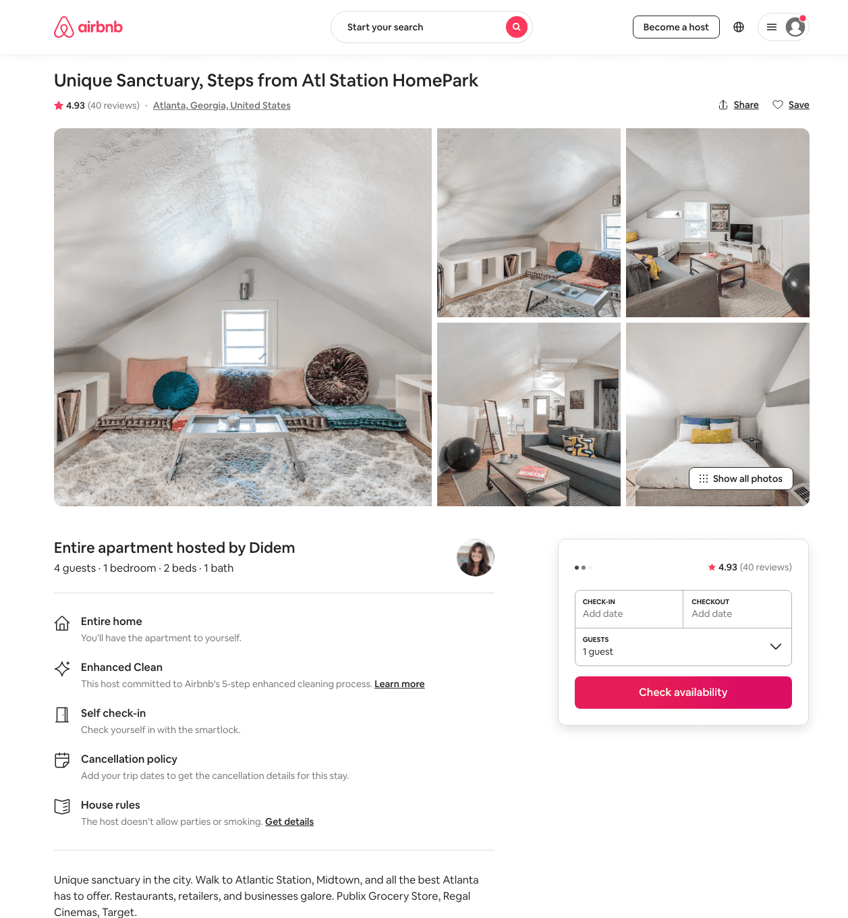
Listing 32618132
1234 FRANCIS ST NW
1
4
$117 - $120
4.91
28
Didem
130464324
8
https://www.airbnb.com/rooms/32618132
Aug 2022

Slide 41
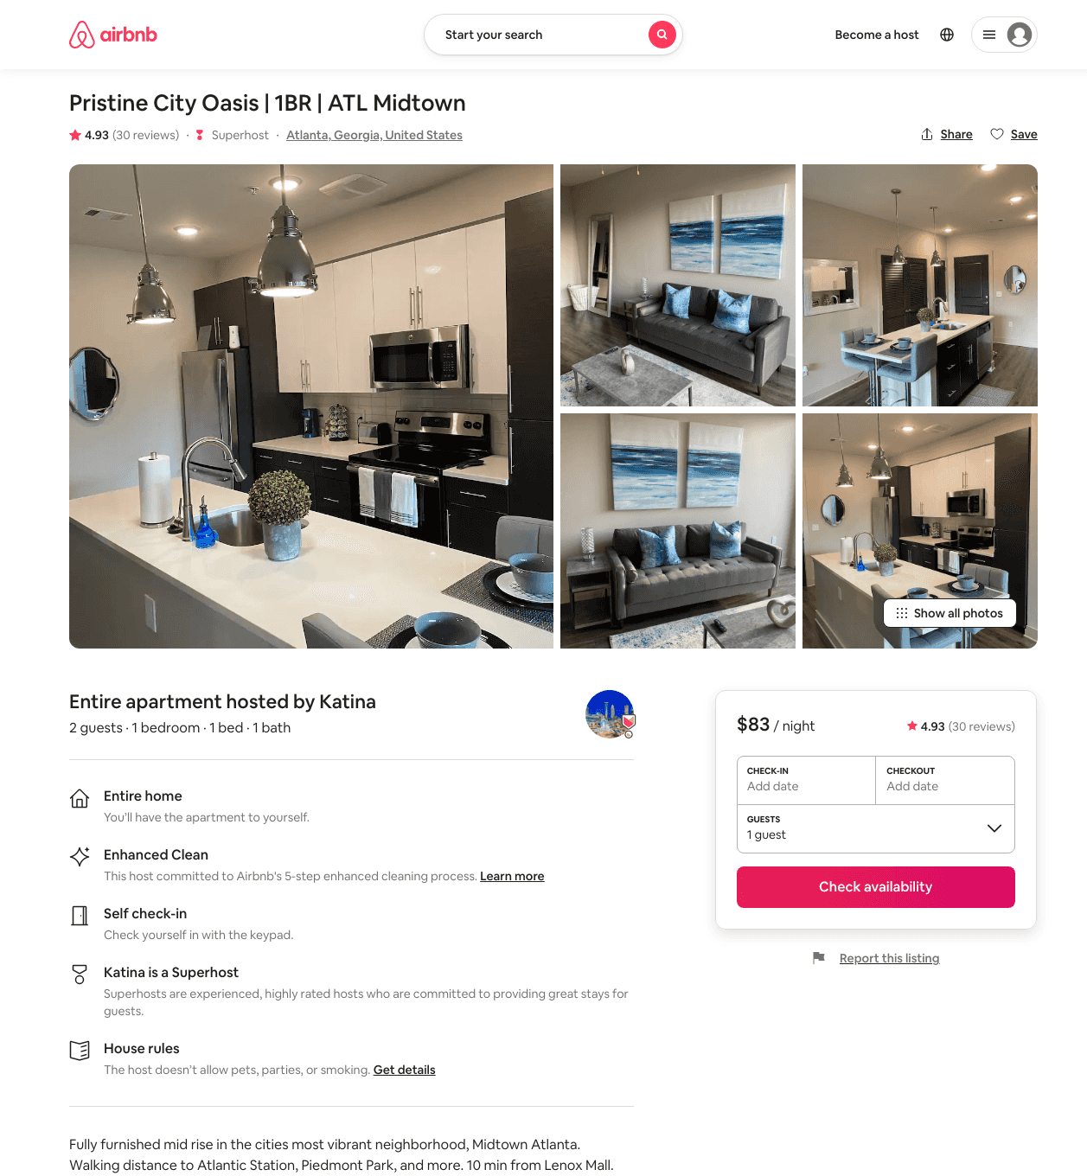
Listing 45603773
455 14TH ST NW
1
2
$79 - $112
4.84
1
Rachael
367118946
1
https://www.airbnb.com/rooms/45603773
Aug 2022

Slide 42
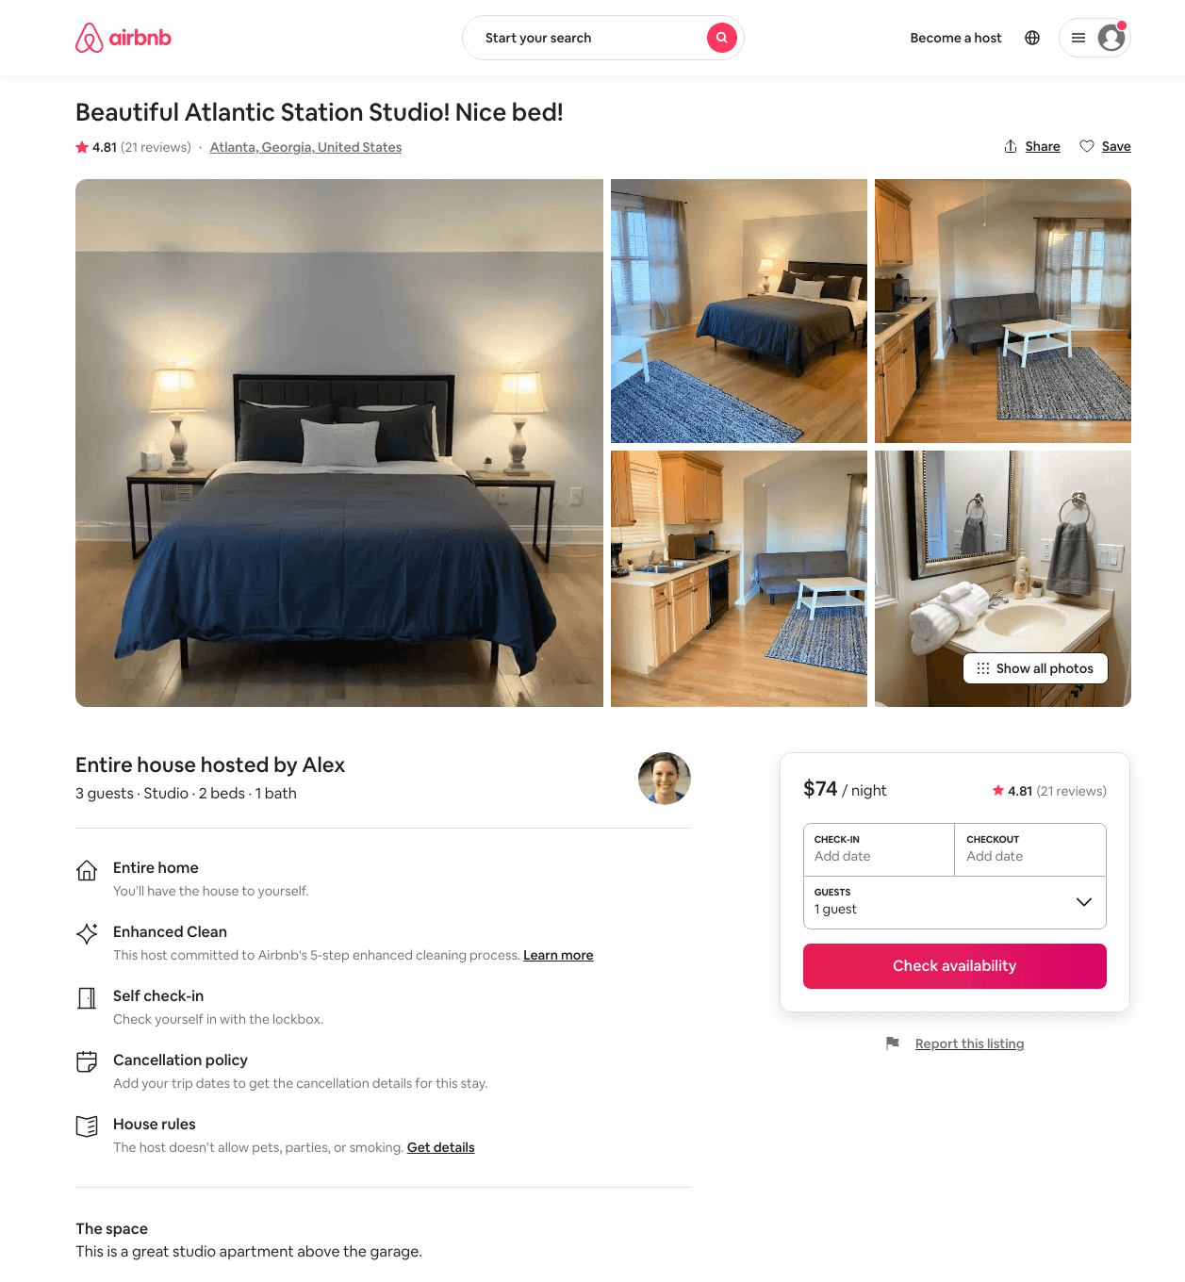
Listing 39796852
1267 ATLANTIC DR NW 2
Studio
2
$64 - $106
4.71
5
Alex And Christina
20605441
40
https://www.airbnb.com/rooms/39796852
Aug 2022

Slide 43
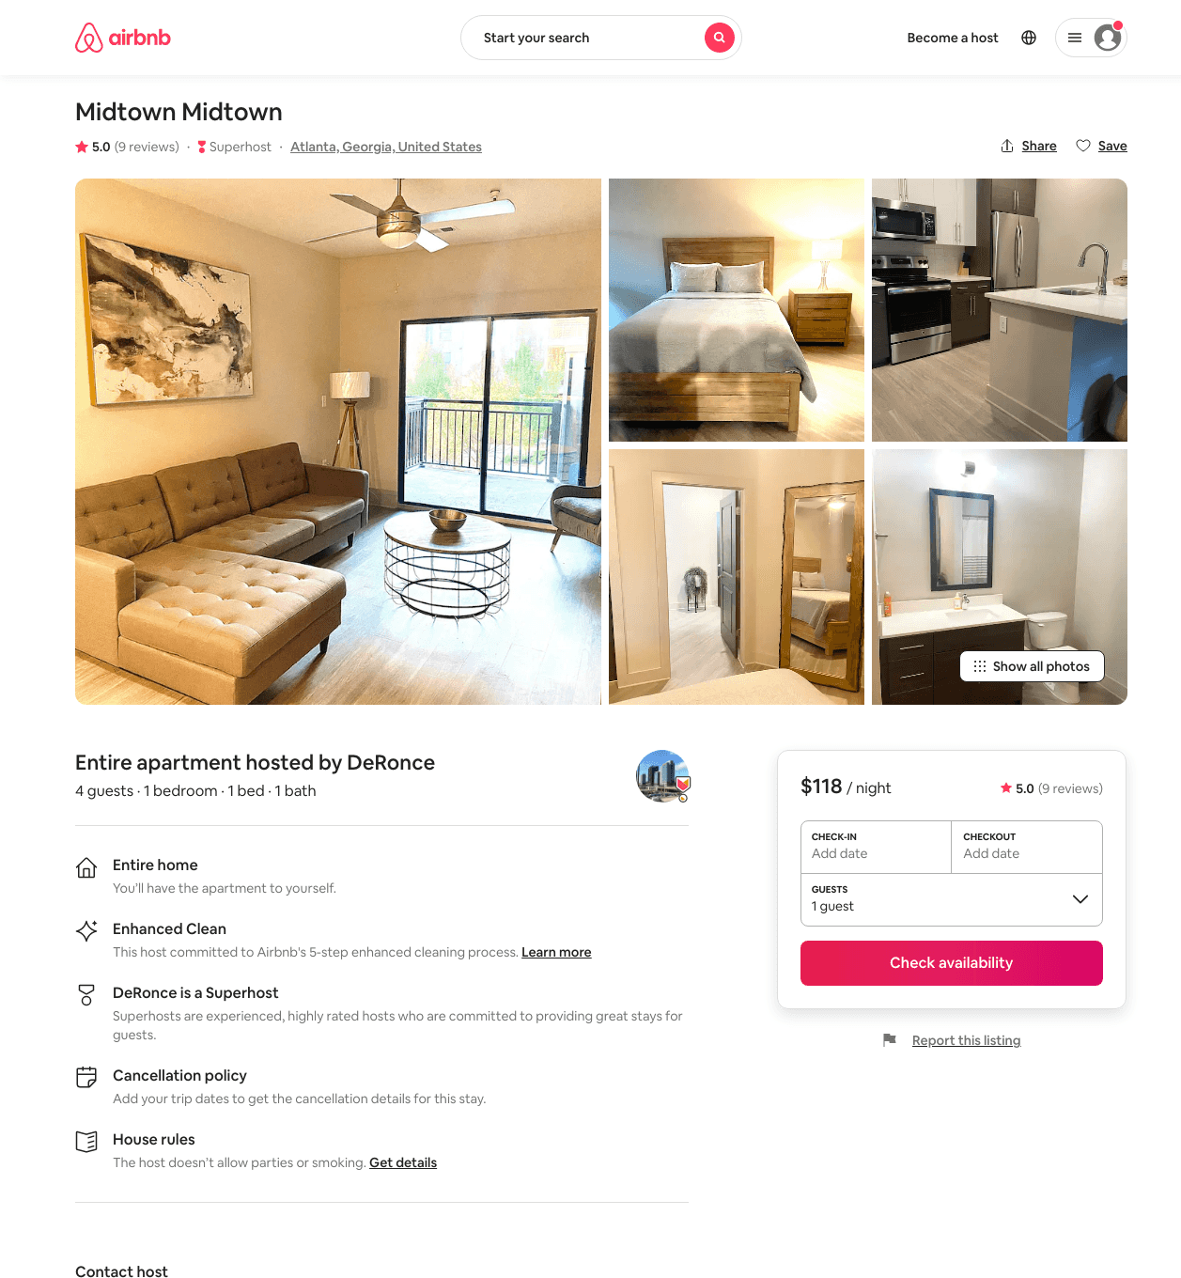
Listing 46510048
455 14TH ST NW
1
4
$86 - $237
4.90
1
DeRonce
165352378
6
https://www.airbnb.com/rooms/46510048
Aug 2022

Slide 44
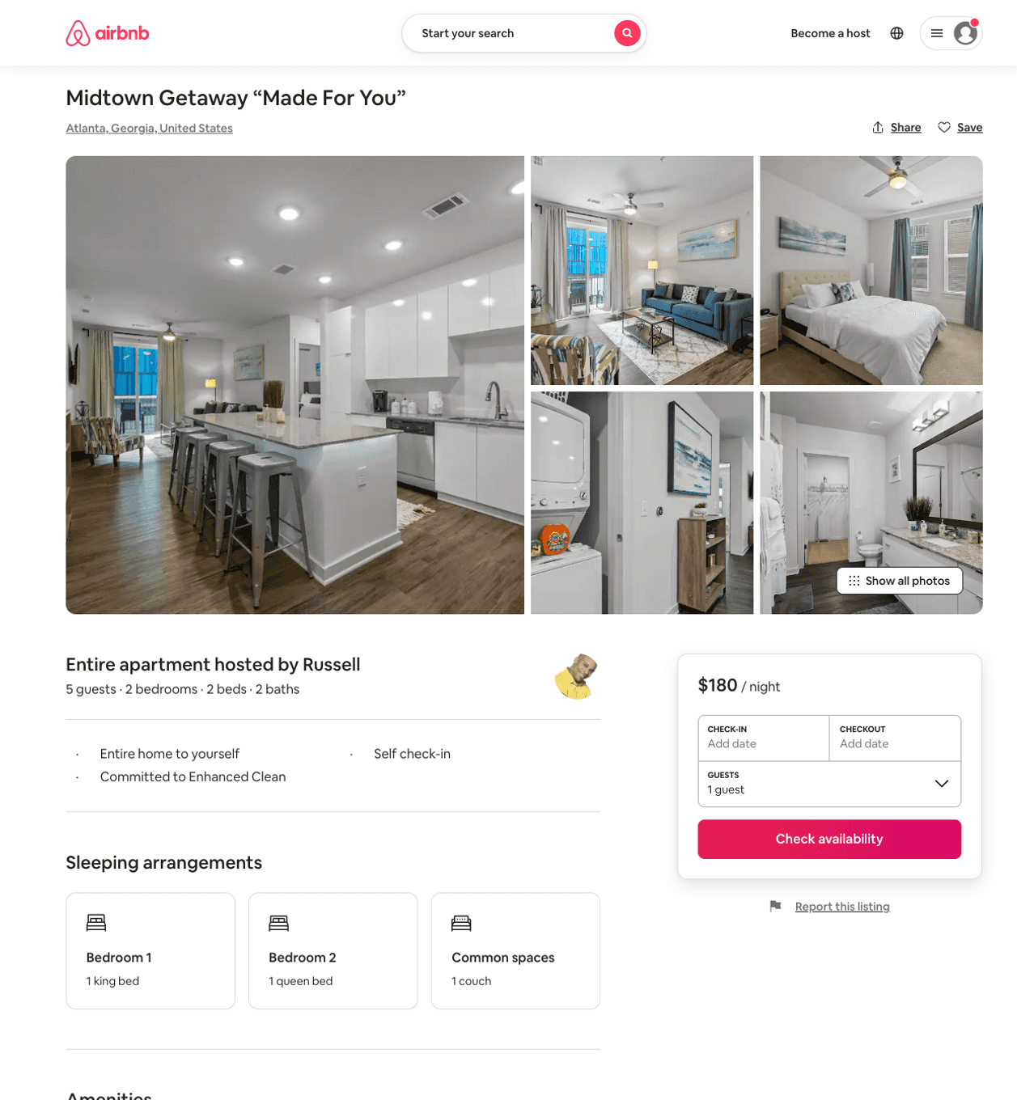
Listing 50508371
2
5
$131 - $172
4.66
1
Superb
168976669
1
https://www.airbnb.com/rooms/50508371
Jun 2022

Slide 45
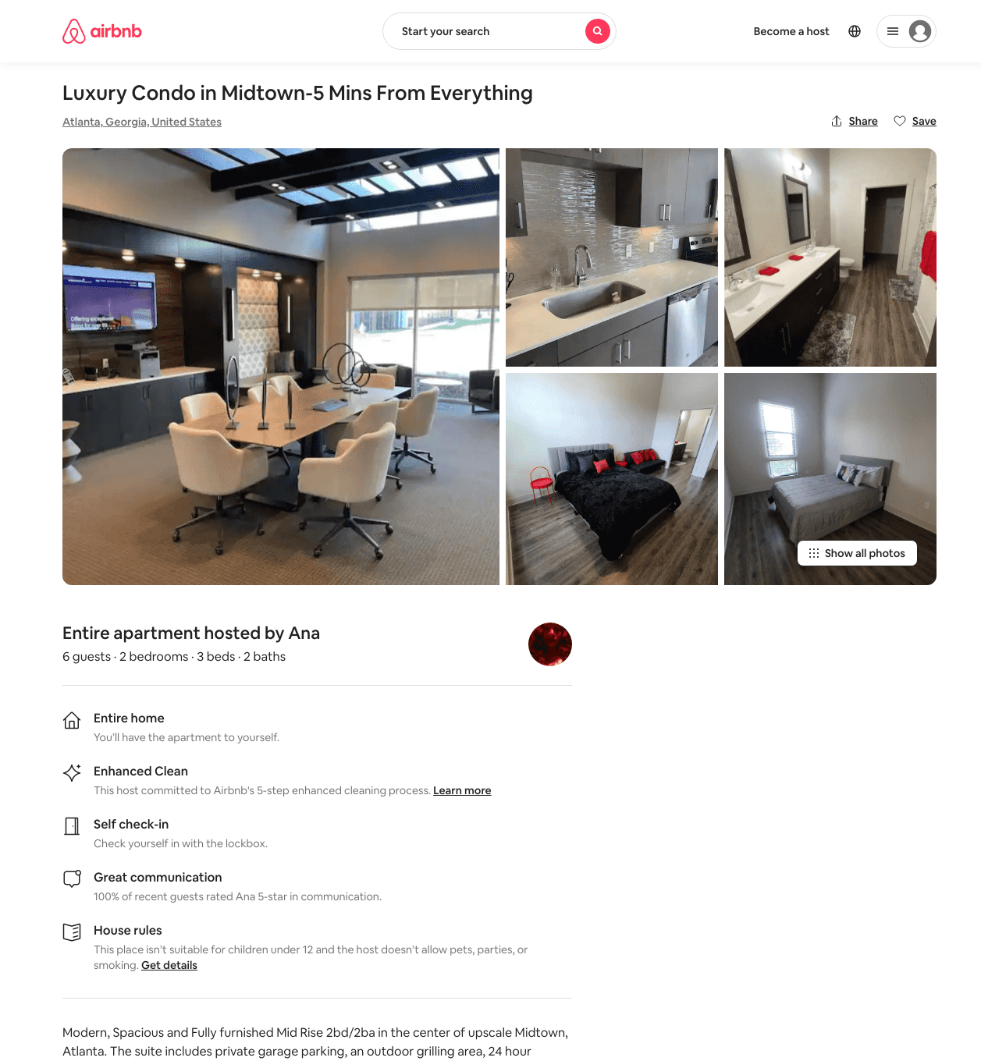
Listing 47121147
2
6
$123 - $230
4.10
4
Jan
20620151
7
https://www.airbnb.com/rooms/47121147
Jun 2022

Slide 46
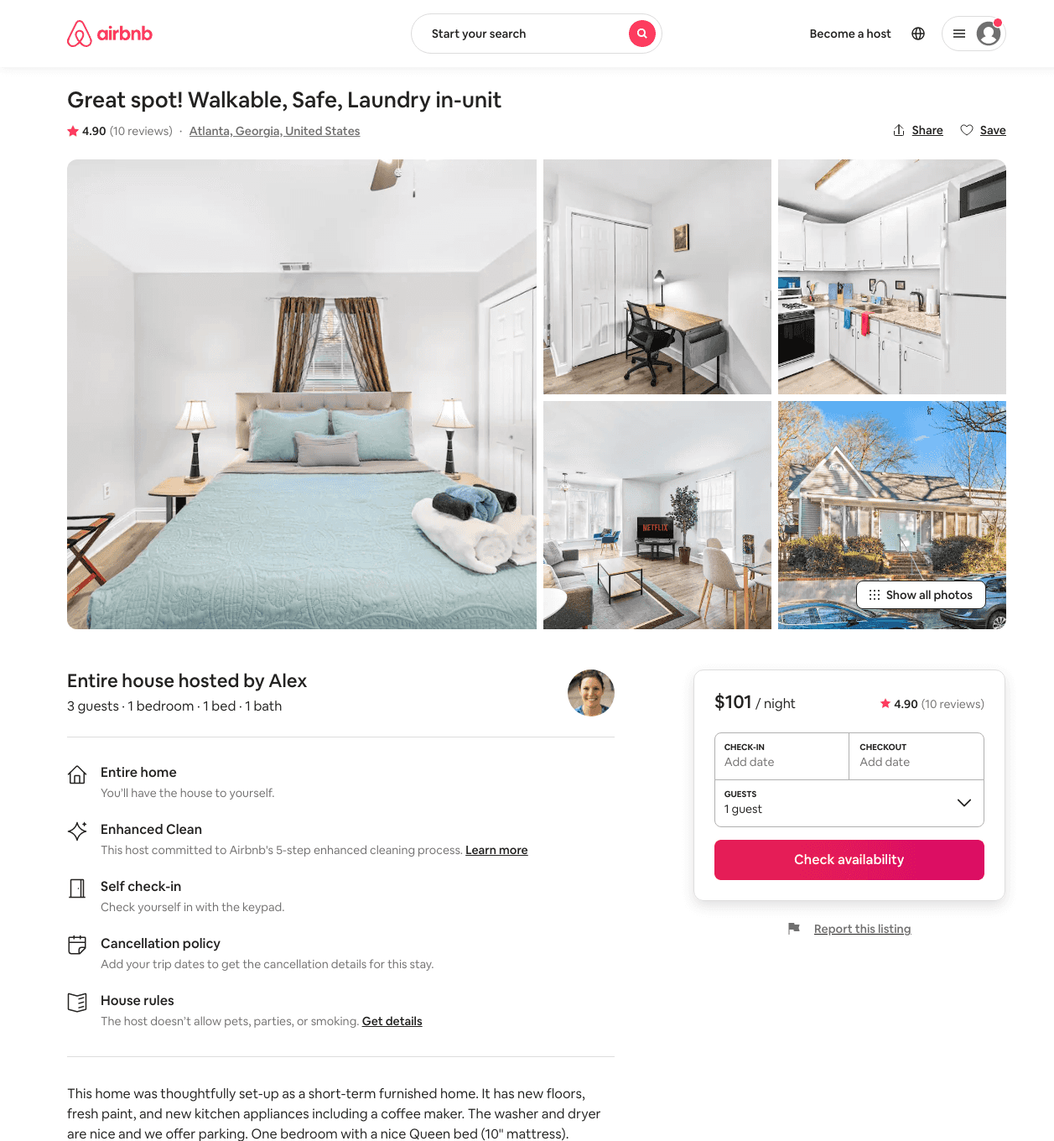
Listing 31616589
1073 TUMLIN ST NW
1
3
$72 - $138
4.59
30
Alex And Christina
20605441
40
https://www.airbnb.com/rooms/31616589
Aug 2022

Slide 47
Listing 40329057
1112-AB MECASLIN ST NW
7
14
$728
4.97
1
Ziyan
224730643
3
https://www.airbnb.com/rooms/40329057
Aug 2022

Slide 48
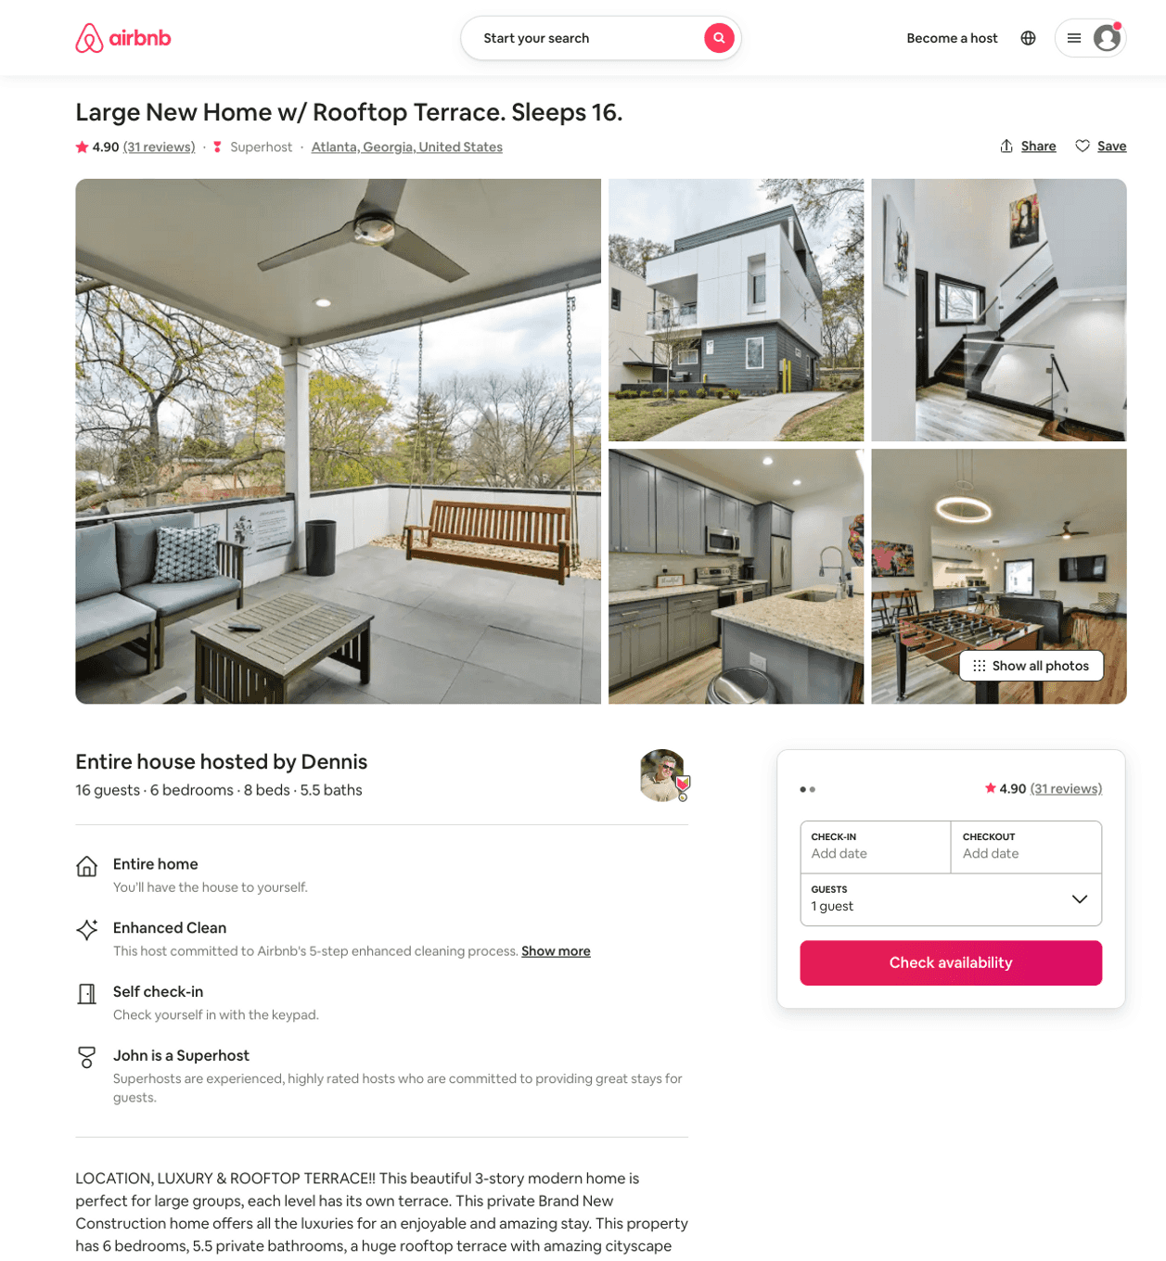
Listing 43836625
1076 CENTER ST NW
6
15
$480 - $637
4.77
2
John
70706635
1
https://www.airbnb.com/rooms/43836625
Aug 2022

Slide 49
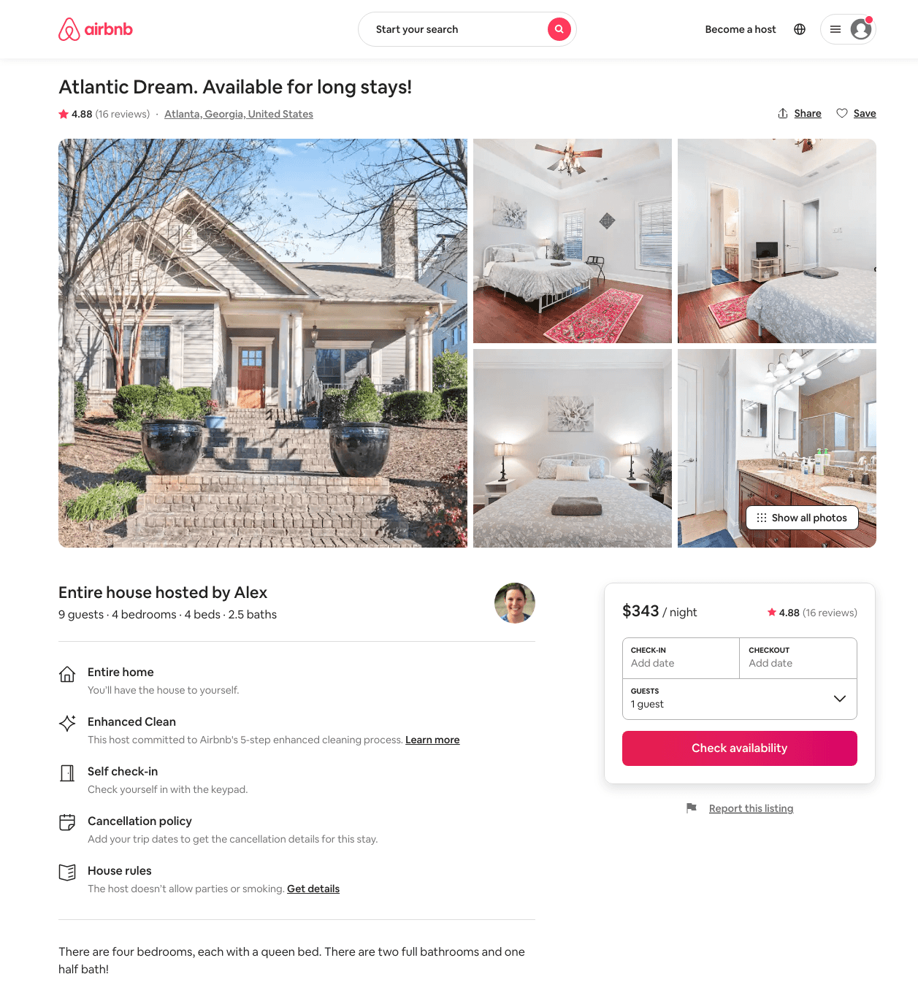
Listing 40321480
1267 ATLANTIC DR NW 2
4
9
$236 - $546
4.71
2
Alex And Christina
20605441
40
https://www.airbnb.com/rooms/40321480
Aug 2022

Slide 50
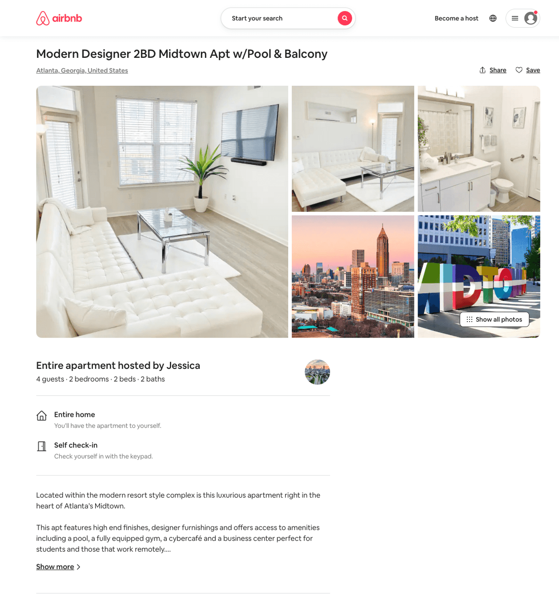
Listing 50671780
470 16TH ST NW
2
4
$150 - $207
5.0
1
Brooke
409453124
1
https://www.airbnb.com/rooms/50671780
Aug 2022

Slide 51
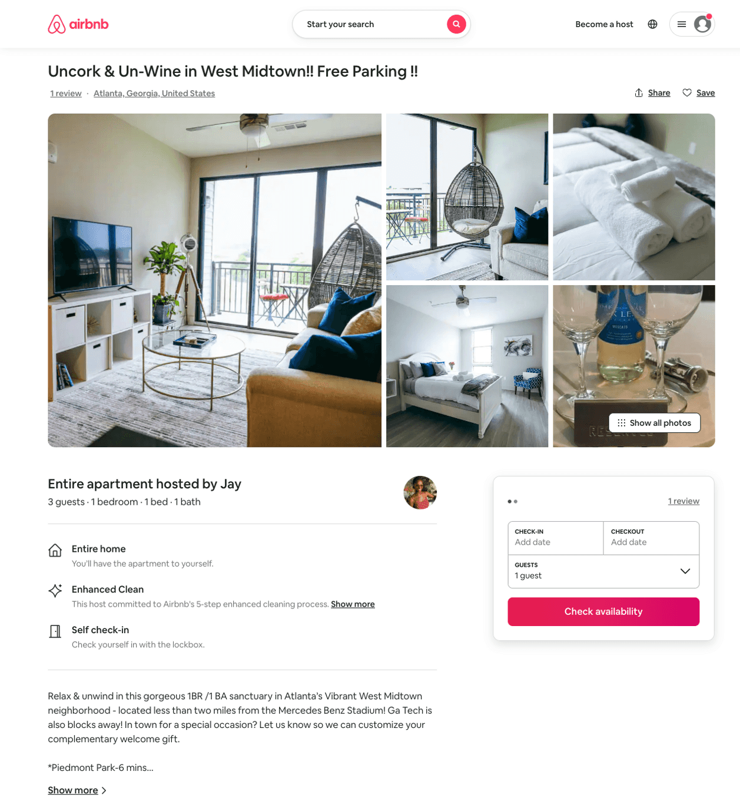
Listing 50271195
455 14TH ST NW
1
4
$99 - $126
4.96
1
Jay
405904321
1
https://www.airbnb.com/rooms/50271195
Jun 2022

Slide 52
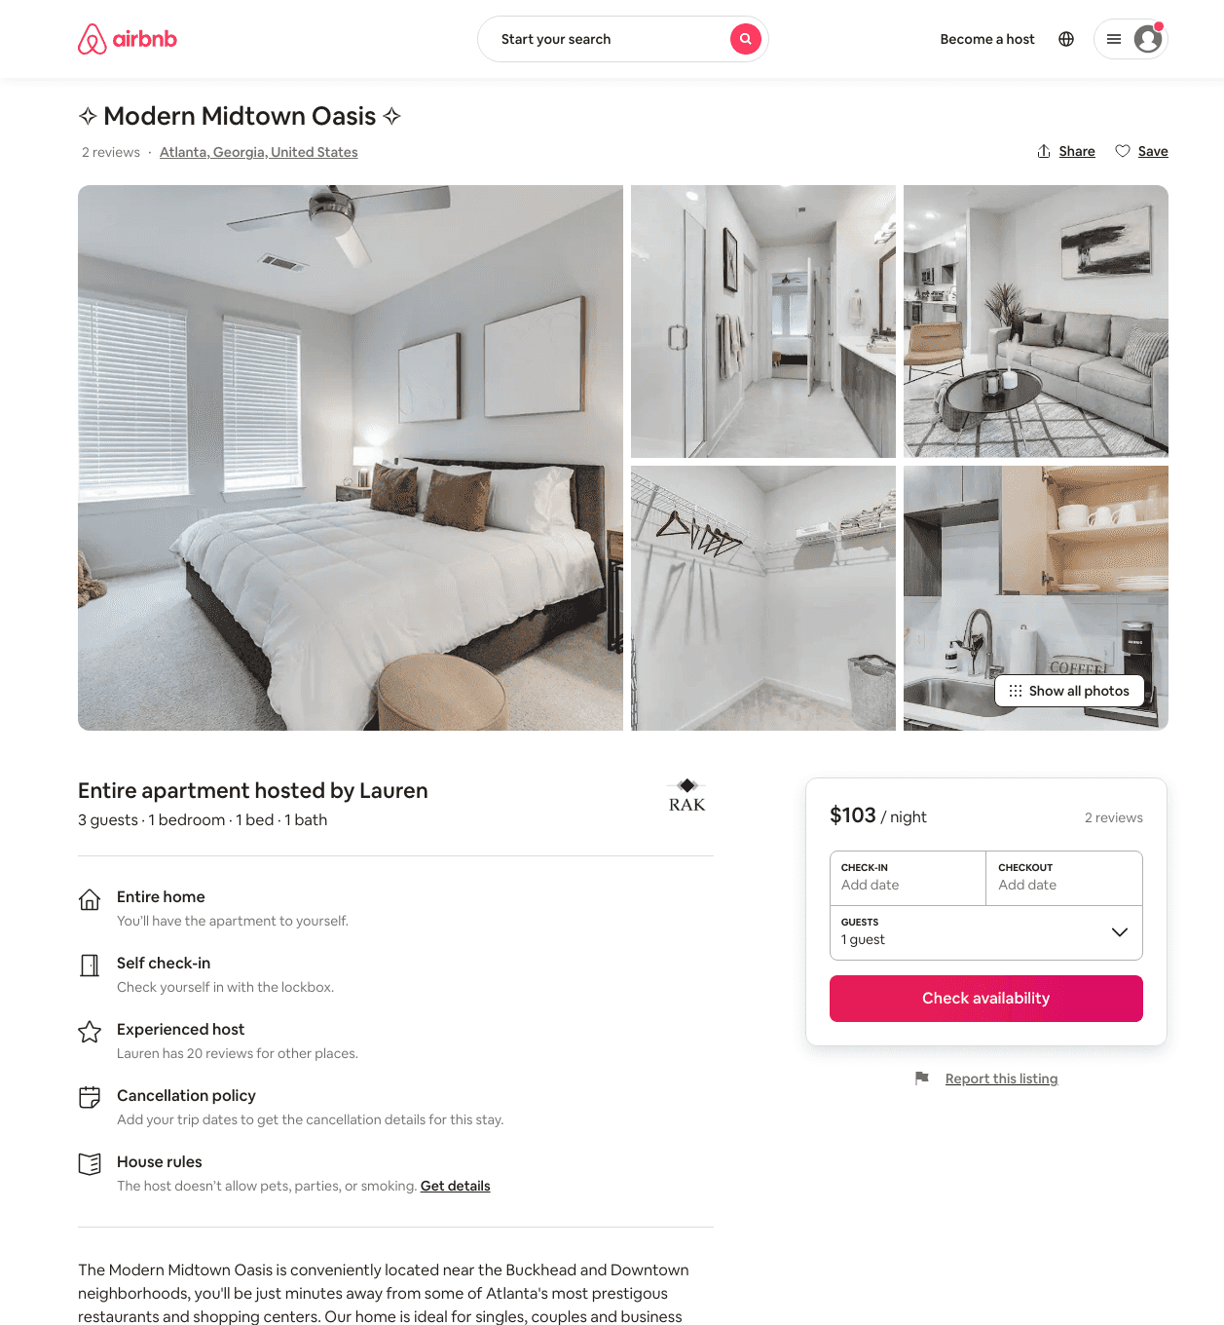
Listing 48643843
455 14TH ST NW
1
3
$95 - $144
4.90
1
Lauren
372426470
1
https://www.airbnb.com/rooms/48643843
Jul 2022

Slide 53
Listing 42501261
455 14TH ST NW
2
5
$150 - $234
4.44
2
Rba
627117
19
https://www.airbnb.com/rooms/42501261
Aug 2022

Slide 54
Listing 49214905
455 14TH ST NW
1
2
$93 - $156
4.71
1
Nashua Properties LLC.
186487242
1
https://www.airbnb.com/rooms/49214905
Aug 2022

Slide 55
Listing 46966752
455 14TH ST NW
1
2
$94 - $152
4.58
1
The Hive
295549667
5
https://www.airbnb.com/rooms/46966752
Aug 2022

Slide 56
Listing 50508504
1068 WESTSHIRE PL NW
1
2
$49 - $104
4.39
3
Mariam
101528711
3
https://www.airbnb.com/rooms/50508504
Aug 2022

Slide 57
Listing 37807038
1112-A MECASLIN ST NW
3
6
$313
4.77
1
Ziyan
224730643
3
https://www.airbnb.com/rooms/37807038
Aug 2022

Slide 58
Listing 46924570
1243 FRANCIS ST NW
1
4
$116 - $119
30
Didem
130464324
8
https://www.airbnb.com/rooms/46924570
Jul 2022

Slide 59
Listing 50735182
455 14TH ST NW
1
3
$95 - $279
4.60
1
GetCozyATL
410000601
1
https://www.airbnb.com/rooms/50735182
Aug 2022

Slide 60
Listing 47999363
421-B ETHEL ST NW
4
14
$501 - $588
4.87
2
Dennis
225005812
7
https://www.airbnb.com/rooms/47999363
Jul 2022

Slide 61
Listing 50362921
1220 MECASLIN ST NW
1
3
$80 - $148
4.88
2
Quality
189478654
1
https://www.airbnb.com/rooms/50362921
Aug 2022

Slide 62
Listing 29074578
1054 MCMILLAN ST NW
2
4
$142 - $181
4.60
30
Stewart
26798403
14
https://www.airbnb.com/rooms/29074578
Aug 2022

Slide 63
Listing 43737887
3
9
$224 - $309
4.73
2
Elle
118427394
4
https://www.airbnb.com/rooms/43737887
Aug 2022

Slide 64
Listing 13167604
3
7
$269 - $279
4.91
15
Nikki
72314295
1
https://www.airbnb.com/rooms/13167604
Aug 2022

Slide 65
Listing 36271043
455 14TH ST NW
1
4
$107 - $129
4.40
1
Tiffany
86611775
2
https://www.airbnb.com/rooms/36271043
Jul 2022

Slide 66
Listing 45568156
1278 BARNES ST NW
1
2
$89 - $149
4.93
2
Cole
368975211
1
https://www.airbnb.com/rooms/45568156
Aug 2022

Slide 67
Listing 50864790
455 14TH ST NW
2
4
$135 - $270
4.65
3
Global Lux Group
405895722
4
https://www.airbnb.com/rooms/50864790
Aug 2022

Slide 68
Listing 51066107
455 14TH ST NW
1
3
$98 - $124
4.86
1
Tiffany
86611775
2
https://www.airbnb.com/rooms/51066107
Aug 2022

Slide 69
Listing 50926435
455 14TH ST NW
1
2
$65 - $100
4.80
2
Hannah
394154174
1
https://www.airbnb.com/rooms/50926435
Jul 2022

Slide 70
Listing 49928479
1186 HOLLY ST NW
2
5
$97 - $150
4.75
30
Tiana
103594061
5
https://www.airbnb.com/rooms/49928479
Aug 2022

Slide 71
Listing 28980616
2
6
$176 - $308
4.87
2
Elle
118427394
4
https://www.airbnb.com/rooms/28980616
Aug 2022

Slide 72
Listing 51968756
455 14TH ST NW
1
2
$69 - $135
4.50
1
C.L.I.F.
195831966
2
https://www.airbnb.com/rooms/51968756
Jul 2022

Slide 73
Listing 52027249
455 14TH ST NW
2
8
$110 - $230
4.11
4
Jan
20620151
7
https://www.airbnb.com/rooms/52027249
Jun 2022

Slide 74
Listing 52067927
1024 CURRAN ST NW
2
6
$110 - $210
5.0
2
Pam
154153763
1
https://www.airbnb.com/rooms/52067927
Aug 2022

Slide 75
Listing 52093556
1170 ATLANTIC DR NW
2
7
$108 - $152
4.0
3
AR Group Of Investments
421785612
5
https://www.airbnb.com/rooms/52093556
Aug 2022

Slide 76
Listing 47860665
1
3
$111 - $114
2
D
360916060
1
https://www.airbnb.com/rooms/47860665
Aug 2022

Slide 77
Listing 52387190
1120 SNYDER ST NW
2
6
$119 - $248
1
Jake
2291945
2
https://www.airbnb.com/rooms/52387190
Jun 2022

Slide 78
Listing 52387278
1120 SNYDER ST NW
2
6
$143 - $379
1
Jake
2291945
2
https://www.airbnb.com/rooms/52387278
Jun 2022

Slide 79
Listing 52601110
455 14TH ST NW
2
5
$128 - $176
4.29
2
Comfy
425789291
1
https://www.airbnb.com/rooms/52601110
Jun 2022

Slide 80
Listing 51786309
1120 SNYDER ST NW
4
12
$187 - $431
4.78
1
Jimmy
303709904
1
https://www.airbnb.com/rooms/51786309
Jun 2022

Slide 81
Listing 52739254
188 15TH ST NW
2
8
$250 - $472
4.78
3
Mariam
101528711
3
https://www.airbnb.com/rooms/52739254
Aug 2022

Slide 82
Listing 47118796
455 14TH ST NW
2
8
$86 - $207
4.56
2
Jan
20620151
7
https://www.airbnb.com/rooms/47118796
Jul 2022

Slide 83
Listing 51542880
1080 MECASLIN ST NW
2
6
$79 - $116
4.36
1
Donnie
354521570
7
https://www.airbnb.com/rooms/51542880
Aug 2022

Slide 84
Listing 52872653
455 14TH ST NW
1
4
$89 - $103
4.58
1
TRO Suites
428071233
1
https://www.airbnb.com/rooms/52872653
Aug 2022

Slide 85
Listing 52892677
455 14TH ST NW
1
3
$88 - $113
4.84
2
Prestige Living
388068651
3
https://www.airbnb.com/rooms/52892677
Aug 2022

Slide 86
Listing 2348884
1
4
$105
5
1
SOBEL
https://www.vrbo.com/2348884
Aug 2022

Slide 87
Listing 53420098
455 14TH ST NW
1
4
$109 - $158
5.0
1
Paul
432536785
1
https://www.airbnb.com/rooms/53420098
Jul 2022

Slide 88
Listing 52175050
1
2
$86 - $130
4.89
3
Niramo
422373608
1
https://www.airbnb.com/rooms/52175050
Aug 2022

Slide 89
Listing 53154622
1186 STATE ST NW
2
6
$106 - $708
4.83
1
Luiz Rogerio
149700196
2
https://www.airbnb.com/rooms/53154622
Aug 2022

Slide 90
Listing 53457560
1179 FRANCIS ST NW
4
14
$225 - $439
4.61
3
AR Group Of Investments
421785612
5
https://www.airbnb.com/rooms/53457560
Aug 2022

Slide 91
Listing 53590219
1253 FRANCIS ST NW
3
12
$294 - $451
4.86
1
Noble Nesters
433985981
1
https://www.airbnb.com/rooms/53590219
Aug 2022

Slide 92
Listing 52824421
455 14TH ST NW
1
2
$103 - $129
4.58
2
Global Lux Group
405895722
4
https://www.airbnb.com/rooms/52824421
Aug 2022

Slide 93
Listing 1456751
1054 MCMILLAN ST NW
2
4
$120 - $140
5
4
Stewart Wyne
https://www.vrbo.com/1456751
Aug 2022

Slide 94
Listing 2570042
1253 FRANCIS ST NW
3
12
$298 - $400
5
2
Noble Nesters, LLC.
https://www.vrbo.com/2570042
Aug 2022

Slide 95
Listing 53784504
455 14TH ST NW
1
2
$90 - $177
4.22
4
Shannon
435632318
1
https://www.airbnb.com/rooms/53784504
Aug 2022

Slide 96
Listing 2561708
455 14TH ST NW
2
6
$295
3
https://www.vrbo.com/2561708
Aug 2022

Slide 97
Listing spacious-2-47-2-with-view-with-free-garage-parking
455 14TH ST NW
undefined
4
8.1
https://www.booking.com/hotel/us/spacious-2-47-2-with-view-with-free-garage-parking.html
Sep 2022

Slide 98
Listing luxury-apartment-in-the-heart-of-atlanta
455 14TH ST NW
undefined
1
6.9
https://www.booking.com/hotel/us/luxury-apartment-in-the-heart-of-atlanta.html
Sep 2022

Slide 99
Listing best-place-in-dtatl-2bed-2bath-w-47-private-entrance
455 14TH ST NW
undefined
6
7
https://www.booking.com/hotel/us/best-place-in-dtatl-2bed-2bath-w-47-private-entrance.html
Sep 2022

Slide 100
Listing 2615161
1
2
$79 - $92
4.5
1
Stephanie Pruitt
https://www.vrbo.com/2615161
Aug 2022

Slide 101
Listing 54214246
1
2
$71 - $94
4.82
1
Stephanie
294543576
1
https://www.airbnb.com/rooms/54214246
Aug 2022

Slide 102
Listing 54142420
1
4
$87 - $181
4.33
3
Jan
438926608
4
https://www.airbnb.com/rooms/54142420
Aug 2022

Slide 103
Listing 54240789
1170 ATLANTIC DR NW
5
15
$236 - $250
4.73
3
AR Group Of Investments
421785612
5
https://www.airbnb.com/rooms/54240789
Aug 2022

Slide 104
Listing 54300743
455 14TH ST NW
2
8
$87 - $111
3
Jan
438926608
4
https://www.airbnb.com/rooms/54300743
Jul 2022

Slide 105
Listing upscale-downtown-midtown-apartment
455 14TH ST NW
undefined
6
8.9
https://www.booking.com/hotel/us/upscale-downtown-midtown-apartment.html
Sep 2022

Slide 106
Listing 54166179
455 14TH ST NW
1
4
$60 - $123
4.93
3
Benjamin
36225667
2
https://www.airbnb.com/rooms/54166179
Aug 2022

Slide 107
Listing 54108729
2
6
$103 - $126
4.33
1
Elite Luxury Suites
420130286
4
https://www.airbnb.com/rooms/54108729
Aug 2022

Slide 108
Listing 2628624
1070 HEMPHILL AVE NW
2
4
$184
2
Cozy Pads
https://www.vrbo.com/2628624
Aug 2022

Slide 109
Listing 53894129
455 14TH ST NW
1
4
$92 - $106
4.85
1
OneStep2Relax
435571997
1
https://www.airbnb.com/rooms/53894129
Aug 2022

Slide 110
Listing 2644015
3
7
$202
4.5
1
willie
https://www.vrbo.com/2644015
Aug 2022

Slide 111
Listing 1-bedroom-midtown-suite-with-self-check-in-free-parking-top-pick
455 14TH ST NW
undefined
3
9.7
https://www.booking.com/hotel/us/1-bedroom-midtown-suite-with-self-check-in-free-parking-top-pick.html
Sep 2022

Slide 112
Listing cozy-modern-apartment-in-midtown-atlanta
455 14TH ST NW
undefined
4
8.4
https://www.booking.com/hotel/us/cozy-modern-apartment-in-midtown-atlanta.html
Sep 2022

Slide 113
Listing 53525355
1
3
$110
2
Jan
20620151
7
https://www.airbnb.com/rooms/53525355
Jul 2022

Slide 114
Listing 2668501
1
2
$163
3
3
Brian
https://www.vrbo.com/2668501
Aug 2022

Slide 115
Listing 52321895
3
6
$101 - $150
4.60
3
Ajibayo
423460017
1
https://www.airbnb.com/rooms/52321895
Aug 2022

Slide 116
Listing 2700084
1186 STATE ST NW
2
6
$166
5
3
Luiz
https://www.vrbo.com/2700084
Aug 2022

Slide 117
Listing 53938228
1185 FRANCIS ST NW
2
8
$124 - $204
4.50
3
AR Group Of Investments
421785612
5
https://www.airbnb.com/rooms/53938228
Aug 2022

Slide 118
Listing 2736261
455 14TH ST NW
1
3
$89
1
Keierica Howard
https://www.vrbo.com/2736261
Aug 2022

Slide 119
Listing 2771189
455 14TH ST NW
2
4
$185
2
https://www.vrbo.com/2771189
Aug 2022

Slide 120
Listing 2782075
1099 CENTER ST NW
3
11
$245
3
Lilly Bari
https://www.vrbo.com/2782075
Aug 2022

Slide 121
Listing 2703903
1170 ATLANTIC DR NW
5
15
$359
3
https://www.vrbo.com/2703903
Aug 2022

Slide 122
Listing 2597411
1068 WESTSHIRE PL NW
5
11
$389
3
https://www.vrbo.com/2597411
Aug 2022

Slide 123
Listing 2597392
188 15TH ST NW
3
8
$479
3
https://www.vrbo.com/2597392
Aug 2022

Slide 124
Listing 2707718
1179 FRANCIS ST NW
4
14
$380
3
https://www.vrbo.com/2707718
Aug 2022

Slide 125
Listing 2597363
1
2
$89
1
https://www.vrbo.com/2597363
Aug 2022

Slide 126
Listing 2707737
1185 FRANCIS ST NW
2
8
$198
3
https://www.vrbo.com/2707737
Aug 2022

Slide 127
Listing 2694106
1
3
$99
2
https://www.vrbo.com/2694106
Aug 2022

Slide 128
Listing 51987363
2
7
$159
3
Kam
318311499
2
https://www.airbnb.com/rooms/51987363
Jun 2022

Slide 129
Listing 54391004
1
3
$88
4.50
2
Jan
438926608
4
https://www.airbnb.com/rooms/54391004
Aug 2022

Slide 130
Listing 2899788
1
4
$79
1
https://www.vrbo.com/2899788
Aug 2022

Slide 131
Listing 1456750
1054 MCMILLAN ST NW
2
4
$120
4
Stewart Wyne
https://www.vrbo.com/1456750
Aug 2022

Slide 132
Listing 2919092
1054 MCMILLAN ST NW
2
4
$131
4
Stewart Wyne
https://www.vrbo.com/2919092
Aug 2022

Slide 133
Listing 2929914
4
12
$415
3
https://www.vrbo.com/2929914
Aug 2022

Slide 134
Listing 681748905989940400
4
14
2
Brandon
284990476
2
https://www.airbnb.com/rooms/681748905989940400
Aug 2022

Slide 135
Listing 2941947
499 CALHOUN ST NW
4
16
$580
2
Dennis Tidwell
https://www.vrbo.com/2941947
Aug 2022

Slide 136
Listing 2946596
6
16
$980
2
https://www.vrbo.com/2946596
Aug 2022

