Slide 2
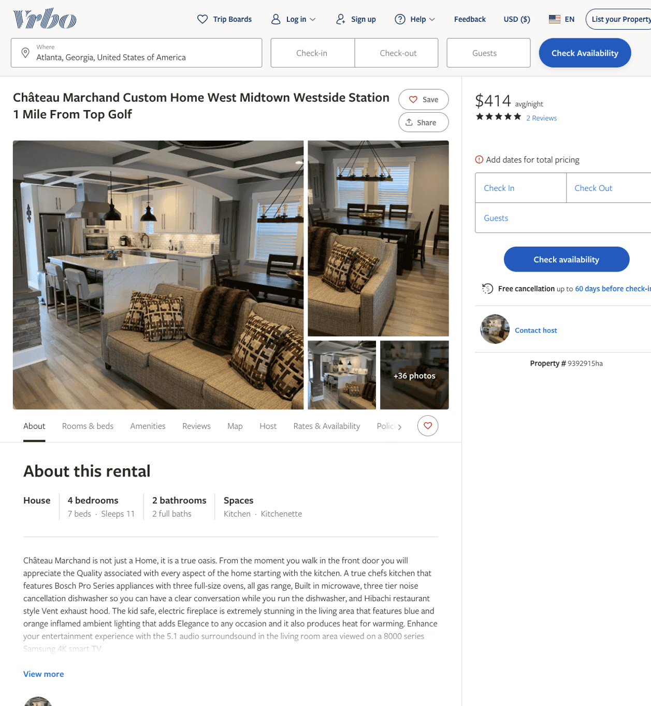
Listing 9392915
4
11
$399 - $420
5
3
Paul Marchand
https://www.vrbo.com/9392915ha
Aug 2022

Slide 3
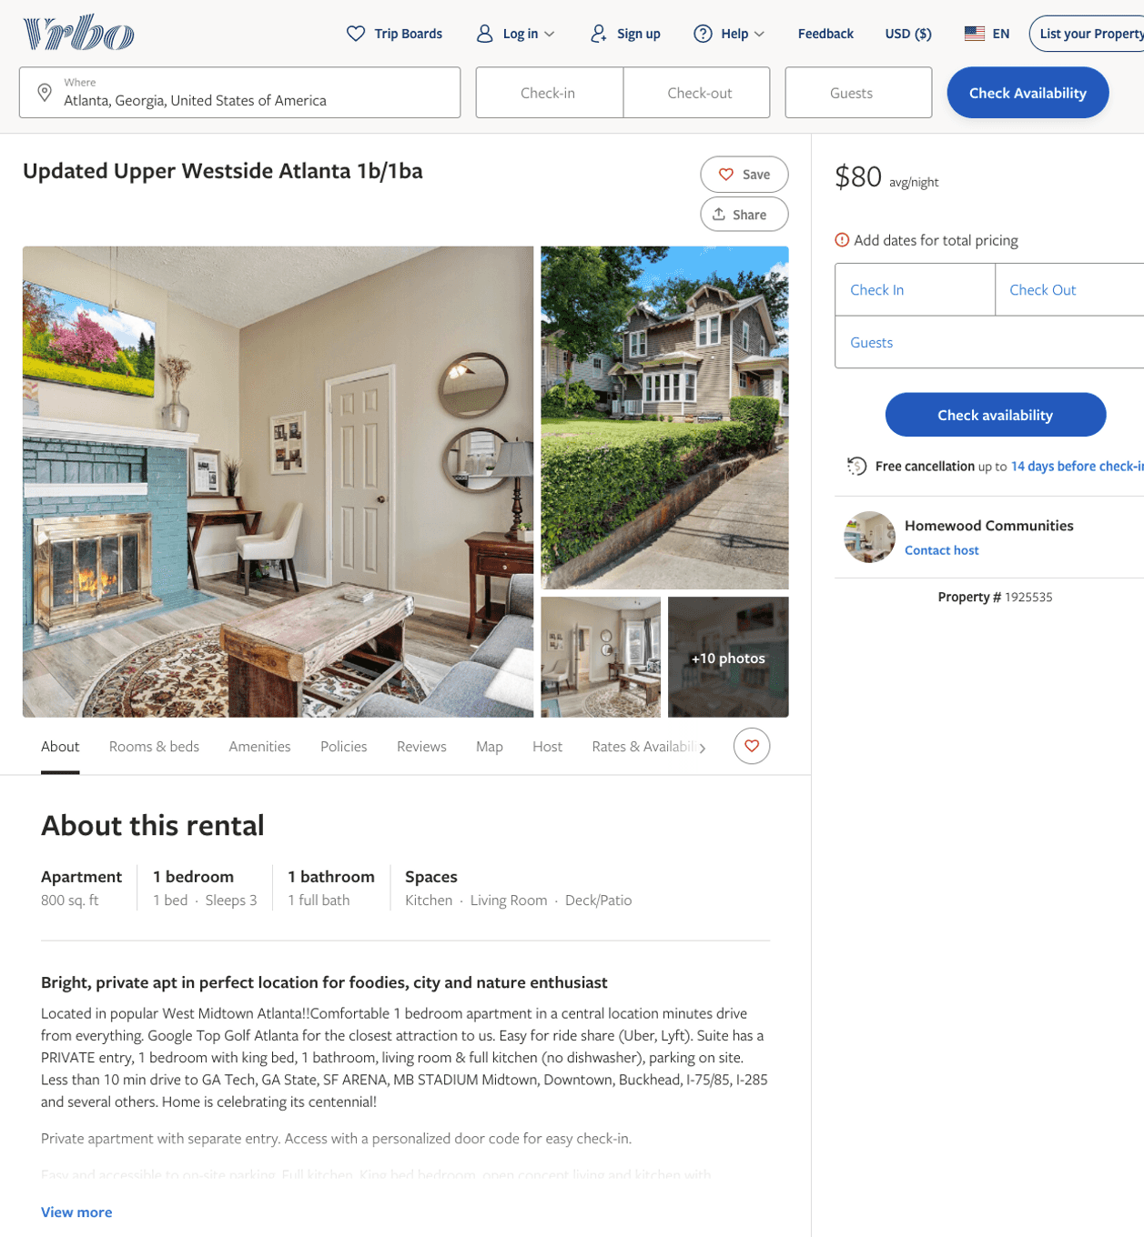
Listing 1925535
1
3
$80 - $91
4
Homewood Communities
https://www.vrbo.com/1925535
Aug 2022

Slide 4
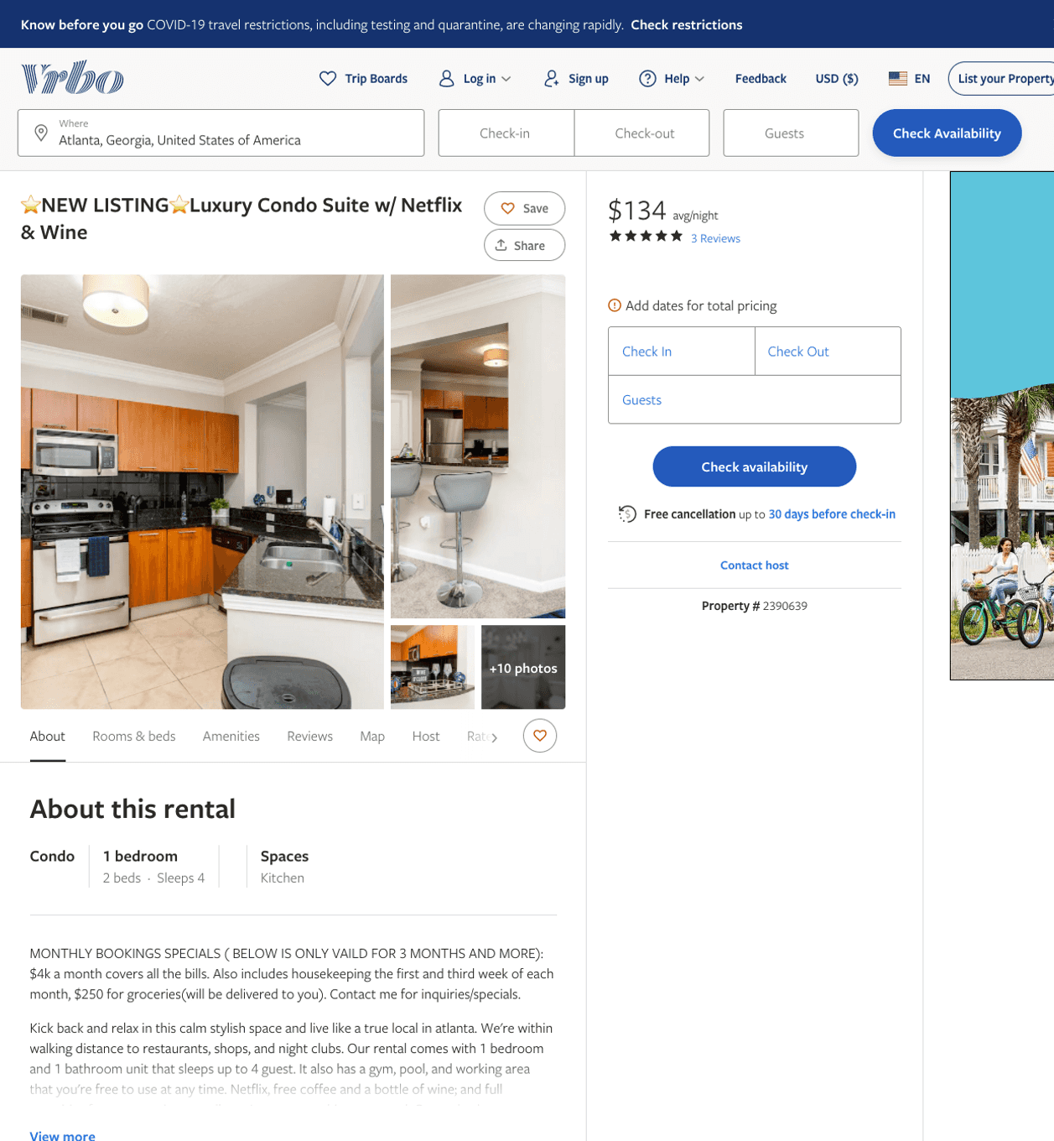
Listing 2390639
1
4
$102 - $150
5
2
cookie
https://www.vrbo.com/2390639
Aug 2022

Slide 5
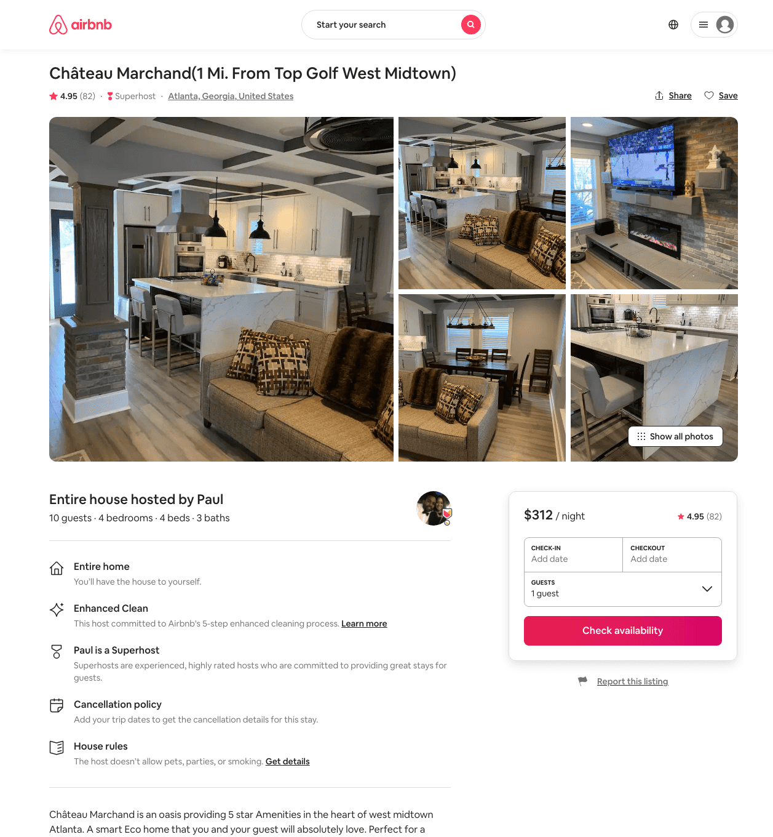
Listing 31663325
4
10
$350 - $450
4.96
1
Paul
108009639
1
https://www.airbnb.com/rooms/31663325
Aug 2022

Slide 6
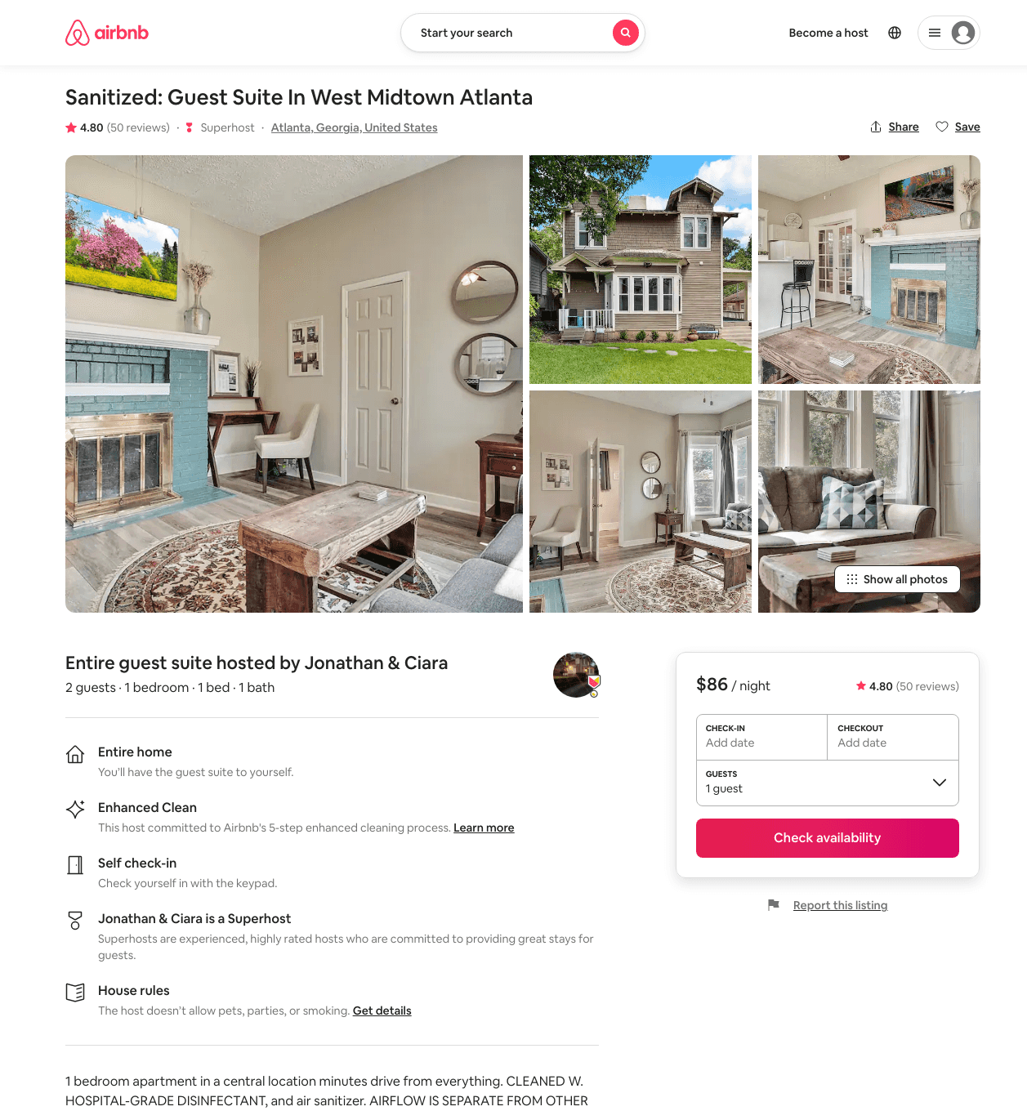
Listing 19073117
1
2
$82 - $95
4.83
2
The Flats At Park West
38511913
3
https://www.airbnb.com/rooms/19073117
Aug 2022

Slide 7
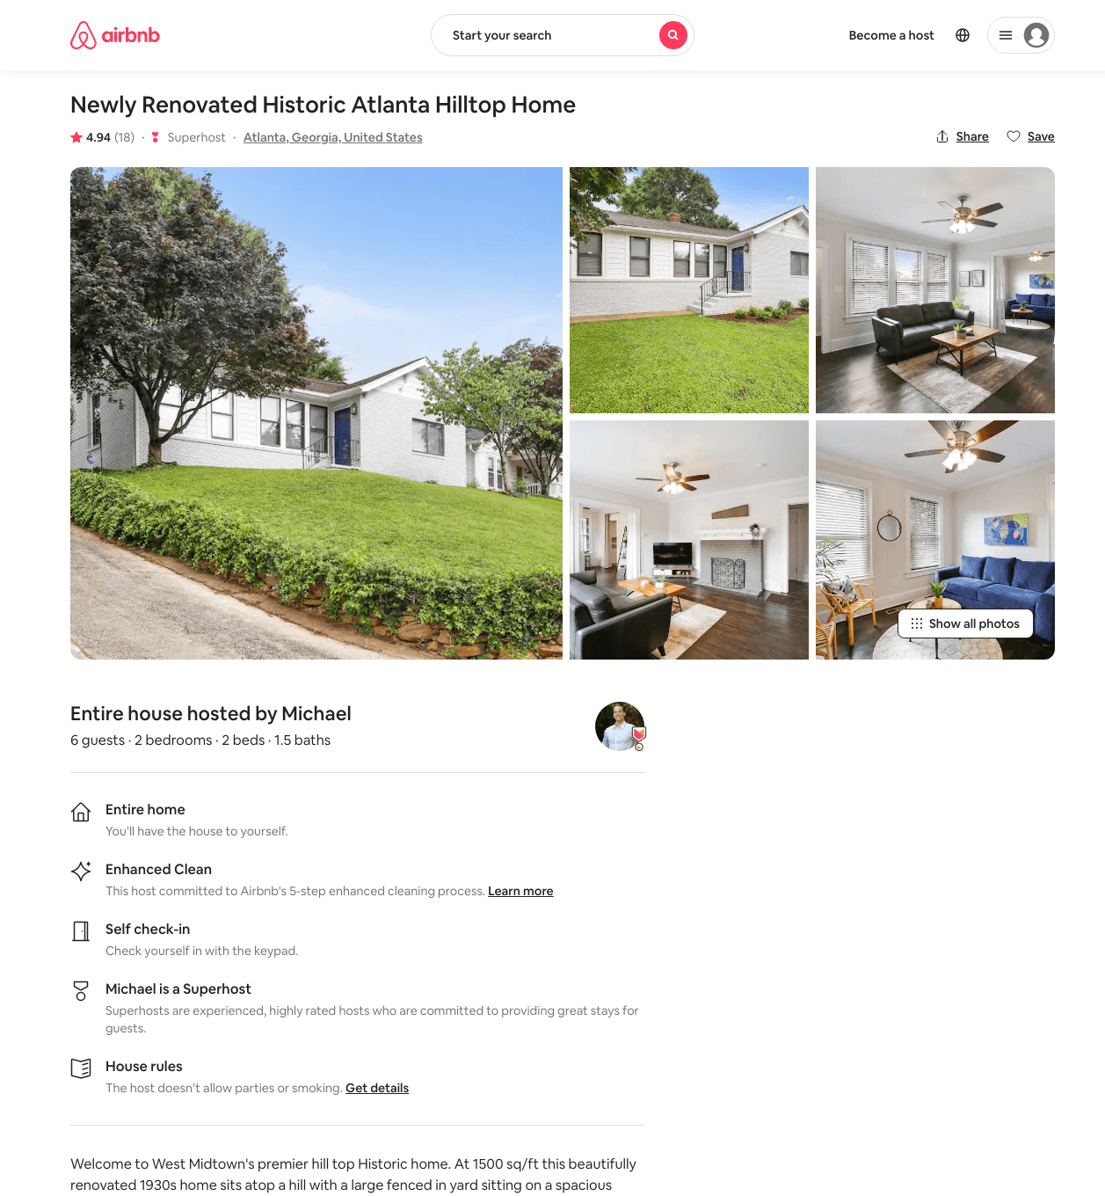
Listing 43712393
2
6
$145 - $178
4.98
5
Michael
170951466
2
https://www.airbnb.com/rooms/43712393
Jun 2022

Slide 8
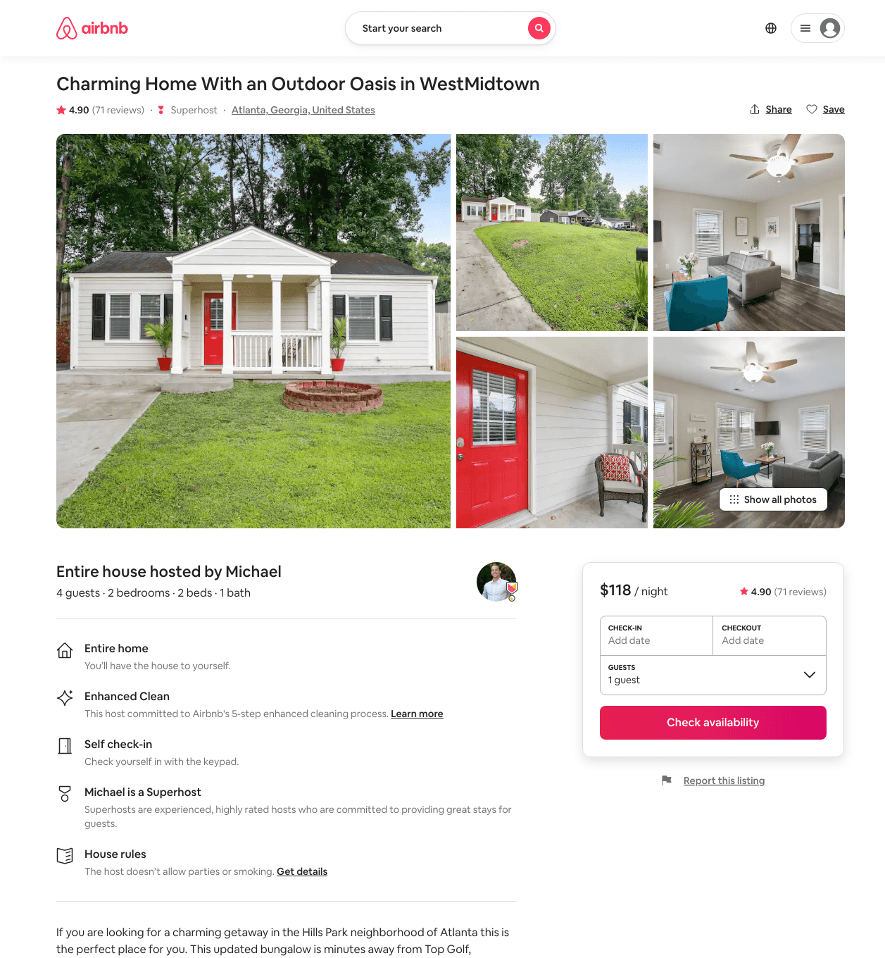
Listing 37968055
2
4
$114 - $157
4.88
3
Michael
170951466
2
https://www.airbnb.com/rooms/37968055
Jun 2022

Slide 9
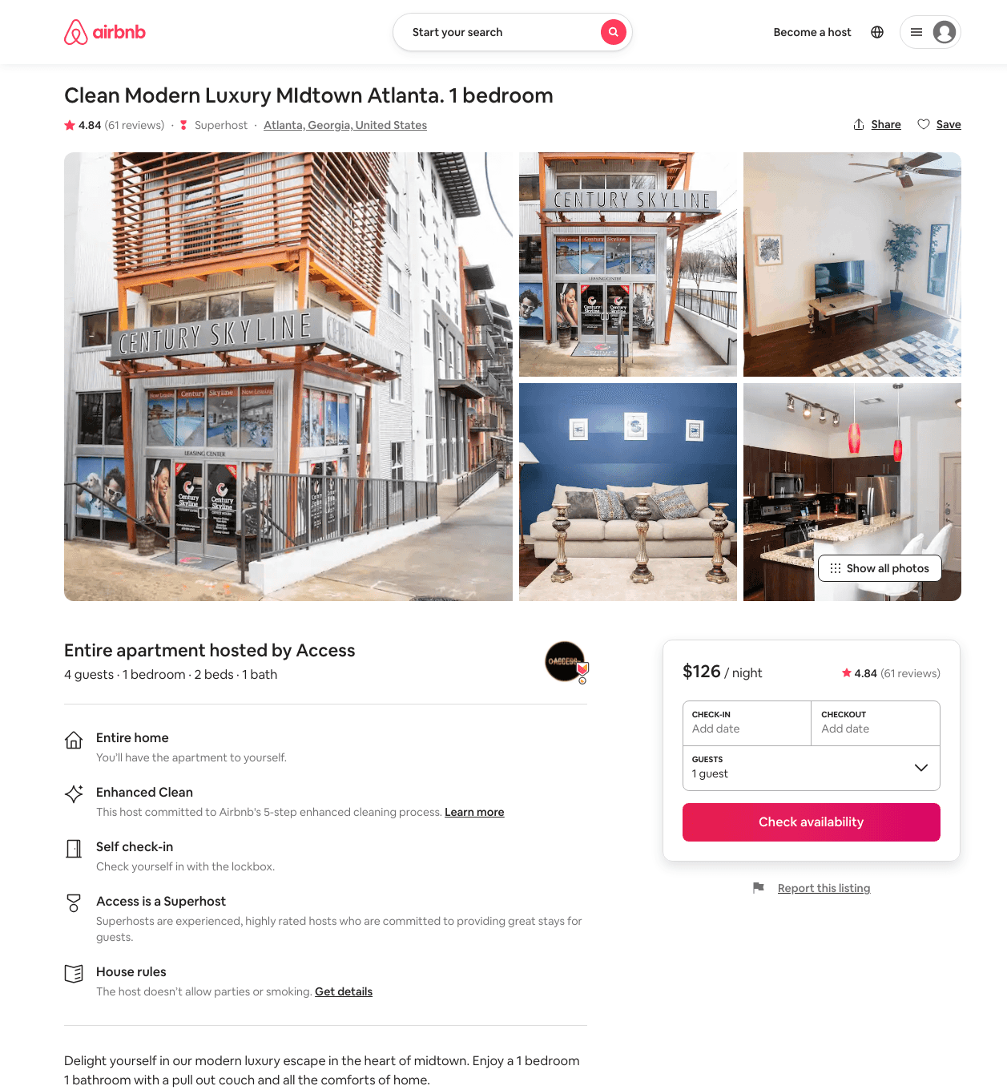
Listing 41764570
2
8
$126 - $750
4.78
2
Access
329915348
2
https://www.airbnb.com/rooms/41764570
Aug 2022

Slide 10
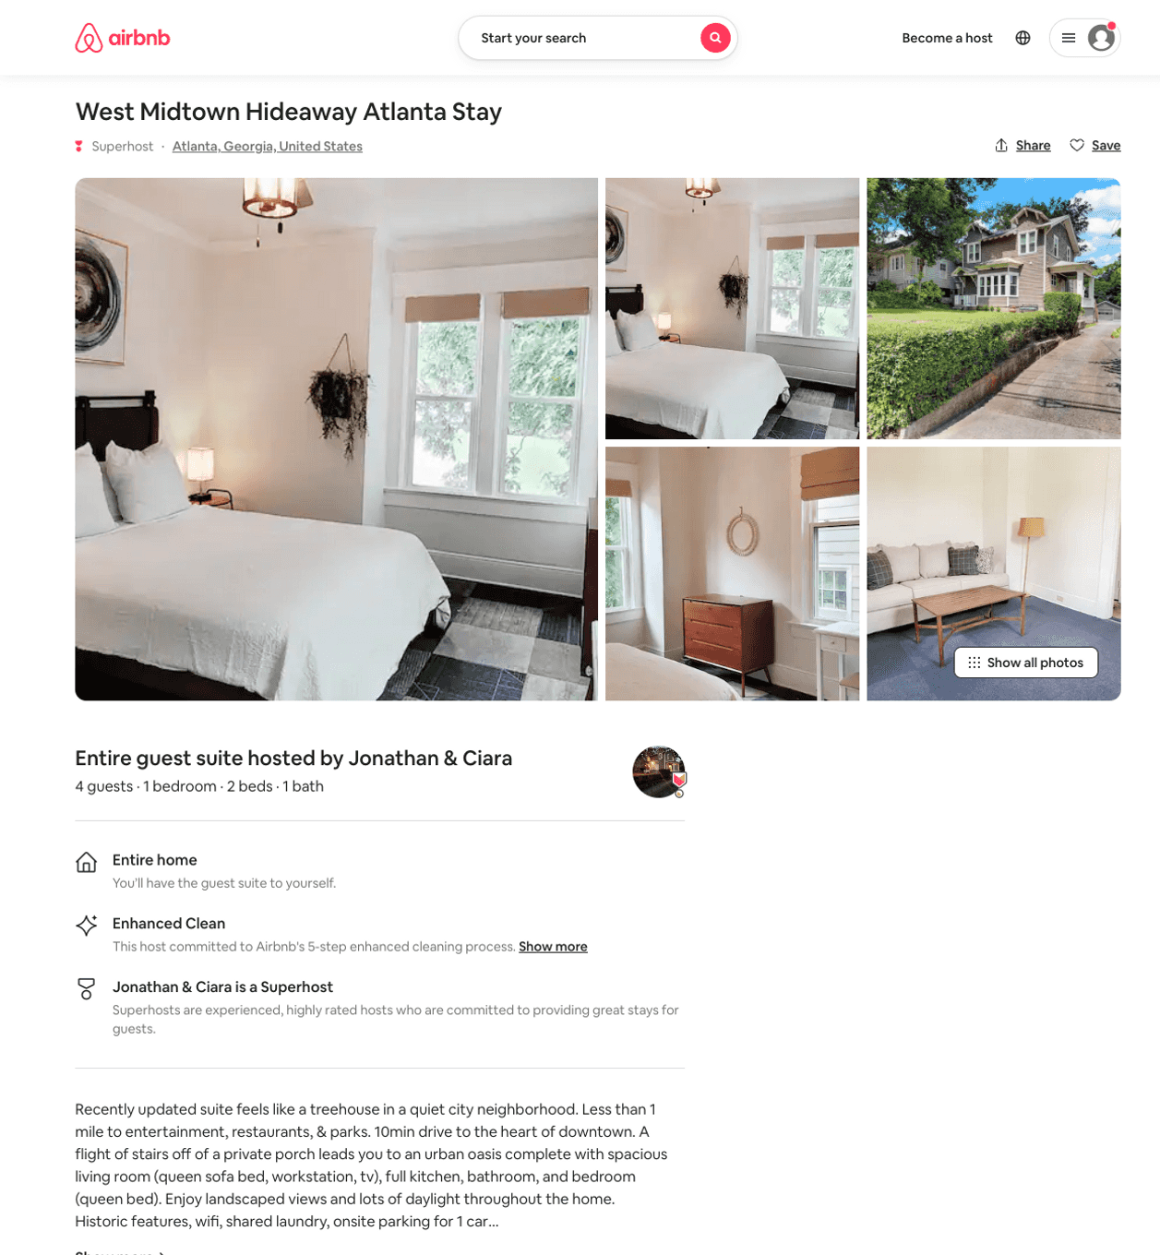
Listing 49797819
1
4
$64 - $97
4.89
2
The Flats At Park West
38511913
3
https://www.airbnb.com/rooms/49797819
Aug 2022

Slide 11
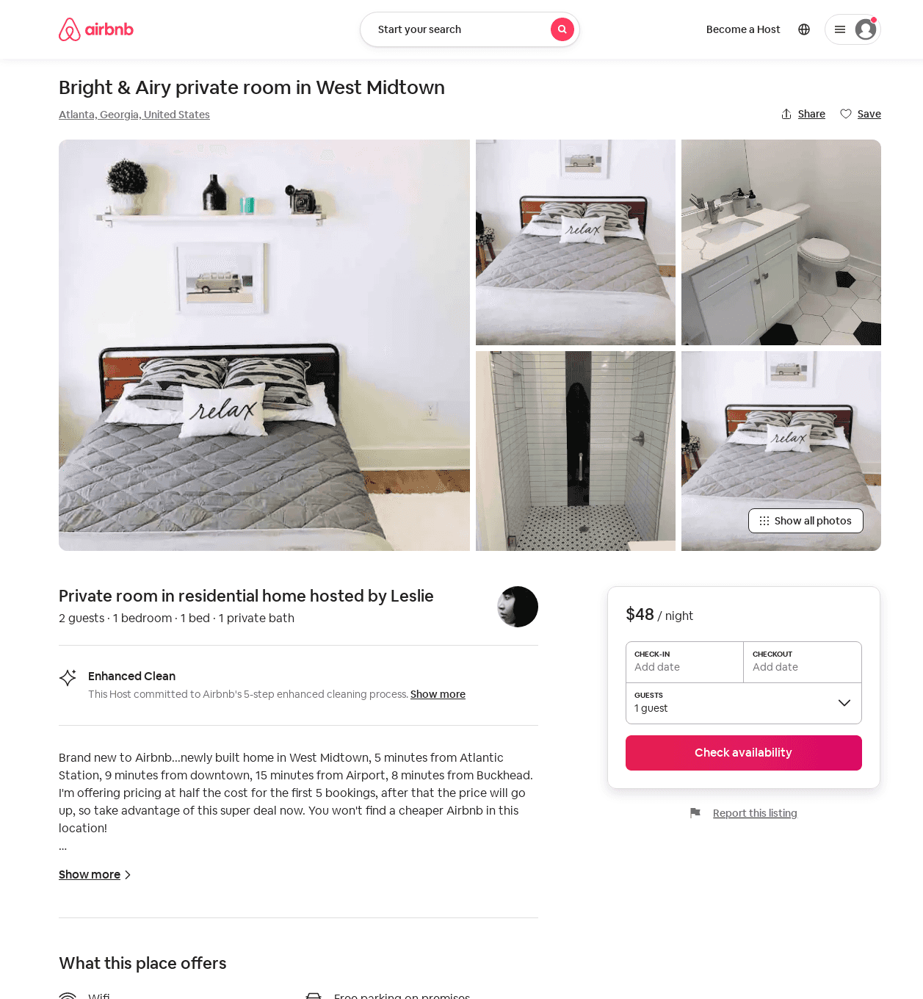
Listing 52838718
1
2
$45 - $66
4.86
1
Leslie
27127
1
https://www.airbnb.com/rooms/52838718
Aug 2022

Slide 12
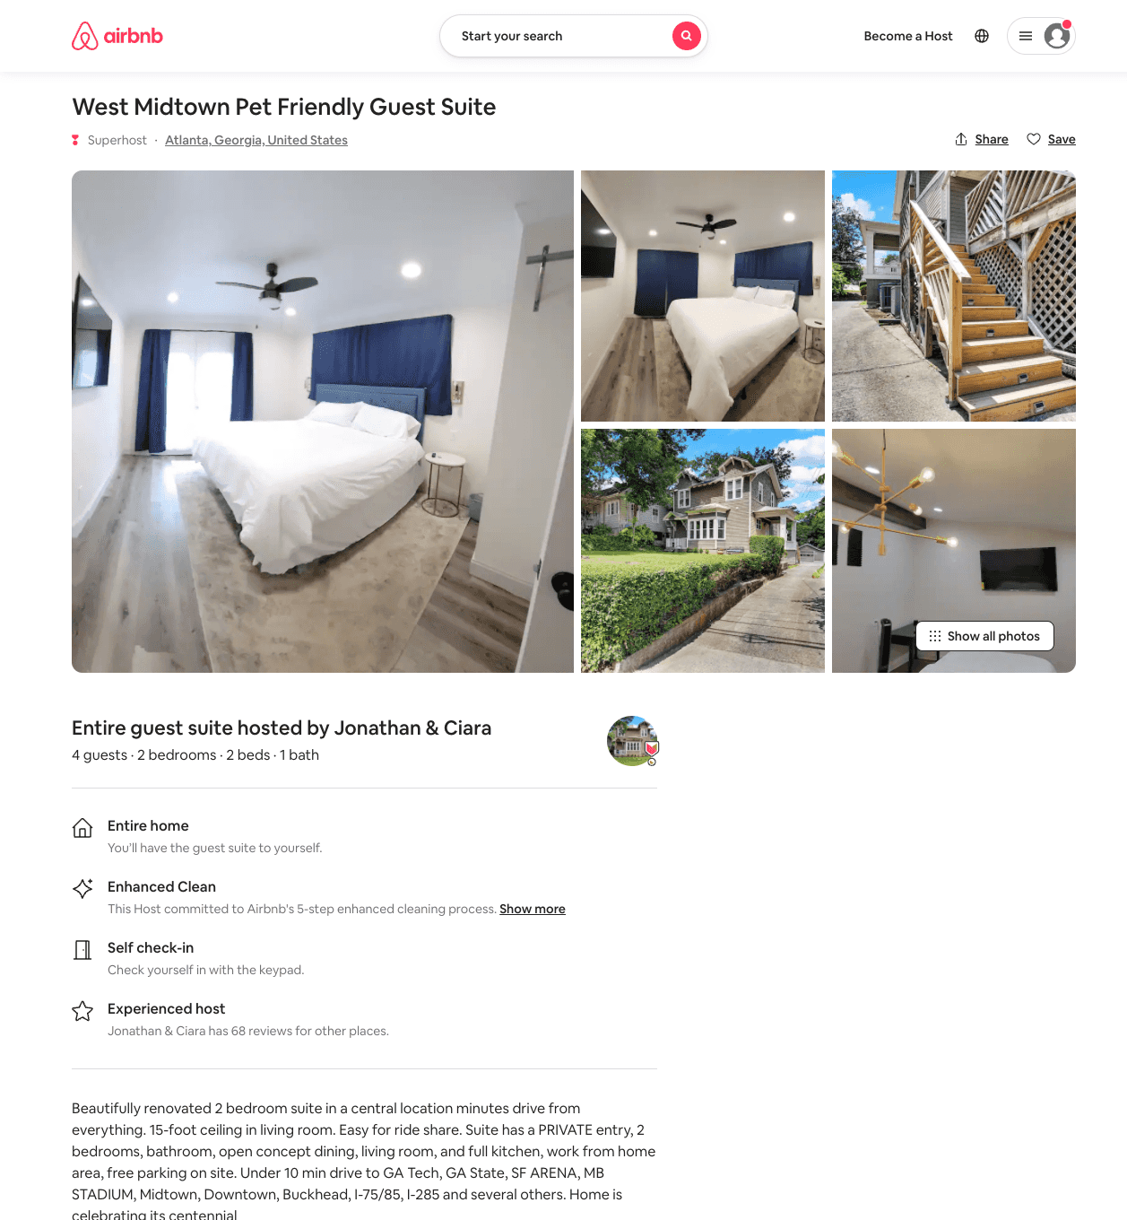
Listing 53379722
2
5
$79 - $88
4.87
2
The Flats At Park West
38511913
3
https://www.airbnb.com/rooms/53379722
Aug 2022

Slide 13
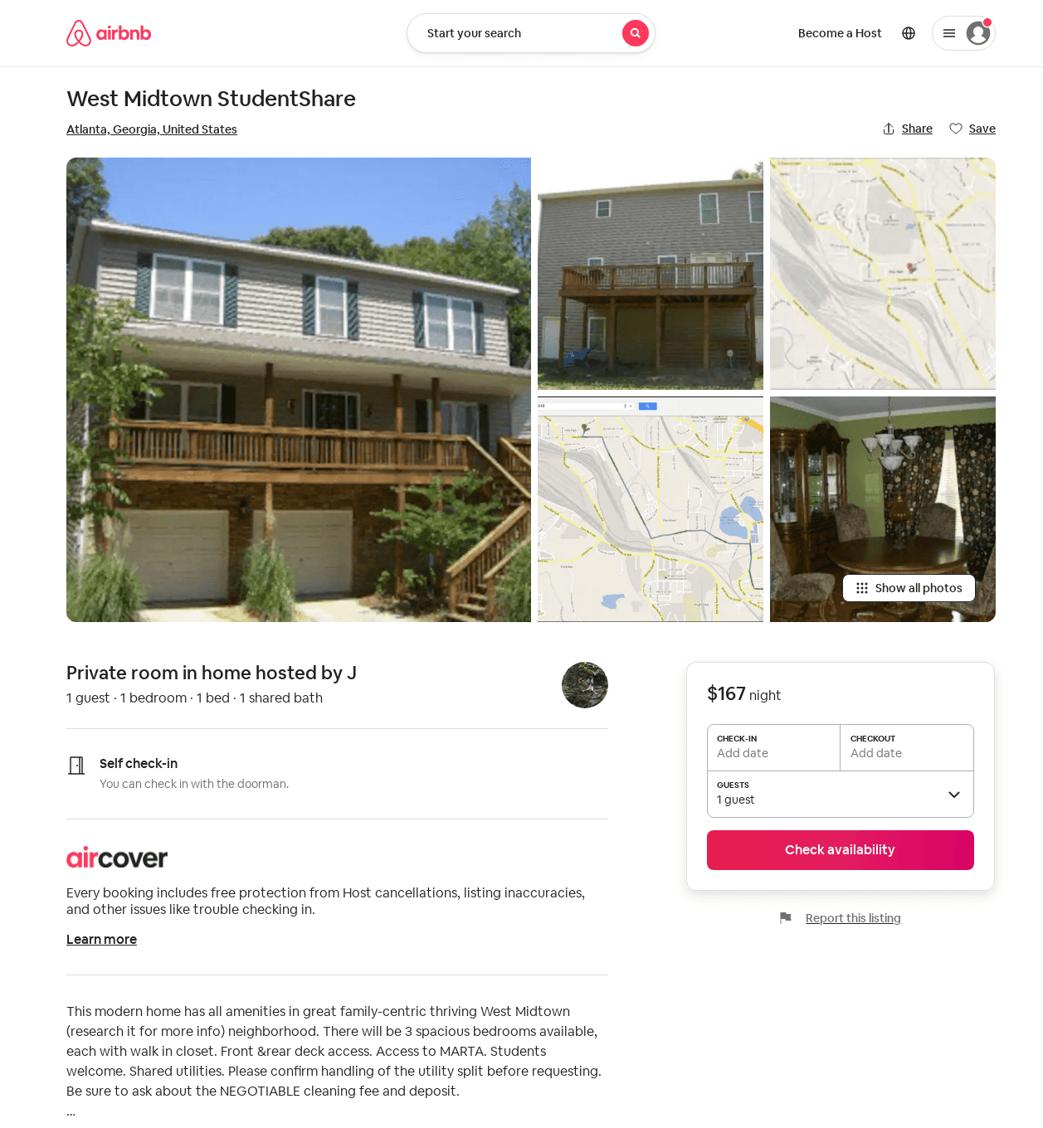
Listing 2774390
1
1
1
J
13419789
6
https://www.airbnb.com/rooms/2774390
Aug 2022

