Slide 2
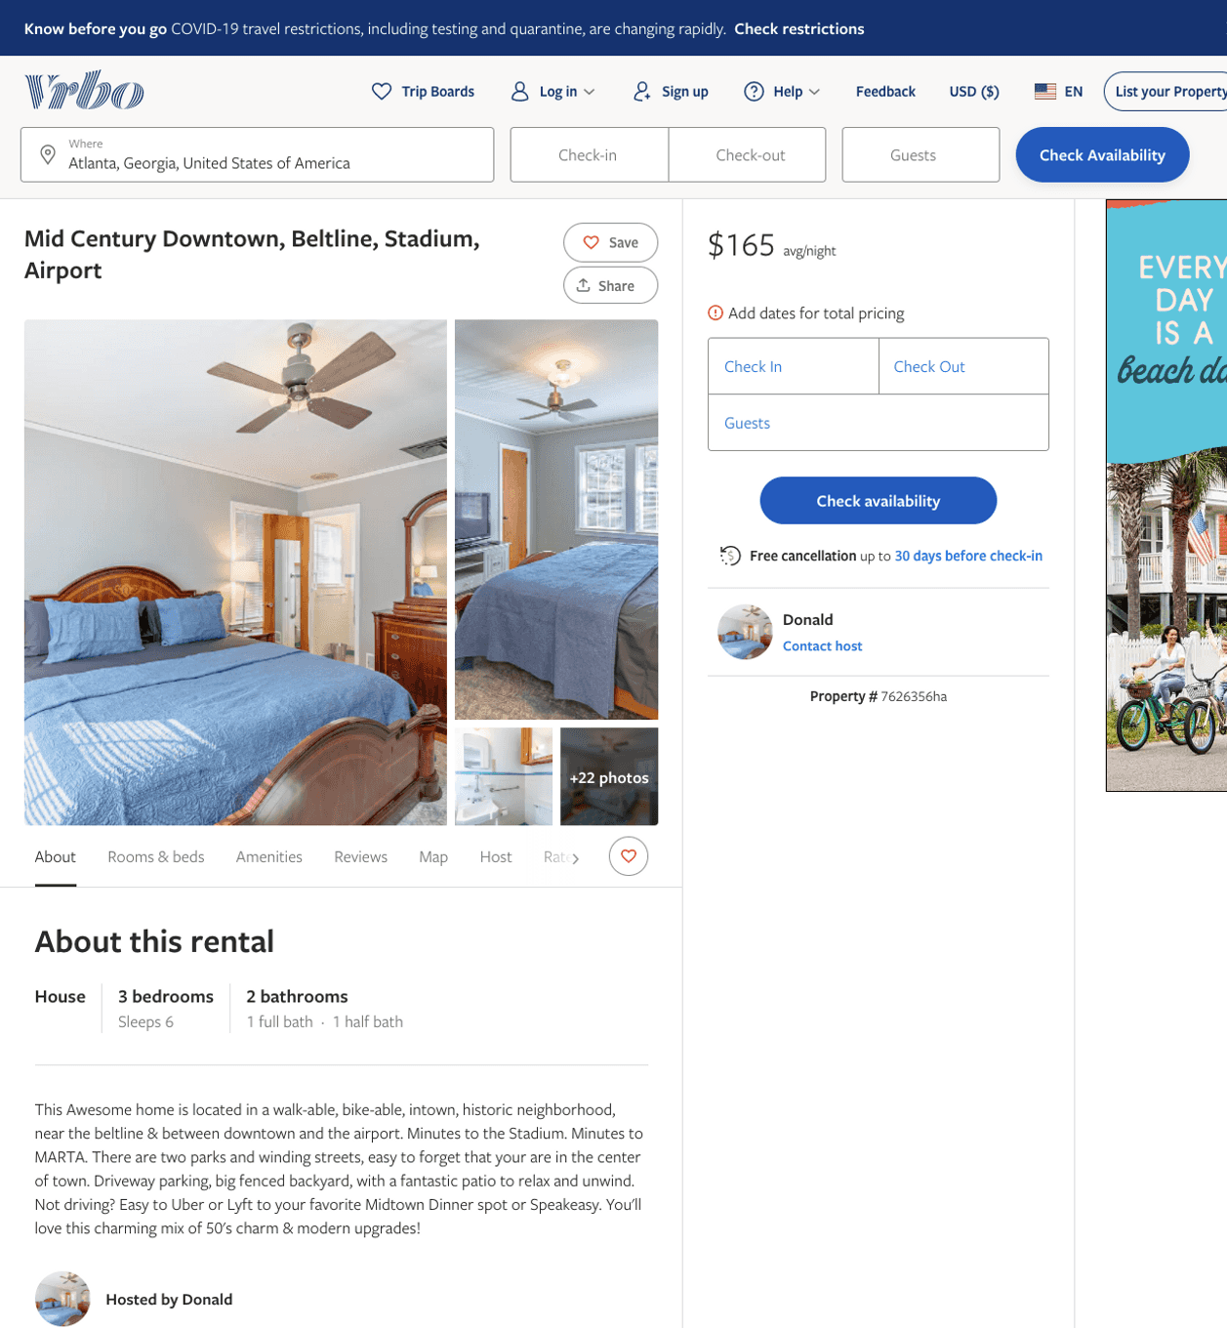
Listing 7626356
3
6
$151 - $189
2
Donald
https://www.vrbo.com/7626356ha
Aug 2022

Slide 3
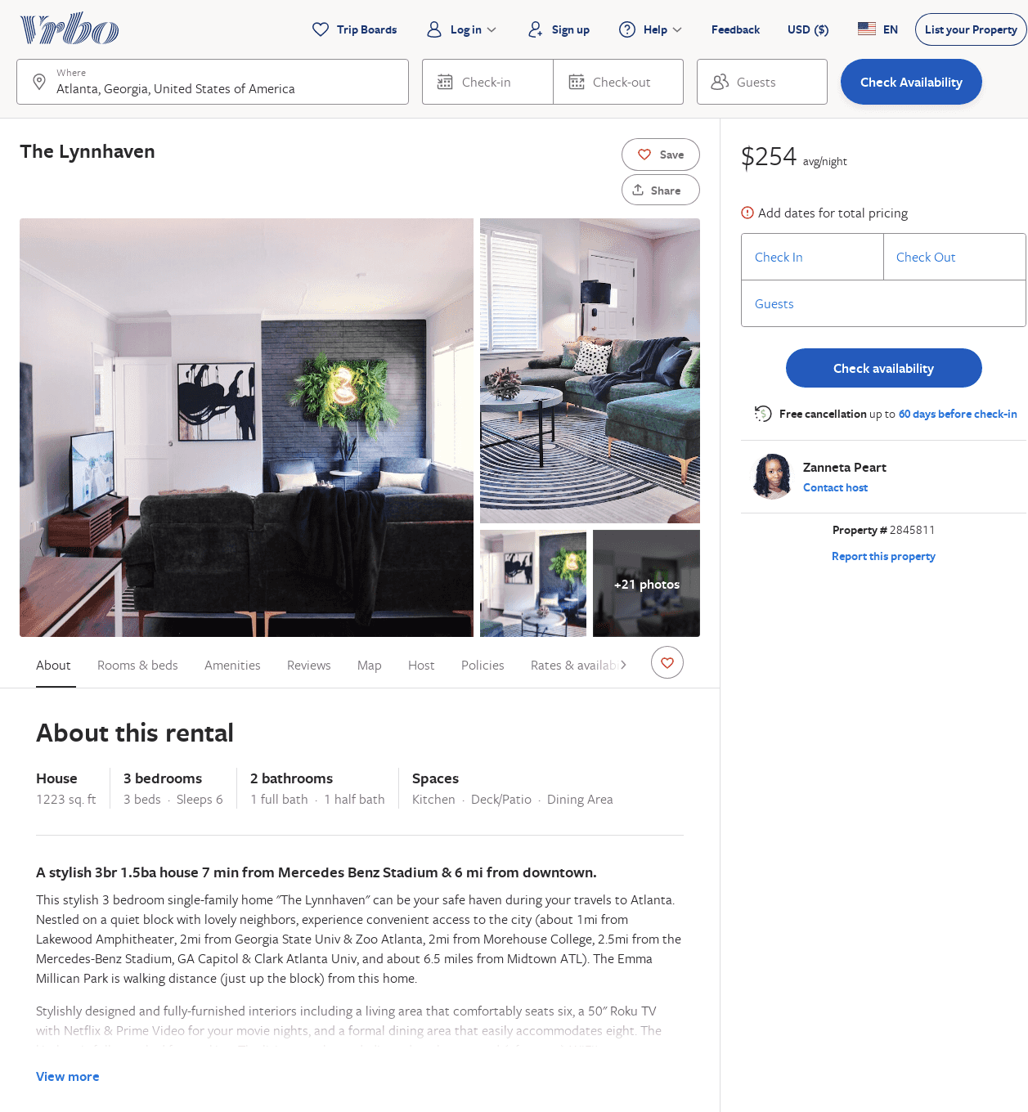
Listing 2845811
3
6
$198
3
Zanneta Peart
https://www.vrbo.com/2845811
Aug 2022

