Slide 2
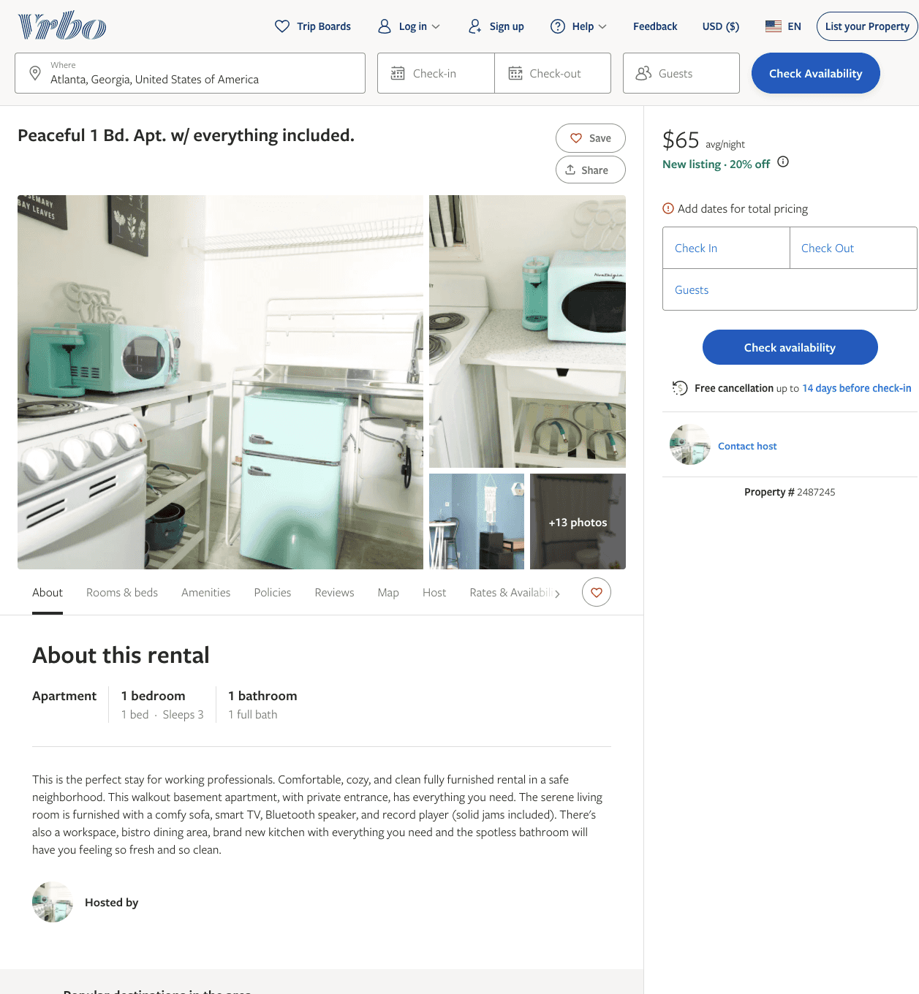
Listing 2487245
1
2
$52 - $68
5
2
https://www.vrbo.com/2487245
Aug 2022

Slide 3
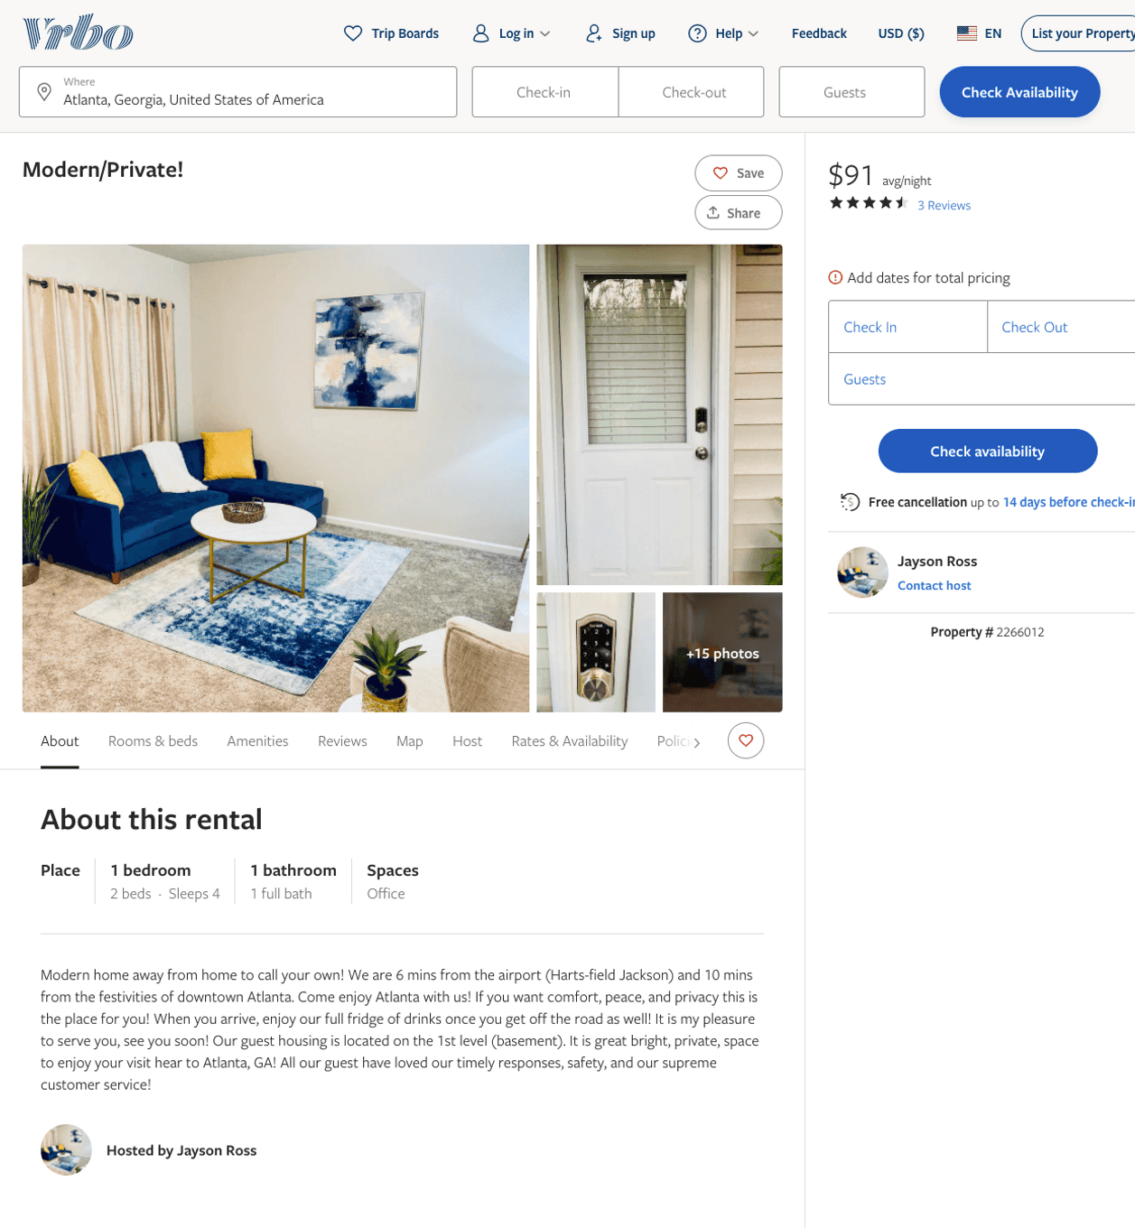
Listing 2266012
1
4
$91 - $97
4.6666665
2
Jayson Ross
https://www.vrbo.com/2266012
Aug 2022

Slide 4
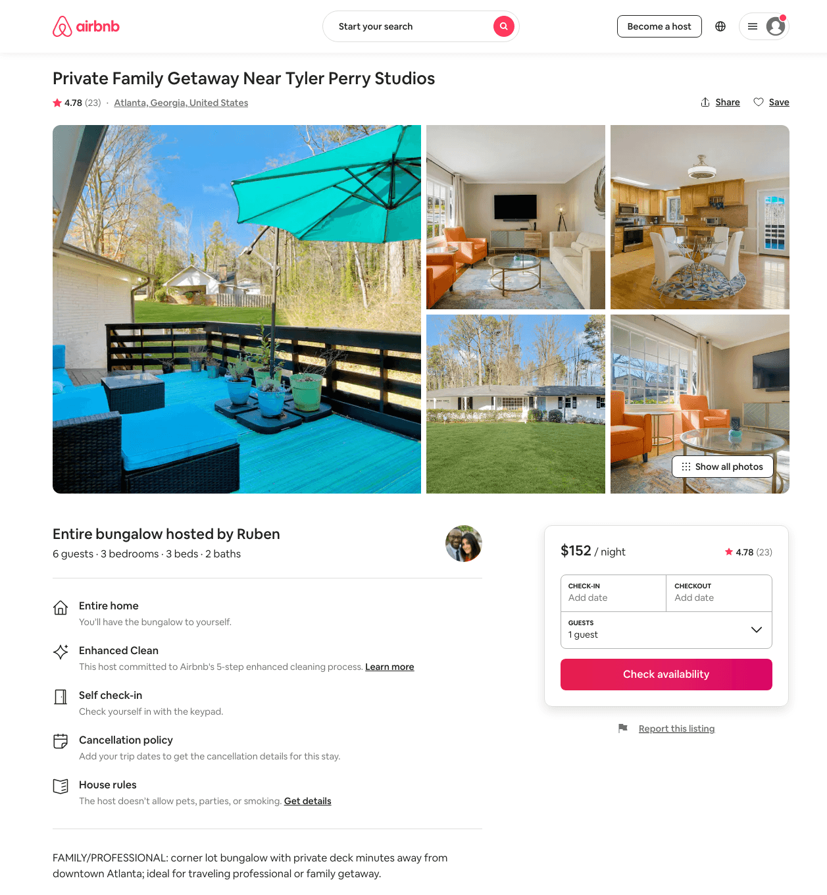
Listing 46628605
3
8
$131 - $200
4.78
1
Ruben And Celine
7208586
3
https://www.airbnb.com/rooms/46628605
Aug 2022

Slide 5
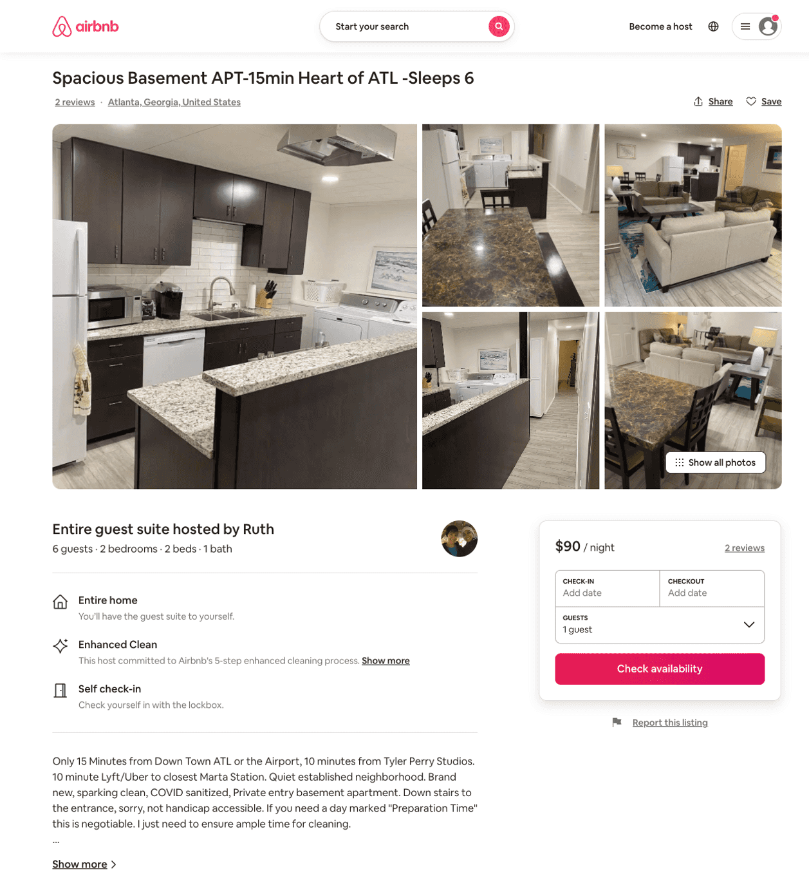
Listing 49938300
2
6
$110 - $118
5.0
30
Ruth
402692884
1
https://www.airbnb.com/rooms/49938300
Aug 2022

Slide 6
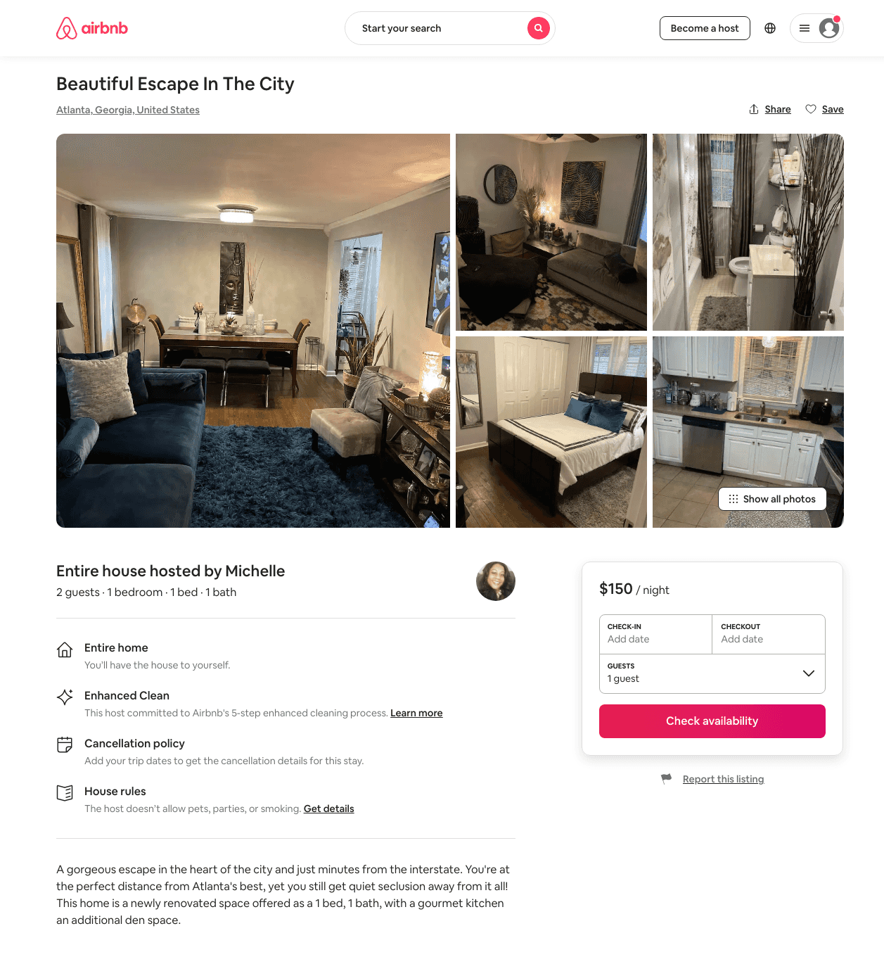
Listing 37150803
2
4
$65 - $196
4.97
2
Michelle
158833432
1
https://www.airbnb.com/rooms/37150803
Aug 2022

Slide 7
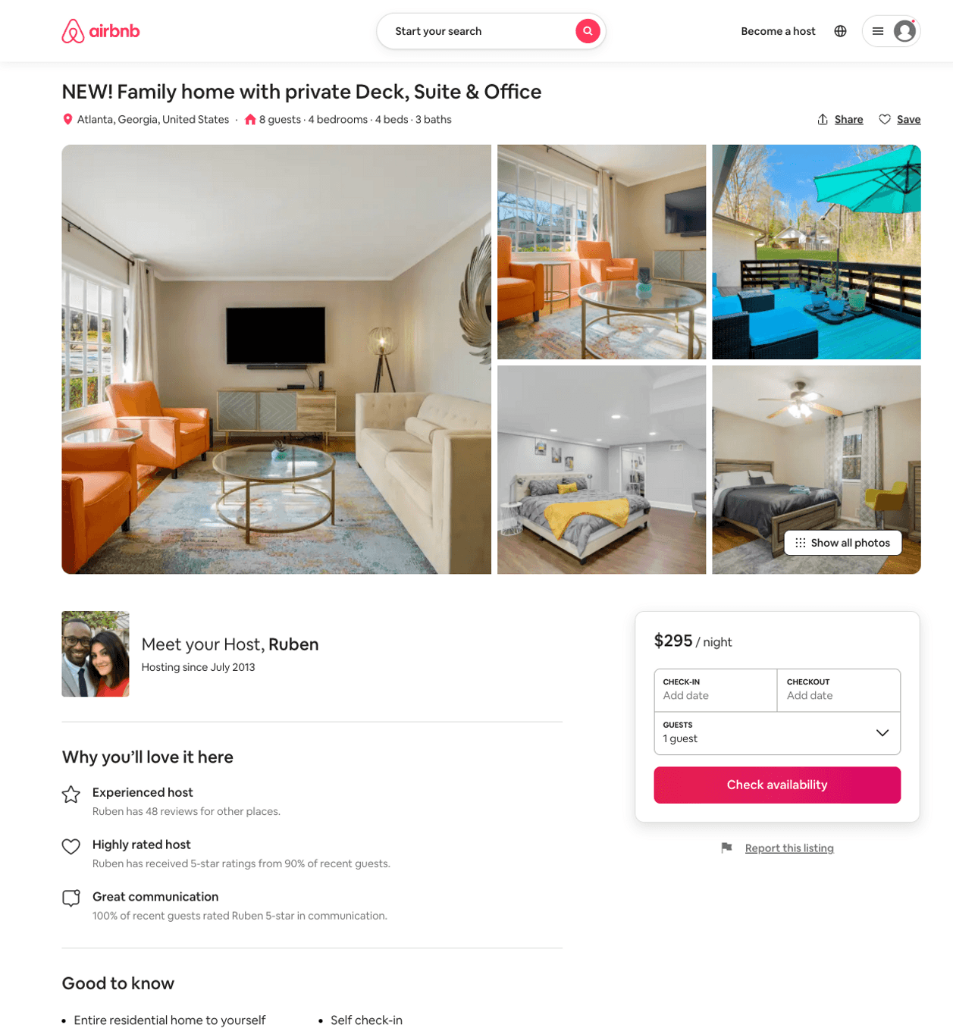
Listing 51665498
4
10
$216 - $388
4.89
1
Ruben And Celine
7208586
3
https://www.airbnb.com/rooms/51665498
Aug 2022

