Slide 2
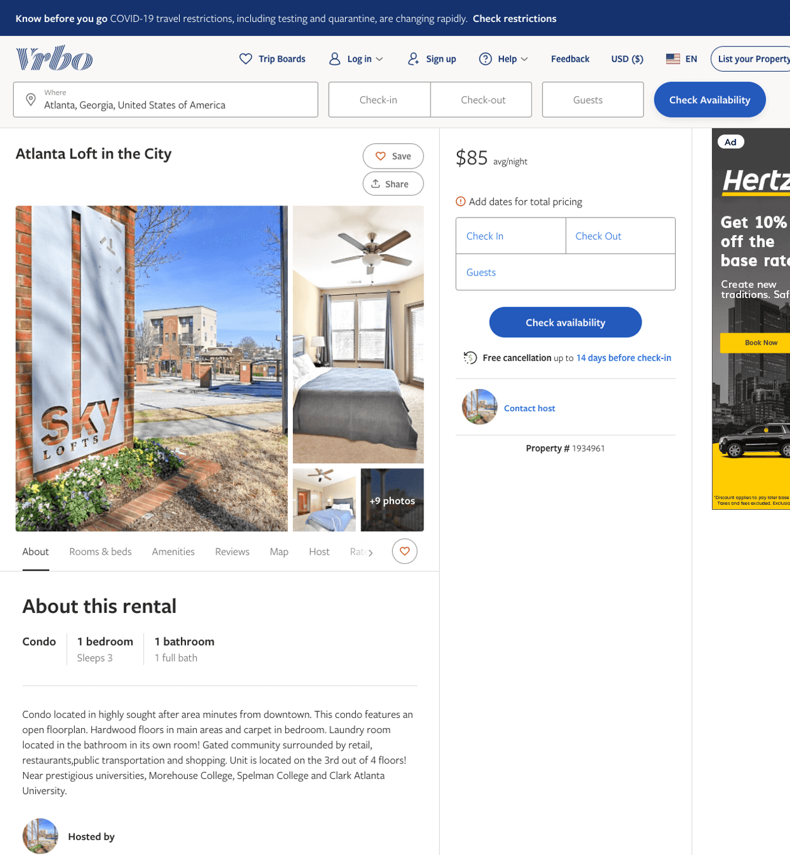
Listing 1934961
1
3
$113 - $85
4
14
https://www.vrbo.com/1934961
Aug 2022

Slide 3
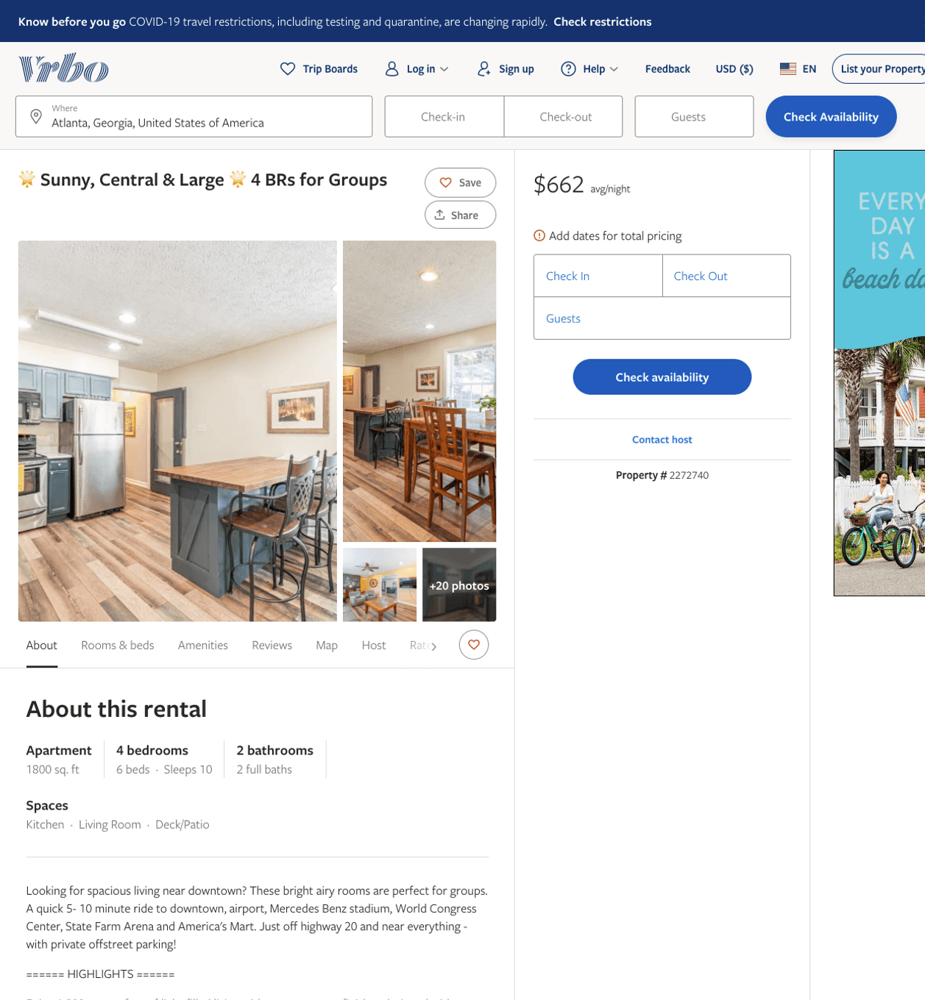
Listing 2272740
4
10
$414 - $730
5
1
Shannon Cook
https://www.vrbo.com/2272740
Aug 2022

Slide 4
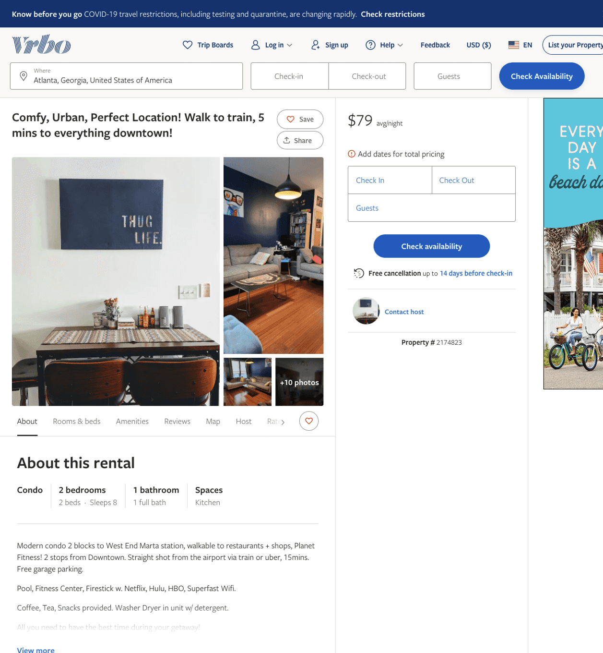
Listing 2174823
2
8
$79
2
https://www.vrbo.com/2174823
Aug 2022

Slide 5
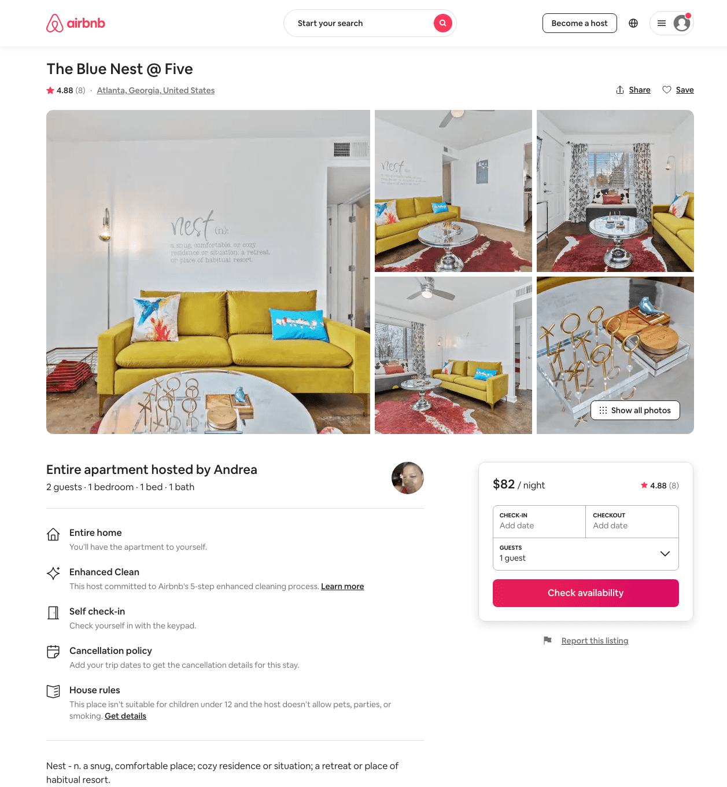
Listing 47033520
1
2
$58 - $121
4.64
1
Andrea
143717562
6
https://www.airbnb.com/rooms/47033520
Aug 2022

Slide 6
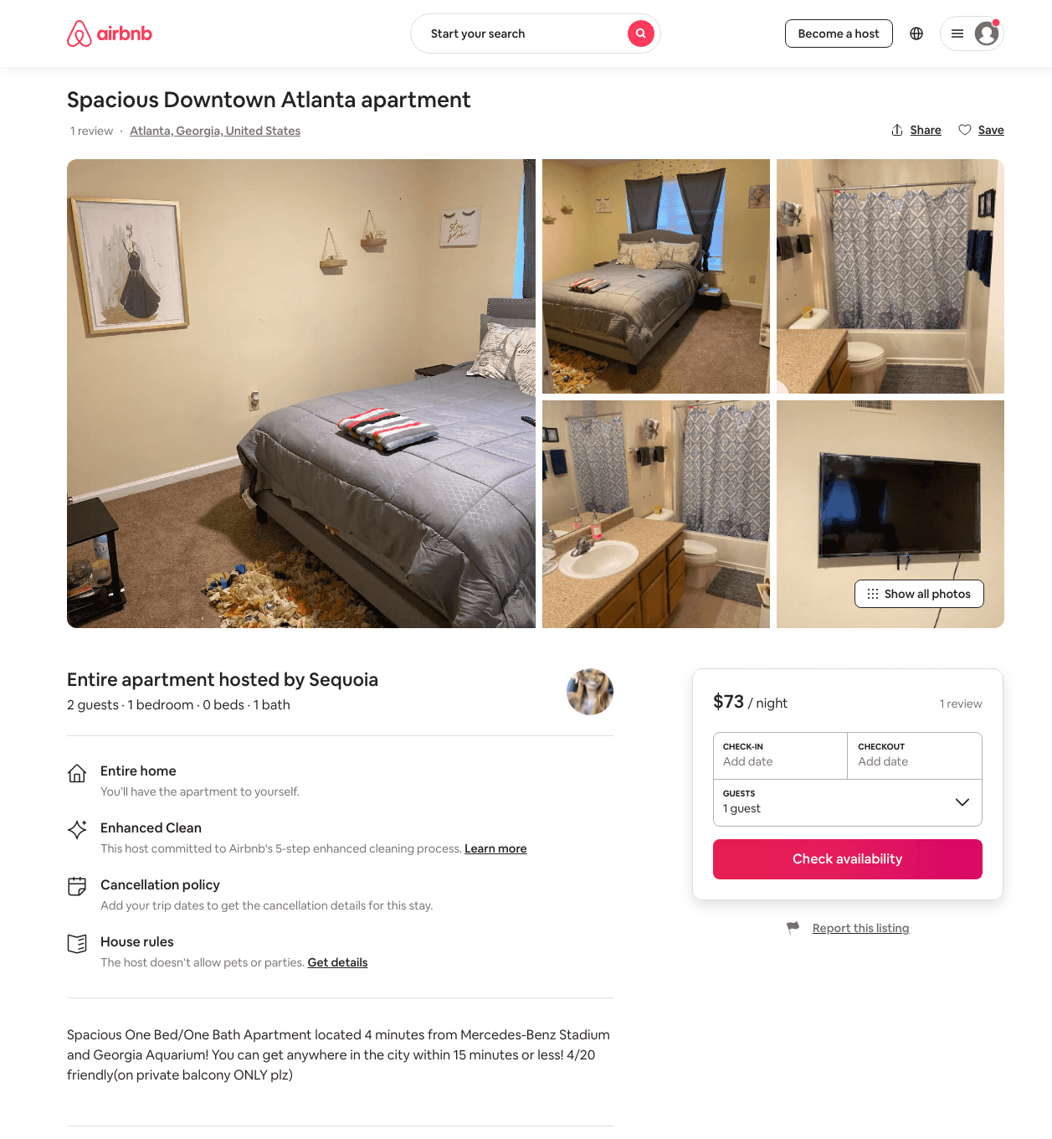
Listing 48749040
1
2
$73 - $98
4.63
2
Sequoia
81981132
1
https://www.airbnb.com/rooms/48749040
Aug 2022

Slide 7
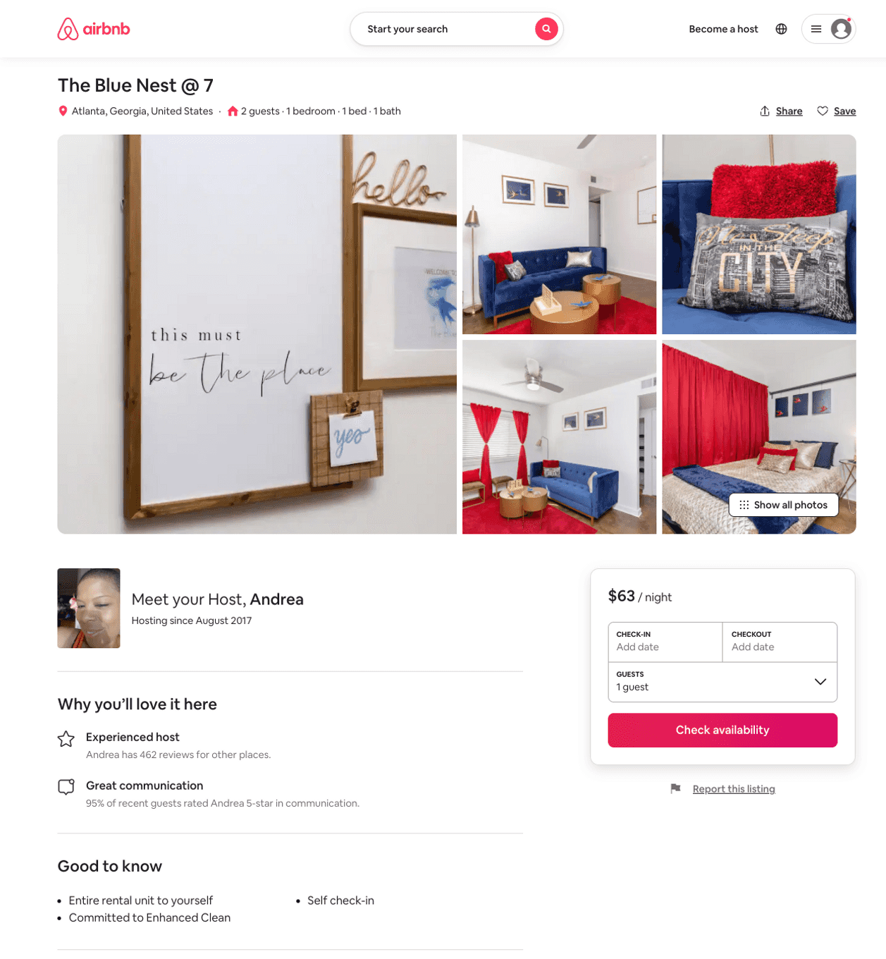
Listing 51751121
1
2
$61 - $144
4.74
1
Andrea
143717562
6
https://www.airbnb.com/rooms/51751121
Aug 2022

Slide 8
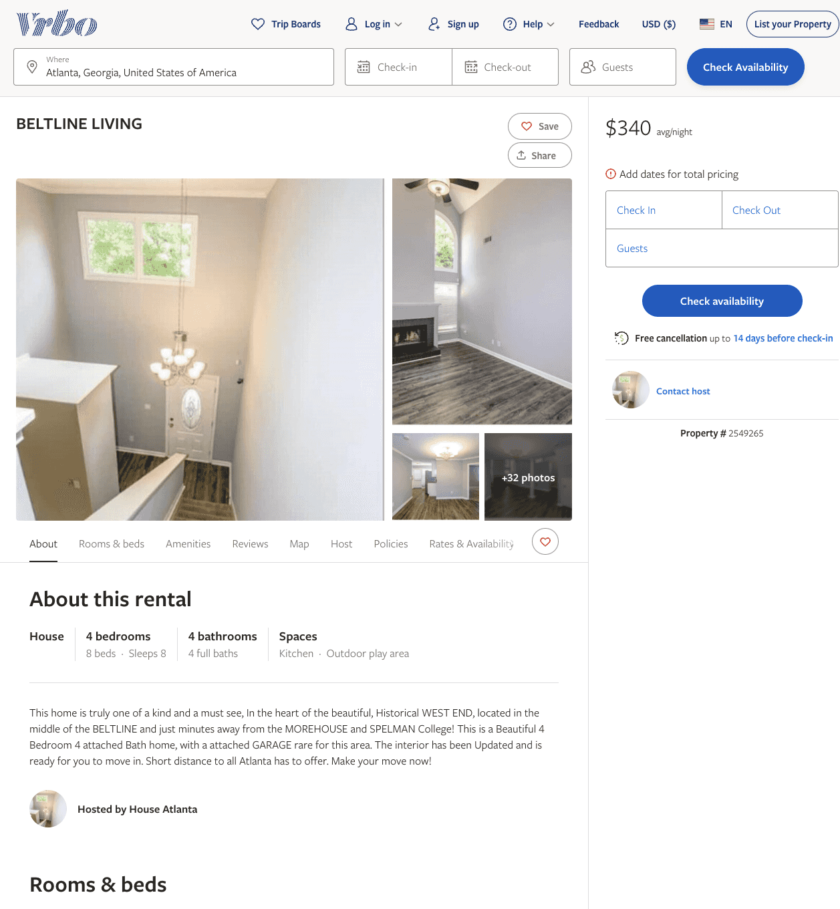
Listing 2549265
4
8
$340
14
https://www.vrbo.com/2549265
Aug 2022

Slide 9
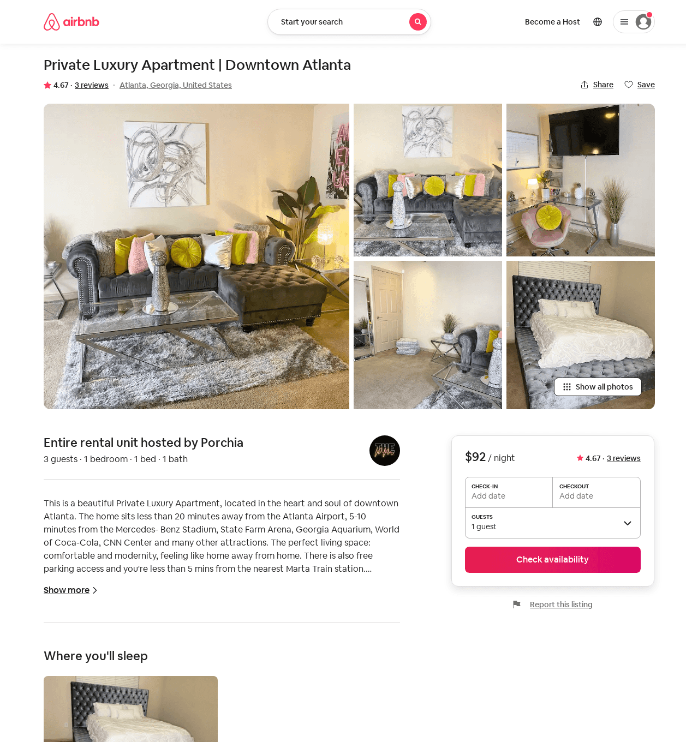
Listing 46220332
1
3
$78 - $92
4.82
2
Porchia
124085268
1
https://www.airbnb.com/rooms/46220332
Aug 2022

